Slide 1
Motivation
Introduction
Model Runs
Questions
Timeline
The Sensitivity of Convection to Microphysics and Boundary Layer Parameterizations in Hurricanes Harvey and Irma 2017
Dylan Card
University at Albany, State University of New York Albany, New York
Committee Members: Kristen L. Corbosiero, Brian H. Tang, Robert G. Fovell, Ryan D. Torn
Prospectus Presentation June 11th, 2020

Slide 2
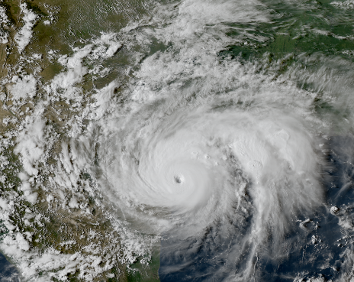
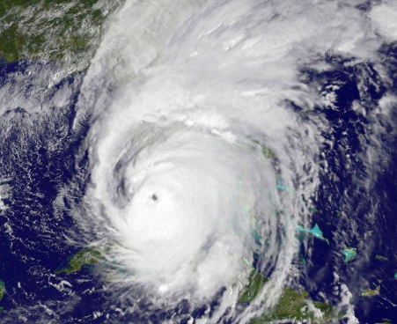
Motivation
Introduction
Model Runs
Questions
Timeline
Outline:
Harvey 2017
Motivation
Introduction
Rotating convection
Tropical cyclone boundaries
Model runs
Model setup
Descriptions of microphysics and PBL schemes
Intensity and track
Proposed questions and hypotheses
Timeline
Irma 2017
Notes:
Here is the outline of the things I will be discussing during this presentation today. First, I will provide some motivation behind my dissertation research and then introduce some of the important concepts. Next, I will describe the setup of my model simulations. And Finally, discuss the proposed questions, hypotheses and preliminary work for my dissertation.

Slide 3
Motivation
Introduction
Model Runs
Questions
Timeline
Motivation

Slide 4
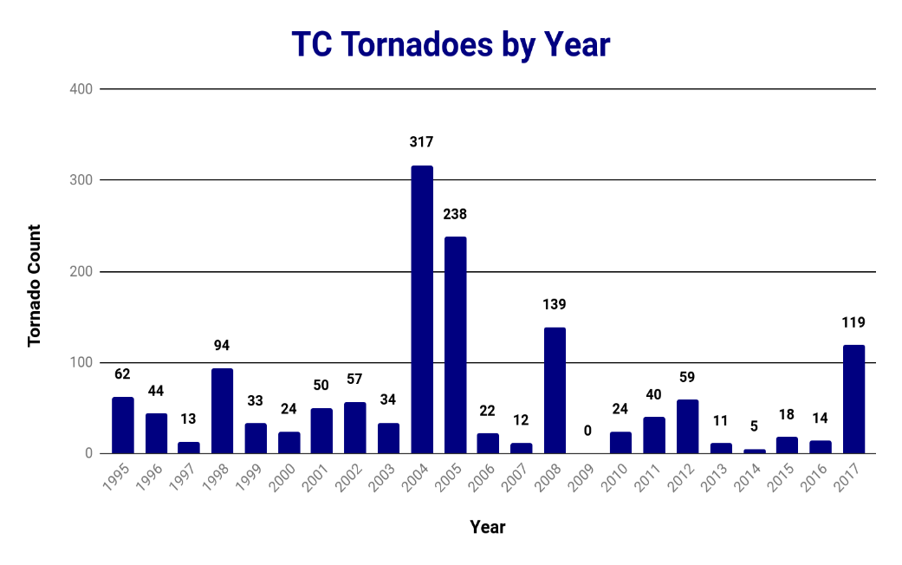
Motivation
Introduction
Model Runs
Questions
Timeline
1163 U.S. Tornadoes resulted from tropical cyclones from 1995-2010 (~6%).
That number has risen to 1429 at the end of 2017.
2017 was the fourth most active year for tropical cyclone tornadoes.
Adapted from Edwards 2010, TCTOR dataset
Notes:
Almost 1200 US tornadoes were a result of TCs from 1995-2010 (6% of all tornadoes in the US)
Over 1400 at the end of 2017
2017 was the 4th most active year for TC tornadoes in the US

Slide 5
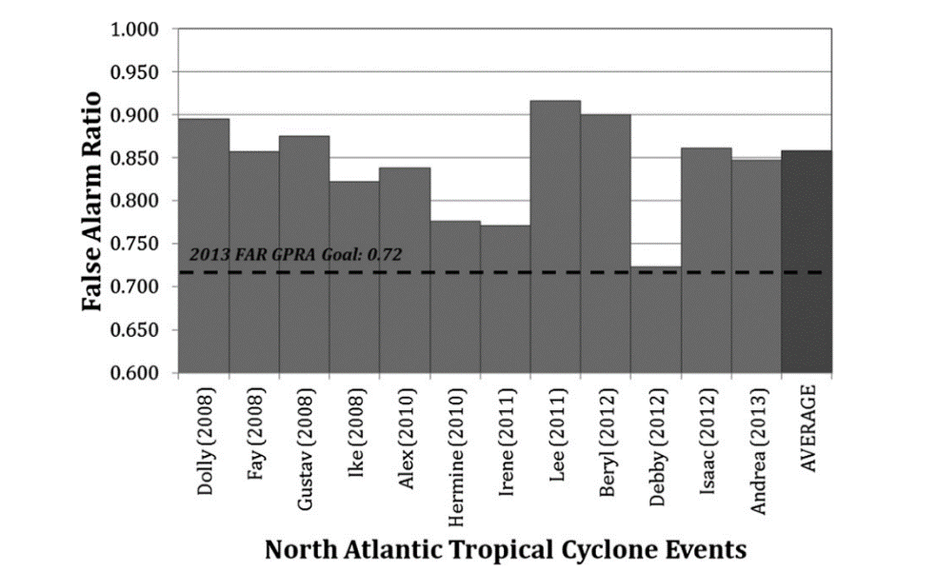
Motivation
Introduction
Model Runs
Questions
Timeline
Tornado False Alarm Ratio
North Atlantic TCs from 2008 to 2013 produced an average tornado warning False Alarm Ratio (FAR) of 85.8%.
(Martinaitis 2017)
Notes:
Figure shows the Tornado Warning FAR for North Atlantic TCs from 2008 to 2013 shown in Martinaitis 2017
The average FAR over this period is nearly 86% (red)

Slide 6
Motivation
Introduction
Model Runs
Questions
Timeline
Tornado False Alarm Ratio
North Atlantic TCs from 2008 to 2013 produced an average tornado warning False Alarm Ratio (FAR) of 85.8%.
Above the threshold of acceptable FAR from the NWS Government Performance Requirements Act (GPRA) of 72%.
(Martinaitis 2017)
Notes:
The threshold for the Government Performance Requirements Act compliance for tornado warning FARs is 72%
Over this period TC tornado warning FARs are much greater than that

Slide 7
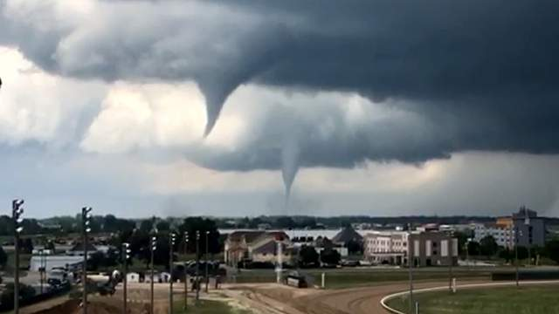
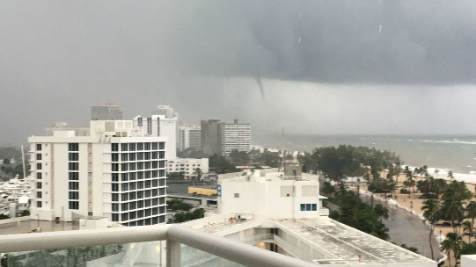
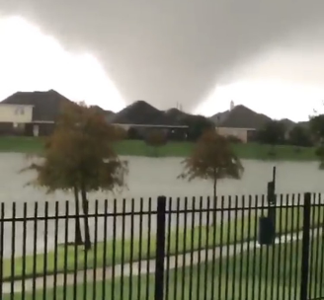
Motivation
Introduction
Model Runs
Questions
Timeline
Tropical Cyclone Tornadoes:
There tends to be large FARs with respect to tornado warnings in tropical cyclones
In 2005 alone, the TC tornado damage estimates totaled over $100 million
Notes:
To summarize TC tornadoes are typically associated with large FARs. They can also add to the total damage caused by Tropical Cyclones, for example TC tornado damage during the 2005 hurricane season totaled over $100 million.

Slide 8
Motivation
Introduction
Model Runs
Questions
Timeline
Introduction

Slide 9
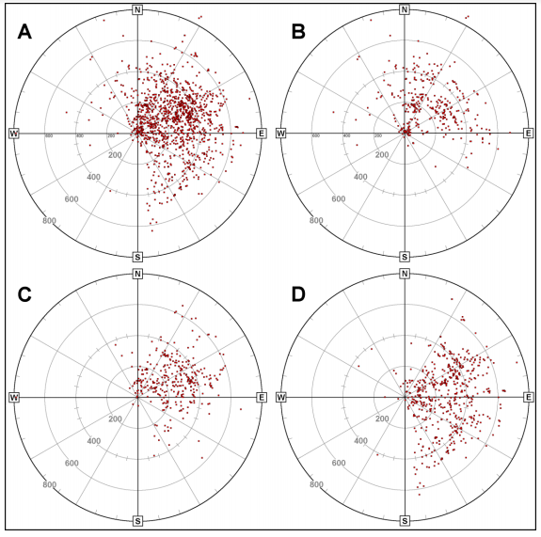
Motivation
Introduction
Model Runs
Questions
Timeline
Spatial Distribution:
All
H
Tropical Cyclone tornado reports 1995 to 2009
Typically occur East and Northeast of the tropical cyclone center
TS
TD
(Edwards 2012)
Notes:
This image from Edwards 2012 shows the distribution of tornado reports in atlantic tropical cyclones form 1995 to 2009
All storms in the upper left, All hurricanes in the upper right, tropical storms in the bottom left, and tropical depressions in the bottom right
Tornado reports typically happen to the east and northeast (wrt geographic north) in atlantic tropical cyclones

Slide 10
Motivation
Introduction
Model Runs
Questions
Timeline
Common Characteristics of tornadic rotating convection:

Slide 11
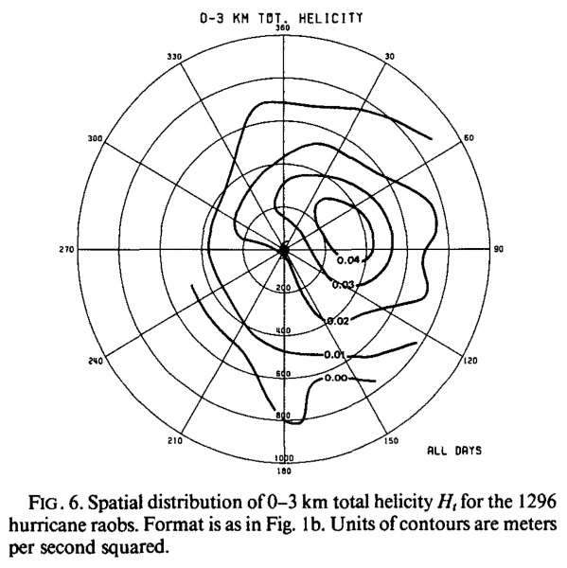
Motivation
Introduction
Model Runs
Questions
Timeline
Common Characteristics of tornadic rotating convection:
1) High 0–3-km Helicity
(McCaul 1991)
Notes:
The figure on the right shows the spatial distribution of 0-3-km total helicity from nearly 1300 hurricane raobs near tropical cyclone tornadoes gathered by McCaul 1991.
0-3-km helicity tends to be maximized in the E and NE quadrants of the hurricane (wrt geographic N)

Slide 12
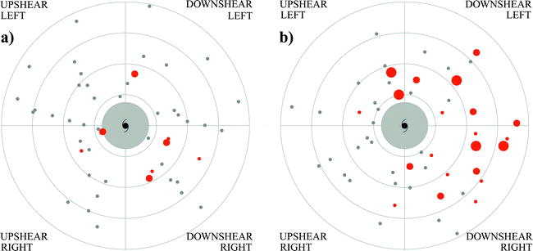
Motivation
Introduction
Model Runs
Questions
Timeline
Common Characteristics of tornadic rotating convection:
1) High 0–3-km Helicity
Shear <= 10 m/s
Shear > 10 m/s
100 km
200 km
300 km
400 km
(Molinari and Vollaro 2010)
>300 m²s⁻²
>100 m²s⁻² and <300 m²s⁻²
<100 m²s⁻²
Notes:
The figures labeled (a) and (b) on the left side show the Molinari and Vollaro 2010 (tropical cyclones sampled by NASA during the Convection and Moisture Experiments (CAMEX))
The dots show the values of the 0-3-km helicity (grey dots (<100), large red dots (>300), small red dots (in between)
a) show the storms in low shear environments (fairly evenly spread around the storm)
b) shows the storms in high shear environments (Highest 0-3km helicity is mainly located downshear)

Slide 13
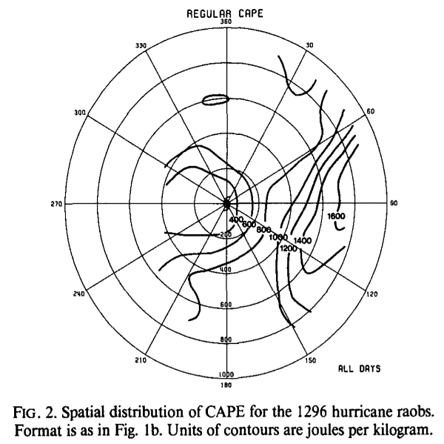
Motivation
Introduction
Model Runs
Questions
Timeline
Common Characteristics of tornadic rotating convection:
2) High 0–3-km convective available potential energy (CAPE)
McCaul and Weisman (2001) showed that small amounts of CAPE maximized at the lower levels would be sufficient to aid in updraft development.
(McCaul 1991)
Notes:
The figure on the right shows the distribution of CAPE in the nearly 1300 Hurricanes from McCaul 1991 (same storms as the last figure)
CAPE tends to be highers at outer radii in TCs (again maximized to the E of the TC center wrt N)
Idealized simulations by McCaul and Weisman 2001 showed that thought TC CAPE tends to be lower than that typically seen in mid-latitude severe weather that if it is maximized in the lower levels it would be sufficient to aid in updraft development.

Slide 14
Motivation
Introduction
Model Runs
Questions
Timeline
Common Characteristics of tornadic rotating convection:
3) Mid-level dry air
Dew Point Depression
(Curtis 2004)
Qualifying- Had mid-level dry air intrusions and tornado outbreaks.
Nonqualifying- Had tornado outbreaks but no mid-level dry air intrusions.
Null- Had mid-level dry air intrusions but no tornado outbreak.
Notes:
Curtis 2004 examined the environmental characteristics of TC tornado outbreaks in a series of Atlantic TCs.
Curtis split them into 3 groups (Qualifying, nonqualifying, and null)
Curtis 2004 also showed that the qualifying storms tended to have greater dew point depressions (i.e. more mid-level dry air) from 700 to 500 hPa.

Slide 15
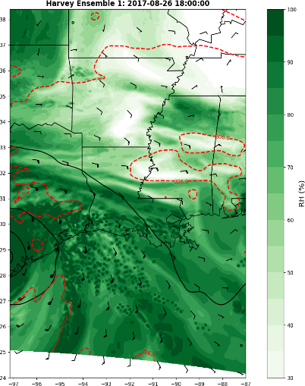
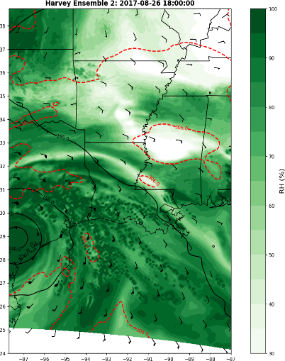
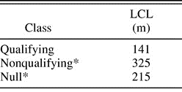
Motivation
Introduction
Model Runs
Questions
Timeline
Common Characteristics of tornadic rotating convection:
4) Low lifting condensation level (LCL) heights
Harvey (2017) NCAR Ensemble: 850 hPa
(Curtis 2004)
(Card 2019)
Notes:
Curtis 2004 also found that the qualifying storms tended to have lower LCLs than the nonqualifying or null groups
The figure on the right shows an image from my Master’s research which shows that low-level moisture tend to be prominent in TCs aiding to the lowering of the LCL.

Slide 16
Motivation
Introduction
Model Runs
Questions
Timeline
Common Characteristics of tornadic rotating convection:
5) Low-level boundaries (convergence axis or baroclinic zones)
Notes:
Low-level boundaries whether baroclinic zones or convergence axes can help promote organization ot tornado reports. Edwards 2006 looks a some case studies of different types of boundaries in TCs that caused TC tornadoes.

Slide 17
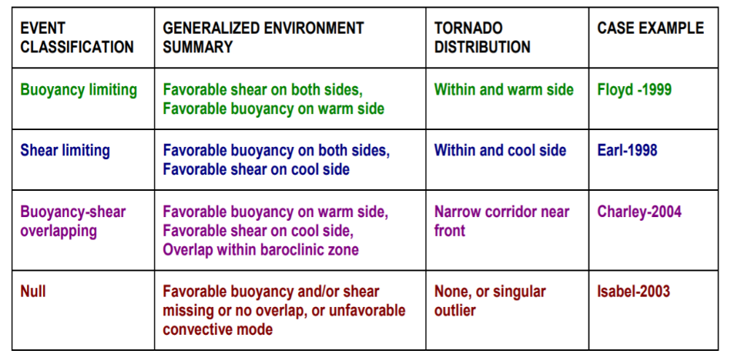
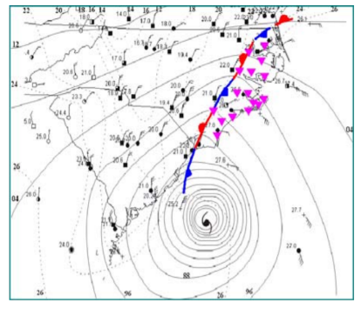
Motivation
Introduction
Model Runs
Questions
Timeline
Tropical Cyclone Boundaries:
Types
Floyd 1999
(Edwards 2006)
Notes:
The work of Edwards 2006 classified different types of TC boundaries.
1st being the buoyancy limiting case: favorable shear on both sides of a boundary, but favorable buoyancy on the warm side of the boundary

Slide 18
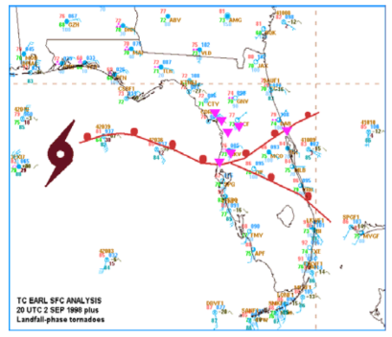
Motivation
Introduction
Model Runs
Questions
Timeline
Tropical Cyclone Boundaries:
Types
Earl 1998
(Edwards 2006)
Notes:
The work of Edwards 2006 classified different types of TC boundaries.
2nd is the shear limiting case: favorable buoyancy on both sides of a boundary, but favorable shear on the cool side.

Slide 19
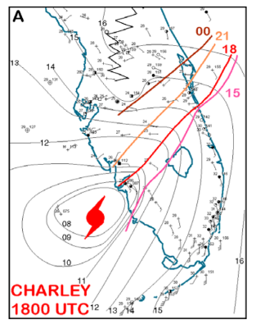
Motivation
Introduction
Model Runs
Questions
Timeline
Tropical Cyclone Boundaries:
Types
Charley 2004
(Edwards 2006)
Notes:
The work of Edwards 2006 classified different types of TC boundaries.
3rd is the overlapping case: where the favorable buoyancy and shear overlap within a baroclinic zone

Slide 20
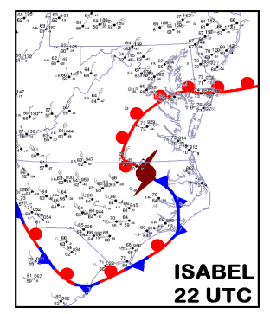
Motivation
Introduction
Model Runs
Questions
Timeline
Tropical Cyclone Boundaries:
Types
Isabel 2003
(Edwards 2006)
Notes:
The work of Edwards 2006 classified different types of TC boundaries.
Lastly is the null case: which has none of the previously discussed

Slide 21
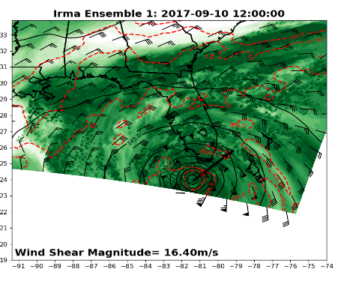
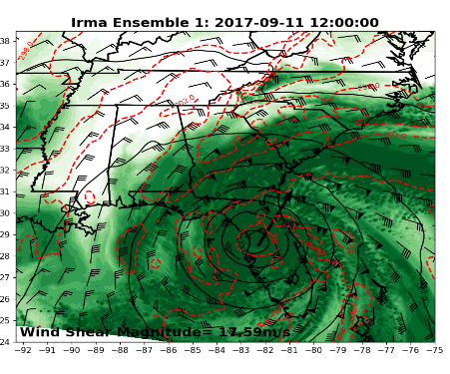
Motivation
Introduction
Model Runs
Questions
Timeline
Tropical Cyclone Boundaries:
Dry Air
Dry air tends to be collocated with warmer potential temperatures at 850 hPa.
This local warming is due to less cloud thickness allowing for more insolation and some subsidence warming from rainband circulations.
Possible evidence of weak baroclinic forcing, particularly right of shear.
(Card 2019)
Notes:
My Master’s work showed that dry air leads to an increase in potential temperatures in the TC environment. Local warming can be due to less cloud thickness (allowing for more insolation) or warm subsidence from the rainband circulation.
Possible evidence of baroclinic focing in the TC environment

Slide 22
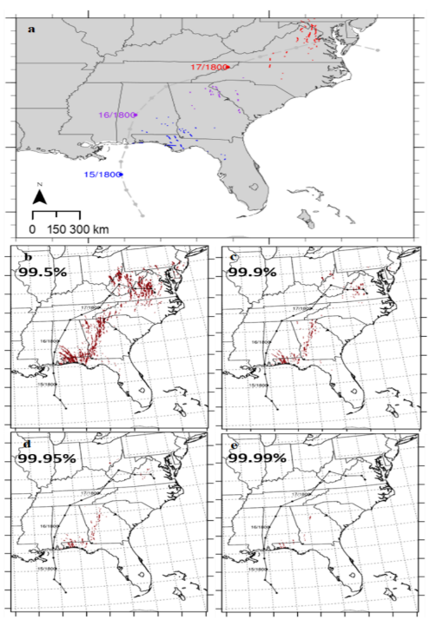
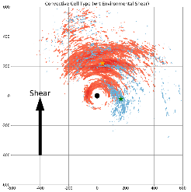
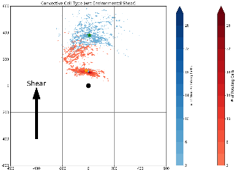
Motivation
Introduction
Model Runs
Questions
Timeline
Tropical cyclone tornado surrogates:
Carroll-Smith et al. (2019) and Card (2019)
Reflectivity, maximum updraft helicity, and maximum updraft can be used as surrogates for rotating convection
Show were tornado reports may occur in numerical models.
Ensemble
Notes:
Using TC tornado reports are great but that doesn’t necessarily make them useful in model world. TC tornado surrogates are a way to estimate where tornadoes may occur in modeled tropical cyclones.
In Carroll-Smith et al. 2019 and in my Master’s work percentile values of Reflectivity and Maximum Updraft Helicity were used to identify surrogates for rotating convection in model outputs. Carroll-Smith et al. 2019 showed that different percentile thresholds worked best for different model grid spacing when trying to match up TC tornado surrogates to actual tornado reports.

Slide 23
Motivation
Introduction
Model Runs
Questions
Timeline
Tropical cyclone tornado surrogates:
Carroll-Smith et al. (2019) and Card (2019)
Reflectivity, maximum updraft helicity, and maximum updraft can be used as surrogates for rotating convection
Show were tornado reports may occur in numerical models.
Carroll-Smith et al. 2019 suggests that further work should investigate model physics including planetary boundary layer sensitivities.
Ensemble

Slide 24
Motivation
Introduction
Model Runs
Questions
Timeline
Goals:
This research will investigate WSM6 and WDM6 microphysics parameterizations.
Determine the effects of microphysics parameterization on the distribution, structure, and longevity of convection in tropical cyclones.
Determine how microphysics parameterization affects the boundaries in the tropical cyclone.
This research will also investigate the YSU, MYNN3, and ACM2 planetary boundary layer (PBL) parameterizations.
Determine the effects of PBL parameterization on the distribution, structure, and longevity of convection in tropical cyclones.
Determine how PBL parameterization affects the boundaries in the tropical cyclone.

Slide 25
Motivation
Introduction
Model Runs
Questions
Timeline
Model Runs
Notes:
Now that I have motivated and introduced some of the important things about rotating convection in TCs we will talk about the modeling aspects of this project.

Slide 26
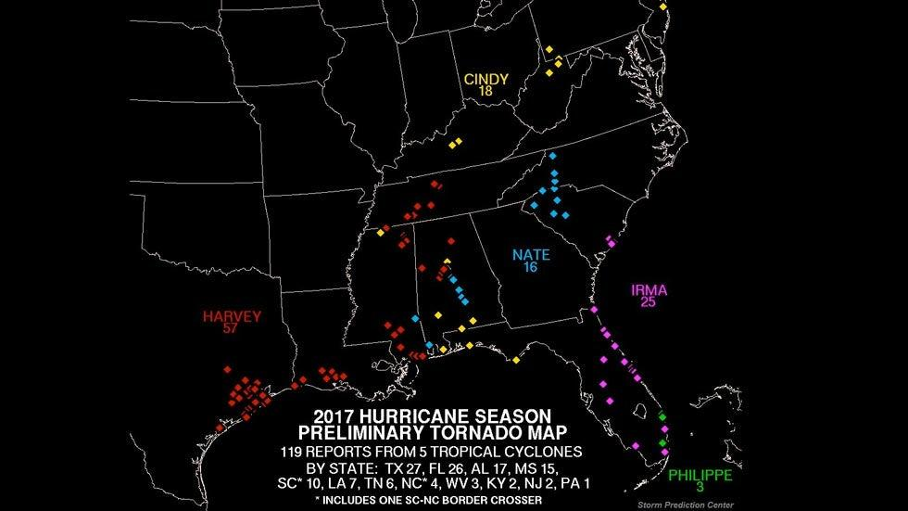
Motivation
Introduction
Model Runs
Questions
Timeline
Notes:
As I mentioned previously 2017 was the 4th most active year for tropical cyclone tornadoes. If we look at the preliminary tornado report map from the SPC from the 2017 Hurricane season we can see that Havey and Irma were the two top tornado producers of the 2017 season.

Slide 27
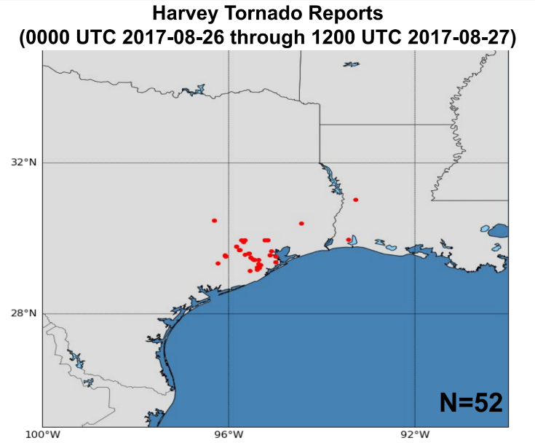
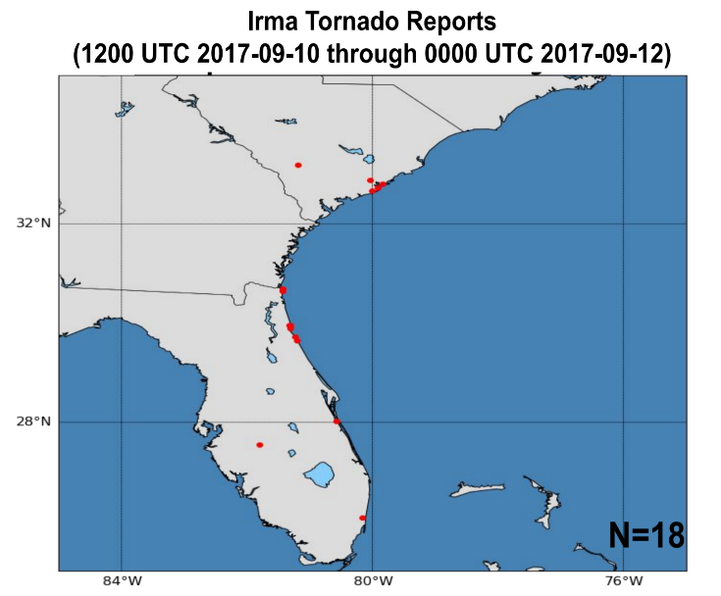
Motivation
Introduction
Model Runs
Questions
Timeline
Notes:
From 00Z 26 August through 12Z 27 August, Hurricane Harvey created 52 tornado reports along the coast and inland in Texas and Louisiana
From 12Z 10 September through 00Z 12 September, Hurricane Irma created 18 tornado reports along the Florida, Georgia, and South Carolina Coasts

Slide 28
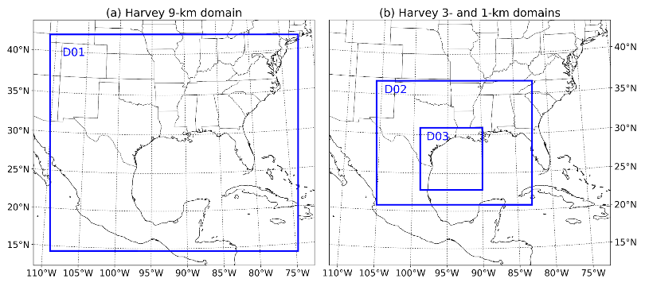
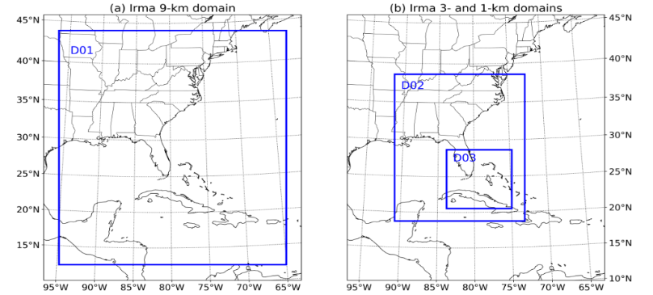
Motivation
Introduction
Model Runs
Questions
Timeline
WRF Model Setup:
Notes:
To begin here are the domains that have been used in this WRF modeling study. The 9km domains (on the left) were run in the first set of simulations and a second set of simulations utilizing a static 3-km domain with a nested 1-km vortex (seen on the right) following domain was used.

Slide 29
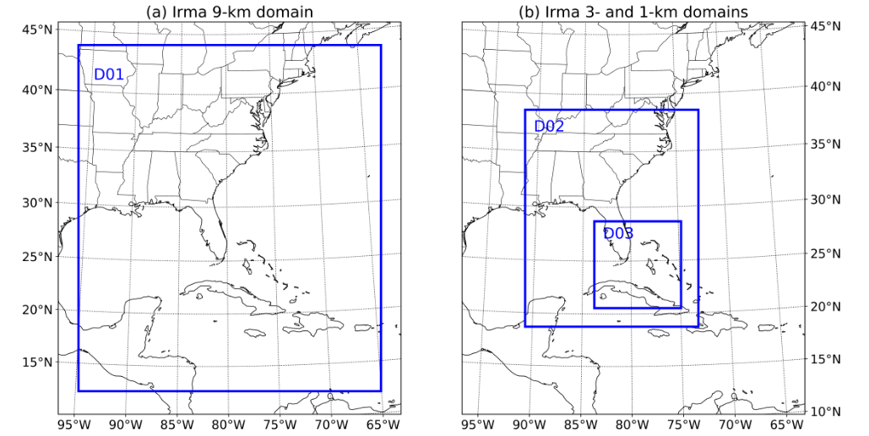
Motivation
Introduction
Model Runs
Questions
Timeline
WRF Model Setup:
Simulation #1
Simulation #2
ERA5
Notes:
The ERA5 was utilized to provide the initial and boundary conditions for the 9-km simulations

Slide 30
Motivation
Introduction
Model Runs
Questions
Timeline
WRF Model Setup:
Simulation #1
Simulation #2
ERA5
+24 h
Notes:
The 9-km simulations were run for a longer period of time allowing 24 hours of spin up before the variables from simulation #1 were used as initial and boundary conditions for the high horizontal resolution runs in simulation #2 (typically referred to as a “hot start”). Additionally 12 hours is given for spin up in simulation #2 before analyzation.

Slide 31
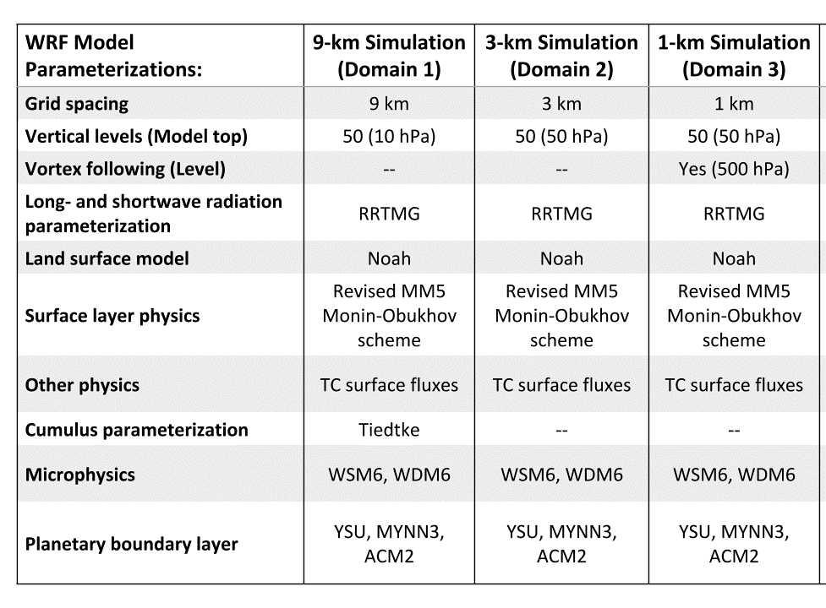
Motivation
Introduction
Model Runs
Questions
Timeline
WRF Model Setup:
WRF Version 4.1
Notes:
Here is a table showing the Model setup for each of the runs. There are a few important this to point out.

Slide 32
Motivation
Introduction
Model Runs
Questions
Timeline
WRF Model Setup:
WRF Version 4.1
Notes:
Here is a table showing the Model setup for each of the runs. There are a few important this to point out.
The 1-km domain is vortex following (at the 500 hPa level)

Slide 33
Motivation
Introduction
Model Runs
Questions
Timeline
WRF Model Setup:
WRF Version 4.1
Notes:
Here is a table showing the Model setup for each of the runs. There are a few important this to point out.
The 9-km domain used cumulus parameterization to allow faster spin up of the tropical cyclones

Slide 34
Motivation
Introduction
Model Runs
Questions
Timeline
WRF Model Setup:
WRF Version 4.1
Notes:
Here is a table showing the Model setup for each of the runs. There are a few important this to point out.
** As mentioned before the goal of this research is to see how these microphysics and PBL parameterizations effect convection in tropical cyclones.**
For each simulation, the same pair of microphysics and PBL parameterizations were used in the 9-, 3-, 1-km runs to avoid possible conflicts between the different model physics.

Slide 35
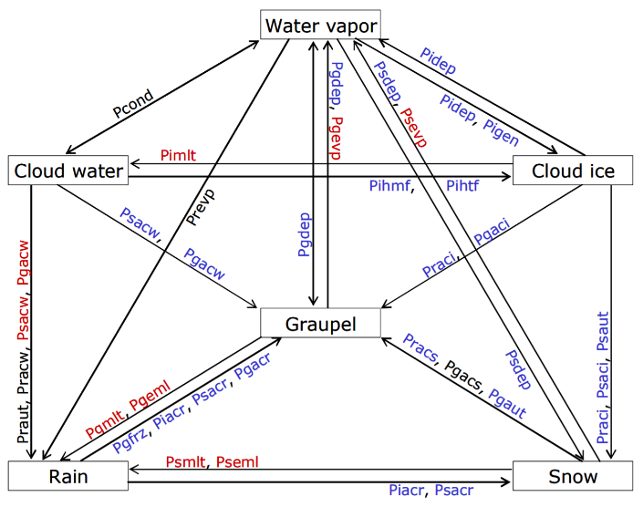
Motivation
Introduction
Model Runs
Questions
Timeline
WRF Microphysics Background:
Hong and Lim 2006
WSM6
WDM6
Lim and Hong 2010
Pcact
Pcact
Notes:
First I will introduce a little information about the microphysics schemes used in the WRF model runs. These can seem rather daunting to look at but I only want to point out that…
The WDM6 microphysics scheme is double moment for warm rain processes (tracks the number concentration of rain and cloud water and the number of CCN)
We can see the pathways in these two MP schemes are very similar the one difference labeled in red in the WDM6 chart.

Slide 36
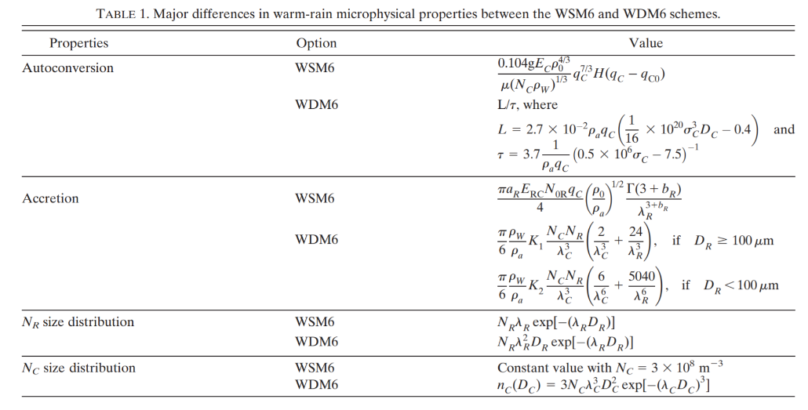
Motivation
Introduction
Model Runs
Questions
Timeline
WRF Microphysics Background:
Hong and Lim 2006
WSM6
WDM6
Lim and Hong 2010
Pcact
Pcact
Notes:
And this table from Lim and Hong 2010 shows the technical details of the differences between the WSM6 and WDM6 equations.

Slide 37
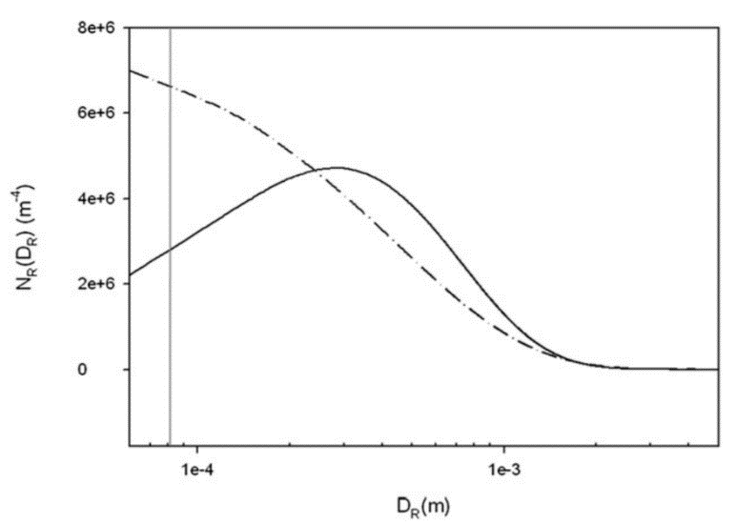
Motivation
Introduction
Model Runs
Questions
Timeline
WRF Microphysics Background:
WDM6
WSM6
Lim and Hong 2010
Notes:
In this plot the WDM6 and WSM6 drop size distribution are shown. The two MP schemes are fairly similar except for the differences at the small drop sizes.

Slide 38
Motivation
Introduction
Model Runs
Questions
Timeline
WRF Microphysics Background:
WSM6
Summary:
WSM6 and WDM6 use the same equations for most processes
WDM6 is double moment in warm rain processes
WDM6 explicitly solves the number concentration of Rain and Cloud water as well as cloud condensation nuclei (CCN)
Both use similar drop size distributions
WDM6
Pcact
Pcact
Notes:
Read summary

Slide 39
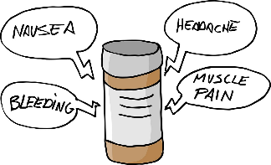
Motivation
Introduction
Model Runs
Questions
Timeline
WRF Microphysics Background:
Interesting Side Effects
WSM6
WDM6
Typically produces spurious light precipitation (Hong et al. 2010)
Rain concentrations tend to be larger than most other hydrometeor types (Putnam et al. 2017)
Bias towards small raindrops and graupel (Putnam et al. 2017)
Tends to suppress spurious light precipitation (Hong et al. 2010)
Ice and graupel concentrations will be impacted by the shared CCN pool with the rain (Putnam et al. 2017)
Bias towards small raindrops and graupel (Putnam et al. 2017)
Squall-lines tend to propagate too quickly with the scheme (Hong et al. 2010)
Notes:
WSM6 tends to produce spurious light precip
WDM6 tends to suppress that light precip (particularly over the ocean)
Rain concentrations tend to be larger than most other hydrometeor types in the WSM6 scheme.
The ice and graupel concentrations can be impacted by the shared pool of CCN in the WDM6 simulations.
Both WSM6 and WDM6 tend to have a bias towards small raindrops and graupel
Squall-lines tend to propagate quicker in the WDM6 scheme (which may be important as TC outer rainbands can sometimes take on squall-line like characteristics)

Slide 40
Motivation
Introduction
Model Runs
Questions
Timeline
WRF Planetary Boundary Layer Background:
Non-local Scheme
YSU
Local Scheme
Hybrid Scheme
First-order, non-local PBL scheme.
K-profile in the unstable mixed layer.
Explicit term to treat entrainment at the top of the PBL.
PBL height is determined by where the bulk Richardson number exceeds 0.

Slide 41
Motivation
Introduction
Model Runs
Questions
Timeline
WRF Planetary Boundary Layer Background:
Non-local Scheme
YSU
Local Scheme
Hybrid Scheme
Advantages
Can accurately simulate deep vertical mixing in buoyancy driven PBLs and shallow mixing layers in strong wind environments.
Disadvantages
In deep convective environments overdeepening of the PBL can occur leading to dry air near the surface.
(Hong and Lim 2006)
(Coniglio et al. 2013)

Slide 42
Motivation
Introduction
Model Runs
Questions
Timeline
WRF Planetary Boundary Layer Background:
Non-local Scheme
YSU
Hybrid Scheme
Local Scheme
MYNN3
Second-order, local PBL scheme.
PBL height is determined by where the turbulent kinetic energy (TKE) falls below a critical value (1.0 × 10⁻⁶ m²s⁻²).

Slide 43
Motivation
Introduction
Model Runs
Questions
Timeline
WRF Planetary Boundary Layer Background:
Non-local Scheme
YSU
Advantages
Can depict statically stable boundary layers well, which is not particularly advantageous in the environment of a tropical cyclone.
Hybrid Scheme
Local Scheme
MYNN3
Disadvantages
Does not account fully for deep vertical mixing associated with large eddies or countergradient fluxes, which results in weaker updrafts than observed.
(Nakanishi and Niino 2006)
(Nakanishi and Niino 2006)

Slide 44
Motivation
Introduction
Model Runs
Questions
Timeline
WRF Planetary Boundary Layer Background:
Local Scheme
MYNN3
Hybrid Scheme
ACM2
First-order, hybrid PBL scheme.
Non-local mixing dominates through most of the depth of the convective PBL.
Local mixing can be large in high shear environments.
PBL height is determined by where the bulk Richardson number exceeds 0.25.

Slide 45
Motivation
Introduction
Model Runs
Questions
Timeline
WRF Planetary Boundary Layer Background:
Local Scheme
MYNN3
Hybrid Scheme
ACM2
Advantages
Capable of depicting vertical profiles of potential temperature and velocity in the PBL with greater accuracy than solley local of non-local schemes.
Disadvantages
Can overdeepen the PBL in deep convective environments.
(Pleim 2007a)
(Coniglio et al. 2013)

Slide 46
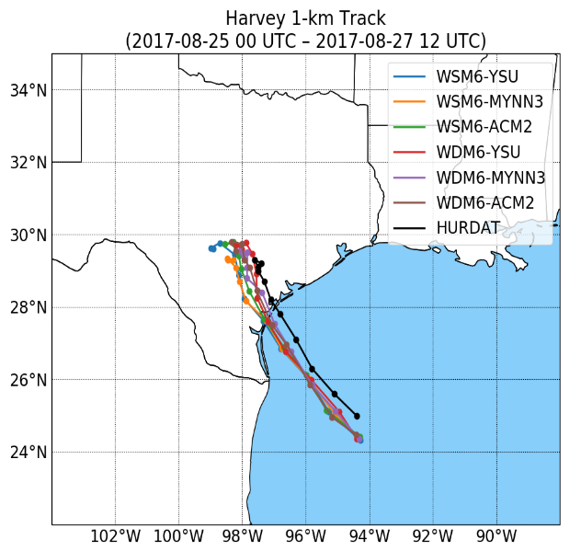
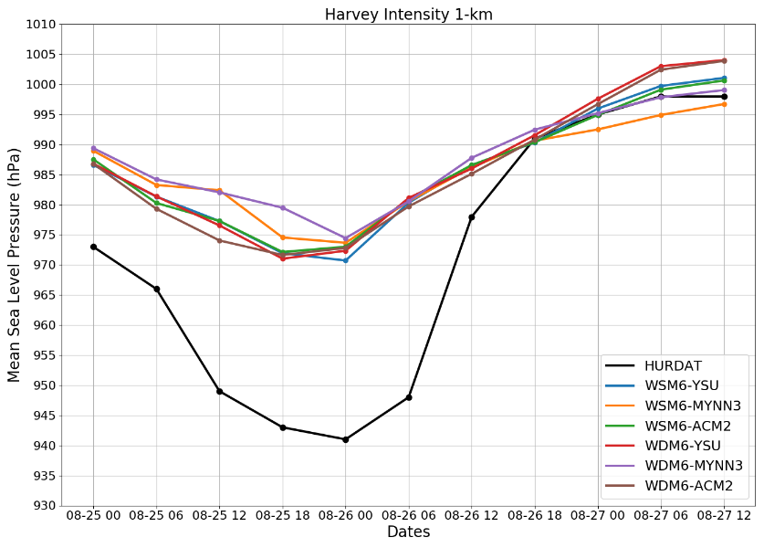
Motivation
Introduction
Model Runs
Questions
Timeline
WRF Model:
Notes:
Left is the intensity of the 1-km simulation of Hurricane Harvey (in terms of MSLP) compared to the HURDAT
The modeled storm does not get as intense at the observed storm.
Right is the track
The modeled storms had a track that was a bit further south than the observed track.
Overall the Modeled storms all were close to each other in terms of tack and intensity and therefore will allow for good comparison to one another.

Slide 47
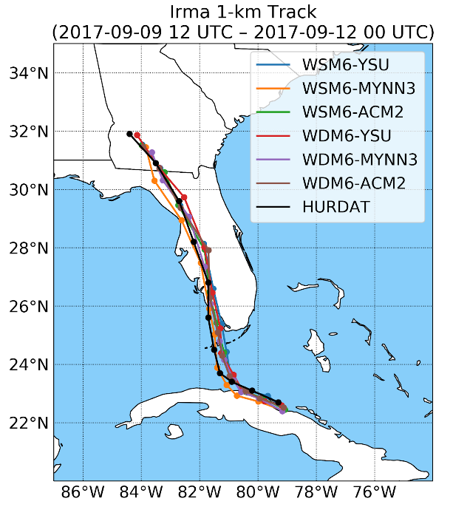
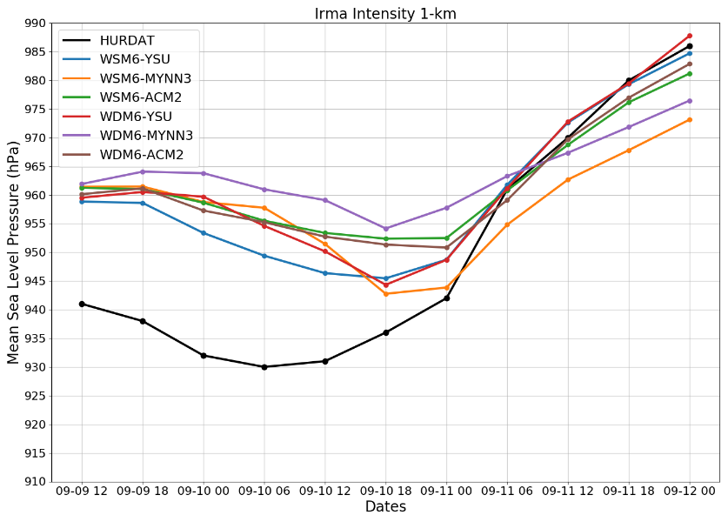
Motivation
Introduction
Model Runs
Questions
Timeline
WRF Model:
Notes:
Left is the intensity of the 1-km simulation of Hurricane Irma (in terms of MSLP) compared to the HURDAT
The modeled storm does not get as intense at the observed storm (as in Harvey)
Right is the track
The modeled storms here started slightly south of the observed track bringing the center of Irma closer to Cuba and turned northerly too quickly compared to observations possibly explaining some of the difference in intensity.
Overall the track was fairly similar to the observed track

Slide 48
Motivation
Introduction
Model Runs
Questions
Timeline
Questions and Hypotheses

Slide 49
Motivation
Introduction
Model Runs
Questions
Timeline
Question 1: How does varying the microphysics and planetary boundary layer parameterizations affect tropical cyclone convection? Does this choice effect the distribution, structure, and longevity of rotating and non-rotating convection?

Slide 50
Motivation
Introduction
Model Runs
Questions
Timeline
Question 1: How does varying the microphysics and planetary boundary layer parameterizations affect tropical cyclone convection? Does this choice effect the distribution, structure, and longevity of rotating and non-rotating convection?
How cell type is determined?

Slide 51
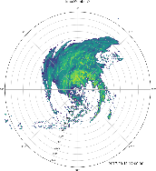
Motivation
Introduction
Model Runs
Questions
Timeline
How cell type is determined:
Model
Reflectivity > 99.9th percentile
*Carroll-Smith et al. (2019)
*Card (2019)
Notes:
As in Carroll-Smith et al. 2019 and my Master’s work, I first identify cells that have a reflectivity in the 99.9th percentile across all the analysis times.

Slide 52
Motivation
Introduction
Model Runs
Questions
Timeline
How cell type is determined:
Model
Reflectivity > 99.9th percentile
0–3-km Updraft Helicity > 99.95th percentile
*Carroll-Smith et al. (2019)
*Card (2019)
Notes:
For those cells if the 0-3 km updraft helicity exceeds the 99.95th percentile….

Slide 53
Motivation
Introduction
Model Runs
Questions
Timeline
How cell type is determined:
Model
Reflectivity > 99.9th percentile
0–3-km Updraft Helicity > 99.95th percentile
Rotating Cells
*Carroll-Smith et al. (2019)
*Card (2019)
Notes:
… I identify those cells as rotating cells.

Slide 54
Motivation
Introduction
Model Runs
Questions
Timeline
How cell type is determined:
Model
Reflectivity > 99.9th percentile
0–3-km Updraft Helicity <= 0
and
Maximum Updraft > 99.9th percentile
0–3-km Updraft Helicity > 99.95th percentile
Rotating Cells
*Carroll-Smith et al. (2019)
*Card (2019)
Notes:
I identify the cells with no updraft helicity, but maximum updraft in the 99.9th percentile…

Slide 55
Motivation
Introduction
Model Runs
Questions
Timeline
How cell type is determined:
Model
Reflectivity > 99.9th percentile
0–3-km Updraft Helicity <= 0
and
Maximum Updraft > 99.9th percentile
0–3-km Updraft Helicity > 99.95th percentile
Rotating Cells
Non-Rotating Cells
*Carroll-Smith et al. (2019)
*Card (2019)
Notes:
… as non-rotating cells.

Slide 56
Motivation
Introduction
Model Runs
Questions
Timeline
WRF Model Runs | Model Reflectivity (dBz)
 | Harvey (2017): | Irma (2017):
WSM6-YSU | 52.4 | 54.7
WSM6-MYNN3 | 51.2 | 53.5
WSM6-ACM2 | 53.2 | 55.3
WDM6-YSU | 51.2 | 52.3
WDM6-MYNN3 | 50.6 | 51.9
WDM6-ACM2 | 51.2 | 52.6
99.9th Percentile
*Using techniques similar to Carroll-Smith 2019 and Card 2019

Slide 57
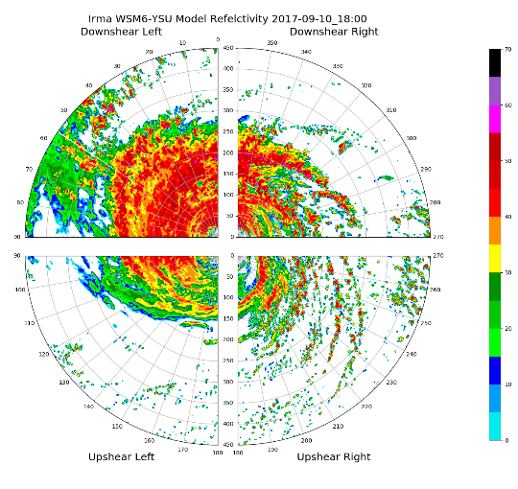
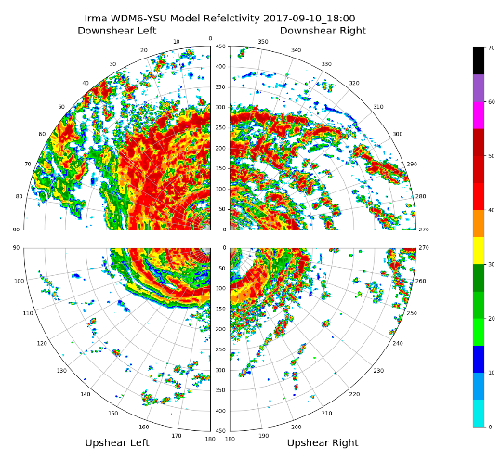
Motivation
Introduction
Model Runs
Questions
Timeline
Irma YSU PBL
SM
DM
WDM6 model reflectivity shows a lack of light reflectivity around the tropical cyclones.
WDM6 scheme tends to suppress spurious light precipitation over oceans. (Hong 2010)
Notes:
Right is an Irma simulation with the single moment microphysics
Left is an Irma simulation with the double moment microphysics scheme
Both simulations use the YSU PBL scheme.
The WDM6 simulation shows lack of model reflectivity particularly between the rainbands.

Slide 58
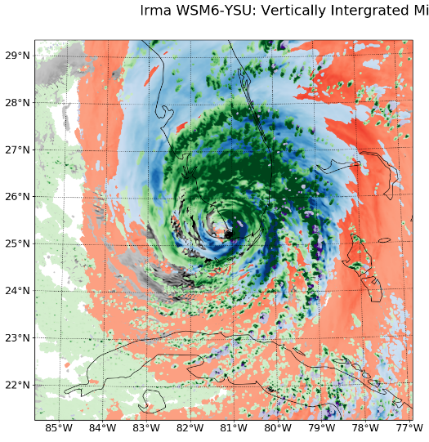
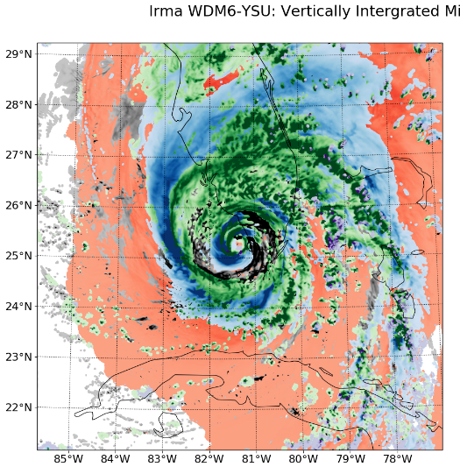
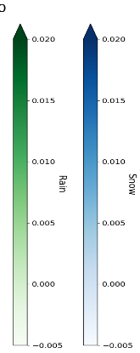
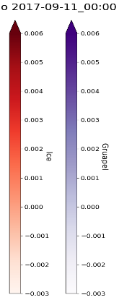
Motivation
Introduction
Model Runs
Questions
Timeline
SM
DM
Irma:
WDM6 simulation produces more rain and graupel than the WSM6 simulation.
Graupel
Cloud
Notes:
These next few slides will show these plots. They show the hydrometeor type of the vertically integrated mixing ratio at each grid point. Each grid point is colored by the hydrometeor type (The value of this mixing ratio is the shading of each point)
The figures show these plots for the single moment (left) and double moment (right) microphysics scheme and YSU PBL scheme for Hurricane Irma.

Slide 59
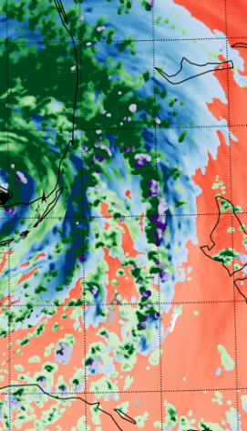
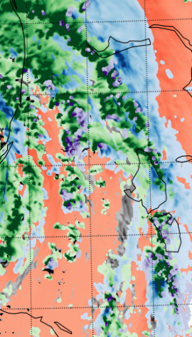
Motivation
Introduction
Model Runs
Questions
Timeline
SM
DM
Irma:
WDM6 simulation produces more rain and graupel than the WSM6 simulation.
Graupel
Cloud
Notes:
If I zoom in on the eastern side of the storm, we can more easily see the difference in the amount of graupel produced by each simulation. The Double moment simulation on the right produces more graupel then the single moment simulation on the left.

Slide 60
Motivation
Introduction
Model Runs
Questions
Timeline
SM
DM
Irma:
WDM6 simulation produces more rain and graupel than the WSM6 simulation.
There is also a lesser areal extent of ice in the WDM6 simulations.
Graupel
Cloud
Notes:
Looking more broadly we can see the difference in the extent of ice around the storm. There is a lesser areal extent of ice in the double moment microphysics scheme.

Slide 61
Motivation
Introduction
Model Runs
Questions
Timeline
WRF Model Runs | 0–3-km Updraft Helicity (m²/s²) | Max Updraft Velocity (m/s) | 0–3-km Updraft Helicity (m²/s²) | Max Updraft Velocity (m/s)
 | Harvey (2017): |  | Irma (2017):
WSM6-YSU | 32.95 | 15.1 | 109.48 | 17.2
WSM6-MYNN3 | 21.71 | 11.2 | 57.62 | 13.5
WSM6-ACM2 | 37.85 | 16.8 | 126.32 | 19.3
WDM6-YSU | 33.64 | 15.3 | 98.45 | 20.2
WDM6-MYNN3 | 21.89 | 11.3 | 65.43 | 14.0
WDM6-ACM2 | 33.92 | 16.4 | 113.50 | 18.3
99.95th Percentile
99.9th Percentile
99.95th Percentile
99.9th Percentile
*Using techniques similar to Carroll-Smith 2019 and Card 2019

Slide 62
Motivation
Introduction
Model Runs
Questions
Timeline
Is the lack of strong updraft helicity in the MYNN3 PBL Schemes a result of weaker updrafts or less helicity?

Slide 63
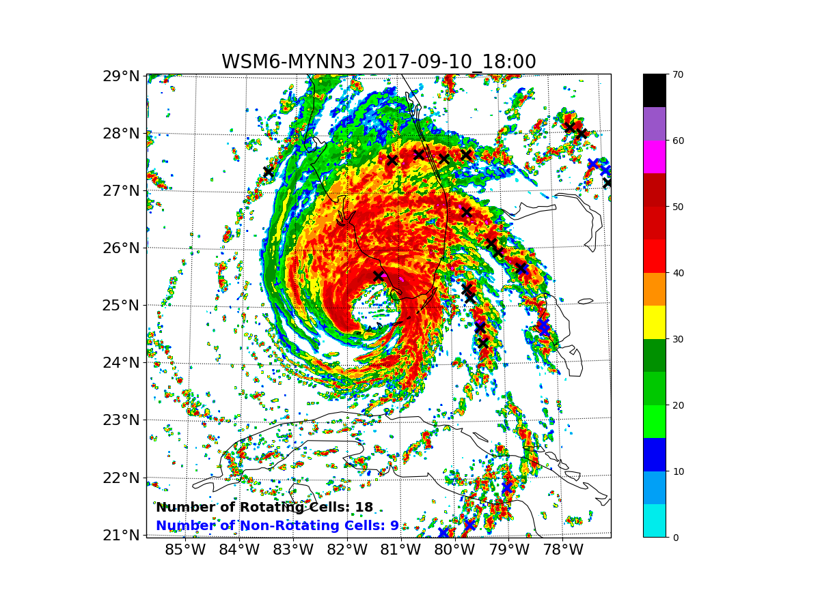
Motivation
Introduction
Model Runs
Questions
Timeline
Is the lack of strong updraft helicity in the MYNN3 PBL Schemes a result of weaker updrafts or less helicity?
Irma: 1800 UTC 10-09-2017
Notes:
Figures show the model reflectivity with black X’s denoting the rotating cells and blue X’s denoting the non-rotating cells.

Slide 64
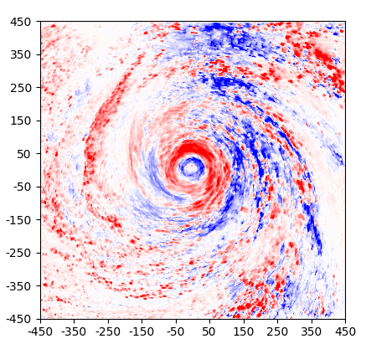
Motivation
Introduction
Model Runs
Questions
Timeline
Is the lack of strong updraft helicity in the MYNN3 PBL Schemes a result of weaker updrafts or less helicity?
Irma Maximum Updraft Velocity Difference: 1800 UTC 2017-09-10
MYNN3-YSU
MYNN3-ACM2
Notes:
Figures here show the difference plots in maximum updraft velocity for Hurricane Irma.
Warmer colors denote where the MYNN3 PBL scheme has the higher vertical velocities than the YSU and ACM2 schemes.
The differences here are not very structurally coherent (looks like popcorn) as the maximum updraft velocity is dependent on the location of convection which unsurprisingly is different in each simulation.

Slide 65
Motivation
Introduction
Model Runs
Questions
Timeline
Is the lack of strong updraft helicity in the MYNN3 PBL Schemes a result of weaker updrafts or less helicity?
Irma 0–3-km Helicity: 1800 UTC 2017-09-10
MYNN3-YSU
MYNN3-ACM2
Notes:
Figures here show the difference plots for 0-3km helicity for Hurricane Irma.
Warmer colors denote where the MYNN3 PBL scheme has the higher 0-3-km helicity than the YSU and ACM2 schemes.
Unlike the maximum udraft velocity the 0-3 km helicity is much more structurally coherent. There are large differences on the northern side of Hurricane Irma.

Slide 66
Motivation
Introduction
Model Runs
Questions
Timeline
Is the lack of strong updraft helicity in the MYNN3 PBL Schemes a result of weaker updrafts or less helicity?
Both hurricanes Harvey and Irma show that most of the difference in 0–3-km updraft helicity is driven by the 0–3-km helicity.
Differences in maximum updraft velocity is at the convective scale, while differences in the 0–3-km helicity is larger scale.

Slide 67
Motivation
Introduction
Model Runs
Questions
Timeline
Is the lack of strong updraft helicity in the MYNN3 PBL Schemes a result of weaker updrafts or less helicity?
Both hurricanes Harvey and Irma show that most of the difference in 0–3-km updraft helicity is driven by the 0–3-km helicity.
Differences in maximum updraft velocity is at the convective scale, while differences in the 0–3-km helicity is larger scale.
Further question: How does the PBL scheme physically affect the 0–3-km helicity? What makes the MYNN3 scheme different?
Notes:
How does the PBL scheme physically affect the 0–3-km helicity? What makes the MYNN3 scheme different?
Like I mentioned the major differences were on the northern side of Hurricane Irma… what would be north of Irma at this time?...

Slide 68
Motivation
Introduction
Model Runs
Questions
Timeline
Further question: How does the PBL scheme physically affect the 0–3-km helicity?
Irma SM
MYNN3
YSU
ACM2
Notes:
… Land.
The shaded field in these figures show the PBL height in the Irma Single Moment microphysics scheme- MYNN3, YSU, and ACM2 (from left to right).
Here we can clearly see that the simulations are producing wildly different PBL heights across the different PBL schemes, particularly over the Florida peninsula.

Slide 69
Motivation
Introduction
Model Runs
Questions
Timeline
Further question: How does the PBL scheme physically affect the 0–3-km helicity?
Irma SM
MYNN3
YSU
ACM2
(TKE)
Richardson Number = 0
Richardson Number = 0.25
Notes:
Just to remind everyone, the three different PBL schemes use different methods to determining the PBL height. Future work will look at how these differences in PBL height effect the low-level winds in the tropical cyclone over land to see if this plays a role in those differences in 0-3 km helicity.

Slide 70
Motivation
Introduction
Model Runs
Questions
Timeline
Question 1: How does varying the microphysics and planetary boundary layer parameterizations affect tropical cyclone convection? Does this choice effect the distribution, structure, and longevity of rotating and non-rotating convection?
Microphysics Hypothesis:
The limited number of CCN in the WDM6 microphysics scheme will limit spurious light precipitation.
Limiting of the CCN will limit the amount of ice and graupel in the tropical cyclones.
The largest impact from the microphysics schemes will come from the diabatic heating and cooling, and the resulting consequences to the convective organization of the tropical cyclones.

Slide 71
Motivation
Introduction
Model Runs
Questions
Timeline
Question 1: How does varying the microphysics and planetary boundary layer parameterizations affect tropical cyclone convection? Does this choice effect the distribution, structure, and longevity of rotating and non-rotating convection?
PBL Hypothesis:
The YSU PBL scheme will result in relatively dry air at the surface near deep convective cells.
The MYNN3 PBL scheme will not fully account for the deep vertical mixing, underestimating the vertical transport of heat, moisture, and momentum.
The ACM2 PBL scheme is non-local for upward fluxes and is likely to experience the same drawbacks as the YSU scheme.

Slide 72
Motivation
Introduction
Model Runs
Questions
Timeline
Question 2: Are there boundaries at the tropical cyclone, or sub-tropical cyclone, scale that help develop or intensify convection locally? Is there a link between dry air intrusion and the development baroclinic boundaries, and does this affect rotating convection? How do baroclinically- and convergence-forced boundaries change over time? How do the choice of microphysics and PBL parameterization affect these boundaries?

Slide 73
Motivation
Introduction
Model Runs
Questions
Timeline
Question 2: Are there boundaries at the tropical cyclone, or sub-tropical cyclone, scale that help develop or intensify convection locally? Is there a link between dry air intrusion and the development baroclinic boundaries, and does this affect rotating convection? How do baroclinically- and convergence-forced boundaries change over time? How do the choice of microphysics and PBL parameterization affect these boundaries?
Those driven by baroclinic differences (gradients of temperature and humidity)
Those driven by convergence of the wind (frictional effects)

Slide 74
Motivation
Introduction
Model Runs
Questions
Timeline
Full 3D Frontogenesis Equation
Notes:
Here is the 3D Frontogenesis equation….

Slide 75
Motivation
Introduction
Model Runs
Questions
Timeline
Full 3D Frontogenesis Equation
Diabatic terms
Horizontal Deformation terms
Vertical Divergence terms
Tilting terms
Notes:
I have color coded the terms to make it less daunting to look at.
The red colors show the diabatic heating terms, the green color shows the horizontal deformation terms, the purple is the vertical divergence term, and the blue are the tilting terms.

Slide 76
Motivation
Introduction
Model Runs
Questions
Timeline
Tropical Cyclone Boundaries:
Irma WSM6-YSU
Diabatic terms from existing convection tends to be the largest term.
Notes:
This plot is showing the different terms in the 3D Frontogenesis equation. In red in the upper left is the diabatic heating terms, in green in the upper right is the deformation terms, in purple in the bottom left is the vertical divergence term. The full 3D frontogenesis equation is in the bottom right.
This plot is of the Single Moment microphysics scheme and YSU PBL scheme simulation of Hurricane Irma at 18Z 10th, September
Here we can clearly see that the diabatic heating terms from existing convection tend to be the largest terms.

Slide 77
Motivation
Introduction
Model Runs
Questions
Timeline
Full 3D Frontogenesis Equation
Baroclinic and Convergence Terms
Largest Terms
Diabatic terms
Horizontal Deformation terms
Vertical Divergence terms
Tilting terms
Notes:
As noted, the diabatic terms are the largest terms. The other terms can be thought of as the baroclinic and convergence terms as their equations are functions of gradients in wind and potential temperature.

Slide 78
Motivation
Introduction
Model Runs
Questions
Timeline
Irma SM: RH & Potential Temperature
YSU
MYNN3
Notes:
These figures show the RH (shaded) and the red contours of potential temperature at 1500m.
As seen in my Master’s work we can see the dry air is co-located with warmer potential temperatures at 1500m…

Slide 79
Motivation
Introduction
Model Runs
Questions
Timeline
Irma SM: RH & Potential Temperature
Baroclinicity between rainbands due to local warming
YSU
MYNN3
Notes:
… Showing signs of baroclinicity between the rainbands.

Slide 80
Motivation
Introduction
Model Runs
Questions
Timeline
Irma SM: MUCAPE & 10-m Wind Convergence
YSU
MYNN3
Notes:
These figures show the MUCAPE shaded and red contours show the convergence of the 10m wind.
Here the strongest convergence is located directly along the Eastern Florida coast…

Slide 81
Motivation
Introduction
Model Runs
Questions
Timeline
Irma SM: MUCAPE & 10-m Wind Convergence
Convergence along coast
YSU
MYNN3
Notes:
The strong winds of the hurricane slow rapidly due to friction as the winds move onshore creating convergence along the coast.

Slide 82
Motivation
Introduction
Model Runs
Questions
Timeline
Question 2: Are there boundaries at the tropical cyclone, or sub-tropical cyclone, scale that help develop or intensify convection locally? Is there a link between dry air intrusion and the development baroclinic boundaries, and does this affect rotating convection? How do baroclinically- and convergence-forced boundaries change over time? How do the choice of microphysics and PBL parameterization affect these boundaries?
Microphysics Hypothesis:
Lack of spurious reflectivity (i.e., clearing) will result in stronger and more frequent baroclinic boundaries in WDM6 microphysics scheme.
Dry air intrusion can also result in clearing between rainbands leading to the development of surface baroclinic boundaries.

Slide 83
Motivation
Introduction
Model Runs
Questions
Timeline
Question 2: Are there boundaries at the tropical cyclone, or sub-tropical cyclone, scale that help develop or intensify convection locally? Is there a link between dry air intrusion and the development baroclinic boundaries, and does this affect rotating convection? How do baroclinically- and convergence-forced boundaries change over time? How do the choice of microphysics and PBL parameterization affect these boundaries?
PBL Hypothesis:
The MYNN3 PBL scheme will have difficulty transporting heat and moisture fluxes from the surface to the layers above.
The low-level distribution of of heat and moisture will affect the formation, and intensity, of baroclinic boundaries and CAPE.
Momentum differences between the PBL schemes will result in less vertical shear in the schemes that do not propagate the effects of surface friction aloft.

Slide 84
Motivation
Introduction
Model Runs
Questions
Timeline
Question 3: Does the rate of weakening at the surface (due to frictional effects), compared to above the boundary layer, generate additional low-level helicity in localized areas during landfall?

Slide 85
Motivation
Introduction
Model Runs
Questions
Timeline
Question 3: Does the rate of weakening at the surface (due to frictional effects), compared to above the boundary layer, generate additional low-level helicity in localized areas during landfall?
Hypothesis:
Friction at the surface during landfall will act to weaken near surface winds faster than winds aloft.
This will generate additional low-level helicity in localized regions over land increasing the likelihood of tornadogenesis.

Slide 86
Motivation
Introduction
Model Runs
Questions
Timeline
Question 1: How does varying the microphysics and planetary boundary layer parameterizations affect tropical cyclone convection? Does this choice effect the distribution, structure, and longevity of rotating and non-rotating convection?
Question 2: Are there boundaries at the tropical cyclone, or sub-tropical cyclone, scale that help develop or intensify convection locally? Is there a link between dry air intrusion and the development baroclinic boundaries, and does this affect rotating convection? How do baroclinically- and convergence-forced boundaries change over time? How do the choice of microphysics and PBL parameterization affect these boundaries?
Question 3: Does the rate of weakening at the surface (due to frictional effects), compared to above the boundary layer, generate additional low-level helicity in localized areas during landfall?

Slide 87
Motivation
Introduction
Model Runs
Questions
Timeline
Timeline

Slide 88
Motivation
Introduction
Model Runs
Questions
Timeline
Timeline:
Summer 2020
Begin writing introduction, literature review, and methods sections of the dissertation
Continue analysis for all hypothesis
Fall 2020
Begin writing result chapters
Edit full Ph.D. dissertation
December 2020
Defend Ph.D. dissertation

Slide 89
Motivation
Introduction
Model Runs
Questions
Timeline
Thanks for your attention!
Dylan Card
University at Albany, State University of New York Albany, New York

Slide 90
Big Thanks To...
My Family
My Boyfriend (Adam)
My Academic Mom- Kristen Corbosiero
My Academic Dad- Brian Tang
Other committee members-
Rob Fovell and Ryan Torn
SMART Fellowship- AFTAC
Tropical Dynasty
DAES Office and Computing Staff
My Office Mates in ES 330 including
honorary members Heather Sussman
and Alex Tomoff
All my other friends at UAlbany

Slide 91
Motivation
Introduction
Model Runs
Questions
Timeline
Questions?
Dylan Card
University at Albany, State University of New York Albany, New York

Slide 92
Extra Slides

Slide 93
Motivation
Introduction
Model Runs
Questions
Timeline
WRF Model Runs | Model Reflectivity (dBz) | 0–3-km Updraft Helicity (m²/s²) | Max Updraft Velocity (m/s)
Harvey (2017):
WSM6-YSU | 52.41 | 32.95 | 15.13
WSM6-MYNN3 | 51.24 | 21.71 | 11.17
WSM6-ACM2 | 53.25 | 37.85 | 16.80
WDM6-YSU | 51.18 | 33.64 | 15.33
WDM6-MYNN3 | 50.61 | 21.89 | 11.31
WDM6-ACM2 | 51.23 | 33.92 | 16.42
99.9th Percentile
99.95th Percentile
99.9th Percentile
*Using techniques similar to Carroll-Smith 2019 and Card 2019

Slide 94
Motivation
Introduction
Model Runs
Questions
Timeline
WRF Model Runs | Model Reflectivity (dBz) | 0–3-km Updraft Helicity (m²/s²) | Max Updraft Velocity (m/s)
Irma (2017):
WSM6-YSU | 54.74 | 109.48 | 17.18
WSM6-MYNN3 | 53.47 | 57.62 | 13.51
WSM6-ACM2 | 55.31 | 126.32 | 19.33
WDM6-YSU | 52.34 | 98.45 | 20.16
WDM6-MYNN3 | 51.91 | 65.43 | 13.98
WDM6-ACM2 | 52.59 | 113.50 | 18.31
99.9th Percentile
99.95th Percentile
99.9th Percentile
*Using techniques similar to Carroll-Smith 2019 and Card 2019

Slide 95
Motivation
Introduction
Model Runs
Questions
Timeline
Harvey:
WDM6 simulation produces more rain and cloud vapor than the WSM6 simulation.
Harvey WSM6-YSU: 1800 UTC 2017-08-26
Harvey WDM6-YSU: 1800 UTC 2017-08-26
Graupel
Notes:
These next few slides will show these plots. They show the hydrometeor type of the vertically integrated mixing ratio at each grid point. (The value of this mixing ratio is the shading of each point)

Slide 96
Motivation
Introduction
Model Runs
Questions
Timeline
Harvey WSM6-YSU: 1800 UTC 2017-08-26
Irma WSM6-YSU: 1800 UTC 2017-09-10
Harvey:
WDM6 simulation produces more rain and cloud vapor than the WSM6 simulation.
Irma:
WDM6 simulation produces more rain and graupel than the WSM6 simulation.
Harvey WDM6-YSU: 1800 UTC 2017-08-26
Irma WDM6-YSU: 1800 UTC 2017-09-10
There is also a lesser areal extent of cloud ice in the WDM6 simulations.
Graupel
Notes:
Same organization as before…

Slide 97
Motivation
Introduction
Model Runs
Questions
Timeline
Is the lack of strong updraft helicity in the MYNN3 PBL Schemes a result of weaker updrafts or less helicity?
Harvey Vertical Velocity: 1800 UTC 2017-08-26
MYNN3-YSU
MYNN3-ACM2
Notes:
Figures here show the difference plots in vertical velocity for Hurricane Harvey (at the same time as before). Warmer colors denote where the MYNN3 PBL scheme has the higher vertical velocities than the YSU and ACM2 schemes.

Slide 98
Motivation
Introduction
Model Runs
Questions
Timeline
Is the lack of strong updraft helicity in the MYNN3 PBL Schemes a result of weaker updrafts or less helicity?
Harvey 0–3-km Helicity: 1800 UTC 2017-08-26
MYNN3-YSU
MYNN3-ACM2
Notes:
Figures here show the difference plots for 0-3km helicity for Hurricane Harvey (at the same time as before). Warmer colors denote where the MYNN3 PBL scheme has the higher 0-3-km helicity than the YSU and ACM2 schemes.

Slide 99
Motivation
Introduction
Model Runs
Questions
Timeline
Further question: How does the PBL scheme physically affect the 0–3-km helicity?
Harvey

Slide 100
Motivation
Introduction
Model Runs
Questions
Timeline
Irma
Tropical Cyclone Boundaries:

Slide 101
Motivation
Introduction
Methodology
Results
Conclusion

Slide 102
Motivation
Introduction
Methodology
Results
Conclusion

Slide 103
Motivation
Introduction
Methodology
Results
Conclusion

Slide 104
Motivation
Introduction
Methodology
Results
Conclusion

Slide 105
Motivation
Introduction
Methodology
Results
Conclusion

