Slide 1
Undergraduate Research Opportunities

Slide 2
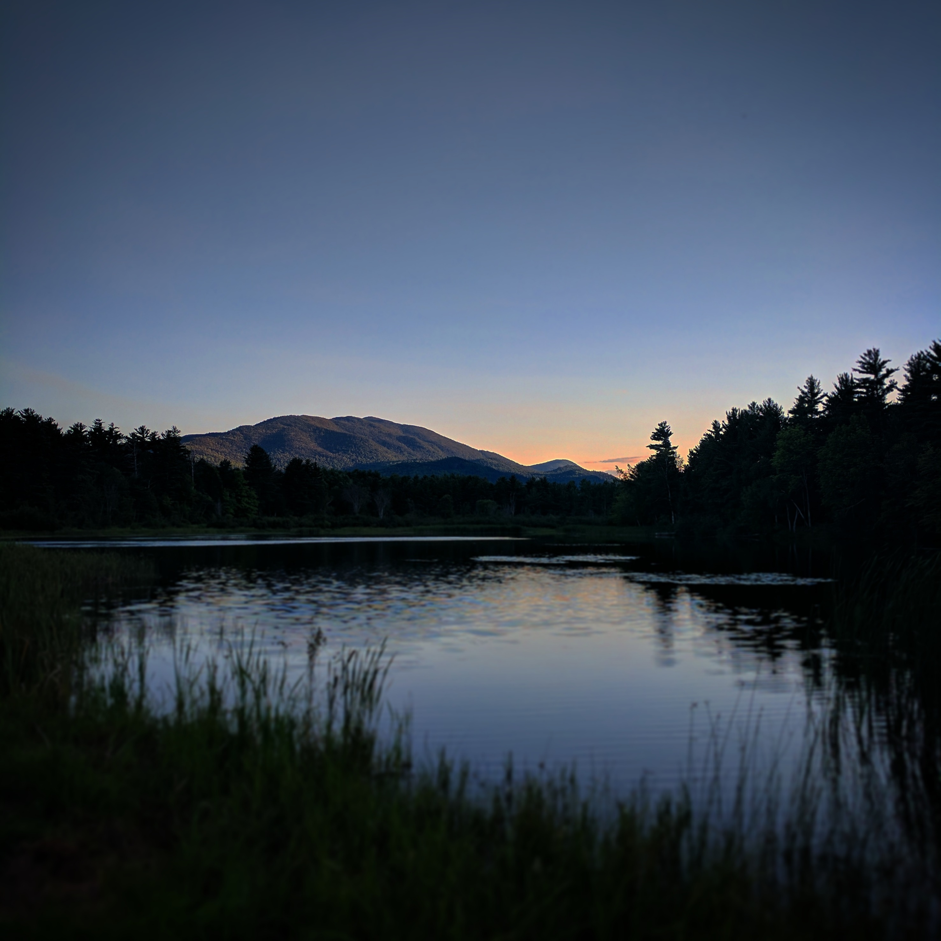
Undergraduate Research
Matthew Brewer

Slide 3
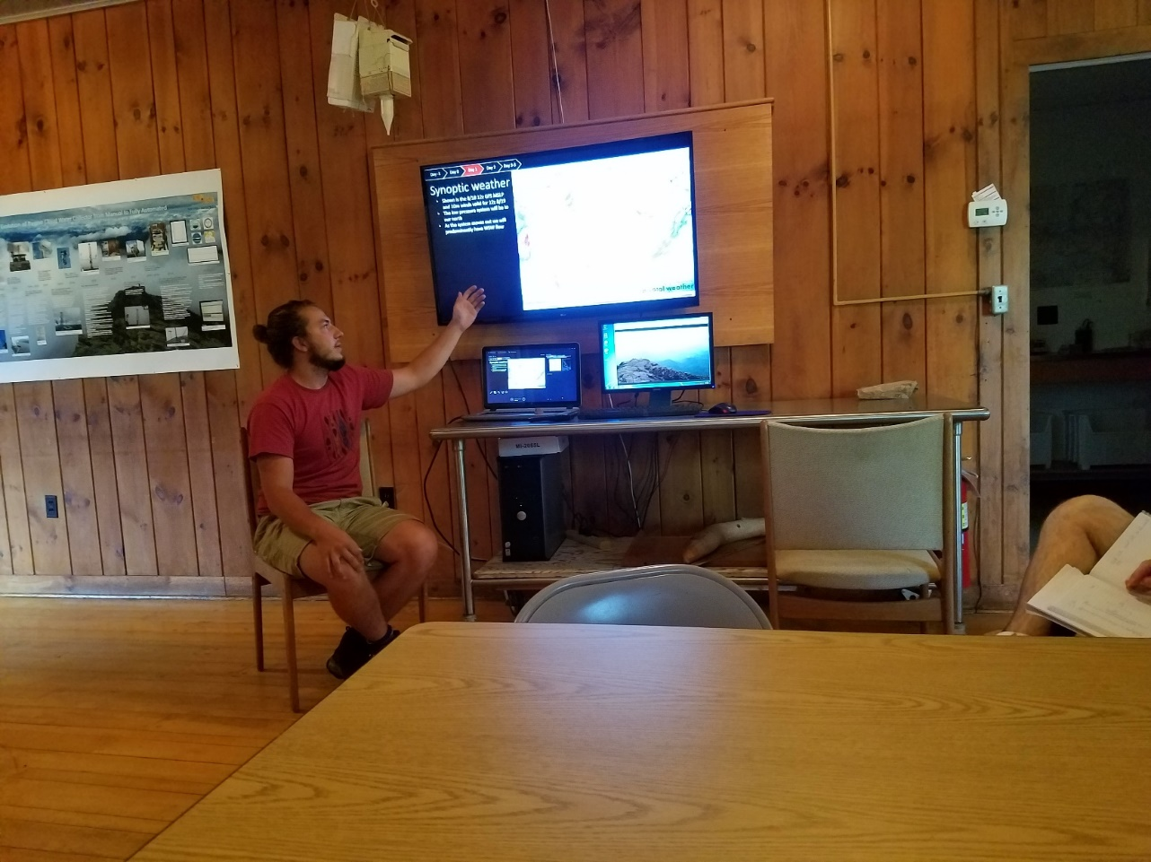
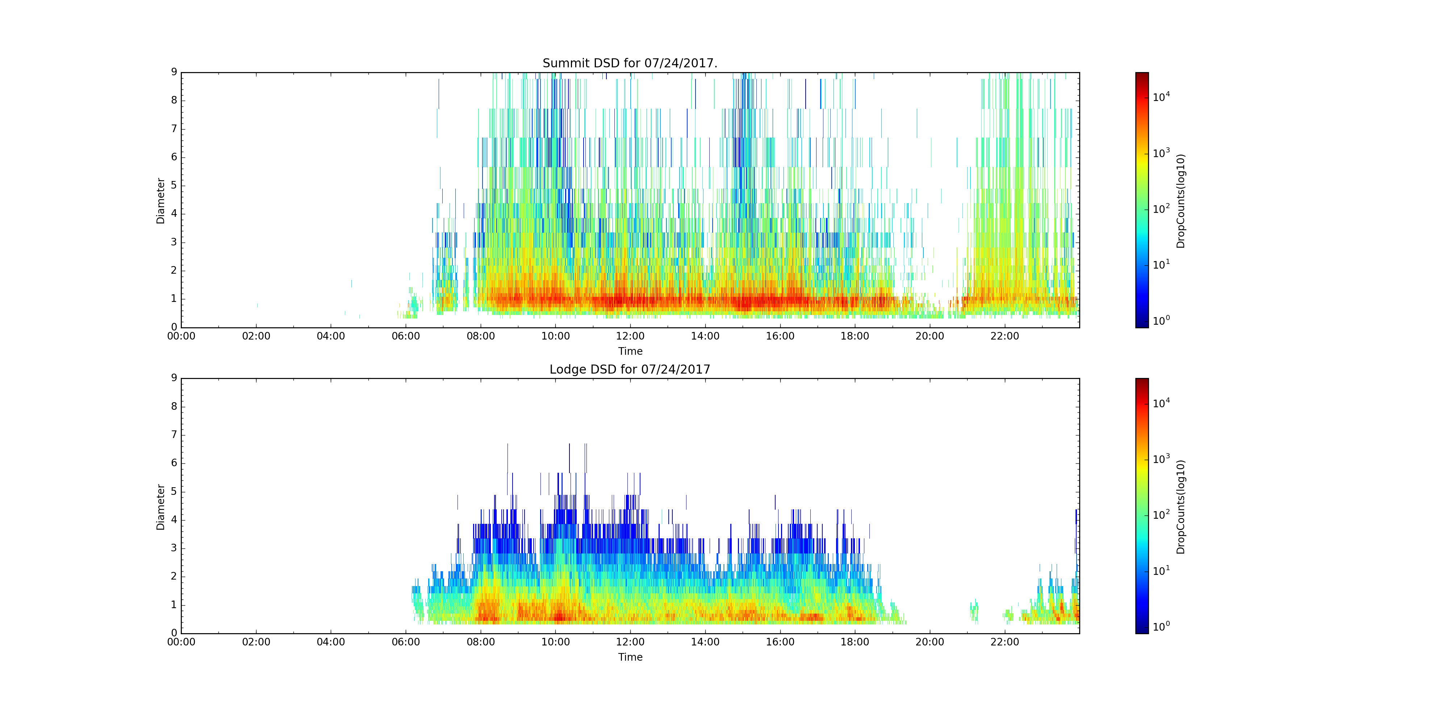
My experience doing undergrad research
Weather Forecasting
Deploying instruments/ launching radiosondes
Data Collection
Learning to code python
Weather camp assistant

Slide 4
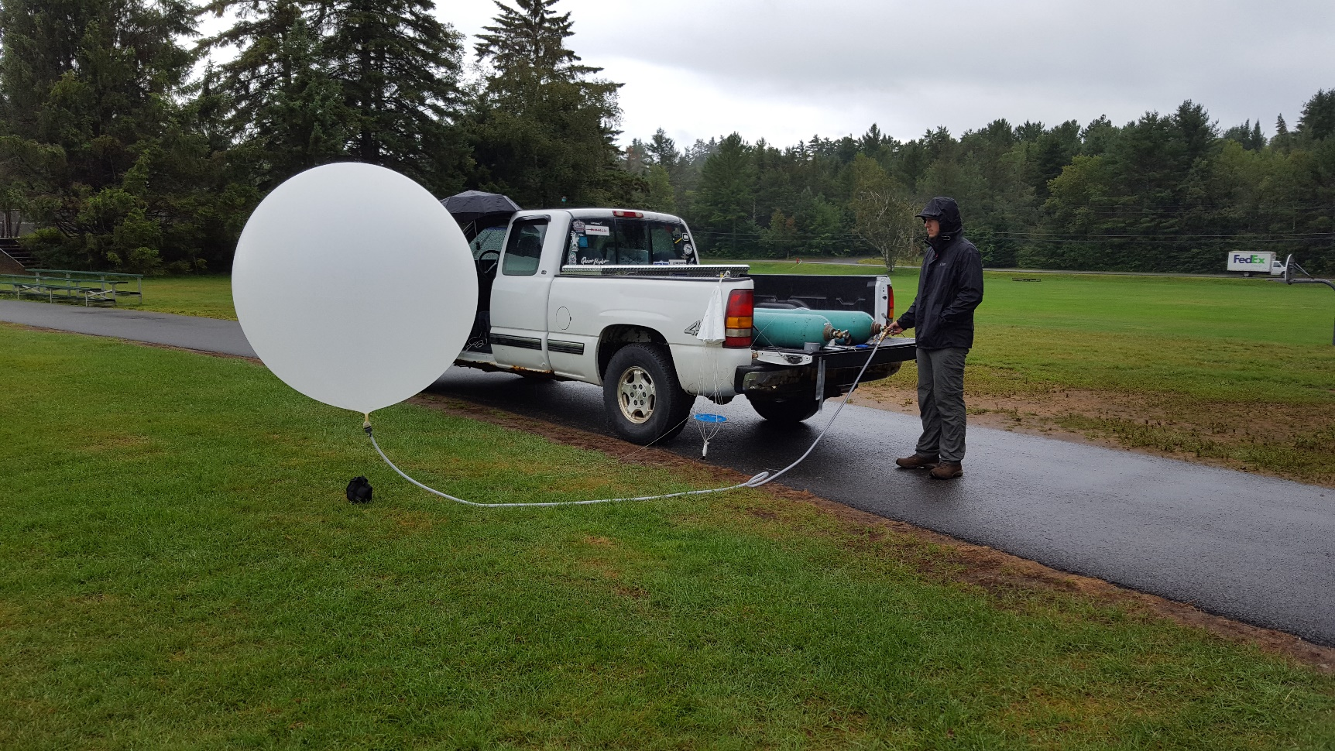
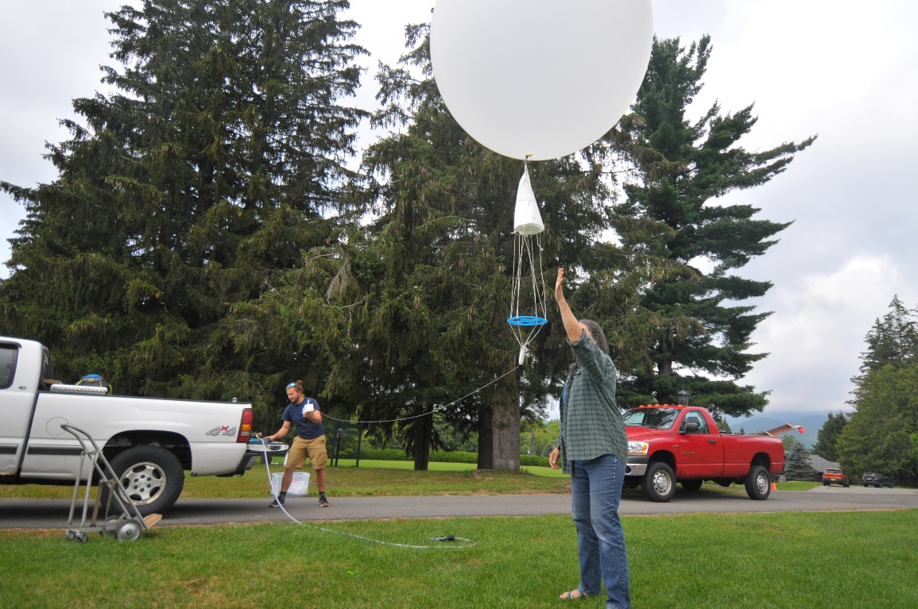
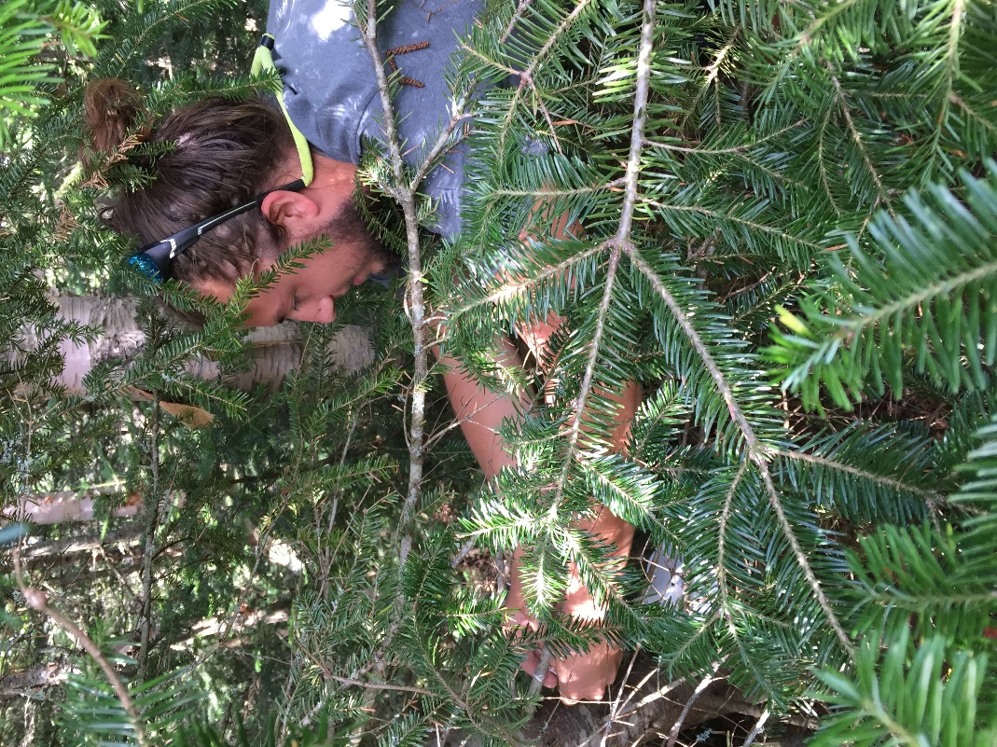
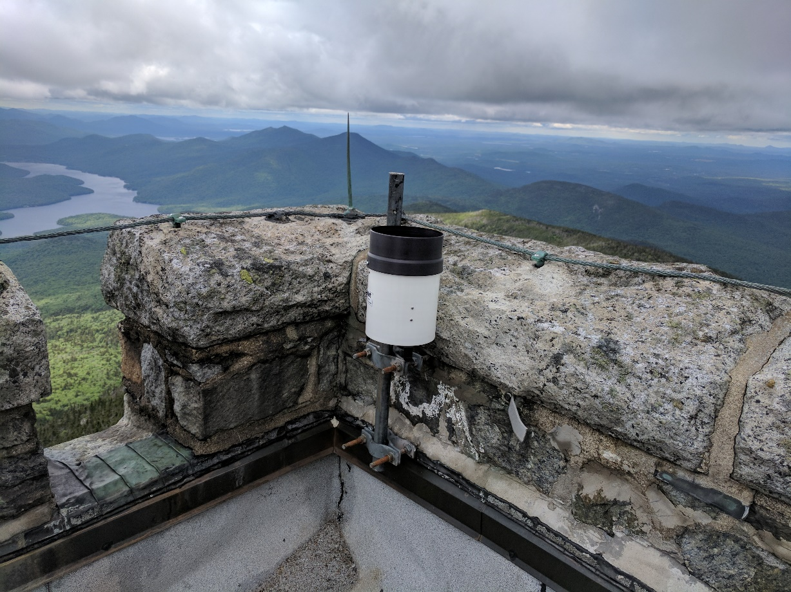
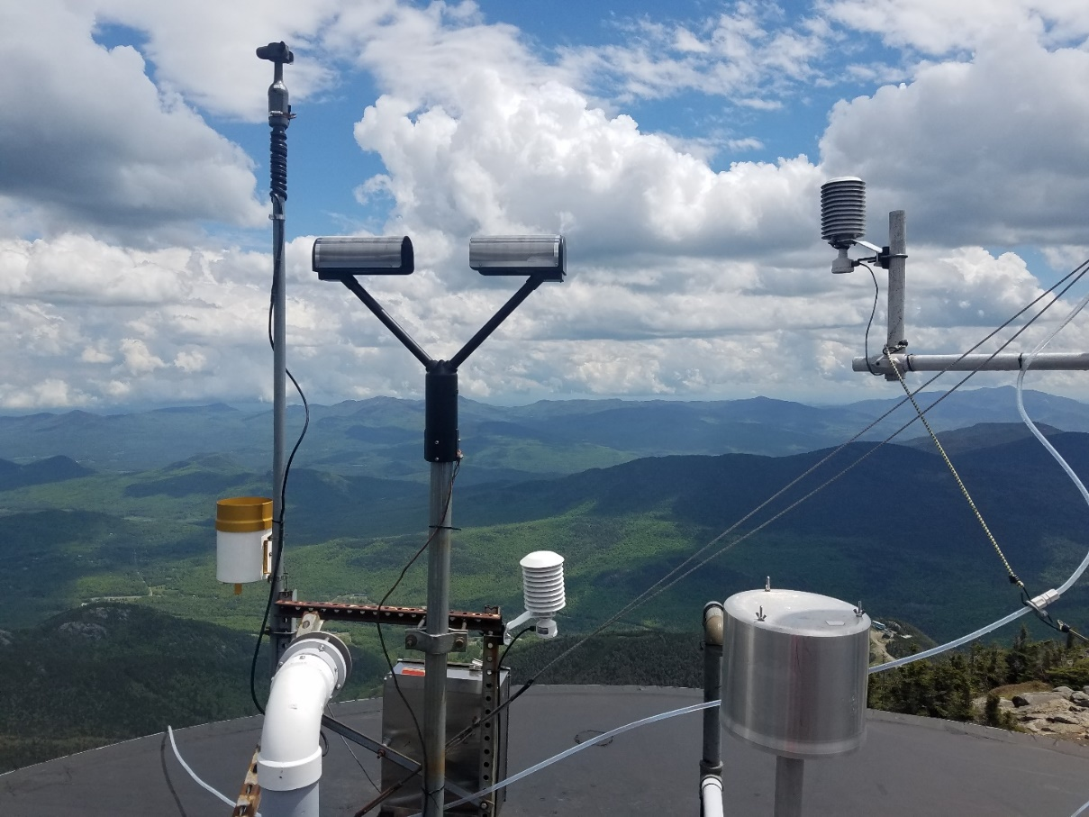
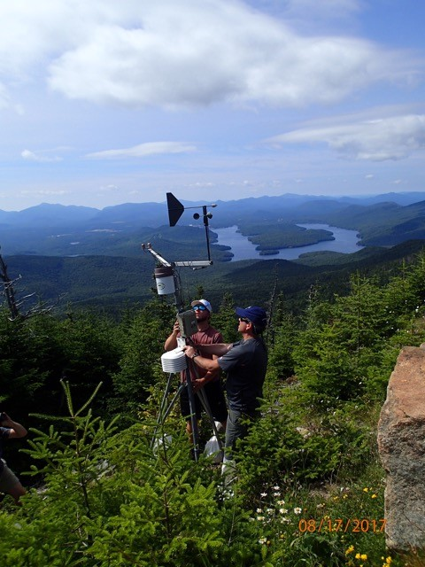

Slide 5

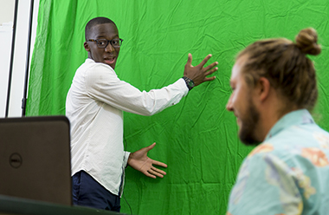
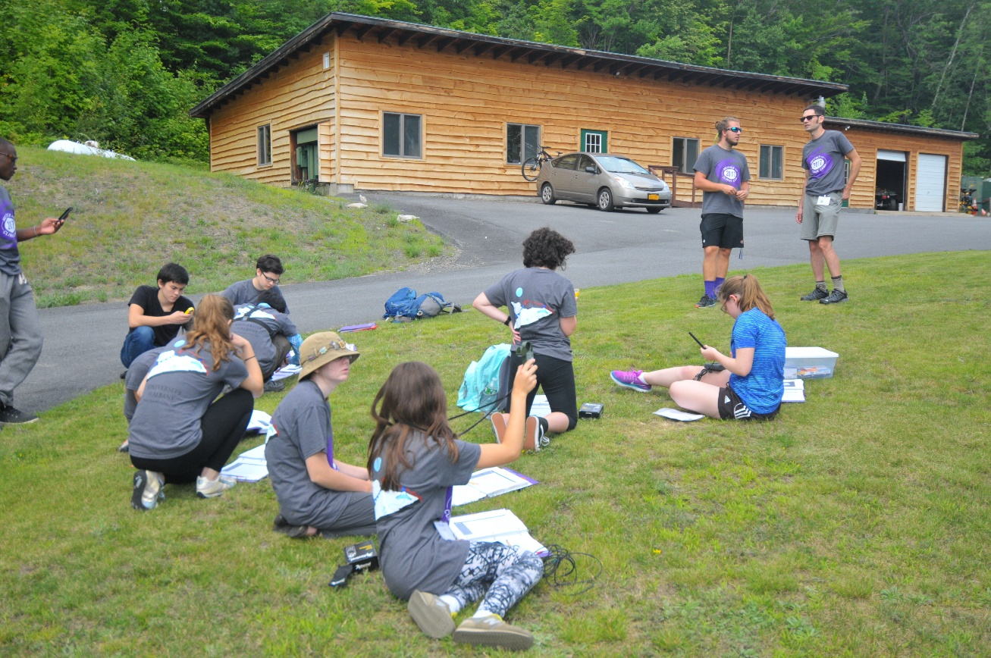

Slide 6
How did I get involved in research with Faculty?
Justin Minder needed an undergraduate assistant to help with the weather camp
Funding was also available to do summer research which lead to working on the field campaign
I was interested in the work that Justin Minder does so emailed him asking to meet with him to discussed working with him this year
We meet every week for about 45 minutes and discuss what I have been doing and future plans

Slide 7
Strategies to initiate research with faculty members
Take their classes
Attend office hours to get to know your professors better
Read some of the papers published by the professor you want to work
Email the professor or talk with them after class to set up a meeting to discuss research possibilities

Slide 8
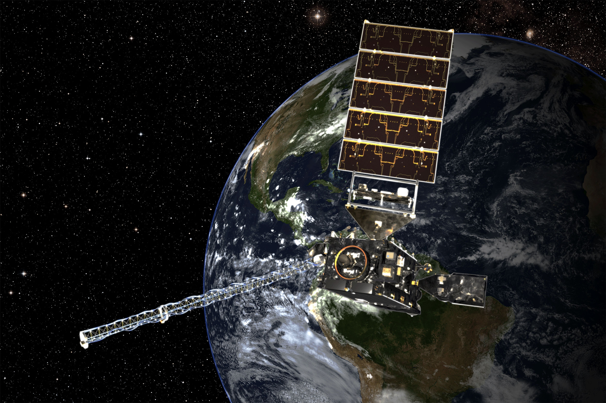
Significant Opportunities in Atmospheric Research & Science
(SOARS)
Briah’ Davis
September 14, 2017
Image Courtesy of nesdis.noaa.gov

Slide 9
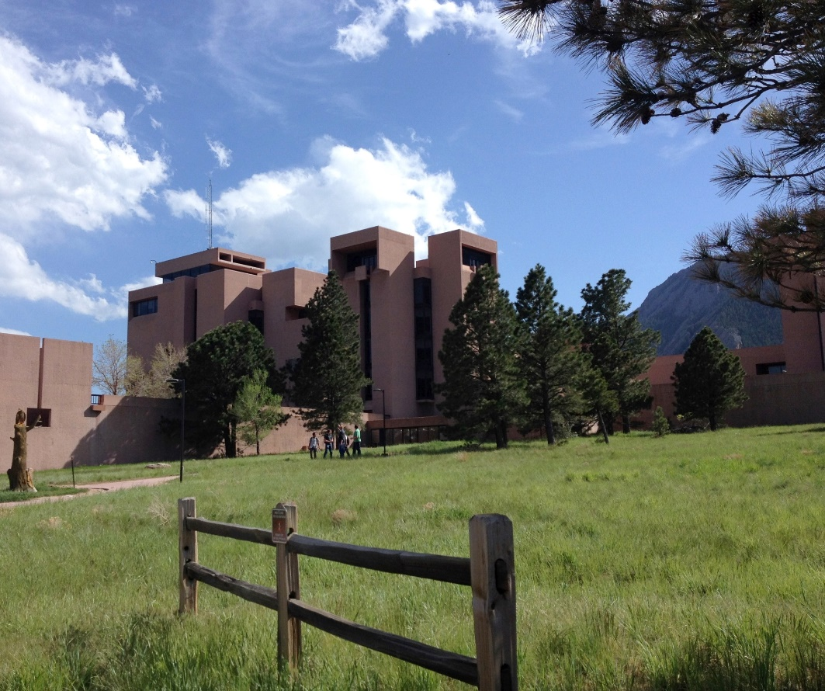
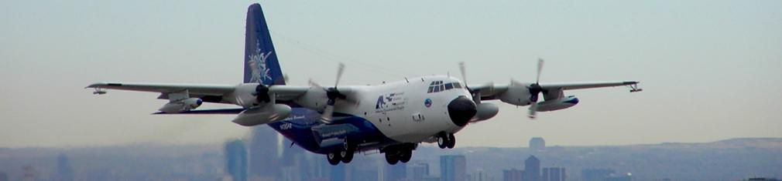
What is SOARS?
A summer research internship at the National Center for Atmospheric Research (NCAR), UC Boulder, or NOAA in Boulder, CO.
Focused on increasing diversity in atmospheric sciences
Undergraduate to graduate bridge program- can participate up to four summers or until you obtain your Master’s
Image Courtesy of UCAR

Slide 10
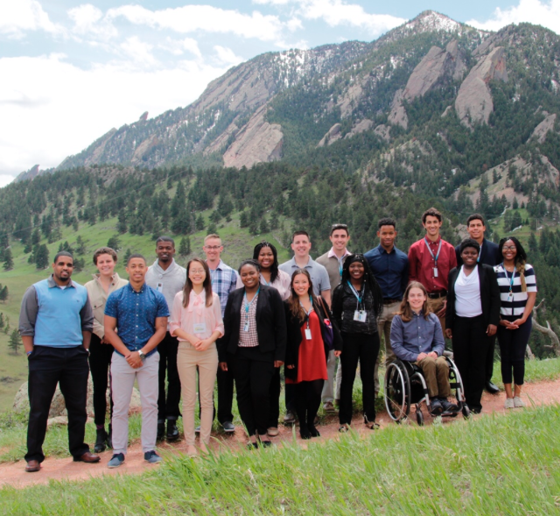
Details
Deadline: End of Jan./ Start of Feb.!
Eligibility:
  Completed 2 years of college (but can’t be graduating senior)
  GPA >3.0
  Majoring in atmospheric science or related fields
  Have U.S. citizen or permanent resident status
Application Requirements:
  Two letters of recommendation
  College transcripts
  SOARS application- basic information and two essays
    1- Academic statement of purpose
    2-SOARS mission and personal journey
Funding:
  Stipend and housing provided
  Travel costs covered
  Conference and school funding available

Slide 11
What Makes SOARS Unique?
Research
Mentoring
Community

Slide 12
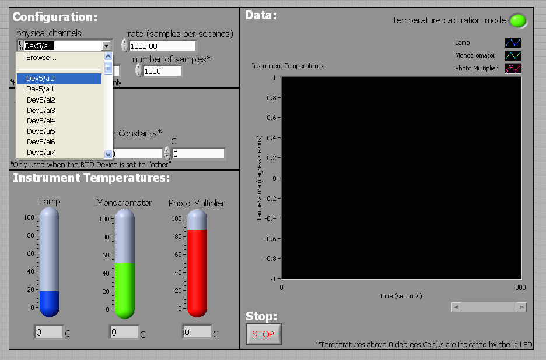
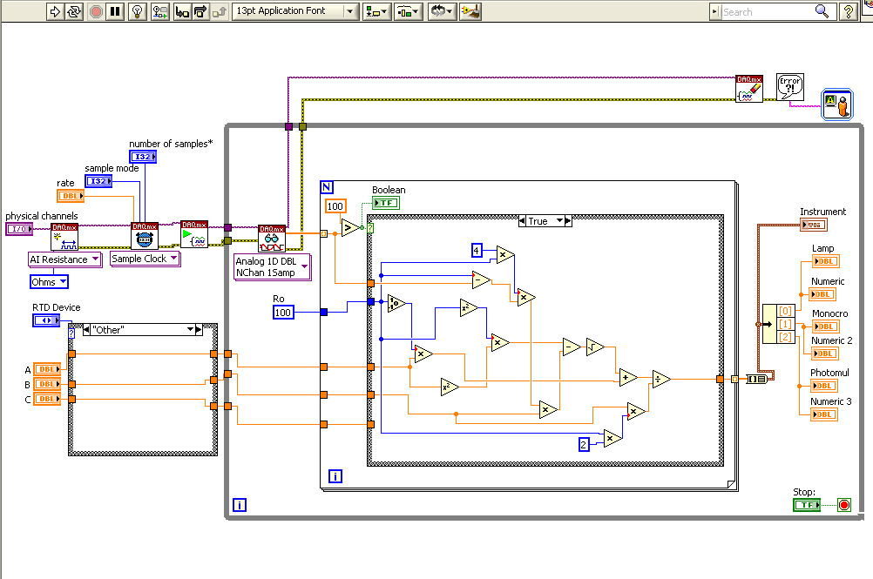
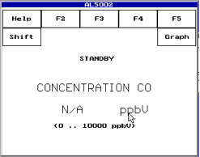
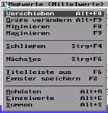
Research

Slide 13
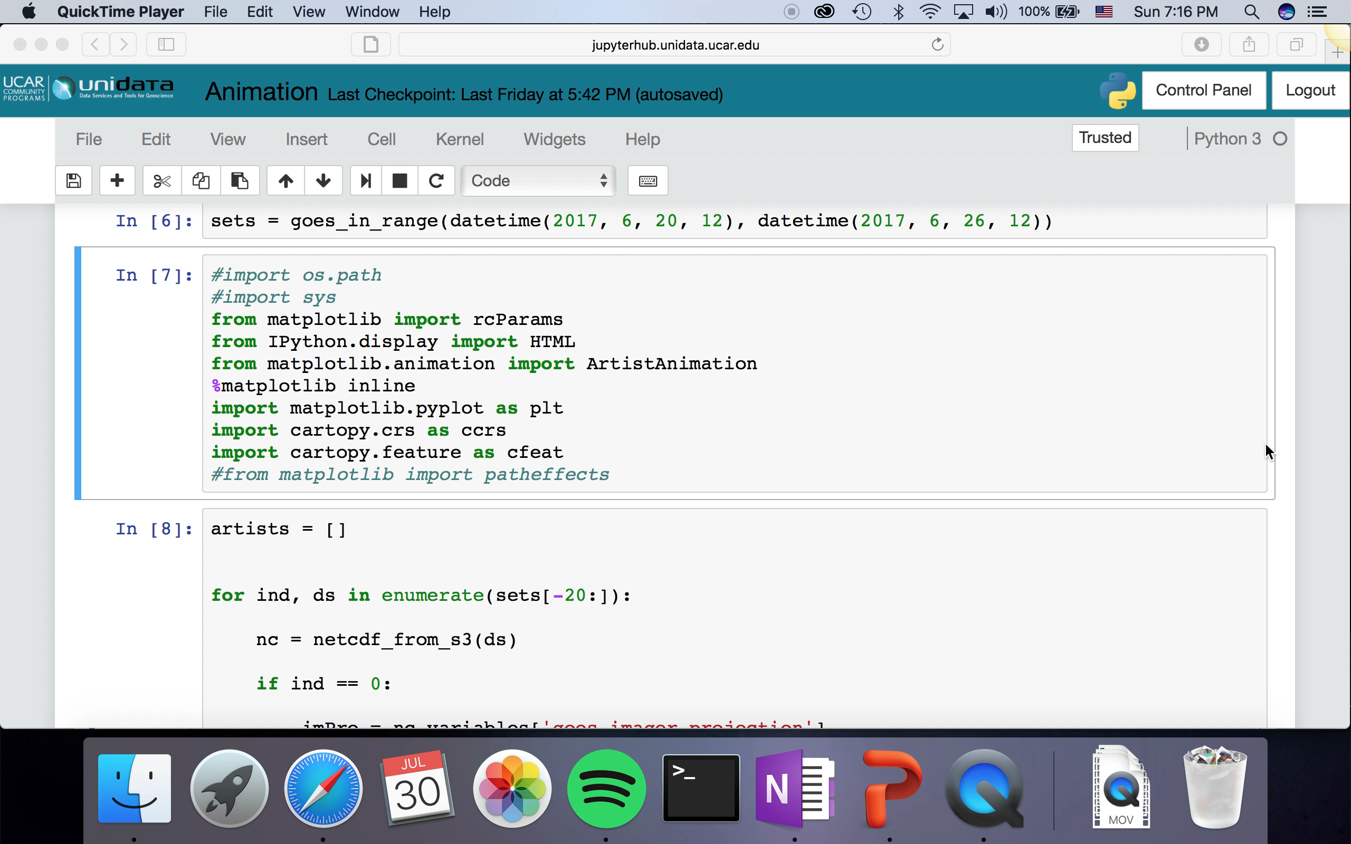
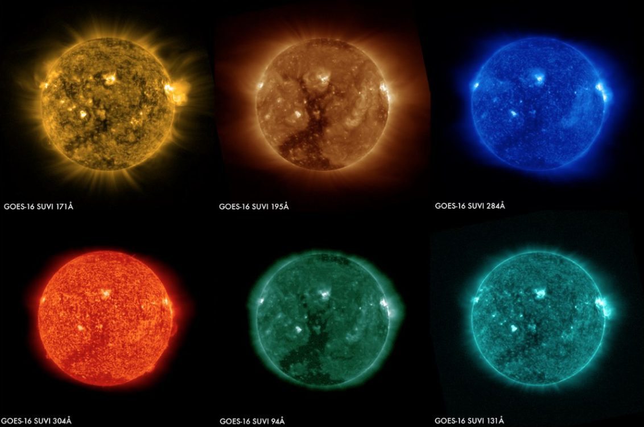
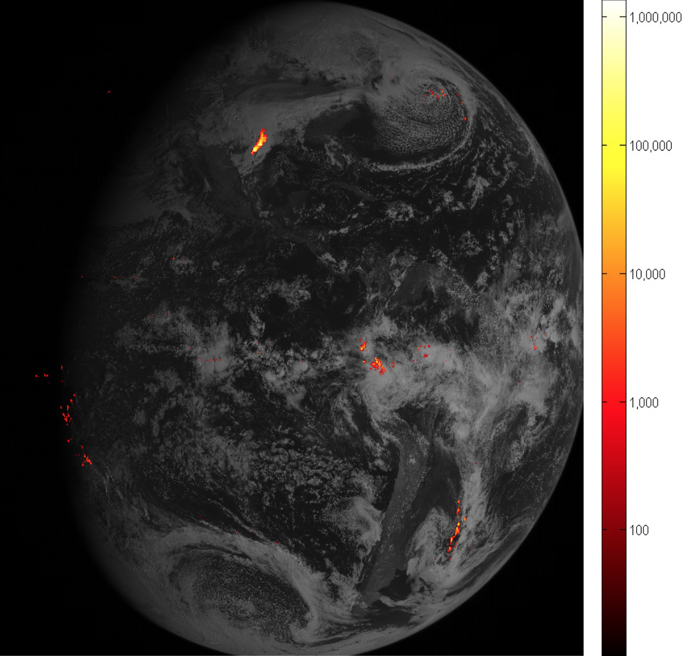
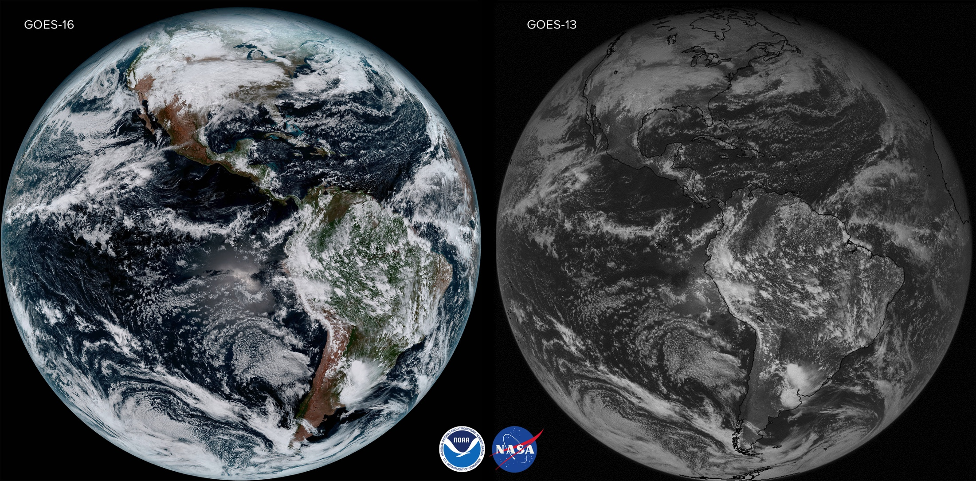
Research

Slide 14
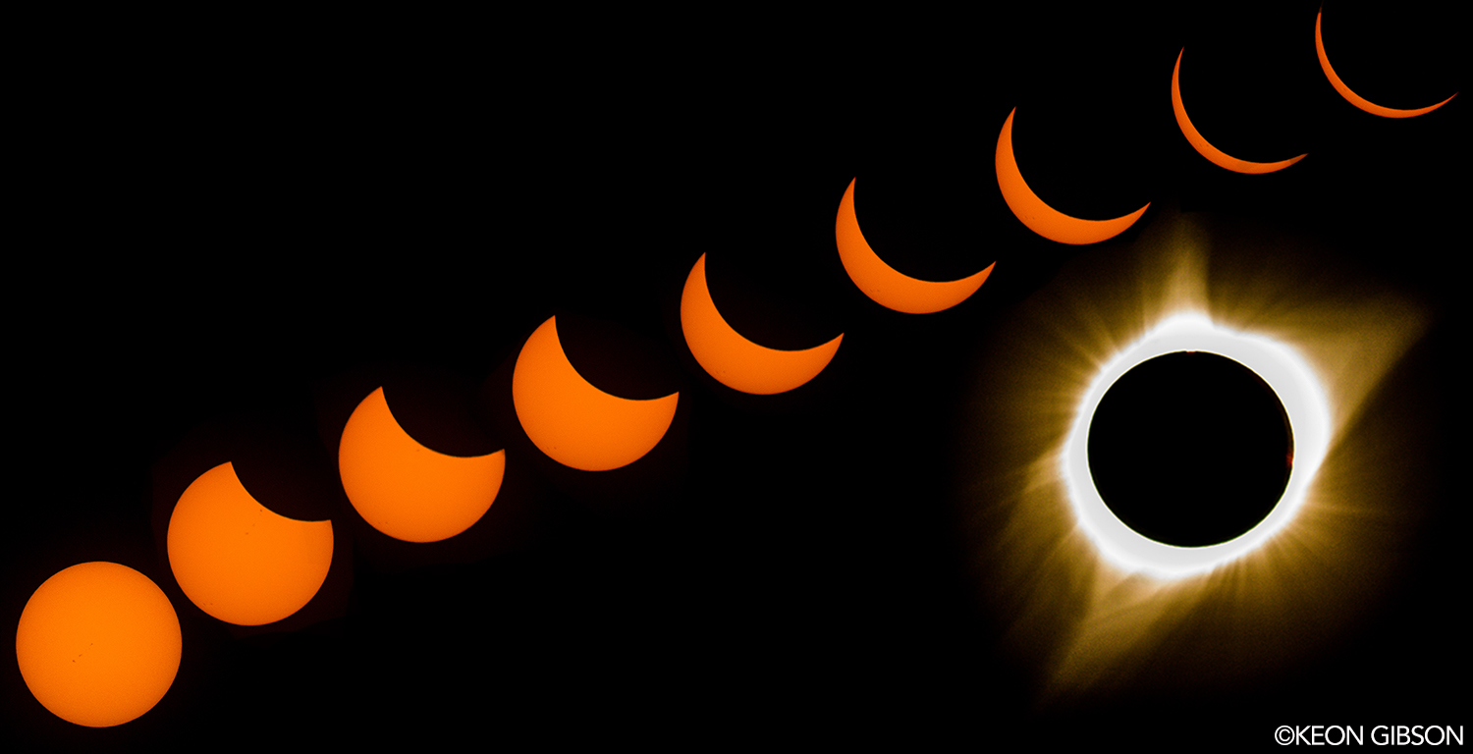
Research
Space
Oceanography
Societal Impacts
Climate
Instrumentation
Road Weather
Aviation
Engineering
Mathematics
Chemistry
Biology

Slide 15
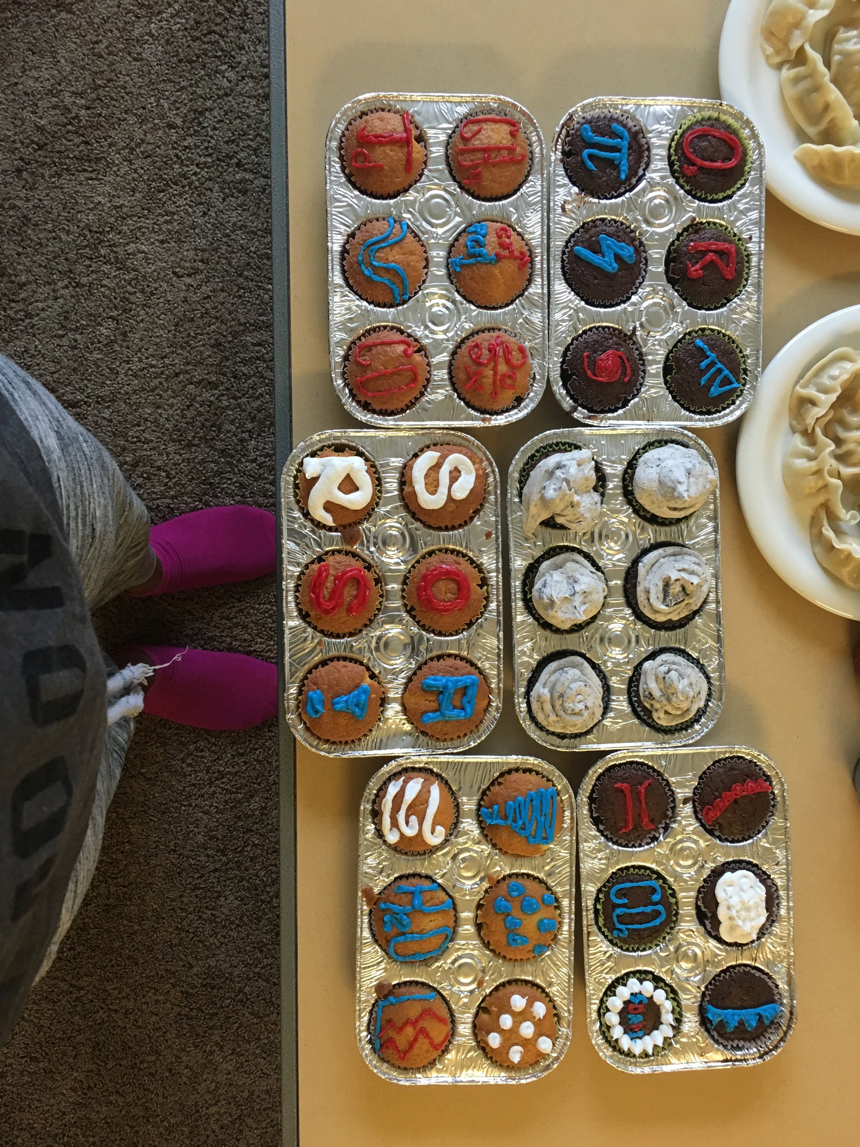
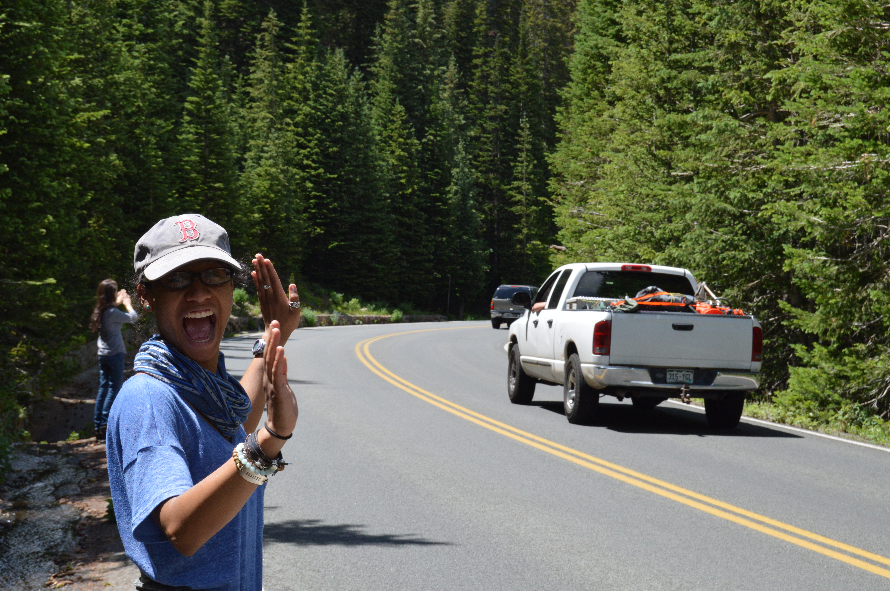
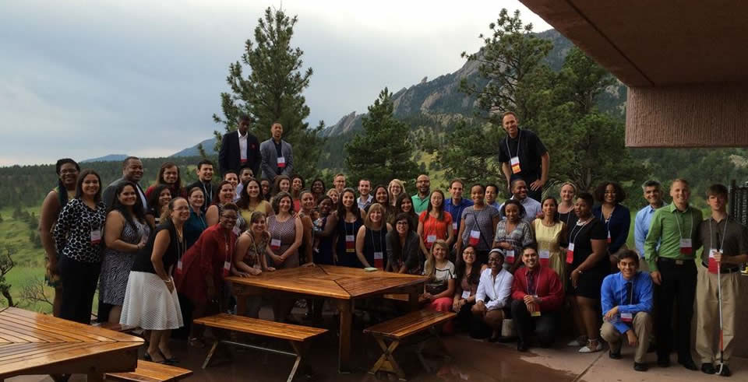
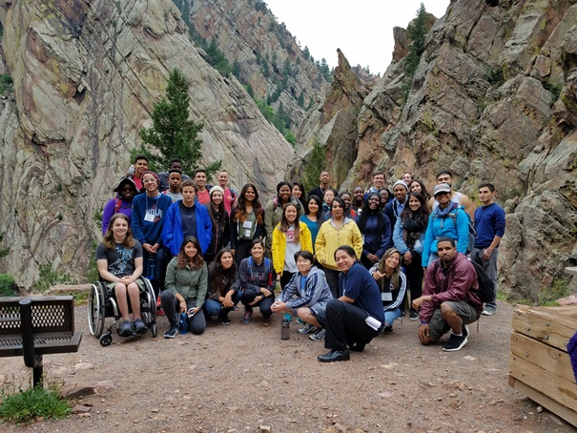
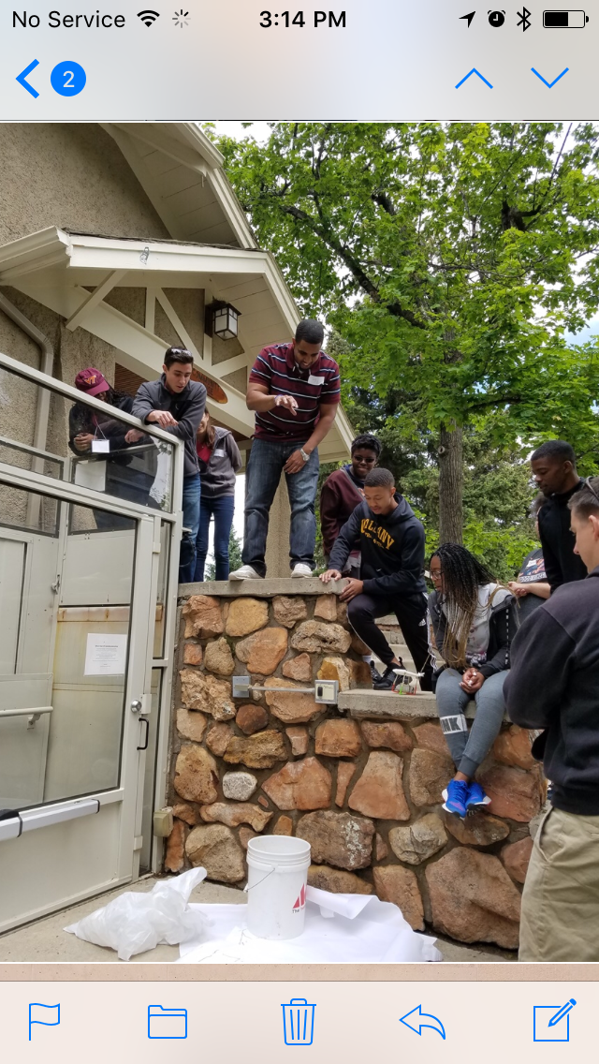
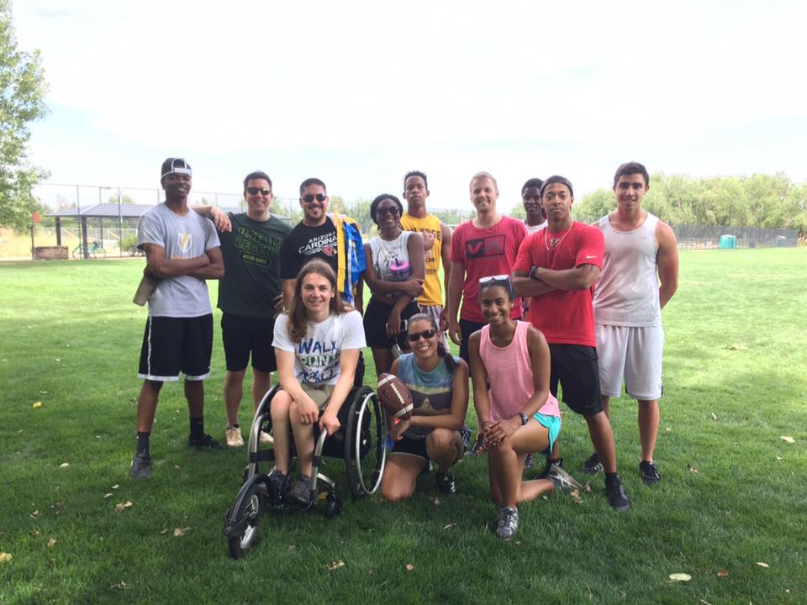
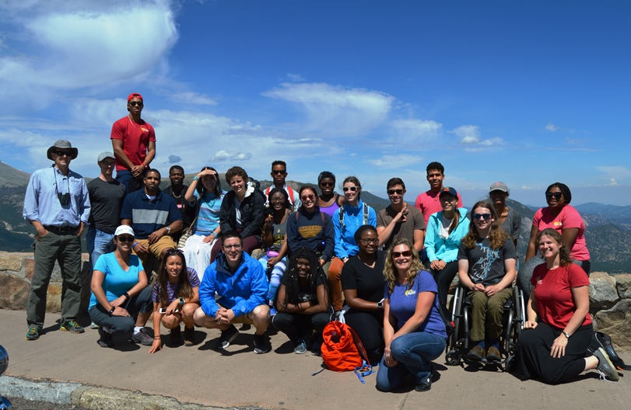
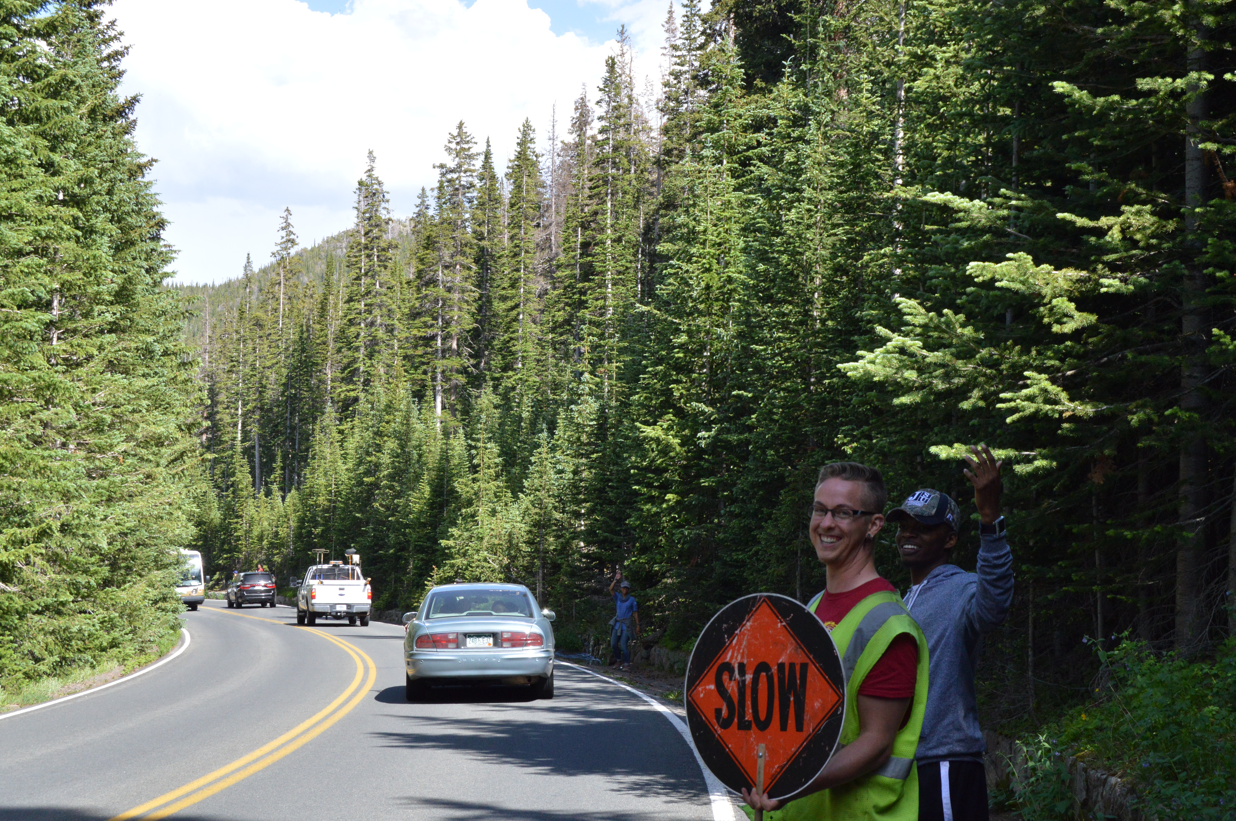
Mentoring & Community

Slide 16
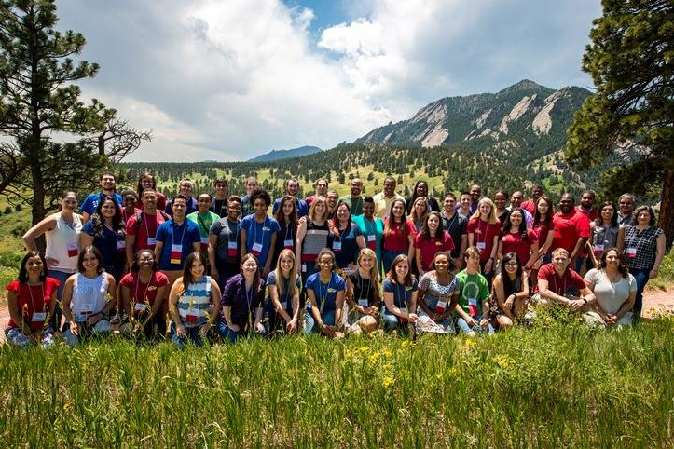
Why SOARS?
Resources:
soars.ucar.edu
“Like” SOARS on Facebook
My email: bdavis3@albany.edu

Slide 17
NOAA Ernest F. Hollings Scholarship
Apply Sophomore year
  Application due at the end of January
Benefits
  10-week paid ($700/week) internship at a NOAA facility
  $9,500 annual tuition assistance
  Housing Supplement
  Travel to 2 conferences to present your research
  NOAA Symposium presentation at NOAA HQ
  Success begets success
    95 NSF fellowship winners. 75% go to graduate school

Slide 18
Application Info
Typically 500+ applications a year and ~120 scholarships awarded (1 in 5 odds are not bad for $19,000 in tuition and a jump-start to your careers)
Don’t feel like you need to be all science; highlight your extracurriculars
Find a faculty member who can write you a GREAT recommendation letter
Feel free to contact me
  mvaughan@albany.edu

Slide 19

Target your essays (and lay it on thick, WRN)
  Have some semblance of a career plan.
Some selected gag-inducing gems:
  “I see my education as a pathway to a fulfilling, altruistic career helping the American people”
  “As a NOAA officer, I will be bounded by oath and heart to serve the NOAA and achieve the administration’s goals”

Slide 20
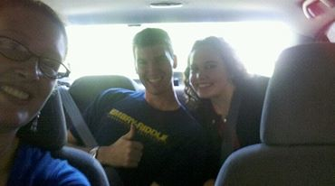
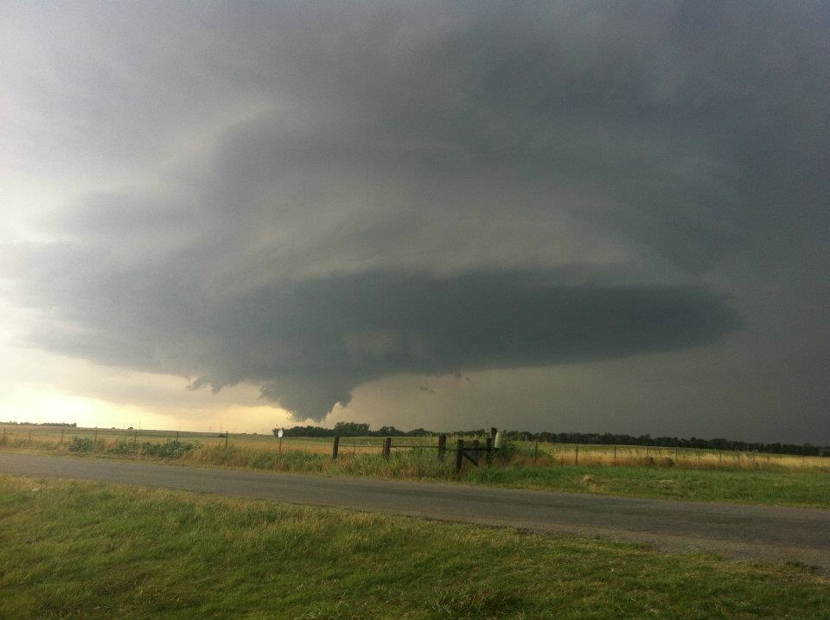
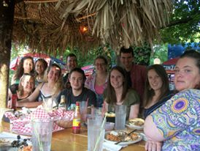
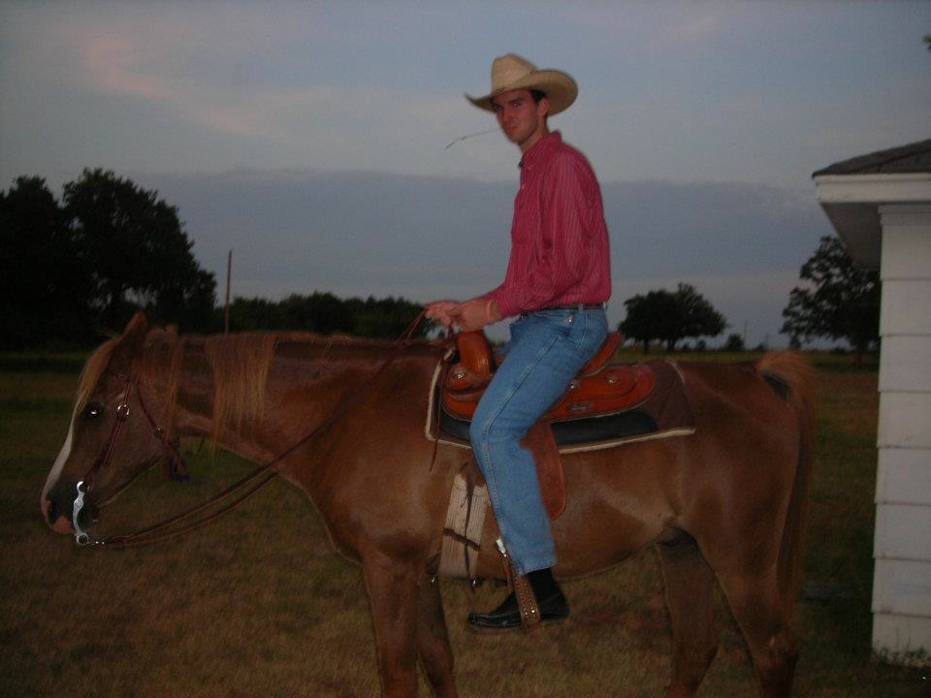
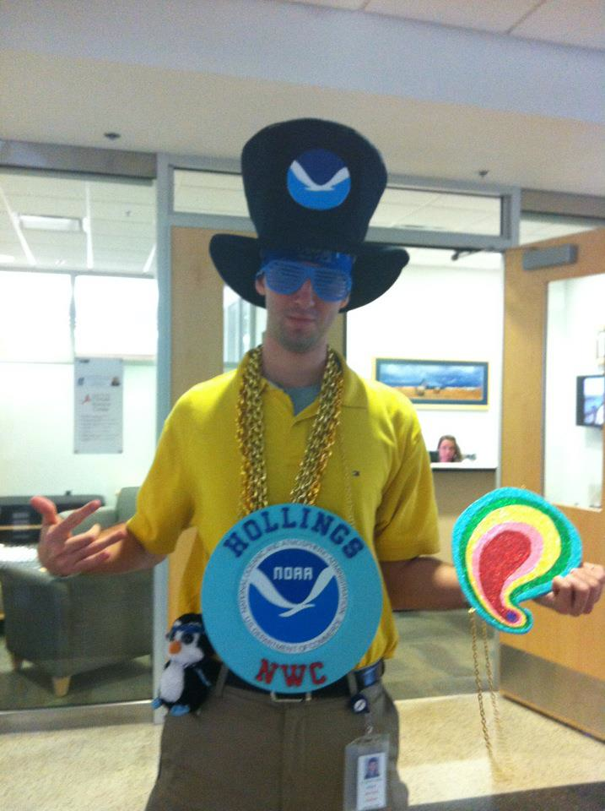
First chase
Kingfisher, OK supercell
Represent
Connect
2012 Hollings @ NSSL
Embarrass

Slide 21
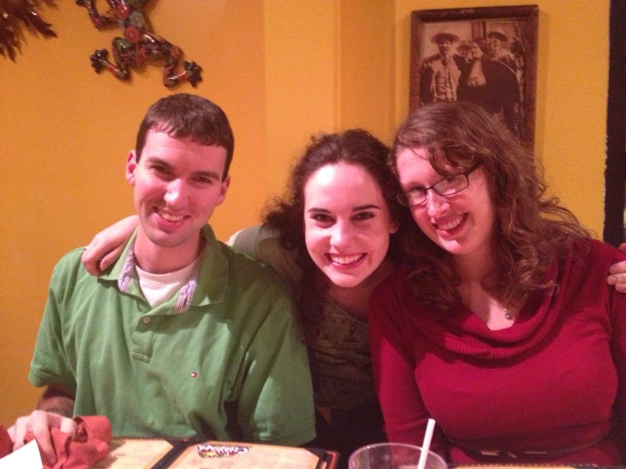
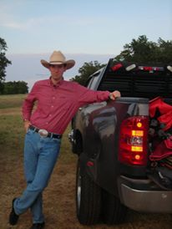
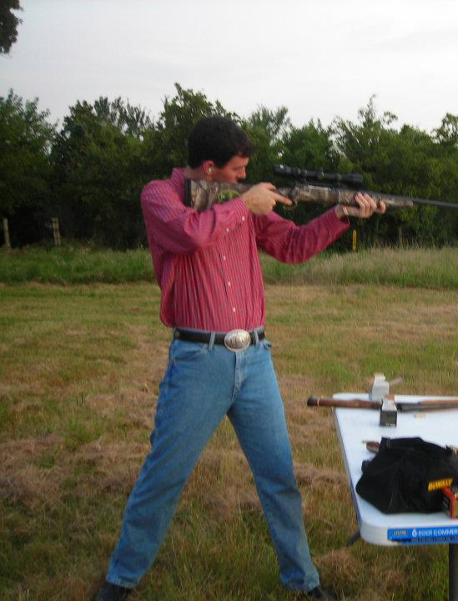
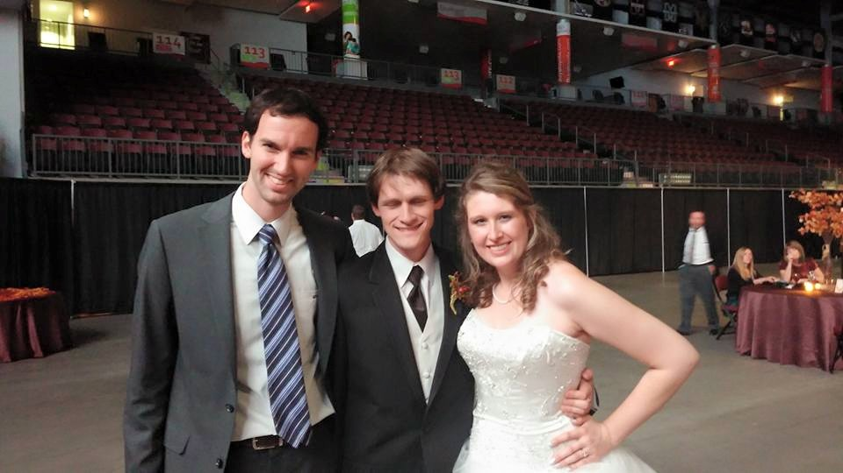
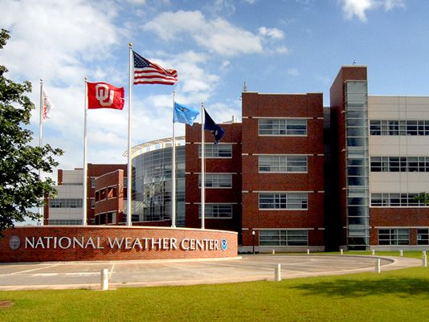
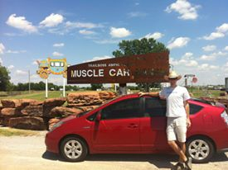
Norman, OK
Friendships
Shoot
Ranch
Experience
Tour

Slide 22
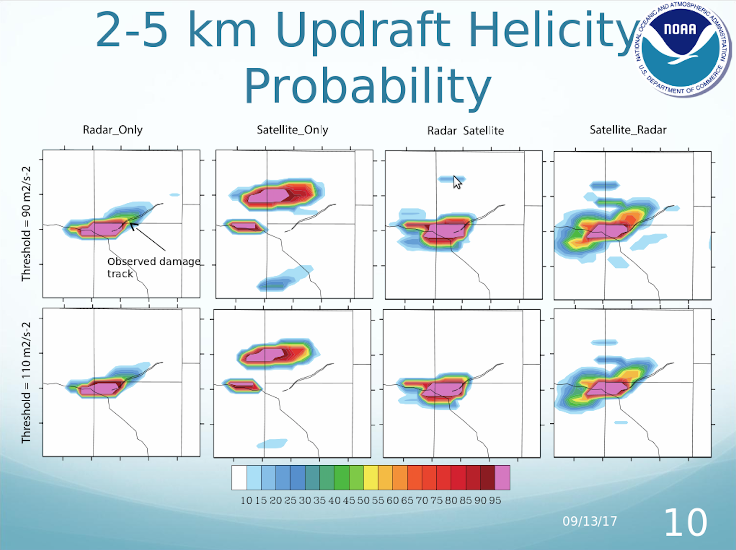
Work

Slide 23
National Weather Center REU
(Deadline: ~Early February 2018)
Eligibility
Application Requirement
US Citizen or permanent resident
Current 1-3rd year students in a 4 year undergraduate program
Application form
Three short essays
Two references
Official transcript
Award
Stipend: $5000
Some subsistence & travel to/from Norman, OK covered
Housing provided
Up to $1500 funding for traveling to national conference

Slide 24
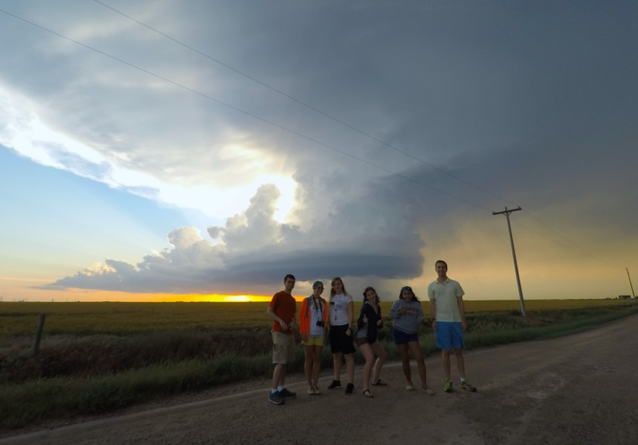
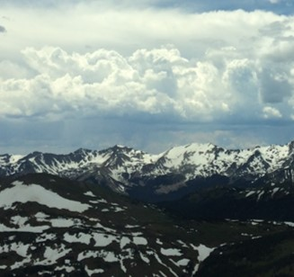
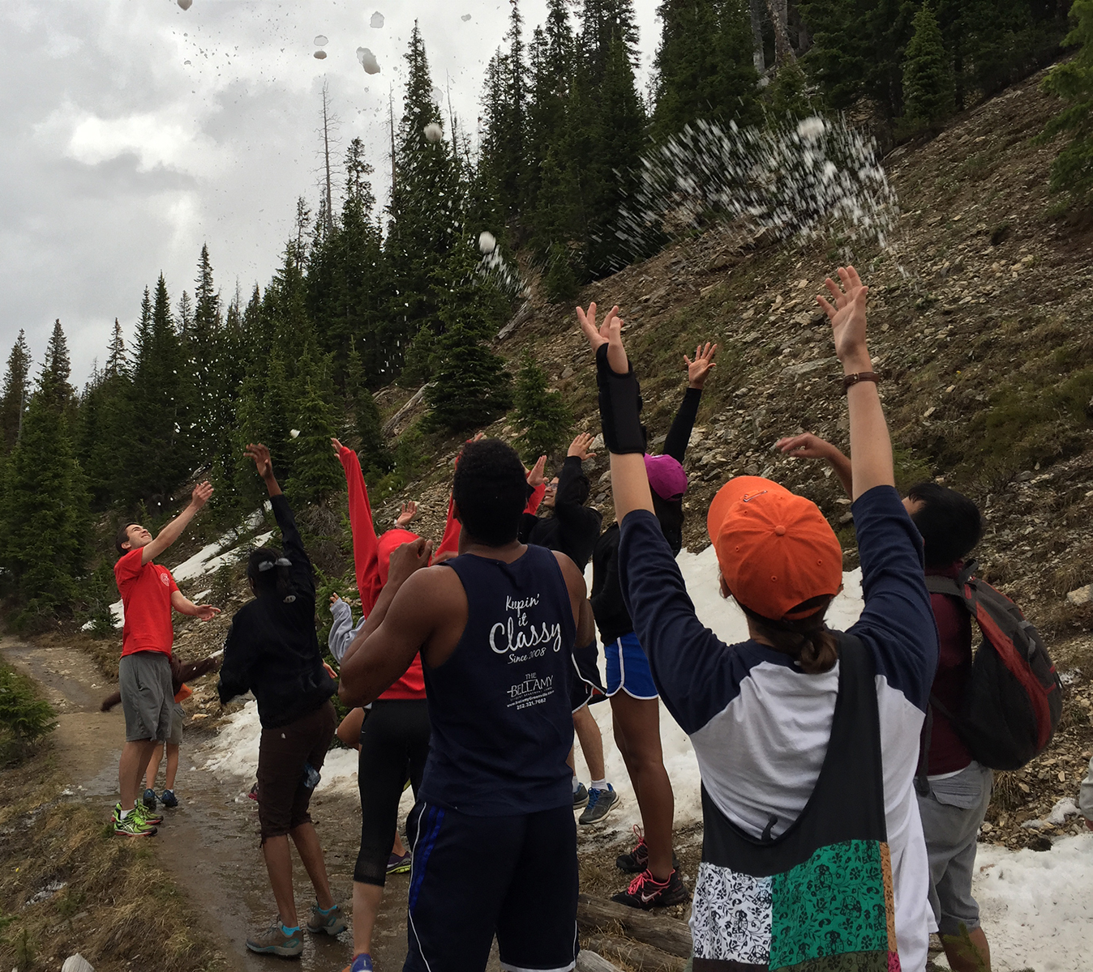
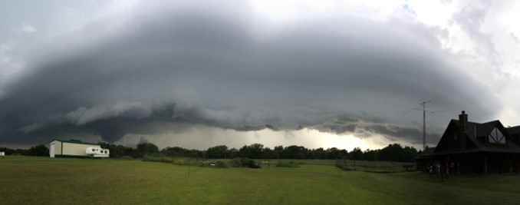
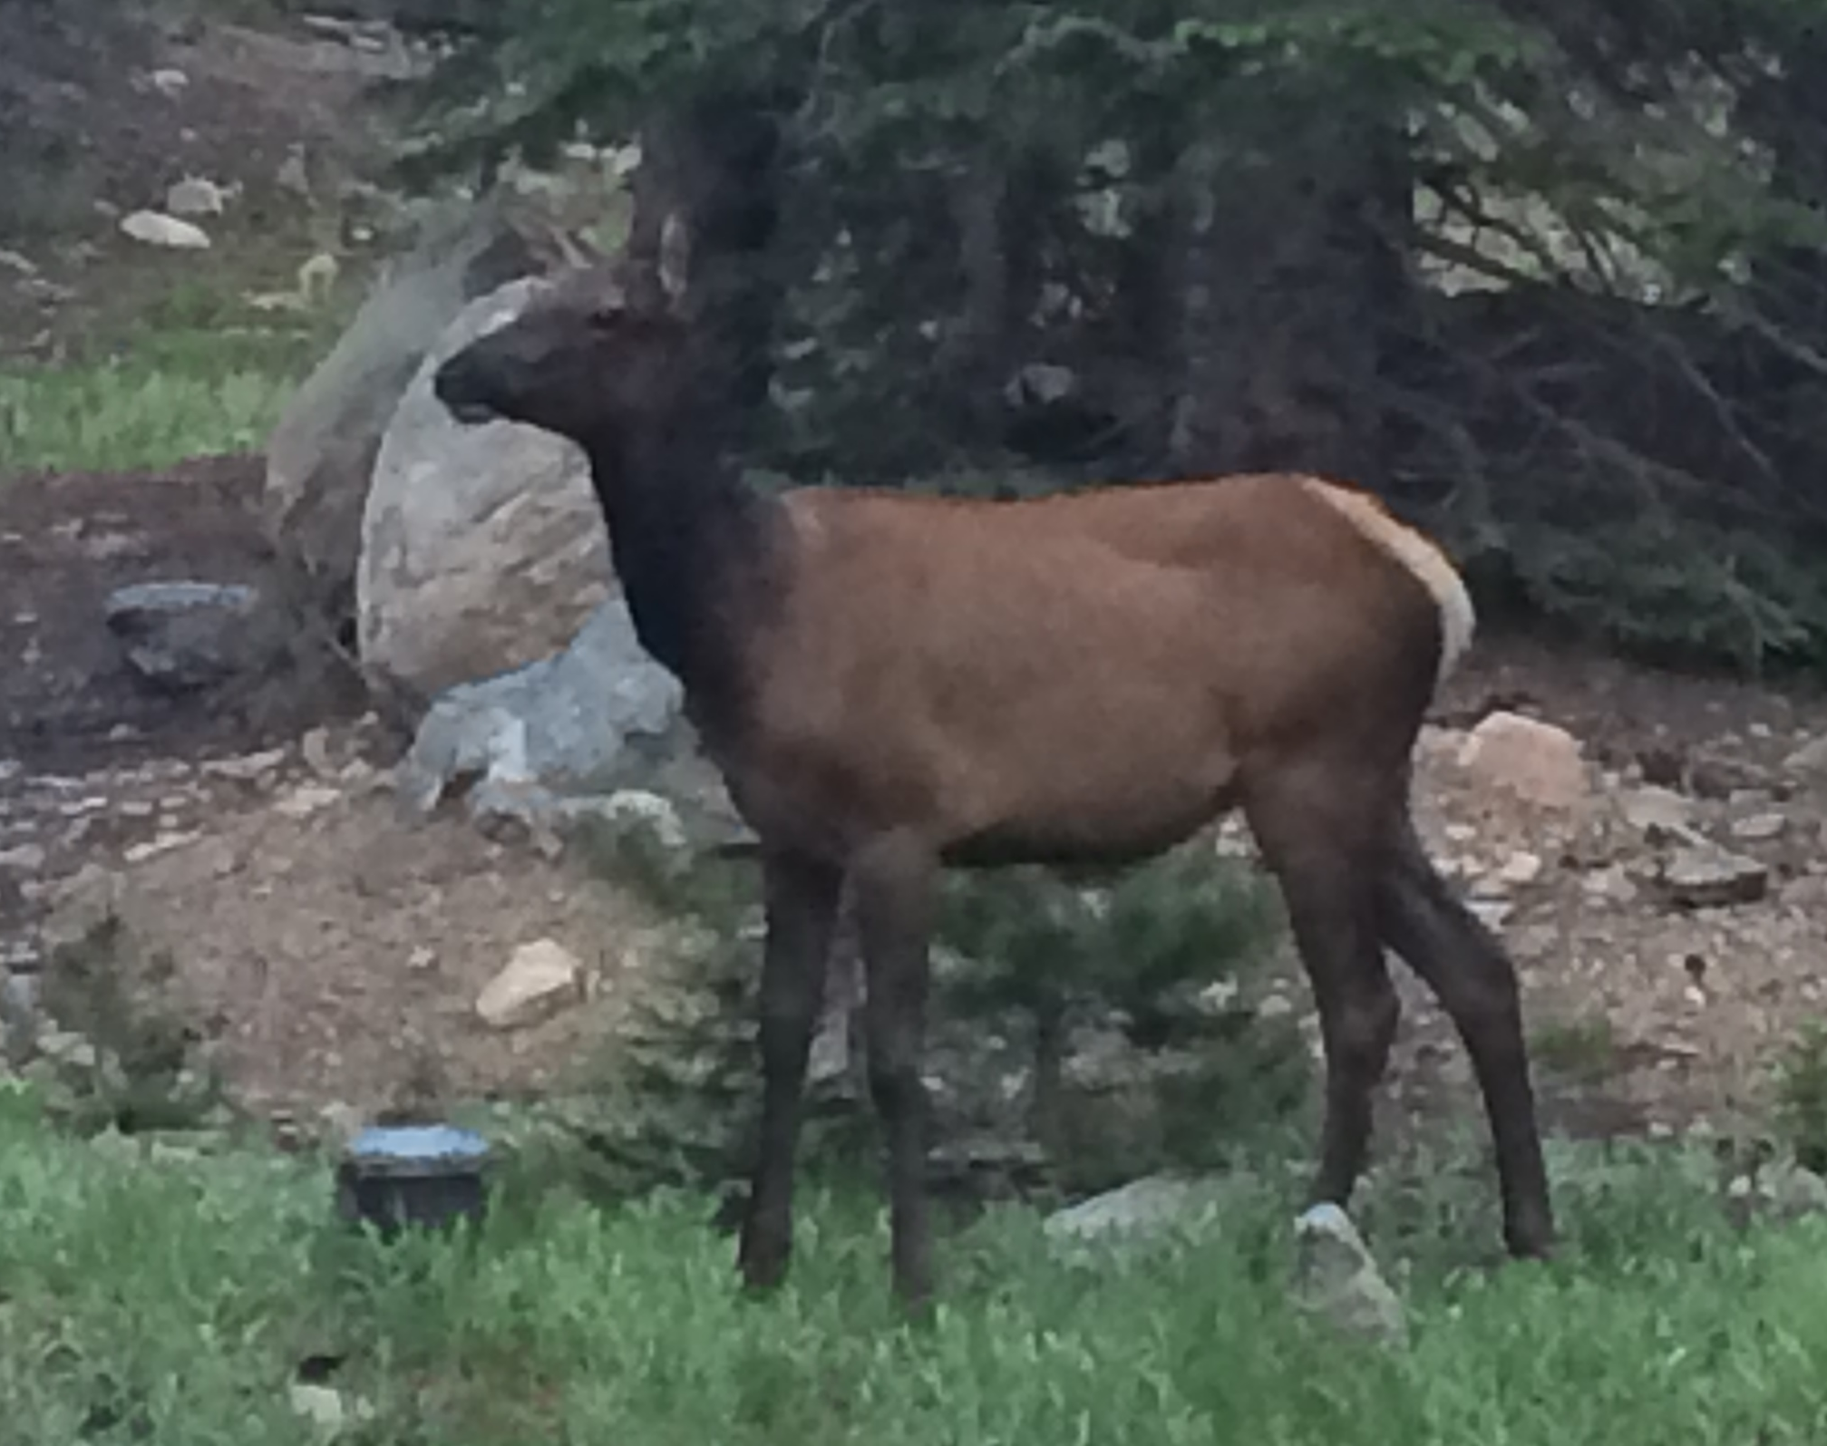


“Superselfie”
Rockies
Snow in June
4th of July “Fireworks”
ELKS!
NWC
Awesome pizza

Slide 25
Hobart and William Smith Colleges
Lauriana Gaudet

Slide 26

Where is this internship?

Slide 27




Slide 28
General Questions
Can I apply?
  All undergraduates can apply, including graduating seniors
What kind of funding will I receive?
  Stipend $4,400 for 2 months of research
  Housing on campus
  Travel to/from Geneva
  Conference travel/lodging
What will I be researching?
  Some type of winter weather phenomena (i.e. lake-effect snow processes)

Slide 29
Application Process
Application opens in November/December
  Go to http://people.hws.edu/laird/ to access application materials
  2 references
  Statement of interest
Deadline: Late January/Early February

Slide 30
Undergraduate Scholarships

Slide 31
National Weather Association Scholarships
Lauriana Gaudet

Slide 32
Open Scholarships
The Arthur C. Pike Scholarship in Meteorology
  Eligibility: Any undergraduate going into junior year or higher or graduate student
  Award: $1000 + Free NWA Membership
The NWA Phillips Family Undergraduate Scholarship for Meteorology
  Eligibility: Undergraduates Only
  Award: $1000 + Free NWA Membership
The NWA Bob Glahn Scholarship in Statistical Meteorology
  Eligibility: Undergraduates Only
  Award: $2500 + Free NWA Membership

Slide 33
Other Information
All Deadlines: Typically mid-November
Application Materials:
    Transcripts
    2 recommendations
    Personal essay

Slide 34
National Weather Association Scholarships
(Deadline: varies based on scholarship)
Eligibility
  US citizen, US national, or permanent resident
  Undergraduate and graduate students
  Some scholarships require an interest on a specific topic within meteorology
Award
  Varies, but generally between $1,000 and $2,500
  Free NWA membership
  In my opinion, these scholarships generally have less applicants!
Application Requirements
  Completed application form
  Statement explaining why you are applying for the scholarship
  Un/Official transcript
  Two references

Slide 35
AMS Senior Named Undergraduate Scholarships
(Deadline: 2 February 2018)
Eligibility
  Junior undergraduate students
  Major in the atmospheric or related sciences
  Cumulative GPA of 3.25
Award
  Varies, but generally between $2,000 and $10,000
  Travel funds to attend the AMS Annual Meeting
Application Requirements
  Completed application form
  Official transcript
  Three references

Slide 36
Graduate Fellowships

Slide 37
AMS Graduate Fellowship
(Deadline: 12 January 2018)
Eligibility
  Entering his or her first year of graduate study in the fall of the current year
  Pursuing a related full-time course of study in the atmospheric, oceanic, or hydrologic sciences over a full academic year
  Minimum GPA of 3.25
  U.S. citizen or hold permanent resident status
Award
  $25,000 stipend
  Travel funds to attend the AMS Annual Meeting
Application Requirements
  Completed application form
  Official transcript
  GRE scores
  Three references

Slide 38

National Science Foundation Graduate Research Fellowship
(Deadline: October 23, 2017 at 5pm)
Eligibility
  US citizen, US national, or permanent resident
  Intend to pursue a research-based Master's or Ph.D. program in a NSF-supported field
  Senior undergraduates and first/second year graduate students
  Can only apply once as a graduate student (first or second year)
Award (36 month tenure for funding)
  Three year annual stipend of $34,000
  $12,000 cost of education allowance per year
  Study abroad opportunities, ability to work with domestic government agencies, and professional development
  Freedom to conduct research at any accredited U.S. institution
Application Requirements
  Completed application form
  Two essays
    Personal statement
    Research proposal
  Un/Official transcript
  Three references
Notes:
Graduate students are limited to only one application to GRFP, submitted either in the first year or the second year of graduate school.

Slide 39

NATIONAL DEFENSE SCIENCE AND ENGINEERING GRADUATE FELLOWSHIP
(Deadline: Dec. 31, 2017)
Eligibility
  U.S. Citizens or Nationals of the U.S.
  Must receive Bachelor’s by Summer 2018
  Completed less than 2 full-time grad. years
  Must be at U.S. institution of higher ed.
Award (up to 4 years)
  Full Tuition and Fees (not room & board)
  Stipend
    2018: Unknown
    Past: $34,000 per year for 3 years
  Health Insurance (up to $1500)
  No additional travel allowance
Application Requirements
  Completed application form
  Official Undergraduate/Graduate Transcript
  GRE Scores
  Three LORs
  One essay < 3000 characters (~250 words)
    Research type | specific research question
    Long term goals | interest to DoD
Statistics: ~200/+3000 awarded

Slide 40


SMART Gradute/Undergraduate Fellowship
(Deadline: 1 December 2017 at 5pm)
Eligibility
  Minimum GPA of 3.0
  a citizen of the United States, Australia, Canada, New Zealand, or United Kingdom at time of application
  18 years of age or older as of August 1, 2018
  Able to participate in summer internships at a DoD facility
  Willing to accept post-graduate employment with the DoD
Award
  Full tuition and education related fees (does not include items such as meal plans, housing, or parking)
  Stipend paid at a rate of $25,000 - $38,000 depending on degree pursuing (may be prorated depending on award length)
  Summer research internships
  Health Insurance allowance up to $1,200 per calendar year
  Miscellaneous Supplies Allowance of $1,000 per academic year
  Mentoring
  Employment placement at a DoD facility after graduation
Application Requirements
  Completed application form
  Official transcript
  GRE (Graduate), ACT/SAT (Undergraduates) scores
  Three references
Notes:
40

