Slide 1
Synergistic Effect of Mid-level Dry Air and Vertical Wind Shear on the Development of the Tropical Cyclone Secondary Circulation
Joshua J. Alland
University at Albany, State University of New York
Committee: Brian H. Tang, Kristen L. Corbosiero, Robert G. Fovell, John Molinari, Ryan D. Torn
Ph.D. Prospectus, Alland

Slide 2
Motivation
dry air
VWS
Ph.D. Prospectus, Alland
Notes:
Previous studies have investigated the effect of dry air or vertical wind shear (VWS) on tropical cyclone (TC) development, but a gap remains on the synergistic effect of both factors.
A better understanding of the synergistic effect of dry air and VWS during development is vital to better forecast TC intensity change.

Slide 3
Motivation
?
dry air
VWS
What is the combined, or synergistic, effect of dry air and vertical wind shear (VWS) on tropical cyclone (TC) development?
Ph.D. Prospectus, Alland
Notes:
Previous studies have investigated the effect of dry air or vertical wind shear (VWS) on tropical cyclone (TC) development, but a gap remains on the synergistic effect of both factors.
A better understanding of the synergistic effect of dry air and VWS during development is vital to better forecast TC intensity change.
Look at TC intensity by analyzing the TC secondary circulation.

Slide 4

Motivation
?
dry air
VWS
Dave Vollaro
Ph.D. Prospectus, Alland
Notes:
What wins out when?
A better understanding of the combined, or synergistic, role of dry air and VWS can have direct forecasting implications. If a forecaster can better predict if a disturbance or TC will intensify, can improve forecasts and save property and lives.

Slide 5
Definitions
“Development” is comprised of:
  pre-genesis
  genesis
  early intensification
(Moist) entropy deficit
  Represents moisture content in atmosphere.
  Difference between saturation entropy and actual entropy.
  Greater entropy deficit = drier atmosphere.
  Direct comparison with relative humidity (RH) is possible in the tropics (Korty et al. 2012).
Ph.D. Prospectus, Alland
Notes:
Mid-level minimum in moist entropy, VWS

Slide 6
Moisture and TC Development
Pre-genesis and genesis
The tropics generally contain a mid-level minimum in entropy.
  Limitation on TC development.
Ekman pumping induces upward motion
midlevel moistening
initial vortex
saturated lower to middle troposphere
heat and moisture redistributed up
deep convection
Ph.D. Prospectus, Alland
Notes:
Starting with an initial vortex, midlevels are moistened by upward motion (Emanuel 1989; Bister and Emanuel 1997; Nolan 2007; Wang 2014; Komaromi 2013; Zawislak and Zipser 2014).

Slide 7
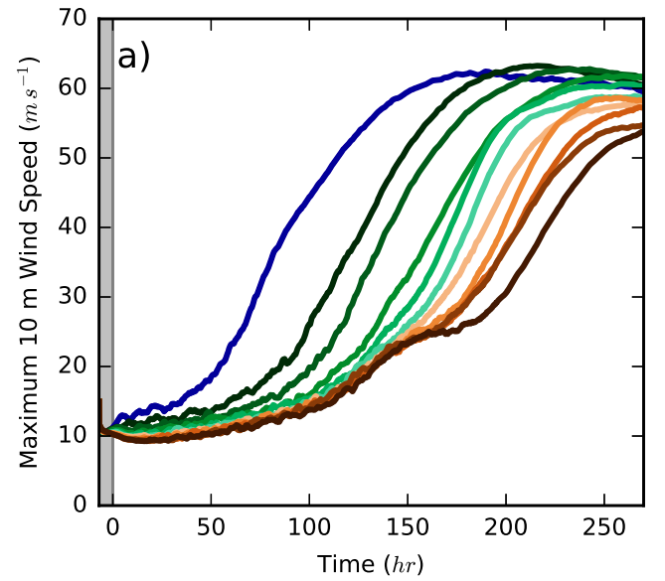
Moisture and TC Development
Pre-genesis and genesis
Tang et al. (2016) ran a suite of idealized, axisymmetric model simulations to determine the role of mid-level dry air on a TC spinup time.
Greater initial entropy deficit
Reduced vertical mass flux
Longer spinup time
Ph.D. Prospectus, Alland
Notes:
Define spinup time

Slide 8
Moisture and TC Development
Pre-genesis and genesis
Tang et al. (2016) ran a suite of idealized, axisymmetric model simulations to determine the role of mid-level dry air on a TC spinup time.
Greater initial entropy deficit
Reduced vertical mass flux
Longer spinup time
(1) How does dry air impact convective motions and the associated TC secondary circulation?
(2) Does dry air affect the structure of the TC secondary circulation?
Ph.D. Prospectus, Alland
Notes:
Define spinup time
(lateral versus vertical dry air entrainment)?

Slide 9
Moisture and TC Development
From the questions in Tang et al. (2016):
Alland et al. (2017) investigated how mid-level dry air affects the strength and size of the secondary circulation.
Ph.D. Prospectus, Alland
Notes:
Define spinup time
Both simulated TCs nare the same strength at the time shown, but the dry experiment has a weaker and a more radially confined secondary circulation. Additionally, low-entropy air from midlevels appears to descend into the subcloud layer at radii between 300 and 400 km. Figure 2, also from Alland et al. (2017), shows the entropy evolution of backward trajectories from convective updrafts. The subsidence of dry air into the subcloud layer, as well as descending motion closer to the inner core, limit the radial width of deep convection, reduce the area of upward motion, and result in less total positive vertical mass flux and a weaker, more narrow secondary circulation.

Slide 10
Moisture and TC Development
From the questions in Tang et al. (2016):
Alland et al. (2017) investigated how mid-level dry air affects the strength and size of the secondary circulation.
(1) How does the secondary circulation develop in a 3D model?
(2) How does dry air impact convective motions and the associated TC secondary circulation?
Ph.D. Prospectus, Alland
Notes:
Define spinup time
Both simulated TCs nare the same strength at the time shown, but the dry experiment has a weaker and a more radially confined secondary circulation. Additionally, low-entropy air from midlevels appears to descend into the subcloud layer at radii between 300 and 400 km. Figure 2, also from Alland et al. (2017), shows the entropy evolution of backward trajectories from convective updrafts. The subsidence of dry air into the subcloud layer, as well as descending motion closer to the inner core, limit the radial width of deep convection, reduce the area of upward motion, and result in less total positive vertical mass flux and a weaker, more narrow secondary circulation.

Slide 11
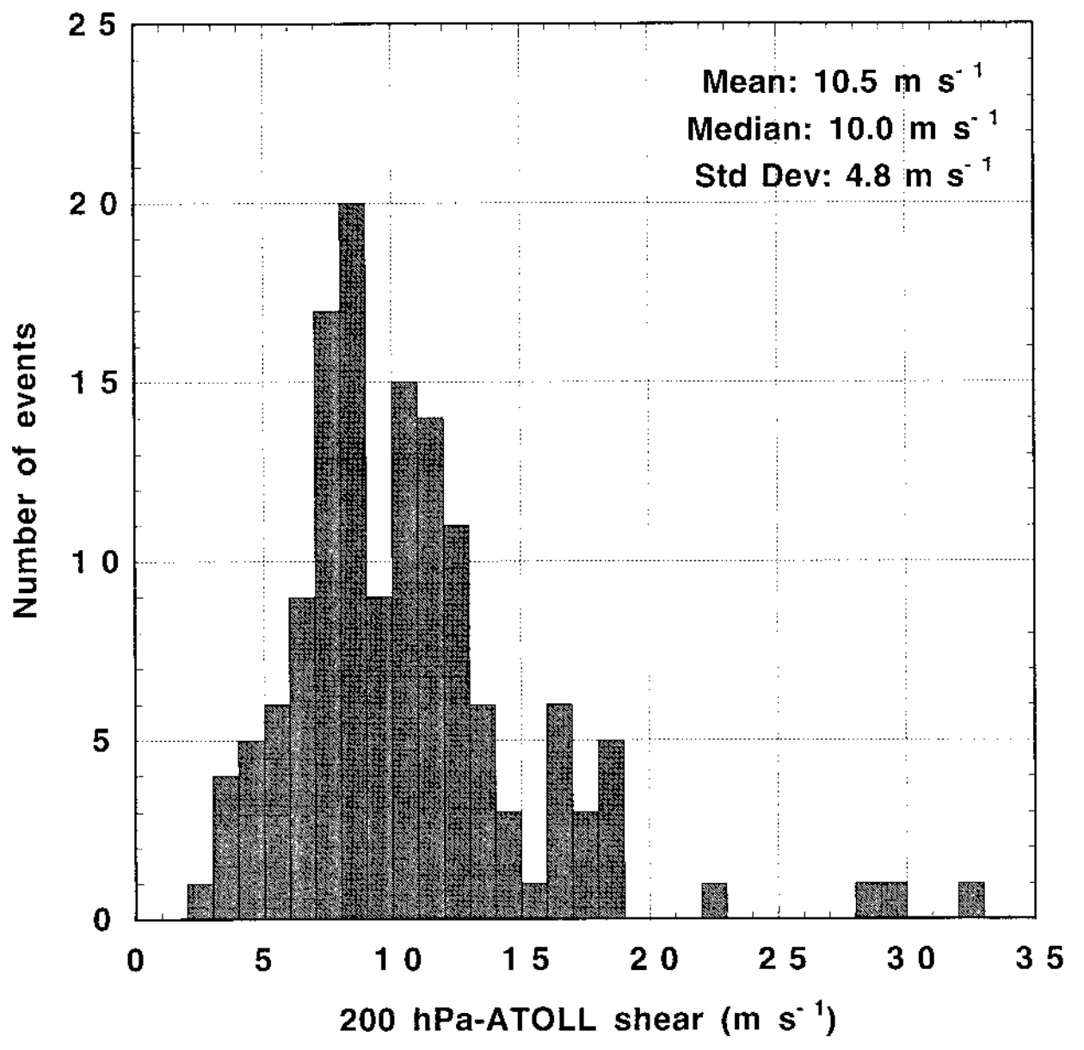
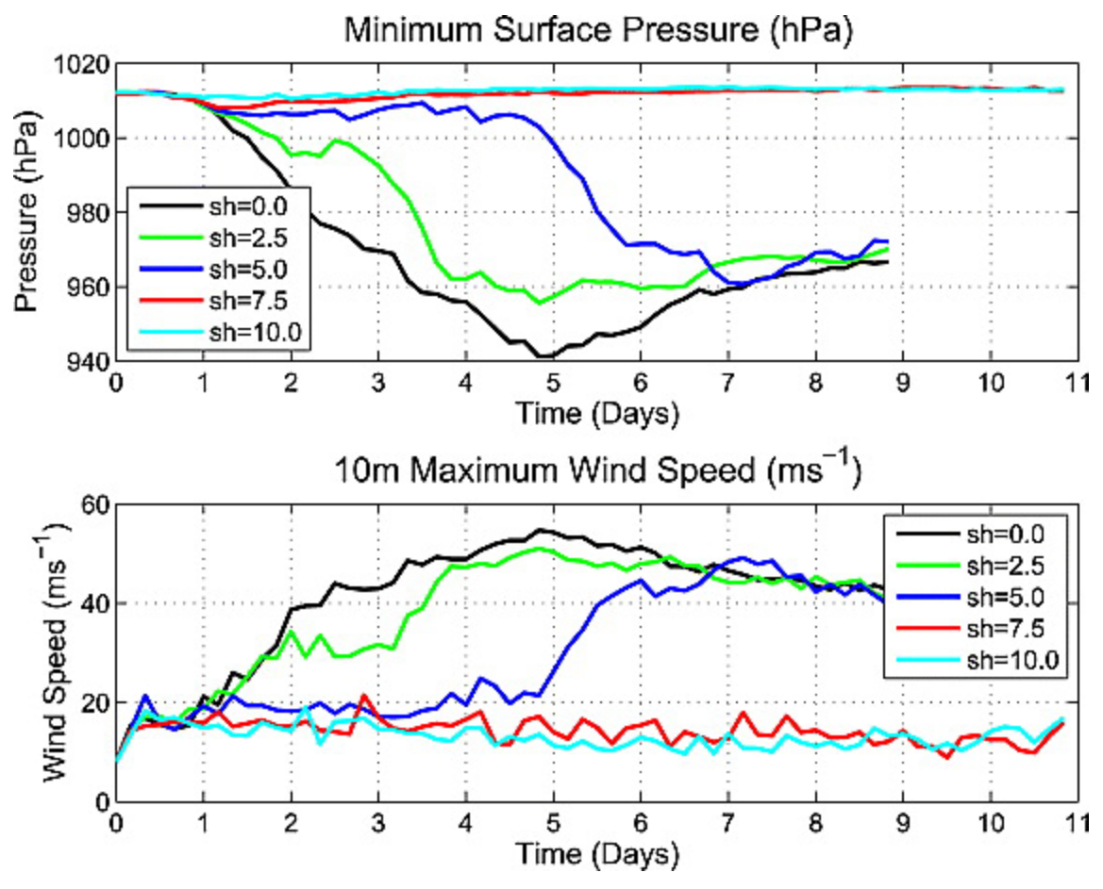
VWS and TC Development
VWS bad for pre-genesis and genesis
Heat of condensation spread out over a larger area.
Hydrostatic response is less amplified storm development.
VWS good for pre-genesis and genesis
Synoptic-scale ascent through quasi-geostrophic forcing.
Nolan and Rappin (2008)
Bracken and Bosart (2000)
Ph.D. Prospectus, Alland
Notes:
Histogram of ATOLL–200 hPa (900 hPa) layer-average
shear magnitude at the time of genesis for all depressions during the time period 1975–93 (139 storms). Shear is computed by
subtracting the ATOLL wind from the 200-hPa wind. The calculation is made for the grid point nearest the depression and the eight grid
points that surround it. The shear value used is the average of those nine grid points.
Low VWS is not as common in the tropics.

Slide 12
VWS and TC Development
VWS bad for pre-genesis and genesis
Heat of condensation spread out over a larger area.
Hydrostatic response is less amplified storm development.
VWS good for pre-genesis and genesis
Synoptic-scale ascent through quasi-geostrophic forcing.
Nolan and Rappin (2008)
It remains uncertain whether VWS is conducive or detrimental to TC genesis, given the differing views in the literature.
Bracken and Bosart (2000)
Ph.D. Prospectus, Alland
Notes:
Mean VWS at genesis locations
Low VWS is not as common in the tropics.

Slide 13
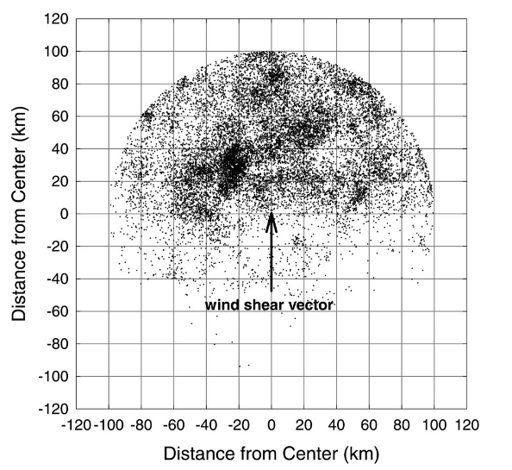
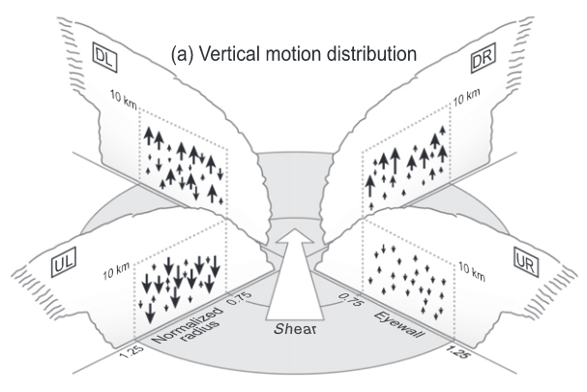
VWS and TC Development
VWS bad for intensification
VWS tilts vortex and causes differential vorticity advection with height.
  Increases low-level convergence through quasi-geostrophic forcing and redistribution of convection ahead of shear vector.
  Can erode TC warm core from the top-down.
Corbosiero and Molinari (2002)
DeHart et al. (2014)
Ph.D. Prospectus, Alland
Notes:
National Lightning Detection Network: strongly-sheared (greater than 10 m/s) TCs: Locations of all flashes occurring within 100 km of the storm centers
Airborne Doppler radar data collected in tropical cyclones by National Oceanic and Atmospheric Administration WP-3D aircraft over an 8-yr period (2003–10). Talk about: downshear-right, and convection matures downshear-left as the updrafts rise within the cyclonic circulation (Frank and Ritchie 1999; DeHart et al. 2014).
VWS erodes the warm core at upper-levels and, through hydrostatic arguments, weakens the TC at low-levels.

Slide 14
VWS and TC Development
VWS bad for intensification
VWS tilts vortex and causes differential vorticity advection with height.
  Increases low-level convergence through quasi-geostrophic forcing and redistribution of convection ahead of shear vector.
  Can erode TC warm core from the top-down.
How do various magnitudes of VWS affect the development of the TC secondary circulation structure during intensification?
Corbosiero and Molinari (2002)
DeHart et al. (2014)
Ph.D. Prospectus, Alland
Notes:
National Lightning Detection Network: strongly-sheared (greater than 10 m/s) TCs: Locations of all flashes occurring within 100 km of the storm centers
Airborne Doppler radar data collected in tropical cyclones by National Oceanic and Atmospheric Administration WP-3D aircraft over an 8-yr period (2003–10). Talk about: downshear-right, and convection matures downshear-left as the updrafts rise within the cyclonic circulation (Frank and Ritchie 1999; DeHart et al. 2014).
VWS erodes the warm core at upper-levels and, through hydrostatic arguments, weakens the TC at low-levels.

Slide 15
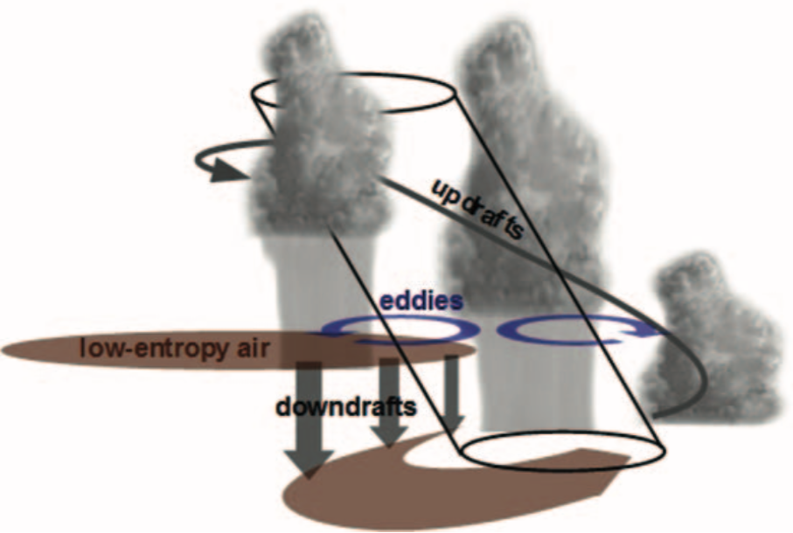
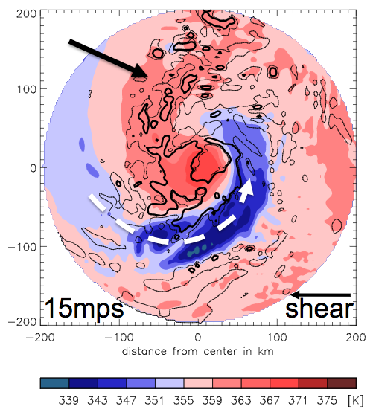
Moisture, VWS, and TC Development
Intensification
Dry air and VWS can work together, or synergistically, to affect TC development.
Ventilation: Flux of low-entropy environmental air into TC inner core.
  Mid-level pathway: Dry air ventilates midlevels.
  Low-level pathway: Dry air ventilates subcloud layer via either:
    (1) subsidence associated with downward branch of secondary circulation.
    (2) convective downdrafts.
Alland et al. (2017)
Riemer et al. (2010)
Tang and Emanuel (2012b)
mid-level ventilation
low-level ventilation
low-level ventilation
Ph.D. Prospectus, Alland
Notes:
Reduces the entropy of rising parcels
Downdrafts that bring low-entropy air into the subcloud layer are associated with helically-rising updrafts and associated convection in the downshear semicircle. Rainfall into unsaturated air below results in evaporative cooling and a quasi-steady location of downdrafts out to a radius of about 150 km (Nguyen and Molinari 2012). Underneath this persistent area of downdrafts, a reservoir of low entropy air builds up and is advected inward by the low-level inflow. This reservoir of low-entropy air increases with the magnitude of VWS (Riemer et al. 2010, 2013). If surface fluxes are not able to recover the entropy of parcels, the eyewall updrafts may have a lower mean entropy (Riemer et al. 2010) and the secondary circulation size may be reduced (Alland et al. 2017).
The mid- and low-level ventilation pathways are described in the literature, but the importance of each pathway and the environments under which they may operate remains unclear (Riemer and Laliberté 2015).
A better understanding of the different ventilation pathways on the development of the TC secondary circulation during genesis and intensification is vital to better forecast TC intensity change.

Slide 16
Moisture, VWS, and TC Development
Intensification
Dry air and VWS can work together, or synergistically, to affect TC development.
Ventilation: Flux of low-entropy environmental air into TC inner core.
  Mid-level pathway: Dry air ventilates midlevels.
  Low-level pathway: Dry air ventilates subcloud layer via either:
    (1) subsidence associated with downward branch of secondary circulation.
    (2) convective downdrafts.
How important are these ventilation pathways in a 3D model and in a moisture–VWS bivariate parameter space?
(2) Is the dominant ventilation pathway a function of TC intensity?
(3) Does the strength and vertical location of ventilation affect the rate of development?
(4) Does the height of dry air influence the dominant ventilation pathway?
Alland et al. (2017)
Riemer et al. (2010)
Tang and Emanuel (2012b)
mid-level ventilation
low-level ventilation
low-level ventilation
Ph.D. Prospectus, Alland
Notes:
Reduces the entropy of rising parcels
Downdrafts that bring low-entropy air into the subcloud layer are associated with helically-rising updrafts and associated convection in the downshear semicircle. Rainfall into unsaturated air below results in evaporative cooling and a quasi-steady location of downdrafts out to a radius of about 150 km (Nguyen and Molinari 2012). Underneath this persistent area of downdrafts, a reservoir of low entropy air builds up and is advected inward by the low-level inflow. This reservoir of low-entropy air increases with the magnitude of VWS (Riemer et al. 2010, 2013). If surface fluxes are not able to recover the entropy of parcels, the eyewall updrafts may have a lower mean entropy (Riemer et al. 2010) and the secondary circulation size may be reduced (Alland et al. 2017).
The mid- and low-level ventilation pathways are described in the literature, but the importance of each pathway and the environments under which they may operate remains unclear (Riemer and Laliberté 2015).
A better understanding of the different ventilation pathways on the development of the TC secondary circulation during genesis and intensification is vital to better forecast TC intensity change.

Slide 17
Questions and Hypotheses
Purpose: Investigate the synergistic effect of mid-level dry air and VWS on the development of the TC secondary circulation in a 3D modeling framework for a variety of dry air and VWS environments.
Tang and Emanuel (2012b)
Ph.D. Prospectus, Alland

Slide 18
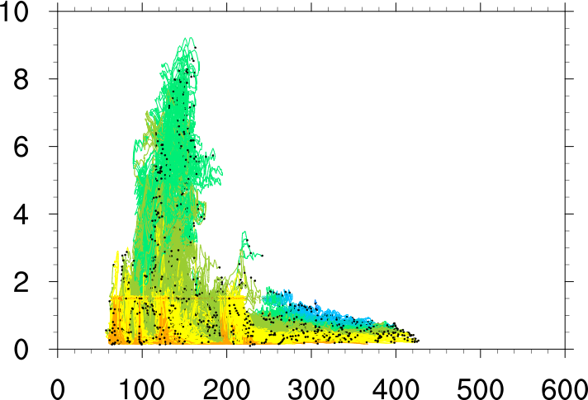
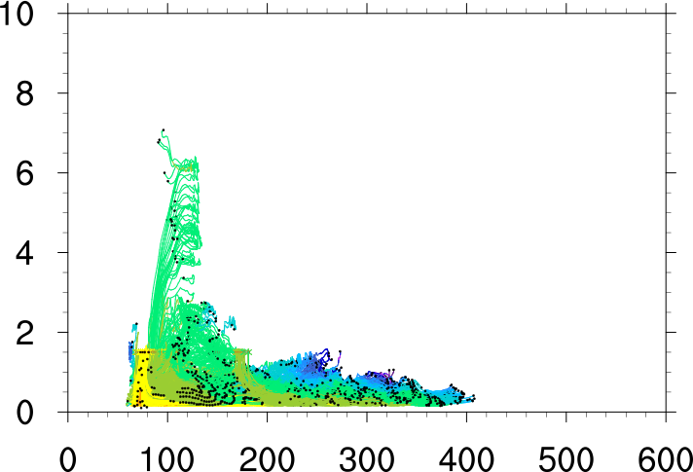
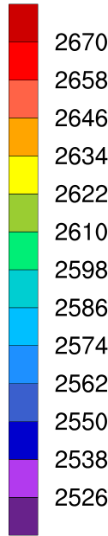
Questions and Hypotheses
Question 1: Without VWS, how does the magnitude of dry air in the free troposphere affect the structure of the TC secondary circulation during development?
Hypothesis:
Low-level entrainment of dry air will decrease strength and width of secondary circulation.
Moist
Dry
dry air
J kg⁻¹ K⁻¹
Height (km)
Radius (km)
Radius (km)
Ph.D. Prospectus, Alland

Slide 19
Questions and Hypotheses
Question 2: With VWS, how does the magnitude of dry air in the free troposphere affect the structure of the TC secondary circulation during development?
Hypotheses:
Low- and mid-level ventilation will increase as the strength of the VWS increases.
Low-level ventilation will decrease the strength and radial width of the secondary circulation.
VWS will increase the rate of initial spinup, but will slow the development rate after spinup due to ventilation.
Tang and Emanuel (2012b)
Ph.D. Prospectus, Alland

Slide 20
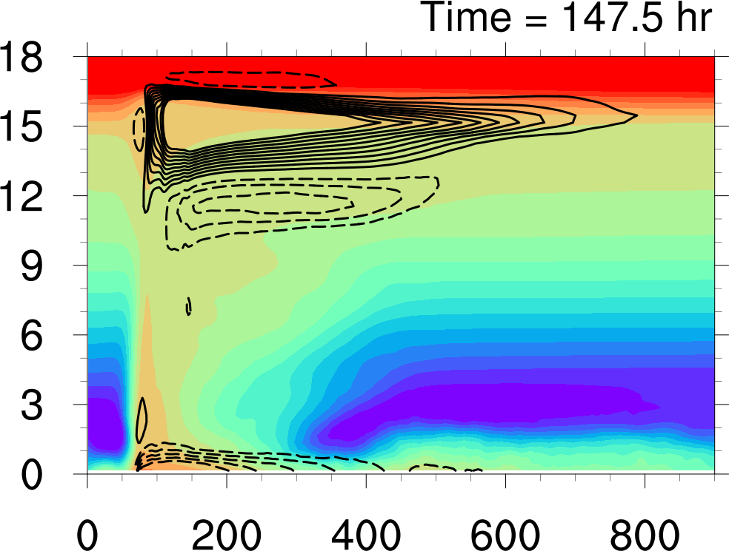
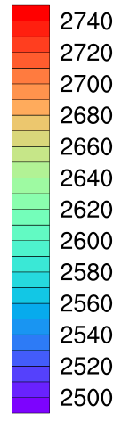
Questions and Hypotheses
Question 3: With VWS, how does the height of dry air in the free troposphere affect the structure of the TC secondary circulation during development?
Hypothesis:
Dry air located at a lower level will be most detrimental to TC development.
Height (km)
J kg⁻¹ K⁻¹
Radius (km)
Alland et al. (2017)
Ph.D. Prospectus, Alland

Slide 21
Methodology: Model Setup
Model: CM1 (Cloud Model 1)
Resolution: 4 km horizontal; 59 vertical levels
Microphysics: Kessler (1969)
Radiation: Newtonian Relaxation (Rotunno and Emanuel 1987)
Turbulence: Down-gradient parameterization
Other specifications:
  f-plane with Coriolis parameter set to 5 x 10⁻⁵ s⁻¹
  Initial vortex: Rotunno and Emanuel (1987)
  Moist tropical temperature profile (Dunion 2011)
  Sea surface temperature: 28°C
Ph.D. Prospectus, Alland
Notes:
When announcing model, have a joyous chorus sing.
CM 1 has nothing to do with a certified meteorologist or a centimeter unit of measure, but it is Cloud Model 1…
CM1: 3D, non-hydrostatic model designed for idealized studies of atmospheric phenomena (TCs!).

Slide 22
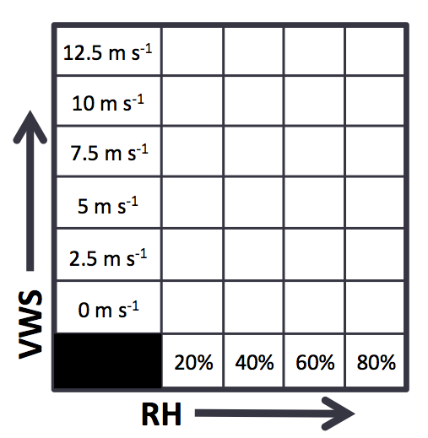
Methodology: Model Setup
Model: CM1 (Cloud Model 1)
Resolution: 4 km horizontal; 59 vertical levels
Microphysics: Kessler (1969)
Radiation: Newtonian Relaxation (Rotunno and Emanuel 1987)
Turbulence: Down-gradient parameterization
Other specifications:
  f-plane with Coriolis parameter set to 5 x 10⁻⁵ s⁻¹
  Initial vortex: Rotunno and Emanuel (1987)
  Moist tropical temperature profile (Dunion 2011)
  Sea surface temperature: 28°C
Experiment 1: No VWS
Ph.D. Prospectus, Alland
Notes:
CM1: 3D, non-hydrostatic model designed for idealized studies of atmospheric phenomena (TCs!).
Initial results I will show will have these parameterizations for comparison to Alland et. al. (2017), but I plan to change the microphysics and radiation schemes to be more sophisticated (Morrison-double moment), NASA Goddard radiation, Turbulence: YSU boundary layer
RH—VWS Bivariate parameter space mention!

Slide 23
Methodology: Model Setup
Experiment 1: No VWS
Experiment 1: No VWS
RH = 40%
RH = 60%
RH = 80%
Ph.D. Prospectus, Alland
Notes:
CM1: 3D, non-hydrostatic model designed for idealized studies of atmospheric phenomena (TCs!).
Initial results I will show will have these parameterizations for comparison to Alland et. al. (2017), but I plan to change the microphysics and radiation schemes to be more sophisticated (Morrison-double moment), NASA Goddard radiation, Turbulence: YSU boundary layer
RH—VWS Bivariate parameter space mention!

Slide 24
Methodology: Model Setup
Experiment 1: No VWS
Experiment 1: No VWS
For all experiments: Four ensemble runs by perturbing initial moisture in the subcloud layer; output written every six minutes.
RH = 40%
RH = 60%
RH = 80%
Ph.D. Prospectus, Alland
Notes:
CM1: 3D, non-hydrostatic model designed for idealized studies of atmospheric phenomena (TCs!).
Initial results I will show will have these parameterizations for comparison to Alland et. al. (2017), but I plan to change the microphysics and radiation schemes to be more sophisticated (Morrison-double moment), NASA Goddard radiation, Turbulence: YSU boundary layer
RH—VWS Bivariate parameter space mention!

Slide 25
Question 1: No VWS
Max. 10-m wind speed (m s⁻¹)
Time (hr)
Ph.D. Prospectus, Alland

Slide 26
Question 1: No VWS
averaged within 80 km of center
relative vorticity
relative humidity
Ph.D. Prospectus, Alland

Slide 27
Methodology: Model Setup
Experiment 2: With VWS
Ph.D. Prospectus, Alland
Notes:
Linearly increasing westerly wind speed with height for VWS
Initial results I will show will have these parameterizations for comparison to Alland et. al. (2017), but I plan to change the microphysics and radiation schemes to be more sophisticated (Morrison-double moment), NASA Goddard radiation, Turbulence: YSU boundary layer
I will compare the WITH VWS simulations to the NO VWS simulations too! They are not isolated from one another.

Slide 28
Methodology: Model Setup
Experiment 2: With VWS
Westerly wind from 850 to 200 hPa that increases linearly with height
Ph.D. Prospectus, Alland
Notes:
Linearly increasing westerly wind speed with height for VWS
Initial results I will show will have these parameterizations for comparison to Alland et. al. (2017), but I plan to change the microphysics and radiation schemes to be more sophisticated (Morrison-double moment), NASA Goddard radiation, Turbulence: YSU boundary layer
I will compare the WITH VWS simulations to the NO VWS simulations too! They are not isolated from one another.

Slide 29
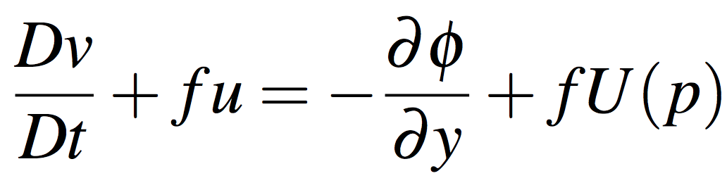
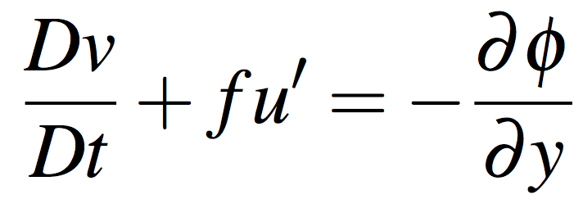
Methodology: Inputting VWS
Point-downscaling:
  Adds VWS without including a meridional temperature gradient.
  Advantages:
    Environmental wind profile remains homogeneous with time.
    Easy to implement in CM1.
  Add additional force term to meridional wind tendency equation.
    Accounts for pressure force to balance the mean VWS.
additional force term
u’ is the deviation of the zonal wind from the desired shear profile
Ph.D. Prospectus, Alland
Notes:
Instead, an additional force term is added in the meridional wind tendency equation to account for the pressure force that would be present to balance the mean VWS if a temperature gradient
U’ = u-u(p)
Coriolis force acts on the perturbation wind.

Slide 30
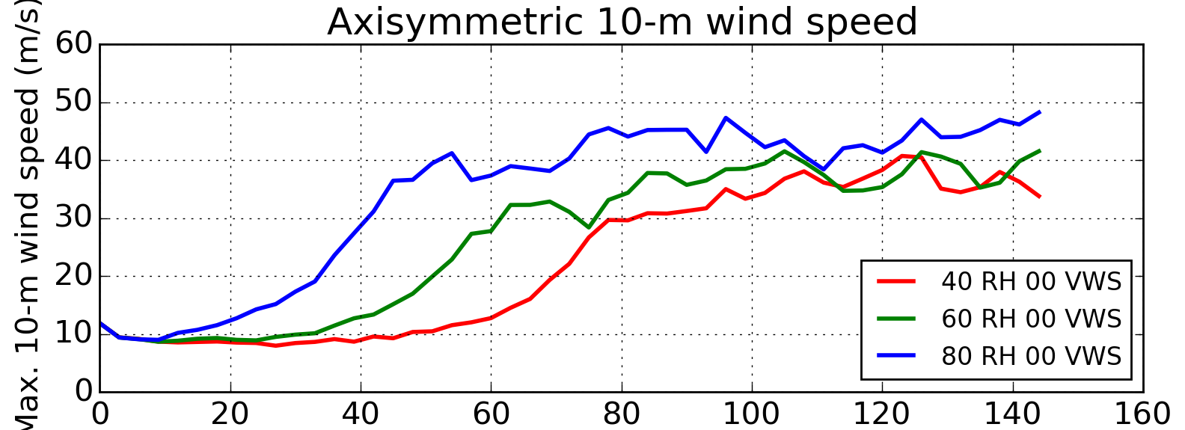
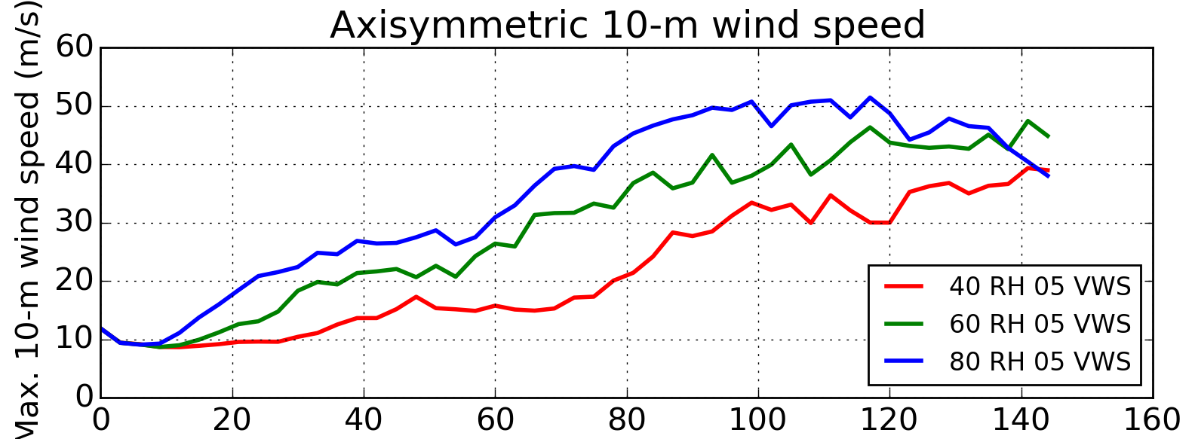
Question 2: With VWS
Max. 10-m wind speed (m s⁻¹)
Time (hr)
Ph.D. Prospectus, Alland

Slide 31
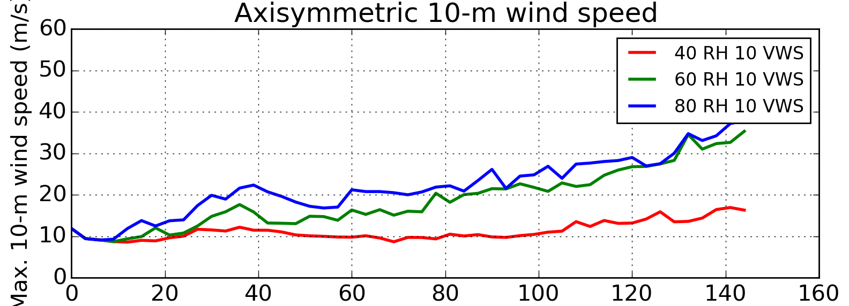
Question 2: With VWS
Max. 10-m wind speed (m s⁻¹)
Time (hr)
Ph.D. Prospectus, Alland

Slide 32
Question 2: With VWS
RH for VWS of 5 m s⁻¹
RH for VWS of 10 m s⁻¹
Ph.D. Prospectus, Alland

Slide 33
Methodology: Model Setup
Experiment 3: Dry air height
12.5 m s⁻¹
10 m s⁻¹
7.5 m s⁻¹
5 m s⁻¹
2.5 m s⁻¹
VWS
0 m s⁻¹
20%
40%
60%
80%
RH
Ph.D. Prospectus, Alland
Notes:
When announcing model, have a joyous chorus sing.
CM1: 3D, non-hydrostatic model designed for idealized studies of atmospheric phenomena (TCs!).
Initial results I will show will have these parameterizations for comparison to Alland et. al. (2017), but I plan to change the microphysics and radiation schemes to be more sophisticated (Morrison-double moment), NASA Goddard radiation, Turbulence: YSU boundary layer
I will compare the WITH VWS simulations to the NO VWS simulations too! They are not isolated from one another.

Slide 34
Question 3: Dry Air Height
Ph.D. Prospectus, Alland

Slide 35
Question 3: Dry Air Height
Ph.D. Prospectus, Alland
Notes:
See sensitivity when adding VWS.

Slide 36
Complimentary Analyses
Purpose: Investigate the synergistic effect of midlevel dry air and VWS on the development of the TC secondary circulation in a 3D modeling framework for a variety of dry air and VWS environments.
Question 1: No VWS
Question 2: With VWS
Question 3: Height of dry air
Analyses:
(1) Entropy budget
(2) Eulerian analysis
(3) Lagrangian analysis
(4) Trajectory analysis
pre-genesis
genesis
early intensification
12 h
12.5 m s⁻¹
20 m s⁻¹
30 m s⁻¹
Ph.D. Prospectus, Alland
Notes:
Although defining these time periods is arbitrary, they represent a consistent basis for comparison based on intensity.

Slide 37
Entropy Budget
Entropy budget: Quantifies mid- and low-level ventilation, as well as the effect of surface fluxes on the entropy evolution in the subcloud layer.
Entropy tendency = lateral entropy transport
+ vertical entropy transport
+ sources/sinks
Ph.D. Prospectus, Alland
Notes:
Lets go crazy

Slide 38
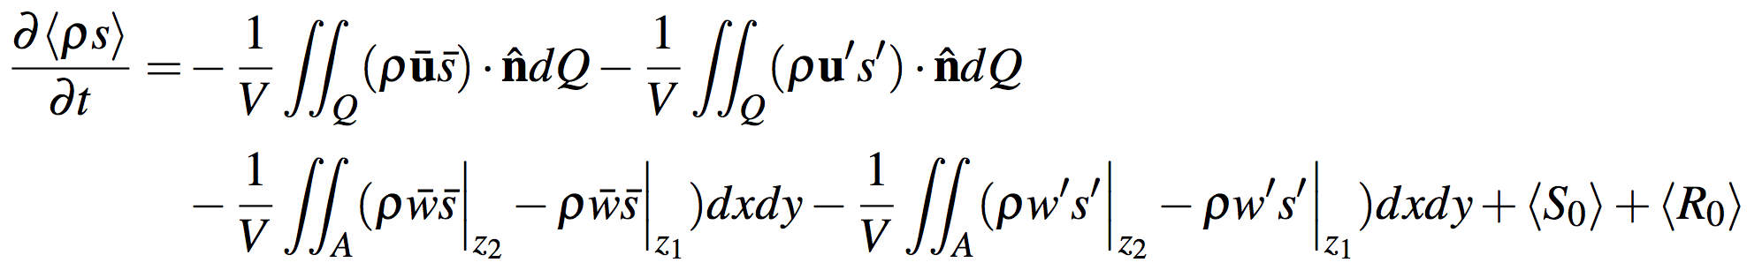
Entropy Budget
Entropy budget: Quantifies mid- and low-level ventilation, as well as the effect of surface fluxes on the entropy evolution in the subcloud layer.
Ph.D. Prospectus, Alland

Slide 39
Entropy Budget
Entropy budget: Quantifies mid- and low-level ventilation, as well as the effect of surface fluxes on the entropy evolution in the subcloud layer.
lateral entropy transport
mid-level ventilation
Tang and Emanuel (2012b)
Ph.D. Prospectus, Alland

Slide 40
Entropy Budget
Entropy budget: Quantifies mid- and low-level ventilation, as well as the effect of surface fluxes on the entropy evolution in the subcloud layer.
vertical entropy transport
mid-level ventilation
low-level ventilation
low-level ventilation
Tang and Emanuel (2012b)
Alland et al. (2017)
Riemer et al. (2010)
Ph.D. Prospectus, Alland
Notes:
Riemer tried an entropy budget but it was super noisy. Signal is second order to the mean circulation. Residual is interesting, how much the low-level ventilation gets replenished. Trjacectories you cannot distinguish between mean and fluxes. 2011 papers, but in shear, vortex flow and storm rel. flow gives stationary pattern. Stationary pattern is prime. A large part of cancelling. See lots of flux on one side. Both cancel.
Trajectories: Good, lose the large mean terms. Changes in parcel because of mixing.

Slide 41
Entropy Budget
Entropy budget: Quantifies mid- and low-level ventilation, as well as the effect of surface fluxes on the entropy evolution in the subcloud layer.
entropy source and radiation terms
mid-level ventilation
low-level ventilation
low-level ventilation
Tang and Emanuel (2012b)
Alland et al. (2017)
Riemer et al. (2010)
Ph.D. Prospectus, Alland

Slide 42
Entropy Budget
Entropy budget: Quantifies mid- and low-level ventilation, as well as the effect of surface fluxes on the entropy evolution in the subcloud layer.
mid-level ventilation
low-level ventilation
Procedure:
(1) Calculate budget in both boxes for each time period.
(2) Mid-level ventilation from mid-level box and low-level ventilation from low-level box.
mid-level box
low-level box
Height
Radius
Ph.D. Prospectus, Alland
Notes:
Compare mid- and low-level ventilation in RH—VWS bivariate parameter space.

Slide 43
Entropy Budget
Entropy budget: Quantifies mid- and low-level ventilation, as well as the effect of surface fluxes on the entropy evolution in the subcloud layer.
Calculate the spatial distribution of mid- and low-level ventilation.
Mid-level ventilation (from eddies):
Tang and Emanuel (2012b)
Ph.D. Prospectus, Alland

Slide 44
Entropy Budget
Entropy budget: Quantifies mid- and low-level ventilation, as well as the effect of surface fluxes on the entropy evolution in the subcloud layer.
Calculate the spatial distribution of mid- and low-level ventilation.
Alland et al. (2017)
Mid-level ventilation (from eddies):
Low-level ventilation (from mean secondary circulation):
Ph.D. Prospectus, Alland

Slide 45
Entropy Budget
Entropy budget: Quantifies mid- and low-level ventilation, as well as the effect of surface fluxes on the entropy evolution in the subcloud layer.
Calculate the spatial distribution of mid- and low-level ventilation.
Riemer et al. (2010)
Mid-level ventilation (from eddies):
Low-level ventilation (from mean secondary circulation):
Low-level ventilation (from shear-induced downdrafts):
Ph.D. Prospectus, Alland

Slide 46
Entropy Budget
Entropy budget: Quantifies mid- and low-level ventilation, as well as the effect of surface fluxes on the entropy evolution in the subcloud layer.
Calculate the spatial distribution of mid- and low-level ventilation.
Potentially transformative, as no previous study has:
(1) implemented a budget analysis to compare ventilation.
(2) compared low-level ventilation pathways.
(3) analyzed the 3D spatial structure of ventilation.
Mid-level ventilation (from eddies):
Low-level ventilation (from mean secondary circulation):
Low-level ventilation (from shear-induced downdrafts):
Ph.D. Prospectus, Alland

Slide 47
Eulerian Analysis
Eulerian analysis: Shows a macroscopic view of the strength of convective motions and the size of the developing TC secondary circulation in radius–height physical space.
Strength: Contoured frequency by altitude diagrams (CFADs)
Size: Eulerian streamfunction
Height (km)
Mass Flux (kg s⁻¹ m⁻²)
Tang et al. (2016)
Alland et al. (2017)
Ph.D. Prospectus, Alland
Notes:
Strength of updrafts and downdrafts

Slide 48
Eulerian Analysis
Eulerian analysis: Shows a macroscopic view of the strength of convective motions and the size of the developing TC secondary circulation in radius–height physical space.
Strength: Contoured frequency by altitude diagrams (CFADs)
Size: Eulerian streamfunction
Potentially Transformative:
No previous study has investigated the development of the secondary circulation within shear-relative quadrants in the RH–VWS bivariate parameter space.
Height (km)
Mass Flux (kg s⁻¹ m⁻²)
Tang et al. (2016)
Alland et al. (2017)
Ph.D. Prospectus, Alland
Notes:
Strength of updrafts and downdrafts

Slide 49
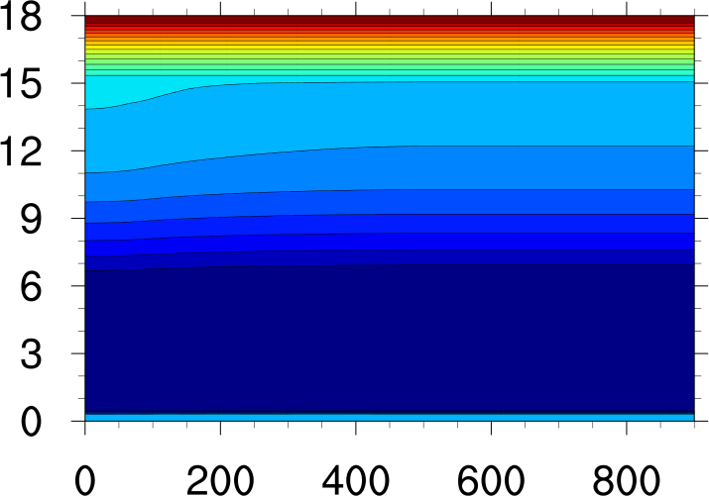
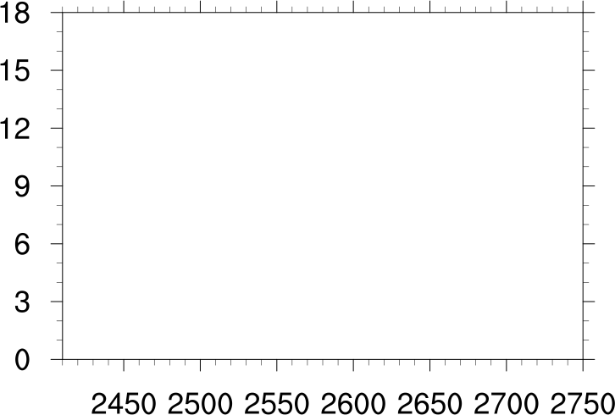
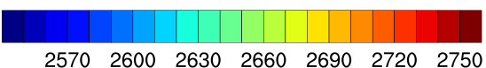
Lagrangian Analysis
Lagrangian analysis: Analyzes convective motions by separating upward, high entropy streams from downward, low entropy streams, allowing one to quantify ventilation in the bulk sense.
2570 J kg⁻¹ K⁻¹
288 K
8 g kg⁻¹
Height (km)
Height (km)
J kg⁻¹ K⁻¹
Radius (km)
Entropy (J kg⁻¹ K⁻¹)
The vertical mass flux in the isentropic framework represents the isentropic mean secondary circulation.
Ph.D. Prospectus, Alland
Notes:
Joke: Peaceful transition of power
No longer have updrafts and downdrafts at the same point. High entropy updrafts are separated from low entropy downdrafts.

Slide 50

Lagrangian Analysis
Lagrangian analysis: Analyzes convective motions by separating upward, high entropy streams from downward, low entropy streams, allowing one to quantify ventilation in the bulk sense.
Alland et al. (2017)
Greater mid-level ventilation = greater slope of upward moving branch with height toward low-entropy values.
Greater low-level ventilation = lower entropy along the downward branch and upward branch in the subcloud layer.
Can calculate mass-weighted diabatic tendency to quantify changes in entropy.
Shading: Vertical Mass Flux (10⁻⁵ kg s⁻¹)
Contours: Streamfunction (every 3 x 10⁻⁴ J s⁻¹ K⁻¹)
Ph.D. Prospectus, Alland
Notes:
Strength of TC secondary circulation; quantify ventilation

Slide 51
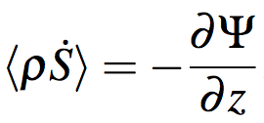
Lagrangian Analysis
Lagrangian analysis: Analyzes convective motions by separating upward, high entropy streams from downward, low entropy streams, allowing one to quantify ventilation in the bulk sense.
Alland et al. (2017)
Entropy can change via:
(1) Surface fluxes
(2) Radiational cooling
(3) Mixing high- and low- entropy streams (transfers entropy)
(4) Irreversible generation
Potentially Transformative: Quantifying ventilation in shear-relative quadrants using the Lagrangian framework.
Shading: Vertical Mass Flux (10⁻⁵ kg s⁻¹)
Contours: Streamfunction (every 3 x 10⁻⁴ J s⁻¹ K⁻¹)
Ph.D. Prospectus, Alland
Notes:
Will show the bulk circulation and the ventilation in each shear quadrant!
The Lagrangian framework shows the bulk thermodynamics of the TC secondary circulation and the effect of mid- and low-level ventilation, but the final analysis moves back to the radius– height physical space to investigate the thermodynamic evolution of individual trajectories.
Procedure: For each experiment, investigate isentropic circulation and mass-weighted diabatic tendency in entire domain, and in shear-relative quadrants

Slide 52
Trajectory Analysis
Trajectory analysis: Tracks the entropy evolution of individual trajectories and the source region of dry air in the subcloud layer.
Six-minute output will be linearly interpolated to one minute.
Runge-Kutta fourth-order scheme will be used to generate the trajectories.
Forward Trajectories: Determine the effect of mid-level ventilation by tracking the entropy evolution.
Backward Trajectories: Determine the effect of low-level ventilation by tracking the entropy evolution.
Alland et al. (2017)
Ph.D. Prospectus, Alland

Slide 53
Trajectory Analysis
Trajectory analysis: Tracks the entropy evolution of individual trajectories and the source region of dry air in the subcloud layer.
Six-minute output will be linearly interpolated to one minute.
Runge-Kutta fourth-order scheme will be used to generate the trajectories.
Forward Trajectories: Determine the effect of mid-level ventilation by tracking the entropy evolution.
Backward Trajectories: Determine the effect of low-level ventilation by tracking the entropy evolution.
A comparison between experiments will show the importance of mid- and low-level ventilation on individual trajectories in the RH–VWS bivariate parameter space.
Alland et al. (2017)
Ph.D. Prospectus, Alland

Slide 54
Summary
A good news story or scientific study can answer the most basic questions:
Ph.D. Prospectus, Alland
Notes:
Where: ES 325, with office mates (add edited photo of Rosi), 1112 Western (pic of Matt and Jeremy) – this will be a team effort to solve!
Why: Dave Knight,,,this is important to taxpayers
How: I just described the how…but let me summarize…

Slide 55
Summary
A good news story or scientific study can answer the most basic questions:
What: Synergistic Effect of Mid-level Dry Air and Vertical Wind Shear on the Development of the Tropical Cyclone Secondary Circulation
Ph.D. Prospectus, Alland
Notes:
Where: ES 325, with office mates (add edited photo of Rosi), 1112 Western (pic of Matt and Jeremy) – this will be a team effort to solve!
Why: Dave Knight,,,this is important to taxpayers
How: I just described the how…but let me summarize…

Slide 56
Summary
A good news story or scientific study can answer the most basic questions:
What: Synergistic Effect of Mid-level Dry Air and Vertical Wind Shear on the Development of the Tropical Cyclone Secondary Circulation
Who: Me (Josh Alland)
Ph.D. Prospectus, Alland
Notes:
Where: ES 325, with office mates (add edited photo of Rosi), 1112 Western (pic of Matt and Jeremy) – this will be a team effort to solve!
Why: Dave Knight,,,this is important to taxpayers
How: I just described the how…but let me summarize…

Slide 57
Summary
A good news story or scientific study can answer the most basic questions:
What: Synergistic Effect of Mid-level Dry Air and Vertical Wind Shear on the Development of the Tropical Cyclone Secondary Circulation
Who: Me (Josh Alland)
Where: ES 325 with my wonderful officemates!
Ph.D. Prospectus, Alland
Notes:
Where: ES 325, with office mates (add edited photo of Rosi), 1112 Western (pic of Matt and Jeremy) – this will be a team effort to solve!
Why: Dave Knight,,,this is important to taxpayers
How: I just described the how…but let me summarize…

Slide 58

Summary
A good news story or scientific study can answer the most basic questions:
What: Synergistic Effect of Mid-level Dry Air and Vertical Wind Shear on the Development of the Tropical Cyclone Secondary Circulation
Who: Me (Josh Alland)
Where: ES 325 with my wonderful officemates!
Picture credit: Dr. Brian H. Tang
Ph.D. Prospectus, Alland
Notes:
Where: ES 325, with office mates (add edited photo of Rosi), 1112 Western (pic of Matt and Jeremy) – this will be a team effort to solve!
Why: Dave Knight,,,this is important to taxpayers
How: I just described the how…but let me summarize…

Slide 59
Summary
A good news story or scientific study can answer the most basic questions:
What: Synergistic Effect of Mid-level Dry Air and Vertical Wind Shear on the Development of the Tropical Cyclone Secondary Circulation
Who: Me (Josh Alland)
Where: ES 325 with my wonderful officemates!
When: Now, if I am granted passage.
Ph.D. Prospectus, Alland
Notes:
Where: ES 325, with office mates (add edited photo of Rosi), 1112 Western (pic of Matt and Jeremy) – this will be a team effort to solve!
Why: Dave Knight,,,this is important to taxpayers
How: I just described the how…but let me summarize…

Slide 60
Summary
A good news story or scientific study can answer the most basic questions:
What: Synergistic Effect of Mid-level Dry Air and Vertical Wind Shear on the Development of the Tropical Cyclone Secondary Circulation
Who: Me (Josh Alland)
Where: ES 325 with my wonderful officemates!
When: Now, if I am granted passage.
Why: A better understanding of the synergistic effect of dry air and VWS during development is vital to better forecast TC intensity change.
Ph.D. Prospectus, Alland
Notes:
Where: ES 325, with office mates (add edited photo of Rosi), 1112 Western (pic of Matt and Jeremy) – this will be a team effort to solve!
Why: Dave Knight,,,this is important to taxpayers
How: I just described the how…but let me summarize…

Slide 61
Summary
Most importantly, how:
Question 1: No VWS
Question 2: With VWS
Question 3: Height of dry air
Analyses:
(1) Entropy budget: Quantifies ventilation pathways
(2) Eulerian analysis: Strength of convective motions and size of secondary circulation
(3) Lagrangian analysis: Bulk characteristics of upward and downward motions; can calculate ventilation explicitly
(4) Trajectory analysis: Ventilation of individual trajectories
Ph.D. Prospectus, Alland
Notes:
Where: ES 325, with office mates (add edited photo of Rosi), 1112 Western (pic of Matt and Jeremy) – this will be a team effort to solve!
Why: Dave Knight,,,this is important to taxpayers
How: I just described the how…but let me summarize…

Slide 62
Timeline
To answer question 1, the goal is to have a completed analysis by the the beginning of the Fall 2017 semester.
To answer question 2, the goal is to have a completed analysis by the end of the Fall 2017 semester.
To answer question 3, the goal is to have a completed analysis by the end of the Spring 2018 semester.
I plan to to write as I go along, with the goal of having a completed dissertation by the end of Summer 2018.
Ph.D. Prospectus, Alland

Slide 63
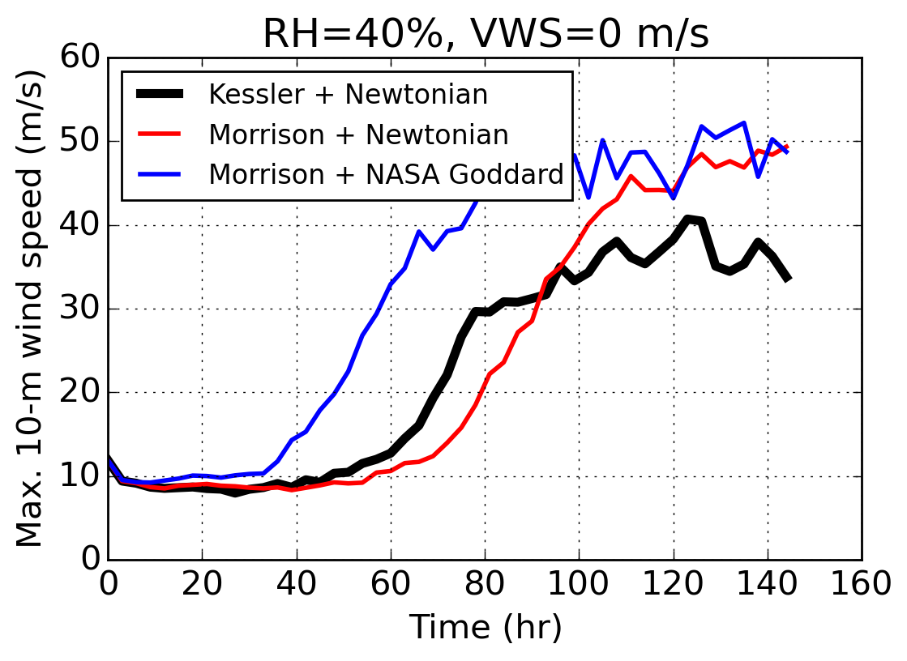
Extra: Microphysics and Radiation
Ph.D. Prospectus, Alland
Notes:
Intensity evolutions: non-axisymmetric

