Slide 1

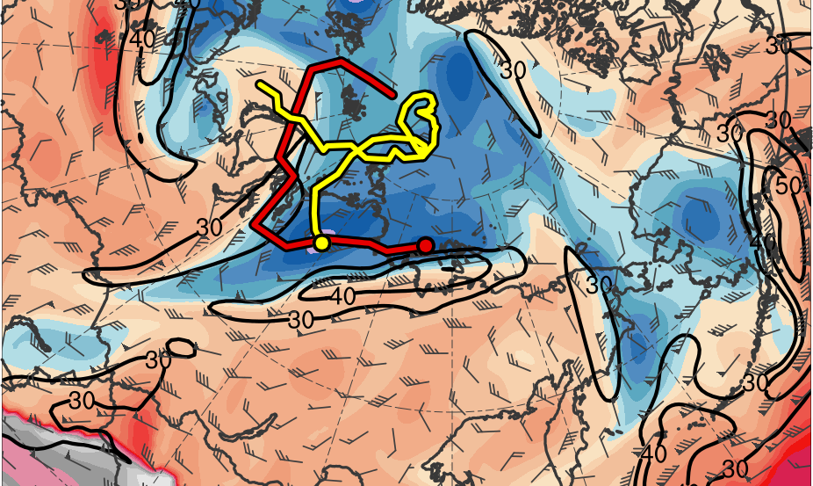
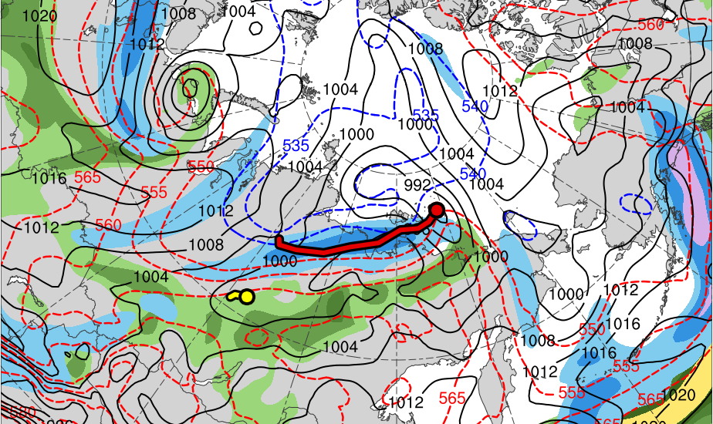
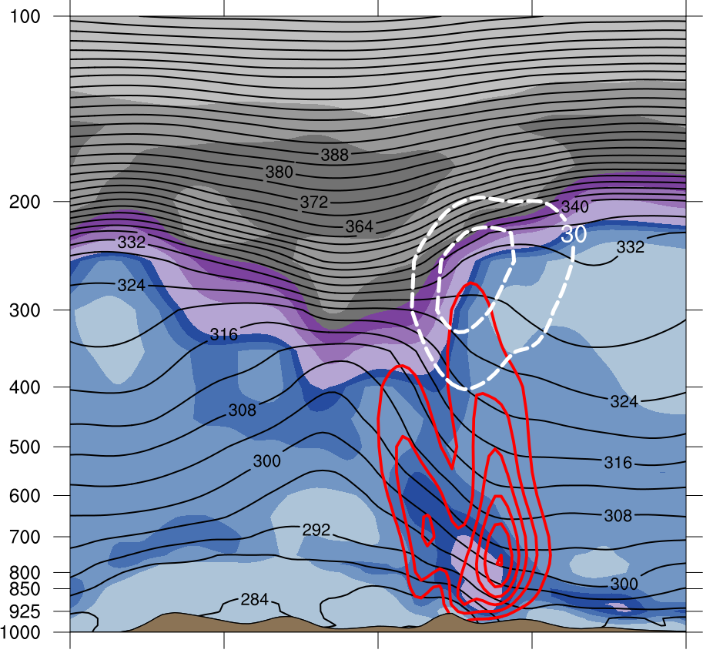
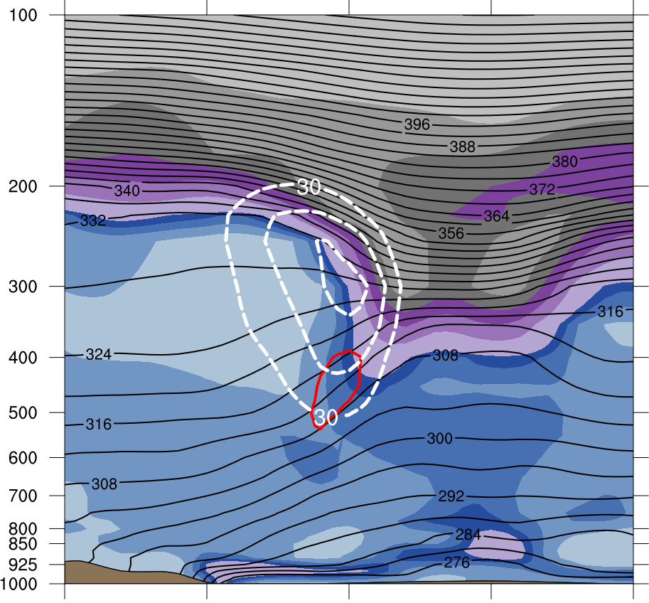
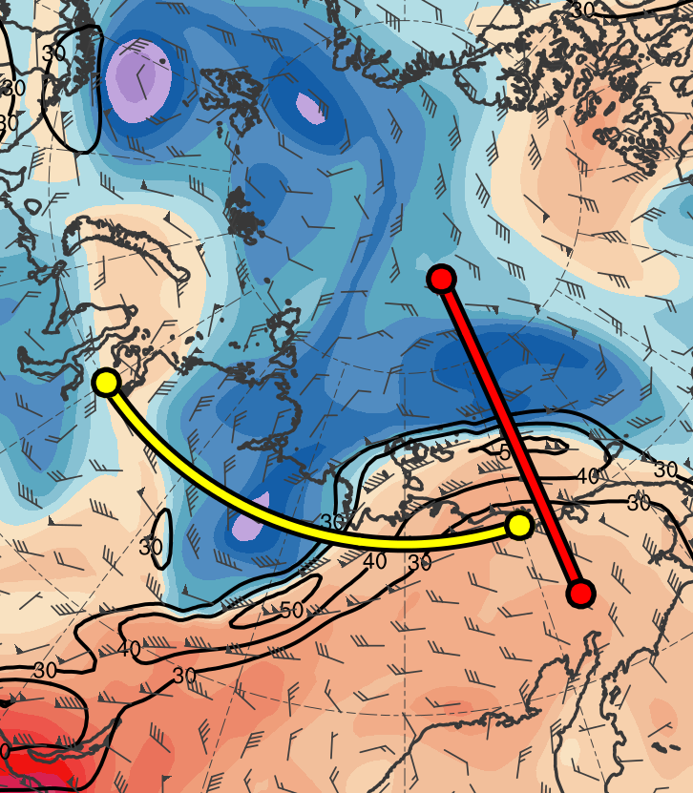
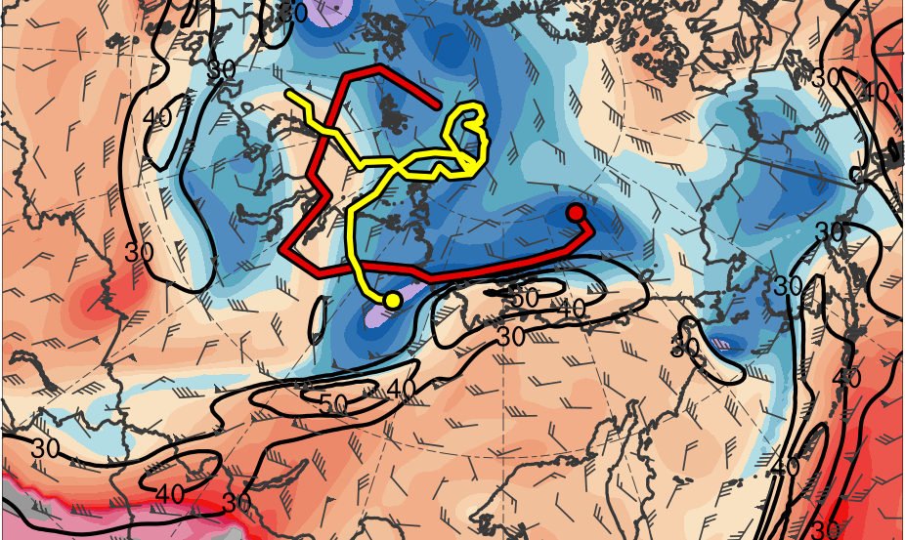
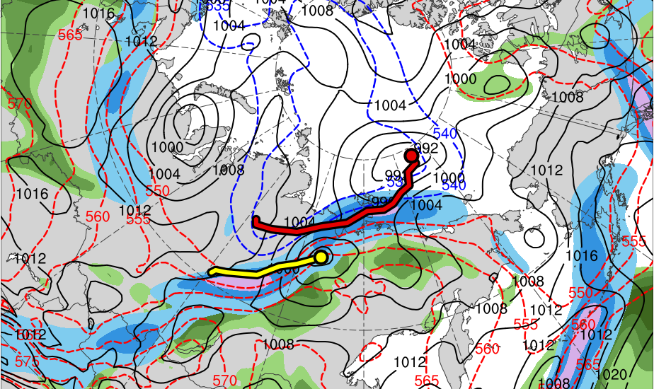
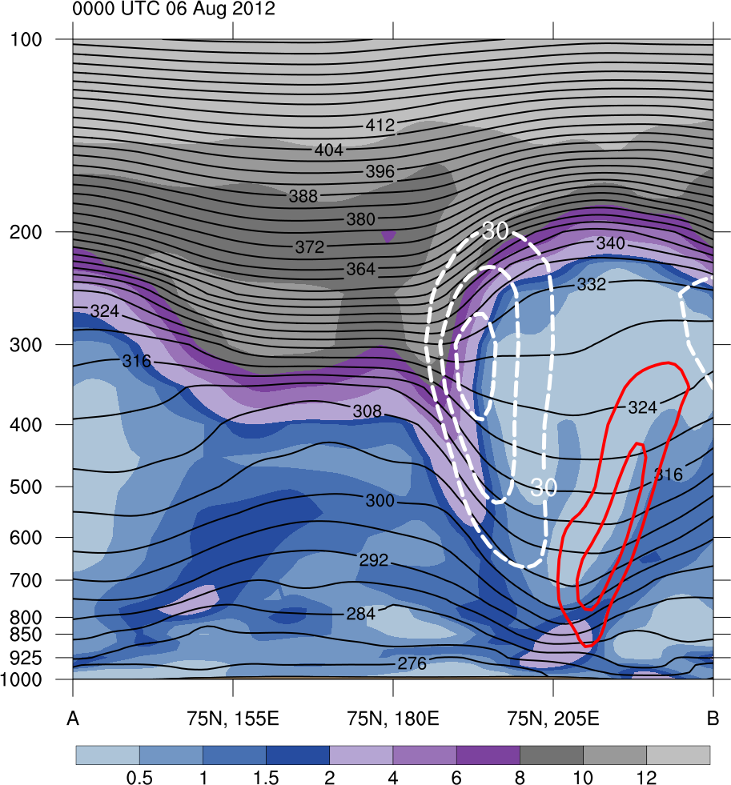
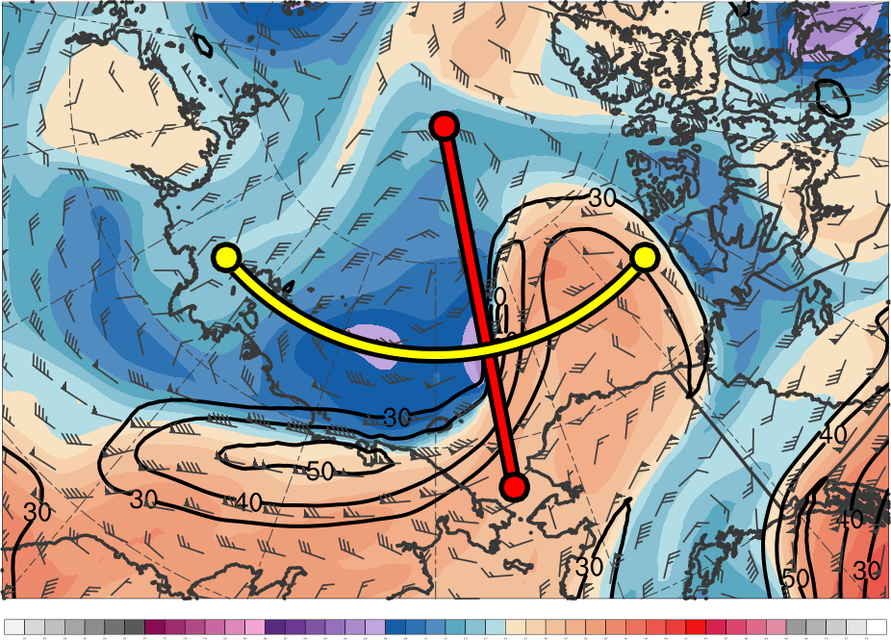
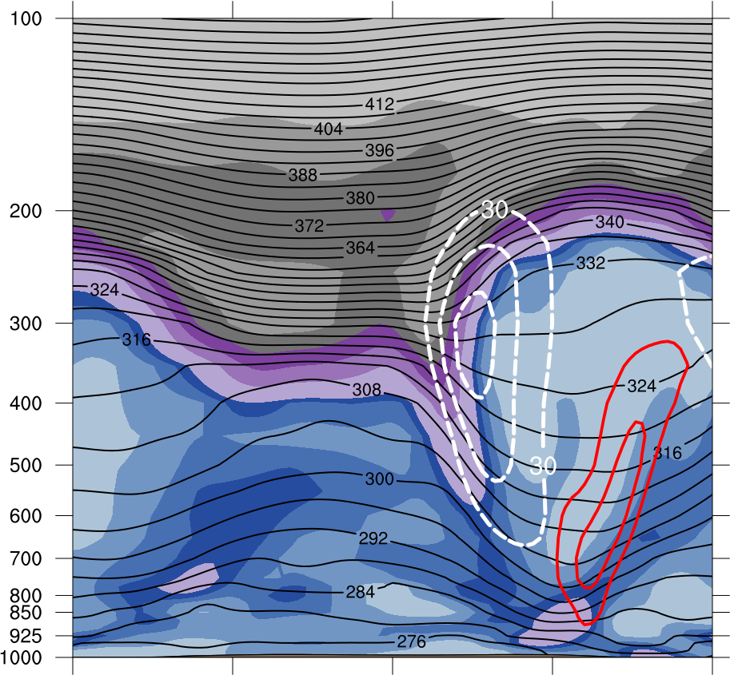
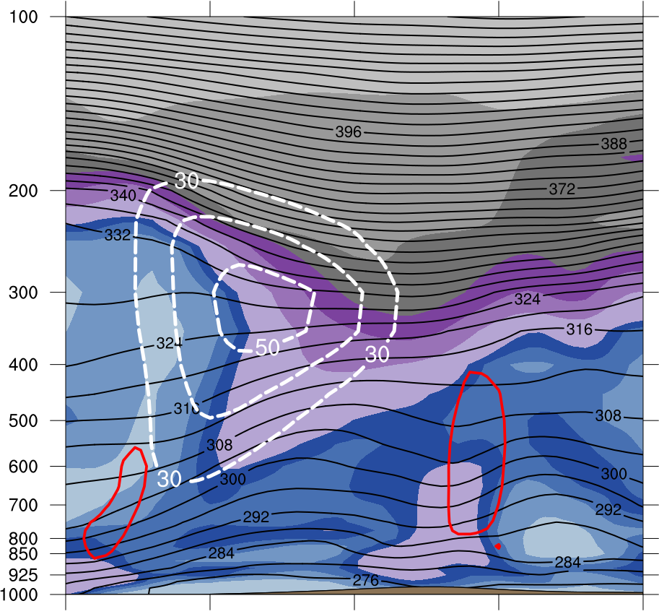
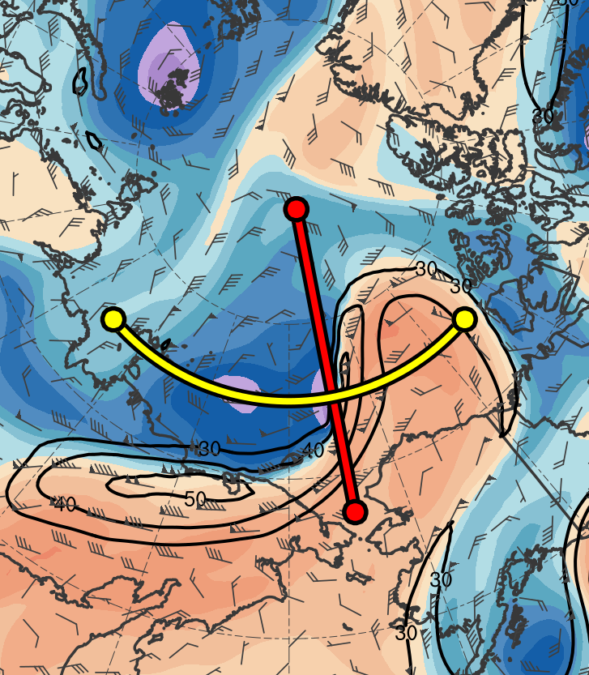
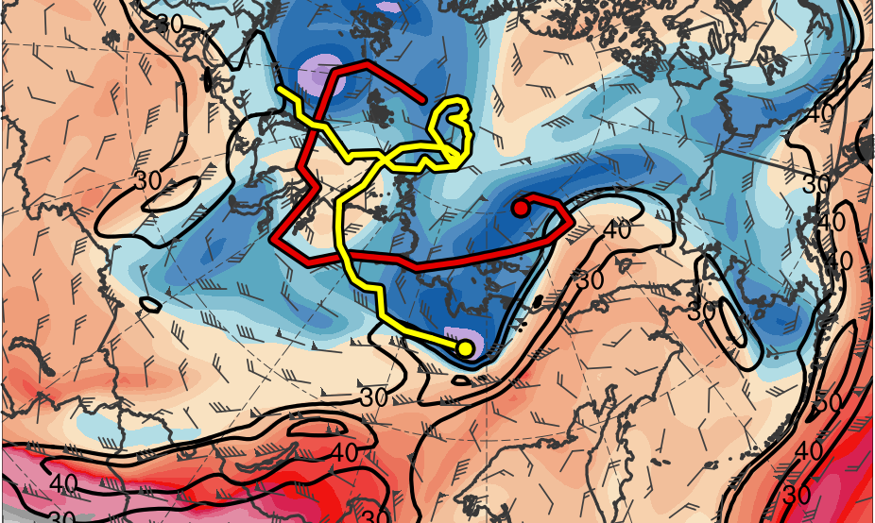
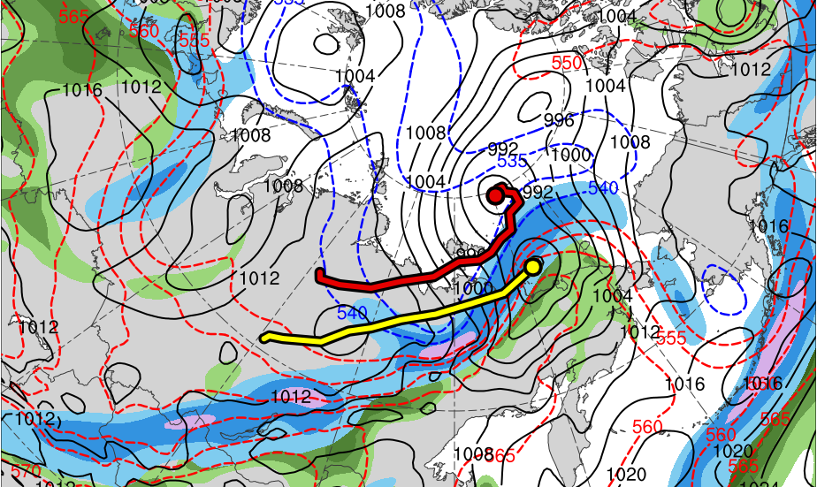
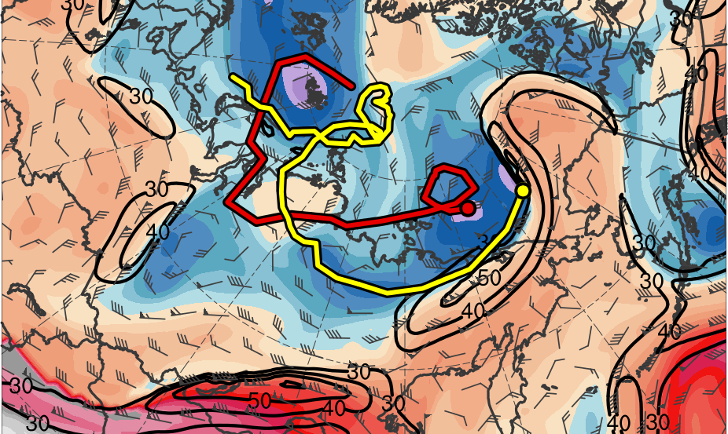
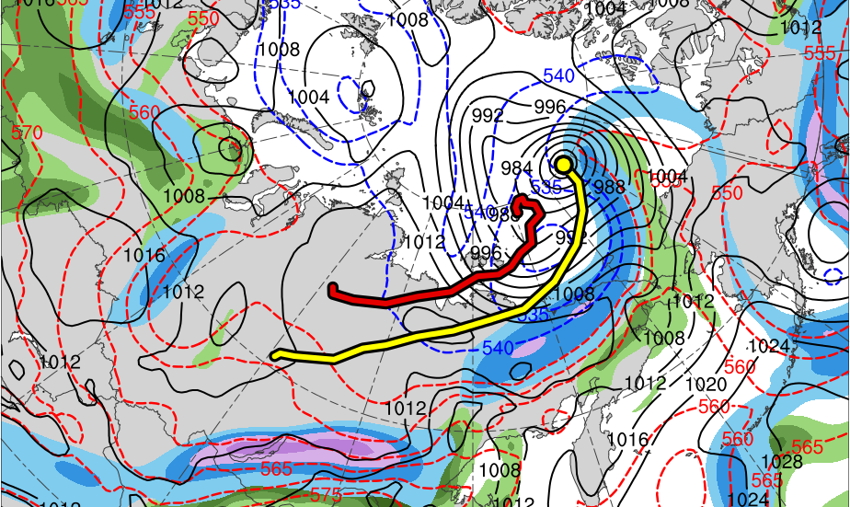
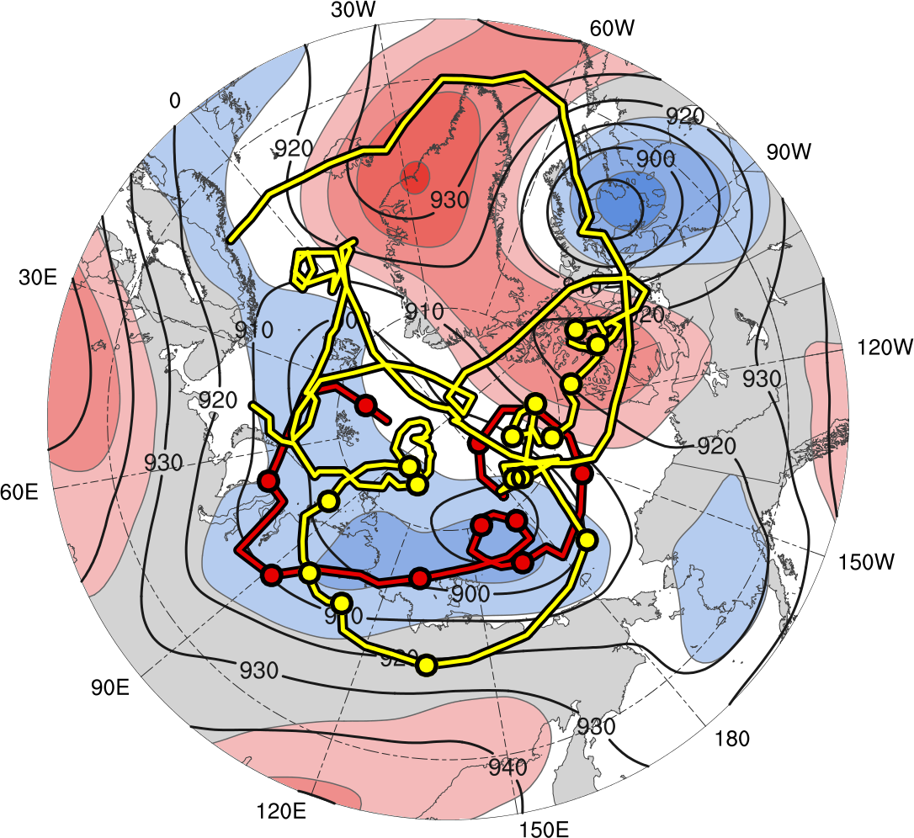
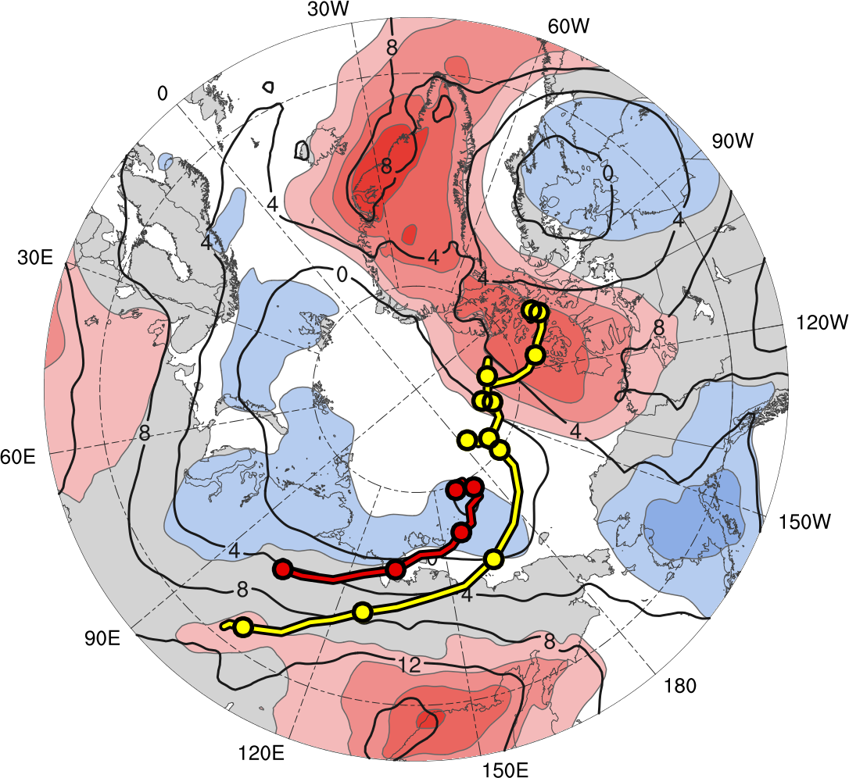
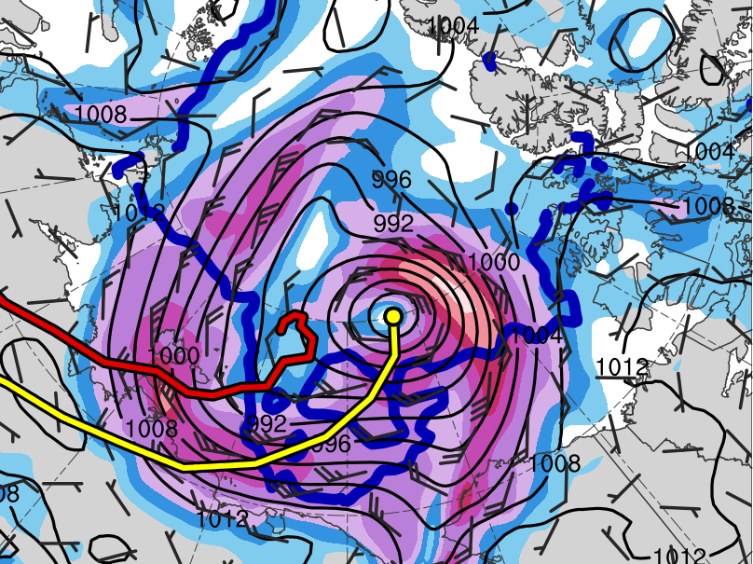
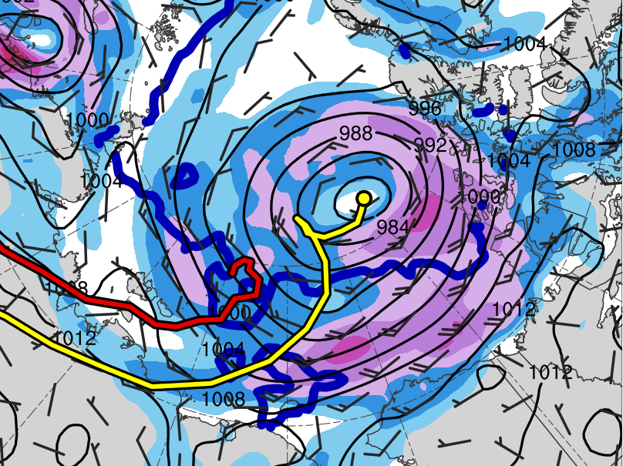
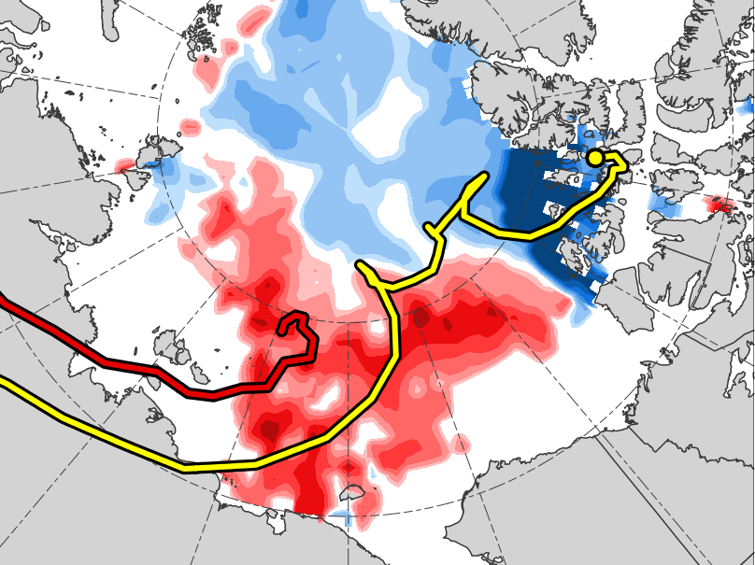
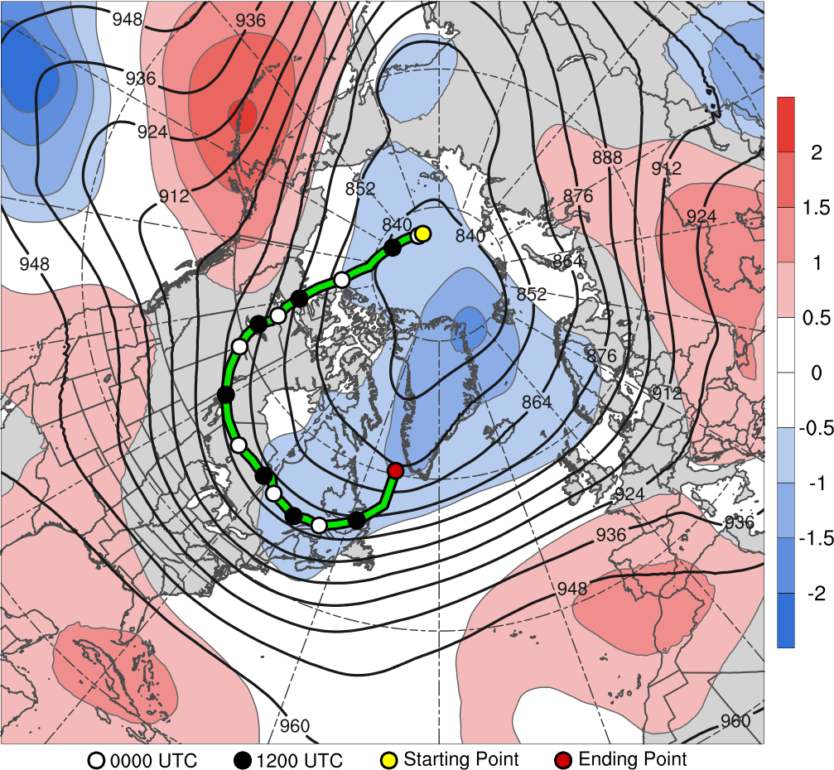
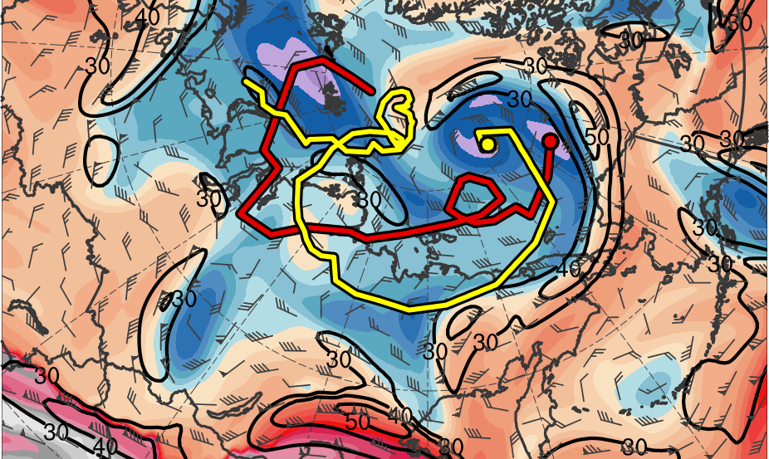
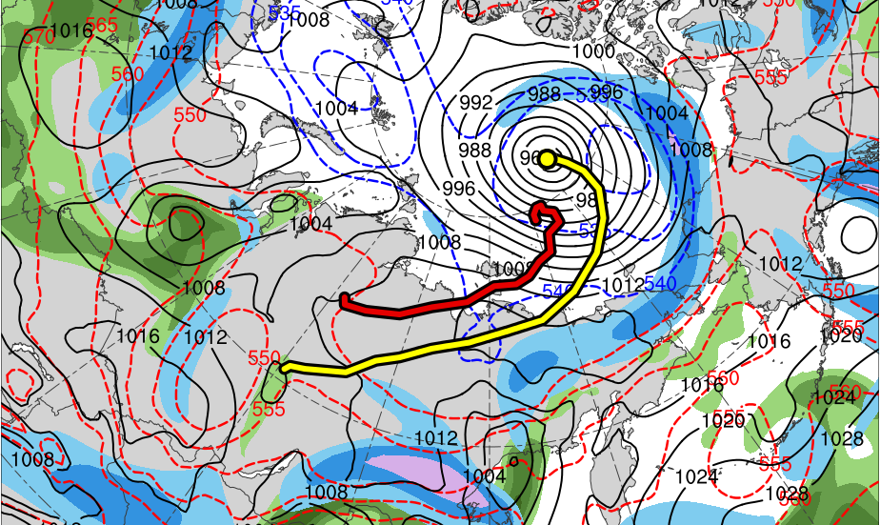
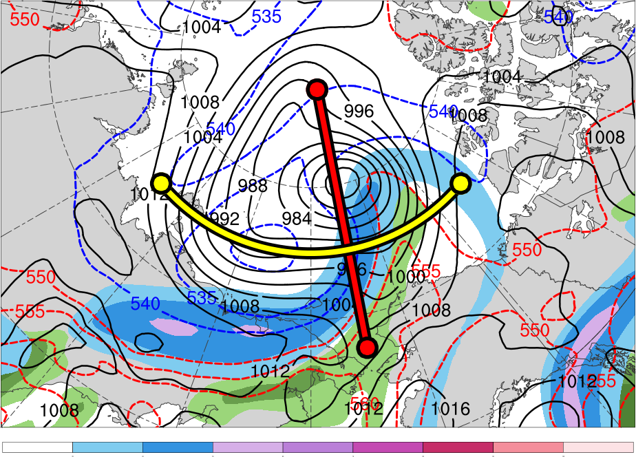
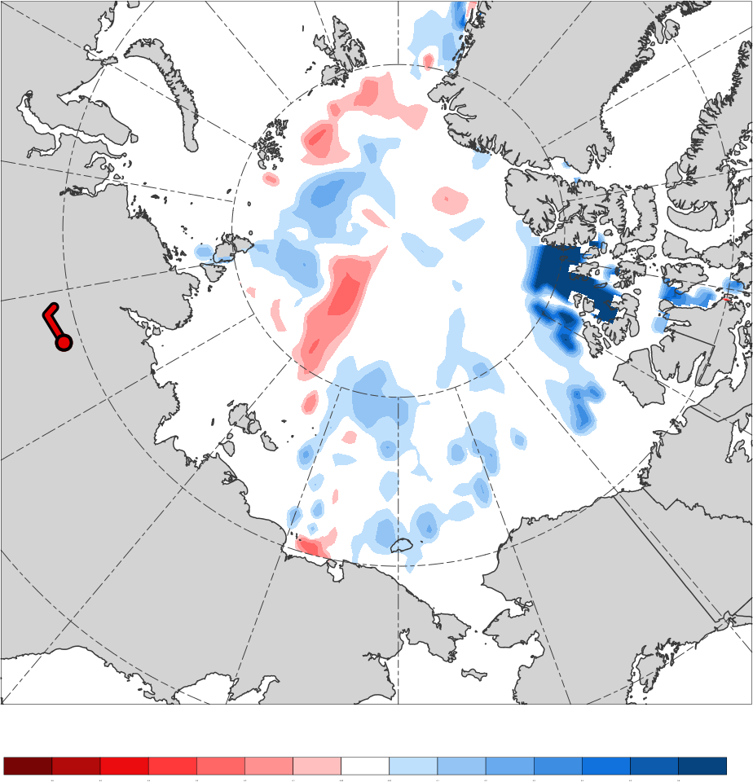
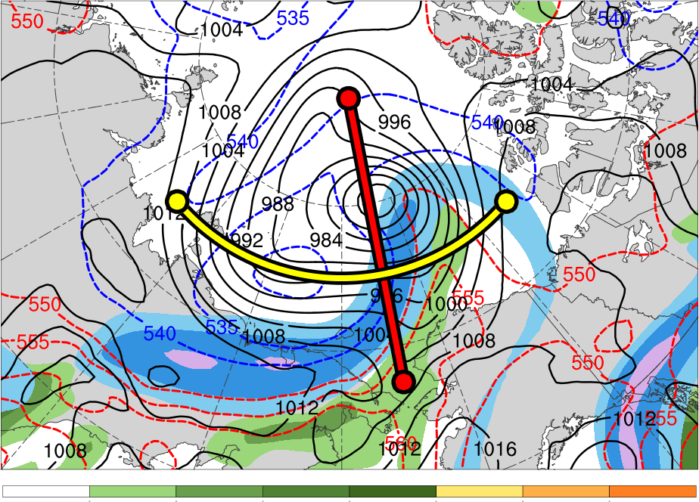
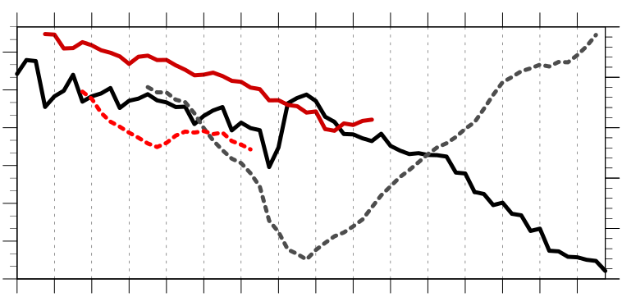
Linkages Between the Great Arctic Cyclone of August 2012 and Tropopause Polar Vortices
A43D-2478
Kevin A. Biernat*, Daniel Keyser, and Lance F. Bosart
Department of Atmospheric and Environmental Sciences,
University at Albany, SUNY
*Corresponding author email: kbiernat@albany.edu
1) Introduction
Tropopause polar vortices (TPVs) are defined as tropopause-based vortices of high-latitude origin and are material features (Pyle et al. 2004; Cavallo and Hakim 2010)
TPVs may interact with and strengthen jet streams, and act as precursors to the development of intense Arctic cyclones, including the Great Arctic Cyclone of August 2012 (hereafter AC12; e.g., Simmonds and Rudeva 2012; Yamazaki et al. 2015)
Arctic cyclones may be associated with strong surface winds and poleward advection of warm, moist air, contributing to reductions in Arctic sea-ice extent (e.g., Zhang et al. 2013)
AC12 was considered the “most extreme” Arctic cyclone in a 1979–2012 CFSR climatology of Arctic cyclones when considering a combination of factors, including minimum SLP, intensity, size, depth, and longevity (Simmonds and Rudeva 2012)
AC12 led to reductions in Arctic sea-ice extent during a time in which Arctic sea ice was thin, with sea-ice volume decreasing twice as fast as normal during AC12 due to melting of bottom and perimeter ice floes (Zhang et al. 2013)
Strong surface winds associated with AC12 helped to break up the thin Arctic sea ice as well (e.g., Parkinson and Comiso 2013)
This study will examine the linkages between the development of AC12 and TPVs
4) Synoptic Evolution of TPVs and Cyclones
5) Three-dimensional Structure of TPVs and Cyclones
(a) 0000 UTC 3 Aug 2012
(b) 0000 UTC 3 Aug 2012
(a) 0600 UTC 4 Aug 2012
(b) 0600 UTC 4 Aug 2012
(c) 0600 UTC 4 Aug 2012
B’
TPV 2
TPV 1
TPV 2
A
TPV 1
A’
B
(c) 0000 UTC 4 Aug 2012
(d) 0000 UTC 4 Aug 2012
AC12
L1
A
70°N, 100°E
70°N, 120°E
70°N, 140°E
PVU
A’
252
B
70°N, 165°E
75°N, 165°E
80°N, 165°E
B’
0.5
1
1.5
2
4
6
8
10
12
258
264
270
276
282
288
294
300
306
312
318
324
330
336
342
348
354
360
366
372
378
K
Figure 4. (a) Cross section along line AA’ and (b) BB’ of PV (PVU, shading), θ (K, black), wind speed (m s⁻¹, white), and ascent (red, every 2.5 × 10⁻³ hPa s⁻¹); (c) DT (2-PVU surface) θ (K, shading), wind speed (m s⁻¹, black), and wind (m s⁻¹, flags and barbs) at 0600 UTC 4 August 2012. Transects shown in (c). Locations of TPV 1, TPV 2, L1, and AC12 indicated where labeled.
(a) 0000 UTC 6 Aug 2012
(b) 0000 UTC 6 Aug 2012
(c) 0000 UTC 6 Aug 2012
(e) 0000 UTC 5 Aug 2012
(f) 0000 UTC 5 Aug 2012
D’
Data: ERA-Interim (Dee et al. 2011)
Utilized TPV tracking algorithm developed by Nicholas Szapiro and Steven Cavallo to identify and track TPVs of interest for AC12 (https://github.com/nickszap/tpvTrack)
Manually tracked a predecessor surface cyclone (L1) and AC12 by following the locations of minimum SLP
C
TPV 1
C’
2) Data and Methods
TPV 2
TPV 1
TPV 1
D
AC12
TPV 2
C
75°N, 155°E
75°N, 180°
75°N, 155°W
PVU
C’
252
D
72.5°N, 169°W
77.5°N, 169°W
82.5°N, 169°W
D’
(g) 0000 UTC 6 Aug 2012
(h) 0000 UTC 6 Aug 2012
0.5
1
1.5
2
4
6
8
10
12
258
264
270
276
282
288
294
300
306
312
318
324
330
336
342
348
354
360
366
372
378
K
3) Track and Intensity of TPVs and Cyclones
Figure 5. As in Fig. 4, but for cross sections along lines CC’ and DD’ at 0000 UTC 6 August 2012.
(a)
TPVs
(b)
Surface Cyclones
6) Impacts of Cyclones on Arctic Sea Ice
(a)
(b)
(c)
12
14
13
14
13
(i) 0000 UTC 7 Aug 2012
(j) 0000 UTC 7 Aug 2012
31
10
9
11
11
12
1
8
10
9
8
1
2
31
7
8
7
7
6
AC12
L1
3
5
4
6
5
4
4
6
8
10
12
14
16
18
m s⁻¹
-60
-50
-40
-30
-20
-10
-5
5
10
20
30
40
50
60
%
2
4
3
6
1
2
3
5
Figure 6. (a) SLP (hPa, black), and 10-m wind speed (m s⁻¹, shading) and wind (m s⁻¹, flags and barbs) at (a) 0000 UTC 6 August 2012 and (b) 0000 UTC 9 August 2012. Also, 20% contour of sea-ice concentration (thick blue) at (a) 0600 UTC 6 August 2012 and (b) 0600 UTC 9 August 2012. (c) Change in sea-ice concentration from 0600 UTC 3 August to 0600 UTC 14 August 2012 (%, shading).
5
3
4
Two TPVs may play an important role in the life cycle of AC12
TPV 1 approaches and interacts with AC12 in region of strong baroclinicity, likely supporting the development of AC12
TPV–jet interactions involving both TPV 1 and TPV 2 likely contribute to the formation of a dual-jet configuration and jet coupling over AC12
The presence of warm, moist air and relatively strong lower-tropospheric ascent in the region of jet coupling and the subsequent interaction between both TPVs likely facilitate the intensification of AC12
Widespread strong surface winds associated with AC12 contributes to reduction in Arctic sea-ice extent, consistent with past studies (e.g., Zhang et al. 2013)
TPVs may play important roles in the life cycles of intense Arctic cyclones that may impact Arctic sea-ice extent
TPV 1
Genesis
Lysis
AC12
TPV 1
TPV 2
AC12
L1
7) Conclusions
TPV 2
-2
-1.5
-1
-0.5
0
0.5
1
1.5
2
σ
L1
252
258
264
270
276
282
288
294
300
306
312
318
324
330
336
342
348
354
360
366
372
378
K
Figure 1. (a) Track of TPV 1 (yellow) from 1200 UTC 23 July to 1200 UTC 7 September 2012 and TPV 2 (red) from 1800 UTC 30 July to 1200 UTC 8 August 2012; 31 July–6 August 2012 time-mean 300-hPa geopotential height (dam, dark gray) and standardized anomaly of 300-hPa geopotential height (σ, shaded). (b) Track of L1 (red) from 1800 UTC 31 July to 0600 UTC 5 August 2012 and AC12 (yellow) from 1200 UTC 2 August to 1200 UTC 14 August 2012; 31 July–6 August 2012 time-mean 850-hPa temperature (°C, dark gray) and standardized anomaly of 850-hPa temperature (σ, shaded). Dots correspond to 0000 UTC positions of the TPVs and surface cyclones during 31 July–14 August 2012, with the corresponding dates labeled.
30
40
50
60
70
80
90
100
m s⁻¹
25
30
35
40
45
50
55
mm
Figure 3. DT (2-PVU surface) θ (K, shading), wind speed (m s⁻¹, black), and wind (m s⁻¹, flags and barbs) at (a) 0000 UTC 3 August, (c) 0000 UTC 4 August, (e) 0000 UTC 5 August, (g) 0000 UTC 6 August, and (i) 0000 UTC 7 August 2012. 250-hPa wind speed (m s⁻¹, shaded), 1000–500-hPa thickness (dam, dashed red and blue), SLP (hPa, black), and precipitable water (mm, shaded) at (b) 0000 UTC 3 August, (d) 0000 UTC 4 August, (f) 0000 UTC 5 August, (h) 0000 UTC 6 August, and (j) 0000 UTC 7 August 2012.
309
1010
Minimum DT θ of TPV 1
References
Cavallo, S. M., and G. J. Hakim, 2010: Composite structure of tropopause polar cyclones. Mon. Wea. Rev., 138,
3840–3857.
Dee, D. P., and Coauthors, 2011: The ERA-Interim reanalysis: Configuration and performance of the data
assimilation system. Quart. J. Roy. Meteor. Soc., 137, 553–597.
Parkinson, C. L., and J. C. Comiso, 2013: On the 2012 record low Arctic sea ice cover: Combined impact of
preconditioning and an August storm. Geophys. Res. Lett., 40, 1356–1361.
Pyle, M. E., D. Keyser, and L. F. Bosart, 2004: A diagnostic study of jet streaks: Kinematic signatures and
relationship to coherent tropopause disturbances. Mon. Wea. Rev., 132, 297–319.
Simmonds, I., and I. Rudeva, 2012: The great Arctic cyclone of August 2012. Geophys. Res. Lett., 39, L23709.
Yamazaki, A., J. Inoue, K. Dethloff, M. Maturilli, and G. König-Langlo, 2015: Impact of radiosonde observations on
forecasting summertime Arctic cyclone formation. J. Geophys. Res. Atmos., 120, 3249–3273.
Zhang, J., R. Lindsay, A. Schweiger, and M. Steele, 2013: The impact of an intense summer cyclone on 2012 Arctic
sea ice retreat. Geophys. Res. Lett., 40, 720–726.
\
306
1000
Minimum DT θ of TPV 2
303
990
Minimum DT θ (K)
Minimum SLP (hPa)
Minimum SLP of L1
300
980
297
970
Minimum SLP of AC12
294
Acknowledgements
Special thanks to Nicholas Szapiro and Steven Cavallo for providing their TPV tracking algorithm. This research was supported by National Science Foundation grant AGS-1355960.
291
30
31
1
2
3
4
5
6
7
8
9
10
11
12
13
14
960
Figure 2. Time series of minimum dynamic tropopause (DT) potential temperature (θ) of TPV 1 (black, solid) and TPV 2 (red, solid), and minimum sea level pressure (SLP) of L1 (red, dashed) and AC12 (gray, dashed) during 30 July–14 August 2012.

