Slide 1

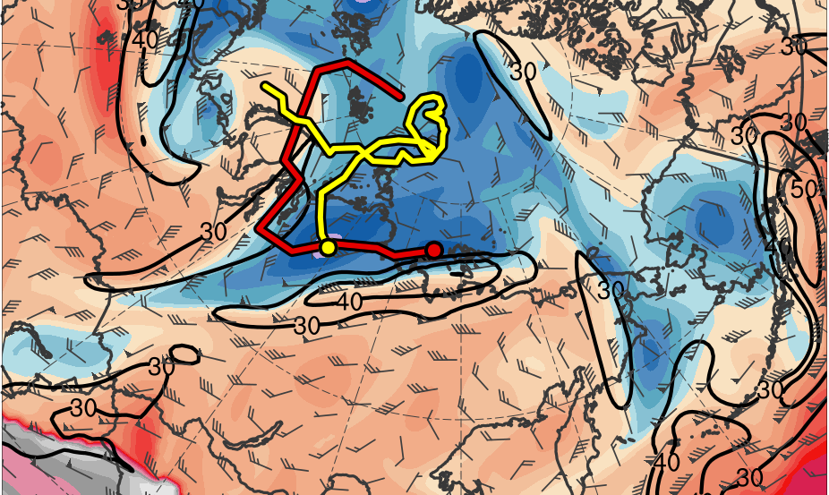
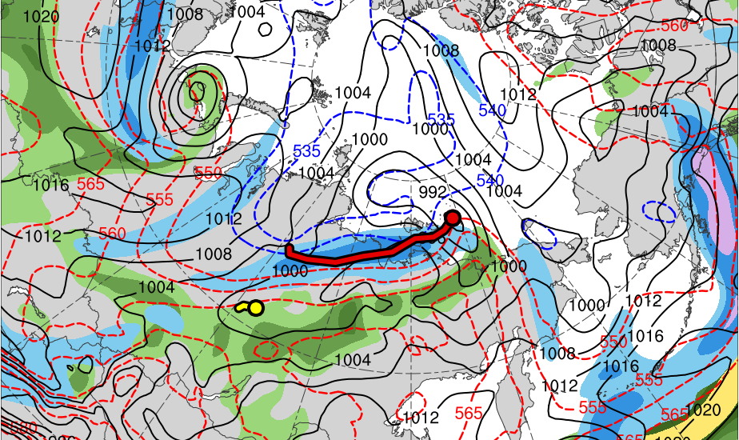
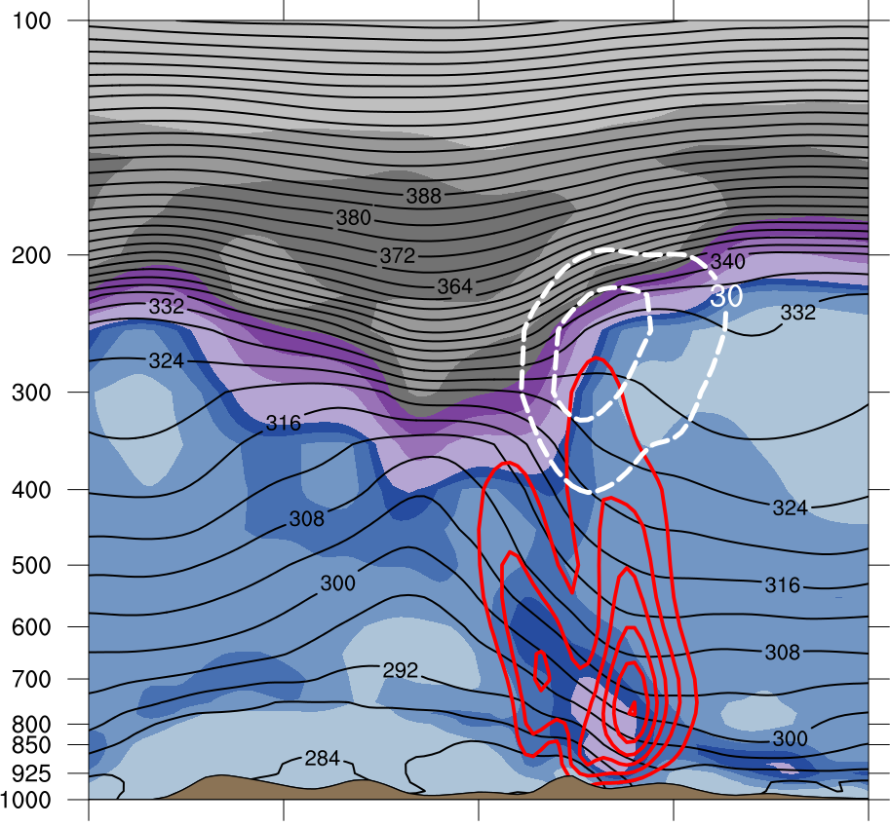
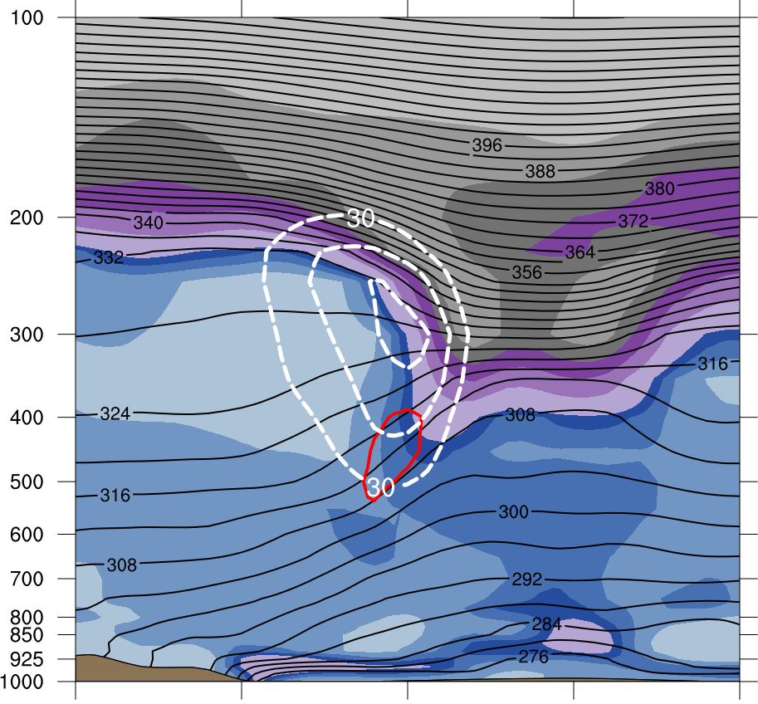
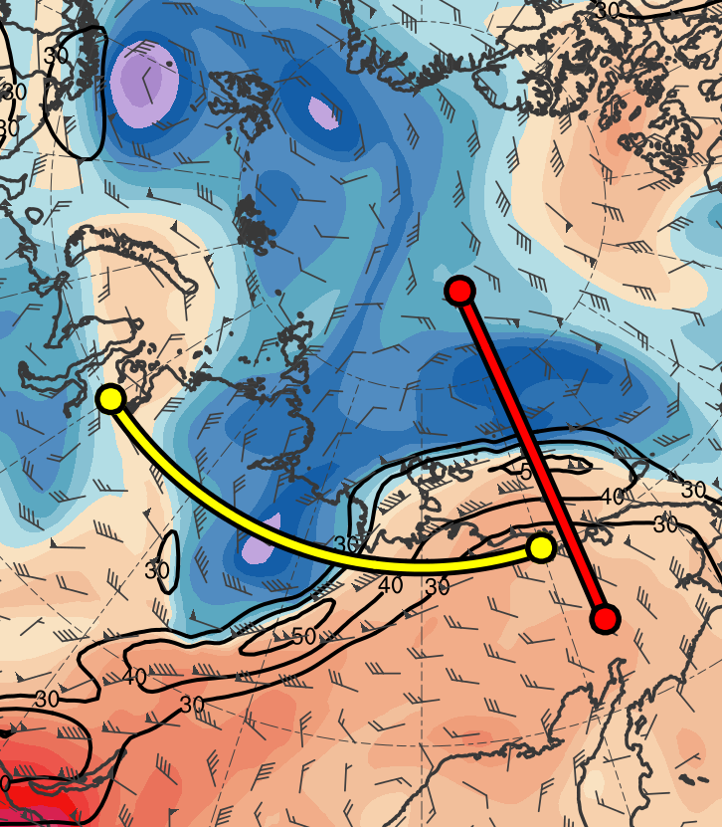
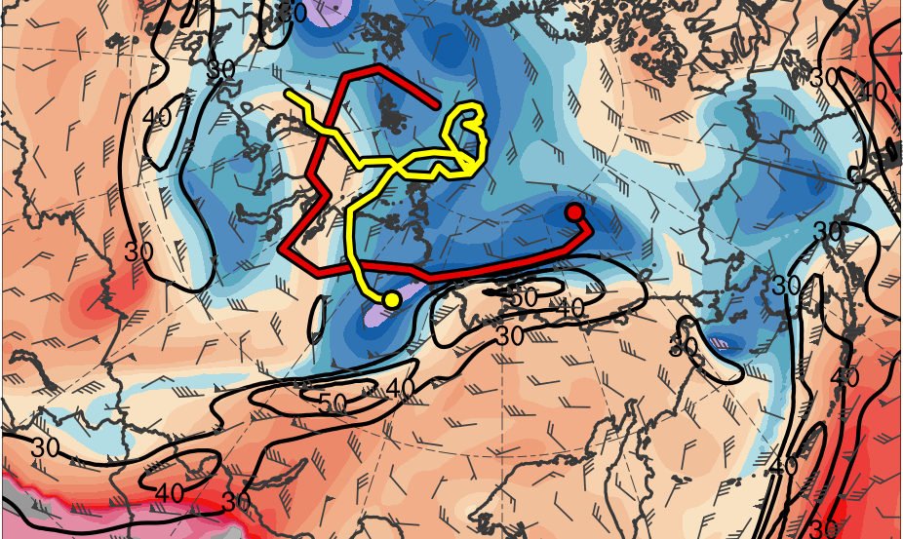
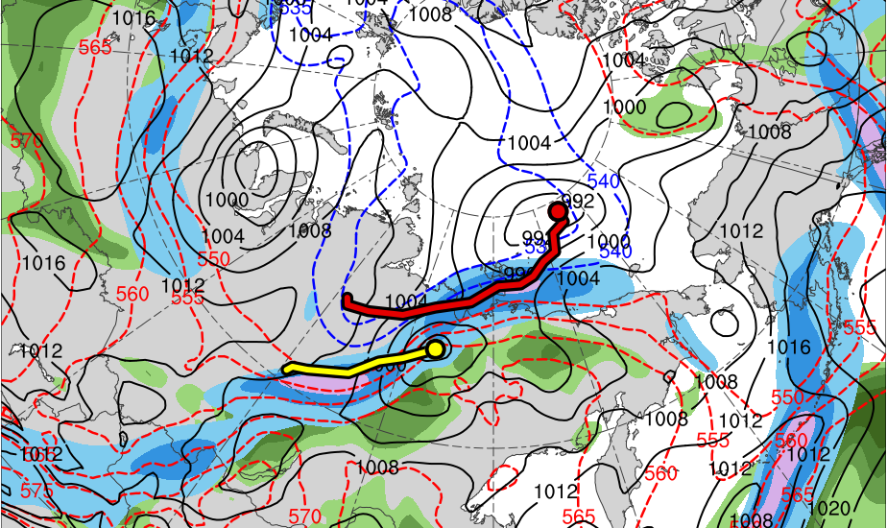
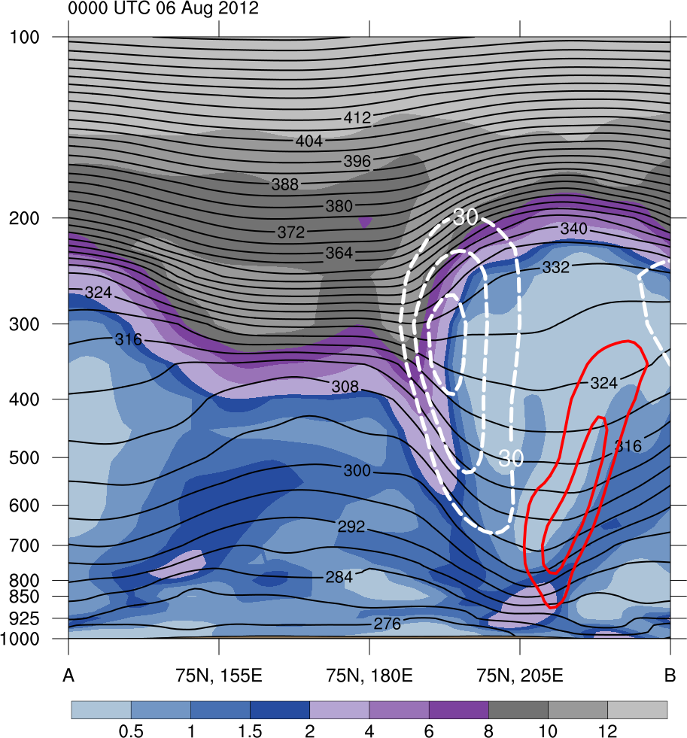
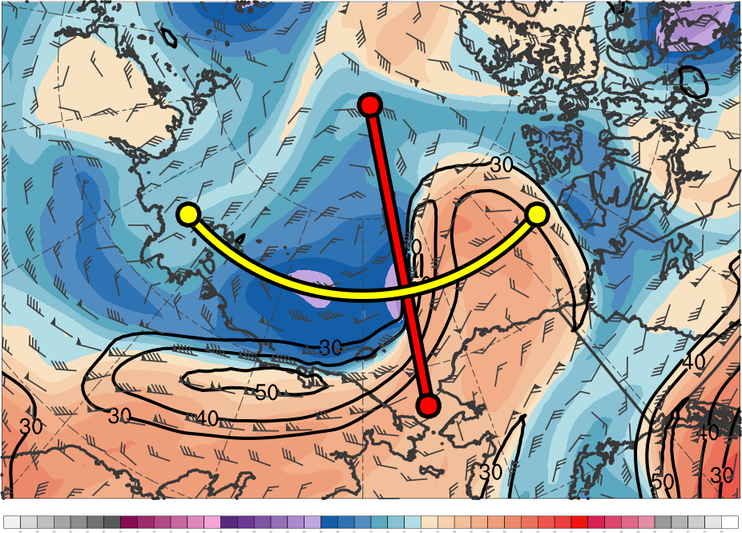
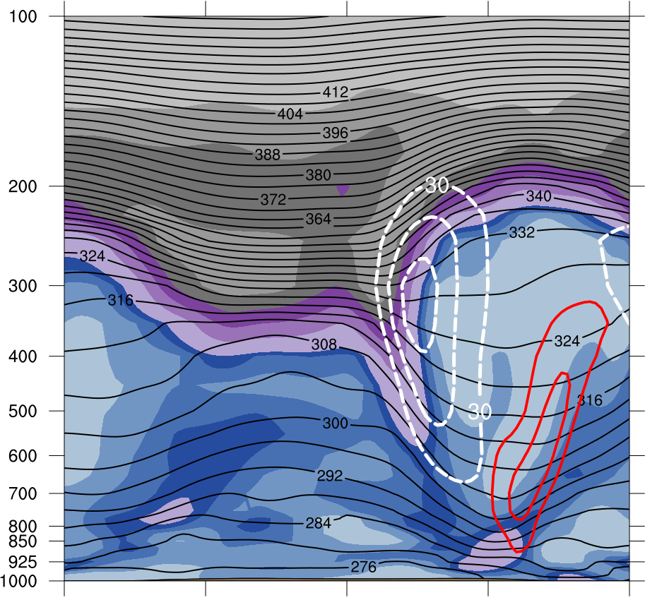
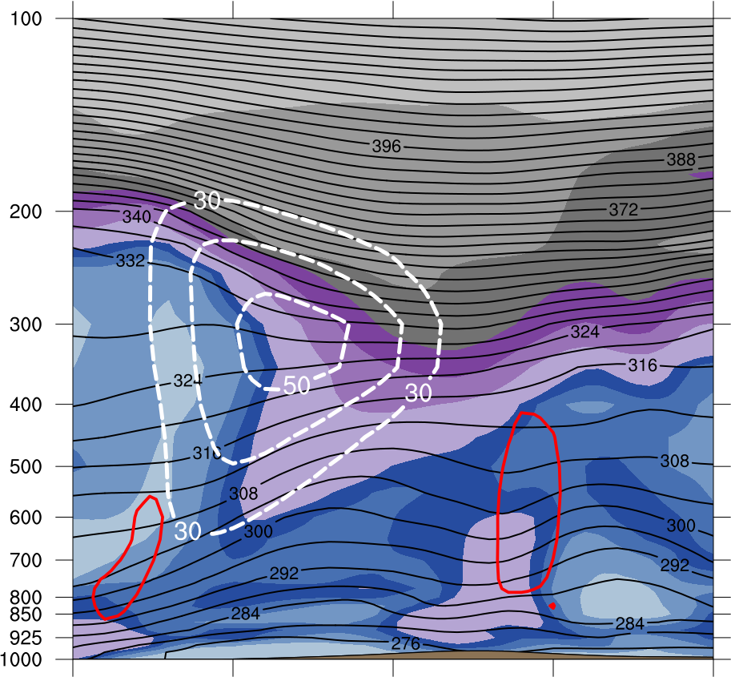
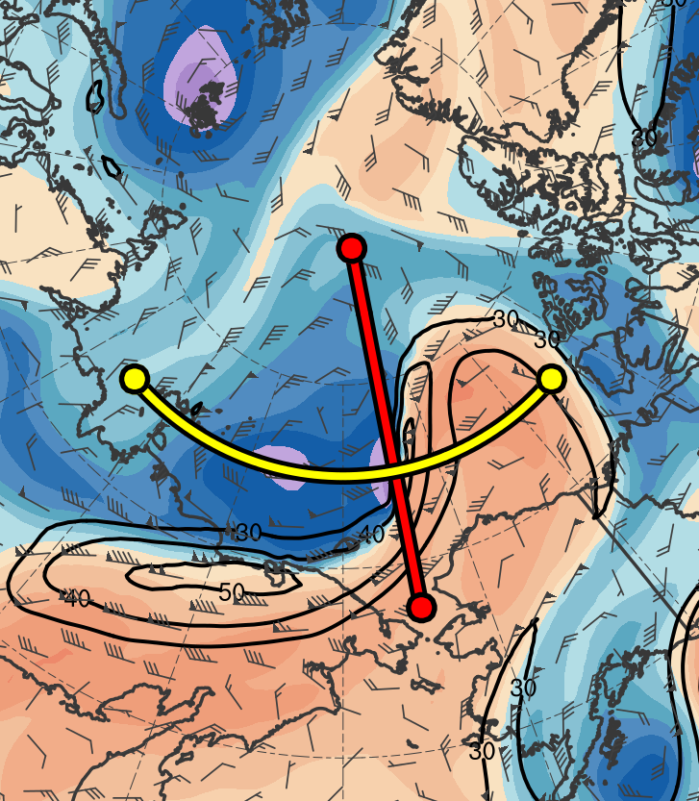
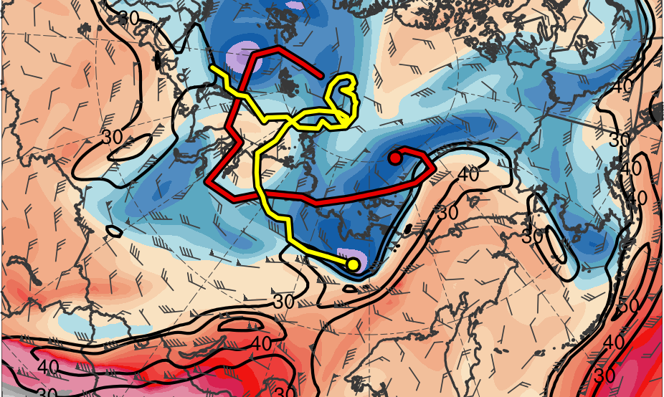
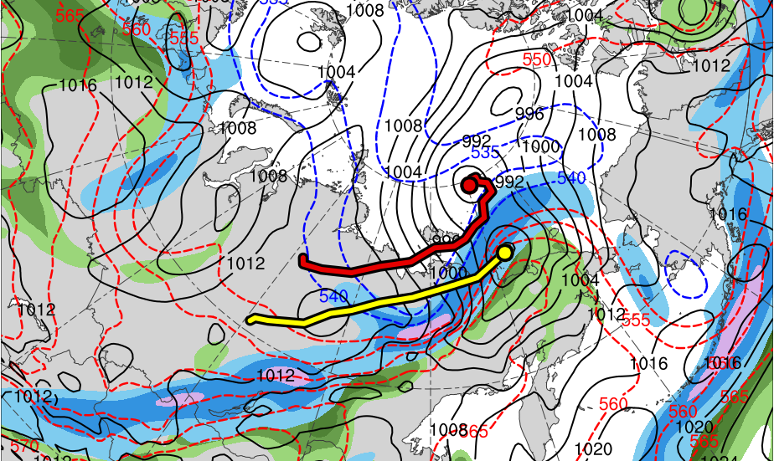
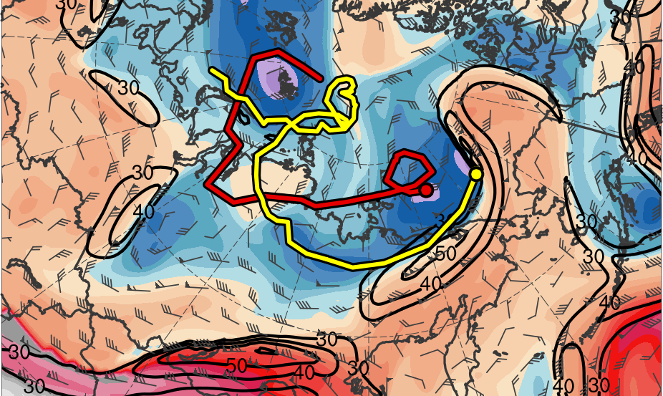
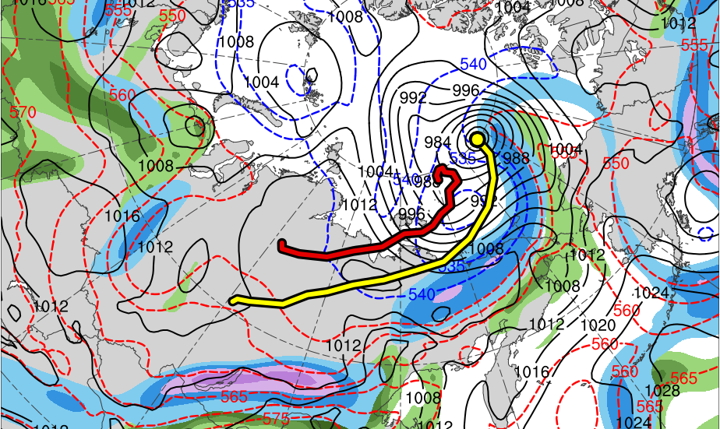
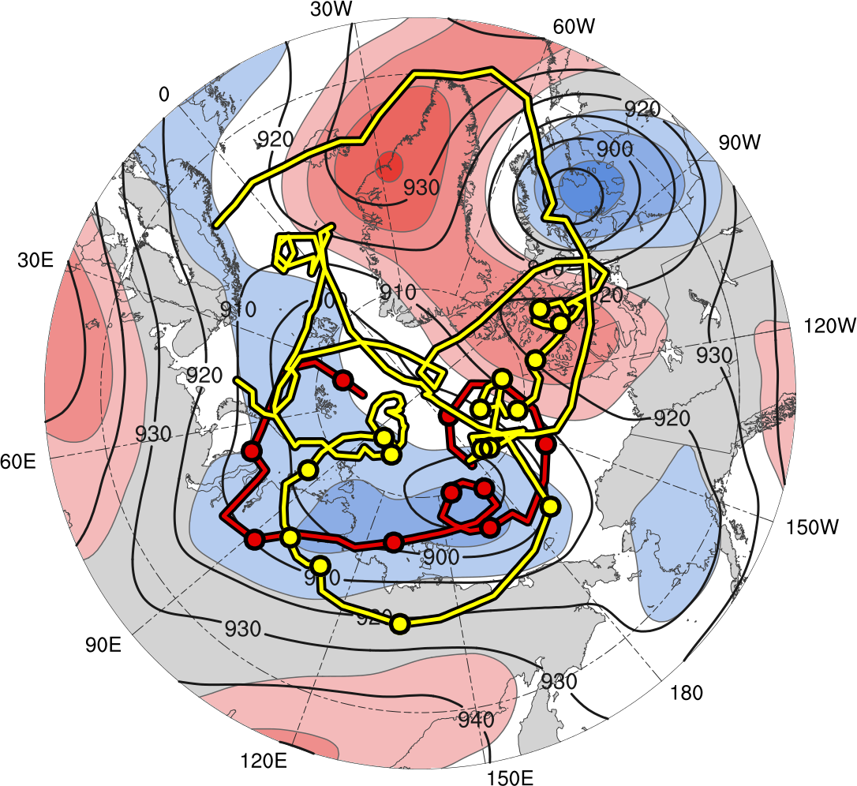
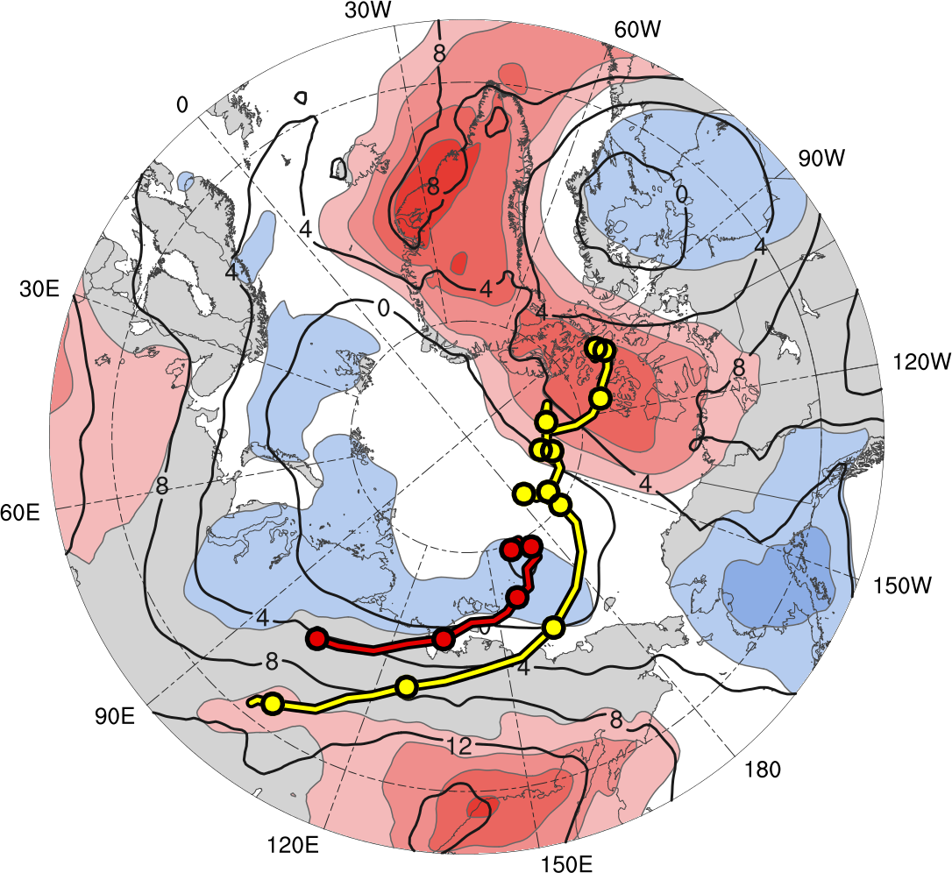
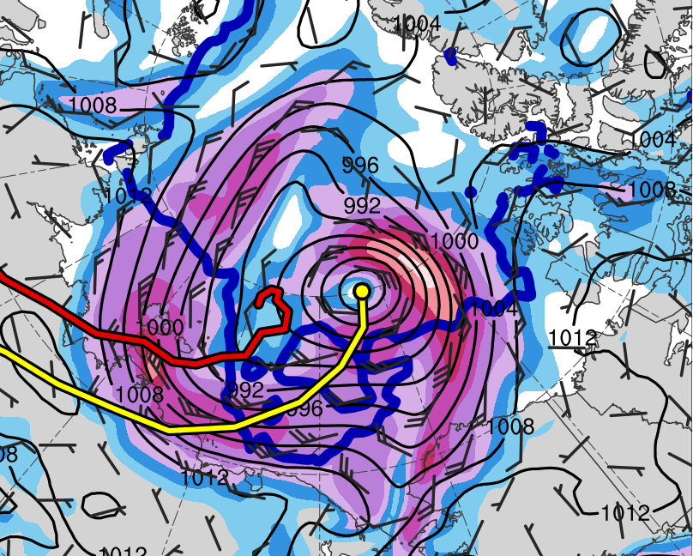
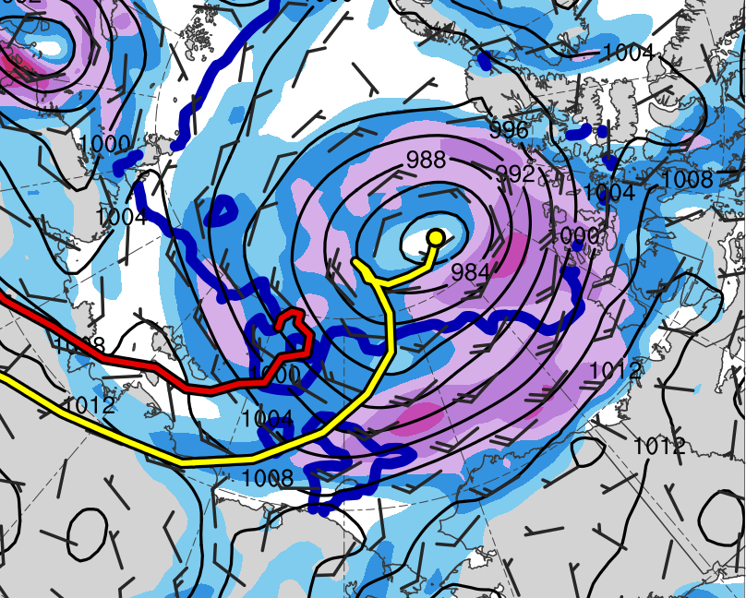
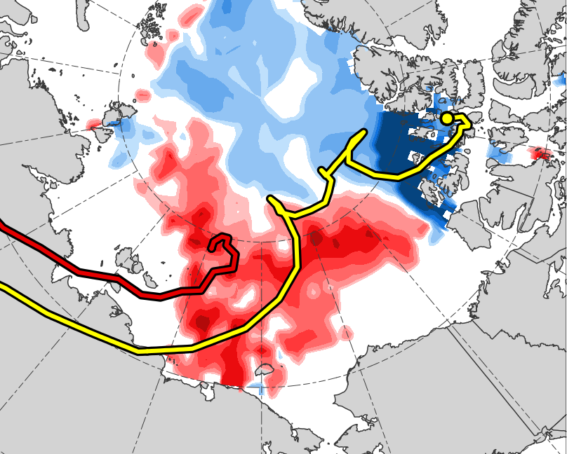
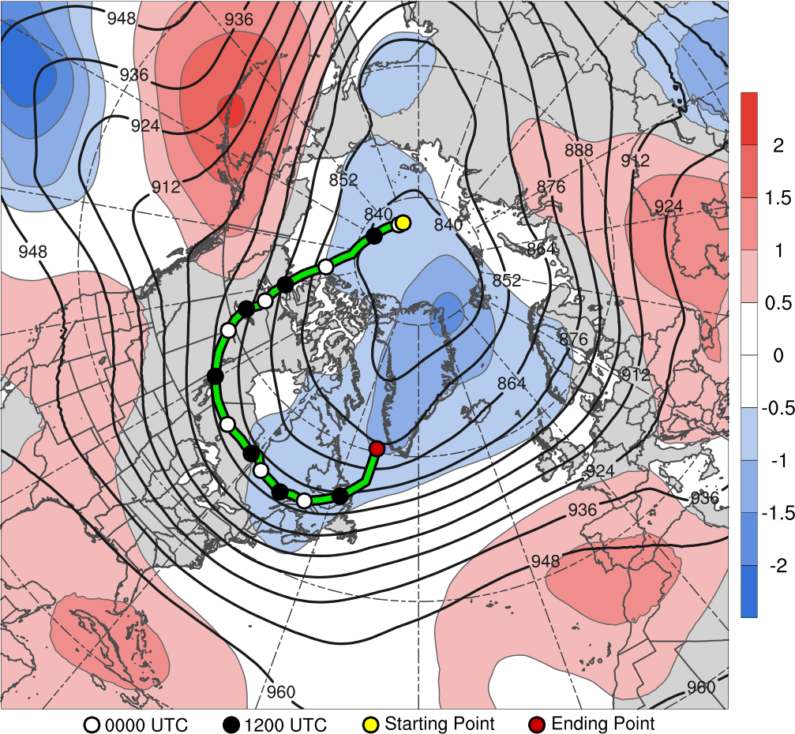
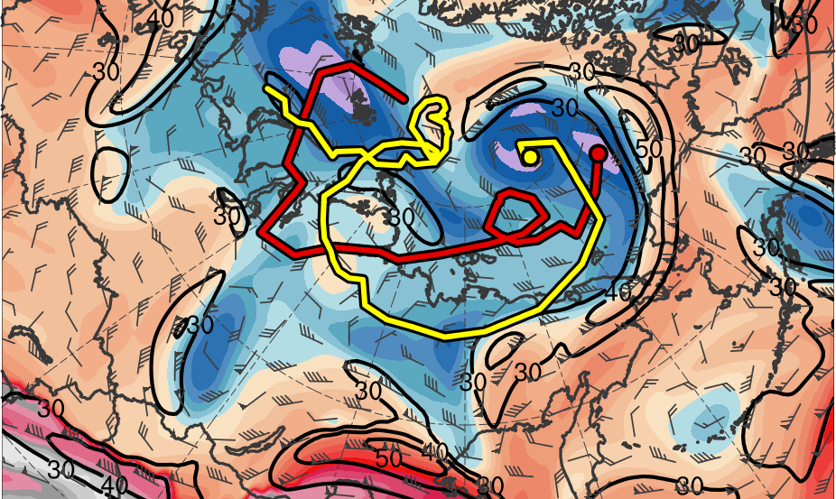
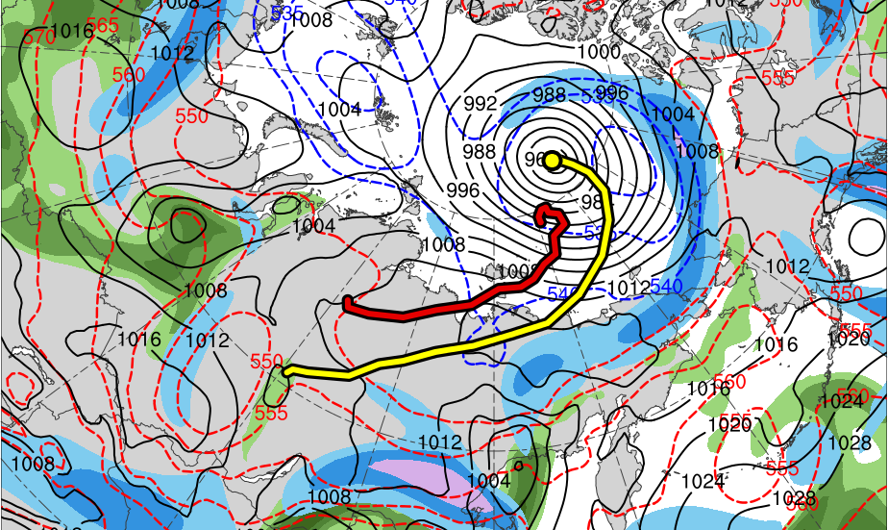
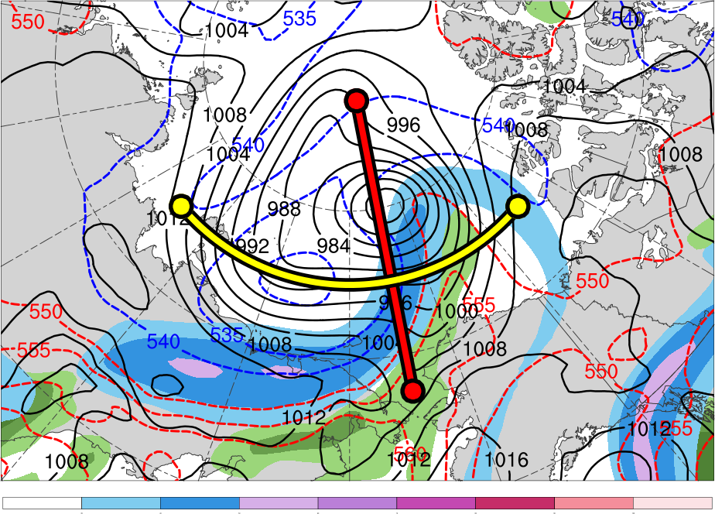
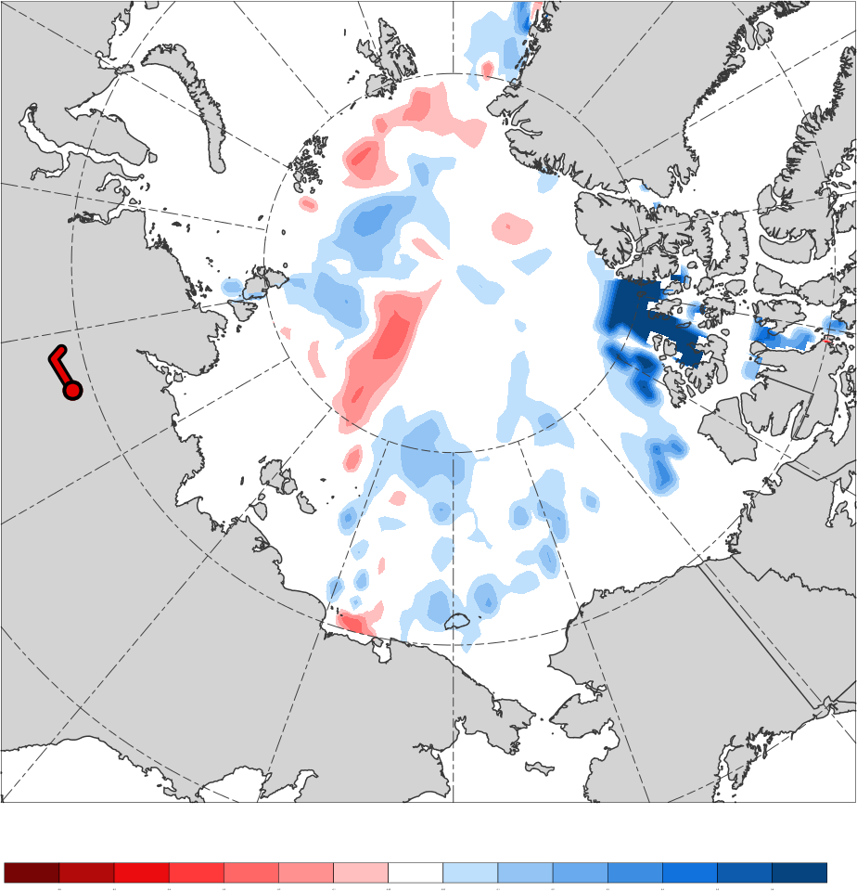
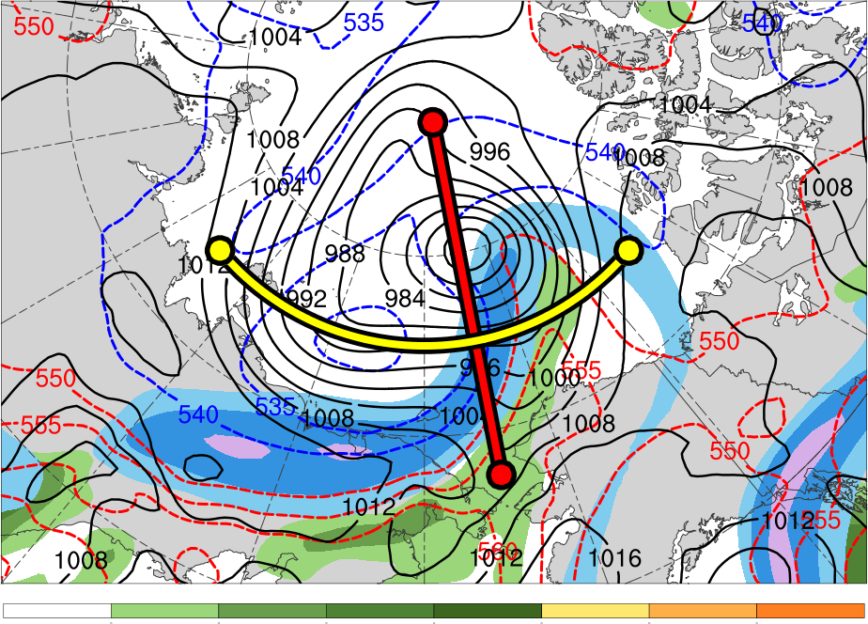
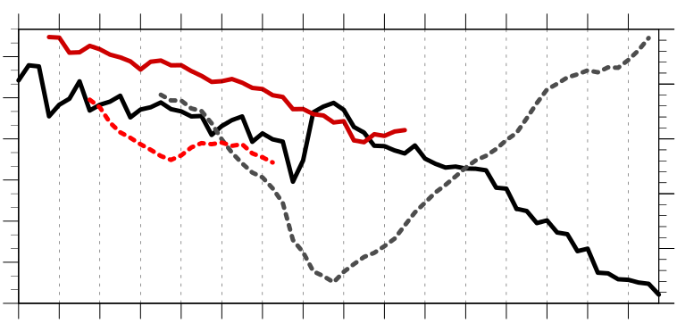
Linkages Between the Great Arctic Cyclone of August 2012 and Tropopause Polar Vortices
Email: kbiernat@albany.edu
Kevin A. Biernat*, Daniel Keyser, and Lance F. Bosart
Department of Atmospheric and Environmental Sciences, University at Albany, SUNY
TPVs are defined as tropopause-based vortices of high-latitude origin and are material features (Pyle et al. 2004; Cavallo and Hakim 2010)
TPVs may interact with and strengthen jet streams, and act as precursors to the development of intense Arctic cyclones, including the Great Arctic Cyclone of 2012 (hereafter AC12; e.g., Simmonds and Rudeva 2012; Yamazaki et al. 2015)
Heavy precipitation, strong surface winds, and large waves due to Arctic cyclones may pose hazards to ships moving through open passageways in the Arctic Ocean
AC12 was considered the “most extreme” Arctic cyclone in a 1979–2012 CFSR climatology of Arctic cyclones when considering a combination of factors, including minimum SLP, intensity, size, depth, and longevity (Simmonds and Rudeva 2012)
Strong surface winds associated with AC12 helped to break up the thin sea ice (e.g., Parkinson and Comiso 2013)
AC12 led to reductions in Arctic sea-ice extent during a time in which sea ice was thin and sea-ice volume was well below normal (Zhang et al. 2013)
4) Synoptic Evolution of TPVs and Cyclones
5) Three-dimensional Structure of TPVs and Cyclones
1) Motivation and Background
(a) 0000 UTC 3 Aug 2012
(b) 0000 UTC 3 Aug 2012
(a) 0600 UTC 4 Aug 2012
(b) 0600 UTC 4 Aug 2012
(c) 0600 UTC 4 Aug 2012
B’
TPV 2
TPV 1
TPV 2
A
TPV 1
A’
B
(c) 0000 UTC 4 Aug 2012
(d) 0000 UTC 4 Aug 2012
AC12
L1
A
70°N, 100°E
70°N, 120°E
70°N, 140°E
A’
B
70°N, 165°E
75°N, 165°E
80°N, 165°E
B’
0.5
1
1.5
2
4
6
8
10
12
PVU
252
258
264
270
276
282
288
294
300
306
312
318
324
330
336
342
348
354
360
366
372
378
K
Figure 4. (a) Cross section along line AA’ and (b) BB’ of PV (PVU, shading), θ (K, black), wind speed (m s⁻¹, white), and ascent (red, every 2.5 × 10⁻³ hPa s⁻¹); (c) θ (K, shading), wind speed (m s⁻¹, black), and wind (m s⁻¹, flags and barbs) on 2-PVU surface at 0600 UTC 4 August 2012. Transects indicated in (c). Locations of TPV 1, TPV 2, and AC12 indicated where labeled.
Date: ERA-Interim (Dee et al. 2011)
Utilized TPV tracking algorithm developed by Nicholas Szapiro and Steven Cavallo to identify and track TPVs of interest for AC12 (https://github.com/nickszap/tpvTrack)
Manually tracked a predecessor surface cyclone (L1) and AC12 by following the locations of minimum SLP
(a) 0000 UTC 6 Aug 2012
(b) 0000 UTC 6 Aug 2012
(c) 0000 UTC 6 Aug 2012
2) Data and Methods
(e) 0000 UTC 5 Aug 2012
(f) 0000 UTC 5 Aug 2012
D’
TPV 2
C
TPV 1
C’
TPV 1
TPV 1
AC12
TPV 2
D
3) Track and Intensity of TPVs and Cyclones
(g) 0000 UTC 6 Aug 2012
(h) 0000 UTC 6 Aug 2012
C
75°N, 155°E
75°N, 180°
75°N, 155°W
C’
D
72.5°N, 169°W
77.5°N, 169°W
82.5°N, 169°W
D’
TPVs
Surface Cyclones
0.5
1
1.5
2
4
6
8
10
12
PVU
252
258
264
270
276
282
288
294
300
306
312
318
324
330
336
342
348
354
360
366
372
378
K
Figure 5. As in Fig. 4, but for cross sections along line CC’ and DD’ at 0000 UTC 6 August 2012.
6) Sea-ice Loss
12
14
13
14
13
31
10
9
11
11
12
1
8
10
9
8
(i) 0000 UTC 7 Aug 2012
(i) 0000 UTC 7 Aug 2012
1
2
31
7
8
7
7
6
3
5
4
6
5
4
2
4
3
6
1
2
3
5
5
3
4
Genesis
Lysis
4
6
8
10
12
14
16
18
m s⁻¹
-60
-50
-40
-30
-20
-10
-5
5
10
20
30
40
50
60
%
TPV 1
AC12
Figure 6. (a) SLP (hPa, black), and 10-m wind speed (m s⁻¹, shading) and wind (m s⁻¹, flags and barbs) at (a) 0000 UTC 6 August 2012 and (b) 0000 UTC 9 August 2012. Also, 20% contour of sea-ice concentration (thick blue) at (a) 0600 UTC 6 August 2012 and (b) 0600 UTC 9 August 2012. (c) Change in sea-ice concentration from 0600 UTC 3 August to 0600 UTC 14 August 2012 (%, shading).
TPV 2
-2
-1.5
-1
-0.5
0
0.5
1
1.5
2
σ
L1
Figure 1. (a) Track of TPV 1 (yellow) from 1200 UTC 23 July to 1200 UTC 7 September 2012 and TPV 2 (red) from 1800 UTC 30 July to 1200 UTC 8 August 2012. 31 July – 6 August 2012 time-mean 300-hPa geopotential height (dam, black) and standardized anomaly of 300-hPa geopotential height (σ, shaded). (b) Track of L1 (red) from 1800 UTC 31 July to 0600 UTC 5 August 2012 and AC12 (yellow) from 1200 UTC 2 August to 1200 UTC 14 August 2012. 31 July–6 August 2012 time-mean 850-hPa temperature (°C, black) and standardized anomaly of 850-hPa temperature (σ, shaded). Numbers represent dates of the 0000 UTC positions of the TPVs and surface cyclones during 31 July–14 August 2012.
TPV 1
TPV 2
AC12
L1
Two TPVs may play an important role in the lifecycle of AC12
TPV–jet interactions involving both TPVs, along with interactions between both TPVs, may be influencing the life cycle of AC12
– E.g., TPV–jet interactions involving both TPVs allow for dual jet configuration to
develop, supporting intensification of AC12
Widespread strong surface winds associated with AC12 contribute to reduction in Arctic sea-ice extend, consistent with past studies (e.g., Zhang et al. 2013)
TPVs may play important roles in the lifecycles of intense Arctic cyclones that may impact Arctic sea-ice extent
252
258
264
270
276
282
288
294
300
306
312
318
324
330
336
342
348
354
360
366
372
378
K
7) Conclusions
30
40
50
60
70
80
90
100
m s⁻¹
25
30
35
40
45
50
55
mm
Figure 3. DT (2-PVU surface) θ (K, shading), wind speed (m s⁻¹, black), and wind (m s⁻¹, flags and barbs) at (a) 0000 UTC 3 August, (c) 0000 UTC 4 August, (e) 0000 UTC 5 August, (g) 0000 UTC 6 August, and (i) 0000 UTC 7 August 2012. 250-hPa wind speed (m s⁻¹, shaded), 1000–500-hPa thickness (dam, dashed red and blue) SLP (hPa, black, hPa), and precipitable water (mm, shaded) at (b) 0000 UTC 3 August, (d) 0000 UTC 4 August, (f) 0000 UTC 5 August, (h) 0000 UTC 6 August, and (j) 0000 UTC 7 August 2012.
309
1010
Minimum DT θ of TPV 1
306
1000
Minimum DT θ of TPV 2
References
Cavallo, S. M., and G. J. Hakim, 2010: Composite structure of tropopause polar cyclones. Mon. Wea. Rev., 138, 3840–
3857.
Dee, D. P., and Coauthors, 2011: The ERA-Interim reanalysis: Configuration and performance of the data assimilation
system. Quart.J. Roy. Meteor. Soc., 137, 553–597.
Parkinson, C. L., and J. C. Comiso, 2013: On the 2012 record low Arctic sea ice cover: Combined impact of
preconditioning and an August storm. Geophys. Res. Lett., 40, 1356–1361.
Pyle, M. E., D. Keyser, and L. F. Bosart, 2004: A diagnostic study of jet streaks: Kinematic signatures and relationship to
coherent tropopause disturbances. Mon. Wea. Rev., 132, 297–319.
Simmonds, I., and I. Rudeva, 2012: The great Arctic cyclone of August 2012. Geophys. Res. Lett., 39, L23709.
Yamazaki, A., J. Inoue, K. Dethloff, M. Maturilli, and G. König-Langlo, 2015: Impact of radiosonde observations on
forecasting summertime arctic cyclone formation. J. Geophys. Res. Atmos., 120, 3249–3273.
Zhang, J., R. Lindsay, A. Schweiger, and M. Steele, 2013: The impact of an intense summer cyclone on 2012 Arctic sea
ice retreat. Geophys. Res. Lett., 40, 720–726.
303
990
Minimum DT θ (K)
Minimum SLP (hPa)
Minimum SLP of L1
300
980
Minimum SLP of AC12
297
970
294
291
30
31
1
2
3
4
5
6
7
8
9
10
11
12
13
14
960
Acknowledgements
Special thanks to Nicholas Szapiro and Steven Cavallo for providing their TPV tracking algorithm. This research was supported by National Science Foundation grant AGS-1355960.
Figure 2. Time series of minimum dynamic tropopause (DT) potential temperature (θ) of TPV 1 (black, solid) and TPV 2 (red, solid), and minimum sea level pressure (SLP) of L1 (red, dashed) and AC12 (gray, dashed) during 30 July–14 August 2012.

