Slide 1


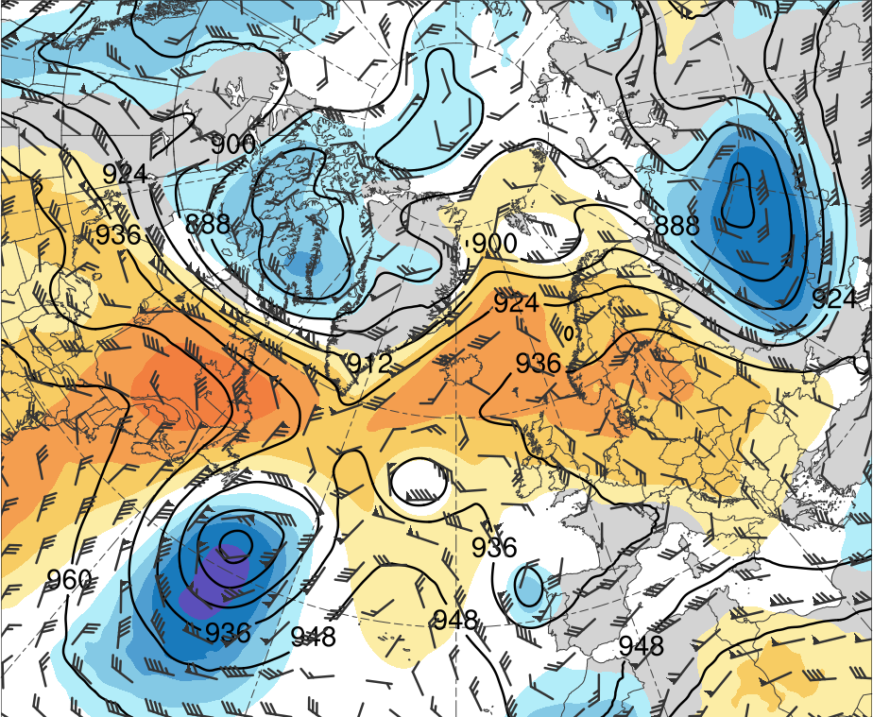
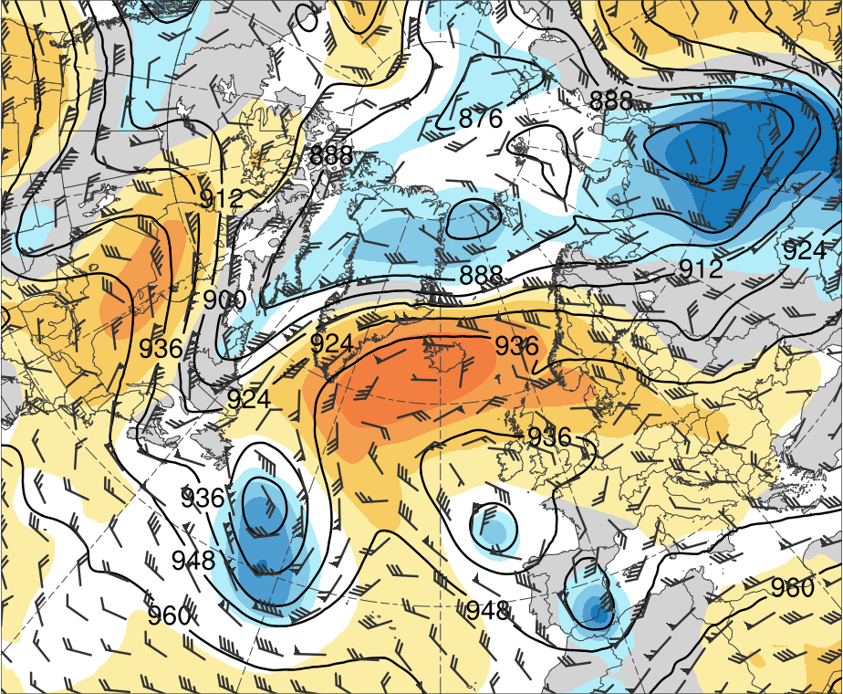
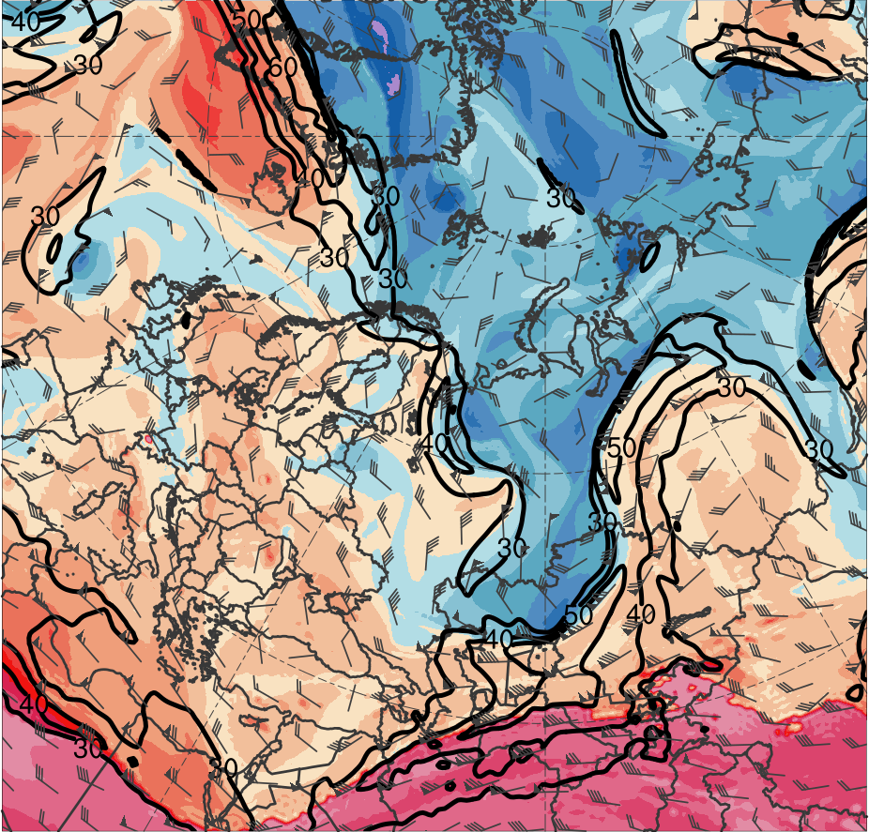
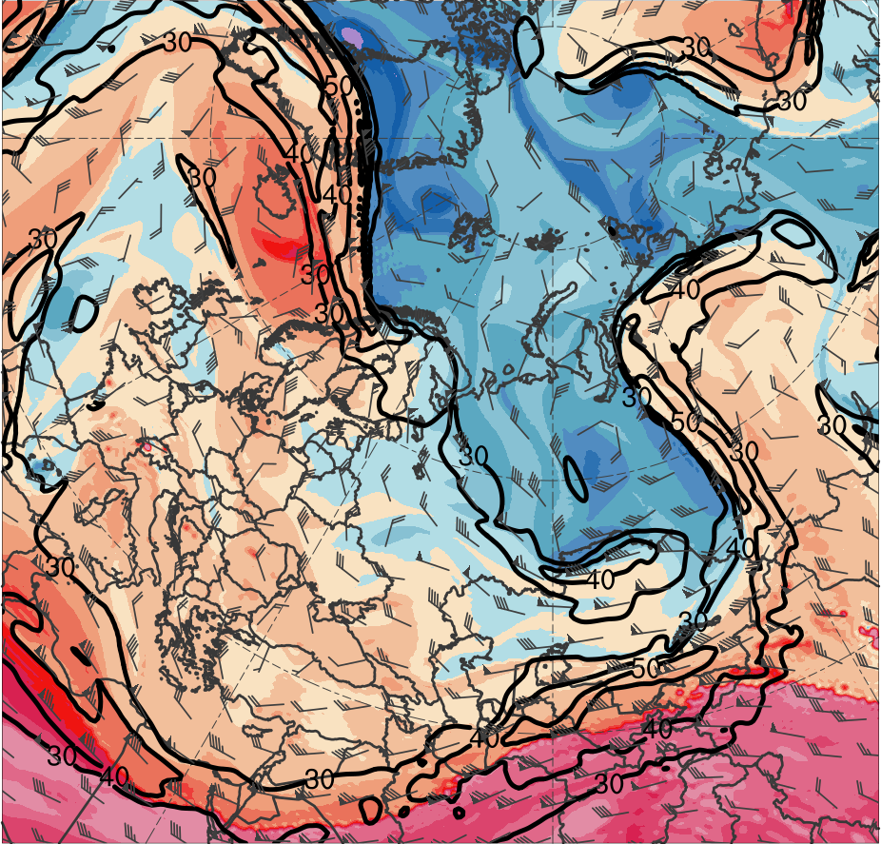
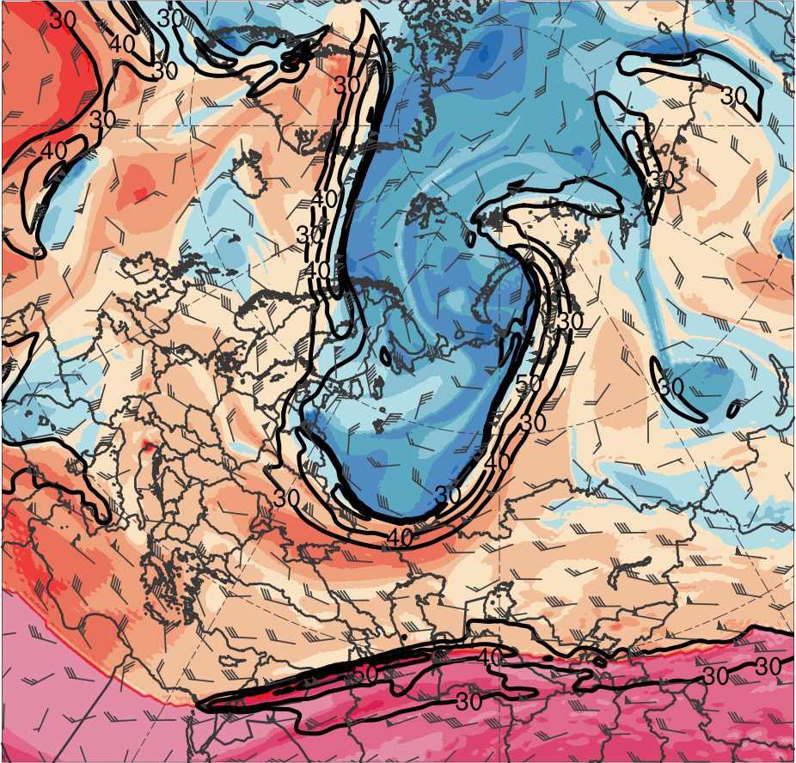
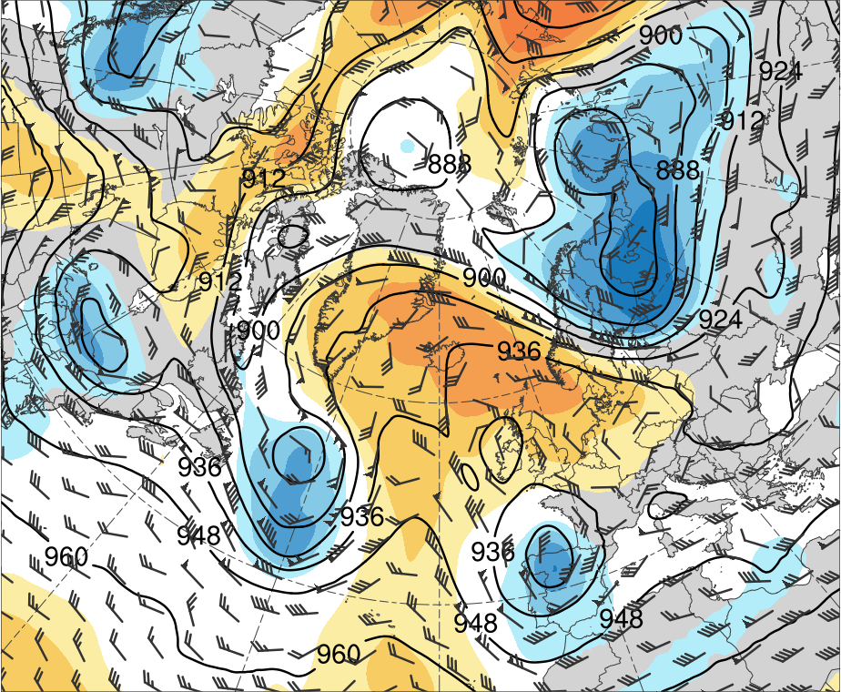
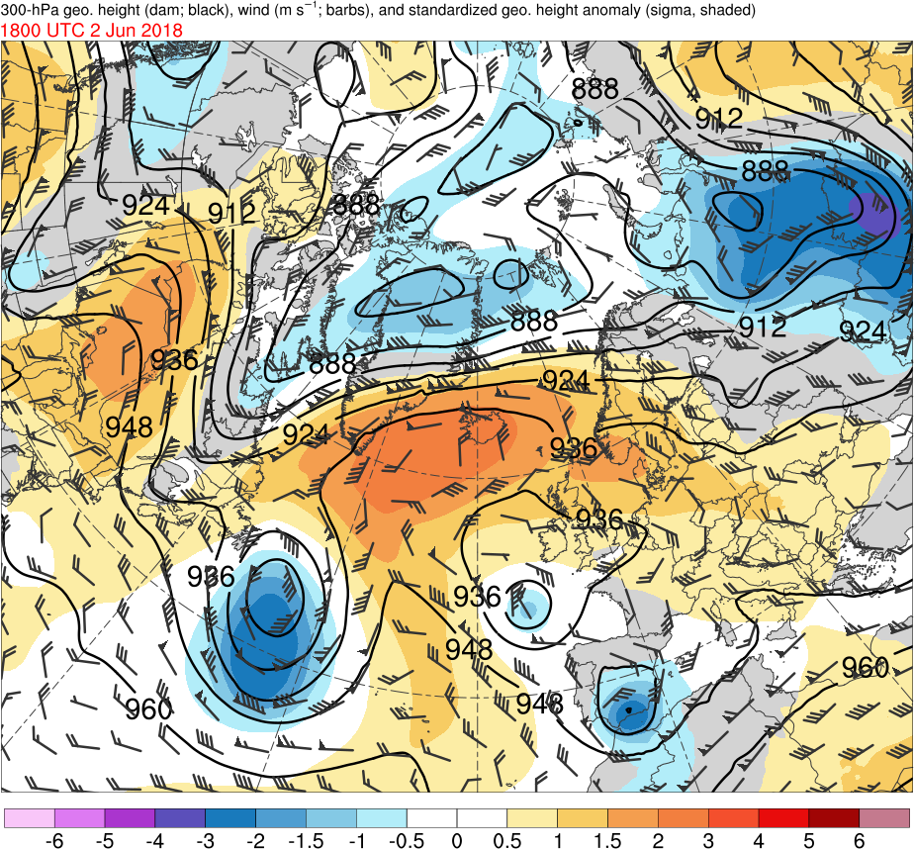
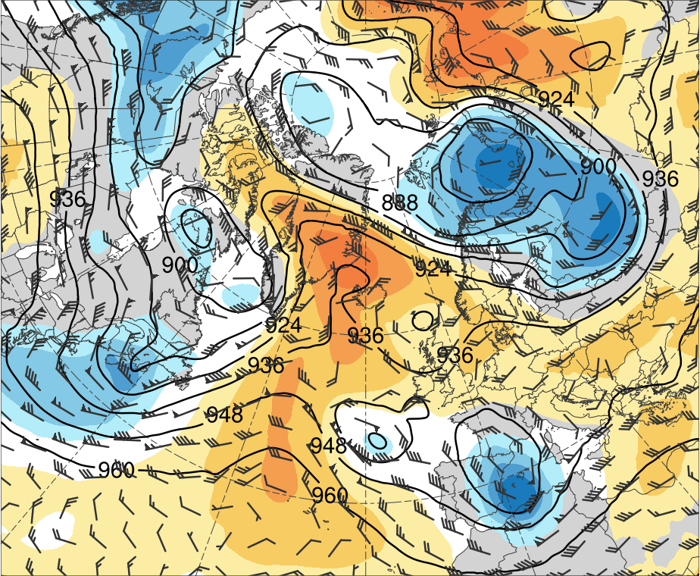
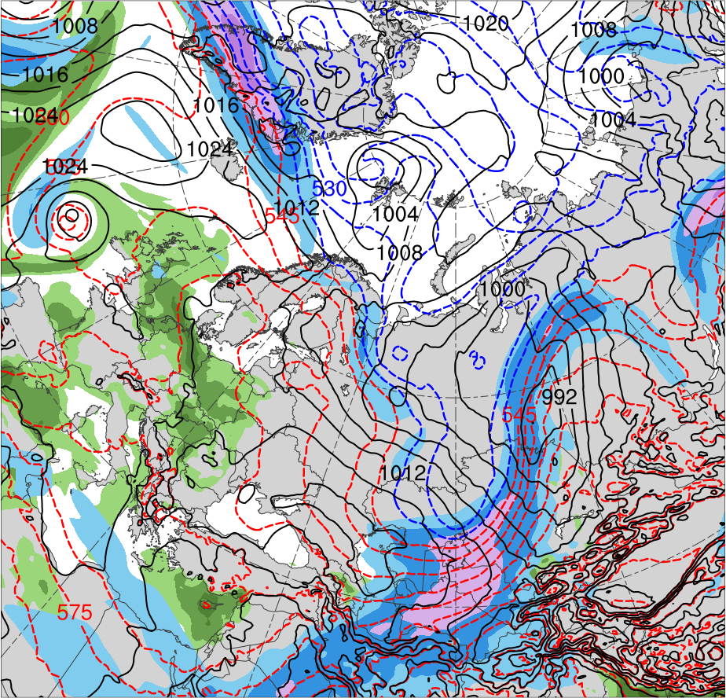
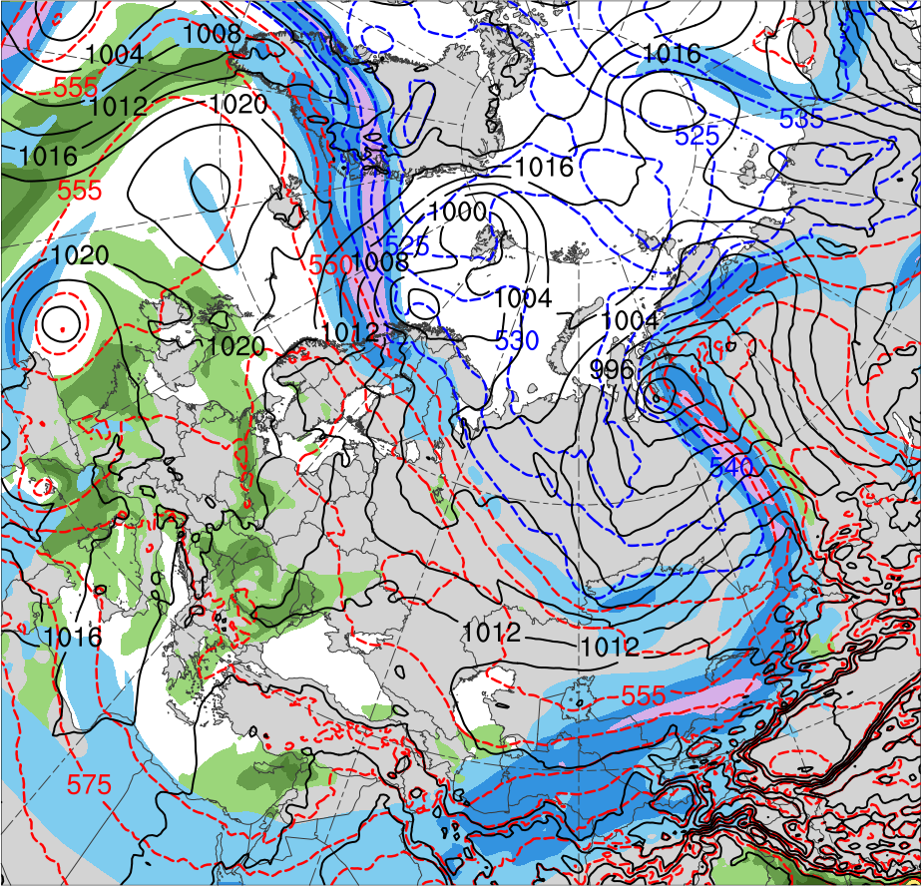
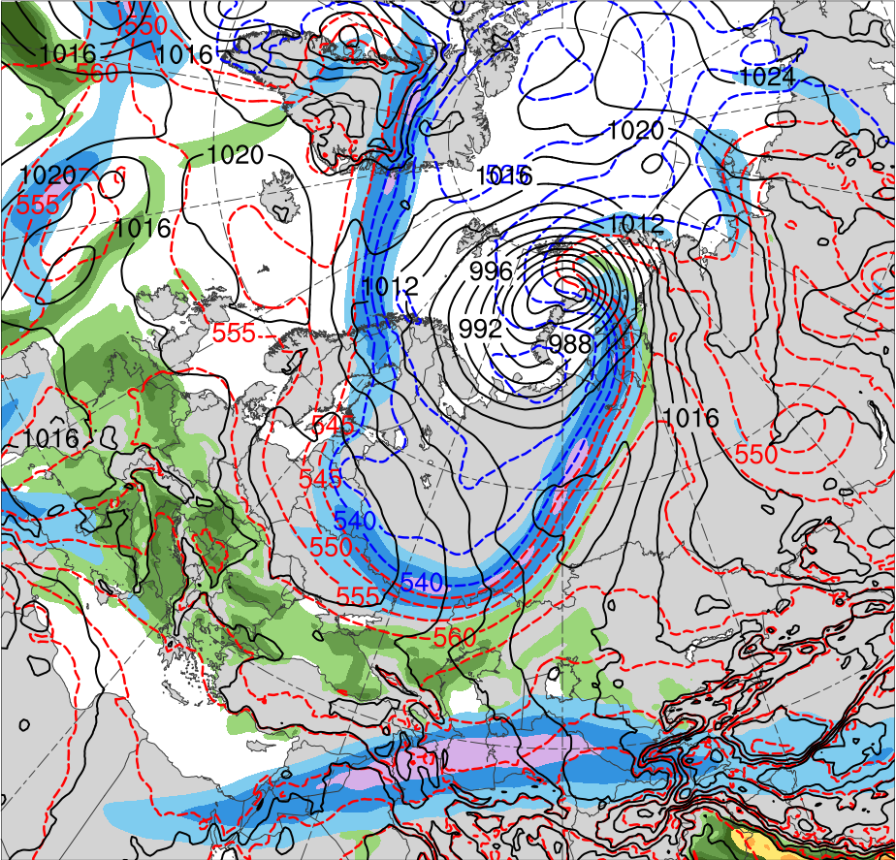
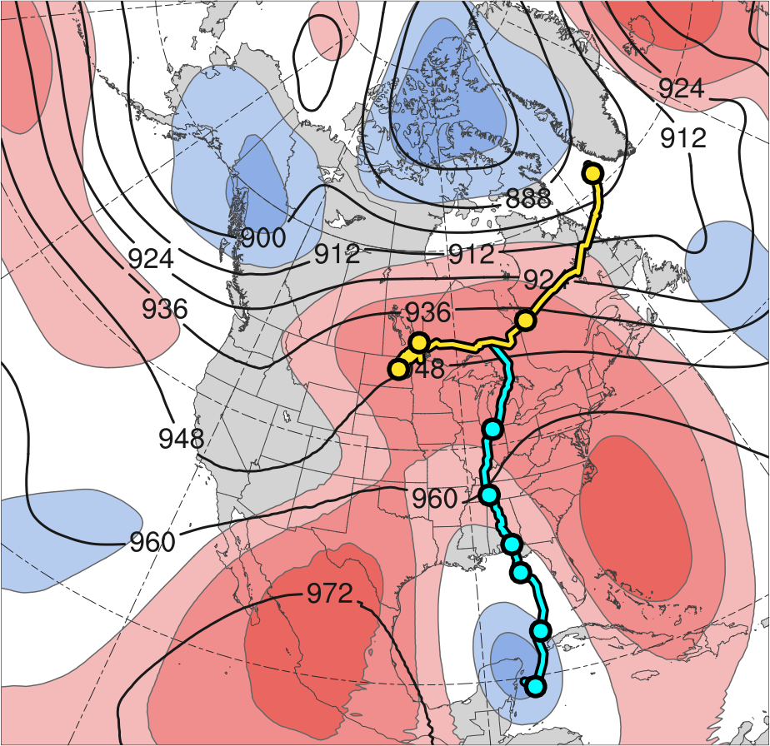
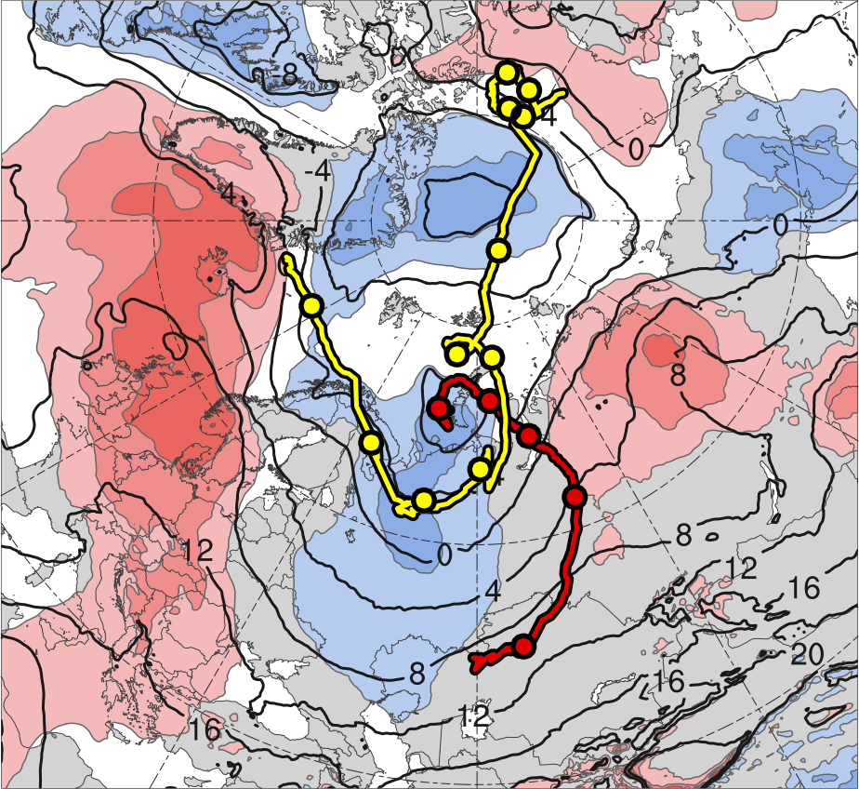
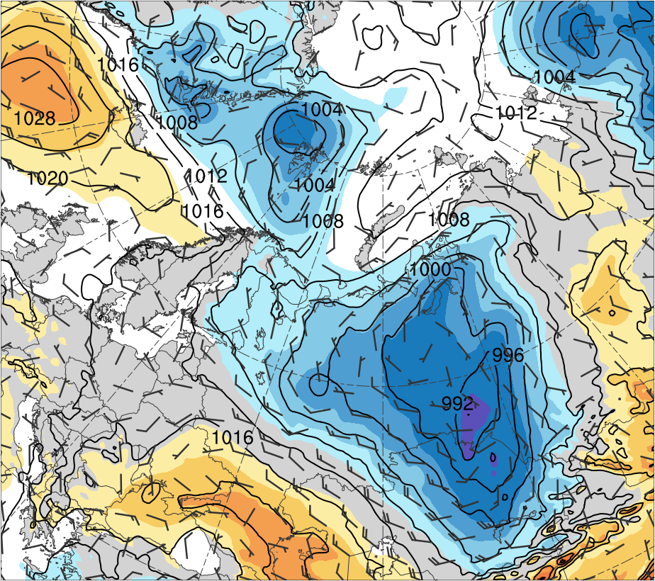
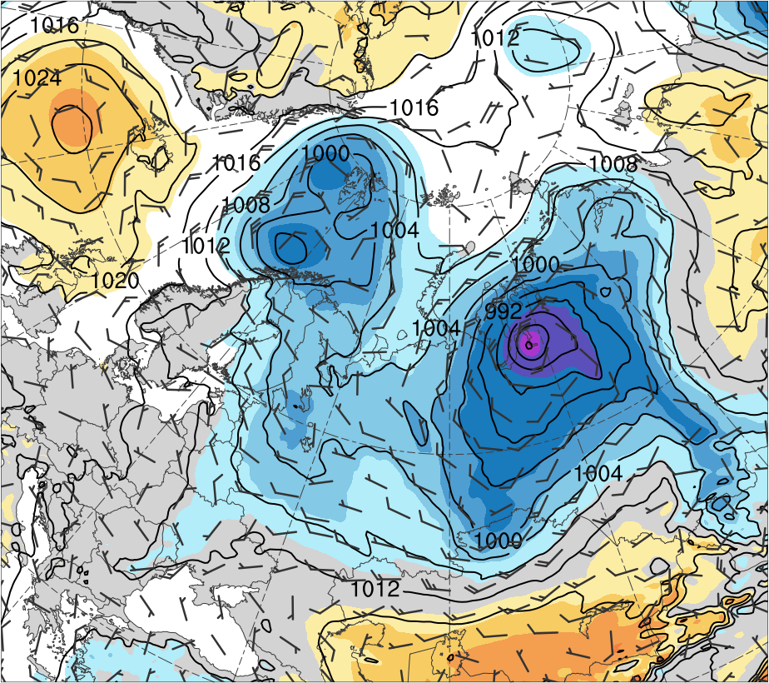
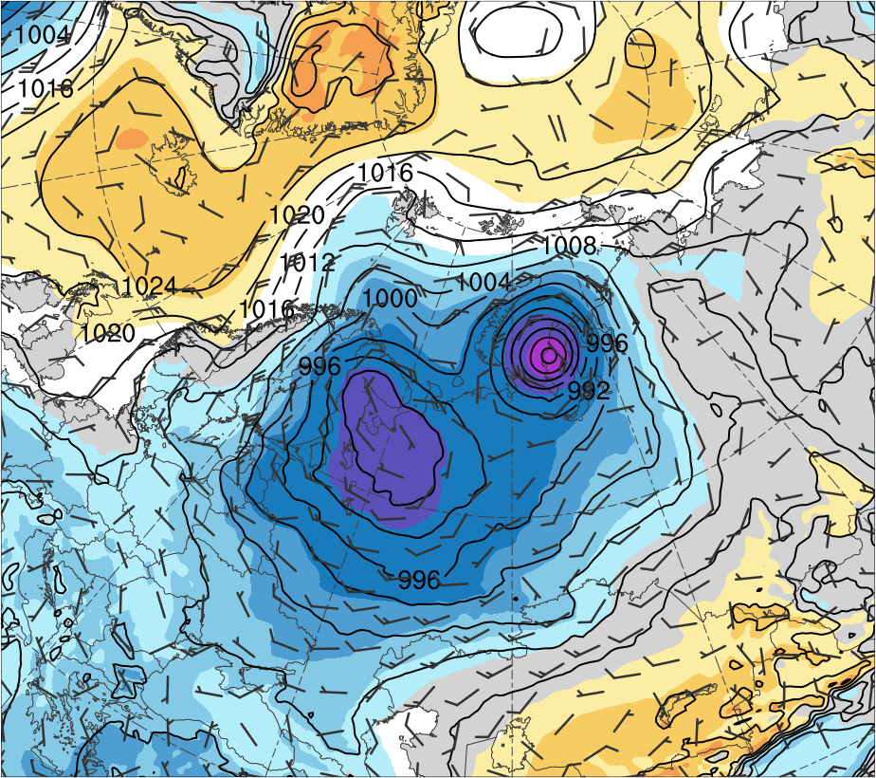
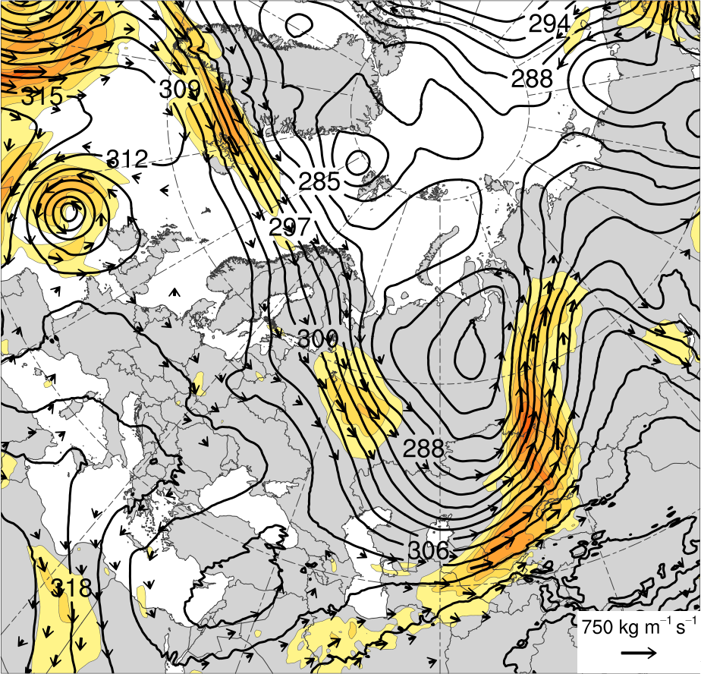
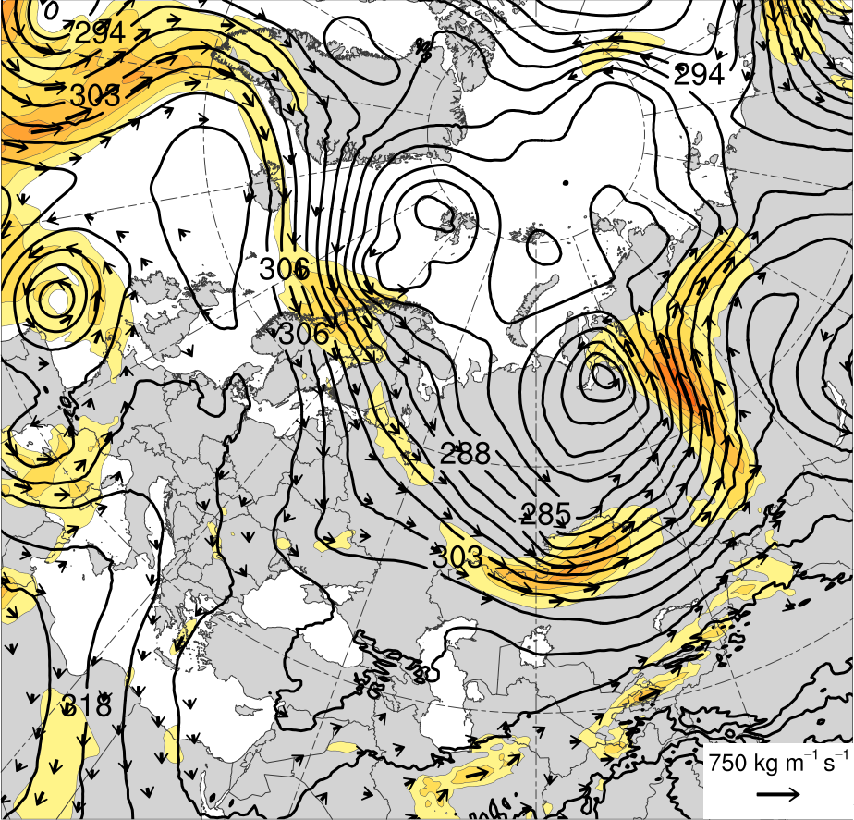
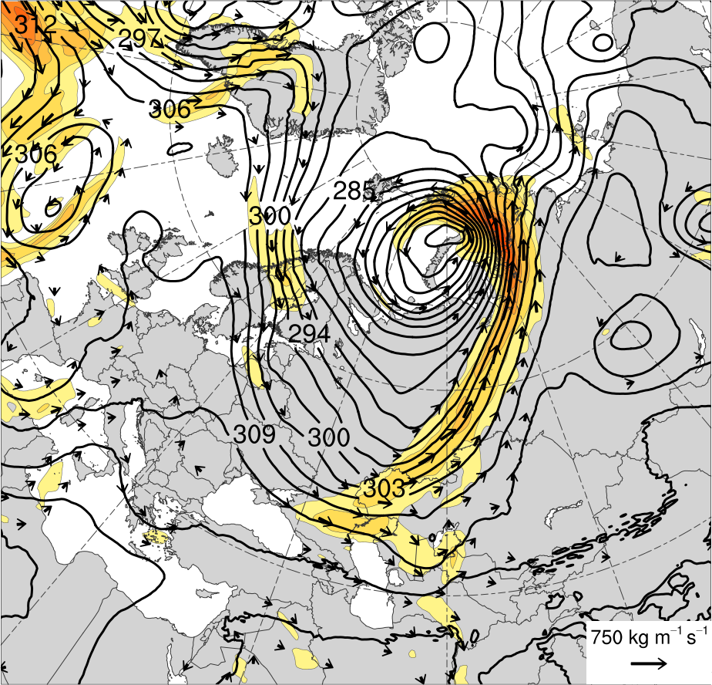
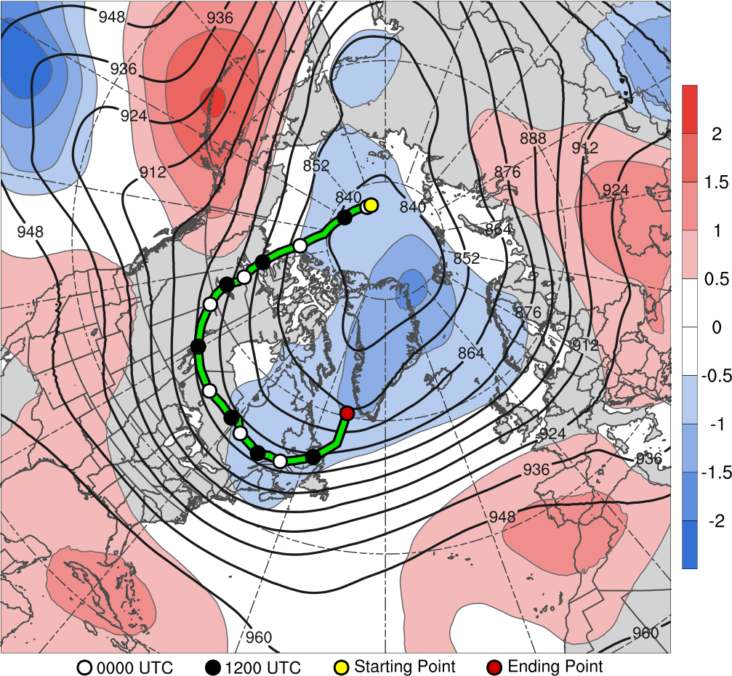
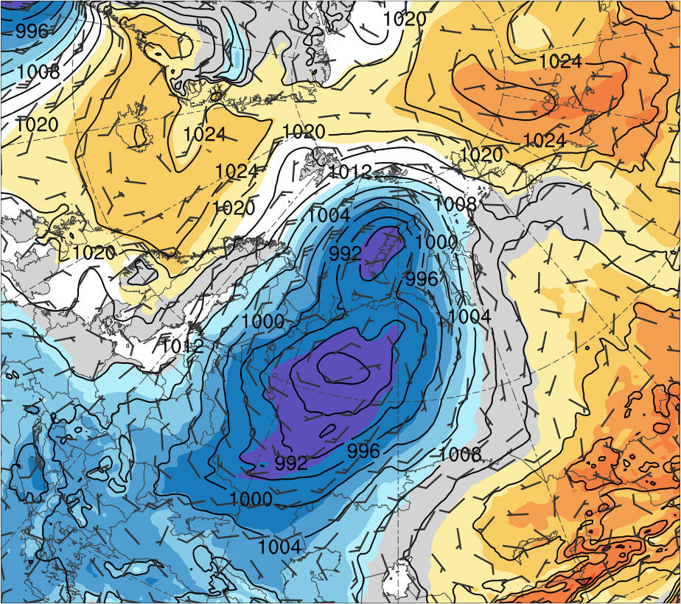
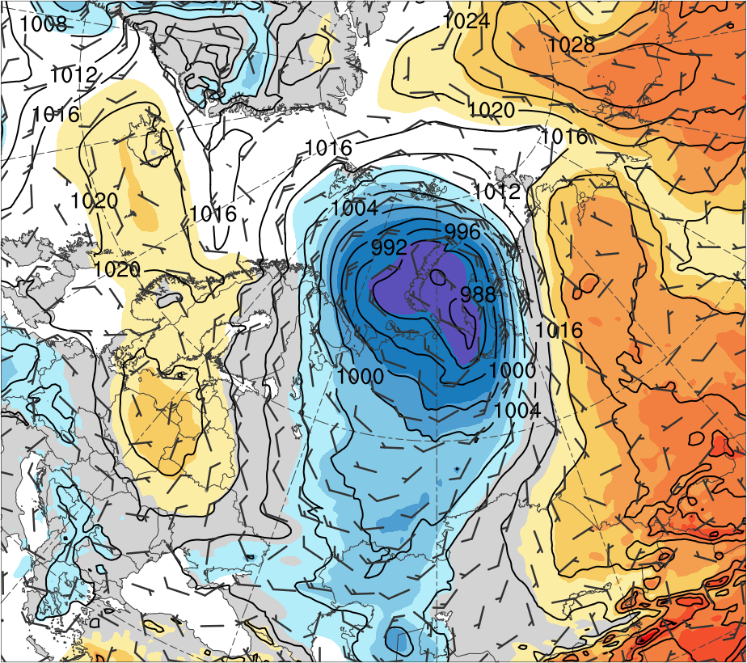
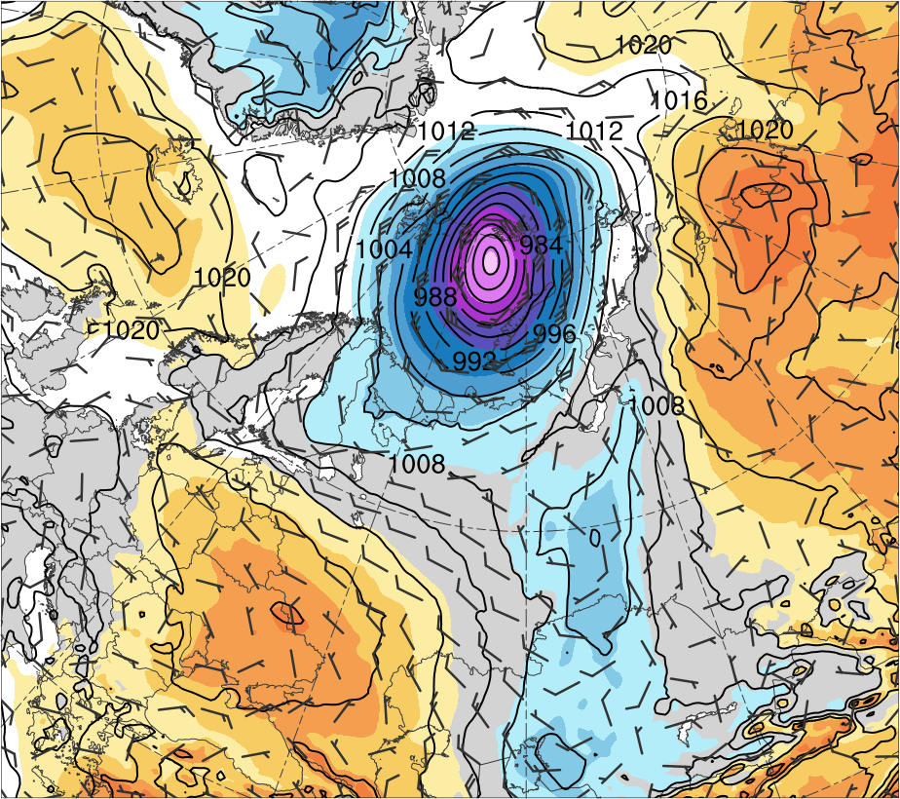
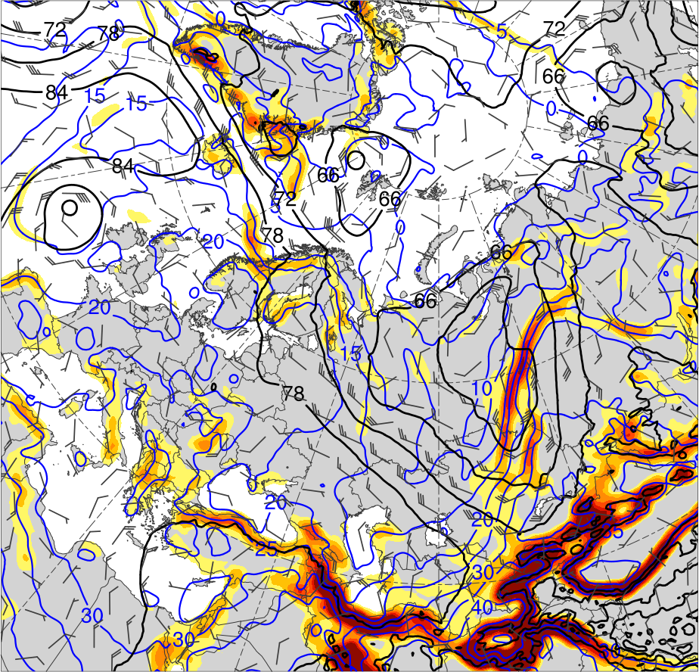
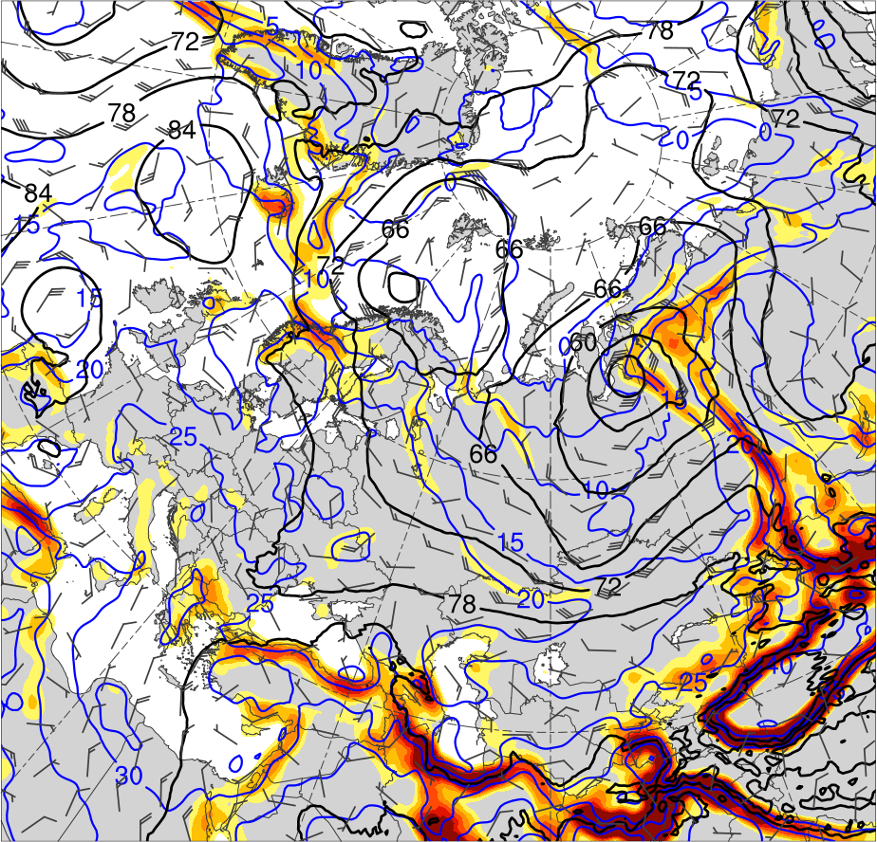
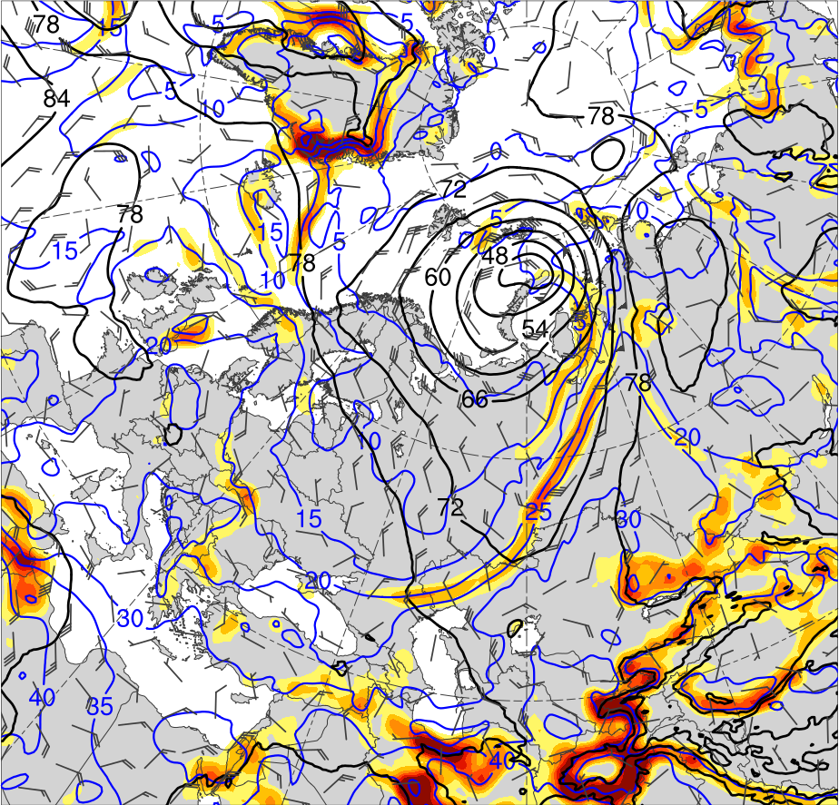
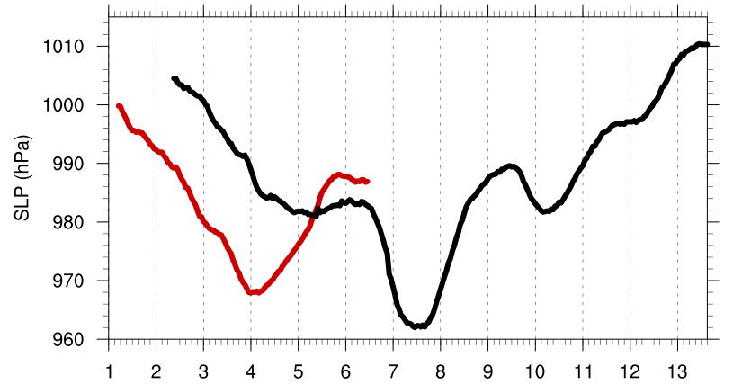
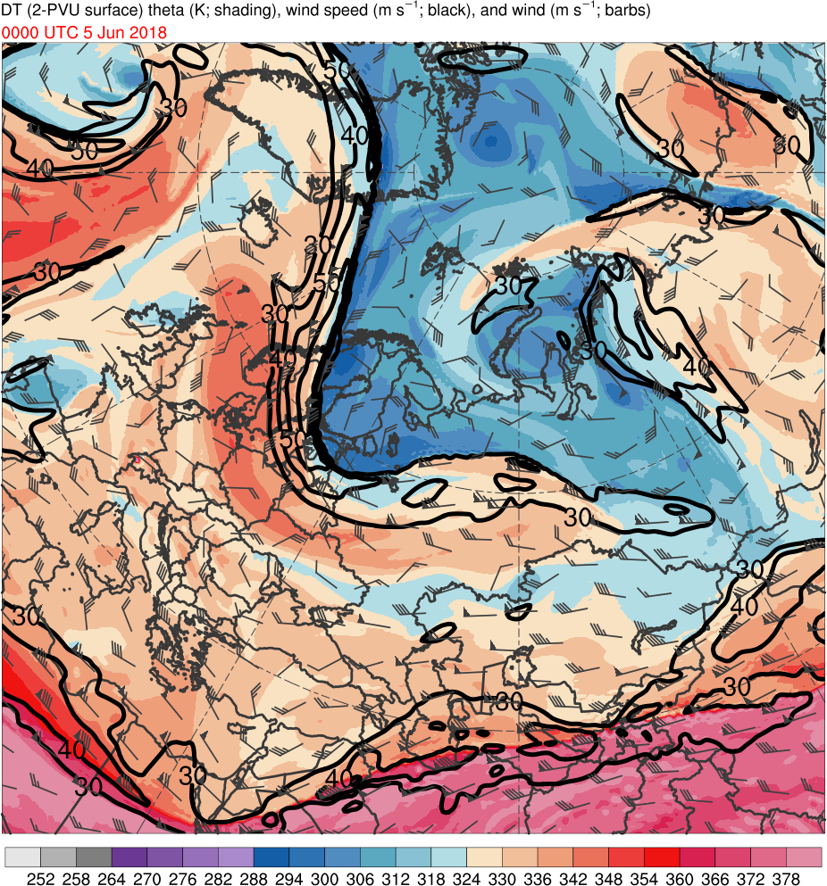
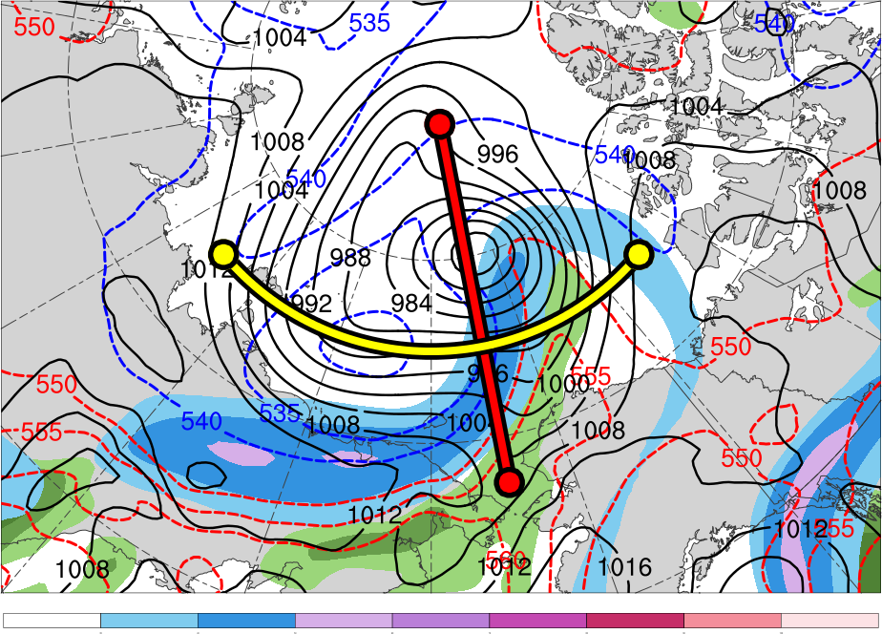
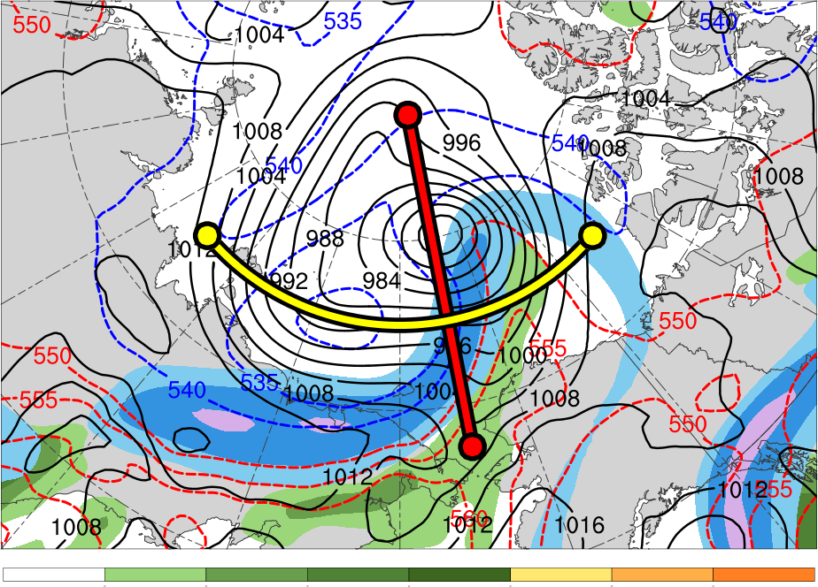
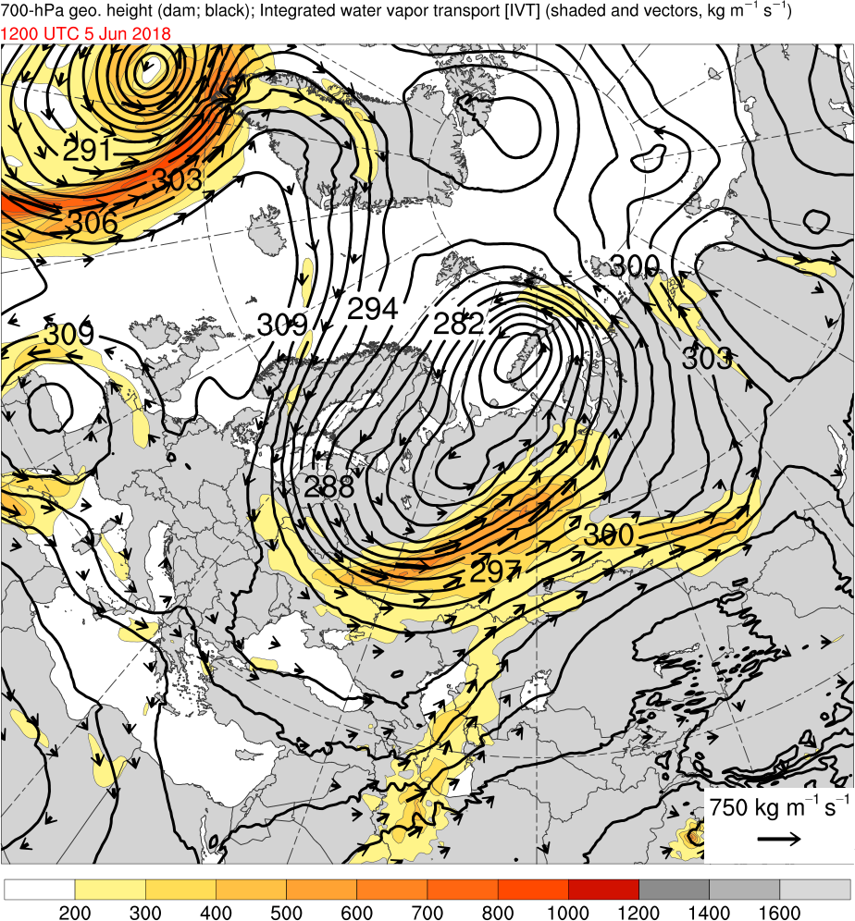
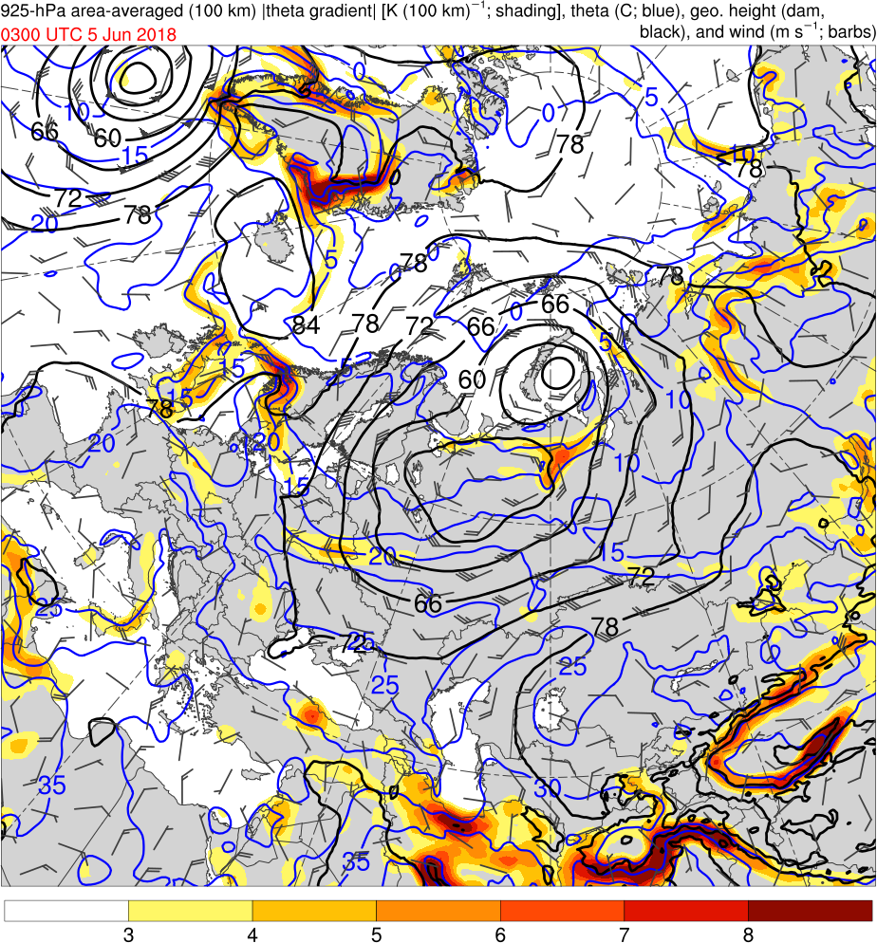
The Contributions of Tropopause Polar Vortices and Remnant Tropical Moisture from Tropical Storm Alberto to the Development of Two Intense Arctic Cyclones in June 2018
¹University at Albany, SUNY
²University of Oklahoma
A51I-2273
Lance F. Bosart¹, Kevin Biernat, Daniel Keyser, and Steven M. Cavallo²
This research was supported by Office of Naval Research Grant N00014-18-1-2200
.
1) Motivation and Background
4) Large-scale Flow Evolution
5) Synoptic Evolution of Arctic Cyclones
Arctic cyclone 1 (AC1) formed along an old cold frontal boundary northeast of the Caspian Sea, moved poleward, performed a cyclonic loop with AC2 near the north coast of Russia, and eventually merged with AC2 over the Arctic Ocean.
AC2 formed via lee cyclogenesis east of Greenland, and may have had some “DNA" from the remnants of Tropical Storm (TS) Alberto, which moved poleward across the central U.S. and northeastern Canada
Tropopause polar vortices (TPVs) are tropopause-based vortices of high-latitude origin (e.g., Cavallo and Hakim 2010) that may act as precursors to the development of Arctic cyclones (e.g., Tao et al. 2017)
Arctic cyclones may be associated with strong surface winds and poleward advection of warm, moist air, contributing to reductions in Arctic sea-ice extent (e.g., Zhang et al. 2013)
Heavy precipitation, strong surface winds, and large waves due to Arctic cyclones may pose hazards to ships navigating through open passageways in the Arctic Ocean
The comparative rarity of two sequential intense Arctic cyclones that interacted with one another, one of which (AC2) may have had antecedent DNA from TS Alberto, motivates this presentation
1200 UTC 2 June 2018 (AC1 strengthens and AC2 forms)
1200 UTC 3 June 2018 (AC1 rapidly strengthens)
0000 UTC 7 June 2018 (AC2 rapidly strengthens)
(a) 0000 UTC 1 Jun 2018
(b) 0000 UTC 3 Jun 2018
6
5
(a)
(e)
(i)
4
3
2
1.5
1
0.5
(c) 0000 UTC 5 Jun 2018
(d) 0000 UTC 7 Jun 2018
0
-0.5
-1
(b)
(f)
(j)
Data: ERA5 downloaded 0.25° horizontal resolution and ERA-Interim 1981–2010 climatology fields gridded to 0.25° horizontal resolution for calculation of standardized anomalies
Manually tracked AC1, AC2, and a Canadian low (CL) by following the locations of minimum sea level pressure (SLP)
Tracked TS Alberto using National Hurricane Center positions during 1500 UTC 25 May–0600 UTC 29 May 2018 and ERA5 afterward
-1.5
2) Data and Methods
-2
-3
-4
-5
-6
3) Track and Intensity
Figure 3. 300-hPa geopotential height (dam, black), wind (m s⁻¹, flags and barbs), and standardized geopotential height anomalies (σ, shaded)
(a)
(b)
6) Interactions between Arctic Cyclones
(c)
(g)
(k)
(a) 1200 UTC 2 Jun 2018
(b) 1200 UTC 3 Jun 2018
(c) 1200 UTC 4 Jun 2018
6
5
4
3
2
1.5
1
0.5
(d) 1200 UTC 5 Jun 2018
(e) 1200 UTC 6 Jun 2018
(f) 1200 UTC 7 Jun 2018
0
-0.5
-1
(d)
(h)
(l)
Genesis
Lysis
Merger
-1.5
-2
-1.5
-1
-0.5
0
0.5
1
1.5
2
σ
-2
Table 1. Lifetimes of cyclones
Figure 1. Tracks of (a) Alberto and a Canadian Low (CL), and (b) AC1 and AC2. Also, (a) 26 May–1 June Aug 2018 time-mean 300-hPa geopotential height (dam, gray) and standardized anomaly of 300-hPa geopotential height (σ, shaded), and (b) 1–7 June 2018 time-mean 850-hPa temperature (°C, gray) and standardized anomaly of 850-hPa temperature (σ, shaded). 0000 UTC positions of cyclones shown by dots.
-3
Feature | Date of Genesis | Date of Lysis | Lifetime (d)
Alberto | 25 May | 31 May | ~6
CL | 29 May | 2 June | ~3
AC1 | 1 June | 6 June | ~5
AC2 | 2 June | 13 June | ~11
-4
-5
Figure 5. SLP (hPa, black), 10-m wind (m s⁻¹, flags and barbs), and standardized SLP anomalies (σ, shaded)
-6
Figure 2. Time series of minimum SLP of of ACs (every 1h)
7) Discussion
AC2
The remnants of TS Alberto and CL, which merge over southern Canada (Fig. 1a), possibly contribute to the formation of AC2, which along with AC1, develop and strengthen in a region of strong baroclinicity extending from Greenland to Eurasia (Figs. 1b and 2)
A deep trough over Eurasia on 1–3 June (Figs. 3a,b) and a second deep trough that develops over Eurasia during 5–7 June (Figs. 3c,d) in response to cyclonic wave breaking south of Greenland during 3–5 June (Figs. 3b,c) likely foster development of AC1 and AC2
Upper-level disturbances, including TPVs, embedded within the deep troughs, as well as baroclinic processes and possibly latent heating may contribute to development and then rapid strengthening of AC1 and AC2 (Figs. 4a–l)
− Upper-level diffluence supported by a shortening of the half-wavelength of the upper-level
flow may further contribute to rapid strengthening of AC1 and AC2 in left-exit region of an
upper-level jet streak (Figs. 4e,f and Figs. 4i,j, respectively)
The interaction between AC1 and AC2 and merger of AC1 with AC2 (Figs. 5a–f) may also contribute to the intensification of AC2, helping allow AC2 to reach a peak intensity of 962 hPa (Fig. 2), which corresponds to a standardized SLP anomaly of <−6σ (Fig. 5f)
Peak intensity of AC1 at 0400 UTC 4 June 2018
(967.9 hPa)
DT (2-PVU) θ (K)
AC2
252
258
264
270
276
282
288
294
300
306
312
318
324
330
336
342
348
354
360
366
372
378
Peak intensity of AC2 at 1100 UTC 7 June 2018
(962.0 hPa)
300-hPa wind speed (m s⁻¹)
PW (mm)
30
40
50
60
70
80
90
100
25
30
35
40
45
50
55
References
Integrated vapor transport (IVT) (kg m⁻¹ s⁻¹)
925-hPa area-averaged (100 km) |θ gradient| [K (100 km)⁻¹]
Cavallo, S. M., and G. J. Hakim, 2010: Composite structure of tropopause polar cyclones. Mon. Wea. Rev., 138, 3840–3857.
Dee, D. P., and Coauthors, 2011: The ERA-Interim reanalysis: Configuration and performance of the data assimilation system. Quart. J. Roy. Meteor. Soc., 137, 553–597.
Hersbach, H., and D. Dee, 2016: ERA5 reanalysis is in production. ECMWF Newsletter, No. 147, ECMWF, Reading, United Kingdom, 7.
[Available online at www.ecmwf.int/sites/ default/files/elibrary/2016/16299-newsletter-no147-spring-2016.pdf.]
Szapiro, N., and S. Cavallo, 2018: TPVTrack v1.0: A watershed segmentation and overlap correspondence method for tracking tropopause polar vortices. Geosci. Model Dev.
Discuss., in review.
Tao, W., J. Zhang, Y. Fu, and X. Zhang, 2017: Driving roles of tropospheric and stratospheric thermal anomalies in intensification and persistence of the Arctic superstorm in 2012.
Geophys. Res. Lett., 44, 10017–10025.
Zhang, J., R. Lindsay, A. Schweiger, and M. Steele, 2013: The impact of an intense summer cyclone on 2012 Arctic sea ice retreat. Geophys. Res. Lett., 40, 720–726.
200
300
400
500
600
700
800
1000
1200
1400
1600
3
4
5
6
7
8
Figure 4. (first row) DT (2-PVU surface) θ (K, shaded), wind speed (black, every 10 m s⁻¹ starting at 30 m s⁻¹), and wind (m s⁻¹, flags and barbs);
(second row) 300-hPa wind speed (m s⁻¹, shaded), PW (mm, shaded), 1000–500-hPa thickness (dam, dashed red and blue), and SLP (hPa, black);
(third row) IVT ( kg m⁻¹ s⁻¹, shaded and vectors), and 700-hPa geopotential height (dam; black) and wind (m s⁻¹, flags and barbs);
(fourth row) 925-hPa area-averaged (100 km) |θ gradient| [K (100 km) ⁻¹, shaded ], θ (°C, blue), geopotential height (dam; black), and wind (m s⁻¹, flags and barbs)

