Slide 1
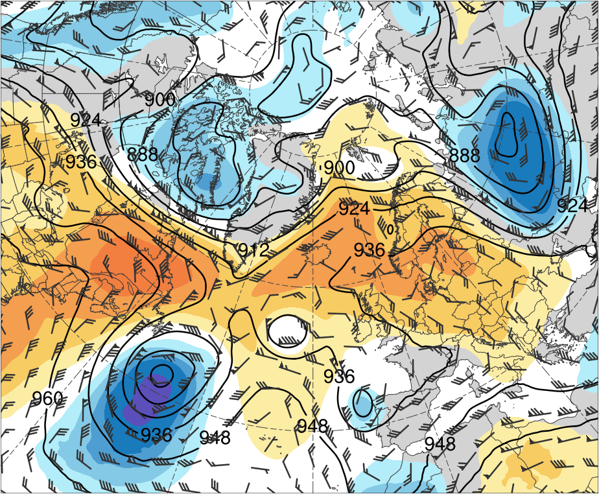
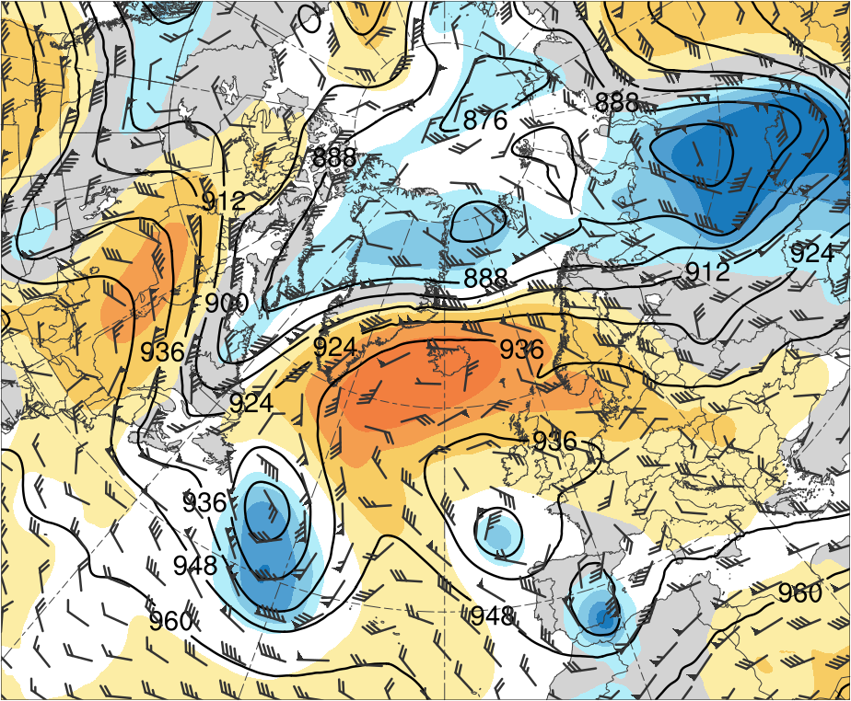
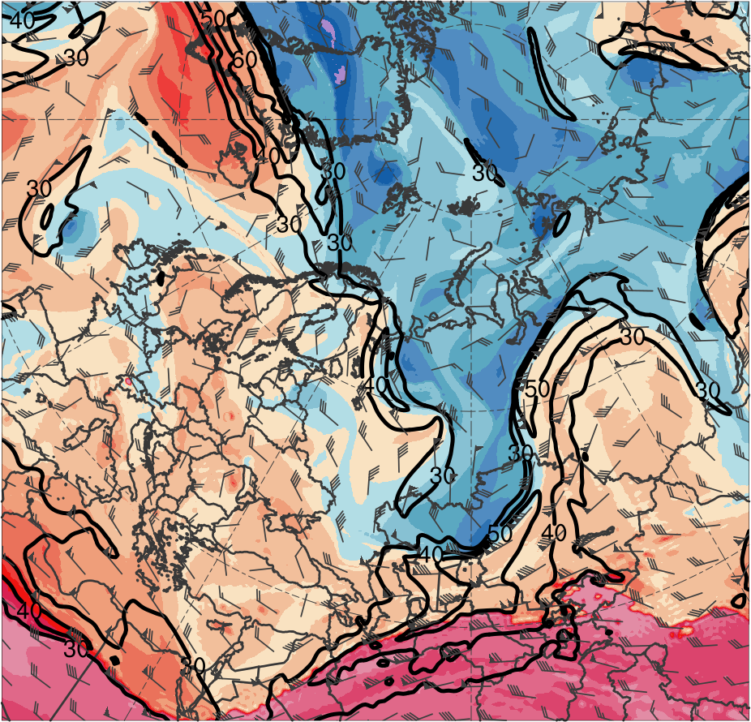
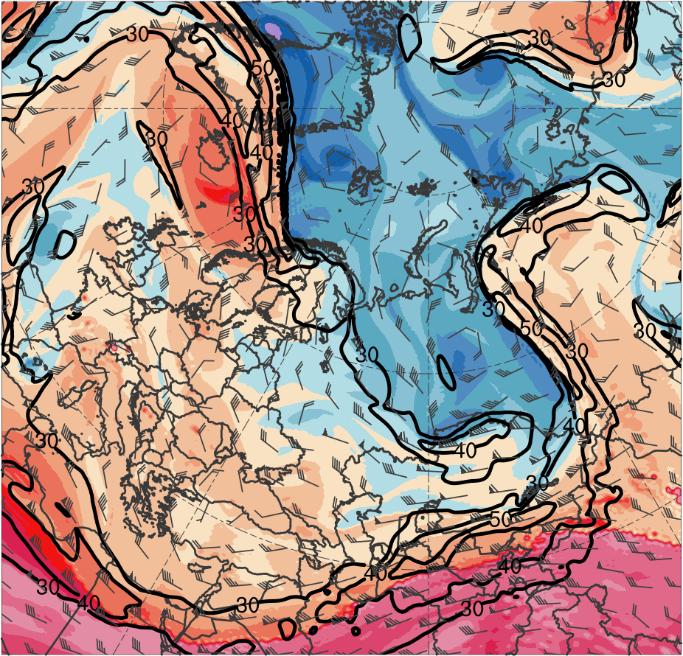
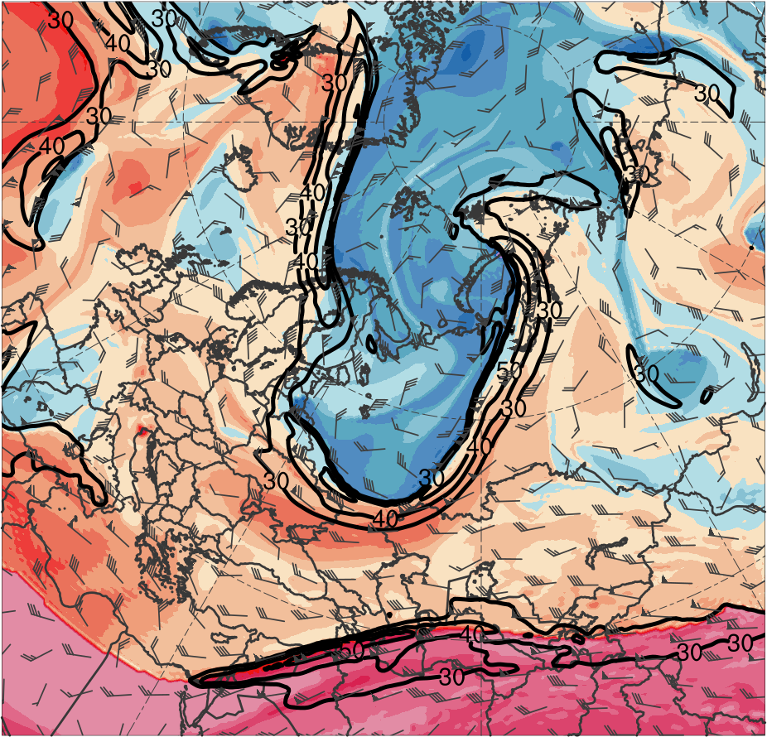
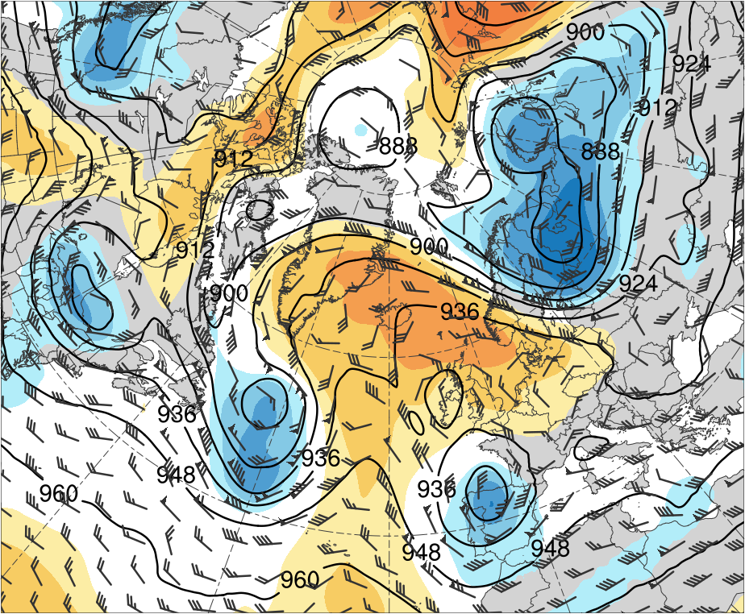
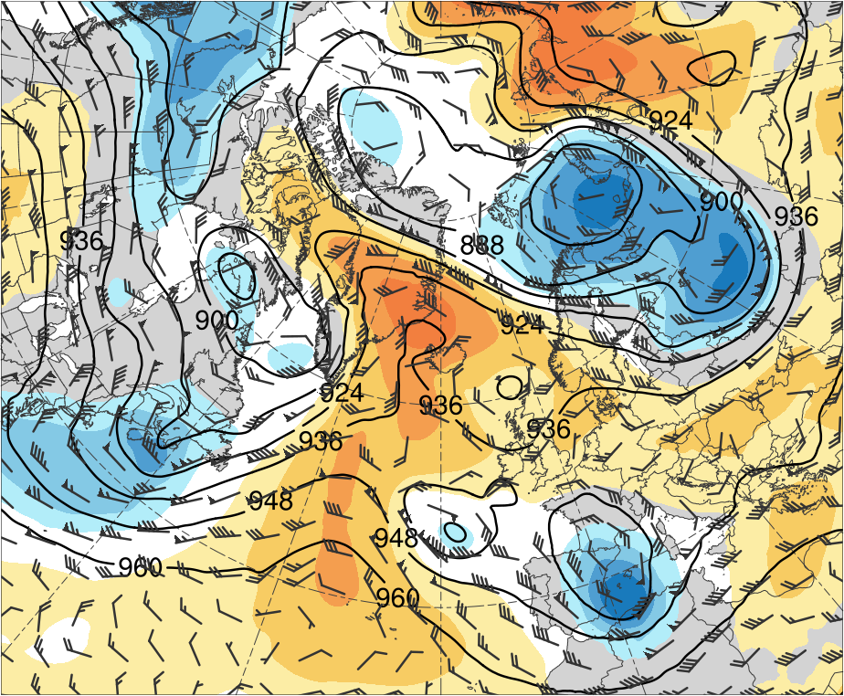
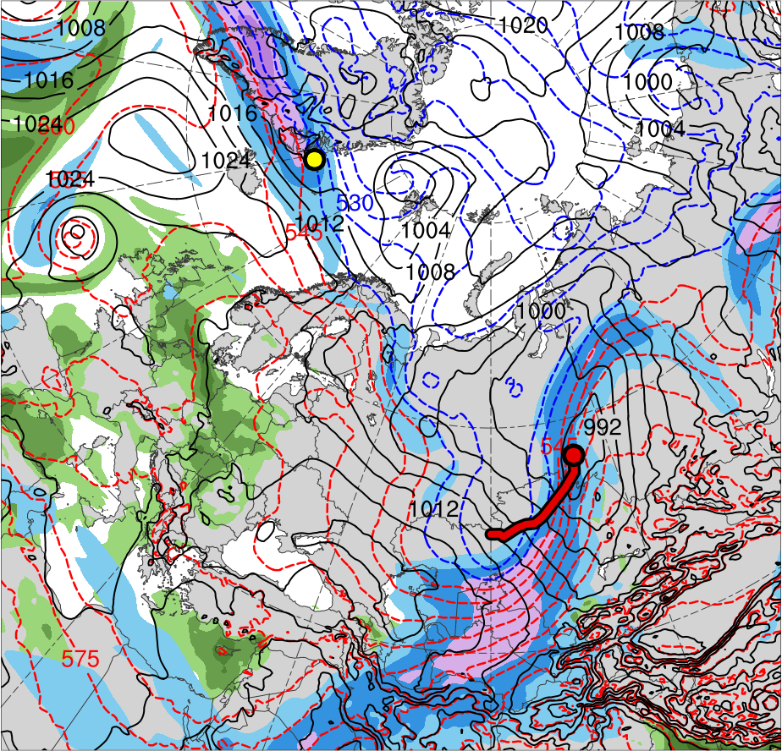
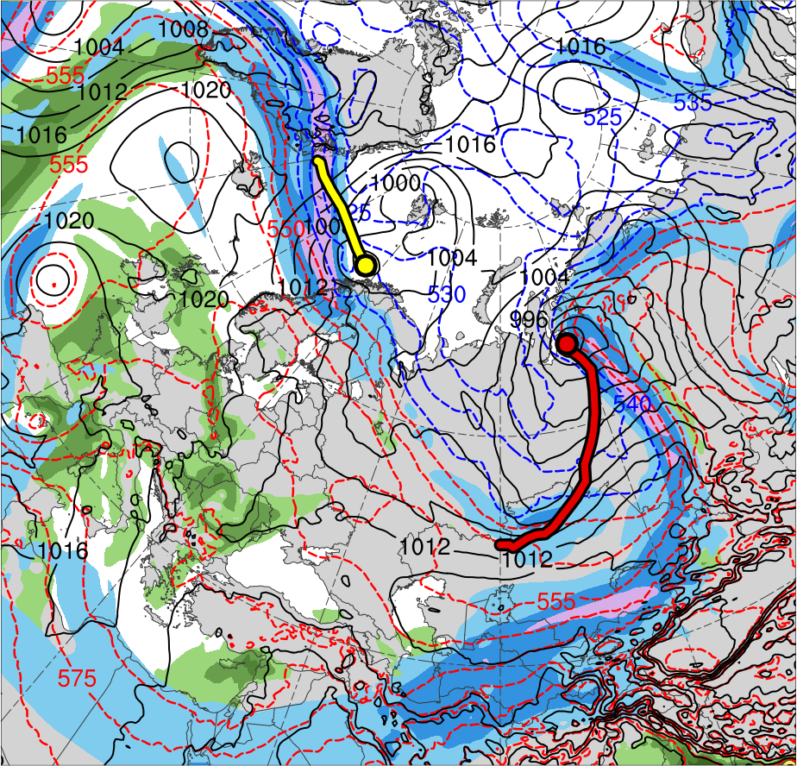
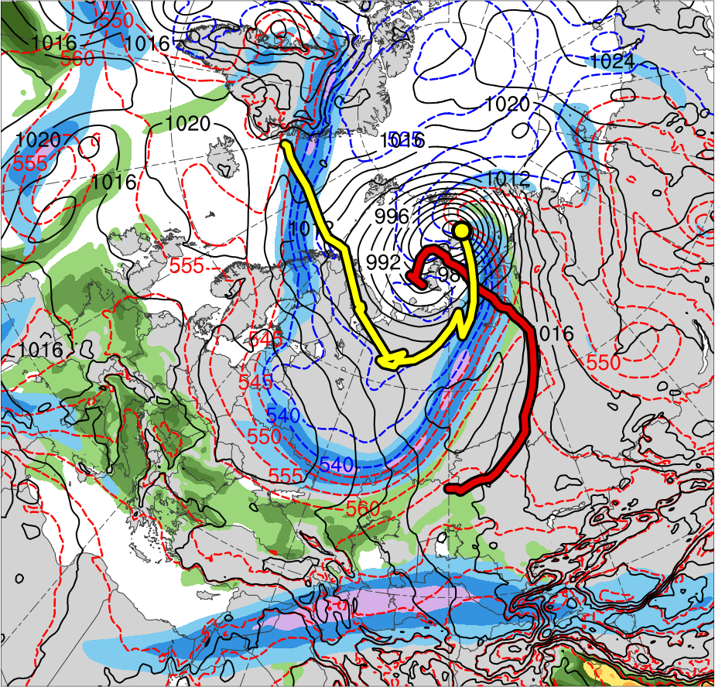
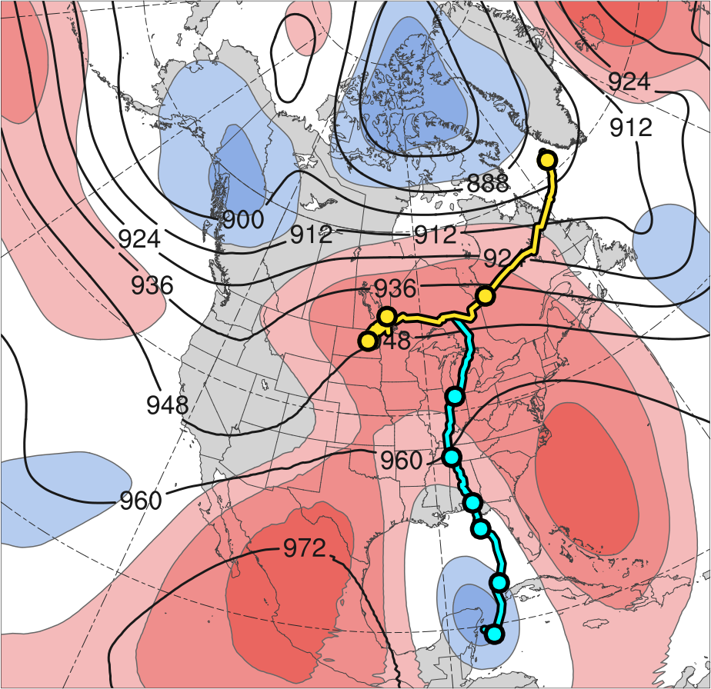
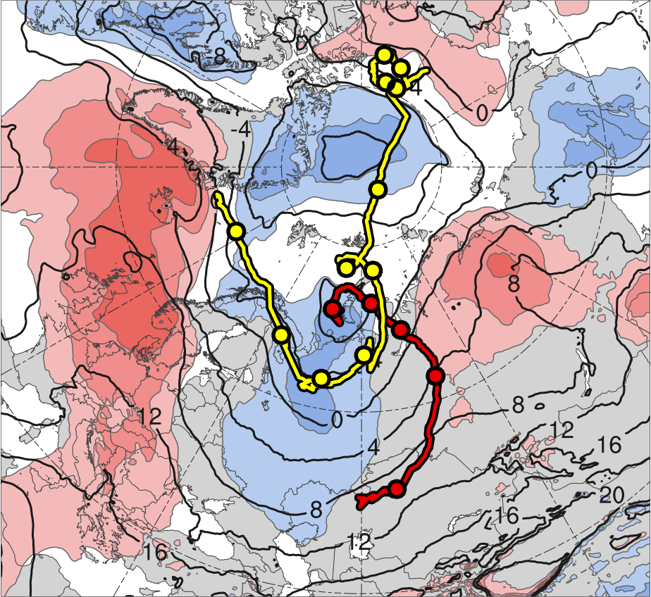
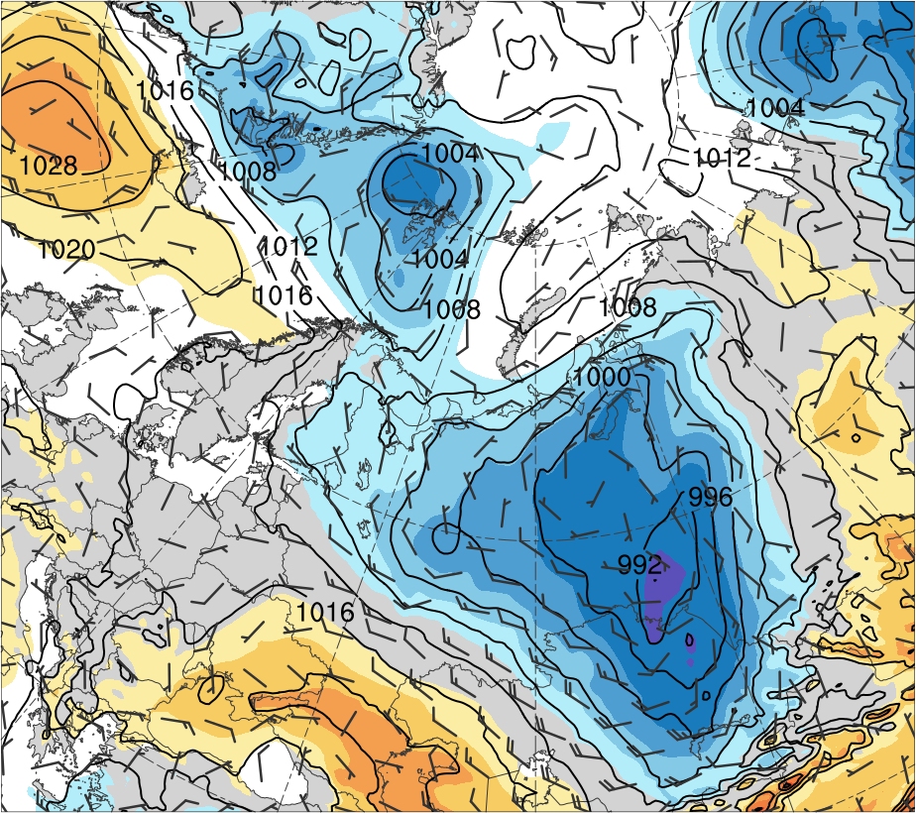
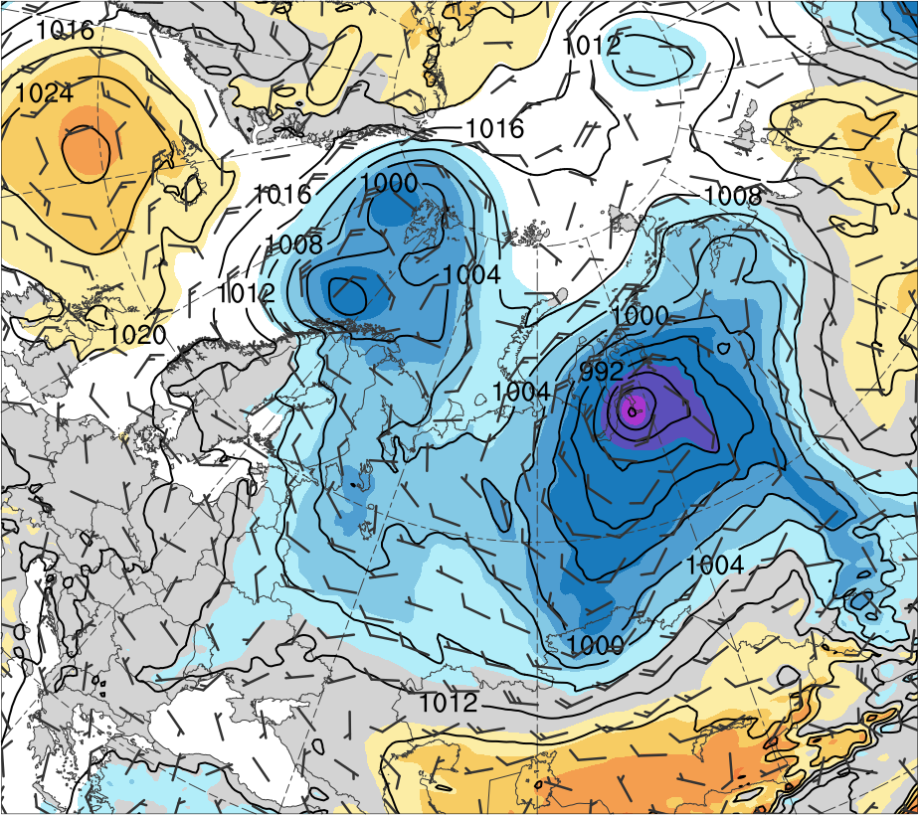
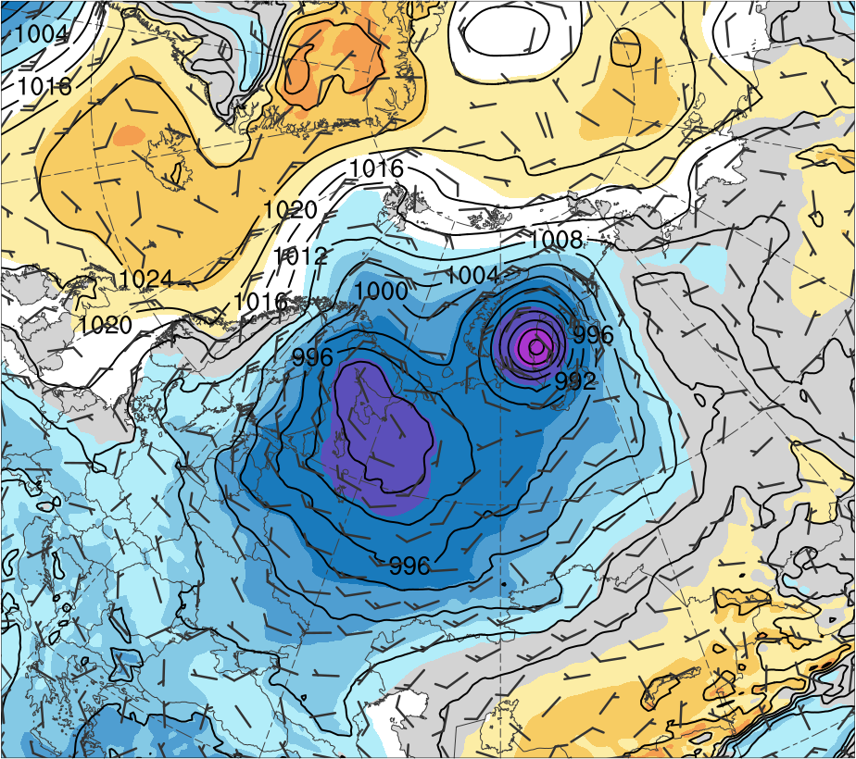
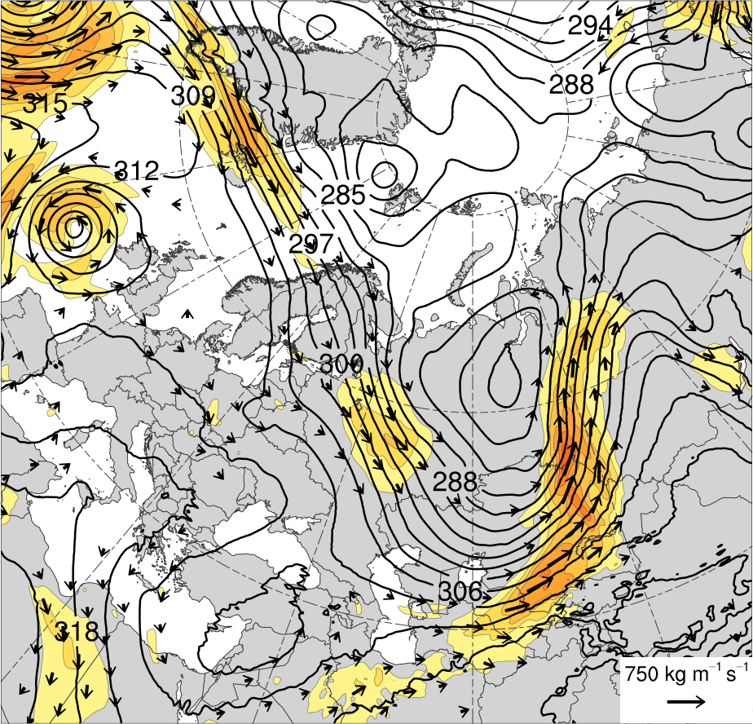
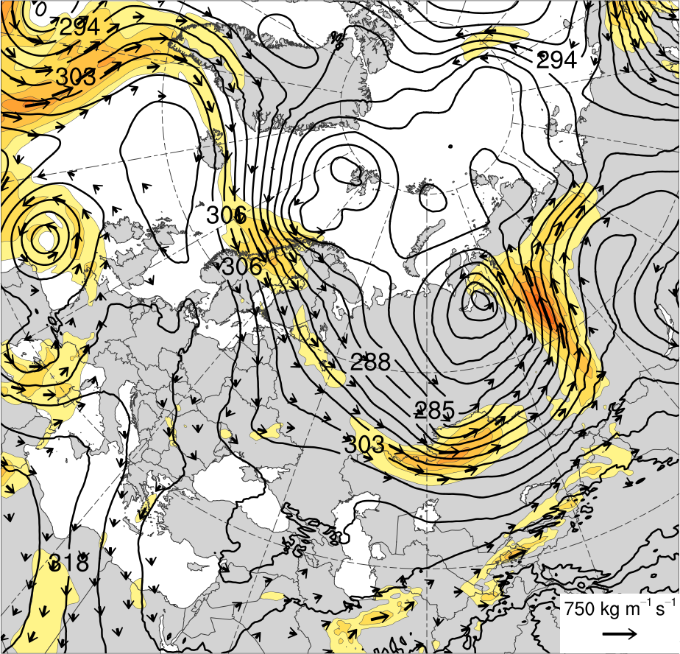
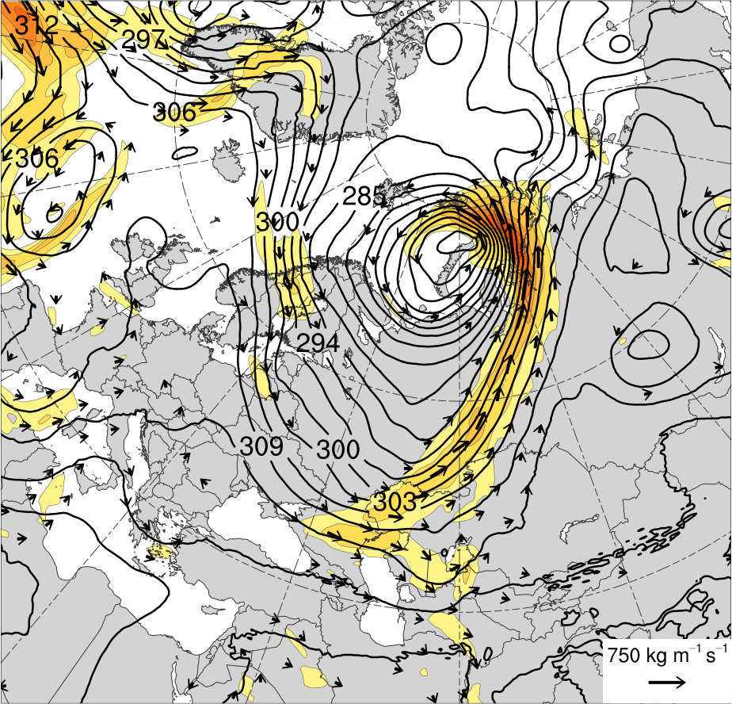
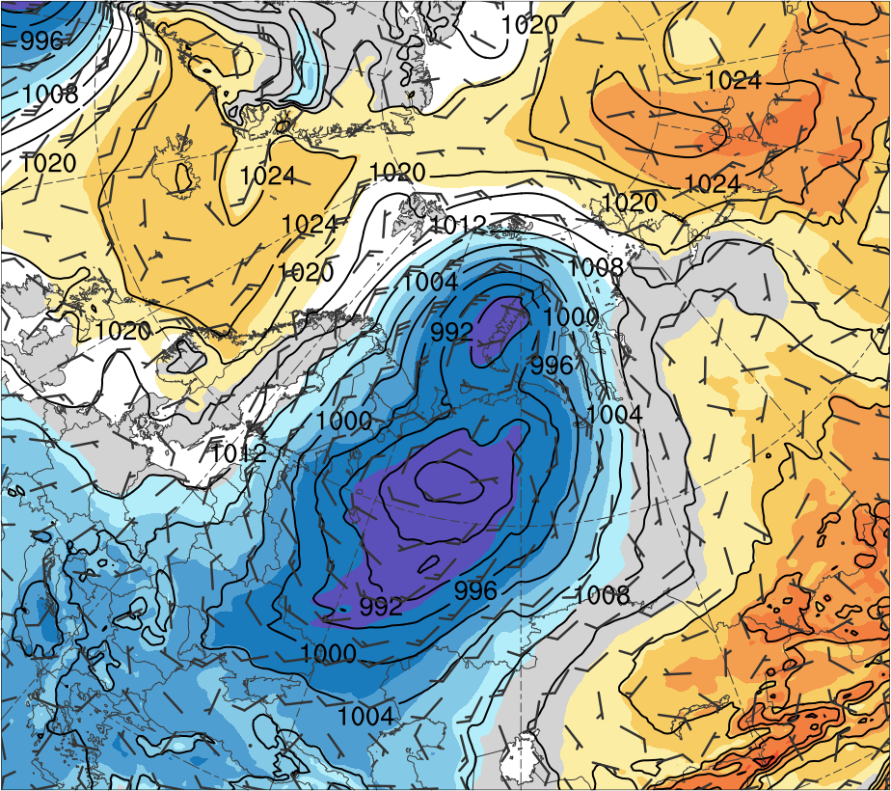
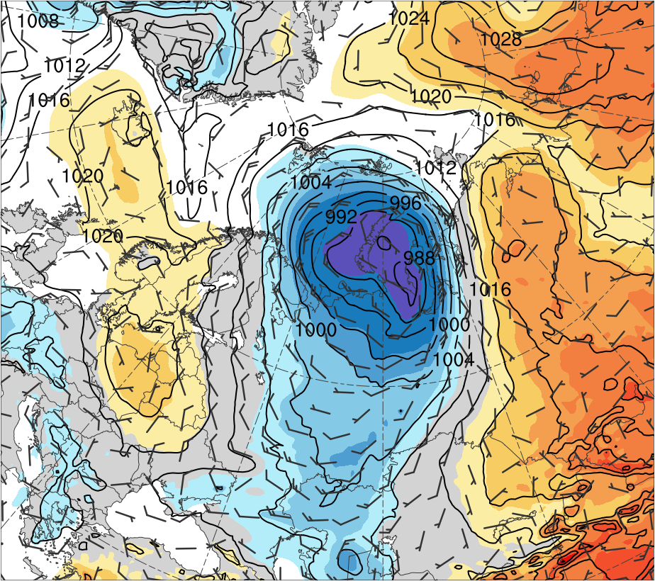
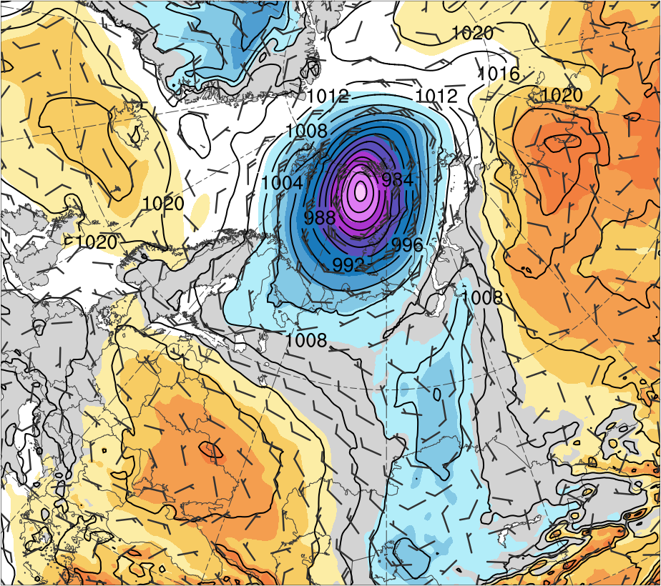
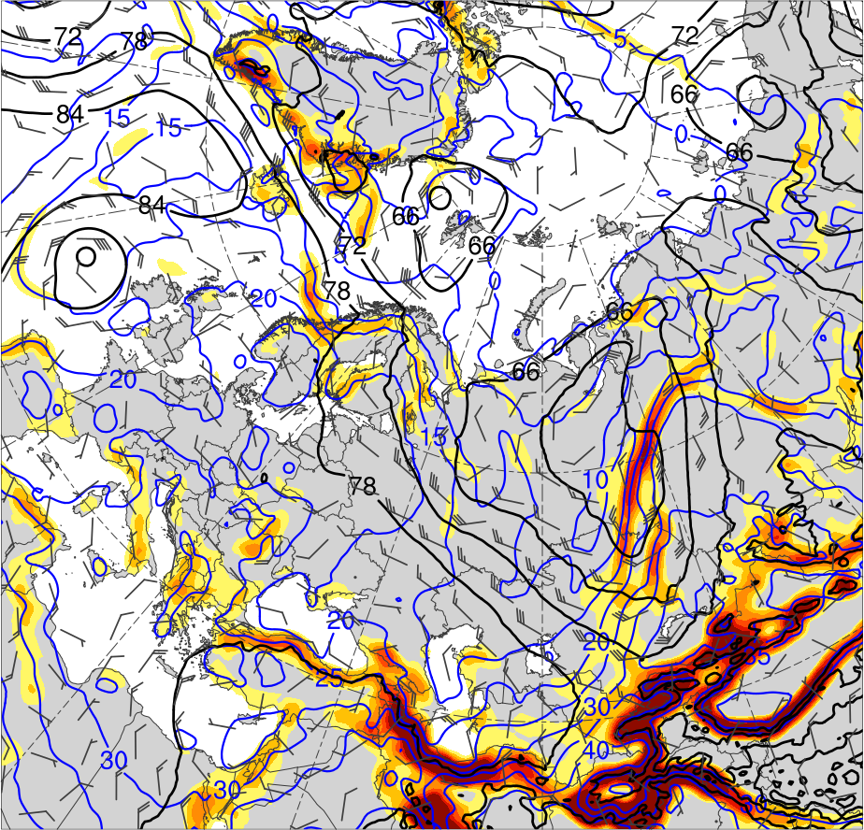
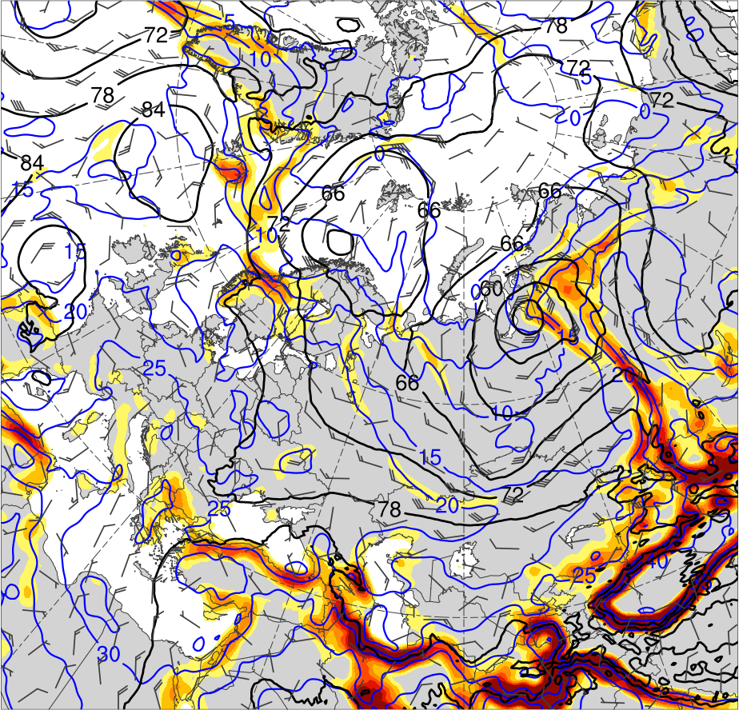
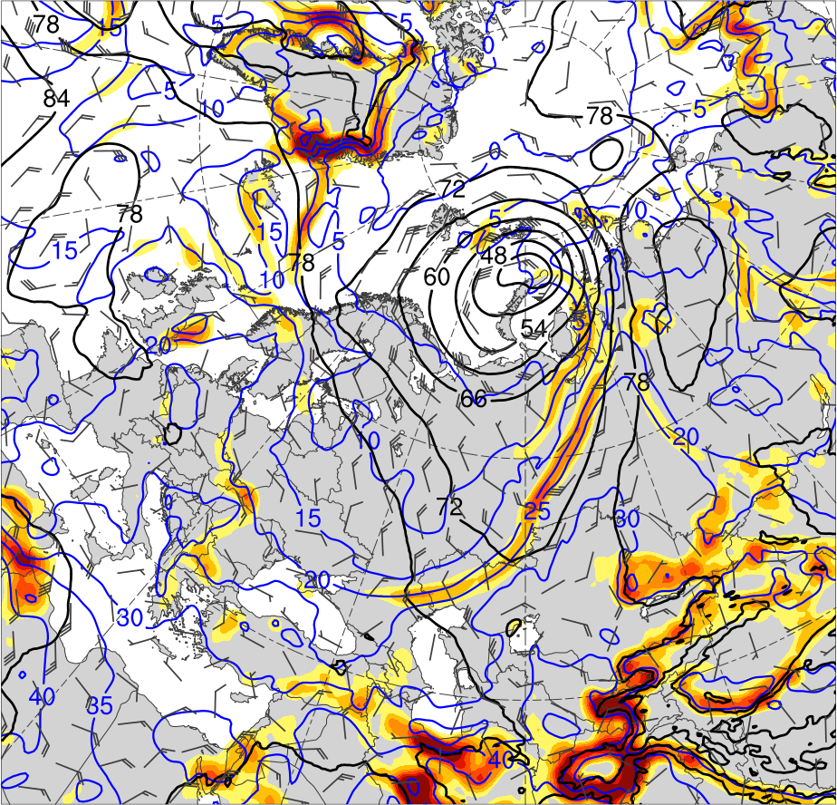
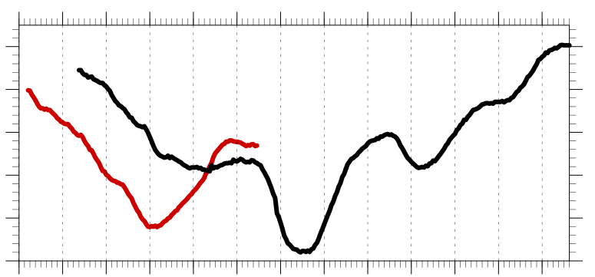
The Contributions of Tropopause Polar Vortices and Remnant Tropical Moisture from Tropical Storm Alberto to the Development of Two Intense Arctic Cyclones in June 2018
Lance F. Bosart^{1*}, Kevin Biernat¹, Daniel Keyser¹, and Steven M. Cavallo²
¹University at Albany, SUNY
²University of Oklahoma
A51I-2279
*E-mail: lbosart@albany.edu
AGU 2018 Fall Meeting, 14 December 2018
This research was supported by Office of Naval Research Grant N00014-18-1-2200
.
1) Motivation and Background
4) Large-scale Flow Evolution
5) Synoptic Evolution of Arctic Cyclones
Arctic cyclone 1 (AC1) formed along an old cold frontal boundary northeast of the Caspian Sea, moved poleward, performed a cyclonic loop with a subsequent Arctic cyclone (AC2) near the north coast of Russia, and eventually merged with AC2 over the Arctic Ocean.
AC2 formed via lee cyclogenesis east of Greenland, and may have had some “DNA" from the remnants of Tropical Storm (TS) Alberto, which moved poleward across the central U.S. and northeastern Canada
Arctic cyclones may be associated with strong surface winds and poleward advection of warm, moist air, contributing to reductions in Arctic sea-ice extent (e.g., Zhang et al. 2013)
Heavy precipitation, strong surface winds, and large waves due to Arctic cyclones may pose hazards to ships navigating through open passageways in the Arctic Ocean
Tropopause polar vortices (TPVs) are tropopause-based vortices of high-latitude origin (e.g., Cavallo and Hakim 2010) that may act as precursors to the development of Arctic cyclones (e.g., Tao et al. 2017)
The comparative rarity of two sequential intense Arctic cyclones that interacted with one another, one of which (AC2) may have had antecedent DNA from TS Alberto, motivates this presentation
(b) 0000 UTC 3 Jun 2018
1200 UTC 2 June 2018 (AC1 strengthens and AC2 forms)
1200 UTC 3 June 2018 (AC1 rapidly strengthens)
0000 UTC 7 June 2018 (AC2 rapidly strengthens)
(a) 0000 UTC 1 Jun 2018
6
T1
T1
5
(a)
TPV 2
(e)
(i)
4
TPV 2
3
TPV 3
2
1.5
TPV 1
TPV 1
1
0.5
(c) 0000 UTC 5 Jun 2018
(d) 0000 UTC 7 Jun 2018
0
-0.5
T2
-1
(b)
(f)
(j)
T2
-1.5
Data: ERA5 (Hersbach and Dee 2016) gridded to 0.25° horizontal resolution for all fields, with ERA-Interim (Dee et al. 2011) 1979–2010 mean and standard deviation of selected fields for calculation of standardized anomalies
Manually tracked AC1, AC2, and a Canadian low (CL) by following the locations of minimum sea level pressure (SLP)
Tracked TS Alberto using National Hurricane Center positions of TS Alberto during 1500 UTC 25 May–0600 UTC 29 May 2018 and remnants of TS Alberto using ERA5 afterward
-2
2) Data and Methods
-3
-4
-5
-6
Figure 3. 300-hPa geopotential height (dam, black), winds (m s⁻¹, flags and barbs), and standardized geopotential height anomalies (σ, shaded). T1 an T2 denote deep troughs 1 and 2, respectively.
3) Track and Intensity
6) Interactions between Arctic Cyclones
(c)
(g)
(k)
(a)
(b)
11
10
(a) 1200 UTC 2 Jun 2018
(b) 1200 UTC 3 Jun 2018
(c) 1200 UTC 4 Jun 2018
AC1
6
2
12
13
AC1
5
9
AC2
AC1
4
31
8
7
AC2
3
30
1
3
6
5
2
4
AC2
1.5
31
4
3
1
30
6
0.5
29
5
(d) 1200 UTC 5 Jun 2018
(e) 1200 UTC 6 Jun 2018
(f) 1200 UTC 7 Jun 2018
0
28
AC1
-0.5
(d)
27
2
-1
(d)
(h)
(l)
26
-1.5
Genesis
Lysis
Merger
AC2
-2
-2
-1.5
-1
-0.5
0
0.5
1
1.5
2
σ
AC2
-3
Table 1. Lifetimes of cyclones
Figure 1. Tracks of (a) Alberto and a Canadian low (CL), and (b) AC1 and AC2. Also, (a) 26 May–1 June 2018 time-mean 300-hPa geopotential height (dam, gray) and standardized geopotential height anomalies (σ, shaded), and (b) 1–7 June 2018 time-mean 850-hPa temperature (°C, gray) and standardized temperature anomalies (σ, shaded). 0000 UTC positions of cyclones shown by dots.
AC2
-4
Feature | Date of Genesis | Date of Lysis | Lifetime (d)
Alberto | 25 May | 31 May | ~6
CL | 29 May | 2 June | ~3
AC1 | 1 June | 6 June | ~5
AC2 | 2 June | 13 June | ~11
-5
Figure 5. SLP (hPa, black), 10-m winds (m s⁻¹, flags and barbs), and standardized SLP anomalies (σ, shaded)
-6
7) Discussion
1010
Figure 2. Time series of minimum SLP of AC1 and AC2 (every 1h).
Remnants of TS Alberto are absorbed into the cyclonic/frontal region of CL over southern Canada (Fig. 1a)
CL moves northeastward, weakens over the Davis Strait, and redevelops as a lee cyclone (AC2) east of Greenland (Figs. 1a,b, 2)
Successive deep troughs over Eurasia in early June that form in response to cyclonic wave breaking foster development of AC1 and AC2 (Figs. 3b,c,d)
AC1 forms near the Caspian Sea along a trailing cold front, moves northeastward, deepens, and reaches the Kara Sea (Figs. 4b,c, 5c)
AC2 intensifies as an ordinary baroclinic cyclone over northwestern Europe in conjunction with a strong jet stream (Figs. 4e,f)
TPVs embedded within deep troughs likely contribute to rapid deepening of AC1 and AC2 in the left exit region of a jet streak (Figs. 4e,f and Figs. 4i,j)
AC2 interacts and merges with AC1 and becomes the dominant cyclone (962 hPa) with a standardized SLP of < −6 σ (Fig. 5f)
1000
AC1
AC1
AC2
990
Peak intensity of AC1 at 0400 UTC 4 June 2018
(967.9 hPa)
DT (2-PVU) θ (K)
SLP (hPa)
252
258
264
270
276
282
288
294
300
306
312
318
324
330
336
342
348
354
360
366
372
378
980
AC2
300-hPa wind speed (m s⁻¹)
PW (mm)
970
Peak intensity of AC2 at 1100 UTC 7 June 2018
(962.0 hPa)
30
40
50
60
70
80
90
100
25
30
35
40
45
50
55
960
1
2
3
4
5
6
7
8
9
10
11
12
13
Integrated vapor transport (IVT) (kg m⁻¹ s⁻¹)
925-hPa area-averaged (100 km) |θ gradient| [K (100 km)⁻¹]
References
200
300
400
500
600
700
800
1000
1200
1400
1600
3
4
5
6
7
8
Cavallo, S. M., and G. J. Hakim, 2010: Composite structure of tropopause polar cyclones. Mon. Wea. Rev., 138, 3840–3857.
Dee, D. P., and Coauthors, 2011: The ERA-Interim reanalysis: Configuration and performance of the data assimilation system. Quart. J. Roy. Meteor. Soc., 137, 553–597.
Hersbach, H., and D. Dee, 2016: ERA5 reanalysis is in production. ECMWF Newsletter, No. 147, ECMWF, Reading, United Kingdom, 7.
[Available online at www.ecmwf.int/sites/ default/files/elibrary/2016/16299-newsletter-no147-spring-2016.pdf.]
Tao, W., J. Zhang, Y. Fu, and X. Zhang, 2017: Driving roles of tropospheric and stratospheric thermal anomalies in intensification and persistence of the Arctic superstorm in 2012.
Geophys. Res. Lett., 44, 10017–10025.
Zhang, J., R. Lindsay, A. Schweiger, and M. Steele, 2013: The impact of an intense summer cyclone on 2012 Arctic sea ice retreat. Geophys. Res. Lett., 40, 720–726.
Figure 4. (first row) DT (2-PVU surface) θ (K, shaded), wind speed (black, every 10 m s⁻¹ starting at 30 m s⁻¹), and winds (m s⁻¹, flags and barbs);
(second row) 300-hPa wind speed (m s⁻¹, shaded), PW (mm, shaded), 1000–500-hPa thickness (dam, dashed red and blue), and SLP (hPa, black);
(third row) IVT ( kg m⁻¹ s⁻¹, shaded and vectors), and 700-hPa geopotential height (dam, black) and winds (m s⁻¹, flags and barbs);
(fourth row) 925-hPa area-averaged (100 km) |θ gradient| [K (100 km) ⁻¹, shaded ], θ (°C, blue), geopotential height (dam, black), and winds (m s⁻¹, flags and barbs)

