Slide 1


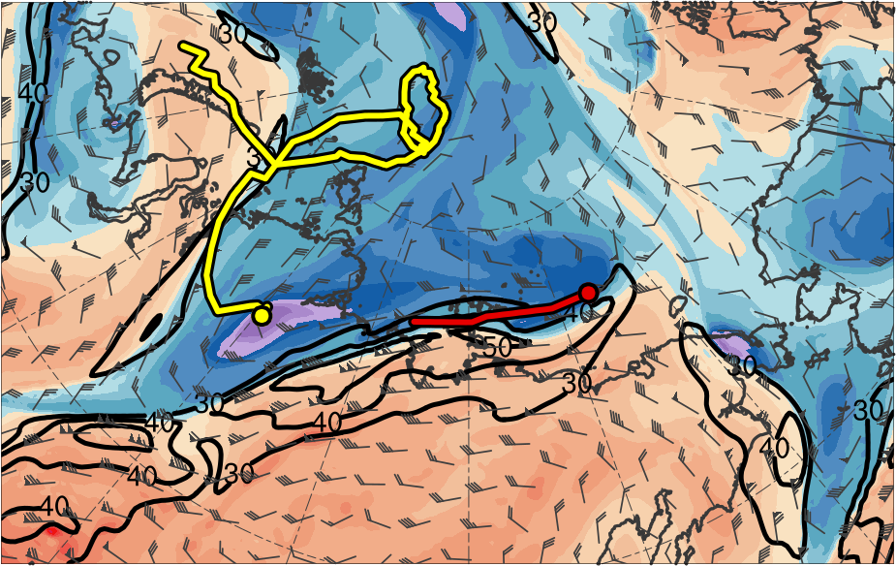
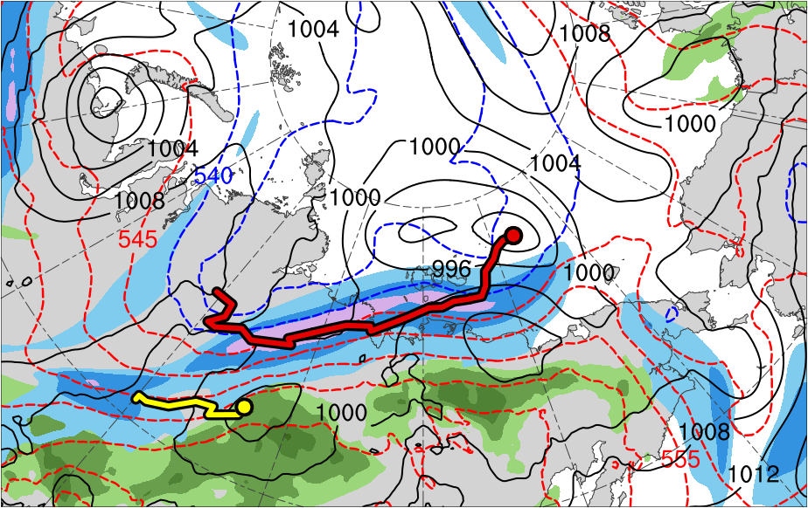
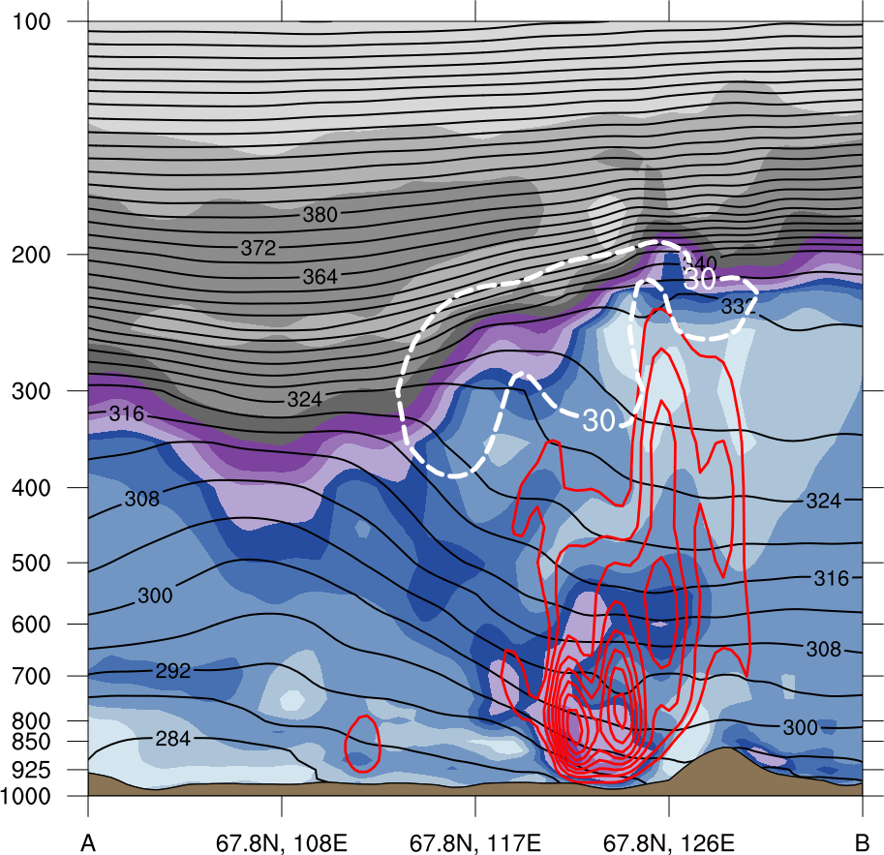
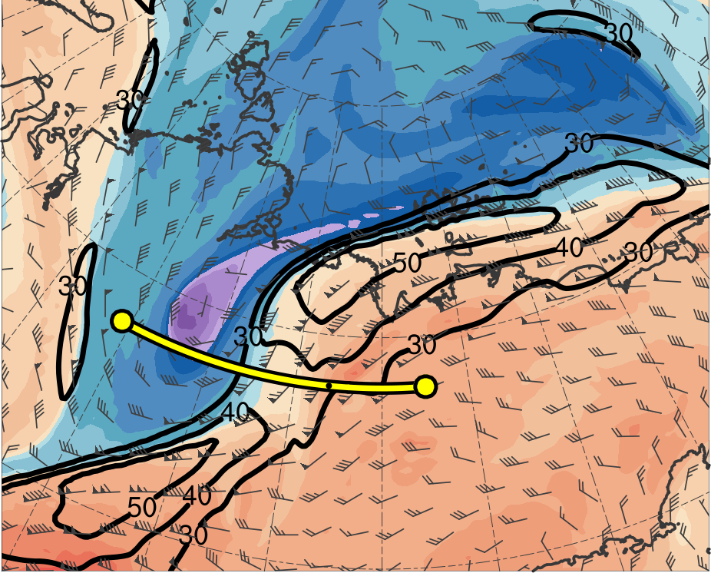
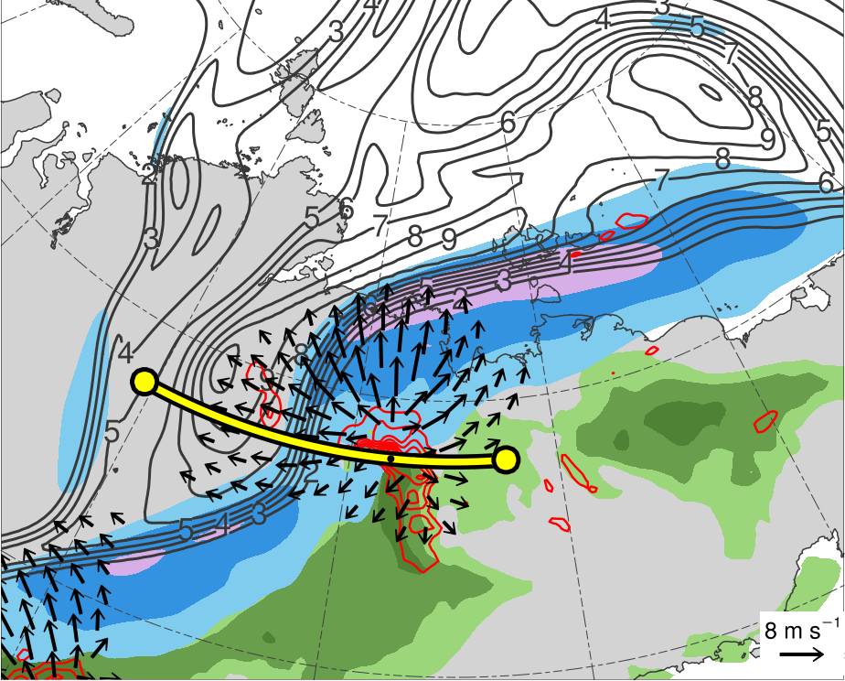
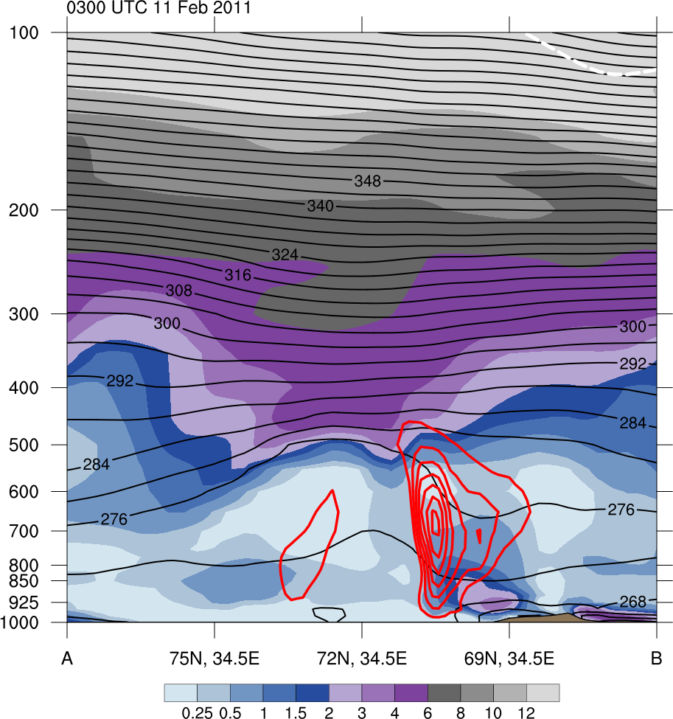
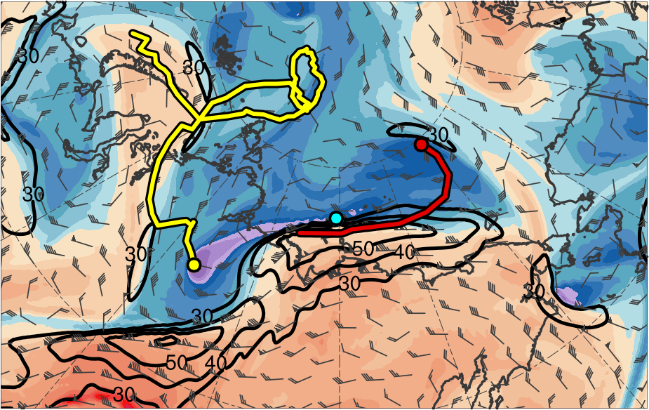
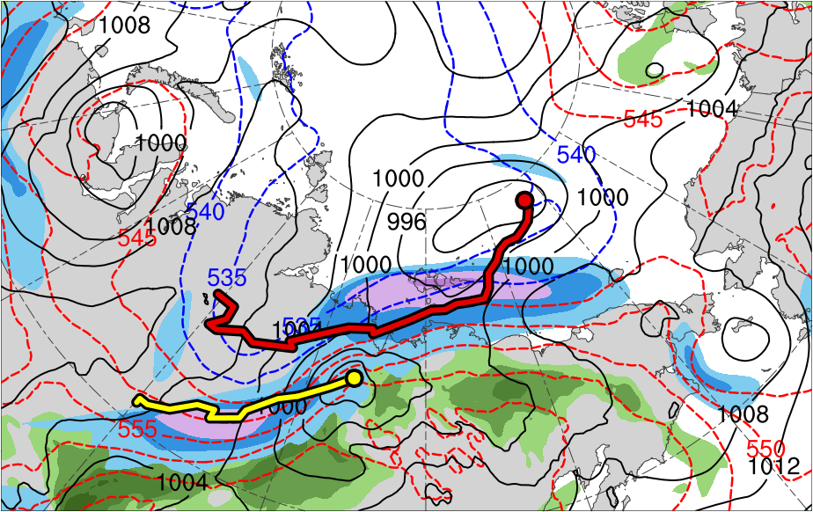
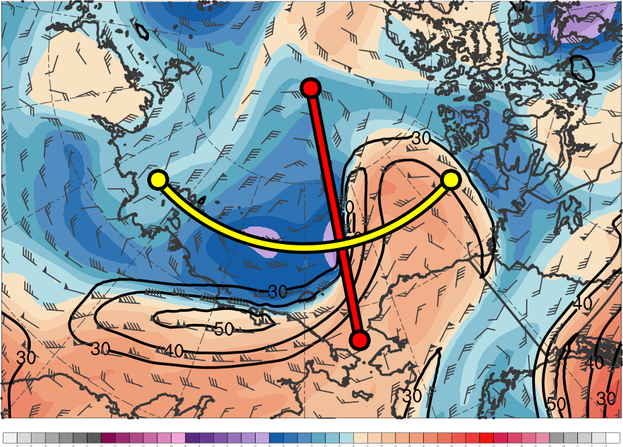
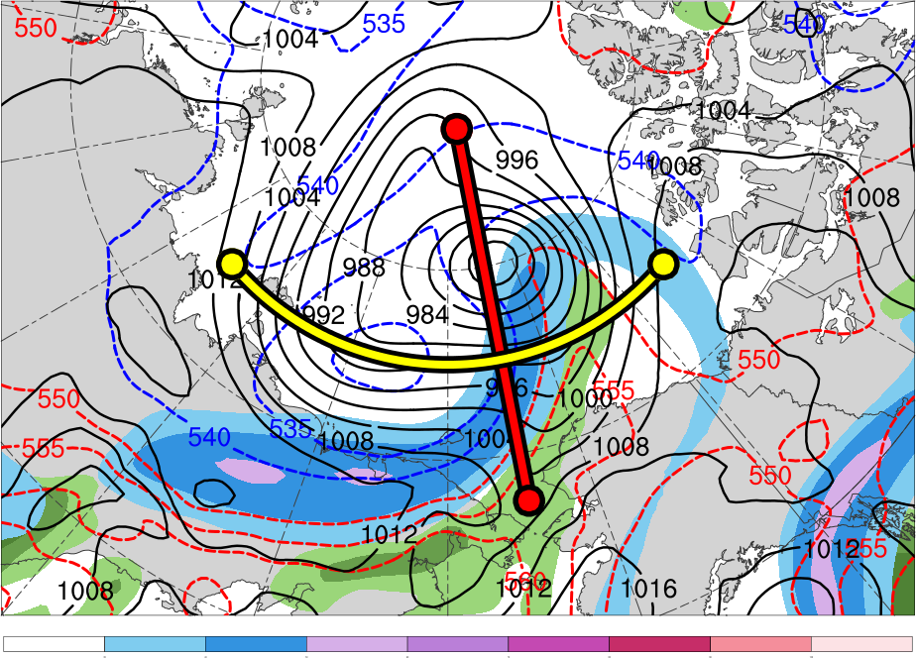
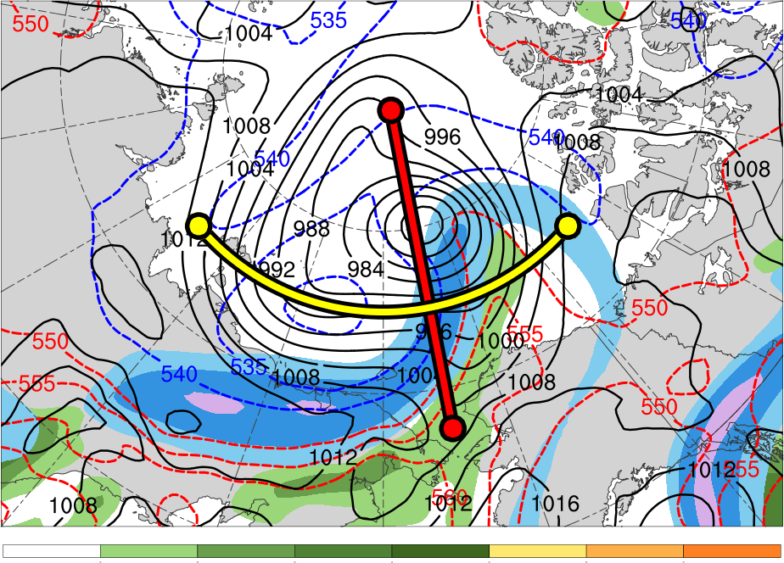
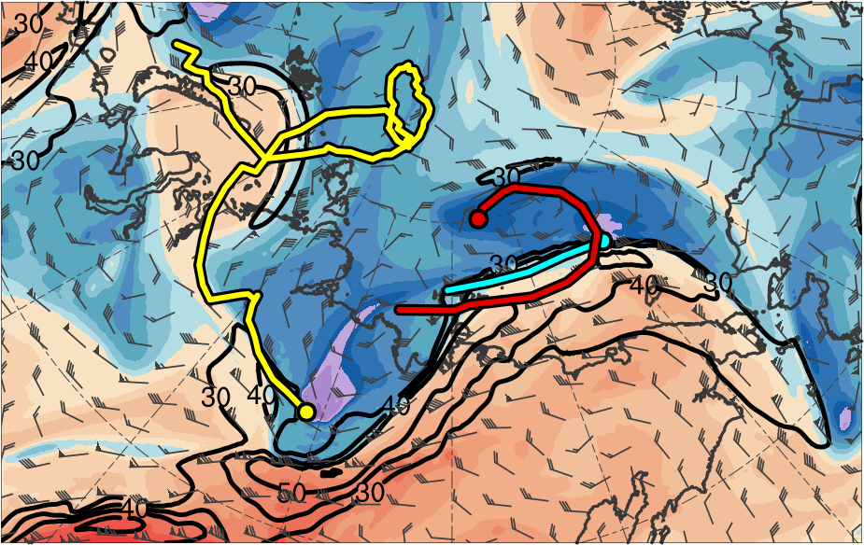
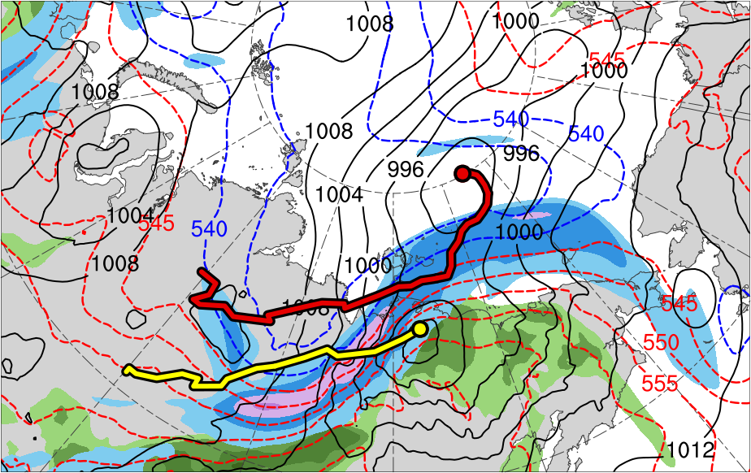
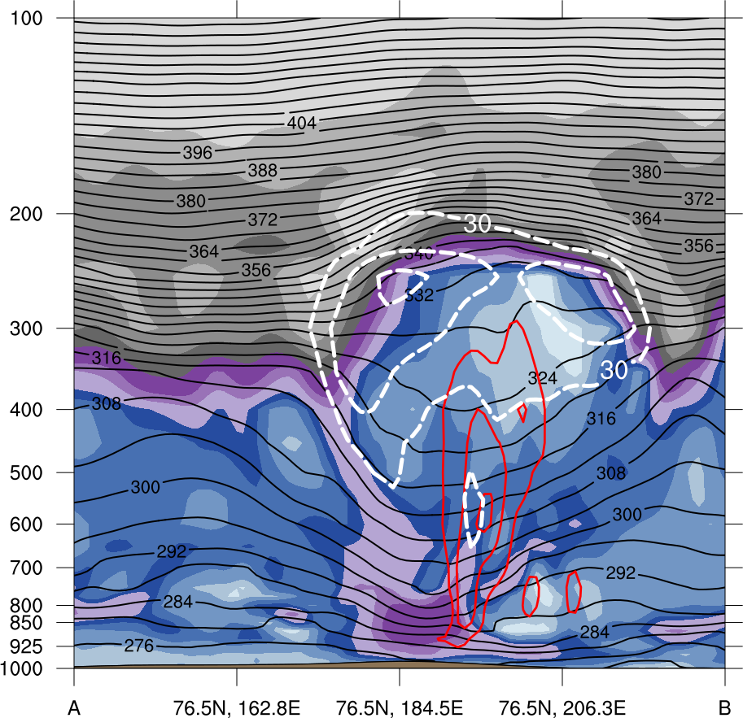
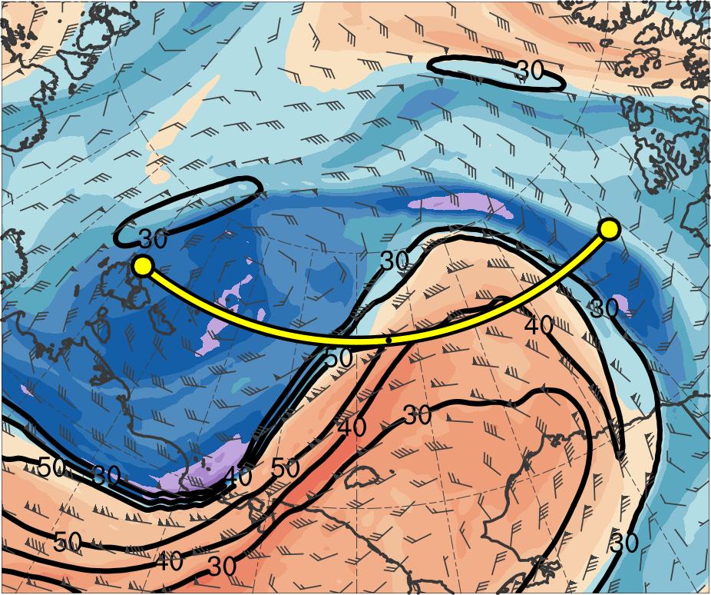
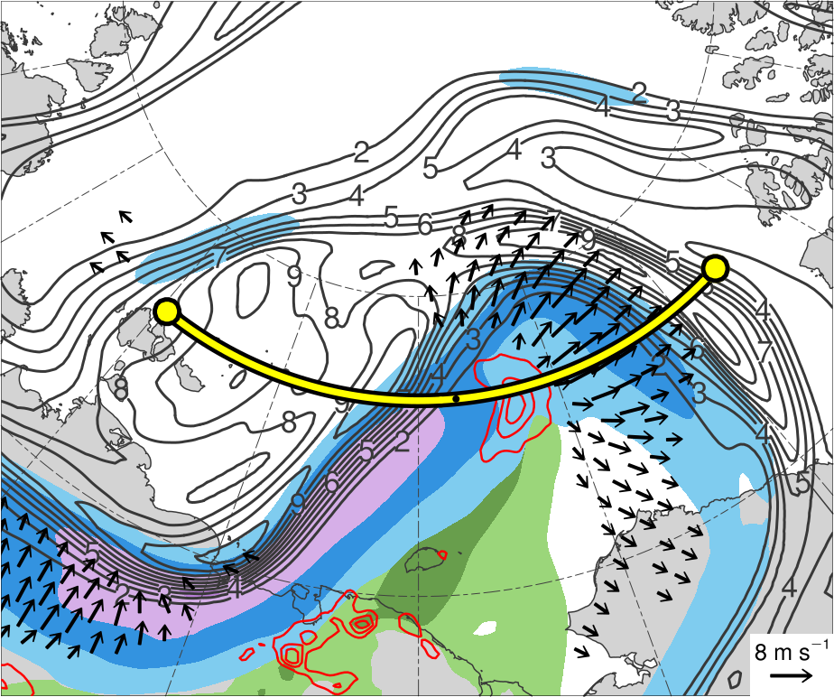
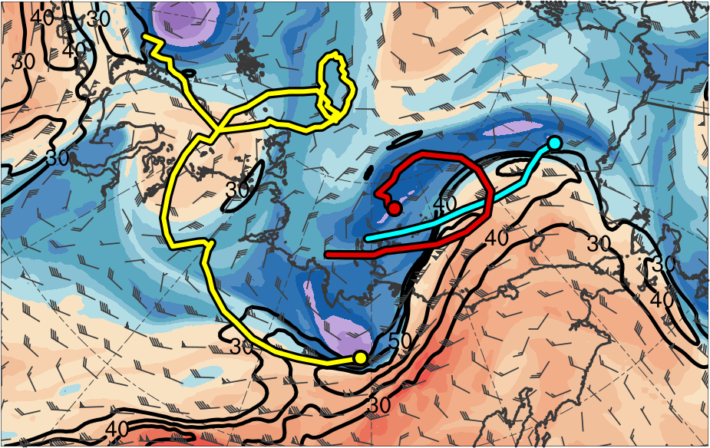
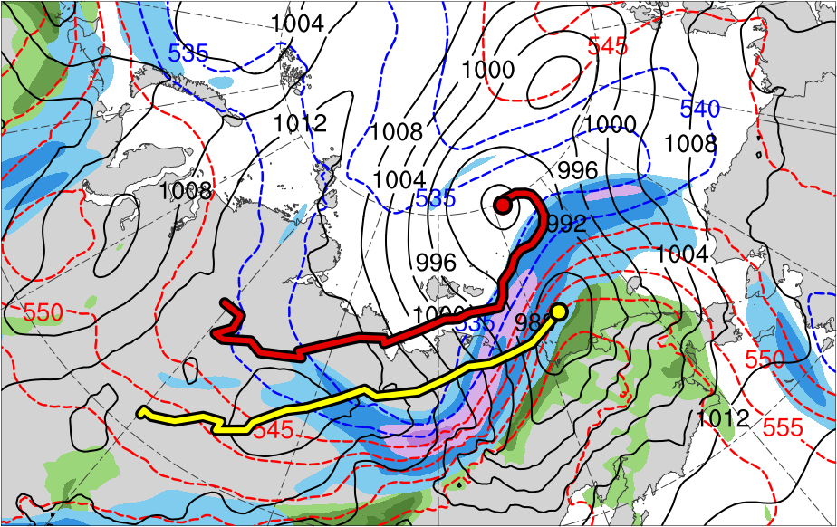
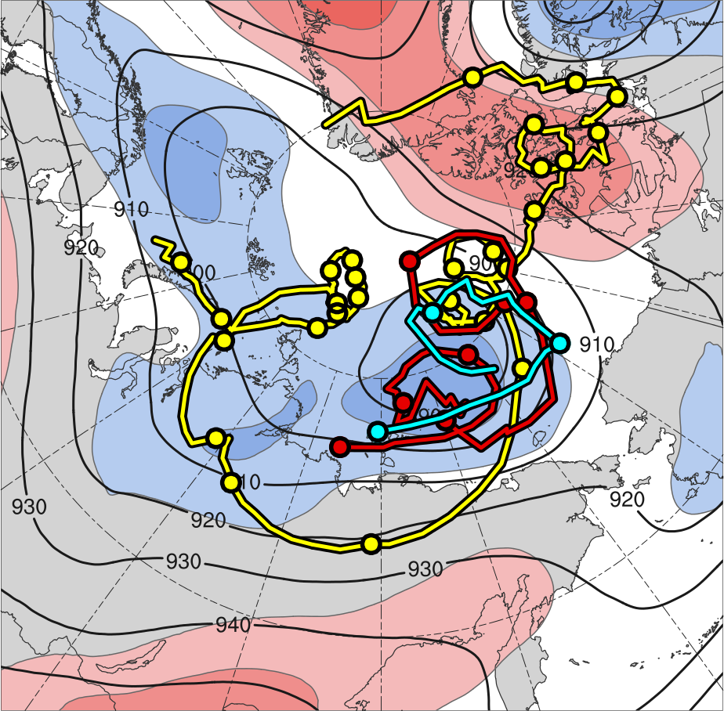
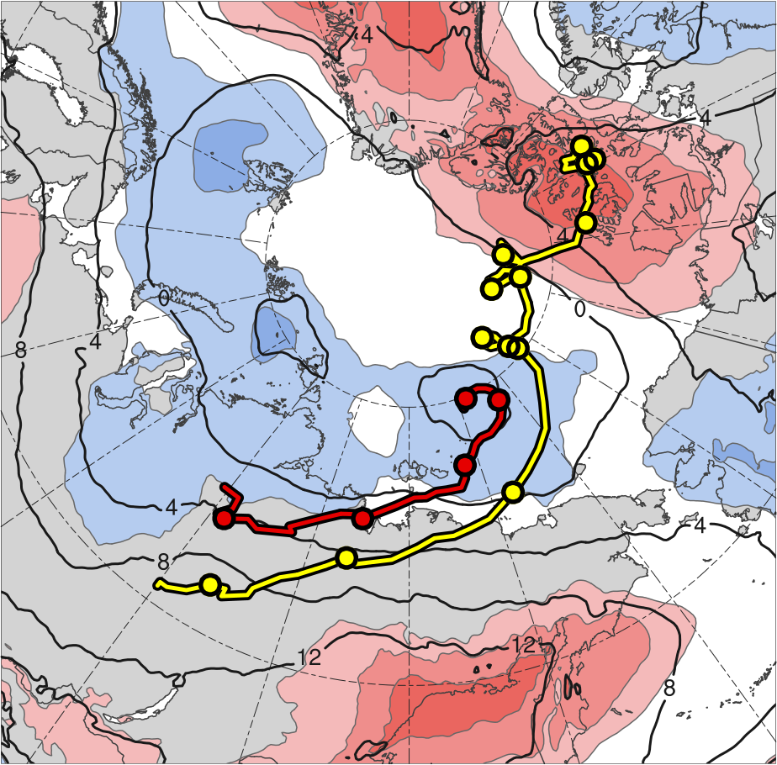
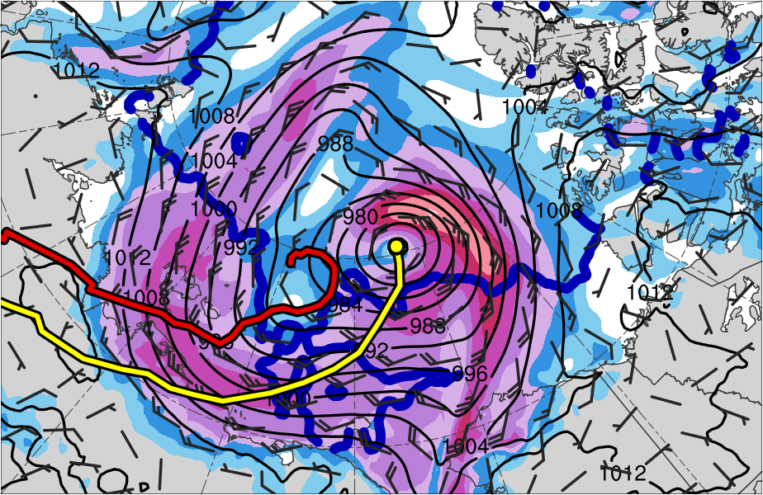
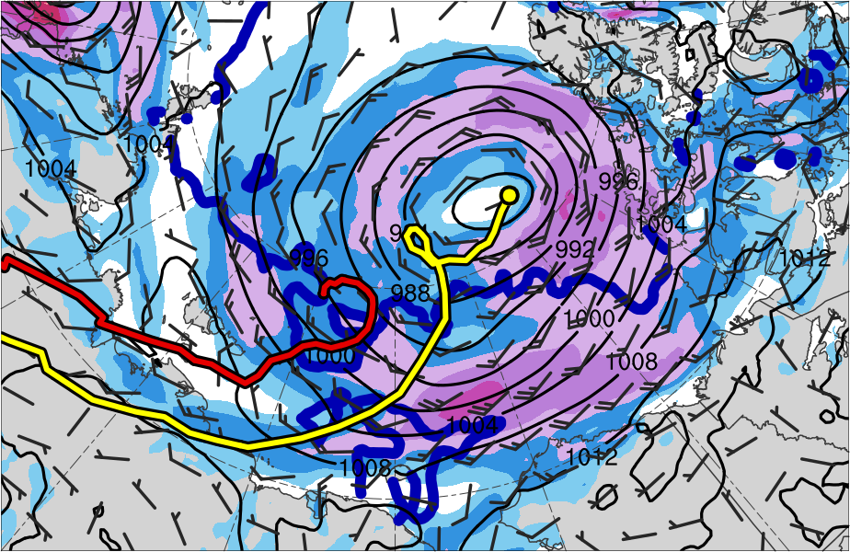
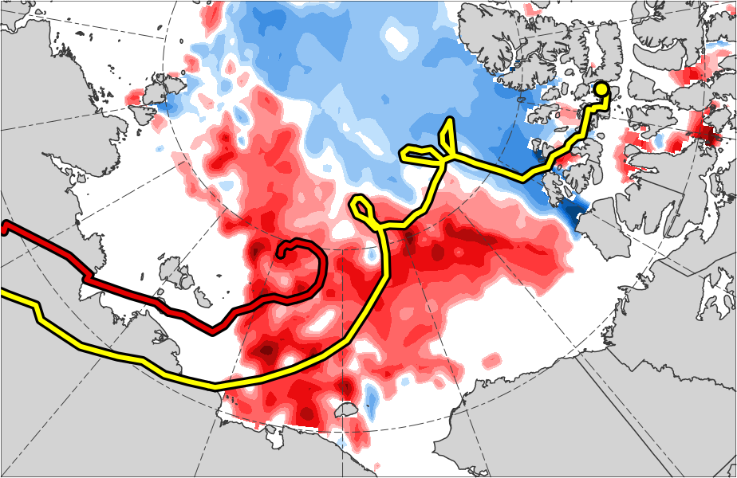
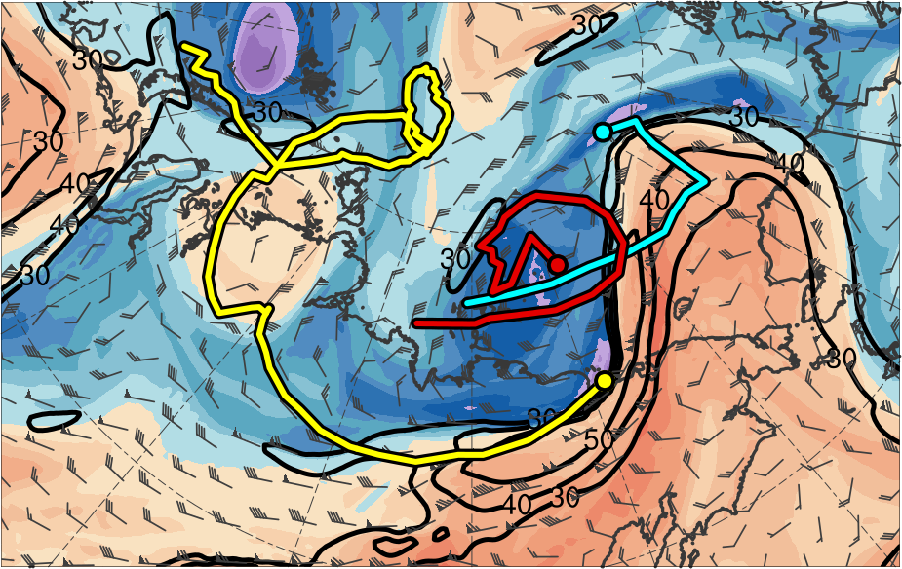
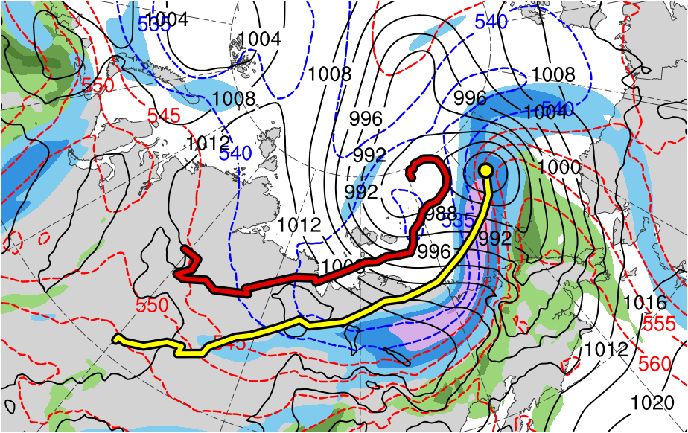
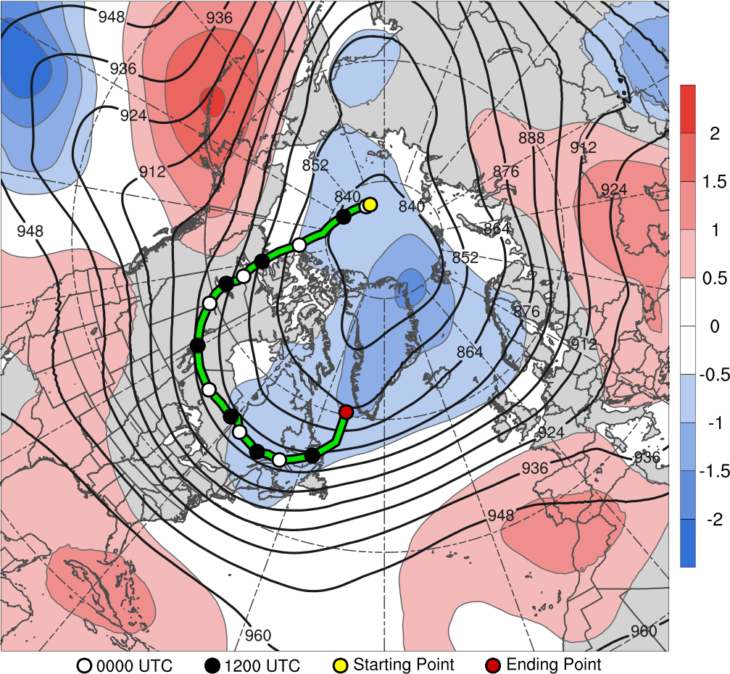
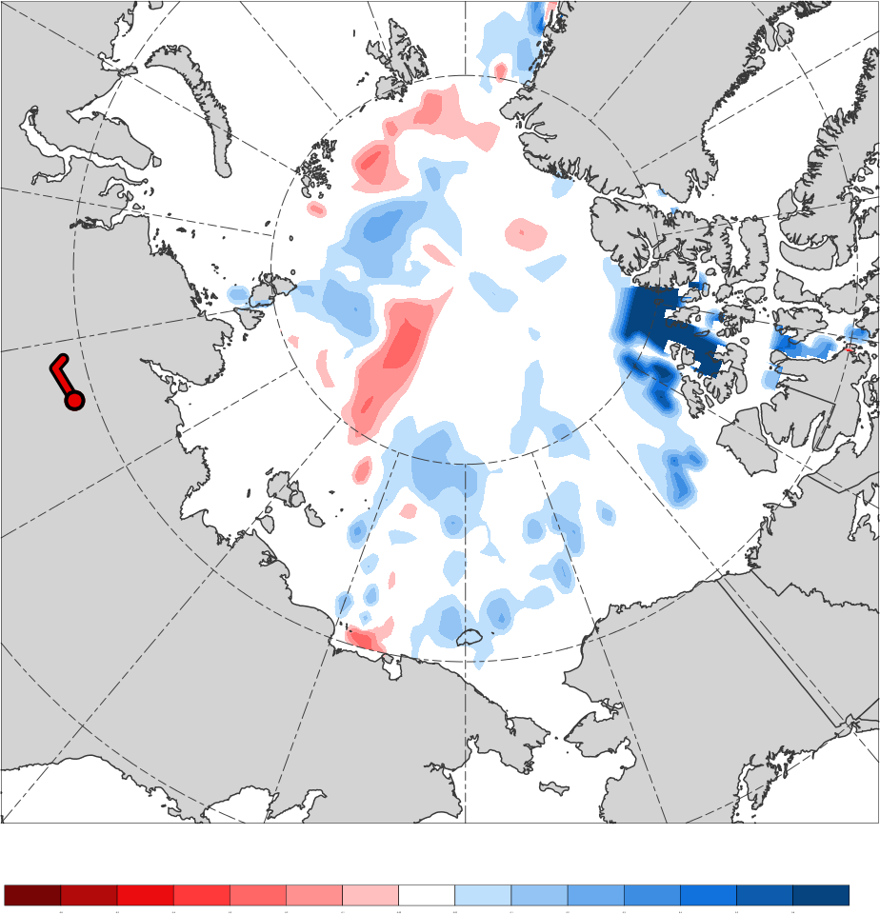
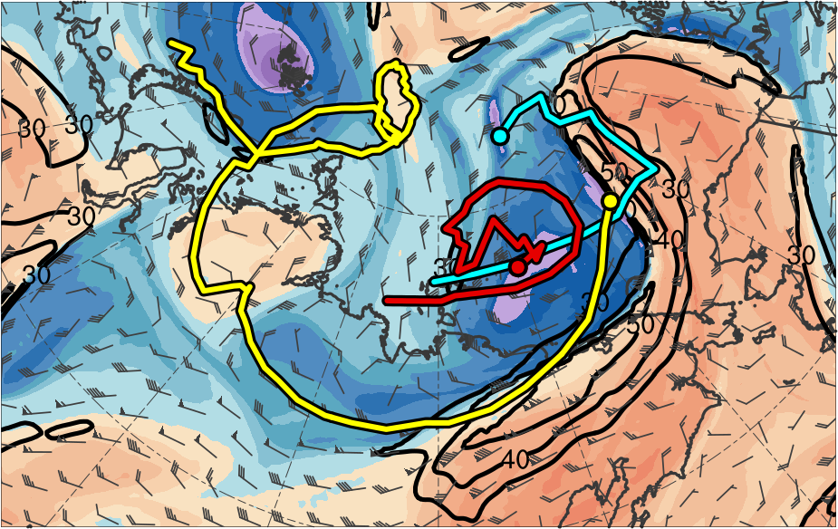
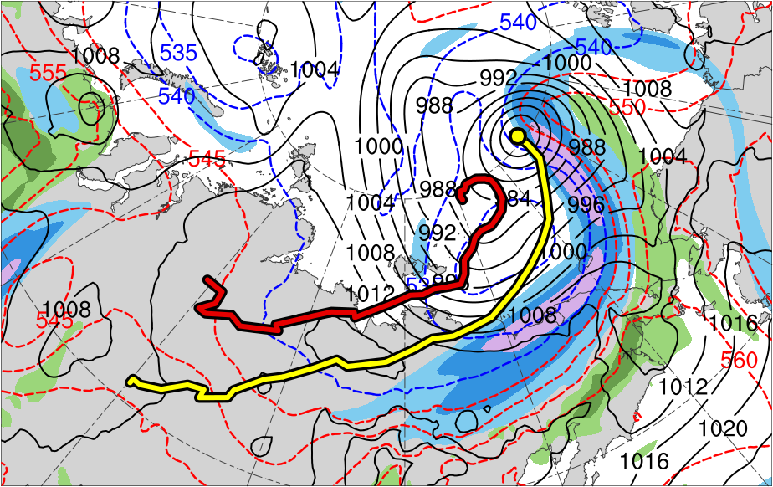
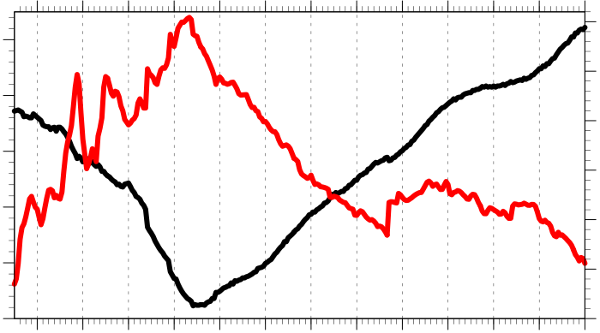
Linkages Between Tropopause Polar Vortices and
the Great Arctic Cyclone of August 2012
A51I-2273
Daniel Keyser¹, Kevin Biernat¹, Lance F. Bosart¹, and Steven M. Cavallo²
¹University at Albany, SUNY
²University of Oklahoma
This research was supported by Office of Naval Research Grant N00014-18-1-2200
.
Tropopause polar vortices (TPVs) are tropopause-based vortices of high-latitude origin and are material features (e.g., Cavallo and Hakim 2010)
TPVs may interact with and strengthen jet streams, and act as precursors to the development of Arctic cyclones, including the Great Arctic Cyclone of August 2012 (hereafter AC12; e.g., Simmonds and Rudeva 2012; Tao et al. 2017)
Arctic cyclones may be associated with strong surface winds and poleward advection of warm, moist air, contributing to reductions in Arctic sea-ice extent (e.g., Zhang et al. 2013)
Heavy precipitation, strong surface winds, and large waves due to Arctic cyclones may pose hazards to ships moving through open passageways in the Arctic Ocean
AC12 formed over Siberia on 2 August 2012 and tracked northeastward into the Arctic, reaching a minimum central sea level pressure (SLP) of 966.4 hPa at 1800 UTC 6 August in the CFSR (Simmonds and Rudeva 2012)
Strong surface winds associated with AC12 helped to break up thin Arctic sea ice (e.g., Parkinson and Comiso 2013), with sea-ice volume decreasing twice as fast as normal during AC12 due to melting of the bottom and perimeter of ice floes (e.g., Zhang et al. 2013)
This study will examine linkages between TPVs and AC12
4) Synoptic Evolution of TPVs and Cyclones
5) Cross Sections
1) Background
PV
(PVU)
(a) 1200 UTC 3 Aug 2012
(b) 1200 UTC 3 Aug 2012
(a) 2100 UTC 3 Aug 2012
(b) 2100 UTC 3 Aug 2012
(c) 2100 UTC 3 Aug 2012
12
TPV 1
TPV 2
TPV 1
TPV 2
10
8
A
A
6
A’
A’
4
3
2
Jet coupling phase
1.5
TPV 1
AC12
(c) 0000 UTC 4 Aug 2012
(d) 0000 UTC 4 Aug 2012
1
DT (2-PVU) θ (K)
0.5
252
258
264
270
276
282
288
294
300
306
312
318
324
330
336
342
348
354
360
366
372
378
0.25
AC12
300-hPa wind speed (m s⁻¹)
PW (mm)
A
67.8°N, 108°E
67.8°N, 117°E
67.8°N, 126°E
A’
30
40
50
60
70
80
90
100
25
30
35
40
45
50
55
Figure 4. Cross section along AA’ at 2100 UTC 3 Aug 2012 of (a) PV (PVU, shaded), θ (K, black), wind speed (white, every 10 m s⁻¹ starting at 30 m s⁻¹), and ascent (red, every 5 × 10⁻³ hPa s⁻¹); (b) DT (2-PVU) θ (K, shaded), wind speed (black, every 10 m s⁻¹ starting at 30 m s⁻¹), and wind (m s⁻¹, flags and barbs); (c) 350–250-hPa PV (PVU, gray) and irrot. wind (m s⁻¹, vectors), 300-hPa wind speed (m s⁻¹, shaded), PW (mm, shaded), and 800–600-hPa ascent (red, every 5 × 10⁻³ hPa s⁻¹).
(e) 1200 UTC 4 Aug 2012
(f) 1200 UTC 4 Aug 2012
PV
(PVU)
(a) 1200 UTC 5 Aug 2012
(b) 1200 UTC 5 Aug 2012
TPV 3
(c) 1200 UTC 5 Aug 2012
TPV 3
2) Data and Methods
12
TPV 2
B’
TPV 2
B’
Data: ERA5 at 0.3° horizontal resolution (Hersbach and Dee 2016)
Utilized TPV tracking algorithm (Szapiro and Cavallo 2018) to identify and track TPVs of interest for AC12
Manually tracked a predecessor surface cyclone (L1) and AC12 by following the locations of minimum SLP
10
B
B
8
6
4
3
TPV 1
TPV 1
2
TPV 2
1.5
AC12
(g) 0000 UTC 5 Aug 2012
(h) 0000 UTC 5 Aug 2012
1
DT (2-PVU) θ (K)
0.5
252
258
264
270
276
282
288
294
300
306
312
318
324
330
336
342
348
354
360
366
372
378
3) Track and Intensity
0.25
B
AC12
B’
300-hPa wind speed (m s⁻¹)
PW (mm)
(a) TPVs
(b) Surface Cyclones
76.5°N, 162.8°E
76.5°N, 175.5°W
76.5°N, 153.7°W
30
40
50
60
70
80
90
100
25
30
35
40
45
50
55
TPV 1
L1
Figure 5. As in Fig. 4, but for cross section along line BB’ at 1200 UTC 5 Aug 2012.
TPV 2
AC12
6) Impacts of Cyclones on Arctic Sea Ice
TPV 3
(a) 0000 UTC 6 Aug 2012
(b) 0000 UTC 9 Aug 2012
(c) 2–14 Aug 2012
6
5
6
(i) 1200 UTC 5 Aug 2012
(j) 1200 UTC 5 Aug 2012
3
5
4
6
5
4
4
3
6
Jet crossing phase
4
3
5
10-m wind speed (m s⁻¹)
L1
Change in sea ice concentration (%)
5
3
4
4
6
8
10
12
14
16
18
AC12
-60
-50
-40
-30
-20
-10
-5
5
10
20
30
40
50
60
(k) 0000 UTC 6 Aug 2012
(l) 0000 UTC 6 Aug 2012
Figure 6. (a) SLP (hPa, black), 10-m wind (m s⁻¹, flags and barbs), and 20% contour of sea-ice concentration (thick blue) at (a) 0000 UTC 6 August 2012 and (b) 0000 UTC 9 August 2012; (c) Change in sea-ice concentration during 2–14 August 2012 (%, shaded).
300 hPa
850 hPa
TPV 1 approaches and interacts with AC12 in a region of strong baroclinicity (Figs. 1a,b and Figs. 3a–l), likely supporting the development of AC12 through baroclinic processes
TPV–jet interactions involving TPV 1, TPV 2, and TPV 3 likely contribute to the formation of a dual-jet configuration and jet coupling over AC12 (jet coupling phase; Figs. 3a–d)
Latent heating related to low-level ascent in the presence of warm, moist air in region of jet coupling likely contributes to the formation of a PV tower associated with AC12 (Figs. 4a–c) and concomitant intensification of AC12 (Fig. 2)
– Interaction between TPV 1 and PV tower (Figs. 4a–c) likely supports the intensification of AC12
Cold air advection in the wake of L1 may support the strong baroclinicity in the vicinity of AC12 (e.g., Figs. 3d,f), which, along with interaction between L1 and AC12 (e.g., Figs. 3h,j) may further support the intensification of AC12
Most rapid intensification of AC12 occurs on 5 Aug 2012 (Fig. 2), when AC12 crosses from the warm side to the cold side of a strong upper-level jet streak (jet crossing phase; Figs. 3g–l)
– Latent heating may contribute to PV tower associated with AC12 and intensification of AC12 during jet
crossing phase (Figs. 5a–c), though this contribution may be smaller than that during jet coupling phase
(compare Figs. 5a–c to Figs. 4a–c)
Widespread, relatively strong surface winds associated with AC12 contribute to reductions in Arctic sea-ice extent as AC12 meanders slowly over the Arctic (Figs. 6a–c)
-2
-1.5
-1
-0.5
0
0.5
1
1.5
2
σ
Genesis
Lysis
7) Discussion
Table 1. Lifetimes of TPVs and surface cyclones
Figure 1. Tracks of (a) TPVs and (b) surface cyclones, as well as 1–7 Aug 2012 time-mean (a) 300-hPa geopotential height (dam, gray) and standardized anomaly of 300-hPa geopotential height (σ, shaded), and (b) 850-hPa temperature (°C, gray) and standardized anomaly of 850-hPa temperature (σ, shaded). 0000 UTC positions of TPVs and surface cyclones shown by dots.
Feature | Date of Genesis | Date of Lysis | Lifetime (d)
TPV 1 | 23 Jul 2012 | 19 Aug 2012 | ~27
TPV 2 | 3 Aug 2012 | 9 Aug 2012 | ~6
TPV 3 | 4 Aug 2012 | 6 Aug 2012 | ~3
L1 | 31 Jul 2012 | 5 Aug 2012 | ~5
AC12 | 2 Aug 2012 | 15 Aug 2012 | ~13
TPV 1
TPV 2
TPV 3
L1
AC12
DT (2-PVU) θ (K)
336
360
252
258
264
270
276
282
288
294
300
306
312
318
324
330
342
348
354
366
372
378
30
Figure 2. Intensity time series of AC12 (every 3 h)
300-hPa wind speed (m s⁻¹)
90
PW (mm)
1010
30
40
50
60
70
80
100
25
30
35
40
45
50
55
1000
25
Minimum SLP (hPa)
Figure 3. (left) DT (2-PVU surface) θ (K, shaded), wind speed (black, every 10 m s⁻¹ starting at 30 m s⁻¹), and wind (m s⁻¹, flags and barbs); (right) 300-hPa wind speed (m s⁻¹, shaded), PW (mm, shaded), 1000–500-hPa thickness (dam, dashed red and blue), and SLP (hPa, black)
990
20
Maximum 925-hPa relative vorticity (averaged within 100-km of gridpoint)
References
SLP (hPa)
925-hPa relative vorticity (10⁻⁵ s⁻¹)
980
15
Jet coupling phase
Cavallo, S. M., and G. J. Hakim, 2010: Composite structure of tropopause polar cyclones. Mon. Wea. Rev., 138, 3840–3857.
Hersbach, H., and D. Dee, 2016: ERA5 reanalysis is in production. ECMWF Newsletter, No. 147, ECMWF, Reading, United Kingdom, 7.
[Available online at www.ecmwf.int/sites/ default/files/elibrary/2016/16299-newsletter-no147-spring-2016.pdf.]
Parkinson, C. L., and J. C. Comiso, 2013: On the 2012 record low Arctic sea ice cover: Combined impact of preconditioning and an August storm. Geophys.
Res. Lett., 40, 1356–1361.
Simmonds, I., and I. Rudeva, 2012: The great Arctic cyclone of August 2012. Geophys. Res. Lett., 39, L23709.
Szapiro, N., and S. Cavallo, 2018: TPVTrack v1.0: A watershed segmentation and overlap correspondence method for tracking tropopause polar vortices.
Geosci. Model Dev. Discuss., in review.
Tao, W., J. Zhang, Y. Fu, and X. Zhang, 2017b: Driving roles of tropospheric and stratospheric thermal anomalies in intensification and persistence of the
Arctic superstorm in 2012. Geophys. Res. Lett., 44, 10017–10025.
Zhang, J., R. Lindsay, A. Schweiger, and M. Steele, 2013: The impact of an intense summer cyclone on 2012 Arctic sea ice retreat.
Geophys. Res. Lett., 40, 720–726.
970
10
Jet crossing phase
5
Peak intensity at 1000 UTC 6 Aug 2012
(962.3 hPa)
960
3
4
5
6
7
8
9
10
11
12
13
14
15
0

