Slide 1
Phenomenological and Predictability Studies of the Structure and Evolution of Arctic Cyclones and Tropopause Polar Vortices
Lance Bosart, Daniel Keyser, and Kevin Biernat
Department of Atmospheric and Environmental Sciences
University at Albany, State University of New York
Thursday 13 December 2018
AGU 2018 Fall Meeting
Research Supported by ONR Grant N00014-18-1-2200

Slide 2
Project Objective
This project addresses three research topics concerned with improving prediction of Arctic cyclones and related phenomena.
This project is expected to contribute to advances in the understanding and prediction of tropopause polar vortices (TPVs) and Arctic cyclones on synoptic-to-subseasonal time scales.
This project is being conducted by the PI (Lance Bosart), Co-PI (Dan Keyser), and two DAES graduate students (Kevin Biernat and Mansour Riachy) in collaboration with Steven Cavallo, Jim Doyle, Andrea Lang, and Ryan Torn.

Slide 3
Research Topics
The role of longitudinally localized incursions of warm, moist air from middle latitudes in disrupting the tropospheric polar vortex and in reconfiguring the large-scale baroclinicity over the Arctic.
The influence of reconfigurations of large-scale baroclinicity, high-latitude ridge amplification and blocking, sea ice and snow cover boundaries, and radiative processes on the genesis and evolution of TPVs and Arctic cyclones.

Slide 4
Research Topics
The dependence of predictability horizons of TPVs and Arctic cyclones on model uncertainty on synoptic-to-subseasonal time scales as determined through the synoptic evaluation of the forecast skill of deterministic and ensemble prediction systems.

Slide 5
Research Topics #1 and #2
Linkages Between Tropopause Polar Vortices and the Great Arctic Cyclone of August 2012
The Contributions of Tropopause Polar Vortices and Remnant Tropical Moisture from Tropical Storm Alberto to the Development of Two Intense Arctic Cyclones in June 2018

Slide 6
Great Arctic Cyclone of August 2012
Background
The Great Arctic Cyclone of August 2012 (hereafter AC12) formed over Siberia on 2 August 2012 and tracked northeastward into the Arctic, reaching a minimum central sea level pressure (SLP) of 962.3 hPa at 1000 UTC 6 August in the ERA5
Strong surface winds and waves associated with AC12 helped break up thin Arctic sea ice and contributed to increased upward ocean heat transport and bottom melting of ice, with sea-ice volume decreasing twice as fast as normal during AC12

Slide 7
Great Arctic Cyclone of August 2012
Background
This presentation examines linkages between TPVs and AC12, and the impact of AC12 on Arctic sea-ice extent

Slide 8
Great Arctic Cyclone of August 2012
Data and Methods
Data: ERA5 gridded to 0.3° horizontal resolution
Utilized TPV tracking algorithm (Szapiro and Cavallo 2018) to identify and track TPVs of interest for AC12
Manually tracked a predecessor surface cyclone (L1) and AC12 by following the locations of minimum SLP

Slide 9
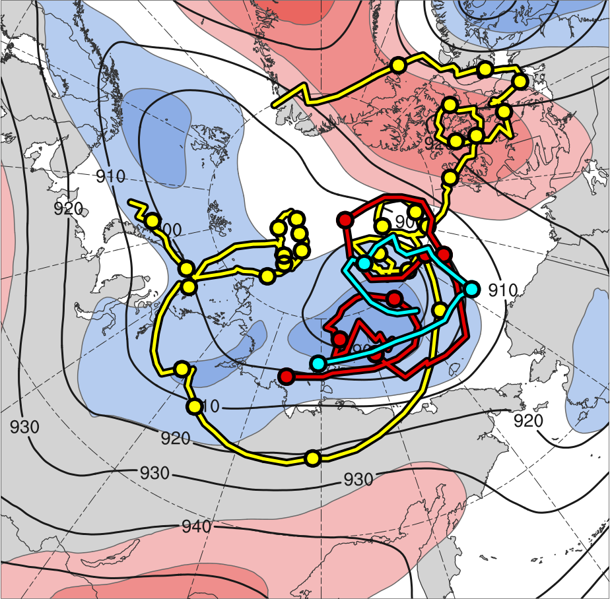
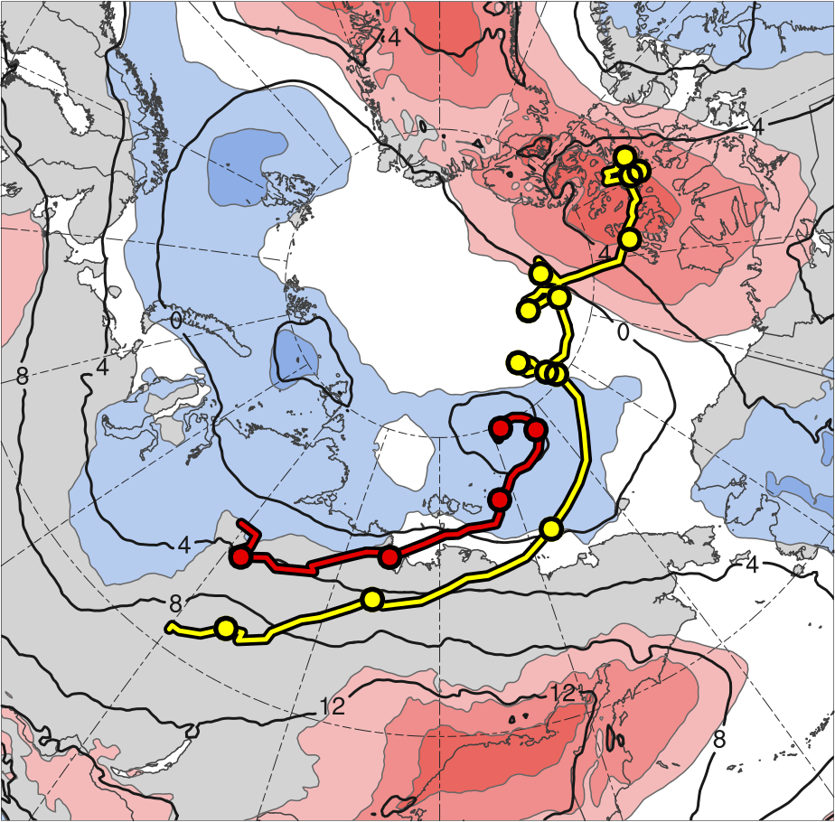
3) Track and Intensity
TPV 1
L1
TPV 2
AC12
TPV 3
2
1.5
1
0.5
0
-0.5
-1
-1.5
-2
300 hPa
850 hPa
(σ)
Feature | Genesis | Lysis | Lifetime
TPV 1 | 23 July | 19 Aug | ~27 d
TPV 2 | 3 Aug | 9 Aug | ~6 d
TPV 3 | 4 Aug | 6 Aug | ~3 d
L1 | 31 July | 5 Aug | ~5 d
AC12 | 2 Aug | 15 Aug | ~13 d
Genesis
Lysis
0000 UTC positions
1–7 Aug 2012 time-mean (left) 300-hPa geopotential height (dam, black) and standardized geopotential height anomalies (σ, shaded); (right) 850-hPa temperature (°C, black) and standardized temperature anomalies (σ, shaded)

Slide 10
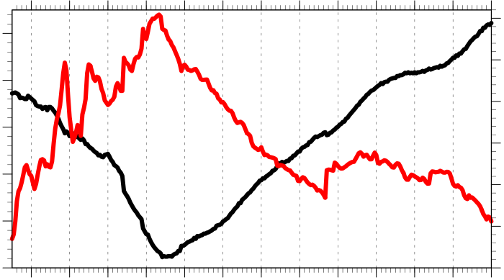
3) Track and Intensity
Hourly intensity time series of AC12
30
1010
25
1000
20
990
925-hPa relative vorticity (10⁻⁵ s⁻¹)
SLP (hPa)
15
980
10
970
5
960
0
3
4
5
6
7
8
9
10
11
12
13
14
15
Day in August 2012 labeled at 0000 UTC
Minimum SLP (hPa)
Jet coupling phase
Peak intensity at 1000 UTC 6 Aug 2012 (962.3 hPa)
Maximum 925-hPa relative vorticity (averaged within 100 km of grid point)
Jet crossing phase

Slide 11
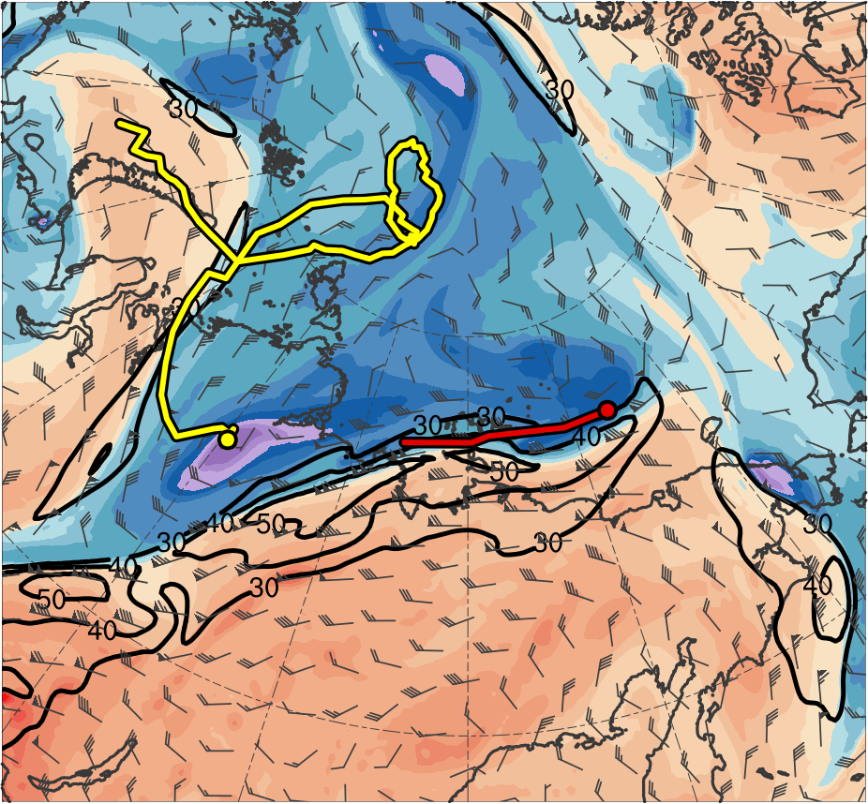
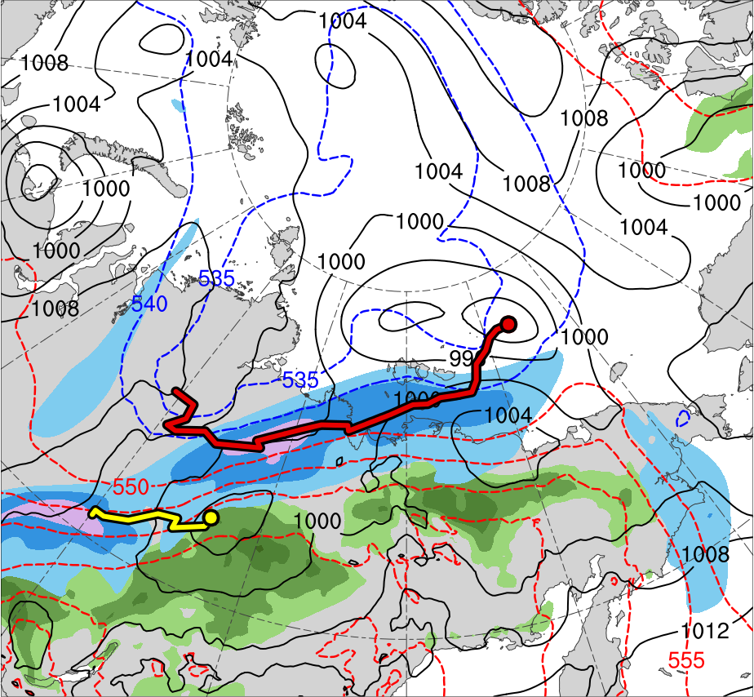
4) Synoptic Evolution
1200 UTC 3 Aug 2012
TPV 1
TPV 2
L1
AC12
(K)
252
258
264
270
276
282
288
294
300
306
312
318
324
330
336
342
348
354
360
366
372
378
(m s⁻¹ )
(mm)
30
40
50
60
70
80
90
100
25
30
35
40
45
50
55
Potential temperature (K, shaded), wind speed (black, every 10 m s⁻¹ starting at 30 m s⁻¹), and wind (m s⁻¹, flags and barbs) on 2-PVU surface
300-hPa wind speed (m s⁻¹, shaded),
1000–500-hPa thickness (dam, blue/red),
SLP (hPa, black), and PW (mm, shaded)

Slide 12
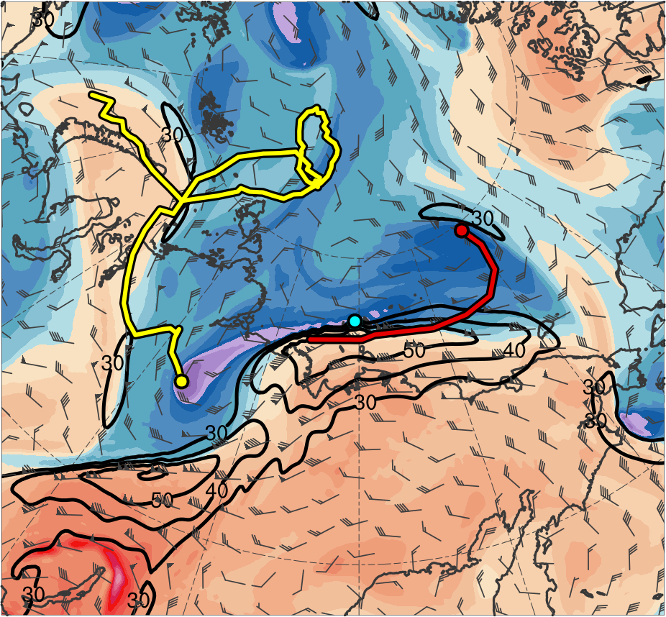
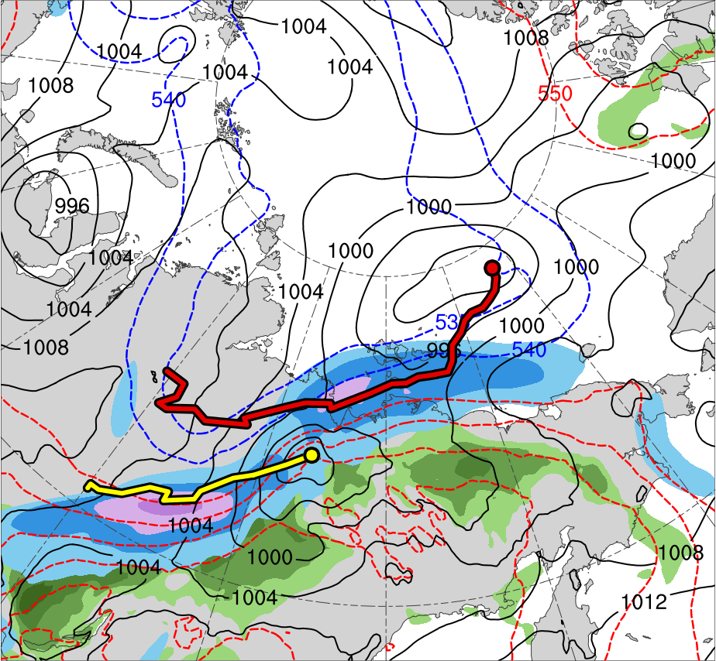
4) Synoptic Evolution
0000 UTC 4 Aug 2012
TPV 1
TPV 2
L1
TPV 3
AC12
(K)
252
258
264
270
276
282
288
294
300
306
312
318
324
330
336
342
348
354
360
366
372
378
(m s⁻¹ )
(mm)
30
40
50
60
70
80
90
100
25
30
35
40
45
50
55
Potential temperature (K, shaded), wind speed (black, every 10 m s⁻¹ starting at 30 m s⁻¹), and wind (m s⁻¹, flags and barbs) on 2-PVU surface
300-hPa wind speed (m s⁻¹, shaded),
1000–500-hPa thickness (dam, blue/red),
SLP (hPa, black), and PW (mm, shaded)

Slide 13
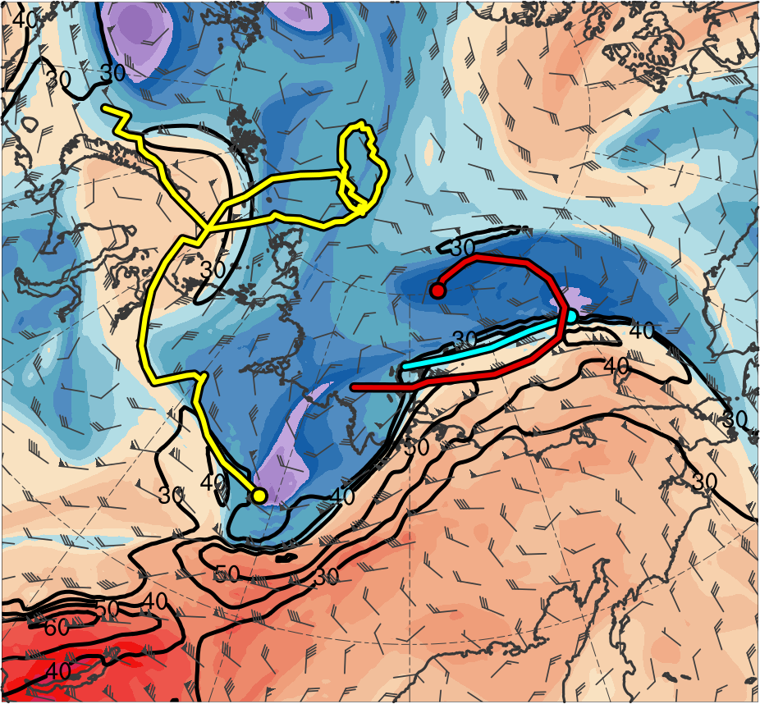
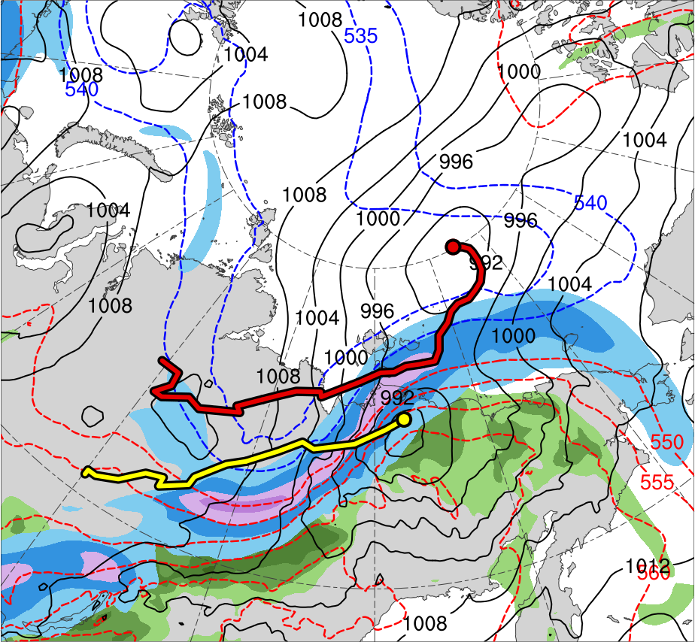
4) Synoptic Evolution
1200 UTC 4 Aug 2012
TPV 1
TPV 2
L1
TPV 3
AC12
(K)
252
258
264
270
276
282
288
294
300
306
312
318
324
330
336
342
348
354
360
366
372
378
(m s⁻¹ )
(mm)
30
40
50
60
70
80
90
100
25
30
35
40
45
50
55
Potential temperature (K, shaded), wind speed (black, every 10 m s⁻¹ starting at 30 m s⁻¹), and wind (m s⁻¹, flags and barbs) on 2-PVU surface
300-hPa wind speed (m s⁻¹, shaded),
1000–500-hPa thickness (dam, blue/red),
SLP (hPa, black), and PW (mm, shaded)

Slide 14
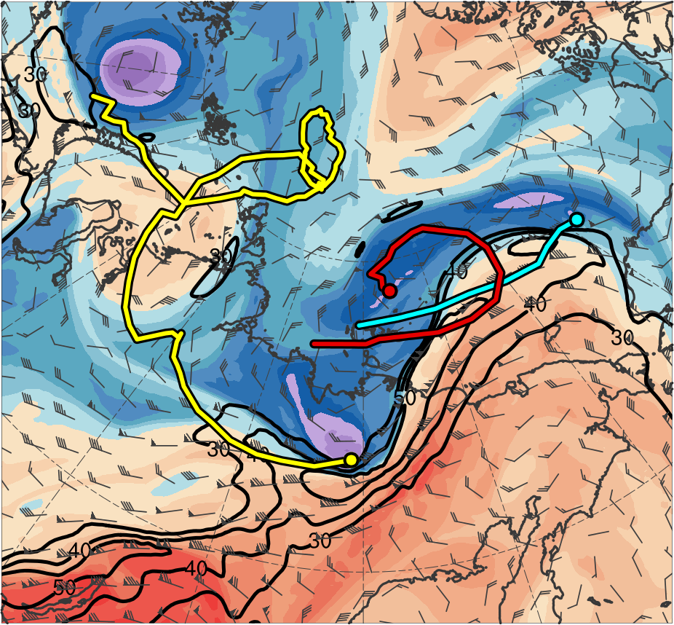
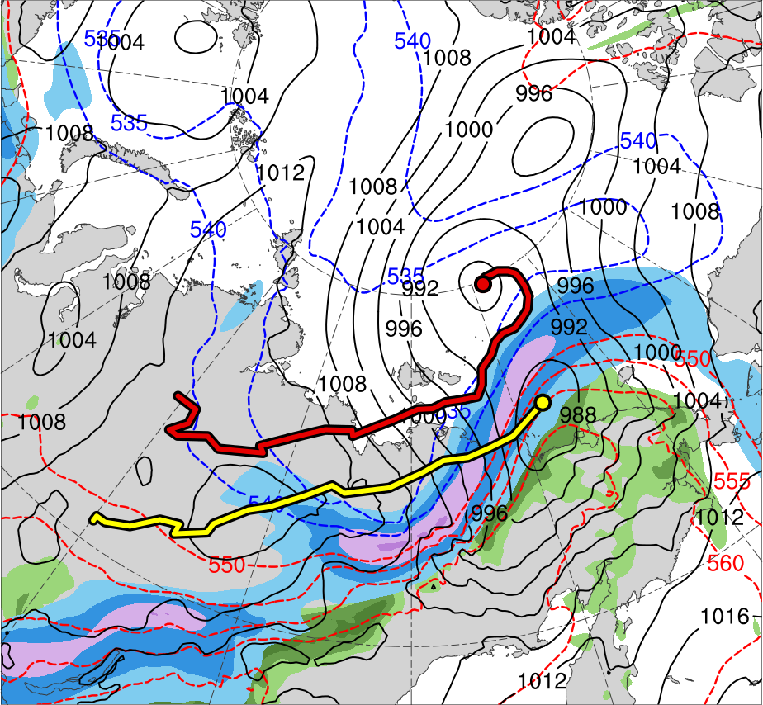
4) Synoptic Evolution
0000 UTC 5 Aug 2012
TPV 1
TPV 2
L1
TPV 3
AC12
(K)
252
258
264
270
276
282
288
294
300
306
312
318
324
330
336
342
348
354
360
366
372
378
(m s⁻¹ )
(mm)
30
40
50
60
70
80
90
100
25
30
35
40
45
50
55
Potential temperature (K, shaded), wind speed (black, every 10 m s⁻¹ starting at 30 m s⁻¹), and wind (m s⁻¹, flags and barbs) on 2-PVU surface
300-hPa wind speed (m s⁻¹, shaded),
1000–500-hPa thickness (dam, blue/red),
SLP (hPa, black), and PW (mm, shaded)

Slide 15
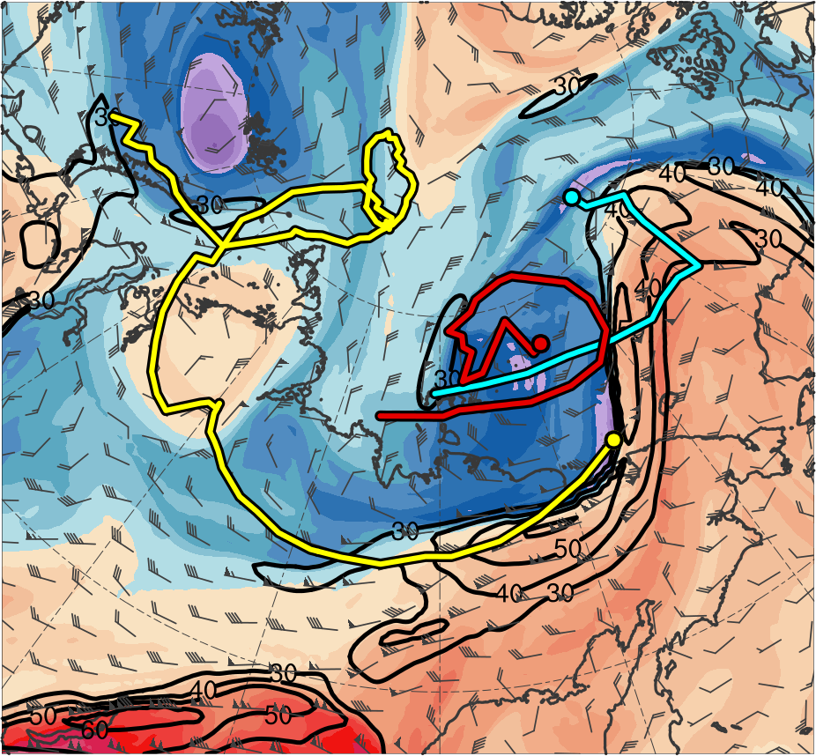
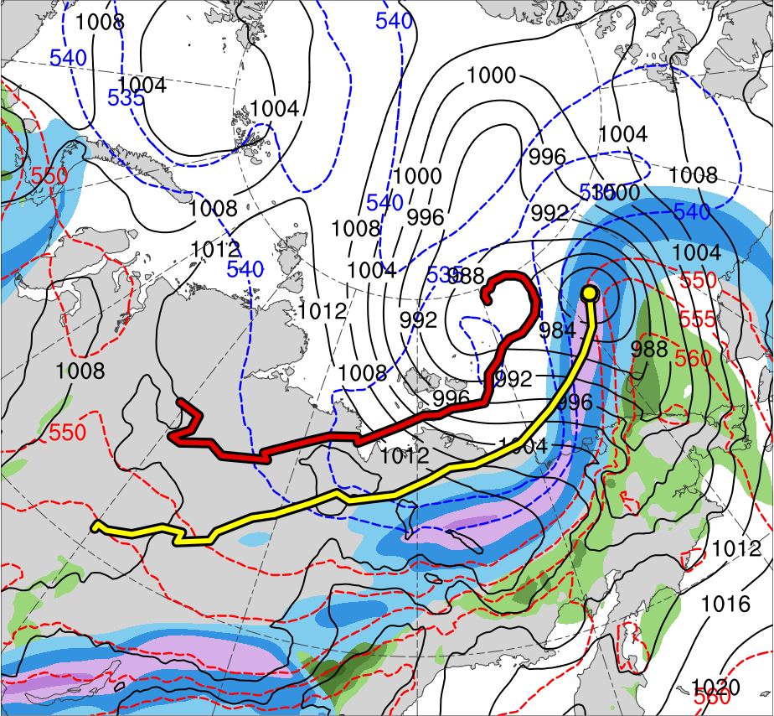
4) Synoptic Evolution
1200 UTC 5 Aug 2012
TPV 1
TPV 2
L1
TPV 3
AC12
(K)
252
258
264
270
276
282
288
294
300
306
312
318
324
330
336
342
348
354
360
366
372
378
(m s⁻¹ )
(mm)
30
40
50
60
70
80
90
100
25
30
35
40
45
50
55
Potential temperature (K, shaded), wind speed (black, every 10 m s⁻¹ starting at 30 m s⁻¹), and wind (m s⁻¹, flags and barbs) on 2-PVU surface
300-hPa wind speed (m s⁻¹, shaded),
1000–500-hPa thickness (dam, blue/red),
SLP (hPa, black), and PW (mm, shaded)

Slide 16
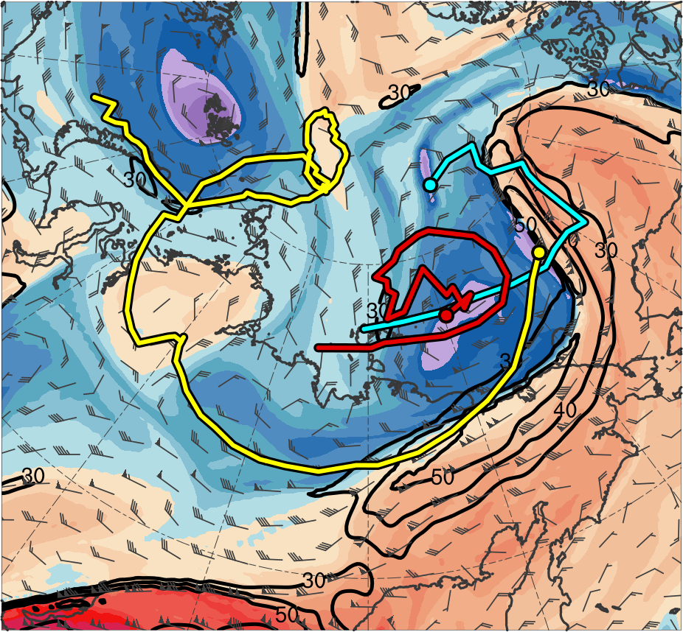
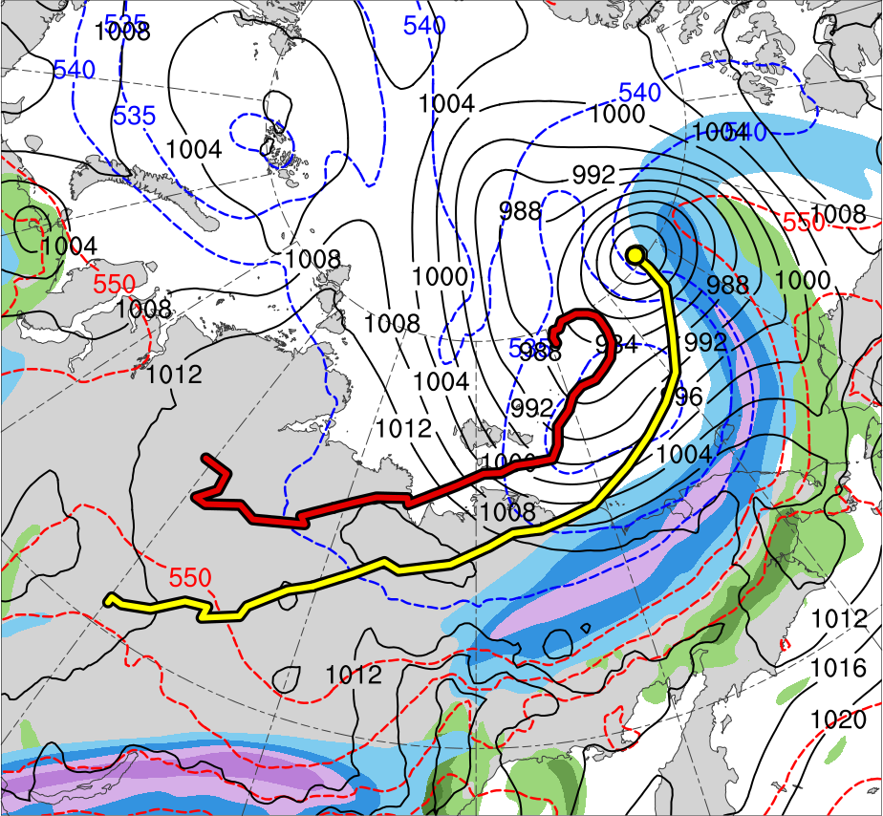
4) Synoptic Evolution
0000 UTC 6 Aug 2012
TPV 1
TPV 2
L1
TPV 3
AC12
(K)
252
258
264
270
276
282
288
294
300
306
312
318
324
330
336
342
348
354
360
366
372
378
(m s⁻¹ )
(mm)
30
40
50
60
70
80
90
100
25
30
35
40
45
50
55
Potential temperature (K, shaded), wind speed (black, every 10 m s⁻¹ starting at 30 m s⁻¹), and wind (m s⁻¹, flags and barbs) on 2-PVU surface
300-hPa wind speed (m s⁻¹, shaded),
1000–500-hPa thickness (dam, blue/red),
SLP (hPa, black), and PW (mm, shaded)

Slide 17
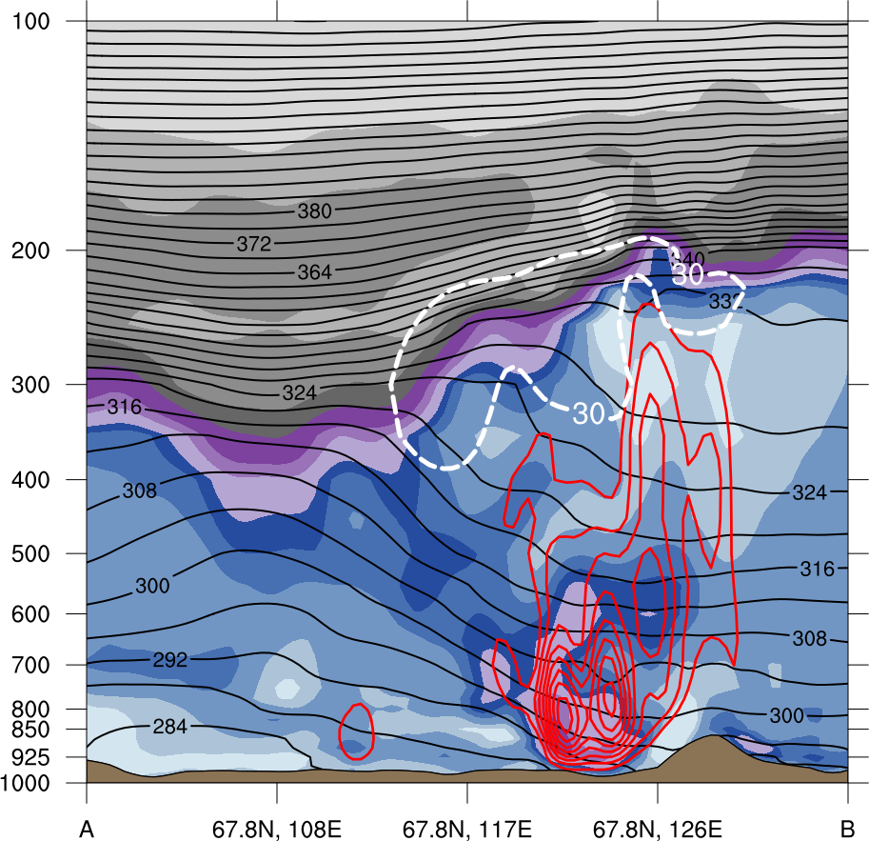
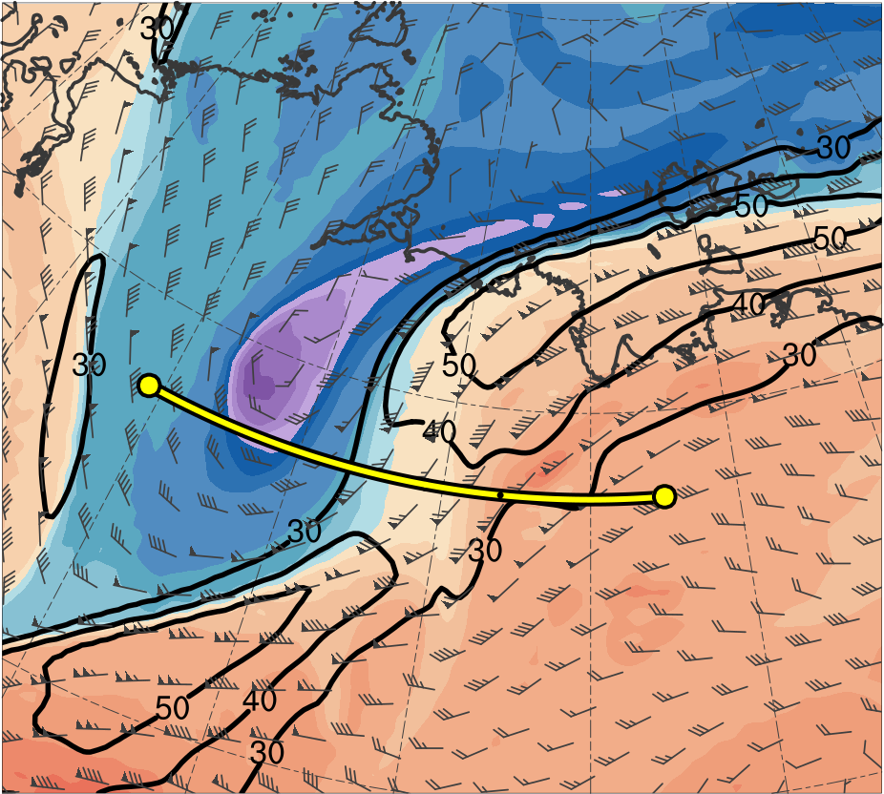
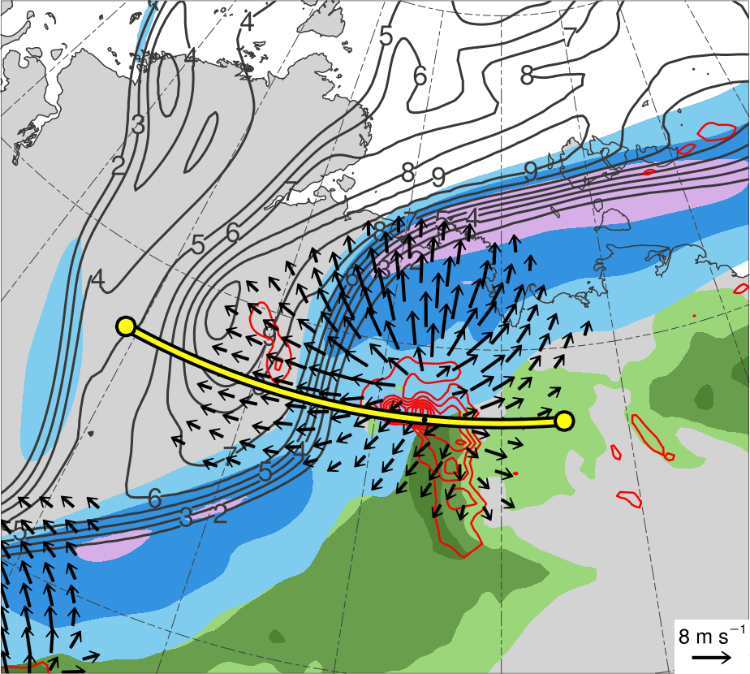
5) Cross Sections
2100 UTC 3 Aug 2012
(b)
(a)
378
100
12
TPV 1
372
90
366
10
A
360
80
354
70
8
A’
348
60
6
342
50
336
4
330
40
324
30
3
AC12
318
(c)
312
(m s⁻¹)
2
306
TPV 1
300
55
1.5
TPV 1
294
50
A
288
1
282
45
0.5
A’
276
40
270
35
0.25
AC12
264
258
30
A
A’
252
25
(PVU)
AC12
(K)
(mm)
(a) PV (PVU, shaded), θ (K, black), ascent (red, every 5 × 10⁻³ hPa s⁻¹), and wind speed (white, every 10 m s⁻¹ starting at 30 m s⁻¹); DT (2-PVU surface) θ (K, shaded), wind speed (black, every 10 m s⁻¹ starting at 30 m s⁻¹), and wind (m s⁻¹, flags and barbs); (c) 350–250-hPa PV (PVU, gray) and irrot. wind (m s⁻¹, vectors), 300-hPa wind speed (m s⁻¹, shaded), 800–600-hPa ascent (every 5 × 10⁻³ hPa s⁻¹), and PW (mm, shading)

Slide 18
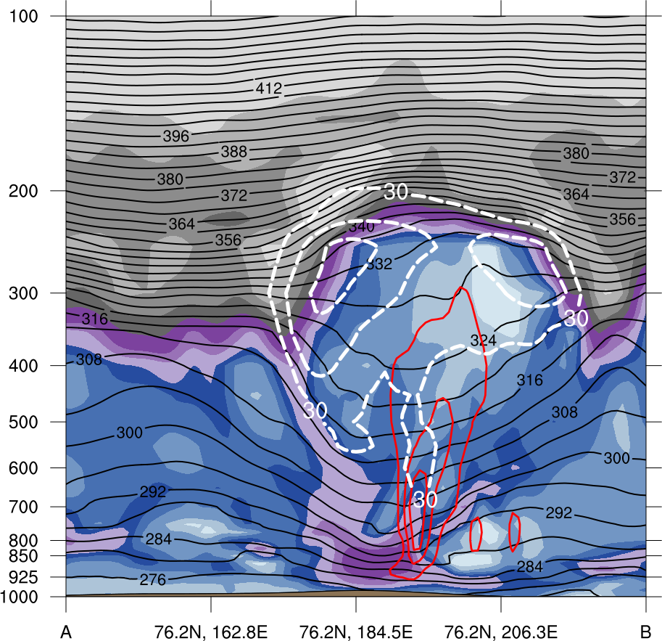
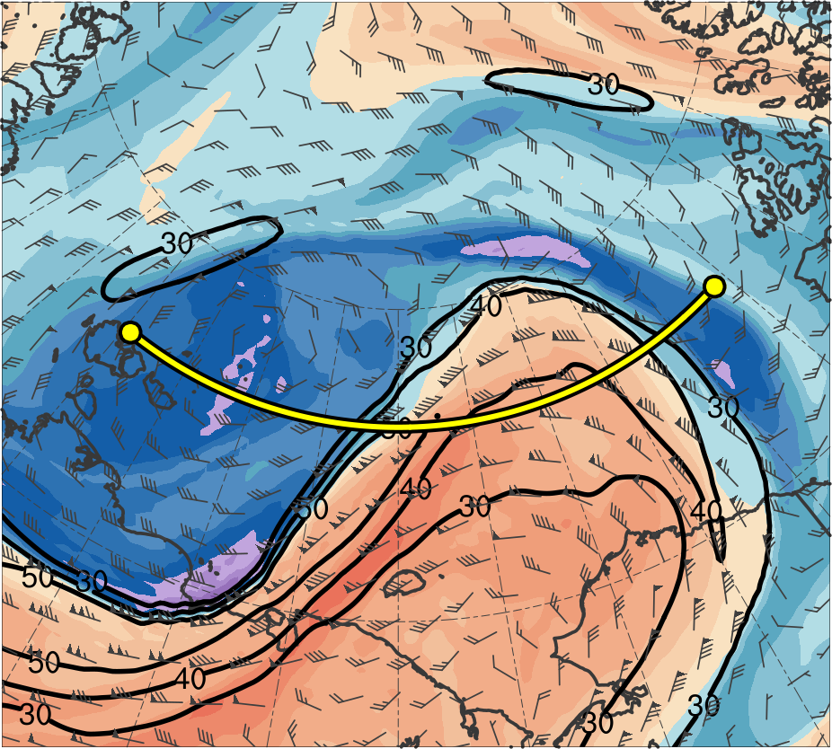
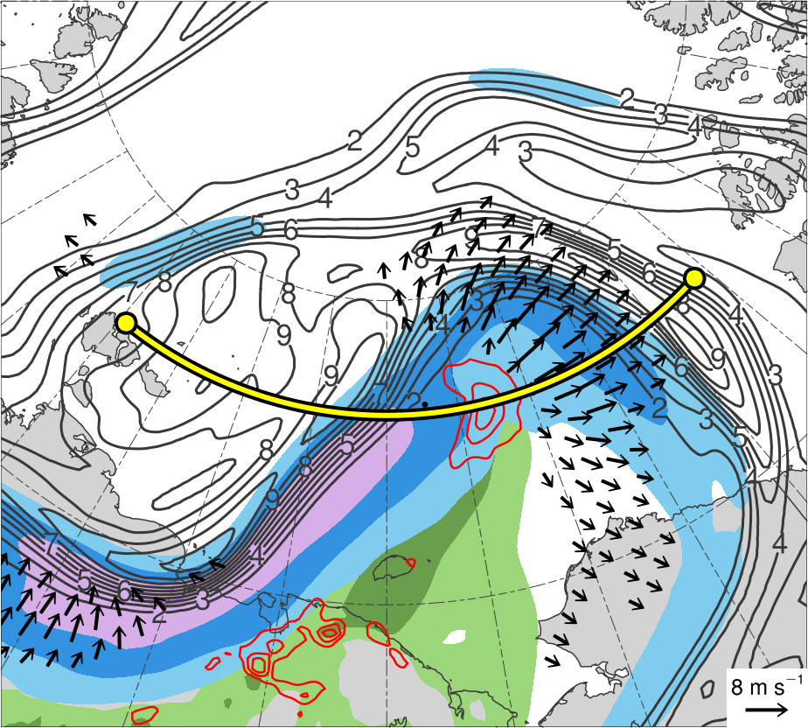
5) Cross Sections
1200 UTC 5 Aug 2012
(b)
(a)
TPV 3
378
100
12
TPV 2
372
90
B’
366
10
B
360
80
354
70
8
348
60
6
342
50
336
4
TPV 1
330
40
324
30
3
AC12
318
(c)
312
(m s⁻¹)
2
TPV 3
306
TPV 2
300
55
1.5
TPV 2
B’
294
50
B
288
1
282
45
0.5
276
40
270
35
0.25
AC12
264
TPV 1
258
30
B
B’
252
25
(PVU)
AC12
(K)
(mm)
(a) PV (PVU, shaded), θ (K, black), ascent (red, every 5 × 10⁻³ hPa s⁻¹), and wind speed (white, every 10 m s⁻¹ starting at 30 m s⁻¹); DT (2-PVU surface) θ (K, shaded), wind speed (black, every 10 m s⁻¹ starting at 30 m s⁻¹), and wind (m s⁻¹, flags and barbs); (c) 350–250-hPa PV (PVU, gray) and irrot. wind (m s⁻¹, vectors), 300-hPa wind speed (m s⁻¹, shaded), 800–600-hPa ascent (every 5 × 10⁻³ hPa s⁻¹), and PW (mm, shading)

Slide 19
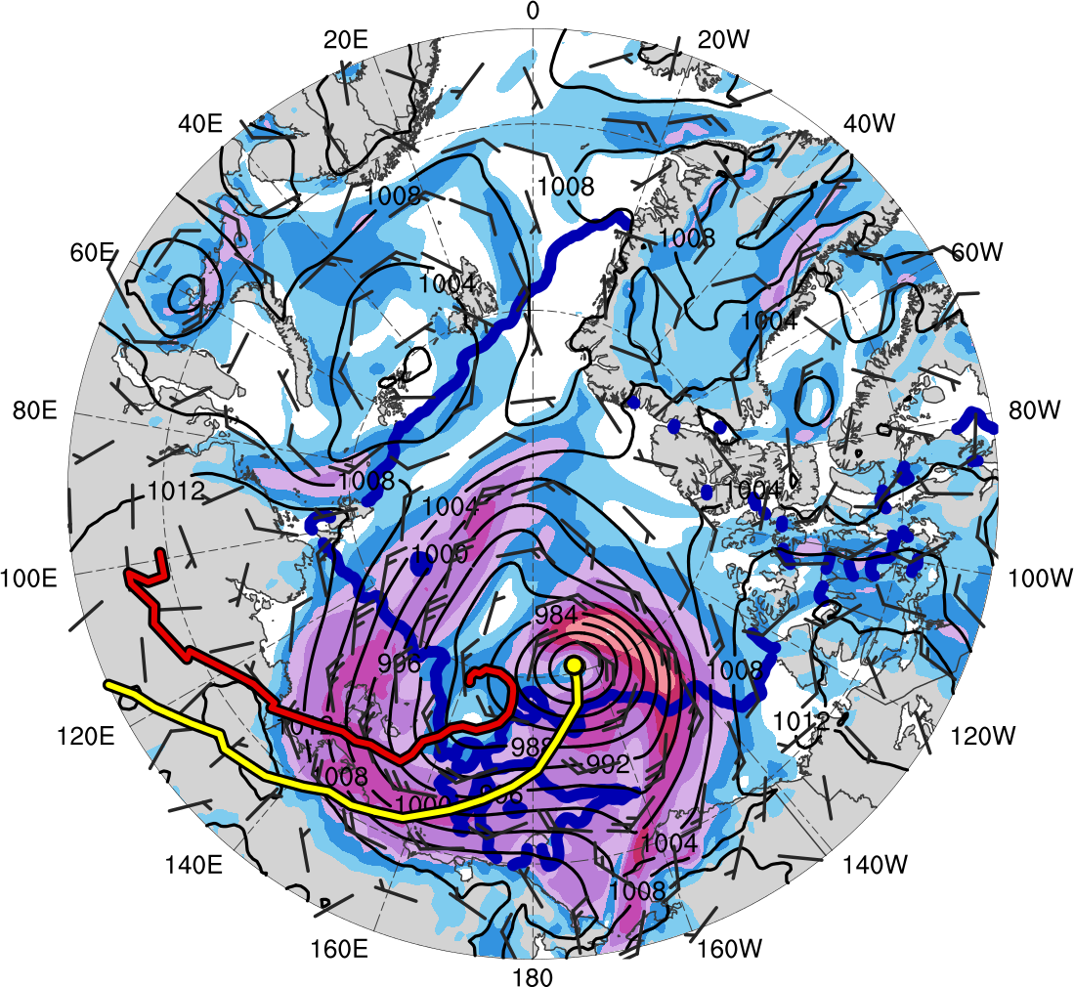
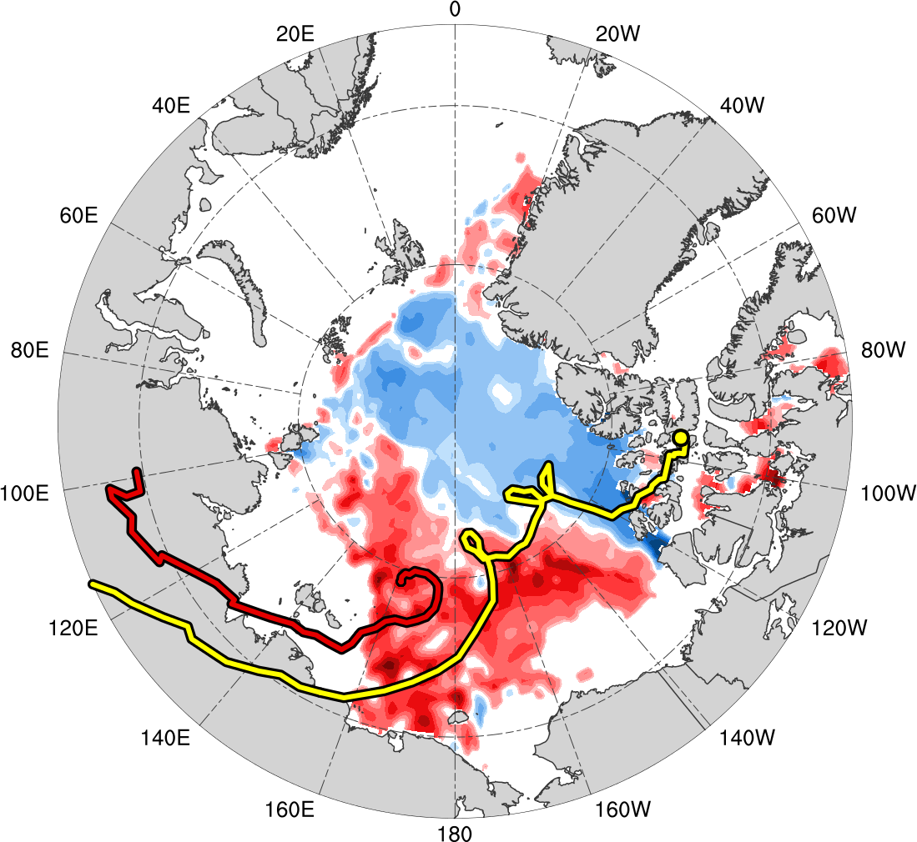
6) Impacts of AC12 on Arctic Sea Ice
0000 UTC 6 Aug 2012
0000 UTC 14 Aug 2012
L1
AC12
(m s⁻¹ )
(%)
4
6
8
10
12
14
16
18
-60
-50
-40
-30
-20
-10
-5
5
10
20
30
40
50
60
SLP (hPa, black); 10-m wind speed (m s⁻¹, shaded) and wind (m s⁻¹, black barbs), and 20% contour of sea-ice concentration (thick blue)
Change in sea-ice concentration (%, shaded) during 0000 UTC 2–0000 UTC 14 Aug 2012

Slide 20
Great Arctic Cyclone of August 2012
Summary
TPV 1 approaches and interacts with AC12 in a region of strong baroclinicity, likely supporting the development of AC12 through baroclinic processes
TPV–jet interactions involving TPV 1, TPV 2, and TPV 3 likely contribute to the formation of a dual-jet configuration and jet coupling over AC12 (jet coupling phase)

Slide 21
Great Arctic Cyclone of August 2012
Summary
Latent heating related to low-level ascent in the presence of warm, moist air in region of jet coupling likely contributes to the formation of a PV tower associated with AC12 and concomitant intensification of AC12
Interaction between TPV 1 and PV tower likely supports the intensification of AC12
Cold air advection in the wake of L1 helps maintain the strong baroclinicity in the vicinity of AC12, which, along with interaction between L1 and AC12, may further support the intensification of AC12

Slide 22
Great Arctic Cyclone of August 2012
Summary
Most rapid intensification of AC12 occurs on 5 Aug 2012, when AC12 crosses from the warm side to the cold side of a strong upper-level jet streak (jet crossing phase)
Latent heating may contribute to PV tower associated with AC12 and intensification of AC12 during jet crossing phase, though this contribution may be smaller than that during jet coupling phase
Widespread, relatively strong surface winds associated with AC12 contribute to reductions in Arctic sea-ice extent as AC12 meanders slowly over the Arctic

Slide 23
Two Intense Arctic Cyclones in June 2018
Background
Arctic cyclone 1 (AC1) formed along an old cold frontal boundary northeast of the Caspian Sea, moved poleward, performed a cyclonic loop with a subsequent Arctic cyclone (AC2) near the north coast of Russia, and eventually merged with AC2 over the Arctic Ocean
AC2 formed via lee cyclogenesis east of Greenland, and may have had some “DNA” (i.e., vorticity) from the remnants of Tropical Storm (TS) Alberto, which moved poleward across the central U.S. and northeastern Canada

Slide 24
Two Intense Arctic Cyclones in June 2018
Background
The comparative rarity of two sequential intense Arctic cyclones that interacted with one another, one of which (AC2) may have had antecedent DNA from TS Alberto, motivates this presentation

Slide 25
Two Intense Arctic Cyclones in June 2018
Data and Methods
Data: ERA5 gridded to 0.25° horizontal resolution for all fields, with ERA-Interim 1979–2010 mean and standard deviation of selected fields for calculation of standardized anomalies
Manually tracked AC1, AC2, and a Canadian low (CL) by following the locations of minimum SLP
Tracked TS Alberto using National Hurricane Center positions of TS Alberto during 1500 UTC 25 May–0600 UTC 29 May 2018 and remnants of TS Alberto using ERA5 afterward

Slide 26
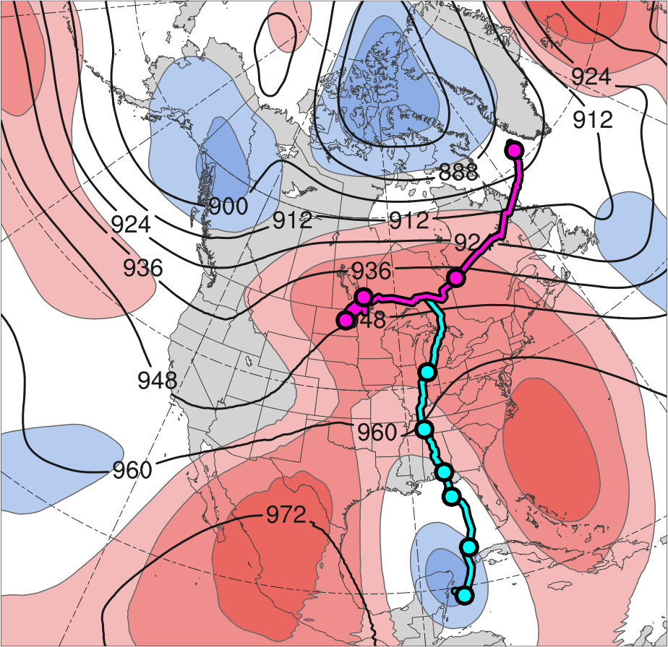
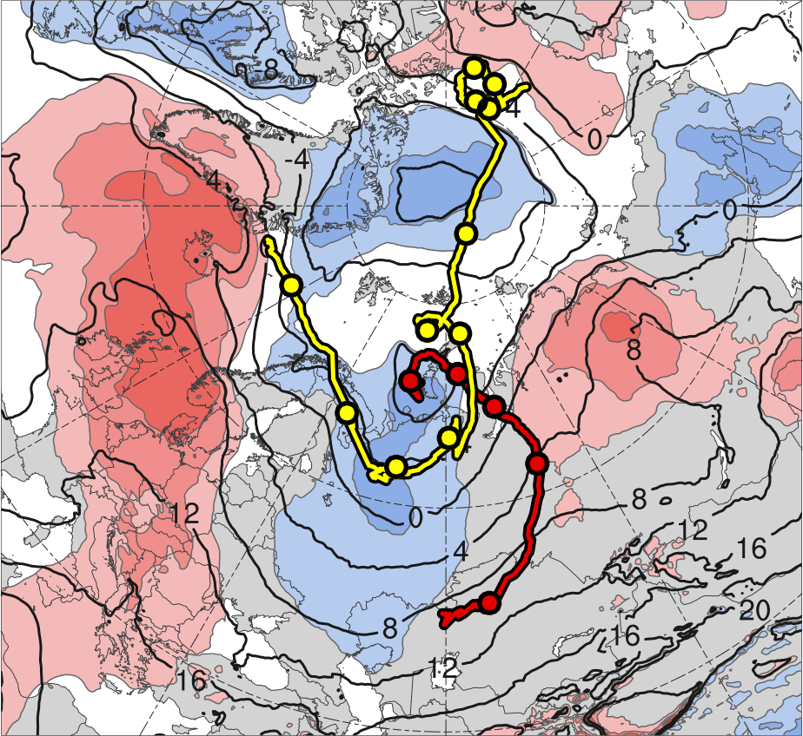
3) Track and Intensity
(a)
(b)
10
11
13
2
12
9
8
31
3
6
7
30
1
5
4
31
4
3
30
6
29
5
28
27
2
Alberto
26
AC1
CL
AC2
Genesis
Merger
-2
-1.5
-1
-0.5
0
0.5
1
1.5
2
σ
Lysis
0000 UTC positions
(a) 26 May–1 June 2018 time-mean 300-hPa geopotential height (dam, black) and standardized geopotential height anomalies (σ, shaded); (b) 1–7 June 2018 time-mean 850-hPa temperature (°C, black) and standardized temperature anomalies (σ, shaded).
Cyclone | Genesis | Lysis | Lifetime
AC1 | 1 June 2018 | 6 June 2018 | ~5 d
AC2 | 2 June 2018 | 13 June 2018 | ~11 d

Slide 27
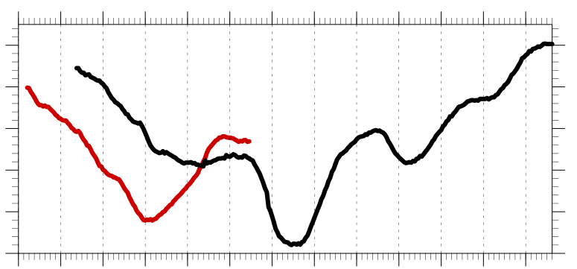
3) Track and Intensity
Hourly minimum SLP time series of AC1 and AC2
1010
1000
990
SLP (hPa)
980
970
960
1
2
3
4
5
6
7
8
9
10
11
12
13
Day in June 2018 labeled at 0000 UTC
AC1
AC2
Peak intensity of AC1 at 0400 UTC 4 June 2018 (967.9 hPa)
Peak intensity of AC2 at 1100 UTC 7 June 2018 (962.0 hPa)

Slide 28
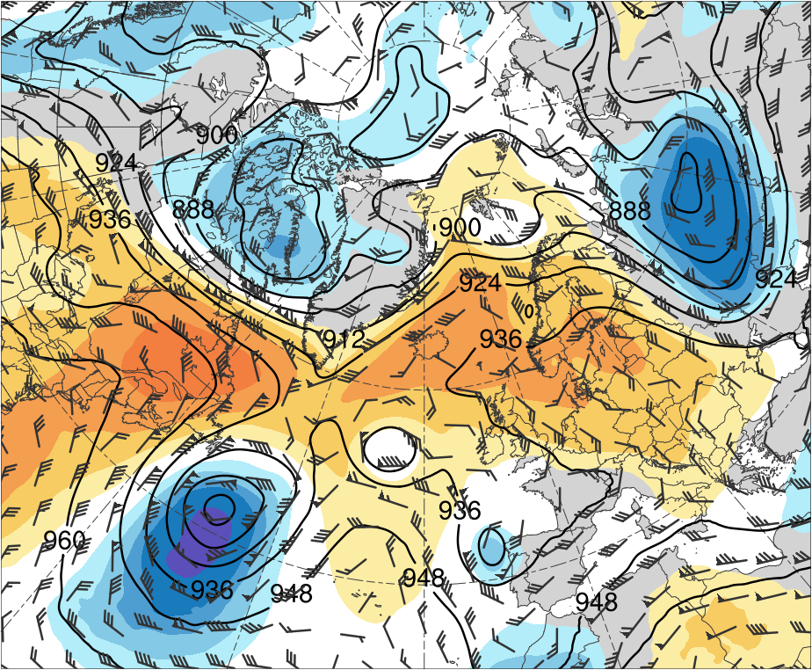
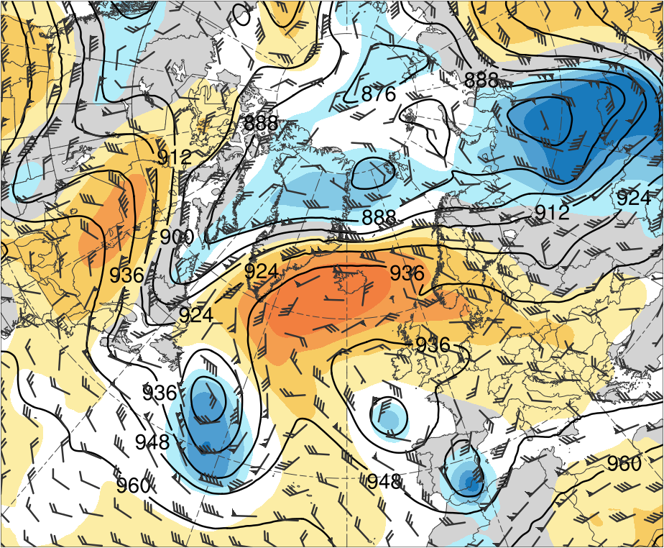
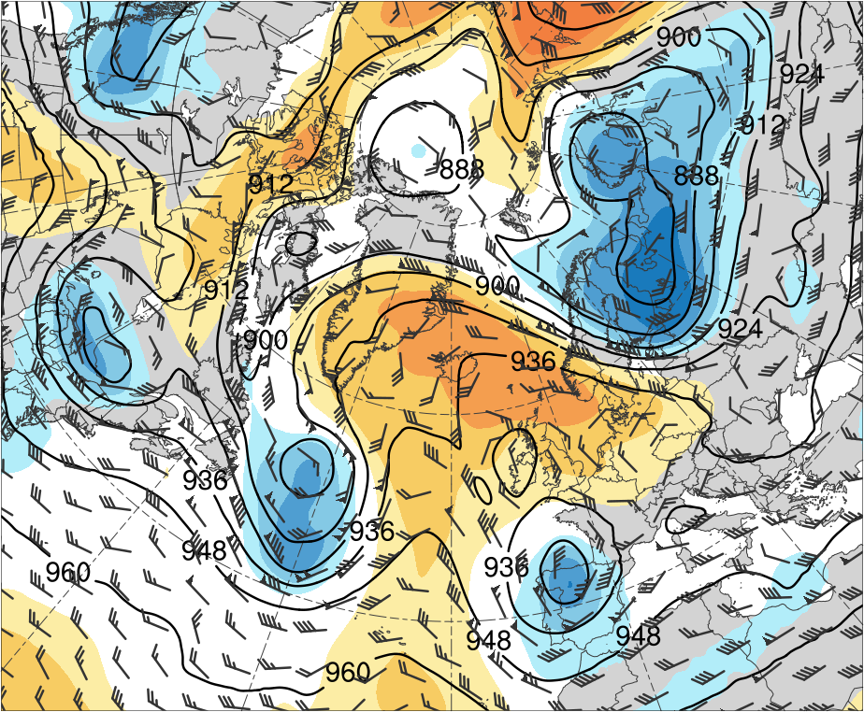
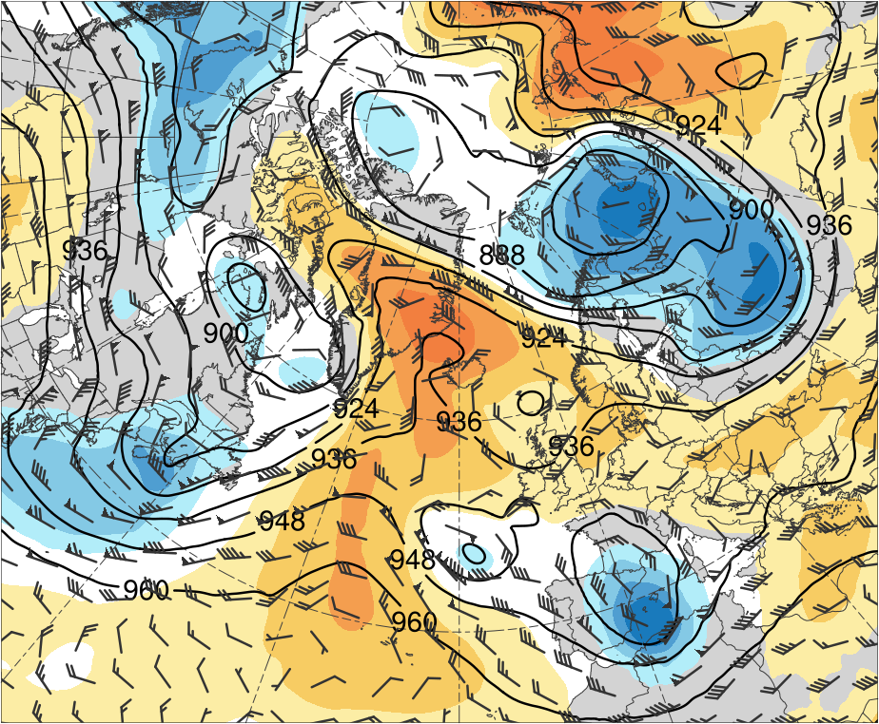
4) Large-Scale Flow Evolution
(a) 0000 UTC 1 Jun 2018
(b) 0000 UTC 3 Jun 2018
T1
6
T1
5
4
3
2
1.5
1
0.5
(c) 0000 UTC 5 Jun 2018
(d) 0000 UTC 7 Jun 2018
0
-0.5
T2
-1
T2
-1.5
-2
-3
-4
-5
-6
300-hPa geopotential height (dam, black), winds (m s⁻¹, flags and barbs), and standardized geopotential height anomalies (σ, shaded)

Slide 29
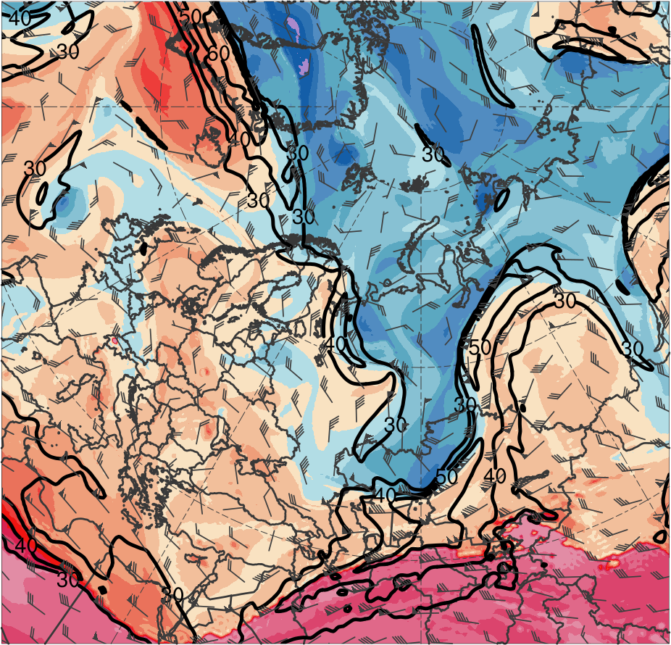
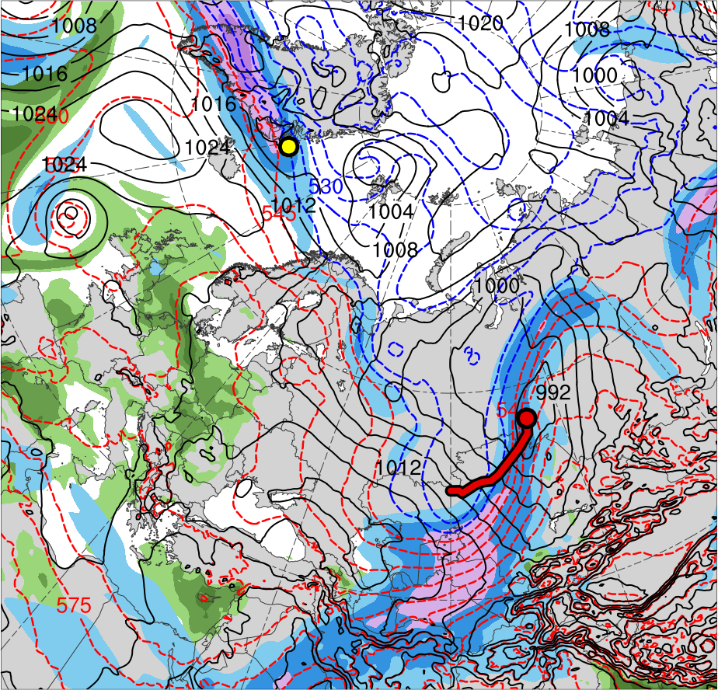
5) Synoptic Evolution
1200 UTC 2 June 2012
TPV 2
Lee cyclogenesis of AC2
TPV 1
AC1
AC2
(K)
252
258
264
270
276
282
288
294
300
306
312
318
324
330
336
342
348
354
360
366
372
378
(m s⁻¹ )
(mm)
30
40
50
60
70
80
90
100
25
30
35
40
45
50
55
Potential temperature (K, shaded), wind speed (black, every 10 m s⁻¹ starting at 30 m s⁻¹), and wind (m s⁻¹, flags and barbs) on 2-PVU surface
300-hPa wind speed (m s⁻¹, shaded),
1000–500-hPa thickness (dam, blue/red),
SLP (hPa, black), and PW (mm, shaded)

Slide 30
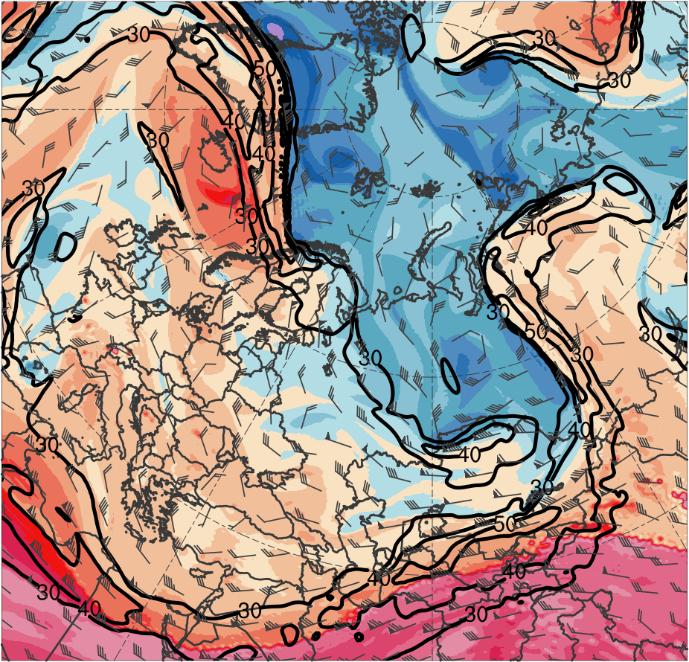
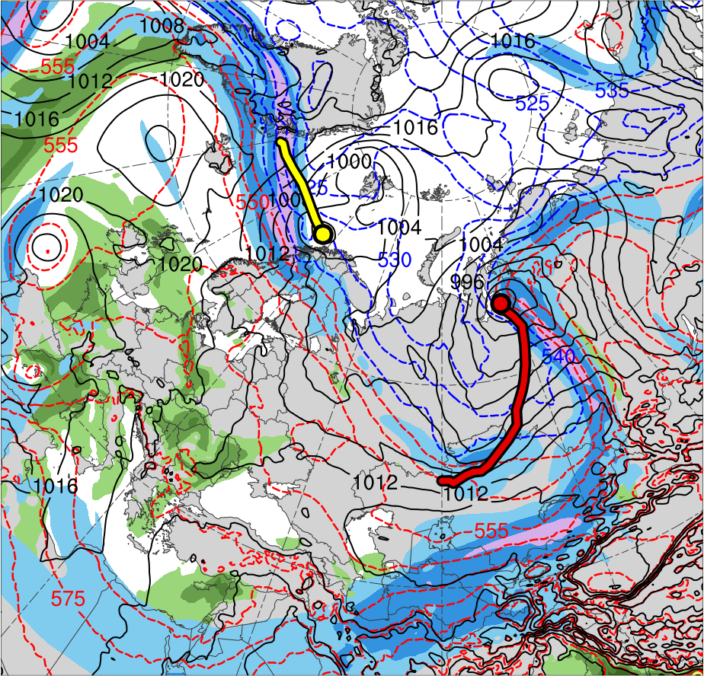
5) Synoptic Evolution
1200 UTC 3 June 2012
TPV 2
TPV 1
AC1
AC2
(K)
252
258
264
270
276
282
288
294
300
306
312
318
324
330
336
342
348
354
360
366
372
378
(m s⁻¹ )
(mm)
30
40
50
60
70
80
90
100
25
30
35
40
45
50
55
Potential temperature (K, shaded), wind speed (black, every 10 m s⁻¹ starting at 30 m s⁻¹), and wind (m s⁻¹, flags and barbs) on 2-PVU surface
300-hPa wind speed (m s⁻¹, shaded),
1000–500-hPa thickness (dam, blue/red),
SLP (hPa, black), and PW (mm, shaded)

Slide 31
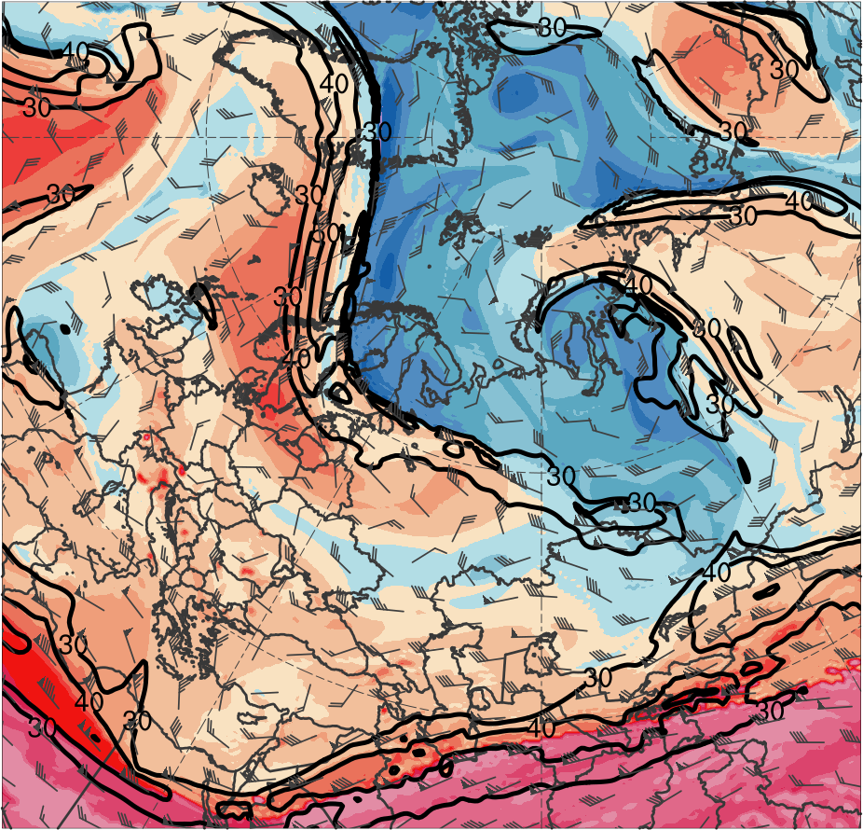
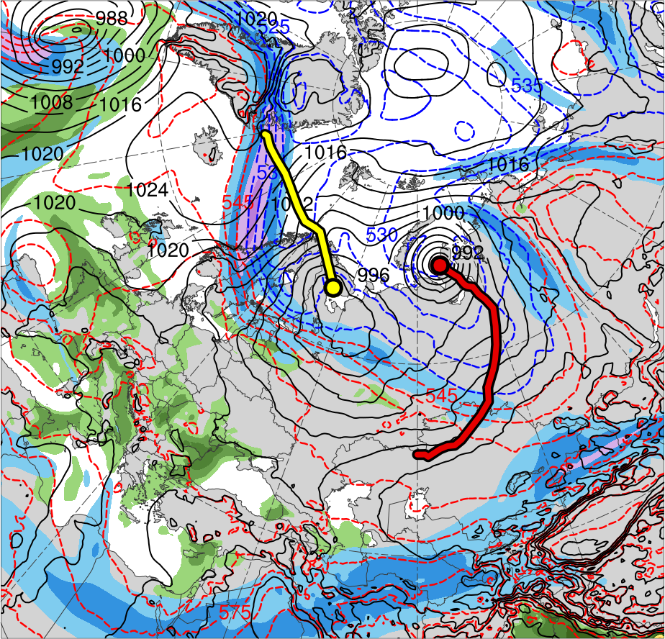
5) Synoptic Evolution
1200 UTC 4 June 2012
TPV 3
TPV 1
AC1
AC2
(K)
252
258
264
270
276
282
288
294
300
306
312
318
324
330
336
342
348
354
360
366
372
378
(m s⁻¹ )
(mm)
30
40
50
60
70
80
90
100
25
30
35
40
45
50
55
Potential temperature (K, shaded), wind speed (black, every 10 m s⁻¹ starting at 30 m s⁻¹), and wind (m s⁻¹, flags and barbs) on 2-PVU surface
300-hPa wind speed (m s⁻¹, shaded),
1000–500-hPa thickness (dam, blue/red),
SLP (hPa, black), and PW (mm, shaded)

Slide 32
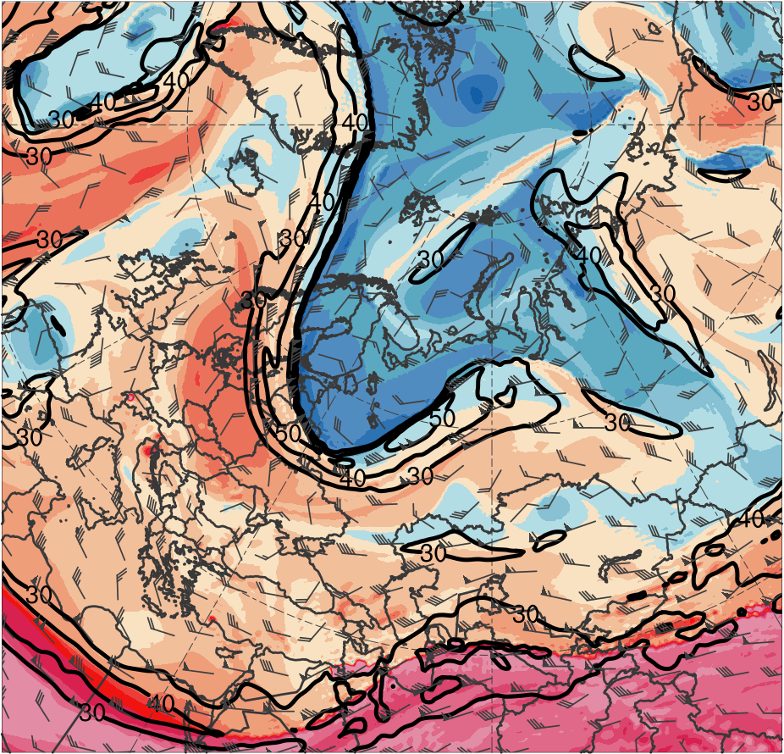
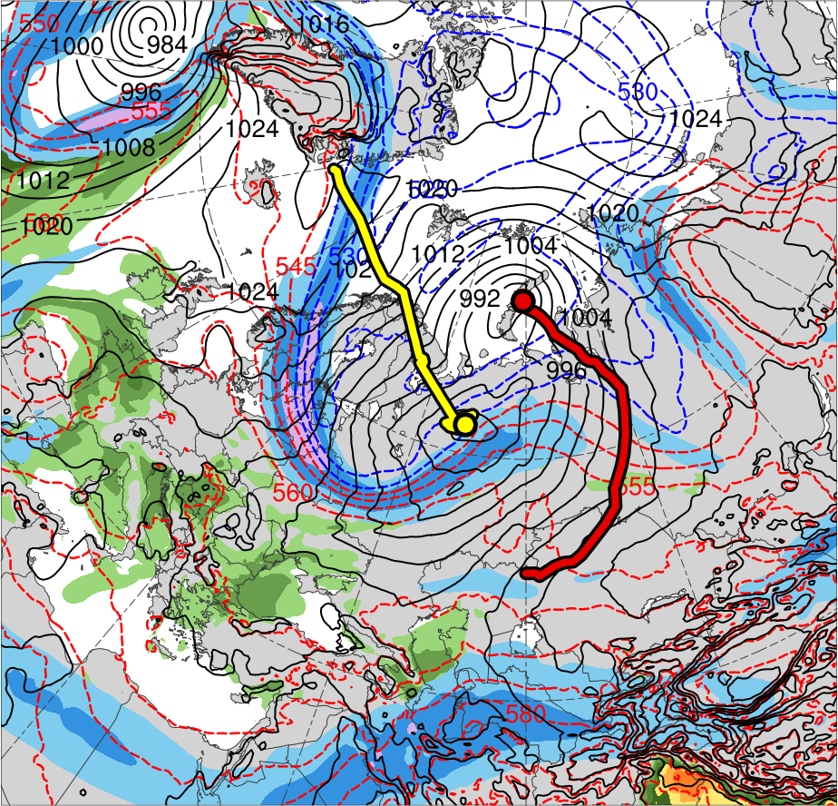
5) Synoptic Evolution
1200 UTC 5 June 2012
TPV 3
TPV 1
AC1
AC2
(K)
252
258
264
270
276
282
288
294
300
306
312
318
324
330
336
342
348
354
360
366
372
378
(m s⁻¹ )
(mm)
30
40
50
60
70
80
90
100
25
30
35
40
45
50
55
Potential temperature (K, shaded), wind speed (black, every 10 m s⁻¹ starting at 30 m s⁻¹), and wind (m s⁻¹, flags and barbs) on 2-PVU surface
300-hPa wind speed (m s⁻¹, shaded),
1000–500-hPa thickness (dam, blue/red),
SLP (hPa, black), and PW (mm, shaded)

Slide 33
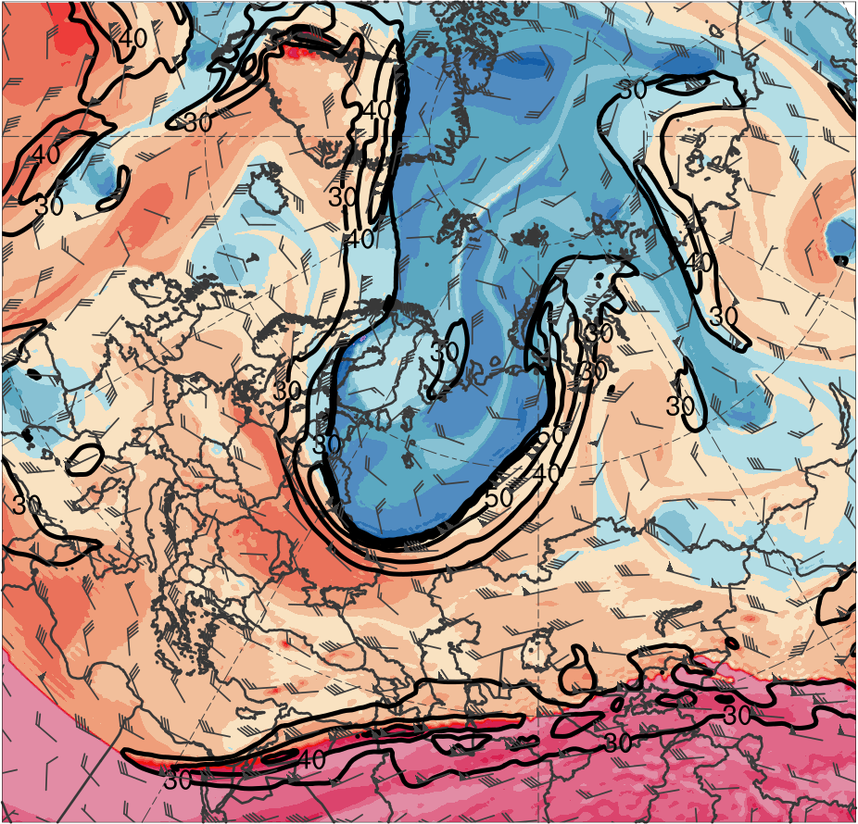
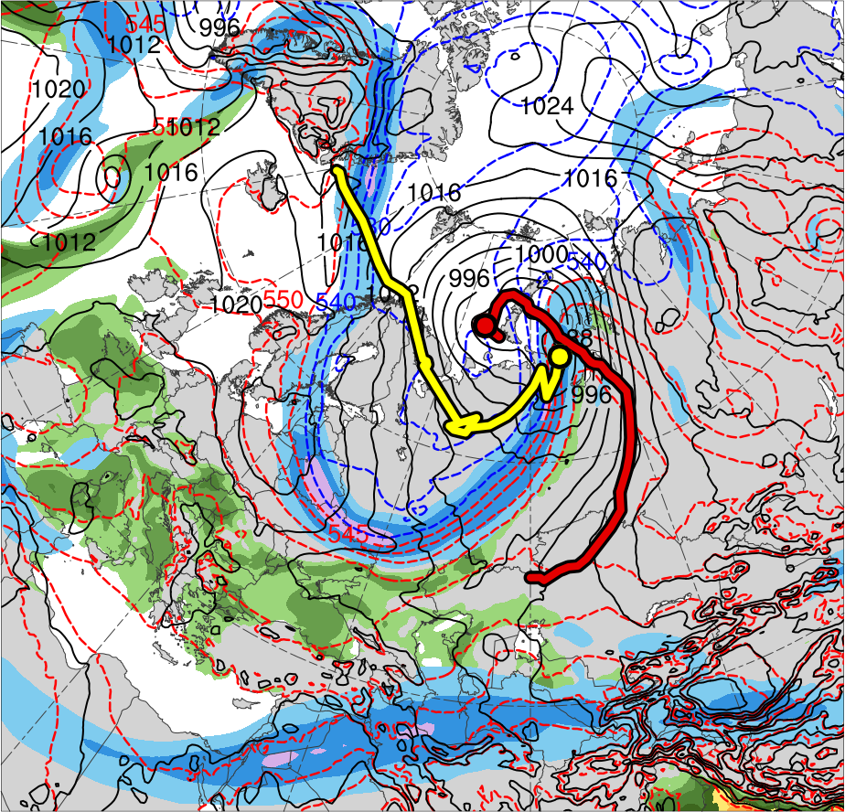
5) Synoptic Evolution
1200 UTC 6 June 2012
TPV 1
TPV 3
AC1
AC2
(K)
252
258
264
270
276
282
288
294
300
306
312
318
324
330
336
342
348
354
360
366
372
378
(m s⁻¹ )
(mm)
30
40
50
60
70
80
90
100
25
30
35
40
45
50
55
Potential temperature (K, shaded), wind speed (black, every 10 m s⁻¹ starting at 30 m s⁻¹), and wind (m s⁻¹, flags and barbs) on 2-PVU surface
300-hPa wind speed (m s⁻¹, shaded),
1000–500-hPa thickness (dam, blue/red),
SLP (hPa, black), and PW (mm, shaded)

Slide 34
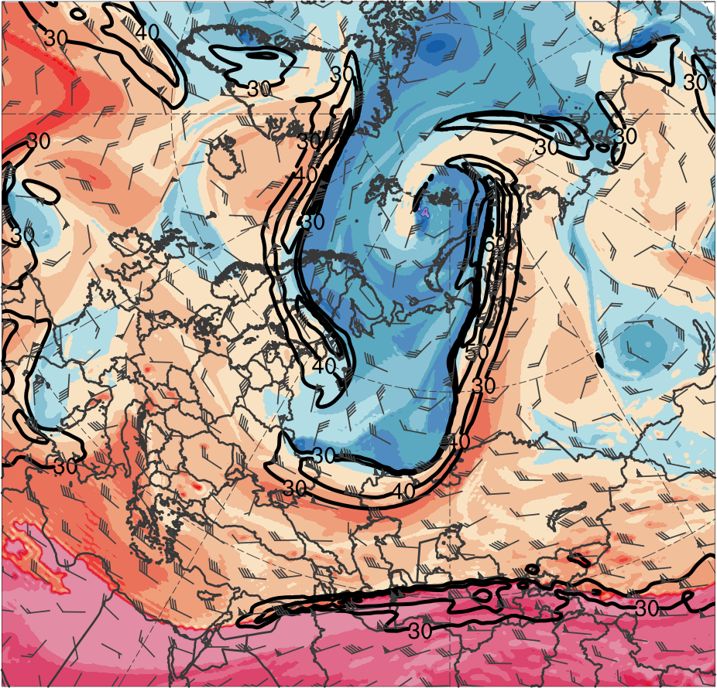
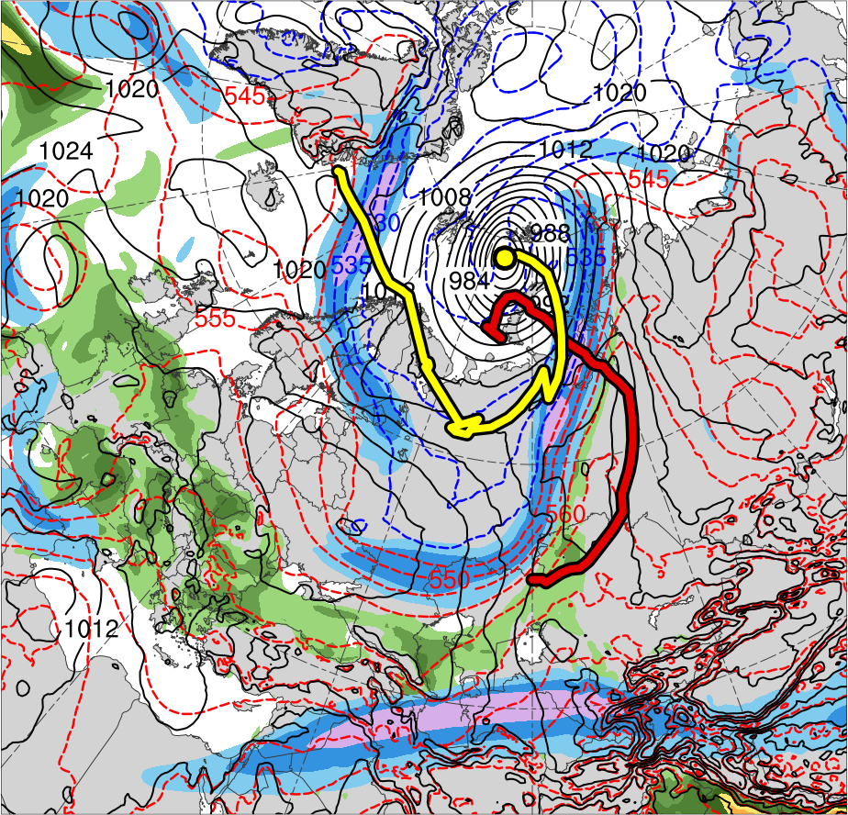
5) Synoptic Evolution
1200 UTC 7 June 2012
TPV 3
TPV 1
AC1
AC2
(K)
252
258
264
270
276
282
288
294
300
306
312
318
324
330
336
342
348
354
360
366
372
378
(m s⁻¹ )
(mm)
30
40
50
60
70
80
90
100
25
30
35
40
45
50
55
Potential temperature (K, shaded), wind speed (black, every 10 m s⁻¹ starting at 30 m s⁻¹), and wind (m s⁻¹, flags and barbs) on 2-PVU surface
300-hPa wind speed (m s⁻¹, shaded),
1000–500-hPa thickness (dam, blue/red),
SLP (hPa, black), and PW (mm, shaded)

Slide 35
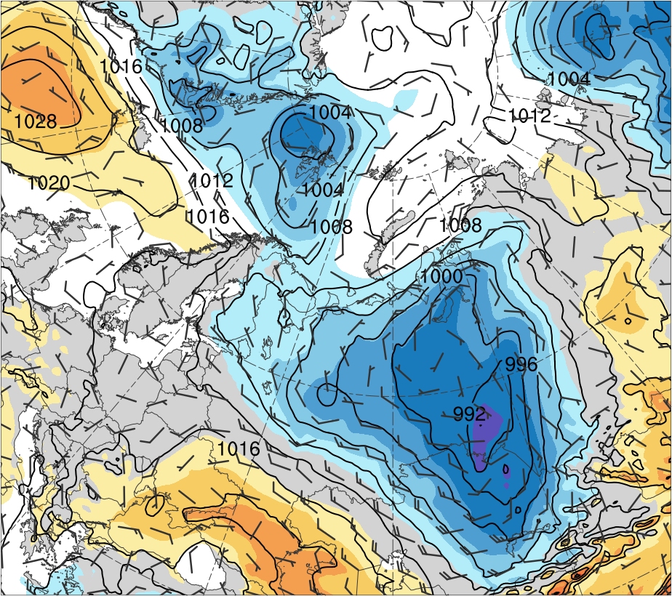
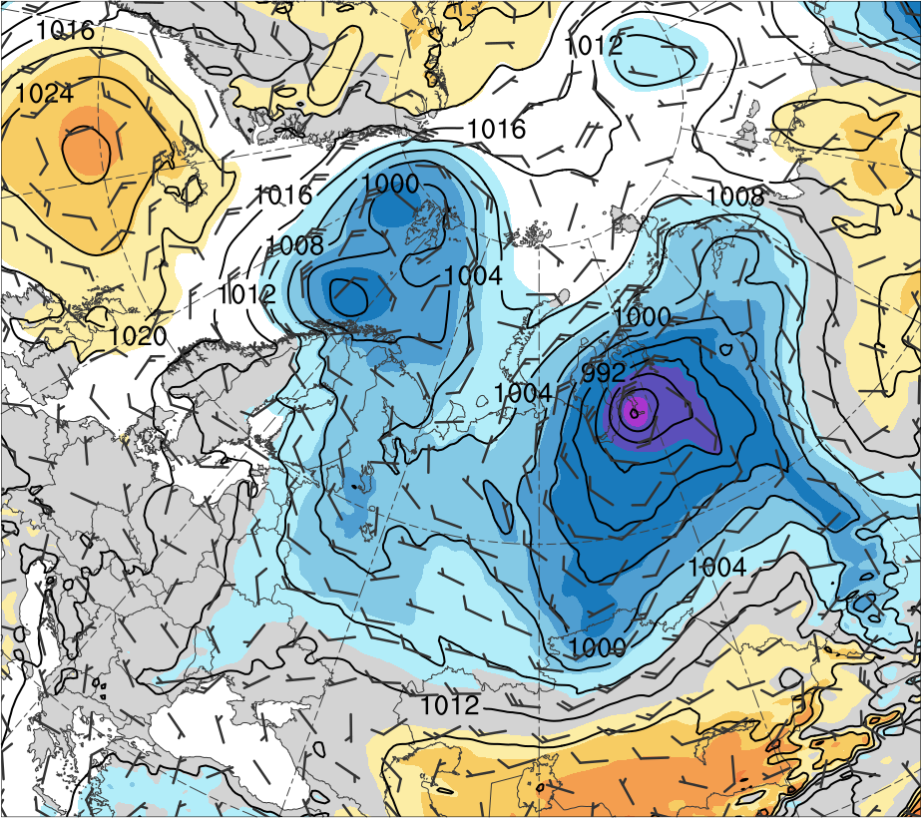
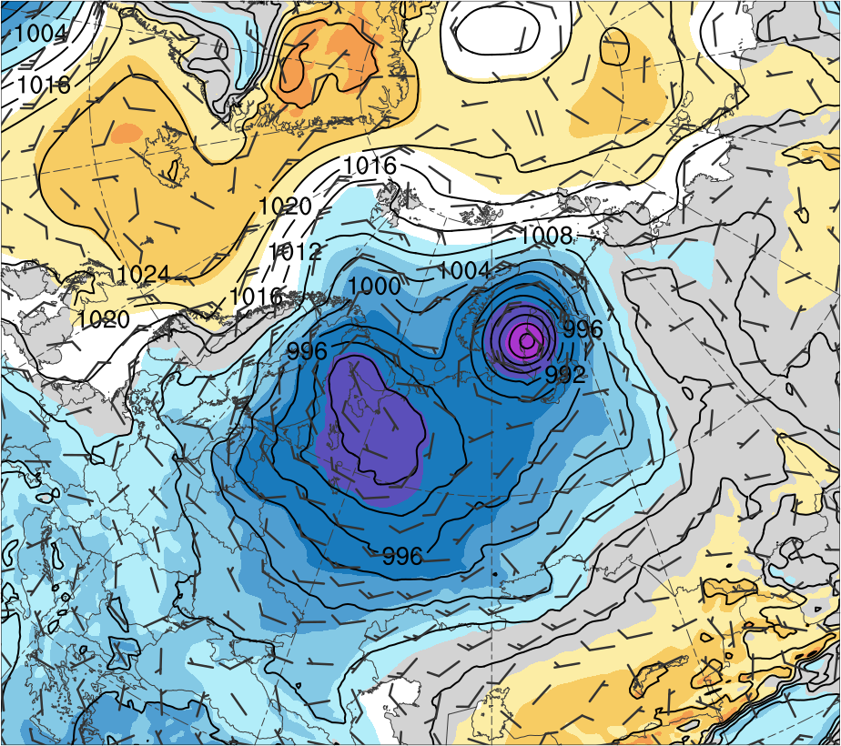
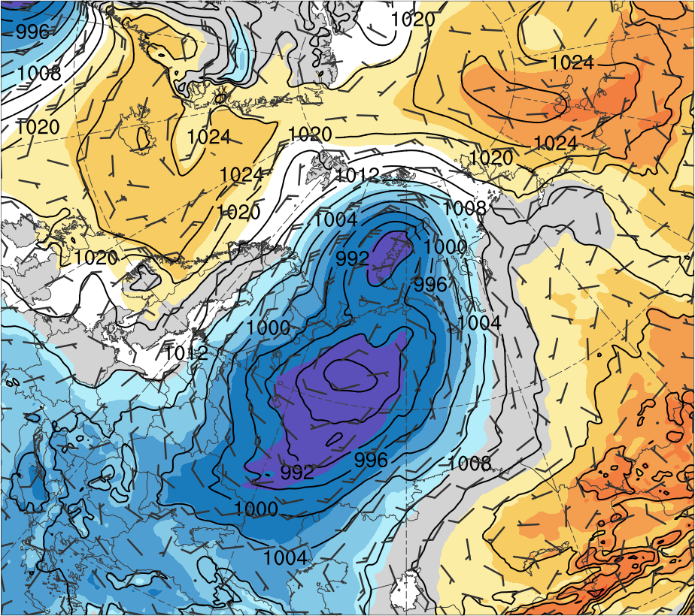
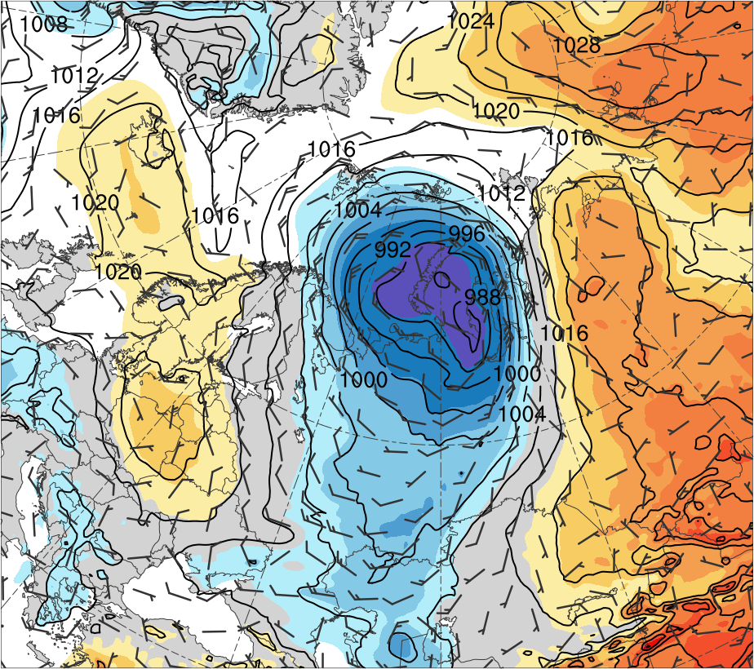
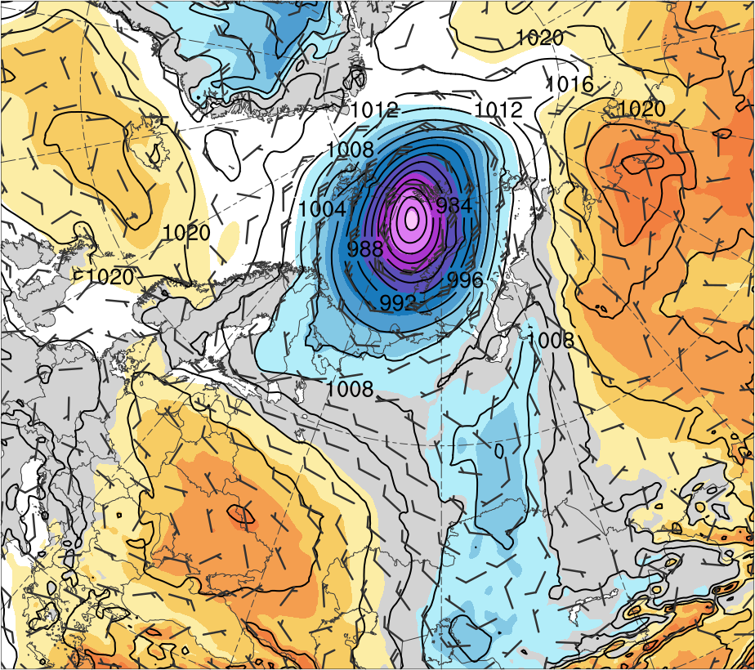
6) Interactions between Arctic Cyclones
(a) 1200 UTC 2 Jun 2018
(b) 1200 UTC 3 Jun 2018
(c) 1200 UTC 4 Jun 2018
AC1
AC1
6
5
AC1
4
AC2
3
AC2
2
1.5
AC2
1
0.5
(d) 1200 UTC 5 Jun 2018
(e) 1200 UTC 6 Jun 2018
(f) 1200 UTC 7 Jun 2018
0
AC1
-0.5
-1
-1.5
-2
AC2
-3
AC2
AC2
-4
-5
-6
SLP (hPa, black), 10-m winds (m s⁻¹, flags and barbs), and standardized SLP anomalies (σ, shaded)

Slide 36
Two Intense Arctic Cyclones in June 2018
Discussion
Remnants of TS Alberto are absorbed into the cyclonic/frontal region of CL over southern Canada
CL moves northeastward, weakens over the Davis Strait, and redevelops as a lee cyclone (AC2) east of Greenland
Successive deep troughs over Eurasia in early June that form in response to cyclonic wave breaking foster development of AC1 and AC2
AC1 forms near the Caspian Sea along a trailing cold front, moves northeastward, deepens, and reaches the Kara Sea

Slide 37
Two Intense Arctic Cyclones in June 2018
Discussion
AC2 intensifies as an ordinary baroclinic cyclone over northwestern Europe in conjunction with a strong jet stream
TPVs embedded within deep troughs likely contribute to rapid deepening of AC1 and AC2 in the left exit region of a jet streak
AC2 interacts and merges with AC1 and becomes the dominant cyclone, with a peak intensity of 962 hPa and a standardized SLP anomaly of < −6 σ

Slide 38
Extra Slide

Slide 39
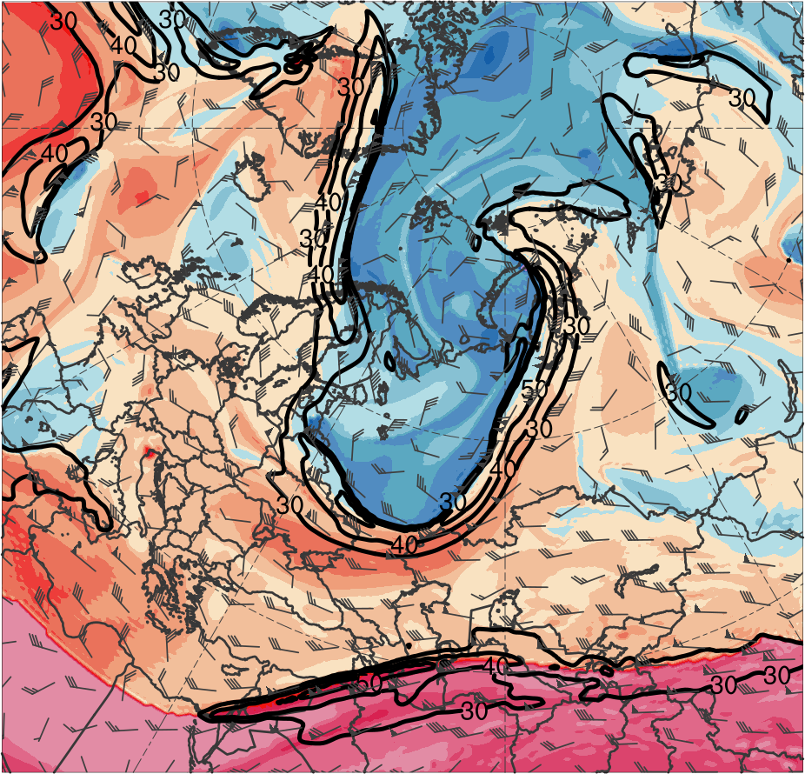
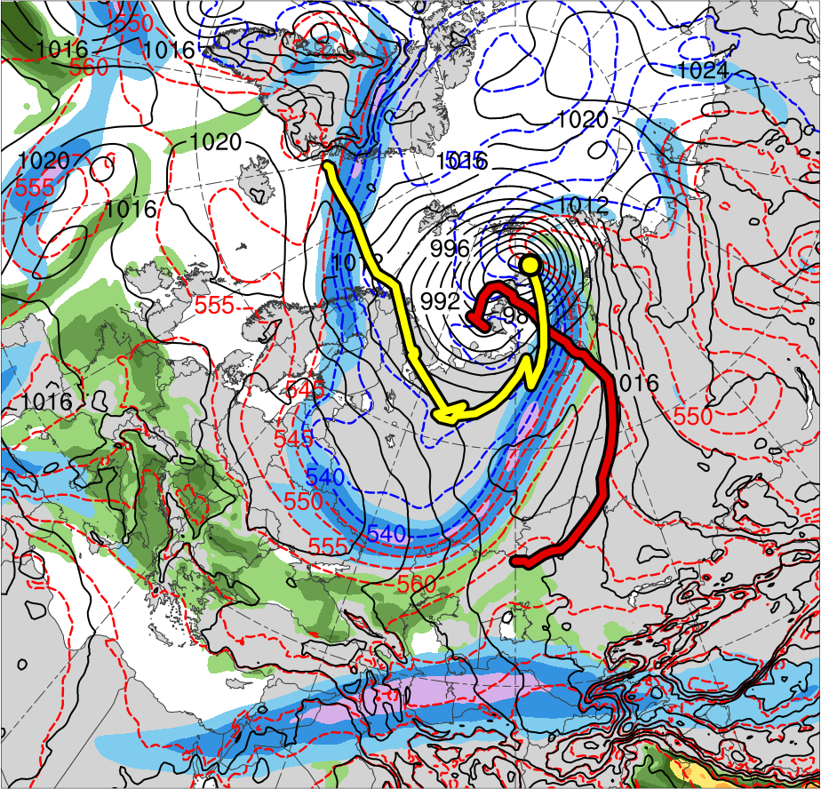
5) Synoptic Evolution
0000 UTC 7 June 2012
TPV 3
TPV 1
AC1
AC2
(K)
252
258
264
270
276
282
288
294
300
306
312
318
324
330
336
342
348
354
360
366
372
378
(m s⁻¹ )
(mm)
30
40
50
60
70
80
90
100
25
30
35
40
45
50
55
Potential temperature (K, shaded), wind speed (black, every 10 m s⁻¹ starting at 30 m s⁻¹), and wind (m s⁻¹, flags and barbs) on 2-PVU surface
300-hPa wind speed (m s⁻¹, shaded),
1000–500-hPa thickness (dam, blue/red),
SLP (hPa, black), and PW (mm, shaded)

