Slide 1


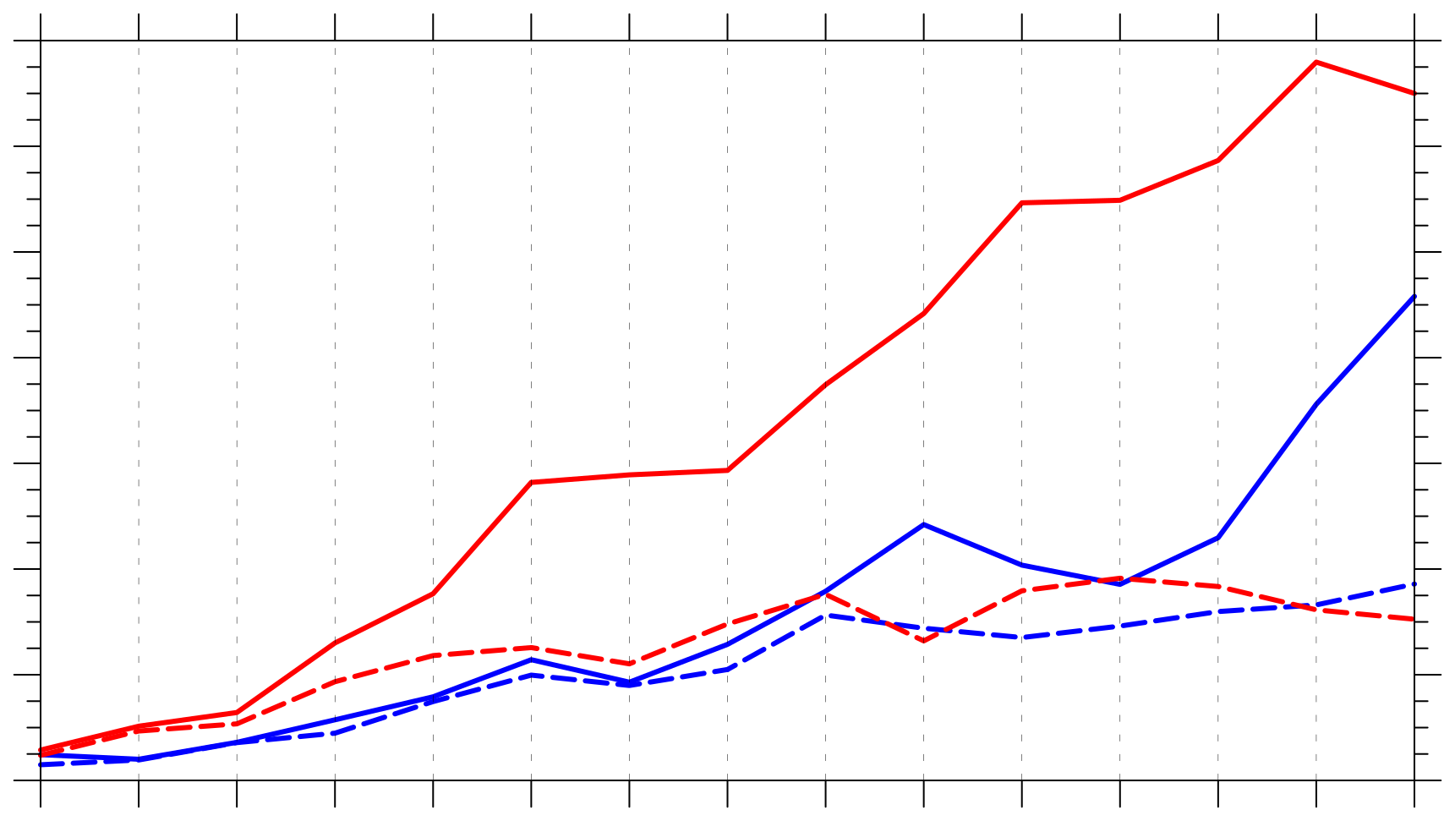
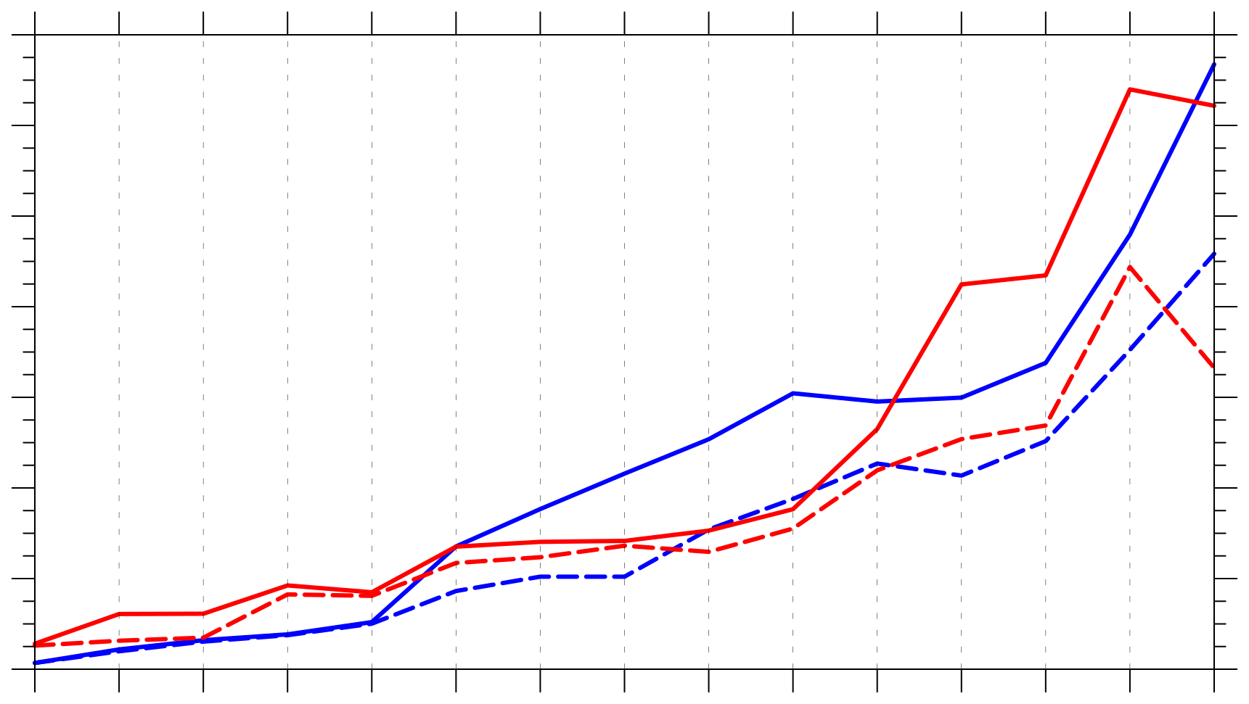
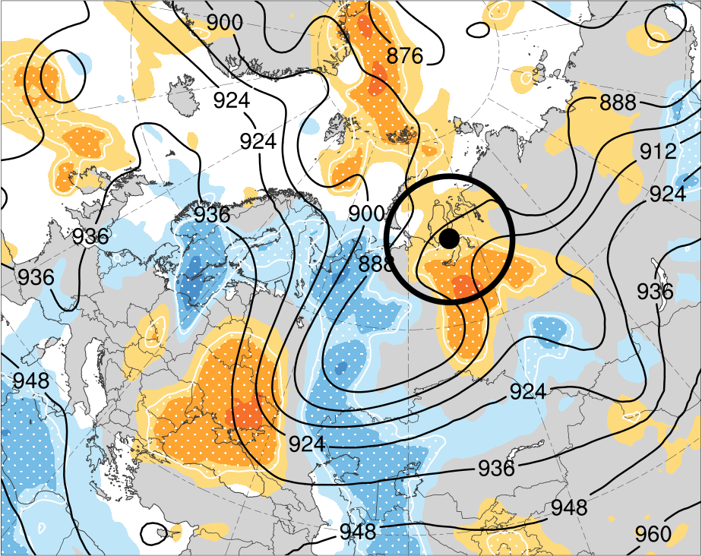
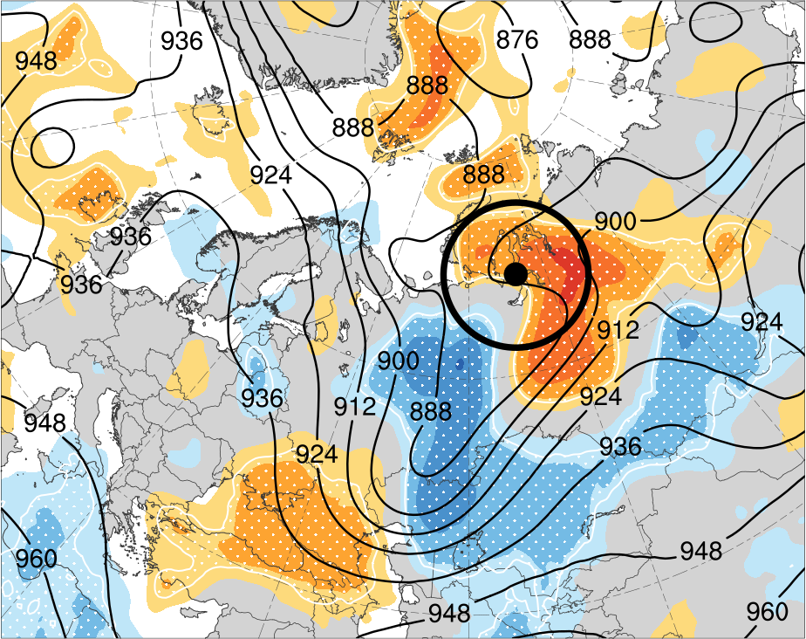
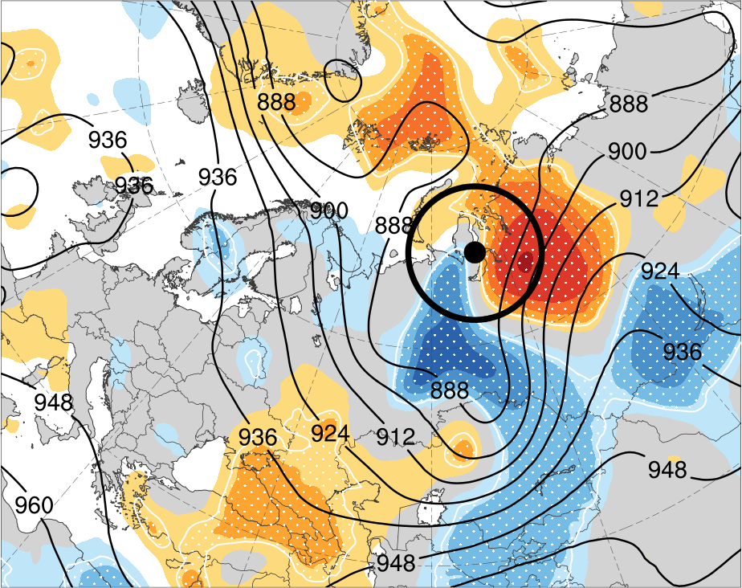
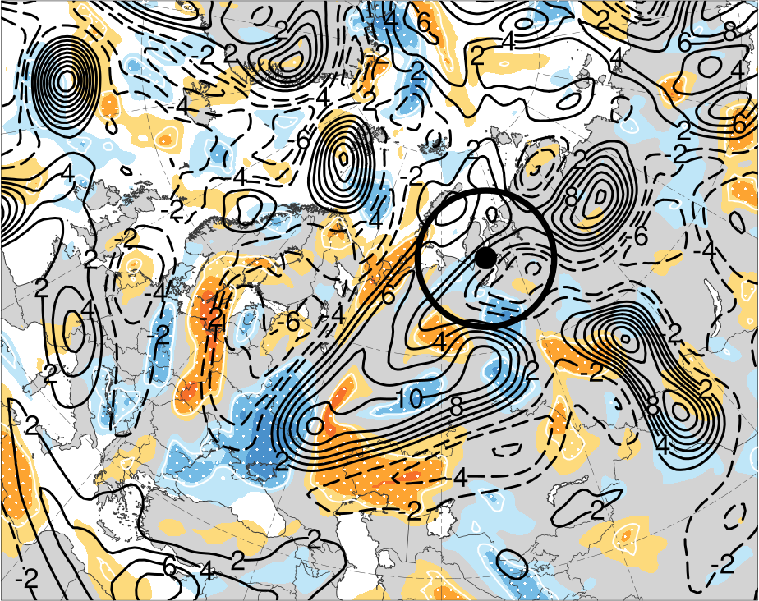
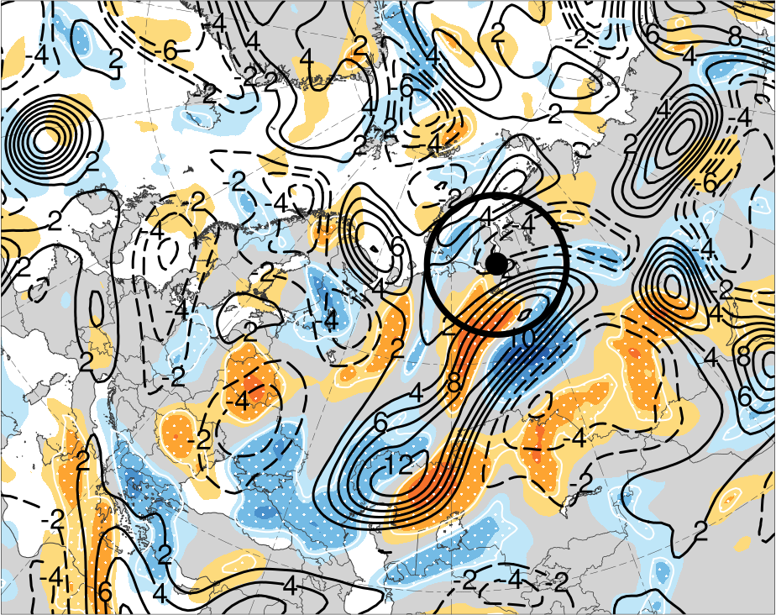
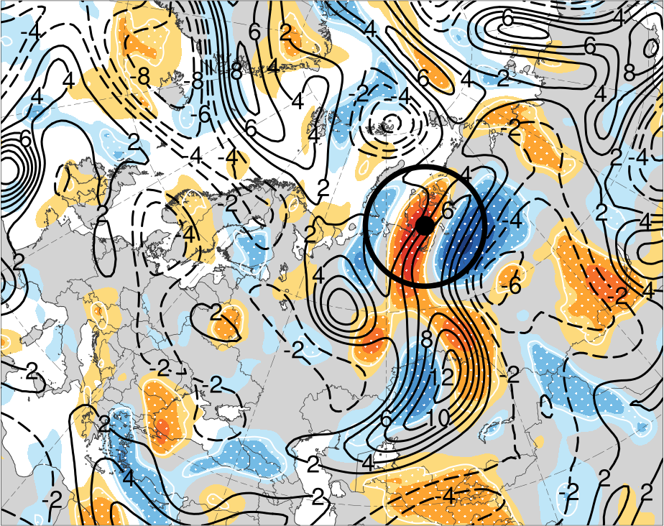
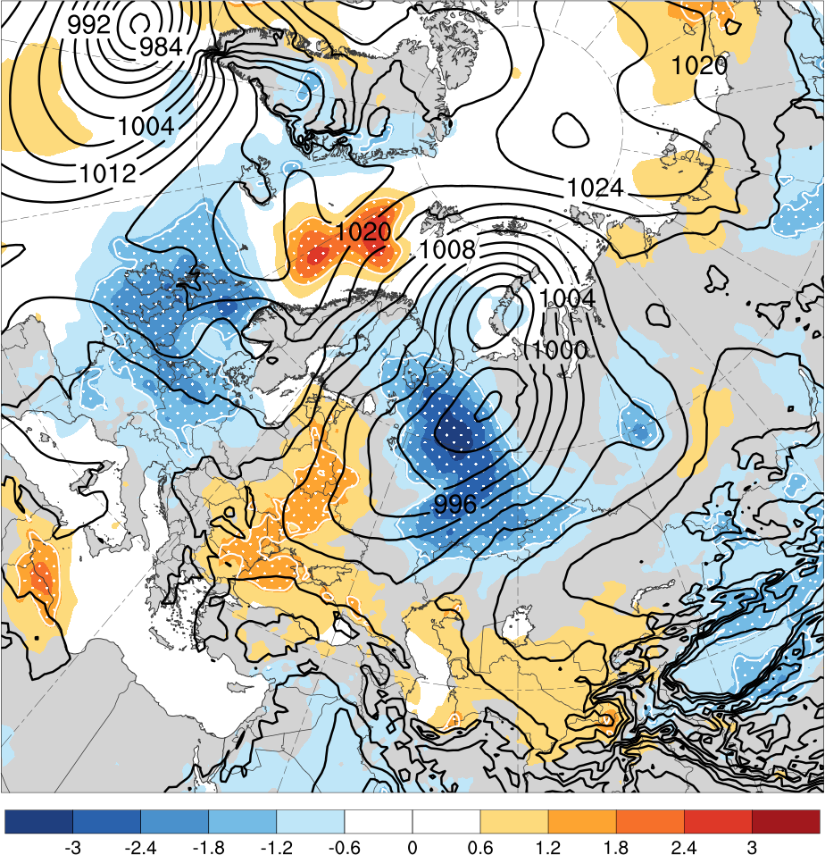
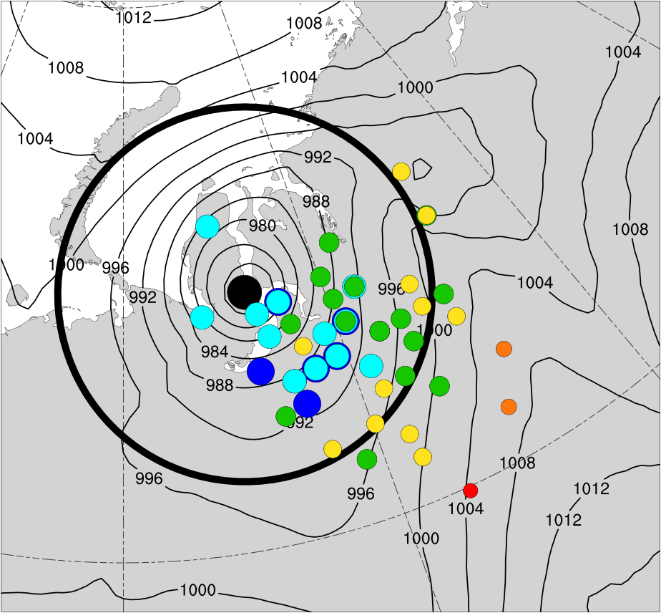
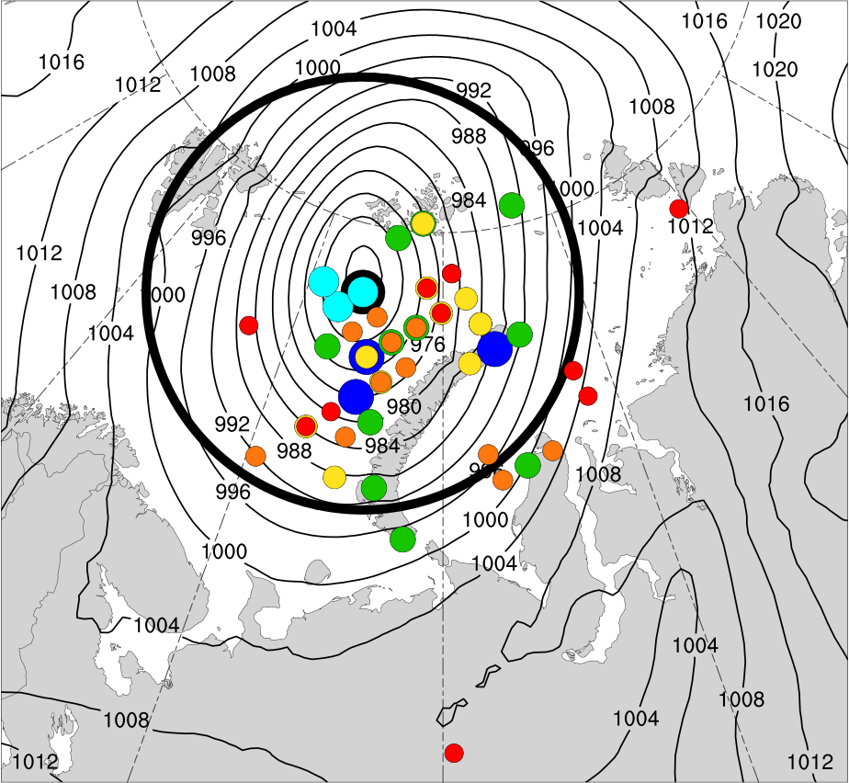
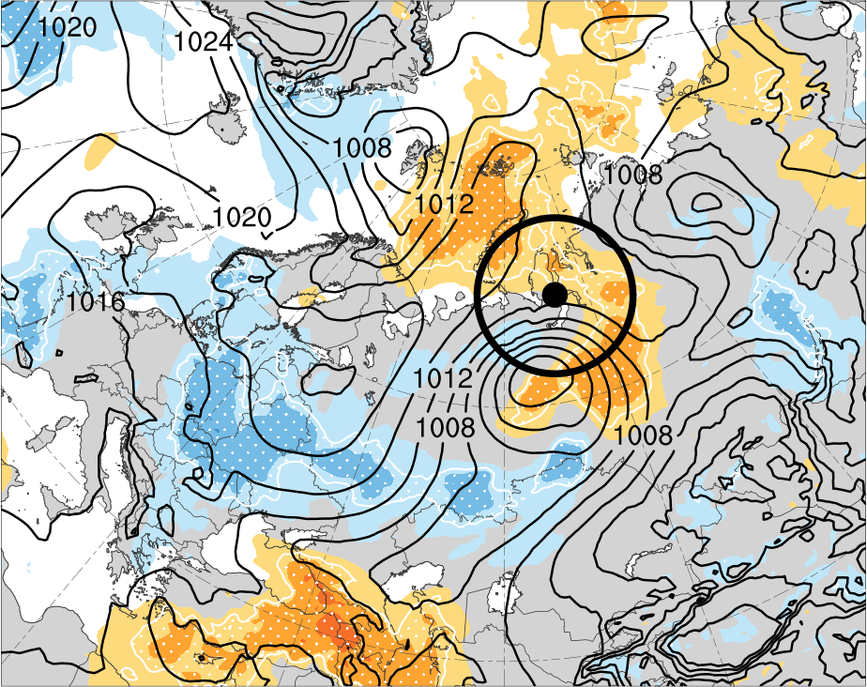
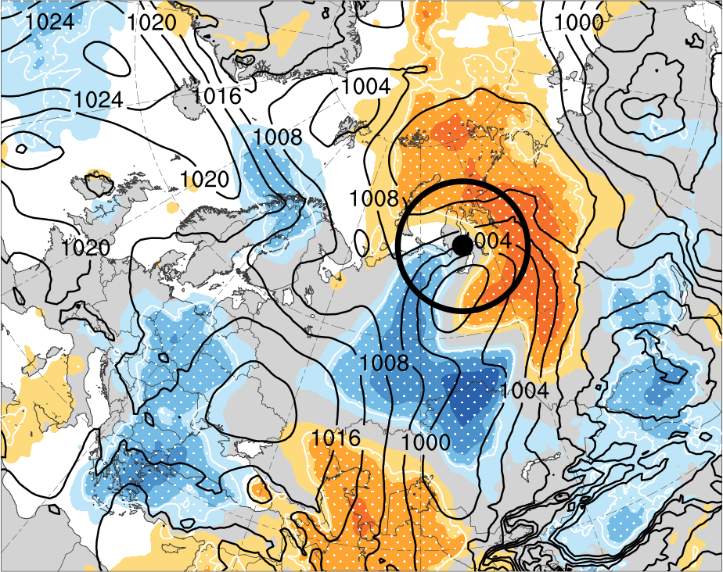
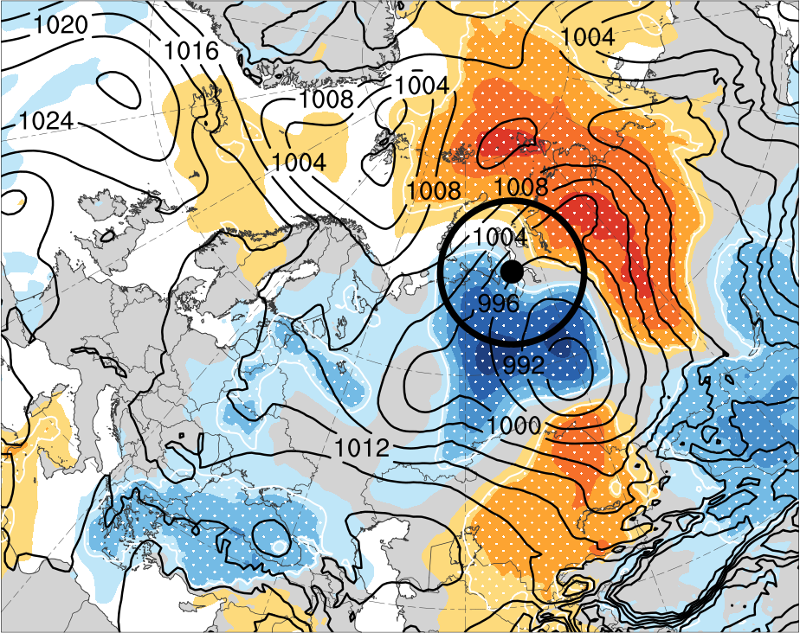
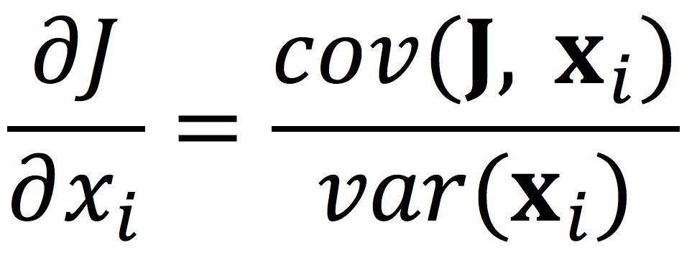
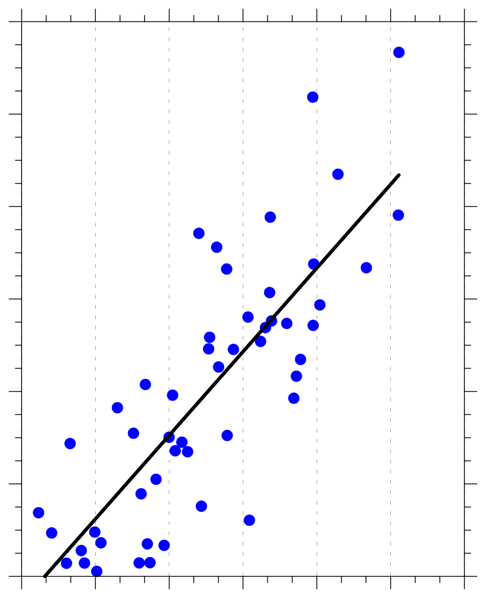
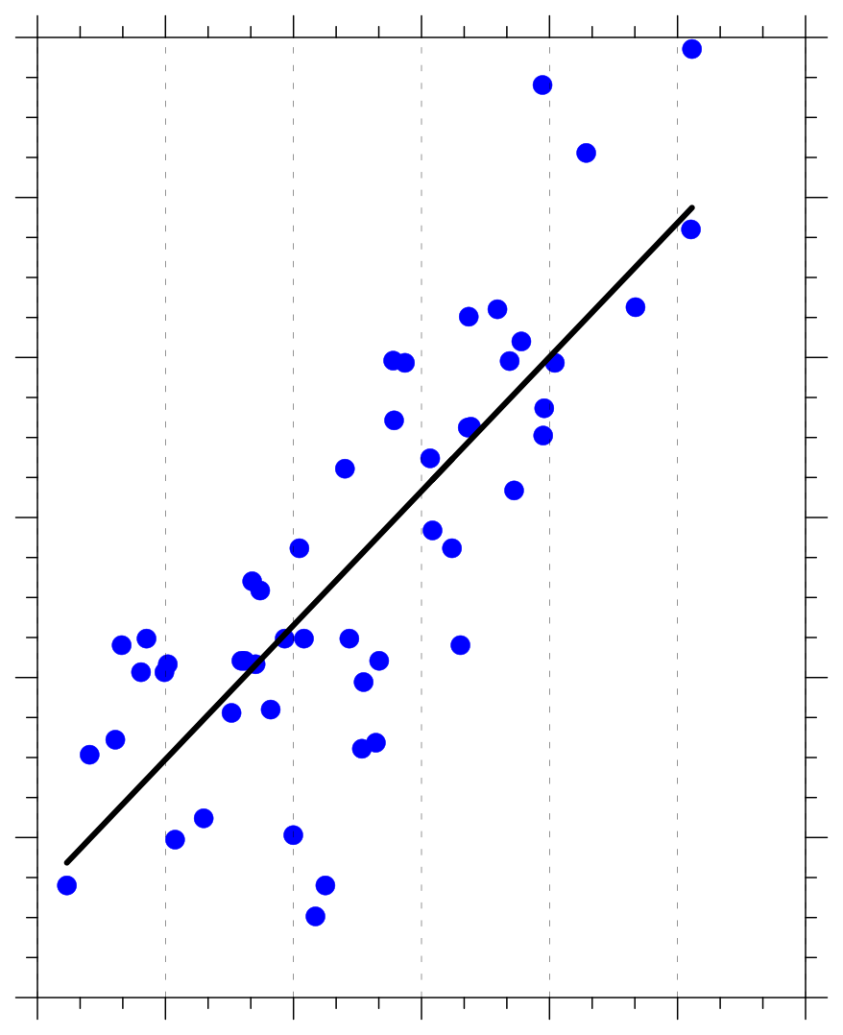
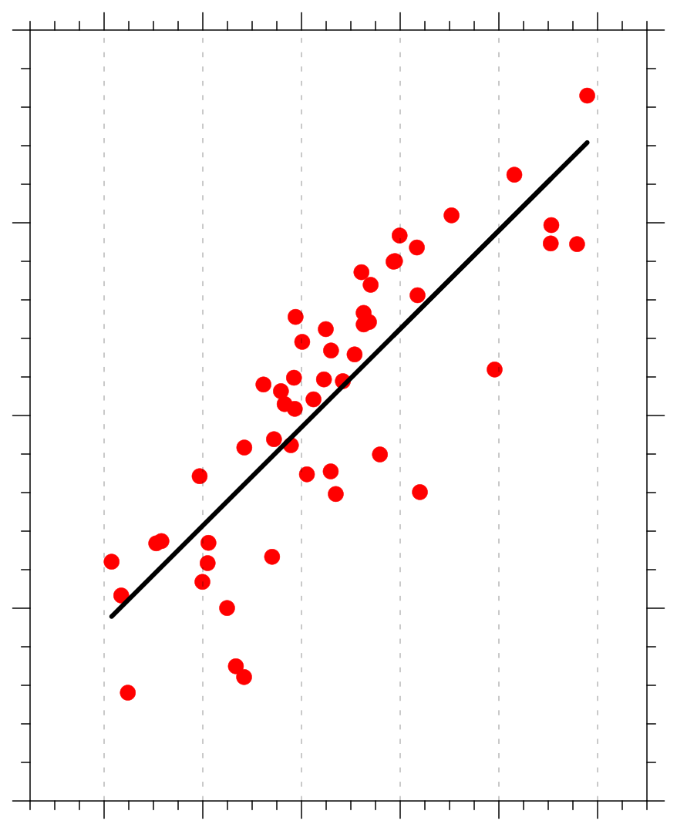
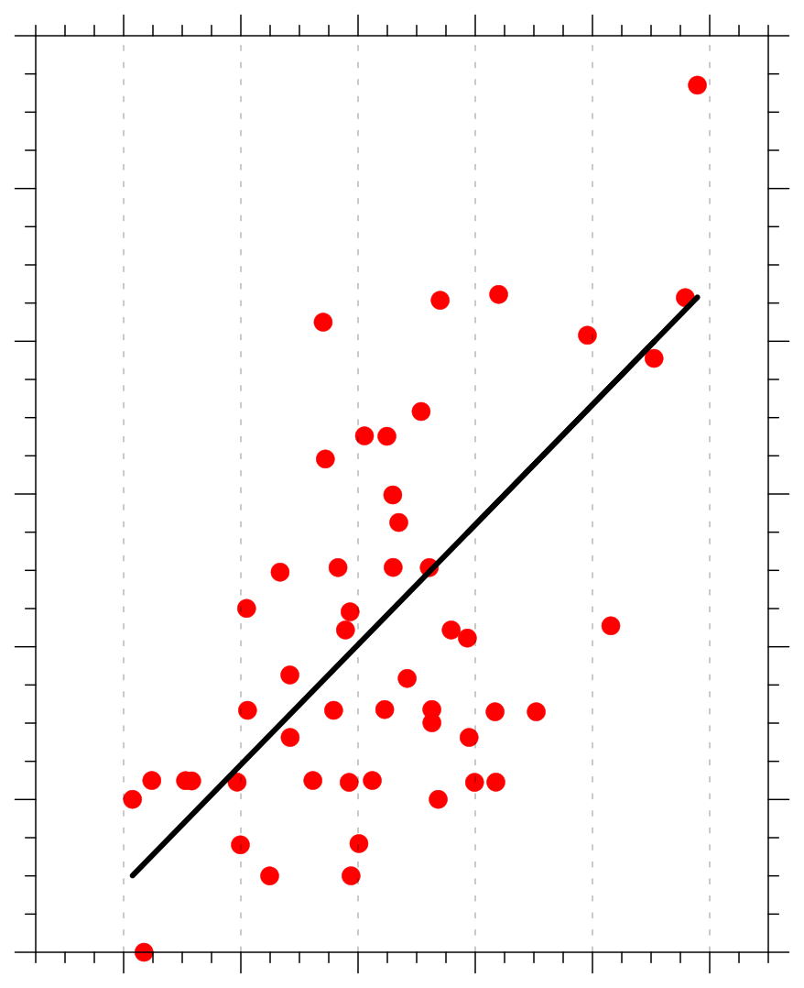
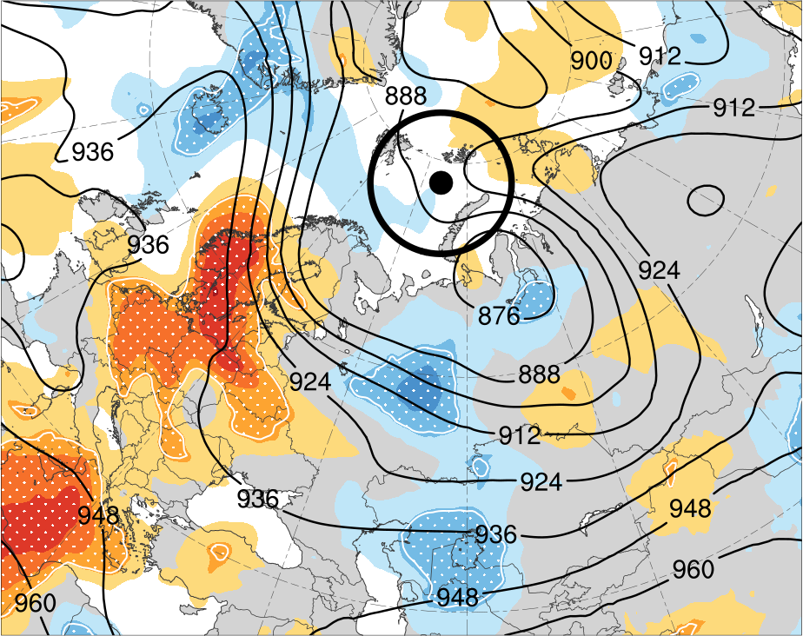
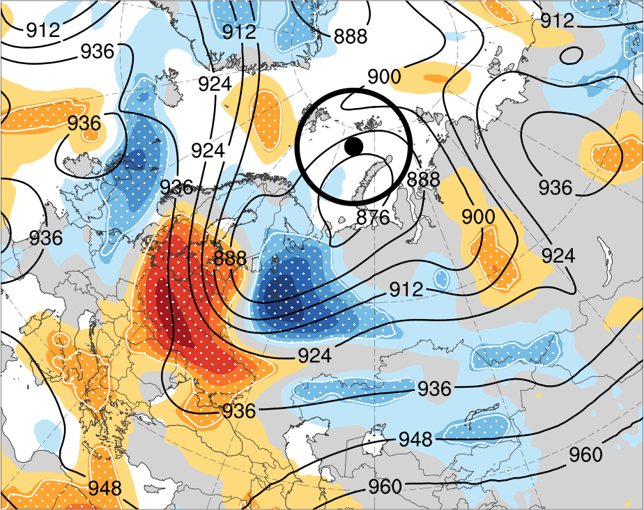
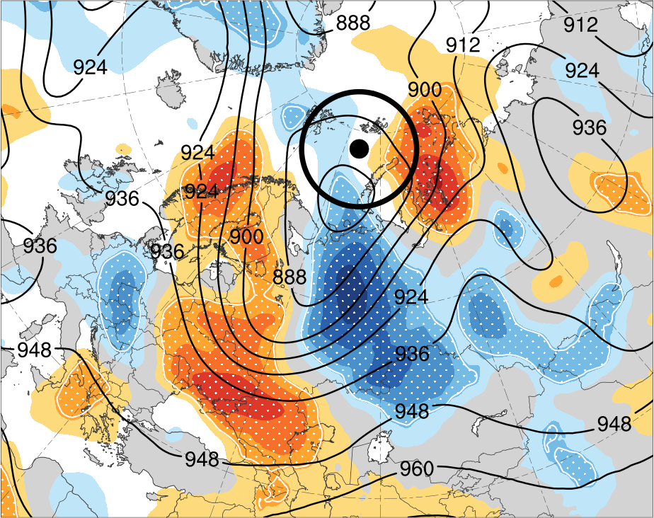
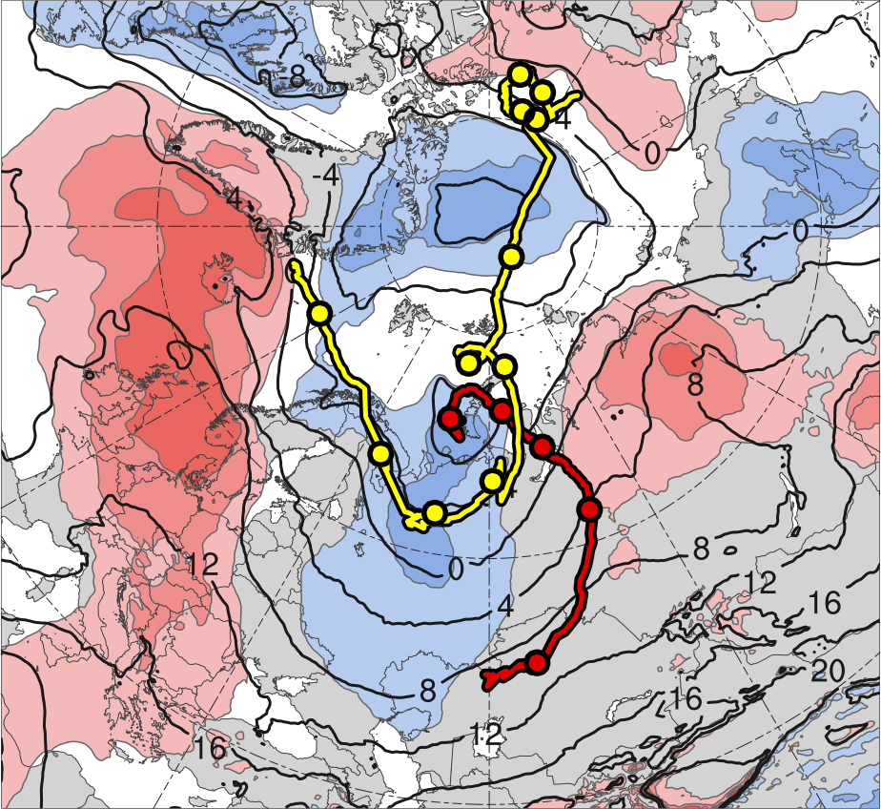
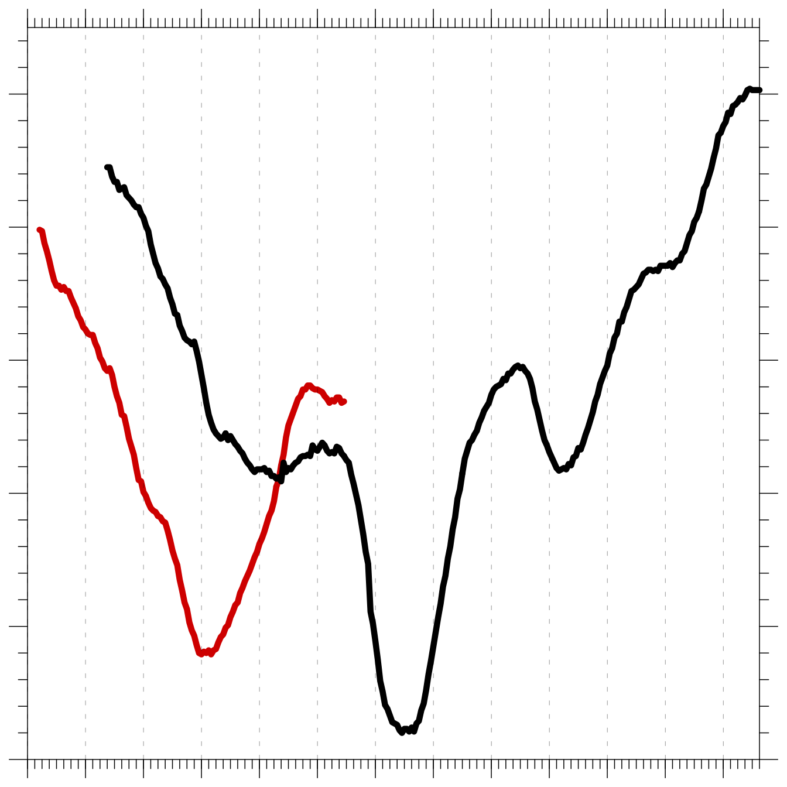
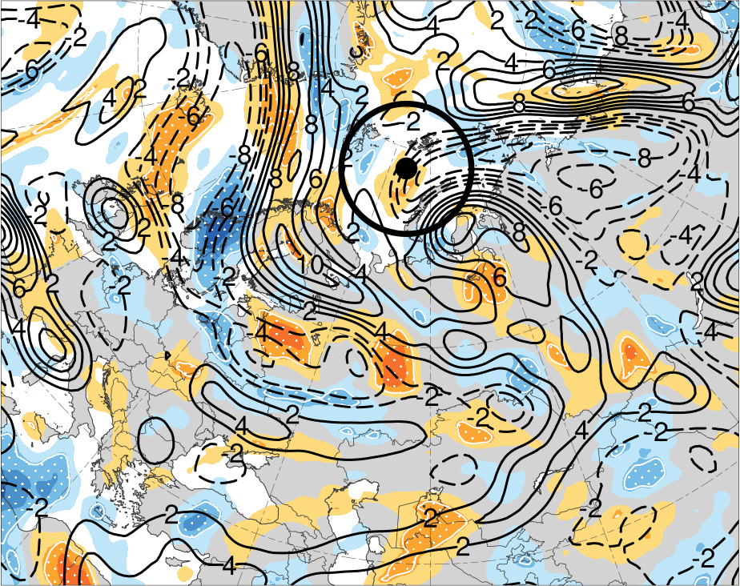
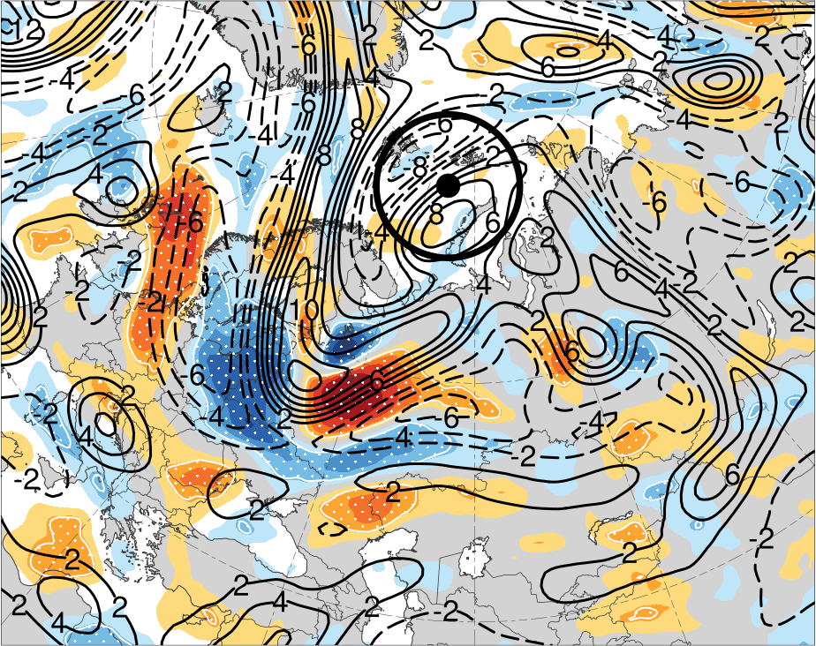
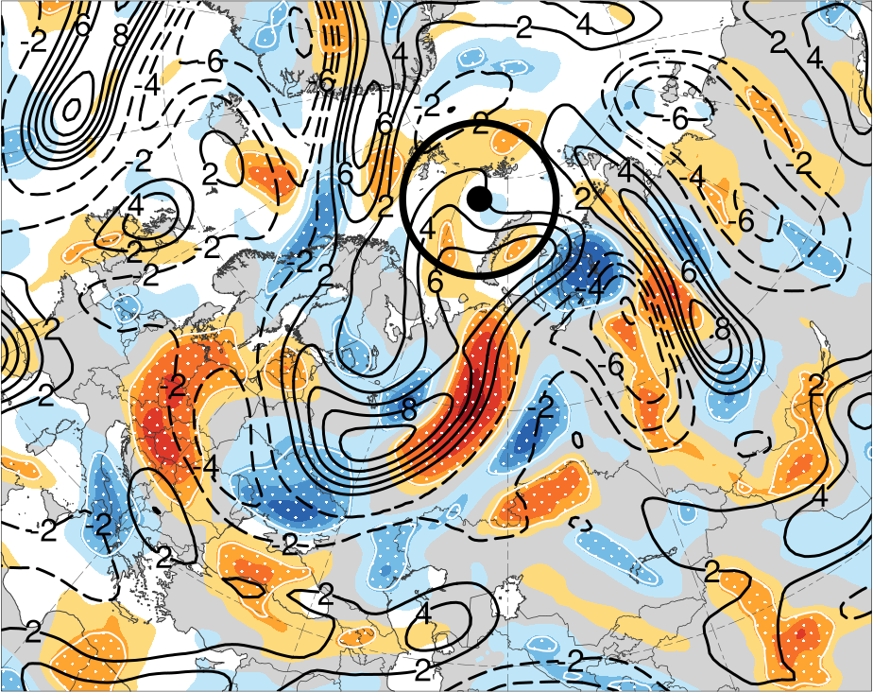
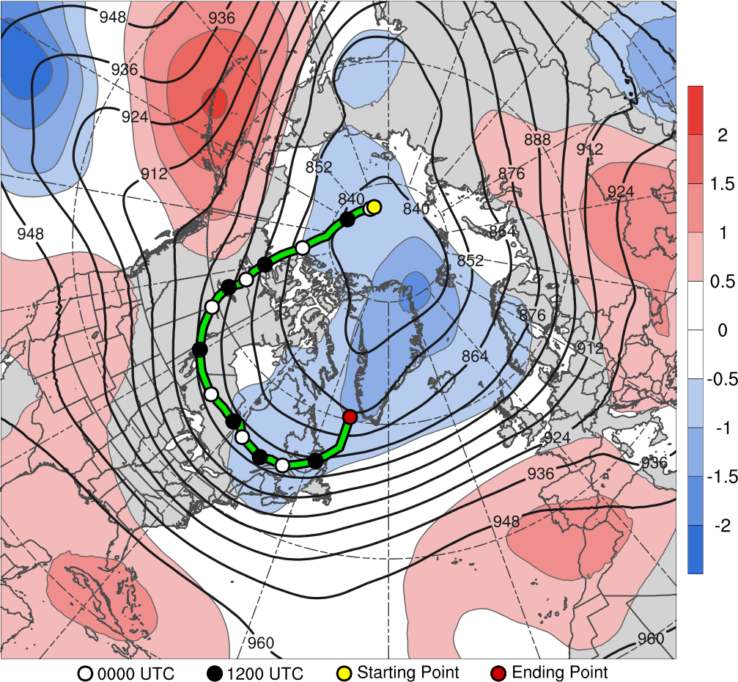
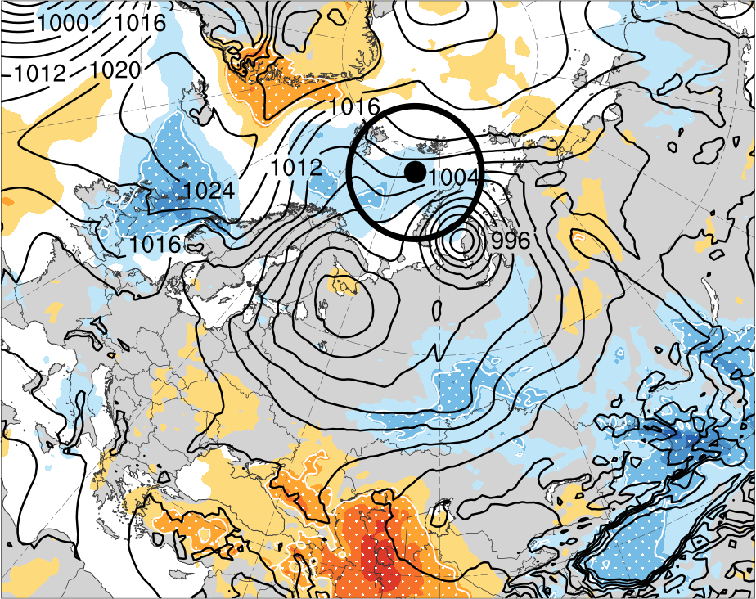
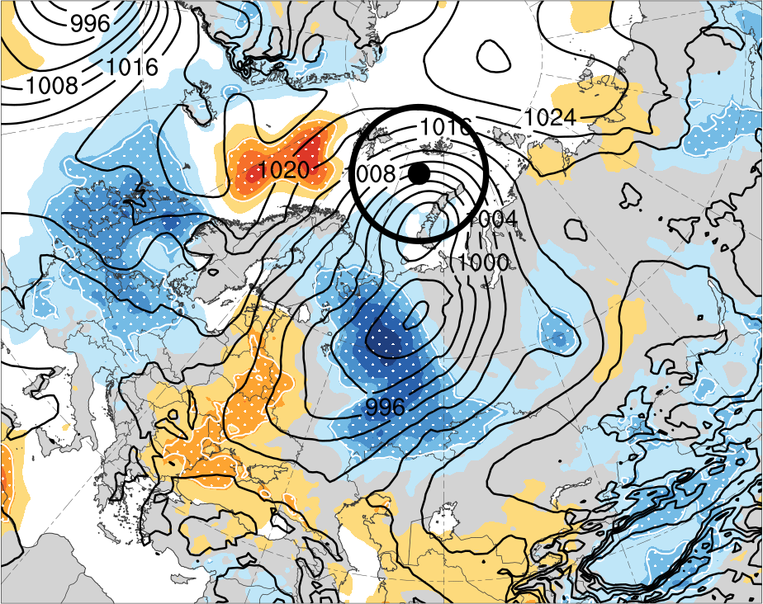
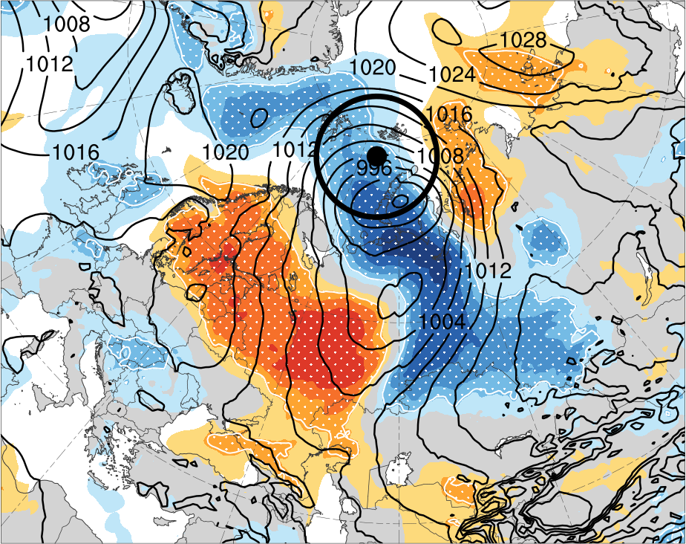
Diagnosing Factors Influencing the Forecast Skill of
Two Intense Arctic Cyclones in Early June 2018
Kevin Biernat*, Lance F. Bosart, and Daniel Keyser
A41O-2807
*E-mail: kbiernat@albany.edu
Presented at AGU 2019 Fall Meeting on 12 December 2019
University at Albany, SUNY
Department of Atmospheric and Environmental Sciences
This research was supported by Office of Naval Research Grant N00014-18-1-2200
1) Background
4) Forecast skill
5) Ensemble Sensitivity Analysis
Arctic cyclones (ACs) are synoptic-scale cyclones that originate within the Arctic or move into the Arctic from lower latitudes (e.g., Crawford and Serreze 2016).
Two unusually intense ACs, AC1 and AC2, occurred in early June 2018, with AC1 forming northeast of the Caspian Sea within a frontal trough, and AC2 forming in the lee of Greenland.
Both AC1 and AC2 strengthened in a region of strong baroclinicity over western Eurasia ahead of respective high-amplitude troughs.
AC1 attained a peak intensity of 968 hPa on 4 June in the ERA5 (Hersbach and Dee 2016), and AC2, which subsequently interacted with and absorbed AC1, attained a peak intensity of 962 hPa on 7 June in the ERA5.
The purpose of this study is to examine the forecast skill of the intensity and position of AC1 and AC2, and to diagnose factors that may influence the forecast skill of the intensity and position of AC1 and AC2.
28
(a) Intensity (hPa)
1400
(b) Position (km)
(a) 0000 UTC 1 Jun (36 h)
(b) 0000 UTC 2 Jun (60 h)
(c) 0000 UTC 3 Jun (84 h)
24
AC1
1200
AC1
20
AC2
1000
AC2
3.0
16
800
12
600
2.4
8
400
4
200
1.8
0
0
12
24
36
48
60
72
84
96
108
120
132
144
156
168
0
0
12
24
36
48
60
72
84
96
108
120
132
144
156
168
Forecast lead time (h)
Forecast lead time (h)
(d) 0000 UTC 1 Jun (36 h)
(e) 0000 UTC 2 Jun (60 h)
(f) 0000 UTC 3 Jun (84 h)
1.2
Figure 3. (a) Intensity RMSE (hPa, solid) and spread (hPa, dashed) for AC1 (blue) in forecasts valid at 0000 UTC 4 June and for AC2 (red) in forecasts valid at 1200 UTC 7 June. (b) As in (a) but for position (km). Forecasts of 0–168 h lead time (every 12 h) were considered.
2) Data and Methods
4) Overview of Two Forecasts and Metrics
0.6
Utilized 51-member ECMWF Ensemble Prediction System (EPS) from TIGGE (Bougeault et al. 2010) initialized 0–168 h (every 12 h) prior to times of peak intensity of AC1 and AC2 in ERA5, and used ERA5 as verification.
Downloaded ECMWF EPS and ERA5 data at 0.5° horizontal resolution and 6-h temporal resolution.
Tracked AC1 and AC2 in ECMWF EPS and ERA5 by utilizing an objective cyclone tracking algorithm based on sea level pressure (SLP) from Crawford and Serreze (2016).
Determined cyclone intensity and position based on value and position, respectively, of SLP minimum for forecasts valid at time of peak intensity in ERA5, which is 0000 UTC 4 June for AC1 and 1200 UTC 7 June for AC2.
Calculated ensemble spread and root mean square error (RMSE) of cyclone intensity and position for aforementioned forecasts to diagnose forecast skill of cyclone intensity and position.
Utilized ensemble sensitivity analysis (Ancell and Hakim 2007; Torn and Hakim 2008) to determine the sensitivity of the intensity and position of each cyclone at the time of peak intensity to selected model state variables at earlier times.
The sensitivity of a forecast metric of interest J to a model state variable x_{i} at an earlier time is given by the equation to the right, where cov denotes the covariance and var denotes the variance.
The values of x_{i} are normalized by the ensemble standard deviation of x_{i}, and thus all sensitivities have units of the forecast metric per standard deviation of the state variable.
Sensitivity values are statistically significant if the absolute value of the sensitivity is greater than the 95% confidence interval using a z-score test outlined in Torn and Hakim (2008).
The metrics that are used in this study are defined in section 5 and the ensemble sensitivity analysis is shown in section 6.
AC1: Forecast initialized at 1200 UTC 30 May, and metric J for AC1 (hereafter J_{AC1}) considered to be average SLP within 750 km of ERA5 position of AC1 at 0000 UTC 4 June (108 h), which is the time of peak intensity of AC1 in ERA5.
AC2: Forecast initialized at 1200 UTC 2 June, and metric J for AC2 (hereafter J_{AC2}) considered to be average SLP within 750 km of ERA5 position of AC2 at 1200 UTC 7 June (120 h), which is the time of peak intensity of AC2 in ERA5.
0
−0.6
(a) 0000 UTC 4 June
(b) 1200 UTC 7 June
Figure 4. (a) SLP from ERA5 (hPa, contours) and position of minimum SLP of AC1 in ERA5 (black dot) and ensembles (dots colored by intensity, hPa) at 0000 UTC 4 June. (b) As in (a), but for AC2 at 1200 UTC 7 June. ERA5 SLP values at black dots are 968 hPa and 962 hPa for AC1 and AC2, respectively. Black circles of radius 750 km surrounding black dots encompass area used to calculate J_{AC1} and J_{AC2}.
(g) 0000 UTC 1 Jun (36 h)
(h) 0000 UTC 2 Jun (60 h)
(i) 0000 UTC 3 Jun (84 h)
−1.2
−1.8
PC
−2.4
PC
AC1
AC1
−3
ERA5
965–970
970–975
975–980
980–985
985–990
≥990
Figure 6. Sensitivity of J_{AC1} valid at 0000 UTC 4 June (108 h) to the (a) 36-, (b) 60-, and (c) 84-h 300-hPa geopotential height (shading, hPa), for forecast initialized at 1200 UTC 30 May. White stippling indicates sensitivity is statistically significant at 95% confidence level. Black contours denote ensemble-mean 300-hPa geopotential height (dam). (d),(e),(f) As in (a),(b),(c), but for 300-hPa relative vorticity (averaged within 300 km of each grid point; units for mean: 10⁻⁵ s⁻¹). (g),(h),(i) As in (a),(b),(c), but for SLP (units for mean: hPa). Black dot represents ERA5 position of AC1 at 0000 UTC 4 June and black circle represents domain in which J_{AC1} was calculated. Sensitivity was multiplied by –1 such that positive values indicate that increasing the value of the state variable (e.g., geopotential height) at the time of interest correlates with a lowering of J_{AC1} (i.e., a lowering of the average SLP in the circle) at 0000 UTC 4 June and negative values indicate that decreasing the value of the state variable at the time of interest correlates with a lowering of J_{AC1} (i.e., a lowering of the average SLP in the circle) at 0000 UTC 4 June. Arrows point to the ensemble mean positions of a PC and AC1.
24
(a) r² = 0.65
1200
(b) r² = 0.64
40
(c) r² = 0.68
1200
(d) r² = 0.38
20
1000
30
1000
16
800
800
Intensity error (hPa)
Position error (km)
Intensity error (hPa)
Position error (km)
12
600
20
600
8
400
10
400
4
200
200
(a) 1200 UTC 4 Jun (48 h)
(b) 1200 UTC 5 Jun (72 h)
(c) 1200 UTC 6 Jun (96 h)
0
987
990
993
996
999
1002
1005
0
987
990
993
996
999
1002
1005
0
988
992
996
1000
1004
1008
0
988
992
996
1000
1004
1008
3.0
J_{AC1} (hPa)
J_{AC1} (hPa)
J_{AC2} (hPa)
J_{AC2} (hPa)
Figure 5. Scatter plot of (a) J_{AC1} (hPa) and intensity error of AC1 (hPa), and (b) J_{AC1} (hPa) and position error of AC1 (km), valid at 0000 UTC 4 June. (c),(d) As in (a),(b), but for AC2 valid at 1200 UTC 7 June. The square of linear correlation (r²) in each plot is shown in upper left, with the linear regression line given in black. Intensity error is the absolute difference in minimum SLP of the cyclone between that in the ensembles and that in ERA5. Position error is the distance between the position of the cyclone in the ensembles and that in ERA5.
2.4
3) Track and Intensity
11
10
1010
6) Discussion
1.8
12
13
AC1 and AC2 strengthen rapidly in a region of strong baroclinicity and amplified flow over western Eurasia, with AC2 absorbing AC1 (Figs. 1 and 2).
Forecast skill of intensity for AC2 is lower than that for AC1, with intensity forecasts being strongly underdispersive for AC2 and slightly underdispersive for AC1 (Fig. 3a).
Forecast skill of position for AC2 is higher than that for AC1 at 72–120-h lead time and lower than that for AC1 at other lead times, with position forecasts being somewhat underdispersive for AC2 and moderately underdispersive for AC1 (Fig. 3b).
The selected ensemble forecasts for AC1 and AC2 valid at time of peak intensity show a wide range solutions for the intensity and position of these cyclones (Figs. 4a,b).
The metrics J_{AC1} and J_{AC2} correlate with both intensity and position error of AC1 and AC2, respectively (Figs. 5a–d), and are used in ensemble sensitivity analysis to help determine to what the forecast skill of the intensity and position of the cyclones may be sensitive.
J_{AC1} exhibits sensitivity to the position and orientation of an upstream trough and embedded vortex, such that a more eastward positioned trough and vortex and more negatively tilted trough may correlate with a more accurate forecast of AC1 (Figs. 6a–f).
J_{AC1} also exhibits sensitivity to the strength and position of a predecessor cyclone (PC) located to the north of AC1, such that a weaker and more westward positioned PC may correlate with a more accurate forecast of AC1 (Figs. 6g,h).
J_{AC2} exhibits sensitivity to the position and orientation of an upstream trough and embedded vortex (Figs. 7a–d), such that a more eastward positioned trough and vortex and more negatively tilted trough may correlate with a more accurate forecast of AC2.
J_{AC2} does not appear to exhibit much sensitivity to the position and intensity of AC1 (Figs. 7g,h).
(d) 1200 UTC 4 Jun (48 h)
(e) 1200 UTC 5 Jun (72 h)
(f) 1200 UTC 6 Jun (96 h)
1.2
8
7
9
1000
0.6
3
6
5
990
0
SLP (hPa)
4
4
3
5
6
980
−0.6
2
970
(g) 1200 UTC 4 Jun (48 h)
(h) 1200 UTC 5 Jun (72 h)
(i) 1200 UTC 6 Jun (96 h)
−1.2
AC1
AC2
960
AC2
−1.8
−2
−1.5
−1
−0.5
0
0.5
1
1.5
2
σ
1
2
3
4
5
6
7
8
9
10
11
12
13
AC1
AC1
Genesis
Lysis
Day in June 2018 labeled at 0000 UTC
AC2
−2.4
Figure 1. Tracks of AC1 (red) and AC2 (yellow). Also, 1–7 June 2018 time-mean 850-hPa temperature (°C, gray) and standardized temperature anomalies (σ, shaded). 0000 UTC positions of cyclones shown by dots, and colored numbers represent dates corresponding to the 0000 UTC positions.
AC1
AC2
AC2
Peak intensity
of AC1: 968 hPa
Peak intensity
of AC2: 962 hPa
−3
Figure 2. Hourly minimum SLP time series of AC1 and AC2 from ERA5.
Figure 7. Sensitivity of J_{AC2} valid at 1200 UTC 7 June (120 h) to the (a) 48-, (b) 72-, and (c) 96-h 300-hPa geopotential height (shading, hPa), for forecast initialized at 1200 UTC 2 June. White stippling indicates sensitivity is statistically significant at 95% confidence level. Black contours denote ensemble-mean 300-hPa geopotential height (dam). (d),(e),(f) As in (a),(b),(c), but for 300-hPa relative vorticity (averaged within 300 km of each grid point; units for mean: 10⁻⁵ s⁻¹). (g),(h),(i) As in (a),(b),(c), but for SLP (units for mean: hPa). Sensitivity was multiplied by −1 as described in Fig. 6. Black dot and circle are as described in Fig. 6, but for AC2 at 1200 UTC 7 June. Arrows point to the ensemble mean positions of AC1 and AC2.
References
Ancell, B., and G. J. Hakim, 2007: Comparing adjoint and ensemble sensitivity analysis with applications to observation targeting. Mon. Wea. Rev., 135, 4117–4134.
Bougeault, P., and Coauthors, 2010: The THORPEX Interactive Grand Global Ensemble. Bull. Amer. Meteor. Soc., 91, 1059–1072.
Crawford, A., and M. Serreze, 2016: Does the summer Arctic frontal zone influence Arctic Ocean cyclone activity? J. Climate, 29, 4977–4993.
Hersbach, H., and D. Dee, 2016: ERA5 reanalysis is in production. ECMWF Newsletter, No. 147, ECMWF, Reading, United Kingdom, 7. [Available online at www.ecmwf.int/sites/ default/files/elibrary/2016/16299-newsletter-no147-spring-2016.pdf.]
Torn, R. D., and G. J. Hakim, 2008: Ensemble-based sensitivity analysis. Mon. Wea. Rev., 136, 663–677.

