Slide 1
Large-Scale Midlatitude–Polar Flow Interactions Leading to Rapid Surface Ice Melt over Greenland and Sea Ice Volume Loss over the Arctic Ocean in June 2019
Lance F. Bosart, Kevin A. Biernat, and Daniel Keyser
Department of Atmospheric and Environmental Sciences
University at Albany, State University of New York
American Geophysical Union
Fall Meeting 2019
San Francisco, CA 94103
Thursday 12 December 2019
A43B-06
Research Supported by ONR Grant N00014-18-1-2200

Slide 2
Purpose
Investigate upstream antecedent atmospheric conditions associated with massive Greenland surface ice melt event of June 2019

Slide 3
Data and Methods
CFSR gridded analyses at 0.5° resolution (Saha et al. 2010)

Slide 4
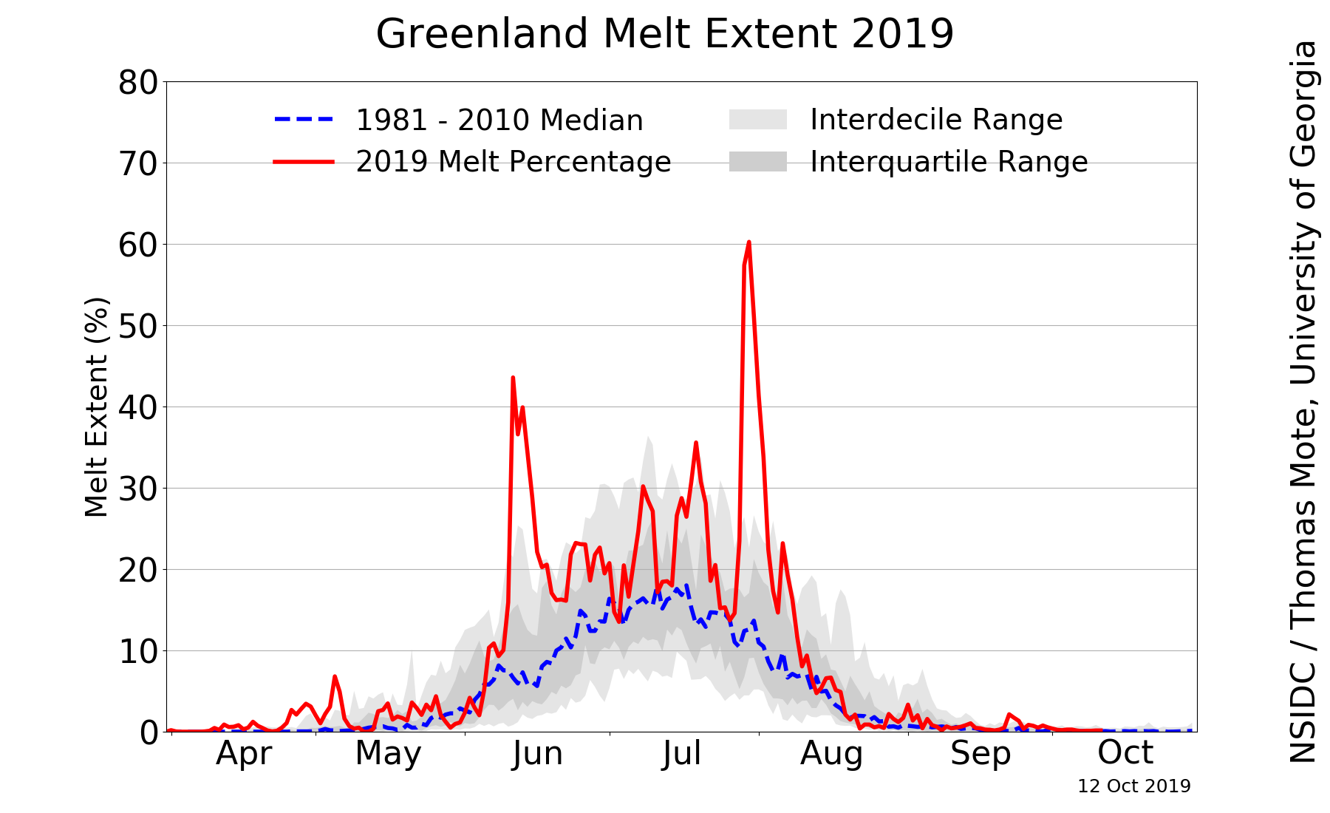
Motivation
Source: NSIDC/Thomas Mote, University of Georgia;
http://nsidc.org/greenland-today/

Slide 5
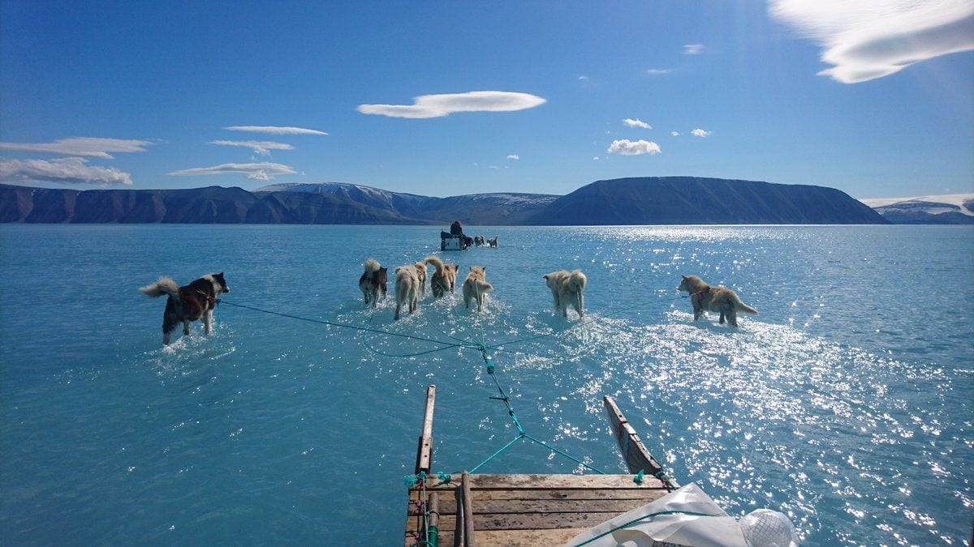
Motivation
“Steffen Olsen, an Arctic researcher with the Danish Meteorological Institute, and dogs set out to retrieve oceanographic moorings and a weather station over meltwater topping sea ice in northwest Greenland on Thursday.” (Photo credit: Steffen Olsen). Source: Jason Samenow, Washington Post, 14 June 2019;https://www.washingtonpost.com/weather/2019/06/14/arctic-ocean-greenland-ice-sheet-have-seen-record-june-ice-loss/

Slide 6
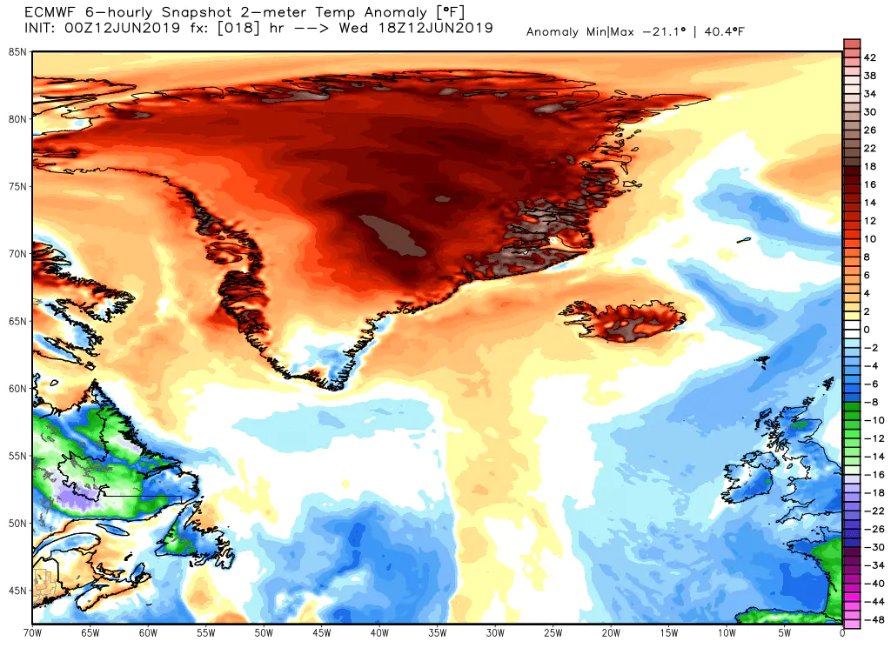
Motivation
+18–40°F
(+10–22°C)
18-h forecast of 2-m temperature anomaly (°F) valid at 1800 UTC 12 June 2019 from ECMWF model initialized at 0000 UTC 12 June 2019.
Source: Jason Samenow, Washington Post, 14 June 2019;
https://www.washingtonpost.com/weather/2019/06/14/arctic-ocean-greenland-ice-sheet-have-seen-record-june-ice-loss/

Slide 7
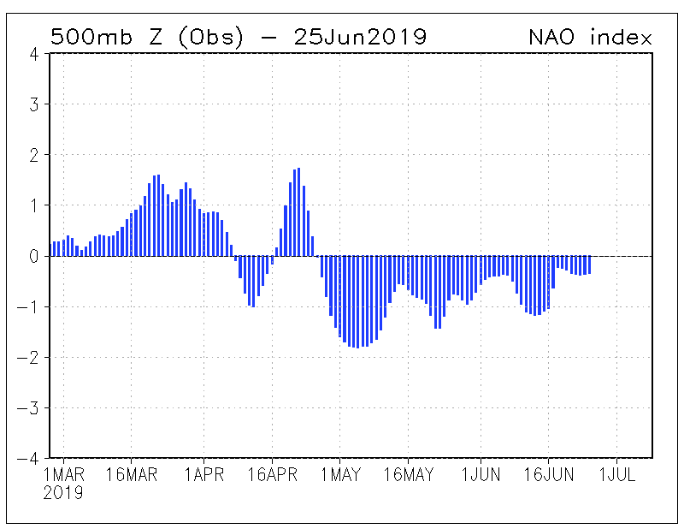
Negative NAO (26 Apr–23 Jun 2019)
Source: NOAA Climate Prediction Center

Slide 8
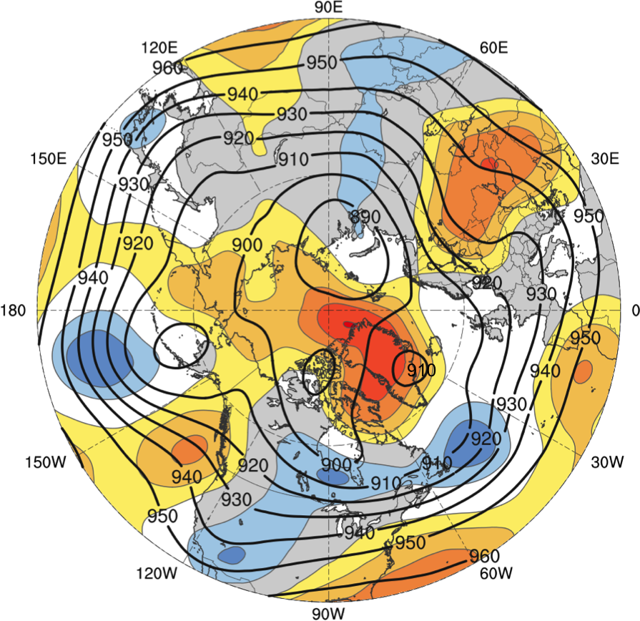
Negative NAO (26 Apr–23 Jun 2019)
3
2.5
2
1.5
1.25
1
0.75
0.5
0.25
0
−0.25
−0.5
−0.75
−1
−1.25
−1.5
−2
−2.5
−3
26 Apr–23 Jun 2019 time-mean 300-hPa geopotential height (dam, black) and time-mean standardized anomalies of geopotential height (σ, shaded)

Slide 9
Upstream Antecedent North Pacific Circulation Regime Evolution 1–9 Jun 2019

Slide 10
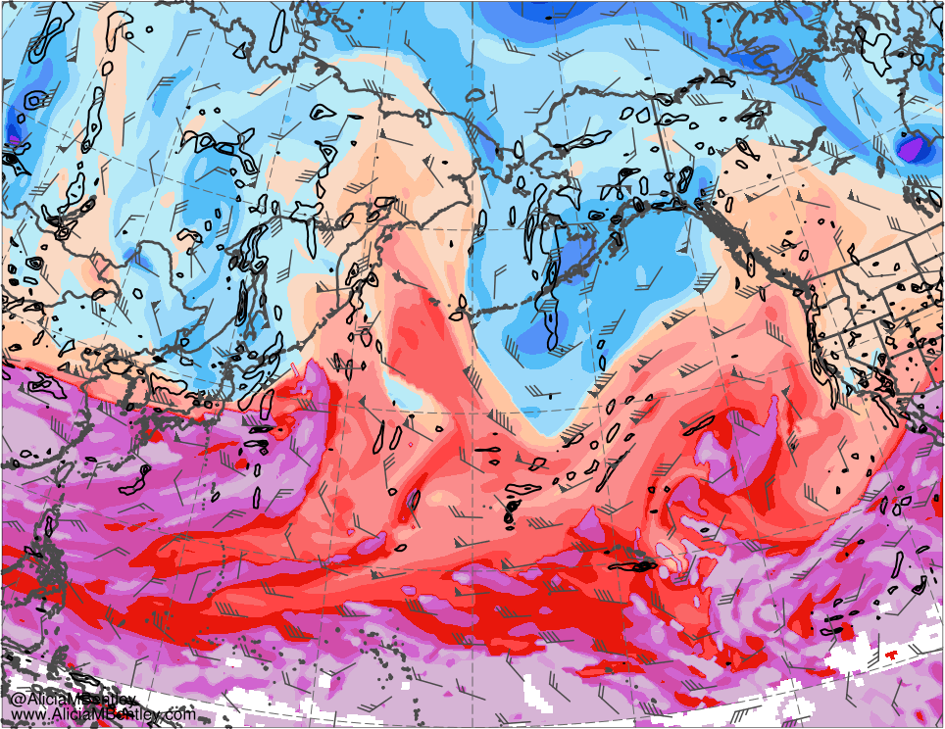
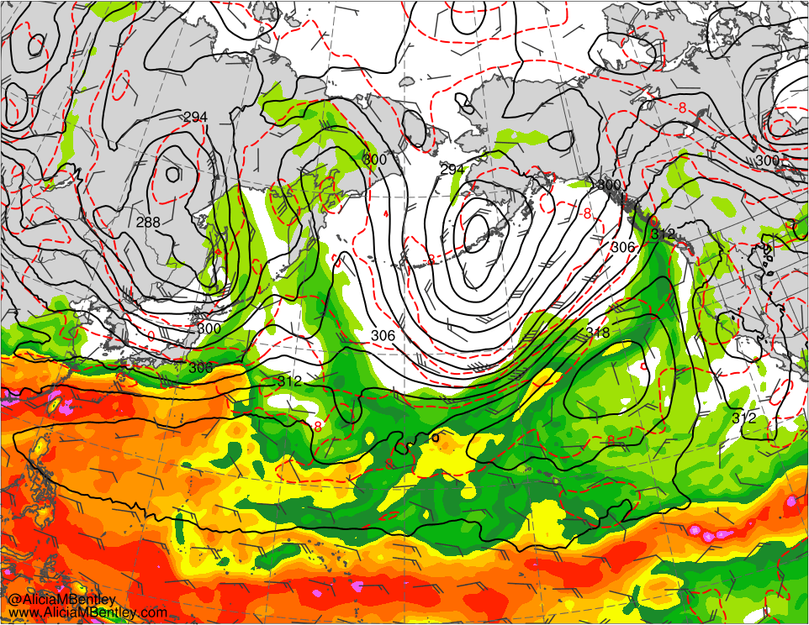
0000 UTC 1 Jun 2019
264
270
276
282
288
294
300
306
312
318
324
330
336
342
348
354
360
366
372
378
384
K
20
25
30
35
40
45
50
55
60
65
70
mm
Potential temperature (K, shaded) and wind (kt, flags and barbs) on 2-PVU surface; 925–850-hPa cycl. rel. vort. (0.5 × 10⁻⁴ s⁻¹; black)
700-hPa geo. height (dam, black), wind (kt, flags and barbs), and temperature (°C, red), and PW (mm, shaded)

Slide 11
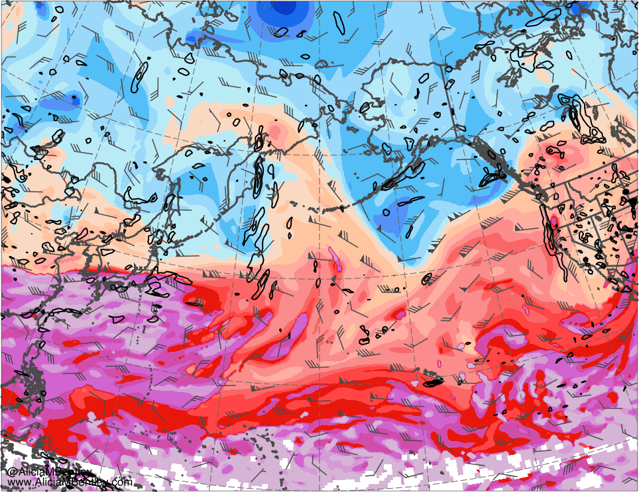
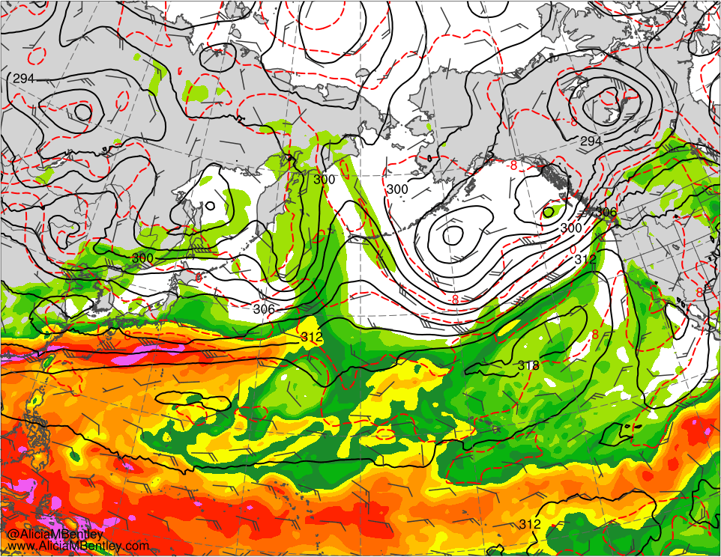
0000 UTC 3 Jun 2019
264
270
276
282
288
294
300
306
312
318
324
330
336
342
348
354
360
366
372
378
384
K
20
25
30
35
40
45
50
55
60
65
70
mm
Potential temperature (K, shaded) and wind (kt, flags and barbs) on 2-PVU surface; 925–850-hPa cycl. rel. vort. (0.5 × 10⁻⁴ s⁻¹; black)
700-hPa geo. height (dam, black), wind (kt, flags and barbs), and temperature (°C, red), and PW (mm, shaded)

Slide 12
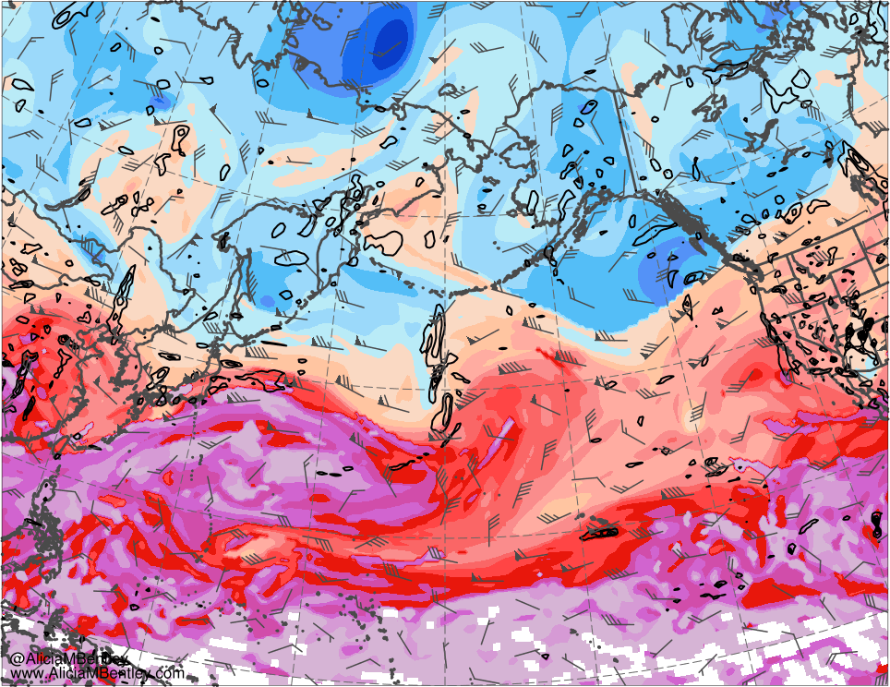
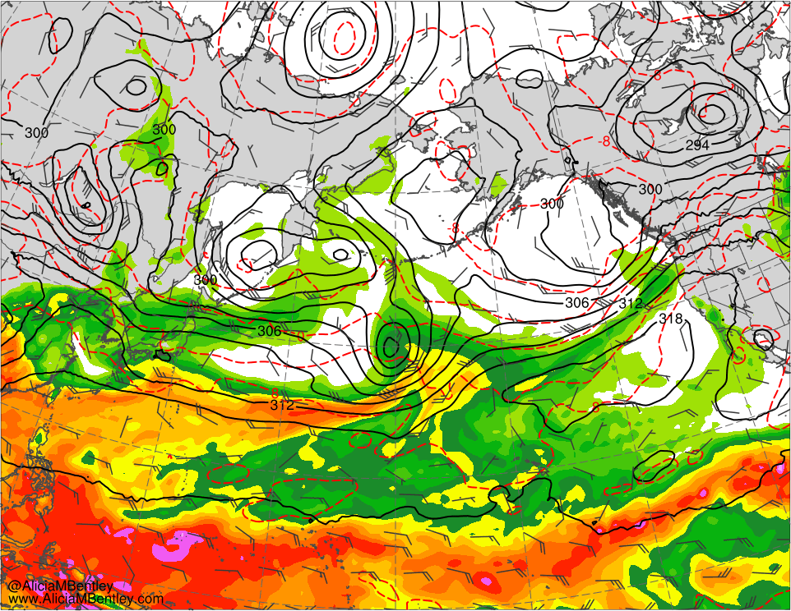
0000 UTC 5 Jun 2019
264
270
276
282
288
294
300
306
312
318
324
330
336
342
348
354
360
366
372
378
384
K
20
25
30
35
40
45
50
55
60
65
70
mm
Potential temperature (K, shaded) and wind (kt, flags and barbs) on 2-PVU surface; 925–850-hPa cycl. rel. vort. (0.5 × 10⁻⁴ s⁻¹; black)
700-hPa geo. height (dam, black), wind (kt, flags and barbs), and temperature (°C, red), and PW (mm, shaded)

Slide 13
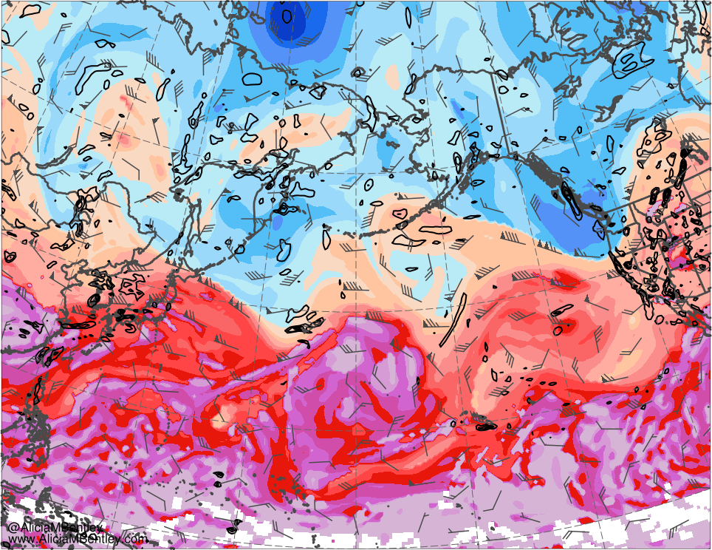
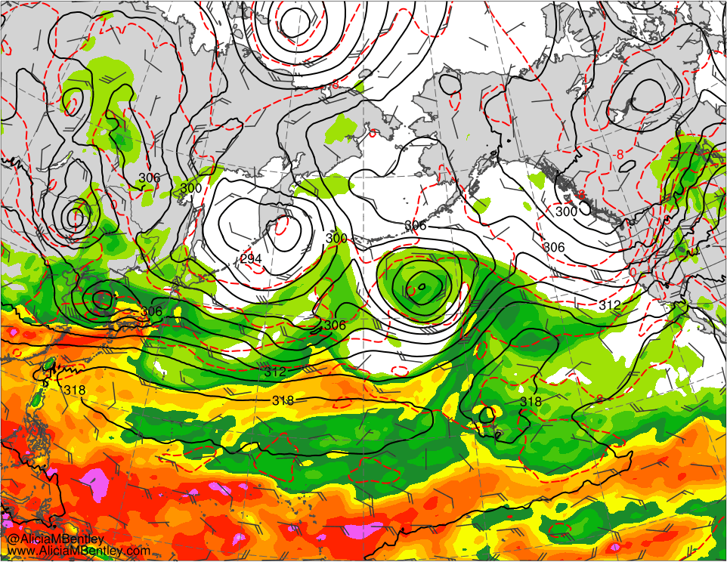
0000 UTC 7 Jun 2019
264
270
276
282
288
294
300
306
312
318
324
330
336
342
348
354
360
366
372
378
384
K
20
25
30
35
40
45
50
55
60
65
70
mm
Potential temperature (K, shaded) and wind (kt, flags and barbs) on 2-PVU surface; 925–850-hPa cycl. rel. vort. (0.5 × 10⁻⁴ s⁻¹; black)
700-hPa geo. height (dam, black), wind (kt, flags and barbs), and temperature (°C, red), and PW (mm, shaded)

Slide 14
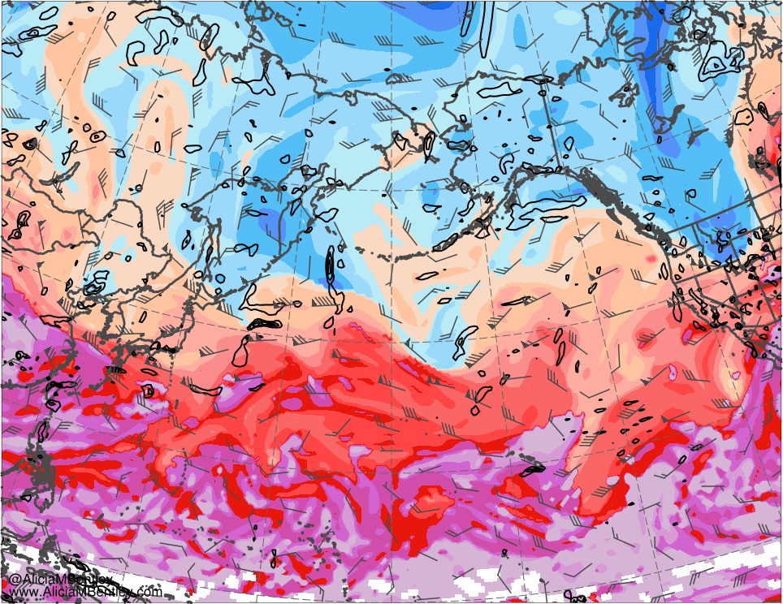
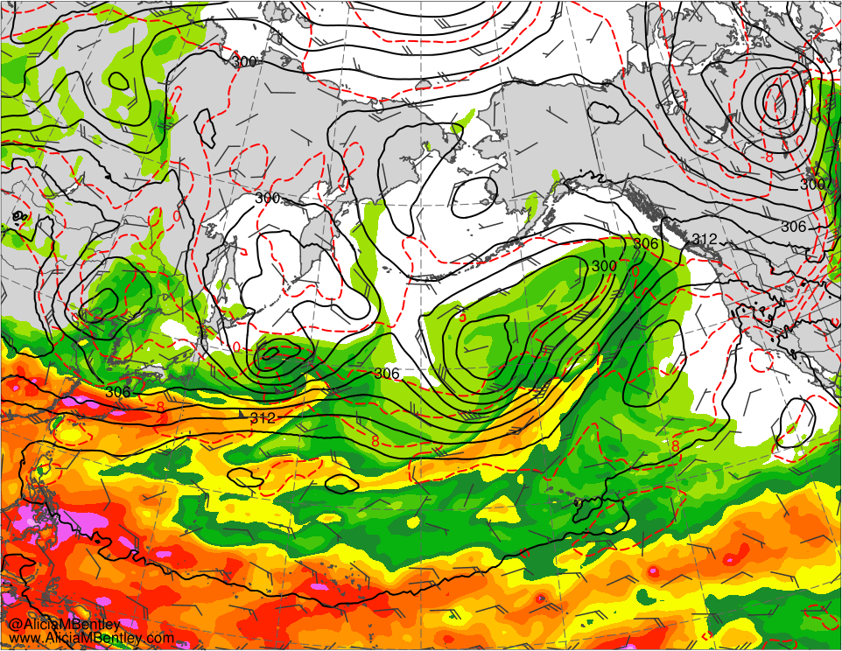
0000 UTC 7 Jun 2019
264
270
276
282
288
294
300
306
312
318
324
330
336
342
348
354
360
366
372
378
384
K
20
25
30
35
40
45
50
55
60
65
70
mm
Potential temperature (K, shaded) and wind (kt, flags and barbs) on 2-PVU surface; 925–850-hPa cycl. rel. vort. (0.5 × 10⁻⁴ s⁻¹; black)
700-hPa geo. height (dam, black), wind (kt, flags and barbs), and temperature (°C, red), and PW (mm, shaded)

Slide 15
Summary
Tibetan Plateau “heat belch” leads to downstream anticyclonic wave breaking (AWB)
Potential vorticity streamer (PVS) formation occurs east of the Dateline in response to AWB
Eastward moisture advection toward California/Mexico occurs equatorward of this PVS
Cyclonic wave breaking (CWB) occurs poleward of a subtropical jet stream (STJ) extension

Slide 16
North America Circulation Regime Evolution 3–9 Jun 2019

Slide 17
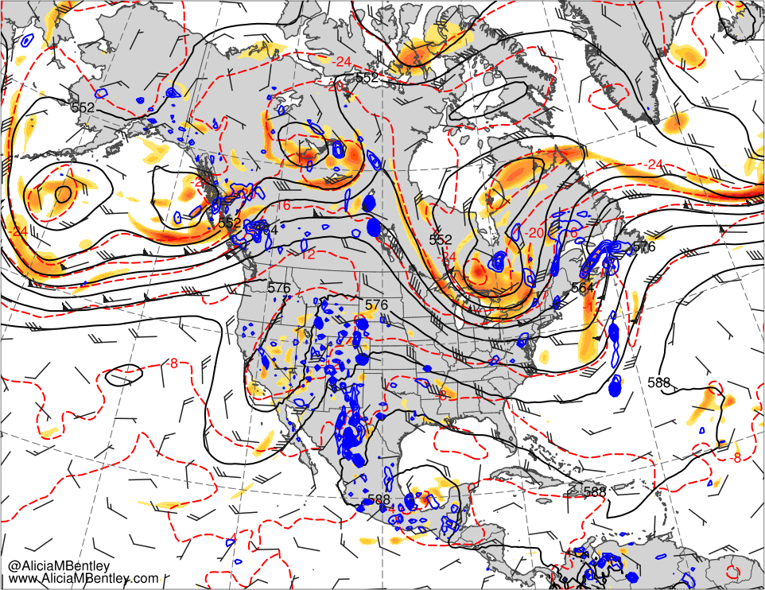
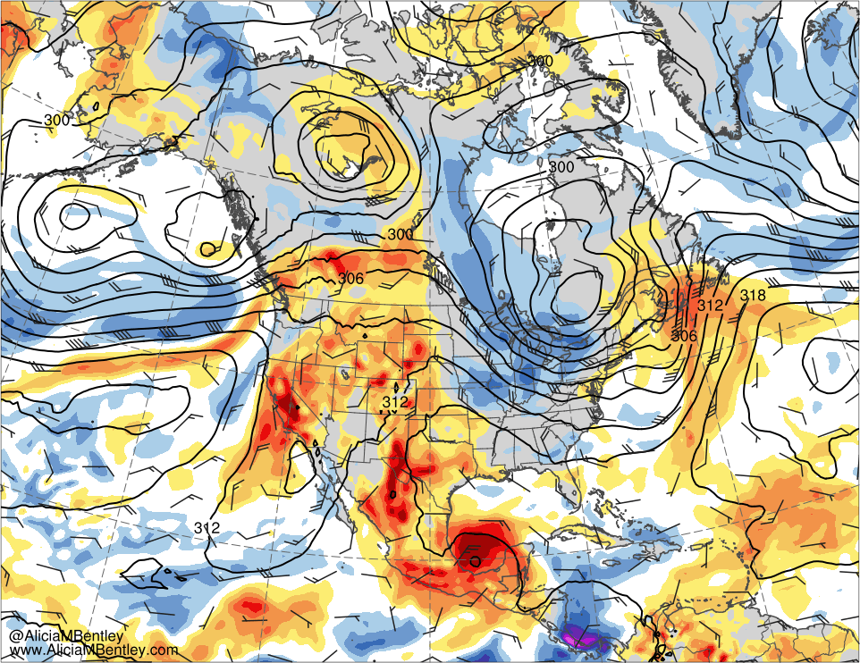
0000 UTC 3 Jun 2019
6
8
10
12
16
20
24
28
10⁻⁵ s⁻¹
−6
−5
−4
−3
−2.5
−2
−1.5
−1
−0.5
0
0.5
1
1.5
2
2.5
3
4
5
6
σ
500-hPa geo. height (dam, black), temp. (K, red), cycl. rel. vort. (10⁻⁵ s⁻¹, shaded), ω (5 × 10⁻³ s⁻¹, blue), and wind (kt, flags and barbs)
700-hPa geo. height (dam, black) and wind (kt, flags and barbs), and standardized anomalies of PW (σ, shaded)

Slide 18
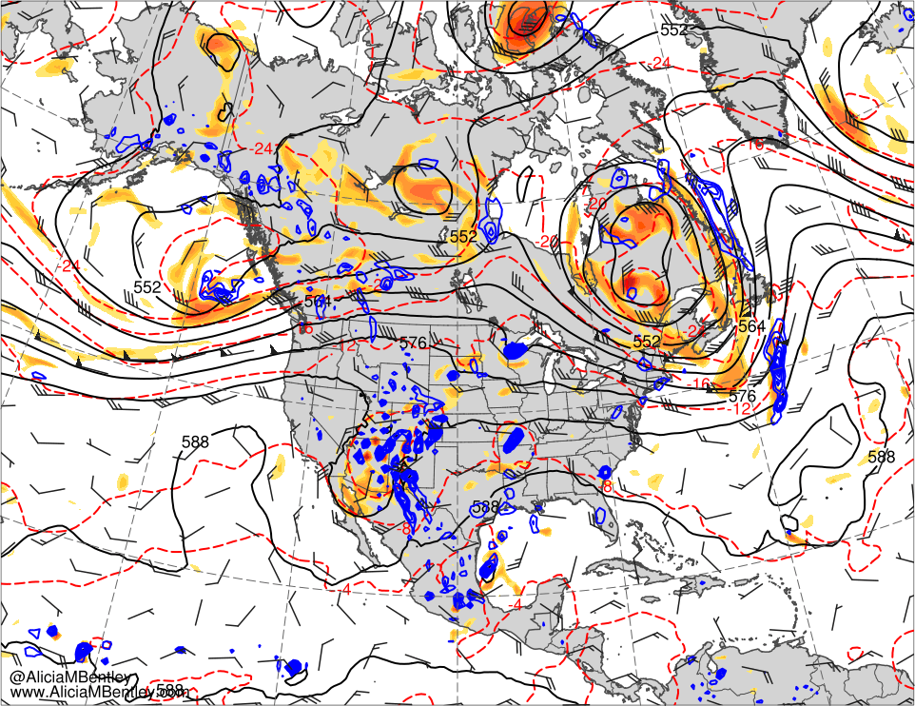
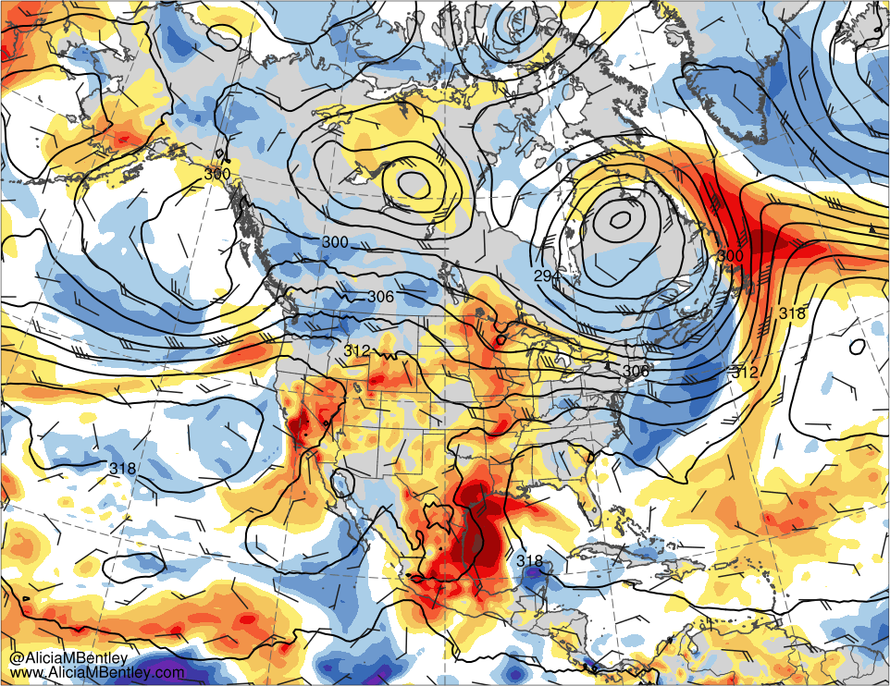
0000 UTC 5 Jun 2019
6
8
10
12
16
20
24
28
10⁻⁵ s⁻¹
−6
−5
−4
−3
−2.5
−2
−1.5
−1
−0.5
0
0.5
1
1.5
2
2.5
3
4
5
6
σ
500-hPa geo. height (dam, black), temp. (K, red), cycl. rel. vort. (10⁻⁵ s⁻¹, shaded), ω (5 × 10⁻³ s⁻¹, blue), and wind (kt, flags and barbs)
700-hPa geo. height (dam, black) and wind (kt, flags and barbs), and standardized anomalies of PW (σ, shaded)

Slide 19
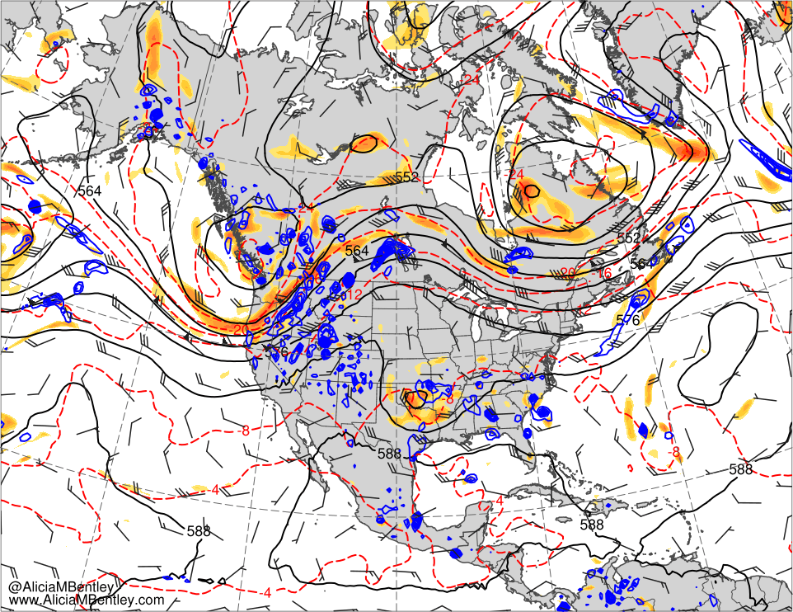
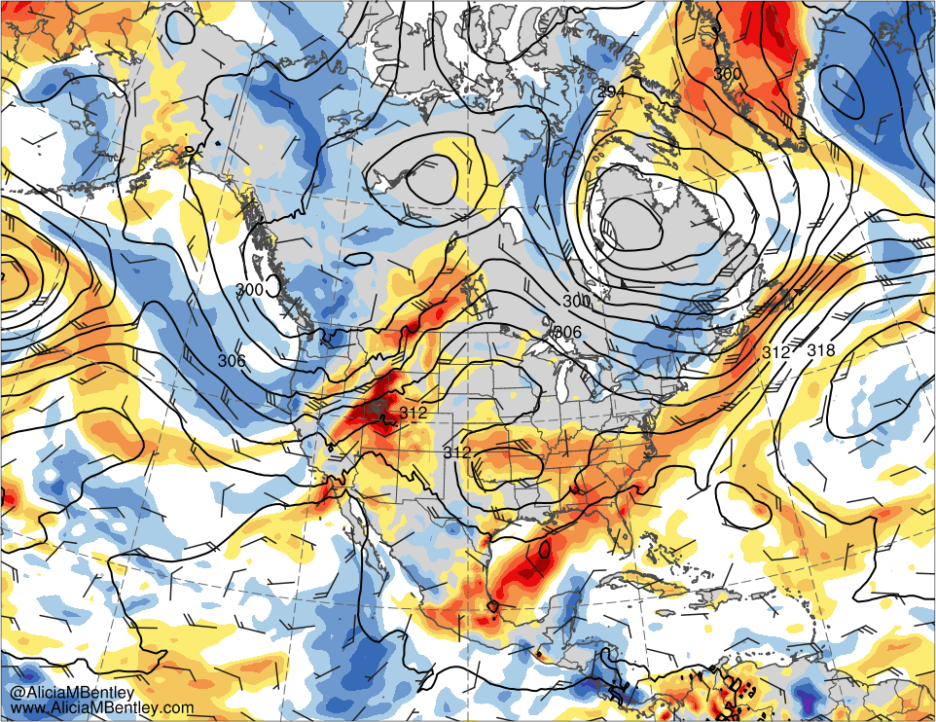
0000 UTC 7 Jun 2019
6
8
10
12
16
20
24
28
10⁻⁵ s⁻¹
−6
−5
−4
−3
−2.5
−2
−1.5
−1
−0.5
0
0.5
1
1.5
2
2.5
3
4
5
6
σ
500-hPa geo. height (dam, black), temp. (K, red), cycl. rel. vort. (10⁻⁵ s⁻¹, shaded), ω (5 × 10⁻³ s⁻¹, blue), and wind (kt, flags and barbs)
700-hPa geo. height (dam, black) and wind (kt, flags and barbs), and standardized anomalies of PW (σ, shaded)

Slide 20
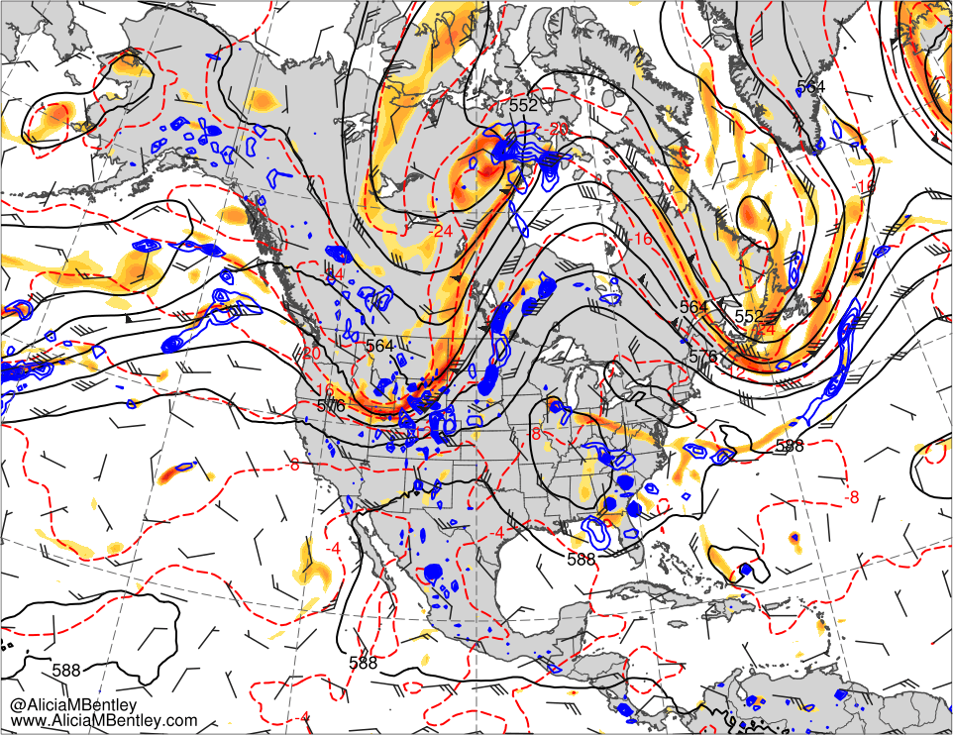
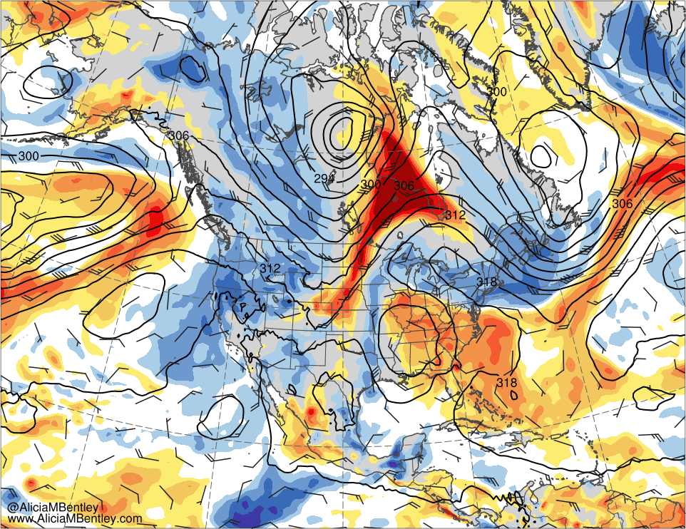
0000 UTC 9 Jun 2019
6
8
10
12
16
20
24
28
10⁻⁵ s⁻¹
−6
−5
−4
−3
−2.5
−2
−1.5
−1
−0.5
0
0.5
1
1.5
2
2.5
3
4
5
6
σ
500-hPa geo. height (dam, black), temp. (K, red), cycl. rel. vort. (10⁻⁵ s⁻¹, shaded), ω (5 × 10⁻³ s⁻¹, blue), and wind (kt, flags and barbs)
700-hPa geo. height (dam, black) and wind (kt, flags and barbs), and standardized anomalies of PW (σ, shaded)

Slide 21
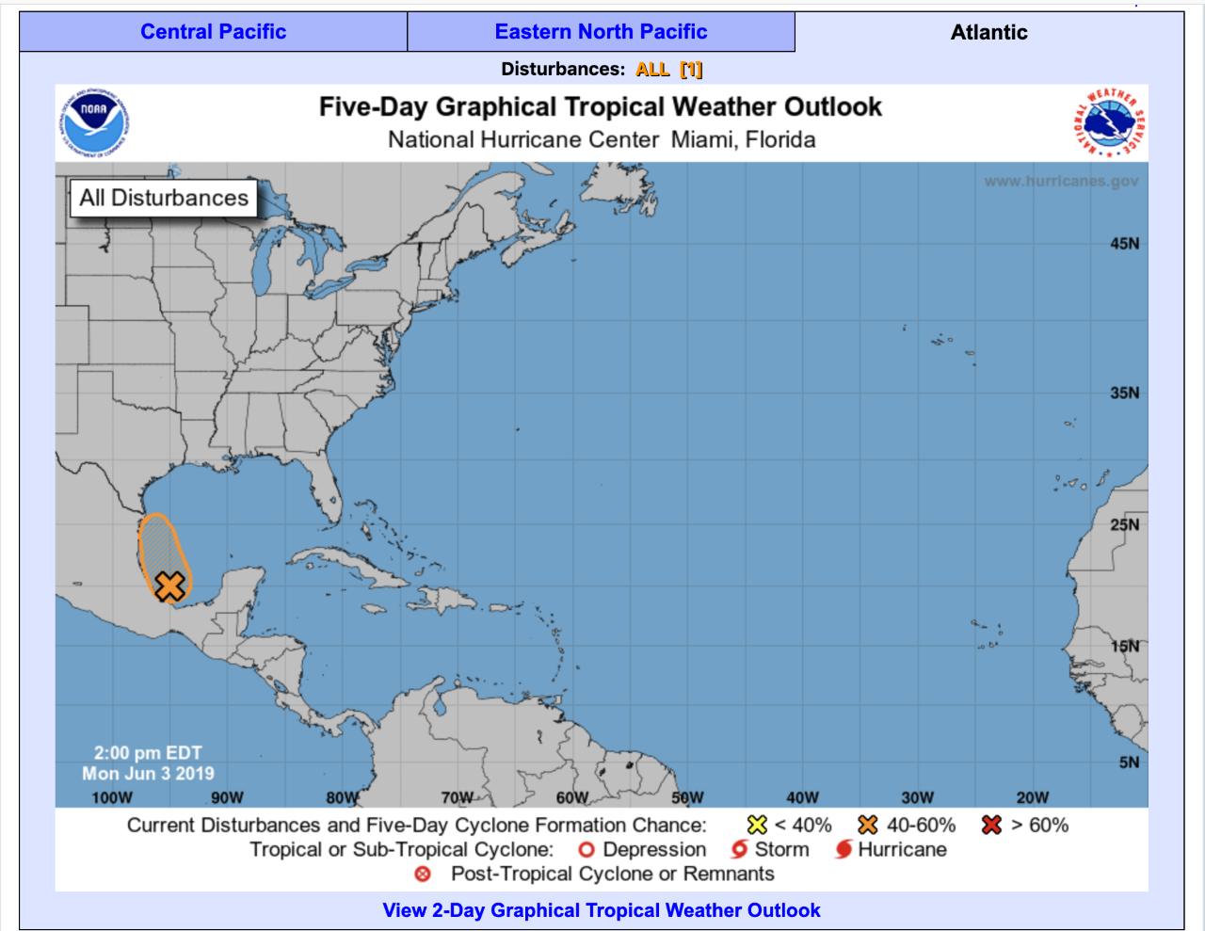
Tropical Disturbance
NHC Graphical Tropical Weather Outlook from 1800 UTC 3 June

Slide 22
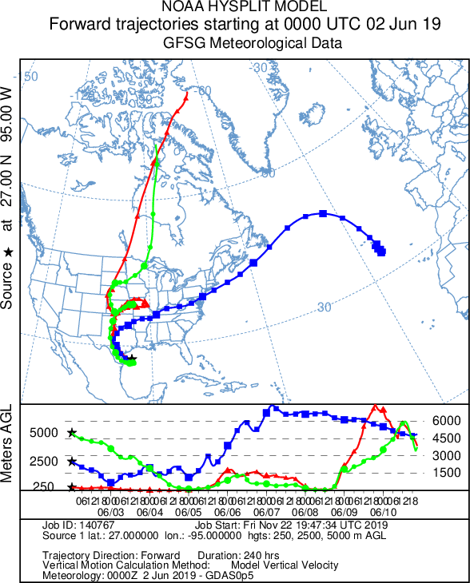
Trajectories
NOAA HYSPLIT forward trajectories starting at 0000 UTC 2 Jun 2019

Slide 23
Summary
Antecedent weak trough forms over the Southwest due to upstream AWB
Southwest trough reaches Texas and taps Gulf of Mexico tropical moisture
Gulf of Mexico moisture originates from the eastern Pacific and Caribbean
Ridging over northwestern North America and downstream trough development supports deep poleward moisture transport

Slide 24
Northeast (NE) Canada and Northern Greenland Ridging 10–14 Jun 2019

Slide 25
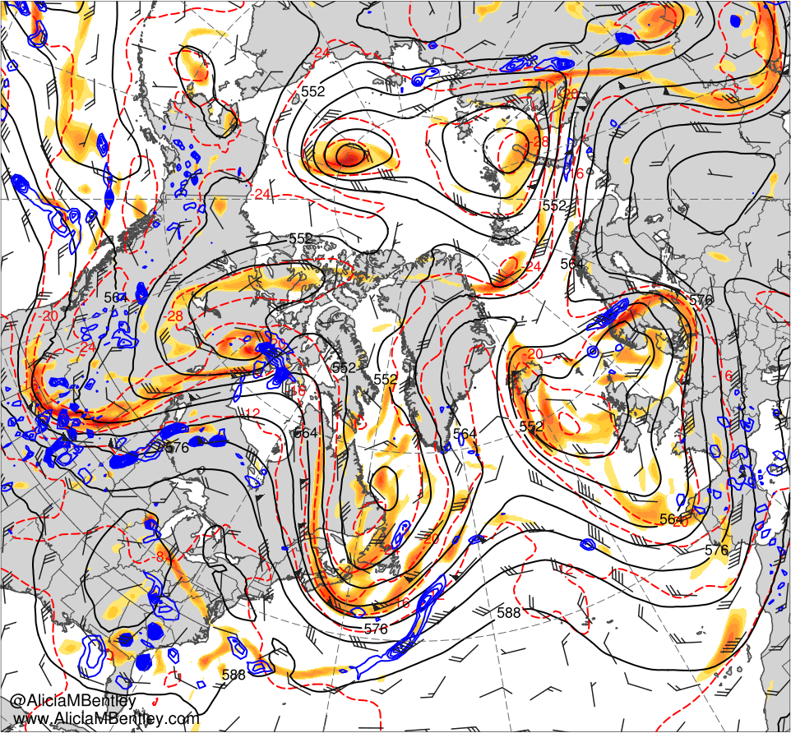
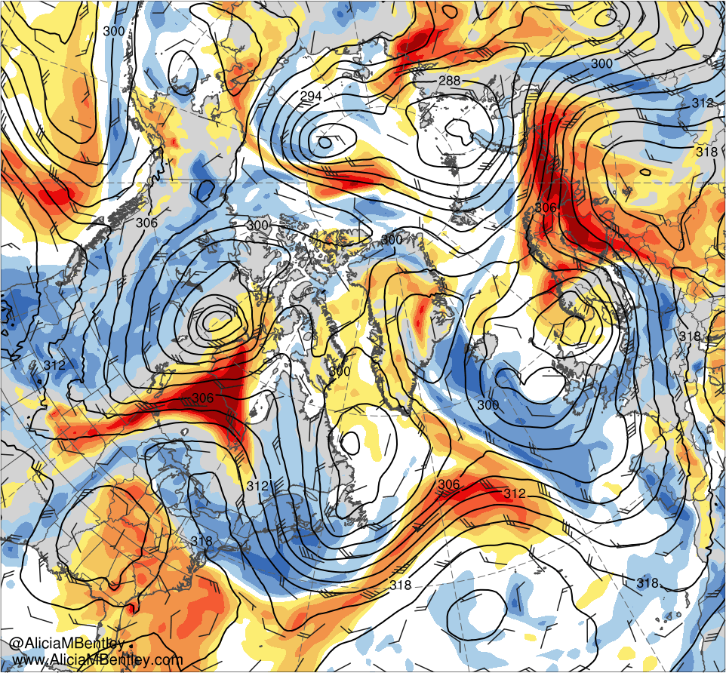
0000 UTC 9 Jun 2019
6
8
10
12
16
20
24
28
10⁻⁵ s⁻¹
−6
−5
−4
−3
−2.5
−2
−1.5
−1
−0.5
0
0.5
1
1.5
2
2.5
3
4
5
6
σ
500-hPa geo. height (dam, black), temp. (K, red), cycl. rel. vort. (10⁻⁵ s⁻¹, shaded), ω (5 × 10⁻³ s⁻¹, blue), and wind (kt, flags and barbs)
700-hPa geo. height (dam, black) and wind (kt, flags and barbs), and standardized anomalies of PW (σ, shaded)

Slide 26
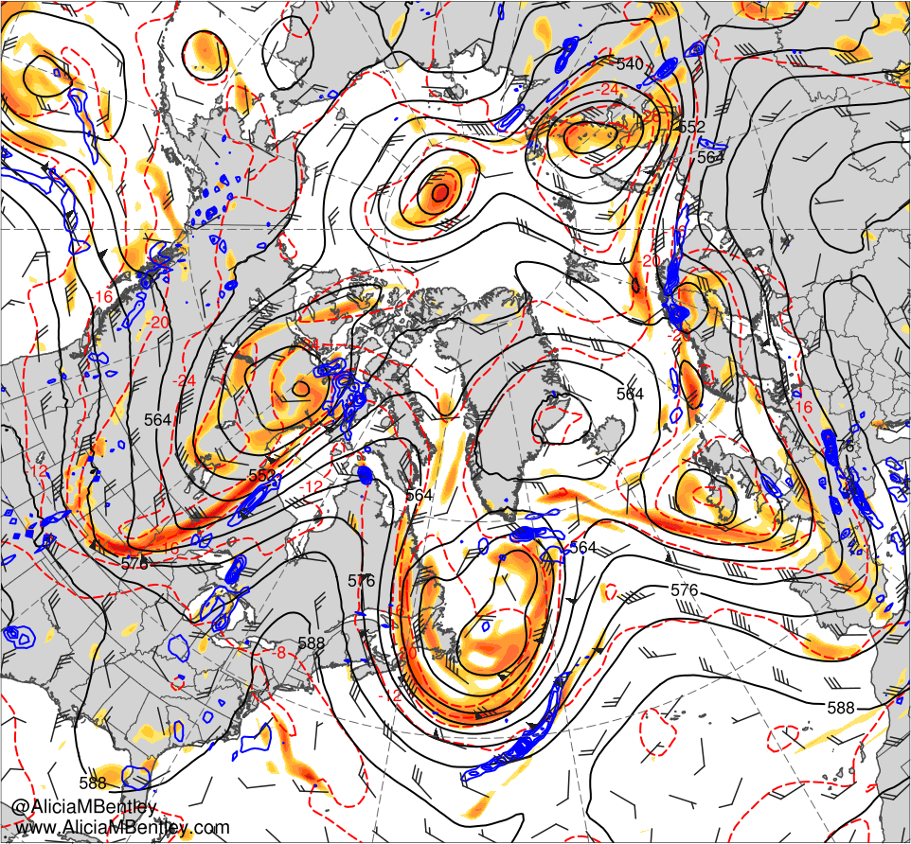
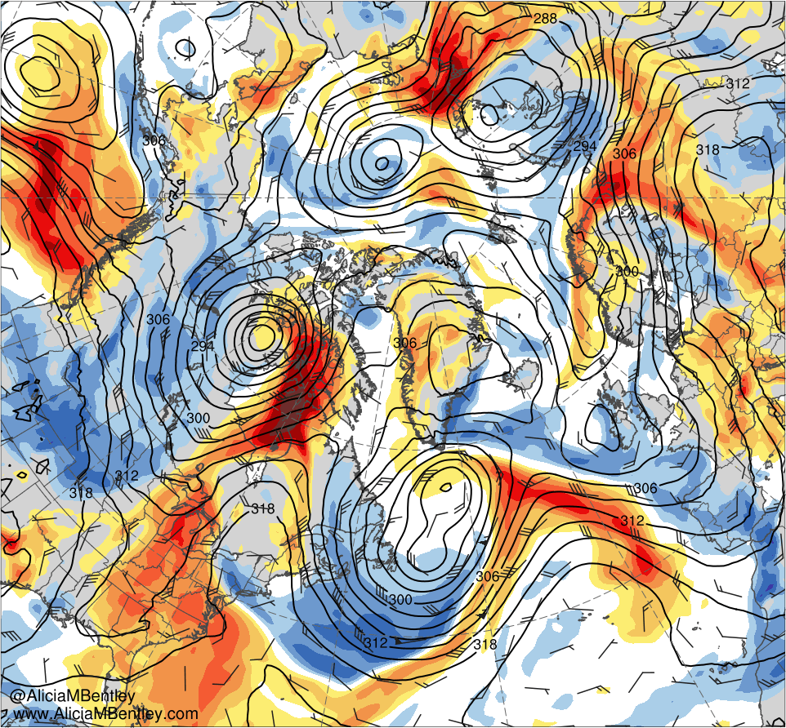
0000 UTC 10 Jun 2019
6
8
10
12
16
20
24
28
10⁻⁵ s⁻¹
−6
−5
−4
−3
−2.5
−2
−1.5
−1
−0.5
0
0.5
1
1.5
2
2.5
3
4
5
6
σ
500-hPa geo. height (dam, black), temp. (K, red), cycl. rel. vort. (10⁻⁵ s⁻¹, shaded), ω (5 × 10⁻³ s⁻¹, blue), and wind (kt, flags and barbs)
700-hPa geo. height (dam, black) and wind (kt, flags and barbs), and standardized anomalies of PW (σ, shaded)

Slide 27
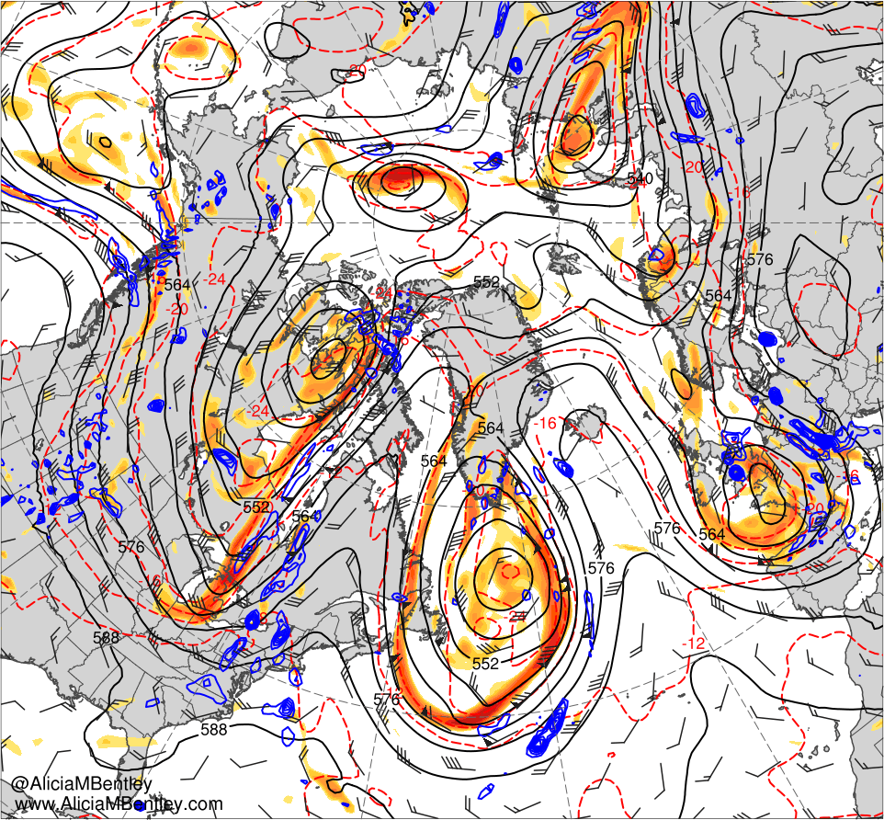
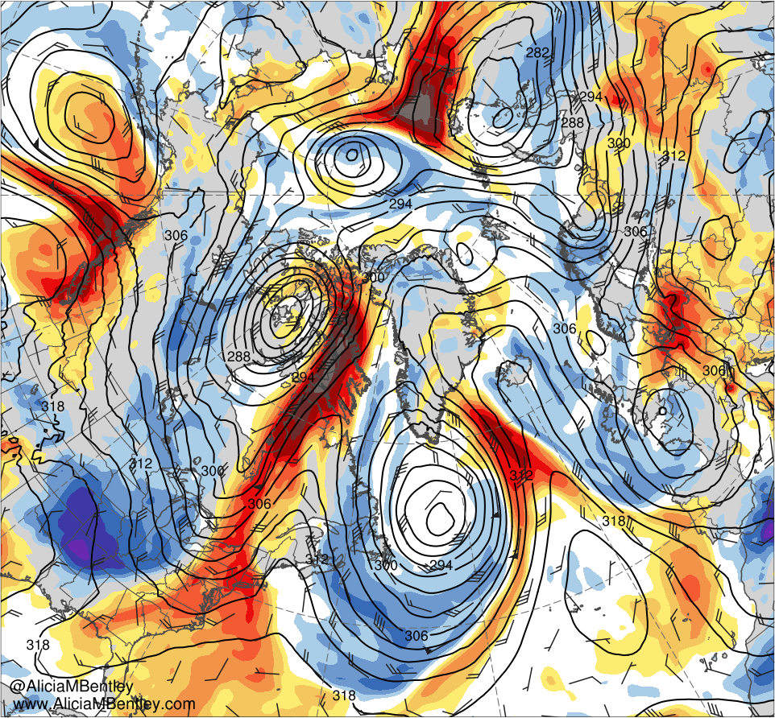
0000 UTC 11 Jun 2019
6
8
10
12
16
20
24
28
10⁻⁵ s⁻¹
−6
−5
−4
−3
−2.5
−2
−1.5
−1
−0.5
0
0.5
1
1.5
2
2.5
3
4
5
6
σ
500-hPa geo. height (dam, black), temp. (K, red), cycl. rel. vort. (10⁻⁵ s⁻¹, shaded), ω (5 × 10⁻³ s⁻¹, blue), and wind (kt, flags and barbs)
700-hPa geo. height (dam, black) and wind (kt, flags and barbs), and standardized anomalies of PW (σ, shaded)

Slide 28
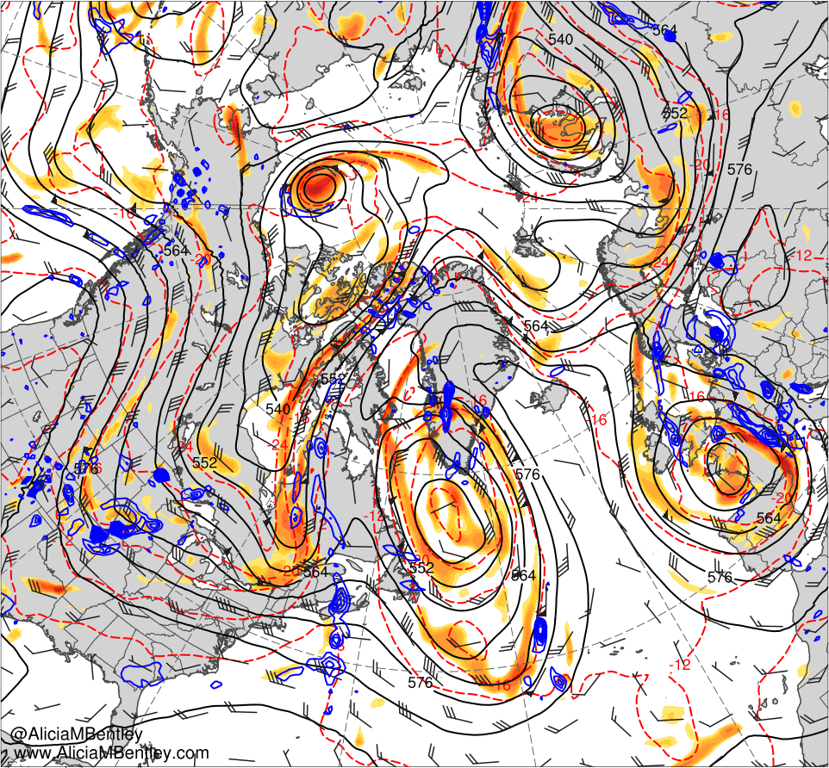
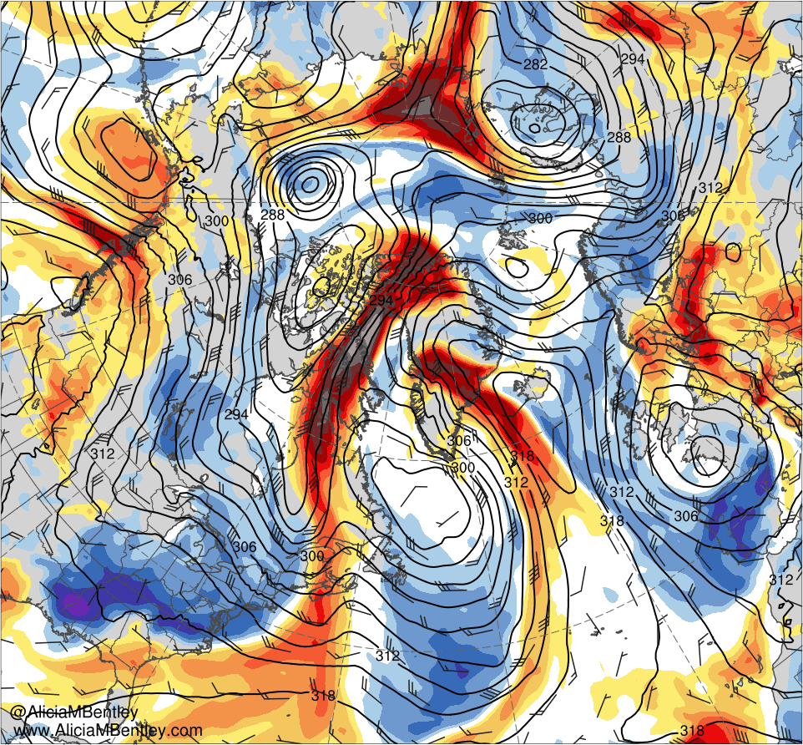
0000 UTC 12 Jun 2019
6
8
10
12
16
20
24
28
10⁻⁵ s⁻¹
−6
−5
−4
−3
−2.5
−2
−1.5
−1
−0.5
0
0.5
1
1.5
2
2.5
3
4
5
6
σ
500-hPa geo. height (dam, black), temp. (K, red), cycl. rel. vort. (10⁻⁵ s⁻¹, shaded), ω (5 × 10⁻³ s⁻¹, blue), and wind (kt, flags and barbs)
700-hPa geo. height (dam, black) and wind (kt, flags and barbs), and standardized anomalies of PW (σ, shaded)

Slide 29
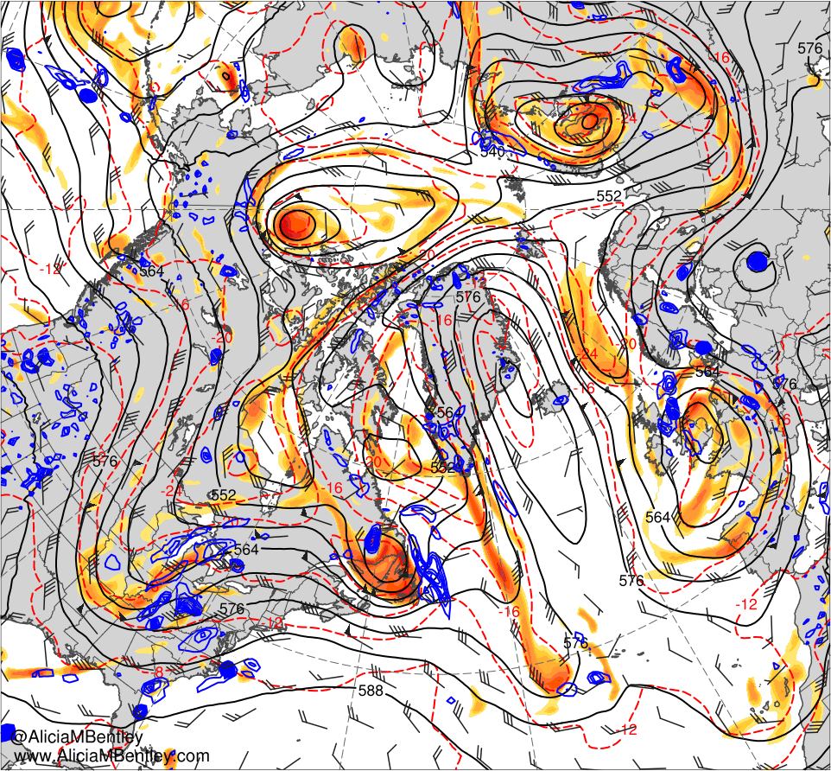
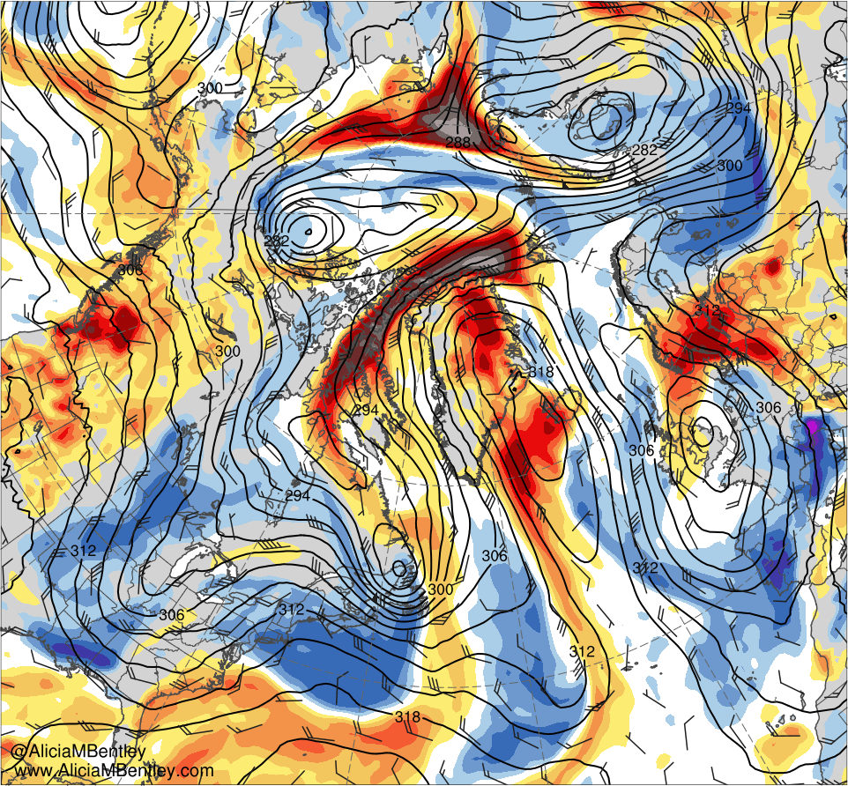
0000 UTC 13 Jun 2019
6
8
10
12
16
20
24
28
10⁻⁵ s⁻¹
−6
−5
−4
−3
−2.5
−2
−1.5
−1
−0.5
0
0.5
1
1.5
2
2.5
3
4
5
6
σ
500-hPa geo. height (dam, black), temp. (K, red), cycl. rel. vort. (10⁻⁵ s⁻¹, shaded), ω (5 × 10⁻³ s⁻¹, blue), and wind (kt, flags and barbs)
700-hPa geo. height (dam, black) and wind (kt, flags and barbs), and standardized anomalies of PW (σ, shaded)

Slide 30
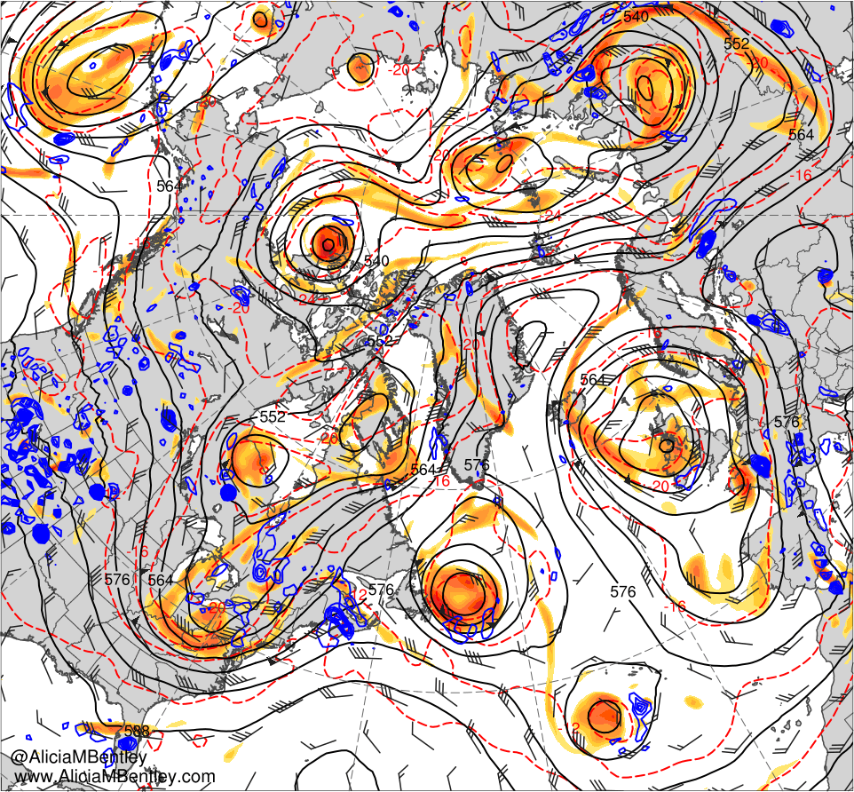
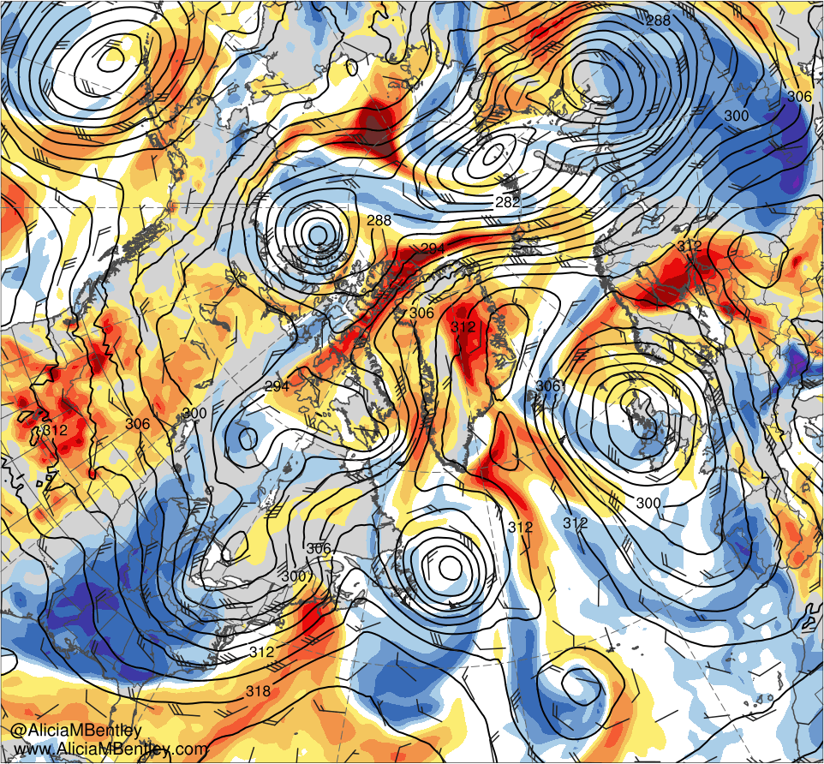
0000 UTC 14 Jun 2019
6
8
10
12
16
20
24
28
10⁻⁵ s⁻¹
−6
−5
−4
−3
−2.5
−2
−1.5
−1
−0.5
0
0.5
1
1.5
2
2.5
3
4
5
6
σ
500-hPa geo. height (dam, black), temp. (K, red), cycl. rel. vort. (10⁻⁵ s⁻¹, shaded), ω (5 × 10⁻³ s⁻¹, blue), and wind (kt, flags and barbs)
700-hPa geo. height (dam, black) and wind (kt, flags and barbs), and standardized anomalies of PW (σ, shaded)

Slide 31
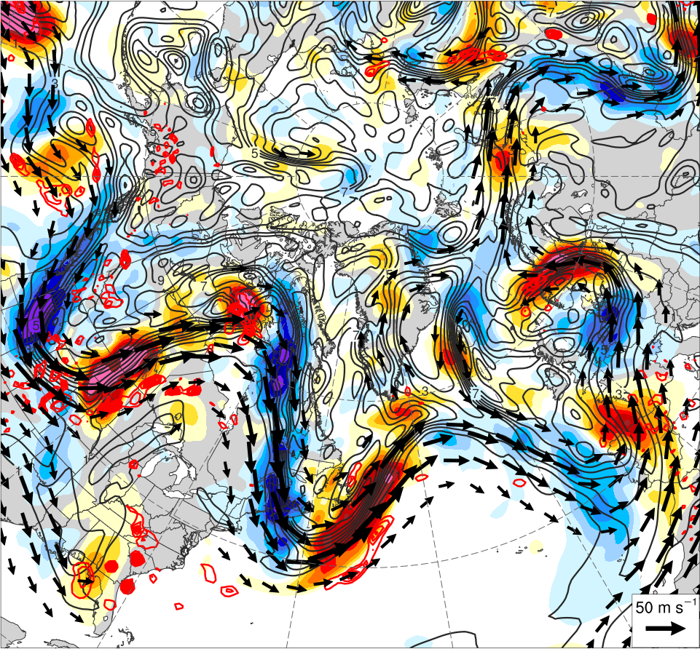
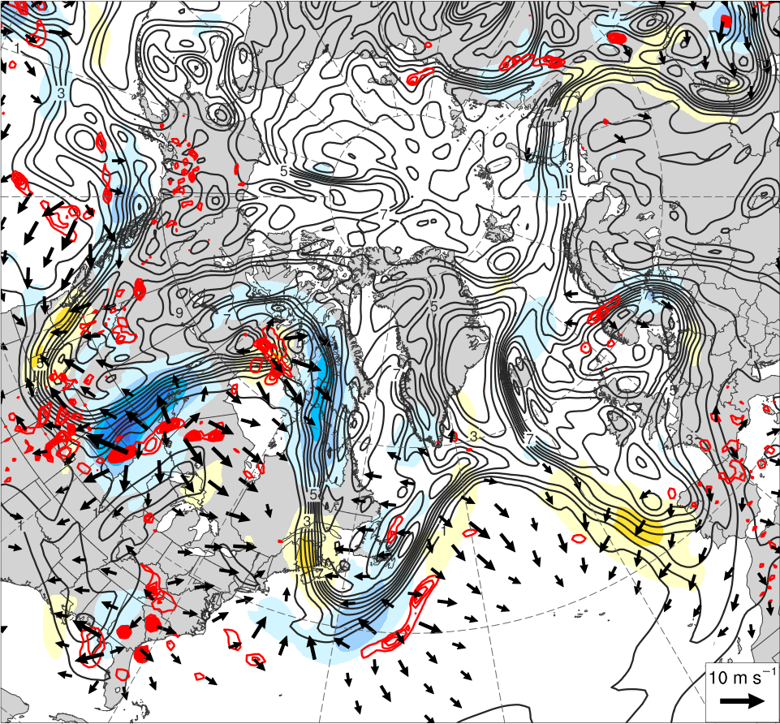
0000 UTC 9 Jun 2019
−15
−13
−11
−9
−7
−5
−3
−1
0
1
3
5
7
9
11
13
15
PVU d⁻¹
300–200-hPa PV (PVU, gray), nondivergent wind (m s⁻¹, vectors), and PV advection by nondivergent wind (PVU d⁻¹, shading), and 600–400-hPa ω (5 × 10⁻³ s⁻¹, red)
300–200-hPa PV (PVU, gray), irrotational wind (m s⁻¹, vectors), and PV advection by irrotational wind (PVU d⁻¹, shading), and 600–400-hPa ω (5 × 10⁻³ s⁻¹, red)

Slide 32
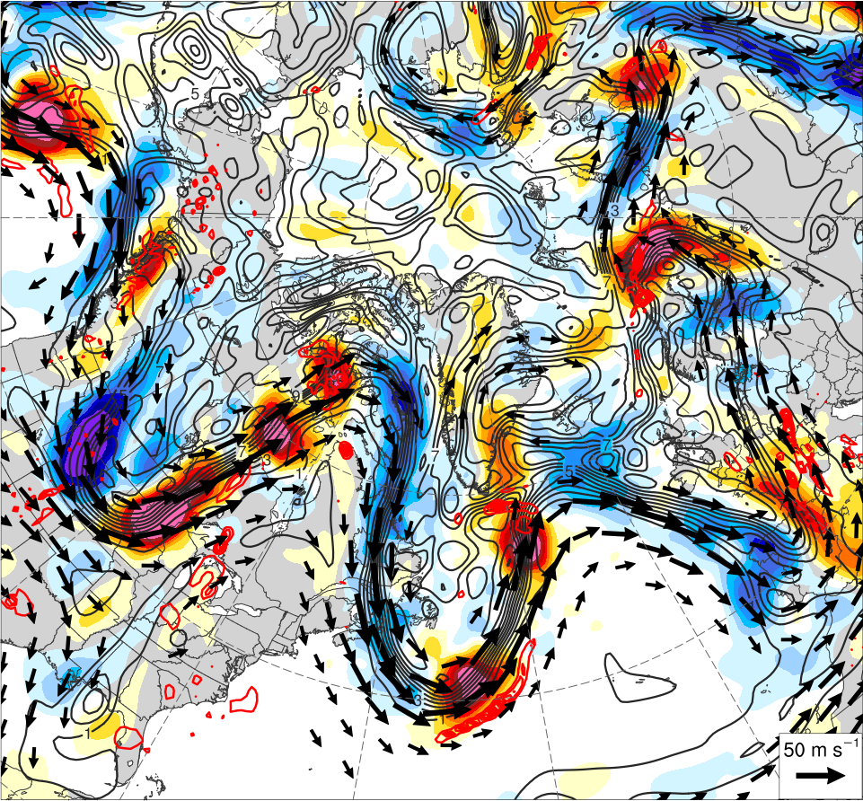
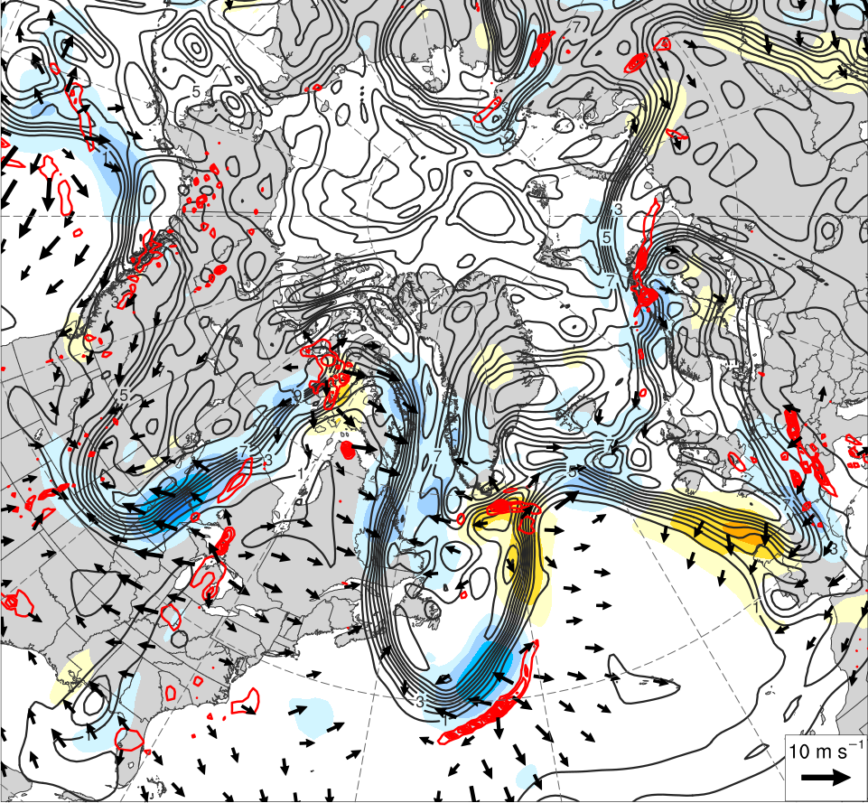
0000 UTC 10 Jun 2019
−15
−13
−11
−9
−7
−5
−3
−1
0
1
3
5
7
9
11
13
15
PVU d⁻¹
300–200-hPa PV (PVU, gray), nondivergent wind (m s⁻¹, vectors), and PV advection by nondivergent wind (PVU d⁻¹, shading), and 600–400-hPa ω (5 × 10⁻³ s⁻¹, red)
300–200-hPa PV (PVU, gray), irrotational wind (m s⁻¹, vectors), and PV advection by irrotational wind (PVU d⁻¹, shading), and 600–400-hPa ω (5 × 10⁻³ s⁻¹, red)

Slide 33
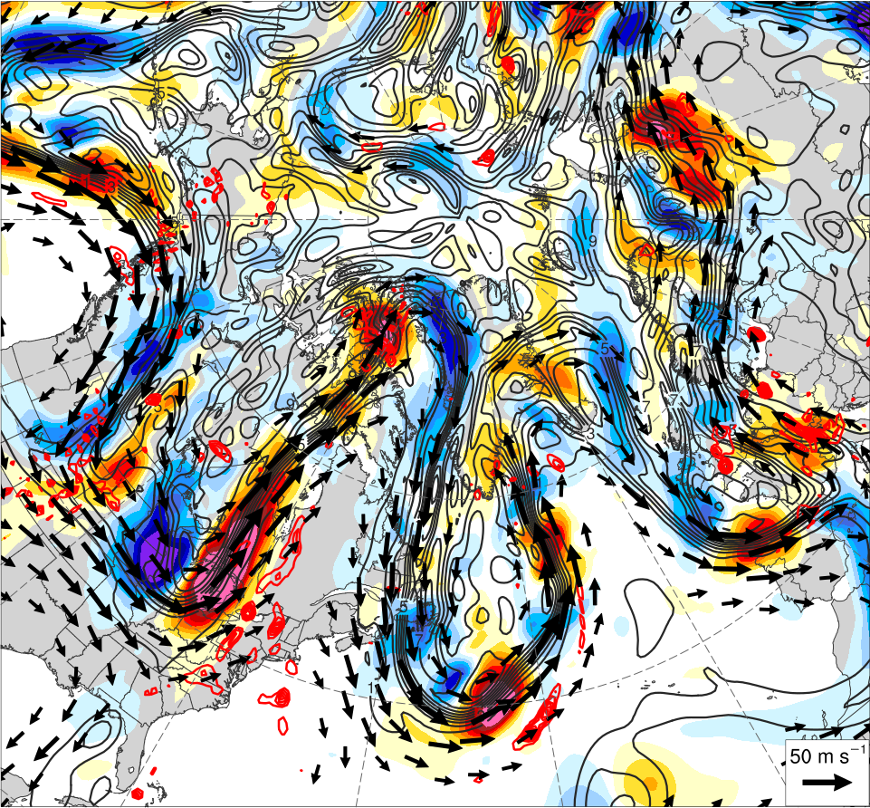
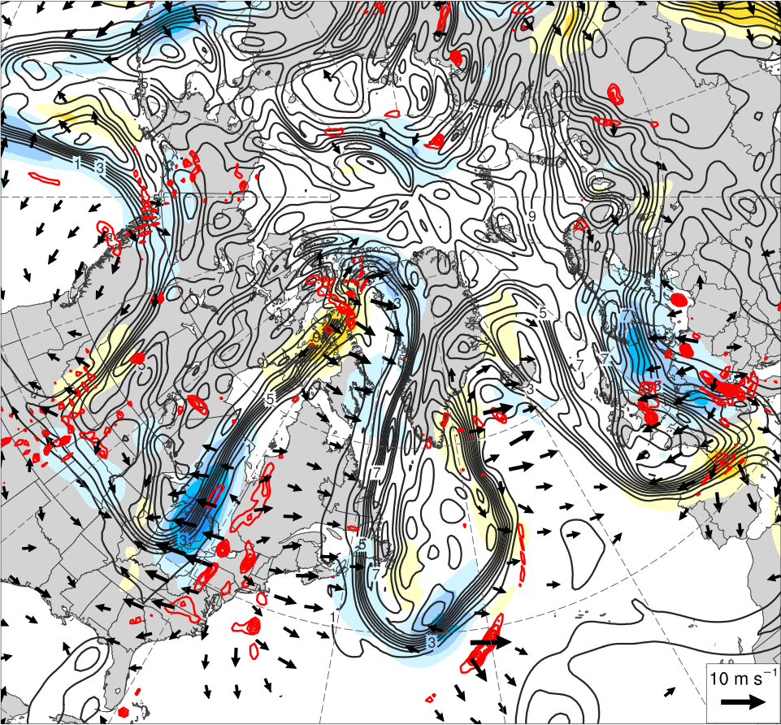
0000 UTC 11 Jun 2019
−15
−13
−11
−9
−7
−5
−3
−1
0
1
3
5
7
9
11
13
15
PVU d⁻¹
300–200-hPa PV (PVU, gray), nondivergent wind (m s⁻¹, vectors), and PV advection by nondivergent wind (PVU d⁻¹, shading), and 600–400-hPa ω (5 × 10⁻³ s⁻¹, red)
300–200-hPa PV (PVU, gray), irrotational wind (m s⁻¹, vectors), and PV advection by irrotational wind (PVU d⁻¹, shading), and 600–400-hPa ω (5 × 10⁻³ s⁻¹, red)

Slide 34
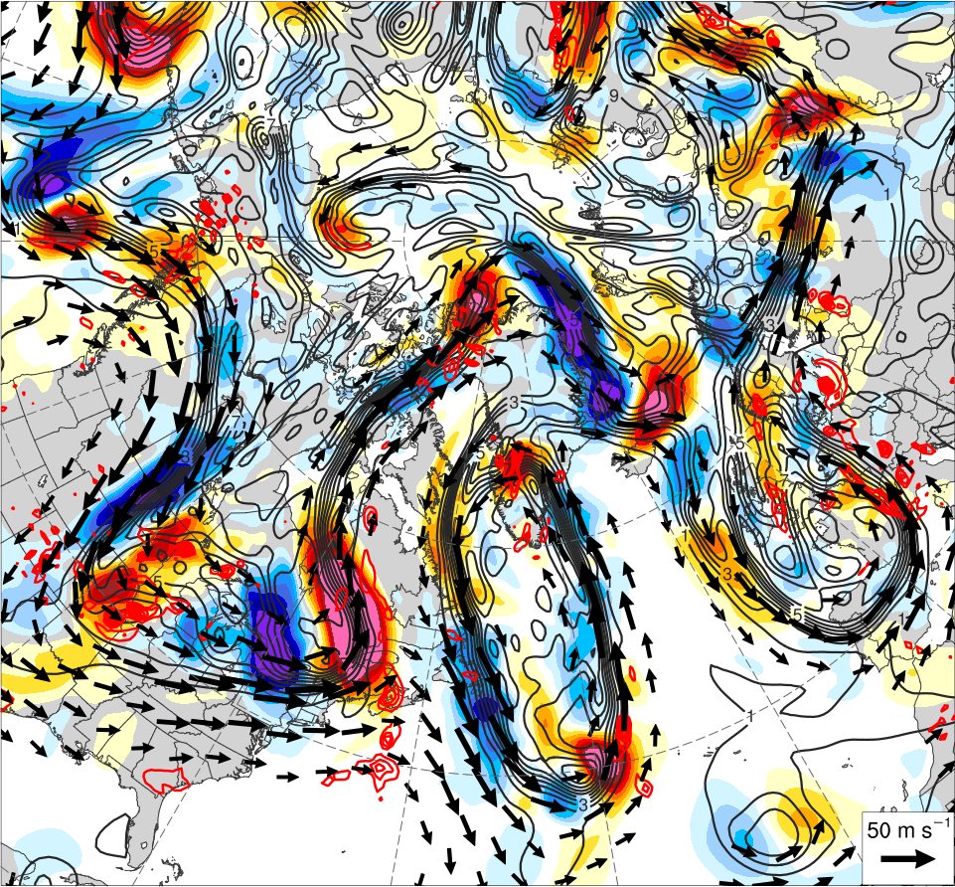
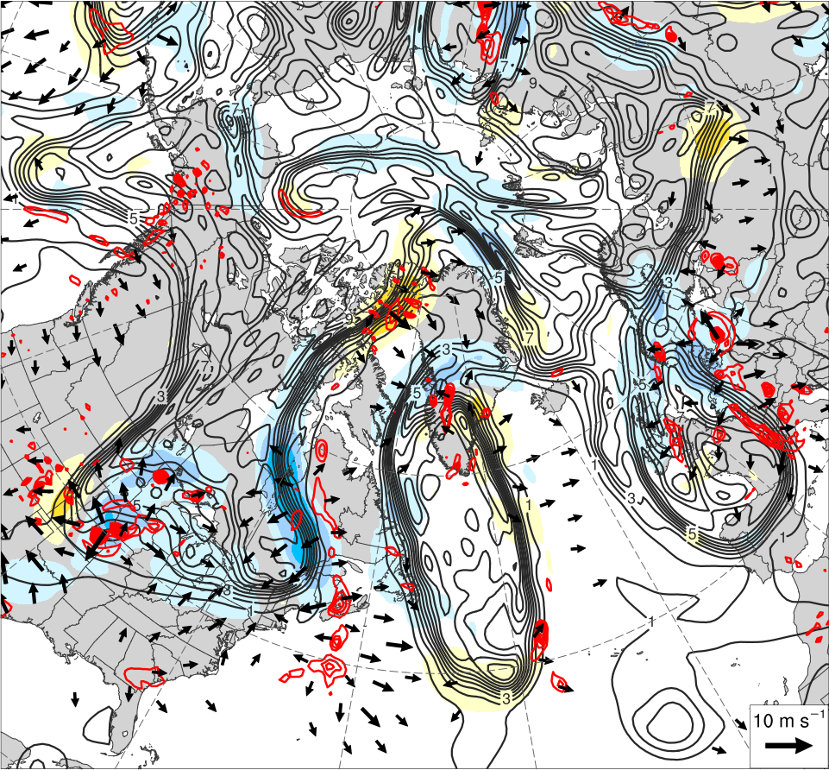
0000 UTC 12 Jun 2019
−15
−13
−11
−9
−7
−5
−3
−1
0
1
3
5
7
9
11
13
15
PVU d⁻¹
300–200-hPa PV (PVU, gray), nondivergent wind (m s⁻¹, vectors), and PV advection by nondivergent wind (PVU d⁻¹, shading), and 600–400-hPa ω (5 × 10⁻³ s⁻¹, red)
300–200-hPa PV (PVU, gray), irrotational wind (m s⁻¹, vectors), and PV advection by irrotational wind (PVU d⁻¹, shading), and 600–400-hPa ω (5 × 10⁻³ s⁻¹, red)

Slide 35
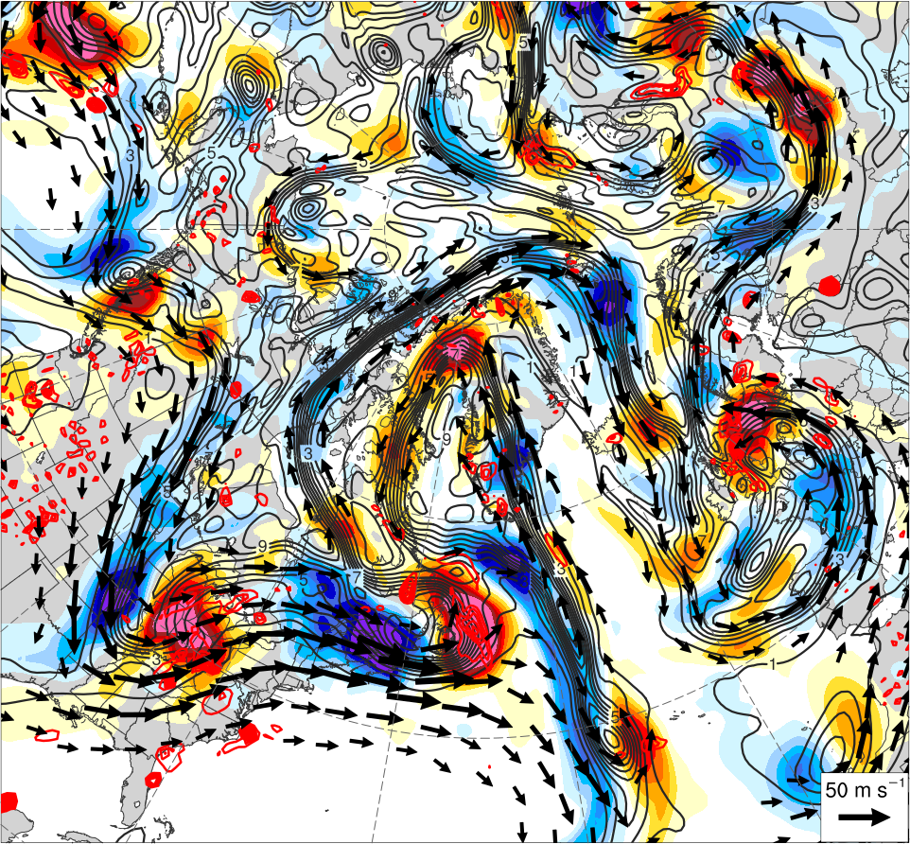
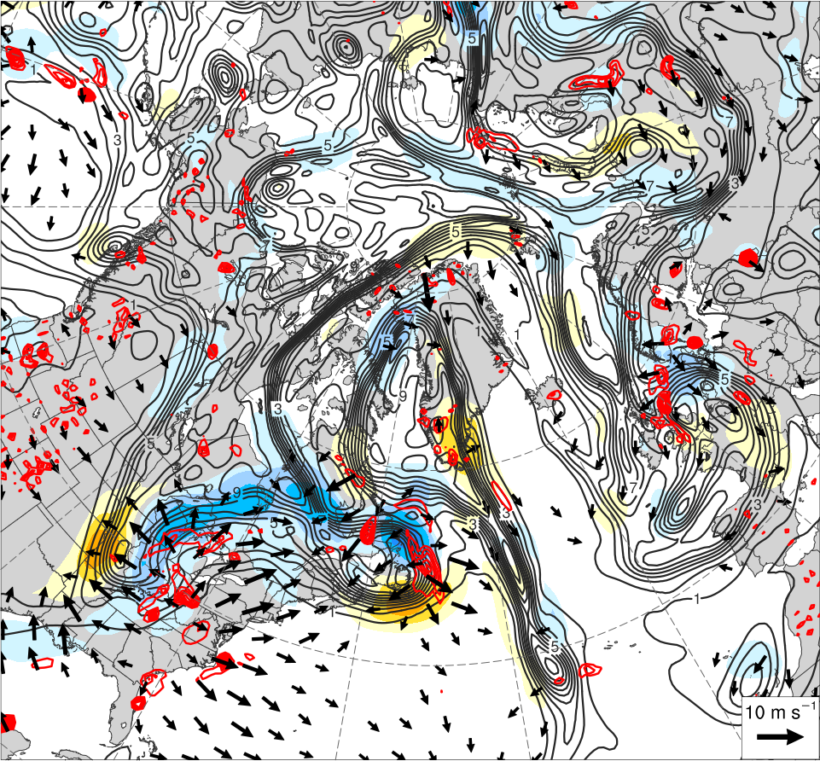
0000 UTC 13 Jun 2019
−15
−13
−11
−9
−7
−5
−3
−1
0
1
3
5
7
9
11
13
15
PVU d⁻¹
300–200-hPa PV (PVU, gray), nondivergent wind (m s⁻¹, vectors), and PV advection by nondivergent wind (PVU d⁻¹, shading), and 600–400-hPa ω (5 × 10⁻³ s⁻¹, red)
300–200-hPa PV (PVU, gray), irrotational wind (m s⁻¹, vectors), and PV advection by irrotational wind (PVU d⁻¹, shading), and 600–400-hPa ω (5 × 10⁻³ s⁻¹, red)

Slide 36
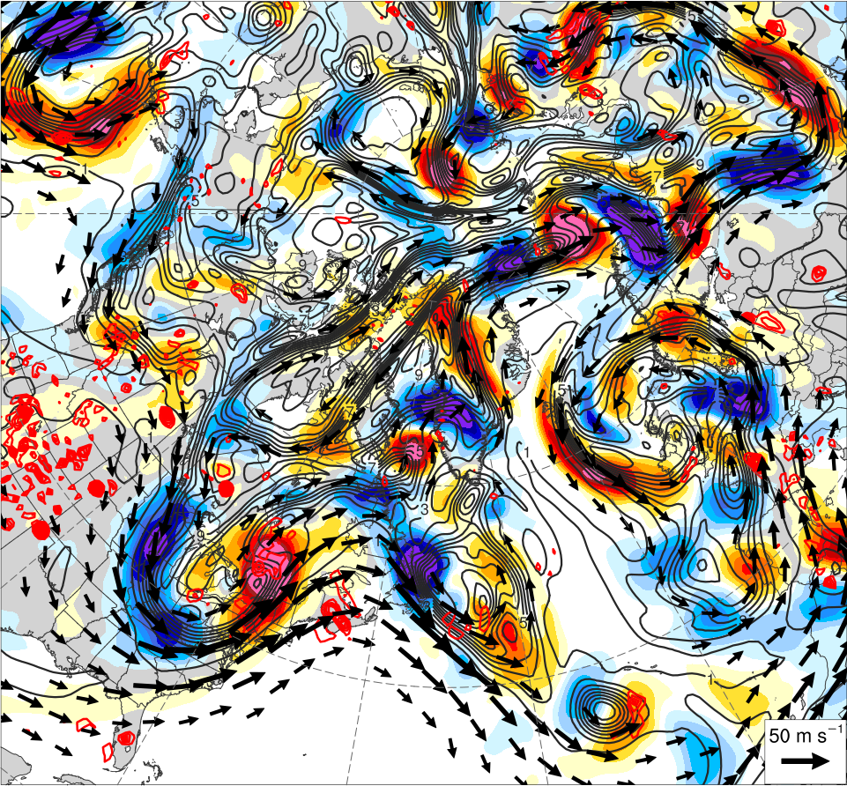
0000 UTC 14 Jun 2019
−15
−13
−11
−9
−7
−5
−3
−1
0
1
3
5
7
9
11
13
15
PVU d⁻¹
300–200-hPa PV (PVU, gray), nondivergent wind (m s⁻¹, vectors), and PV advection by nondivergent wind (PVU d⁻¹, shading), and 600–400-hPa ω (5 × 10⁻³ s⁻¹, red)
300–200-hPa PV (PVU, gray), irrotational wind (m s⁻¹, vectors), and PV advection by irrotational wind (PVU d⁻¹, shading), and 600–400-hPa ω (5 × 10⁻³ s⁻¹, red)

Slide 37
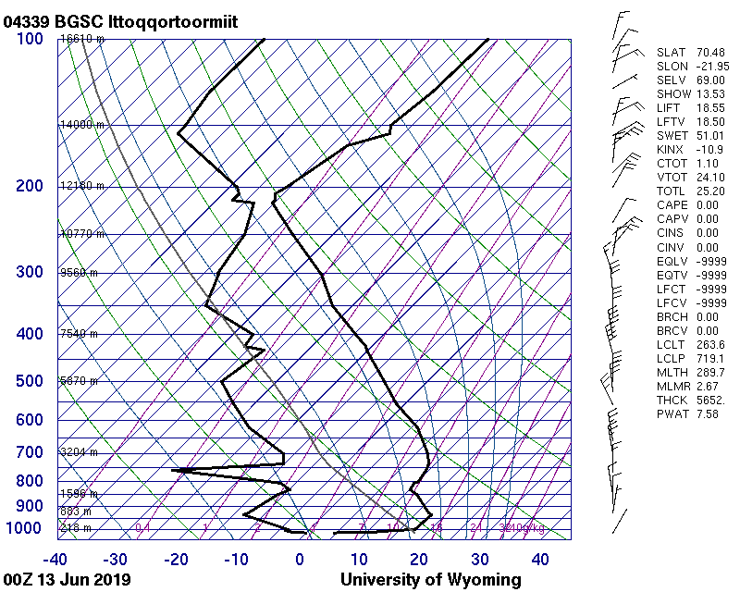
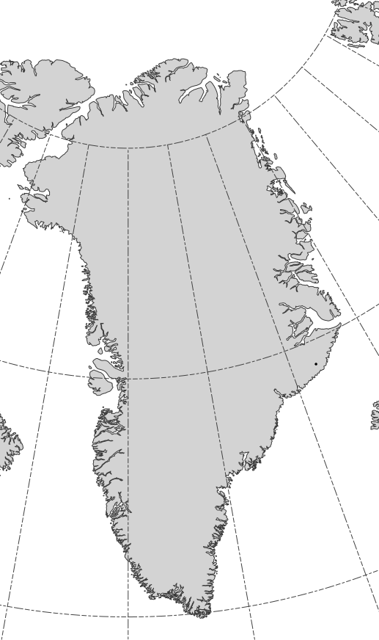
Sounding (0000 UTC 13 Jun 2019)
Source: University of Wyoming

Slide 38
Time Series
500-hPa geopotential height (dam)
1000–500-hPa thickness (dam)
Day in Jun 2019 labeled at 0000 UTC
500-hPa geopotential height (dam)
1000–500-hPa thickness (dam)

Slide 39
Time Series
PW (mm)
IVT (kg m⁻¹ s⁻¹)
Day in Jun 2019 labeled at 0000 UTC
PW (mm)
IVT (kg m⁻¹ s⁻¹)

Slide 40
Time Series
850-hPa temperature (K)
Day in Jun 2019 labeled at 0000 UTC
850-hPa temperature (K)
850-hPa wind (kt)

Slide 41
Trajectories
NOAA HYSPLIT backward trajectories ending at
(left) 1200 UTC 12 Jun 2019 and (right) 0000 UTC 13 Jun 2019

Slide 42
Summary
Initial ridging over northeast Canada and northwest Greenland occurs east of an elongated tropical moisture axis
Negative PV advection by the nondivergent and irrotational winds supports Canada/Greenland ridging
Second ridge building event occurs over northeast Greenland north of a deep cutoff cyclone
Negative PV advection by the nondivergent and irrotational winds supports Greenland ridging
Twin poleward-directed tropical moisture “freeways” enhance diabatically driven ridge building across northeast Canada and Greenland

Slide 43
Summary of Flow Evolution 3–14 June 2019

Slide 44
0000 UTC 3 Jun 2019
500-hPa geo. height
PW
552 dam
576 dam
≥ 25 mm

Slide 45
0000 UTC 4 Jun 2019
500-hPa geo. height
PW
552 dam
576 dam
≥ 25 mm

Slide 46
0000 UTC 5 Jun 2019
500-hPa geo. height
PW
552 dam
576 dam
≥ 25 mm

Slide 47
0000 UTC 6 Jun 2019
500-hPa geo. height
PW
552 dam
576 dam
≥ 25 mm

Slide 48
0000 UTC 7 Jun 2019
500-hPa geo. height
PW
552 dam
576 dam
≥ 25 mm

Slide 49
0000 UTC 8 Jun 2019
500-hPa geo. height
PW
552 dam
576 dam
≥ 25 mm

Slide 50
0000 UTC 9 Jun 2019
500-hPa geo. height
PW
552 dam
576 dam
≥ 25 mm

Slide 51
0000 UTC 9 Jun 2019
500-hPa geo. height
PW
552 dam
576 dam
≥ 25 mm

Slide 52
0000 UTC 10 Jun 2019
500-hPa geo. height
PW
552 dam
576 dam
≥ 25 mm

Slide 53
0000 UTC 11 Jun 2019
500-hPa geo. height
PW
552 dam
576 dam
≥ 25 mm

Slide 54
0000 UTC 12 Jun 2019
500-hPa geo. height
PW
552 dam
576 dam
≥ 25 mm

Slide 55
0000 UTC 13 Jun 2019
500-hPa geo. height
PW
552 dam
576 dam
≥ 25 mm

Slide 56
0000 UTC 14 Jun 2019
500-hPa geo. height
PW
552 dam
576 dam
≥ 25 mm

Slide 57
D(prog)/Dt valid 0000 UTC 13 June 2019

Slide 58
D(prog)/Dt valid 0000 UTC 13 Jun 2019
Lead time: 0 h
500-hPa geo. height (dam, black), temp. (K, red), cycl. rel. vort. (10⁻⁵ s⁻¹, shaded), ω (5 × 10⁻³ s⁻¹, blue), and wind (kt, flags and barbs) from GFS

Slide 59
D(prog)/Dt valid 0000 UTC 13 Jun 2019
Lead time: 24 h
500-hPa geo. height (dam, black), temp. (K, red), cycl. rel. vort. (10⁻⁵ s⁻¹, shaded), ω (5 × 10⁻³ s⁻¹, blue), and wind (kt, flags and barbs) from GFS

Slide 60
D(prog)/Dt valid 0000 UTC 13 Jun 2019
Lead time: 48 h
500-hPa geo. height (dam, black), temp. (K, red), cycl. rel. vort. (10⁻⁵ s⁻¹, shaded), ω (5 × 10⁻³ s⁻¹, blue), and wind (kt, flags and barbs) from GFS

Slide 61
D(prog)/Dt valid 0000 UTC 13 Jun 2019
Lead time: 72 h
500-hPa geo. height (dam, black), temp. (K, red), cycl. rel. vort. (10⁻⁵ s⁻¹, shaded), ω (5 × 10⁻³ s⁻¹, blue), and wind (kt, flags and barbs) from GFS

Slide 62
D(prog)/Dt valid 0000 UTC 13 Jun 2019
Lead time: 96 h
500-hPa geo. height (dam, black), temp. (K, red), cycl. rel. vort. (10⁻⁵ s⁻¹, shaded), ω (5 × 10⁻³ s⁻¹, blue), and wind (kt, flags and barbs) from GFS

Slide 63
D(prog)/Dt valid 0000 UTC 13 Jun 2019
Lead time: 120 h
500-hPa geo. height (dam, black), temp. (K, red), cycl. rel. vort. (10⁻⁵ s⁻¹, shaded), ω (5 × 10⁻³ s⁻¹, blue), and wind (kt, flags and barbs) from GFS

Slide 64
D(prog)/Dt valid 0000 UTC 13 Jun 2019
Lead time: 144 h
500-hPa geo. height (dam, black), temp. (K, red), cycl. rel. vort. (10⁻⁵ s⁻¹, shaded), ω (5 × 10⁻³ s⁻¹, blue), and wind (kt, flags and barbs) from GFS

Slide 65
D(prog)/Dt valid 0000 UTC 13 Jun 2019
Lead time: 168 h
500-hPa geo. height (dam, black), temp. (K, red), cycl. rel. vort. (10⁻⁵ s⁻¹, shaded), ω (5 × 10⁻³ s⁻¹, blue), and wind (kt, flags and barbs) from GFS

Slide 66
Conclusions:
Origins of the great Greenland surface ice-melt of June 2019 were over the Tibetan Plateau and North Pacific
Tibetan Plateau “heat belch” leads to downstream AWB, a subtropical jet extension, and NW North America ridging
Ridging over NW North America leads to downstream trough deepening east of the Rockies
Rockies trough phases with a Southwest trough and results in a deep southerly flow of moist tropical from the Gulf of Mexico to the Arctic
Massive ridging occurs over northern Greenland in response to negative PV advection by the nondivergent and irrotational winds

Slide 67
0000 UTC 3 Jun 2019
500-hPa geo. height
PW Stnd. Anom.
552 dam
576 dam
≥ 1 σ

Slide 68
0000 UTC 4 Jun 2019
500-hPa geo. height
PW Stnd. Anom.
552 dam
576 dam
≥ 1 σ

Slide 69
0000 UTC 5 Jun 2019
500-hPa geo. height
PW Stnd. Anom.
552 dam
576 dam
≥ 1 σ

Slide 70
0000 UTC 6 Jun 2019
500-hPa geo. height
PW Stnd. Anom.
552 dam
576 dam
≥ 1 σ

Slide 71
0000 UTC 7 Jun 2019
500-hPa geo. height
PW Stnd. Anom.
552 dam
576 dam
≥ 1 σ

Slide 72
0000 UTC 8 Jun 2019
500-hPa geo. height
PW Stnd. Anom.
552 dam
576 dam
≥ 1 σ

Slide 73
0000 UTC 9 Jun 2019
500-hPa geo. height
PW Stnd. Anom.
552 dam
576 dam
≥ 1 σ

Slide 74
0000 UTC 9 Jun 2019
500-hPa geo. height
PW Stnd. Anom.
552 dam
576 dam
≥ 1 σ

Slide 75
0000 UTC 10 Jun 2019
500-hPa geo. height
PW Stnd. Anom.
552 dam
576 dam
≥ 1 σ

Slide 76
0000 UTC 11 Jun 2019
500-hPa geo. height
PW Stnd. Anom.
552 dam
576 dam
≥ 1 σ

Slide 77
0000 UTC 12 Jun 2019
500-hPa geo. height
PW Stnd. Anom.
552 dam
576 dam
≥ 1 σ

Slide 78
0000 UTC 13 Jun 2019
500-hPa geo. height
PW Stnd. Anom.
552 dam
576 dam
≥ 1 σ

Slide 79
0000 UTC 14 Jun 2019
500-hPa geo. height
PW Stnd. Anom.
552 dam
576 dam
≥ 1 σ

