Slide 1
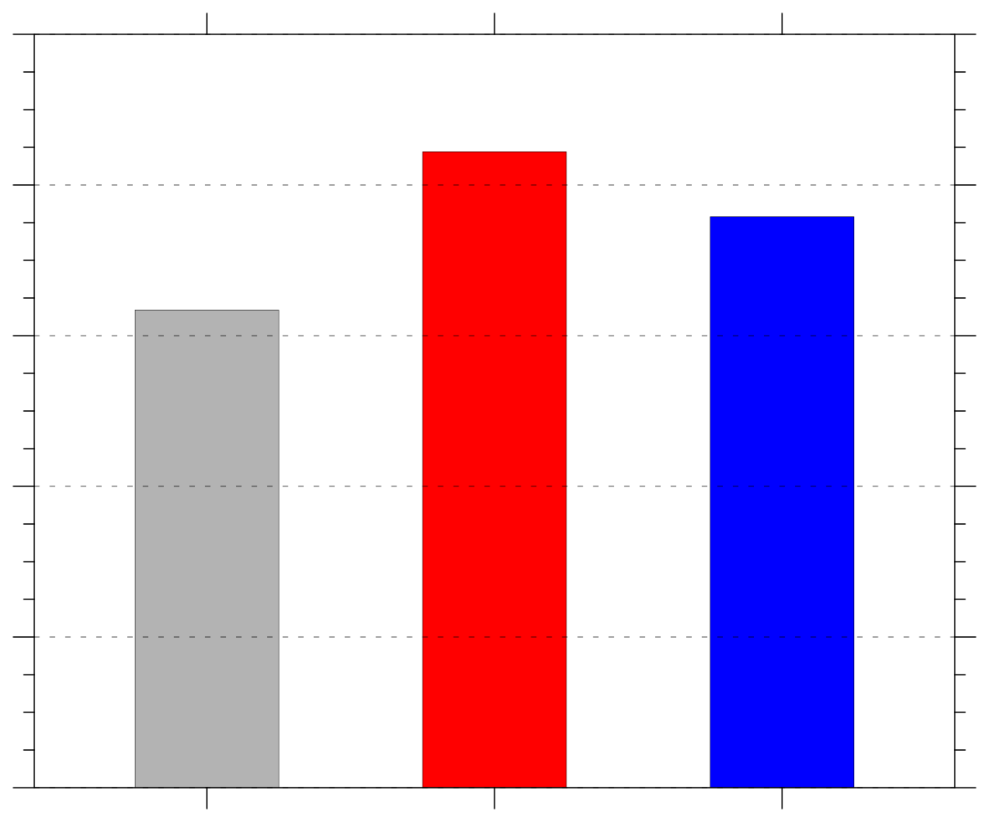
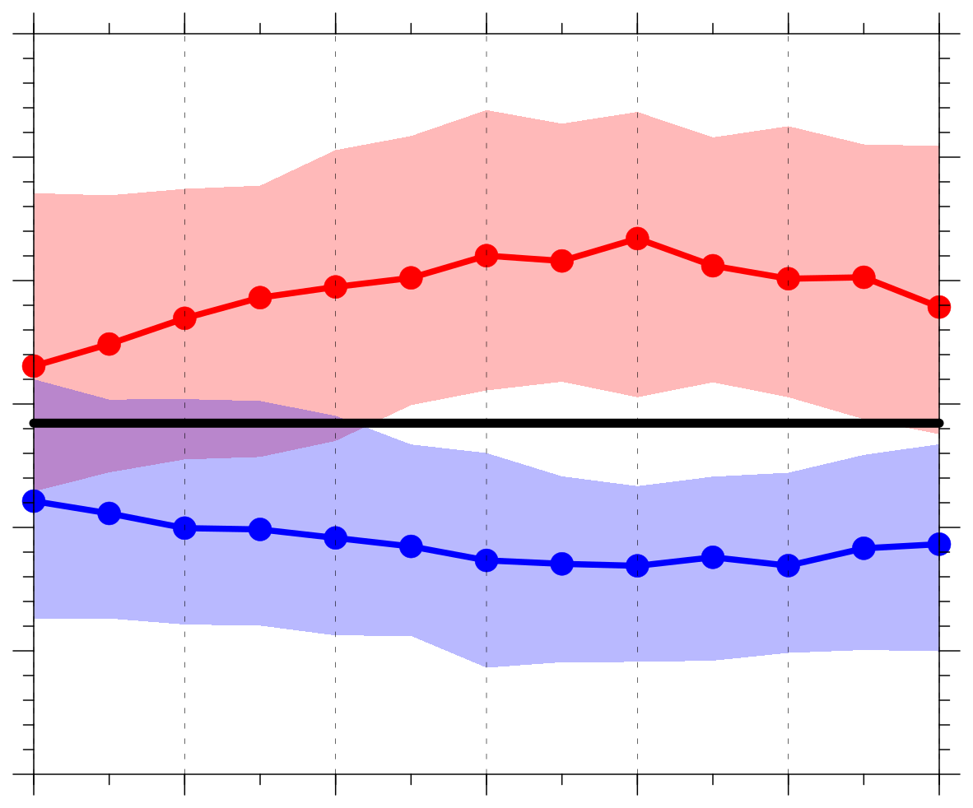
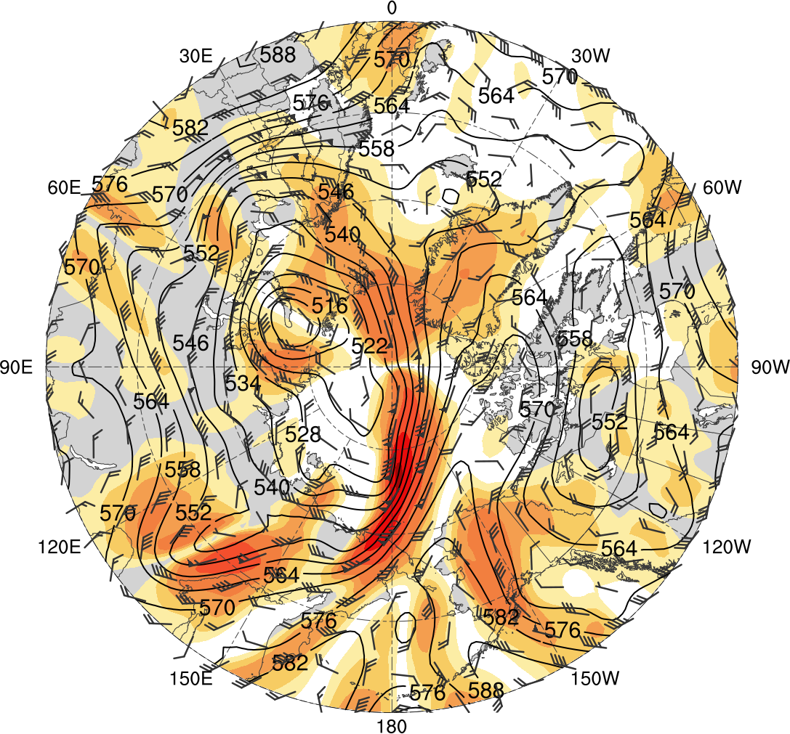
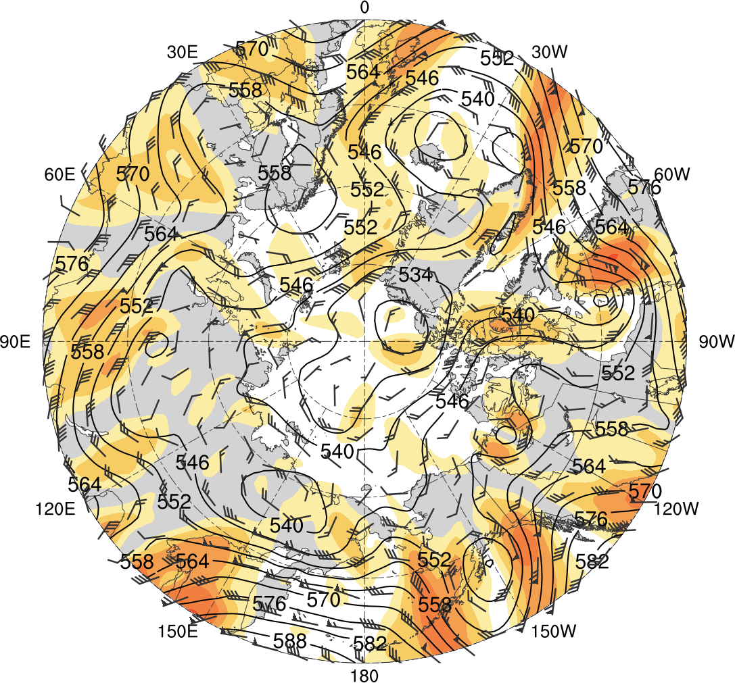
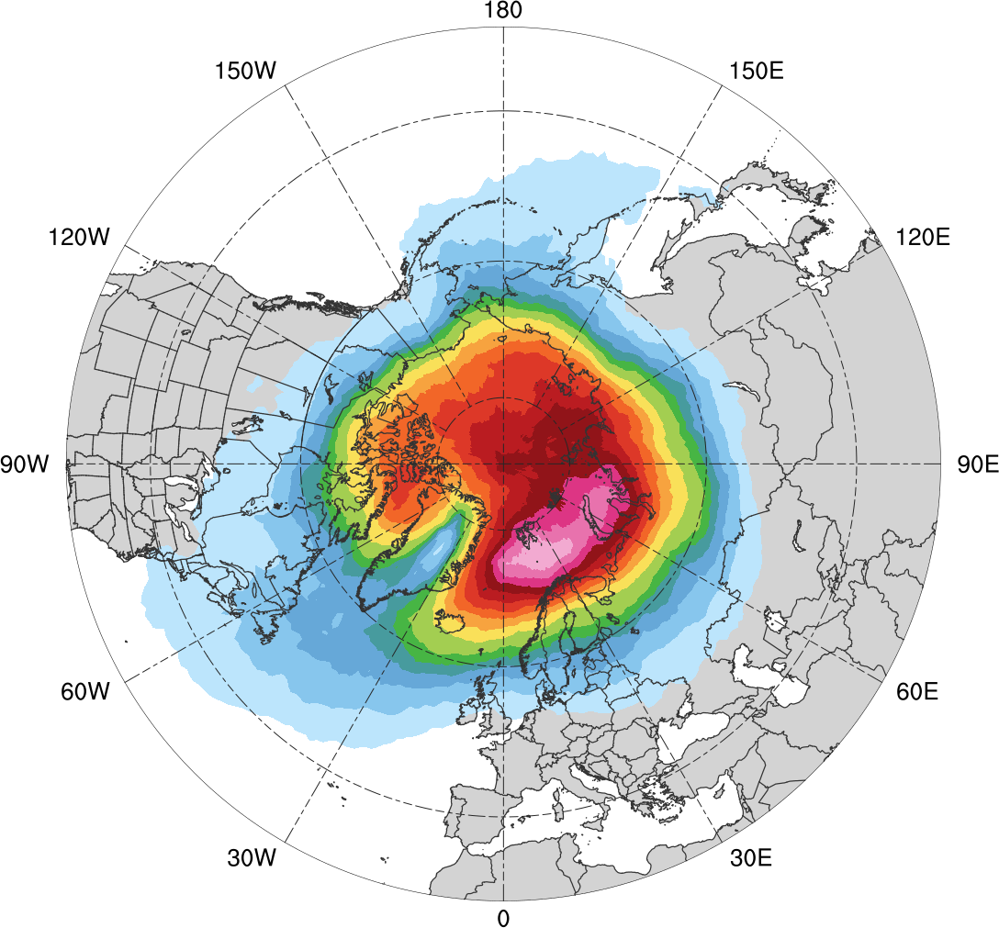
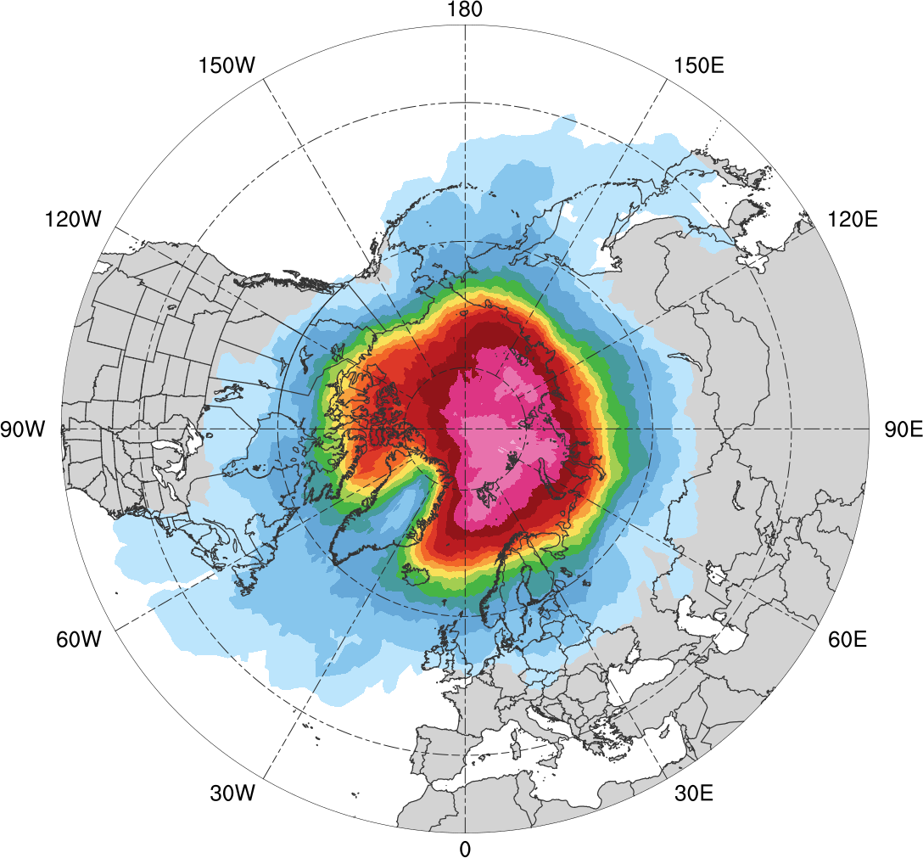
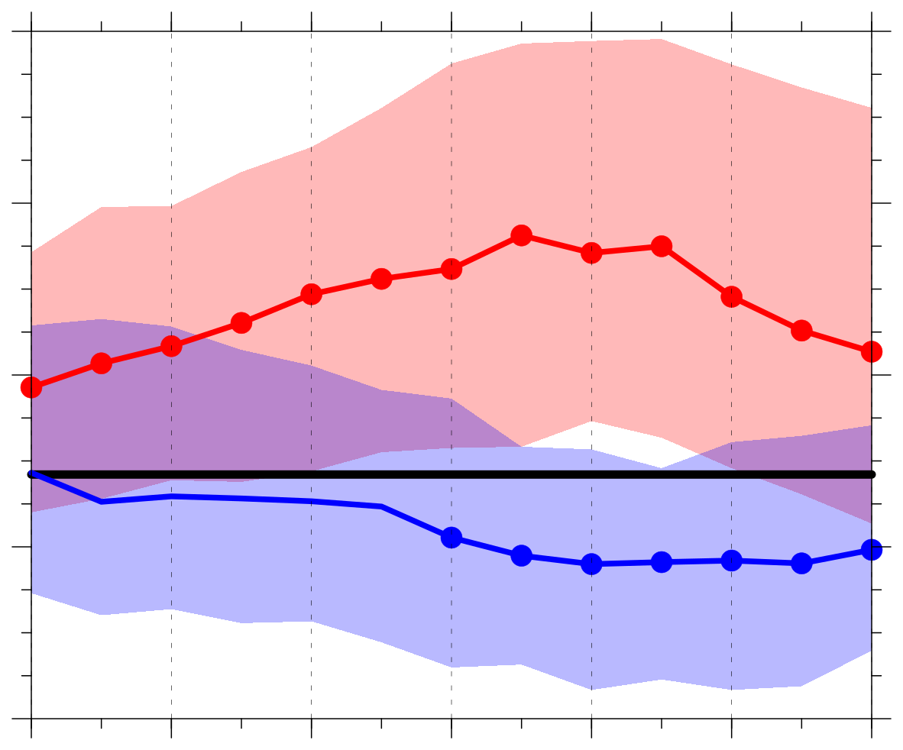
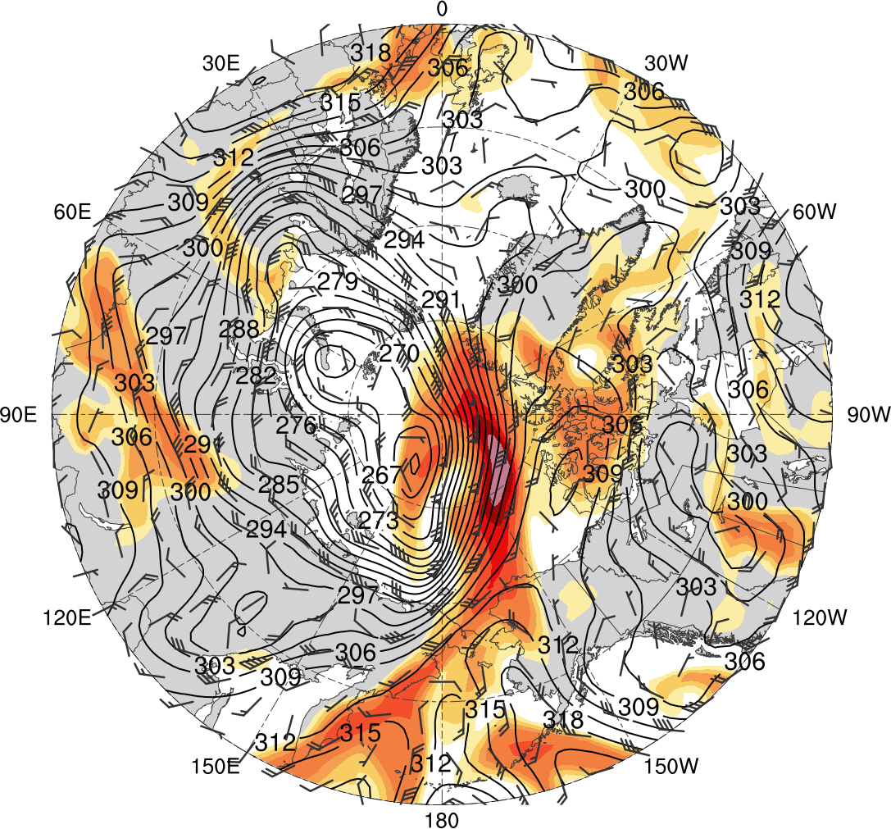
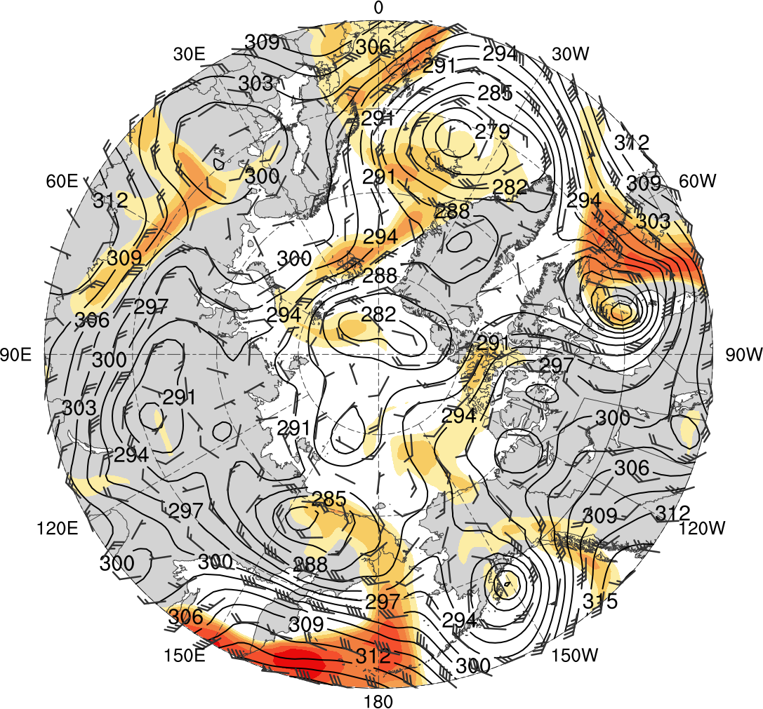
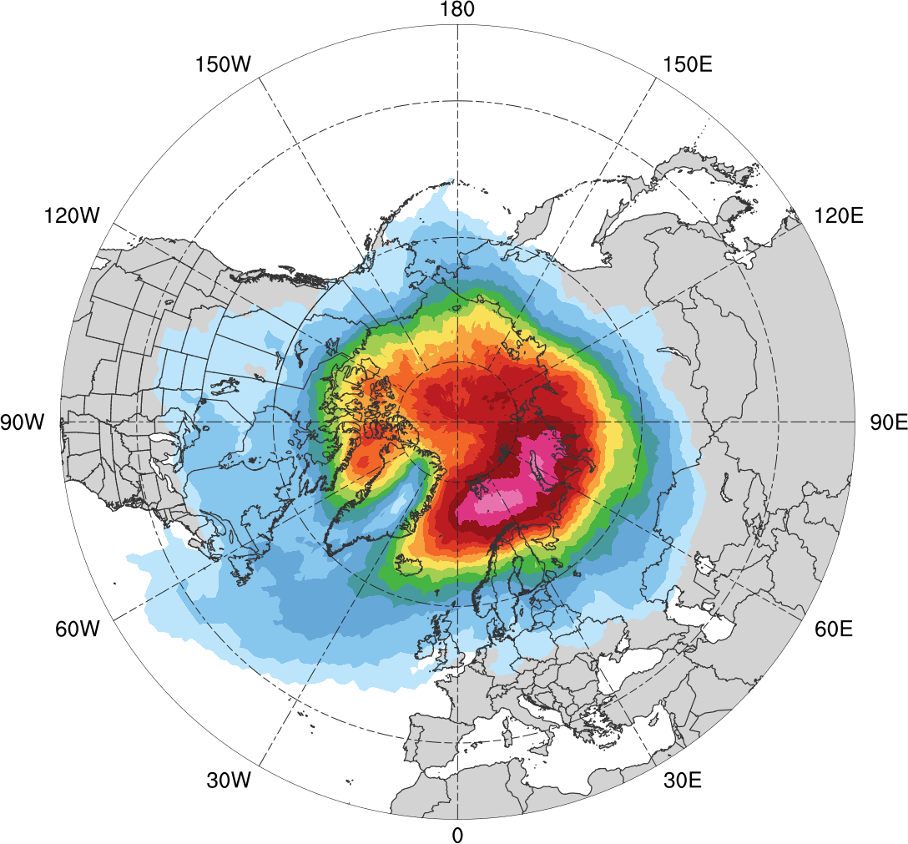
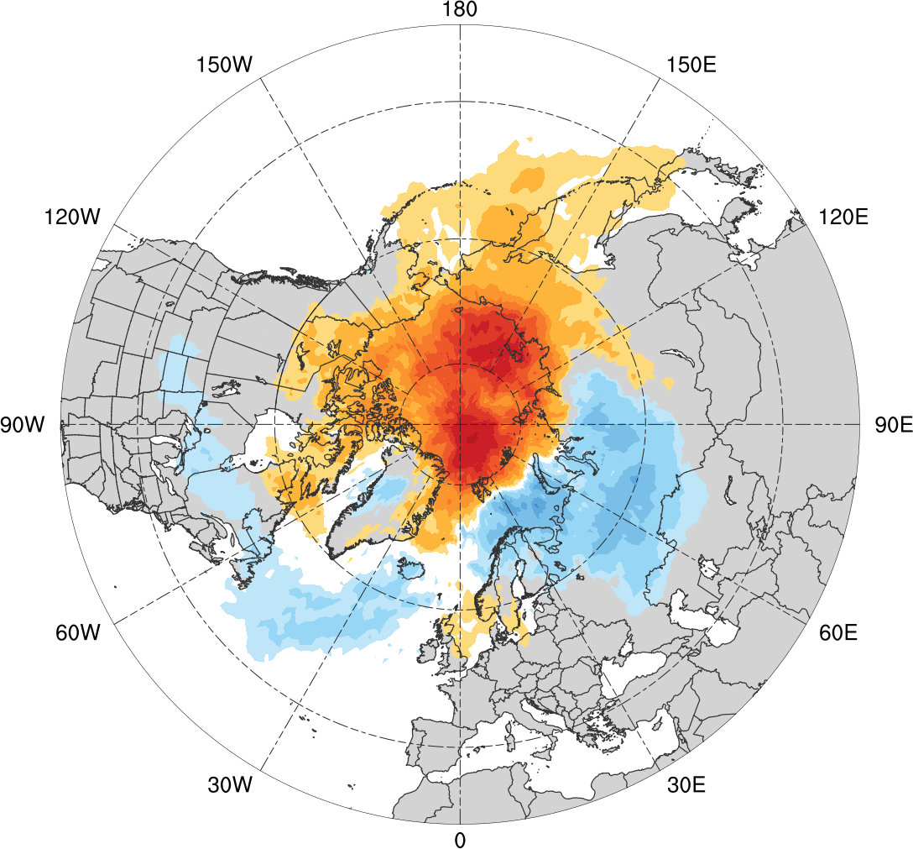
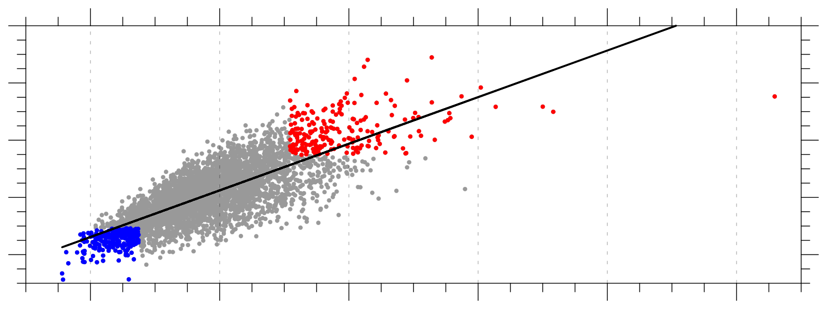
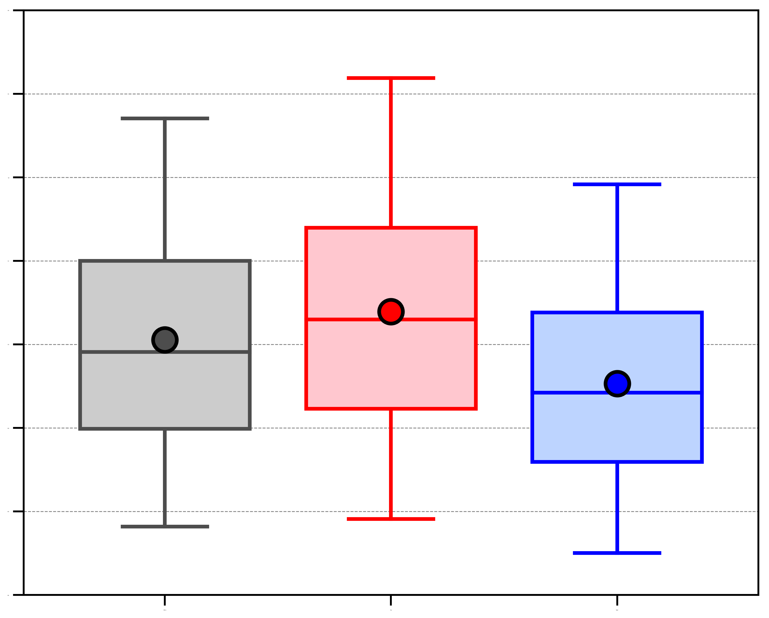
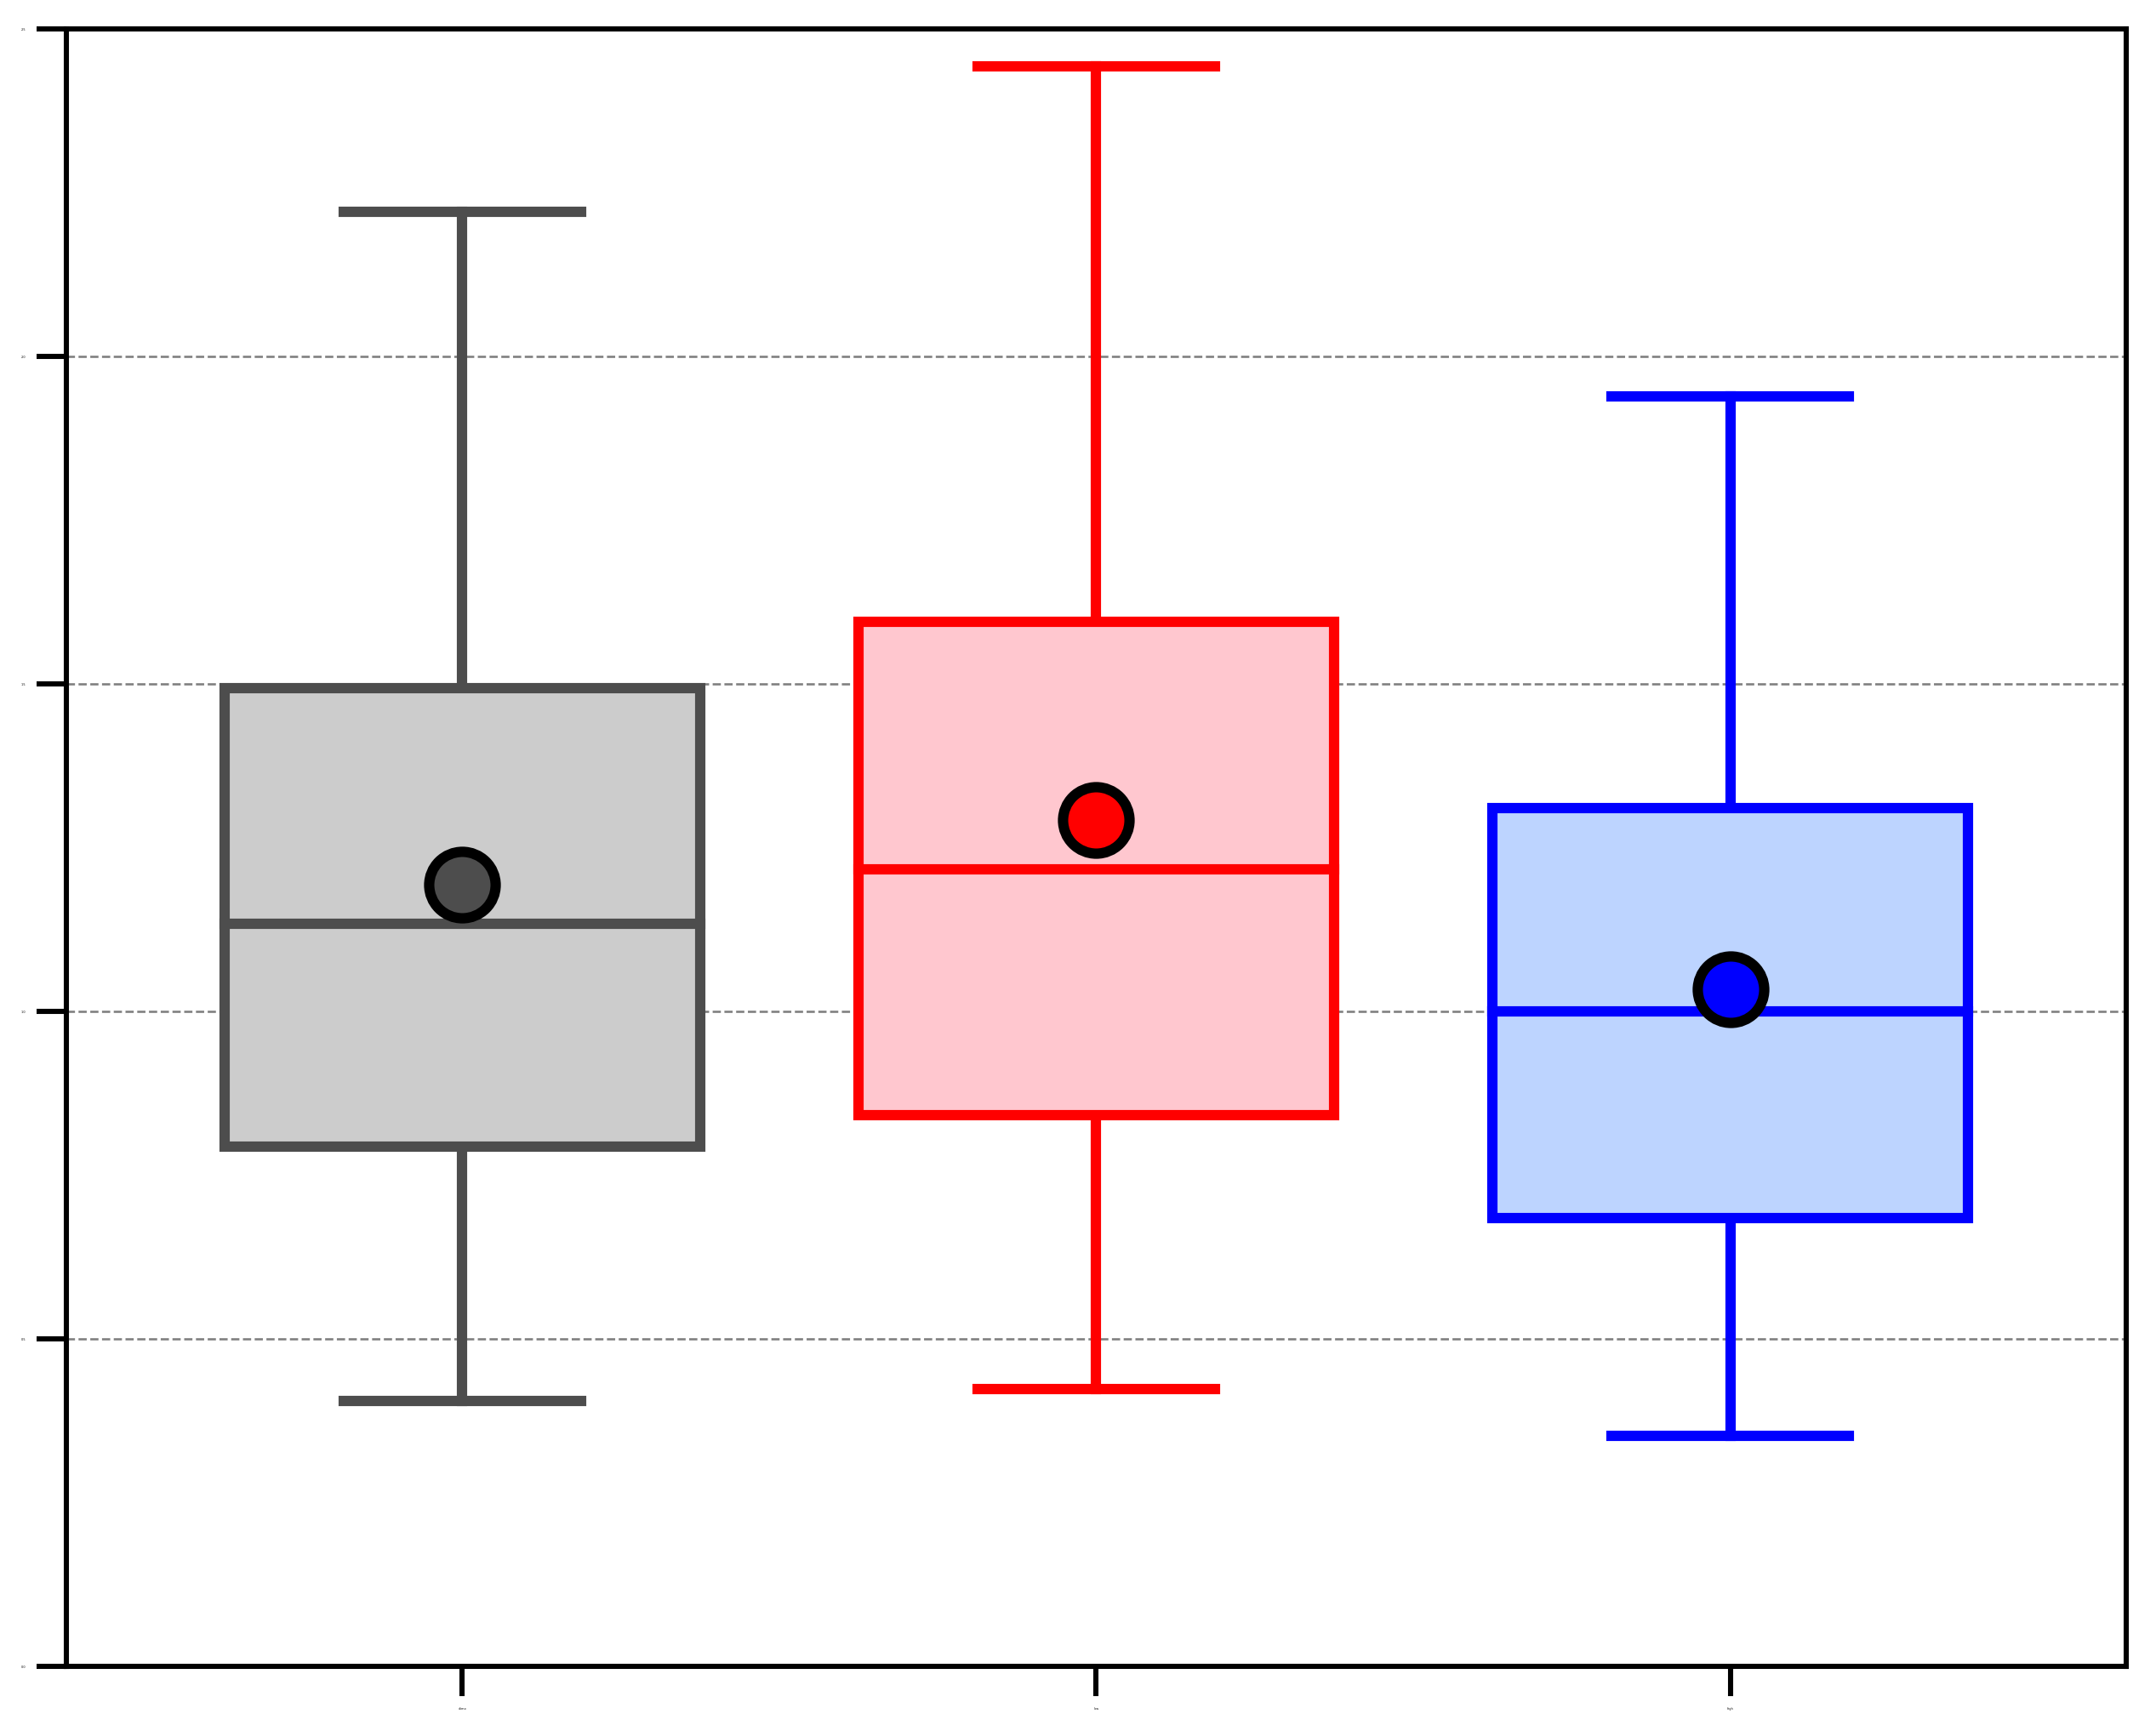
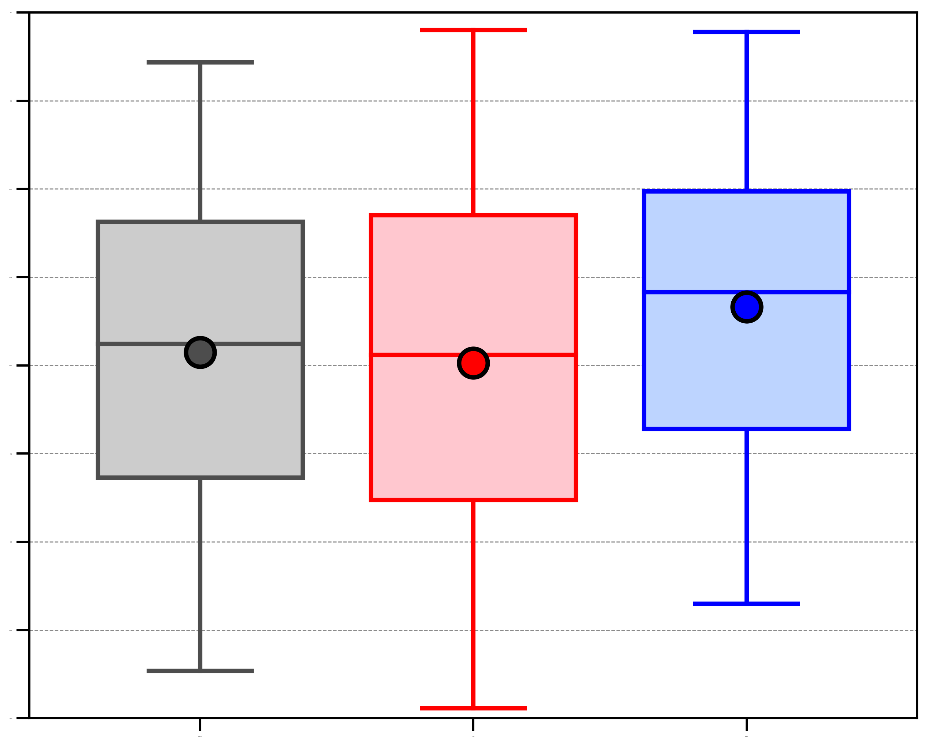
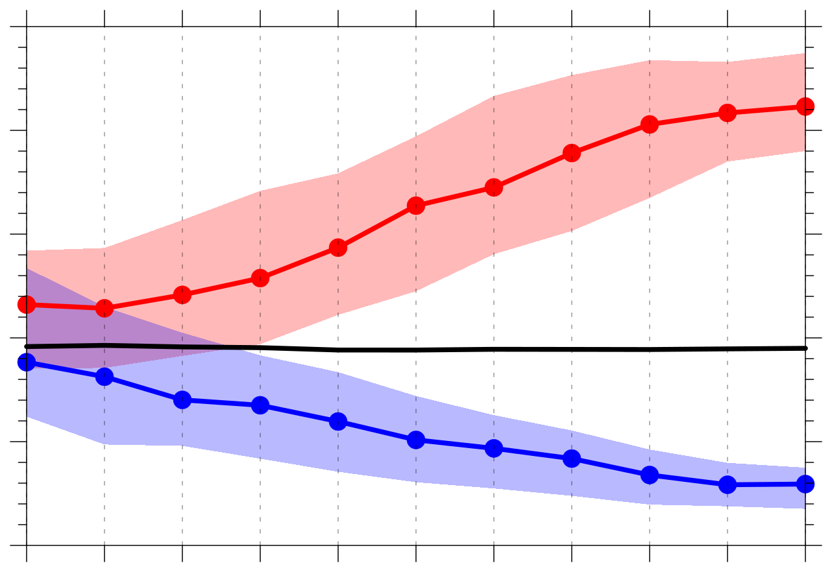
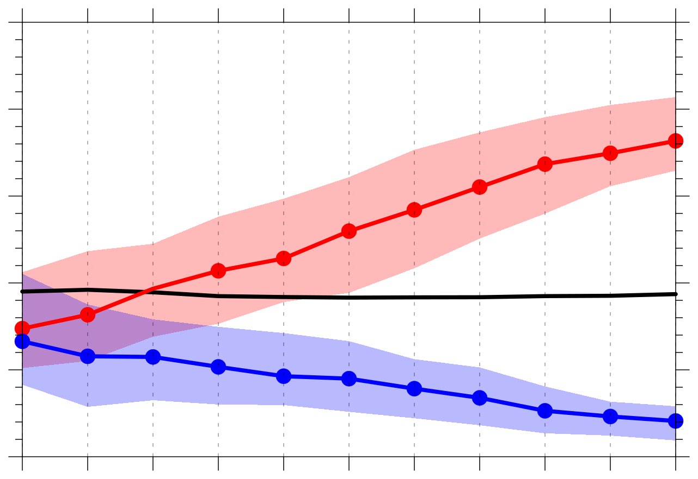
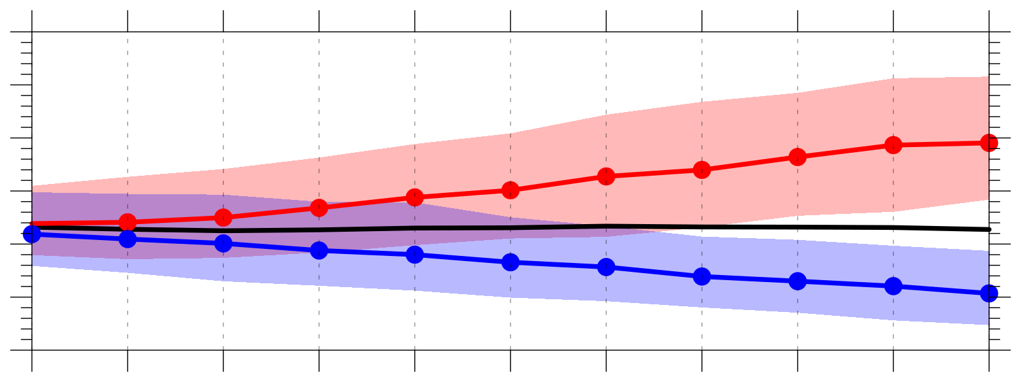
Examining the Forecast Skill of the Synoptic-Scale Flow
Associated with Arctic Cyclones
Daniel Keyser*, Kevin Biernat, and Lance F. Bosart
Poster number: A41O-2811
*E-mail: dkeyser@albany.edu
Presented at AGU 2019 Fall Meeting on 12 December 2019
University at Albany, SUNY
Department of Atmospheric and Environmental Sciences
This research was supported by Office of Naval Research Grant N00014-18-1-2200
1) Background
4) AC Frequency and Location
5) Synoptic-Scale Flow over Arctic
Arctic cyclones (ACs) are synoptic-scale cyclones that originate within the Arctic or move into the Arctic from lower latitudes (e.g., Crawford and Serreze 2016).
ACs may be associated with the poleward advection of warm, moist air, which can contribute to alterations of the synoptic-scale flow over the Arctic.
It is anticipated that relatively low forecast skill of the synoptic-scale flow over the Arctic may be attributed in part to forecast error growth accompanying alterations of the synoptic-scale flow induced by ACs.
The purpose of this study is to investigate whether there are differences in the frequency, location, and intensity of ACs, and synoptic-scale flow patterns associated with ACs, between periods of low and high forecast skill of the synoptic-scale flow over the Arctic.
Table 1. Number of days and ACs in climatology, low skill periods, and high skill periods.
1
Frequency of ACs (number of ACs day⁻¹)
(a) Low skill (avg. σ_{v} = 1.14 )
0000 UTC 28 Aug 2016
(b) High skill (avg. σ_{v} = 0.45 )
0000 UTC 3 Sep 2011
1.1
(c)
Period | Number of days in period | Number of ACs in period
Climatology | 4018 | 2549
Low skill | 801 | 676
High skill | 800 | 606
0.8
1
0.6
0.9
0.4
0.8
0.2
Figure 3. (right) Frequency of ACs in climatology (gray),
and for low skill periods (red) and high skill periods (blue).
0
climo
low
high
0.7
(a) Climatology (N = 2549)
(b) Low Skill (N = 676)
0.6
2) Data and Methods
0.5
−120
−96
−72
−48
−24
0
24
AC Identification
Created a 2007–2017 AC climatology by obtaining cyclone tracks from 1° ERA-Interim (Dee et al. 2011) cyclone climatology prepared by Sprenger et al. (2017).
ACs are deemed cyclones that last ≥ 2 days and spend at least some portion of their lifetimes in the Arctic (> 70°N).
Forecast Skill Evaluation
Utilized forecasts of 500-hPa geopotential height initialized at 0000 UTC during 2007–2017 from 11-member GEFS reforecast dataset v2 (Hamill et al. 2013).
Calculated area-averaged ensemble spread and area-averaged root mean square error (RMSE; ERA-Interim used as verification) of 500-hPa geopotential height over the Arctic (≥ 70°N).
Calculated standardized anomaly of area-averaged ensemble spread (σ_{spread}) and of area-averaged RMSE (σ_{RMSE}) relative to a 1985–2017 climatology of σ_{spread} and σ_{RMSE} following Moore (2017).
Forecast days valid at day 5 associated with the top and bottom 10% of σ_{spread} and σ_{RMSE} are referred to as low and high skill days, respectively, with the forecasts initialized five days prior to low and high skill days referred to as low and high skill forecasts, respectively.
Time periods through day 5 encompassed by low and high skill forecasts are referred to as low and high skill periods.
ACs that exist in the Arctic within the low and high skill periods are selected for further analysis.
Hours relative to 0000 UTC of
low and high skill days
0.5
1
1.5
2
3
4
5
6
climo
low skill
high skill
Figure 5. 500-hPa geopotential height (dam, black), wind (m s⁻¹, flags and barbs), and absolute value of standardized anomaly of 500-hPa meridional wind (σ_{v}, shading) from ERA-Interim for (a) a low skill day valid at 0000 UTC 28 Aug 2016 and (b) a high skill day valid at 0000 UTC 3 Sep 2011. (c) Median value of average σ_{v} over the Arctic (≥ 70°N) for low skill periods (red line), high skill periods (blue line), and 1985–2017 climatology (black line). Shading is IQR and dots indicate statistically significant differences as described in Fig. 2. Dashed black line corresponds to 0000 UTC of low and high skill days.
(a) Low skill (avg. positive σ_{PW} = 1.82)
0000 UTC 28 Aug 2016
(b) High skill (avg. positive σ_{PW} = 0.63)
0000 UTC 3 Sep 2011
1.4
(c)
1.2
.005
.01
.015
.02
.025
.03
.04
.05
.06
.07
.08
.09
.10
.11
.12
.005
.01
.02
.03
.04
.05
.06
.07
.08
.09
.10
.12
.14
.16
.18
1.0
(c) High Skill (N = 606)
(d) Low skill minus high skill
0.8
0.6
−120
−96
−72
−48
−24
0
24
Hours relative to 0000 UTC of
low and high skill days
0.5
1
1.5
2
3
4
5
6
climo
low skill
high skill
3) Forecast Skill
Figure 6. 700-hPa geopotential height (dam, black) and wind (m s⁻¹, flags and barbs), and positive standardized anomaly of PW (σ_{PW}, shading) from ERA-Interim for (a) a low skill day valid at 0000 UTC 28 Aug 2016 and (b) a high skill day valid at 0000 UTC 3 Sep 2011. (c) As in Fig. 5c, but for average positive σ_{PW} over the Arctic (≥ 70°N).
6
r² = 0.57
6) Synoptic-Scale Flow Surrounding ACs
4
1.8
(a) Highest average σ_{v}
2.5
(b) Highest average positive σ_{PW}
0.0
(c) Lowest σ_{SLP}
2
.005
.01
.02
.03
.04
.05
.06
.07
.08
.09
.10
.12
.14
.16
.18
−.08
−.06
−.05
−.04
−.03
−.02
−.01
−.005
0
.005
.01
.02
.03
.04
.05
.06
.08
1.6
−0.5
σ_{spread}
Figure 4. AC track frequency for (a) climatology, (b) low skill periods, and (c) high skill periods, given as total number of ACs within 500 km of a grid point, divided by the total number of days in period. (d) Difference in AC track frequency between low and high skill periods [(b)−(c)].
1.4
2.0
−1.0
0
Low skill days (N = 215)
1.2
1.5
−1.5
High skill days (N = 226)
7) Summary
1.0
1.0
−2.0
−2
All other days (N = 3577)
0.8
−2.5
There is more variability in σ_{spread} and σ_{RMSE} for low skill days compared to high skill days, with some low skill days characterized by very large values of σ_{spread} and σ_{RMSE} (Fig. 1).
Forecast skill of the synoptic-scale flow over the Arctic becomes anomalously lower and higher relative to climatology throughout the low and high skill forecasts leading up to low and high skill days, respectively (Figs. 2a,b).
AC frequency is higher for low skill periods compared to high skill periods (Table 1, Fig. 3).
ACs during low skill periods occur more frequently over eastern Eurasia and much of the Arctic Ocean relative to ACs during high skill periods (Figs. 4b,d).
ACs during high skill periods occur more frequently over the North Atlantic, Barents Sea, and western Eurasia relative to ACs during low skill periods (Figs. 4c,d).
There tends to be significantly amplified and deamplified synoptic-scale flow over the Arctic relative to climatology during low and high skill periods, respectively (Figs. 5a–c).
There tends to be significantly large and small amounts of moisture over the Arctic relative to climatology during low and high skill periods, respectively (Figs. 6a–c).
ACs during low skill periods tend to be embedded within a region of more amplified flow, tend to be associated with larger amounts of moisture, and tend to be stronger relative to ACs during high skill periods (Figs. 7a–c).
The forecast skill of the synoptic-scale flow surrounding ACs tends to become anomalously lower and higher relative to climatology throughout the low and high skill forecasts leading up to low and high skill days, respectively (Fig. 8).
0.6
0.5
−3.0
−2
0
2
4
6
8
−3.5
σ_{RMSE}
0.4
climo
low
high
0.0
climo
low
high
−4.0
climo
low
high
Figure 1. Scatter plot of day-5 σ_{RMSE} and σ_{spread} from low and high skill forecasts valid at 0000 UTC of low skill days (red) and high skill days (blue), respectively, and from all other 2007–2017 forecasts valid at 0000 UTC of all other days (gray). The square of linear correlation (r²) between σ_{RMSE} and σ_{spread} is shown in upper left, with the linear regression line given in black.
Figure 7. (a) Distribution of highest value of average σ_{v} within 1000 km of AC centers in the Arctic for ACs occurring during the entire climatology (gray), low skill periods (red), and high skill periods (blue). (b) As in (a), but for highest value of average positive σ_{PW} within 1000 km of AC centers. (c) As in (a), but for lowest standardized anomaly of SLP (σ_{SLP}) at AC centers. AC center is location of minimum SLP of AC in ERA-Interim. Shaded boxes show IQR, dots show mean values, and whiskers extend to the 5th and 95th percentiles. Differences in mean value between each category (i.e., climatology, low skill, and high skill) in (a)–(c) are statistically significant at 95% confidence level using bootstrap resampling except that between climatology and low skill in (c).
3
(a) σ_{spread}
3
(b) σ_{RMSE}
climo
climo
2
low skill
2
low skill
2.0
Figure 8. Median value of average standardized anomaly of ensemble spread of 500-hPa geopotential height within 1000 km of AC centers at each forecast hour (0–120 h, every 12 h) for low skill forecasts (red line), high skill forecasts (blue line), and any forecast in the climatology (black line). AC center is as described in Fig. 7. Shading is IQR and dots indicate statistically significant differences as described in Fig. 2.
high skill
high skill
1.5
climo
low skill
1
1
1.0
high skill
0
0
0.5
−1
−1
0.0
−0.5
−2
0
24
48
72
96
120
−2
0
24
48
72
96
120
−1.0
0
24
48
72
96
120
Forecast hour
Forecast hour
Forecast hour
Figure 2. Median value of (a) σ_{spread} and (b) σ_{RMSE} at each forecast hour (0–120 h, every 12 h) for low skill forecasts (red line), high skill forecasts (blue line), and for all forecasts during 1985–2017 (black line). Shading denotes interquartile range (IQR), and dots indicate statistically significant differences at 95% confidence level between low/high skill median and climatology median using bootstrap resampling.
References
Crawford, A., and M. Serreze, 2016: Does the summer Arctic frontal zone influence Arctic Ocean cyclone activity? J. Climate, 29, 4977–4993.
Dee, D. P., and Coauthors, 2011: The ERA-Interim reanalysis: Configuration and performance of the data assimilation system. Quart. J. Roy. Meteor. Soc.,137, 553–597.
Hamill, T. M., G. T. Bates, J. S. Whitaker, D. R. Murray, M. Fiorino, T. J. Galarneau Jr., Y. Zhu, and W. Lapenta, 2013: NOAA’s second-generation global medium-range ensemble reforecast dataset. Bull. Amer. Meteor. Soc., 94, 1553–1565.
Moore, B. J., 2017: Rossby wave breaking and widespread extreme precipitation events in the central and eastern U.S. Ph.D. dissertation, University at Albany, State University of New York, Albany, NY, 182 pp.
Sprenger, M., and Coauthors, 2017: Global climatologies of Eulerian and Lagrangian flow features based on ERA-Interim. Bull. Amer. Meteor. Soc., 98, 1739–1748.

