Slide 1
Phenomenological and Predictability Studies of the Structure and Evolution of Arctic Cyclones and Tropopause Polar Vortices
Lance F. Bosart, Daniel Keyser, and Kevin Biernat
Department of Atmospheric and Environmental Sciences
University at Albany, State University of New York
Tuesday 10 December 2019
AGU 2019 Fall Meeting
Research Supported by ONR Grant N00014-18-1-2200

Slide 2
Project Objective
This project addresses three research topics concerned with improving prediction of Arctic cyclones and related phenomena.
This project is expected to contribute to advances in the understanding and prediction of tropopause polar vortices (TPVs) and Arctic cyclones on synoptic-to-subseasonal time scales.
This project is being conducted by the PI (Lance Bosart), Co-PI (Dan Keyser), and two DAES graduate students (Kevin Biernat and Mansour Riachy) in collaboration with Steven Cavallo, Jim Doyle, Andrea Lang, and Ryan Torn.

Slide 3
Research Topics
The role of longitudinally localized incursions of warm, moist air from middle latitudes in disrupting the tropospheric polar vortex and in reconfiguring the large-scale baroclinicity over the Arctic.
The influence of reconfigurations of large-scale baroclinicity, high-latitude ridge amplification and blocking, sea ice and snow cover boundaries, and radiative processes on the genesis and evolution of TPVs and Arctic cyclones.

Slide 4
Research Topics
The dependence of predictability horizons of TPVs and Arctic cyclones on model uncertainty on synoptic-to-subseasonal time scales as determined through the synoptic evaluation of the forecast skill of deterministic and ensemble prediction systems.

Slide 5
Large-Scale Midlatitude–Polar Flow Interactions Leading to Rapid Surface Ice Melt over Greenland and Sea Ice Volume Loss over the Arctic Ocean in June 2019
Lance F. Bosart, Kevin Biernat, and Daniel Keyser
Department of Atmospheric and Environmental Sciences
University at Albany, State University of New York
Thursday 12 December 2019
AGU 2019 Fall Meeting
Oral Presentation No.: A43B-06
Research Supported by ONR Grant N00014-18-1-2200

Slide 6
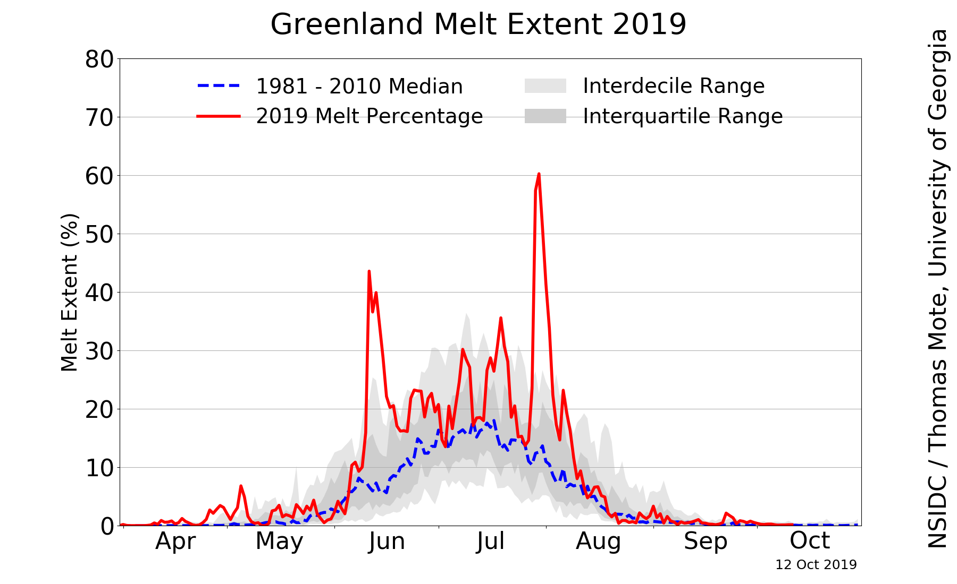
Greenland Ice Melt Extent in 2019
Source: NSIDC/Thomas Mote, University of Georgia;
http://nsidc.org/greenland-today/

Slide 7
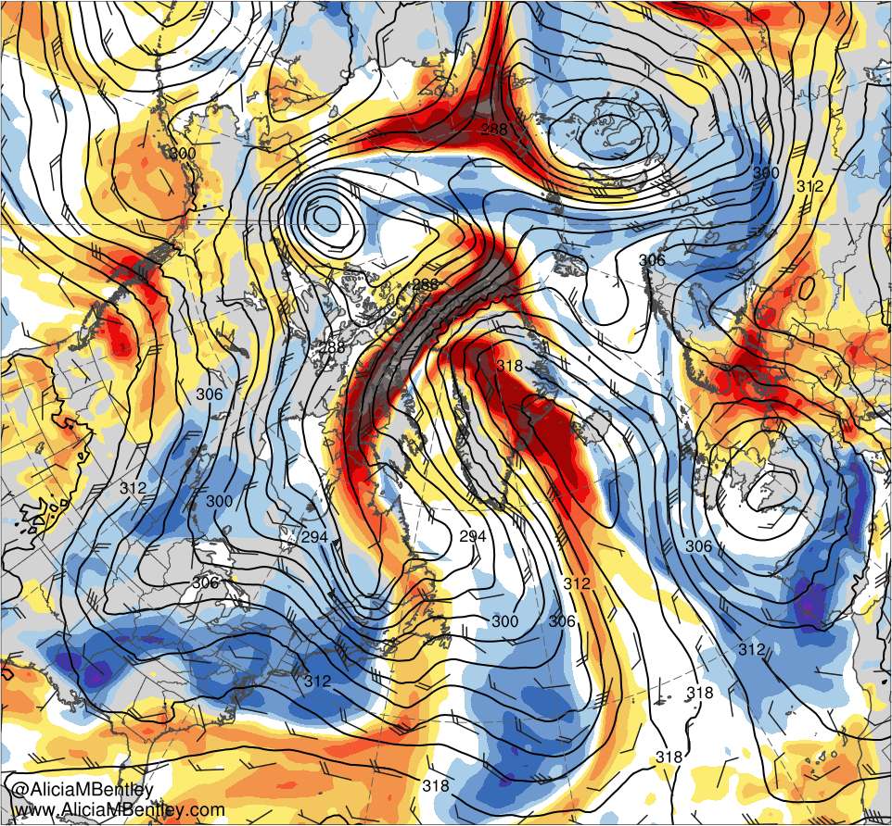
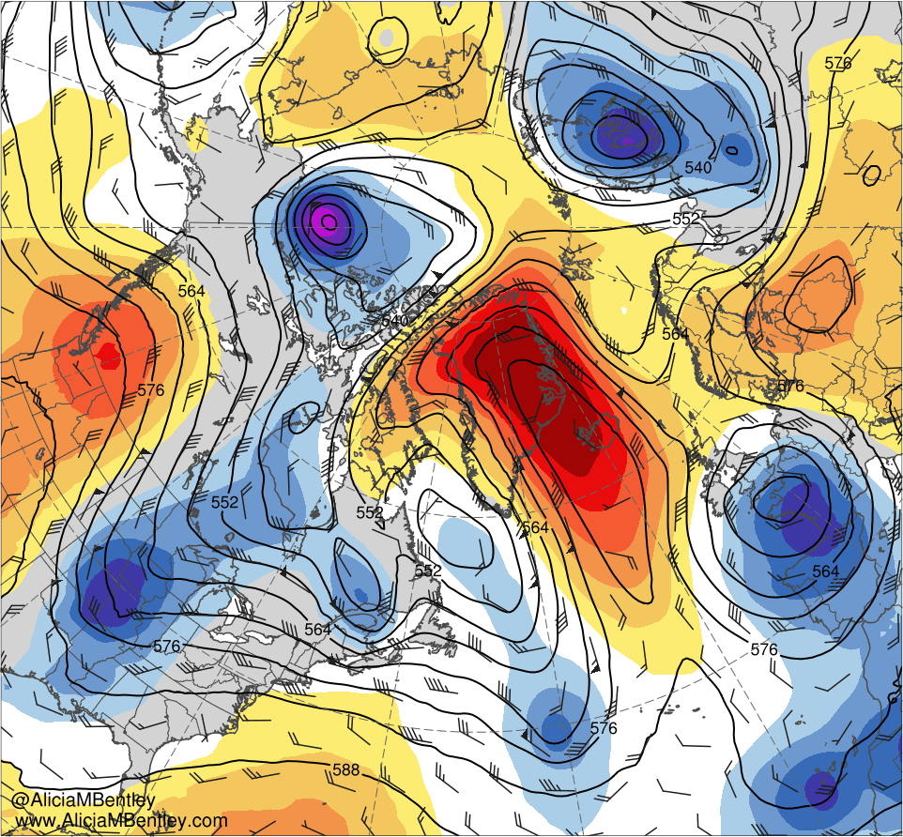
Standardized Anomalies for 1200 UTC 12 June 2019
−6
−5
−4
−3
−2.5
−2
−1.5
−1
−0.5
0
0.5
1
1.5
2
2.5
3
4
5
6
σ
700-hPa geo. height (dam, black) and wind (kt, flags and barbs), and standardized anomalies of PW (σ, shaded)
500-hPa geo. height (dam, black), wind (kt, flags and barbs), and standardized anomalies of geo. height (σ, shaded)

Slide 8
Examining the Forecast Skill of the Synoptic-Scale Flow Associated with Arctic Cyclones
Daniel Keyser, Kevin Biernat, and Lance F. Bosart
Department of Atmospheric and Environmental Sciences
University at Albany, State University of New York
Thursday 12 December 2019
AGU 2019 Fall Meeting
Poster Presentation No.: A41O-2811
Research Supported by ONR Grant N00014-18-1-2200

Slide 9
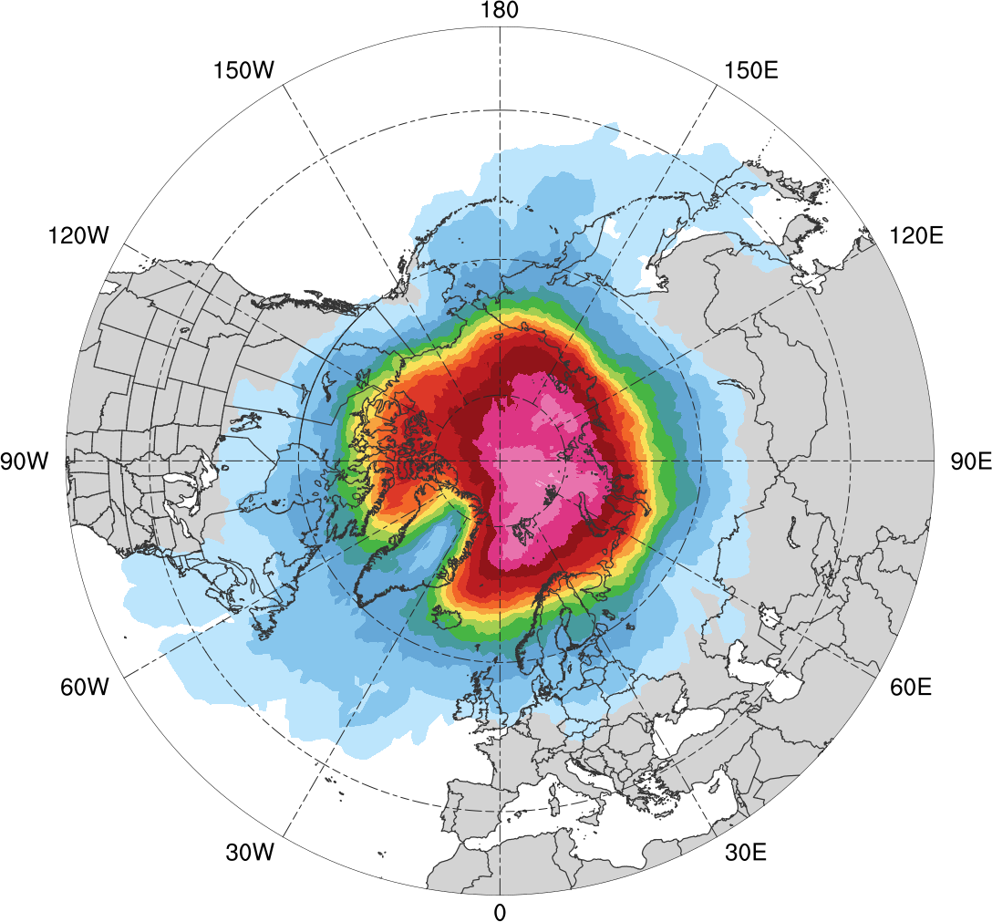
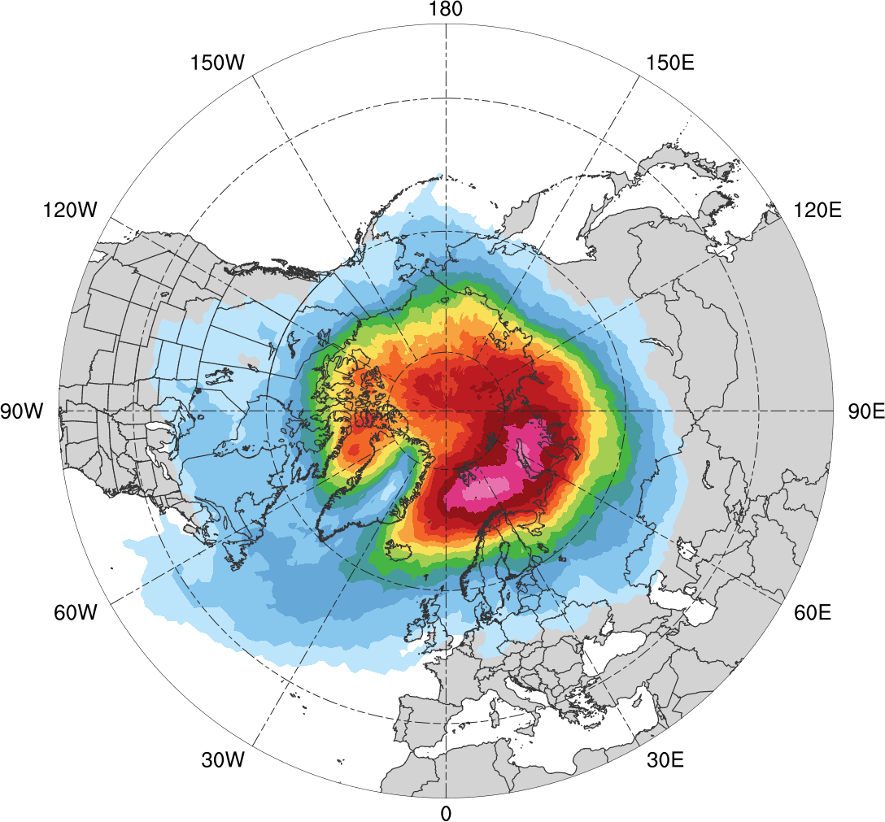
AC Track Frequency
Low skill (N = 676)
High skill (N = 606)
0.005
0.01
0.02
0.03
0.04
0.05
0.06
0.07
0.08
0.09
0.1
0.12
0.14
0.16
0.18
0.005
0.01
0.02
0.03
0.04
0.05
0.06
0.07
0.08
0.09
0.1
0.12
0.14
0.16
0.18
Total number of ACs within 500 km of a grid point, divided by number of days in period (number of ACs day⁻¹)

Slide 10
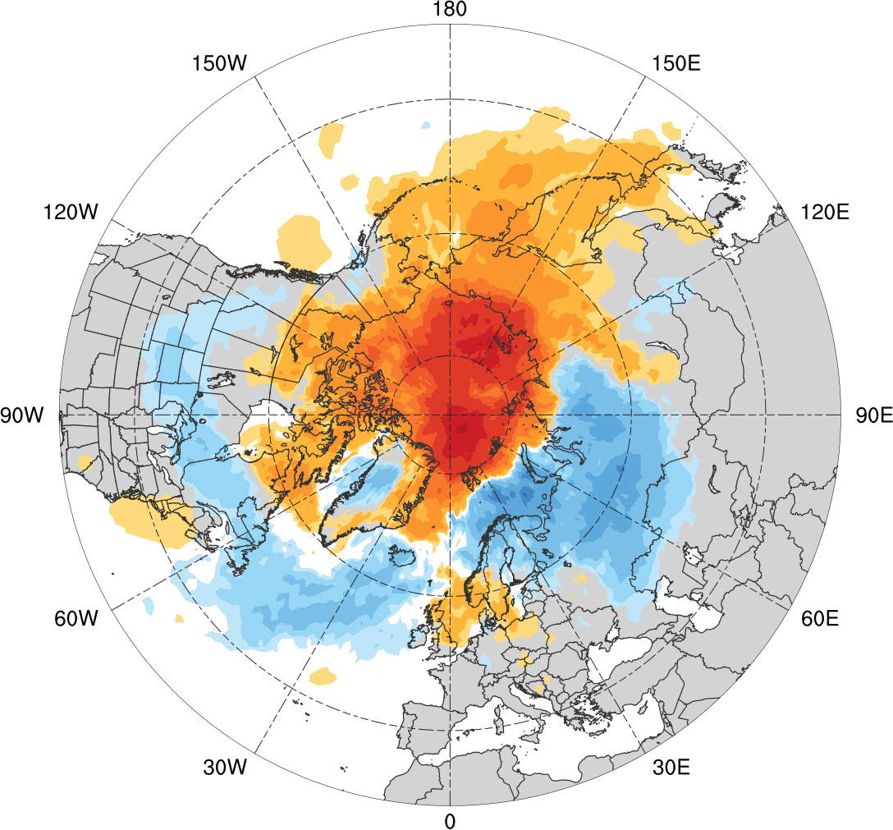
AC Track Frequency Difference
Low skill minus high skill
-0.1
-0.08
-0.06
-0.04
-0.03
-0.02
-0.01
-0.005
0
0.005
0.01
0.02
0.03
0.04
0.06
0.08
0.1
Difference in AC track density (number of ACs day⁻¹)

Slide 11
Diagnosing Factors Influencing the Forecast Skill of Two Intense Arctic Cyclones in Early June 2018
Kevin Biernat, Lance F. Bosart, and Daniel Keyser
Department of Atmospheric and Environmental Sciences
University at Albany, State University of New York
Thursday 12 December 2019
AGU 2019 Fall Meeting
Poster Presentation No.: A41O-2807
Research Supported by ONR Grant N00014-18-1-2200

Slide 12
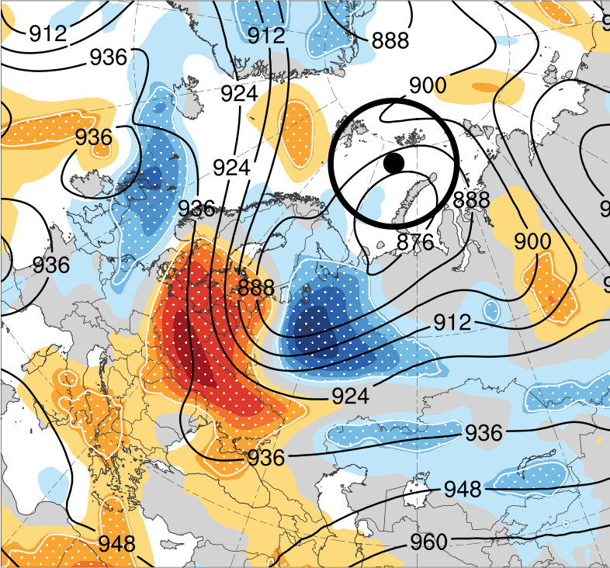
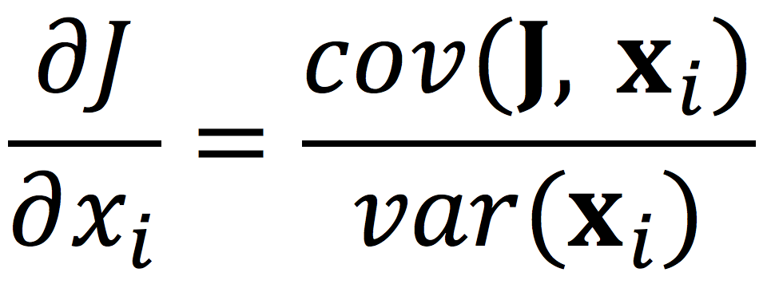
Ensemble Sensitivity Analysis
Forecast:
Used forecast from ECMWF EPS initialized at 1200 UTC 2 June 2018, which is 120 h prior to time of peak intensity of 2nd AC in ERA5 (1200 UTC 7 June; 962 hPa)
1200 UTC 5 June (72 h)
(e.g., Ancell and Hakim 2007;
Torn and Hakim 2008)
Forecast metric (J): Avg. SLP within 750-km circle surrounding ERA5 position of AC (black dot) at 1200 UTC 7 June (120 h)
Model state variable (x_{i}):
300-hPa geopotential height at 1200 UTC 5 June (72h)
Ensemble mean position of AC at 1200 UTC 5 June
−3
−2.4
−1.8
−1.2
−0.6
0
0.6
1.2
1.8
2.4
3
hPa
Ensemble mean 300-hPa
geopotential height (dam)
Shading: (−1) × Sensitivity (hPa)
Stippling: Statistical significance
at 95% confidence level

Slide 13
Proposed Future Research
The role of longitudinally localized incursions of warm, moist air from middle latitudes in disrupting the tropospheric polar vortex and in reconfiguring the large-scale baroclinicity over the Arctic.
The influence of reconfigurations of large-scale baroclinicity, high-latitude ridge amplification and blocking, sea ice and snow cover boundaries, and radiative processes on the genesis and evolution of TPVs and Arctic cyclones.

Slide 14
Proposed Future Research
Mansour Riachy will address research topics 1 and 2 by focusing on how ACs modify the tropospheric polar vortex by quantifying the strength, configuration, and waviness of its equatorward edge in terms of sinuosity. Sinuosity climatologies at lower- and upper-tropospheric levels will be constructed and will be used to relate AC track, intensity, and life cycle to characteristic evolutions of various sectors of the tropospheric polar vortex.

Slide 15
Proposed Future Research
The dependence of predictability horizons of TPVs and Arctic cyclones on model uncertainty on synoptic-to-subseasonal time scales as determined through the synoptic evaluation of the forecast skill of deterministic and ensemble prediction systems.
Kevin Biernat will address research topic 3 by performing synoptic-dynamic case studies of difficult-to-forecast ACs to assess their predictability in terms of model forecast skill derived from operational ensemble prediction systems. The envisioned assessment of predictability will include comparisons of ACs between periods of low- and high-forecast skill of the synoptic-scale flow.

