Slide 1
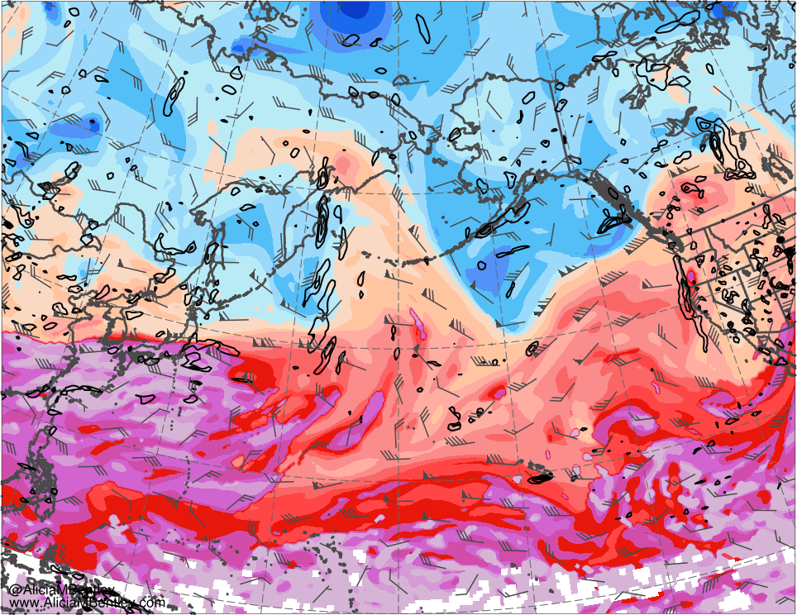
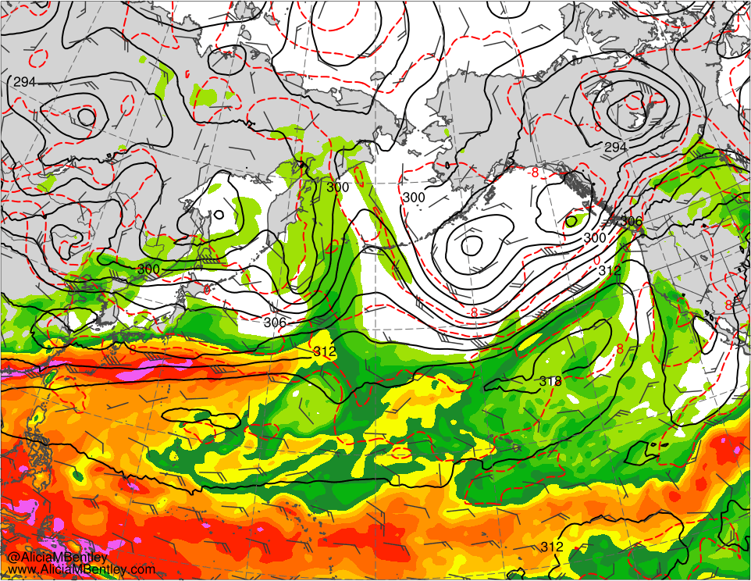
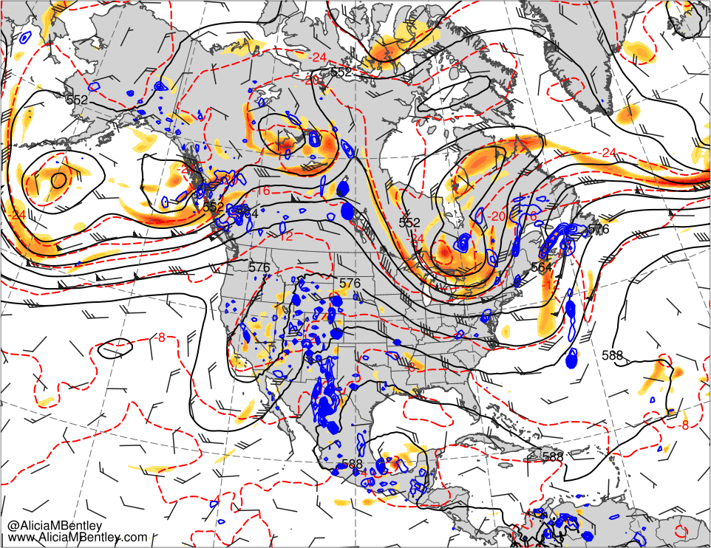
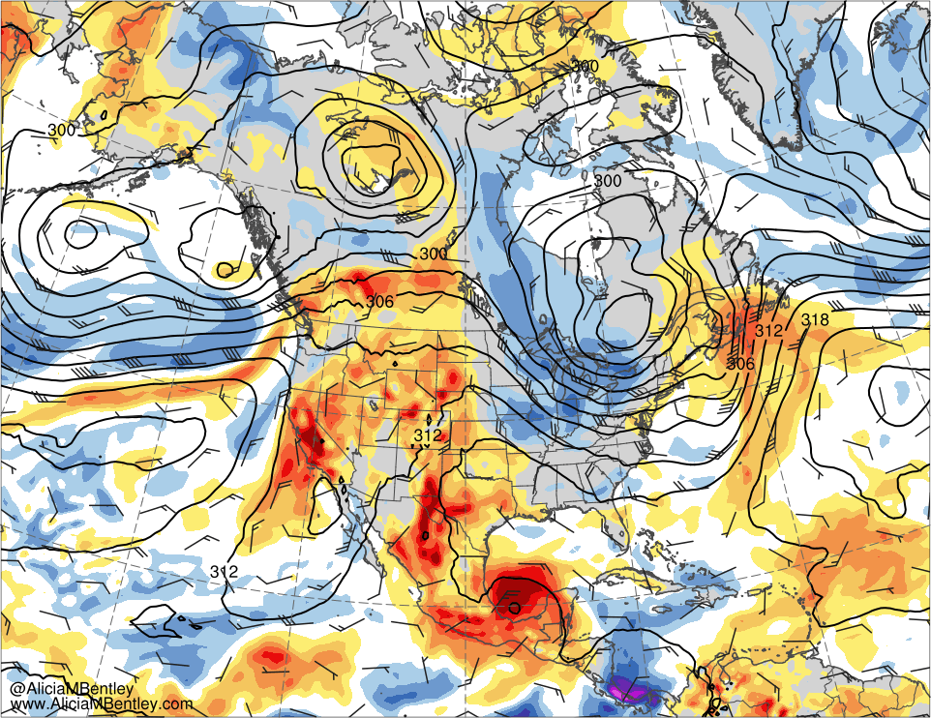
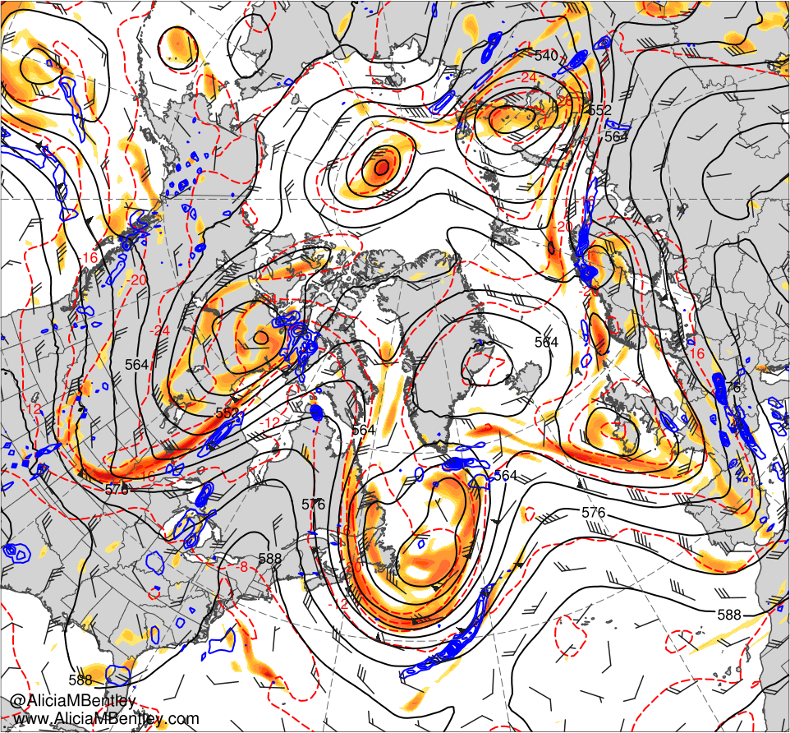
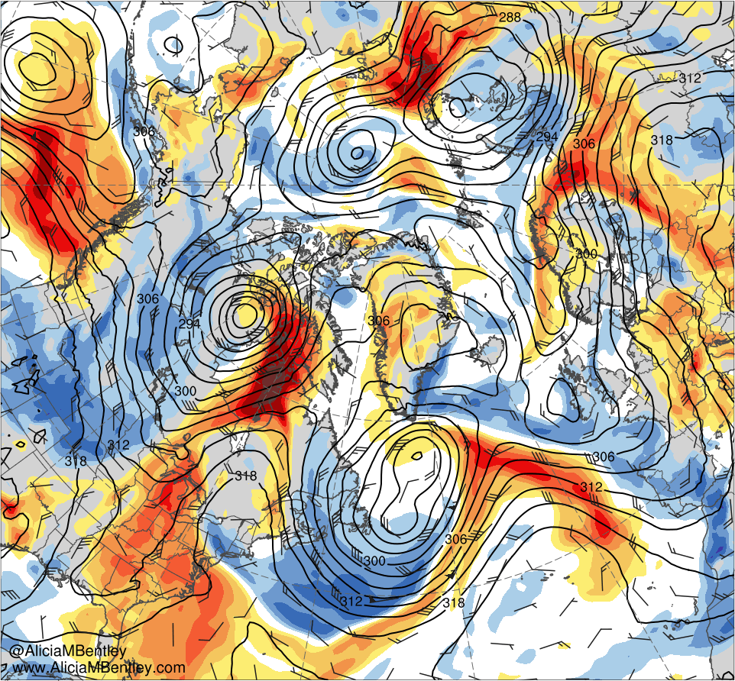
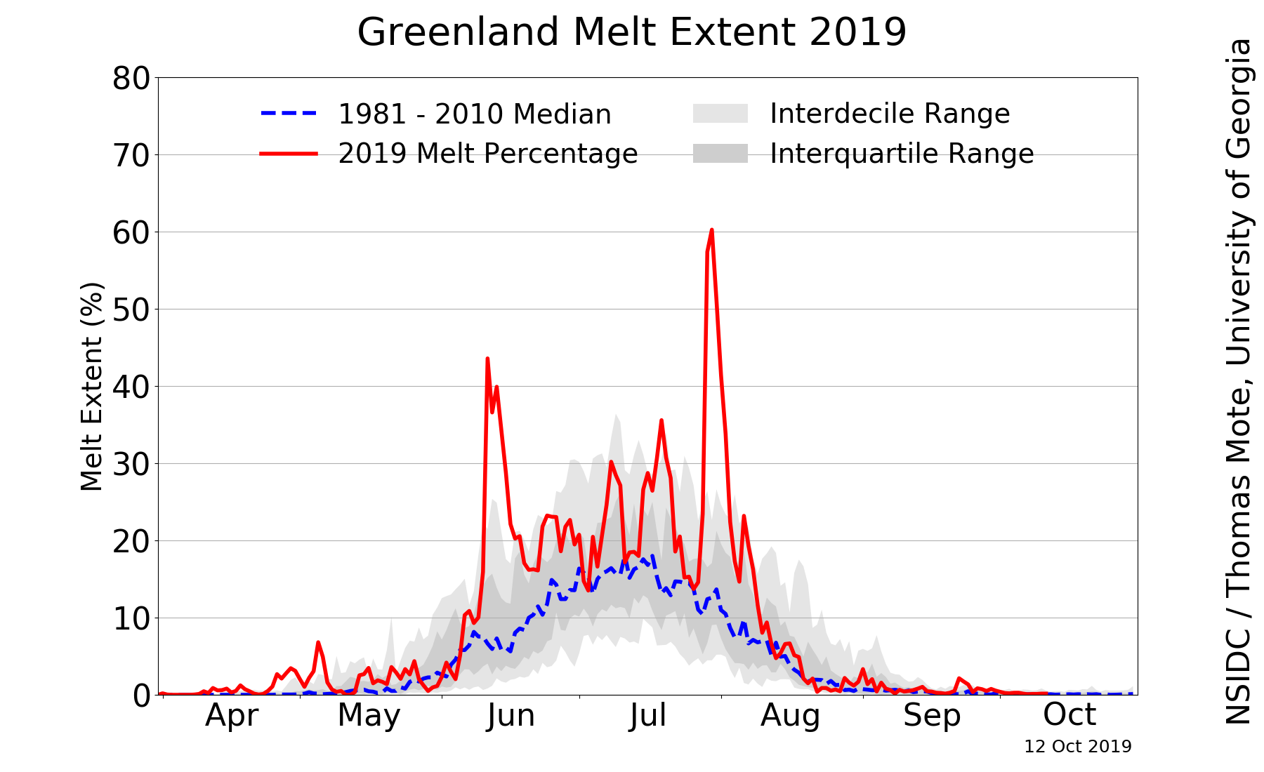
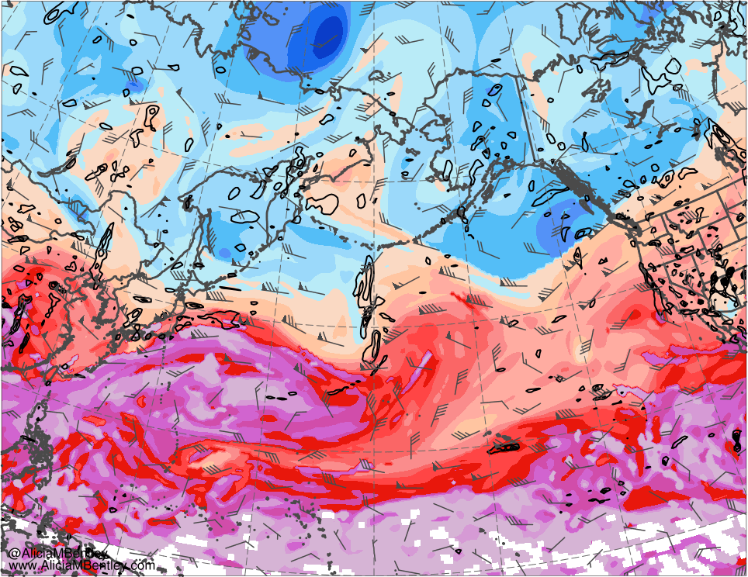
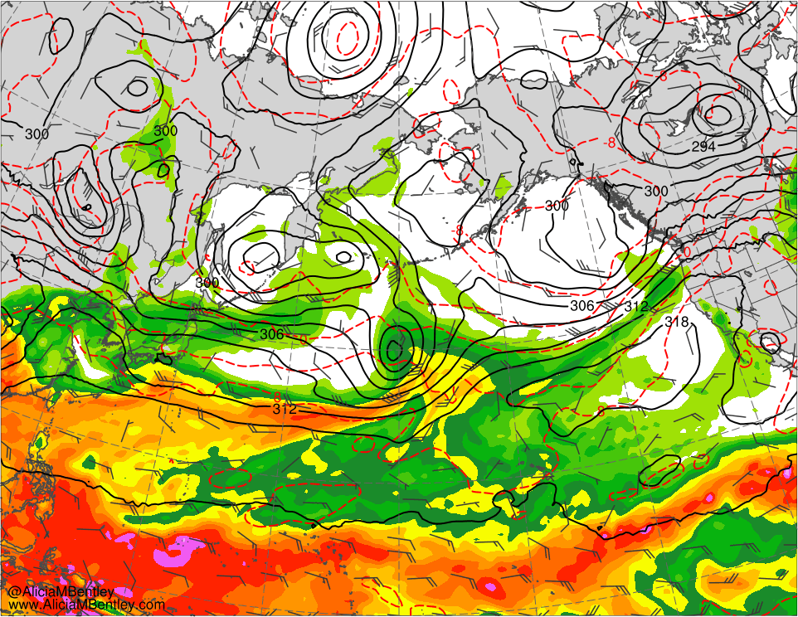
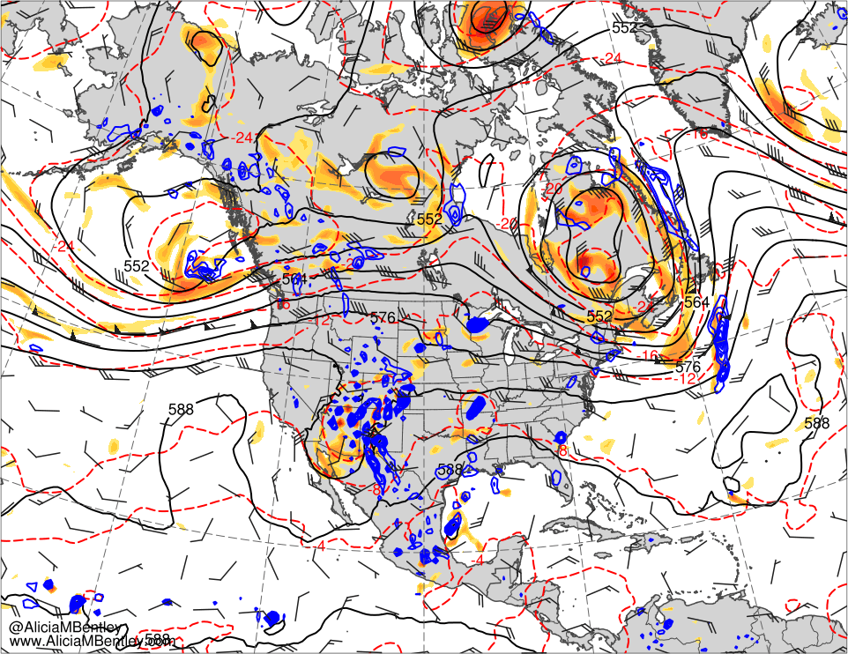
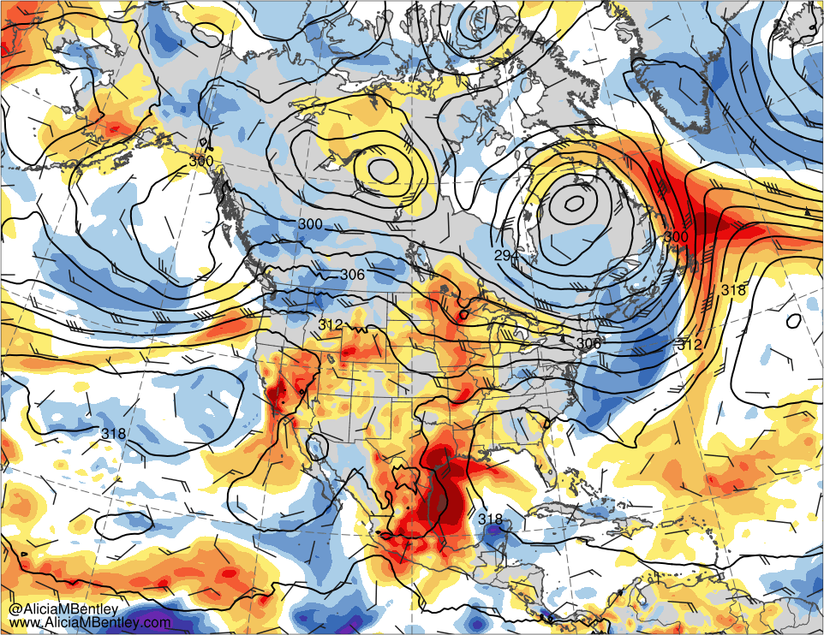
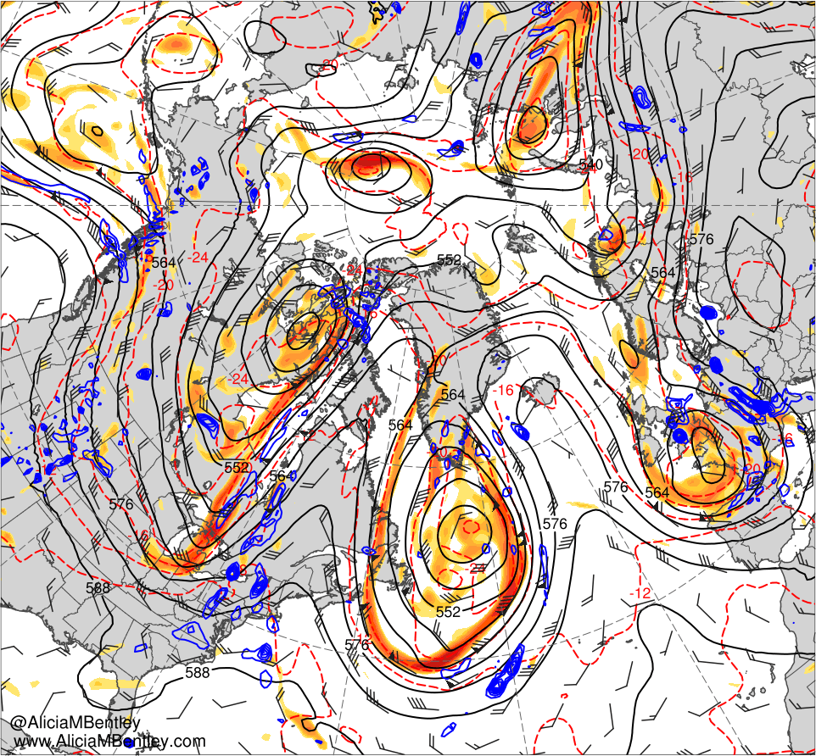
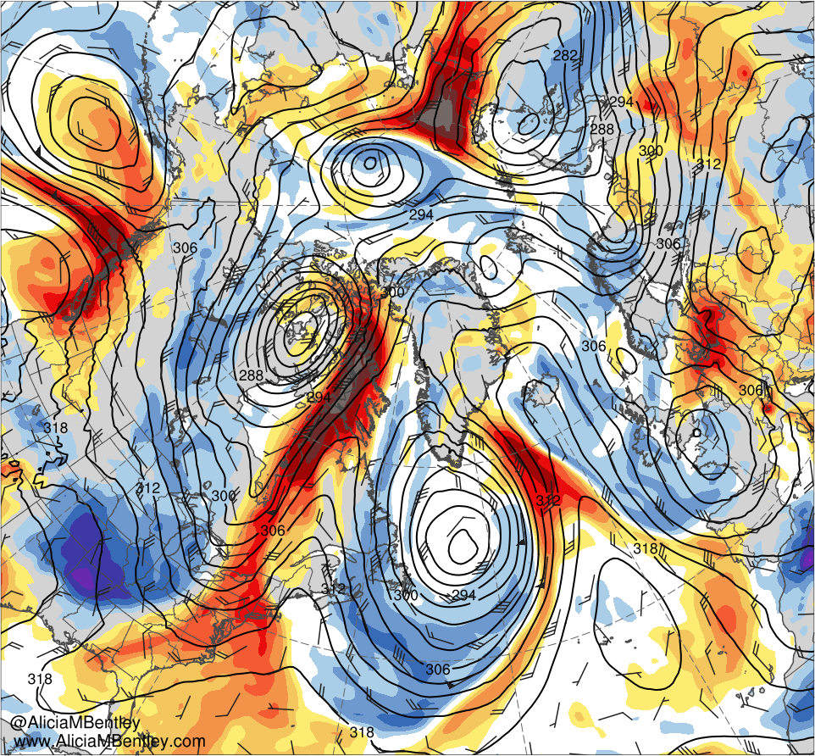
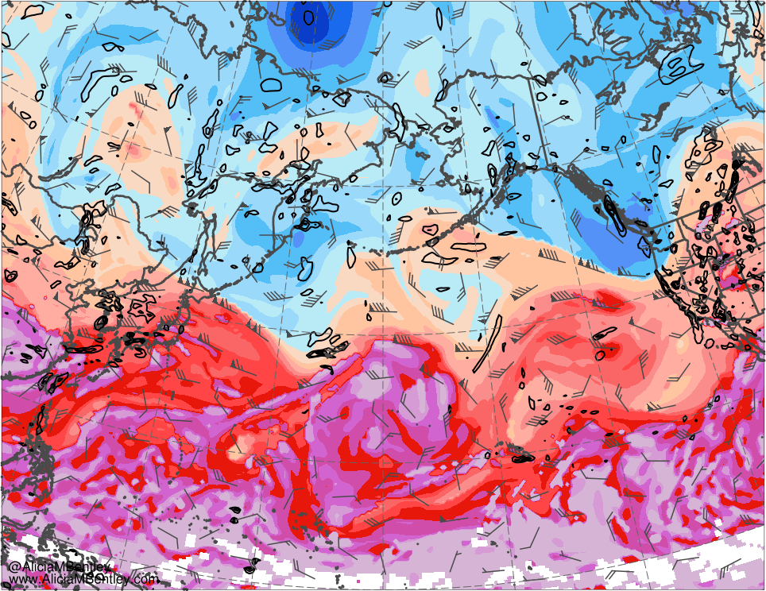
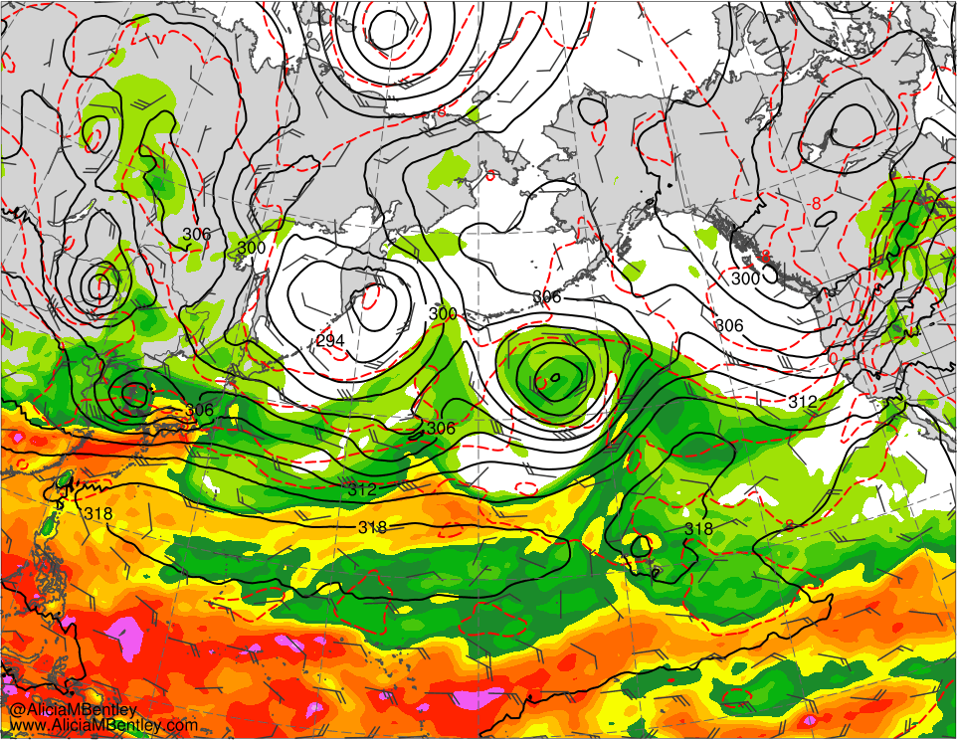
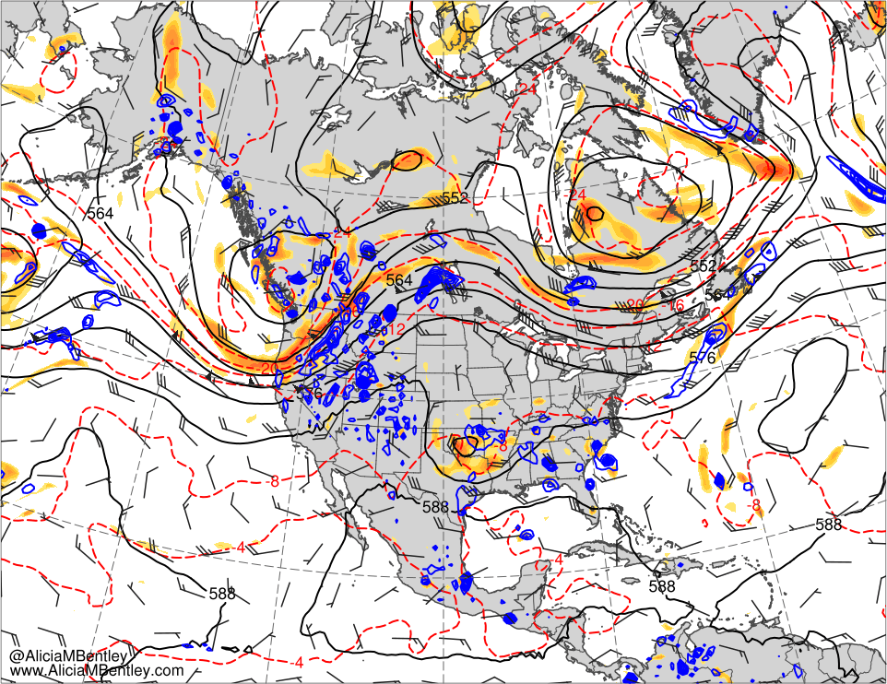
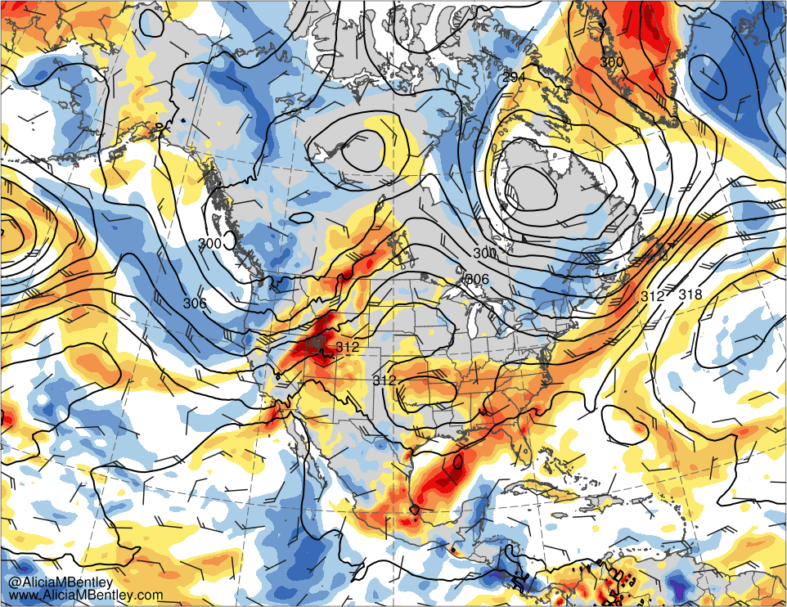
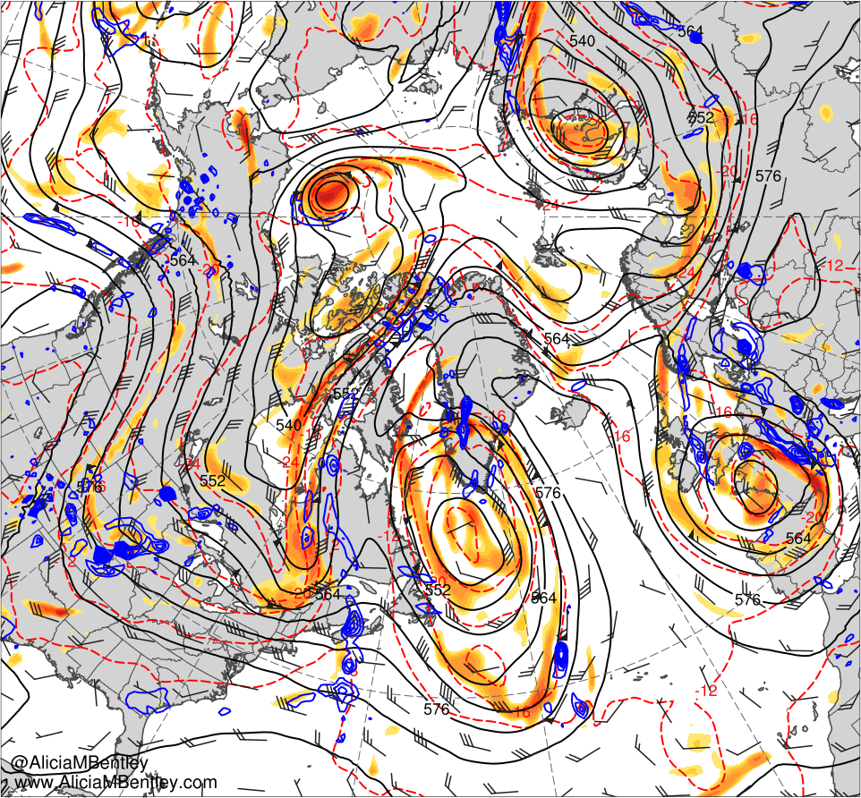
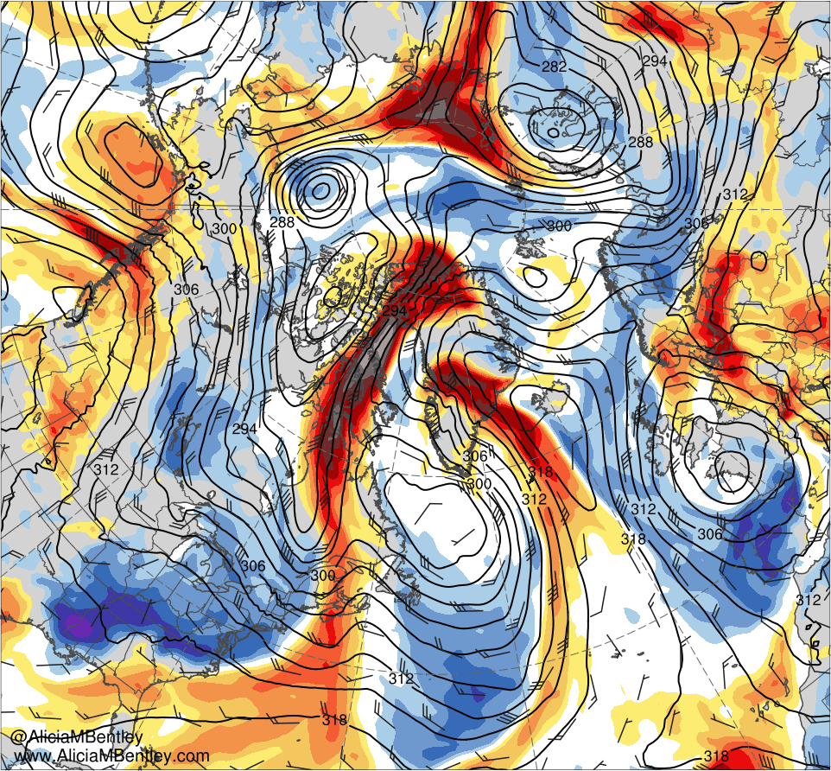
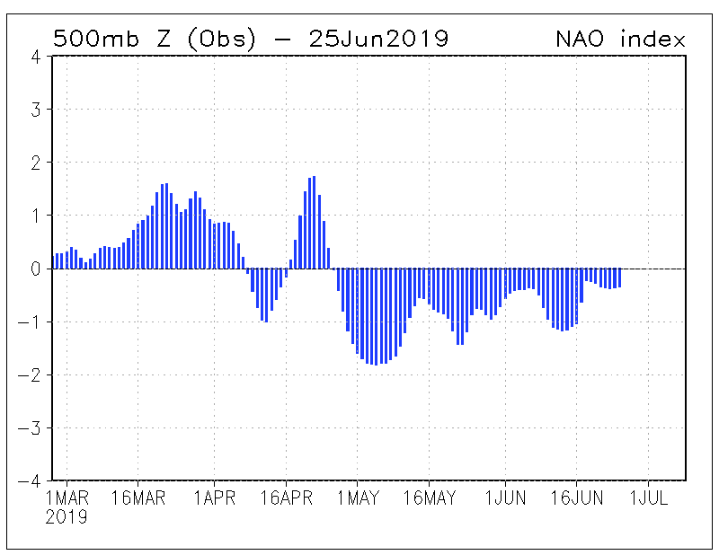
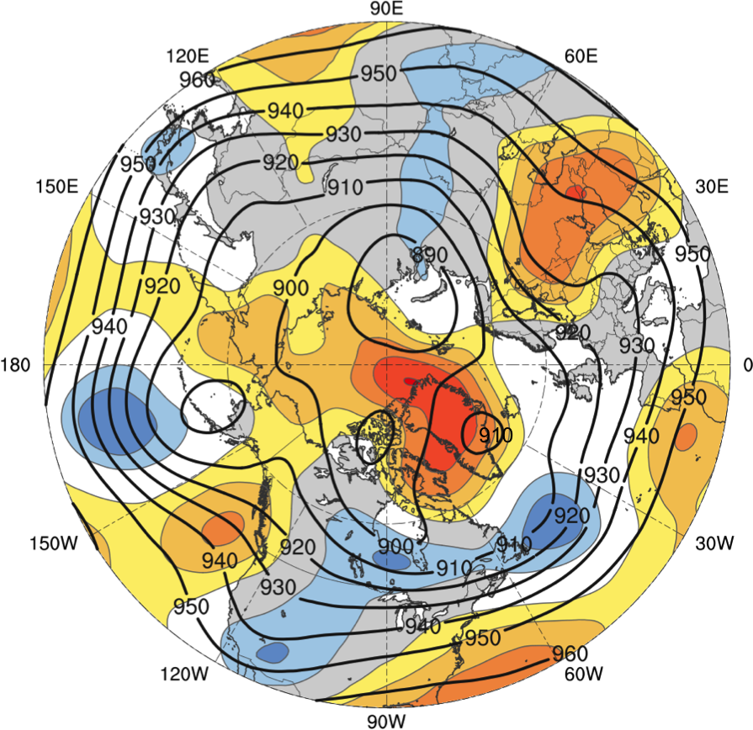
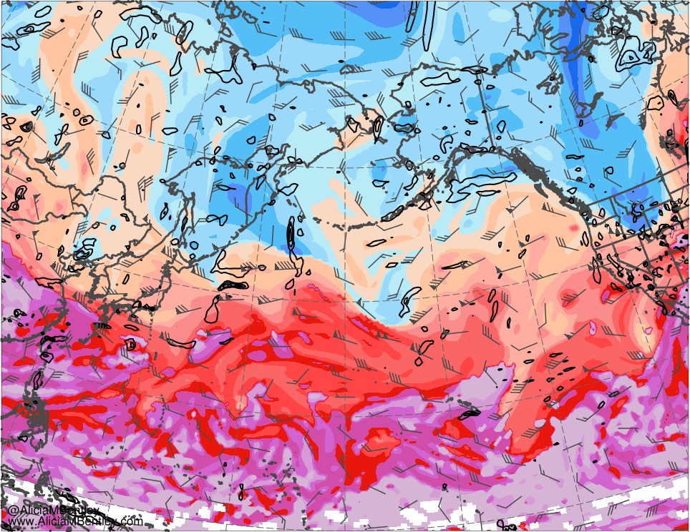
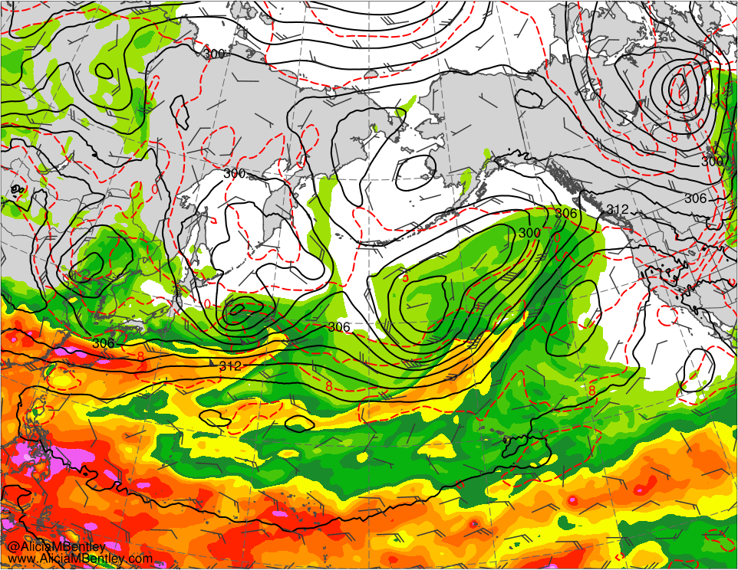
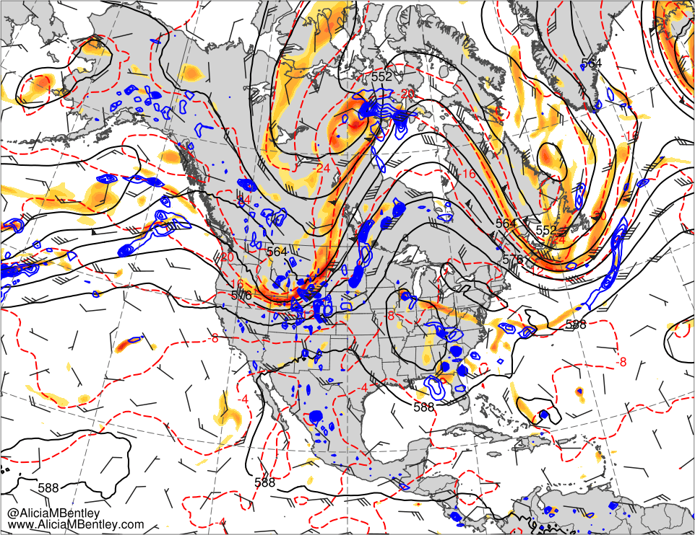
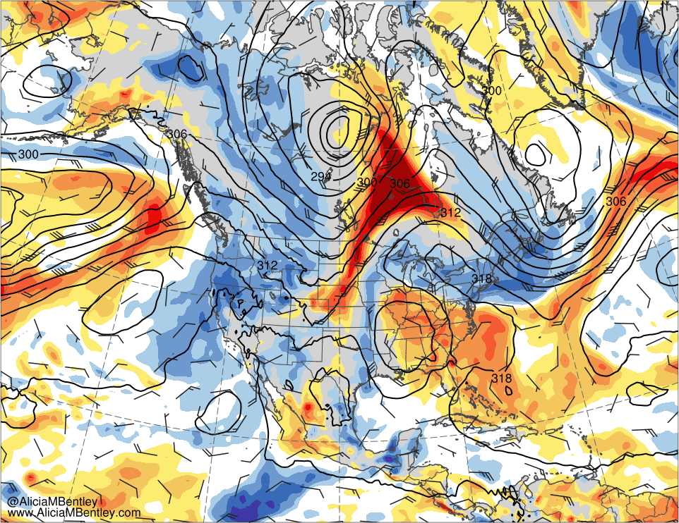
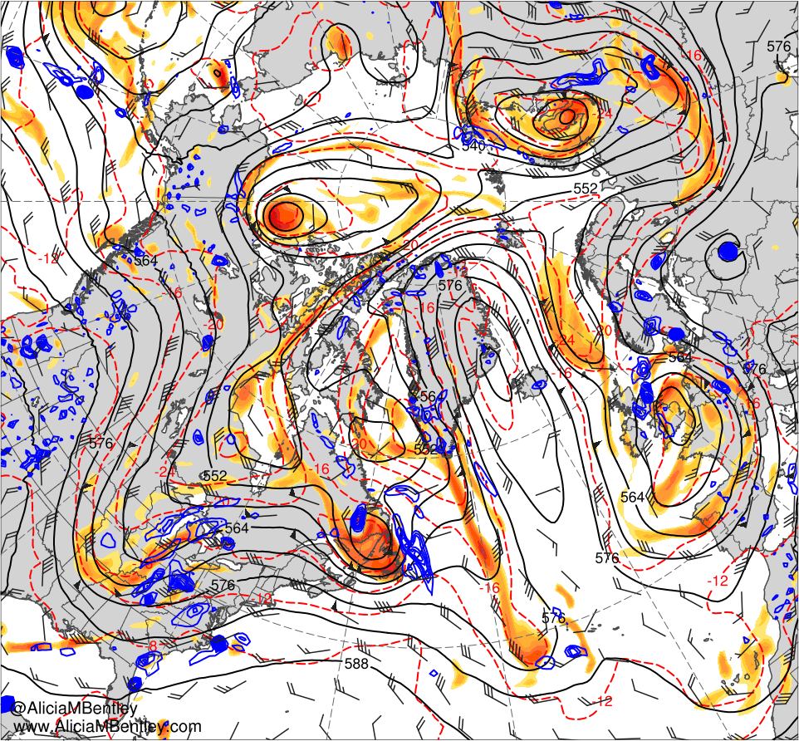
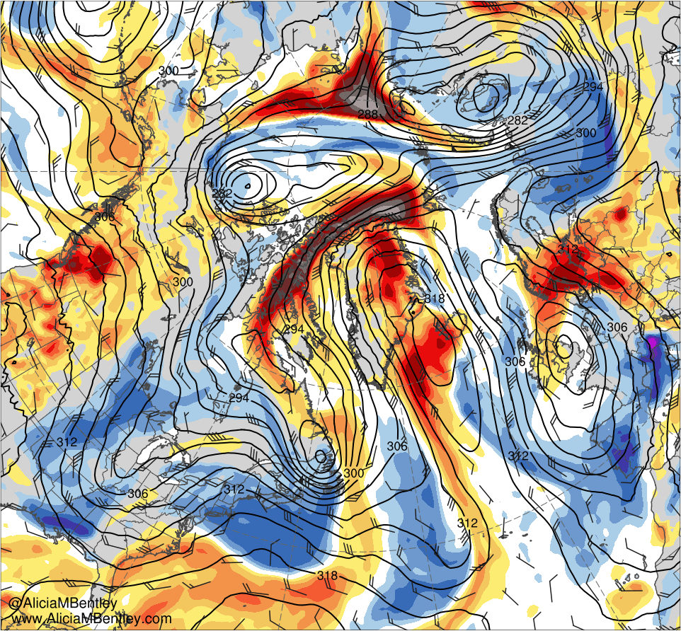
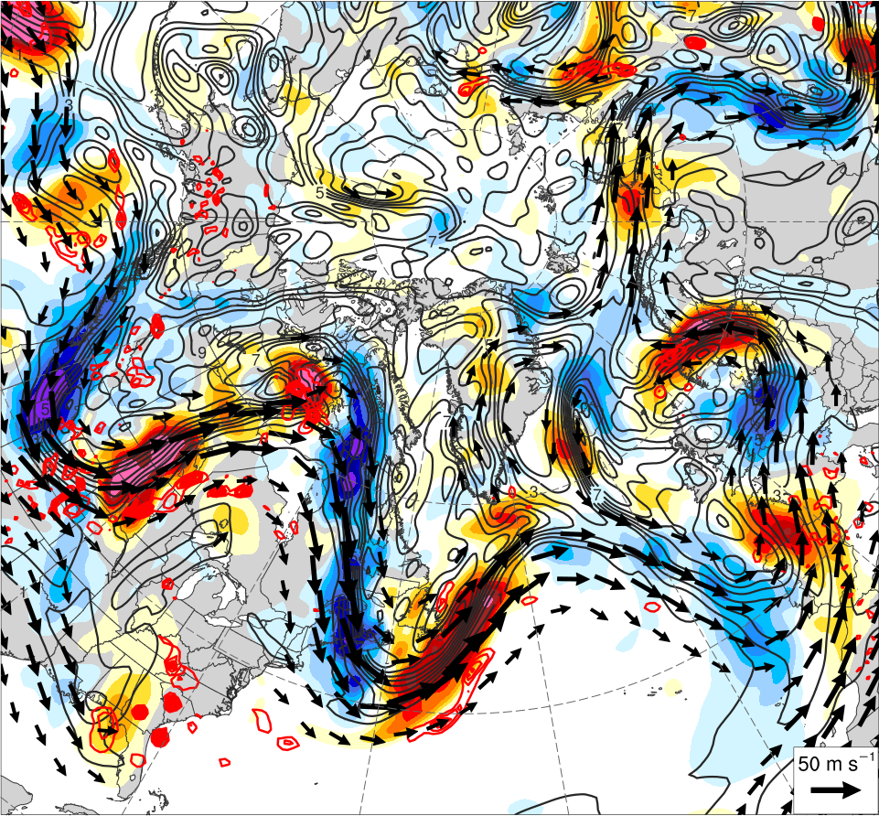
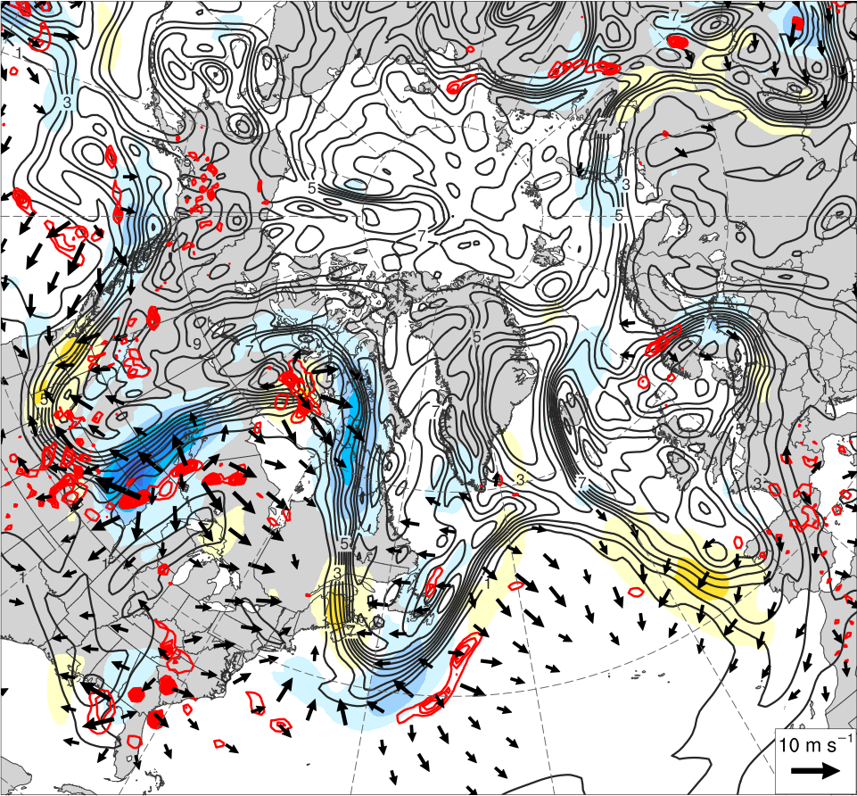
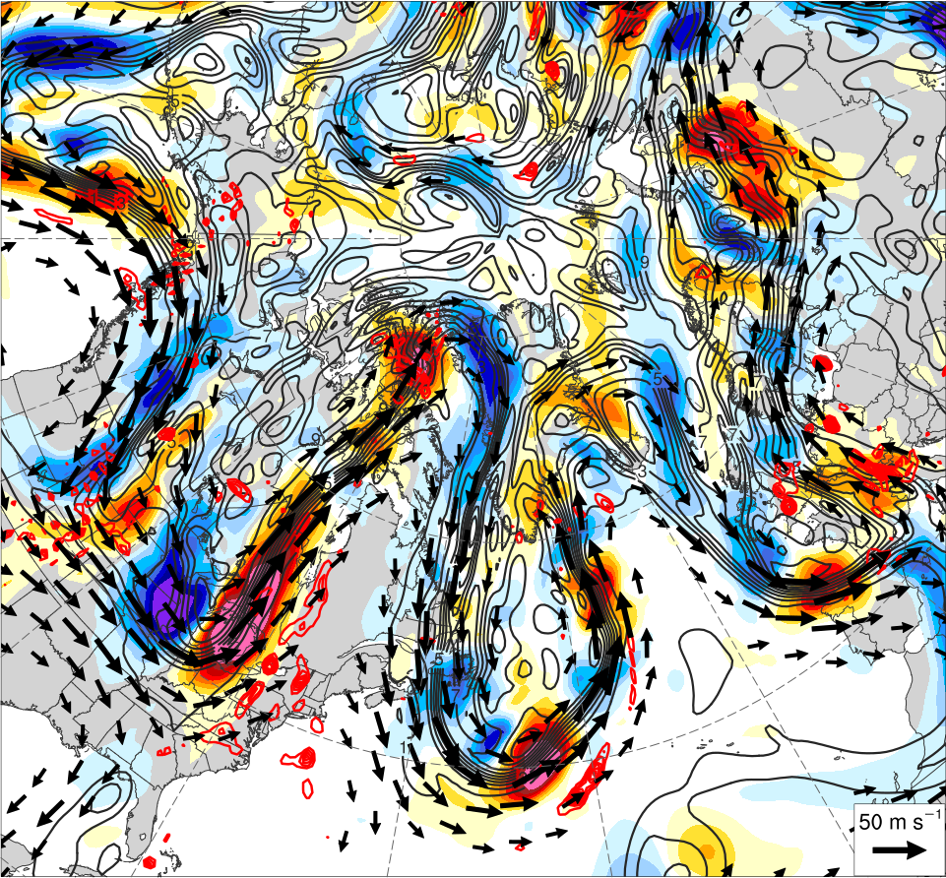
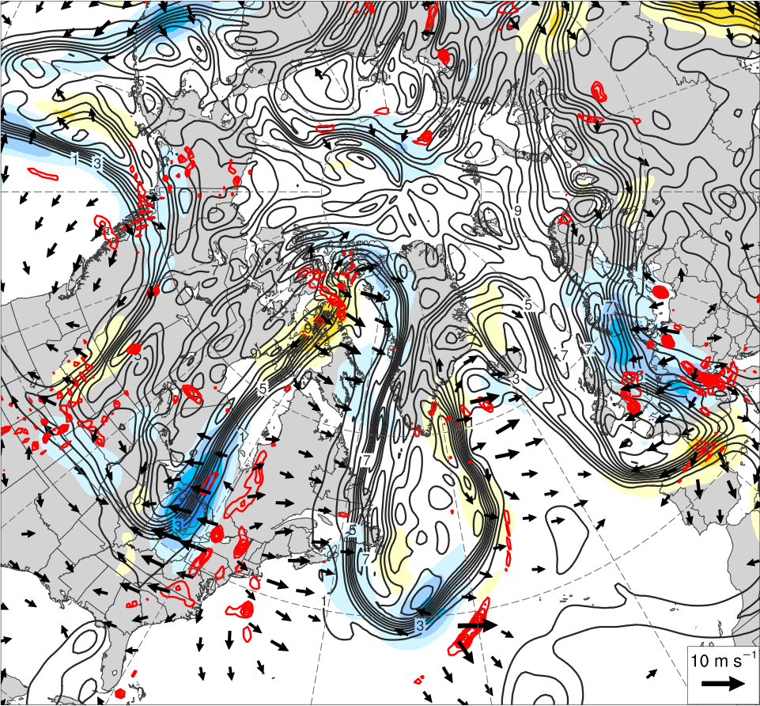
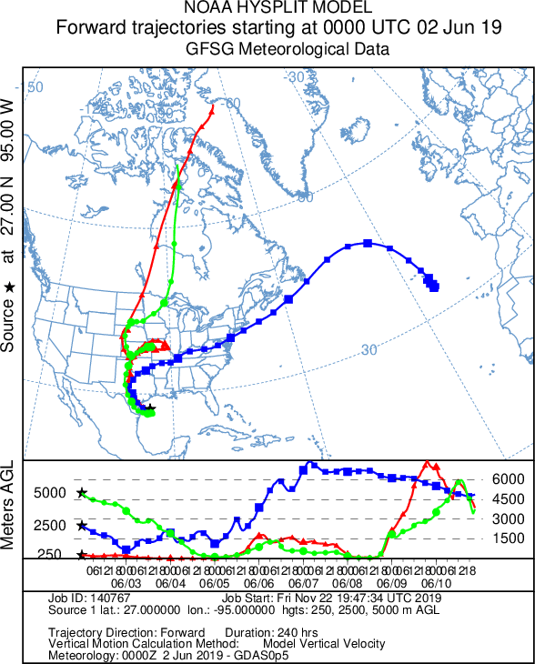
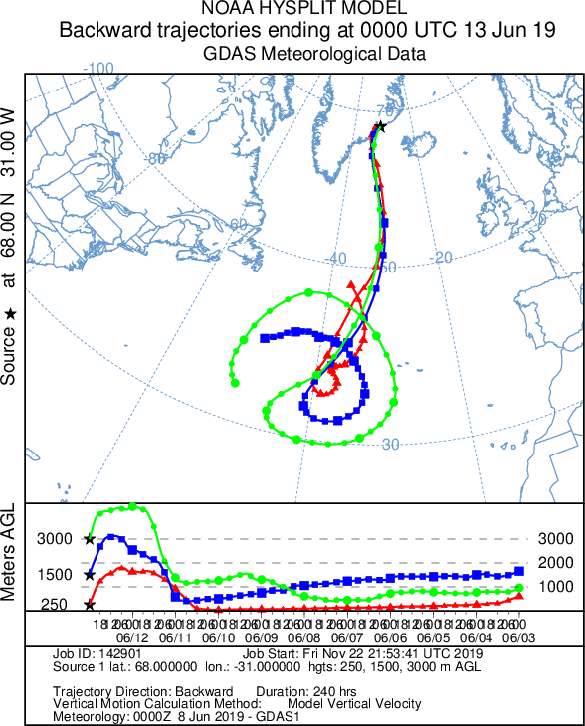
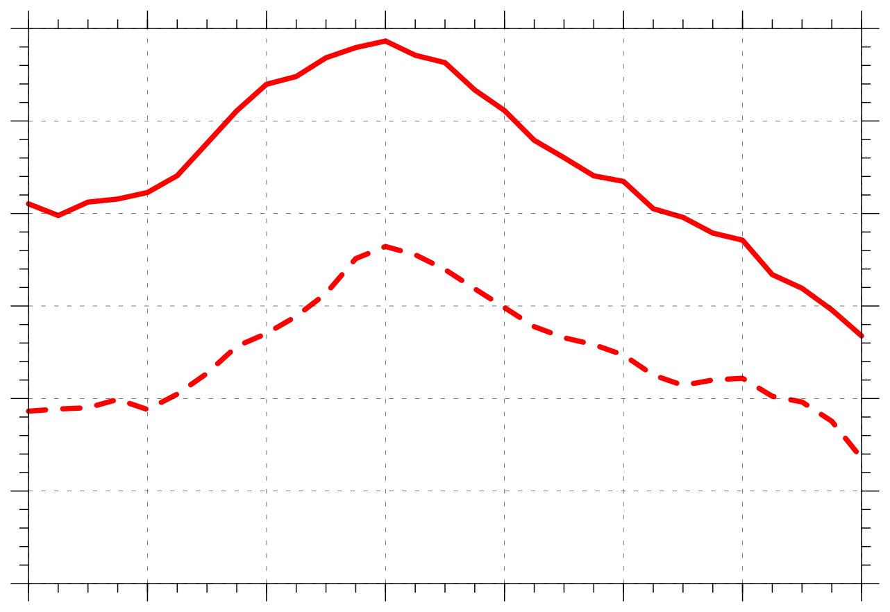
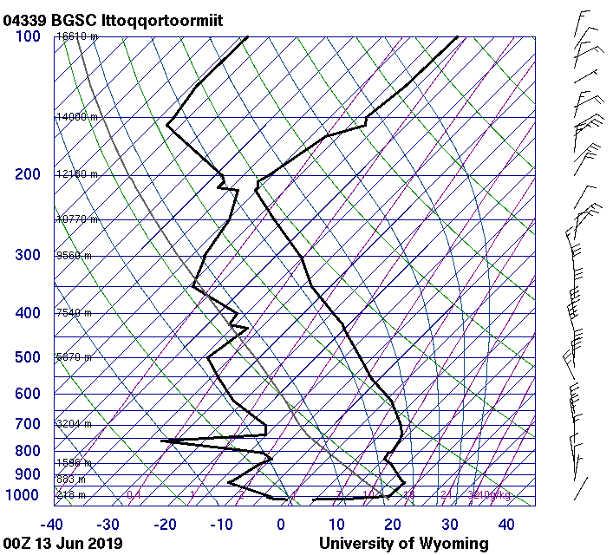
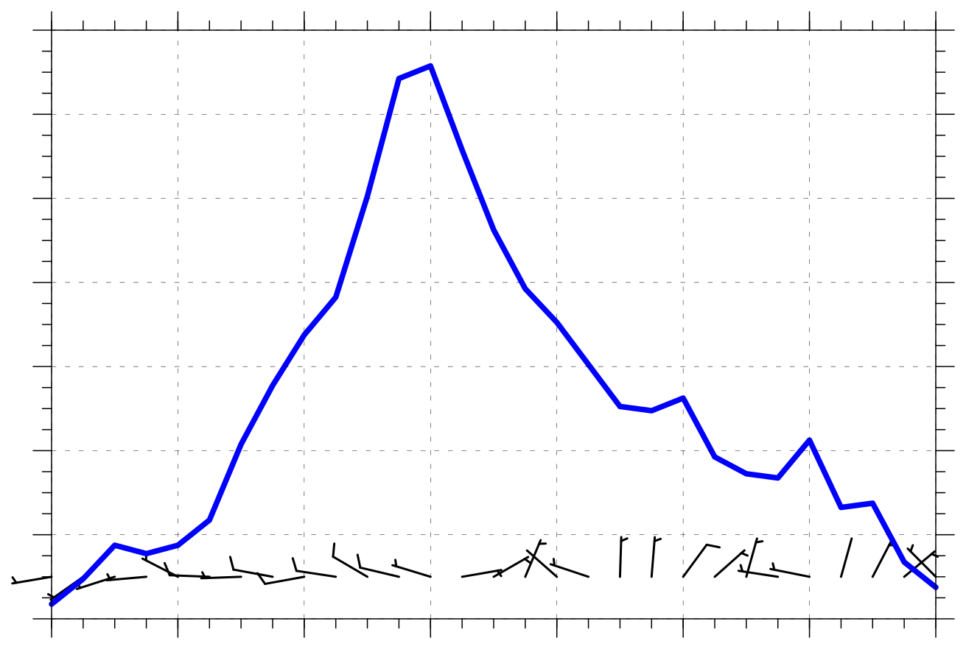
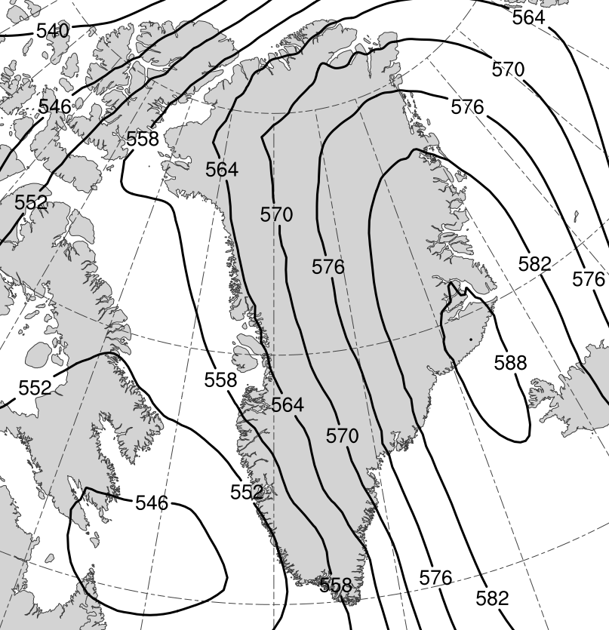
Large-Scale Midlatitude–Polar Flow Interactions Leading to Rapid Surface Ice Melt
over Greenland and Sea Ice Volume Loss over the Arctic Ocean in June 2019
Lance F. Bosart*, Kevin A. Biernat, and Daniel Keyser
Poster number: 628
*E-mail: lbosart@albany.edu
Presented at 100th AMS Annual Meeting on 14 January 2020
University at Albany, SUNY
Department of Atmospheric and Environmental Sciences
This research was supported by Office of Naval Research Grant N00014-18-1-2200
1) Background, Purpose, and Data
3) Upstream North Pacific Flow Evolution
4) North America Flow Evolution
5) Northeast Canada and Greenland Ridging
Background: Massive Greenland surface ice melt event occurred in June 2019.
(a) 0000 UTC 3 June 2019
(b) 0000 UTC 3 June 2019
(a) 0000 UTC 3 June 2019
(b) 0000 UTC 3 June 2019
(a) 0000 UTC 10 June 2019
(b) 0000 UTC 10 June 2019
(c) 0000 UTC 5 June 2019
(d) 0000 UTC 5 June 2019
(c) 0000 UTC 5 June 2019
(d) 0000 UTC 5 June 2019
(c) 0000 UTC 11 June 2019
(d) 0000 UTC 11 June 2019
Figure 1. Greenland Melt extent (%) during 2019. Source: NSIDC/Thomas Mote, University of Georgia; http://nsidc.org/greenland-today/.
Purpose: Investigate upstream antecedent atmospheric conditions associated with massive Greenland surface ice melt event of June 2019.
Data: CFSR gridded analyses at 0.5° resolution (Saha et al. 2010).
(e) 0000 UTC 7 June 2019
(f) 0000 UTC 7 June 2019
(e) 0000 UTC 7 June 2019
(f) 0000 UTC 7 June 2019
(e) 0000 UTC 12 June 2019
(f) 0000 UTC 12 June 2019
2) Negative NAO
(b)
3
(a)
2.5
2
1.5
1.25
1
0.75
0.5
0.25
0
−0.25
−0.5
−0.75
−1
−1.25
(g) 0000 UTC 9 June 2019
(h) 0000 UTC 9 June 2019
(g) 0000 UTC 9 June 2019
(h) 0000 UTC 9 June 2019
(g) 0000 UTC 13 June 2019
(h) 0000 UTC 13 June 2019
−1.5
−2
−2.5
−3
Figure 2. (a) NAO index from Climate Prediction Center, and (b) 26 April–23 June 2019 time-mean 300-hPa geopotential height (dam, black) and time-mean standardized anomalies of 300-hPa geopotential height (σ, shaded).
6) Potential Vorticity (PV) Advection
(a) 0000 UTC 9 June 2019
(b) 0000 UTC 9 June 2019
264
276
288
K
40
60
65
mm
6
12
20
−6
−5
−4
−3
−2.5
−2
−1.5
−1
−0.5
0
0.5
1
1.5
2
2.5
3
4
5
6
σ
8
10
12
10⁻⁵ s⁻¹
−2.5
−2
−1.5
−1
1
1.5
2
2.5
3
4
5
6
σ
300
312
324
336
348
360
372
384
20
25
30
35
45
50
55
70
8
10
16
24
28
10⁻⁵ s⁻¹
6
16
20
24
28
−6
−5
−4
−3
−0.5
0
0.5
Figure 3. (left) DT (2-PVU surface) θ (K, shaded) and wind (kt, flags and barbs), and 925–850-hPa ζ (10⁻⁵ s⁻¹); (right) 700-hPa geopotential height (dam, black), temperature (K, red), and wind (kt, flags and barbs), and PW (mm, shaded).
Figure 4. (left) 500-hPa ζ (10⁻⁵ s⁻¹, shaded), geopotential height (dam, black), temperature (K, red), ascent (5 × 10⁻³ hPa s⁻¹, blue), and wind (kt, flags and barbs); (right) 700-hPa geopotential height (dam, black) and wind (kt, flags and barbs), and standardized anomalies of PW (σ, shaded).
Figure 5. (left) 500-hPa ζ (10⁻⁵ s⁻¹, shaded), geopotential height (dam, black), temperature (K, red), ascent (5 × 10⁻³ hPa s⁻¹, blue), and wind (kt, flags and barbs); (right) 700-hPa geopotential height (dam, black) and wind (kt, flags and barbs), and standardized anomalies of PW (σ, shaded).
7) Trajectories, Time Series, and Sounding
8) Discussion
(c) 0000 UTC 11 June 2019
(d) 0000 UTC 11 June 2019
(a)
(b)
590
(a)
(c)
The massive Greenland surface ice melt event of June 2019 (Fig. 1) occurs during a persistent negative NAO regime that began in late April (Fig. 2).
The melt event is linked to a Tibetan Plateau “heat burst” that triggers NPAC Rossby wave breaking, which subsequently leads to EPAC ridging, a CA tropical moisture surge, and a deepening progressive western North American trough (Figs. 3a–h).
The progressive western North American trough eventually interacts with a trough over the MS Valley and the trough interaction produces a strong moist southerly flow that allows deep tropical moisture to reach northeast Canada (Figs. 4a–h).
Strong ridging occurs over northeast Canada ahead of a now negatively tilted trough over the Great Lakes lifting to the northeast, and strong ridging occurs over northeast Greenland to the northeast of a cutoff cyclone that forms to the northeast of Labrador (Figs. 5a–h).
Both ridging events are associated with the transport of deep tropical moisture toward the Arctic (Figs. 5a–h; Figs. 7a,b).
Negative PV advection by the nondivergent and irrotational winds contribute to building the Canada and Greenland ridges (Figs. 6a–d).
Greenland ridge 500-hPa geopotential height, 1000–500-hPa thickness, and 850-hPa temperature values reach 588 dam, 566 dam, and 15°C, respectively (Figs. 8a–b), and a deep layer of above-freezing temperatures extends from the surface to near 600 hPa (Fig. 8c).
580
570
560
550
540
500-hPa geopotential
height (dam)
1000–500-hPa
thickness (dam)
530
10
11
12
13
14
15
16
17
16
Day in June 2019 labeled at 0000 UTC
(d)
14
(b)
850-hPa temperature (K)
−15
−13
−11
−9
−7
−5
−3
−1
0
1
3
5
7
9
11
13
15
PVU day⁻¹
12
850-hPa
wind (kt)
Figure 6. (left) 300–200-hPa PV (PVU, gray), nondivergent wind (m s⁻¹, vectors), and PV advection by nondivergent wind (PVU day⁻¹, shaded), and 600–400-hPa ascent (5 × 10⁻³ hPa s⁻¹, red); (right) As in (left), but for irrotational wind.
Figure 7. (a) Forward trajectories starting at 0000 UTC 2 June and (b) backward trajectories ending at 0000 UTC 13 June. Source: NOAA HYSPLIT.
10
8
Figure 8. (a) Time series of (a) 500-hPa geopotential height (dam) and 1000–500-hPa thickness (dam), and (b) 850-hPa temperature (K) and wind (kt), for yellow star location in (d). (c) 0000 UTC 13 June 2019 sounding for Ittoqqortoormitt, Greenland [red star location in (d)] (source: University of Wyoming). (d) 500-hPa geopotential height (dam) at 0000 UTC 13 June 2019.
6
Reference and Acknowledgement
4
Saha, S., and Coauthors, 2010: The NCEP Climate Forecast System Reanalysis. Bull. Amer. Meteor. Soc., 91, 1015–1057.
Special thanks to Alicia Bentley for scripts to generates CFSR analyses.
2
10
11
12
13
14
15
16
17
Day in June 2019 labeled at 0000 UTC

