Slide 1
Examining the Forecast Skill of the Synoptic-Scale Flow Associated with Arctic Cyclones
Daniel Keyser, Kevin A. Biernat, and Lance F. Bosart
Department of Atmospheric and Environmental Sciences
University at Albany, SUNY
33rd AMS Conference on Climate Variability and Change
Boston, MA
Tuesday 14 January 2020
Research Supported by ONR Grant N00014-18-1-2200

Slide 2
Motivation
Arctic cyclones (ACs) are synoptic-scale cyclones that originate within the Arctic or move into the Arctic from lower latitudes (e.g., Crawford and Serreze 2016)
ACs may be associated with the poleward advection of warm, moist air, which can contribute to alterations of the synoptic-scale flow over the Arctic
It is anticipated that relatively low forecast skill of the synoptic-scale flow over the Arctic may be attributed in part to forecast error growth accompanying alterations of the synoptic-scale flow induced by ACs

Slide 3
Purpose
Investigate whether there are differences in the frequency, location, and intensity of ACs, and in the synoptic-scale flow patterns associated with ACs, between periods of low and high forecast skill of the synoptic-scale flow over the Arctic.

Slide 4
Data and Methods: AC Identification
Created a 2007–2017 AC climatology by obtaining cyclone tracks from 1° ERA-Interim (Dee et al. 2011) cyclone climatology prepared by Sprenger et al. (2017)
ACs are deemed cyclones that last ≥ 2 d and spend at least some portion of their lifetimes in the Arctic (> 70°N)

Slide 5
Data and Methods: Forecast Skill Evaluation
Utilized forecasts of 500-hPa geopotential height initialized at 0000 UTC during 2007–2017 from 11-member GEFS reforecast dataset v2 (Hamill et al. 2013)
Calculated area-averaged ensemble forecast spread of 500-hPa geopotential height over the Arctic (≥70°N)
Calculated area-averaged root mean square error (RMSE) of 500-hPa geopotential height over the Arctic, using ERA-Interim as verification
Calculated standardized anomaly of area-averaged ensemble spread (σ_{spread}) and of area-averaged RMSE (σ_{RMSE}) following Moore (2017)

Slide 6
Data and Methods: Forecast Skill Evaluation
Forecast days valid at day 5 associated with the top and bottom 10% of σ_{spread} and σ_{RMSE} are referred to as low and high skill days, respectively
Forecasts initialized five days prior to low and high skill days are referred to as low and high skill forecasts, respectively
Time periods through day 5 encompassed by low and high skill forecasts are referred to as low and high skill periods, respectively
ACs that exist in the Arctic (> 70°N) within the low and high skill periods are selected for further analysis

Slide 7
Forecast Skill
There is greater variability in σ_{spread} and σ_{RMSE} for low skill days compared to high skill days, with some low skill days characterized by very large values of σ_{spread} and σ_{RMSE}

Slide 8
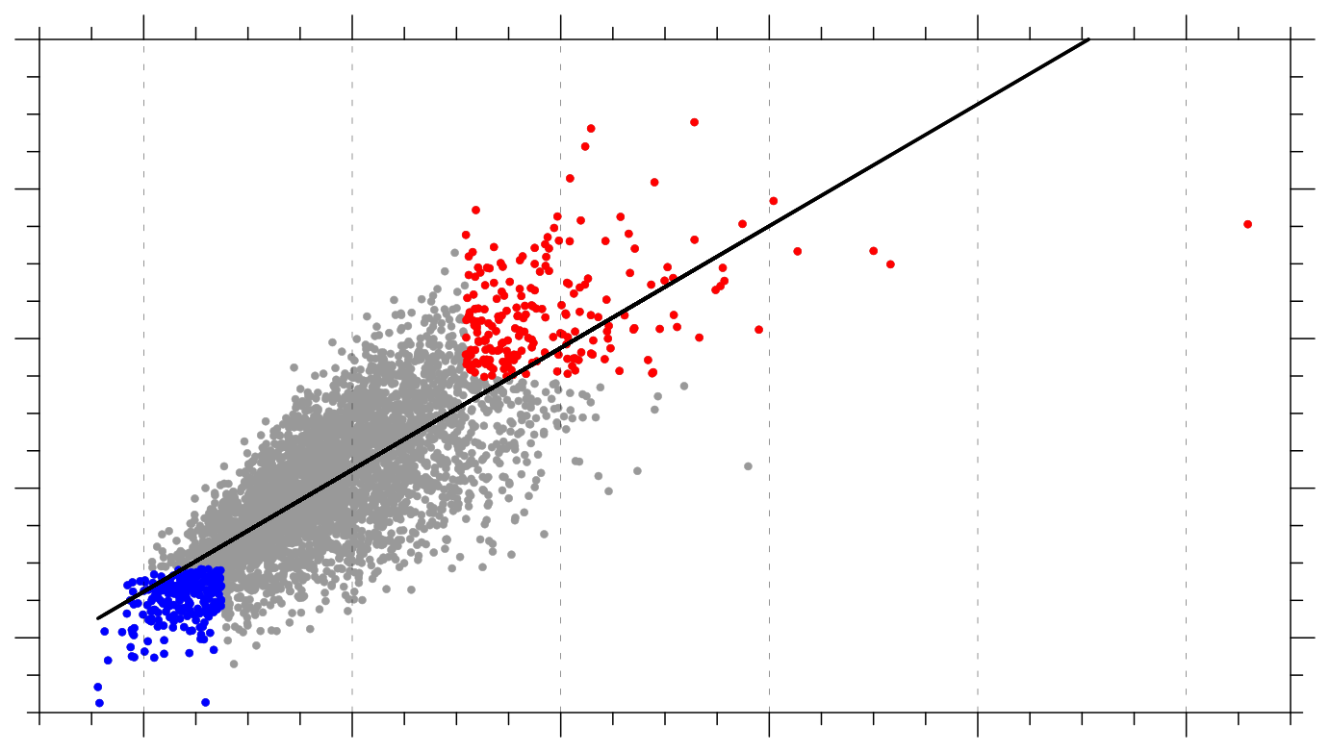
Forecast Skill
6
r² = 0.57
4
2
σ_{spread}
0
Low skill days (N = 215)
High skill days (N = 226)
−2
All other days (N = 3577)
−2
0
2
4
6
8
σ_{RMSE}
Day-5 σ_{RMSE} and σ_{spread} from low and high skill forecasts valid at 0000 UTC on low skill days (red) and high skill days (blue), respectively, and from all other 2007–2017 forecasts valid at 0000 UTC on all other days (gray)

Slide 9
Number and Frequency of ACs
AC frequency is higher for low skill periods compared to high skill periods

Slide 10
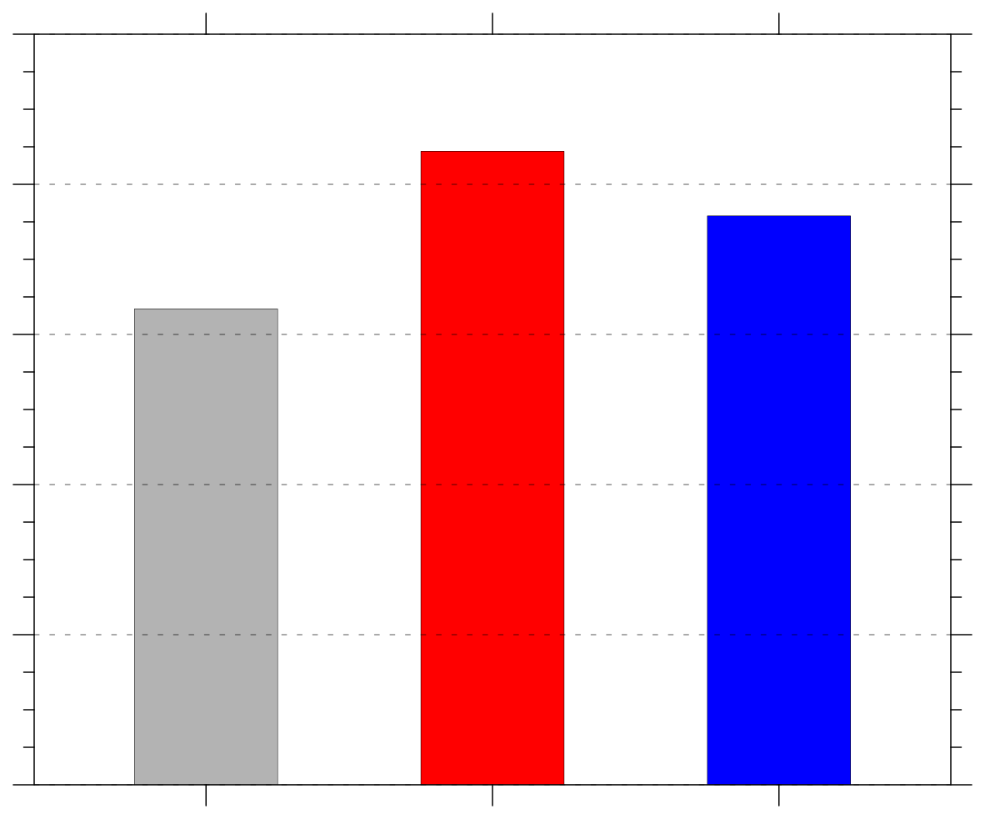
Number and Frequency of ACs
Frequency of ACs (number of ACs day⁻¹)
Period | Number of days in period | Number of ACs in period
Climo | 4018 | 2549
Low skill | 801 | 676
High skill | 800 | 606
1.0
0.8
0.6
0.4
0.2
0.0
climo
low
high
Frequency = number of ACs within period / number of days within period

Slide 11
AC Track Frequency
ACs during low skill periods occur more frequently over eastern Eurasia and much of the Arctic Ocean relative to ACs during high skill periods
ACs during high skill periods occur more frequently over the North Atlantic, Barents Sea, and western Eurasia relative to ACs during low skill periods

Slide 12
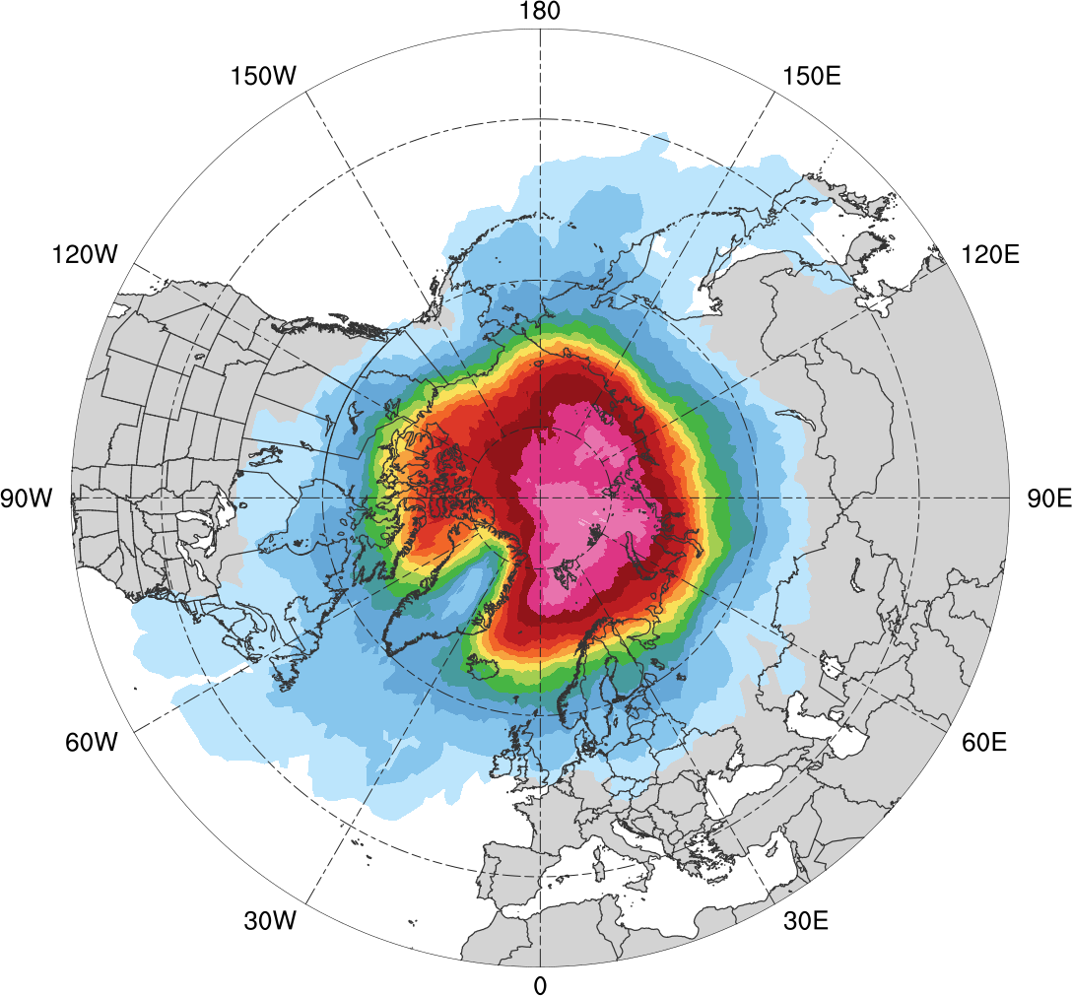
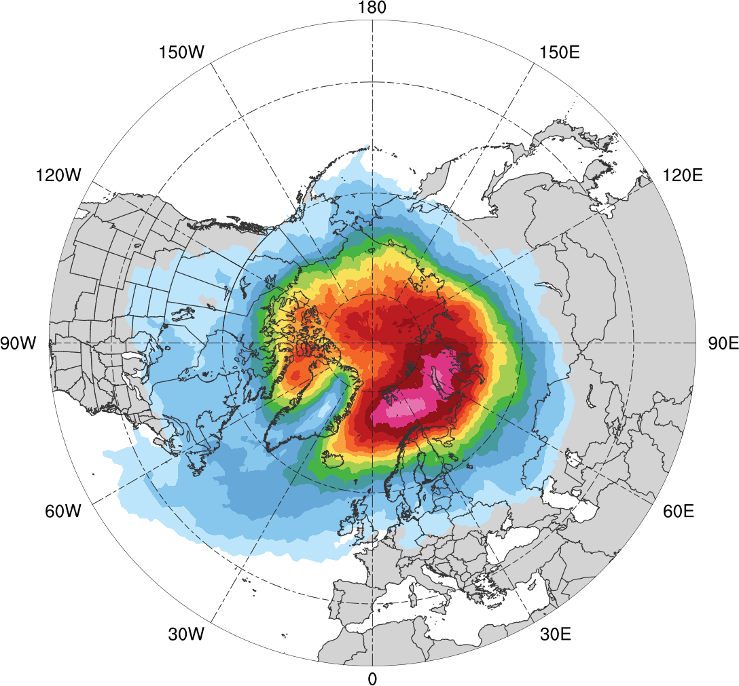
AC Track Frequency
Low skill (N = 676)
High skill (N = 606)
0.005
0.01
0.02
0.03
0.04
0.05
0.06
0.07
0.08
0.09
0.1
0.12
0.14
0.16
0.18
0.005
0.01
0.02
0.03
0.04
0.05
0.06
0.07
0.08
0.09
0.1
0.12
0.14
0.16
0.18
Total number of ACs within 500 km of a grid point divided by number of days in period (number of ACs day⁻¹)

Slide 13
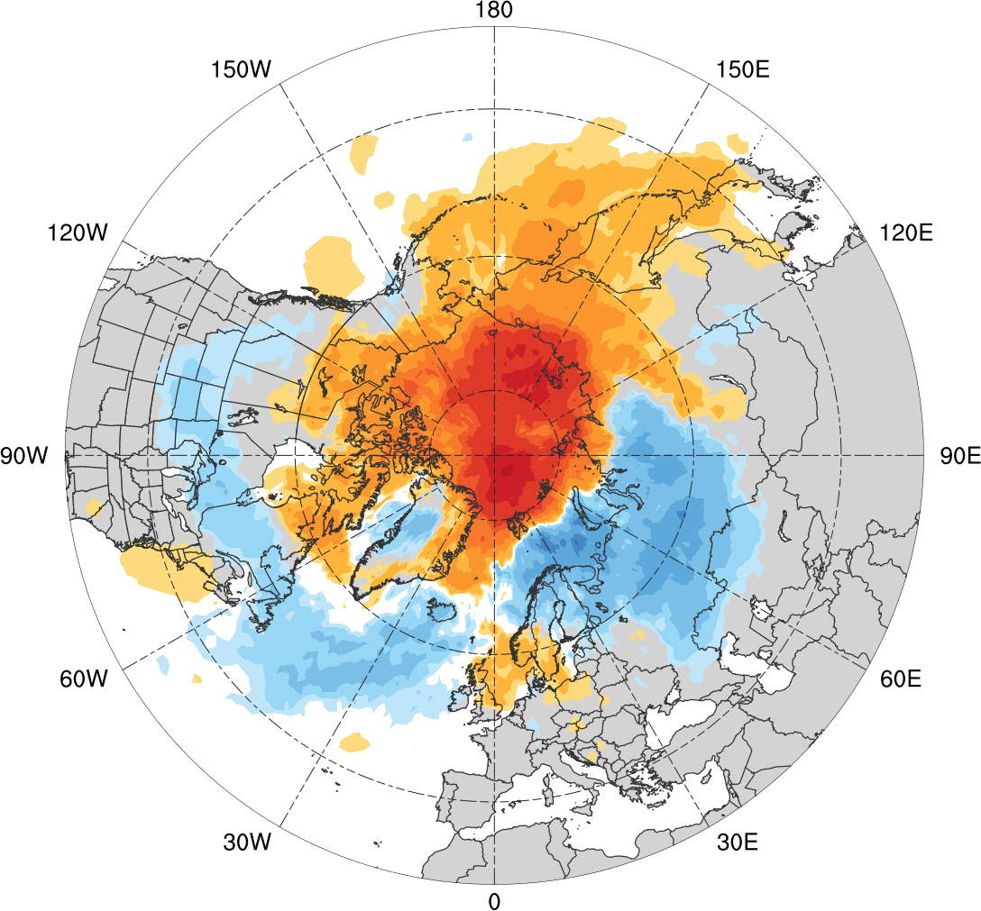
AC Track Frequency Difference
Low skill minus high skill
-0.1
-0.08
-0.06
-0.04
-0.03
-0.02
-0.01
-0.005
0
0.005
0.01
0.02
0.03
0.04
0.06
0.08
0.1
Difference in AC track frequency (number of ACs day⁻¹)

Slide 14
Flow Amplitude over Arctic
There tends to be significantly amplified and deamplified synoptic-scale flow over the Arctic relative to climatology during low and high skill periods, respectively

Slide 15
Flow Amplitude over Arctic
Calculated absolute value of standardized anomaly of 500-hPa v-wind (hereafter σ_{v}) using ERA-Interim
Calculated area average of σ_{v} over the Arctic (≥ 70°N) for low and high skill periods

Slide 16
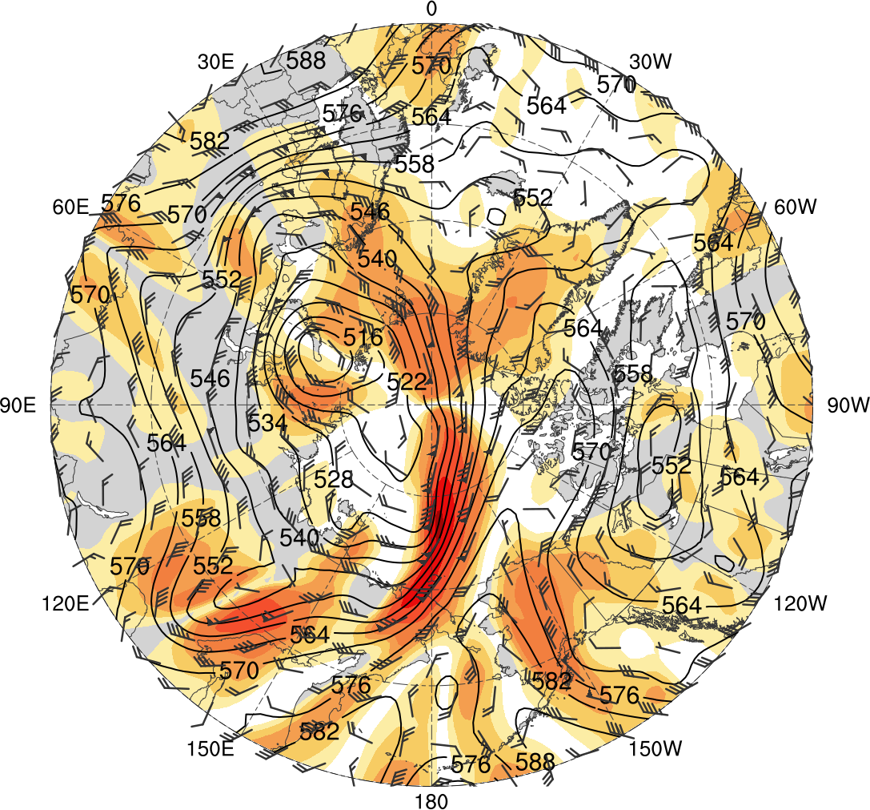
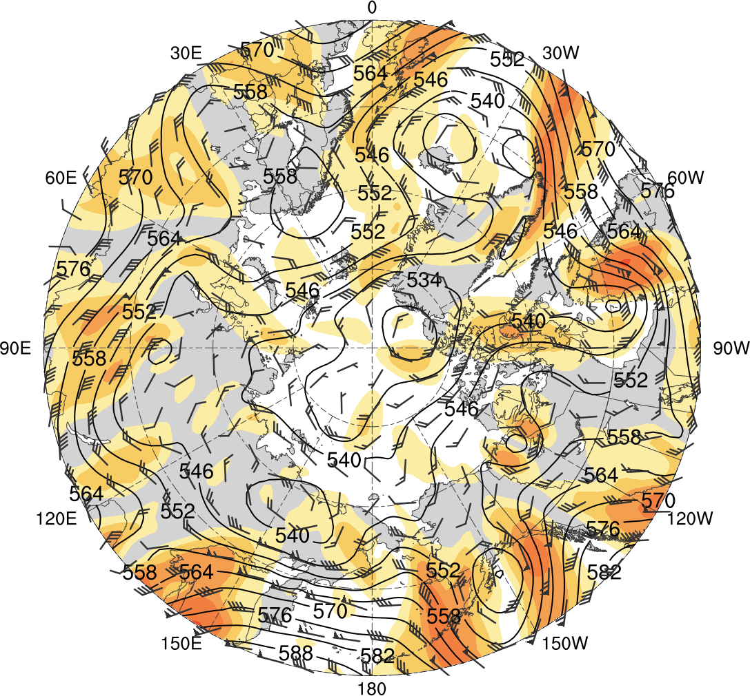
Flow Amplitude over Arctic
Low skill (avg. σ_{v} = 1.14)
0000 UTC 28 Aug 2016
High skill (avg. σ_{v} = 0.45)
0000 UTC 3 Sep 2011
0.5
1
1.5
2
3
4
5
6
500-hPa geopotential height (dam, black), wind (flags and barbs, m s⁻¹), and σ_{v} (shading) from ERA-Interim

Slide 17
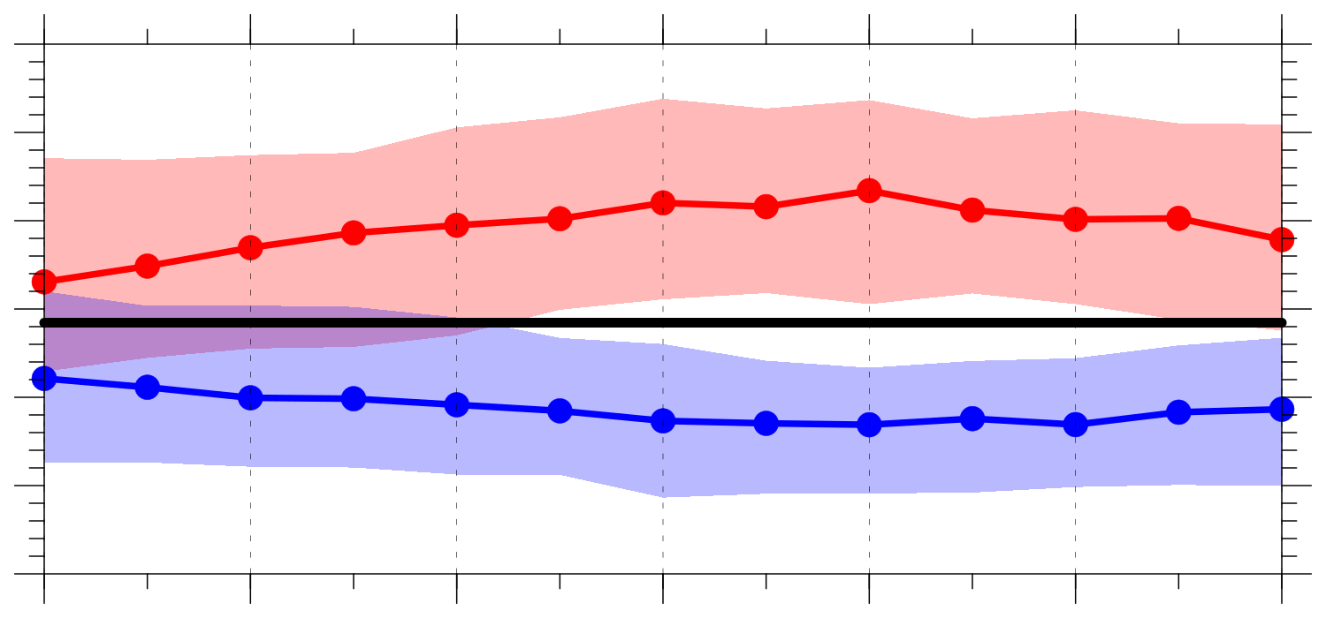
Flow Amplitude over Arctic
Area average σ_{v} over the Arctic (≥ 70°N)
1.1
1.0
0.9
0.8
0.7
0.6
0.5
-120
-96
-72
-48
-24
0
24
Hours relative to 0000 UTC of low and high skill days
1985–2017 climo median
statistically significant difference between low/high skill median and climo median
shading: interquartile range
low-skill median
high-skill median

Slide 18
Moisture in Arctic
There tends to be significantly large and small amounts of moisture over the Arctic relative to climatology during low and high skill periods, respectively

Slide 19
Moisture in Arctic
Calculated standardized anomaly of PW (hereafter σ_{PW}) using ERA-Interim
Calculated area average of positive values of σ_{PW} over the Arctic (≥ 70°N) for low and high skill periods

Slide 20
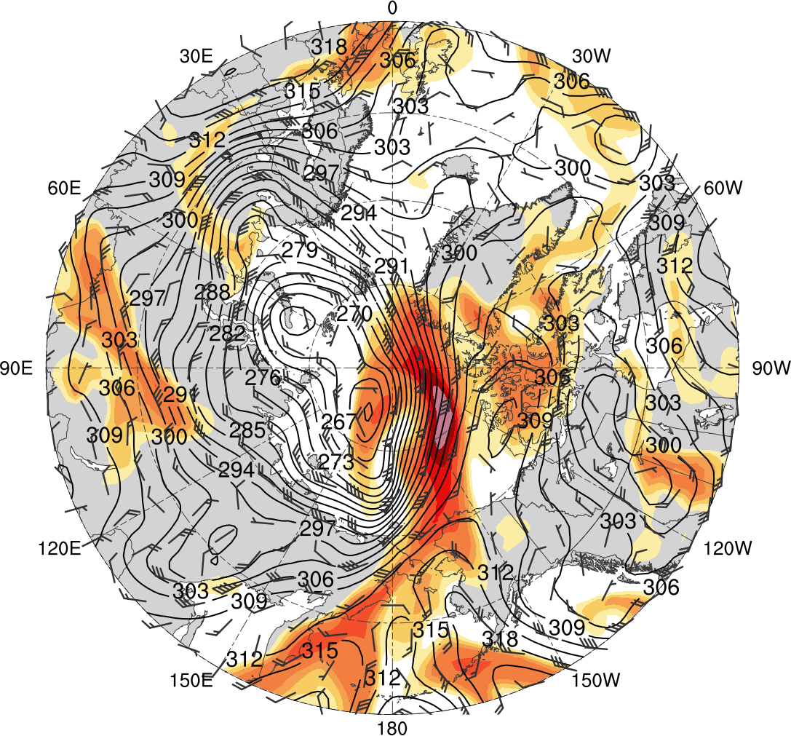
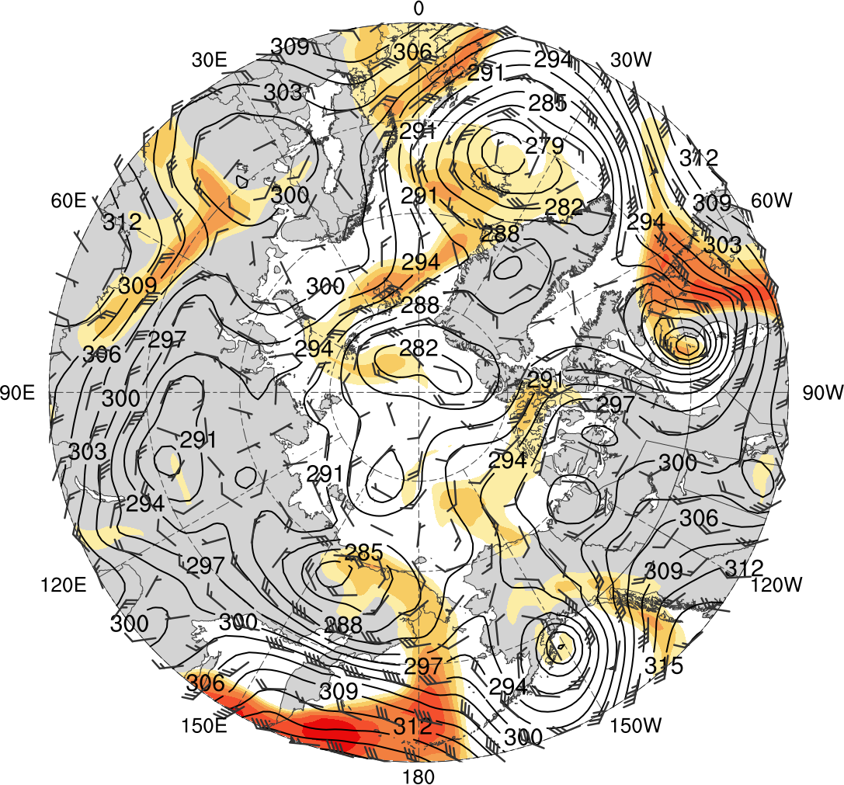
Moisture in Arctic
Low skill (avg. positive σ_{PW} = 1.82)
0000 UTC 28 Aug 2016
High skill (avg. positive σ_{PW} = 0.63)
0000 UTC 3 Sep 2011
0.5
1
1.5
2
3
4
5
6
700-hPa geopotential height (dam, black) and wind (flags and barbs, m s⁻¹), and positive σ_{PW} (shading) from ERA-Interim

Slide 21
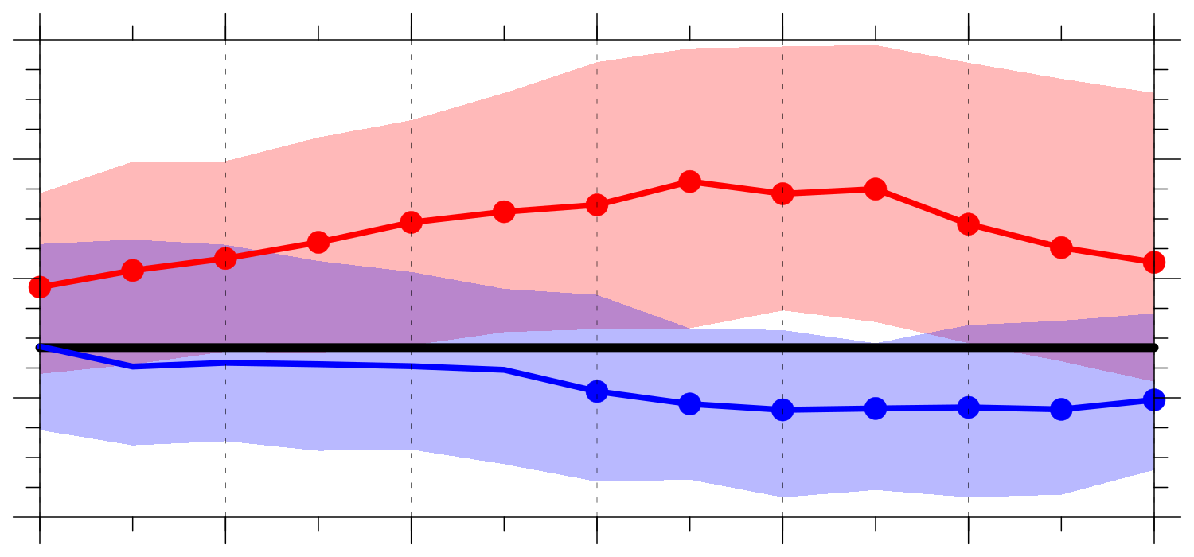
Moisture in Arctic
Area average of positive σ_{PW} over the Arctic (≥ 70°N)
1.4
1.2
1.0
0.8
0.6
-120
-96
-72
-48
-24
0
24
Hours relative to 0000 UTC of low and high skill days
1985–2017 climo median
statistically significant difference between low/high skill median and climo median
shading: interquartile range
low-skill median
high-skill median

Slide 22
AC Characteristics
ACs during low skill periods tend to be embedded within a region of more amplified flow, tend to be associated with larger amounts of moisture, and tend to be stronger relative to ACs during high skill periods

Slide 23
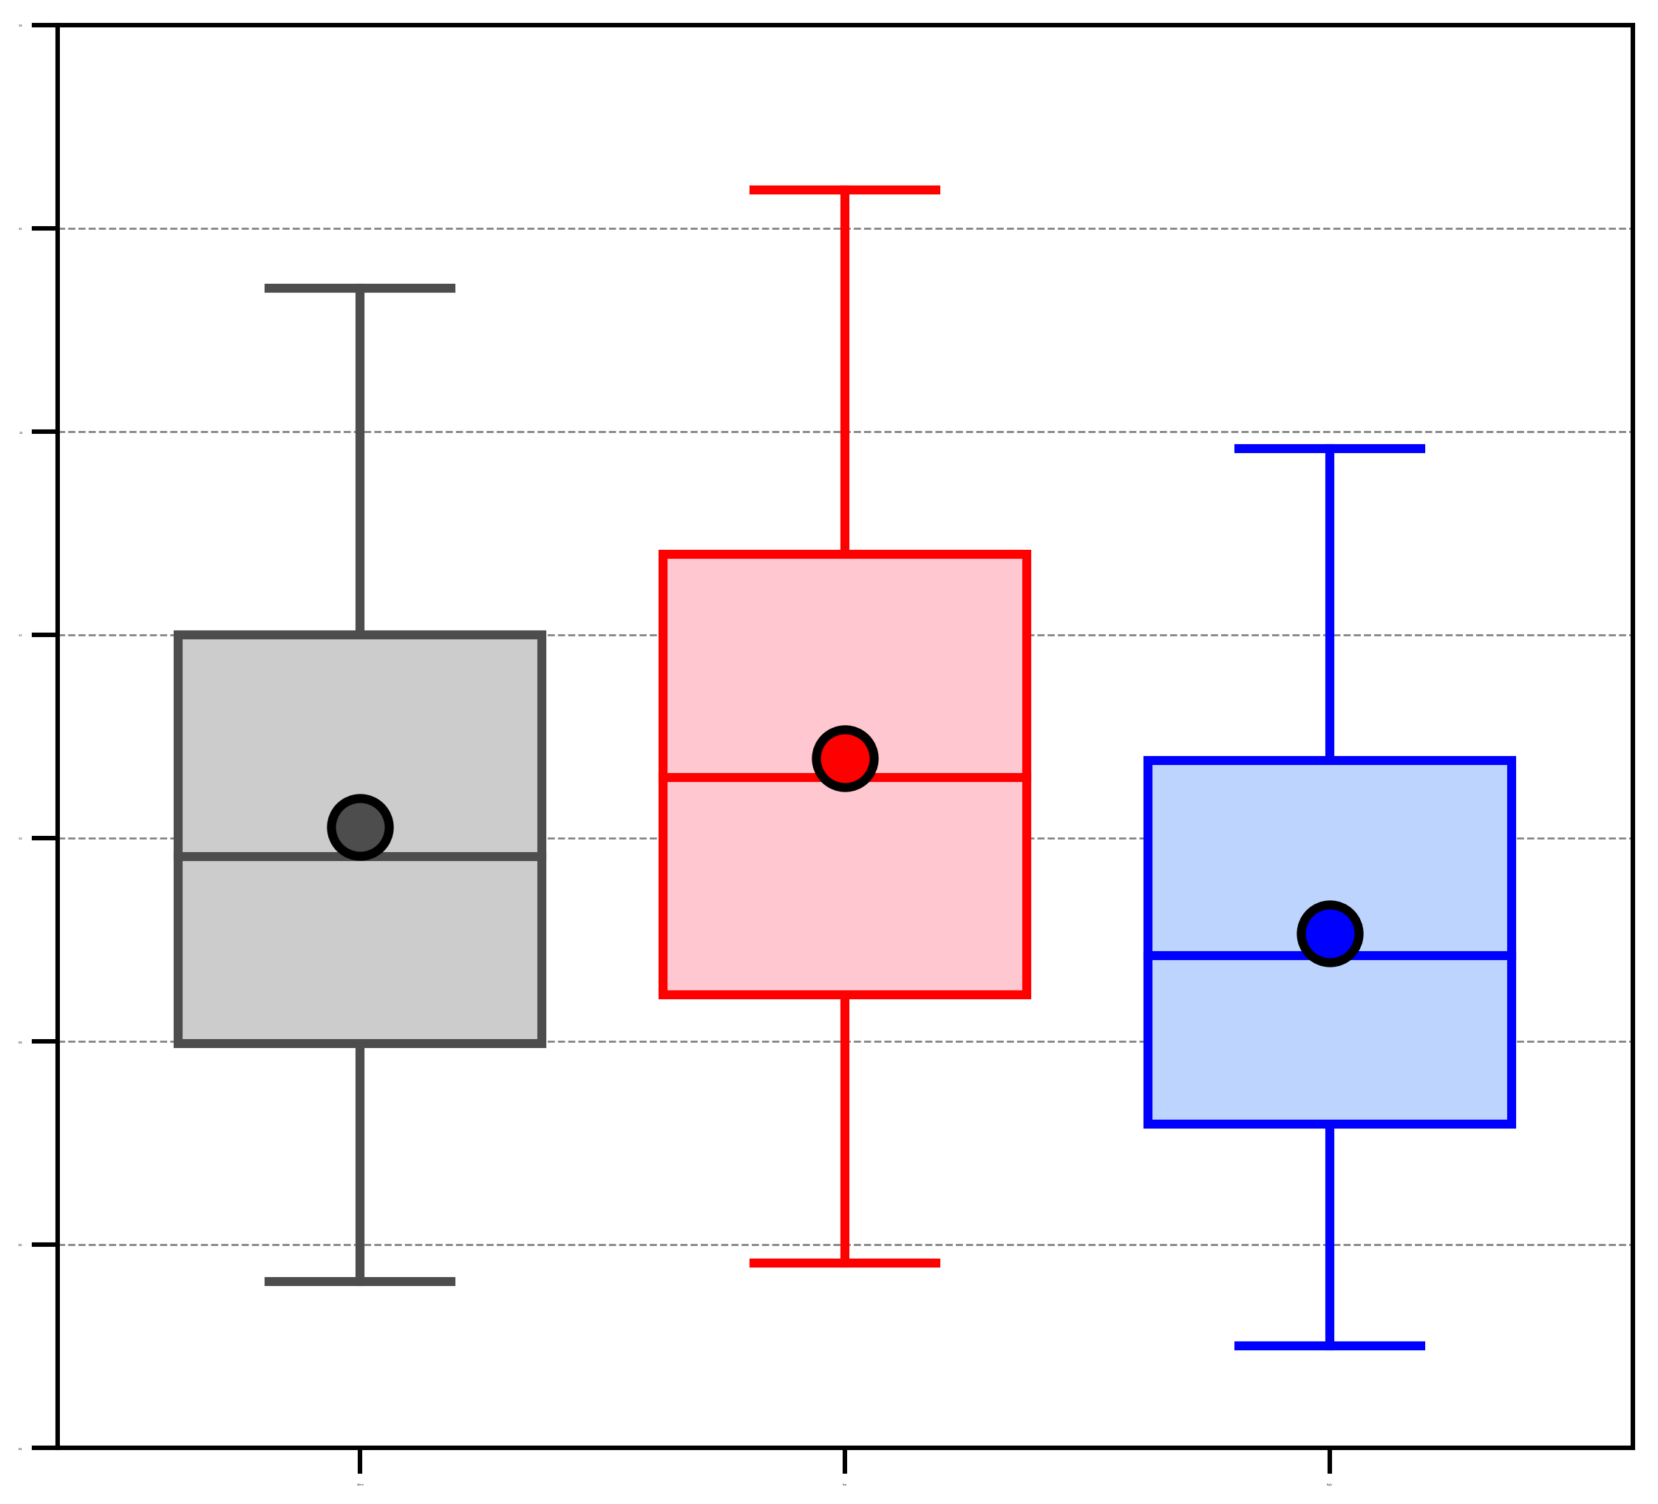
Highest Average σ_{v} Surrounding ACs
1.8
Highest value of average σ_{v} within 1000 km of AC centers in the Arctic
1.6
1.4
95%
1.2
75%
median
1.0
25%
5%
0.8
mean
0.6
Differences in mean value between each category are statistically significant at 95% confidence level using bootstrap resampling
0.4
climo
(N=2549)
low
(N=676)
high
(N=606)

Slide 24
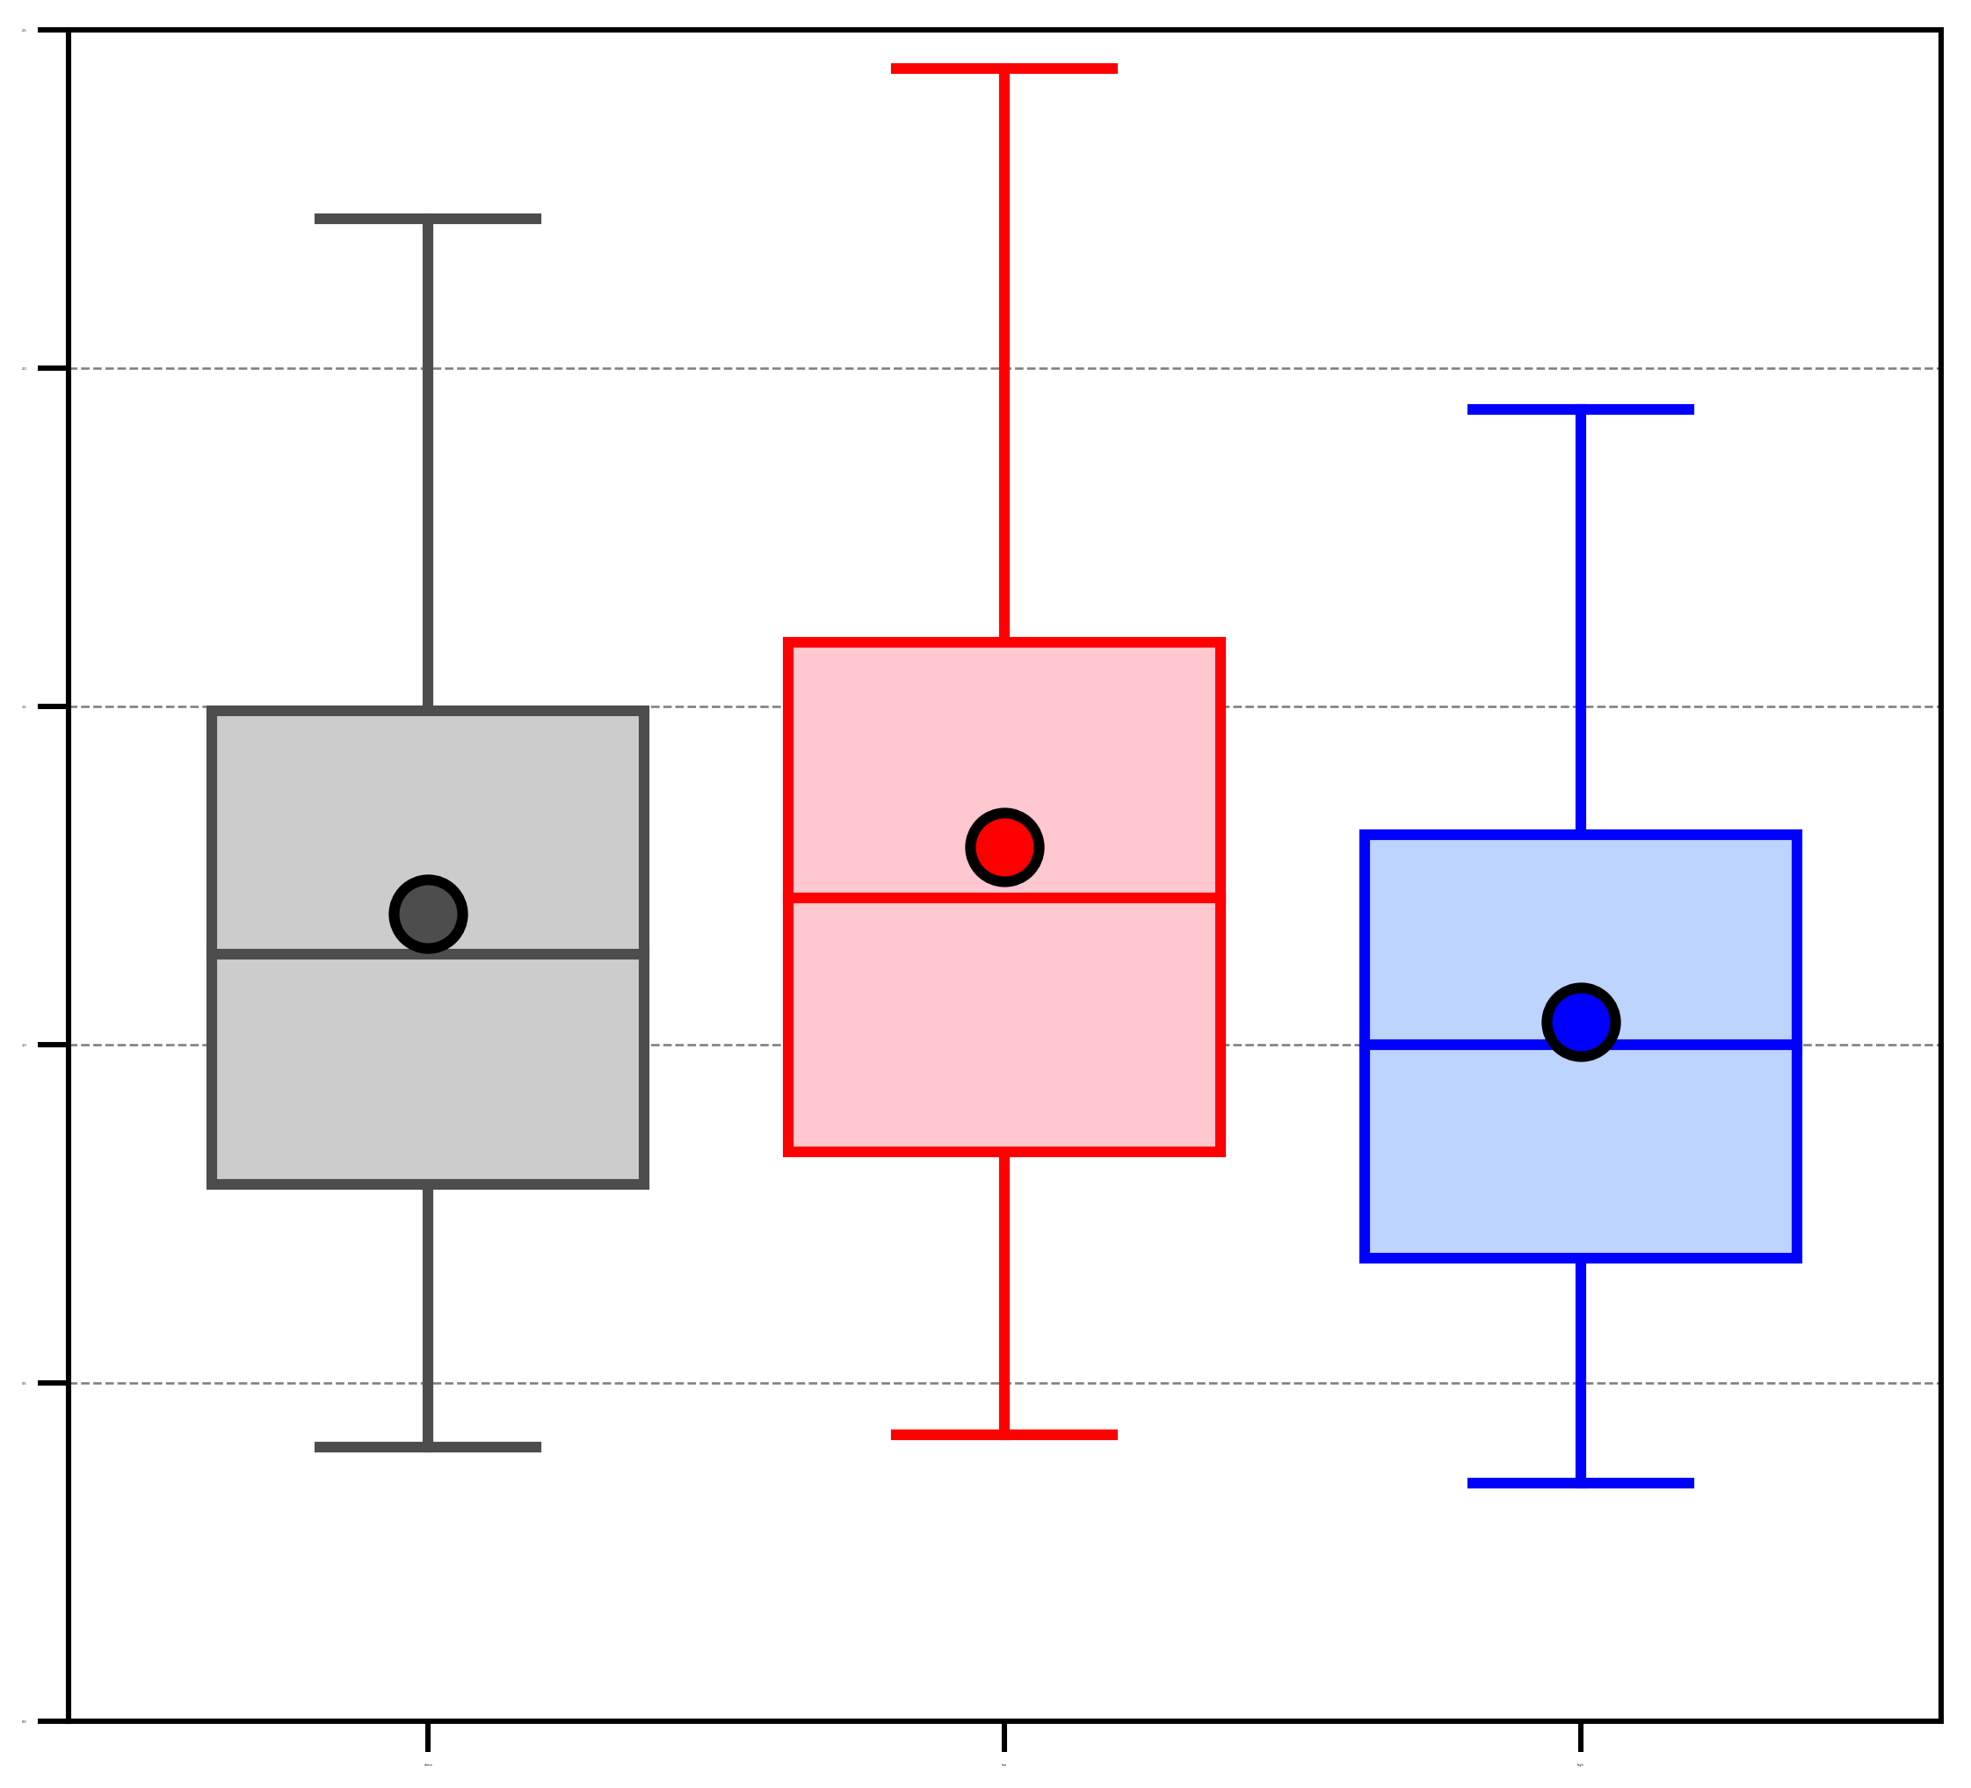
Highest Average Positive σ_{PW} Surrounding ACs
2.5
Highest value of average positive σ_{PW} within 1000 km of AC centers in the Arctic
2.0
1.5
95%
75%
median
1.0
25%
5%
mean
0.5
Differences in mean value between each category are statistically significant at 95% confidence level using bootstrap resampling
0.0
climo
(N=2549)
low
(N=676)
high
(N=606)

Slide 25
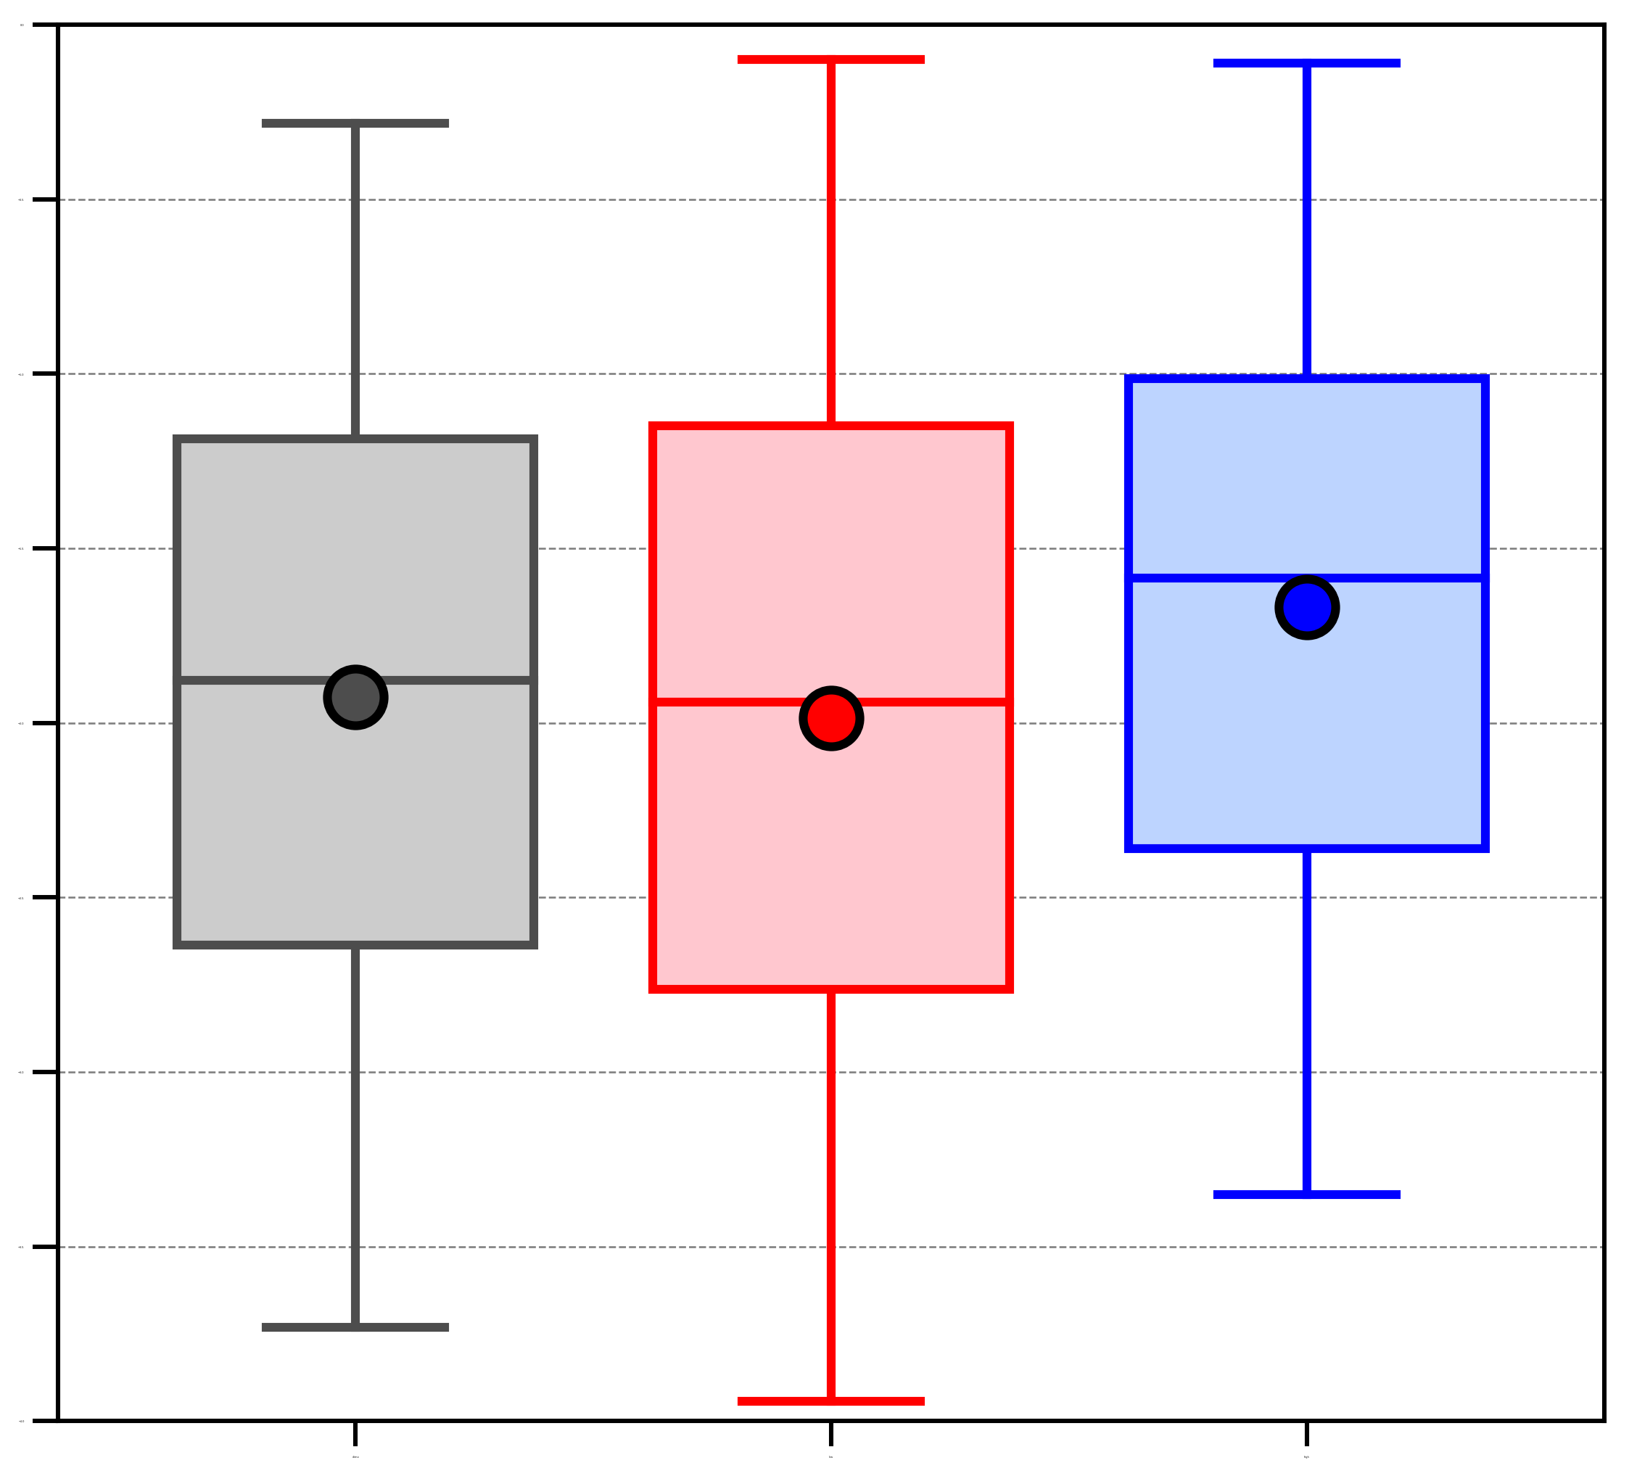
Maximum Intensity of ACs
0.0
Lowest standardized anomaly of SLP at AC center in Arctic
−0.5
−1.0
−1.5
95%
75%
−2.0
median
25%
−2.5
5%
−3.0
mean
−3.5
Differences in mean value between each category are statistically significant at 95% confidence level using bootstrap resampling, except between climatology and low skill
−4.0
climo
(N=2549)
low
(N=676)
high
(N=606)

Slide 26
Summary
AC frequency is higher for low skill periods compared to high skill periods
ACs during low skill periods occur more frequently over eastern Eurasia and much of the Arctic Ocean relative to ACs during high skill periods
ACs during high skill periods occur more frequently over the North Atlantic, Barents Seas, and western Eurasia relative to ACs during low skill periods
ACs during low skill periods tend to be embedded within a region of more amplified flow, tend to be associated with larger amounts of moisture, and tend to be stronger relative to ACs during high skill periods

Slide 27
References
Crawford, A., and M. Serreze, 2016: Does the summer Arctic frontal zone influence Arctic Ocean cyclone activity? J. Climate, 29, 4977–4993.
Dee, D. P., and Coauthors, 2011: The ERA-Interim reanalysis: Configuration and performance of the data assimilation system. Quart. J. Roy. Meteor. Soc., 137, 553–597.
Hamill, T. M., G. T. Bates, J. S. Whitaker, D. R. Murray, M. Fiorino, T. J. Galarneau Jr., Y. Zhu, and W. Lapenta, 2013: NOAA’s second-generation global medium-range ensemble reforecast dataset. Bull. Amer. Meteor. Soc., 94, 1553–1565.
Moore, B. J., 2017: Rossby wave breaking and widespread extreme precipitation events in the central and eastern U.S. Ph.D. dissertation, University at Albany, State University of New York, Albany, NY, 182 pp.
Sprenger, M., and Coauthors, 2017: Global climatologies of Eulerian and Lagrangian flow features based on ERA-Interim. Bull. Amer. Meteor. Soc., 98, 1739–1748.

