Slide 1
A Diagnosis of Factors Influencing the Forecast Skill of an Intense Arctic Cyclone during August 2016
Kevin A. Biernat, Lance F. Bosart, and Daniel Keyser
Department of Atmospheric and Environmental Sciences University at Albany, State University of New York
35th AMS Conference on Climate Variability and Change
Wednesday 26 January 2022
Research supported by ONR Grant N00014-18-1-2200

Slide 2
Motivation
Arctic cyclones (ACs) are extratropical cyclones that may originate within the Arctic or move into the Arctic from lower latitudes (e.g., Zhang et al. 2004; Crawford and Serreze 2016).
ACs may be associated with strong surface winds and high waves (e.g., Zhang et al. 2013; Thomson and Rogers 2014), and may contribute to rapid sea ice loss (e.g., Asplin et al. 2012; Stern et al. 2020).
There have been a limited number of studies that have examined features and processes influencing the forecast skill of ACs (e.g., Tao et al. 2017; Yamagami et al. 2018; Johnson and Wang 2021).

Slide 3
Purpose
Determine features and processes influencing the forecast skill of a strong low-skill AC occurring during August 2016 (AC16).
AC16 attained a minimum sea level pressure (SLP) of 962.5 hPa in ERA5 (Hersbach et al. 2020) and is characterized by low forecast skill of intensity.
AC16 contributed to rapid sea ice loss (Peng et al. 2021).

Slide 4
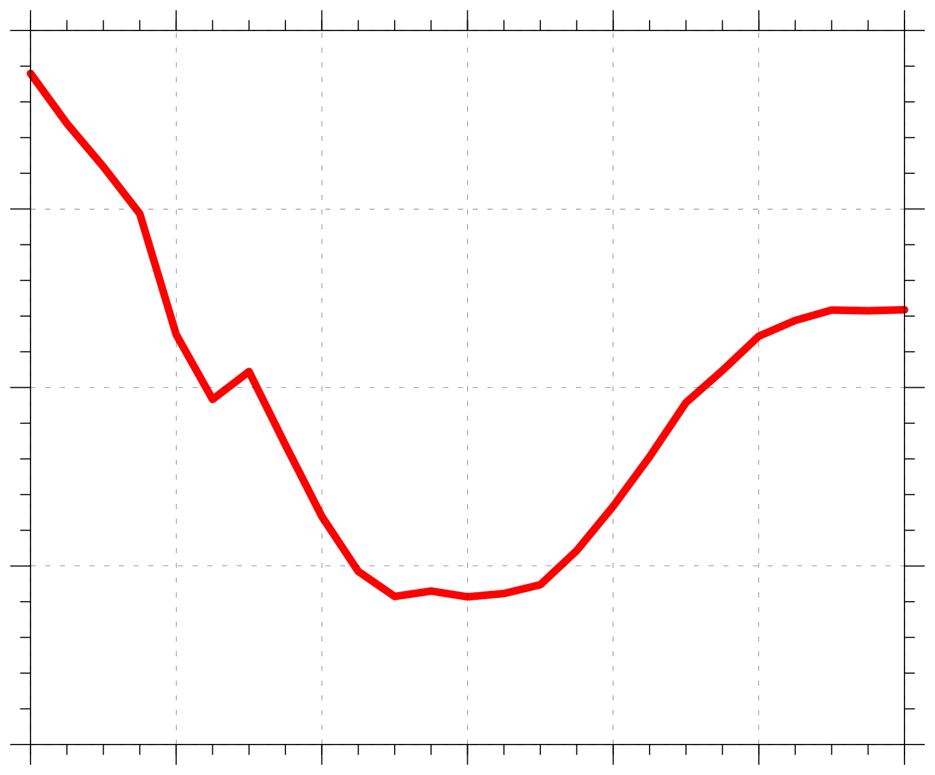
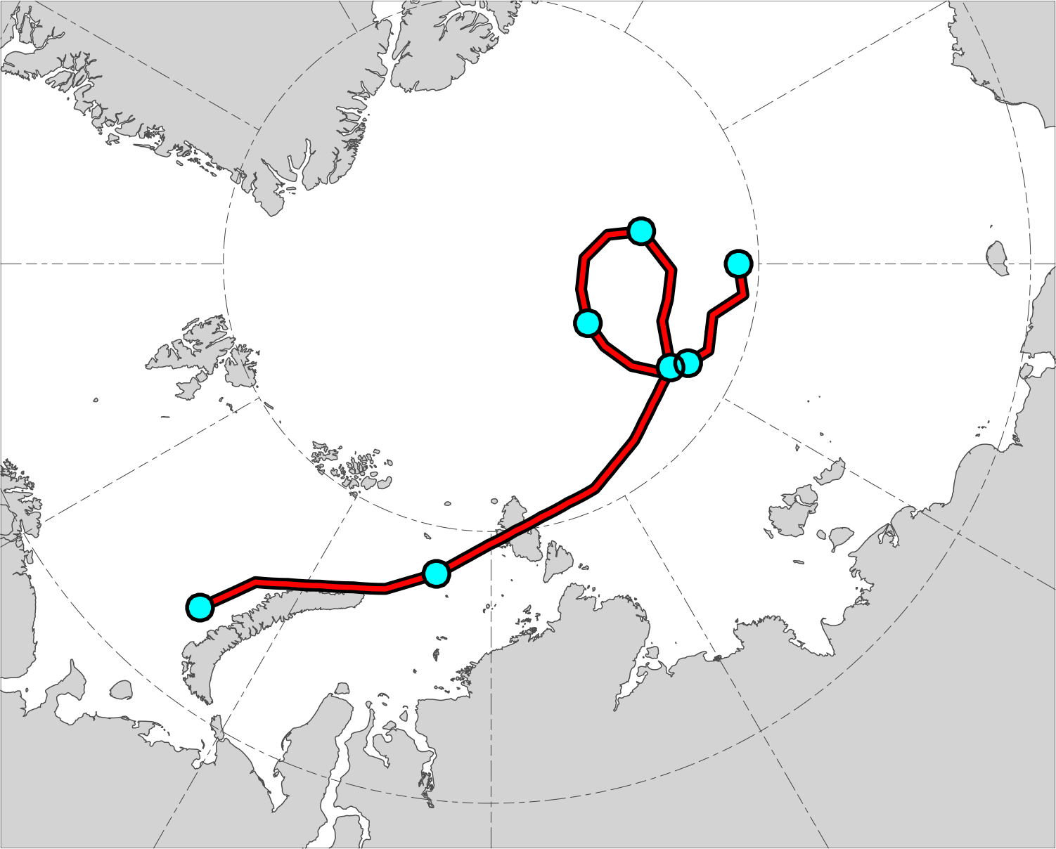
AC16 track and intensity
(a)
1000
(b)
16
19
990
17
18
980
Minimum SLP (hPa)
14
15
13
970
960
0000 UTC positions of AC16
13
14
15
16
17
18
19
Day in August 2016 labeled at 0000 UTC
Red line shows track of AC16 during 13–19 Aug 2016. Numbers represent dates of 0000 UTC positions for AC16.
Time series of minimum SLP (hPa) for AC16 during 13–19 Aug 2016.
Data source: ERA5

Slide 5
Data and methods
Use ensemble forecasts from the 51-member ECMWF ensemble prediction system extracted from The Observing System Research and Predictability Experiment (THORPEX) Interactive Grand Global Ensemble (TIGGE) (Bougeault et al. 2010).
Use ensemble forecasts initialized at 0000 UTC 10 August and verifying at 0000 UTC 15 August (120 h).
Use ERA5 as verification.

Slide 6
Data and methods
Track AC16 in the ensemble forecasts by utilizing an objective SLP-based cyclone tracking algorithm developed by Crawford et al. (2021).
Adapt methodology of Korfe and Colle (2018) to identify the AC that matches AC16 in each ensemble forecast.
If no AC is identified to match AC16 in an ensemble forecast, AC16 is manually identified and tracked in the ensemble forecast.

Slide 7
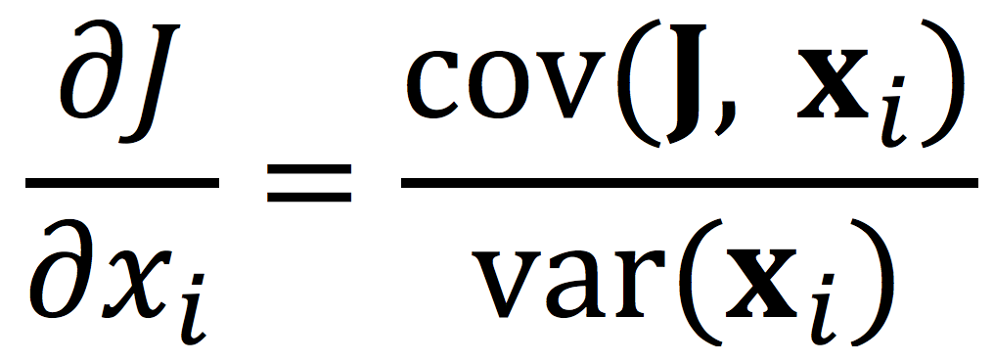
Data and methods
Utilize ensemble-based sensitivity analysis (ESA) technique (e.g., Torn and Hakim 2008) to examine the sensitivity of the forecast skill of intensity and position of AC16 to selected dynamic and thermodynamic quantities at earlier forecast lead times.
Calculate the sensitivity of a forecast metric of interest J to a model state variable x_{i} at an earlier forecast lead time for an ensemble of size M via
J and x_{i} denote the 1 × M ensemble estimates of the forecast metric and ith model state variable, respectively, cov denotes the covariance, and var denotes the variance (e.g., Torn and Hakim 2008).

Slide 8
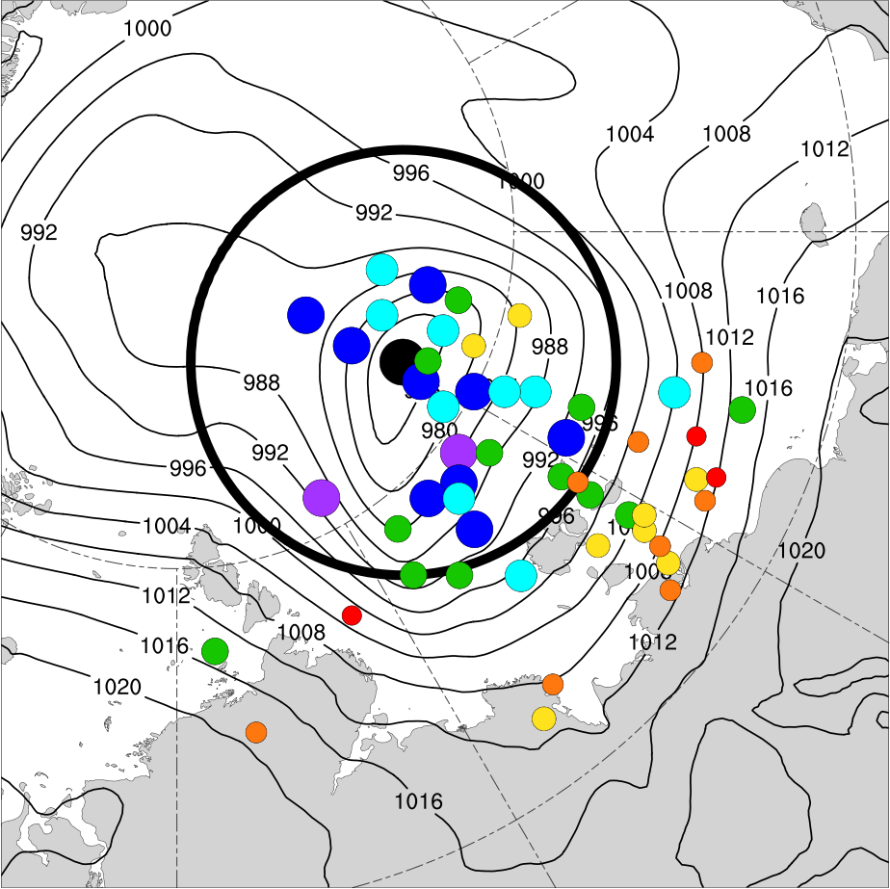
Data and methods
0000 UTC 15 Aug (120 h)
ERA5 SLP (hPa)
SLP within a 700-km radius circle surrounding the ERA5 position of AC16 at 0000 UTC 15 August (120 h) correlates relatively well with the intensity error and position error of AC16 at this time (not shown).
Use average SLP within the 700-km radius circle surrounding the ERA5 position of AC16 at 0000 UTC 15 August (120 h) as the forecast metric, which is hereafter referred to as J_{AC}.
ERA5 min SLP (972.8 hPa)
Ensemble member min SLP (hPa):
< 970
970–975
975–980
980–985
985–990
990–995
≥ 995
700-km radius circle surrounding ERA5 location of AC16.

Slide 9
Interpreting sensitivity values
All sensitivity values are multiplied by −1, such that a more accurate prediction of the intensity and position of AC16 at 0000 UTC 15 August (120 h) is associated with an increase in the value of the quantity for positive sensitivity values and with a decrease in the value of the quantity for negative sensitivity values.

Slide 10
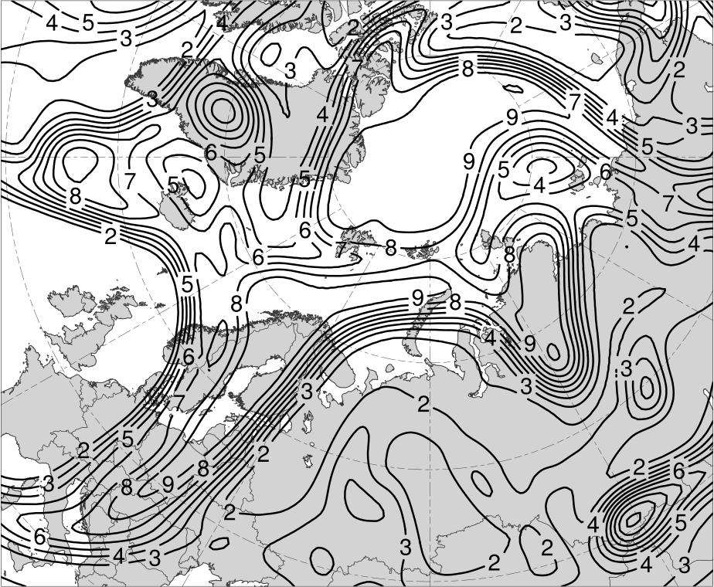
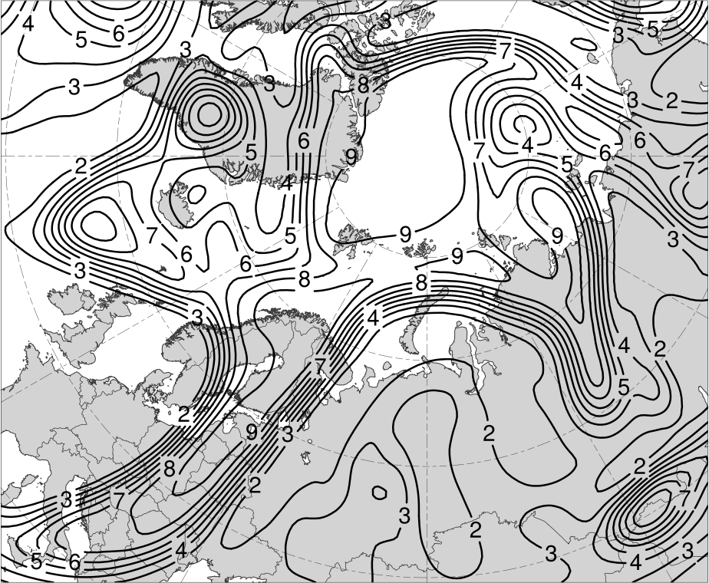
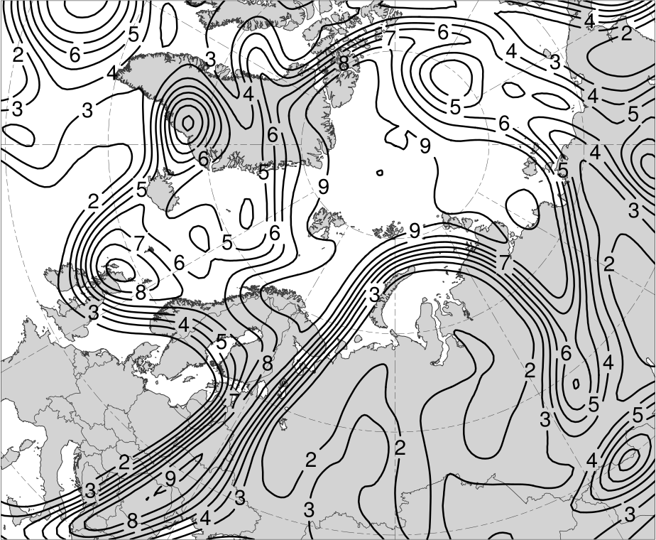
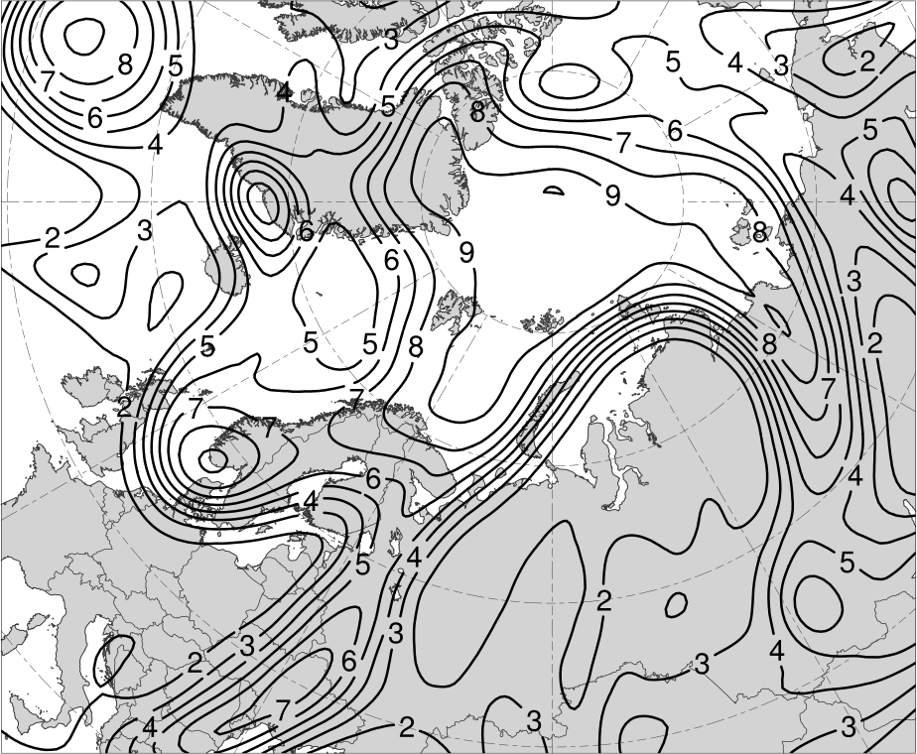
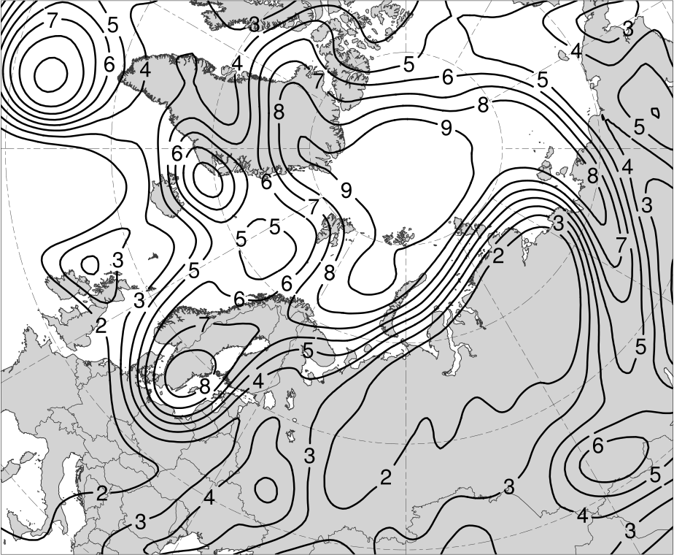
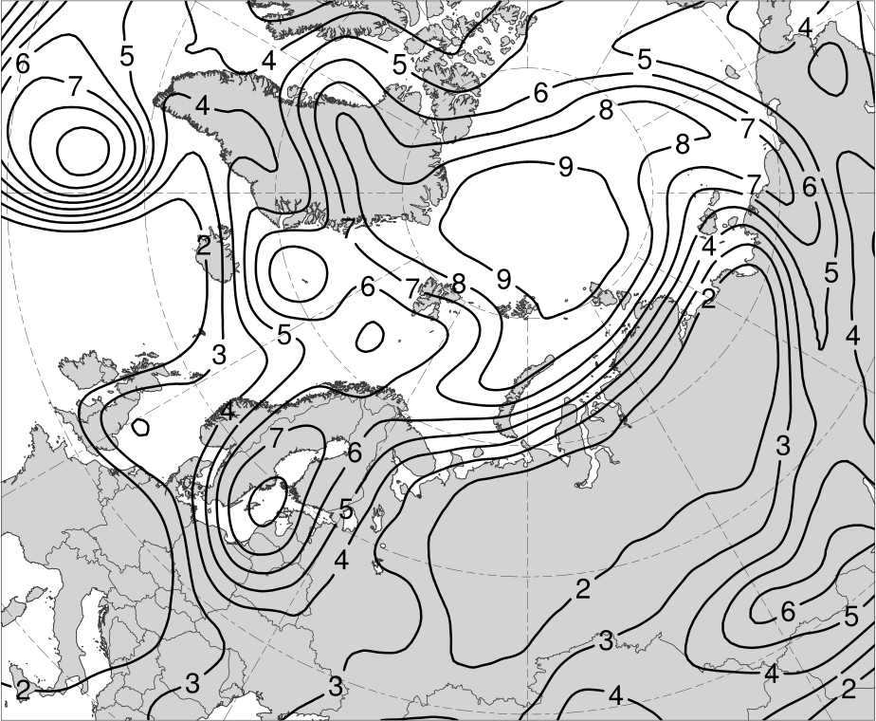
(a) 0000 UTC 12 Aug (48 h)
(b) 1200 UTC 12 Aug (60 h)
(c) 0000 UTC 13 Aug (72 h)
(d) 1200 UTC 13 Aug (84 h)
(e) 0000 UTC 14 Aug (96 h)
(f) 1200 UTC 14 Aug (108 h)
Ensemble mean 200-km area-averaged 250-hPa potential vorticity (PV; PVU)

Slide 11
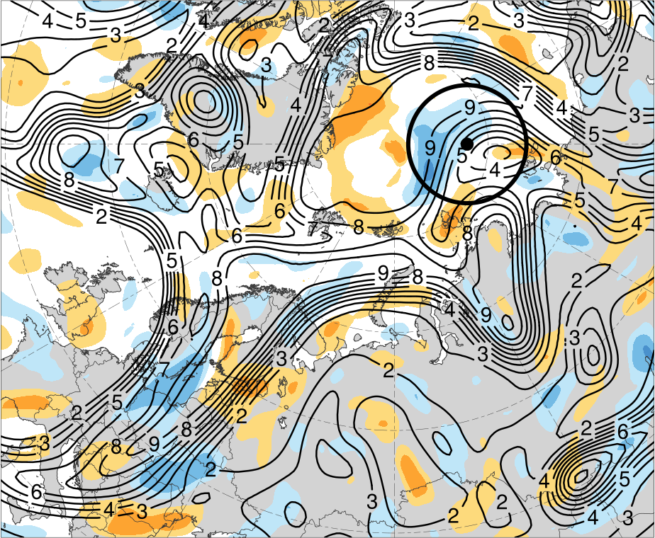
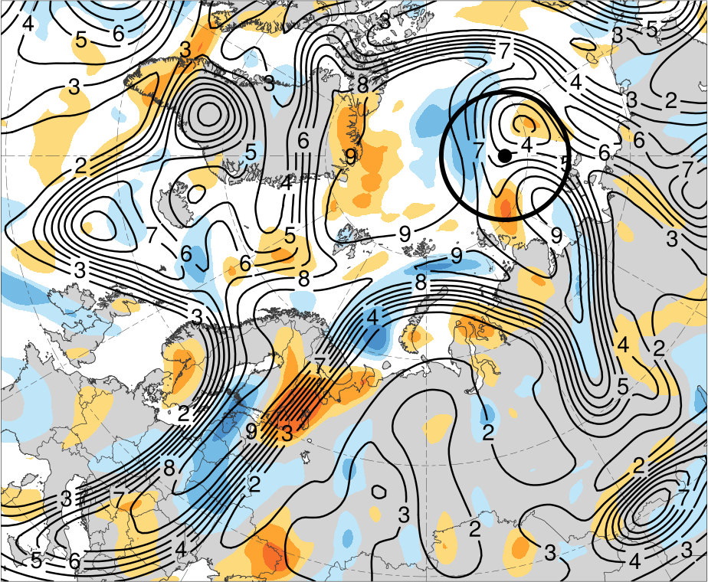
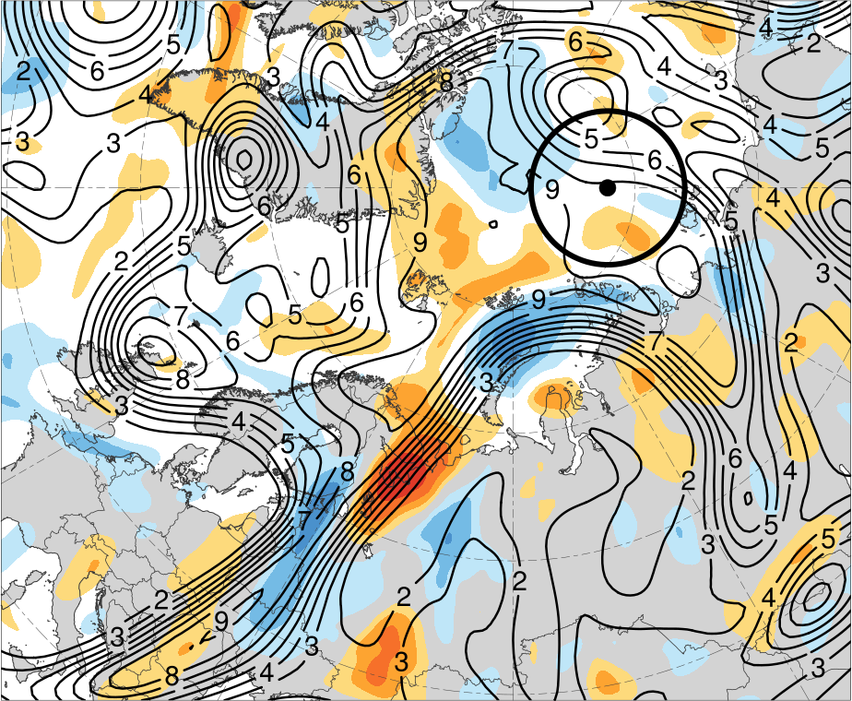
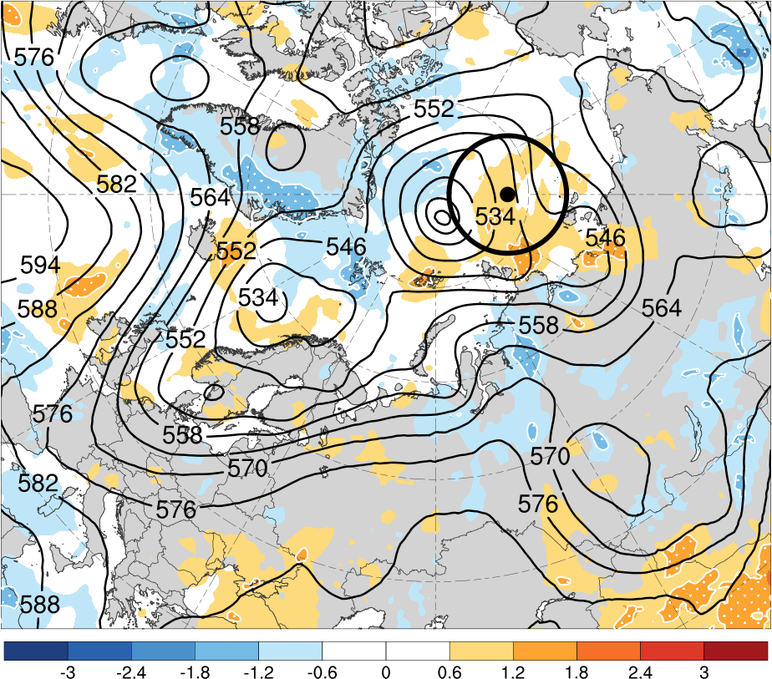
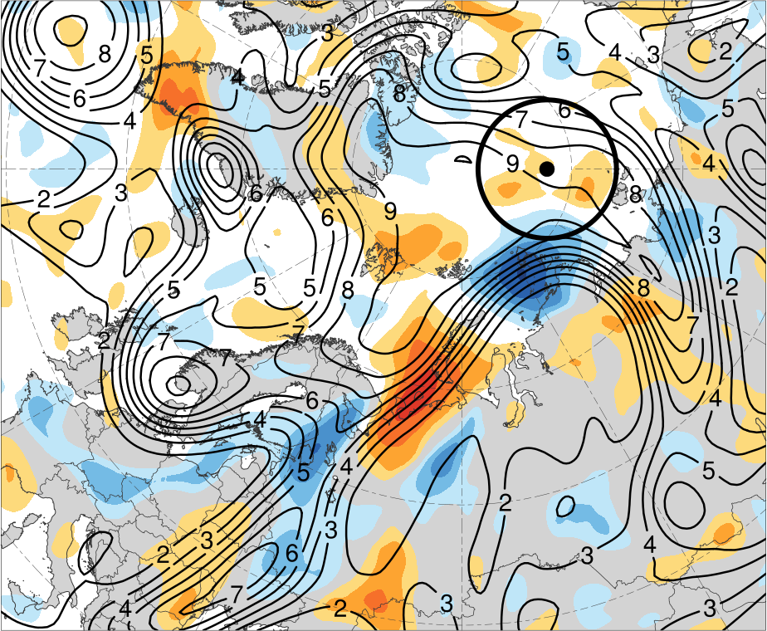
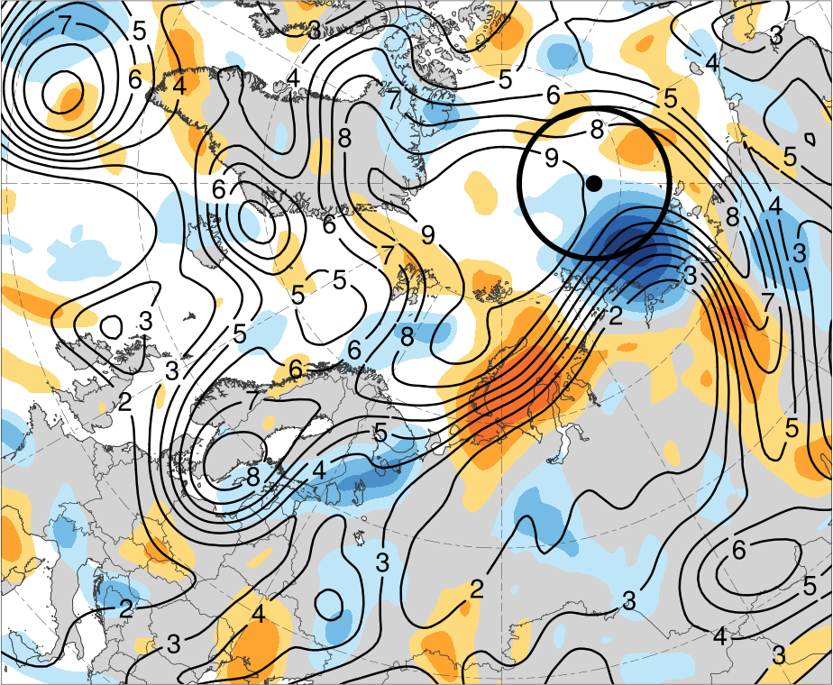
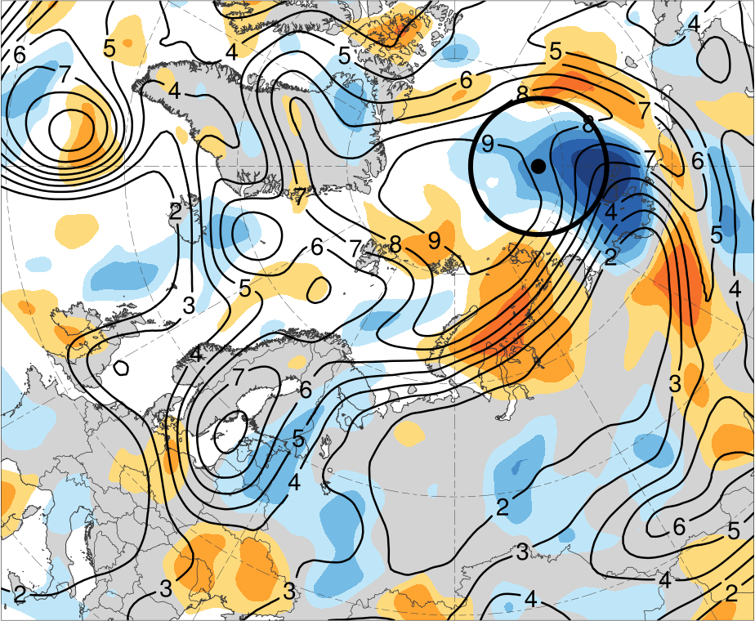
(a) 0000 UTC 12 Aug (48 h)
(b) 1200 UTC 12 Aug (60 h)
(c) 0000 UTC 13 Aug (72 h)
3.0
2.4
1.8
1.2
0.6
0
(d) 1200 UTC 13 Aug (84 h)
(e) 0000 UTC 14 Aug (96 h)
(f) 1200 UTC 14 Aug (108 h)
−0.6
−1.2
−1.8
−2.4
−3
(hPa)
Ensemble mean 200-km area-averaged 250-hPa potential vorticity (PV; PVU)
Shading: Sensitivity of J_{AC} to 200-km area-averaged 250-hPa PV (hPa)

Slide 12
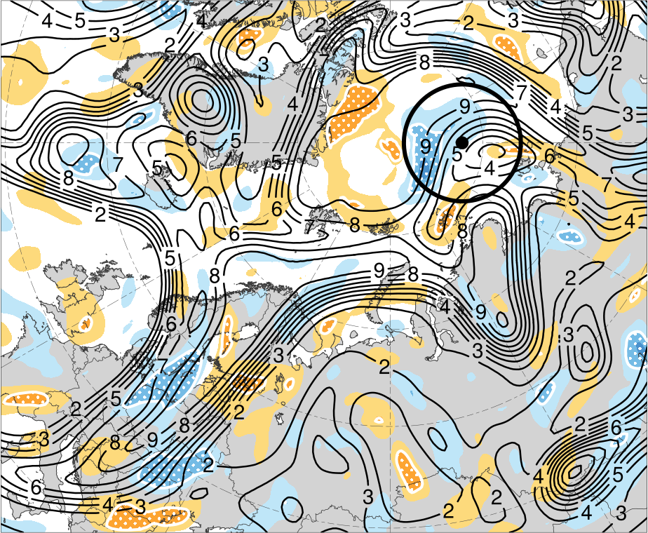
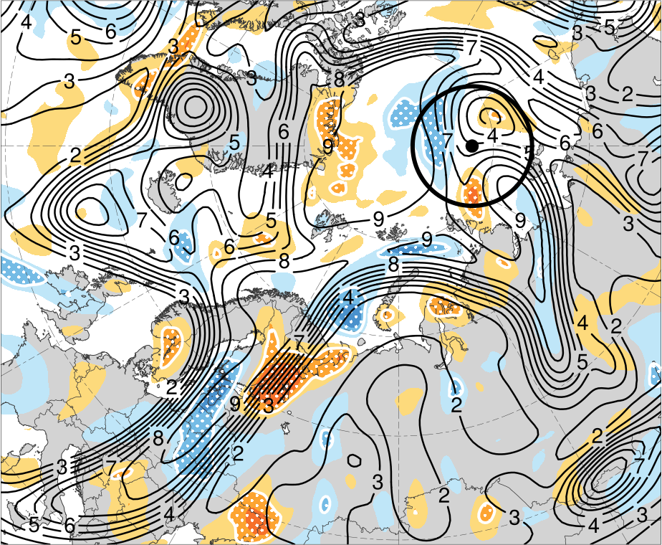
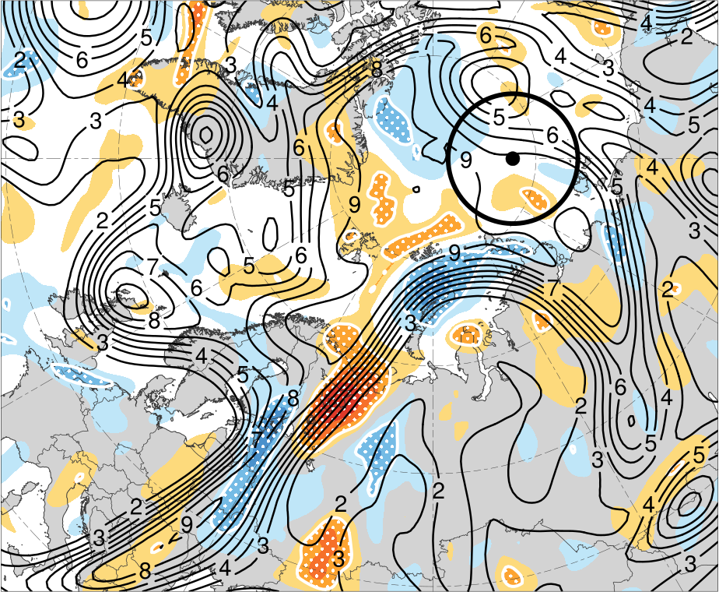
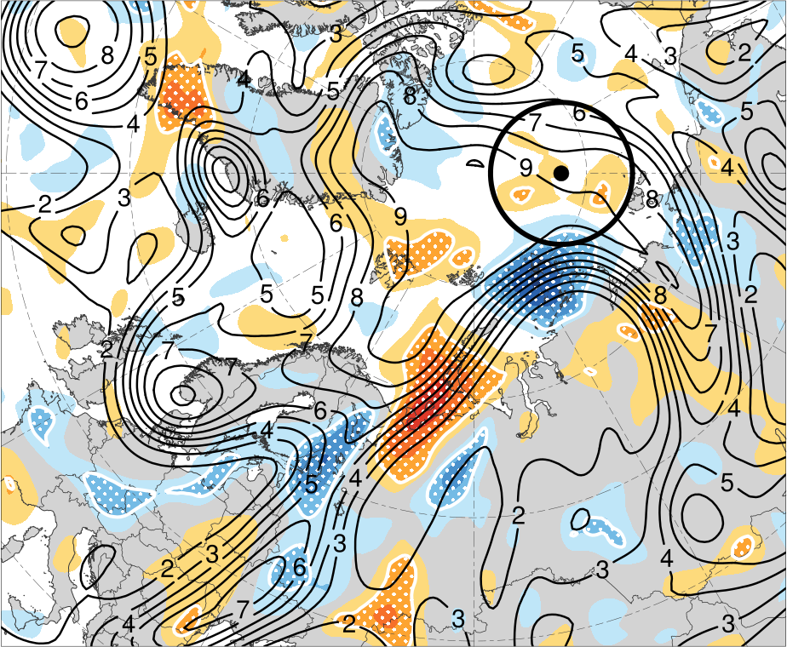
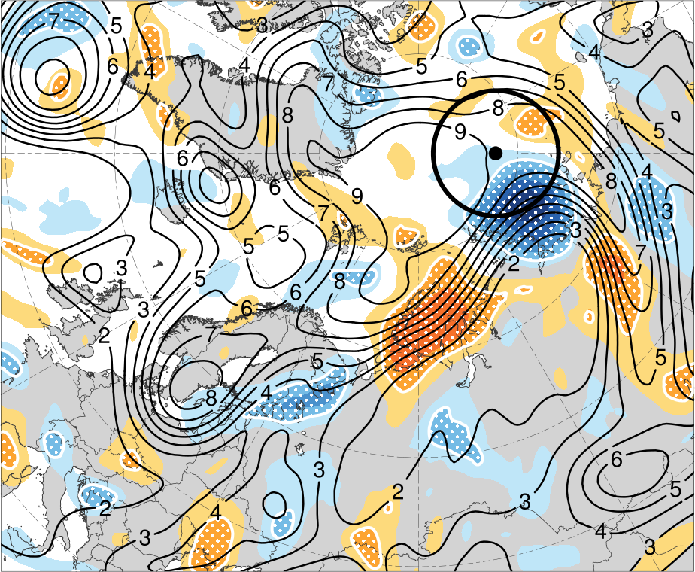
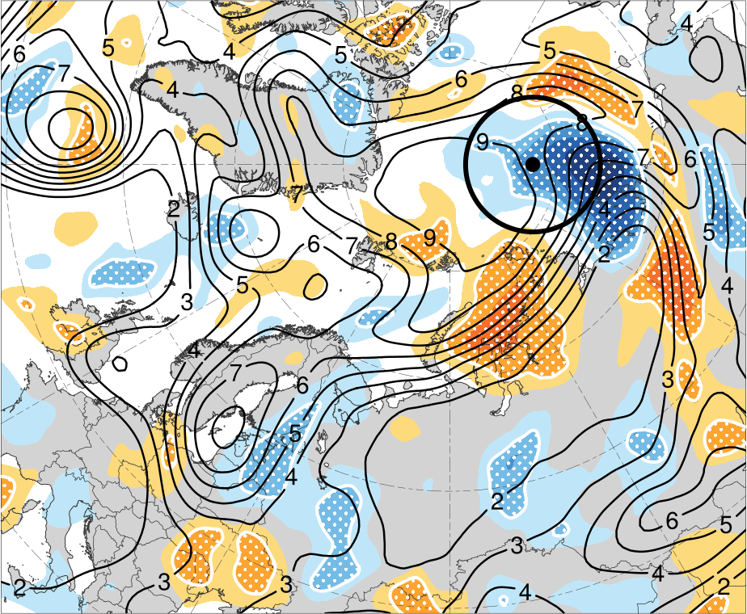
(a) 0000 UTC 12 Aug (48 h)
(b) 1200 UTC 12 Aug (60 h)
(c) 0000 UTC 13 Aug (72 h)
3.0
2.4
1.8
1.2
0.6
0
(d) 1200 UTC 13 Aug (84 h)
(e) 0000 UTC 14 Aug (96 h)
(f) 1200 UTC 14 Aug (108 h)
−0.6
−1.2
−1.8
−2.4
−3
(hPa)
Ensemble mean 200-km area-averaged 250-hPa potential vorticity (PV; PVU)
Shading: Sensitivity of J_{AC} to 200-km area-averaged 250-hPa PV (hPa)
White stippling: Sensitivity is statistically significant at 95% confidence level

Slide 13
(a) 0000 UTC 12 Aug (48 h)
(b) 1200 UTC 12 Aug (60 h)
(c) 0000 UTC 13 Aug (72 h)
3.0
2.4
T1
T1
T1
R1
R2
1.8
R1
R2
R2
R1
1.2
0.6
0
(d) 1200 UTC 13 Aug (84 h)
(e) 0000 UTC 14 Aug (96 h)
(f) 1200 UTC 14 Aug (108 h)
−0.6
−1.2
T1
T1
R2
T1
R2
−1.8
R2
−2.4
R1
−3
(hPa)
Ensemble mean 200-km area-averaged 250-hPa potential vorticity (PV; PVU)
Shading: Sensitivity of J_{AC} to 200-km area-averaged 250-hPa PV (hPa)
White stippling: Sensitivity is statistically significant at 95% confidence level

Slide 14
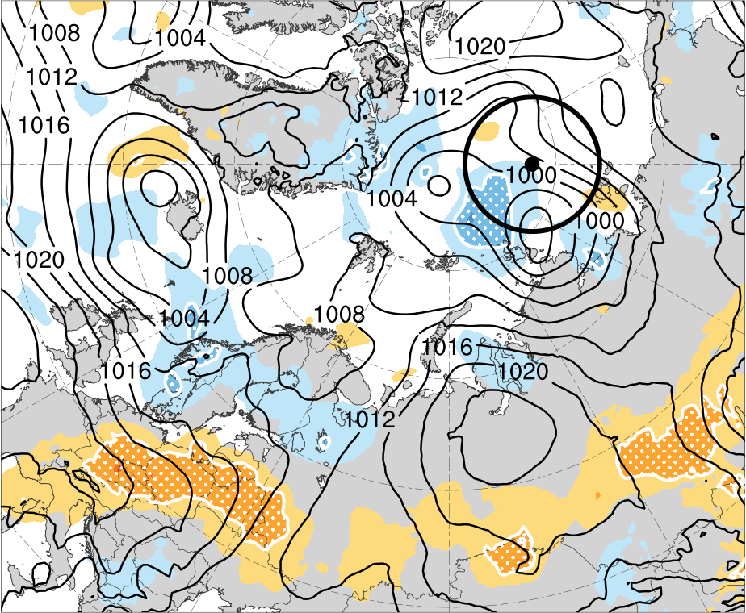
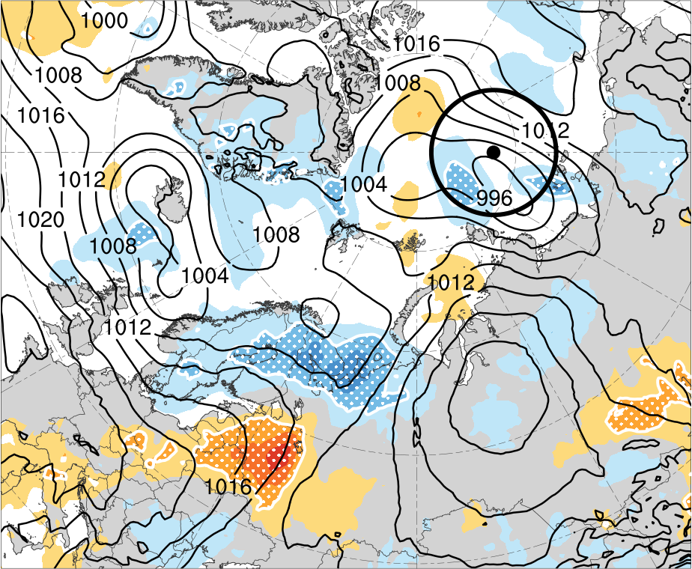
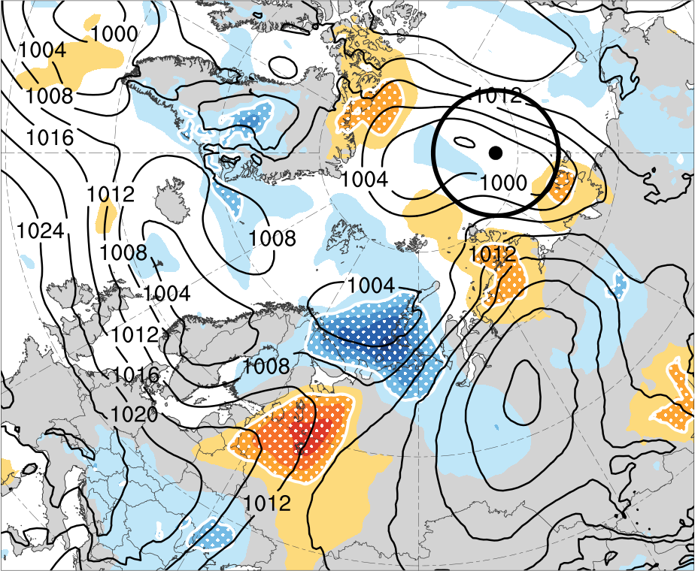
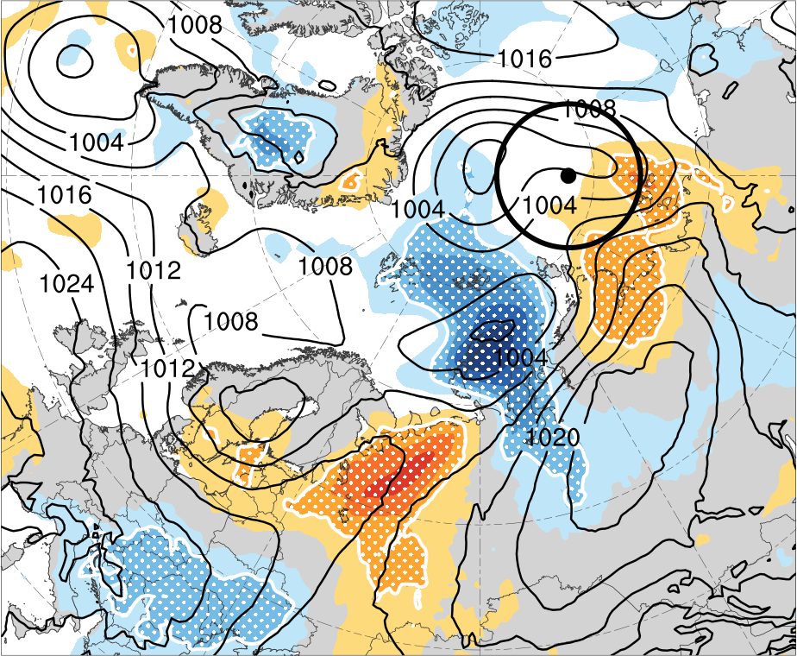
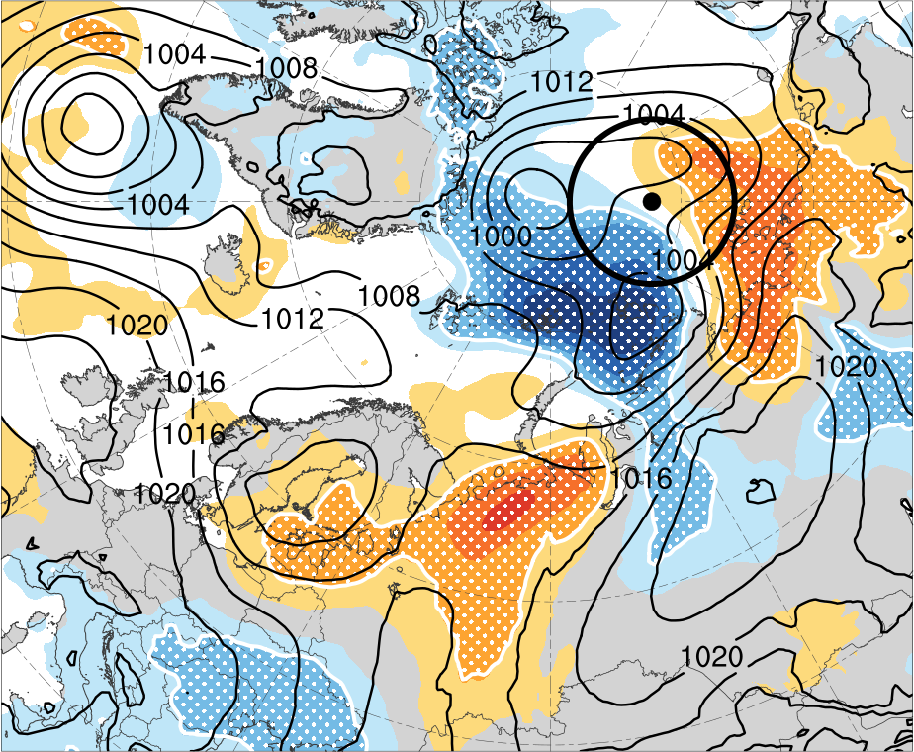
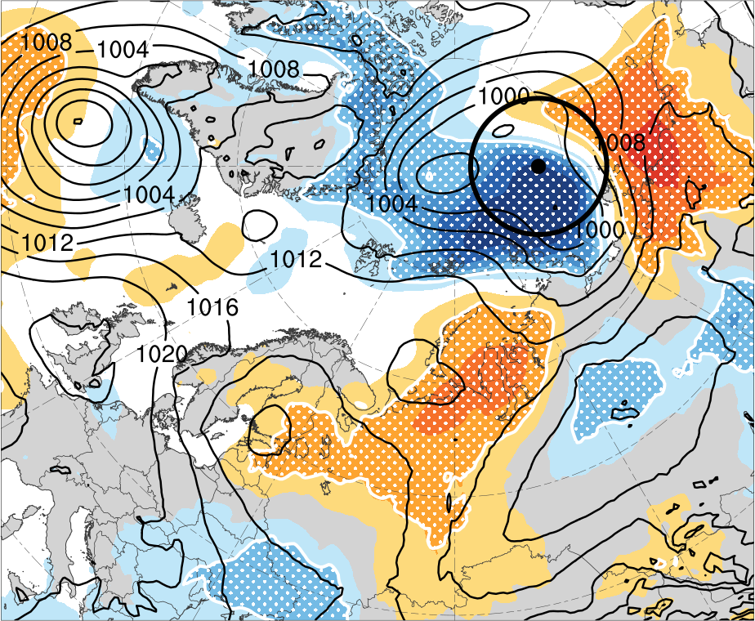
(a) 0000 UTC 12 Aug (48 h)
(b) 1200 UTC 12 Aug (60 h)
(c) 0000 UTC 13 Aug (72 h)
3.0
2.4
1.8
1.2
0.6
0
(d) 1200 UTC 13 Aug (84 h)
(e) 0000 UTC 14 Aug (96 h)
(f) 1200 UTC 14 Aug (108 h)
−0.6
−1.2
−1.8
−2.4
−3
(hPa)
Ensemble mean SLP (hPa)
Shading: Sensitivity of J_{AC} to SLP (hPa)
White stippling: Sensitivity is statistically significant at 95% confidence level

Slide 15
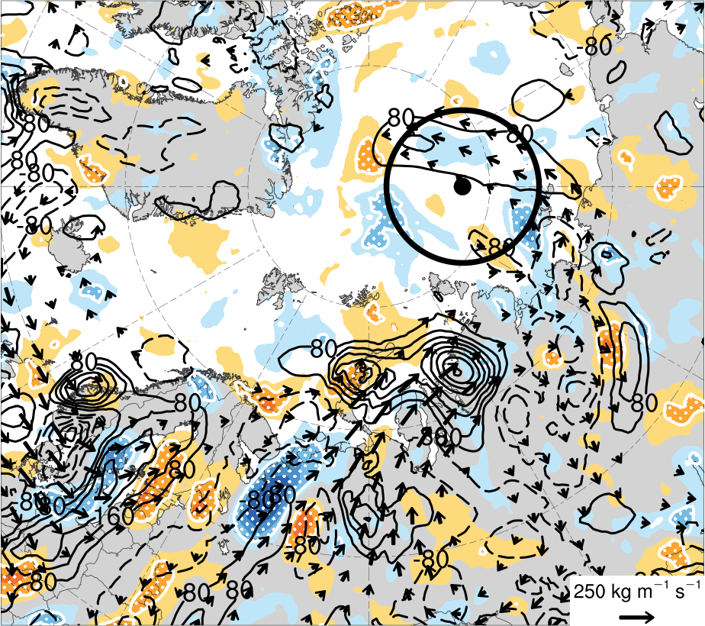
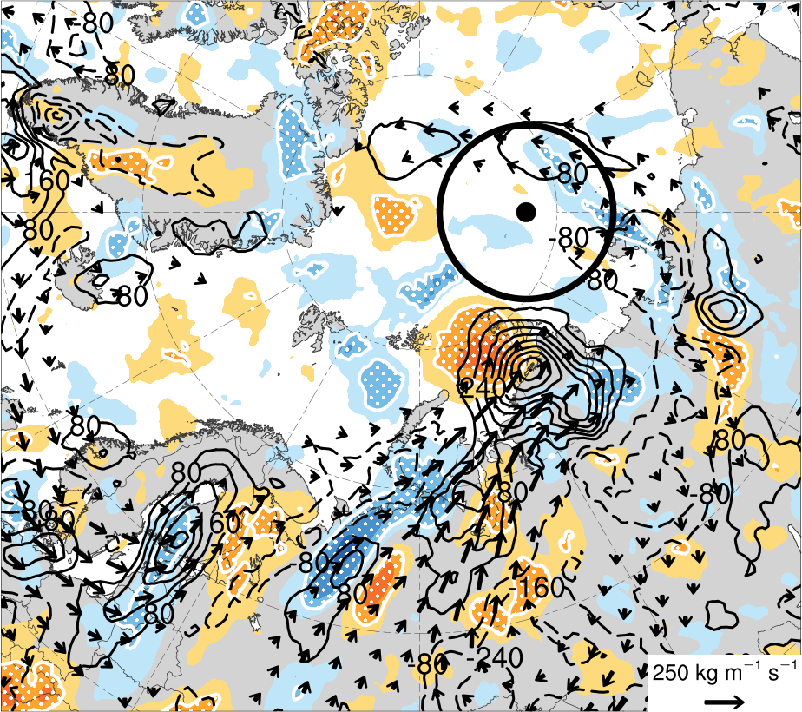
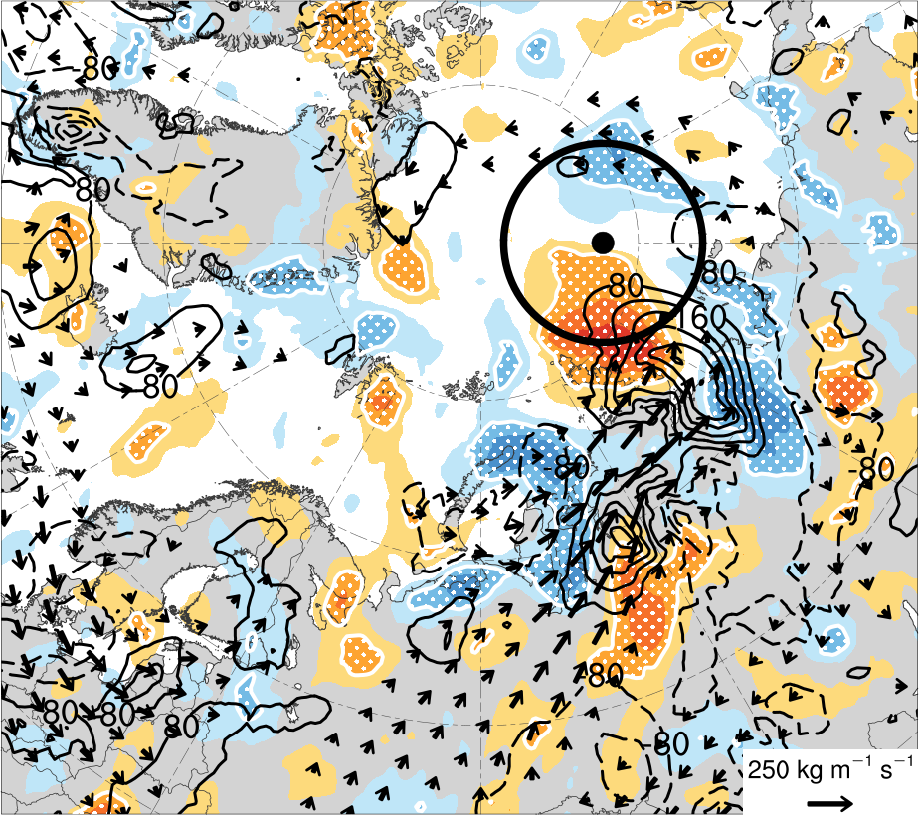
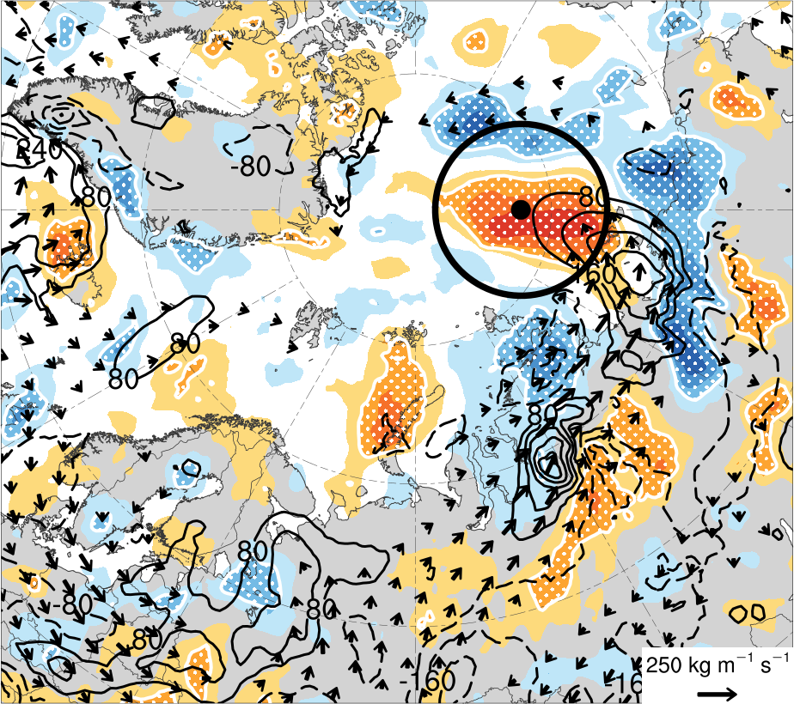
(a) 0000 UTC 13 Aug (72 h)
(b) 1200 UTC 13 Aug (84 h)
Ensemble mean 200-km area-averaged 1000–850-hPa integrated moisture flux convergence (IMFC; every 80 W m⁻²)
3.0
2.4
1.8
1.2
Ensemble mean 1000–850-hPa integrated water vapor transport (kg m⁻¹ s⁻¹)
0.6
(c) 0000 UTC 14 Aug (96 h)
(d) 1200 UTC 14 Aug (108 h)
0
−0.6
Shading: Sensitivity of J_{AC} to 200-km area-averaged 1000–850-hPa IMFC (hPa)
−1.2
−1.8
−2.4
White stippling: Sensitivity is statistically significant at 95% confidence level
−3
(hPa)

Slide 16
Summary
The ESA of AC16 suggests that the forecast skill of AC16 is sensitive to the amplitude and strength of an upper-tropospheric trough, and to the strength of an embedded tropopause polar vortex (TPV), upstream of AC16.
It is speculated from the ESA of AC16 that a more amplified and stronger upper-tropospheric trough, and a stronger embedded TPV, upstream of AC16 are associated with greater downstream upper-tropospheric flow amplification and greater intensification of AC16.
It is also speculated from the ESA of AC16 that the position of a region of latent heating associated with AC16 may matter more to the forecast skill of AC16 than the magnitude of latent heating.

Slide 17
References
Asplin, M. G., R. Galley, D. G. Barber, and S. Prinsenberg, 2012: Fracture of summer perennial sea ice by ocean swell as a result of Arctic storms. J. Geophys. Res., 117, C06025.
Bougeault, P., and Coauthors, 2010: The THORPEX Interactive Grand Global Ensemble. Bull. Amer. Meteor. Soc., 91, 1059–1072.
Crawford, A. D., and M. C. Serreze, 2016: Does the summer Arctic frontal zone influence Arctic Ocean cyclone activity? J. Climate, 29, 4977–4993.
Crawford, A. D., E. A. P. Schreiber, N. Sommer, M. C. Serreze, J. C. Stroeve, and D. G. Barber, 2021: Sensitivity of Northern Hemisphere cyclone detection and tracking results to fine spatial and temporal resolution using ERA5. Mon. Wea. Rev., 149, 2581–2598.
Hersbach, H., and Coauthors, 2020: The ERA5 global reanalysis. Quart. J. Roy. Meteor. Soc., 146, 1999–2049.
Johnson, A., and X. Wang, 2021: Observation impact study of an Arctic cyclone associated with a tropopause polar vortex (TPV)-induced Rossby wave initiation event. Mon. Wea. Rev., 149, 1577–1591.
Korfe, N. G., and B. A. Colle, 2018: Evaluation of cool-season extratropical cyclones in a multimodel ensemble for eastern North America and the Western Atlantic Ocean. Wea. Forecasting, 33, 109–127.

Slide 18
References
Peng, L., X. Zhang, J.-H. Kim, K.-H. Cho, B.-M. Kim, Z. Wang, and H. Tang, 2021: Role of intense Arctic storm in accelerating summer sea ice melt: An in situ observational study. Geophys. Res. Lett., 48, e2021GL092714.
Stern, D. P, J. D. Doyle, N. P. Barton, P. M. Finocchio, W. A. Komaromi, and E. J. Metzger, 2020: The impact of an intense cyclone on short-term sea ice loss in a fully coupled atmosphere-ocean-ice model. Geophys. Res. Lett., 47, e2019GL085580.
Tao, W., J. Zhang, Y. Fu, and X. Zhang, 2017: Driving roles of tropospheric and stratospheric thermal anomalies in intensification and persistence of the Arctic superstorm in 2012. Geophys. Res. Lett., 44, 10017–10025.
Thomson, J., and W. E. Rogers, 2014: Swell and sea in the emerging Arctic Ocean. Geophys. Res. Lett., 41, 3136–3140.
Torn, R. D., and G. J. Hakim, 2008: Ensemble-based sensitivity analysis. Mon. Wea. Rev., 136, 663–677.
Yamagami, A., M. Matsueda, and H. L. Tanaka, 2018: Predictability of the 2012 great Arctic cyclone on medium-range timescales. Polar Sci., 15, 13–23.
Zhang, X., J. E. Walsh, J. Zhang, U. S. Bhatt, and M. Ikeda, 2004: Climatology and interannual variability of Arctic cyclone activity: 1948–2002. J. Climate, 17, 2300–2317.
Zhang, J., R. Lindsay, A. Schweiger, and M. Steele, 2013: The impact of an intense summer cyclone on 2012 Arctic sea ice retreat. Geophys. Res. Lett., 40, 720–726.

