Slide 1
Cross Sections

Slide 2
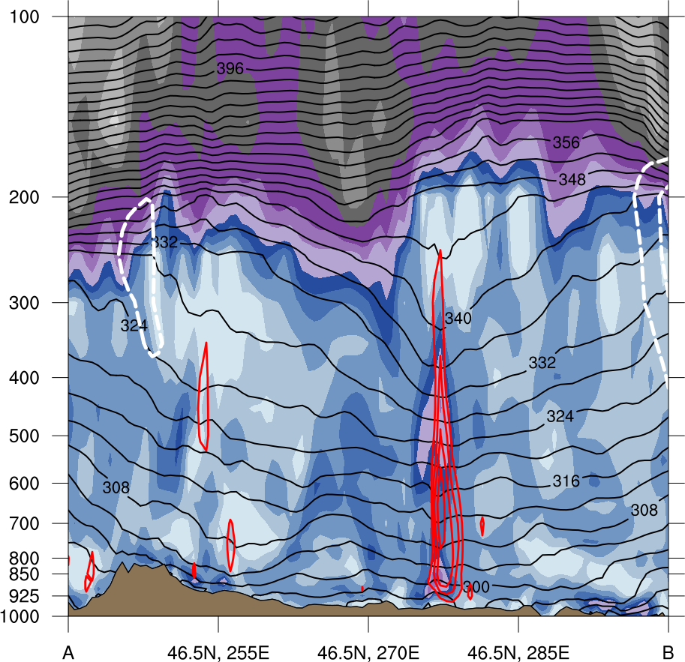
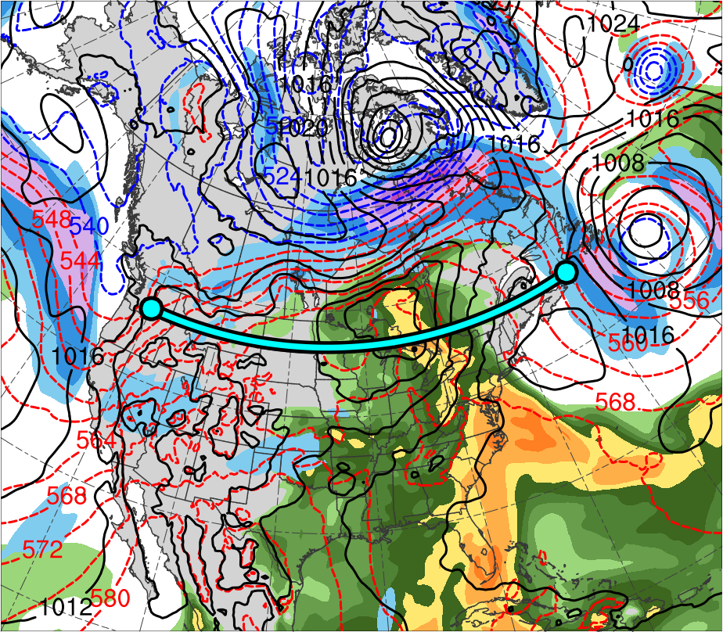
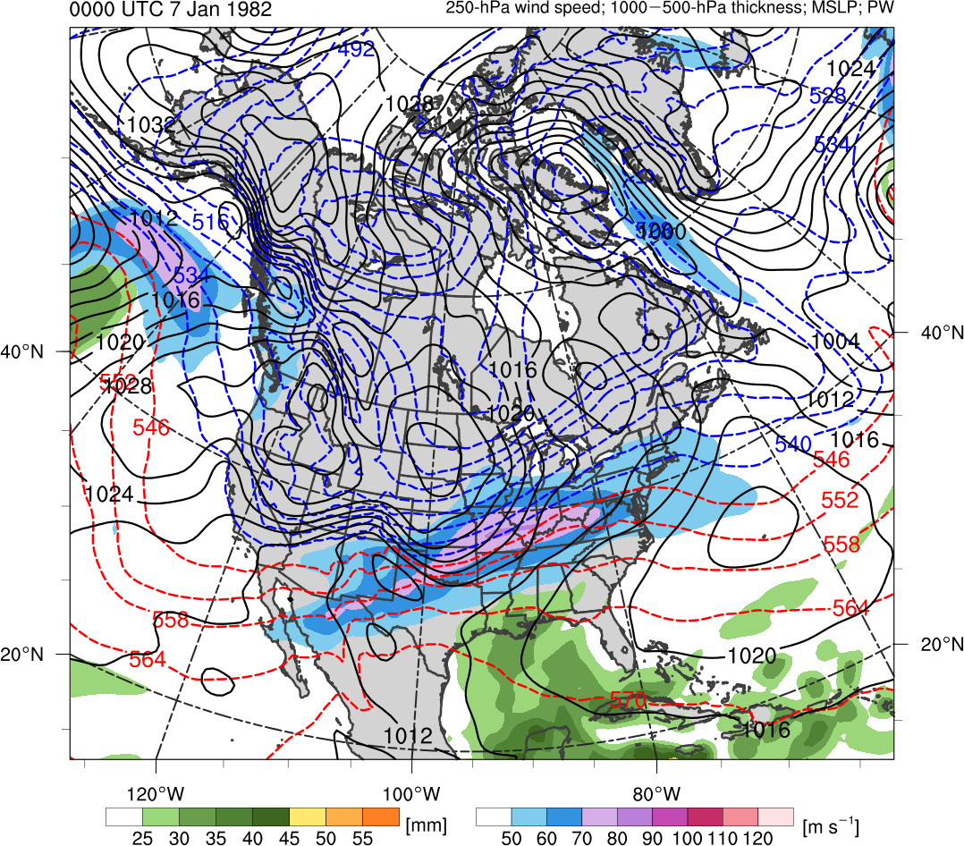
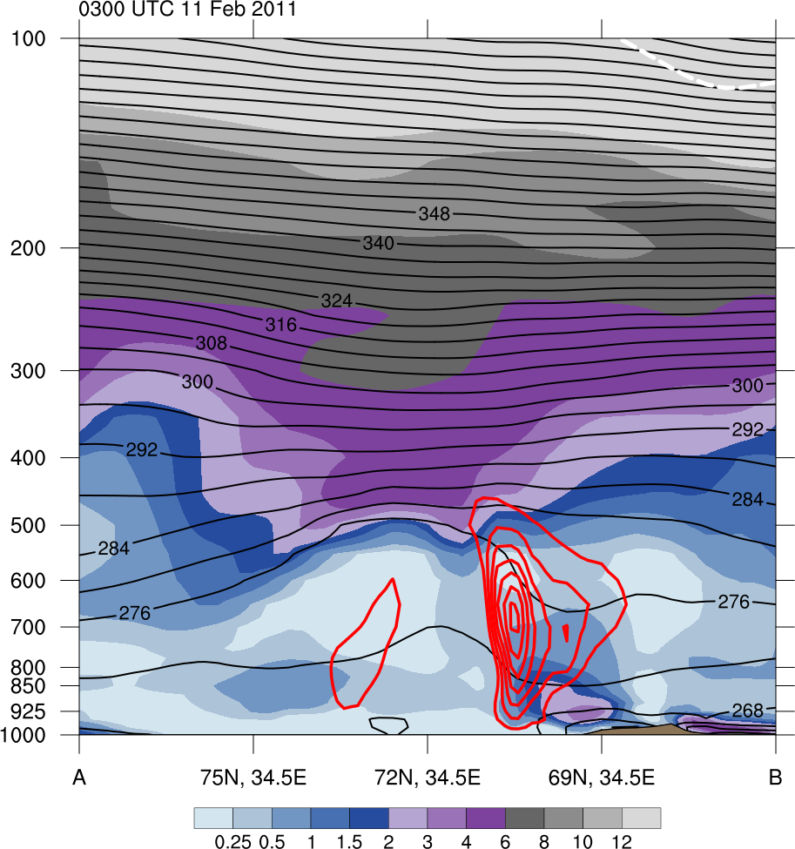
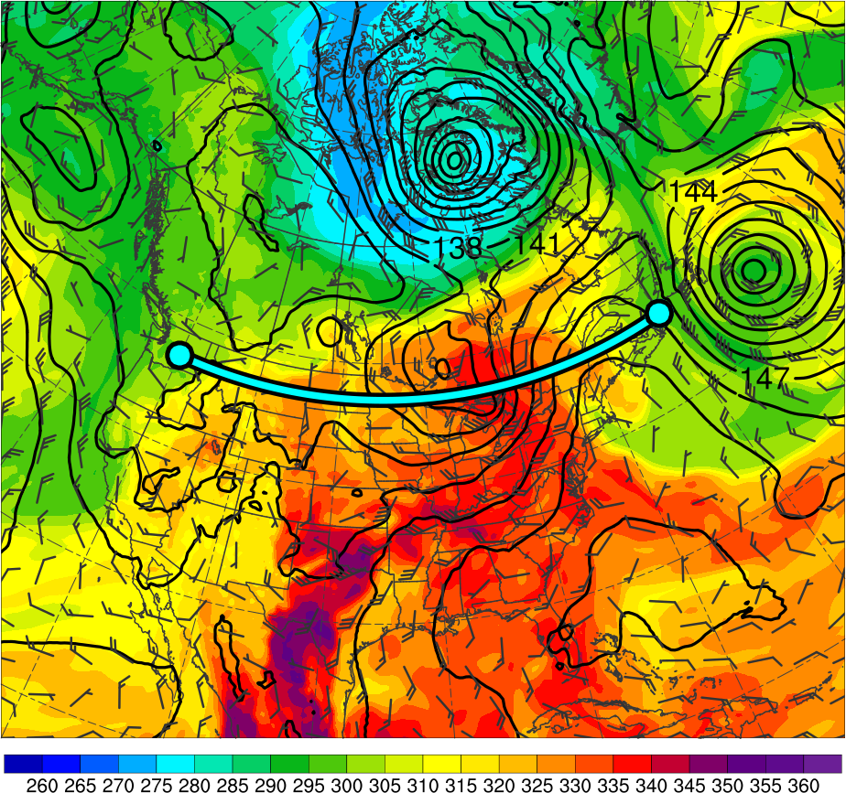
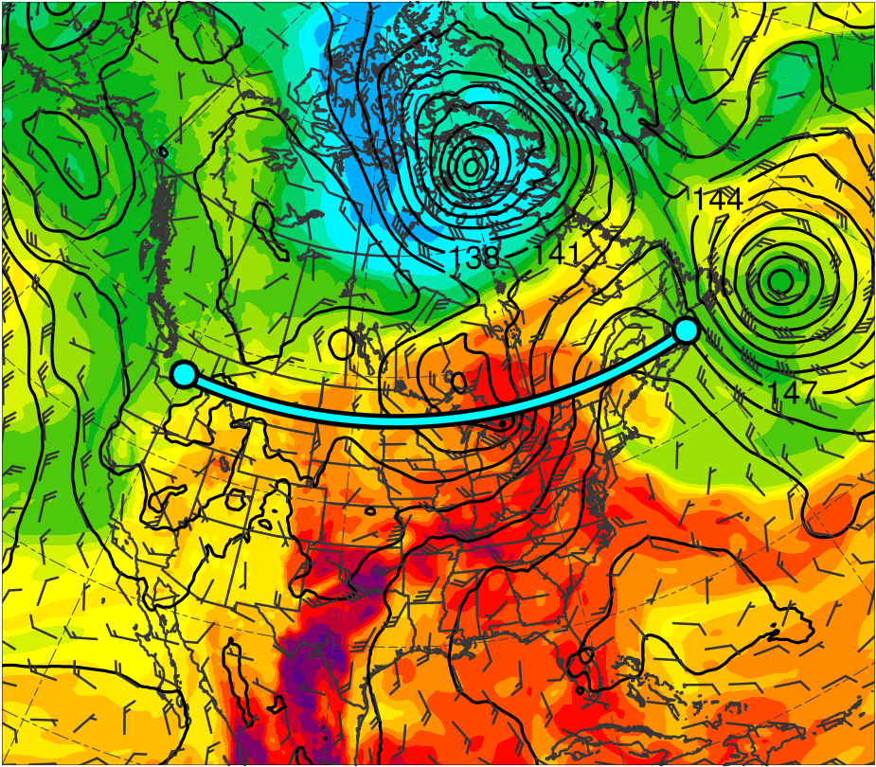
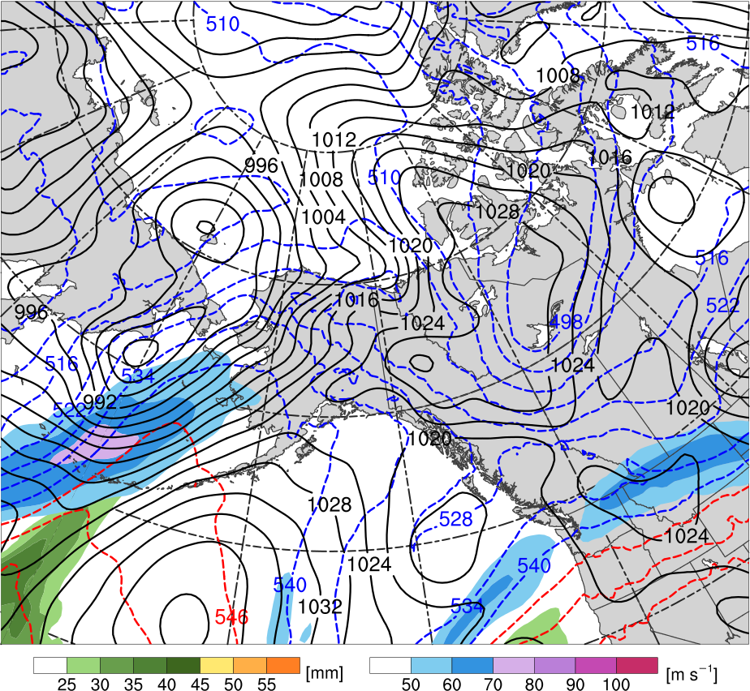
1200 UTC 31 May 2018
(a)
(b)
360
100
12
355
90
10
A’
350
80
A
345
340
70
8
335
60
6
330
50
325
40
4
320
Alberto
315
30
3
310
(m s⁻¹)
(c)
305
2
300
295
55
1.5
A’
50
A
290
1
285
45
280
40
0.5
275
270
35
0.25
Alberto
265
30
A’
260
25
(PVU)
A
Alberto
(K)
(mm)
(a) PV (PVU, shaded), θ (K, black), ascent (red, every 5 × 10⁻³ hPa s⁻¹), and wind speed (white, every 10 m s⁻¹ starting at 30 m s⁻¹); (b) 300-hPa wind speed (m s⁻¹, shaded),1000–500-hPa thickness (dam, blue/red), SLP (hPa, black), and PW (mm, shaded); (c) 850-hPa θ_{e} (K, shaded), geopotential height (dam, black), and wind (m s⁻¹, flags and barb)

Slide 3
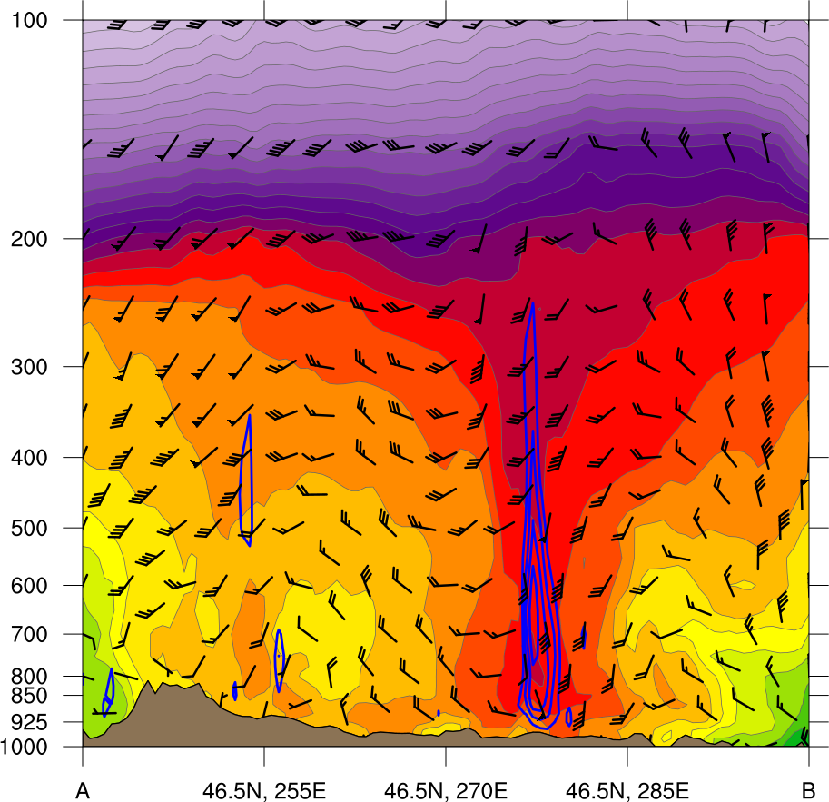
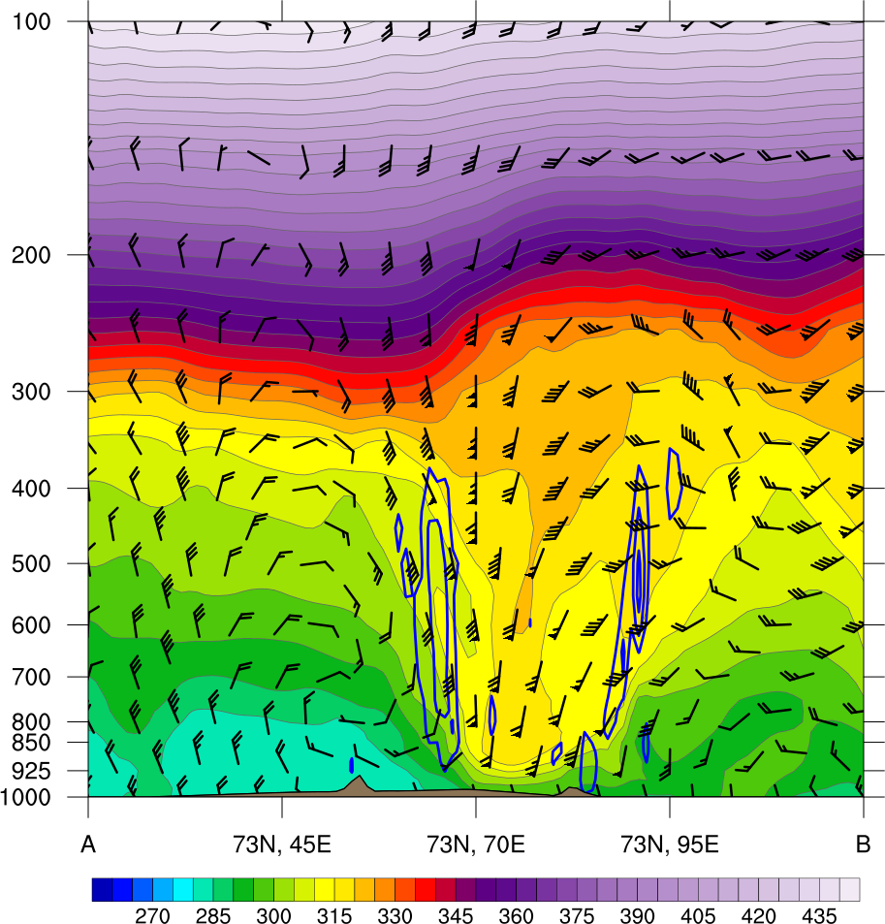
1200 UTC 31 May 2018
440
(a)
(b)
360
100
430
355
90
420
A’
350
80
410
A
345
400
340
70
390
335
60
380
330
50
325
40
370
320
360
Alberto
315
30
350
310
(m s⁻¹)
340
(c)
305
330
300
55
320
295
A’
290
50
310
A
285
45
300
280
40
290
275
35
280
270
270
Alberto
265
30
A’
260
25
260
A
Alberto
(K)
(K)
(mm)
(a) θ_{e} (K, shaded), ascent (blue, every 5 × 10⁻³ hPa s⁻¹), and wind (m s⁻¹, flags and barb); (b) 300-hPa wind speed (m s⁻¹, shaded),1000–500-hPa thickness (dam, blue/red), SLP (hPa, black), and PW (mm, shaded); (c) 850-hPa θ_{e} (K, shaded), geopotential height (dam, black), and wind (m s⁻¹, flags and barb)

Slide 4
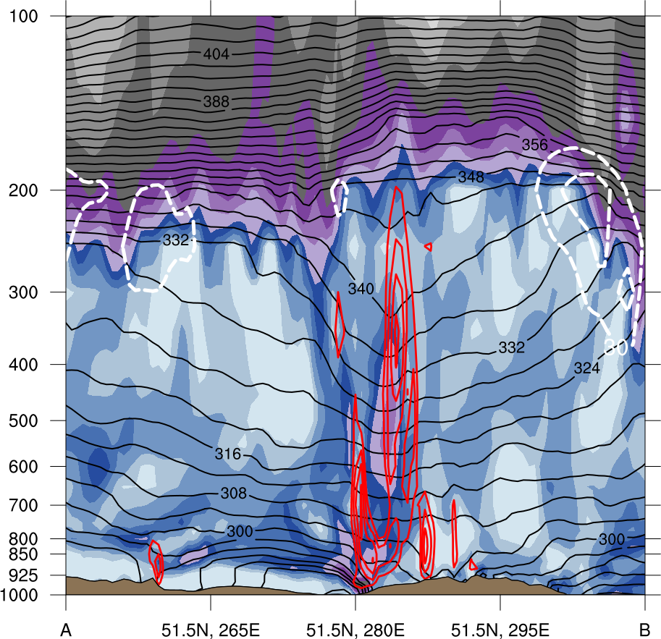
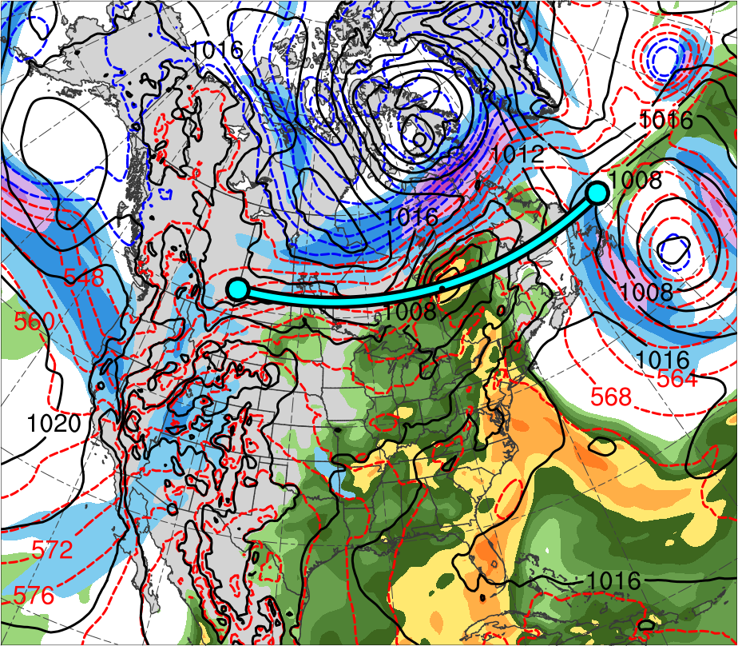
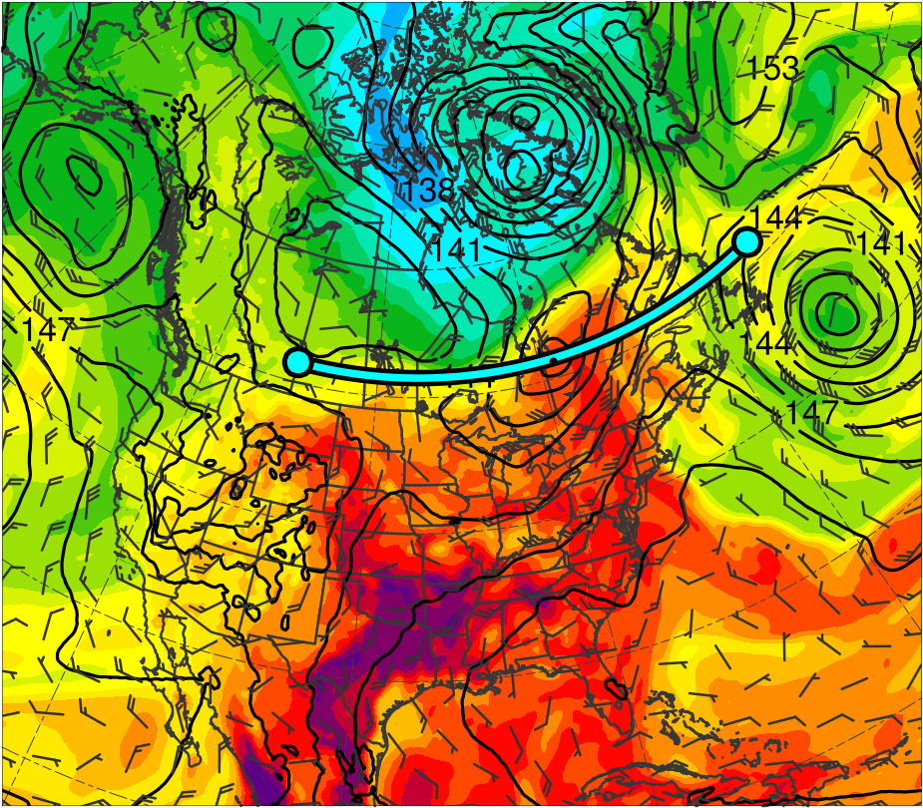
0000 UTC 1 Jun 2018
(a)
(b)
360
100
12
B’
355
90
10
B
350
80
345
70
8
340
335
60
6
330
50
325
40
4
320
CL
315
30
3
310
(m s⁻¹)
(c)
305
2
300
B’
295
55
1.5
50
B
290
1
285
45
280
40
0.5
275
270
35
0.25
CL
265
30
B’
260
25
(PVU)
B
CL
(K)
(mm)
(a) PV (PVU, shaded), θ (K, black), ascent (red, every 5 × 10⁻³ hPa s⁻¹), and wind speed (white, every 10 m s⁻¹ starting at 30 m s⁻¹); (b) 300-hPa wind speed (m s⁻¹, shaded),1000–500-hPa thickness (dam, blue/red), SLP (hPa, black), and PW (mm, shaded); (c) 850-hPa θ_{e} (K, shaded), geopotential height (dam, black), and wind (m s⁻¹, flags and barb)

Slide 5
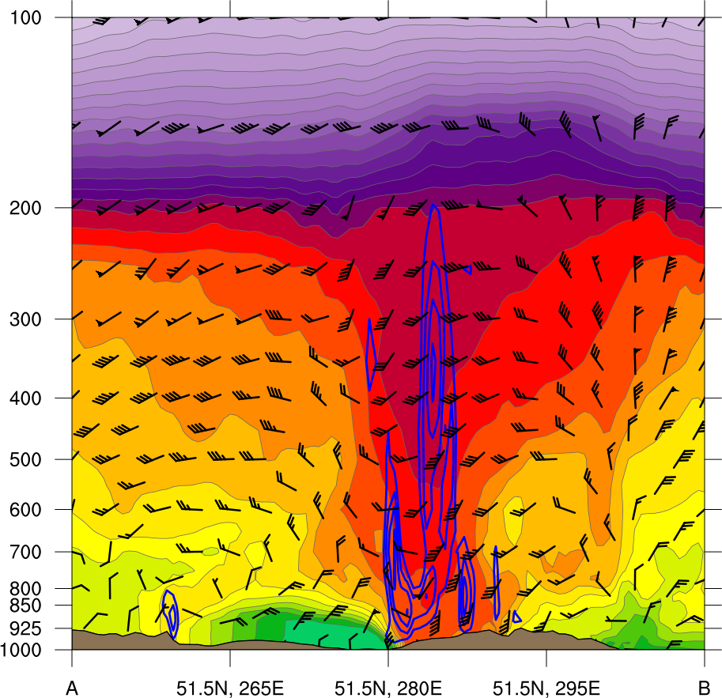
0000 UTC 1 Jun 2018
440
(a)
(b)
360
100
430
B’
355
90
420
B
350
80
410
345
70
400
340
390
335
60
380
330
50
325
40
370
320
360
CL
315
30
350
310
(m s⁻¹)
340
(c)
305
330
B’
300
55
320
295
B
290
50
310
285
45
300
280
40
290
275
35
280
270
270
CL
265
30
B’
260
25
260
B
CL
(K)
(K)
(mm)
(a) θ_{e} (K, shaded), ascent (blue, every 5 × 10⁻³ hPa s⁻¹), and wind (m s⁻¹, flags and barb); (b) 300-hPa wind speed (m s⁻¹, shaded),1000–500-hPa thickness (dam, blue/red), SLP (hPa, black), and PW (mm, shaded); (c) 850-hPa θ_{e} (K, shaded), geopotential height (dam, black), and wind (m s⁻¹, flags and barb)

Slide 6
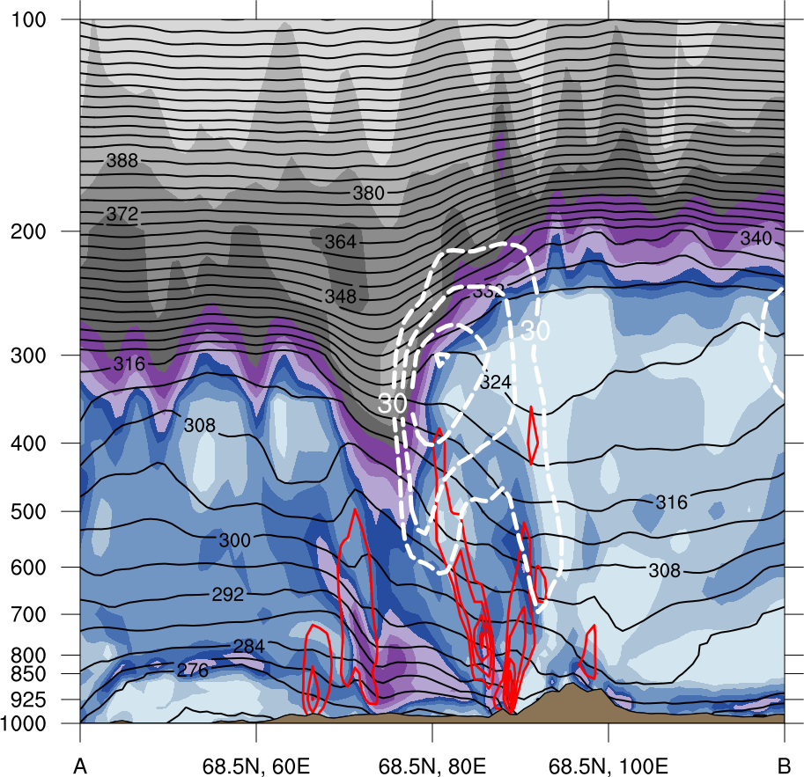
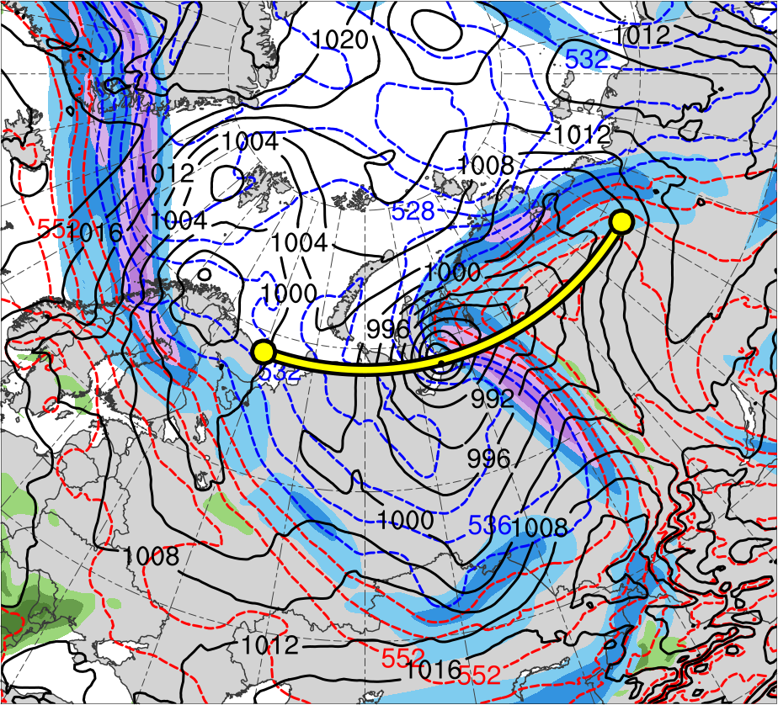
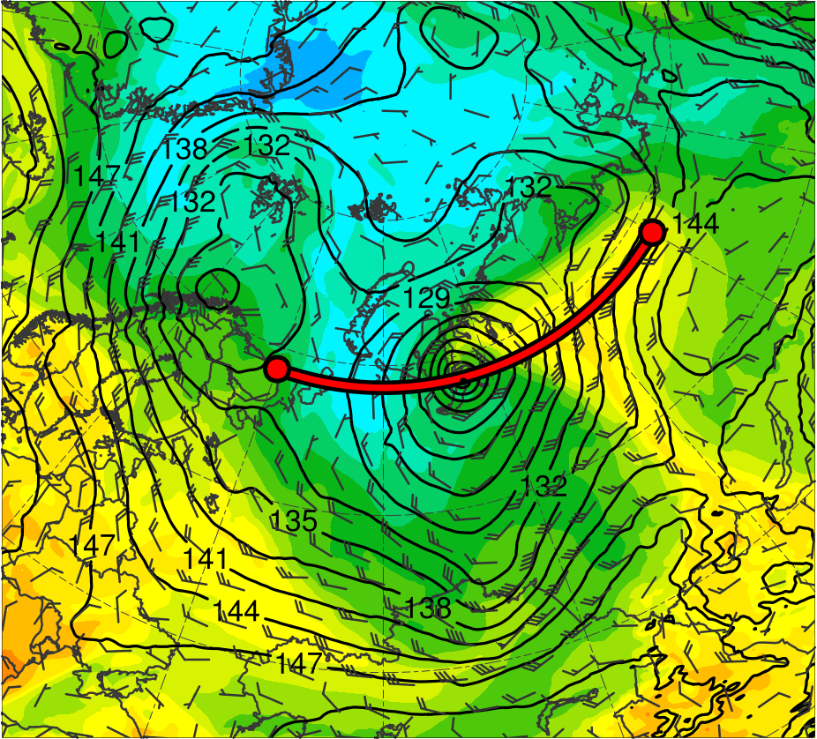
1800 UTC 3 Jun 2018
(b)
(a)
360
100
12
C’
355
90
10
350
80
C
345
70
8
340
335
60
6
330
50
325
40
4
320
315
30
3
AC1
310
(c)
305
(m s⁻¹)
2
TPV 2
300
C’
295
55
1.5
50
290
1
C
285
45
280
40
0.5
275
270
35
0.25
AC1
265
30
C’
260
25
(PVU)
C
AC1
(K)
(mm)
(a) PV (PVU, shaded), θ (K, black), ascent (red, every 5 × 10⁻³ hPa s⁻¹), and wind speed (white, every 10 m s⁻¹ starting at 30 m s⁻¹); (b) 300-hPa wind speed (m s⁻¹, shaded),1000–500-hPa thickness (dam, blue/red), SLP (hPa, black), and PW (mm, shaded); (c) 850-hPa θ_{e} (K, shaded), geopotential height (dam, black), and wind (m s⁻¹, flags and barb)

Slide 7
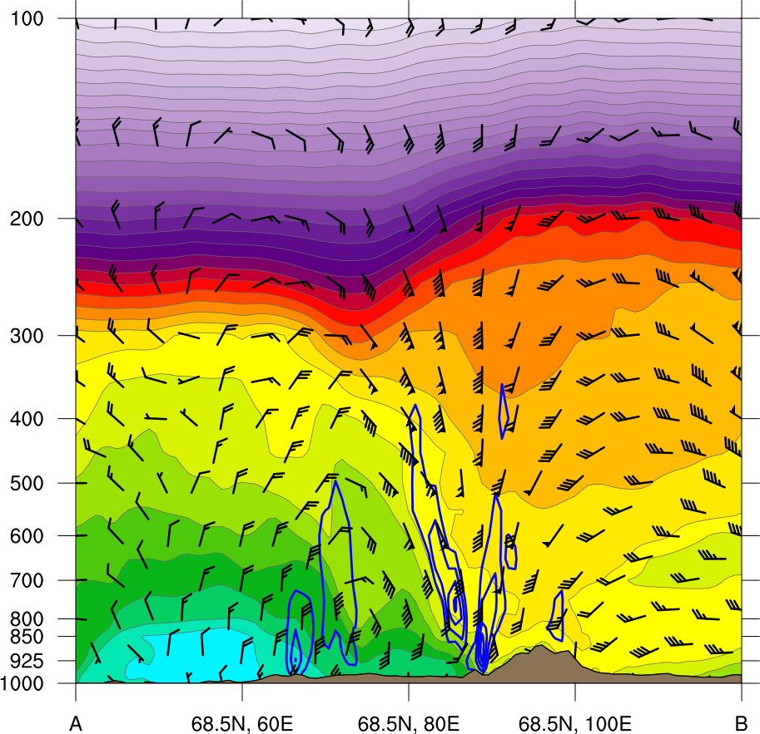
1800 UTC 3 Jun 2018
440
(b)
(a)
360
100
430
C’
355
90
420
350
80
410
C
345
70
400
340
390
335
60
380
330
50
325
40
370
320
360
315
30
350
AC1
310
(c)
305
(m s⁻¹)
340
330
300
55
C’
295
320
290
50
310
C
285
45
300
280
40
290
275
35
280
270
270
AC1
265
30
C’
260
25
260
C
(K)
AC1
(K)
(mm)
(a) θ_{e} (K, shaded), ascent (blue, every 5 × 10⁻³ hPa s⁻¹), and wind (m s⁻¹, flags and barb); (b) 300-hPa wind speed (m s⁻¹, shaded),1000–500-hPa thickness (dam, blue/red), SLP (hPa, black), and PW (mm, shaded); (c) 850-hPa θ_{e} (K, shaded), geopotential height (dam, black), and wind (m s⁻¹, flags and barb)

Slide 8
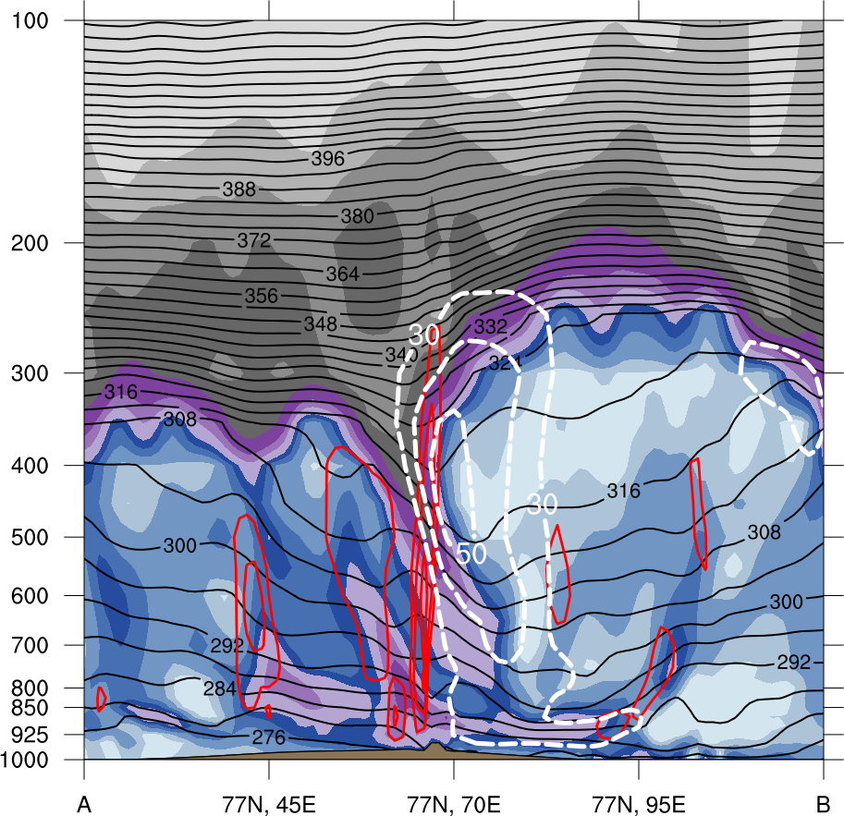
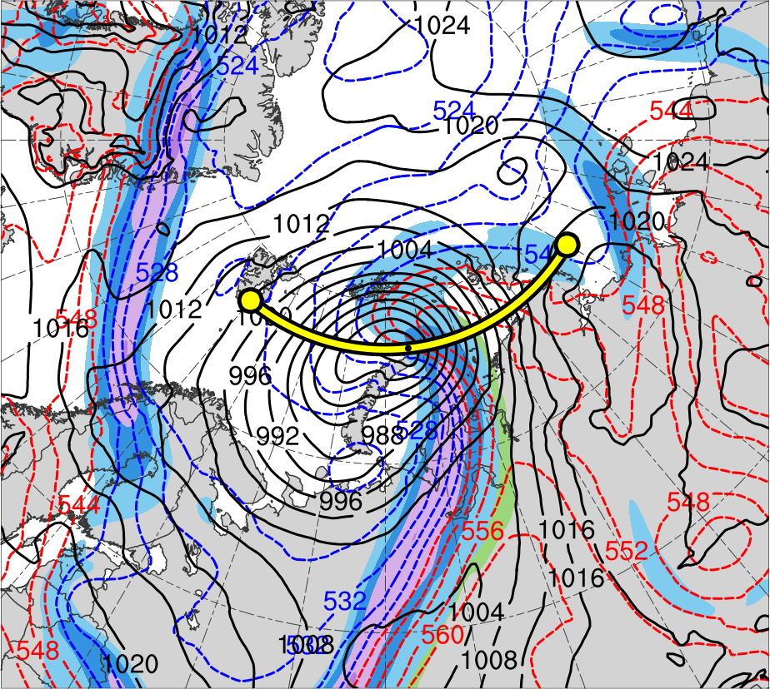
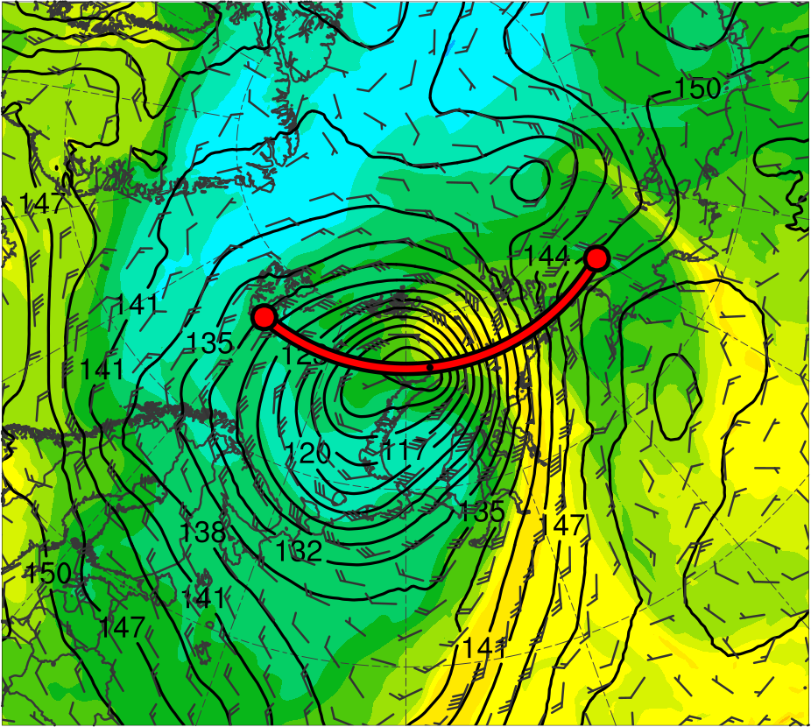
0000 UTC 7 Jun 2018
(b)
(a)
360
100
12
D’
355
90
10
D
350
80
345
70
8
340
335
60
6
330
50
325
40
4
320
315
30
3
AC2
310
(c)
305
(m s⁻¹)
2
300
295
55
1.5
TPV 1d
D’
50
D
290
1
285
45
280
40
0.5
275
270
35
0.25
AC2
265
30
D’
260
25
(PVU)
D
AC2
(K)
(mm)
(a) PV (PVU, shaded), θ (K, black), ascent (red, every 5 × 10⁻³ hPa s⁻¹), and wind speed (white, every 10 m s⁻¹ starting at 30 m s⁻¹); (b) 300-hPa wind speed (m s⁻¹, shaded),1000–500-hPa thickness (dam, blue/red), SLP (hPa, black), and PW (mm, shaded); (c) 850-hPa θ_{e} (K, shaded), geopotential height (dam, black), and wind (m s⁻¹, flags and barb)

Slide 9
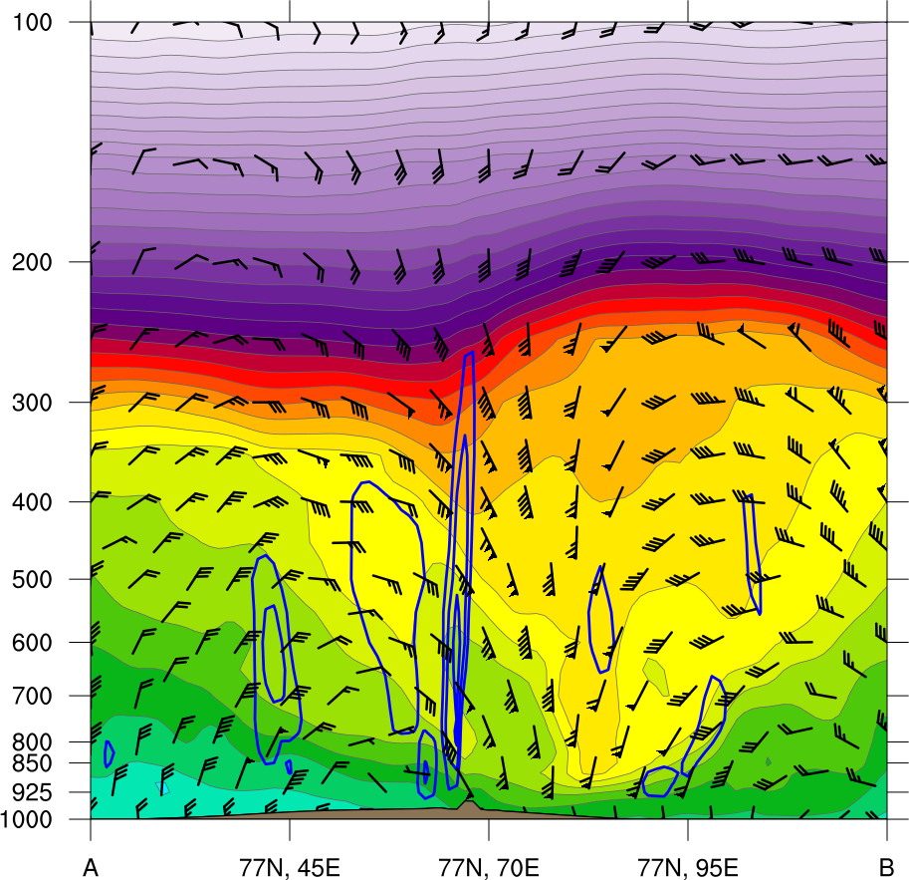
0000 UTC 7 Jun 2018
440
(b)
(a)
360
100
430
D’
355
90
420
D
350
80
410
345
70
400
340
390
335
60
380
330
50
325
40
370
320
360
315
30
350
AC2
310
(c)
305
(m s⁻¹)
340
330
300
55
320
D’
295
D
290
50
310
285
45
300
280
40
290
275
35
280
270
270
AC2
265
30
D’
260
25
260
D
AC2
(K)
(K)
(mm)
(a) θ_{e} (K, shaded), ascent (blue, every 5 × 10⁻³ hPa s⁻¹), and wind (m s⁻¹, flags and barb); (b) 300-hPa wind speed (m s⁻¹, shaded),1000–500-hPa thickness (dam, blue/red), SLP (hPa, black), and PW (mm, shaded); (c) 850-hPa θ_{e} (K, shaded), geopotential height (dam, black), and wind (m s⁻¹, flags and barb)

