Slide 1
Richard Anthes: Professor, Adviser, and Mentor
Daniel Keyser
Department of Atmospheric and Environmental Sciences
University at Albany, SUNY
Richard Anthes Symposium
Wednesday 9 January 2019

Slide 2
Overview
Introduction
Photographs
Personal Reminiscence
Students
Student Reminiscences
Lessons Learned
Conclusion

Slide 3
Introduction
In this presentation, I take a retrospective look at Rick’s academic career with emphasis on the principles and practices that informed his teaching, advising, and mentoring.

Slide 4
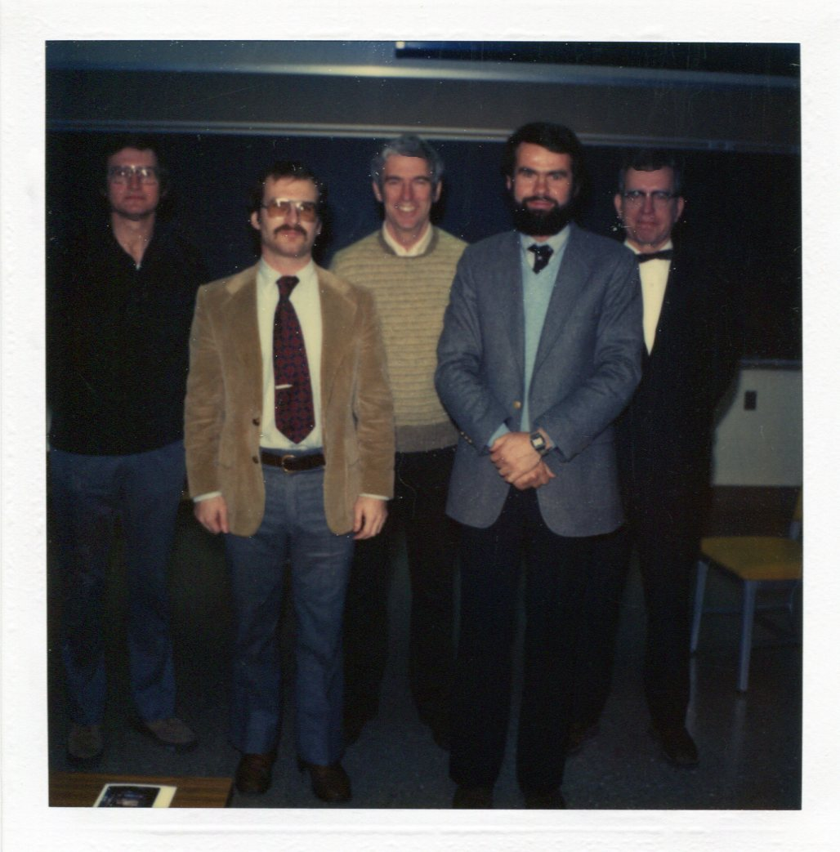
Photographs
Dan Keyser (second from left) and his Ph.D. Committee on the day of his Ph.D. defense, 7 March 1981: Professors William Thompson, Jr., John J. Cahir, Richard A. Anthes, and Alfred K. Blackadar.

Slide 5
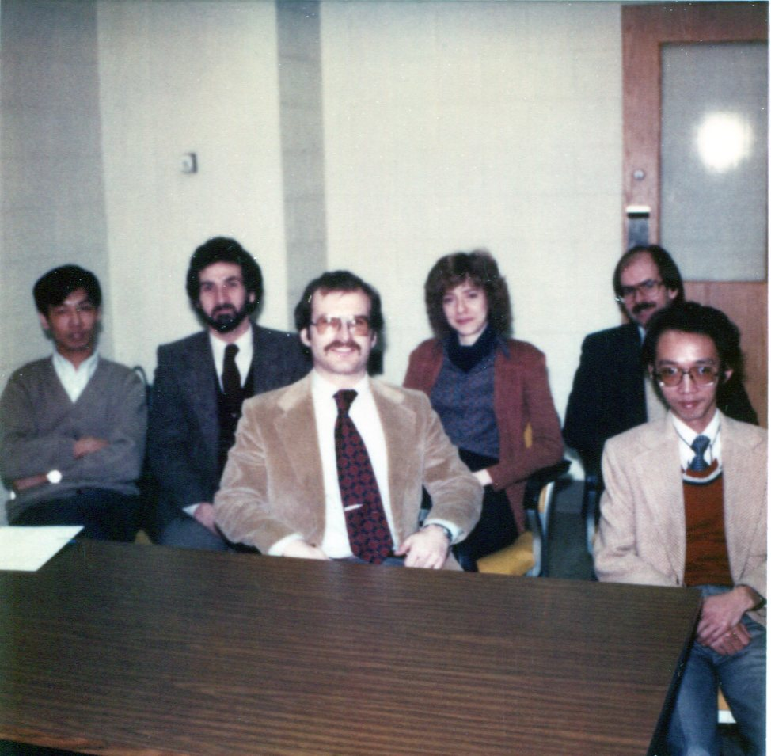
Photographs
Dan Keyser (third from left) and graduate student colleagues on the day of his Ph.D. defense, 7 March 1981: Da-Lin Zhang, Joe Sardie, Ellen Salmon, Stan Benjamin, and Eirh-Yu Hsie.

Slide 6
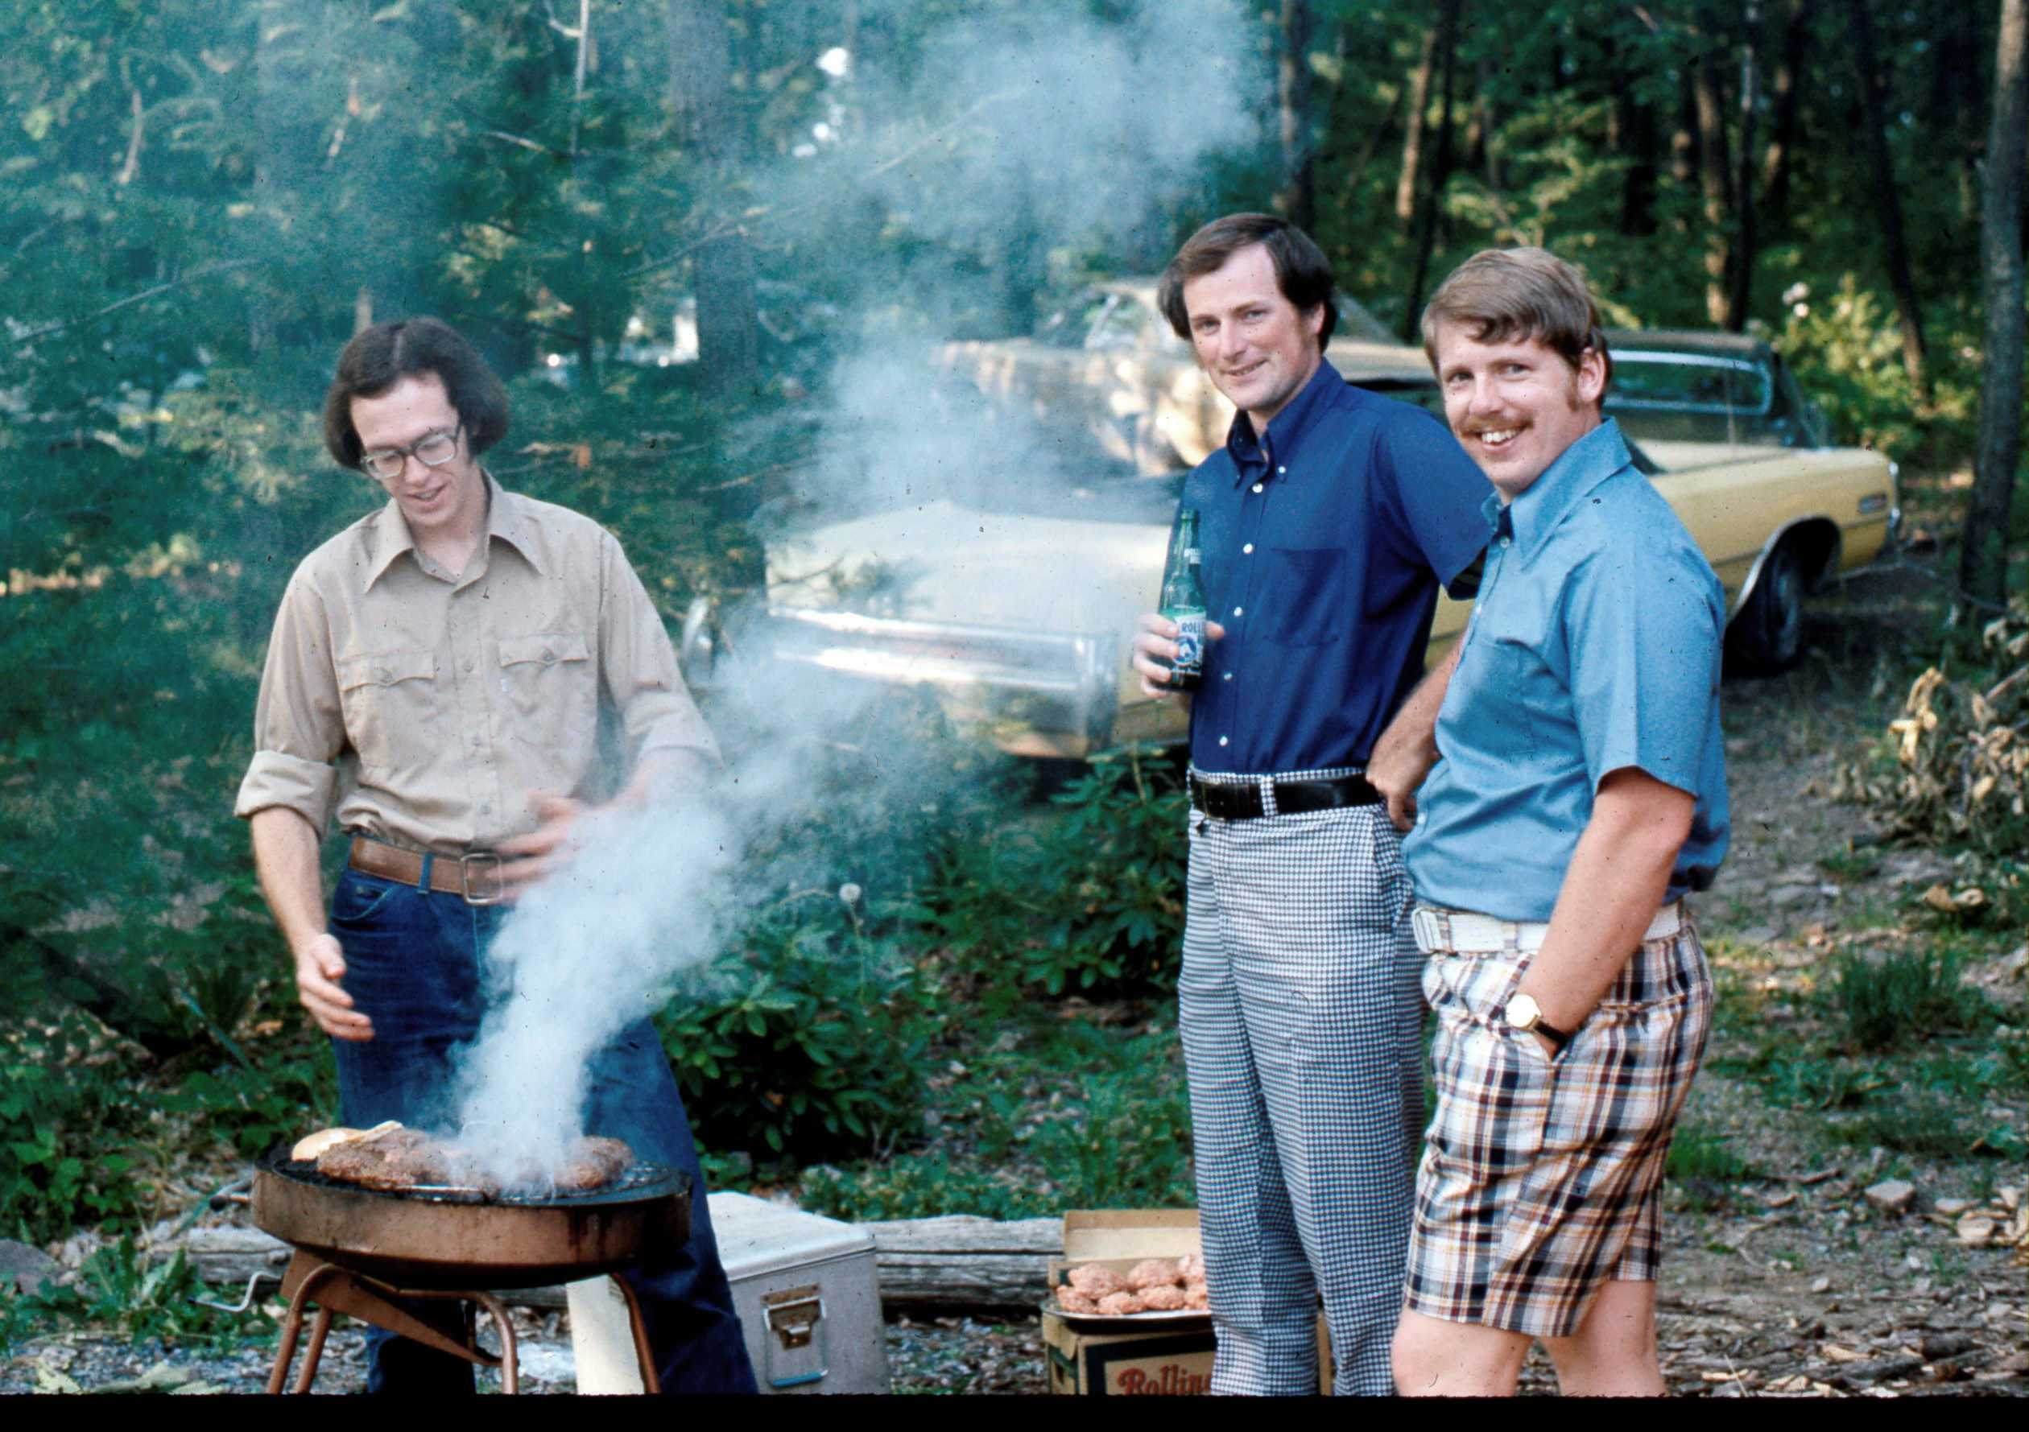
Photographs
Ed O’Lenic, Pete Black, and Tom Warner at an Anthes-hosted picnic on an unspecified date in 1975.

Slide 7
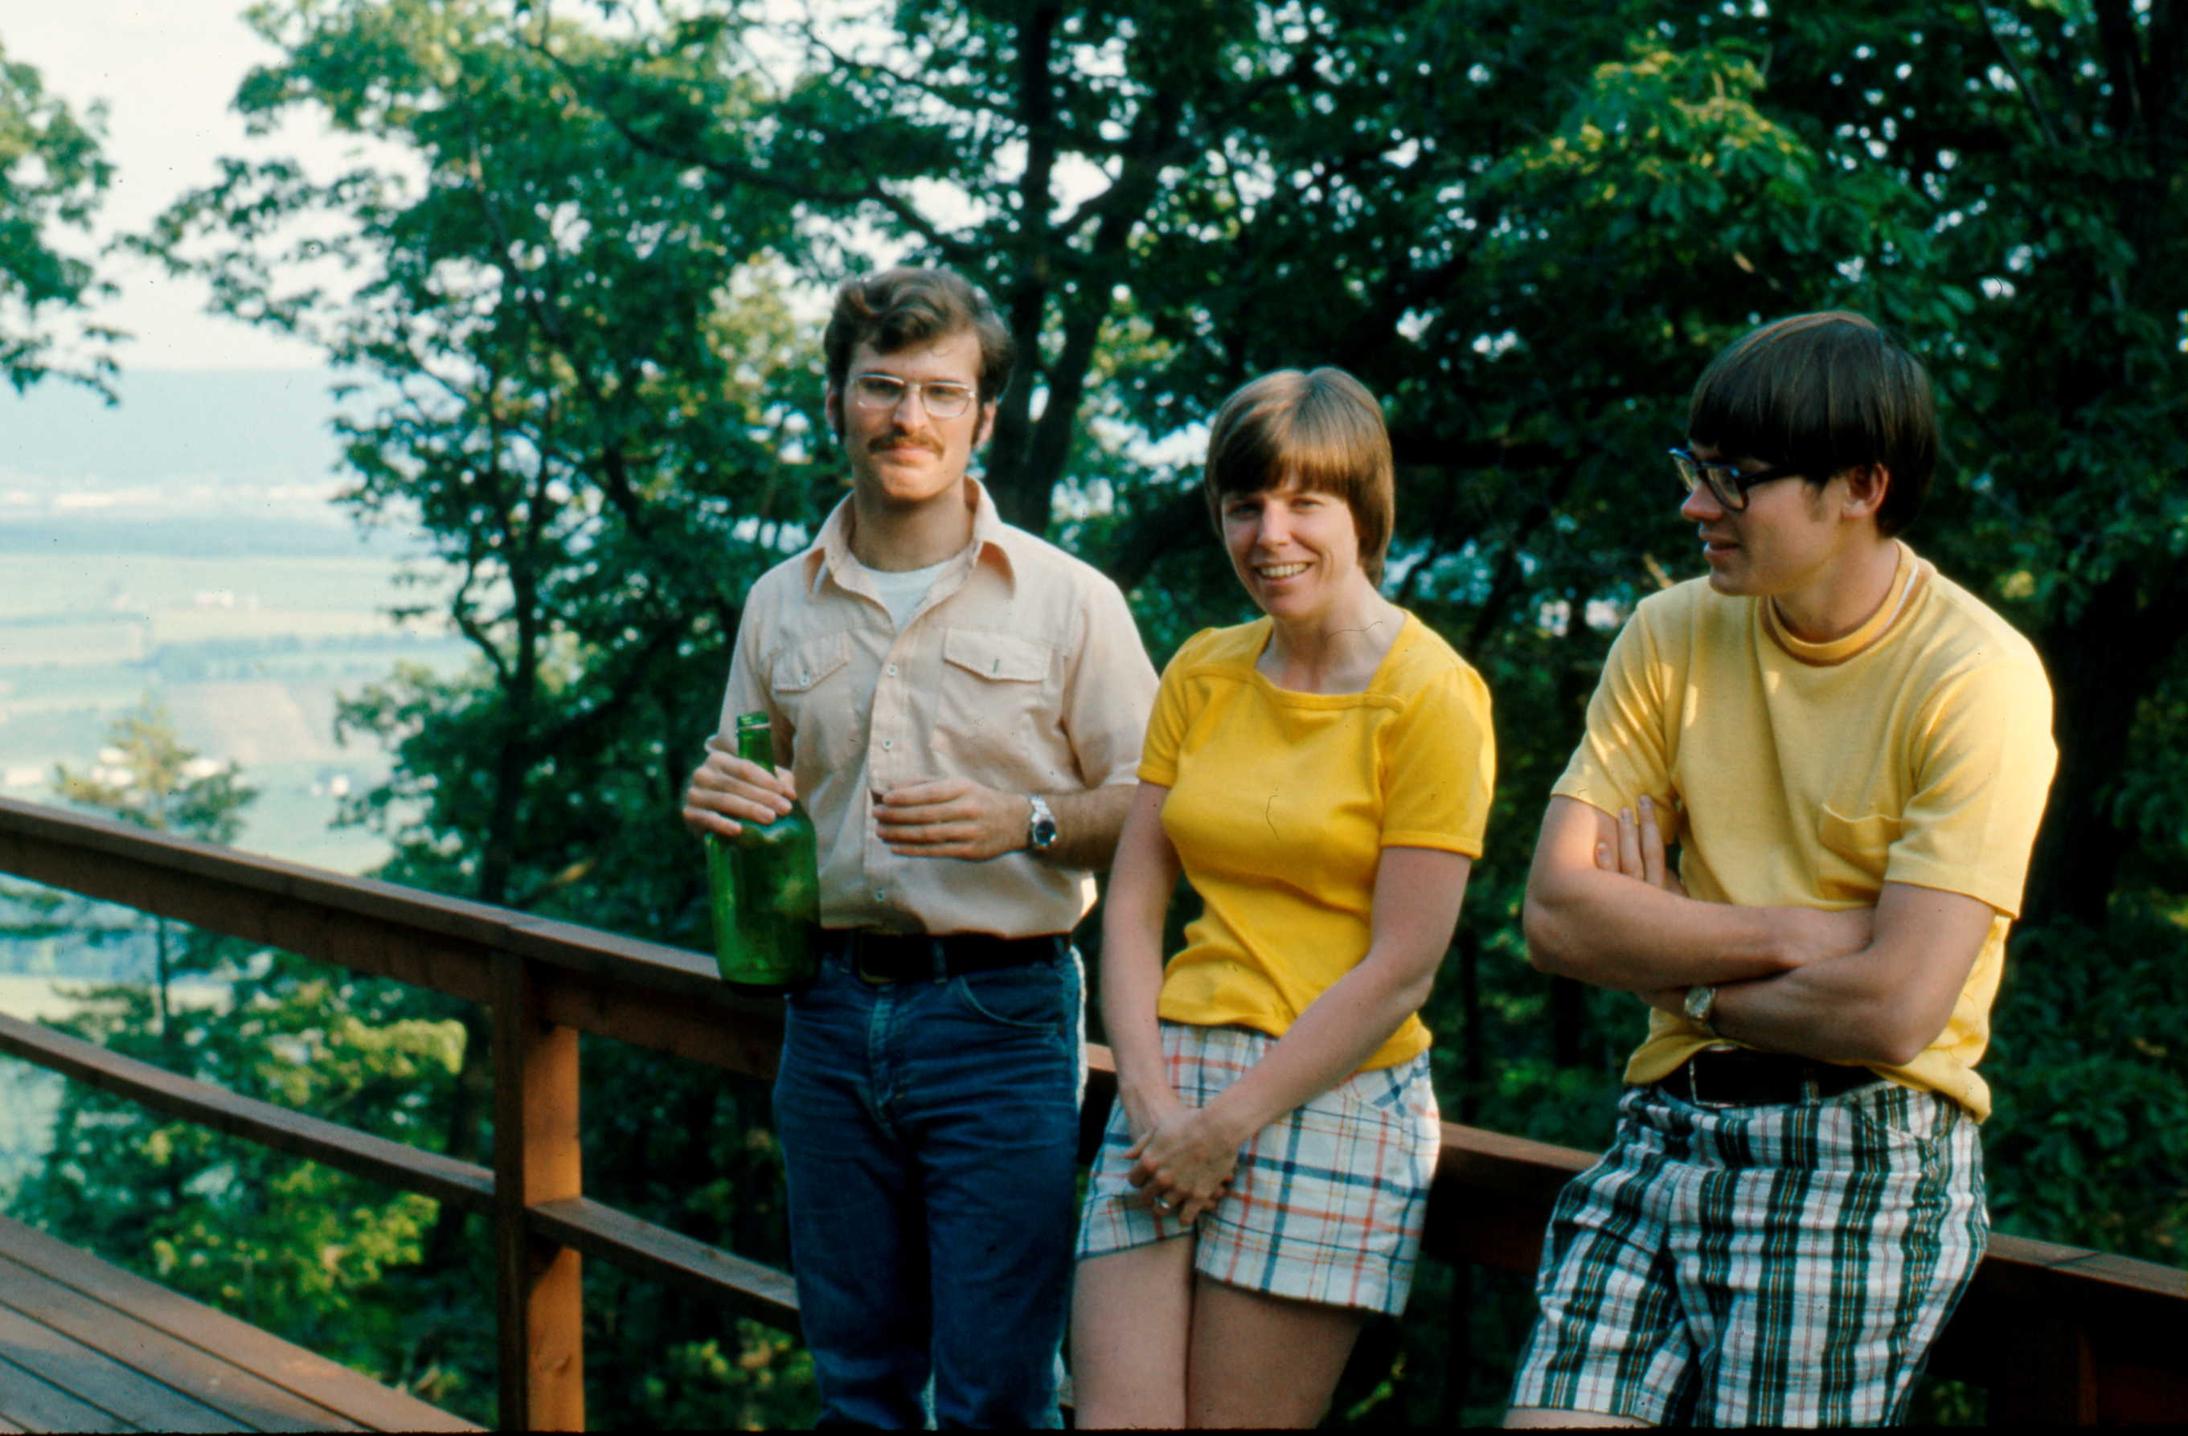
Photographs
Dan Keyser, Kathy Hoke, and Jim Hoke at an Anthes-hosted picnic on an unspecified date in 1975.

Slide 8
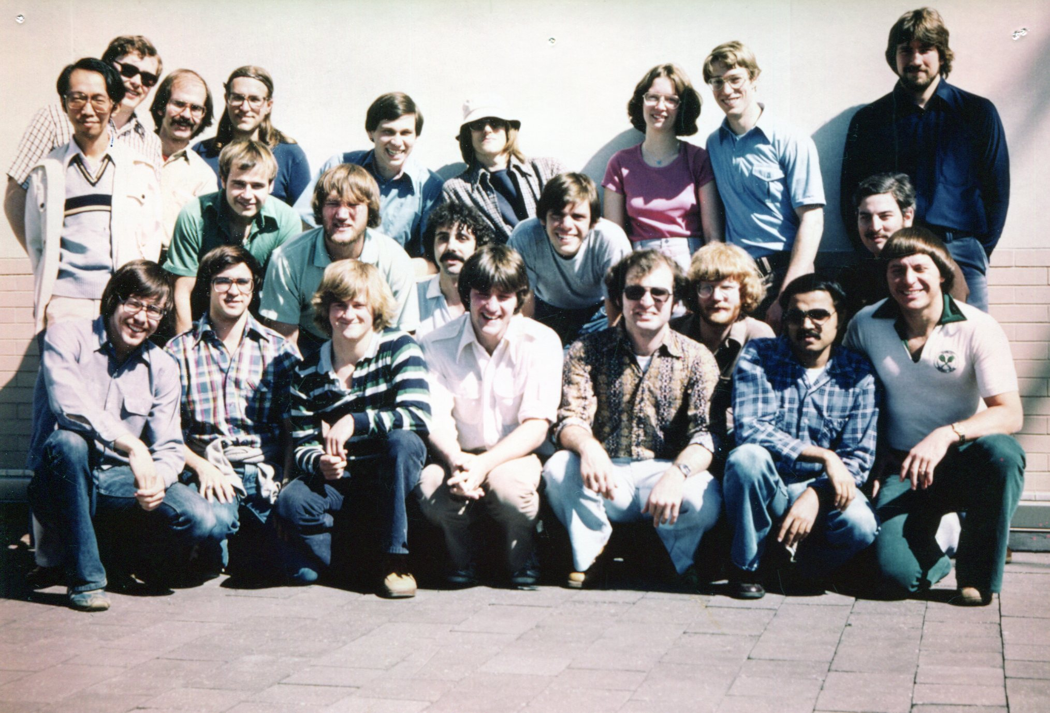
Photographs
Penn State meteorology graduate students on the roof of Walker Building on an unspecified date in 1979. The names of the participants in this photograph are given in the caption for the same photograph appearing on p. 41 of the Richard Anthes Symposium booklet.

Slide 9
Personal Reminiscence
By a fortunate coincidence Rick Anthes and I arrived at Penn State within a month of each other in 1971, he an assistant professor and I a freshman undergraduate meteorology major.
During 1971–1981, I earned my B.S., M.S., and Ph.D. at Penn State, all under Rick’s advisement.
By further coincidence, Rick and I left Penn State in 1981, when he headed to NCAR and I to NASA/Goddard Space Flight Center.
The foregoing coincidences enabled me to closely observe Rick in action as a research scientist and professor making pioneering contributions to tropical and mesoscale meteorology and numerical weather prediction.

Slide 10
Personal Reminiscence
Rick was a skillful and influential classroom teacher, and an effective and inspiring adviser and mentor, who continually challenged, motivated, and prepared me for a professional career as a researcher and educator.
Rick’s classroom teaching was distinguished by the following ingredients: preparation, organization, clarity, and command of the subject, seasoned with a dash of empathy.

Slide 11
Personal Reminiscence
The 1971–1981 period included a year at the Naval Postgraduate School, during 1977–1978, where Rick was a research professor and I had the good fortune to accompany him and work on the transition of the-then Penn State mesoscale model (I believe this version was referred to as MM0) to run in a forecast mode in near real time.
With the benefit of hindsight, perspective and experience, I now can appreciate how fortunate I am to have had the opportunity to be advised and mentored by Rick as an undergraduate and graduate student.

Slide 12
Personal Reminiscence
Rick was a superb role model, providing, through his actions and words, a roadmap of best practices to follow during my post-Penn State career.
Rick instilled in me the importance of identifying and pursuing opportunities, trying things that might or might not work, completing tasks, and continually moving forward.
I especially value Rick’s admonition to show him only “the top ten percent” of my research results at our weekly meetings, which challenged me to get lot between meetings and to prioritize my findings.

Slide 13
Personal Reminiscence
Rick encouraged and supported participation in conferences and workshops as soon as I had research results that were ready for prime time, and impressed upon me the importance of documenting the outcome of research projects in the refereed literature.
Rick was, and is, a gifted, talented, and accomplished writer and speaker; for a student who felt that a benefit of majoring in meteorology as an undergraduate was the minimal expectation of writing papers and making oral presentations, Rick was ideally positioned to convince me to adopt a more mature outlook on scientific communication.

Slide 14
Personal Reminiscence
Perhaps the best of the best practices that I developed from observing and working with Rick was how to solve not only scientific problems, but also administrative and organizational problems.
Observing Rick as a science administrator has allowed me to make it a goal to solve more problems than I create on any given day.

Slide 15
Students
Rick has advised and coadvised a sizable cohort of graduate students (13 M.S. theses; 12 Ph.D. dissertations) on a range of topics concerned with tropical cyclones, mesoscale weather systems, numerical modeling and weather prediction, and applications of GPS-based radio occultation measurements
Rick’s graduate students have pursued successful careers in diverse sectors of the atmospheric science enterprise, including the federal government, the military, private industry, and academia.

Slide 16
Student Reminiscences: Stan Benjamin
Rick was willing to take on an important second advisor role with me to join Toby Carlson (my lead Ph.D. advisor) at Penn State. Toby and Rick (adding Greg Forbes) were as strong a Ph.D. committee as a student could hope for … . I have not yet seen a second advisor take a more important role, as Rick did for me. Rick has kept launching younger scientists throughout his career—I was another one.
I join many others in our larger community in saluting Rick, still somewhat stunned at his wisdom and effectiveness throughout his career, and with much gratefulness.

Slide 17
Student Reminiscences: Pete Black
Rick invited me to attend Penn State and work on my Ph.D. with him. At first, I had a hard time coming to grips with working for a friend who would also be my thesis advisor. … I accepted the offer, which changed my life.
Rick charged me with continuing observational studies of [the hurricane–ocean interaction] process in the real world. A better collaboration I could not imagine, with Simon [Chang] modeling what I had been observing, a situation that was also life-changing. It was, yet again, another example of devious means used by Rick to motivate students and colleagues by encouraging them to work together.

Slide 18
Student Reminiscences: Pete Black
I owe a 50-year career in chasing hurricanes to Rick as friend and mentor and his philosophy of “Never Give Up.” Thank you, Rick!

Slide 19
Student Reminiscences: Simon Chang
Rick was very helpful to students, but also a lot of fun to be with – a great drinking buddy, whether in a bar or at home. My wife and I were very lucky to know Rick and his wife Susie, and welcomed to their wonderful holiday parties when most students had left town.
During the writing of my dissertation, Rick requested that I conduct exhaustive literature search to ensure all claims were legitimate, and double check all citations and give due credits. One time after one of our manuscripts was about to be published, a coding error was found. I was apologetic, but he just said “Never publish a paper with known error.”

Slide 20
Student Reminiscences: Simon Chang
It has been my great fortune to know and work with Rick. I am humbled by his scientific achievements, organizational skills, and personal integrity. He is really exceptional.

Slide 21
Student Reminiscences: John Diercks
Rick Anthes was my Ph.D. adviser from 1971 to 1975. My dissertation was centered around spiral bands in linear and nonlinear hurricane models. Rick was a great adviser. We had weekly meetings which we seldom missed. His research at the time was on hurricanes as well, so he had a keen interest in my research.
On the nonacademic side, Rick liked to entertain at his house. Looking back on these events, the parties were fun and brought his graduate students together as a group.

Slide 22
Student Reminiscences: Jim Hoke
Words cannot express how appreciative I am that Rick was willing to be the thesis advisor for my master’s and Ph.D. He instilled a work ethic in us grad students that served us well throughout our careers.
Despite the uncountable demands for his time, Rick somehow carved out time each week for each of his students. He always had helpful suggestions when our research efforts bogged and was there whenever needed with his contagious smile and words of encouragement.

Slide 23
Student Reminiscences: Jim Hoke
Working with Rick at Penn State prepared me well for the remarkable string of such visionaries I had the great fortune to work with throughout my career.
Rick enjoyed playing tennis and was an especially hard-charging doubles player. We have played a number of times over the years. It was one of the few things I ever got the upper hand on him.

Slide 24
Student Reminiscences: Bill Kuo
Rick has had a huge influence on me. In fact, I owe him my entire career. In addition to giving me my English name, he taught me how to do modeling, how to do research, how to write a paper, how to run a research project, and how to manage a research program. Most importantly, he taught me how to be a better person, as you cannot be a good scientist without being a good person first.

Slide 25
Student Reminiscences: Therese Rieckh
They say a great teacher will never stop learning.
I sincerely thank Rick for advising me, for sharing his enthusiasm for science, and for words of motivation and encouragement when I needed them. And most of all, I thank Rick for discussions and communication on one eye-level where I was free to bring up any thought and idea without hesitation.
For me, Rick has set an example for exceptional leadership.

Slide 26
Student Reminiscences: Rich Shaginaw
As an undergraduate at PSU, I had benefitted from Rick’s skillful classroom teaching, witnessed his enthusiasm for the atmospheric sciences, understood the quality of his scientific contributions, and observed his true gifts for mentoring and advising. So, I lobbied hard and gained acceptance into his group to begin my Master’s studies.
Over the next couple of years, Rick contributed to my formation in ways far beyond academic and scientific tutelage.

Slide 27
Student Reminiscences: Rich Shaginaw
For me Rick was a model of grit and determination, integrity and accountability, energy and professionalism.
I appreciate this opportunity to express my deep gratitude to Rick Anthes—teacher, mentor, and model.

Slide 28
Student Reminiscences: Russ Sinclair
Not only did Rick make significant contributions to mesoscale modeling, he helped educate, advise, and inspire many students along the way. As my professor and advisor, Rick helped initialize my professional life, starting me on a career that has verified as fun and rewarding. Thank you, Rick!

Slide 29
Student Reminiscences: Joe Sobel
I fondly remember several informal get togethers at Rick’s castle on the hill. Our wives and significant others were always welcomed and it was truly a family atmosphere.
At the time I was the manager of the Department of Meteorology softball team and I remember Rick being an occasional player. Let’s just say I remember his skill as a teacher, scientist and advisor as greater than those of a softball player!!!

Slide 30
Student Reminiscences: Da-Lin Zhang
Shortly after China was opened to the west, I was admitted in early 1980 as the first graduate student from mainland China to the Penn State University, but with no university transcripts, no English test score and little educational background in meteorology. So, I have been extremely grateful to Rick Anthes for his taking a risk of accepting me as one of his graduate students. Being a professor today myself, I would be reluctant to consider recruiting such a student even with his/her own funds.
Rick is truly an innovative scientist and a great mentor.

Slide 31
Lessons Learned
Teach and mentor by example.
Do the right thing by doing things right.
Solve problems by trying numerous approaches until one of them works.
Finish what you start.
Relate to your students on a first-name basis.

Slide 32
Lessons Learned
Foster a sense of camaraderie and community among your students.
Offer your students multiple chances to succeed.
Learn by doing.
Never stop learning.
Never give up.

Slide 33
Conclusion
I extend my heartfelt appreciation and gratitude to Rick, to whom I owe a great deal of my professional success, for his encouragement, guidance, and inspiration over so many years.

Slide 34
Ph.D. recipients and dissertation titles:
John Diercks, 1975: Generation, propagation, and maintenance of spiral bands in linear and nonlinear hurricane models.
Thomas T. Warner (deceased, 1944–2011), 1976: The initial growth of data-related errors in mesoscale numerical weather prediction models.
James E. Hoke, 1976: Initialization of models for numerical weather prediction by a dynamic-initialization technique.
Joseph P. Sobel, 1976: Nested grids in numerical weather prediction and an application to a mesoscale jet streak.

Slide 35
Ph.D. recipients and dissertation titles:
Donald Perkey, 1976: Prediction of convective activity using a system of parasitic nested numerical models (coadvised with John Hovermale)
Simon Chang, 1977: The mutual response of the tropical cyclone and the ocean as revealed by an interacting atmospheric and oceanic model.
Nelson L. Seaman, 1977: The development of a mesoscale semi-implicit numerical model.
Daniel Keyser, 1981: Frontogenesis in the planetary boundary layer of an amplifying, two-dimensional baroclinic wave.

Slide 36
Ph.D. recipients and dissertation titles:
Ying-Hwa Kuo, 1983: A diagnostic case study of the effects of deep extratropical convection on the large-scale temperature and moisture structure.
Eirh-Yu Hsie, 1983: Frontogenesis in a moist atmosphere.
Peter G. Black, 1983: Ocean temperature change induced by tropical cyclones.
Therese Rieckh, 2018: Investigating the value of GPS radio occultation water vapor data using in-situ and remote sensing techniques and models (University of Graz, Austria, coadvised with Ulrich Foelsche).

Slide 37
M.S. recipients and thesis titles:
Paul Allan Eisen, 1972: A mesoscale study of the Oklahoma squall line of 8 and 9 June 1966.
Russell Sinclair, 1972: Variation of the low level winds during passage of a thunderstorm gust front.
James E. Hoke, 1973: A comparison of three methods for computing isentropic trajectories.
Ed O’lenic, 1976: Mesoscale interactions between a cold front and the planetary boundary layer.
Daniel Keyser, 1977: Sensitivity tests and a real-data forecast for the planetary boundary layer using a mixed-layer model.

Slide 38
M.S. recipients and thesis titles:
Gary D. Fried (deceased,1953–2008), 1978: Introducing subsynoptic scale perturbations into a primitive equation forecast model (coadvised with John Cahir).
Michael Fiorino 1978: The incorporation of satellite-sensed surface winds into the real-data initialization of a mesoscale hurricane model.
Richard Shaginaw, 1979: Effects of planetary boundary-layer formulation on a subsynoptic-scale numerical forecast.
Richard Burkhart, 1980: Subsynoptic scale processes leading to the development of severe weather in the vicinity of an upper level jet streak.

Slide 39
M.S. recipients and thesis titles:
Douglas L. Westphal, 1981: The interaction between radiative and boundary layer processes in stratus clouds.
Nancy Norton, 1980: Comparison of finite element and finite difference solution of a planetary boundary layer model.
Da-Lin Zhang, 1982: A verification of one-dimensional model simulation of the planetary boundary layer over dry and moist terrain.
Daniel G. Baldwin, 1983: The effect of diabatic and frictional processes on frontal circulations.

