Slide 1
A Comparison of Arctic Cyclones between Periods of Low and High Forecast Skill of the Synoptic-scale Flow over the Arctic
Kevin A. Biernat, Lance F. Bosart, and Daniel Keyser
Department of Atmospheric and Environmental Sciences
University at Albany, SUNY
15th AMS Conference on Polar Meteorology and Oceanography
Monday 20 May 2019
Research Supported by ONR Grant N00014-18-1-2200

Slide 2
Motivation
Yamagami et al. (2018a,b) show that forecast skill of strong Arctic cyclones (ACs) can be low
Forecast skill of the synoptic-scale flow over the Arctic may be low at times relative to climatology
It is anticipated that low forecast skill of the synoptic-scale flow over the Arctic may be attributed in part to low forecast skill of ACs

Slide 3
Purpose
Investigate whether there are differences in the frequency, location, intensity, and associated synoptic-scale flow patterns of ACs between periods of low and high forecast skill of the synoptic-scale flow over the Arctic

Slide 4
Data and Methods: AC Identification
Create a 2007–2017 AC climatology
Obtain cyclone tracks from 1° ERA-Interim cyclone climatology prepared by Sprenger et al. (2017)
ACs are deemed cyclones that last ≥ 2 d and spend at least some portion of their lifetimes in the Arctic (>70°N)

Slide 5
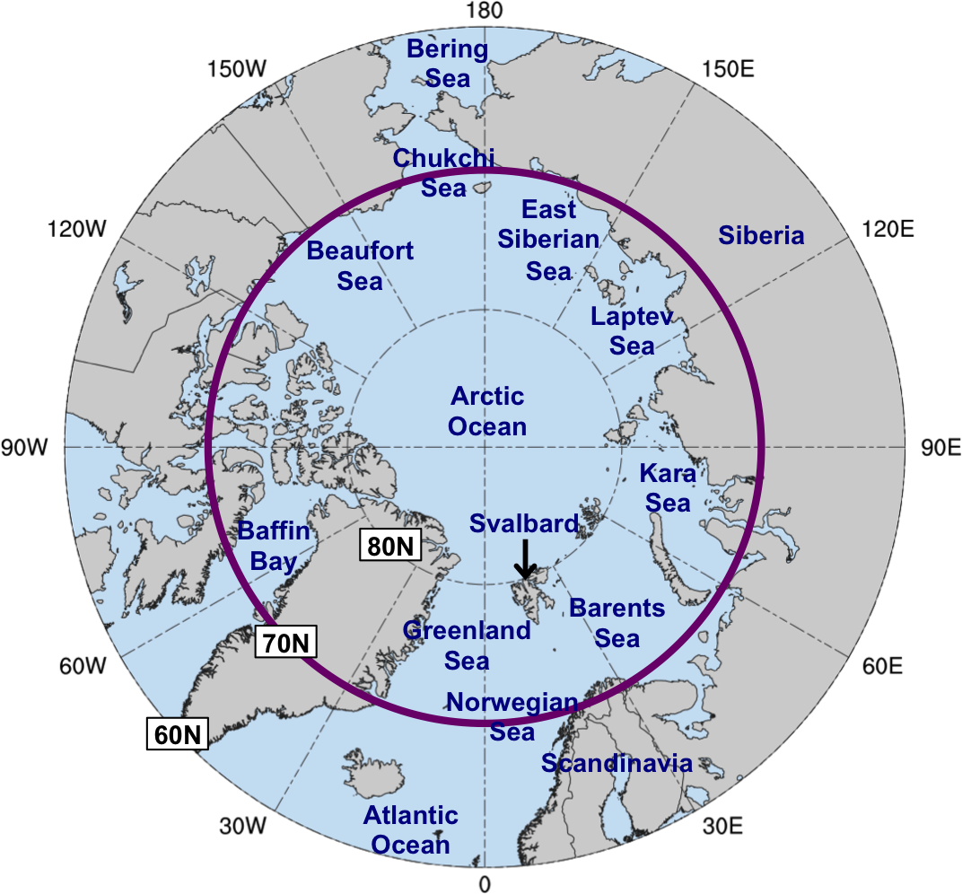
Data and Methods: Forecast Skill Evaluation
Calculate standardized anomaly of ensemble forecast spread of 500-hPa geopotential height (σ_{anom}) following Torn (2017) and determine area-weighted average of σ_{anom} over the Arctic (≥70°N)
Utilize forecasts initialized at 0000 UTC during 2007–2017 and valid at day 5 from:
  11-member GEFS reforecast dataset v2 (Hamill et al. 2013)
  51-member ECMWF Ensemble Prediction System (EPS; Buizza et al. 2007)

Slide 6
Data and Methods: Forecast Skill Evaluation
Forecast days valid at day 5 associated with the top and bottom 10% of the area-weighted average of σ_{anom} in both the GEFS and ECMWF EPS are referred to as low and high skill days, respectively
Time periods beginning five days prior to day 5 (i.e., day 0) through day 5 are referred to as low and high skill periods
ACs that exist in the Arctic (>70°N) at any time within the low and high skill periods are identified

Slide 7
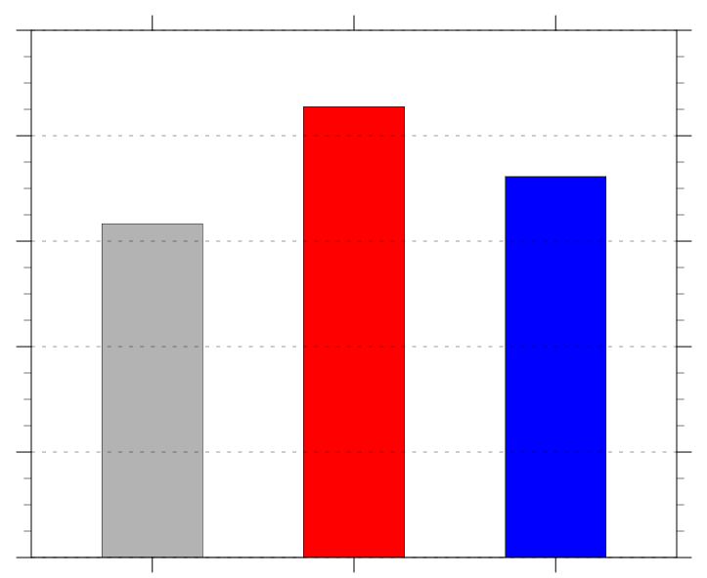
Number and Frequency of ACs
Frequency of ACs (number of ACs day⁻¹)
Period | Number of days in period | Number of ACs in period
Climo | 4018 | 2542
Low skill | 469 | 401
High skill | 477 | 345
1.0
0.8
0.6
0.4
0.2
0.0
climo
low
high
Frequency = number of ACs within period / number of days within period

Slide 8
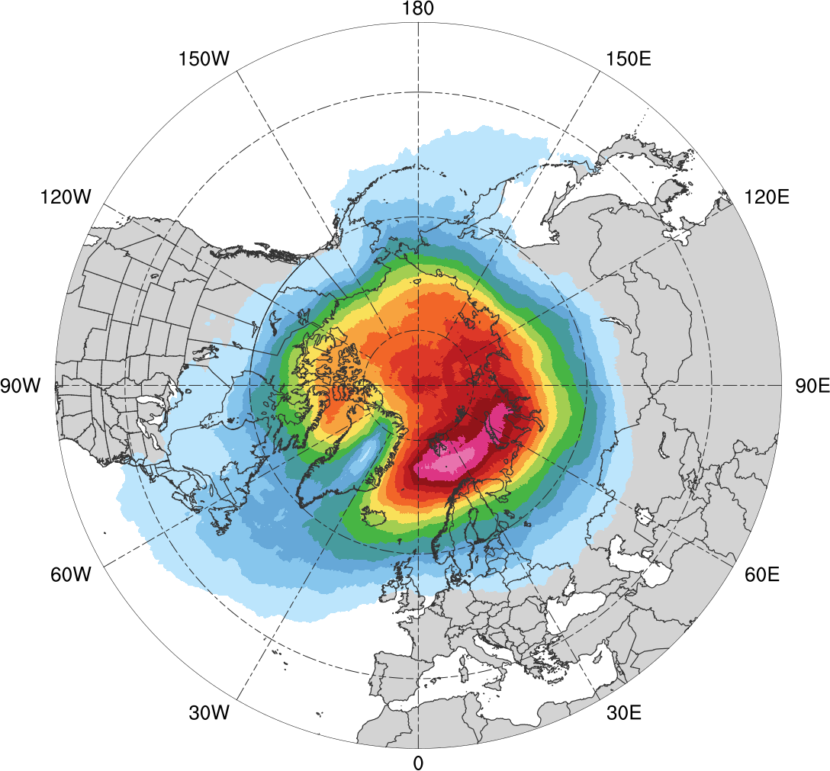
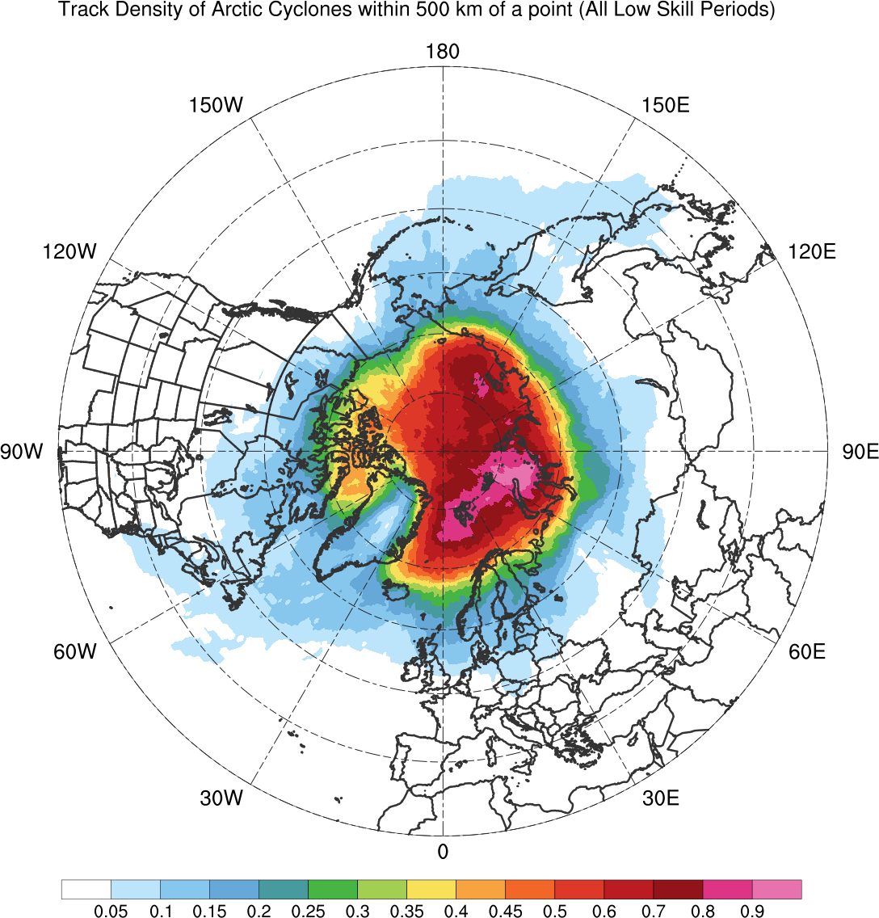
AC Track Frequency
Climatology (N = 2542)
0.005
0.01
0.015
0.02
0.03
0.04
0.05
0.06
0.07
0.08
0.09
0.1
0.11
0.12
Total number of ACs within 500 km of a grid point, divided by number of days in climatology (number of ACs day⁻¹)

Slide 9
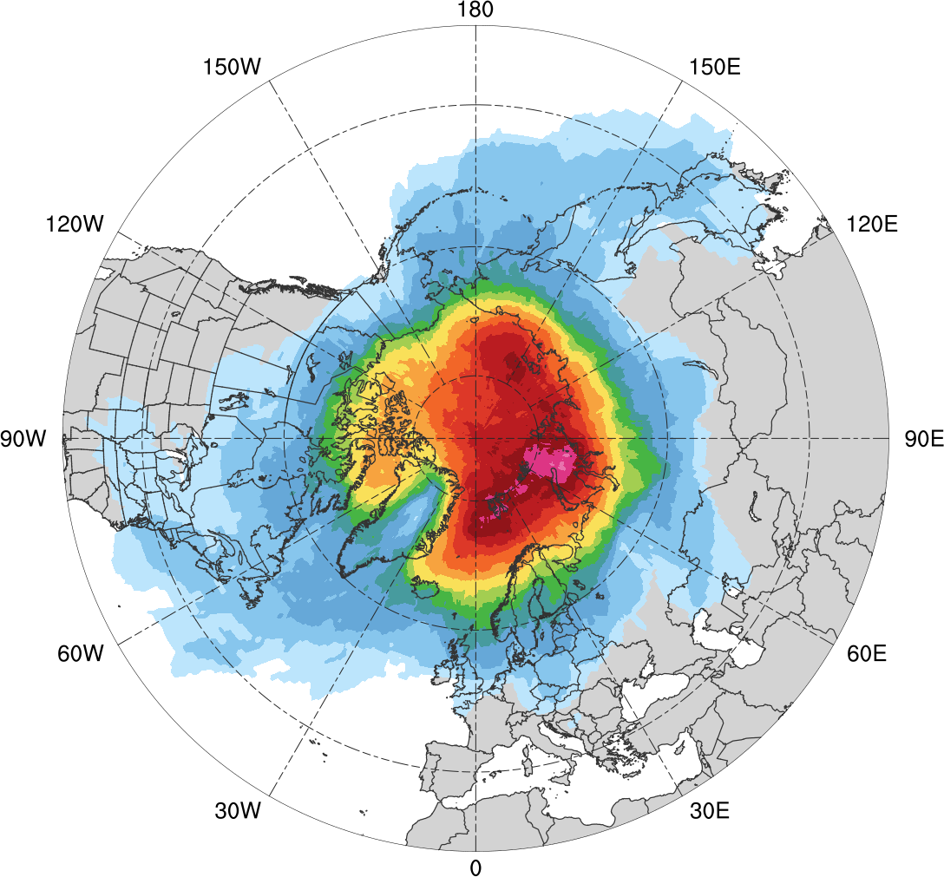
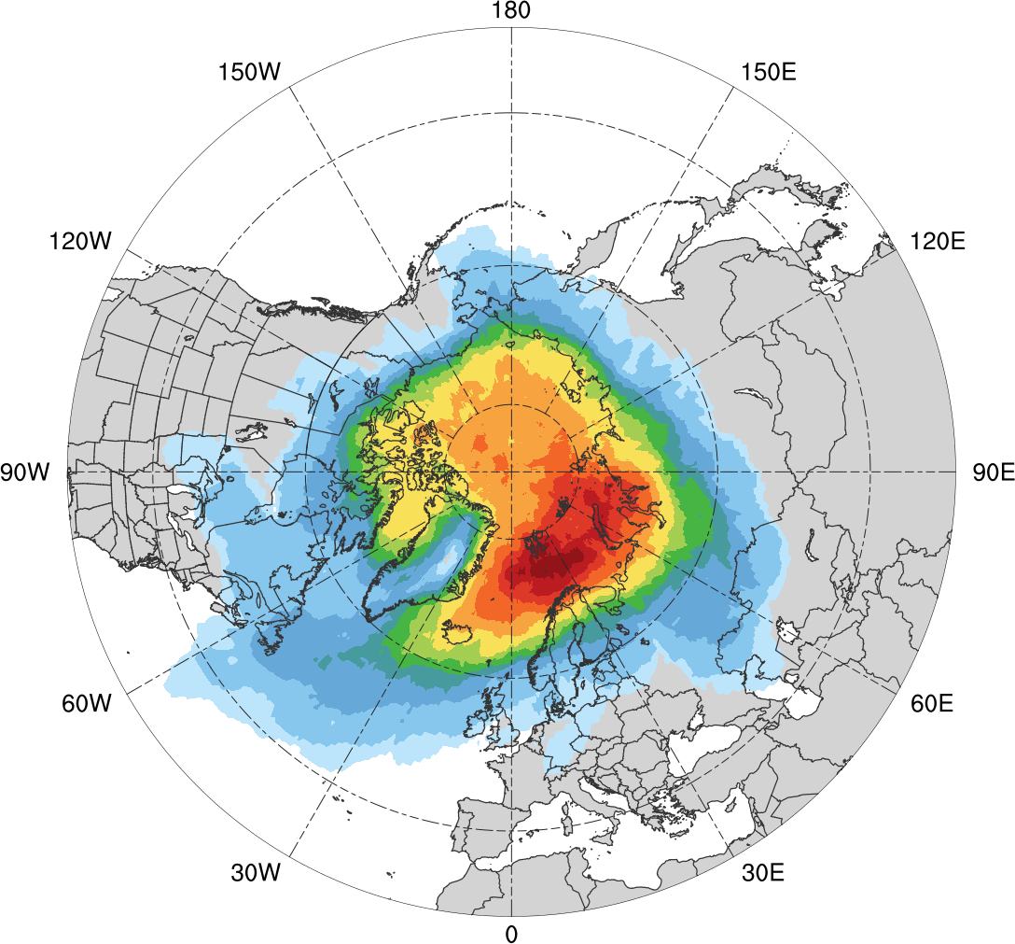
AC Track Frequency
Low skill (N = 401)
High skill (N = 345)
0.005
0.01
0.02
0.03
0.04
0.05
0.06
0.08
0.1
0.12
0.14
0.16
0.18
0.2
Total number of ACs within 500 km of a grid point, divided by number of days in period (number of ACs day⁻¹)

Slide 10
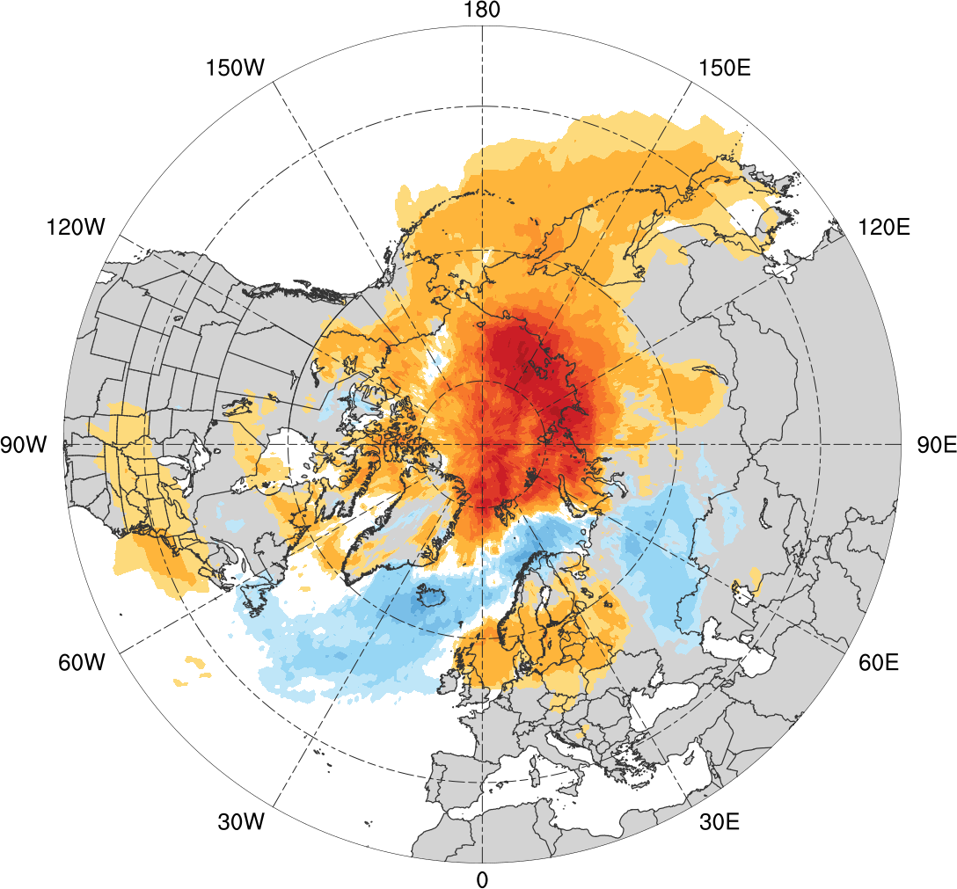
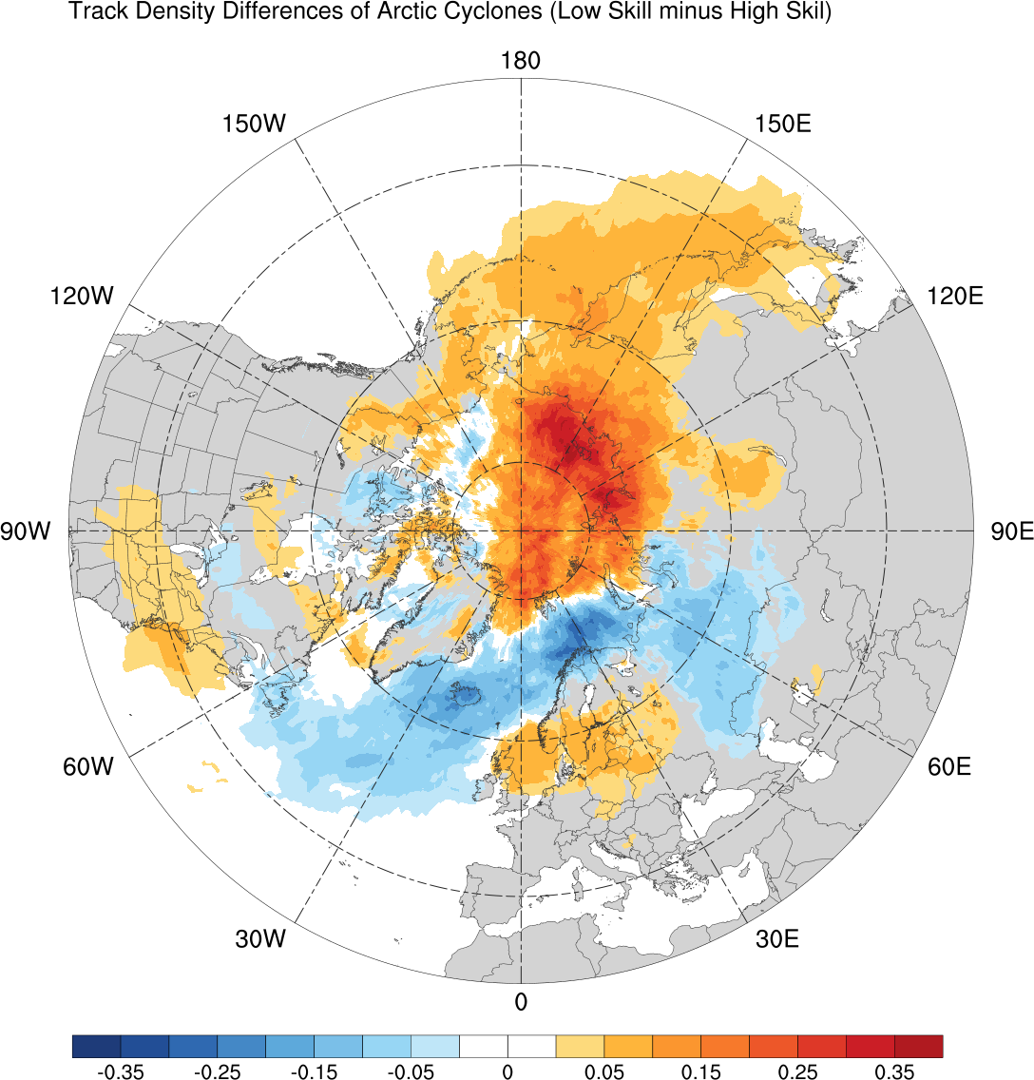
AC Track Frequency Differences
Low skill minus high skill
-0.08
-0.06
-0.05
-0.04
-0.03
-0.02
-0.01
-0.005
0
0.005
0.01
0.02
0.03
0.04
0.05
0.06
0.08
Difference in AC track density (number of ACs day⁻¹)

Slide 11
Intensity
Minimum standardized anomaly of SLP (σ) of ACs
2
min and max
0
mean
-2
95%
75%
-4
median
25%
5%
-6
Statistically significant differences in means
-8
-10
climo
(N=2542)
low
(N=401)
high
(N=345)

Slide 12
Intensity
Minimum standardized anomaly of SLP (σ) of ACs
2
min and max
0
mean
-2
95%
75%
-4
median
25%
5%
-6
Statistically significant differences in means
-8
-10
climo
(N=2542)
low
(N=401)
high
(N=345)

Slide 13
Intensity
Minimum standardized anomaly of SLP (σ) of ACs by season
2
0
-2
-4
-6
-8
low
(N =130)
high
(N=119)
low
(N=110)
high
(N=110)
low
(N=92)
high
(N=55)
low
(N=69)
high
(N=61)
DJF
MAM
JJA
SON
95%
75%
min and max
mean
median
Statistically significant differences in means
25%
5%

Slide 14
Flow Amplitude
Calculate absolute value of standardized anomaly of 500-hPa v-wind (hereafter σ_{v}) using ERA-Interim
Calculate area-weighted average of σ_{v} over the Arctic (≥70°N) for low and high skill periods

Slide 15
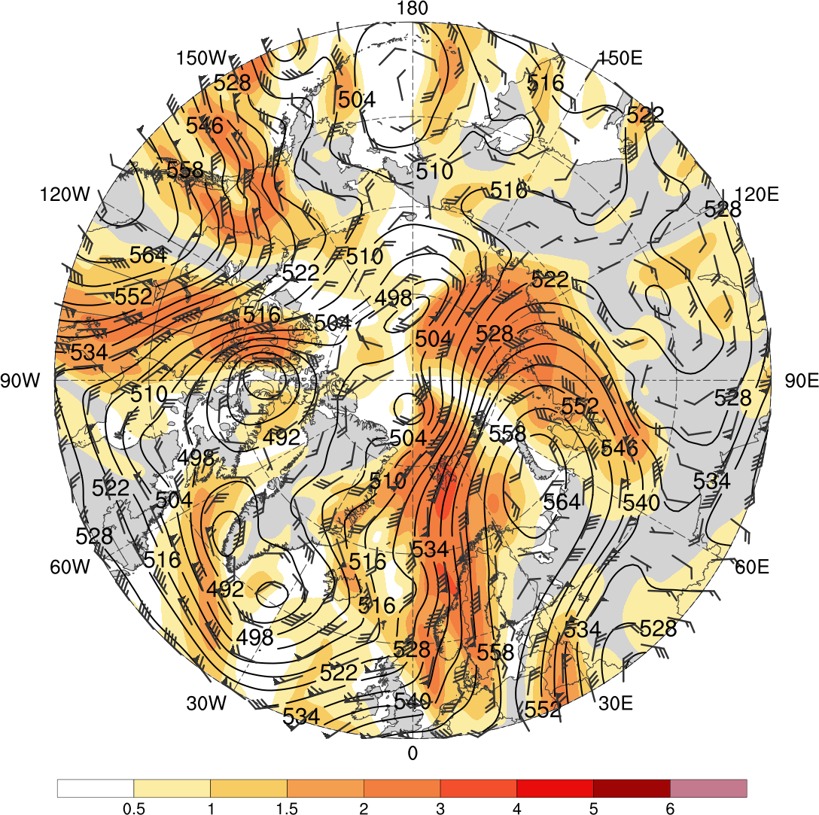
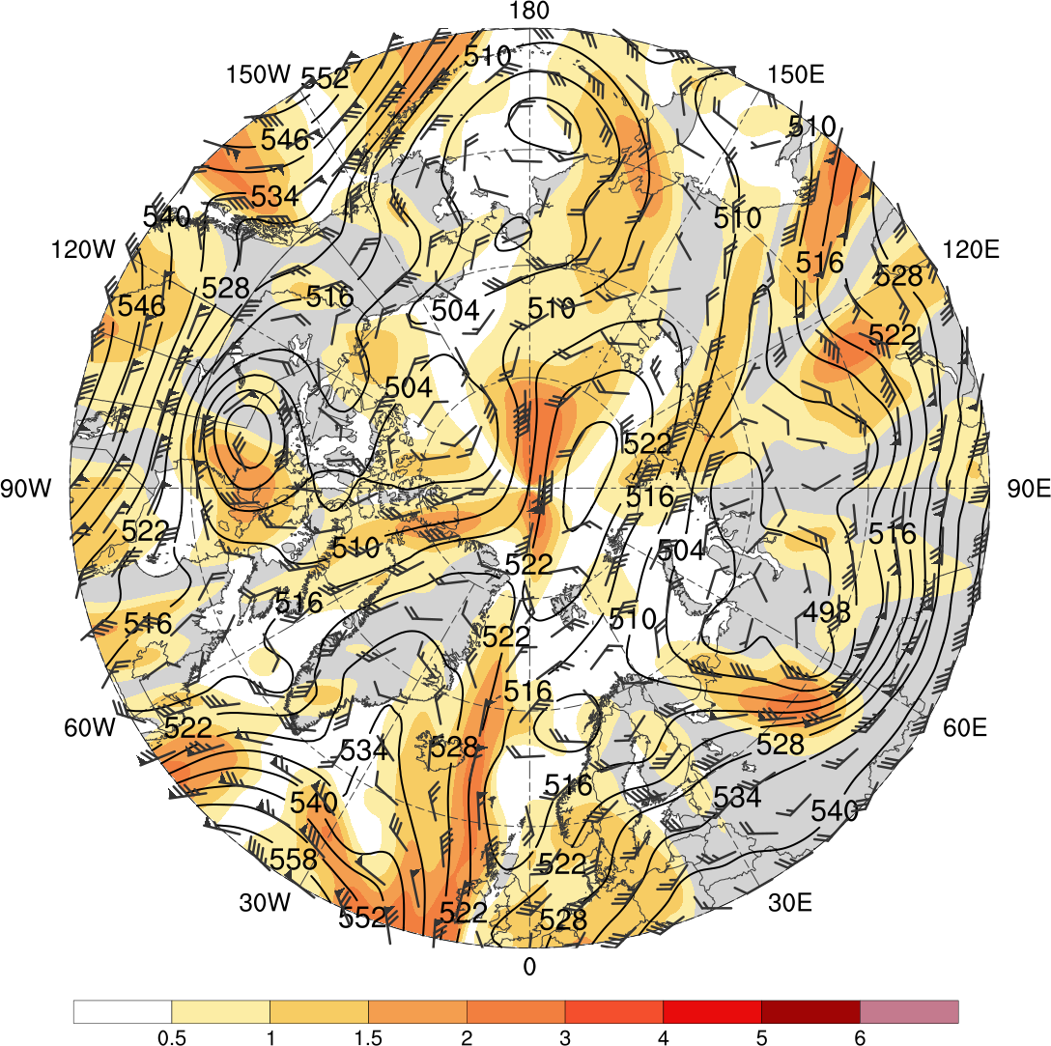
Flow Amplitude
Low skill
0000 UTC 1 Jan 2016
High skill
0000 UTC 6 Feb 2009
0.5
1
1.5
2
3
4
5
6
500-hPa geopotential height (dam, black), wind (flags and barbs, m s⁻¹), and σ_{v} (shading) from ERA-Interim

Slide 16
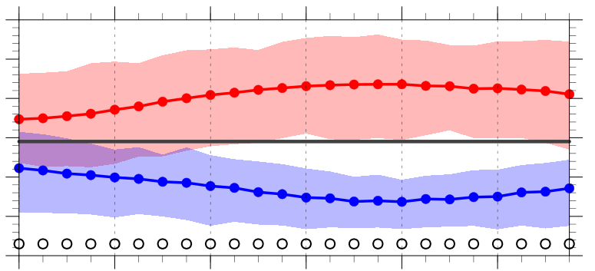
Flow Amplitude
Area-weighted average of σ_{v} over the Arctic (≥70°N)
1.1
1.0
0.9
0.8
0.7
0.6
0.5
-120
-96
-72
-48
-24
0
Hours relative to 0000 UTC of low and high skill days
1979–2017 climo mean
statistically significant difference between low/high skill mean and climo mean
statistically significant difference between low and high skill means
shading: interquartile range
low-skill mean
high-skill mean

Slide 17
Summary
Arctic cyclone frequency is higher for low skill periods compared to high skill periods
Arctic cyclones during low skill periods occur more frequently over northern portions of central and eastern Eurasia and much of the adjacent Arctic Ocean relative to Arctic cyclones during high skill periods
Arctic cyclones during high skill periods occur more frequently over the northern North Atlantic and the adjacent Norwegian and Barents Seas relative to Arctic cyclones during low skill periods

Slide 18
Summary
Arctic cyclones tend to be stronger during low skill periods compared to high skill periods
The synoptic-scale flow over the Arctic tends to be significantly more amplified during low skill periods compared to high skill periods

Slide 19
Questions? Email: kbiernat@albany.edu
Arctic cyclones tend to be stronger during low skill periods compared to high skill periods
The synoptic-scale flow over the Arctic tends to be significantly more amplified during low skill periods compared to high skill periods

Slide 20
References
Buizza, R., J. R. Bidlot, N. Wedi, M. Fuentes, M. Hamrud, G. Holt, and F. Vitart,
2007: The new ECMWF VAREPS (Variable Resolution Ensemble Prediction
System). Quart. J. Roy. Meteor. Soc., 133, 681–695.
Hamill, T. M., G. T. Bates, J. S. Whitaker, D. R. Murray, M. Fiorino, T. J.
Galarneau Jr., Y. Zhu, and W. Lapenta, 2013: NOAA’s second-generation
global medium-range ensemble reforecast dataset. Bull. Amer. Meteor. Soc.,
94, 1553–1565.
Sprenger, M., and Coauthors, 2017: Global climatologies of Eulerian and
Lagrangian flow features based on ERA-Interim. Bull. Amer. Meteor. Soc.,
98, 1739–1748.
Torn, R. D., 2017: A comparison of the downstream predictability associated with
ET and baroclinic cyclones. Mon. Wea. Rev., 145, 4651–4672.
Yamagami, A., M. Matsueda, and H. L. Tanaka, 2018a: Predictability of the 2012
great Arctic cyclone on medium-range timescales. Polar Science, 15, 13–23.
——, ——, and ——, 2018b: Medium-range forecast skill for extraordinary Arctic
cyclones in summer of 2008–2016. Geophys. Res. Lett., 45, 4429– 4437.

Slide 21
Extra Slides

Slide 22
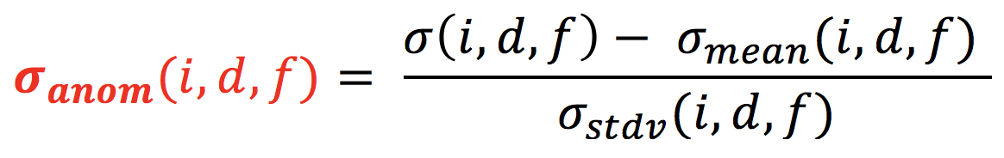
Data and Methods: Forecast Skill Evaluation
At each grid point (i), day of the year (d), and forecast lead time (f), σ_{anom} is calculated following Torn (2017) as:
σ = raw ensemble spread
σ_{mean} = climatological mean ensemble spread
σ_{stdv} = climatological standard deviation of ensemble spread
σ_{mean} and σ_{stdv} are calculated for 1985–2017 period from the GEFS reforecast dataset v2

Slide 23
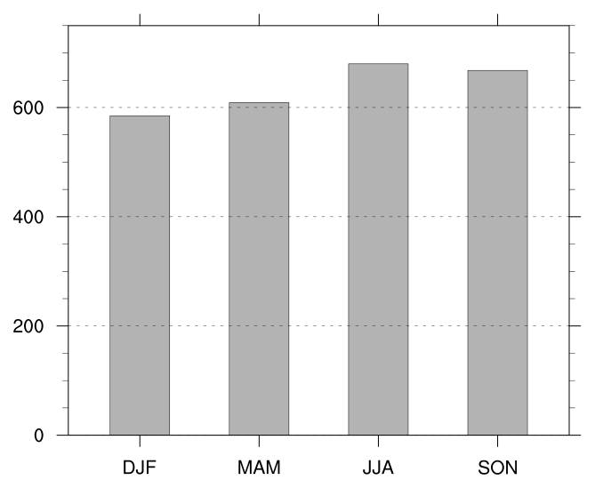
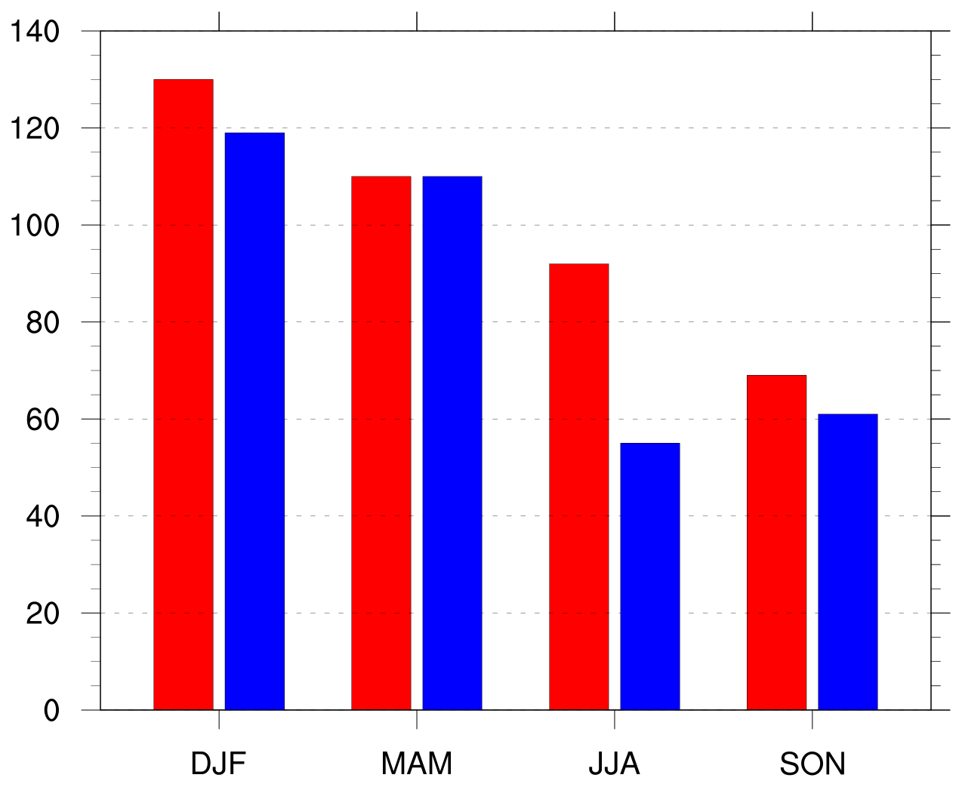
Number of Arctic Cyclones by Season
Number of Arctic cyclones in climatology by season
Number of Arctic cyclones in low and high skill periods by season
Low skill
High skill

Slide 24
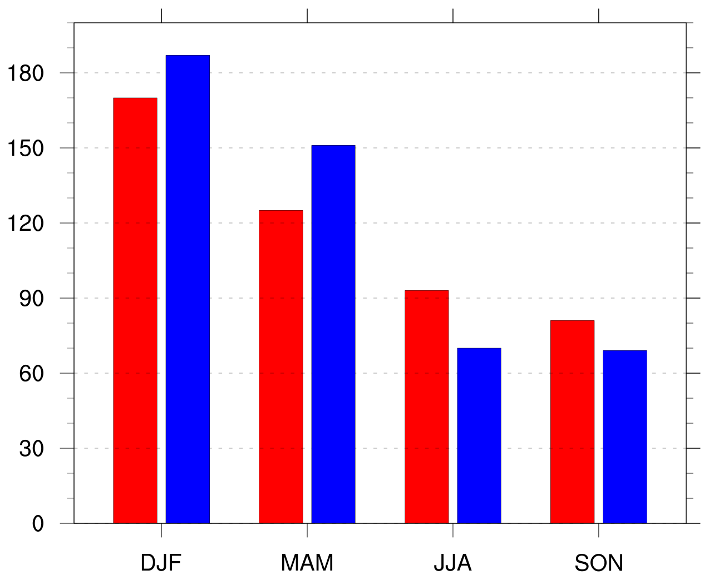
Number of Arctic Cyclones by Season
Number of days in low and high skill periods by season
Number of Arctic cyclones in low and high skill periods by season
Low skill
Low skill
High skill
High skill

Slide 25
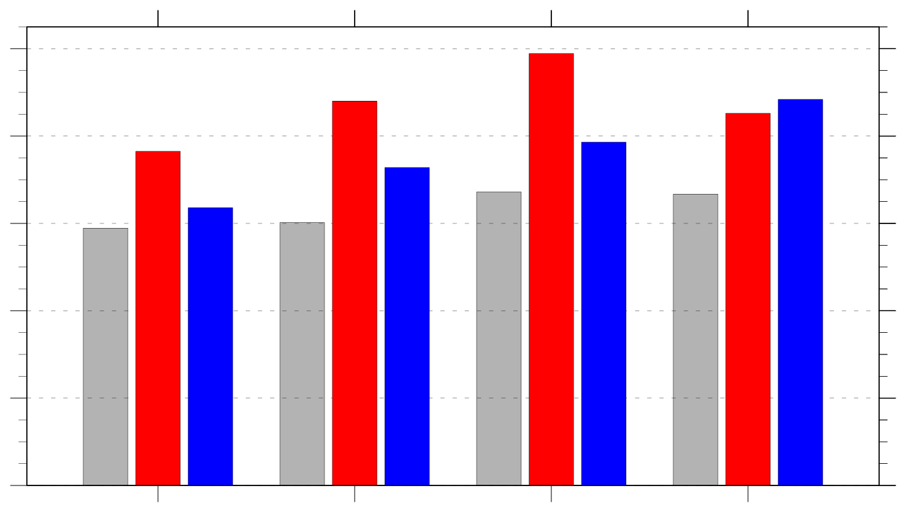
Frequency of ACs by Season
Frequency of ACs (number of ACs day⁻¹) by season
1.0
climo
low skill
high skill
0.8
0.6
0.4
0.2
0.0
DJF
MAM
JJA
SON
Frequency = number of ACs within period / number of days within period

Slide 26
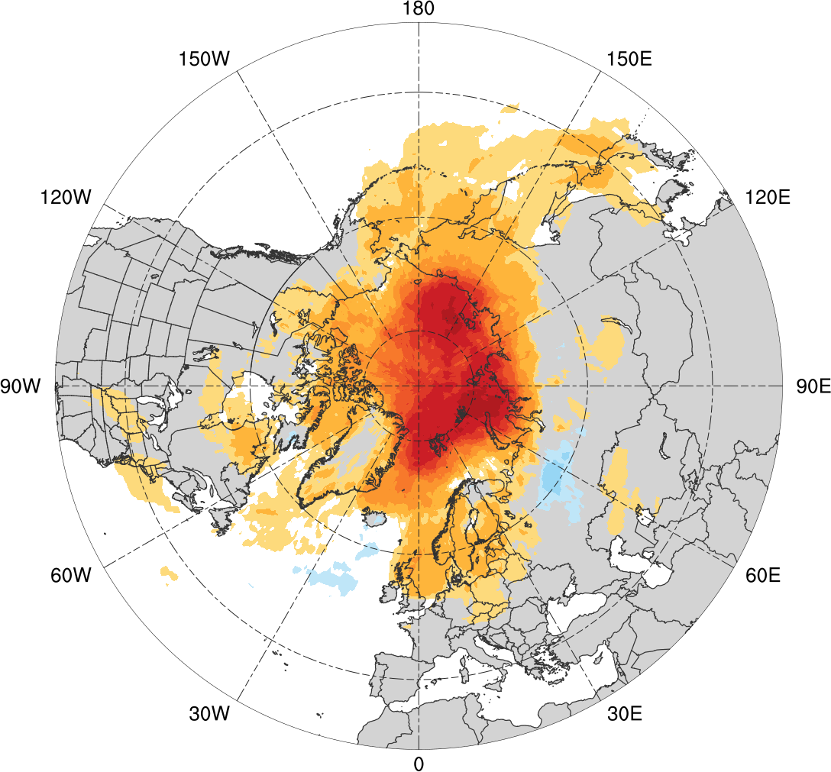
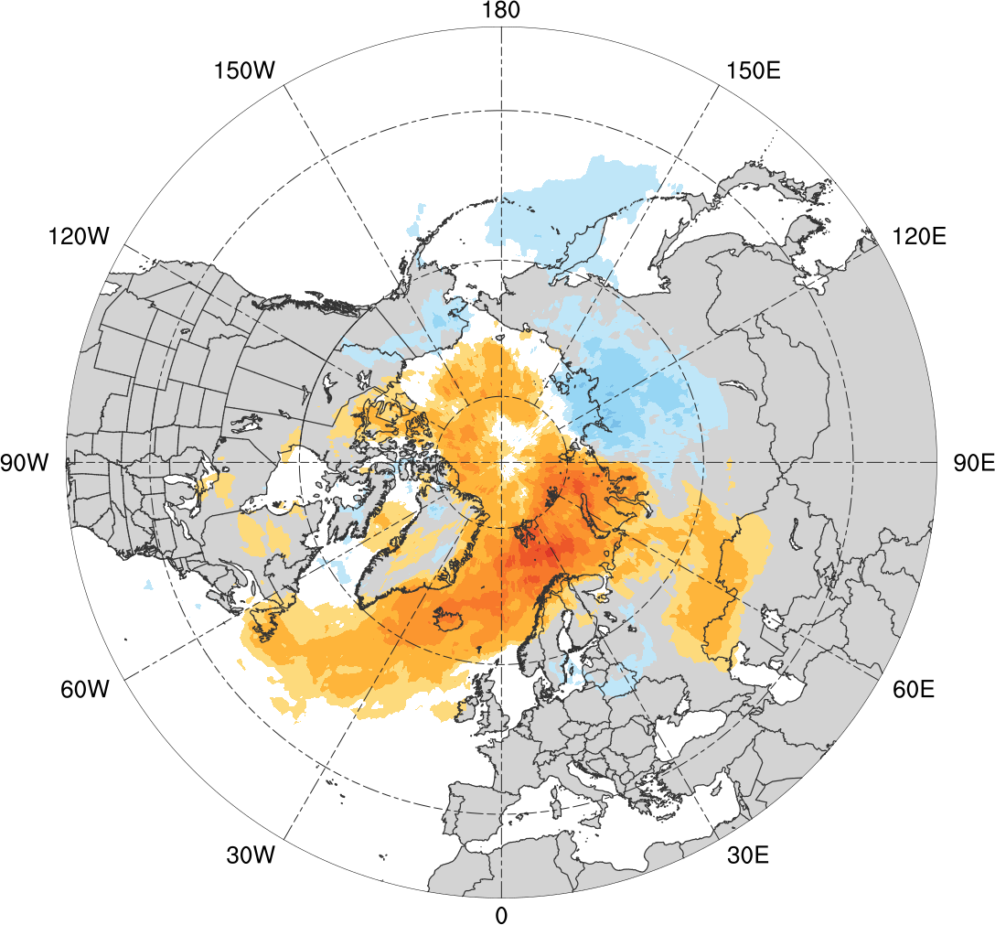
Track Frequency Differences
Low skill minus climatology
High skill minus climatology
-0.08
-0.06
-0.05
-0.04
-0.03
-0.02
-0.01
-0.005
0
0.005
0.01
0.02
0.03
0.04
0.05
0.06
0.08
Difference in AC track frequency (number of ACs day⁻¹)

Slide 27
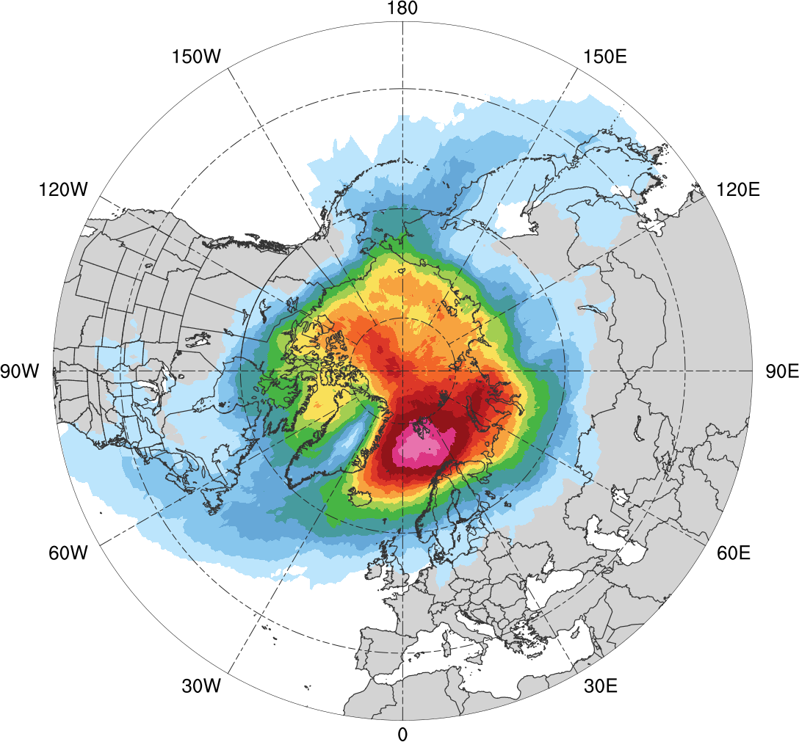
Track Frequency (DJF)
DJF climatology (N = 585)
0.005
0.01
0.015
0.02
0.03
0.04
0.05
0.06
0.07
0.08
0.09
0.1
0.12
0.14
Total number of ACs within 500 km of a grid point, divided by number of days in climatology during DJF (number of ACs day⁻¹)

Slide 28
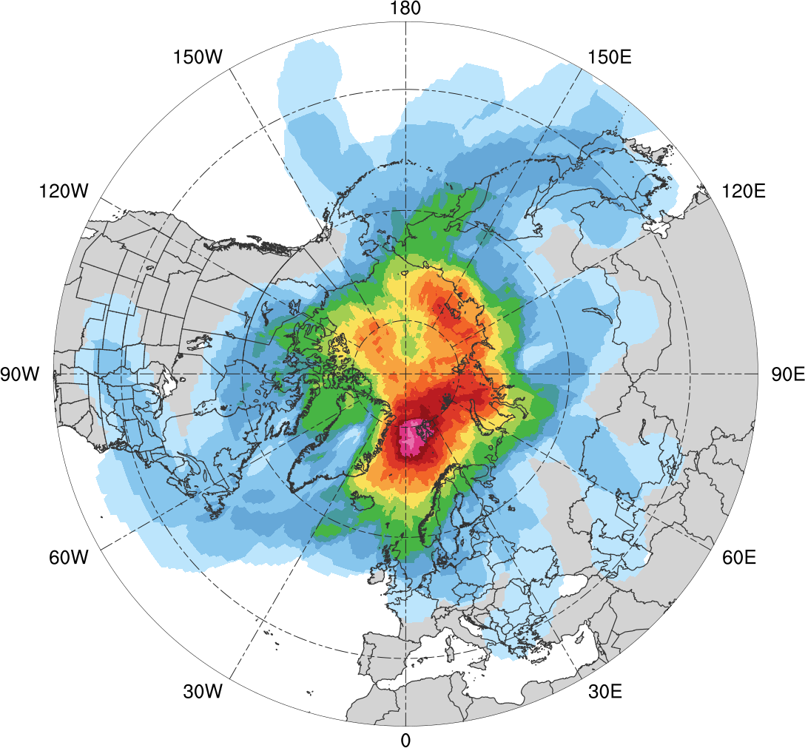
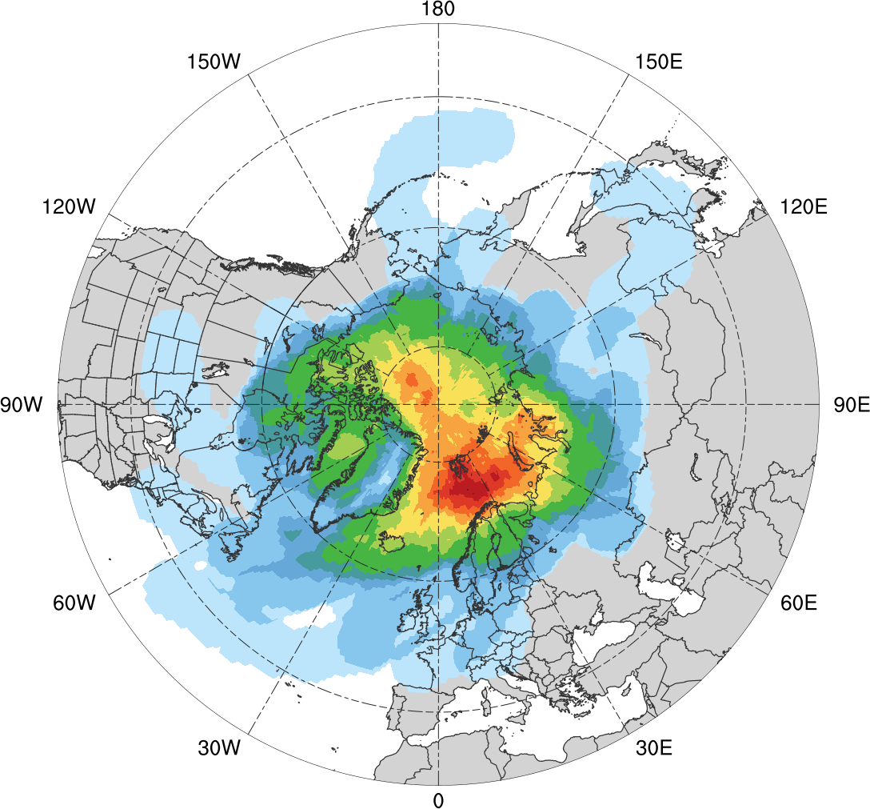
Track Frequency (DJF)
Low skill (N = 130)
High Skill (N = 119)
0.005
0.01
0.02
0.03
0.04
0.06
0.08
0.1
0.12
0.14
0.16
0.18
0.2
0.22
Total number of ACs within 500 km of a grid point, divided by number of days in period during DJF (number of ACs day⁻¹)

Slide 29
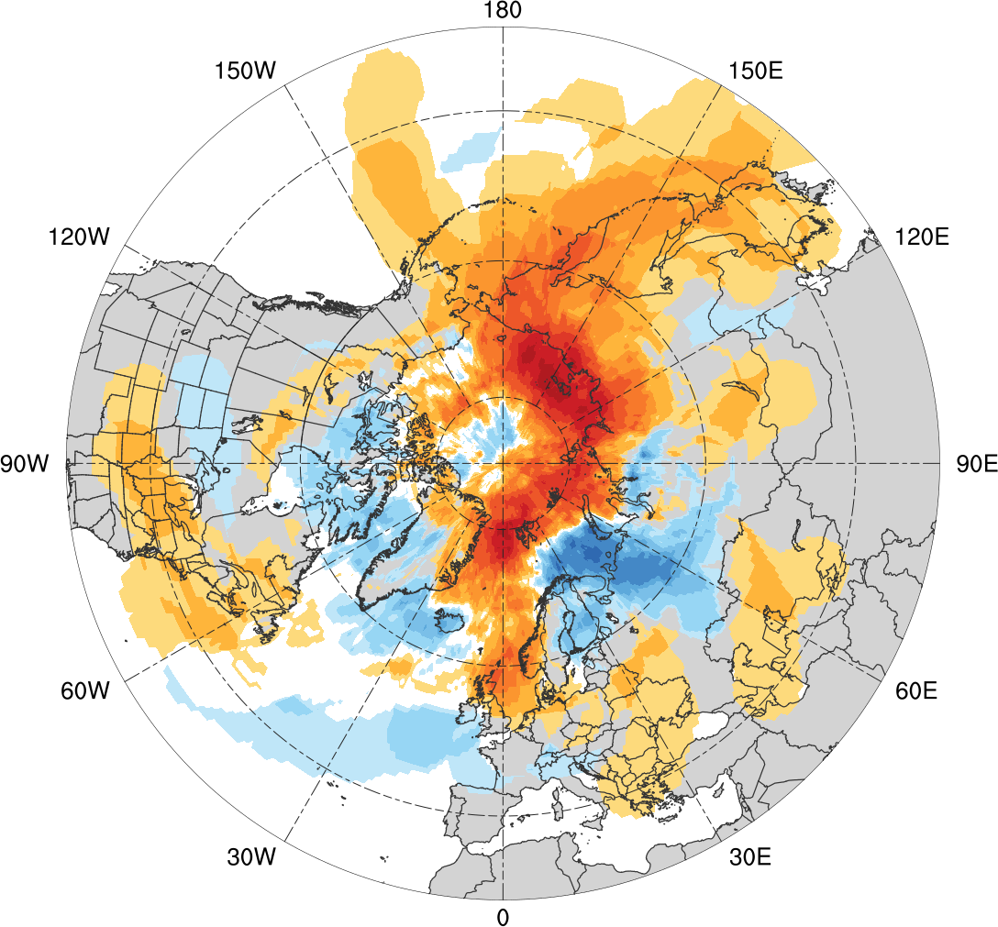
Track Frequency Differences (DJF)
Low skill minus high skill
-0.1
-0.08
-0.06
-0.04
-0.03
-0.02
-0.01
-0.005
0
0.005
0.01
0.02
0.03
0.04
0.06
0.08
0.1
Difference in AC track density during DJF (number of ACs day⁻¹)

Slide 30
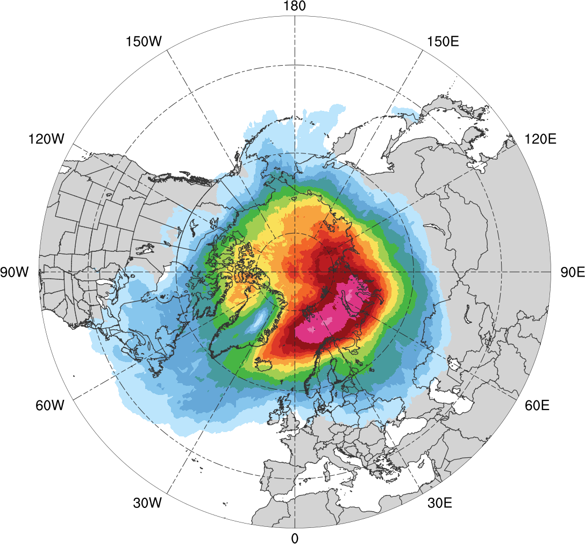
Track Frequency (MAM)
MAM climatology (N = 609)
0.005
0.01
0.015
0.02
0.03
0.04
0.05
0.06
0.07
0.08
0.09
0.1
0.12
0.14
Total number of ACs within 500 km of a grid point, divided by number of days in climatology during MAM (number of ACs day⁻¹)

Slide 31
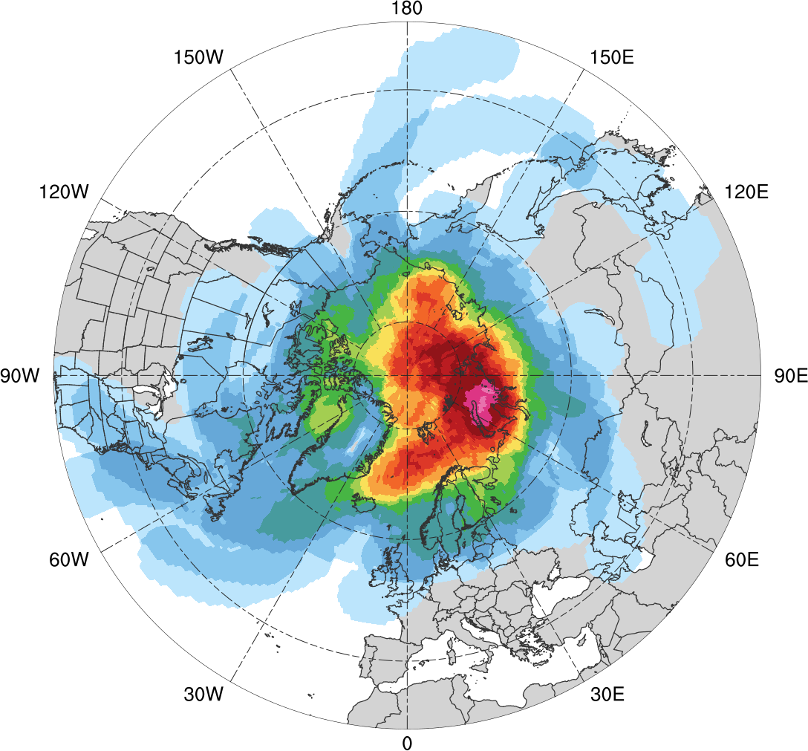
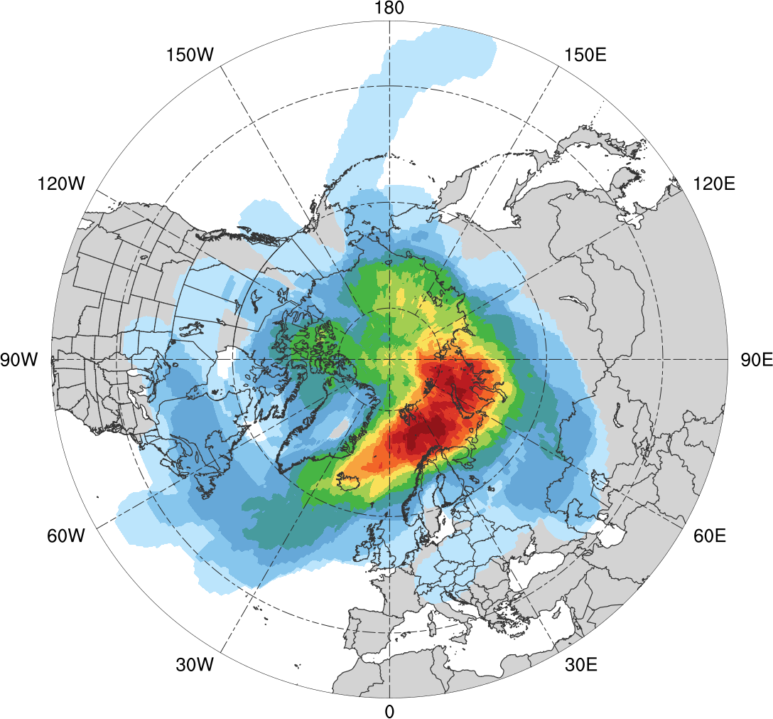
Track Frequency (MAM)
Low skill (N = 110)
High Skill (N = 110)
0.005
0.01
0.02
0.04
0.06
0.08
0.1
0.12
0.14
0.16
0.18
0.2
0.24
0.28
Total number of ACs within 500 km of a grid point, divided by number of days in period during MAM (number of ACs day⁻¹)

Slide 32
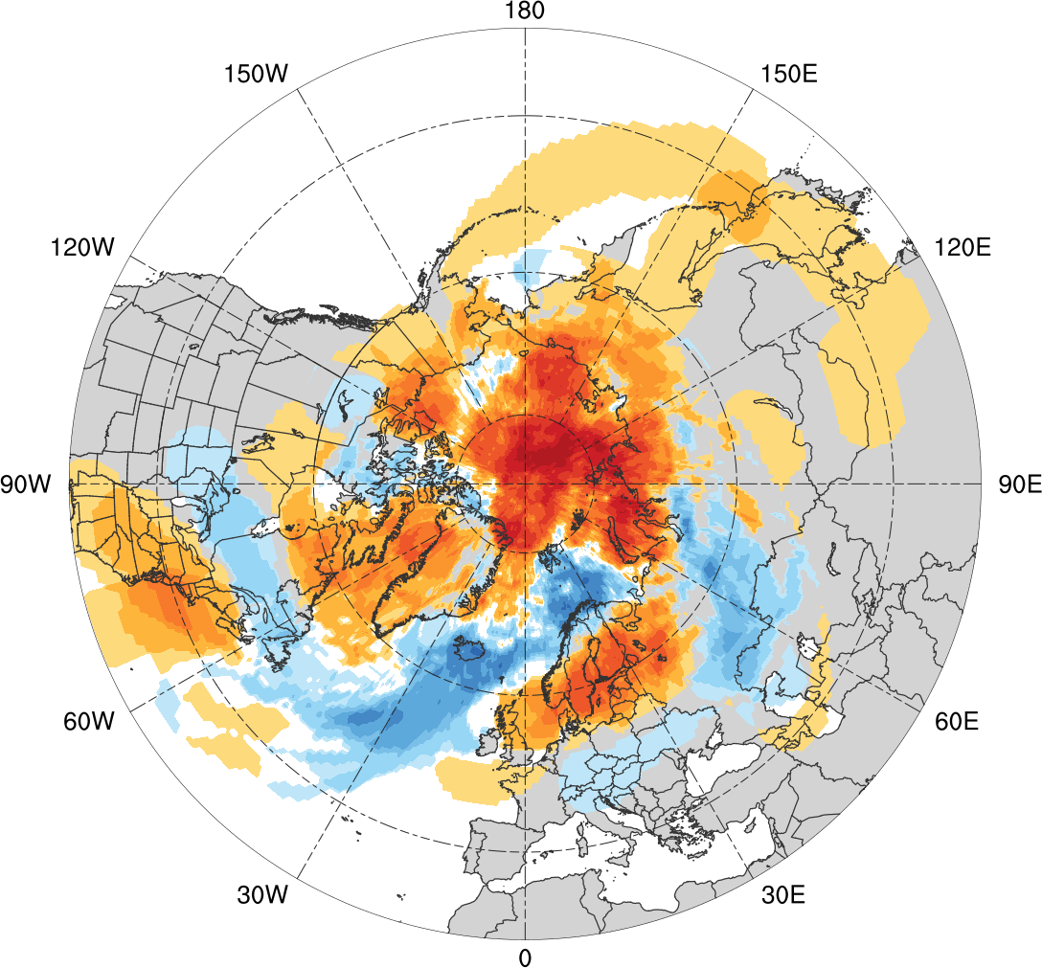
Track Frequency Differences (MAM)
Low skill minus high skill
-0.1
-0.08
-0.06
-0.04
-0.03
-0.02
-0.01
-0.005
0
0.005
0.01
0.02
0.03
0.04
0.06
0.08
0.1
Difference in AC track density during MAM (number of ACs day⁻¹)

Slide 33
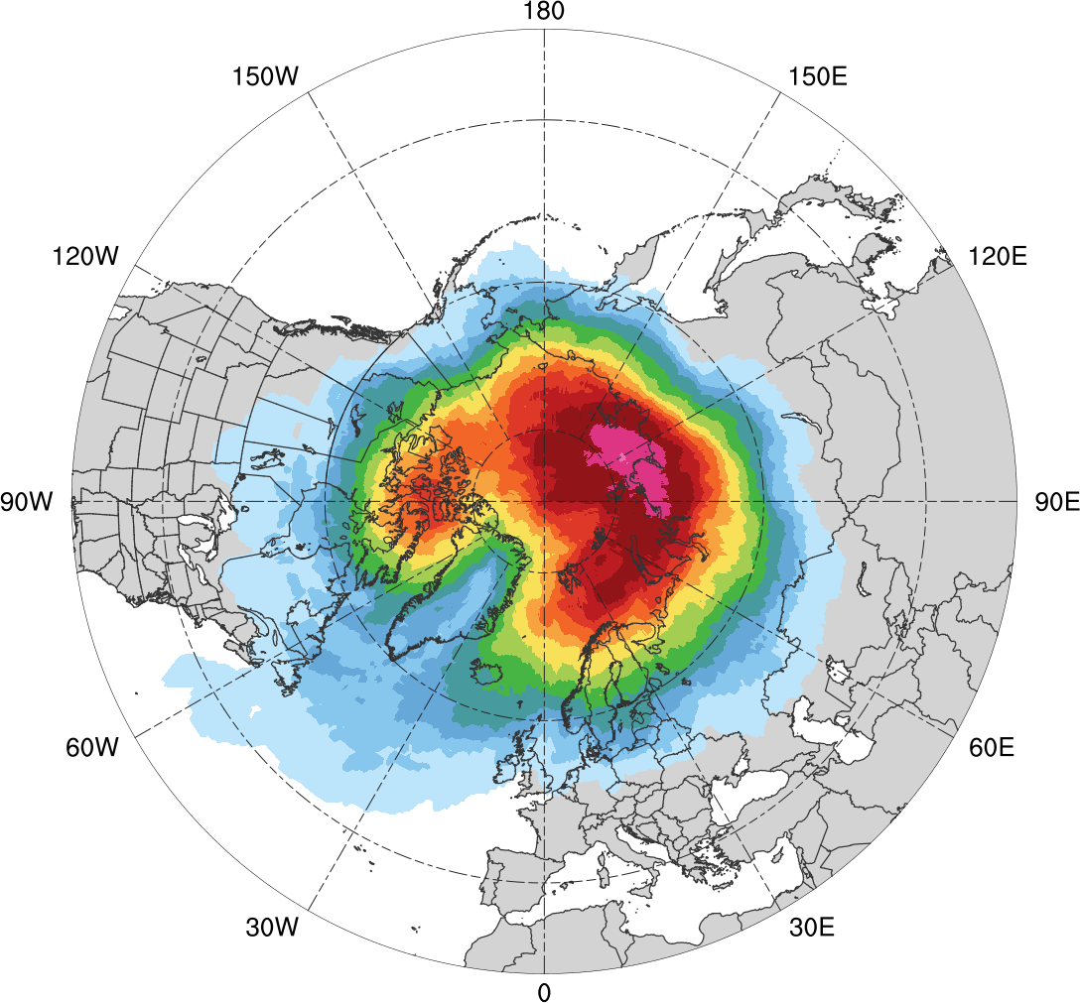
Track Frequency (JJA)
JJA climatology (N = 680)
0.005
0.01
0.015
0.02
0.03
0.04
0.05
0.06
0.07
0.08
0.09
0.1
0.12
0.14
Total number of ACs within 500 km of a grid point, divided by number of days in climatology during JJA (number of ACs day⁻¹)

Slide 34
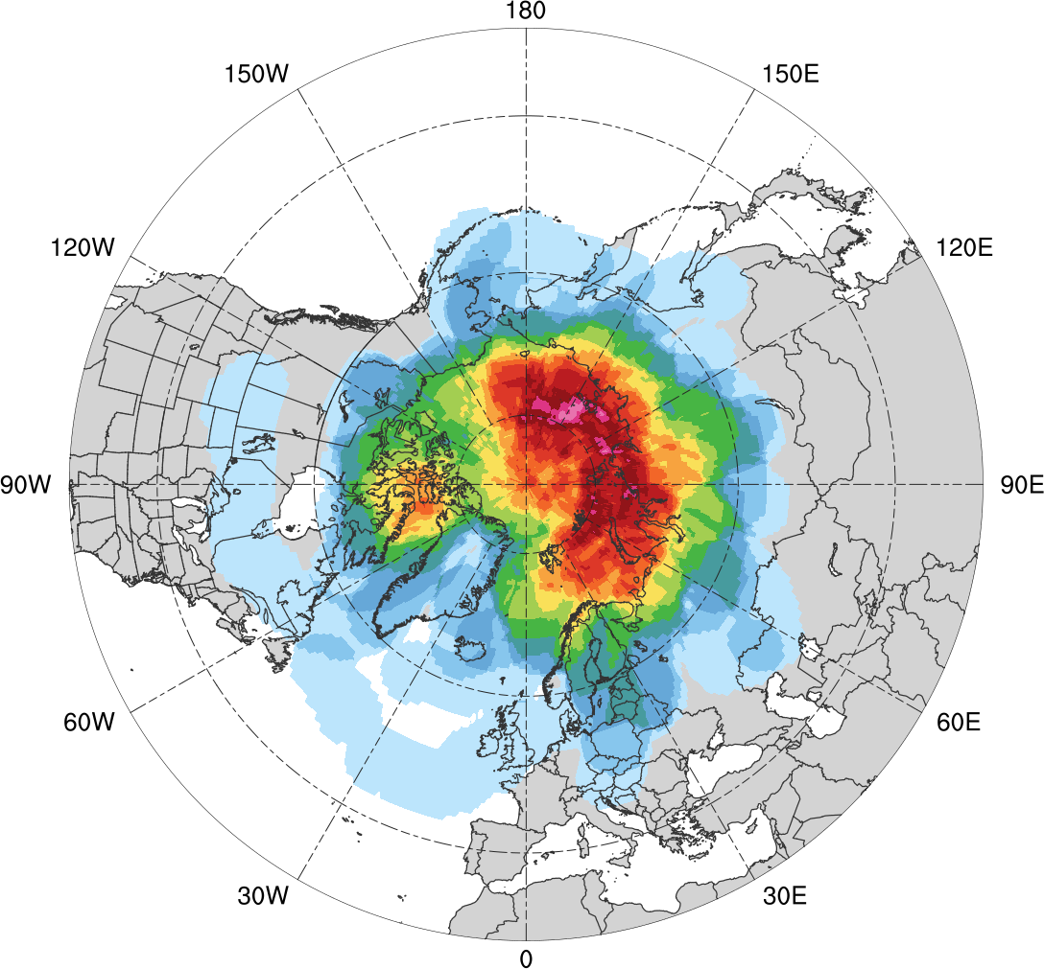
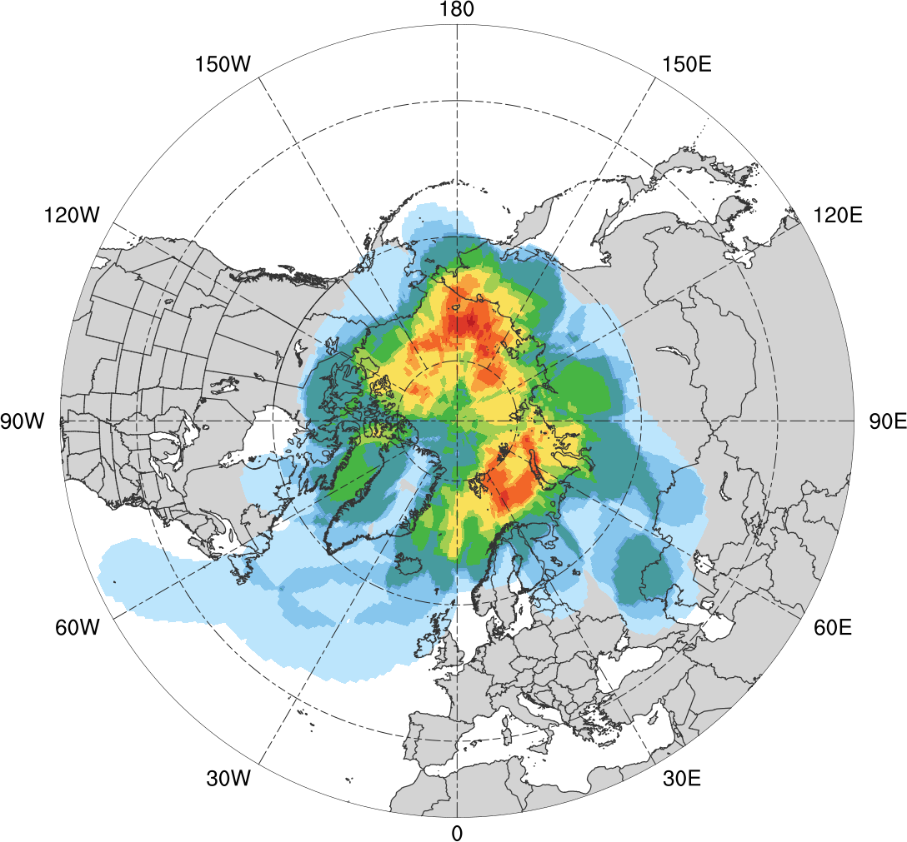
Track Frequency (JJA)
Low skill (N = 92)
High Skill (N = 52)
0.01
0.02
0.03
0.04
0.06
0.08
0.1
0.12
0.14
0.16
0.18
0.2
0.22
0.24
Total number of ACs within 500 km of a grid point, divided by number of days in period during JJA (number of ACs day⁻¹)

Slide 35
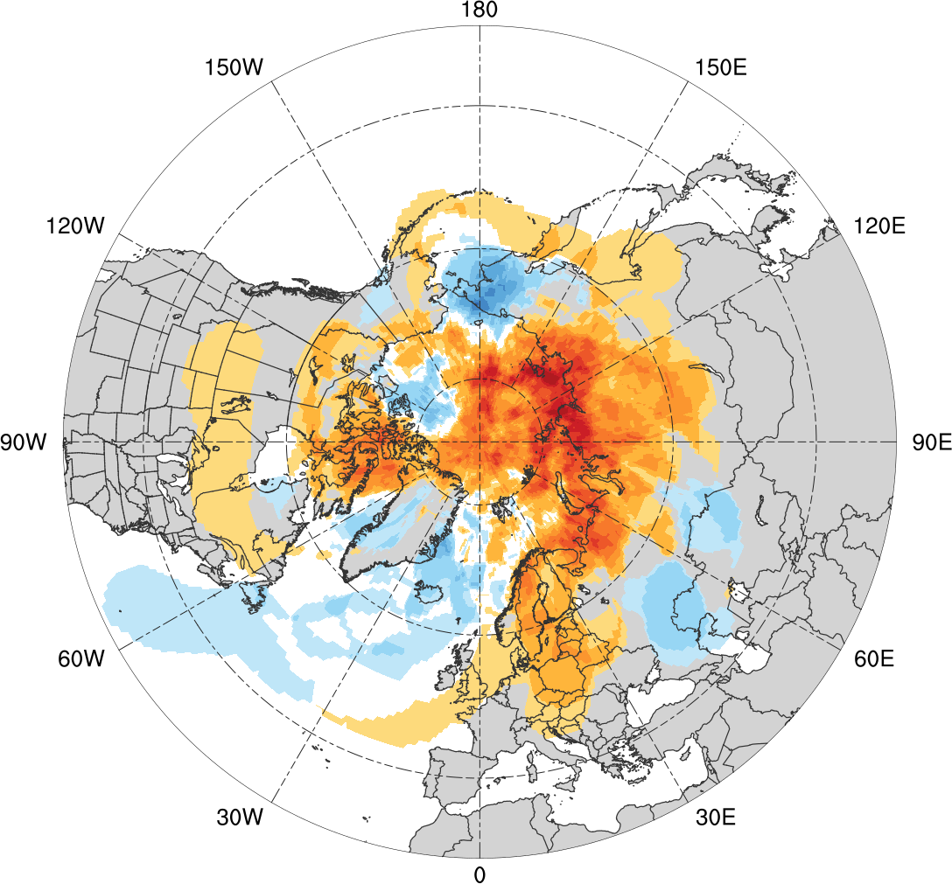
Track Frequency Differences (JJA)
Low skill minus high skill
-0.14
-0.12
-0.1
-0.08
-0.06
-0.04
-0.02
-0.01
0
0.01
0.02
0.04
0.06
0.08
0.1
0.12
0.14
Difference in AC track density during JJA (number of ACs day⁻¹)

Slide 36
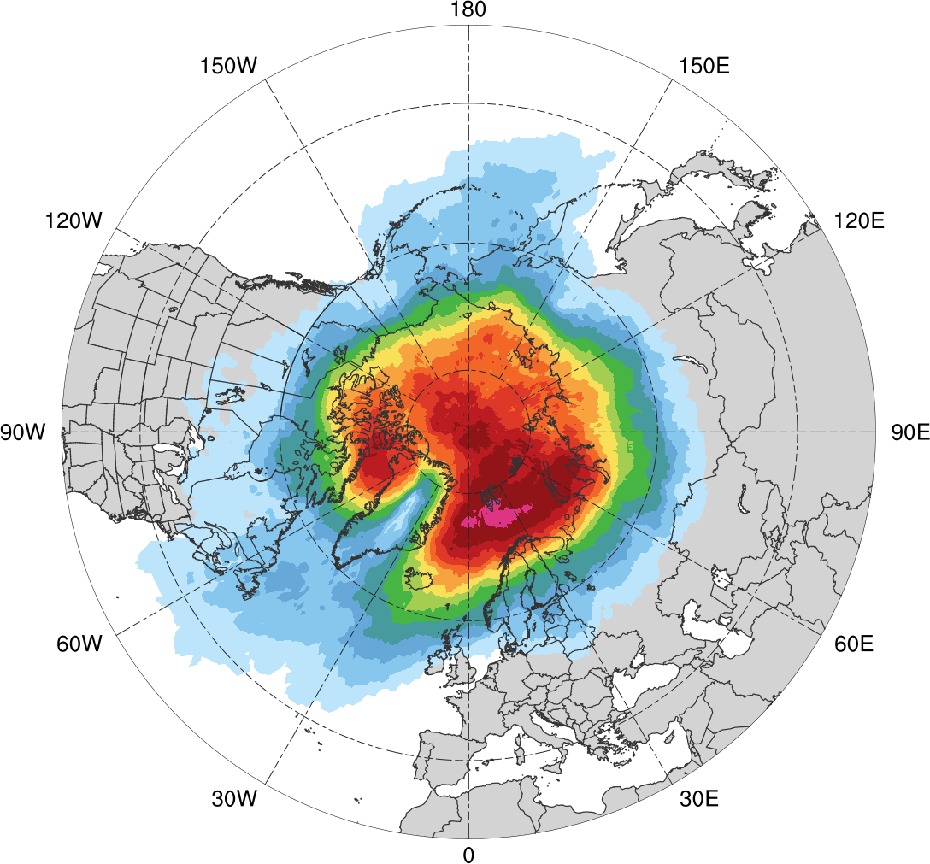
Track Frequency (SON)
SON climatology (N = 668)
0.005
0.01
0.015
0.02
0.03
0.04
0.05
0.06
0.07
0.08
0.09
0.1
0.12
0.14
Total number of ACs within 500 km of a grid point, divided by number of days in climatology during SON (number of ACs day⁻¹)

Slide 37
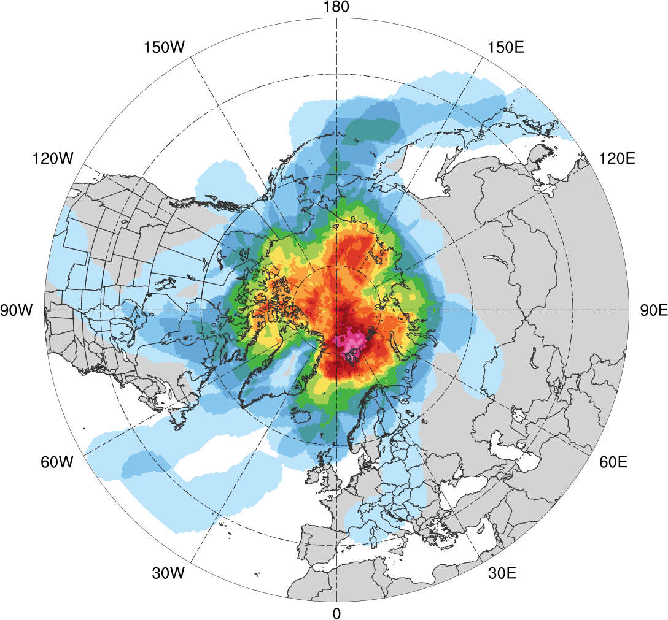
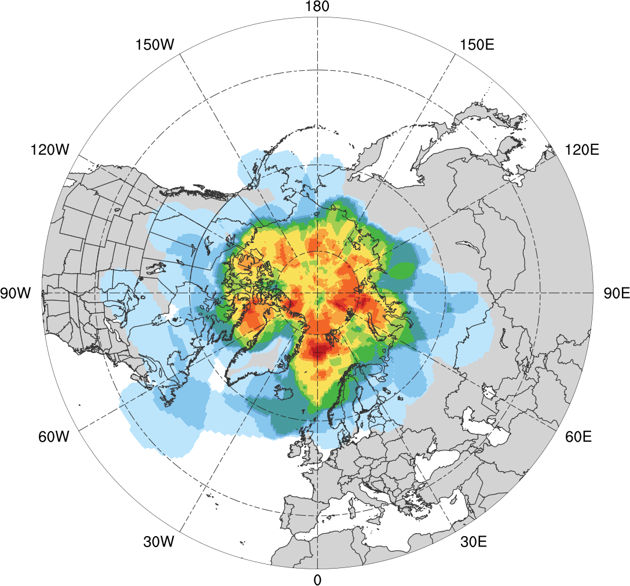
Track Frequency (SON)
Low skill (N = 69)
High Skill (N = 61)
0.01
0.02
0.03
0.04
0.06
0.08
0.1
0.12
0.14
0.16
0.18
0.2
0.22
0.24
Total number of ACs within 500 km of a grid point, divided by number of days in period during SON (number of ACs day⁻¹)

Slide 38
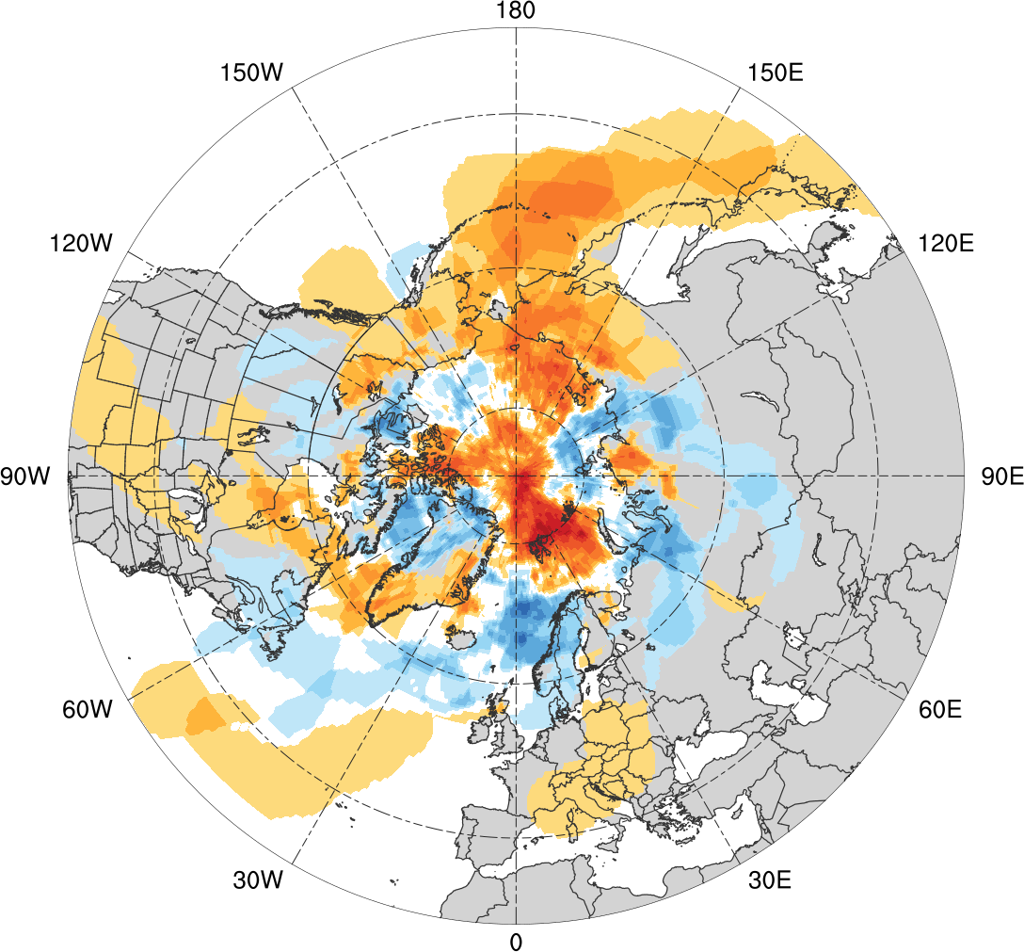
Track Frequency Differences (SON)
Low skill minus high skill
-0.12
-0.1
-0.08
-0.06
-0.04
-0.03
-0.02
-0.01
0
0.01
0.02
0.03
0.04
0.06
0.08
0.1
0.12
Difference in AC track density during SON (number of ACs day⁻¹)

Slide 39
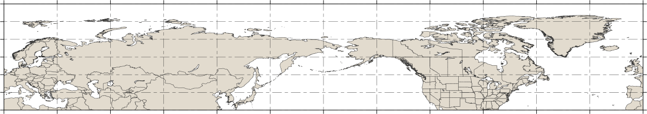
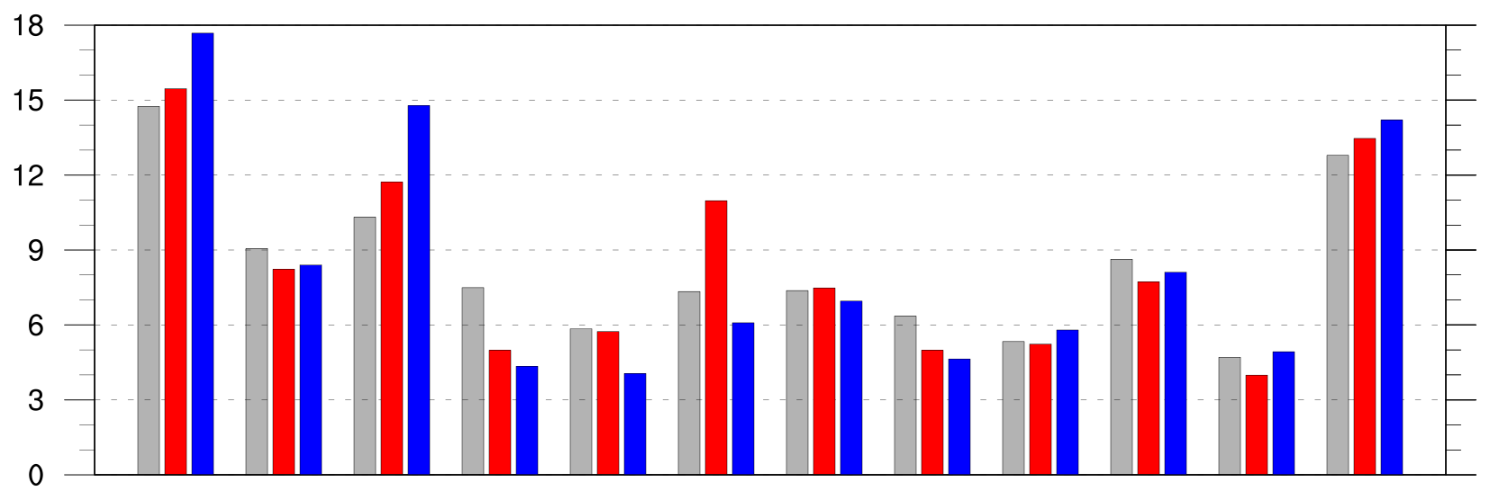
Preferred Longitudinal Corridors
Distribution of longitude of Arctic cyclones at first time in Arctic (>70°N; % per longitudinal bin)
90°N
70°N
50°N
30°N
0°
30°E
60°E
90°E
120°E
150°E
180°
150°W
120°W
90°W
60°W
30°W
0°
0°
30°E
60°E
90°E
120°E
150°E
180°
150°W
120°W
90°W
60°W
30°W
0°
climo (N=2542)
low (N=401)
high (N=345)

Slide 40
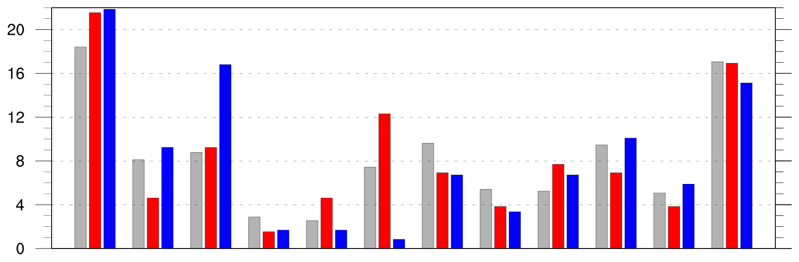
Preferred Longitudinal Corridors (DJF)
Distribution of longitude of Arctic cyclones at first time in Arctic (>70°N; % per longitudinal bin) during DJF
90°N
70°N
50°N
30°N
0°
30°E
60°E
90°E
120°E
150°E
180°
150°W
120°W
90°W
60°W
30°W
0°
0°
30°E
60°E
90°E
120°E
150°E
180°
150°W
120°W
90°W
60°W
30°W
0°
climo (N=585)
low (N=130)
high (N=119)

Slide 41
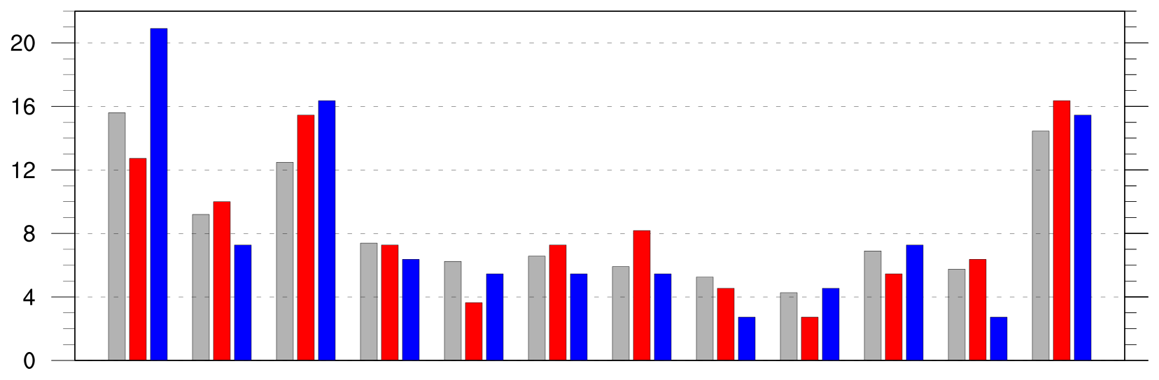
Preferred Longitudinal Corridors (MAM)
Distribution of longitude of Arctic cyclones at first time in Arctic (>70°N; % per longitudinal bin) during MAM
90°N
70°N
50°N
30°N
0°
30°E
60°E
90°E
120°E
150°E
180°
150°W
120°W
90°W
60°W
30°W
0°
0°
30°E
60°E
90°E
120°E
150°E
180°
150°W
120°W
90°W
60°W
30°W
0°
climo (N=609)
low (N=110)
high (N=110)

Slide 42
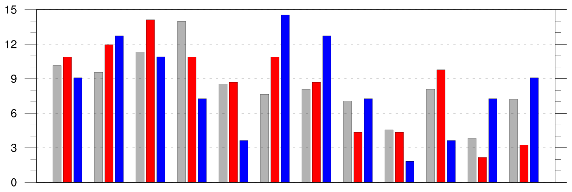
Preferred Longitudinal Corridors (JJA)
Distribution of longitude of Arctic cyclones at first time in Arctic (>70°N; % per longitudinal bin) during JJA
90°N
70°N
50°N
30°N
0°
30°E
60°E
90°E
120°E
150°E
180°
150°W
120°W
90°W
60°W
30°W
0°
0°
30°E
60°E
90°E
120°E
150°E
180°
150°W
120°W
90°W
60°W
30°W
0°
climo (N=680)
low (N=92)
high (N=55)

Slide 43
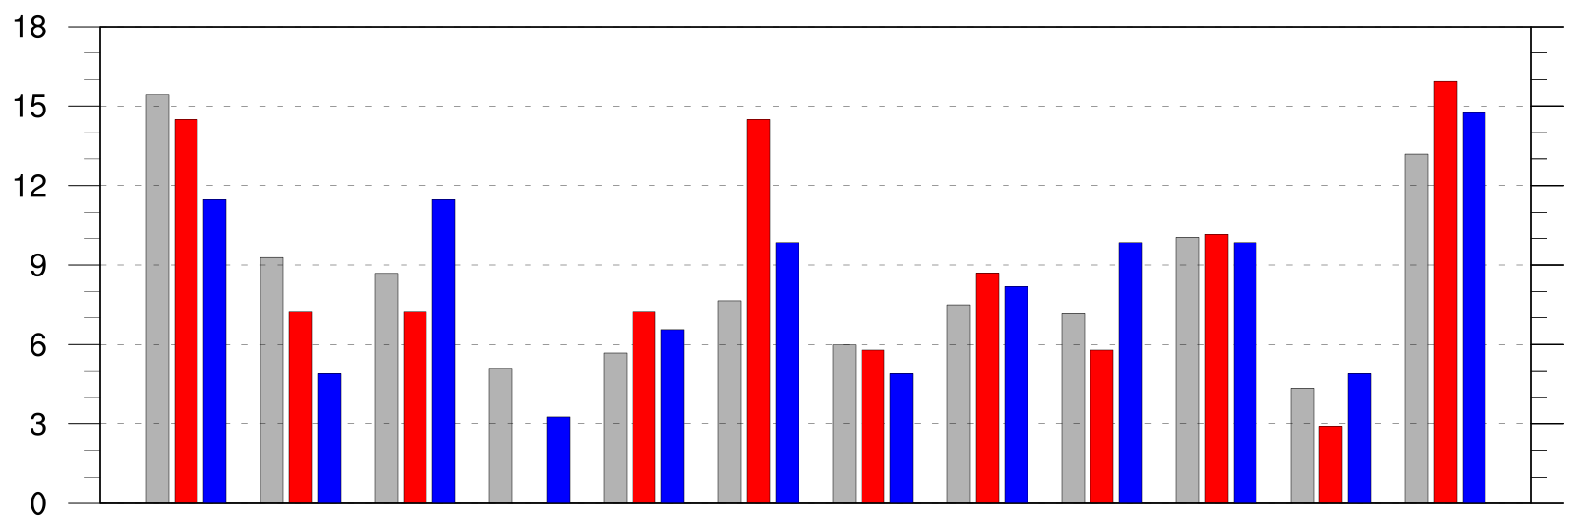
Preferred Longitudinal Corridors (SON)
Distribution of longitude of Arctic cyclones at first time in Arctic (>70°N; % per longitudinal bin) during SON
90°N
70°N
50°N
30°N
0°
30°E
60°E
90°E
120°E
150°E
180°
150°W
120°W
90°W
60°W
30°W
0°
0°
30°E
60°E
90°E
120°E
150°E
180°
150°W
120°W
90°W
60°W
30°W
0°
climo (N=668)
low (N=69)
high (N=61)

Slide 44
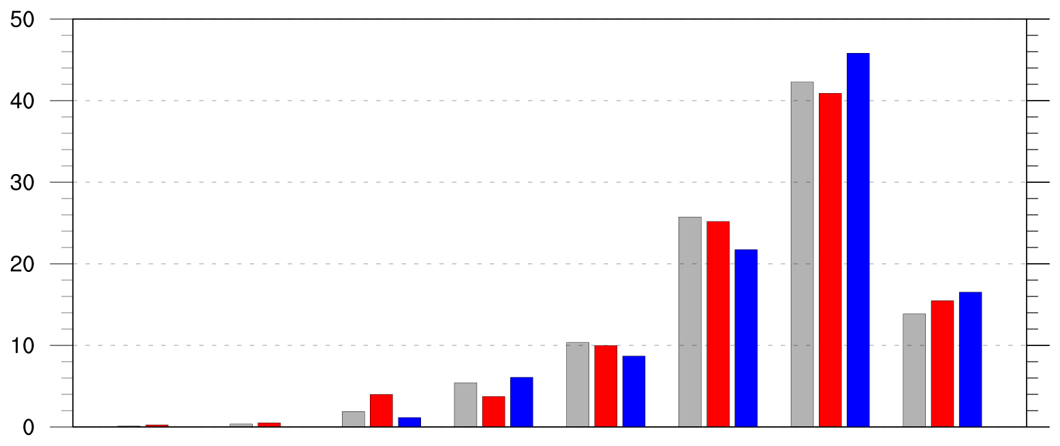
Genesis Latitude
Distribution of AC genesis latitude (% per latitude bin)
50
40
30
20
10
0
10°N
20°N
30°N
40°N
50°N
60°N
70°N
80°N
90°N
climo (N=2542)
low (N=401)
high (N=345)

Slide 45
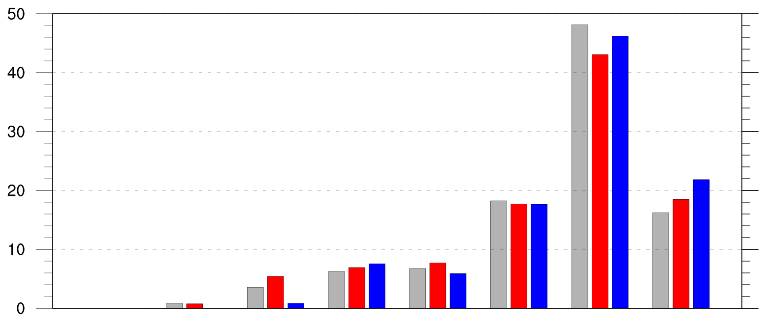
Genesis Latitude (DJF)
Distribution of Arctic cyclone genesis latitude (% per latitude bin) during DJF
10°N
20°N
30°N
40°N
50°N
60°N
70°N
80°N
90°N
climo (N=585)
low (N=130)
high (N=119)

Slide 46
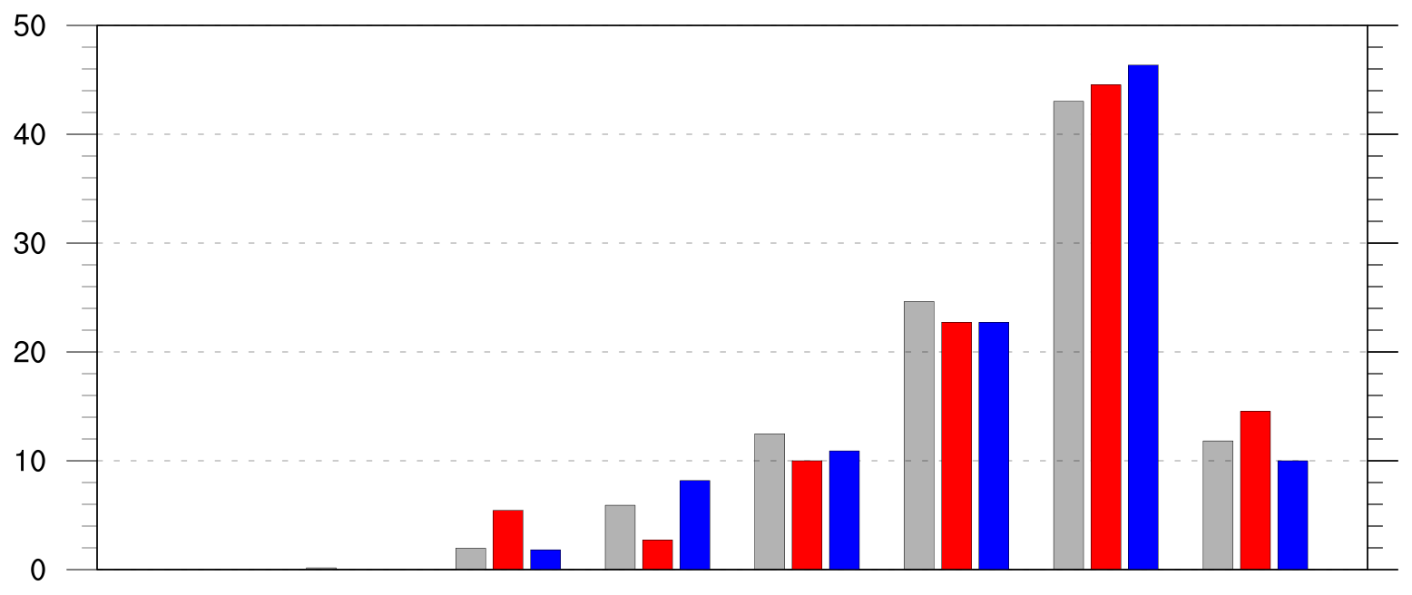
Genesis Latitude (MAM)
Distribution of Arctic cyclone genesis latitude (% per latitude bin) during MAM
10°N
20°N
30°N
40°N
50°N
60°N
70°N
80°N
90°N
climo (N=609)
low (N=110)
high (N=110)

Slide 47
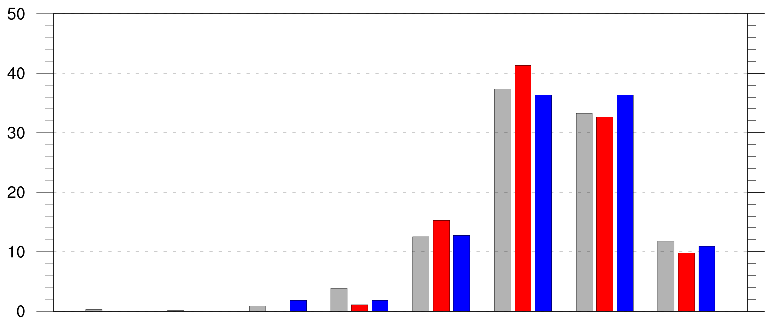
Genesis Latitude (JJA)
Distribution of Arctic cyclone genesis latitude (% per latitude bin) during JJA
10°N
20°N
30°N
40°N
50°N
60°N
70°N
80°N
90°N
climo (N=680)
low (N=92)
high (N=55)

Slide 48
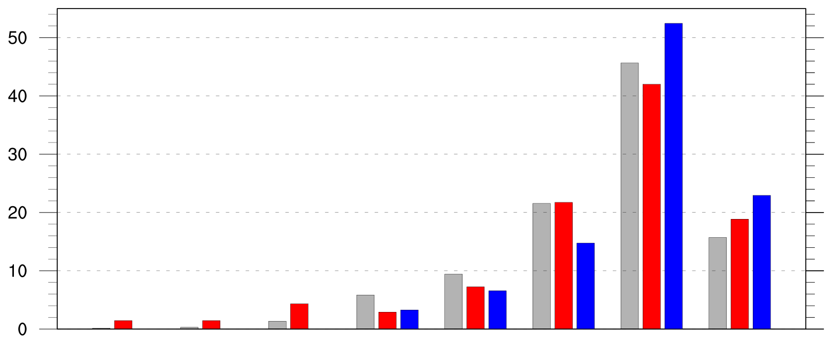
Genesis Latitude (SON)
Distribution of Arctic cyclone genesis latitude (% per latitude bin) during SON
10°N
20°N
30°N
40°N
50°N
60°N
70°N
80°N
90°N
climo (N=668)
low (N=69)
high (N=61)

Slide 49
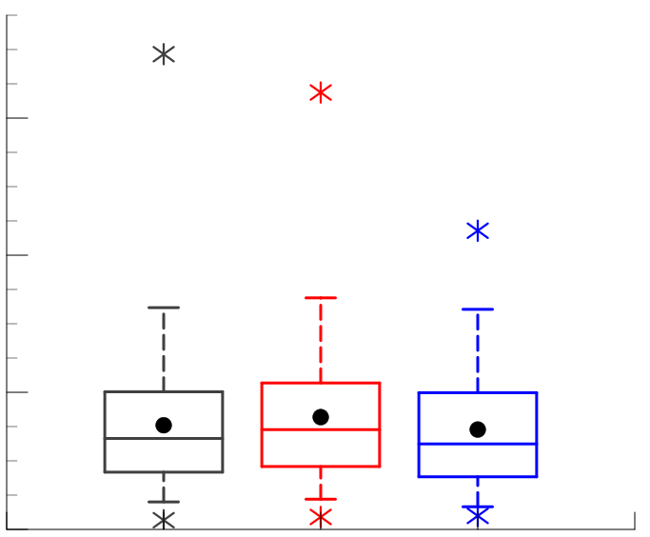
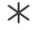
Intensity: Maximum SLP Depth
Maximum SLP depth (hPa) of ACs
min and max
60
mean
95%
75%
40
median
25%
5%
20
Statistically significant differences in means
0
climo
(N=2542)
low
(N=401)
high
(N=345)

Slide 50
Intensity: Maximum SLP Depth
Maximum SLP depth (hPa) of ACs
min and max
60
mean
95%
75%
40
median
25%
5%
20
Statistically significant differences in means
0
climo
(N=2542)
low
(N=401)
high
(N=345)

Slide 51
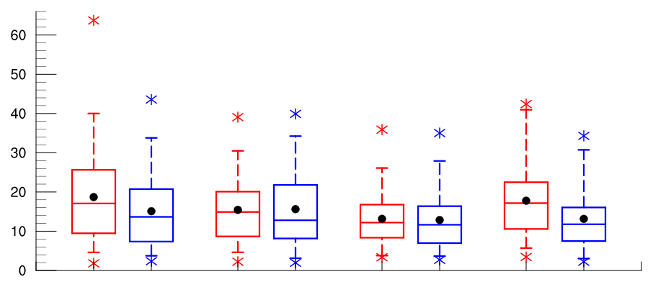
Intensity: Maximum SLP Depth
Maximum SLP depth (hPa) of ACs by season
60
50
40
30
20
10
0
low
(N =130)
high
(N=119)
low
(N=110)
high
(N=110)
low
(N=92)
high
(N=55)
low
(N=69)
high
(N=61)
DJF
MAM
JJA
SON
95%
75%
min and max
mean
median
Statistically significant differences in means
25%
5%

Slide 52
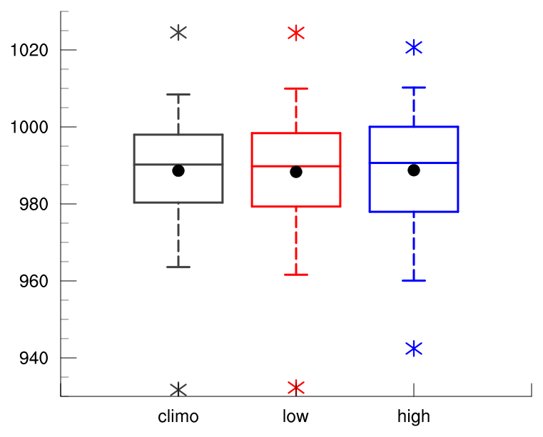
Intensity: Minimum SLP
Minimum SLP (hPa) of Arctic cyclones
min and max
mean
95%
75%
median
25%
5%
climo
(N=2542)
low
(N=401)
high
(N=345)

Slide 53
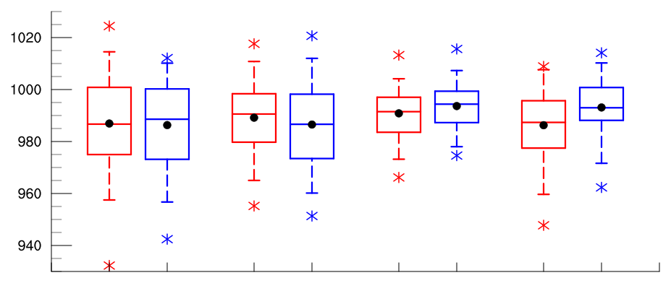
Intensity: Minimum SLP
Minimum SLP (hPa) of Arctic cyclones by season
low
(N =130)
high
(N=119)
low
(N=110)
high
(N=110)
low
(N=92)
high
(N=55)
low
(N=69)
high
(N=61)
DJF
MAM
JJA
SON
95%
75%
min and max
mean
median
Statistically significant differences in means
25%
5%

