Slide 1
A Predictability Study of Two Intense Arctic Cyclones in Early June 2018
Daniel Keyser, Kevin A. Biernat, and Lance F. Bosart
Department of Atmospheric and Environmental Sciences
University at Albany, SUNY
15th AMS Conference on Polar Meteorology and Oceanography
Monday 20 May 2019
Research Supported by ONR Grant N00014-18-1-2200

Slide 2
Motivation
Two unusually intense Arctic cyclones, AC1 and AC2, occurred in early June 2018
Both AC1 and AC2 strengthen in a region of strong baroclinicity over western Eurasia ahead of respective high-amplitude upper-level troughs
AC1 and AC2 undergo a cyclonic rotation over the Arctic Ocean, during which AC1 is absorbed by AC2

Slide 3
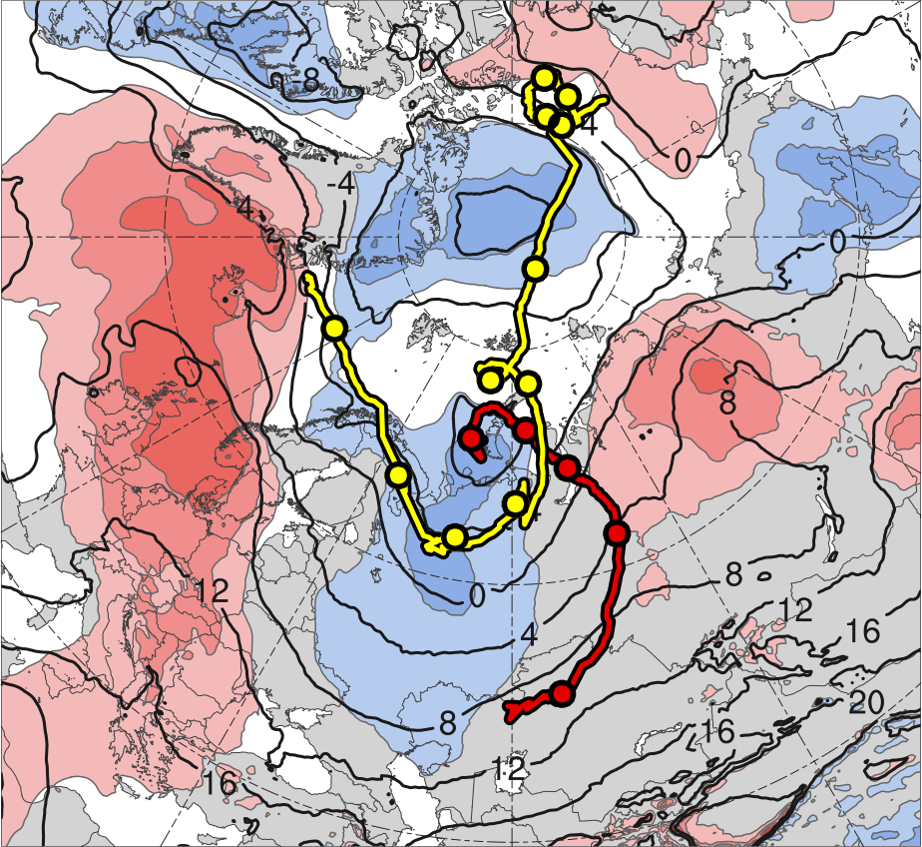
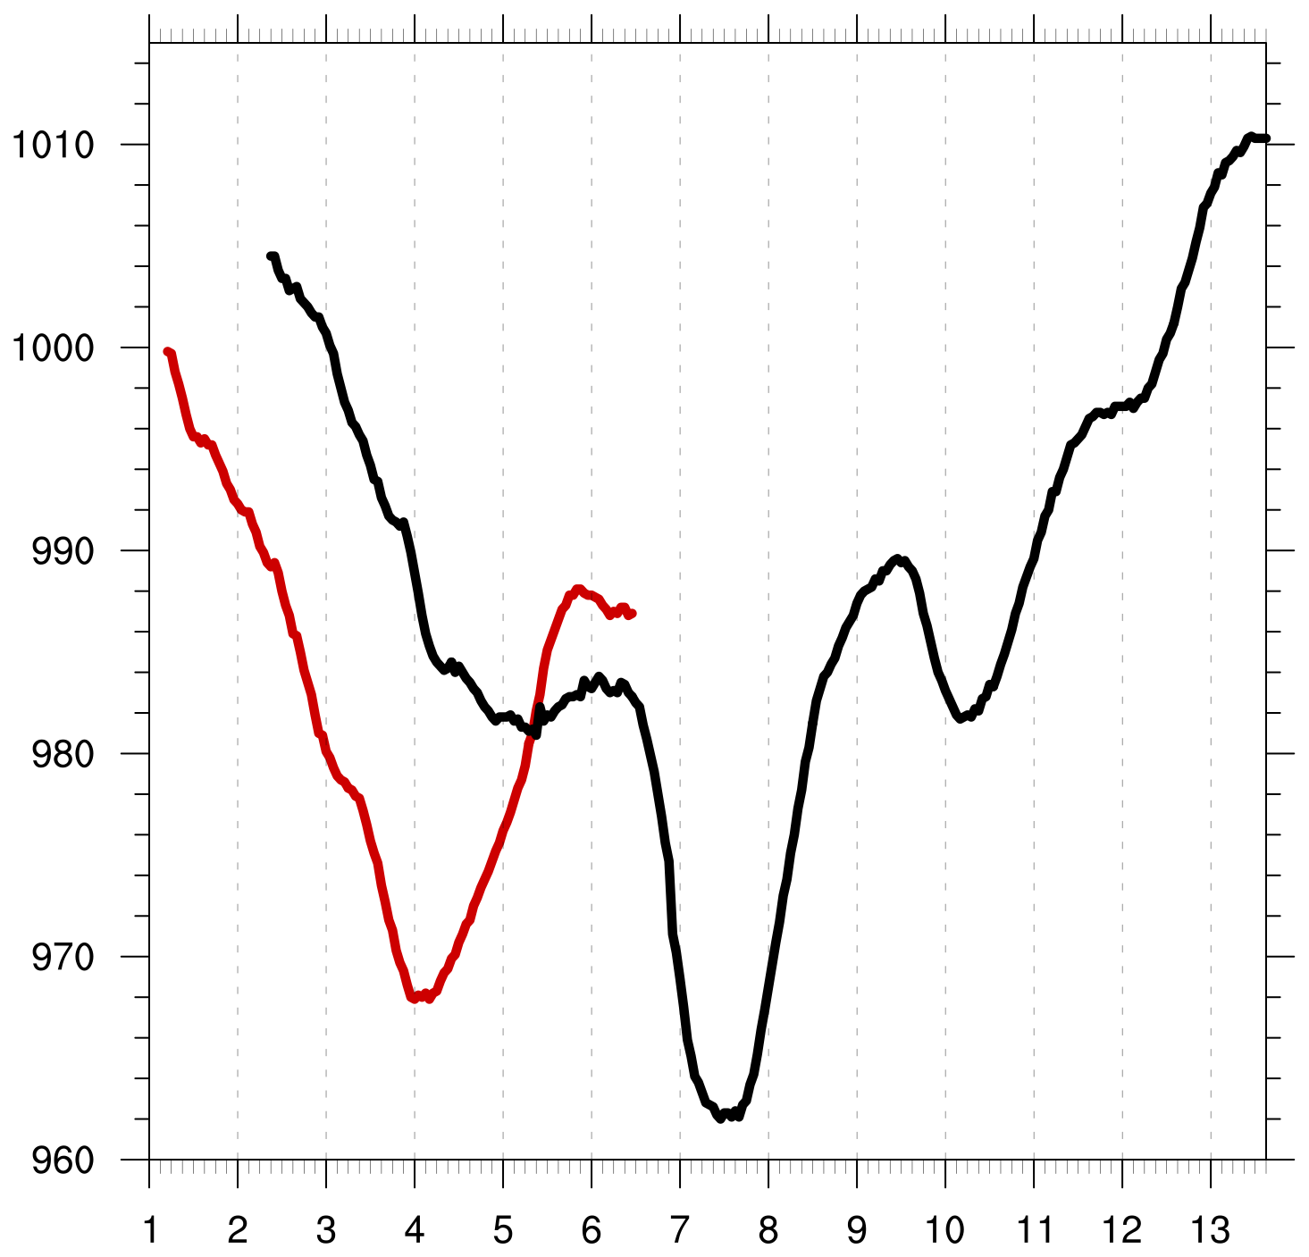
Motivation
Data source: ERA5
10
11
13
12
9
8
3
6
7
5
SLP (hPa)
4
4
3
6
5
2
AC1
AC2
-2
-1.5
-1
-0.5
0
0.5
1
1.5
2
σ
Day in June 2018 labeled at 0000 UTC
Genesis
Lysis
0000 UTC positions
AC1
AC2
1–7 June 2018 time-mean 850-hPa temperature (°C, black) and standardized temperature anomalies (σ, shaded)
Peak intensity of AC1 at 0400 UTC 4 June 2018 (968 hPa)
Peak intensity of AC2 at 1100 UTC 7 June 2018 (962 hPa)

Slide 4
Motivation
Yamagami et al. (2018a,b) show that forecast skill for strong Arctic cyclones in summer can be low
Accurate forecasts of the Great Arctic Cyclone of August 2012 (AC12) extend only to 2–3 day lead time prior to peak intensity

Slide 5
Purpose
Evaluate the forecast skill of AC1 and AC2
Diagnose factors that may influence the forecast skill of AC1
Why focus on AC1? AC1 is absorbed by AC2, so that understanding the forecast skill of AC2 would require diagnosing factors that may influence the forecast skill of AC1

Slide 6
Data and Methods
Utilize 51-member ECMWF Ensemble Prediction System (EPS; Buizza et al. 2007) from TIGGE (Bougeault et al. 2010) initialized 0–168 h prior to times of peak intensity of AC1 and AC2 in ERA5 (Hersbach and Dee 2016)
Utilize ERA5 as verification
Download ensemble and verification data at 0.5° horizontal resolution and 6-h temporal resolution

Slide 7
Data and Methods
Track AC1 and AC2 in ECMWF EPS and ERA5 utilizing an objective cyclone tracking algorithm based on sea level pressure (SLP) from Crawford and Serreze (2016)

Slide 8
Data and Methods
Determine cyclone intensity and position error based on value and position, respectively, of SLP minimum for forecasts valid at time of peak intensity in ERA5
AC1: forecasts valid at 0000 UTC 4 June
AC2: forecasts valid at 1200 UTC 7 June
Calculate corresponding spread and root mean square error (RMSE) of cyclone intensity and position for aforementioned forecasts

Slide 9
Intensity Error
AC1: valid at 0000 UTC 4 Jun 2018
intensity error (hPa)
forecast lead time (h)
max
75%
median
mean
intensity error = | min SLP_{EPS}− min SLP_{ERA5} |
25%
min

Slide 10
Intensity Error
AC1: valid at 0000 UTC 4 Jun 2018
AC2: valid at 1200 UTC 7 Jun 2018
intensity error (hPa)
forecast lead time (h)
max
75%
median
mean
intensity error = | min SLP_{EPS}− min SLP_{ERA5} |
25%
min

Slide 11
Position Error
AC1: valid at 0000 UTC 4 Jun 2018
position error (km)
forecast lead time (h)
max
75%
median
mean
position error = great circle distance between location
of min SLP_{EPS} and location of min SLP_{ERA5}
25%
min

Slide 12
Position Error
AC1: valid at 0000 UTC 4 Jun 2018
AC2: valid at 1200 UTC 7 Jun 2018
position error (km)
forecast lead time (h)
max
75%
median
mean
position error = great circle distance between location
of min SLP_{EPS} and location of min SLP_{ERA5}
25%
min

Slide 13
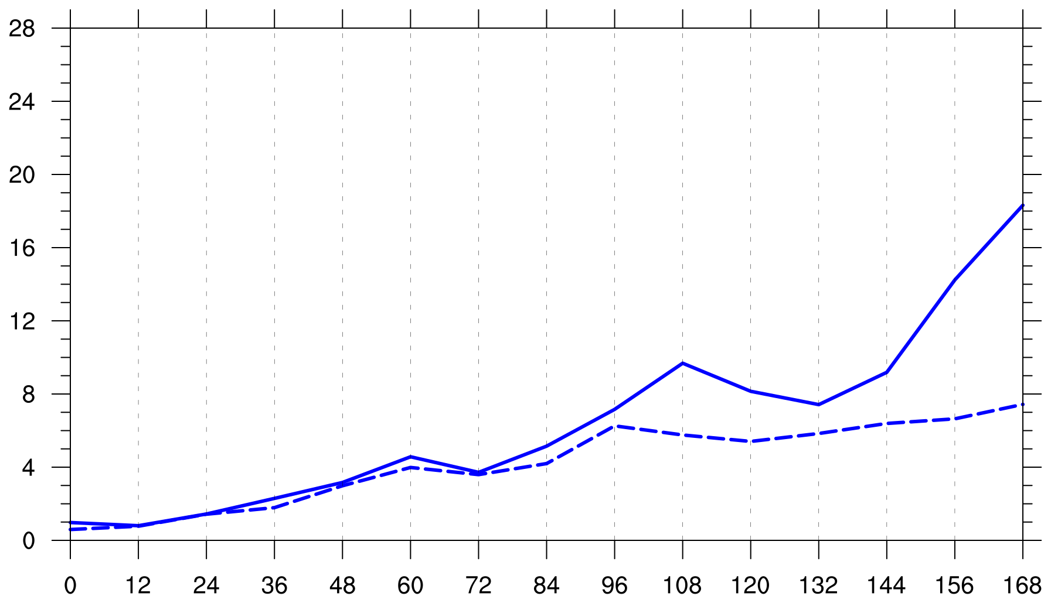
Intensity RMSE and Spread
AC1: valid at 0000 UTC 4 Jun 2018
hPa
forecast lead time (h)
RMSE
spread

Slide 14
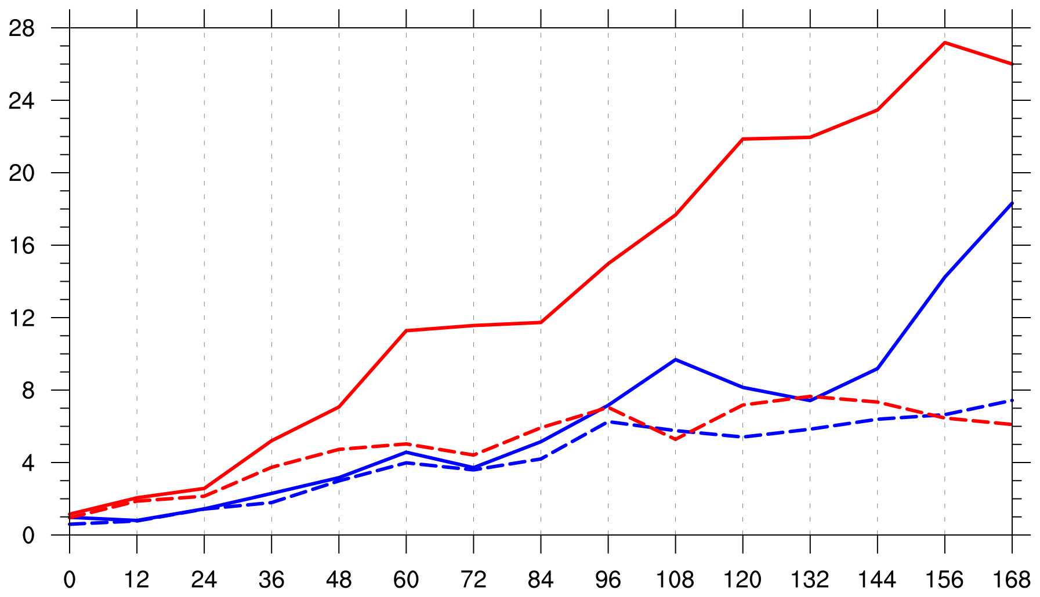
Intensity RMSE and Spread
AC1: valid at 0000 UTC 4 Jun 2018
AC2: valid at 1200 UTC 7 Jun 2018
hPa
forecast lead time (h)
RMSE
spread

Slide 15
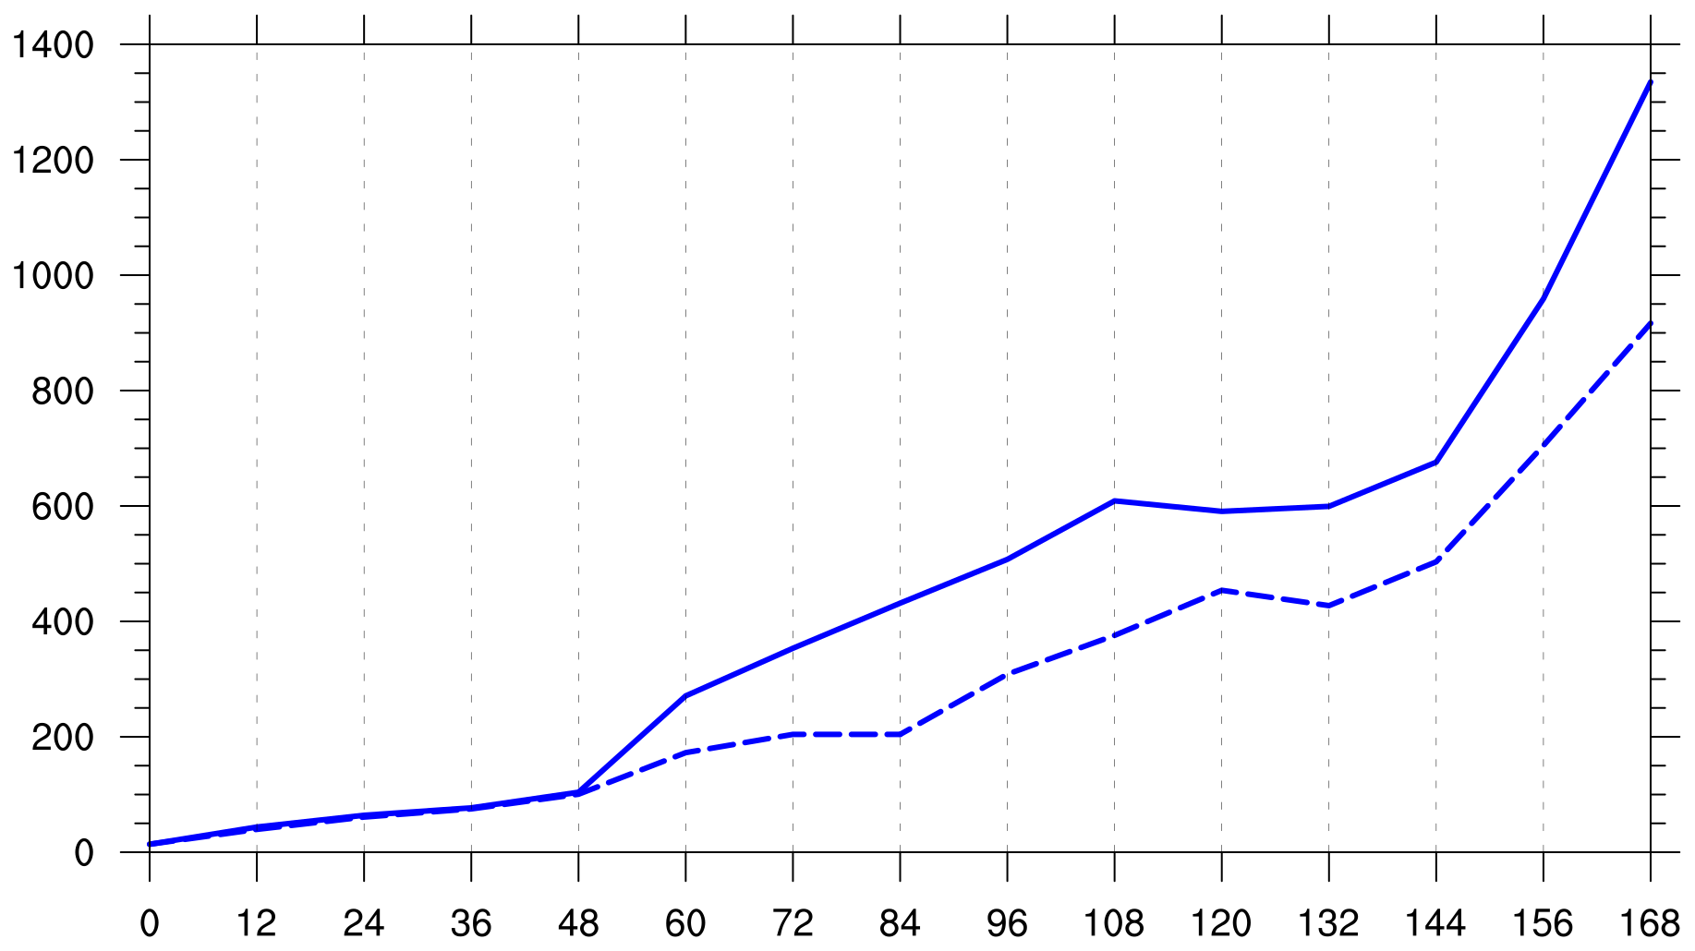
Position RMSE and Spread
AC1: valid at 0000 UTC 4 Jun 2018
km
forecast lead time (h)
RMSE
spread

Slide 16
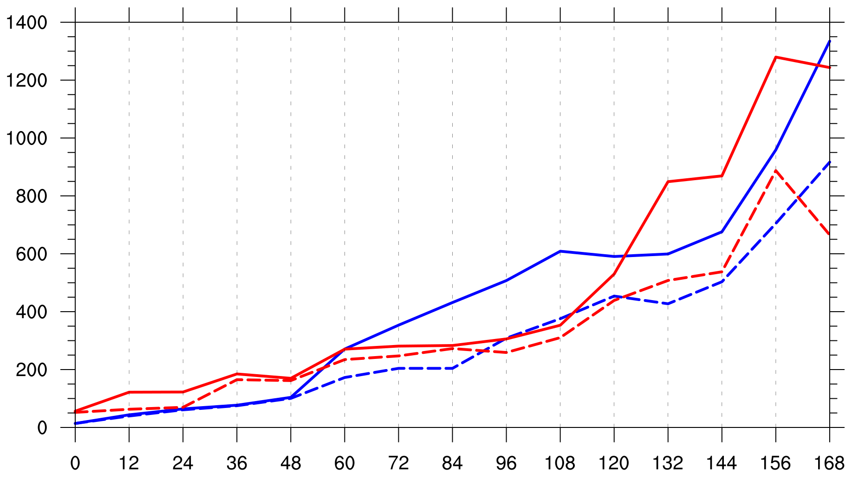
Position RMSE and Spread
AC1: valid at 0000 UTC 4 Jun 2018
AC2: valid at 1200 UTC 7 Jun 2018
km
forecast lead time (h)
RMSE
spread

Slide 17
Diagnose Factors Influencing Forecast Skill of AC1
Utilize ensemble forecasts initialized at 1200 UTC 30 May, which is 108 h prior to time of peak intensity of AC1 in ERA5 (0000 UTC 4 Jun)

Slide 18
Diagnose Factors Influencing Forecast Skill of AC1
AC1: valid at 0000 UTC 4 Jun 2018
intensity
hPa
RMSE
forecast lead time (h)
spread
AC1: valid at 0000 UTC 4 Jun 2018
position
km
forecast lead time (h)

Slide 19
Diagnose Factors Influencing Forecast Skill of AC1
Separate ensemble members in terms of a metric adapted from Lamberson et al. (2016) that combines intensity and position error of AC1
Subdivide members into two groups in terms of metric: one containing the 10 most accurate members and one containing the 10 least accurate members

Slide 20
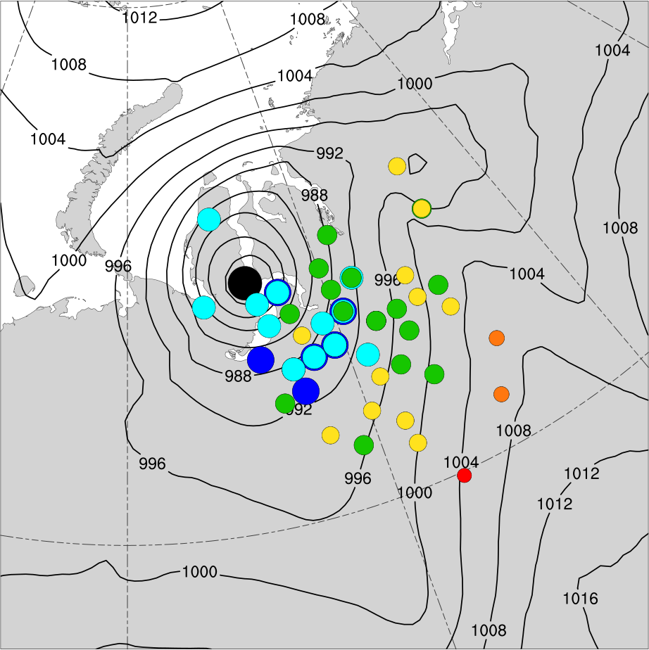
108-h Forecast Position and Intensity of AC1
108-h forecast valid 0000 UTC 4 Jun 2018
SLP from ERA5 (hPa, contours);
position of minimum SLP of AC1 [dots, colored by intensity (hPa) for ensembles]
ERA5 (969)
965–970
970–975
975–980
980–985
985–990
990–995

Slide 21
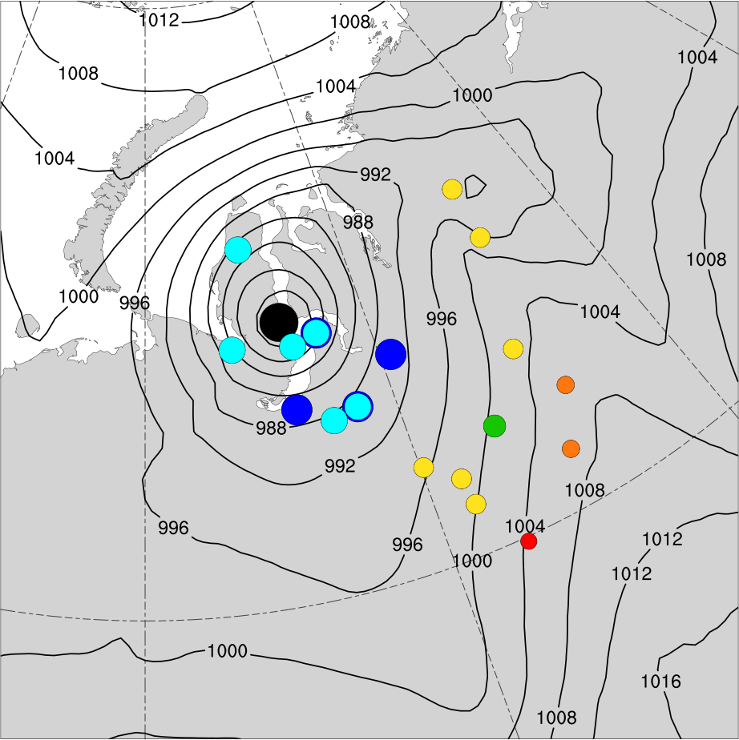
108-h Forecast Position and Intensity of AC1
108-h forecast valid 0000 UTC 4 Jun 2018
SLP from ERA5 (hPa, contours);
position of minimum SLP of AC1 [dots, colored by intensity (hPa) for ensembles]
ERA5 (969)
965–970
970–975
975–980
980–985
985–990
990–995
most accurate group
least accurate group

Slide 22
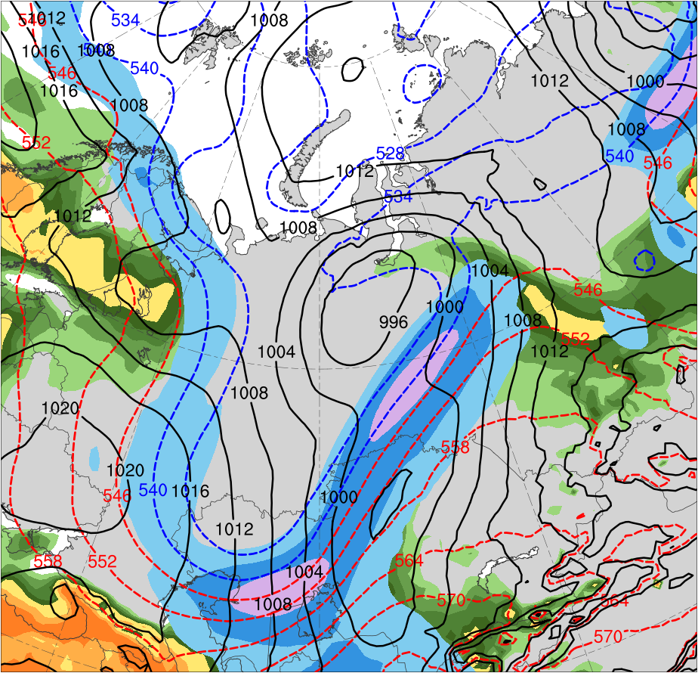
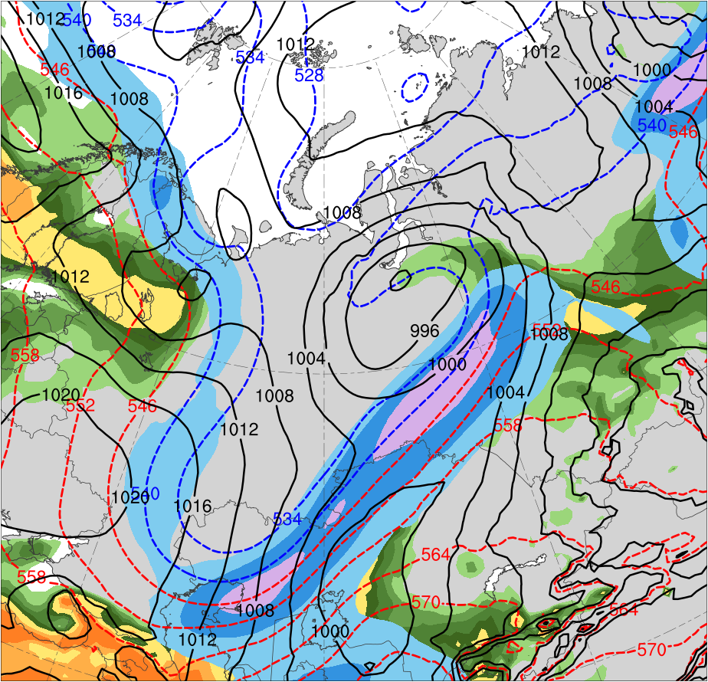
Synoptic Comparison
0000 UTC 2 June (60-h forecast)
Most Accurate Group
Least Accurate Group
PC
PC
AC1
AC1
(m s⁻¹ )
(g kg⁻¹)
30
40
50
60
70
80
90
100
4
4.5
5
5.5
6
7
8
Ensemble mean 300-hPa wind speed (m s⁻¹, shaded), 1000–500-hPa thickness (dam, blue/red),
SLP (hPa, black), and 925-hPa mixing ratio (g kg⁻¹, shaded) for most and least accurate groups

Slide 23
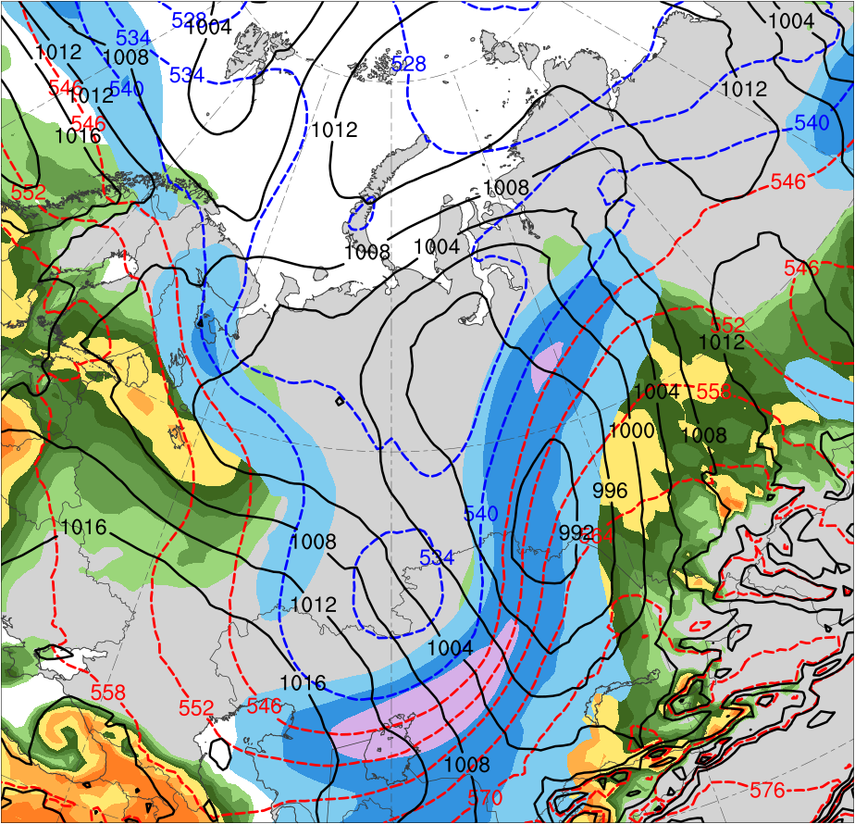
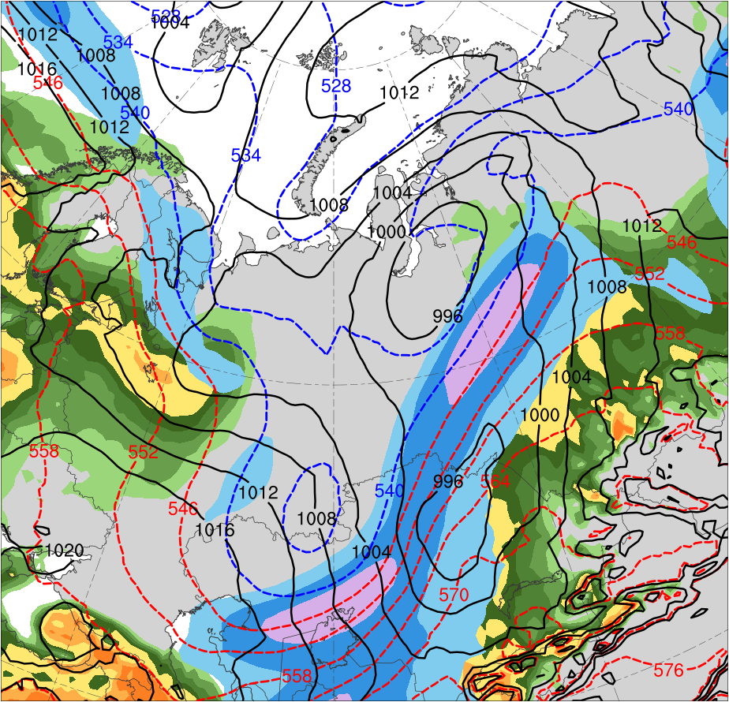
Synoptic Comparison
1200 UTC 2 June (72-h forecast)
Most Accurate Group
Least Accurate Group
PC
AC1
AC1
(m s⁻¹ )
(g kg⁻¹)
30
40
50
60
70
80
90
100
4
4.5
5
5.5
6
7
8
Ensemble mean 300-hPa wind speed (m s⁻¹, shaded), 1000–500-hPa thickness (dam, blue/red),
SLP (hPa, black), and 925-hPa mixing ratio (g kg⁻¹, shaded) for most and least accurate groups

Slide 24
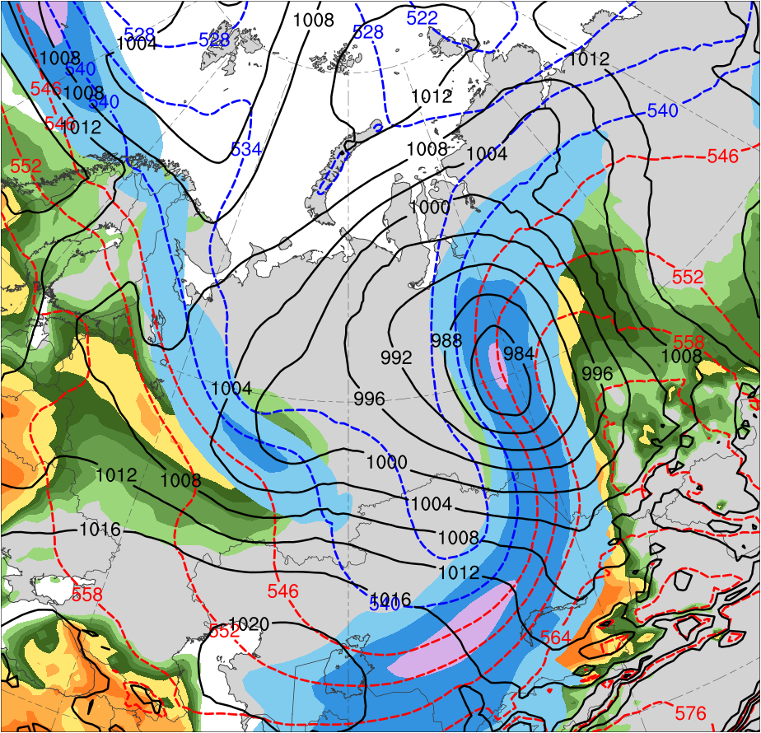
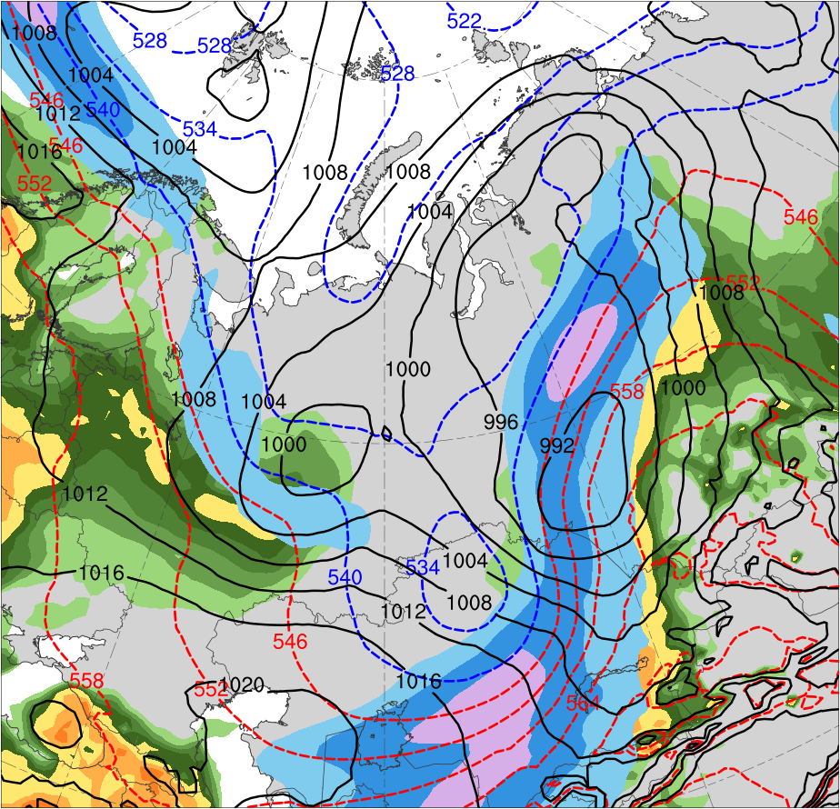
Synoptic Comparison
0000 UTC 3 June (84-h forecast)
Most Accurate Group
Least Accurate Group
AC1
AC1
(m s⁻¹ )
(g kg⁻¹)
30
40
50
60
70
80
90
100
4
4.5
5
5.5
6
7
8
Ensemble mean 300-hPa wind speed (m s⁻¹, shaded), 1000–500-hPa thickness (dam, blue/red),
SLP (hPa, black), and 925-hPa mixing ratio (g kg⁻¹, shaded) for most and least accurate groups

Slide 25
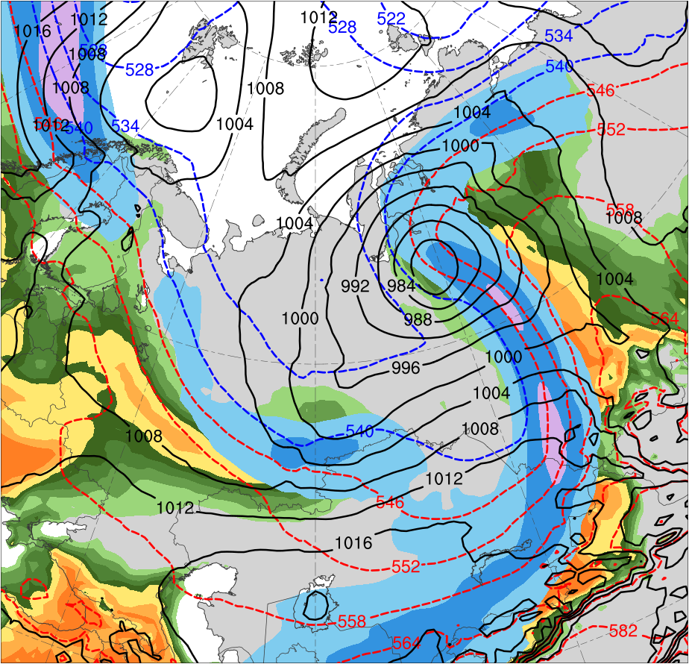
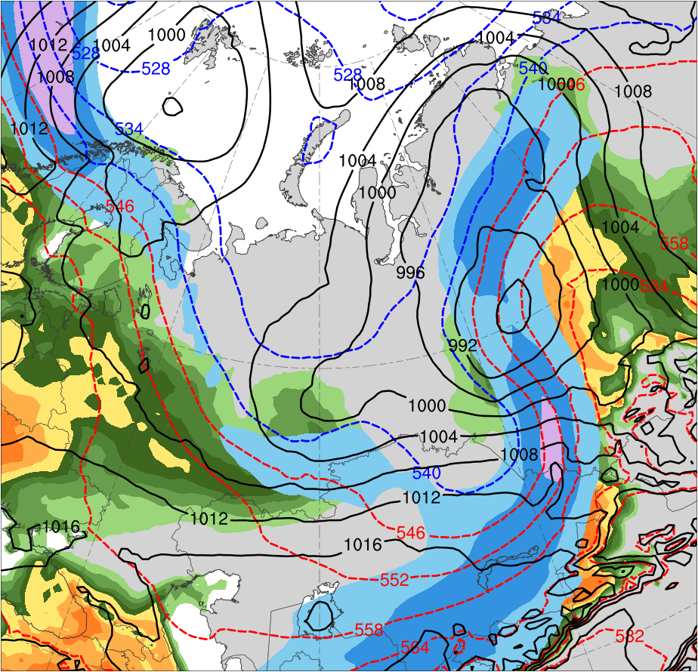
Synoptic Comparison
1200 UTC 3 June (96-h forecast)
Most Accurate Group
Least Accurate Group
AC1
AC1
(m s⁻¹ )
(g kg⁻¹)
30
40
50
60
70
80
90
100
4
4.5
5
5.5
6
7
8
Ensemble mean 300-hPa wind speed (m s⁻¹, shaded), 1000–500-hPa thickness (dam, blue/red),
SLP (hPa, black), and 925-hPa mixing ratio (g kg⁻¹, shaded) for most and least accurate groups

Slide 26
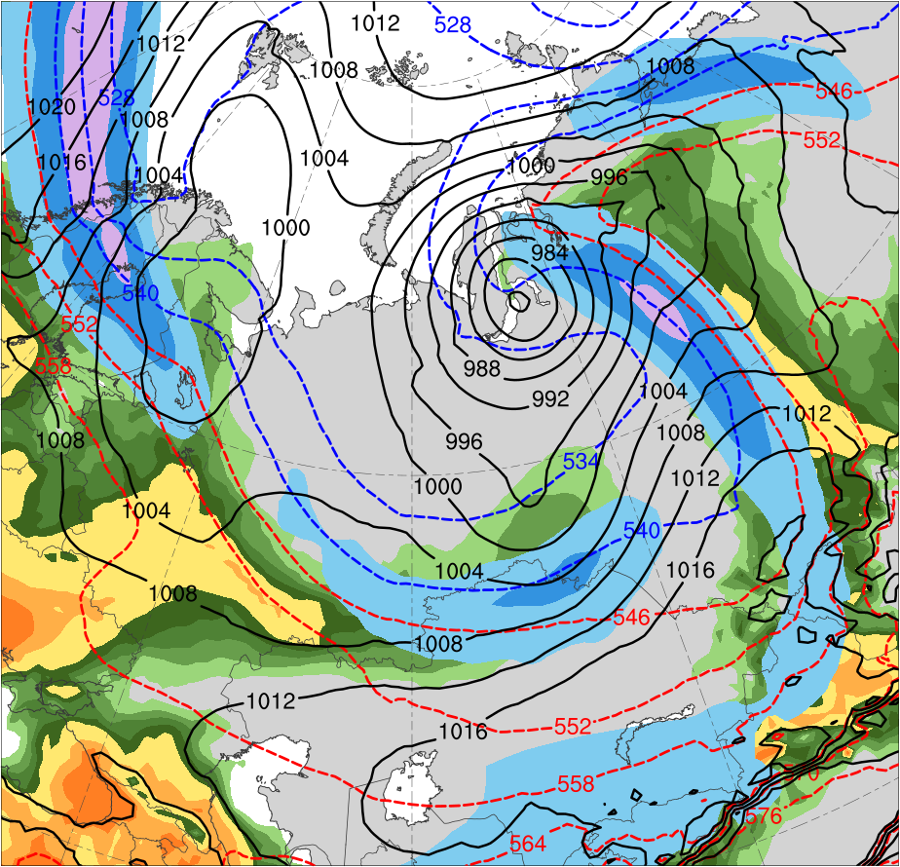
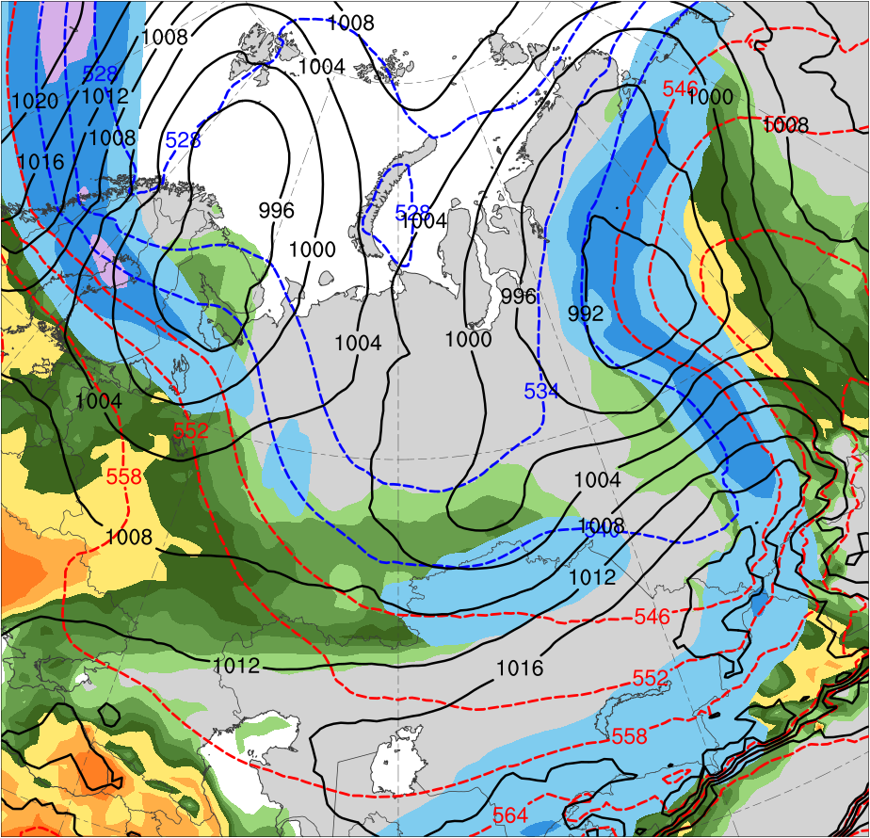
Synoptic Comparison
0000 UTC 4 June (108-h forecast)
Most Accurate Group
Least Accurate Group
AC1
AC1
(m s⁻¹ )
(g kg⁻¹)
30
40
50
60
70
80
90
100
4
4.5
5
5.5
6
7
8
Ensemble mean 300-hPa wind speed (m s⁻¹, shaded), 1000–500-hPa thickness (dam, blue/red),
SLP (hPa, black), and 925-hPa mixing ratio (g kg⁻¹, shaded) for most and least accurate groups

Slide 27
Summary
Forecast skill of intensity in terms of RMSE for AC2 is much lower than that for AC1
Intensity forecasts are strongly underdispersive for AC2 and slightly underdispersive for AC1
Forecast skill of position in terms of RMSE for AC2 is higher than that for AC1 at 72–120-h lead time and lower than that for AC1 at other lead times
Position forecasts are somewhat underdispersive for AC2 and moderately underdispersive for AC1

Slide 28
Summary
Intensity forecasts for AC1 are less underdispersive than position forecasts for AC1
Intensity forecasts for AC2 are more underdispersive than position forecasts for AC2

Slide 29
Summary
Comparison between most and least accurate groups for AC1 show a thermal trough is more amplified and a predecessor cyclone is weaker and positioned farther westward in most accurate group
Enables AC1 to intensify more and move farther northwestward in most accurate group

Slide 30
References
Bougeault, P., and Coauthors, 2010: The THORPEX Interactive Grand Global
Ensemble. Bull. Amer. Meteor. Soc., 91, 1059–1072.
Buizza, R., J. R. Bidlot, N. Wedi, M. Fuentes, M. Hamrud, G. Holt, and F. Vitart,
2007: The new ECMWF VAREPS (Variable Resolution Ensemble Prediction
System). Quart. J. Roy. Meteor. Soc., 133, 681–695.
Crawford, A., and M. Serreze, 2016: Does the summer Arctic frontal zone influence
Arctic Ocean cyclone activity? J. Climate, 29, 4977–4993.
Hersbach, H., and D. Dee, 2016: ERA5 reanalysis is in production. ECMWF
Newsletter, No. 147 ECMWF, Reading, United Kingdom, 7. [Available online at
www.ecmwf.int/sites/ default/files/elibrary/2016/16299-newsletter-no147-
spring-2016.pdf.]
Lamberson, W. S., R. D. Torn, and L. F. Bosart, 2016: Diganosis of the source and
evolution of medium-range forecast errors for Extratropical Cyclone Joachim.
Wea. Forecasting, 31, 1197–1214.
Yamagami, A., M. Matsueda, and H. L. Tanaka, 2018a: Predictability of the 2012
great Arctic cyclone on medium-range timescales. Polar Science, 15, 13–23.
——, ——, and ——, 2018b: Medium-range forecast skill for extraordinary Arctic
cyclones in summer of 2008–2016. Geophys. Res. Lett., 45, 4429– 4437.

Slide 31
Appendix

Slide 32
Diagnose Factors Influencing Forecast Skill of AC1
Separate ensemble members in terms of a metric adapted from Lamberson et al. (2016) that combines intensity error and position error of AC1
Rank members 1–51 for both intensity error and position error at time of peak intensity of AC1, with 1 corresponding to member with lowest error
Add intensity error rank to position error rank to determine a combined error rank
Subdivide members into two groups: one containing the 10 most accurate members and one containing the 10 least accurate members in terms of combined error rank

Slide 33
108-h Forecast Position and Intensity of AC1
108-h forecast valid 0000 UTC 4 Jun 2018
ERA5 (969)
965–970
970–975
975–980
980–985
985–990
990–995
Distribution of minimum SLP of AC1 (hPa) for most accurate group and least accurate group
SLP from ERA5 (hPa, contours);
position of minimum SLP of AC1 [dots, colored by intensity (hPa) for ensembles]
ERA5
ensemble group mean

