Slide 1
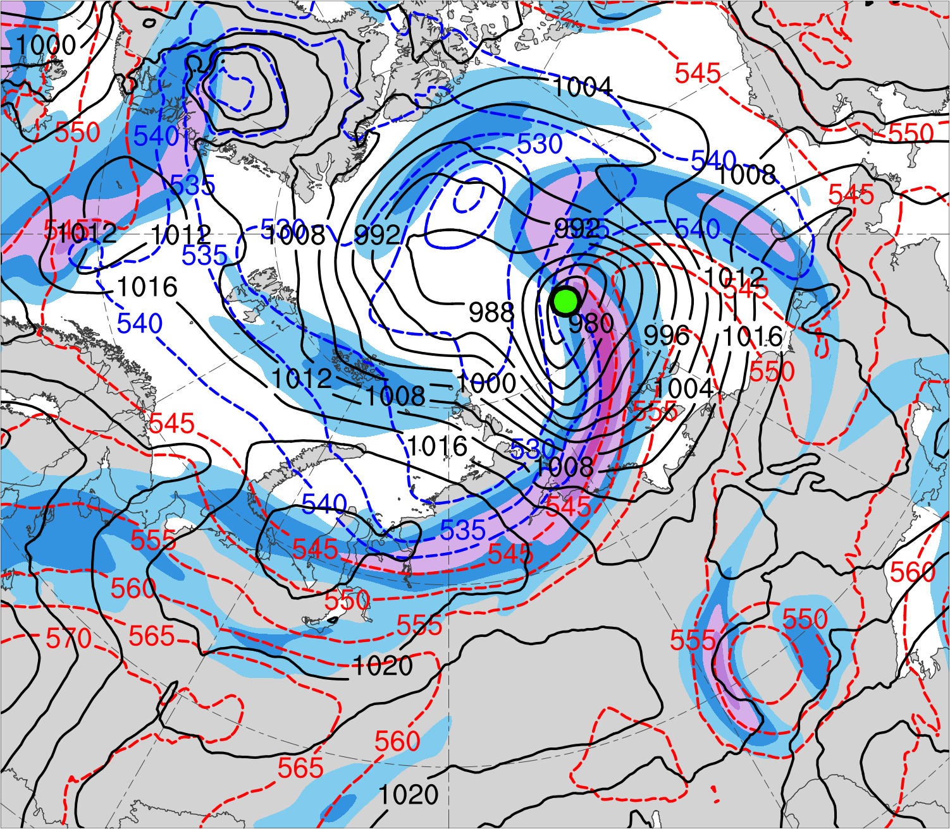
Composite Analyses of Low-Skill Arctic Cyclones during Summer
Kevin A. Biernat, Lance F. Bosart, and Daniel Keyser
Department of Atmospheric and Environmental Sciences, University at Albany, State University of New York
16th AMS Conference on Polar Meteorology and Oceanography
Paper 5.1
Wednesday 2 June 2021, 2:05 p.m.–2:15 p.m.
Research Supported by ONR Grant N00014-18-1-2200
300-hPa wind
speed (m s⁻¹)
0000 UTC 15 Aug 2016
Data and Methods
Use day-5 forecasts from the 11-member NOAA GEFS reforecast dataset v2 to identify intense low-skill ACs occurring during periods of low forecast skill of the synoptic-scale flow over the Arctic during Jun–Aug 2007–2017.
Conduct AC-centered composite analyses of the intense low-skill ACs at various lag times relative to the time of lowest SLP of the ACs when located in the Arctic using ERA5.
Purpose
Examine features and processes governing the evolution of intense low-skill Arctic cyclones (ACs) occurring during periods of low forecast skill of the synoptic-scale flow over the Arctic during summer.
80
72
64
56
48
40
32
24
AC location
Data source: ERA5
SLP (hPa)
1000–500-hPa thickness (dam)

Slide 2
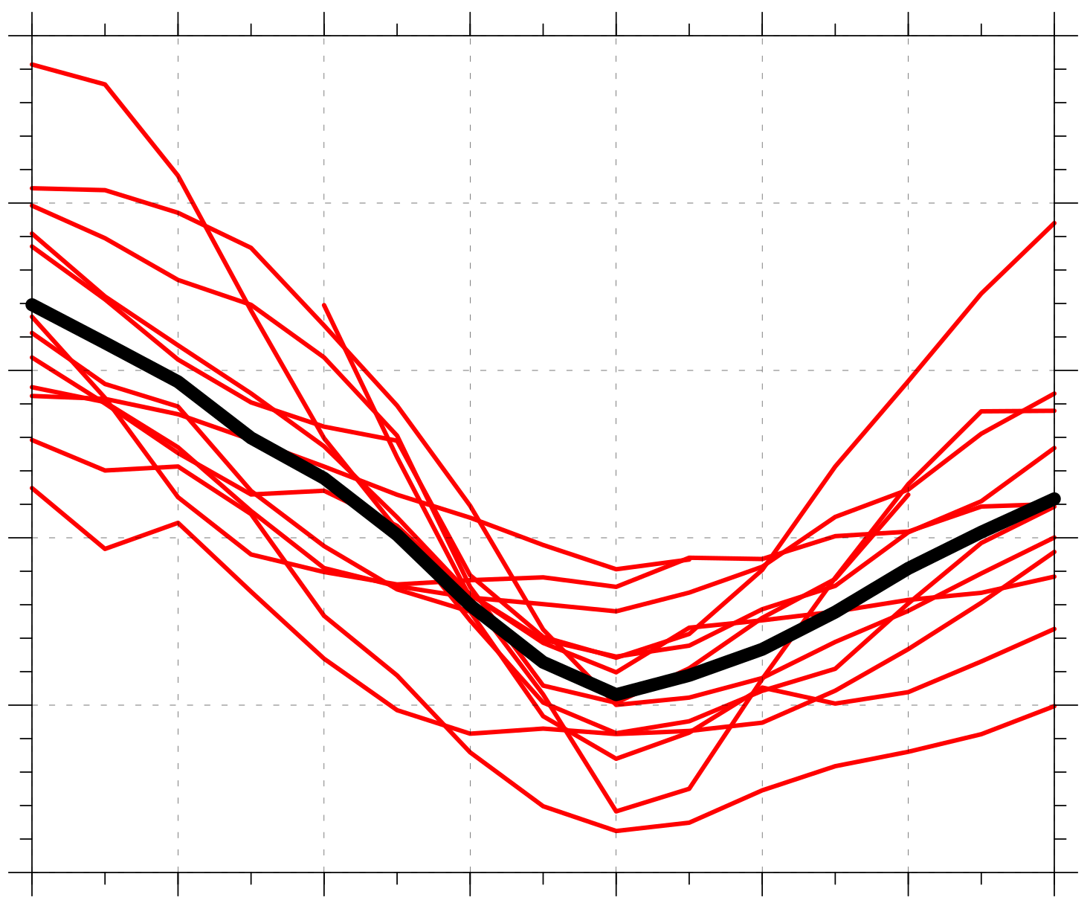
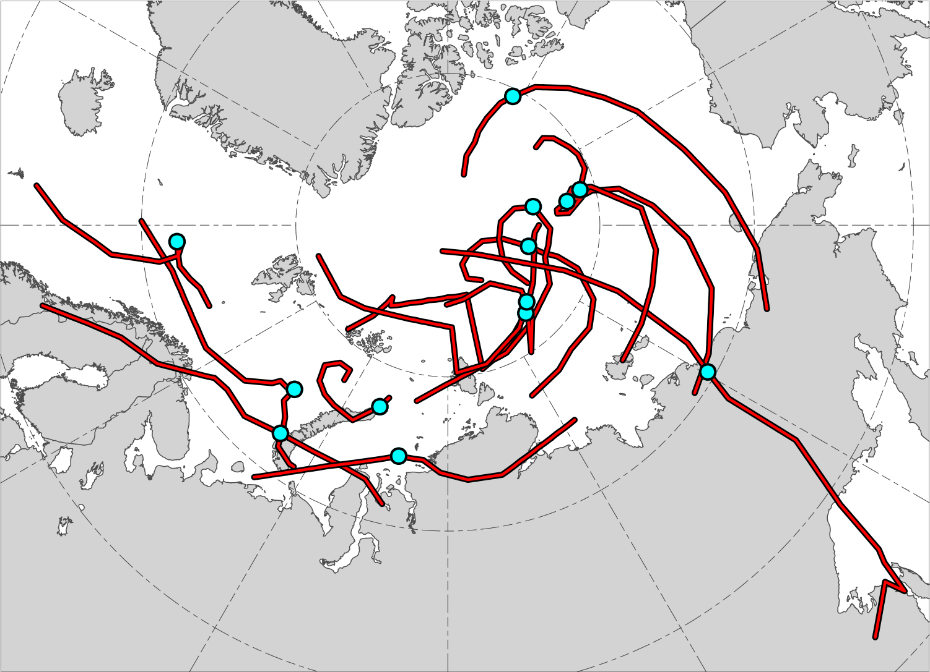
Track and intensity of composited ACs
N = 13
1010
N = 13
1000
990
Minimum SLP (hPa)
980
970
960
AC location at lag 0 h (time of lowest SLP of AC in Arctic)
−48
−36
−24
−12
0
12
24
36
Lag hour relative to time of lowest SLP of AC in Arctic
Red lines show tracks of ACs during lags –48 h to 36 h,
when valid.
Time series of minimum SLP (hPa) of ACs (red) and of mean minimum SLP (hPa) of ACs (black) during lags –48 h to 36 h, when valid.

Slide 3
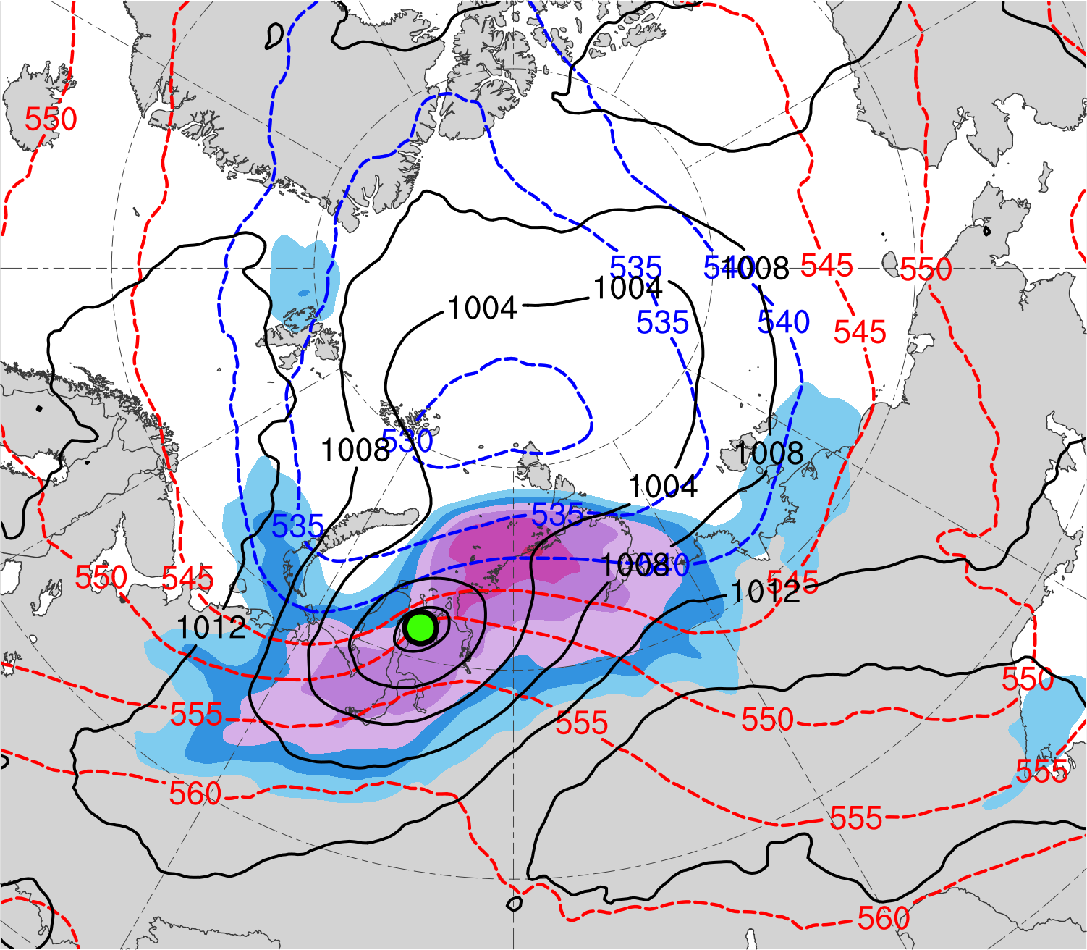
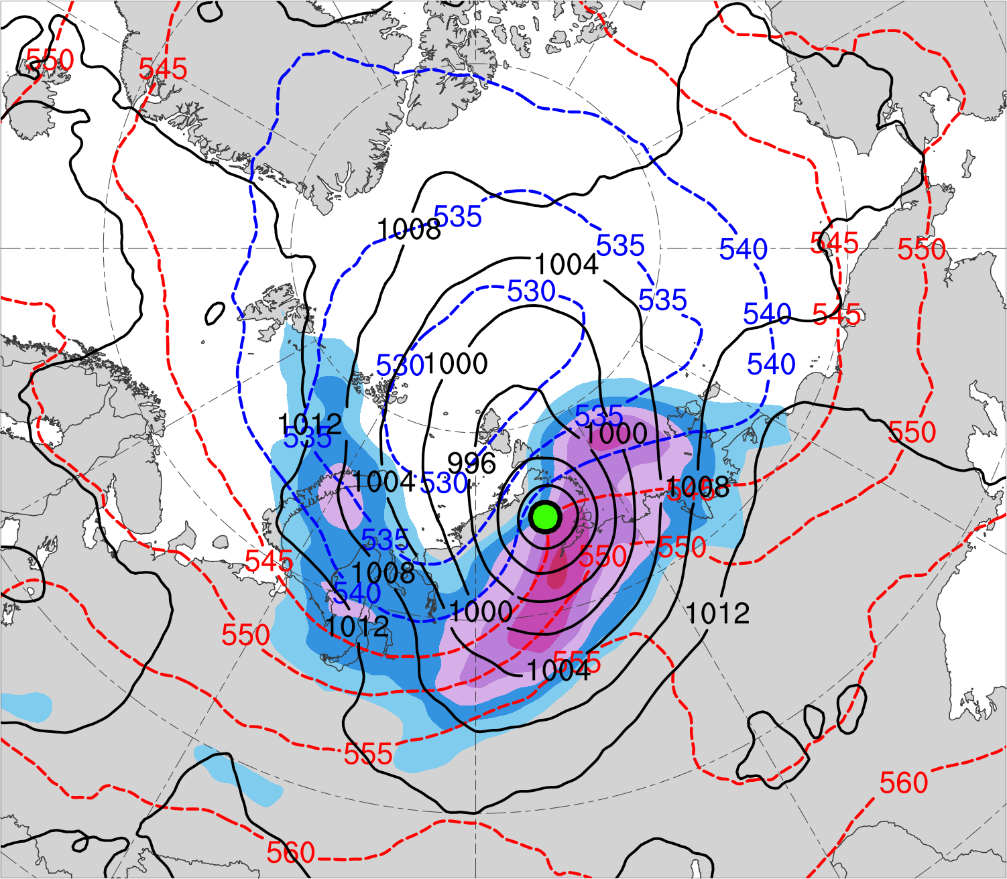
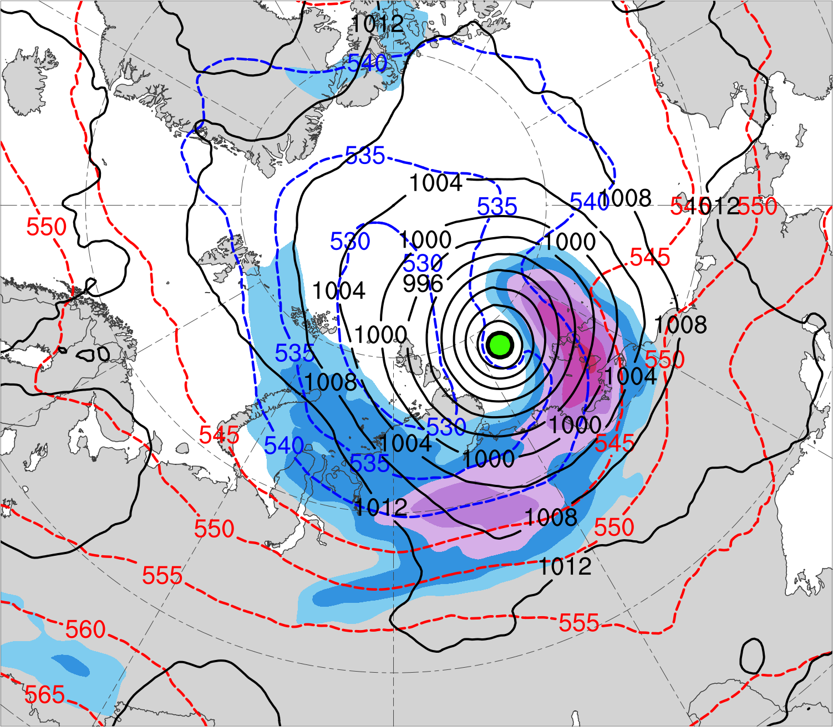
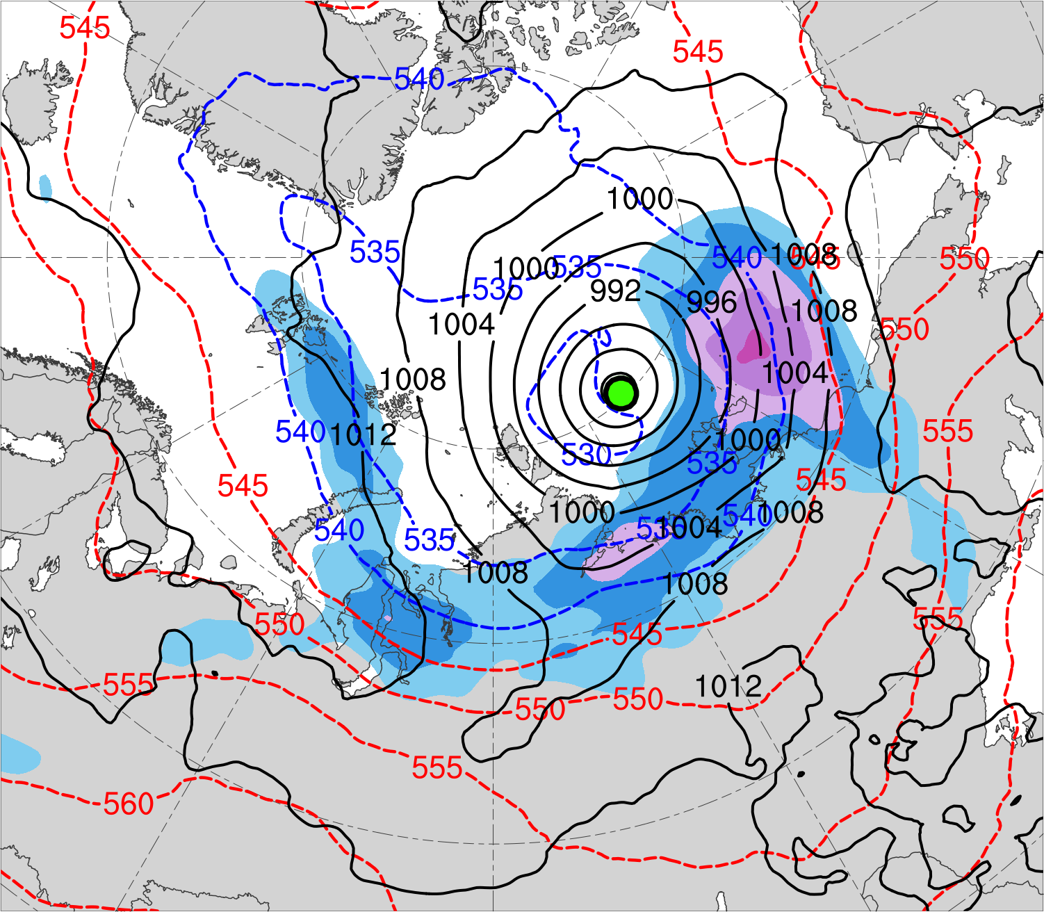
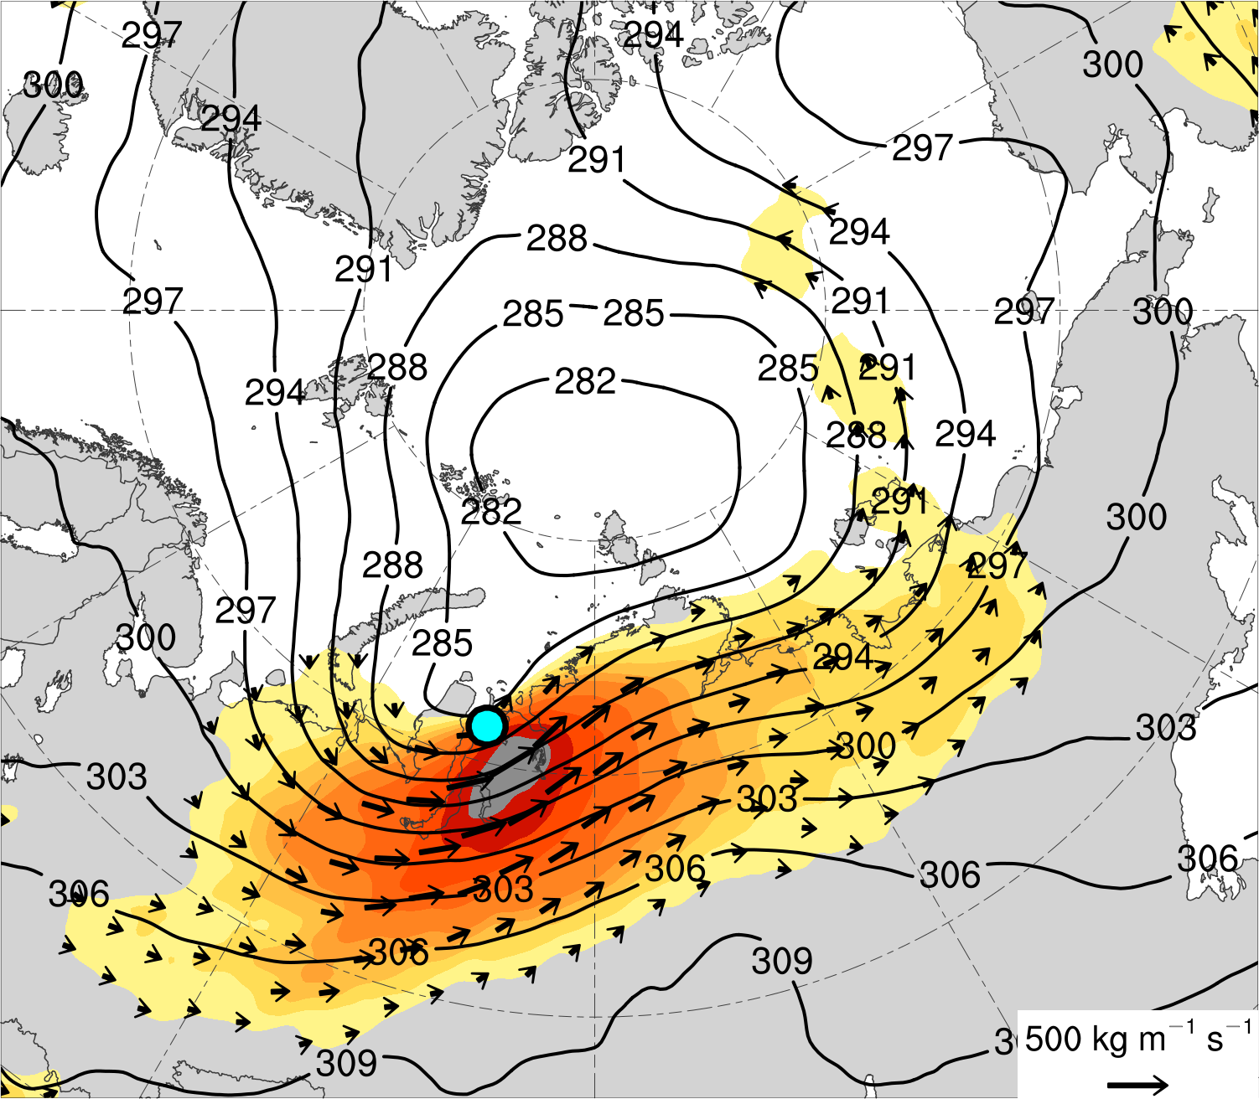
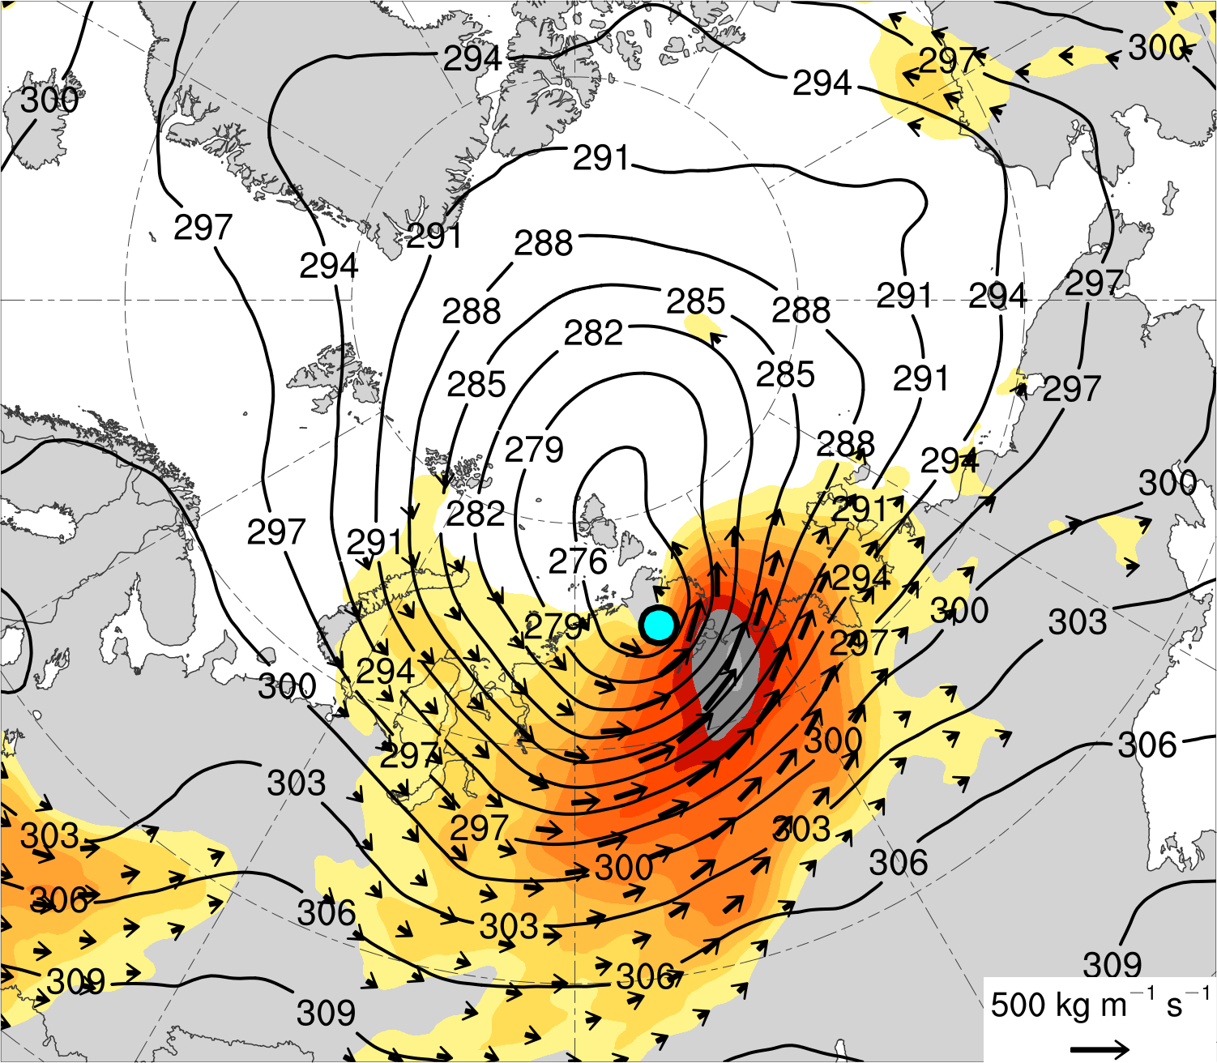
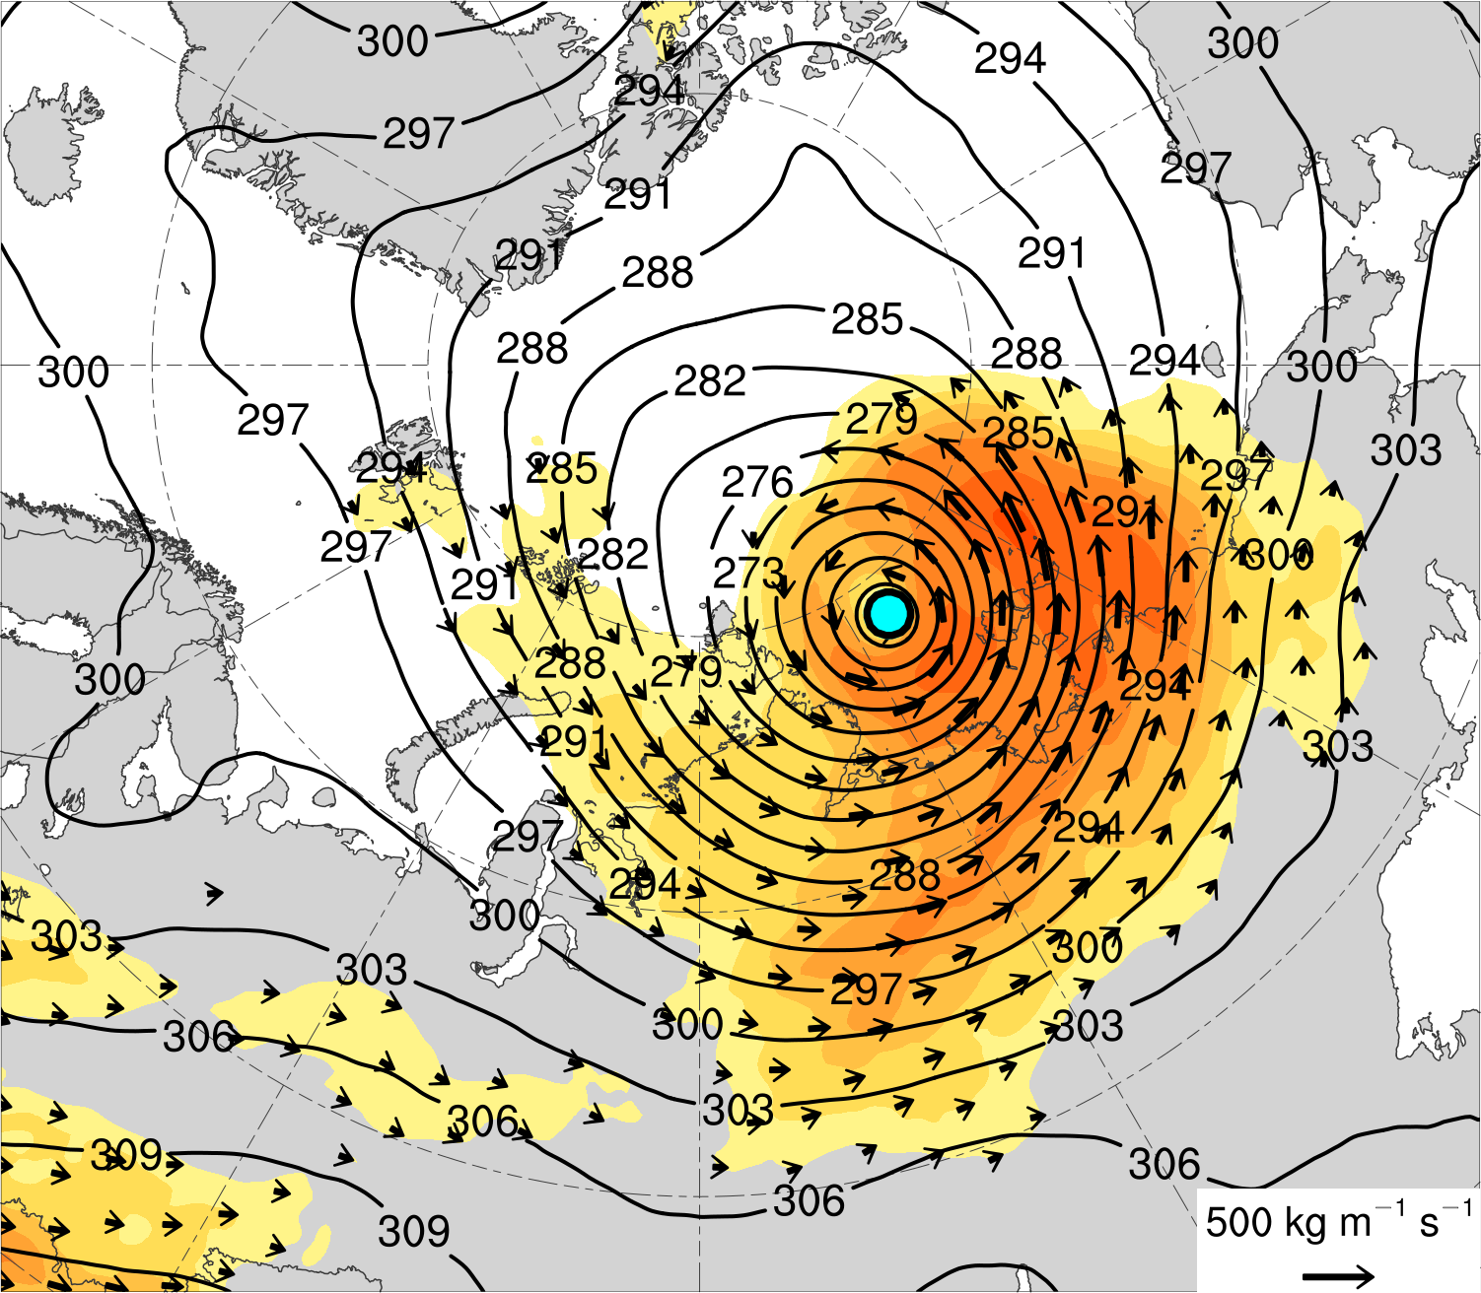
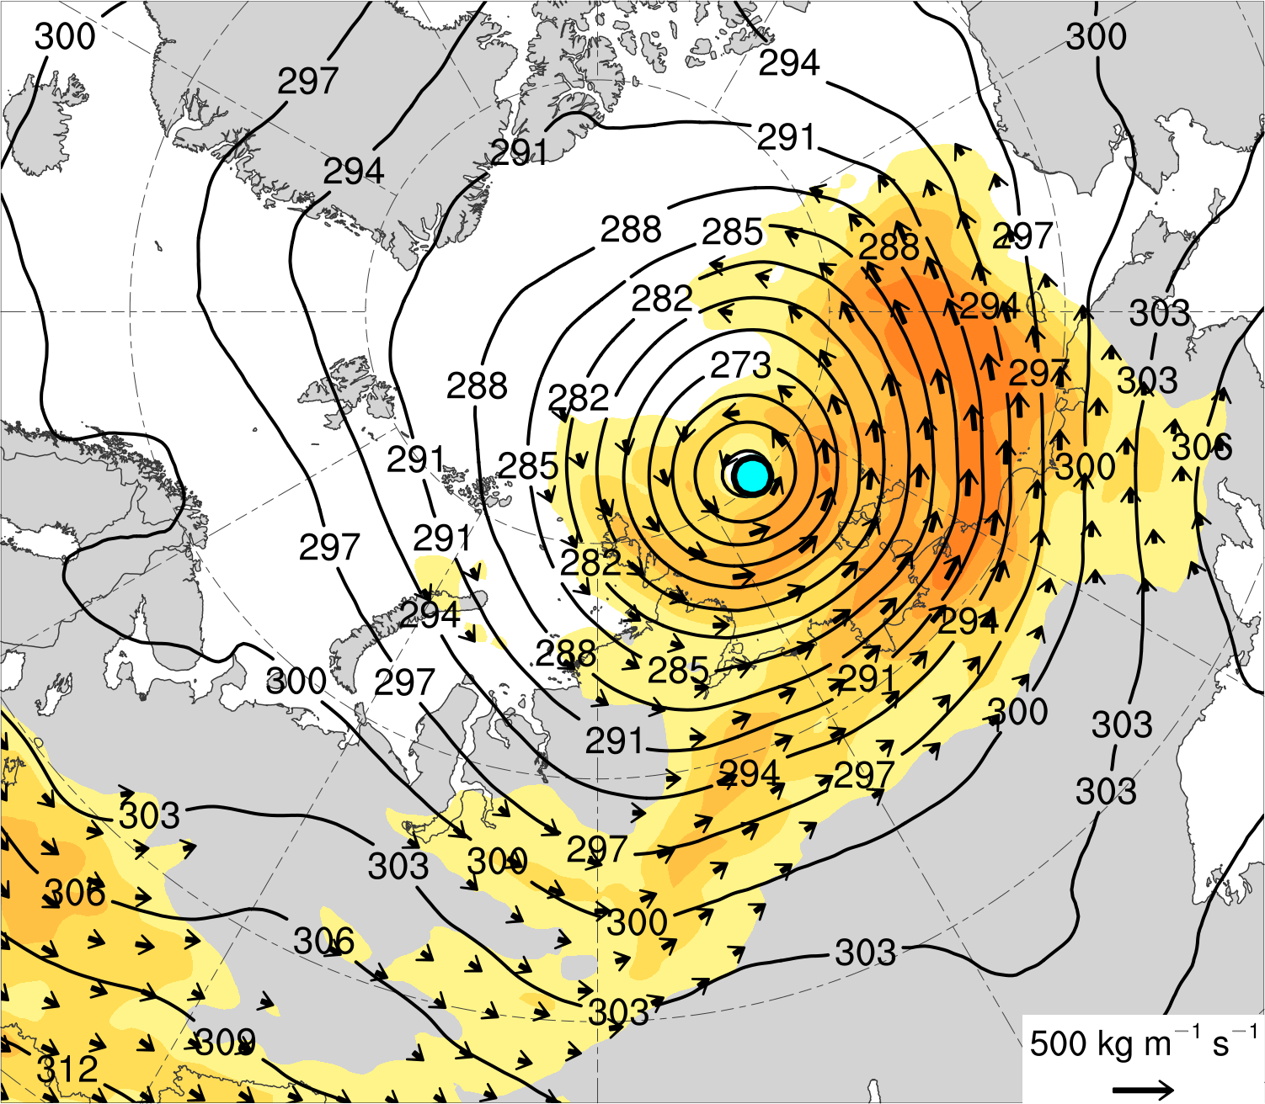
(a) Lag −48 h (N = 12)
(b) Lag −24 h (N = 13)
(c) Lag 0 h (N = 13)
(d) Lag 24 h (N = 12)
300-hPa wind speed (m s⁻¹)
1000–500-hPa thickness (dam)
SLP (hPa)
Mean AC location
18
21
24
27
30
33
36
39
(a) Lag −48 h (N = 12)
(b) Lag −24 h (N = 13)
(c) Lag 0 h (N = 13)
(d) Lag 24 h (N = 12)
Integrated vapor transport (IVT) (kg m⁻¹ s⁻¹)
700-hPa geopotential
height (dam)
IVT (kg m⁻¹ s⁻¹)
Mean AC location
100
125
150
175
200
250
300
350
400
450
500

Slide 4
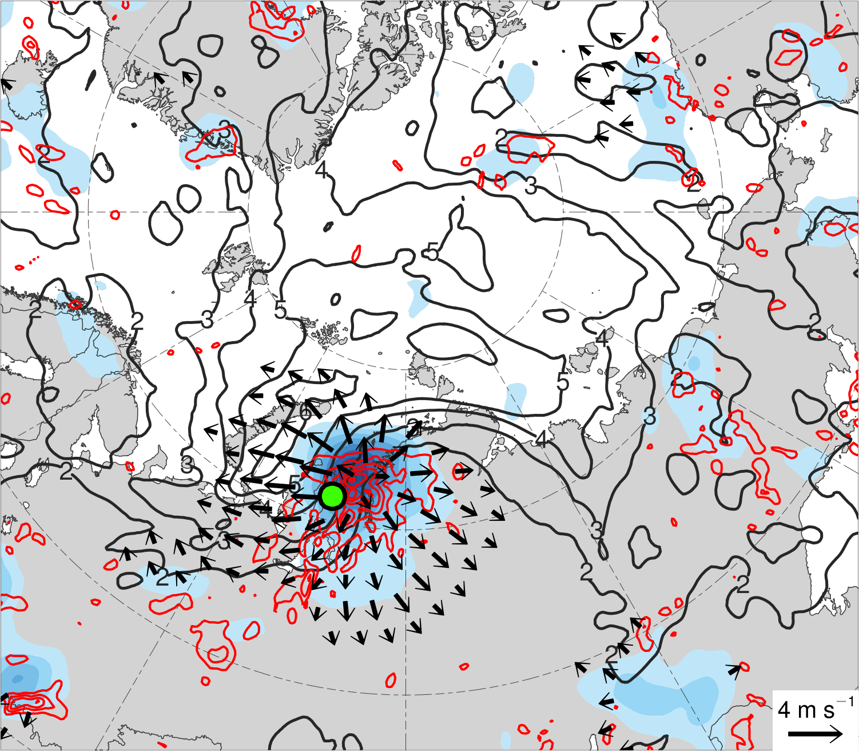
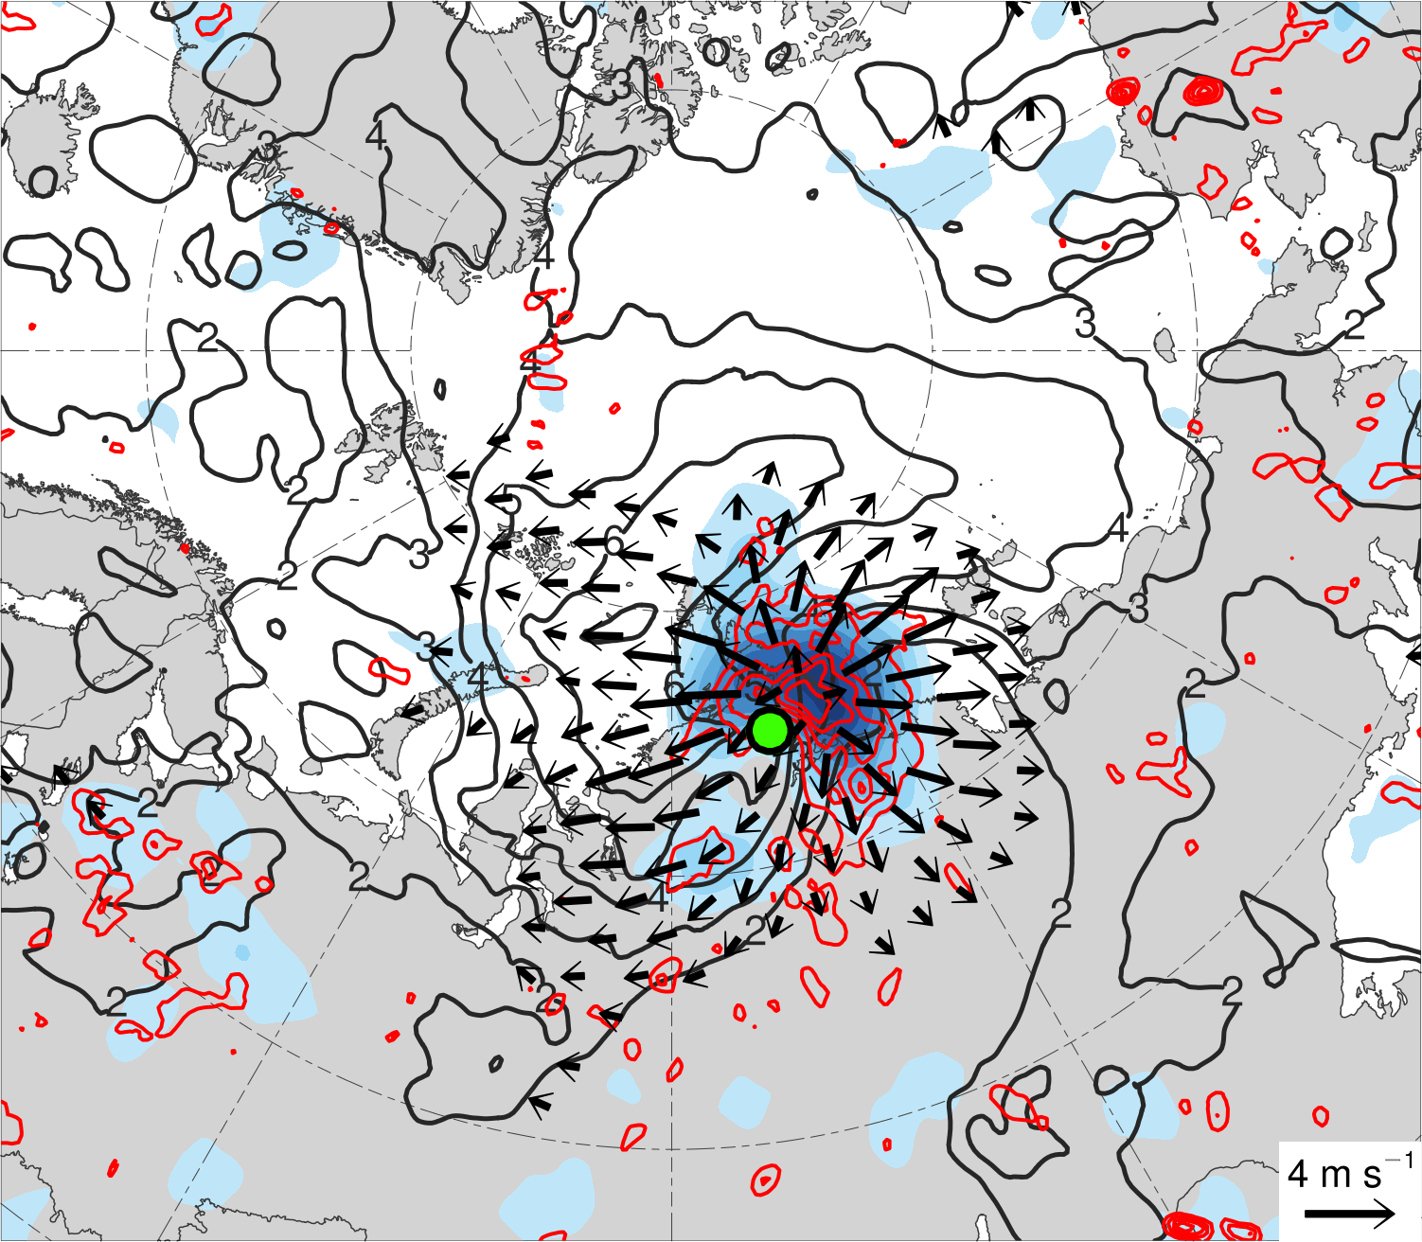
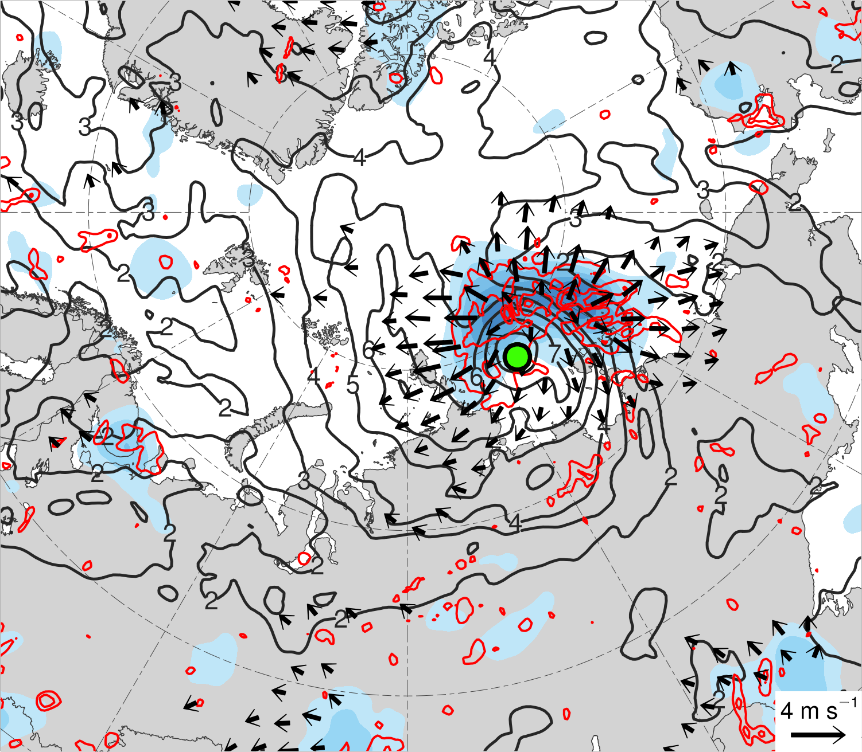
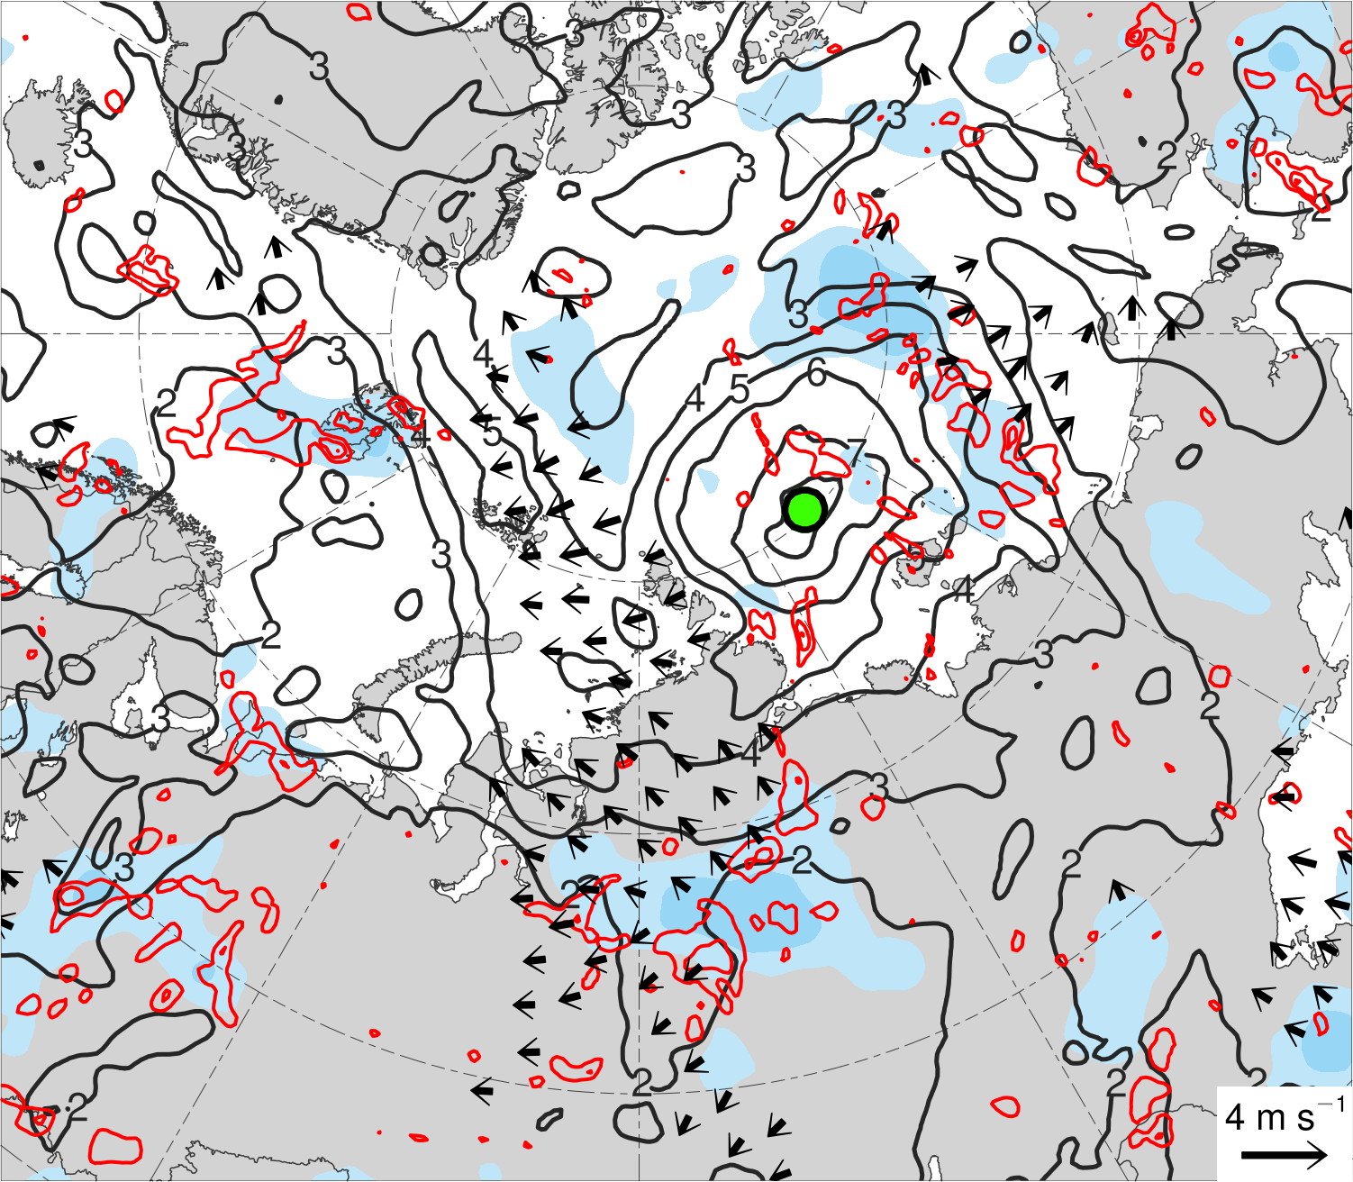
(a) Lag −48 h (N = 12)
(b) Lag −24 h (N = 13)
350–250-hPa irrotational wind (m s⁻¹)
350–250-hPa PV (PVU)
Negative values of 800–600-hPa ω (every 1 × 10⁻³ hPa s⁻¹)
Mean AC location
Summary
The composite AC intensifies downstream of an upper-tropospheric potential vorticity maximum in a region of relatively strong lower-to-midtropospheric baroclinicity, lower-to-midtropospheric ascent, tropospheric-integrated vapor transport, and upper-tropospheric divergence.
A combination of baroclinic processes and latent heating play important roles in the intensification of intense low-skill ACs.
(c) Lag 0 h (N = 13)
(d) Lag 24 h (N = 12)
200-km area-averaged 350–250-hPa divergence (10⁻⁶ s⁻¹)
2
4
6
8
10
12
14
16

