Slide 1
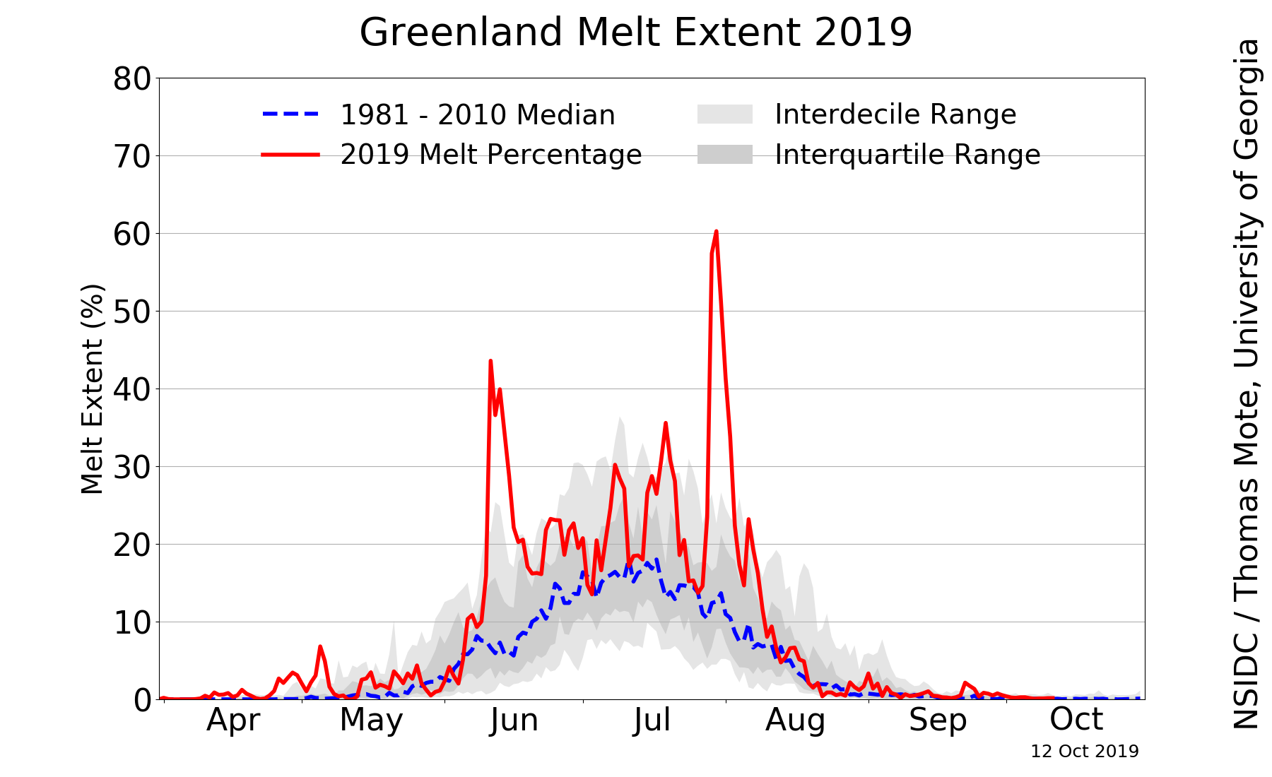
An Analysis of Complex Polar–Midlatitude–Tropical Interactions that Culminated in the Largest Greenland Surface Ice-Melt Event of 2019
Lance F. Bosart, Scott W. Feldman, Kevin A. Biernat, and Daniel Keyser
Department of Atmospheric and Environmental Sciences, University at Albany, State University of New York
16th AMS Conference on Polar Meteorology and Oceanography
Paper 10.5
Friday 4 June 2021, 12:45 p.m.–12:55 p.m.
Research Supported by ONR Grant N00014-18-1-2200
Motivation
A record-breaking surface ice melt event occurred over Greenland during 31 July–1 Aug 2019 and can be directly linked to a predecessor record-breaking heat wave over Europe via a backward trajectory analysis in conjunction with high-latitude ridge building.
Data and Methods
Use 0.5° CFSR gridded reanalyses to document large-scale flow evolution.
Use NOAA HYSPLIT Trajectory Model to investigate origin of anomalously warm air.
Source:
NSIDC
http://nsidc.org/greenland-today/

Slide 2
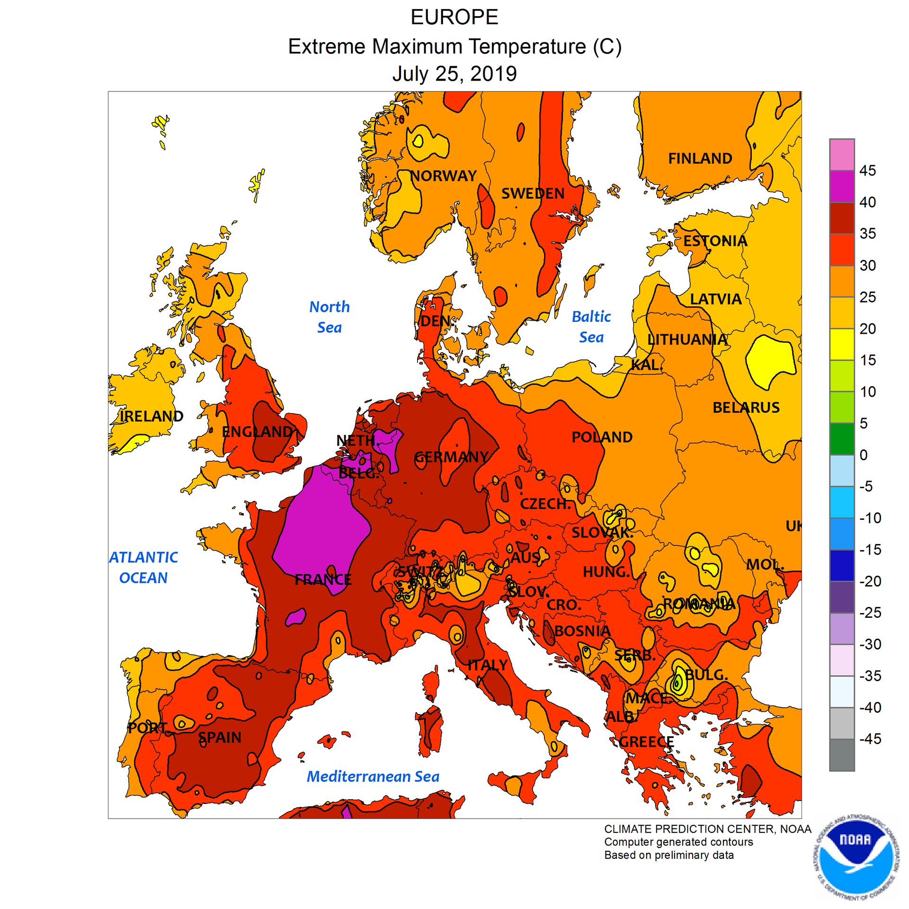
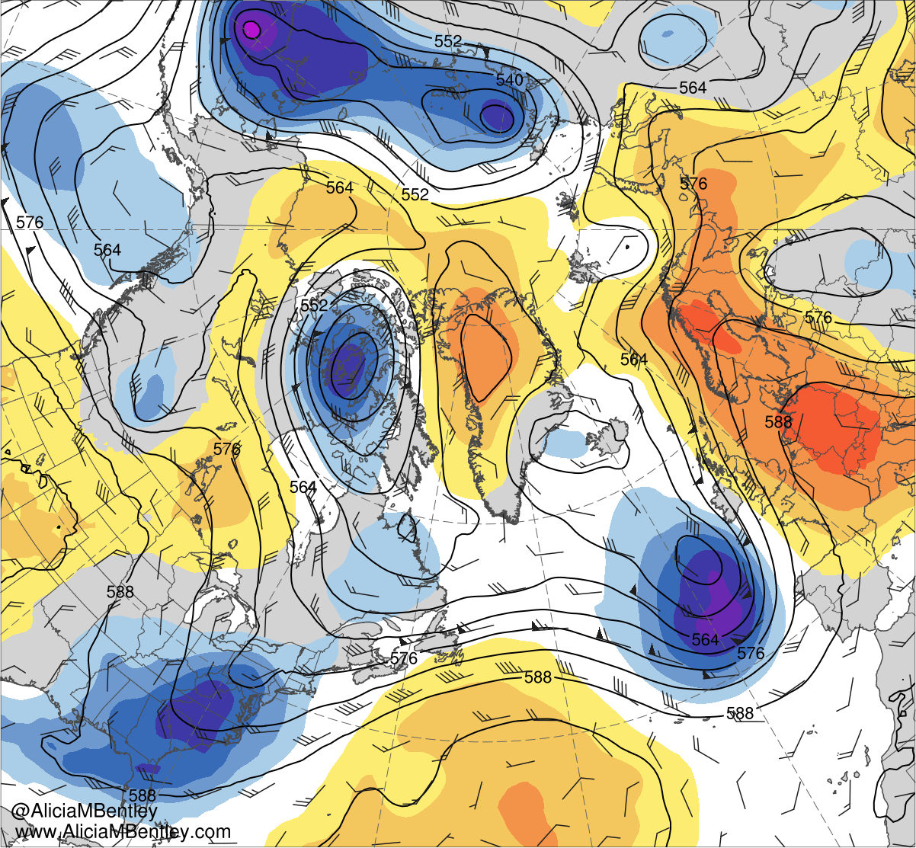
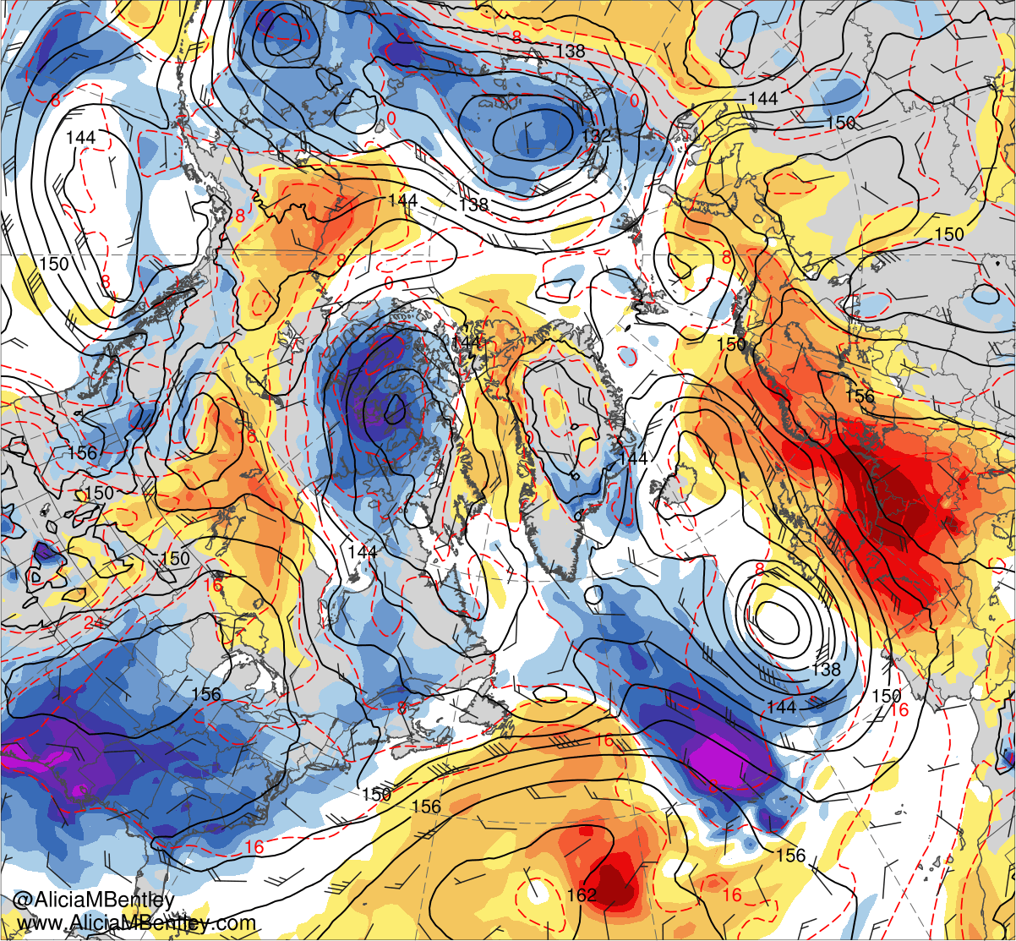
European Heat Wave
0000 UTC 25 July 2019
0000 UTC 25 July 2019
−6
−5
−4
−3
−2.5
−2
−1.5
−1
−0.5
0
0.5
1
1.5
2
2.5
3
4
5
6
Shading: Standardized 500-hPa
geopotential height anomalies (σ)
Shading: Standardized 850-hPa
temperature anomalies (σ)
All-time European Heat Records on 25 July 2019
France: Paris (42.6 °C) [Previous: 40.4 °C]
Germany: Lingen (42.6 °C) [Previous: 40.3 °C] Luxembourg: Steinsel (40.8 °C ) [Previous: 40.5 °C] Netherlands: Gilze-Rijen (40.7 °C) [Previous: 38.6 °C] UK: Cambridge Univ. (38.7 °C) [Previous: 38.5 °C]
500-hPa geopotential
height (dam)
850-hPa geopotential
height (dam)
850-hPa temperature (K)
500-hPa wind (kt)
850-hPa wind (kt)

Slide 3
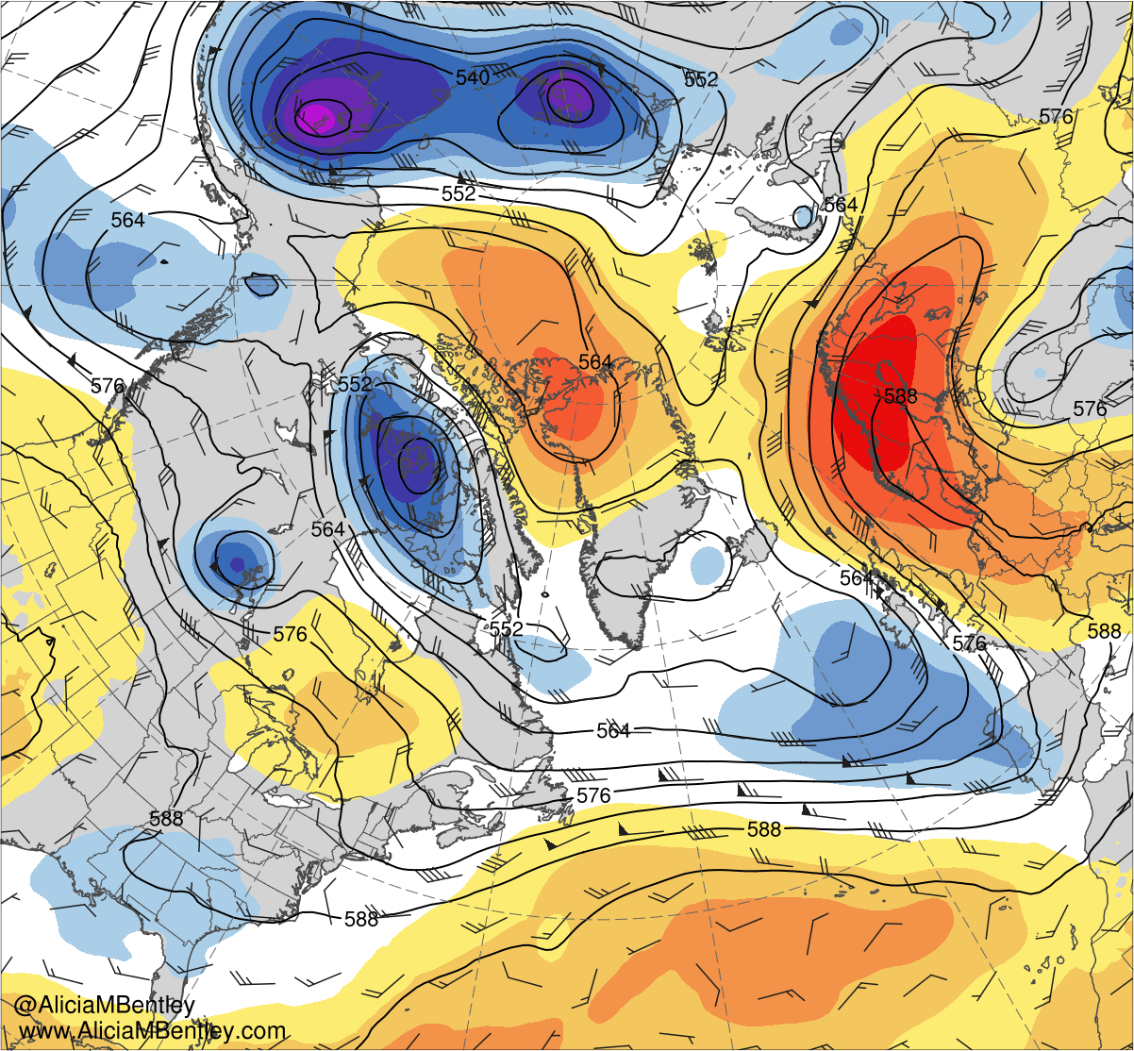
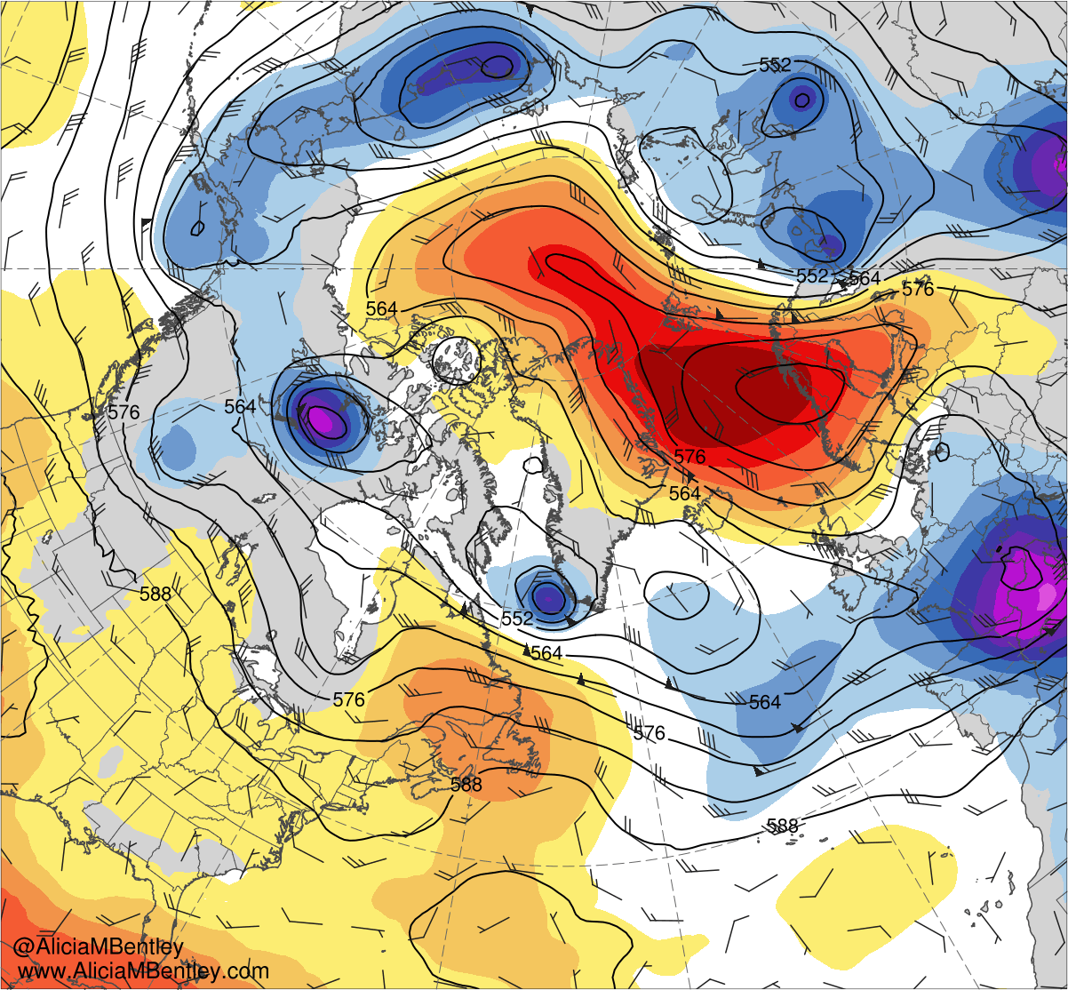
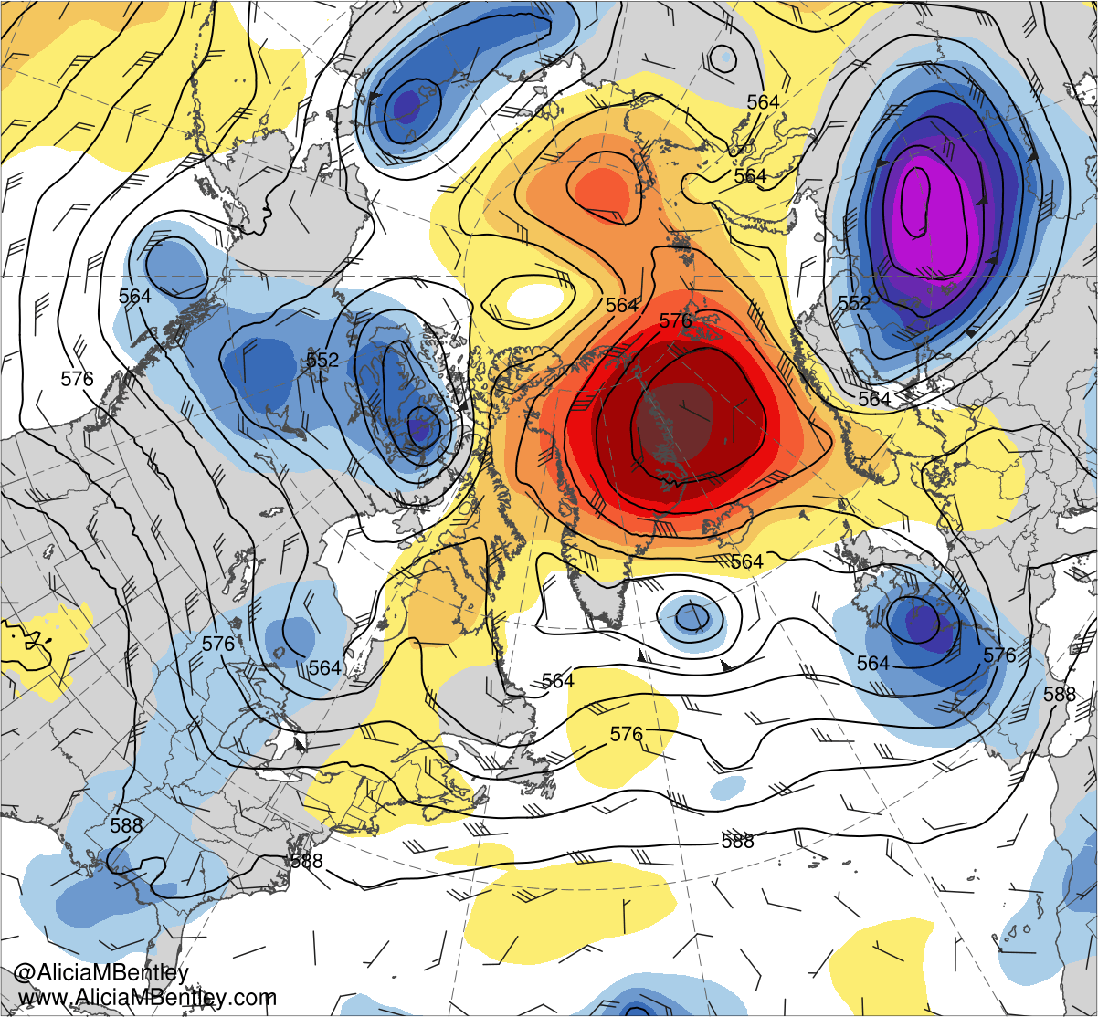
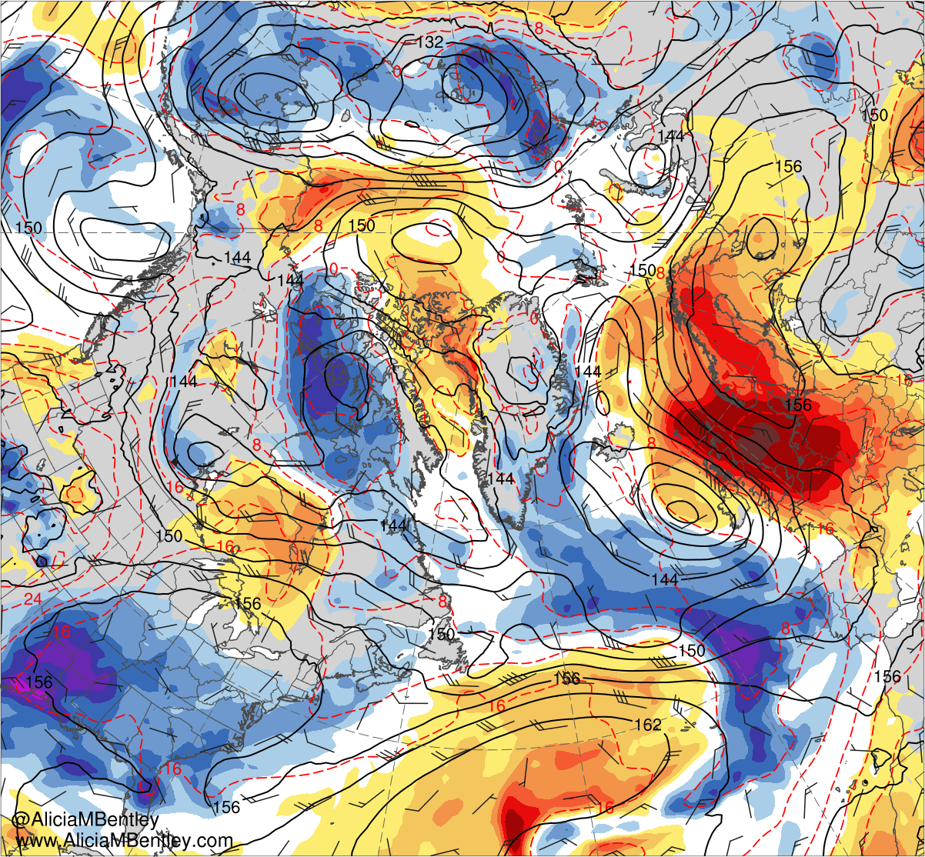
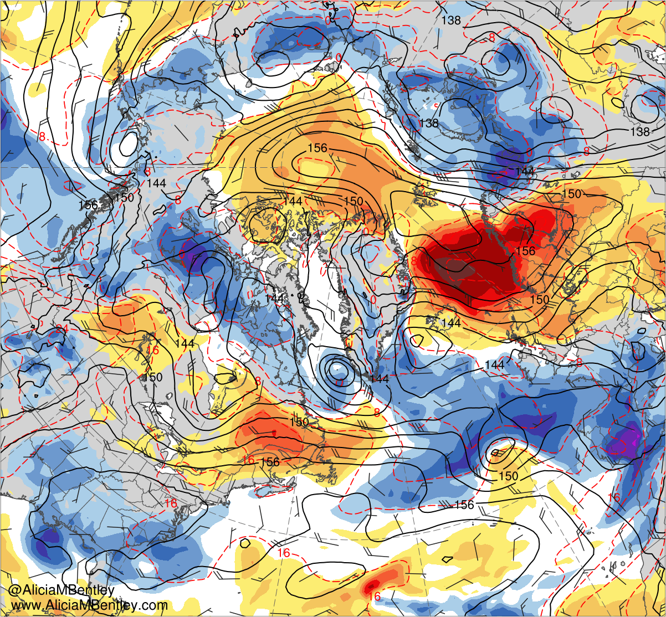
Flow Amplification and Poleward Heat Transport
0000 UTC 26 July 2019
0000 UTC 28 July 2019
0000 UTC 30 July 2019
Shading:
Standardized 500-hPa geopotential
height anomalies (σ)
6
5
4
3
500-hPa geopotential
height (dam)
2.5
2
1.5
500-hPa wind (kt)
1
0.5
0000 UTC 26 July 2019
0000 UTC 28 July 2019
0000 UTC 30 July 2019
0
−0.5
Shading:
Standardized 850-hPa temperature
anomalies (σ)
−1
−1.5
−2
850-hPa geopotential
height (dam)
−2.5
−3
−4
850-hPa temperature (K)
−5
−6
850-hPa wind (kt)

Slide 4
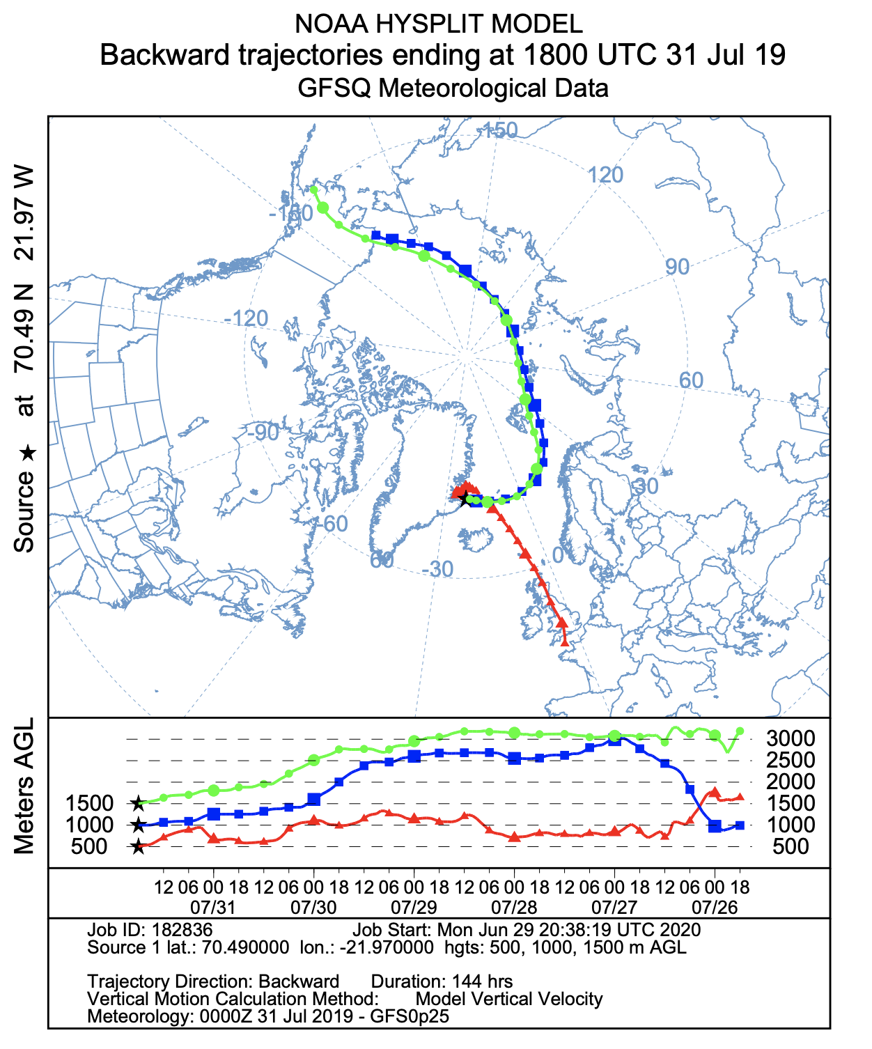
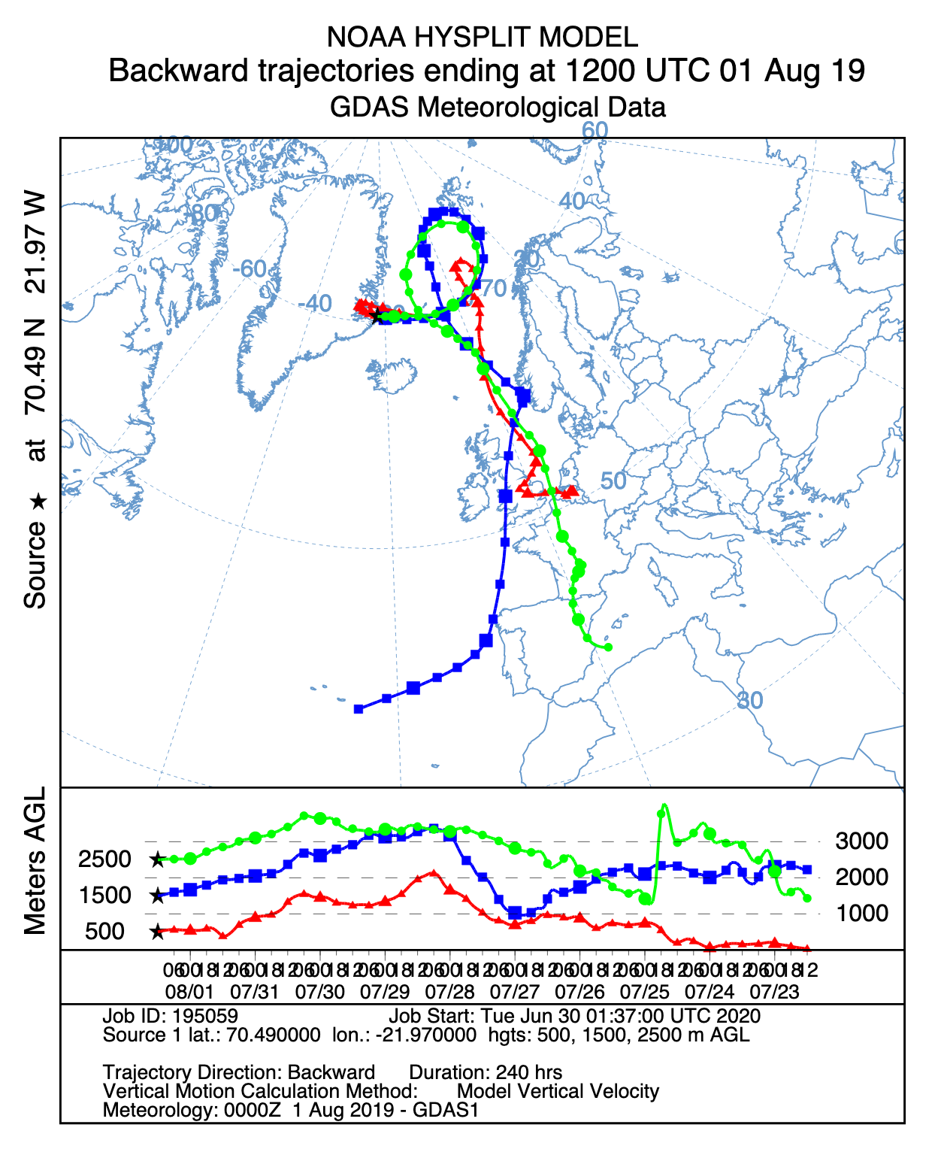
Trajectories and Key Takeaways
Key Takeaways
A progressive North Atlantic trough enables a northwestern Africa ridge to build poleward across western Europe to Scandinavia.
Ridging enables very hot, dry Saharan air to reach western Europe and expand toward Scandinavia.
Additional Arctic ridging forces modified Saharan air over Scandinavia to turn westward to Greenland.

