Slide 1
An Analysis of Complex Polar–Midlatitude–Tropical Interactions that Culminated in the Largest Greenland Surface Ice-Melt Event of 2019
Lance F. Bosart, Scott W. Feldman, Kevin A. Biernat, and Daniel Keyser
Department of Atmospheric and Environmental Sciences
University at Albany, State University of New York
16th AMS Conference on Polar Meteorology and Oceanography
Paper 10.5
Friday 4 June 2021
Research Supported by ONR Grant N00014-18-1-2200

Slide 2
Background Information

Slide 3
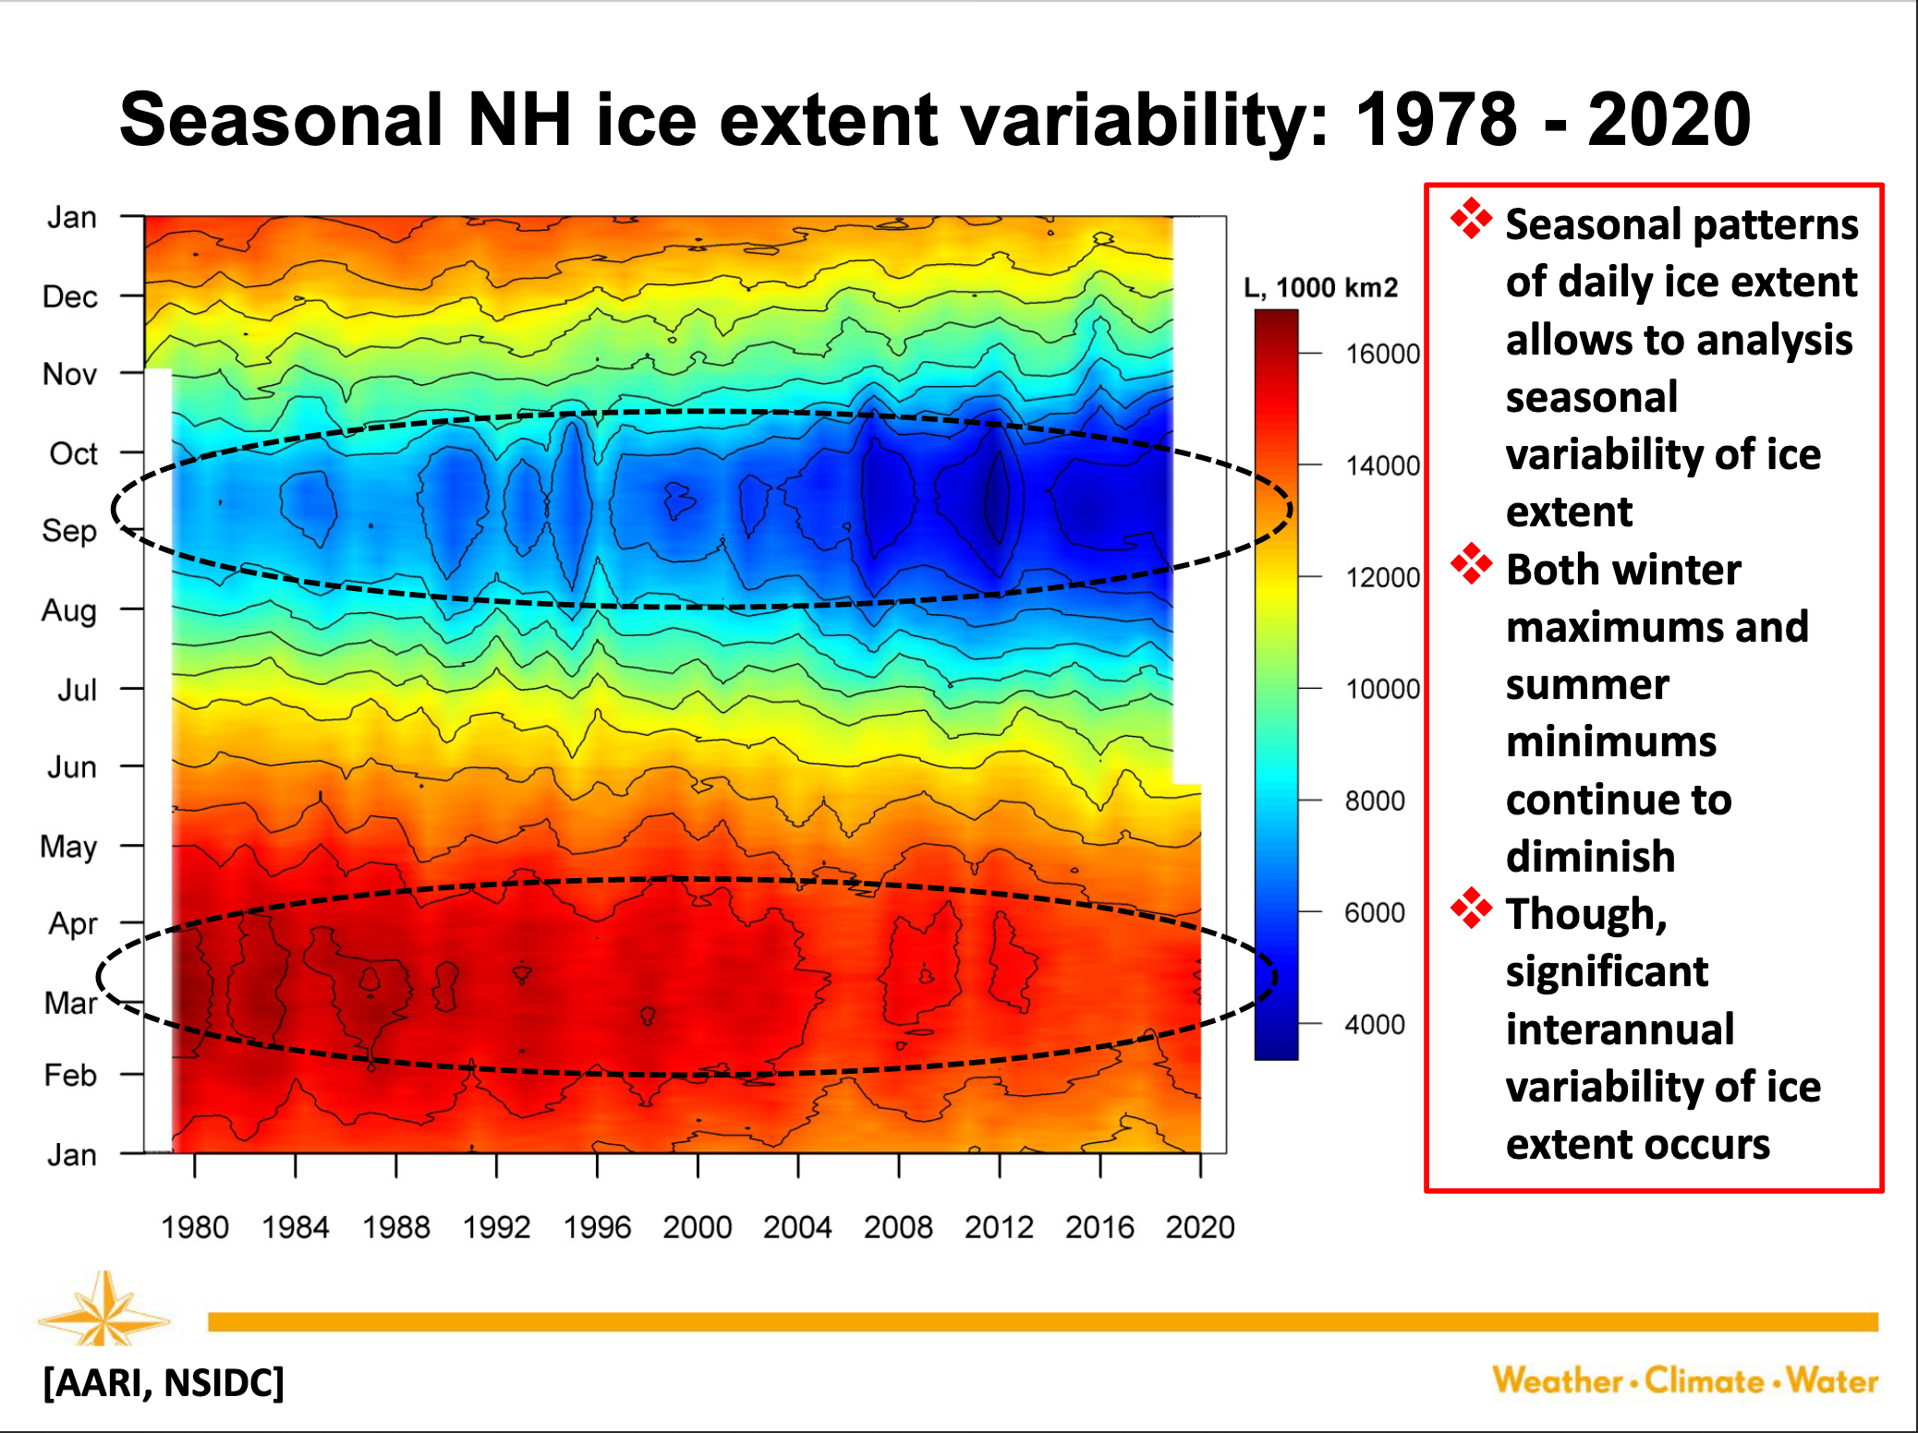

Slide 4
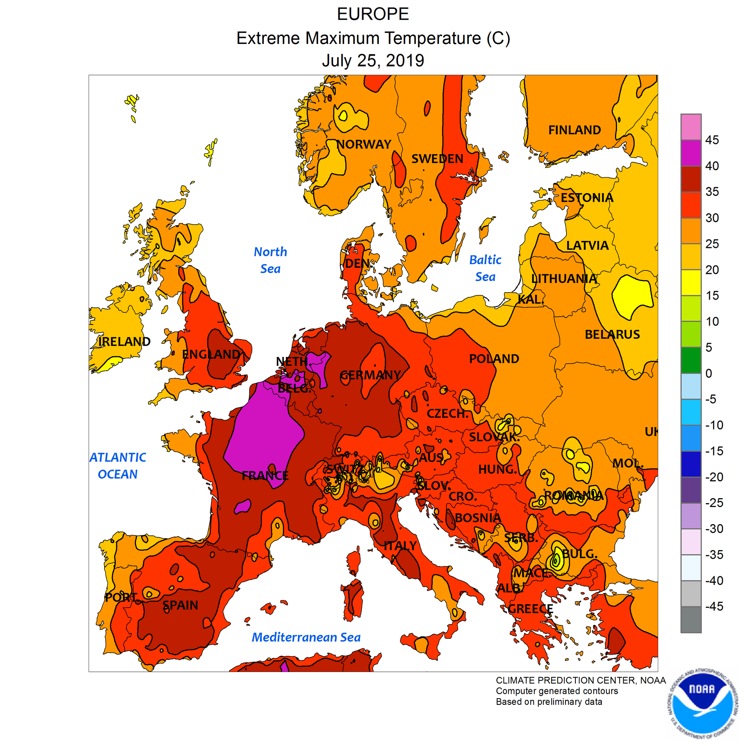
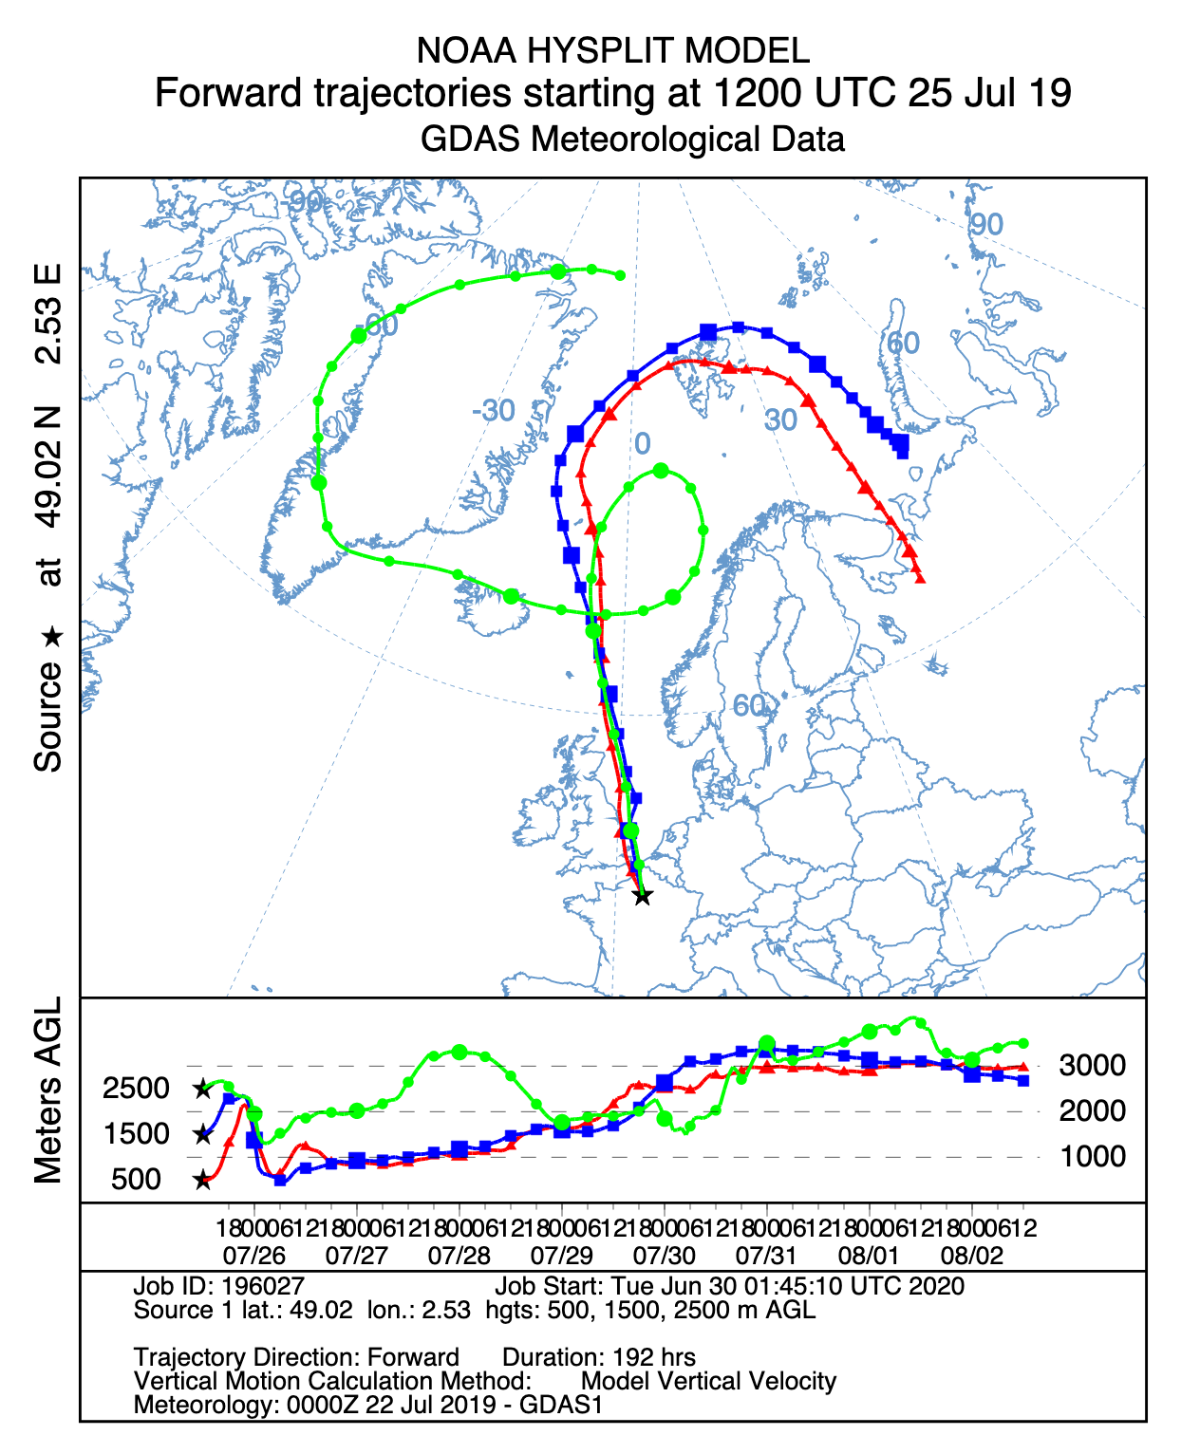
European Heat and Forward Trajectories
Paris
All-time European Heat Records on 25 July 2019
France: Paris (42.6 °C) [Previous: 40.4 °C]
Germany: Lingen (42.6 °C) [Previous: 40.3 °C]
Luxembourg: Steinsel (40.8 °C ) [Previous: 40.5 °C]
Netherlands: Gilze-Rijen (40.7 °C) [Previous: 38.6 °C]
UK: Cambridge Univ. (38.7 °C) [Previous: 38.5 °C]

Slide 5
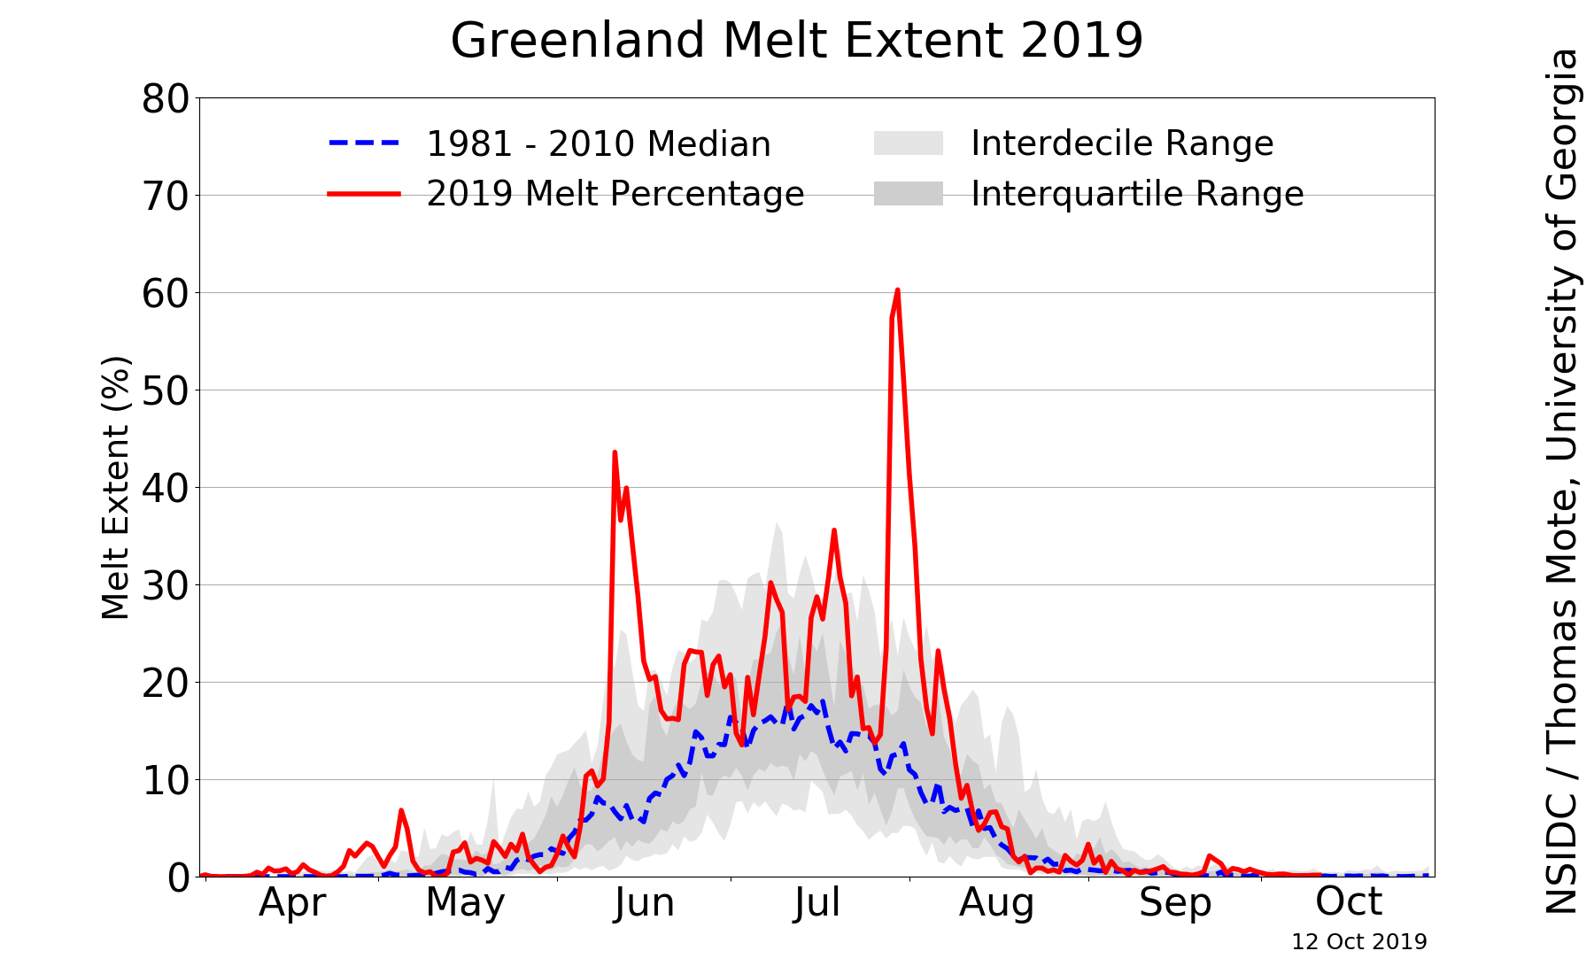
Motivation
Source: NSIDC/Thomas Mote, University of Georgia;
http://nsidc.org/greenland-today/

Slide 6
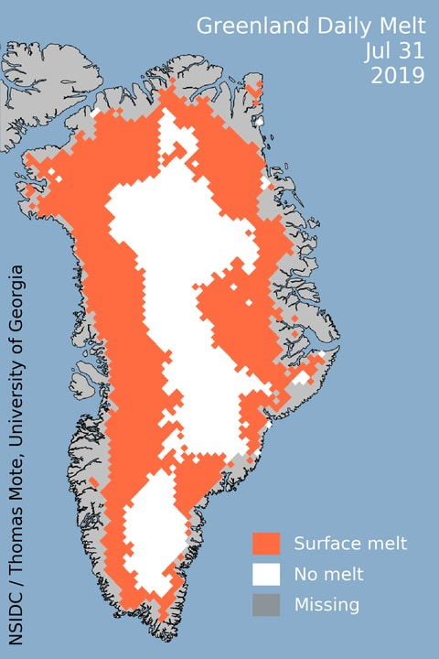
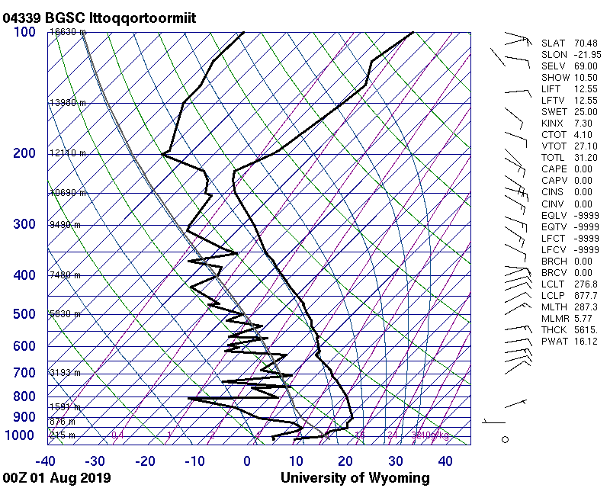
Motivation
Source: University of Wyoming

Slide 7
Motivation
Investigate the antecedent evolution of the large-scale flow pattern that contributed to a record-breaking surface ice-melt event over Greenland during 31 July–1 August 2019

Slide 8
Data and Methods
Use the CFSR 0.5° gridded reanalyses (Saha et al. 2010) to illustrate and document the antecedent large-scale flow evolution that governed the record-breaking Greenland surface ice-melt event
Use the NOAA HYSPLIT trajectory model to investigate the origin of anomalously warm air that contributed to the record-breaking Greenland surface ice-melt event

Slide 9
Case Overview
Cyclonic flow over the Arctic Ocean during 22–24 July was replaced by anticyclonic flow with a strong ridge near the North Pole during 25–27 July
A deep trough over the eastern Atlantic during 24–27 July enabled a ridge over northwestern Africa to build poleward across western Europe to Scandinavia
A blocking anticyclone was established over Scandinavia as Saharan air reached western Europe and Scandinavia by 26–27 July
Modified Saharan air reached Greenland as the blocking Scandinavian anticyclone shifted westward during 31 July–1 August

Slide 10
Loop of 500-hPa heights, winds, and standardized height anomalies (sigma) for
0000 UTC 22 July to 0000 UTC 2 August 2019

Slide 11
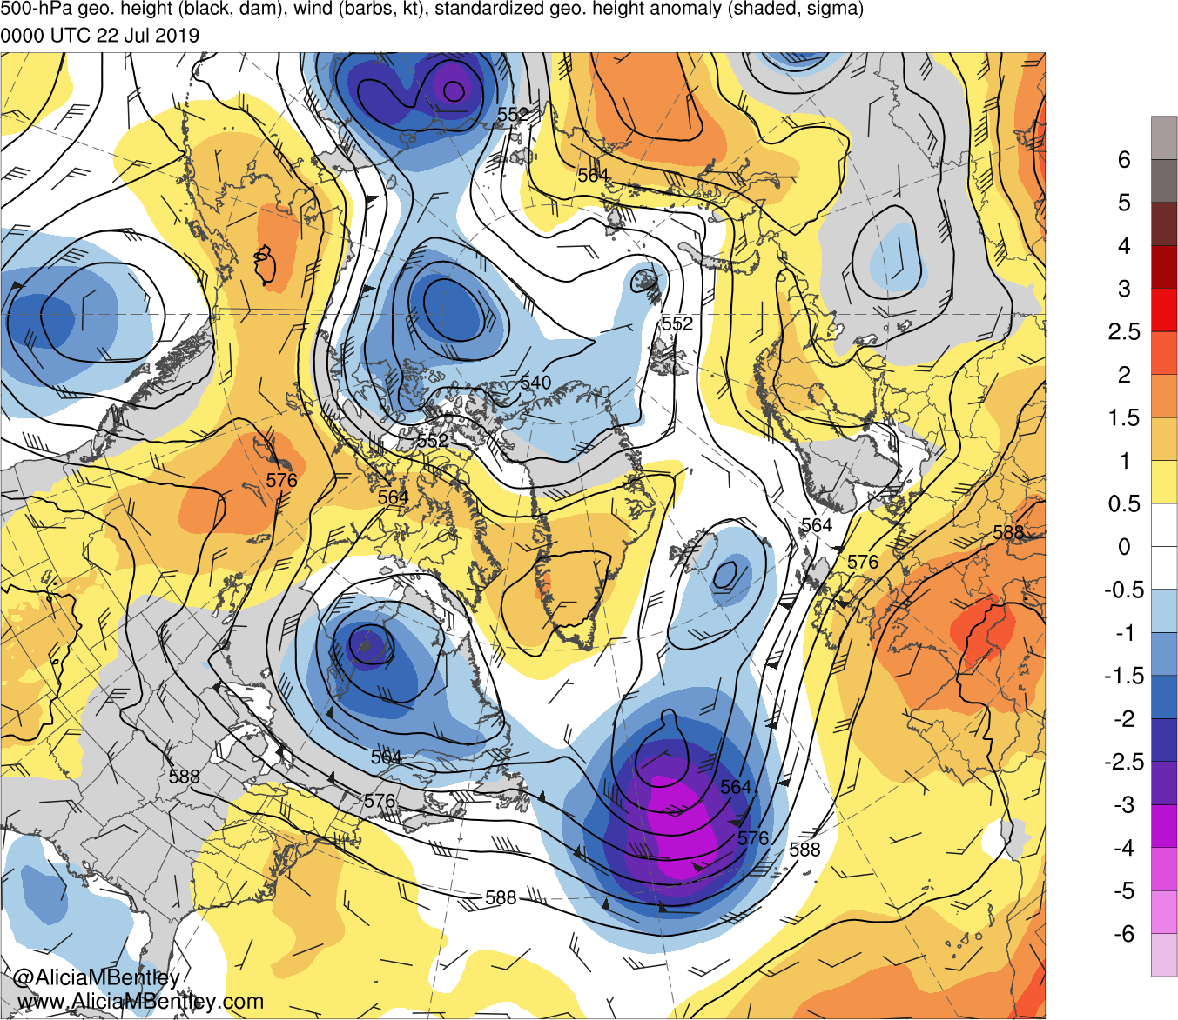
0000 UTC 22 July 2019

Slide 12
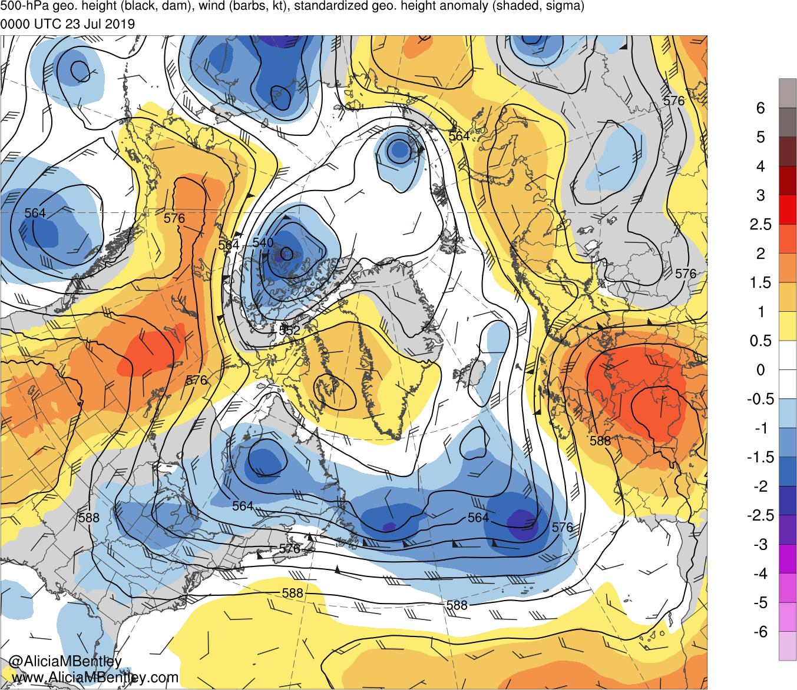
0000 UTC 23 July 2019

Slide 13
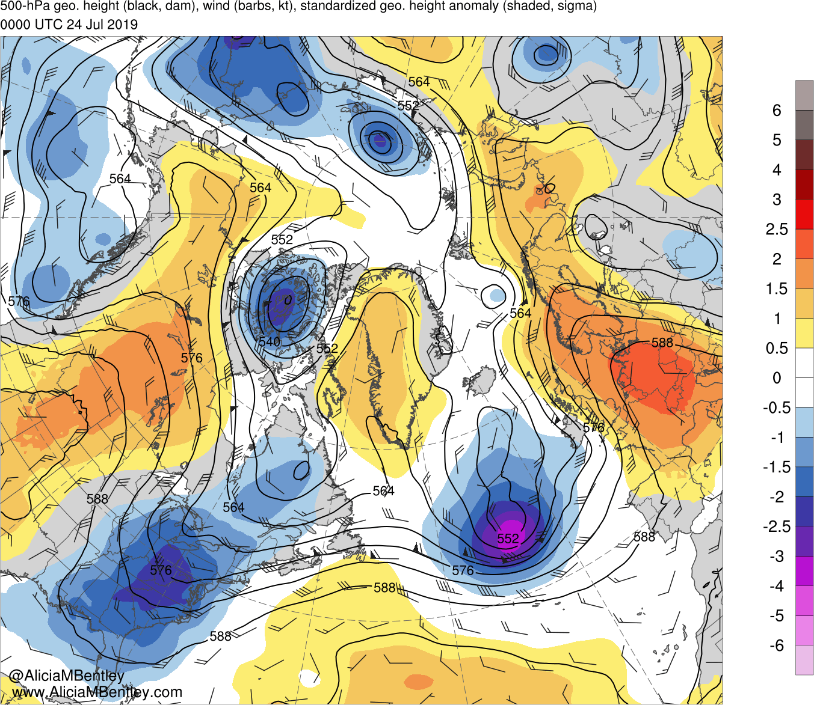
0000 UTC 24 July 2019

Slide 14
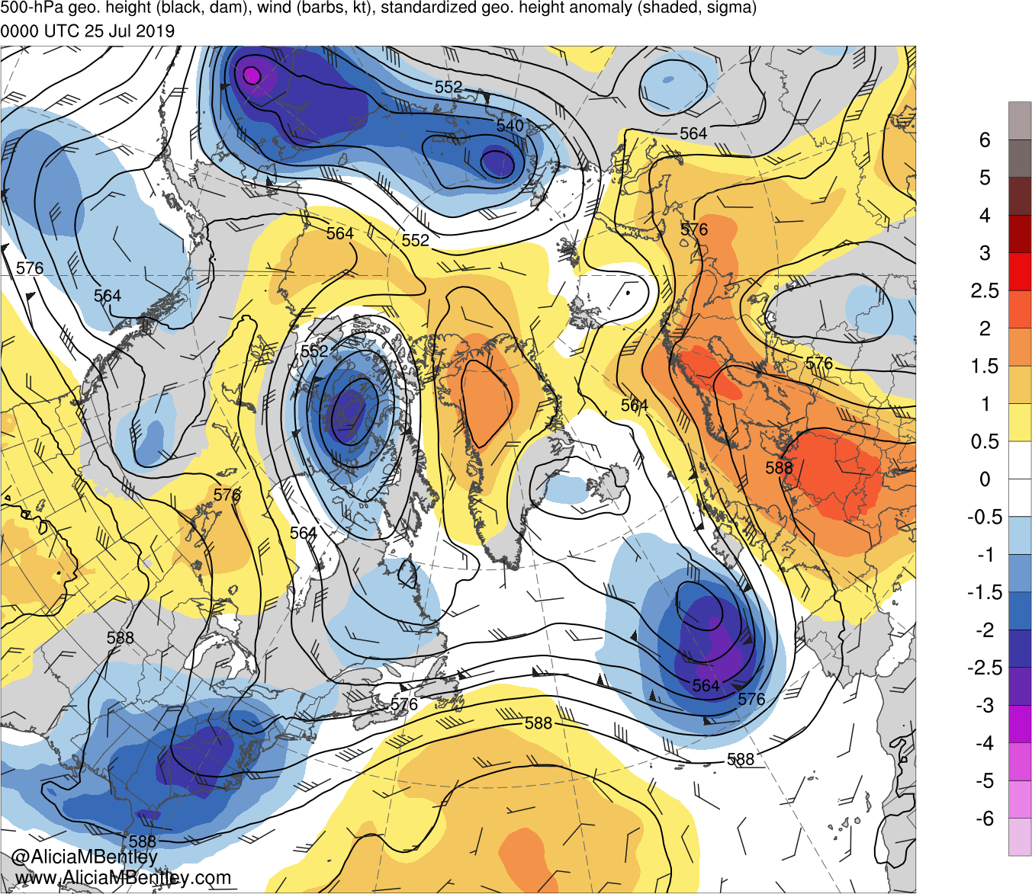
0000 UTC 25 July 2019

Slide 15
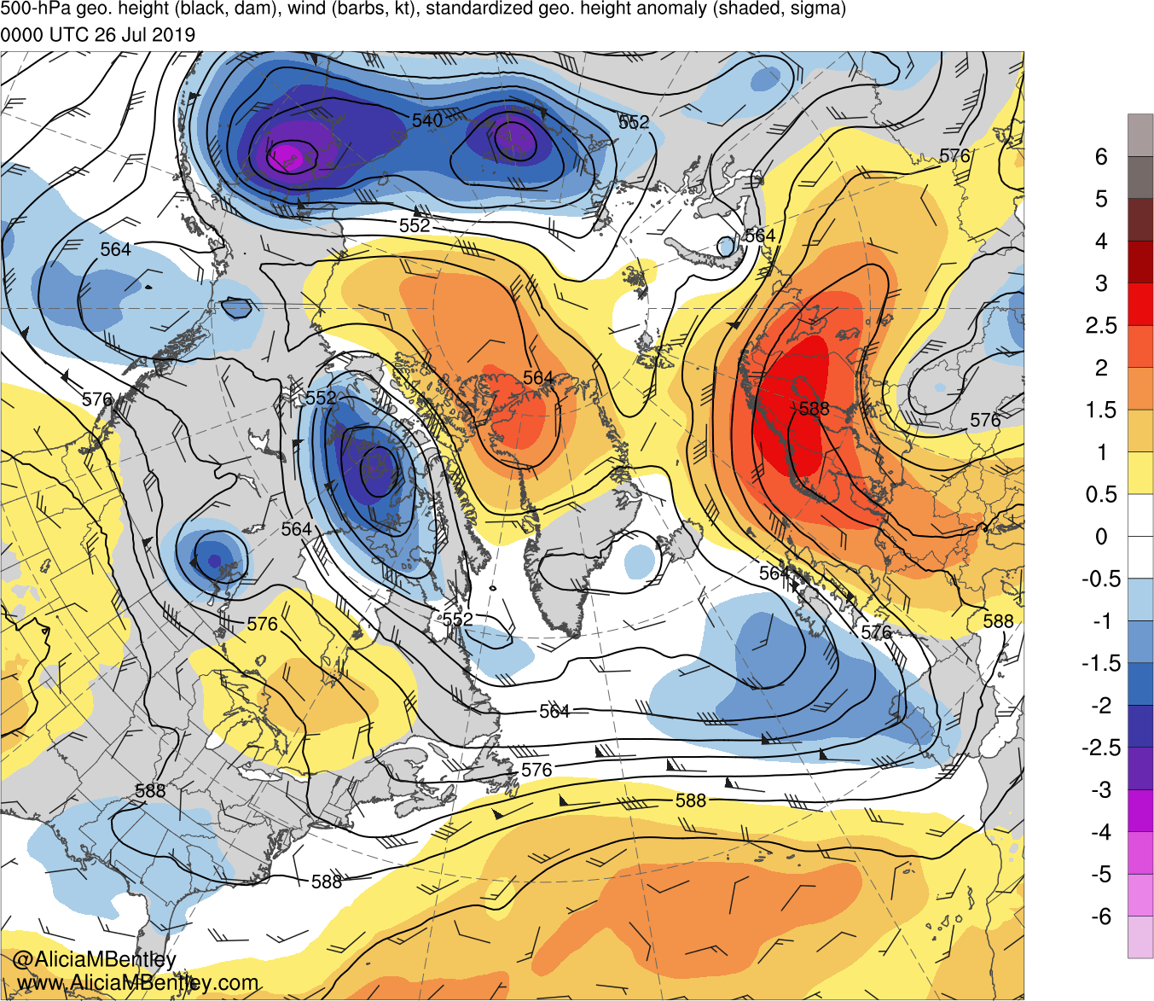
0000 UTC 26 July 2019

Slide 16
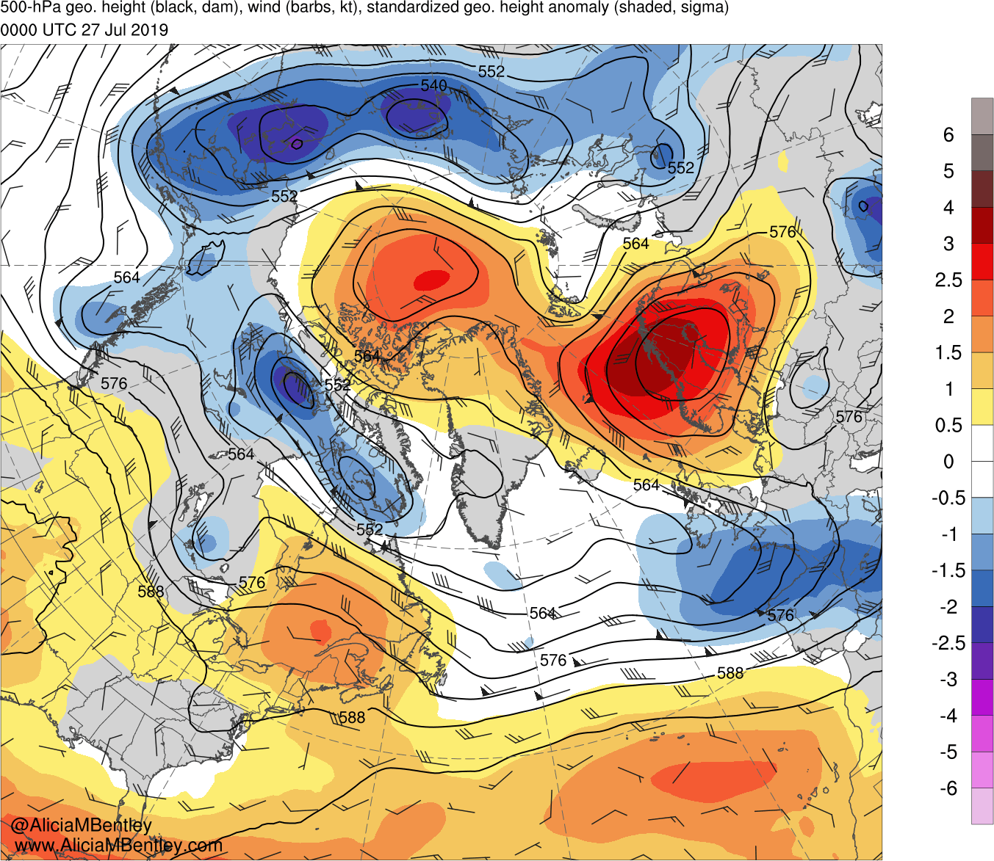
0000 UTC 27 July 2019

Slide 17
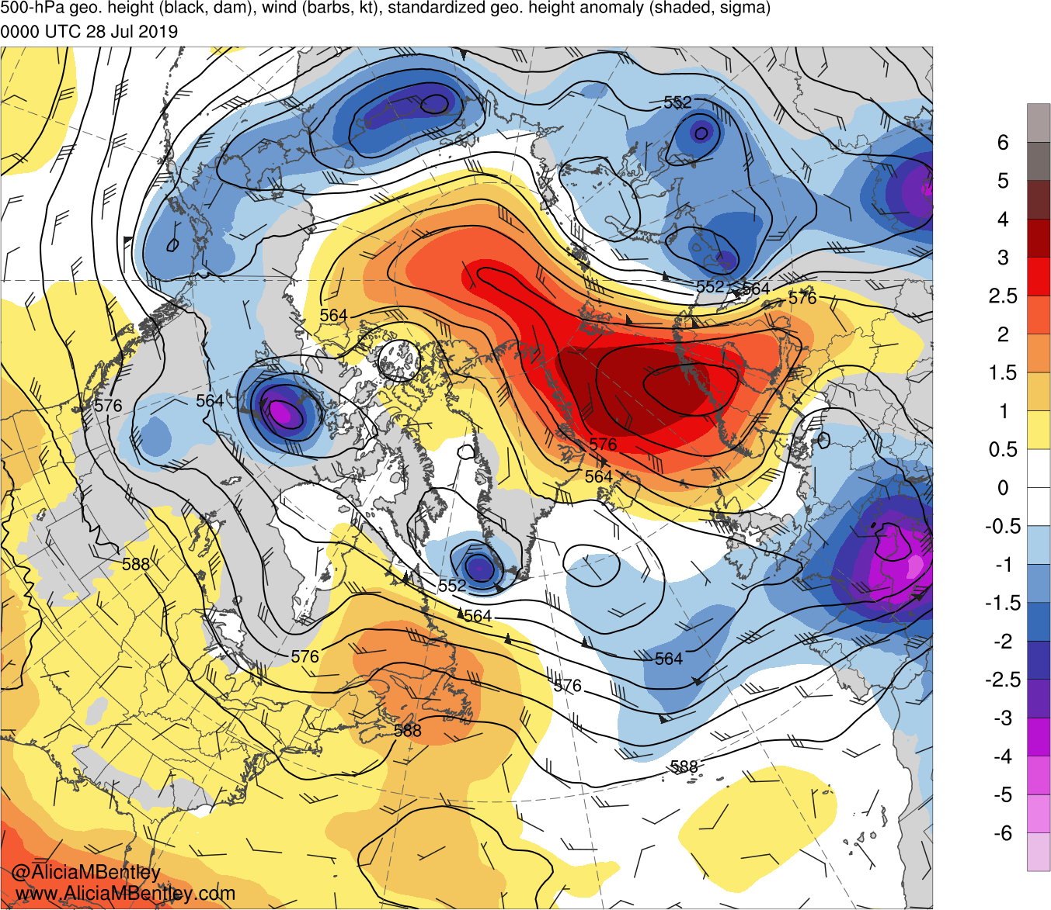
0000 UTC 28 July 2019

Slide 18
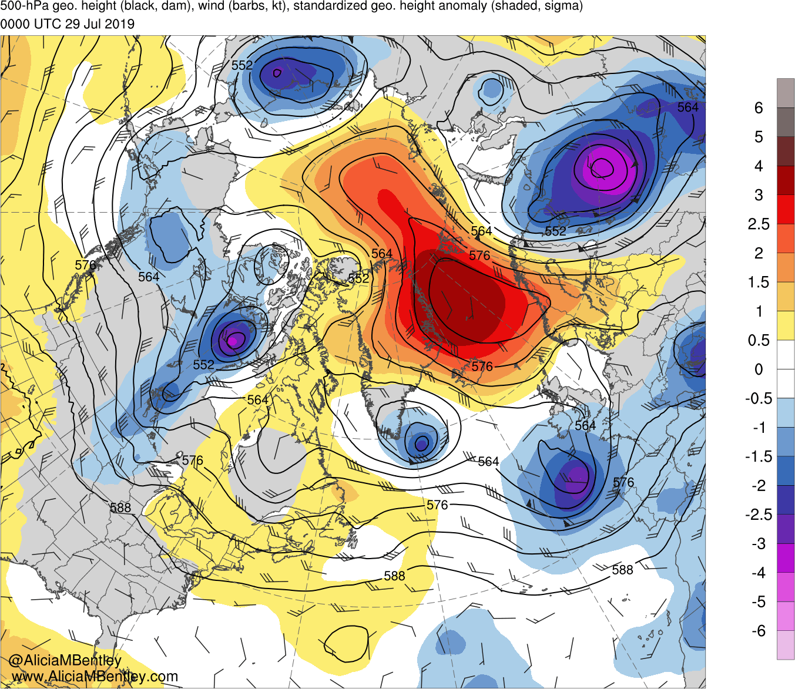
0000 UTC 29 July 2019

Slide 19
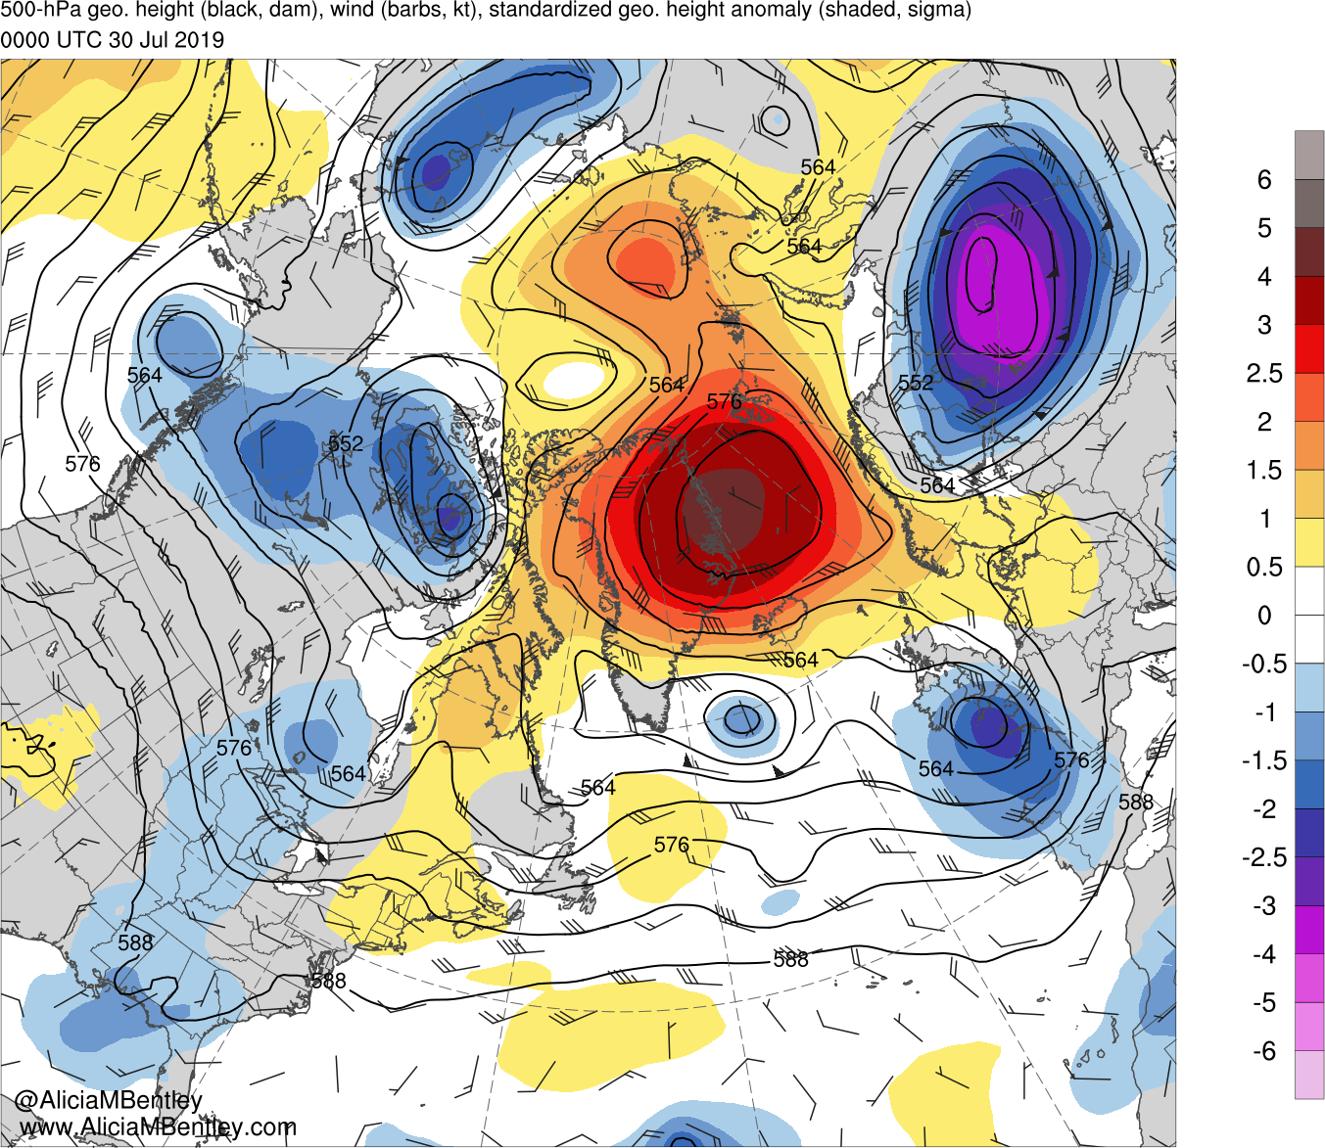
0000 UTC 30 July 2019

Slide 20
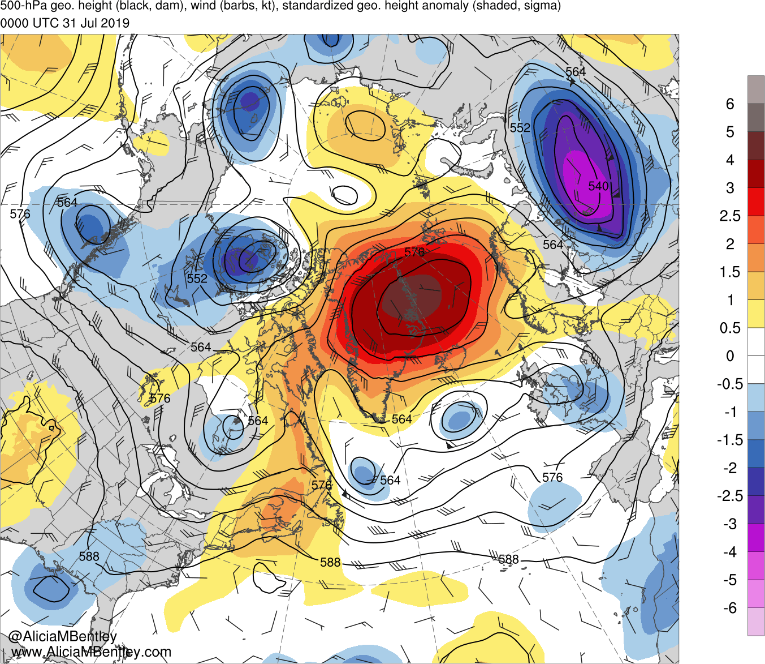
0000 UTC 31 July 2019

Slide 21
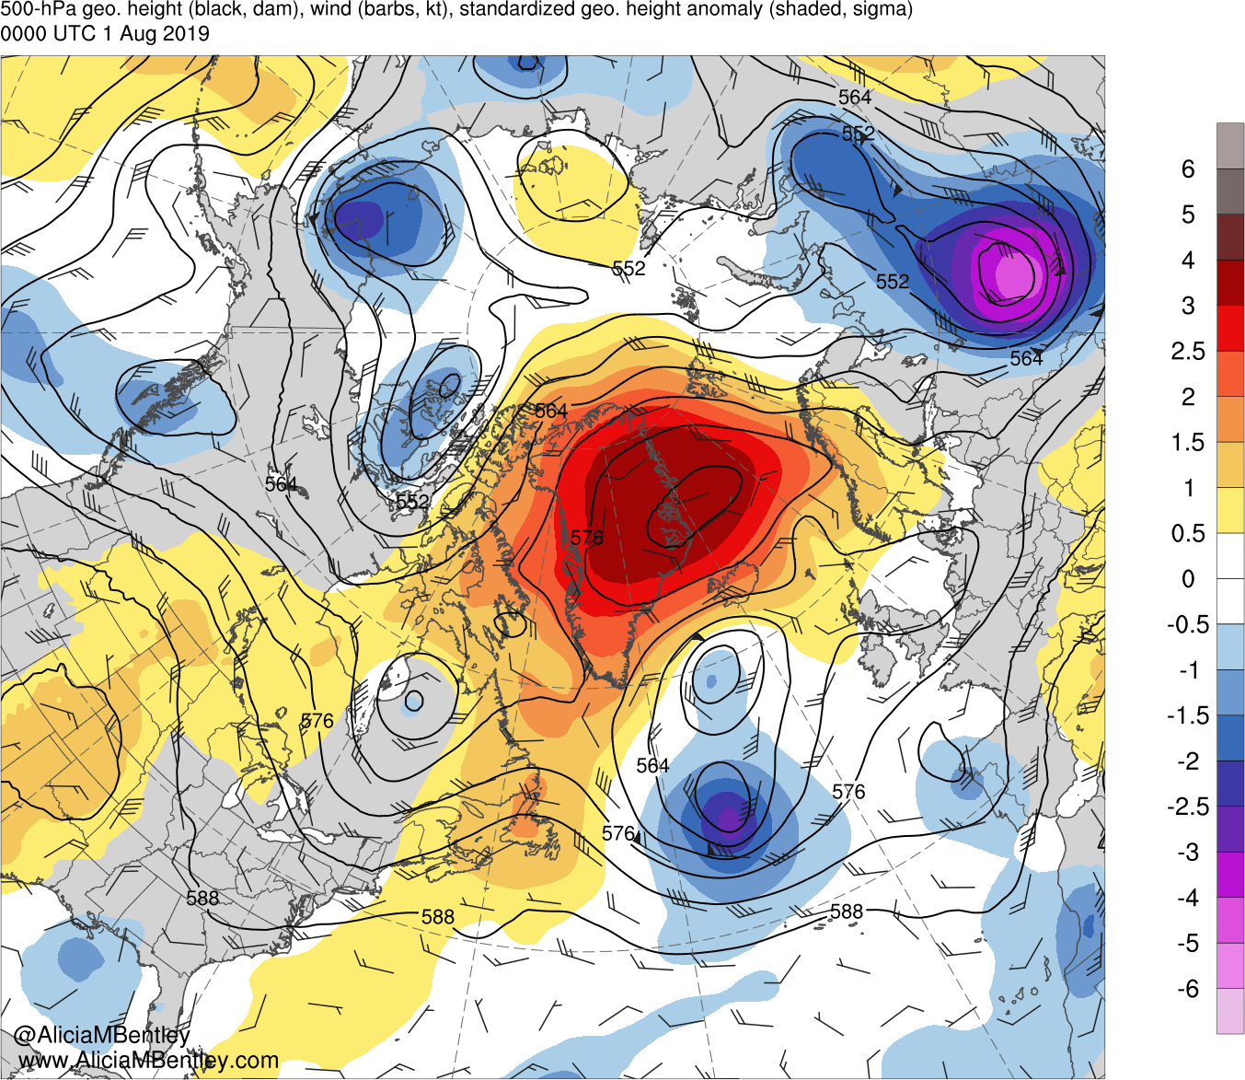
0000 UTC 1 August 2019

Slide 22
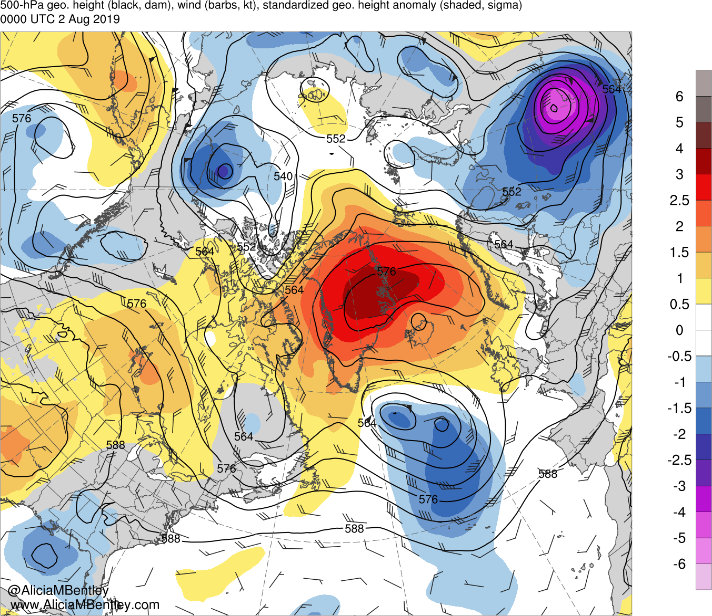
0000 UTC 2 August 2019

Slide 23
Loop of 850-hPa heights, temperatures, winds, and standardized temperature anomalies (sigma) for
0000 UTC 22 July to 0000 UTC 2 August 2019

Slide 24
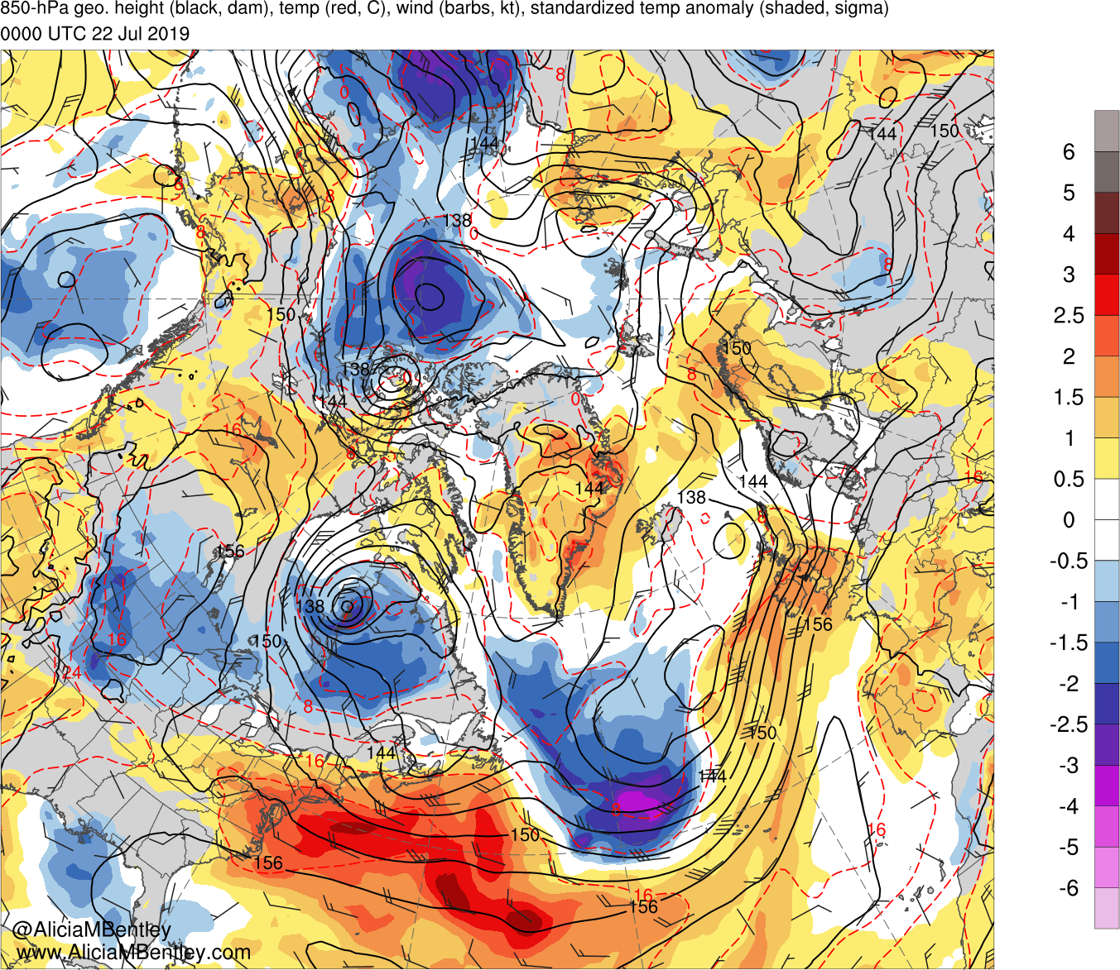
0000 UTC 22 July 2019

Slide 25
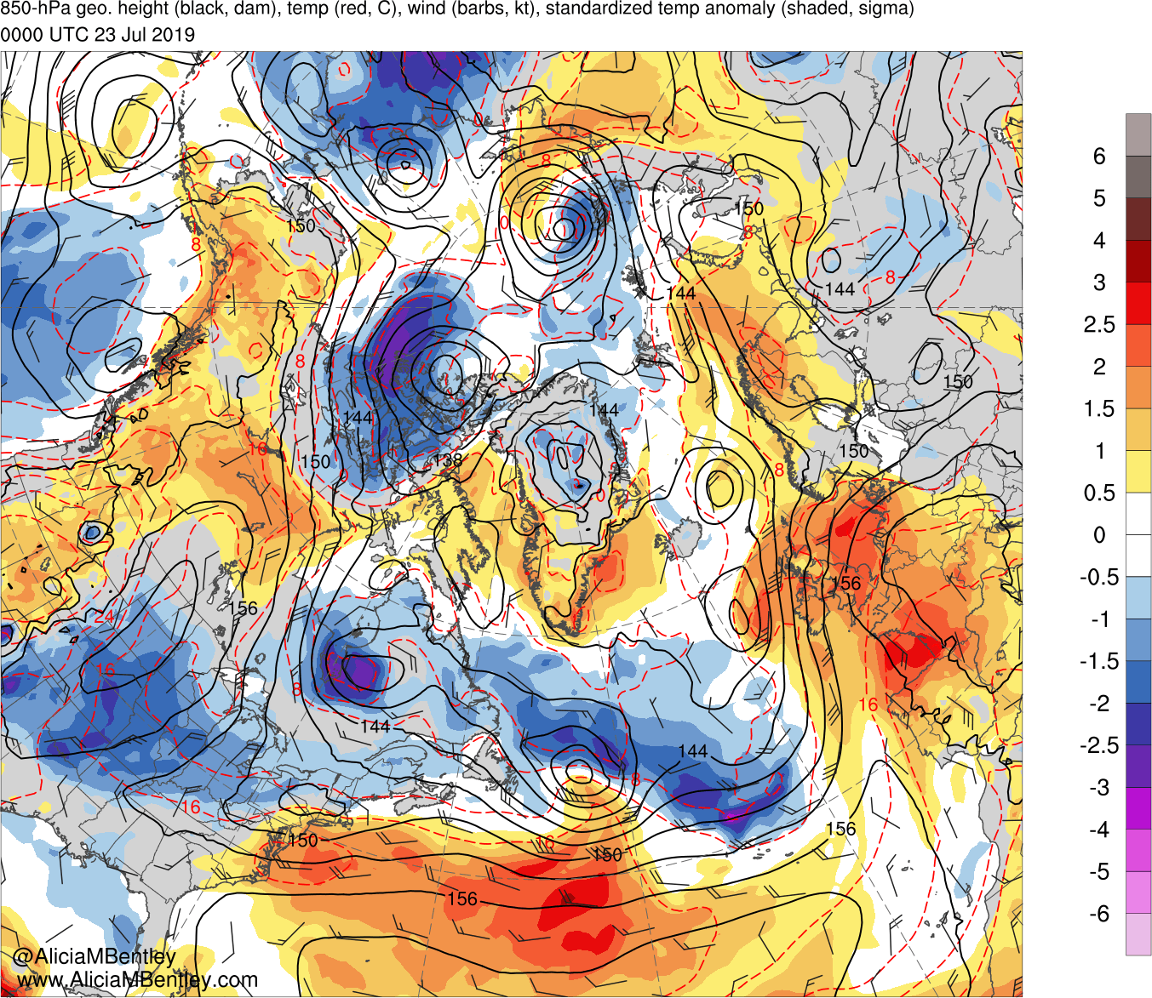
0000 UTC 23 July 2019

Slide 26
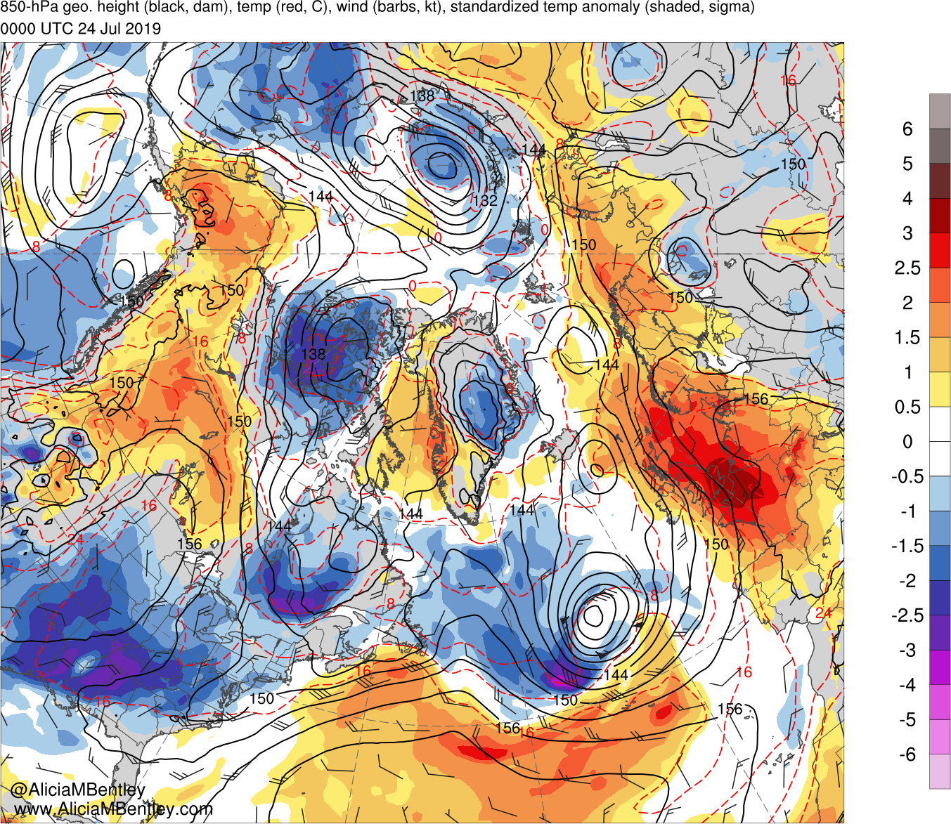
0000 UTC 24 July 2019

Slide 27
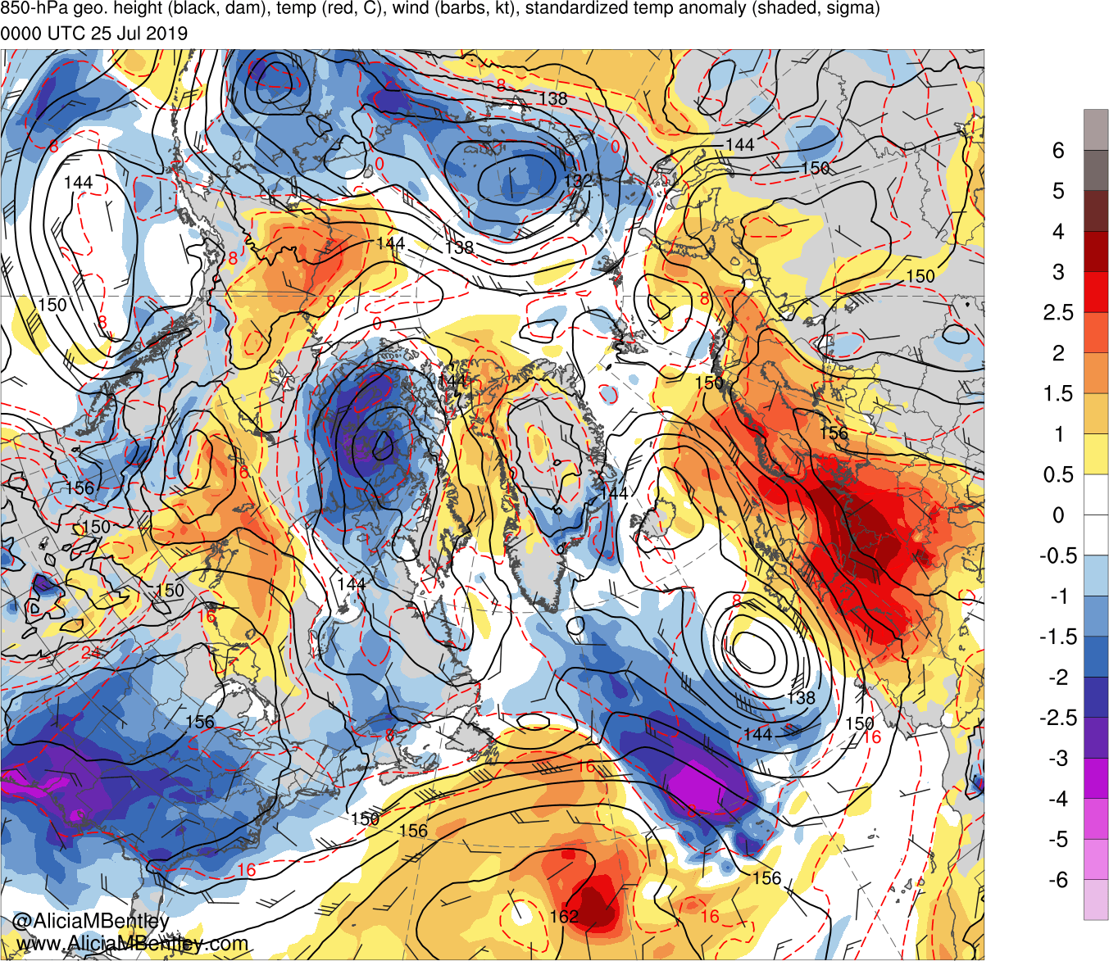
0000 UTC 25 July 2019

Slide 28
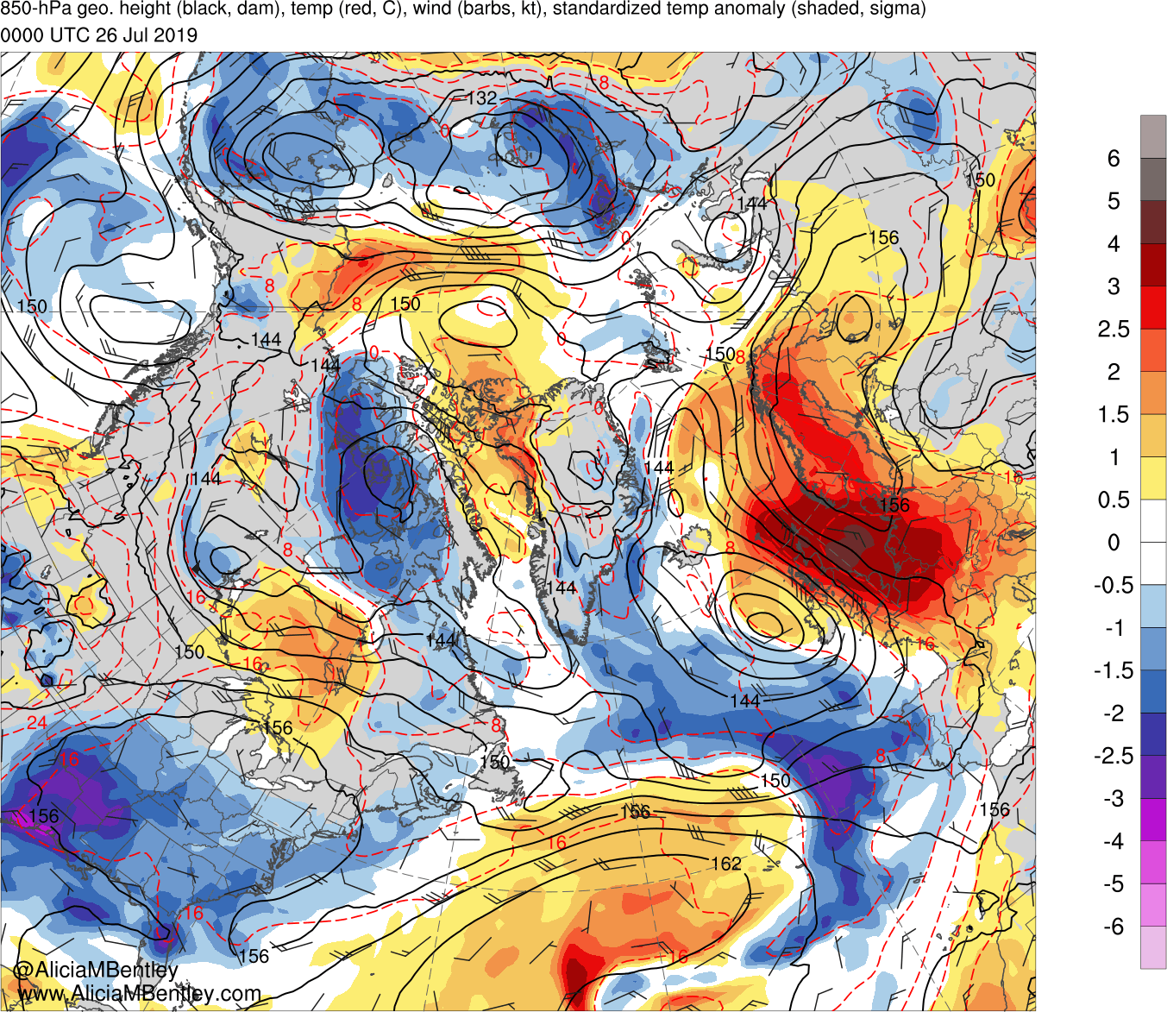
0000 UTC 26 July 2019

Slide 29
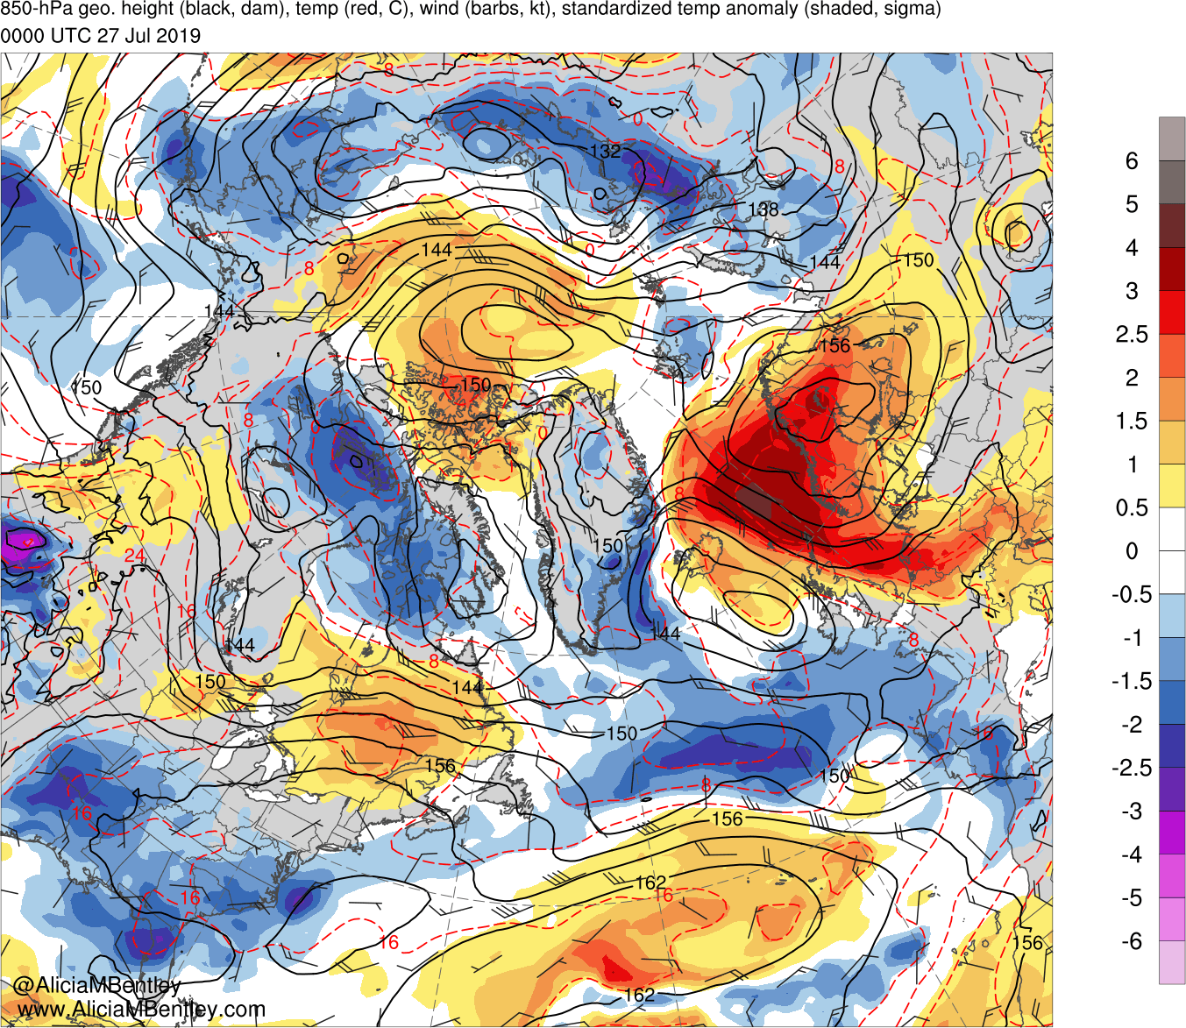
0000 UTC 27 July 2019

Slide 30
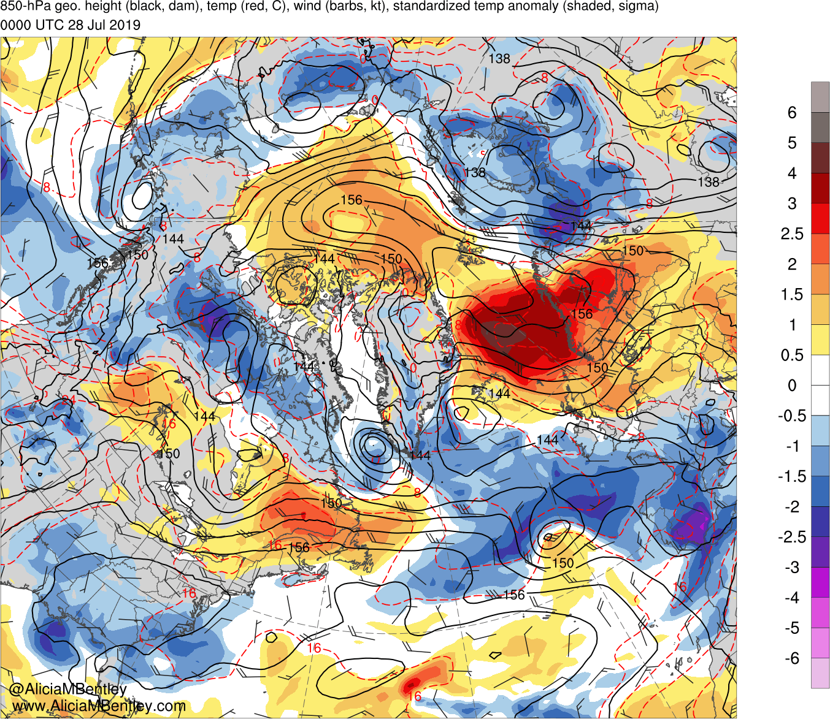
0000 UTC 28 July 2019

Slide 31
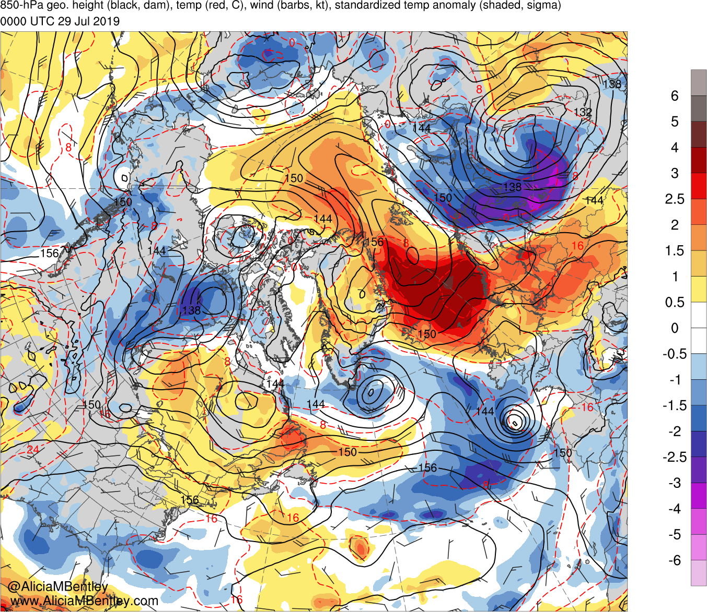
0000 UTC 29 July 2019

Slide 32
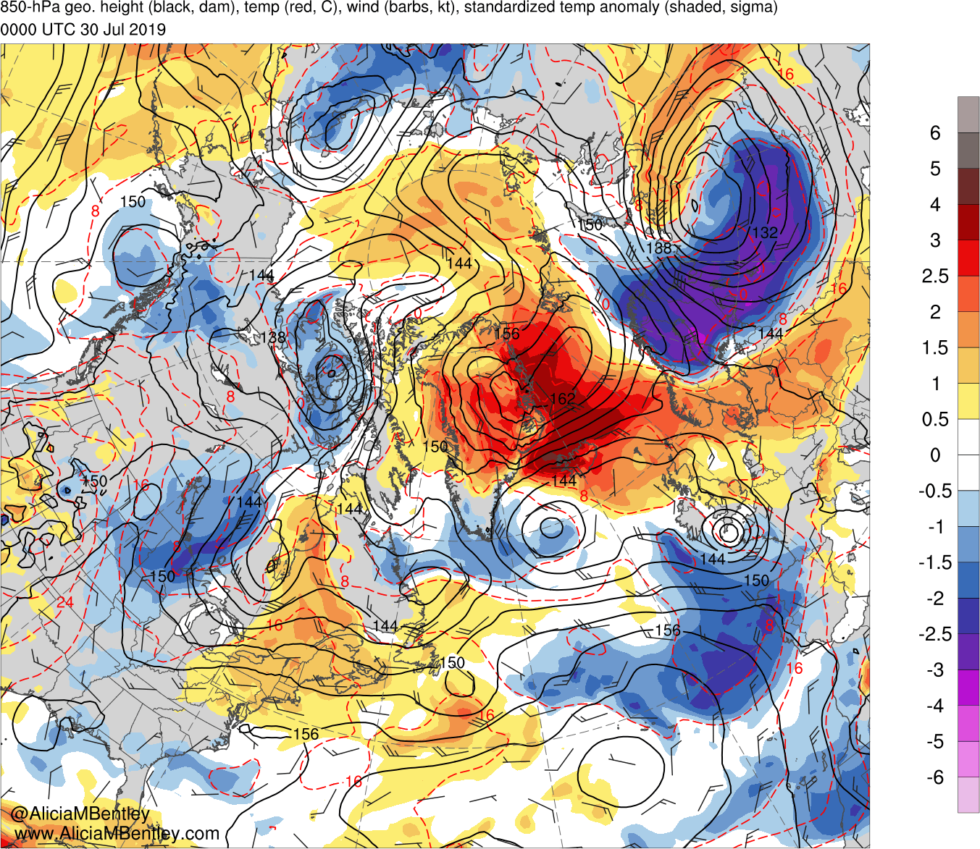
0000 UTC 30 July 2019

Slide 33
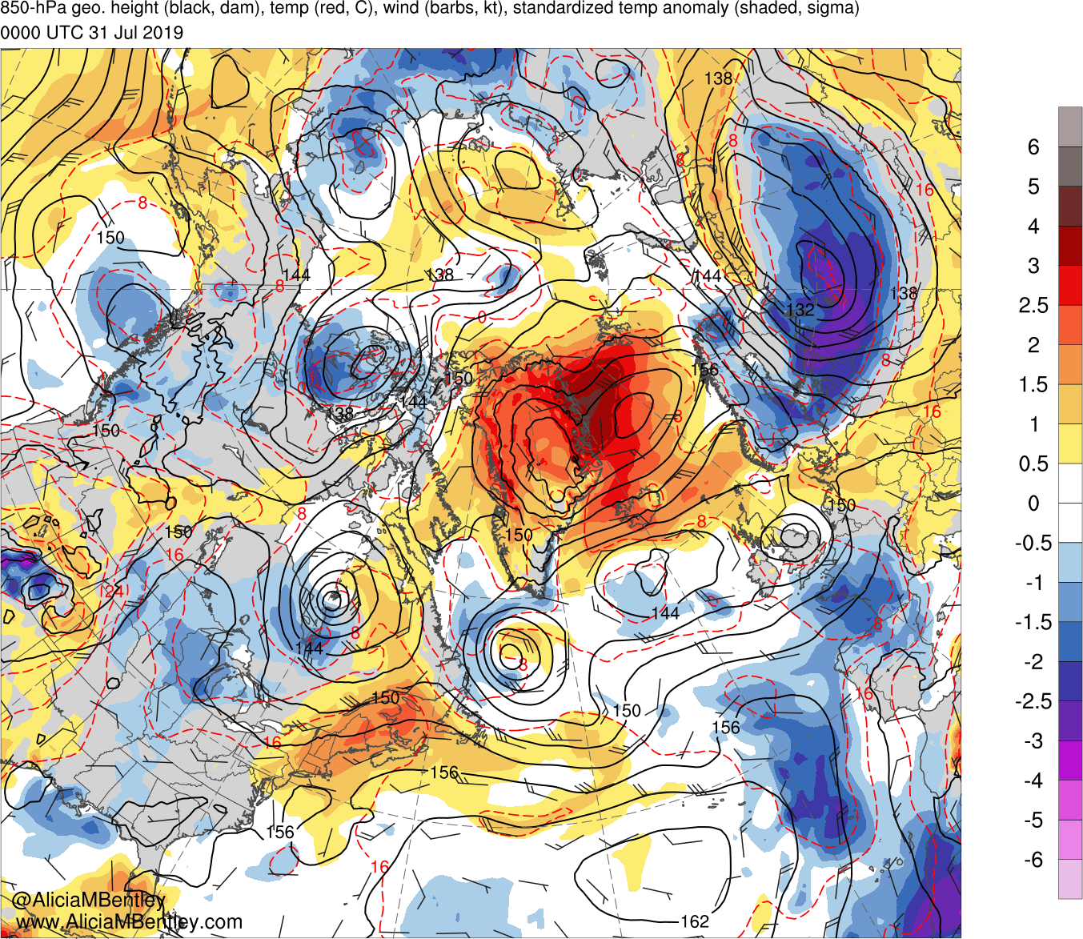
0000 UTC 31 July 2019

Slide 34
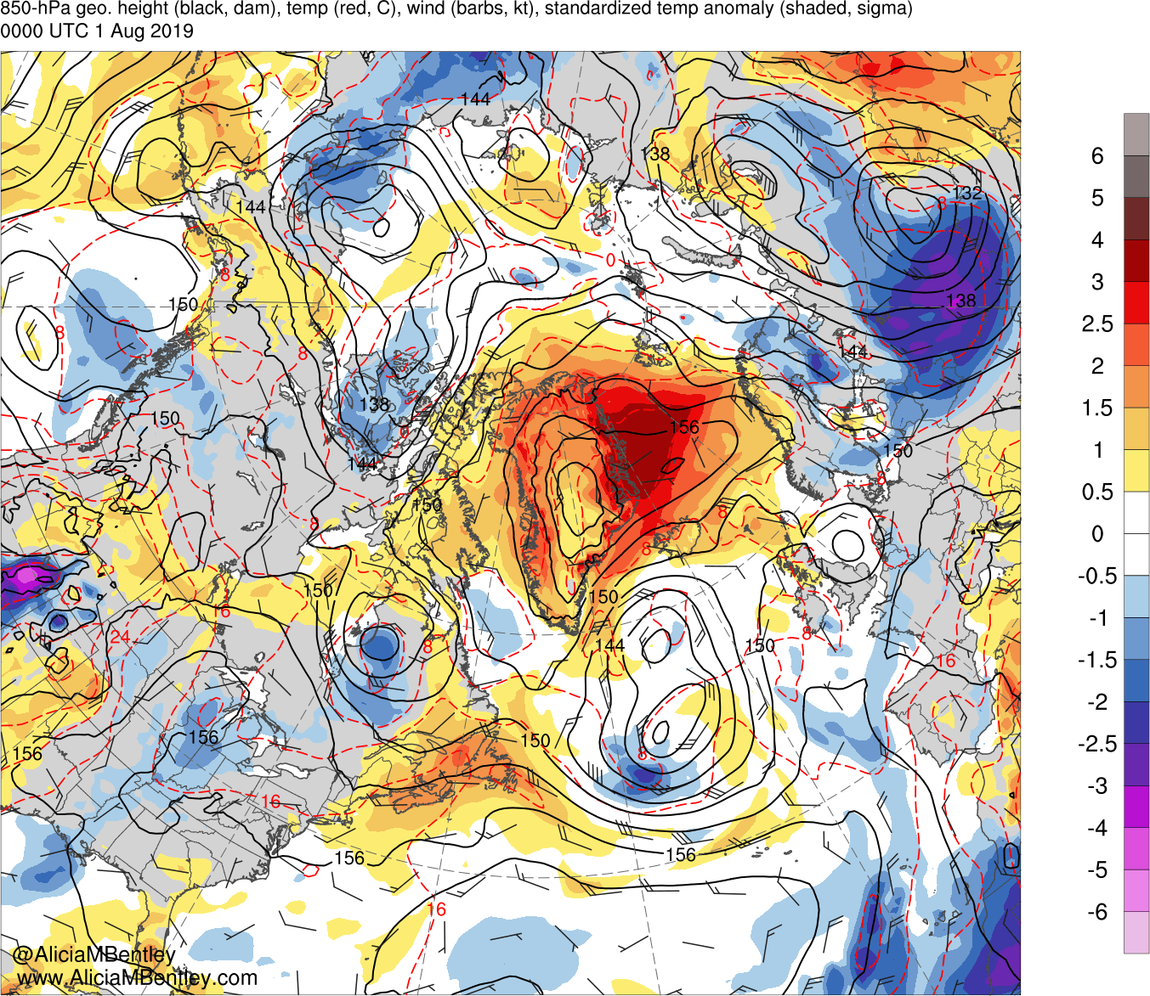
0000 UTC 1 August 2019

Slide 35
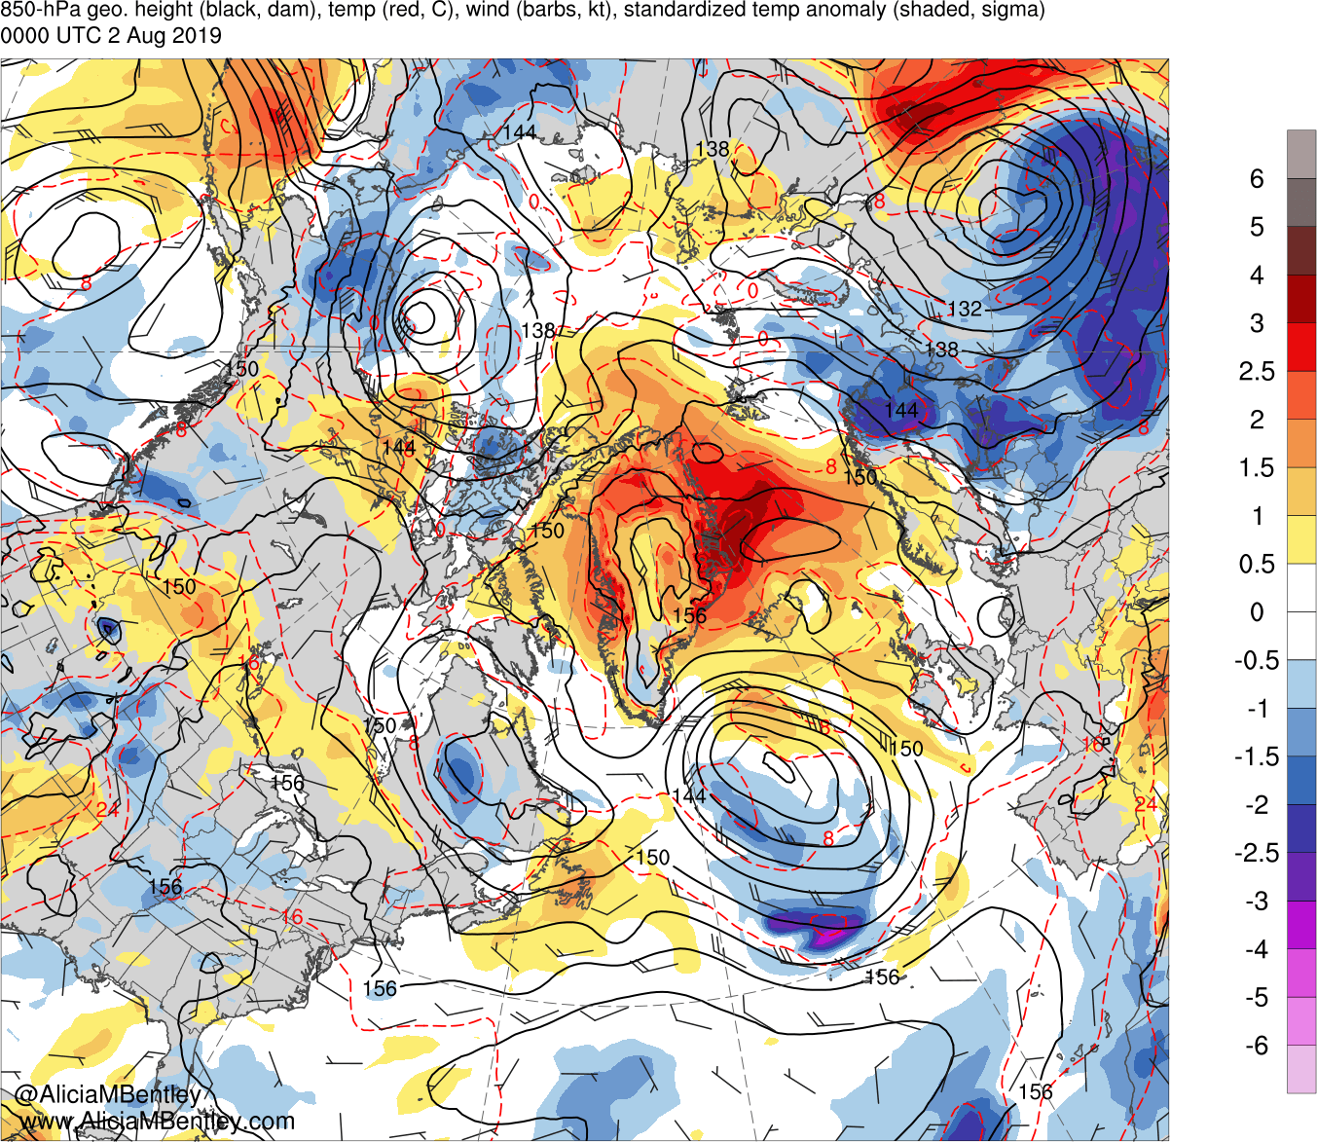
0000 UTC 2 August 2019

Slide 36
A Backward Trajectory Perspective and a Standardized Precipitable Water (PW) Analysis

Slide 37
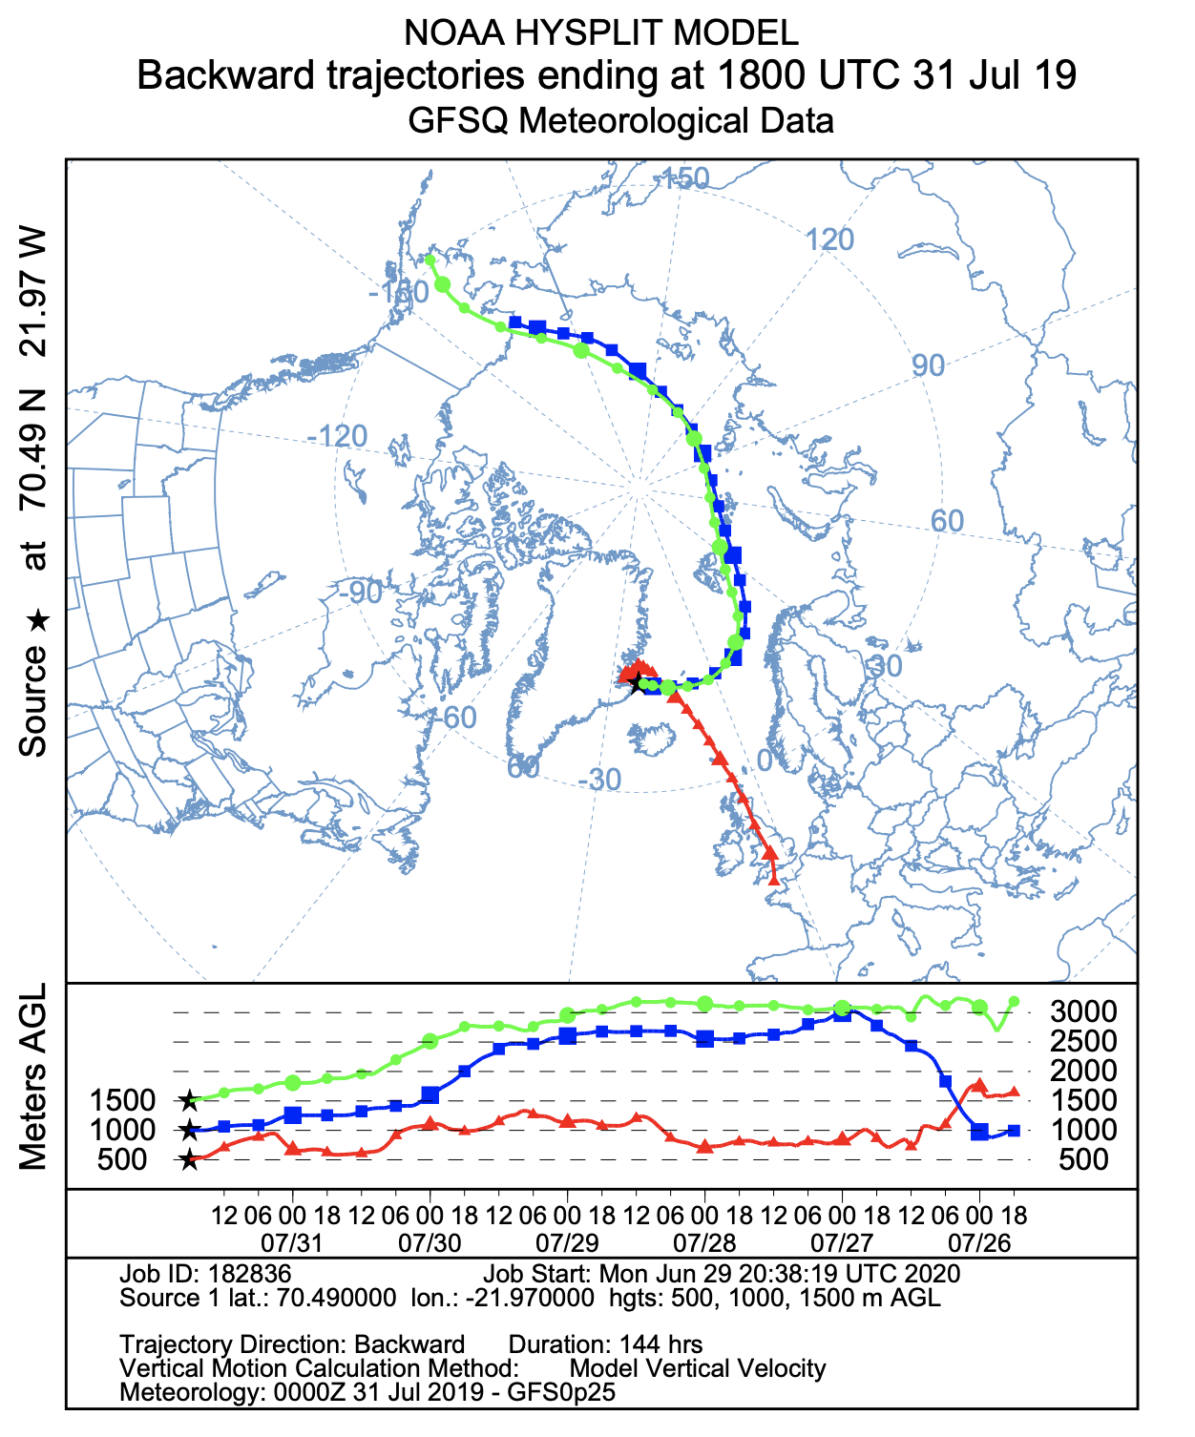
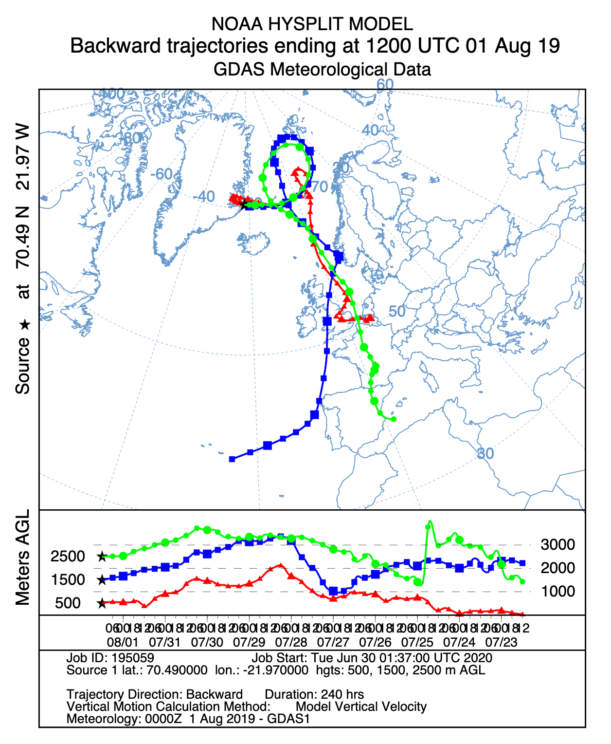
Greenland Backward Trajectories

Slide 38
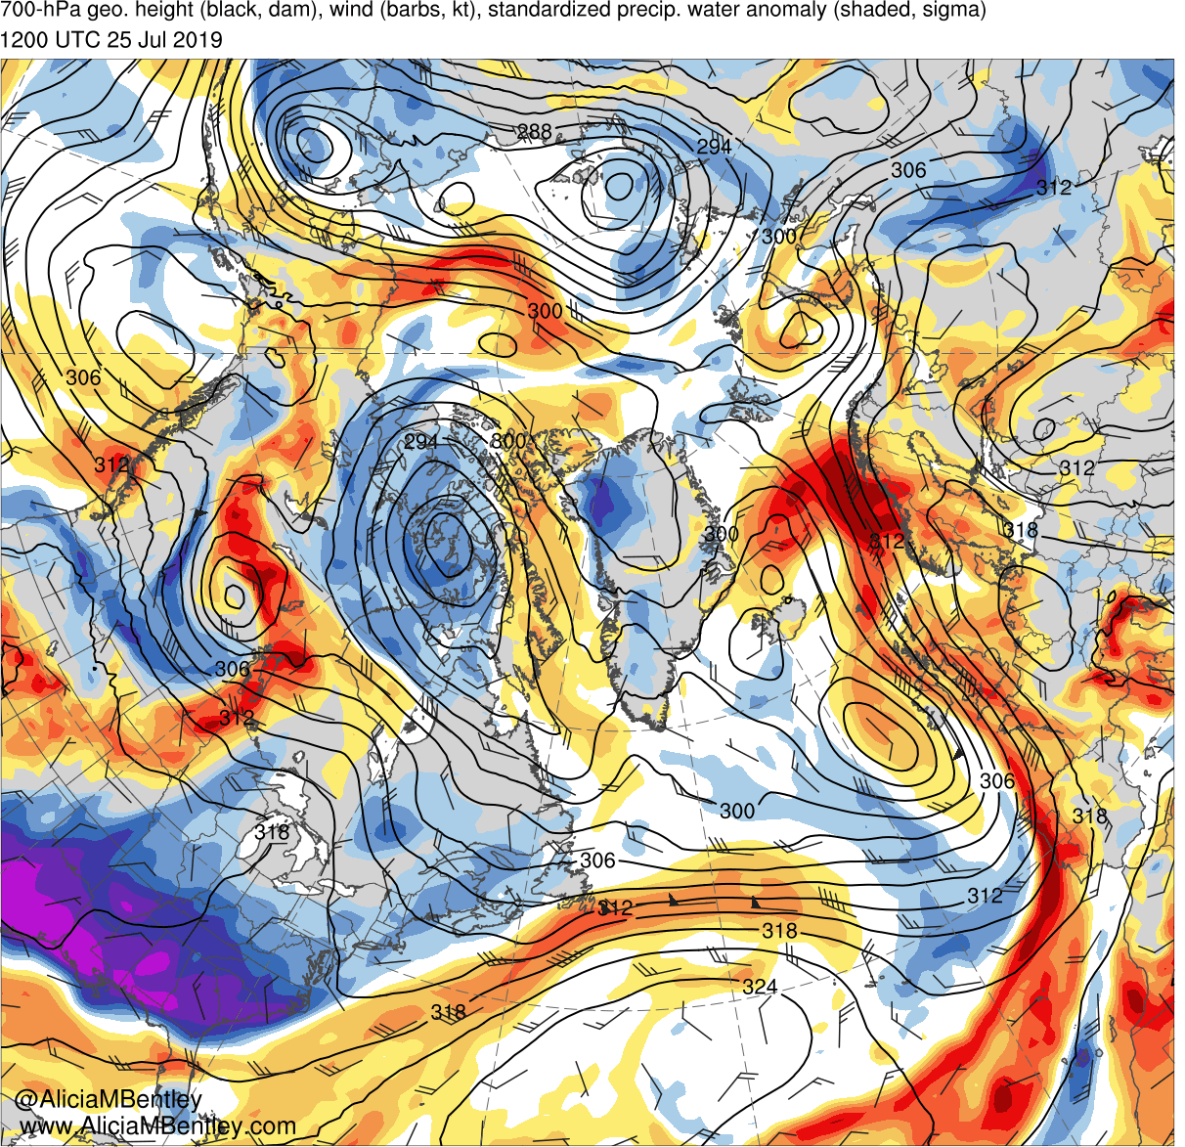
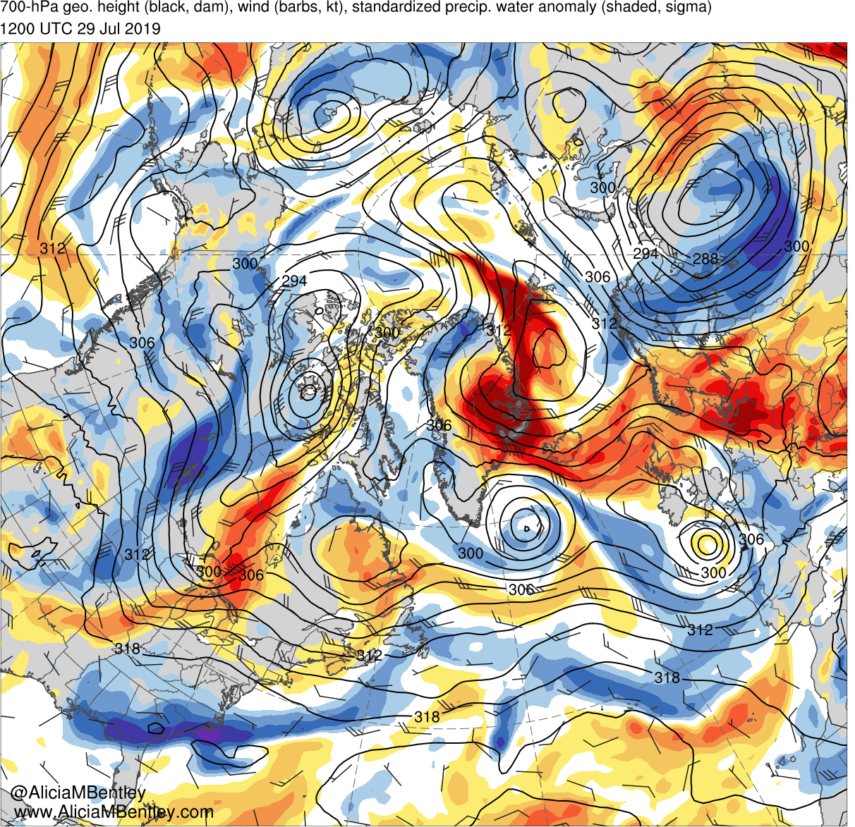
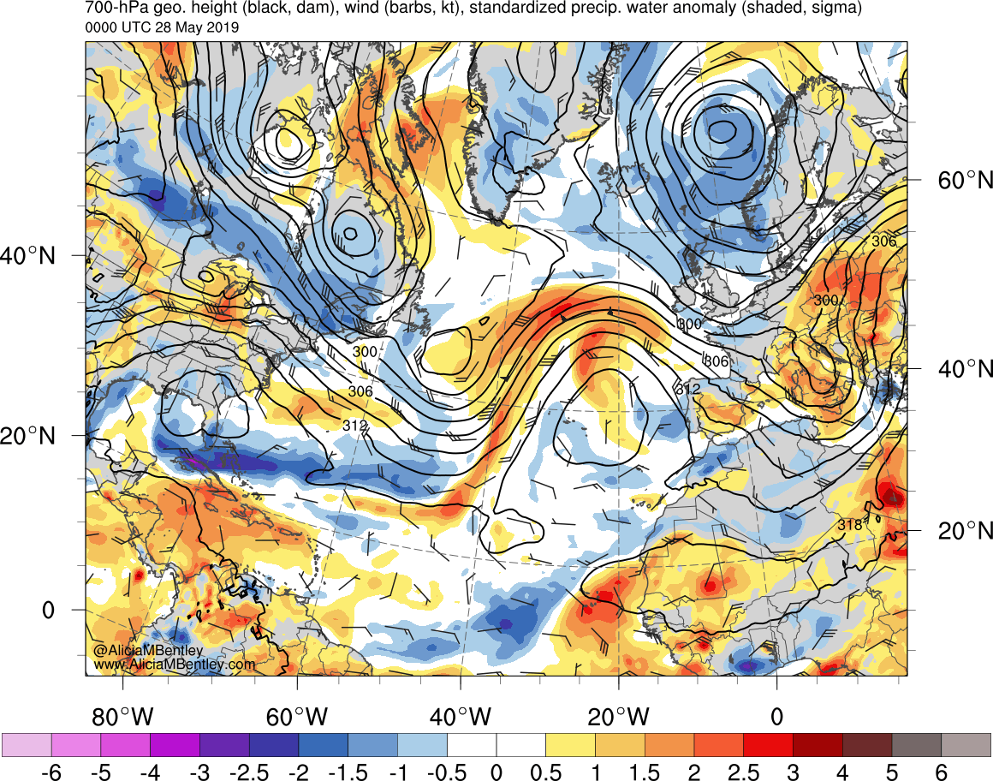
700-hPa heights (dam), winds (kt), and PW std anom (shaded) for 1200 UTC 25 July (left) and 1200 UTC 29 July (right) 2019
−6
−5
−4
−3
−2.5
−2
−1.5
−1
−0.5
0
0.5
1
1.5
2
2.5
3
4
5
6
σ

Slide 39
Summary
Antecedent Arctic ridging north of Greenland in late July 2019 set the stage for deep easterly flow across Greenland
A progressive North Atlantic trough enabled a northwestern Africa ridge to transition into a blocking Scandinavian anticyclone by late July
Record-breaking Saharan hot air (> 4 sigma at 850 hPa) overspread western Europe in conjunction with ridge building by 25 July
Modified Saharan hot air reached Greenland by late July as the blocking Scandinavian anticyclone built westward in deep easterly flow

