Slide 1
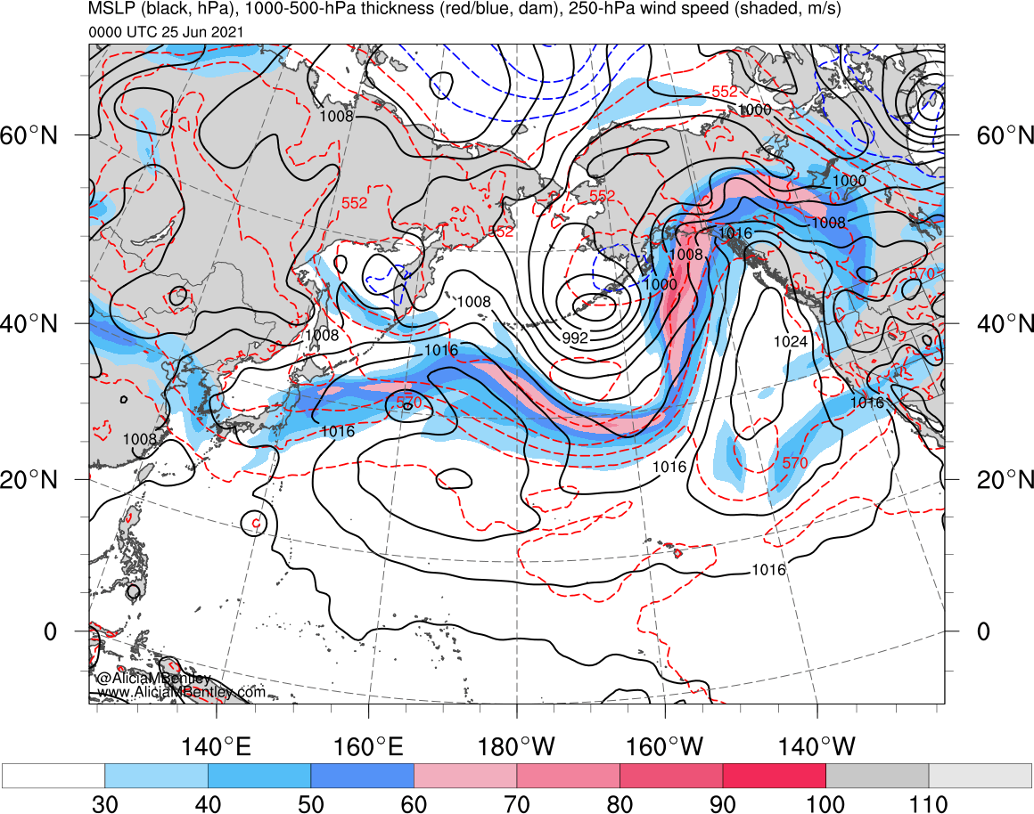
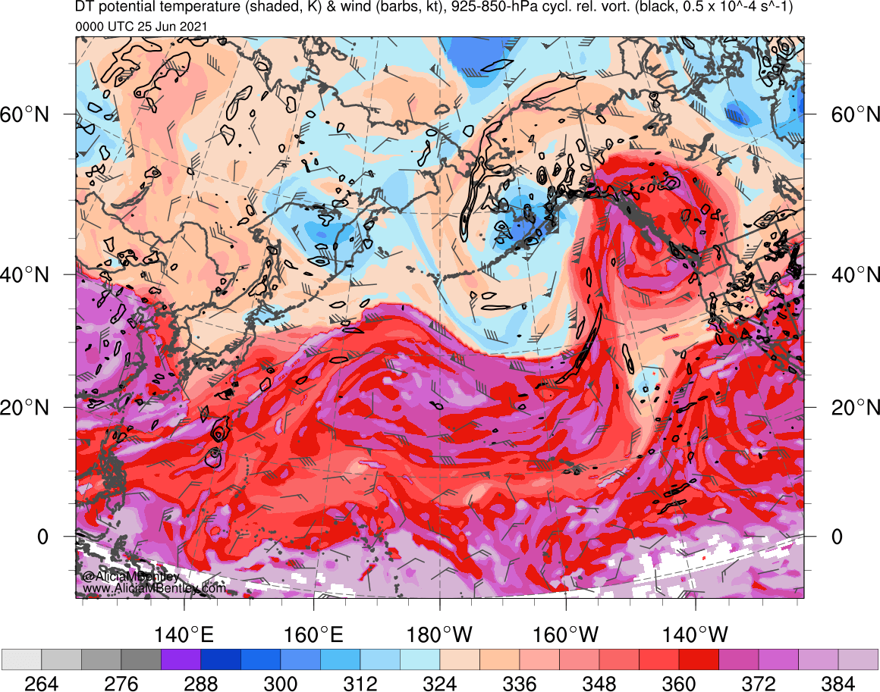
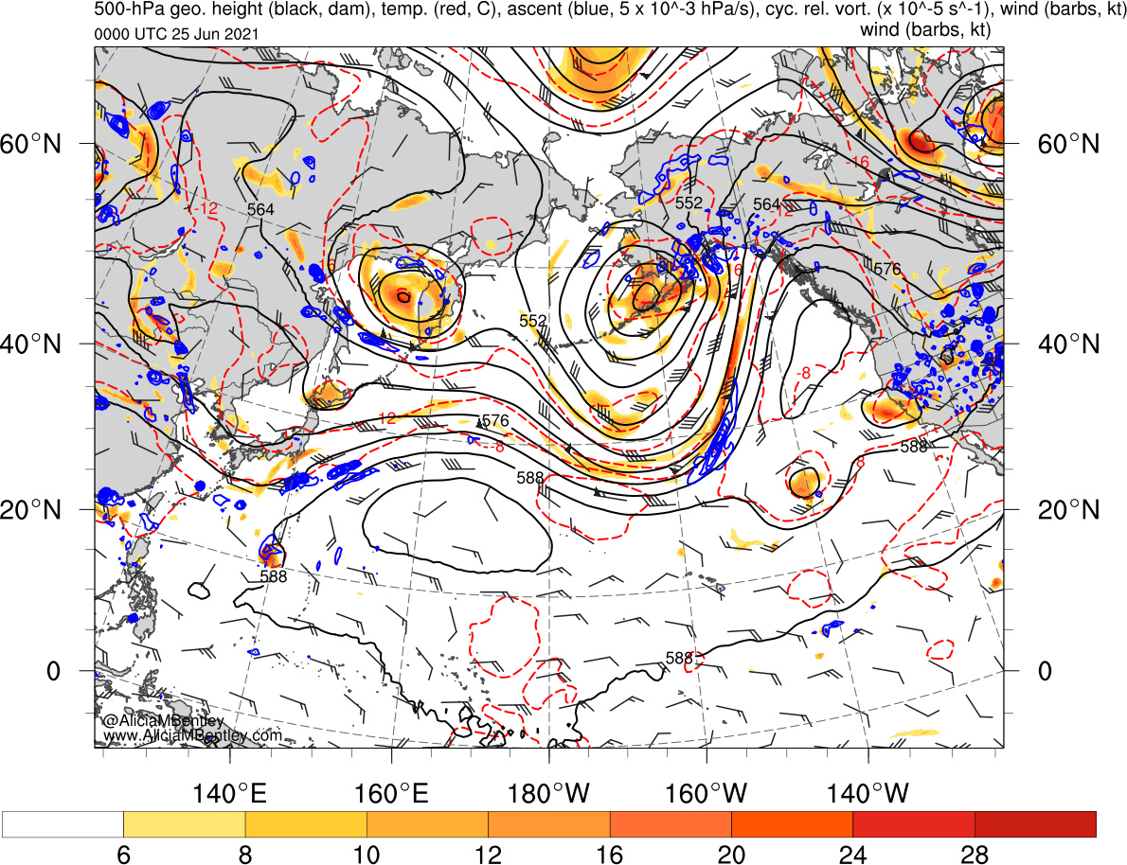
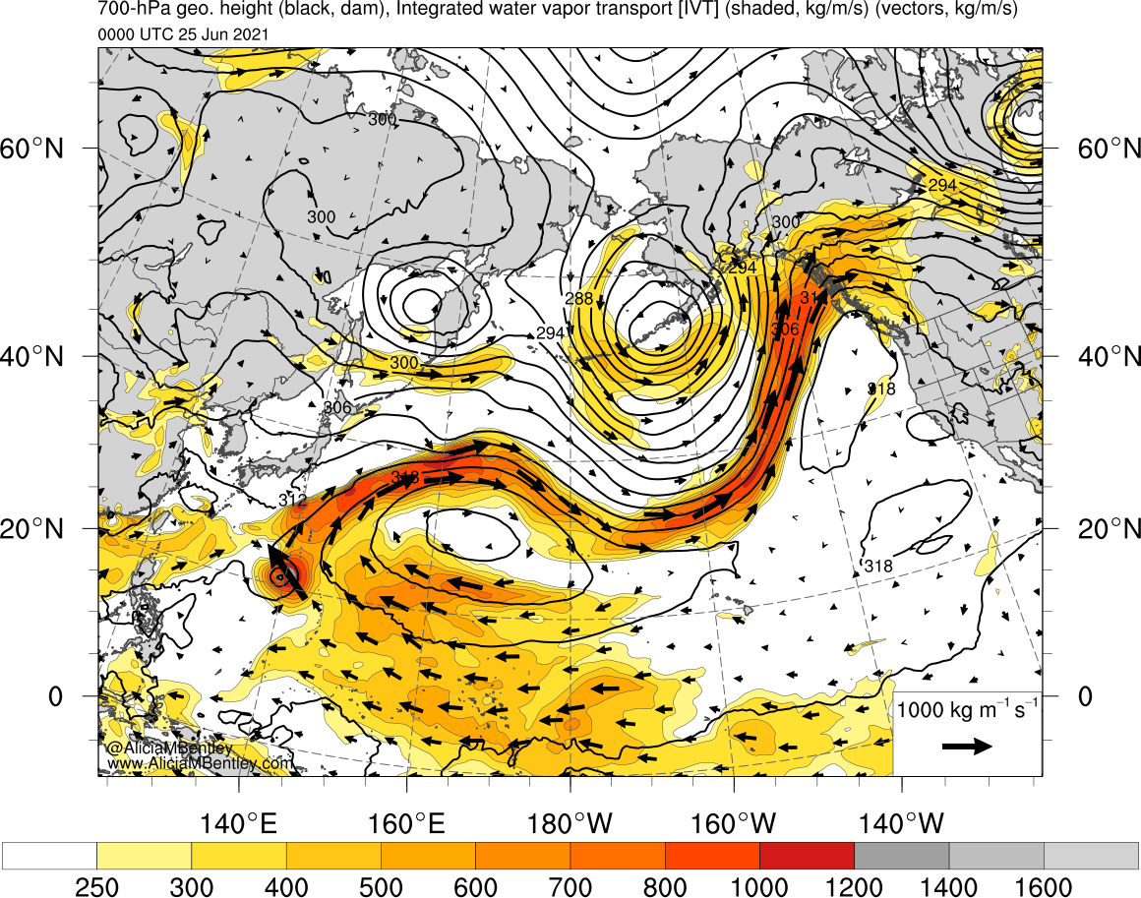
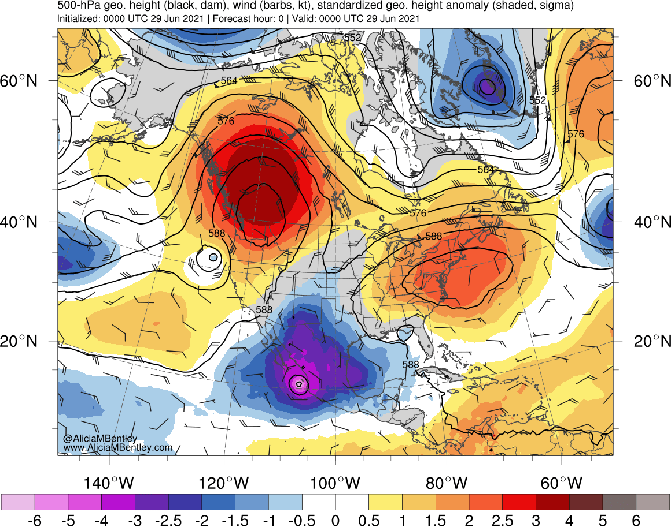
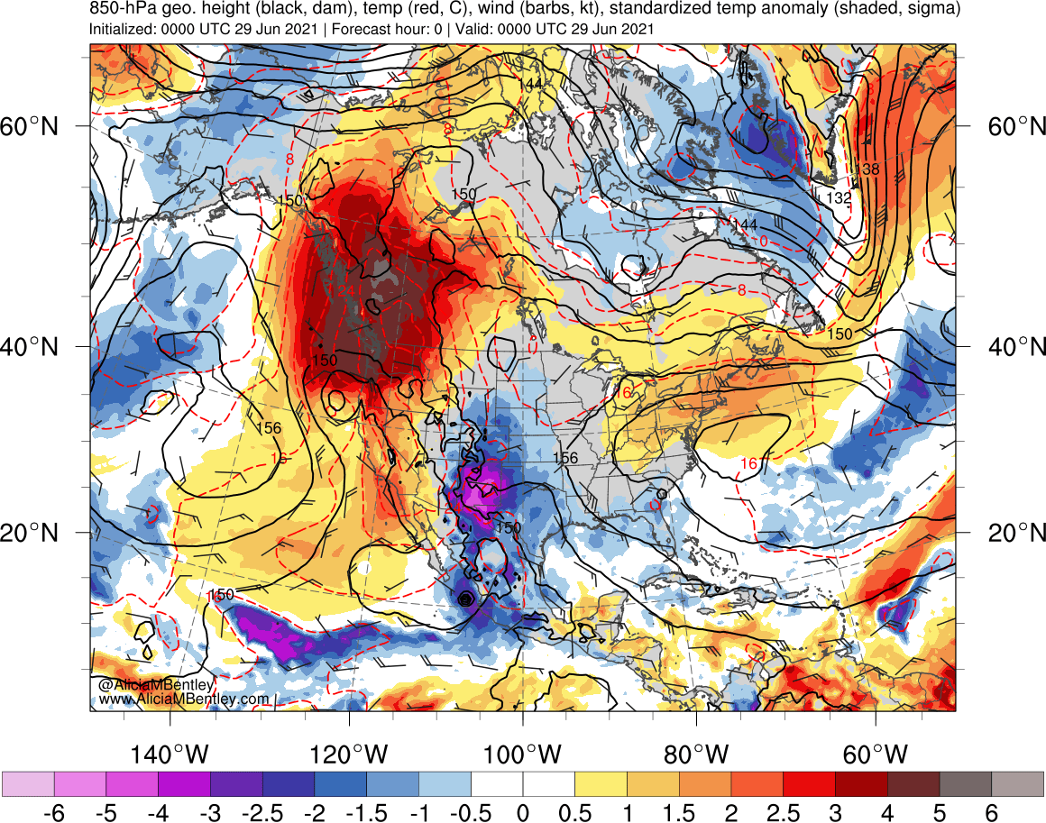
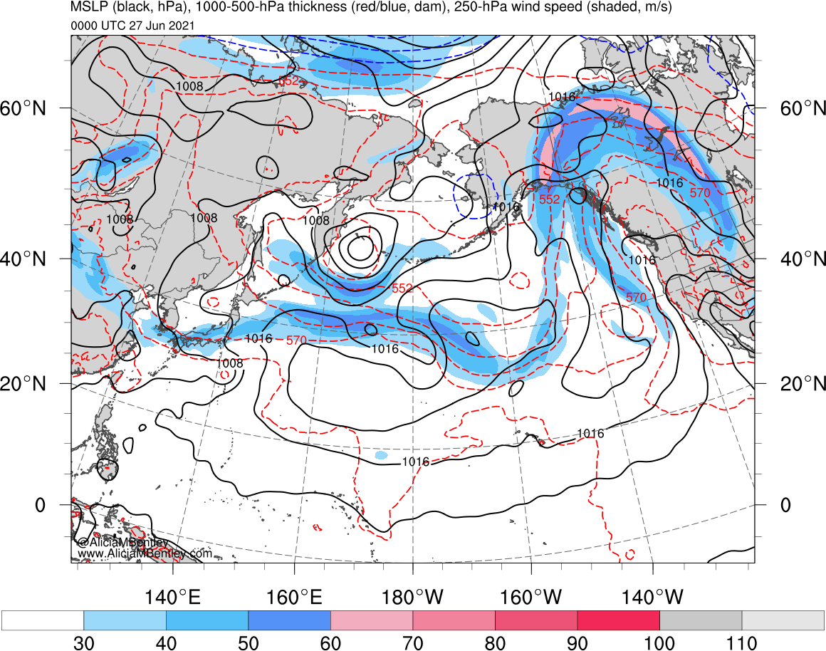
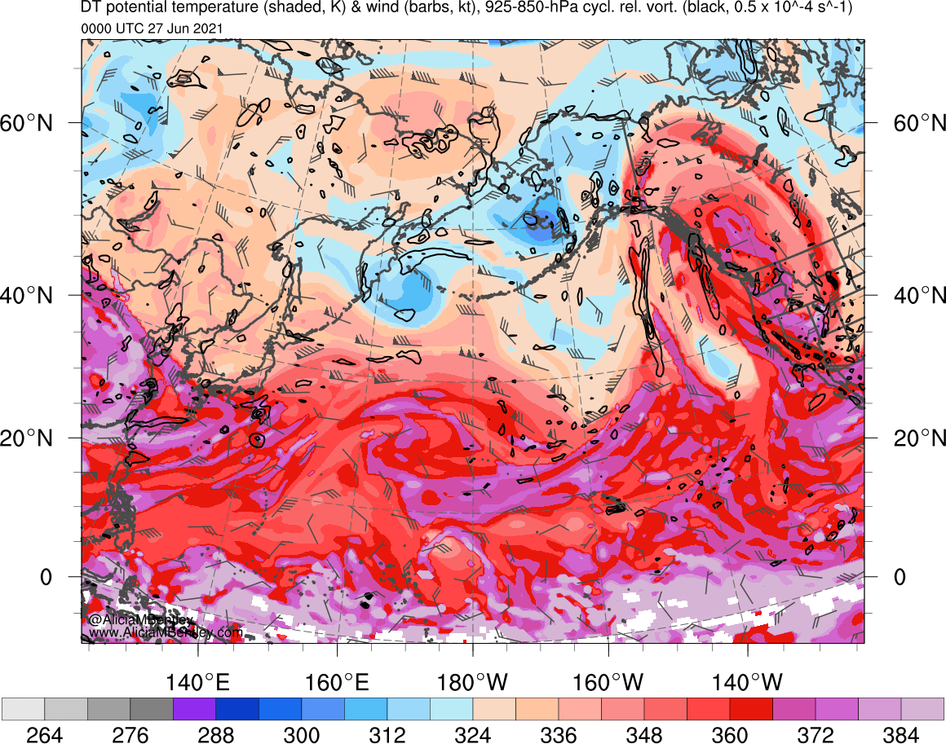
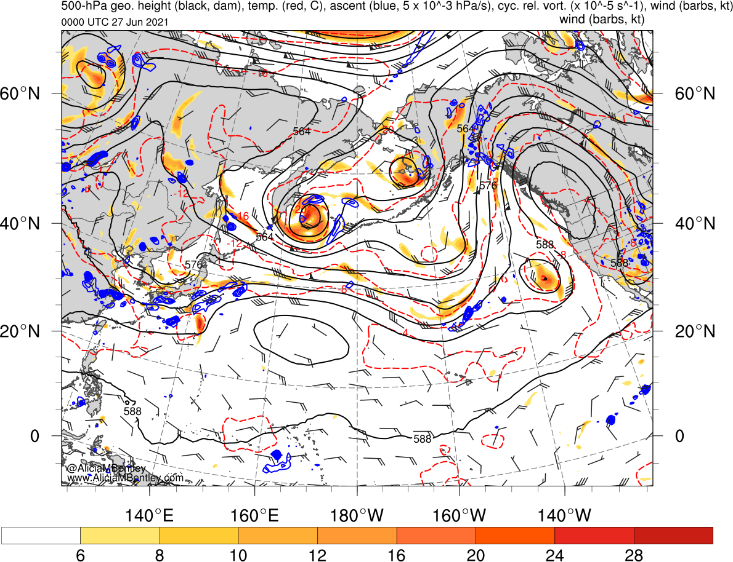
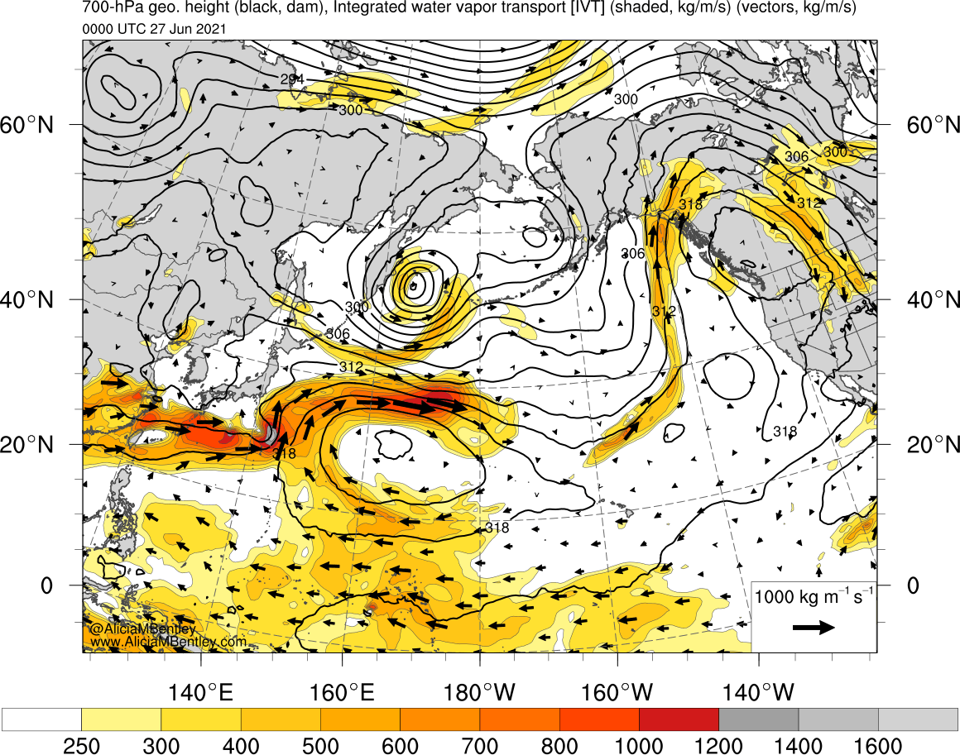
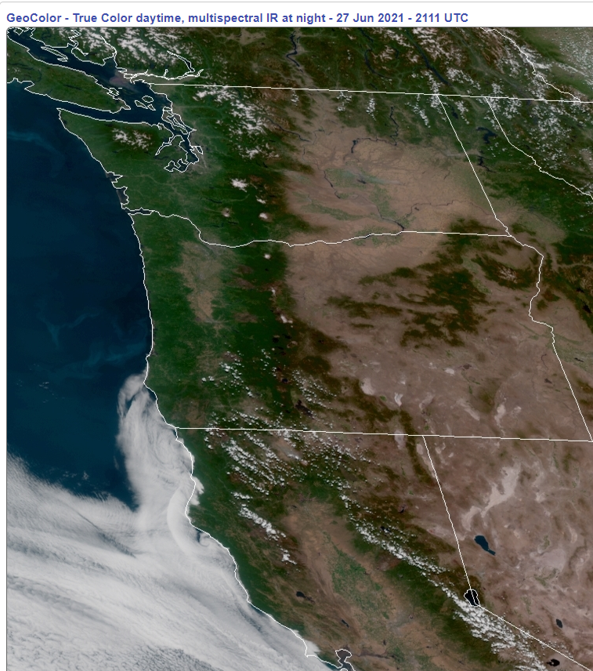
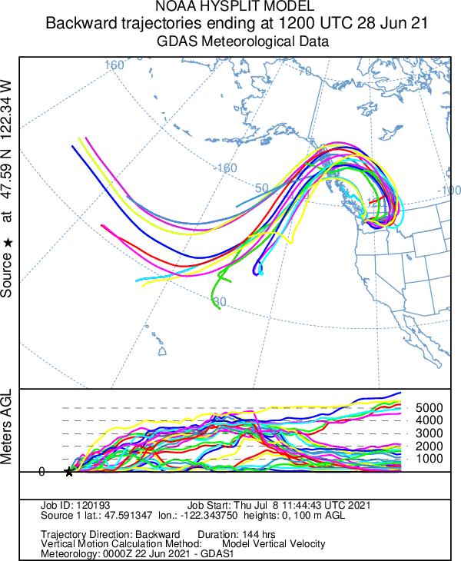
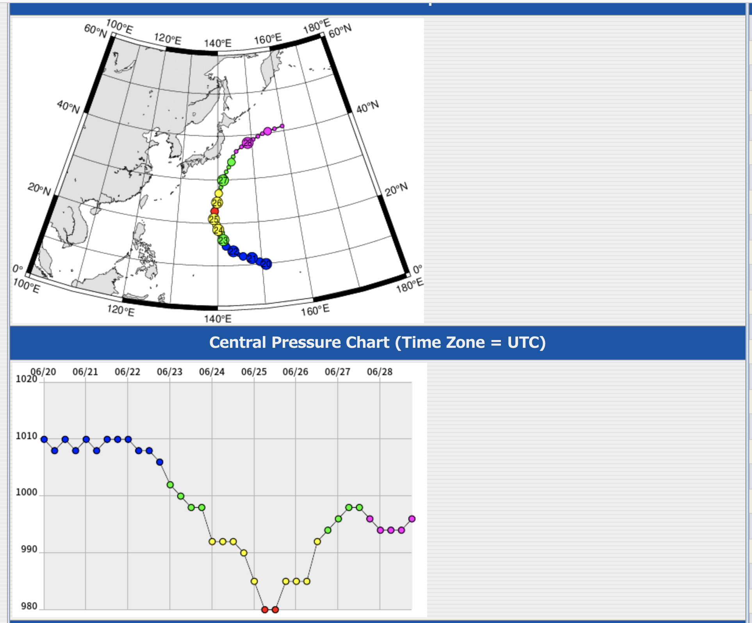
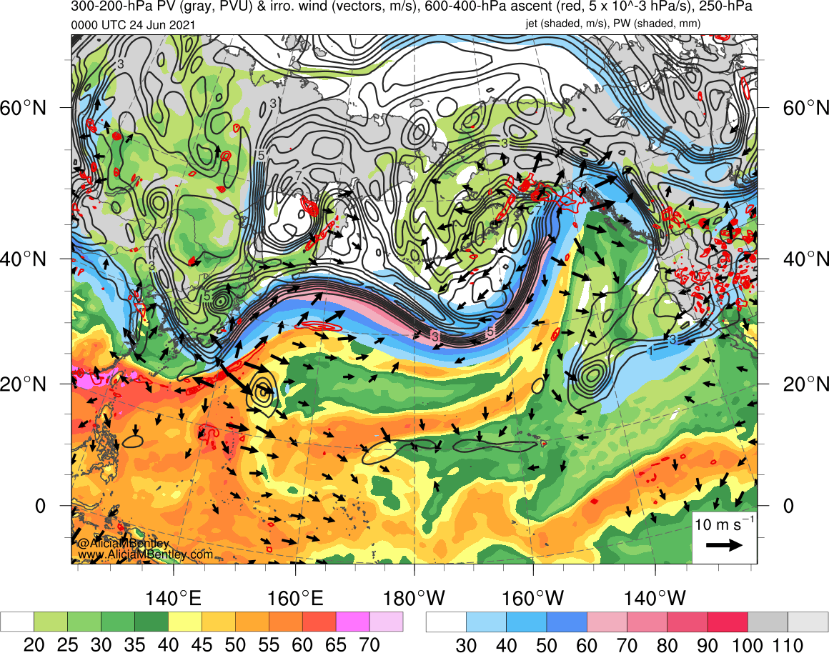
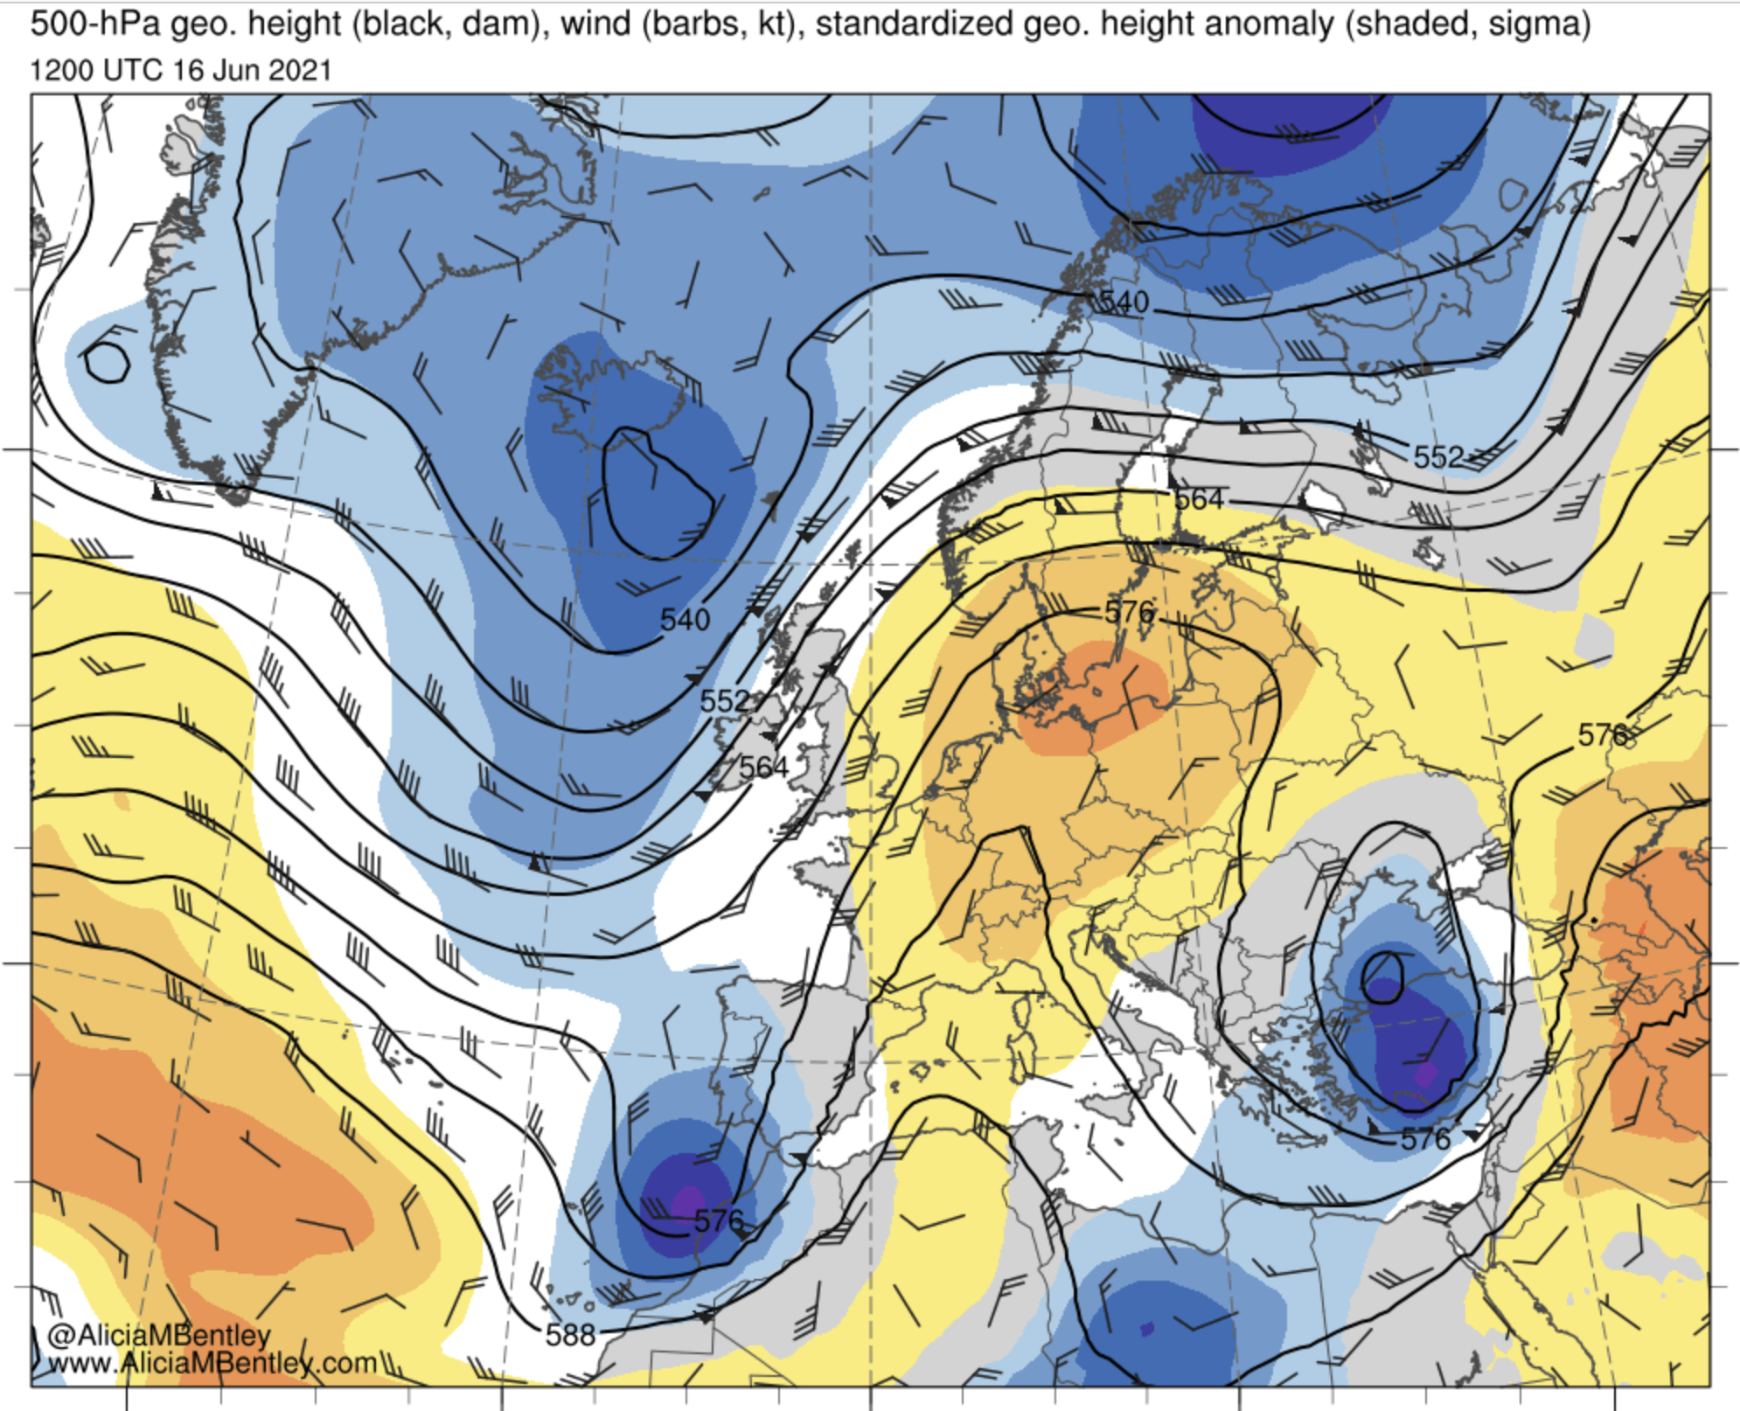
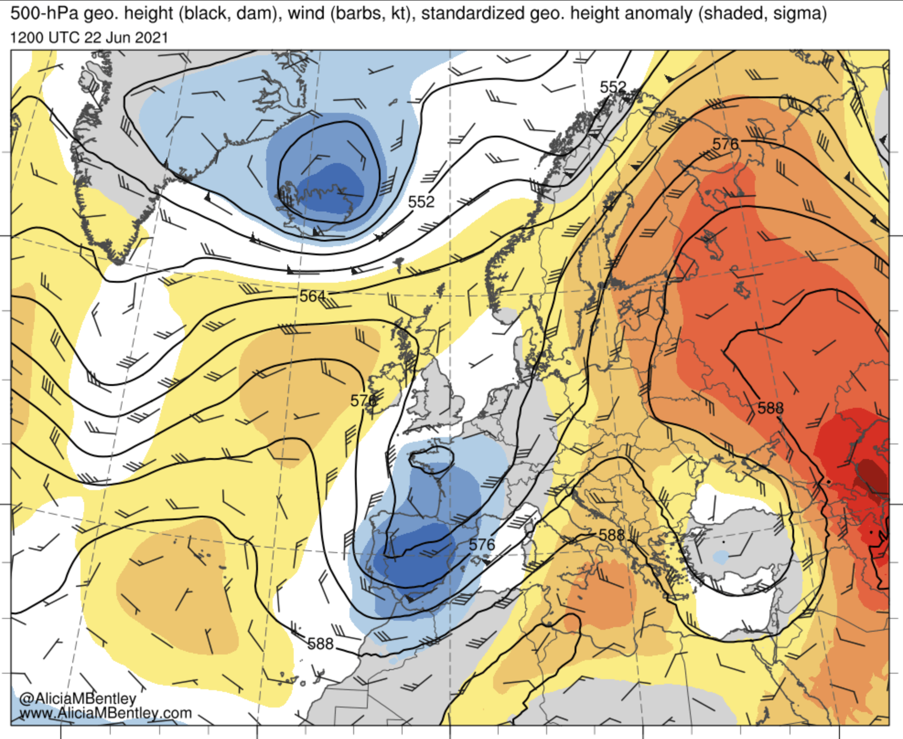
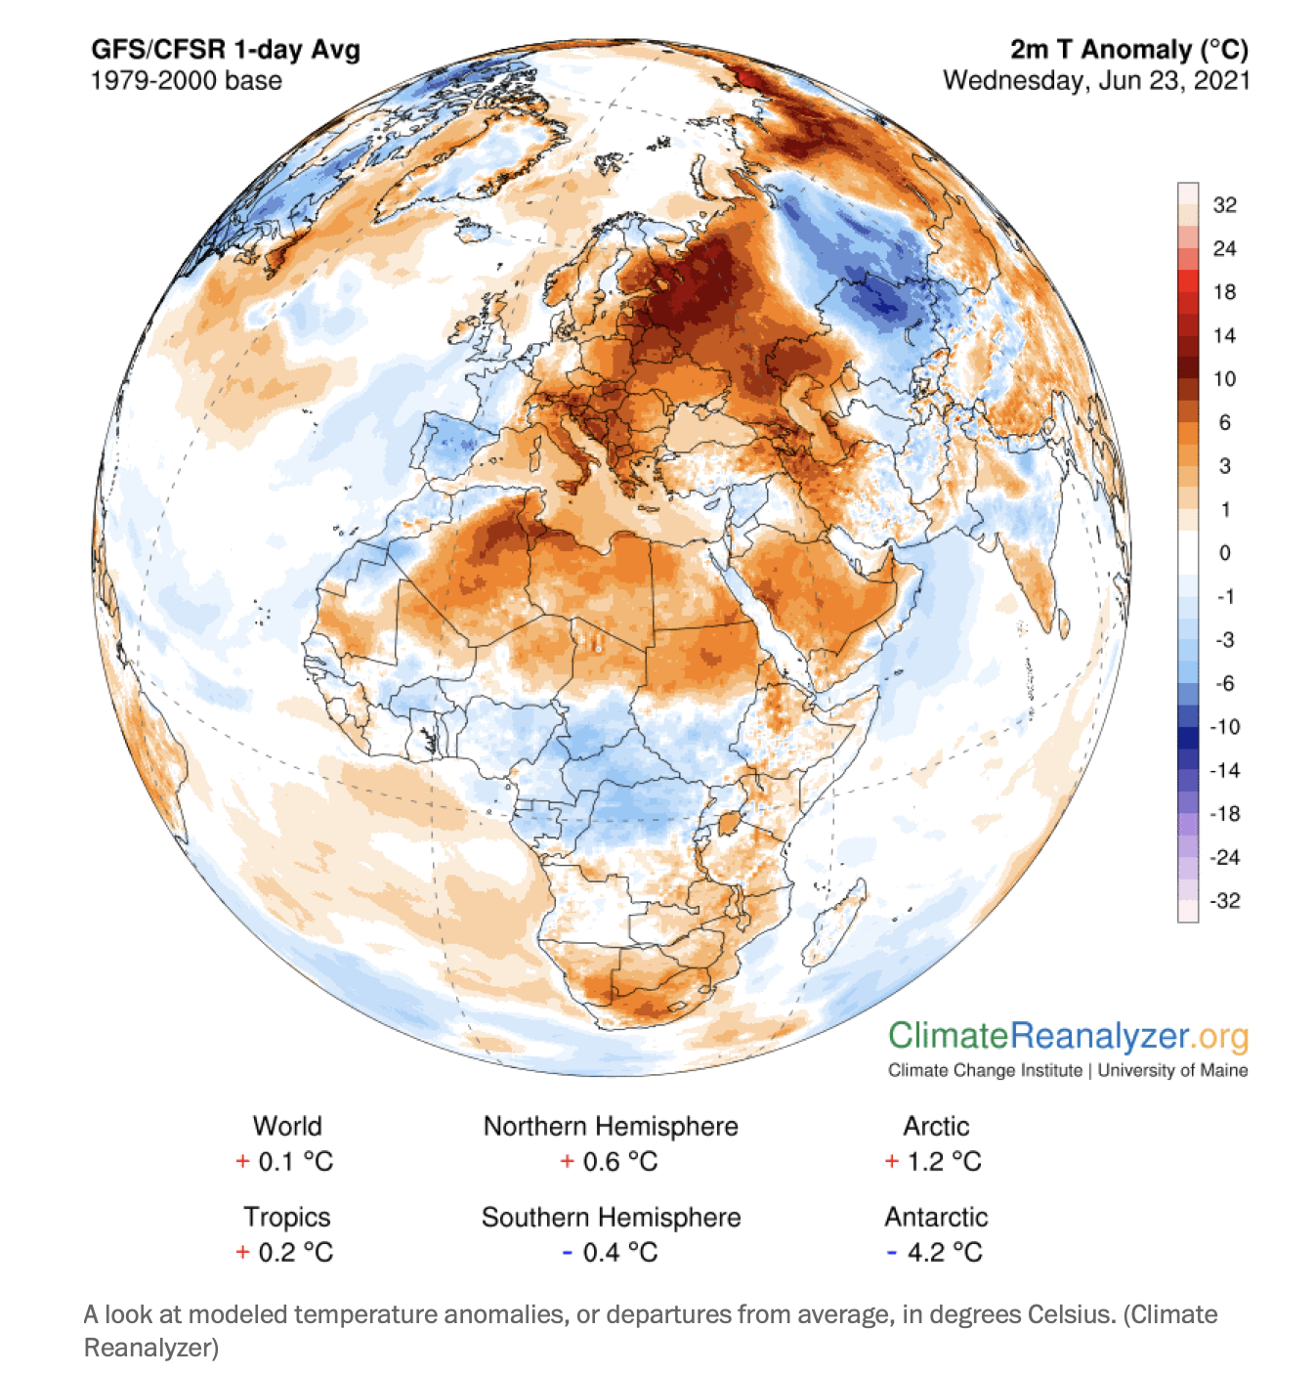
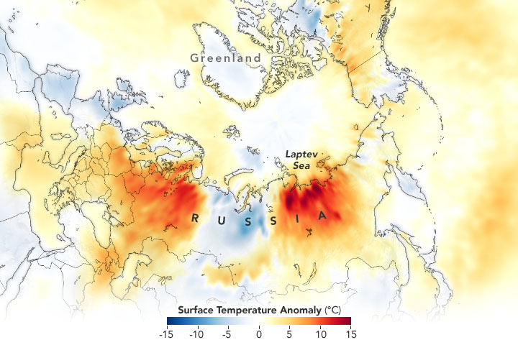
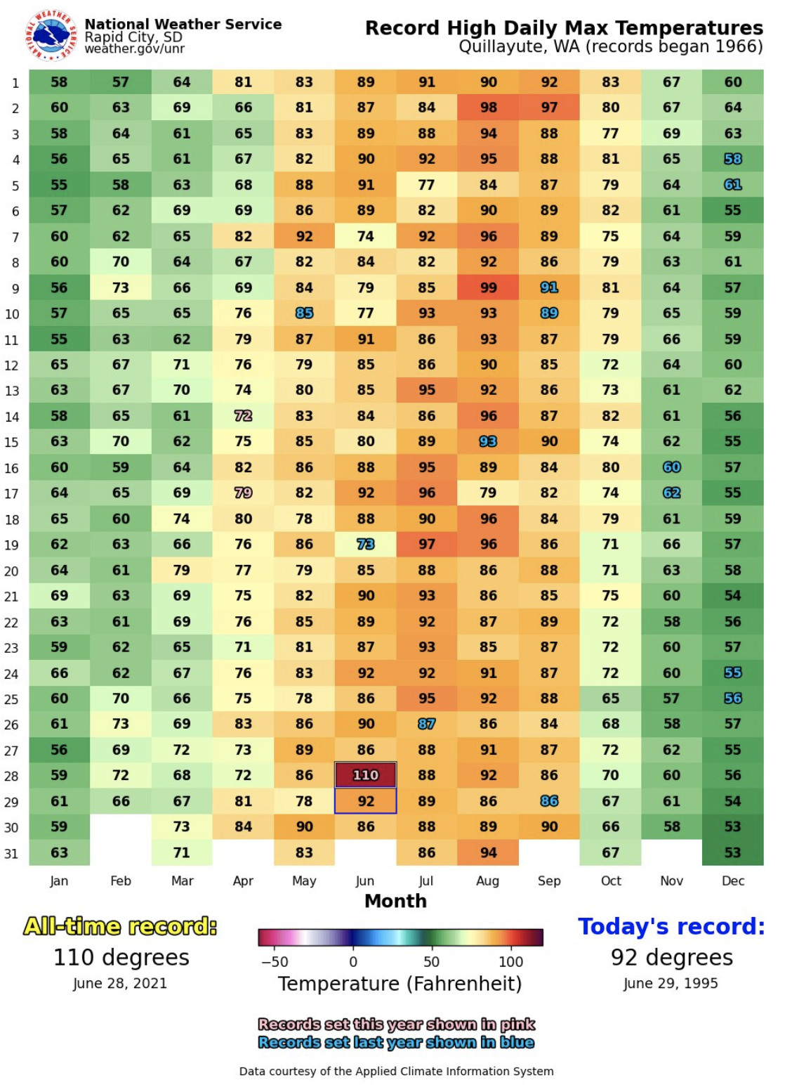
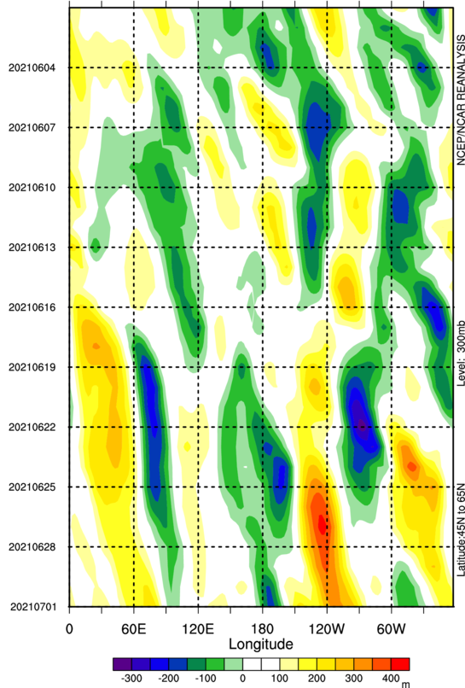
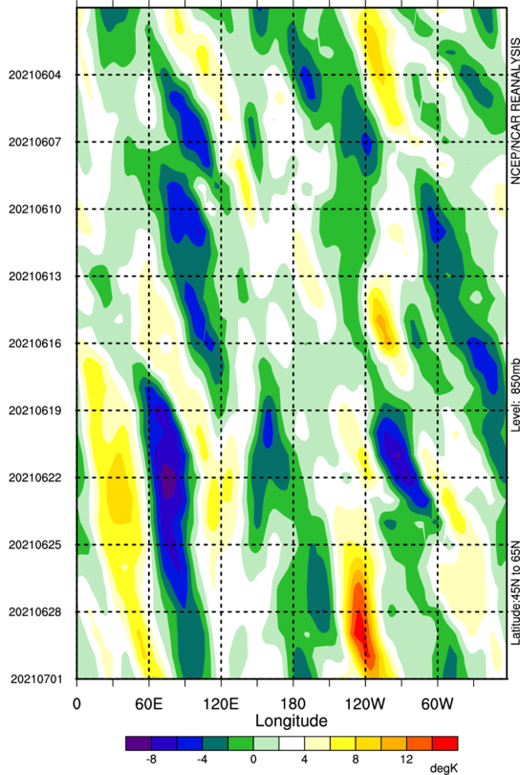
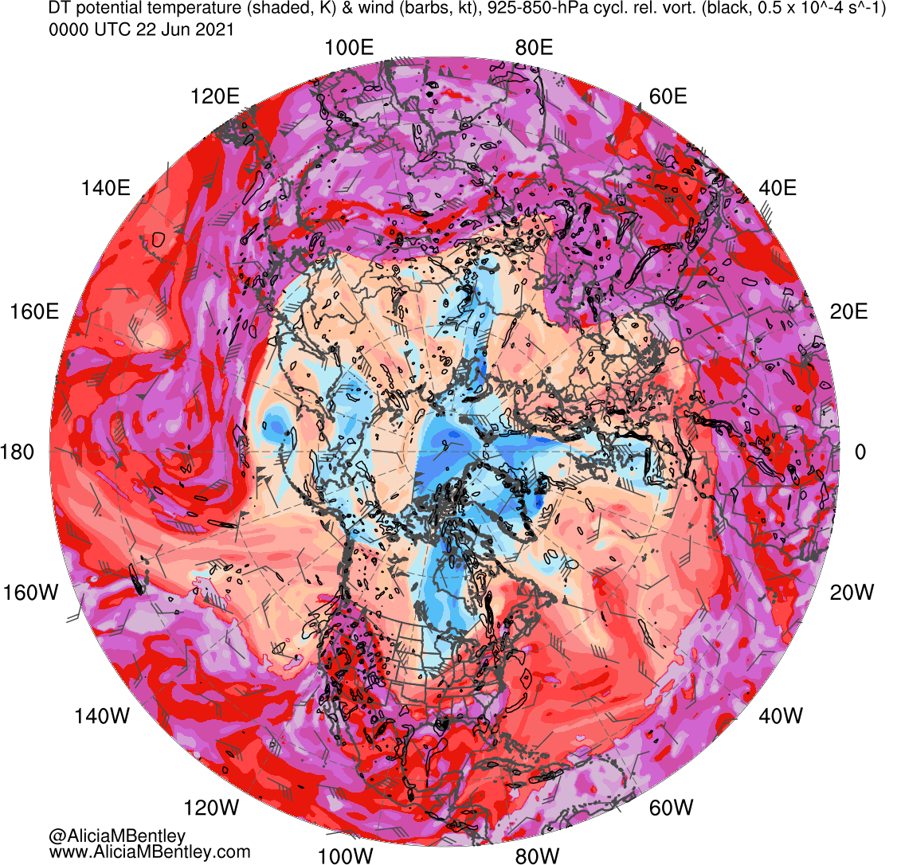
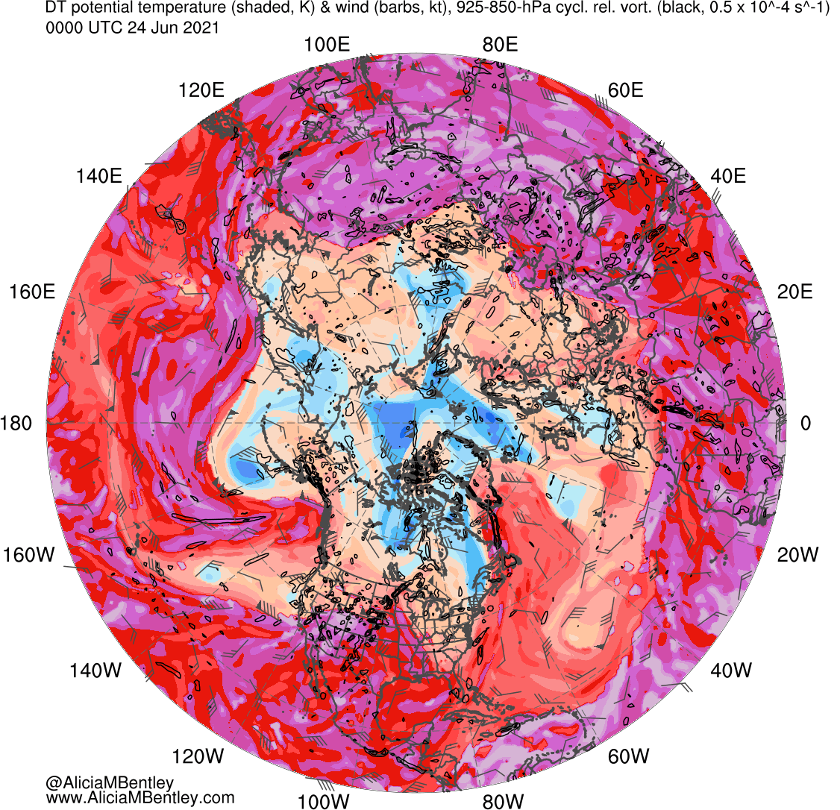
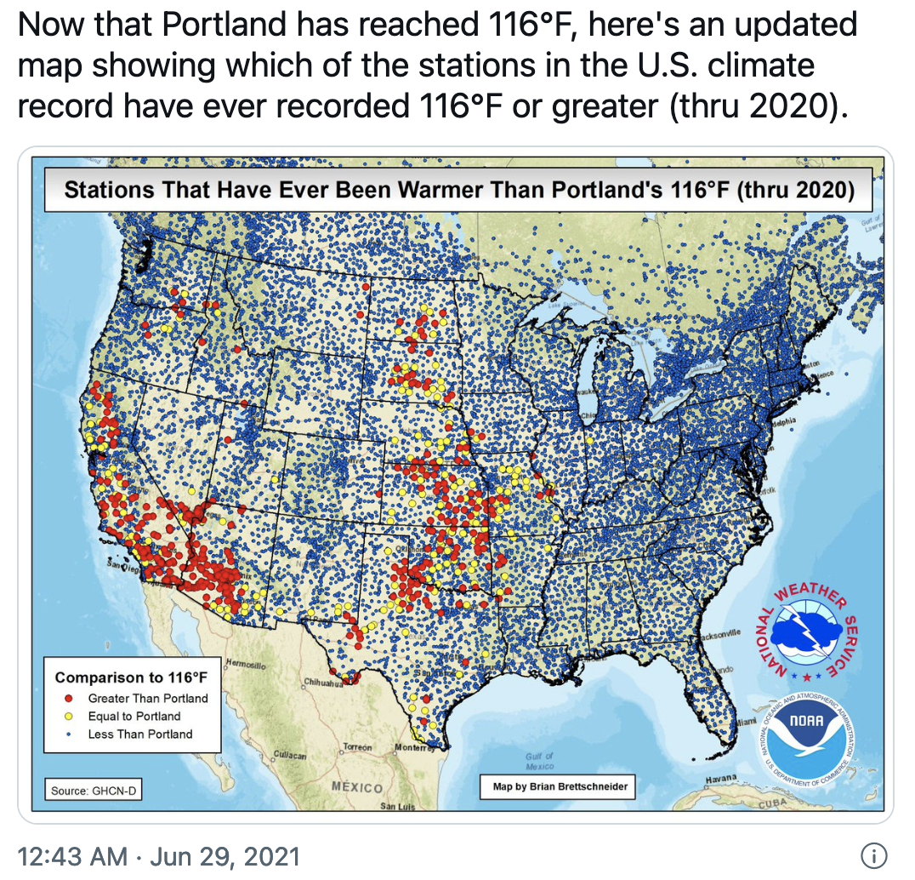
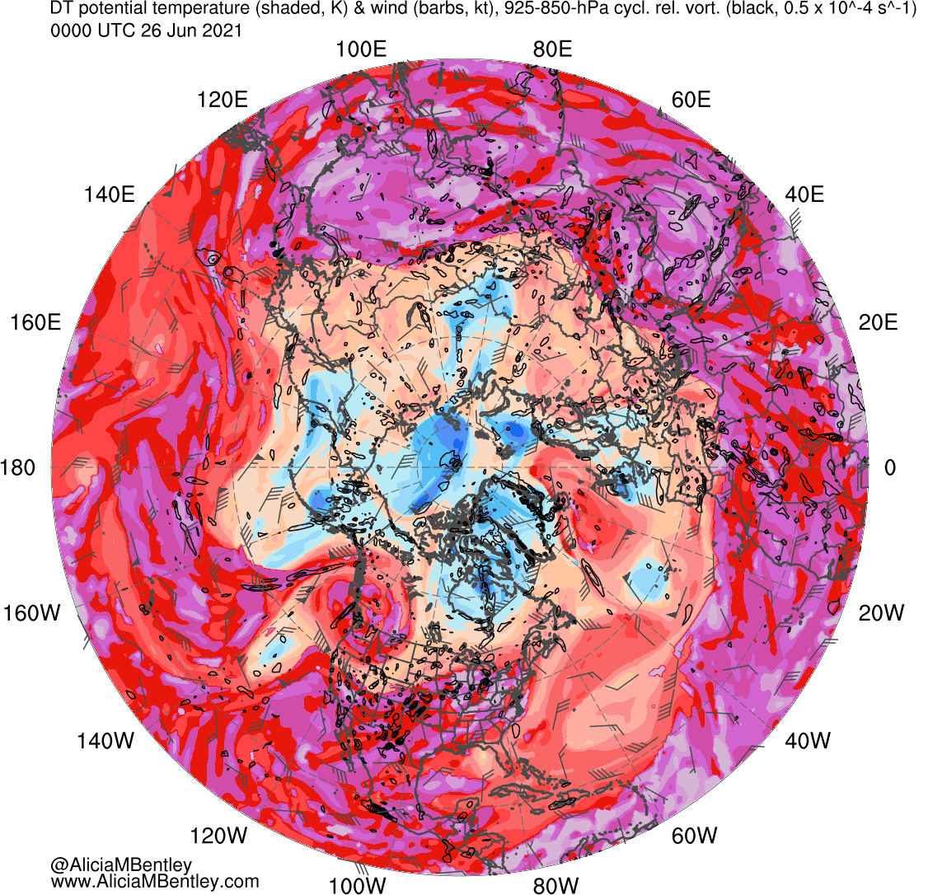
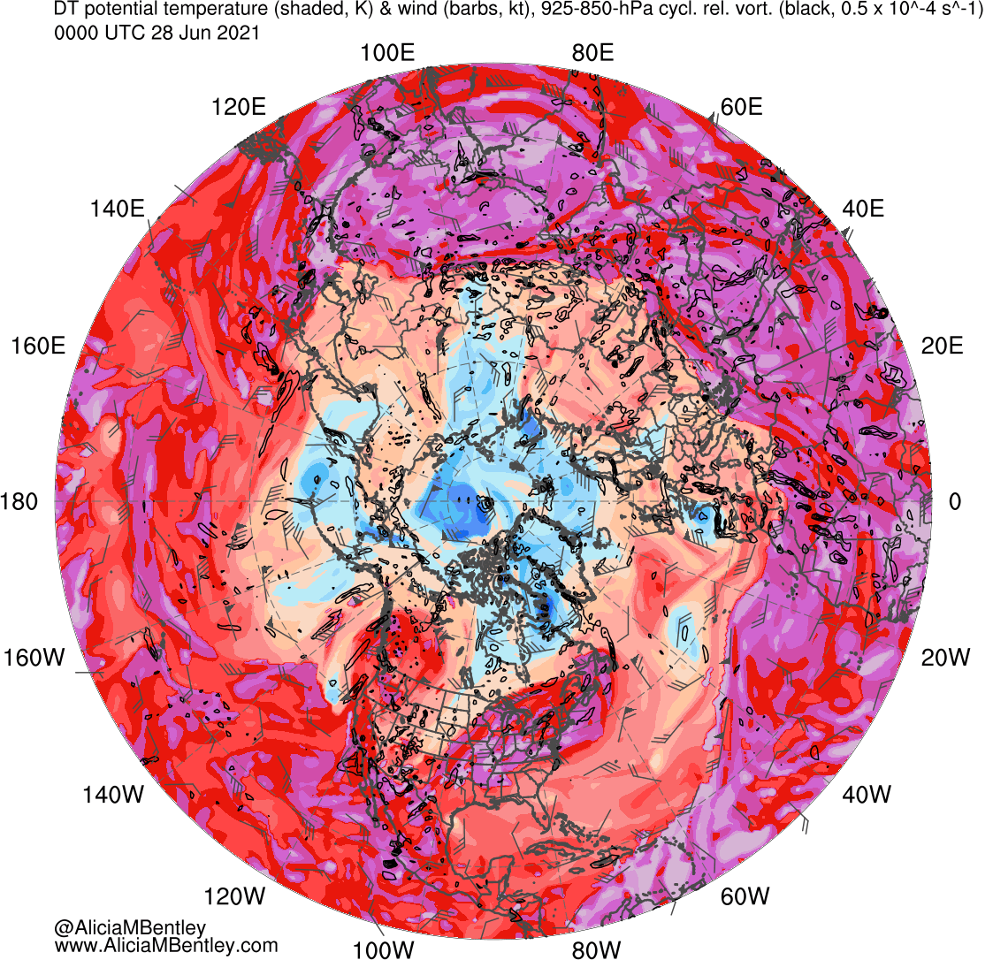
High-Latitude Anticyclonic Rossby Wave Breaking and High-Latitude Heat Waves over Parts of the Northern Hemisphere during Late June 2021
Lance F. Bosart¹, Tyler C. Leicht¹, Alex K. Mitchell¹, Minghao Zhou¹, Kevin A. Biernat², and Daniel Keyser¹
Research support provided by Office of Naval Research Grant N00014-18-1-2200
¹Department of Atmospheric and Environmental Sciences, University at Albany, State University of New York, Albany, NY
²National Research Council, Naval Research Laboratory, Monterey, CA
Presented at 17th AMS Conference on Polar Meteorology and Oceanography on 11 August 2022
1) Purpose
4) North Pacific Large-Scale Flow Pattern Perspective: 25–27 June 2021
Illustrate upstream flow conditions over the North Pacific (NPAC) that contributed to the Pacific Northwest heat wave of late June 2021.
Document the evolution of the large-scale flow pattern over the eastern NPAC and western North America during the heat wave.
Link the Pacific Northwest heat wave to a subsequent high-latitude Eurasian heat wave.
0000 UTC 25 Jun 2021
0000 UTC 25 Jun 2021
0000 UTC 25 Jun 2021
0000 UTC 25 Jun 2021
2) Overview
Illustrate the Pacific Northwest heat wave via selected standardized anomaly maps valid 0000 UTC 29 June 2021 (source: Alicia Bentley).
0000 UTC 29 Jun 2021
0000 UTC 29 Jun 2021
Source: Alicia Bentley
0000 UTC 27 Jun 2021
0000 UTC 27 Jun 2021
0000 UTC 27 Jun 2021
0000 UTC 27 Jun 2021
Source: Dan Lindsey
Source: Gary Lackmann
5) Did TC Champi Contribute to Downstream Baroclinic Development Prior to the Pacific Northwest Heat Wave?
7) Postscript
Is there any linkage between the Eurasian and Pacific Northwest heat waves of late June 2021?
0000 UTC 24 Jun 2021
1200 UTC 16 Jun 2021
1200 UTC 22 Jun 2021
Source: Digital Typhoon
Standardized 500-hPa geopotential height anomaly (σ; shaded), and 500-hPa geopotential height (dam; black) and wind (kt; flags and barbs). Source: Alicia Bentley.
CFSR 2-m temperature anomalies on 23 June 2021 (source: Climate Reanalyzer).
Surface temperature anomaly (°C) during 18–25 June 2021 (source: NASA Observatory).
3) Climate Context
0000 UTC 22 Jun
0000 UTC 24 Jun
Unprecedented heat in the Pacific Northwest: Quillayute, WA, reached 110°F (43.3°C) on 28 June. Previous monthly record was 92°F (33.3°C).
Little evidence for significant negative PV advection by the irrotational wind in the upper troposphere downstream of TC Champi.
Better evidence that tropical moisture advection contributed to deep cyclogenesis in the Gulf of Alaska and downstream ridge amplification.
16 June
16 June
22 June
22 June
6) Conclusions
Hovmöller diagrams (45–65°N) of (left) anomalous 300-hPa geopotential height (m) and (right) anomalous 850-hPa temperature (K) during 1 June–1 July 2021.
Downstream baroclinic development (DBD) occurs across the NPAC during late June 2021.
Strong cyclogenesis in the Gulf of Alaska fueled by tropical moisture induces strong ridge amplification over western Canada.
Pacific Northwest experiences a deep ESE (offshore) flow equatorward of the western Canada ridge.
Combination of a strong ridge to the north and an offshore trough drives a hot and dry downslope offshore flow.
An extremely hot, subsidence-warmed air mass (30°C at 850 hPa) supports widespread record-breaking temperatures.
8) Postscript Conclusions
0000 UTC 26 Jun
0000 UTC 28 Jun
DBD occurs across the NH during the latter half of June 2021.
Whether or not TC Champi’s interaction with the NPAC jet stream induces further DBD is still an open question.
Hovmöller analyses are inconclusive as to whether the June 2021 Eurasian and Pacific Northwest heat waves are linked.
NH dynamic tropopause analyses suggest, but *do not* prove, that the Eurasian and Pacific Northwest heat waves may be linked.
Source: Alicia Bentley

