Slide 1
Linkages between the Great Arctic Cyclone of August 2012 and Tropopause Polar Vortices
Kevin A. Biernat, Lance F. Bosart, and Daniel Keyser
Department of Atmospheric and Environmental Sciences
University at Albany, SUNY
Arctic Meteorology Meeting
10 July 2017
Seattle, WA
Research support provided by NSF Grant AGS-1355960

Slide 2
What are Tropopause Polar Vortices (TPVs)
TPVs are defined as tropopause-based vortices of high-latitude origin and are material features (Pyle et al. 2004; Cavallo and Hakim 2009, 2010, 2012, 2013)
TPV
TPV
(left) Dynamic tropopause (DT) wind speed (every 15 m s⁻¹ starting at 50 m s⁻¹, thick contours) and DT potential temperature (K, thin contours and shading) on 1.5-PVU surface valid 0000 UTC 1 Dec 1991; (right) same as left except DT pressure (hPa, thin contours and shading). Adapted from Fig. 11 in Pyle et al. (2004).

Slide 3
Motivation
TPVs may interact with and strengthen jet streams, and act as precursors to the development of intense Arctic cyclones (e.g., Simmonds and Rudeva 2012, 2014)
Arctic cyclones may be associated with strong surface winds and poleward advection of warm, moist air, contributing to reductions in Arctic sea-ice extent (e.g., Zhang et al. 2013)
Heavy precipitation, strong surface winds, and large waves due to Arctic cyclones may pose hazards to ships moving through open passageways in the Arctic Ocean

Slide 4
The Great Arctic Cyclone of August 2012 (AC12)
AC12 formed over Siberia on 2 August 2012 and tracked northeastward into the Arctic, reaching a minimum central sea level pressure (SLP) of 966.4 hPa at 1800 UTC 6 August (Simmonds and Rudeva 2012)
AC12 was considered the “most extreme” Arctic cyclone in a 1979–2012 CFSR climatology of Arctic cyclones when considering a combination of factors, including minimum SLP, intensity, size, depth, and longevity (Simmonds and Rudeva 2012)

Slide 5
Impacts of AC12 on Arctic Sea-ice
AC12 led to reductions in Arctic sea-ice extent during a time in which sea ice was thin and sea-ice volume was well below normal (Zhang et al. 2013)
Zhang et al. (2013) found using numerical simulations that AC12 reduced Arctic sea-ice extent by 4.4% (0.15 × 10⁶ km²)
Strong surface winds associated with AC12 helped to break up the thin sea ice (e.g., Parkinson and Comiso 2013)
Additionally, according to Zhang et al. (2013) sea-ice volume decreased twice as fast as normal during AC12 due to melting of the bottom and perimeter of ice floes
This melting was attributed to increased upward ocean heat transport due to strong surface winds and fast ice movement

Slide 6
Impacts of a TPV on AC12
Simmonds and Rudeva (2012) and Yamazaki et al. (2015) found that a TPV played an important role in the lifecycle of AC12

Slide 7
Impacts of a TPV on AC12
(a)
(b)
TPV
TPV
(c)
(d)
TPV
TPV
Potential temperature on 2-PVU surface (shading, K) and surface potential temperature (contours, K) at (a) 1200 UTC 1 Aug, (b) 0000 UTC 3 Aug, (c) 1200 UTC 4 Aug, and (d) 0000 UTC 6 Aug 2012. A reference map is shown in the center. Adapted from Fig. 6 of Yamazaki et al. (2015).

Slide 8
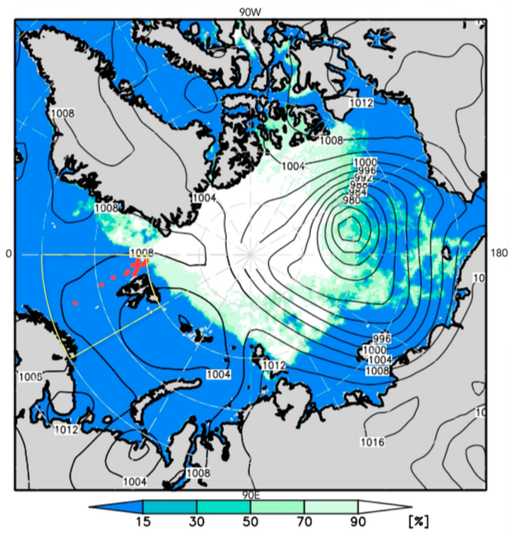
Impacts of a TPV on AC12
Yamazaki et al. (2015) examined the impact of radiosonde observations from a ship of opportunity on the representation of the upper-tropospheric flow over the Arctic and the TPV, and consequently the development of AC12
Locations of radiosonde observations performed by the German research vessel Polarstern (red dots in red circle) during 13–29 July 2012, SLP at 0000 UTC 6 August 2012 from ERA-Interim, and sea-ice concentration on 6 August 2012 from the Advanced Scanning Microwave Radiometer 2. Adapted from Fig. 1 in Yamazaki et al. (2015).

Slide 9
Impacts of a TPV on AC12
Yamazaki et al. (2015) compared an ensemble reanalysis experiment that included the Polarstern radiosonde data with an experiment that excluded the Polarstern radiosonde data
Including the Polarstern radiosonde data led to improved representation of the upper-tropospheric flow and the TPV and consequently much better forecasts of AC12 than when excluding the Polarstern radiosonde data

Slide 10
Outline
Identification and synoptic examination of two TPVs, a predecessor surface cyclone, and AC12
Impact of AC12 on Arctic sea-ice extent
Evolution of one of the TPVs after AC12 peaks in intensity

Slide 11
Data and Methods
Data:
ERA-Interim (Dee et al. 2011)
Utilized TPV tracking algorithm developed by Nicholas Szapiro and Steven Cavallo to identify and track TPVs of interest for AC12
Potential temperature minima on 2-PVU surface tracked spatially and temporally to create tracks for the two TPVs of interest
Obtained size and intensity metrics for one of the TPVs from TPV tracking algorithm
Link for Tracking Algorithm: https://github.com/nickszap/tpvTrack

Slide 12
Data and Methods
Manually tracked the predecessor surface cyclone and AC12 by following the locations of minimum SLP

Slide 13
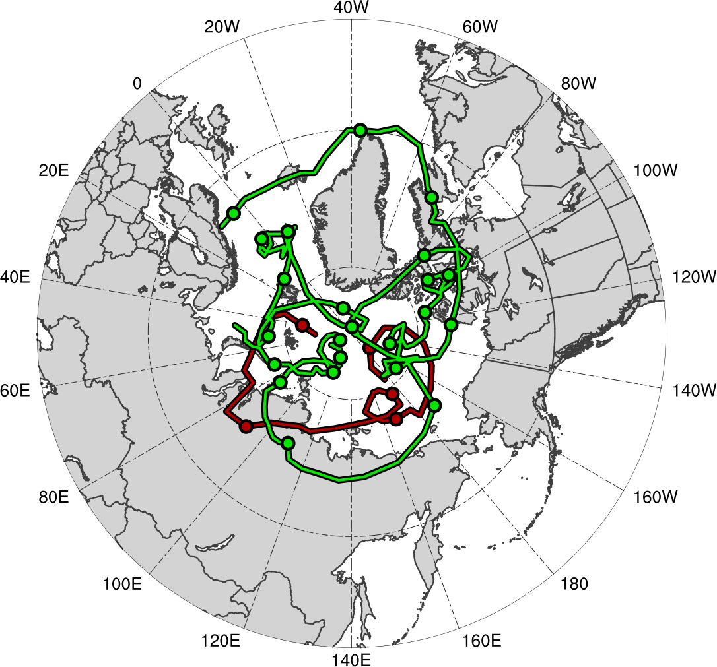
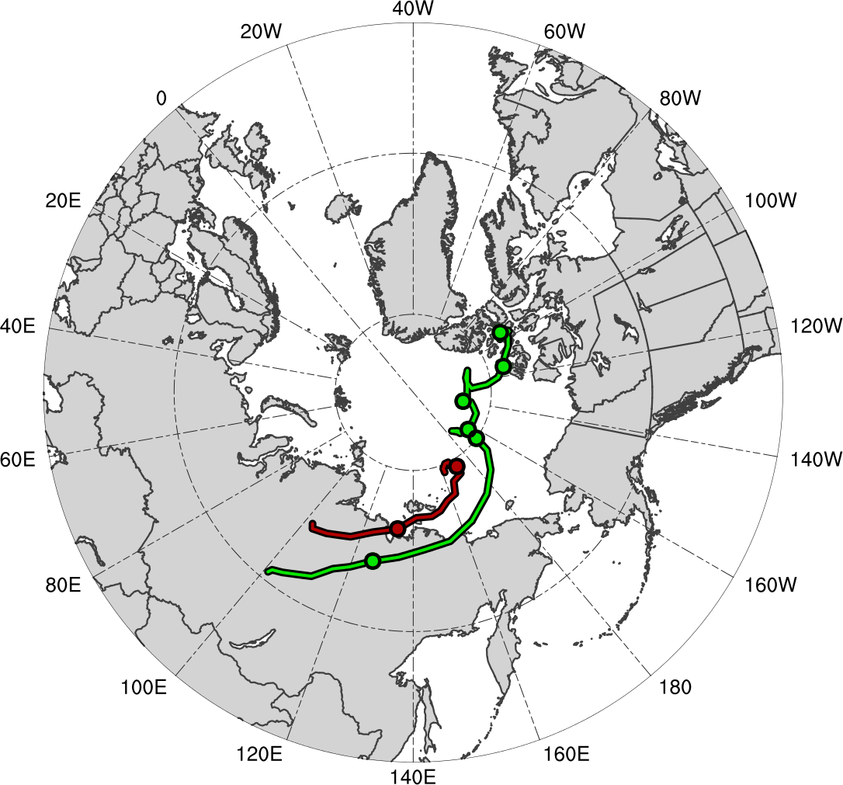
TPV and Surface Cyclone Tracks
TPVs
Surface Cyclones
TPV 1
TPV 2
L1
AC12
Genesis
0000 UTC (every 48 h)
Lysis
TPV 1
Genesis: 23 Jul 2012
Lysis: 7 Sep 2012
Lifetime: ~46 days
TPV 2
Genesis: 30 Jul 2012
Lysis: 8 Aug 2012
Lifetime: ~9 days
L1
Genesis: 31 Jul 2012
Lysis: 5 Aug 2012
Lifetime: ~5 days
AC12
Genesis: 2 Aug 2012
Lysis: 14 Aug 2012
Lifetime: ~12 days

Slide 14
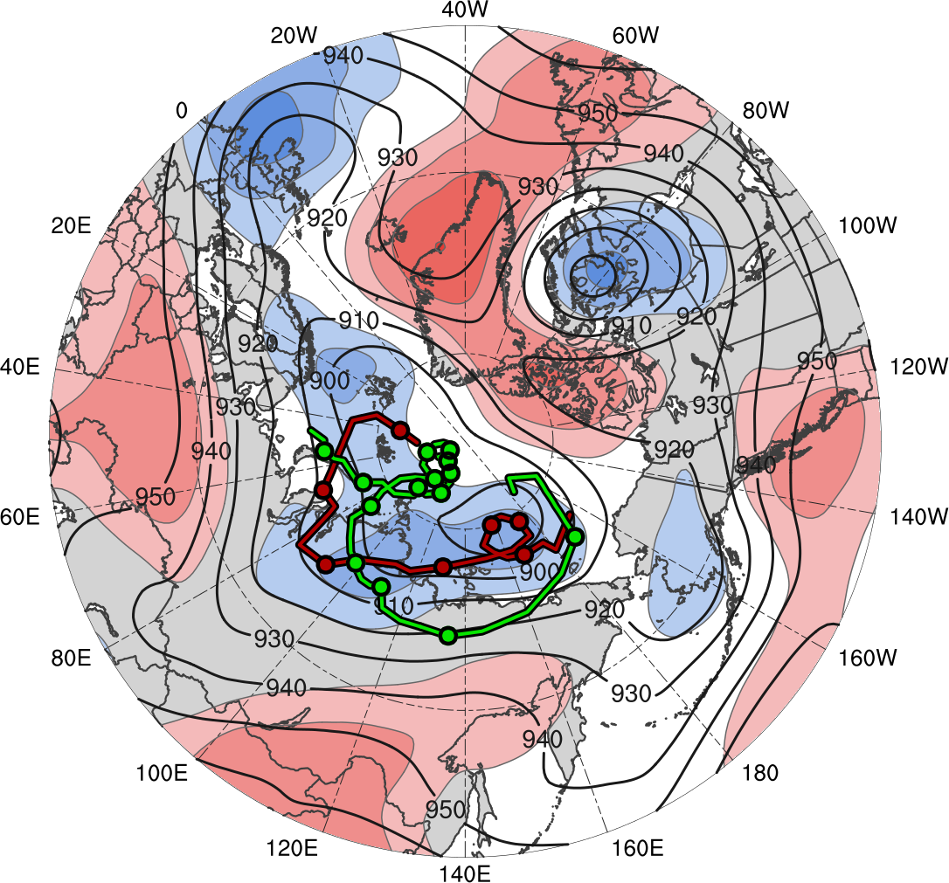
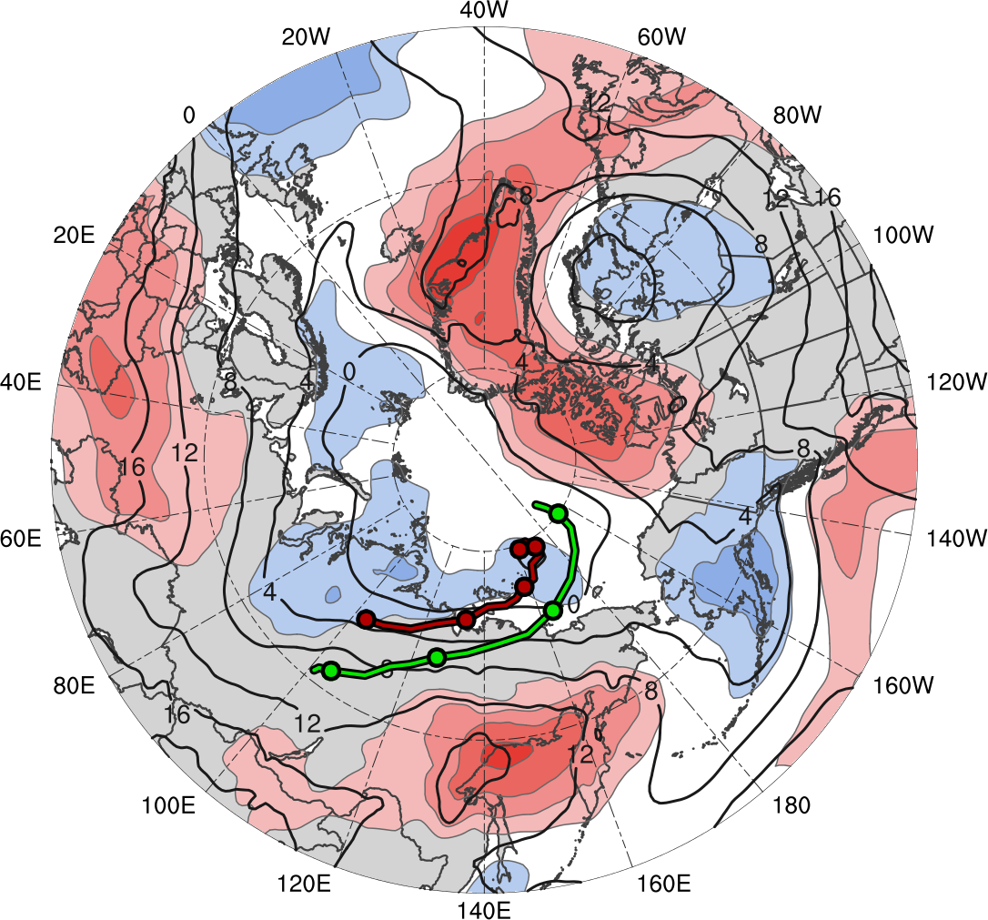
Time-mean Conditions (1–6 Aug 2012)
TPVs
Surface Cyclones
TPV 2
L1
TPV 1
AC12
Genesis
0000 UTC (every 24 h)
1800 UTC 6 Aug 2012
(σ)
-2
-1.5
-1
-0.5
0
0.5
1
1.5
2
1–6 Aug 2012 time-mean (left) 300-hPa geopotential height (dam, black) and standardized anomaly of 300-hPa geopotential height (σ, shaded); (right) 850-hPa temperature (°C, black) and standardized anomaly of 850-hPa temperature (σ, shaded)

Slide 15
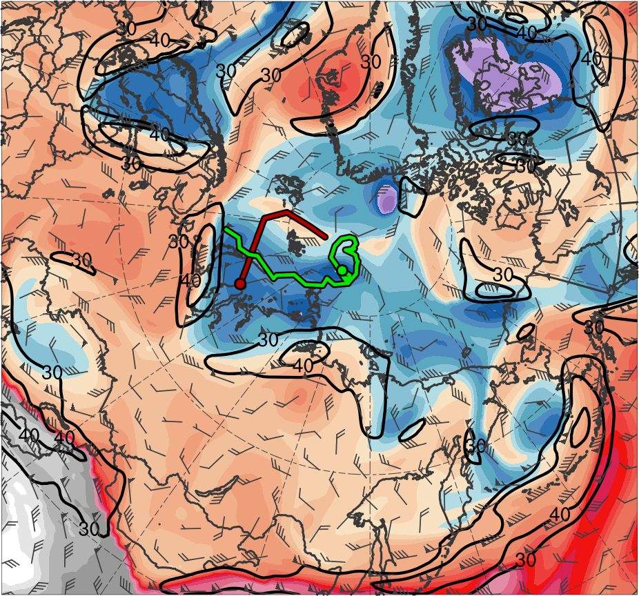
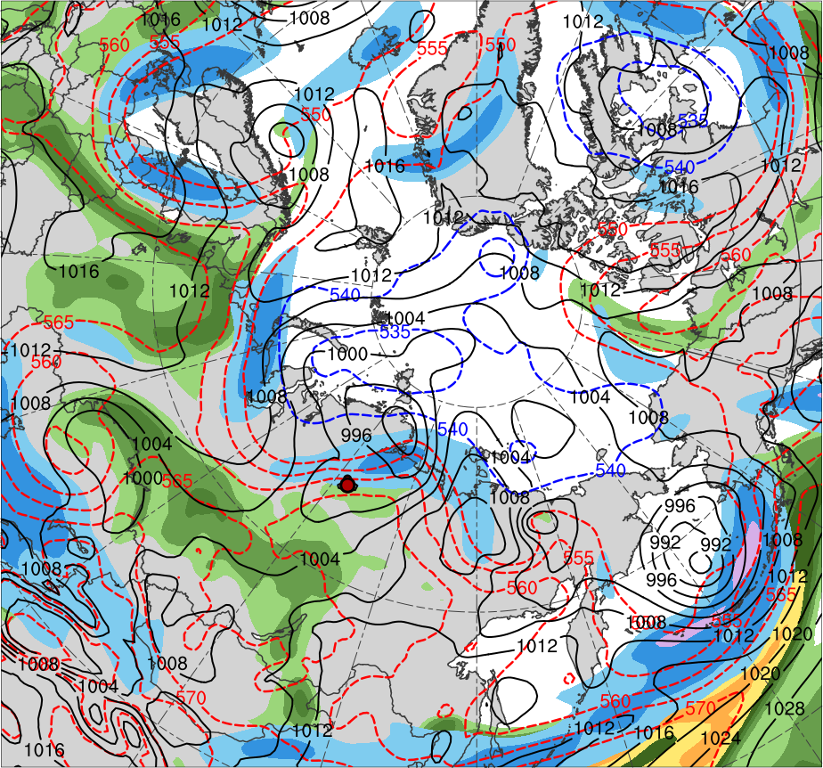
Synoptic Evolution
0000 UTC 1 Aug 2012
TPV 1
TPV 2
L1
(K)
252
258
264
270
276
282
288
294
300
306
312
318
324
330
336
342
348
354
360
366
372
378
(mm)
(m s⁻¹ )
25
30
35
40
45
50
55
30
40
50
60
70
80
90
100
Potential temperature (K, shaded), wind speed (black, every 10 m s⁻¹ starting at 30 m s⁻¹), and wind (m s⁻¹, barbs) on 2-PVU surface
250-hPa wind speed (m s⁻¹, shaded),
1000–500-hPa thickness (dam, blue/red),
SLP (hPa, black), PW (mm, shaded)

Slide 16
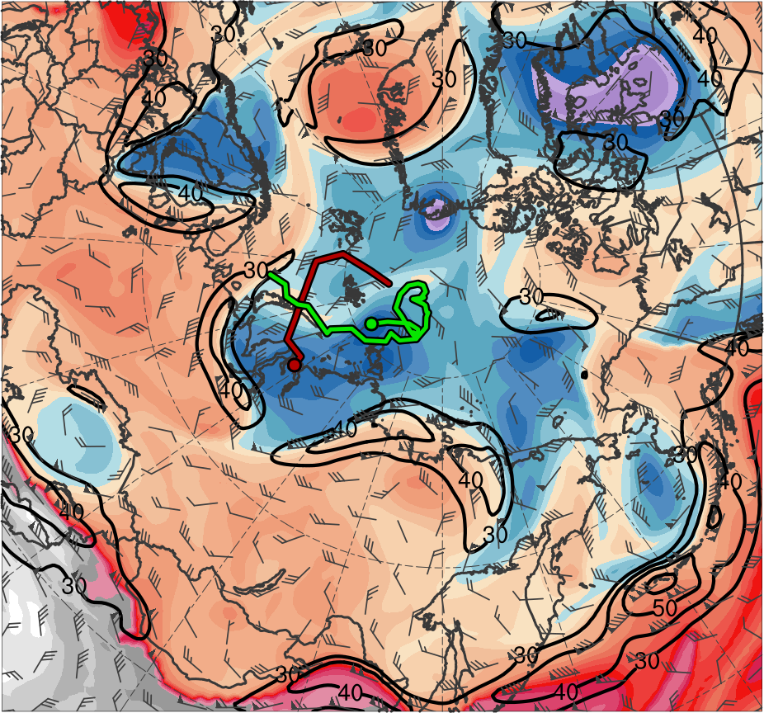
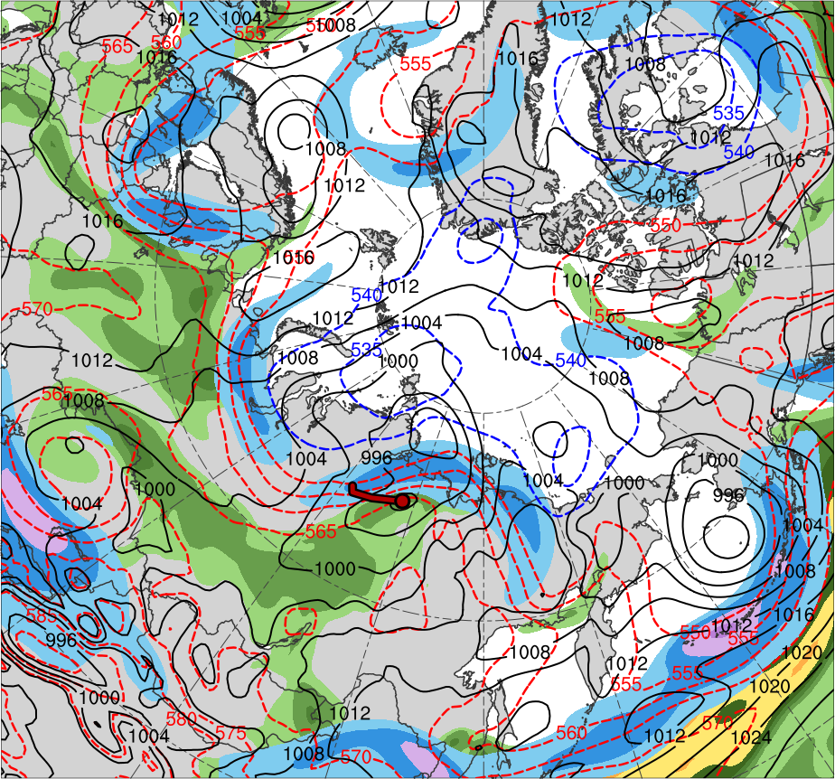
Synoptic Evolution
1200 UTC 1 Aug 2012
TPV 1
TPV 2
L1
(K)
252
258
264
270
276
282
288
294
300
306
312
318
324
330
336
342
348
354
360
366
372
378
(mm)
(m s⁻¹ )
25
30
35
40
45
50
55
30
40
50
60
70
80
90
100
Potential temperature (K, shaded), wind speed (black, every 10 m s⁻¹ starting at 30 m s⁻¹), and wind (m s⁻¹, barbs) on 2-PVU surface
250-hPa wind speed (m s⁻¹, shaded),
1000–500-hPa thickness (dam, blue/red),
SLP (hPa, black), PW (mm, shaded)

Slide 17
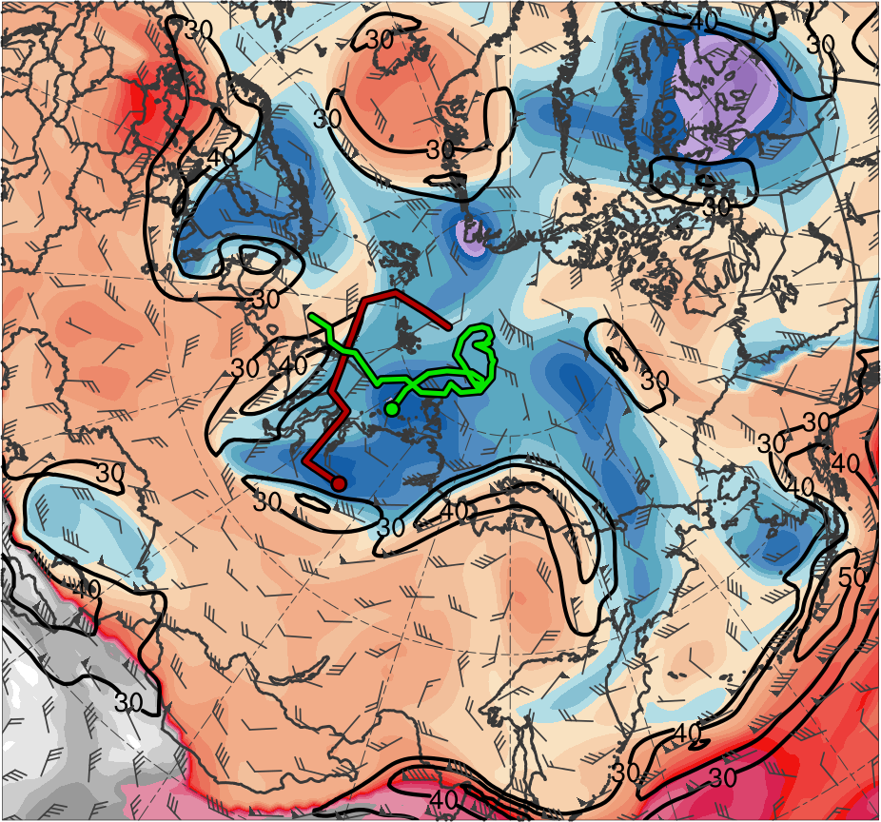
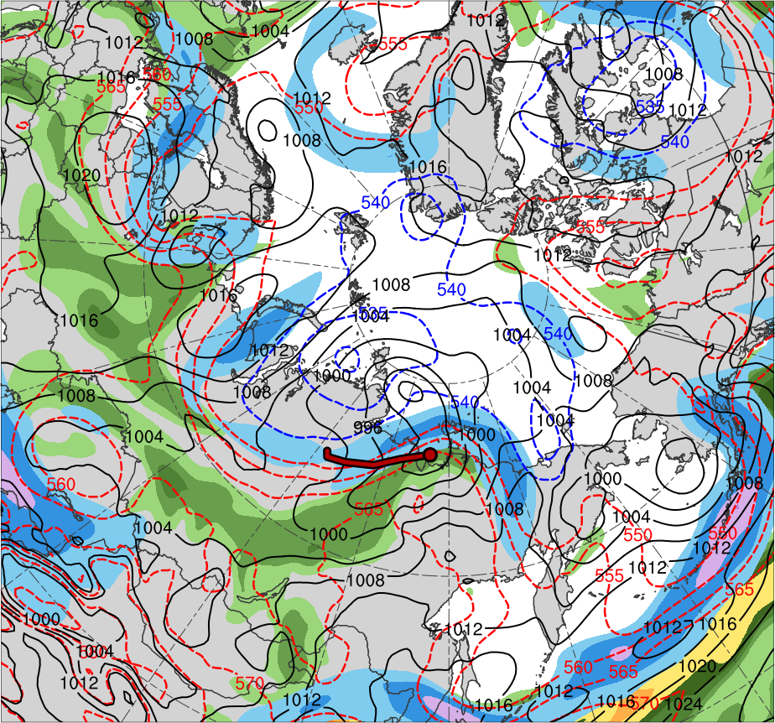
Synoptic Evolution
0000 UTC 2 Aug 2012
TPV 1
TPV 2
L1
(K)
252
258
264
270
276
282
288
294
300
306
312
318
324
330
336
342
348
354
360
366
372
378
(mm)
(m s⁻¹ )
25
30
35
40
45
50
55
30
40
50
60
70
80
90
100
Potential temperature (K, shaded), wind speed (black, every 10 m s⁻¹ starting at 30 m s⁻¹), and wind (m s⁻¹, barbs) on 2-PVU surface
250-hPa wind speed (m s⁻¹, shaded),
1000–500-hPa thickness (dam, blue/red),
SLP (hPa, black), PW (mm, shaded)

Slide 18
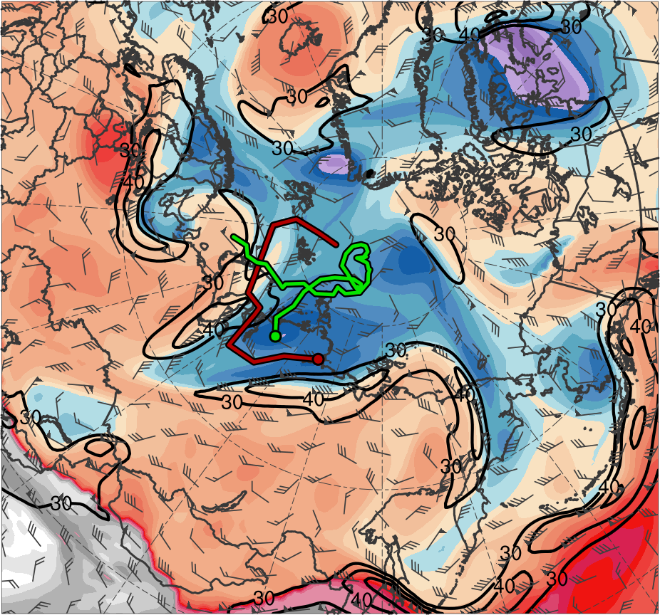
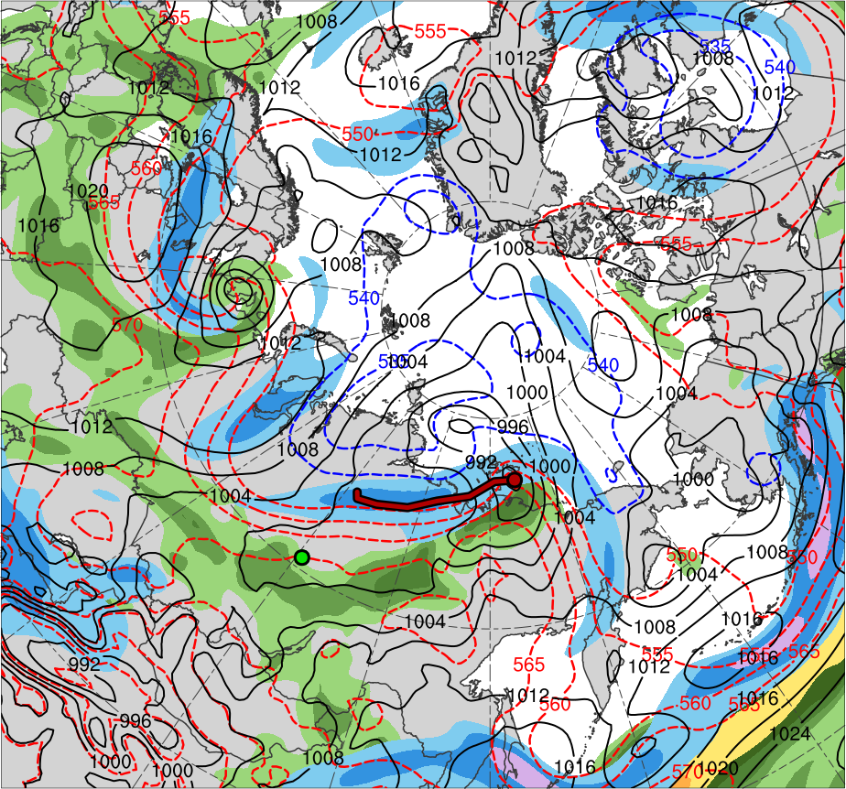
Synoptic Evolution
1200 UTC 2 Aug 2012
TPV 1
AC12
TPV 2
L1
(K)
252
258
264
270
276
282
288
294
300
306
312
318
324
330
336
342
348
354
360
366
372
378
(mm)
(m s⁻¹ )
25
30
35
40
45
50
55
30
40
50
60
70
80
90
100
Potential temperature (K, shaded), wind speed (black, every 10 m s⁻¹ starting at 30 m s⁻¹), and wind (m s⁻¹, barbs) on 2-PVU surface
250-hPa wind speed (m s⁻¹, shaded),
1000–500-hPa thickness (dam, blue/red),
SLP (hPa, black), PW (mm, shaded)

Slide 19
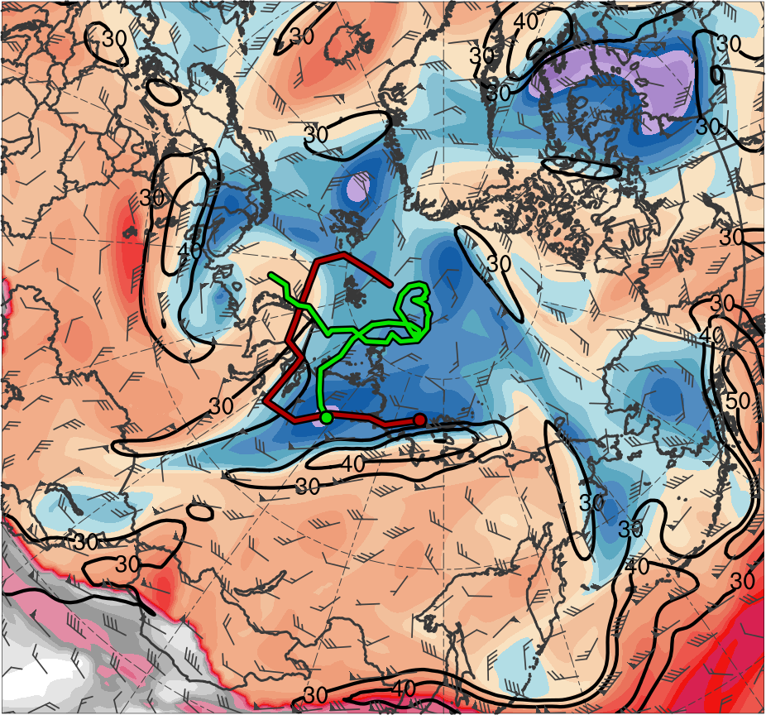
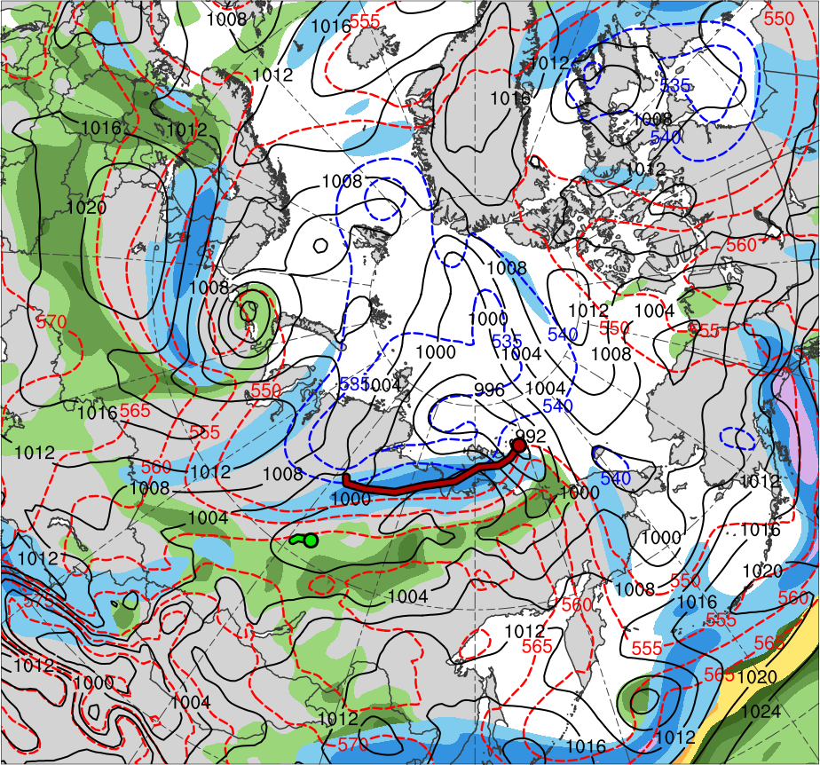
Synoptic Evolution
0000 UTC 3 Aug 2012
TPV 1
AC12
TPV 2
L1
(K)
252
258
264
270
276
282
288
294
300
306
312
318
324
330
336
342
348
354
360
366
372
378
(mm)
(m s⁻¹ )
25
30
35
40
45
50
55
30
40
50
60
70
80
90
100
Potential temperature (K, shaded), wind speed (black, every 10 m s⁻¹ starting at 30 m s⁻¹), and wind (m s⁻¹, barbs) on 2-PVU surface
250-hPa wind speed (m s⁻¹, shaded),
1000–500-hPa thickness (dam, blue/red),
SLP (hPa, black), PW (mm, shaded)

Slide 20
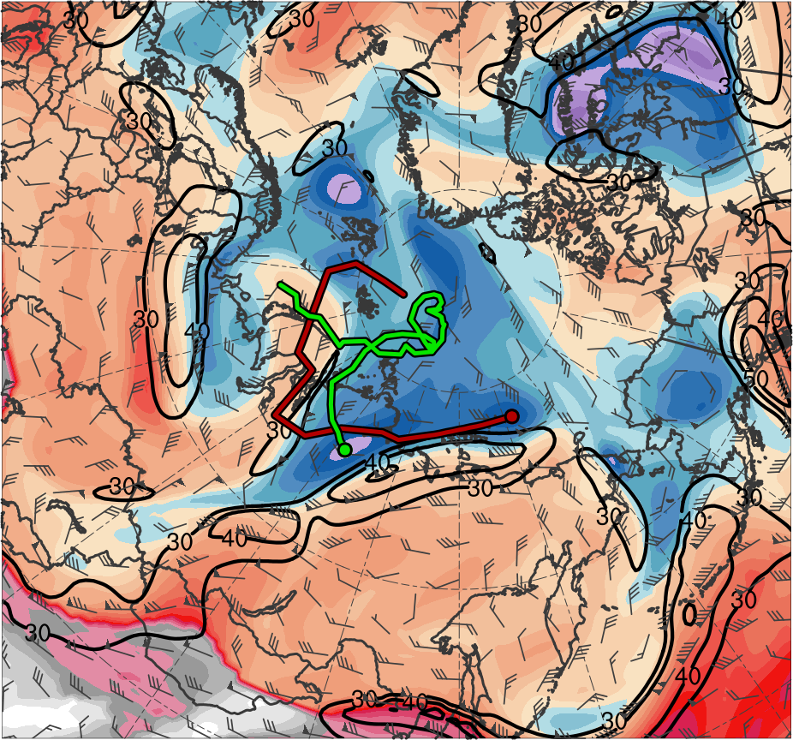
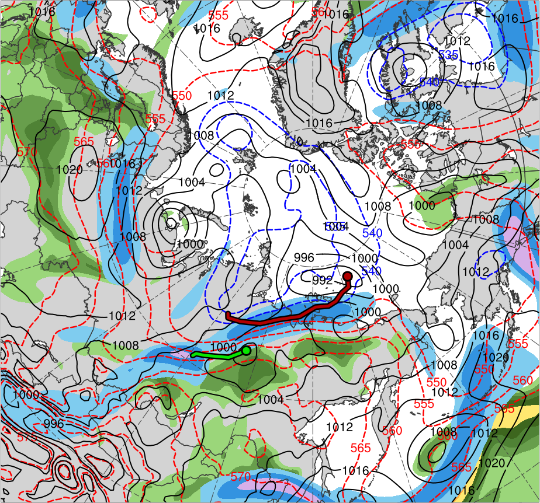
Synoptic Evolution
1200 UTC 3 Aug 2012
TPV 1
AC12
TPV 2
L1
(K)
252
258
264
270
276
282
288
294
300
306
312
318
324
330
336
342
348
354
360
366
372
378
(mm)
(m s⁻¹ )
25
30
35
40
45
50
55
30
40
50
60
70
80
90
100
Potential temperature (K, shaded), wind speed (black, every 10 m s⁻¹ starting at 30 m s⁻¹), and wind (m s⁻¹, barbs) on 2-PVU surface
250-hPa wind speed (m s⁻¹, shaded),
1000–500-hPa thickness (dam, blue/red),
SLP (hPa, black), PW (mm, shaded)

Slide 21
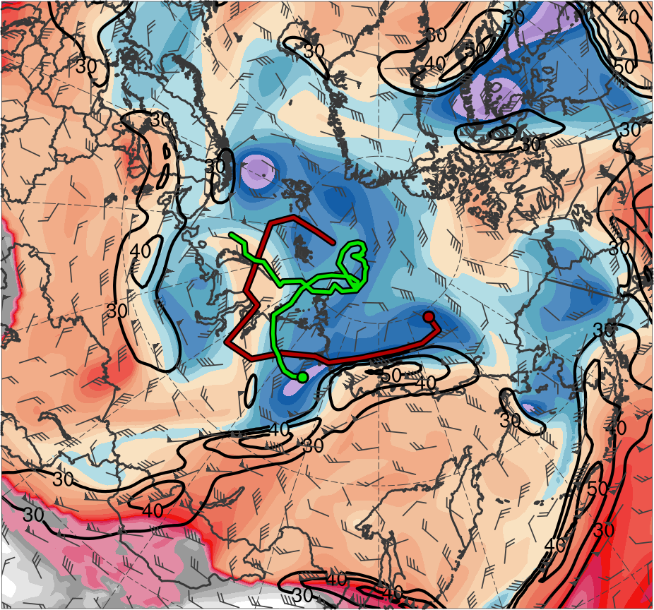
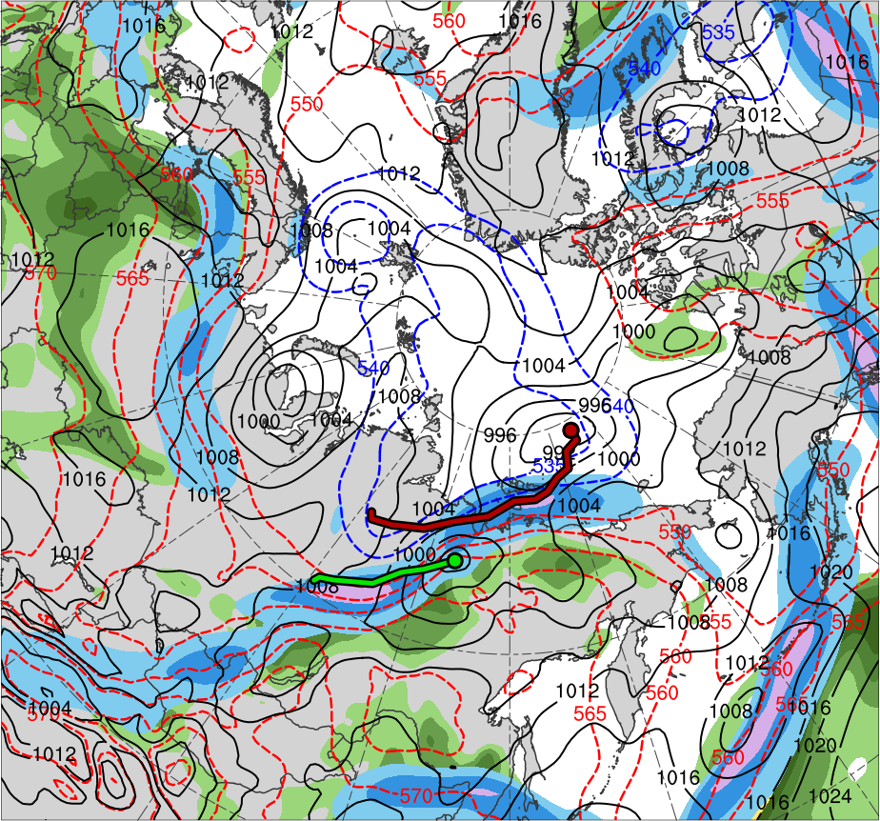
Synoptic Evolution
0000 UTC 4 Aug 2012
TPV 1
AC12
TPV 2
L1
(K)
252
258
264
270
276
282
288
294
300
306
312
318
324
330
336
342
348
354
360
366
372
378
(mm)
(m s⁻¹ )
25
30
35
40
45
50
55
30
40
50
60
70
80
90
100
Potential temperature (K, shaded), wind speed (black, every 10 m s⁻¹ starting at 30 m s⁻¹), and wind (m s⁻¹, barbs) on 2-PVU surface
250-hPa wind speed (m s⁻¹, shaded),
1000–500-hPa thickness (dam, blue/red),
SLP (hPa, black), PW (mm, shaded)

Slide 22
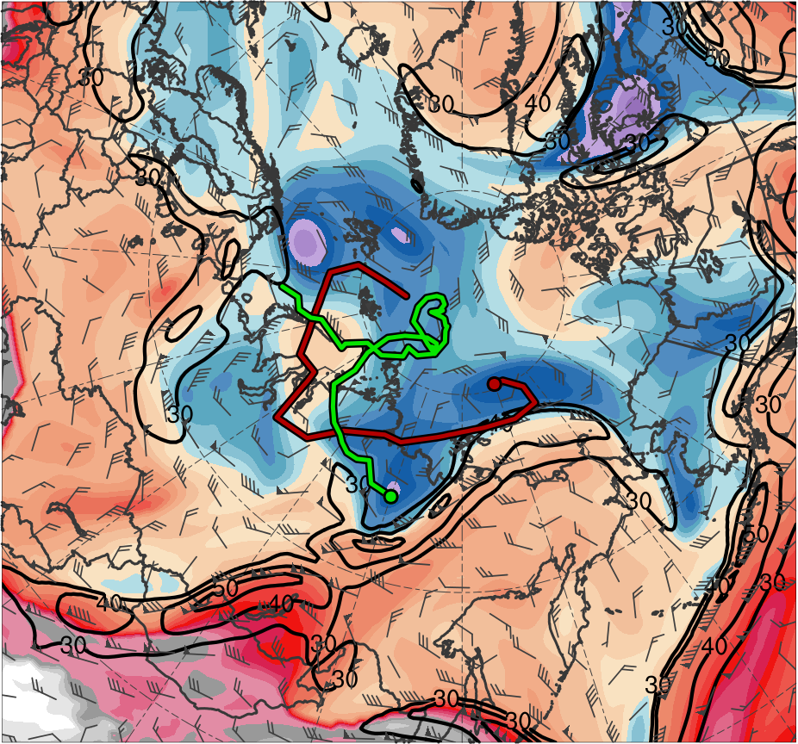
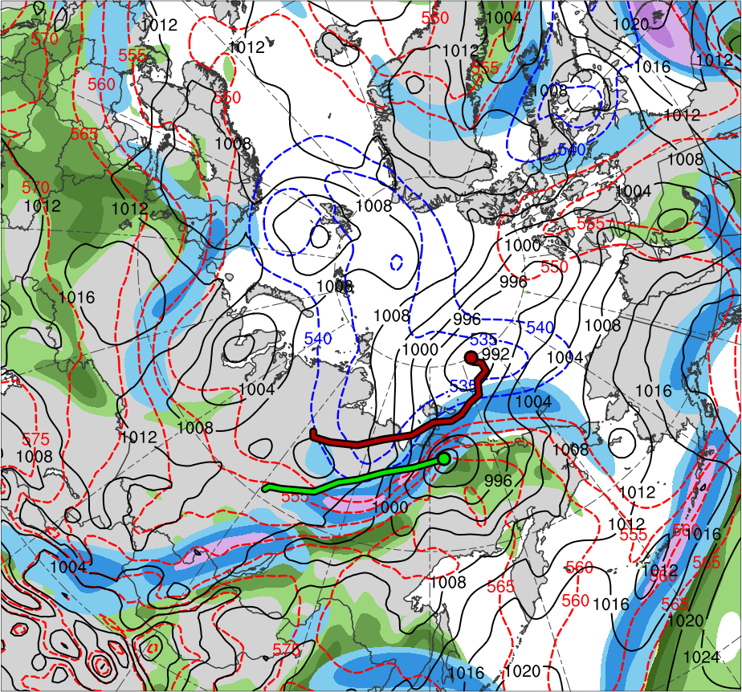
Synoptic Evolution
1200 UTC 4 Aug 2012
TPV 1
AC12
TPV 2
L1
(K)
252
258
264
270
276
282
288
294
300
306
312
318
324
330
336
342
348
354
360
366
372
378
(mm)
(m s⁻¹ )
25
30
35
40
45
50
55
30
40
50
60
70
80
90
100
Potential temperature (K, shaded), wind speed (black, every 10 m s⁻¹ starting at 30 m s⁻¹), and wind (m s⁻¹, barbs) on 2-PVU surface
250-hPa wind speed (m s⁻¹, shaded),
1000–500-hPa thickness (dam, blue/red),
SLP (hPa, black), PW (mm, shaded)

Slide 23
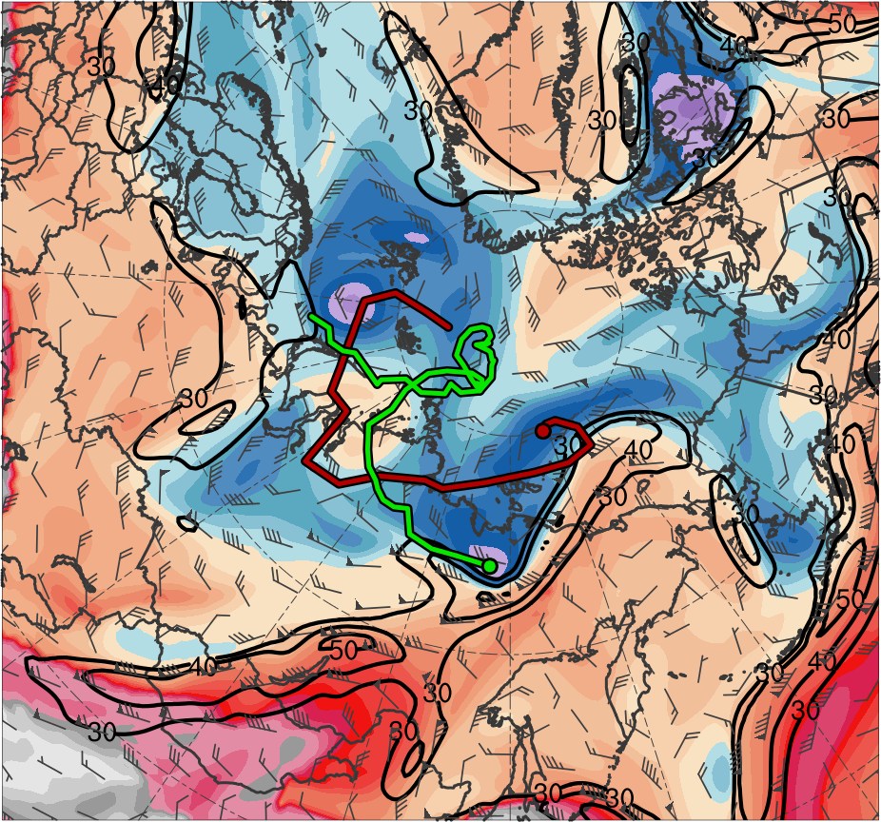
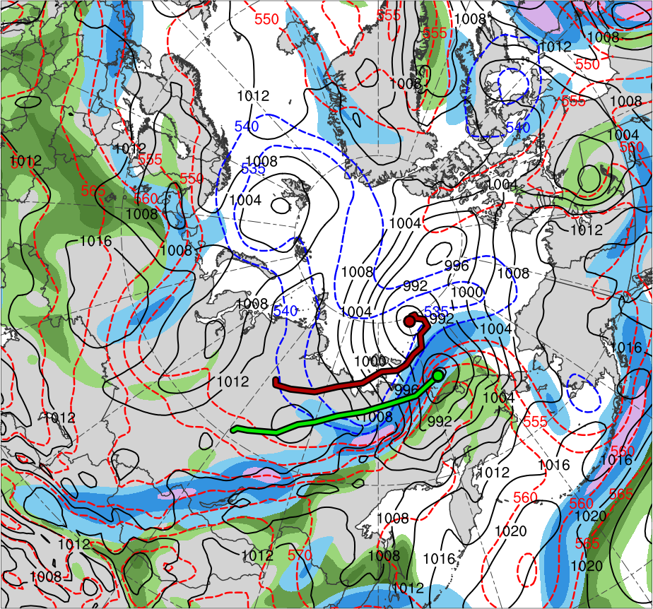
Synoptic Evolution
0000 UTC 5 Aug 2012
TPV 1
AC12
TPV 2
L1
(K)
252
258
264
270
276
282
288
294
300
306
312
318
324
330
336
342
348
354
360
366
372
378
(mm)
(m s⁻¹ )
25
30
35
40
45
50
55
30
40
50
60
70
80
90
100
Potential temperature (K, shaded), wind speed (black, every 10 m s⁻¹ starting at 30 m s⁻¹), and wind (m s⁻¹, barbs) on 2-PVU surface
250-hPa wind speed (m s⁻¹, shaded),
1000–500-hPa thickness (dam, blue/red),
SLP (hPa, black), PW (mm, shaded)

Slide 24
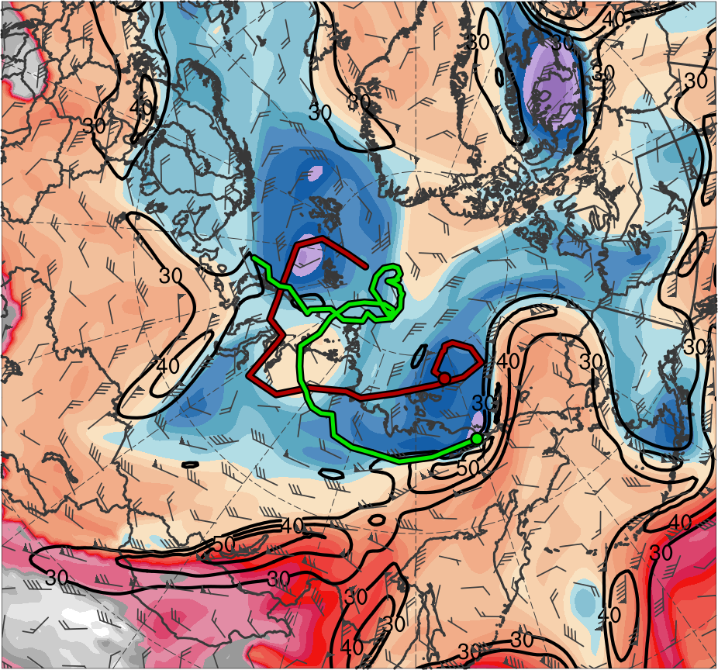
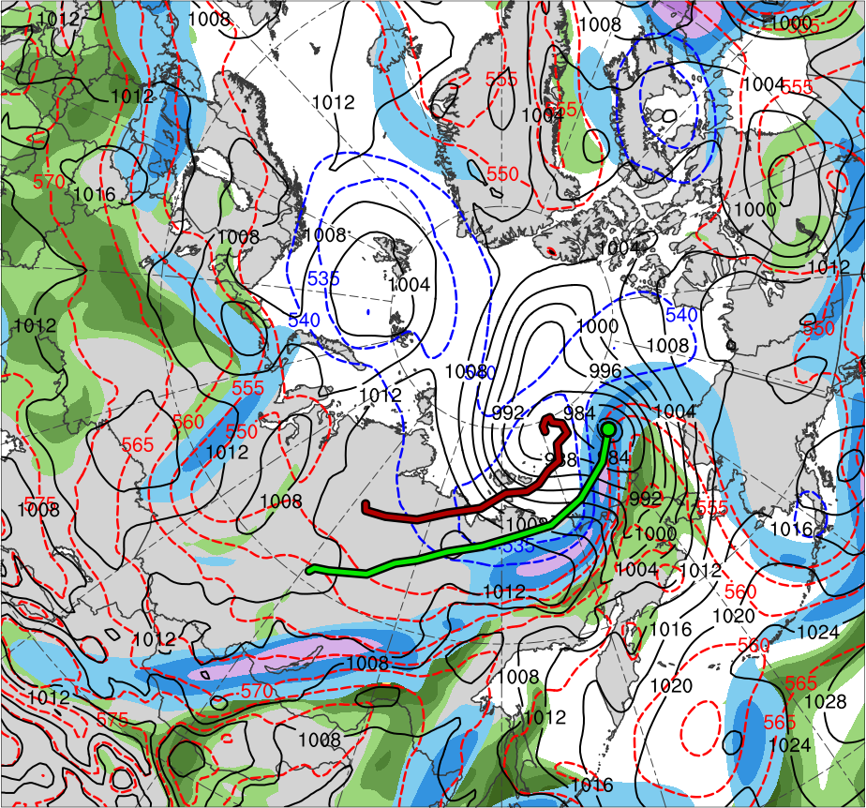
Synoptic Evolution
1200 UTC 5 Aug 2012
TPV 1
AC12
TPV 2
L1
(K)
252
258
264
270
276
282
288
294
300
306
312
318
324
330
336
342
348
354
360
366
372
378
(mm)
(m s⁻¹ )
25
30
35
40
45
50
55
30
40
50
60
70
80
90
100
Potential temperature (K, shaded), wind speed (black, every 10 m s⁻¹ starting at 30 m s⁻¹), and wind (m s⁻¹, barbs) on 2-PVU surface
250-hPa wind speed (m s⁻¹, shaded),
1000–500-hPa thickness (dam, blue/red),
SLP (hPa, black), PW (mm, shaded)

Slide 25
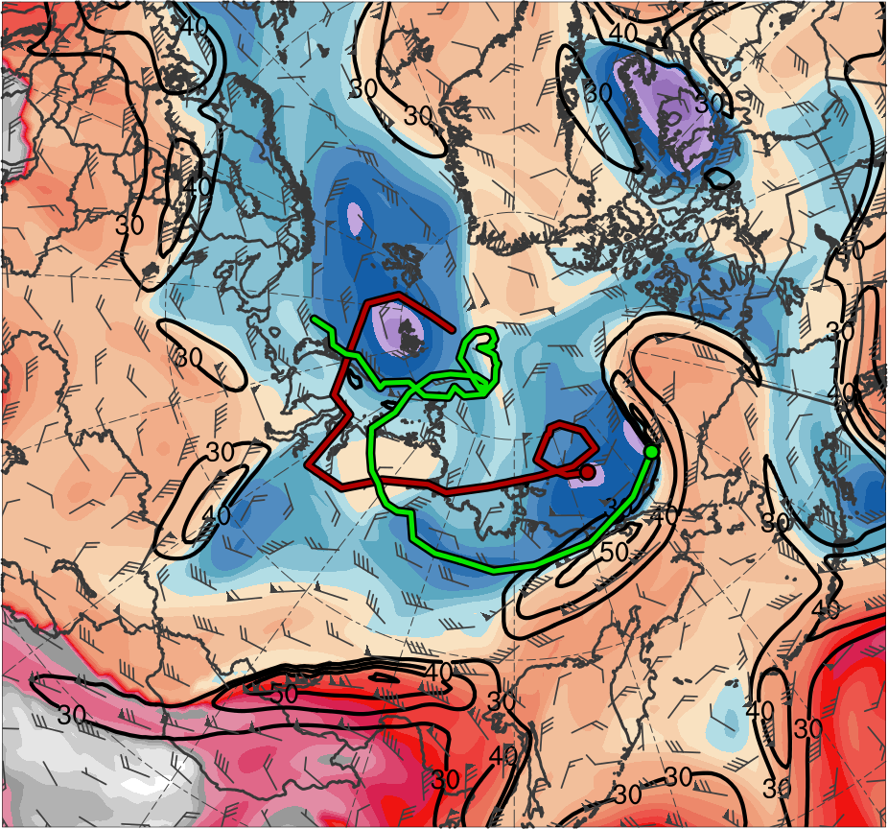
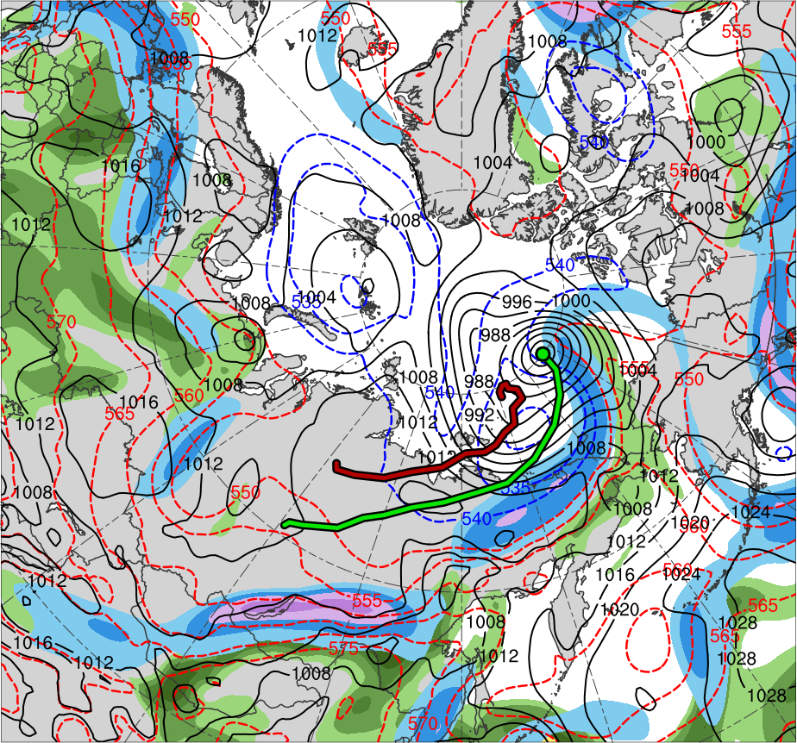
Synoptic Evolution
0000 UTC 6 Aug 2012
TPV 1
AC12
TPV 2
L1
(K)
252
258
264
270
276
282
288
294
300
306
312
318
324
330
336
342
348
354
360
366
372
378
(mm)
(m s⁻¹ )
25
30
35
40
45
50
55
30
40
50
60
70
80
90
100
Potential temperature (K, shaded), wind speed (black, every 10 m s⁻¹ starting at 30 m s⁻¹), and wind (m s⁻¹, barbs) on 2-PVU surface
250-hPa wind speed (m s⁻¹, shaded),
1000–500-hPa thickness (dam, blue/red),
SLP (hPa, black), PW (mm, shaded)

Slide 26
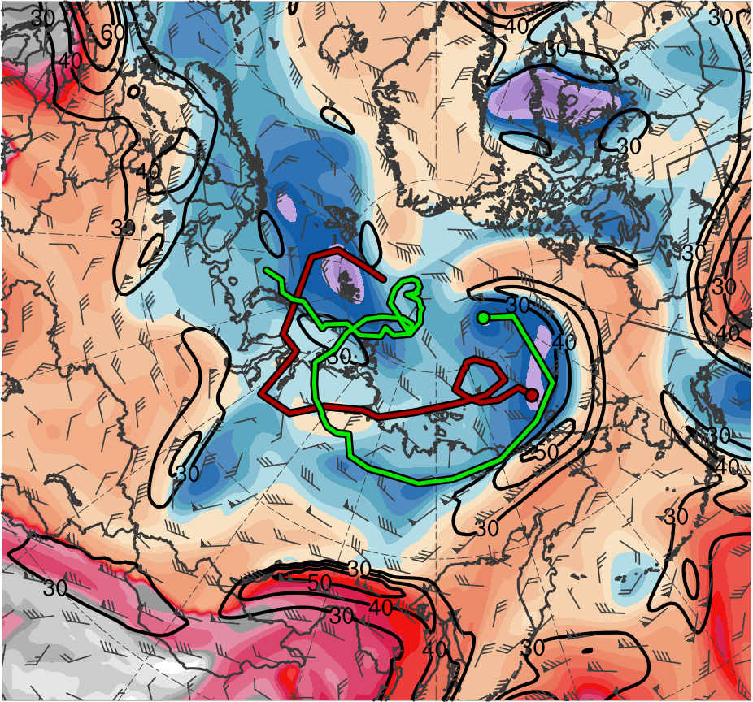
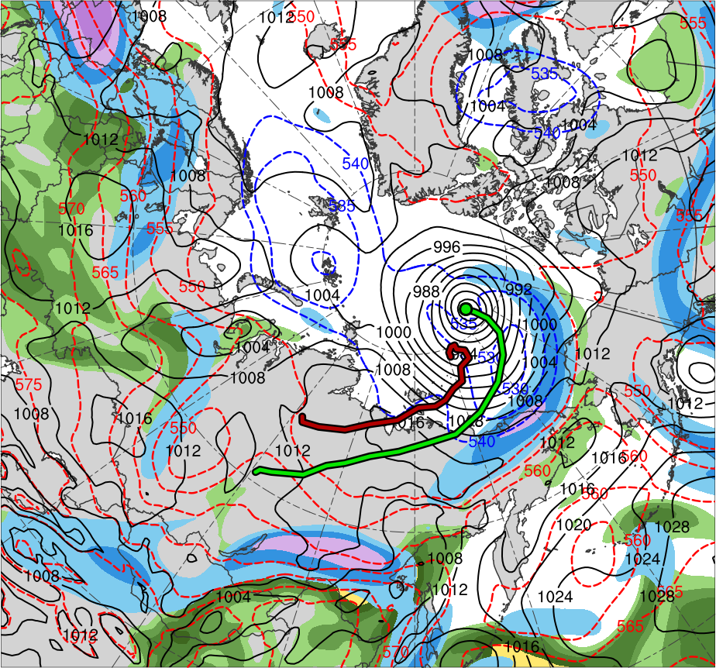
Synoptic Evolution
1200 UTC 6 Aug 2012
TPV 1
AC12
TPV 2
L1
(K)
252
258
264
270
276
282
288
294
300
306
312
318
324
330
336
342
348
354
360
366
372
378
(mm)
(m s⁻¹ )
25
30
35
40
45
50
55
30
40
50
60
70
80
90
100
Potential temperature (K, shaded), wind speed (black, every 10 m s⁻¹ starting at 30 m s⁻¹), and wind (m s⁻¹, barbs) on 2-PVU surface
250-hPa wind speed (m s⁻¹, shaded),
1000–500-hPa thickness (dam, blue/red),
SLP (hPa, black), PW (mm, shaded)

Slide 27
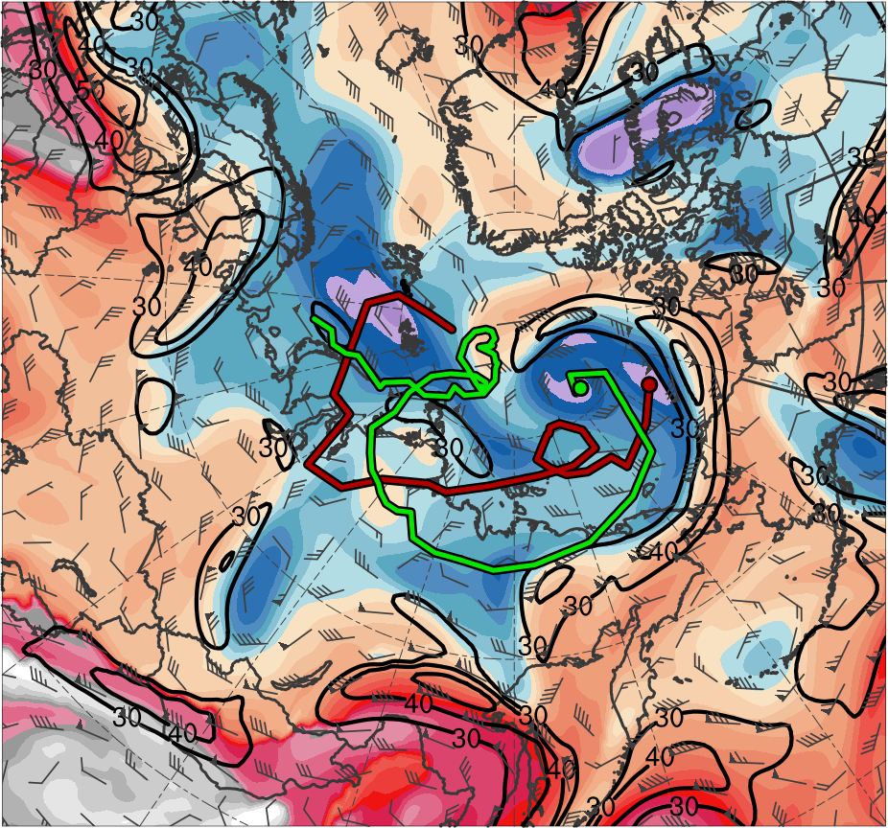
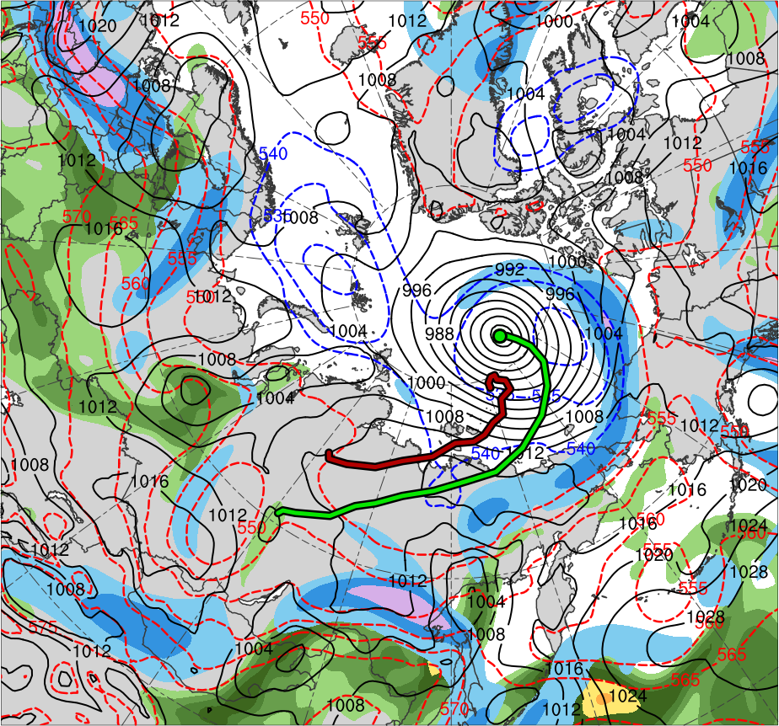
Synoptic Evolution
0000 UTC 7 Aug 2012
TPV 1
AC12
TPV 2
L1
(K)
252
258
264
270
276
282
288
294
300
306
312
318
324
330
336
342
348
354
360
366
372
378
(mm)
(m s⁻¹ )
25
30
35
40
45
50
55
30
40
50
60
70
80
90
100
Potential temperature (K, shaded), wind speed (black, every 10 m s⁻¹ starting at 30 m s⁻¹), and wind (m s⁻¹, barbs) on 2-PVU surface
250-hPa wind speed (m s⁻¹, shaded),
1000–500-hPa thickness (dam, blue/red),
SLP (hPa, black), PW (mm, shaded)

Slide 28
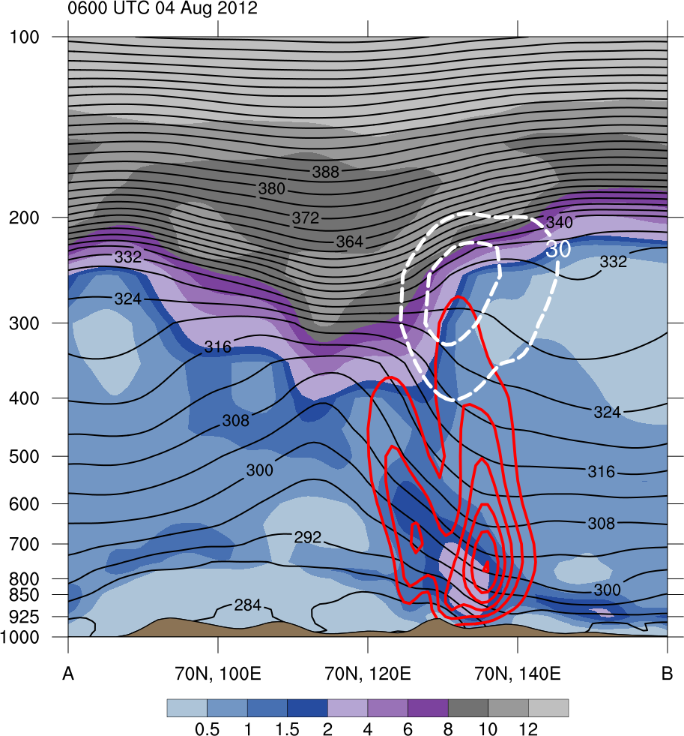
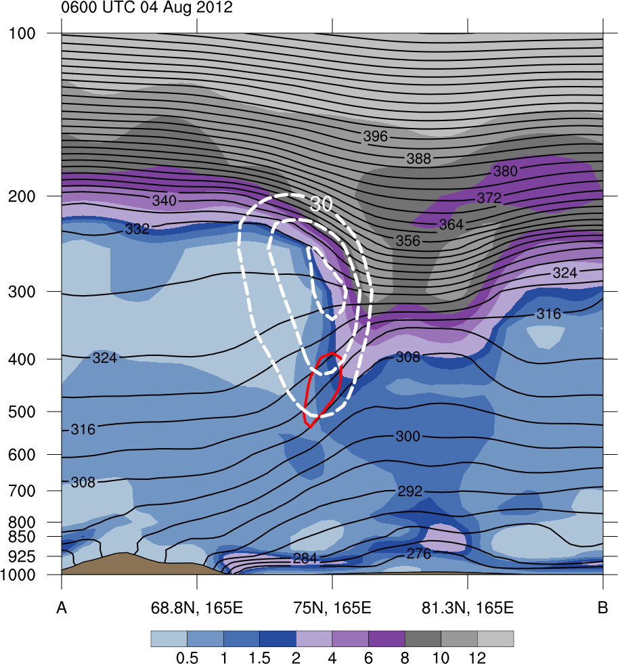
3D Structure of TPVs and Cyclones
0600 UTC 4 Aug 2012
378
372
12
(left) Zonal and (right) meridional cross sections of potential vorticity (PVU, shaded), wind speed (white, every 10 m s⁻¹ starting at 30 m s⁻¹), potential temperature (K, black), and upward vertical motion (red, every 2.5 × 10⁻³ hPa s⁻¹)
366
10
360
8
354
6
TPV 1
TPV 2
348
4
342
2
336
1.5
330
1
AC12
L1
324
318
0.5
A
A’
B
B’
312
(PVU)
306
(left) Potential temperature (K, shaded), wind speed (black, every 10 m s⁻¹ starting at 30 m s⁻¹), and wind (m s⁻¹, barbs) on 2-PVU surface; and (right) 250-hPa wind speed (m s⁻¹, shaded),1000–500-hPa thickness (dam, blue/red), SLP (hPa, black), and PW (mm, shaded)
300
B’
B’
294
55
100
TPV 2
50
90
288
80
L1
282
45
40
70
A
A
276
60
270
35
50
A’
A’
264
30
40
TPV 1
B
258
AC12
B
25
30
252
(mm)
(m s⁻¹)
(K)

Slide 29
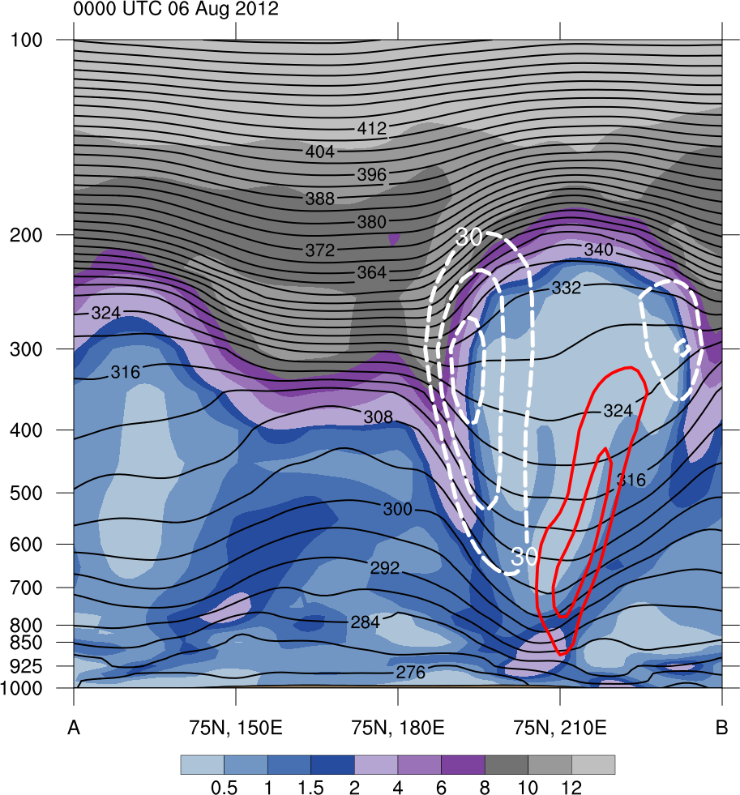
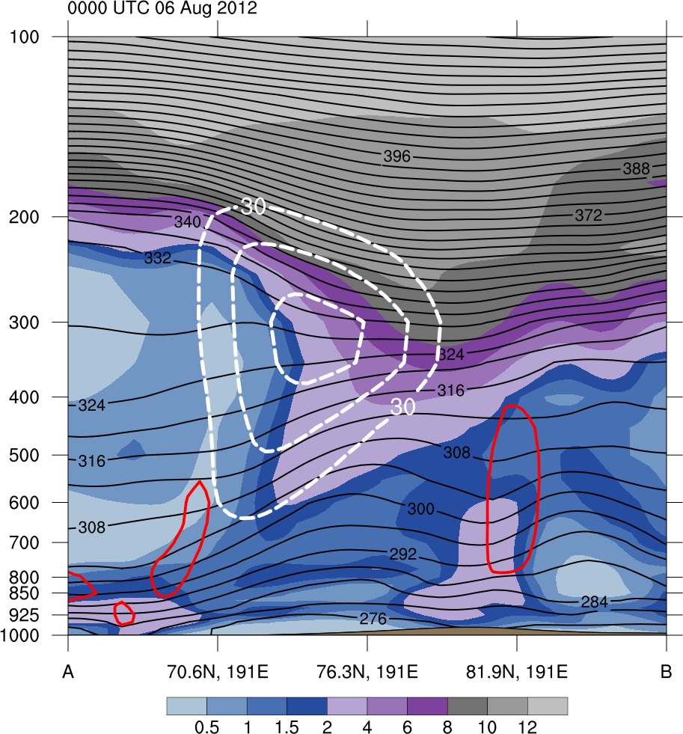
3D Structure of TPVs and Cyclones
0000 UTC 6 Aug 2012
378
372
12
(left) Zonal and (right) meridional cross sections of potential vorticity (PVU, shaded), wind speed (white, every 10 m s⁻¹ starting at 30 m s⁻¹), potential temperature (K, black), and upward vertical motion (red, every 2.5 × 10⁻³ hPa s⁻¹)
366
10
360
8
354
TPV 2
6
348
4
TPV 1
342
2
336
TPV 1
1.5
330
1
AC12
324
318
0.5
C
C’
D
D’
312
(PVU)
306
(left) Potential temperature (K, shaded), wind speed (black, every 10 m s⁻¹ starting at 30 m s⁻¹), and wind (m s⁻¹, barbs) on 2-PVU surface; and (right) 250-hPa wind speed (m s⁻¹, shaded),1000–500-hPa thickness (dam, blue/red), SLP (hPa, black), and PW (mm, shaded)
300
C’
C’
294
55
100
D’
D’
50
90
288
80
AC12
282
45
TPV 1
40
70
276
60
C
C
270
35
50
D
D
264
30
40
TPV 2
258
25
30
252
(mm)
(m s⁻¹)
(K)

Slide 30
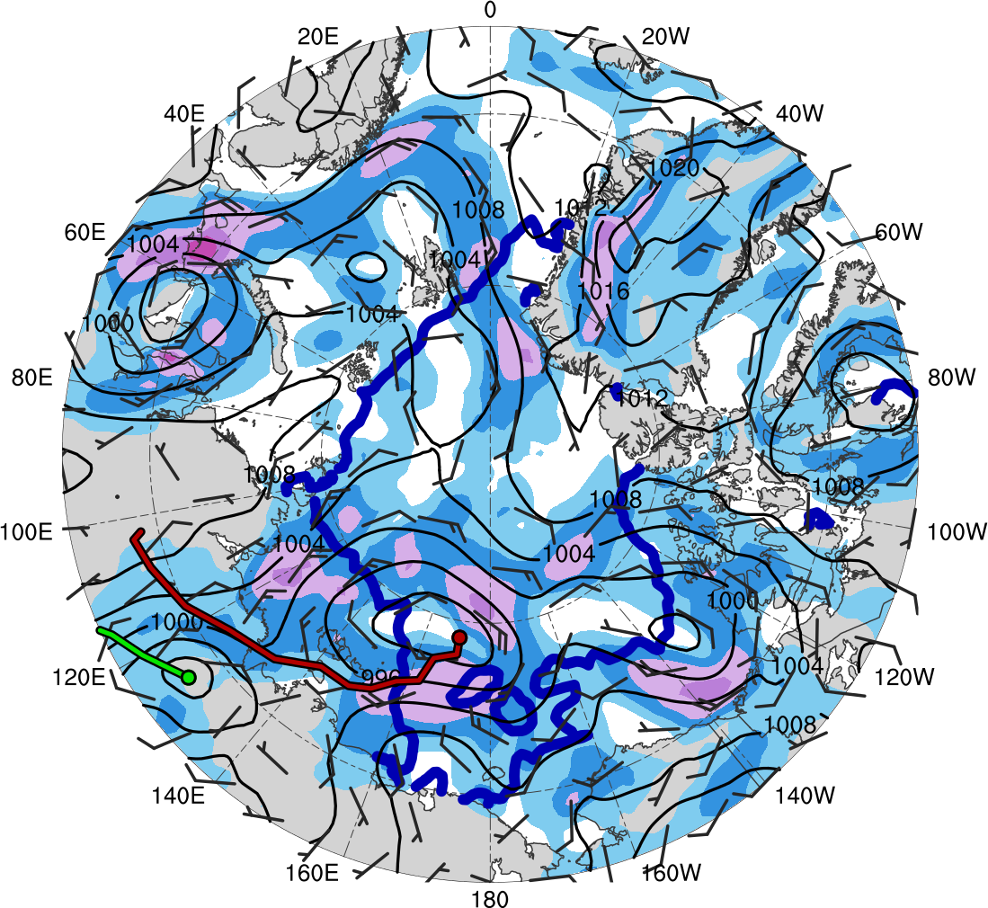
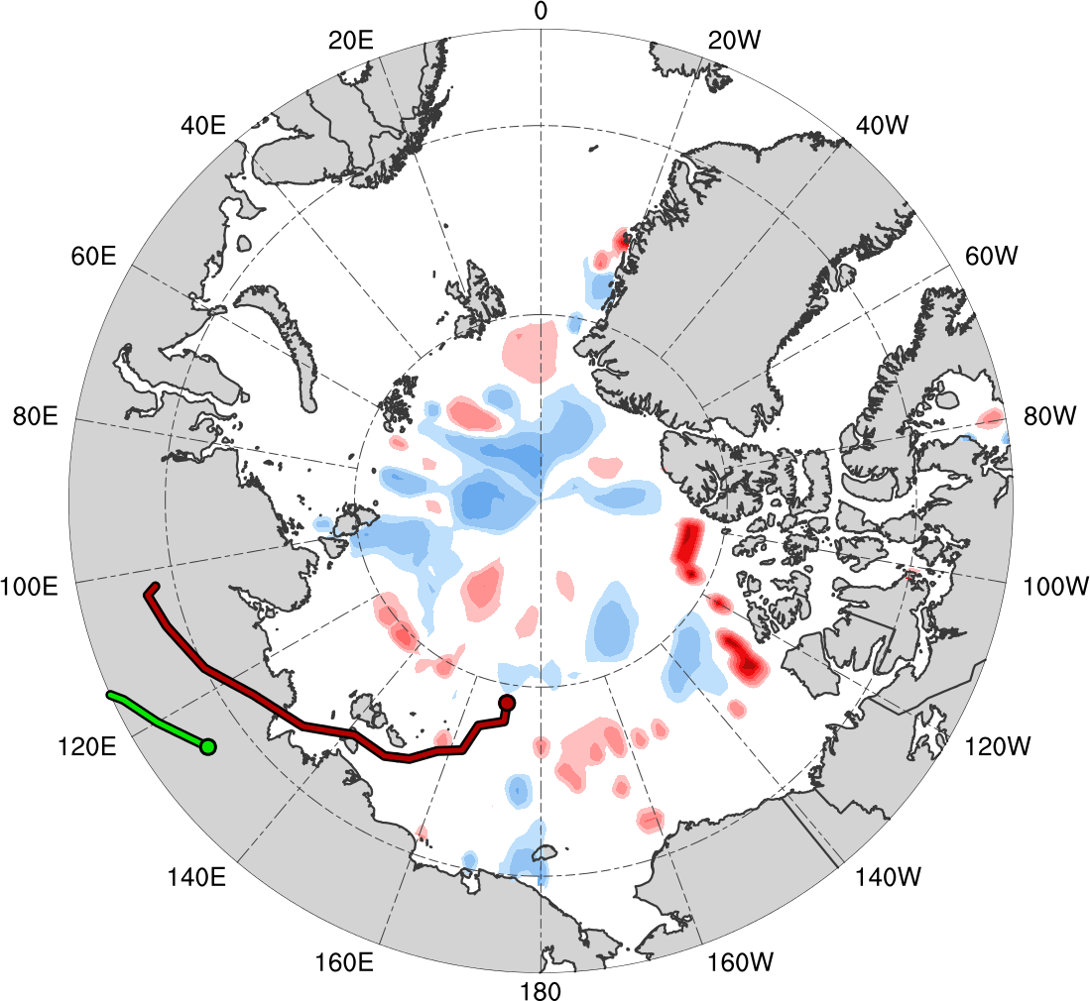
Impacts of Surface Cyclones on Arctic Sea Ice
Synoptic fields valid: 0000 UTC 4 Aug 2012
Sea ice valid: 0600 UTC 4 Aug 2012
0600 UTC 4 Aug − 0600 UTC 3 Aug 2012
L1
AC12
(m s⁻¹ )
(%)
4
6
8
10
12
14
16
18
-60
-50
-40
-30
-20
-10
-5
5
10
20
30
40
50
60
SLP (hPa, black); 10-m wind speed (m s⁻¹, shaded) and wind (m s⁻¹, black barbs); and 20% contour of sea-ice concentration (thick blue)
Change in sea-ice concentration (shaded, %) since 0600 UTC 3 Aug 2012

Slide 31
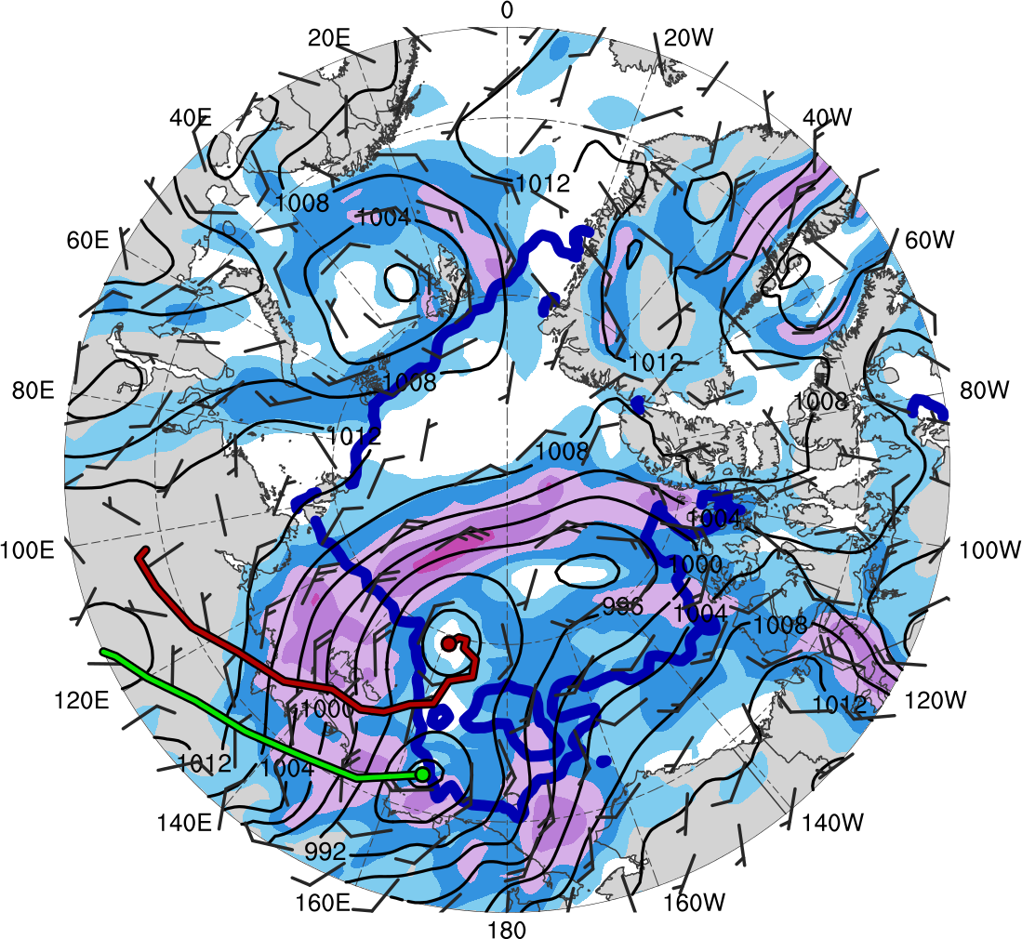
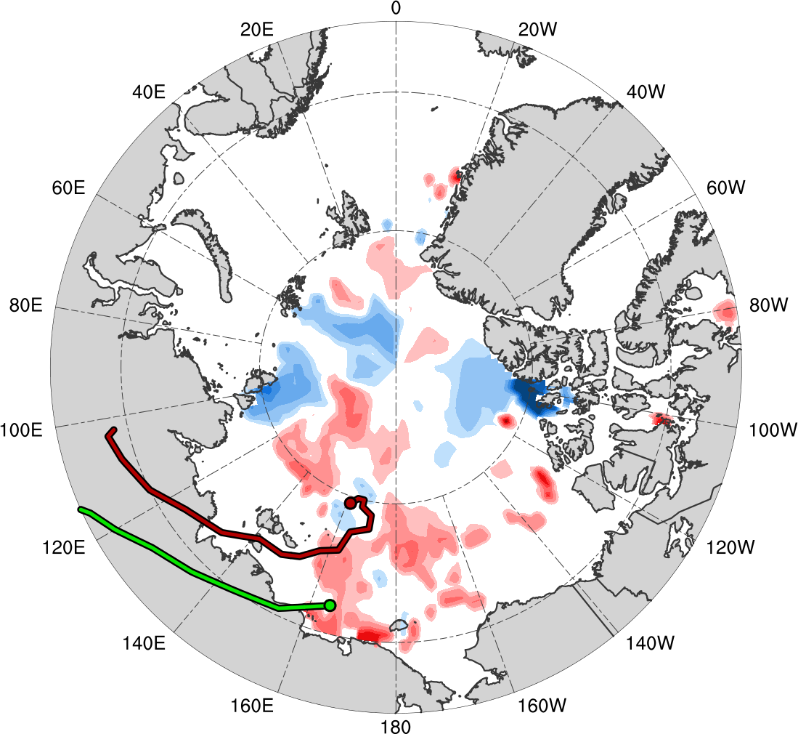
Impacts of Surface Cyclones on Arctic Sea Ice
Synoptic fields valid: 0000 UTC 5 Aug 2012
Sea ice valid: 0600 UTC 5 Aug 2012
0600 UTC 5 Aug − 0600 UTC 3 Aug 2012
L1
AC12
(m s⁻¹ )
(%)
4
6
8
10
12
14
16
18
-60
-50
-40
-30
-20
-10
-5
5
10
20
30
40
50
60
SLP (hPa, black); 10-m wind speed (m s⁻¹, shaded) and wind (m s⁻¹, black barbs); and 20% contour of sea-ice concentration (thick blue)
Change in sea-ice concentration (shaded, %) since 0600 UTC 3 Aug 2012

Slide 32
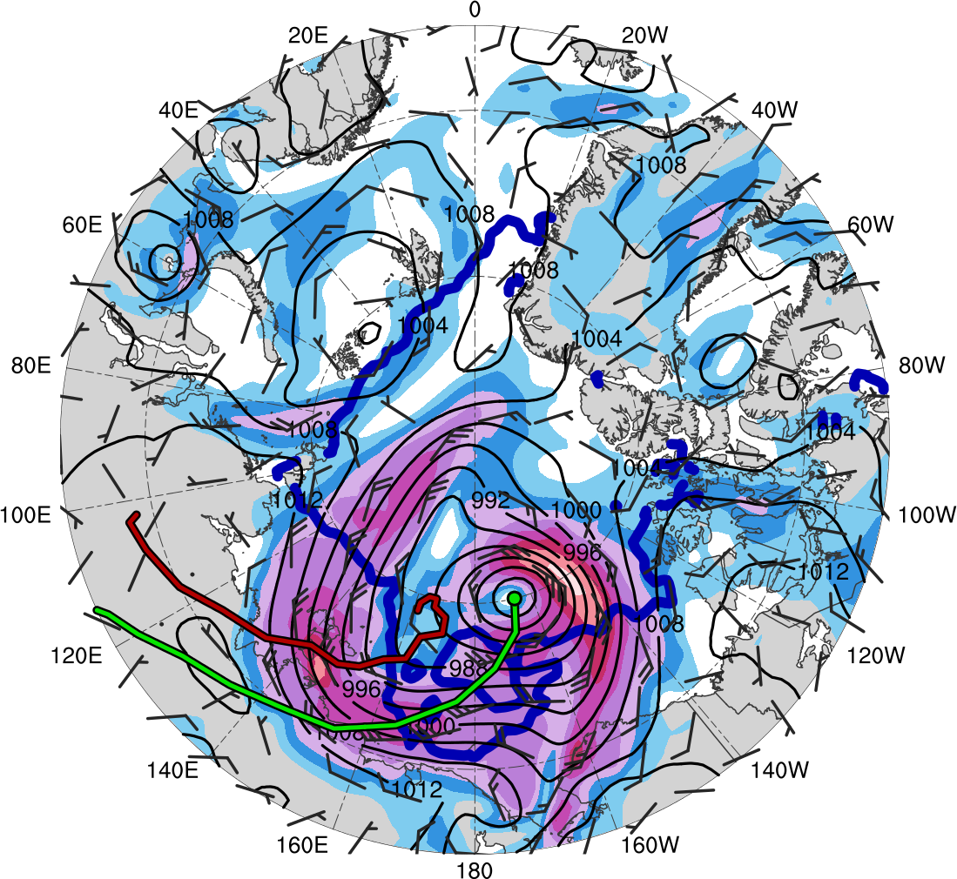
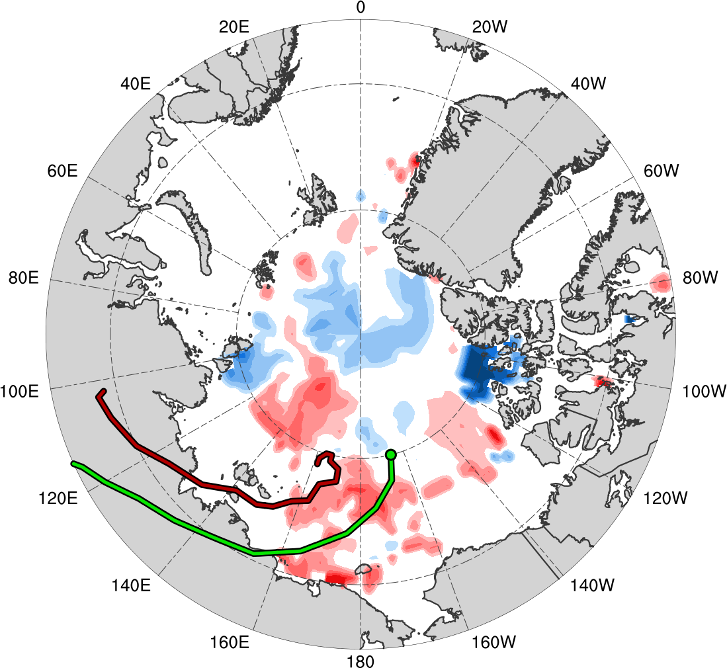
Impacts of Surface Cyclones on Arctic Sea Ice
Synoptic fields valid: 0000 UTC 6 Aug 2012
Sea ice valid: 0600 UTC 6 Aug 2012
0600 UTC 6 Aug − 0600 UTC 3 Aug 2012
L1
AC12
(m s⁻¹ )
(%)
4
6
8
10
12
14
16
18
-60
-50
-40
-30
-20
-10
-5
5
10
20
30
40
50
60
SLP (hPa, black); 10-m wind speed (m s⁻¹, shaded) and wind (m s⁻¹, black barbs); and 20% contour of sea-ice concentration (thick blue)
Change in sea-ice concentration (shaded, %) since 0600 UTC 3 Aug 2012

Slide 33
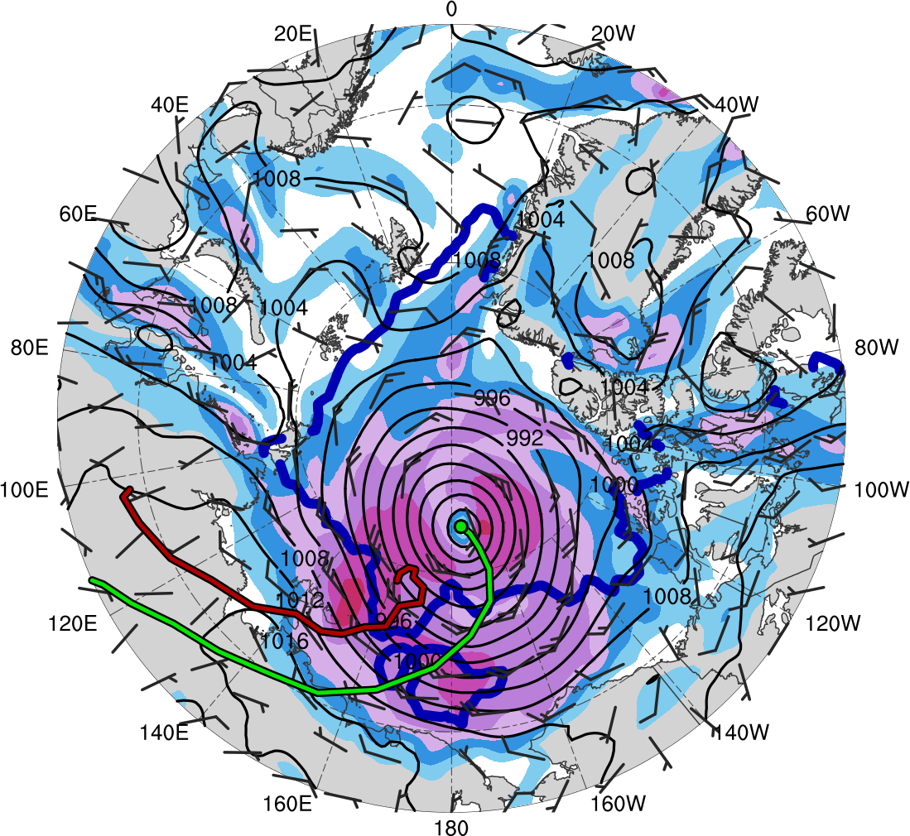
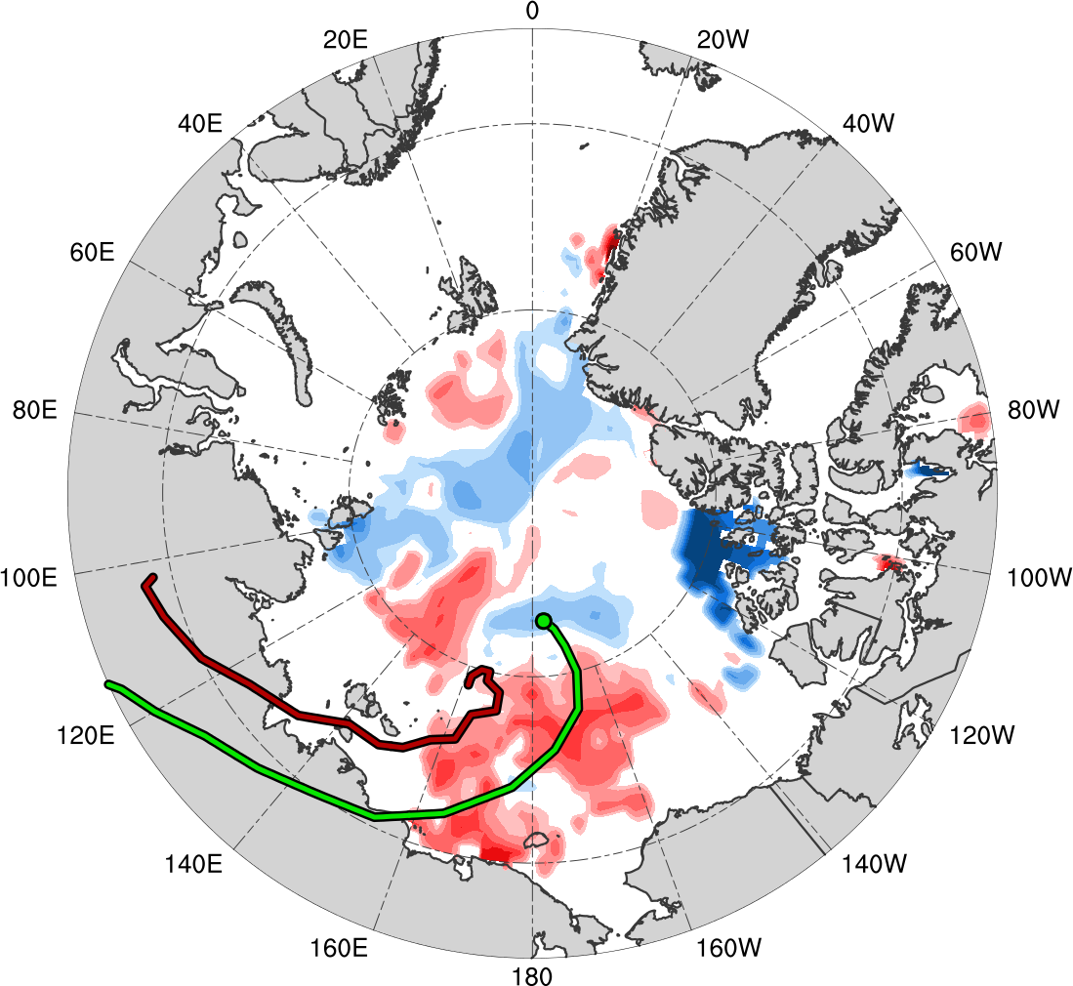
Impacts of Surface Cyclones on Arctic Sea Ice
Synoptic fields valid: 0000 UTC 7 Aug 2012
Sea ice valid: 0600 UTC 7 Aug 2012
0600 UTC 7 Aug − 0600 UTC 3 Aug 2012
L1
AC12
(m s⁻¹ )
(%)
4
6
8
10
12
14
16
18
-60
-50
-40
-30
-20
-10
-5
5
10
20
30
40
50
60
SLP (hPa, black); 10-m wind speed (m s⁻¹, shaded) and wind (m s⁻¹, black barbs); and 20% contour of sea-ice concentration (thick blue)
Change in sea-ice concentration (shaded, %) since 0600 UTC 3 Aug 2012

Slide 34
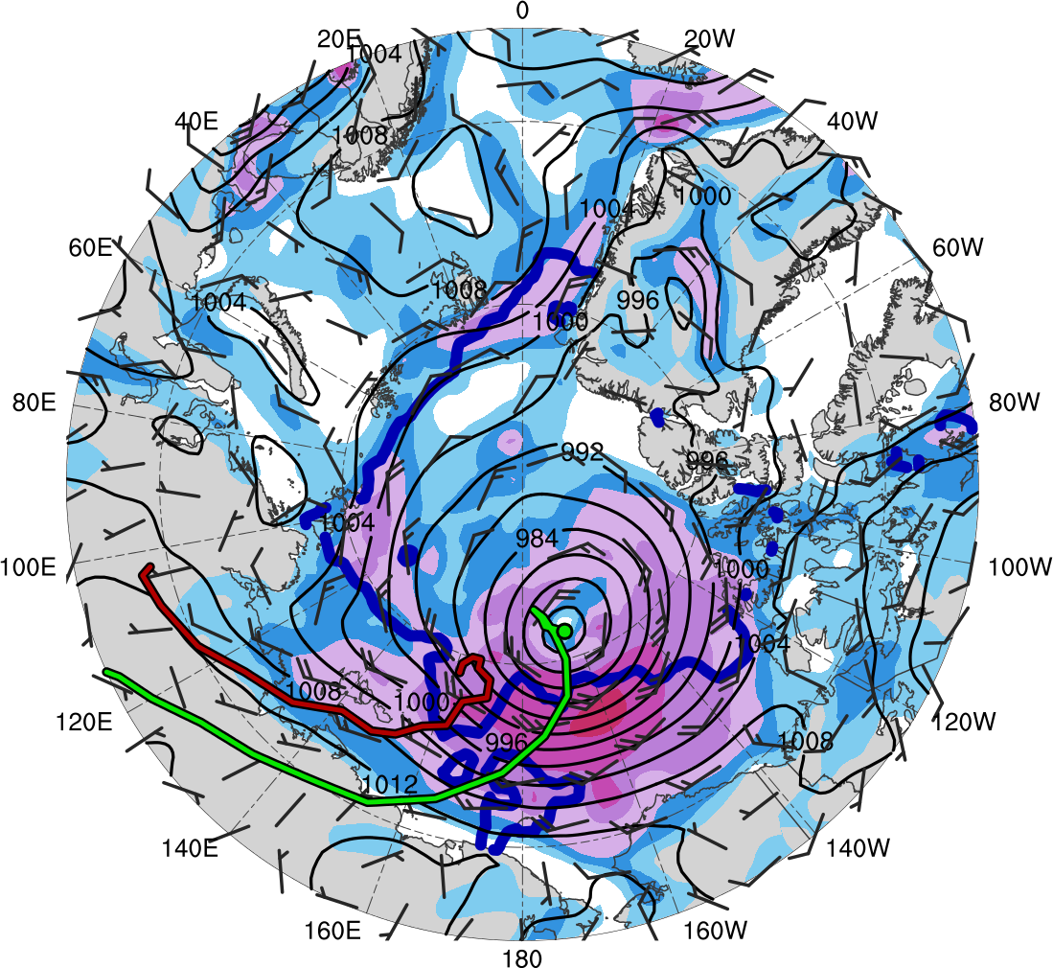
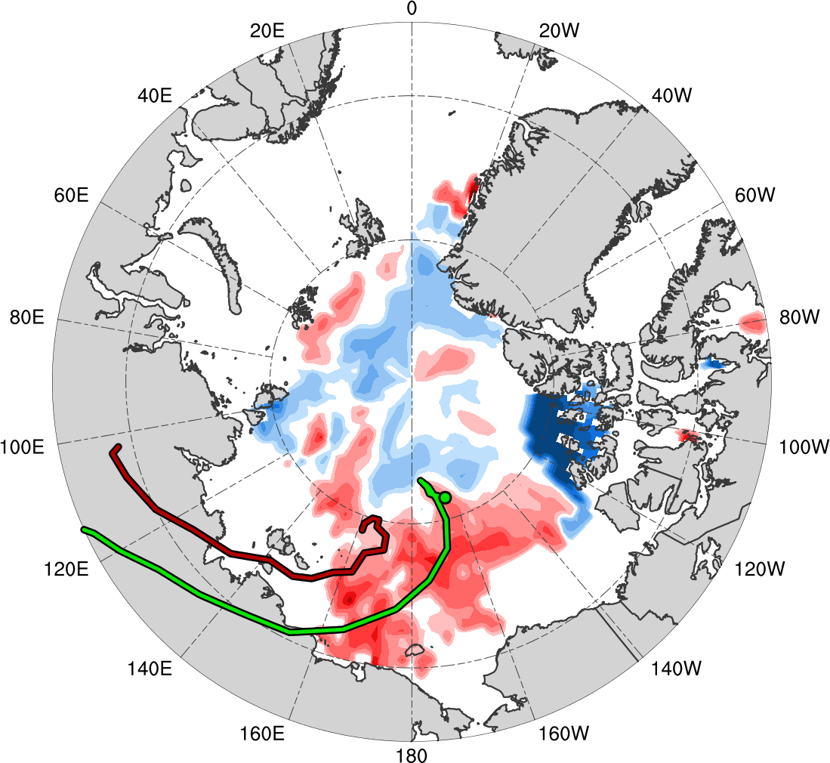
Impacts of Surface Cyclones on Arctic Sea Ice
Synoptic fields valid: 0000 UTC 8 Aug 2012
Sea ice valid: 0600 UTC 8 Aug 2012
0600 UTC 8 Aug − 0600 UTC 3 Aug 2012
L1
AC12
(m s⁻¹ )
(%)
4
6
8
10
12
14
16
18
-60
-50
-40
-30
-20
-10
-5
5
10
20
30
40
50
60
SLP (hPa, black); 10-m wind speed (m s⁻¹, shaded) and wind (m s⁻¹, black barbs); and 20% contour of sea-ice concentration (thick blue)
Change in sea-ice concentration (shaded, %) since 0600 UTC 3 Aug 2012

Slide 35
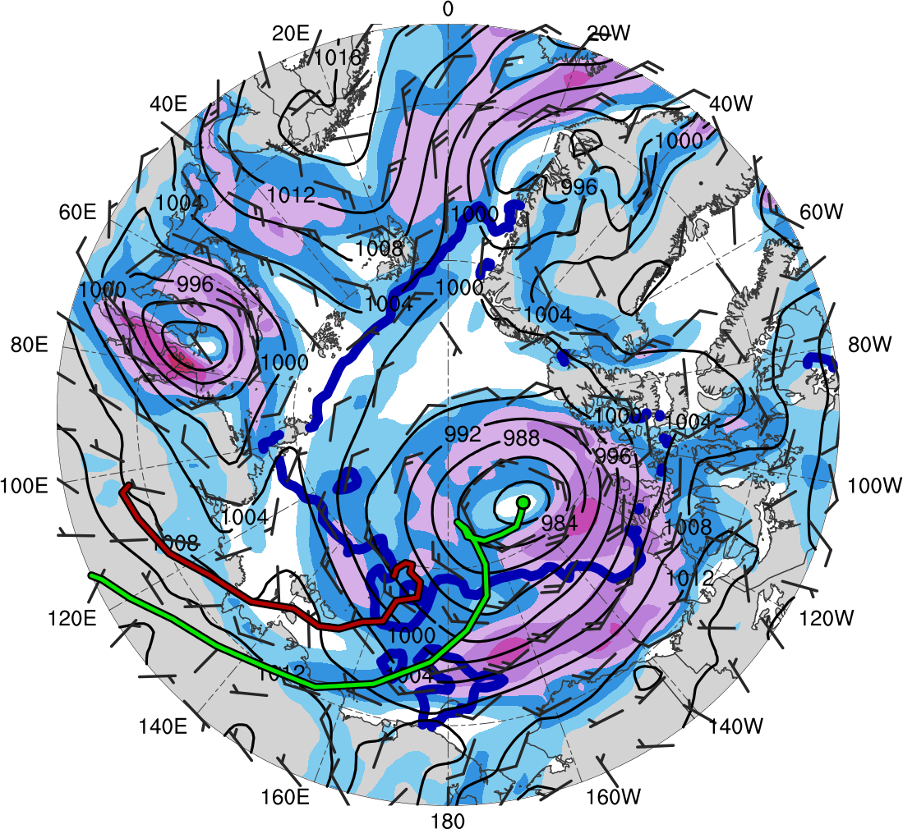
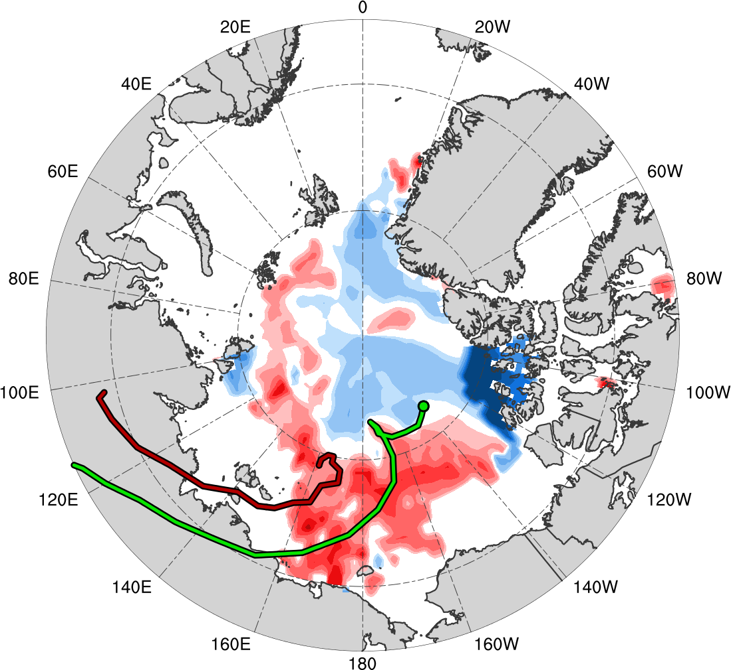
Impacts of Surface Cyclones on Arctic Sea Ice
Synoptic fields valid: 0000 UTC 9 Aug 2012
Sea ice valid: 0600 UTC 9 Aug 2012
0600 UTC 9 Aug − 0600 UTC 3 Aug 2012
L1
AC12
(m s⁻¹ )
(%)
4
6
8
10
12
14
16
18
-60
-50
-40
-30
-20
-10
-5
5
10
20
30
40
50
60
SLP (hPa, black); 10-m wind speed (m s⁻¹, shaded) and wind (m s⁻¹, black barbs); and 20% contour of sea-ice concentration (thick blue)
Change in sea-ice concentration (shaded, %) since 0600 UTC 3 Aug 2012

Slide 36
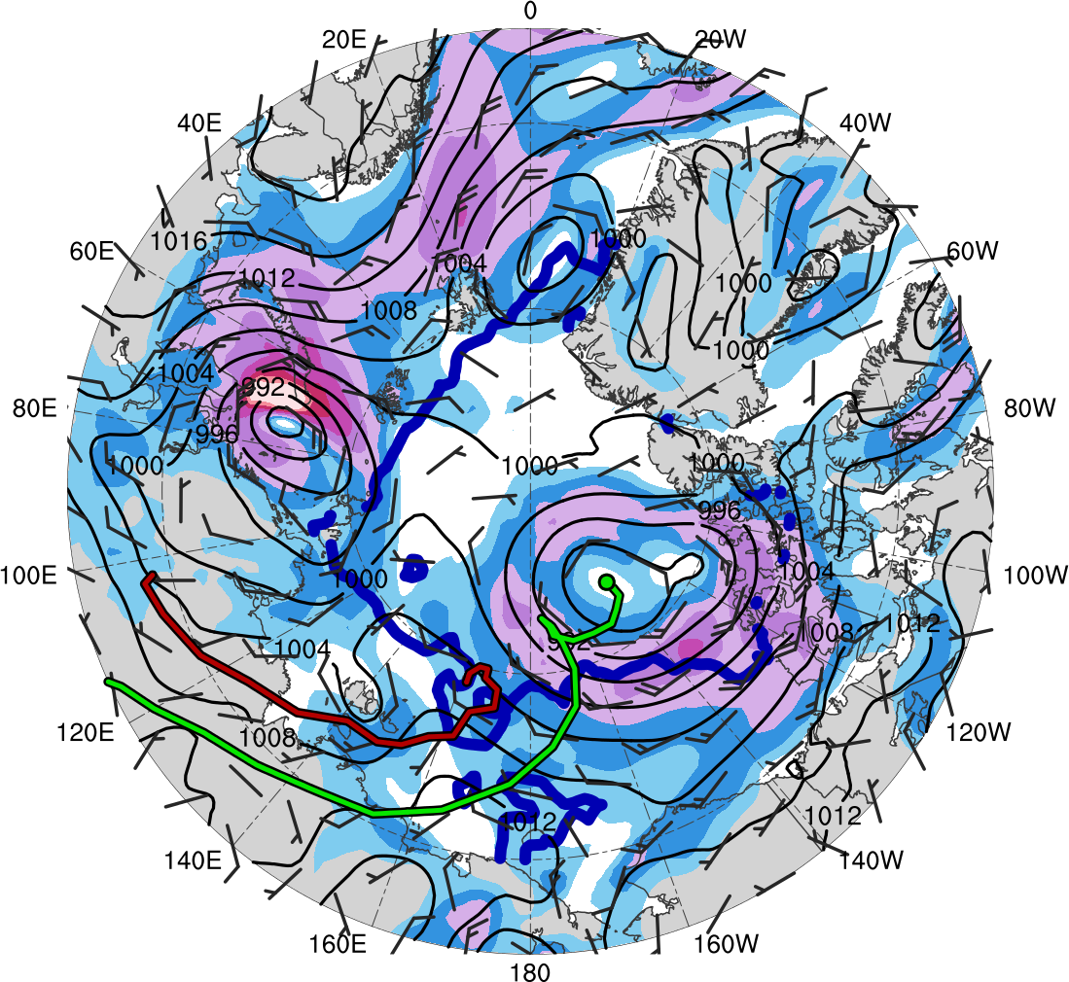
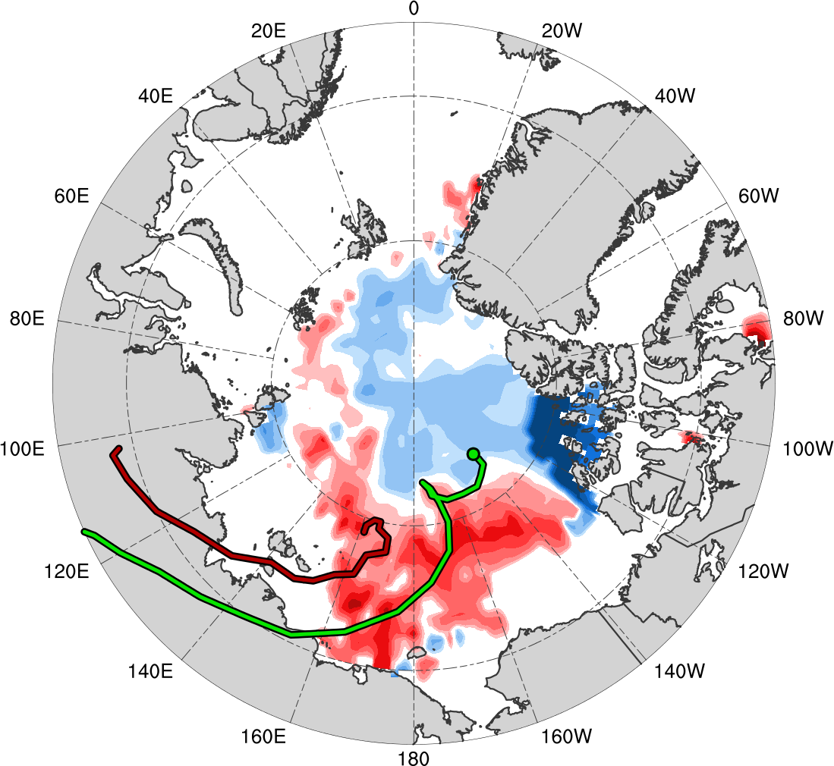
Impacts of Surface Cyclones on Arctic Sea Ice
Synoptic fields valid: 0000 UTC 10 Aug 2012
Sea ice valid: 0600 UTC 10 Aug 2012
0600 UTC 10 Aug − 0600 UTC 3 Aug 2012
L1
AC12
(m s⁻¹ )
(%)
4
6
8
10
12
14
16
18
-60
-50
-40
-30
-20
-10
-5
5
10
20
30
40
50
60
SLP (hPa, black); 10-m wind speed (m s⁻¹, shaded) and wind (m s⁻¹, black barbs); and 20% contour of sea-ice concentration (thick blue)
Change in sea-ice concentration (shaded, %) since 0600 UTC 3 Aug 2012

Slide 37
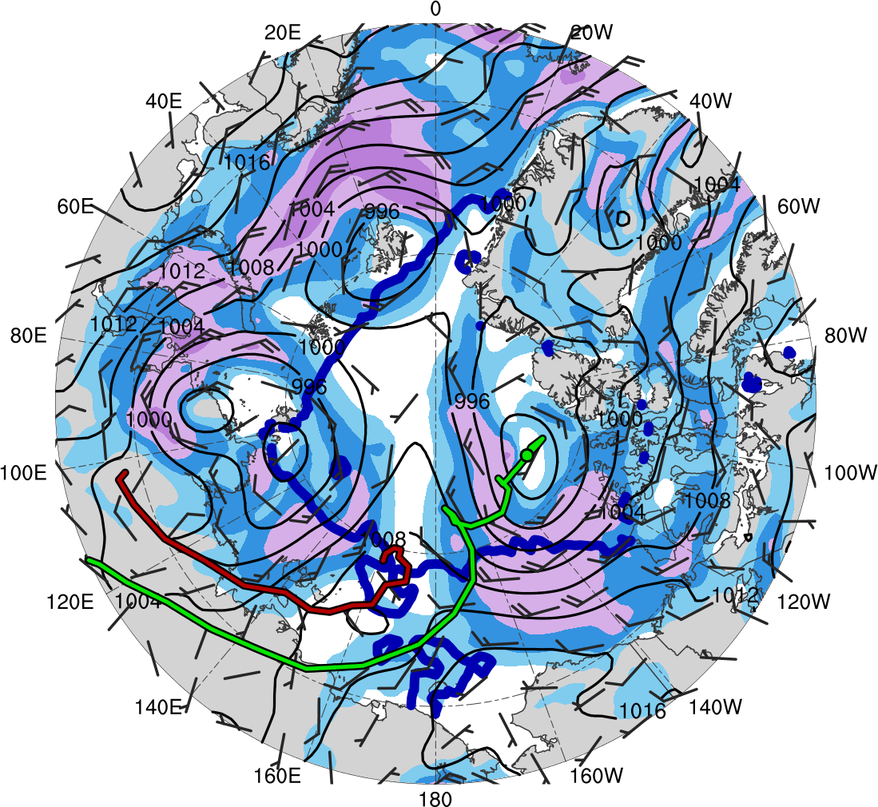
Impacts of Surface Cyclones on Arctic Sea Ice
Synoptic fields valid: 0000 UTC 11 Aug 2012
Sea ice valid: 0600 UTC 11 Aug 2012
0600 UTC 11 Aug − 0600 UTC 3 Aug 2012
L1
AC12
(m s⁻¹ )
(%)
4
6
8
10
12
14
16
18
-60
-50
-40
-30
-20
-10
-5
5
10
20
30
40
50
60
SLP (hPa, black); 10-m wind speed (m s⁻¹, shaded) and wind (m s⁻¹, black barbs); and 20% contour of sea-ice concentration (thick blue)
Change in sea-ice concentration (shaded, %) since 0600 UTC 3 Aug 2012

Slide 38
Evolution of TPV 1
1010
306
303
1000
Minimum DT θ
of TPV 1 (K)
300
990
Minimum DT θ (K)
Minimum MSLP (hPa)
297
980
Minimum MSLP
of AC12 (hPa)
294
970
291
960
1
2
3
4
5
6
7
8
9
10
11
12
13
14
15
306
3000
303
2500
Minimum DT θ
of TPV 1 (K)
300
2000
Minimum DT θ (K)
TPV area (10³ km²)
1500
Area of TPV 1 (10³ km²)
297
1000
294
500
291
1
2
3
4
5
6
7
8
9
10
11
12
13
14
15
Date

Slide 39
Evolution of TPV 1
0000 UTC 7 Aug 2012
TPV 1
AC12
TPV 2
L1
(K)
252
258
264
270
276
282
288
294
300
306
312
318
324
330
336
342
348
354
360
366
372
378
(mm)
(m s⁻¹ )
25
30
35
40
45
50
55
30
40
50
60
70
80
90
100
Potential temperature (K, shaded), wind speed (black, every 10 m s⁻¹ starting at 30 m s⁻¹), and wind (m s⁻¹, barbs) on 2-PVU surface
250-hPa wind speed (m s⁻¹, shaded),
1000–500-hPa thickness (dam, blue/red),
SLP (hPa, black), PW (mm, shaded)

Slide 40
Evolution of TPV 1
0000 UTC 8 Aug 2012
TPV 1
AC12
TPV 2
L1
(K)
252
258
264
270
276
282
288
294
300
306
312
318
324
330
336
342
348
354
360
366
372
378
(mm)
(m s⁻¹ )
25
30
35
40
45
50
55
30
40
50
60
70
80
90
100
Potential temperature (K, shaded), wind speed (black, every 10 m s⁻¹ starting at 30 m s⁻¹), and wind (m s⁻¹, barbs) on 2-PVU surface
250-hPa wind speed (m s⁻¹, shaded),
1000–500-hPa thickness (dam, blue/red),
SLP (hPa, black), PW (mm, shaded)

Slide 41
Evolution of TPV 1
0000 UTC 9 Aug 2012
TPV 1
AC12
TPV 2
L1
(K)
252
258
264
270
276
282
288
294
300
306
312
318
324
330
336
342
348
354
360
366
372
378
(mm)
(m s⁻¹ )
25
30
35
40
45
50
55
30
40
50
60
70
80
90
100
Potential temperature (K, shaded), wind speed (black, every 10 m s⁻¹ starting at 30 m s⁻¹), and wind (m s⁻¹, barbs) on 2-PVU surface
250-hPa wind speed (m s⁻¹, shaded),
1000–500-hPa thickness (dam, blue/red),
SLP (hPa, black), PW (mm, shaded)

Slide 42
Evolution of TPV 1
0000 UTC 10 Aug 2012
TPV 1
AC12
TPV 2
L1
(K)
252
258
264
270
276
282
288
294
300
306
312
318
324
330
336
342
348
354
360
366
372
378
(mm)
(m s⁻¹ )
25
30
35
40
45
50
55
30
40
50
60
70
80
90
100
Potential temperature (K, shaded), wind speed (black, every 10 m s⁻¹ starting at 30 m s⁻¹), and wind (m s⁻¹, barbs) on 2-PVU surface
250-hPa wind speed (m s⁻¹, shaded),
1000–500-hPa thickness (dam, blue/red),
SLP (hPa, black), PW (mm, shaded)

Slide 43
Evolution of TPV 1
0000 UTC 11 Aug 2012
TPV 1
AC12
TPV 2
L1
(K)
252
258
264
270
276
282
288
294
300
306
312
318
324
330
336
342
348
354
360
366
372
378
(mm)
(m s⁻¹ )
25
30
35
40
45
50
55
30
40
50
60
70
80
90
100
Potential temperature (K, shaded), wind speed (black, every 10 m s⁻¹ starting at 30 m s⁻¹), and wind (m s⁻¹, barbs) on 2-PVU surface
250-hPa wind speed (m s⁻¹, shaded),
1000–500-hPa thickness (dam, blue/red),
SLP (hPa, black), PW (mm, shaded)

Slide 44
Evolution of TPV 1
0000 UTC 12 Aug 2012
TPV 1
AC12
TPV 2
L1
(K)
252
258
264
270
276
282
288
294
300
306
312
318
324
330
336
342
348
354
360
366
372
378
(mm)
(m s⁻¹ )
25
30
35
40
45
50
55
30
40
50
60
70
80
90
100
Potential temperature (K, shaded), wind speed (black, every 10 m s⁻¹ starting at 30 m s⁻¹), and wind (m s⁻¹, barbs) on 2-PVU surface
250-hPa wind speed (m s⁻¹, shaded),
1000–500-hPa thickness (dam, blue/red),
SLP (hPa, black), PW (mm, shaded)

Slide 45
Evolution of TPV 1
0000 UTC 13 Aug 2012
TPV 1
AC12
TPV 2
L1
(K)
252
258
264
270
276
282
288
294
300
306
312
318
324
330
336
342
348
354
360
366
372
378
(mm)
(m s⁻¹ )
25
30
35
40
45
50
55
30
40
50
60
70
80
90
100
Potential temperature (K, shaded), wind speed (black, every 10 m s⁻¹ starting at 30 m s⁻¹), and wind (m s⁻¹, barbs) on 2-PVU surface
250-hPa wind speed (m s⁻¹, shaded),
1000–500-hPa thickness (dam, blue/red),
SLP (hPa, black), PW (mm, shaded)

Slide 46
Evolution of TPV 1
0000 UTC 14 Aug 2012
TPV 1
AC12
TPV 2
L1
(K)
252
258
264
270
276
282
288
294
300
306
312
318
324
330
336
342
348
354
360
366
372
378
(mm)
(m s⁻¹ )
25
30
35
40
45
50
55
30
40
50
60
70
80
90
100
Potential temperature (K, shaded), wind speed (black, every 10 m s⁻¹ starting at 30 m s⁻¹), and wind (m s⁻¹, barbs) on 2-PVU surface
250-hPa wind speed (m s⁻¹, shaded),
1000–500-hPa thickness (dam, blue/red),
SLP (hPa, black), PW (mm, shaded)

Slide 47
Conclusions
It has been shown that two TPVs may play an important role in the life cycle of AC12
TPV–jet interactions involving both TPVs, along with interactions between both TPVs, may be influencing the life cycle of AC12
Widespread strong surface winds associated with AC12 leads to reduction in Arctic sea-ice extent, consistent with past studies (e.g., Zhang et al. 2013)

Slide 48
Conclusions
TPV 1 strengthens and expands in size after AC12 peaks in intensity, possibly due to:
TPV 1 moving away from vertical wind shear associated with jet streaks
TPV 1 and AC12 becoming equivalent barotropic
Longwave radiative cooling
Merger of TPV 1 and TPV 2 during cyclonic wave breaking

Slide 49
Conclusions
Size and intensity changes of TPVs may impact surrounding synoptic-scale flow
TPVs may play important roles in the life cycles of intense Arctic cyclones that may impact Arctic sea-ice extent

Slide 50
Questions? kbiernat@albany.edu
Acknowledgments
Special thanks to Steven Cavallo, Jim Doyle, and Nicholas Szapiro

Slide 51
References
Cavallo, S. M., and G. J. Hakim, 2009: Potential vorticity diagnosis of a tropopause polar cyclone. Mon. Wea. Rev., 137, 1358–1371.
——, and ——, 2010: The composite structure of tropopause polar cyclones from a mesoscale model. Mon. Wea. Rev., 138, 3840–3857.
——, and ——, 2012: Radiative impact on tropopause polar vortices over the Arctic. Mon. Wea. Rev., 140, 1683–1702.
——, and ——, 2013: Physical mechanisms of tropopause polar vortex intensity change. J. Atmos. Sci., 70, 3359– 3373.
——, N. Szapiro, and U. Gutierrez, 2017: Atmospheric dynamics and impacts on abrupt Arctic summer sea ice loss events. 14th Conference on Polar Meteorology and Oceanography, Seattle, WA, Amer. Meteor. Soc., 4.6.
Dee, D. P., and Coauthors, 2011: The ERA-Interim reanalysis: configuration and performance of the data assimilation system. Quart. J. Roy. Meteor. Soc., 137, 553–597.
Parkinson, C. L., and J. C. Comiso, 2013: On the 2012 record low Arctic sea ice cover: Combined impact of preconditioning and an August storm. Geophys. Res. Lett., 40, 1356–1361.
Pyle, M. E., D. Keyser, and L. F. Bosart, 2004: A diagnostic study of jet streaks: Kinematic signatures and relationship to coherent tropopause disturbances. Mon. Wea. Rev., 132, 297–319.
Simmonds, I., and I. Rudeva, 2012: The great Arctic cyclone of August 2012. Geophys. Res. Lett., 39, L23709.
——, and ——, 2014: A comparison of tracking methods for extreme cyclones in the Arctic basin. Tellus., 66A, 25252.
Yamazaki, A., J. Inoue, K. Dethloff, M. Maturilli, and G. König-Langlo, 2015: Impact of radiosonde observations on forecasting summertime arctic cyclone formation. J. Geophys. Res. Atmos., 120, 3249–3273.
Zhang, J., R. Lindsay, A. Schweiger, and M. Steele, 2013: The impact of an intense summer cyclone on 2012 Arctic sea ice retreat, Geophys. Res. Lett., 40, 720–726.

Slide 52
Extra Slides

Slide 53
Impacts of TPV 1 on North America
0000 UTC 14 Aug 2012
TPV 1
AC12
TPV 2
L1
T
(K)
252
258
264
270
276
282
288
294
300
306
312
318
324
330
336
342
348
354
360
366
372
378
(mm)
(m s⁻¹ )
25
30
35
40
45
50
55
30
40
50
60
70
80
90
100
Potential temperature (K, shaded), wind speed (black, every 10 m s⁻¹ starting at 30 m s⁻¹), and wind (m s⁻¹, barbs) on 2-PVU surface
250-hPa wind speed (m s⁻¹, shaded),
1000–500-hPa thickness (dam, blue/red),
SLP (hPa, black), PW (mm, shaded)

Slide 54
Impacts of TPV 1 on North America
1200 UTC 14 Aug 2012
TPV 1
AC12
TPV 2
L1
T
(K)
252
258
264
270
276
282
288
294
300
306
312
318
324
330
336
342
348
354
360
366
372
378
(mm)
(m s⁻¹ )
25
30
35
40
45
50
55
30
40
50
60
70
80
90
100
Potential temperature (K, shaded), wind speed (black, every 10 m s⁻¹ starting at 30 m s⁻¹), and wind (m s⁻¹, barbs) on 2-PVU surface
250-hPa wind speed (m s⁻¹, shaded),
1000–500-hPa thickness (dam, blue/red),
SLP (hPa, black), PW (mm, shaded)

Slide 55
Impacts of TPV 1 on North America
0000 UTC 15 Aug 2012
TPV 1
AC12
TPV 2
L1
T
(K)
252
258
264
270
276
282
288
294
300
306
312
318
324
330
336
342
348
354
360
366
372
378
(mm)
(m s⁻¹ )
25
30
35
40
45
50
55
30
40
50
60
70
80
90
100
Potential temperature (K, shaded), wind speed (black, every 10 m s⁻¹ starting at 30 m s⁻¹), and wind (m s⁻¹, barbs) on 2-PVU surface
250-hPa wind speed (m s⁻¹, shaded),
1000–500-hPa thickness (dam, blue/red),
SLP (hPa, black), PW (mm, shaded)

Slide 56
Impacts of TPV 1 on North America
1200 UTC 15 Aug 2012
TPV 1
AC12
TPV 2
L1
T
(K)
252
258
264
270
276
282
288
294
300
306
312
318
324
330
336
342
348
354
360
366
372
378
(mm)
(m s⁻¹ )
25
30
35
40
45
50
55
30
40
50
60
70
80
90
100
Potential temperature (K, shaded), wind speed (black, every 10 m s⁻¹ starting at 30 m s⁻¹), and wind (m s⁻¹, barbs) on 2-PVU surface
250-hPa wind speed (m s⁻¹, shaded),
1000–500-hPa thickness (dam, blue/red),
SLP (hPa, black), PW (mm, shaded)

Slide 57
Impacts of TPV 1 on North America
0000 UTC 16 Aug 2012
TPV 1
AC12
TPV 2
L1
T
(K)
252
258
264
270
276
282
288
294
300
306
312
318
324
330
336
342
348
354
360
366
372
378
(mm)
(m s⁻¹ )
25
30
35
40
45
50
55
30
40
50
60
70
80
90
100
Potential temperature (K, shaded), wind speed (black, every 10 m s⁻¹ starting at 30 m s⁻¹), and wind (m s⁻¹, barbs) on 2-PVU surface
250-hPa wind speed (m s⁻¹, shaded),
1000–500-hPa thickness (dam, blue/red),
SLP (hPa, black), PW (mm, shaded)

Slide 58
Impacts of TPV 1 on North America
1200 UTC 16 Aug 2012
TPV 1
AC12
TPV 2
L1
T
(K)
252
258
264
270
276
282
288
294
300
306
312
318
324
330
336
342
348
354
360
366
372
378
(mm)
(m s⁻¹ )
25
30
35
40
45
50
55
30
40
50
60
70
80
90
100
Potential temperature (K, shaded), wind speed (black, every 10 m s⁻¹ starting at 30 m s⁻¹), and wind (m s⁻¹, barbs) on 2-PVU surface
250-hPa wind speed (m s⁻¹, shaded),
1000–500-hPa thickness (dam, blue/red),
SLP (hPa, black), PW (mm, shaded)

Slide 59
Impacts of TPV 1 on North America
0000 UTC 17 Aug 2012
TPV 1
AC12
TPV 2
L1
T
(K)
252
258
264
270
276
282
288
294
300
306
312
318
324
330
336
342
348
354
360
366
372
378
(mm)
(m s⁻¹ )
25
30
35
40
45
50
55
30
40
50
60
70
80
90
100
Potential temperature (K, shaded), wind speed (black, every 10 m s⁻¹ starting at 30 m s⁻¹), and wind (m s⁻¹, barbs) on 2-PVU surface
250-hPa wind speed (m s⁻¹, shaded),
1000–500-hPa thickness (dam, blue/red),
SLP (hPa, black), PW (mm, shaded)

Slide 60
July 2012 Temperature and Precipitation
(left) Departure from normal temperature (°F) and (right) percent of normal precipitation (%). Figures courtesy of NOAA National Centers for Environmental Information (NCEI), State of the Climate: Synoptic Discussion for July 2012 (https://www.ncdc.noaa.gov/sotc/synoptic/201207)

Slide 61
Time-mean Conditions (July 2012)
(σ)
-2
-1.5
-1
-0.5
0
0.5
1
1.5
2
July 2012 time-mean (left) 300-hPa geopotential height (dam, black) and standardized anomaly of 300-hPa geopotential height (σ, shaded); (right) 850-hPa temperature (°C, black) and standardized anomaly of 850-hPa temperature (σ, shaded)

Slide 62
Impact of TPV 1 on North America
TPV 1
TPV 1
(σ)
-2
-1.5
-1
-0.5
0
0.5
1
1.5
2
13–19 Aug 2012 time-mean (left) 300-hPa geopotential height (dam, black) and standardized anomaly of 300-hPa geopotential height (σ, shaded); (right) 850-hPa temperature (°C, black) and standardized anomaly of 850-hPa temperature (σ, shaded)

Slide 63
JJA TPV Climatology
JJA TPVs (N = 12,649)
Total number of unique TPV tracks within 500 km of each grid point (using a 0.5° grid) for TPVs occurring during June–August (JJA) for 1979–2015

