Slide 1
A Comparison of Arctic Cyclones between Periods of Low and High Forecast Skill of the Synoptic-scale Flow over the Arctic
Kevin A. Biernat
Department of Atmospheric and Environmental Sciences
University at Albany, SUNY
Cyclone Research Group
Monday 8 April 2019
Research Supported by ONR Grant N00014-18-1-2200

Slide 2
Motivation
Arctic cyclones are synoptic-scale cyclones that may originate within the Arctic or move into the Arctic from lower latitudes (e.g., Crawford and Serreze 2016)
Arctic cyclones may be associated with strong surface winds and poleward advection of warm, moist air, contributing to Arctic sea-ice loss (e.g., Zhang et al. 2013)
Predictability of Arctic cyclones has received limited attention in the literature

Slide 3
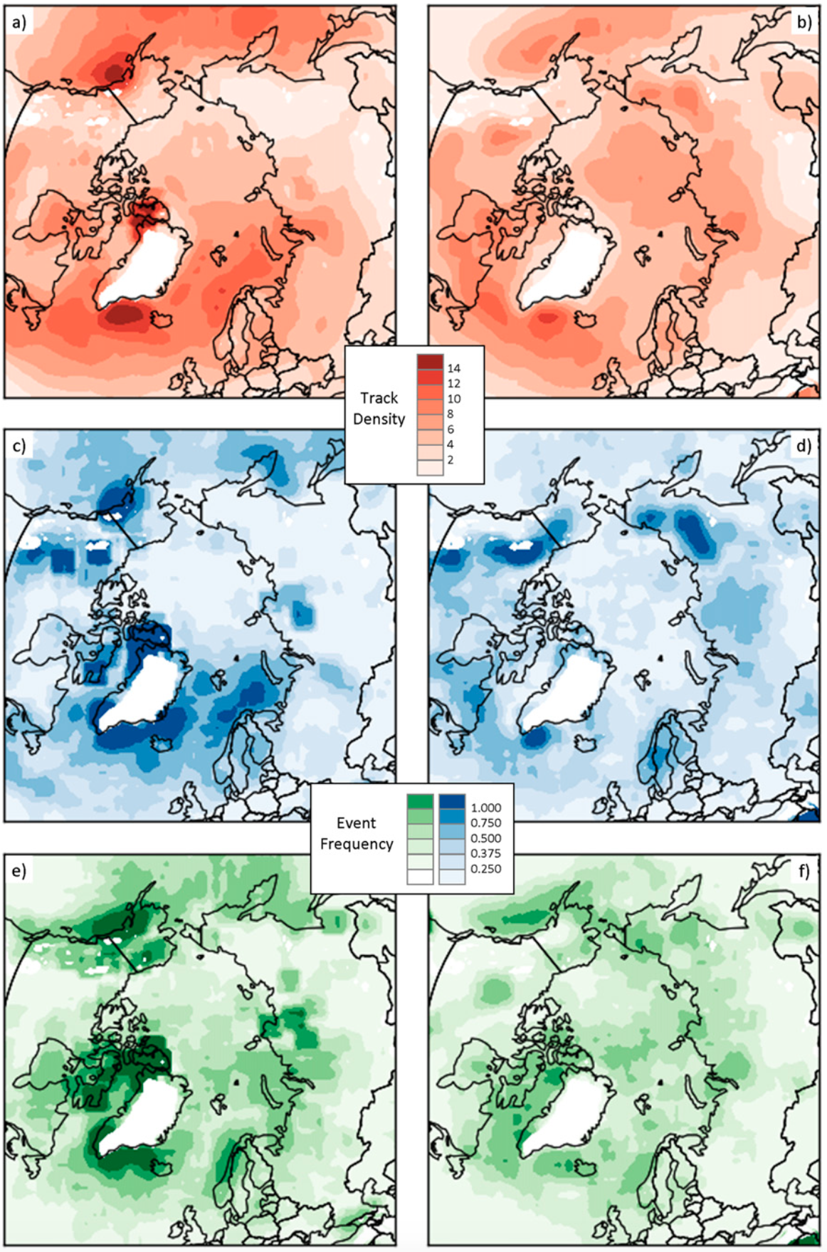
Background
Winter
Summer
Arctic cyclones may originate within and outside of Arctic
~30–40% of Arctic cyclones originate within Arctic during both winter and Summer
During winter, Arctic cyclones often originate from North Atlantic
During summer, Arctic cyclones often originate from Eurasia
Track Density
Genesis Frequency
Lysis Frequency
Figure 3 adapted from Crawford and Serreze (2016)

Slide 4
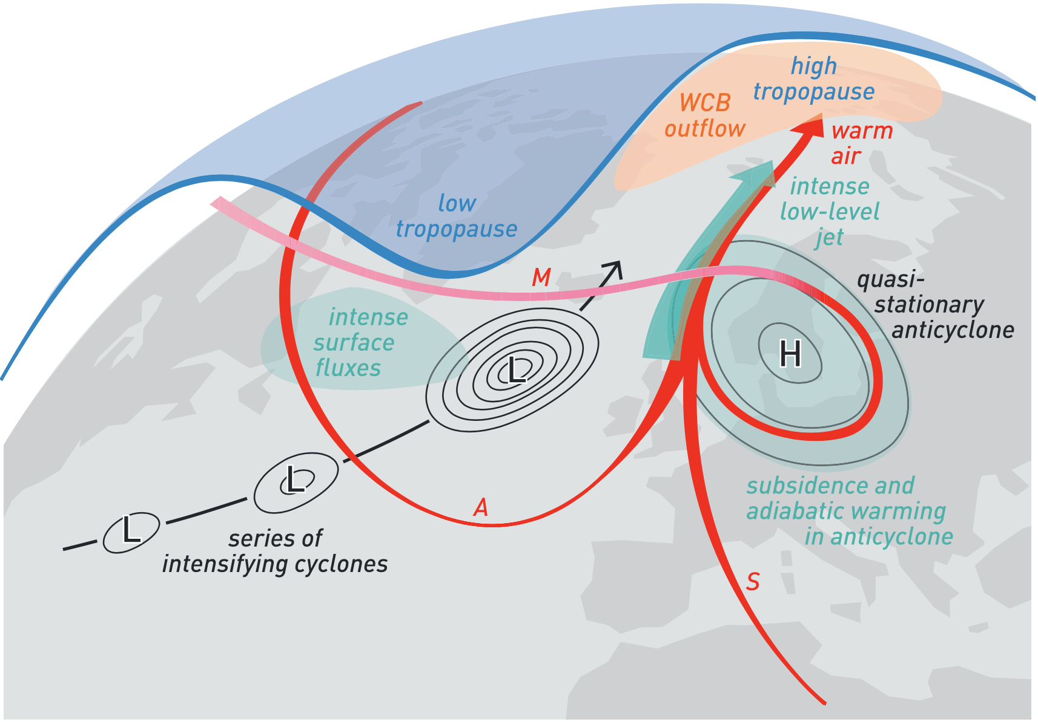
Background
Highly-amplified flow may enable cyclones and associated intrusions of warm, moist air to enter the Arctic
During late Dec 2015 and early Jan 2016, warm, moist air transported between series of cyclones and blocking anticyclone (Binder et al. 2017)
More than 30 cm of sea ice thinning in the Barents and Kara Seas occurred during this event
Kara
Sea
Barents Sea
L
H
L
L
Figure 4 adapted from Binder et al. (2017)

Slide 5
Background
Forecast skill over the Arctic may be lower than in middle latitudes (e.g., Sandu and Bauer 2018)
Yamagami et al. (2018) examine medium-range forecast skill for 10 strong Arctic cyclones occurring during the summers of 2008–2016 using five operational ensemble predictions systems (EPSs)
  Forecast skill of these Arctic cyclones is lower than that of midlatitude cyclones in the Northern Hemisphere
Low Arctic forecast skill may be attributed in part to low forecast skill of Arctic cyclones

Slide 6
Purpose
Investigate whether there are differences in the number, intensity, location, seasonality, and associated teleconnection patterns of Arctic cyclones between periods of low and high forecast skill of the synoptic-scale flow over the Arctic

Slide 7
Data and Methods
Create a 2007–2017 Arctic cyclone climatology
Obtain cyclone tracks from 1° ERA-Interim cyclone climatology prepared by Sprenger et al. (2017)
Arctic cyclones will be deemed cyclones that last at least 48 h and spend at least some portion of their lifetimes in the Arctic (>70°N), as done similarly by Simmonds and Rudeva (2014)

Slide 8
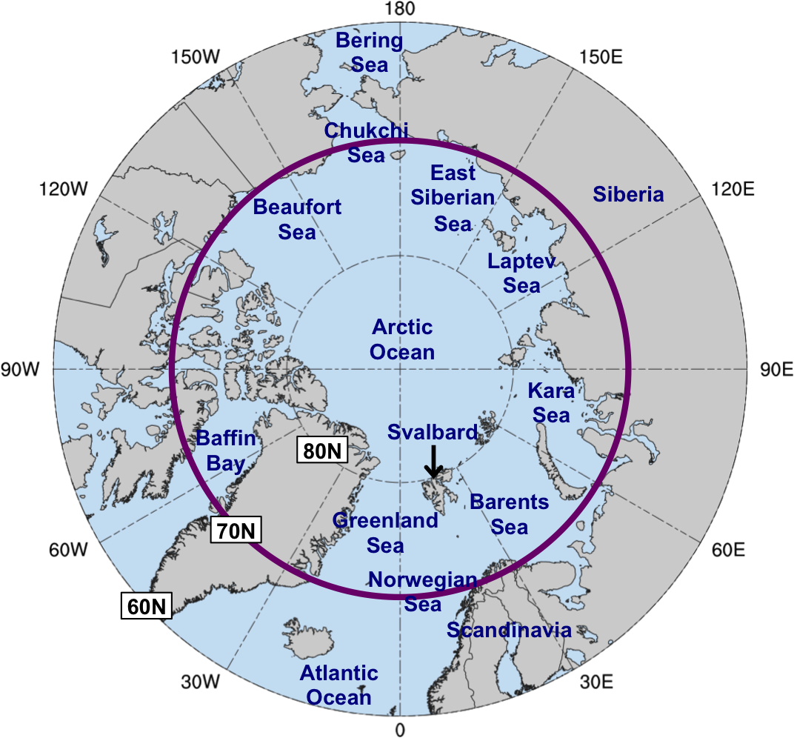
Data and Methods
Evaluate Arctic forecast skill in terms of an area-weighted average of standardized anomaly of ensemble spread (σ_{anom}) of 500-hPa geopotential height over the Arctic (≥70°N)
  Forecasts initialized at 0000 UTC and valid at day 5 during 2007–2017 from:
    11-member GEFS reforecast dataset v2 (Hamill et al 2013)
    51-member ECMWF EPS (Buizza et al. 2007)

Slide 9
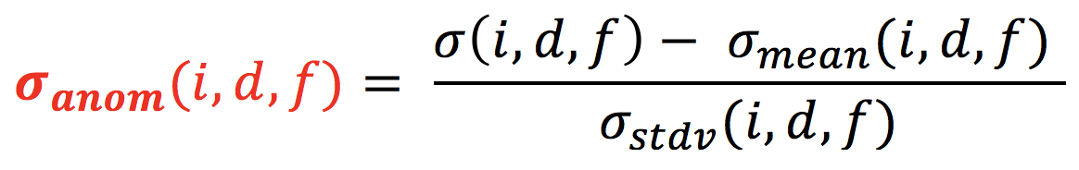
Data and Methods
At each grid point (i), day of the year (d), and forecast lead time (f), σ_{anom} is calculated similarly following Torn (2017) as:
σ = raw ensemble spread
σ_{mean} = climatological mean ensemble spread
σ_{stdv} = climatological standard deviation of ensemble spread
σ_{mean} and σ_{stdv} calculated for 1985–2017 period from the GEFS reforecast dataset v2

Slide 10
Data and Methods
Forecast days valid at day 5 associated with the top and bottom 10% of area-averaged σ_{anom} in both the GEFS and ECMWF EPS are referred to as low and high skill days, respectively
Time periods beginning five days prior to day 5 (i.e., day 0) through day 5 are referred to as low and high skill periods
All Arctic cyclones that exist in the Arctic (>70°N) at any time within the low and high skill periods are determined

Slide 11
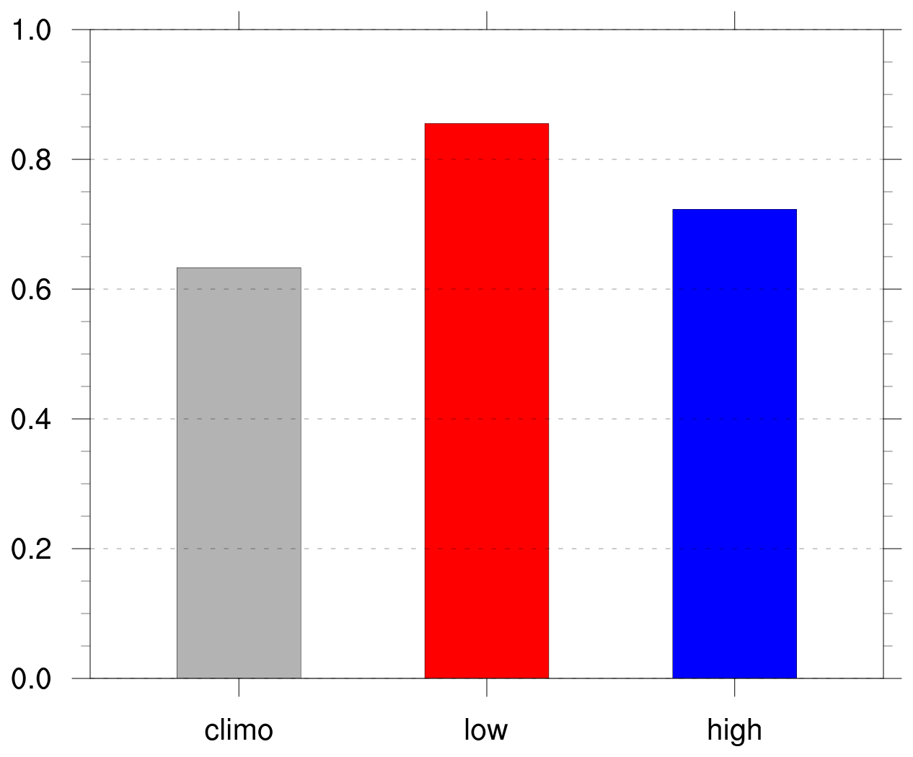
Number and Frequency of Arctic Cyclones
Frequency of Arctic cyclones (cyclones day⁻¹)
 | Number of days in period | Number of Arctic cyclones
Climo | 4018 | 2542
Low skill | 469 | 401
High skill | 477 | 345
Frequency = number of ACs within period / number of days within period

Slide 12
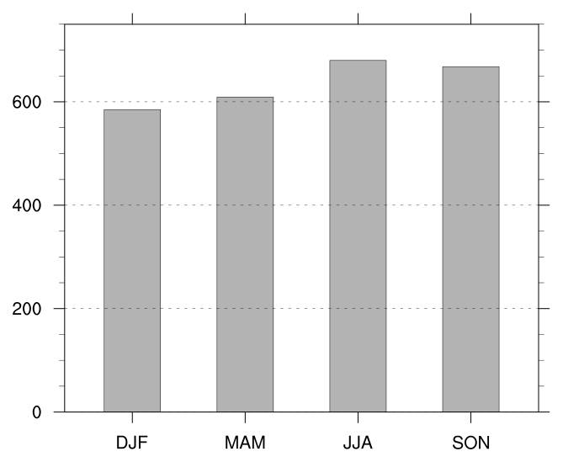
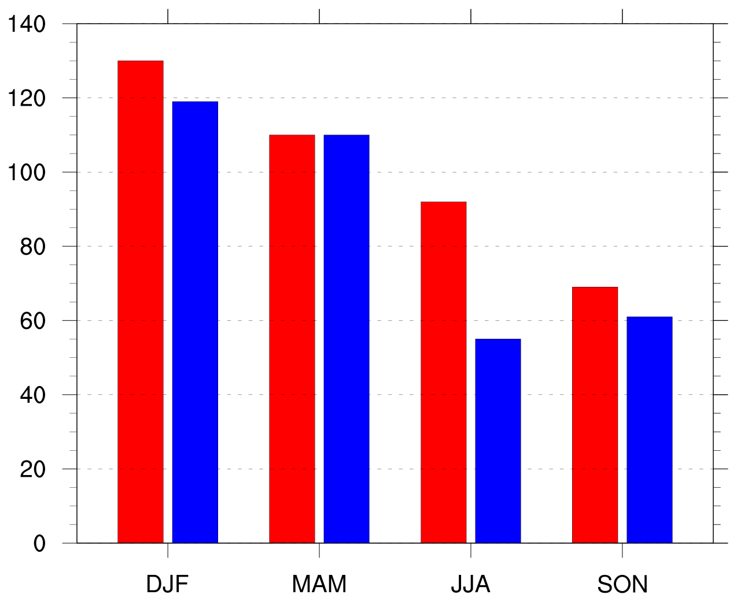
Number of Arctic Cyclones by Season
Number of Arctic cyclones in climatology by season
Number of Arctic cyclones in low and high skill periods by season
Low skill
High skill

Slide 13
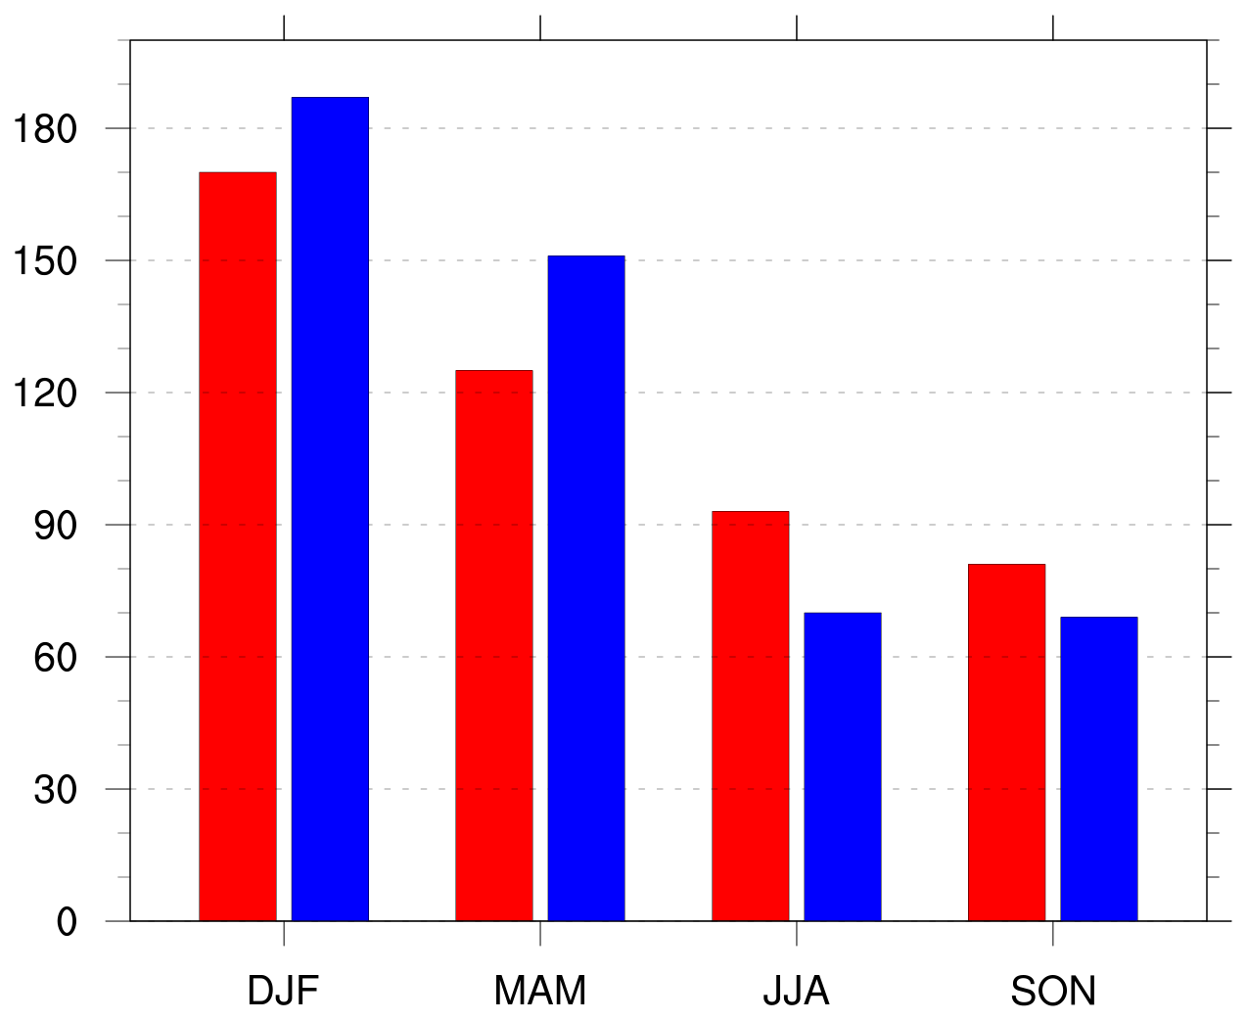
Number of Arctic Cyclones by Season
Number of days in low and high skill periods by season
Number of Arctic cyclones in low and high skill periods by season
Low skill
Low skill
High skill
High skill

Slide 14
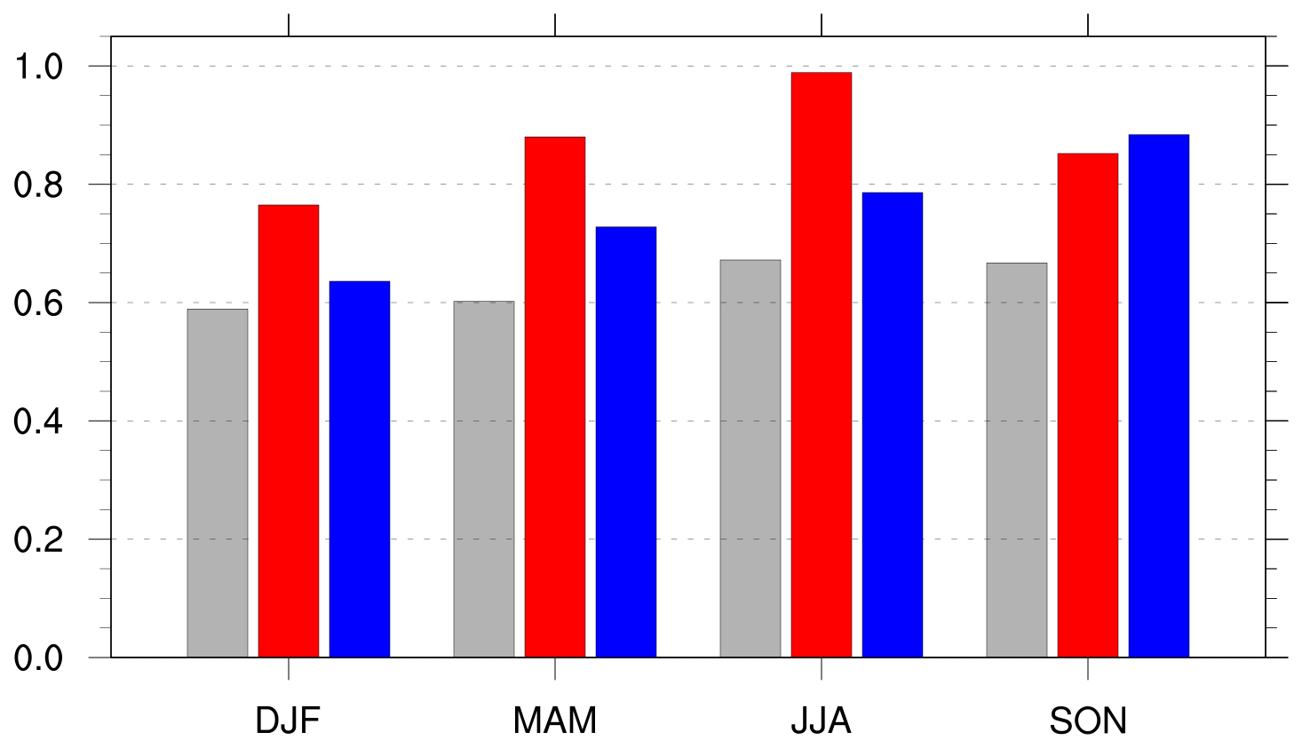
Frequency of Arctic Cyclones by Season
Frequency of Arctic cyclones (cyclones day⁻¹)
Climo
Low skill
High skill
Frequency = number of ACs within period / number of days within period

Slide 15
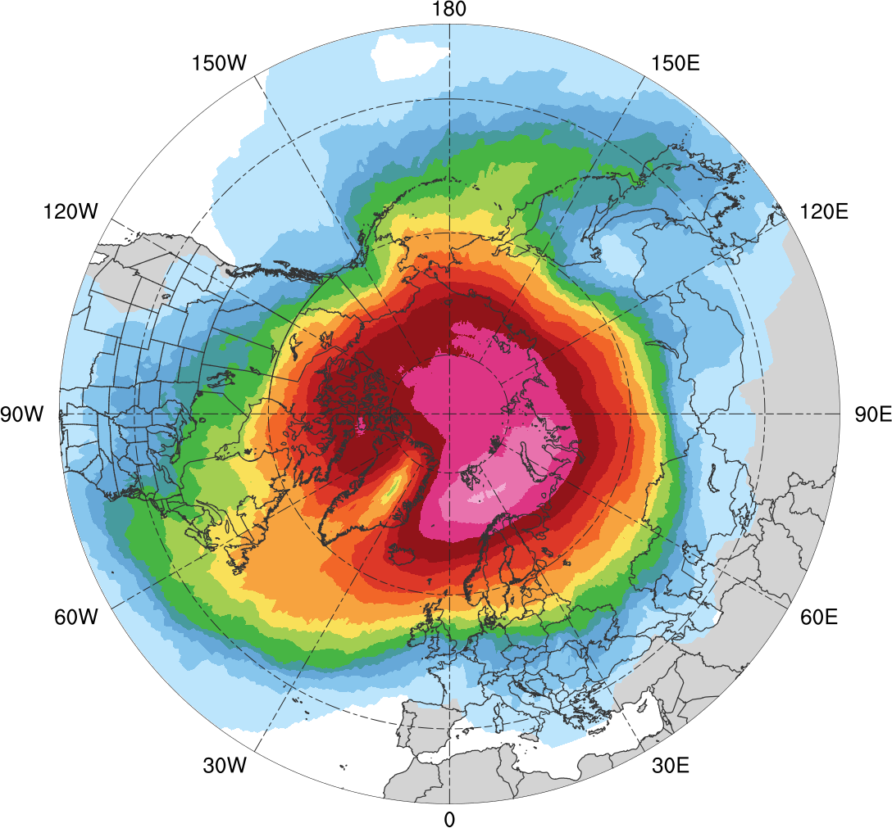
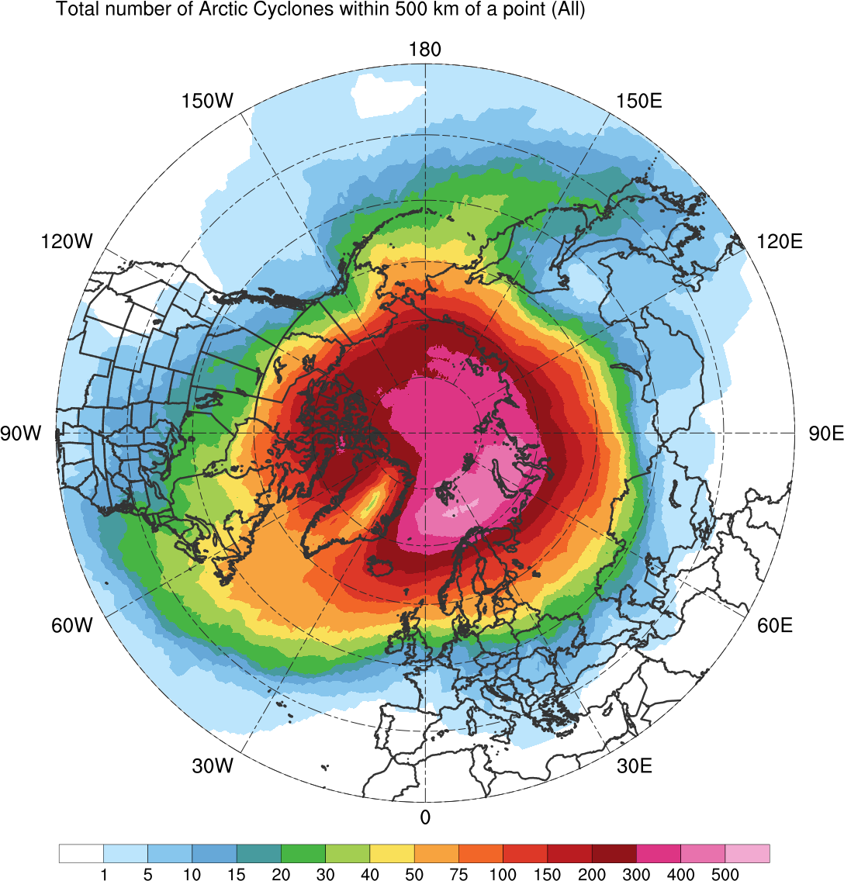
Track Density
Entire climatology (N = 2542)
1
5
10
15
20
30
40
50
75
100
150
200
300
400
500
Total number of Arctic cyclones within 500 km of a grid point

Slide 16
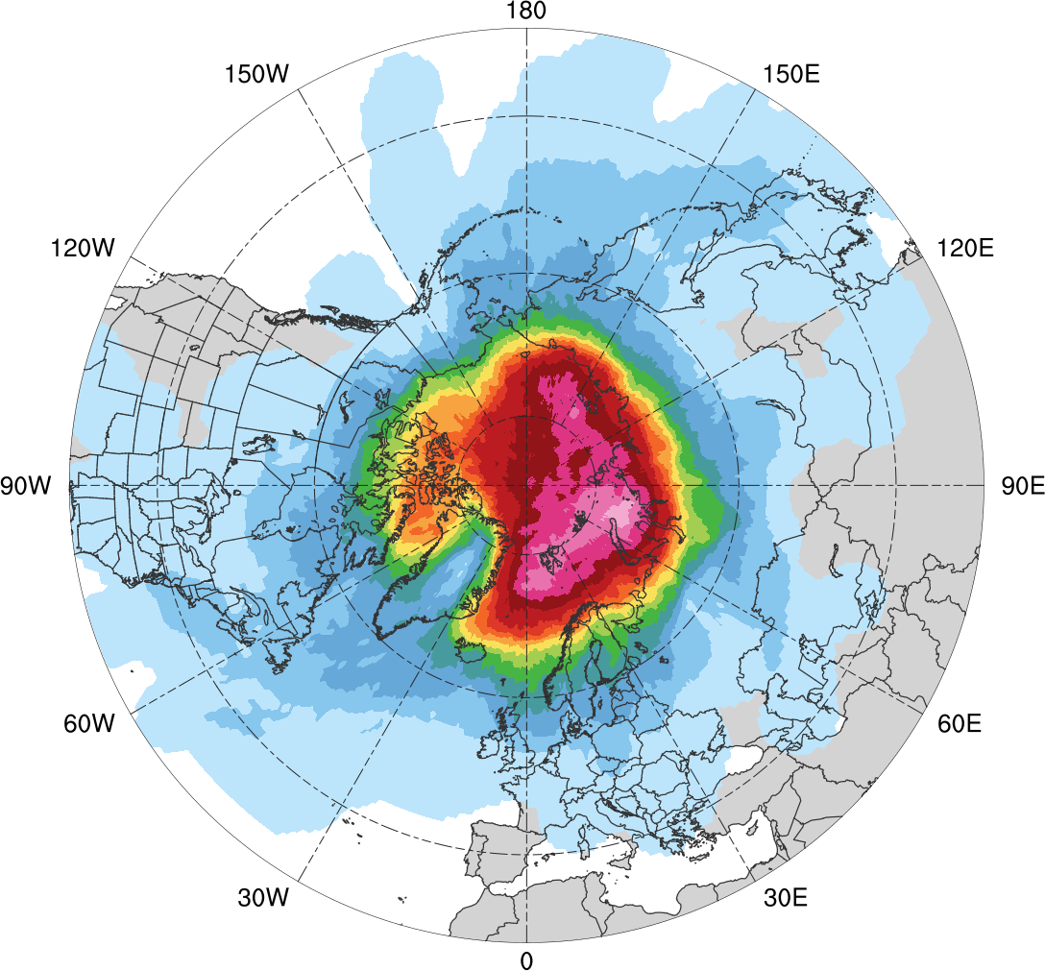
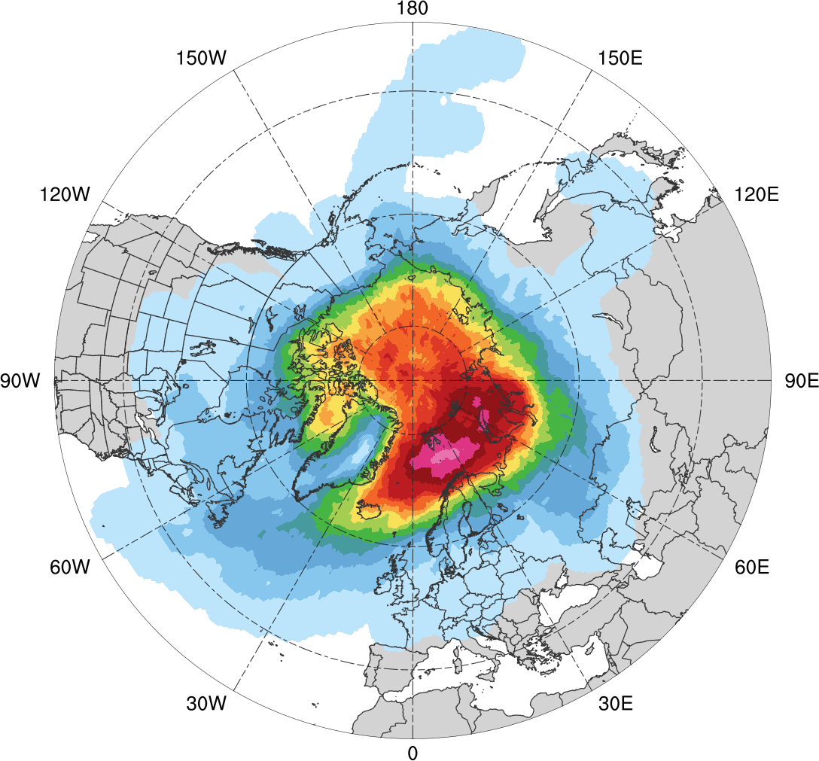
Track Density
Low skill (N = 401)
High Skill (N = 345)
1
5
10
15
20
25
30
35
40
45
50
60
70
80
90
Total number of Arctic cyclones within 500 km of a grid point

Slide 17
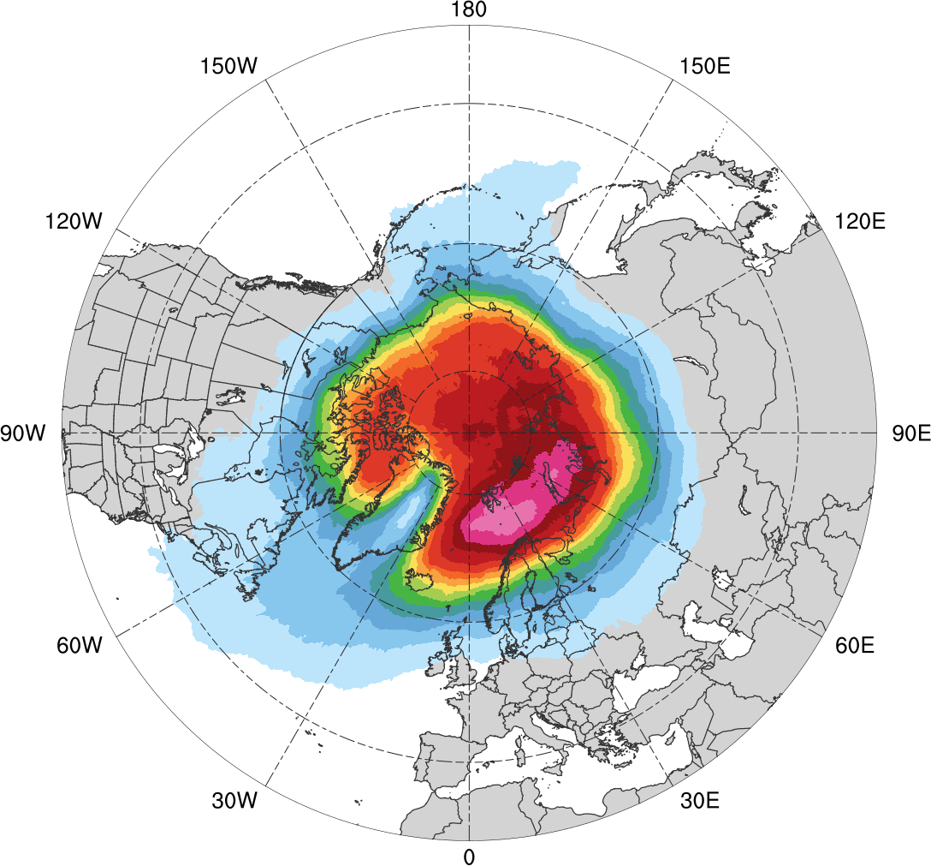
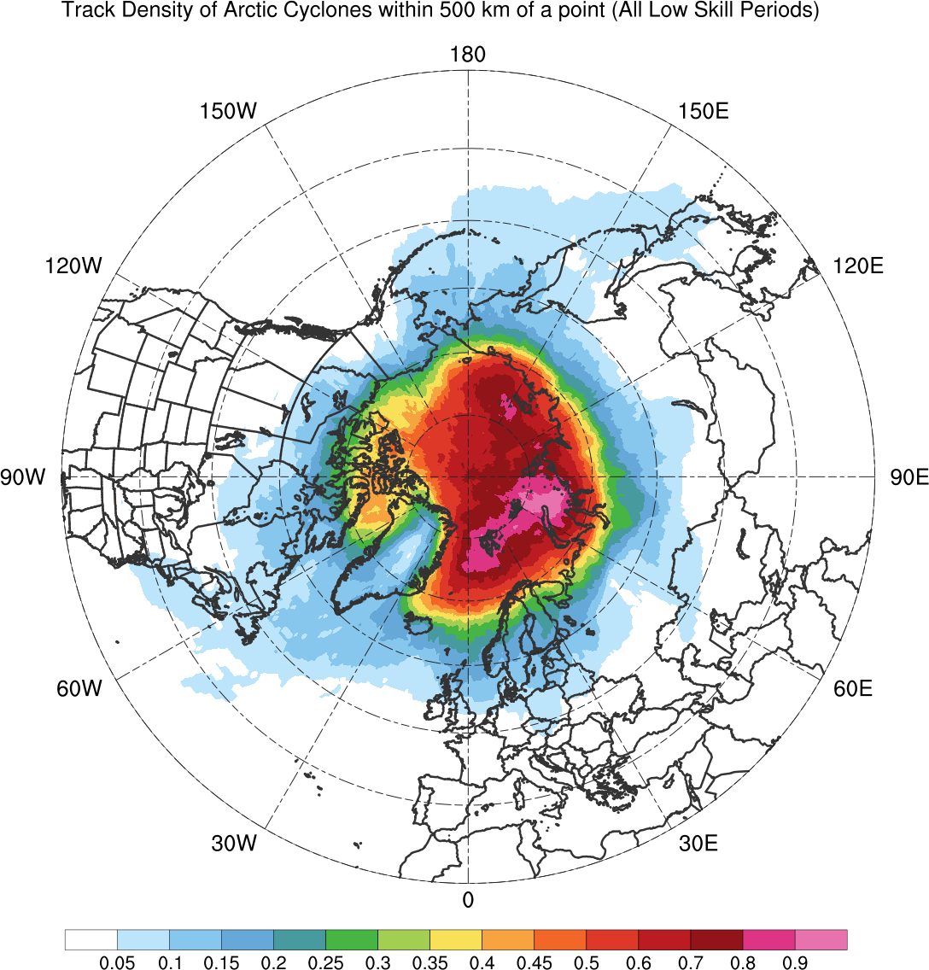
Results: Normalized Track Density
Entire climatology (N = 2542)
0.05
0.1
0.15
0.2
0.25
0.3
0.35
0.4
0.45
0.5
0.6
0.7
0.8
0.9
Total number of Arctic cyclones within 500 km of a grid point, normalized by maximum value

Slide 18
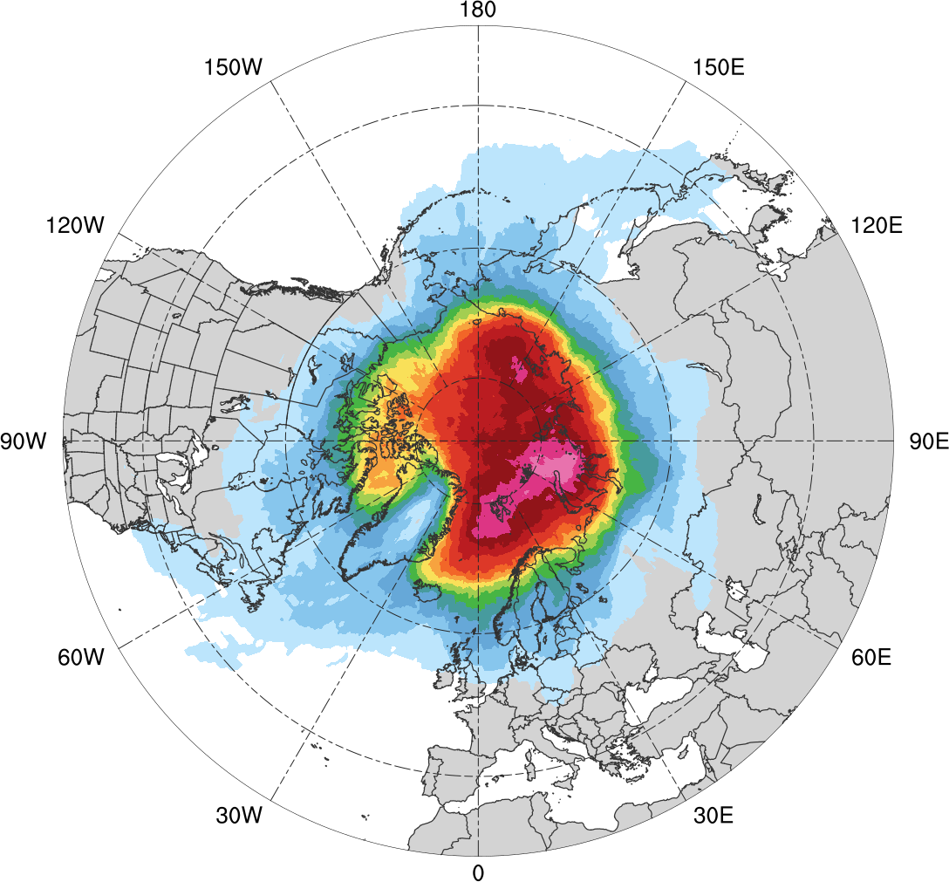
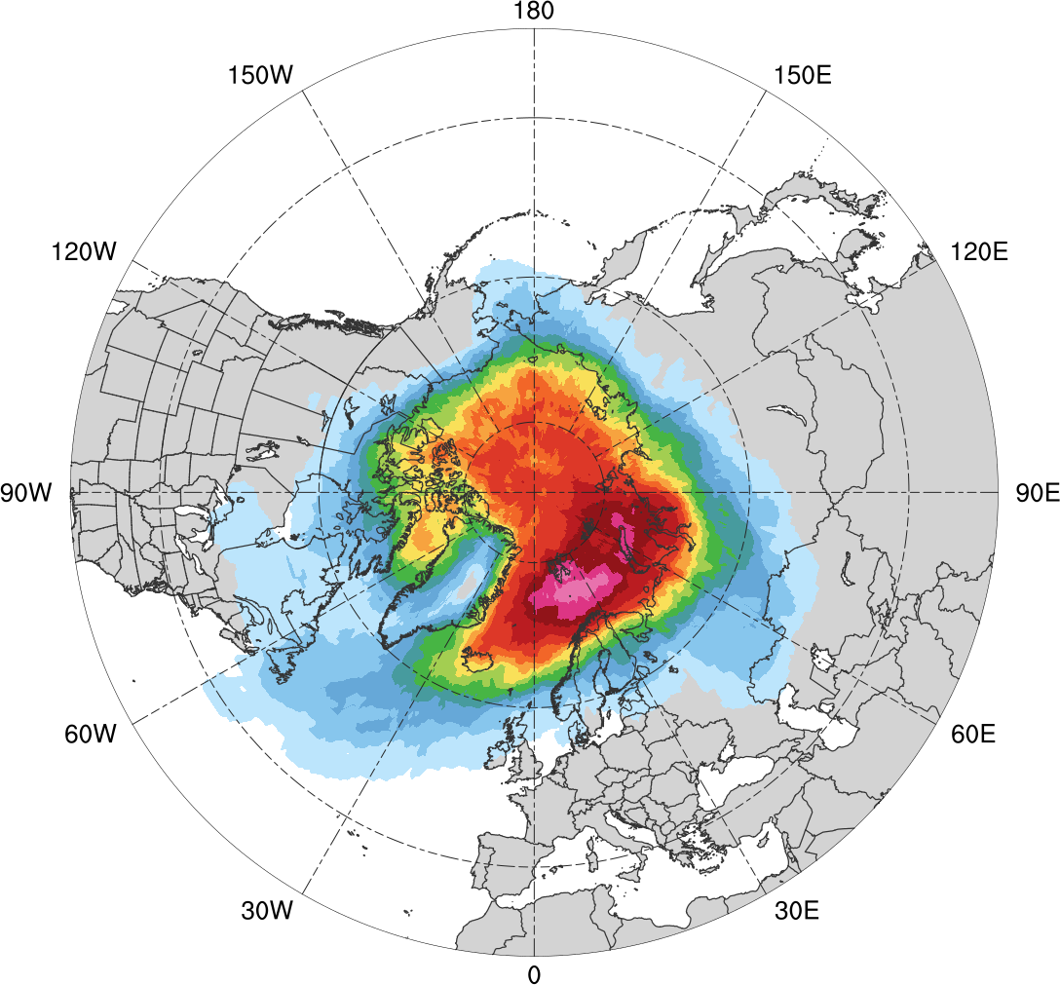
Normalized Track Density
Low skill (N = 401)
High Skill (N = 401)
0.05
0.1
0.15
0.2
0.25
0.3
0.35
0.4
0.45
0.5
0.6
0.7
0.8
0.9
Total number of Arctic cyclones within 500 km of a grid point, normalized by maximum value, for each period

Slide 19
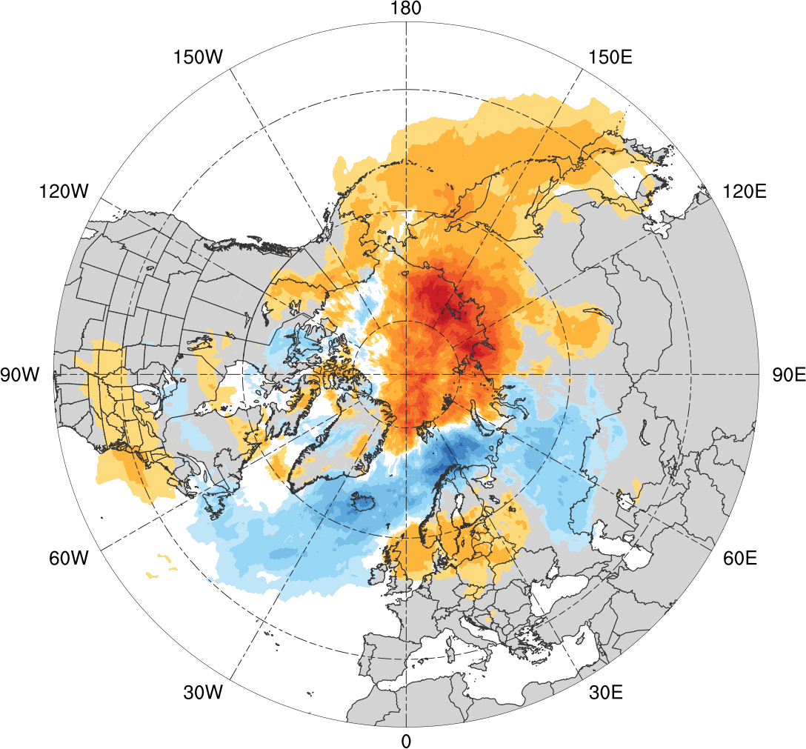
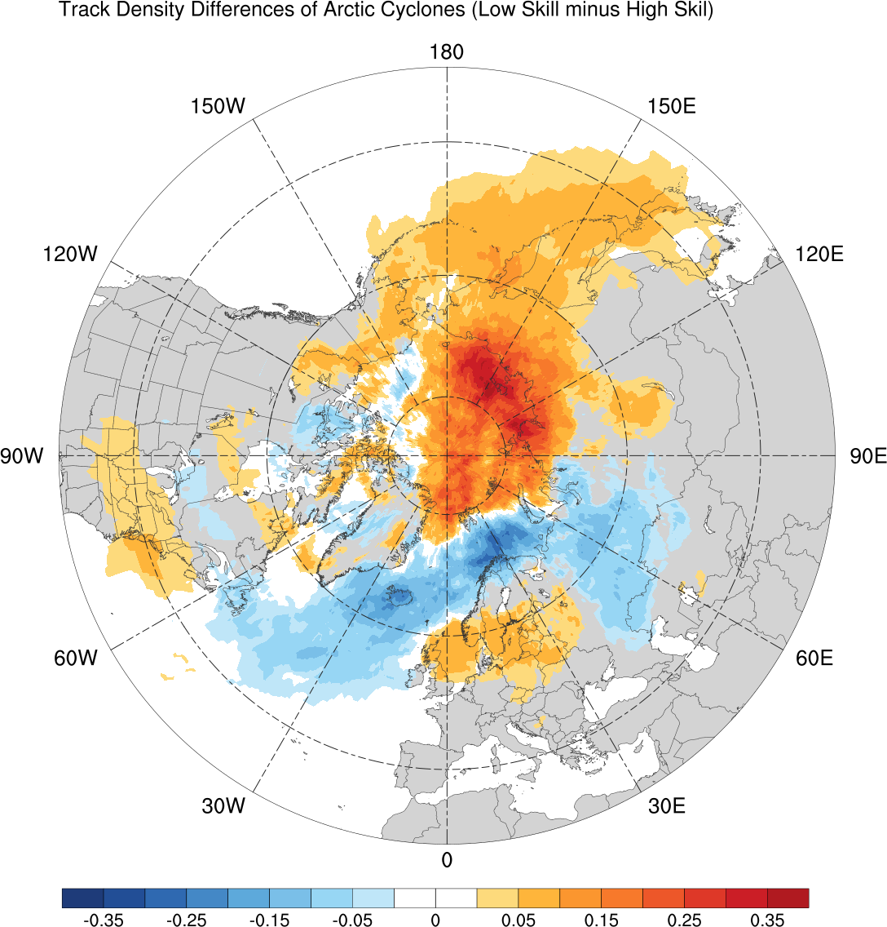
Normalized Track Density Differences
Low skill minus high skill
-0.35
-0.3
-0.25
-0.2
-0.15
-0.1
-0.025
-0.05
0
0.025
0.05
0.1
0.15
0.2
0.25
0.3
0.35
Difference in normalized Arctic cyclone track density

Slide 20
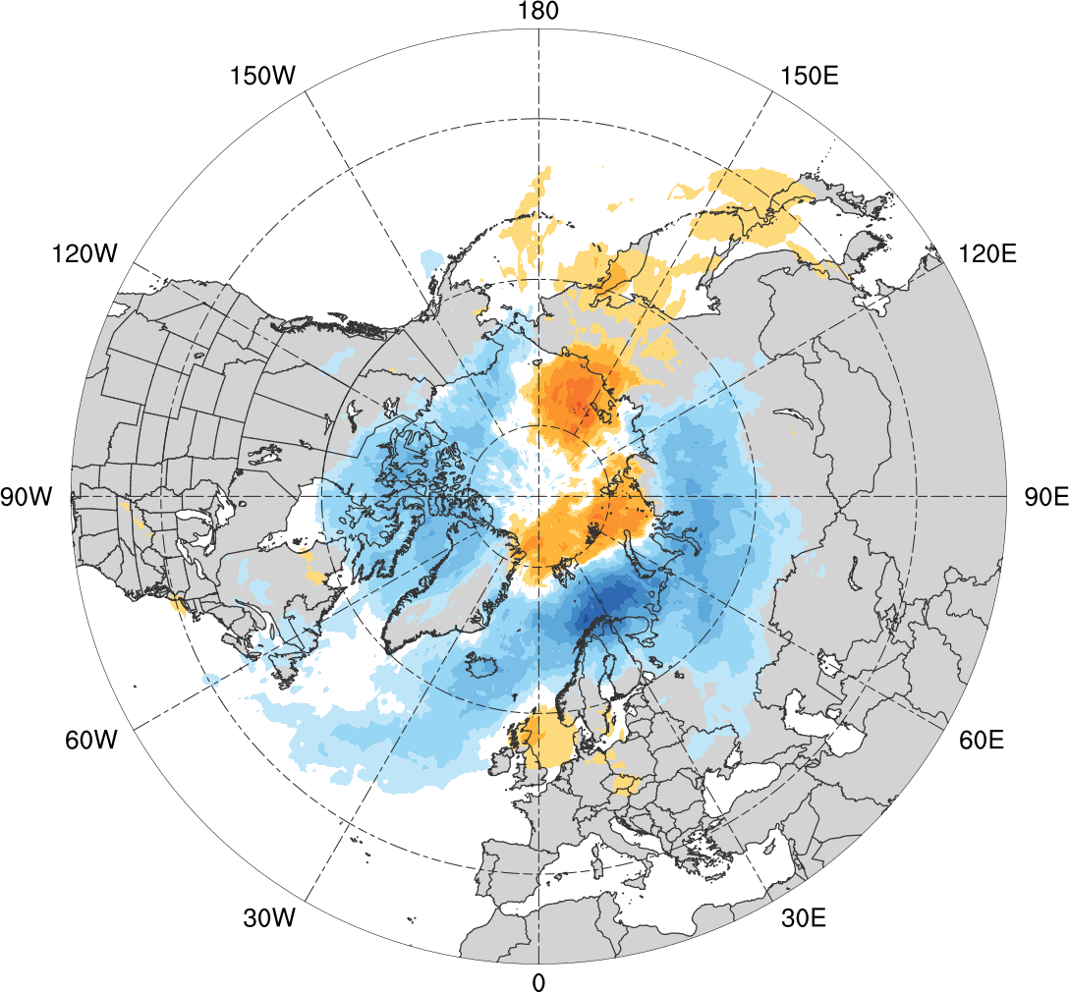
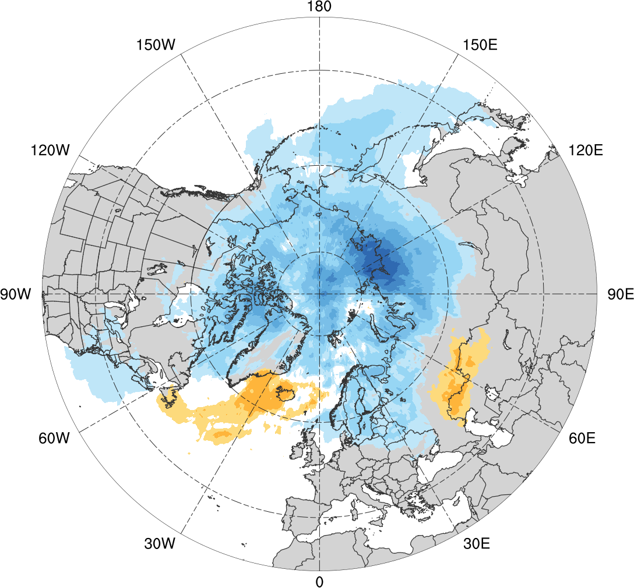
Normalized Track Density Differences
Low skill minus climatology
High skill minus climatology
-0.35
-0.3
-0.25
-0.2
-0.15
-0.1
-0.025
-0.05
0
0.025
0.05
0.1
0.15
0.2
0.25
0.3
0.35
Difference in normalized Arctic cyclone track density

Slide 21
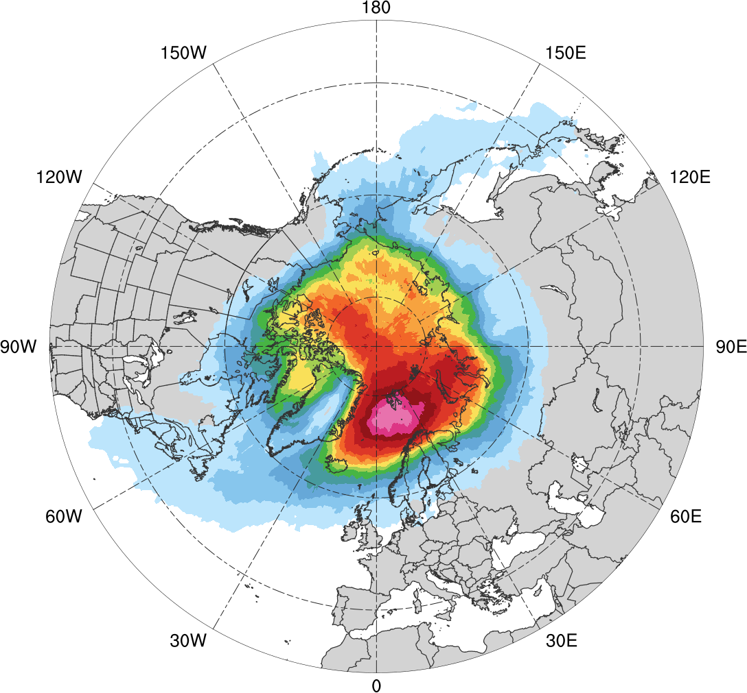
Normalized Track Density (DJF)
DJF climatology (N = 585)
0.05
0.1
0.15
0.2
0.25
0.3
0.35
0.4
0.45
0.5
0.6
0.7
0.8
0.9
Total number of Arctic cyclones during DJF within 500 km of a grid point, normalized by maximum value

Slide 22
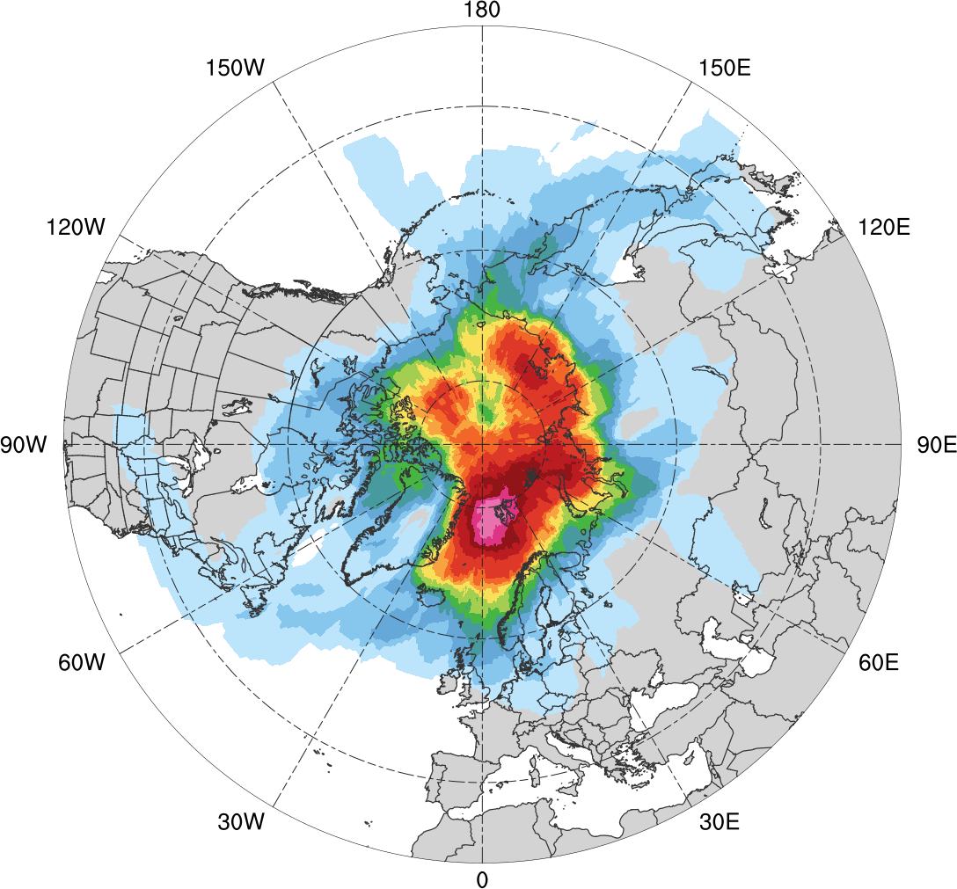
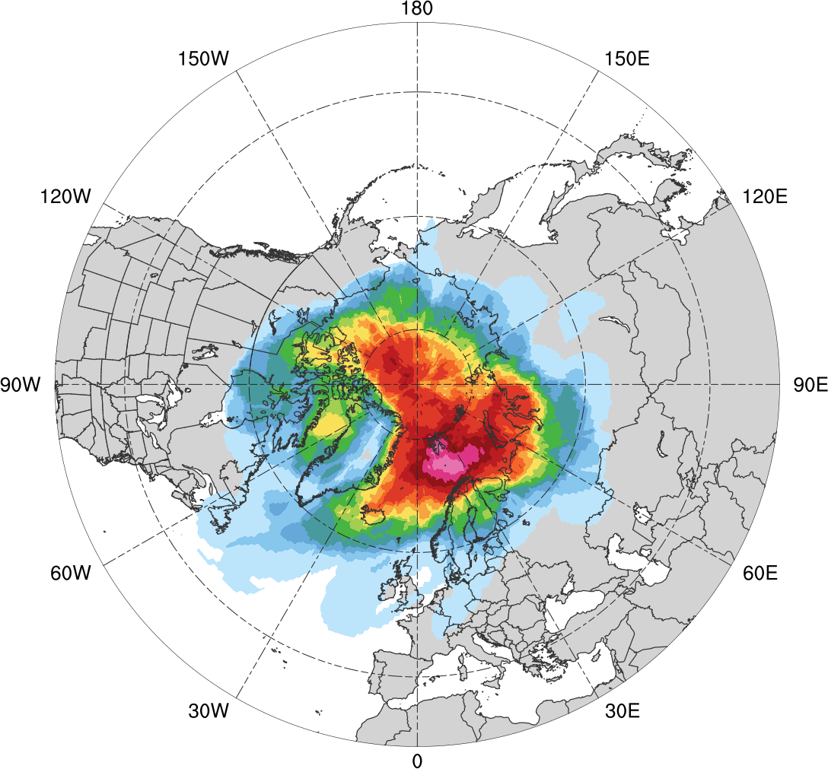
Normalized Track Density (DJF)
Low skill (N = 130)
High Skill (N = 119)
0.05
0.1
0.15
0.2
0.25
0.3
0.35
0.4
0.45
0.5
0.6
0.7
0.8
0.9
Total number of Arctic cyclones during DJF within 500 km of a grid point, normalized by maximum value, for each period

Slide 23
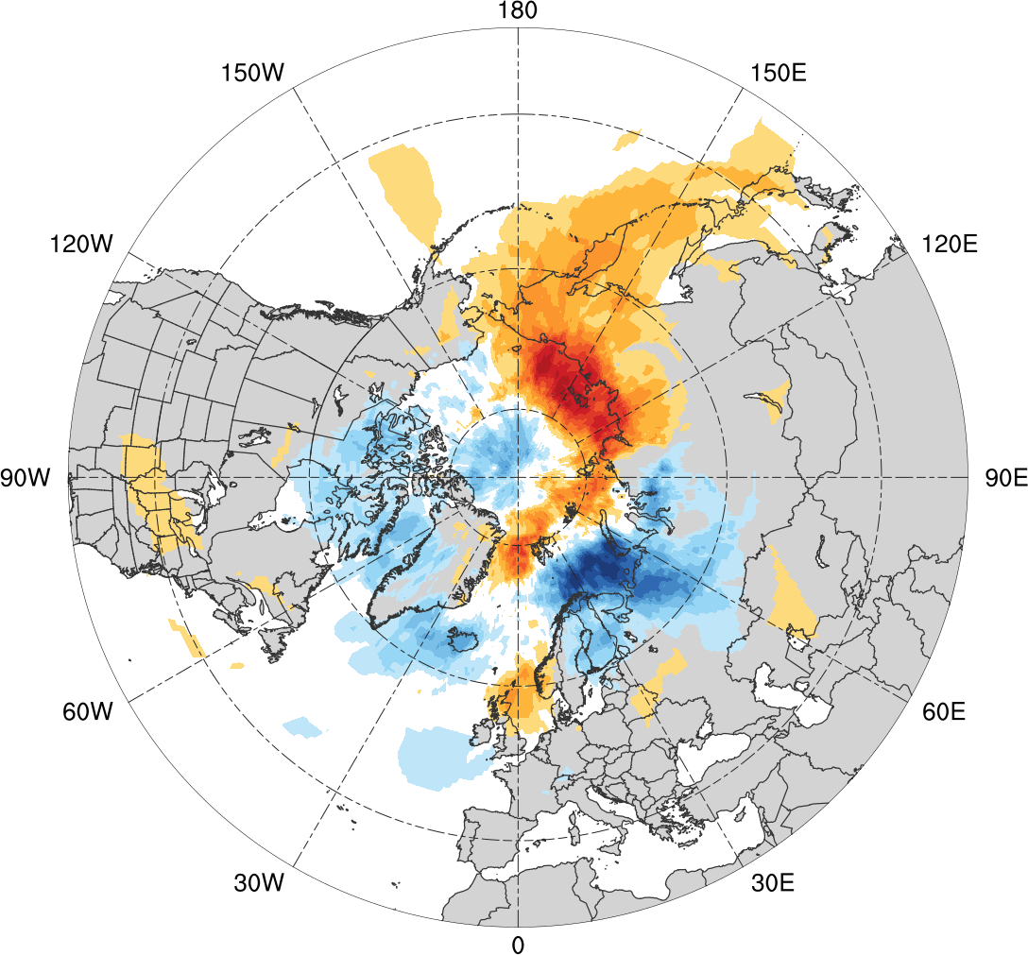
Normalized Track Density Differences (DJF)
Low skill minus high skill
-0.4
-0.35
-0.3
-0.25
-0.2
-0.15
-0.1
-0.05
0
0.05
0.1
0.15
0.2
0.25
0.3
0.35
0.4
Difference in normalized Arctic cyclone track density during DJF

Slide 24
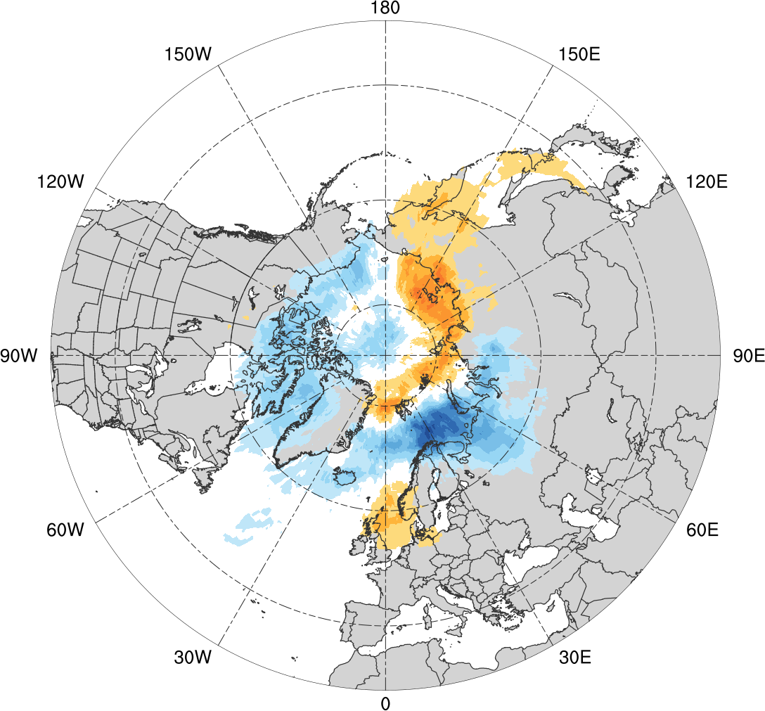
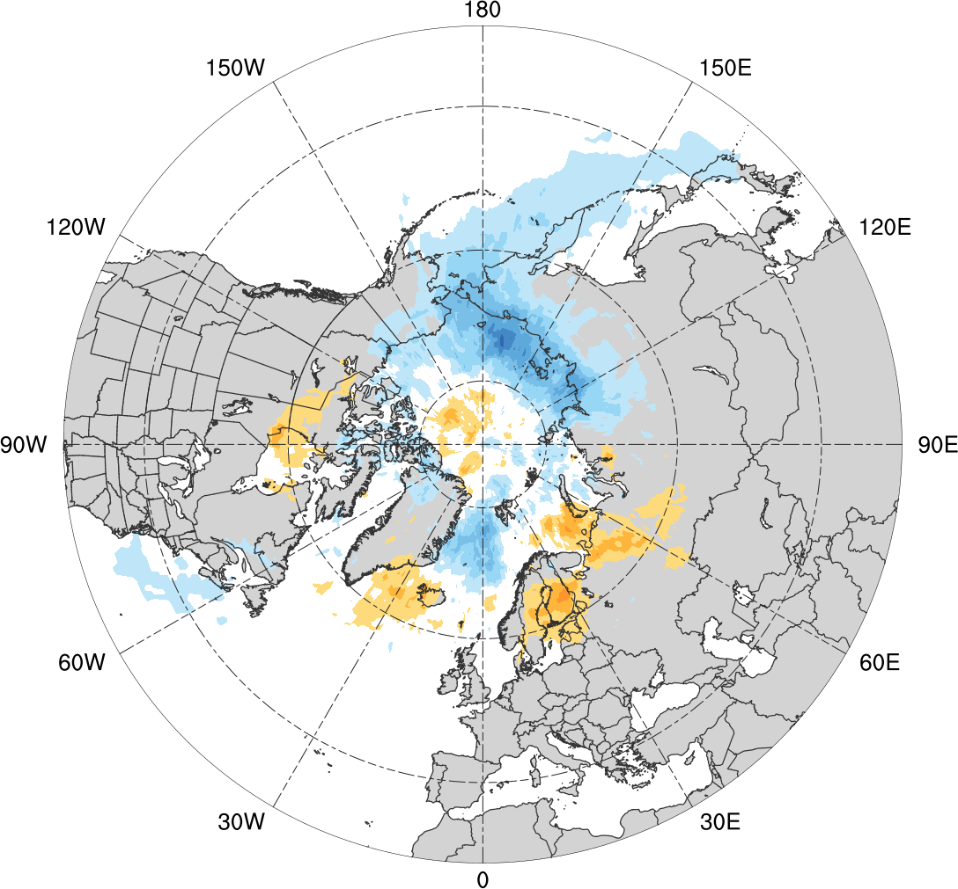
Normalized Track Density Differences (DJF)
Low skill minus climatology
High skill minus climatology
-0.4
-0.35
-0.3
-0.25
-0.2
-0.15
-0.1
-0.05
0
0.05
0.1
0.15
0.2
0.25
0.3
0.35
0.4
Difference in normalized Arctic cyclone track density during DJF

Slide 25
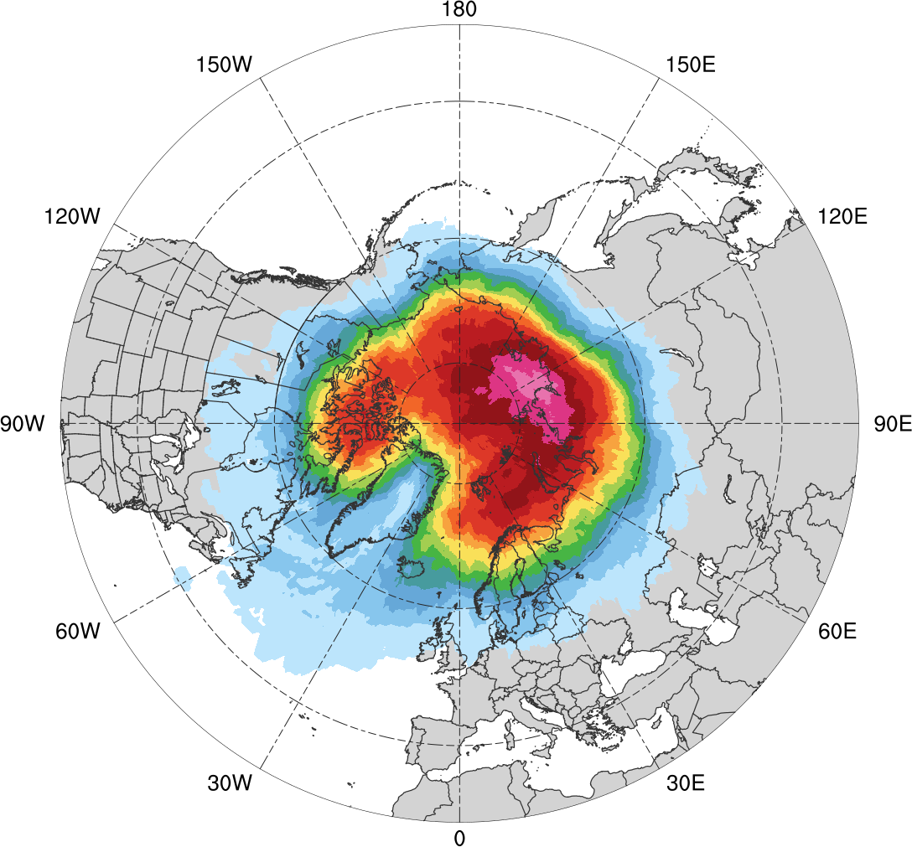
Normalized Track Density (JJA)
JJA climatology (N = 680)
0.05
0.1
0.15
0.2
0.25
0.3
0.35
0.4
0.45
0.5
0.6
0.7
0.8
0.9
Total number of Arctic cyclones during JJA within 500 km of a grid point, normalized by maximum value

Slide 26
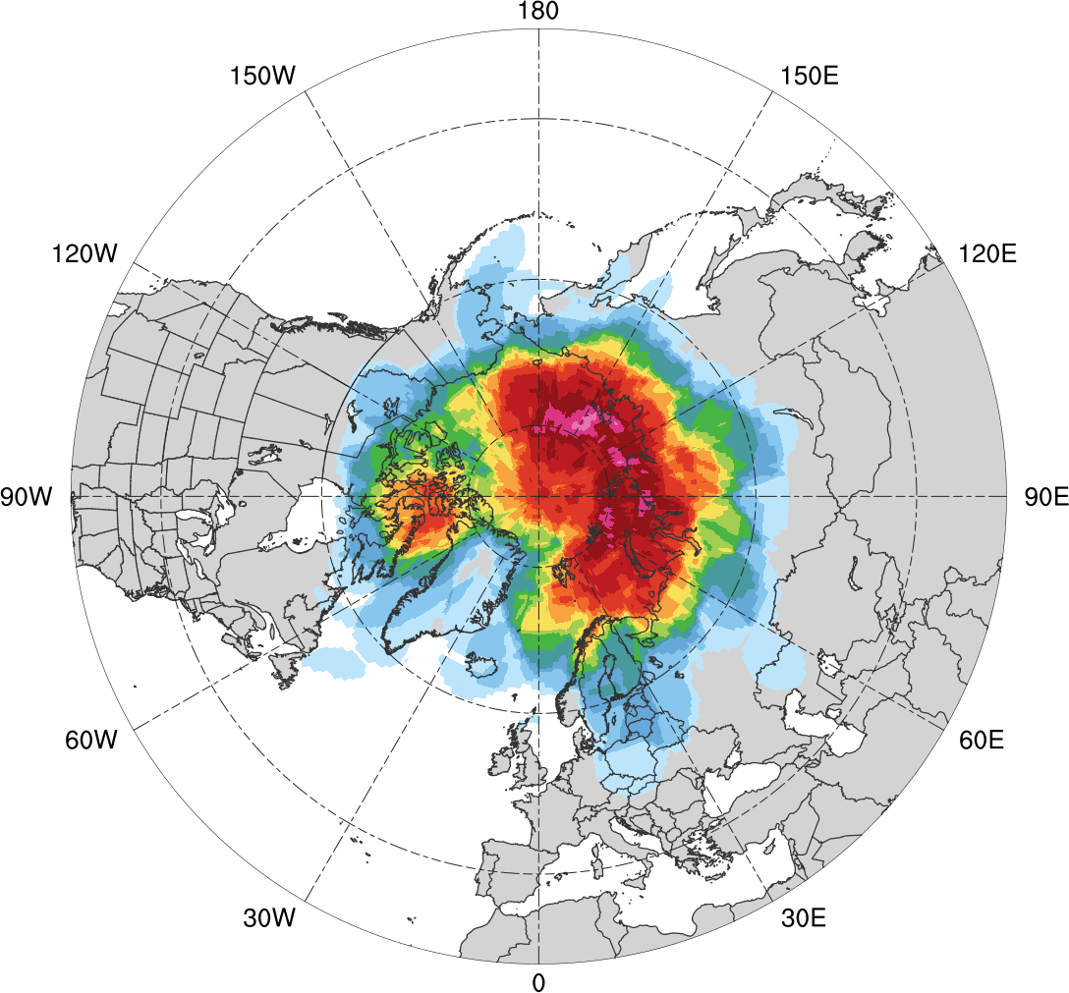
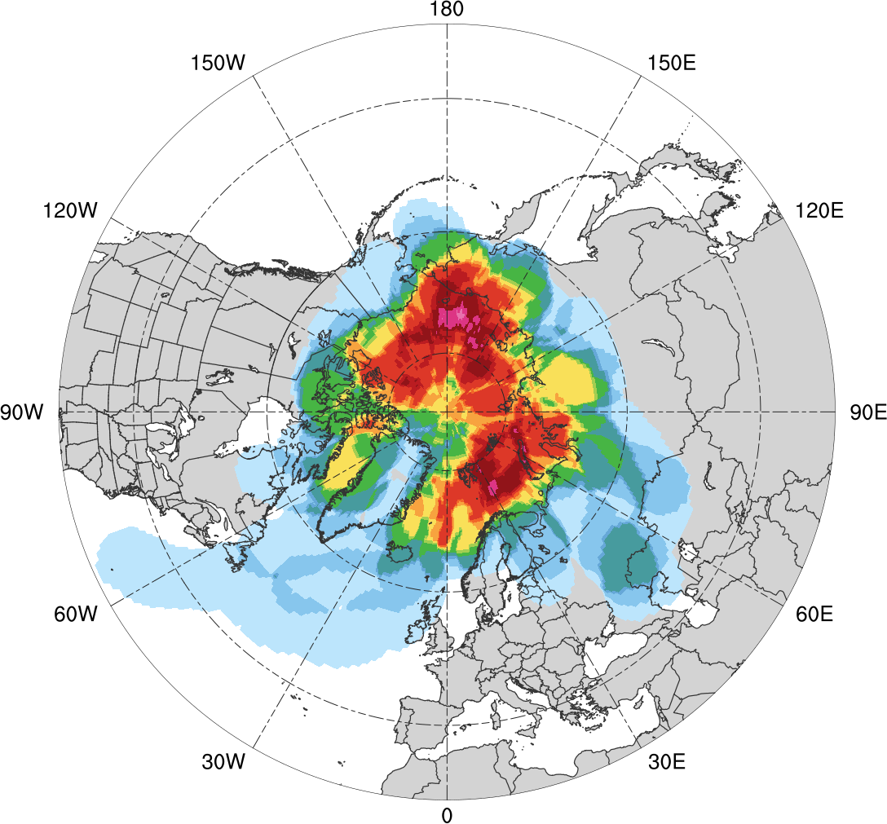
Normalized Track Density (JJA)
Low skill (N = 92)
High Skill (N = 52)
0.05
0.1
0.15
0.2
0.25
0.3
0.35
0.4
0.45
0.5
0.6
0.7
0.8
0.9
Total number of Arctic cyclones during JJA within 500 km of a grid point, normalized by maximum value, for each period

Slide 27
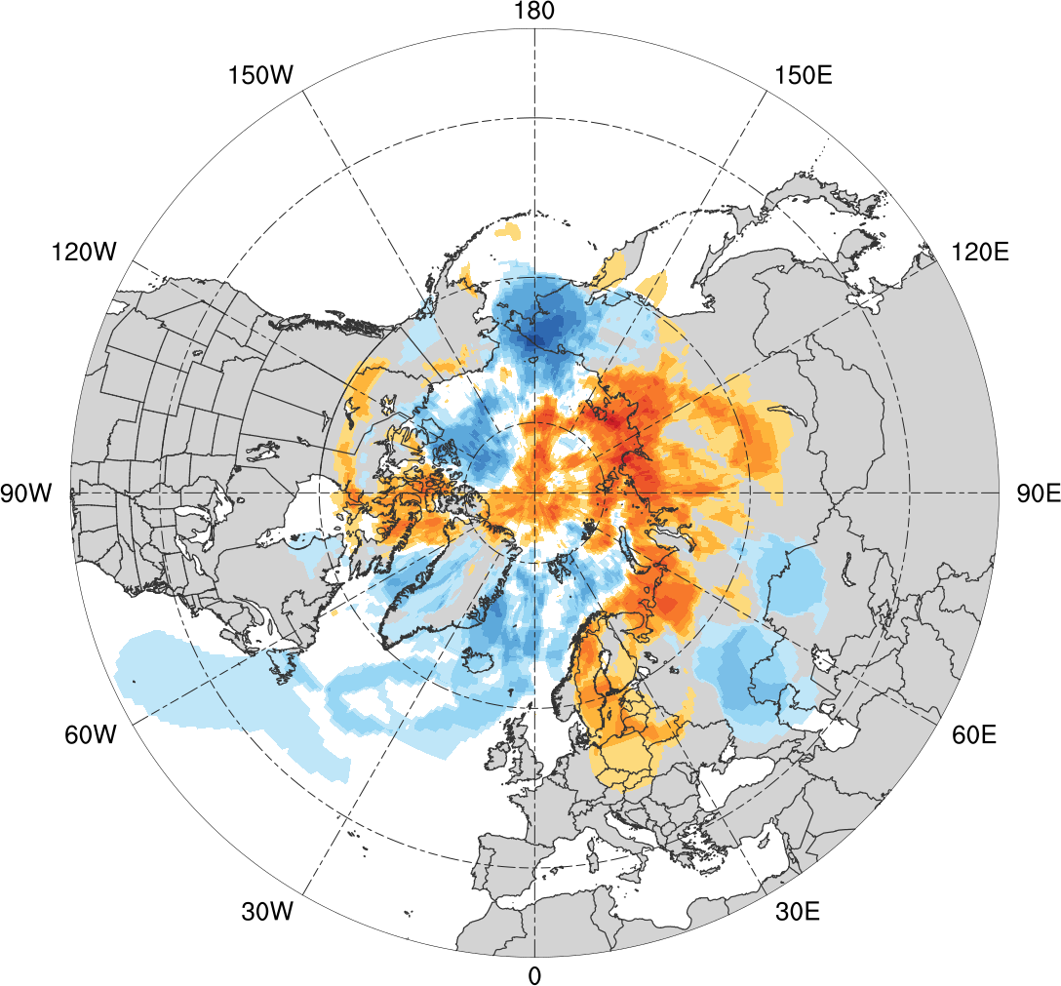
Normalized Track Density Differences (JJA)
Low skill minus high skill
-0.6
-0.5
-0.4
-0.3
-0.2
-0.15
-0.1
-0.05
0
0.05
0.1
0.15
0.2
0.3
0.4
0.5
0.6
Difference in normalized Arctic cyclone track density during JJA

Slide 28
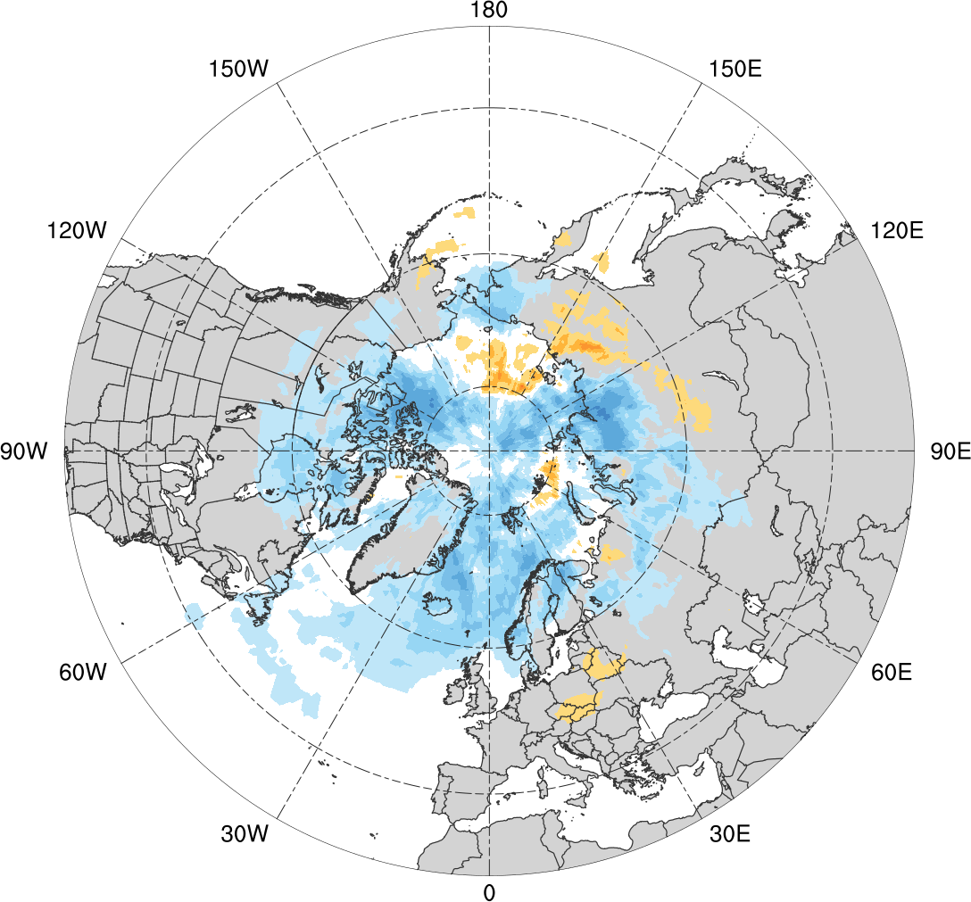
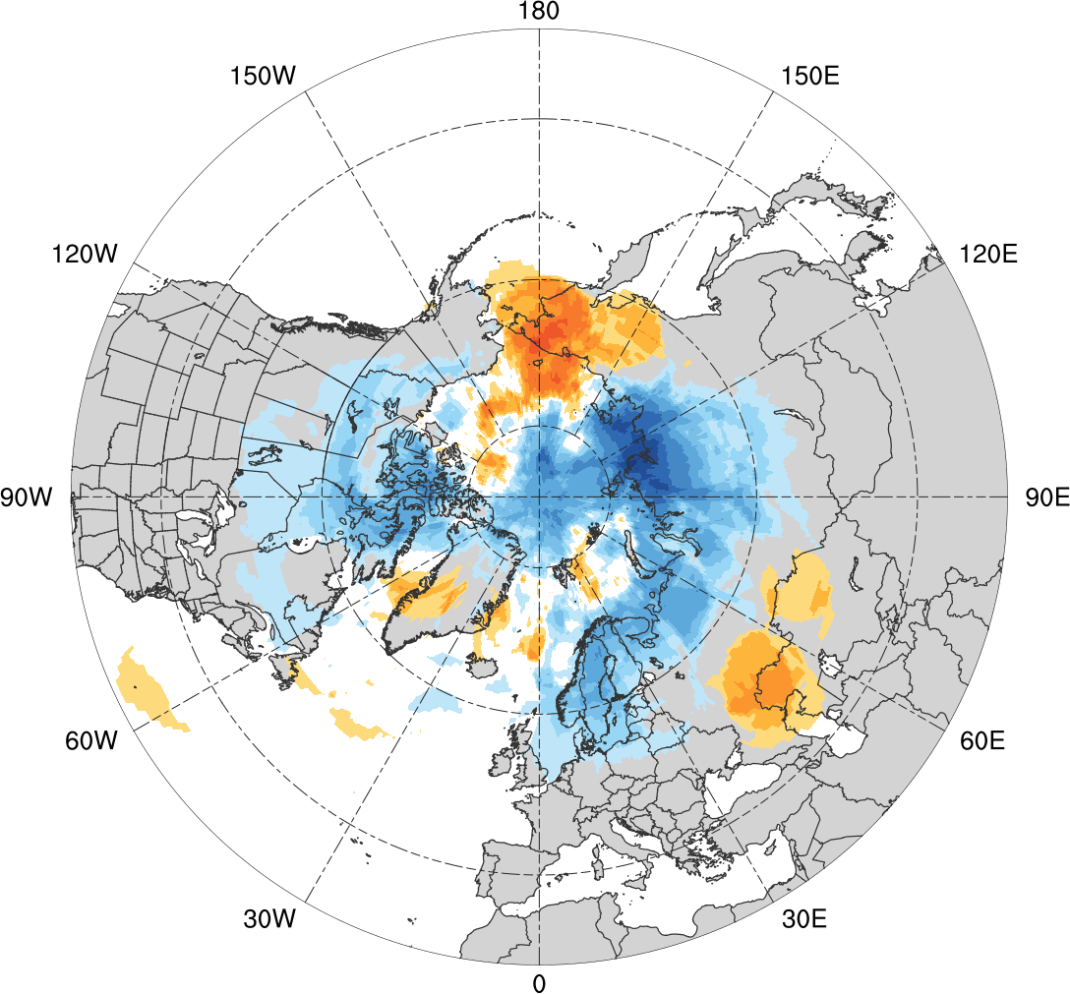
Normalized Track Density Differences (JJA)
Low skill minus climatology
High skill minus climatology
-0.6
-0.5
-0.4
-0.3
-0.2
-0.15
-0.1
-0.05
0
0.05
0.1
0.15
0.2
0.3
0.4
0.5
0.6
Difference in normalized Arctic cyclone track density during JJA

Slide 29
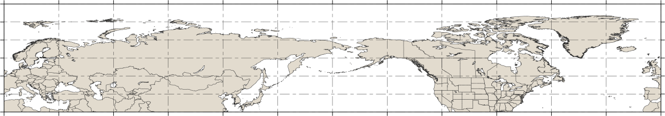
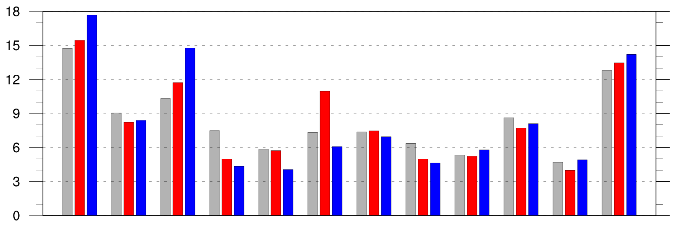
Preferred Longitudinal Corridors
Distribution of longitude of Arctic cyclones at first time in Arctic (>70°N; % per longitudinal bin)
90°N
70°N
50°N
30°N
0°
30°E
60°E
90°E
120°E
150°E
180°
150°W
120°W
90°W
60°W
30°W
0°
0°
30°E
60°E
90°E
120°E
150°E
180°
150°W
120°W
90°W
60°W
30°W
0°
climo
low
high

Slide 30
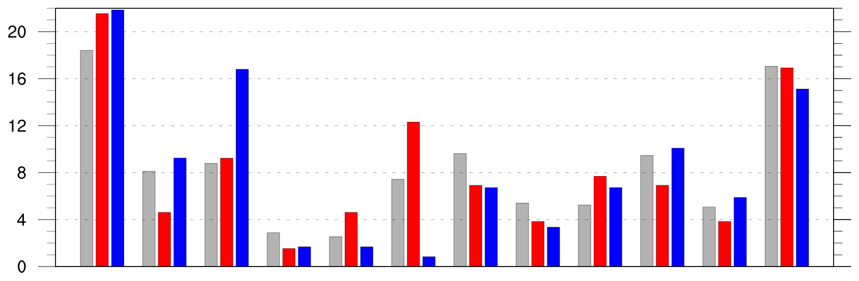
Preferred Longitudinal Corridors (DJF)
Distribution of longitude of Arctic cyclones at first time in Arctic (>70°N; % per longitudinal bin) during DJF
90°N
70°N
50°N
30°N
0°
30°E
60°E
90°E
120°E
150°E
180°
150°W
120°W
90°W
60°W
30°W
0°
0°
30°E
60°E
90°E
120°E
150°E
180°
150°W
120°W
90°W
60°W
30°W
0°
climo
low
high

Slide 31
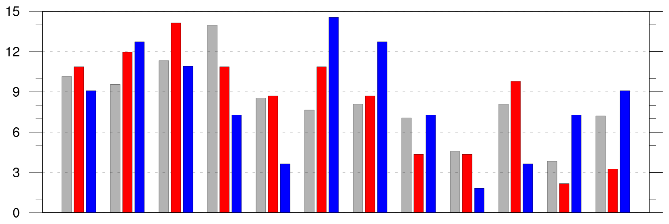
Preferred Longitudinal Corridors (JJA)
Distribution of longitude of Arctic cyclones at first time in Arctic (>70°N; % per longitudinal bin) during JJA
90°N
70°N
50°N
30°N
0°
30°E
60°E
90°E
120°E
150°E
180°
150°W
120°W
90°W
60°W
30°W
0°
0°
30°E
60°E
90°E
120°E
150°E
180°
150°W
120°W
90°W
60°W
30°W
0°
climo
low
high

Slide 32
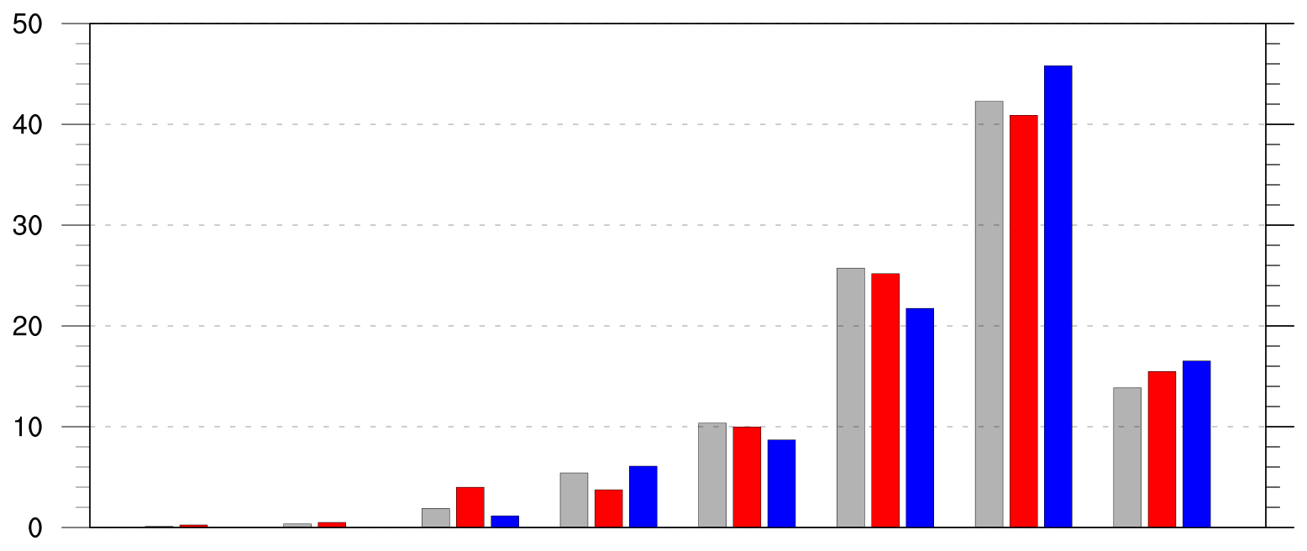
Genesis Latitude
Distribution of Arctic cyclone genesis latitude (% per latitude bin)
10°N
20°N
30°N
40°N
50°N
60°N
70°N
80°N
90°N
climo
low
high

Slide 33
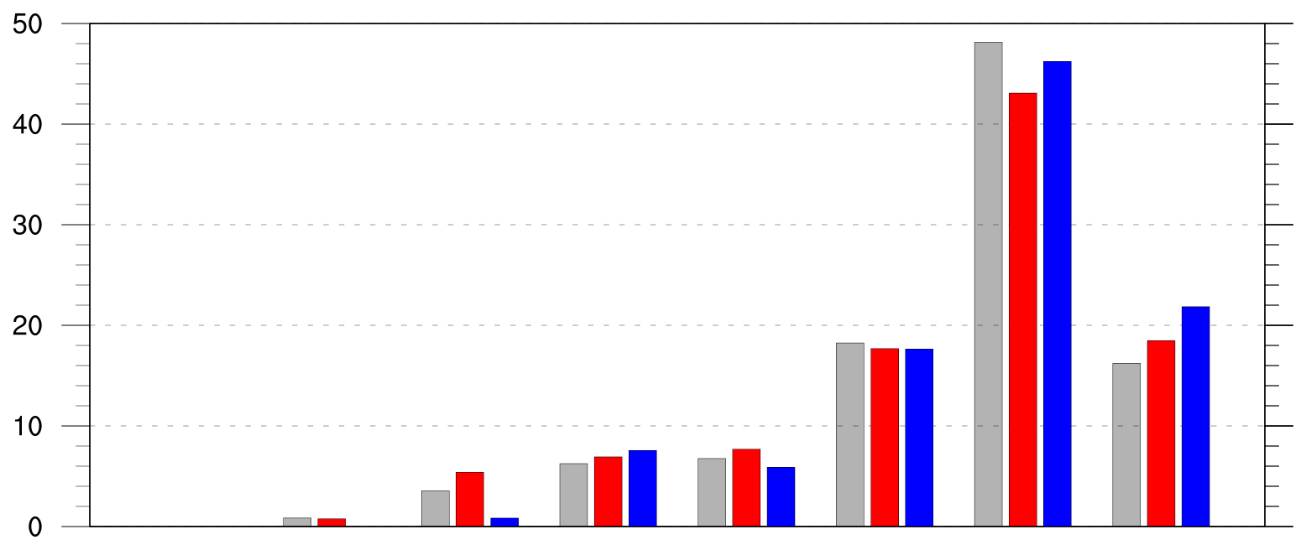
Genesis Latitude (DJF)
Distribution of Arctic cyclone genesis latitude (% per latitude bin) during DJF
10°N
20°N
30°N
40°N
50°N
60°N
70°N
80°N
90°N
climo
low
high

Slide 34
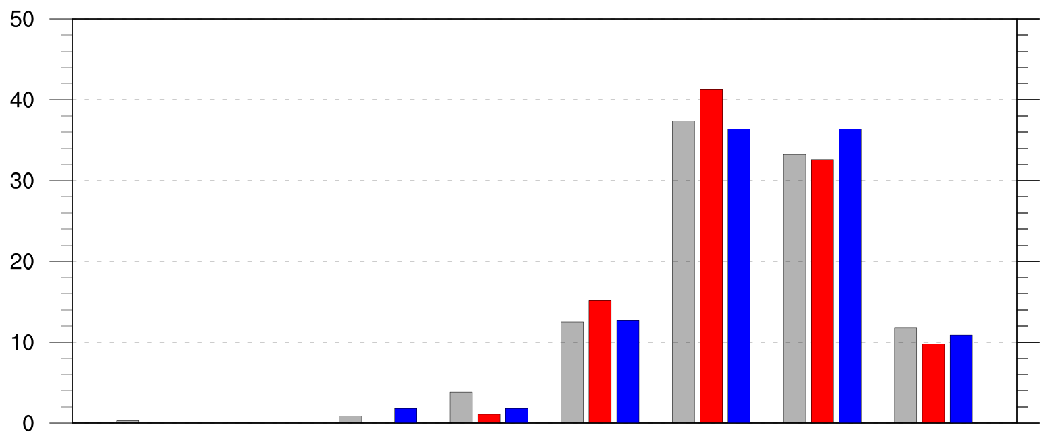
Genesis Latitude (JJA)
Distribution of Arctic cyclone genesis latitude (% per latitude bin) during JJA
10°N
20°N
30°N
40°N
50°N
60°N
70°N
80°N
90°N
climo
low
high

Slide 35
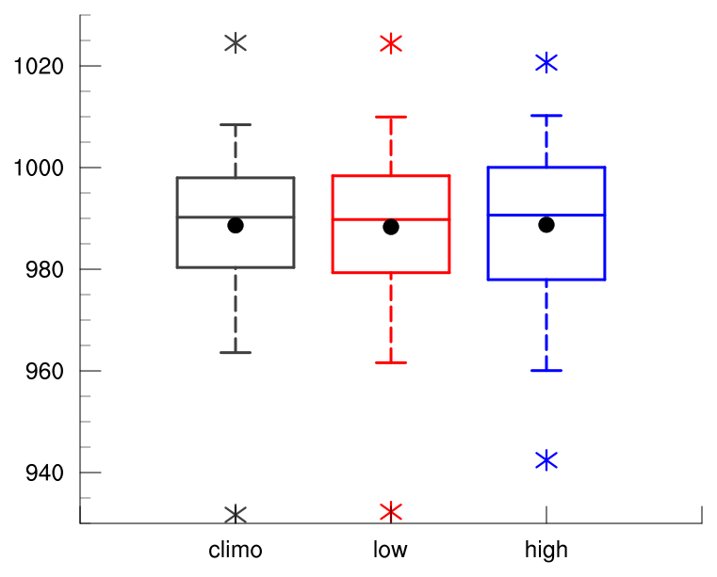
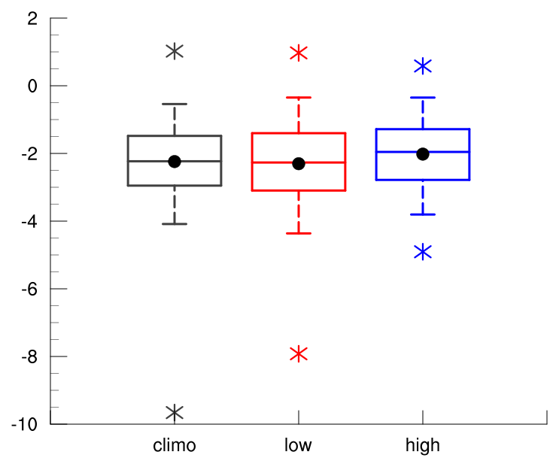
Intensity: Minimum SLP
Minimum SLP (hPa) of Arctic cyclones
min and max
mean
95%
75%
median
25%
5%
climo
low
high

Slide 36
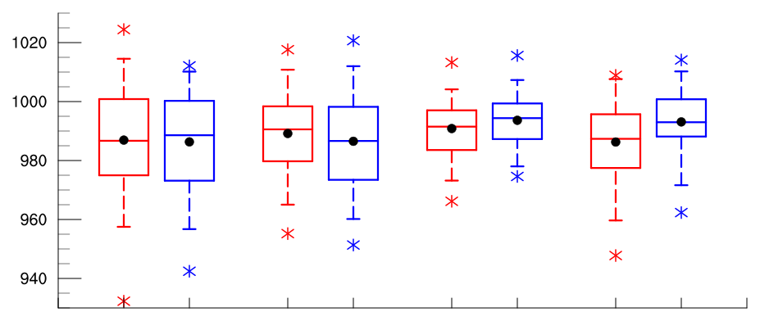
Intensity: Minimum SLP
Minimum SLP (hPa) of Arctic cyclones by season
low
high
low
high
low
high
low
high
DJF
MAM
JJA
SON
95%
75%
min and max
mean
median
Statistically significant differences in means
25%
5%

Slide 37
Intensity: Minimum Standardized Anomaly of SLP
Minimum standardized anomaly of SLP (σ) of Arctic cyclones
min and max
mean
95%
75%
median
25%
5%
Statistically significant differences in means
climo
low
high

Slide 38
Intensity: Minimum Standardized Anomaly of SLP
Minimum standardized anomaly of SLP (σ) of Arctic cyclones
min and max
mean
95%
75%
median
25%
5%
Statistically significant differences in means
climo
low
high

Slide 39
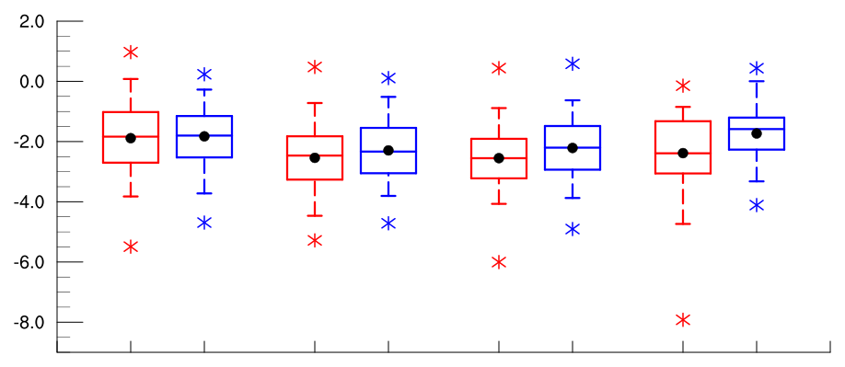
Intensity: Minimum Standardized Anomaly of SLP
Minimum standardized anomaly of SLP (σ) of Arctic cyclones by season
low
high
low
high
low
high
low
high
DJF
MAM
JJA
SON
95%
75%
min and max
mean
median
Statistically significant differences in means
25%
5%

Slide 40
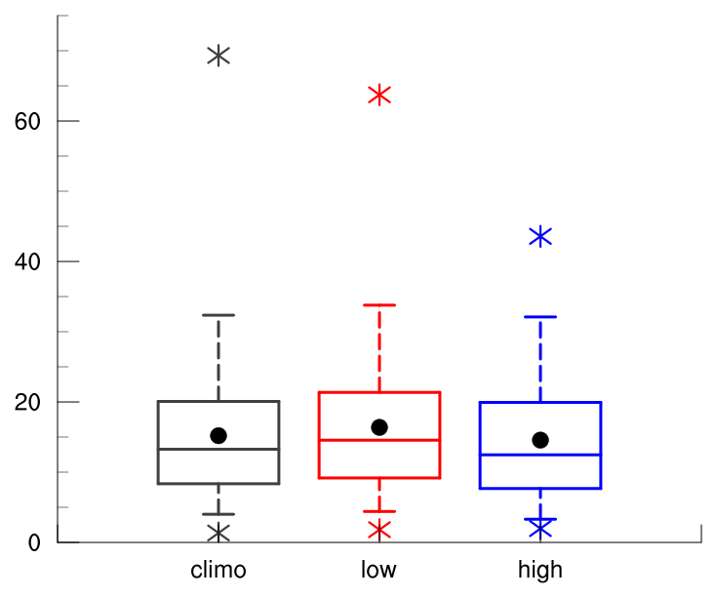
Intensity: Maximum SLP Depth
Maximum SLP depth (hPa) of Arctic cyclones
min and max
mean
95%
75%
median
25%
5%
Statistically significant differences in means
climo
low
high

Slide 41
Intensity: Maximum SLP Depth
Maximum SLP depth (hPa) of Arctic cyclones
min and max
mean
95%
75%
median
25%
5%
Statistically significant differences in means
climo
low
high

Slide 42
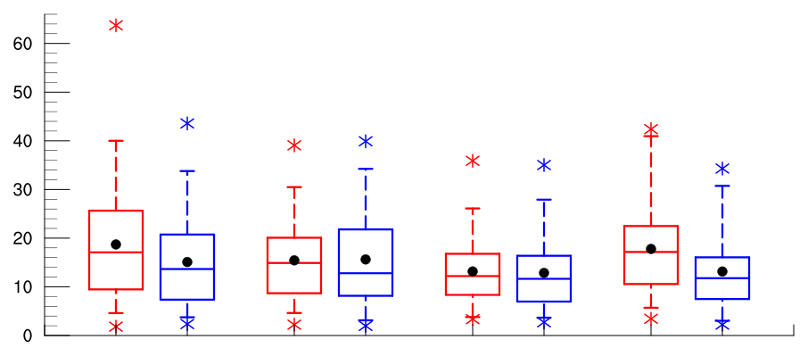
Intensity: Maximum SLP Depth
Maximum SLP depth (hPa) of Arctic cyclones by season
low
high
low
high
low
high
low
high
DJF
MAM
JJA
SON
95%
75%
min and max
mean
median
Statistically significant differences in means
25%
5%

Slide 43
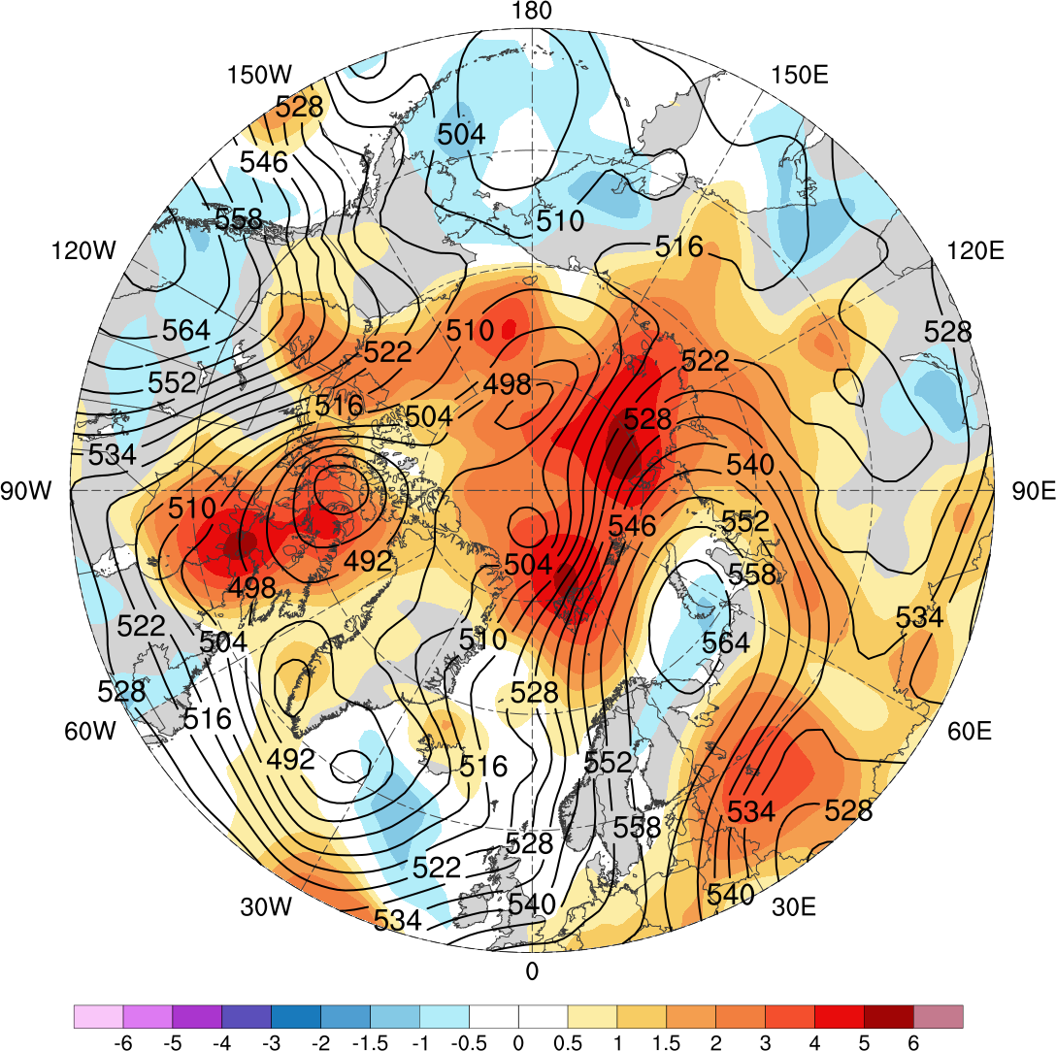
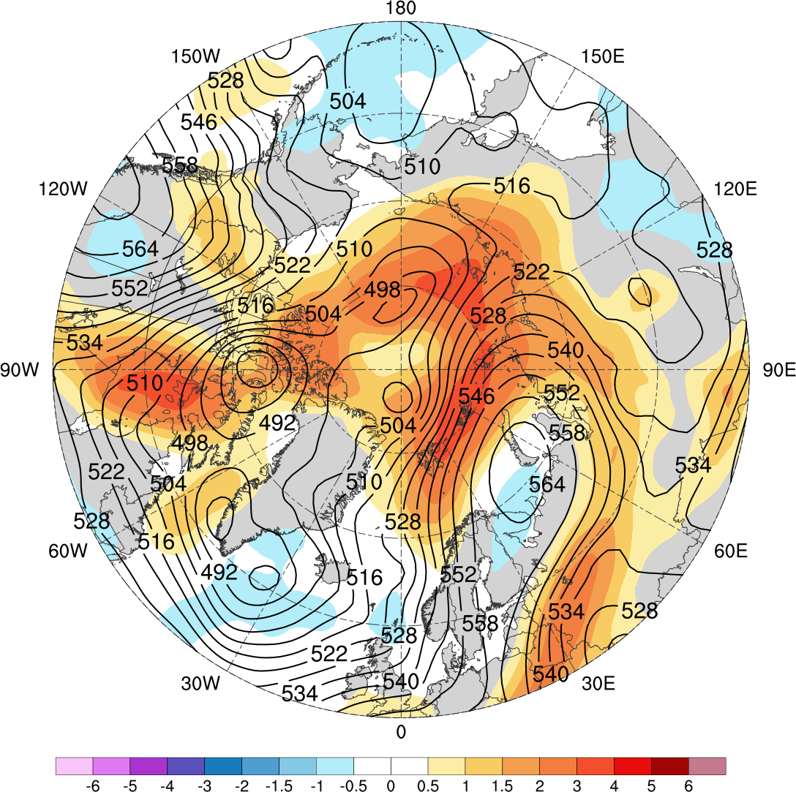
Low Skill Period Example
GEFS
0000 UTC 1 Jan 2016
ECMWF EPS
Standardized anomaly of ensemble spread of 500-hPa geopotential height (shading) valid at 0000 UTC 1 Jan 2016 (day-5 forecast) from GEFS (left) and ECMWF EPS (right); 500-hPa geopotential heights (dam, black) from ERA-Interim

Slide 44
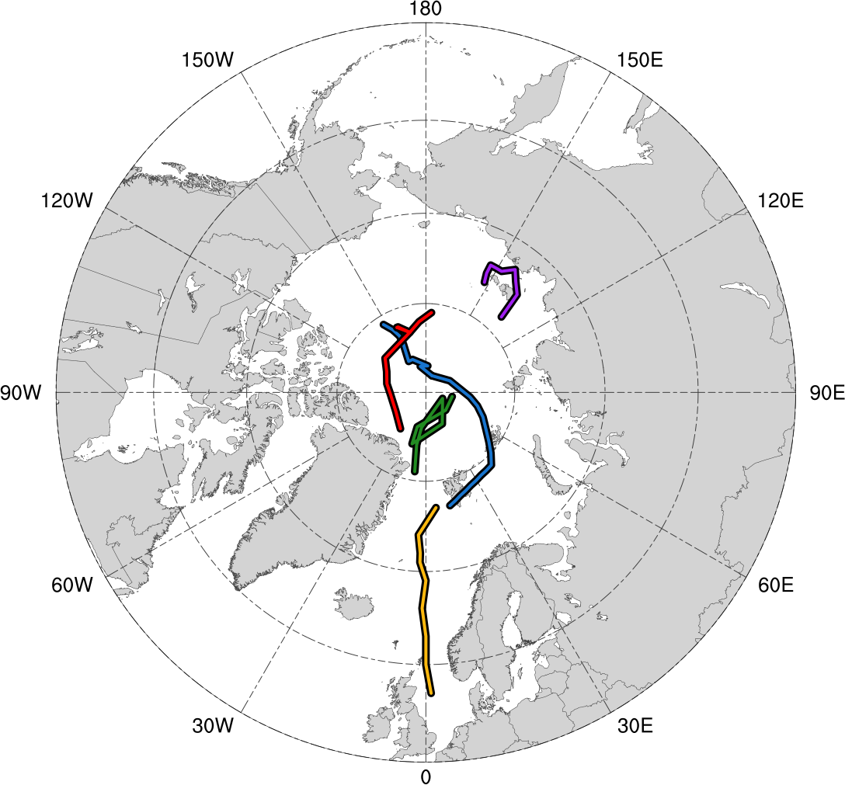
Low Skill Period Example
GEFS
0000 UTC 1 Jan 2016
Genesis
Lysis
Standardized anomaly of ensemble spread of 500-hPa geopotential height (shading) valid at 0000 UTC 1 Jan 2016 (day-5 forecast) from GEFS; 500-hPa geopotential heights (dam, black) from ERA-Interim
Tracks of Arctic cyclones occurring during 27 Dec 2015–1 Jan 2016

Slide 45
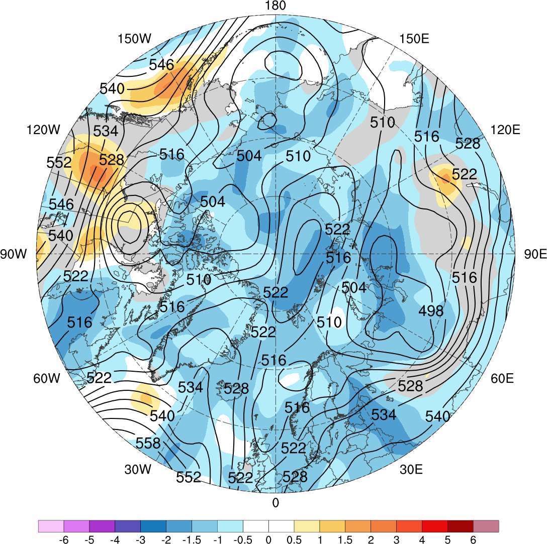

High Skill Period Example
GEFS
0000 UTC 6 Feb 2009
ECMWF EPS
Standardized anomaly of ensemble spread of 500-hPa geopotential height (shading) valid at 0000 UTC 6 Feb 2009 (day-5 forecast) from GEFS (left) and ECMWF EPS (right); 500-hPa geopotential heights (dam, black) from ERA-Interim

Slide 46

High Skill Period Example
GEFS
0000 UTC 6 Feb 2009
Genesis
Lysis
Standardized anomaly of ensemble spread of 500-hPa geopotential height (shading) valid at 0000 UTC 6 Feb 2009 (day-5 forecast) from GEFS; 500-hPa geopotential heights (dam, black) from ERA-Interim
Tracks of Arctic cyclones occurring during 1–6 Feb 2009

Slide 47
Flow Amplitude
Calculate an area-weighted average of standardized anomaly of | 500-hPa v-wind | over the Arctic (≥70°N) using ERA-interim during low and high skill periods

Slide 48


Flow Amplitude
Low Skill Case
0000 UTC 1 Jan 2016
High Skill Case
0000 UTC 6 Feb 2009
500-hPa geopotential height (dam), wind (barbs and flags, m s⁻¹), and standardized anomaly of | 500-hPa v-wind | (σ, shading) from ERA-Interim

Slide 49

Flow Amplitude
Area-weighted average of standardized anomaly of | 500-hPa v-wind | over the Arctic (≥70°N)
1979–2017 climo mean
statistically significant difference between low/high skill mean and climo mean
statistically significant difference between low and high skill means
shading: interquartile range
low skill mean
high skill mean

Slide 50
Extra Slides

Slide 51
Results: Number of Arctic Cyclones
 | Number of days in period | Number of Arctic cyclones | *Normalized number of Arctic cyclones
Climo | 4018 | 2542 | N/A
Low skill | 469 | 401 | 404.4
High skill | 477 | 345 | 342.1
*Normalized by multiplying number of cyclones by average number of cyclones between low and high periods and then dividing by number of cyclones during respective period

Slide 52

Results: Number of Arctic Cyclones by Season
Number of days in low and high skill periods by season
*Normalized number of Arctic cyclones in low and high skill periods by season
Low skill
Low skill
High skill
High skill
*Normalized by multiplying number of cyclones by average number of cyclones between low and high periods and then dividing by number of cyclones during respective period, for each season

Slide 53
Results: Normalized Track Density
Entire climatology (N = 2542)
0.05
0.1
0.15
0.2
0.25
0.3
0.35
0.4
0.45
0.5
0.6
0.7
0.8
0.9
Total number of Arctic cyclones within 500 km of a grid point, normalized by maximum value

Slide 54

Results: Preferred Longitudinal Corridors (MAM)
Percentage of Arctic cyclones per longitude bin according to longitude of Arctic cyclones at first time in Arctic (>70°N) during MAM
90°N
70°N
50°N
30°N
0°
30°E
60°E
90°E
120°E
150°E
180°
150°W
120°W
90°W
60°W
30°W
0°
0°
30°E
60°E
90°E
120°E
150°E
180°
150°W
120°W
90°W
60°W
30°W
0°
climo
low
high

Slide 55

Results: Preferred Longitudinal Corridors (SON)
Percentage of Arctic cyclones per longitude bin according to longitude of Arctic cyclones at first time in Arctic (>70°N) during SON
90°N
70°N
50°N
30°N
0°
30°E
60°E
90°E
120°E
150°E
180°
150°W
120°W
90°W
60°W
30°W
0°
0°
30°E
60°E
90°E
120°E
150°E
180°
150°W
120°W
90°W
60°W
30°W
0°
climo
low
high

Slide 56

Results: Genesis Latitude (MAM)
Genesis latitude of Arctic cyclones during MAM
10°N
20°N
30°N
40°N
50°N
60°N
70°N
80°N
90°N
climo
low
high

Slide 57

Results: Genesis Latitude (SON)
Genesis latitude of Arctic cyclones during SON
10°N
20°N
30°N
40°N
50°N
60°N
70°N
80°N
90°N
climo
low
high

