Slide 1
Extreme Weather Events Originating from Interactions between Tropopause Polar Vortices and the North Atlantic Jet Stream
Kevin A. Biernat, Daniel Keyser, and Lance F. Bosart
Department of Atmospheric and Environmental Sciences
University at Albany, SUNY
17th Cyclone Workshop
28 October 2015
Research support provided by NSF Grant AGS-1355960
kbiernat@albany.edu

Slide 2
What are Tropopause Polar Vortices (TPVs)?
TPVs are defined as tropopause-based vortices of high-latitude origin and are material features (Cavallo and Hakim 2009, 2010)
A TPV is a particular type of coherent tropopause disturbance (CTD; Pyle et al. 2004)
A CTD is defined as a tropopause-based material feature that is not necessarily of high-latitude origin and does not necessarily correspond to a vortex
Notes:
Spend more time on it. Possible ven diagram

Slide 3
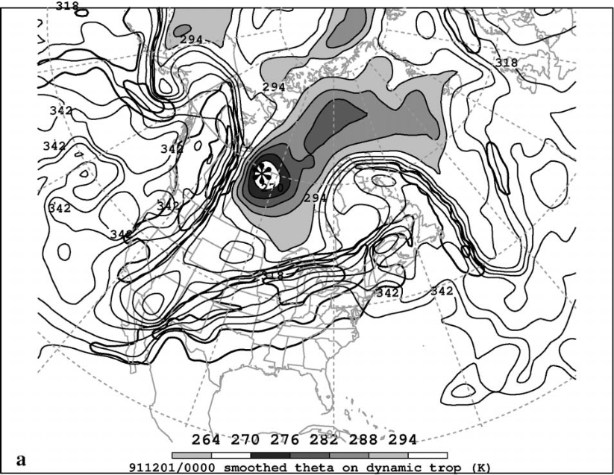
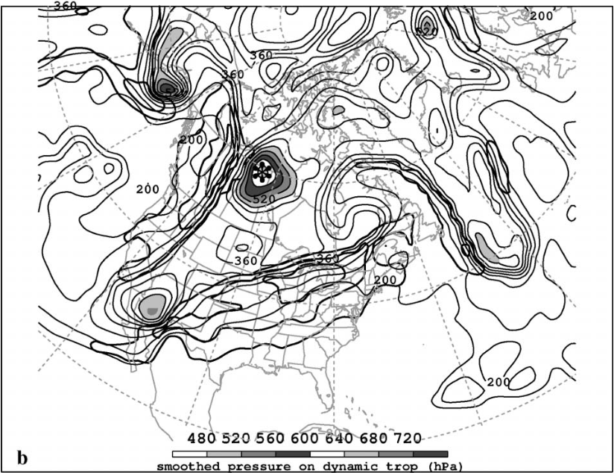
What are Tropopause Polar Vortices (TPVs)?
TPV
TPV
(left) Dynamic tropopause (DT) wind speed (every 15 m s⁻¹ starting at 50 m s⁻¹, thick contours) and DT potential temperature (K, thin contours and shading) on 1.5-PVU surface valid 0000 UTC 1 Dec 1991; (right) same as left except DT pressure (hPa, thin contours and shading). Adapted from Fig. 11 in Pyle et al. (2004).
Notes:
Also a CTD but meets TPV criterion
Lower DT theta and higher DT pressure
Tropopause extends downward
Local minimum of DT theta, max in DT pressure, and relatively circular symmetric

Slide 4
Motivation
TPVs may interact with and strengthen midlatitude jet streams, and act as precursors to intense midlatitude cyclogenesis events

Slide 5
Motivation
TPVs may interact with and strengthen midlatitude jet streams, and act as precursors to intense midlatitude cyclogenesis events
Interactions between TPVs and North Atlantic jet stream (NAJ) may lead to development of extreme weather events (EWEs) between North America and Europe

Slide 6
Outline
Data and Methodology
Case Studies
1) 18–19 November 2013 extreme flooding event over
Sardinia, Italy
2) 21–22 December 2013 ice storm over southeast Canada
Conclusions
Notes:
Take out periods

Slide 7
Data and Methodology
0.5° NCEP CFSR (Saha et al. 2010)
Subjective TPV identification and tracking
  TPV must be a coherent vortex that exhibits a local minimum of DT θ (i.e., closed contours of DT θ)
  The vortex must be of high-latitude origin and last ≥ 2 days, similar to Cavallo and Hakim (2009)
  Stop tracking TPV when it becomes significantly deformed during interaction with NAJ

Slide 8
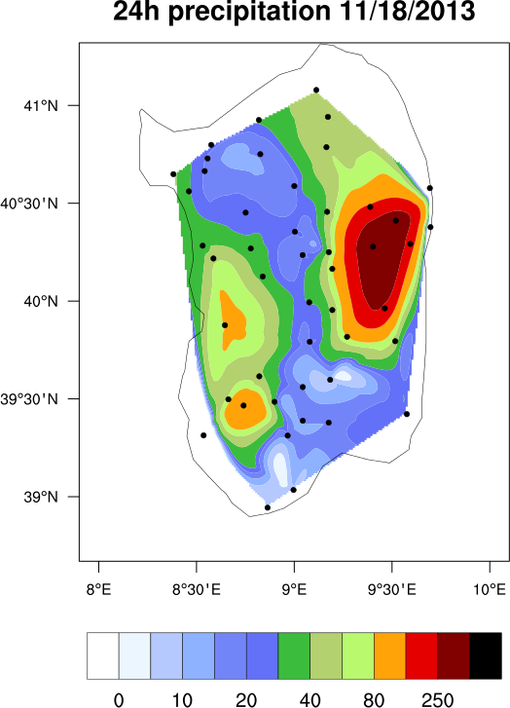
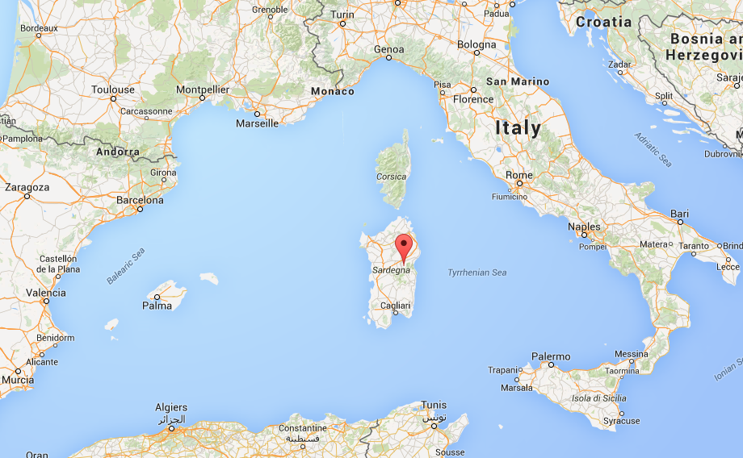
18–19 November 2013 Sardinia Flood Event
Slow-moving cutoff cyclone over Mediterranean leads to significant rainfall and flooding over portions of Sardinia
Up to 467 mm of rain reported
16 deaths (Munich RE, 2014)
Overall losses: ~780 million USD
(Munich RE, 2014)
24-h accumulated precipitation (mm, shaded) during 18 Nov 2013 (Source: Julian Quinting)
(Source: Google Maps)
Notes:
1–2 May 2010 Nashville Flood Event resulted in 26 fatalities and 2–3 billion USD in damages throughout Tennessee and Kentucky during 1–4 May (Moore et al. 2012)
May 2013 Central European Flood resulted in 22 billion USD in damages (costliest natural disaster in 2013)
Hurricane Sandy: 71.4 billion USD

Slide 9
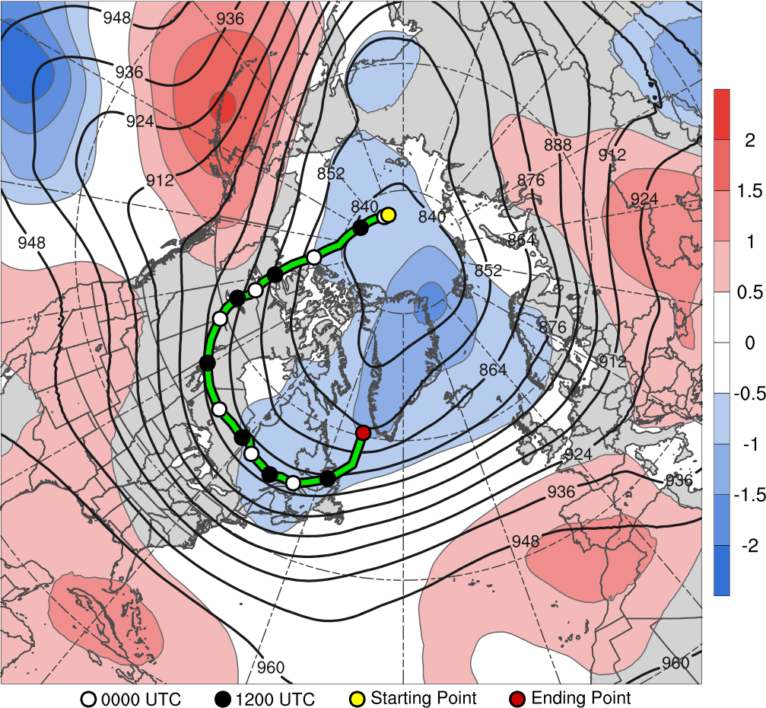
TPV Track: 1800 UTC 6 Nov – 0000 UTC 14 Nov 2013
7
8
9
10
11
14
12
13
6–14 Nov 2013 time-mean 300-hPa geopotential height (dam, black) and geopotential height anomaly (σ, shaded)
Notes:
Change color of track line. Low res of continents thiner contours for continents.

Slide 10
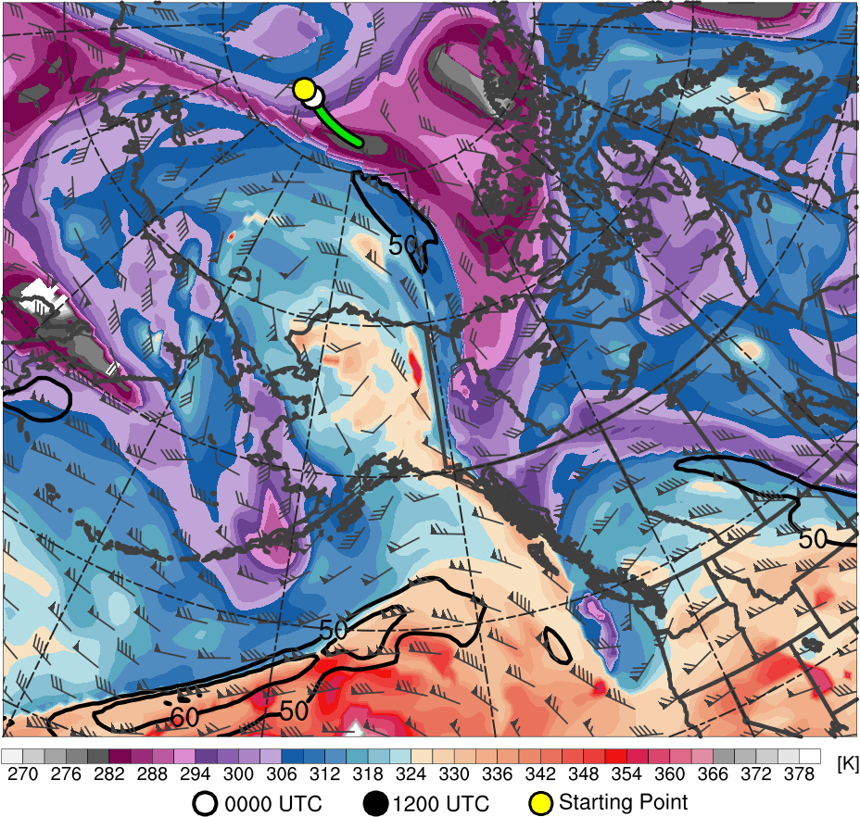
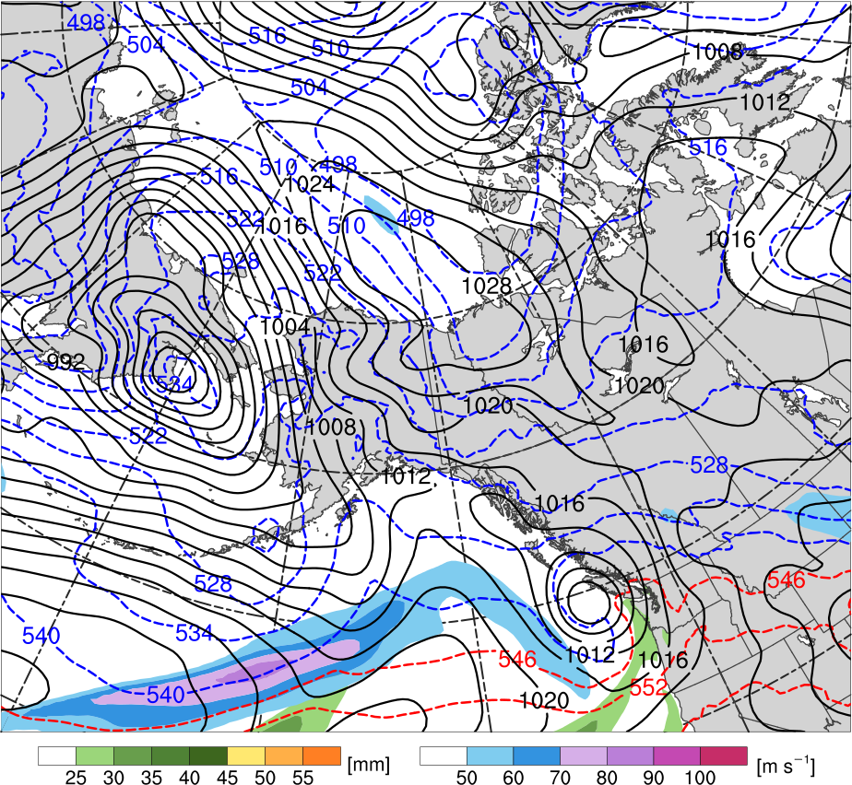
TPV Extraction
1200 UTC 7 Nov 2013
TPV
C
H
L₉₅₅
R1
Potential temperature (K, shaded), wind speed (black, every 10 m s⁻¹ starting at 50 m s⁻¹), and wind (m s⁻¹, barbs) on 2-PVU surface
250-hPa wind speed (m s⁻¹, shaded),
1000–500-hPa thickness (dam, blue/red),
MSLP (hPa, black), PW (mm, shaded)

Slide 11
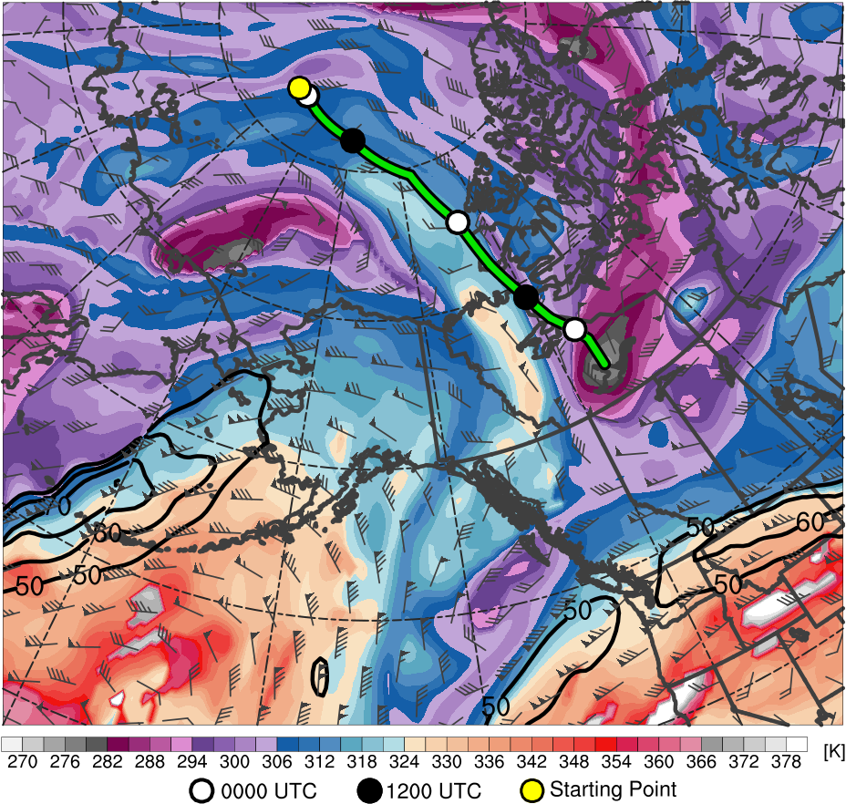
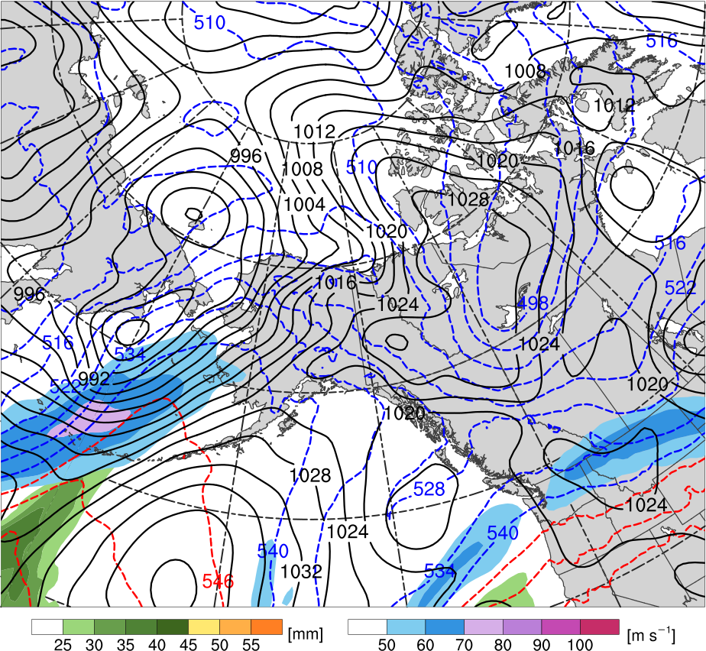
TPV Extraction
1200 UTC 9 Nov 2013
R1
C
TPV
H
Potential temperature (K, shaded), wind speed (black, every 10 m s⁻¹ starting at 50 m s⁻¹), and wind (m s⁻¹, barbs) on 2-PVU surface
250-hPa wind speed (m s⁻¹, shaded),
1000–500-hPa thickness (dam, blue/red),
MSLP (hPa, black), PW (mm, shaded)

Slide 12
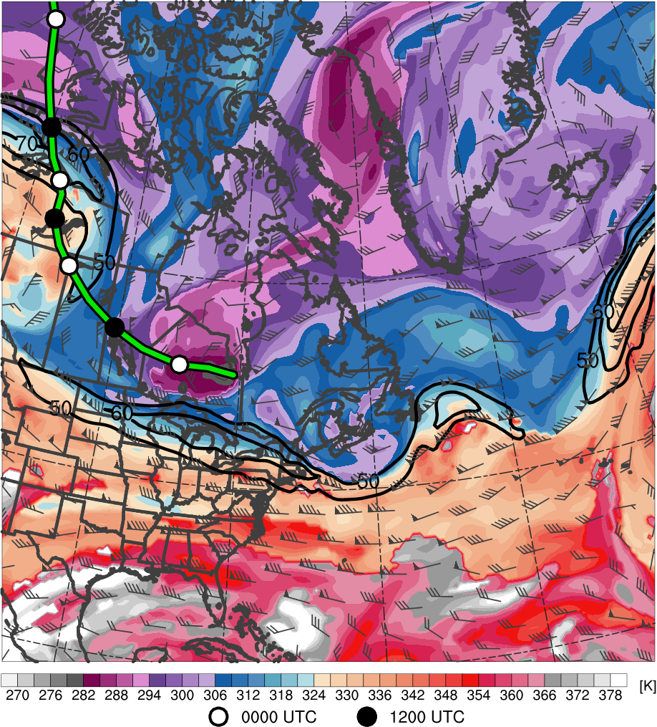
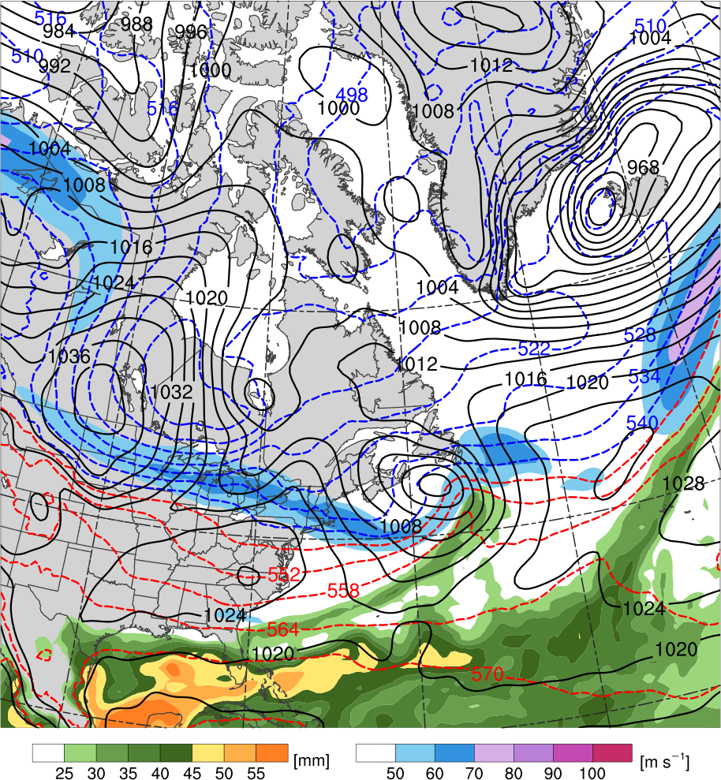
TPV–NAJ Interaction
1200 UTC 11 Nov 2013
R2
TPV
T1
L₁₀₀₂
H
C
T2
Potential temperature (K, shaded), wind speed (black, every 10 m s⁻¹ starting at 50 m s⁻¹), and wind (m s⁻¹, barbs) on 2-PVU surface
250-hPa wind speed (m s⁻¹, shaded),
1000–500-hPa thickness (dam, blue/red),
MSLP (hPa, black), PW (mm, shaded)

Slide 13
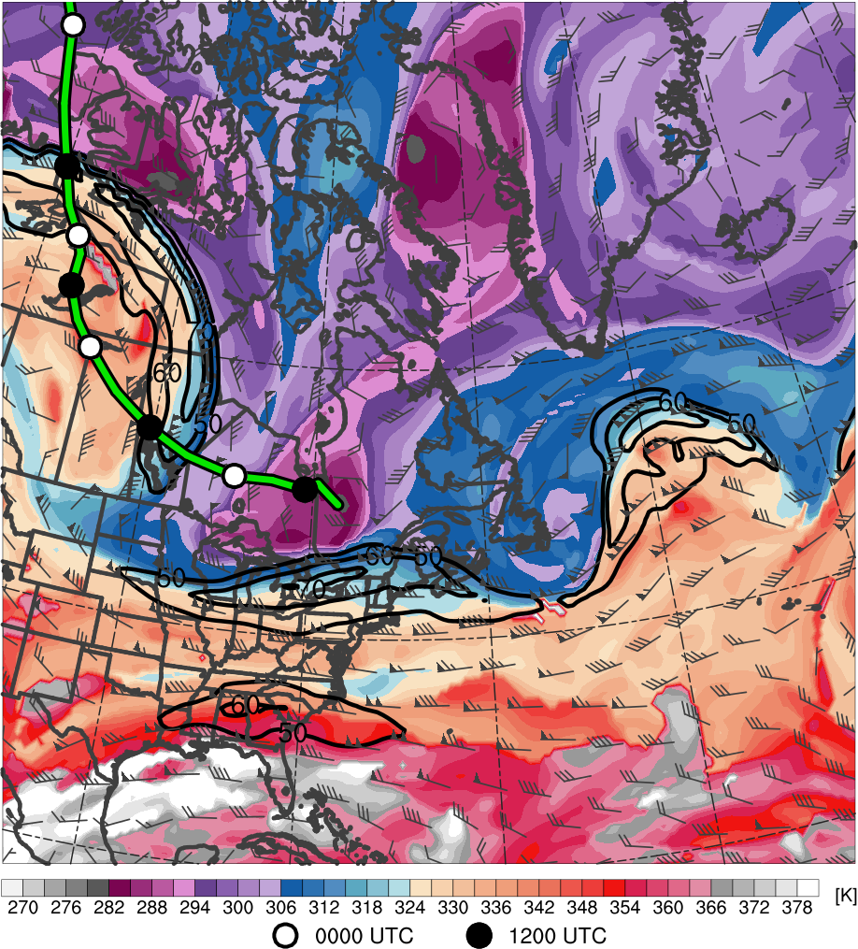
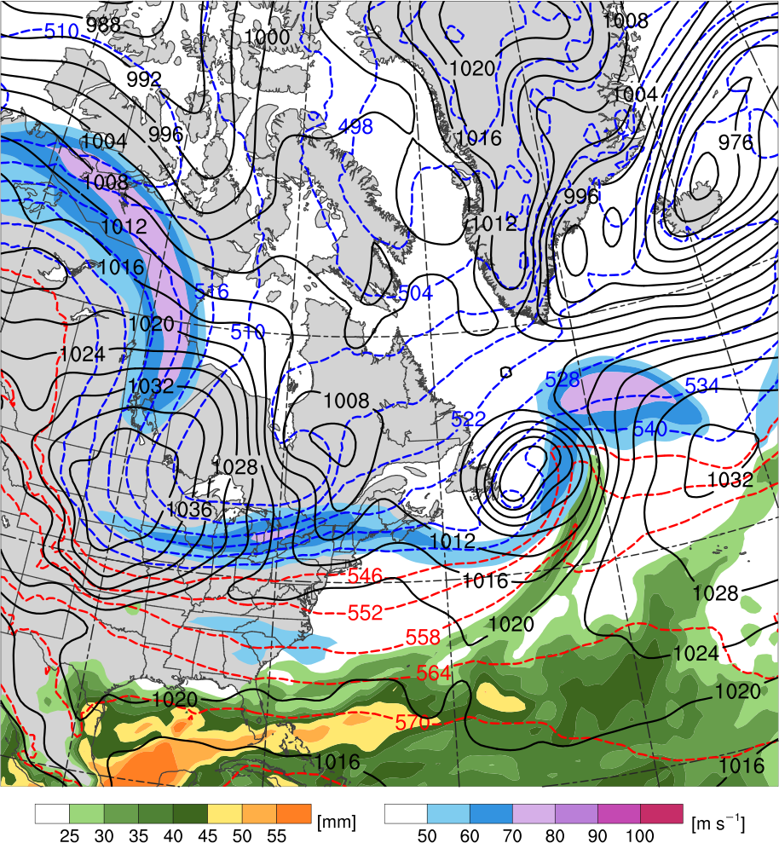
TPV–NAJ Interaction
0000 UTC 12 Nov 2013
R2
TPV
L₁₀₀₂
H
C
T1
T2
R3
Potential temperature (K, shaded), wind speed (black, every 10 m s⁻¹ starting at 50 m s⁻¹), and wind (m s⁻¹, barbs) on 2-PVU surface
250-hPa wind speed (m s⁻¹, shaded),
1000–500-hPa thickness (dam, blue/red),
MSLP (hPa, black), PW (mm, shaded)

Slide 14
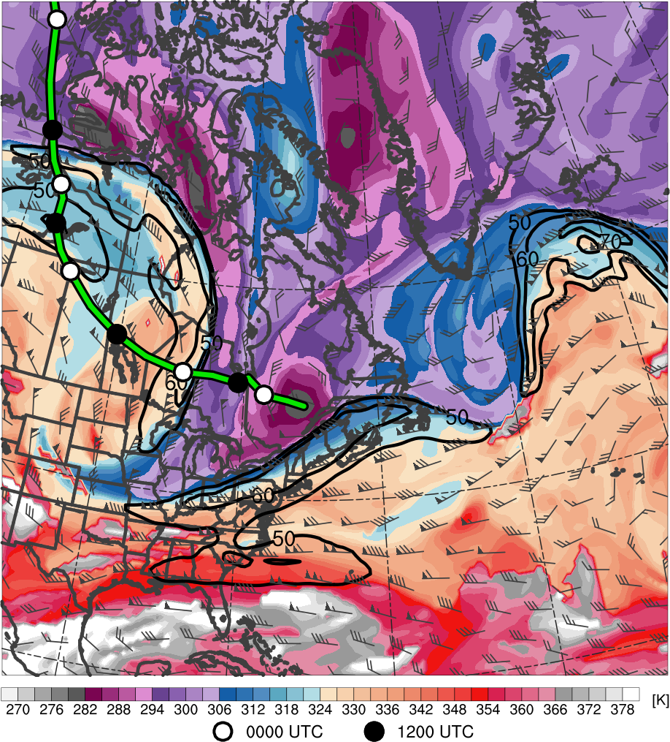
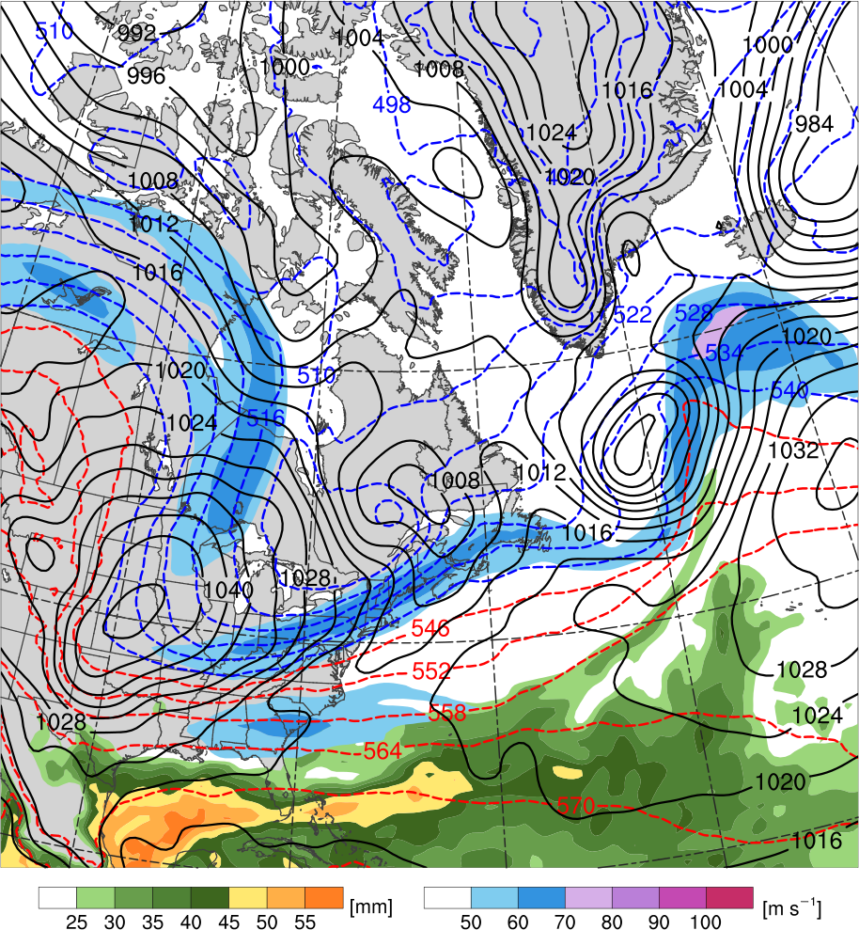
TPV–NAJ Interaction
1200 UTC 12 Nov 2013
R2
TPV
L₁₀₀₃
H
T2
C
T1
R3
H
H
Potential temperature (K, shaded), wind speed (black, every 10 m s⁻¹ starting at 50 m s⁻¹), and wind (m s⁻¹, barbs) on 2-PVU surface
250-hPa wind speed (m s⁻¹, shaded),
1000–500-hPa thickness (dam, blue/red),
MSLP (hPa, black), PW (mm, shaded)

Slide 15
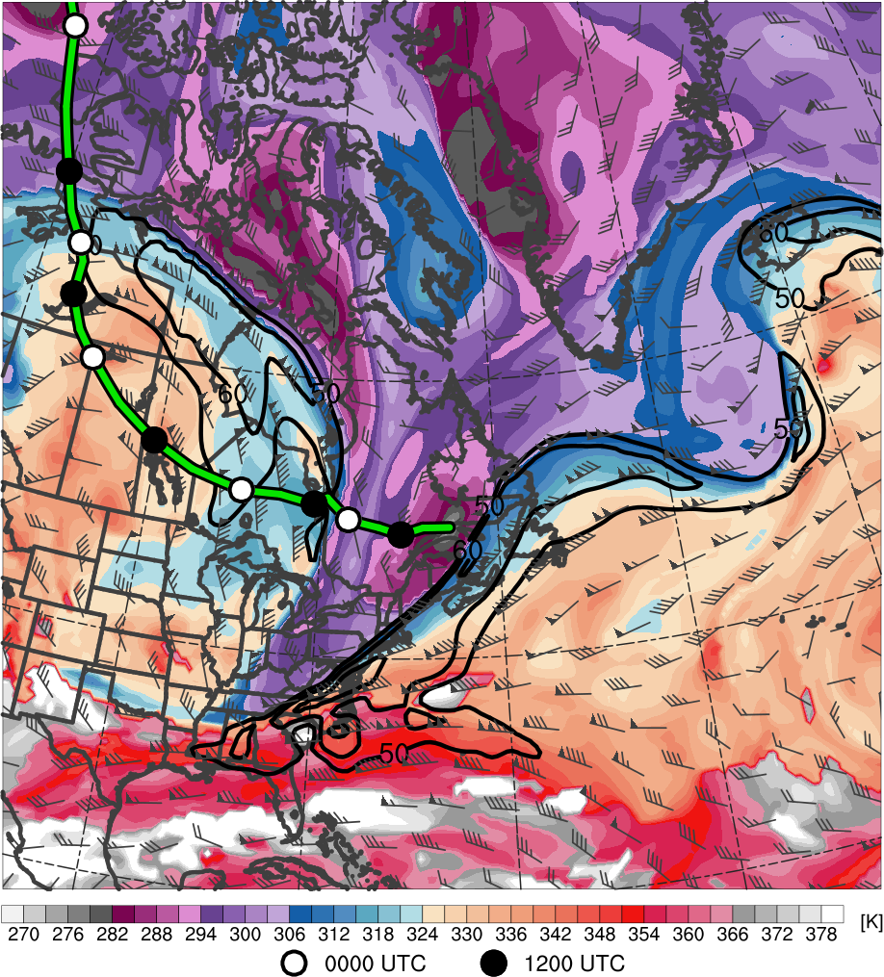
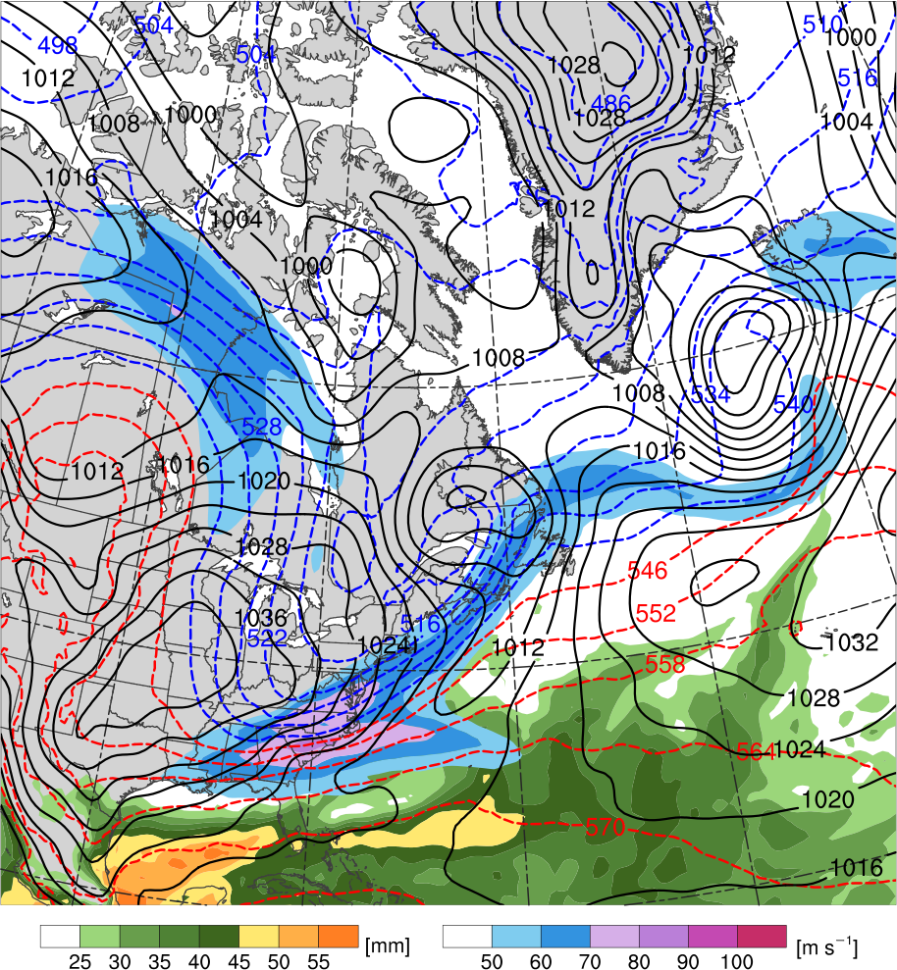
TPV–NAJ Interaction
0000 UTC 13 Nov 2013
TPV
T2
R2
L₉₉₉
R3
C
H
T1
H
Potential temperature (K, shaded), wind speed (black, every 10 m s⁻¹ starting at 50 m s⁻¹), and wind (m s⁻¹, barbs) on 2-PVU surface
250-hPa wind speed (m s⁻¹, shaded),
1000–500-hPa thickness (dam, blue/red),
MSLP (hPa, black), PW (mm, shaded)

Slide 16
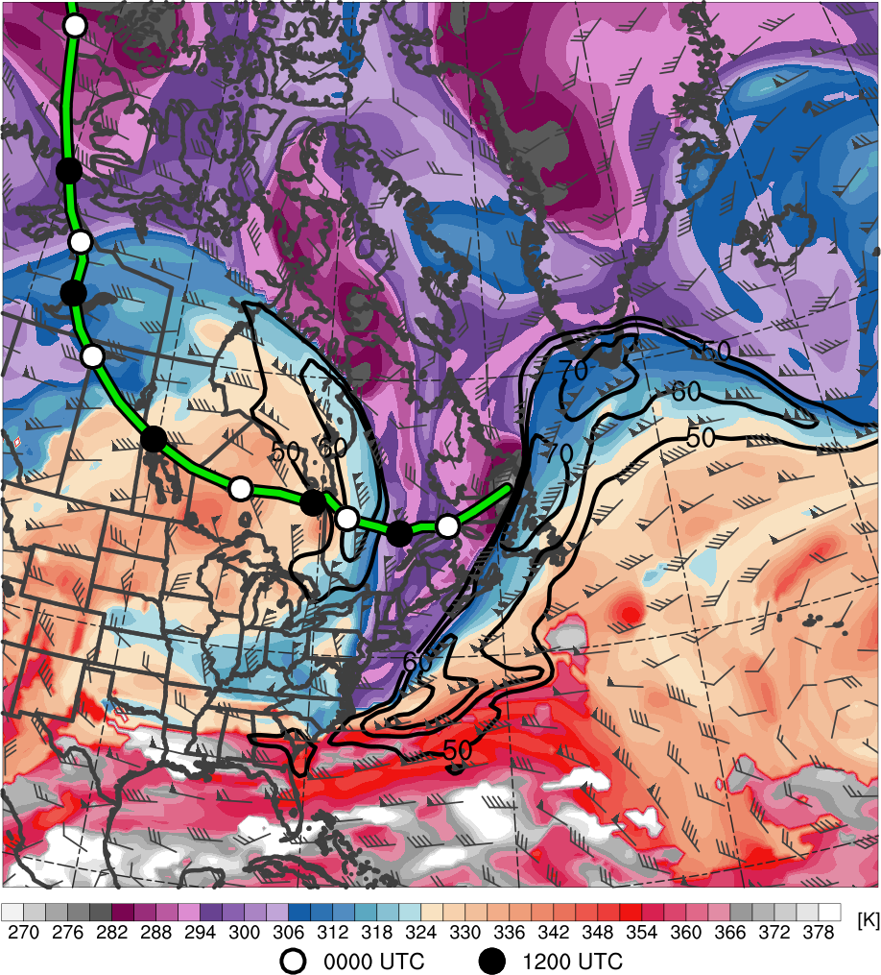
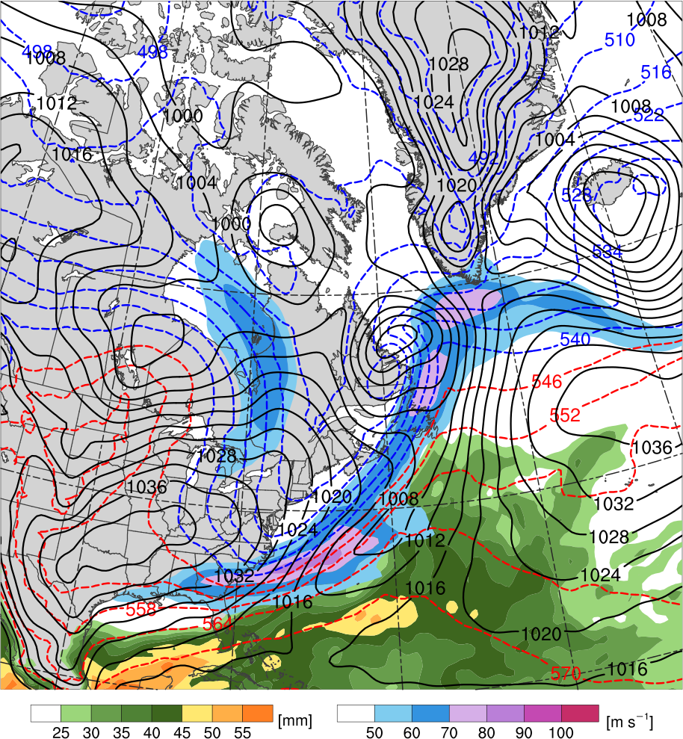
TPV–NAJ Interaction
1200 UTC 13 Nov 2013
TPV
T2
L₉₈₆
R3
C
H
R2
T1
H
Potential temperature (K, shaded), wind speed (black, every 10 m s⁻¹ starting at 50 m s⁻¹), and wind (m s⁻¹, barbs) on 2-PVU surface
250-hPa wind speed (m s⁻¹, shaded),
1000–500-hPa thickness (dam, blue/red),
MSLP (hPa, black), PW (mm, shaded)

Slide 17
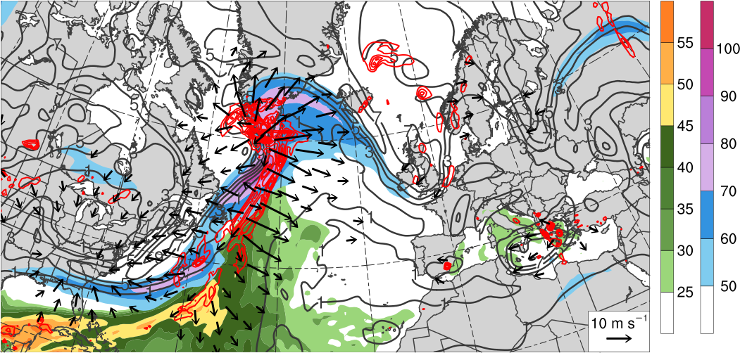
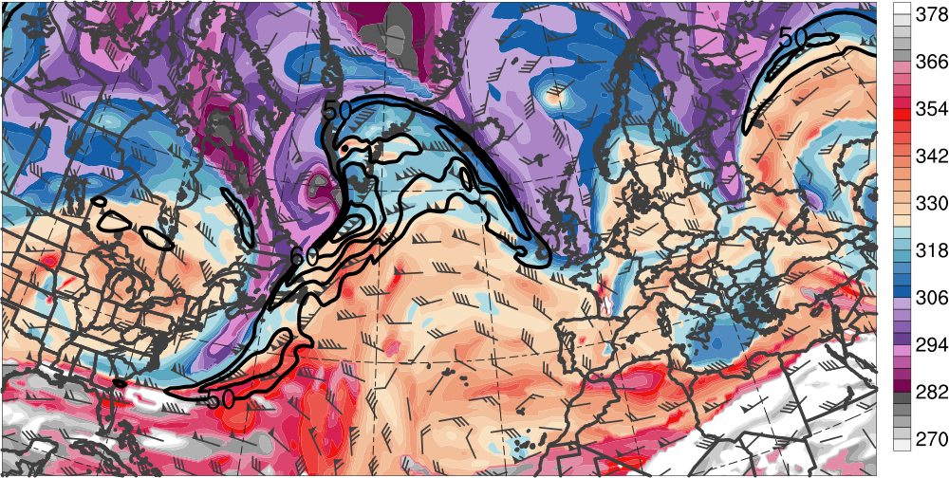
Downstream Development
0000 UTC 14 Nov 2013
300–200-hPa PV (PVU, gray)
and irrot. wind (m s⁻¹, vectors),
250-hPa wind speed (m s⁻¹, shaded),
600–400-hPa ascent
(every 0.5 × 10⁻³ hPa s⁻¹, red),
PW (mm, shaded)
L₉₆₆
H
L₁₀₀₀
[mm]
[m s⁻¹]
DT θ (K, shaded),
wind speed (black, every 10 m s⁻¹ starting at 50 m s⁻¹), and wind (m s⁻¹, barbs) on 2-PVU surface
TPV
R3
T2
R2
T1
[K]

Slide 18
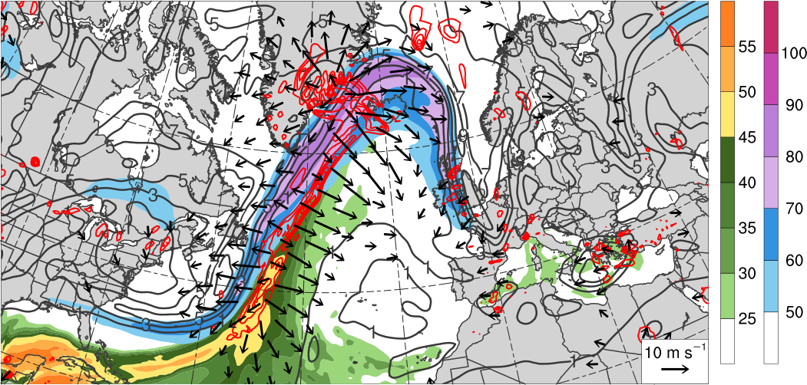
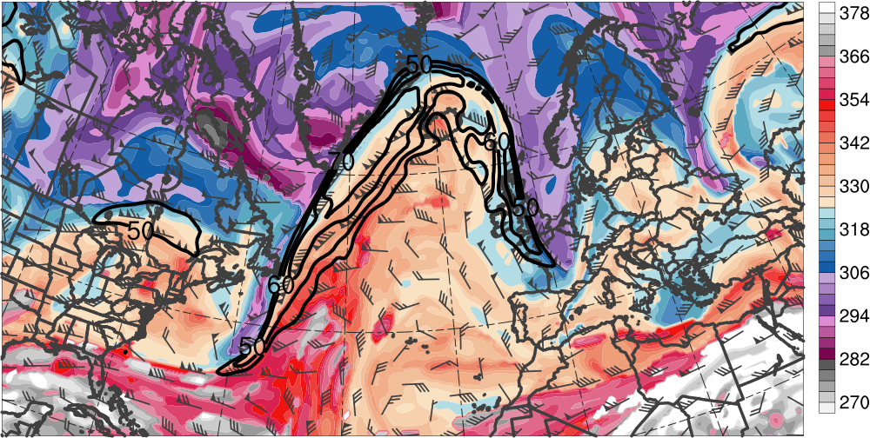
Downstream Development
1200 UTC 14 Nov 2013
300–200-hPa PV (PVU, gray)
and irrot. wind (m s⁻¹, vectors),
250-hPa wind speed (m s⁻¹, shaded),
600–400-hPa ascent
(every 0.5 × 10⁻³ hPa s⁻¹, red),
PW (mm, shaded)
L₉₇₅
L₉₇₁
L₉₉₉
H
[mm]
[m s⁻¹]
DT θ (K, shaded),
wind speed (black, every 10 m s⁻¹ starting at 50 m s⁻¹), and wind (m s⁻¹, barbs) on 2-PVU surface
R3
T2
R2
T1
[K]
Notes:
Consistency with the labels

Slide 19
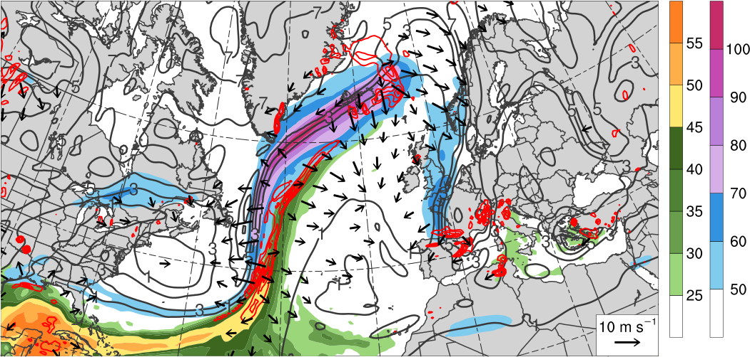
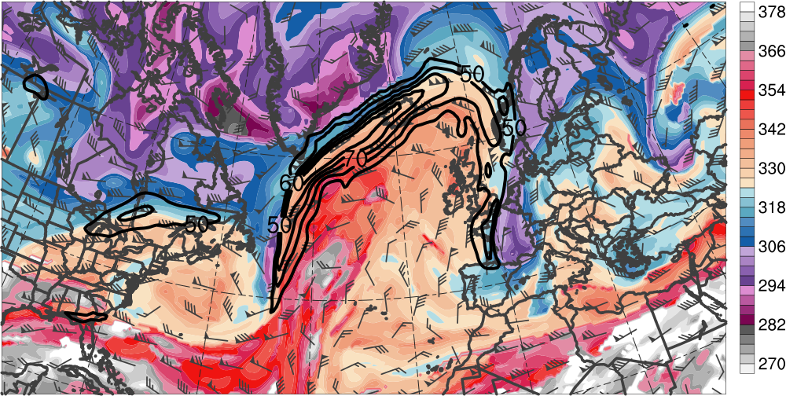
Downstream Development
0000 UTC 15 Nov 2013
300–200-hPa PV (PVU, gray)
and irrot. wind (m s⁻¹, vectors),
250-hPa wind speed (m s⁻¹, shaded),
600–400-hPa ascent
(every 0.5 × 10⁻³ hPa s⁻¹, red),
PW (mm, shaded)
L₉₇₆
L₉₉₆
H
[mm]
[m s⁻¹]
DT θ (K, shaded),
wind speed (black, every 10 m s⁻¹ starting at 50 m s⁻¹), and wind (m s⁻¹, barbs) on 2-PVU surface
R3
T2
R2
T1
[K]

Slide 20
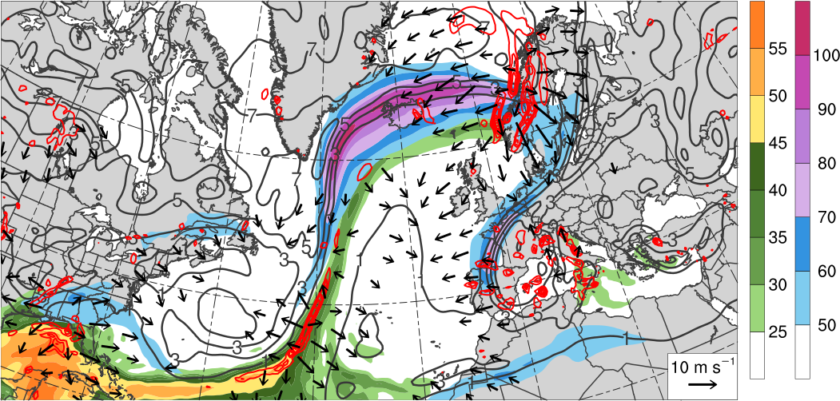
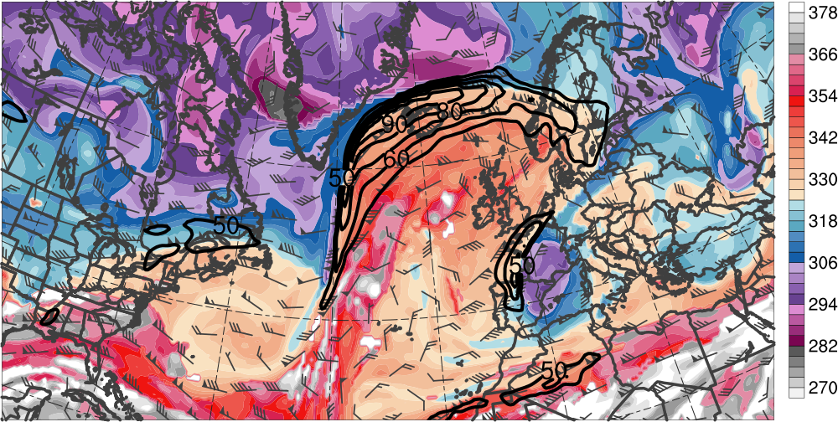
Downstream Development
1200 UTC 15 Nov 2013
L₉₅₈
300–200-hPa PV (PVU, gray)
and irrot. wind (m s⁻¹, vectors),
250-hPa wind speed (m s⁻¹, shaded),
600–400-hPa ascent
(every 0.5 × 10⁻³ hPa s⁻¹, red),
PW (mm, shaded)
L₉₉₄
H
[mm]
[m s⁻¹]
DT θ (K, shaded),
wind speed (black, every 10 m s⁻¹ starting at 50 m s⁻¹), and wind (m s⁻¹, barbs) on 2-PVU surface
R3
T1
T2
R2
[K]

Slide 21
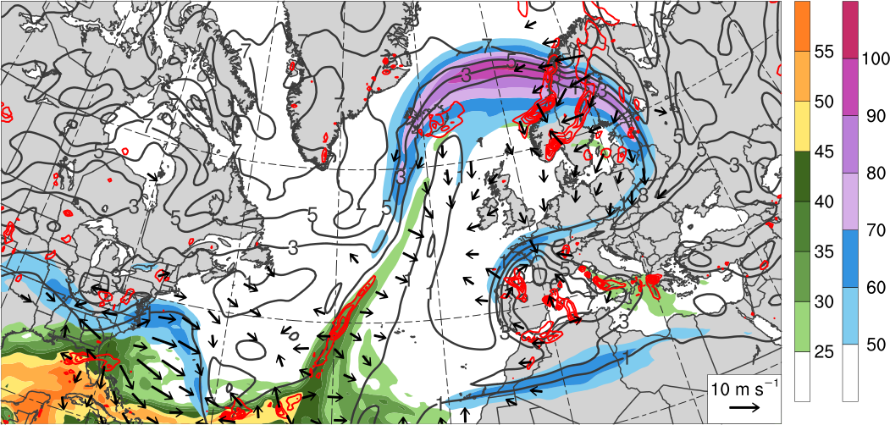
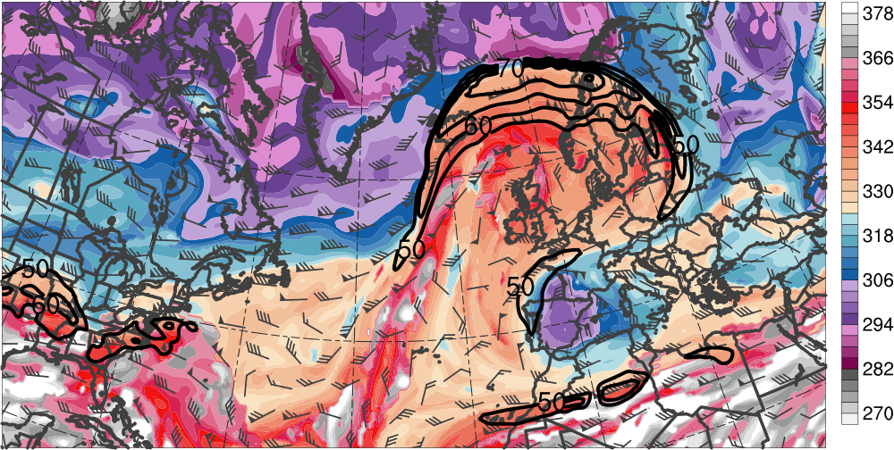
Downstream Development
0000 UTC 16 Nov 2013
300–200-hPa PV (PVU, gray)
and irrot. wind (m s⁻¹, vectors),
250-hPa wind speed (m s⁻¹, shaded),
600–400-hPa ascent
(every 0.5 × 10⁻³ hPa s⁻¹, red),
PW (mm, shaded)
L₉₈₇
H
[mm]
[m s⁻¹]
DT θ (K, shaded),
wind speed (black, every 10 m s⁻¹ starting at 50 m s⁻¹), and wind (m s⁻¹, barbs) on 2-PVU surface
R3
T2
[K]
Notes:
Fig captions: units in parentheses

Slide 22
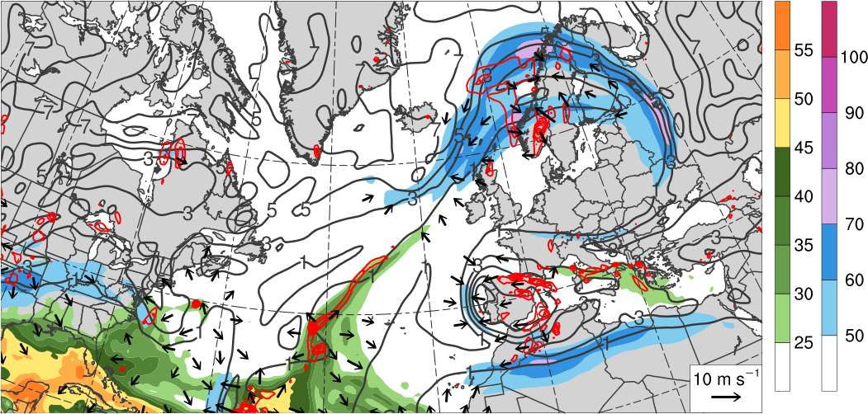
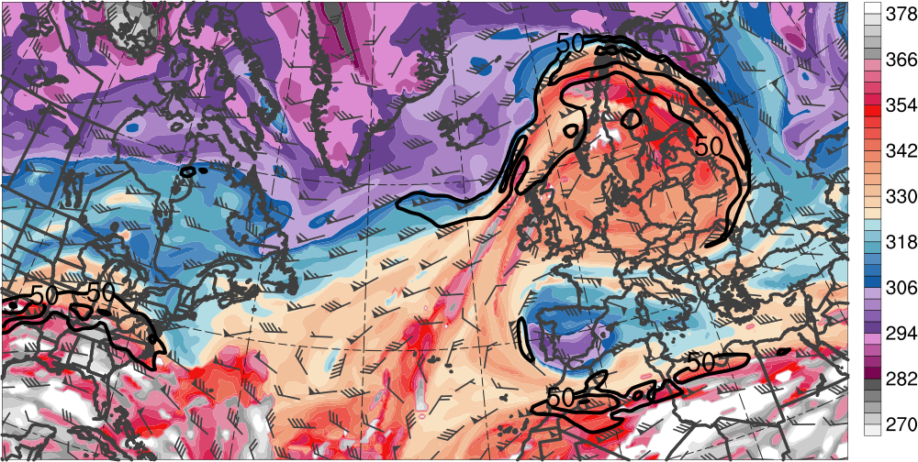
Downstream Development
1200 UTC 16 Nov 2013
300–200-hPa PV (PVU, gray)
and irrot. wind (m s⁻¹, vectors),
250-hPa wind speed (m s⁻¹, shaded),
600–400-hPa ascent
(every 0.5 × 10⁻³ hPa s⁻¹, red),
PW (mm, shaded)
L₉₇₄
H
[mm]
[m s⁻¹]
DT θ (K, shaded),
wind speed (black, every 10 m s⁻¹ starting at 50 m s⁻¹), and wind (m s⁻¹, barbs) on 2-PVU surface
R3
T2
[K]

Slide 23
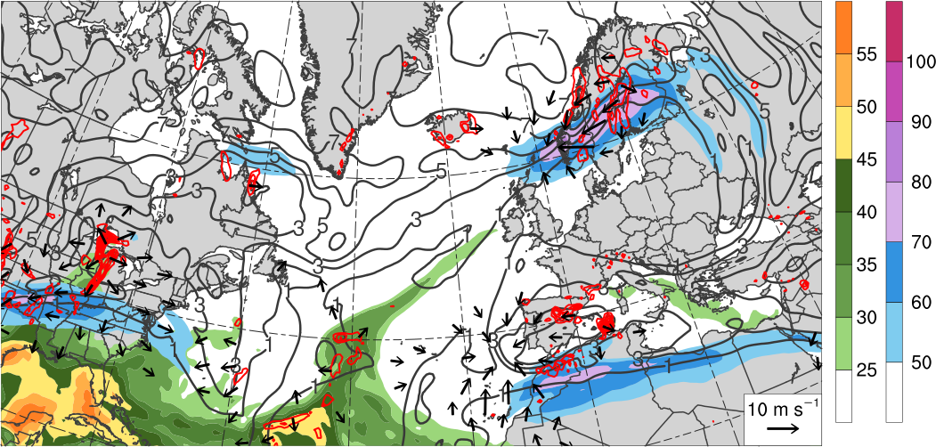
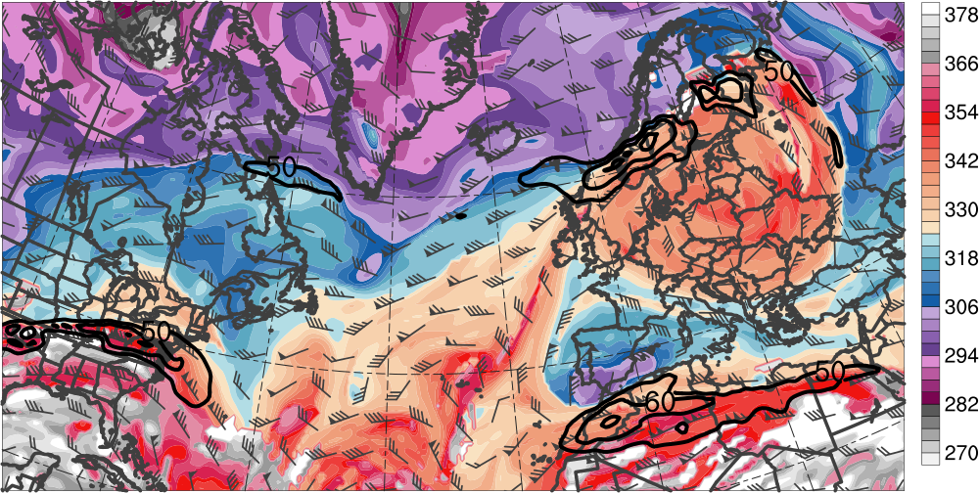
Downstream Development
0000 UTC 17 Nov 2013
300–200-hPa PV (PVU, gray)
and irrot. wind (m s⁻¹, vectors),
250-hPa wind speed (m s⁻¹, shaded),
600–400-hPa ascent
(every 0.5 × 10⁻³ hPa s⁻¹, red),
PW (mm, shaded)
L₉₆₉
H
[mm]
[m s⁻¹]
DT θ (K, shaded),
wind speed (black, every 10 m s⁻¹ starting at 50 m s⁻¹), and wind (m s⁻¹, barbs) on 2-PVU surface
R3
T2
[K]

Slide 24
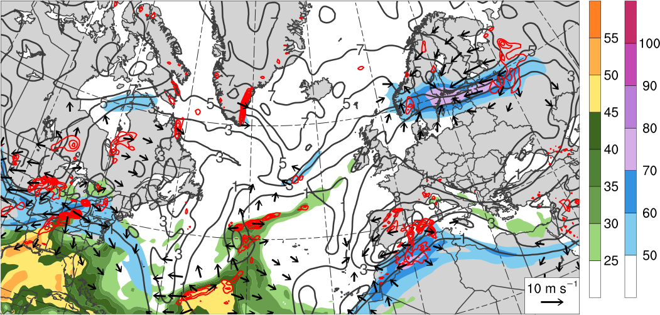
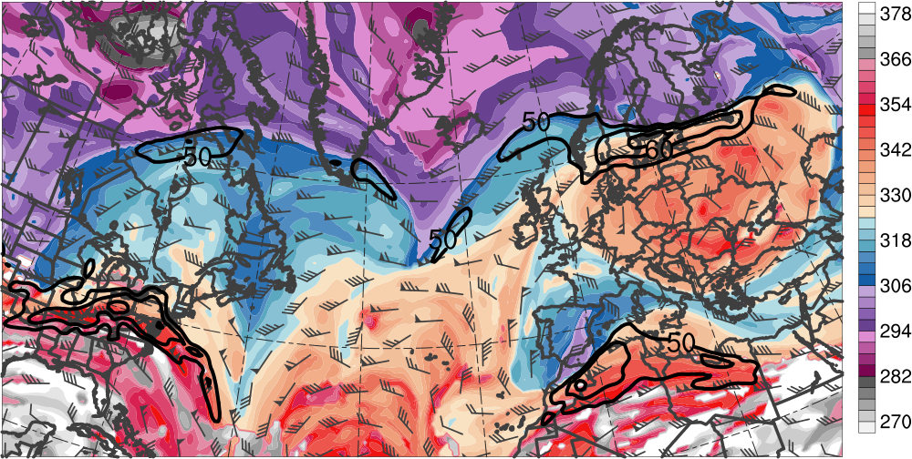
Downstream Development
1200 UTC 17 Nov 2013
300–200-hPa PV (PVU, gray)
and irrot. wind (m s⁻¹, vectors),
250-hPa wind speed (m s⁻¹, shaded),
600–400-hPa ascent
(every 0.5 × 10⁻³ hPa s⁻¹, red),
PW (mm, shaded)
L₉₇₁
H
[mm]
[m s⁻¹]
DT θ (K, shaded),
wind speed (black, every 10 m s⁻¹ starting at 50 m s⁻¹), and wind (m s⁻¹, barbs) on 2-PVU surface
R3
T2
[K]

Slide 25
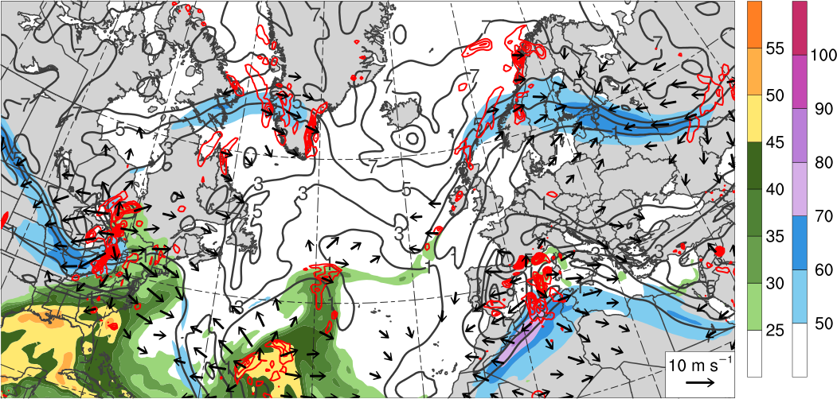
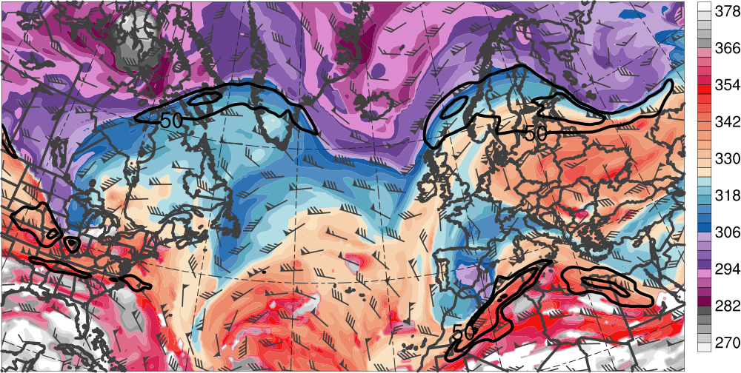
Downstream Development
0000 UTC 18 Nov 2013
300–200-hPa PV (PVU, gray)
and irrot. wind (m s⁻¹, vectors),
250-hPa wind speed (m s⁻¹, shaded),
600–400-hPa ascent
(every 0.5 × 10⁻³ hPa s⁻¹, red),
PW (mm, shaded)
L₉₇₅
L₁₀₀₅
H
[mm]
[m s⁻¹]
DT θ (K, shaded),
wind speed (black, every 10 m s⁻¹ starting at 50 m s⁻¹), and wind (m s⁻¹, barbs) on 2-PVU surface
R3
T2
[K]
Notes:
Point out low over med more clearly

Slide 26
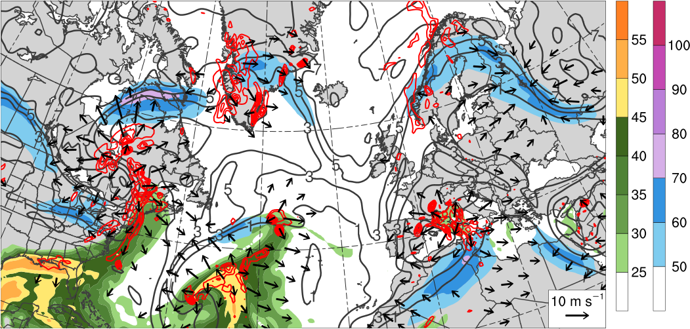
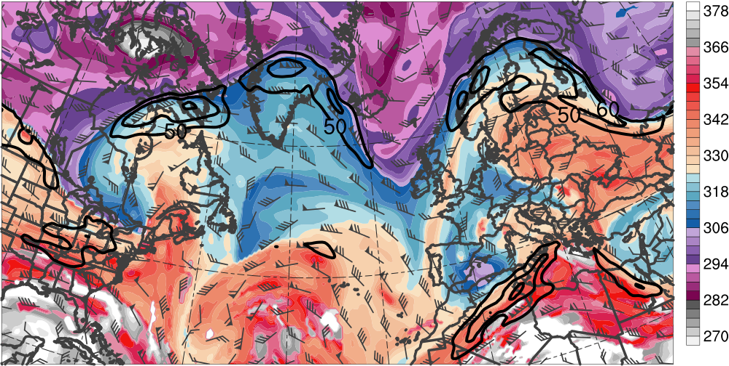
Downstream Development
1200 UTC 18 Nov 2013
300–200-hPa PV (PVU, gray)
and irrot. wind (m s⁻¹, vectors),
250-hPa wind speed (m s⁻¹, shaded),
600–400-hPa ascent
(every 0.5 × 10⁻³ hPa s⁻¹, red),
PW (mm, shaded)
L₉₇₅
L₉₉₉
H
[mm]
[m s⁻¹]
DT θ (K, shaded),
wind speed (black, every 10 m s⁻¹ starting at 50 m s⁻¹), and wind (m s⁻¹, barbs) on 2-PVU surface
R3
T2
[K]

Slide 27
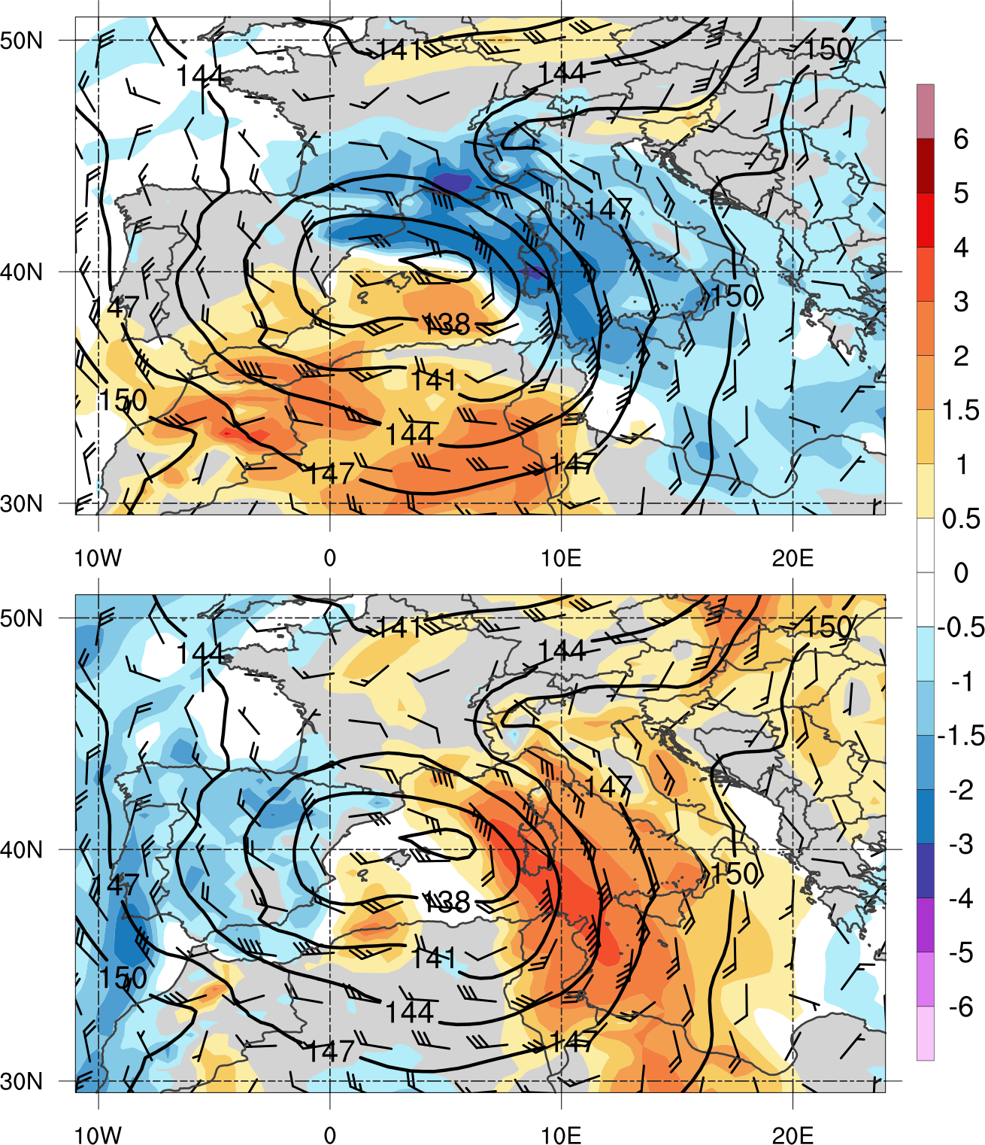
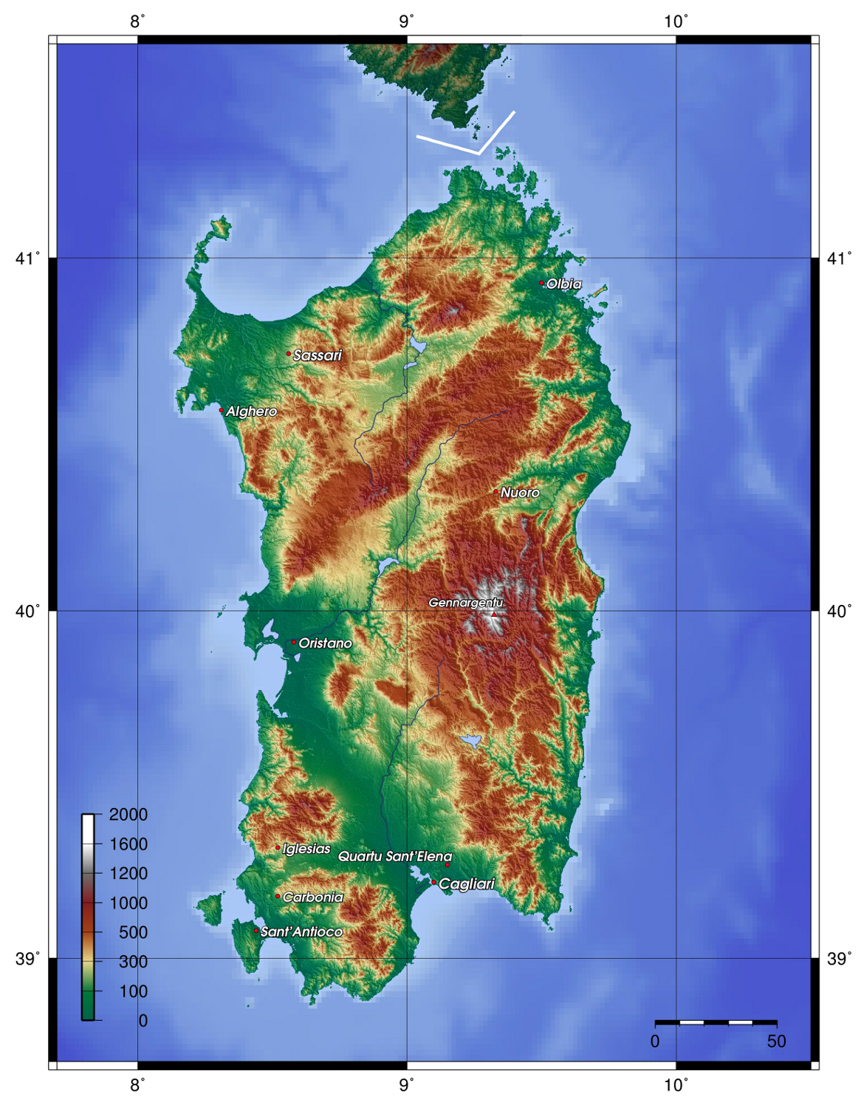
Flooding Event
1200 UTC 18 Nov 2013
850-hPa geopotential height (dam, black), wind (m s⁻¹, barbs), and standardized anomalies (σ, shaded) of u wind (top) and v wind (bottom)
Sardinia
(Source: http://it.wikipedia.org/wiki/Campidano)

Slide 28

Flooding Event
1230 UTC 18 Nov 2013
Radar-derived rainfall rate (mm h⁻¹, color shading) and IR brightness temperature (gray shading) valid 1230 UTC 18 Nov 2013 (Source: http://sop.hymex.org/)
24-h accumulated precipitation (mm, shaded) during 18 Nov 2013 (Source: Julian Quinting)
Notes:
Check for future talks: find out if color bar for ir BT

Slide 29
Case Summary
Ridge amplification over North Pacific is critical to the extraction of TPV from high latitudes
TPV and associated cold surge increase baroclinicity associated with NAJ throughout the troposphere
Interaction between TPV and NAJ leads to explosive cyclogenesis in left-exit region of NAJ
Interaction between TPV, upstream trough, and downstream anticyclone induce significant ridge amplification over western North Atlantic

Slide 30
Case Summary
NAJ intensifies to over 100 m s⁻¹ and wave breaks anticyclonically over northern Europe
Downstream trough cuts off and retrogrades over southwestern Europe before interacting with subtropical jet over northern Africa
Slow-moving cutoff cyclone over Mediterranean leads to anomalously strong southeasterly upslope flow and heavy rainfall over Sardinia

Slide 31
21–22 December 2013 Ice Storm
Juxtaposition of a TPV with a subtropical ridge leads to exceptionally strong jet (the “uber jet”) over eastern Canada
Significant ice accumulation over portions of southeast Canada, the Great Lakes, and Northeast in equatorward entrance region of jet
  Over 3 cm of ice accumulation reported, with Greater Toronto Area among the hardest hit
Significant socioeconomic disruption
Over 1 million people lost power
27 reported deaths
Notes:
Consistent line spacing wrt remainder of talk

Slide 32
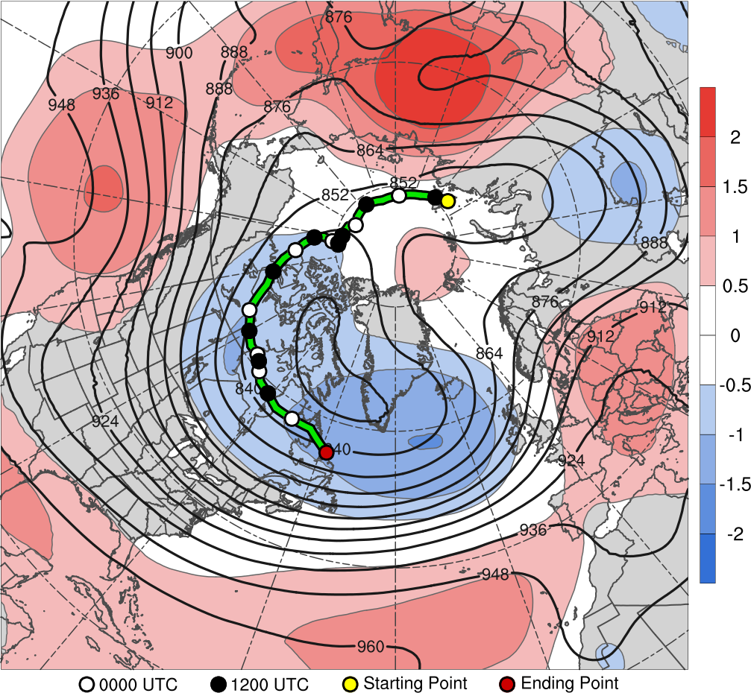
TPV Track: 0600 UTC 13 Dec – 1200 UTC 22 Dec 2013
14
18
15
17
19
20
21
22
13–22 Dec 2013 time-mean 300-hPa geopotential height (dam, black) and geopotential height anomaly (σ, shaded)

Slide 33
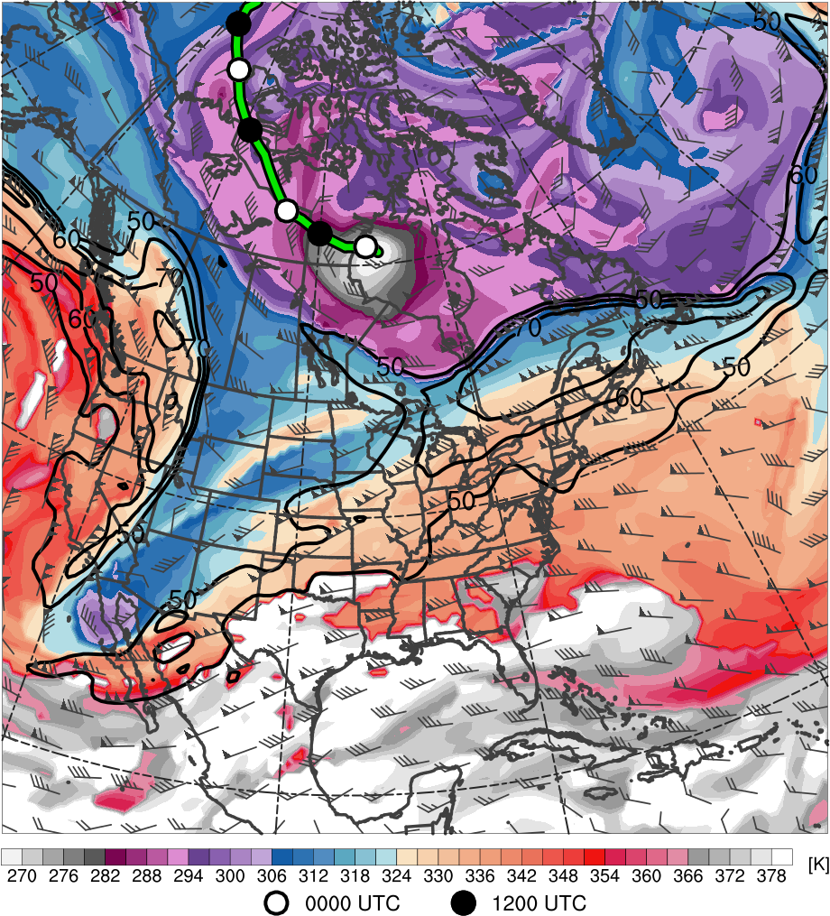
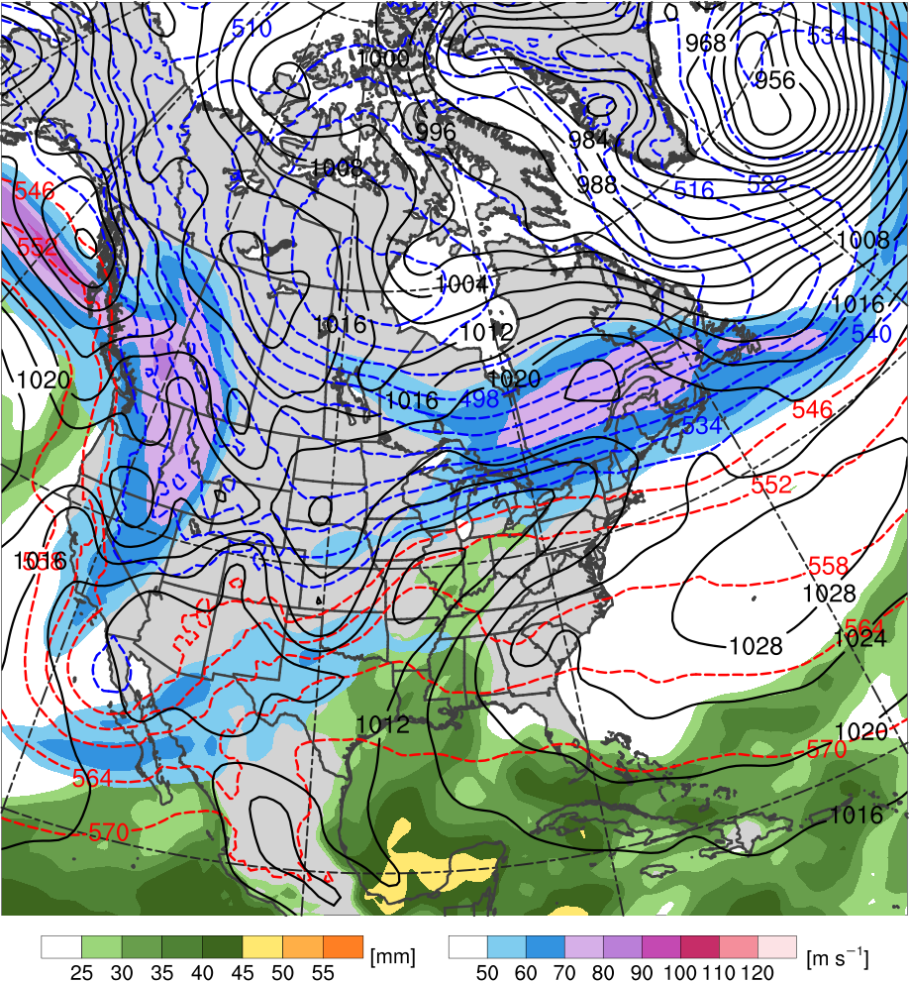
TPV–NAJ Interaction
1200 UTC 20 Dec 2013
TPV
H
C
H
R
T
Potential temperature (K, shaded), wind speed (black, every 10 m s⁻¹ starting at 50 m s⁻¹), and wind (m s⁻¹, barbs) on 2-PVU surface
250-hPa wind speed (m s⁻¹, shaded),
1000–500-hPa thickness (dam, blue/red),
MSLP (hPa, black), PW (mm, shaded)

Slide 34
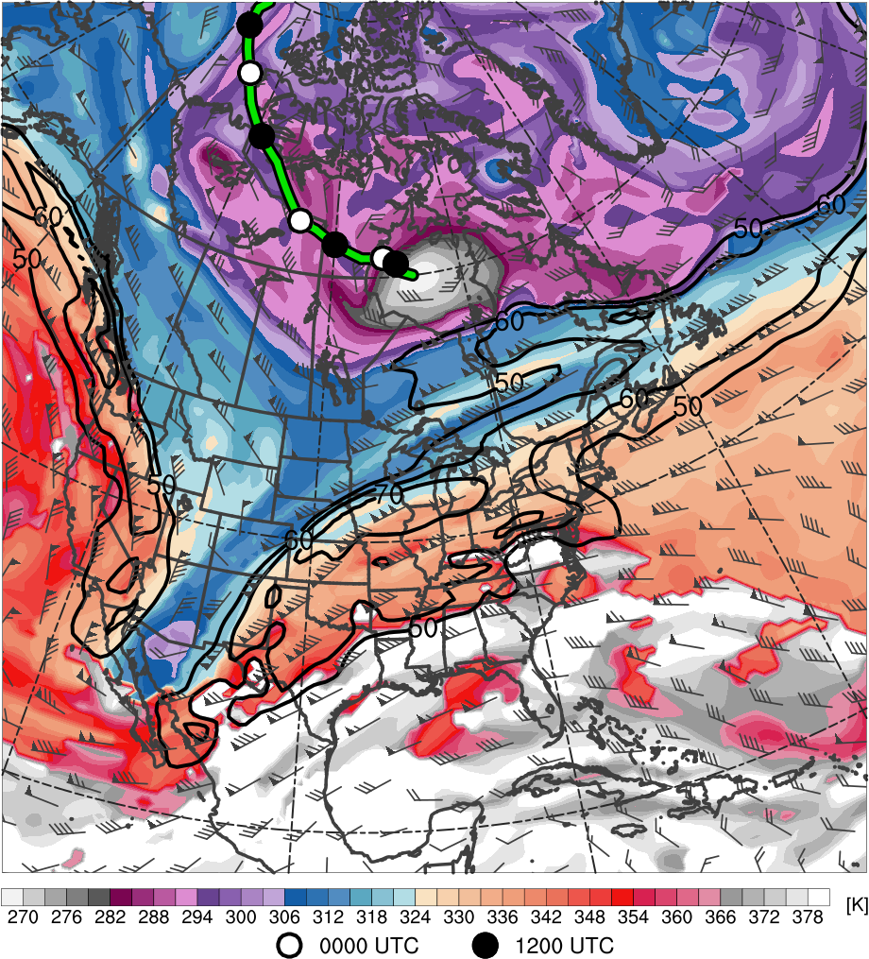
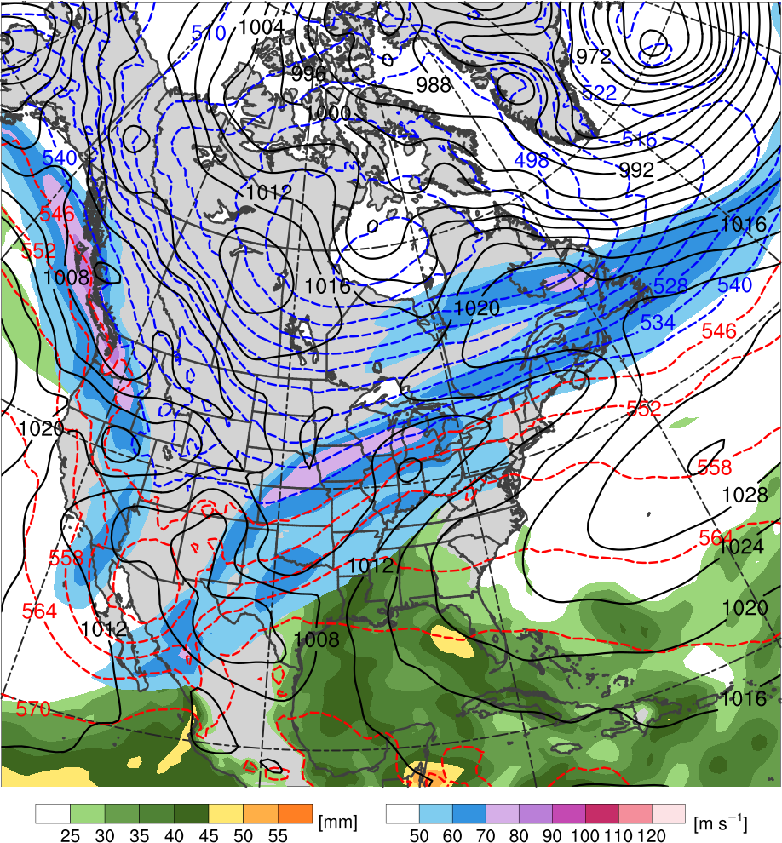
TPV–NAJ Interaction
0000 UTC 21 Dec 2013
TPV
H
C
H
R
T
Potential temperature (K, shaded), wind speed (black, every 10 m s⁻¹ starting at 50 m s⁻¹), and wind (m s⁻¹, barbs) on 2-PVU surface
250-hPa wind speed (m s⁻¹, shaded),
1000–500-hPa thickness (dam, blue/red),
MSLP (hPa, black), PW (mm, shaded)

Slide 35
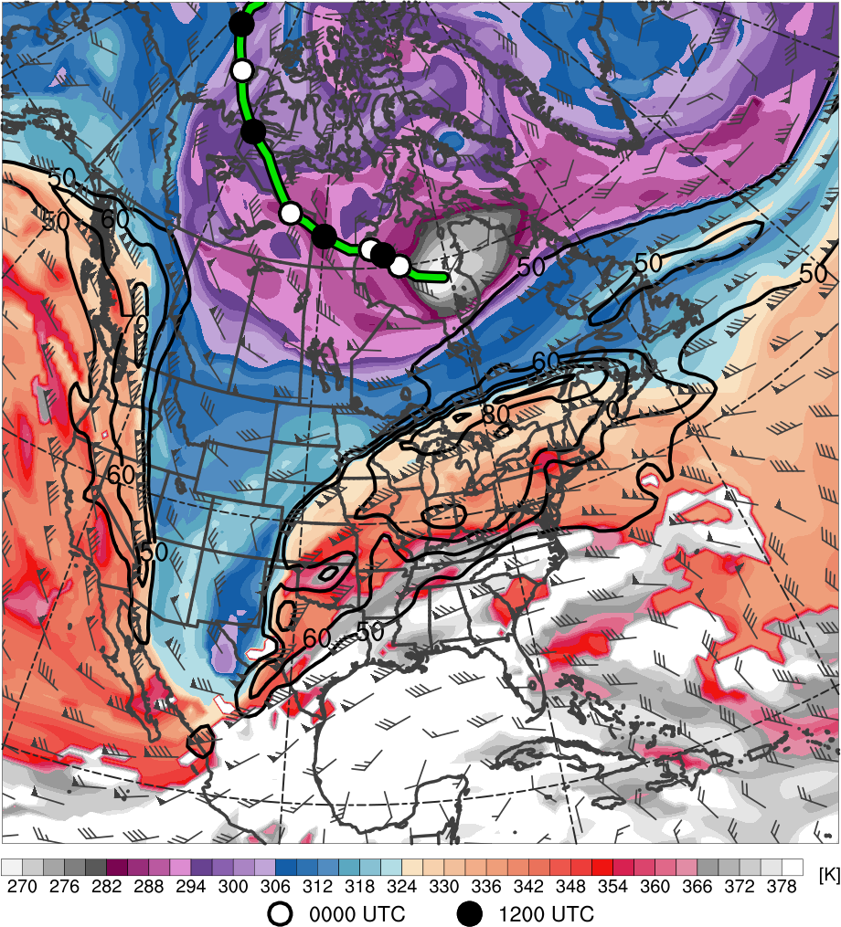
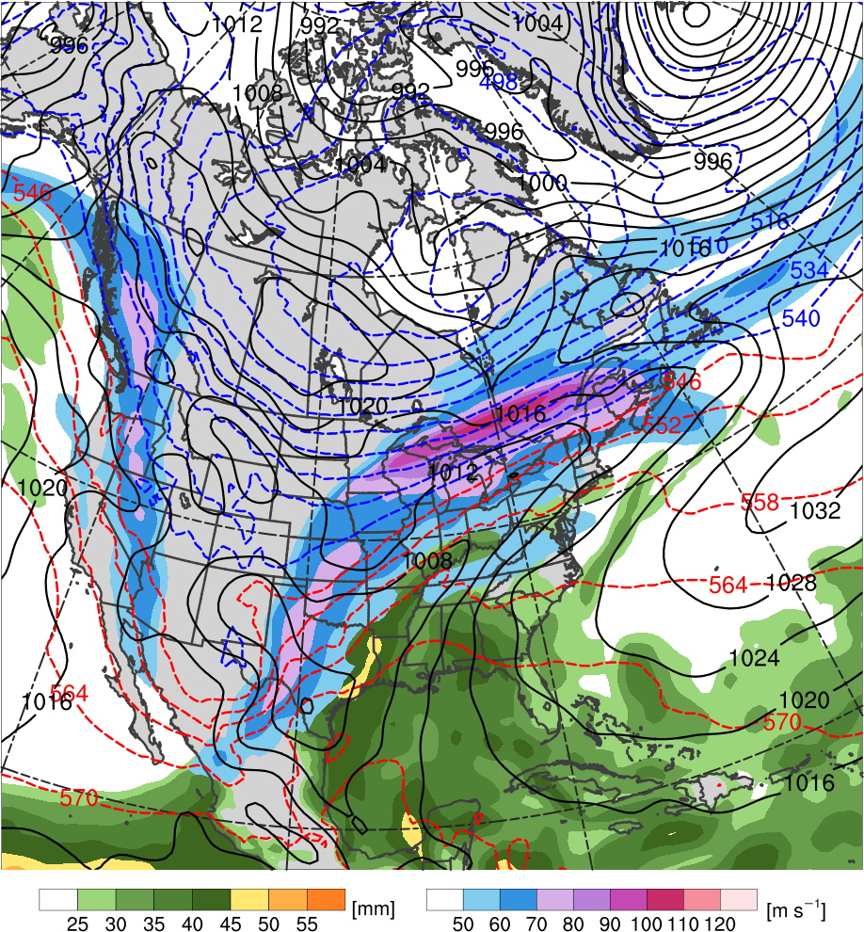
TPV–NAJ Interaction
1200 UTC 21 Dec 2013
TPV
C
H
H
R
T
L
Potential temperature (K, shaded), wind speed (black, every 10 m s⁻¹ starting at 50 m s⁻¹), and wind (m s⁻¹, barbs) on 2-PVU surface
250-hPa wind speed (m s⁻¹, shaded),
1000–500-hPa thickness (dam, blue/red),
MSLP (hPa, black), PW (mm, shaded)

Slide 36
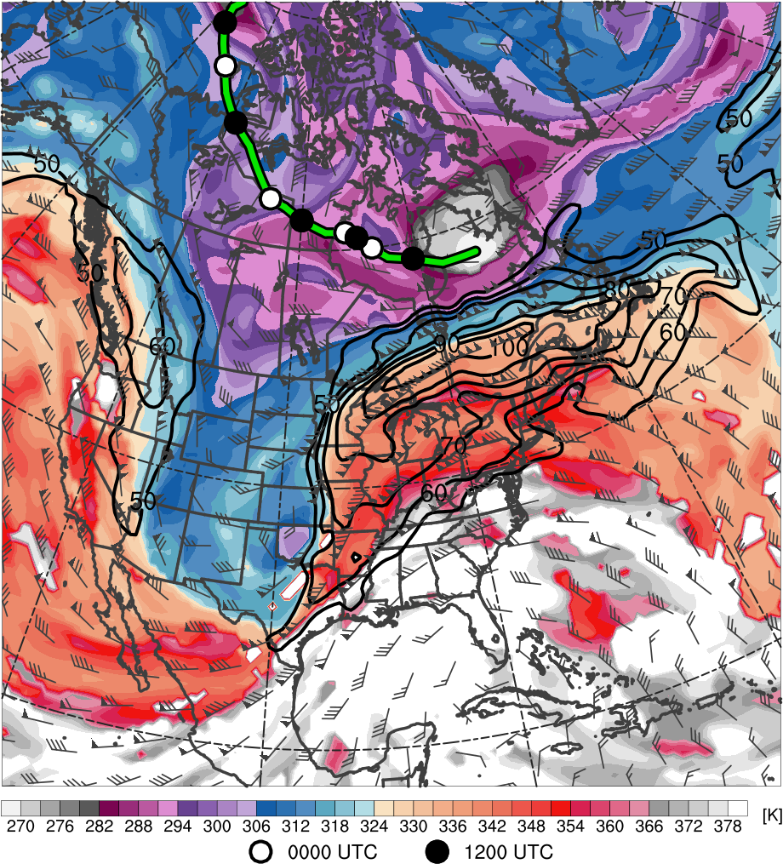
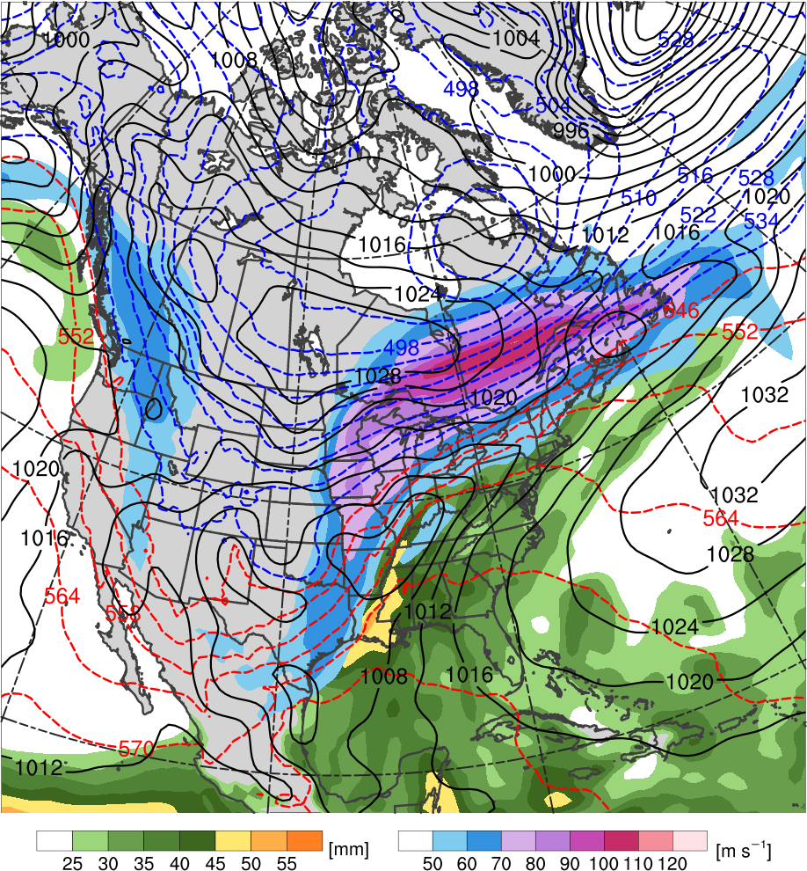
TPV–NAJ Interaction
0000 UTC 22 Dec 2013
TPV
C
H
H
R
L
T
Potential temperature (K, shaded), wind speed (black, every 10 m s⁻¹ starting at 50 m s⁻¹), and wind (m s⁻¹, barbs) on 2-PVU surface
250-hPa wind speed (m s⁻¹, shaded),
1000–500-hPa thickness (dam, blue/red),
MSLP (hPa, black), PW (mm, shaded)

Slide 37


TPV–NAJ Interaction
1200 UTC 22 Dec 2013
TPV
C
H
R
L
H
T
Potential temperature (K, shaded), wind speed (black, every 10 m s⁻¹ starting at 50 m s⁻¹), and wind (m s⁻¹, barbs) on 2-PVU surface
250-hPa wind speed (m s⁻¹, shaded),
1000–500-hPa thickness (dam, blue/red),
MSLP (hPa, black), PW (mm, shaded)

Slide 38


PV Wall Formation
1200 UTC 21 Dec 2013
B
TPV
TPV
A
A
B
Potential temperature (K, shaded), wind speed (black, every 10 m s⁻¹ starting at 50 m s⁻¹), and wind (m s⁻¹, barbs) on 2-PVU surface
Potential vorticity (PVU, shaded), wind speed (white, every 10 m s⁻¹ starting at 50 m s⁻¹), and potential temperature (K, black)
Notes:
PV Wall

Slide 39


PV Wall Formation
0000 UTC 22 Dec 2013
B
TPV
TPV
A
A
B
Potential temperature (K, shaded), wind speed (black, every 10 m s⁻¹ starting at 50 m s⁻¹), and wind (m s⁻¹, barbs) on 2-PVU surface
Potential vorticity (PVU, shaded), wind speed (white, every 10 m s⁻¹ starting at 50 m s⁻¹), and potential temperature (K, black)
Notes:
E.g., superposed polar and subtropical jets may be associated with EWEs (Winters and Martin 2014, 2015)
TPV interactions with superposed jets may support EWE development as illustrated in Case 2

Slide 40


PV Wall Formation
1200 UTC 22 Dec 2013
B
TPV
TPV
A
A
B
Potential temperature (K, shaded), wind speed (black, every 10 m s⁻¹ starting at 50 m s⁻¹), and wind (m s⁻¹, barbs) on 2-PVU surface
Potential vorticity (PVU, shaded), wind speed (white, every 10 m s⁻¹ starting at 50 m s⁻¹), and potential temperature (K, black)

Slide 41


Low-level Baroclinicity
1200 UTC 22 Dec 2013
H
CAA
L
WAA
925-hPa θ (K, black), θ advection
[K (3 h)⁻¹, shaded], and wind (m s⁻¹, barbs)
925-hPa θ (K, black), frontogenesis
[K (100 km) ⁻¹ (3 h)⁻¹, shaded], and
wind (m s⁻¹, barbs)

Slide 42


Soundings
1200 UTC 22 Dec 2013
BUF
PIT
Observed Soundings for Buffalo, NY (BUF), and
Pittsburgh, PA (PIT), at 1200 UTC 22 Dec 2013
925-hPa temperature (°C, blue/red)
and wind (knots, barbs)

Slide 43
Case Summary
Deep southwesterly flow and anomalous moisture induce diabatically enhanced ridge amplification over eastern North America ahead of short-wave trough
Juxtaposition of strong TPV over Canada with amplifying ridge leads to formation of PV wall associated with an exceptionally strong jet (the “uber jet”)
Anticyclogenesis in poleward entrance region of jet drives shallow arctic air equatorward, inducing strong lower-tropospheric frontogenesis
Strong WAA occurring above a surface-based layer of shallow arctic air leads to widespread freezing rain
Notes:
Check last statement for accuracy

Slide 44
Conclusions
Case 1 exhibits an example of a TPV–NAJ interaction that contributes to downstream EWE development
Case 2 exhibits an example of a TPV–NAJ interaction that contributes to local EWE development
In both cases, the large-scale flow configuration and disturbances embedded within and/or equatorward of the NAJ also play important roles in EWE development
As illustrated in Case 2, TPV interactions with superposed polar and subtropical jets (Winters and Martin 2014, 2015) may support EWE development

Slide 45
Conclusions
Anticipate that there is a spectrum of possible types of TPV–NAJ interactions, with certain types of interactions more conducive to EWE development than others

Slide 46
Extra Slides

Slide 47

AO and NAO Indices
6–14 Nov 2013
Daily values of the AO and NAO indices obtained from the
Climate Prediction Center (CPC)

Slide 48

AO and NAO Indices
13–22 Dec 2013
Daily values of the AO and NAO indices obtained from the CPC

Slide 49




TPV–NAJ Interaction
1200 UTC 13 Nov 2013
L
L
925–850-hPa θ (K, black), θ advection [K (3 h)⁻¹, shaded],
and wind (m s⁻¹, barbs)
925–850-hPa θ (K, black), frontogenesis
[K (100 km) ⁻¹ (3 h)⁻¹, shaded], and wind (m s⁻¹, barbs)
TPV
309 K
θ on DT
TPV
309 K
θ on DT
450–350-hPa PV (PVU, gray), PV gradient magnitude [PVU (100 km)⁻¹, shaded], wind speed (m s⁻¹, blue)
450–350-hPa PV (PVU, gray), PV frontogenesis
[PVU (100 km)⁻¹ (day)⁻¹, shaded], wind speed (m s⁻¹, blue)

Slide 50


Anomalous Moisture
0000 UTC 22 Dec 2013
700-hPa geopotential heights (dam, black), temperature (°C, red), and wind (m s⁻¹, barbs); PW (mm, shaded)
700-hPa geopotential heights (dam, black) and wind (m s⁻¹, barbs); standardized anomalies of PW (σ, shaded)

Slide 51


Ridge Amplification
0000 UTC 22 Dec 2013
300–200-hPa PV (PVU, gray) and irrot. wind
(m s⁻¹, vectors), 250-hPa wind speed (m s⁻¹),
600–400-hPa ascent (every 0.5 × 10⁻³ hPa s⁻¹, red),
PW (mm)
300–200-hPa PV (PVU, gray),
irrot. wind (m s⁻¹, vectors), and
PV advection by irrot. wind (PVU day⁻¹)

