Slide 1
Linkages Between the Equatorward Transport of Tropopause Polar Vortices and the Development of Cold Air Outbreaks
Kevin A. Biernat, Daniel Keyser, and Lance F. Bosart
Department of Atmospheric and Environmental Sciences
University at Albany, SUNY
18th Cyclone Workshop
6 October 2017
Sainte-Adèle, QC, Canada
Research support provided by NSF Grant AGS-1355960

Slide 2
What are Tropopause Polar Vortices (TPVs)?
TPVs are defined as tropopause-based vortices of high-latitude origin and are material features (Pyle et al. 2004; Cavallo and Hakim 2009, 2010, 2012, 2013)
TPV
TPV
(left) Dynamic tropopause (DT) wind speed (every 15 m s⁻¹ starting at 50 m s⁻¹, thick contours) and DT potential temperature (K, thin contours and shading) on 1.5-PVU surface valid 0000 UTC 1 Dec 1991; (right) same as left except DT pressure (hPa, thin contours and shading). Adapted from Fig. 11 in Pyle et al. (2004).

Slide 3
Motivation
TPVs may interact with and strengthen midlatitude jet streams, and act as precursors to intense midlatitude cyclones

Slide 4
Motivation
TPVs may interact with and strengthen midlatitude jet streams, and act as precursors to intense midlatitude cyclones
Arctic air surges that accompany TPVs as they are transported into middle latitudes may lead to widespread cold air outbreaks (CAOs)

Slide 5
Motivation
TPVs may interact with and strengthen midlatitude jet streams, and act as precursors to intense midlatitude cyclones
Arctic air surges that accompany TPVs as they are transported into middle latitudes may lead to widespread cold air outbreaks (CAOs)
CAOs may lead to significant socioeconomic impacts, posing a hazard to society, agriculture, and infrastructure

Slide 6
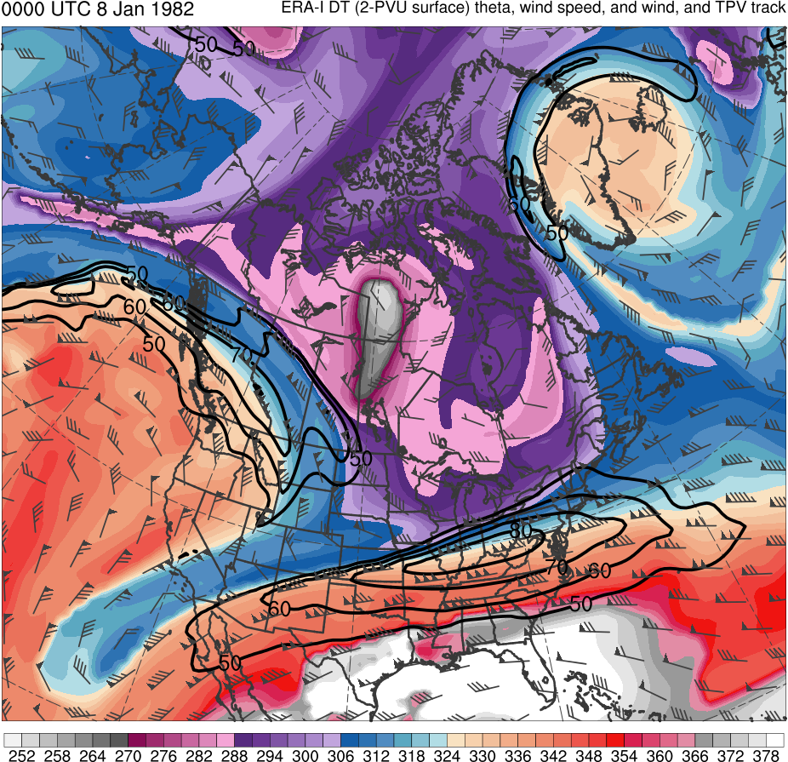
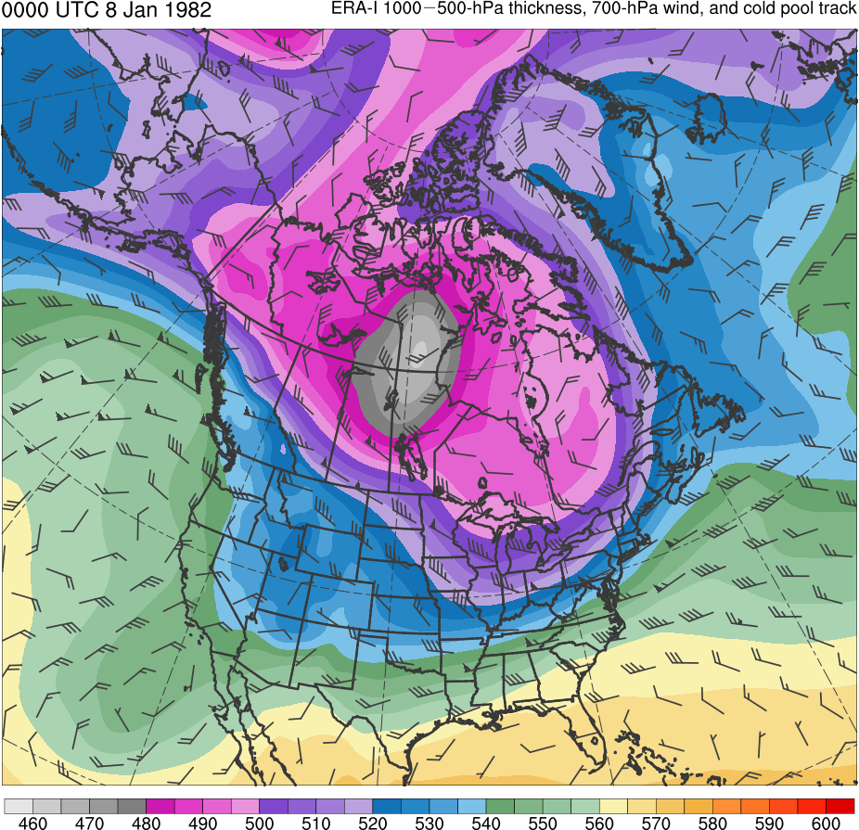
Example: 9–12 Jan 1982 CAO
0000 UTC 8 Jan 1982
Data Source: ERA-Interim
TPV
CP
(K)
252
258
264
270
276
282
288
294
300
306
312
318
324
330
336
342
348
354
360
366
372
378
(dam)
460
470
480
490
500
510
520
530
540
550
560
570
580
590
600
Potential temperature (K, shaded), wind speed (black, every 10 m s⁻¹ starting at 50 m s⁻¹), and wind (m s⁻¹, flags and barbs) on 2-PVU surface
1000–500-hPa thickness (dam, shaded) and 700-hPa wind (m s⁻¹, flags and barbs); CP denotes “cold pool”

Slide 7
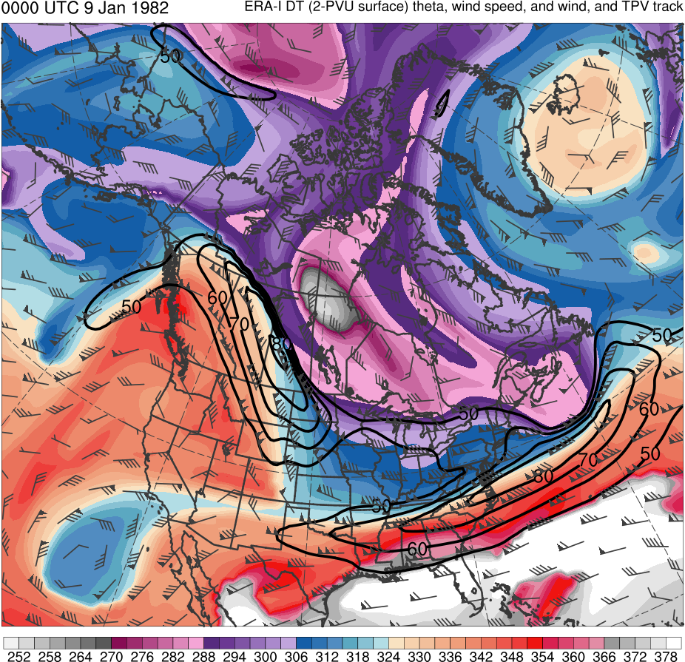
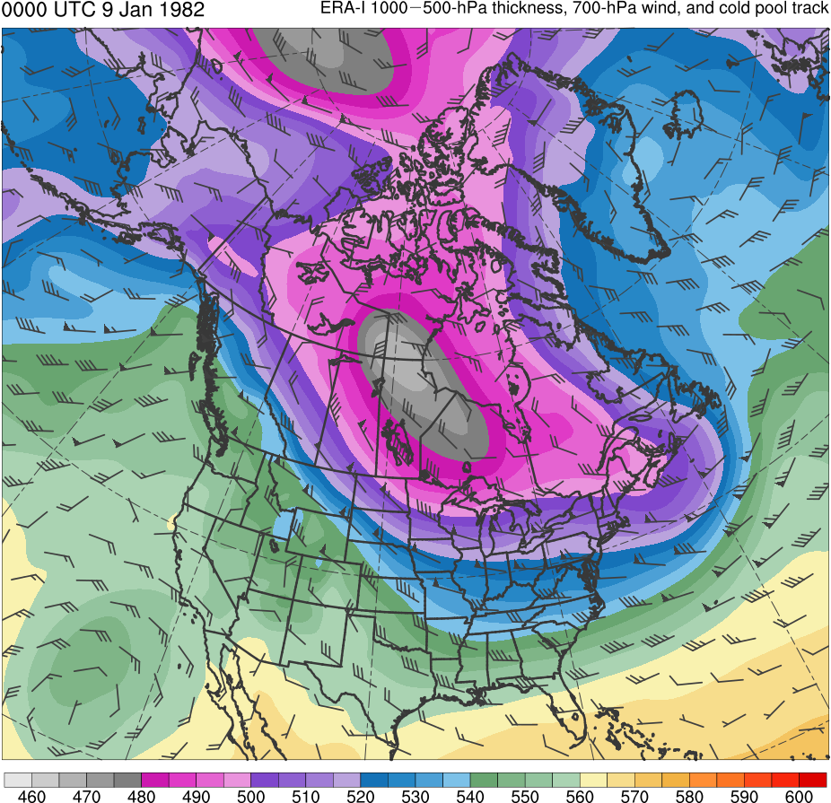
Example: 9–12 Jan 1982 CAO
0000 UTC 9 Jan 1982
Data Source: ERA-Interim
TPV
CP
(K)
252
258
264
270
276
282
288
294
300
306
312
318
324
330
336
342
348
354
360
366
372
378
(dam)
460
470
480
490
500
510
520
530
540
550
560
570
580
590
600
Potential temperature (K, shaded), wind speed (black, every 10 m s⁻¹ starting at 50 m s⁻¹), and wind (m s⁻¹, flags and barbs) on 2-PVU surface
1000–500-hPa thickness (dam, shaded) and 700-hPa wind (m s⁻¹, flags and barbs); CP denotes “cold pool”

Slide 8
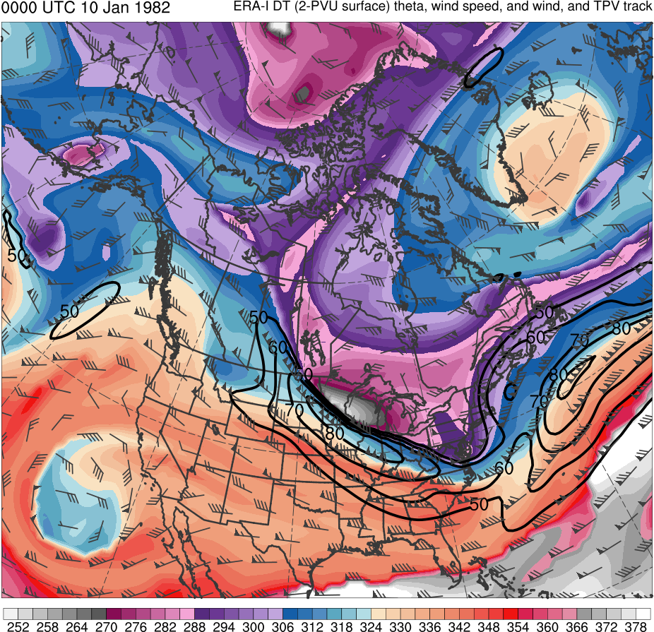
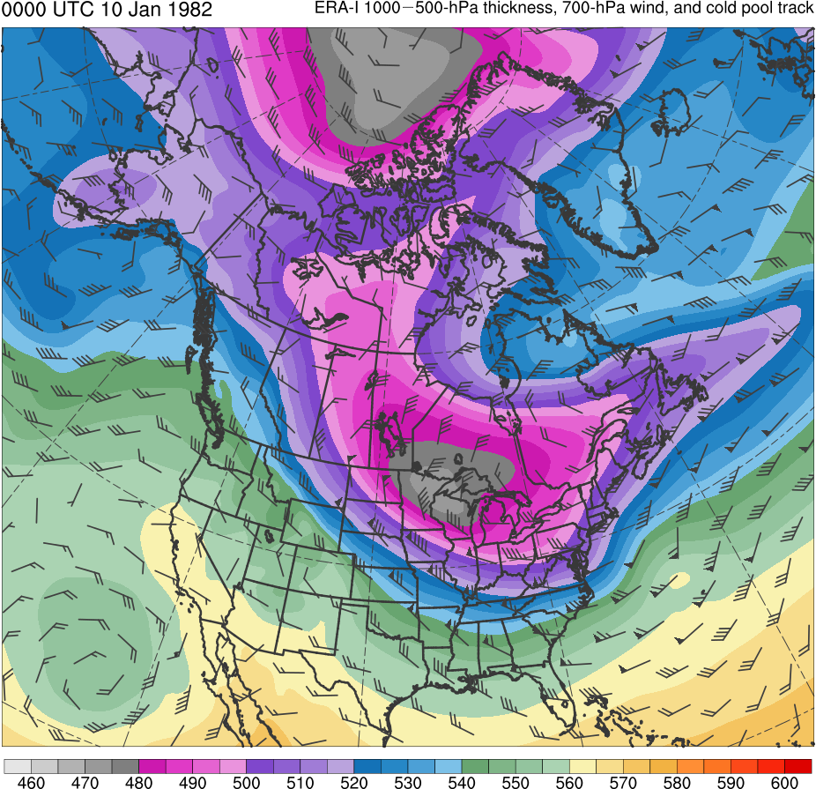
Example: 9–12 Jan 1982 CAO
0000 UTC 10 Jan 1982
Data Source: ERA-Interim
CP
TPV
(K)
252
258
264
270
276
282
288
294
300
306
312
318
324
330
336
342
348
354
360
366
372
378
(dam)
460
470
480
490
500
510
520
530
540
550
560
570
580
590
600
Potential temperature (K, shaded), wind speed (black, every 10 m s⁻¹ starting at 50 m s⁻¹), and wind (m s⁻¹, flags and barbs) on 2-PVU surface
1000–500-hPa thickness (dam, shaded) and 700-hPa wind (m s⁻¹, flags and barbs); CP denotes “cold pool”

Slide 9
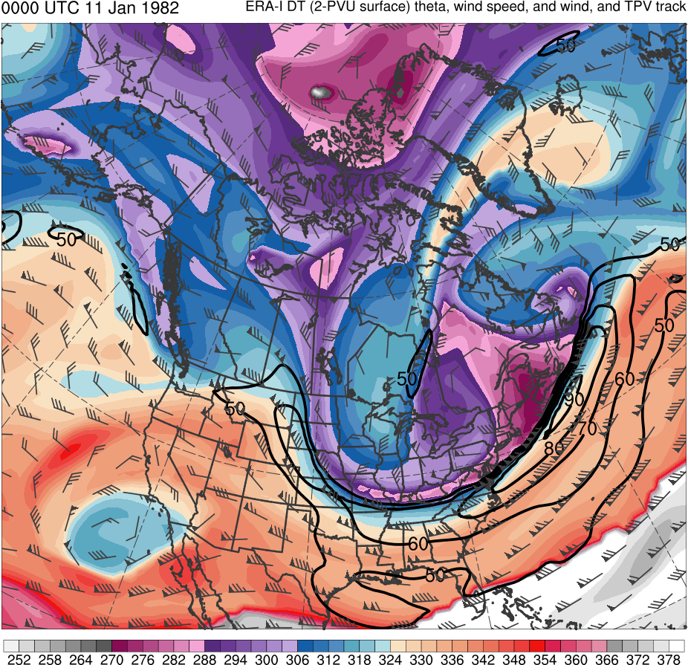
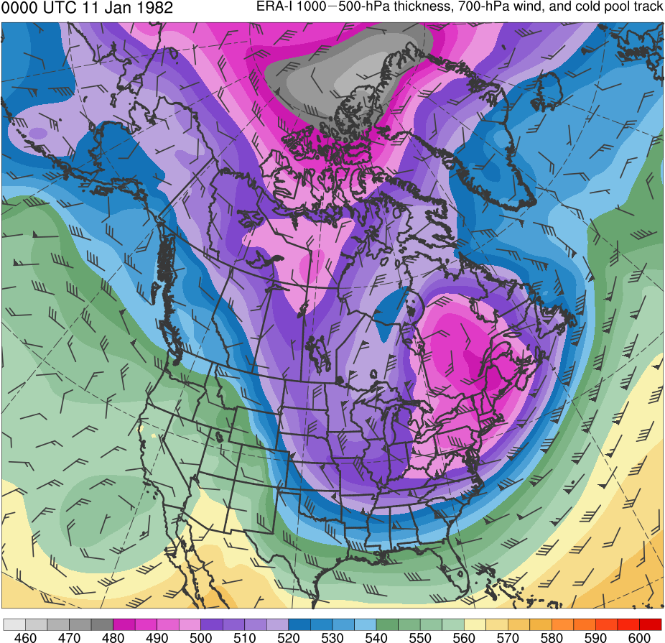
Example: 9–12 Jan 1982 CAO
0000 UTC 11 Jan 1982
Data Source: ERA-Interim
TPV
CP
(K)
252
258
264
270
276
282
288
294
300
306
312
318
324
330
336
342
348
354
360
366
372
378
(dam)
460
470
480
490
500
510
520
530
540
550
560
570
580
590
600
Potential temperature (K, shaded), wind speed (black, every 10 m s⁻¹ starting at 50 m s⁻¹), and wind (m s⁻¹, flags and barbs) on 2-PVU surface
1000–500-hPa thickness (dam, shaded) and 700-hPa wind (m s⁻¹, flags and barbs); CP denotes “cold pool”

Slide 10
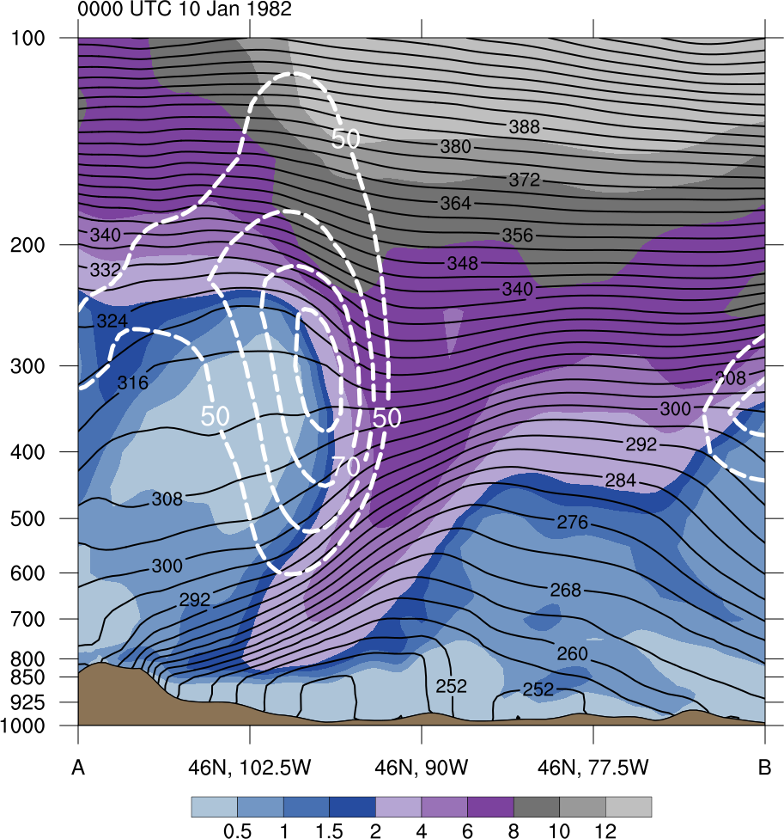
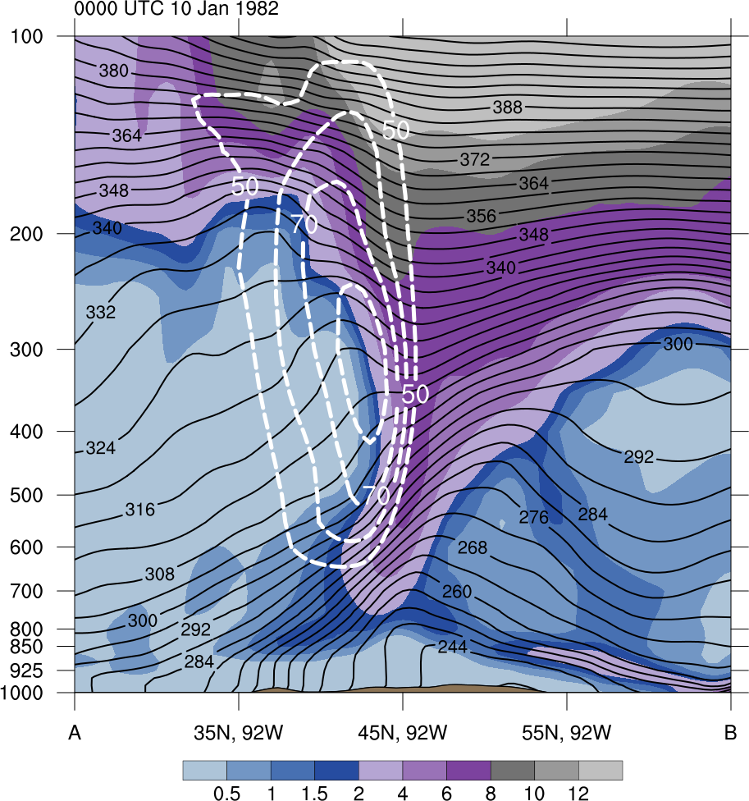
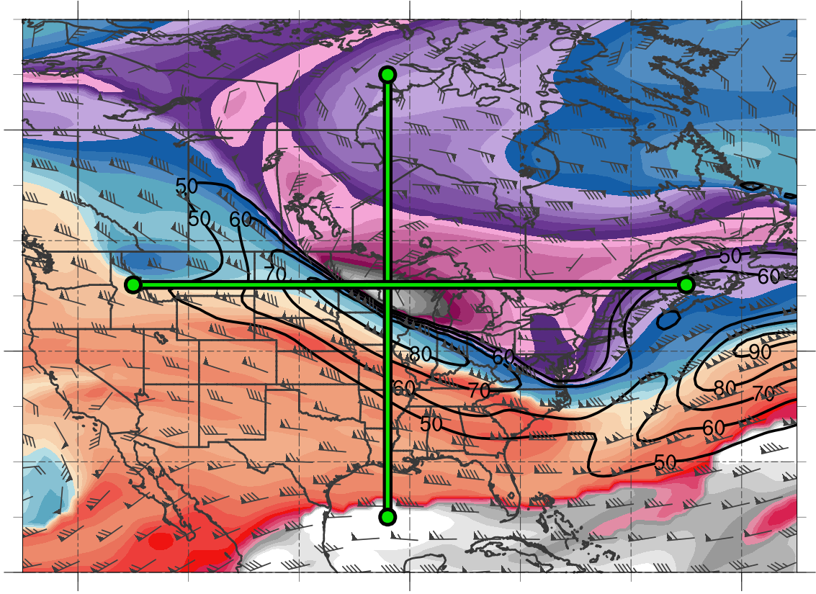
Example: 9–12 Jan 1982 CAO
0000 UTC 10 Jan 1982
378
372
12
366
10
360
8
354
6
348
4
342
2
TPV
TPV
336
1.5
330
1
324
318
0.5
312
(PVU)
A
A’
B
B’
306
B’
(top left) Zonal and (top right) meridional cross sections of potential vorticity (PVU, shaded), wind speed (white, every 10 m s⁻¹ starting at 50 m s⁻¹), and potential temperature (K, black)
(bottom left) Potential temperature (K, shaded), wind speed (black, every 10 m s⁻¹ starting at 50 m s⁻¹), wind (m s⁻¹, flags and barbs) on 2-PVU surface, and cross section transect lines
300
294
60N
TPV
288
282
A
A’
276
40N
270
264
258
B
252
20N
Data Source: ERA-Interim
(K)
120W
90W
60W

Slide 11
Example: 9–12 Jan 1982 CAO
0000 UTC 10 Jan 1982
378
372
12
366
10
360
8
354
6
348
4
342
2
TPV
TPV
336
1.5
330
1
324
318
0.5
312
(PVU)
A
A’
B
B’
306
B’
(top left) Zonal and (top right) meridional cross sections of potential vorticity (PVU, shaded), wind speed (white, every 10 m s⁻¹ starting at 50 m s⁻¹), and potential temperature (K, black)
(bottom left) Potential temperature (K, shaded), wind speed (black, every 10 m s⁻¹ starting at 50 m s⁻¹), wind (m s⁻¹, flags and barbs) on 2-PVU surface, and cross section transect lines
300
294
60N
TPV
288
282
A
A’
276
40N
270
264
258
B
252
20N
Data Source: ERA-Interim
(K)
120W
90W
60W

Slide 12
Example: 9–12 Jan 1982 CAO
0000 UTC 10 Jan 1982
378
372
12
366
10
360
8
354
6
348
4
342
2
TPV
TPV
336
1.5
330
1
324
318
0.5
312
(PVU)
A
A’
B
B’
306
B’
(top left) Zonal and (top right) meridional cross sections of potential vorticity (PVU, shaded), wind speed (white, every 10 m s⁻¹ starting at 50 m s⁻¹), and potential temperature (K, black)
(bottom left) Potential temperature (K, shaded), wind speed (black, every 10 m s⁻¹ starting at 50 m s⁻¹), wind (m s⁻¹, flags and barbs) on 2-PVU surface, and cross section transect lines
300
294
60N
TPV
288
282
A
A’
276
40N
270
264
258
B
252
20N
Data Source: ERA-Interim
(K)
120W
90W
60W

Slide 13
Outline
TPV and cold pool tracking
TPV and cold pool climatologies
Identification of CAOs
Identification of CAOs linked to cold pools
Identification of cold pools associated with TPVs
Identification of CAOs that are linked to cold pools associated with TPVs
Conclusions

Slide 14
TPV Tracking
Data:
0.5° ERA-Interim (Dee et al. 2011)
1979–2015, every 6 h
Utilized TPV tracking algorithm developed by Nicholas Szapiro and Steven Cavallo to identify and track TPVs
Input variables: potential temperature, relative vorticity, and wind on 2-PVU surface
Potential temperature minima on 2-PVU surface tracked spatially and temporally to create TPV tracks
Link for Tracking Algorithm: https://github.com/nickszap/tpvTrack

Slide 15
Cold Pool Tracking
Modified TPV tracking algorithm by changing input variables to identify and track cold pools
Input variables: 1000–500-hPa thickness and thermal vorticity, and 700-hPa wind
1000–500-hPa thickness minima tracked spatially and temporally to create cold pool tracks

Slide 16
Filtering TPV and Cold Pool Tracks
TPVs must last at least 2 days and spend at least 6 h poleward of 60°N (adapted from criteria of Cavallo and Hakim 2010)
Cold pools must last at least 2 days and spend at least 6 h poleward of 60°N
Focus on TPVs and cold pools transported from high latitudes to middle latitudes
Require that TPVs and cold pools in high latitudes move equatorward of 60°N

Slide 17
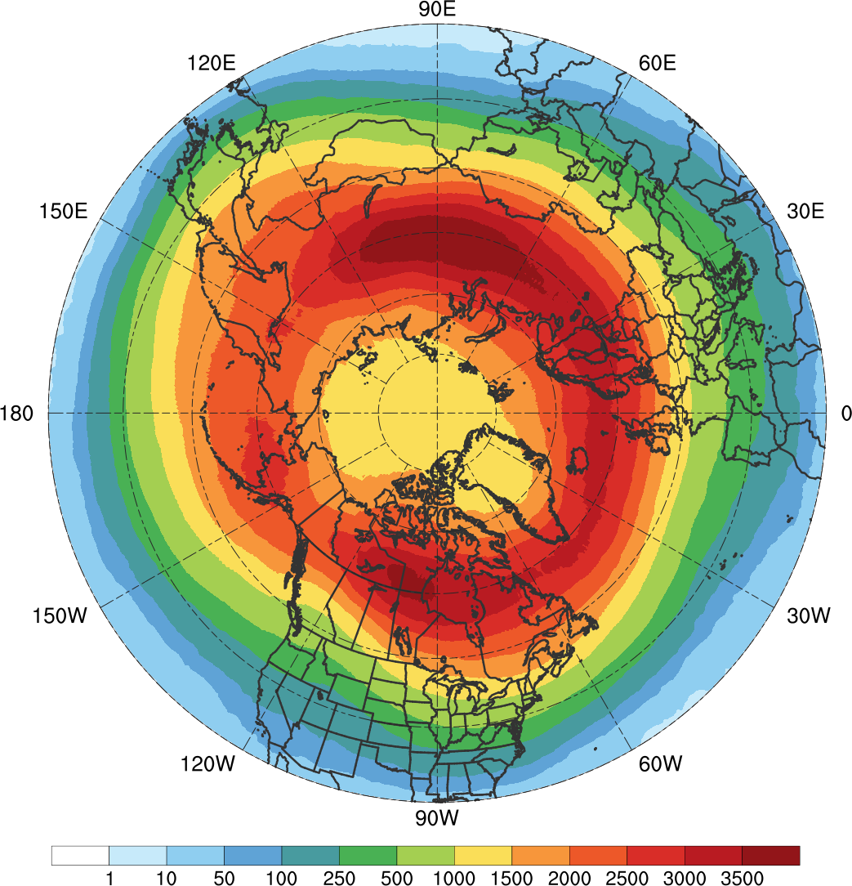
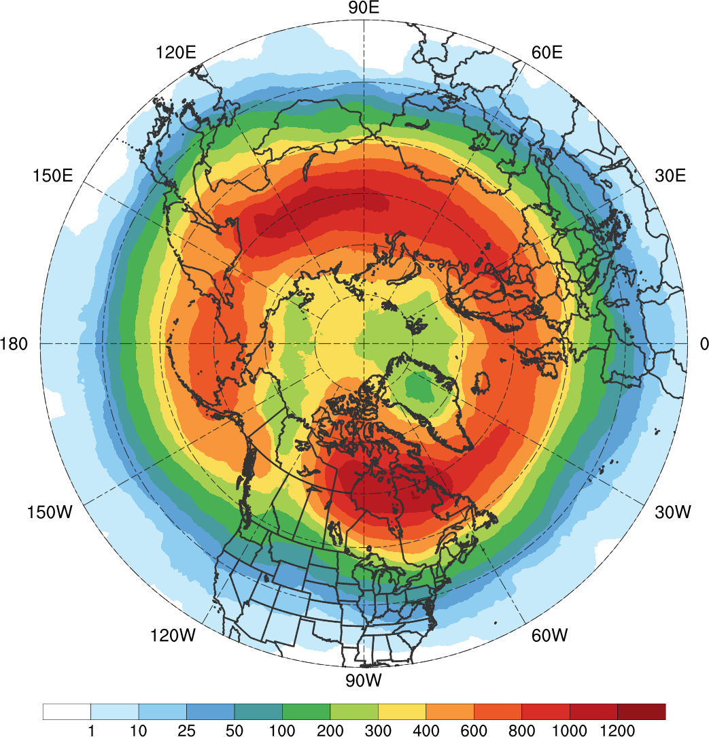
TPV and Cold Pool Track Density
TPVs Transported to Middle Latitudes
(N = 25,085; avg. of ~678 per yr)
Cold Pools Transported to Middle Latitudes
(N = 8,395; avg. of ~227 per yr)
Total number of unique TPVs (left) and cold pools (right) within 500 km of each grid point (using a 0.5° grid) for TPVs and cold pools that move equatorward of 60°N during 1979–2015

Slide 18
TPV and Cold Pool Track Density
TPVs Transported to Middle Latitudes
(N = 25,085; avg. of ~678 per yr)
Cold Pools Transported to Middle Latitudes
(N = 8,395; avg. of ~227 per yr)
Total number of unique TPVs (left) and cold pools (right) within 500 km of each grid point (using a 0.5° grid) for TPVs and cold pools that move equatorward of 60°N during 1979–2015

Slide 19
TPV and Cold Pool Track Density
TPVs Transported to Middle Latitudes
(N = 25,085; avg. of ~678 per yr)
Cold Pools Transported to Middle Latitudes
(N = 8,395; avg. of ~227 per yr)
Total number of unique TPVs (left) and cold pools (right) within 500 km of each grid point (using a 0.5° grid) for TPVs and cold pools that move equatorward of 60°N during 1979–2015

Slide 20
TPV and Cold Pool Track Density
TPVs Transported to Middle Latitudes
(N = 25,085; avg. of ~678 per yr)
Cold Pools Transported to Middle Latitudes
(N = 8,395; avg. of ~227 per yr)
Total number of unique TPVs (left) and cold pools (right) within 500 km of each grid point (using a 0.5° grid) for TPVs and cold pools that move equatorward of 60°N during 1979–2015

Slide 21
TPV and Cold Pool Track Density
TPVs Transported to Middle Latitudes
(N = 25,085; avg. of ~678 per yr)
Cold Pools Transported to Middle Latitudes
(N = 8,395; avg. of ~227 per yr)
Total number of unique TPVs (left) and cold pools (right) within 500 km of each grid point (using a 0.5° grid) for TPVs and cold pools that move equatorward of 60°N during 1979–2015

Slide 22
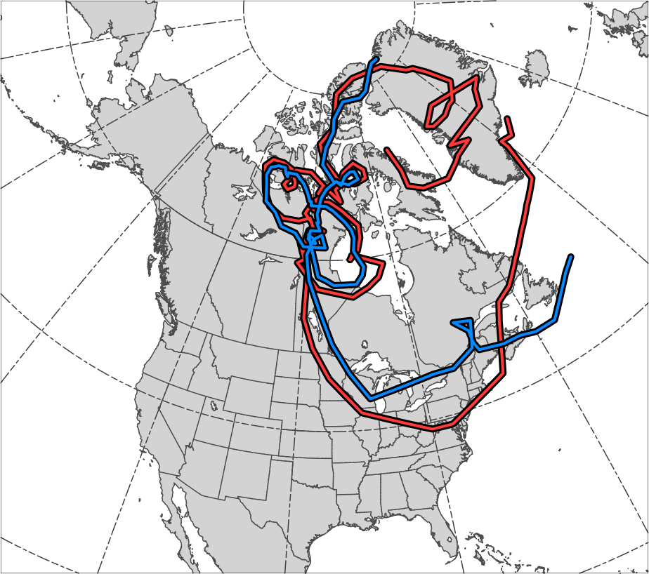
Tracks for Jan 1982 CAO
TPV Track:
Genesis:
0600 UTC 15 Dec 1981
Lysis:
0000 UTC 13 Jan 1982
Lifetime:
~29 days
Cold Pool Track:
Genesis:
1800 UTC 20 Dec 1981
Lysis:
1800 UTC 13 Jan 1982
Lifetime:
~24 days
TPV
Cold
Pool
Genesis
Lysis

Slide 23
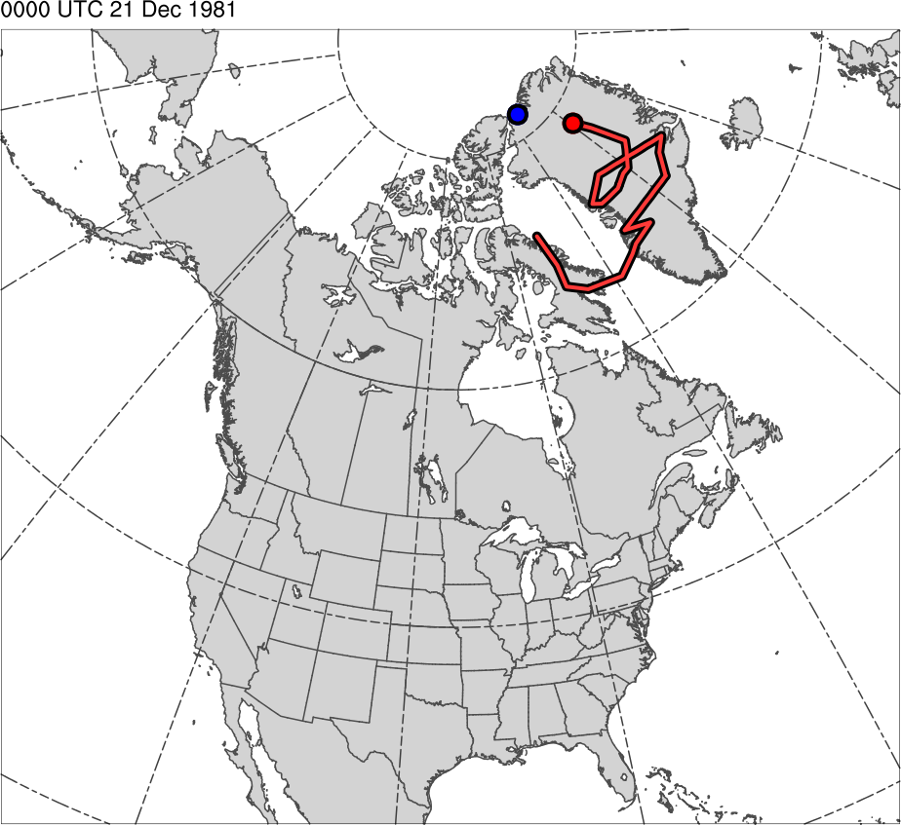
Tracks for Jan 1982 CAO
0000 UTC 21 Dec 1981
TPV Track:
Genesis:
0600 UTC 15 Dec 1981
Lysis:
0000 UTC 13 Jan 1982
Lifetime:
~29 days
Cold Pool Track:
Genesis:
1800 UTC 20 Dec 1981
Lysis:
1800 UTC 13 Jan 1982
Lifetime:
~24 days
TPV
Cold Pool

Slide 24
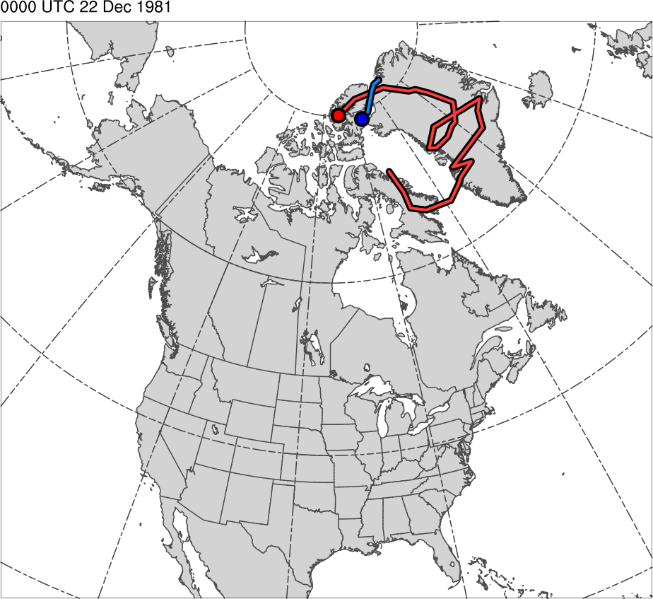
Tracks for Jan 1982 CAO
0000 UTC 22 Dec 1981
TPV Track:
Genesis:
0600 UTC 15 Dec 1981
Lysis:
0000 UTC 13 Jan 1982
Lifetime:
~29 days
Cold Pool Track:
Genesis:
1800 UTC 20 Dec 1981
Lysis:
1800 UTC 13 Jan 1982
Lifetime:
~24 days
TPV
Cold Pool

Slide 25
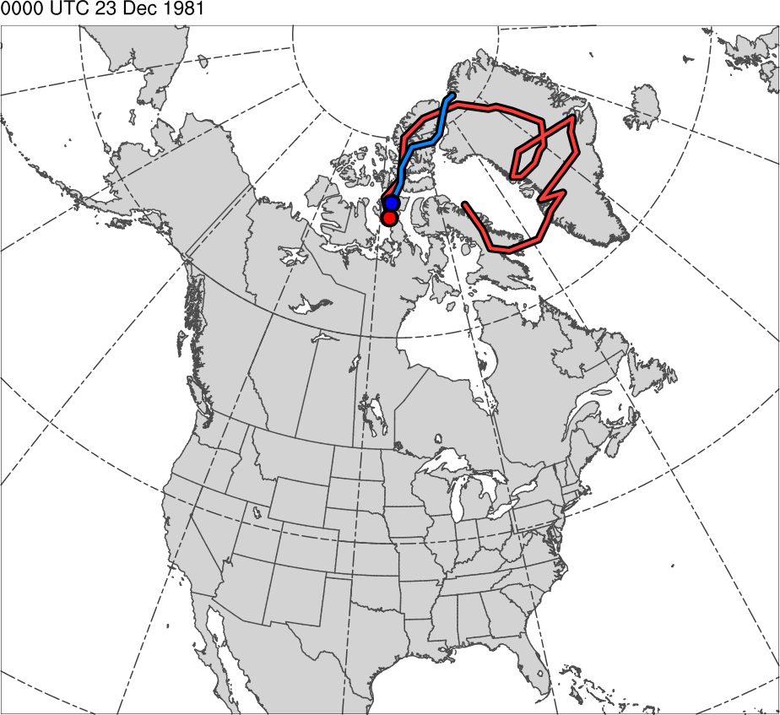
Tracks for Jan 1982 CAO
0000 UTC 23 Dec 1981
TPV Track:
Genesis:
0600 UTC 15 Dec 1981
Lysis:
0000 UTC 13 Jan 1982
Lifetime:
~29 days
Cold Pool Track:
Genesis:
1800 UTC 20 Dec 1981
Lysis:
1800 UTC 13 Jan 1982
Lifetime:
~24 days
TPV
Cold Pool

Slide 26
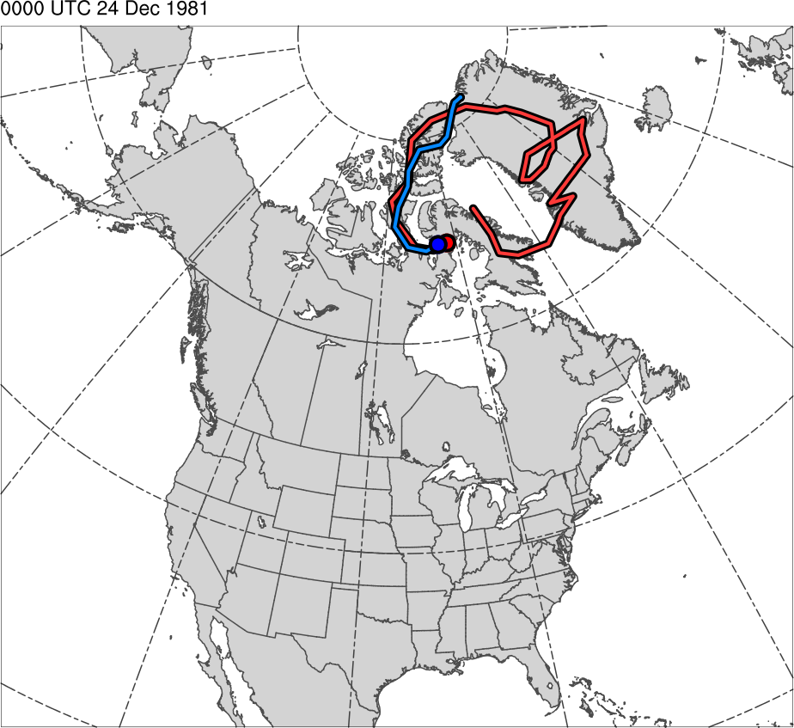
Tracks for Jan 1982 CAO
0000 UTC 24 Dec 1981
TPV Track:
Genesis:
0600 UTC 15 Dec 1981
Lysis:
0000 UTC 13 Jan 1982
Lifetime:
~29 days
Cold Pool Track:
Genesis:
1800 UTC 20 Dec 1981
Lysis:
1800 UTC 13 Jan 1982
Lifetime:
~24 days
TPV
Cold Pool

Slide 27
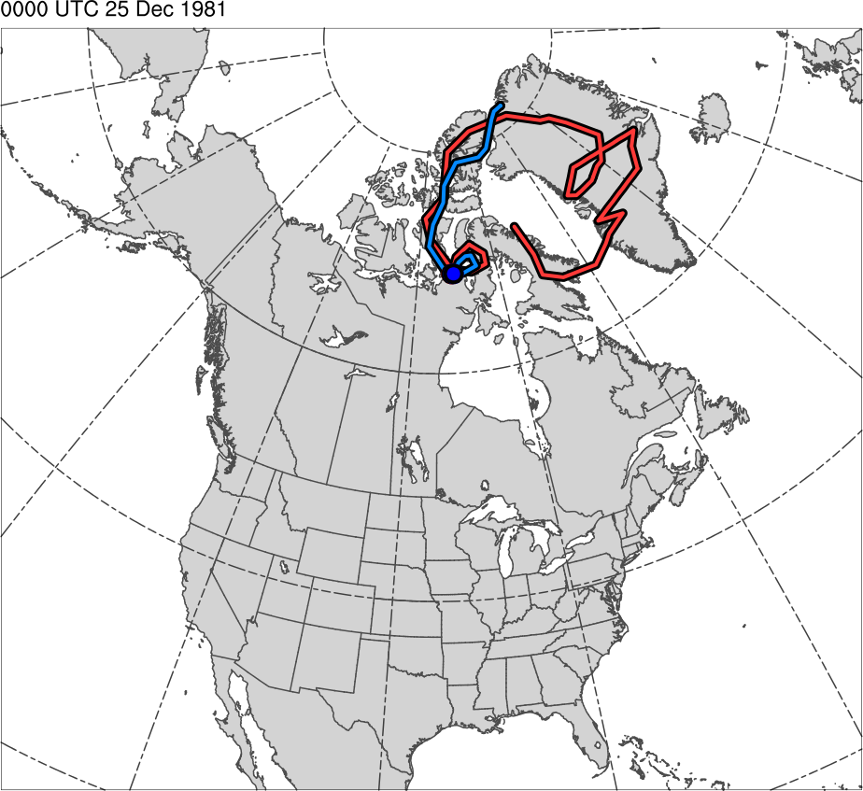
Tracks for Jan 1982 CAO
0000 UTC 25 Dec 1981
TPV Track:
Genesis:
0600 UTC 15 Dec 1981
Lysis:
0000 UTC 13 Jan 1982
Lifetime:
~29 days
Cold Pool Track:
Genesis:
1800 UTC 20 Dec 1981
Lysis:
1800 UTC 13 Jan 1982
Lifetime:
~24 days
TPV
Cold Pool

Slide 28
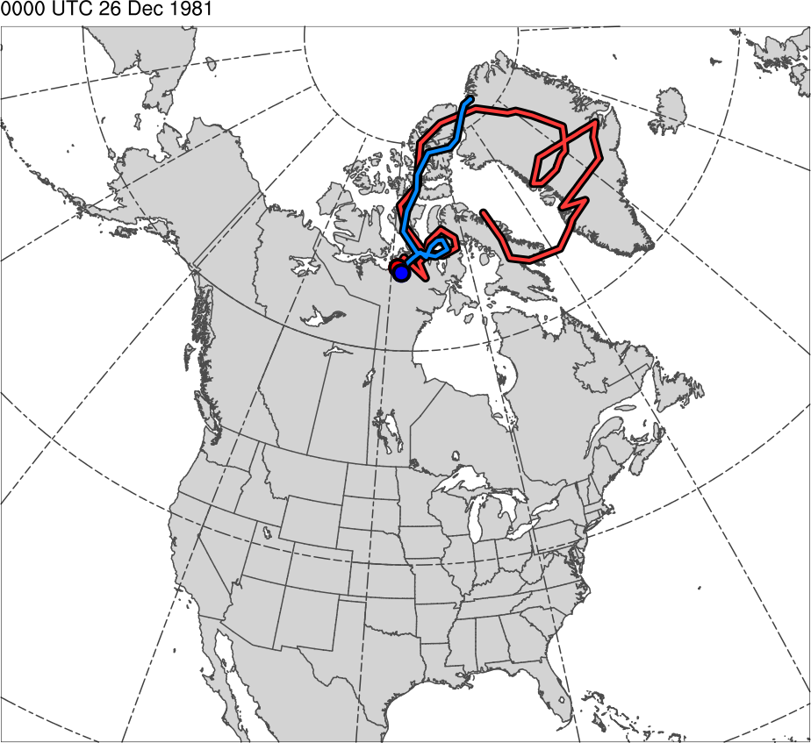
Tracks for Jan 1982 CAO
0000 UTC 26 Dec 1981
TPV Track:
Genesis:
0600 UTC 15 Dec 1981
Lysis:
0000 UTC 13 Jan 1982
Lifetime:
~29 days
Cold Pool Track:
Genesis:
1800 UTC 20 Dec 1981
Lysis:
1800 UTC 13 Jan 1982
Lifetime:
~24 days
TPV
Cold Pool

Slide 29
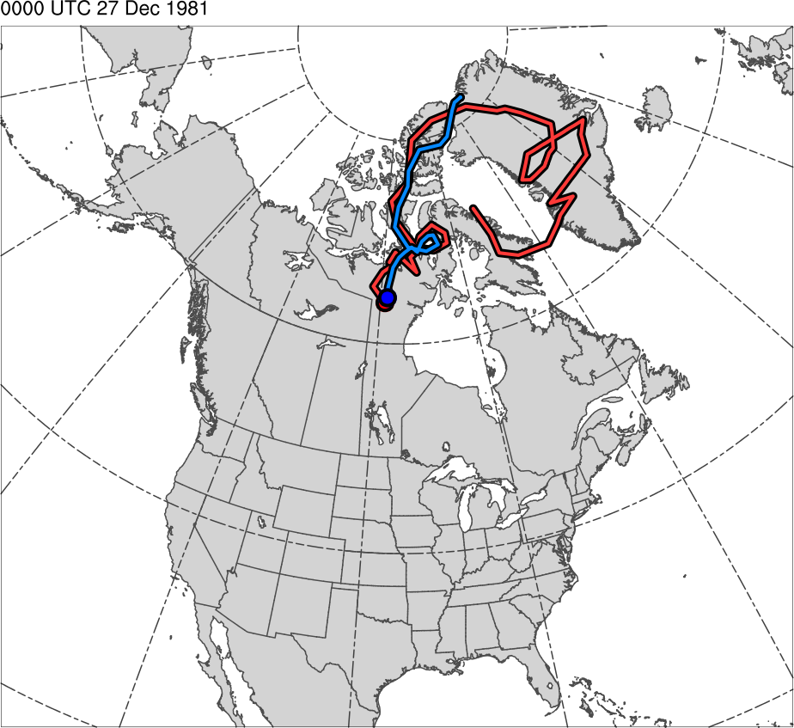
Tracks for Jan 1982 CAO
0000 UTC 27 Dec 1981
TPV Track:
Genesis:
0600 UTC 15 Dec 1981
Lysis:
0000 UTC 13 Jan 1982
Lifetime:
~29 days
Cold Pool Track:
Genesis:
1800 UTC 20 Dec 1981
Lysis:
1800 UTC 13 Jan 1982
Lifetime:
~24 days
TPV
Cold Pool

Slide 30
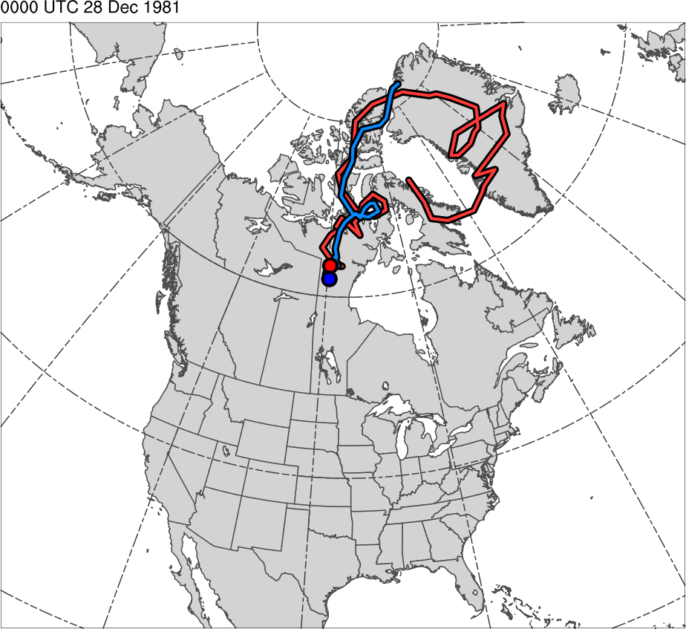
Tracks for Jan 1982 CAO
0000 UTC 28 Dec 1981
TPV Track:
Genesis:
0600 UTC 15 Dec 1981
Lysis:
0000 UTC 13 Jan 1982
Lifetime:
~29 days
Cold Pool Track:
Genesis:
1800 UTC 20 Dec 1981
Lysis:
1800 UTC 13 Jan 1982
Lifetime:
~24 days
TPV
Cold Pool

Slide 31
Tracks for Jan 1982 CAO
0000 UTC 29 Dec 1981
TPV Track:
Genesis:
0600 UTC 15 Dec 1981
Lysis:
0000 UTC 13 Jan 1982
Lifetime:
~29 days
Cold Pool Track:
Genesis:
1800 UTC 20 Dec 1981
Lysis:
1800 UTC 13 Jan 1982
Lifetime:
~24 days
TPV
Cold Pool

Slide 32
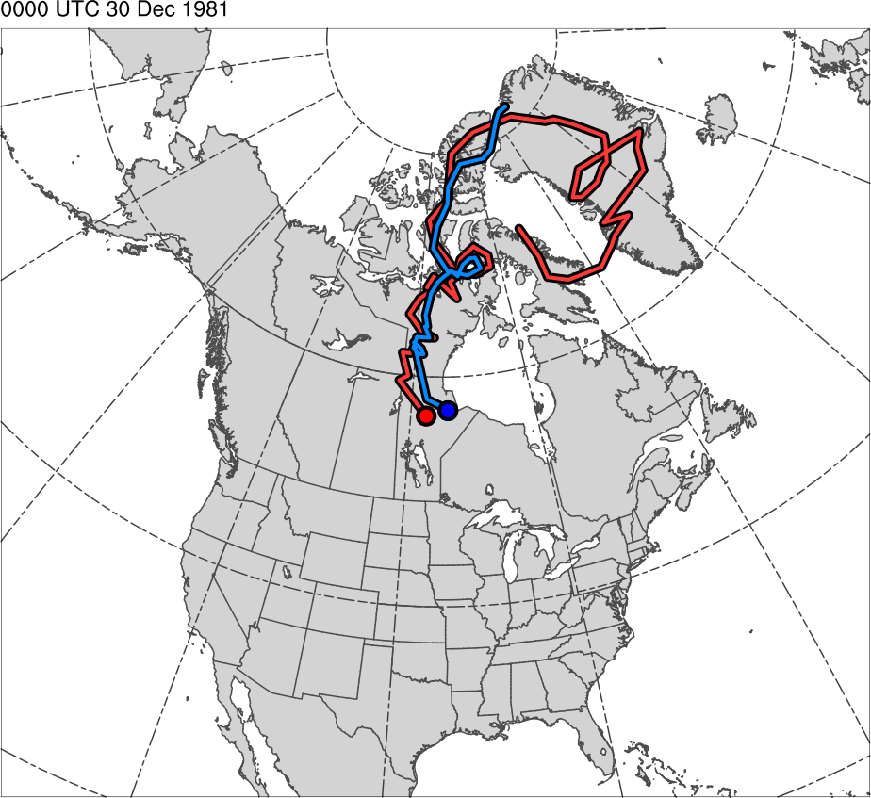
Tracks for Jan 1982 CAO
0000 UTC 30 Dec 1981
TPV Track:
Genesis:
0600 UTC 15 Dec 1981
Lysis:
0000 UTC 13 Jan 1982
Lifetime:
~29 days
Cold Pool Track:
Genesis:
1800 UTC 20 Dec 1981
Lysis:
1800 UTC 13 Jan 1982
Lifetime:
~24 days
TPV
Cold Pool

Slide 33
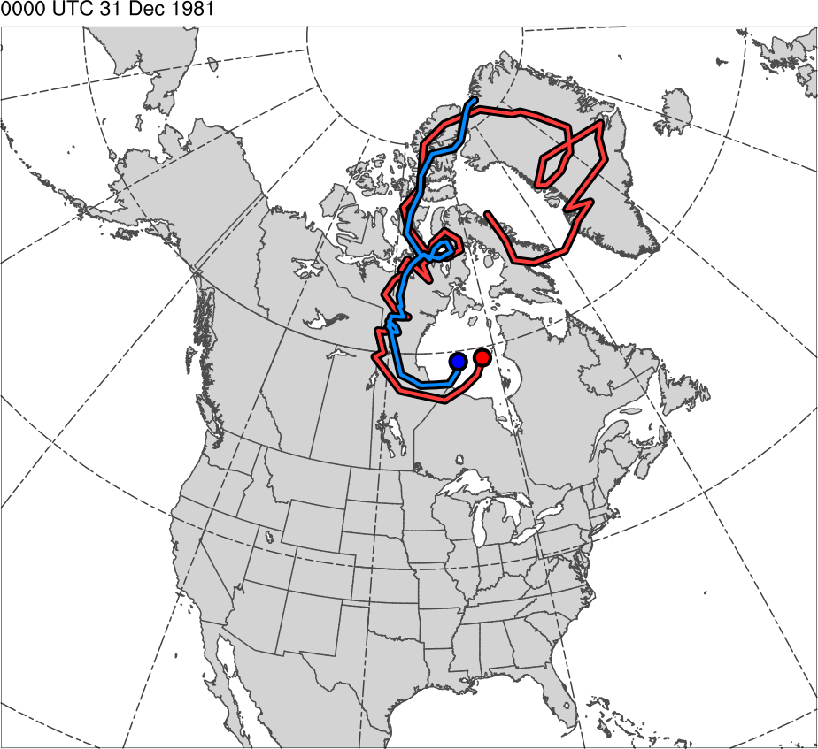
Tracks for Jan 1982 CAO
0000 UTC 31 Dec 1981
TPV Track:
Genesis:
0600 UTC 15 Dec 1981
Lysis:
0000 UTC 13 Jan 1982
Lifetime:
~29 days
Cold Pool Track:
Genesis:
1800 UTC 20 Dec 1981
Lysis:
1800 UTC 13 Jan 1982
Lifetime:
~24 days
TPV
Cold Pool

Slide 34
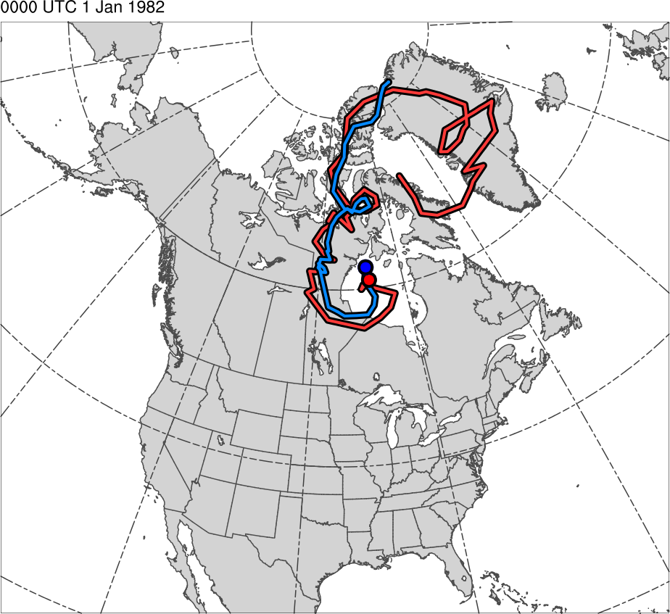
Tracks for Jan 1982 CAO
0000 UTC 1 Jan 1982
TPV Track:
Genesis:
0600 UTC 15 Dec 1981
Lysis:
0000 UTC 13 Jan 1982
Lifetime:
~29 days
Cold Pool Track:
Genesis:
1800 UTC 20 Dec 1981
Lysis:
1800 UTC 13 Jan 1982
Lifetime:
~24 days
TPV
Cold Pool

Slide 35
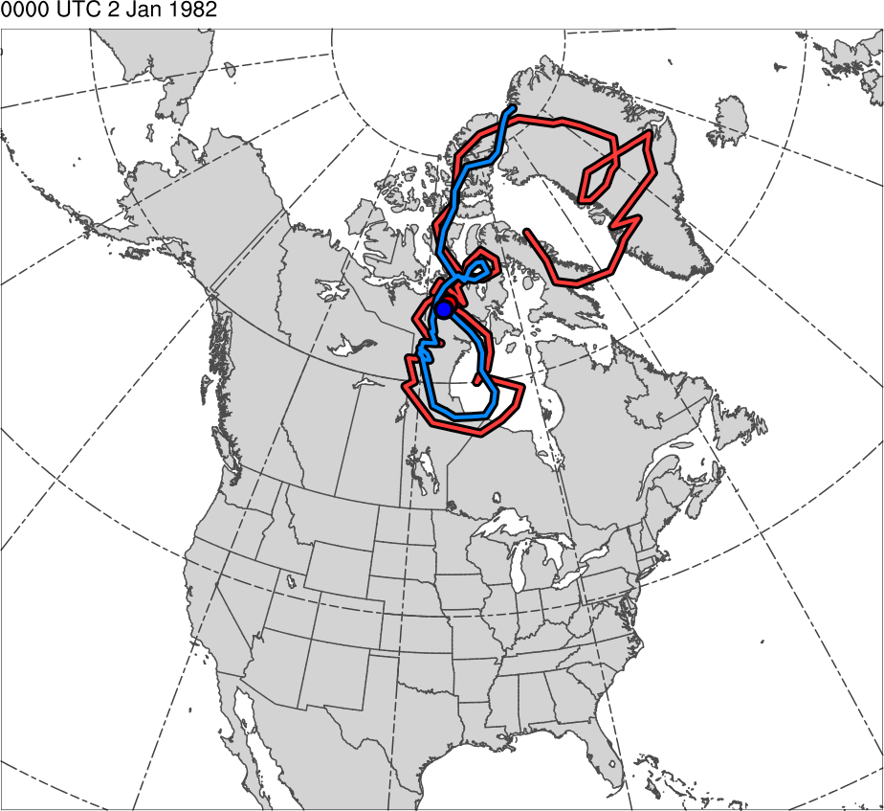
Tracks for Jan 1982 CAO
0000 UTC 2 Jan 1982
TPV Track:
Genesis:
0600 UTC 15 Dec 1981
Lysis:
0000 UTC 13 Jan 1982
Lifetime:
~29 days
Cold Pool Track:
Genesis:
1800 UTC 20 Dec 1981
Lysis:
1800 UTC 13 Jan 1982
Lifetime:
~24 days
TPV
Cold Pool

Slide 36
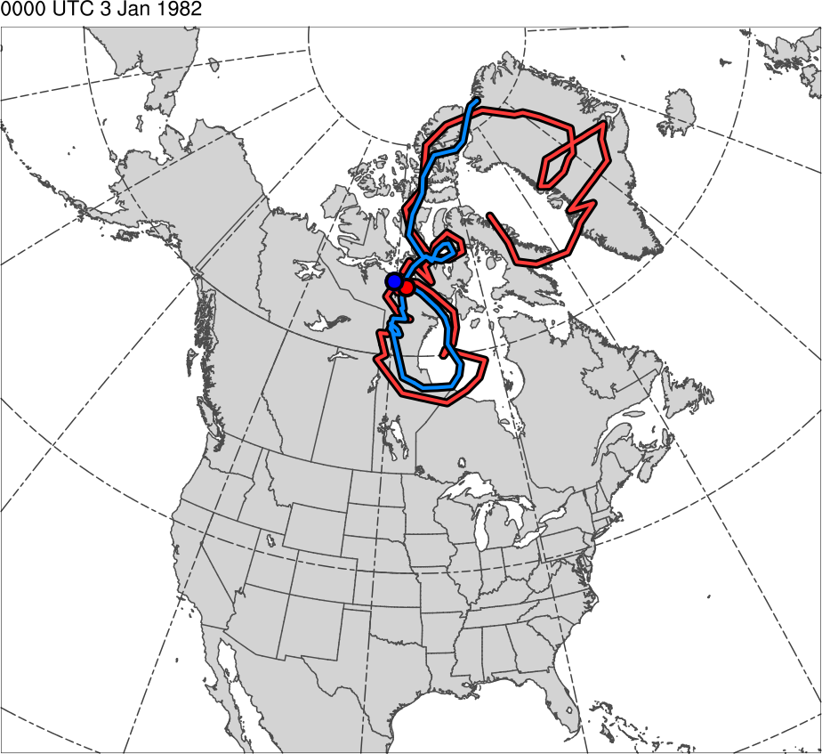
Tracks for Jan 1982 CAO
0000 UTC 3 Jan 1982
TPV Track:
Genesis:
0600 UTC 15 Dec 1981
Lysis:
0000 UTC 13 Jan 1982
Lifetime:
~29 days
Cold Pool Track:
Genesis:
1800 UTC 20 Dec 1981
Lysis:
1800 UTC 13 Jan 1982
Lifetime:
~24 days
TPV
Cold Pool

Slide 37
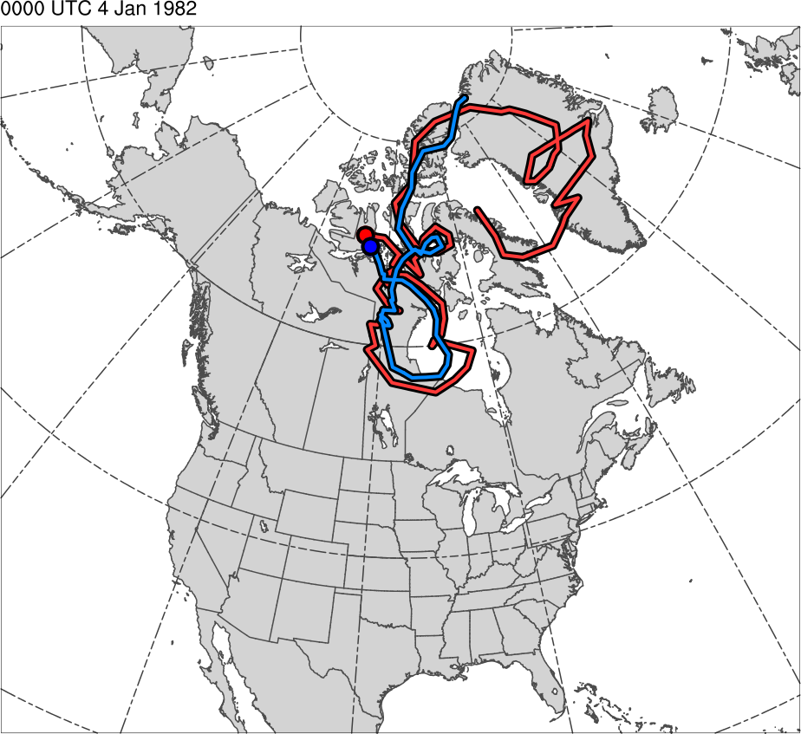
Tracks for Jan 1982 CAO
0000 UTC 4 Jan 1982
TPV Track:
Genesis:
0600 UTC 15 Dec 1981
Lysis:
0000 UTC 13 Jan 1982
Lifetime:
~29 days
Cold Pool Track:
Genesis:
1800 UTC 20 Dec 1981
Lysis:
1800 UTC 13 Jan 1982
Lifetime:
~24 days
TPV
Cold Pool

Slide 38
Tracks for Jan 1982 CAO
0000 UTC 5 Jan 1982
TPV Track:
Genesis:
0600 UTC 15 Dec 1981
Lysis:
0000 UTC 13 Jan 1982
Lifetime:
~29 days
Cold Pool Track:
Genesis:
1800 UTC 20 Dec 1981
Lysis:
1800 UTC 13 Jan 1982
Lifetime:
~24 days
TPV
Cold Pool

Slide 39
Tracks for Jan 1982 CAO
0000 UTC 6 Jan 1982
TPV Track:
Genesis:
0600 UTC 15 Dec 1981
Lysis:
0000 UTC 13 Jan 1982
Lifetime:
~29 days
Cold Pool Track:
Genesis:
1800 UTC 20 Dec 1981
Lysis:
1800 UTC 13 Jan 1982
Lifetime:
~24 days
TPV
Cold Pool

Slide 40
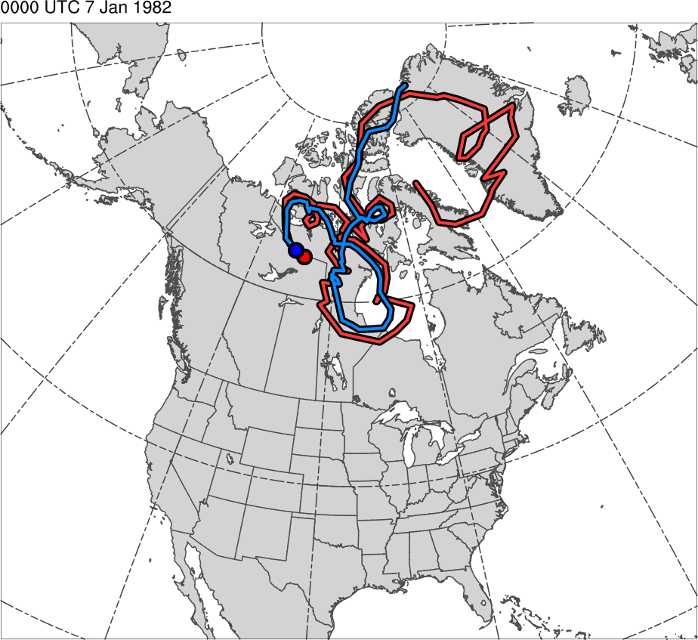
Tracks for Jan 1982 CAO
0000 UTC 7 Jan 1982
TPV Track:
Genesis:
0600 UTC 15 Dec 1981
Lysis:
0000 UTC 13 Jan 1982
Lifetime:
~29 days
Cold Pool Track:
Genesis:
1800 UTC 20 Dec 1981
Lysis:
1800 UTC 13 Jan 1982
Lifetime:
~24 days
TPV
Cold Pool

Slide 41
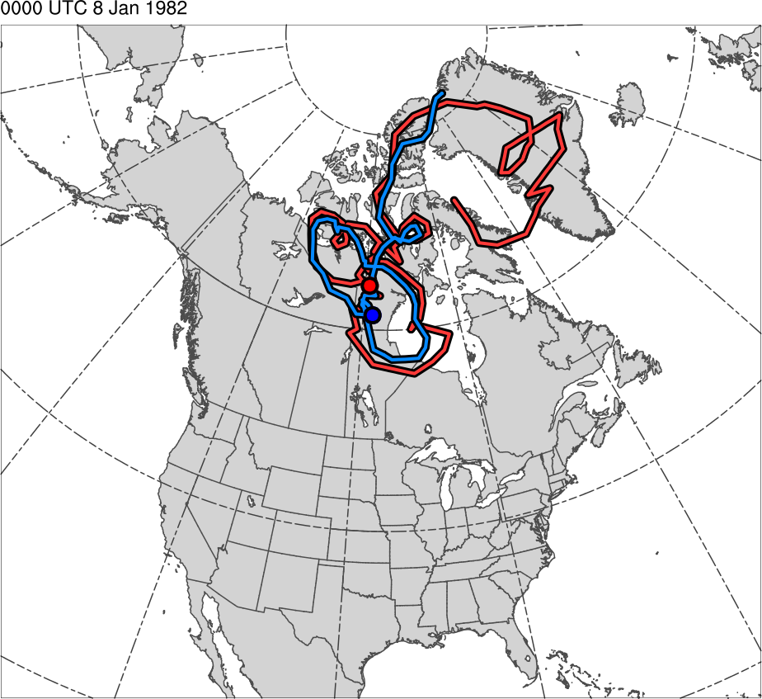
Tracks for Jan 1982 CAO
0000 UTC 8 Jan 1982
TPV Track:
Genesis:
0600 UTC 15 Dec 1981
Lysis:
0000 UTC 13 Jan 1982
Lifetime:
~29 days
Cold Pool Track:
Genesis:
1800 UTC 20 Dec 1981
Lysis:
1800 UTC 13 Jan 1982
Lifetime:
~24 days
TPV
Cold Pool

Slide 42
Tracks for Jan 1982 CAO
0000 UTC 9 Jan 1982
TPV Track:
Genesis:
0600 UTC 15 Dec 1981
Lysis:
0000 UTC 13 Jan 1982
Lifetime:
~29 days
Cold Pool Track:
Genesis:
1800 UTC 20 Dec 1981
Lysis:
1800 UTC 13 Jan 1982
Lifetime:
~24 days
TPV
Cold Pool

Slide 43
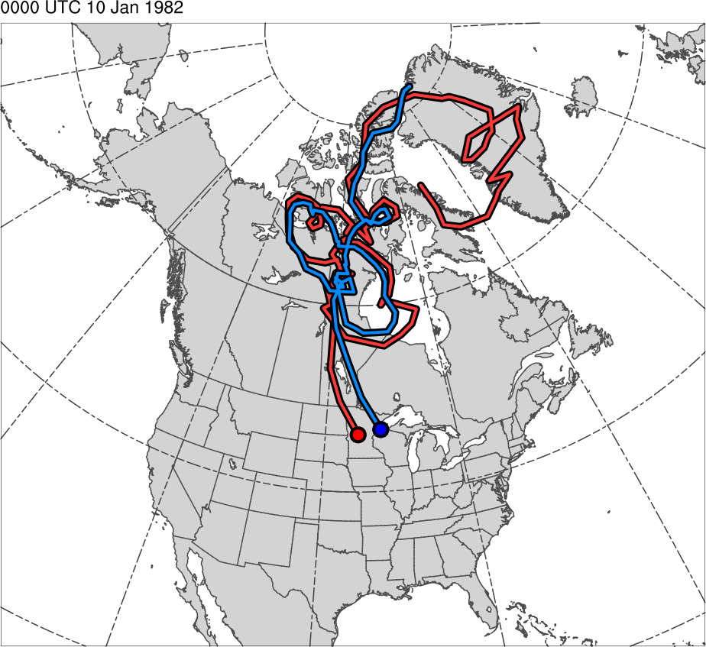
Tracks for Jan 1982 CAO
0000 UTC 10 Jan 1982
TPV Track:
Genesis:
0600 UTC 15 Dec 1981
Lysis:
0000 UTC 13 Jan 1982
Lifetime:
~29 days
Cold Pool Track:
Genesis:
1800 UTC 20 Dec 1981
Lysis:
1800 UTC 13 Jan 1982
Lifetime:
~24 days
TPV
Cold Pool

Slide 44
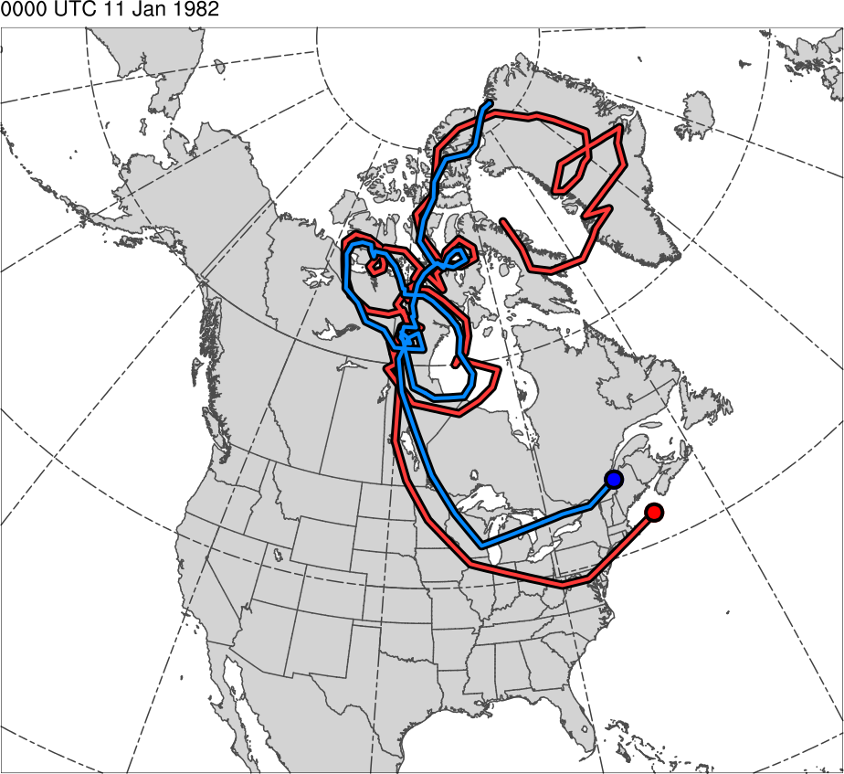
Tracks for Jan 1982 CAO
0000 UTC 11 Jan 1982
TPV Track:
Genesis:
0600 UTC 15 Dec 1981
Lysis:
0000 UTC 13 Jan 1982
Lifetime:
~29 days
Cold Pool Track:
Genesis:
1800 UTC 20 Dec 1981
Lysis:
1800 UTC 13 Jan 1982
Lifetime:
~24 days
TPV
Cold Pool

Slide 45
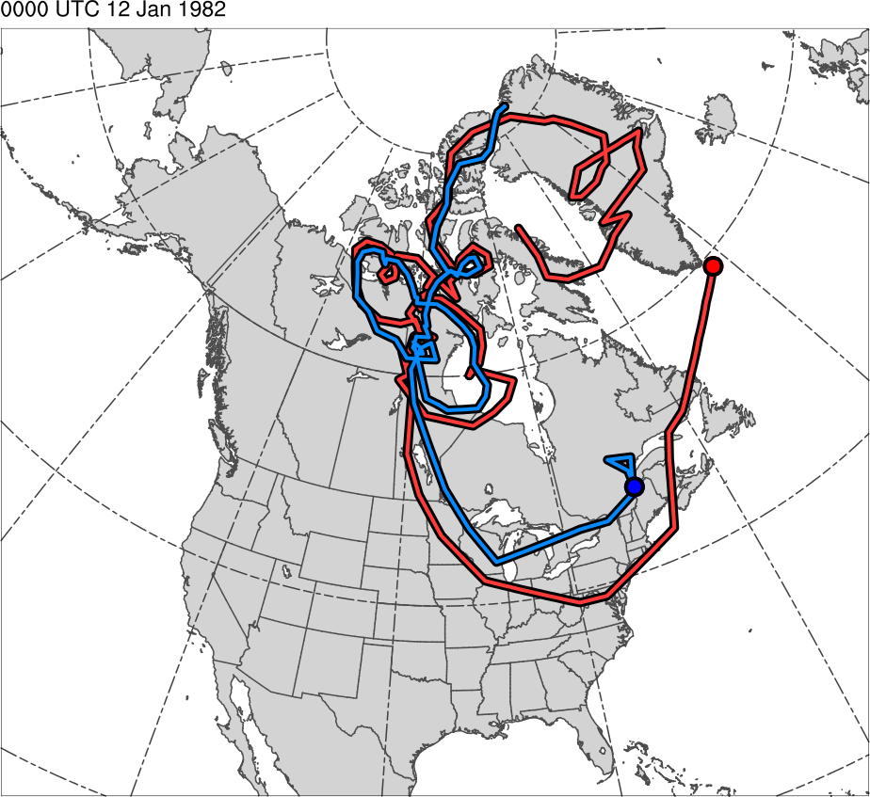
Tracks for Jan 1982 CAO
0000 UTC 12 Jan 1982
TPV Track:
Genesis:
0600 UTC 15 Dec 1981
Lysis:
0000 UTC 13 Jan 1982
Lifetime:
~29 days
Cold Pool Track:
Genesis:
1800 UTC 20 Dec 1981
Lysis:
1800 UTC 13 Jan 1982
Lifetime:
~24 days
TPV
Cold Pool

Slide 46
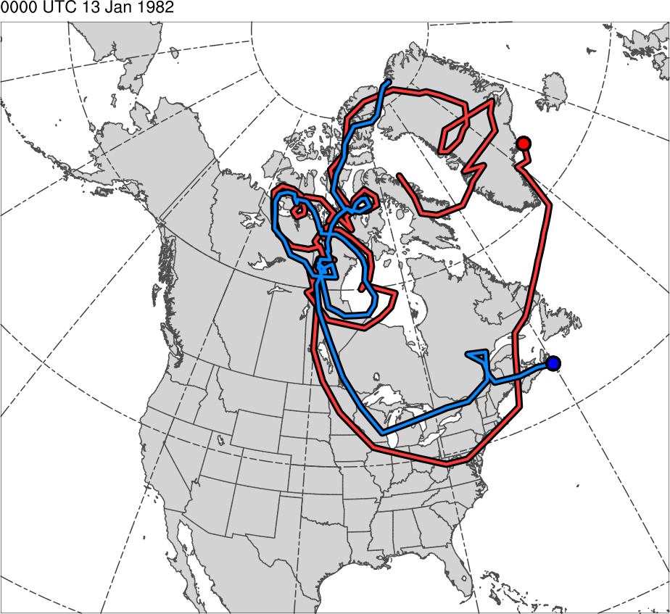
Tracks for Jan 1982 CAO
0000 UTC 13 Jan 1982
TPV Track:
Genesis:
0600 UTC 15 Dec 1981
Lysis:
0000 UTC 13 Jan 1982
Lifetime:
~29 days
Cold Pool Track:
Genesis:
1800 UTC 20 Dec 1981
Lysis:
1800 UTC 13 Jan 1982
Lifetime:
~24 days
TPV
Cold Pool

Slide 47
CAO Identification
Regional CAOs are identified using CAO climatology created by Murphy (2017)
Dataset: Global Historical Climatology Network-Daily minimum temperature data
Period of study: 1979–2015

Slide 48
CAO Identification
Regions studied: Six NCEI climate regions encompassing central and eastern U.S. are examined (regions are color shaded in map below)
Regional CAO Definition:
Two or more stations within a NCEI climate region experience three or more consecutive days where minimum temperatures fall below the 31-day centered moving average of the 5th percentile minimum temperature for those days and share at least one overlapping day
West North Central
East North Central
Northeast
Central
South
Southeast
Station

Slide 49
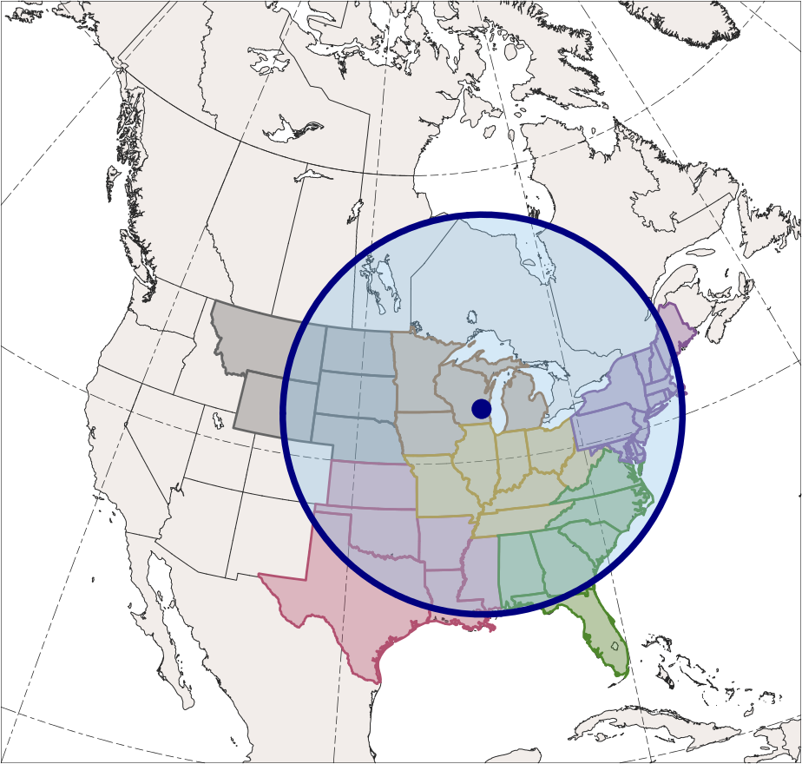
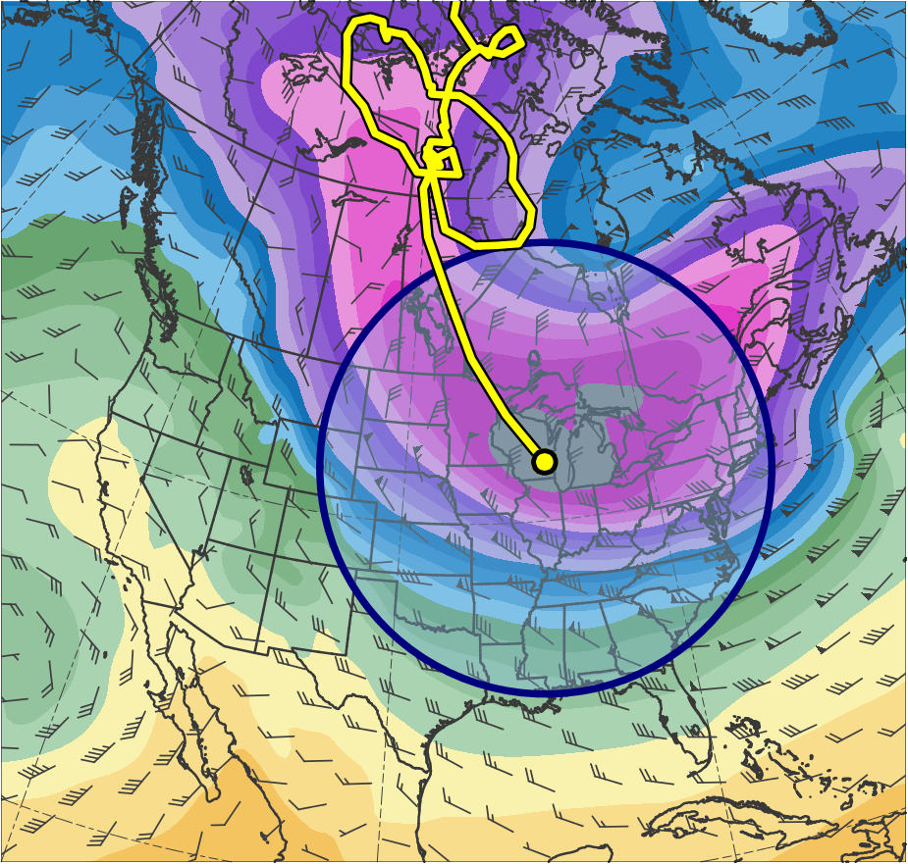
CAOs Linked to Cold Pools
Identification of CAOs linked to cold pools:
Circle of radius 1500 km surrounding 1000–500-hPa thickness minimum of a cold pool must overlap at least one grid point (using a 0.5° grid) of region for at least one time stamp (6 h interval) during CAO
0600 UTC 10 Jan 1982
600
590
580
570
560
550
East North Central
540
West North Central
530
Northeast
520
Central
510
500
Southeast
490
South
480
470
460
(dam)
1500-km
radius circle
Cold Pool

Slide 50
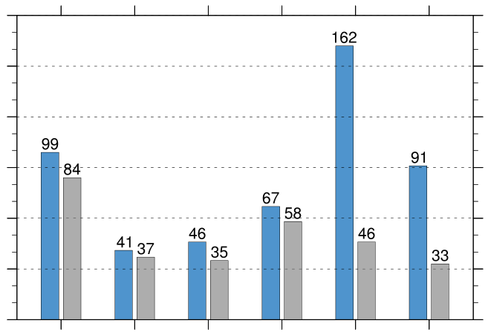
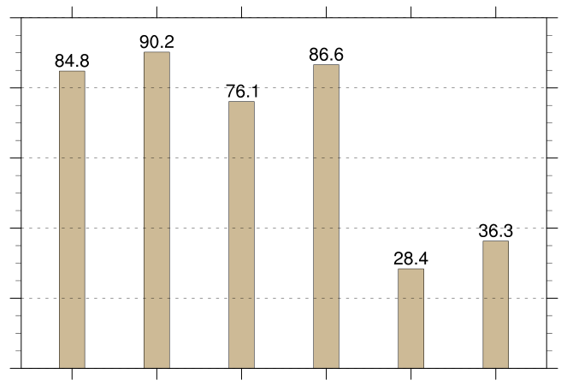
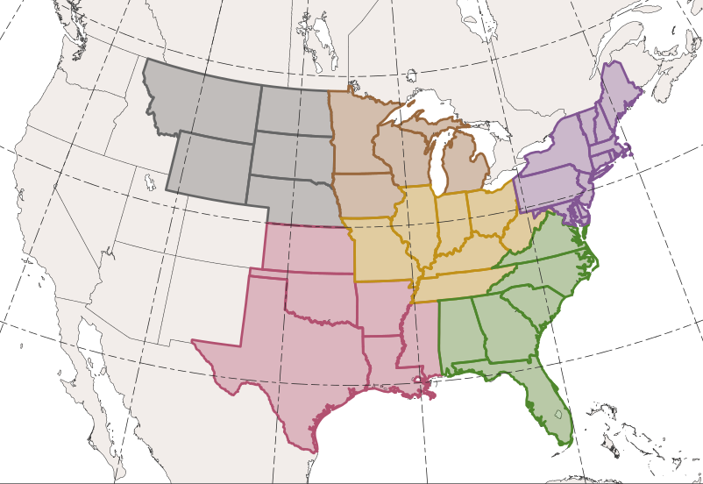
CAOs Linked to Cold Pools
CAOs Linked to Cold Pools
Percentage of CAOs Linked to Cold Pools
180
100
150
80
120
60
90
count
percent
40
60
30
20
0
0
WNC
ENC
Central
Northeast
South
Southeast
WNC
ENC
Central
Northeast
South
Southeast
Total number of CAOs
East North Central (ENC)
West North Central (WNC)
Northeast
Number of unique CAOs linked to at least one cold pool
Central
Percentage of unique CAOs linked to at least one cold pool [(gray/blue) × 100]
Southeast
South

Slide 51
CAOs Linked to Cold Pools
CAOs Linked to Cold Pools
Percentage of CAOs Linked to Cold Pools
180
100
150
80
120
60
90
count
percent
40
60
30
20
0
0
WNC
ENC
Central
Northeast
South
Southeast
WNC
ENC
Central
Northeast
South
Southeast
Total number of CAOs
East North Central (ENC)
West North Central (WNC)
Northeast
Number of unique CAOs linked to at least one cold pool
Central
Percentage of unique CAOs linked to at least one cold pool [(gray/blue) × 100]
Southeast
South

Slide 52
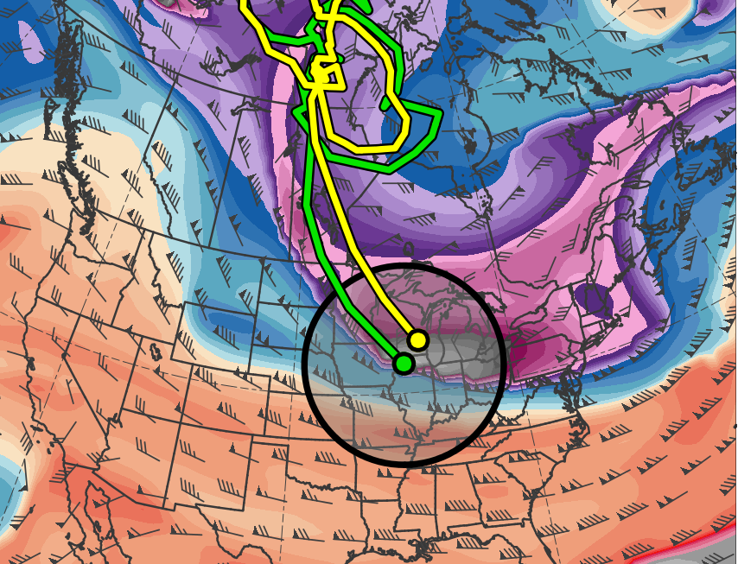
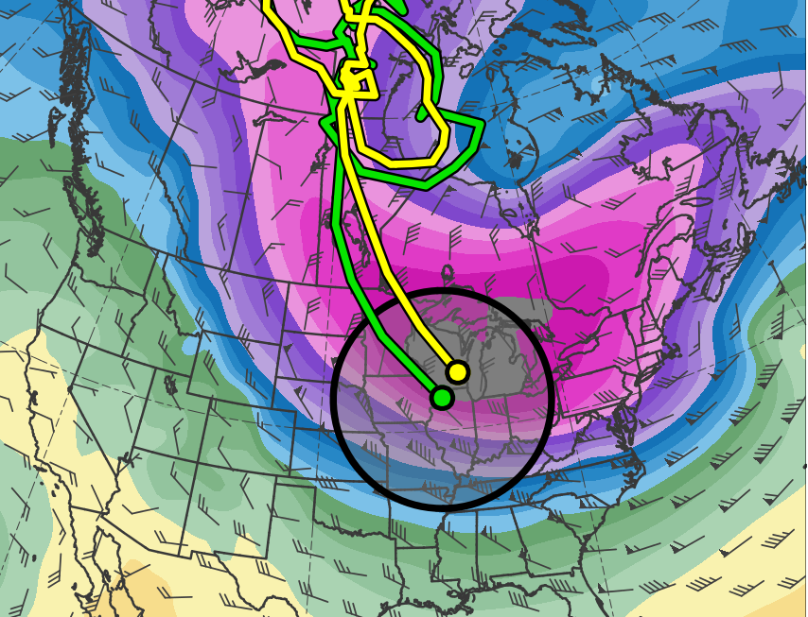
Cold Pools Associated with TPVs
Identification of cold pools associated with TPVs:
Centers of TPVs and cold pools must be located within 750 km of each other for at least two consecutive days to be identified as a match
0600 UTC 10 Jan 1982
(K)
252
258
264
270
276
282
288
294
300
306
312
318
324
330
336
342
348
354
360
366
372
378
(dam)
460
470
480
490
500
510
520
530
540
550
560
570
580
590
600
750-km
radius circle
TPV
Cold Pool

Slide 53
Cold Pools Associated with TPVs
6,288 out of a total of 8,395 cold pools, or 74.9%, match with at least one TPV
6,510 out of a total of 25,085 TPVs, or 26.0%, match with at least one cold pool

Slide 54
CAOs Linked to Cold Pools Associated with TPVs
CAOs that are linked to cold pools associated with TPVs can now be identified

Slide 55
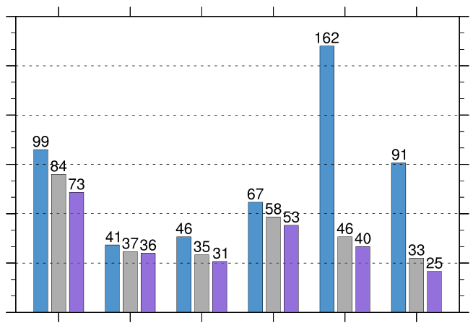
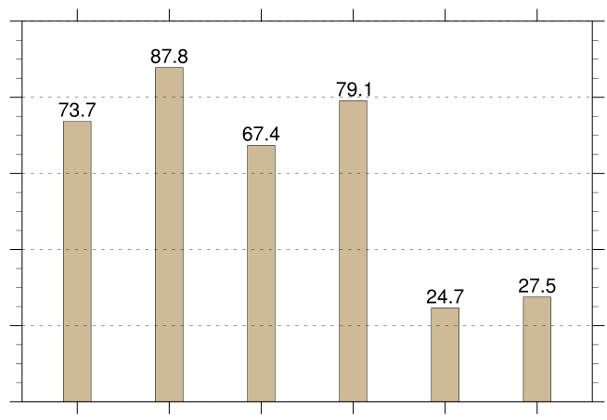
CAOs Linked to Cold Pools Associated with TPVs
CAOs Linked to Cold Pools Associated with TPVs
Percentage of CAOs Linked to Cold Pools Associated with TPVs
180
100
150
80
120
60
90
count
percent
40
60
30
20
0
0
WNC
ENC
Central
Northeast
South
Southeast
WNC
ENC
Central
Northeast
South
Southeast
Total number of CAOs
East North Central (ENC)
West North Central (WNC)
Northeast
Number of unique CAOs linked to at least one cold pool
Number of unique CAOs linked to at least one cold pool associated with TPVs
Central
South
Southeast
Percentage of unique CAOs linked to at least one cold pool associated with TPVs [(purple/blue) × 100]

Slide 56
Conclusions
Large spatial overlap and temporal coincidence of TPV and cold pool in Jan 1982 CAO case suggests that the TPV and cold pool are dynamically linked and demonstrates that:
The influence of TPVs can extend through the depth of the troposphere and over a widespread geographical area
The equatorward transport of TPVs can lead to CAO development
There is a much higher percentage of CAOs linked to cold pools over northern regions of U.S. compared to southern regions

Slide 57
Conclusions
6,510 out of a total of 25,085 TPVs, or 26.0%, match with at least one cold pool
TPVs may not match with cold pools because:
TPVs may be too small or too weak to be associated with trackable cold pools
TPVs may be associated with thickness troughs that are not trackable
TPVs may match with cold pools not meeting latitude criteria
It is possible that TPVs that do not match with cold pools may still contribute to CAO development

Slide 58
Conclusions
The majority of CAOs that are linked to cold pools are also associated with TPVs
TPVs play a role in the development of ~74–88% of CAOs over northern regions of the U.S., suggesting that improved understanding of TPVs may lead to improved understanding of CAOs

Slide 59
Conclusions
The majority of CAOs that are linked to cold pools are also associated with TPVs
TPVs play a role in the development of ~74–88% of CAOs over northern regions of the U.S., suggesting that improved understanding of TPVs may lead to improved understanding of CAOs
Acknowledgments
Special thanks to Nicholas Szapiro, Steven Cavallo, and Zachary Murphy

Slide 60
Extra Slides

Slide 61
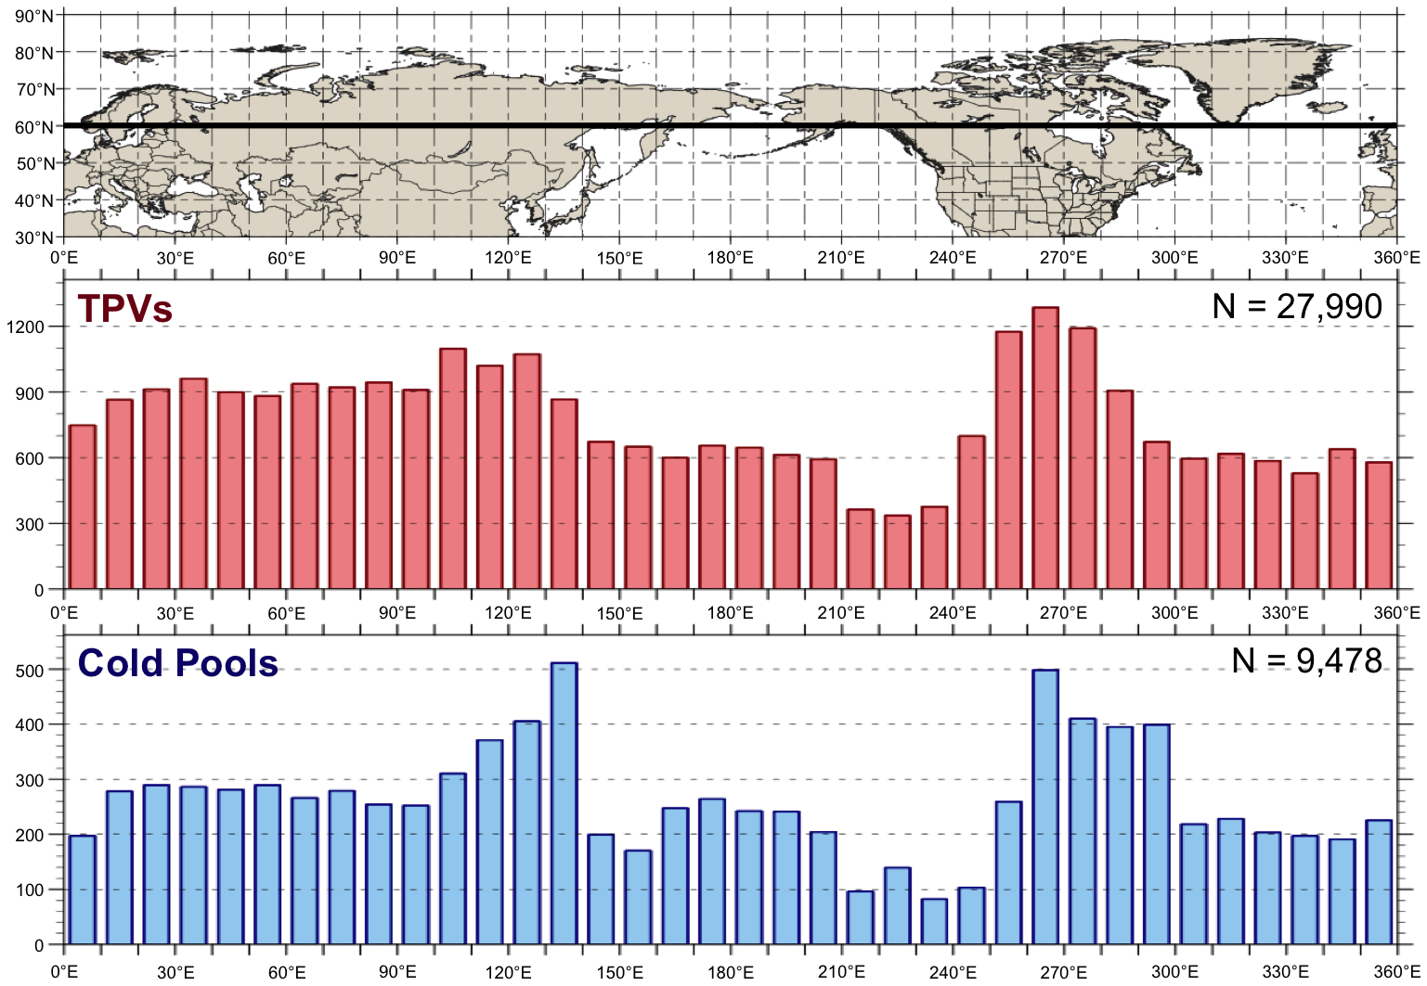
Equatorward Transport of TPVs and Cold Pools
Histograms showing total number of instances in which a TPV (red) and cold pool (blue) is transported equatorward of 60°N (black line on map) for each 10° longitude bin globally. A TPV and cold pool can be counted more than once if it returns equatorward of 60°N only after returning poleward of 60°N

Slide 62
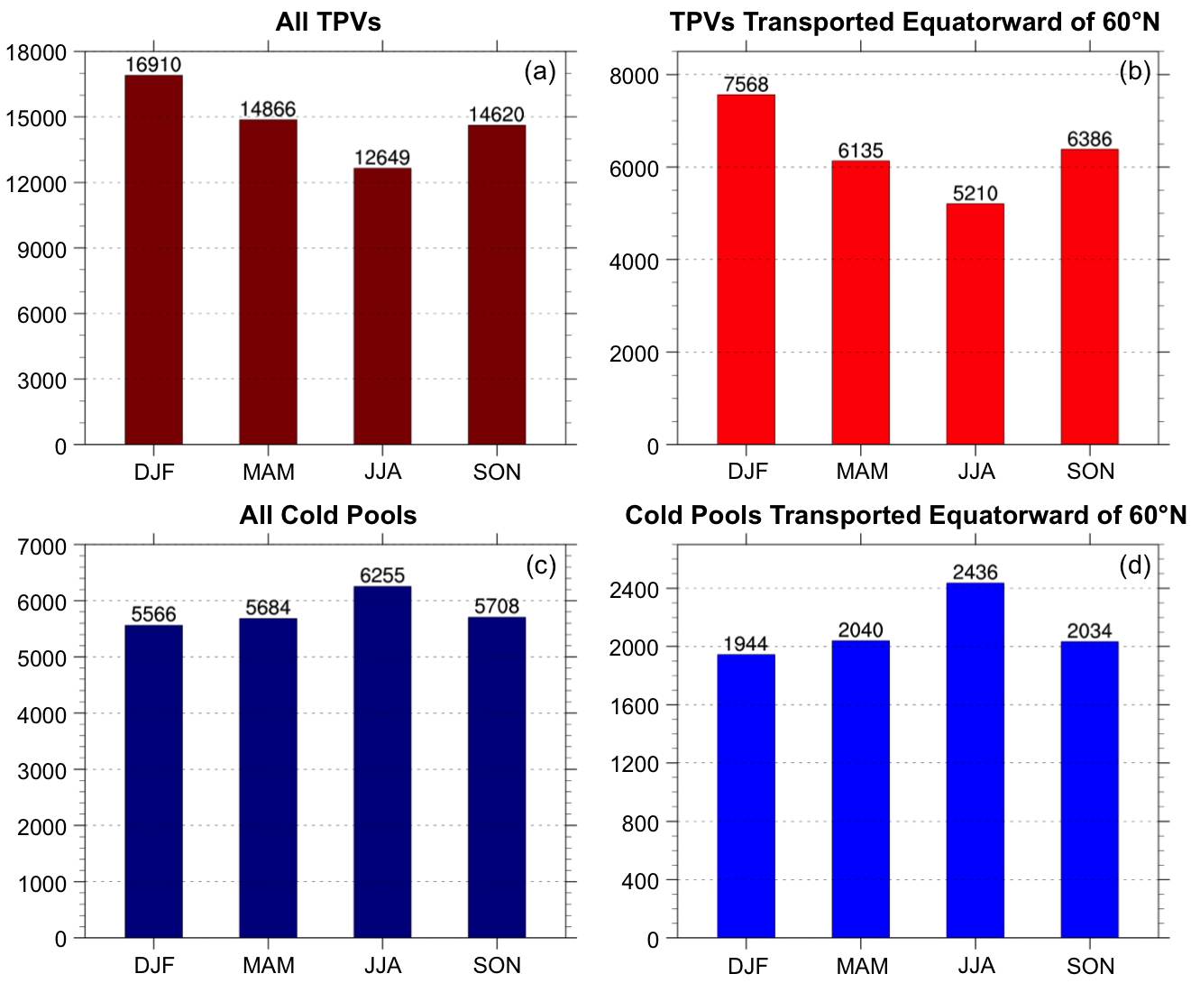
Seasonal Variability
(a) Total number of TPVs per season, (b) total number of TPVs transported equatorward of 60°N per season, (c) total number of cold pools per season, and (d) total number of cold pools transported equatorward of 60°N per season

Slide 63
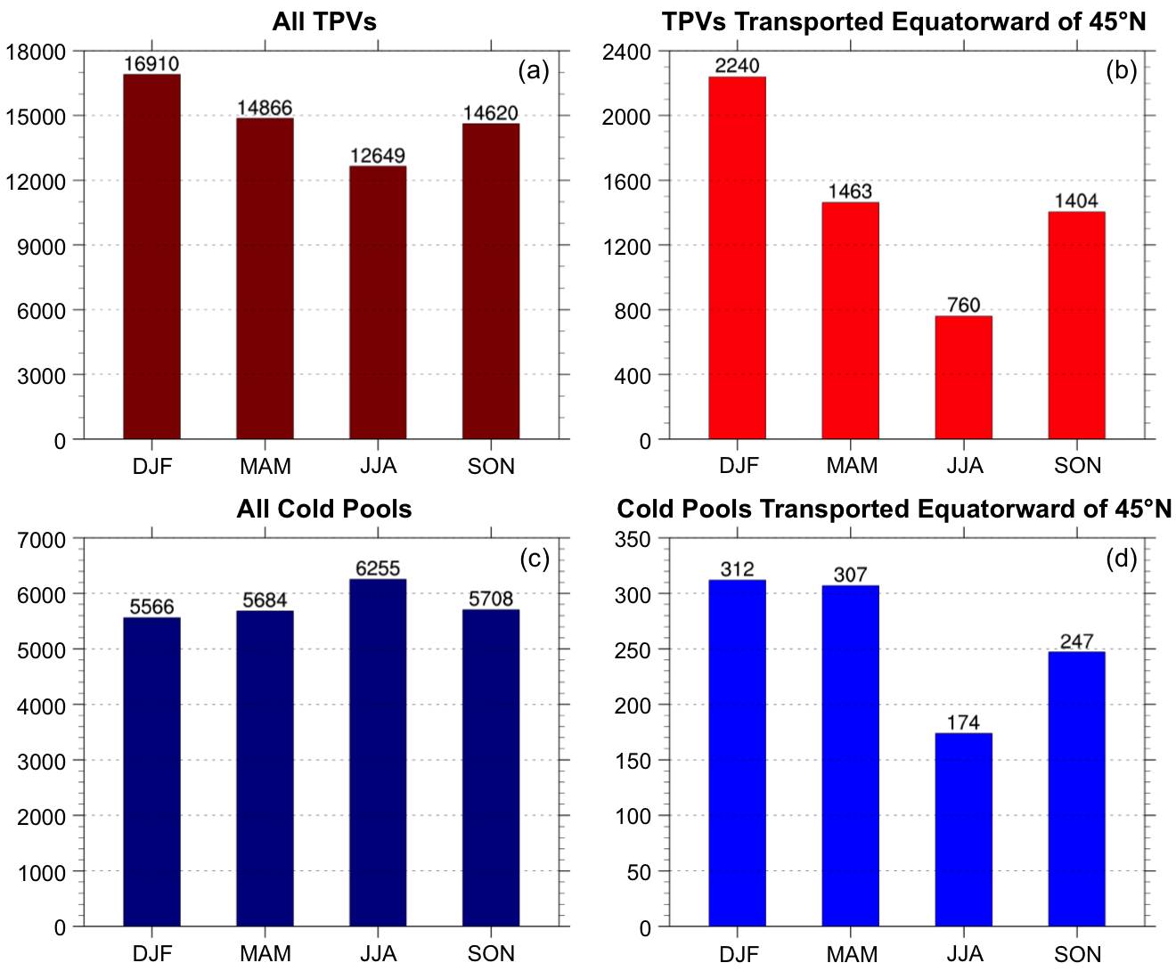
Seasonal Variability
(a) Total number of TPVs per season, (b) total number of TPVs transported equatorward of 45°N per season, (c) total number of cold pools per season, and (d) total number of cold pools transported equatorward of 45°N per season

