Slide 1
Linkages between Tropopause Polar Vortices and the Great Arctic Cyclone of August 2012
Daniel Keyser¹, Kevin A. Biernat¹, Lance F. Bosart¹,
and Steven M. Cavallo²
¹Department of Atmospheric and Environmental Sciences
University at Albany, State University of New York
²University of Oklahoma
Department of Atmospheric and Oceanic Sciences
McGill University
Monday 28 January 2019
Research Supported by ONR Grant N00014-18-1-2200

Slide 2
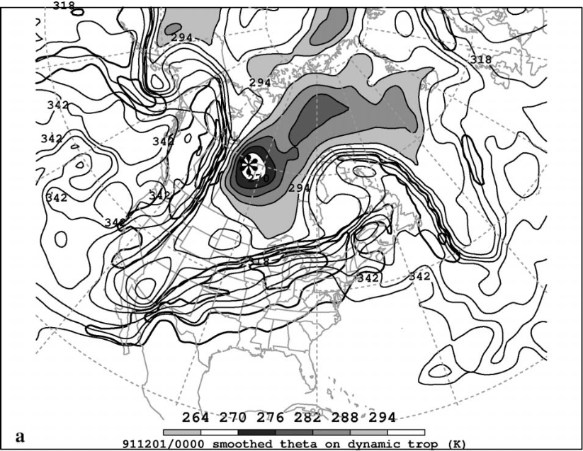
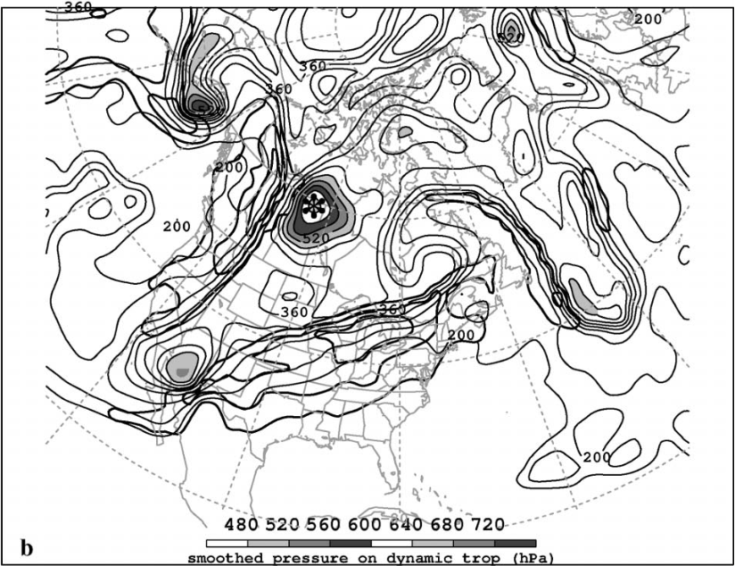
What are Tropopause Polar Vortices (TPVs)?
TPVs are defined as tropopause-based vortices of high-latitude origin and are material features (Pyle et al. 2004; Cavallo and Hakim 2009, 2010, 2012, 2013)
TPV
TPV
(left) Dynamic tropopause (DT) wind speed (every 15 m s⁻¹ starting at 50 m s⁻¹, thick contours) and DT potential temperature (K, thin contours and shading) on 1.5-PVU surface valid at 0000 UTC 1 Dec 1991; (right) same as left except DT pressure (hPa, thin contours and shading). Adapted from Fig. 11 in Pyle et al. (2004).

Slide 3
Motivation
TPVs may interact with and strengthen jet streams, and act as precursors to the development of intense Arctic cyclones (e.g., Tao et al. 2017)
Arctic cyclones may be associated with strong surface winds and poleward advection of warm, moist air, contributing to reductions in Arctic sea-ice extent (e.g., Zhang et al. 2013)
Heavy precipitation, strong surface winds, and large waves accompanying Arctic cyclones may pose hazards to ships navigating through open passageways in the Arctic Ocean

Slide 4
The Great Arctic Cyclone of August 2012 (AC12)
AC12 formed over Siberia on 2 August 2012 and tracked northeastward into the Arctic, reaching a minimum central sea level pressure (SLP) of 962.3 hPa at 1000 UTC 6 August in the ERA5
Strong surface winds and waves associated with AC12 helped break up thin sea ice (e.g., Parkinson and Comiso 2013)
Strong surface winds and waves associated with AC12 also contributed to increased upward ocean heat transport and bottom melting of ice, with sea-ice volume decreasing twice as fast as normal during AC12 (e.g., Zhang et al. 2013)

Slide 5
The Great Arctic Cyclone of August 2012 (AC12)
Simmonds and Rudeva (2012), Yamazaki et al. (2015), and Tao et al. (2017) found that a TPV played an important role in the life cycle of AC12

Slide 6
The Great Arctic Cyclone of August 2012 (AC12)
Yamagami et al. (2018) examined the medium-range forecast skill of AC12 with five operational ensemble prediction systems
They found that AC12 has relatively low predictability, with accurate forecasts of AC12 only out to 2–3 d lead time prior to peak intensity of AC12
They also found that a more-accurate prediction of upper-level features, including TPVs, in the vicinity of AC12 results in a more-accurate prediction of AC12

Slide 7
The Great Arctic Cyclone of August 2012 (AC12)
This presentation examines linkages between TPVs and AC12, and the impact of AC12 on Arctic sea-ice extent

Slide 8
Outline
Identification and synoptic examination of three TPVs, a predecessor surface cyclone (L1), and AC12
Impact of AC12 on Arctic sea-ice extent

Slide 9
Data and Methods
Data: ERA5 (Hersbach and Dee 2016) gridded to 0.3° horizontal resolution
Identified and tracked TPVs of interest for AC12 objectively by utilizing a TPV tracking algorithm (Szapiro and Cavallo 2018)
Tracked L1 and AC12 manually by following the locations of minimum SLP

Slide 10
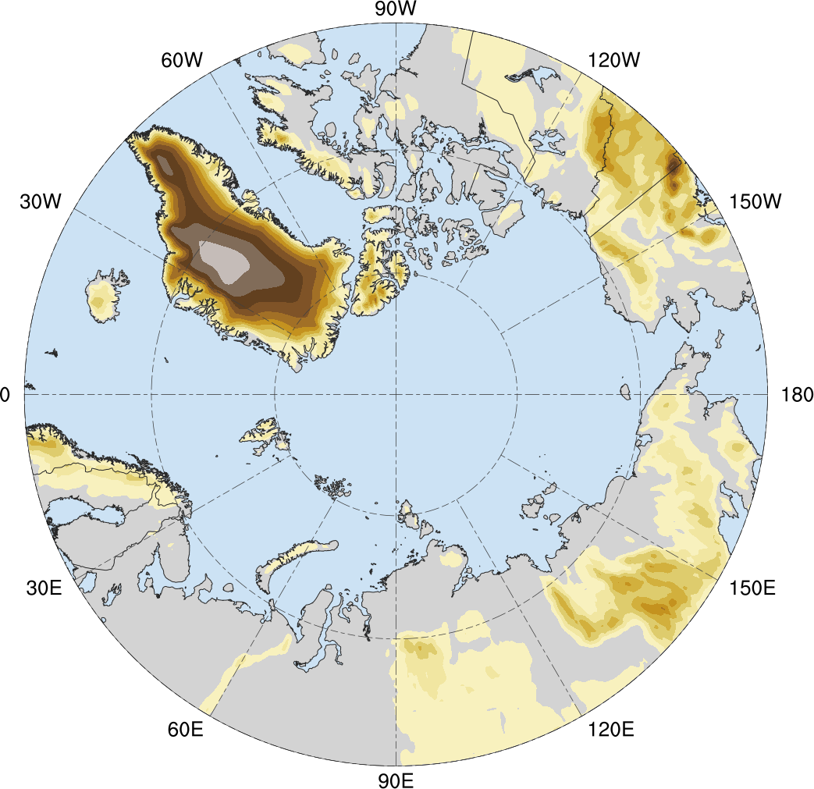
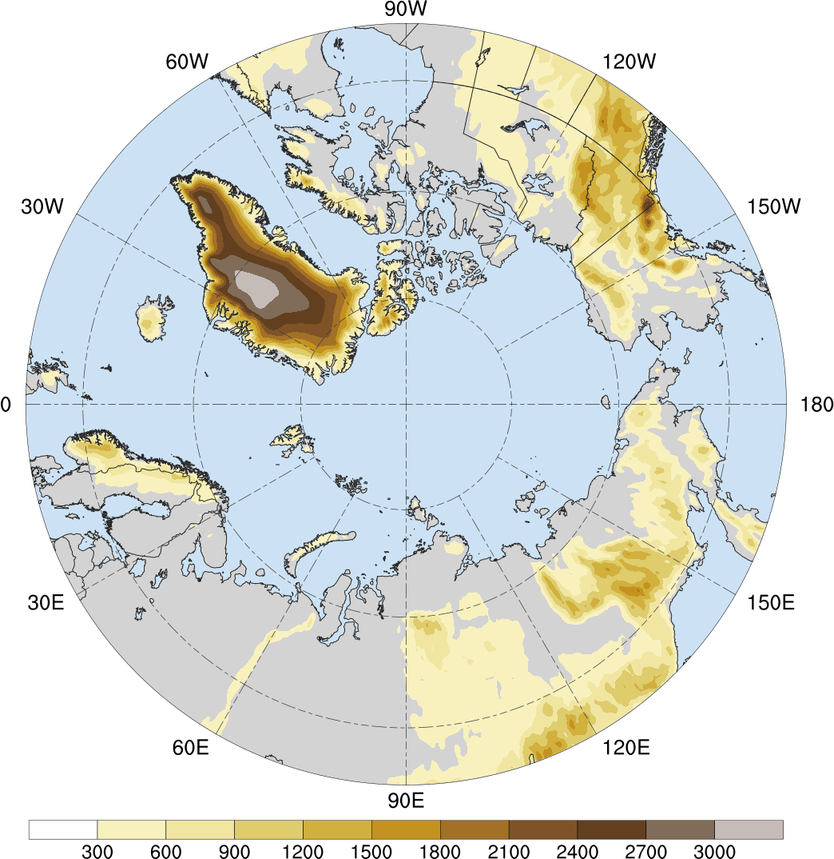
Arctic Geography
3000
2700
Baffin Bay
2400
Beaufort Sea
2100
Chukchi Sea
Bering Sea
1800
Greenland Sea
Arctic Ocean
Norwegian Sea
East Siberian Sea
1500
80N
Kolyma
Mtns.
1200
Barents Sea
Laptev Sea
Kara
Sea
900
70N
Chersky
Range
Verkhoyansk Range
600
60N
Ural
Mtns.
300
Central
Siberian
Plateau
(m)

Slide 11
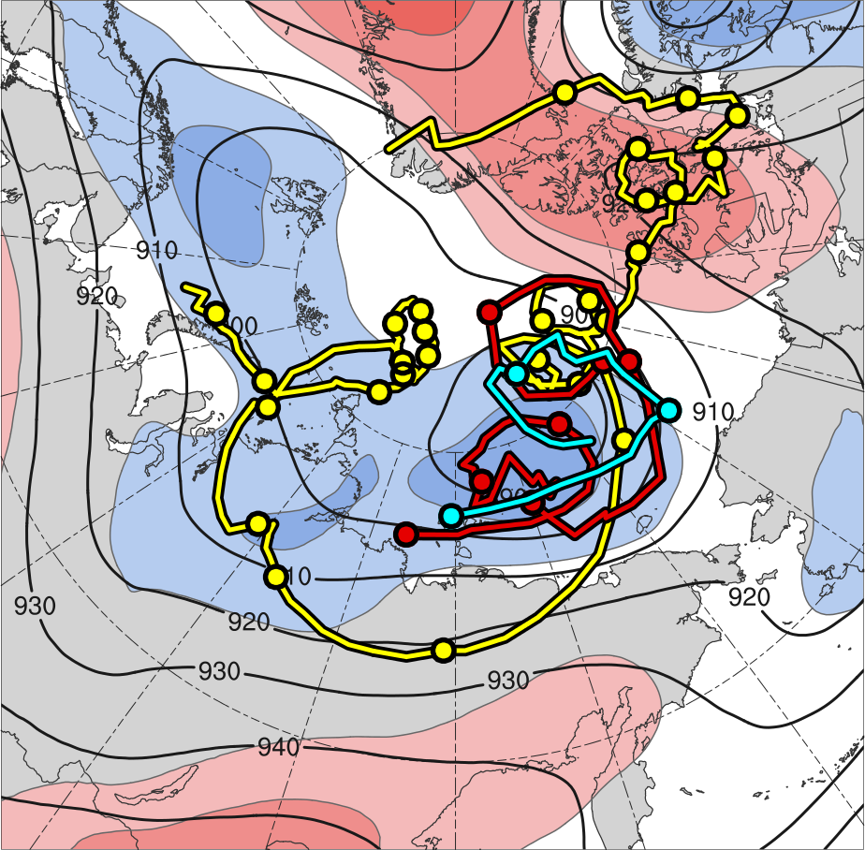
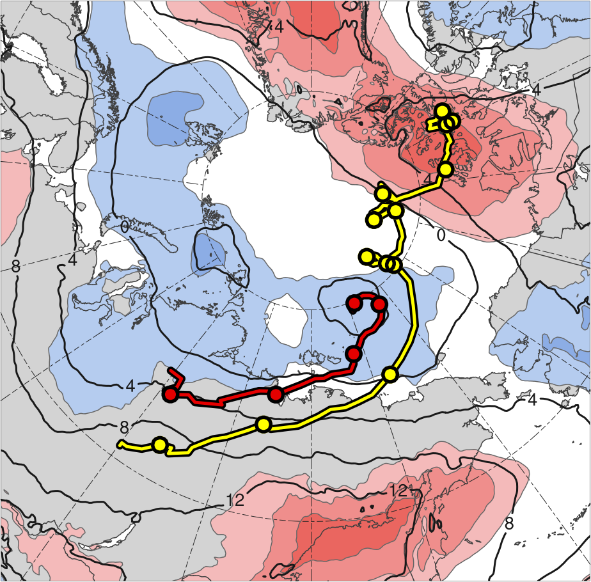
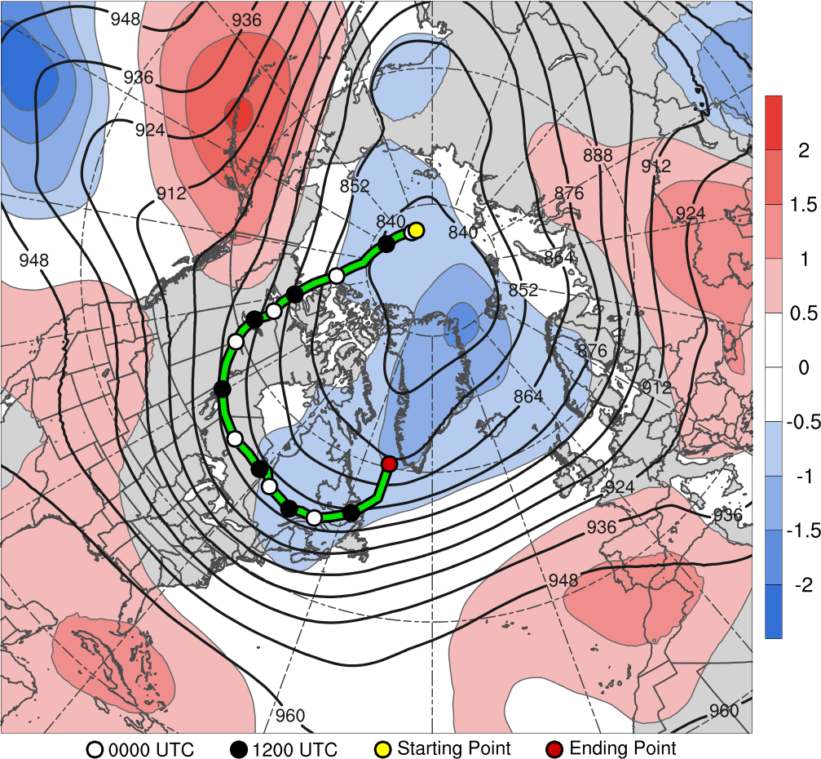
Track and Intensity
TPV 1
L1
TPV 2
AC12
TPV 3
2
1.5
1
0.5
0
-0.5
-1
-1.5
-2
300 hPa
850 hPa
(σ)
Feature | Genesis | Lysis | Lifetime
TPV 1 | 23 July | 19 Aug | ~27 d
TPV 2 | 3 Aug | 9 Aug | ~6 d
TPV 3 | 4 Aug | 6 Aug | ~3 d
L1 | 31 July | 5 Aug | ~5 d
AC12 | 2 Aug | 15 Aug | ~13 d
Genesis
Lysis
0000 UTC positions
1–7 Aug 2012 time-mean (left) 300-hPa geopotential height (dam, black) and standardized geopotential height anomalies (σ, shaded); (right) 850-hPa temperature (°C, black) and standardized temperature anomalies (σ, shaded)

Slide 12
Track and Intensity
TPV 1 is the longest-lived of the three TPVs and corresponds to the TPV shown in previous studies to play an important role in the evolution of AC12
TPV 2 and TPV 3 are shorter-lived TPVs and play supporting roles in the evolution of AC12
L1 is the predecessor cyclone that interacts and merges with AC12
AC12 is the main cyclone of interest and has a lifetime of ~13 days
TPV 1 and AC12 track in a region of tropospheric-deep baroclinicity over Siberia

Slide 13
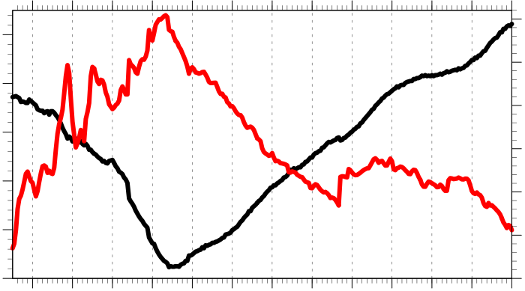
Track and Intensity
Hourly intensity time series of AC12
30
1010
25
1000
20
990
925-hPa relative vorticity (10⁻⁵ s⁻¹)
SLP (hPa)
15
980
10
970
5
960
0
3
4
5
6
7
8
9
10
11
12
13
14
15
Day in August 2012 labeled at 0000 UTC
Minimum SLP (hPa)
Jet coupling phase
Peak intensity at 1000 UTC 6 Aug 2012 (962.3 hPa)
Maximum 925-hPa relative vorticity (averaged within 100 km of grid point)
Jet crossing phase

Slide 14
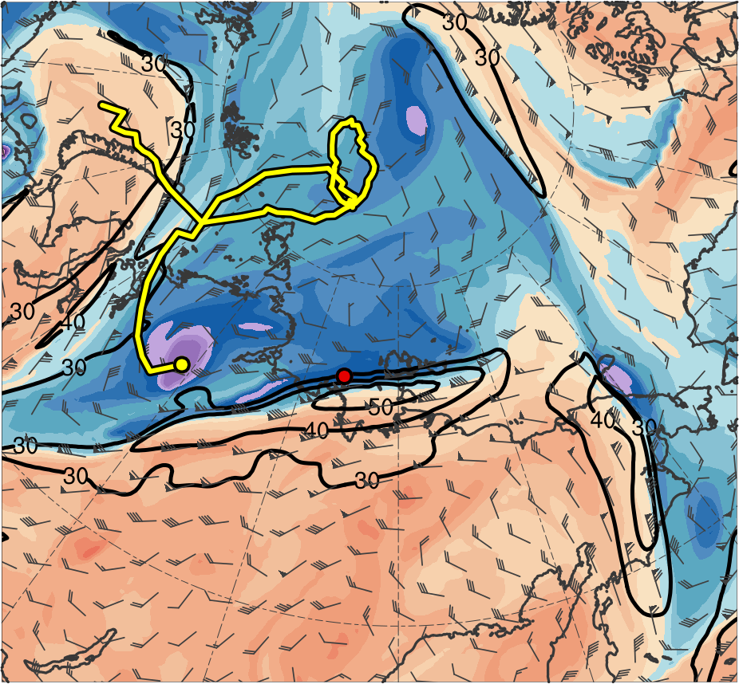
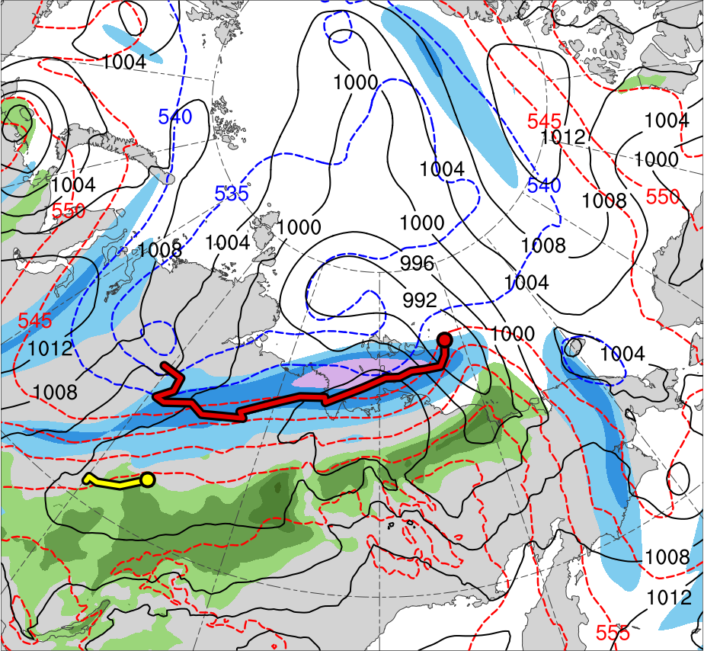
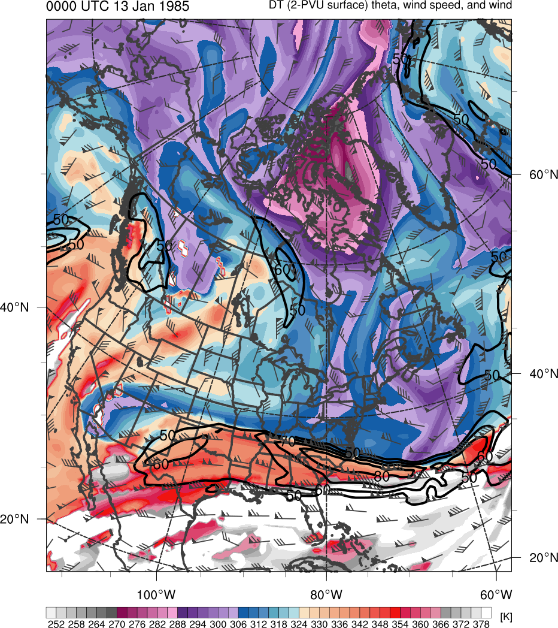
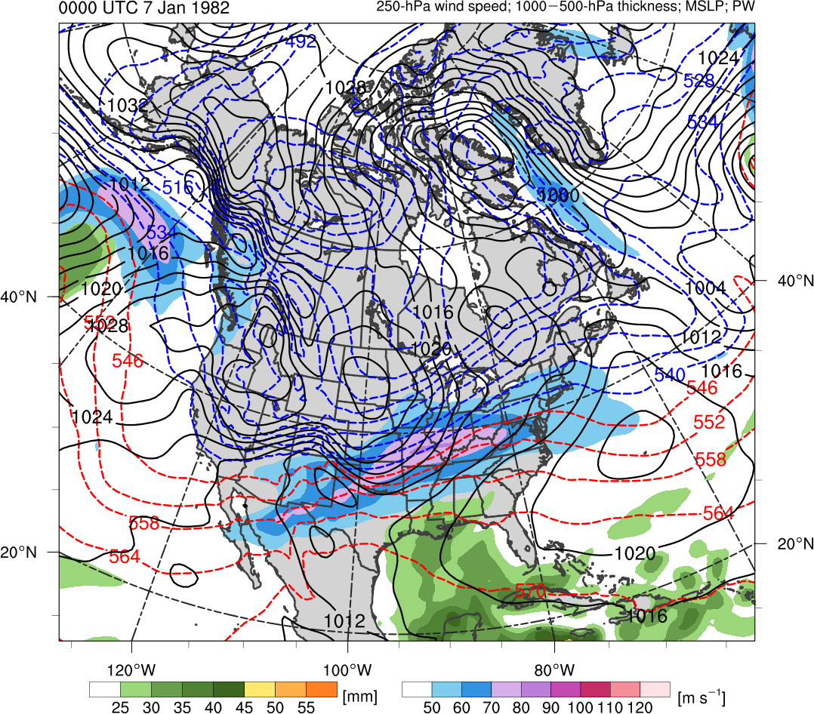
Synoptic Evolution
0000 UTC 3 Aug 2012
TPV 1
TPV 2
L1
AC12
(K)
252
258
264
270
276
282
288
294
300
306
312
318
324
330
336
342
348
354
360
366
372
378
(m s⁻¹ )
(mm)
30
40
50
60
70
80
90
100
25
30
35
40
45
50
55
Potential temperature (K, shaded), wind speed (black, every 10 m s⁻¹ starting at 30 m s⁻¹), and wind (m s⁻¹, flags and barbs) on 2-PVU surface
300-hPa wind speed (m s⁻¹, shaded),
1000–500-hPa thickness (dam, blue/red),
SLP (hPa, black), and PW (mm, shaded)
Notes:
Start day of TPV 2: 3 Aug 2012

Slide 15
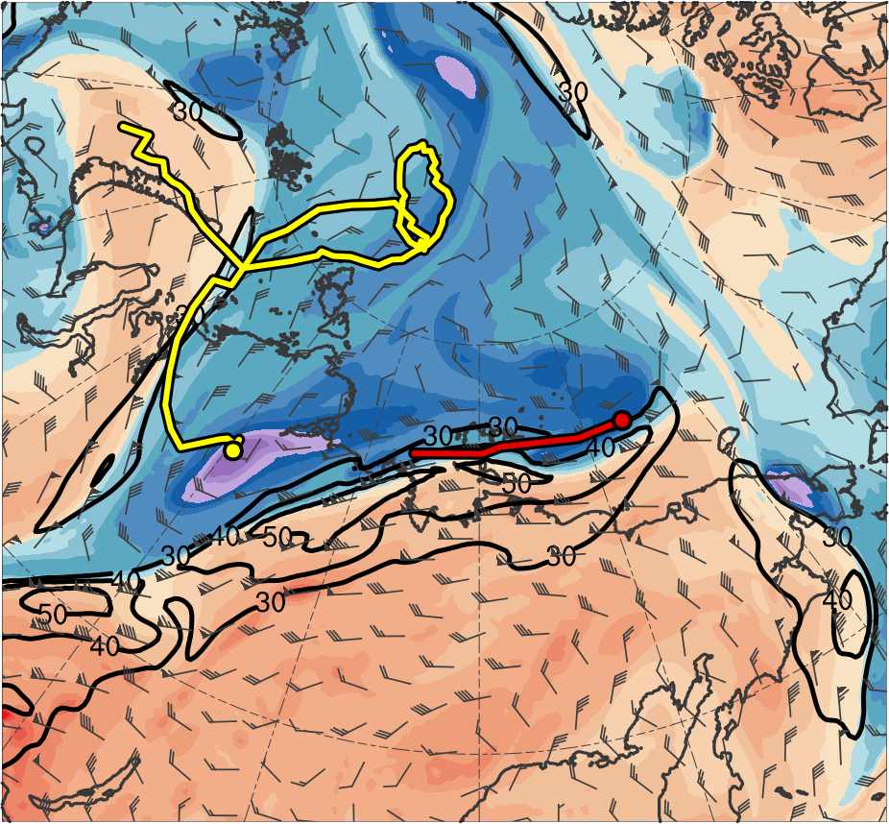
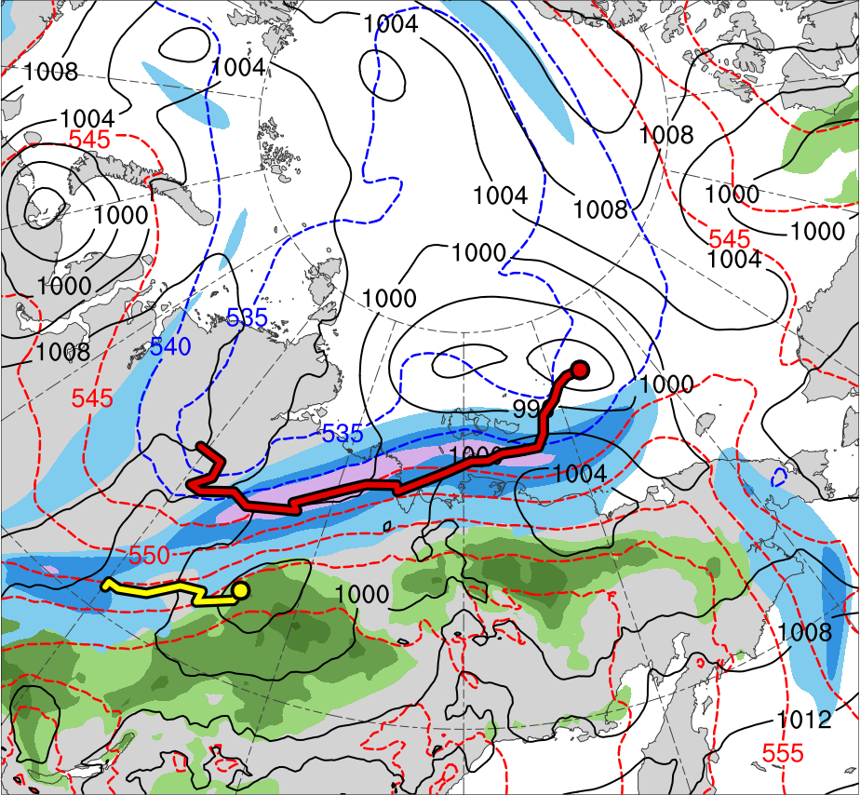
Synoptic Evolution
1200 UTC 3 Aug 2012
TPV 1
TPV 2
L1
AC12
(K)
252
258
264
270
276
282
288
294
300
306
312
318
324
330
336
342
348
354
360
366
372
378
(m s⁻¹ )
(mm)
30
40
50
60
70
80
90
100
25
30
35
40
45
50
55
Potential temperature (K, shaded), wind speed (black, every 10 m s⁻¹ starting at 30 m s⁻¹), and wind (m s⁻¹, flags and barbs) on 2-PVU surface
300-hPa wind speed (m s⁻¹, shaded),
1000–500-hPa thickness (dam, blue/red),
SLP (hPa, black), and PW (mm, shaded)

Slide 16
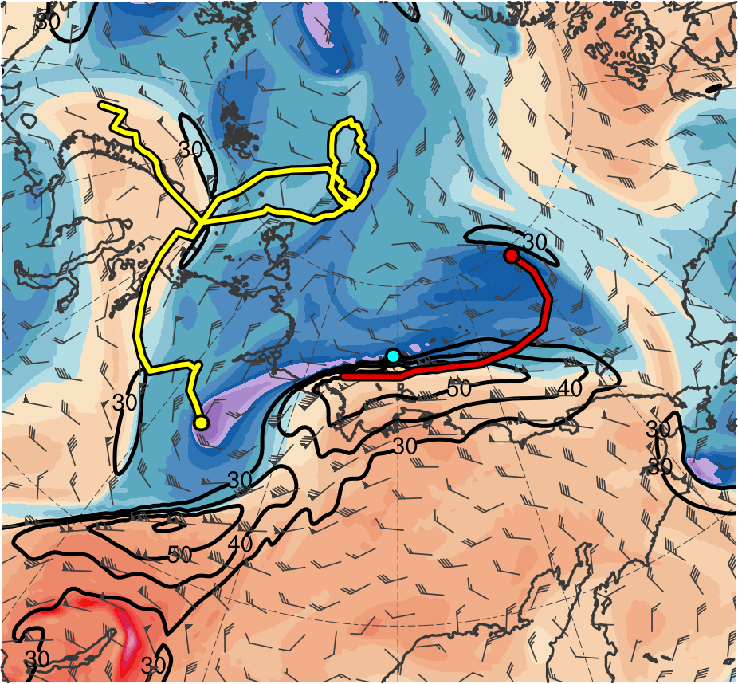
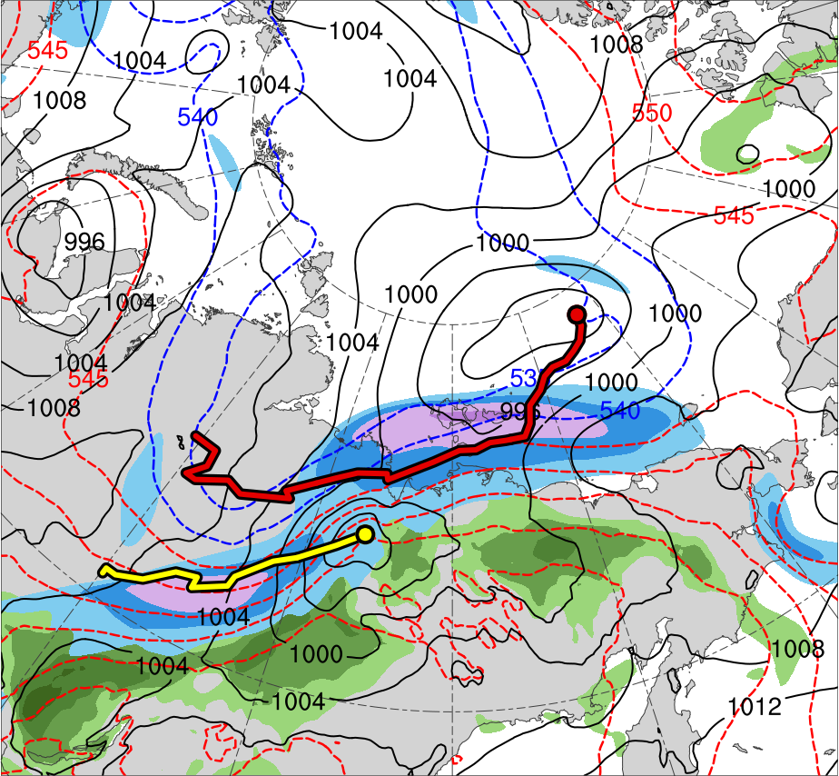
Synoptic Evolution
0000 UTC 4 Aug 2012
TPV 1
TPV 2
L1
TPV 3
AC12
(K)
252
258
264
270
276
282
288
294
300
306
312
318
324
330
336
342
348
354
360
366
372
378
(m s⁻¹ )
(mm)
30
40
50
60
70
80
90
100
25
30
35
40
45
50
55
Potential temperature (K, shaded), wind speed (black, every 10 m s⁻¹ starting at 30 m s⁻¹), and wind (m s⁻¹, flags and barbs) on 2-PVU surface
300-hPa wind speed (m s⁻¹, shaded),
1000–500-hPa thickness (dam, blue/red),
SLP (hPa, black), and PW (mm, shaded)
Notes:
Start Day of TPV 3: 4 Aug 2012

Slide 17
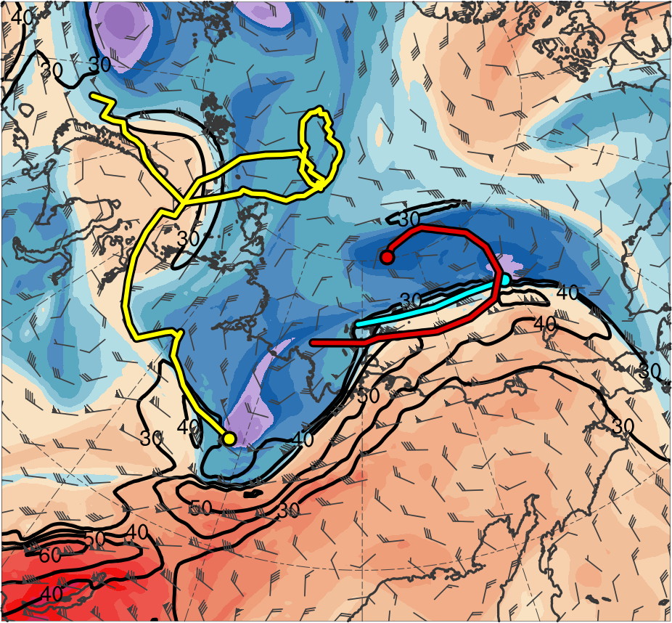
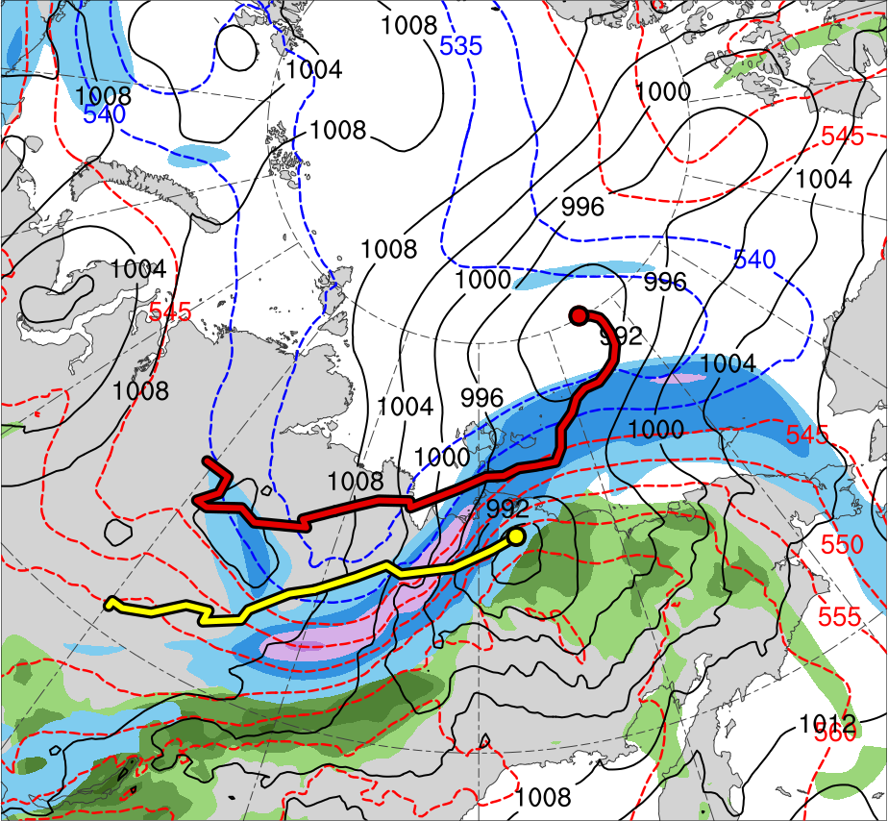
Synoptic Evolution
1200 UTC 4 Aug 2012
TPV 1
TPV 2
L1
TPV 3
AC12
(K)
252
258
264
270
276
282
288
294
300
306
312
318
324
330
336
342
348
354
360
366
372
378
(m s⁻¹ )
(mm)
30
40
50
60
70
80
90
100
25
30
35
40
45
50
55
Potential temperature (K, shaded), wind speed (black, every 10 m s⁻¹ starting at 30 m s⁻¹), and wind (m s⁻¹, flags and barbs) on 2-PVU surface
300-hPa wind speed (m s⁻¹, shaded),
1000–500-hPa thickness (dam, blue/red),
SLP (hPa, black), and PW (mm, shaded)

Slide 18
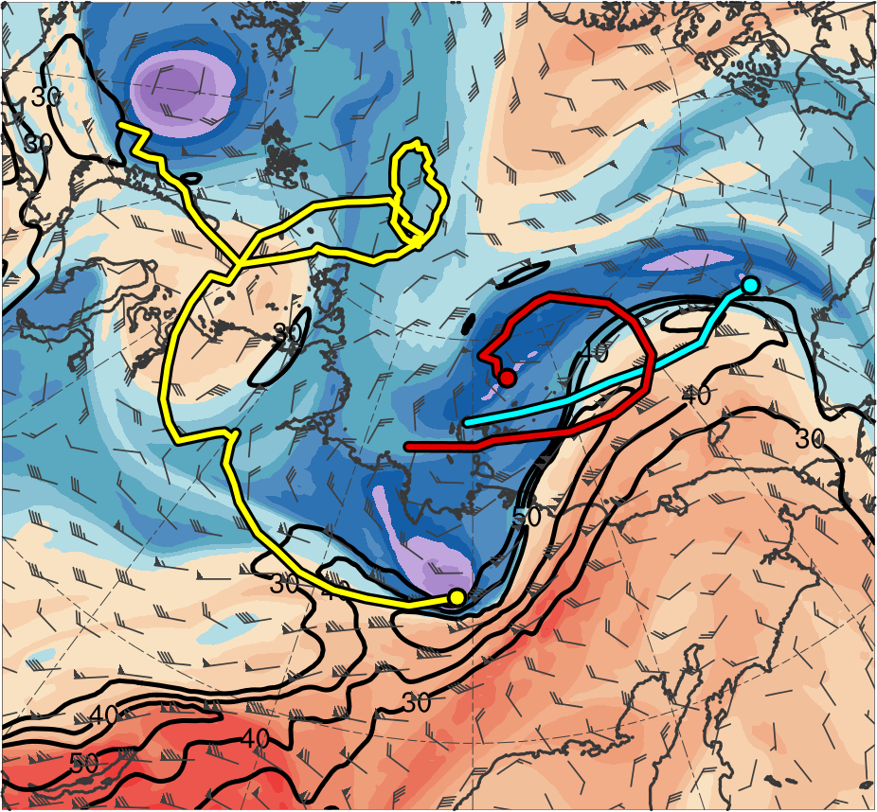
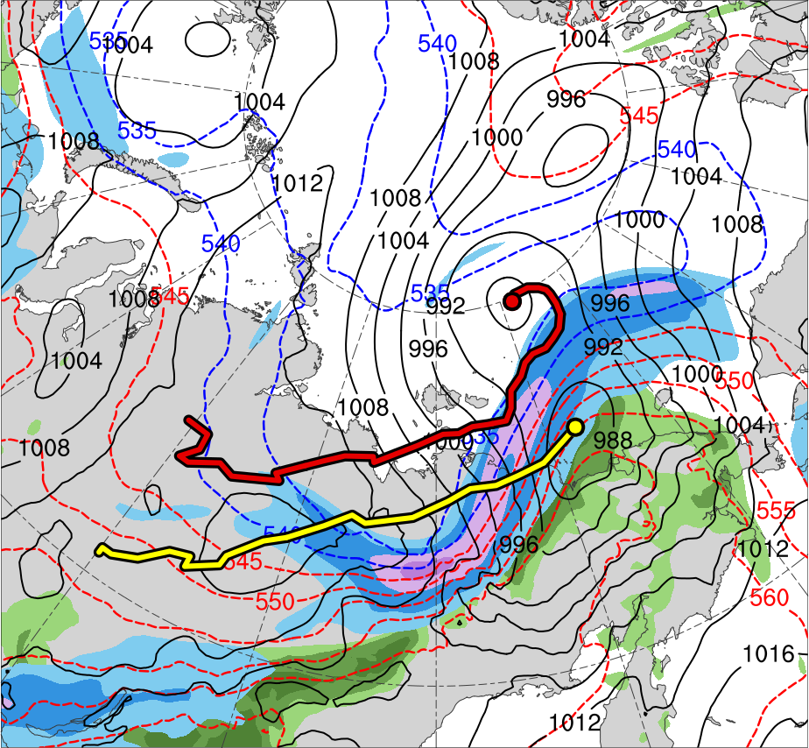
Synoptic Evolution
0000 UTC 5 Aug 2012
TPV 1
TPV 2
L1
TPV 3
AC12
(K)
252
258
264
270
276
282
288
294
300
306
312
318
324
330
336
342
348
354
360
366
372
378
(m s⁻¹ )
(mm)
30
40
50
60
70
80
90
100
25
30
35
40
45
50
55
Potential temperature (K, shaded), wind speed (black, every 10 m s⁻¹ starting at 30 m s⁻¹), and wind (m s⁻¹, flags and barbs) on 2-PVU surface
300-hPa wind speed (m s⁻¹, shaded),
1000–500-hPa thickness (dam, blue/red),
SLP (hPa, black), and PW (mm, shaded)

Slide 19
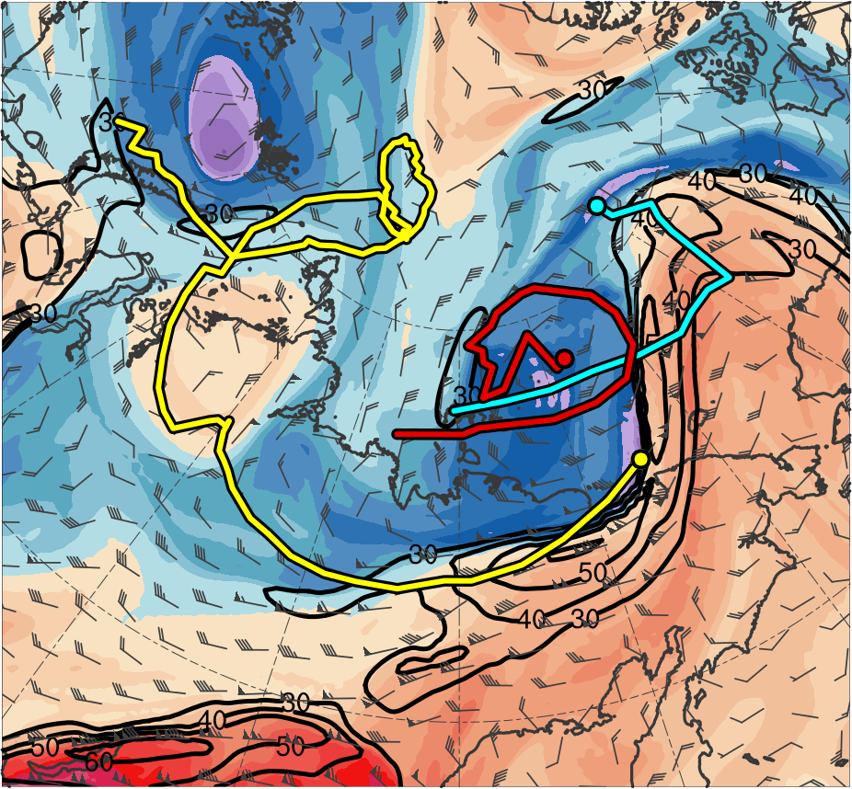
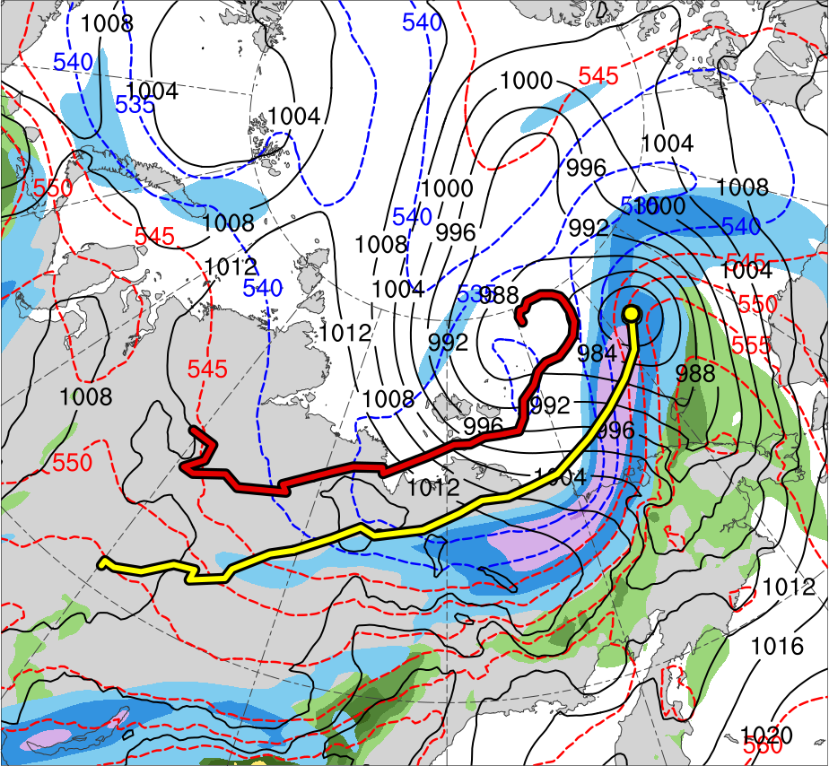
Synoptic Evolution
1200 UTC 5 Aug 2012
TPV 1
TPV 2
L1
TPV 3
AC12
(K)
252
258
264
270
276
282
288
294
300
306
312
318
324
330
336
342
348
354
360
366
372
378
(m s⁻¹ )
(mm)
30
40
50
60
70
80
90
100
25
30
35
40
45
50
55
Potential temperature (K, shaded), wind speed (black, every 10 m s⁻¹ starting at 30 m s⁻¹), and wind (m s⁻¹, flags and barbs) on 2-PVU surface
300-hPa wind speed (m s⁻¹, shaded),
1000–500-hPa thickness (dam, blue/red),
SLP (hPa, black), and PW (mm, shaded)
Notes:
End day of L1: 5 Aug 2012

Slide 20
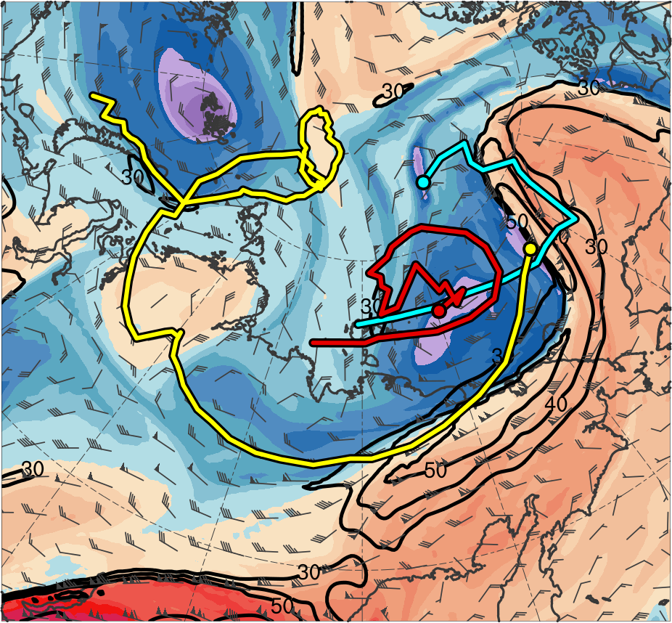
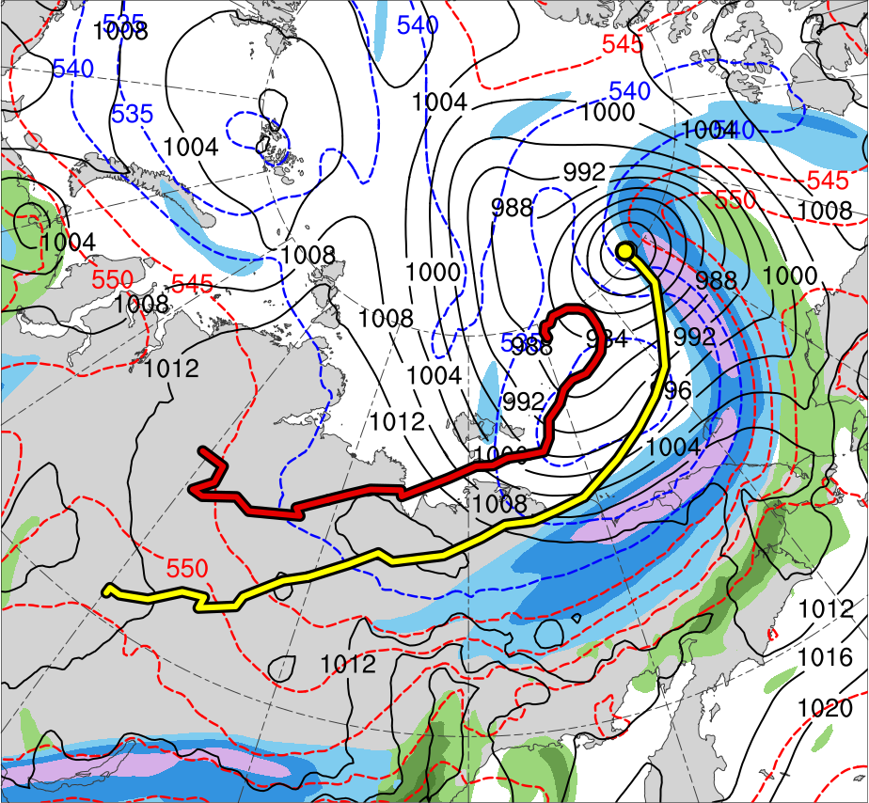
Synoptic Evolution
0000 UTC 6 Aug 2012
TPV 1
TPV 2
L1
TPV 3
AC12
(K)
252
258
264
270
276
282
288
294
300
306
312
318
324
330
336
342
348
354
360
366
372
378
(m s⁻¹ )
(mm)
30
40
50
60
70
80
90
100
25
30
35
40
45
50
55
Potential temperature (K, shaded), wind speed (black, every 10 m s⁻¹ starting at 30 m s⁻¹), and wind (m s⁻¹, flags and barbs) on 2-PVU surface
300-hPa wind speed (m s⁻¹, shaded),
1000–500-hPa thickness (dam, blue/red),
SLP (hPa, black), and PW (mm, shaded)

Slide 21
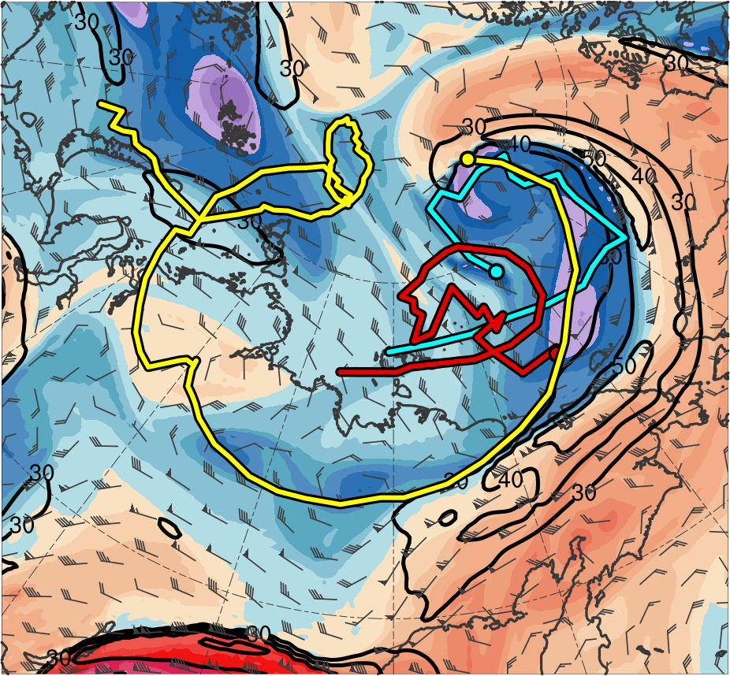
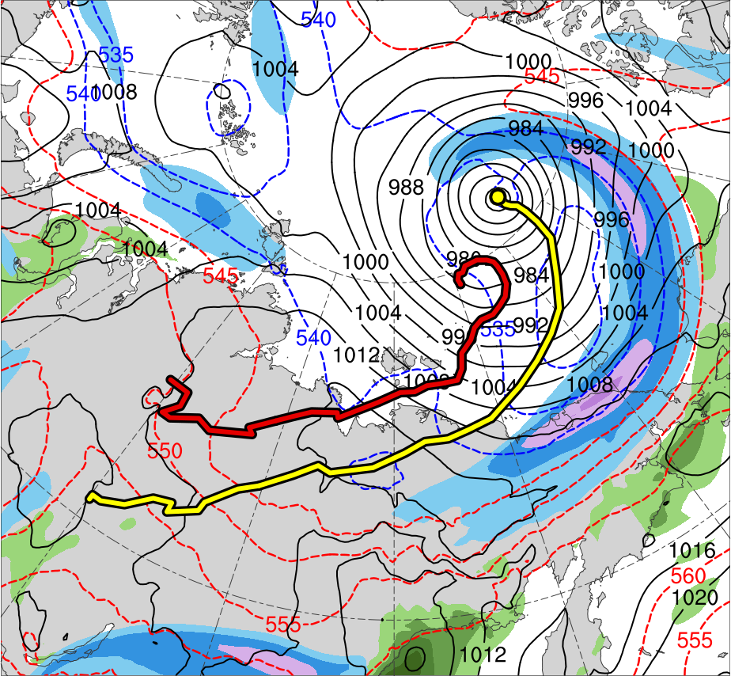
Synoptic Evolution
1200 UTC 6 Aug 2012
TPV 1
TPV 2
L1
TPV 3
AC12
(K)
252
258
264
270
276
282
288
294
300
306
312
318
324
330
336
342
348
354
360
366
372
378
(m s⁻¹ )
(mm)
30
40
50
60
70
80
90
100
25
30
35
40
45
50
55
Potential temperature (K, shaded), wind speed (black, every 10 m s⁻¹ starting at 30 m s⁻¹), and wind (m s⁻¹, flags and barbs) on 2-PVU surface
300-hPa wind speed (m s⁻¹, shaded),
1000–500-hPa thickness (dam, blue/red),
SLP (hPa, black), and PW (mm, shaded)

Slide 22
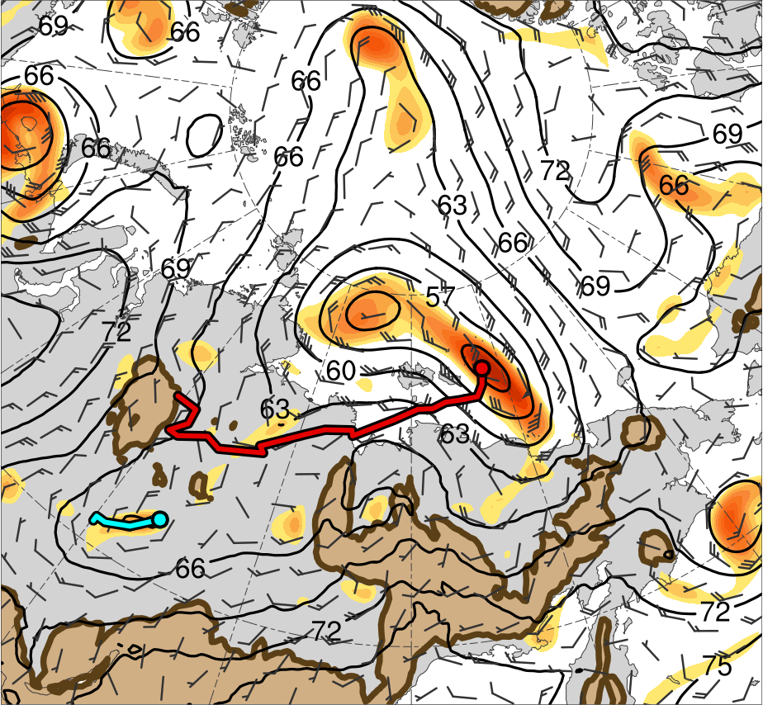
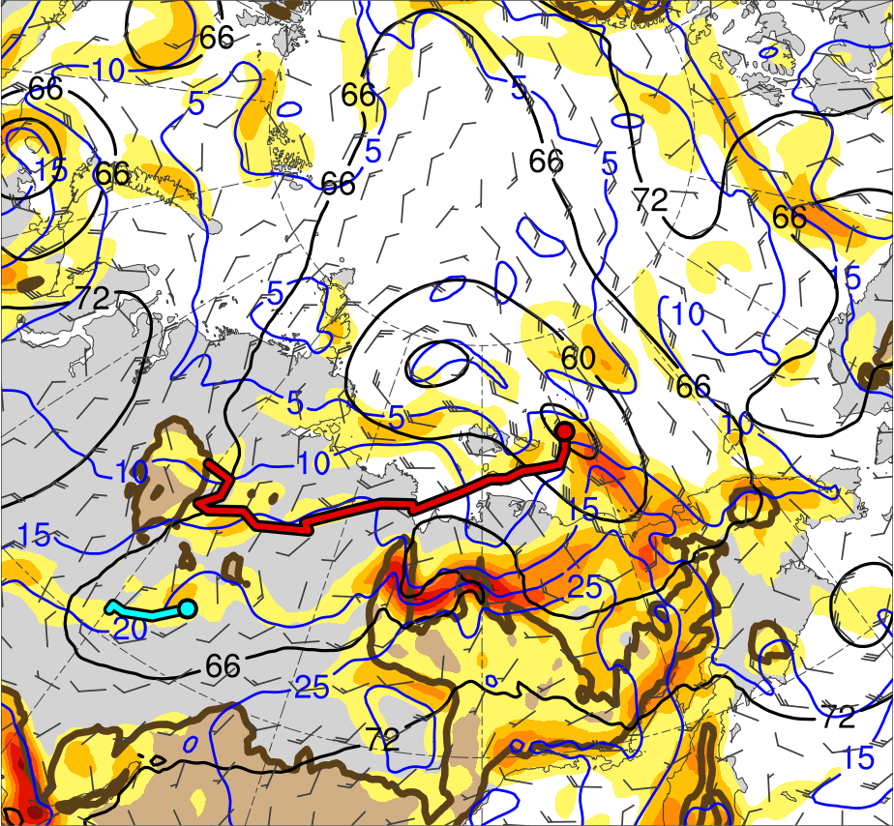
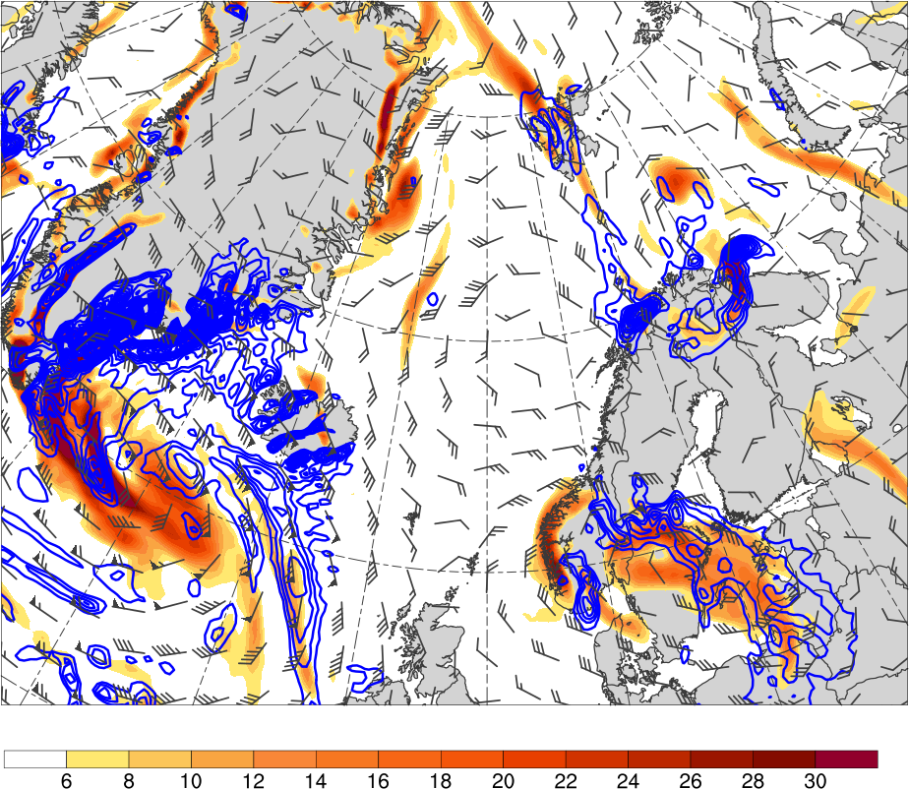
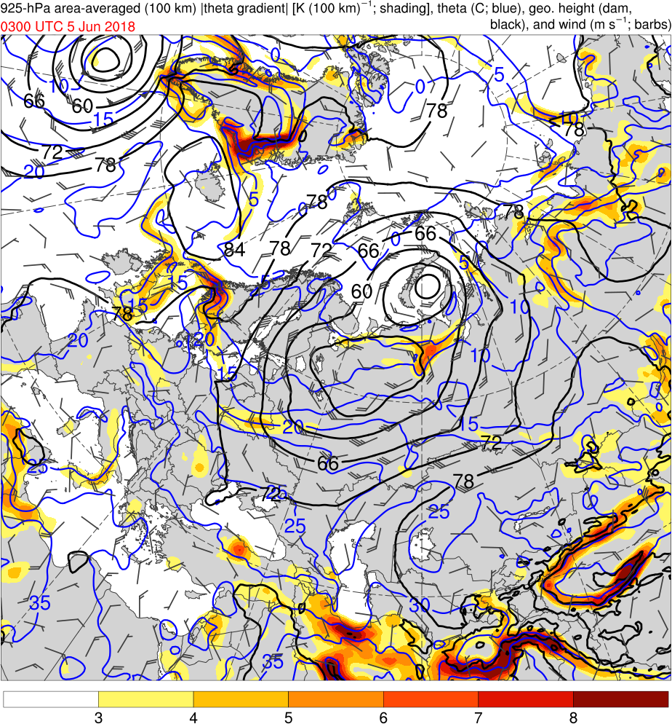
Synoptic Evolution
0000 UTC 3 Aug 2012
L1
L1
AC12
≥ 600 m
AC12
≥ 600 m
4
6
8
10
12
14
16
18
20
22
24
26
28
2
3
4
5
6
7
925-hPa area-averaged (100 km) relative vorticity (10⁻⁵ s⁻¹, shaded), geopotential height (dam, black), and wind (m s⁻¹, flags and barbs)
925-hPa area-averaged (100 km) θ gradient [K (100 km) ⁻¹, shaded ], θ (°C, blue), geopotential height (dam, black), and wind (m s⁻¹, flags and barbs)

Slide 23
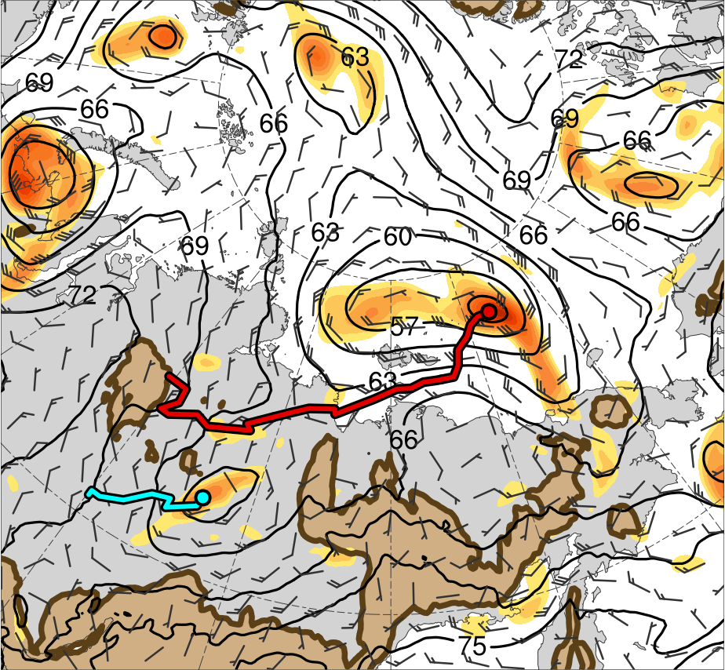
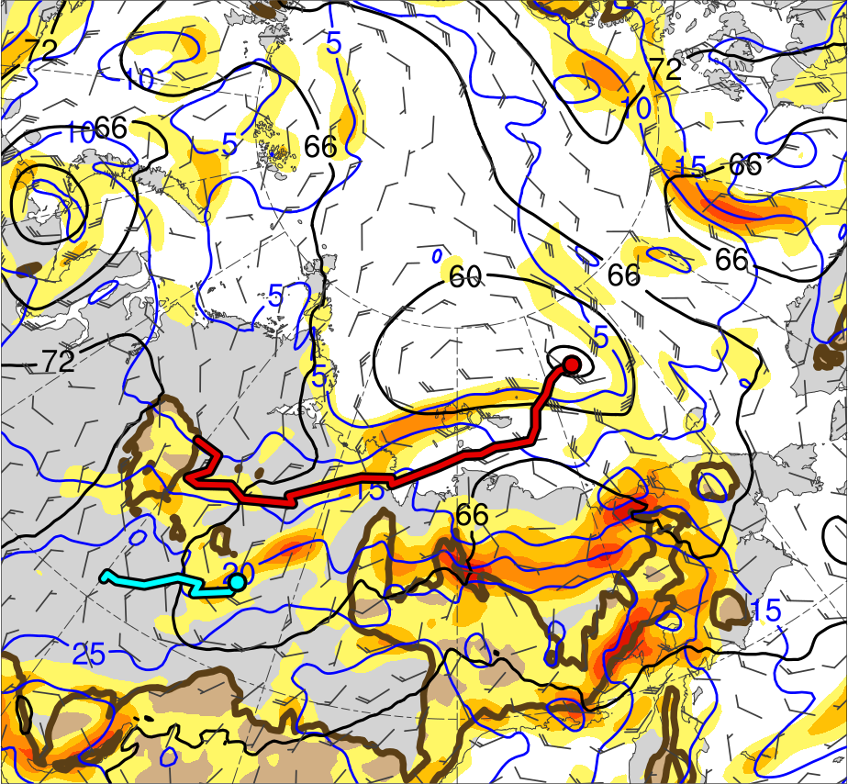
Synoptic Evolution
1200 UTC 3 Aug 2012
L1
L1
AC12
≥ 600 m
AC12
≥ 600 m
4
6
8
10
12
14
16
18
20
22
24
26
28
2
3
4
5
6
7
925-hPa area-averaged (100 km) relative vorticity (10⁻⁵ s⁻¹, shaded), geopotential height (dam, black), and wind (m s⁻¹, flags and barbs)
925-hPa area-averaged (100 km) θ gradient [K (100 km) ⁻¹, shaded ], θ (°C, blue), geopotential height (dam, black), and wind (m s⁻¹, flags and barbs)

Slide 24
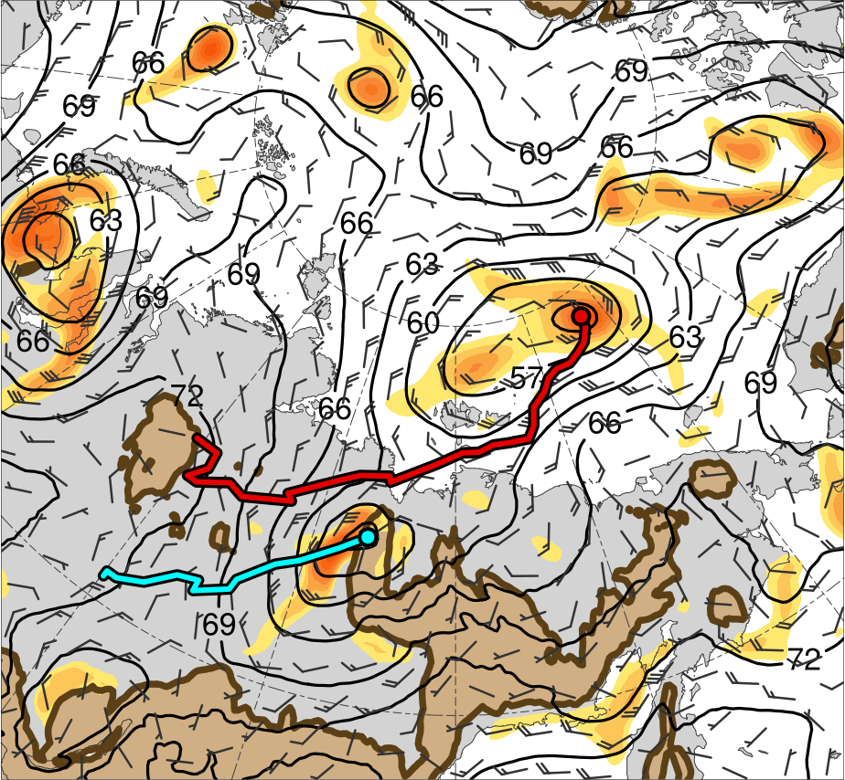
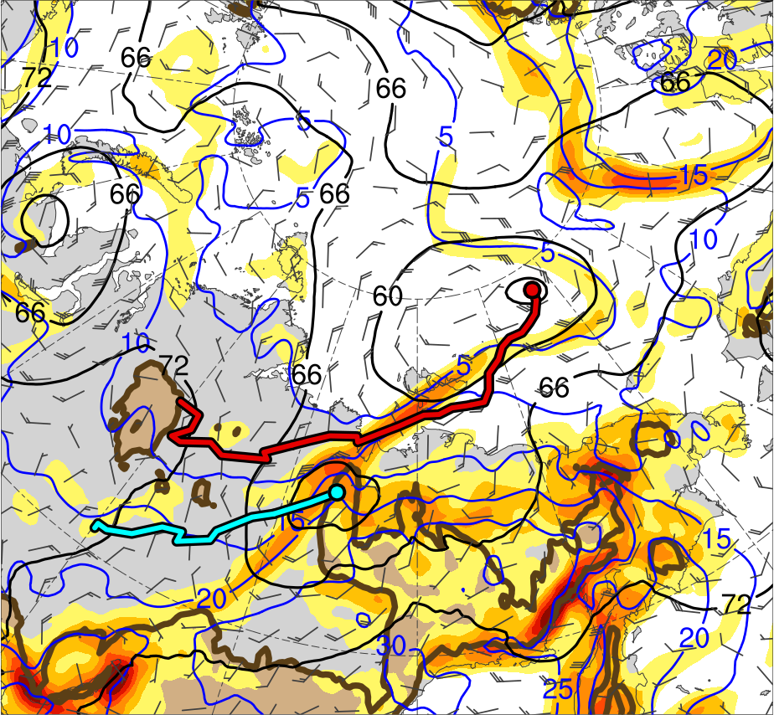
Synoptic Evolution
0000 UTC 4 Aug 2012
L1
L1
AC12
≥ 600 m
AC12
≥ 600 m
4
6
8
10
12
14
16
18
20
22
24
26
28
2
3
4
5
6
7
925-hPa area-averaged (100 km) relative vorticity (10⁻⁵ s⁻¹, shaded), geopotential height (dam, black), and wind (m s⁻¹, flags and barbs)
925-hPa area-averaged (100 km) θ gradient [K (100 km) ⁻¹, shaded ], θ (°C, blue), geopotential height (dam, black), and wind (m s⁻¹, flags and barbs)

Slide 25
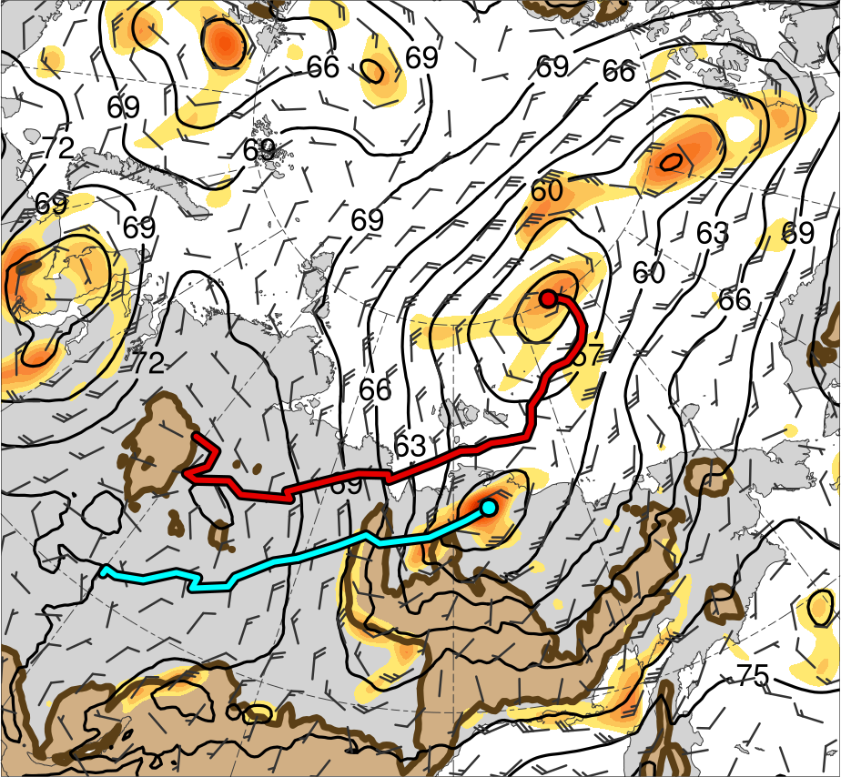
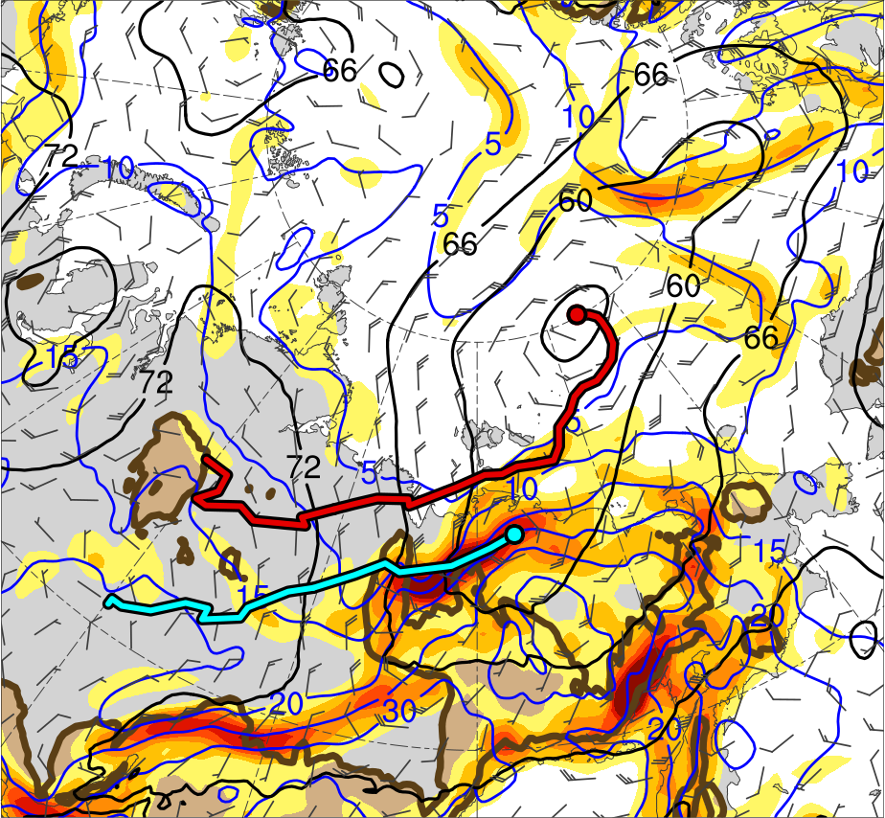
Synoptic Evolution
1200 UTC 4 Aug 2012
L1
L1
AC12
≥ 600 m
AC12
≥ 600 m
4
6
8
10
12
14
16
18
20
22
24
26
28
2
3
4
5
6
7
925-hPa area-averaged (100 km) relative vorticity (10⁻⁵ s⁻¹, shaded), geopotential height (dam, black), and wind (m s⁻¹, flags and barbs)
925-hPa area-averaged (100 km) θ gradient [K (100 km) ⁻¹, shaded ], θ (°C, blue), geopotential height (dam, black), and wind (m s⁻¹, flags and barbs)

Slide 26
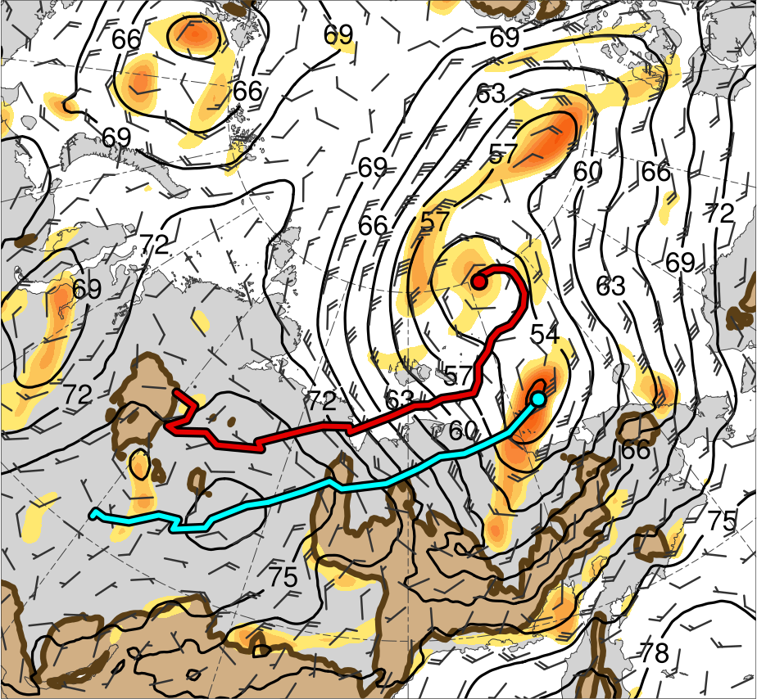
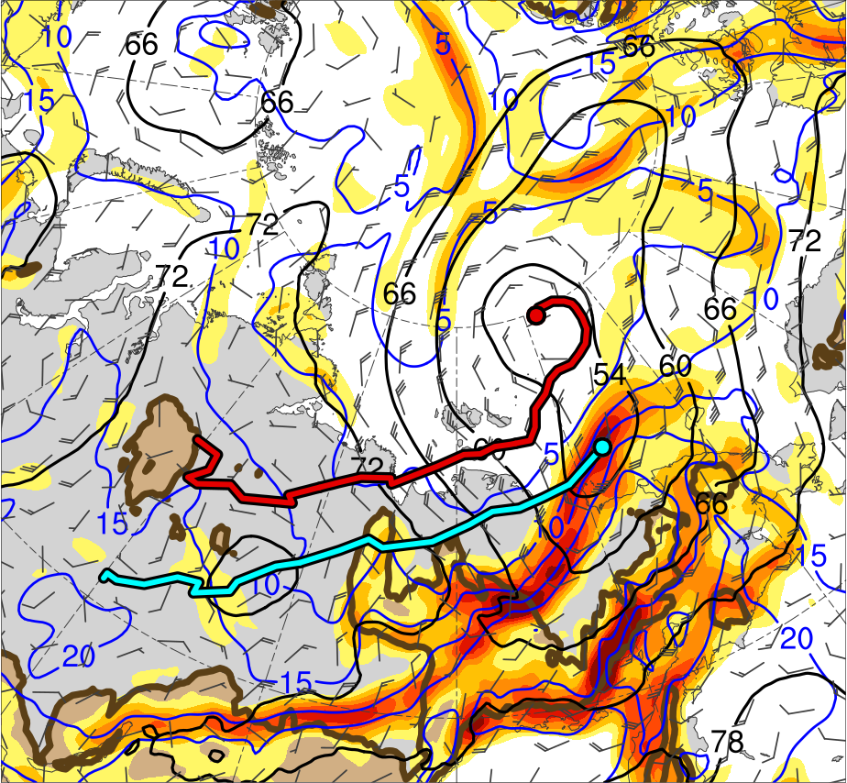
Synoptic Evolution
0000 UTC 5 Aug 2012
L1
L1
AC12
≥ 600 m
AC12
≥ 600 m
4
6
8
10
12
14
16
18
20
22
24
26
28
2
3
4
5
6
7
925-hPa area-averaged (100 km) relative vorticity (10⁻⁵ s⁻¹, shaded), geopotential height (dam, black), and wind (m s⁻¹, flags and barbs)
925-hPa area-averaged (100 km) θ gradient [K (100 km) ⁻¹, shaded ], θ (°C, blue), geopotential height (dam, black), and wind (m s⁻¹, flags and barbs)

Slide 27
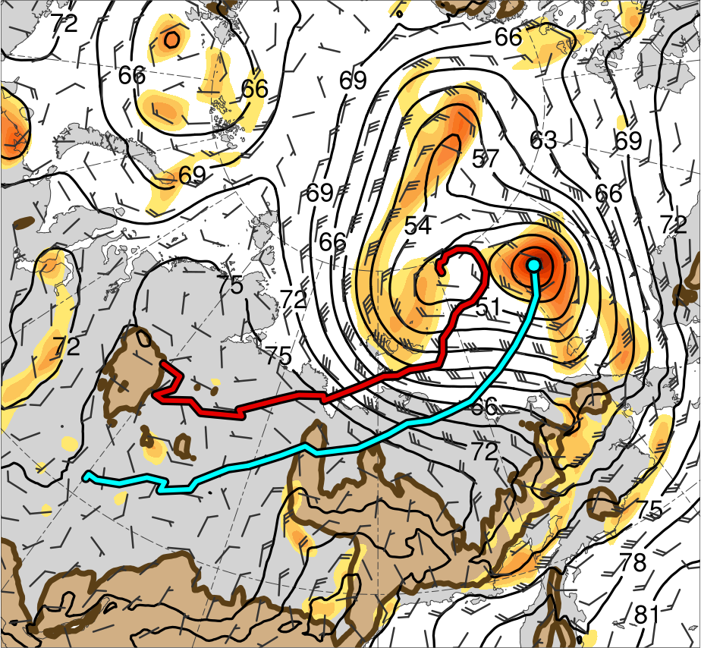
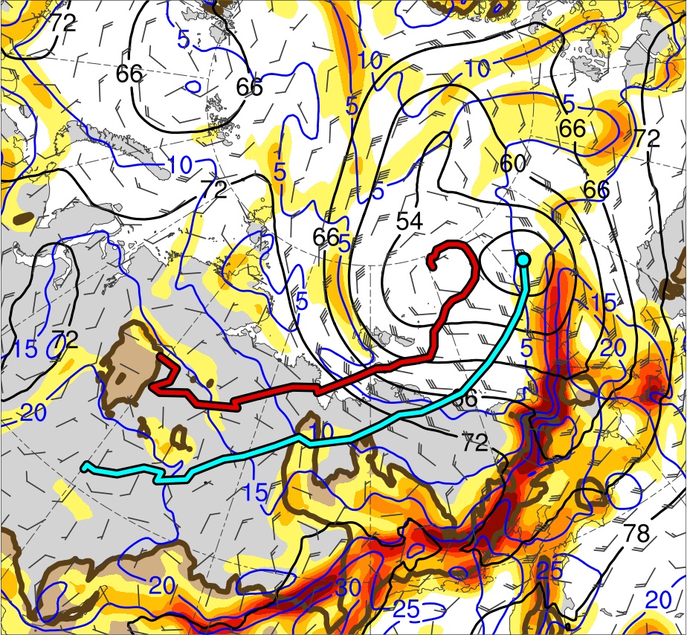
Synoptic Evolution
1200 UTC 5 Aug 2012
L1
L1
AC12
≥ 600 m
AC12
≥ 600 m
4
6
8
10
12
14
16
18
20
22
24
26
28
2
3
4
5
6
7
925-hPa area-averaged (100 km) relative vorticity (10⁻⁵ s⁻¹, shaded), geopotential height (dam, black), and wind (m s⁻¹, flags and barbs)
925-hPa area-averaged (100 km) θ gradient [K (100 km) ⁻¹, shaded ], θ (°C, blue), geopotential height (dam, black), and wind (m s⁻¹, flags and barbs)

Slide 28
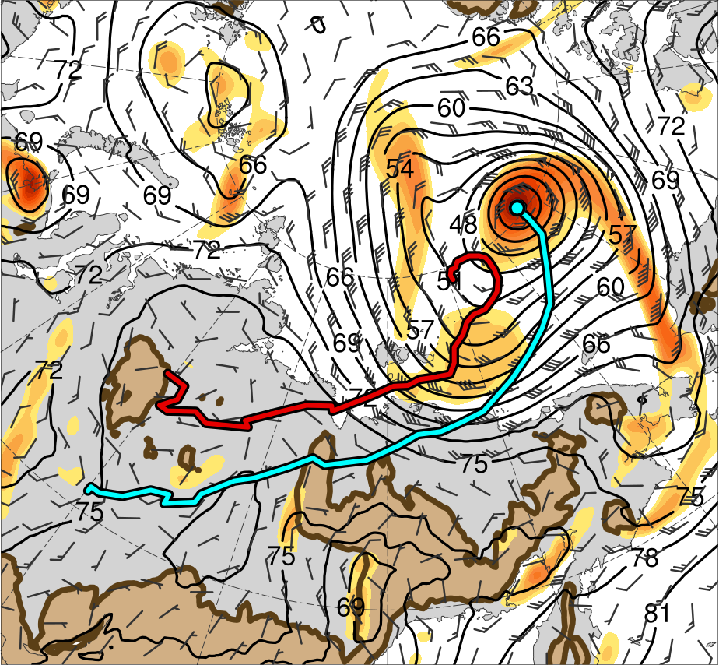
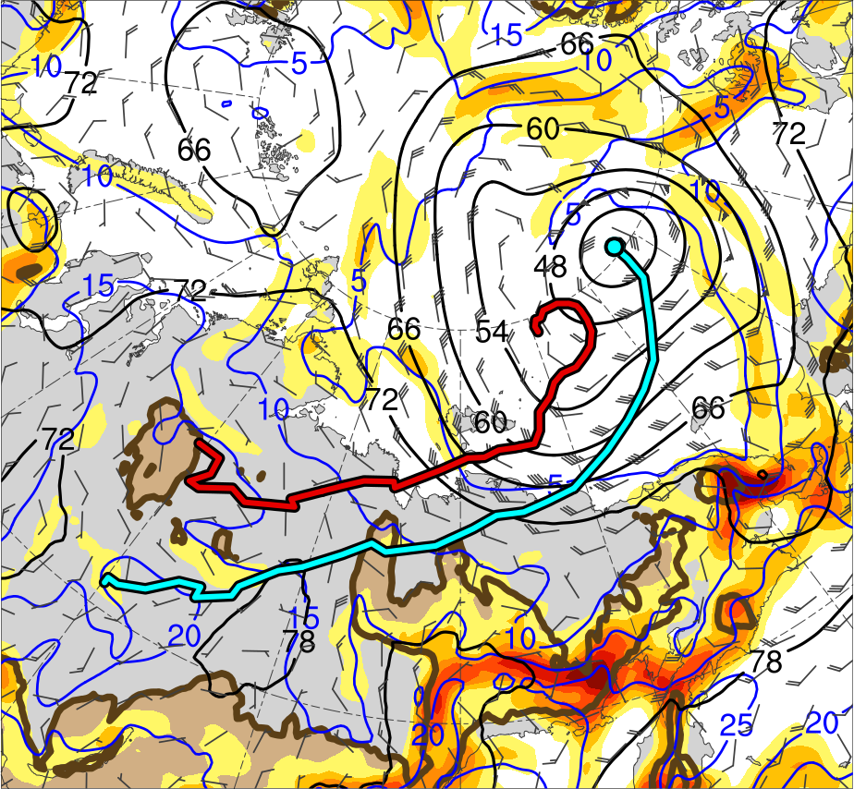
Synoptic Evolution
0000 UTC 6 Aug 2012
L1
L1
AC12
≥ 600 m
AC12
≥ 600 m
4
6
8
10
12
14
16
18
20
22
24
26
28
2
3
4
5
6
7
925-hPa area-averaged (100 km) relative vorticity (10⁻⁵ s⁻¹, shaded), geopotential height (dam, black), and wind (m s⁻¹, flags and barbs)
925-hPa area-averaged (100 km) θ gradient [K (100 km) ⁻¹, shaded ], θ (°C, blue), geopotential height (dam, black), and wind (m s⁻¹, flags and barbs)

Slide 29
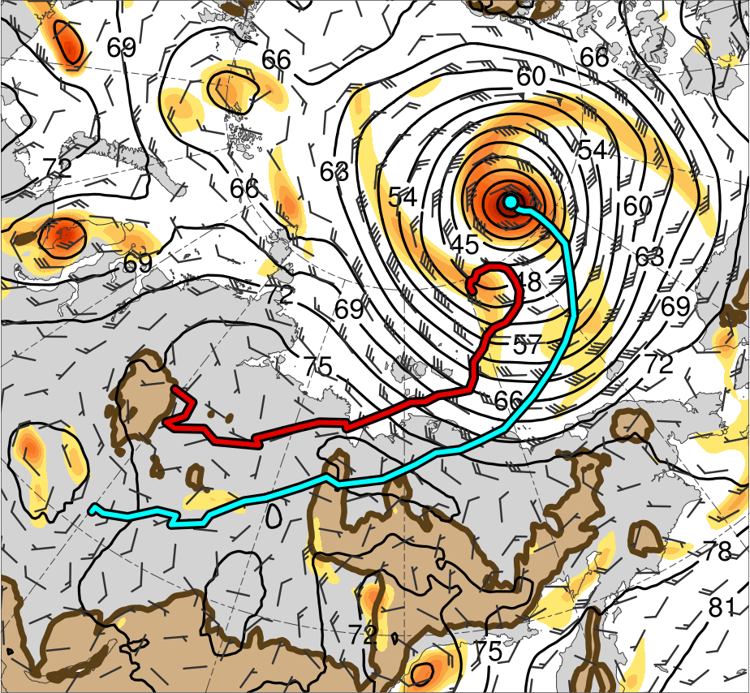
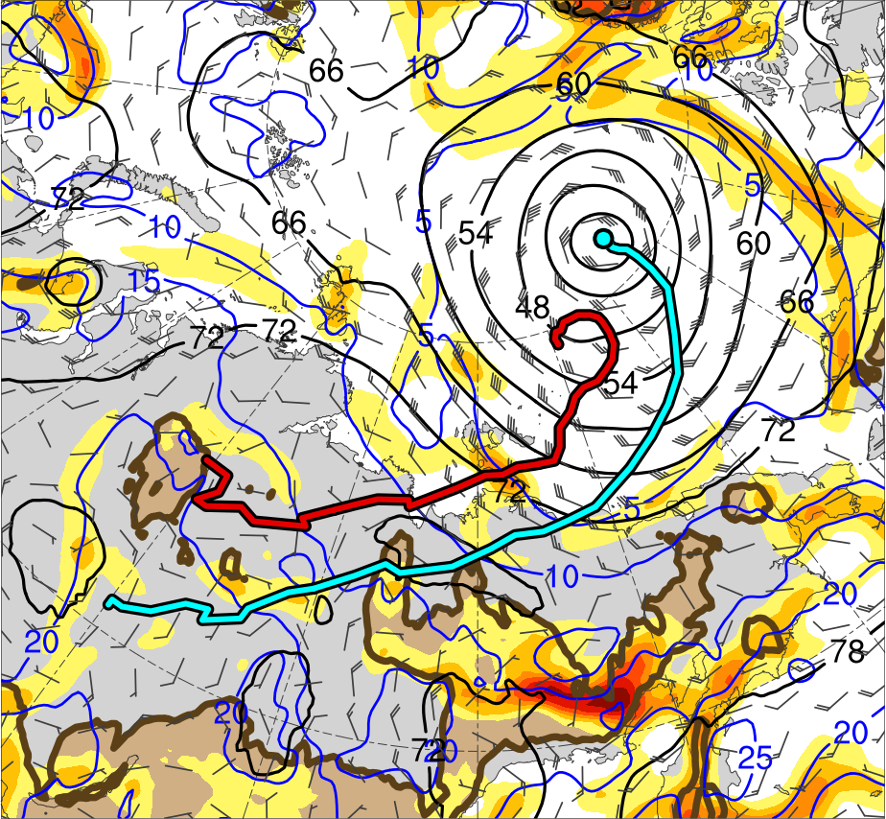
Synoptic Evolution
1200 UTC 6 Aug 2012
L1
L1
AC12
≥ 600 m
AC12
≥ 600 m
4
6
8
10
12
14
16
18
20
22
24
26
28
2
3
4
5
6
7
925-hPa area-averaged (100 km) relative vorticity (10⁻⁵ s⁻¹, shaded), geopotential height (dam, black), and wind (m s⁻¹, flags and barbs)
925-hPa area-averaged (100 km) θ gradient [K (100 km) ⁻¹, shaded ], θ (°C, blue), geopotential height (dam, black), and wind (m s⁻¹, flags and barbs)

Slide 30
Synoptic Evolution
TPV 1 approaches and interacts with AC12 in a region of strong baroclinicity, likely supporting the development of AC12 through baroclinic processes
TPV 2 forms at 0000 UTC 3 Aug east of TPV 1, and TPV 3 forms at 0000 UTC 4 Aug by splitting off from TPV 1
TPV–jet interactions involving TPV 1, TPV 2, and TPV 3 likely contribute to the formation of a dual-jet configuration and jet coupling over AC12 during 1200 UTC 3 Aug–0000 UTC 4 Aug (jet coupling phase)

Slide 31
Synoptic Evolution
Upper-level divergence associated with the jet coupling likely supports the intensification of AC12
The interaction and merger of L1 with AC12 may further support the intensification of AC12
Cold air advection in the wake of L1 helps maintain the strong baroclinicity in the vicinity of AC12, which also may support the intensification of AC12

Slide 32
Synoptic Evolution
Most rapid intensification of AC12 occurs during 0000 UTC 5 Aug–0000 UTC 6 Aug, when AC12 crosses from the warm side to the cold side of a strong upper-level jet streak (jet crossing phase)
AC12 attains peak intensity of 962.3 hPa at 1000 UTC 6 Aug in the ERA5 and becomes vertically aligned with TPV 1 by 1200 UTC 6 Aug
AC12 and TPV 1 then meander slowly in tandem over the Arctic, while AC12 slowly weakens

Slide 33
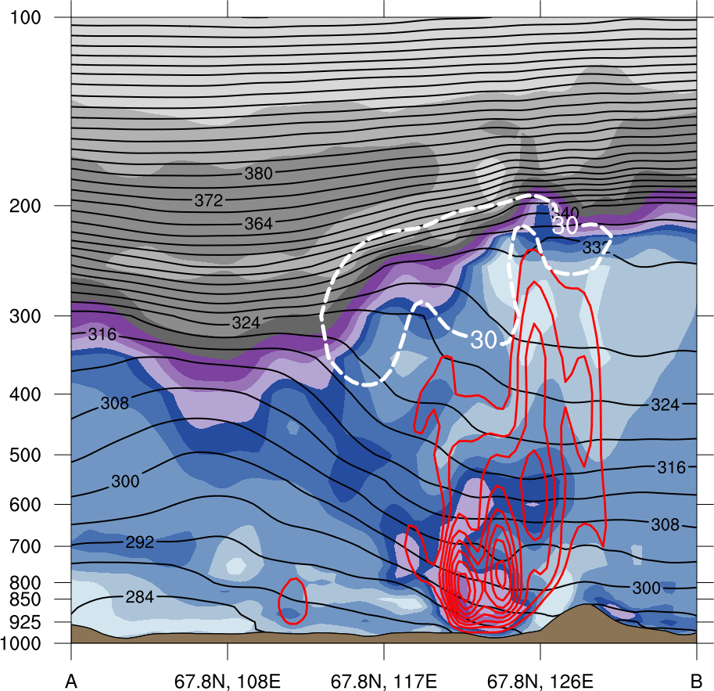
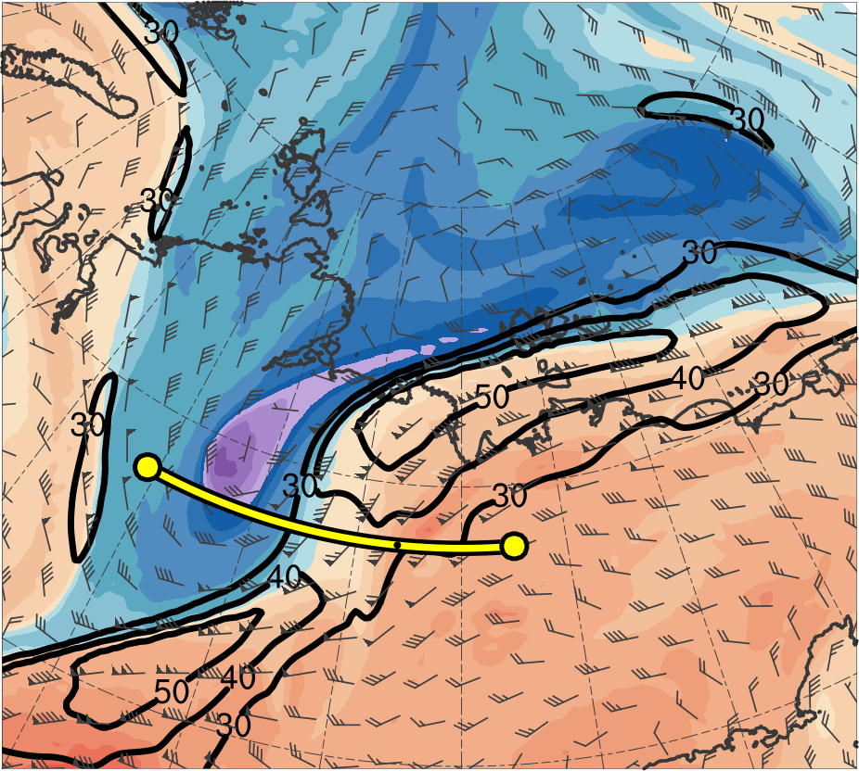
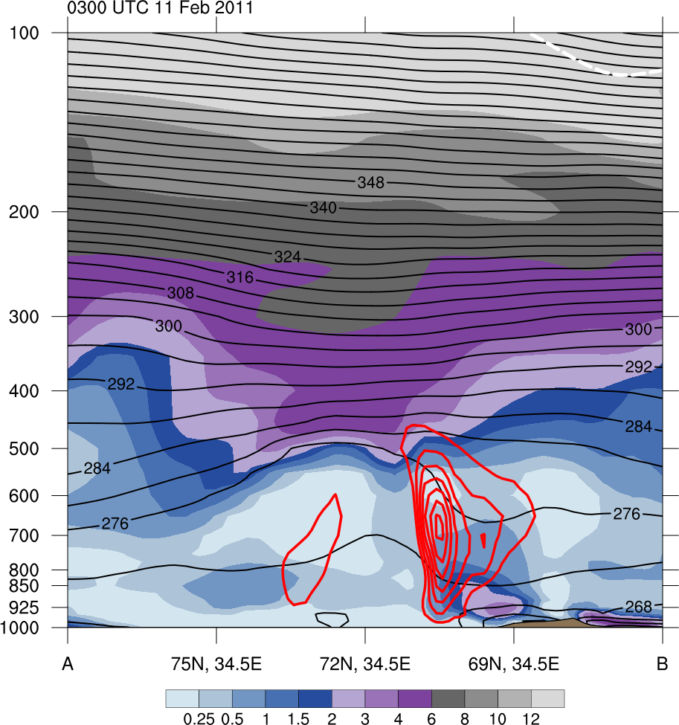
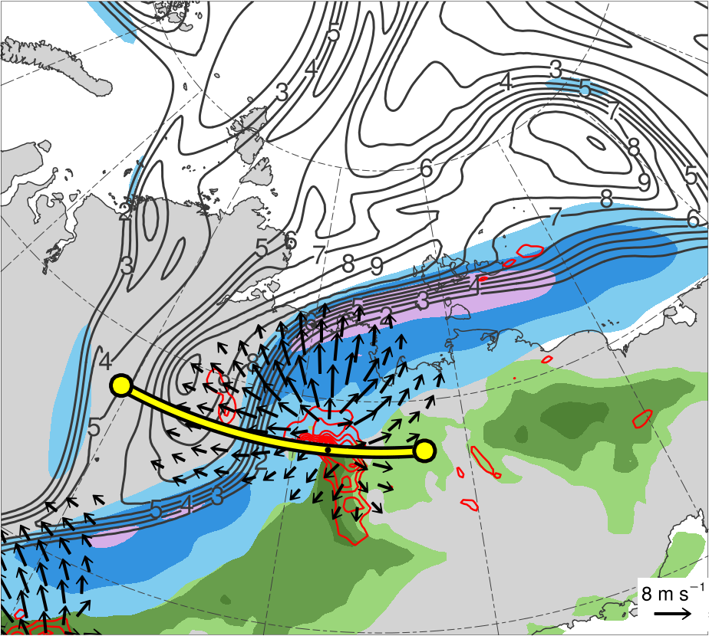
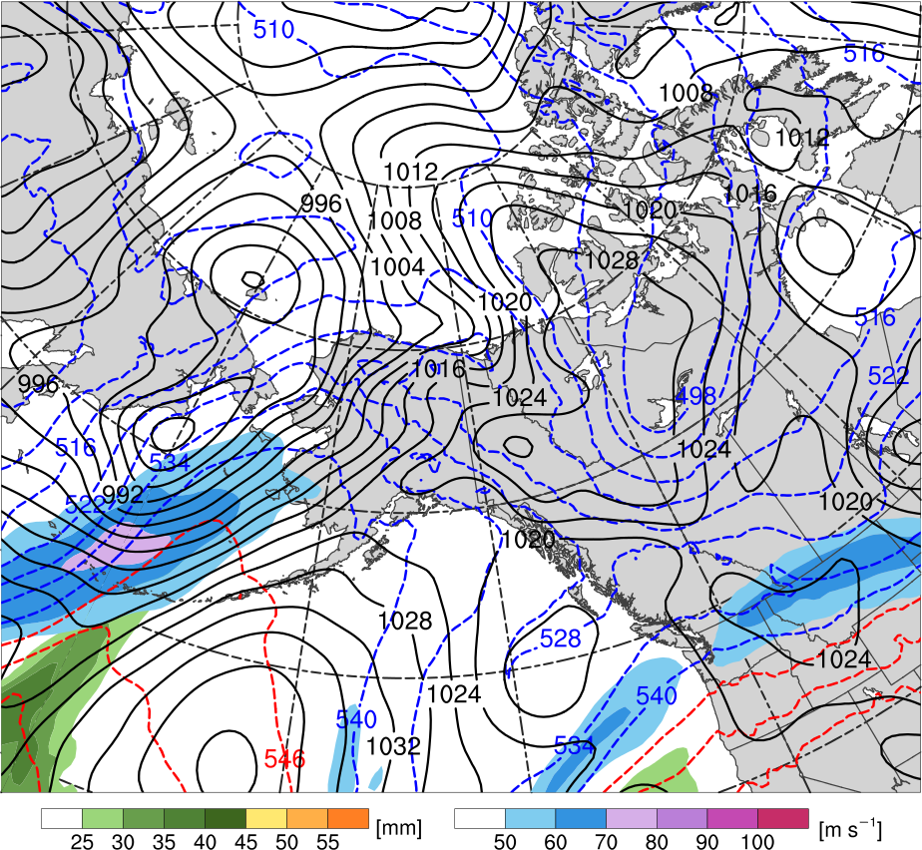
Cross Sections: Jet Coupling
2100 UTC 3 Aug 2012
(b)
TPV 2
(a)
378
100
12
372
90
TPV 1
366
10
360
80
A
354
70
8
348
60
6
A’
342
50
336
4
330
40
324
30
3
AC12
318
(c)
TPV 2
312
(m s⁻¹)
2
306
300
55
1.5
TPV 1
TPV 1
294
50
288
1
282
45
A
276
40
0.5
A’
270
264
35
0.25
AC12
258
30
A
A’
252
25
(PVU)
AC12
(K)
(mm)
(a) PV (PVU, shaded), θ (K, black), ascent (red, every 5 × 10⁻³ hPa s⁻¹), and wind speed (white, every 10 m s⁻¹ starting at 30 m s⁻¹); (b) DT (2-PVU surface) θ (K, shaded), wind speed (black, every 10 m s⁻¹ starting at 30 m s⁻¹), and wind (m s⁻¹, flags and barbs); (c) 350–250-hPa PV (PVU, gray) and irrot. wind (m s⁻¹, vectors), 300-hPa wind speed (m s⁻¹, shaded), 800–600-hPa ascent (red, every 5 × 10⁻³ hPa s⁻¹), and PW (mm, shading)

Slide 34
Cross Sections
At 2100 UTC 3 Aug, TPV–jet interactions involving TPV1 and TPV 2 likely contribute to the dual-jet configuration and jet coupling over AC12 (jet coupling phase)
Jet coupling likely supports relatively strong low-level ascent over AC12
Latent heating related to the low-level ascent in the presence of warm, moist air likely contributes to the formation of a potential vorticity (PV) tower associated with AC12 and the concomitant intensification of AC12

Slide 35
Cross Sections
At 2100 UTC 3 Aug, the interaction between TPV 1 and the PV tower also likely supports the intensification of AC12

Slide 36
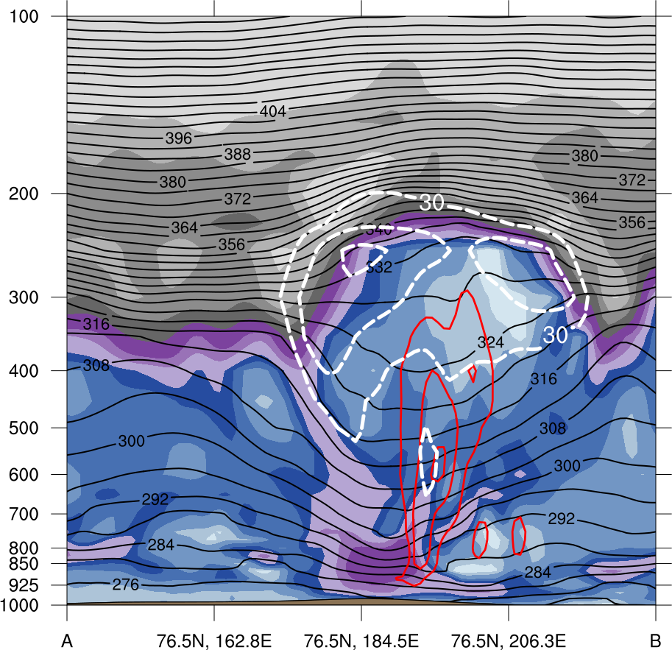


Cross Sections: Jet Crossing
1200 UTC 5 Aug 2012
(a)
(b)
378
100
TPV 3
372
12
TPV 2
90
B’
366
10
B
360
80
354
70
8
348
60
6
342
50
336
4
TPV 1
330
40
AC12
324
30
3
318
(c)
312
(m s⁻¹)
2
TPV 3
306
TPV 2
B’
300
55
1.5
TPV 2
B
294
50
288
1
282
45
0.5
276
40
270
35
0.25
AC12
TPV 1
264
258
30
AC12
252
25
(PVU)
B
B’
(K)
(mm)
(a) PV (PVU, shaded), θ (K, black), ascent (red, every 5 × 10⁻³ hPa s⁻¹), and wind speed (white, every 10 m s⁻¹ starting at 30 m s⁻¹); (b) DT (2-PVU surface) θ (K, shaded), wind speed (black, every 10 m s⁻¹ starting at 30 m s⁻¹), and wind (m s⁻¹, flags and barbs); (c) 350–250-hPa PV (PVU, gray) and irrot. wind (m s⁻¹, vectors), 300-hPa wind speed (m s⁻¹, shaded), 800–600-hPa ascent (red, every 5 × 10⁻³ hPa s⁻¹), and PW (mm, shading)

Slide 37
Cross Sections
  At 1200 UTC 5 Aug, latent heating likely contributes to the maintenance of the PV tower associated with AC12 and the intensification of AC12 (jet crossing phase)
  The contribution of latent heating at 1200 UTC 5 Aug (jet crossing phase) likely is smaller than at 2100 UTC 3 Aug (jet coupling phase)

Slide 38



Impacts of AC12 on Arctic Sea Ice
0000 UTC 6 Aug 2012
0000 UTC 15 Aug 2012
L1
AC12
(m s⁻¹ )
(%)
4
6
8
10
12
14
16
18
-60
-50
-40
-30
-20
-10
-5
5
10
20
30
40
50
60
SLP (hPa, black); 10-m wind speed (m s⁻¹, shaded) and wind (m s⁻¹, black barbs), and 20% contour of sea-ice concentration (thick blue)
Change in sea-ice concentration (%, shaded) during 0000 UTC 2–0000 UTC 15 Aug 2012

Slide 39
Impacts of AC12 on Arctic Sea Ice
AC12 is associated with an expansive field of relatively strong winds
The relatively strong southerly winds to the east of the center of AC12 are approximately perpendicular to the sea-ice edge, likely helping to move and break up the thin sea ice
AC12 meanders slowly over the Arctic, leading to a prolonged impact on the sea ice, as illustrated by the relatively large reduction in sea-ice concentration northeast of Siberia

Slide 40
Summary
TPV 1 approaches and interacts with AC12 in a region of strong baroclinicity, likely supporting the development of AC12 through baroclinic processes
Cold air advection in the wake of L1 helps maintain the strong baroclinicity in the vicinity of AC12, which also may support the intensification of AC12
TPV–jet interactions involving TPV 1, TPV 2, and TPV 3 likely contribute to the formation of a dual-jet configuration over AC12 during the jet coupling phase

Slide 41
Summary
Latent heating related to low-level ascent in the presence of warm, moist air in the region of jet coupling likely contributes to the formation of a PV tower associated with AC12 and the concomitant intensification of AC12
The interaction between TPV 1 and the PV tower during jet coupling also likely supports the intensification of AC12
The interaction and merger of L1 with AC12 may further support the intensification of AC12

Slide 42
Summary
Most rapid intensification of AC12 occurs when AC12 crosses from the warm side to the cold side of a strong upper-level jet streak
  Latent heating likely contributes to the maintenance of the PV tower associated with AC12 and the intensification of AC12 during the jet crossing phase
  Widespread, relatively strong surface winds associated with AC12 contribute to a reduction in Arctic sea-ice extent as AC12 meanders slowly over the Arctic

Slide 43
References
Cavallo, S. M., and G. J. Hakim, 2009: Potential vorticity diagnosis of a tropopause polar cyclone. Mon. Wea.
Rev., 137, 1358–1371.
——, and ——, 2010: Composite structure of tropopause polar cyclones. Mon. Wea. Rev., 138, 3840–3857.
——, and ——, 2012: Radiative impact on tropopause polar vortices over the Arctic. Mon. Wea. Rev., 140, 1683–
1702.
——, and ——, 2013: Physical mechanisms of tropopause polar vortex intensity change. J. Atmos. Sci., 70, 3359–
3373.
Hersbach, H., and D. Dee, 2016: ERA5 reanalysis is in production. ECMWF Newsletter, No. 147 ECMWF,
Reading, United Kingdom, 7. [Available online at
www.ecmwf.int/sites/default/files/elibrary/2016/16299-newsletter-no147-spring-2016.pdf.]
Parkinson, C. L., and J. C. Comiso, 2013: On the 2012 record low Arctic sea ice cover: Combined impact of
preconditioning and an August storm. Geophys. Res. Lett., 40, 1356–1361.
Pyle, M. E., D. Keyser, and L. F. Bosart, 2004: A diagnostic study of jet streaks: Kinematic signatures and
relationship to coherent tropopause disturbances. Mon. Wea. Rev., 132, 297–319.
Simmonds, I., and I. Rudeva, 2012: The Great Arctic Cyclone of August 2012. Geophys. Res. Lett., 39, L23709.
Szapiro, N., and S. Cavallo, 2018: TPVTrack v1.0: A watershed segmentation and overlap correspondence
method for tracking tropopause polar vortices. Geosci. Model Dev., 11, 5173–5187.
Tao, W., J. Zhang, Y. Fu, and X. Zhang, 2017: Driving roles of tropospheric and stratospheric thermal anomalies
in intensification and persistence of the Arctic Superstorm in 2012. Geophys. Res. Lett., 44, 10017–10025.
Yamagami, A., M. Matsueda, and H. L. Tanaka, 2018: Predictability of the 2012 Great Arctic Cyclone on medium-
range timescales. Polar Science, 15, 13–23.
Yamazaki, A., J. Inoue, K. Dethloff, M. Maturilli, and G. König-Langlo, 2015: Impact of radiosonde observations on
forecasting summertime Arctic cyclone formation. J. Geophys. Res. Atmos., 120, 3249–3273.
Zhang, J., R. Lindsay, A. Schweiger, and M. Steele, 2013: The impact of an intense summer cyclone on 2012
Arctic sea ice retreat. Geophys. Res. Lett., 40, 720–726.

