Slide 1
Extreme Weather Events Originating from Interactions between Tropopause Polar Vortices and the North Atlantic Jet Stream
Kevin A. Biernat, Lance F. Bosart, and Daniel Keyser
Department of Atmospheric and Environmental Sciences
University at Albany, SUNY
41st Annual Northeastern Storm Conference
6 March 2016
Research support provided by NSF Grant AGS-1355960
kbiernat@albany.edu

Slide 2
What are Tropopause Polar Vortices (TPVs)?
TPVs are defined as tropopause-based vortices of high-latitude origin and are material features (Pyle et al. 2004; Cavallo and Hakim 2009, 2010)
TPV
TPV
(left) Dynamic tropopause (DT) wind speed (every 15 m s⁻¹ starting at 50 m s⁻¹, thick contours) and DT potential temperature (K, thin contours and shading) on 1.5-PVU surface valid 0000 UTC 1 Dec 1991; (right) same as left except DT pressure (hPa, thin contours and shading). Adapted from Fig. 11 in Pyle et al. (2004).

Slide 3
Motivation
TPVs may interact with and strengthen midlatitude jet streams, and act as precursors to intense midlatitude cyclogenesis events

Slide 4
Motivation
TPVs may interact with and strengthen midlatitude jet streams, and act as precursors to intense midlatitude cyclogenesis events
Interactions between TPVs and North Atlantic jet stream (NAJ) may lead to development of extreme weather events (EWEs) between North America and Europe

Slide 5
Outline
Data and Methodology
Case Study of 18–19 November 2013 extreme flooding event over Sardinia, Italy
Conclusions

Slide 6
Data and Methodology
0.5° NCEP CFSR (Saha et al. 2010)
Subjective TPV identification and tracking
TPV must be a coherent vortex that exhibits a local minimum of DT θ (i.e., closed contours of DT θ)
The vortex must be of high-latitude origin and last ≥ 2 days, similar to Cavallo and Hakim (2009)
Stop tracking TPV when it becomes significantly deformed during interaction with NAJ

Slide 7
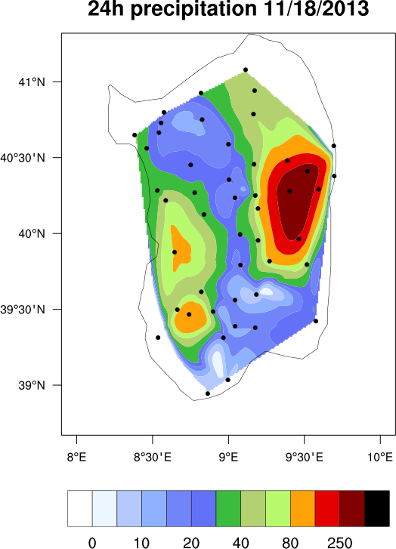
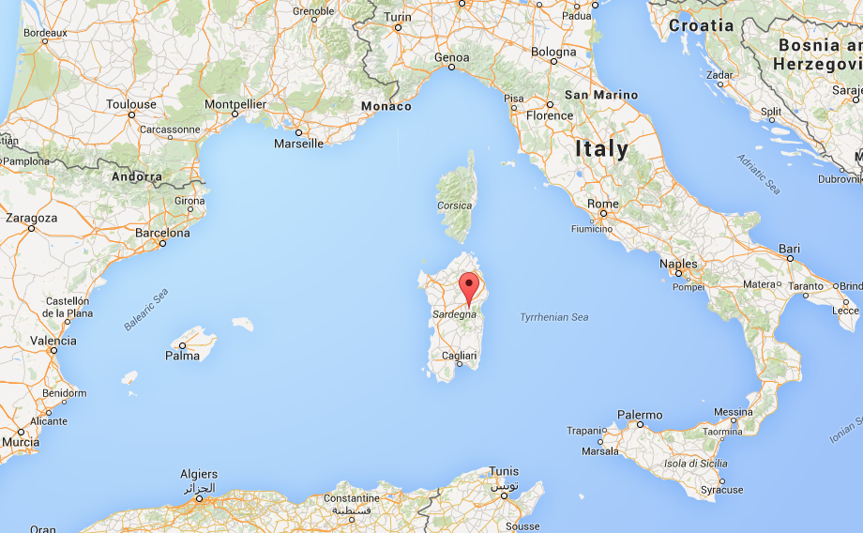
18–19 November 2013 Sardinia Flood Event
Slow-moving cutoff cyclone over Mediterranean leads to significant rainfall and flooding over portions of Sardinia
Up to 467 mm of rain reported
16 deaths (Munich RE, 2014)
Overall losses: ~780 million USD
(Munich RE, 2014)
24-h accumulated precipitation (mm, shaded) during 18 Nov 2013 (Source: Julian Quinting)
(Source: Google Maps)

Slide 8
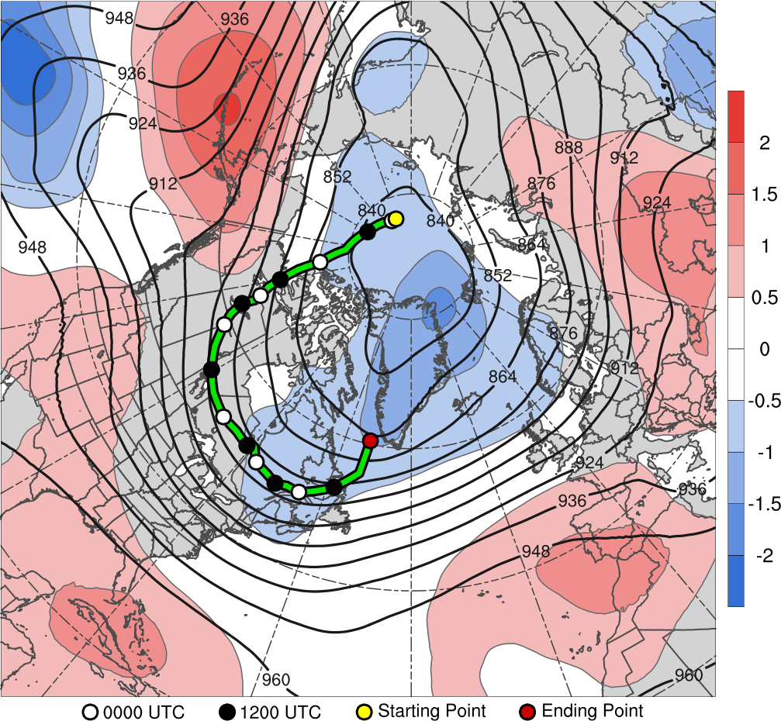
TPV Track: 1800 UTC 6 Nov – 0000 UTC 14 Nov 2013
7
8
9
10
11
14
12
13
(σ)
6–14 Nov 2013 time-mean 300-hPa geopotential height (dam, black) and standardized anomaly of geopotential height (σ, shaded)

Slide 9
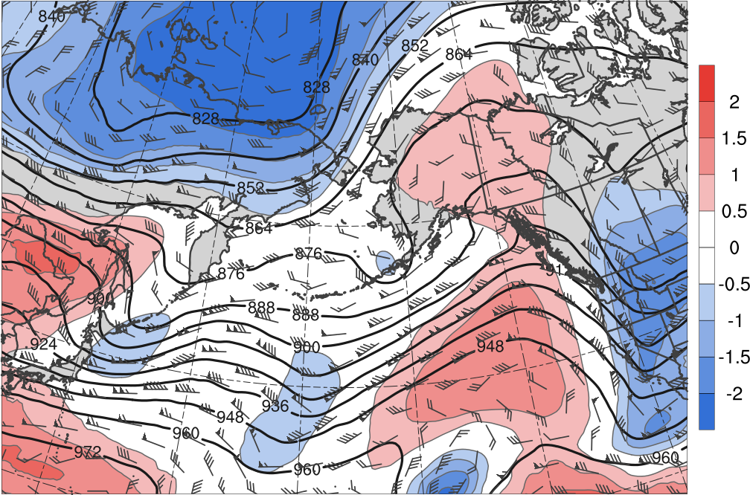
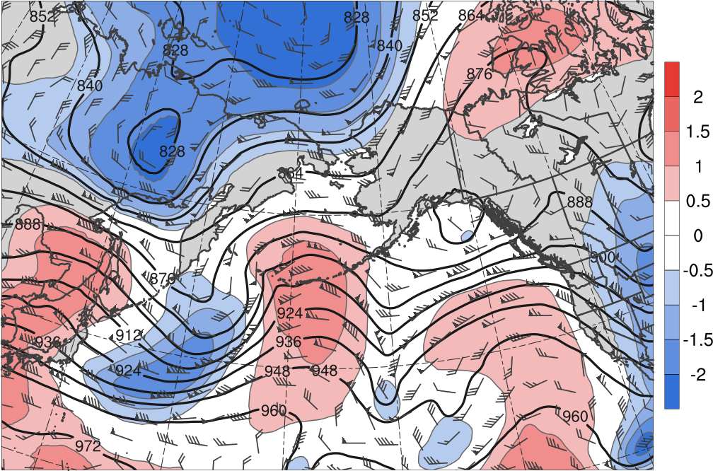
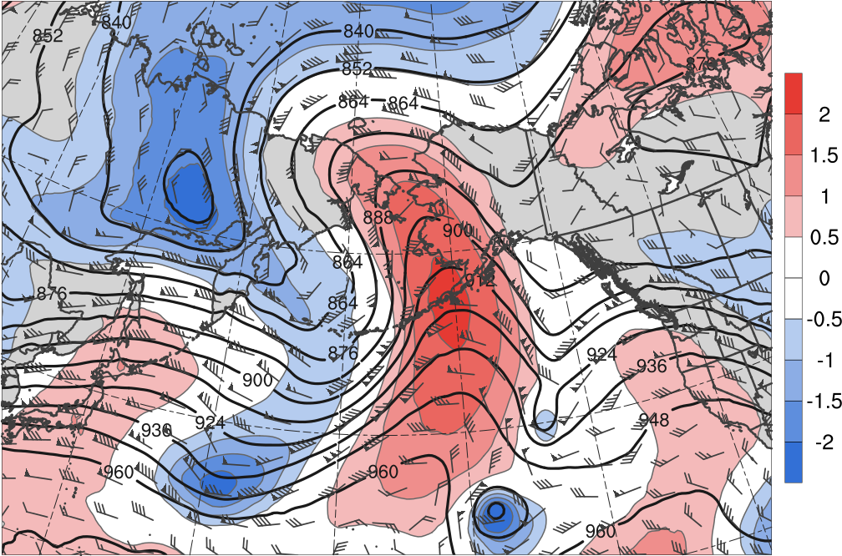
TPV Extraction
1200 UTC 4 Nov 2013
1200 UTC 5 Nov 2013
2
R1
1.5
T1
R1
T1
1
0.5
0
1200 UTC 6 Nov 2013
1200 UTC 7 Nov 2013
-0.5
R1
-1
R1
T1
-1.5
T1
-2
(σ)
300-hPa geopotential height (dam, black), wind (m s⁻¹, barbs), and standardized anomaly of geopotential height (σ, shaded)

Slide 10
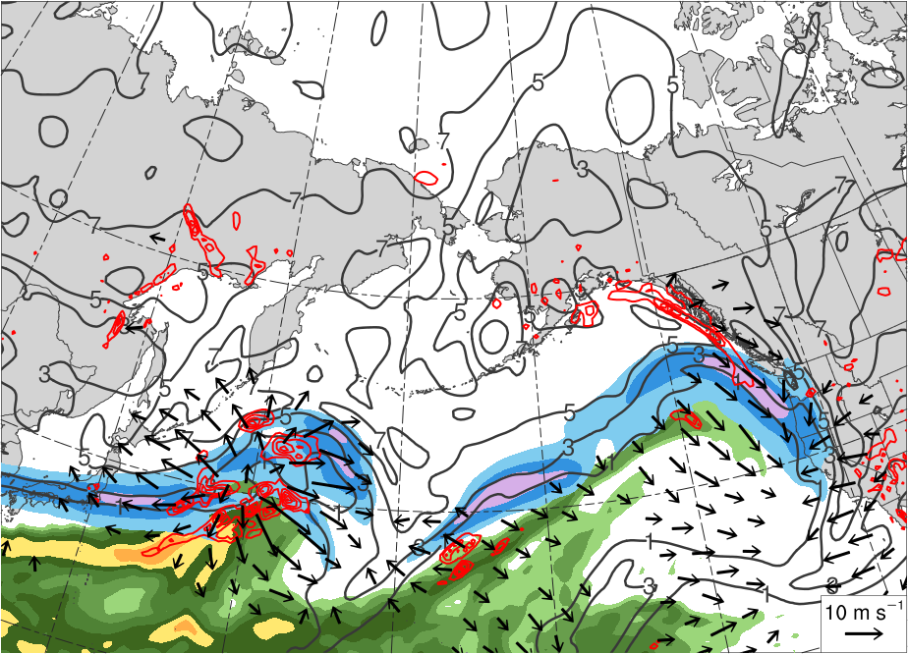
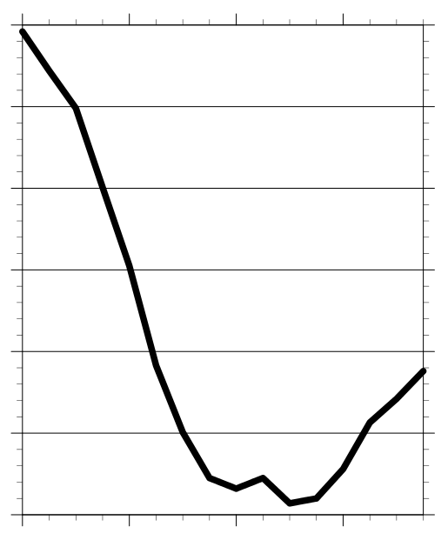
TPV Extraction
1200 UTC 4 Nov 2013
(mm)
25
30
35
40
45
50
55
(m s⁻¹ )
50
60
70
80
90
100
Minimum MSLP Trace
1010
1000
990
MSLP (hPa)
T1
980
L
R1
970
960
950
4 Nov
5 Nov
6 Nov
7 Nov
300–200-hPa PV (PVU, gray) and irrot. wind (m s⁻¹, vectors), 250-hPa wind speed (m s⁻¹, shaded),
600–400-hPa ascent (every 0.5 × 10⁻³ hPa s⁻¹, red), PW (mm, shaded)

Slide 11
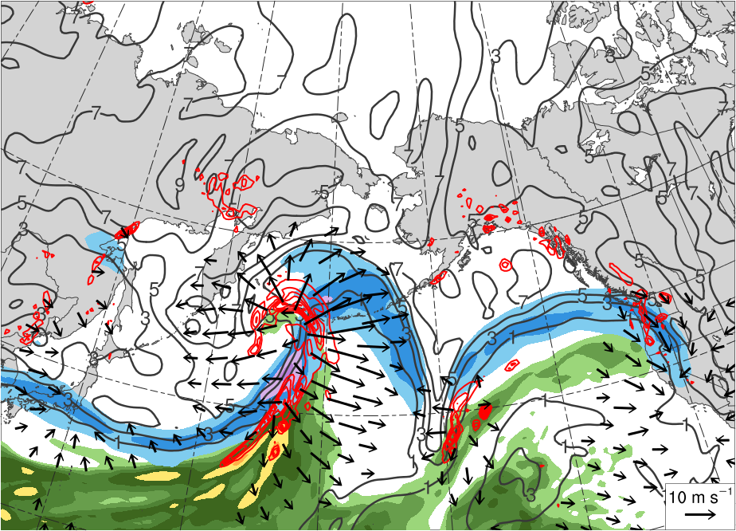
TPV Extraction
1200 UTC 5 Nov 2013
(mm)
25
30
35
40
45
50
55
(m s⁻¹ )
50
60
70
80
90
100
Minimum MSLP Trace
1010
1000
L
R1
990
MSLP (hPa)
980
T1
970
960
950
4 Nov
5 Nov
6 Nov
7 Nov
300–200-hPa PV (PVU, gray) and irrot. wind (m s⁻¹, vectors), 250-hPa wind speed (m s⁻¹, shaded),
600–400-hPa ascent (every 0.5 × 10⁻³ hPa s⁻¹, red), PW (mm, shaded)

Slide 12
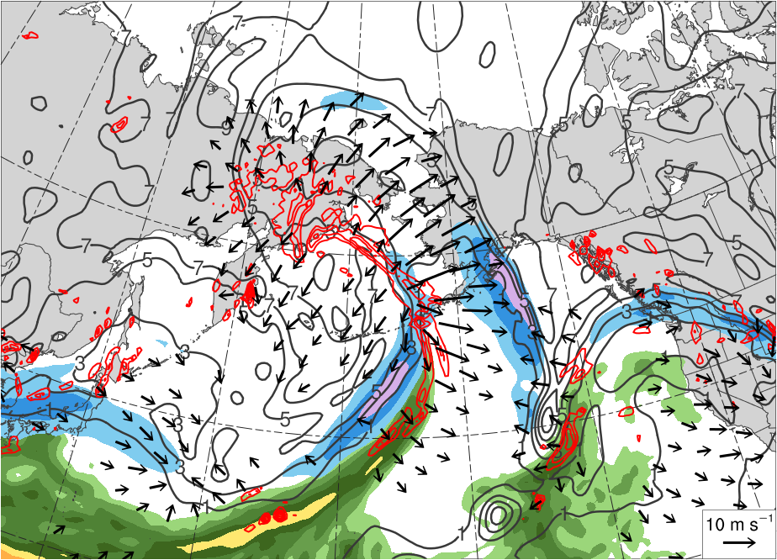
TPV Extraction
1200 UTC 6 Nov 2013
(mm)
25
30
35
40
45
50
55
(m s⁻¹ )
50
60
70
80
90
100
Minimum MSLP Trace
R1
1010
L
1000
T1
990
MSLP (hPa)
980
970
960
950
4 Nov
5 Nov
6 Nov
7 Nov
300–200-hPa PV (PVU, gray) and irrot. wind (m s⁻¹, vectors), 250-hPa wind speed (m s⁻¹, shaded),
600–400-hPa ascent (every 0.5 × 10⁻³ hPa s⁻¹, red), PW (mm, shaded)

Slide 13
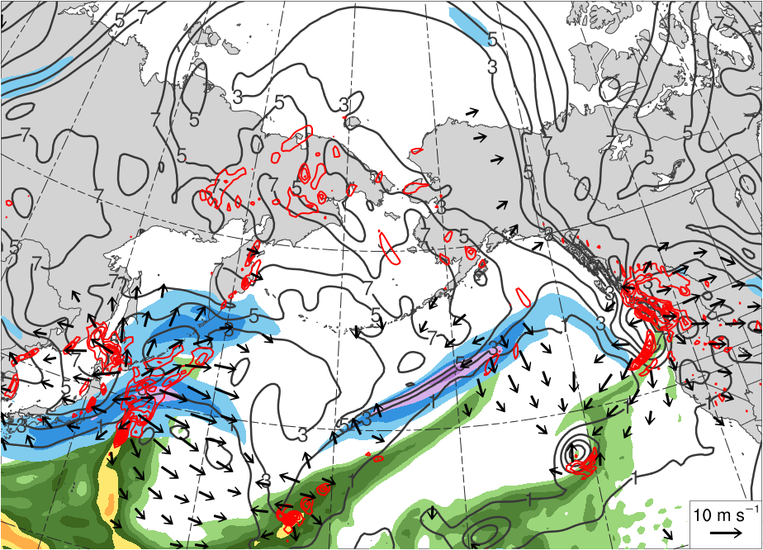
TPV Extraction
1200 UTC 7 Nov 2013
(mm)
25
30
35
40
45
50
55
(m s⁻¹ )
R1
50
60
70
80
90
100
L
Minimum MSLP Trace
1010
T1
1000
990
MSLP (hPa)
980
970
960
950
4 Nov
5 Nov
6 Nov
7 Nov
300–200-hPa PV (PVU, gray) and irrot. wind (m s⁻¹, vectors), 250-hPa wind speed (m s⁻¹, shaded),
600–400-hPa ascent (every 0.5 × 10⁻³ hPa s⁻¹, red), PW (mm, shaded)

Slide 14
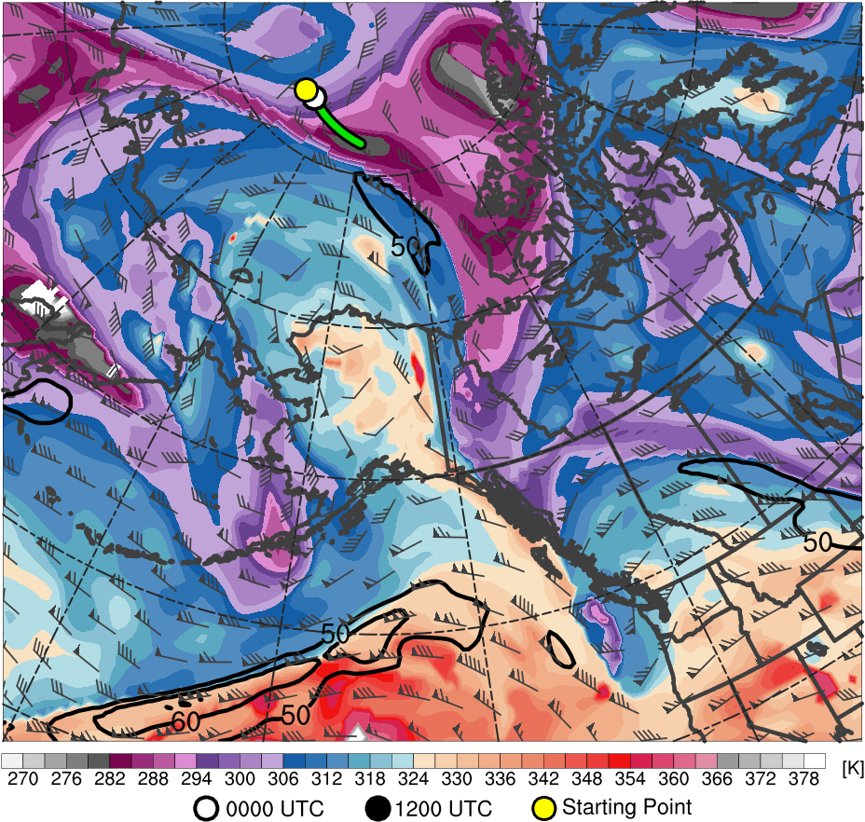
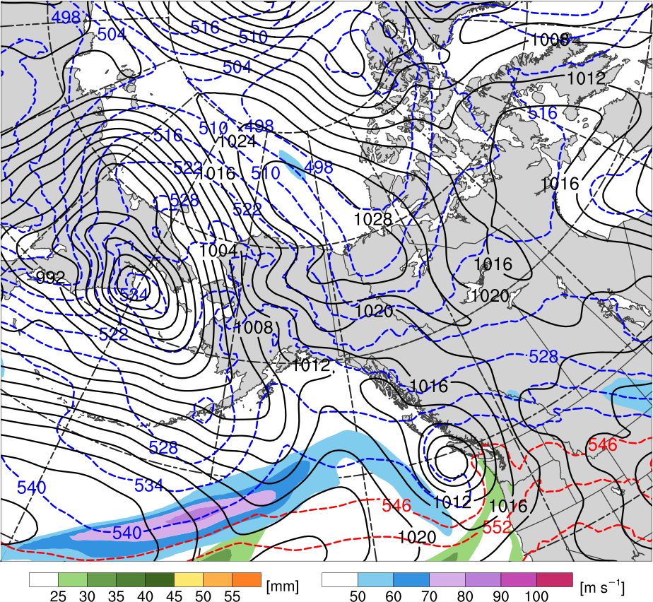
TPV Extraction
1200 UTC 7 Nov 2013
TPV
C
H
R1
L₉₆₄
T1
Potential temperature (K, shaded), wind speed (black, every 10 m s⁻¹ starting at 50 m s⁻¹), and wind (m s⁻¹, barbs) on 2-PVU surface
250-hPa wind speed (m s⁻¹, shaded),
1000–500-hPa thickness (dam, blue/red),
MSLP (hPa, black), PW (mm, shaded)

Slide 15
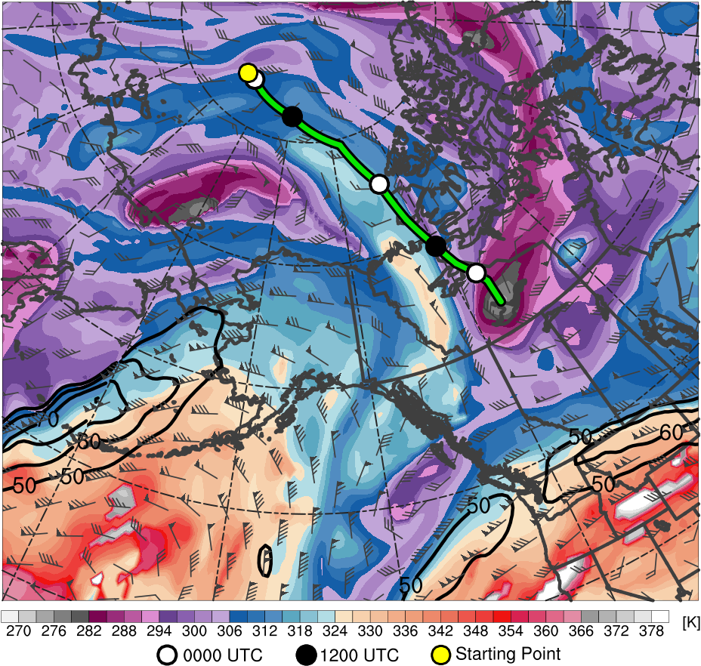
TPV Extraction
1200 UTC 9 Nov 2013
R1
C
TPV
H
Potential temperature (K, shaded), wind speed (black, every 10 m s⁻¹ starting at 50 m s⁻¹), and wind (m s⁻¹, barbs) on 2-PVU surface
250-hPa wind speed (m s⁻¹, shaded),
1000–500-hPa thickness (dam, blue/red),
MSLP (hPa, black), PW (mm, shaded)

Slide 16
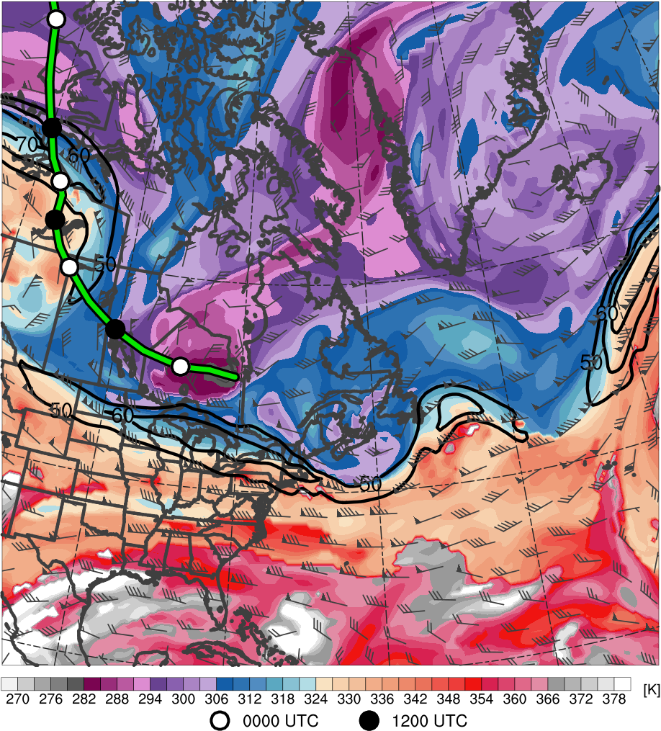
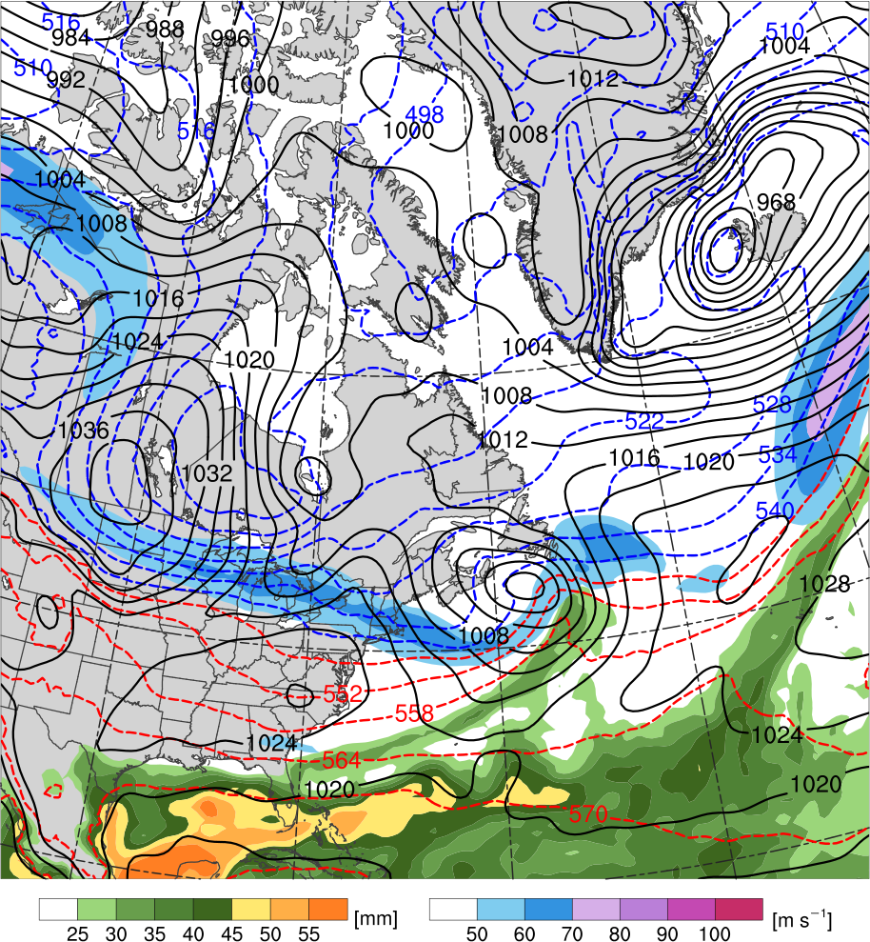
TPV–NAJ Interaction
1200 UTC 11 Nov 2013
R2
TPV
T2
L₁₀₀₂
H
C
T3
Potential temperature (K, shaded), wind speed (black, every 10 m s⁻¹ starting at 50 m s⁻¹), and wind (m s⁻¹, barbs) on 2-PVU surface
250-hPa wind speed (m s⁻¹, shaded),
1000–500-hPa thickness (dam, blue/red),
MSLP (hPa, black), PW (mm, shaded)

Slide 17
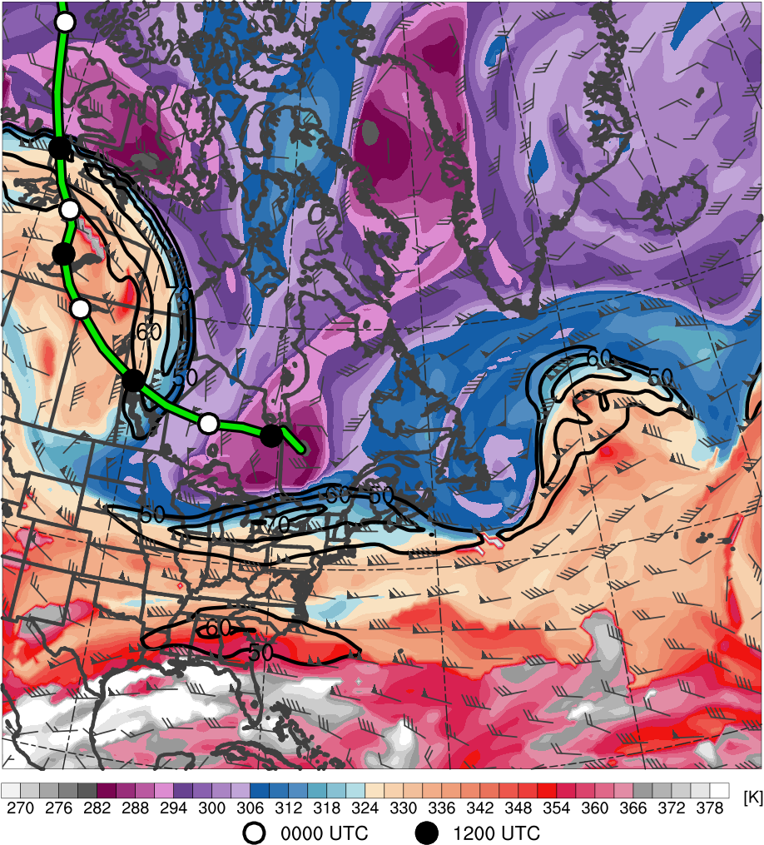
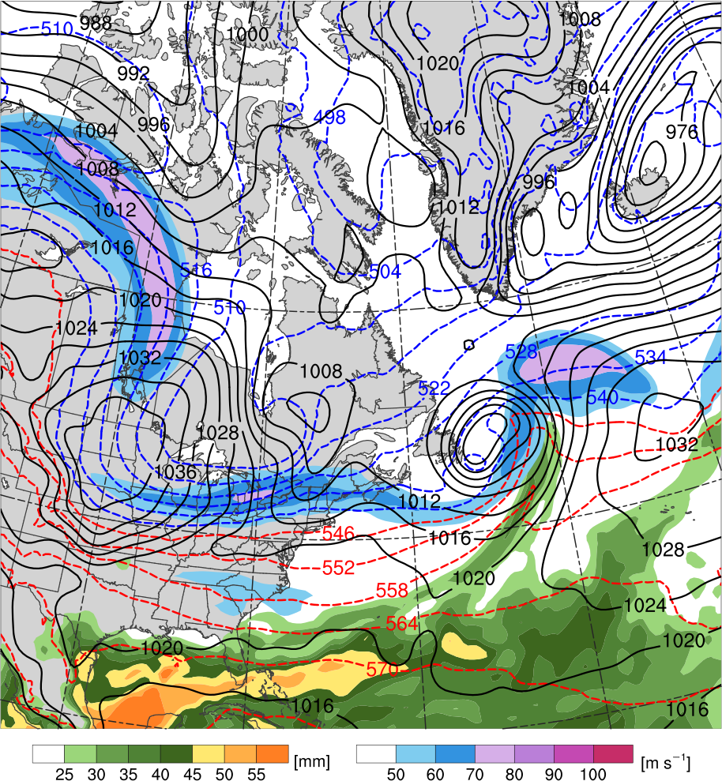
TPV–NAJ Interaction
0000 UTC 12 Nov 2013
R2
TPV
L₁₀₀₂
H
C
T2
T3
R3
Potential temperature (K, shaded), wind speed (black, every 10 m s⁻¹ starting at 50 m s⁻¹), and wind (m s⁻¹, barbs) on 2-PVU surface
250-hPa wind speed (m s⁻¹, shaded),
1000–500-hPa thickness (dam, blue/red),
MSLP (hPa, black), PW (mm, shaded)

Slide 18
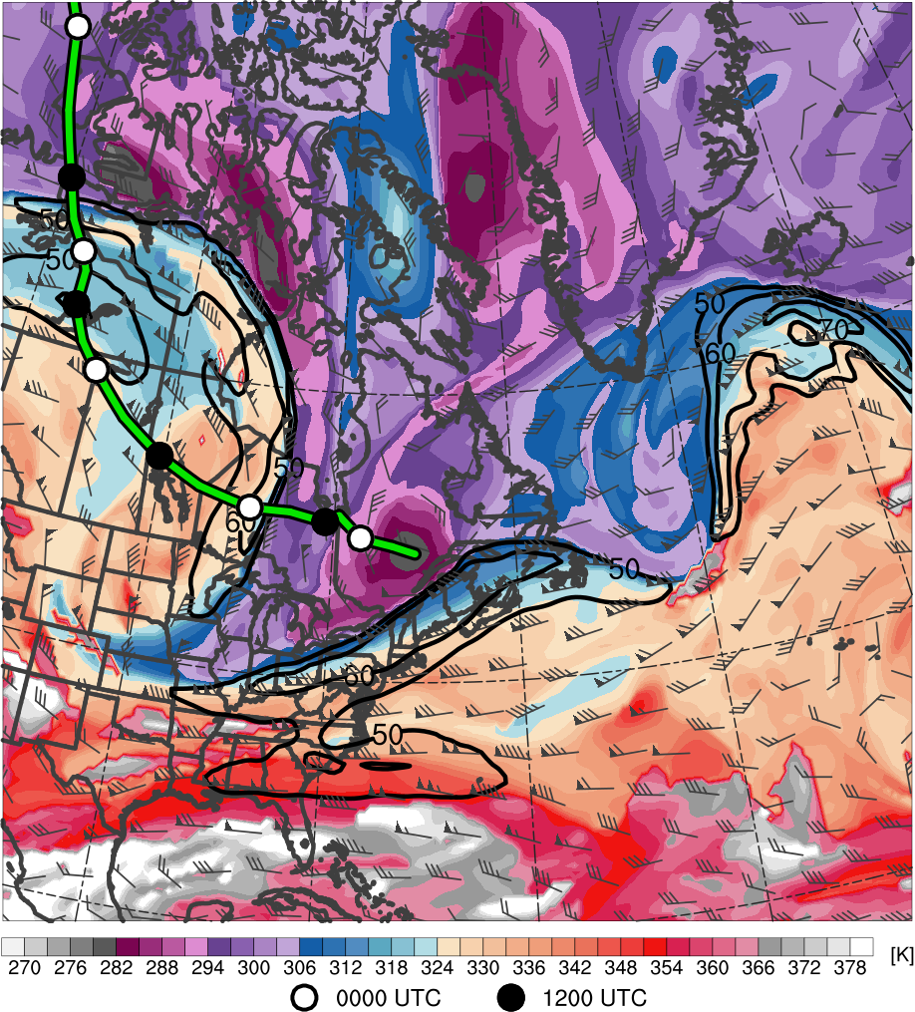
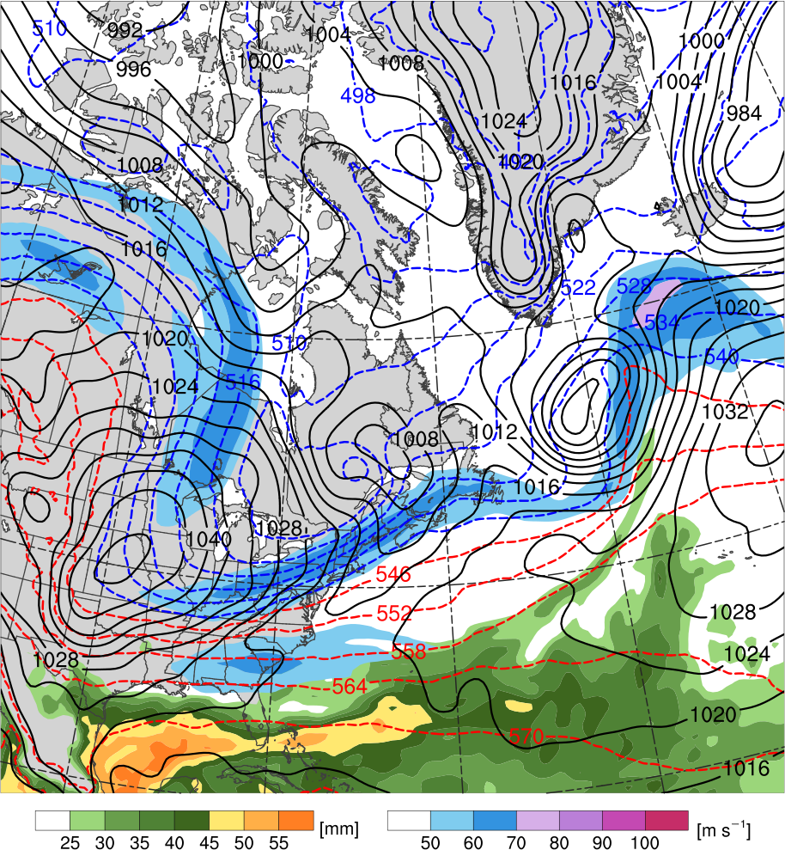
TPV–NAJ Interaction
1200 UTC 12 Nov 2013
R2
TPV
L₁₀₀₃
H
T3
C
T2
R3
H
H
Potential temperature (K, shaded), wind speed (black, every 10 m s⁻¹ starting at 50 m s⁻¹), and wind (m s⁻¹, barbs) on 2-PVU surface
250-hPa wind speed (m s⁻¹, shaded),
1000–500-hPa thickness (dam, blue/red),
MSLP (hPa, black), PW (mm, shaded)

Slide 19
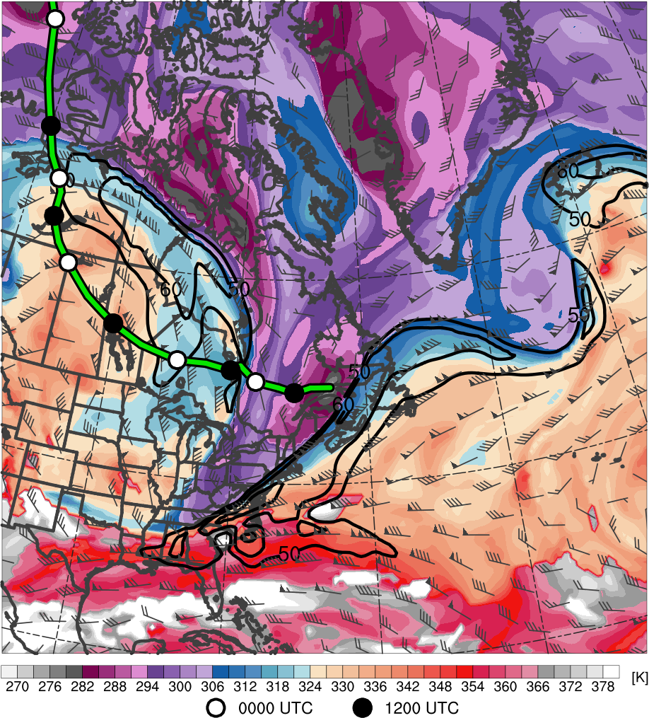
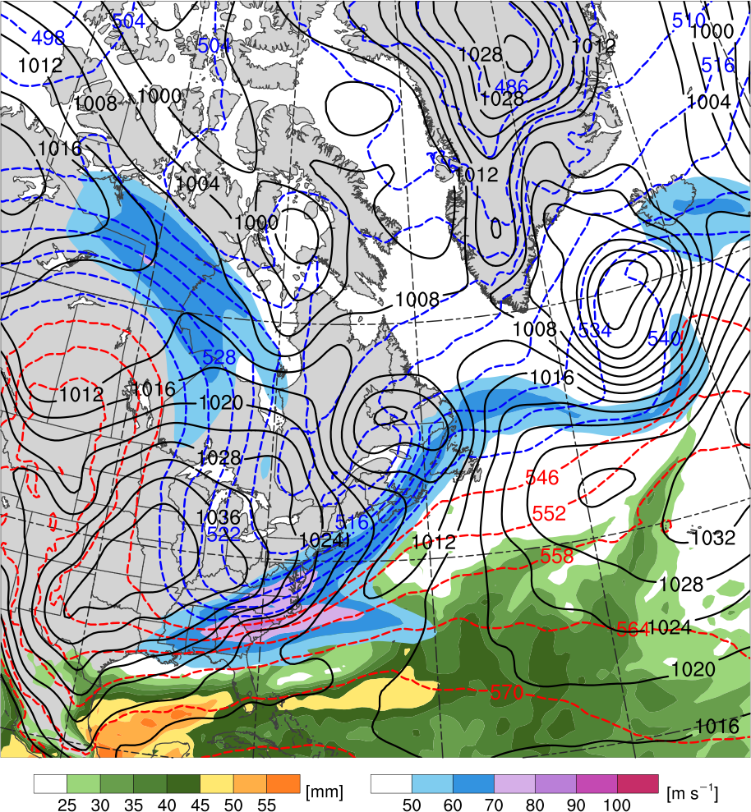
TPV–NAJ Interaction
0000 UTC 13 Nov 2013
TPV
T3
R2
L₉₉₉
R3
C
H
T2
H
Potential temperature (K, shaded), wind speed (black, every 10 m s⁻¹ starting at 50 m s⁻¹), and wind (m s⁻¹, barbs) on 2-PVU surface
250-hPa wind speed (m s⁻¹, shaded),
1000–500-hPa thickness (dam, blue/red),
MSLP (hPa, black), PW (mm, shaded)

Slide 20
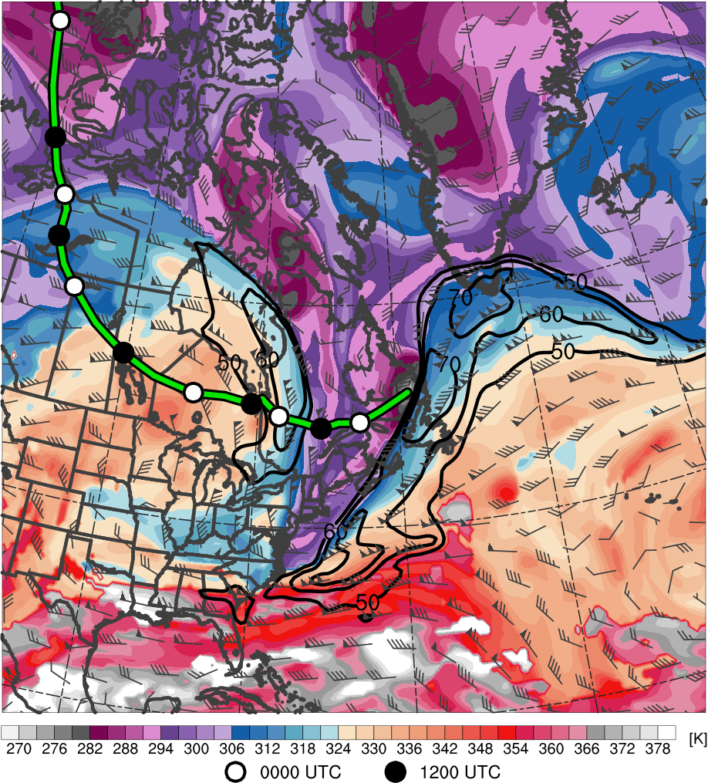
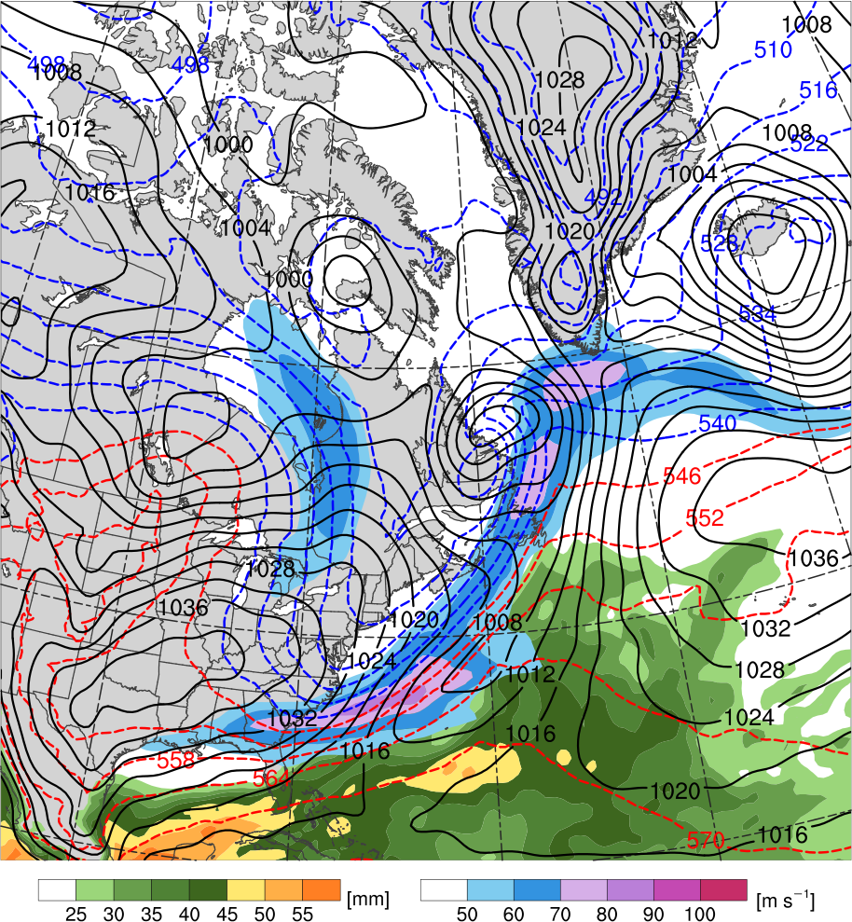
TPV–NAJ Interaction
1200 UTC 13 Nov 2013
TPV
T3
L₉₈₆
R3
C
H
R2
T2
H
Potential temperature (K, shaded), wind speed (black, every 10 m s⁻¹ starting at 50 m s⁻¹), and wind (m s⁻¹, barbs) on 2-PVU surface
250-hPa wind speed (m s⁻¹, shaded),
1000–500-hPa thickness (dam, blue/red),
MSLP (hPa, black), PW (mm, shaded)

Slide 21
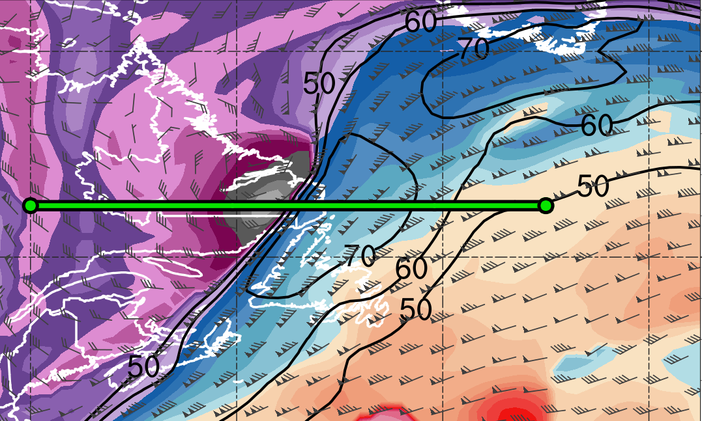
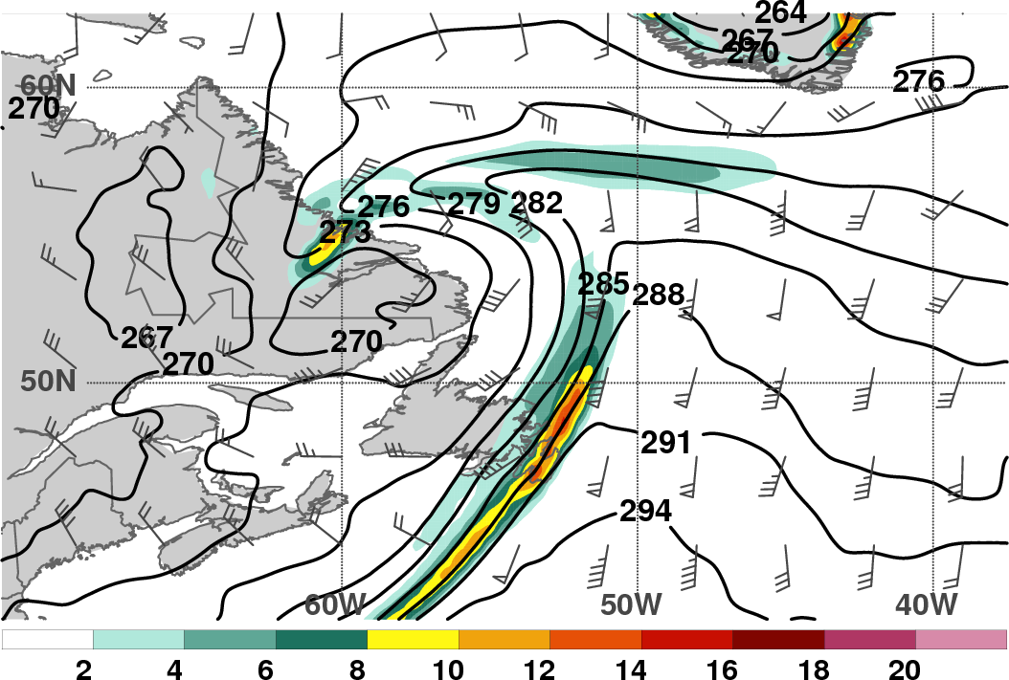
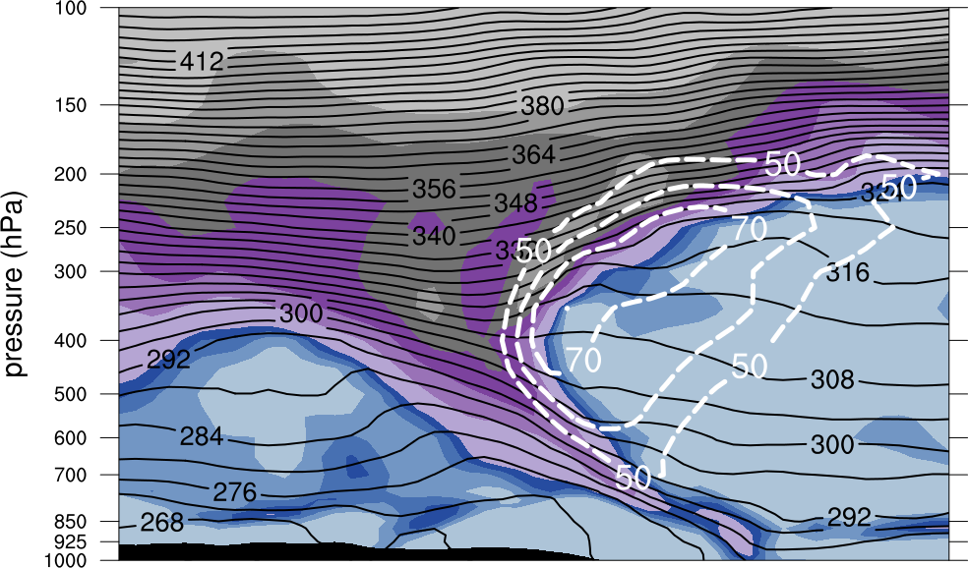
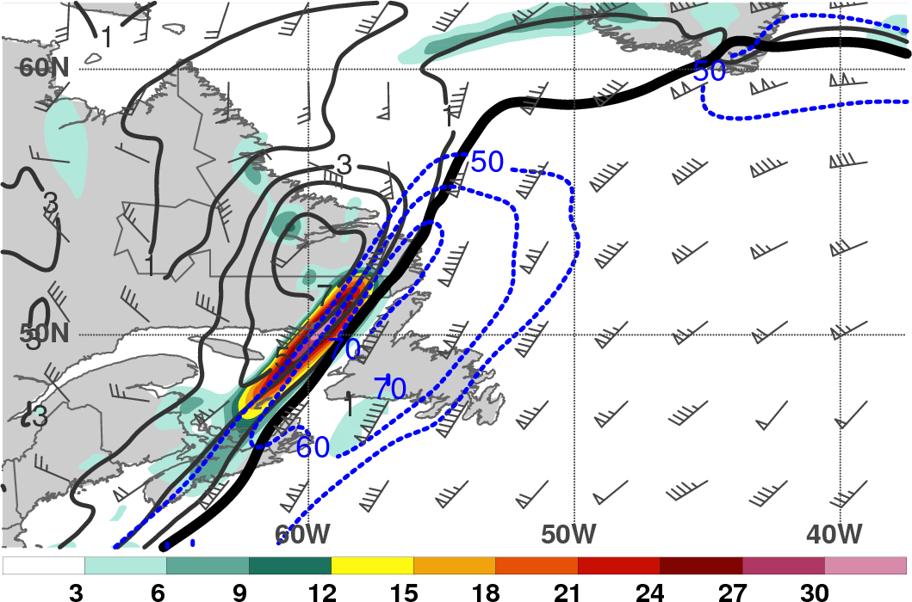
TPV–NAJ Interaction
1200 UTC 13 Nov 2013
TPV
L
A
B
270
282
294
306
318
330
342
354
366
378
925–850-hPa θ (K, black), frontogenesis due to full horizontal wind [K (100 km) ⁻¹ (3 h)⁻¹, shaded], and wind (m s⁻¹, barbs)
DT potential temperature (K, shaded), wind speed (black, every 10 m s⁻¹ starting at 50 m s⁻¹), and wind (m s⁻¹, barbs)
TPV
309 K
θ on DT
TPV
52.5°N, 70°W
0.5
1
1.5
2
4
6
8
10
12
52.5°N, 45°W
A
B
450–350-hPa PV (PVU, gray), PV frontogenesis due to full horizontal
wind [PVU (100 km)⁻¹ (day)⁻¹, shaded], wind speed (m s⁻¹, blue)
Potential vorticity (PVU, shaded), wind speed (white, every 10 m s⁻¹ starting at 50 m s⁻¹), and potential temperature (K, black)

Slide 22
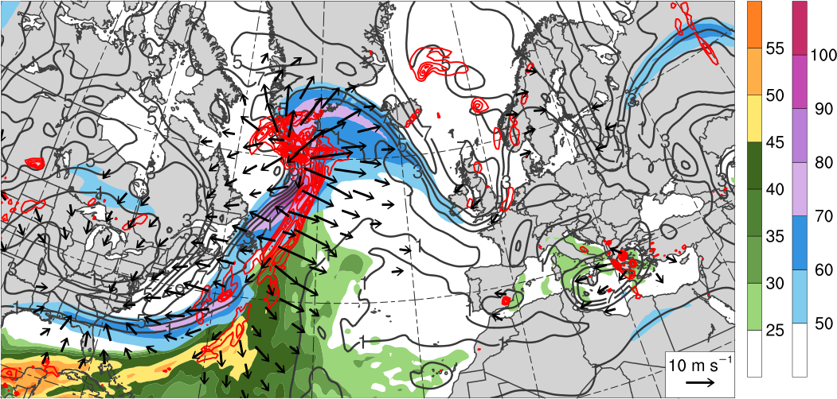
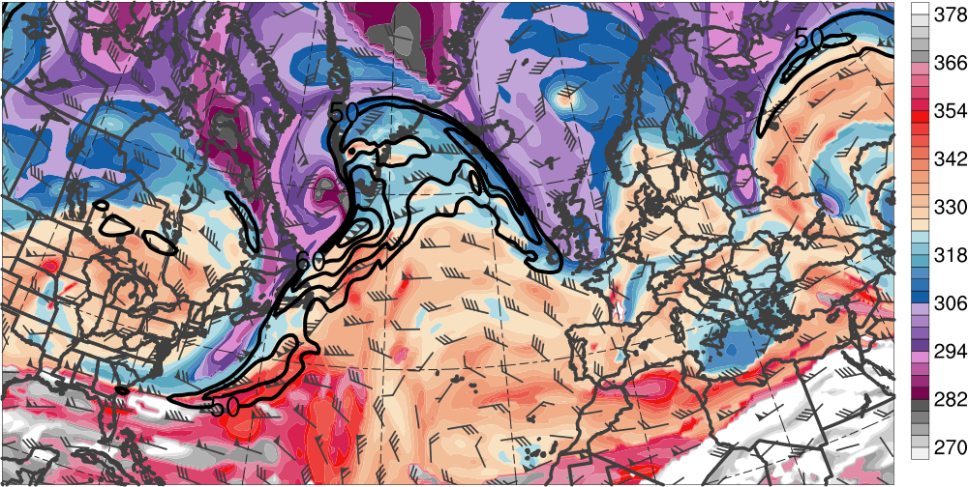
Downstream Development
0000 UTC 14 Nov 2013
300–200-hPa PV (PVU, gray)
and irrot. wind (m s⁻¹, vectors),
250-hPa wind speed (m s⁻¹, shaded),
600–400-hPa ascent
(every 0.5 × 10⁻³ hPa s⁻¹, red),
PW (mm, shaded)
L₉₆₆
H
L₁₀₀₀
[mm]
[m s⁻¹]
DT θ (K, shaded),
wind speed (black, every 10 m s⁻¹ starting at 50 m s⁻¹), and wind (m s⁻¹, barbs) on 2-PVU surface
TPV
R3
T3
R2
T2
[K]

Slide 23
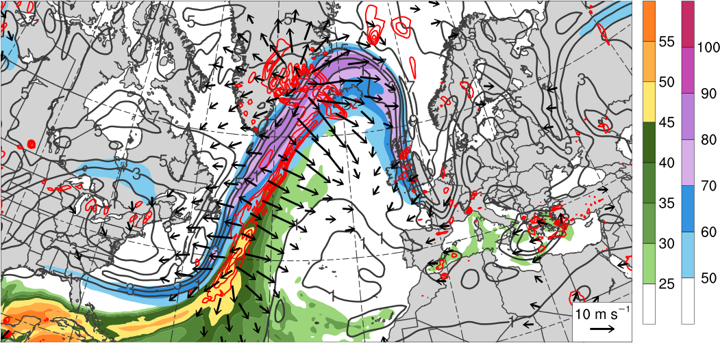
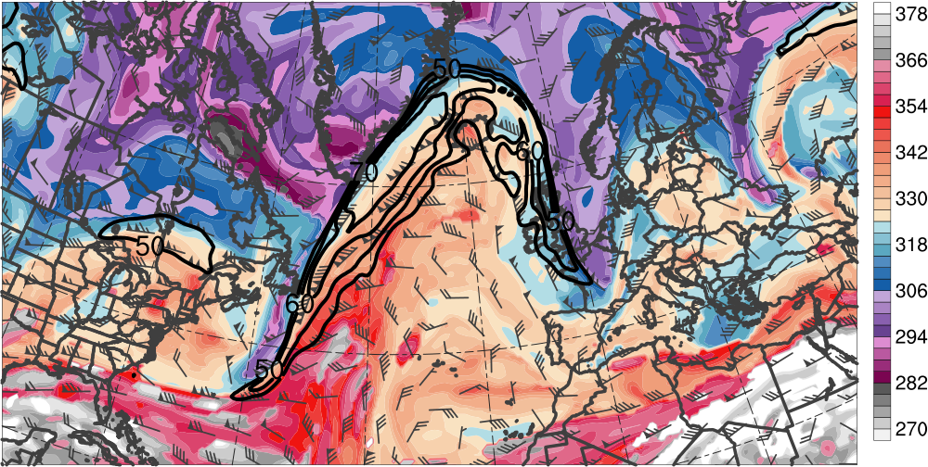
Downstream Development
1200 UTC 14 Nov 2013
300–200-hPa PV (PVU, gray)
and irrot. wind (m s⁻¹, vectors),
250-hPa wind speed (m s⁻¹, shaded),
600–400-hPa ascent
(every 0.5 × 10⁻³ hPa s⁻¹, red),
PW (mm, shaded)
L₉₇₅
L₉₇₁
L₉₉₉
H
[mm]
[m s⁻¹]
DT θ (K, shaded),
wind speed (black, every 10 m s⁻¹ starting at 50 m s⁻¹), and wind (m s⁻¹, barbs) on 2-PVU surface
R3
T3
R2
T2
[K]

Slide 24
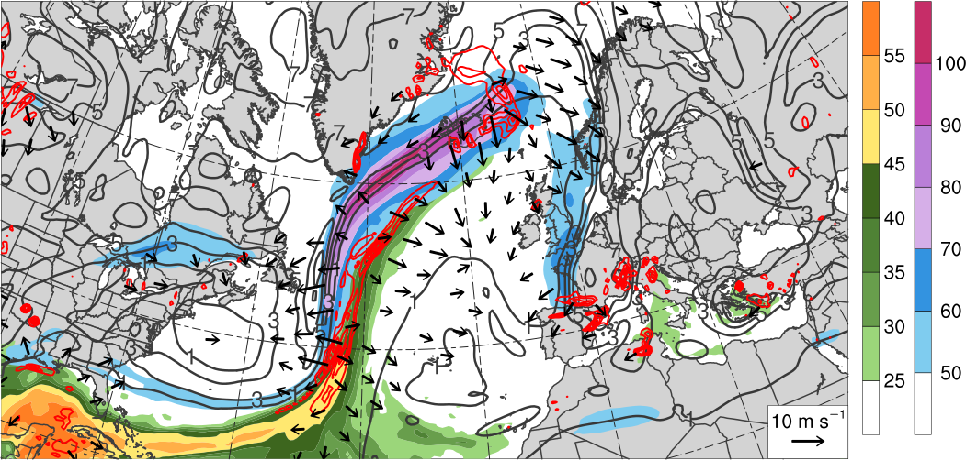
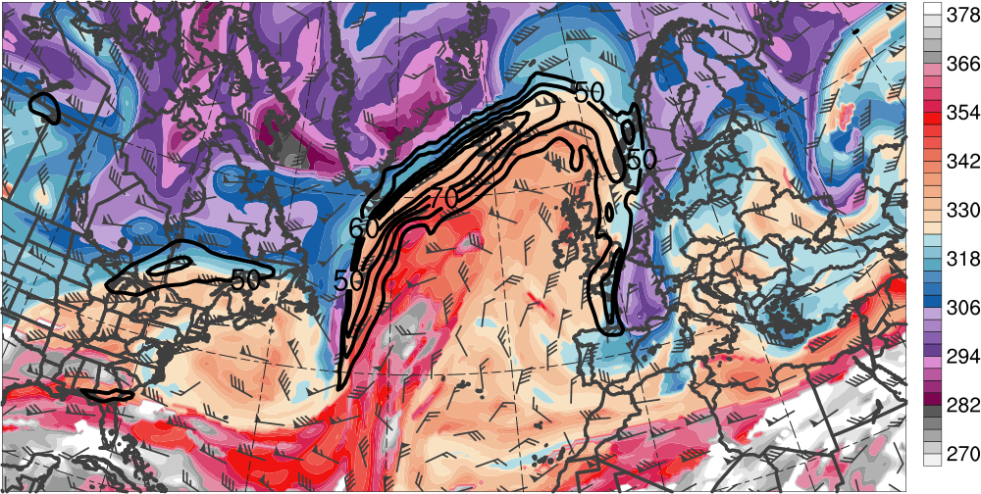
Downstream Development
0000 UTC 15 Nov 2013
300–200-hPa PV (PVU, gray)
and irrot. wind (m s⁻¹, vectors),
250-hPa wind speed (m s⁻¹, shaded),
600–400-hPa ascent
(every 0.5 × 10⁻³ hPa s⁻¹, red),
PW (mm, shaded)
L₉₇₆
L₉₉₆
H
[mm]
[m s⁻¹]
DT θ (K, shaded),
wind speed (black, every 10 m s⁻¹ starting at 50 m s⁻¹), and wind (m s⁻¹, barbs) on 2-PVU surface
R3
T3
R2
T2
[K]

Slide 25
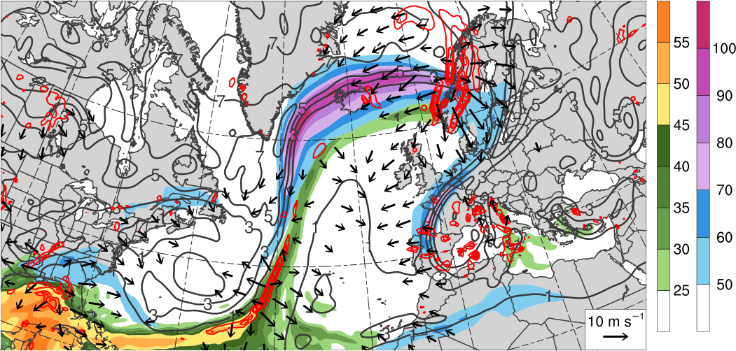
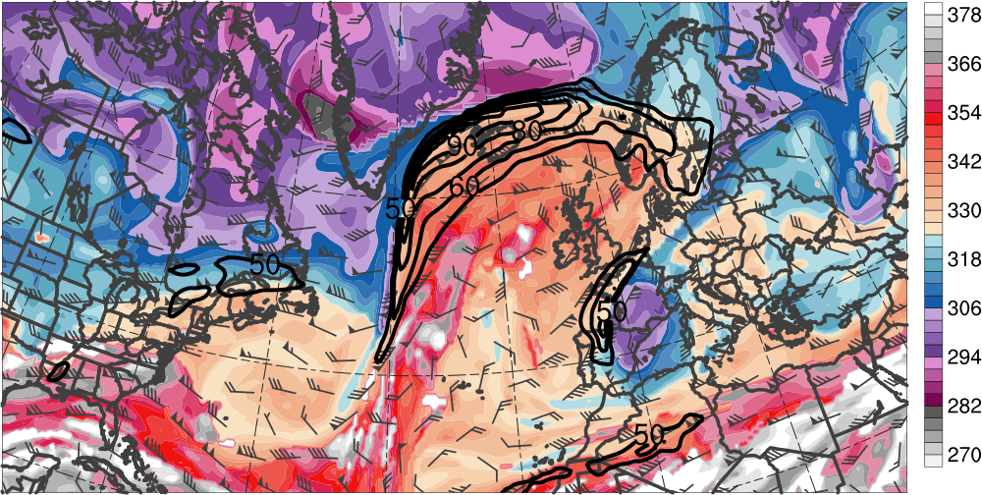
Downstream Development
1200 UTC 15 Nov 2013
L₉₅₈
300–200-hPa PV (PVU, gray)
and irrot. wind (m s⁻¹, vectors),
250-hPa wind speed (m s⁻¹, shaded),
600–400-hPa ascent
(every 0.5 × 10⁻³ hPa s⁻¹, red),
PW (mm, shaded)
L₉₉₄
H
[mm]
[m s⁻¹]
DT θ (K, shaded),
wind speed (black, every 10 m s⁻¹ starting at 50 m s⁻¹), and wind (m s⁻¹, barbs) on 2-PVU surface
R3
T2
T3
R2
[K]

Slide 26
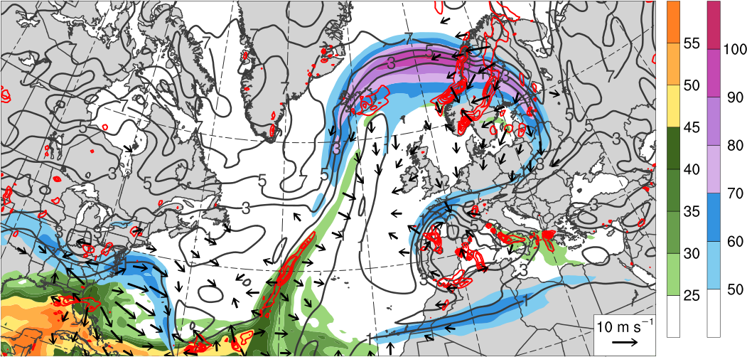
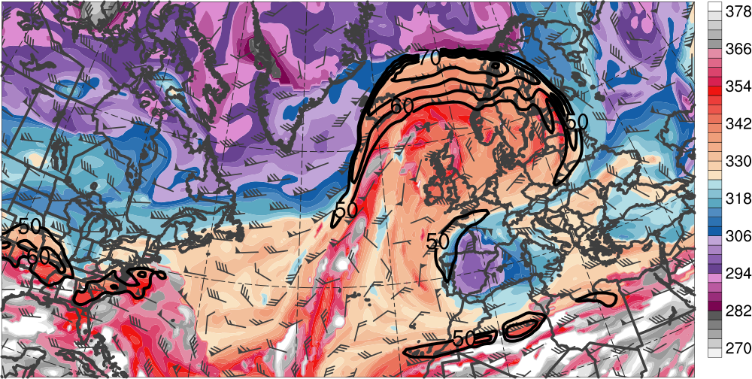
Downstream Development
0000 UTC 16 Nov 2013
300–200-hPa PV (PVU, gray)
and irrot. wind (m s⁻¹, vectors),
250-hPa wind speed (m s⁻¹, shaded),
600–400-hPa ascent
(every 0.5 × 10⁻³ hPa s⁻¹, red),
PW (mm, shaded)
L₉₈₇
H
[mm]
[m s⁻¹]
DT θ (K, shaded),
wind speed (black, every 10 m s⁻¹ starting at 50 m s⁻¹), and wind (m s⁻¹, barbs) on 2-PVU surface
R3
T3
[K]

Slide 27
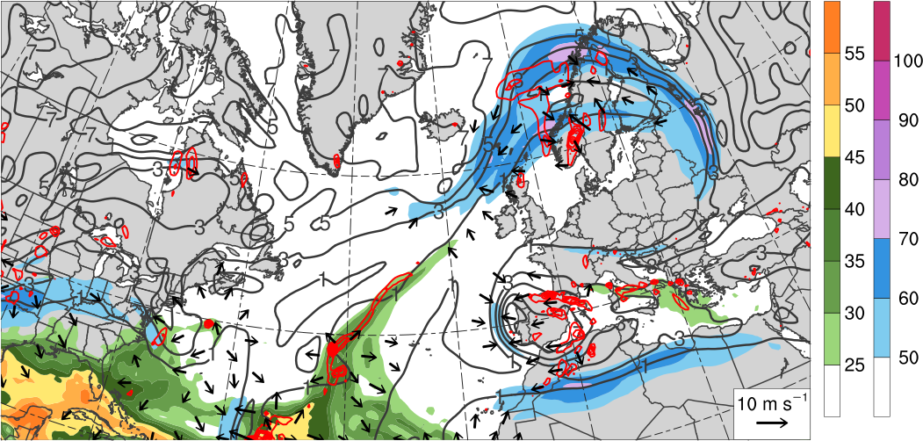
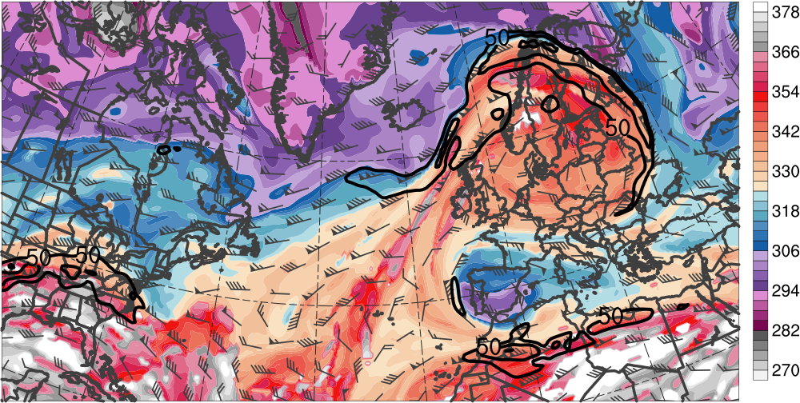
Downstream Development
1200 UTC 16 Nov 2013
300–200-hPa PV (PVU, gray)
and irrot. wind (m s⁻¹, vectors),
250-hPa wind speed (m s⁻¹, shaded),
600–400-hPa ascent
(every 0.5 × 10⁻³ hPa s⁻¹, red),
PW (mm, shaded)
L₉₇₄
H
[mm]
[m s⁻¹]
DT θ (K, shaded),
wind speed (black, every 10 m s⁻¹ starting at 50 m s⁻¹), and wind (m s⁻¹, barbs) on 2-PVU surface
R3
T3
[K]

Slide 28
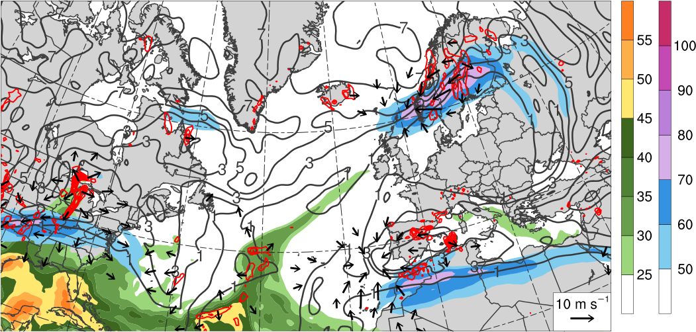
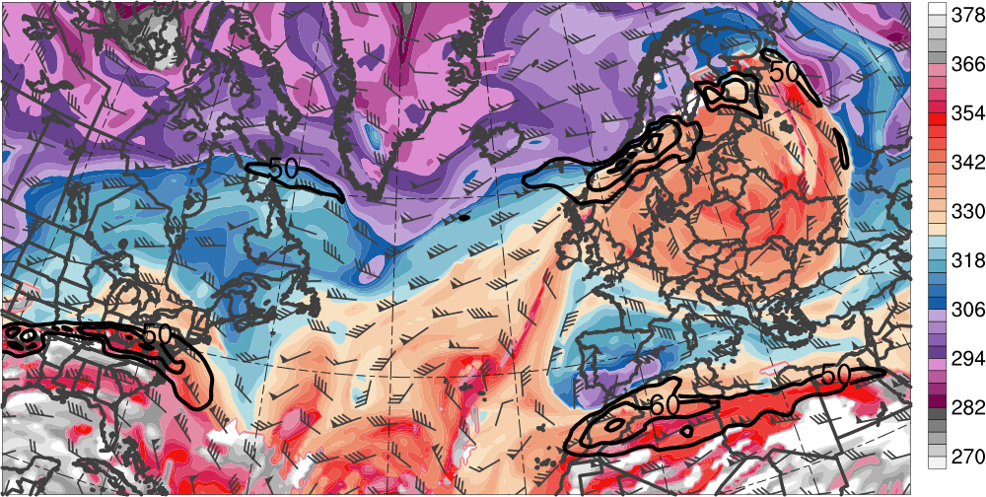
Downstream Development
0000 UTC 17 Nov 2013
300–200-hPa PV (PVU, gray)
and irrot. wind (m s⁻¹, vectors),
250-hPa wind speed (m s⁻¹, shaded),
600–400-hPa ascent
(every 0.5 × 10⁻³ hPa s⁻¹, red),
PW (mm, shaded)
L₉₆₉
H
[mm]
[m s⁻¹]
DT θ (K, shaded),
wind speed (black, every 10 m s⁻¹ starting at 50 m s⁻¹), and wind (m s⁻¹, barbs) on 2-PVU surface
R3
T3
[K]

Slide 29
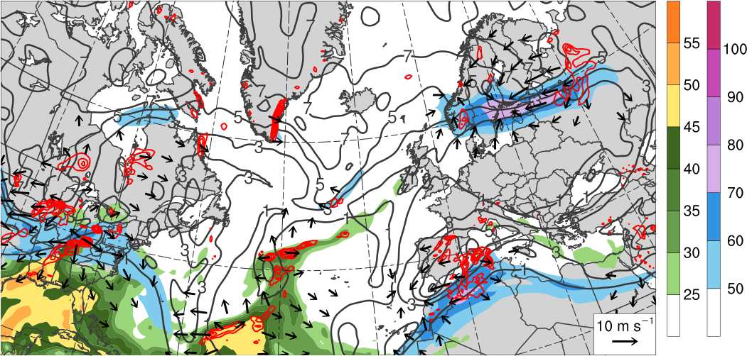
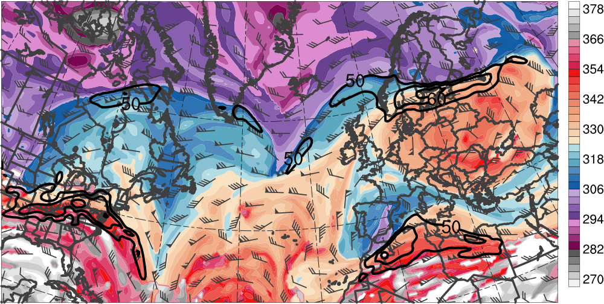
Downstream Development
1200 UTC 17 Nov 2013
300–200-hPa PV (PVU, gray)
and irrot. wind (m s⁻¹, vectors),
250-hPa wind speed (m s⁻¹, shaded),
600–400-hPa ascent
(every 0.5 × 10⁻³ hPa s⁻¹, red),
PW (mm, shaded)
L₉₇₁
H
[mm]
[m s⁻¹]
DT θ (K, shaded),
wind speed (black, every 10 m s⁻¹ starting at 50 m s⁻¹), and wind (m s⁻¹, barbs) on 2-PVU surface
R3
T3
[K]

Slide 30
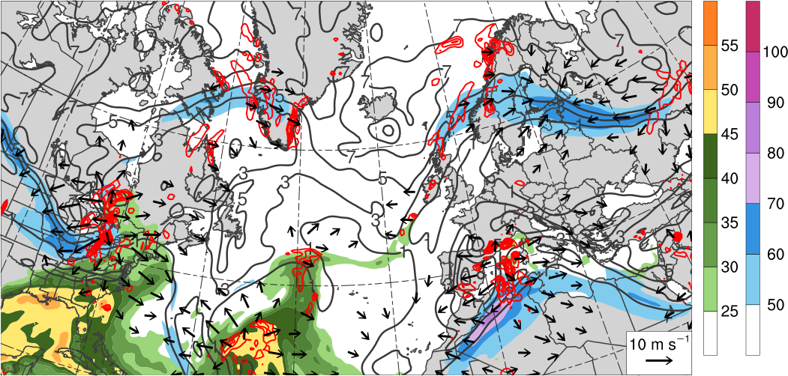
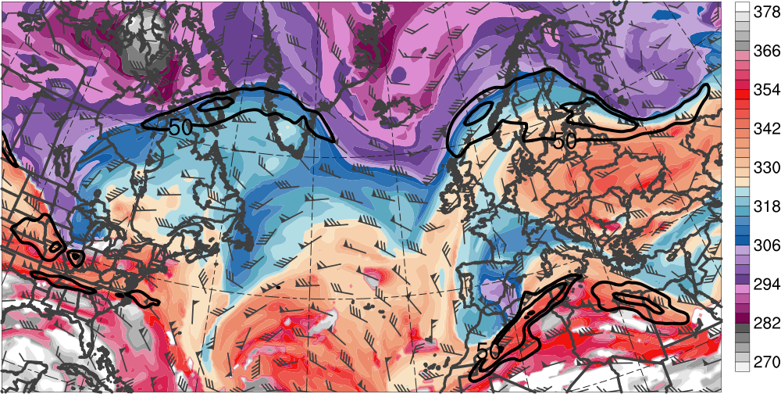
Downstream Development
0000 UTC 18 Nov 2013
300–200-hPa PV (PVU, gray)
and irrot. wind (m s⁻¹, vectors),
250-hPa wind speed (m s⁻¹, shaded),
600–400-hPa ascent
(every 0.5 × 10⁻³ hPa s⁻¹, red),
PW (mm, shaded)
L₉₇₅
L₁₀₀₅
H
[mm]
[m s⁻¹]
DT θ (K, shaded),
wind speed (black, every 10 m s⁻¹ starting at 50 m s⁻¹), and wind (m s⁻¹, barbs) on 2-PVU surface
R3
T3
[K]

Slide 31
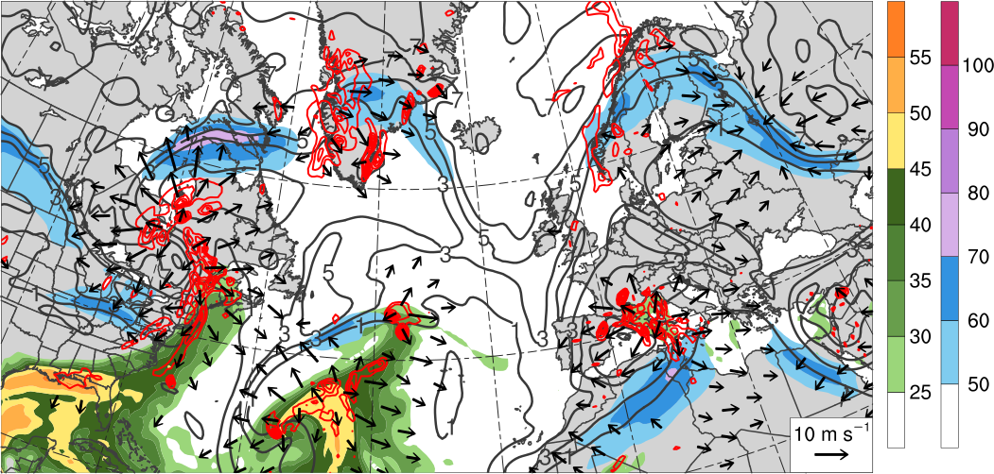
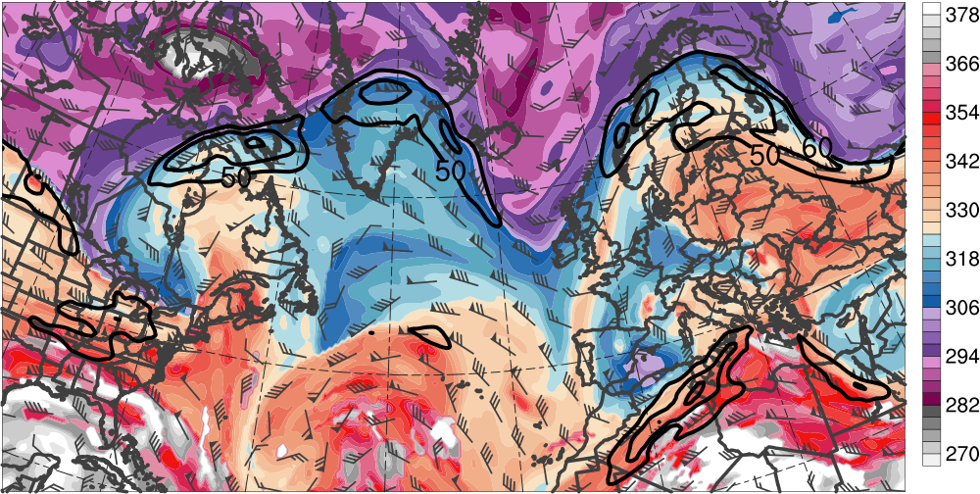
Downstream Development
1200 UTC 18 Nov 2013
300–200-hPa PV (PVU, gray)
and irrot. wind (m s⁻¹, vectors),
250-hPa wind speed (m s⁻¹, shaded),
600–400-hPa ascent
(every 0.5 × 10⁻³ hPa s⁻¹, red),
PW (mm, shaded)
L₉₇₅
L₉₉₉
H
[mm]
[m s⁻¹]
DT θ (K, shaded),
wind speed (black, every 10 m s⁻¹ starting at 50 m s⁻¹), and wind (m s⁻¹, barbs) on 2-PVU surface
R3
T3
[K]

Slide 32
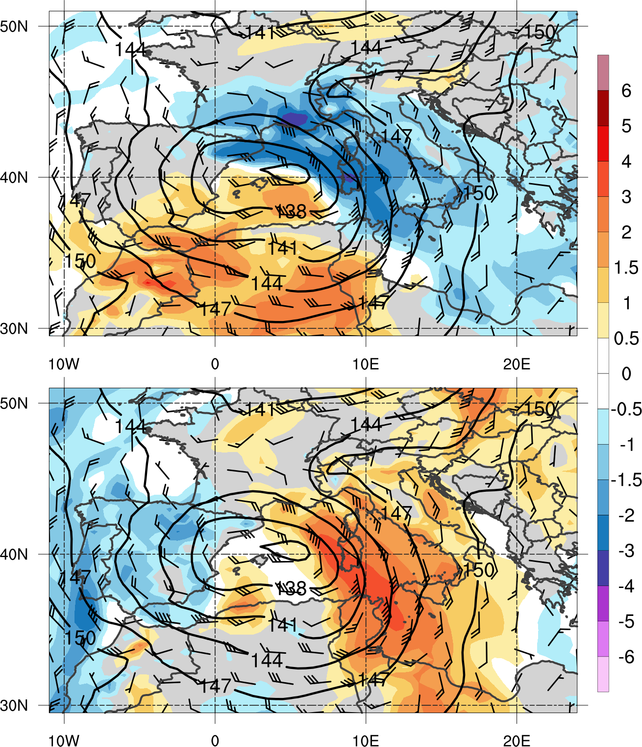
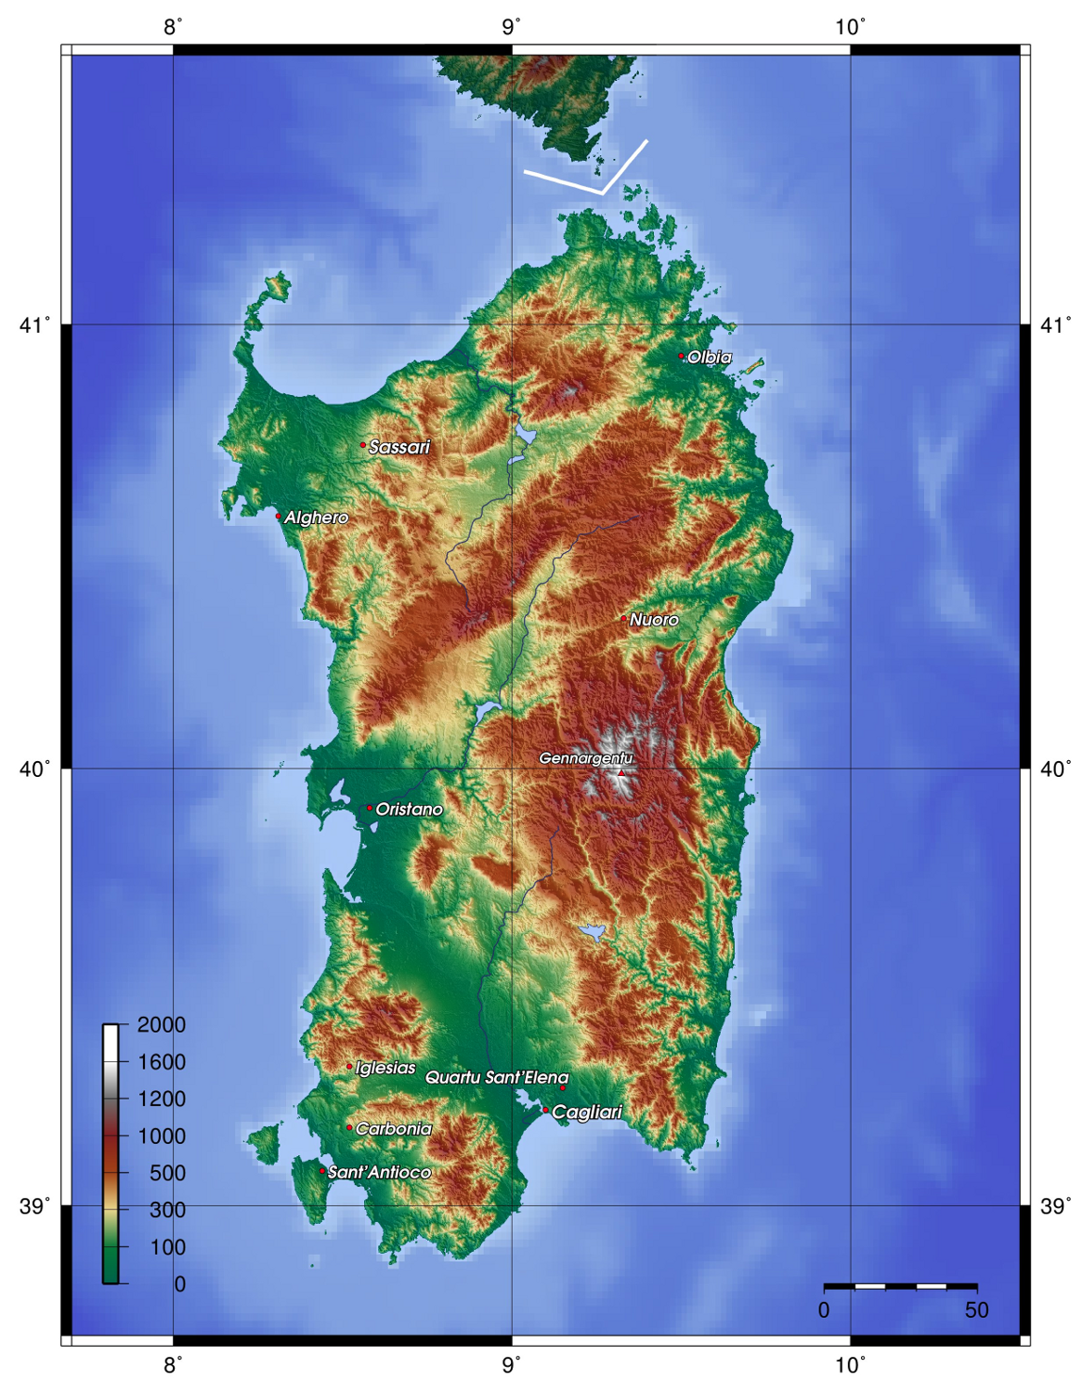
Flooding Event
1200 UTC 18 Nov 2013
Sardinia
850-hPa geopotential height (dam, black), wind (m s⁻¹, barbs), and standardized anomalies (σ, shaded) of u wind (top) and v wind (bottom)
Relief map of Sardinia (Source: http://it.wikipedia.org/wiki/Campidano)

Slide 33
Flooding Event
1200 UTC 18 Nov 2013
1230 UTC 18 Nov 2013
Sardinia
850-hPa geopotential height (dam, black), wind (m s⁻¹, barbs), and standardized anomalies (σ, shaded) of u wind (top) and v wind (bottom)
Radar-derived rainfall rate (mm h⁻¹, color shading) and IR brightness temperature (gray shading) valid 1230 UTC 18 Nov 2013 (Source: http://sop.hymex.org/)

Slide 34
Flooding Event
1200 UTC 18 Nov 2013
Sardinia
850-hPa geopotential height (dam, black), wind (m s⁻¹, barbs), and standardized anomalies (σ, shaded) of u wind (top) and v wind (bottom)
24-h accumulated precipitation (mm, shaded) during 18 Nov 2013 (Source: Julian Quinting)

Slide 35
Case Summary
Explosive cyclogenesis over North Pacific leads to high-latitude ridge amplification
Ridge amplification over North Pacific is critical to the extraction of TPV from high latitudes
TPV and associated cold surge increase baroclinicity associated with NAJ throughout the troposphere
Interaction between TPV and NAJ leads to explosive cyclogenesis in left-exit region of NAJ

Slide 36
Case Summary
Interaction between TPV, upstream trough, and downstream anticyclone induce significant ridge amplification over western North Atlantic
NAJ intensifies to over 100 m s⁻¹ and wave breaks anticyclonically over northern Europe
Downstream trough cuts off and retrogrades over southwestern Europe before interacting with subtropical jet over northern Africa
Slow-moving cutoff cyclone over Mediterranean leads to anomalously strong southeasterly upslope flow and heavy rainfall over Sardinia

