Slide 1
A Case Study of Two Intense Arctic Cyclones in Early June 2018
Kevin A. Biernat, Daniel Keyser, and Lance F. Bosart
Department of Atmospheric and Environmental Sciences
University at Albany, SUNY
44th Annual Northeastern Storm Conference
9 March 2019
Saratoga Springs, NY
Research Supported by ONR Grant N00014-18-1-2200

Slide 2
What are Arctic Cyclones?
Arctic cyclones are synoptic-scale cyclones that may originate within the Arctic or move into the Arctic from lower latitudes (e.g., Crawford and Serreze 2016)
Arctic cyclones may be associated with strong surface winds and poleward advection of warm, moist air, contributing to reductions in Arctic sea-ice extent (e.g., Zhang et al. 2013)
Heavy precipitation, strong surface winds, and large waves accompanying Arctic cyclones may pose hazards to ships navigating through open passageways in the Arctic Ocean

Slide 3
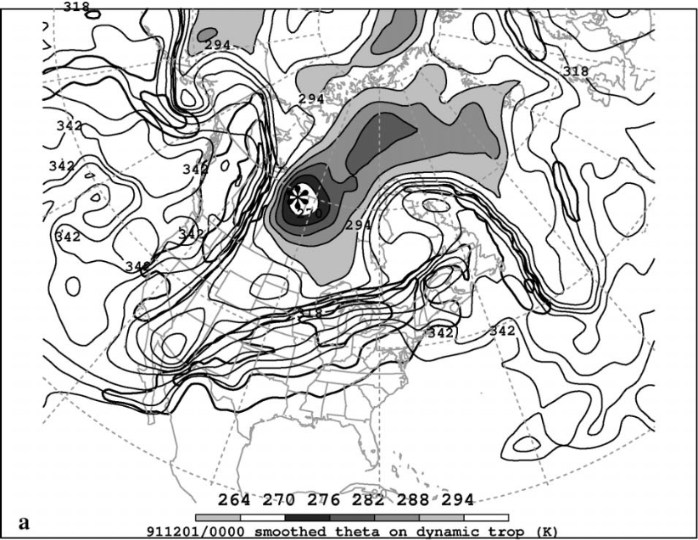
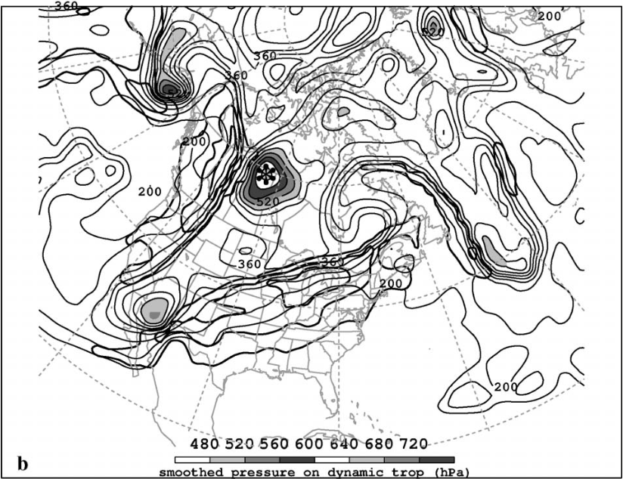
What are Tropopause Polar Vortices (TPVs)?
TPVs are tropopause-based vortices of high-latitude origin and are material features (e.g., Pyle et al. 2004; Cavallo and Hakim 2009, 2010)
TPV
TPV
(left) Dynamic tropopause (DT) wind speed (every 15 m s⁻¹ starting at 50 m s⁻¹, thick contours) and DT potential temperature (K, thin contours and shading) on 1.5-PVU surface valid at 0000 UTC 1 Dec 1991; (right) same as left except DT pressure (hPa, thin contours and shading). Adapted from Fig. 11 in Pyle et al. (2004).

Slide 4
What are Tropopause Polar Vortices (TPVs)?
TPVs may act as precursors to the development of Arctic cyclones (e.g., Tao et al. 2017)
TPV
TPV
(left) Dynamic tropopause (DT) wind speed (every 15 m s⁻¹ starting at 50 m s⁻¹, thick contours) and DT potential temperature (K, thin contours and shading) on 1.5-PVU surface valid at 0000 UTC 1 Dec 1991; (right) same as left except DT pressure (hPa, thin contours and shading). Adapted from Fig. 11 in Pyle et al. (2004).

Slide 5
Case Overview
Two sequential intense Arctic cyclones, AC1 and AC2, occurred in early June 2018
AC1 forms northeast of the Caspian Sea within a frontal trough
AC2 forms east of Greenland and may be linked to the remnants of Tropical Storm (TS) Alberto
AC1 and AC2 strengthen over western Eurasia as they interact with TPVs
AC1 and AC2 undergo a cyclonic rotation over the Arctic Ocean, during which AC2 absorbs AC1

Slide 6
Data and Methods
Obtained gridded analyses from ERA-5 (Hersbach and Dee 2016) at 0.25° resolution
Tracked cyclones manually by following locations of minimum sea level pressure (SLP)
Identified and tracked TPVs objectively by utilizing a TPV tracking algorithm (Szapiro and Cavallo 2018)
Computed backward trajectories by using NOAA HYSPLIT trajectory model

Slide 7
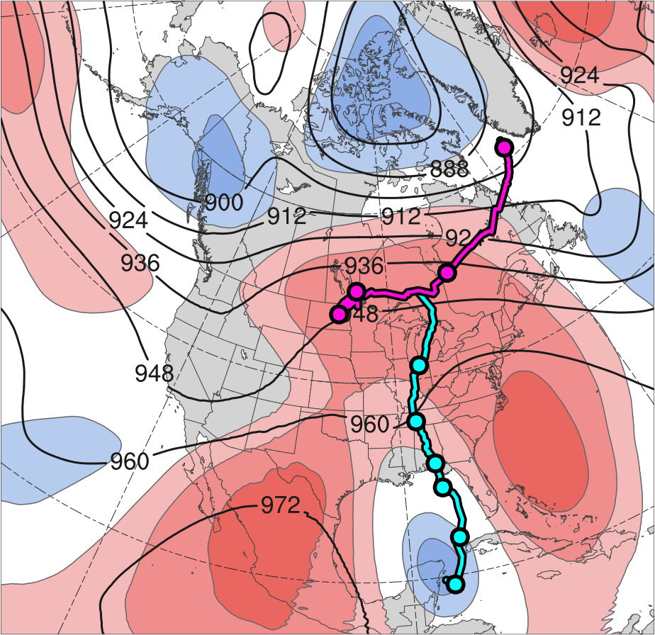
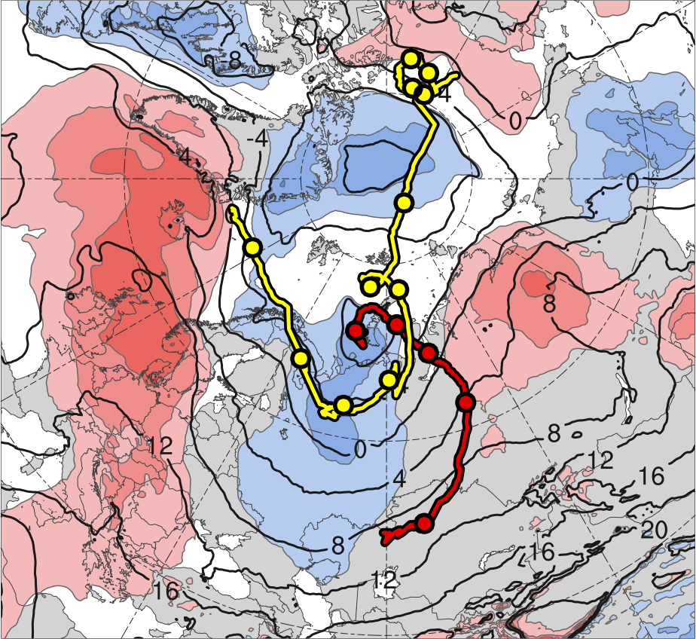
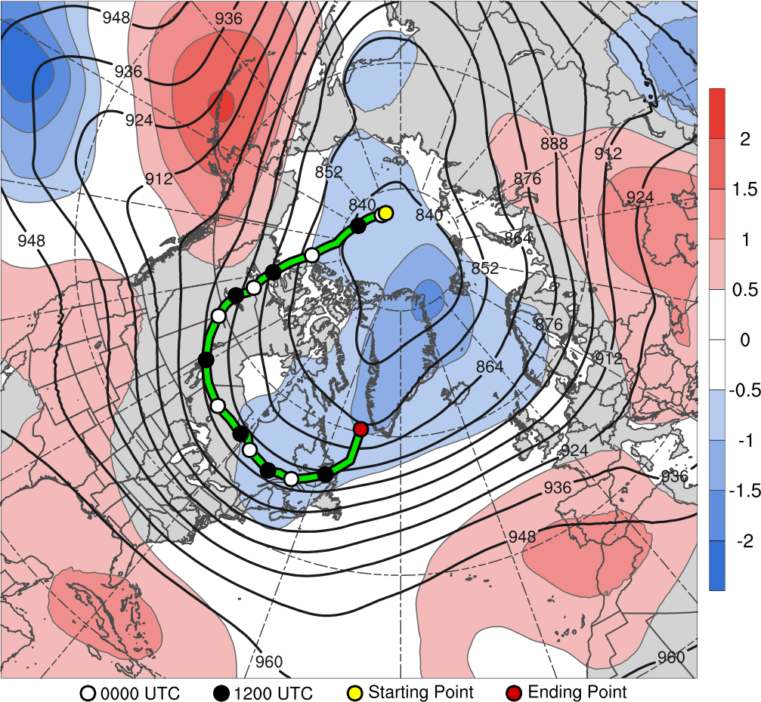
Track and Intensity of Cyclones
(a)
(b)
10
11
13
2
12
9
8
31
3
6
7
30
1
5
4
31
4
3
30
6
29
5
28
27
2
Alberto
26
AC1
CL
AC2
Genesis
Merger
-2
-1.5
-1
-0.5
0
0.5
1
1.5
2
σ
Lysis
0000 UTC positions
(a) 26 May–1 June 2018 time-mean 300-hPa geopotential height (dam, black) and standardized geopotential height anomalies (σ, shaded); (b) 1–7 June 2018 time-mean 850-hPa temperature (°C, black) and standardized temperature anomalies (σ, shaded).
Cyclone | Genesis | Lysis | Lifetime
AC1 | 1 June | 6 June | ~5 d
AC2 | 2 June | 13 June | ~11 d

Slide 8
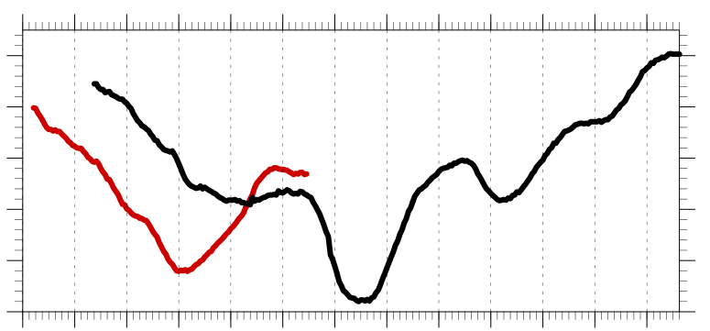
Track and Intensity of Cyclones
Hourly minimum SLP time series of AC1 and AC2
1010
1000
990
SLP (hPa)
980
970
960
1
2
3
4
5
6
7
8
9
10
11
12
13
Day in June 2018 labeled at 0000 UTC
AC1
AC2
Peak intensity of AC1 at 0400 UTC 4 June 2018 (967.9 hPa)
Peak intensity of AC2 at 1100 UTC 7 June 2018 (962.0 hPa)

Slide 9
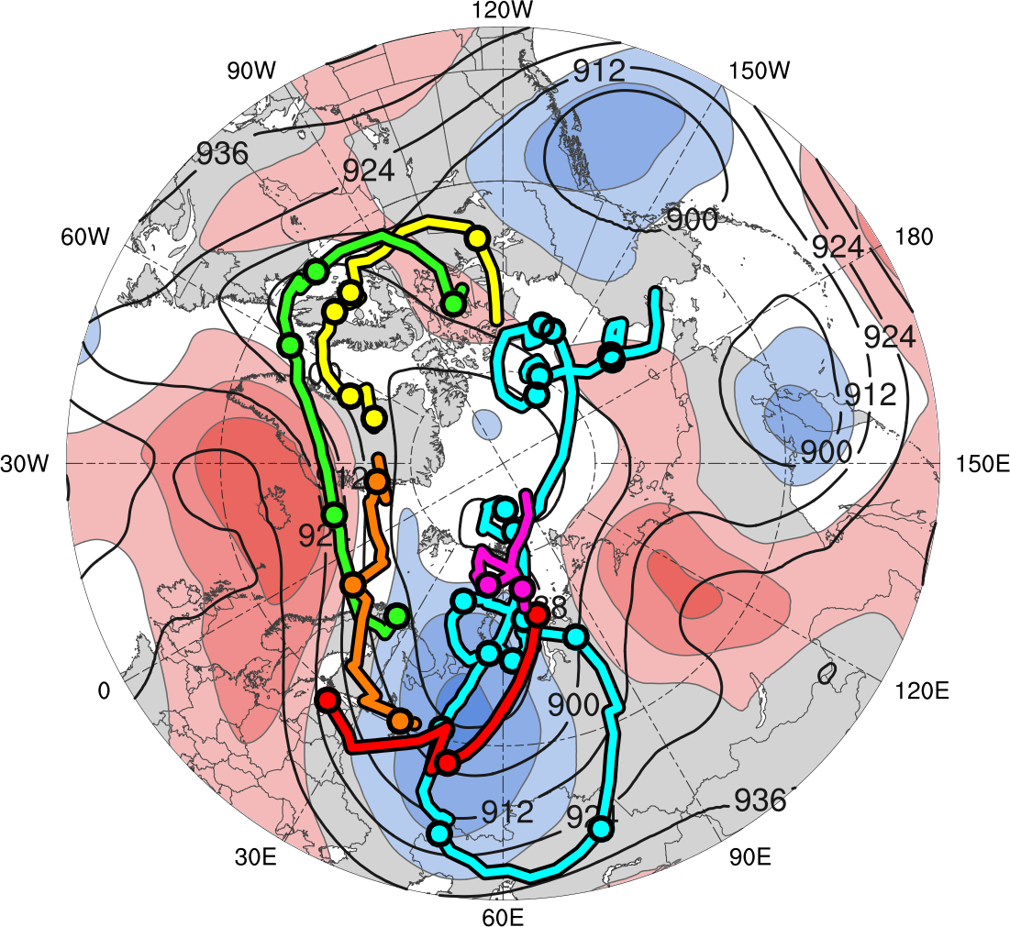
Tracks of TPVs
TPV | Genesis | Lysis | Lifetime
TPV 1a | 29 May | 3 June | ~5.4 d
TPV 1b | 2 June | 5 June | 2.5 d
TPV 1c | 5 June | 7 June | ~2.4 d
TPV 1d | 6 June | 8 June | 2 d
TPV 2 | 30 May | 4 June | ~4.4 d
TPV 3 | 30 May | 15 June | ~17 d
TPV 1a
TPV 1d
TPV 1b
TPV 2
TPV 1c
TPV 3
Genesis
Lysis
0000 UTC positions
1–7 June 2018 time-mean 300-hPa geopotential height (dam, black) and standardized geopotential height anomalies (σ, shaded)
-2
-1.5
-1
-0.5
0
0.5
1
1.5
2
σ

Slide 10
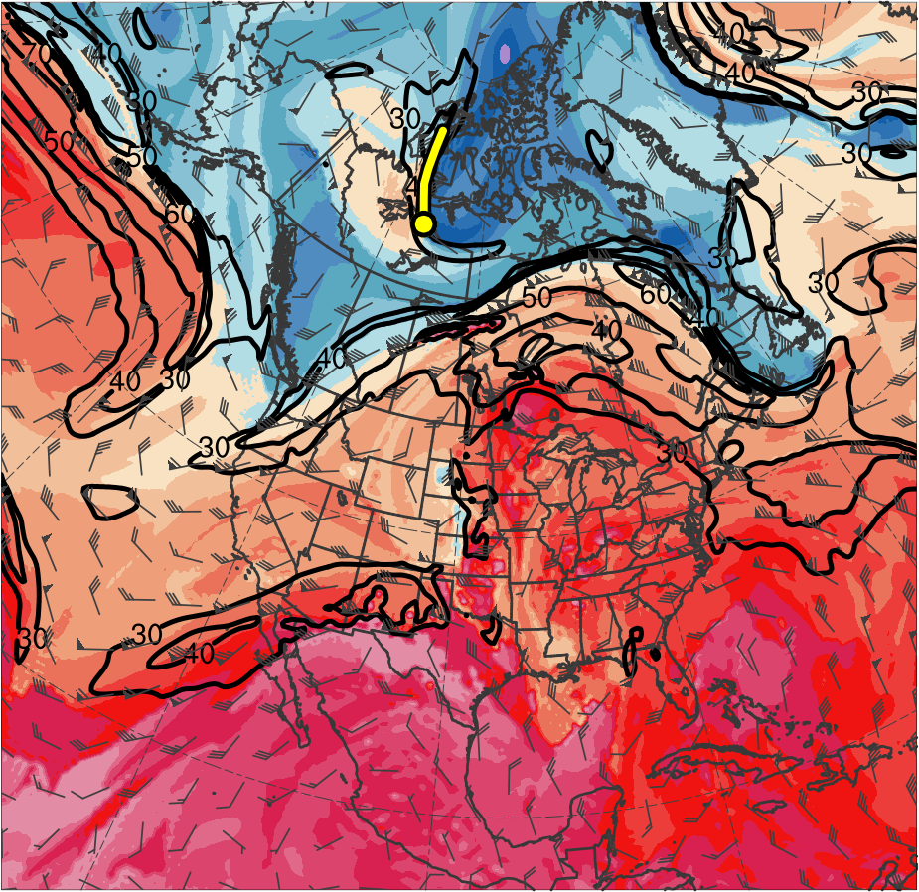
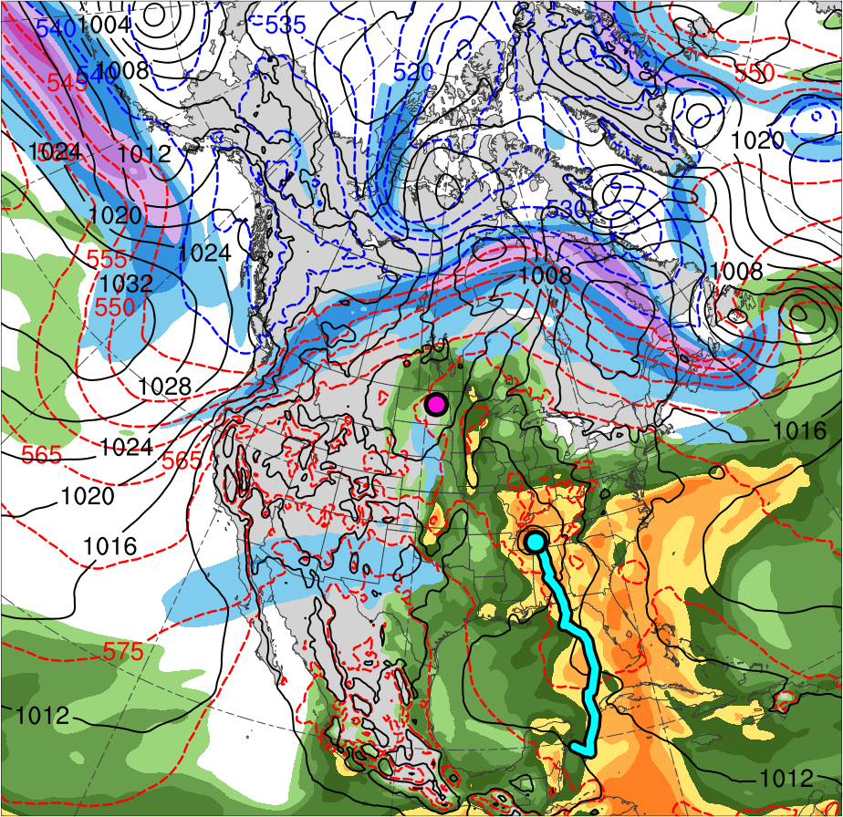
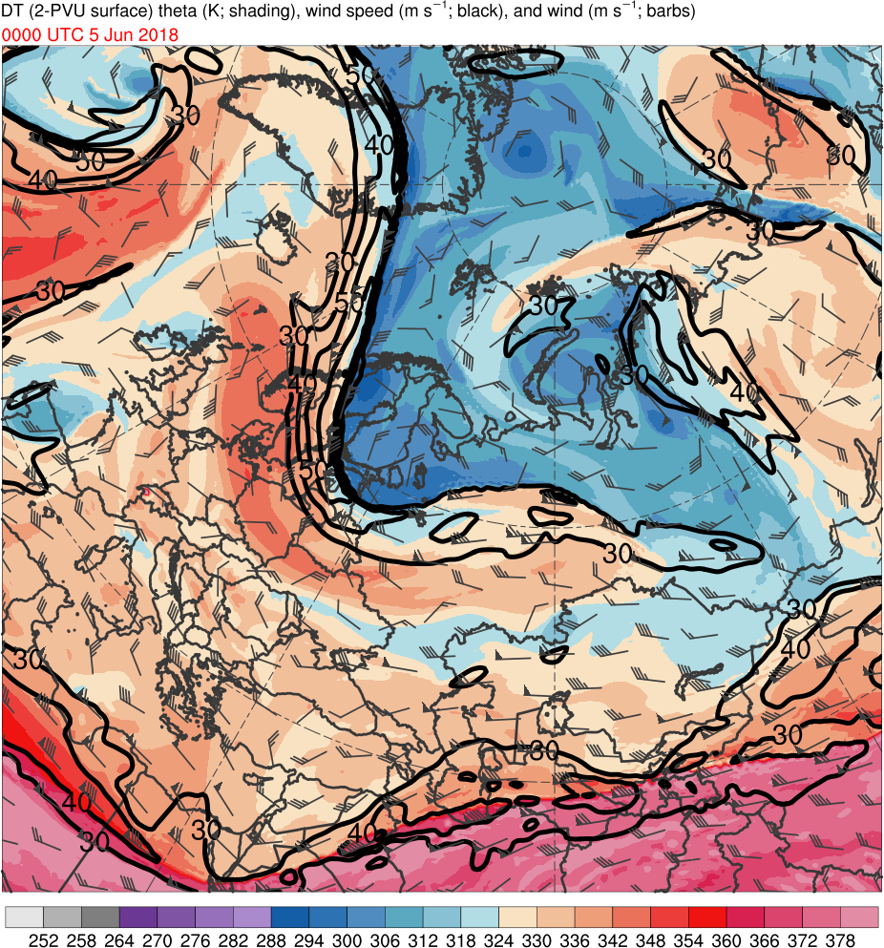
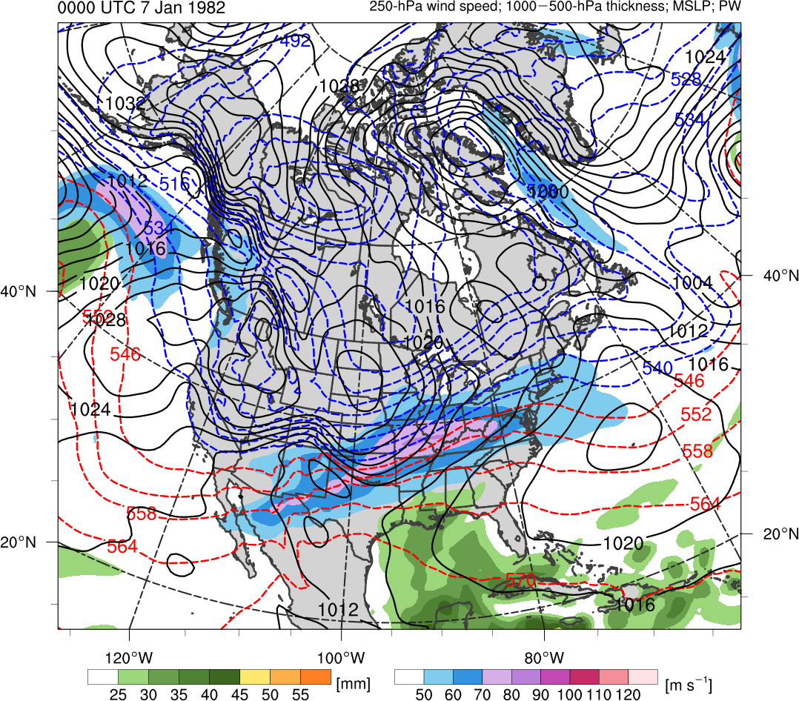
Synoptic Evolution
0000 UTC 30 May 2018
TPV 1a
Alberto
CL
(K)
252
258
264
270
276
282
288
294
300
306
312
318
324
330
336
342
348
354
360
366
372
378
(m s⁻¹ )
(mm)
30
40
50
60
70
80
90
100
25
30
35
40
45
50
55
Potential temperature (K, shaded), wind speed (black, every 10 m s⁻¹ starting at 30 m s⁻¹), and wind (m s⁻¹, flags and barbs) on 2-PVU surface
300-hPa wind speed (m s⁻¹, shaded),
1000–500-hPa thickness (dam, blue/red),
SLP (hPa, black), and PW (mm, shaded)

Slide 11
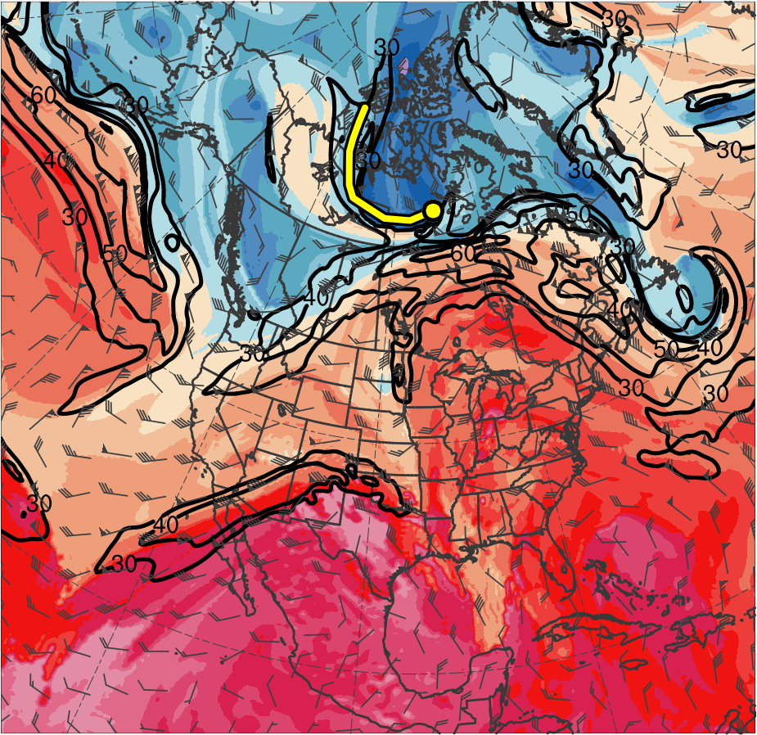
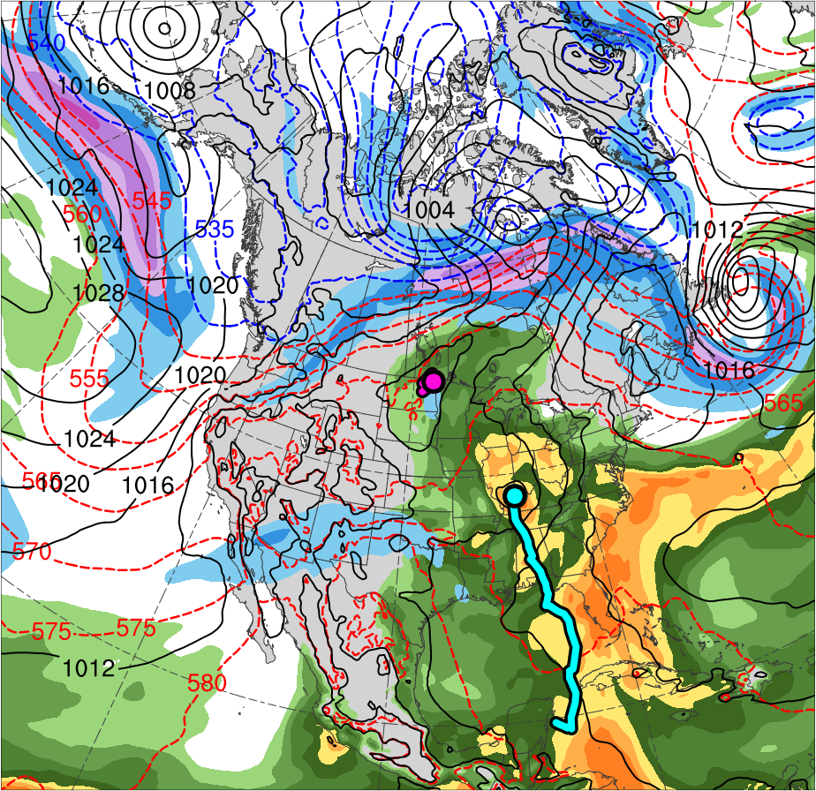
Synoptic Evolution
1200 UTC 30 May 2018
TPV 1a
Alberto
CL
(K)
252
258
264
270
276
282
288
294
300
306
312
318
324
330
336
342
348
354
360
366
372
378
(m s⁻¹ )
(mm)
30
40
50
60
70
80
90
100
25
30
35
40
45
50
55
Potential temperature (K, shaded), wind speed (black, every 10 m s⁻¹ starting at 30 m s⁻¹), and wind (m s⁻¹, flags and barbs) on 2-PVU surface
300-hPa wind speed (m s⁻¹, shaded),
1000–500-hPa thickness (dam, blue/red),
SLP (hPa, black), and PW (mm, shaded)

Slide 12
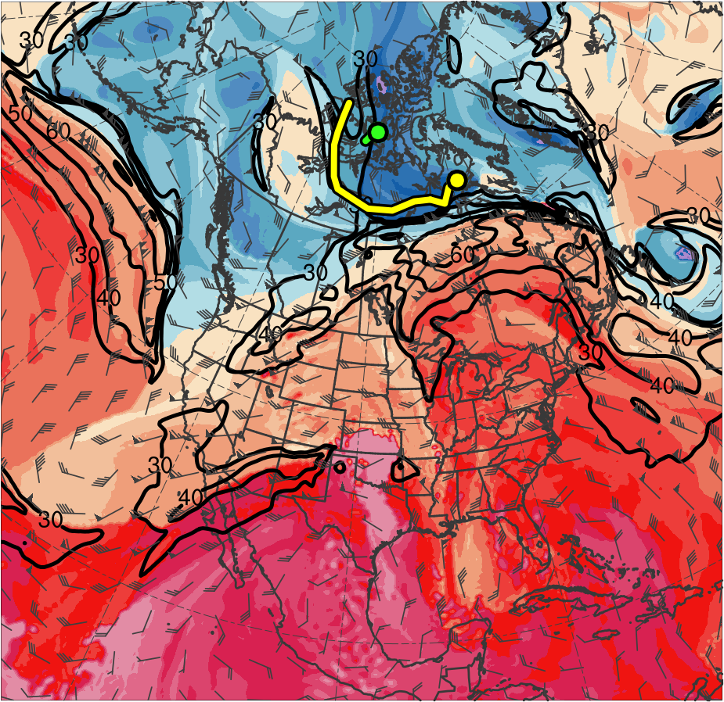
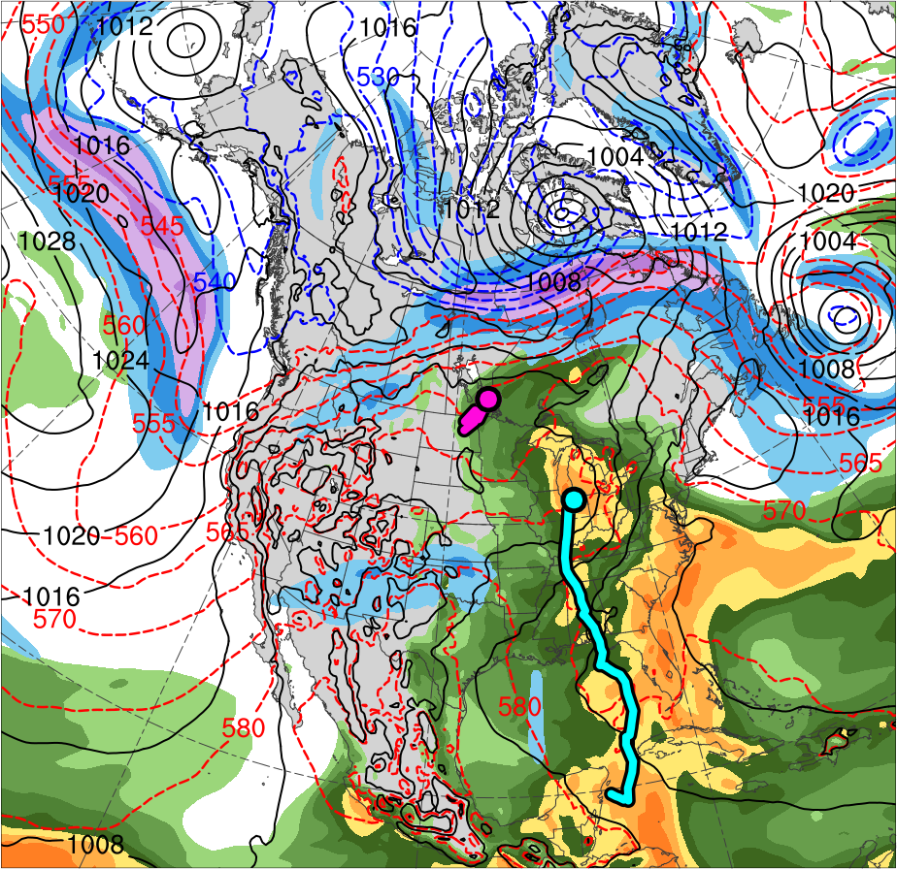
Synoptic Evolution
0000 UTC 31 May 2018
TPV 1a
Alberto
TPV 2
CL
(K)
252
258
264
270
276
282
288
294
300
306
312
318
324
330
336
342
348
354
360
366
372
378
(m s⁻¹ )
(mm)
30
40
50
60
70
80
90
100
25
30
35
40
45
50
55
Potential temperature (K, shaded), wind speed (black, every 10 m s⁻¹ starting at 30 m s⁻¹), and wind (m s⁻¹, flags and barbs) on 2-PVU surface
300-hPa wind speed (m s⁻¹, shaded),
1000–500-hPa thickness (dam, blue/red),
SLP (hPa, black), and PW (mm, shaded)

Slide 13
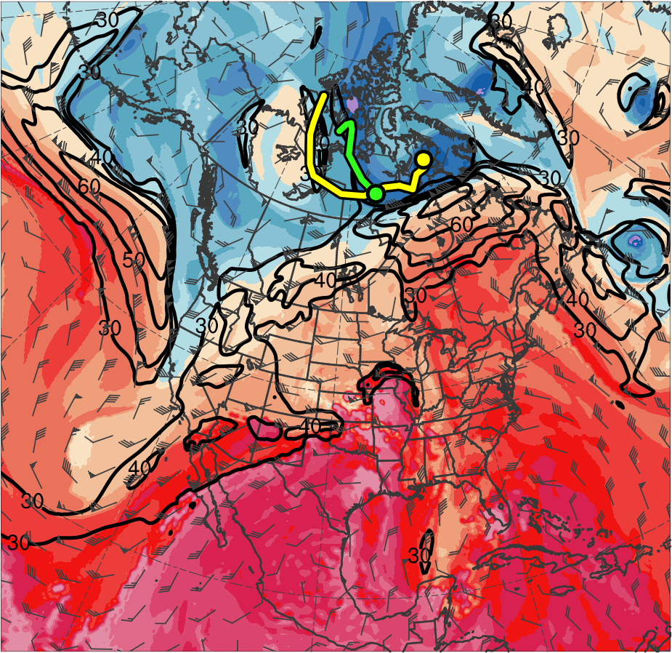
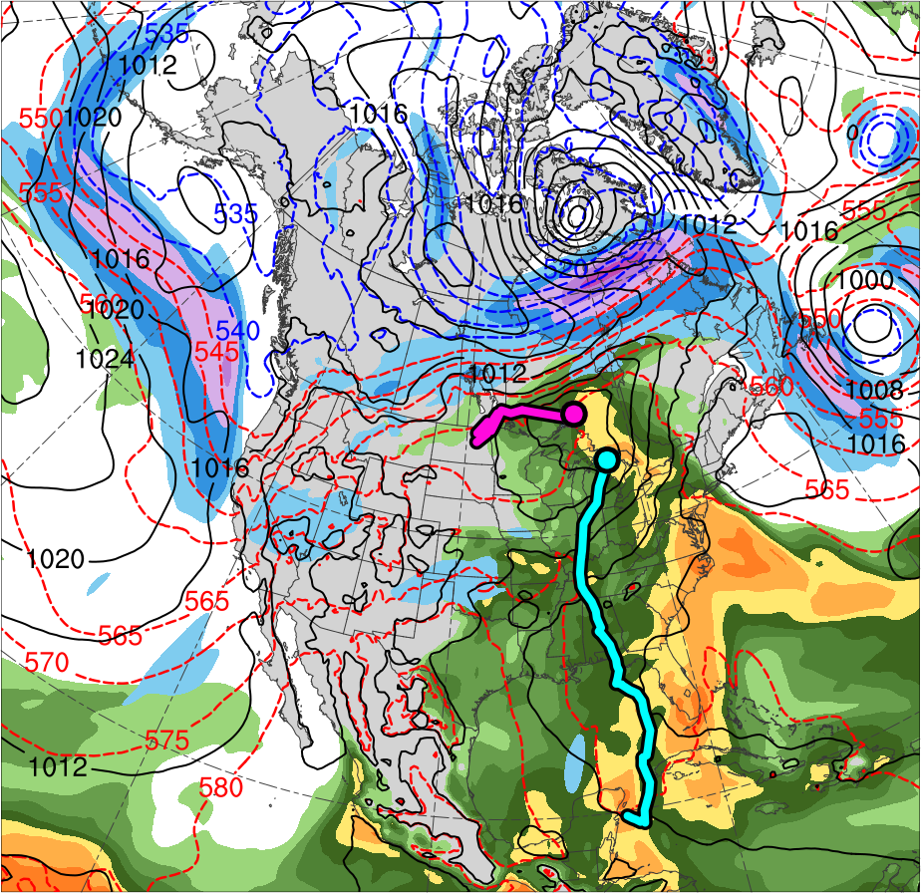
Synoptic Evolution
1200 UTC 31 May 2018
TPV 1a
Alberto
TPV 2
CL
(K)
252
258
264
270
276
282
288
294
300
306
312
318
324
330
336
342
348
354
360
366
372
378
(m s⁻¹ )
(mm)
30
40
50
60
70
80
90
100
25
30
35
40
45
50
55
Potential temperature (K, shaded), wind speed (black, every 10 m s⁻¹ starting at 30 m s⁻¹), and wind (m s⁻¹, flags and barbs) on 2-PVU surface
300-hPa wind speed (m s⁻¹, shaded),
1000–500-hPa thickness (dam, blue/red),
SLP (hPa, black), and PW (mm, shaded)

Slide 14
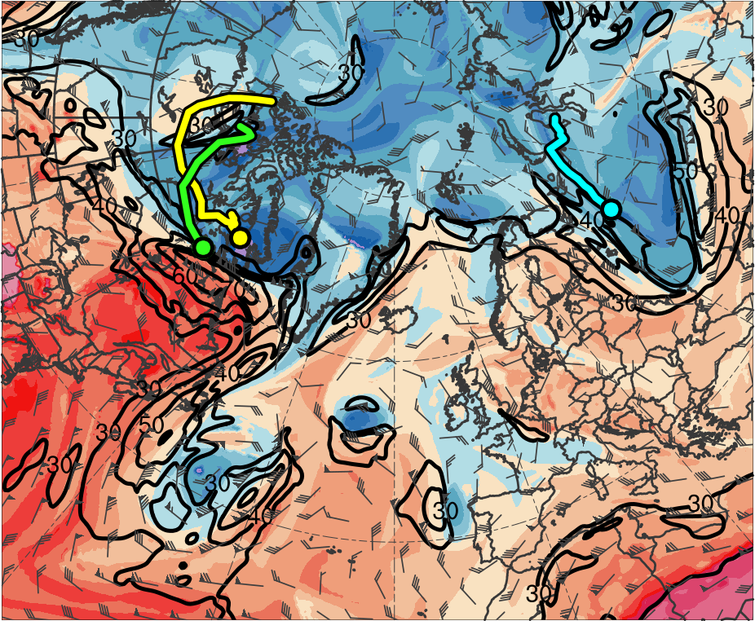
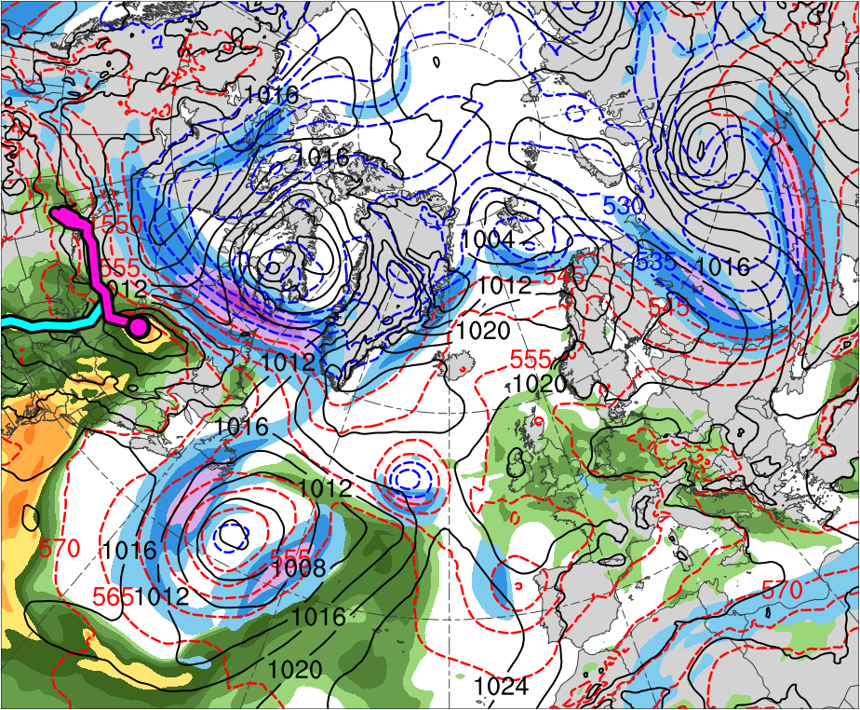
Synoptic Evolution
0000 UTC 1 June 2018
Alberto
TPV 1a
CL
TPV 2
TPV 3
(K)
252
258
264
270
276
282
288
294
300
306
312
318
324
330
336
342
348
354
360
366
372
378
(m s⁻¹ )
(mm)
30
40
50
60
70
80
90
100
25
30
35
40
45
50
55
Potential temperature (K, shaded), wind speed (black, every 10 m s⁻¹ starting at 30 m s⁻¹), and wind (m s⁻¹, flags and barbs) on 2-PVU surface
300-hPa wind speed (m s⁻¹, shaded),
1000–500-hPa thickness (dam, blue/red),
SLP (hPa, black), and PW (mm, shaded)

Slide 15
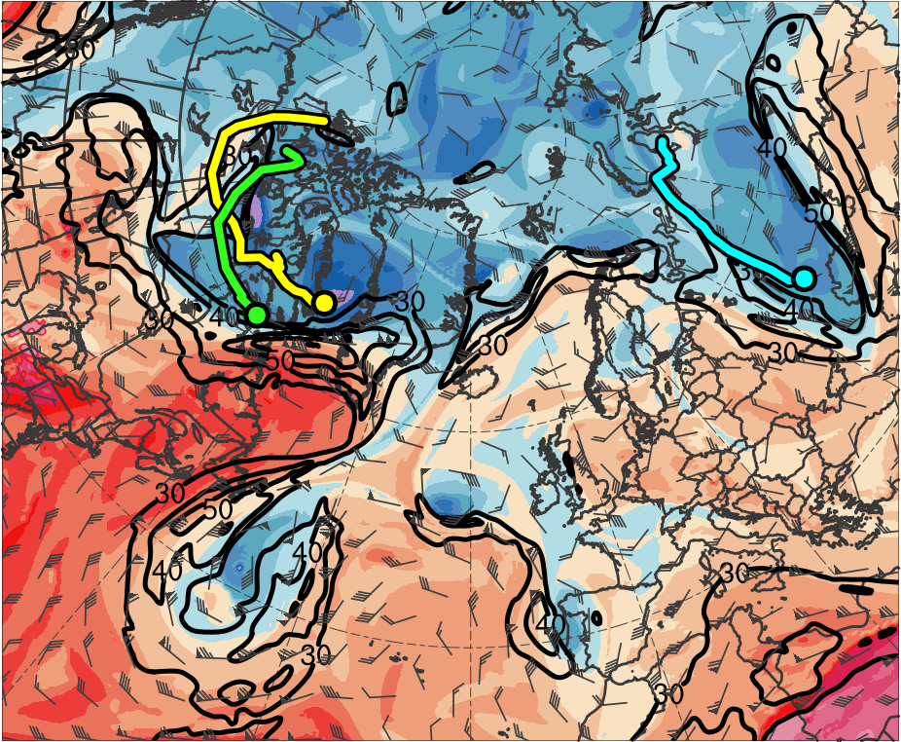
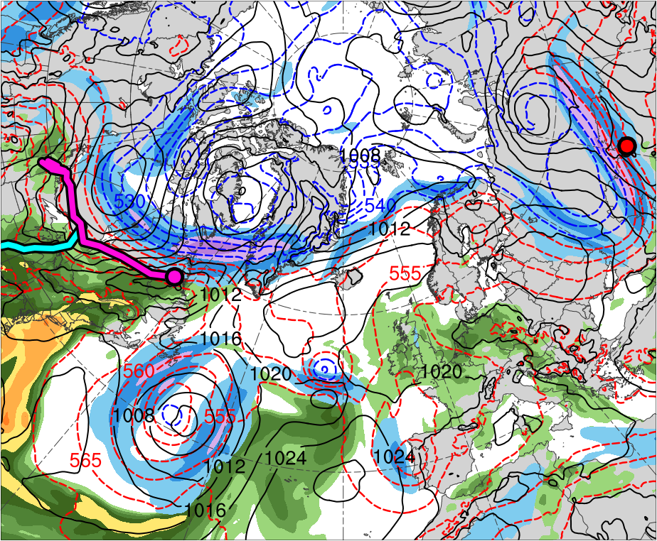
Synoptic Evolution
1200 UTC 1 June 2018
Cyclogenesis of AC1
Alberto
TPV 1a
CL
TPV 2
AC1
TPV 3
(K)
252
258
264
270
276
282
288
294
300
306
312
318
324
330
336
342
348
354
360
366
372
378
(m s⁻¹ )
(mm)
30
40
50
60
70
80
90
100
25
30
35
40
45
50
55
Potential temperature (K, shaded), wind speed (black, every 10 m s⁻¹ starting at 30 m s⁻¹), and wind (m s⁻¹, flags and barbs) on 2-PVU surface
300-hPa wind speed (m s⁻¹, shaded),
1000–500-hPa thickness (dam, blue/red),
SLP (hPa, black), and PW (mm, shaded)

Slide 16
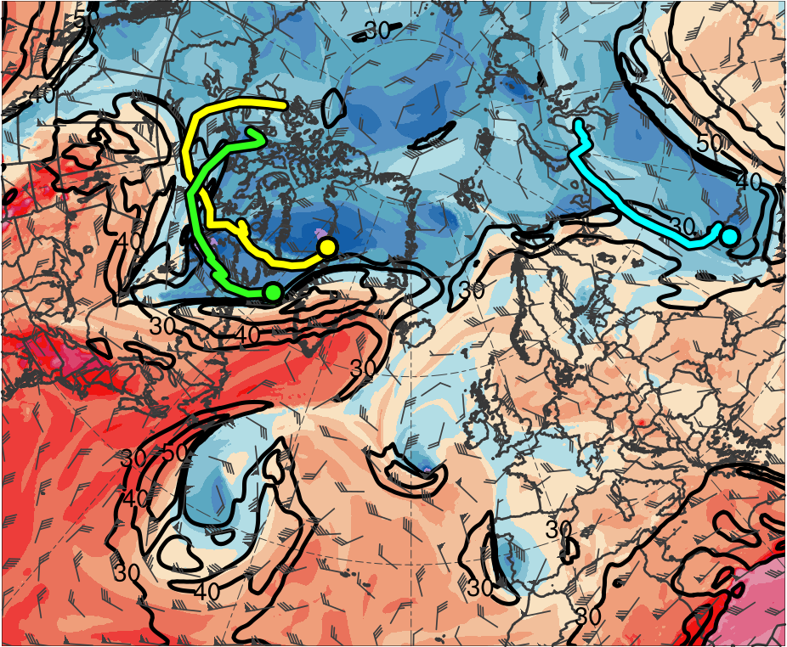
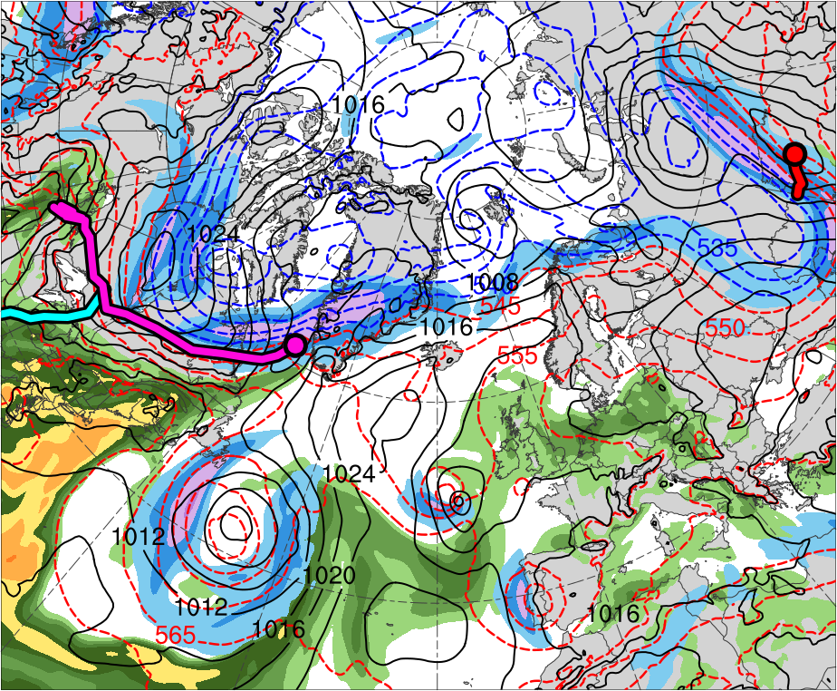
Synoptic Evolution
0000 UTC 2 June 2018
Alberto
TPV 1a
CL
TPV 2
AC1
TPV 3
(K)
252
258
264
270
276
282
288
294
300
306
312
318
324
330
336
342
348
354
360
366
372
378
(m s⁻¹ )
(mm)
30
40
50
60
70
80
90
100
25
30
35
40
45
50
55
Potential temperature (K, shaded), wind speed (black, every 10 m s⁻¹ starting at 30 m s⁻¹), and wind (m s⁻¹, flags and barbs) on 2-PVU surface
300-hPa wind speed (m s⁻¹, shaded),
1000–500-hPa thickness (dam, blue/red),
SLP (hPa, black), and PW (mm, shaded)

Slide 17
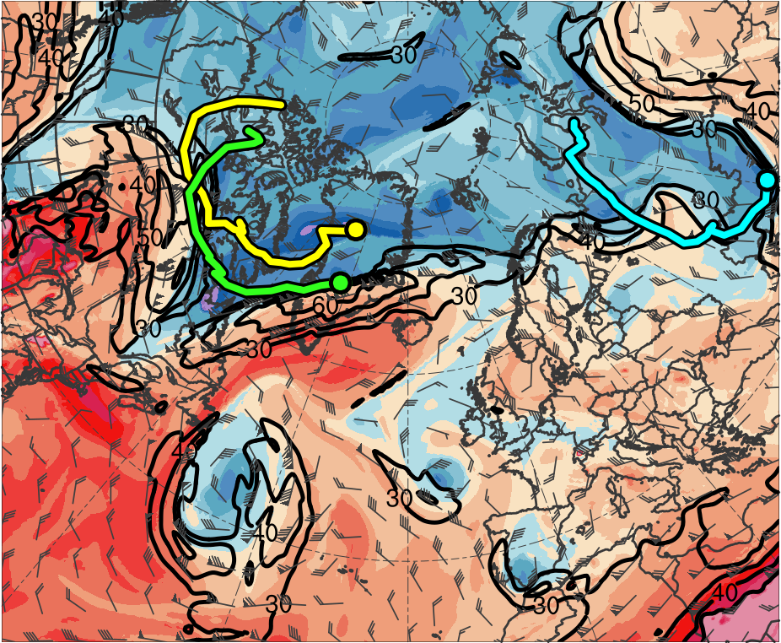
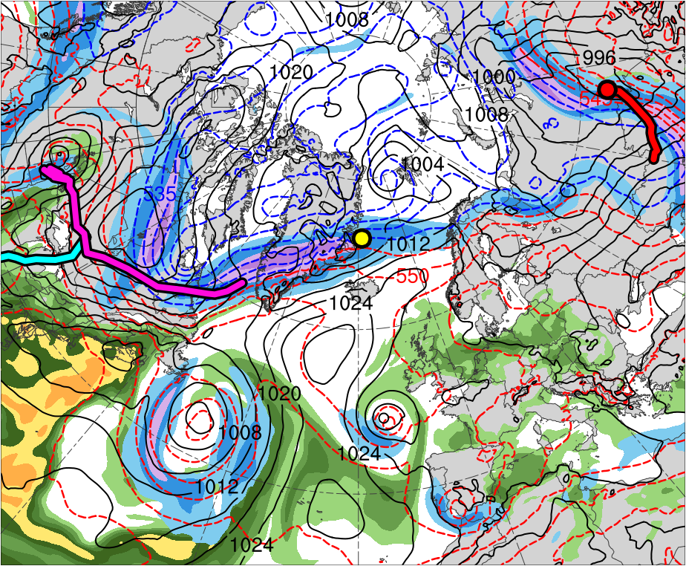
Synoptic Evolution
1200 UTC 2 June 2018
Lee cyclogenesis of AC2
Alberto
TPV 1a
Alberto
CL
TPV 2
CL
AC1
TPV 3
AC1
AC2
(K)
252
258
264
270
276
282
288
294
300
306
312
318
324
330
336
342
348
354
360
366
372
378
(m s⁻¹ )
(mm)
30
40
50
60
70
80
90
100
25
30
35
40
45
50
55
Potential temperature (K, shaded), wind speed (black, every 10 m s⁻¹ starting at 30 m s⁻¹), and wind (m s⁻¹, flags and barbs) on 2-PVU surface
300-hPa wind speed (m s⁻¹, shaded),
1000–500-hPa thickness (dam, blue/red),
SLP (hPa, black), and PW (mm, shaded)

Slide 18
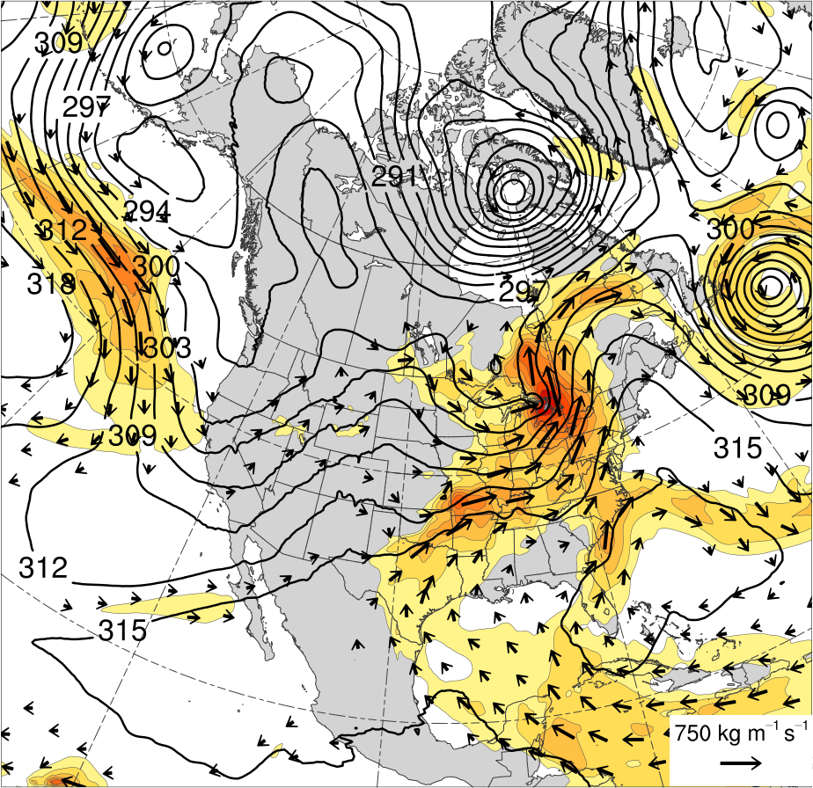
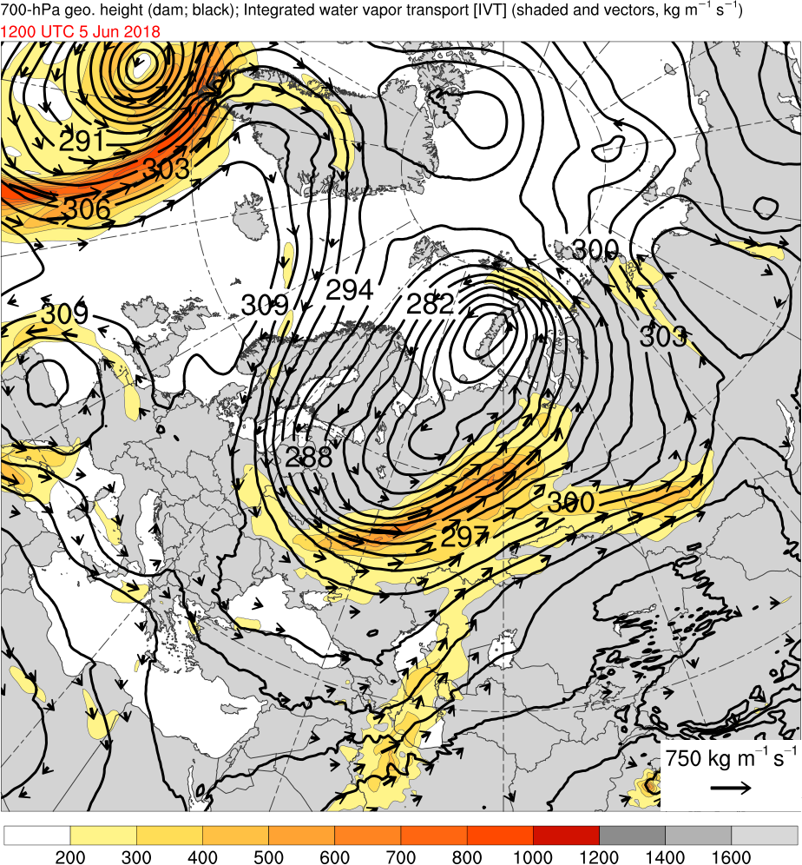
Moisture from TS Alberto
1200 UTC 31 May 2018
(kg m⁻¹ s⁻¹)
200
300
400
500
600
700
800
1000
1200
1400
1600
IVT (kg m⁻¹ s⁻¹, shaded and vectors) and 700-hPa geopotential height (dam, black)
NOAA HYSPLIT 5-d backward trajectories ending at 1200 UTC 31 May 2018

Slide 19
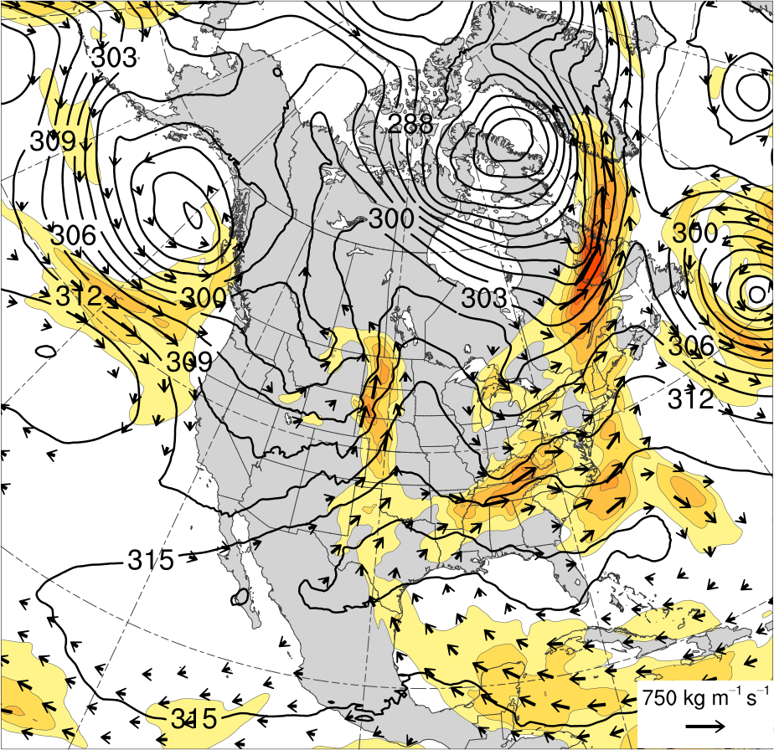
Moisture from TS Alberto
1200 UTC 1 June 2018
(kg m⁻¹ s⁻¹)
200
300
400
500
600
700
800
1000
1200
1400
1600
IVT (kg m⁻¹ s⁻¹, shaded and vectors) and 700-hPa geopotential height (dam, black)
NOAA HYSPLIT 5-d backward trajectories ending at 1200 UTC 1 June 2018

Slide 20
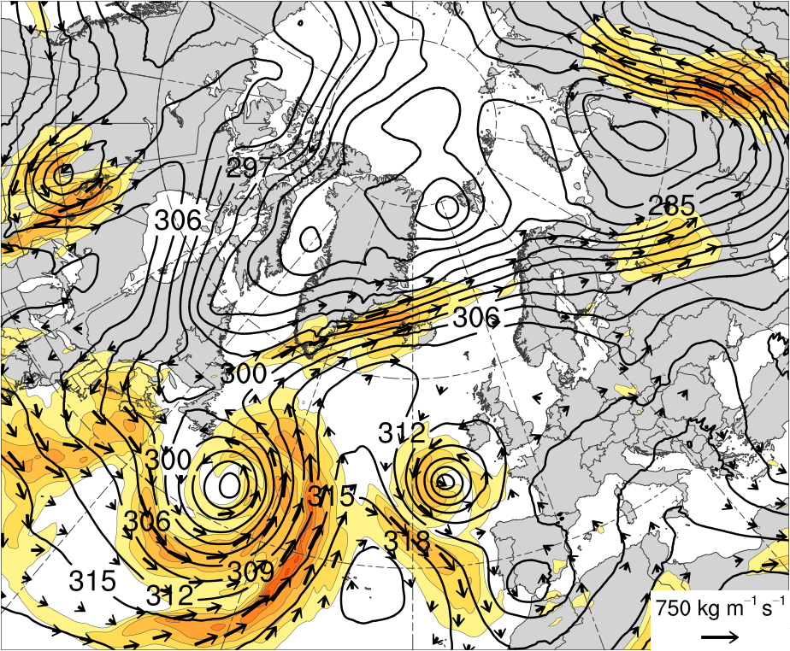
Moisture from TS Alberto
1200 UTC 2 June 2018
(kg m⁻¹ s⁻¹)
200
300
400
500
600
700
800
1000
1200
1400
1600
IVT (kg m⁻¹ s⁻¹, shaded and vectors) and 700-hPa geopotential height (dam, black)
NOAA HYSPLIT 5-d backward trajectories ending at 1200 UTC 2 June 2018

Slide 21
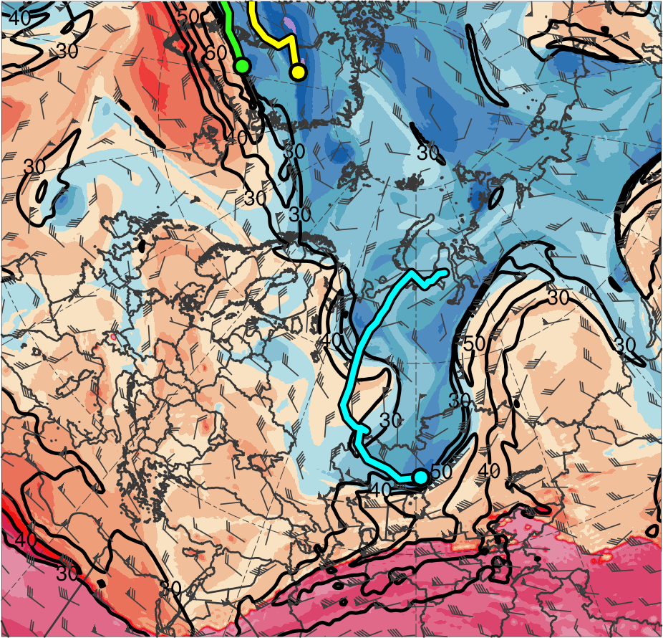
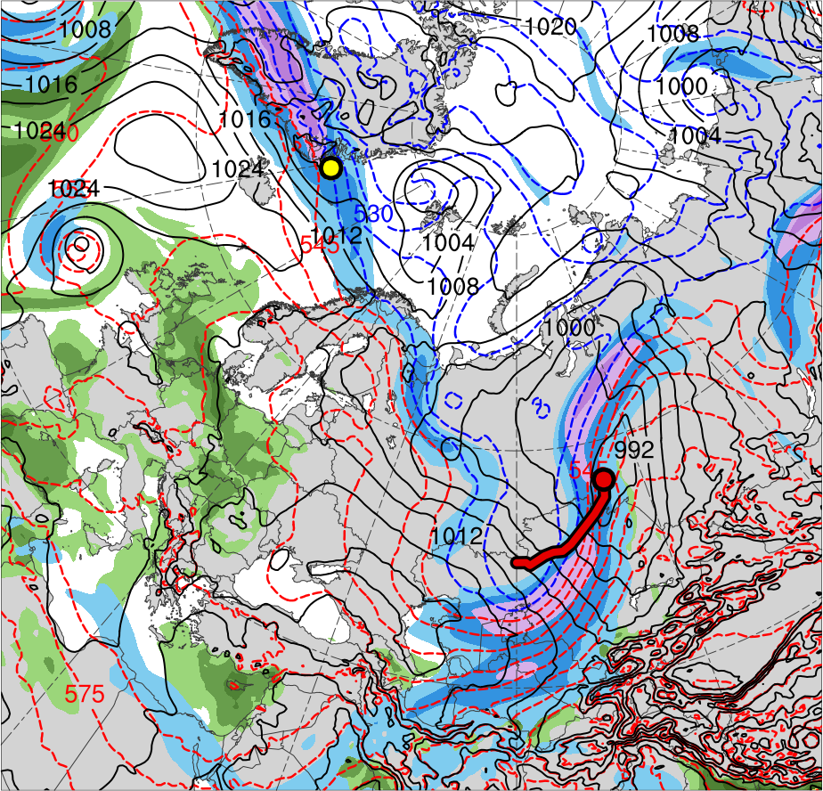
Synoptic Evolution
1200 UTC 2 June 2018
Lee cyclogenesis of AC2
TPV 1a
TPV 2
TPV 3
AC1
AC2
(K)
252
258
264
270
276
282
288
294
300
306
312
318
324
330
336
342
348
354
360
366
372
378
(m s⁻¹ )
(mm)
30
40
50
60
70
80
90
100
25
30
35
40
45
50
55
Potential temperature (K, shaded), wind speed (black, every 10 m s⁻¹ starting at 30 m s⁻¹), and wind (m s⁻¹, flags and barbs) on 2-PVU surface
300-hPa wind speed (m s⁻¹, shaded),
1000–500-hPa thickness (dam, blue/red),
SLP (hPa, black), and PW (mm, shaded)

Slide 22
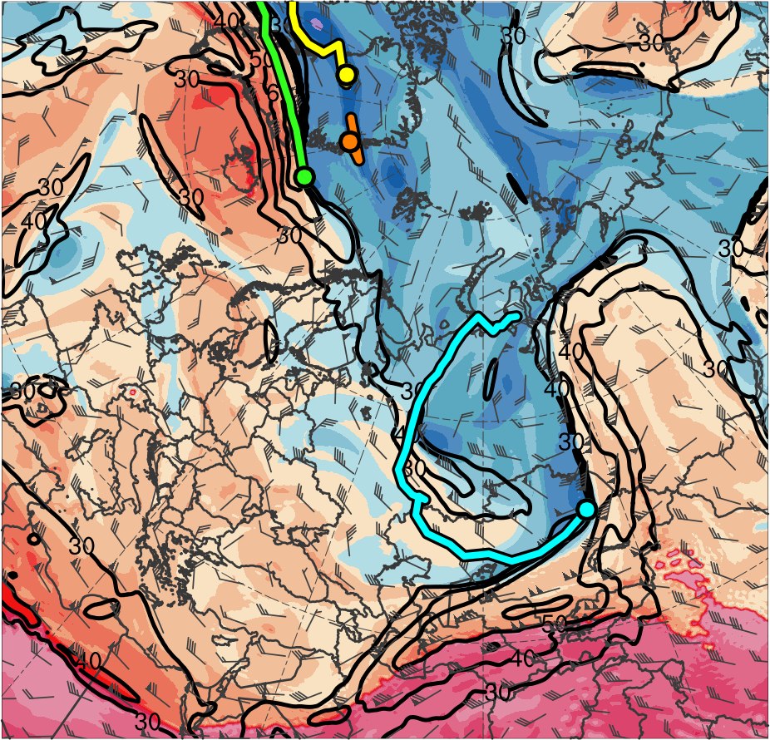
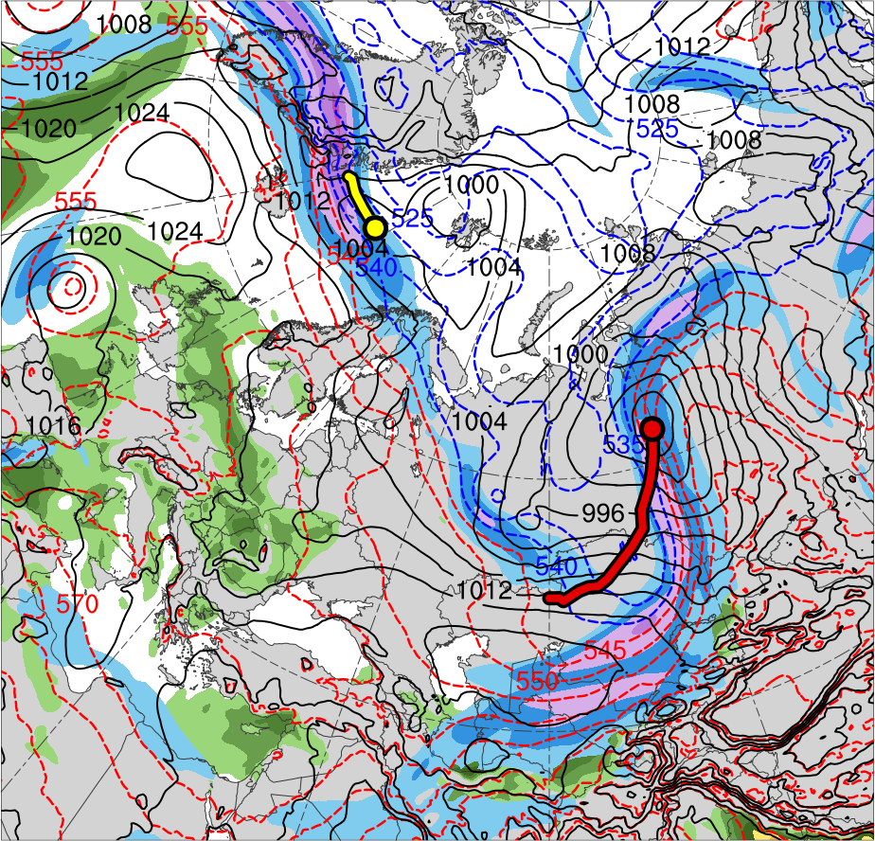
Synoptic Evolution
0000 UTC 3 June 2018
TPV 1a
TPV 2
TPV 3
TPV 1b
AC1
AC2
(K)
252
258
264
270
276
282
288
294
300
306
312
318
324
330
336
342
348
354
360
366
372
378
(m s⁻¹ )
(mm)
30
40
50
60
70
80
90
100
25
30
35
40
45
50
55
Potential temperature (K, shaded), wind speed (black, every 10 m s⁻¹ starting at 30 m s⁻¹), and wind (m s⁻¹, flags and barbs) on 2-PVU surface
300-hPa wind speed (m s⁻¹, shaded),
1000–500-hPa thickness (dam, blue/red),
SLP (hPa, black), and PW (mm, shaded)

Slide 23
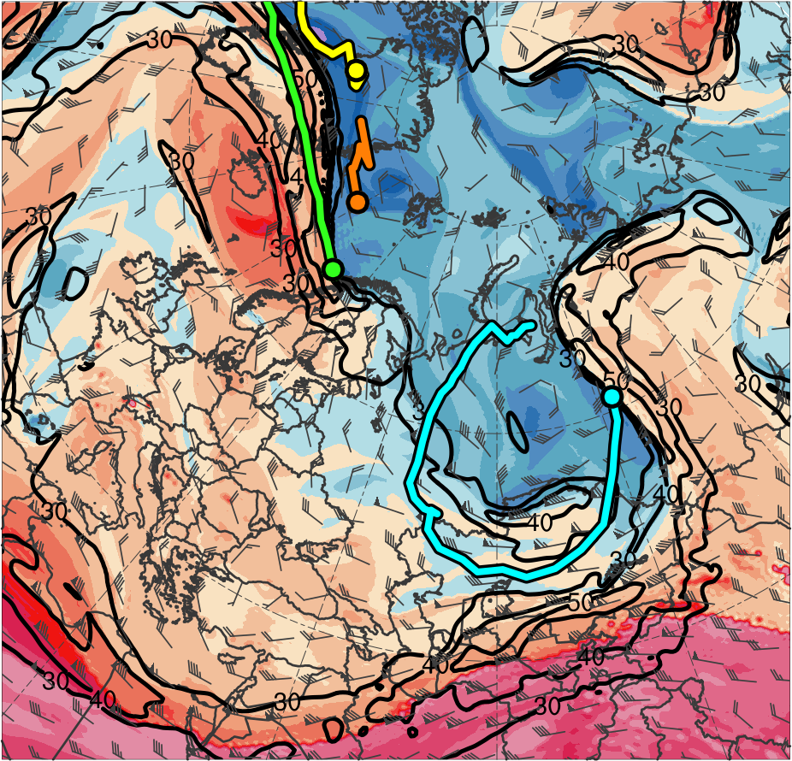
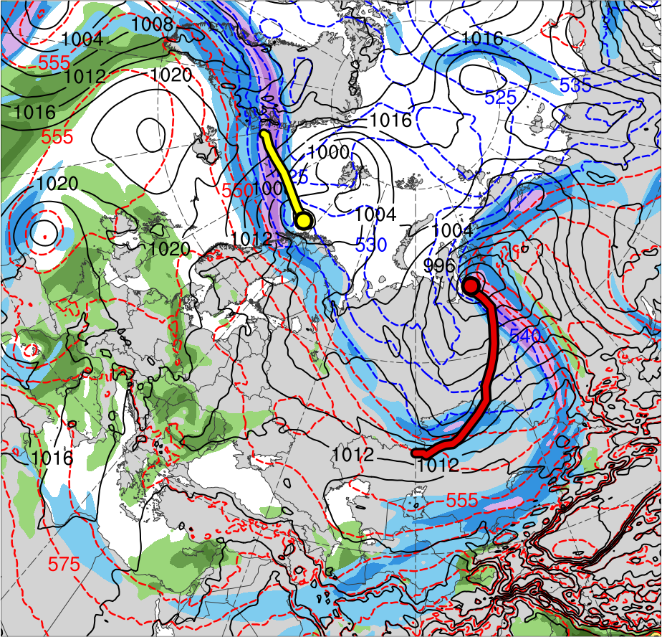
Synoptic Evolution
1200 UTC 3 June 2018
TPV 1a
TPV 2
TPV 3
TPV 1b
AC1
AC2
(K)
252
258
264
270
276
282
288
294
300
306
312
318
324
330
336
342
348
354
360
366
372
378
(m s⁻¹ )
(mm)
30
40
50
60
70
80
90
100
25
30
35
40
45
50
55
Potential temperature (K, shaded), wind speed (black, every 10 m s⁻¹ starting at 30 m s⁻¹), and wind (m s⁻¹, flags and barbs) on 2-PVU surface
300-hPa wind speed (m s⁻¹, shaded),
1000–500-hPa thickness (dam, blue/red),
SLP (hPa, black), and PW (mm, shaded)

Slide 24
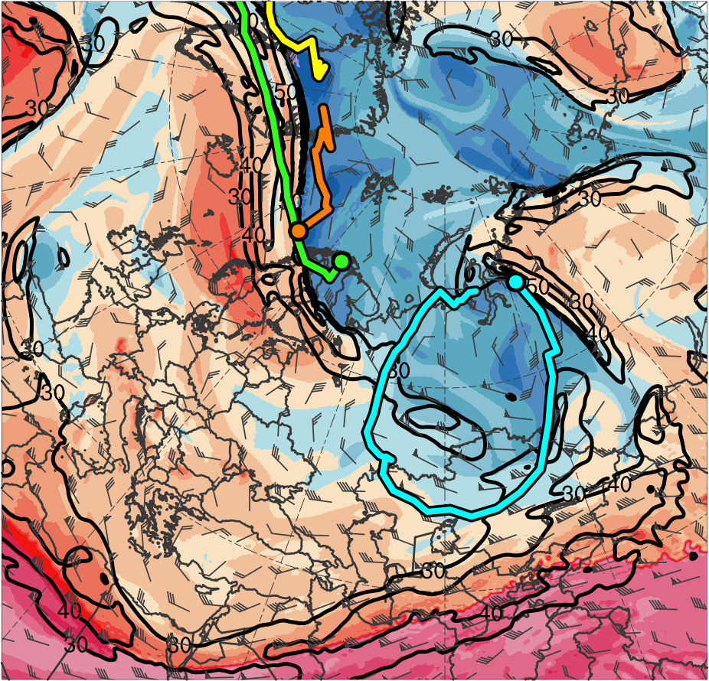
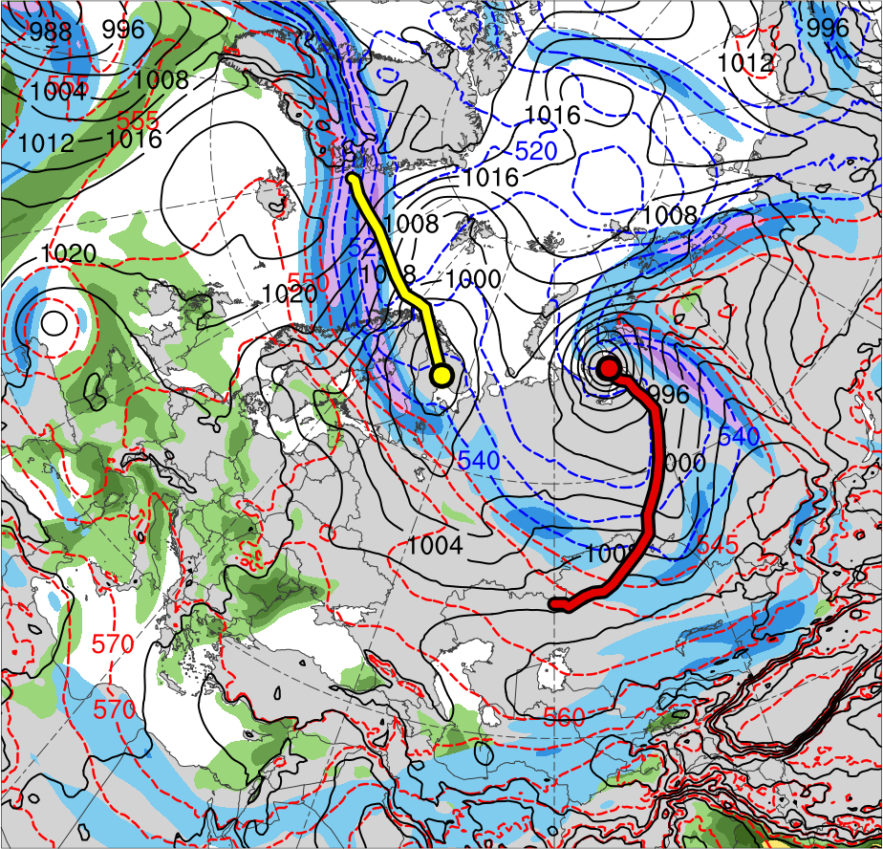
Synoptic Evolution
0000 UTC 4 June 2018
TPV 1a
TPV 2
TPV 3
TPV 1b
AC1
AC2
(K)
252
258
264
270
276
282
288
294
300
306
312
318
324
330
336
342
348
354
360
366
372
378
(m s⁻¹ )
(mm)
30
40
50
60
70
80
90
100
25
30
35
40
45
50
55
Potential temperature (K, shaded), wind speed (black, every 10 m s⁻¹ starting at 30 m s⁻¹), and wind (m s⁻¹, flags and barbs) on 2-PVU surface
300-hPa wind speed (m s⁻¹, shaded),
1000–500-hPa thickness (dam, blue/red),
SLP (hPa, black), and PW (mm, shaded)

Slide 25
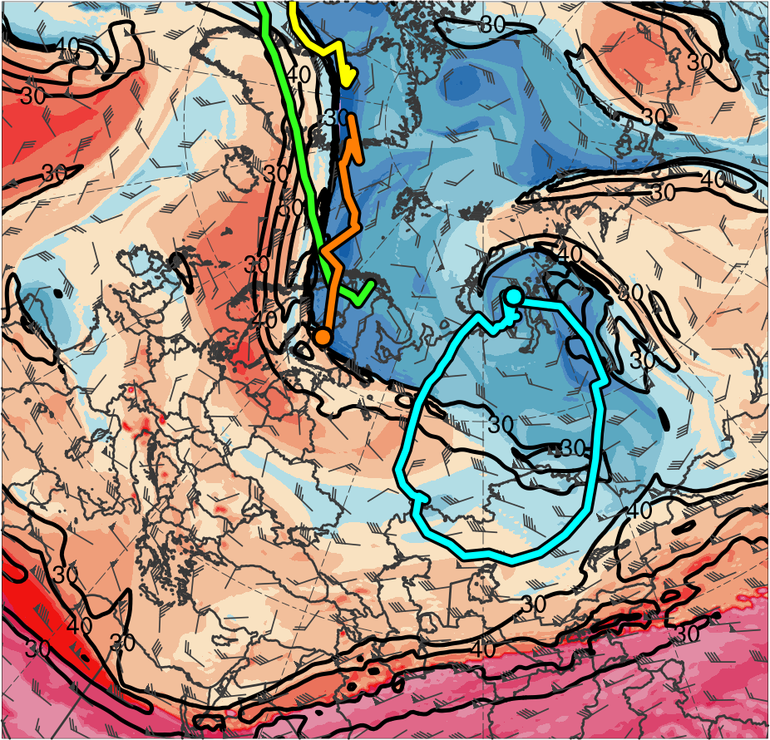
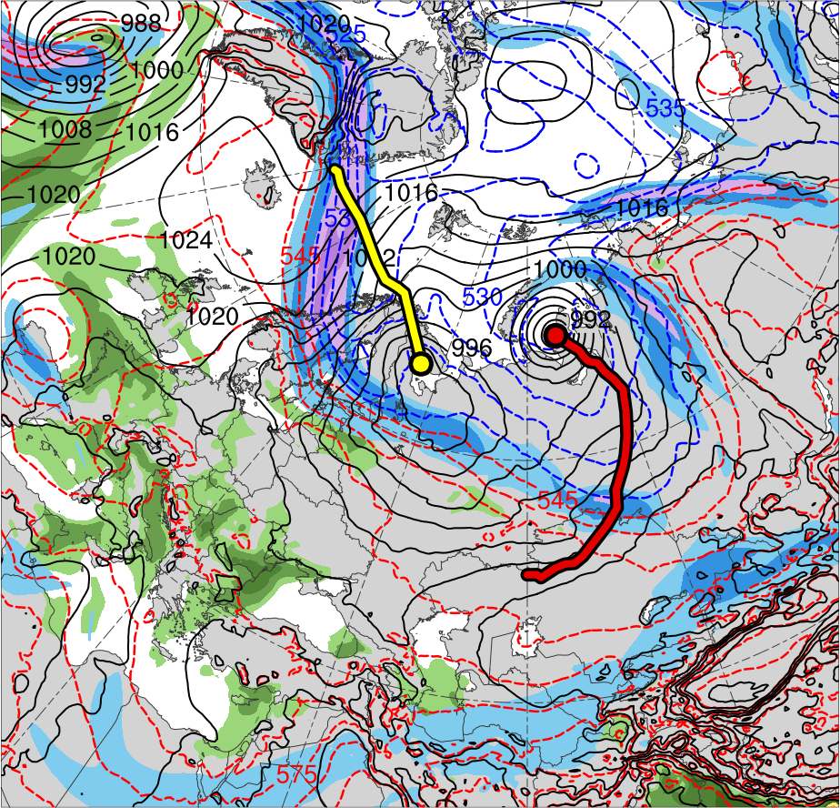
Synoptic Evolution
1200 UTC 4 June 2018
TPV 1a
TPV 2
TPV 3
TPV 1b
AC1
AC2
(K)
252
258
264
270
276
282
288
294
300
306
312
318
324
330
336
342
348
354
360
366
372
378
(m s⁻¹ )
(mm)
30
40
50
60
70
80
90
100
25
30
35
40
45
50
55
Potential temperature (K, shaded), wind speed (black, every 10 m s⁻¹ starting at 30 m s⁻¹), and wind (m s⁻¹, flags and barbs) on 2-PVU surface
300-hPa wind speed (m s⁻¹, shaded),
1000–500-hPa thickness (dam, blue/red),
SLP (hPa, black), and PW (mm, shaded)

Slide 26
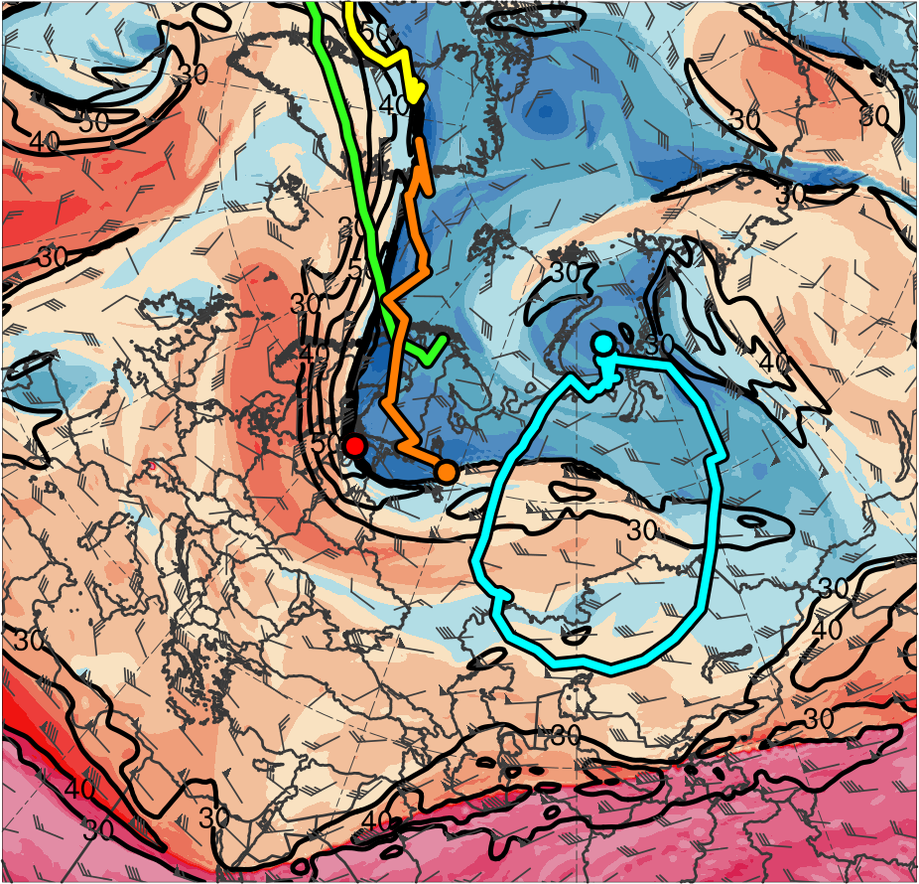
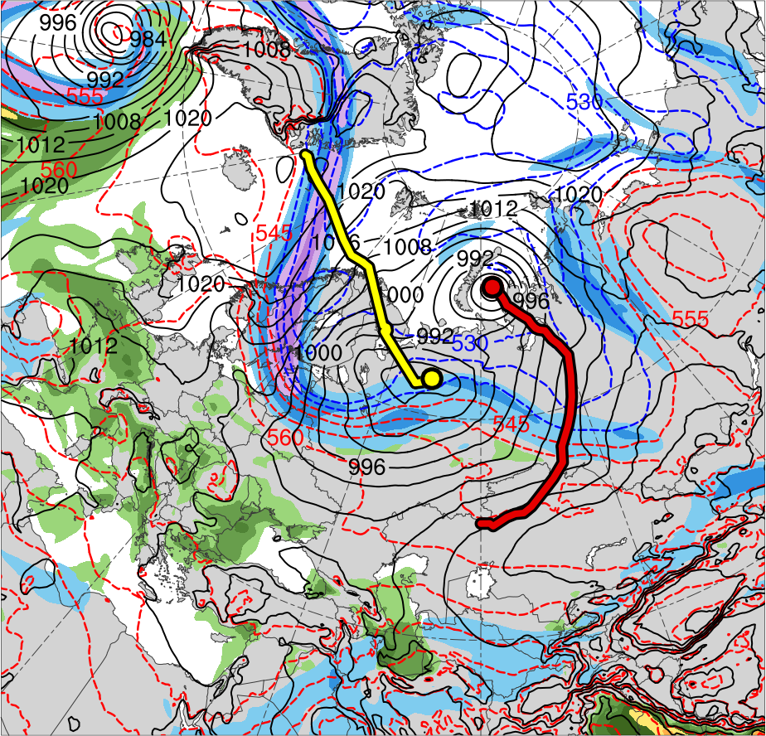
Synoptic Evolution
0000 UTC 5 June 2018
TPV 1a
TPV 2
TPV 3
TPV 1b
TPV 1c
AC1
AC2
(K)
252
258
264
270
276
282
288
294
300
306
312
318
324
330
336
342
348
354
360
366
372
378
(m s⁻¹ )
(mm)
30
40
50
60
70
80
90
100
25
30
35
40
45
50
55
Potential temperature (K, shaded), wind speed (black, every 10 m s⁻¹ starting at 30 m s⁻¹), and wind (m s⁻¹, flags and barbs) on 2-PVU surface
300-hPa wind speed (m s⁻¹, shaded),
1000–500-hPa thickness (dam, blue/red),
SLP (hPa, black), and PW (mm, shaded)

Slide 27
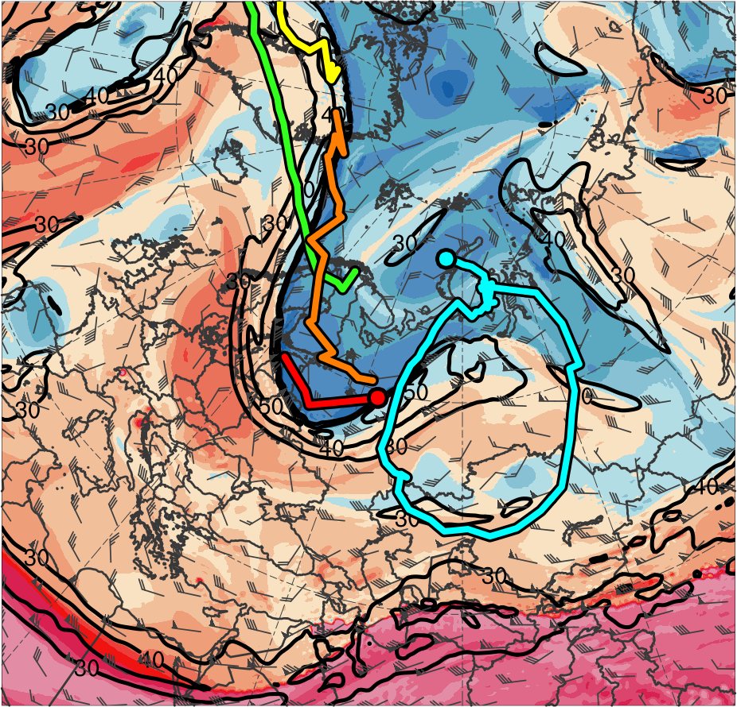
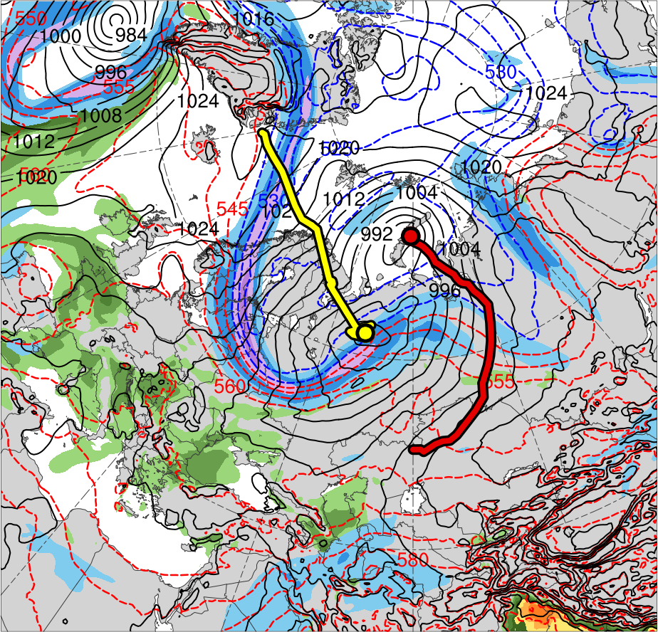
Synoptic Evolution
1200 UTC 5 June 2018
TPV 1a
TPV 2
TPV 3
TPV 1b
TPV 1c
AC1
AC2
(K)
252
258
264
270
276
282
288
294
300
306
312
318
324
330
336
342
348
354
360
366
372
378
(m s⁻¹ )
(mm)
30
40
50
60
70
80
90
100
25
30
35
40
45
50
55
Potential temperature (K, shaded), wind speed (black, every 10 m s⁻¹ starting at 30 m s⁻¹), and wind (m s⁻¹, flags and barbs) on 2-PVU surface
300-hPa wind speed (m s⁻¹, shaded),
1000–500-hPa thickness (dam, blue/red),
SLP (hPa, black), and PW (mm, shaded)

Slide 28
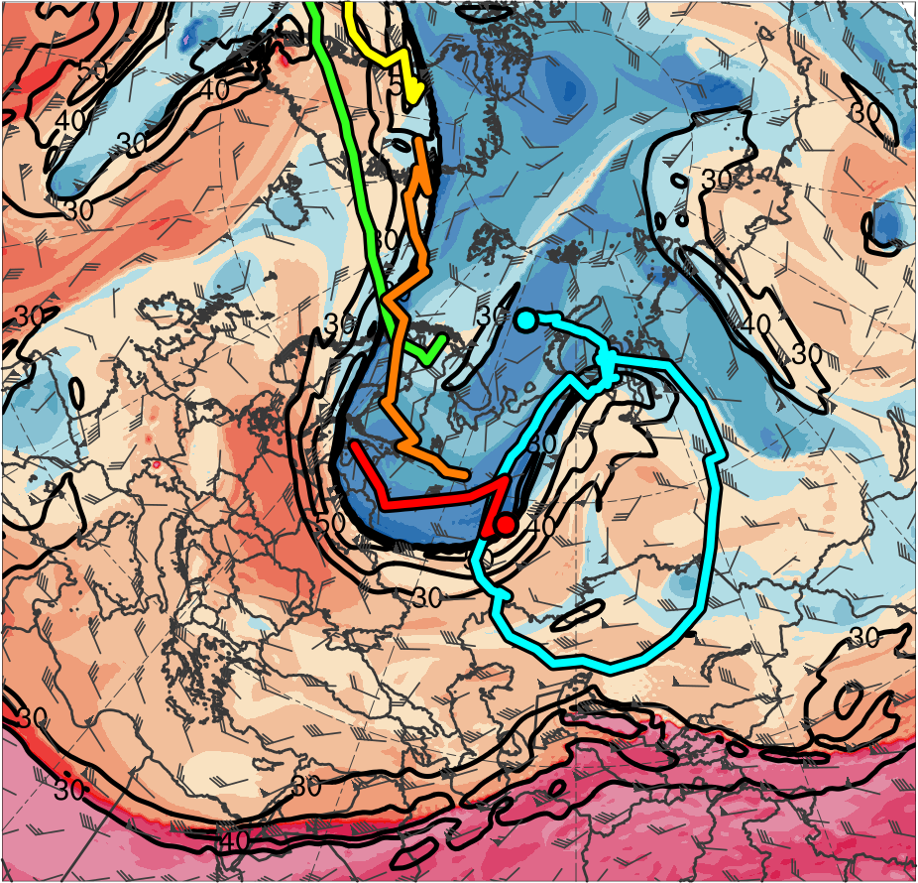
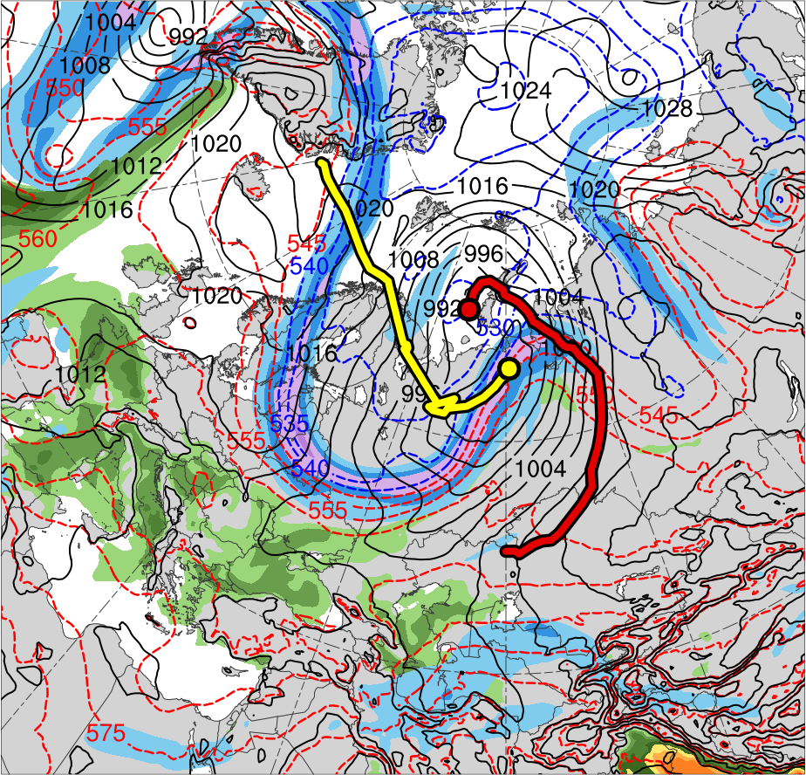
Synoptic Evolution
0000 UTC 6 June 2018
TPV 1a
TPV 2
TPV 3
TPV 1b
TPV 1c
AC1
AC2
(K)
252
258
264
270
276
282
288
294
300
306
312
318
324
330
336
342
348
354
360
366
372
378
(m s⁻¹ )
(mm)
30
40
50
60
70
80
90
100
25
30
35
40
45
50
55
Potential temperature (K, shaded), wind speed (black, every 10 m s⁻¹ starting at 30 m s⁻¹), and wind (m s⁻¹, flags and barbs) on 2-PVU surface
300-hPa wind speed (m s⁻¹, shaded),
1000–500-hPa thickness (dam, blue/red),
SLP (hPa, black), and PW (mm, shaded)

Slide 29
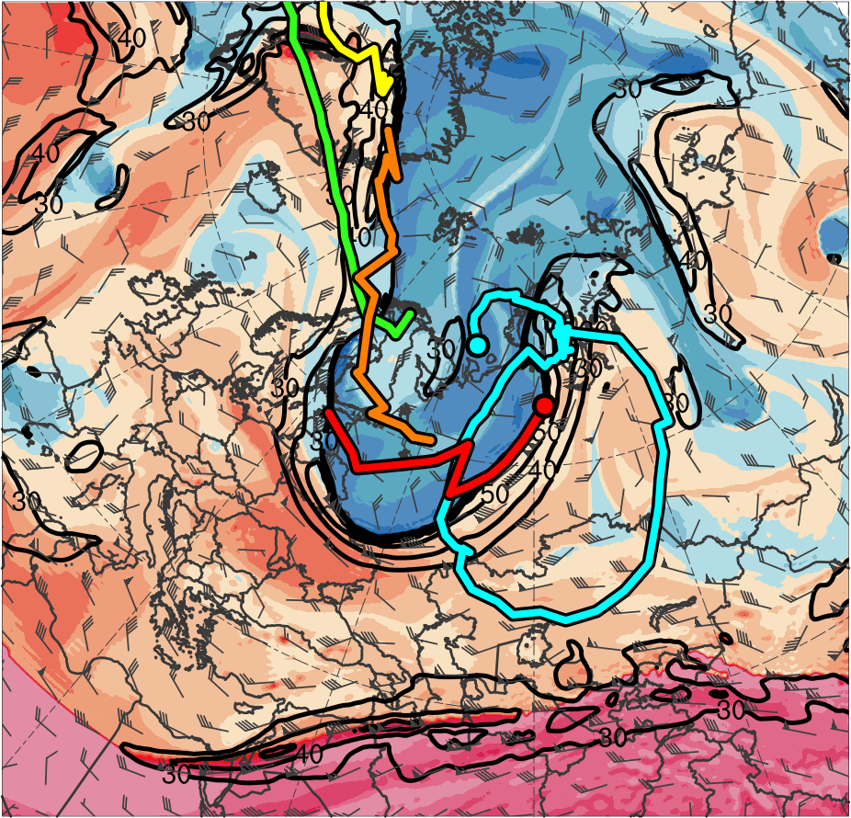
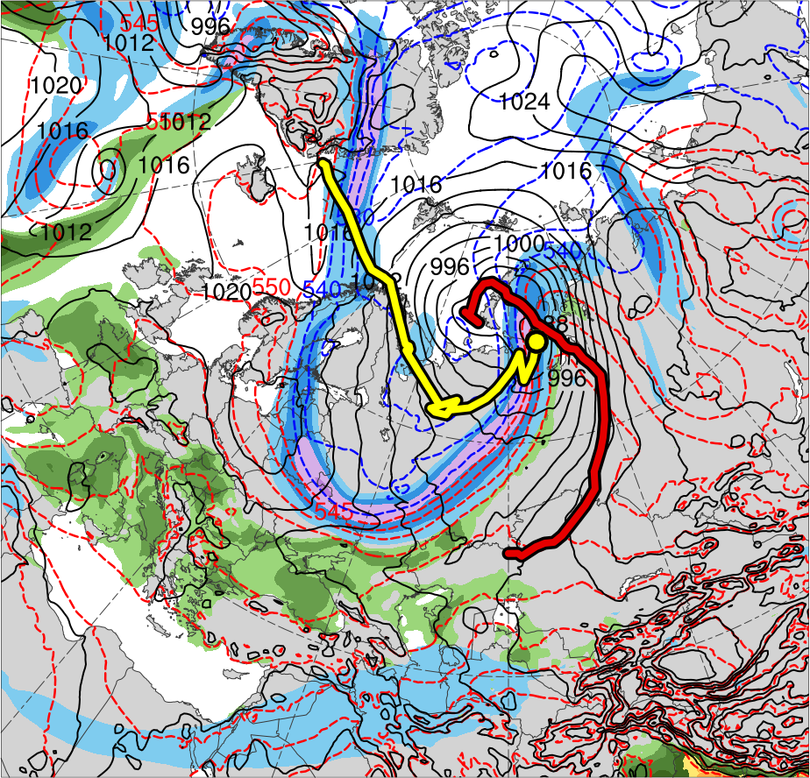
Synoptic Evolution
1200 UTC 6 June 2018
TPV 1a
TPV 2
TPV 3
TPV 1b
TPV 1c
AC1
AC2
(K)
252
258
264
270
276
282
288
294
300
306
312
318
324
330
336
342
348
354
360
366
372
378
(m s⁻¹ )
(mm)
30
40
50
60
70
80
90
100
25
30
35
40
45
50
55
Potential temperature (K, shaded), wind speed (black, every 10 m s⁻¹ starting at 30 m s⁻¹), and wind (m s⁻¹, flags and barbs) on 2-PVU surface
300-hPa wind speed (m s⁻¹, shaded),
1000–500-hPa thickness (dam, blue/red),
SLP (hPa, black), and PW (mm, shaded)

Slide 30
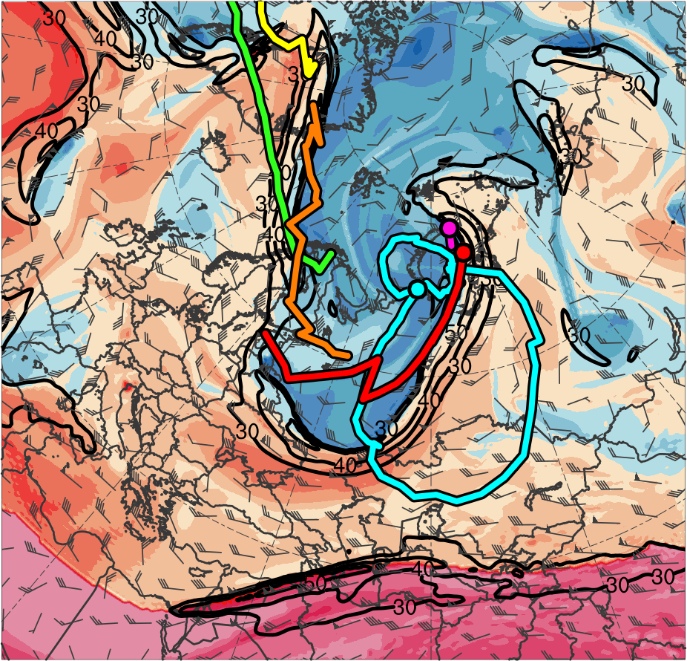
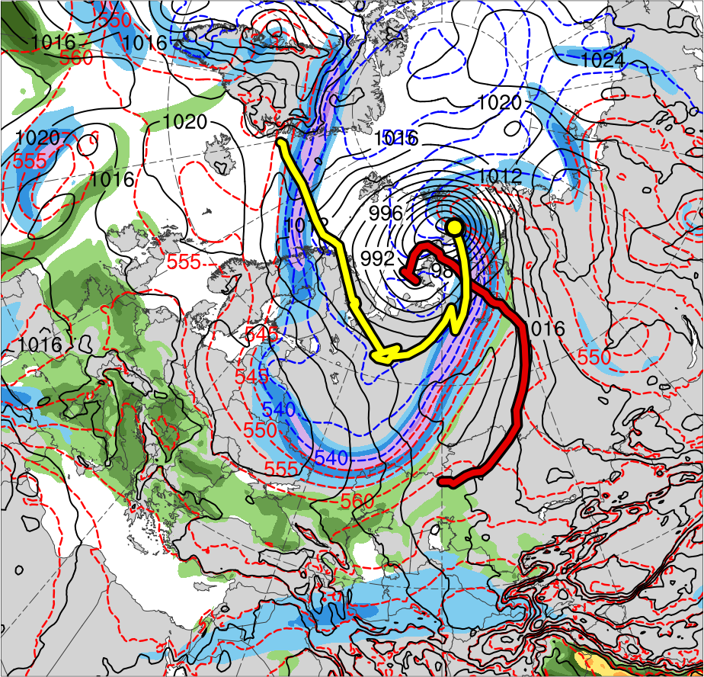
Synoptic Evolution
0000 UTC 7 June 2018
TPV 1a
TPV 2
TPV 3
TPV 1b
TPV 1c
AC1
TPV 1d
AC2
(K)
252
258
264
270
276
282
288
294
300
306
312
318
324
330
336
342
348
354
360
366
372
378
(m s⁻¹ )
(mm)
30
40
50
60
70
80
90
100
25
30
35
40
45
50
55
Potential temperature (K, shaded), wind speed (black, every 10 m s⁻¹ starting at 30 m s⁻¹), and wind (m s⁻¹, flags and barbs) on 2-PVU surface
300-hPa wind speed (m s⁻¹, shaded),
1000–500-hPa thickness (dam, blue/red),
SLP (hPa, black), and PW (mm, shaded)

Slide 31
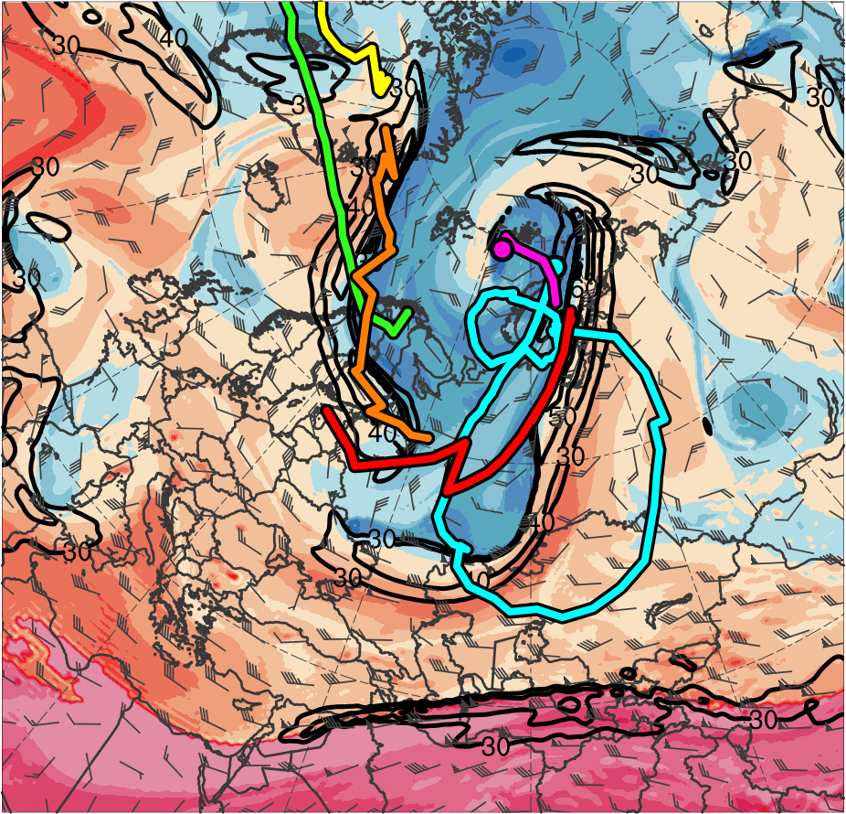

Synoptic Evolution
1200 UTC 7 June 2018
TPV 1a
TPV 2
TPV 3
TPV 1b
TPV 1c
AC1
TPV 1d
AC2
(K)
252
258
264
270
276
282
288
294
300
306
312
318
324
330
336
342
348
354
360
366
372
378
(m s⁻¹ )
(mm)
30
40
50
60
70
80
90
100
25
30
35
40
45
50
55
Potential temperature (K, shaded), wind speed (black, every 10 m s⁻¹ starting at 30 m s⁻¹), and wind (m s⁻¹, flags and barbs) on 2-PVU surface
300-hPa wind speed (m s⁻¹, shaded),
1000–500-hPa thickness (dam, blue/red),
SLP (hPa, black), and PW (mm, shaded)

Slide 32
Conclusions
AC1 forms within a cold frontal trough near the Caspian Sea
AC2 forms in the lee of Greenland along a moisture axis accompanying the remnants of TS Alberto, which previously merged with CL

Slide 33
Conclusions
Both AC1 and AC2 strengthen in a region of strong baroclinicity over western Eurasia ahead of respective high-amplitude upper-level troughs
Upper-level forcing associated with TPVs embedded within the upper-level troughs and baroclinic processes likely foster the strengthening of AC1 and AC2
AC2 interacts with and absorbs AC1, becoming the dominant Arctic cyclone with a peak intensity of 962 hPa (SLP standardized anomaly of < −6 σ)

Slide 34
Questions? Email: kbiernat@albany.edu
Both AC1 and AC2 strengthen in a region of strong baroclinicity over western Eurasia ahead of respective high-amplitude upper-level troughs
Upper-level forcing associated with TPVs embedded within the upper-level troughs and baroclinic processes likely foster the strengthening of AC1 and AC2
AC2 interacts with and absorbs AC1, becoming the dominant Arctic cyclone with a peak intensity of 962 hPa (SLP standardized anomaly of < −6 σ)

