Slide 1
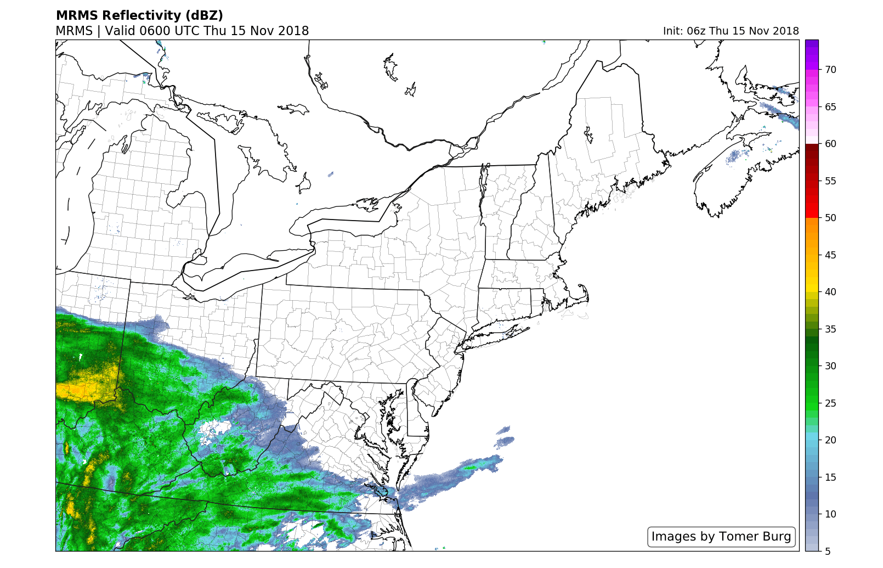
Radar Loop (Tomer Burg)

