Slide 1
A Synoptic Analysis of the Late July–Early August 2019 Major Greenland Ice Melt Event
Scott W. Feldman, Lance F. Bosart, and Daniel Keyser
Department of Atmospheric and Environmental Sciences
University at Albany, State University of New York
45th Annual Northeastern Storm Conference
8 March 2020
Saratoga Springs, NY
Research Supported by ONR Grant N00014-18-1-2200

Slide 2
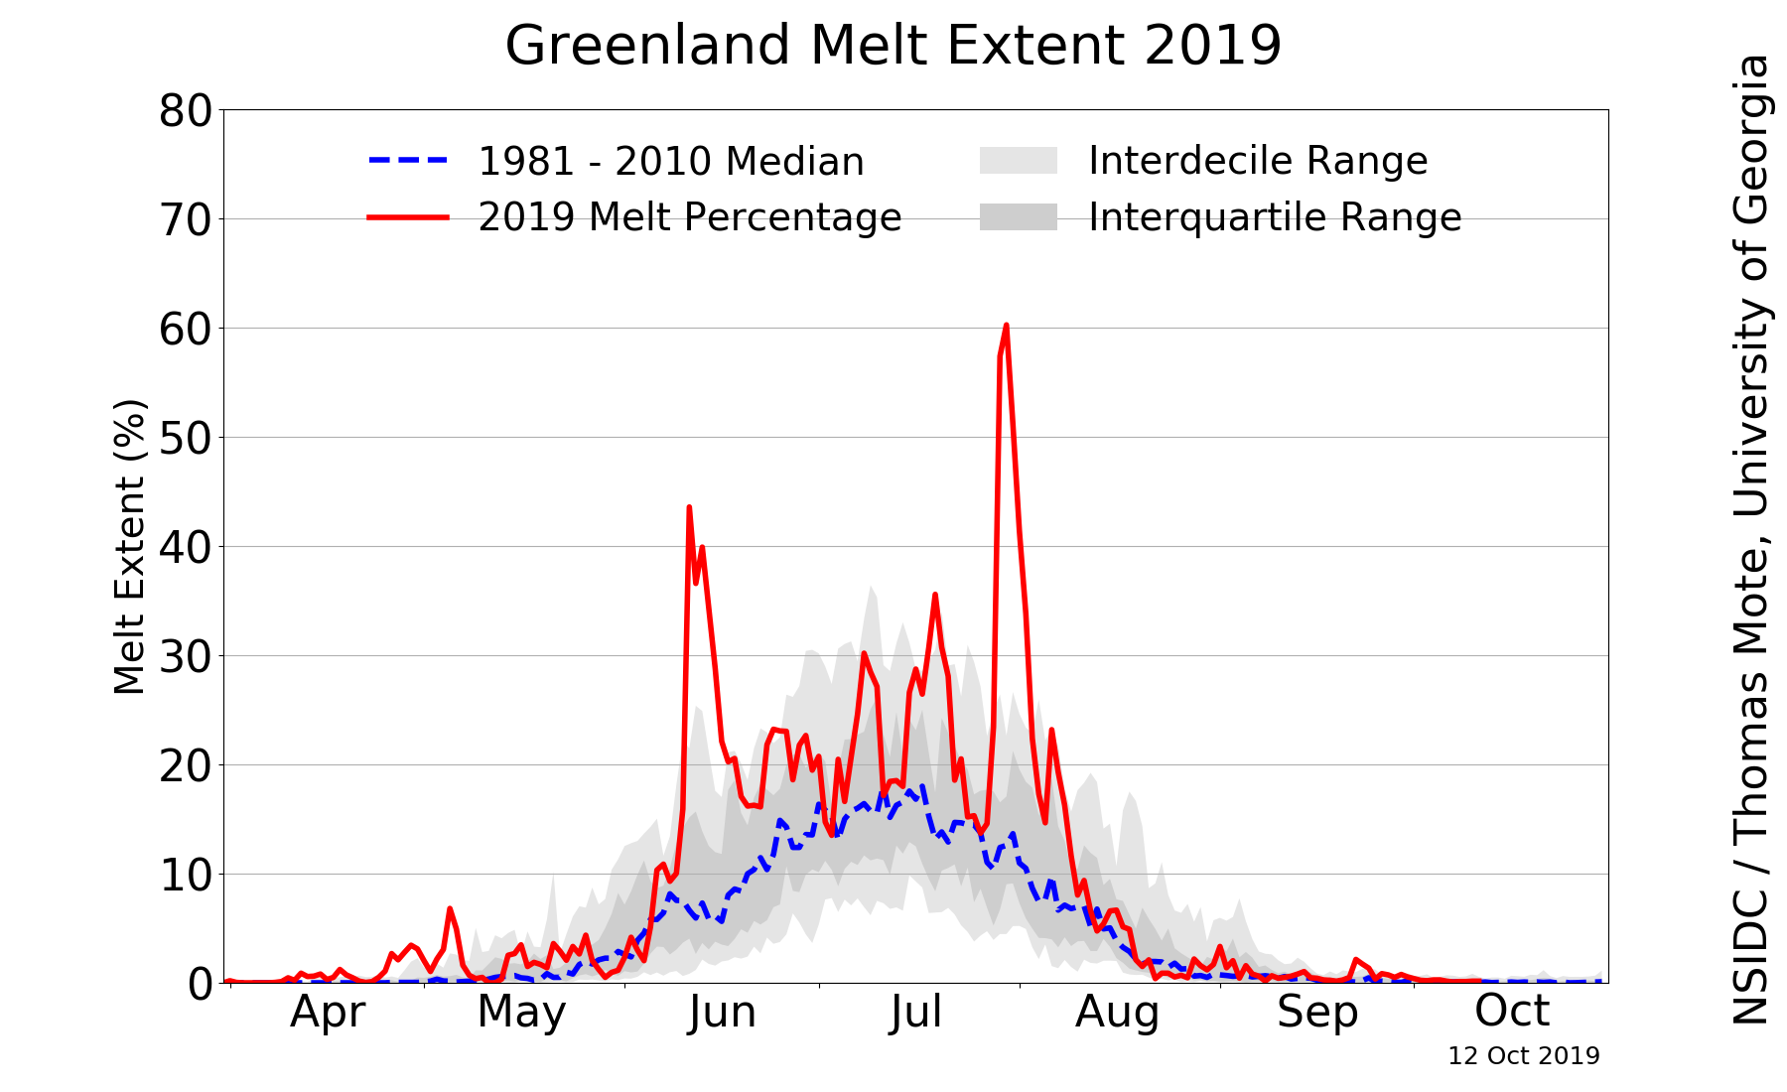
Motivation
Source: NSIDC/Thomas Mote, University of Georgia;
http://nsidc.org/greenland-today/

Slide 3
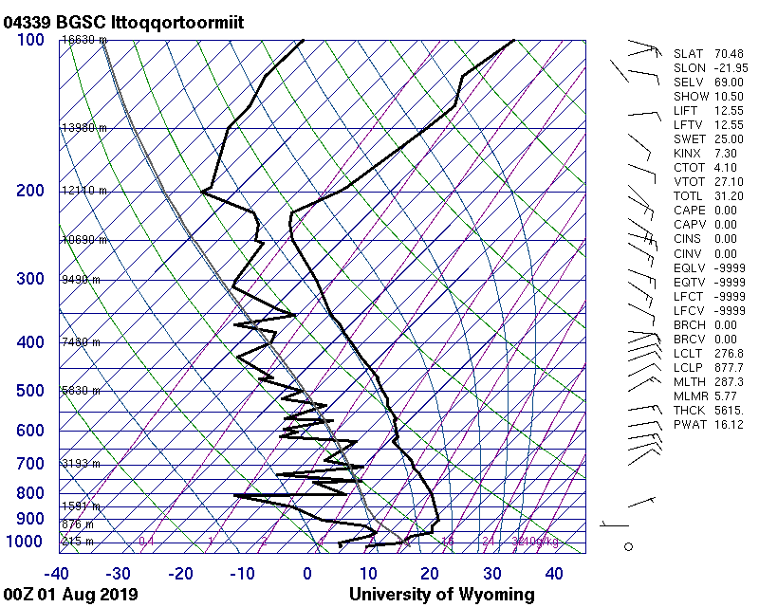
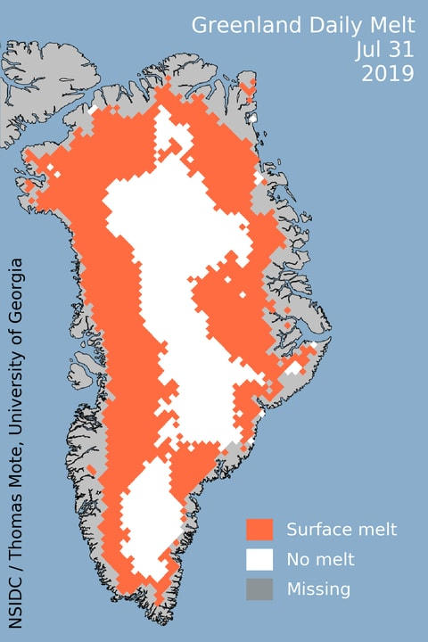
Motivation
Source: University of Wyoming
Notes:
850 mb temperatures as high as 12 degrees Celsius. Warm layer reaching the highest elevations of the ice sheet

Slide 4
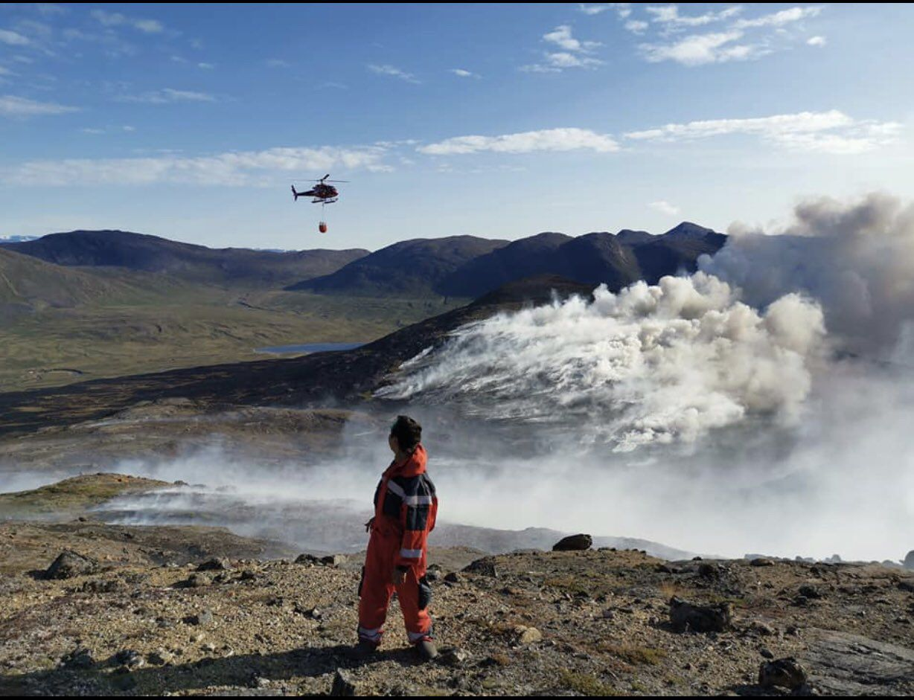
Motivation
“A wildfire burns in western Greenland on July 31, 2019.” (Photo credit: Orla Joelsen). Source: Andrew Freedman and Jason Samenow, Washington Post, 3 August 2019; https://www.washingtonpost.com/weather/2019/08/01/greenland-ice-sheet-poured-billion-tons-water-into-north-atlantic-july-alone/

Slide 5
Purpose
Investigate the antecedent evolution of the large-scale flow pattern that contributed to the record-breaking surface ice melt over Greenland during 31 July–1 August 2019

Slide 6
Data and Methods
Use CFSR gridded analyses at 0.5° resolution (Saha et al. 2010) to illustrate and document the antecedent large-scale flow evolution that governed the Greenland ice melt event
Compute backward trajectories by using NOAA HYSPLIT trajectory model to investigate the origin of anomalously warm air that contributed to the Greenland ice melt event

Slide 7
Case Overview
An upper-level ridge over northwestern Africa extended poleward in response to flow amplification from North America to western Europe
Very warm Saharan air reached western Europe and Scandinavia as the ridge over northwest Africa moved poleward and became a blocking anticyclone over Scandinavia by 26–27 July
The Scandinavian blocking anticyclone shifted westward, transporting very warm air of Saharan origin to Greenland during 31 July–1 August

Slide 8
North America Synoptic Evolution: 20–24 July 2019

Slide 9
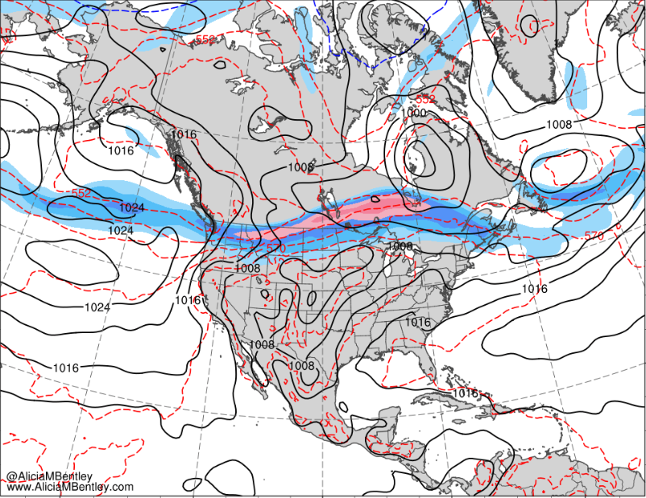
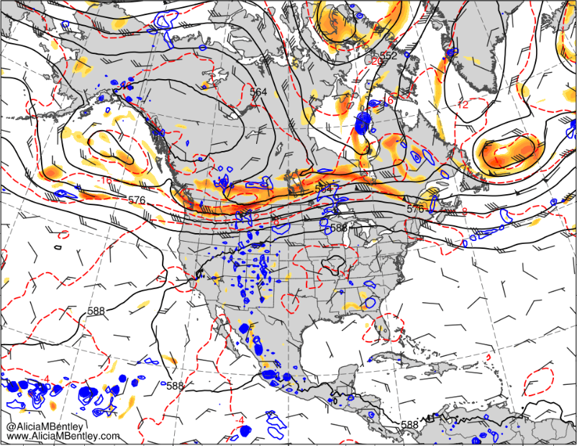
0000 UTC 20 July 2019
30
40
50
60
70
80
90
100
110
m s⁻¹
6
8
10
12
16
20
24
28
10⁻⁵ s⁻¹
MSLP (black, hPa), 1000–500-hPa thickness (red/blue, dam), and 250-hPa wind speed (shaded m s⁻¹)
500-hPa geo. height (dam, black), temp. (K, red), cycl. rel. vort. (10⁻⁵ s⁻¹, shaded), ascent (5 × 10⁻³ hPa s⁻¹, blue), and wind (kt, flags and barbs)

Slide 10
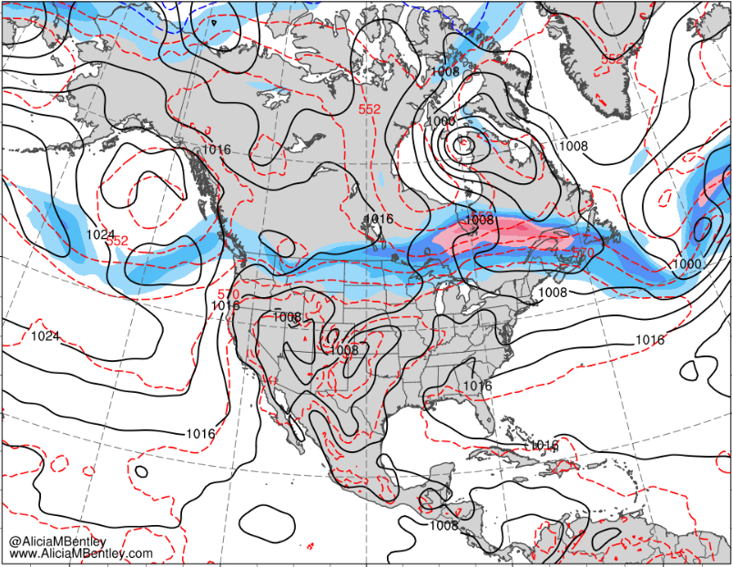
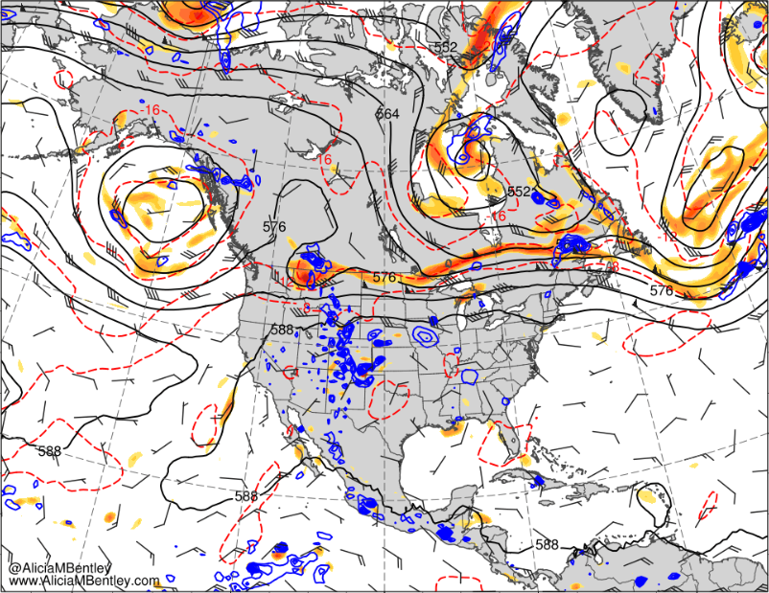
0000 UTC 21 July 2019
30
40
50
60
70
80
90
100
110
m s⁻¹
6
8
10
12
16
20
24
28
10⁻⁵ s⁻¹
MSLP (black, hPa), 1000–500-hPa thickness (red/blue, dam), and 250-hPa wind speed (shaded m s⁻¹)
500-hPa geo. height (dam, black), temp. (K, red), cycl. rel. vort. (10⁻⁵ s⁻¹, shaded), ascent (5 × 10⁻³ hPa s⁻¹, blue), and wind (kt, flags and barbs)

Slide 11
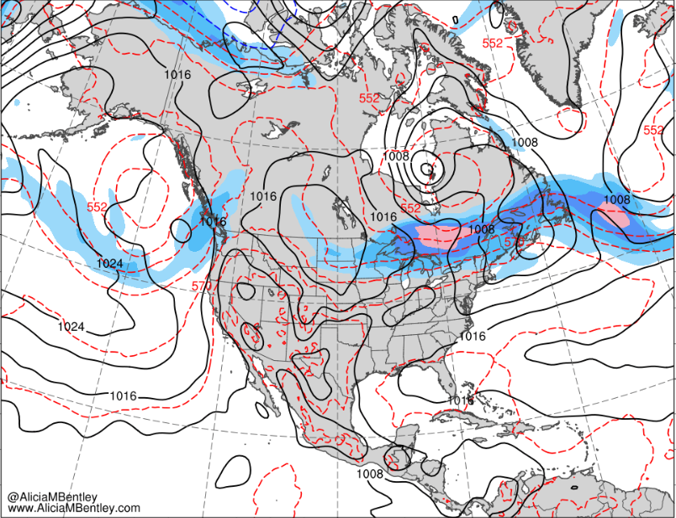
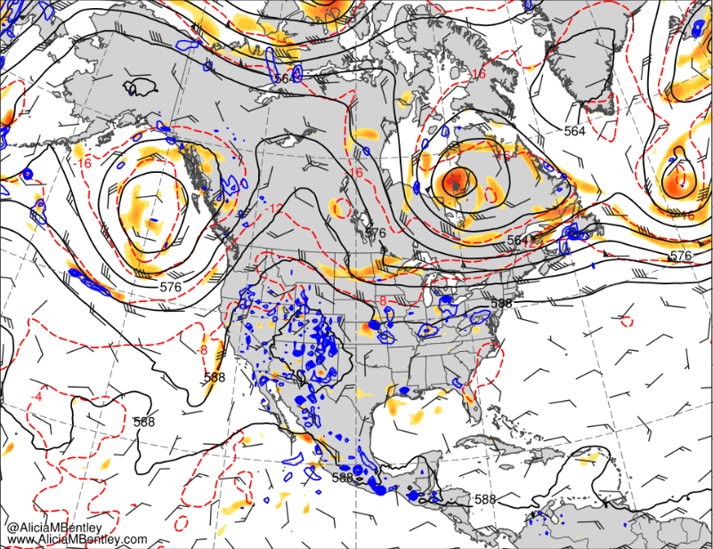
0000 UTC 22 July 2019
30
40
50
60
70
80
90
100
110
m s⁻¹
6
8
10
12
16
20
24
28
10⁻⁵ s⁻¹
MSLP (black, hPa), 1000–500-hPa thickness (red/blue, dam), and 250-hPa wind speed (shaded m s⁻¹)
500-hPa geo. height (dam, black), temp. (K, red), cycl. rel. vort. (10⁻⁵ s⁻¹, shaded), ascent (5 × 10⁻³ hPa s⁻¹, blue), and wind (kt, flags and barbs)

Slide 12
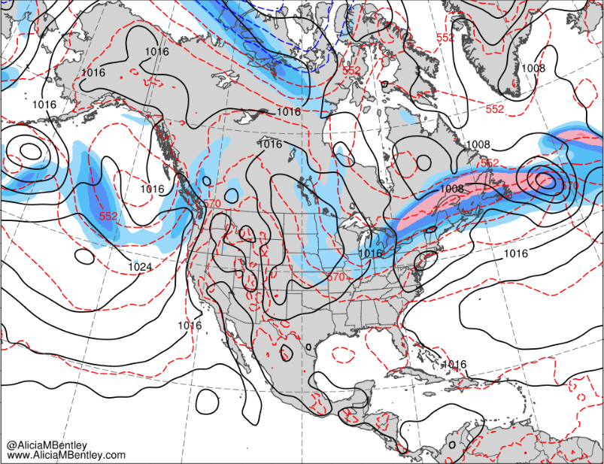
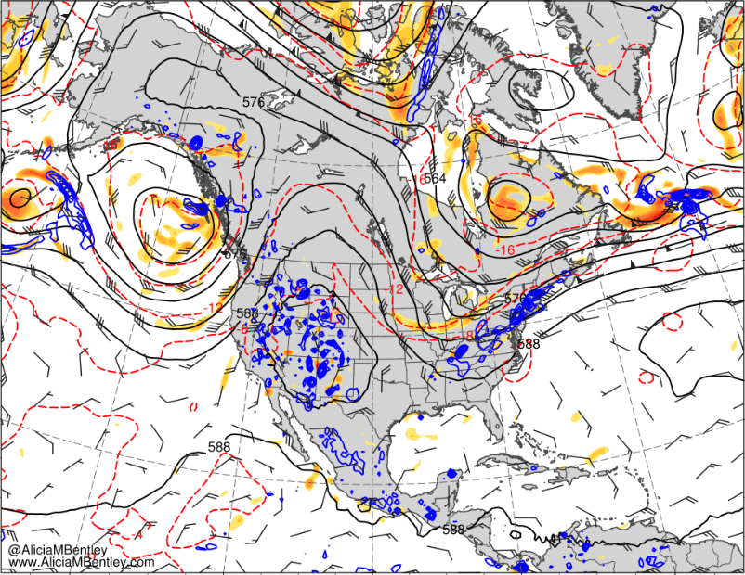
0000 UTC 23 July 2019
30
40
50
60
70
80
90
100
110
m s⁻¹
6
8
10
12
16
20
24
28
10⁻⁵ s⁻¹
MSLP (black, hPa), 1000–500-hPa thickness (red/blue, dam), and 250-hPa wind speed (shaded m s⁻¹)
500-hPa geo. height (dam, black), temp. (K, red), cycl. rel. vort. (10⁻⁵ s⁻¹, shaded), ascent (5 × 10⁻³ hPa s⁻¹, blue), and wind (kt, flags and barbs)

Slide 13
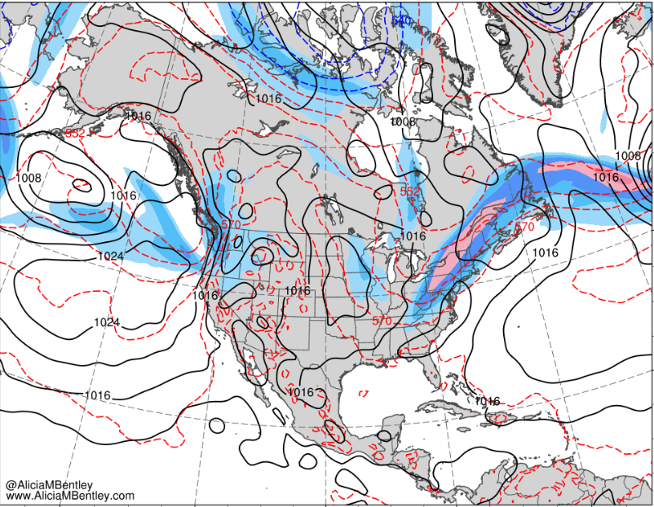
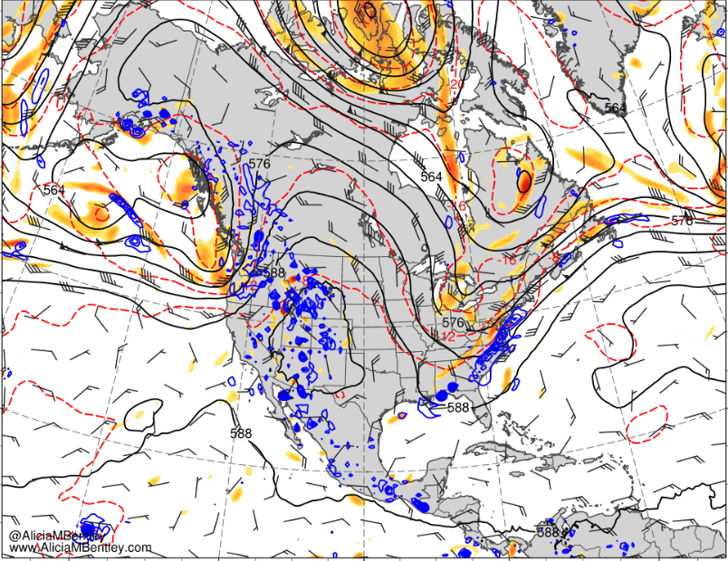
0000 UTC 24 July 2019
30
40
50
60
70
80
90
100
110
m s⁻¹
6
8
10
12
16
20
24
28
10⁻⁵ s⁻¹
MSLP (black, hPa), 1000–500-hPa thickness (red/blue, dam), and 250-hPa wind speed (shaded m s⁻¹)
500-hPa geo. height (dam, black), temp. (K, red), cycl. rel. vort. (10⁻⁵ s⁻¹, shaded), ascent (5 × 10⁻³ hPa s⁻¹, blue), and wind (kt, flags and barbs)

Slide 14
European and Scandinavian Ridge Amplification: 20–25 July 2019

Slide 15
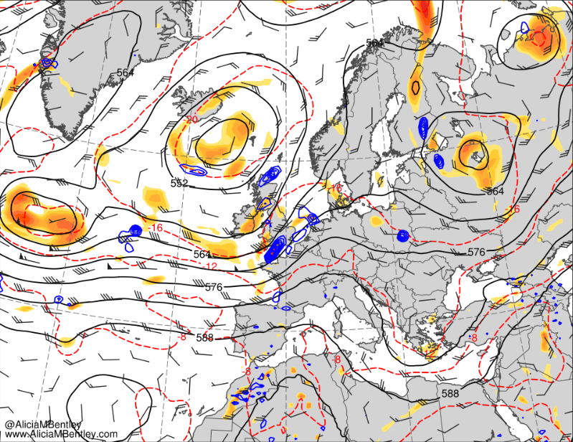
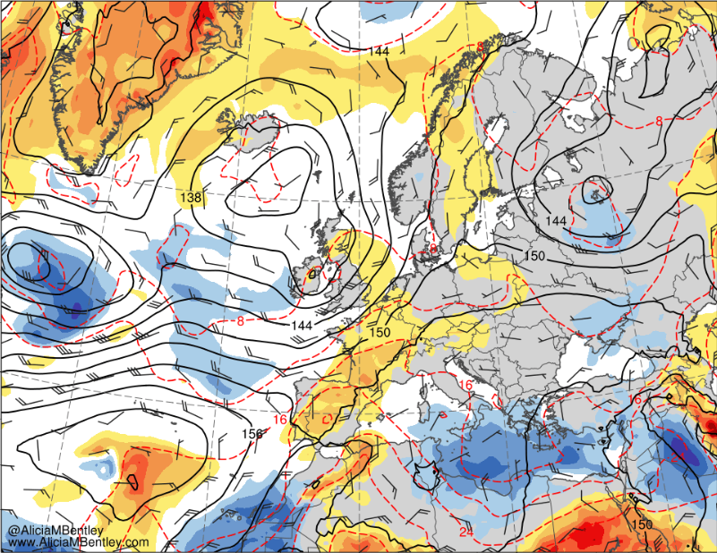
0000 UTC 20 July 2019
6
8
10
12
16
20
24
28
10⁻⁵ s⁻¹
−6
−5
−4
−3
−2.5
−2
−1.5
−1
−0.5
0
0.5
1
1.5
2
2.5
3
4
5
6
σ
500-hPa geo. height (dam, black), temp. (K, red), cycl. rel. vort. (10⁻⁵ s⁻¹, shaded), ascent (5 × 10⁻³ hPa s⁻¹, blue), and wind (kt, flags and barbs)
850-hPa geo. height (dam, black), temp (red, °C), wind (barbs, kts), and standardized temp anomaly (shaded, sigma)
Notes:
strong zonally oriented jet streak over the northern United States enabled a series of short-wave troughs to propagate eastward in conjunction with amplification of the upper-level flow from eastern North America to western Europe during 20–24 July

Slide 16
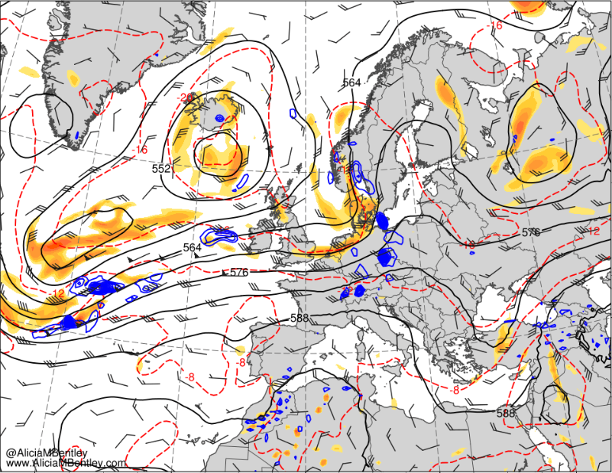
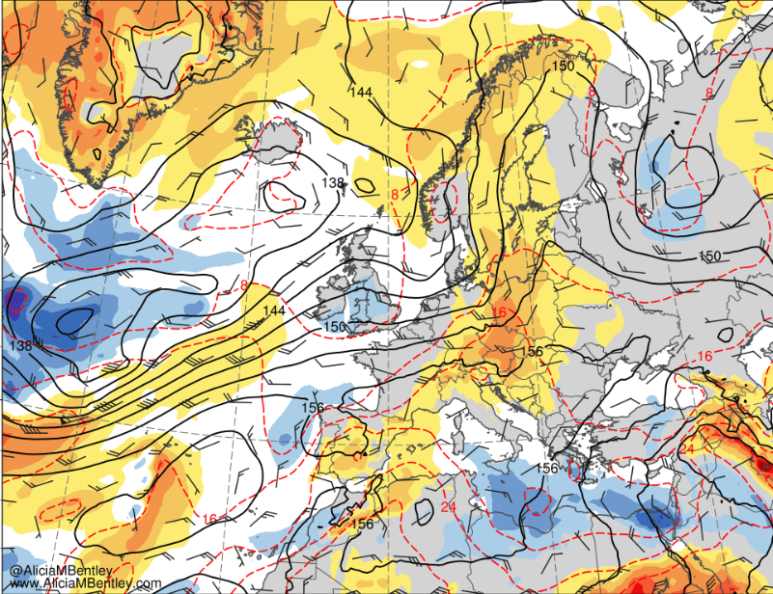
0000 UTC 21 July 2019
6
8
10
12
16
20
24
28
10⁻⁵ s⁻¹
−6
−5
−4
−3
−2.5
−2
−1.5
−1
−0.5
0
0.5
1
1.5
2
2.5
3
4
5
6
σ
500-hPa geo. height (dam, black), temp. (K, red), cycl. rel. vort. (10⁻⁵ s⁻¹, shaded), ascent (5 × 10⁻³ hPa s⁻¹, blue), and wind (kt, flags and barbs)
850-hPa geo. height (dam, black), temp (red, °C), wind (barbs, kts), and standardized temp anomaly (shaded, sigma)

Slide 17
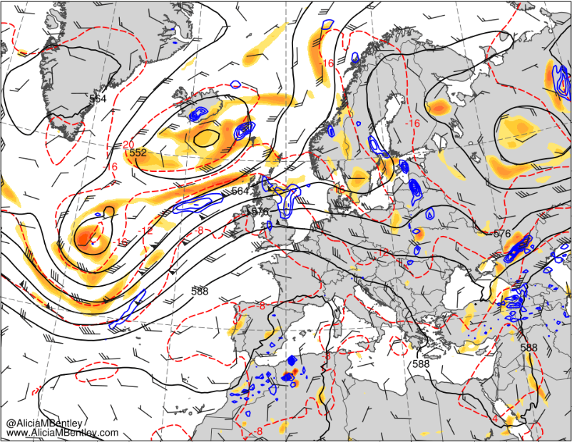
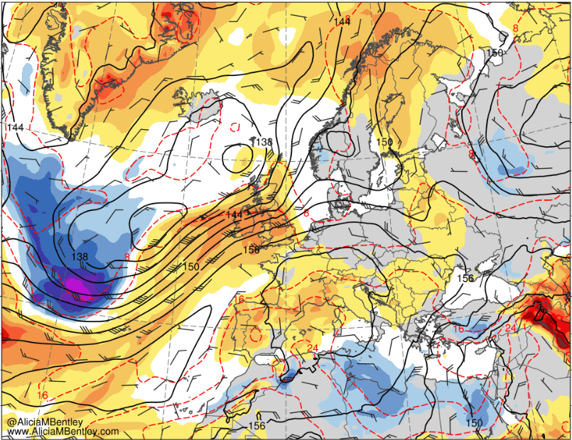
0000 UTC 22 July 2019
6
8
10
12
16
20
24
28
10⁻⁵ s⁻¹
−6
−5
−4
−3
−2.5
−2
−1.5
−1
−0.5
0
0.5
1
1.5
2
2.5
3
4
5
6
σ
500-hPa geo. height (dam, black), temp. (K, red), cycl. rel. vort. (10⁻⁵ s⁻¹, shaded), ascent (5 × 10⁻³ hPa s⁻¹, blue), and wind (kt, flags and barbs)
850-hPa geo. height (dam, black), temp (red, °C), wind (barbs, kts), and standardized temp anomaly (shaded, sigma)

Slide 18
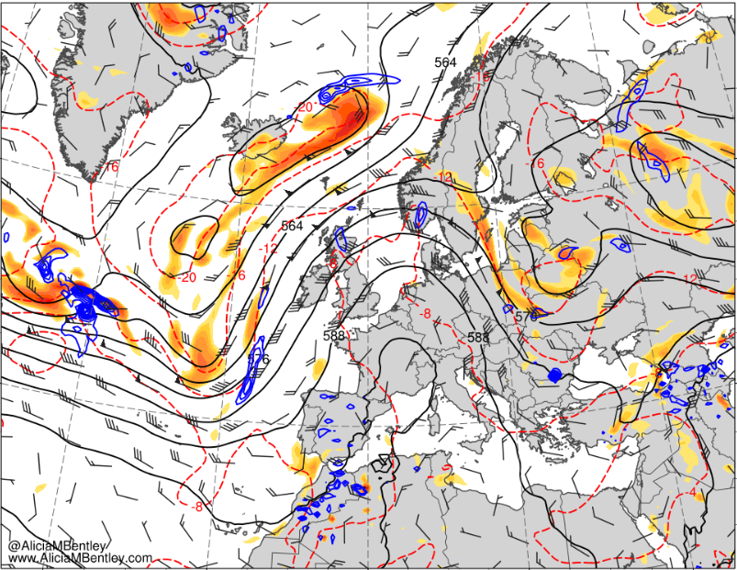
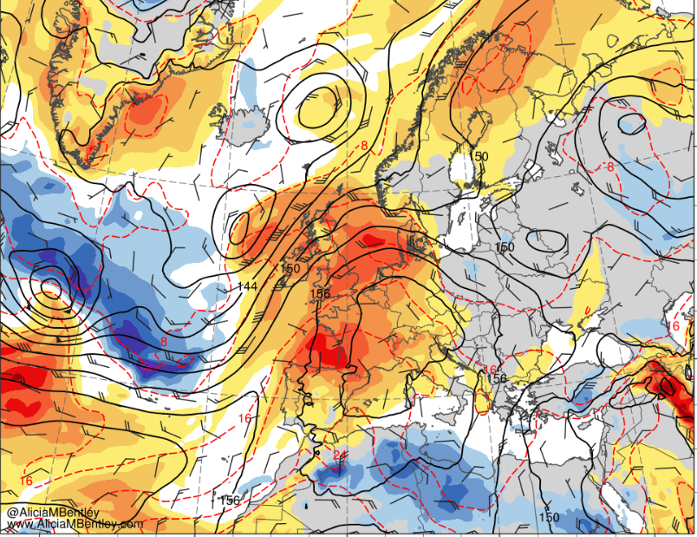
0000 UTC 23 July 2019
6
8
10
12
16
20
24
28
10⁻⁵ s⁻¹
−6
−5
−4
−3
−2.5
−2
−1.5
−1
−0.5
0
0.5
1
1.5
2
2.5
3
4
5
6
σ
500-hPa geo. height (dam, black), temp. (K, red), cycl. rel. vort. (10⁻⁵ s⁻¹, shaded), ascent (5 × 10⁻³ hPa s⁻¹, blue), and wind (kt, flags and barbs)
850-hPa geo. height (dam, black), temp (red, °C), wind (barbs, kts), and standardized temp anomaly (shaded, sigma)

Slide 19
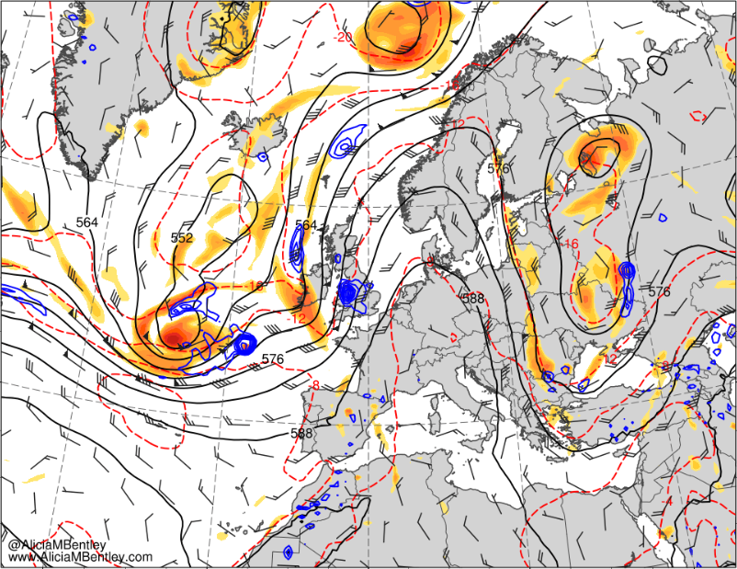
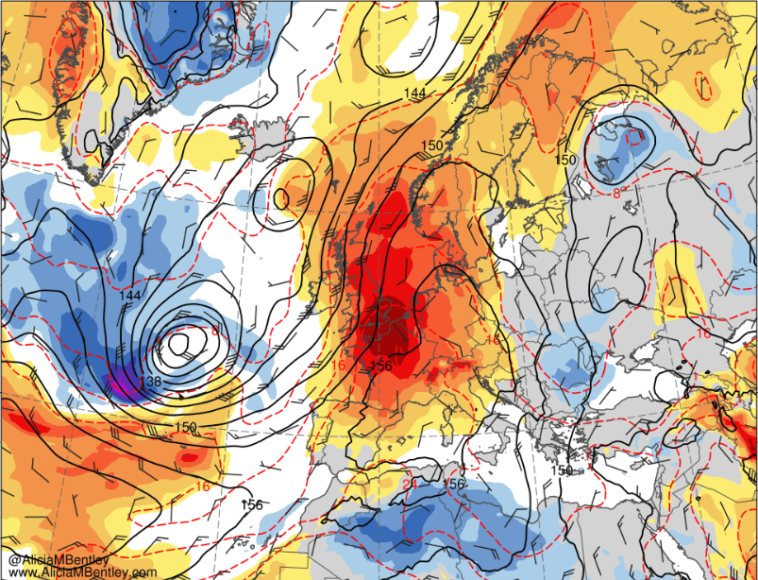
0000 UTC 24 July 2019
6
8
10
12
16
20
24
28
10⁻⁵ s⁻¹
−6
−5
−4
−3
−2.5
−2
−1.5
−1
−0.5
0
0.5
1
1.5
2
2.5
3
4
5
6
σ
500-hPa geo. height (dam, black), temp. (K, red), cycl. rel. vort. (10⁻⁵ s⁻¹, shaded), ascent (5 × 10⁻³ hPa s⁻¹, blue), and wind (kt, flags and barbs)
850-hPa geo. height (dam, black), temp (red, °C), wind (barbs, kts), and standardized temp anomaly (shaded, sigma)

Slide 20
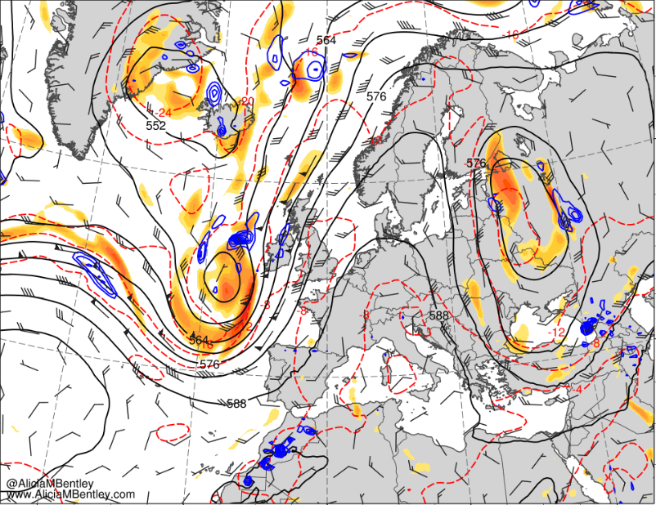
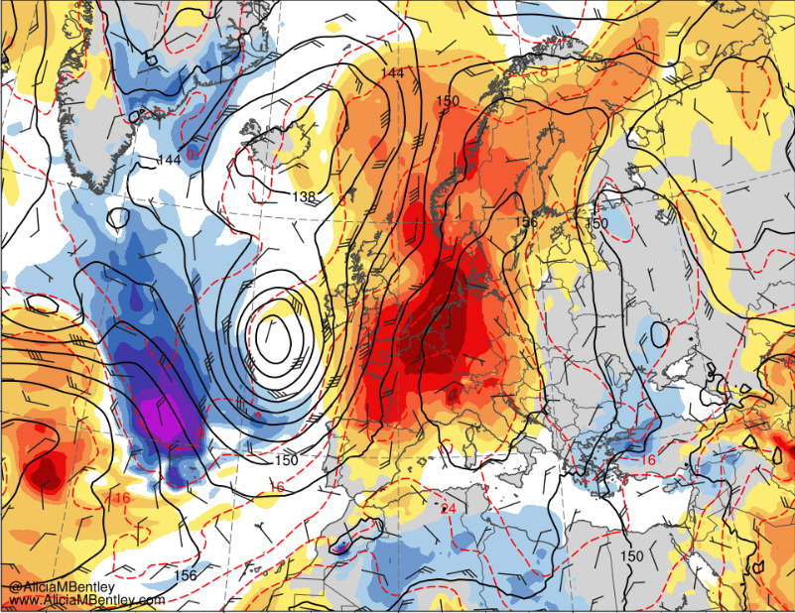
0000 UTC 25 July 2019
6
8
10
12
16
20
24
28
10⁻⁵ s⁻¹
−6
−5
−4
−3
−2.5
−2
−1.5
−1
−0.5
0
0.5
1
1.5
2
2.5
3
4
5
6
σ
500-hPa geo. height (dam, black), temp. (K, red), cycl. rel. vort. (10⁻⁵ s⁻¹, shaded), ascent (5 × 10⁻³ hPa s⁻¹, blue), and wind (kt, flags and barbs)
850-hPa geo. height (dam, black), temp (red, °C), wind (barbs, kts), and standardized temp anomaly (shaded, sigma)

Slide 21
Development and Westward Progression of Scandinavian Blocking Anticyclone: 26 July–1 August 2019

Slide 22
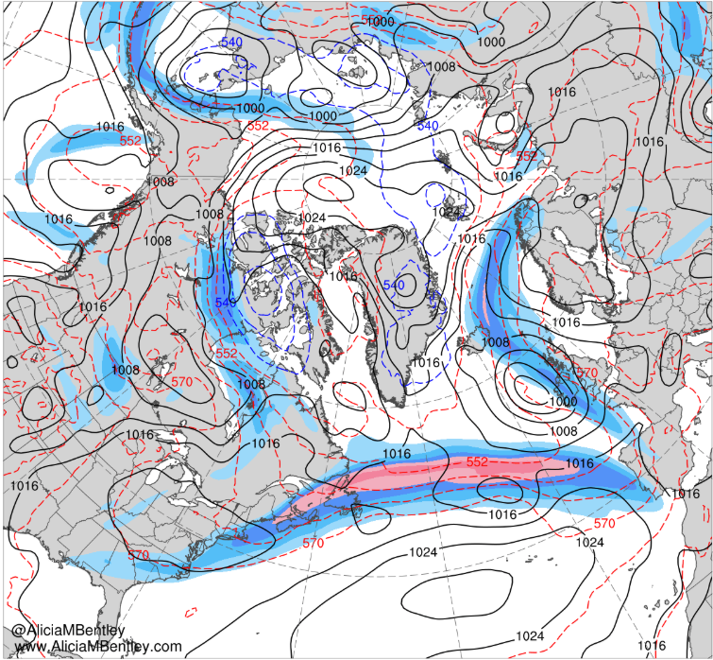
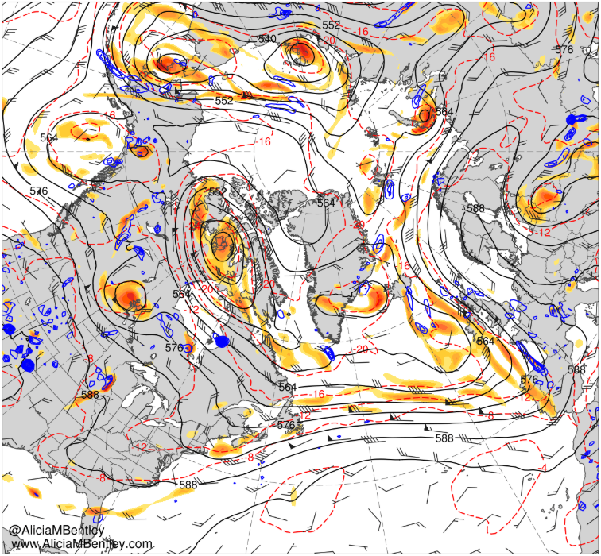
0000 UTC 26 July 2019
30
40
50
60
70
80
90
100
110
m s⁻¹
6
8
10
12
16
20
24
28
10⁻⁵ s⁻¹
MSLP (black, hPa), 1000–500-hPa thickness (red/blue, dam), and 250-hPa wind speed (shaded m s⁻¹)
500-hPa geo. height (dam, black), temp. (K, red), cycl. rel. vort. (10⁻⁵ s⁻¹, shaded), ascent (5 × 10⁻³ hPa s⁻¹, blue), and wind (kt, flags and barbs)

Slide 23
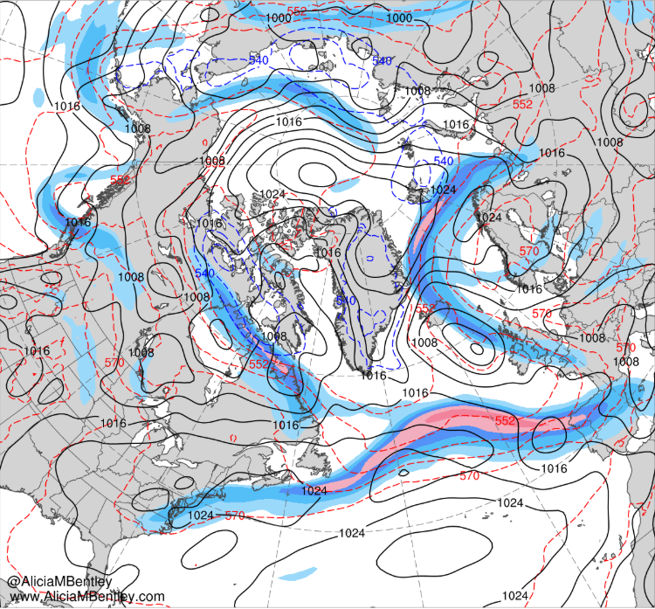
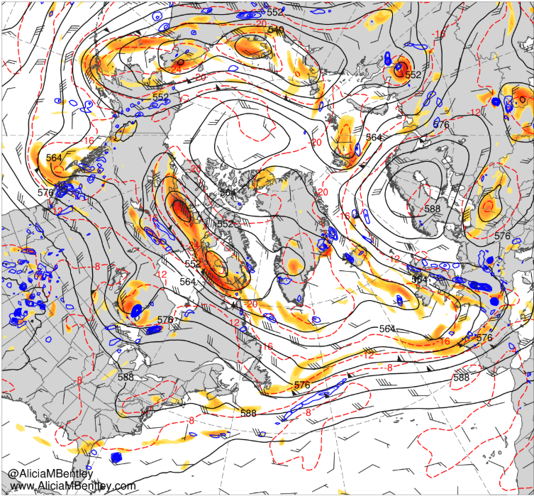
0000 UTC 27 July 2019
30
40
50
60
70
80
90
100
110
m s⁻¹
6
8
10
12
16
20
24
28
10⁻⁵ s⁻¹
MSLP (black, hPa), 1000–500-hPa thickness (red/blue, dam), and 250-hPa wind speed (shaded m s⁻¹)
500-hPa geo. height (dam, black), temp. (K, red), cycl. rel. vort. (10⁻⁵ s⁻¹, shaded), ascent (5 × 10⁻³ hPa s⁻¹, blue), and wind (kt, flags and barbs)

Slide 24
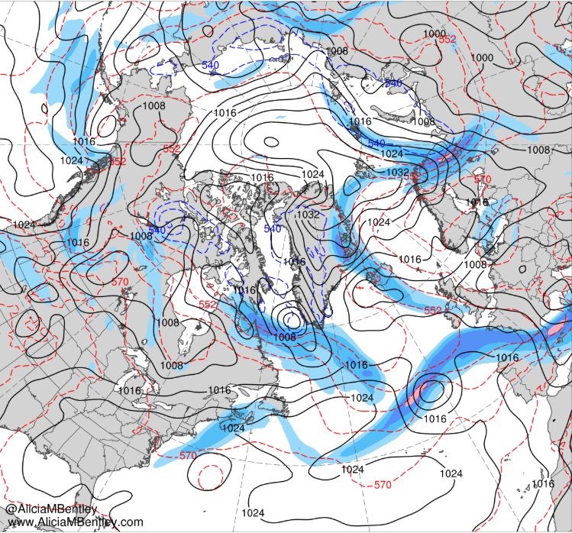
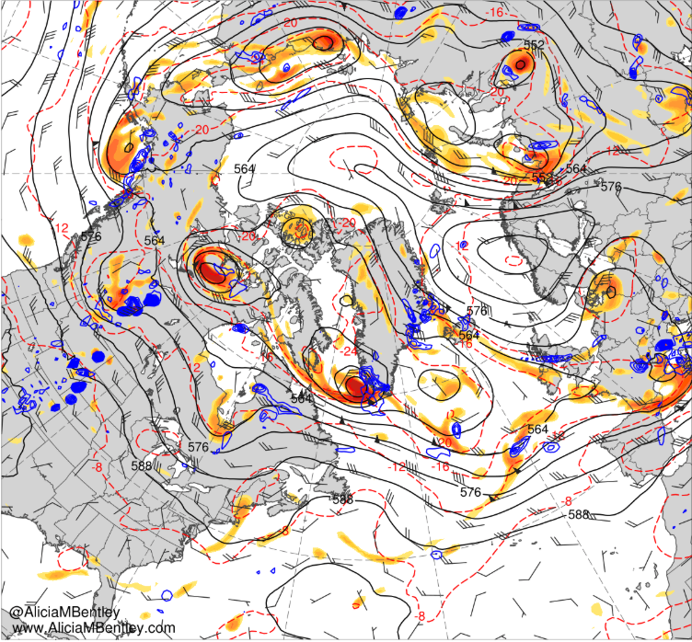
0000 UTC 28 July 2019
30
40
50
60
70
80
90
100
110
m s⁻¹
6
8
10
12
16
20
24
28
10⁻⁵ s⁻¹
MSLP (black, hPa), 1000–500-hPa thickness (red/blue, dam), and 250-hPa wind speed (shaded m s⁻¹)
500-hPa geo. height (dam, black), temp. (K, red), cycl. rel. vort. (10⁻⁵ s⁻¹, shaded), ascent (5 × 10⁻³ hPa s⁻¹, blue), and wind (kt, flags and barbs)

Slide 25
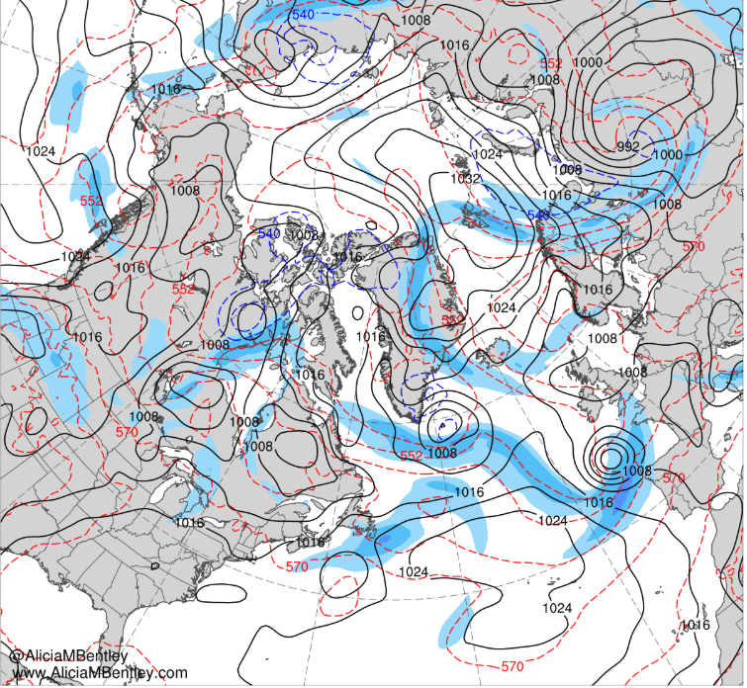
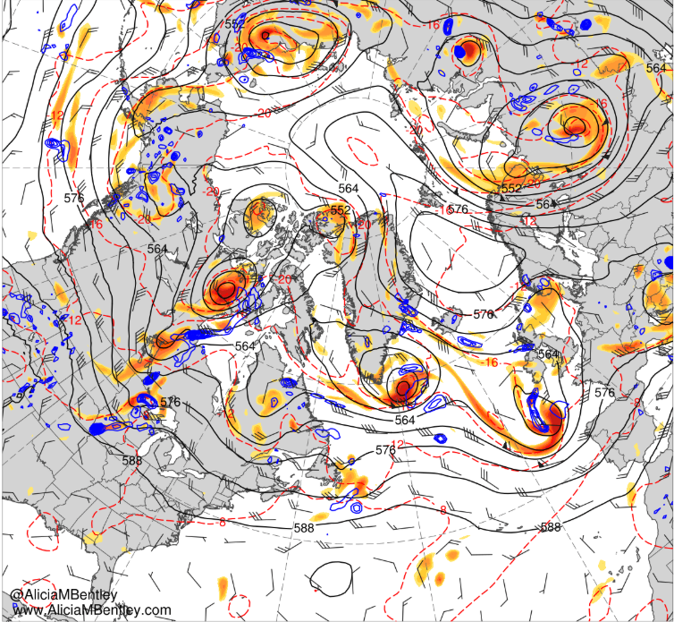
0000 UTC 29 July 2019
30
40
50
60
70
80
90
100
110
m s⁻¹
6
8
10
12
16
20
24
28
10⁻⁵ s⁻¹
MSLP (black, hPa), 1000–500-hPa thickness (red/blue, dam), and 250-hPa wind speed (shaded m s⁻¹)
500-hPa geo. height (dam, black), temp. (K, red), cycl. rel. vort. (10⁻⁵ s⁻¹, shaded), ascent (5 × 10⁻³ hPa s⁻¹, blue), and wind (kt, flags and barbs)

Slide 26
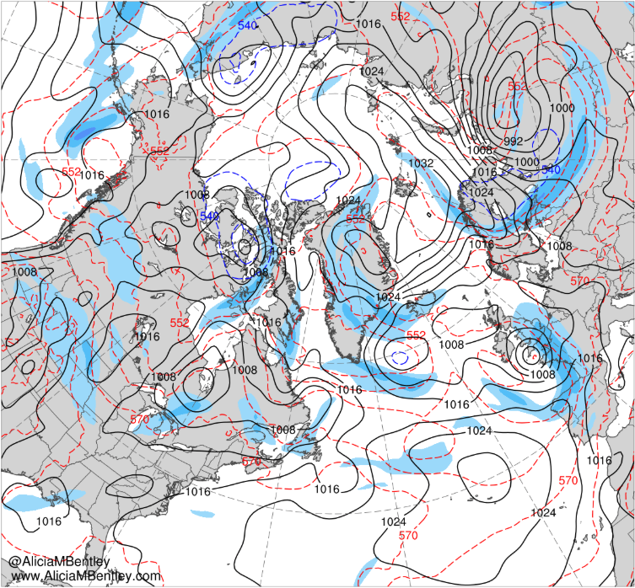
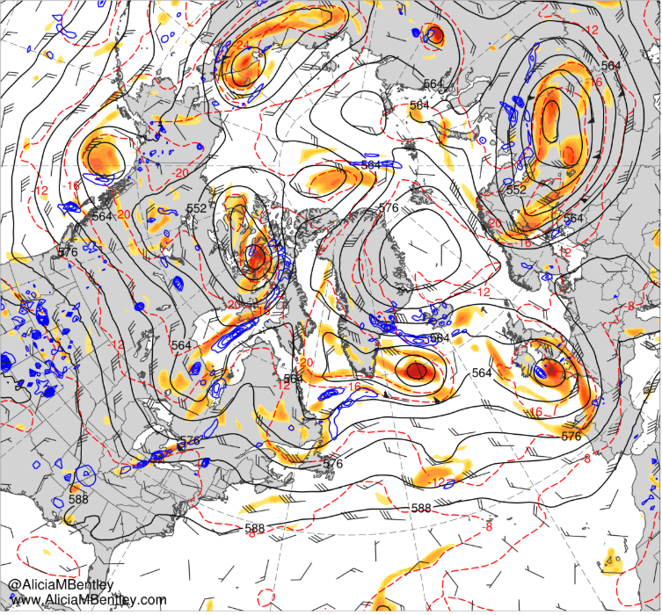
0000 UTC 30 July 2019
30
40
50
60
70
80
90
100
110
m s⁻¹
6
8
10
12
16
20
24
28
10⁻⁵ s⁻¹
MSLP (black, hPa), 1000–500-hPa thickness (red/blue, dam), and 250-hPa wind speed (shaded m s⁻¹)
500-hPa geo. height (dam, black), temp. (K, red), cycl. rel. vort. (10⁻⁵ s⁻¹, shaded), ascent (5 × 10⁻³ hPa s⁻¹, blue), and wind (kt, flags and barbs)

Slide 27
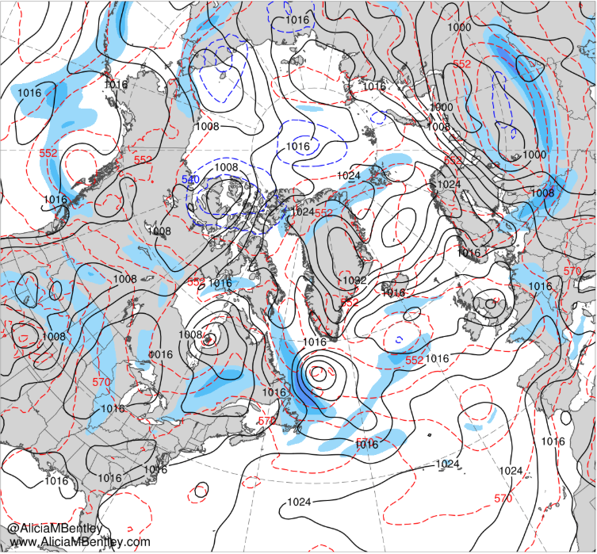
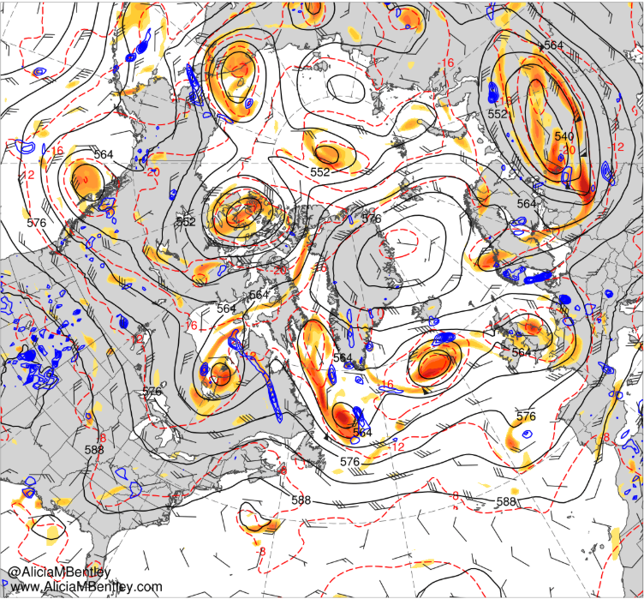
0000 UTC 31 July 2019
30
40
50
60
70
80
90
100
110
m s⁻¹
6
8
10
12
16
20
24
28
10⁻⁵ s⁻¹
MSLP (black, hPa), 1000–500-hPa thickness (red/blue, dam), and 250-hPa wind speed (shaded m s⁻¹)
500-hPa geo. height (dam, black), temp. (K, red), cycl. rel. vort. (10⁻⁵ s⁻¹, shaded), ascent (5 × 10⁻³ hPa s⁻¹, blue), and wind (kt, flags and barbs)

Slide 28
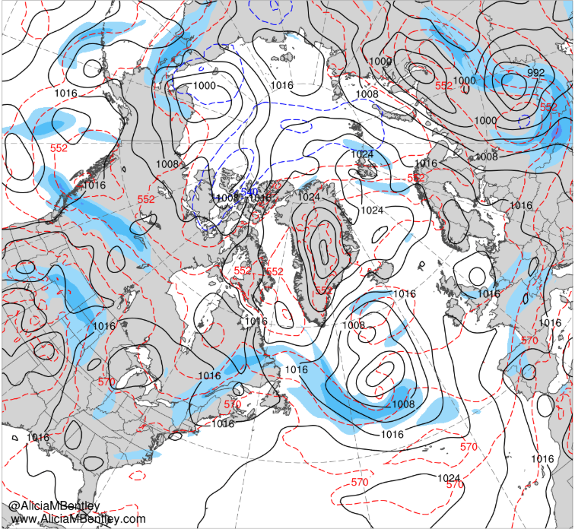
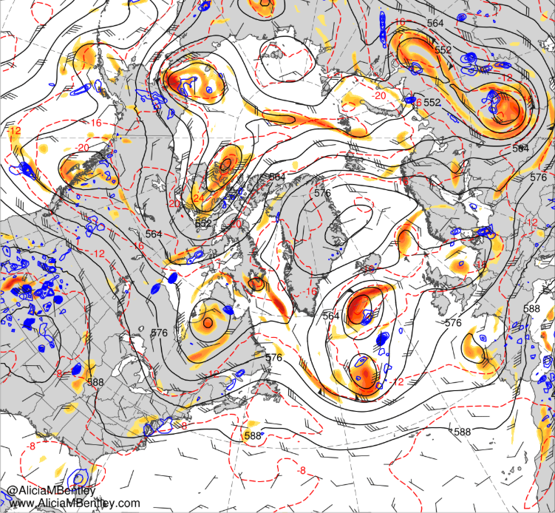
0000 UTC 1 August 2019
30
40
50
60
70
80
90
100
110
m s⁻¹
6
8
10
12
16
20
24
28
10⁻⁵ s⁻¹
MSLP (black, hPa), 1000–500-hPa thickness (red/blue, dam), and 250-hPa wind speed (shaded m s⁻¹)
500-hPa geo. height (dam, black), temp. (K, red), cycl. rel. vort. (10⁻⁵ s⁻¹, shaded), ascent (5 × 10⁻³ hPa s⁻¹, blue), and wind (kt, flags and barbs)

Slide 29
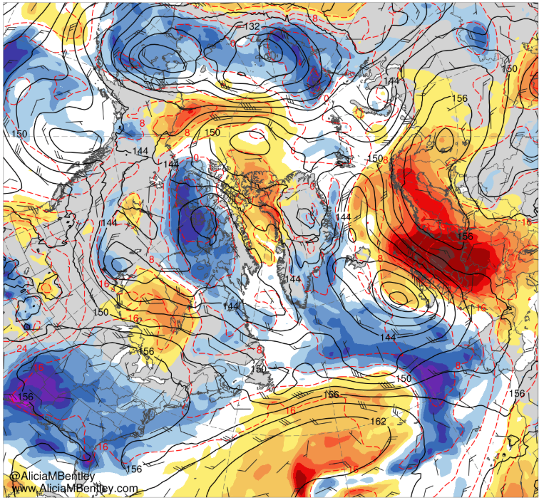
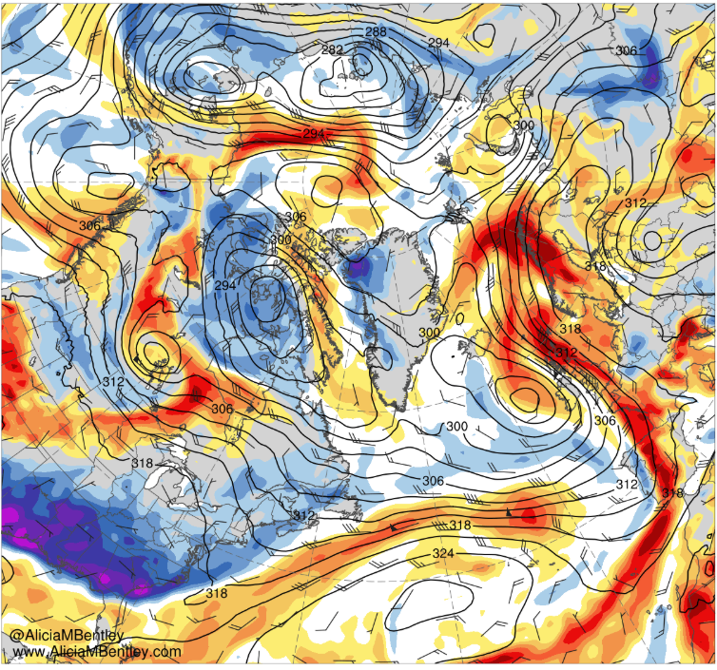
0000 UTC 26 July 2019
−6
−5
−4
−3
−2.5
−2
−1.5
−1
−0.5
0
0.5
1
1.5
2
2.5
3
4
5
6
σ
850-hPa geo. height (dam, black), temp (red, °C), wind (barbs, kts), and standardized temp anomaly (shaded, sigma)
700-hPa geo. height (dam, black) and wind (kt, flags and barbs), and standardized anomalies of PW (σ, shaded)

Slide 30
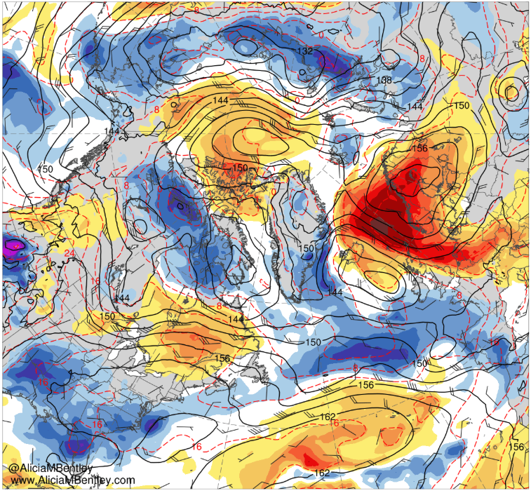
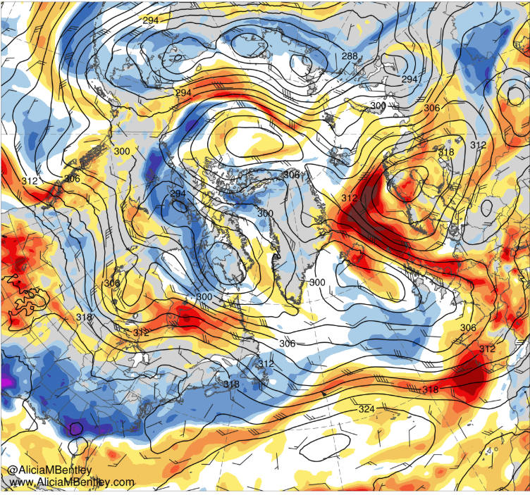
0000 UTC 27 July 2019
−6
−5
−4
−3
−2.5
−2
−1.5
−1
−0.5
0
0.5
1
1.5
2
2.5
3
4
5
6
σ
850-hPa geo. height (dam, black), temp (red, °C), wind (barbs, kts), and standardized temp anomaly (shaded, sigma)
700-hPa geo. height (dam, black) and wind (kt, flags and barbs), and standardized anomalies of PW (σ, shaded)

Slide 31
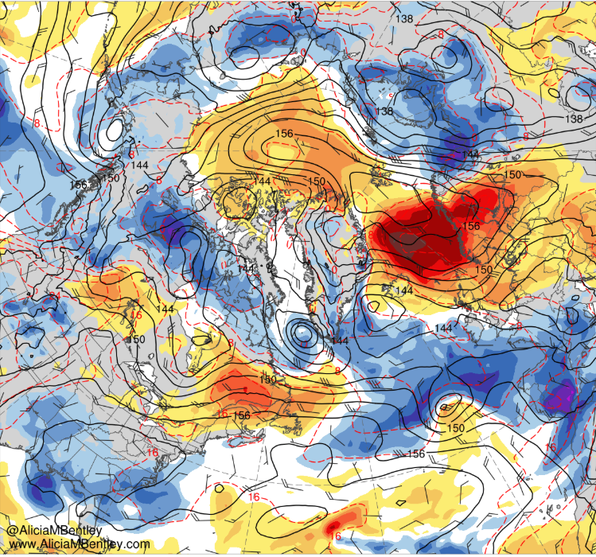
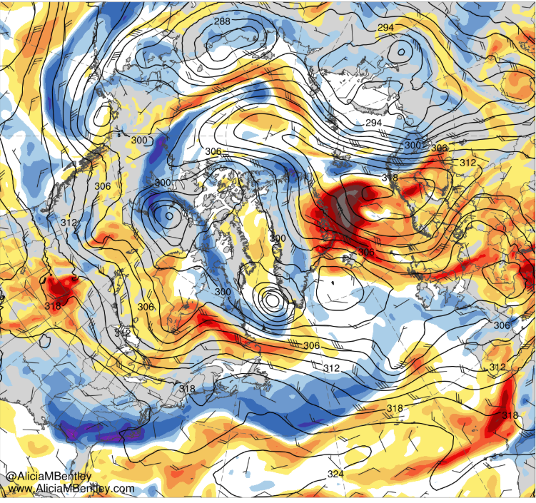
0000 UTC 28 July 2019
−6
−5
−4
−3
−2.5
−2
−1.5
−1
−0.5
0
0.5
1
1.5
2
2.5
3
4
5
6
σ
850-hPa geo. height (dam, black), temp (red, °C), wind (barbs, kts), and standardized temp anomaly (shaded, sigma)
700-hPa geo. height (dam, black) and wind (kt, flags and barbs), and standardized anomalies of PW (σ, shaded)

Slide 32
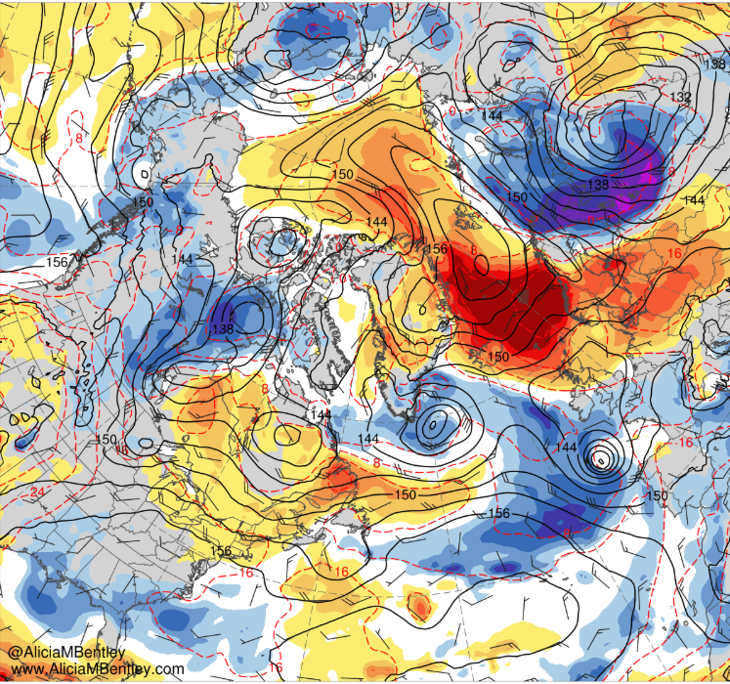
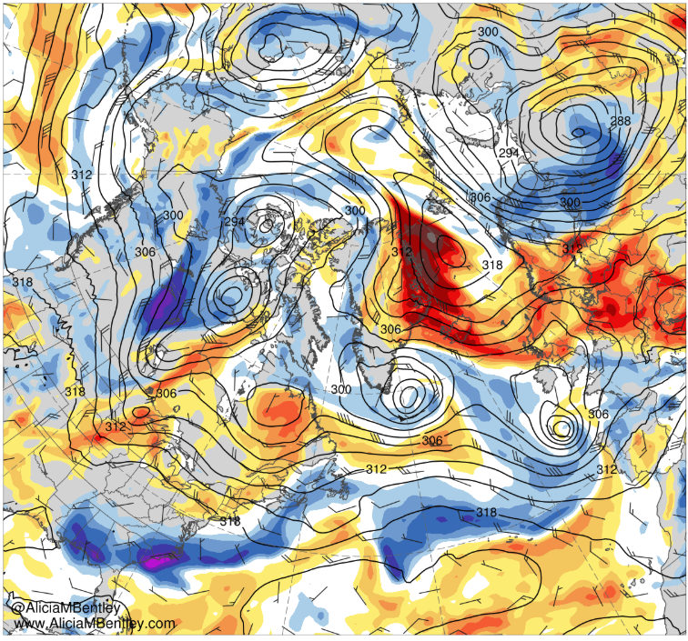
0000 UTC 29 July 2019
−6
−5
−4
−3
−2.5
−2
−1.5
−1
−0.5
0
0.5
1
1.5
2
2.5
3
4
5
6
σ
850-hPa geo. height (dam, black), temp (red, °C), wind (barbs, kts), and standardized temp anomaly (shaded, sigma)
700-hPa geo. height (dam, black) and wind (kt, flags and barbs), and standardized anomalies of PW (σ, shaded)

Slide 33
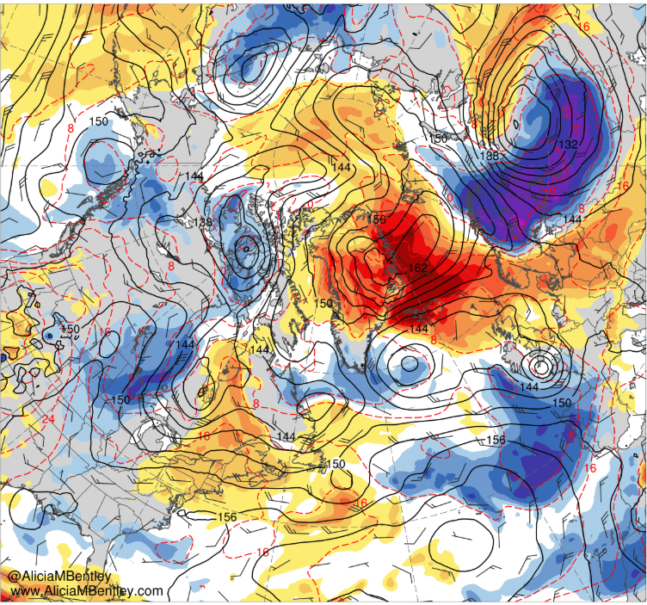
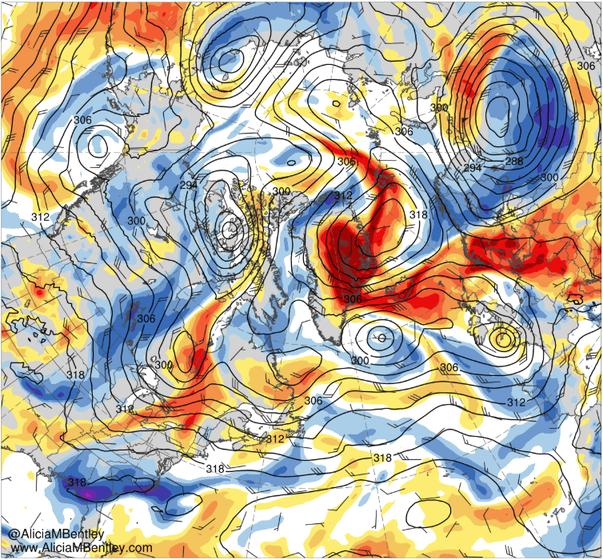
0000 UTC 30 July 2019
−6
−5
−4
−3
−2.5
−2
−1.5
−1
−0.5
0
0.5
1
1.5
2
2.5
3
4
5
6
σ
850-hPa geo. height (dam, black), temp (red, °C), wind (barbs, kts), and standardized temp anomaly (shaded, sigma)
700-hPa geo. height (dam, black) and wind (kt, flags and barbs), and standardized anomalies of PW (σ, shaded)

Slide 34
0000 UTC 31 July 2019
−6
−5
−4
−3
−2.5
−2
−1.5
−1
−0.5
0
0.5
1
1.5
2
2.5
3
4
5
6
σ
850-hPa geo. height (dam, black), temp (red, °C), wind (barbs, kts), and standardized temp anomaly (shaded, sigma)
700-hPa geo. height (dam, black) and wind (kt, flags and barbs), and standardized anomalies of PW (σ, shaded)

Slide 35
0000 UTC 1 August 2019
−6
−5
−4
−3
−2.5
−2
−1.5
−1
−0.5
0
0.5
1
1.5
2
2.5
3
4
5
6
σ
850-hPa geo. height (dam, black), temp (red, °C), wind (barbs, kts), and standardized temp anomaly (shaded, sigma)
700-hPa geo. height (dam, black) and wind (kt, flags and barbs), and standardized anomalies of PW (σ, shaded)

Slide 36
Trajectories
NOAA HYSPLIT backward trajectories ending at
(left) 1900 UTC 28 July 2019 and (right) 0000 UTC 1 August 2019

Slide 37
Summary
A strong jet streak over the northern United States enabled a series of short-wave troughs to propagate eastward from eastern North America toward western Europe
A progressive short-wave trough over the western North Atlantic became increasingly negatively tilted as it approached the eastern North Atlantic
The progressive short-wave trough helped facilitate downstream ridge amplification from northwest Africa to western Europe

Slide 38
Summary
The aforementioned ridge amplification resulted in the development of a Scandinavian blocking anticyclone
As the blocking anticyclone moved westward, anomalously warm and moist air was advected towards Greenland

