Slide 1
An Examination of Low-Skill Arctic Cyclones During Summer
Kevin Biernat, Lance Bosart, and Dan Keyser
Department of Atmospheric and Environmental Sciences
University at Albany, State University of New York
Friday 26 February 2021
ONR Arctic Cyclone DRI Meeting
Research Supported by ONR Grant N00014-18-1-2200

Slide 2
Overview
Identify periods of low and high forecast skill of the synoptic-scale flow over the Arctic and low-skill Arctic cyclones (ACs) occurring during these periods.
Examine dynamical and thermodynamic quantities characterizing the Arctic environment and low-skill ACs during low-skill and high-skill periods.
Conduct AC-centered composite analyses of intense low-skill ACs during low-skill periods to identify features and processes governing the evolution of these ACs.

Slide 3
Arctic forecast skill evaluation
Utilize day-5 forecasts of 500-hPa geopotential height initialized at 0000 UTC during June, July, and August of 2007–2017 from 11-member 1° GEFS reforecast dataset v2 (Hamill et al. 2013).
Calculate area-averaged root mean square error (RMSE) of 500-hPa geopotential height over the Arctic, using ERA-Interim as verification.
Calculate standardized anomaly of area-averaged RMSE (σ_{RMSE}).

Slide 4
Arctic forecast skill evaluation
Refer to forecast days valid at day 5 associated with the top and bottom 10% of σ_{RMSE} as low-skill days and high-skill days, respectively.
Refer to forecasts initialized 5 days prior to low-skill days and high-skill days as low-skill forecasts and high-skill forecasts, respectively.
Refer to time periods through day 5 encompassed by low-skill forecasts and high-skill forecasts as low-skill periods and high-skill periods, respectively.

Slide 5
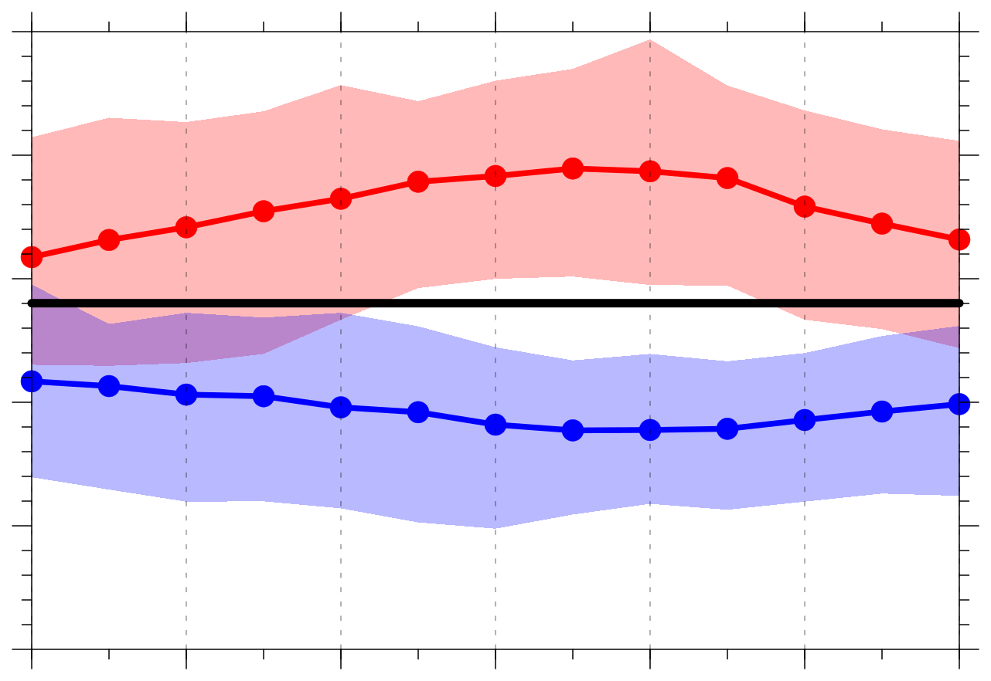
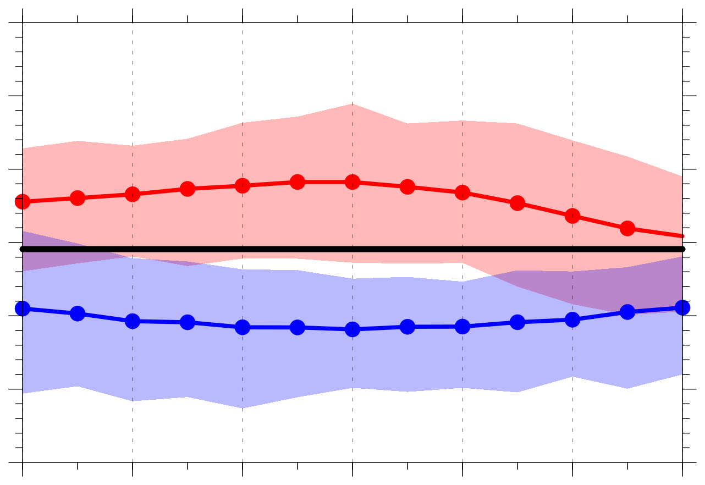
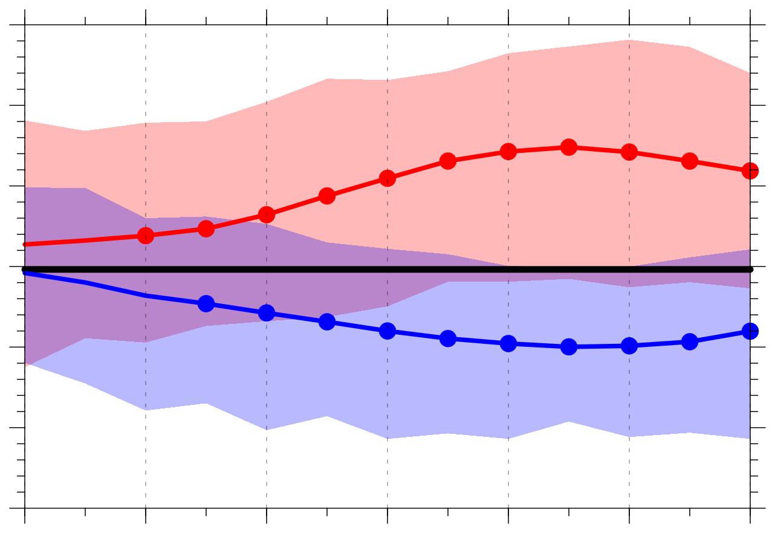
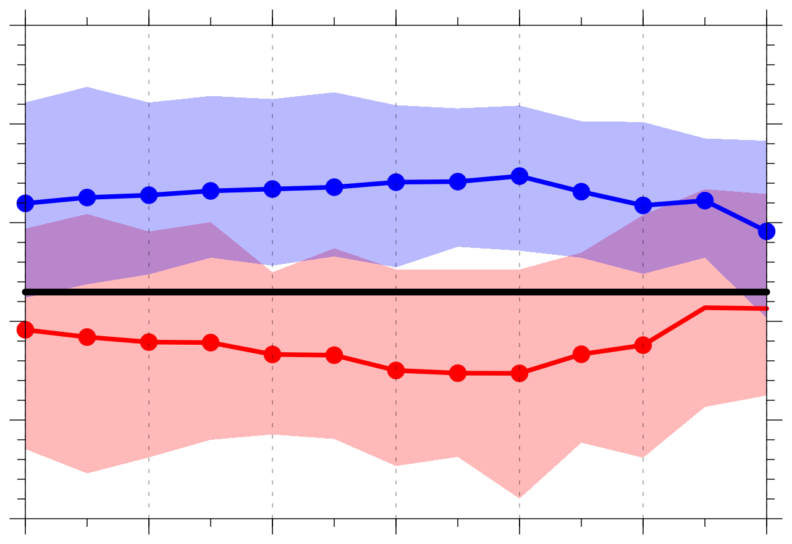
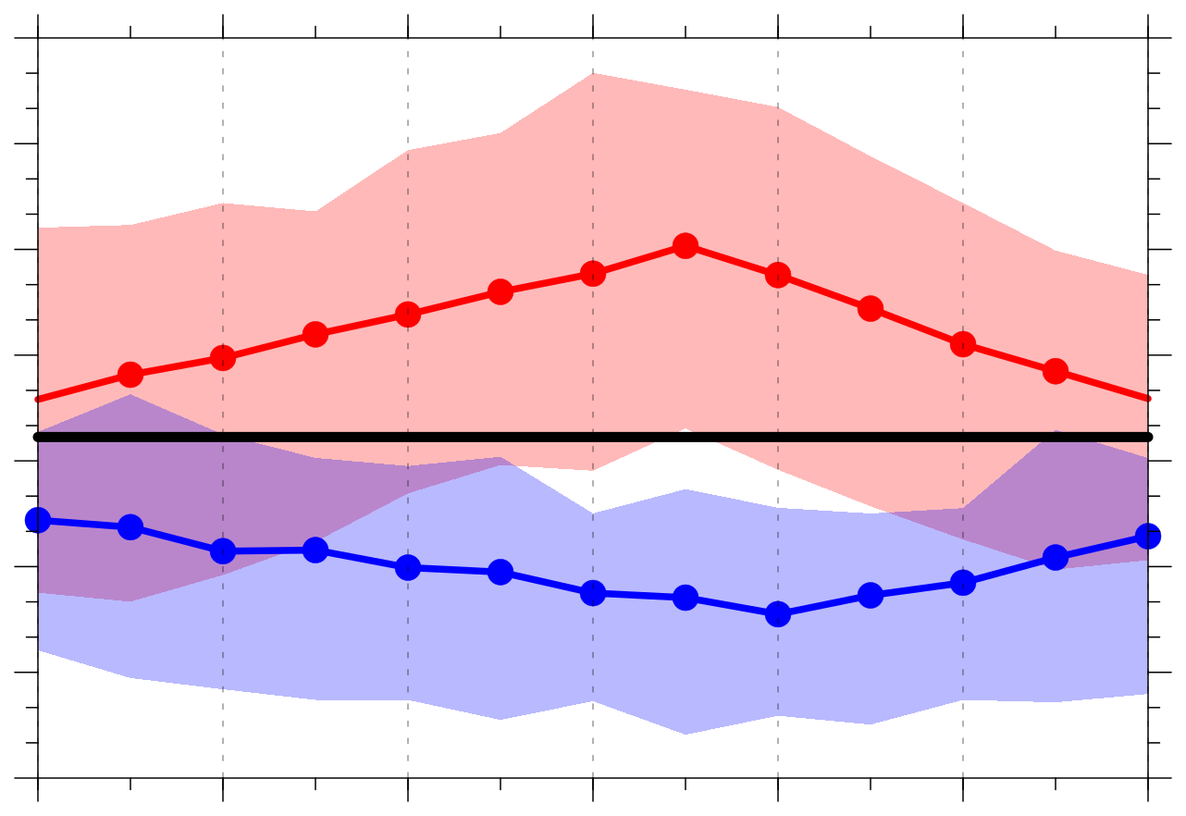
Quantities characterizing the Arctic environment
(a) Abs. value of stnd. anom. of 500-hPa v wind (σ)
(b) 850–600-hPa Eady growth rate (day⁻¹)
(c) Integrated vapor transport (IVT) (kg m⁻¹ s⁻¹)
1.0
0.75
130
0.9
0.70
120
0.65
110
0.8
0.60
100
0.7
0.55
90
0.6
0.50
80
0.5
0.45
70
−120
−96
−72
−48
−24
0
24
−120
−96
−72
−48
−24
0
24
−120
−96
−72
−48
−24
0
24
Hours relative to 0000 UTC of low and high skill days
Hours relative to 0000 UTC of low and high skill days
Hours relative to 0000 UTC of low and high skill days
(d) Negative 800–600-hPa ω (10⁻³ hPa s⁻¹)
(e) 350–250-hPa divergence (10⁻⁶ s⁻¹)
−0.5
5.1
Legend
−0.6
4.8
Distribution of quantities area-averaged over the Arctic (≥ 70°N)
4.5
−0.7
4.2
Low-skill mean
Statistically significant difference with respect to climo at 95% confidence level
−0.8
3.9
High-skill mean
3.6
2007–2017
climo mean
−0.9
3.3
−1.0
3.0
Shading: Interquartile range
−120
−96
−72
−48
−24
0
24
−120
−96
−72
−48
−24
0
24
Data: 1° ERA-Interim
Hours relative to 0000 UTC of low and high skill days
Hours relative to 0000 UTC of low and high skill days

Slide 6
Identification of low-skill ACs
Create a climatology of ACs occuring during June, July, and August of 2007–2017 by obtaining cyclone tracks from 1° ERA-Interim cyclone climatology prepared by Sprenger et al. (2017).
Deem cyclones that last ≥ 48 h and spend at least some portion of their lifetimes in the Arctic (> 70°N) as ACs.

Slide 7
Identification of low-skill ACs
Track ACs in forecasts from GEFS reforecast dataset v2 by utilizing an objective sea level pressure (SLP)-based tracking algorithm (Crawford et al. 2020).
Consider forecasts initialized 120 h prior to the time of lowest SLP of the ACs when located in the Arctic during low-skill and high-skill periods.
Calculate 120-h intensity RMSE based on minimum SLP of the ACs at the aforementioned time of lowest SLP, using ERA-Interim as verification.
Refer to ACs associated with the top 25% of 120-h intensity RMSE for low-skill and high-skill periods as low-skill ACs for these respective periods.

Slide 8
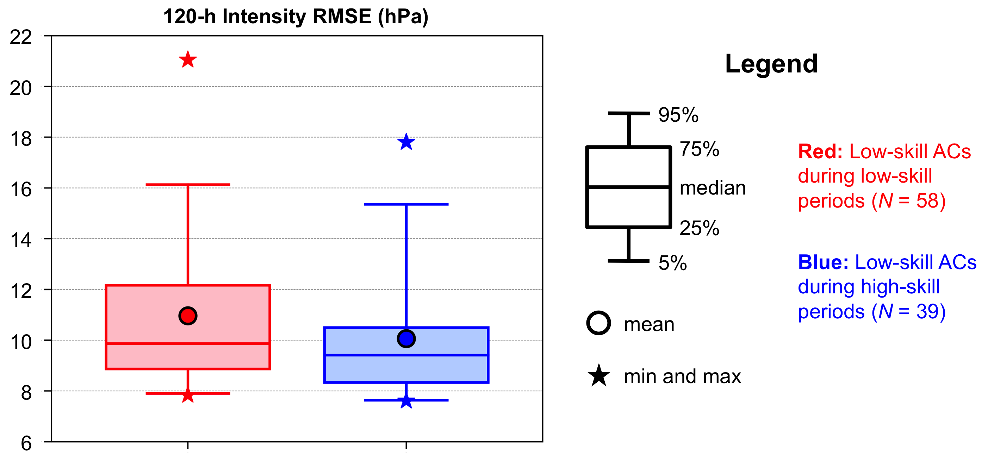
Identification of low-skill ACs

Slide 9
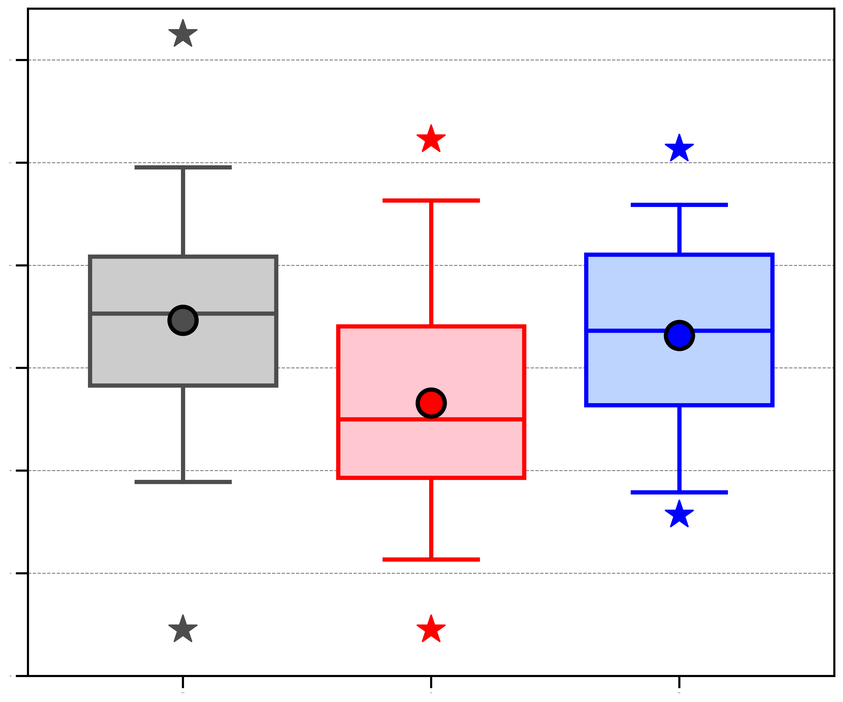
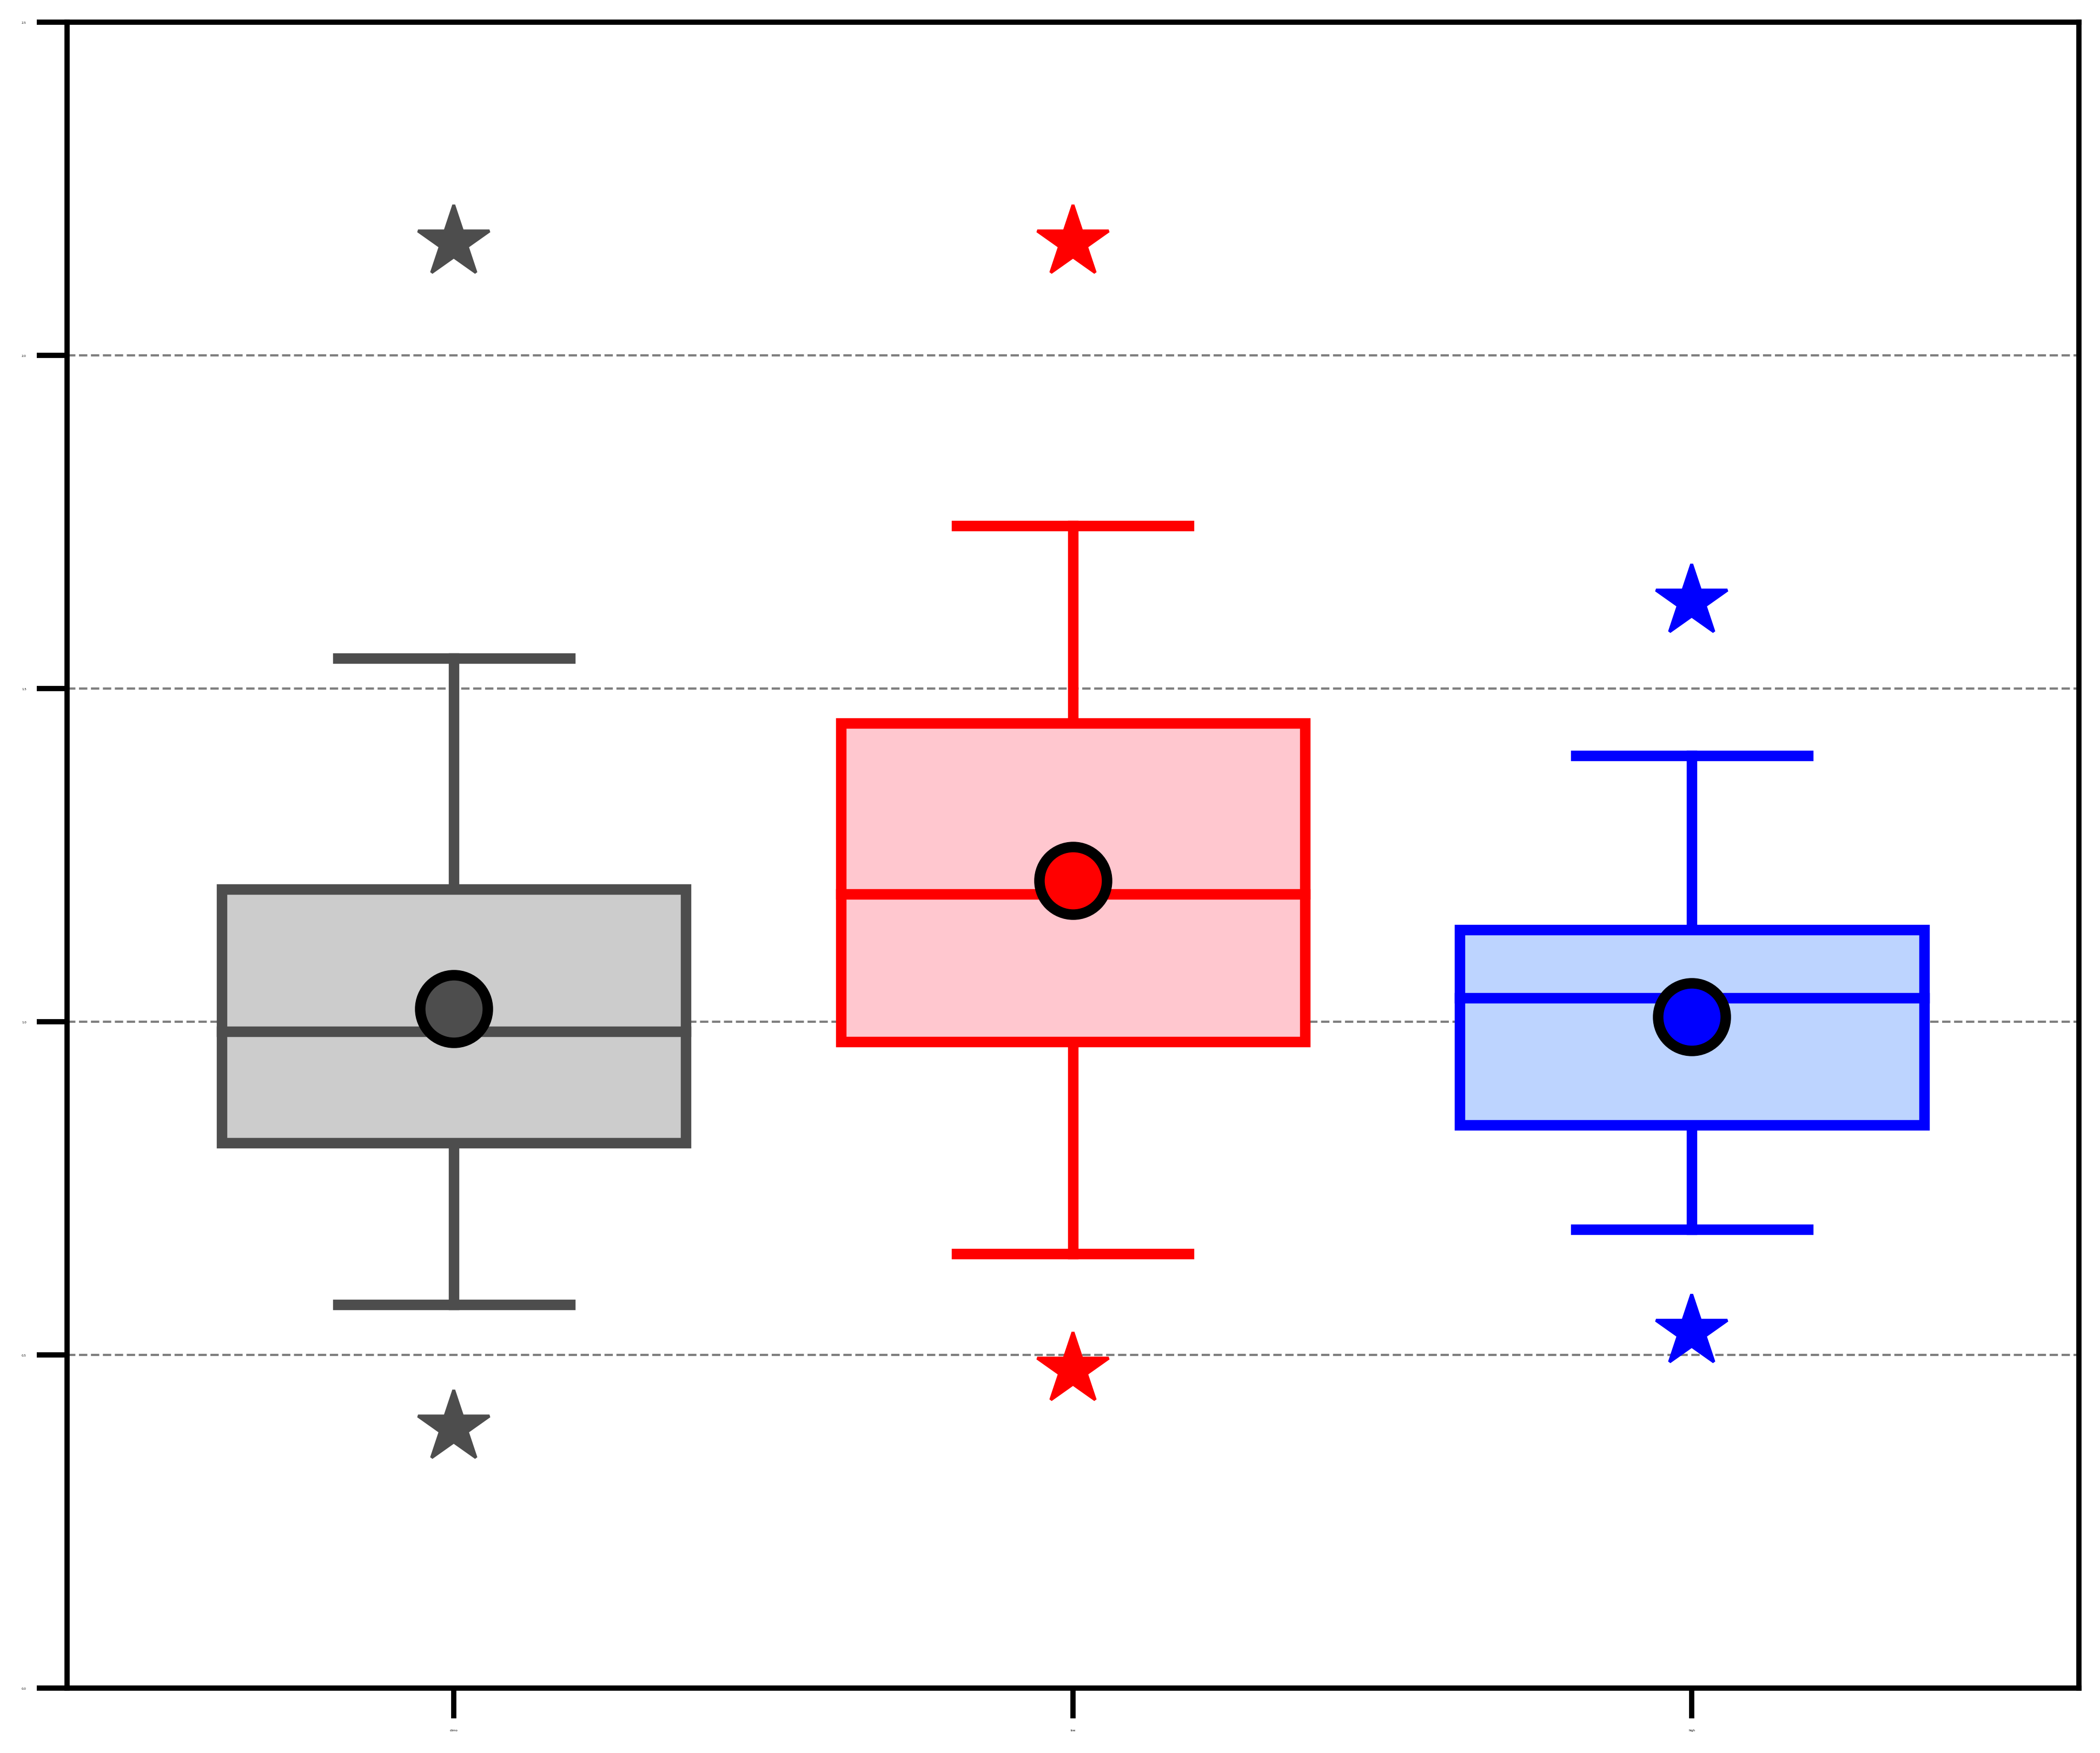
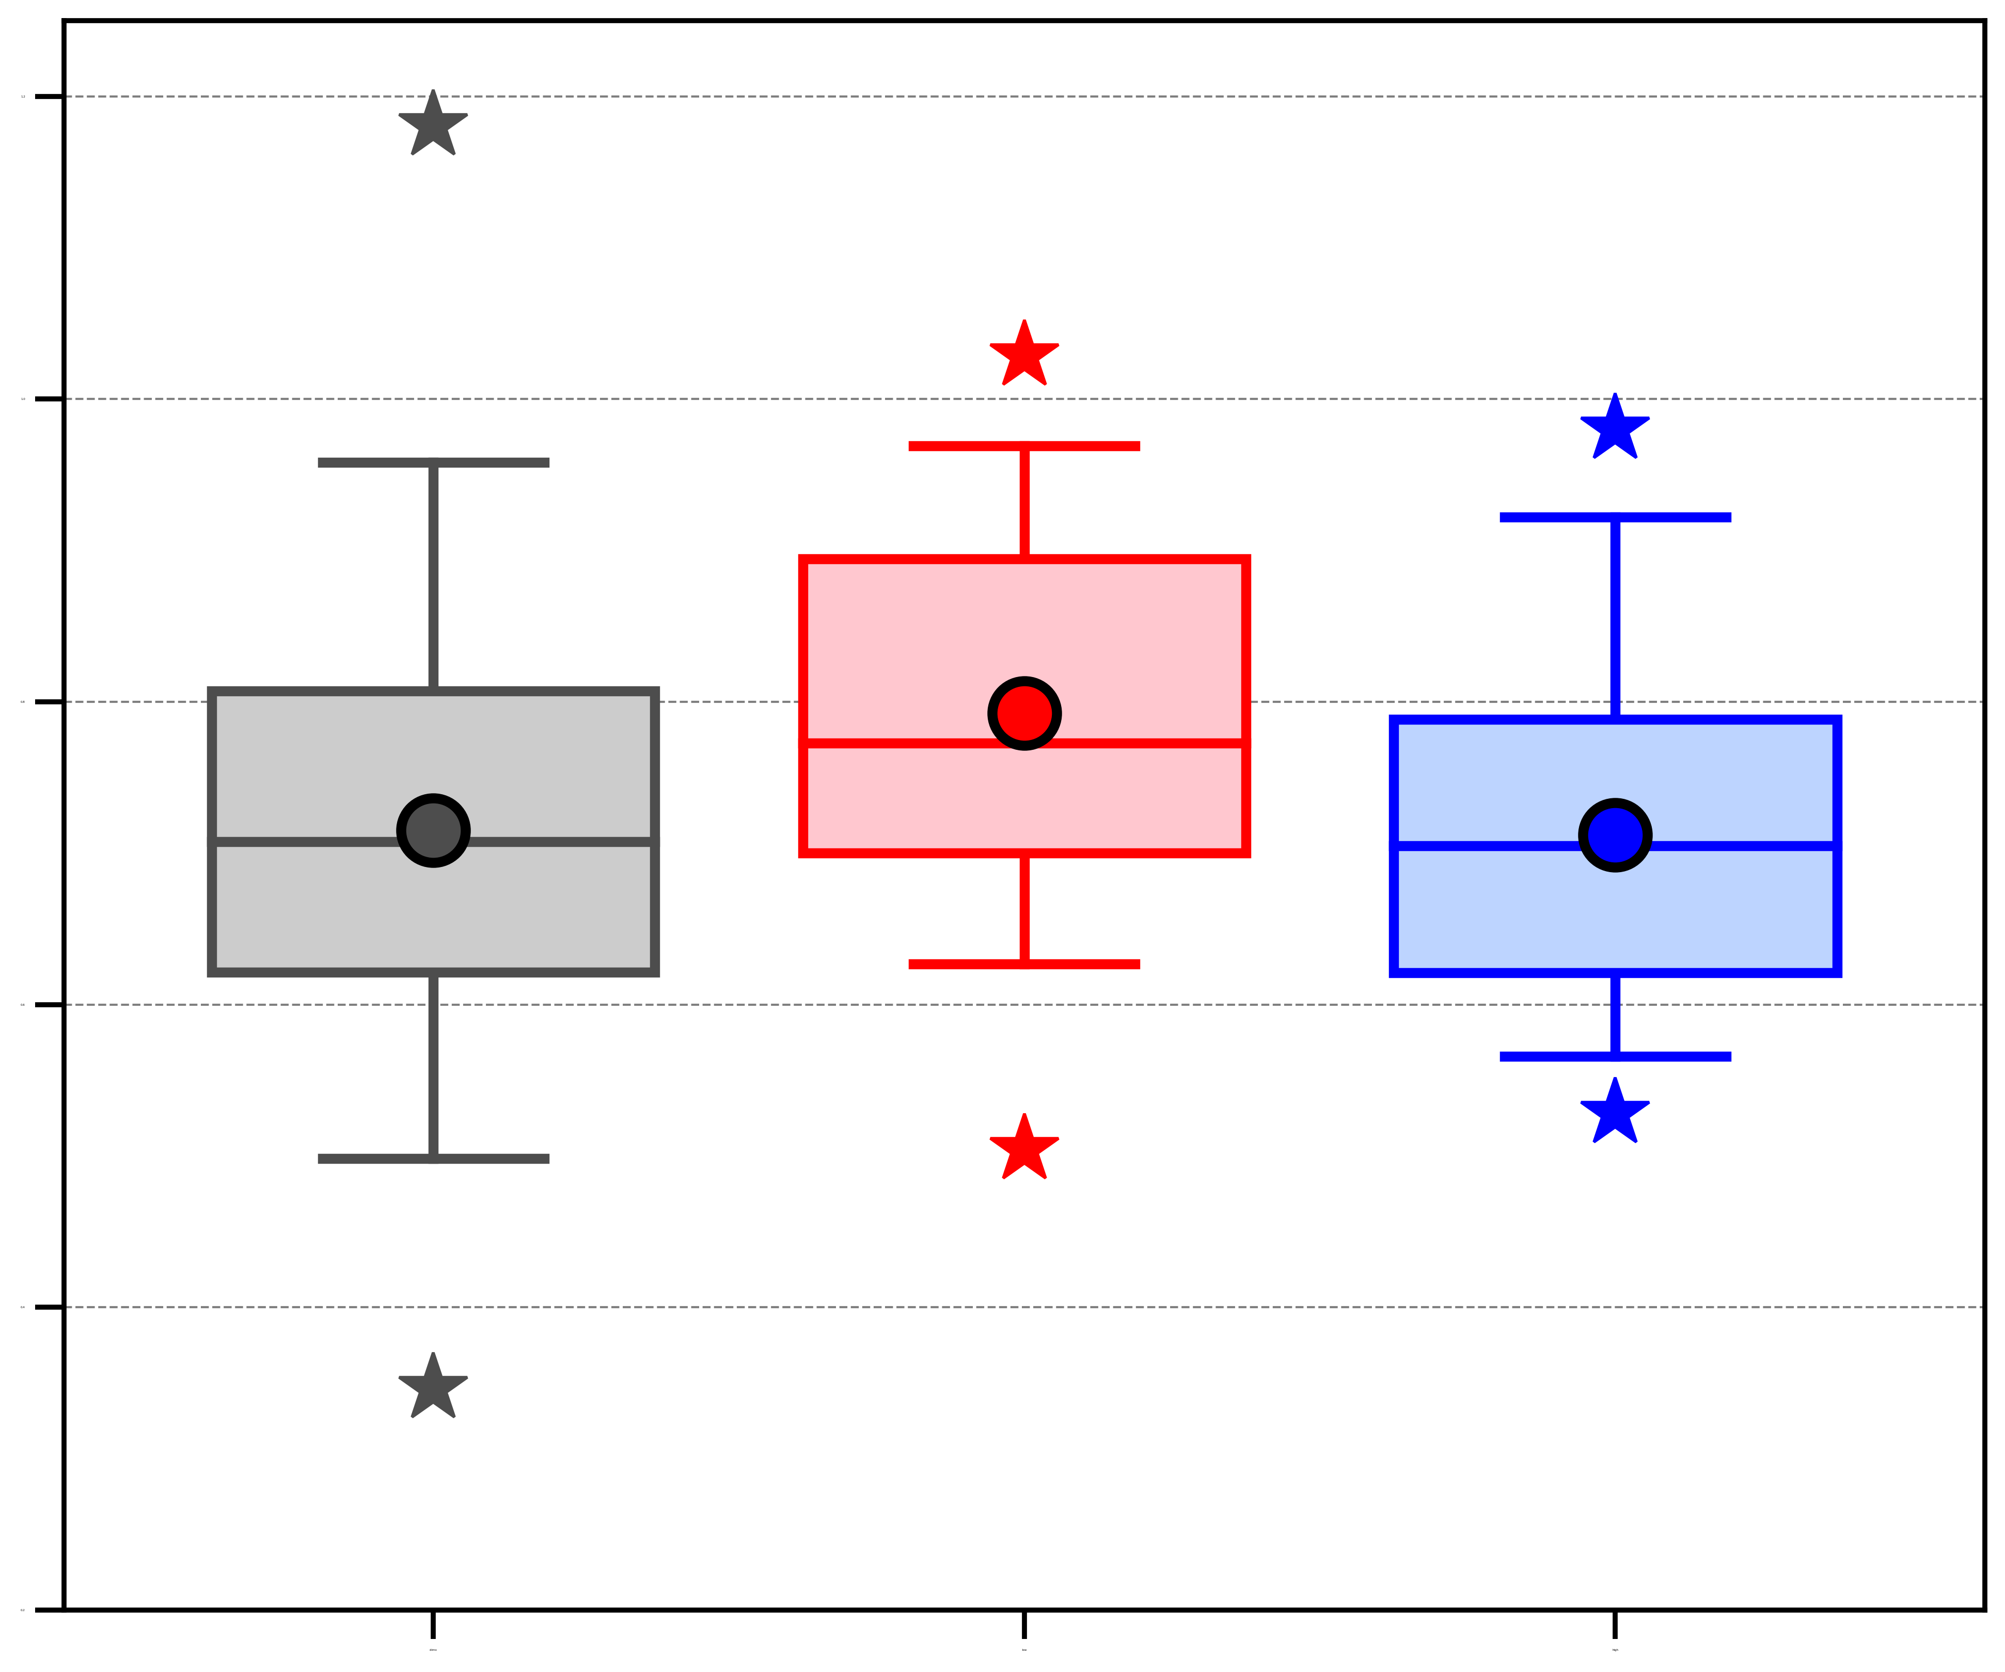
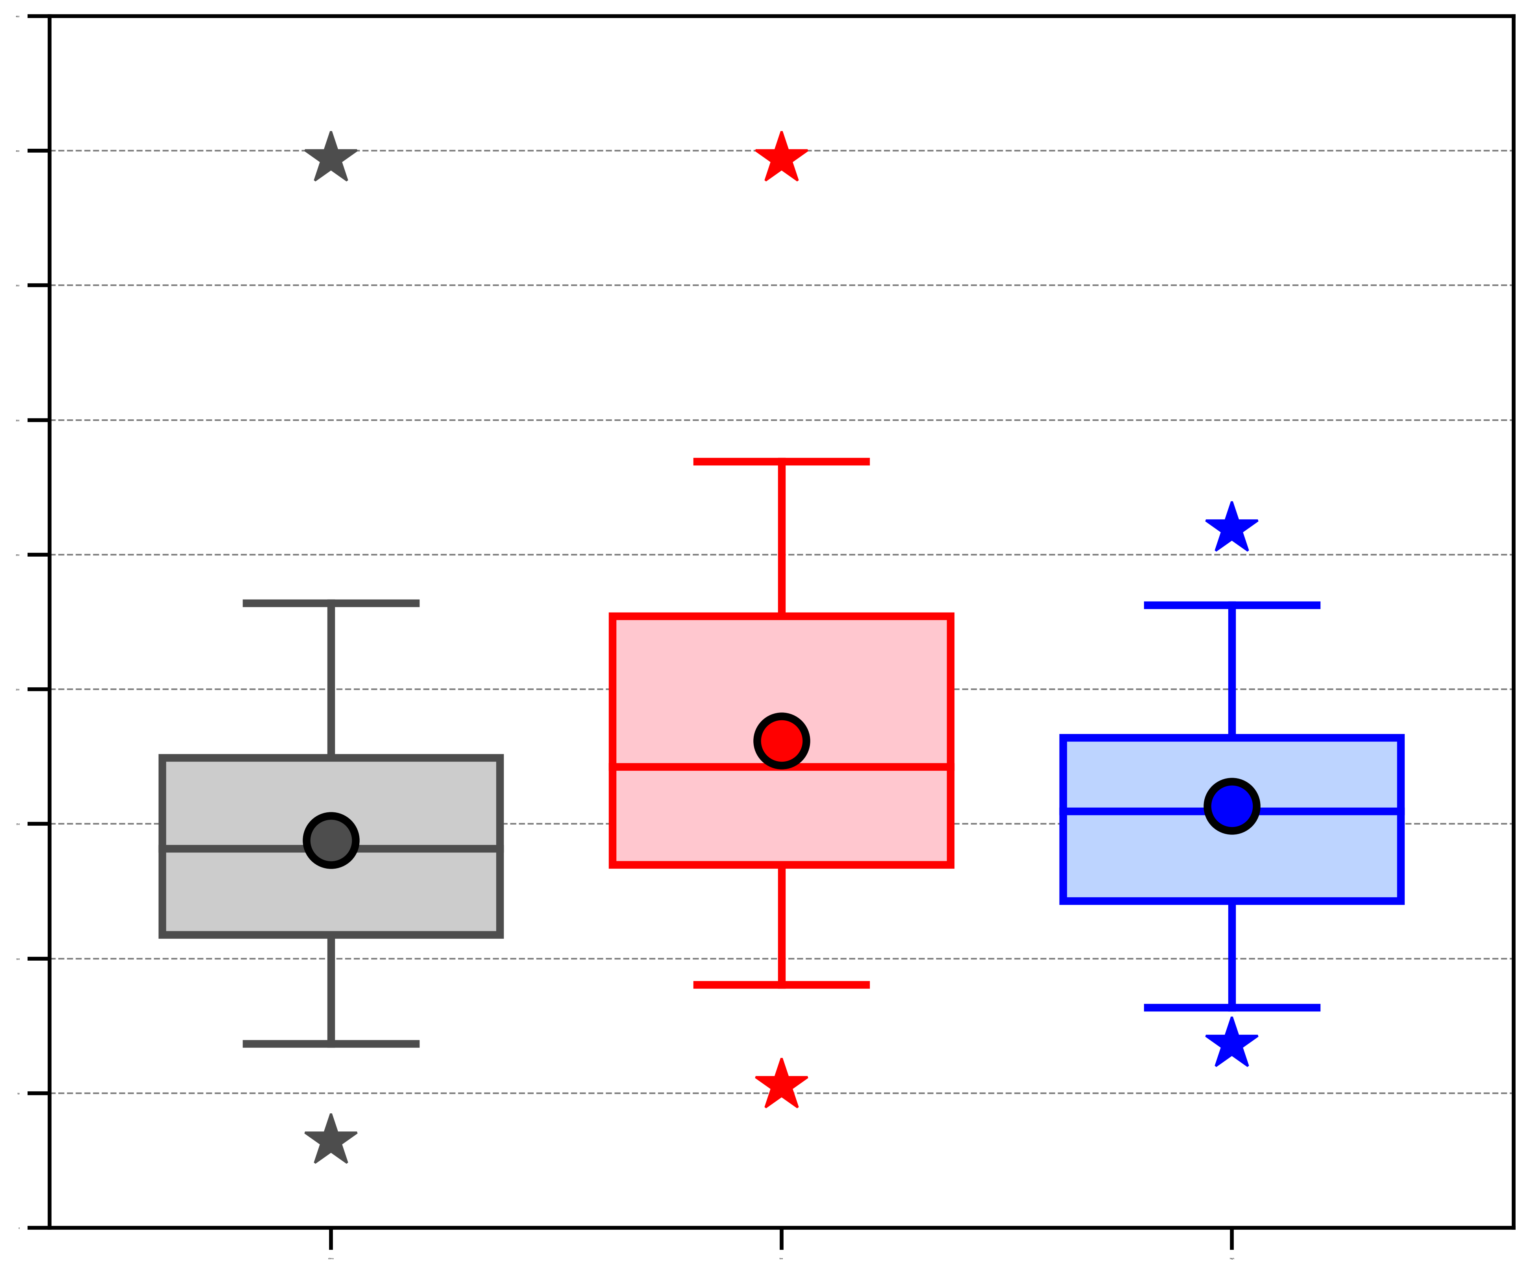
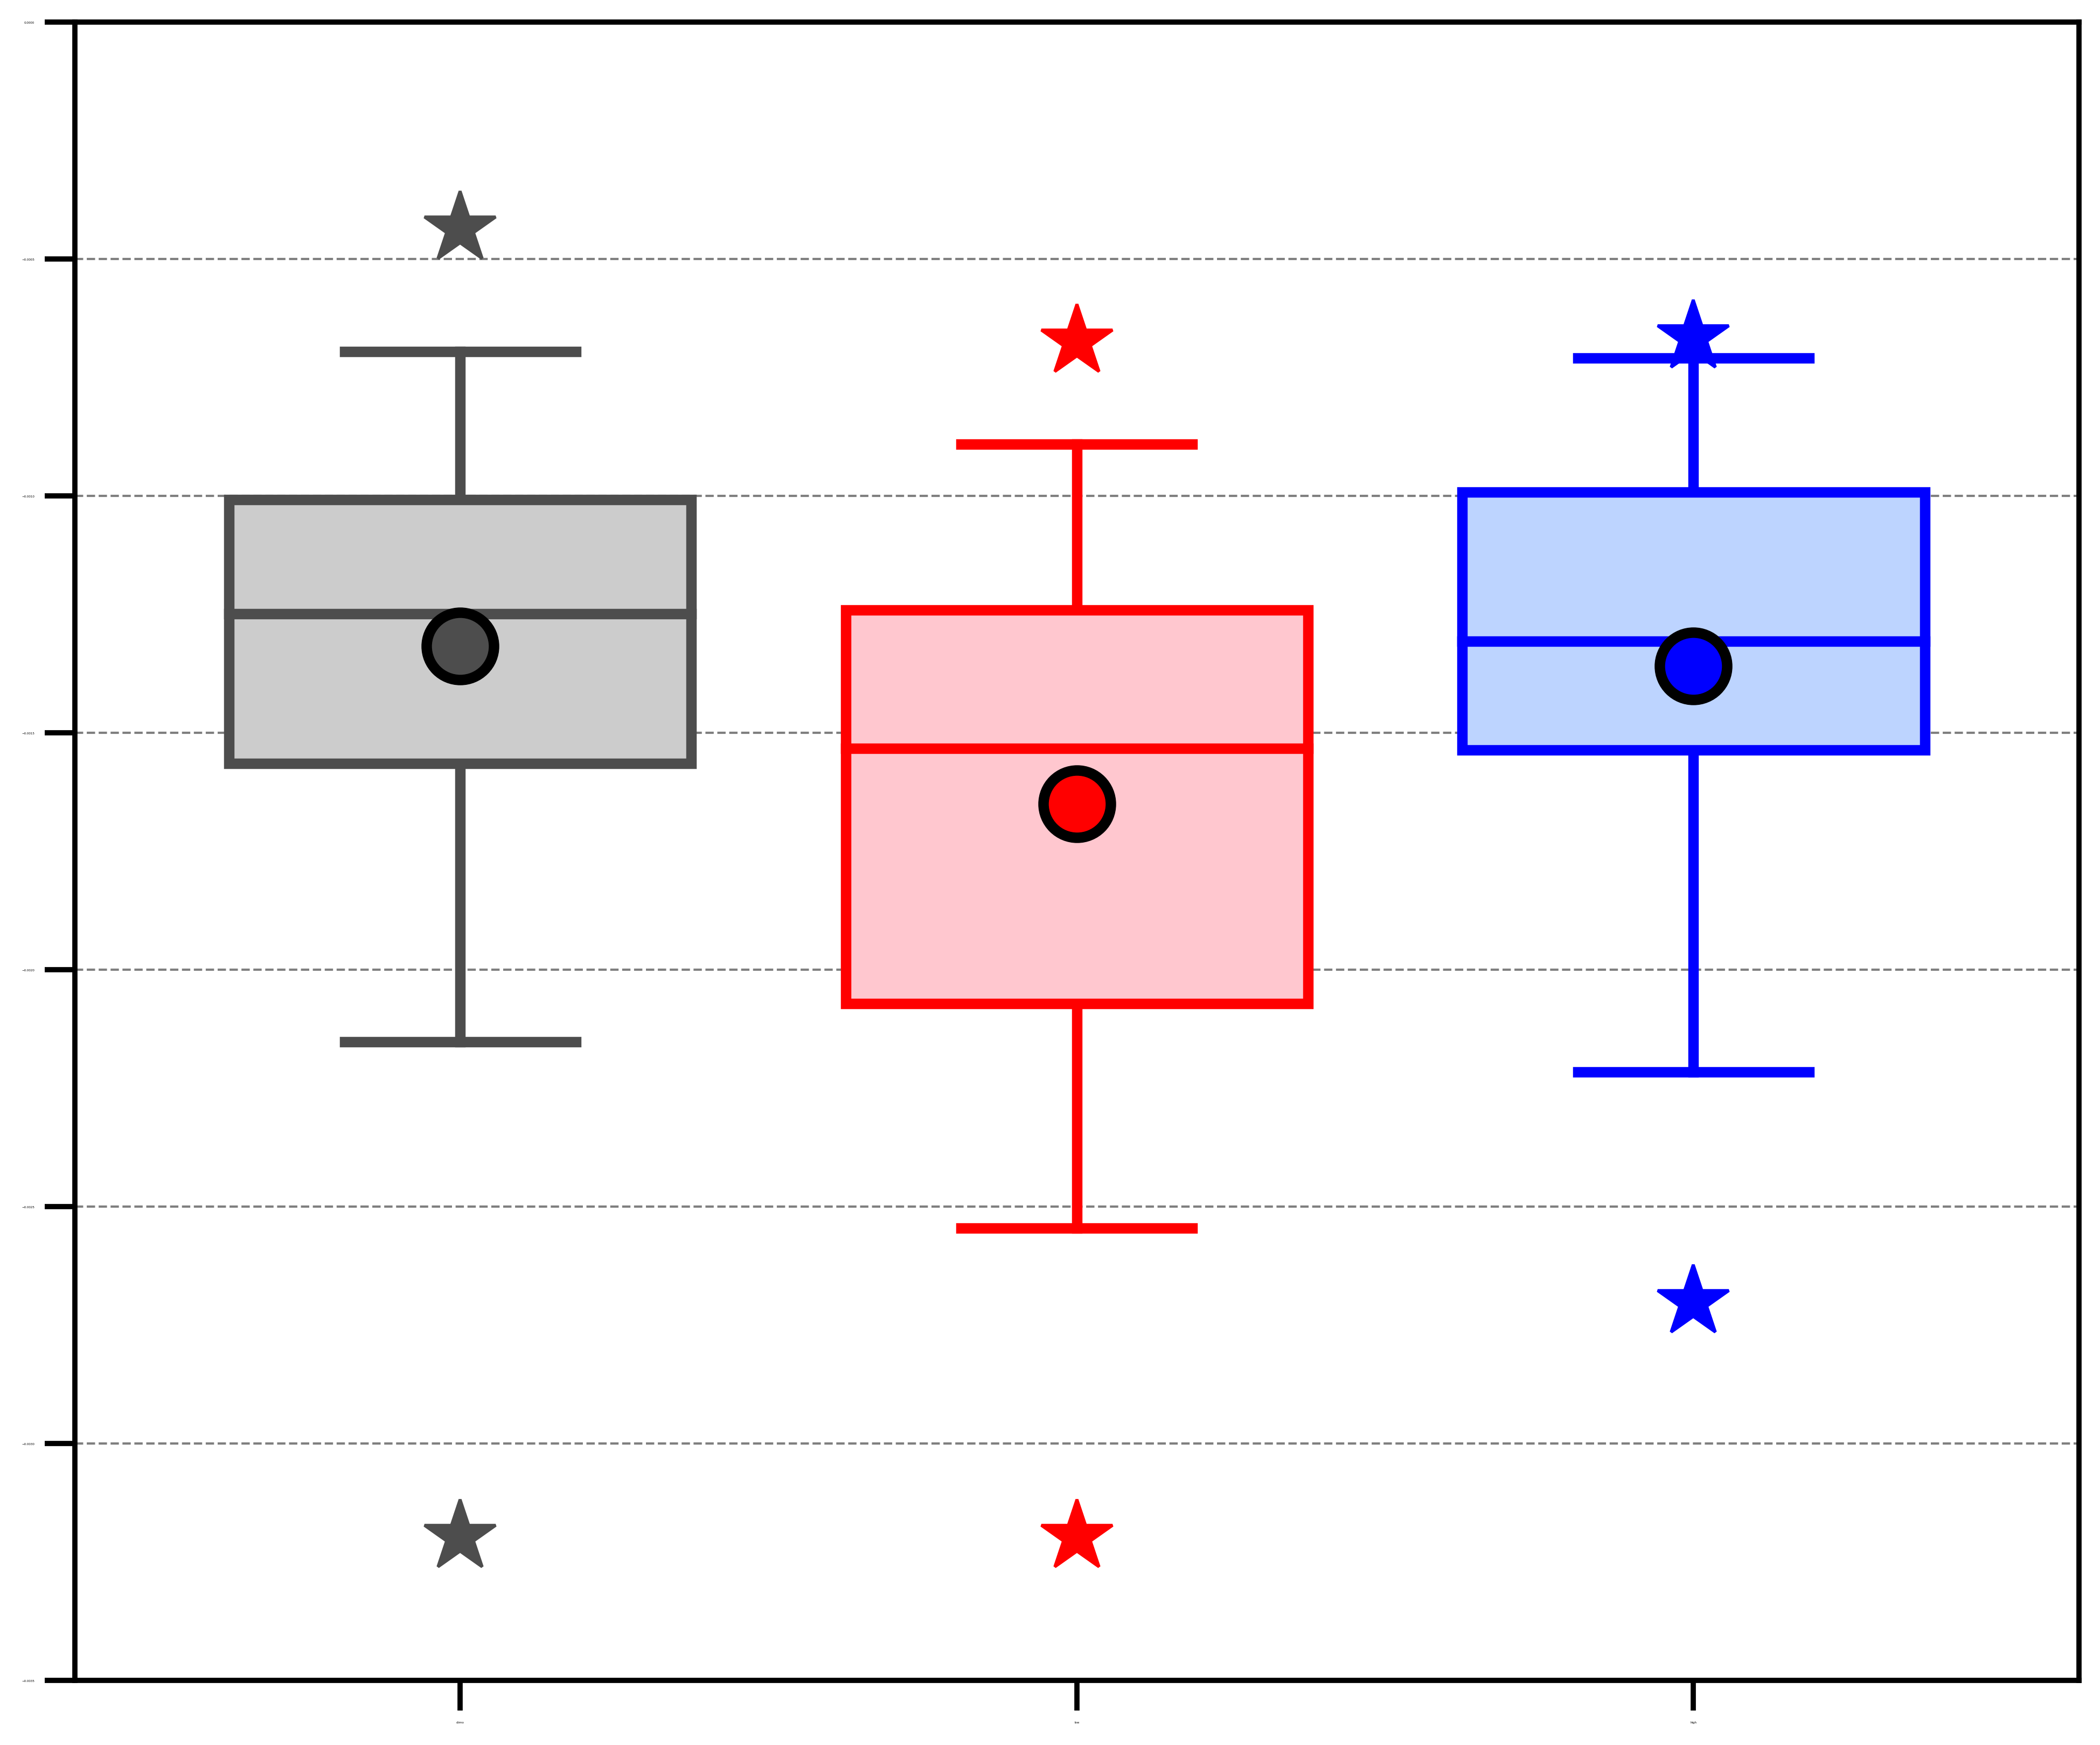
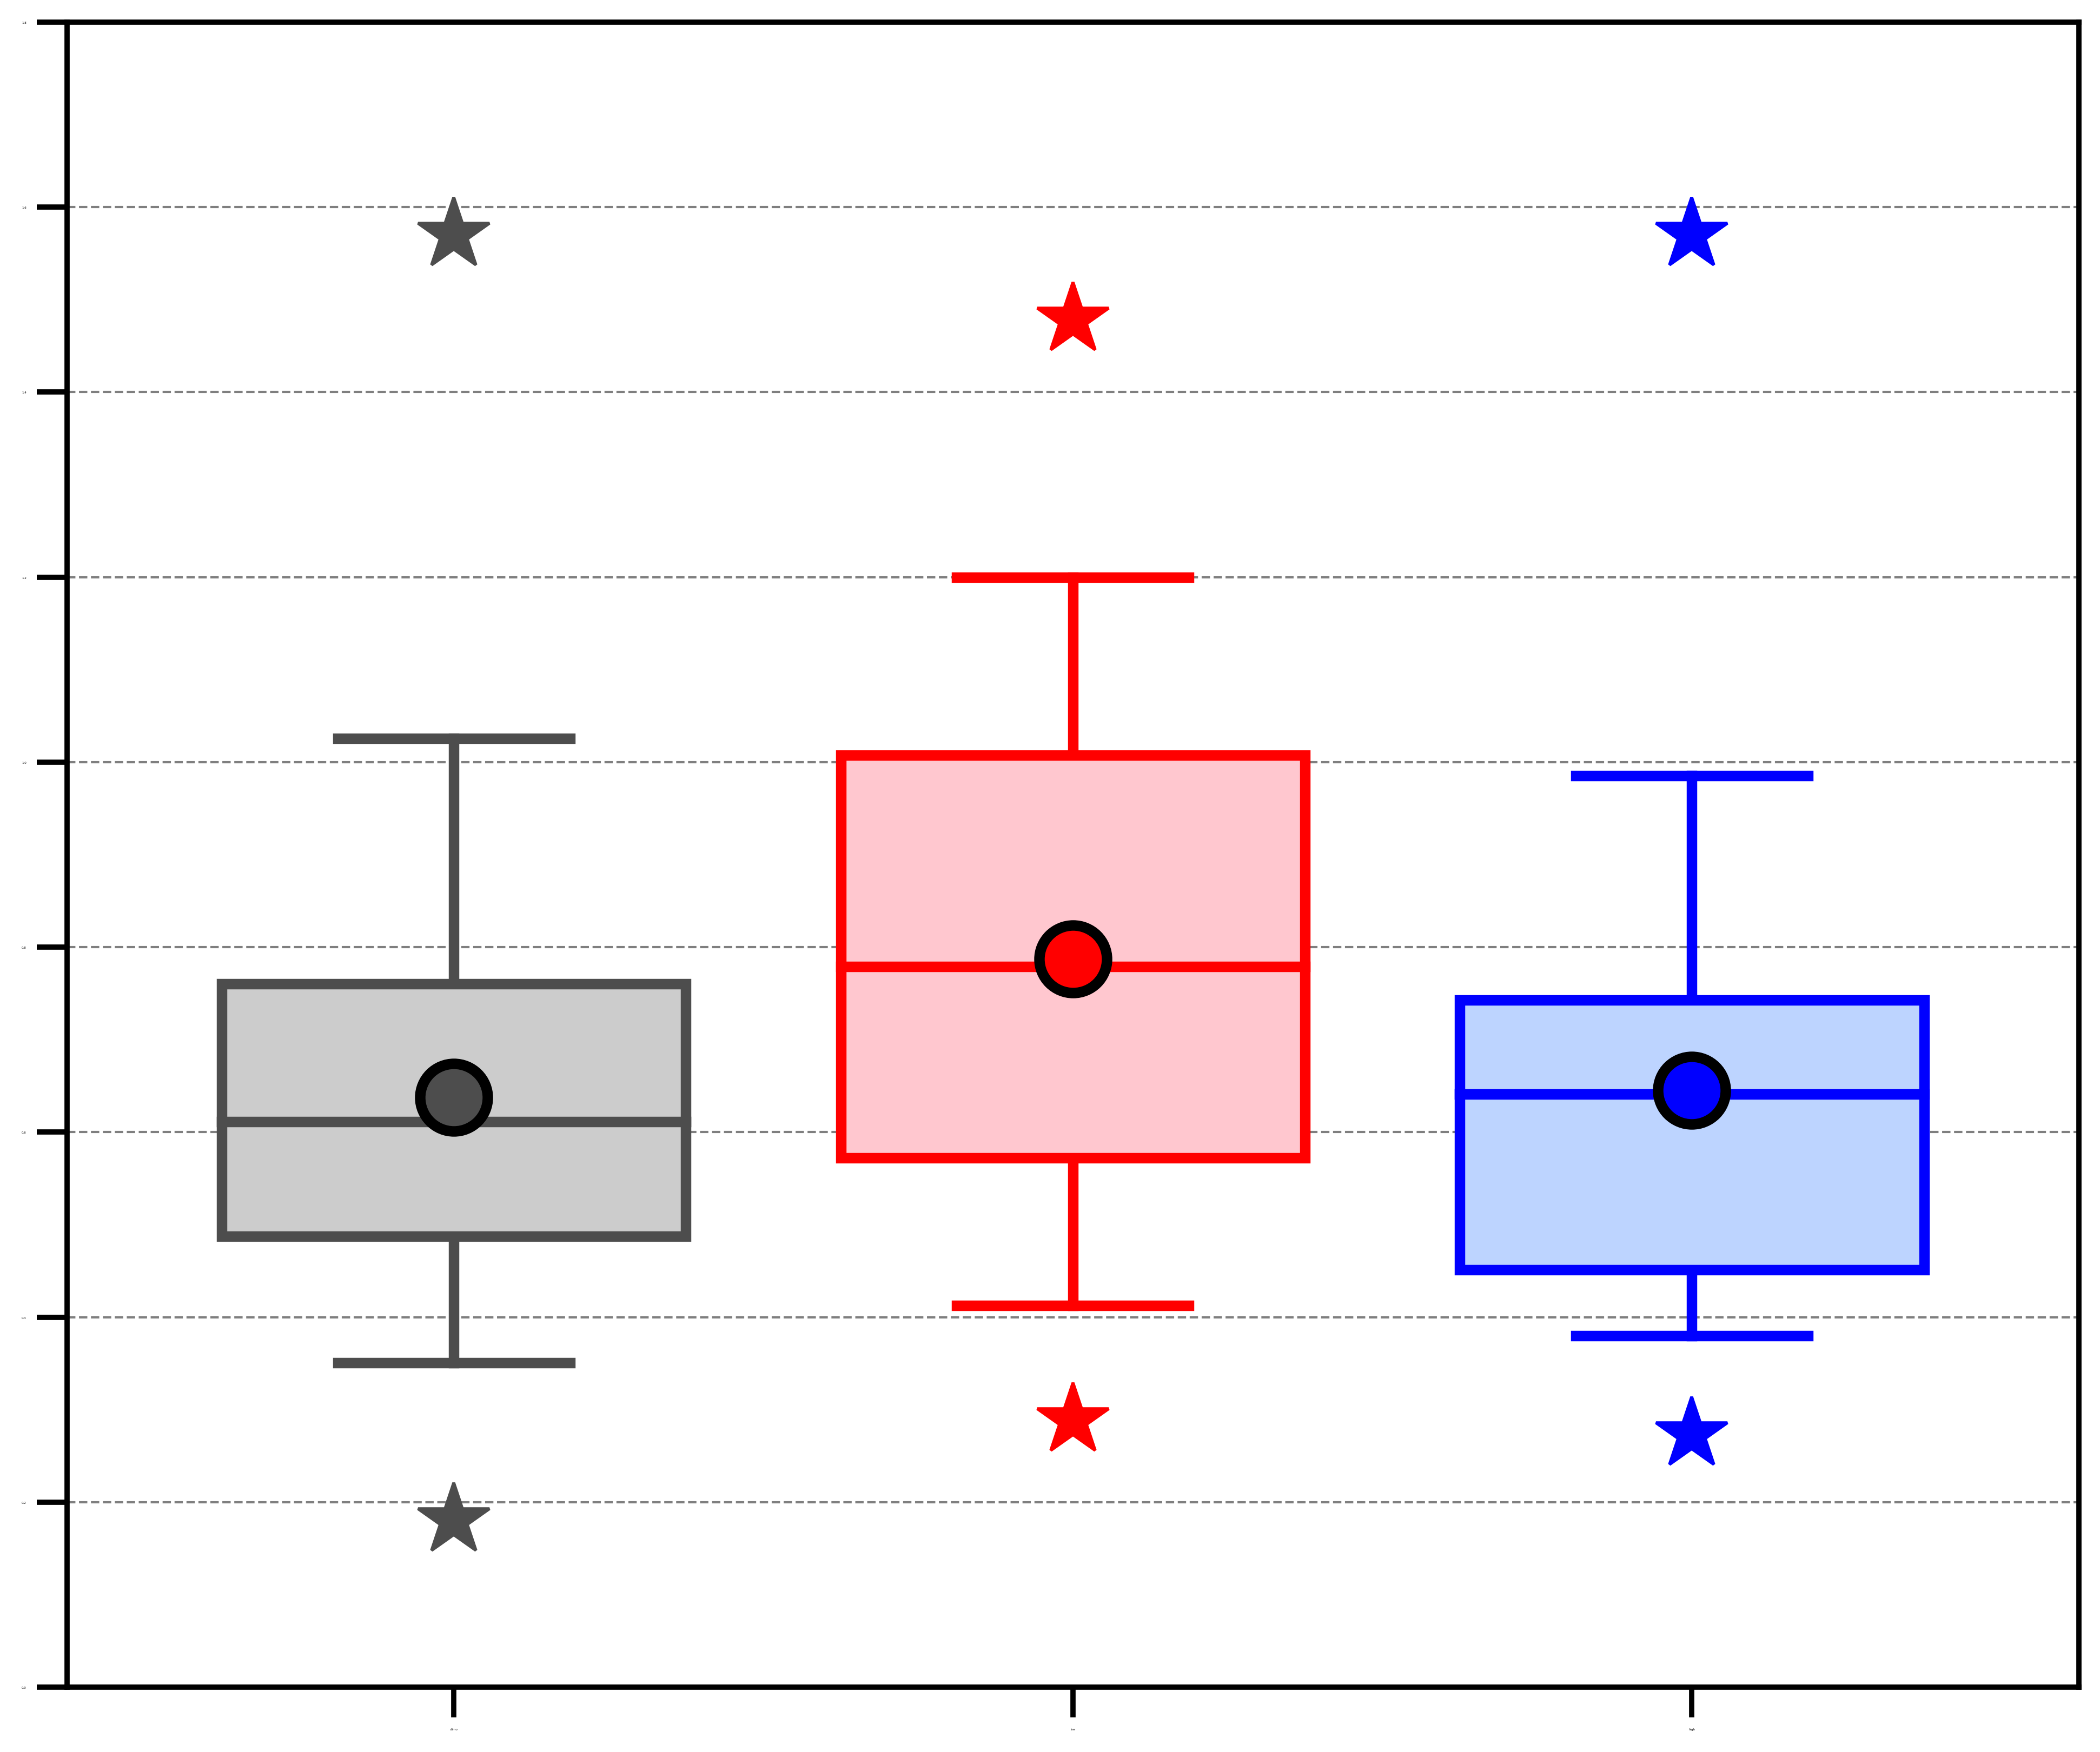
Quantities characterizing low-skill ACs
(b) Area-averaged abs. value of
stnd. anom. of 500-hPa v wind (σ)
(c) Area-averaged 850–600-hPa
Eady growth rate (day⁻¹)
Legend
(a) Min SLP (hPa)
Distribution of most extreme value of quantities characterizing ACs when the ACs are located in the Arctic for the following categories:
2.5
1.2
1020
1010
2.0
1.0
1000
1.5
0.8
990
Gray: All ACs in 2007–2017 climatology (N = 730)
1.0
0.6
980
Red: Low-skill ACs during low-skill periods (N = 58)
970
0.5
0.4
Blue: Low-skill ACs during high-skill periods (N = 39)
960
0.0
0.2
(e) Area-averaged negative 800–600-hPa ω (10⁻³ hPa s⁻¹)
(f) Area-averaged 350–250-hPa
divergence (10⁻⁶ s⁻¹)
95%
(d) Area-averaged IVT (kg m⁻¹ s⁻¹)
75%
mean
450
0.0
18
median
400
16
min/
max
−0.5
25%
350
14
5%
300
−1.0
12
250
−1.5
10
Statistically significant difference with respect to climatology at 95% confidence level
200
−2.0
8
150
−2.5
6
100
4
Area-averaged quantities are calculated within 1000 km of AC center
50
−3.0
2
0
−3.5
0
Data: 1° ERA-Interim

Slide 10
AC-centered composites
Composite top 25% strongest low-skill ACs during low-skill periods (N = 14) at various lag times relative to the time of lowest SLP of the ACs when located in the Arctic using ERA5 (0.25° × 0.25°).

Slide 11
AC-centered composites
Composite top 25% strongest low-skill ACs during low-skill periods (N = 14) at various lag times relative to the time of lowest SLP of the ACs when located in the Arctic using ERA5 (0.25° × 0.25°).
For each lag time:
  Determine mean latitude and longitude of ACs.

Slide 12
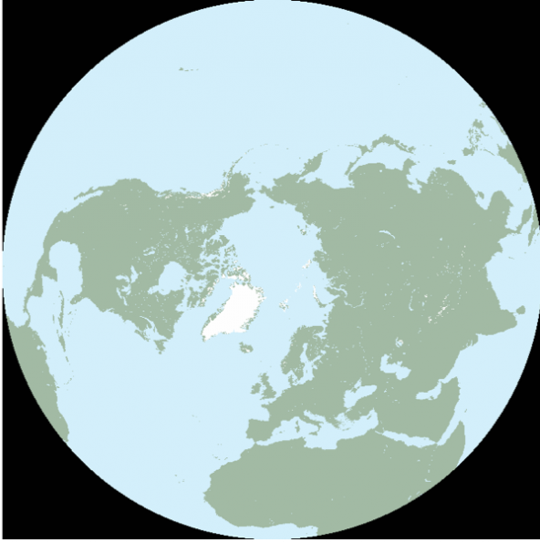
AC-centered composites
Composite top 25% strongest low-skill ACs during low-skill periods (N = 14) at various lag times relative to the time of lowest SLP of the ACs when located in the Arctic using ERA5 (0.25° × 0.25°).
For each lag time:
  Determine mean latitude and longitude of ACs.
  Rotate and project ERA5 grids to a 25 × 25 km Equal-Area Scalable Earth 2.0 (EASE2) grid such that the AC center lies on y-axis (0° longitude) of the EASE2 grid.
EASE2 Grid
(source: NSIDC: https://nsidc.org/ease/ease-grid-projection-gt)

Slide 13
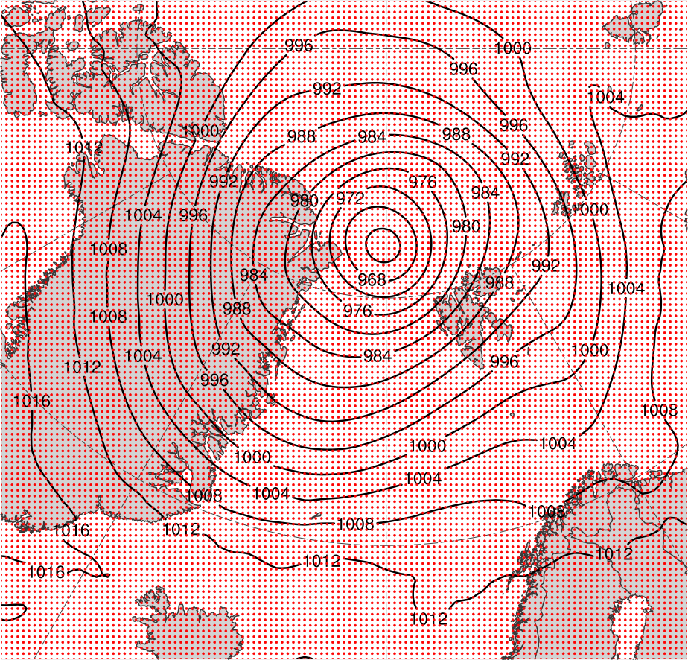
AC-centered composites
Composite top 25% strongest low-skill ACs during low-skill periods (N = 14) at various lag times relative to the time of lowest SLP of the ACs when located in the Arctic using ERA5 (0.25° × 0.25°).
For each lag time:
  Determine mean latitude and longitude of ACs.
  Rotate and project ERA5 grids to a 25 × 25 km Equal-Area Scalable Earth 2.0 (EASE2) grid such that the AC center lies on y-axis (0° longitude) of the EASE2 grid.
SLP (black) on 25 × 25 km EASE2 grid (grid points in red) valid 1200 UTC 6 Aug 2012

Slide 14
AC-centered composites
Composite top 25% strongest low-skill ACs during low-skill periods (N = 14) at various lag times relative to the time of lowest SLP of the ACs when located in the Arctic using ERA5 (0.25° × 0.25°).
For each lag time:
  Determine mean latitude and longitude of ACs.
  Rotate and project ERA5 grids to a 25 × 25 km Equal-Area Scalable Earth 2.0 (EASE2) grid such that the AC center lies on y-axis (0° longitude) of the EASE2 grid.
  Shift projected grids to mean latitude of ACs.
SLP (black) on 25 × 25 km EASE2 grid (grid points in red) valid 1200 UTC 6 Aug 2012

Slide 15
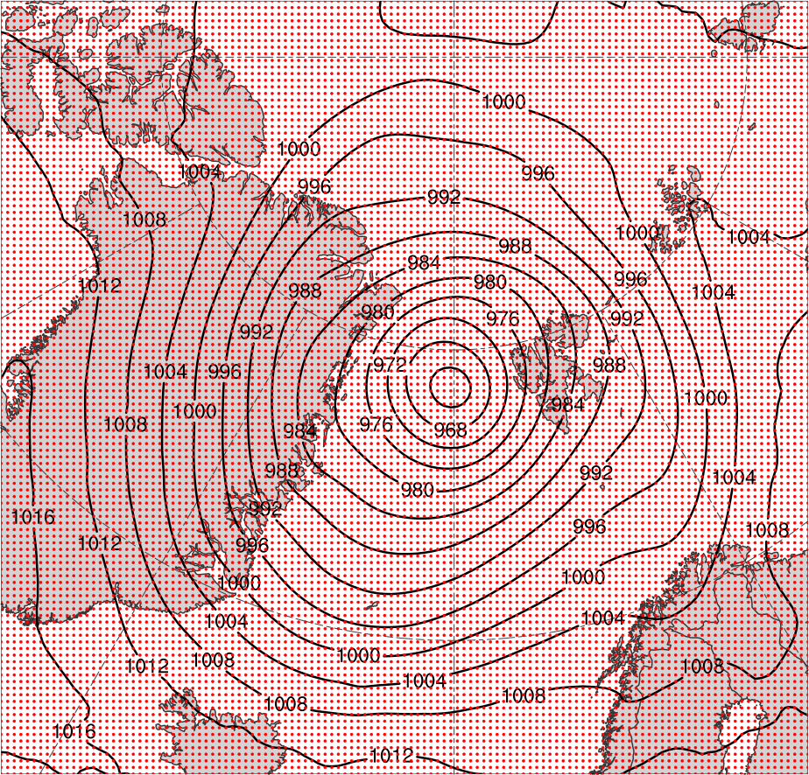
AC-centered composites
Grid before shifting to mean latitude
Grid after shifting to mean latitude

Slide 16
AC-centered composites
Composite top 25% strongest low-skill ACs during low-skill periods (N = 14) at various lag times relative to the time of lowest SLP of the ACs when located in the Arctic using ERA5 (0.25° × 0.25°).
For each lag time:
  Determine mean latitude and longitude of ACs.
  Rotate and project ERA5 grids to a 25 × 25 km Equal-Area Scalable Earth 2.0 (EASE2) grid such that the AC center lies on y-axis (0° longitude) of the EASE2 grid.
  Shift projected grids to mean latitude of ACs.
  Rotate shifted grids to mean longitude of ACs.

Slide 17
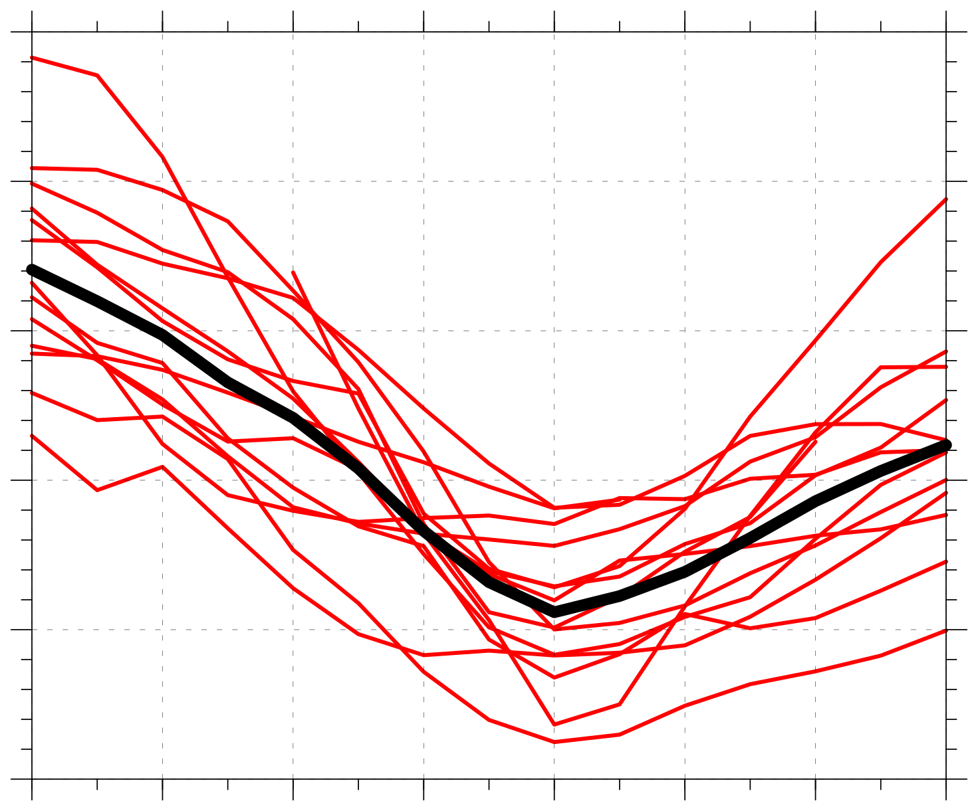
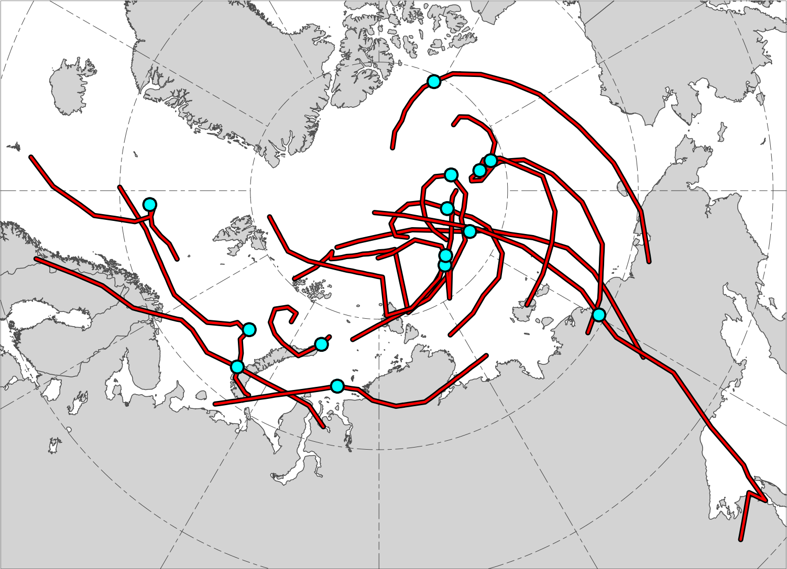
AC-centered composites
N = 14
1010
N = 14
1000
990
Minimum SLP (hPa)
980
970
960
AC location at lag 0 h (time of lowest SLP of AC in Arctic)
−48
−36
−24
−12
0
12
24
36
Lag hour relative to time of lowest SLP of AC in Arctic
Red lines show tracks of ACs during lag –48 h to lag 36 h,
when valid.
Time series of minimum SLP (hPa) of ACs (red) and of mean minimum SLP (hPa) of ACs (black) during lag –48 h to lag 36 h, when valid.

Slide 18
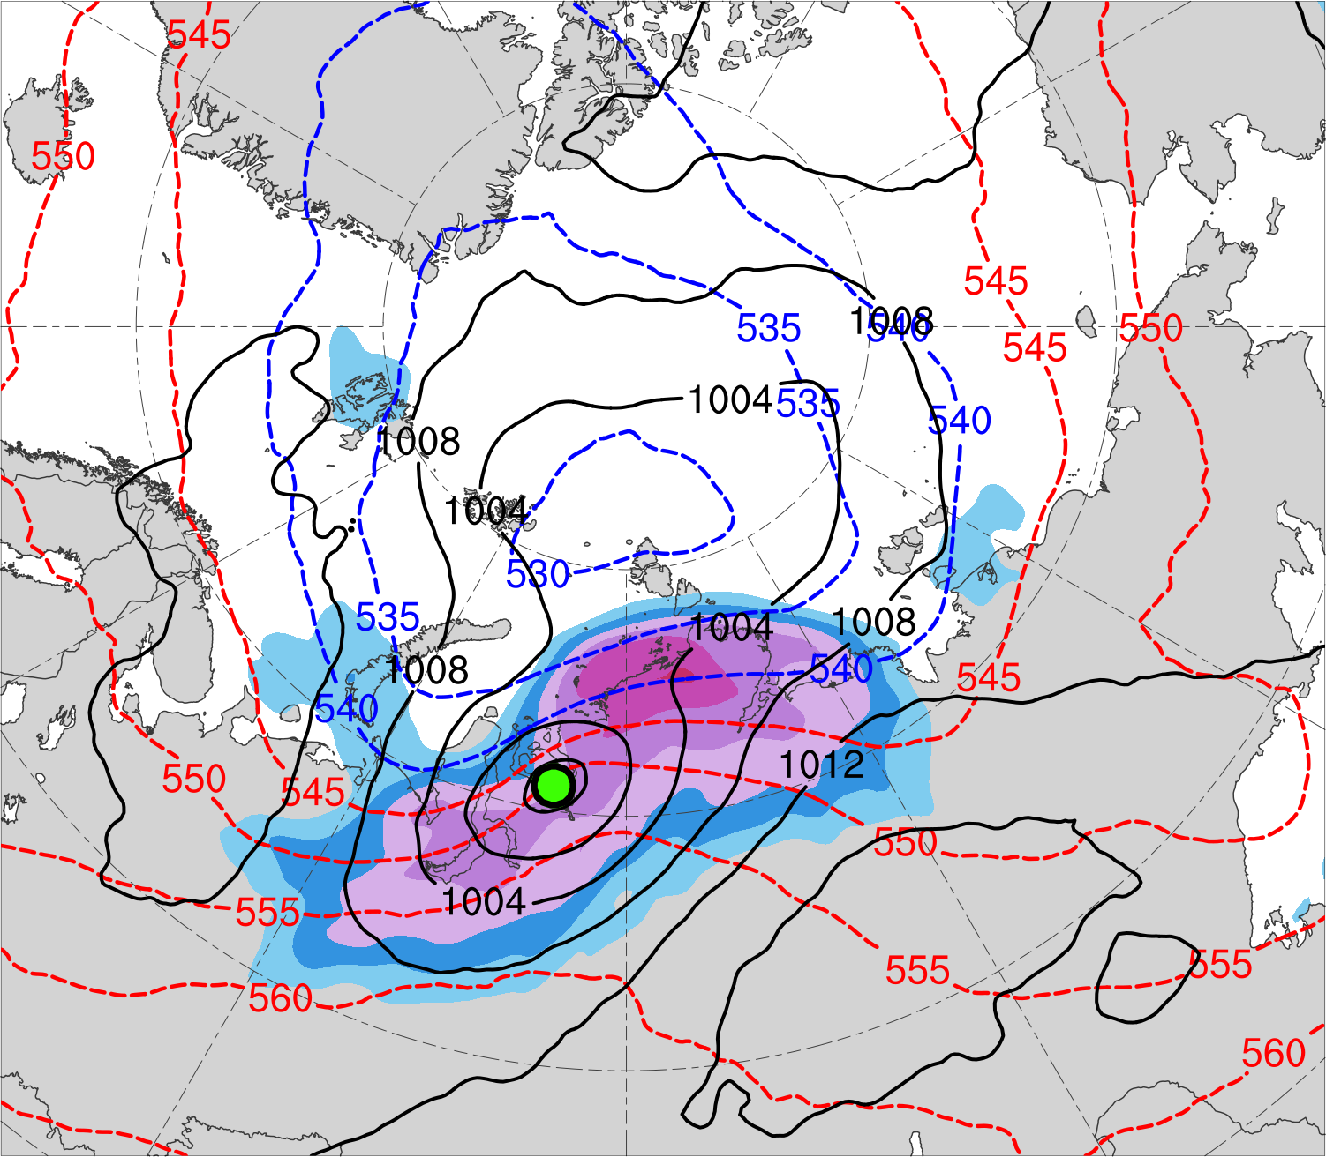
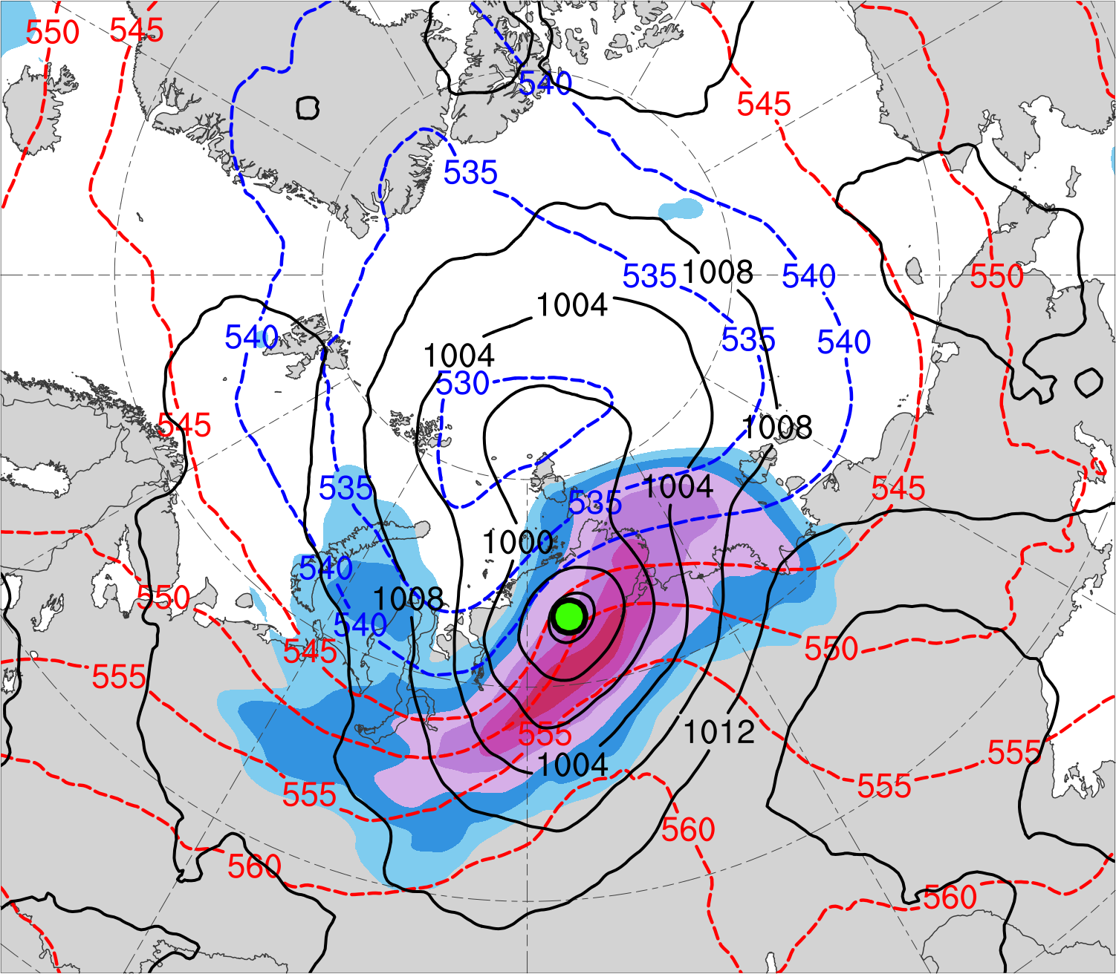
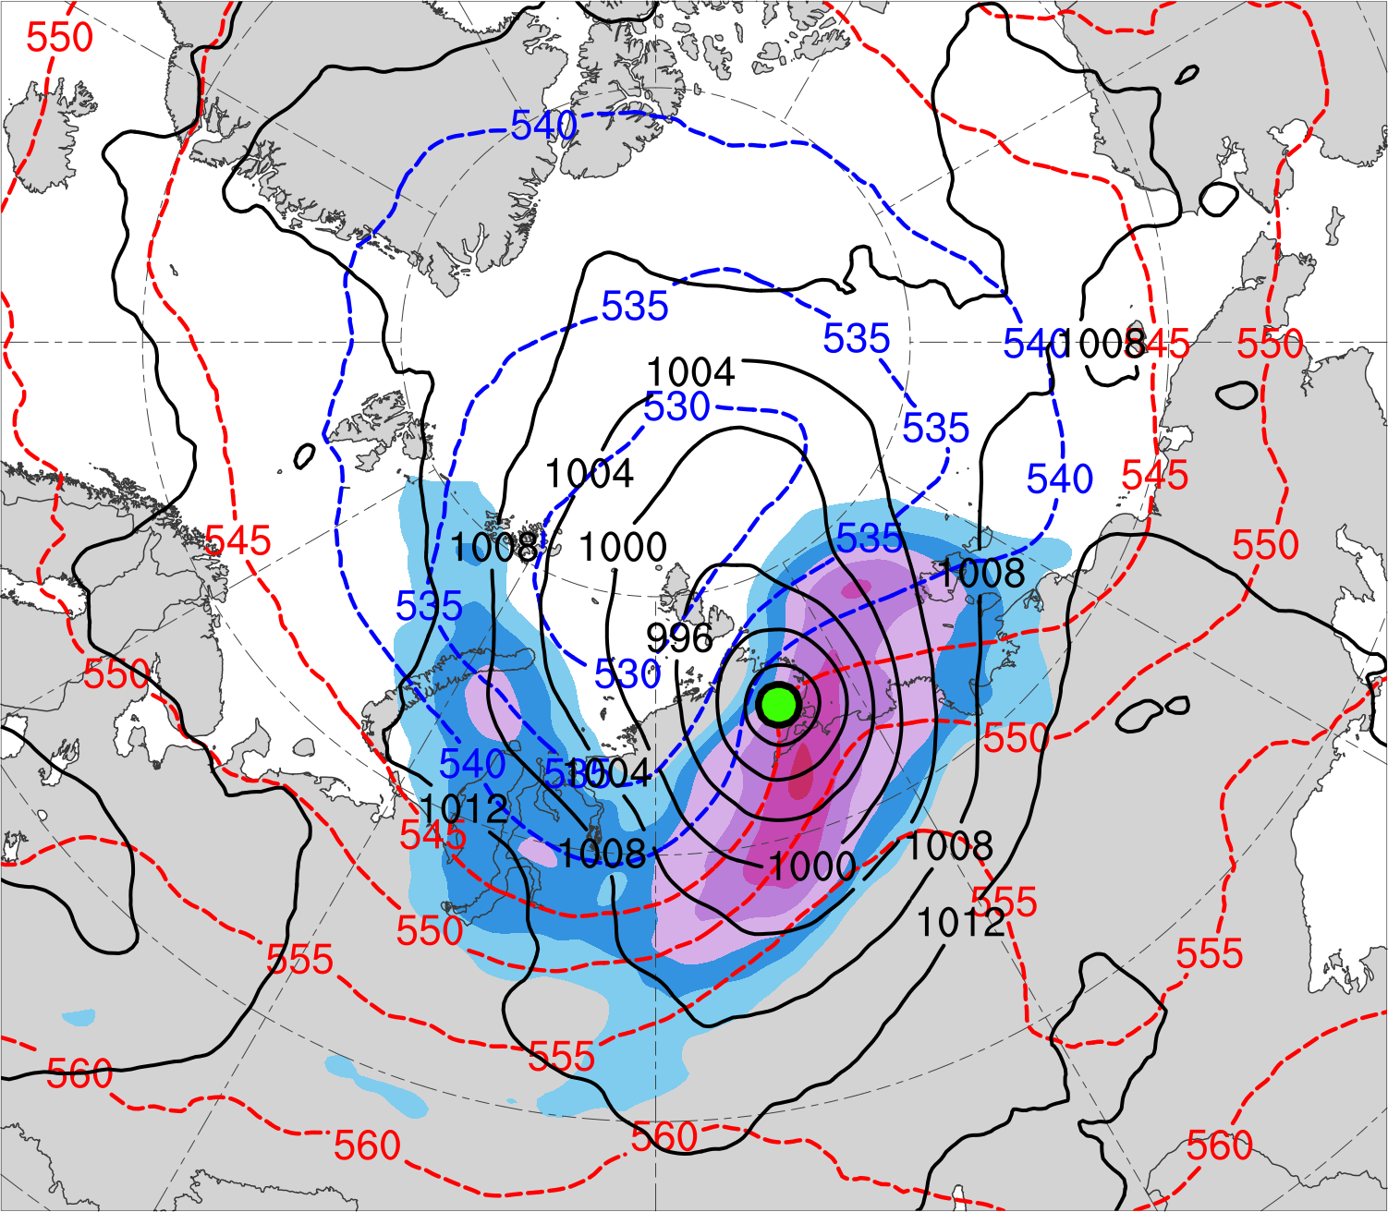
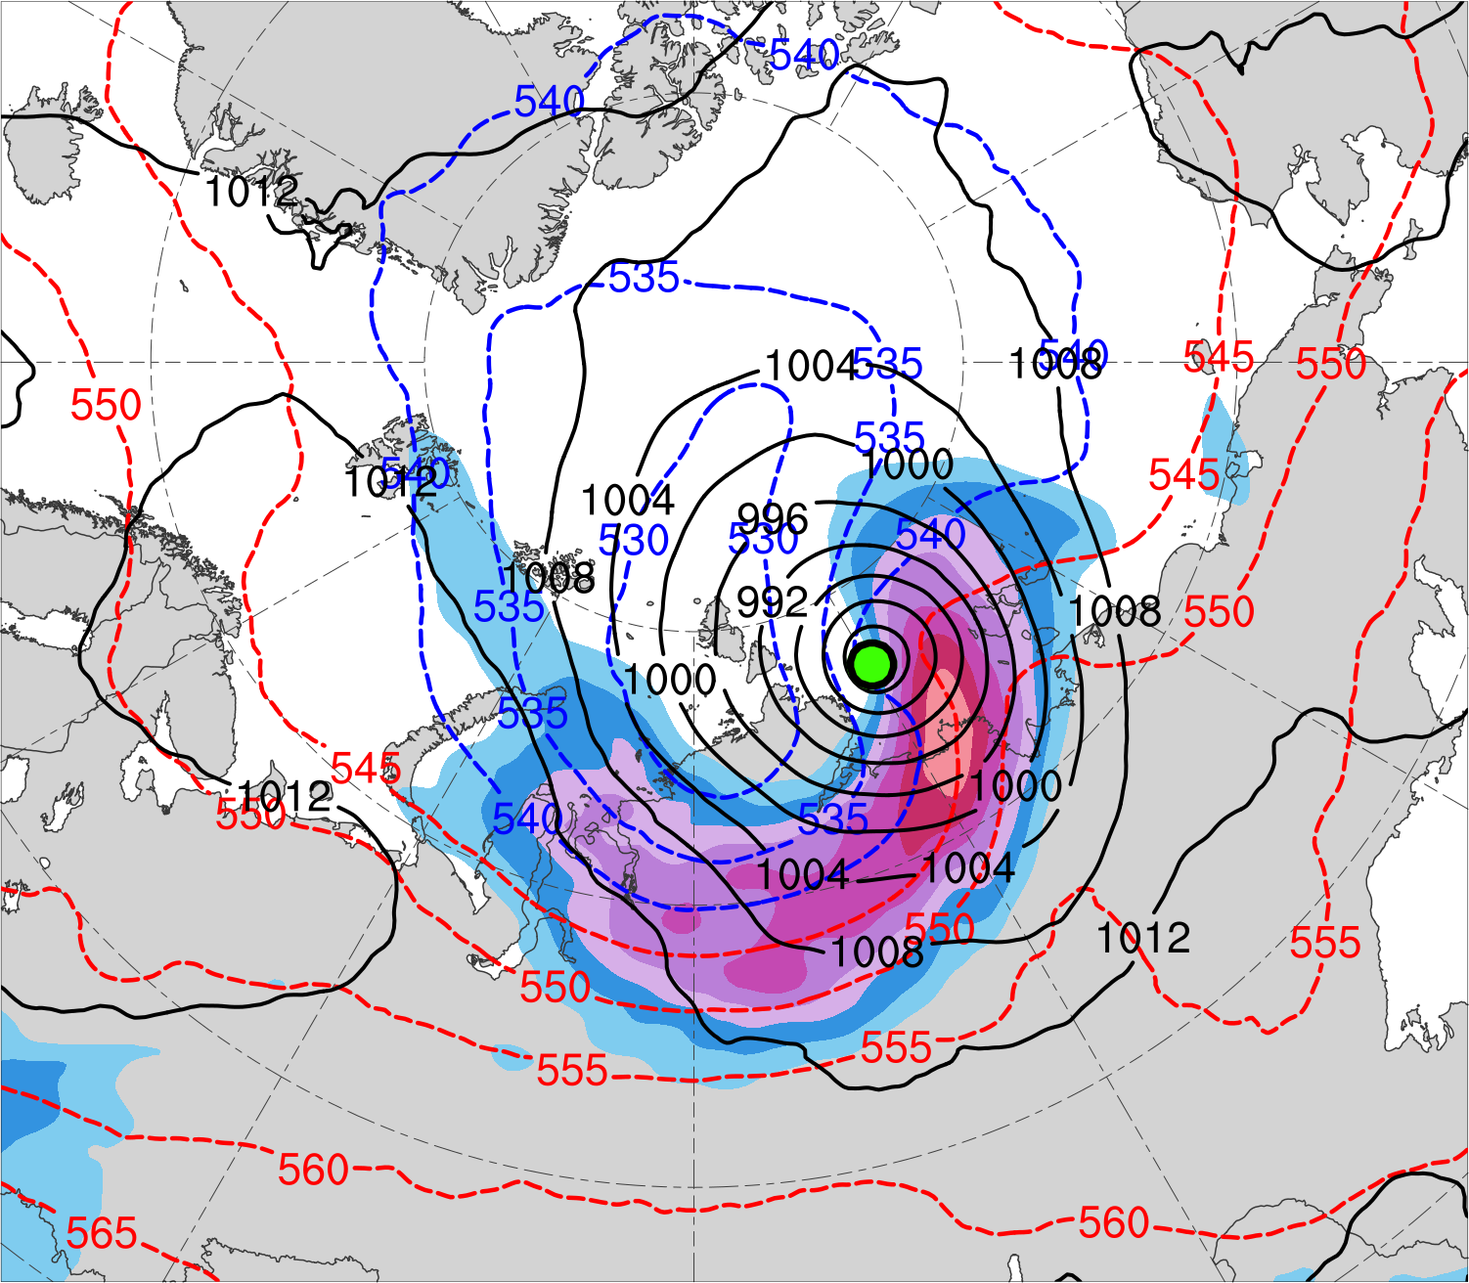
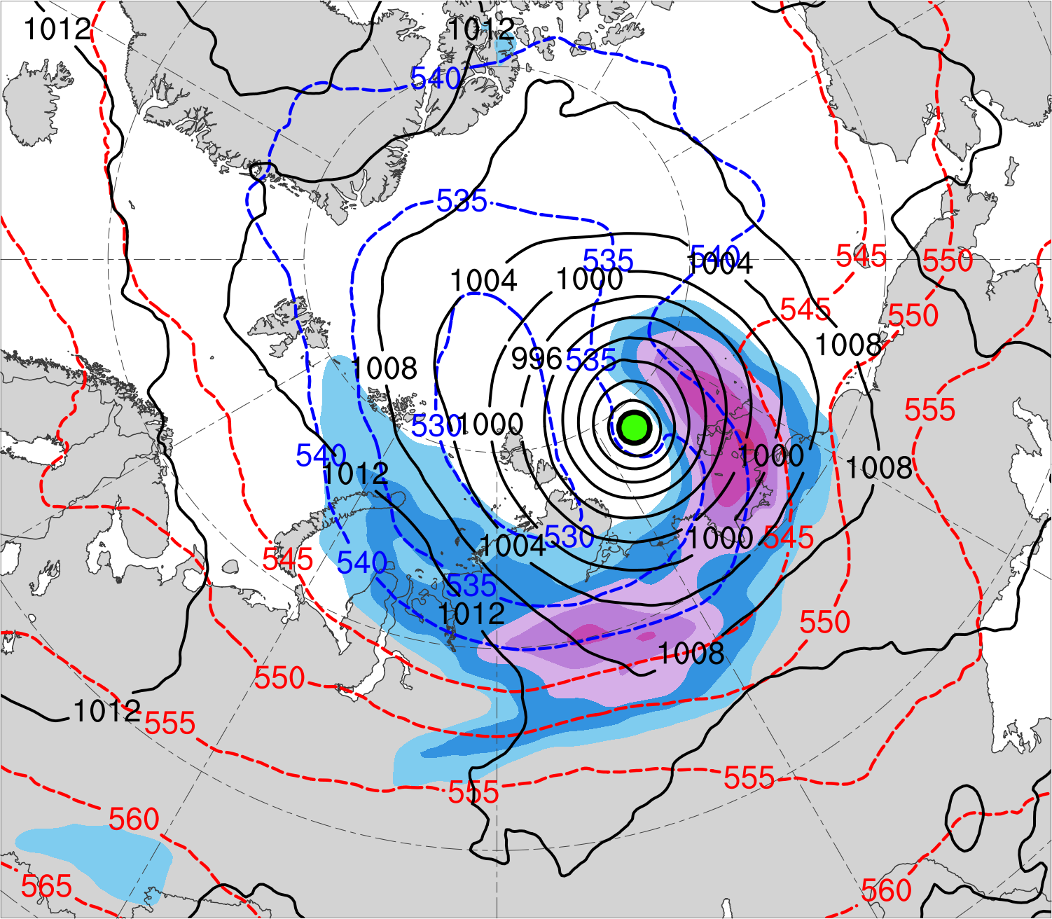
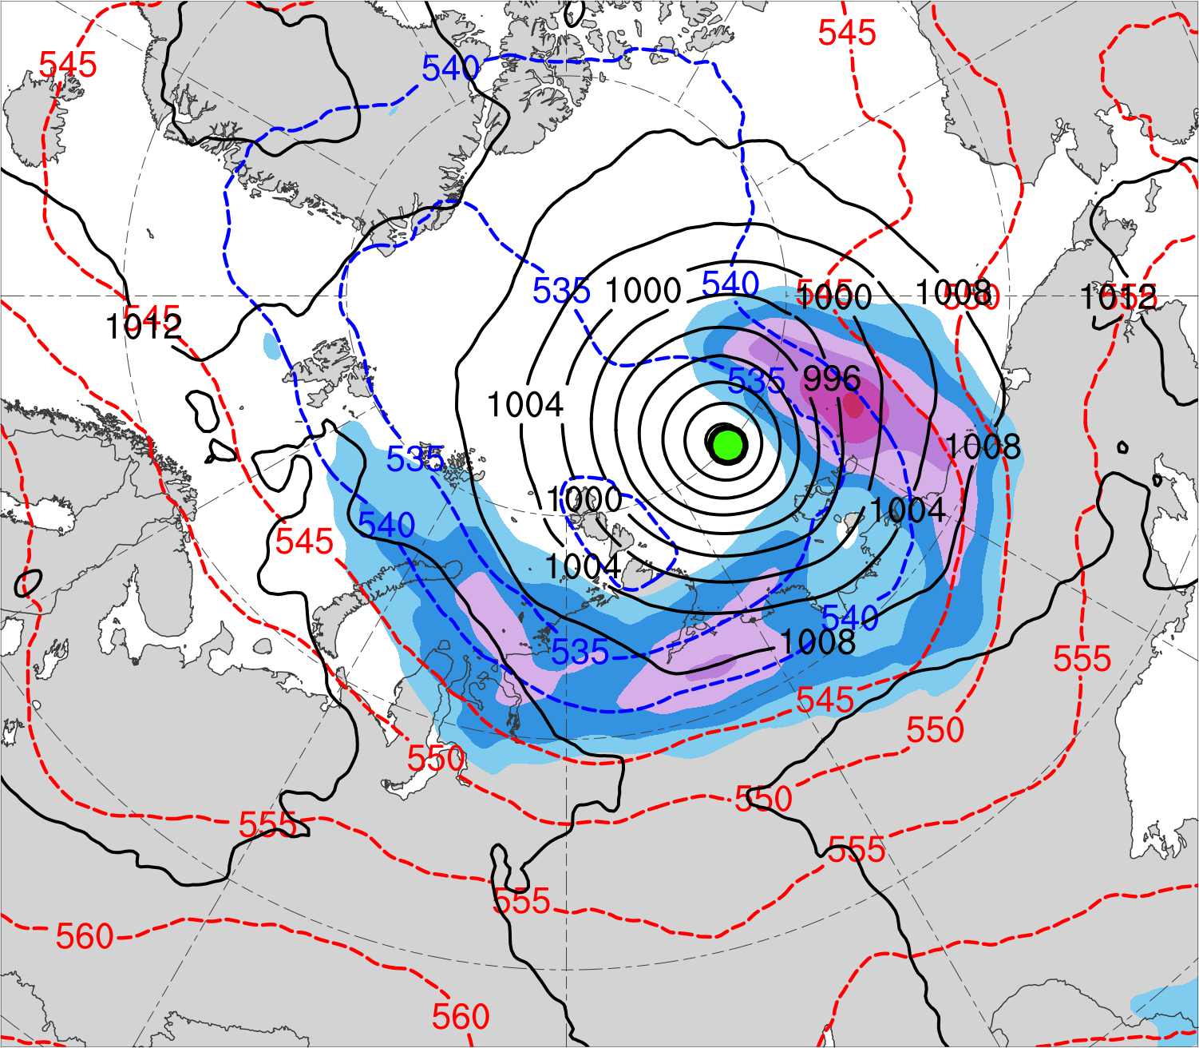
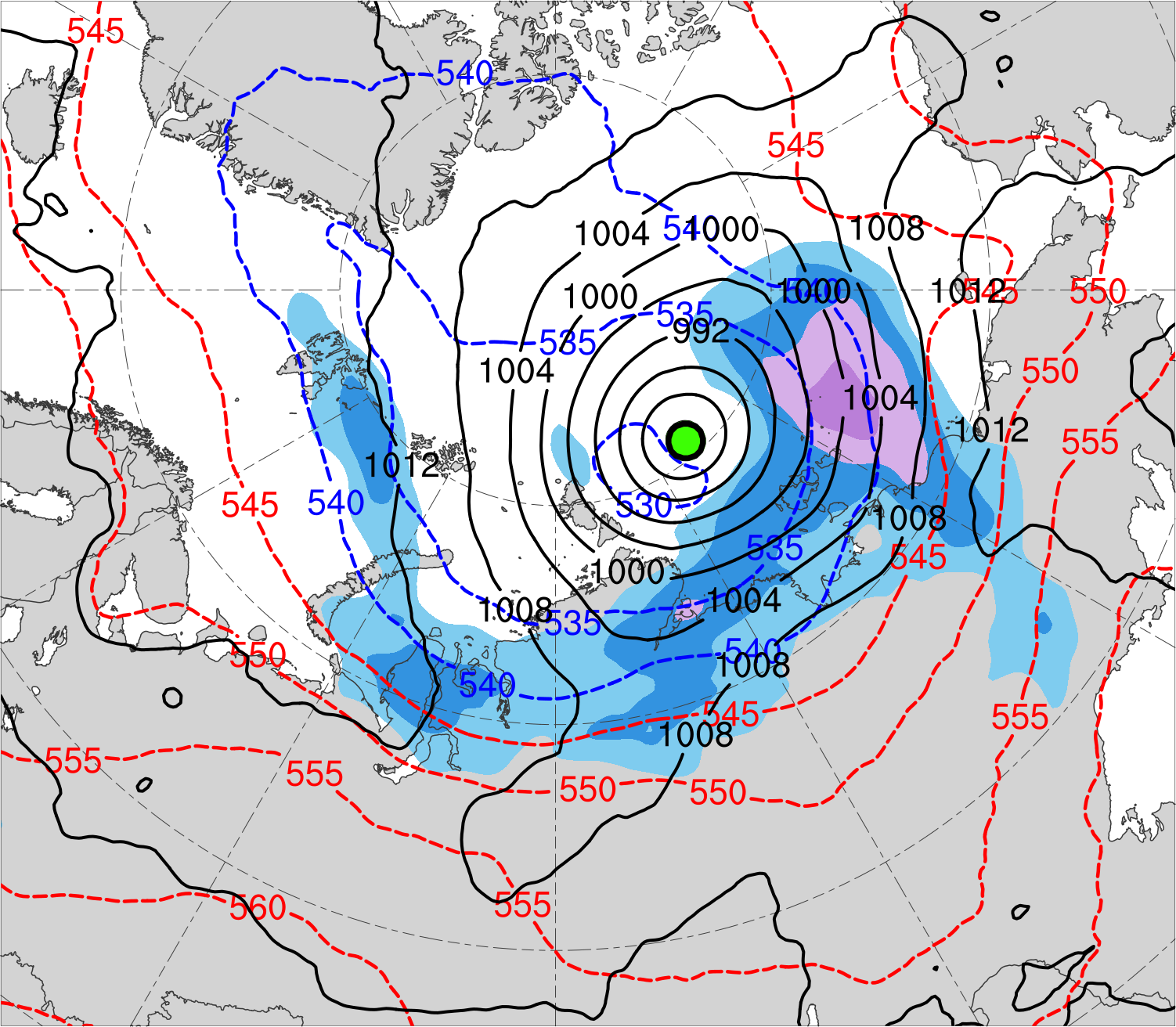
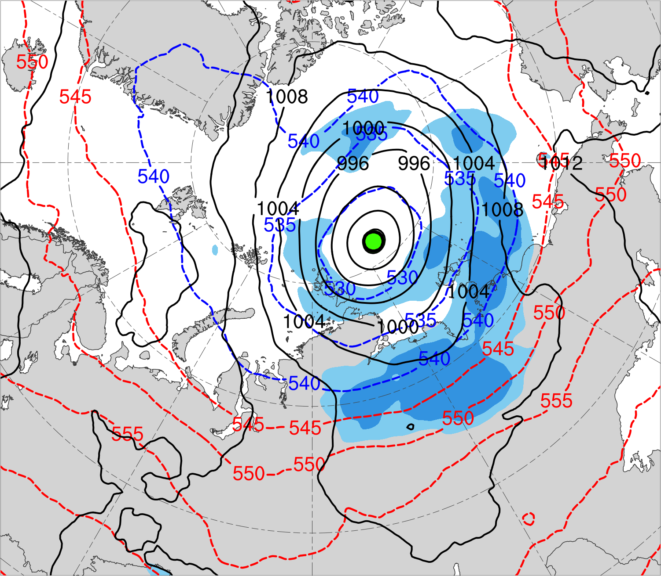
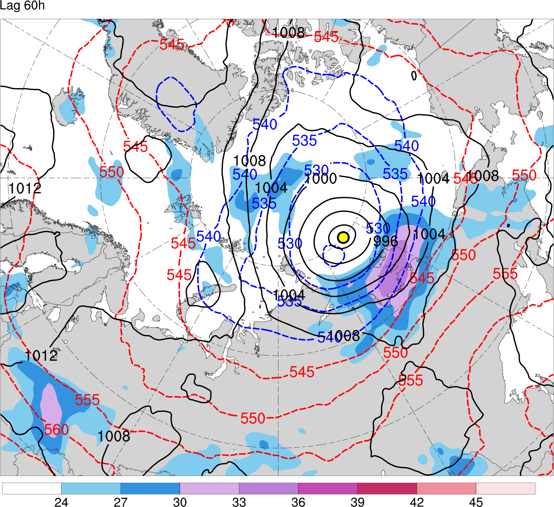
(a) Lag = −48 h (N = 13)
(b) Lag = −36 h (N = 13)
(c) Lag = −24 h (N = 14)
(d) Lag = −12 h (N = 14)
(e) Lag = 0 h (N = 14)
(f) Lag = 12 h (N = 13)
(g) Lag = 24 h (N = 13)
(h) Lag = 36 h (N = 12)
300-hPa wind speed (m s⁻¹)
Mean AC location
18
21
24
27
30
33
36
39
SLP (hPa)
1000–500-hPa thickness (dam)

Slide 19
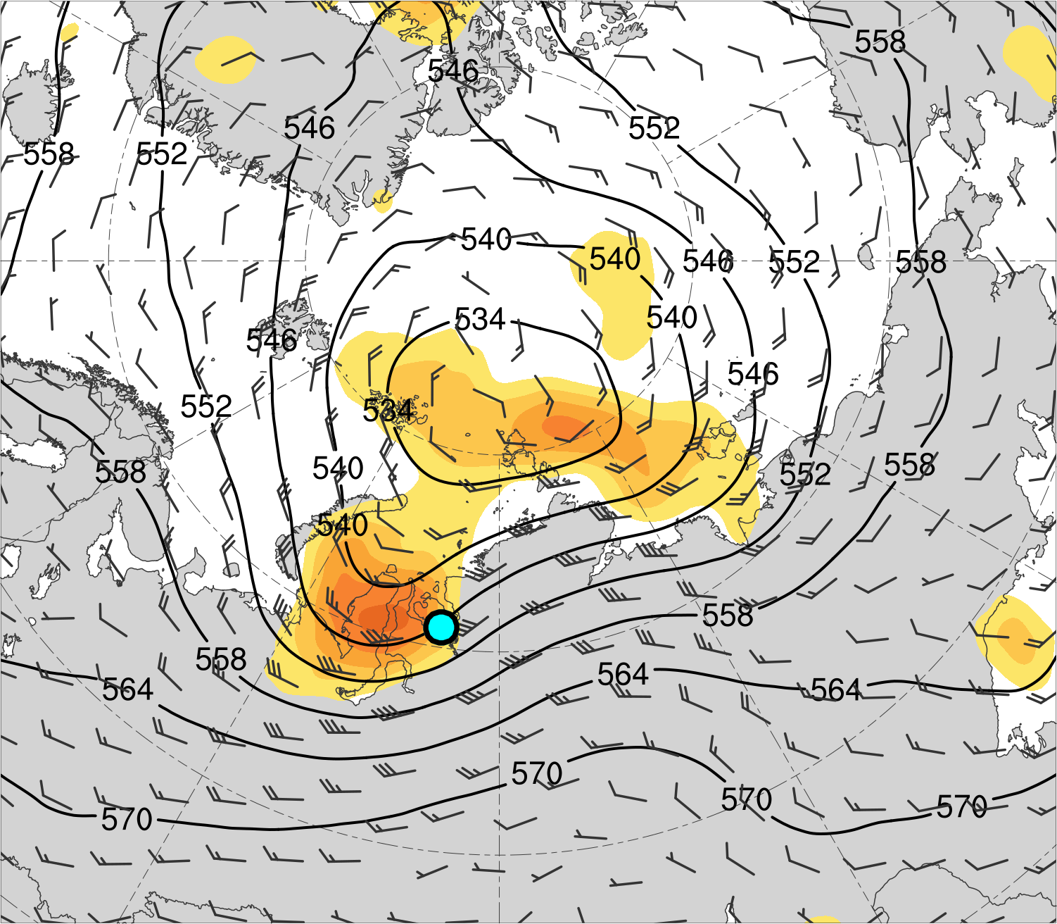
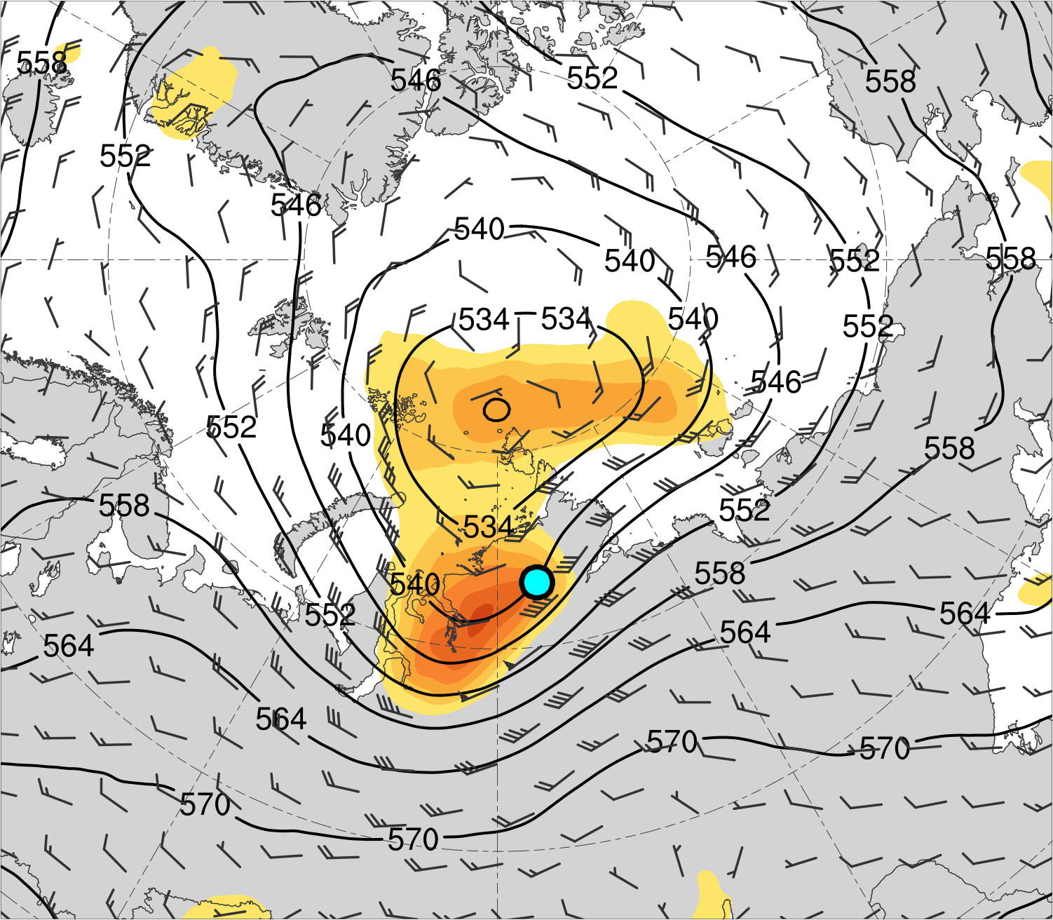
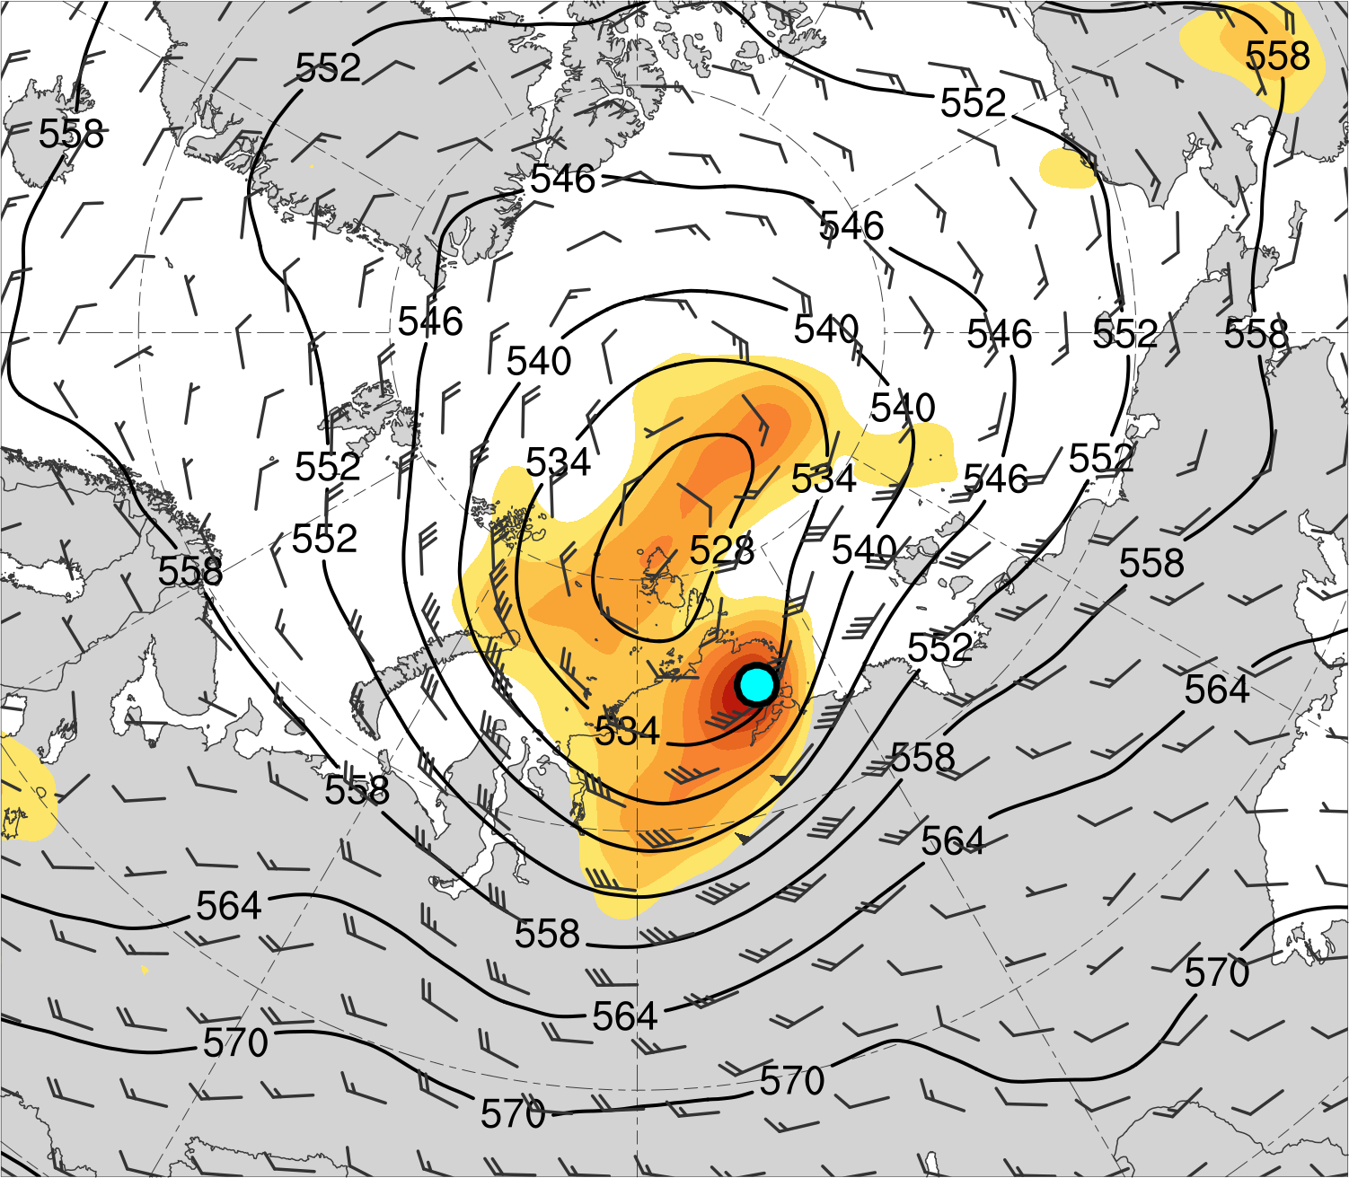
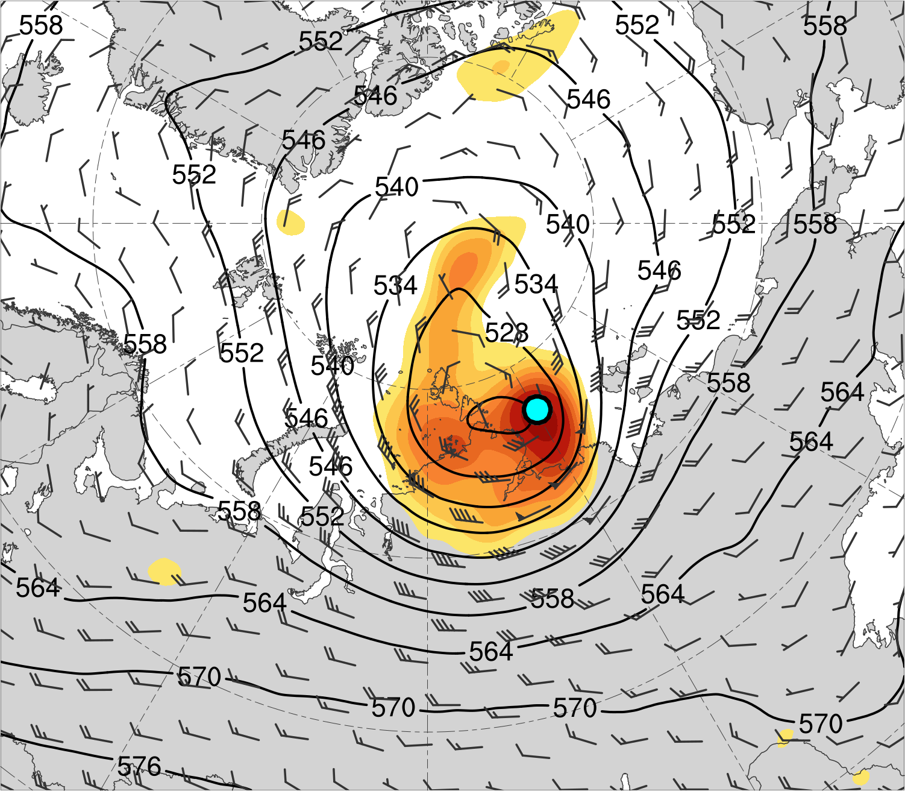
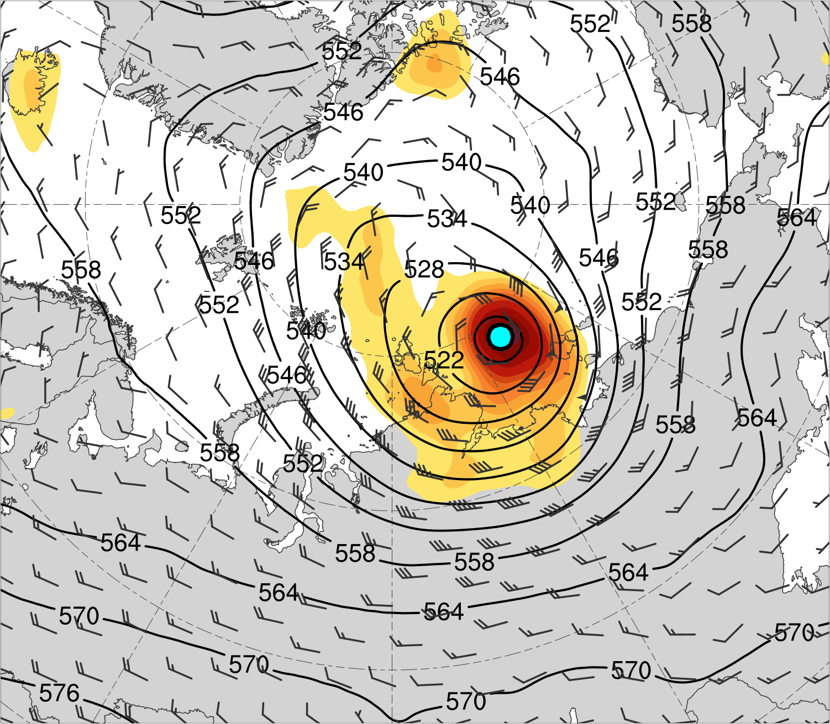
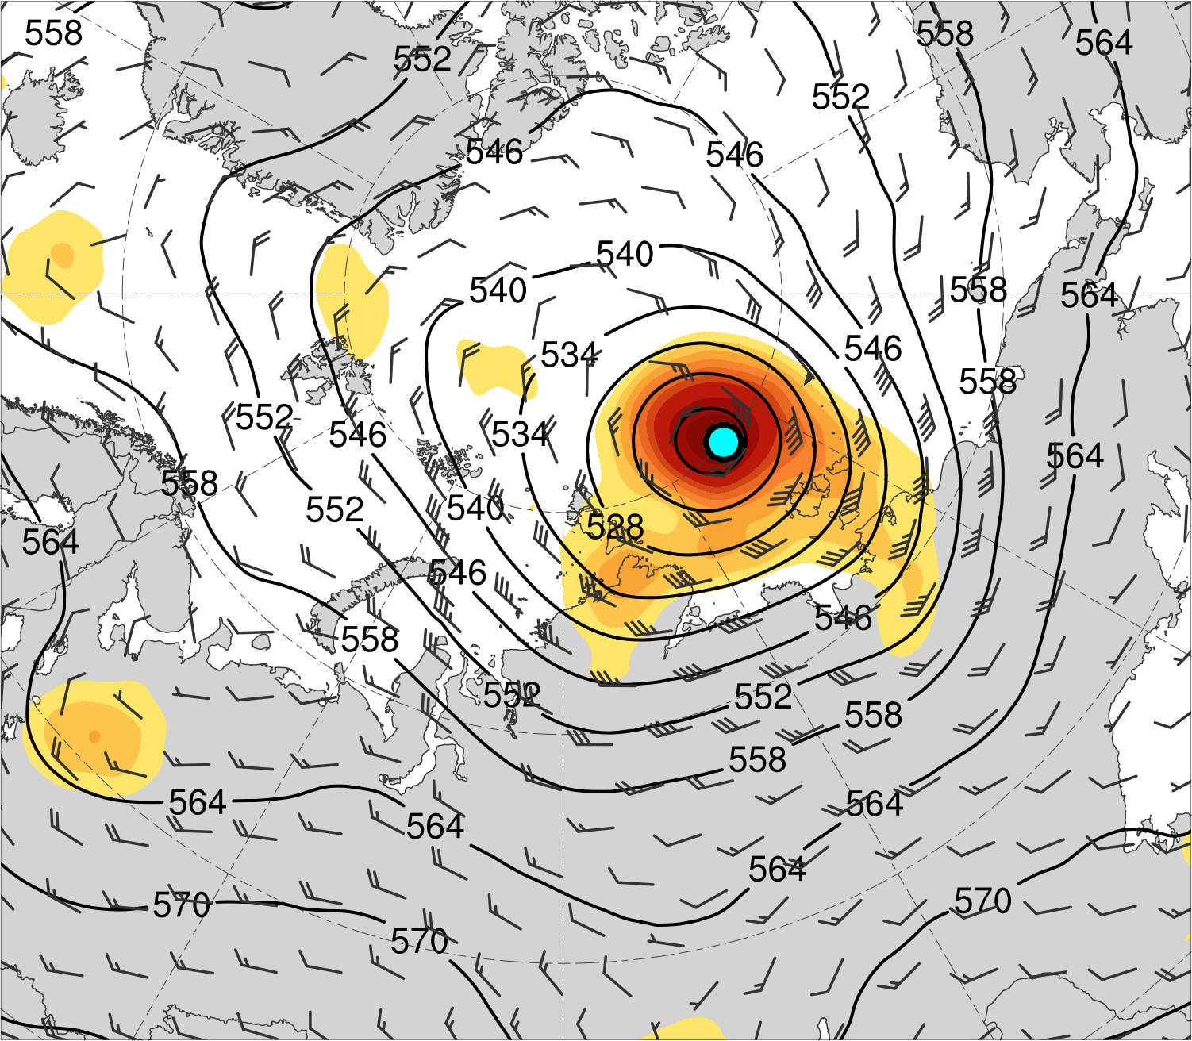
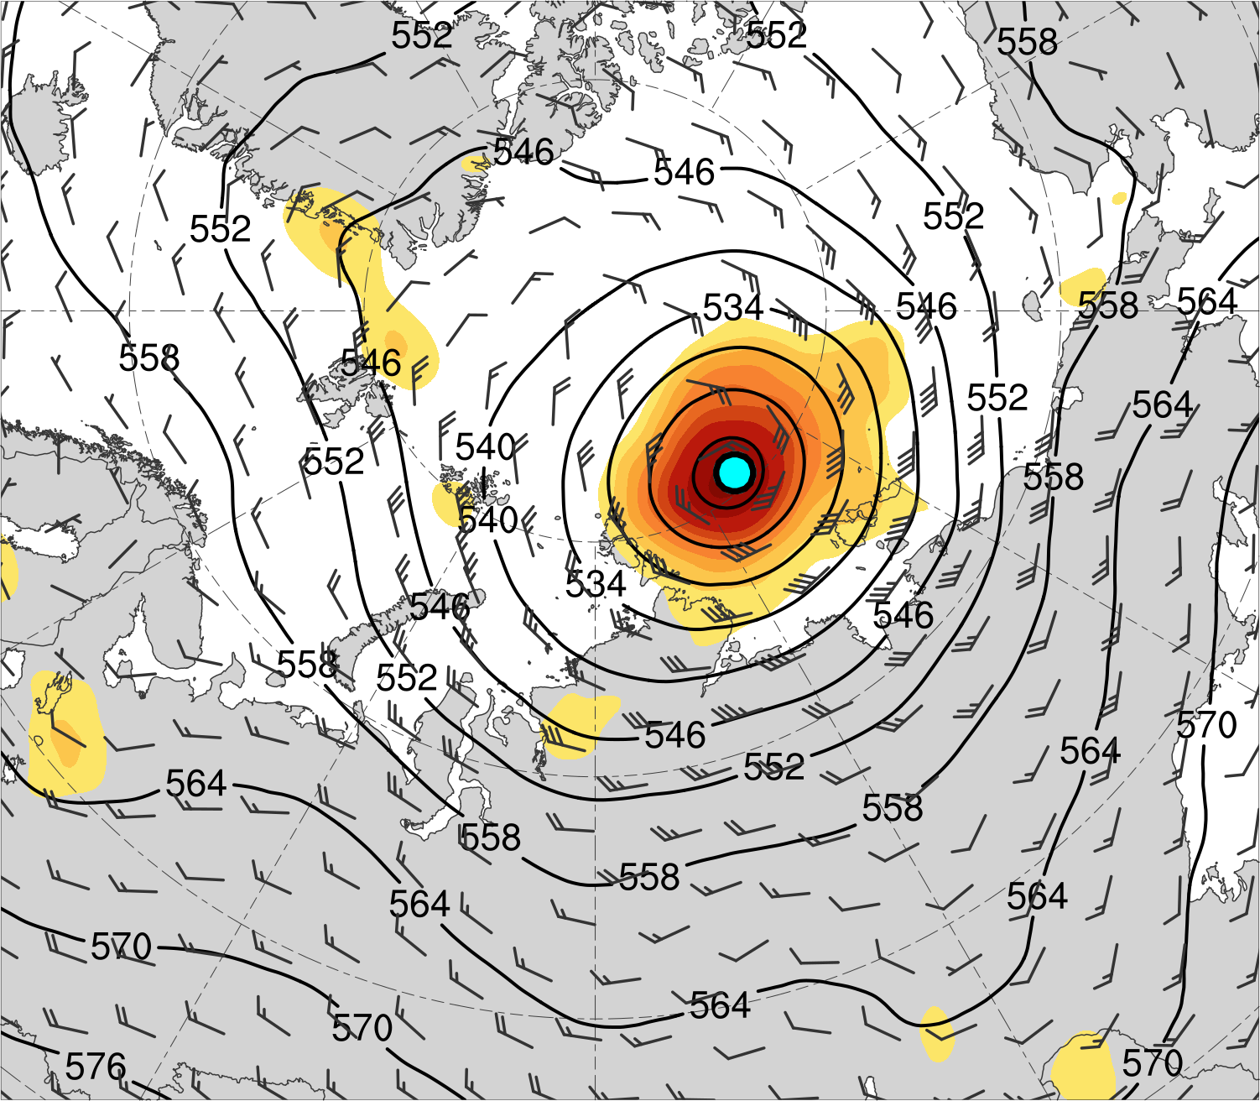
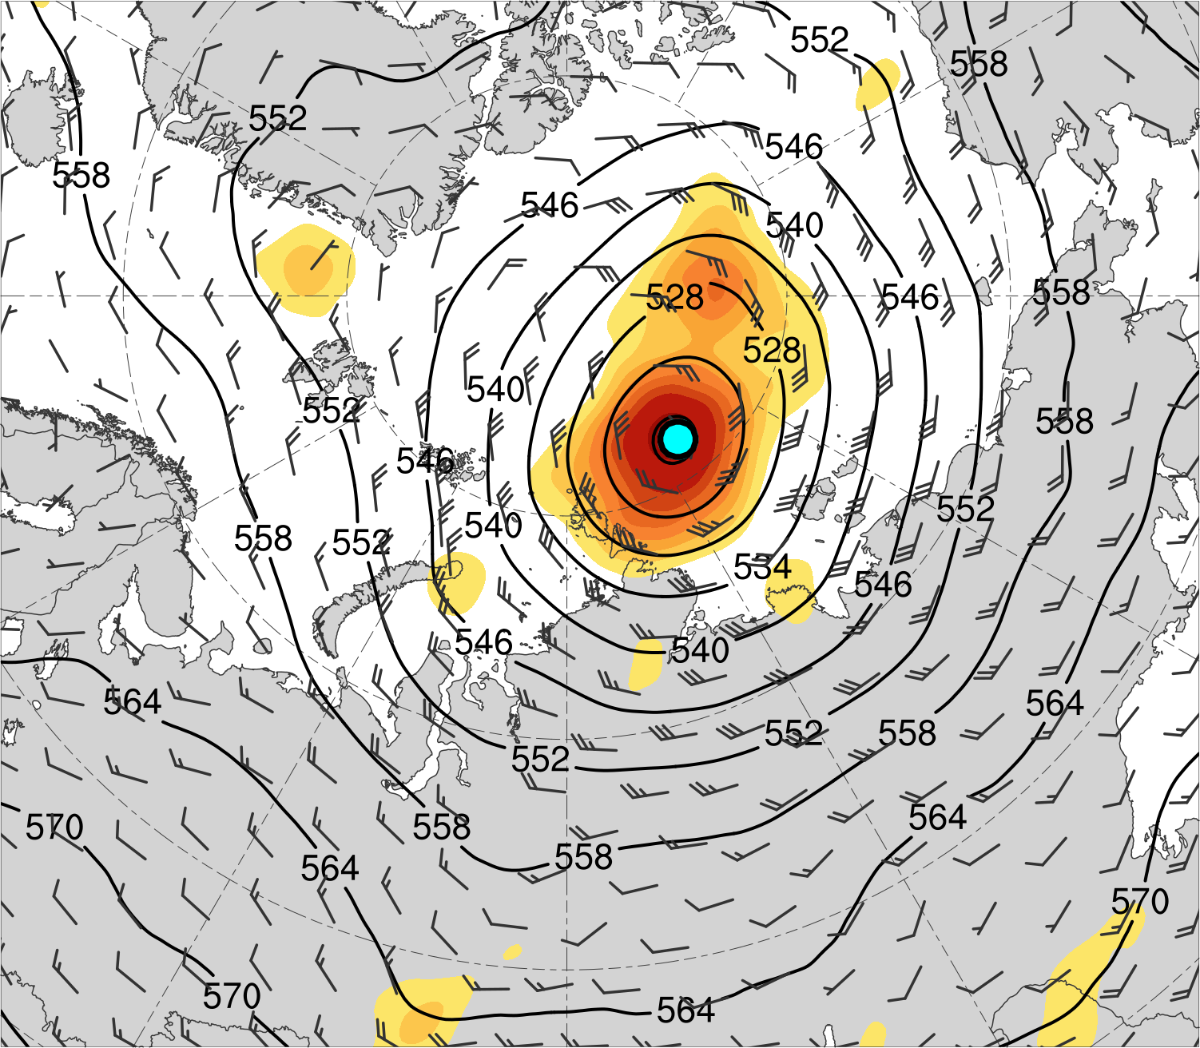
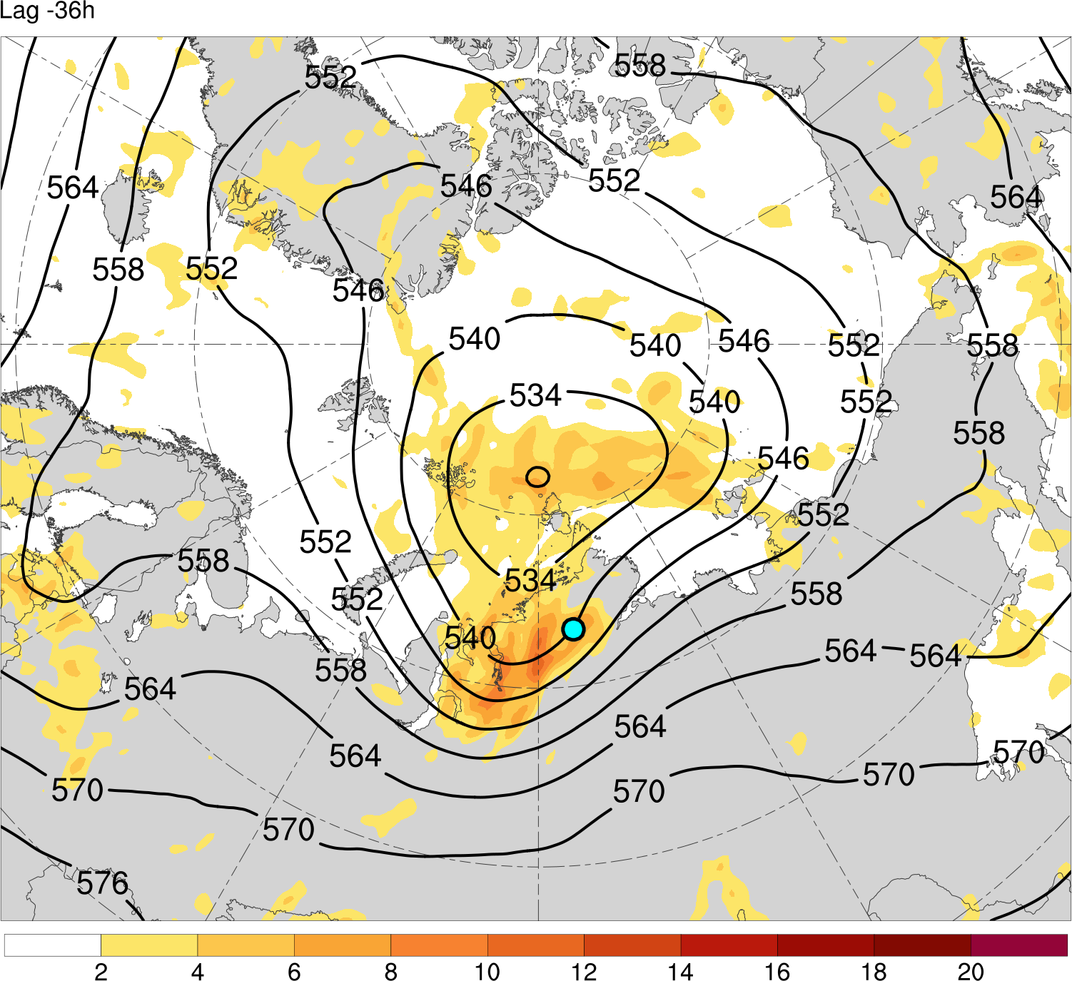
(a) Lag = −48 h (N = 13)
(b) Lag = −36 h (N = 13)
(c) Lag = −24 h (N = 14)
(d) Lag = −12 h (N = 14)
(e) Lag = 0 h (N = 14)
(f) Lag = 12 h (N = 13)
(g) Lag = 24 h (N = 13)
(h) Lag = 36 h (N = 12)
200-km area-averaged 500-hPa relative vorticity (10⁻⁵ s⁻¹)
Mean AC location
2
3
4
5
6
7
8
10
12
14
500-hPa geopotential
height (dam)
500-hPa wind (m s⁻¹)

Slide 20
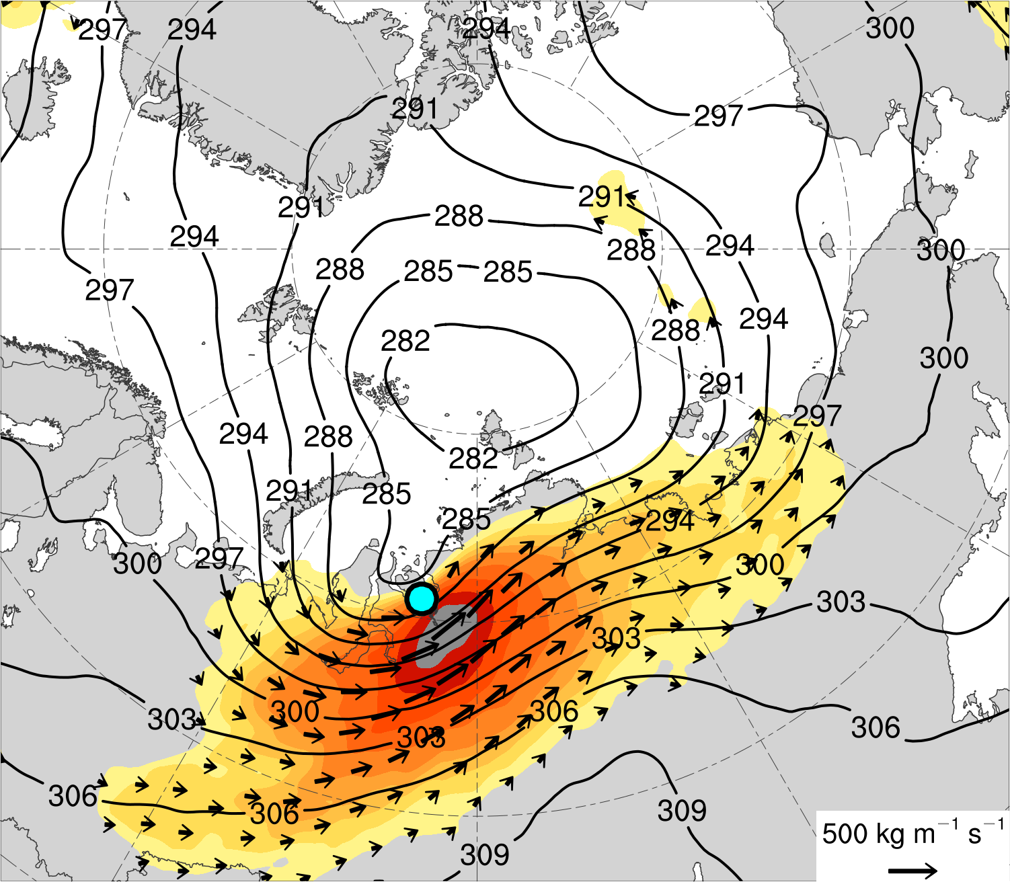
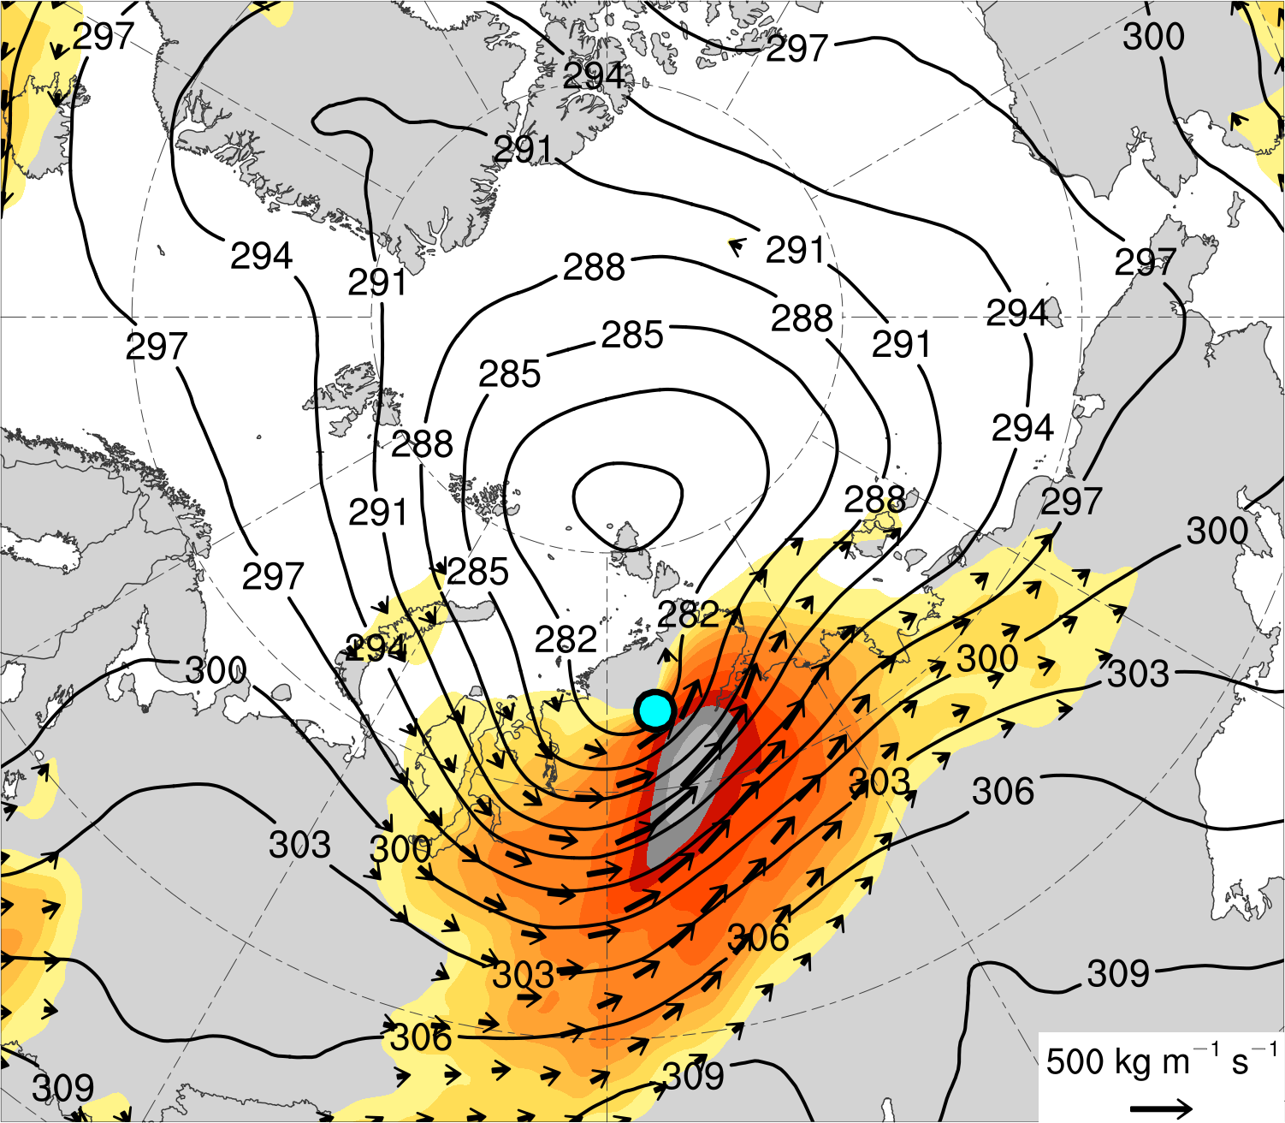
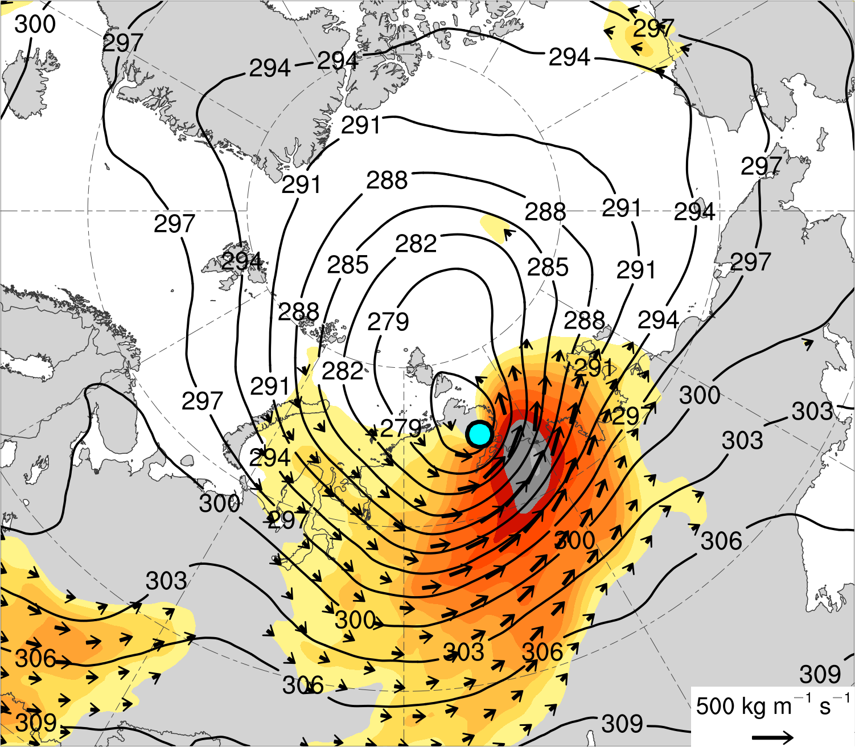
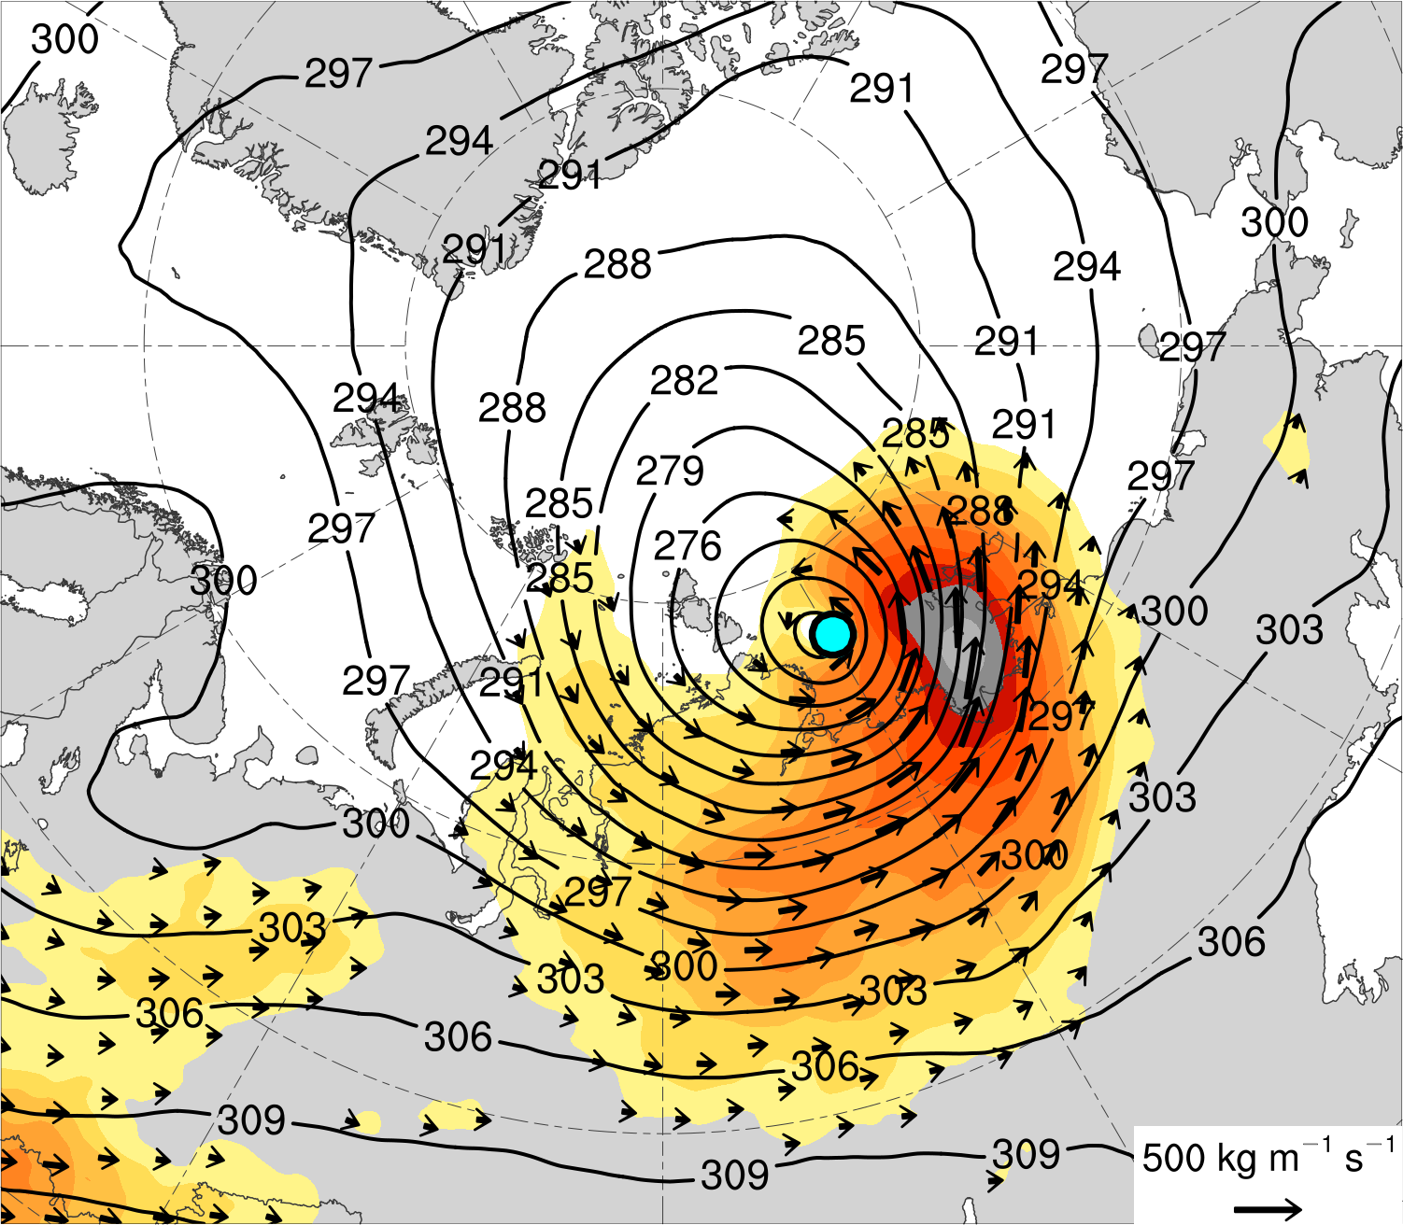
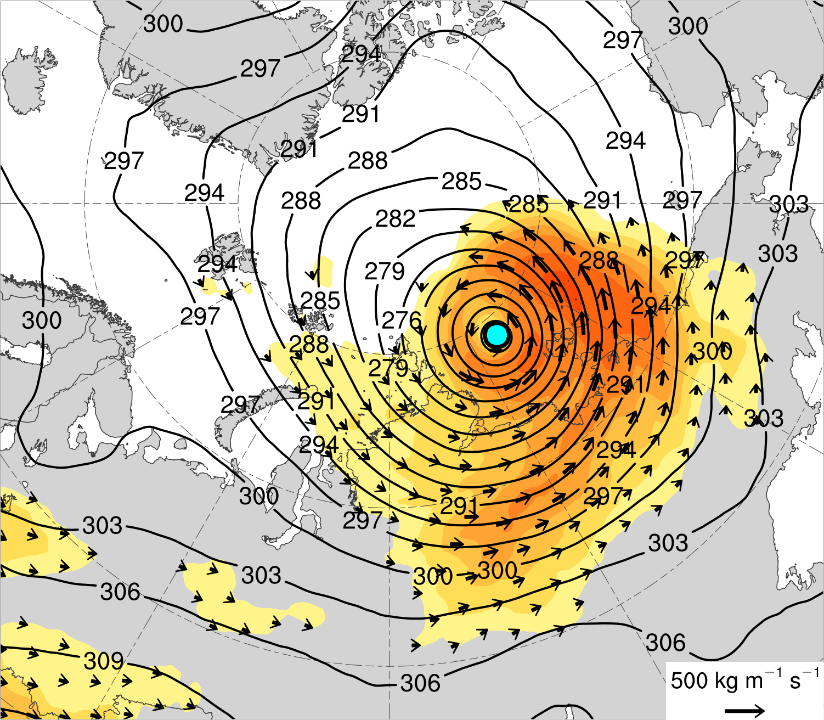
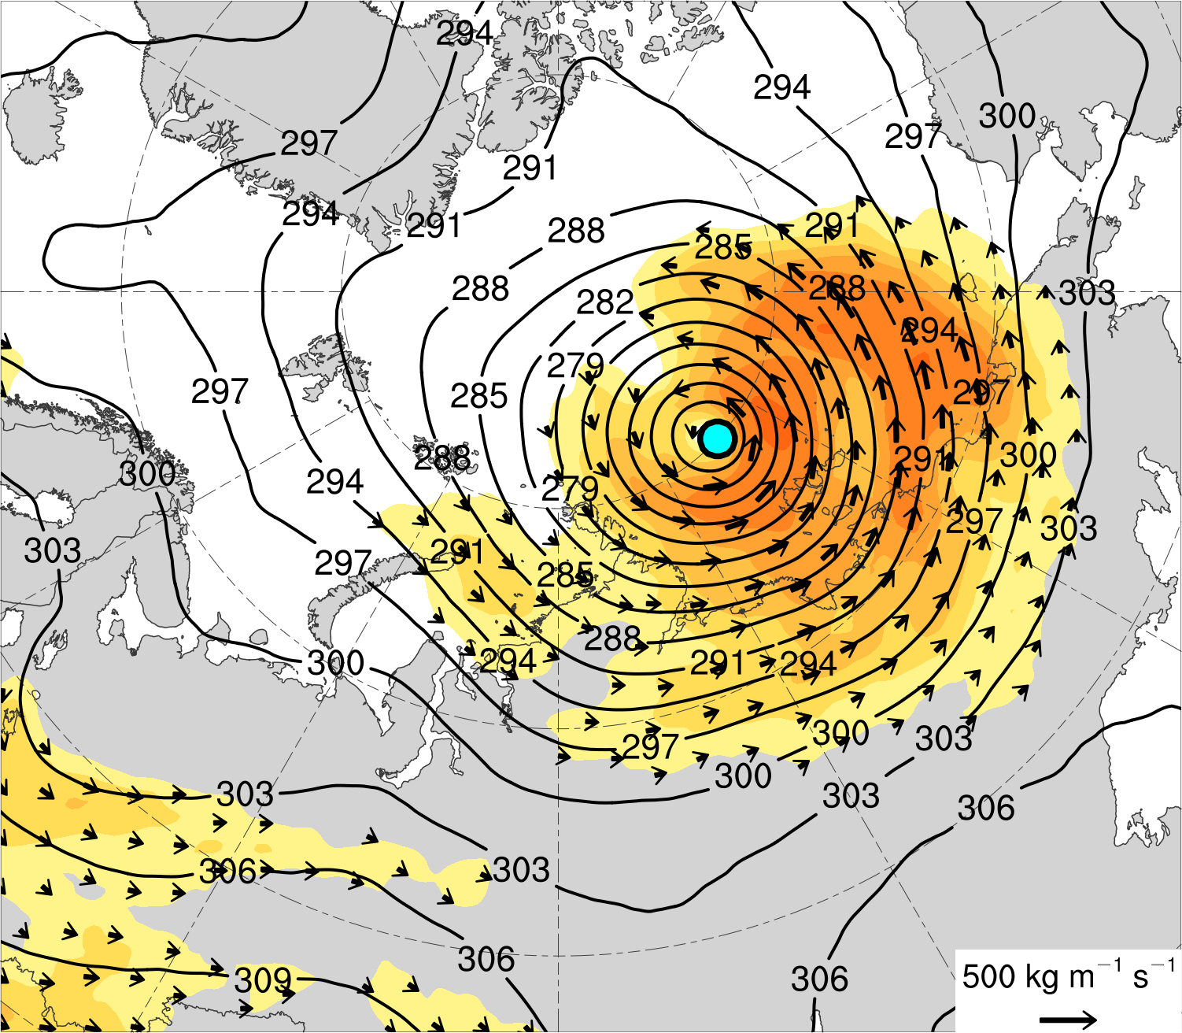
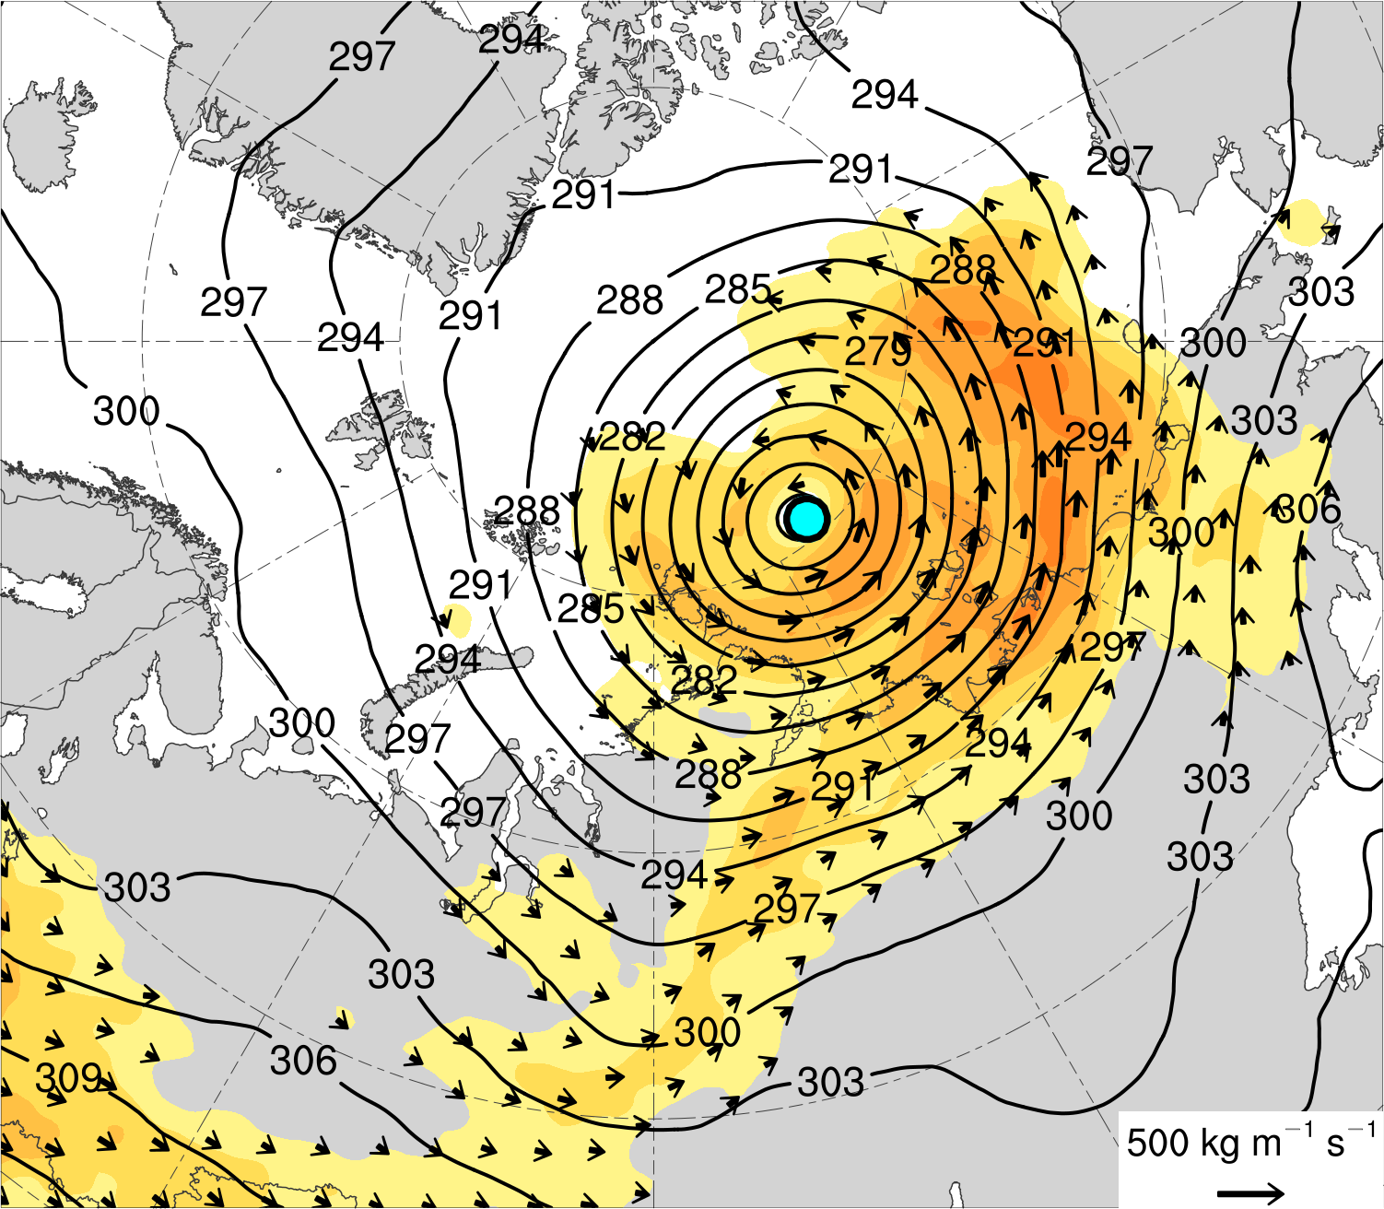
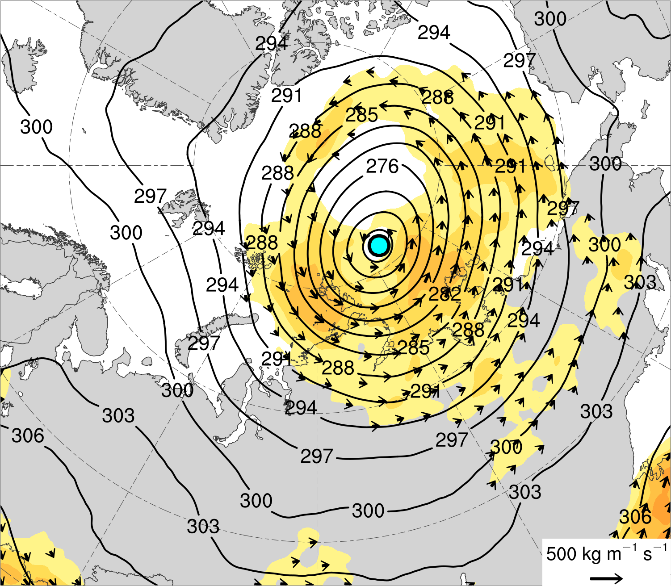
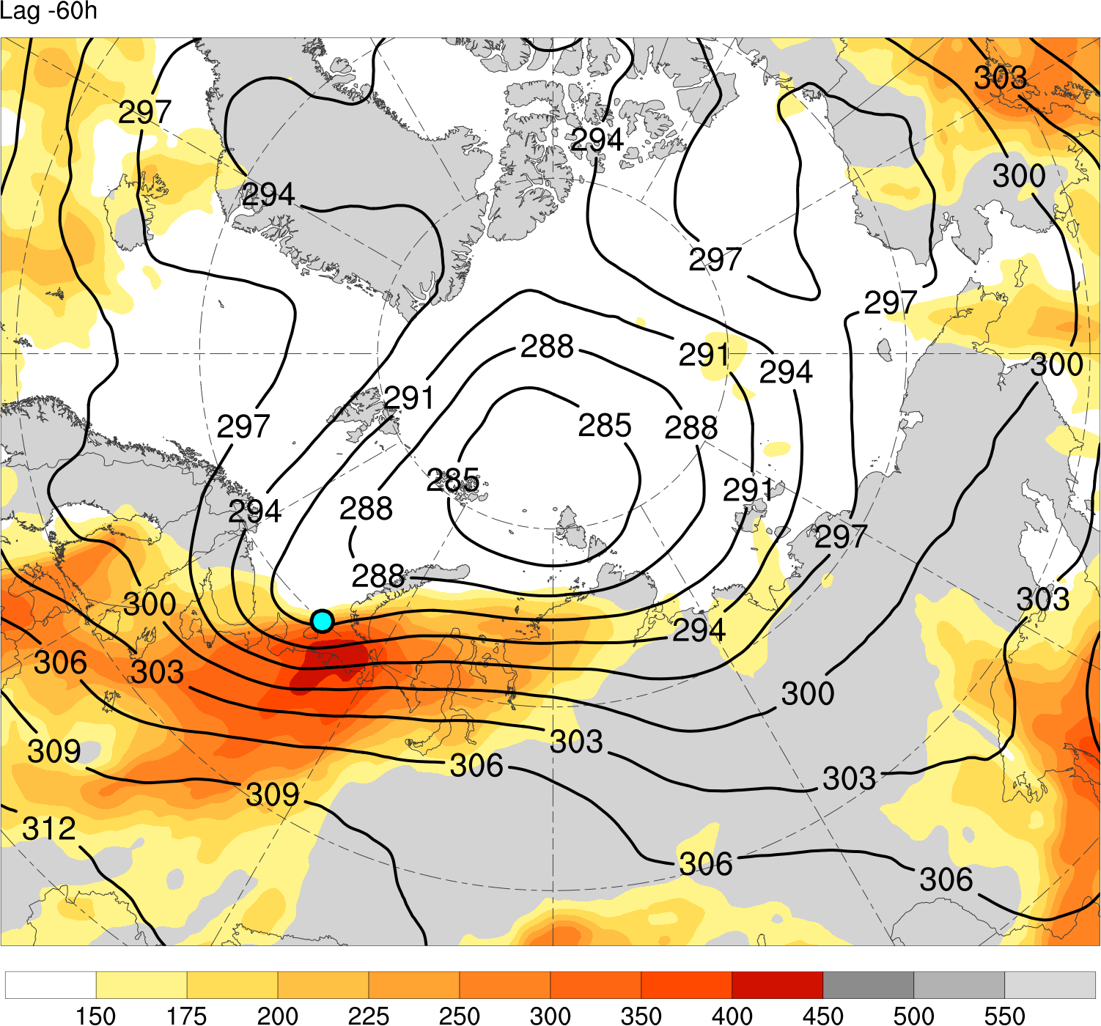
(a) Lag = −48 h (N = 13)
(b) Lag = −36 h (N = 13)
(c) Lag = −24 h (N = 14)
(d) Lag = −12 h (N = 14)
(e) Lag = 0 h (N = 14)
(f) Lag = 12 h (N = 13)
(g) Lag = 24 h (N = 13)
(h) Lag = 36 h (N = 12)
Integrated vapor transport (IVT) (kg m⁻¹ s⁻¹)
Mean AC location
100
125
150
175
200
250
300
350
400
450
500
IVT (kg m⁻¹ s⁻¹)
700-hPa geopotential
height (dam)

Slide 21
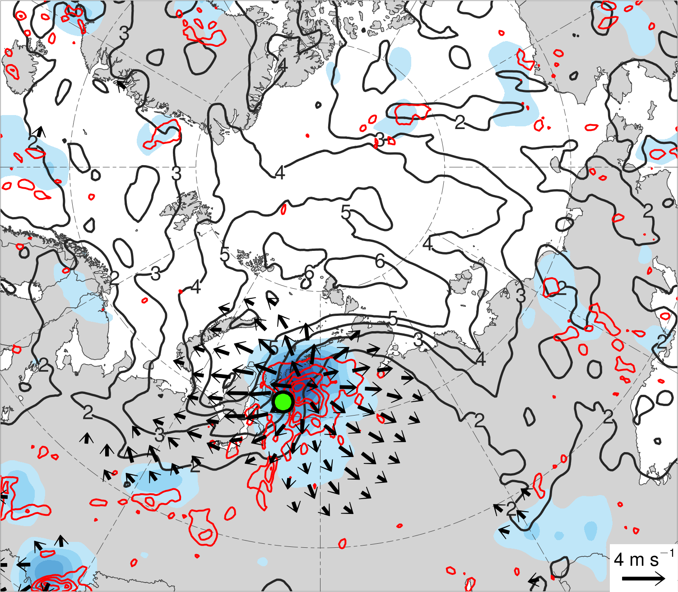
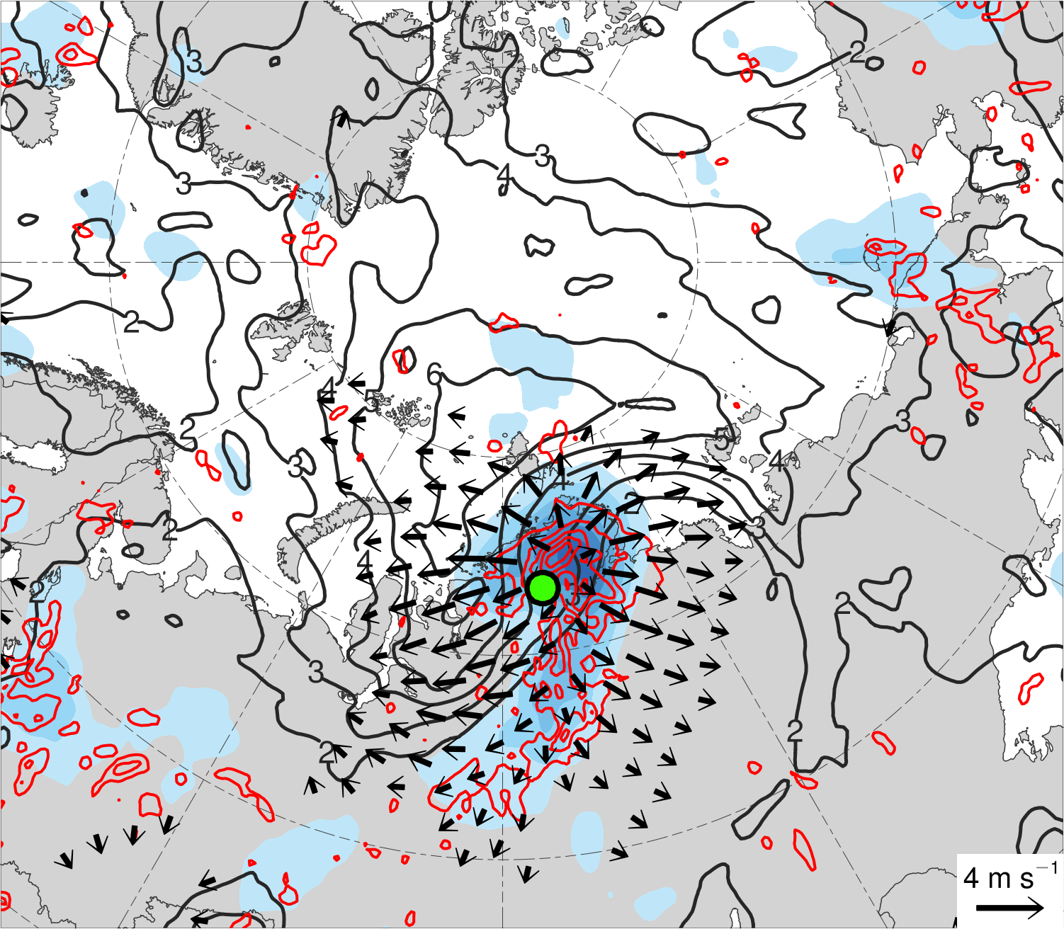
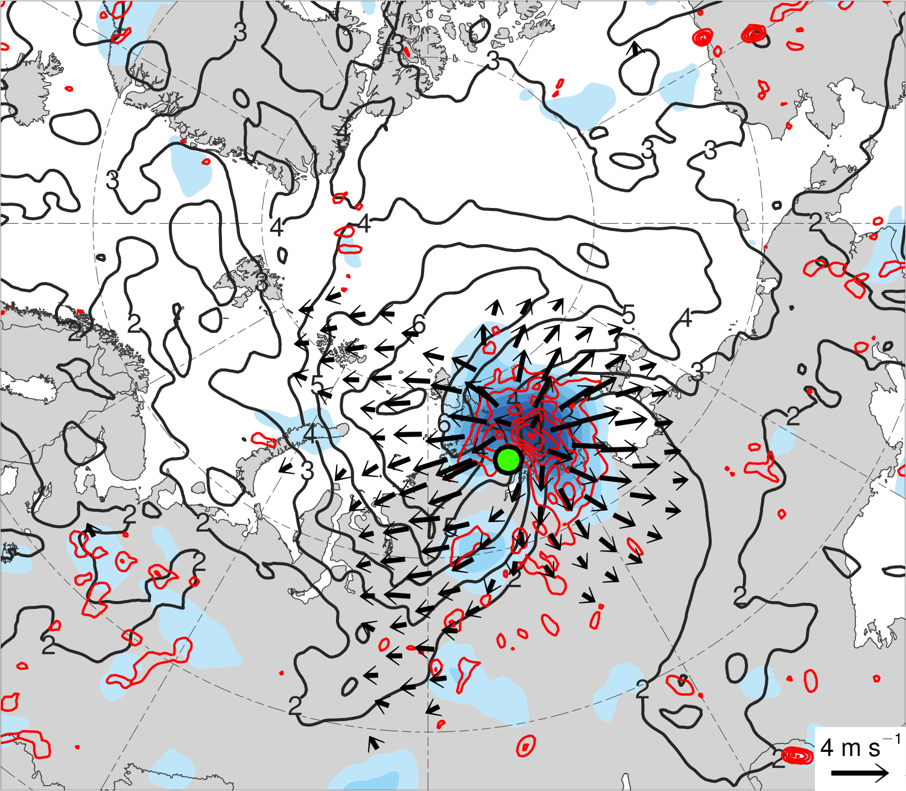
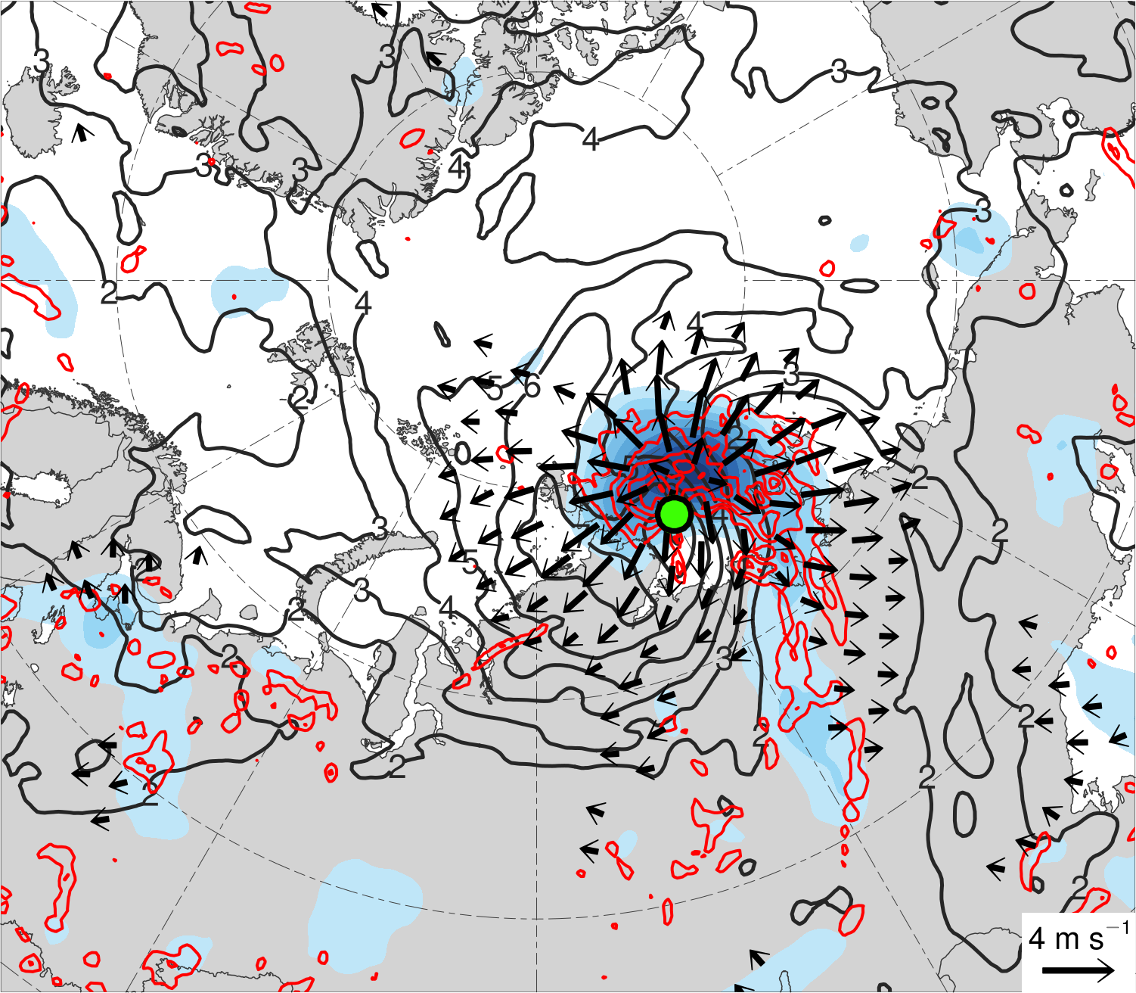
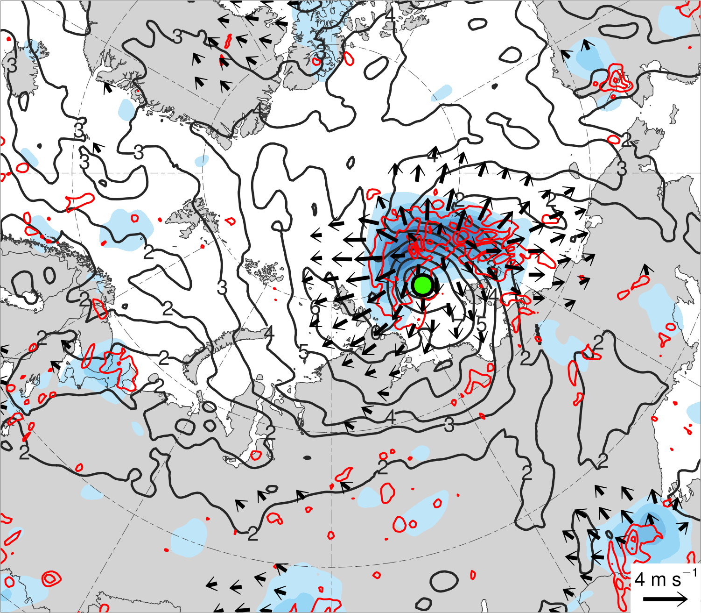
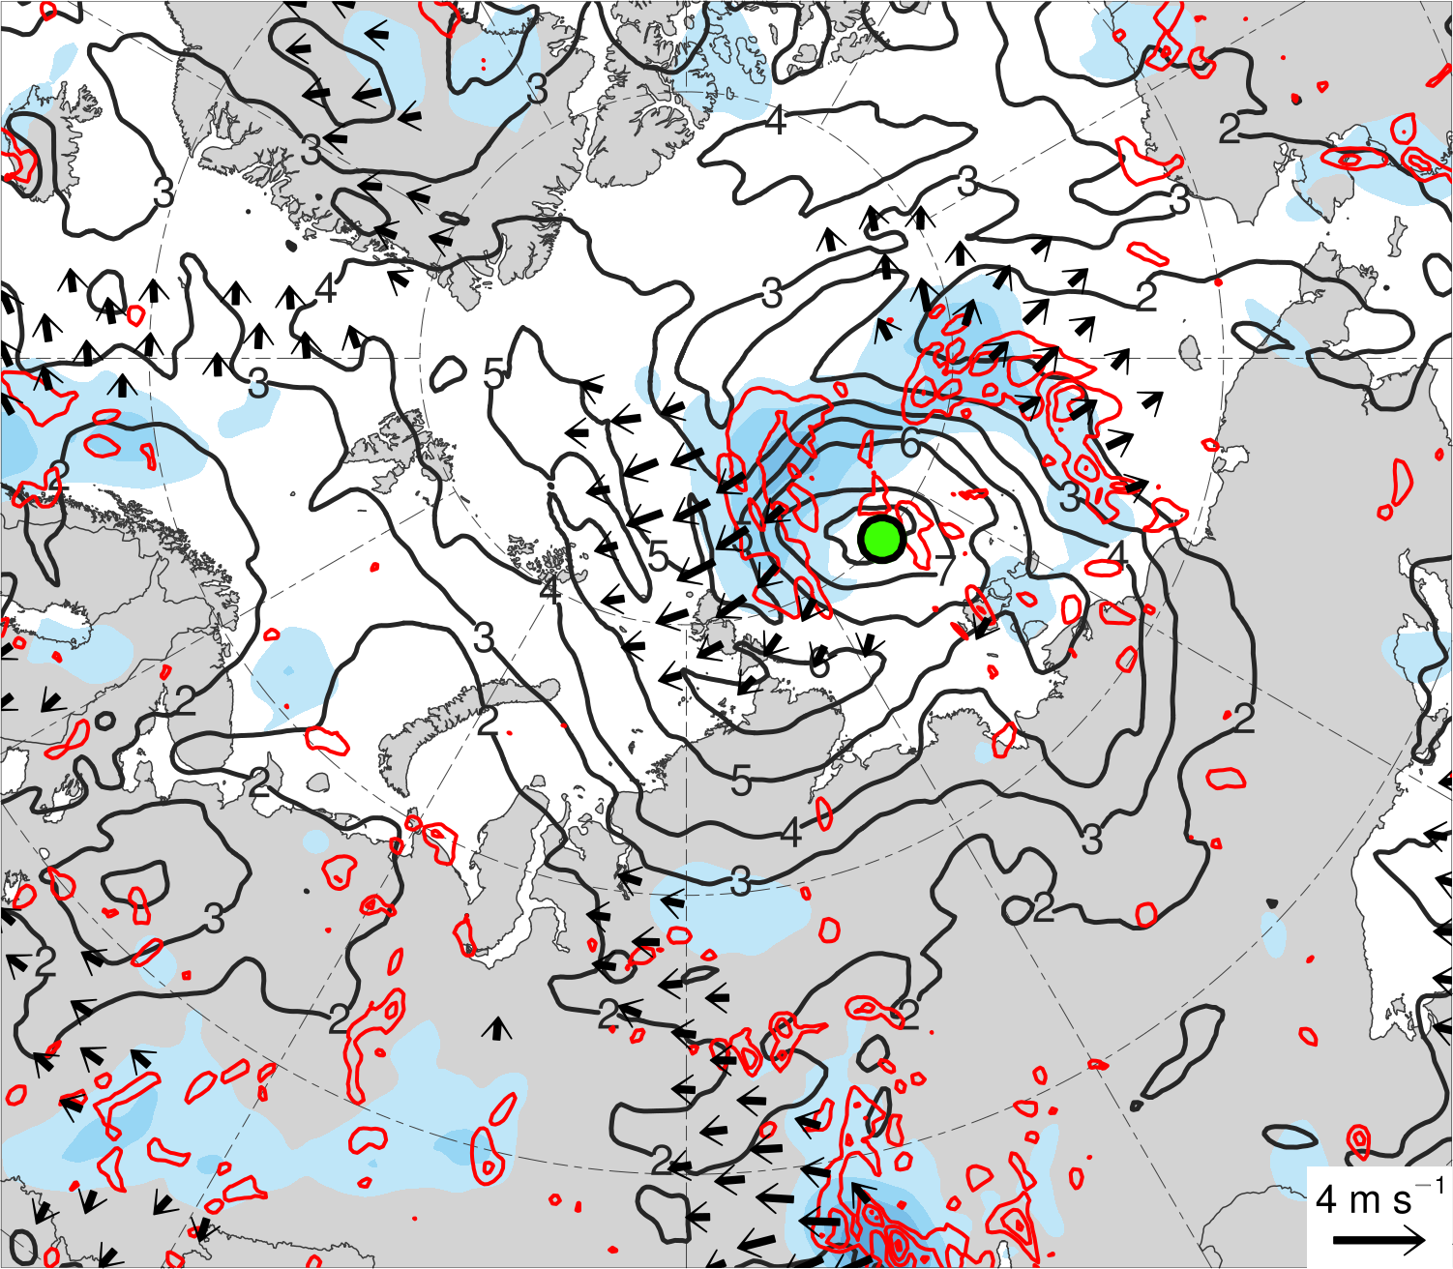



(a) Lag = −48 h (N = 13)
(b) Lag = −36 h (N = 13)
(c) Lag = −24 h (N = 14)
(d) Lag = −12 h (N = 14)
(e) Lag = 0 h (N = 14)
(f) Lag = 12 h (N = 13)
(g) Lag = 24 h (N = 13)
(h) Lag = 36 h (N = 12)
200-km area-averaged 350–250-hPa divergence (10⁻⁶ s⁻¹)
Mean AC location
2
4
6
8
10
12
14
16
350–250-hPa irrotational wind (m s⁻¹)
350–250-hPa PV (PVU)
Negative values of 800–600-hPa ω
(every 1 × 10⁻³ hPa s⁻¹)

Slide 22









(a) Lag = −48 h (N = 13)
(b) Lag = −36 h (N = 13)
(c) Lag = −24 h (N = 14)
(d) Lag = −12 h (N = 14)
(e) Lag = 0 h (N = 14)
(f) Lag = 12 h (N = 13)
(g) Lag = 24 h (N = 13)
(h) Lag = 36 h (N = 12)
850–600-hPa Eady growth rate (day⁻¹)
Mean AC location
0.4
0.5
0.6
0.7
0.8
1.0
1.2
1.4
SLP (hPa)

Slide 23
Summary
The Arctic environment tends to be characterized by more amplified synoptic-scale flow, greater baroclinic growth rates, and potentially greater latent heating during low-skill periods compared to high-skill periods.
Low-skill ACs tend to be stronger and embedded in a region of more amplified synoptic-scale flow, greater baroclinic growth rates, and potentially greater latent heating during low-skill periods compared to high-skill periods.
Intense low-skill ACs during low-skill periods intensify downstream of a mid-to-upper-tropospheric vortex in a region of relatively strong lower-to-midtropospheric baroclinicity, lower-to-midtropospheric ascent, tropospheric-integrated vapor transport, and upper-tropospheric divergence.
A combination of baroclinic processes and latent heating likely plays important roles in the intensification of intense low-skill ACs during low-skill periods.

Slide 24
Extra Slides

Slide 25


Example AC in Composite (AC during 13–19 Aug 2016)
1000
16
19
990
17
18
Minimum SLP (hPa)
980
14
15
13
970
960
0000 UTC positions of AC
13
14
15
16
17
18
19
Day in August 2016 labeled at 0000 UTC
Red line shows track of AC during 13–19 Aug 2016. Numbers represent dates of 0000 UTC positions of AC.
Time series of minimum SLP (hPa) of AC during 13–19 Aug 2016.
Data source: ERA5

Slide 26








(a) Lag = −48 h (0000 UTC 14 Aug 2016)
(b) Lag = −36 h (1200 UTC 14 Aug 2016)
(c) Lag = −24 h (0000 UTC 15 Aug 2016)
(d) Lag = −12 h (1200 UTC 15 Aug 2016)
(e) Lag = 0 h (0000 UTC 16 Aug 2016)
(f) Lag = 12 h (1200 UTC 16 Aug 2016)
(g) Lag = 24 h (0000 UTC 17 Aug 2016)
(h) Lag = 36 h (1200 UTC 17 Aug 2016)
300-hPa wind speed (m s⁻¹)
AC location
24
32
40
48
56
64
72
80
SLP (hPa)
1000–500-hPa thickness (dam)
Data source: ERA5

Slide 27








(a) Lag = −48 h (0000 UTC 14 Aug 2016)
(b) Lag = −36 h (1200 UTC 14 Aug 2016)
(c) Lag = −24 h (0000 UTC 15 Aug 2016)
(d) Lag = −12 h (1200 UTC 15 Aug 2016)
(e) Lag = 0 h (0000 UTC 16 Aug 2016)
(f) Lag = 12 h (1200 UTC 16 Aug 2016)
(g) Lag = 24 h (0000 UTC 17 Aug 2016)
(h) Lag = 36 h (1200 UTC 17 Aug 2016)
200-km area-averaged 500-hPa relative vorticity (10⁻⁵ s⁻¹)
AC location
2
4
6
8
10
12
14
16
18
20
500-hPa geopotential
height (dam)
500-hPa wind (m s⁻¹)
Data source: ERA5

Slide 28








(a) Lag = −48 h (0000 UTC 14 Aug 2016)
(b) Lag = −36 h (1200 UTC 14 Aug 2016)
(c) Lag = −24 h (0000 UTC 15 Aug 2016)
(d) Lag = −12 h (1200 UTC 15 Aug 2016)
(e) Lag = 0 h (0000 UTC 16 Aug 2016)
(f) Lag = 12 h (1200 UTC 16 Aug 2016)
(g) Lag = 24 h (0000 UTC 17 Aug 2016)
(h) Lag = 36 h (1200 UTC 17 Aug 2016)
Integrated vapor transport (IVT) (kg m⁻¹ s⁻¹)
AC location
200
250
300
350
400
500
600
700
800
900
1000
IVT (kg m⁻¹ s⁻¹)
700-hPa geopotential
height (dam)
Data source: ERA5

Slide 29








(a) Lag = −48 h (0000 UTC 14 Aug 2016)
(b) Lag = −36 h (1200 UTC 14 Aug 2016)
(c) Lag = −24 h (0000 UTC 15 Aug 2016)
(d) Lag = −12 h (1200 UTC 15 Aug 2016)
(e) Lag = 0 h (0000 UTC 16 Aug 2016)
(f) Lag = 12 h (1200 UTC 16 Aug 2016)
(g) Lag = 24 h (0000 UTC 17 Aug 2016)
(h) Lag = 36 h (1200 UTC 17 Aug 2016)
200-km area-averaged 350–250-hPa divergence (10⁻⁶ s⁻¹)
AC location
5
10
15
20
25
30
35
40
350–250-hPa irrotational wind (m s⁻¹)
350–250-hPa PV (PVU)
Negative values of 800–600-hPa ω
(every 1 × 10⁻³ hPa s⁻¹)
Data source: ERA5

Slide 30








(a) Lag = −48 h (0000 UTC 14 Aug 2016)
(b) Lag = −36 h (1200 UTC 14 Aug 2016)
(c) Lag = −24 h (0000 UTC 15 Aug 2016)
(d) Lag = −12 h (1200 UTC 15 Aug 2016)
(e) Lag = 0 h (0000 UTC 16 Aug 2016)
(f) Lag = 12 h (1200 UTC 16 Aug 2016)
(g) Lag = 24 h (0000 UTC 17 Aug 2016)
(h) Lag = 36 h (1200 UTC 17 Aug 2016)
850–600-hPa Eady growth rate (day⁻¹)
AC location
0.5
0.75
1.0
1.25
1.5
2.0
2.5
3.0
Data source: ERA5
SLP (hPa)

