Slide 1
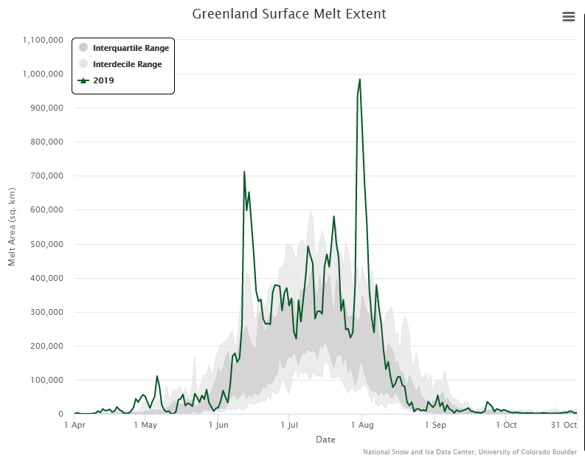
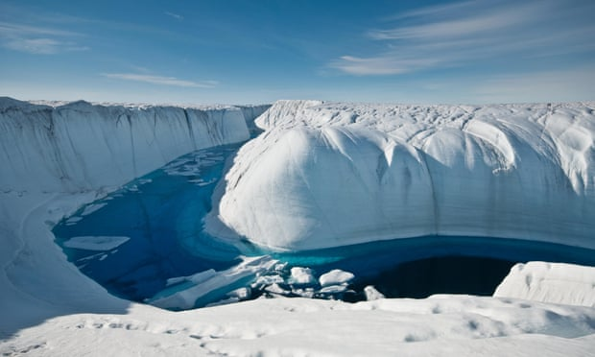
Diagnosing High Sinuosity Regimes Associated with Greenland Ice-Melt Events
Mansour El Riachy, Daniel Keyser, and Lance Bosart
Department of Atmospheric and Environmental Sciences
University at Albany, SUNY
AMS 16th Virtual Conference on Polar Meteorology and Oceanography
Research Supported by ONR Grant N00014-18-1-2200
A meltwater canyon on the Greenland ice sheet.
Photograph: Ian Joughin/University of Washington/PA
Significant ice-melt events:

Slide 2
Motivation
Greater warming at higher latitudes compared with lower latitudes, i.e., Arctic amplification, is associated with Arctic–midlatitude interactions and an increase in cyclone-related incursions of warm, moist air from middle latitudes into the Arctic
These incursions can result in longitudinally varying horizontal temperature gradients associated with disruptions of the tropospheric polar vortex and occur within preferred longitudinal sectors
These disruptions, in the West of Greenland longitudinal sector, influence the synoptic flow regime and are sometimes associated with anomalous Greenland ice-melt events concurrent with flow amplification

Slide 3
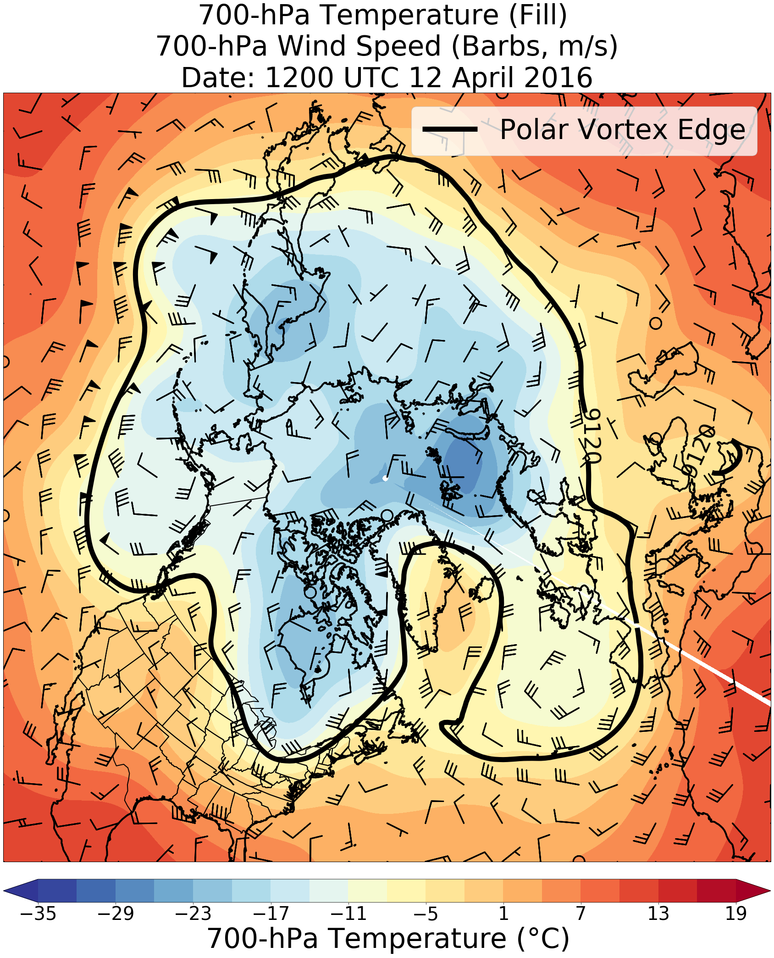
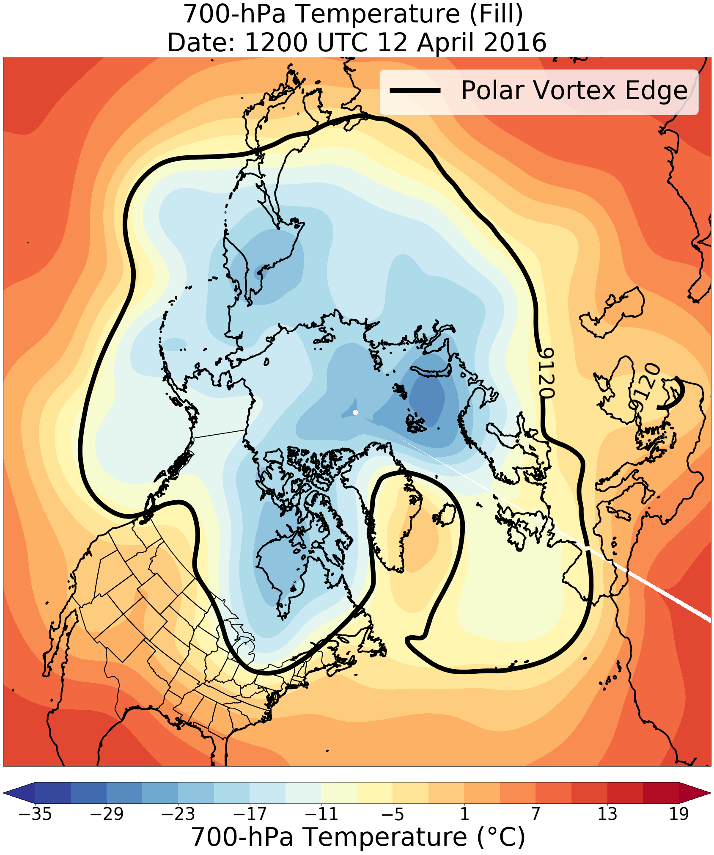
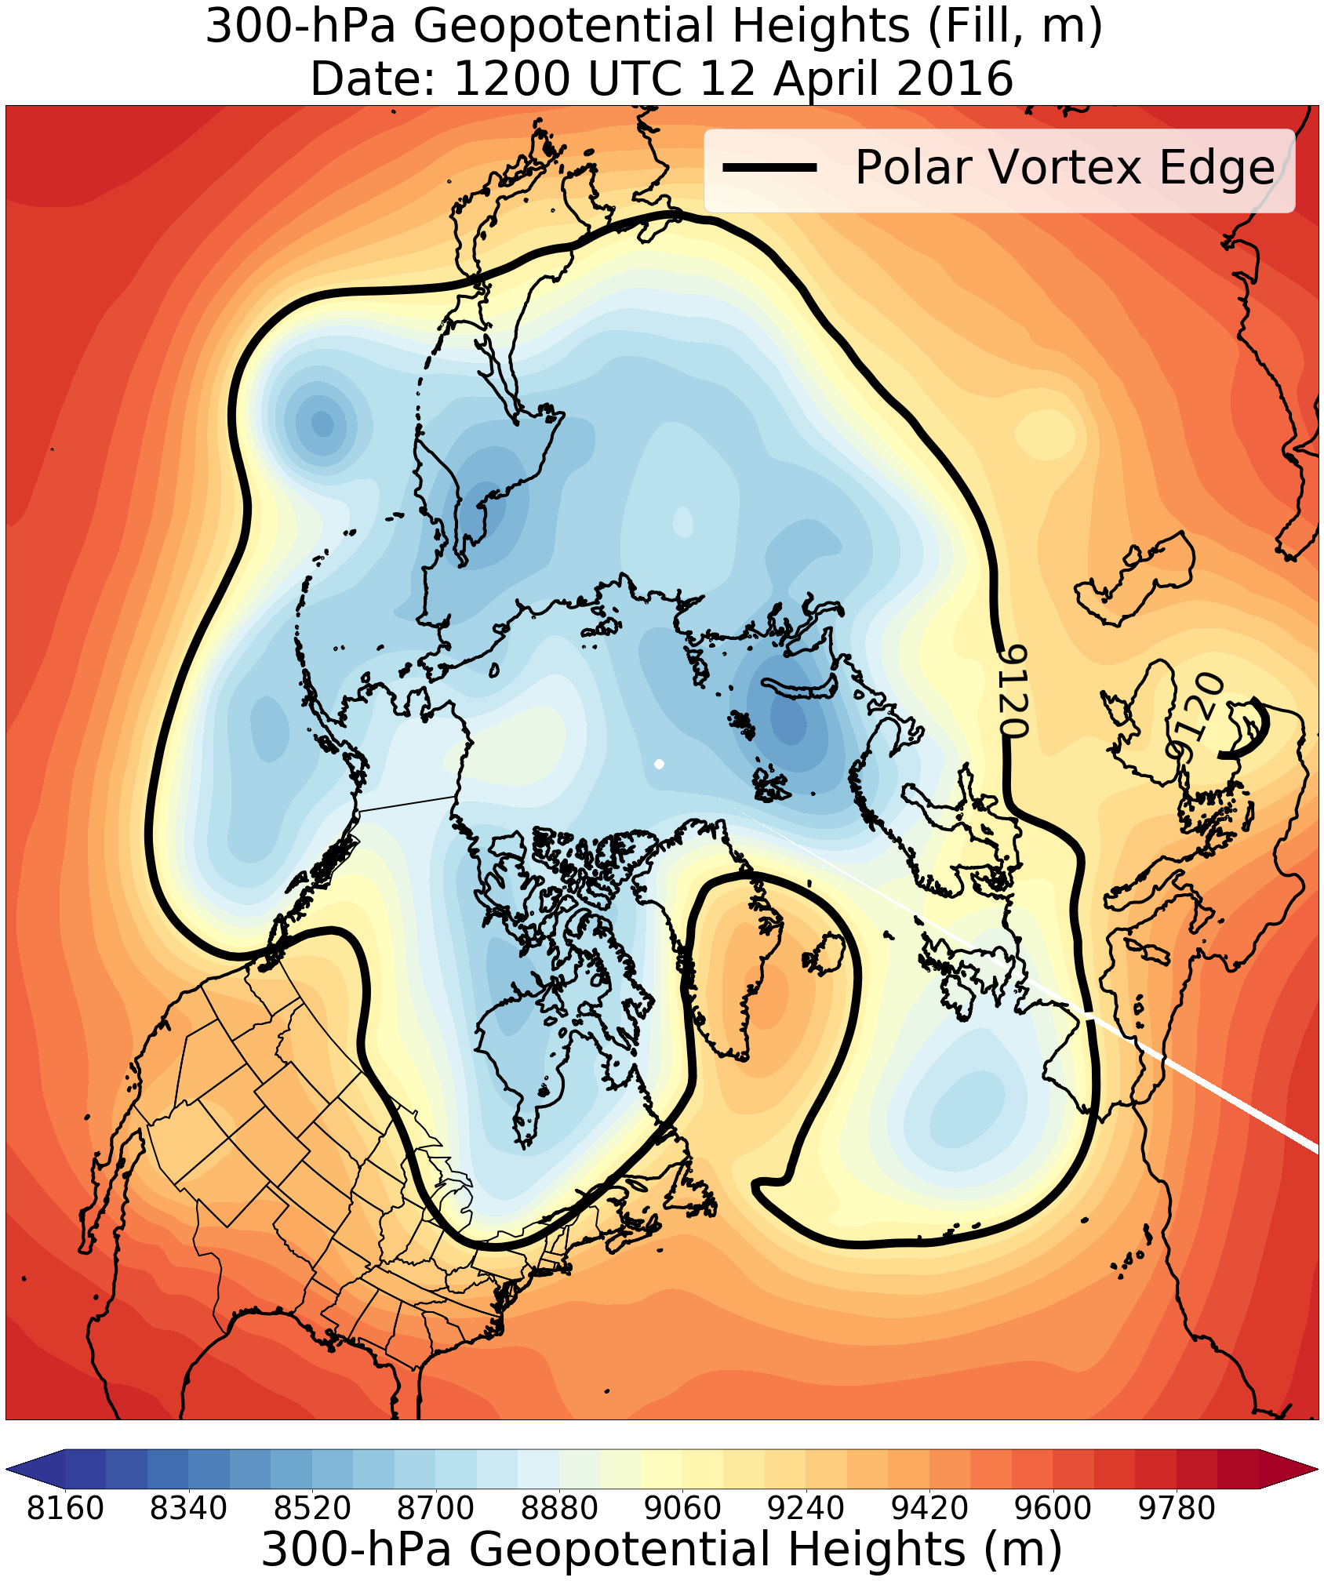
Motivation
300-hPa geopotential height pattern shows amplified troughs and ridges over Greenland
700-hPa temperature pattern shows equatorward-directed cold-air surges and poleward-directed warm-air surges
Sinuosity, a metric describing flow amplitude, will be used to quantify the amplification of the tropospheric polar vortex edge (black contour)
Sinuosity on the indicated day was 1.78 at the 92.5 percentile of climatology

Slide 4
Overview
Identify favorable pathways or longitudinal corridors for Arctic cyclones (ACs) originating in middle latitudes and tracking into the Arctic
Quantify disruptions, within longitudinal sectors associated with the identified longitudinal corridors, of the tropospheric polar vortex by warm, moist air intrusions using sinuosity
Classify anomalous Greenland ice-melt days using sinuosity to quantify flow amplitude

Slide 5
Overview
Identify characteristic synoptic patterns conducive to Greenland ice melt events using self-organizing maps (SOMs)
Diagnose 700-hPa thermal characteristics over Greenland associated with these events

Slide 6
Data and Methods: AC Identification
Create a 1979–2018 AC climatology
Obtain cyclone tracks from 1° ERA-Interim cyclone climatology prepared by Sprenger et al. (2017)
ACs are deemed cyclones that last ≥ 2 days and spend at least some portion of their lifetimes in the Arctic (>70°N)

Slide 7
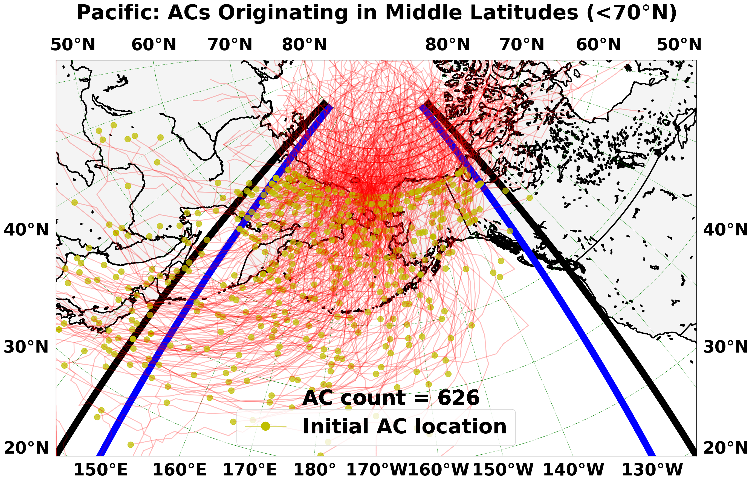
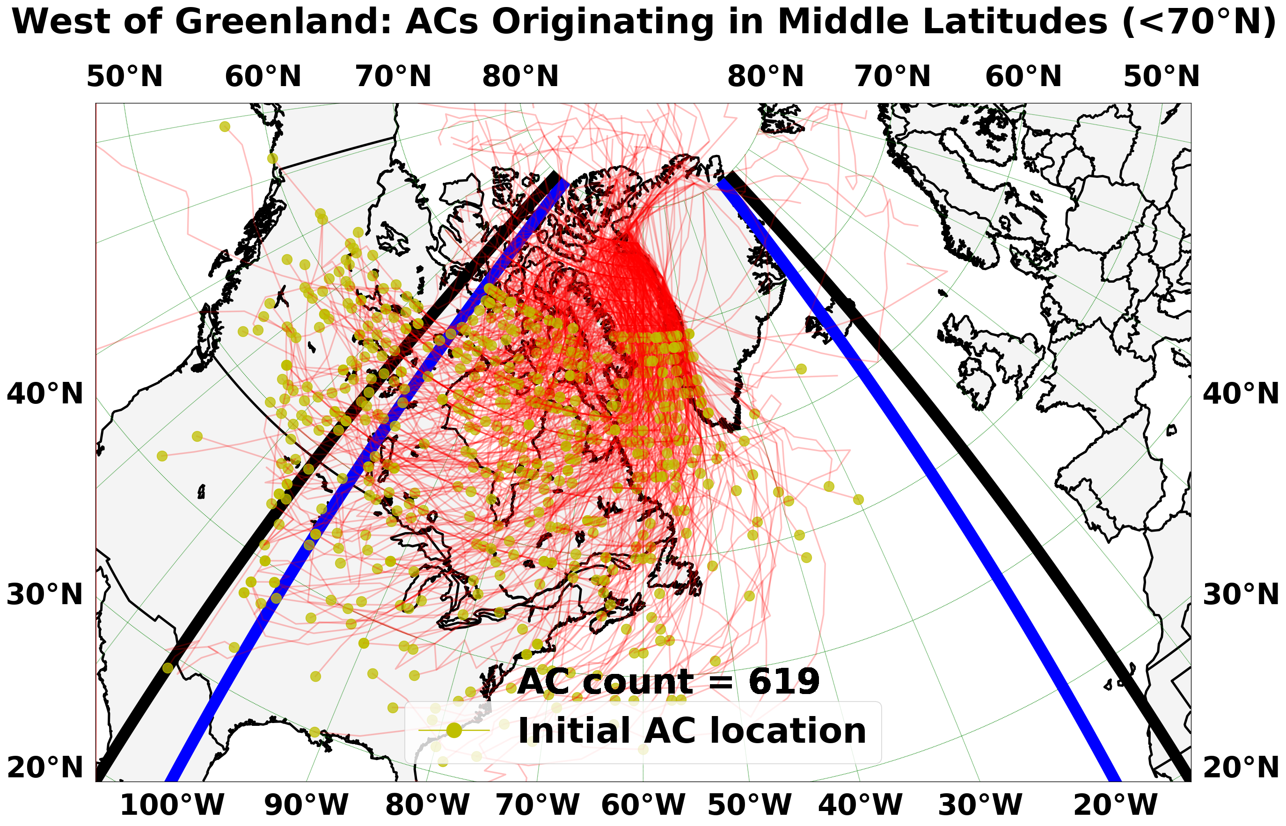
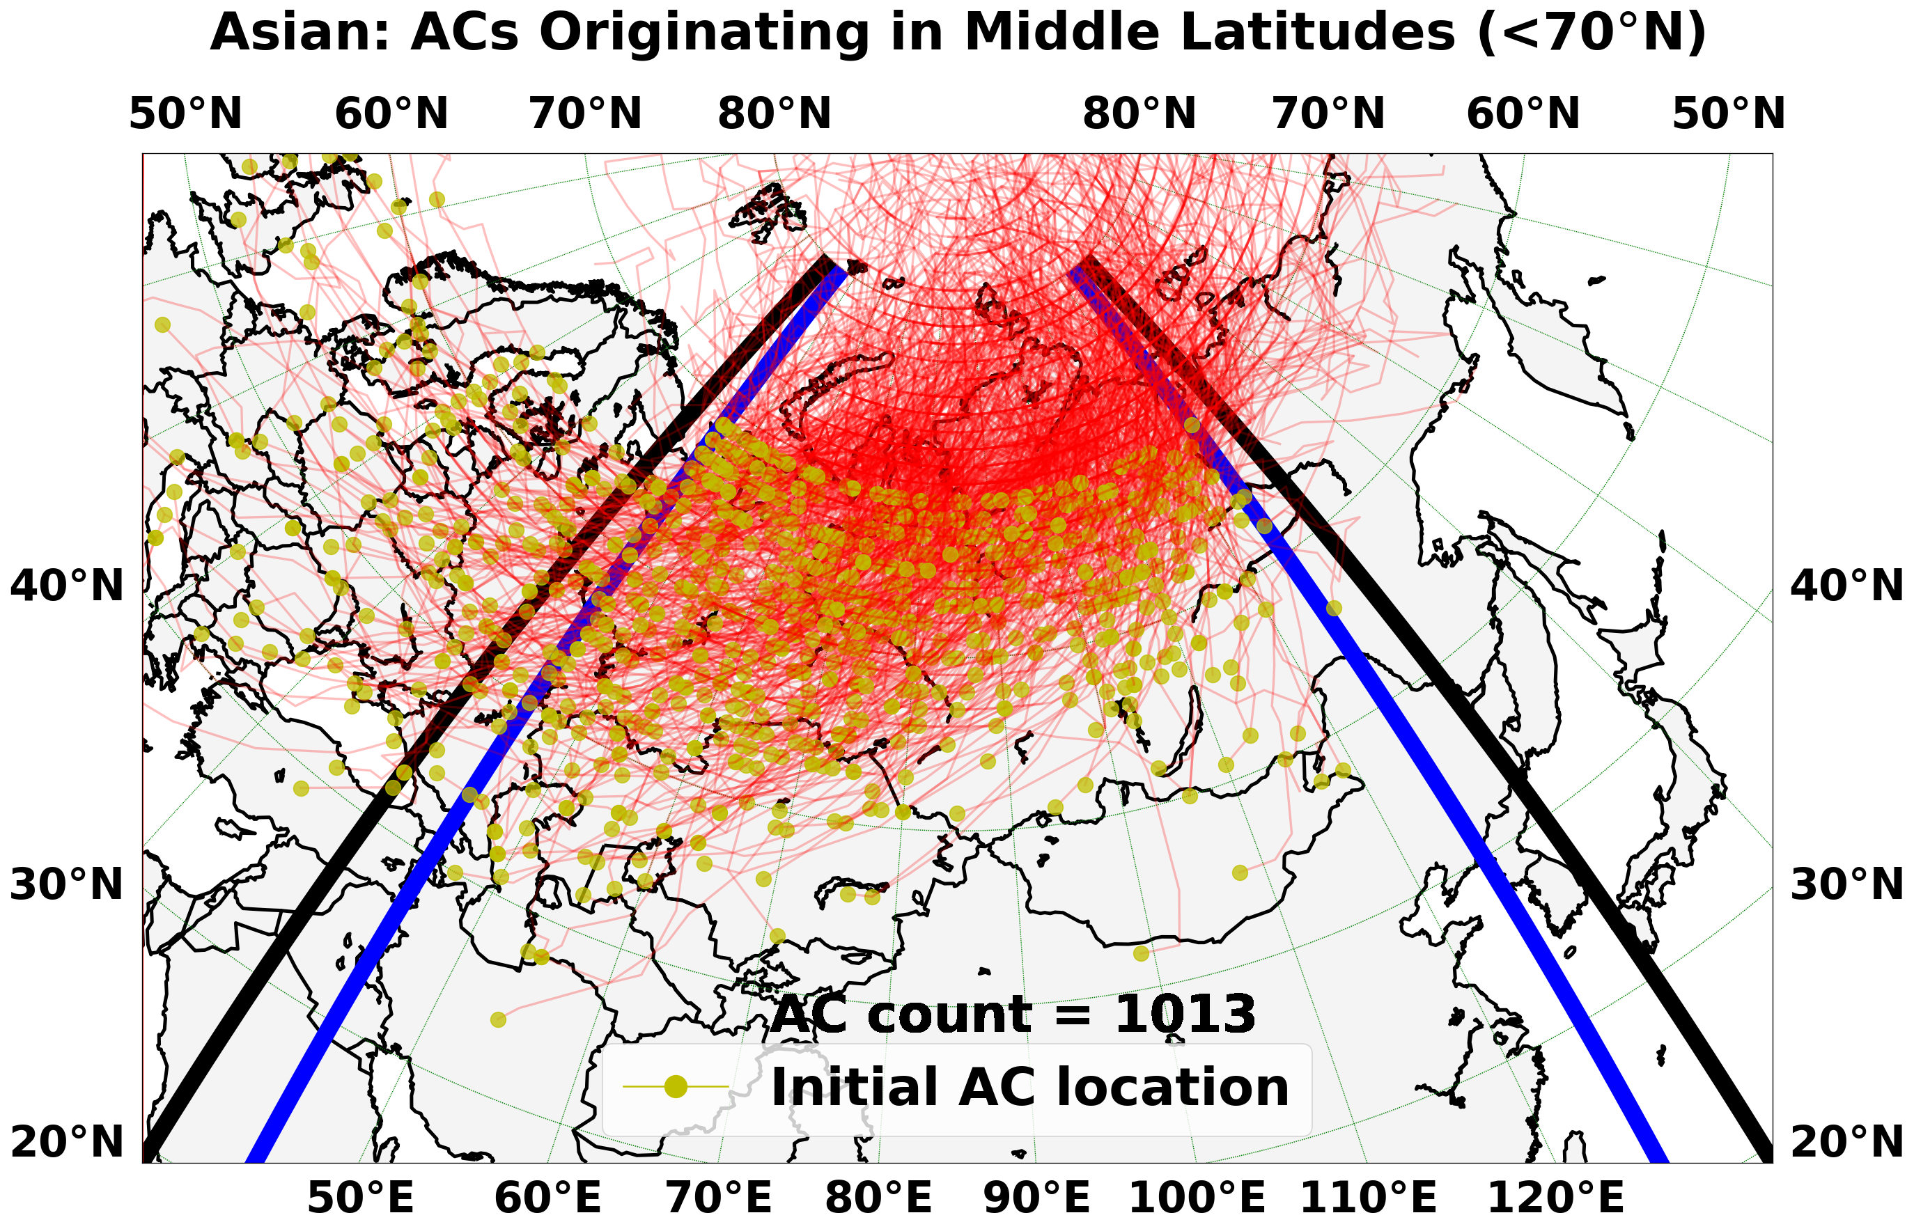
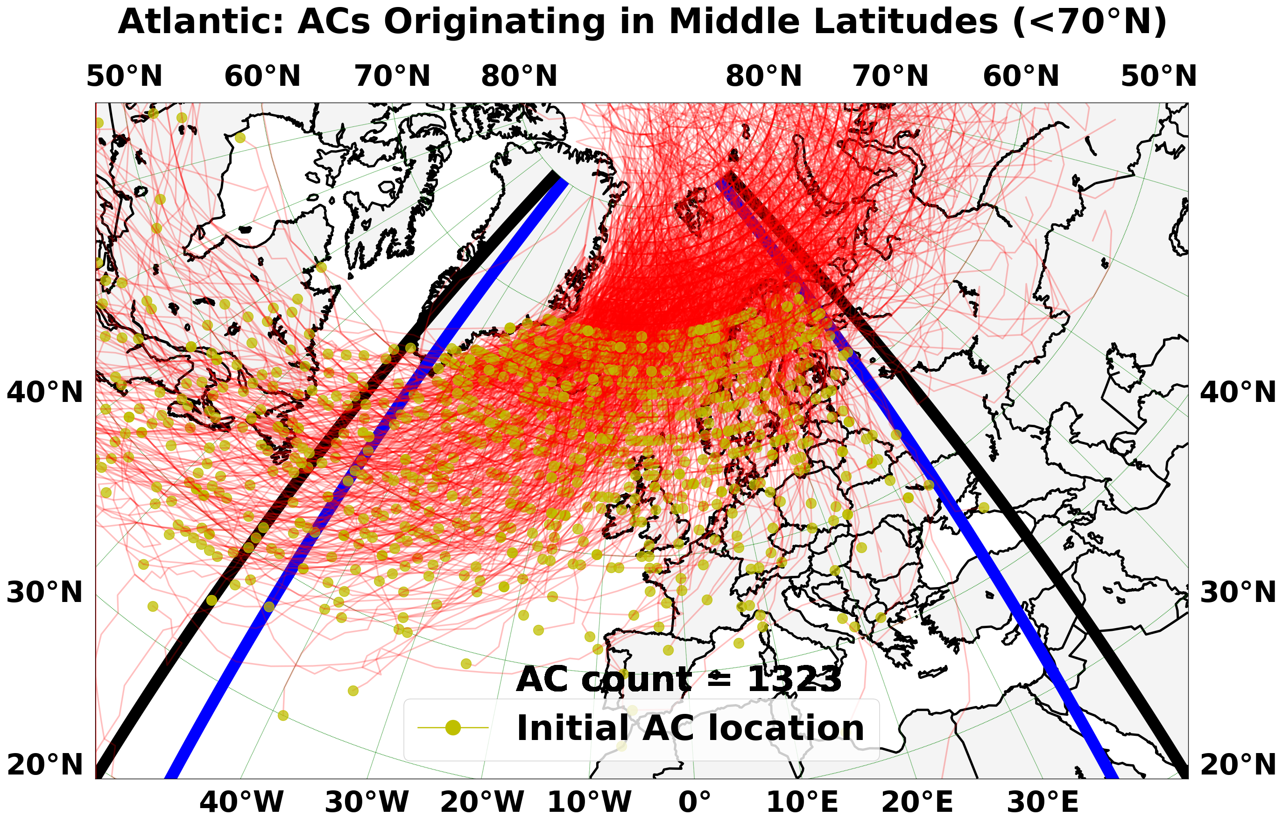
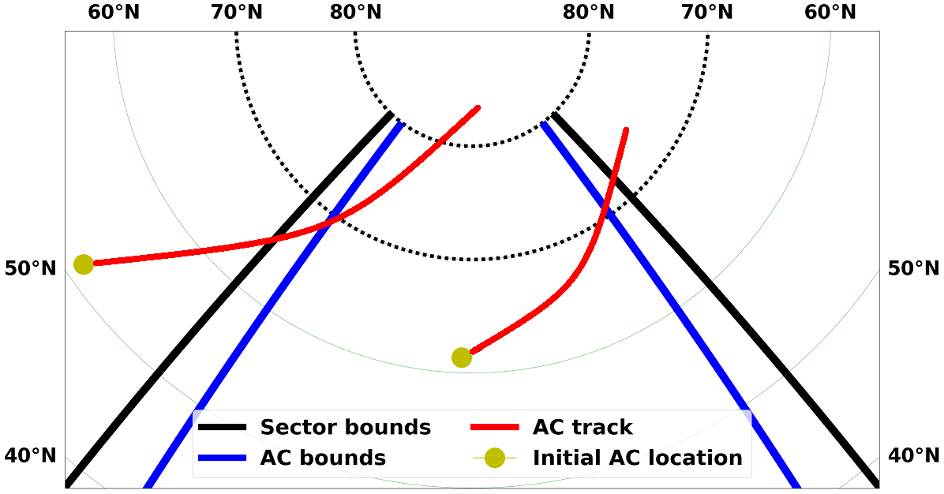
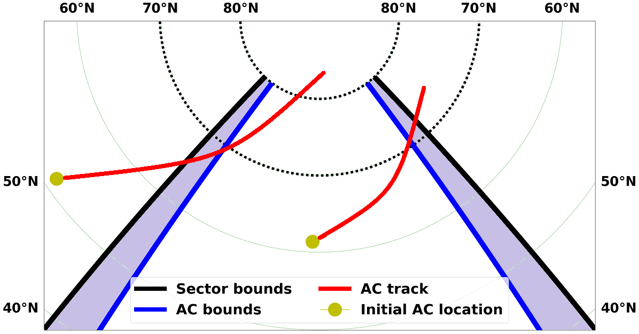
Data and Methods: Sector Identification
AC tracks are identified, and 90° longitudinal sectors are centered at locations of high AC track frequency.
An AC that originates or terminates outside of a given sector is associated with that sector if the longitude of the cyclone at 70°N falls 5° of longitude inward from the bounds of that sector

Slide 8
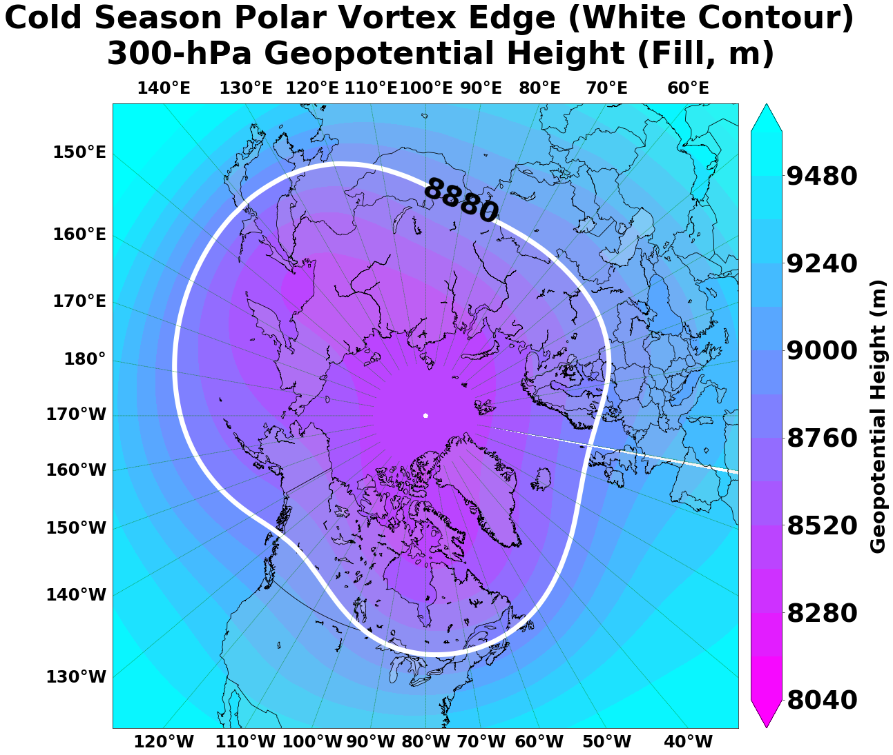
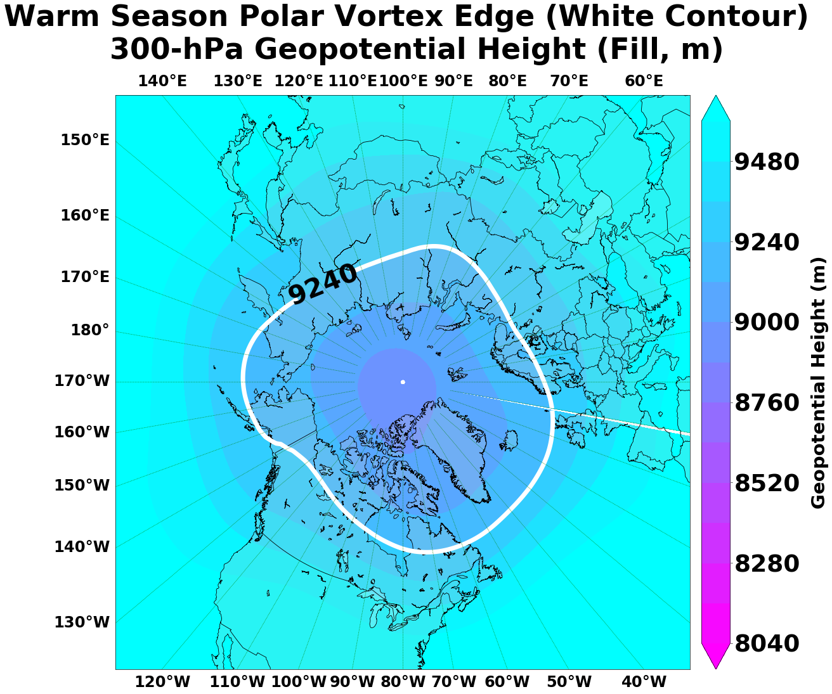
Data and Methods: Polar Vortex Edge
Following Frauenfeld and Davis (2003), the 300-hPa geopotential height threshold for the polar vortex edge varies by month from a minimum of 8880 m in the cold season to a maximum of 9240 m in the warm season

Slide 9
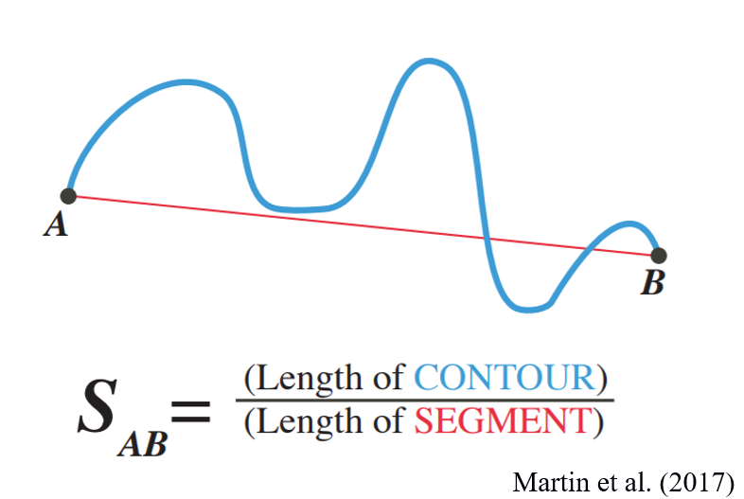
Data and Methods: Sinuosity
Sinuosity is calculated using the methodology adopted by Martin et al. (2016)
Source: Martin et al. (2016)

Slide 10
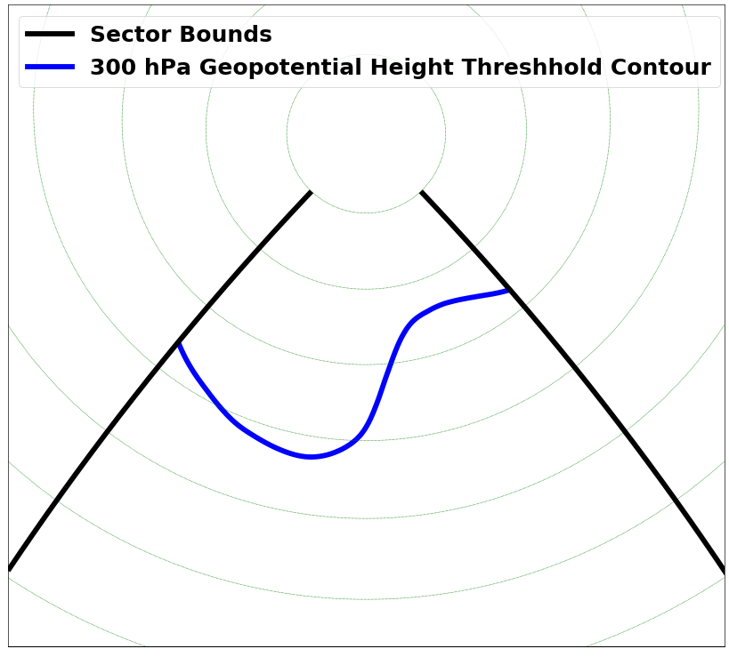
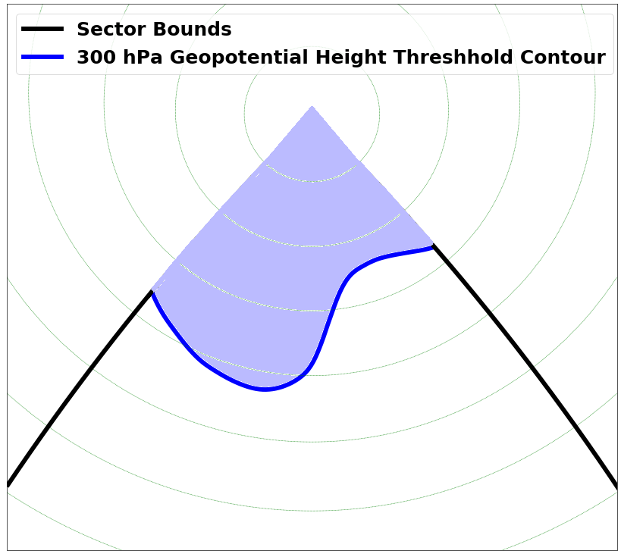
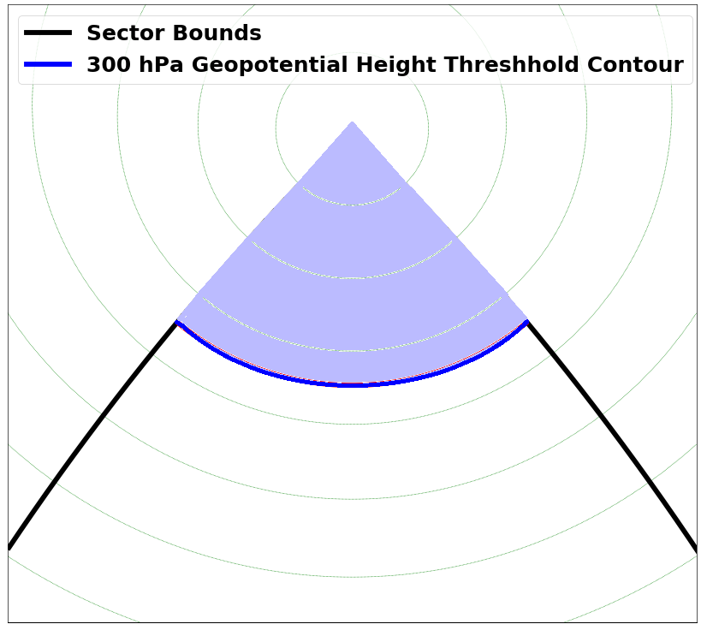
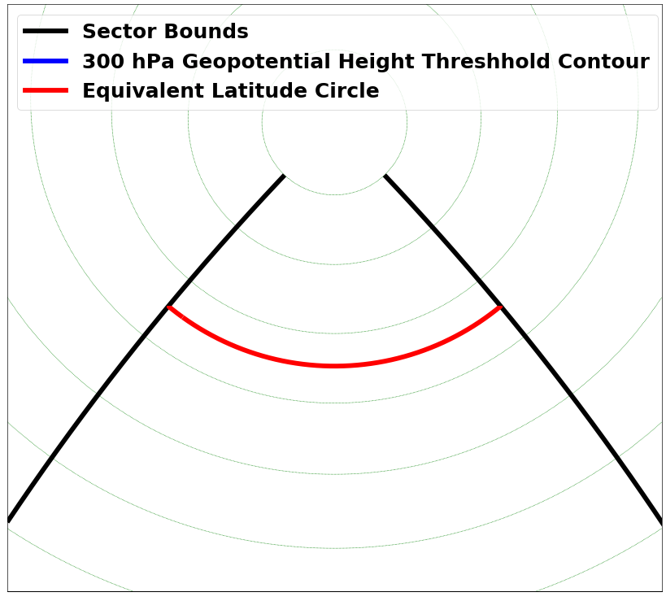
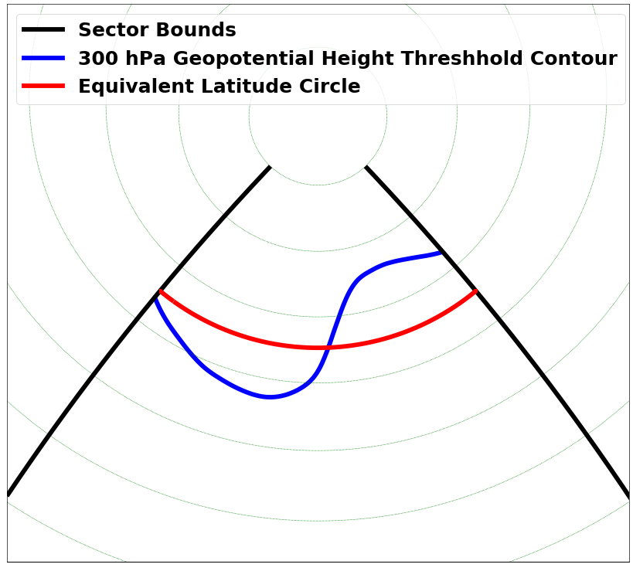
Data and Methods: Sectorial Sinuosity
Calculate area of the sector enclosed by the 300-hPa geopotential height threshold contour (blue) determined by Frauenfeld and Davis (2003)
Determine the equivalent latitude (red) corresponding to the calculated area of the sector
Calculate the ratio of the length of the 300-hPa geopotential height threshold contour (blue) to the length of the equivalent latitude sector (red)

Slide 11
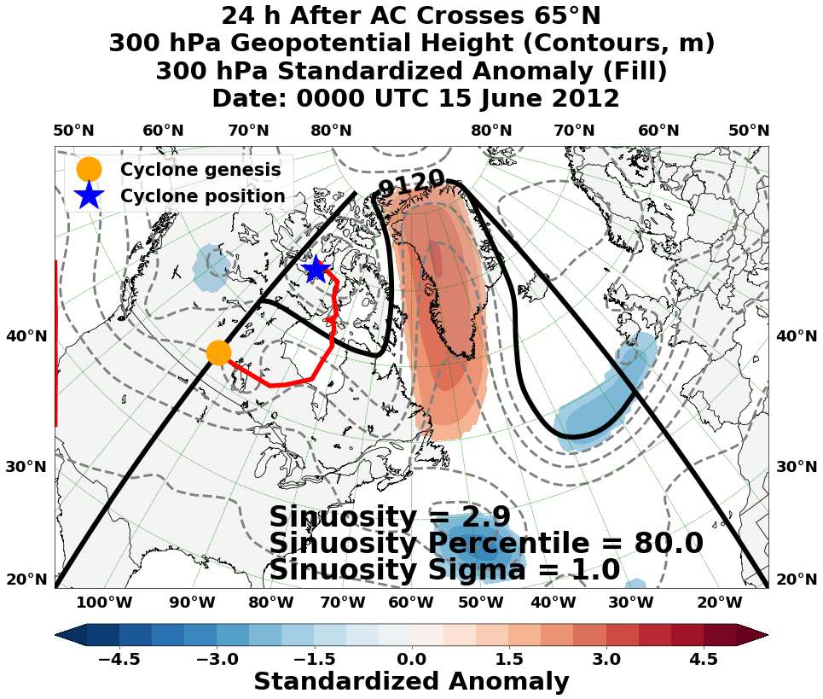
West of Greenland ACs:
This study focuses on the West of Greenland sector, which exhibits amplified flow associated with ridge amplification over Greenland
Warm, moist air advected from middle latitudes with ridge amplification sometimes is concurrent with Greenland ice-melt events
Some Greenland ice-melt events are associated with ACs
SOMs are used to identify characteristic upper-level synoptic patterns associated with anomalous Greenland ice-melt events

Slide 12
Data and Methods: Self-Organizing Maps
Characteristic 300-hPa geopotential height patterns conducive to anomalous Greenland ice-melt events are identified and are classified according to the magnitude of flow amplitude:
A climatology of +1 sigma ice-melt events that last 3 or more days during April–October 1979–2018 is constructed from data obtained from the National Snow and Ice Data Center attributed to Mote and Anderson (1995)
129 events comprising a total of 690 days are identified, and the 690 days are classified according to the magnitude of sectorial sinuosity into three groups:
Group 1 (low amplitude): sectorial sinuosity between 1 and 2
Group 2 (medium amplitude): sectorial sinuosity between 2 and 3
Group 3 (high amplitude): sectorial sinuosity above 3

Slide 13
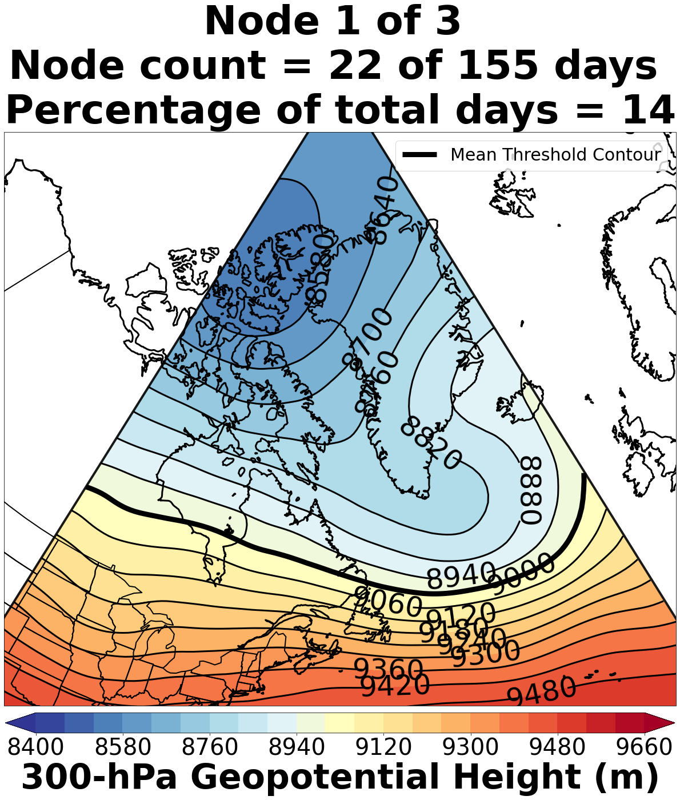
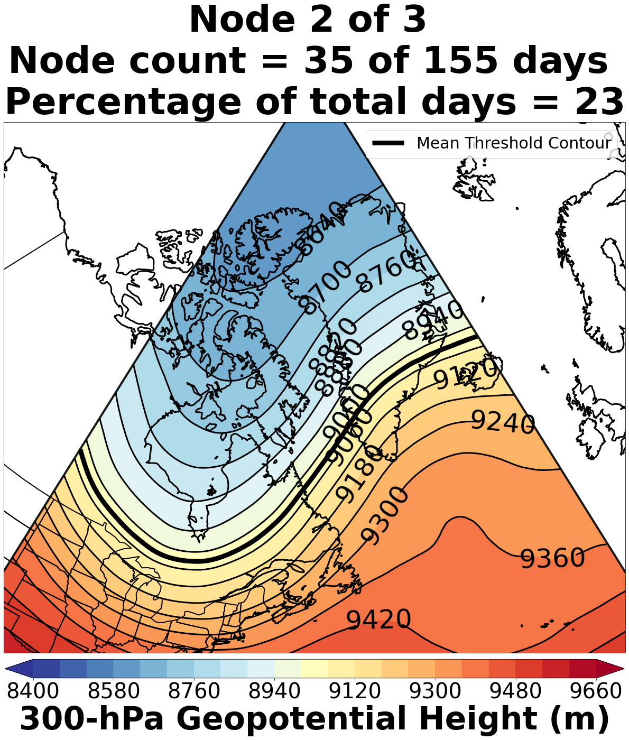
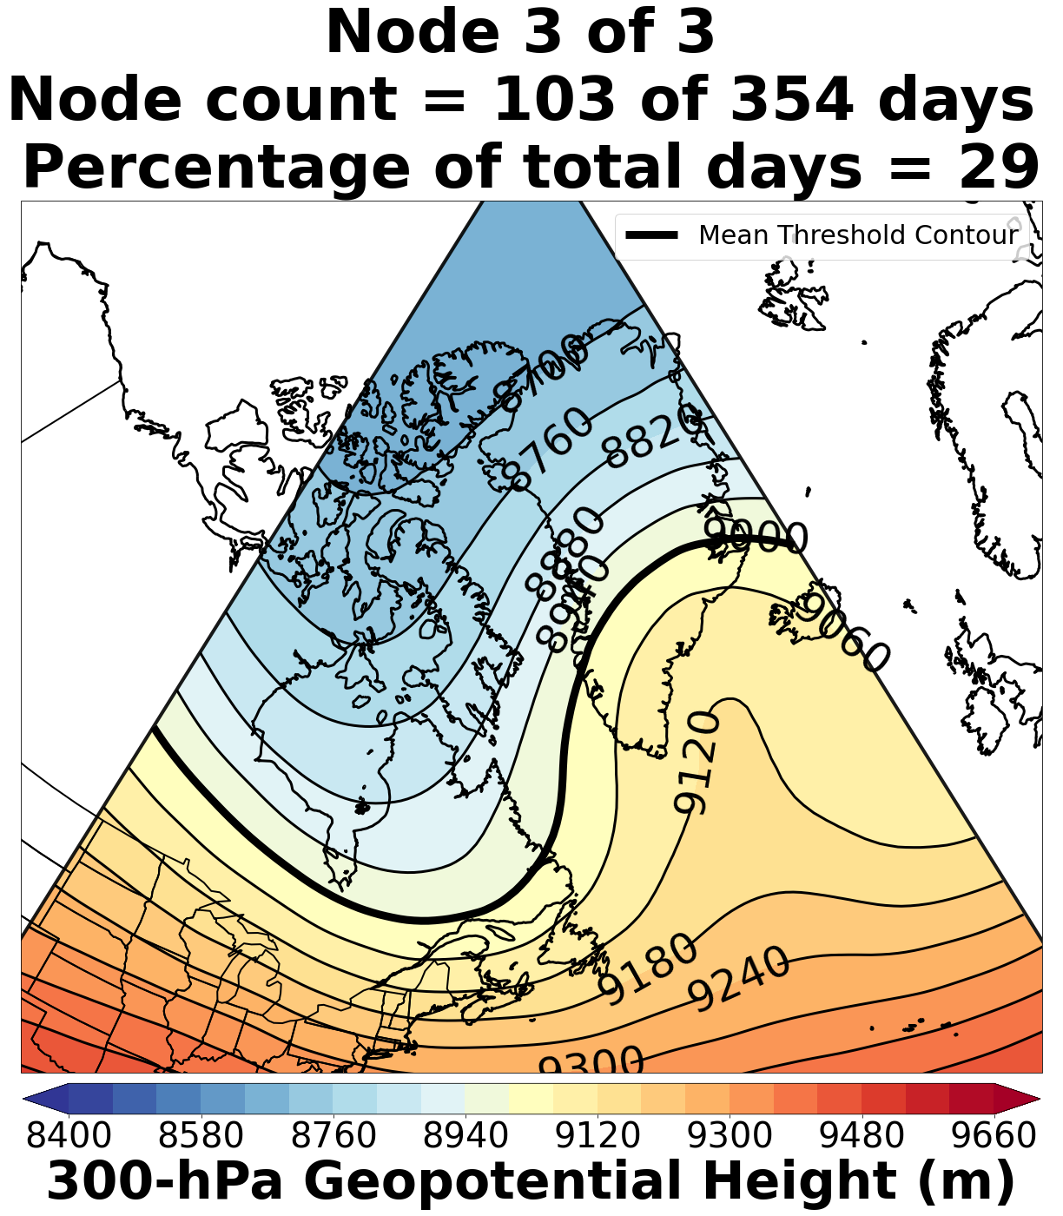
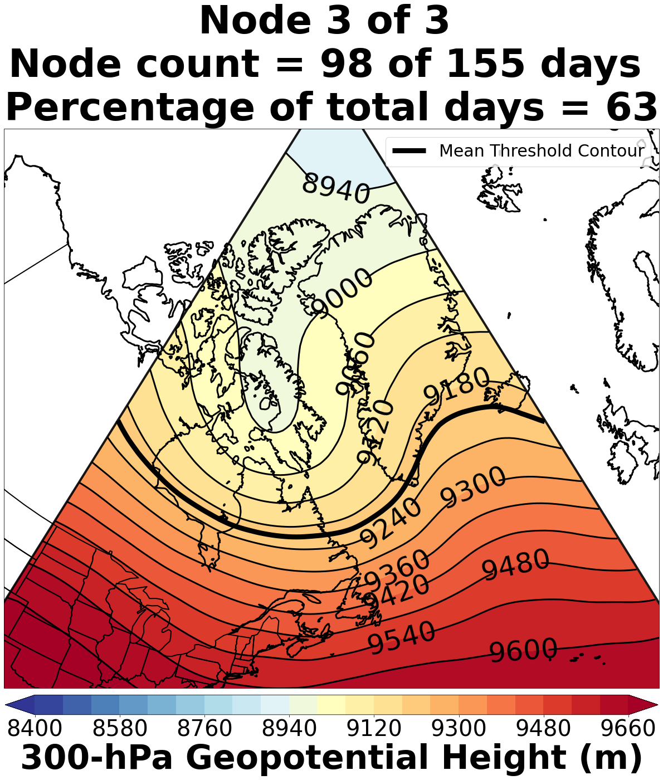
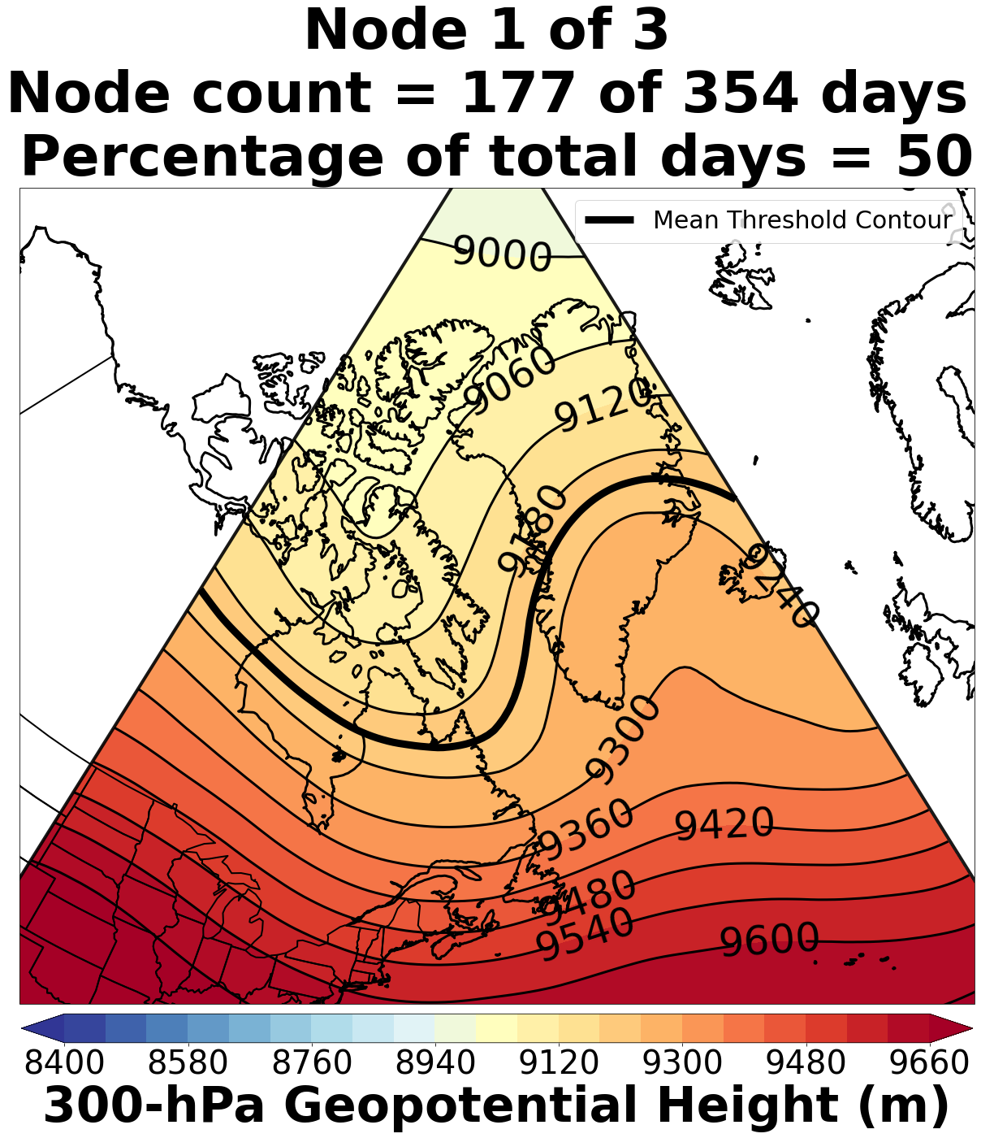
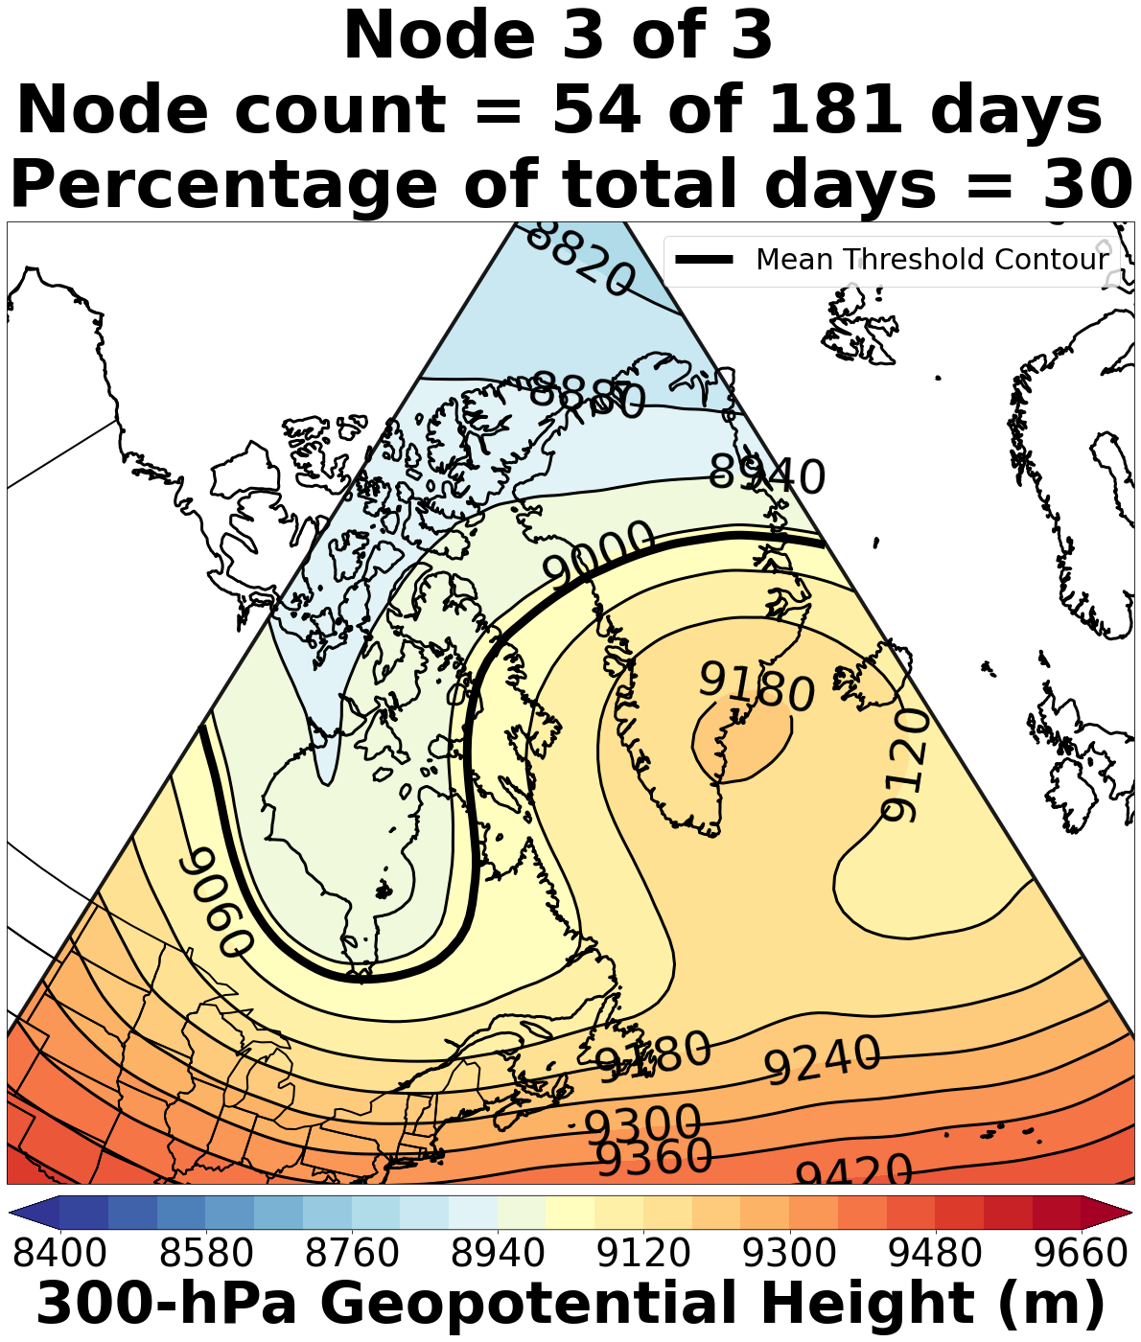
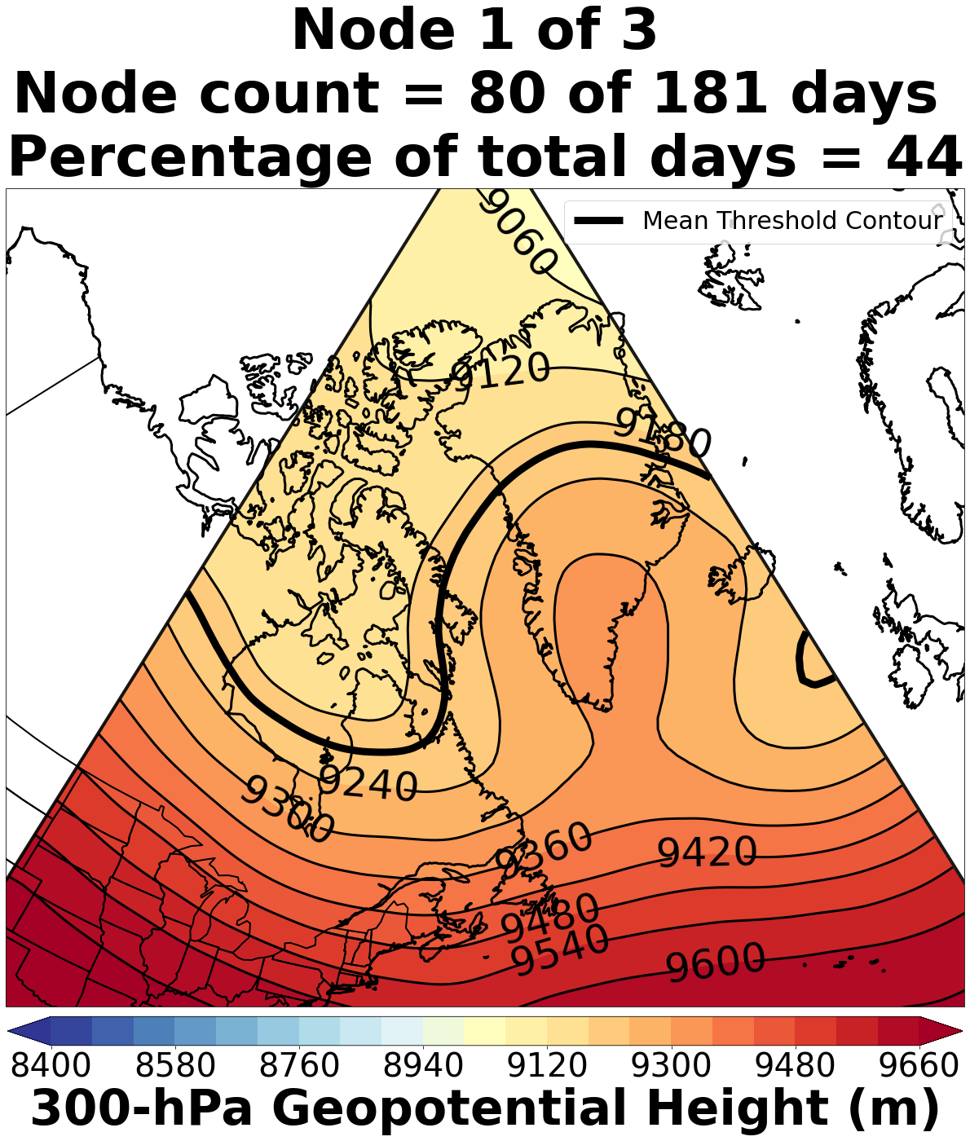
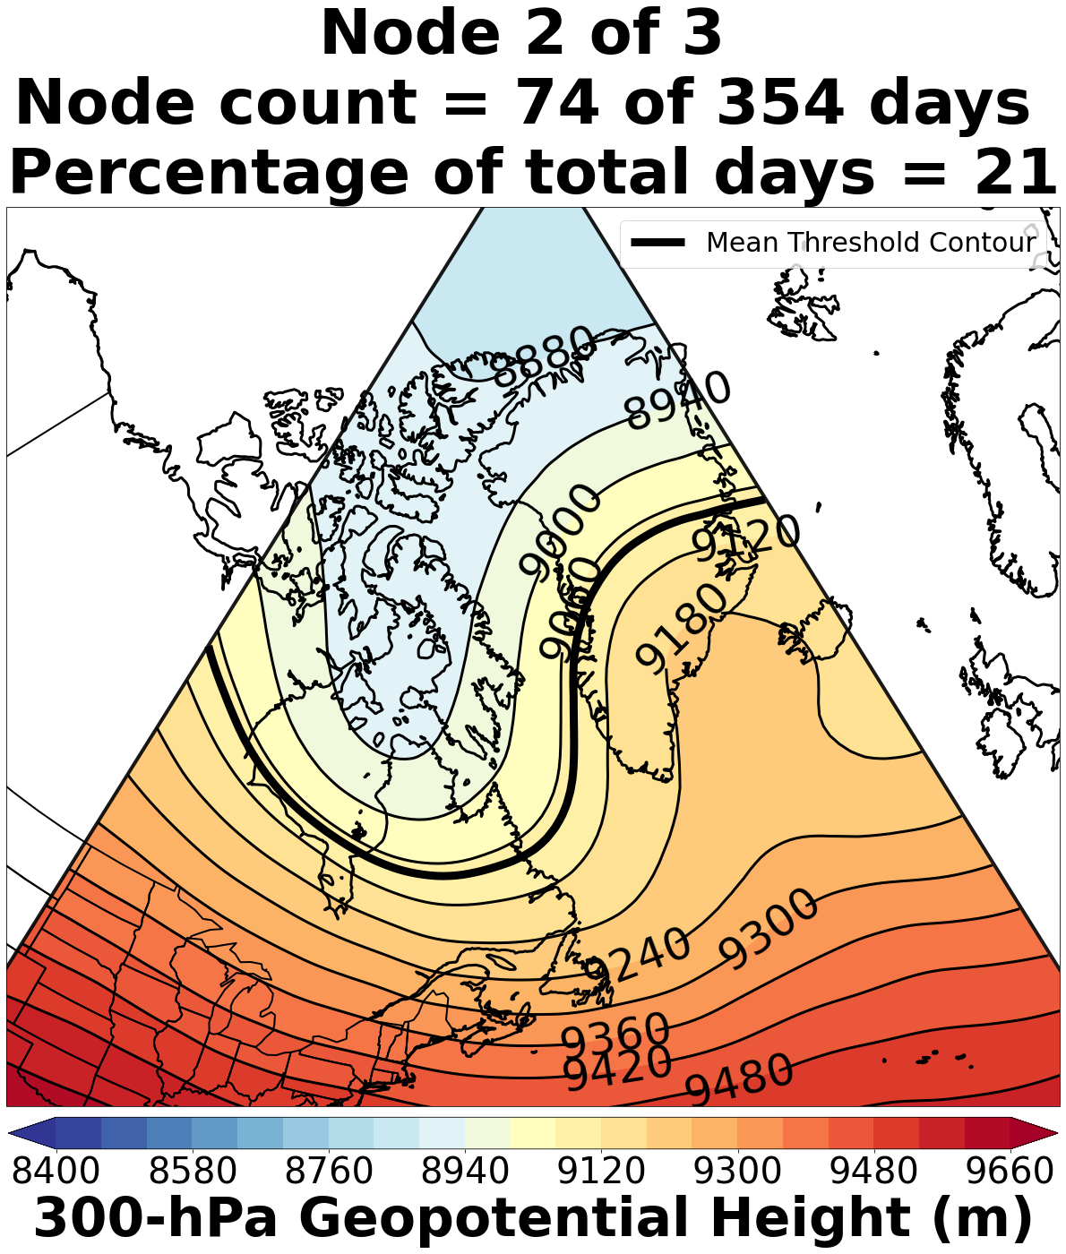
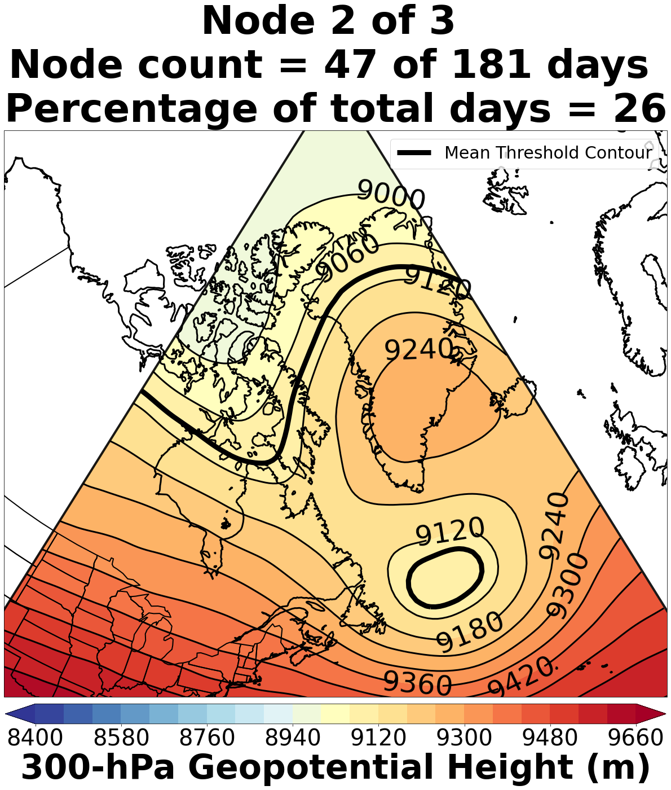
Data and Methods: Self-Organizing Maps
For Group 3 (high amplitude): Days with sectorial sinuosity above 3
For Group 2 (medium amplitude): Days with sectorial sinuosity between 2 and 3
9 nodes (3 nodes per sinuosity group) of characteristic 300-hPa geopotential height patterns associated with anomalous Greenland ice-melt events are identified using SOMs constructed from ERA-Interim reanalysis data
For Group 1 (low amplitude): Days with sectorial sinuosity between 1 and 2

Slide 14
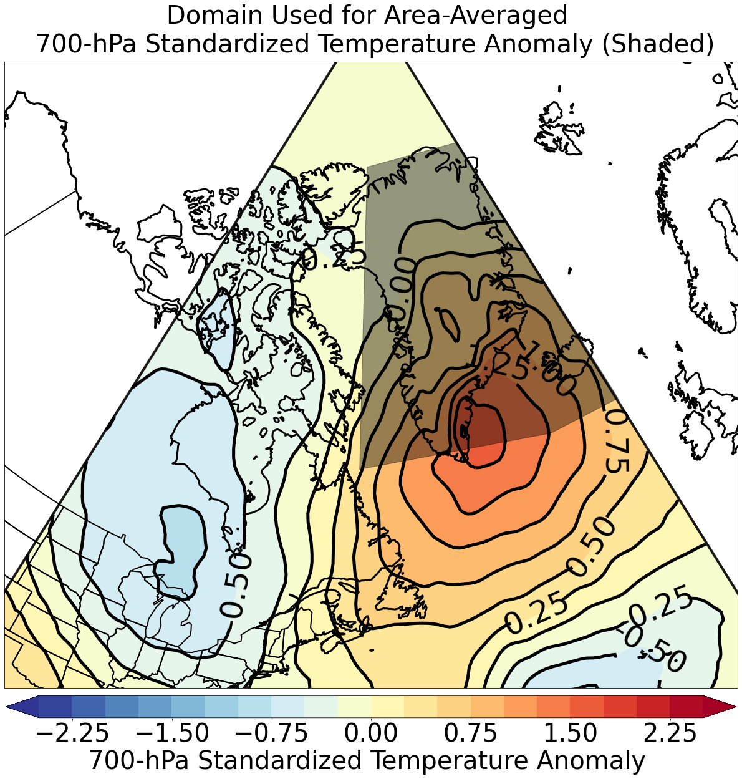
Data and Methods: Thermal Metric
A thermal metric is used to link 300-hPa geopotential height patterns to 700-hPa temperature patterns
Calculated by taking the area-averaged value of the 700-hPa standardized temperature anomaly for a domain over Greenland for every anomalous Greenland ice-melt day
Domain bounds:
Latitude: 60°N–80°N
Longitude: 60°W–15°W

Slide 15
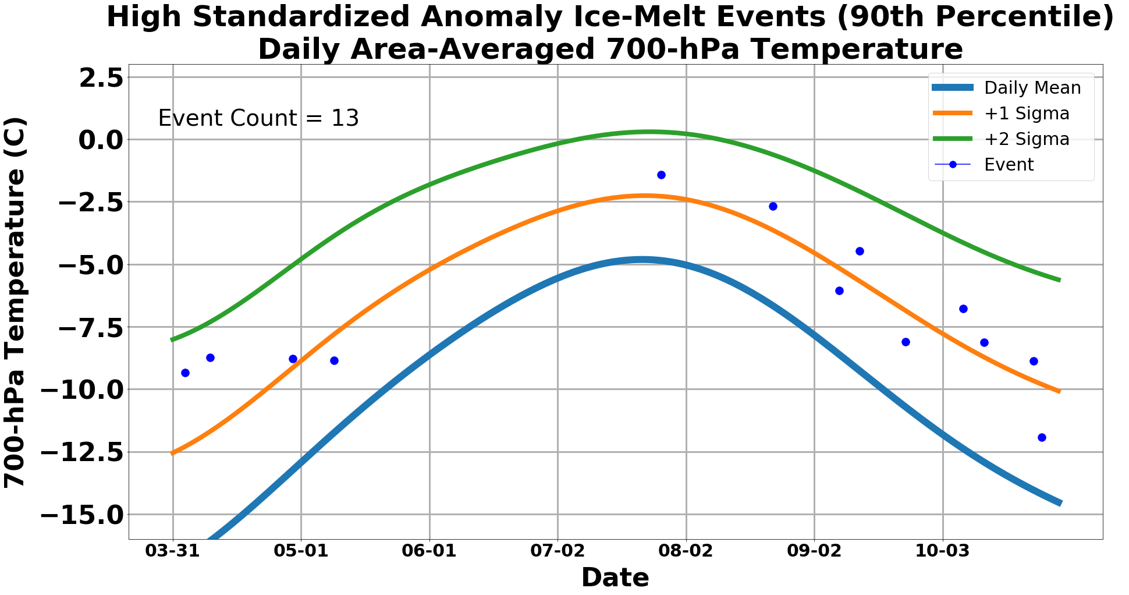
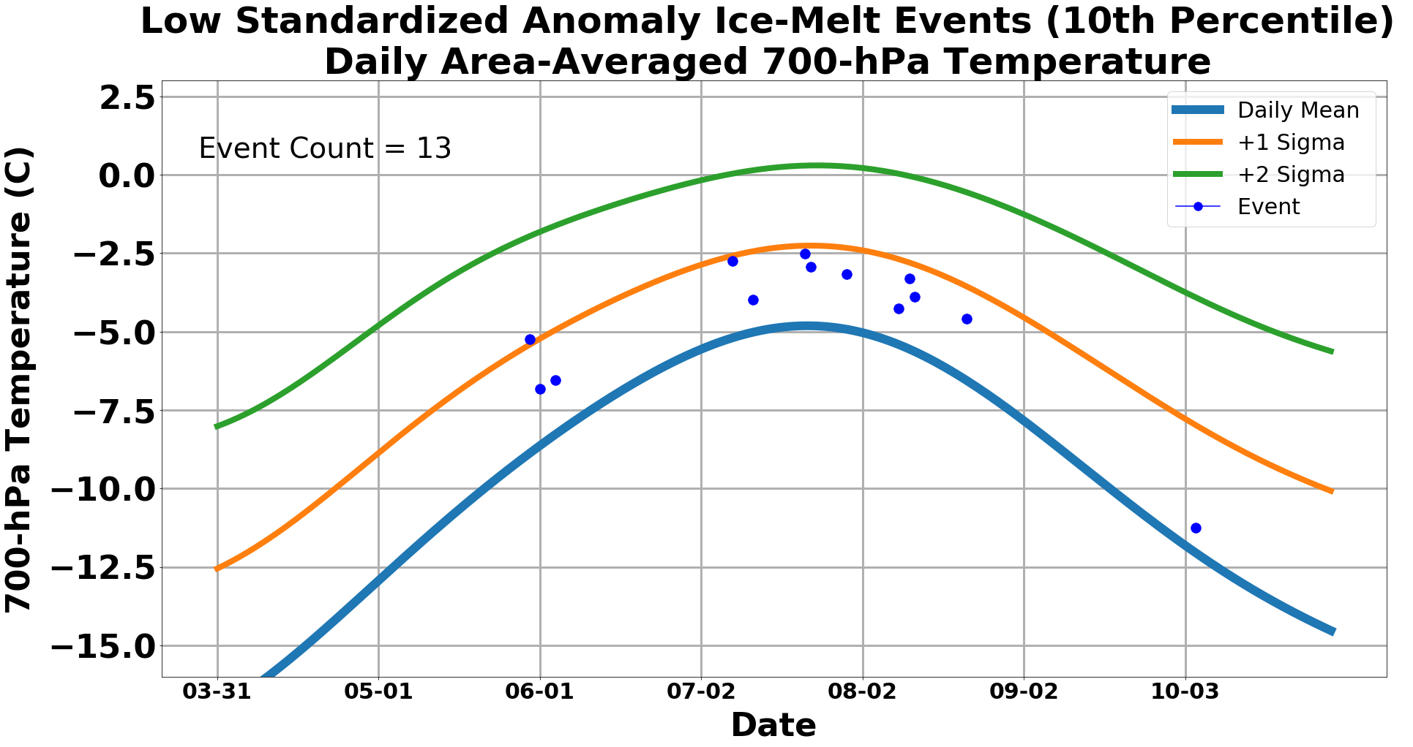
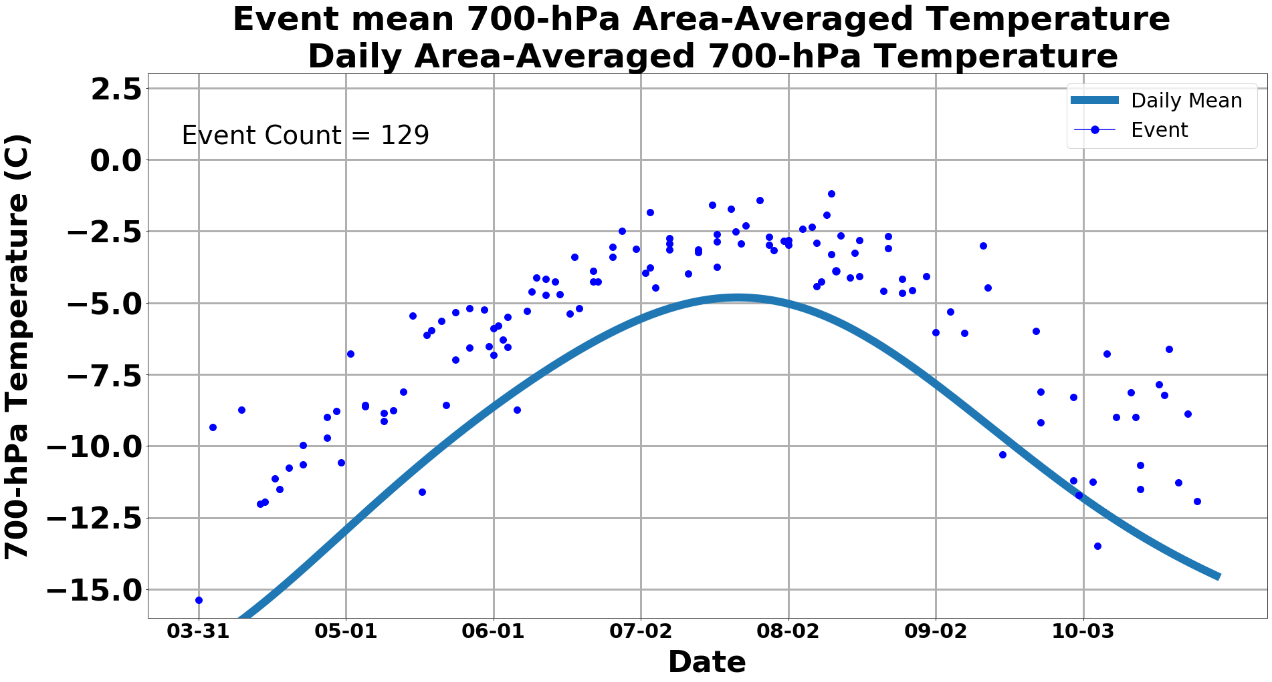
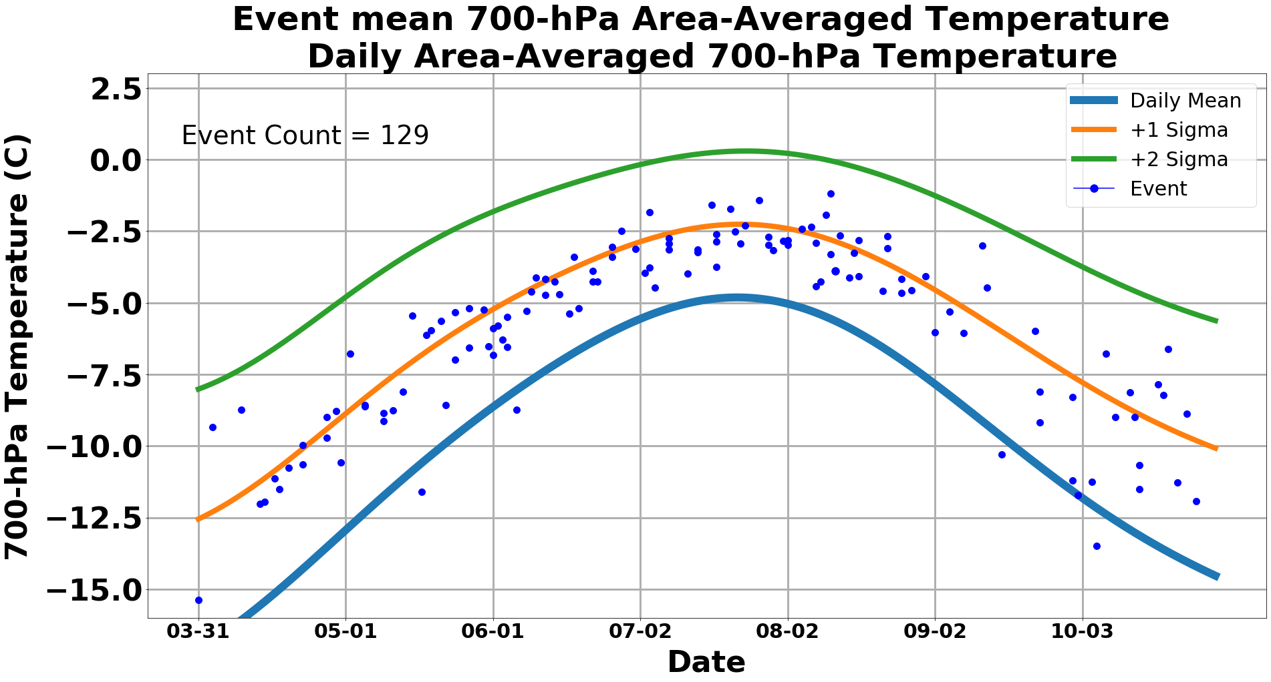
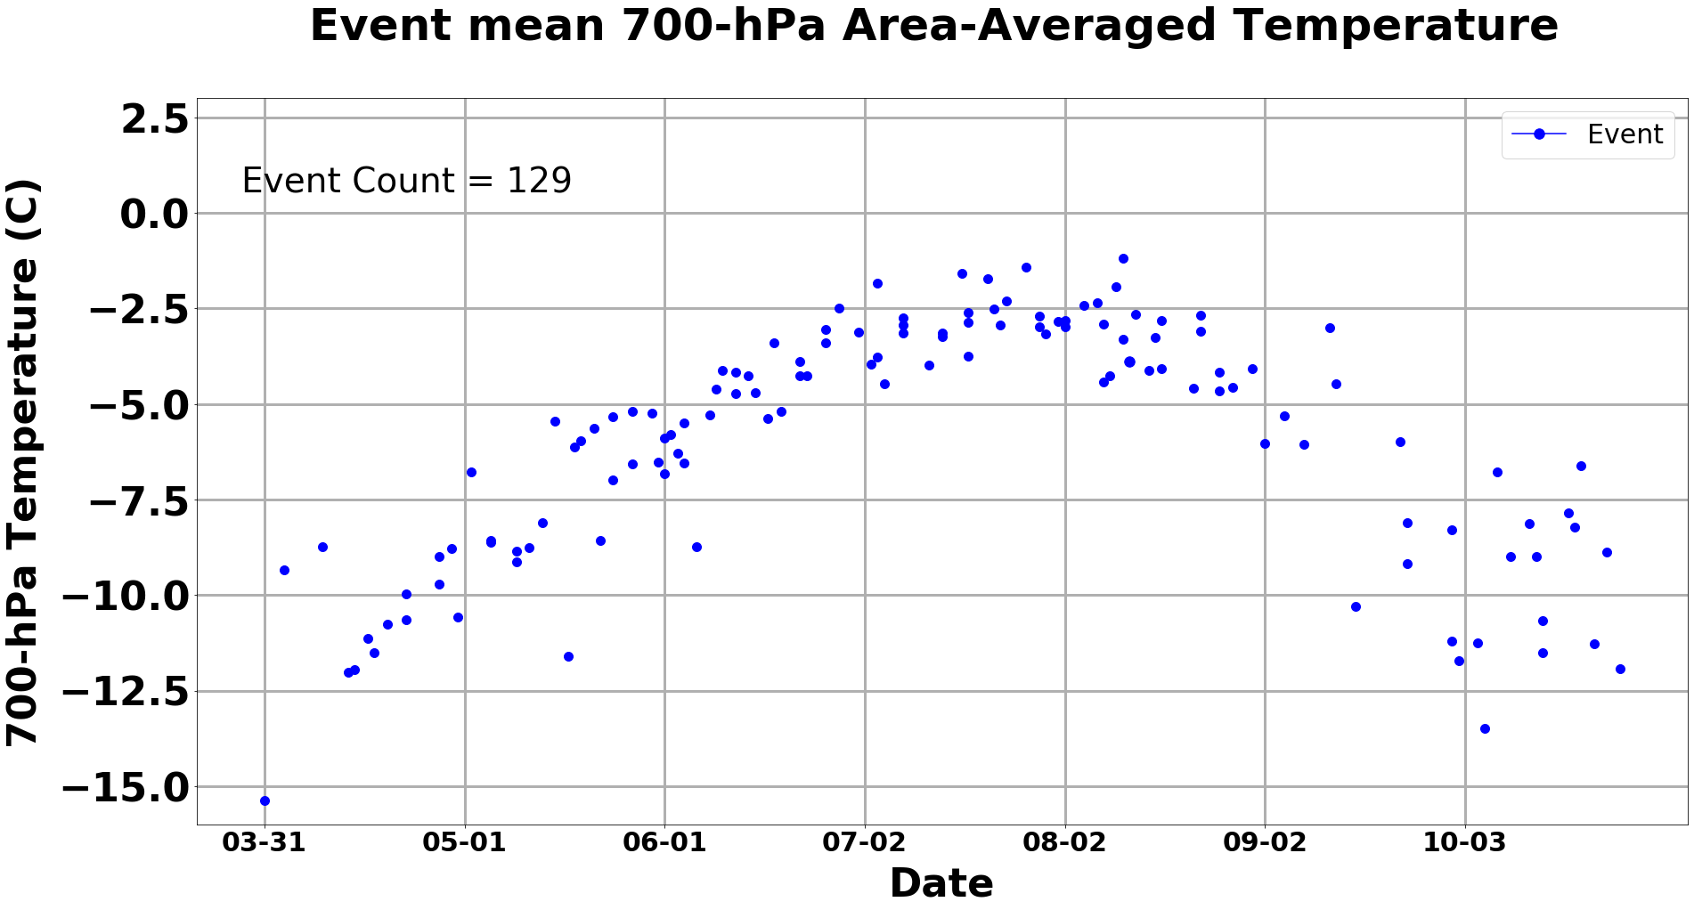
Data and Methods: Thermal Metric
For the 129 anomalous ice-melt events, we plot the event mean area-averaged 700-hPa temperature
Events at the 10th percentile and 90th percentile of the standardized anomaly of ice melt are identified
Events at the 10th percentile:
Tend to occur in the warmer months (June, July, August) of the ice-melt season
Are associated with low positive values of 700-hPa area-averaged standardized temperature anomaly
Events at the 90th percentile:
Tend to occur in the colder months (April, May, September, October) of the ice-melt season
Are associated with high positive values of 700-hPa area-averaged standardized temperature anomaly

Slide 16
Summary
Modification of the tropospheric polar vortex edge associated with intrusions of warm, moist air from middle latitudes into the Arctic is quantified using sectorial sinuosity
9 characteristic 300-hPa geopotential height patterns conducive to Greenland ice melt are identified using SOMs and are classified according to the magnitude of flow amplification
A thermal metric is used to link 300-hPa geopotential height patterns to 700-hPa temperature patterns for every anomalous Greenland ice-melt day

Slide 17
Summary
Events at the 90th percentile of standardized anomaly of ice melt tend to occur in the colder months of the ice-melt season with high positive values of 700-hPa area-averaged temperature standardized anomaly
Events at the 10th percentile of standardized anomaly of ice melt tend to occur in the warmer months of the ice-melt season with low positive values of 700-hPa area-averaged temperature standardized anomaly

Slide 18
References
Frauenfeld, O. W., and R. E. Davis, 2003: Northern Hemisphere circumpolar vortex trends and climate change implications. J. Geophys. Res., 108(D14), https://doi.org/10.1029/2002JD002958
Martin, J. E., S. J. Vavrus, F. Wang, and J. A. Francis, 2016: Sinuosity as a measure of middle tropospheric waviness. http://marrella.aos.wisc.edu/SIN_paper_JCLIM_FIN.pdf
Sprenger, M., G. Fragkoulidis, H. Binder, M. Croci-Maspoli, P. Graf, C.M. Grams, P. Knippertz, E. Madonna, S. Schemm, B. Škerlak, and H. Wernli, 2017: Global climatologies of Eulerian and Lagrangian flow features based on ERA-Interim. Bull. Amer. Meteor. Soc., 98, 1739–1748, https://doi.org/10.1175/BAMS-D-15-00299.1
Mote, T. L., Anderson, M. R. 1995: Variations in snowpack melt on the Greenland ice sheet based on passive-microwave measurements. Journal of Glaciology, 41(137), 51–60, https://doi.org/10.3189/S0022143000017755

