Slide 1
An Examination of the Arctic Environment and Arctic Cyclones During Periods of Low and High Forecast Skill of the Synoptic-Scale Flow
Kevin A. Biernat
Department of Atmospheric and Environmental Sciences
University at Albany, State University of New York
Ph.D. Dissertation Defense
Thursday 16 December 2021
Committee Members: Lance Bosart, Daniel Keyser, Steven Cavallo, Andrea Lang, and Ryan Torn
Research Supported by ONR Grant N00014-18-1-2200

Slide 2
Motivation
The Arctic environment is rapidly changing in response to enhanced near-surface warming relative to the rest of the globe, referred to as Arctic amplification, and diminishing sea ice (e.g., Stroeve et al. 2007; Screen and Simmonds 2010).
As the Arctic environment rapidly changes, human activities, including shipping, tourism, and military operations, are increasing in the Arctic (e.g., Hall and Saarinen 2010; Melia et al. 2016, 2017; U.S. Department of the Navy 2021).
Accurate weather prediction over the Arctic is important given that these human activities can be impacted by weather conditions in the Arctic.
There has been a dearth of research concerning Arctic environmental conditions associated with periods of low and high forecast skill of the synoptic-scale flow over the Arctic, aside from a recent study by Yamagami and Matsueda (2021).

Slide 3
Motivation
Arctic cyclones (ACs) are synoptic-scale surface cyclones that may originate within the Arctic or move into the Arctic from lower latitudes (e.g., Serreze 1995; Zhang et al. 2004; Serreze and Barrett 2008; Crawford and Serreze 2016).
ACs occur most frequently during summer (e.g., Zhang et al. 2004; Serreze and Barrett 2008) and may play important roles in influencing Arctic environmental conditions and the forecast skill of the synoptic-scale flow over the Arctic (e.g., Yamagami and Matsueda 2021).
ACs may be associated with strong surface winds and high waves (e.g., Zhang et al. 2013; Thomson and Rogers 2014), may transport warm, moist air into the Arctic (e.g., Messori et al. 2018; Fearon et al. 2021), and may contribute to rapid sea ice loss and rapid sea ice movement (e.g., Asplin et al. 2012; Stern et al. 2020; Peng et al. 2021).

Slide 4
Motivation
Previous studies that have examined features and processes influencing the evolution of ACs have primarily been conducted through case studies of selected ACs (e.g., Simmonds and Rudeva 2012; Tao et al. 2017a,b; Yamagami et al. 2017).
There have been a limited number of studies that have examined features and processes influencing the forecast skill of ACs (e.g., Tao et al. 2017b; Yamagami et al. 2018a; Johnson and Wang 2021).

Slide 5
Objectives
Examine characteristics of the Arctic environment, and the frequency, characteristics, and forecast skill of ACs, during periods of low and high forecast skill of the synoptic-scale flow over the Arctic, hereafter referred to as low-skill periods and high-skill periods, respectively.
Examine features and processes influencing the evolution of strong low-skill ACs during low-skill periods and strong high-skill ACs during low-skill periods.
Examine features and processes influencing the forecast skill of a selected strong low-skill AC during a low-skill period.

Slide 6
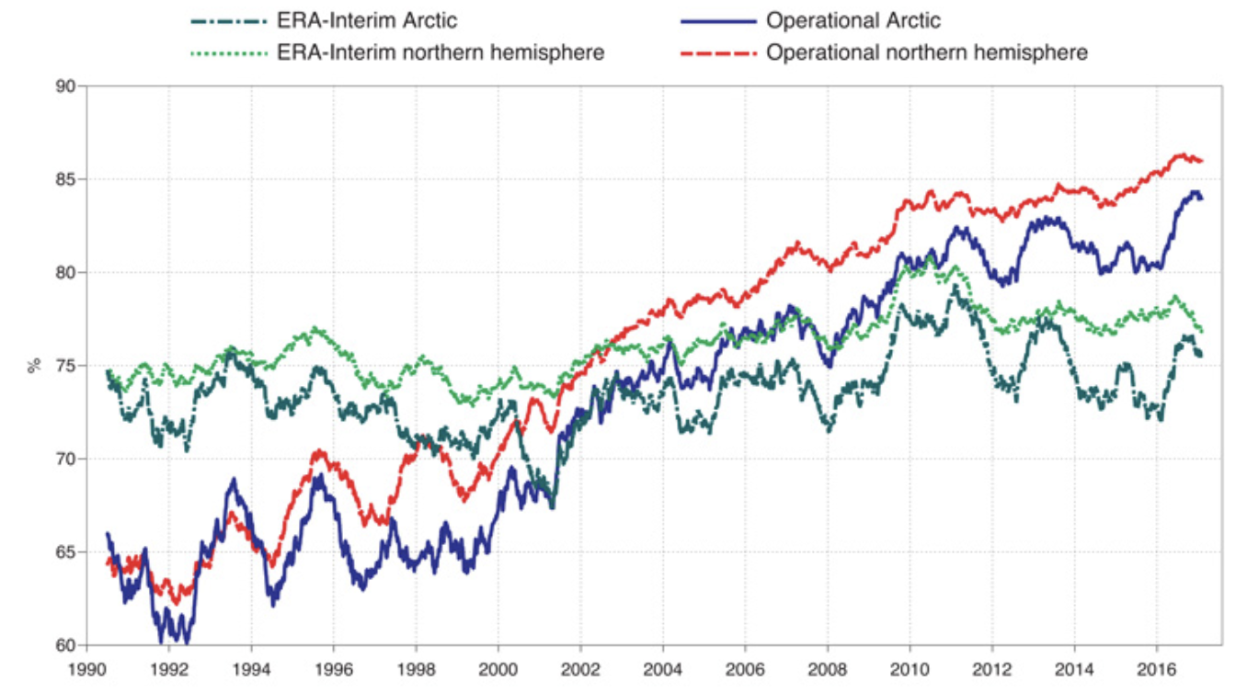
Literature review
Sandu and Bauer (2018) conclude that forecast skill over the Arctic is lower than that over Northern Hemisphere middle latitudes.
Jung and Matsueda (2016) conclude that forecast skill over the Arctic is slightly lower than, but comparable to, that over Northern Hemisphere middle latitudes during winter.
Anomaly correlation of 500-hPa geopotential height at forecast day 6 for the Northern Hemisphere and for the Arctic (60–90°N) in the ECMWF operational system and ERA-Interim reanalysis. [Figure 2 and adapted caption from Sandu and Bauer (2018).]

Slide 7
Literature review
Yamagami and Matsueda (2021) identify forecast busts over the Arctic based on anomaly correlation coefficient and root mean square error (RMSE) of day-6 forecasts of 500-hPa geopotential height over the Arctic for the control runs of five different ensemble prediction systems (EPSs) during 2008–2019.
They show that the largest proportion of forecast busts generally occurs during summer, the season during which ACs occur most frequently (e.g., Zhang et al. 2004; Serreze and Barrett 2008).
They examine Arctic weather patterns associated with forecast busts during summer at forecast initialization, and find that one of the most frequent patterns is referred to as the “Arctic Cyclone” pattern.

Slide 8
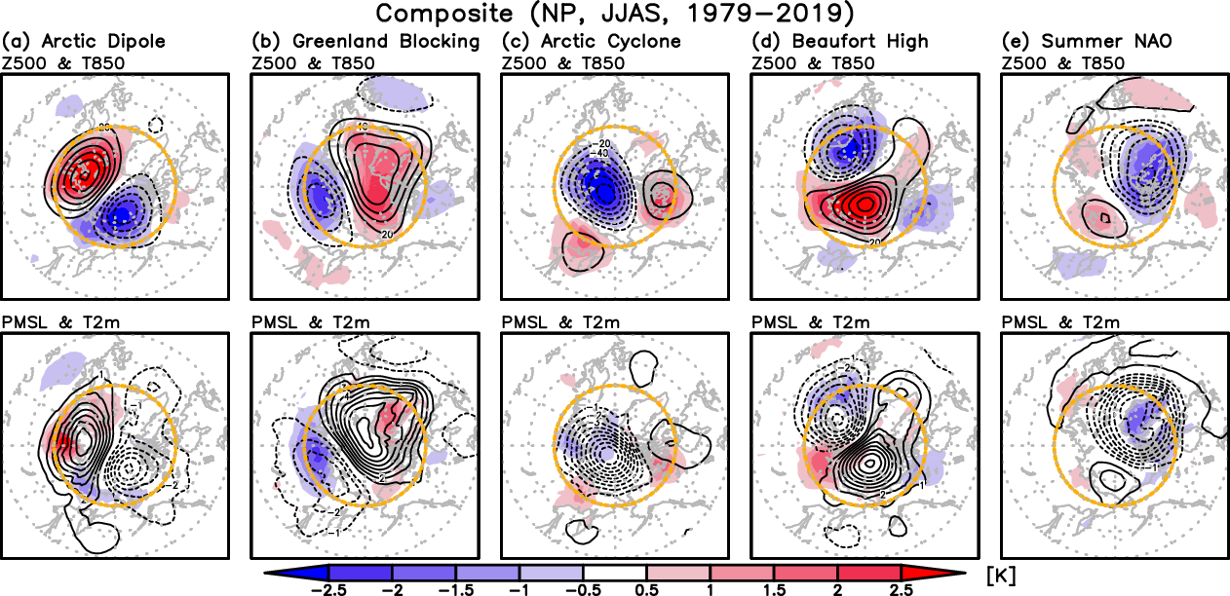
Literature review
Composites for “Arctic cyclone” weather pattern during JJAS 1979–2019. Figure S2 adapted from Yamagami and Matsueda (2021).
Yamagami and Matsueda (2021) suggest that forecast busts over the Arctic during summer may be linked to forecast errors in synoptic-scale systems such as ACs.
Contours: 500-hPa geopotential
height anomalies
Contours: SLP anomalies
Shading: 850-hPa temperature
anomalies
Shading: 2-m temperature
anomalies

Slide 9
Literature review
Forecast errors propagating along upper-tropospheric waveguides (e.g., Langland et al. 2002; Hakim 2005) and forecast errors associated with features embedded within upper-tropospheric waveguides (e.g., troughs and ridges) (e.g., Sanders 1992; Davies and Didione 2013; Baumgart et al. 2018) can contribute to forecast errors in the synoptic-scale flow over the middle latitudes.
Forecast errors related to baroclinic processes (e.g.,Tribbia and Baumhefner 2004; Davies and Didone 2013) and latent heating (e.g., Rodwell et al. 2013; Martínez-Alvarado et al. 2016; Grams et al. 2018) can contribute to forecast errors in the synoptic-scale flow over the middle latitudes.
Anticipate that the aforementioned forecast errors may contribute to forecast errors in the synoptic-scale flow over the Arctic.

Slide 10
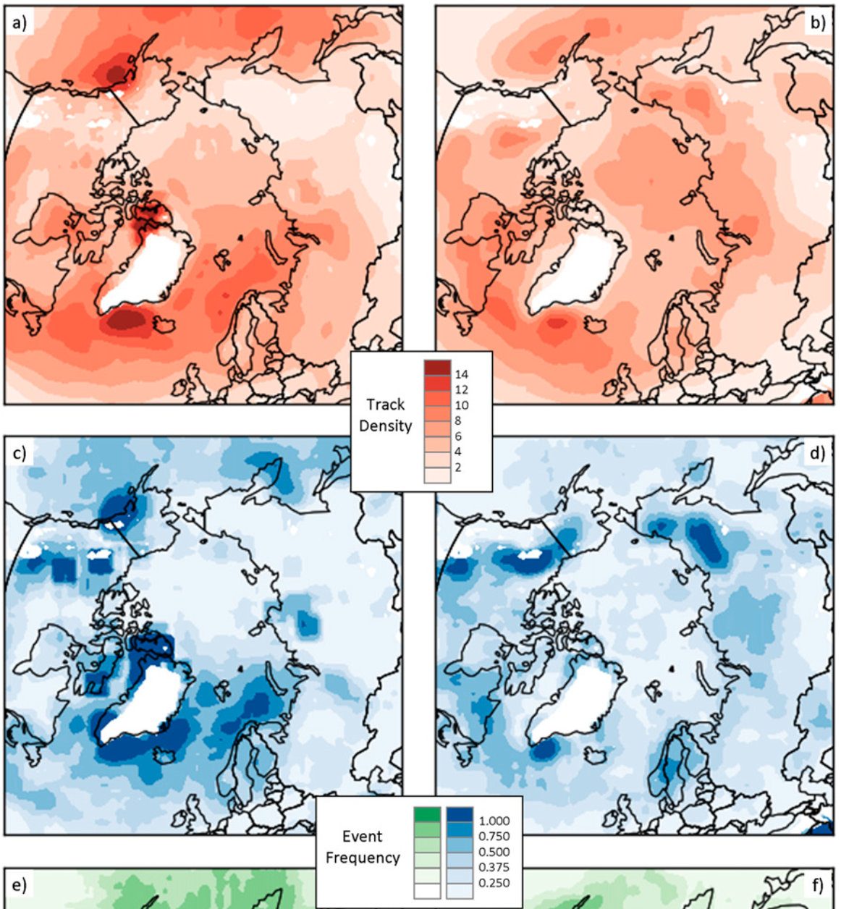
Literature review
Winter
Summer
ACs track more frequently over Eurasia, adjacent seas, and Arctic Ocean during summer.
ACs track more frequently over the North Atlantic and adjacent seas during winter.
AC genesis more frequent over Eurasia during summer.
AC genesis more frequent over North Atlantic and adjacent seas during winter.
Track Density
Genesis Frequency
Figure 3 adapted from Crawford et al. (2016)

Slide 11
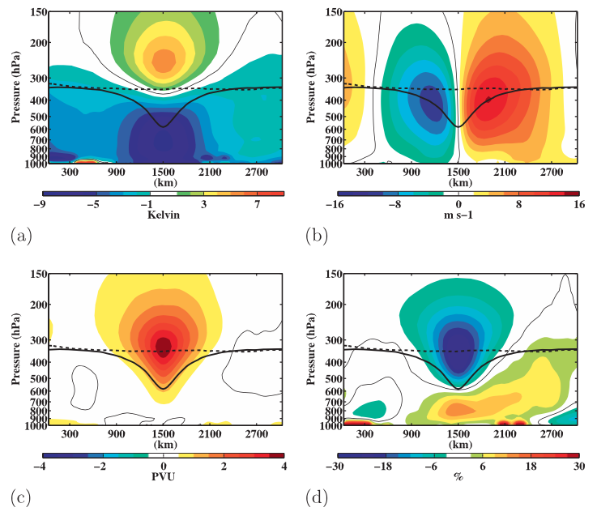
Literature review
Temperature anomaly (K)
v-wind anomaly (m s⁻¹)
Composite west-to-east cross sections of TPVs. Figure 9 adapted from Cavallo and Hakim (2010).
Tropopause polar vorticies (TPVs) are coherent tropopause-based cyclonic vortices (e.g., Cavallo and Hakim 2009, 2010, 2012)
TPVs occur frequently across the Arctic (e.g., Cavallo and Hakim 2010)
Ertel PV anomaly (PVU)
Relative humidity anomaly (%)

Slide 12
Literature review
TPVs have been shown to play an important role in the development and intensification of ACs (e.g., Simmonds and Rudeva 2012, 2014; Tanaka et al. 2012; Aizawa and Tanaka 2016; Tao et al. 2017a,b; Yamagami et al. 2017).
Baroclinic processes have also been shown to play an important role in the development and intensification of ACs (e.g., Simmonds and Rudeva 2012; Aizawa et al. 2014; Yamazaki et al. 2015; Tao et al. 2017a,b; Yamagami et al. 2017)

Slide 13
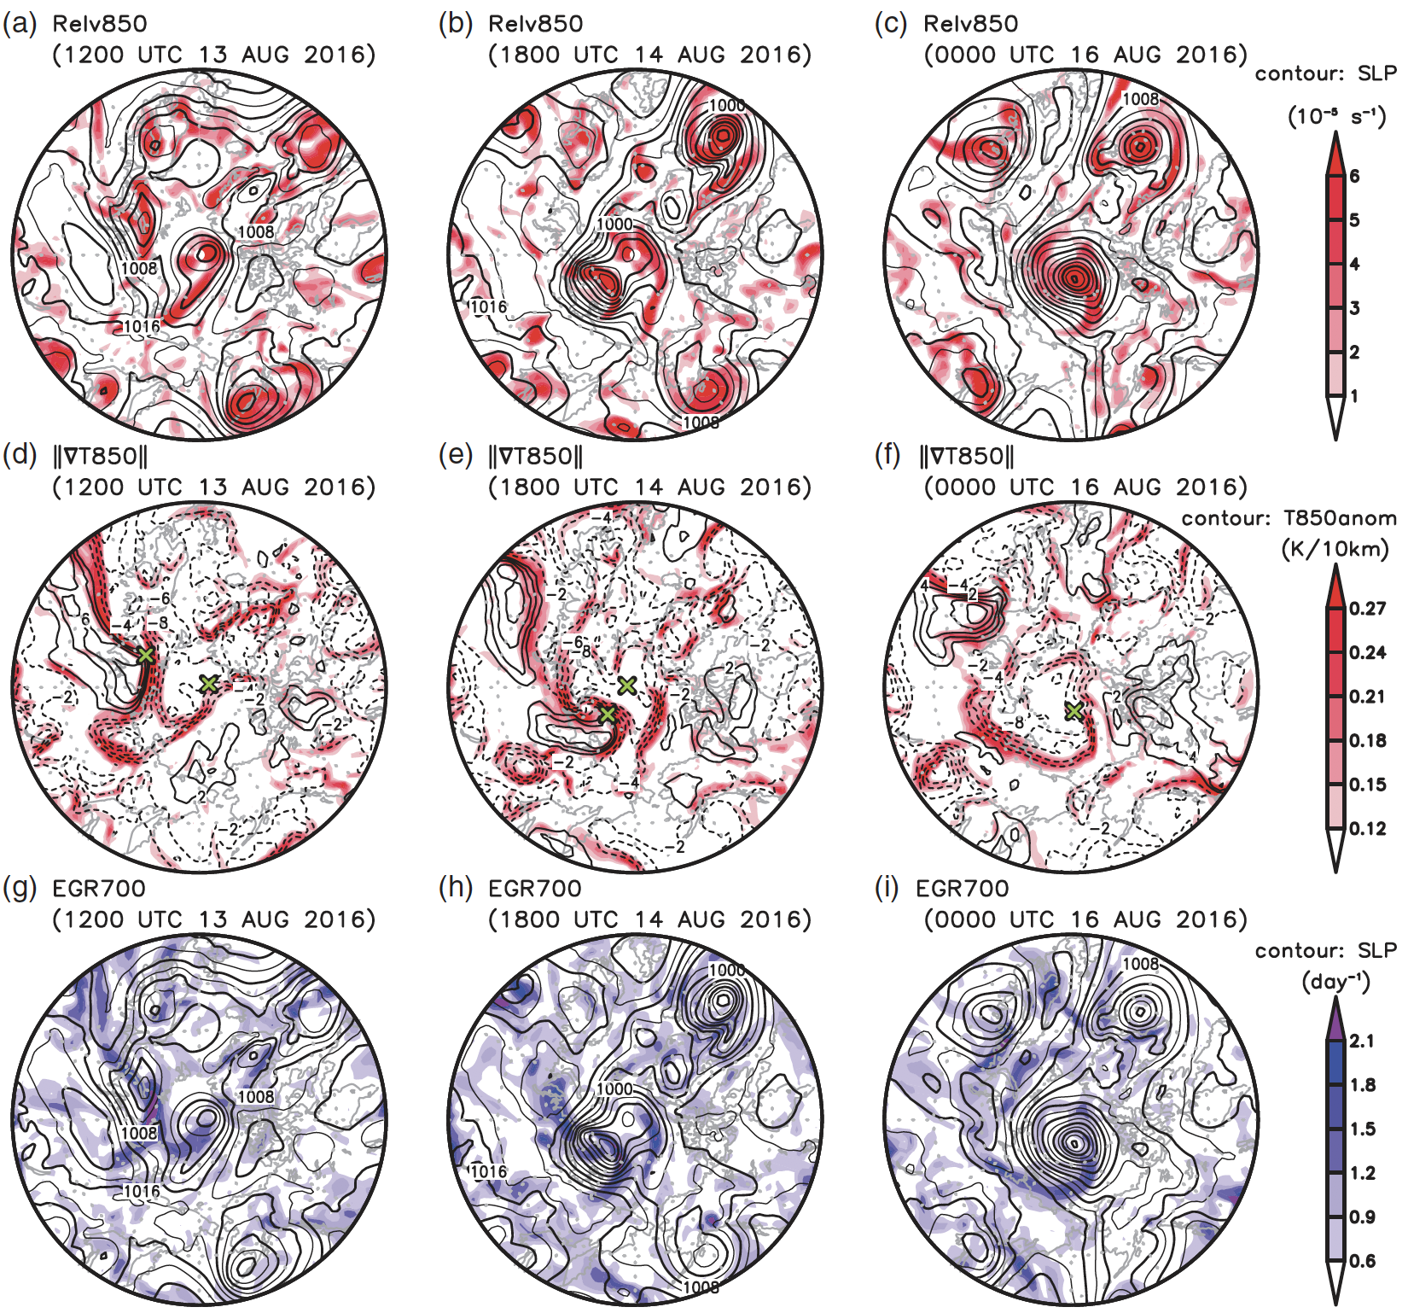
Literature review
×
Location of a strong AC during August 2016 (AC16)
Shading: 850-hPa horizontal temperature gradient magnitude [K (10 km)⁻¹]
850-hPa temperature anomaly (contours, every 2 K)
Figure 3 adapted from Yamagami et al. (2017).

Slide 14
Literature review
×
Location of a strong AC during August 2016 (AC16)
Shading: 700-hPa Eady growth rate (day⁻¹, shading)
SLP (contours, every 3 hPa)
Figure 3 adapted from Yamagami et al. (2017).

Slide 15
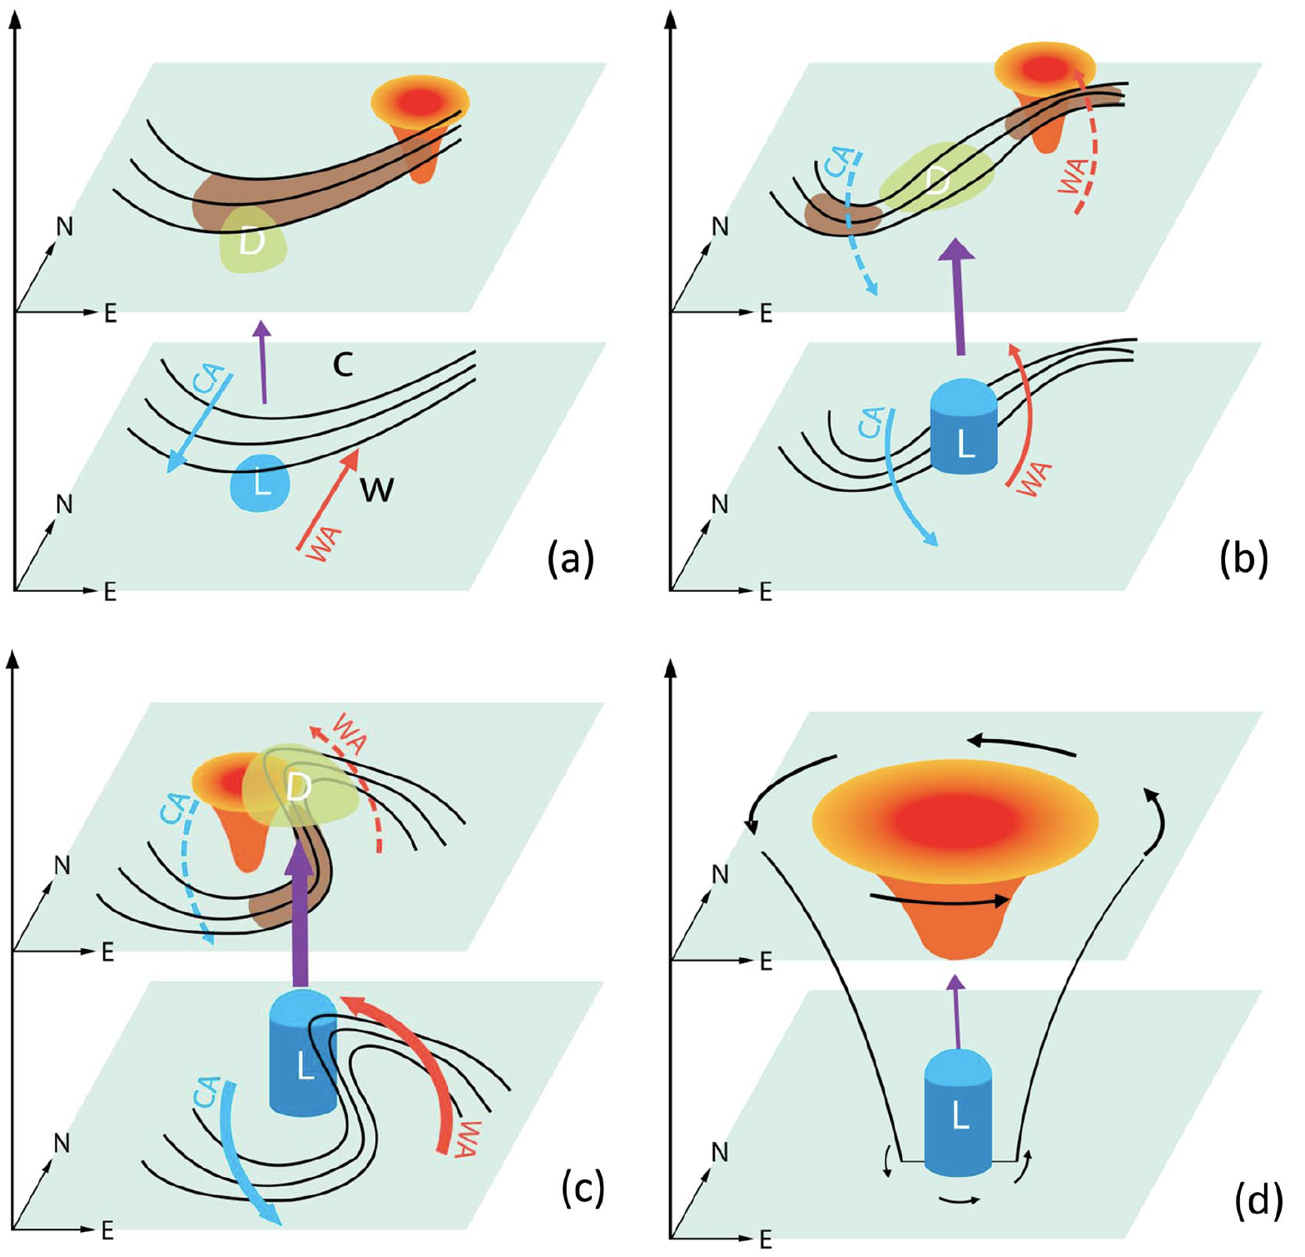
Literature review
“Insipient stage”
“Development stage”
Sketch of the development of the Great Arctic Cyclone of August 2012 (AC12). Figure 4 adapted from Tao et al. (2017)
Isotherms
“C”: Cold air mass
“W”: Warm air mass
“CA”
Cold and warm temperature advections and associated directions in which cold and warm air are advected
“WA”
“Drastic intensification period”
“Lingering stage”
Jet streaks
“D”
Divergence
Ascent
L
Storm center
TPV and associated stratospheric warm temperature anomaly
Cyclonic circulations

Slide 16
Literature review
Latent heating associated with the formation of clouds and precipitation has been shown to contribute to the development and intensification of midlatitude cyclones in numerous studies (e.g., Tracton 1973; Kuo and Reed 1988; Davis et al. 1993; Stoelinga 1996; Wernli et al. 2002).
There has been a dearth of research that has examined the role of latent heating in the development and intensification of ACs.
ACs can be associated with intrusions of warm, moist air into the Arctic (e.g., Binder et al. 2017; Messori et al. 2018; Fearon et al. 2021), which may be related to atmospheric rivers (ARs) and warm conveyor belts (WCBs) of ACs.

Slide 17
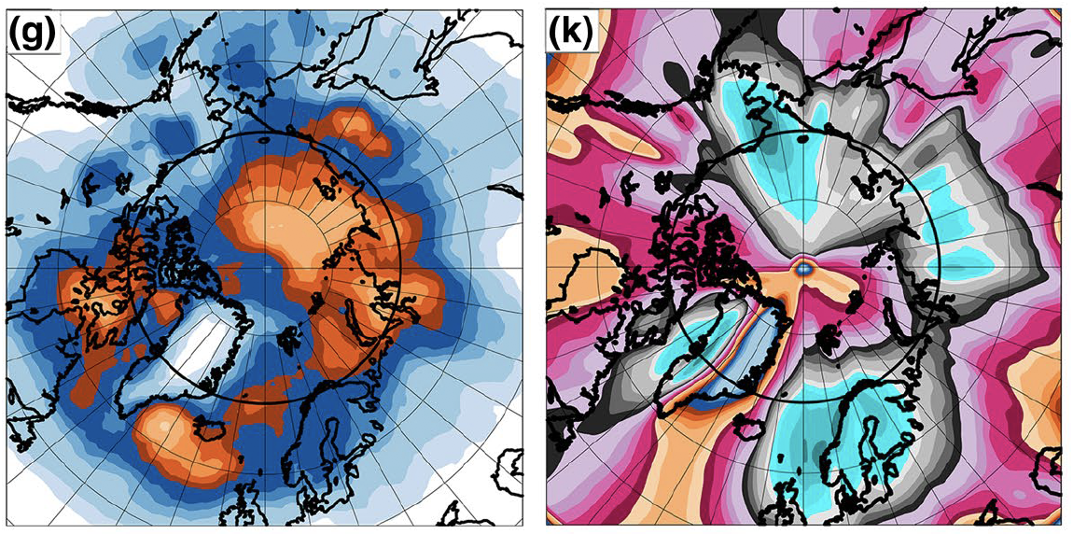
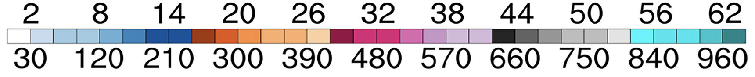
Literature review
Figure 1 adapted from Fearon et al. (2021). Time period considered is June–August 1998–2017.
Fearon et al. (2021) identified moist intrusions based on 1000–300-hPa integrated water vapor transport (IVT) calculated from ERA5.
They also identified ACs associated with moist intrusions that extend poleward from lower latitudes to the Arctic, across 70°N.
(left) Cyclone-center grid cell counts per month for ACs associated with moist intrusions (top values of color bar)
(right) Moist intrusion grid cell counts per month (bottom values of color bar)

Slide 18
Literature review
Yamagami et al. (2018a) find that accurate forecasts of AC12 only extend out to 2–3-day lead times relative to the time of peak intensity of AC12.
Yamagami et al. (2018b) state that the forecast skill of extraordinary ACs is lower than that of midlatitude cyclones in the Northern Hemisphere.
Capute and Torn (2021) show that ACs are less predictable in terms of position, and more predictable in terms of intensity, compared to midlatitude cyclones over the North Atlantic

Slide 19
Literature review
Forecast errors propagating along upper-tropospheric waveguides and forecast errors associated with features embedded within upper-tropospheric waveguides have been shown to contribute to forecast errors in midlatitude cyclones (e.g., Chang et al. 2013; Zheng et al. 2013; Lamberson et al. 2016).
Forecast errors related to baroclinic processes (e.g., Sanders 1986; Zhu and Thorpe 2006; Zheng et al. 2013) and latent heating (e.g., Zhang et al. 2003, 2007; Doyle et al. 2014, 2019) have also been shown to contribute to forecast errors in midlatitude cyclones.
Anticipate that these forecast errors may also contribute to forecast errors in ACs.

Slide 20
Literature review
The forecast skill of AC12 has been shown to be sensitive to the strength of TPVs (e.g., Tao et al. 2017b; Yamazaki et al. 2015), position of TPVs (e.g., Yamagami et al. 2018a), and to the strength of tropospheric baroclinicity (e.g., Tao et al. 2017b).
Johnson and Wang (2021) find that track and intensity errors of an AC during July 2018 are sensitive to the position and intensity of TPVs, the amount of midtropospheric moisture located within the WCB of the AC, and the structure of the lower-tropospheric thermal field.

Slide 21
Literature review
Capute and Torn (2021) find that low-skill ACs are typically embedded in environments characterized by larger lower-to-midtropospheric Eady growth rates compared to high-skill ACs, when considering low-skill ACs and high-skill ACs determined based on forecast skill of intensity.
Capute and Torn (2021) find that there is no systematic difference in latent heating between the aforementioned low-skill ACs and high-skill ACs.
Yamagami et al. (2019) and Capute and Torn (2021) show that ACs with lower forecast skill of intensity tend to be stronger.

Slide 22
Hypotheses
The Arctic environment tends to be characterized by greater synoptic-scale flow amplitude, greater baroclinic growth rates, and greater latent heating during low-skill periods compared to high-skill periods.

Slide 23
Hypotheses
The Arctic environment tends to be characterized by greater synoptic-scale flow amplitude, greater baroclinic growth rates, and greater latent heating during low-skill periods compared to high-skill periods.
ACs occur more frequently across the Arctic, tend to be stronger, tend to be embedded in more favorable dynamic and thermodynamic environments for development and intensification, and tend to be characterized by lower forecast skill during low-skill periods compared to high-skill periods.

Slide 24
Hypotheses
Low-skill ACs during low-skill periods tend to be stronger and tend to be embedded in more favorable dynamic and thermodynamic environments for development and intensification compared to high-skill ACs during low-skill periods. Similarly, low-skill ACs during high-skill periods tend to be stronger and tend to be embedded in more favorable dynamic and thermodynamic environments for development and intensification compared to high-skill ACs during high-skill periods.

Slide 25
Hypotheses
TPVs, baroclinic zones, and WCBs, and TPV–AC interactions, baroclinic processes, and latent heating, influence the evolution of strong low-skill ACs during low-skill periods and strong high-skill ACs during low-skill periods, although these features and processes tend to be more robust for strong low-skill ACs during low-skill periods.

Slide 26
Hypotheses
TPVs, baroclinic zones, and WCBs, and TPV–AC interactions, baroclinic processes, and latent heating, influence the evolution of strong low-skill ACs during low-skill periods and strong high-skill ACs during low-skill periods, although these features and processes tend to be more robust for strong low-skill ACs during low-skill periods.
Forecast errors in TPVs, baroclinic zones, and WCBs, and forecast errors in TPV–AC interactions, baroclinic processes, and latent heating, contribute to forecast errors in strong low-skill ACs during low-skill periods.

Slide 27
Hypotheses
The Arctic environment tends to be characterized by greater synoptic-scale flow amplitude, greater baroclinic growth rates, and greater latent heating during low-skill periods compared to high-skill periods.
ACs occur more frequently across the Arctic, tend to be stronger, tend to be embedded in more favorable dynamic and thermodynamic environments for development and intensification, and tend to be characterized by lower forecast skill during low-skill periods compared to high-skill periods.

Slide 28
Arctic forecast skill evaluation
Utilize day-5 forecasts of 500-hPa geopotential height initialized at 0000 UTC during June–August 2007–2017 from 11-member 1° NOAA GEFS reforecast dataset version 2 (Hamill et al. 2013).
Calculate area-averaged root mean square error (RMSE) of 500-hPa geopotential height over the Arctic, using ERA-Interim (Dee et al. 2011) as verification.
Calculate standardized anomaly of area-averaged RMSE (σ_{RMSE}) relative to a 1985–2017 climatology of area-averaged RMSE following the approach used by Moore [2017, section 5b(3)].

Slide 29
Arctic forecast skill evaluation
Refer to forecasts associated with the top and bottom 10% of σ_{RMSE} at day 5 are referred to as low-skill forecasts and high-skill forecasts, respectively.
Refer to time periods extending from day 0 through day 5 that are encompassed by low-skill forecasts and high-skill forecasts as low-skill periods and high-skill periods, respectively.
If a day is identified to occur during both a low-skill period and a high-skill period, the day is assigned to the period that occurs earlier.

Slide 30
Identification of ACs
Create a climatology of ACs occurring during June–August 2007–2017 by obtaining cyclone tracks from 1° ERA-Interim cyclone climatology prepared by Sprenger et al. (2017).
Deem cyclones that last ≥ 48 h and spend at at least 6 h poleward of 70°N as ACs.
Identify ACs that occur during low-skill periods and high-skill periods.

Slide 31
Characteristics of the Arctic Environment and ACs
Calculate selected dynamic and thermodynamic quantities to characterize the Arctic environment and ACs using ERA-Interim dataset at 1° horizontal resolution.
The selected quantities are area-averaged over the Arctic (≥ 70°N) to characterize the Arctic environment.
The selected quantities are area-averaged within a 1000-km radius from the center of each AC to characterize the environment in the vicinity of each AC.
The most extreme value of the area-averaged quantities, and the lowest SLP, for each AC during a period of interest (i.e., climatology, low-skill periods, or high-skill periods) when located in the Arctic during the period of interest are determined.

Slide 32
Characteristics of the Arctic Environment and ACs
The selected quantities that are area-averaged are:
  The absolute value of the standardized anomaly of 500-hPa v wind, hereafter referred to as σ_{v500}.
  300-hPa wind speed.
  850-hPa potential temperature (θ) gradient magnitude.
  850–600-hPa Eady growth rate.
  Positive values of 350–250-hPa divergence.
  Negative values of 850–600-hPa vertical motions (ω).
  1000–300-hPa IVT.
  1000–300-hPa integrated moisture flux convergence (IMFC).

Slide 33
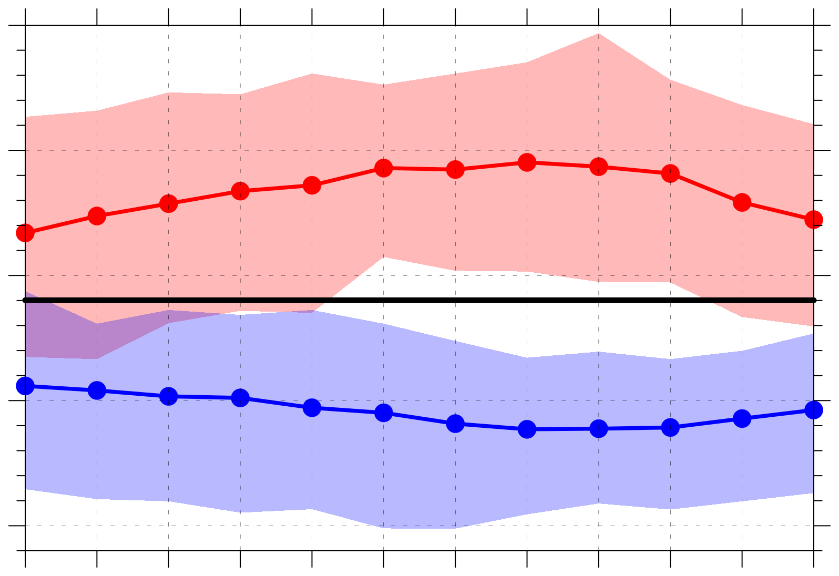
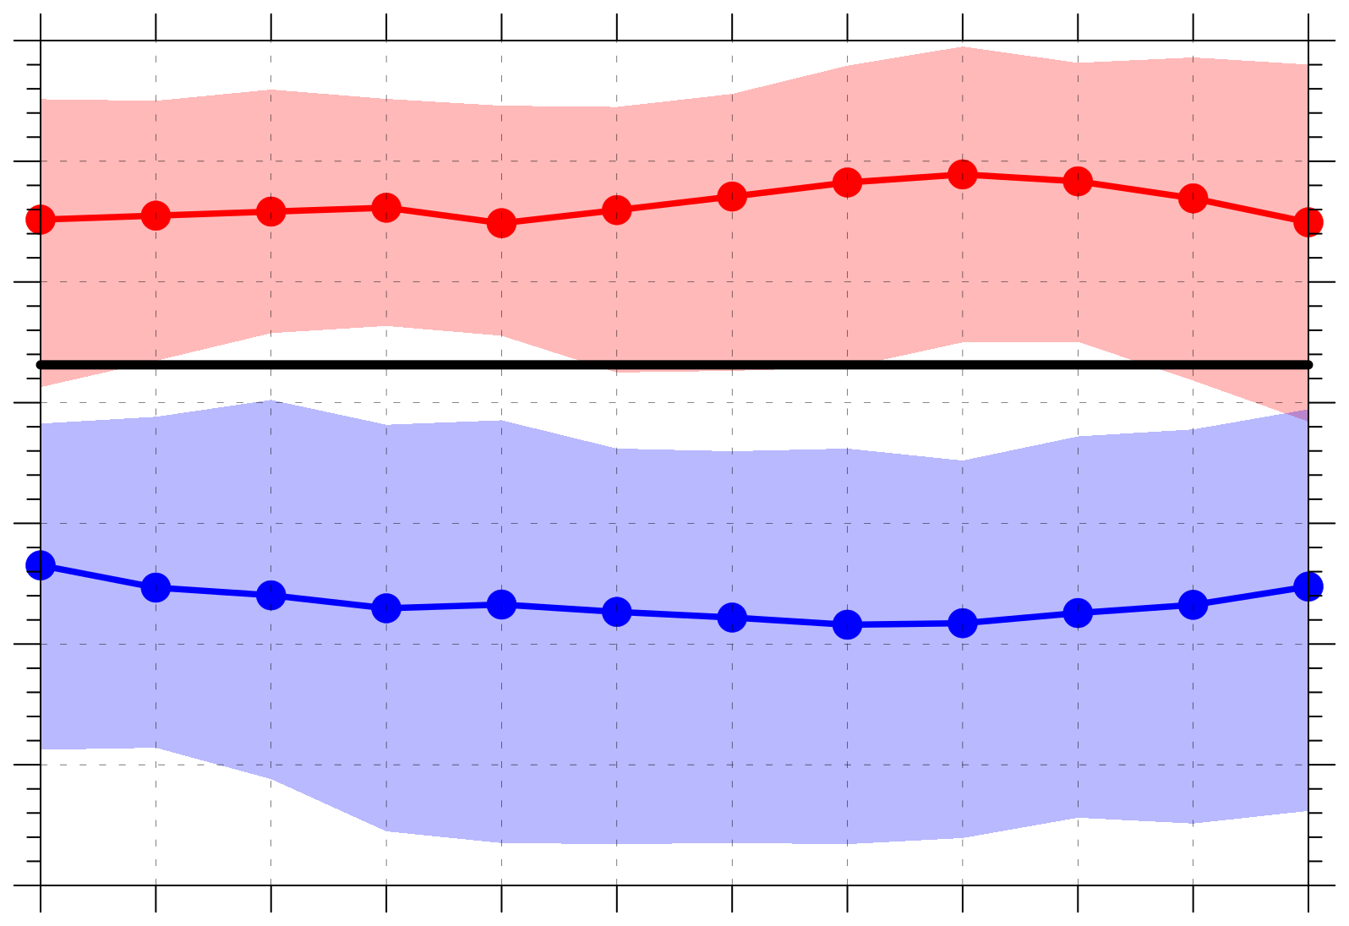
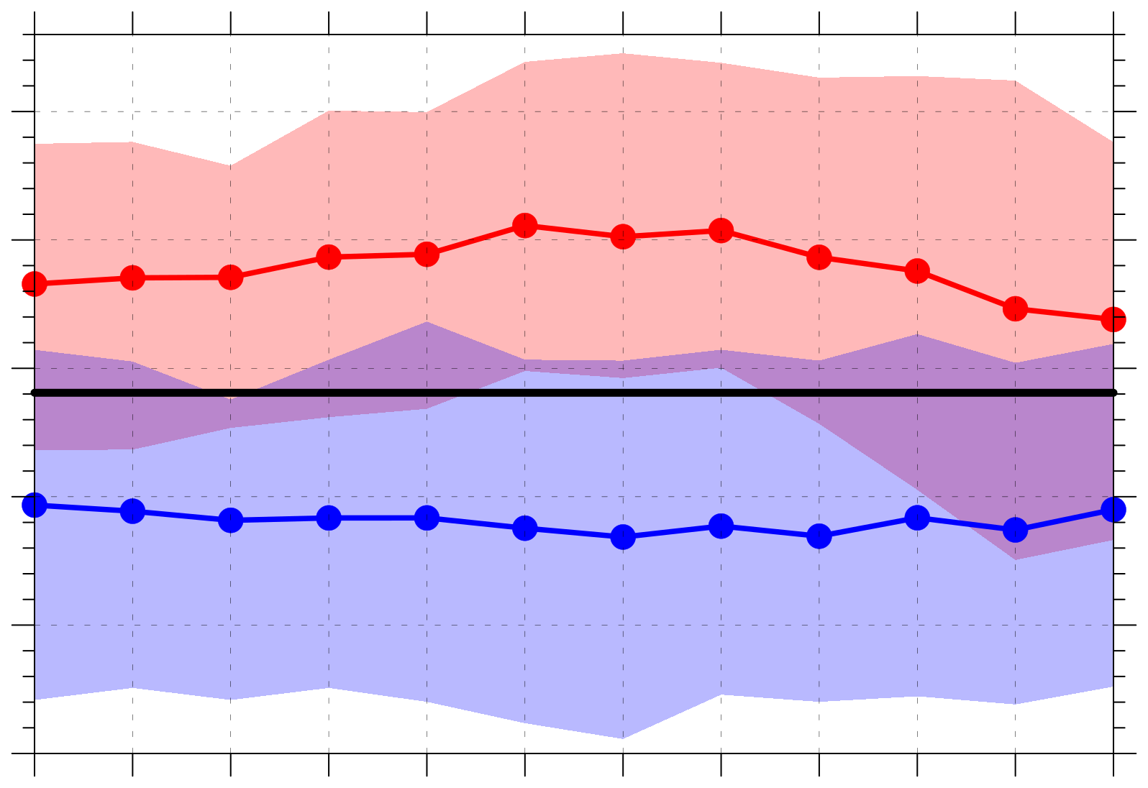
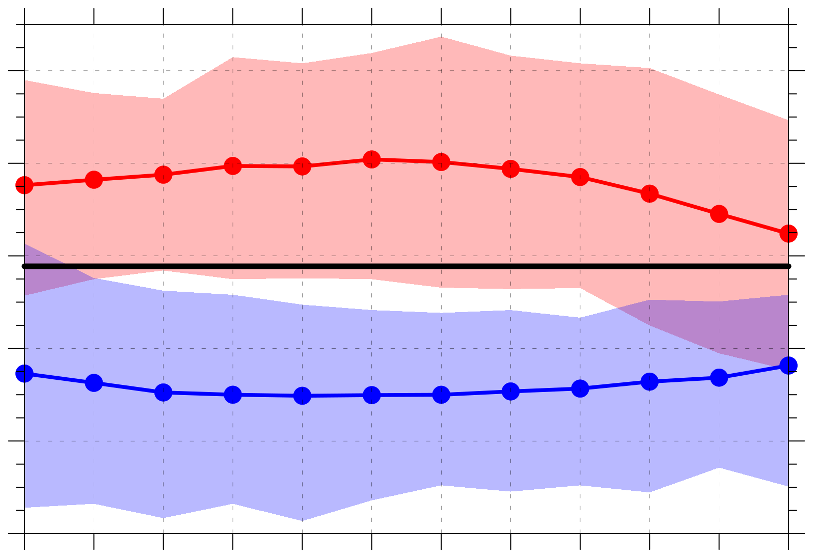
(a) σ_{v500} (σ)
(b) 300-hPa wind speed (m s⁻¹)
1.0
20
Legend
19
0.9
Distributions of quantities area-averaged over the Arctic (≥ 70°N)
18
0.8
17
16
0.7
15
Low-skill mean
14
0.6
13
High-skill mean
0
0.5
1
1.5
2
2.5
3
3.5
4
4.5
5
5.5
0
0.5
1
1.5
2
2.5
3
3.5
4
4.5
5
5.5
Day
Day
2007–2017
climo mean
(c) 850-hPa θ gradient magnitude [K (100 km)⁻¹]
(d) 850–600-hPa Eady growth rate (day⁻¹)
1.30
0.68
Statistically significant difference with respect to climo at 95% confidence level
1.25
0.64
1.20
0.60
1.15
0.56
0.52
Shading: Interquartile range
1.10
1.05
0.48
0
0.5
1
1.5
2
2.5
3
3.5
4
4.5
5
5.5
0
0.5
1
1.5
2
2.5
3
3.5
4
4.5
5
5.5
Day
Day

Slide 34
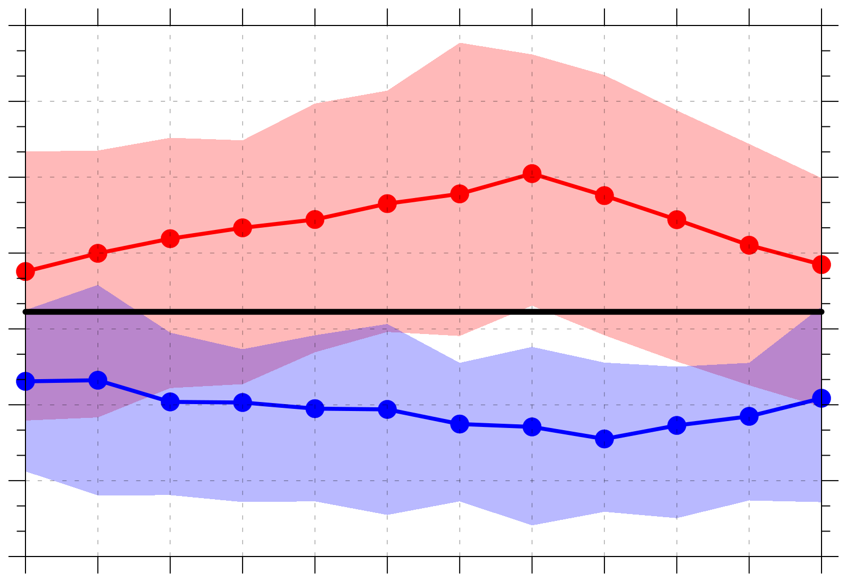
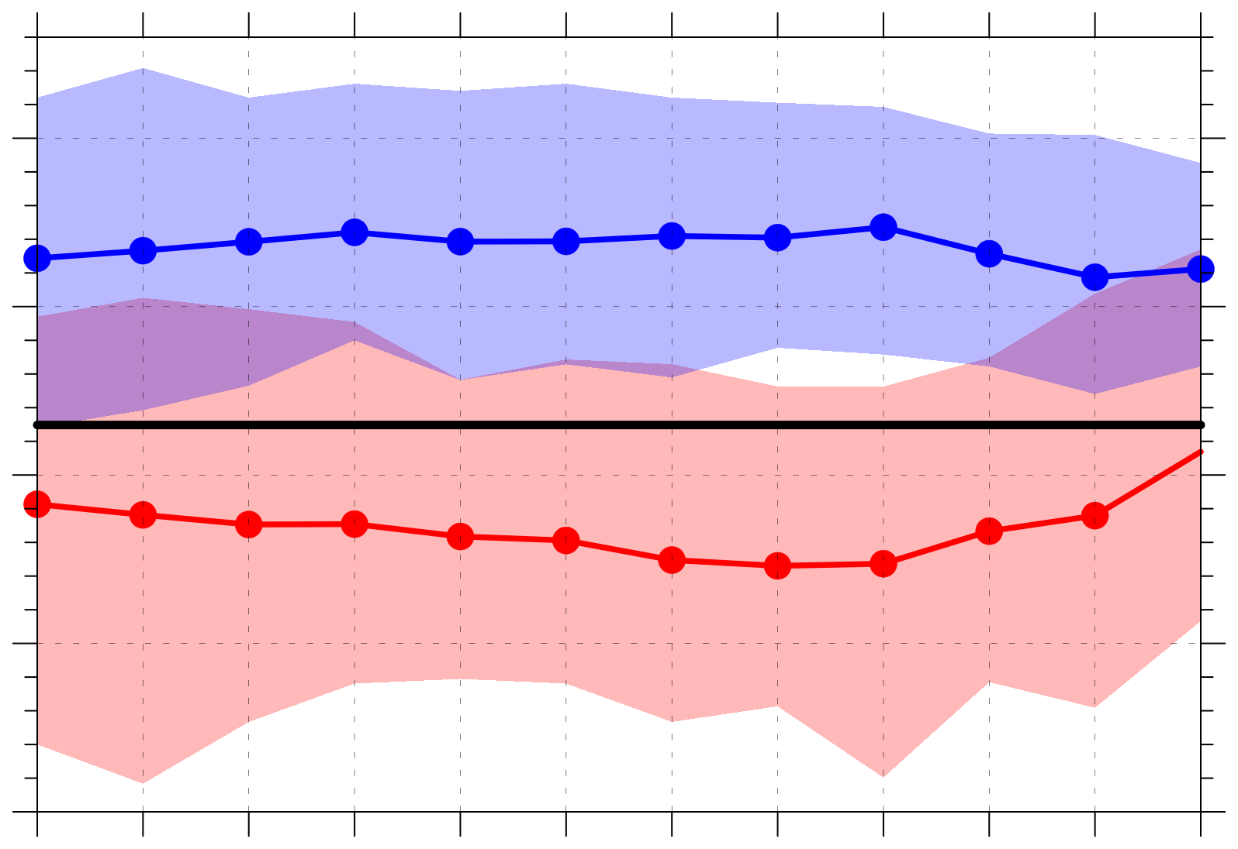
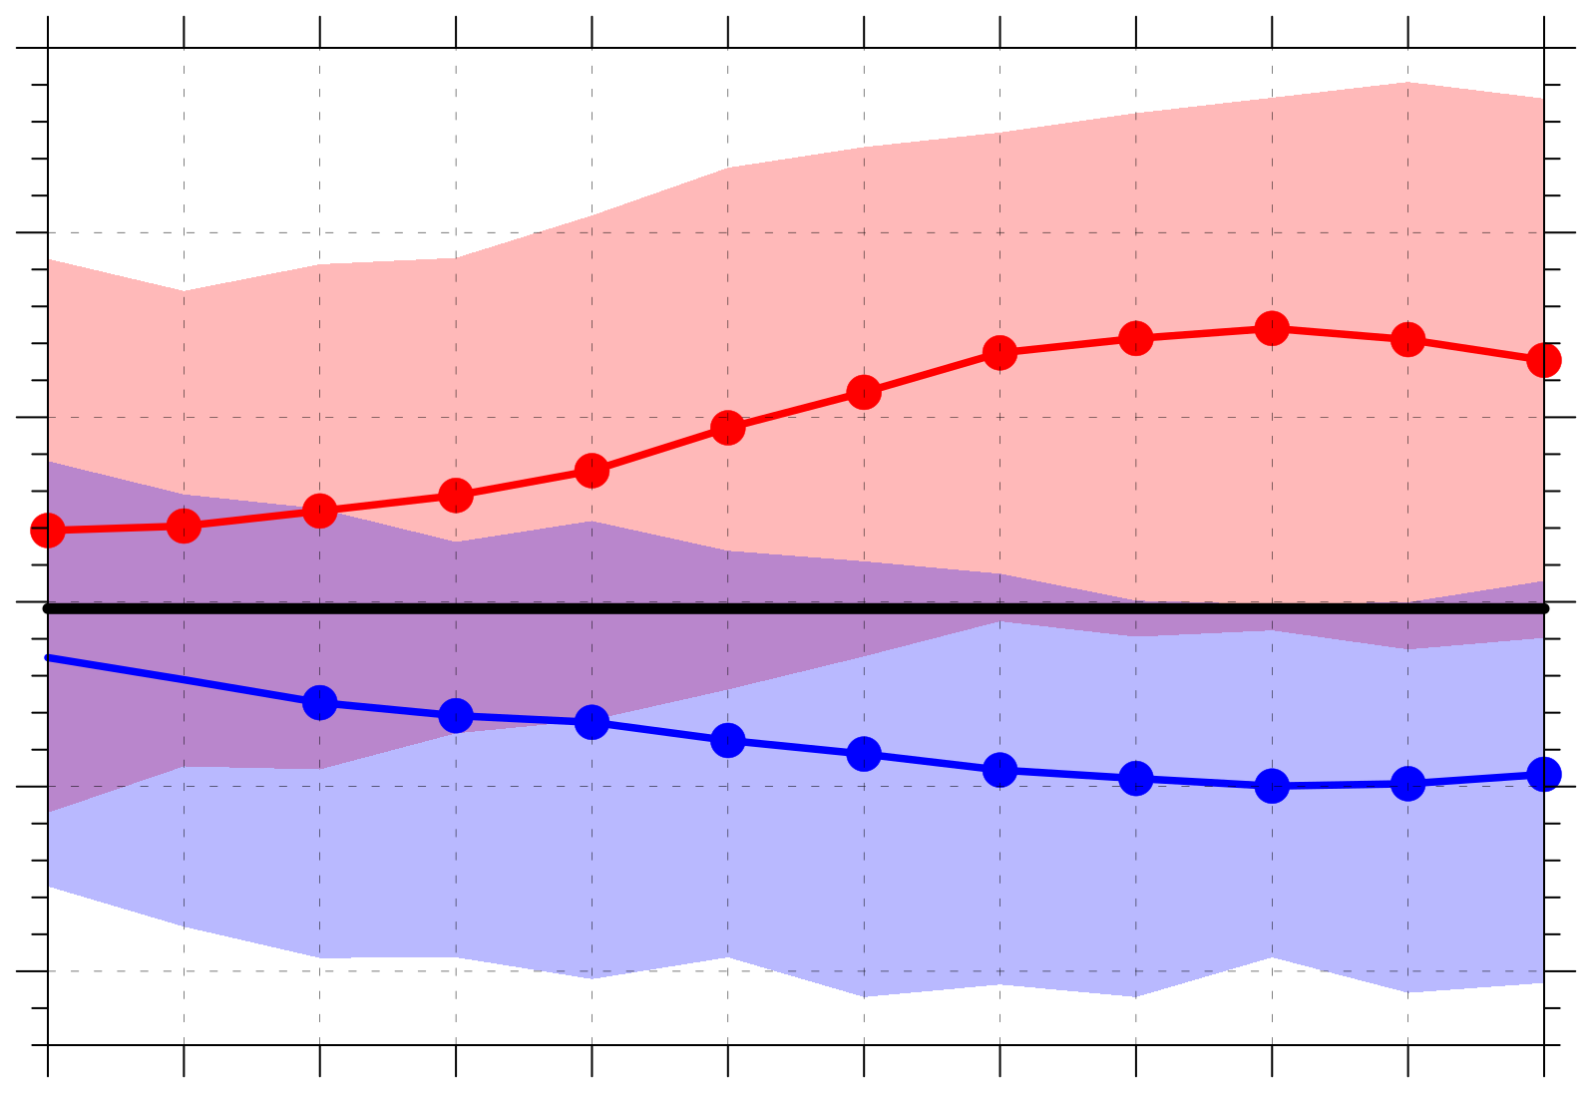
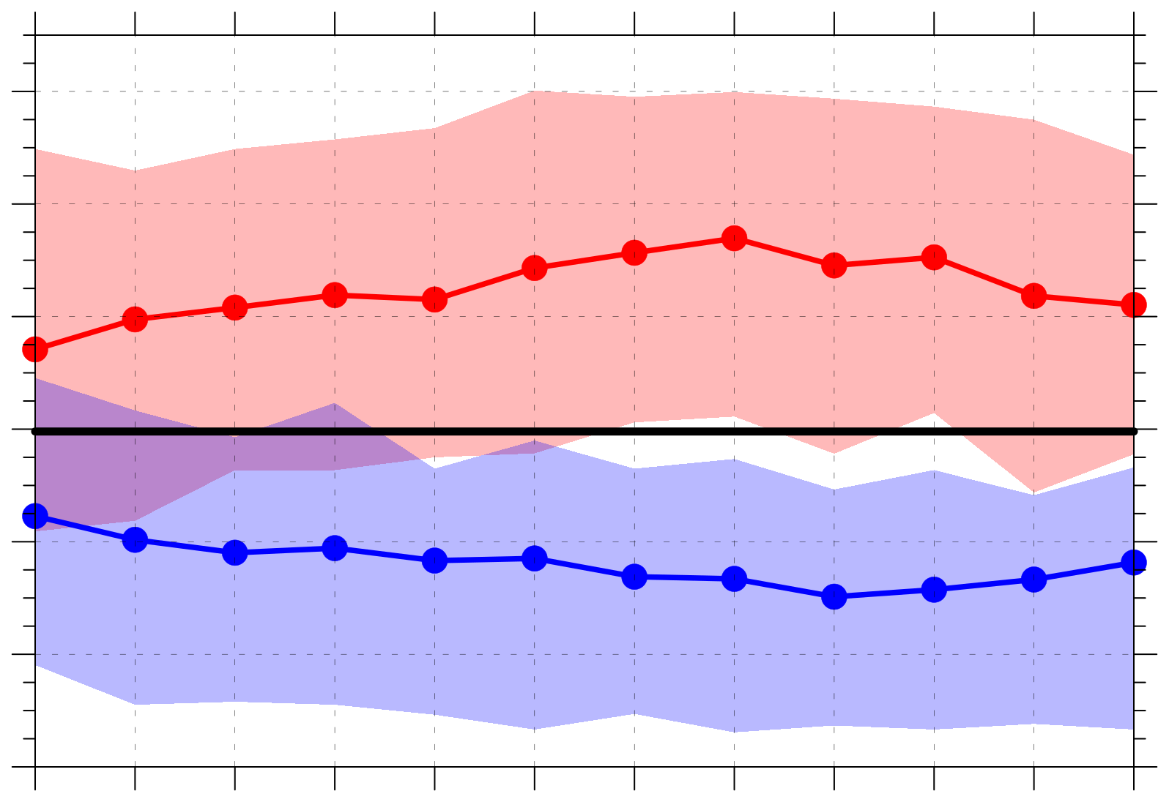
(a) Positive values of 350–250-hPa divergence (10⁻⁶ s⁻¹)
(b) Negative values of 800–600-hPa ω (10⁻³ hPa s⁻¹)
5.1
Legend
4.8
−0.6
Distributions of quantities area-averaged over the Arctic (≥ 70°N)
4.5
−0.7
4.2
3.9
−0.8
3.6
Low-skill mean
−0.9
3.3
3.0
−1.0
High-skill mean
0
0.5
1
1.5
2
2.5
3
3.5
4
4.5
5
5.5
0
0.5
1
1.5
2
2.5
3
3.5
4
4.5
5
5.5
Day
Day
2007–2017
climo mean
(c) 1000–300-hPa IVT (kg m⁻¹ s⁻¹)
(d) Positive values of 1000–300-hPa IMFC (W m⁻²)
130
260
Statistically significant difference with respect to climo at 95% confidence level
120
240
110
220
100
200
90
180
Shading: Interquartile range
160
80
140
0
0.5
1
1.5
2
2.5
3
3.5
4
4.5
5
5.5
0
0.5
1
1.5
2
2.5
3
3.5
4
4.5
5
5.5
Day
Day

Slide 35
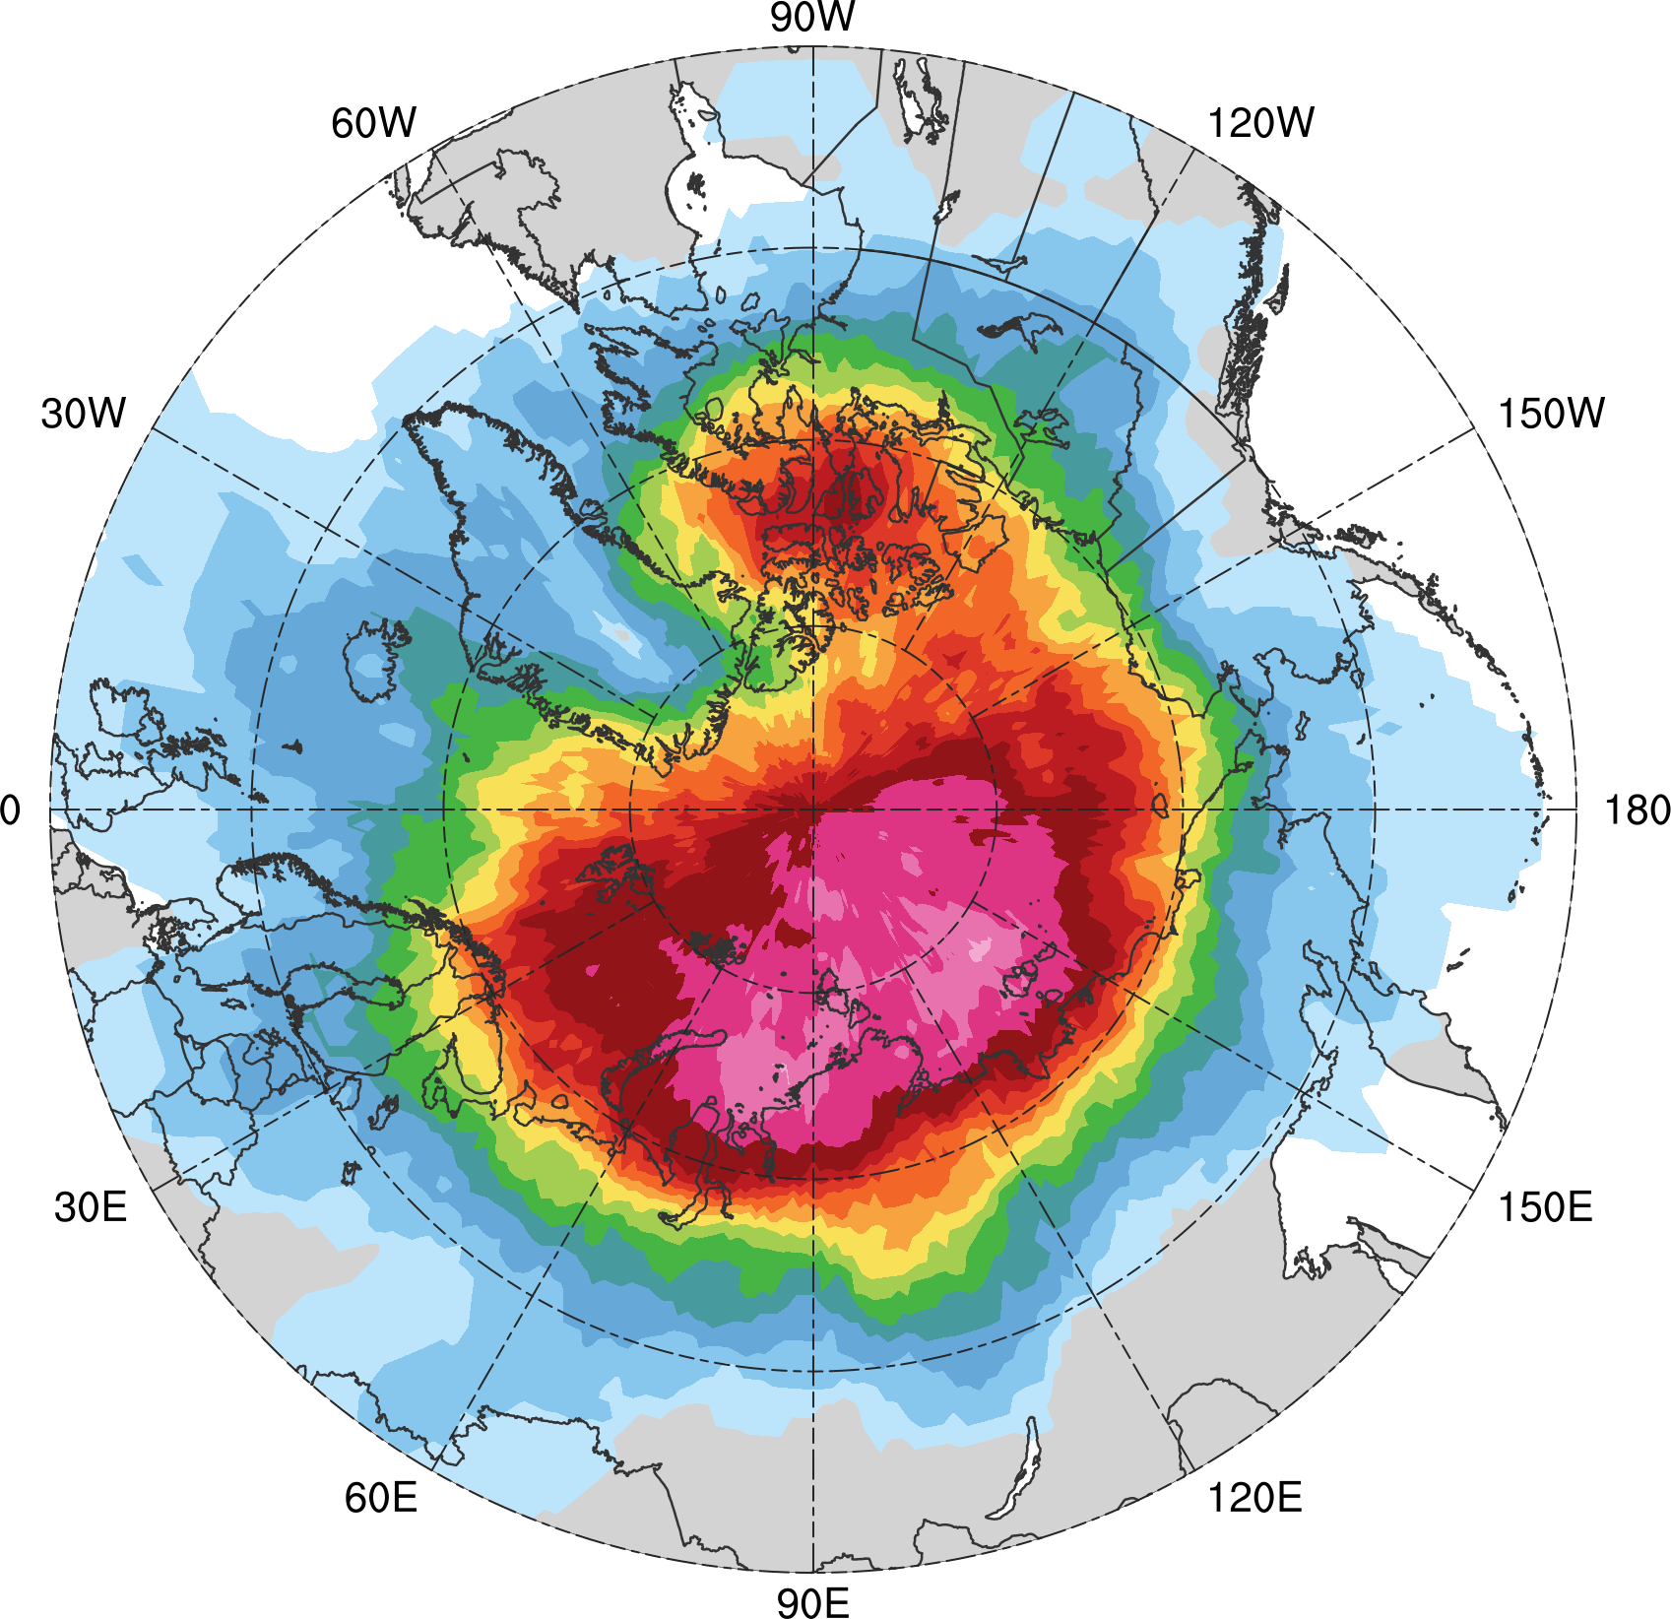
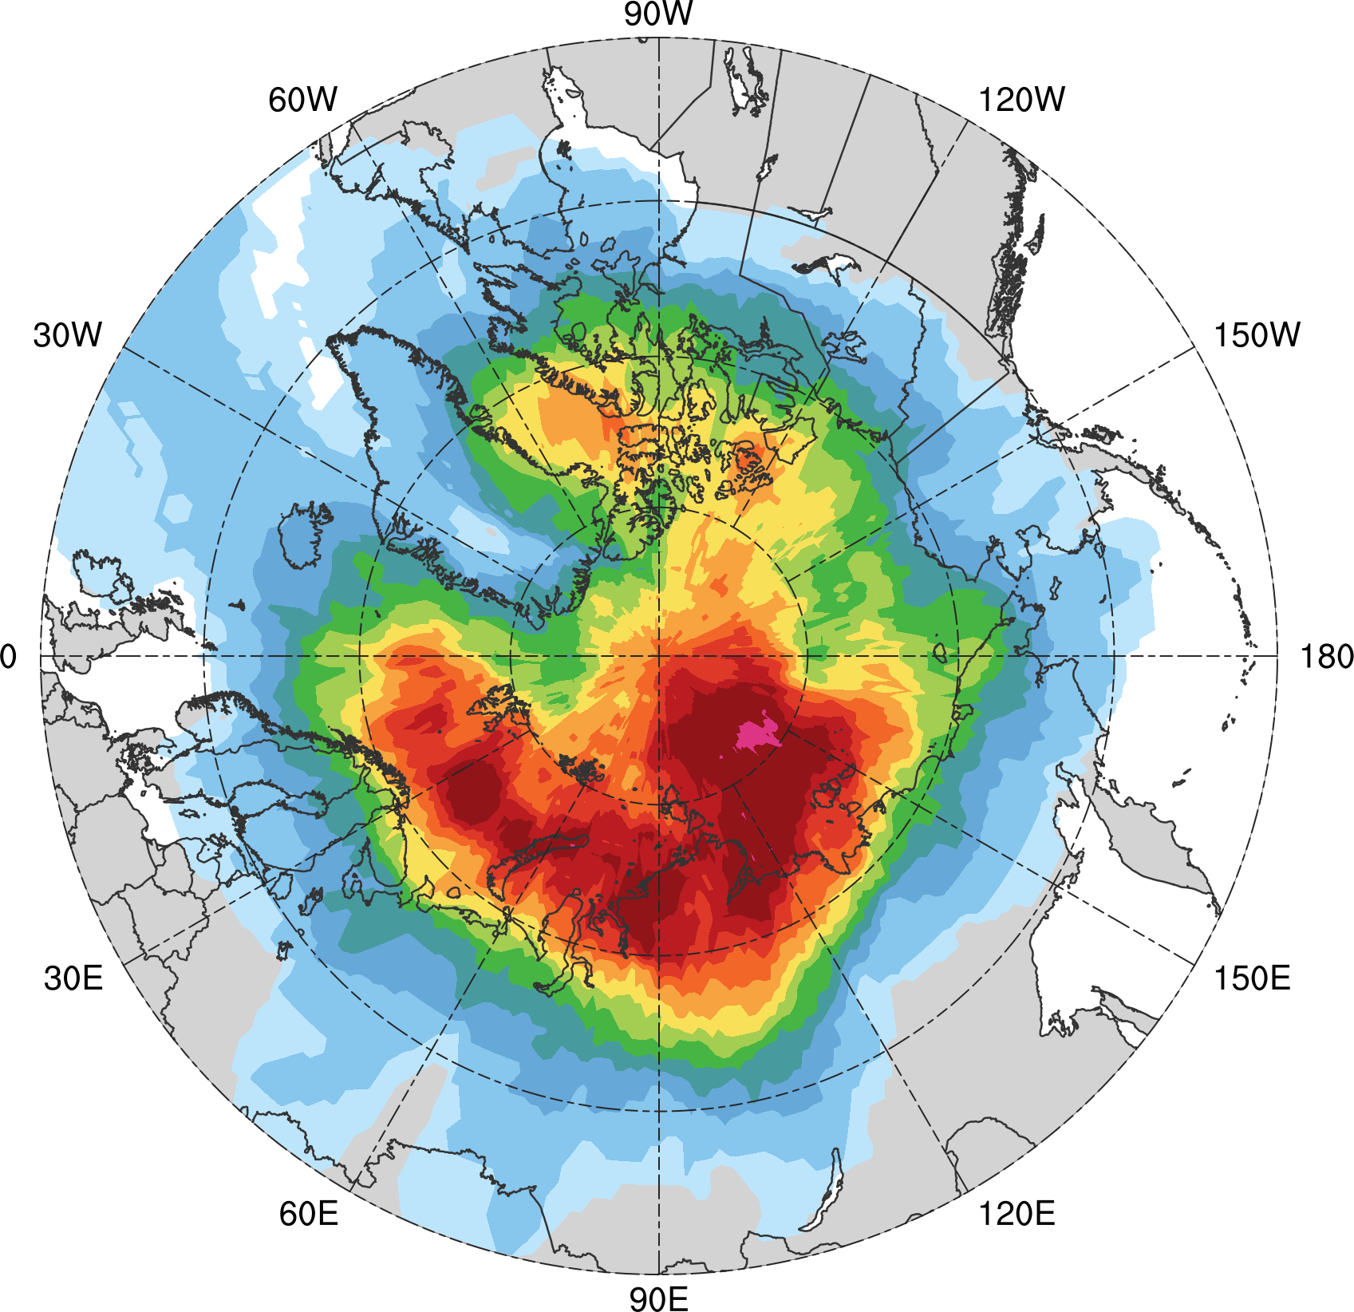
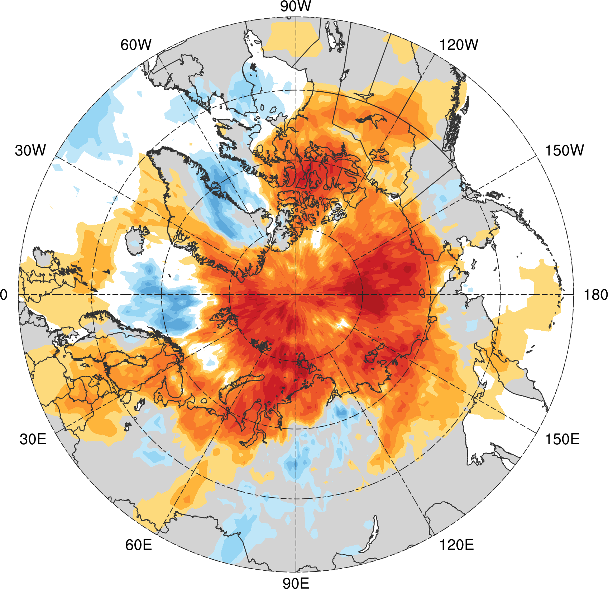
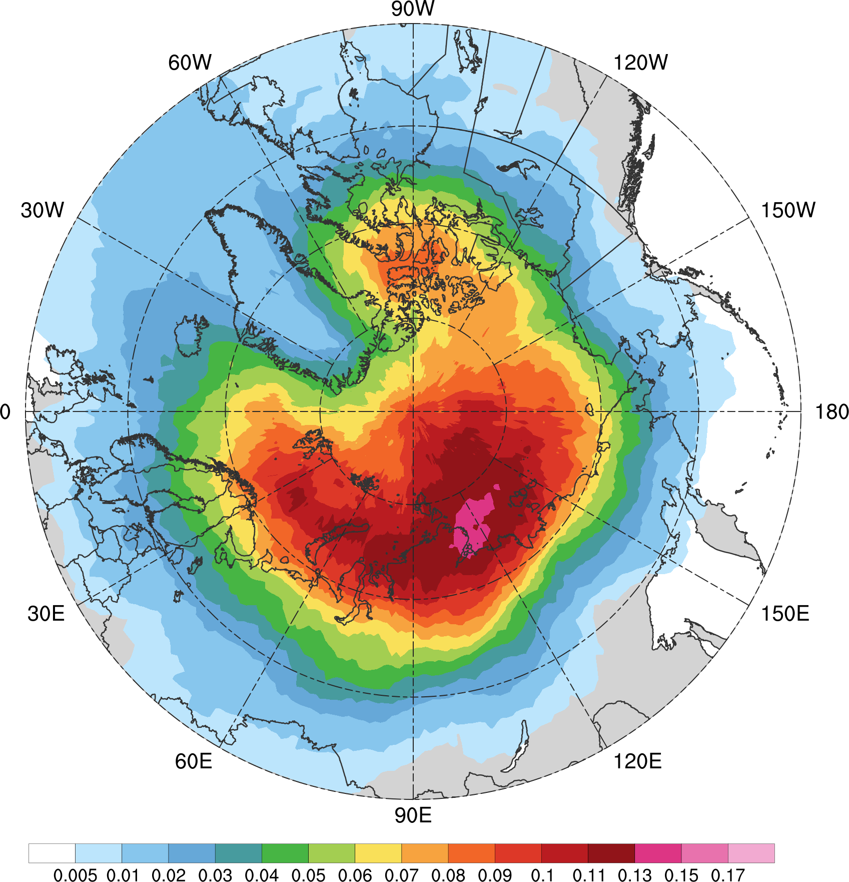
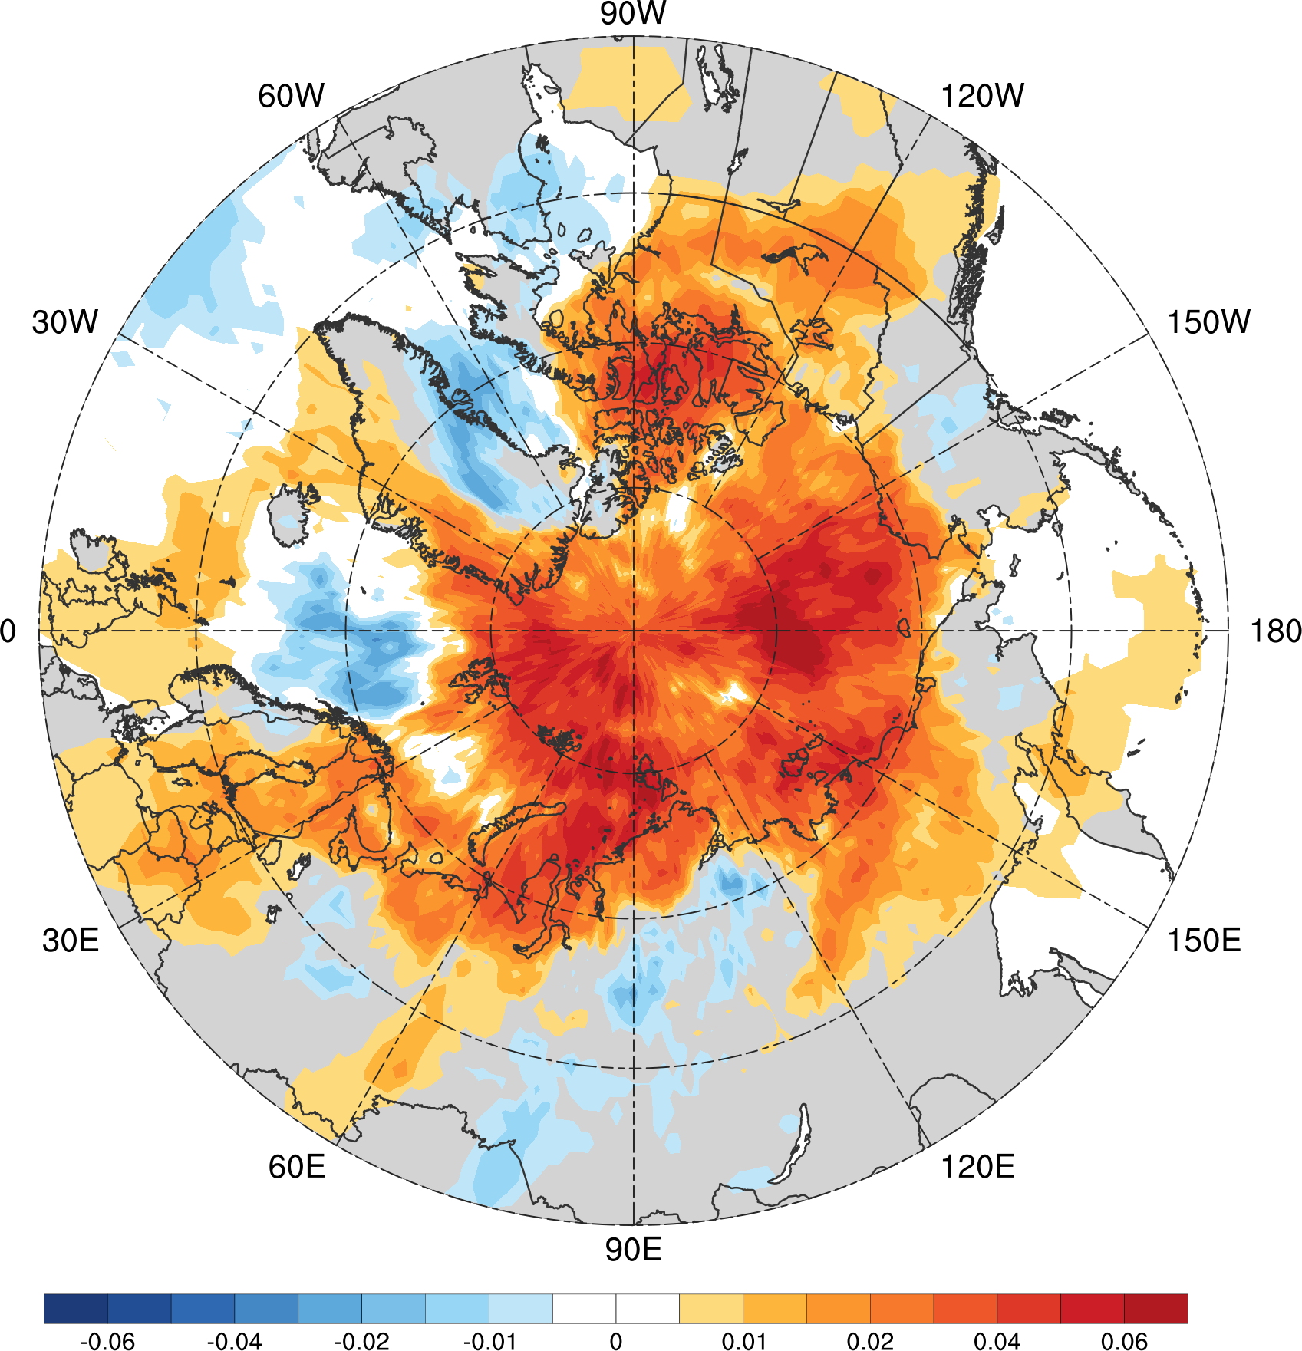
AC track frequency
ACs during low-skill periods (number of ACs day⁻¹) (N = 298)
ACs during high-skill periods (number of ACs day⁻¹) (N = 208)
Low-skill periods minus high-skill periods (number of ACs day⁻¹)
0.005
0.01
0.02
0.03
0.04
0.05
0.06
0.07
0.08
0.09
0.1
0.11
0.13
0.15
0.17
−0.06
−0.05
−0.04
−0.03
−0.02
−0.015
−0.01
−0.005
0
0.005
0.01
0.015
0.02
0.03
0.04
0.05
0.06

Slide 36
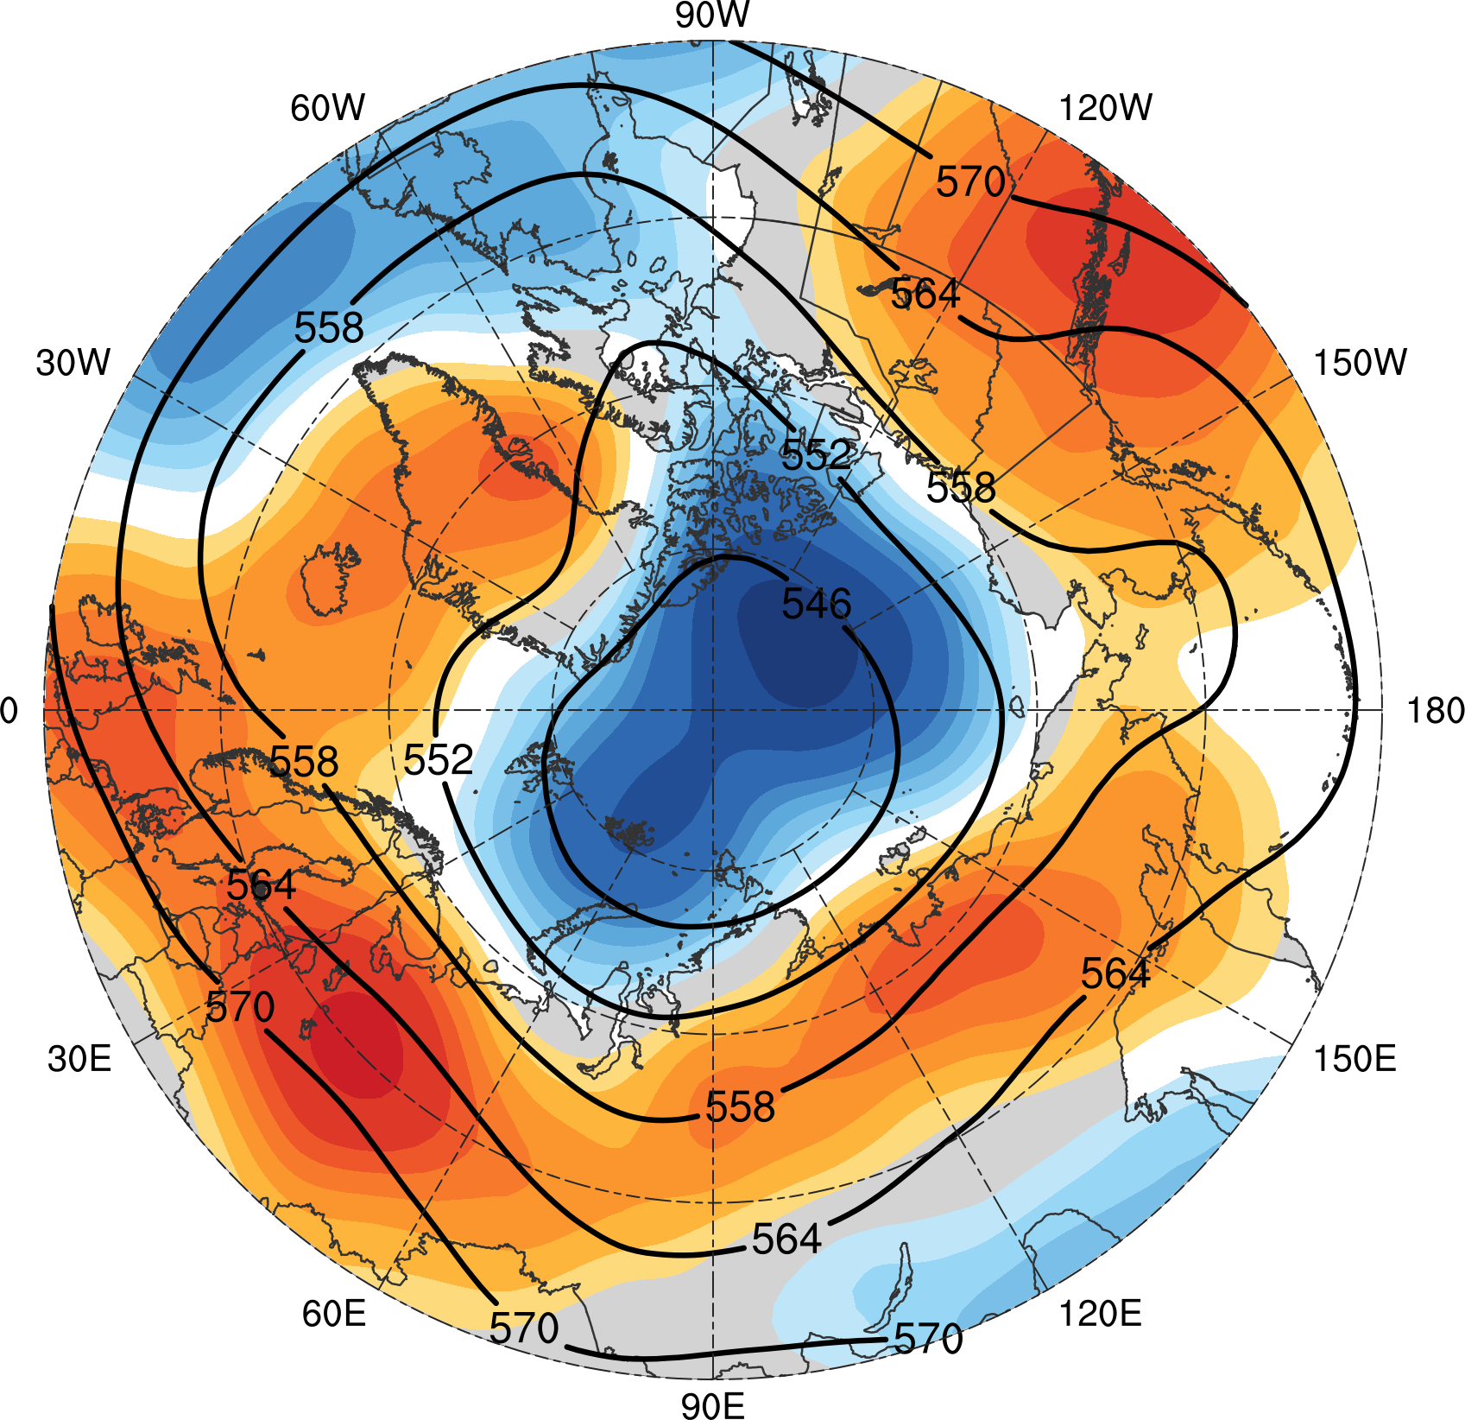
Arctic environment
Mean 500-hPa geopotential height during low-skill periods (every 6 dam)
Shading: Differences of mean 500-hPa geopotential height (dam) between low-skill periods and high-skill periods (low-skill periods minus high-skill periods)
−5
−4
−3
−2.5
−2
−1.5
−1
−0.5
0
0.5
1
1.5
2
2.5
3
4
5

Slide 37
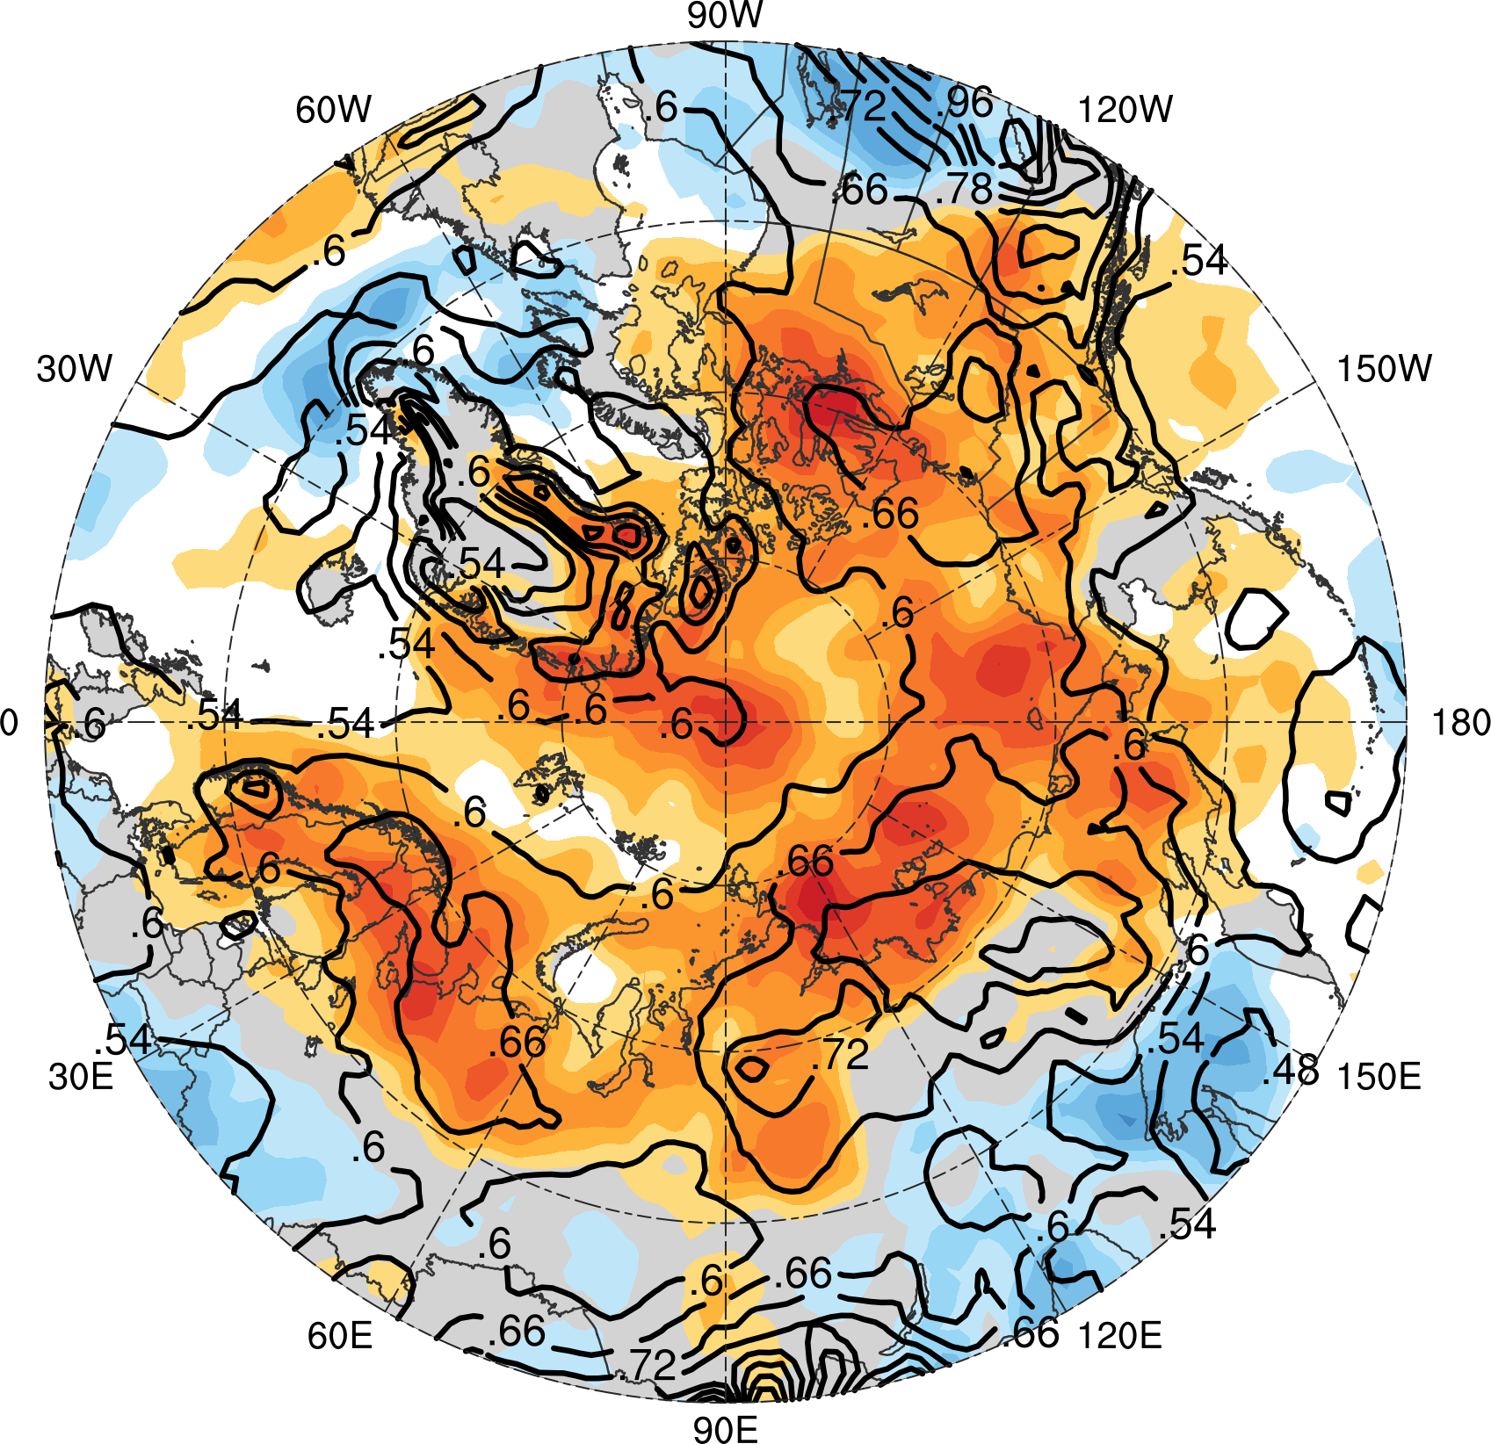
Arctic environment
Mean 850–600-hPa Eady growth rate during low-skill periods (every 0.06 day⁻¹)
Shading: Differences of mean 850–600-hPa Eady growth rate (day⁻¹) between low-skill periods and high-skill periods (low-skill periods minus high-skill periods)
−0.16
−0.14
−0.12
−0.10
−0.08
−0.06
−0.04
−0.02
0
0.02
0.04
0.06
0.08
0.10
0.12
0.14
0.16

Slide 38
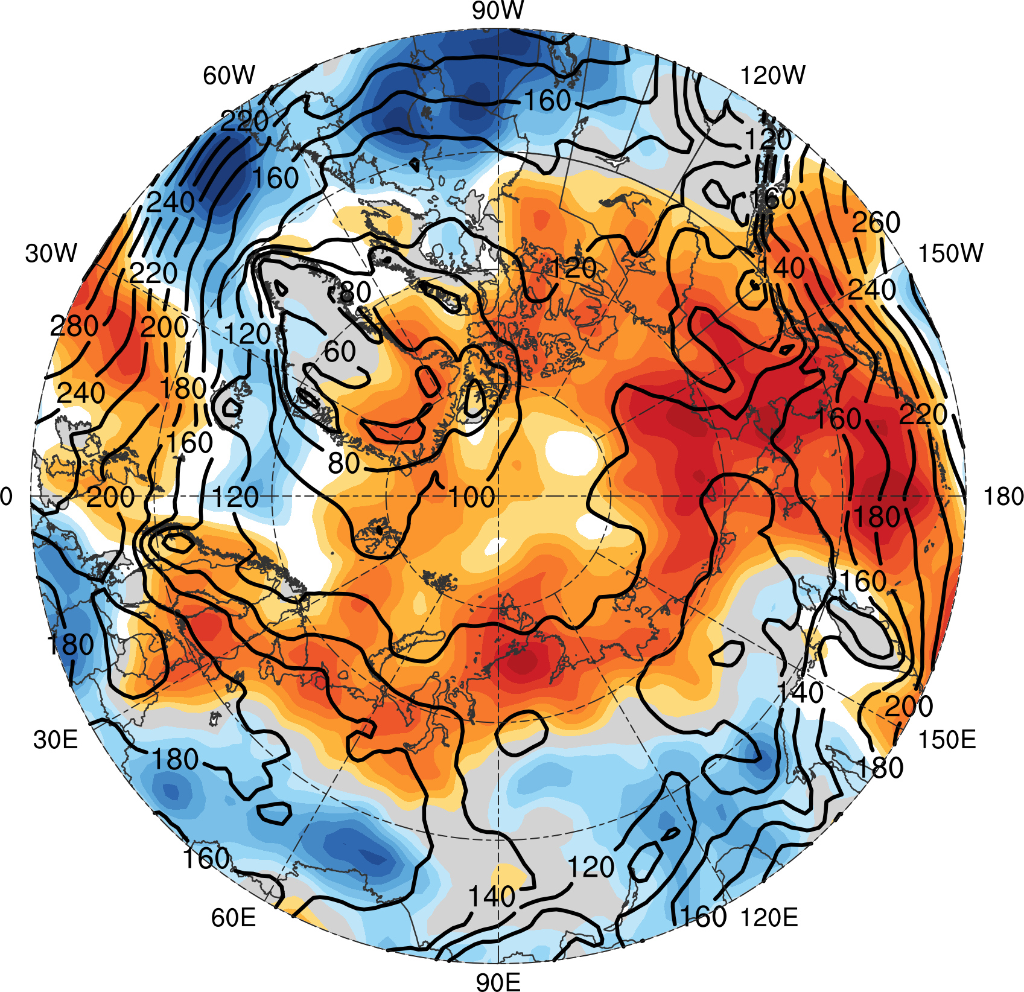
Arctic environment
Mean 1000–300-hPa IVT during low-skill periods (every 20 kg m⁻¹ s⁻¹)
Shading: Differences of mean 1000–300-hPa IVT (kg m⁻¹ s⁻¹) between low-skill periods and high-skill periods (low-skill periods minus high-skill periods)
−32
−28
−24
−20
−16
−12
−8
−4
0
4
8
12
16
20
24
28
32

Slide 39
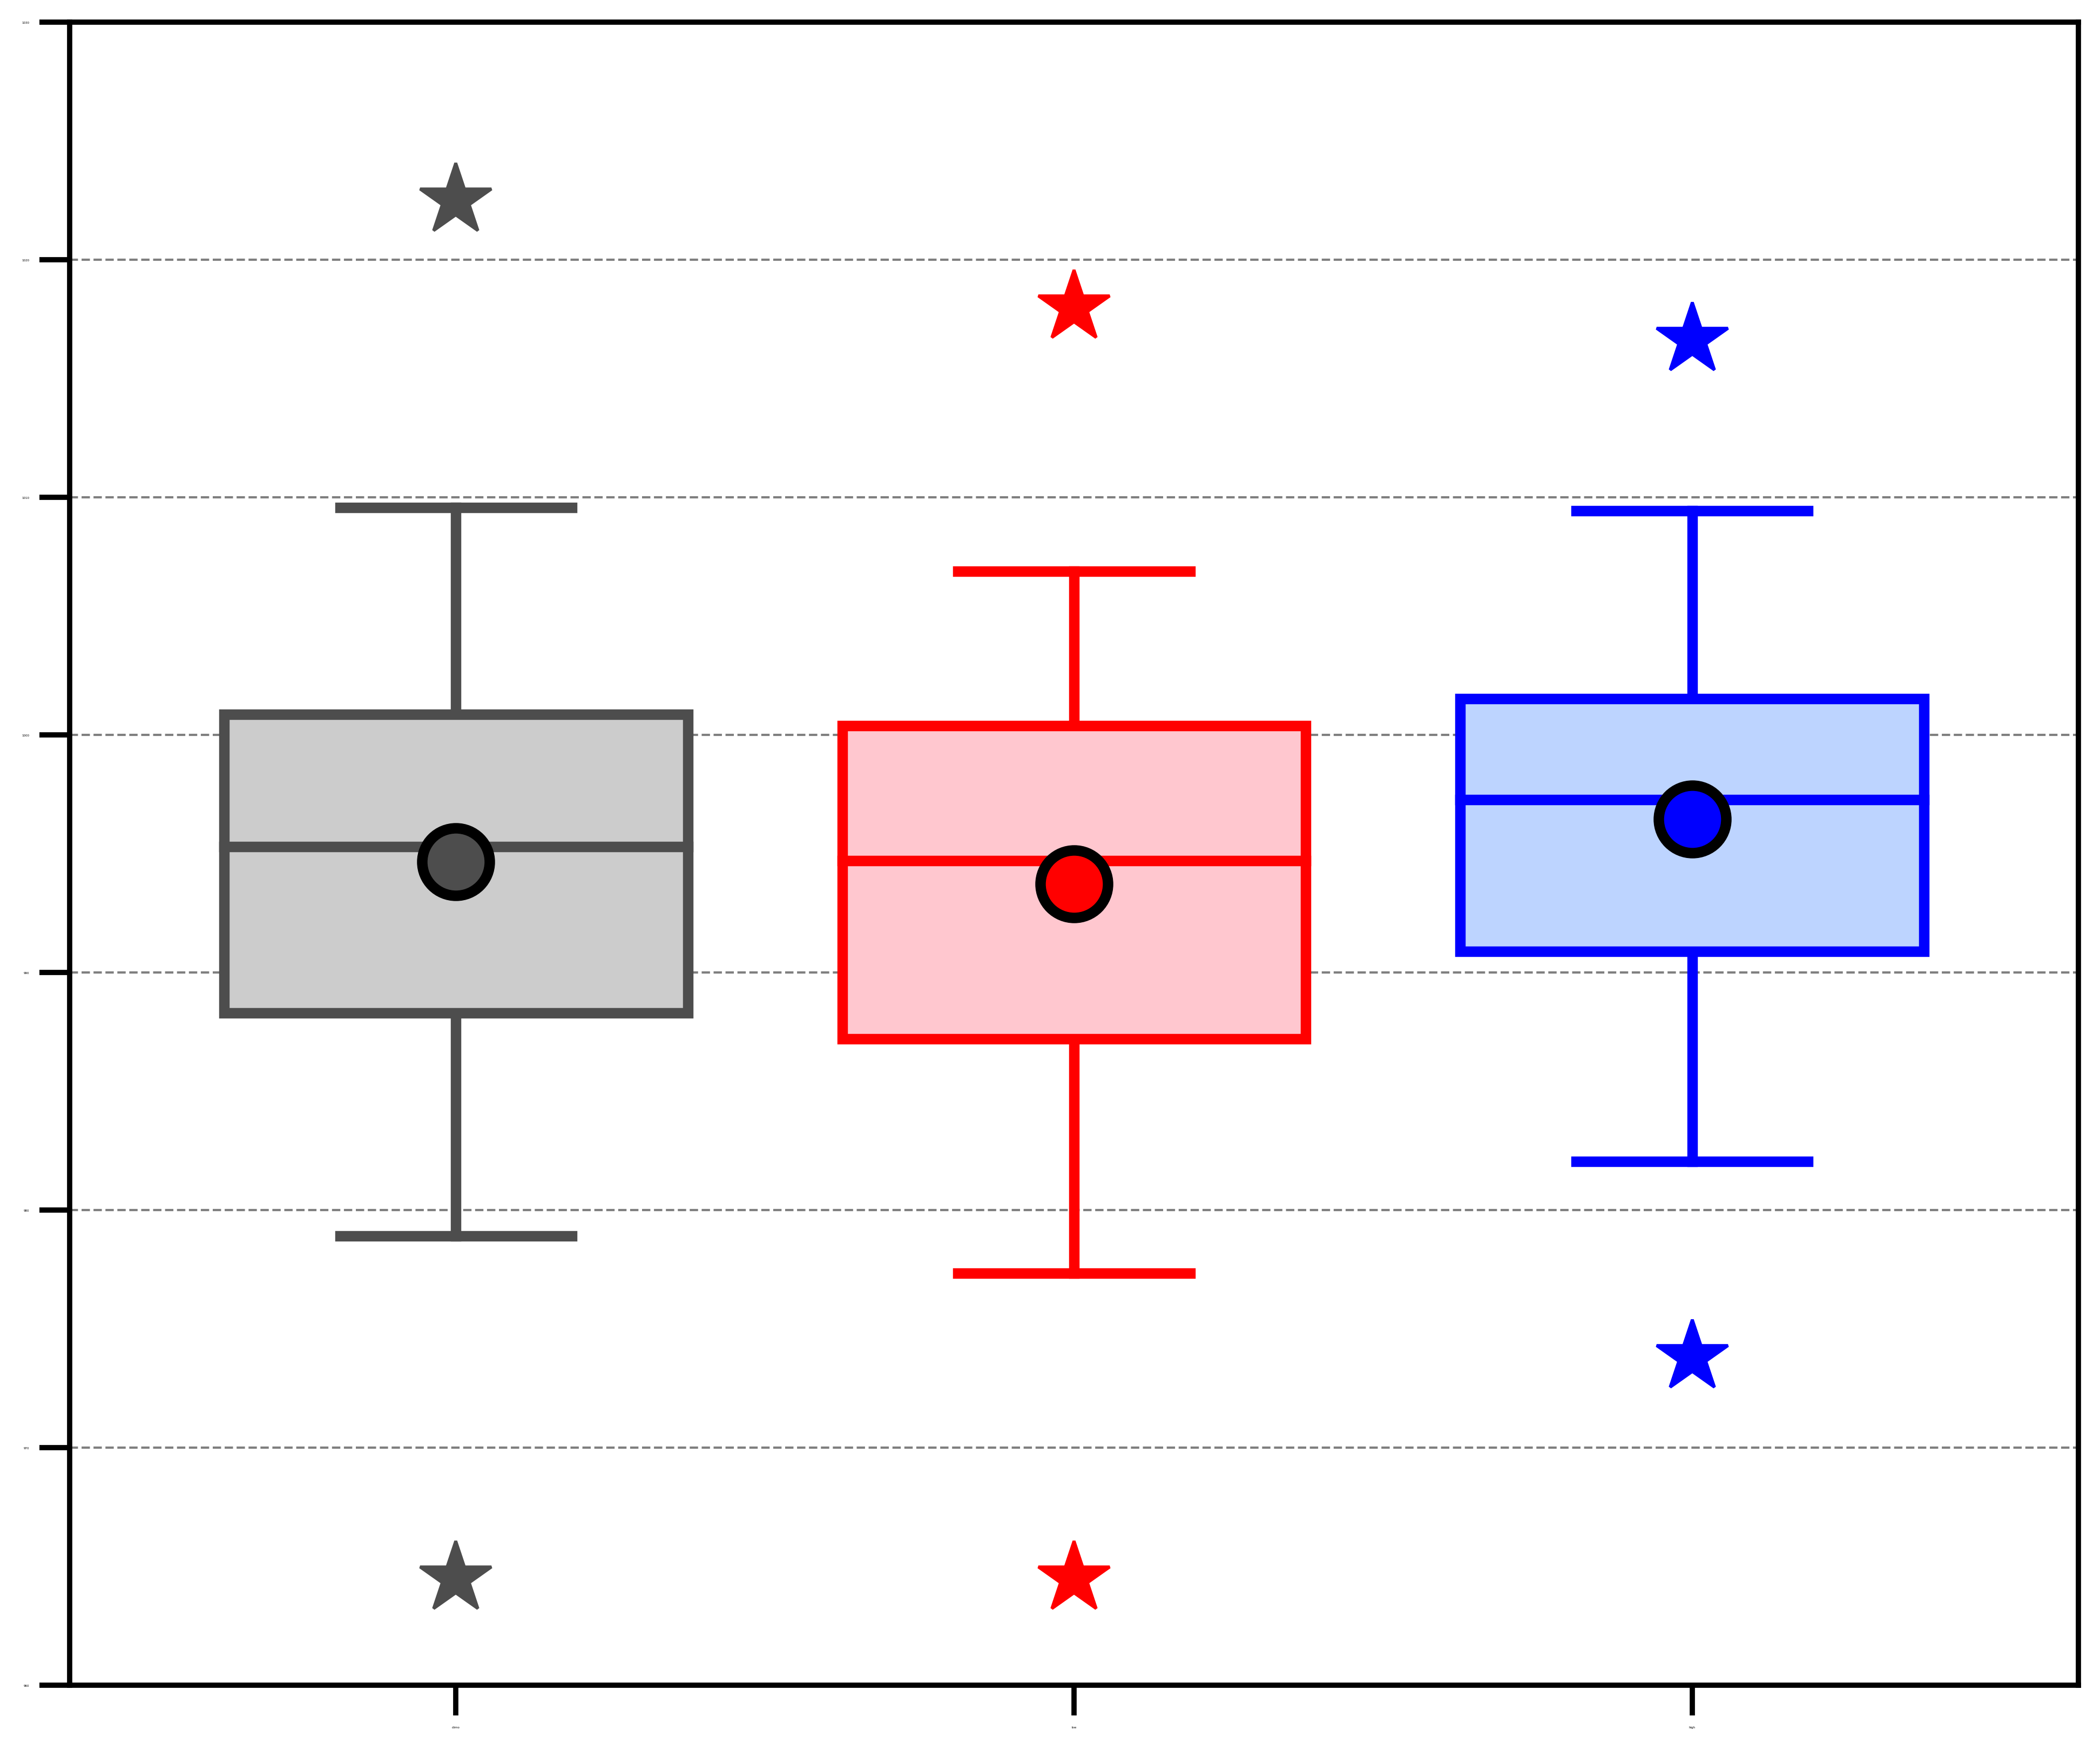
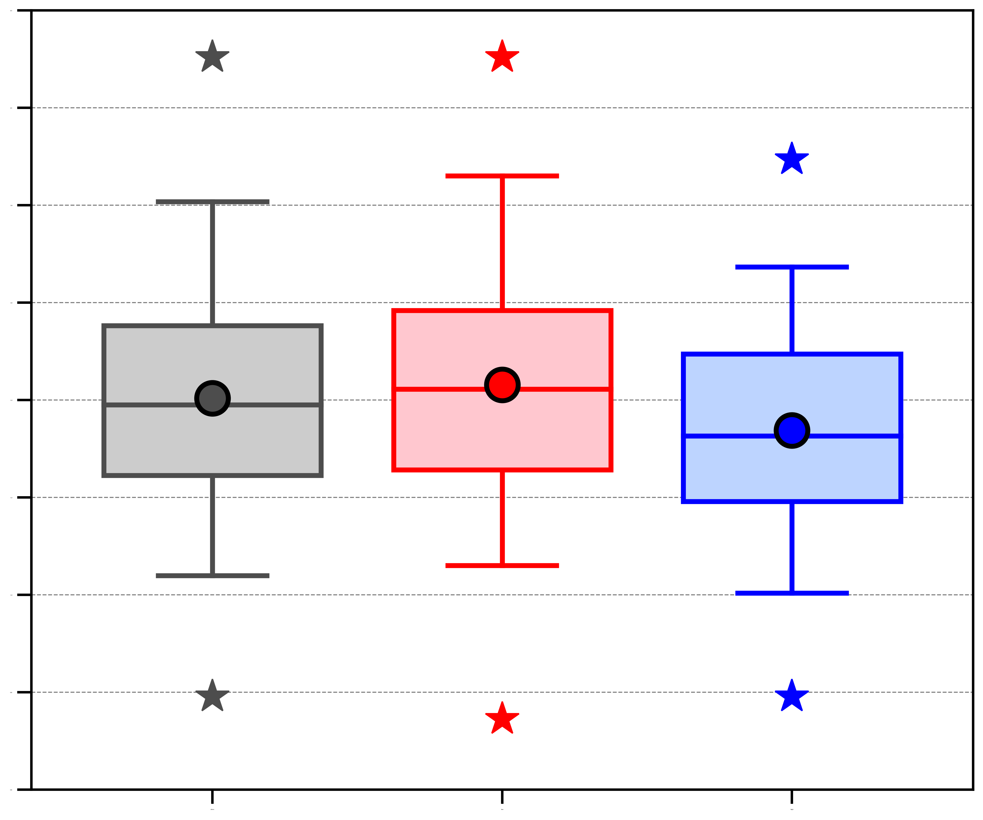
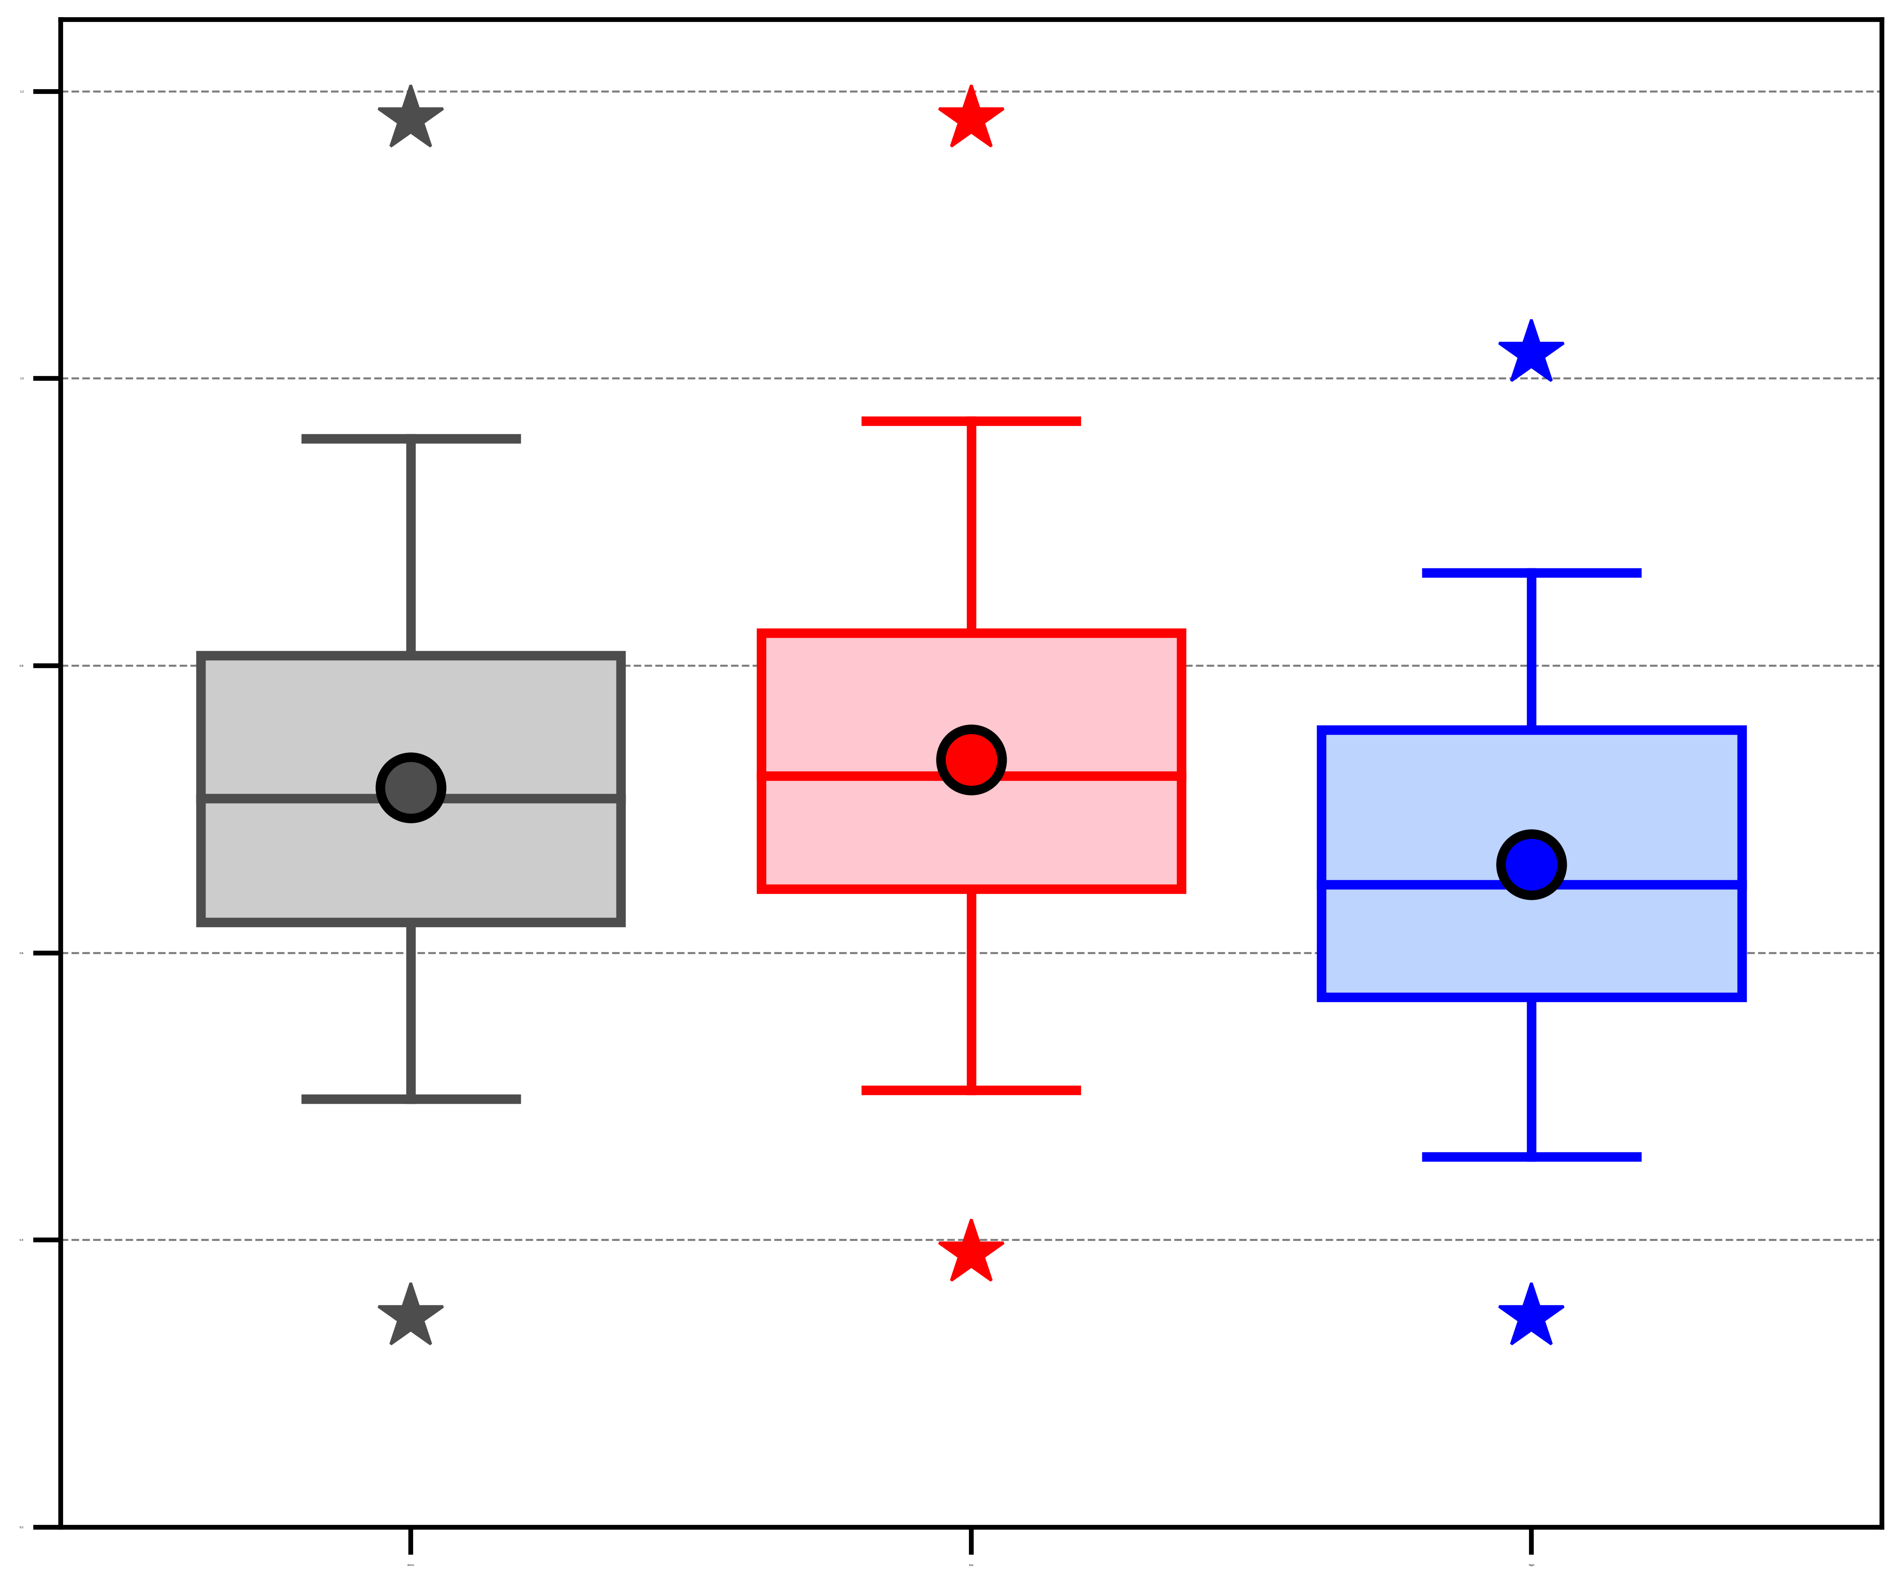
AC characteristics
(b) Area-averaged 850-hPa θ gradient magnitude [K (100 km)⁻¹]
(c) Area-averaged 850–600-hPa Eady growth rate (day⁻¹)
(a) Minimum SLP (hPa)
1030
2.2
1.2
1020
2.0
1010
1.8
1.0
1000
1.6
0.8
1.4
990
0.6
1.2
980
1.0
970
0.4
0.8
960
0.6
0.2
ACs during climatology (N = 730)
ACs during low-skill periods (N = 298)
ACs during high-skill periods (N = 208)
Distribution of most extreme value of quantities characterizing ACs when the ACs are located in the Arctic during the various periods.
95%
75%
Mean
Statistically significant difference with respect to climatology at 95% confidence level
Statistically significant difference between ACs during low-skill periods and ACs during high-skill periods at 95% confidence level
Median
Min/
Max
25%
5%

Slide 40
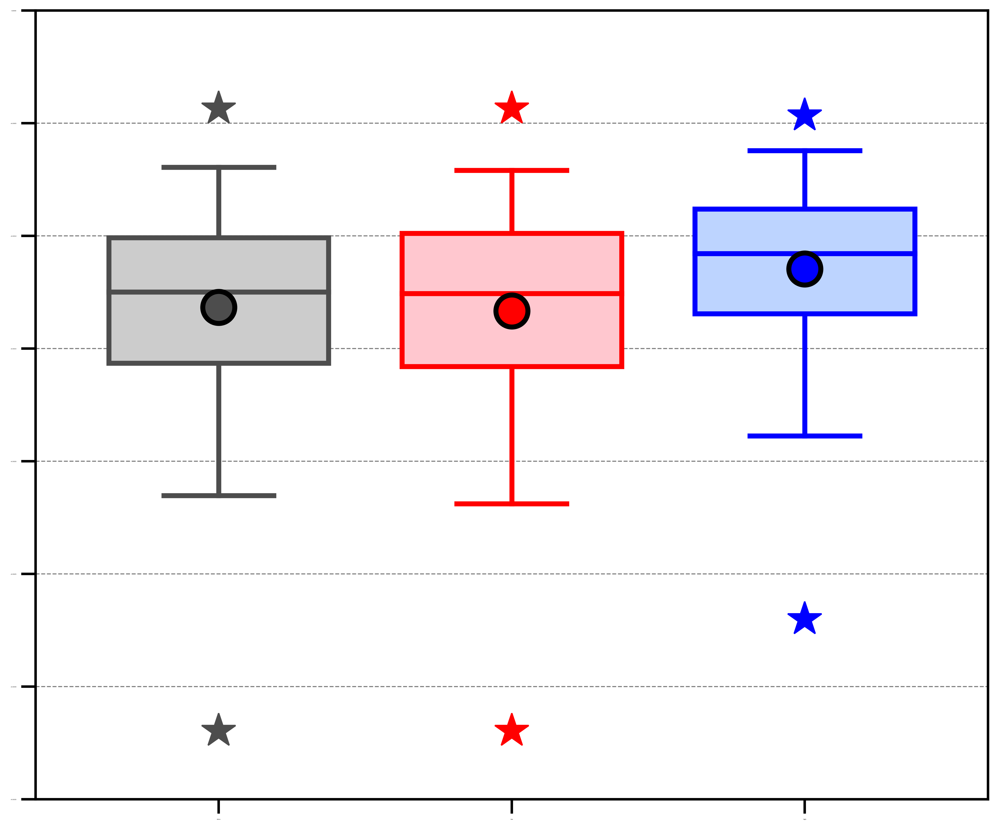
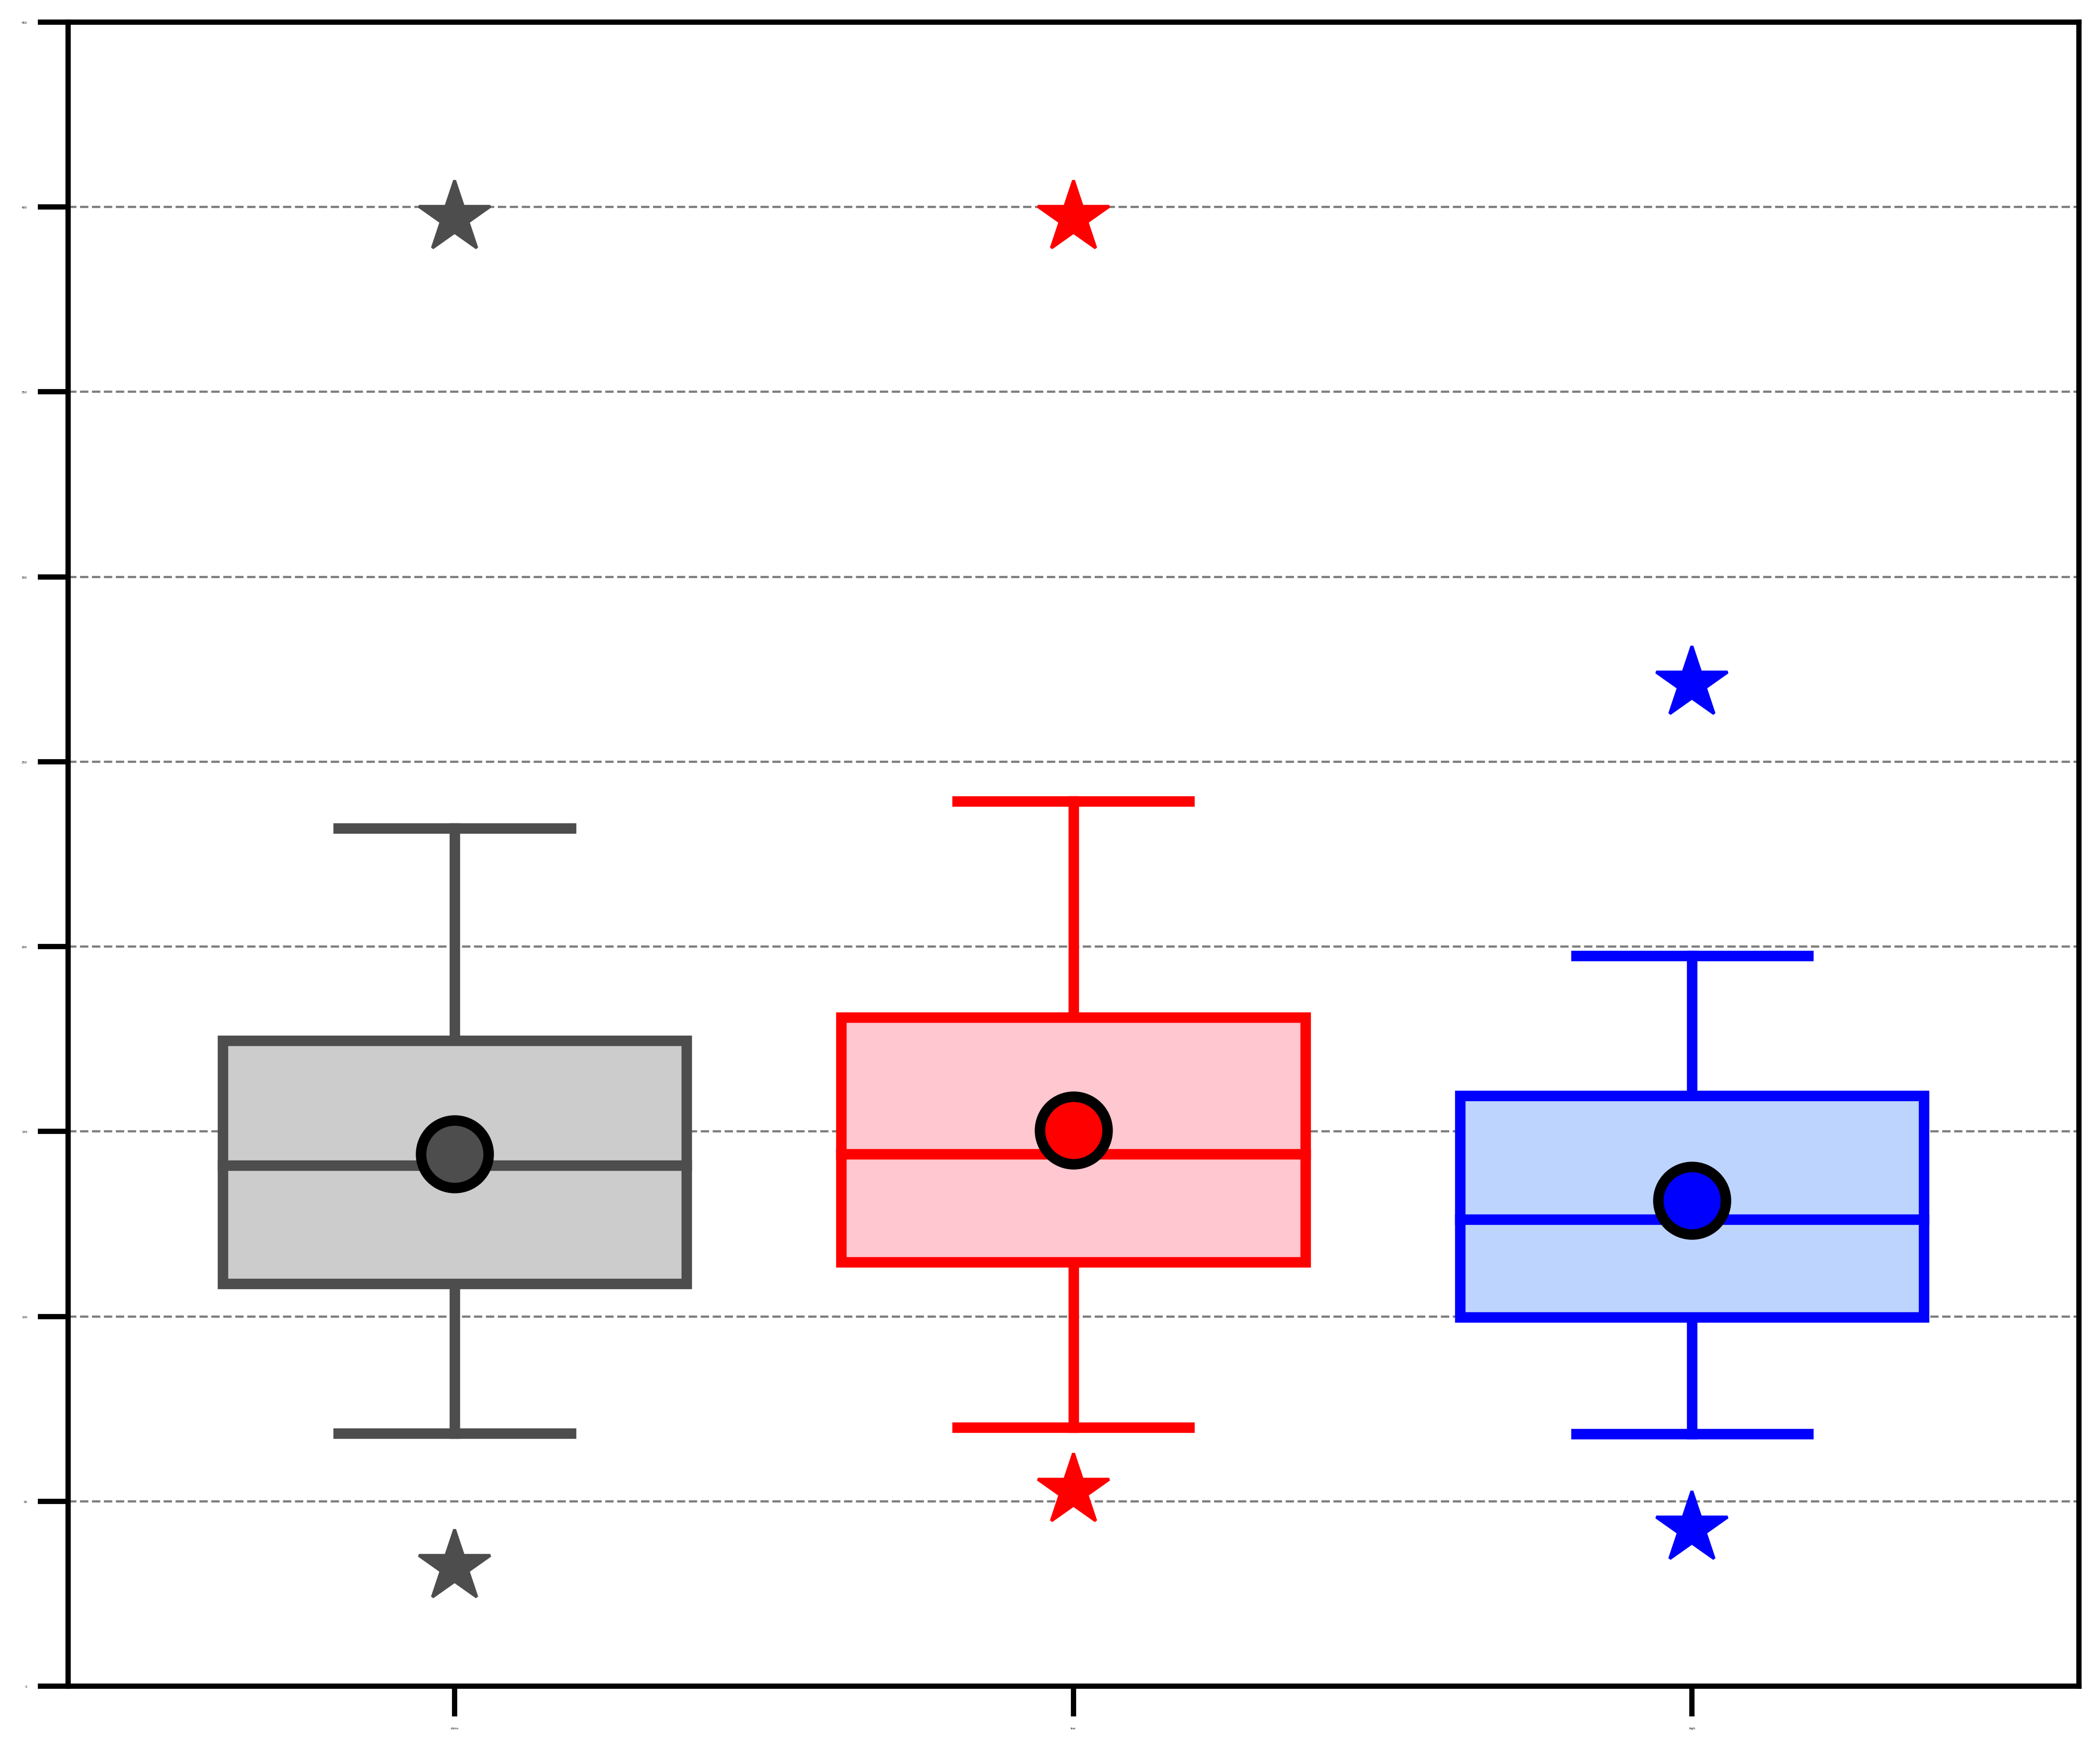
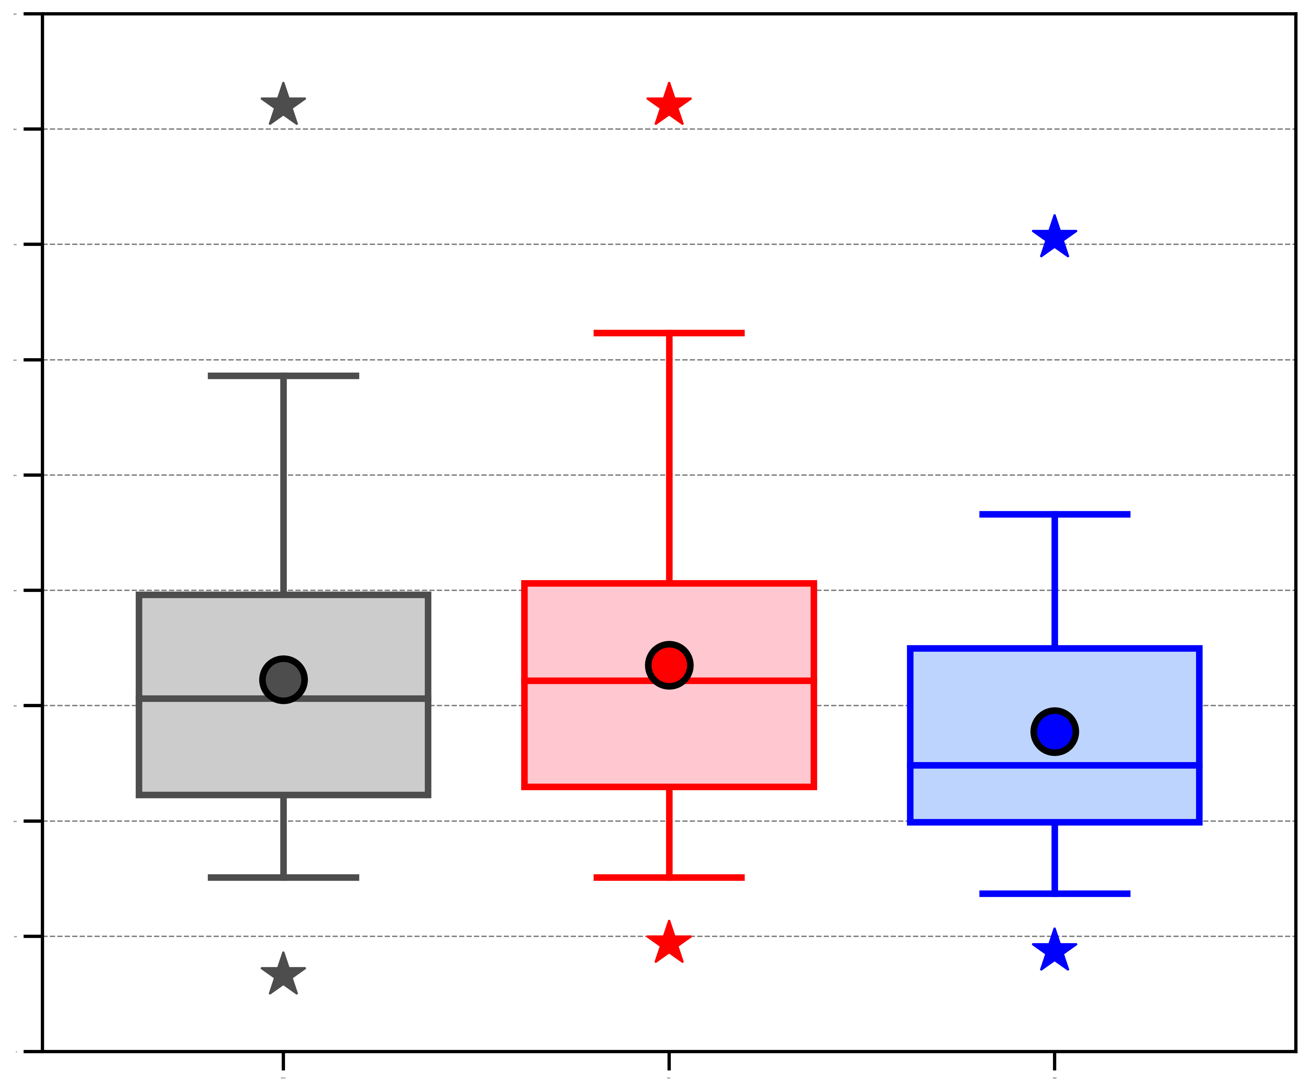
AC characteristics
(a) Area-averaged negative values of 800–600-hPa ω (10⁻³ hPa s⁻¹)
(b) Area-averaged 1000–300-hPa IVT (kg m⁻¹ s⁻¹)
(c) Area-averaged positive values of 1000–300-hPa IMFC (W m⁻²)
0.0
450
900
−0.5
400
800
350
700
−1.0
300
600
−1.5
250
500
−2.0
200
400
−2.5
150
300
100
200
−3.0
50
100
−3.5
0
0
ACs during climatology (N = 730)
ACs during low-skill periods (N = 298)
ACs during high-skill periods (N = 208)
Distribution of most extreme value of quantities characterizing ACs when the ACs are located in the Arctic during the various periods.
95%
75%
Mean
Statistically significant difference with respect to climatology at 95% confidence level
Statistically significant difference between ACs during low-skill periods and ACs during high-skill periods at 95% confidence level
Median
Min/
Max
25%
5%

Slide 41
Hypotheses
Low-skill ACs during low-skill periods tend to be stronger and tend to be embedded in more favorable dynamic and thermodynamic environments for development and intensification compared to high-skill ACs during low-skill periods. Similarly, low-skill ACs during high-skill periods tend to be stronger and tend to be embedded in more favorable dynamic and thermodynamic environments for development and intensification compared to high-skill ACs during high-skill periods.

Slide 42
Forecast skill evaluation of ACs
Track ACs during low-skill periods and high-skill periods (hereafter analysis ACs) in forecasts from NOAA GEFS reforecast dataset version 2 by utilizing an objective sea level pressure (SLP)-based tracking algorithm developed by Crawford et al. 2020.
Consider forecasts initialized 5 days prior to the time of lowest SLP of the analysis ACs when located in the Arctic during low-skill periods and high-skill periods (verification time).
Adapt methodology of Korfe and Colle (2018) to match ACs in ensemble forecasts to analysis ACs.

Slide 43
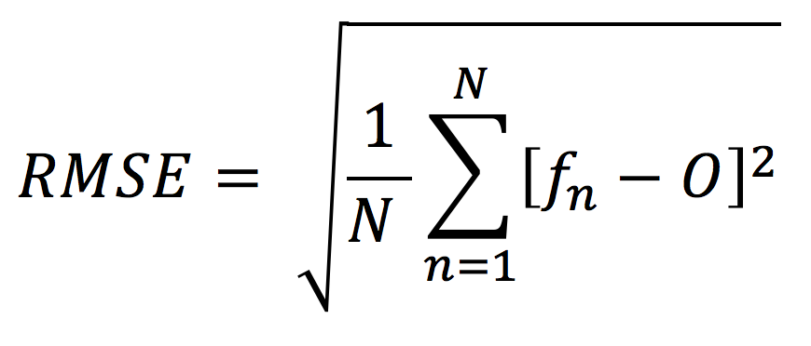
Forecast skill evaluation of ACs
Determine 5-day intensity RMSE at the verification time using the equation below, considering only analysis ACs for which there are ≥ 5 ensemble members with a matching forecast AC.
Refer to ACs associated with the top 25% of 5-day intensity RMSE for low-skill periods and high-skill periods as low-skill ACs for these respective periods
Refer to ACs associated with the bottom 25% of 5-day intensity RMSE for low-skill periods and high-skill periods as high-skill ACs for these respective periods
N = Number of matching forecast ACs
f_{n} = Min SLP from n^{th} matching forecast AC
O = Min SLP from analysis AC

Slide 44
Forecast skill evaluation of ACs
The following four skill categories of ACs are examined:
  Low-skill ACs during low-skill periods.
  High-skill ACs during low-skill periods.
  Low-skill ACs during high-skill periods.
  High-skill ACs during high-skill periods.

Slide 45
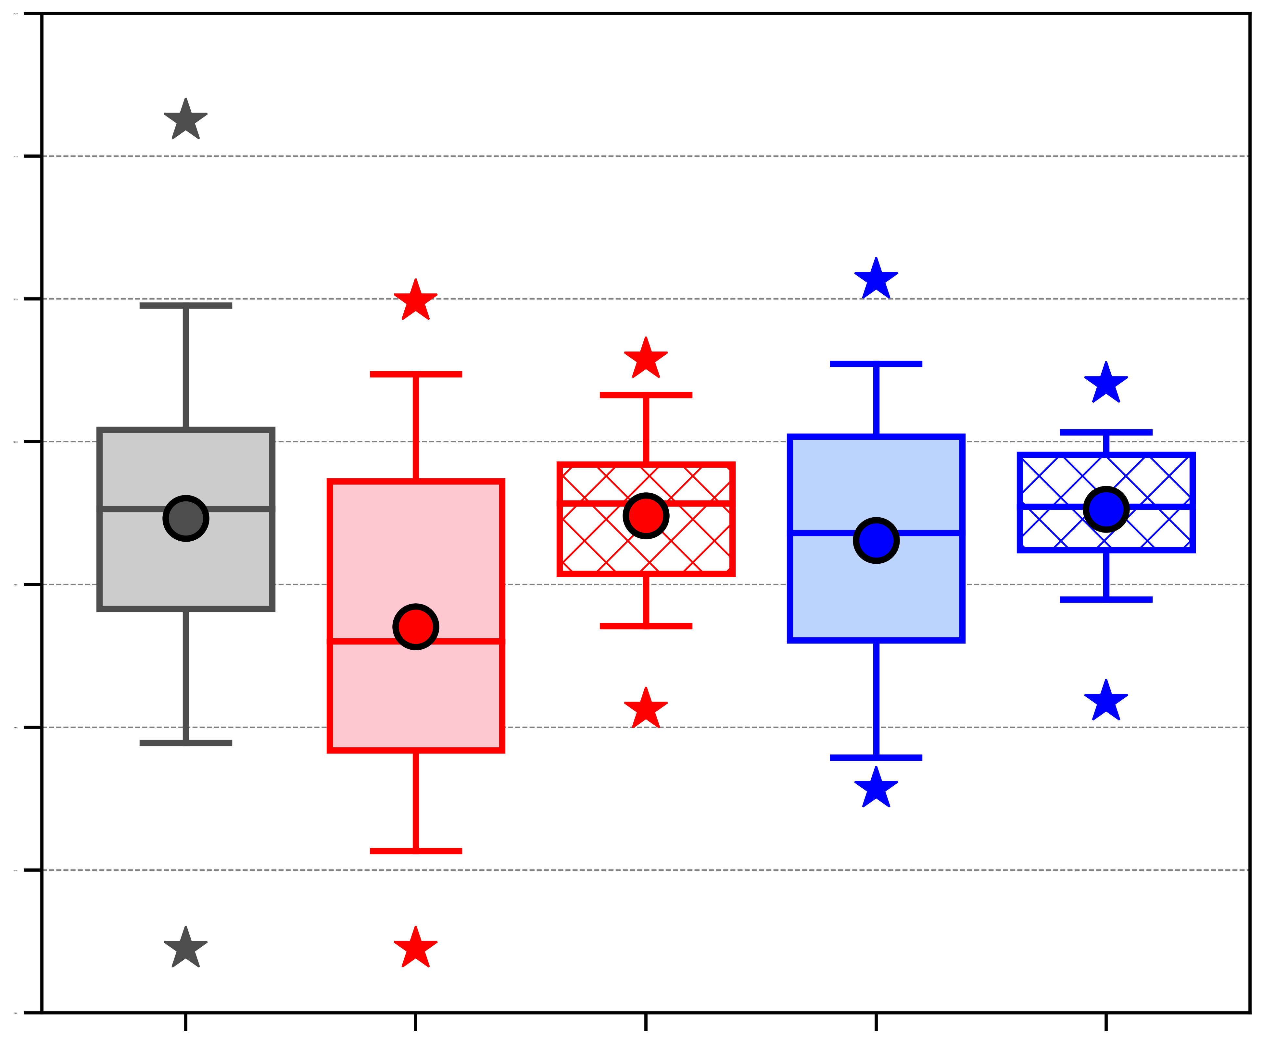
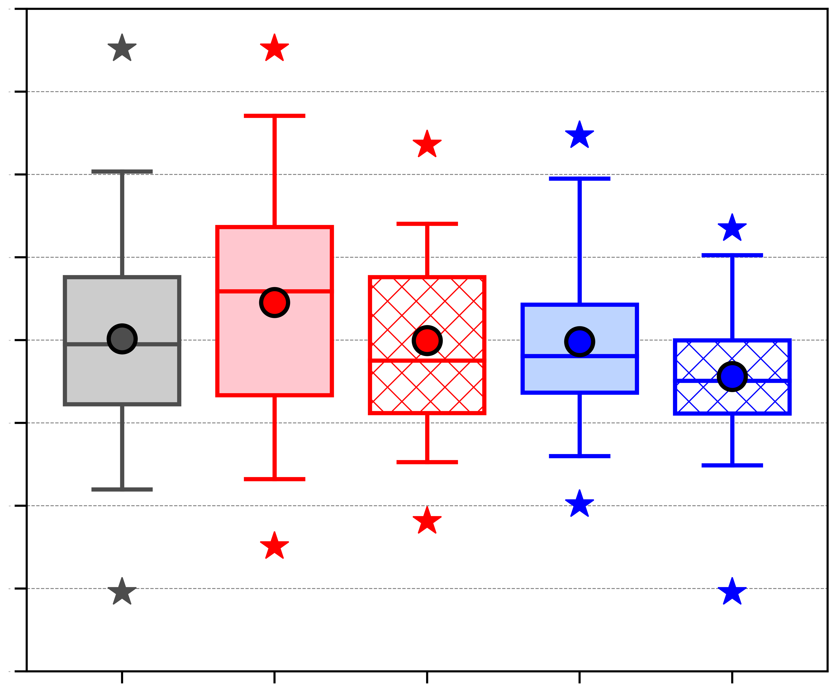
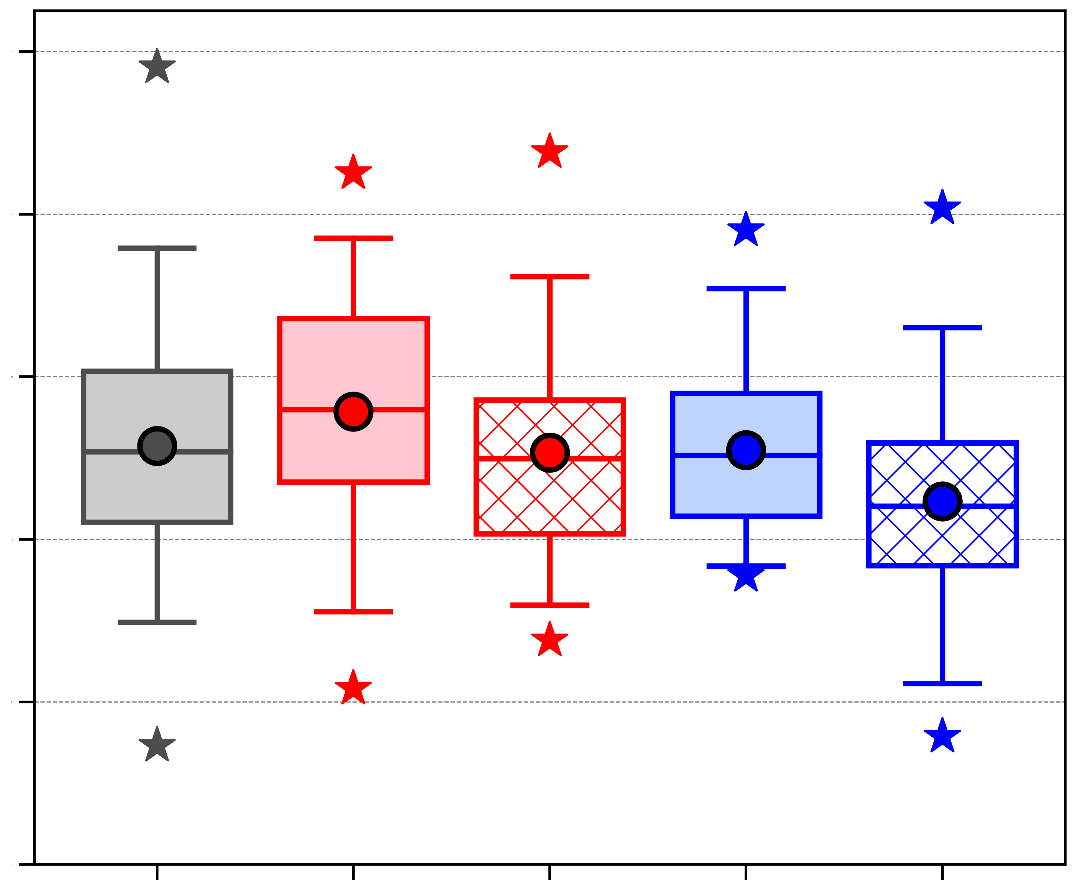
AC characteristics
(b) Area-averaged 850-hPa θ gradient magnitude [K (100 km)⁻¹]
(c) Area-averaged 850–600-hPa Eady growth rate (day⁻¹)
(a) Minimum SLP (hPa)
1030
2.2
1.2
1020
2.0
1010
1.8
1.0
1000
1.6
0.8
1.4
990
0.6
1.2
980
1.0
970
0.4
0.8
960
0.6
0.2
ACs during climatology (N = 730)
Low-skill ACs during low-skill periods (N = 51)
High-skill ACs during low-skill periods (N = 51)
Low-skill ACs during high-skill periods (N = 35)
High-skill ACs during high-skill periods (N = 35)
Distribution of most extreme value of quantities characterizing ACs when the ACs are located in the Arctic during the various periods.
95%
Statistically significant difference between low-skill ACs during low-skill periods and high-skill ACs during low-skill periods at 95% confidence level
Statistically significant difference between low-skill ACs during high-skill periods and high-skill ACs during high-skill periods at 95% confidence level
75%
Mean
Statistically significant difference with respect to climatology at 95% confidence level
Median
Min/
Max
25%
5%

Slide 46
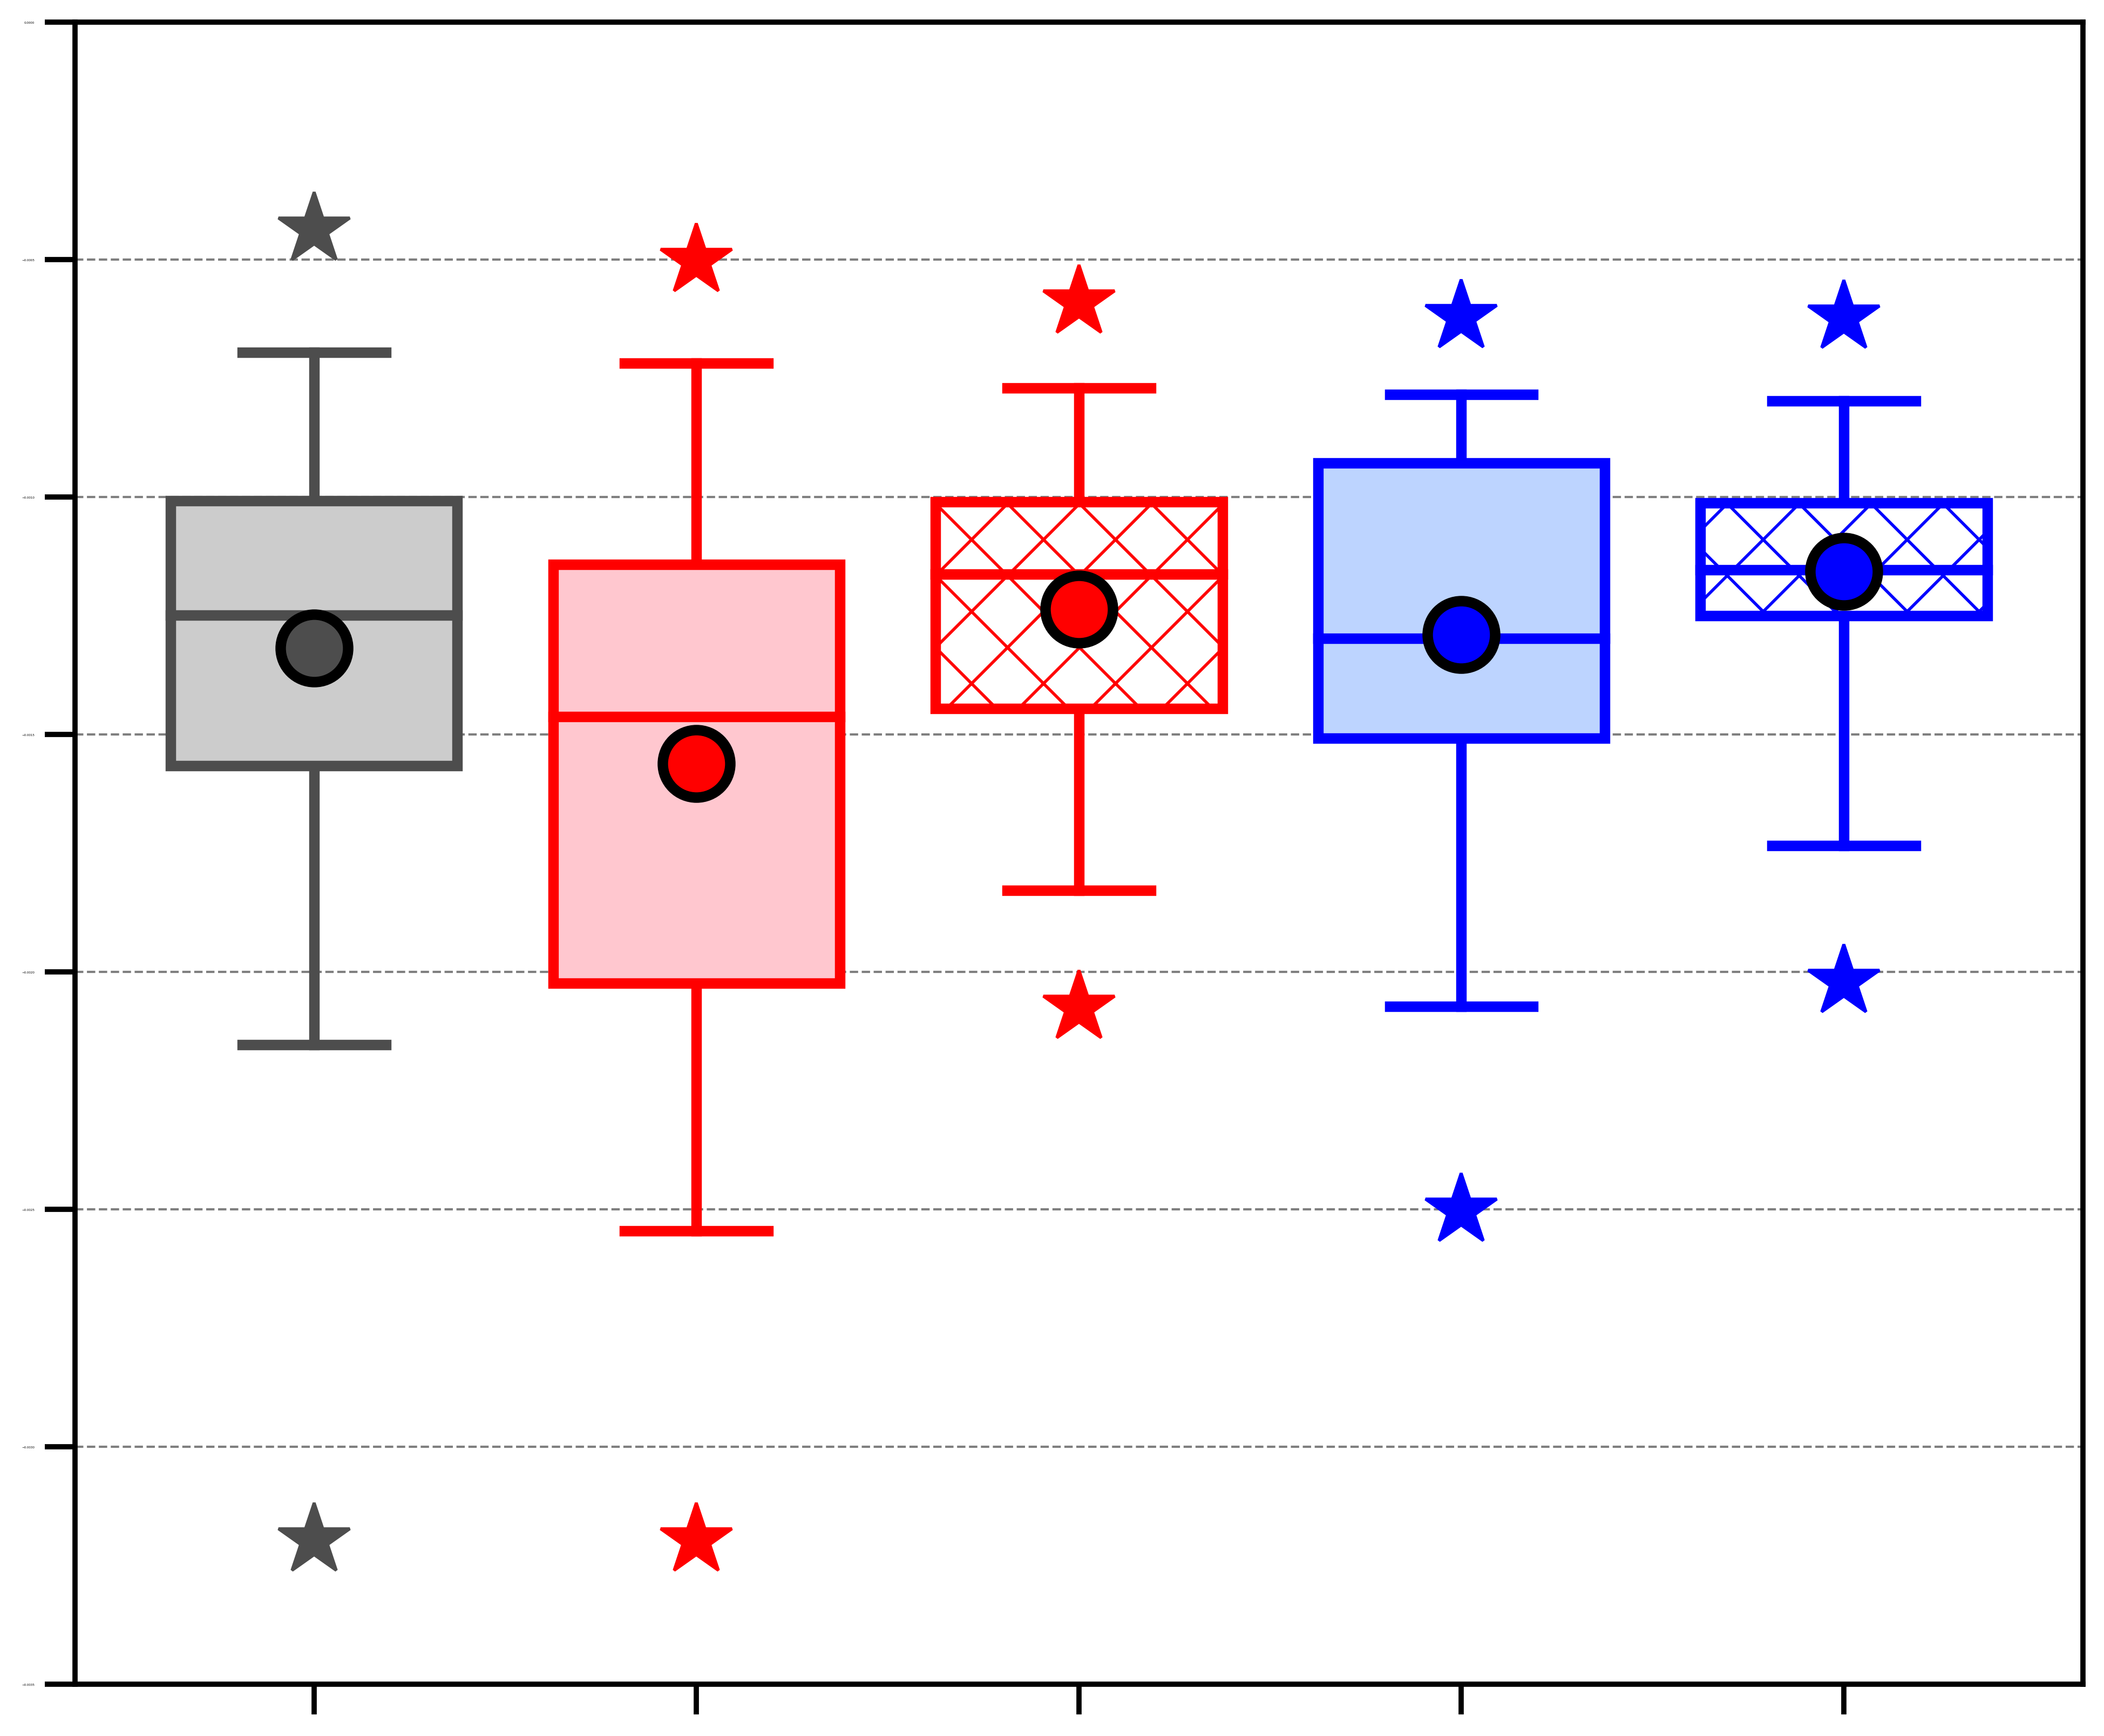
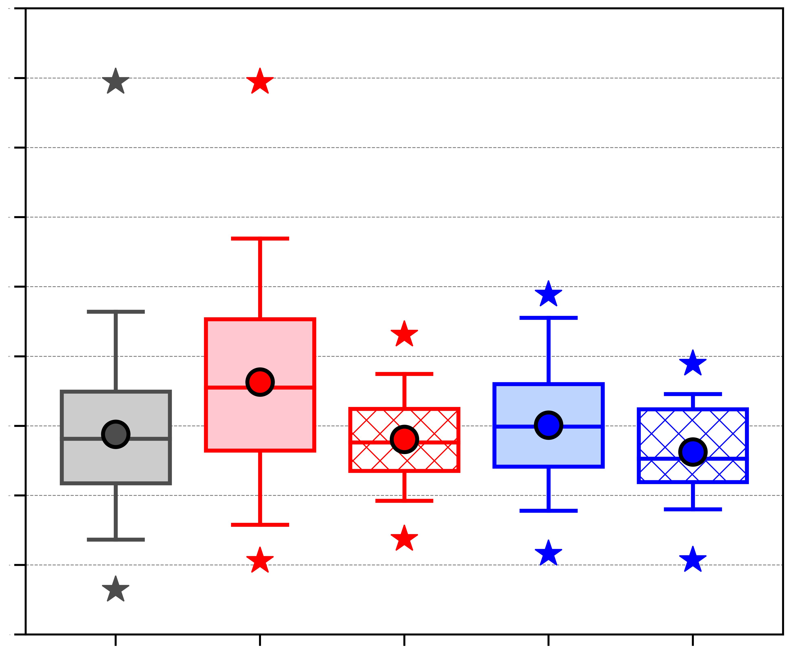
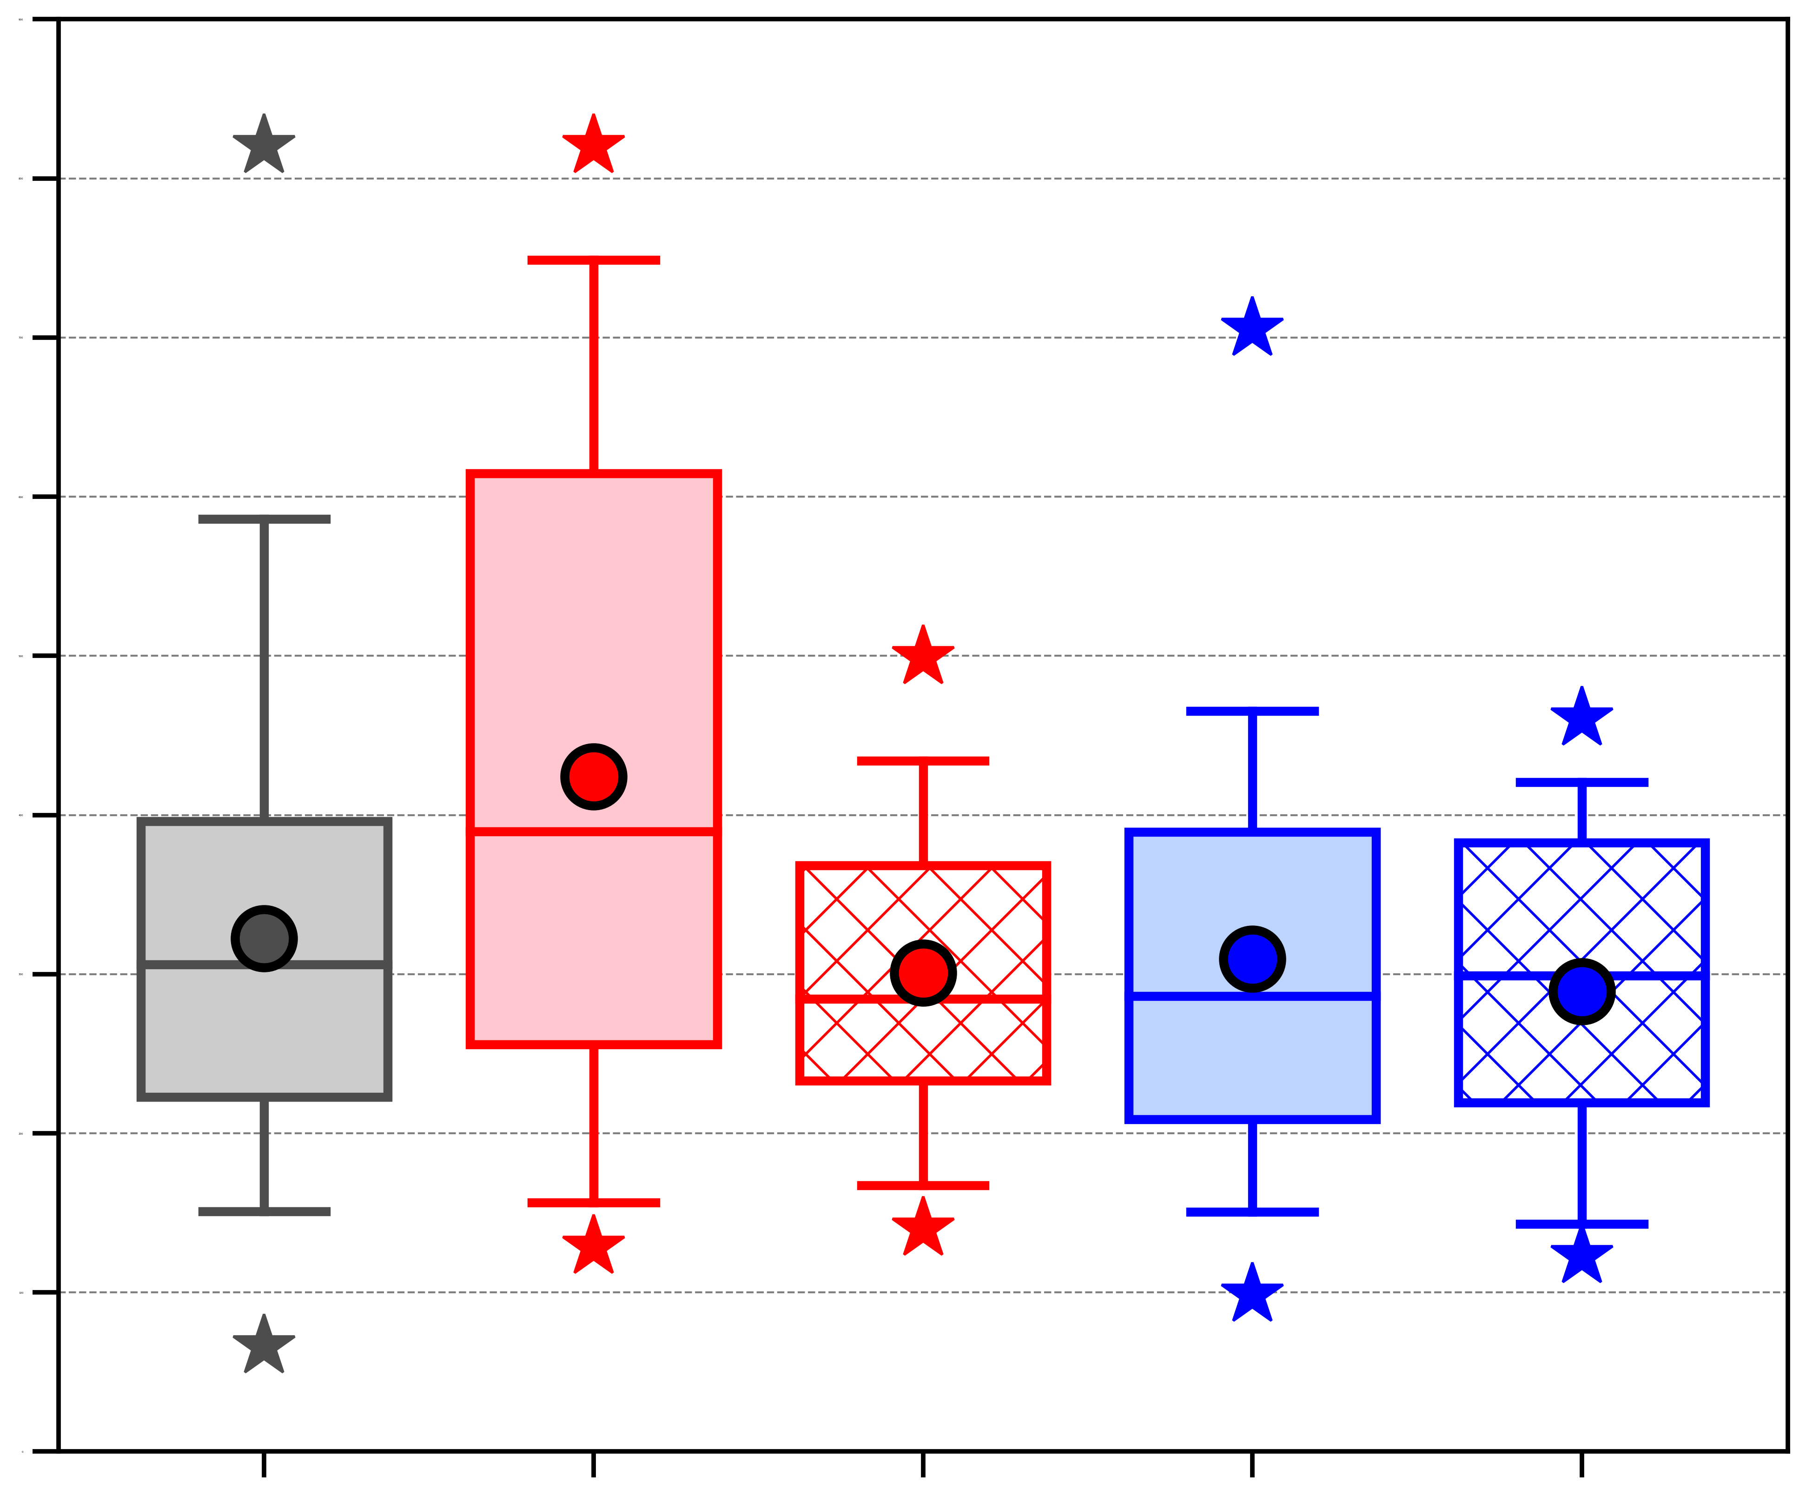
AC characteristics
(a) Area-averaged negative values of 800–600-hPa ω (10⁻³ hPa s⁻¹)
(b) Area-averaged 1000–300-hPa IVT (kg m⁻¹ s⁻¹)
(c) Area-averaged positive values of 1000–300-hPa IMFC (W m⁻²)
0.0
450
900
−0.5
400
800
350
700
−1.0
300
600
−1.5
250
500
−2.0
200
400
−2.5
150
300
100
200
−3.0
50
100
−3.5
0
0
ACs during climatology (N = 730)
Low-skill ACs during low-skill periods (N = 51)
High-skill ACs during low-skill periods (N = 51)
Low-skill ACs during high-skill periods (N = 35)
High-skill ACs during high-skill periods (N = 35)
Distribution of most extreme value of quantities characterizing ACs when the ACs are located in the Arctic during the various periods.
95%
Statistically significant difference between low-skill ACs during low-skill periods and high-skill ACs during low-skill periods at 95% confidence level
Statistically significant difference between low-skill ACs during high-skill periods and high-skill ACs during high-skill periods at 95% confidence level
75%
Mean
Statistically significant difference with respect to climatology at 95% confidence level
Median
Min/
Max
25%
5%

Slide 47
Hypotheses
TPVs, baroclinic zones, and WCBs, and TPV–AC interactions, baroclinic processes, and latent heating, influence the evolution of strong low-skill ACs during low-skill periods and strong high-skill ACs during low-skill periods, although these features and processes tend to be more robust for strong low-skill ACs during low-skill periods.

Slide 48
AC-centered composites
Determine top 25% strongest low-skill ACs during low-skill periods based on the lowest SLP attained by these ACs when located in the Arctic (> 70°N) during low-skill periods.
  These ACs are hereafter referred to as strong low-skill ACs
Track strong low-skill ACs using ERA5 (Hersbach et al. 2020) at 0.25° horizontal resolution, every 6h.
Construct AC-centered composites for strong low-skill ACs at various lag times relative to the time of lowest SLP of these ACs when located in the Arctic (t_{low}).
Focus on lag times of t_{low}−48 h to t_{low}+12 h, every 12 h, to examine the evolution of the strong low-skill ACs when these ACs intensify and reach peak intensity.

Slide 49
AC-centered composites
For each lag time:
  Determine the mean latitude and longitude of ACs.
  Rotate each ERA5 grid such that the AC center is located at 0°E.
  Project each ERA5 grid onto a 25-km polar Equal-Area Scalable Earth 2.0 (EASE2) grid, where 0°E corresponds to y-axis of EASE2 grid.
  Shift each EASE2 grid north or south along the y-axis to grid point closest to the mean latitude of ACs.
  Project each shifted EASE2 grid onto a 0.25° latitude–longitude grid and then rotate such that AC center is located at mean longitude of ACs.

Slide 50
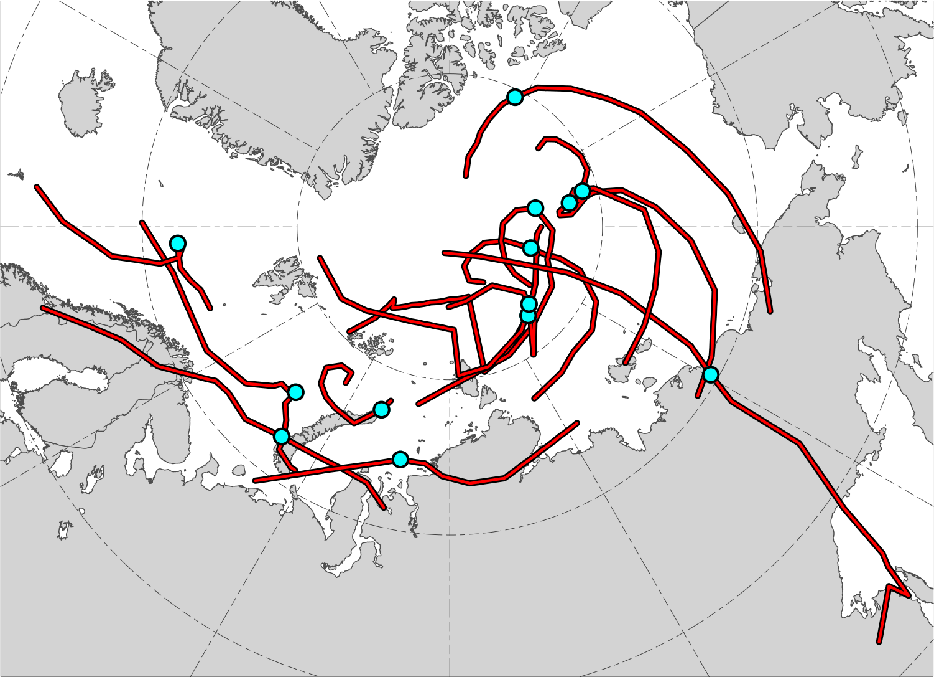
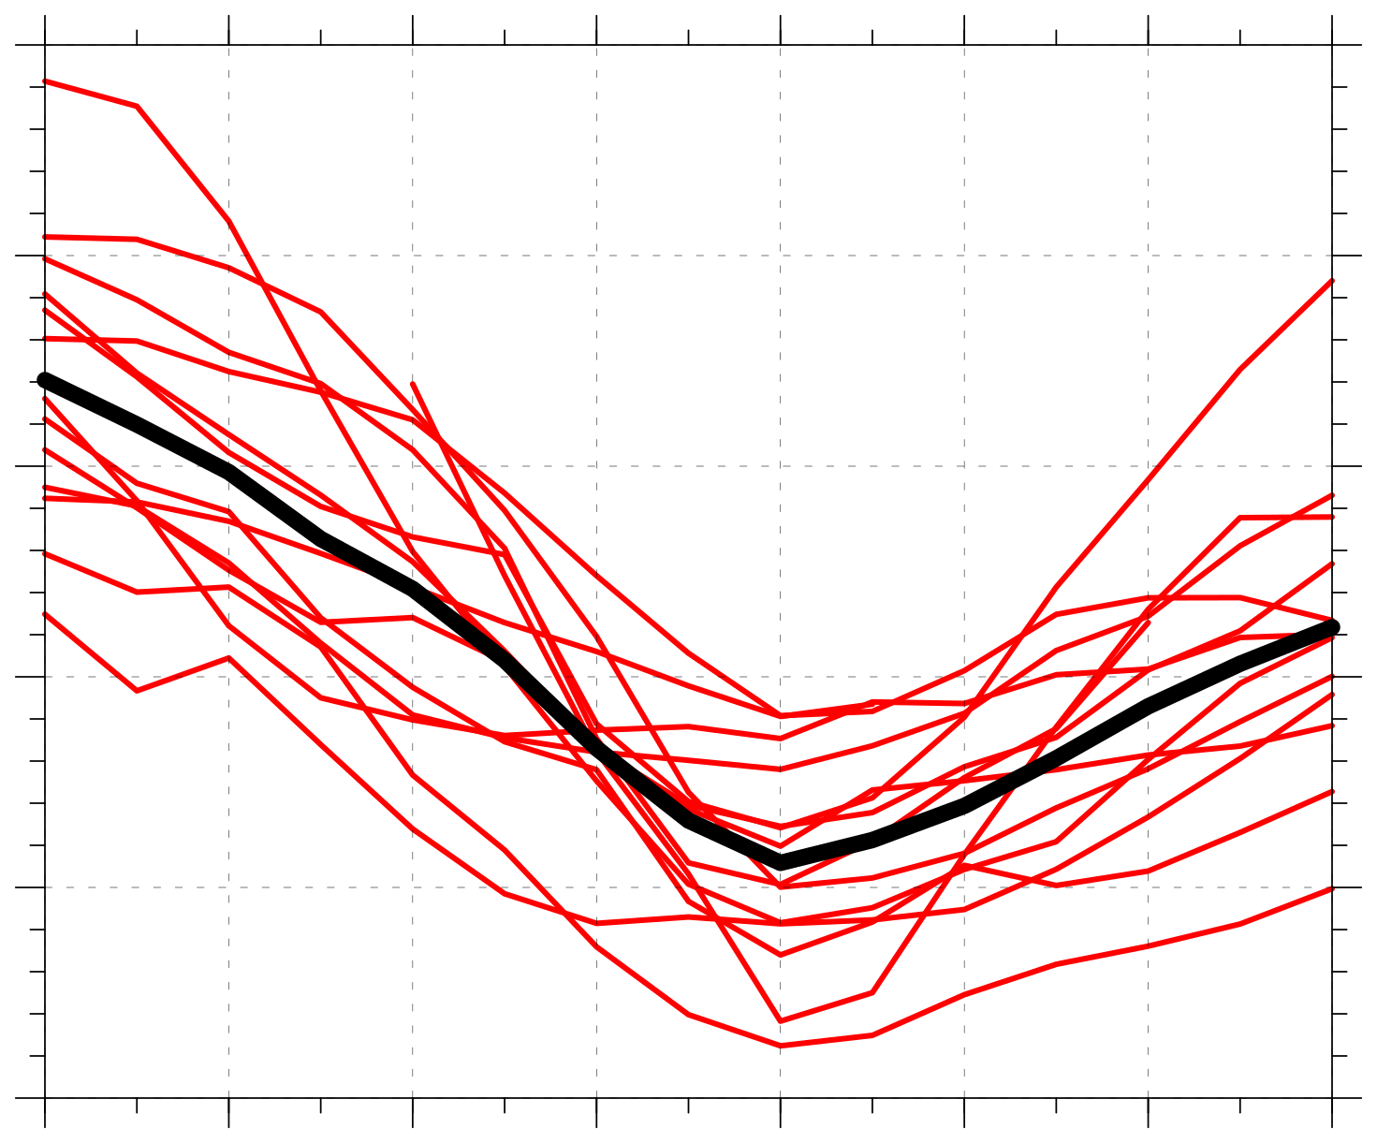
Strong low-skill ACs
N = 13
1010
N = 13
1000
990
Minimum SLP (hPa)
980
970
960
AC location at earliest valid lag hour
−48
−36
−24
−12
0
12
24
36
Lag hour relative to t_{low}
AC location at t_{low} (time of lowest SLP of AC when in Arctic)
Time series of minimum SLP (hPa) of ACs (red) and of mean minimum SLP (hPa) of ACs (black) during lag hours of –48 to +36 h, every 6 h, relative to t_{low}, when valid
Red lines show tracks of ACs during lag hours of –48 to +36 h, every 6 h, relative to t_{low}, when valid

Slide 51
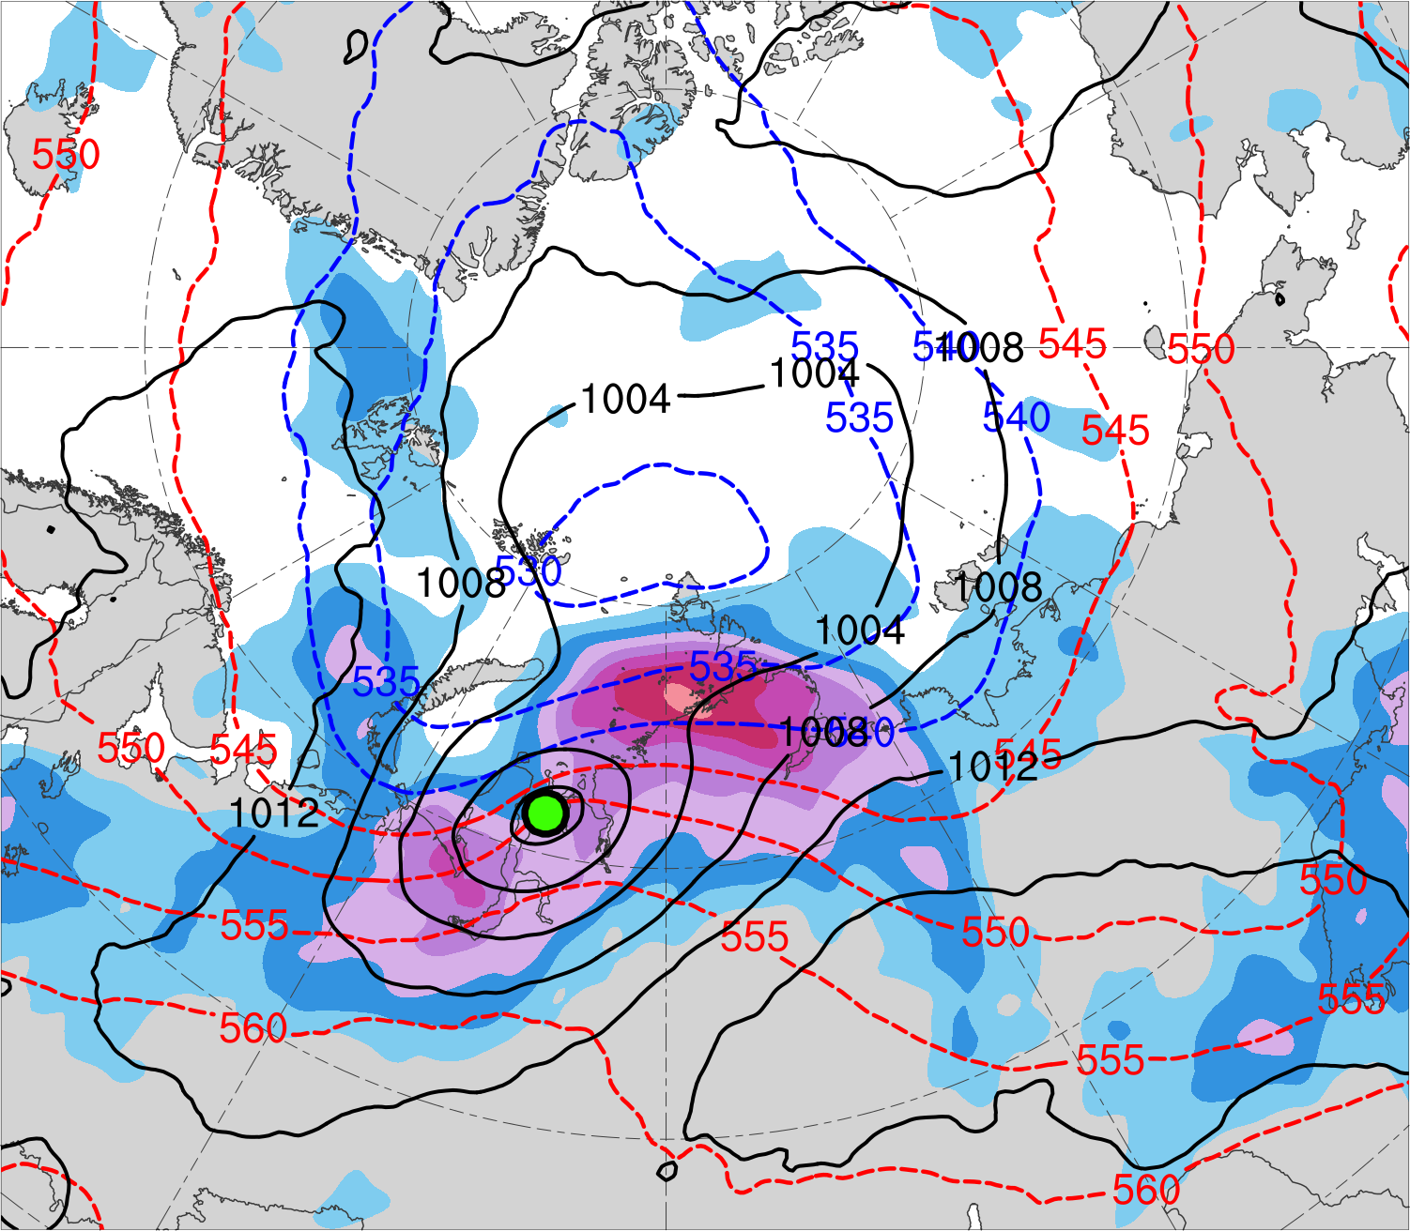
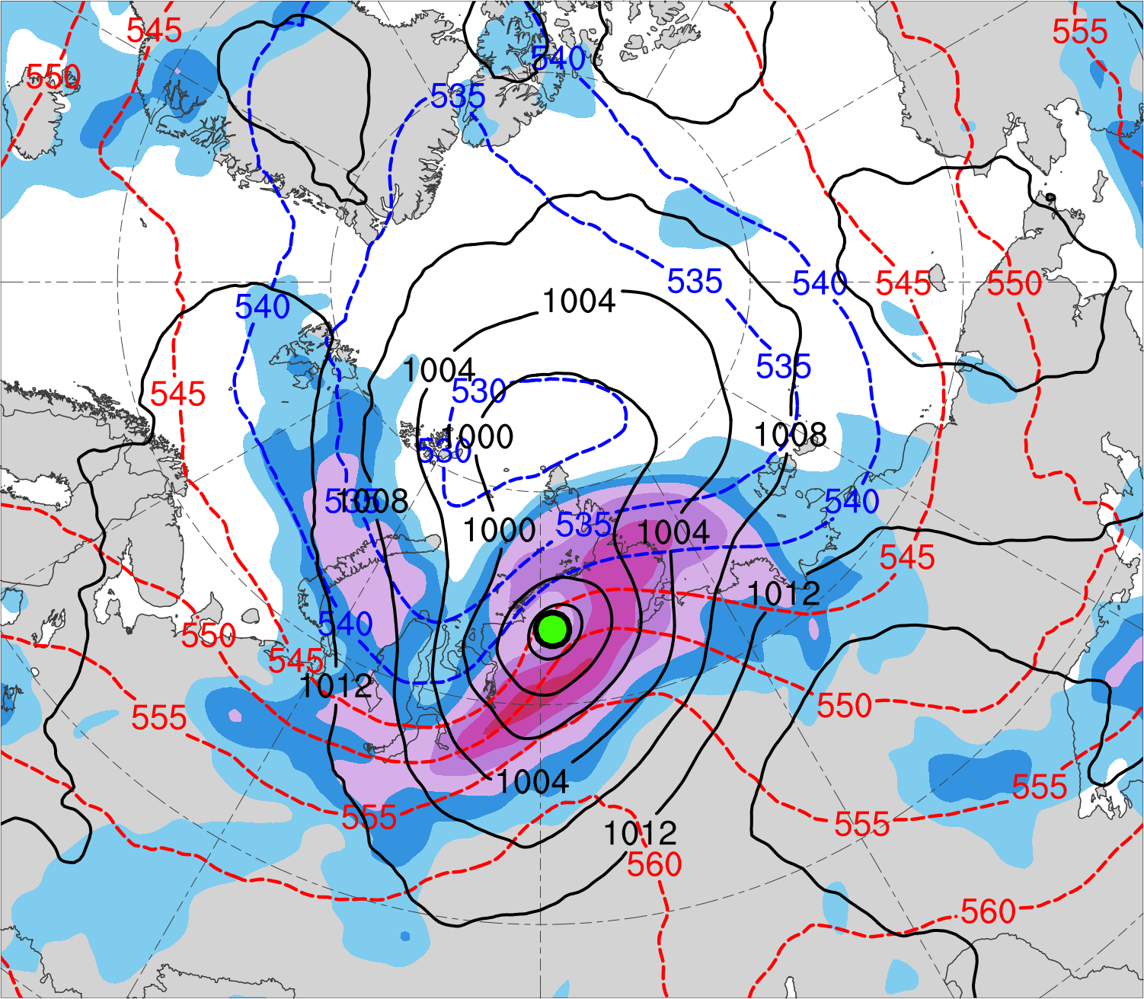
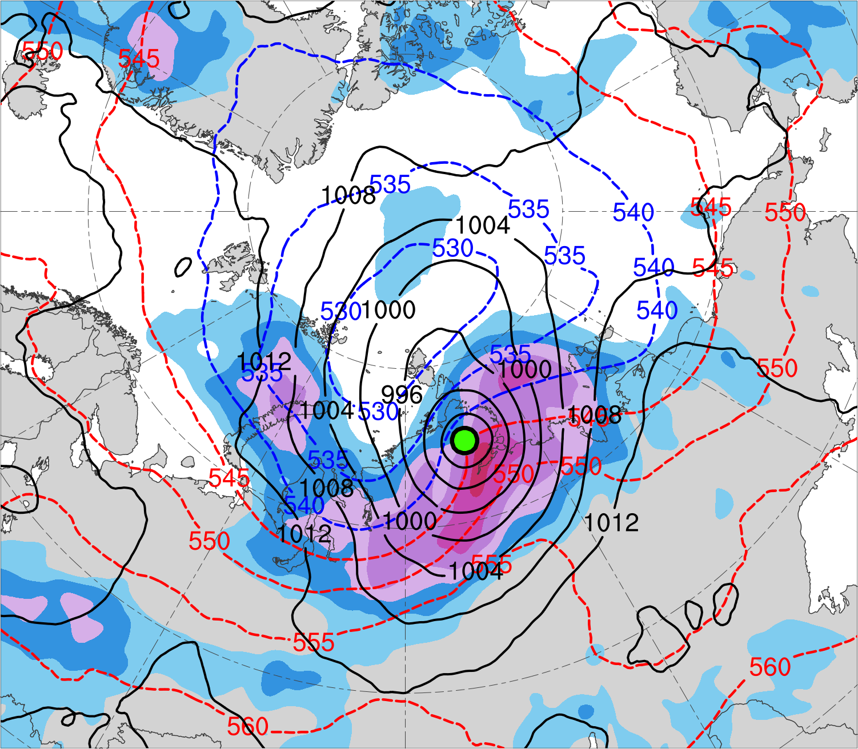
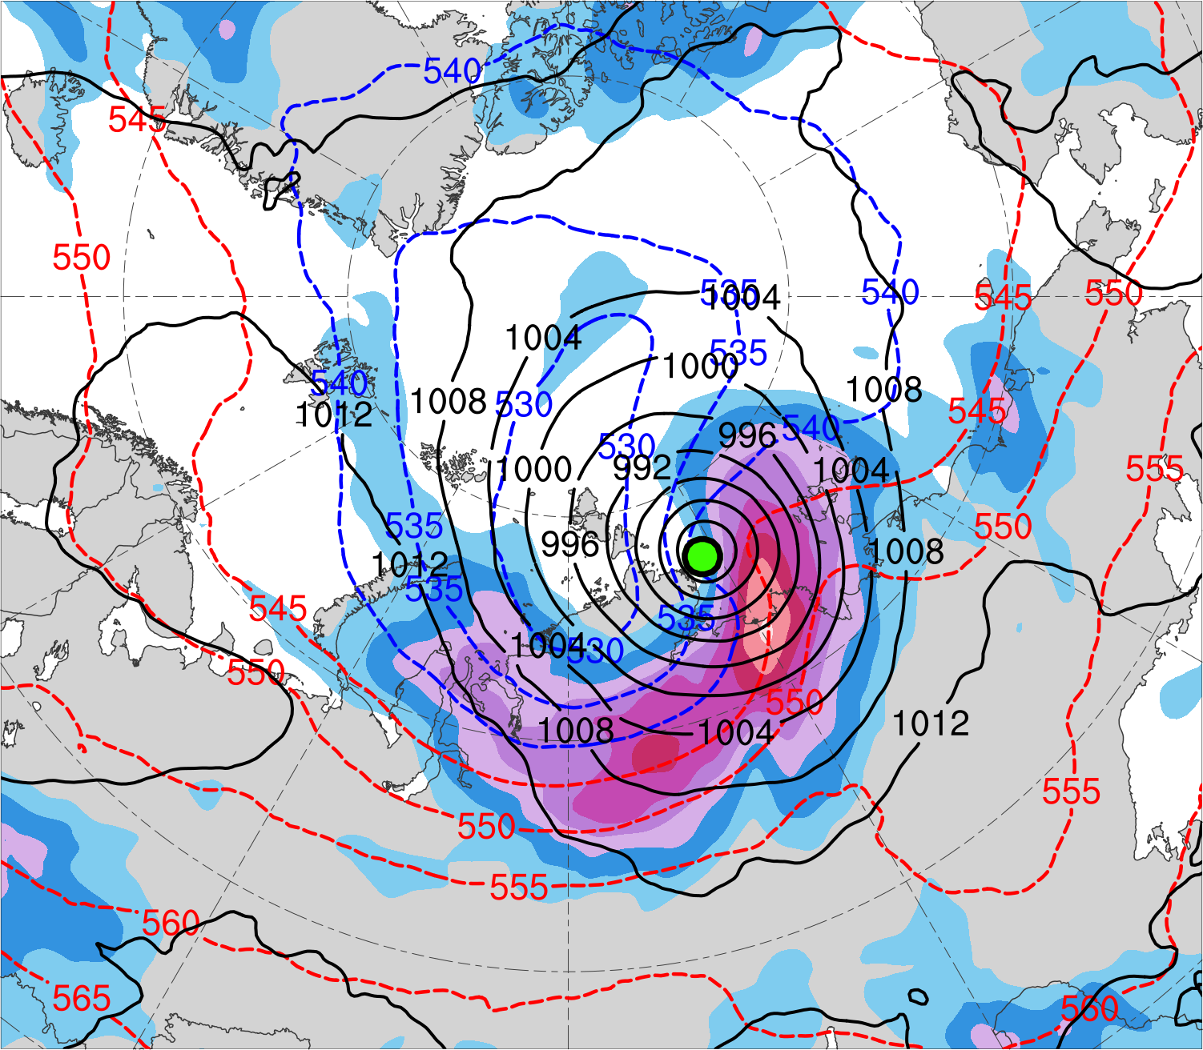
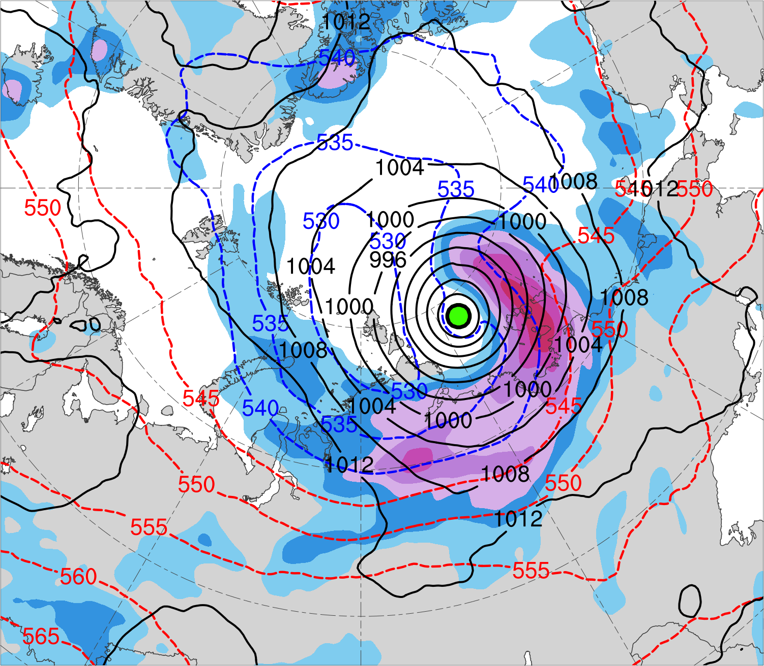
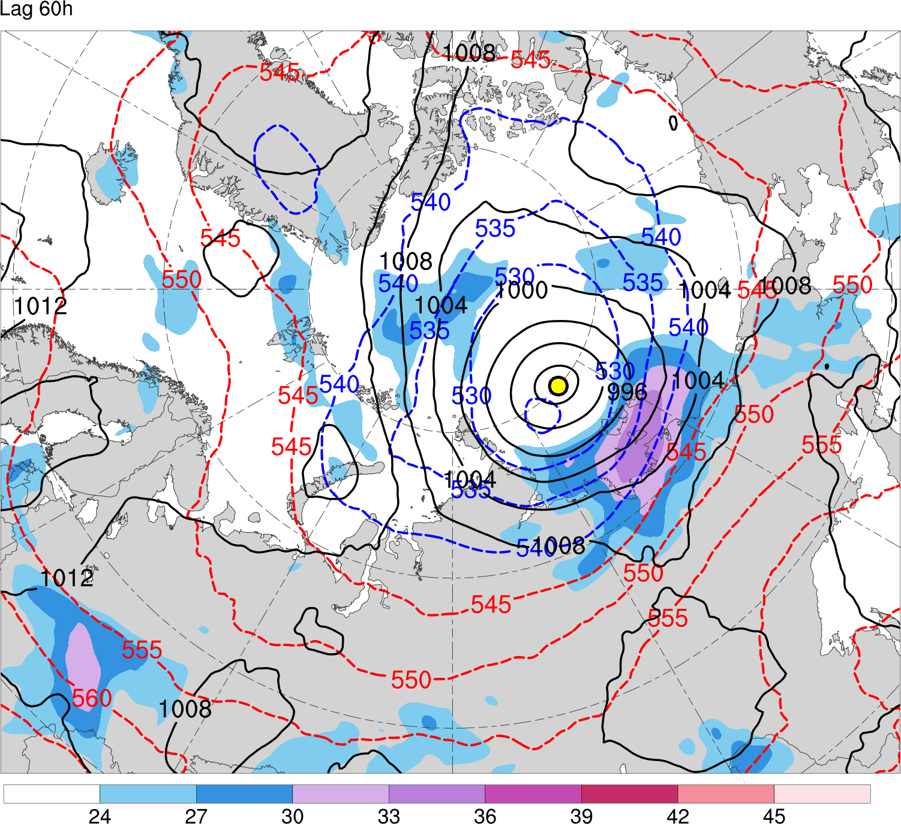
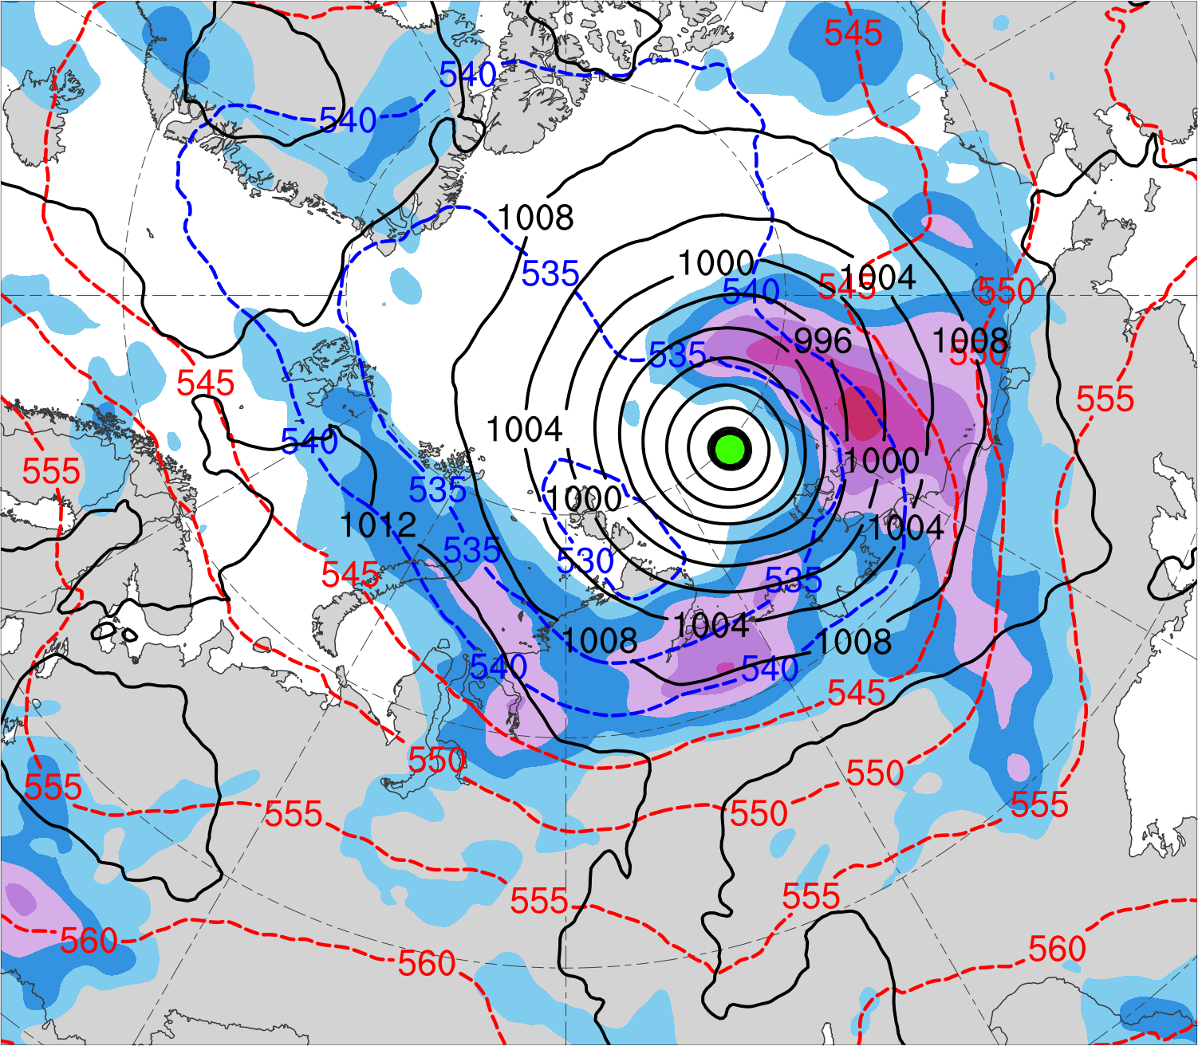
(a) t_{low}−48 h (N = 12)
(b) t_{low}−36 h (N = 12)
(c) t_{low}−24 h (N = 13)
42
39
36
33
(d) t_{low}−12 h (N = 13)
(e) t_{low} (N = 13)
300-hPa wind speed (m s⁻¹)
(f) t_{low}+12 h (N = 12)
30
27
24
21
SLP (hPa)
1000–500-hPa thickness (dam)
Mean AC location

Slide 52
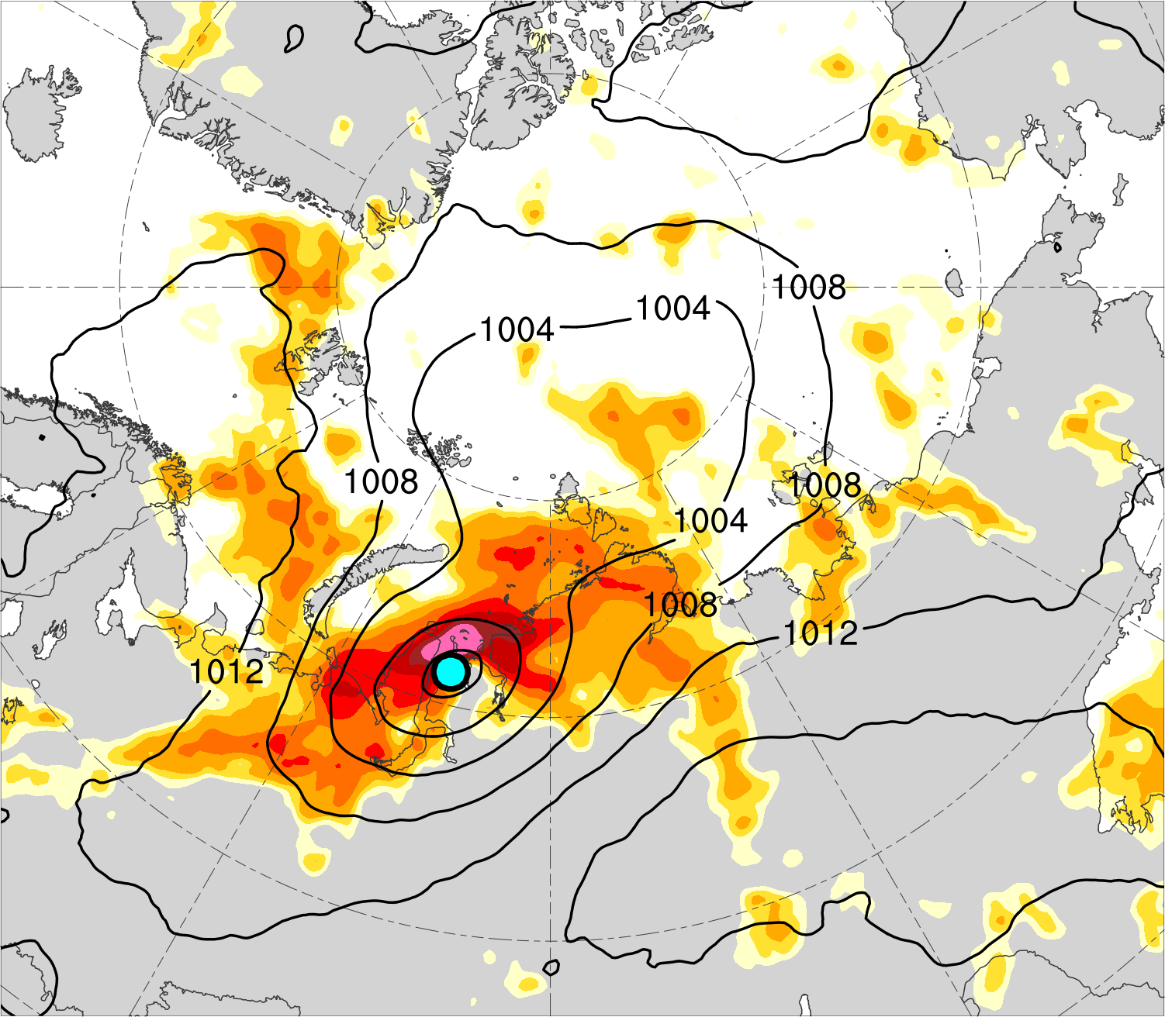
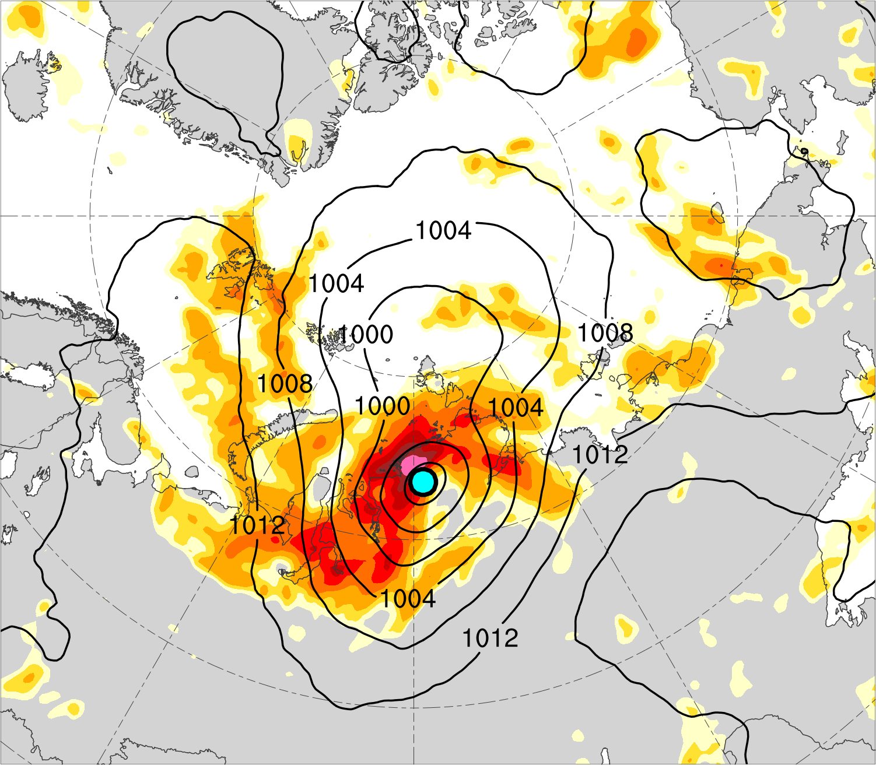
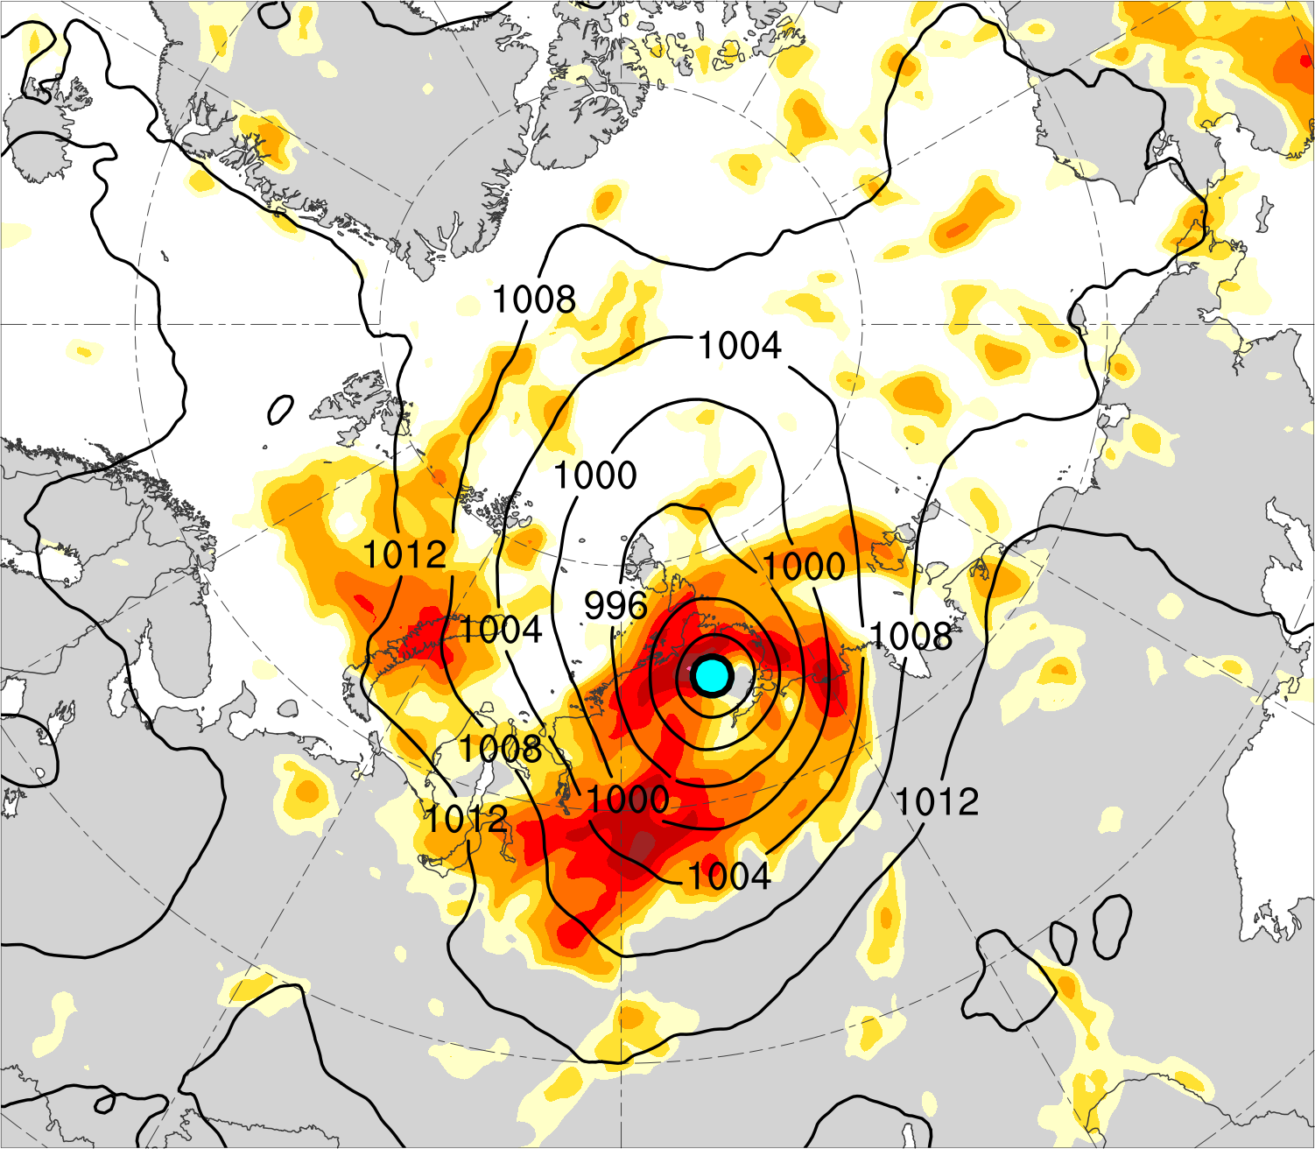
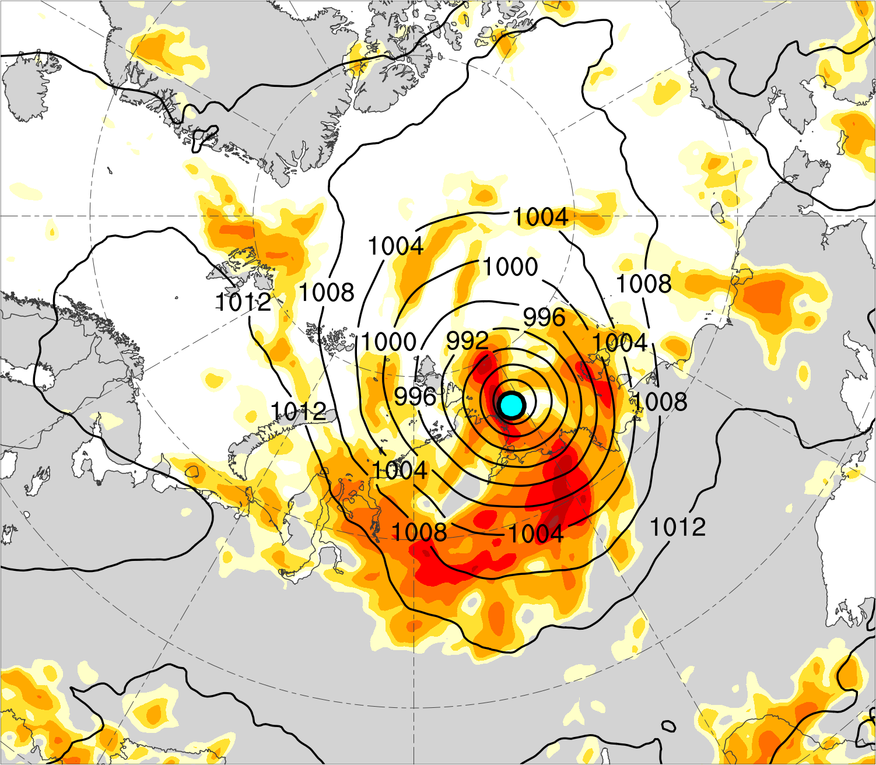



(a) t_{low}−48 h (N = 12)
(b) t_{low}−36 h (N = 12)
(c) t_{low}−24 h (N = 13)
1.3
1.2
1.1
1.0
(d) t_{low}−12 h (N = 13)
(e) t_{low} (N = 13)
850–600-hPa Eady growth rate (day⁻¹)
(f) t_{low}+12 h (N = 12)
0.9
0.8
0.75
0.7
SLP (hPa)
Mean AC location

Slide 53







(a) t_{low}−48 h (N = 12)
(b) t_{low}−36 h (N = 12)
(c) t_{low}−24 h (N = 13)
14
12
10
8
7
(d) t_{low}−12 h (N = 13)
(e) t_{low} (N = 13)
200-km area averaged 500-hPa relative vorticity (10⁻⁵ s⁻¹)
(f) t_{low}+12 h (N = 12)
6
5
4
3
2
500-hPa geopotential
height (dam)
500-hPa wind (m s⁻¹)
Mean AC location

Slide 54







(a) t_{low}−48 h (N = 12)
(b) t_{low}−36 h (N = 12)
(c) t_{low}−24 h (N = 13)
16
14
12
10
(d) t_{low}−12 h (N = 13)
(e) t_{low} (N = 13)
200-km area averaged 350–250-hPa divergence (10⁻⁶ s⁻¹)
(f) t_{low}+12 h (N = 12)
8
6
4
2
350–250-hPa irrotational wind (m s⁻¹)
350–250-hPa PV (PVU)
Negative values of 800–600-hPa ω (every 1 × 10⁻³ hPa s⁻¹)
Mean AC location

Slide 55







(a) t_{low}−48 h (N = 12)
(b) t_{low}−36 h (N = 12)
(c) t_{low}−24 h (N = 13)
500
450
400
350
300
1000–300-hPa IVT (kg m⁻¹ s⁻¹)
(d) t_{low}−12 h (N = 13)
(e) t_{low} (N = 13)
(f) t_{low}+12 h (N = 12)
250
200
175
150
125
100
IVT (kg m⁻¹ s⁻¹)
700-hPa geopotential
height (dam)
Positive values of 1000–300-hPa IMFC (every 100 W m⁻²)
Mean AC location

Slide 56
Hypotheses
Forecast errors in TPVs, baroclinic zones, and WCBs, and forecast errors in TPV–AC interactions, baroclinic processes, and latent heating, contribute to forecast errors in strong low-skill ACs during low-skill periods.

Slide 57
Case selection
Selected a strong low-skill AC that occurred during 13–19 August 2016 (i.e., AC16), which is a representative member of the strong low-skill ACs during low-skill periods.
ERA5 is first utilized to perform a synoptic-dynamic analysis of AC16 and to identify features and processes influencing the evolution of AC16.

Slide 58


AC16 track and intensity
(a)
1000
(b)
16
19
990
17
18
980
Minimum SLP (hPa)
14
15
13
970
960
0000 UTC positions of AC
13
14
15
16
17
18
19
Day in August 2016 labeled at 0000 UTC
Red line shows track of AC16 during 13–19 Aug 2016. Numbers represent dates of 0000 UTC positions of AC.
Time series of minimum SLP (hPa) of AC16 during 13–19 Aug 2016.
Data source: ERA5

Slide 59






(a) 1200 UTC 13 Aug 2016
(b) 0000 UTC 14 Aug 2016
(c) 1200 UTC 14 Aug 2016
80
72
64
56
(d) 0000 UTC 15 Aug 2016
(e) 1200 UTC 15 Aug 2016
300-hPa wind speed (m s⁻¹)
(f) 0000 UTC 16 Aug 2016
48
40
32
24
SLP (hPa)
1000–500-hPa thickness (dam)
Mean AC location

Slide 60






(a) 1200 UTC 13 Aug 2016
(b) 0000 UTC 14 Aug 2016
(c) 1200 UTC 14 Aug 2016
40
35
30
25
(d) 0000 UTC 15 Aug 2016
(e) 1200 UTC 15 Aug 2016
200-km area averaged 350–250-hPa divergence (10⁻⁶ s⁻¹)
(f) 0000 UTC 16 Aug 2016
20
15
10
5
350–250-hPa irrotational wind (m s⁻¹)
350–250-hPa PV (PVU)
Negative values of 800–600-hPa ω (every 1 × 10⁻³ hPa s⁻¹)
Mean AC location

Slide 61






(a) 1200 UTC 13 Aug 2016
(b) 0000 UTC 14 Aug 2016
(c) 1200 UTC 14 Aug 2016
1000
900
800
700
600
1000–300-hPa IVT (kg m⁻¹ s⁻¹)
(d) 0000 UTC 15 Aug 2016
(e) 1200 UTC 15 Aug 2016
(f) 0000 UTC 16 Aug 2016
500
400
300
250
200
150
IVT (kg m⁻¹ s⁻¹)
700-hPa geopotential
height (dam)
Positive values of 1000–300-hPa IMFC (every 250 W m⁻²)
Mean AC location

Slide 62
AC16 in ECMWF EPS
Use ensemble forecasts from the 51-member ECMWF ensemble prediction system extracted from The Observing System Research and Predictability Experiment (THORPEX) Interactive Grand Global Ensemble (TIGGE) (Bougeault et al. 2010).
Use ensemble forecasts initialized at 0000 UTC 10 August and verifying at 0000 UTC 15 August (120 h).

Slide 63
AC16 in ECMWF EPS
AC16 is tracked in the ensemble forecasts by utilizing the objective SLP-based cyclone tracking algorithm developed by Crawford et al. (2020).
The cyclone matching procedure mentioned earlier in presentation is used to find the matching forecast AC track corresponding to AC16 in each ensemble forecast.
If no matching forecast AC track is identified in an ensemble forecast, AC16 is manually identified and tracked in the ensemble forecast.

Slide 64

Ensemble-based sensitivity analysis (ESA)
Utilize ensemble-based sensitivity analysis (ESA) technique (e.g., Torn and Hakim 2008) to examine the sensitivity of the forecast skill of intensity and position of AC16 to selected dynamic and thermodynamic quantities at earlier forecast lead times.
Calculate the sensitivity of a forecast metric of interest J to a model state variable x_{i} at an earlier forecast lead time for an ensemble of size M via
J and x_{i} denote the 1 × M ensemble estimates of the forecast metric and ith model state variable, respectively, cov denotes the covariance, and var denotes the variance (e.g., Torn and Hakim 2008).

Slide 65
Ensemble-based sensitivity analysis (ESA)
Normalize the values of x_{i} by the ensemble standard deviation of x_{i} following Torn and Romine (2015), such that all sensitivities have units of the forecast metric per standard deviation of the model state variable.
Determine sensitivity to be statistically significant at the 95% confidence level by following the methodology of Torn and Hakim (2008).

Slide 66

Ensemble-based sensitivity analysis (ESA)
0000 UTC 15 Aug (120 h)
ERA5 min SLP (972.8 hPa)
SLP within a 700-km radius circle surrounding the ERA5 position of AC16 at 0000 UTC 15 August (120 h) correlates relatively well with the intensity error and position error of AC16 at this time.
Use average SLP within the 700-km radius circle surrounding the ERA5 position of AC16 at 0000 UTC 15 August (120 h) as the forecast metric, which is hereafter referred to as J_{AC}.
Ensemble member min SLP (hPa):
< 970
970–975
975–980
980–985
985–990
990–995
≥ 995
700-km radius circle surrounding ERA5 location of the AC

Slide 67
Ensemble-based sensitivity analysis (ESA)
All sensitivity values are multiplied by −1, such that a more accurate prediction of the intensity and position of AC16 at 0000 UTC 15 August (120 h) is associated with increasing the value of the model state variable at an earlier forecast lead time for positive sensitivity values and with decreasing the value of the model state variable at an earlier forecast lead time for negative sensitivity values.

Slide 68





(a) 0000 UTC 10 Aug (0 h)
(b) 1200 UTC 10 Aug (12 h)
R1
3.0
T1
R1
Ensemble mean 200-km area-averaged 250-hPa PV (PVU)
T1
2.4
1.8
1.2
0.6
Shading: Sensitivity of J_{AC} to 200-km area-averaged 250-hPa PV (hPa)
(c) 0000 UTC 11 Aug (24 h)
(d) 1200 UTC 11 Aug (36 h)
0
−0.6
−1.2
R1
−1.8
White stippling: Sensitivity is statistically significant at 95% confidence level
T1
R1
T1
−2.4
−3
(hPa)

Slide 69






(a) 0000 UTC 12 Aug (48 h)
(b) 1200 UTC 12 Aug (60 h)
(c) 0000 UTC 13 Aug (72 h)
3.0
2.4
T1
T1
T1
R1
R2
1.8
R1
R2
R2
R1
1.2
0.6
0
(d) 1200 UTC 13 Aug (84 h)
(e) 0000 UTC 14 Aug (96 h)
(f) 1200 UTC 14 Aug (108 h)
−0.6
−1.2
T1
T1
R2
T1
R2
−1.8
R2
−2.4
R1
−3
(hPa)
Ensemble mean 200-km area-averaged 250-hPa PV (PVU)
Shading: Sensitivity of J_{AC} to 200-km area-averaged 250-hPa PV (hPa)
White stippling: Sensitivity is statistically significant at 95% confidence level

Slide 70






(a) 0000 UTC 12 Aug (48 h)
(b) 1200 UTC 12 Aug (60 h)
(c) 0000 UTC 13 Aug (72 h)
3.0
2.4
1.8
1.2
0.6
0
(d) 1200 UTC 13 Aug (84 h)
(e) 0000 UTC 14 Aug (96 h)
(f) 1200 UTC 14 Aug (108 h)
−0.6
−1.2
−1.8
−2.4
−3
(hPa)
Ensemble mean SLP (hPa)
Shading: Sensitivity of J_{AC} to SLP (hPa)
White stippling: Sensitivity is statistically significant at 95% confidence level

Slide 71




(a) 0000 UTC 13 Aug (72 h)
(b) 1200 UTC 13 Aug (84 h)
3.0
2.4
Ensemble mean 850-hPa specific humidity (g kg⁻¹)
1.8
1.2
0.6
Shading: Sensitivity of J_{AC} to 850-hPa specific humidity (hPa)
(c) 0000 UTC 14 Aug (96 h)
(d) 1200 UTC 14 Aug (108 h)
0
−0.6
−1.2
−1.8
White stippling: Sensitivity is statistically significant at 95% confidence level
−2.4
−3
(hPa)

Slide 72




(a) 0000 UTC 13 Aug (72 h)
(b) 1200 UTC 13 Aug (84 h)
Ensemble mean 200-km area-averaged 1000–850-hPa IMFC (every 80 W m⁻²)
3.0
2.4
1.8
1.2
Ensemble mean 200-km area-averaged 1000–850-hPa IVT (kg m⁻¹ s⁻¹)
0.6
(c) 0000 UTC 14 Aug (96 h)
(d) 1200 UTC 14 Aug (108 h)
0
−0.6
Shading: Sensitivity of J_{AC} to 200-km area-averaged 1000–850-hPa IMFC (hPa)
−1.2
−1.8
−2.4
White stippling: Sensitivity is statistically significant at 95% confidence level
−3
(hPa)

