Slide 1
Linkages between a Coherent Tropopause Disturbance and the Presidents’ Day Storm of 1979
Kevin A. Biernat
Department of Atmospheric and Environmental Sciences
University at Albany, SUNY
ATM 401/501 Presidents’ Day Lecture
Tuesday 19 February 2019

Slide 2
CTDs and TPVs
Coherent tropopause disturbances (CTDs) are tropopause-based vortices and are material features (e.g., Pyle et al. 2004)
Tropopause Polar Vortices (TPVs) are CTDs originating at high latitudes (e.g., Cavallo and Hakim 2009, 2010, 2012, 2013)
TPV
TPV
(left) Dynamic tropopause (DT) wind speed (every 15 m s⁻¹ starting at 50 m s⁻¹, thick contours) and DT potential temperature (K, thin contours and shading) on 1.5-PVU surface valid at 0000 UTC 1 Dec 1991; (right) same as left except DT pressure (hPa, thin contours and shading). Adapted from Fig. 11 in Pyle et al. (2004).

Slide 3
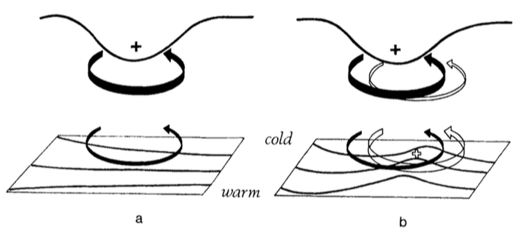
CTDs/TPVs and Cyclogenesis
Hoskins et al. (1985)
Cyclonic PV Anomaly
Trop.
θ
t = t₀
Figure 21 adapted from Hoskins et al. (1985, section 6e).
Notes:
Adapted from Fig. 21 in Hoskins et al. (1985).

Slide 4
CTDs/TPVs and Cyclogenesis
Hoskins et al. (1985)
Cyclonic PV Anomaly
Trop.
WAA
θ
t = t₀
Figure 21 adapted from Hoskins et al. (1985, section 6e).
Notes:
Adapted from Fig. 21 in Hoskins et al. (1985).

Slide 5
CTDs/TPVs and Cyclogenesis
Hoskins et al. (1985)
Cyclonic PV Anomaly
Trop.
WAA
θ
Cyclonic PV Anomaly
t = t₀
t = t₀ + Δt
Figure 21 adapted from Hoskins et al. (1985, section 6e).
Notes:
Adapted from Fig. 21 in Hoskins et al. (1985).

Slide 6
CTDs/TPVs and Cyclogenesis
Hoskins et al. (1985)
Cyclonic PV Anomaly
Positive PV Advection
Trop.
WAA
θ
Cyclonic PV Anomaly
t = t₀
t = t₀ + Δt
Figure 21 adapted from Hoskins et al. (1985, section 6e).
Notes:
Adapted from Fig. 21 in Hoskins et al. (1985).

Slide 7
CTDs/TPVs and Cyclogenesis
Hoskins et al. (1985)
Cyclonic PV Anomaly
Positive PV Advection
Trop.
WAA
“Phase Locking”
θ
Cyclonic PV Anomaly
t = t₀
t = t₀ + Δt
Figure 21 adapted from Hoskins et al. (1985, section 6e).
Notes:
Adapted from Fig. 21 in Hoskins et al. (1985).

Slide 8
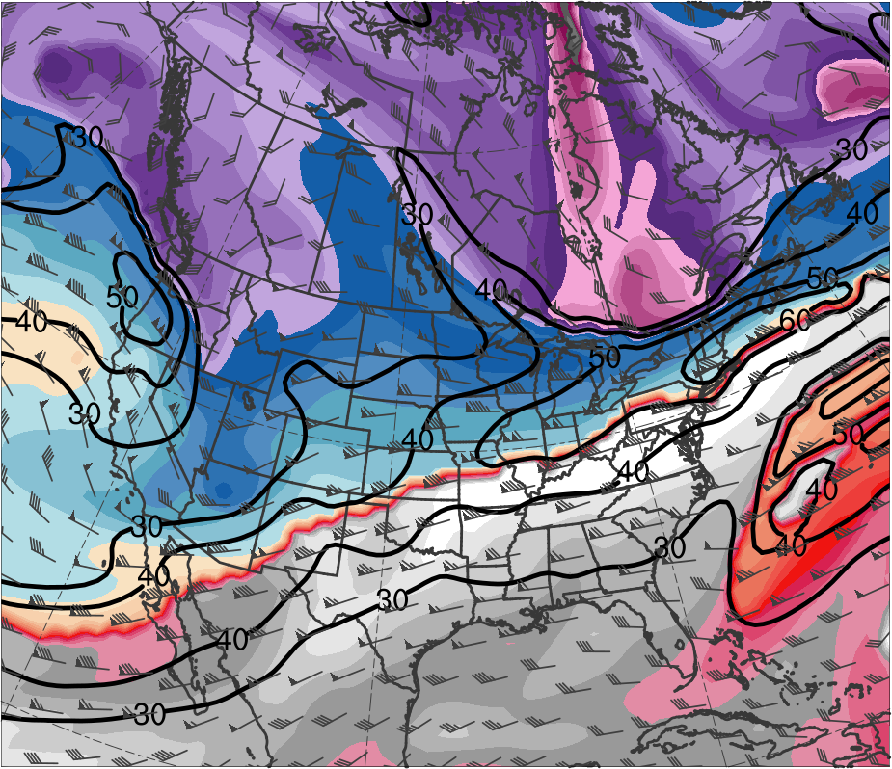
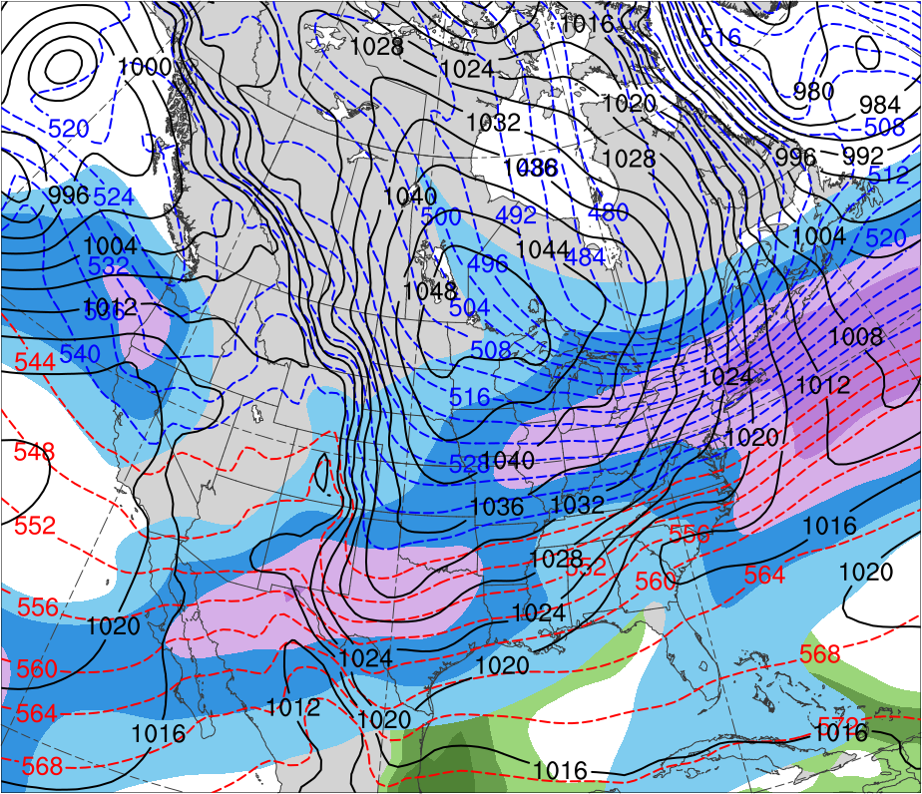
Presidents’ Day Storm of 1979
0000 UTC 17 Feb 1979
Data Source: ERA-Interim
(K)
252
258
264
270
276
282
288
294
300
306
312
318
324
330
336
342
348
354
360
366
372
378
(mm)
(m s⁻¹ )
25
30
35
40
45
50
55
30
40
50
60
70
80
90
100
Potential temperature (K, shaded), wind speed (black, every 10 m s⁻¹ starting at 30 m s⁻¹), and wind (m s⁻¹, flags and barbs) on 2-PVU surface
250-hPa wind speed (m s⁻¹, shaded),
1000–500-hPa thickness (dam, blue/red),
SLP (hPa, black), PW (mm, shaded)

Slide 9
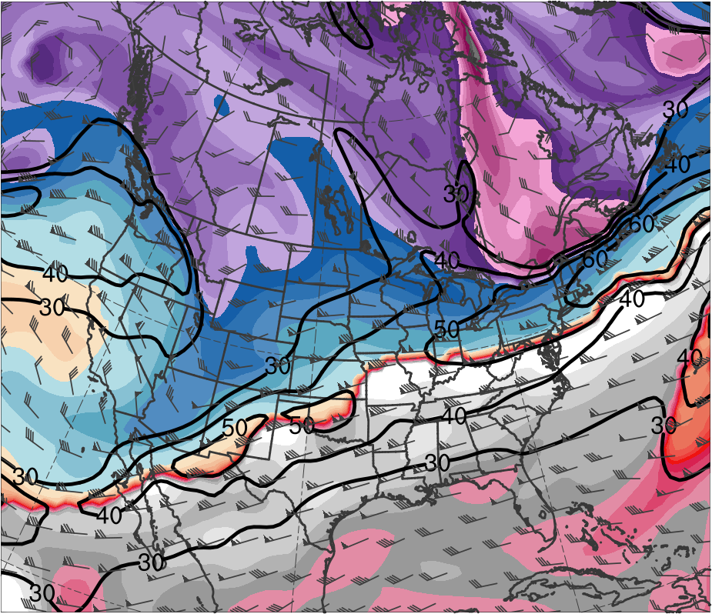
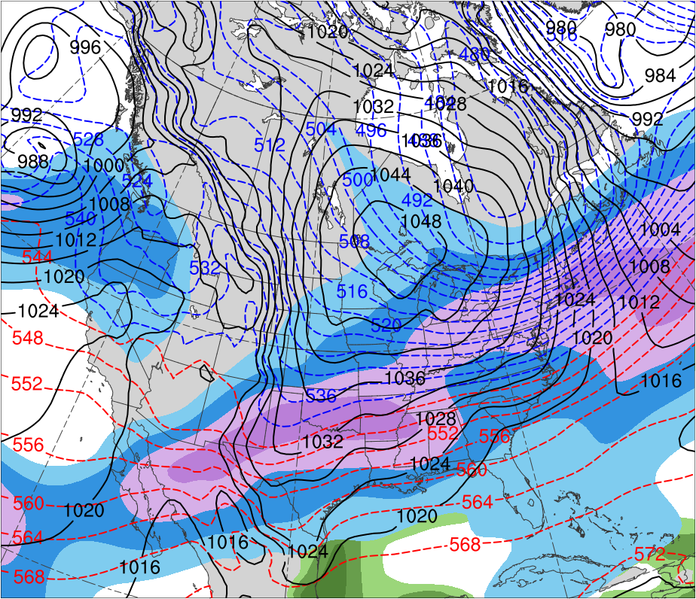
Presidents’ Day Storm of 1979
0600 UTC 17 Feb 1979
Data Source: ERA-Interim
(K)
252
258
264
270
276
282
288
294
300
306
312
318
324
330
336
342
348
354
360
366
372
378
(mm)
(m s⁻¹ )
25
30
35
40
45
50
55
30
40
50
60
70
80
90
100
Potential temperature (K, shaded), wind speed (black, every 10 m s⁻¹ starting at 30 m s⁻¹), and wind (m s⁻¹, flags and barbs) on 2-PVU surface
250-hPa wind speed (m s⁻¹, shaded),
1000–500-hPa thickness (dam, blue/red),
SLP (hPa, black), PW (mm, shaded)

Slide 10
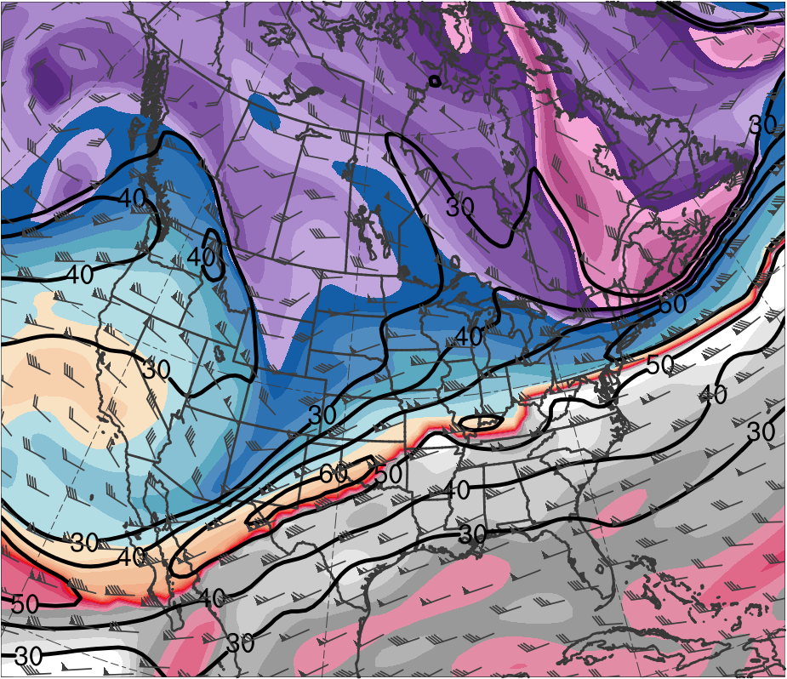
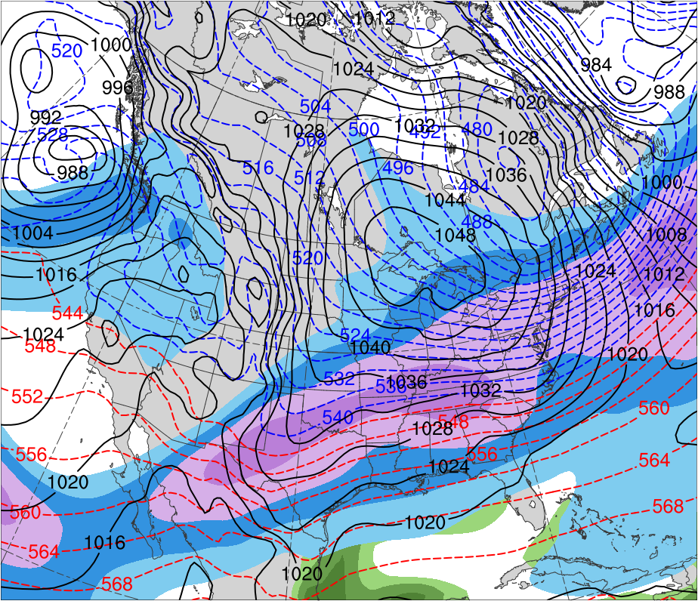
Presidents’ Day Storm of 1979
1200 UTC 17 Feb 1979
Data Source: ERA-Interim
(K)
252
258
264
270
276
282
288
294
300
306
312
318
324
330
336
342
348
354
360
366
372
378
(mm)
(m s⁻¹ )
25
30
35
40
45
50
55
30
40
50
60
70
80
90
100
Potential temperature (K, shaded), wind speed (black, every 10 m s⁻¹ starting at 30 m s⁻¹), and wind (m s⁻¹, flags and barbs) on 2-PVU surface
250-hPa wind speed (m s⁻¹, shaded),
1000–500-hPa thickness (dam, blue/red),
SLP (hPa, black), PW (mm, shaded)

Slide 11
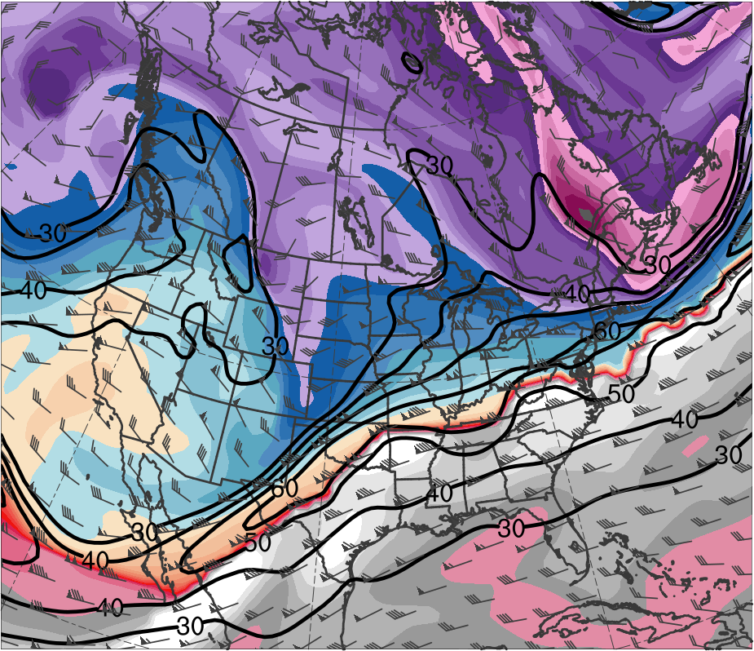
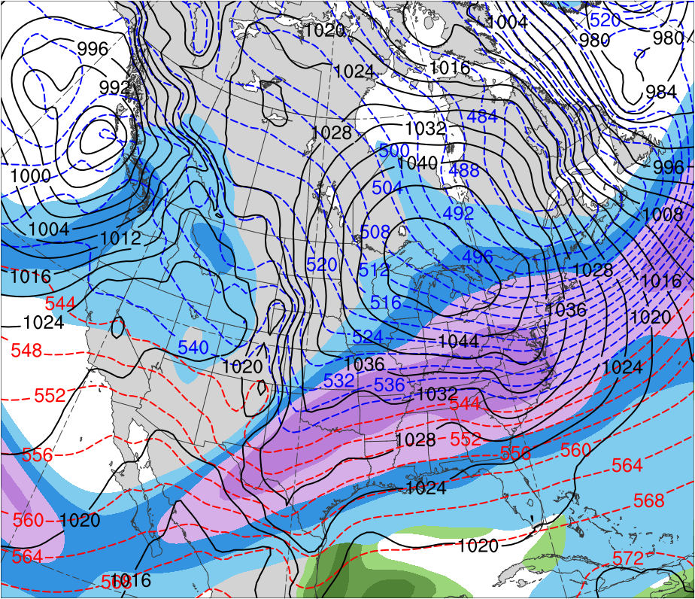
Presidents’ Day Storm of 1979
1800 UTC 17 Feb 1979
Data Source: ERA-Interim
CTD
(K)
252
258
264
270
276
282
288
294
300
306
312
318
324
330
336
342
348
354
360
366
372
378
(mm)
(m s⁻¹ )
25
30
35
40
45
50
55
30
40
50
60
70
80
90
100
Potential temperature (K, shaded), wind speed (black, every 10 m s⁻¹ starting at 30 m s⁻¹), and wind (m s⁻¹, flags and barbs) on 2-PVU surface
250-hPa wind speed (m s⁻¹, shaded),
1000–500-hPa thickness (dam, blue/red),
SLP (hPa, black), PW (mm, shaded)

Slide 12
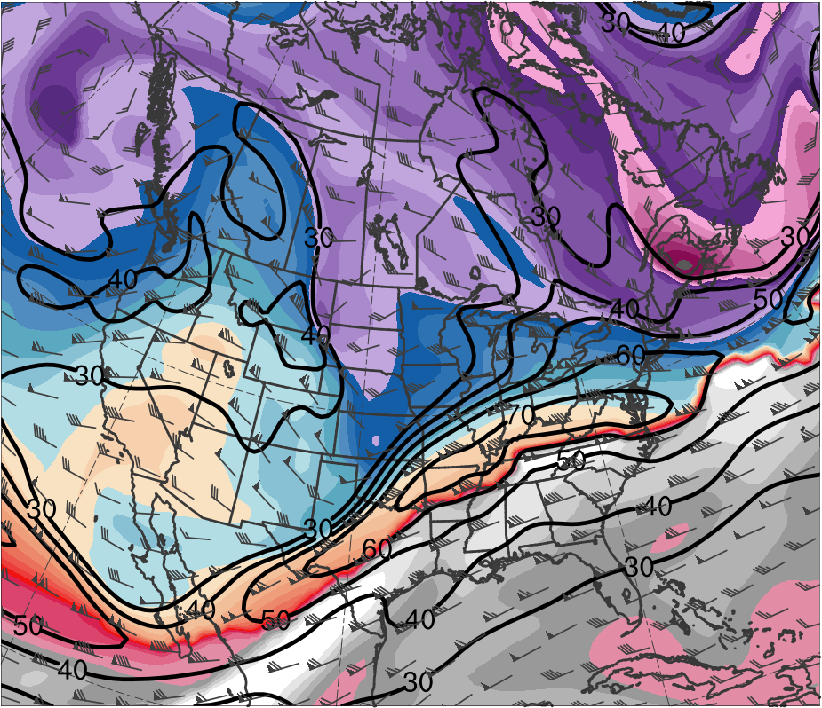
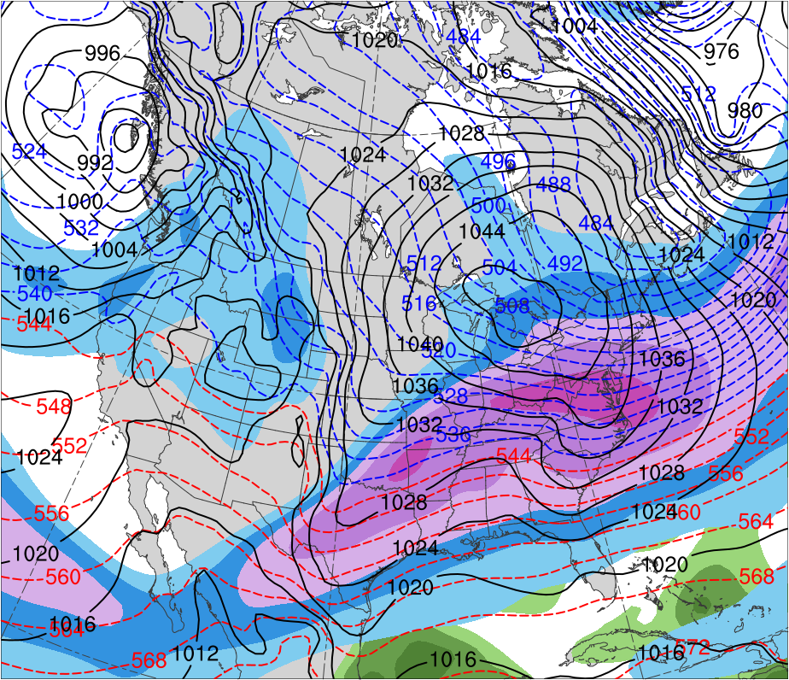
Presidents’ Day Storm of 1979
0000 UTC 18 Feb 1979
Data Source: ERA-Interim
CTD
(K)
252
258
264
270
276
282
288
294
300
306
312
318
324
330
336
342
348
354
360
366
372
378
(mm)
(m s⁻¹ )
25
30
35
40
45
50
55
30
40
50
60
70
80
90
100
Potential temperature (K, shaded), wind speed (black, every 10 m s⁻¹ starting at 30 m s⁻¹), and wind (m s⁻¹, flags and barbs) on 2-PVU surface
250-hPa wind speed (m s⁻¹, shaded),
1000–500-hPa thickness (dam, blue/red),
SLP (hPa, black), PW (mm, shaded)

Slide 13
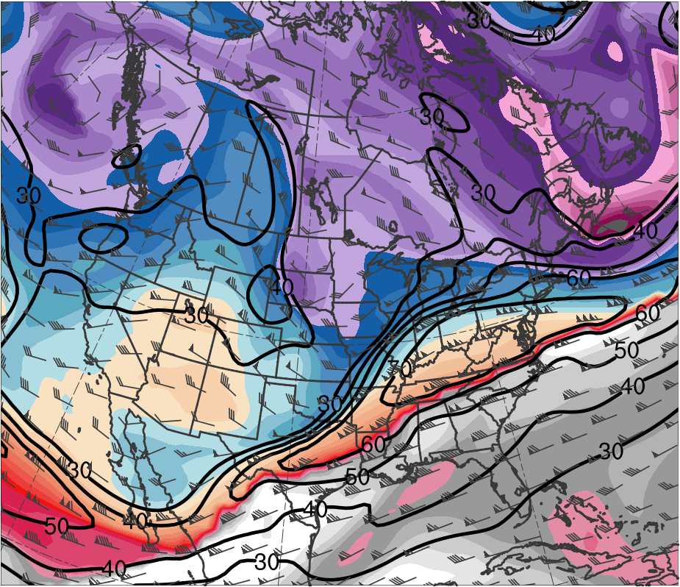
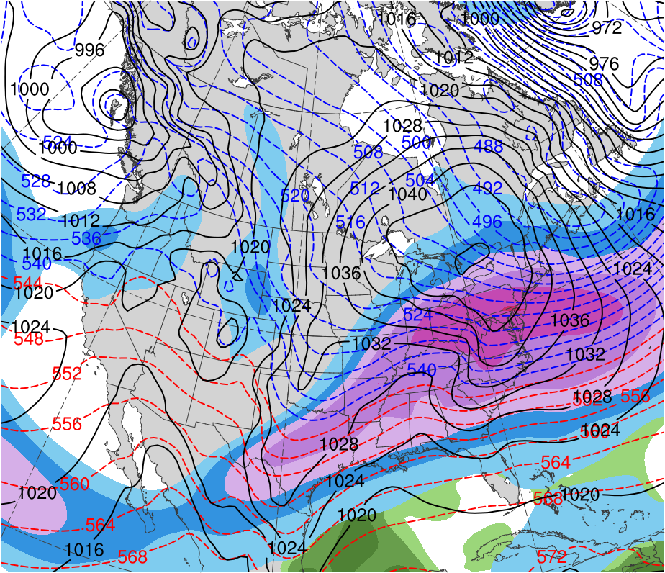
Presidents’ Day Storm of 1979
0600 UTC 18 Feb 1979
Data Source: ERA-Interim
CTD
(K)
252
258
264
270
276
282
288
294
300
306
312
318
324
330
336
342
348
354
360
366
372
378
(mm)
(m s⁻¹ )
25
30
35
40
45
50
55
30
40
50
60
70
80
90
100
Potential temperature (K, shaded), wind speed (black, every 10 m s⁻¹ starting at 30 m s⁻¹), and wind (m s⁻¹, flags and barbs) on 2-PVU surface
250-hPa wind speed (m s⁻¹, shaded),
1000–500-hPa thickness (dam, blue/red),
SLP (hPa, black), PW (mm, shaded)

Slide 14
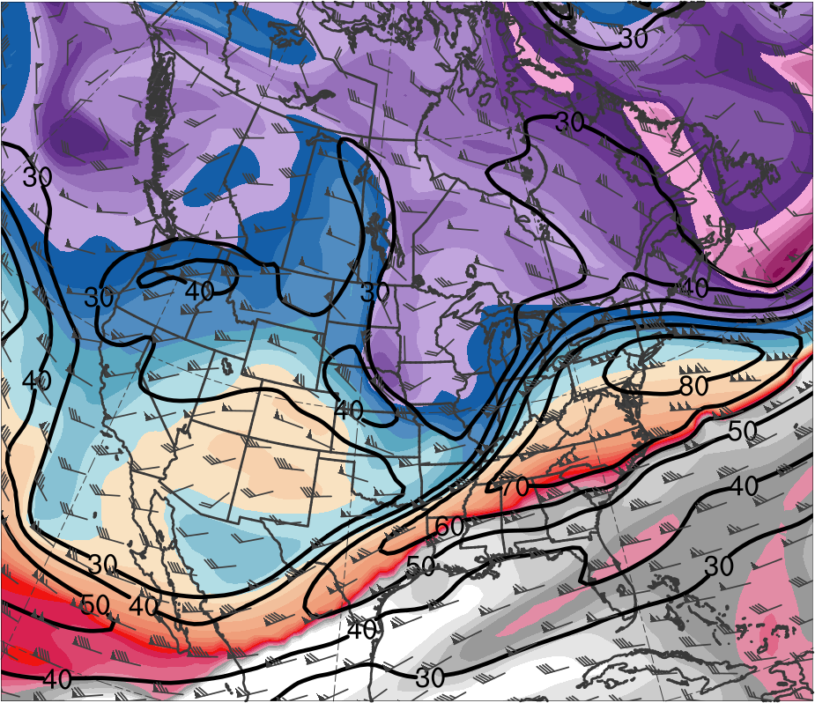
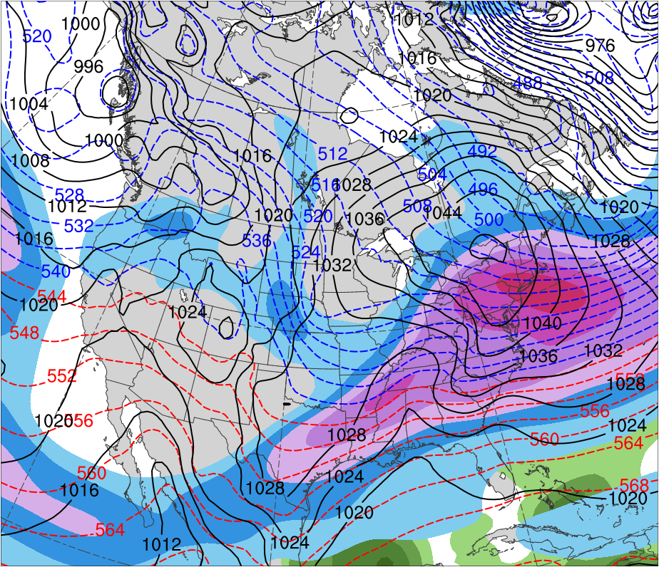
Presidents’ Day Storm of 1979
1200 UTC 18 Feb 1979
Data Source: ERA-Interim
CTD
(K)
252
258
264
270
276
282
288
294
300
306
312
318
324
330
336
342
348
354
360
366
372
378
(mm)
(m s⁻¹ )
25
30
35
40
45
50
55
30
40
50
60
70
80
90
100
Potential temperature (K, shaded), wind speed (black, every 10 m s⁻¹ starting at 30 m s⁻¹), and wind (m s⁻¹, flags and barbs) on 2-PVU surface
250-hPa wind speed (m s⁻¹, shaded),
1000–500-hPa thickness (dam, blue/red),
SLP (hPa, black), PW (mm, shaded)

Slide 15
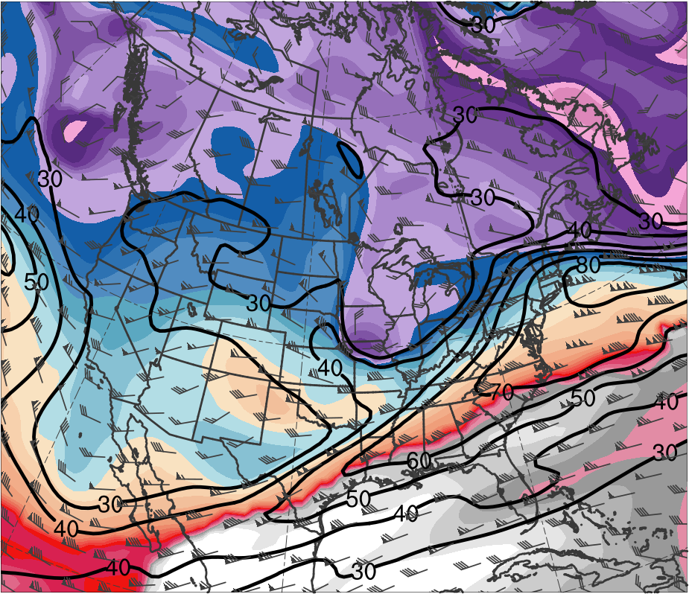
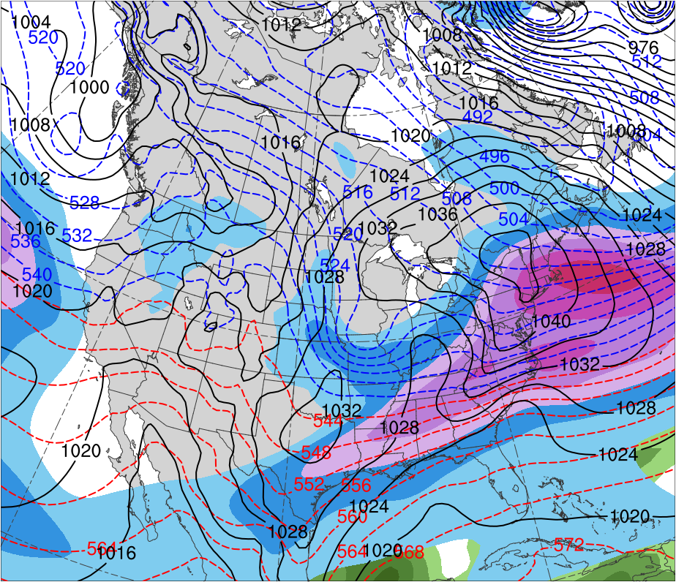
Presidents’ Day Storm of 1979
1800 UTC 18 Feb 1979
Data Source: ERA-Interim
CTD
L
(K)
252
258
264
270
276
282
288
294
300
306
312
318
324
330
336
342
348
354
360
366
372
378
(mm)
(m s⁻¹ )
25
30
35
40
45
50
55
30
40
50
60
70
80
90
100
Potential temperature (K, shaded), wind speed (black, every 10 m s⁻¹ starting at 30 m s⁻¹), and wind (m s⁻¹, flags and barbs) on 2-PVU surface
250-hPa wind speed (m s⁻¹, shaded),
1000–500-hPa thickness (dam, blue/red),
SLP (hPa, black), PW (mm, shaded)

Slide 16
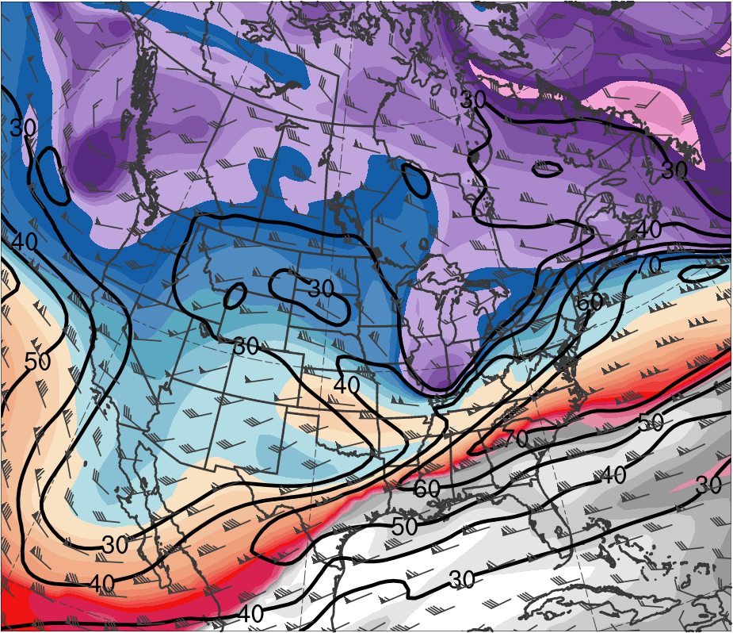
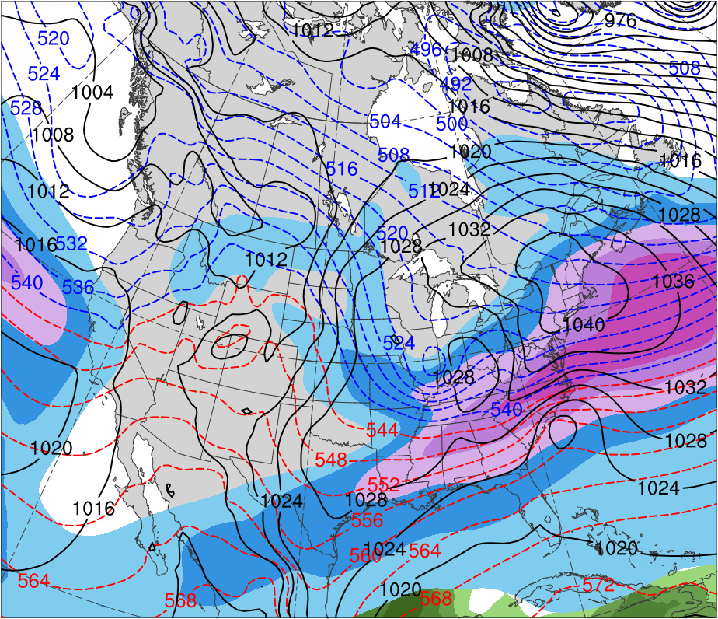
Presidents’ Day Storm of 1979
0000 UTC 19 Feb 1979
Data Source: ERA-Interim
CTD
L
L
(K)
252
258
264
270
276
282
288
294
300
306
312
318
324
330
336
342
348
354
360
366
372
378
(mm)
(m s⁻¹ )
25
30
35
40
45
50
55
30
40
50
60
70
80
90
100
Potential temperature (K, shaded), wind speed (black, every 10 m s⁻¹ starting at 30 m s⁻¹), and wind (m s⁻¹, flags and barbs) on 2-PVU surface
250-hPa wind speed (m s⁻¹, shaded),
1000–500-hPa thickness (dam, blue/red),
SLP (hPa, black), PW (mm, shaded)

Slide 17
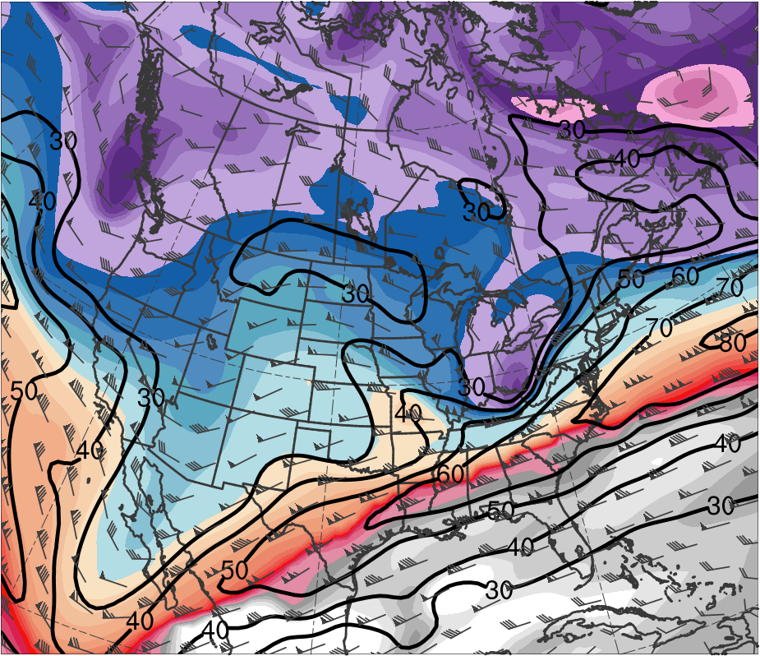
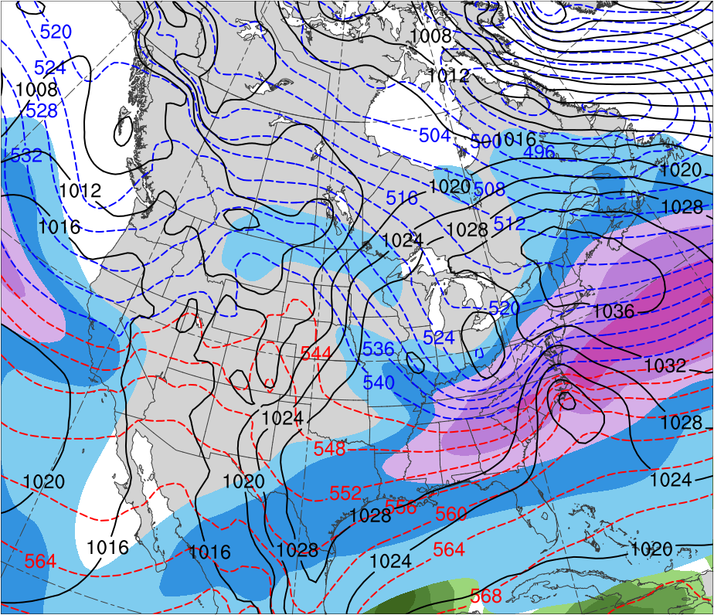
Presidents’ Day Storm of 1979
0600 UTC 19 Feb 1979
Data Source: ERA-Interim
CTD
L
L
(K)
252
258
264
270
276
282
288
294
300
306
312
318
324
330
336
342
348
354
360
366
372
378
(mm)
(m s⁻¹ )
25
30
35
40
45
50
55
30
40
50
60
70
80
90
100
Potential temperature (K, shaded), wind speed (black, every 10 m s⁻¹ starting at 30 m s⁻¹), and wind (m s⁻¹, flags and barbs) on 2-PVU surface
250-hPa wind speed (m s⁻¹, shaded),
1000–500-hPa thickness (dam, blue/red),
SLP (hPa, black), PW (mm, shaded)

Slide 18
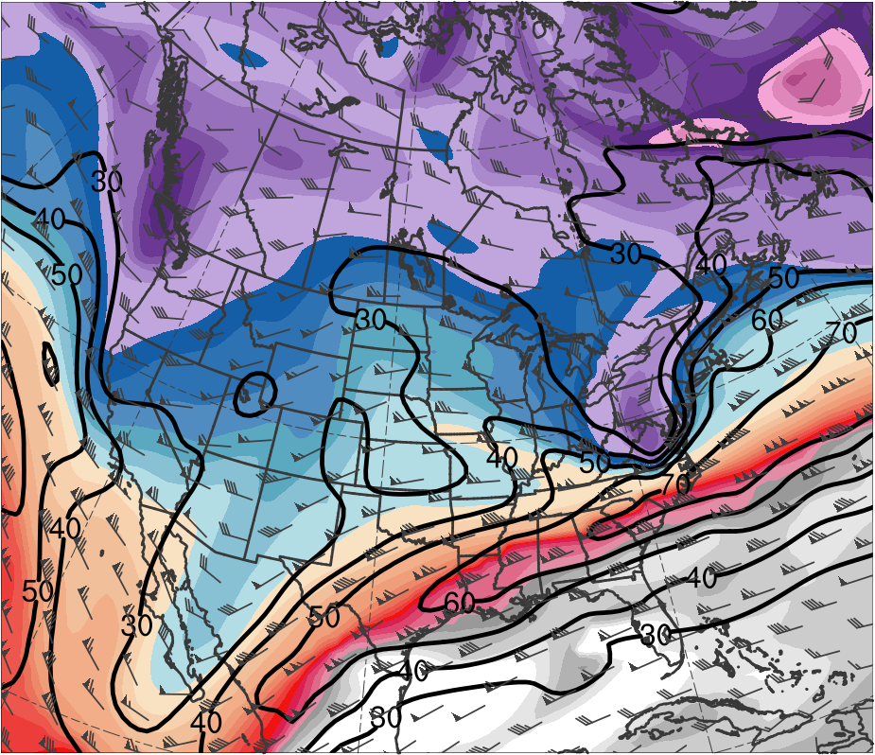
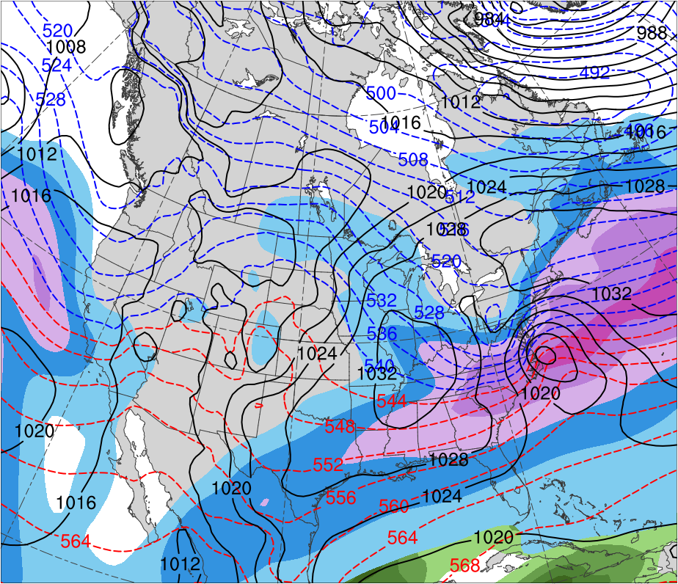
Presidents’ Day Storm of 1979
1200 UTC 19 Feb 1979
Data Source: ERA-Interim
CTD
L
(K)
252
258
264
270
276
282
288
294
300
306
312
318
324
330
336
342
348
354
360
366
372
378
(mm)
(m s⁻¹ )
25
30
35
40
45
50
55
30
40
50
60
70
80
90
100
Potential temperature (K, shaded), wind speed (black, every 10 m s⁻¹ starting at 30 m s⁻¹), and wind (m s⁻¹, flags and barbs) on 2-PVU surface
250-hPa wind speed (m s⁻¹, shaded),
1000–500-hPa thickness (dam, blue/red),
SLP (hPa, black), PW (mm, shaded)

Slide 19
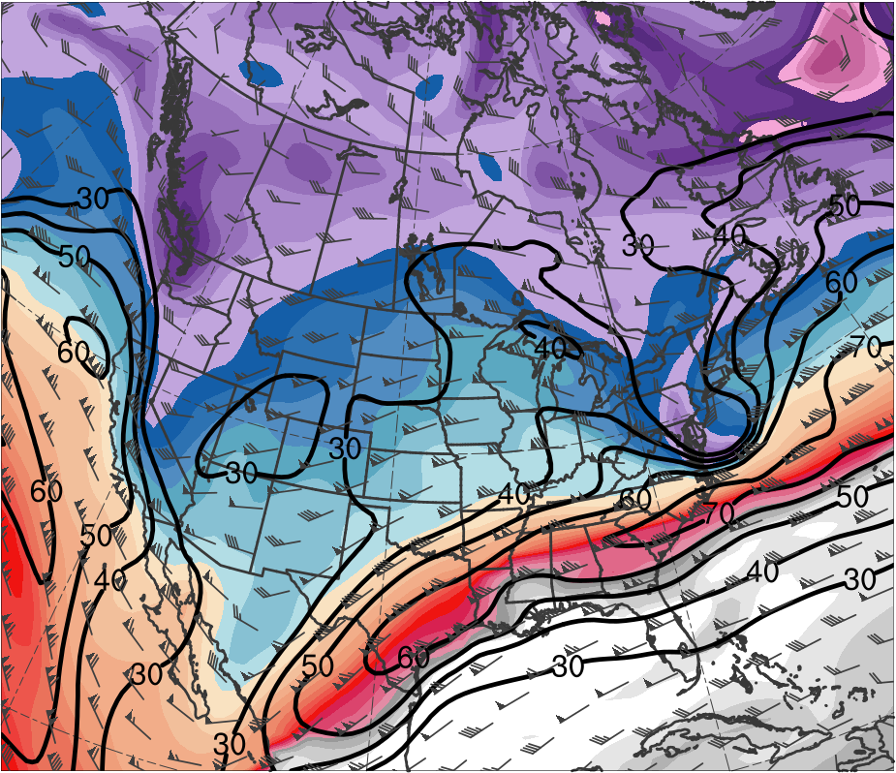
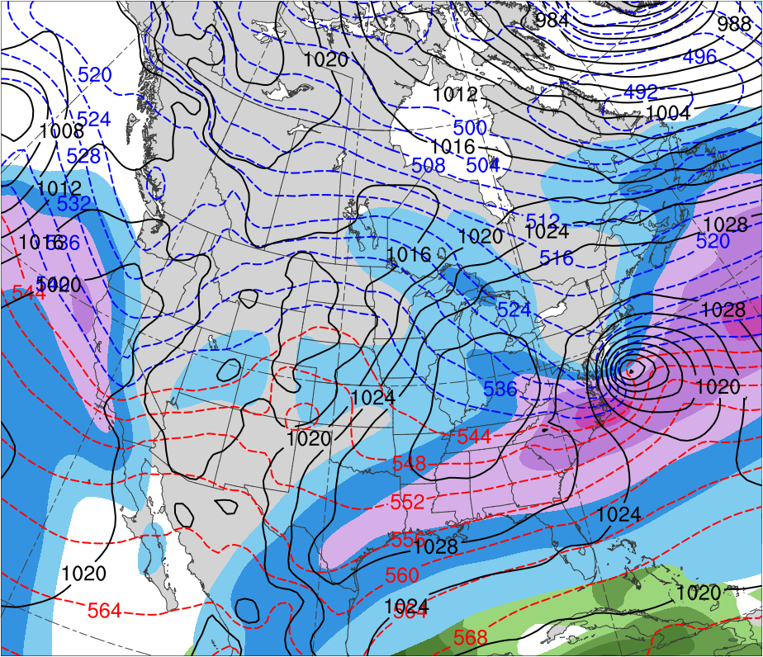
Presidents’ Day Storm of 1979
1800 UTC 19 Feb 1979
Data Source: ERA-Interim
CTD
L
(K)
252
258
264
270
276
282
288
294
300
306
312
318
324
330
336
342
348
354
360
366
372
378
(mm)
(m s⁻¹ )
25
30
35
40
45
50
55
30
40
50
60
70
80
90
100
Potential temperature (K, shaded), wind speed (black, every 10 m s⁻¹ starting at 30 m s⁻¹), and wind (m s⁻¹, flags and barbs) on 2-PVU surface
250-hPa wind speed (m s⁻¹, shaded),
1000–500-hPa thickness (dam, blue/red),
SLP (hPa, black), PW (mm, shaded)

Slide 20
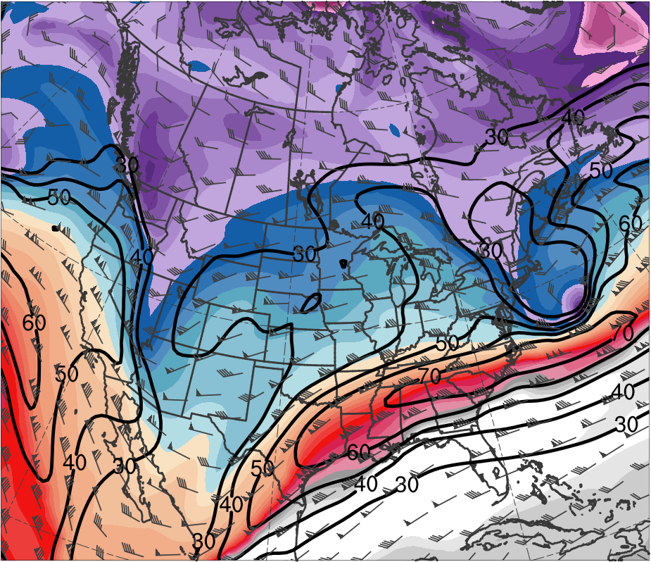
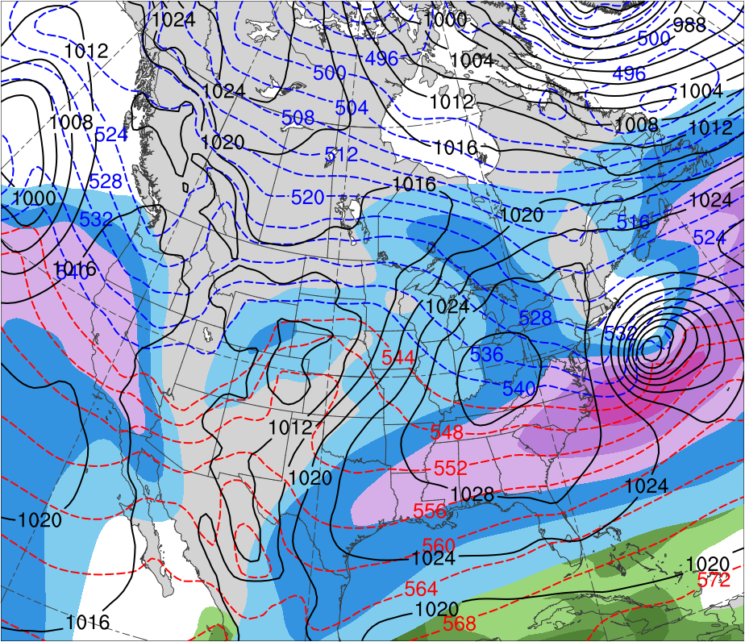
Presidents’ Day Storm of 1979
0000 UTC 20 Feb 1979
Data Source: ERA-Interim
CTD
L
(K)
252
258
264
270
276
282
288
294
300
306
312
318
324
330
336
342
348
354
360
366
372
378
(mm)
(m s⁻¹ )
25
30
35
40
45
50
55
30
40
50
60
70
80
90
100
Potential temperature (K, shaded), wind speed (black, every 10 m s⁻¹ starting at 30 m s⁻¹), and wind (m s⁻¹, flags and barbs) on 2-PVU surface
250-hPa wind speed (m s⁻¹, shaded),
1000–500-hPa thickness (dam, blue/red),
SLP (hPa, black), PW (mm, shaded)

Slide 21
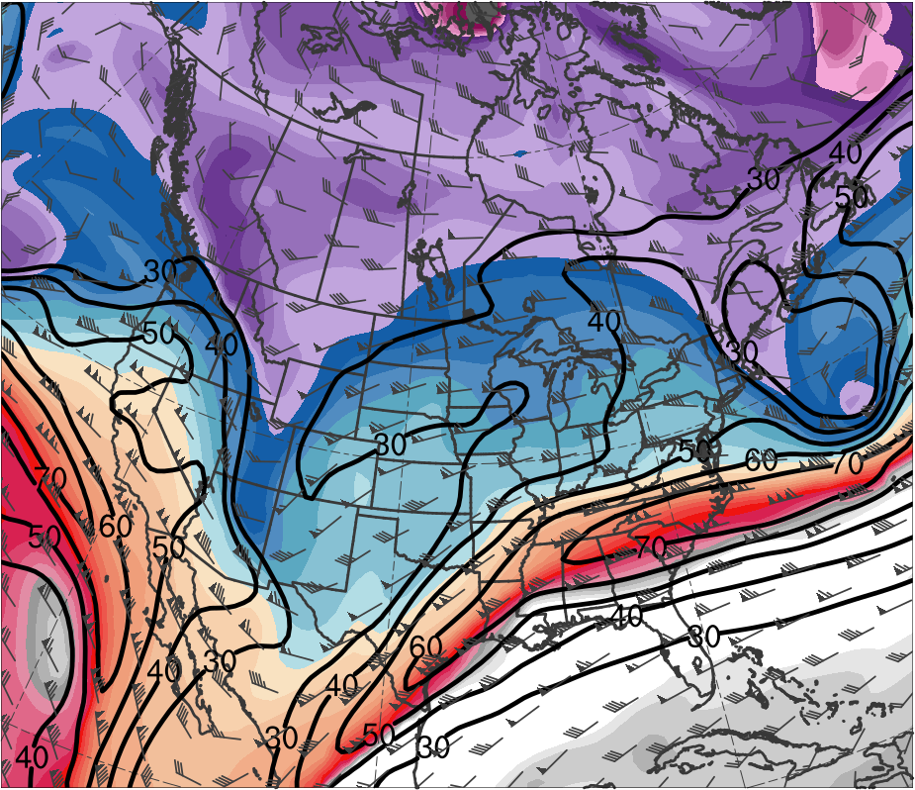
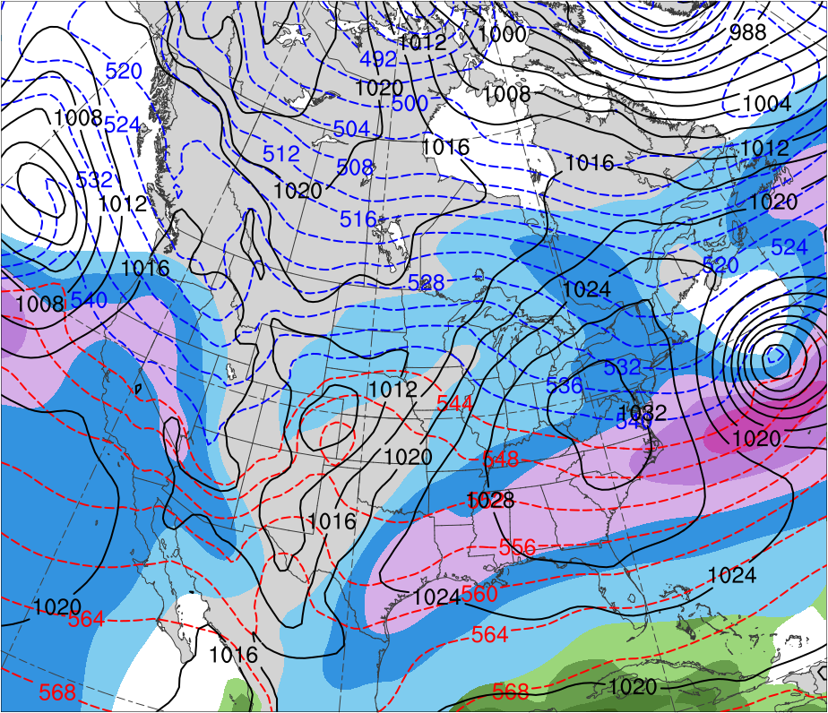
Presidents’ Day Storm of 1979
0600 UTC 20 Feb 1979
Data Source: ERA-Interim
CTD
L
(K)
252
258
264
270
276
282
288
294
300
306
312
318
324
330
336
342
348
354
360
366
372
378
(mm)
(m s⁻¹ )
25
30
35
40
45
50
55
30
40
50
60
70
80
90
100
Potential temperature (K, shaded), wind speed (black, every 10 m s⁻¹ starting at 30 m s⁻¹), and wind (m s⁻¹, flags and barbs) on 2-PVU surface
250-hPa wind speed (m s⁻¹, shaded),
1000–500-hPa thickness (dam, blue/red),
SLP (hPa, black), PW (mm, shaded)

Slide 22
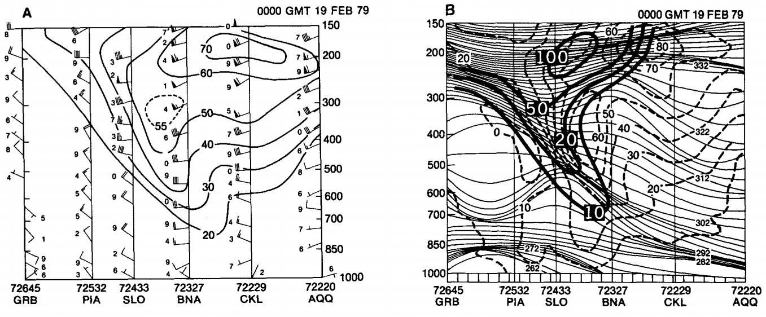
Presidents’ Day Storm of 1979
Uccellini et al. (1985)
(top) Isentropic analysis for 312 K surface for 0000 UTC 19 Feb 1979, including Montgomery streamfunction (solid, 100 = 3.100 × 10⁵ m² s⁻²), isotachs (dot dashed, m s⁻¹), and wind (barbs, m s⁻¹). Fig. 5 adapted from Uccellini et al. 1985.
(bottom) Vertical cross sections for 0000 UTC 19 Feb 1979. (left) Total wind speed (solid, m s⁻¹). (right) Isentropes (solid, K), geostrophic wind (dashed, m s⁻¹), and PV (heavy solid where 10 = 10 × 10⁻⁶ K mb⁻¹ s⁻¹). Fig. 10 adapted from Uccellini et al. 1985.

Slide 23
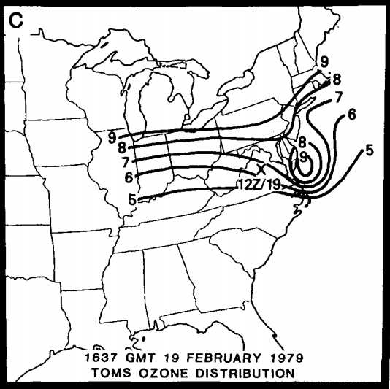
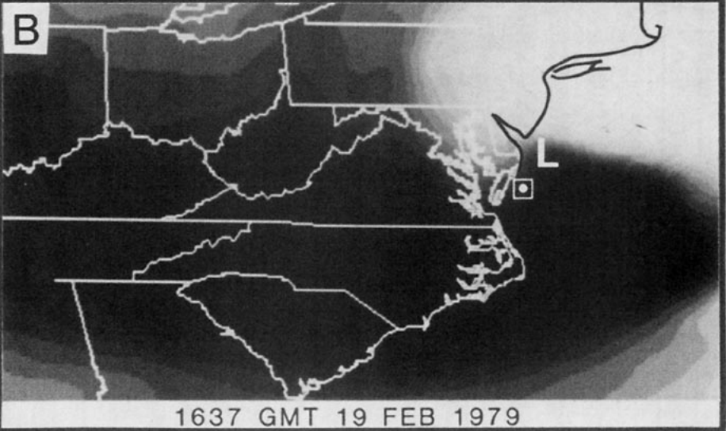
Presidents’ Day Storm of 1979
Uccellini et al. (1985)
(left) Water vapor infrared imagery from the Temperature-Humidity Infrared Radiometer (THIR) on Nimbus 7 for 1637 GMT 19 Feb 1979. Box indicates position of ozone maximum measured by the Total Ozone Mapping Spectrometer (TOMS). L indicates estimated position of surface low for 1500 GMT. Fig. 4 adapted from Uccellini et al. (1985).
(right) Total ozone distribution measured by TOMS for 1637 GMT 19 Feb 1979. Analysis in Dobson units (1 DU = 10⁻³ atm-cm) where contour interval is as follows: 5 to 6 (325–339 DU); 6 to 7 (340–354 DU); 7 to 8 (355–369 DU); 8 to 9 (370–384 DU); 9 to 10 (385–400 DU). Location marked with “x” denotes position of maximum potential vorticity on 292 K surface at 1200 UTC 19 Feb 1979. Fig. 11 adapted from Uccellini et al. (1985).

