Slide 1
A Multiscale Analysis and Predictability Study of a Polar Low Linked to a Tropopause Polar Vortex
Kevin A. Biernat, Daniel Keyser, and Lance F. Bosart
Department of Atmospheric and Environmental Sciences
University at Albany, SUNY
29th AMS Conference on Weather Analysis and Forecasting
Tuesday 5 June 2018
Research Supported by NSF Grant AGS-1355960 and ONR Grant N00014-18-1-2200

Slide 2
What are Tropopause Polar Vortices (TPVs)?
TPVs are defined as tropopause-based vortices of high-latitude origin and are material features (Pyle et al. 2004; Cavallo and Hakim 2009, 2010, 2012, 2013)
TPV
TPV
(left) Dynamic tropopause (DT) wind speed (every 15 m s⁻¹ starting at 50 m s⁻¹, thick contours) and DT potential temperature (K, thin contours and shading) on 1.5-PVU surface valid at 0000 UTC 1 Dec 1991; (right) same as left except DT pressure (hPa, thin contours and shading). Adapted from Fig. 11 in Pyle et al. (2004).

Slide 3
What are Polar Lows?
Polar lows are small, intense cyclones characterized by horizontal scales from 10s to 100s of km, short lifetimes, and rapid evolution (e.g., Rasmussen and Turner 2003)
Polar lows often form within a cold air mass or along an Arctic front at the leading edge of a cold air mass moving over warmer sea surfaces in high latitudes (e.g., Shapiro et al. 1987)

Slide 4
Motivation
Polar lows may be associated with strong surface winds and heavy precipitation, posing hazards to ships and infrastructure (e.g., Businger and Reed 1989)
TPVs may act as precursors to the development of polar lows (e.g. Kolstad 2011)

Slide 5
Outline
Analyze the evolution of a polar low that is linked to a TPV
Investigate factors influencing the predictability of the evolution of the polar low

Slide 6
Climatology of Polar Lows
Obtain polar lows from Sea Surface Temperature and Altimeter Synergy for Improved Forecasting of Polar lows (STARS) database of polar lows over the Norwegian Sea and Barents Sea (Sætra et al. 2010)
STARS database covers the 2002–2011 period, for a total of 140 polar lows.
Link for STARS Database: http://polarlow.met.no/stars-dat/

Slide 7
Climatology of Polar Lows Linked to TPVs
Compare STARS database to a 1979–2015 database of TPVs constructed using the ERA-Interim (Dee et al. 2011) and a TPV tracking algorithm developed by Nicholas Szapiro and Steven Cavallo
Determine which polar lows may be linked to TPVs by requiring that a polar low be located within 500 km of at least one TPV at any point in the lifetime of the polar low
Link for Tracking Algorithm: https://github.com/nickszap/tpvTrack

Slide 8
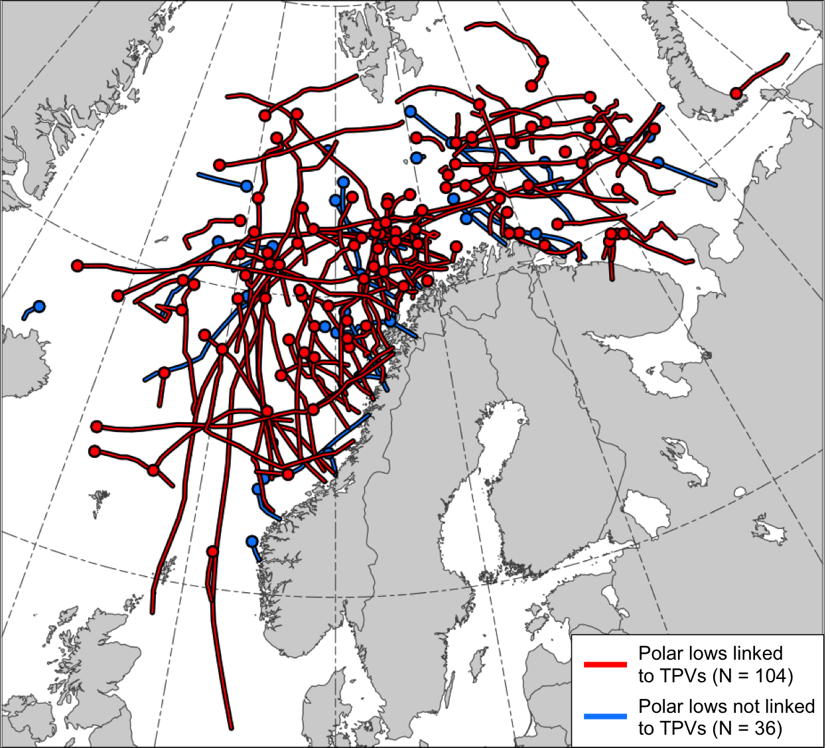
Climatology of Polar Lows Linked to TPVs
104 out of the total 140 polar lows, or 74.3%, match with at least one TPV
Tracks of the polar lows in the STARS database. Tracks of polar lows linked to TPVs (red) and tracks of polar lows not linked to TPVs (blue). Dots indicate the genesis locations of the polar lows.

Slide 9
Case Selection
Use the ERA5 (Hersbach and Dee 2016) for analysis of a polar low case
ERA5 downloaded at 0.3° horizontal resolution
Choose a case for which a polar low is capable of being tracked in the ERA5
Choose a case for which the polar low is clearly related to a single TPV

Slide 10
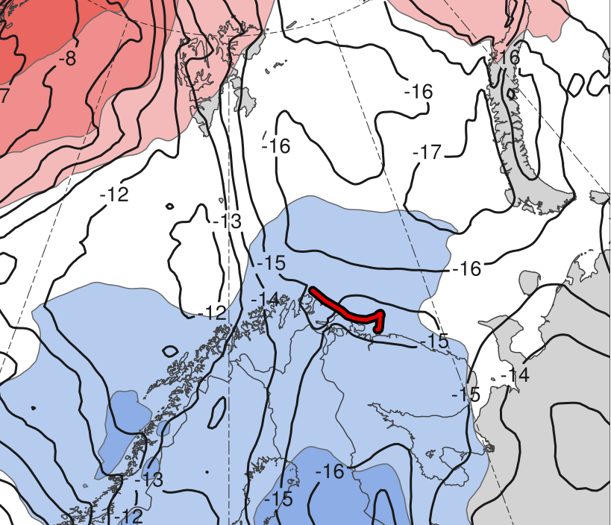
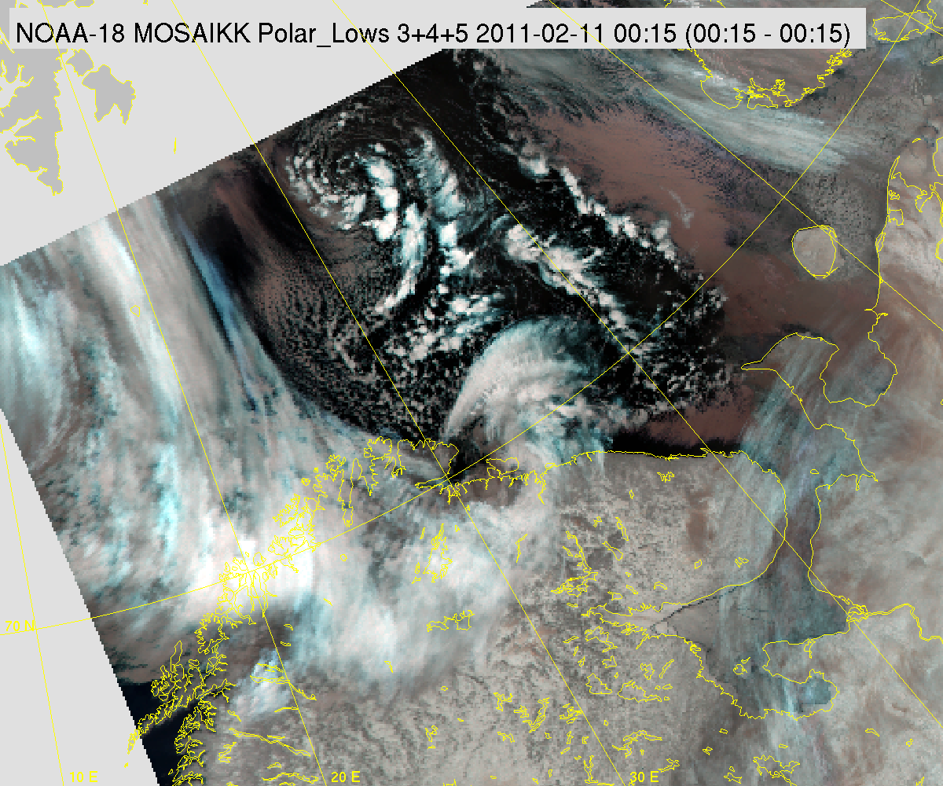
The Polar Low
(a)
(b)
Genesis
Lysis
(a) Track of polar low (red) and 10–11 Feb 2011 time mean 850-hPa temperature (K) and standardized anomaly of 850-hPa temperature (σ, shaded).
(b) NOAA Advanced Very High Resolution Radiometer IR satellite image valid at 0015 UTC 11 Feb 2011. Image obtained from the STARS database.
(σ)
-2
-1.5
-1
-0.5
0
0.5
1
1.5
2
Genesis | Lysis | Lifetime
1800 UTC 10 Feb 2011 | 1200 UTC 11 Feb 2011 | 18 h
Link for STARS Database: http://polarlow.met.no/stars-dat/

Slide 11
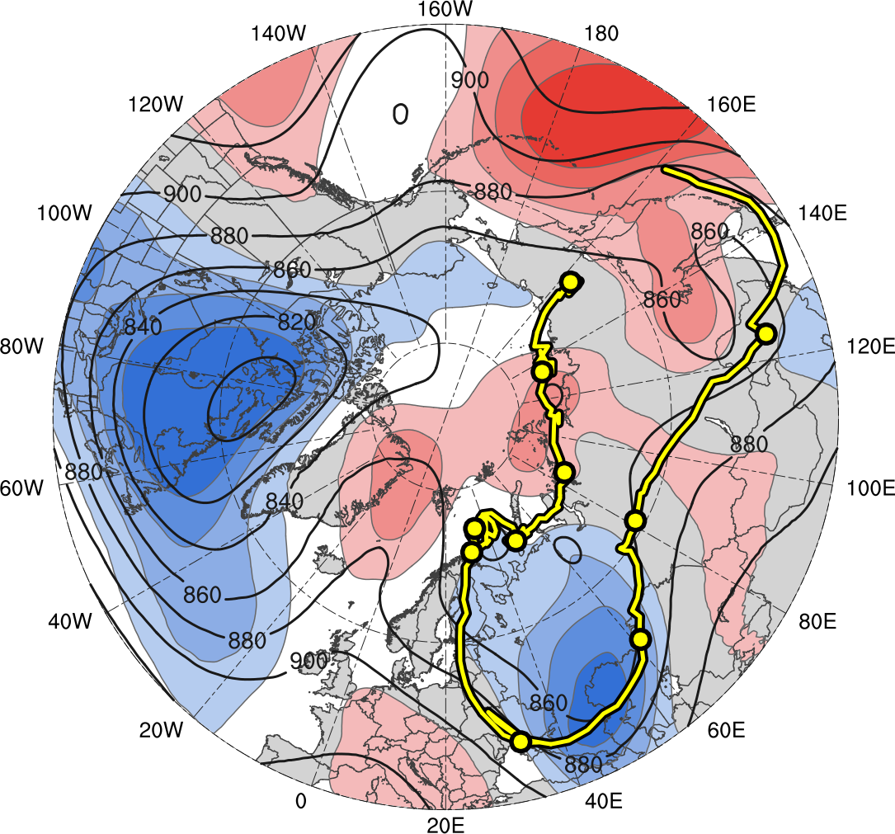
The Polar Low and TPV
(a)
(b)
1
3
19
5
9
17
11
7
15
13
(σ)
Genesis
Lysis
0000 UTC positions
(every 48 h)
-2
-1.5
-1
-0.5
0
0.5
1
1.5
2
Track of (a) polar low (red) and (b) the TPV linked to the polar low (yellow). Also, the 10–11 Feb 2011 time-mean (a) 850-hPa temperature (K, black) and standardized anomaly of 850-hPa temperature (σ, shaded), and (b) 300-hPa geopotential height (dam) and standardized anomaly of 300-hPa geopotential height (σ, shaded).
Feature | Genesis | Lysis | Lifetime
PL | 10 Feb | 11 Feb | 18 h
TPV | 31 Jan | 20 Feb | 20 d

Slide 12
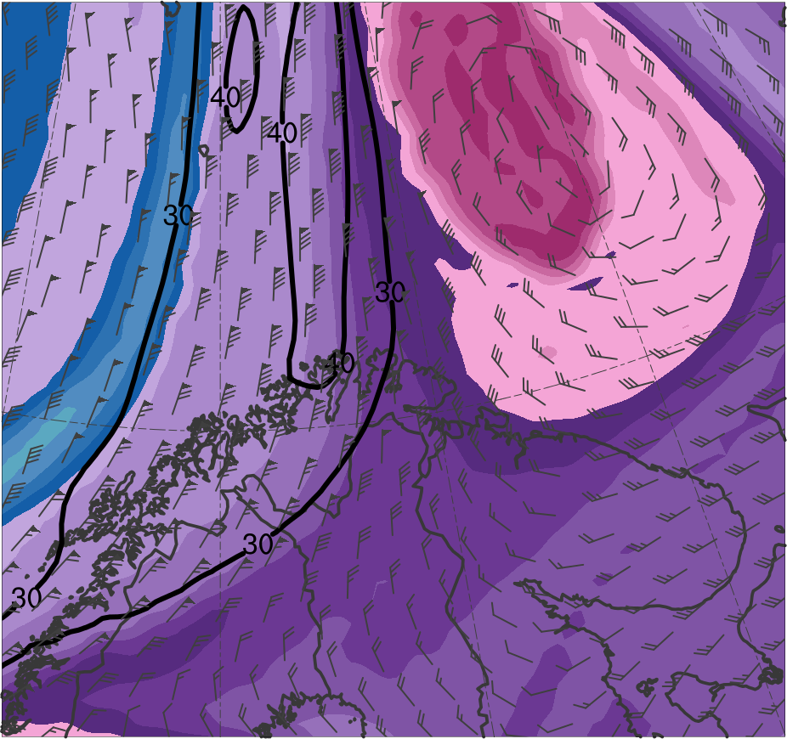
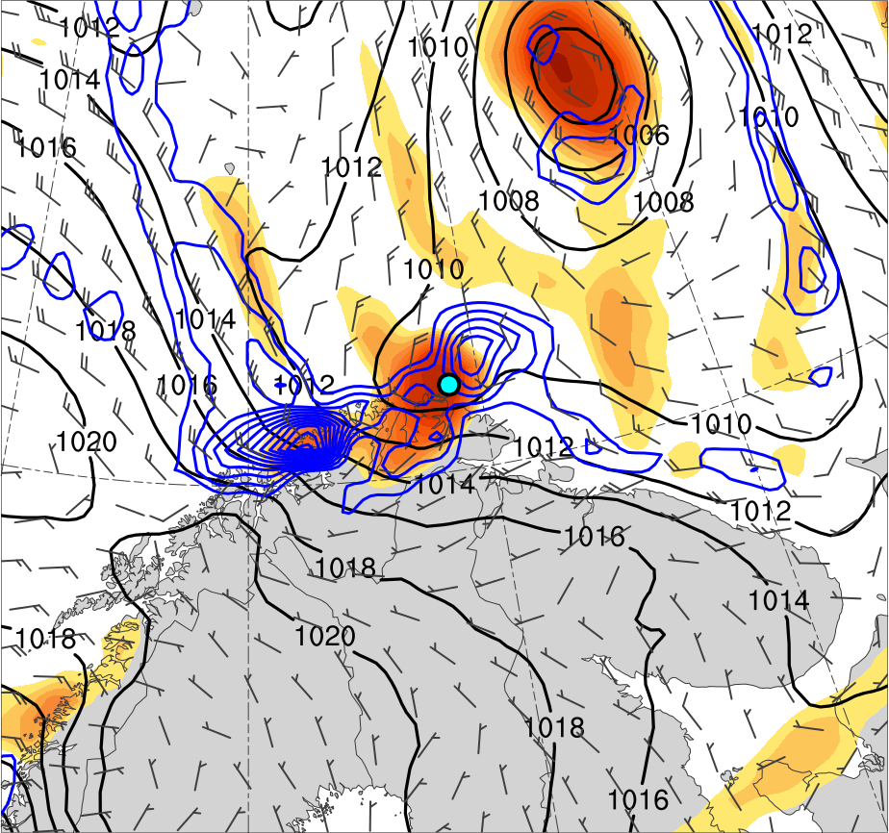
Mesoscale Evolution
1800 UTC 10 Feb 2011
TPV
PL
(K)
252
258
264
270
276
282
288
294
300
306
312
318
324
330
336
342
348
354
360
366
372
378
4
6
8
10
12
14
16
18
20
25
30
35
40
Potential temperature (K, shaded), wind speed (black, every 10 m s⁻¹ starting at 30 m s⁻¹), and wind (m s⁻¹, flags and barbs) on 2-PVU surface
850-hPa relative vorticity (10⁻⁵ s⁻¹, shaded),
850–600-hPa ascent (blue, every 2.5 × 10⁻³ hPa s⁻¹),
SLP (hPa, black), and 10-m wind (m s⁻¹, barbs)

Slide 13
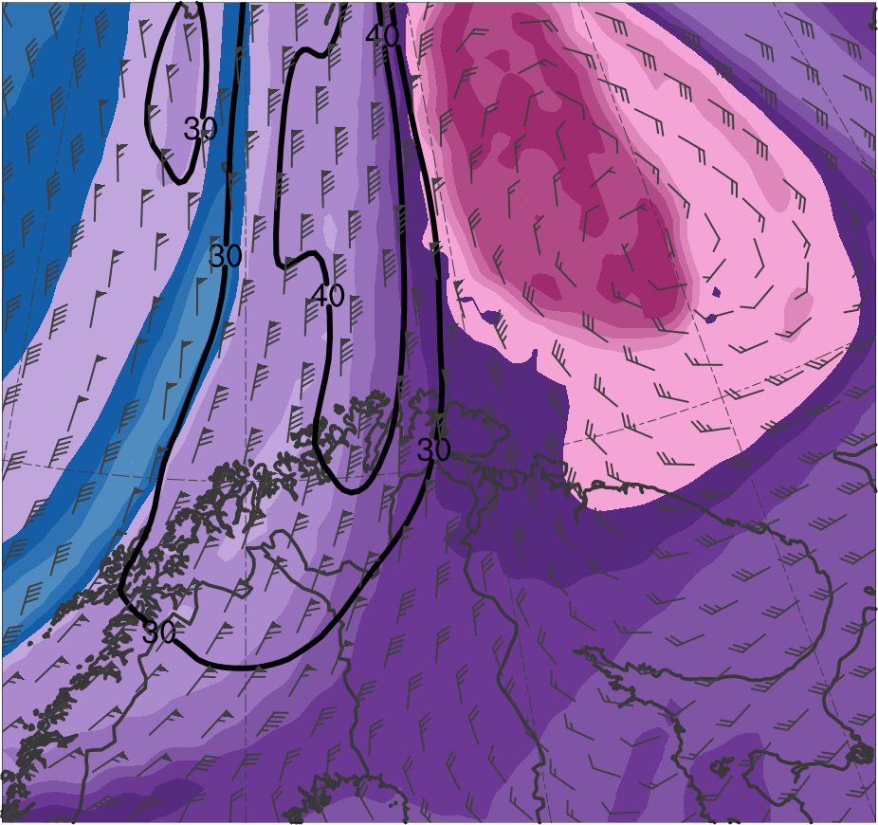
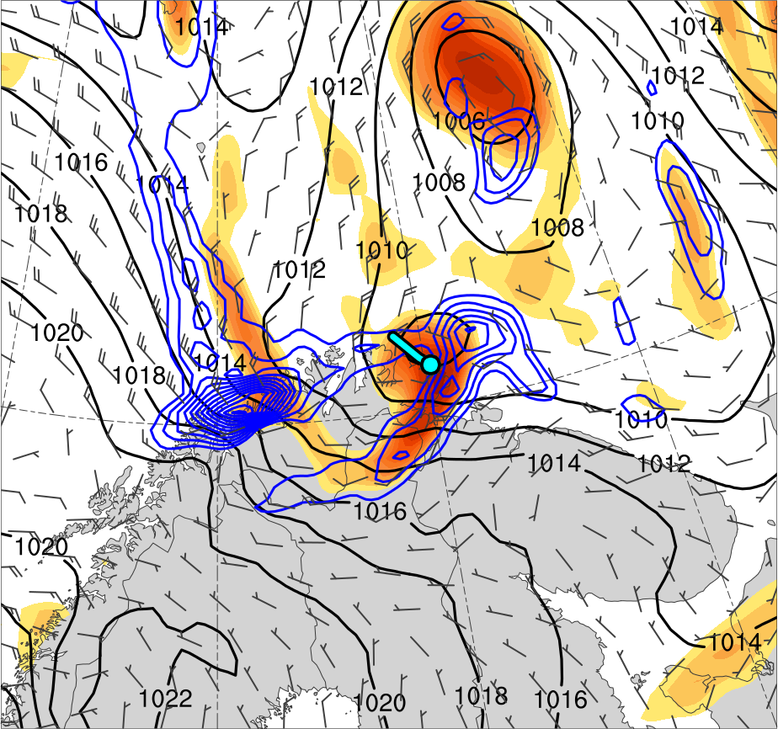
Mesoscale Evolution
2100 UTC 10 Feb 2011
TPV
PL
(K)
252
258
264
270
276
282
288
294
300
306
312
318
324
330
336
342
348
354
360
366
372
378
4
6
8
10
12
14
16
18
20
25
30
35
40
Potential temperature (K, shaded), wind speed (black, every 10 m s⁻¹ starting at 30 m s⁻¹), and wind (m s⁻¹, flags and barbs) on 2-PVU surface
850-hPa relative vorticity (10⁻⁵ s⁻¹, shaded),
850–600-hPa ascent (blue, every 2.5 × 10⁻³ hPa s⁻¹),
SLP (hPa, black), and 10-m wind (m s⁻¹, barbs)

Slide 14
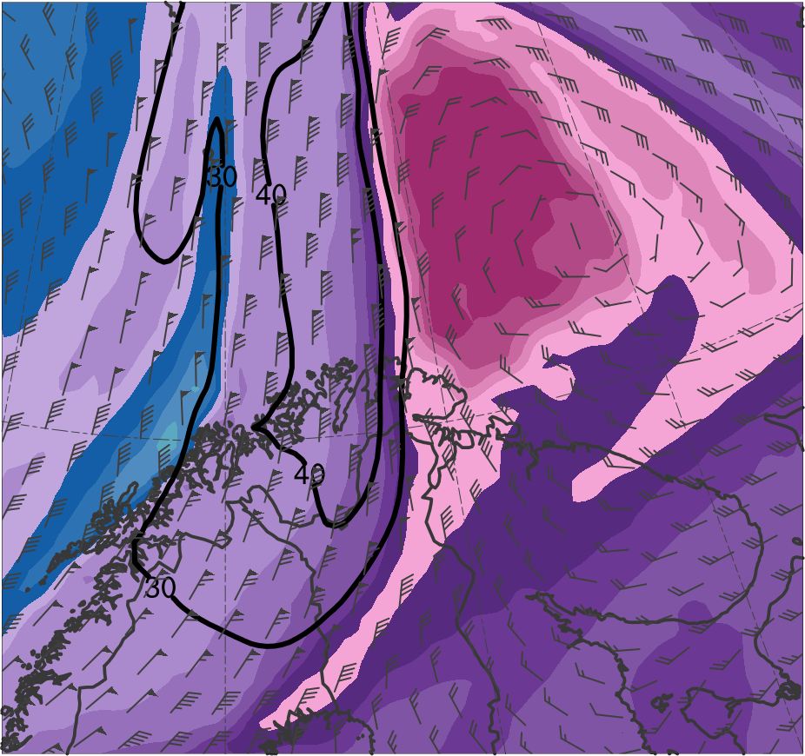
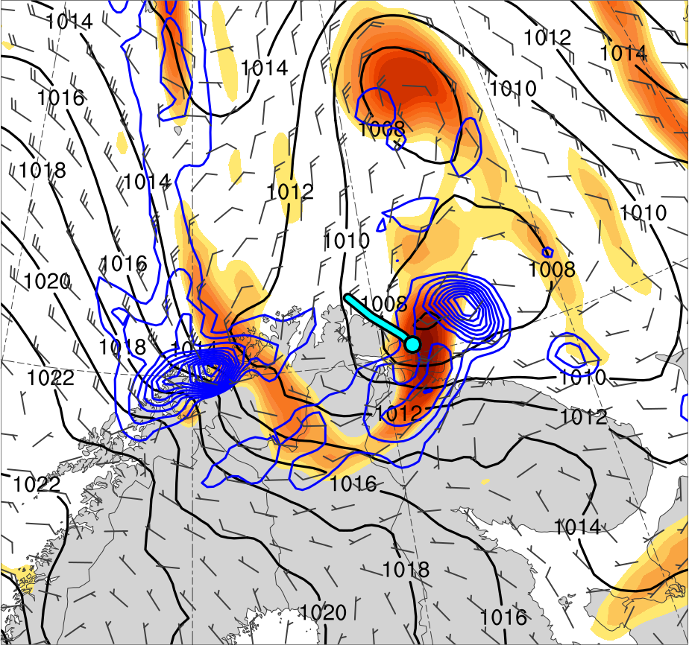
Mesoscale Evolution
0000 UTC 11 Feb 2011
TPV
PL
(K)
252
258
264
270
276
282
288
294
300
306
312
318
324
330
336
342
348
354
360
366
372
378
4
6
8
10
12
14
16
18
20
25
30
35
40
Potential temperature (K, shaded), wind speed (black, every 10 m s⁻¹ starting at 30 m s⁻¹), and wind (m s⁻¹, flags and barbs) on 2-PVU surface
850-hPa relative vorticity (10⁻⁵ s⁻¹, shaded),
850–600-hPa ascent (blue, every 2.5 × 10⁻³ hPa s⁻¹),
SLP (hPa, black), and 10-m wind (m s⁻¹, barbs)

Slide 15
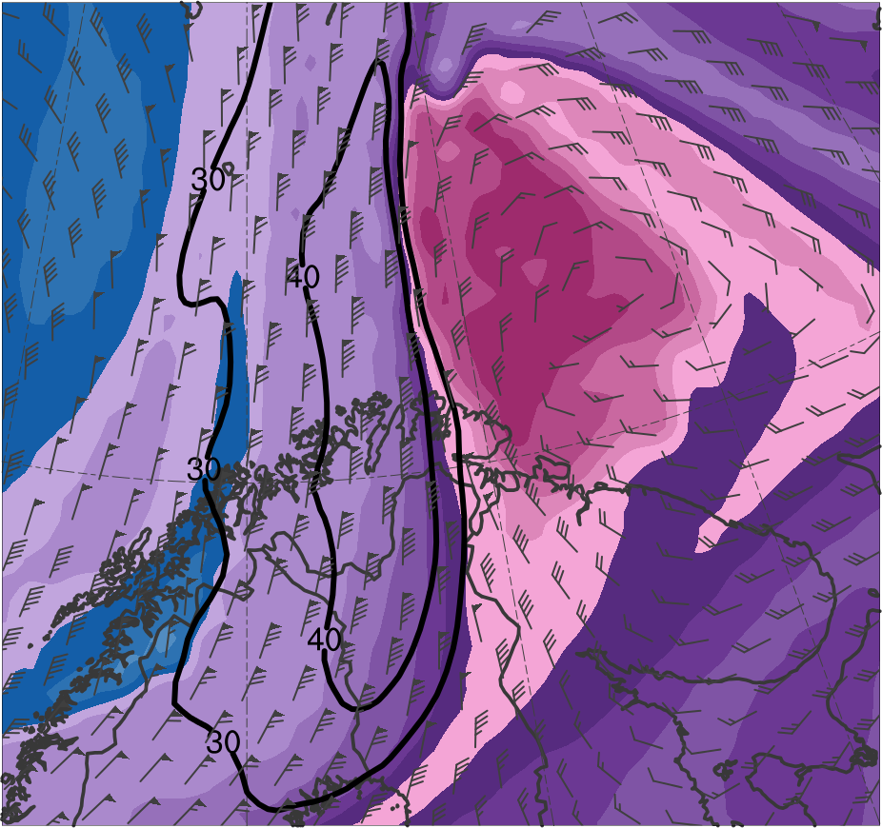
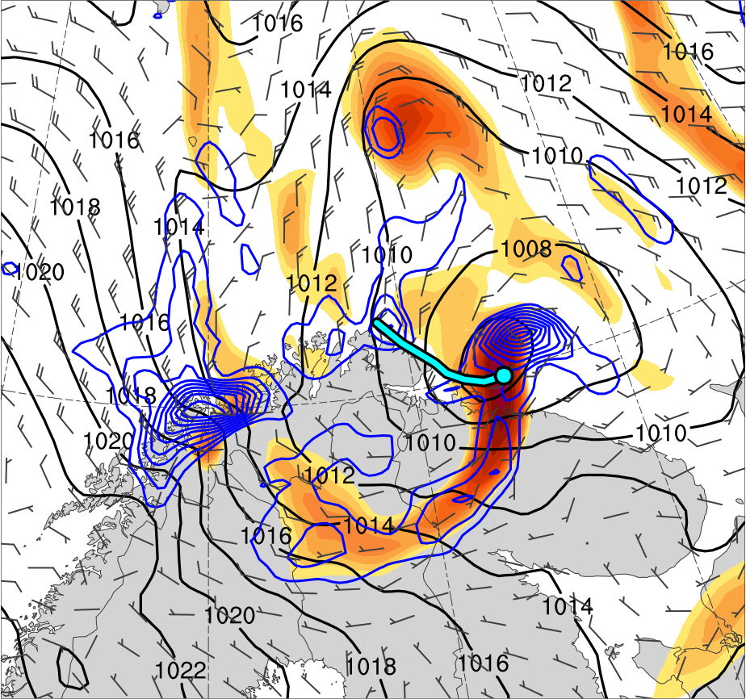
Mesoscale Evolution
0300 UTC 11 Feb 2011
TPV
PL
(K)
252
258
264
270
276
282
288
294
300
306
312
318
324
330
336
342
348
354
360
366
372
378
4
6
8
10
12
14
16
18
20
25
30
35
40
Potential temperature (K, shaded), wind speed (black, every 10 m s⁻¹ starting at 30 m s⁻¹), and wind (m s⁻¹, flags and barbs) on 2-PVU surface
850-hPa relative vorticity (10⁻⁵ s⁻¹, shaded),
850–600-hPa ascent (blue, every 2.5 × 10⁻³ hPa s⁻¹),
SLP (hPa, black), and 10-m wind (m s⁻¹, barbs)

Slide 16
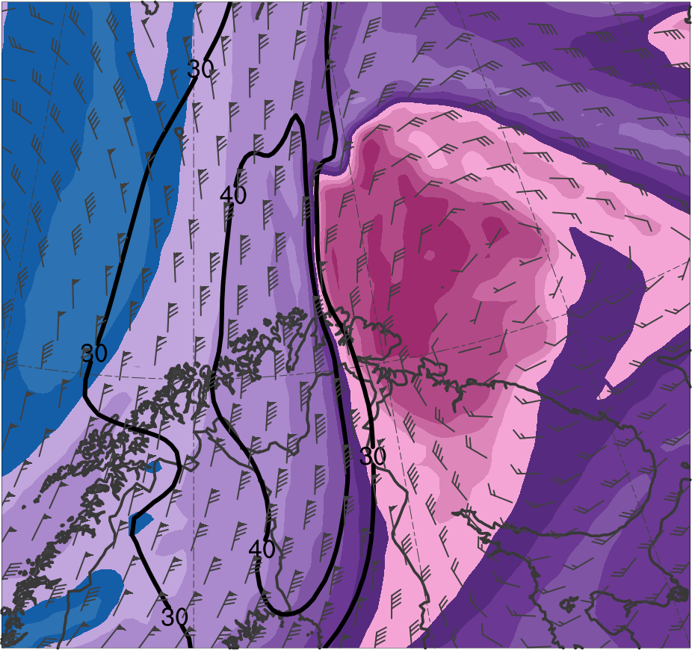
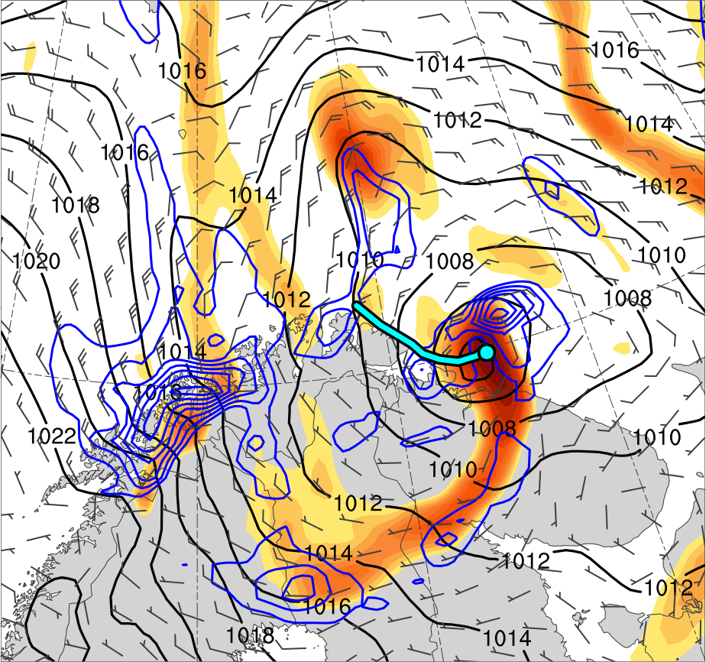
Mesoscale Evolution
0600 UTC 11 Feb 2011
TPV
PL
(K)
252
258
264
270
276
282
288
294
300
306
312
318
324
330
336
342
348
354
360
366
372
378
4
6
8
10
12
14
16
18
20
25
30
35
40
Potential temperature (K, shaded), wind speed (black, every 10 m s⁻¹ starting at 30 m s⁻¹), and wind (m s⁻¹, flags and barbs) on 2-PVU surface
850-hPa relative vorticity (10⁻⁵ s⁻¹, shaded),
850–600-hPa ascent (blue, every 2.5 × 10⁻³ hPa s⁻¹),
SLP (hPa, black), and 10-m wind (m s⁻¹, barbs)

Slide 17
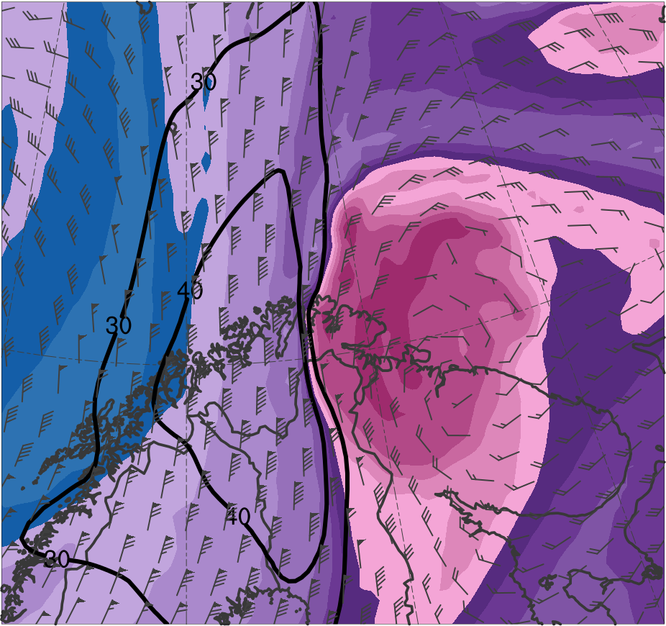
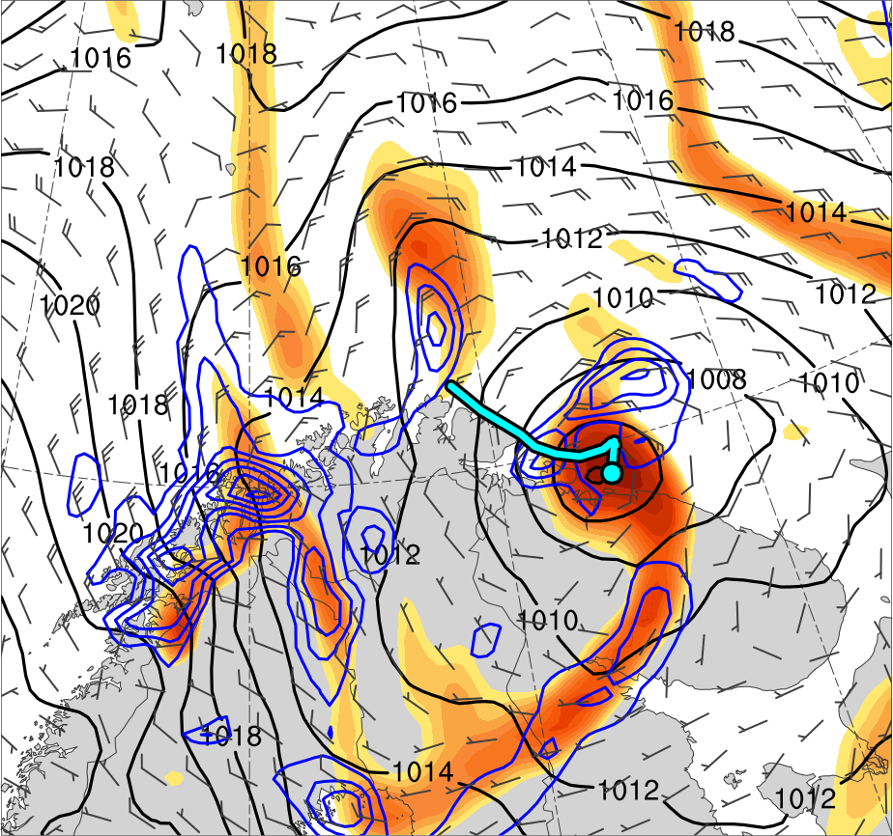
Mesoscale Evolution
0900 UTC 11 Feb 2011
TPV
PL
(K)
252
258
264
270
276
282
288
294
300
306
312
318
324
330
336
342
348
354
360
366
372
378
4
6
8
10
12
14
16
18
20
25
30
35
40
Potential temperature (K, shaded), wind speed (black, every 10 m s⁻¹ starting at 30 m s⁻¹), and wind (m s⁻¹, flags and barbs) on 2-PVU surface
850-hPa relative vorticity (10⁻⁵ s⁻¹, shaded),
850–600-hPa ascent (blue, every 2.5 × 10⁻³ hPa s⁻¹),
SLP (hPa, black), and 10-m wind (m s⁻¹, barbs)

Slide 18
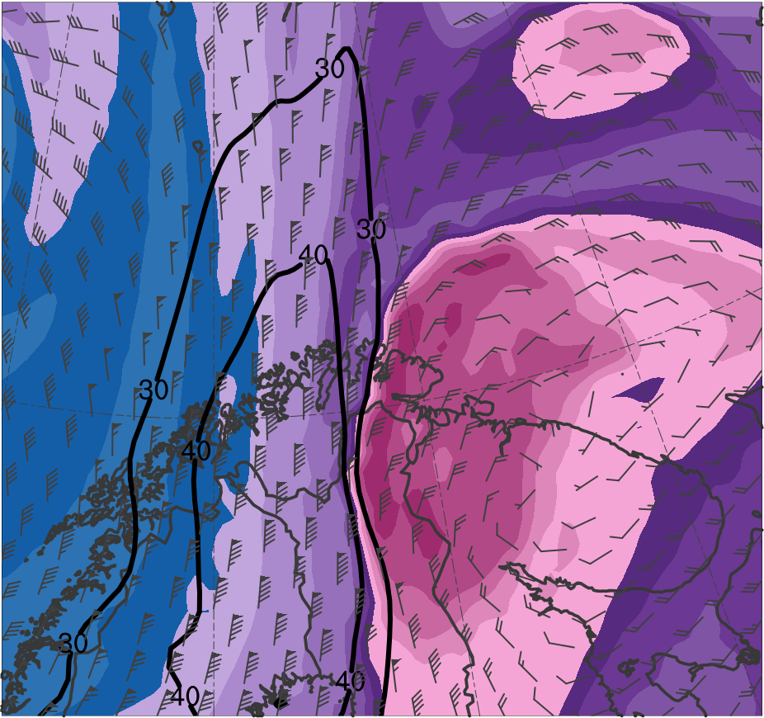
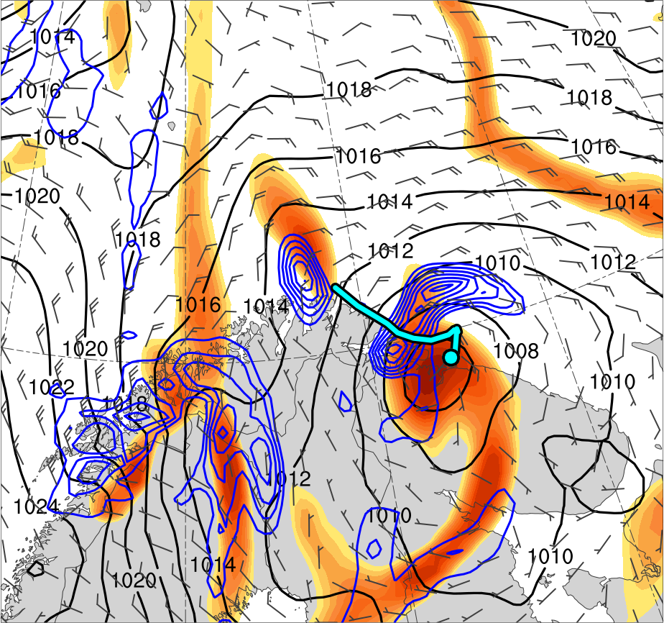
Mesoscale Evolution
1200 UTC 11 Feb 2011
TPV
PL
(K)
252
258
264
270
276
282
288
294
300
306
312
318
324
330
336
342
348
354
360
366
372
378
4
6
8
10
12
14
16
18
20
25
30
35
40
Potential temperature (K, shaded), wind speed (black, every 10 m s⁻¹ starting at 30 m s⁻¹), and wind (m s⁻¹, flags and barbs) on 2-PVU surface
850-hPa relative vorticity (10⁻⁵ s⁻¹, shaded),
850–600-hPa ascent (blue, every 2.5 × 10⁻³ hPa s⁻¹),
SLP (hPa, black), and 10-m wind (m s⁻¹, barbs)

Slide 19
Summary
The evolution of the polar low appears to be related to the interaction between the TPV and a tropospheric-deep baroclinic zone
Forcing for ascent associated with the TPV and a favorable thermodynamic environment likely play an important role in supporting
the relatively strong lower-to-midtropospheric ascent associated with the polar low
the intensification of the polar low

Slide 20
Outline
Analyze the evolution of a polar low that is linked to a TPV
Investigate factors influencing the predictability of the evolution of the polar low

Slide 21
Evaluating Forecast Skill of the Polar Low
Use ECMWF Ensemble Prediction System (EPS; Buizza et al. 2007) from TIGGE (Bougeault et al. 2010) initialized at 1200 UTC 9 February 2011
30 h prior to genesis of polar low
0.5° horizontal resolution
Use ERA5 regridded to 0.5° horizontal resolution as verification

Slide 22
Evaluating Forecast Skill of the Polar Low
Assess forecast skill of polar low in terms of a metric combining track error and intensity error of polar low
Calculate metric by adapting methodology used by Lamberson et al. (2016) to evaluate forecast skill of a strong extratropical cyclone
Calculate track error and intensity error every 6 h from 1800 UTC 10 Feb 2011 to 1200 UTC 11 Feb 2011 for each member

Slide 23
Evaluating Forecast Skill of the Polar Low
Calculate track error as the distance between the location of the polar low in ERA5 and in each member
Location of the polar low corresponds to location of the maximum value of 850-hPa relative vorticity of the polar low
Calculate intensity error as the absolute difference in intensity of the polar low in ERA5 and in each member
Intensity of the polar low corresponds to the maximum value of 850-hPa relative vorticity of the polar low

Slide 24
Evaluating Forecast Skill of the Polar Low
Average errors over time and rank members 1–51 for both track and intensity, with 1 corresponding to member with lowest average error
Add track error rank to intensity error rank to determine a combined track and intensity error rank for each member
Subdivide members into two groups: one containing the eight most accurate members and one containing the eight least accurate members in terms of combined track and intensity error rank

Slide 25
Calculating Normalized Composite Differences
Calculate normalized composite differences between the most accurate and least accurate groups for selected quantities following Lamberson et al. (2016)
= mean of the ith state variable for most accurate members
= mean of the ith state variable for least accurate members
= ensemble standard deviation of x_{i} computed for all members

Slide 26
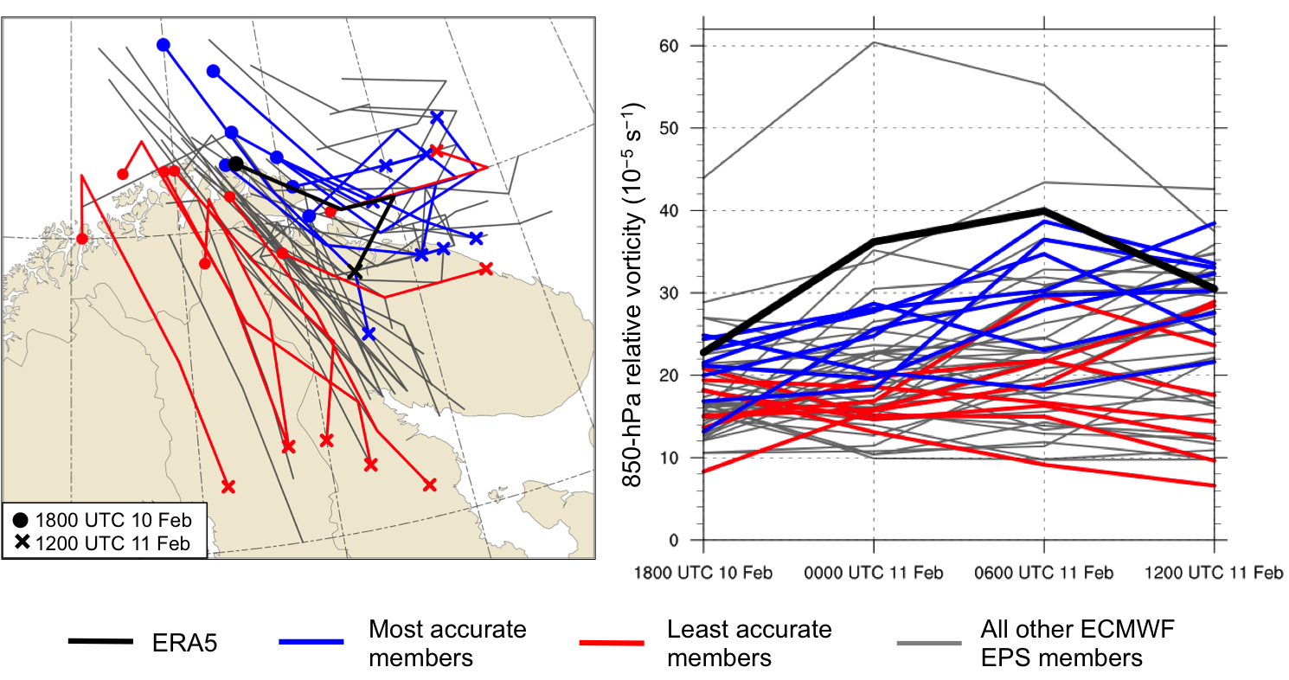
Track and Intensity
(a)
(b)
(a) Track and (b) intensity of 850-hPa relative vorticity maximum (10⁻⁵ s⁻¹) associated with polar low, every 6 h during 1800 UTC 10–1200 UTC 11 February 2011 for ERA5 (black), most accurate members (blue), least accurate members (red), and all other ECMWF EPS members (gray)

Slide 27
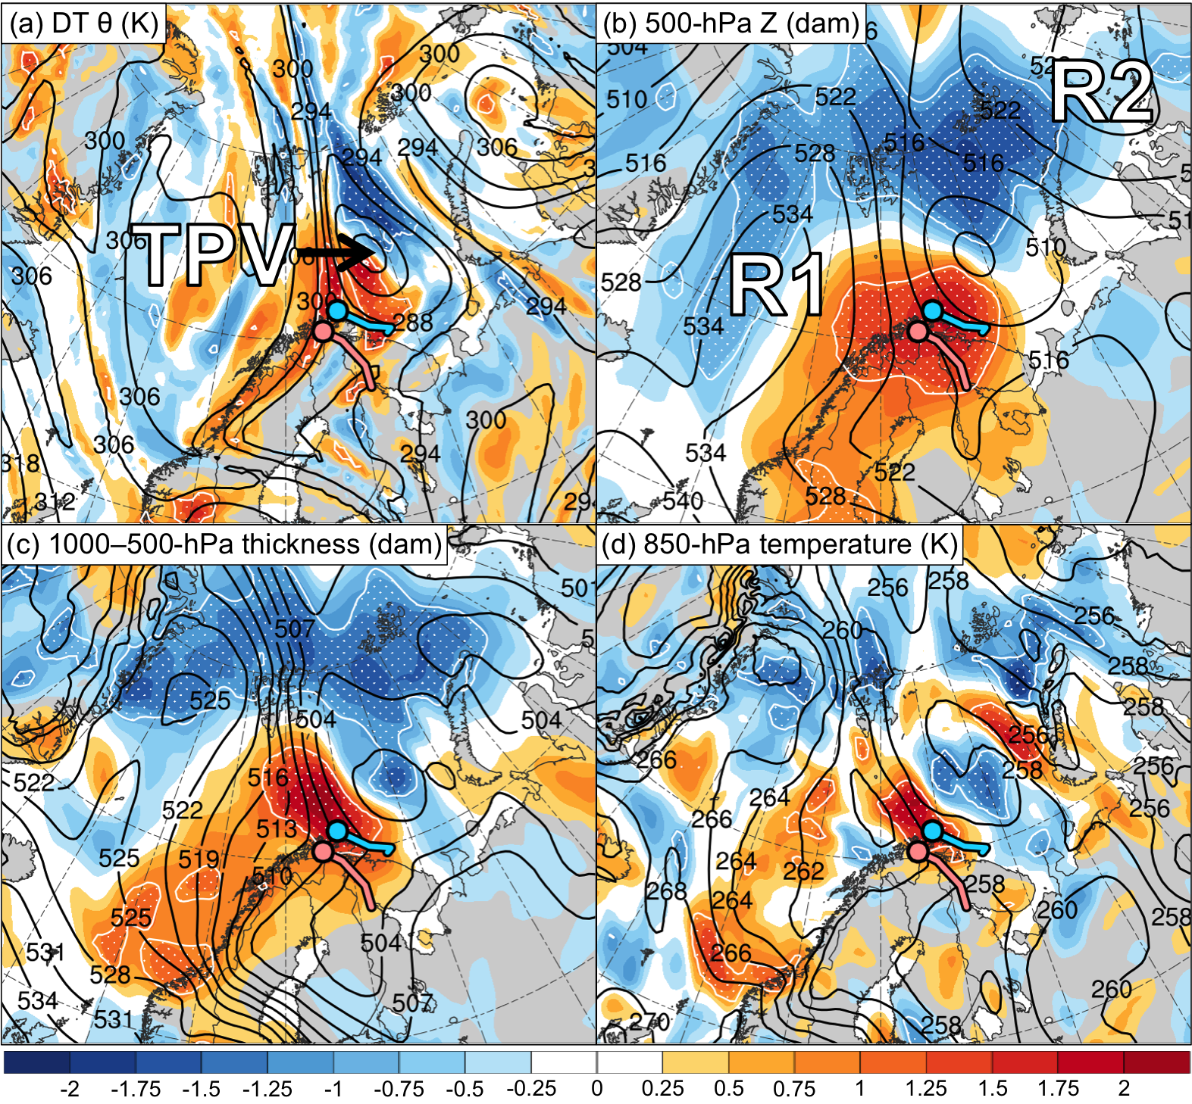
Composite Differences
1800 UTC 10 Feb 2011 (30 h)
Ensemble mean
shading: normalized composite differences (most accurate minus least accurate; units:
standardized anomaly)
stippling: statistically significant differences between groups at 95% confidence level according to a two-sided Student’s t test
Mean position of PL in most accurate group*
Mean position of PL in least accurate group*
*Corresponding line shows mean track of PL from 1800 UTC 10 to 1200 UTC 11 Feb 2011

Slide 28
Summary
Composite differences between the most accurate and least accurate groups suggest that the TPV is positioned farther northward and the tropospheric-deep baroclinic zone farther eastward in the most accurate group
The differences in position of the TPV and baroclinic zone likely contribute to the farther northward and eastward track of the polar low in the most accurate group
The more conducive thermodynamic environment for polar low development in the most accurate group may contribute to the polar low being stronger in the most accurate group

Slide 29
Conclusions
The results of this study show that
The interaction between a TPV and a tropospheric-deep baroclinic zone is shown to play an important role in the evolution of a polar low
Forecast differences in the positions of the TPV and the baroclinic zone are shown to contribute to significant forecast differences in the track and intensity of the polar low

Slide 30
Questions? Email: kbiernat@albany.edu
The results of this study show that
The interaction between a TPV and a tropospheric-deep baroclinic zone is shown to play an important role in the evolution of a polar low
Forecast differences in the positions of the TPV and the baroclinic zone are shown to contribute to significant forecast differences in the track and intensity of the polar low
Acknowledgments
Jeremy Berman

Slide 31
Supplementary Figures

Slide 32
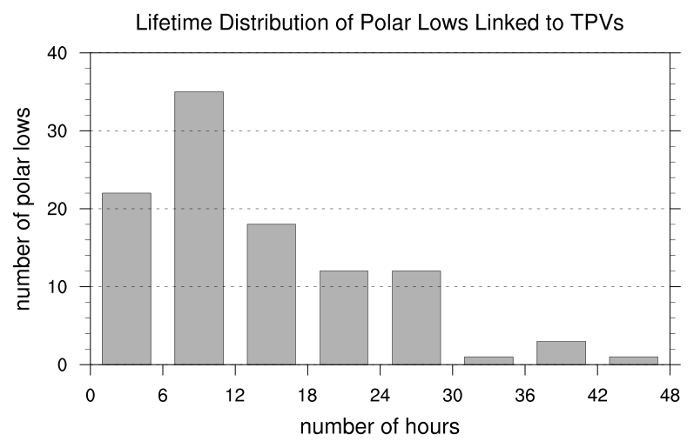
Climatology of Polar Lows Linked to TPVs
N = 104
Mean: 12.9 h
Median: 9 h
Lifetime distribution of polar lows linked to TPVs, with lifetime in number of hours.

Slide 33
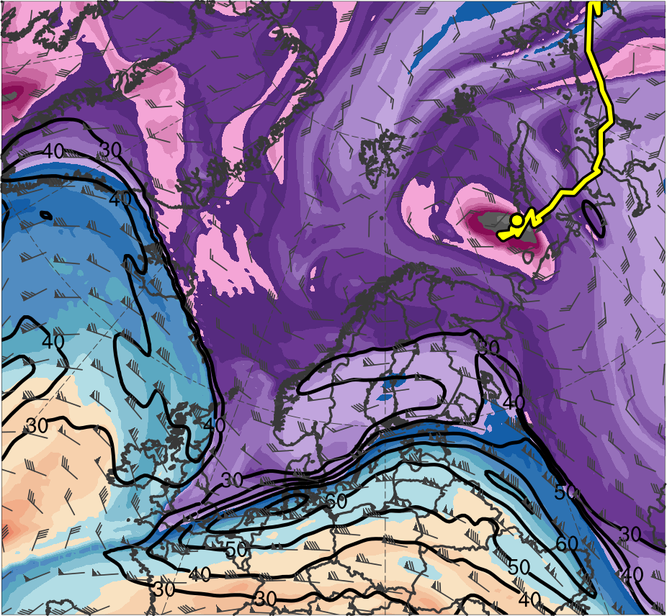
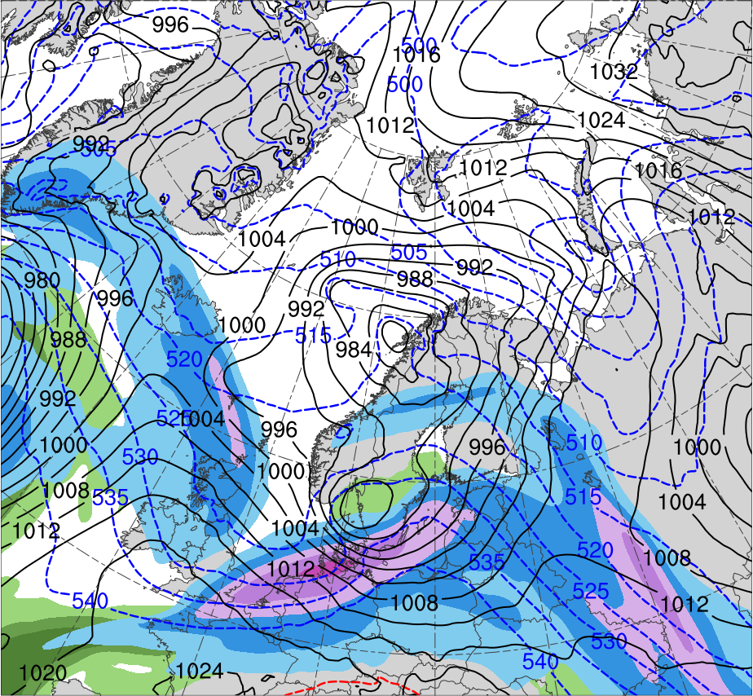
Synoptic Evolution
0000 UTC 8 Feb 2011
R1
TPV
(K)
252
258
264
270
276
282
288
294
300
306
312
318
324
330
336
342
348
354
360
366
372
378
(m s⁻¹ )
(mm)
30
40
50
60
70
80
90
100
10
15
20
25
30
35
40
Potential temperature (K, shaded), wind speed (black, every 10 m s⁻¹ starting at 30 m s⁻¹), and wind (m s⁻¹, flags and barbs) on 2-PVU surface
300-hPa wind speed (m s⁻¹, shaded),
1000–500-hPa thickness (dam, blue/red),
SLP (hPa, black), and PW (mm, shaded)

Slide 34
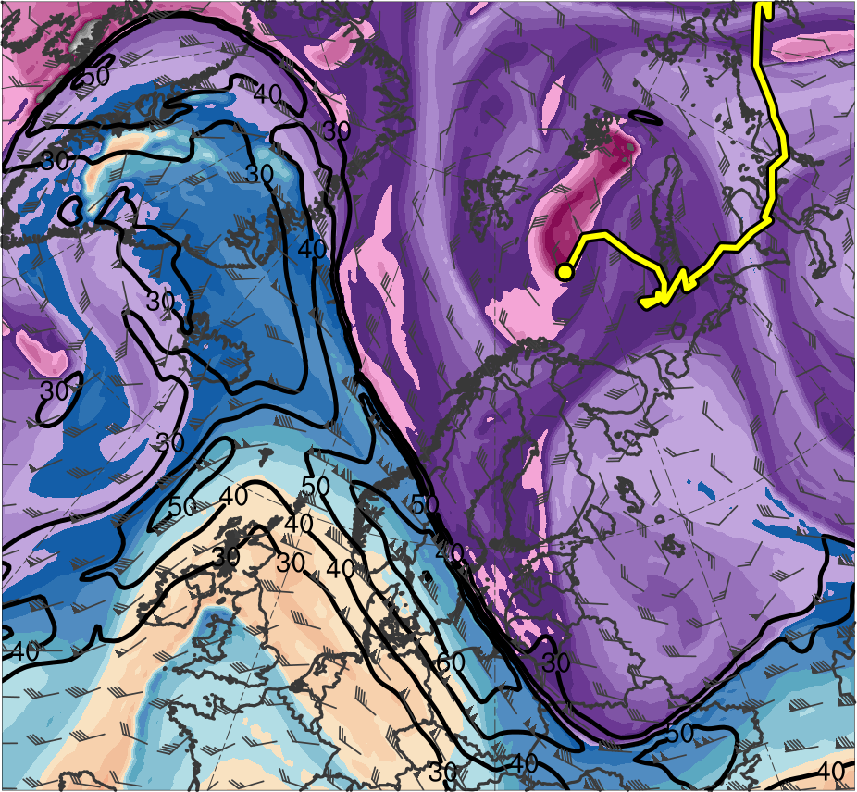
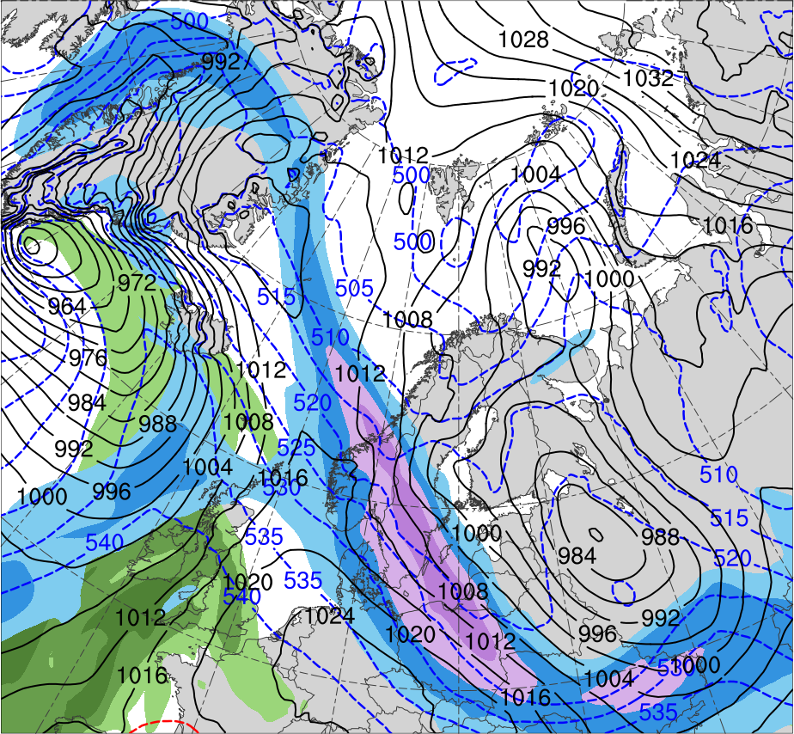
Synoptic Evolution
0000 UTC 9 Feb 2011
R1
R2
TPV
(K)
252
258
264
270
276
282
288
294
300
306
312
318
324
330
336
342
348
354
360
366
372
378
(m s⁻¹ )
(mm)
30
40
50
60
70
80
90
100
10
15
20
25
30
35
40
Potential temperature (K, shaded), wind speed (black, every 10 m s⁻¹ starting at 30 m s⁻¹), and wind (m s⁻¹, flags and barbs) on 2-PVU surface
300-hPa wind speed (m s⁻¹, shaded),
1000–500-hPa thickness (dam, blue/red),
SLP (hPa, black), and PW (mm, shaded)

Slide 35
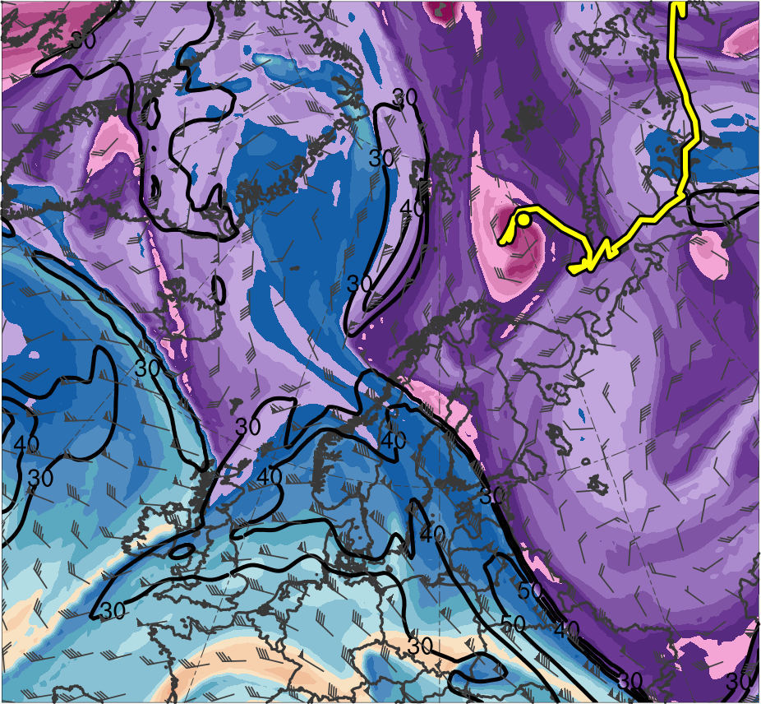
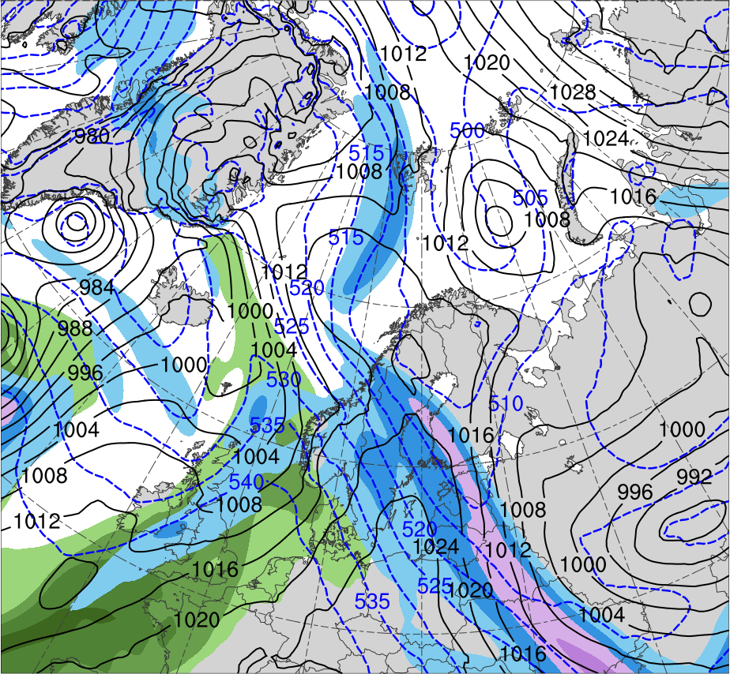
Synoptic Evolution
0000 UTC 10 Feb 2011
R2
R1
TPV
(K)
252
258
264
270
276
282
288
294
300
306
312
318
324
330
336
342
348
354
360
366
372
378
(m s⁻¹ )
(mm)
30
40
50
60
70
80
90
100
10
15
20
25
30
35
40
Potential temperature (K, shaded), wind speed (black, every 10 m s⁻¹ starting at 30 m s⁻¹), and wind (m s⁻¹, flags and barbs) on 2-PVU surface
300-hPa wind speed (m s⁻¹, shaded),
1000–500-hPa thickness (dam, blue/red),
SLP (hPa, black), and PW (mm, shaded)

Slide 36
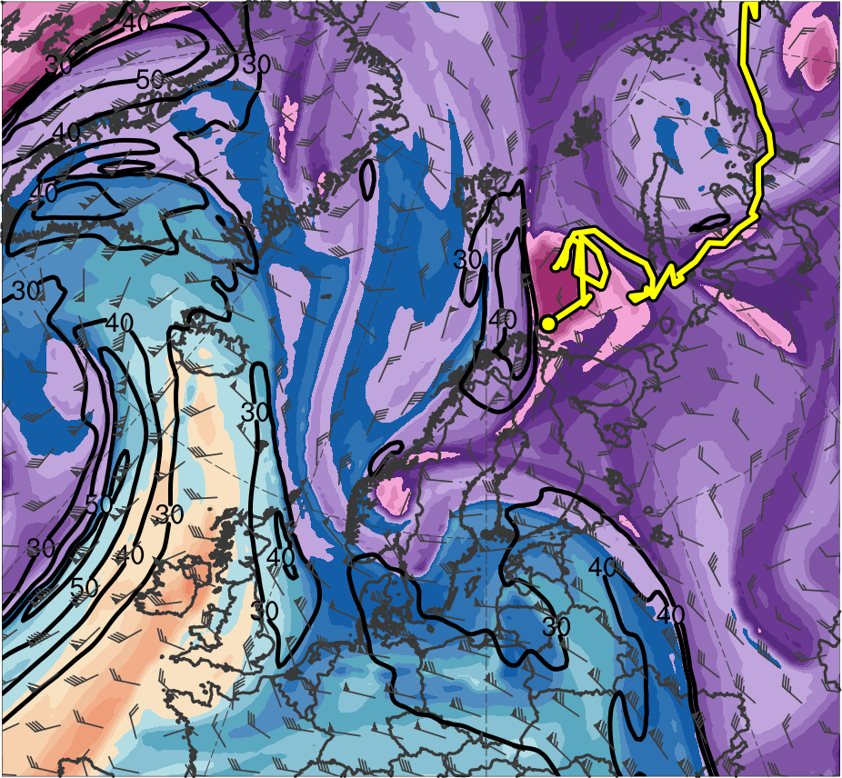
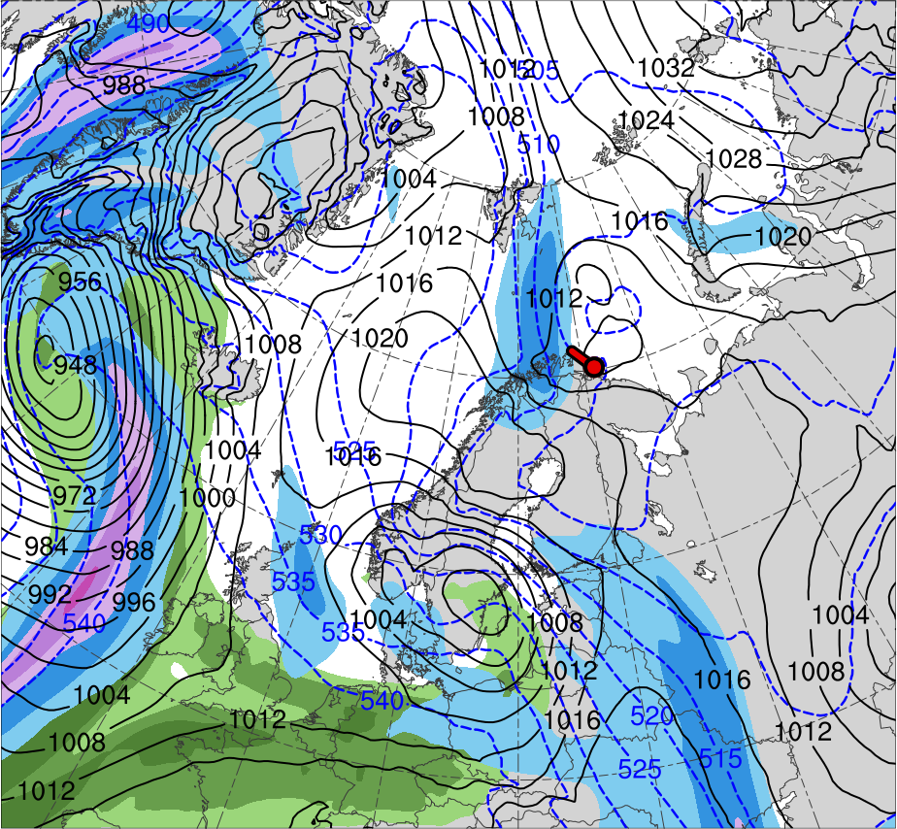
Synoptic Evolution
0000 UTC 11 Feb 2011
R2
R1
TPV
PL
(K)
252
258
264
270
276
282
288
294
300
306
312
318
324
330
336
342
348
354
360
366
372
378
(m s⁻¹ )
(mm)
30
40
50
60
70
80
90
100
10
15
20
25
30
35
40
Potential temperature (K, shaded), wind speed (black, every 10 m s⁻¹ starting at 30 m s⁻¹), and wind (m s⁻¹, flags and barbs) on 2-PVU surface
300-hPa wind speed (m s⁻¹, shaded),
1000–500-hPa thickness (dam, blue/red),
SLP (hPa, black), and PW (mm, shaded)

Slide 37
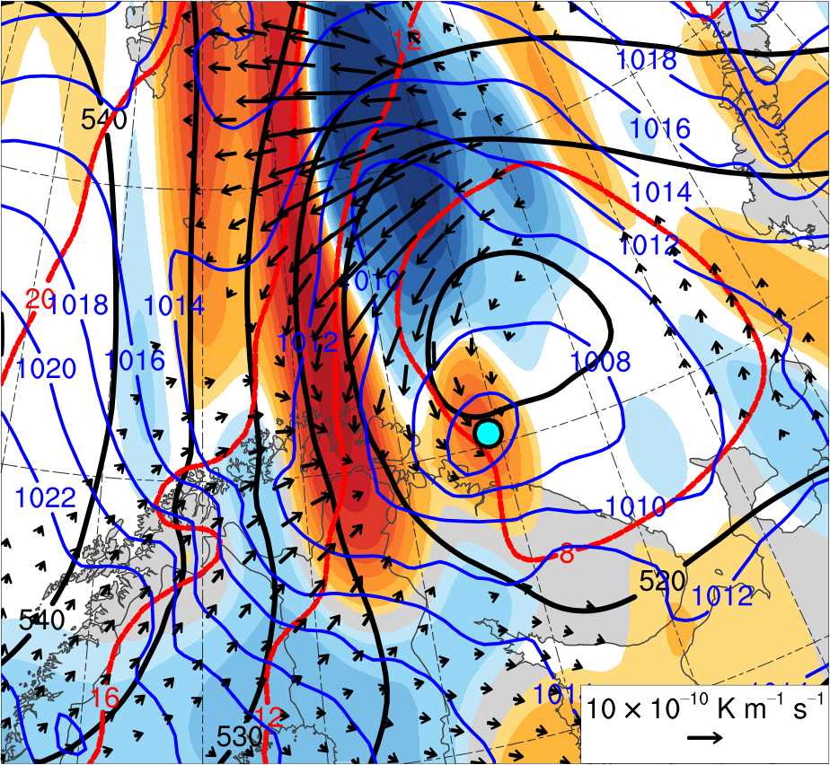
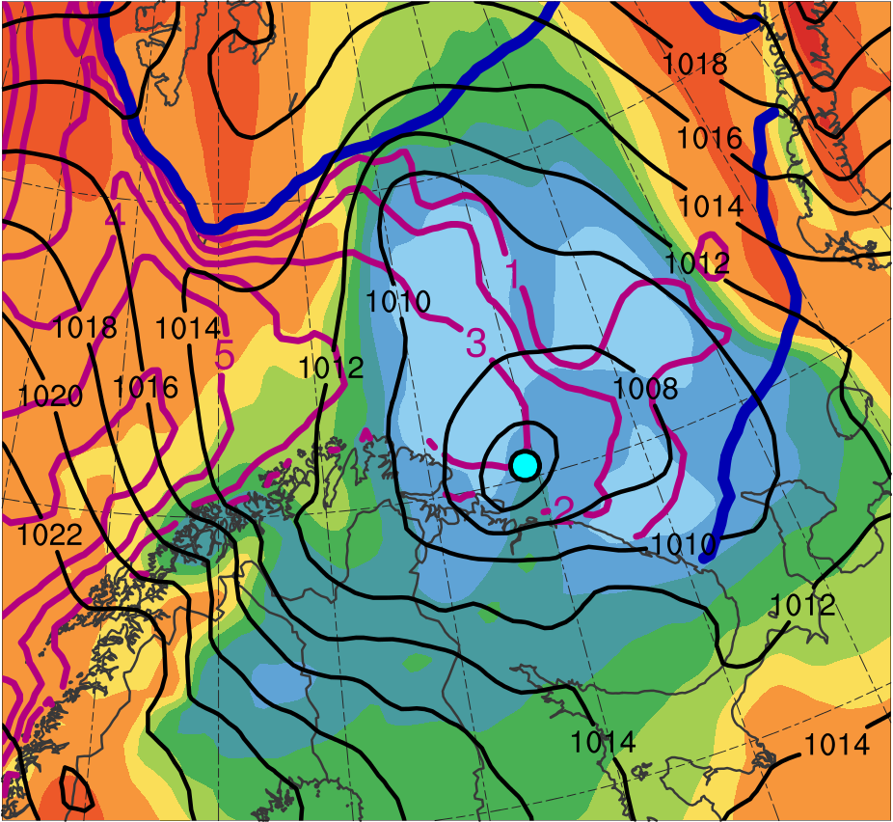
Favorable Conditions
0300 UTC 11 Feb 2011
TPV
TPV
PL
PL
-10
-7.5
-5
-4
-3
-2
-1
-0.5
0
0.5
1
2
3
4
5
7.5
10
0.5
1
1.5
2
2.5
3
3.5
4
5
6
7
8
SLP (hPa, blue); 600–400-hPa Q (K m⁻¹ s⁻¹, vectors), Q forcing for vertical motion (10⁻¹⁷ Pa⁻¹ s⁻³, shaded), θ (°C, red), and geopotential height (dam, black)
900–600-hPa static stability [K (100 hPa)⁻¹, shaded], SLP (hPa, black), SST (°C, purple), and 20% contour of sea-ice concentration (thick blue)

Slide 38
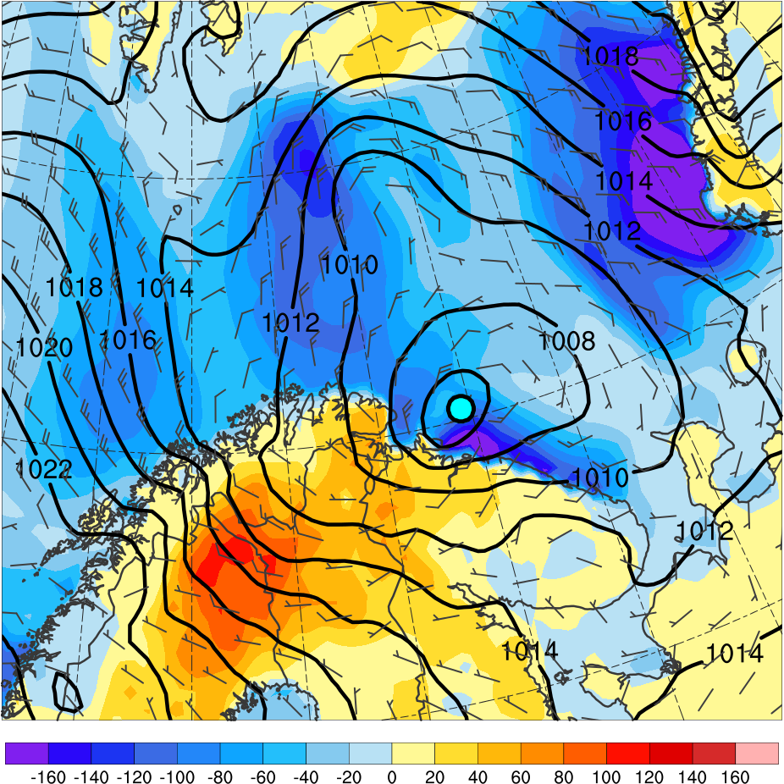
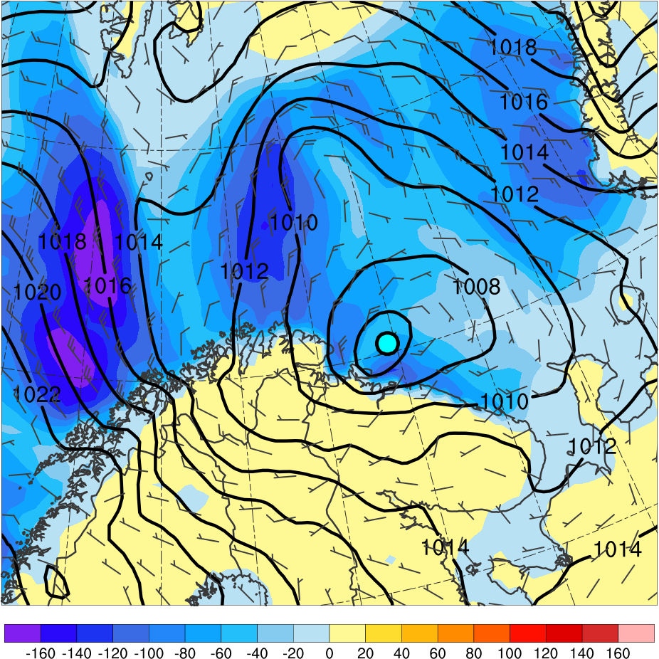
Favorable Conditions
0300 UTC 11 Feb 2011
PL
PL
-160
-140
-120
-100
-80
-60
-40
-20
0
20
40
60
80
100
120
140
160
Sensible heat flux [W m⁻², shaded],
SLP (hPa, black), and 10-m wind (m s⁻¹, barbs)
Latent heat flux [W m⁻², shaded],
SLP (hPa, black), and 10-m wind (m s⁻¹, barbs)

Slide 39
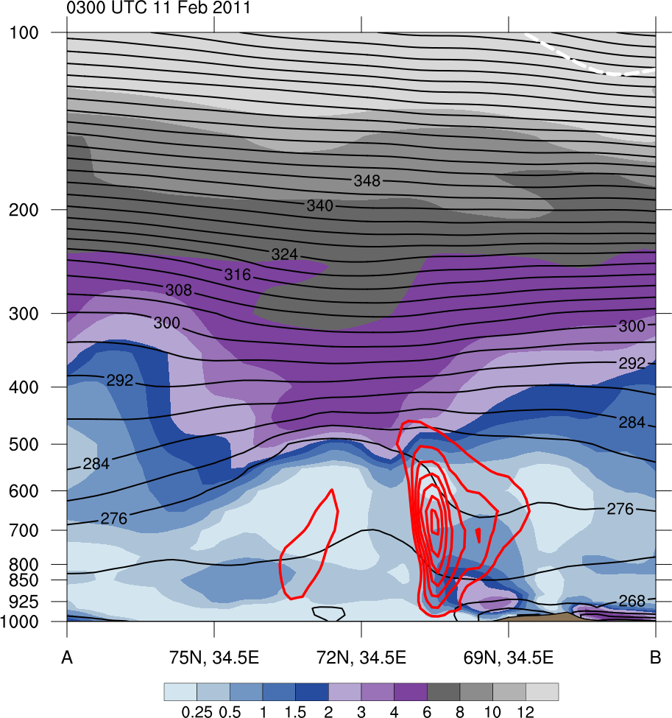
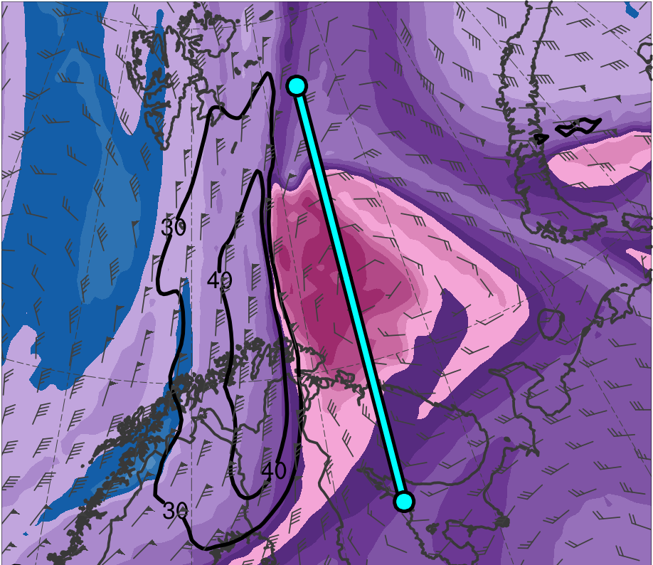
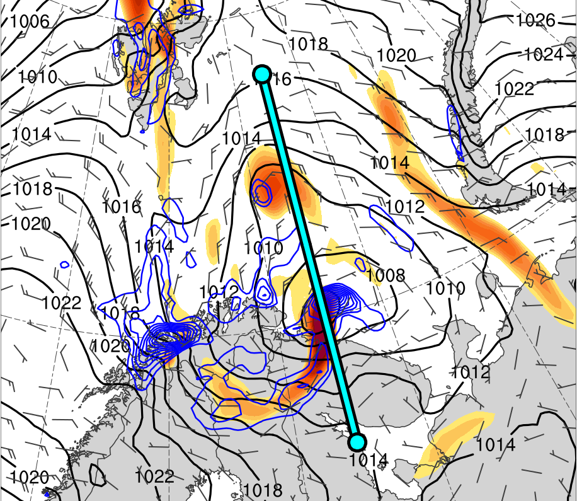
Cross Sections
0300 UTC 11 Feb 2011
(a)
(b)
A
378
12
TPV
372
30
366
28
10
360
354
26
8
348
342
24
6
336
330
22
4
A’
324
20
3
A
318
18
(c)
312
2
306
16
300
1.5
294
14
TPV
288
12
1
PL
282
276
10
0.5
PL
270
264
8
0.25
258
6
A’
252
(PVU)
A
75.0°N, 34.5°E
72.0°N, 34.5°E
69.0°N, 34.5°E
A’
(K)
(a) PV (PVU, shaded), θ (K, black), ascent (red, every 2.5 × 10⁻³ hPa s⁻¹), and wind speed (white, every 10 m s⁻¹ starting at 30 m s⁻¹); (b) DT (2-PVU surface) θ (K, shaded), wind speed (black, every 10 m s⁻¹ starting at 30 m s⁻¹), and wind (m s⁻¹, flags and barbs); (c) 850-hPa relative vorticity (10⁻⁵ s⁻¹, shaded), 850–600-hPa ascent (blue, every 2.5 × 10⁻³ hPa s⁻¹), SLP (hPa, black), and 10-m wind (m s⁻¹, barbs)

Slide 40
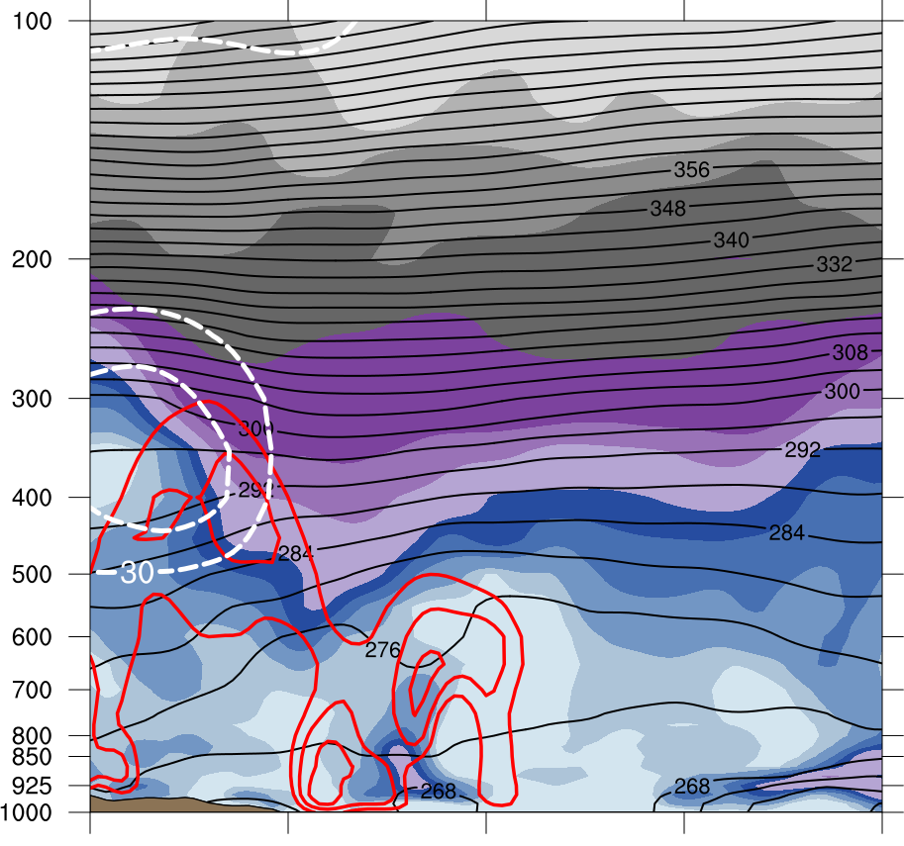
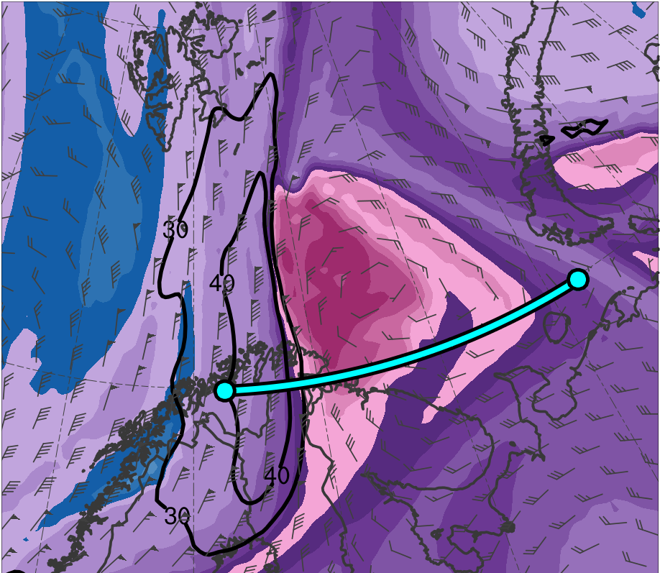
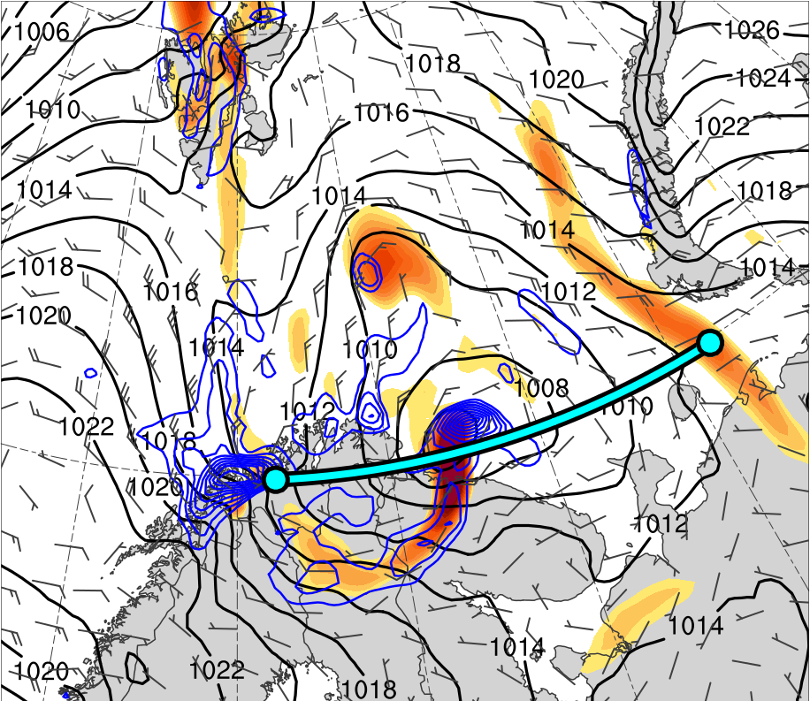
Cross Sections
0300 UTC 11 Feb 2011
(a)
(b)
378
12
TPV
372
30
366
28
10
360
B’
354
26
8
348
B
342
24
6
336
330
22
4
324
20
3
318
18
(c)
312
2
TPV
306
16
300
1.5
294
14
B’
288
12
1
PL
282
276
10
0.5
PL
B
270
264
8
0.25
258
6
252
(PVU)
B
69.9°N, 30.0°E
69.9°N, 37.5°E
69.9°N, 45.0°E
B’
(K)
(a) PV (PVU, shaded), θ (K, black), ascent (red, every 2.5 × 10⁻³ hPa s⁻¹), and wind speed (white, every 10 m s⁻¹ starting at 30 m s⁻¹); (b) DT (2-PVU surface) θ (K, shaded), wind speed (black, every 10 m s⁻¹ starting at 30 m s⁻¹), and wind (m s⁻¹, flags and barbs); (c) 850-hPa relative vorticity (10⁻⁵ s⁻¹, shaded), 850–600-hPa ascent (blue, every 2.5 × 10⁻³ hPa s⁻¹), SLP (hPa, black), and 10-m wind (m s⁻¹, barbs)

Slide 41
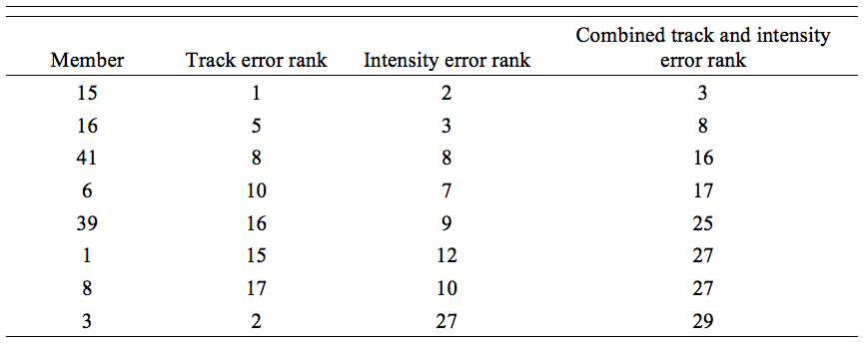
Most Accurate Members
Track error rank, intensity error rank, and combined track and intensity error rank for the eight ensemble members in the most accurate group.

Slide 42
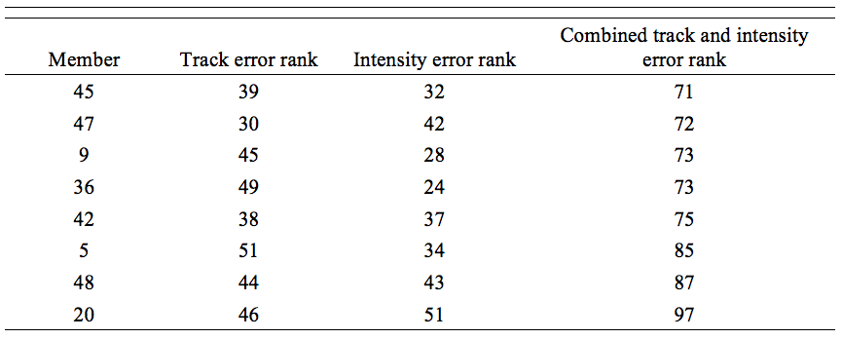
Least Accurate Members
Track error rank, intensity error rank, and combined track and intensity error rank for the eight ensemble members in the least accurate group.

Slide 43
Significant Differences
Values of selected quantities for 1800 UTC 10 February–1200 UTC 11 February 2011 time period for ERA5, most accurate group, and least accurate group. The difference between the means of the most accurate and least accurate group for each quantity are shown as well, with confidence levels for the significance of the difference between the means of the most accurate and least accurate group for each quantity based on a two-sided Student’s t test given in parentheses.

