Slide 1
Mechanisms for the Extraction of Tropopause Polar Vortices and Associated Surface-based Pools of Arctic Air from High Latitudes and their Transport to Middle Latitudes
Kevin A. Biernat
Department of Atmospheric and Environmental Sciences
University at Albany, SUNY
ATM 619 Project Presentation
3 May 2016

Slide 2
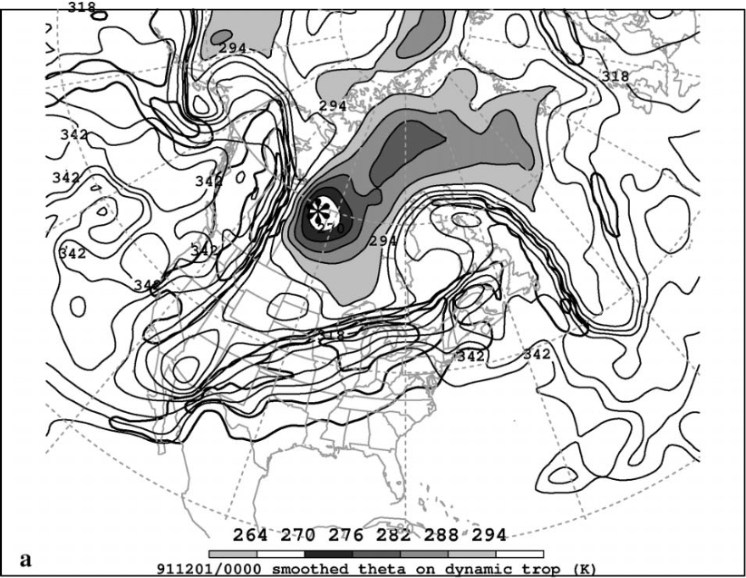
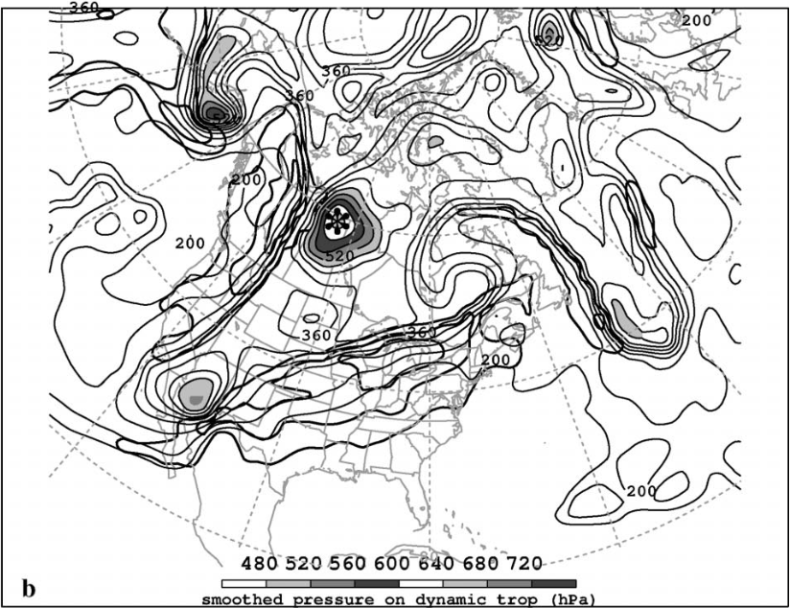
What are Tropopause Polar Vortices (TPVs)?
TPVs are defined as tropopause-based vortices of high-latitude origin and are material features (Pyle et al. 2004; Cavallo and Hakim 2009, 2010)
TPV
TPV
(left) Dynamic tropopause (DT) wind speed (every 15 m s⁻¹ starting at 50 m s⁻¹, thick contours) and DT potential temperature (K, thin contours and shading) on 1.5-PVU surface valid 0000 UTC 1 Dec 1991; (right) same as left except DT pressure (hPa, thin contours and shading). Adapted from Fig. 11 in Pyle et al. (2004).

Slide 3
Motivation
TPVs may interact with and strengthen midlatitude jet streams, and act as precursors to intense midlatitude cyclogenesis events
Interactions between TPVs and midlatitude jet streams may lead to development of extreme weather events
Surges of arctic air may accompany TPVs as they are transported to middle latitudes, resulting in widespread cold air outbreaks (CAOs)

Slide 4
Research Goals
Increase understanding of the mechanisms responsible for the extraction of TPVs from high latitudes and their transport to middle latitudes
Increase understanding of the relationship between TPVs and cold surges

Slide 5
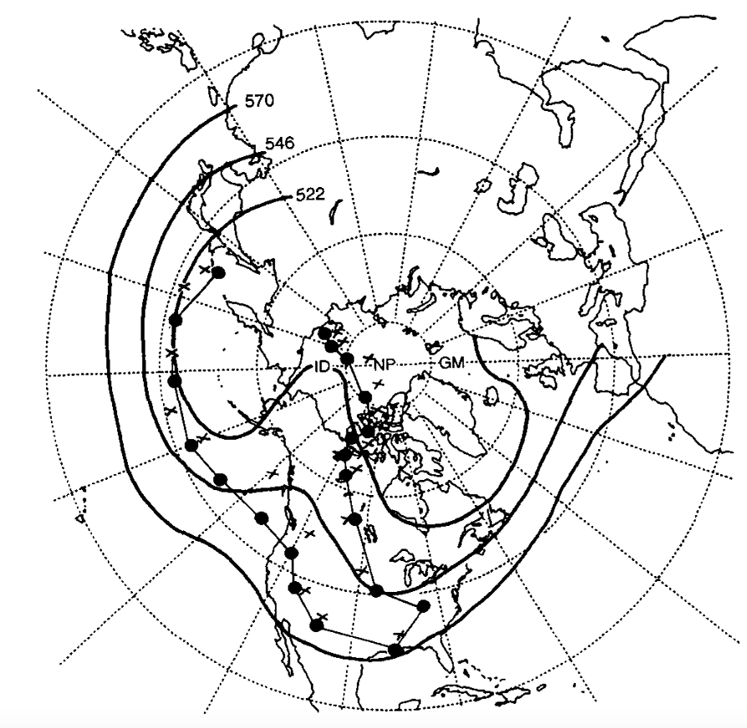
Literature Review
Past studies such as Hakim et al. (1995, 1996) and Bosart et al. (1996) have shown that ridge amplification may lead to the transport of TPVs to middle latitudes, where they may participate in the the development of intense midlatitude cyclones
Position of QGPV maxima (colored dots) and thickness minima (black crosses) associated with CTDs every 24 h starting at 0000 UTC 17 January and ending 0000 UTC 27 January 1978; time-mean 500-hPa geopotential height field (black, contoured every 120 m) for 17–27 January 1978.
TPV
R
L
1978 Cleveland Superbomb
Adapted from Fig. 3 in Hakim et al. 1995

Slide 6
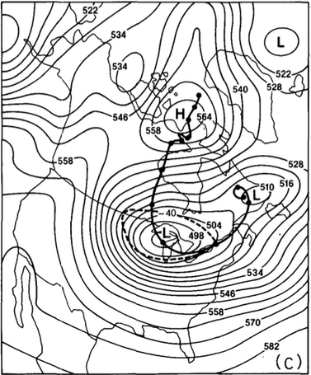
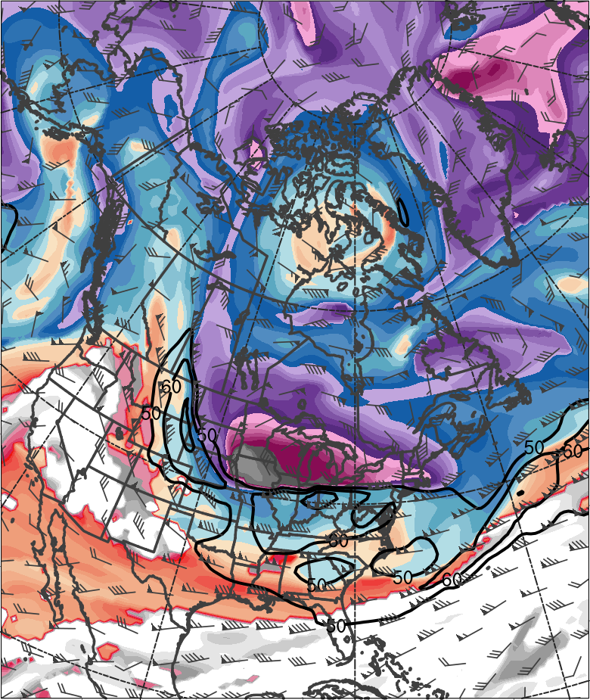
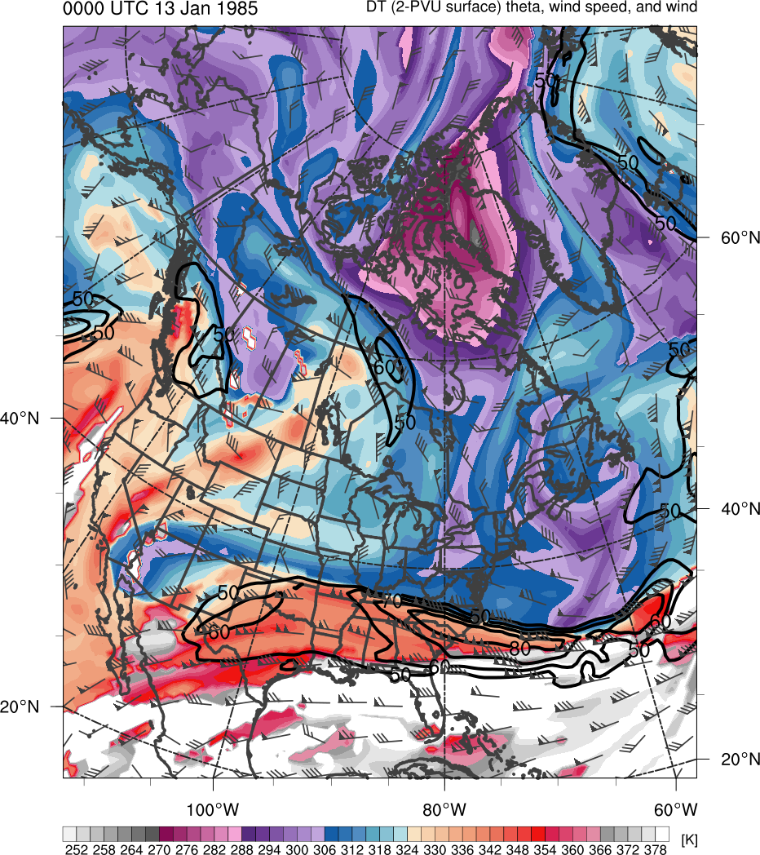
Literature Review
0000 UTC 20 Jan 1985
Adapted from Fig. 5 in Shapiro et al. (1987)
0.5° NCEP CFSR
378
372
366
360
354
348
342
336
“Polar Vortex”
“Polar Vortex”
330
324
318
312
306
300
294
288
282
276
270
264
258
252
(K)
500-hPa geopotential height (black, every 6 dam) and −40°C isotherm (dashed contour); track of polar vortex from 0000 UTC 12 January to 0000 UTC 24 January 1985 (heavy black)
Potential temperature (K, shaded), wind speed (black, every 10 m s⁻¹ starting at 50 m s⁻¹), and wind (m s⁻¹, barbs) on 2-PVU surface

Slide 7
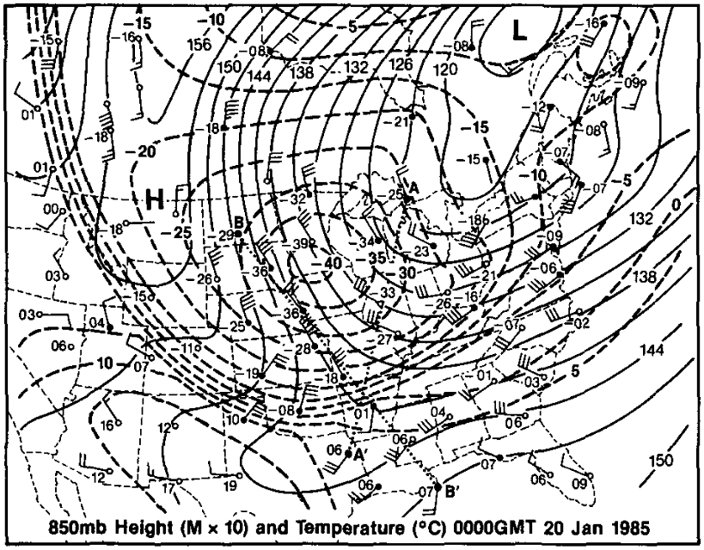
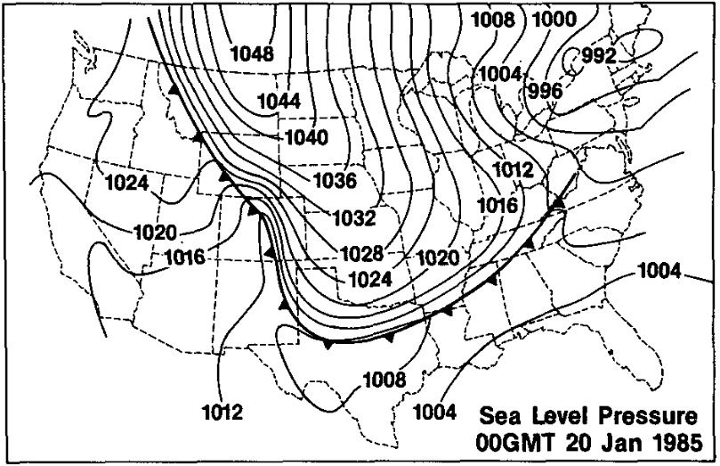
Literature Review
0000 UTC 20 Jan 1985
A commonality of cold air outbreaks (CAOs) over North America is surface anticyclogenesis occurring over northwestern North America prior to CAO onset (Colucci and Davenport 1987)
850-hPa geopotential height (solid, every 3 dam), temperature (dashed contour, every 5 K, and wind (barbs, m s⁻¹) at 0000 UTC 20 January 1985. Adapted from Fig. 8 in Shapiro et al. (1987).
SLP (solid) and Arctic front (heavy spiked line) at 0000 UTC 20 January 1985. Adapted from Fig. 12 in Shapiro et al. (1987).

Slide 8
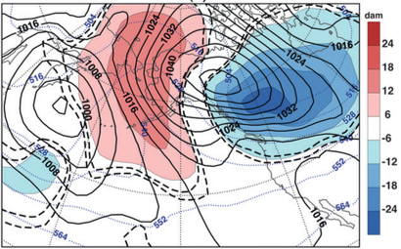
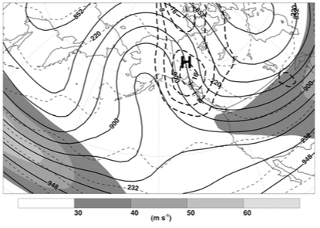
Literature Review
Jones and Cohen (2011) composited 21 strong anticyclones (maximum MSLP ≥ 1050 hPa) occurring over northwestern North America from Nov–Mar of 1978/79 through 2001/02
Anticyclogenesis occurs in region of strong forcing for descent downstream of a ridge, in left-entrance region of jet
Cold air is advected equatorward east of the Rockies
Composite SLP (hPa, solid black), 1000–500-hPa thickness (dam; dotted blue), thickness anomalies (shaded) at time of maximum SLP. Adapted from Fig. 4 in Jones and Cohen (2011)
Composite 300-hPa geopotential heights (dam, solid black), wind speed (shaded, m s⁻¹), temperature (short dashes), and horizontal velocity convergence (×10⁻⁶ s⁻¹, long dashes) at time of maximum SLP. Adapted from Fig. 3 in Jones and Cohen (2011)

Slide 9
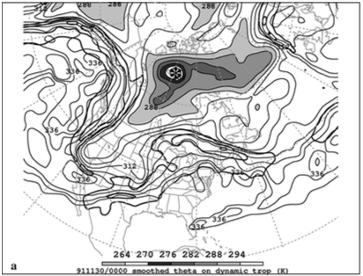
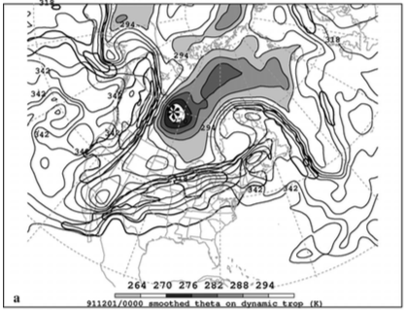
Literature Review
Pyle et al. (2004) has shown that the close approach of a TPV with a northerly flow jet over western North America resulted in jet intensification
Could TPV interactions with jets lead to stronger secondary ageostrophic circulations, promoting increased subsidence, and contributing to stronger surface anticyclogenesis in the entrance region of these jets?
Jet
TPV
Jet
TPV
(left) DT (1.5-PVU surface) wind speed (every 15 m s⁻¹ starting at 50 m s⁻¹, thick contours) and potential temperature (K, thin contours and shading) at 0000 UTC 30 Nov 1991; (right) same as left except 0000 UTC 1 Dec 1991

Slide 10
Hypotheses
The northerly flow found just downstream of amplifying ridges supports the extraction of TPVs from high latitudes and their transport into middle latitudes
Disturbances such as extratropical cyclones and transitioning and recurving tropical cyclones may play important roles in leading to these amplifying ridges
TPVs may serve as catalysts for CAOs as artic air found beneath and behind TPVs surge equatorward when TPVs are transported into middle latitudes
TPVs interactions with jets on the downstream side of ridges may lead to strengthening of these jets, supporting stronger forcing for descent and thus stronger surface anticyclogenesis in the entrance region

Slide 11
Methodology
Perform multi-scale case study investigations of two TPVs associated with CAOs using 0.5° NCEP CFSR dataset (Saha et al. 2010)
  Case 1: 9–11 January 1982 CAO over central and eastern North America
  Case 2: 13–14 February 2016 CAO over eastern North America
Both events resulted in minimum temperature records across portions of North America

Slide 12
Methodology
Subjective TPV identification and tracking
  TPV must be a coherent vortex that exhibits a local minimum of DT θ (i.e., closed contours of DT θ) on 2 PVU surface
  The vortex must be of high-latitude origin and last ≥ 2 days, similar to Cavallo and Hakim (2009)
  Stop tracking TPV when it becomes significantly deformed during interaction with NAJ

Slide 13

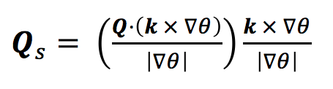
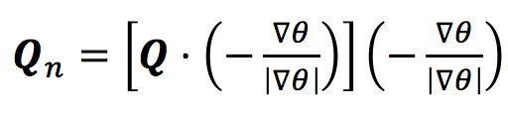
Methodology
Diagnose QG forcing for vertical motion as TPV approaches and/or interacts with northerly flow jet located on downstream side of upstream ridge in each case
Q-vectors in pressure coordinates calculated following Hoskins and Pedder (1980):
Q-vectors separated into along-isentrope (Q_{s}) and across-isentrope (Q_{n}) components following Keyser et al. (1992) as follows:

Slide 14

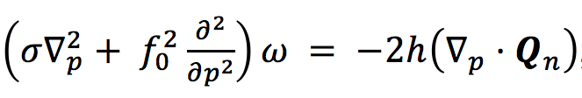
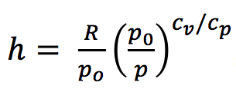

Methodology
QG forcing for Q_{s} and Q_{n} calculated by adapting Q-vector form of omega equation in pressure coordinates from Hoskins and Pedder (1980)
where , or equivalently,
Q-vector components and respective forcings for vertical motion averaged over 600–400-hPa layer

Slide 15
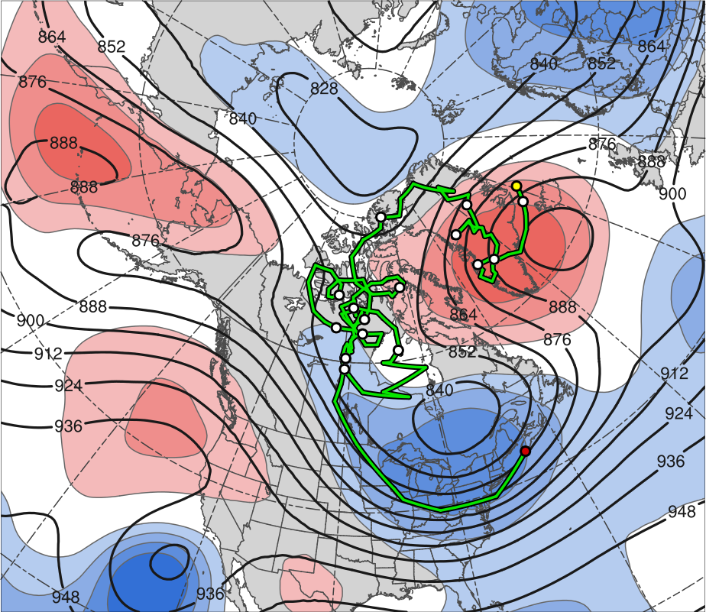
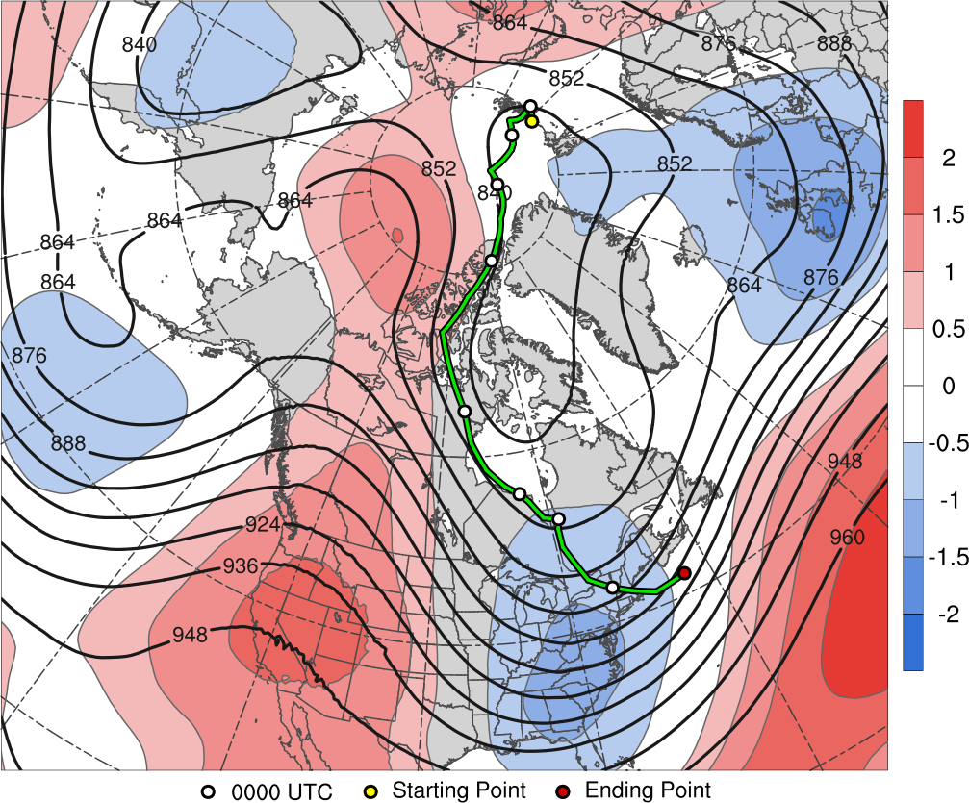
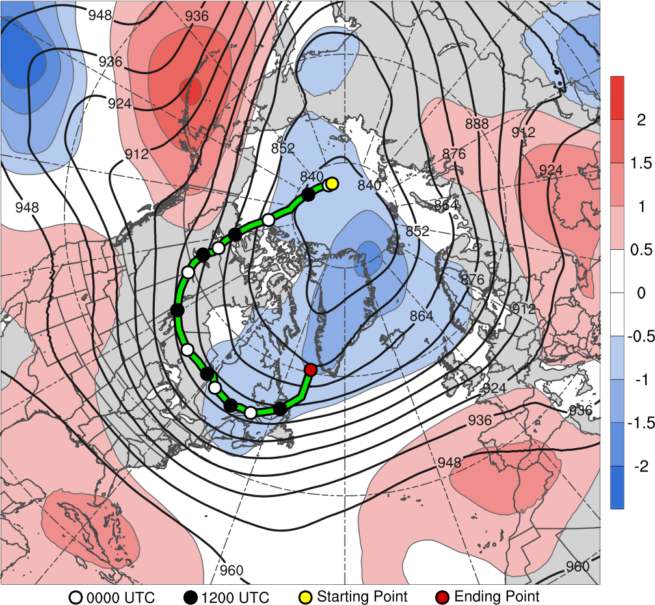
TPV 1 Track: 1800 UTC 11 Dec 1981 – 0000 UTC 11 Jan 1982
2
1.5
22
20
12
1
18
14
16
0.5
5
24
26
0
7
3
28
9
1
30
-0.5
-1
-1.5
-2
(σ)
0000 UTC (every 48 h)
Starting Point
Ending Point
7–11 January 1982 time-mean 300-hPa geopotential height (dam, black) and standardized anomaly of geopotential height (σ, shaded)

Slide 16
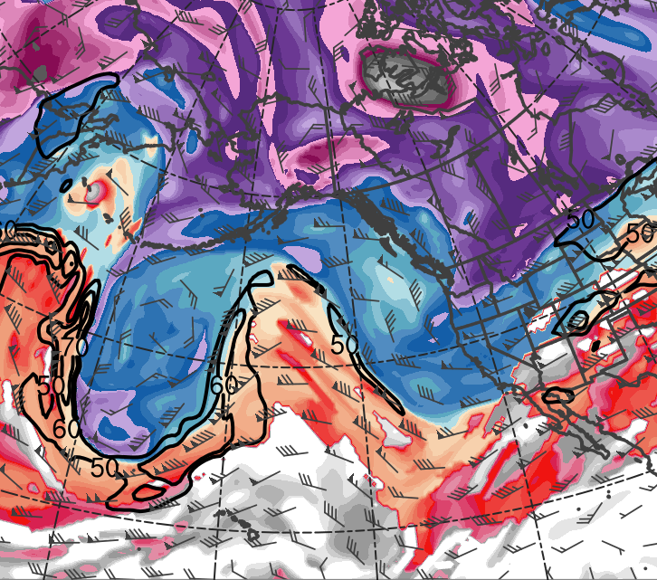
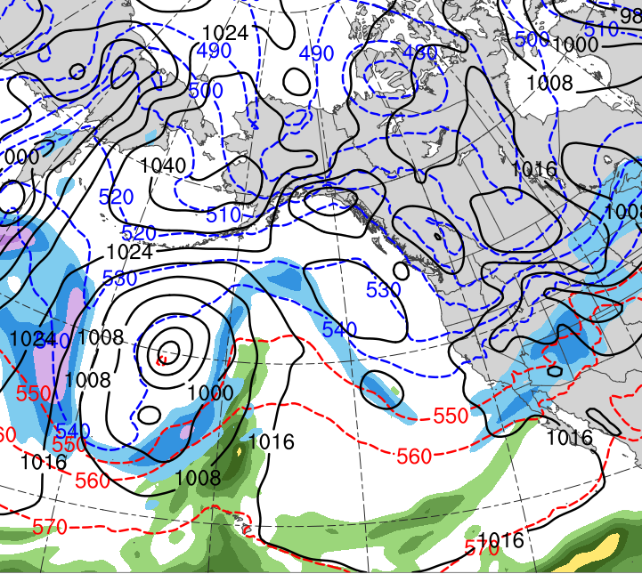
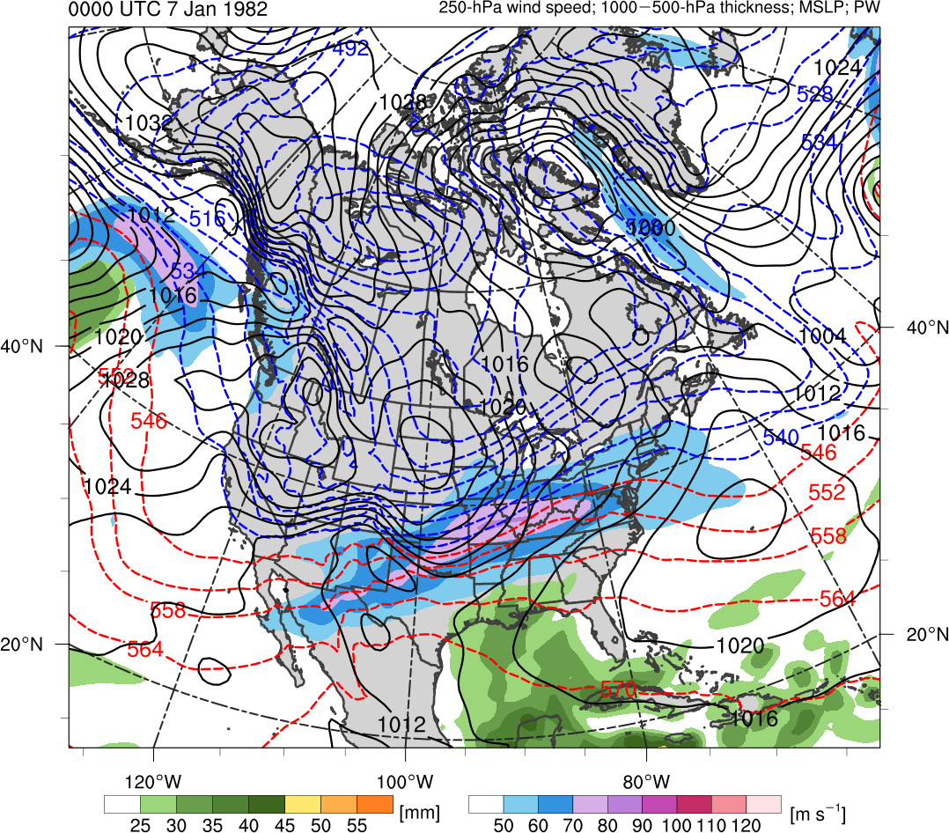
Case 1: Upstream Ridge Evolution
0000 UTC 6 Jan 1982
TPV
C
R
(K)
252
258
264
270
276
282
288
294
300
306
312
318
324
330
336
342
348
354
360
366
372
378
(mm)
(m s⁻¹ )
25
30
35
40
45
50
55
50
60
70
80
90
100
110
120
Potential temperature (K, shaded), wind speed (black, every 10 m s⁻¹ starting at 50 m s⁻¹), and wind (m s⁻¹, barbs) on 2-PVU surface
250-hPa wind speed (m s⁻¹, shaded),
1000–500-hPa thickness (every 10 dam, blue/red),
MSLP (every 8 hPa, black), PW (mm, shaded)

Slide 17
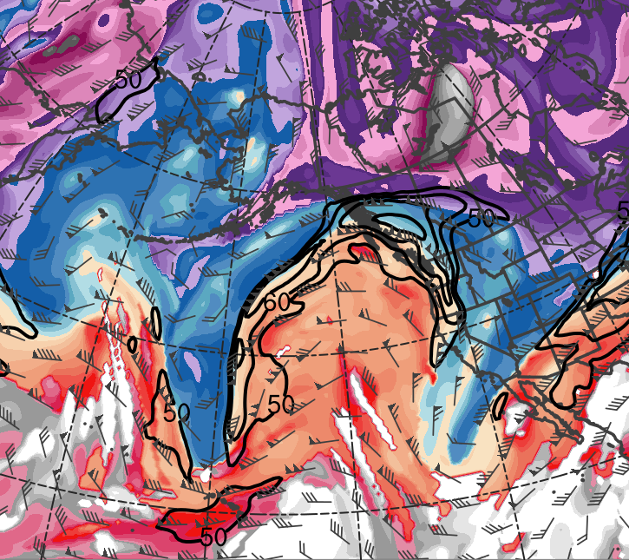
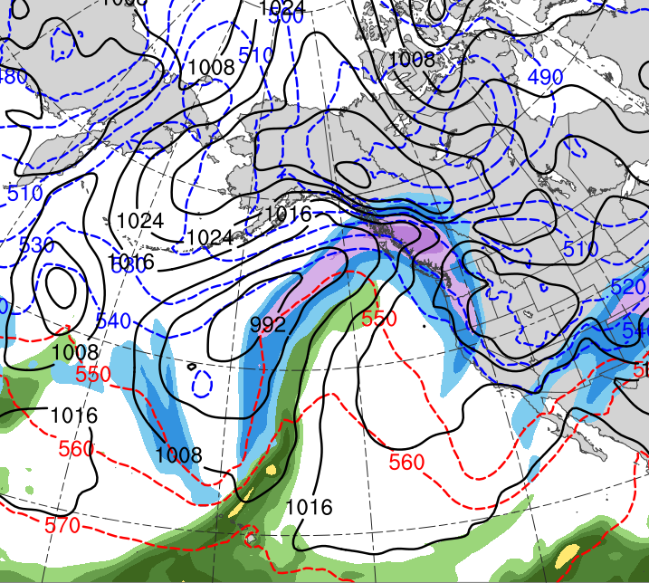
Case 1: Upstream Ridge Evolution
1200 UTC 7 Jan 1982
TPV
C
R
(K)
252
258
264
270
276
282
288
294
300
306
312
318
324
330
336
342
348
354
360
366
372
378
(mm)
(m s⁻¹ )
25
30
35
40
45
50
55
50
60
70
80
90
100
110
120
Potential temperature (K, shaded), wind speed (black, every 10 m s⁻¹ starting at 50 m s⁻¹), and wind (m s⁻¹, barbs) on 2-PVU surface
250-hPa wind speed (m s⁻¹, shaded),
1000–500-hPa thickness (every 10 dam, blue/red),
MSLP (every 8 hPa, black), PW (mm, shaded)

Slide 18
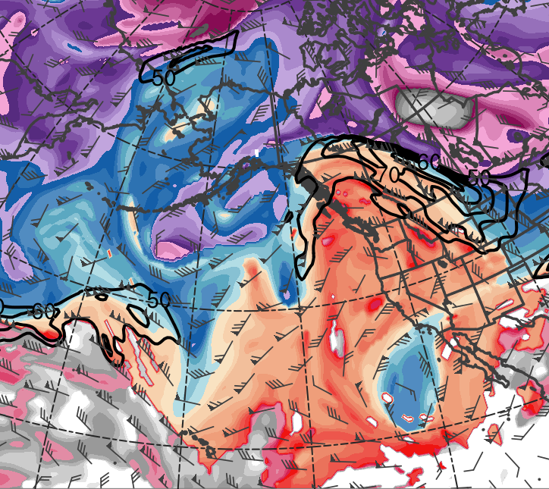
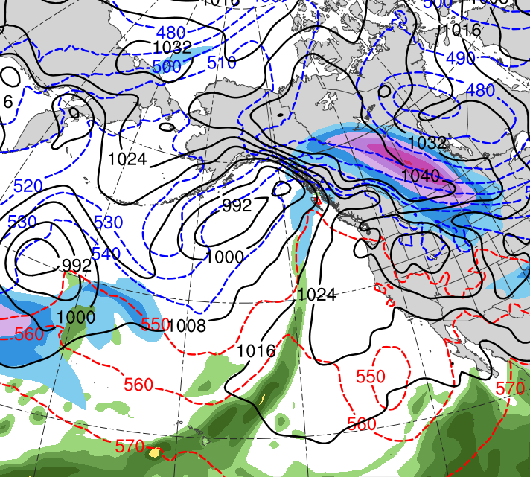
Case 1: Upstream Ridge Evolution
0000 UTC 9 Jan 1982
TPV
C
R
(K)
252
258
264
270
276
282
288
294
300
306
312
318
324
330
336
342
348
354
360
366
372
378
(mm)
(m s⁻¹ )
25
30
35
40
45
50
55
50
60
70
80
90
100
110
120
Potential temperature (K, shaded), wind speed (black, every 10 m s⁻¹ starting at 50 m s⁻¹), and wind (m s⁻¹, barbs) on 2-PVU surface
250-hPa wind speed (m s⁻¹, shaded),
1000–500-hPa thickness (every 10 dam, blue/red),
MSLP (every 8 hPa, black), PW (mm, shaded)

Slide 19
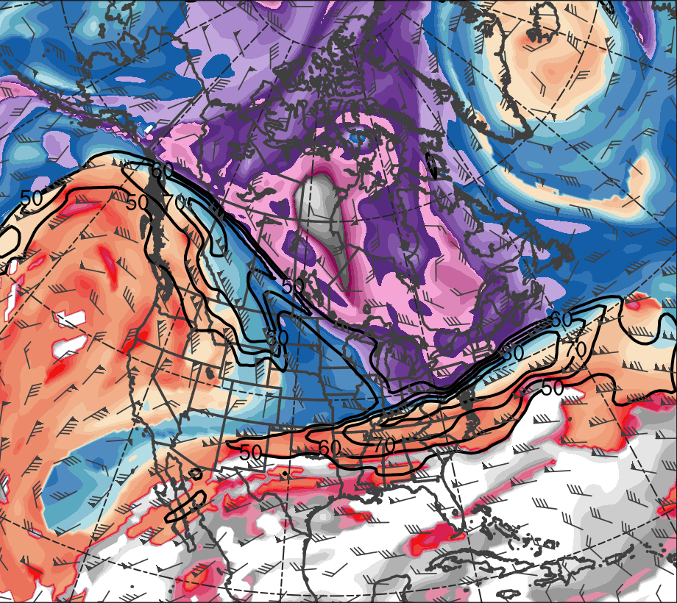
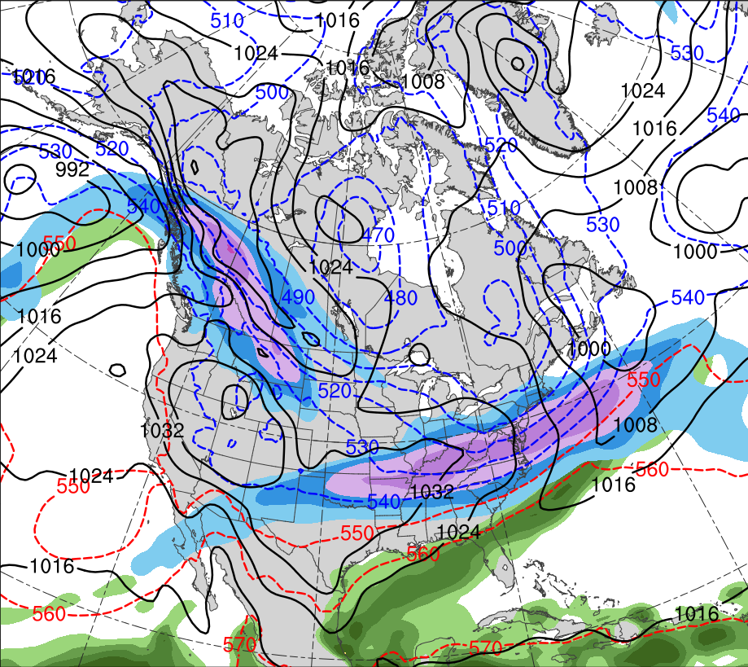
Case 1: TPV Transport and CAO
1200 UTC 8 Jan 1982
H
TPV
C
R
L
(K)
252
258
264
270
276
282
288
294
300
306
312
318
324
330
336
342
348
354
360
366
372
378
(mm)
(m s⁻¹ )
25
30
35
40
45
50
55
50
60
70
80
90
100
110
120
Potential temperature (K, shaded), wind speed (black, every 10 m s⁻¹ starting at 50 m s⁻¹), and wind (m s⁻¹, barbs) on 2-PVU surface
250-hPa wind speed (m s⁻¹, shaded),
1000–500-hPa thickness (every 10 dam, blue/red),
MSLP (every 8 hPa, black), PW (mm, shaded)

Slide 20
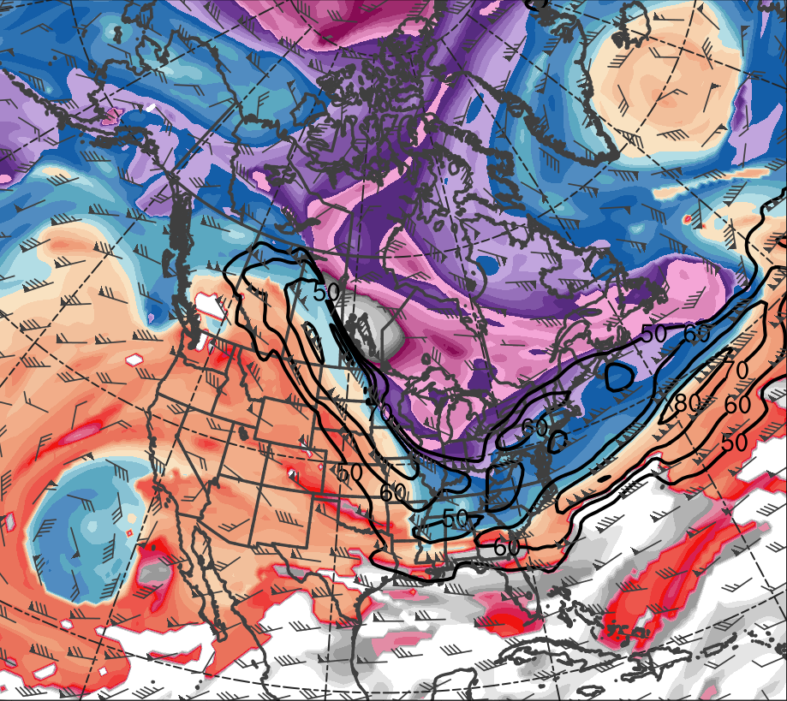
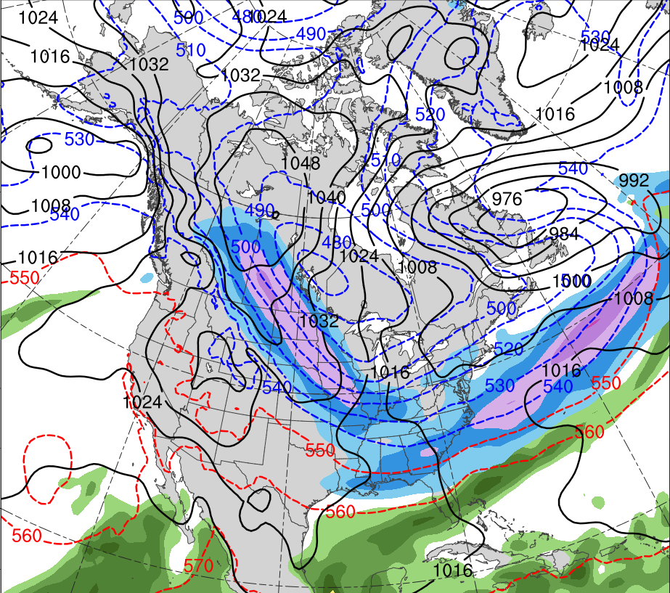
Case 1: TPV Transport and CAO
1200 UTC 9 Jan 1982
H
L
TPV
C
R
L
(K)
252
258
264
270
276
282
288
294
300
306
312
318
324
330
336
342
348
354
360
366
372
378
(mm)
(m s⁻¹ )
25
30
35
40
45
50
55
50
60
70
80
90
100
110
120
Potential temperature (K, shaded), wind speed (black, every 10 m s⁻¹ starting at 50 m s⁻¹), and wind (m s⁻¹, barbs) on 2-PVU surface
250-hPa wind speed (m s⁻¹, shaded),
1000–500-hPa thickness (every 10 dam, blue/red),
MSLP (every 8 hPa, black), PW (mm, shaded)

Slide 21
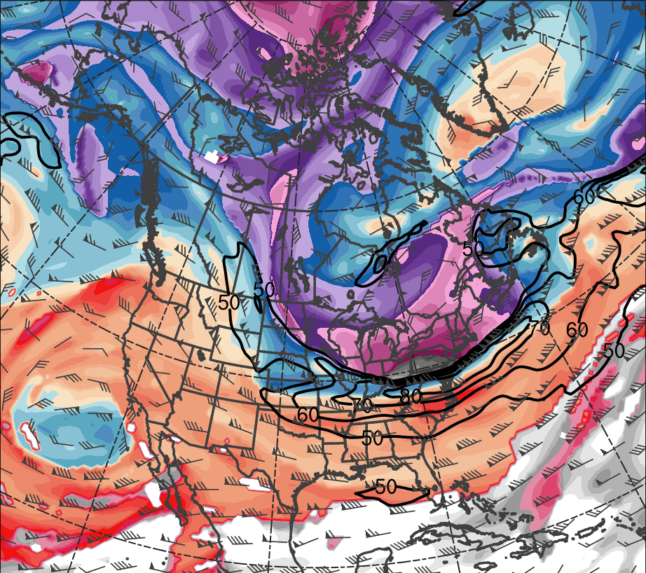
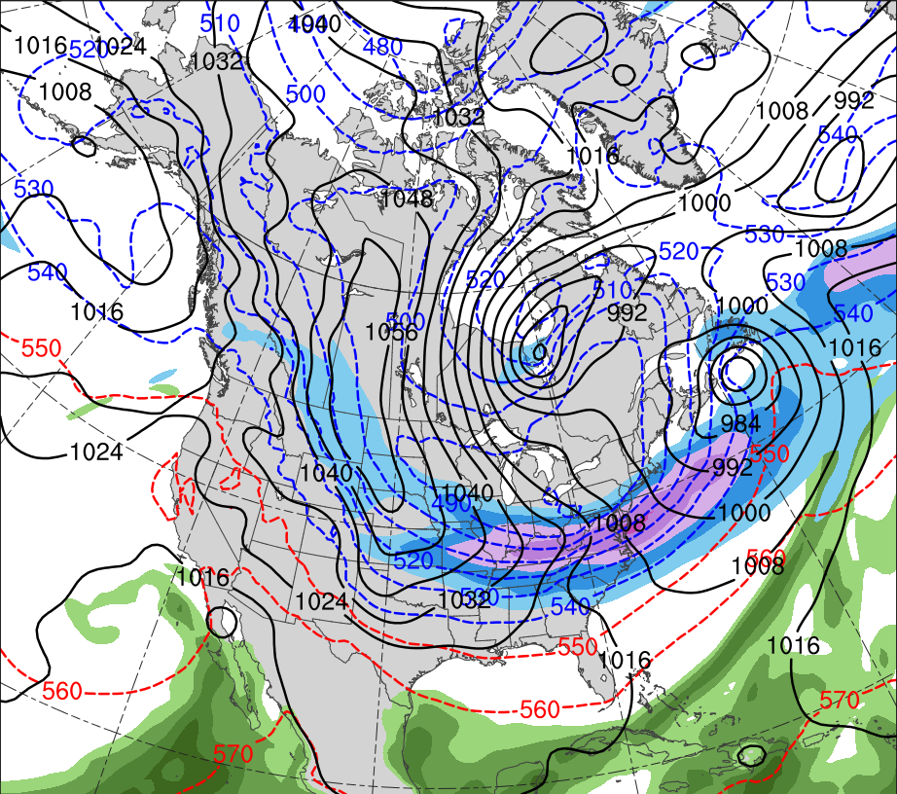
Case 1: TPV Transport and CAO
1200 UTC 10 Jan 1982
L
L
R
TPV
H
C
(K)
252
258
264
270
276
282
288
294
300
306
312
318
324
330
336
342
348
354
360
366
372
378
(mm)
(m s⁻¹ )
25
30
35
40
45
50
55
50
60
70
80
90
100
110
120
Potential temperature (K, shaded), wind speed (black, every 10 m s⁻¹ starting at 50 m s⁻¹), and wind (m s⁻¹, barbs) on 2-PVU surface
250-hPa wind speed (m s⁻¹, shaded),
1000–500-hPa thickness (every 10 dam, blue/red),
MSLP (every 8 hPa, black), PW (mm, shaded)

Slide 22
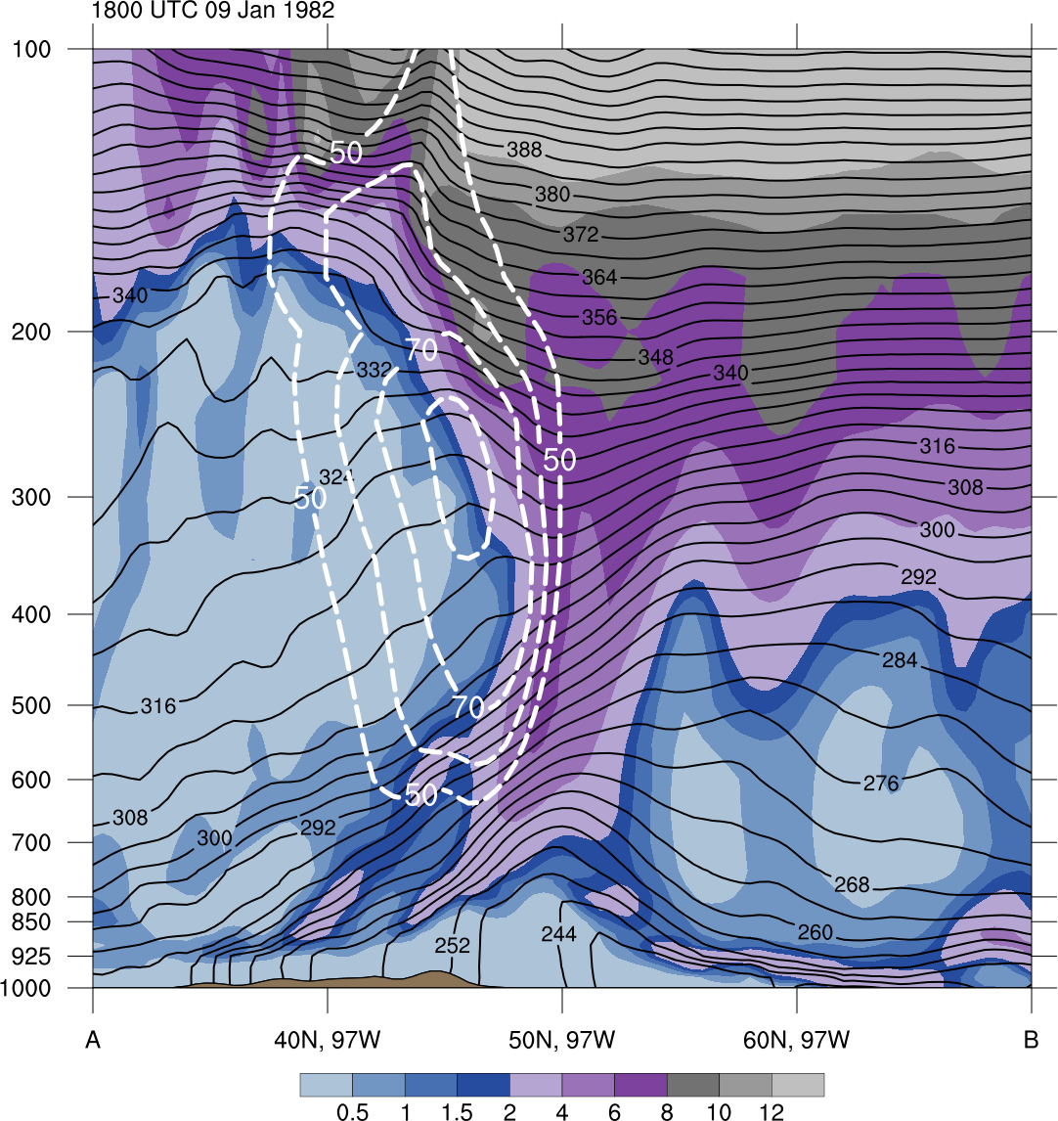
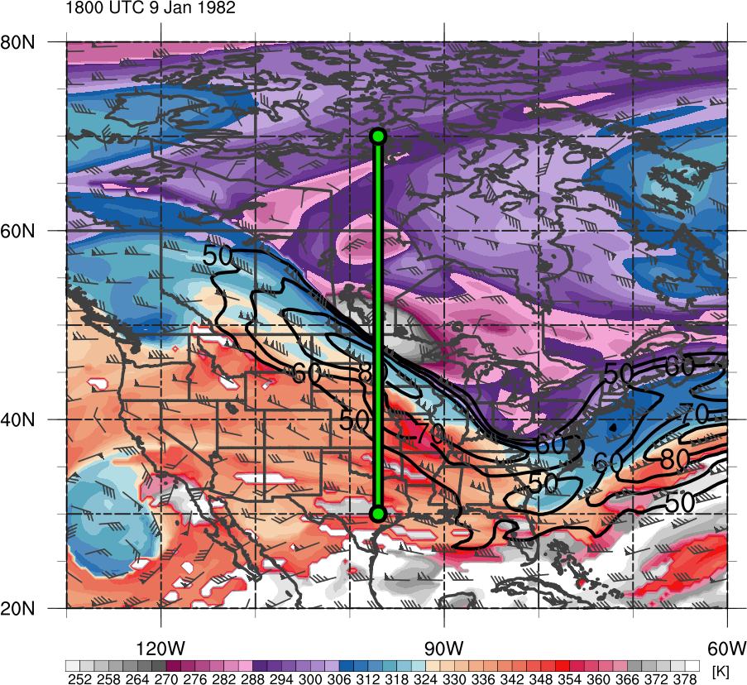
Case 1: Cross Section
1800 UTC 9 Jan 1982
B
TPV
TPV
A
Potential vorticity (PVU, shaded), wind speed (white, every 10 m s⁻¹ starting at 50 m s⁻¹), and potential temperature (K, black)
Potential temperature (K, shaded), wind speed (black, every 10 m s⁻¹ starting at 50 m s⁻¹), and wind (m s⁻¹, barbs) on 2-PVU surface

Slide 23
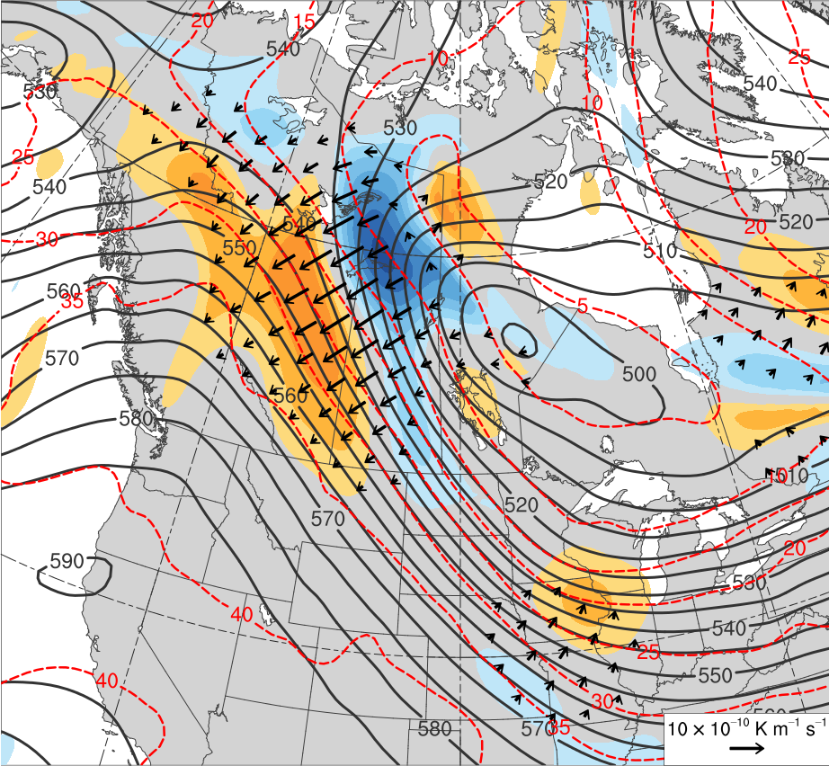
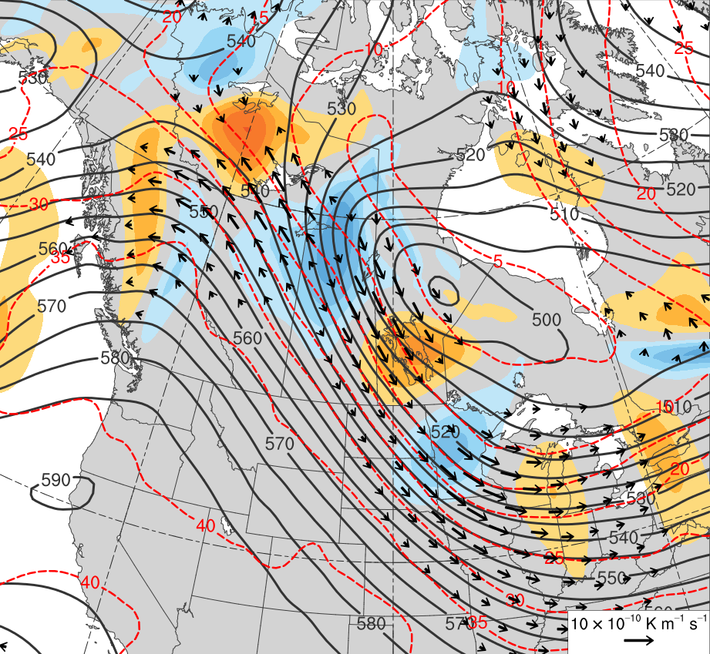
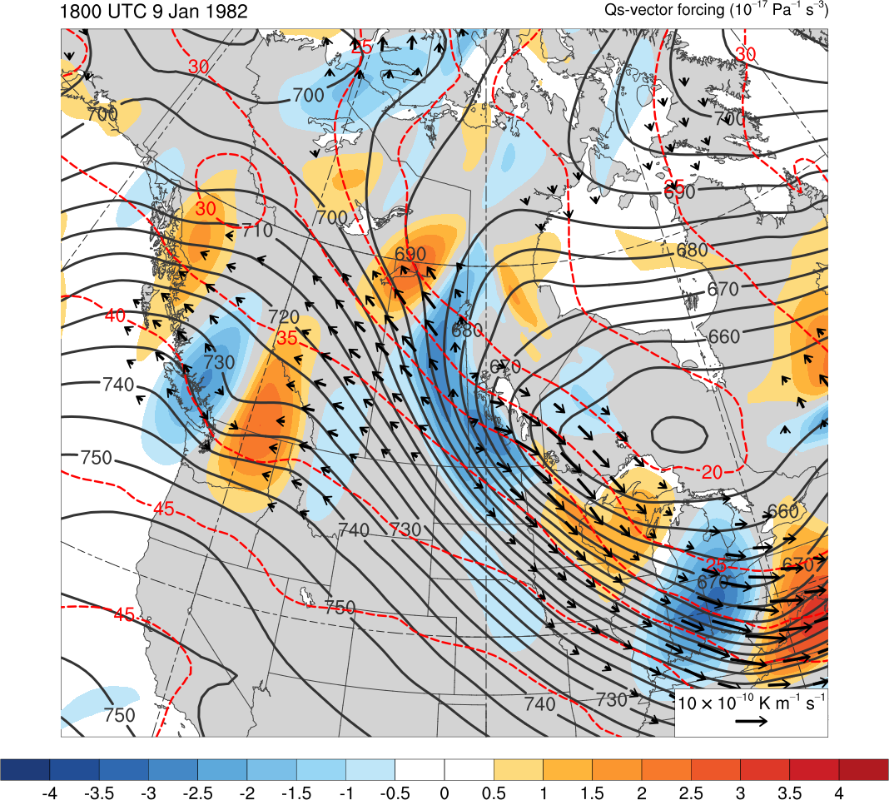
Case 1: QG Diagnostics
0600 UTC 9 Jan 1982
H
H
1050 hPa
1050 hPa
-4
-3.5
-3
-2.5
-2
-1.5
-1
-0.5
0
0.5
1
1.5
2
2.5
3
3.5
4
600–400-hPa layer averaged Q_{n} (K m⁻¹ s⁻¹, vectors), Q_{n} forcing for vertical motion (×10⁻¹⁸ Pa⁻¹ s⁻³, shaded), geopotential height (dam, gray), and potential temperature (K, red)
600–400-hPa layer averaged Q_{s} (K m⁻¹ s⁻¹, vectors), Q_{s} forcing for vertical motion (×10⁻¹⁸ Pa⁻¹ s⁻³, shaded), geopotential height (dam, gray), and potential temperature (K, red)

Slide 24
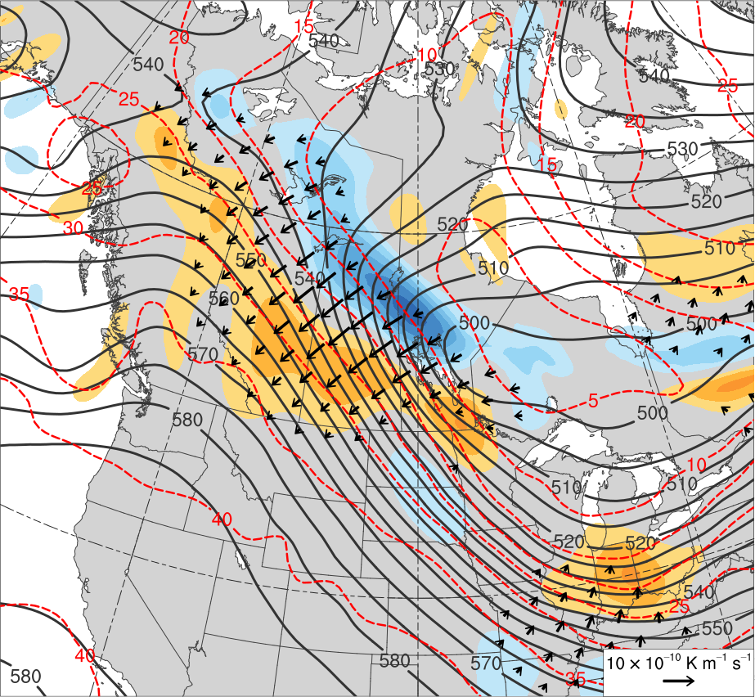
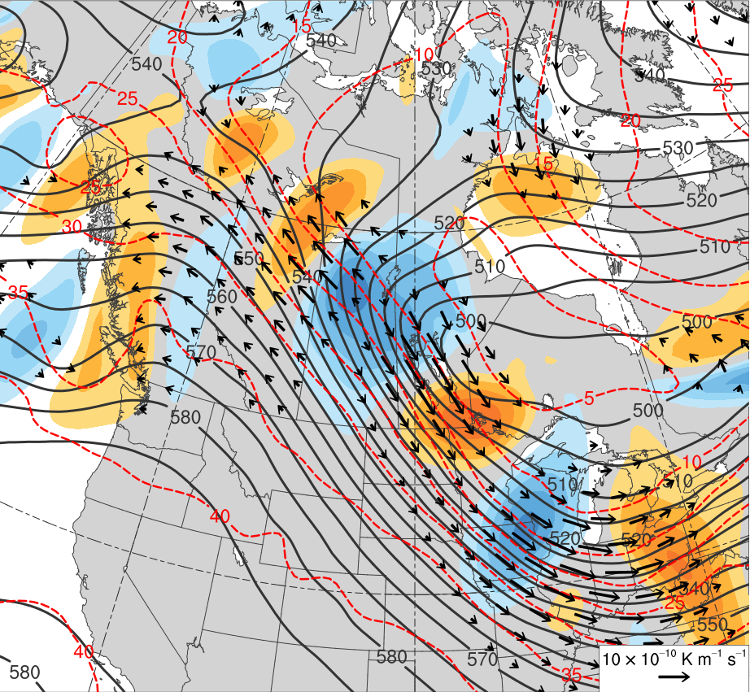
Case 1: QG Diagnostics
1200 UTC 9 Jan 1982
H
H
1056 hPa
1056 hPa
-4
-3.5
-3
-2.5
-2
-1.5
-1
-0.5
0
0.5
1
1.5
2
2.5
3
3.5
4
600–400-hPa layer averaged Q_{n} (K m⁻¹ s⁻¹, vectors), Q_{n} forcing for vertical motion (×10⁻¹⁸ Pa⁻¹ s⁻³, shaded), geopotential height (dam, gray), and potential temperature (K, red)
600–400-hPa layer averaged Q_{s} (K m⁻¹ s⁻¹, vectors), Q_{s} forcing for vertical motion (×10⁻¹⁸ Pa⁻¹ s⁻³, shaded), geopotential height (dam, gray), and potential temperature (K, red)

Slide 25
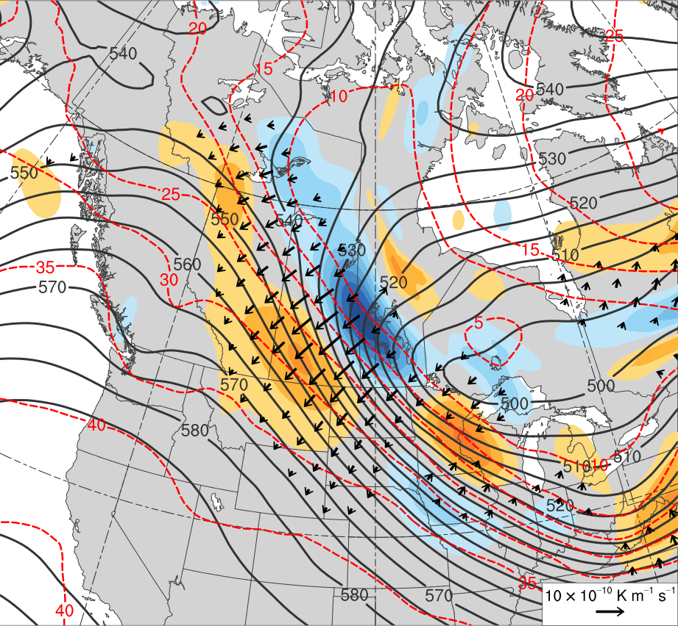
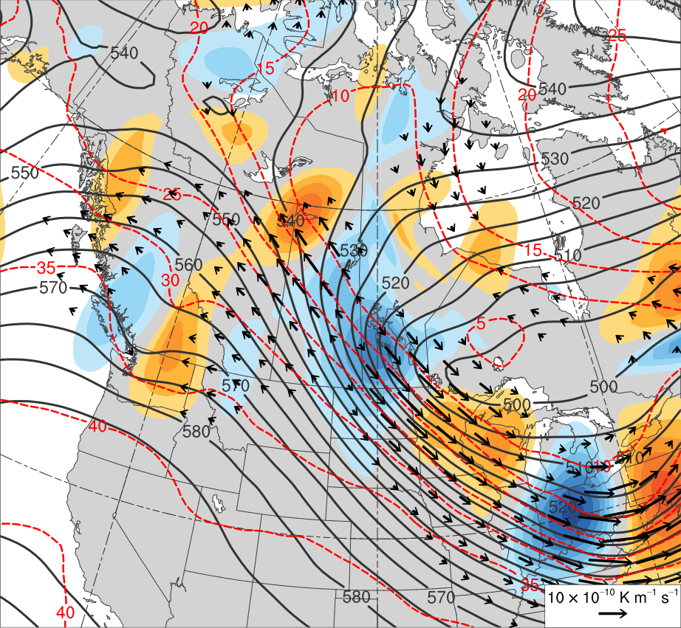
Case 1: QG Diagnostics
1200 UTC 9 Jan 1982
H
H
1062 hPa
1062 hPa
-4
-3.5
-3
-2.5
-2
-1.5
-1
-0.5
0
0.5
1
1.5
2
2.5
3
3.5
4
600–400-hPa layer averaged Q_{n} (K m⁻¹ s⁻¹, vectors), Q_{n} forcing for vertical motion (×10⁻¹⁸ Pa⁻¹ s⁻³, shaded), geopotential height (dam, gray), and potential temperature (K, red)
600–400-hPa layer averaged Q_{s} (K m⁻¹ s⁻¹, vectors), Q_{s} forcing for vertical motion (×10⁻¹⁸ Pa⁻¹ s⁻³, shaded), geopotential height (dam, gray), and potential temperature (K, red)

Slide 26
TPV 2 Track: 1800 UTC 6 Feb – 1800 UTC 14 Feb 2016
7
8
2
9
1.5
10
1
0.5
11
0
12
-0.5
13
-1
14
-1.5
-2
(σ)
0000 UTC (every 24 h)
Starting Point
Ending Point
6–14 February 2016 time-mean 300-hPa geopotential height (dam, black) and standardized anomaly of geopotential height (σ, shaded)

Slide 27
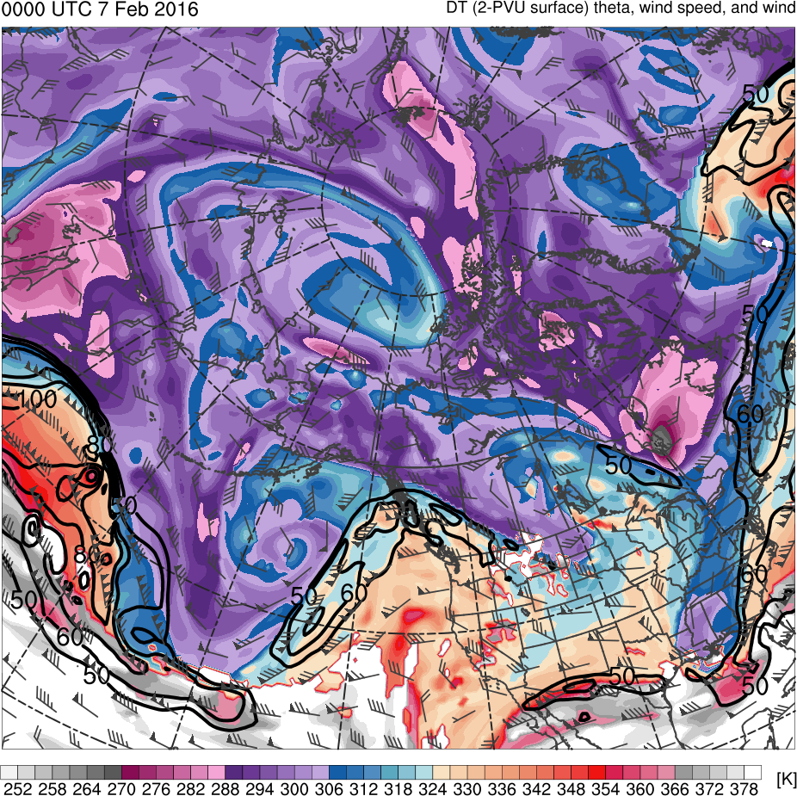
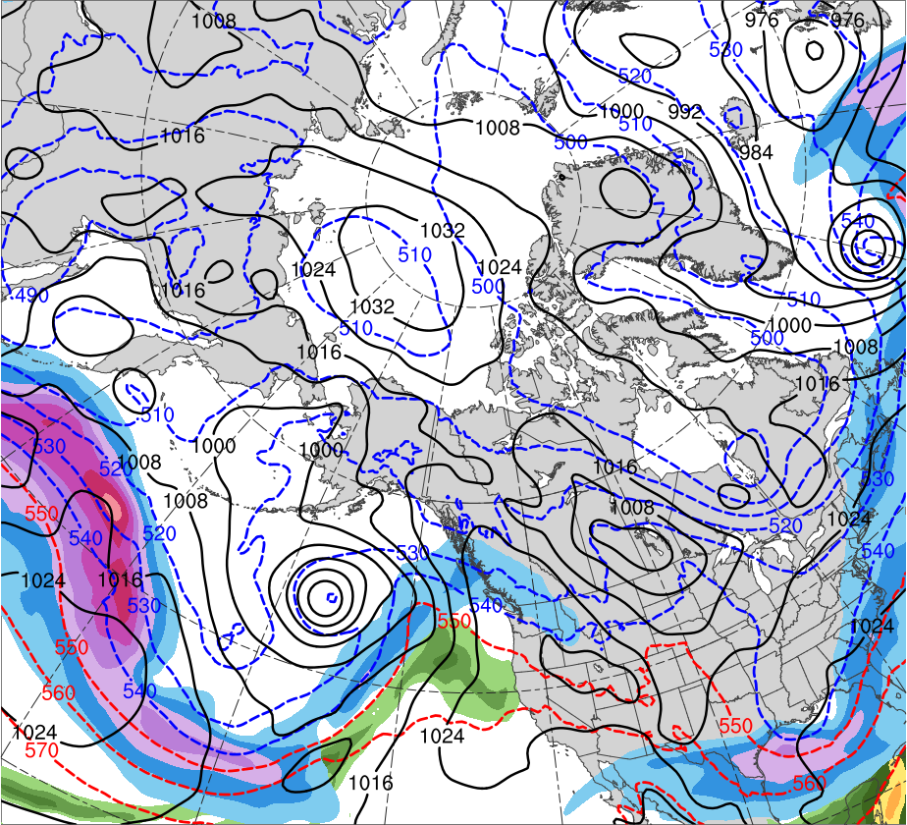
Case 2: Upstream Ridge Evolution
0000 UTC 7 Feb 2016
TPV
C
R
(K)
252
258
264
270
276
282
288
294
300
306
312
318
324
330
336
342
348
354
360
366
372
378
(mm)
(m s⁻¹ )
25
30
35
40
45
50
55
50
60
70
80
90
100
110
120
Potential temperature (K, shaded), wind speed (black, every 10 m s⁻¹ starting at 50 m s⁻¹), and wind (m s⁻¹, barbs) on 2-PVU surface
250-hPa wind speed (m s⁻¹, shaded),
1000–500-hPa thickness (every 10 dam, blue/red),
MSLP (every 8 hPa, black), PW (mm, shaded)

Slide 28
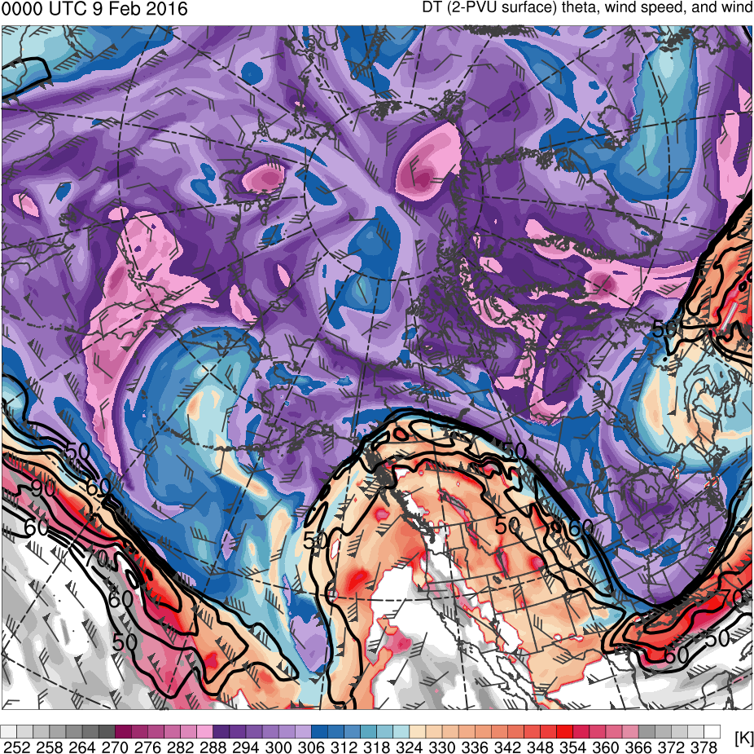
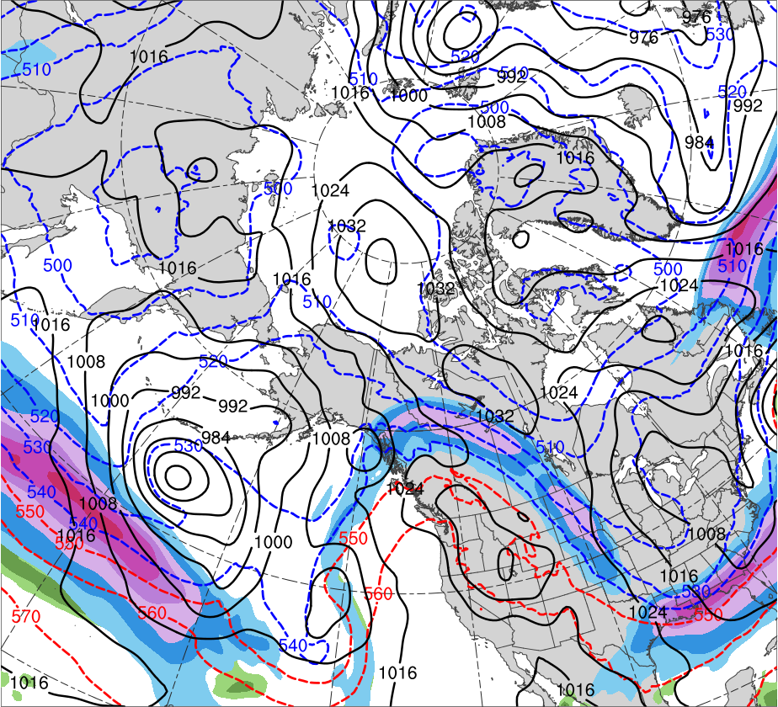
Case 2: Upstream Ridge Evolution
0000 UTC 9 Feb 2016
TPV
TPV
C
R
R
(K)
252
258
264
270
276
282
288
294
300
306
312
318
324
330
336
342
348
354
360
366
372
378
(mm)
(m s⁻¹ )
25
30
35
40
45
50
55
50
60
70
80
90
100
110
120
Potential temperature (K, shaded), wind speed (black, every 10 m s⁻¹ starting at 50 m s⁻¹), and wind (m s⁻¹, barbs) on 2-PVU surface
250-hPa wind speed (m s⁻¹, shaded),
1000–500-hPa thickness (every 10 dam, blue/red),
MSLP (every 8 hPa, black), PW (mm, shaded)

Slide 29
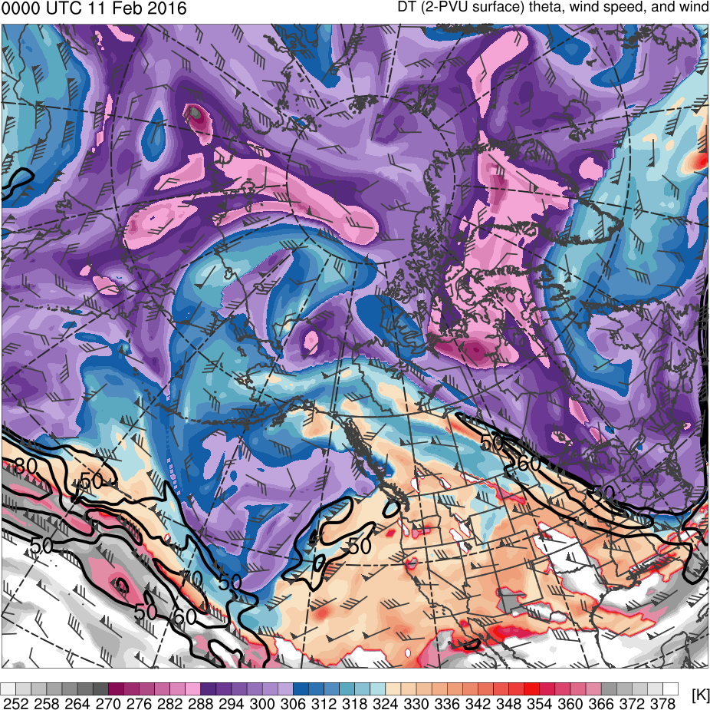
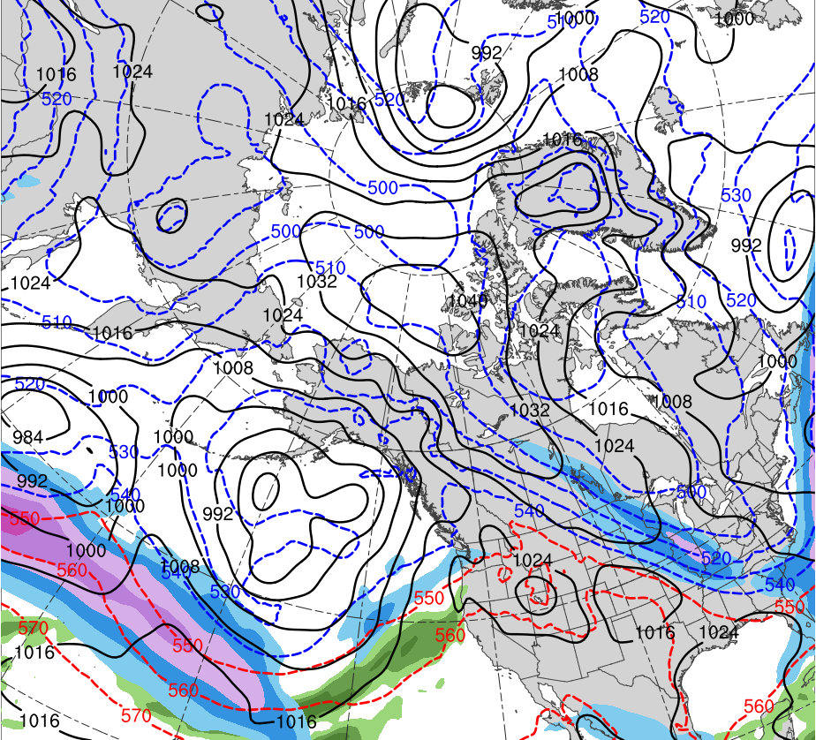
Case 2: Upstream Ridge Evolution
0000 UTC 11 Feb 2016
TPV
C
R
(K)
252
258
264
270
276
282
288
294
300
306
312
318
324
330
336
342
348
354
360
366
372
378
(mm)
(m s⁻¹ )
25
30
35
40
45
50
55
50
60
70
80
90
100
110
120
Potential temperature (K, shaded), wind speed (black, every 10 m s⁻¹ starting at 50 m s⁻¹), and wind (m s⁻¹, barbs) on 2-PVU surface
250-hPa wind speed (m s⁻¹, shaded),
1000–500-hPa thickness (every 10 dam, blue/red),
MSLP (every 8 hPa, black), PW (mm, shaded)

Slide 30
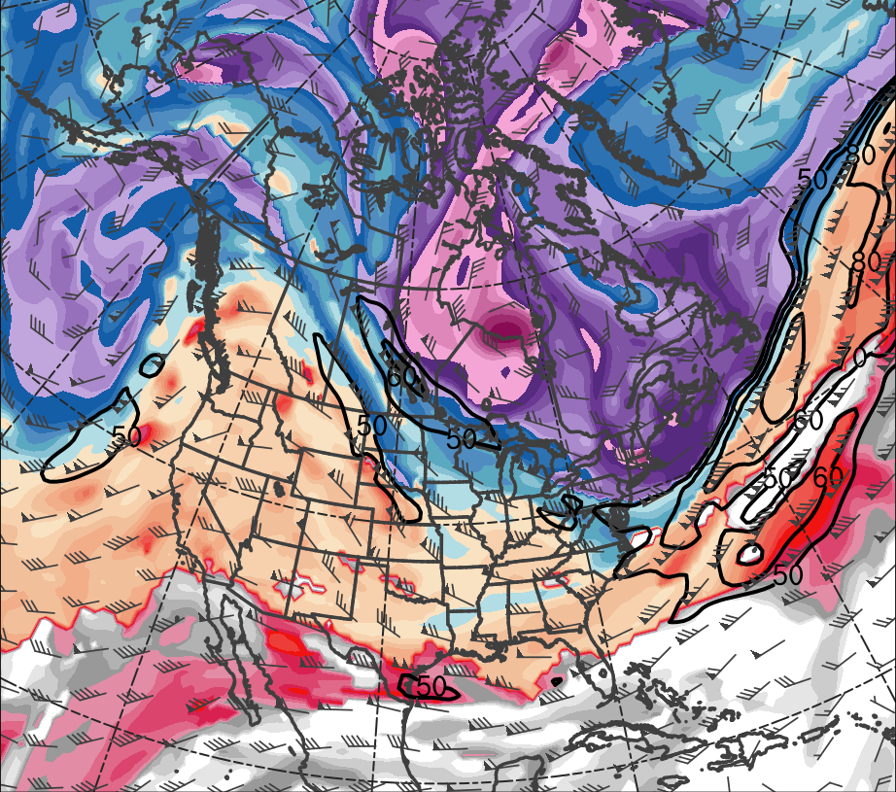
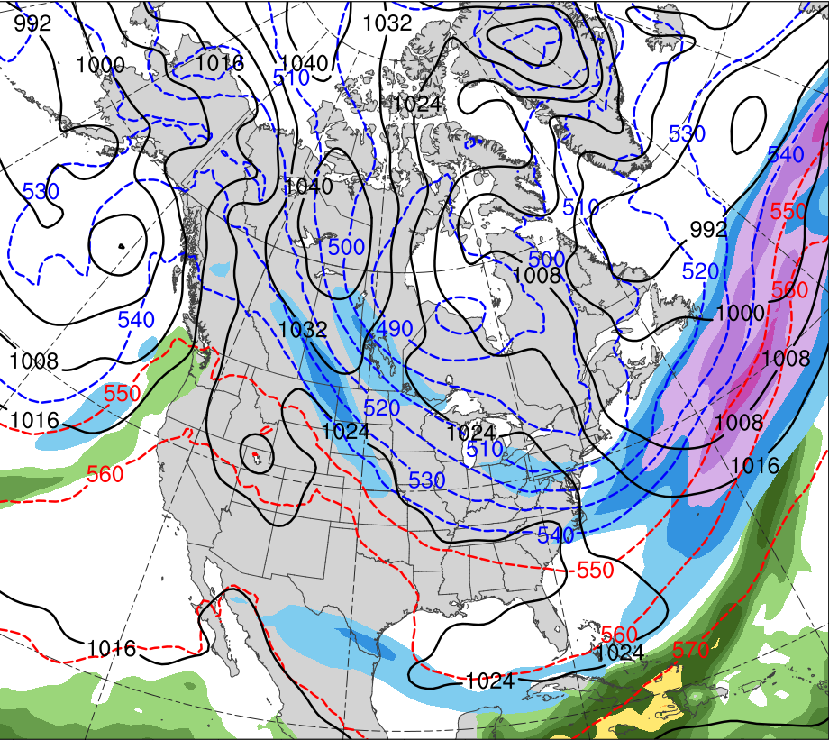
Case 2: TPV Transport and CAO
0000 UTC 12 Feb 2016
H
TPV
C
R
(K)
252
258
264
270
276
282
288
294
300
306
312
318
324
330
336
342
348
354
360
366
372
378
(mm)
(m s⁻¹ )
25
30
35
40
45
50
55
50
60
70
80
90
100
110
120
Potential temperature (K, shaded), wind speed (black, every 10 m s⁻¹ starting at 50 m s⁻¹), and wind (m s⁻¹, barbs) on 2-PVU surface
250-hPa wind speed (m s⁻¹, shaded),
1000–500-hPa thickness (every 10 dam, blue/red),
MSLP (every 8 hPa, black), PW (mm, shaded)

Slide 31
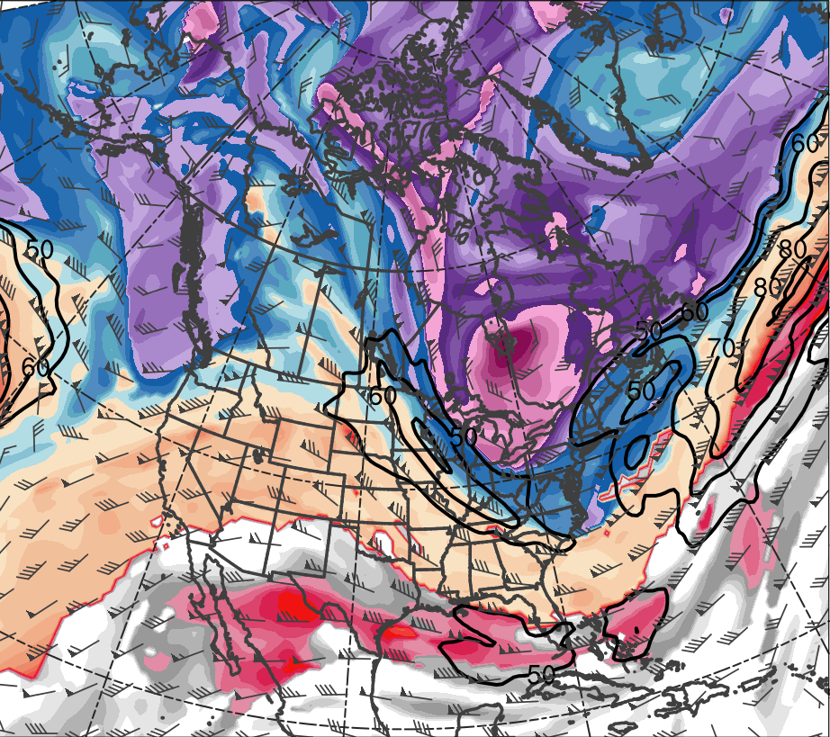

Case 2: TPV Transport and CAO
0000 UTC 13 Feb 2016
TPV
R
H
C
L
(K)
252
258
264
270
276
282
288
294
300
306
312
318
324
330
336
342
348
354
360
366
372
378
(mm)
(m s⁻¹ )
25
30
35
40
45
50
55
50
60
70
80
90
100
110
120
Potential temperature (K, shaded), wind speed (black, every 10 m s⁻¹ starting at 50 m s⁻¹), and wind (m s⁻¹, barbs) on 2-PVU surface
250-hPa wind speed (m s⁻¹, shaded),
1000–500-hPa thickness (every 10 dam, blue/red),
MSLP (every 8 hPa, black), PW (mm, shaded)

Slide 32


Case 2: TPV Transport and CAO
0000 UTC 14 Feb 2016
L
TPV
R
C
H
(K)
252
258
264
270
276
282
288
294
300
306
312
318
324
330
336
342
348
354
360
366
372
378
(mm)
(m s⁻¹ )
25
30
35
40
45
50
55
50
60
70
80
90
100
110
120
Potential temperature (K, shaded), wind speed (black, every 10 m s⁻¹ starting at 50 m s⁻¹), and wind (m s⁻¹, barbs) on 2-PVU surface
250-hPa wind speed (m s⁻¹, shaded),
1000–500-hPa thickness (every 10 dam, blue/red),
MSLP (every 8 hPa, black), PW (mm, shaded)

Slide 33


Case 2: Cross Section
0000 UTC 14 Feb 2016
B
TPV
TPV
A
Potential vorticity (PVU, shaded), wind speed (white, every 10 m s⁻¹ starting at 50 m s⁻¹), and potential temperature (K, black)
Potential temperature (K, shaded), wind speed (black, every 10 m s⁻¹ starting at 50 m s⁻¹), and wind (m s⁻¹, barbs) on 2-PVU surface

Slide 34


Case 2: QG Diagnostics
1200 UTC 11 Feb 2016
H
H
1042 hPa
1042 hPa
-4
-3.5
-3
-2.5
-2
-1.5
-1
-0.5
0
0.5
1
1.5
2
2.5
3
3.5
4
600–400-hPa layer averaged Q_{n} (K m⁻¹ s⁻¹, vectors), Q_{n} forcing for vertical motion (×10⁻¹⁸ Pa⁻¹ s⁻³, shaded), geopotential height (dam, gray), and potential temperature (K, red)
600–400-hPa layer averaged Q_{s} (K m⁻¹ s⁻¹, vectors), Q_{s} forcing for vertical motion (×10⁻¹⁸ Pa⁻¹ s⁻³, shaded), geopotential height (dam, gray), and potential temperature (K, red)

Slide 35


Case 2: QG Diagnostics
0000 UTC 12 Feb 2016
H
H
1046 hPa
1046 hPa
-4
-3.5
-3
-2.5
-2
-1.5
-1
-0.5
0
0.5
1
1.5
2
2.5
3
3.5
4
600–400-hPa layer averaged Q_{n} (K m⁻¹ s⁻¹, vectors), Q_{n} forcing for vertical motion (×10⁻¹⁸ Pa⁻¹ s⁻³, shaded), geopotential height (dam, gray), and potential temperature (K, red)
600–400-hPa layer averaged Q_{s} (K m⁻¹ s⁻¹, vectors), Q_{s} forcing for vertical motion (×10⁻¹⁸ Pa⁻¹ s⁻³, shaded), geopotential height (dam, gray), and potential temperature (K, red)

Slide 36


Case 2: QG Diagnostics
0000 UTC 12 Feb 2016
H
H
1047 hPa
1047 hPa
-4
-3.5
-3
-2.5
-2
-1.5
-1
-0.5
0
0.5
1
1.5
2
2.5
3
3.5
4
600–400-hPa layer averaged Q_{n} (K m⁻¹ s⁻¹, vectors), Q_{n} forcing for vertical motion (×10⁻¹⁸ Pa⁻¹ s⁻³, shaded), geopotential height (dam, gray), and potential temperature (K, red)
600–400-hPa layer averaged Q_{s} (K m⁻¹ s⁻¹, vectors), Q_{s} forcing for vertical motion (×10⁻¹⁸ Pa⁻¹ s⁻³, shaded), geopotential height (dam, gray), and potential temperature (K, red)

Slide 37
Conclusions
Extratropical cyclones in exit region of North Pacific jet play important role in downstream development and amplification or ridges responsible for equatorward TPV transport in both cases
Both TPVs collocated with surface-based pool of arctic air, with an arctic frontal feature extending downward and equatorward from TPVs
January 1982 case, in particular, indicates that TPV–jet interactions may enhance QG forcing for descent in jet entrance region, supporting intensification of surface anticyclone in this region
February 2016 TPV interacts less with upstream jet, and overall QG forcing for descent is weaker near surface anticyclone in this case compared to January 1982 case

Slide 38
Conclusions
Stronger surface anticyclones may be associated with stronger downstream MSLP gradient
Equatorward transport of surface-based pools of arctic air associated with TPVs may lead to enhanced thermal gradients over middle latitudes
Stronger MSLP and thermal gradients may lead to stronger cold air advection
Regardless, as surface-based pools of arctic air beneath and behind TPVs moves equatorward along with TPVs into middle latitudes, CAOs may result

