Slide 1
Coherent Disturbances on the Dynamic Tropopause
Kevin A. Biernat
Department of Atmospheric and Environmental Sciences
University at Albany, SUNY
ATM 619: Cyclone Workshop Seminar

Slide 2
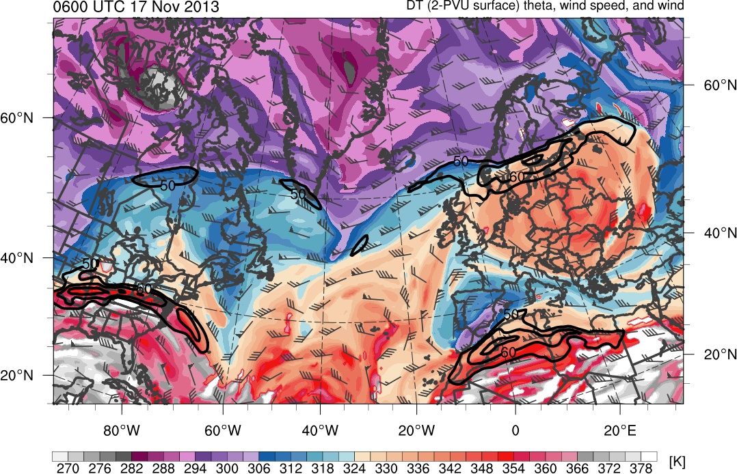
What are Coherent Disturbances on the Dynamic Tropopause (DT)?
Coherent disturbances on the DT are material features
Can be identified by closed contours of DT potential temperature or DT pressure, indicative of parcel trapping (Hakim 2000; Pyle et al. 2004; Cavallo and Hakim 2009)
0600 UTC 17 November 2013
Potential temperature (K, shaded), wind speed (black, every 10 m s⁻¹ starting at 50 m s⁻¹), and wind (m s⁻¹, barbs) on 2-PVU surface. Plotted using 0.5° NCEP CFSR dataset.
(K)
270
276
282
288
294
300
306
312
318
324
330
336
342
348
354
360
366
372
378

Slide 3
What are Coherent Disturbances on the DT?
A coherent tropopause disturbance (CTD; Pyle et al. 2004) is defined as a tropopause-based material feature that is not necessarily of high-latitude origin
A tropopause polar vortex (TPV; Cavallo and Hakim 2009, 2010) is a particular type of CTD, defined as a tropopause-based vortex of high-latitude origin
0600 UTC 17 November 2013
TPVs
Potential temperature (K, shaded), wind speed (black, every 10 m s⁻¹ starting at 50 m s⁻¹), and wind (m s⁻¹, barbs) on 2-PVU surface. Plotted using 0.5° NCEP CFSR dataset.
CTDs
(K)
270
276
282
288
294
300
306
312
318
324
330
336
342
348
354
360
366
372
378

Slide 4
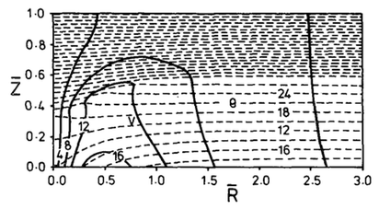
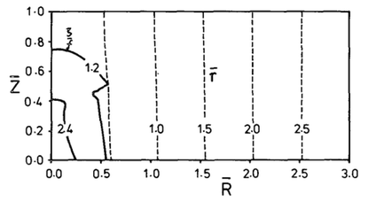
Balanced Vortex Structure using Potential Vorticity (PV)
Thorpe (1985)
Derived equation set analogous to two-dimensional semigeostrophic set for axisymmetric flow in gradient wind balance
Equation set consists of prognostic equation for PV and two elliptic (diagnostic) equations for the potential function giving the balanced vortex structure
Vortex structure completely determined at any time by solution of potential function equation and interior variations of PV
Found that increased surface temperature, a lower tropopause, or larger tropospheric PV within core of vortex are each consistent with cyclonic circulation
Potential temperature (dashed contours, K) and azimuthal wind (solid contours, m s⁻¹). Adapted from Fig. 3 in Thorpe (1985).
Ratio of relative vorticity to planetary vorticity (solid contours) and radius (dashed contours). Adapted from Fig. 3 in Thorpe (1985).

Slide 5
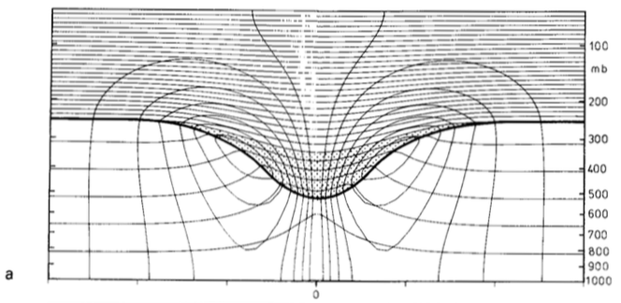
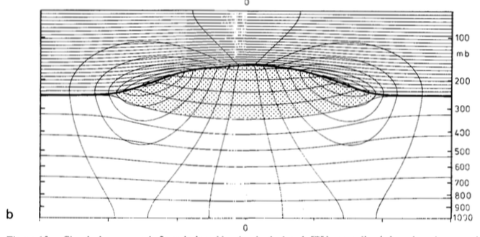
Structure of Tropopause-based PV Anomalies
Hoskins et al. (1985)
positive (cyclonic) PV anomaly
✕
Potential temperature (solid contours, every 5 K) and azimuthal wind (thin contours, every 3 m s⁻¹). Thick line is tropopause. Stippled regions represent the PV anomalies. Surface pressure anomaly is (top) −41 hPa and (bottom) +13 hPa and relative vorticity extrema (located at tropopause) are (top) 1.7 × f and (bottom) −0.6 × f where f = 10⁻⁴ s⁻¹ . Calculations done following method of Thorpe (1985). Adapted from Fig. 15 in Hoskins et al. 1985).
L
negative (anticyclonic) PV anomaly
✕
H

Slide 6
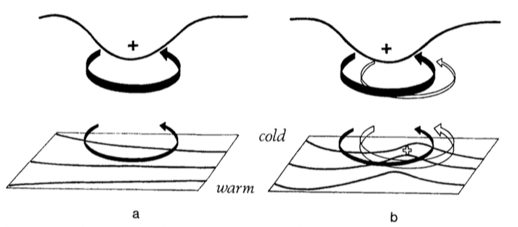
Cyclonic PV Anomalies and Cyclogenesis
Hoskins et al. (1985)
Cyclonic PV Anomaly
Trop.
θ
t = t₀
Notes:
Adapted from Fig. 21 in Hoskins et al. (1985).

Slide 7
Cyclonic PV Anomalies and Cyclogenesis
Hoskins et al. (1985)
Cyclonic PV Anomaly
Trop.
WAA
θ
t = t₀
Notes:
Adapted from Fig. 21 in Hoskins et al. (1985).

Slide 8
Cyclonic PV Anomalies and Cyclogenesis
Hoskins et al. (1985)
Cyclonic PV Anomaly
Trop.
WAA
θ
Cyclonic PV Anomaly
t = t₀
t = t₀ + Δt
Notes:
Adapted from Fig. 21 in Hoskins et al. (1985).

Slide 9
Cyclonic PV Anomalies and Cyclogenesis
Hoskins et al. (1985)
Cyclonic PV Anomaly
Positive PV Advection
Trop.
WAA
θ
Cyclonic PV Anomaly
t = t₀
t = t₀ + Δt
Notes:
Adapted from Fig. 21 in Hoskins et al. (1985).

Slide 10
Cyclonic PV Anomalies and Cyclogenesis
Hoskins et al. (1985)
Cyclonic PV Anomaly
Positive PV Advection
Trop.
WAA
“Phase Locking”
θ
Cyclonic PV Anomaly
t = t₀
t = t₀ + Δt
Notes:
Adapted from Fig. 21 in Hoskins et al. (1985).

Slide 11

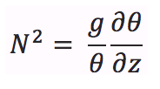
Cyclonic PV Anomalies and Cyclogenesis
Hoskins et al. (1985)
Including Moist Processes
H: Rossby penetration depth
f : Coriolis parameter
L: horizontal scale of flow
N: static stability
Positive PV Advection
Moist processes may modify amplification process
Ascent in region of reduced N beneath approaching upper-level PV anomaly
If enough moisture, condensation will lead to further reduction in N
This results in larger H
Positive feedback between PV anomalies will be enhanced
“Phase Locking”
θ
θ
Cyclonic PV Anomaly
t = t₀ + Δt
Notes:
Adapted from Fig. 21 in Hoskins et al. (1985).

Slide 12
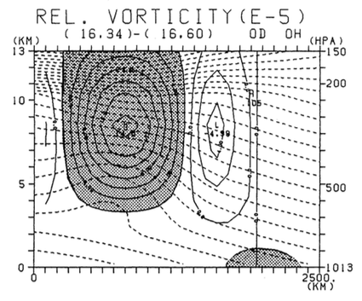
“Coupling Development”
Takayabu (1991)
Used simplified three-dimensional, β-plane channel, dry primitive equation model to simulate rapid cyclogenesis resulting from coupling of upper and lower tropospheric vortices
Used a simple baroclinic westerly jet as basic flow and superimposed finite amplitude upper vortex and lower vortex
Initial upper vortex associated with temperature anomaly of −9 K in upper-troposphere, while lower vortex associated with temperature anomaly of +4 K at surface
Initial upper vortex placed 1200 km north of basic state jet axis, while initial lower vortex is placed on jet axis, 1500 km east of upper vortex
Meridional–height cross section of initial disturbances with potential temperature (dashed contours, every 5 K) and relative vorticity (solid contours, every 2×10⁻⁵ s⁻¹). Relative vorticity values greater than 2×10⁻⁵ s⁻¹ are shaded for the upper vortex and relative vorticity values greater than 1×10⁻⁵ s⁻¹ are shaded for lower vortex (located 1500 km east of cross section). Adapted from Fig. 3 of Takayabu (1991).

Slide 13
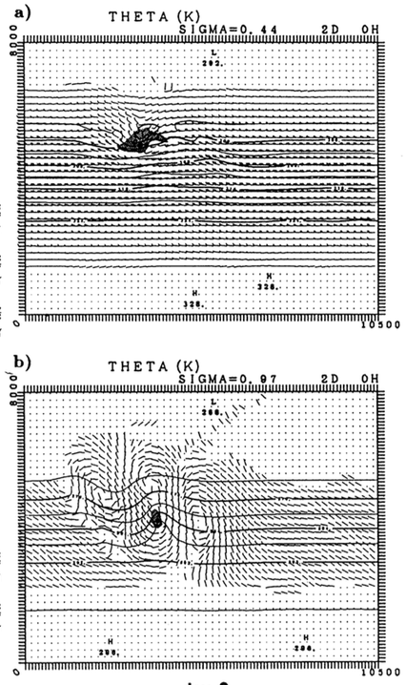
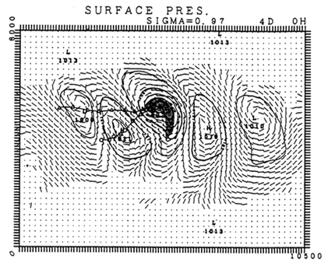
“Coupling Development”
Takayabu (1991)
σ = 0.44
σ = 0.97
Vortex track at σ = 0.44
L
J
Vortex track at σ = 0.97
σ = 0.97
Day 4
(left) Potential temperature (solid, contoured every 4 K), wind (flags and barbs), and relative vorticity greater than 4×10⁻⁵ s⁻¹ (shading) at (top) σ = 0.44 and (bottom) σ = 0.97. Adapted from Fig. 5 in Takayabu (1991).
(right) Surface pressure (solid, contoured every 4 hPa), winds (flags and barbs), and relative vorticity greater than 4×10⁻⁵ s⁻¹ (shading) at σ = 0.97. Adapted from Fig. 6 in Takayabu (1991).
Day 2

Slide 14
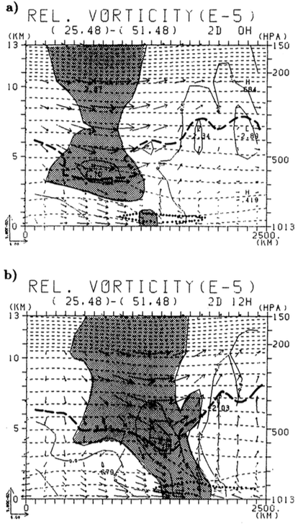
“Coupling Development”
Takayabu (1991)
Day 2
Day 2.5
“Coupling Development”
Zonal–height cross section at a latitude between upper and lower-level vortices (denoted by plus symbols). Potential temperature (thin dashed contours, every 5 K), relative vorticity (every 4 × 10⁻⁵ s⁻¹), motion along section (vectors). Thick solid line corresponding to tropopause represents 1.0 PVU surface and thick dotted line corresponding to low-level cyclonic PV anomaly represents 0.6 PVU surface.

Slide 15
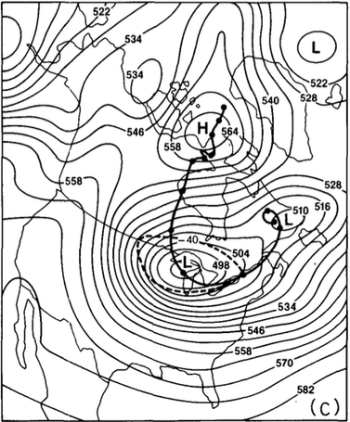
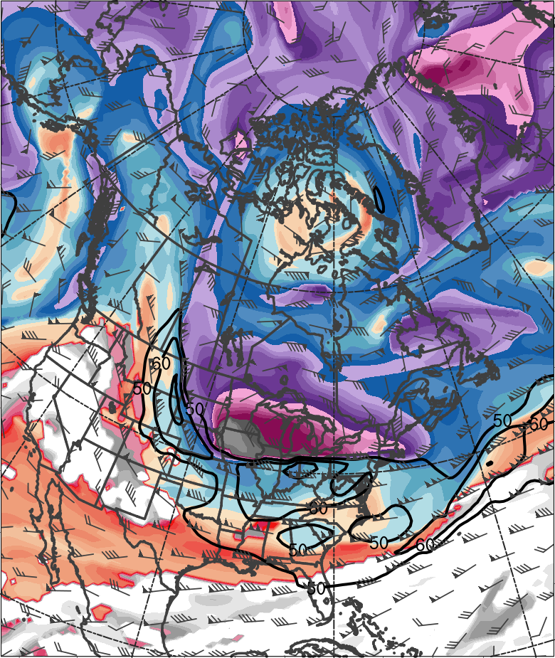
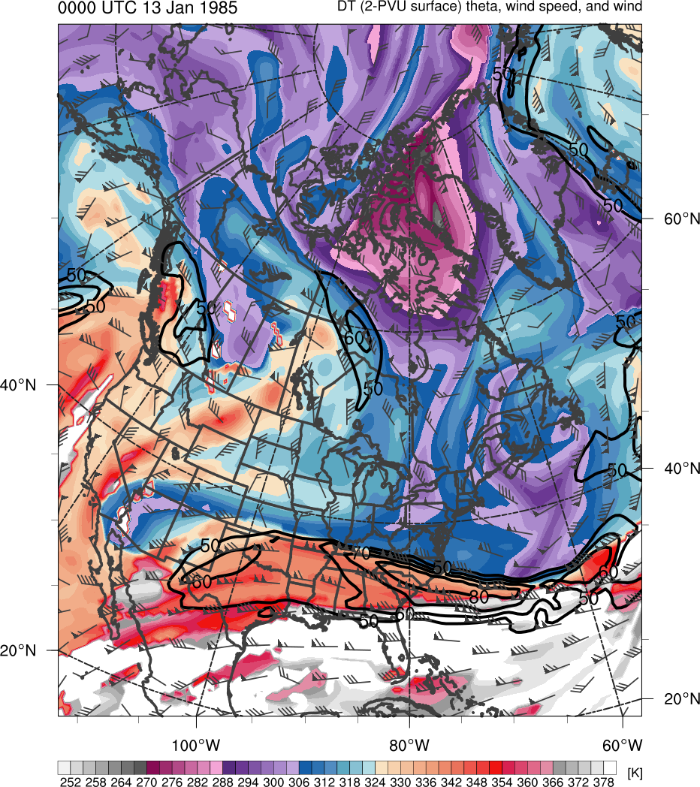
The Arctic Tropopause Fold and Arctic Jet
Shapiro et al. (1987)
0000 UTC 20 January 1985
378
372
366
360
354
348
342
336
“Polar Vortex”
“Polar Vortex”
330
324
318
312
306
300
294
288
282
276
270
264
258
252
(K)
500-hPa geopotential height (black, every 6 dam) and −40°C isotherm (dashed contour); track of polar vortex from 0000 UTC 12 January to 0000 UTC 24 January 1985 (heavy black). Adapted from Fig. 5 in Shapiro et al. (1987).
Potential temperature (K, shaded), wind speed (black, every 10 m s⁻¹ starting at 50 m s⁻¹), and wind (m s⁻¹, barbs) on 2-PVU surface. Plotted using 0.5° NCEP CFSR dataset.

Slide 16
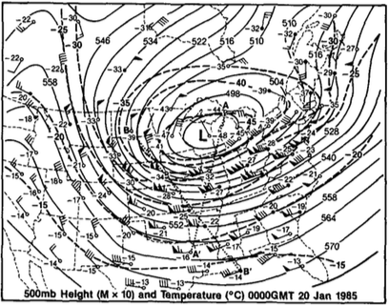
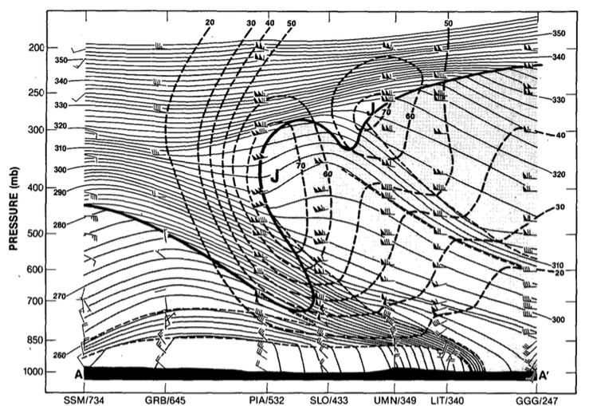
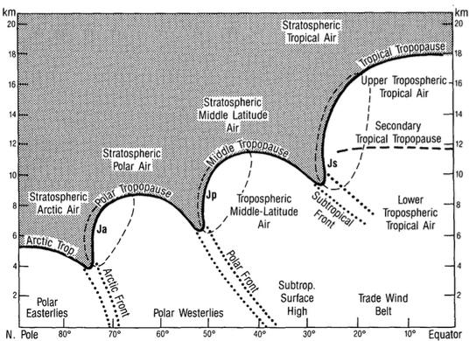
The Arctic Tropopause Fold and Arctic Jet
Shapiro et al. (1987)
0000 UTC 20 January 1985
(upper left) 500-hPa geopotential height (dam, solid contours), temperature (°C, dashed contours), and wind (barbs and flags, m s⁻¹). (lower-left) Cross-section of potential temperature (K, thin solid), wind speed (m s⁻¹, heavy dashed contours), and wind (m s⁻¹, barbs and flags) between Sault Sainte Marie, MI and Longview, TX. Heavy solid line is tropopause (10⁻⁷ K s⁻¹ hPa⁻¹ isopleth of PV) and light dashed lines indicate tropospheric frontal and stable layer boundaries. (lower-right) “threefold” structure of tropopause where heavy line is PV discontinuity tropopause, shading is stratospheric air, and light dashed contours represent 40 m s⁻¹ isotach.
A
A’
Adapted from Fig. 7 in Shapiro et al. (1987)
PJ
STJ
AJ
PJ
AJ
A
A’
Adapted from Fig. 17 in Shapiro et al. (1987)
Adapted from Fig. 9 in Shapiro et al. (1987)

Slide 17
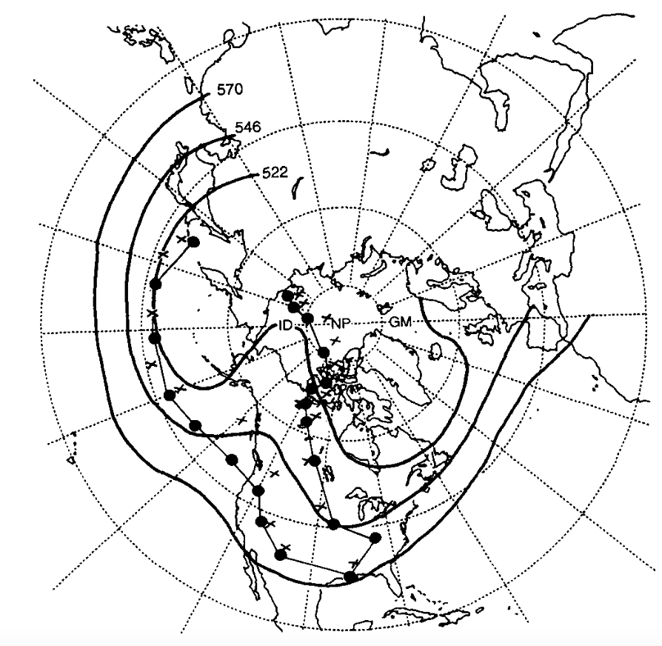
1978 Cleveland Superbomb
Hakim et al. (1995, 1996)
Midlatitude CTD
Arctic CTD
Position of QGPV maxima (colored dots) and 1000–500-hPa thickness minima (black crosses) every 24 h starting at 0000 UTC 17 January and ending 0000 UTC 27 January 1978; time-mean 500-hPa geopotential height field (black, contoured every 120 m) for 17–27 January 1978. Adapted from Fig. 3 in Hakim et al. (1995).
“Merged” CTD

Slide 18
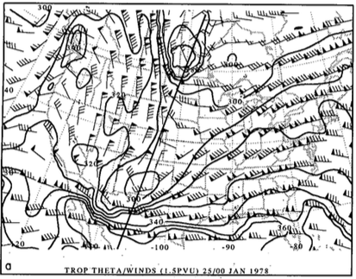
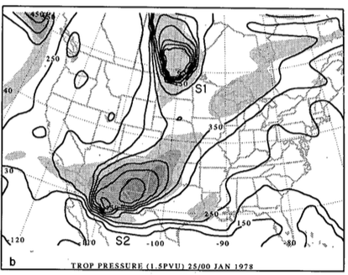
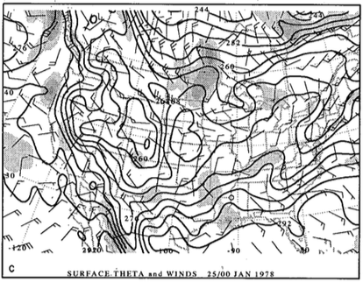
1978 Cleveland Superbomb
Hakim et al. (1995, 1996)
0000 UTC 25 January 1978
R
CTD 1
R
CTD 1
CTD 2
CTD 2
A
(a) Dynamic tropopause (DT; 1.5 PVU) potential temperature (black contours, every 10 K) and wind (flags and barbs, m s⁻¹); (b) DT pressure (black contours, every 50 hPa) and relative vorticity (shaded every 2×10⁻⁵ s⁻¹ for values greater than 4×10⁻⁵ s⁻¹ ); (c) surface potential temperature (black contours, every 4 K) and relative vorticity (shaded every 2×10⁻⁵ s⁻¹ for values greater than 2×10⁻⁵ s⁻¹). Adapted from Fig. 4 in Hakim et al. (1995).

Slide 19
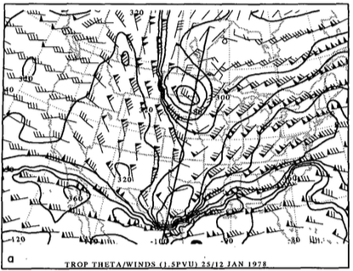
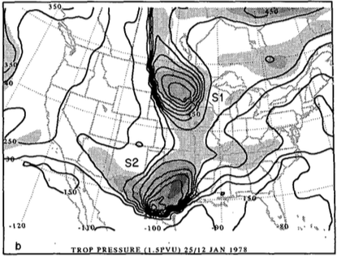
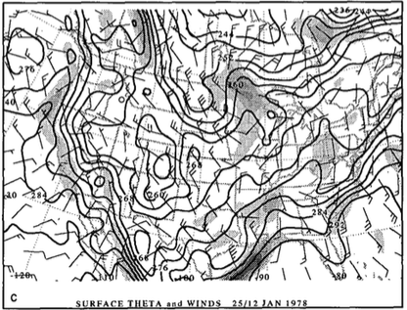
1978 Cleveland Superbomb
Hakim et al. (1995, 1996)
1200 UTC 25 January 1978
R
R
CTD 1
CTD 1
CTD 2
CTD 2
(a) Dynamic tropopause (DT; 1.5 PVU) potential temperature (black contours, every 10 K) and wind (flags and barbs, m s⁻¹); (b) DT pressure (black contours, every 50 hPa) and relative vorticity (shaded every 2×10⁻⁵ s⁻¹ for values greater than 4×10⁻⁵ s⁻¹ ); (c) surface potential temperature (black contours, every 4 K) and relative vorticity (shaded every 2×10⁻⁵ s⁻¹ for values greater than 2×10⁻⁵ s⁻¹). Adapted from Fig. 6 in Hakim et al. (1995).
A
L
998 hPa

Slide 20
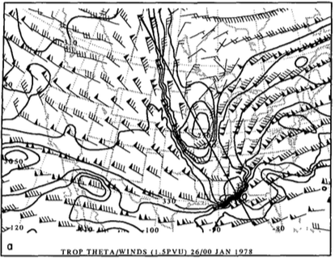
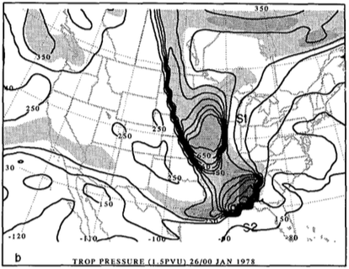
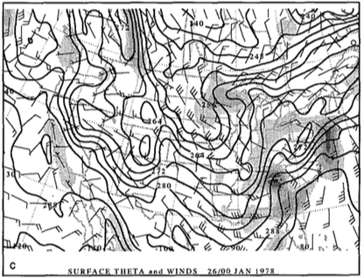
1978 Cleveland Superbomb
Hakim et al. (1995, 1996)
0000 UTC 26 January 1978
R
R
CTD 1
CTD 1
CTD 2
CTD 2
(a) Dynamic tropopause (DT; 1.5 PVU) potential temperature (black contours, every 10 K) and wind (flags and barbs, m s⁻¹); (b) DT pressure (black contours, every 50 hPa) and relative vorticity (shaded every 2×10⁻⁵ s⁻¹ for values greater than 4×10⁻⁵ s⁻¹ ); (c) surface potential temperature (black contours, every 4 K) and relative vorticity (shaded every 2×10⁻⁵ s⁻¹ for values greater than 2×10⁻⁵ s⁻¹). Adapted from Fig. 8 in Hakim et al. (1995).
A
L
982 hPa

Slide 21
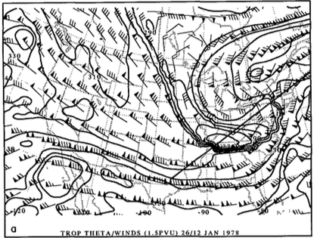
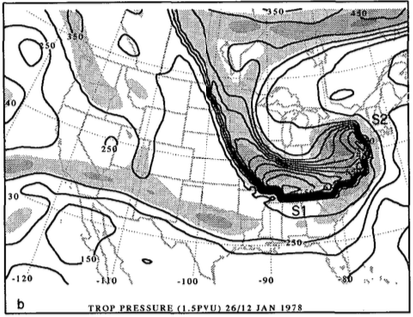
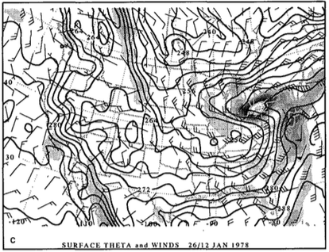
1978 Cleveland Superbomb
Hakim et al. (1995, 1996)
1200 UTC 26 January 1978
CTD 2
CTD 2
R
R
CTD 1
CTD 1
(a) Dynamic tropopause (DT; 1.5 PVU) potential temperature (black contours, every 10 K) and wind (flags and barbs, m s⁻¹); (b) DT pressure (black contours, every 50 hPa) and relative vorticity (shaded every 2×10⁻⁵ s⁻¹ for values greater than 4×10⁻⁵ s⁻¹ ); (c) surface potential temperature (black contours, every 4 K) and relative vorticity (shaded every 2×10⁻⁵ s⁻¹ for values greater than 2×10⁻⁵ s⁻¹). Adapted from Fig. 9 in Hakim et al. (1995).
L
A
955 hPa

Slide 22
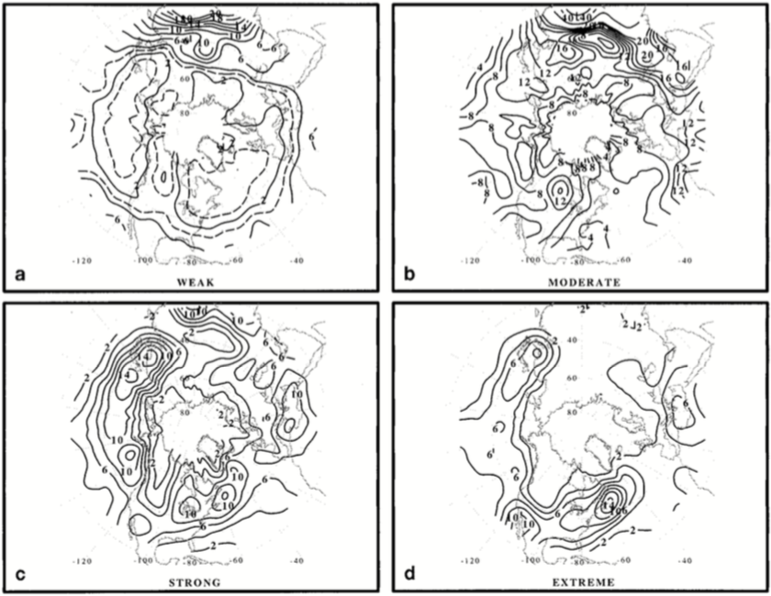
Climatology of Coherent Disturbances on Tropopause
Hakim (2000)
Weak: 0 < ζ_{g} ≤ 4 ×10⁻⁵ s⁻¹
Moderate: 4 ×10⁻⁵ s⁻¹ < ζ_{g} ≤ 8 ×10⁻⁵ s⁻¹
Strong: 8 ×10⁻⁵ s⁻¹ < ζ_{g} ≤ 12 ×10⁻⁵ s⁻¹
Extreme: 12 ×10⁻⁵ s⁻¹ < ζ_{g} ≤ 30 ×10⁻⁵ s⁻¹
Percentage of date times with occurrences of 500-hPa geostrophic relative vorticity for DJF during 1957–87. Defined as ratio of total number of events occurring within a 10° × 10° box centered at each grid point to total number of data times. Data used is twice-daily NCEP gridded 500-hPa height. Adapted from Fig. 3 in Hakim (2000).

Slide 23
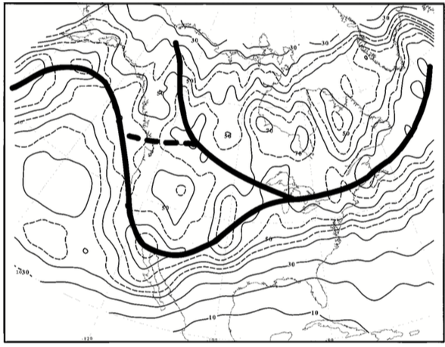
Climatology of Coherent Disturbances on Tropopause
Hakim (2000)
Percentage of 500-hPa vorticity maxima (4–30×10⁻⁵ s⁻¹) during ERICA period of Dec 1988–Feb 1989. Adapted from Fig. 7 in Hakim (2000).

Slide 24
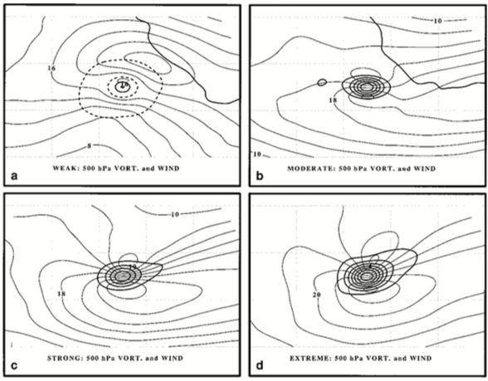
Climatology of Coherent Disturbances on Tropopause
Hakim (2000)
Weak: 0 < ζ ≤ 4 ×10⁻⁵ s⁻¹; N = 1635
Moderate: 4 ×10⁻⁵ s⁻¹ < ζ ≤ 8 ×10⁻⁵ s⁻¹ ; N = 1620
Strong: 8 ×10⁻⁵ s⁻¹ < ζ ≤ 12 ×10⁻⁵ s⁻¹; N = 1039
Extreme: 12 ×10⁻⁵ s⁻¹ < ζ ≤ 30 ×10⁻⁵ s⁻¹; N = 932
Mean 500-hPa total-wind relative vorticity (thick contours every 1×10⁻⁵ s⁻¹ in top and every 2×10⁻⁵ s⁻¹ in bottom) and total-wind speed (thing contours, every 4 m s⁻¹) for ERICA period of Dec 1988–Feb 1989. Data taken from ECMWF data assimilation system (1.125° × 1.125° interpolated to 1° × 1°). Adapted from Fig. 8 of Hakim (2000).

Slide 25
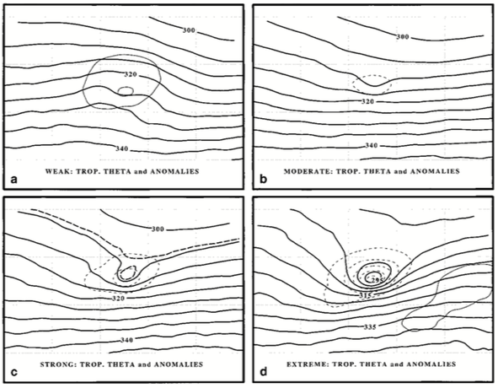
Climatology of Coherent Disturbances on Tropopause
Hakim (2000)
Weak: 0 < ζ ≤ 4 ×10⁻⁵ s⁻¹; N = 1635
Moderate: 4 ×10⁻⁵ s⁻¹ < ζ ≤ 8 ×10⁻⁵ s⁻¹ ; N = 1620
Strong: 8 ×10⁻⁵ s⁻¹ < ζ ≤ 12 ×10⁻⁵ s⁻¹; N = 1039
Extreme: 12 ×10⁻⁵ s⁻¹ < ζ ≤ 30 ×10⁻⁵ s⁻¹; N = 932
DT potential temperature (solid contours, every 5 K) and anomaly (thin lines every 4 K) for ERICA period of Dec 1988–Feb 1989. Data taken from ECMWF data assimilation system (1.125° × 1.125° interpolated to 1° × 1°). Adapted from Fig. 8 of Hakim (2000).

Slide 26
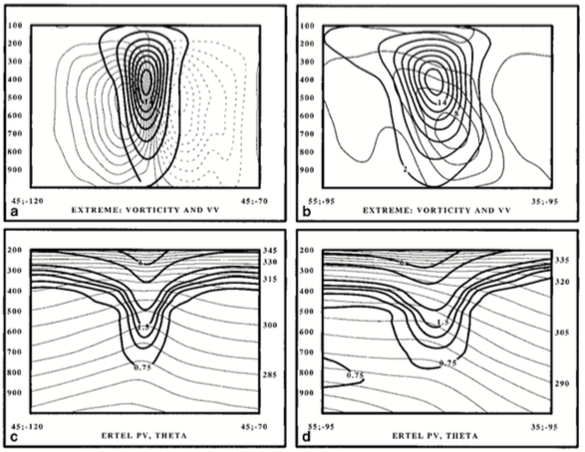
Climatology of Coherent Disturbances on Tropopause
Hakim (2000)
Cross sections of extreme vorticity maximum of (top) Relative vorticity (thick lines, every 2×10⁻⁵ s⁻¹) and vertical motion (thin lines, every 0.2×10⁻¹ Pa s⁻¹ and (bottom) EPV (thick lines, PVU) and potential temperature (thin lines, every 5 K). Cross sections are (left) zonal and (right) meridional. Adapted from Fig. 10 in Hakim (2000).

Slide 27
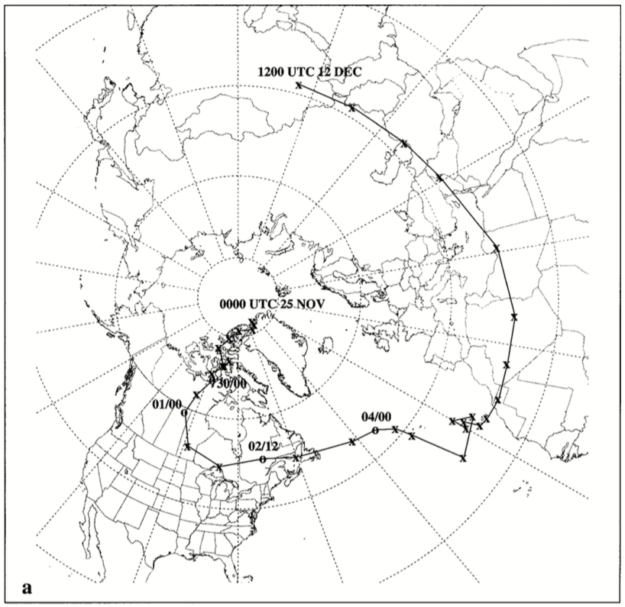
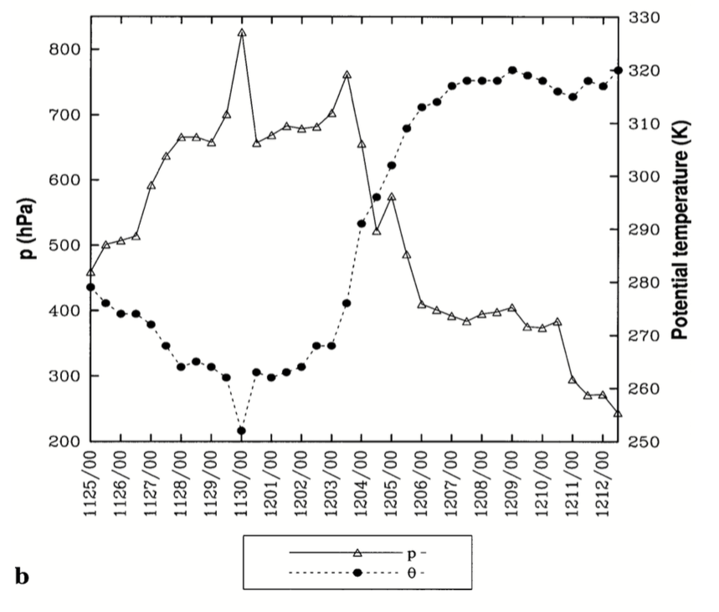
CTD–Jet Interaction
Pyle et al. (2004)
CTD track from 0000 UTC 25 Nov to 1200 UTC 26 Nov 1991. Adapted from Fig. 9 in Pyle et al. 2004.
Time series of DT pressure maximum (hPa, triangles) and potential temperature minimum (K, circles) associated with CTD. Adapted from Fig. 9 in Pyle et al. 2004.

Slide 28
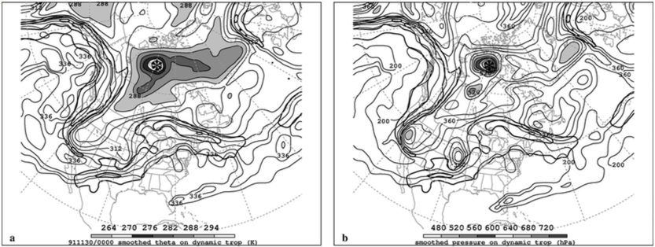
CTD–Jet Interaction
Pyle et al. (2004)
TPV/CTD–jet interactions may lead to formation or intensification of a jet streak
Gradient of DT potential temperature and pressure becomes locally enhanced as TPV/CTD closely approaches the waveguide/jet stream
In the figure below, a TPV over northern Canada is separate from a jet streak (J1) upstream
0000 UTC 30 November 1991
J1
TPV
J1
TPV
(left) DT (1.5-PVU surface) wind speed (every 15 m s⁻¹ starting at 50 m s⁻¹, thick contours) and potential temperature (K, thin contours and shading); (right) same as left except DT pressure (hPa, thin contours and shading). Adapted from Fig. 10 in Pyle et al. (2004).

Slide 29
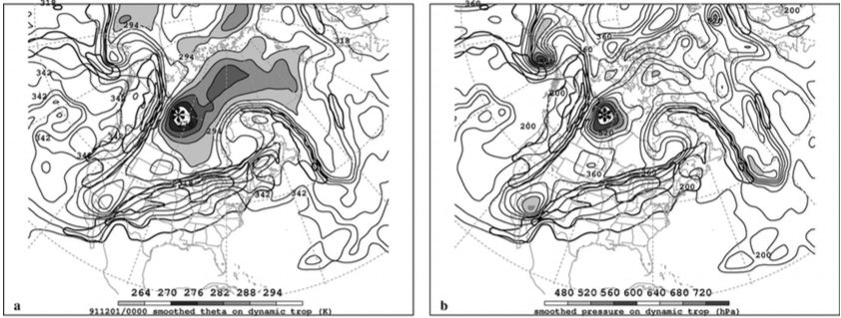
CTD–Jet Interaction
Pyle et al. (2004)
As TPV closely approaches J1, gradient in DT potential temperature and pressure strengthen in between these features, and J1 thus strengthens
Jet Streak 2 (J2) forms over the central U.S.
0000 UTC 1 December 1991
J1
J1
TPV
TPV
J2
J2
(left) DT (1.5-PVU surface) wind speed (every 15 m s⁻¹ starting at 50 m s⁻¹, thick contours) and potential temperature (K, thin contours and shading); (right) same as left except DT pressure (hPa, thin contours and shading). Adapted from Fig. 11 in Pyle et al. (2004).

Slide 30
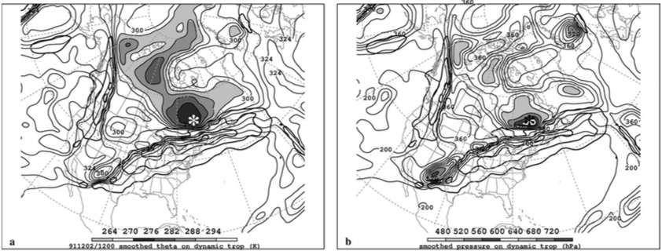
CTD–Jet Interaction
Pyle et al. (2004)
J1 weakens as the TPV shifts away from J1
TPV has come into close proximity with J2
J2 has strengthened from 91 to 104 m s⁻¹ over past 36 hours (not shown)
High, localized DT pressure maxima associated with TPV suggest tropopause folding beneath J2 (not shown)
1200 UTC 2 December 1991
TPV
TPV
J1
J1
J2
J2
(left) DT (1.5-PVU surface) wind speed (every 15 m s⁻¹ starting at 50 m s⁻¹, thick contours) and potential temperature (K, thin contours and shading); (right) same as left except DT pressure (hPa, thin contours and shading). Adapted from Fig. 12 in Pyle et al. (2004).

Slide 31
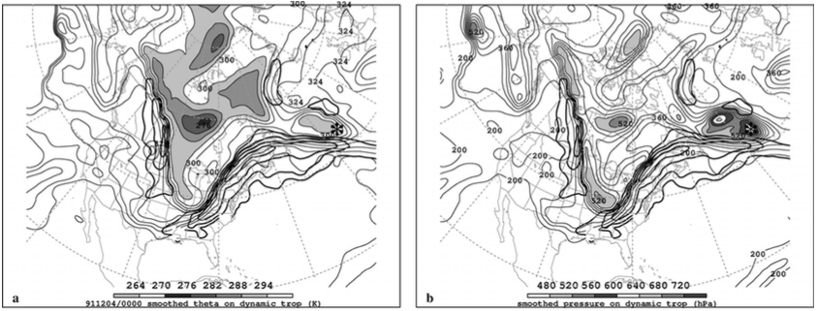
CTD–Jet Interaction
Pyle et al. (2004)
Strong horizontal shear associated with midlatitude jets may lead to deformation and/or destruction of TPVs
There is a double structure in DT pressure field, indicating fracture of the TPV
0000 UTC 4 December 1991
TPV
TPV
J1
J1
J2
J2
(left) DT (1.5-PVU surface) wind speed (every 15 m s⁻¹ starting at 50 m s⁻¹, thick contours) and potential temperature (K, thin contours and shading); (right) same as left except DT pressure (hPa, thin contours and shading). Adapted from Fig. 13 in Pyle et al. (2004).

Slide 32
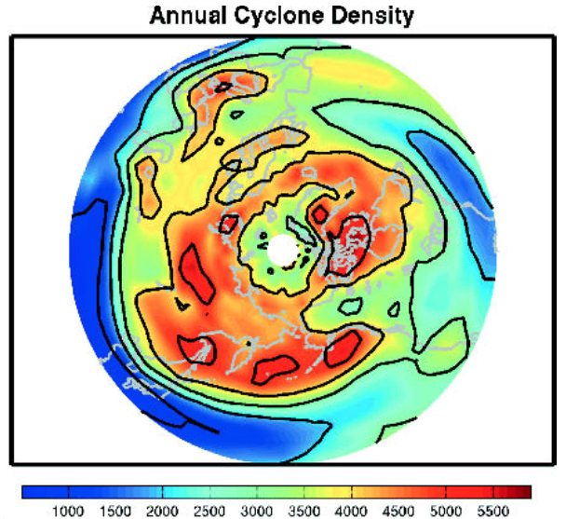
CTD/TPV Tracking and Climatology
Hakim and Canavan (2005)
Utilized 2.5° NCEP–NCAR reanalysis dataset from 1948 through 1999 to track CTDs (including TPVs)
Tracking algorithm finds local minimum of potential temperature along DT (1.5 PVU surface in this study)
Grid point is local minimum in DT θ if DT θ value is smaller than any other point within 650 km of grid point
Last closed contour identified by scanning outward from vortex core along eight equally spaced radials until gradient in DT θ changes and choosing the minimum of these eight DT θ values
Total number of tropopause cyclonic vortex events. Adapted from Fig. 2 of Hakim and Canavan (2005).

Slide 33
CTD/TPV Tracking and Climatology
Hakim and Canavan (2005)
Vortex track extended from time t₀ to time t₀ + 6 h if another vortex located within 600 km of vortex at time t₀
If not, retested at t₀ + 12 h; failure to extend track defines a lysis event
Vortex at time t₀ + 6 h that is unmatched with vortex at time t₀ is marked as a genesis event
Total number of tropopause cyclonic vortex events. Adapted from Fig. 2 of Hakim and Canavan (2005).

Slide 34
CTD/TPV Tracking and Climatology
Hakim and Canavan (2005)
Total of 1,576,732 cyclones identified
Identified cyclones correspond to 310,605 cyclone tracks
Preferred cyclone locations:
  Cyclonic shear side of jets
  Canadian Arctic
  Russia
  Mediterranean Sea through the Middle East
126,522 arctic cyclones (i.e. TPVs) identified
9032 TPV tracks (average of 15 cyclones per month
Total number of tropopause cyclonic vortex events. Adapted from Fig. 2 of Hakim and Canavan (2005).

Slide 35
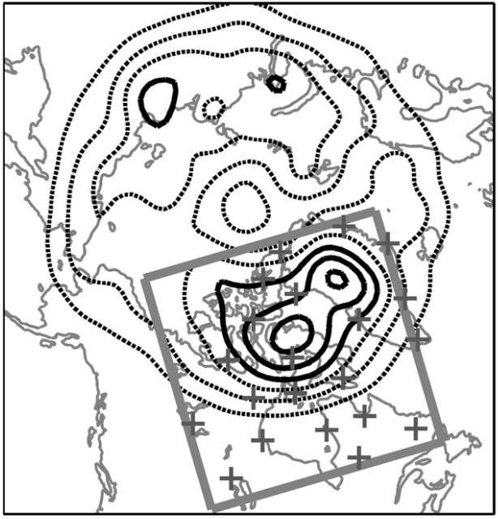
TPV Composite Structure
Cavallo and Hakim (2010)
Evaluated composite structure of TPVs from 2 August 2007 to 31 July 2009 for domain show in figure
Used Advanced Research Weather (ARW) version of Weather Research and Forecasting Model (WRF)
Horizontal grid spacing of 30 km × 30 km, 31 vertical levels, and time step of 120 s
Forecasts initialized with GFS analyses at 0000 UTC daily
Boundary conditions derived from GFS forecasts every 3 h
Only considered TPVs with minimum DT θ at least 2 standard deviations below domain mean
Area-weighted occurrence of intensifying TPVs (referring to location of greatest increase in TPV amplitude during a 24-h period along a unique vortex track) during 1948–99 (contours; contour interval every 50). Values equal to number of unique TPVs within a 5° latitude × 15° longitude box divided by cosine of latitude. Radiosonde stations denoted by “+” symbol. Adapted from Fig. 1 in Cavallo and Hakim (2010).

Slide 36
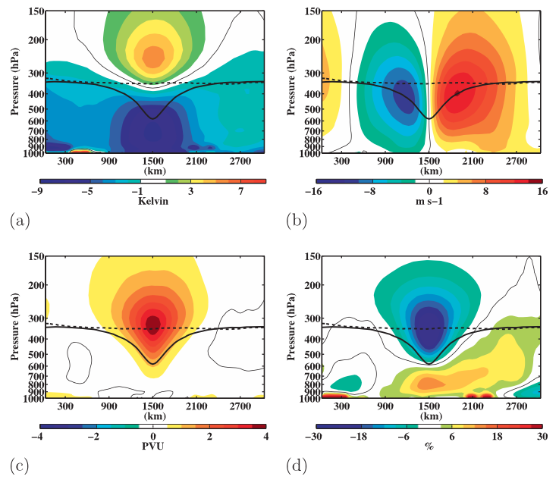
TPV Composite Structure
Cavallo and Hakim (2010)
temperature anomaly (K)
v-wind anomaly (m s⁻¹)
Ertel PV anomaly (PVU)
relative humidity anomaly (%)
Notes:
Adapted from Fig. 9 in Cavallo and Hakim (2010).

Slide 37
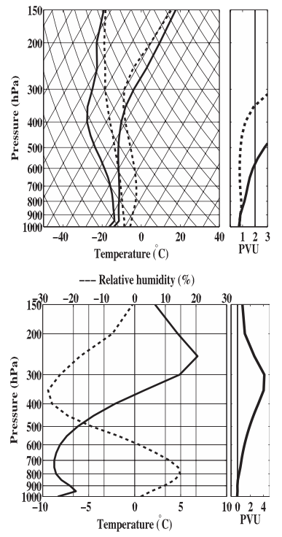
TPV Composite Structure
Cavallo and Hakim (2010)
Composite temperature, dewpoint temperature, and PV at TPV core (solid) and background (dashed)
(left) TPV–background difference in temperature (solid) and relative humidity (dashed); (right) PV anomaly of TPV from background
Notes:
Adapted from Fig. 6 in Cavallo and Hakim (2010).

Slide 38
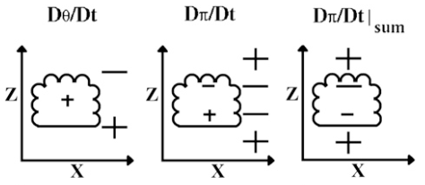
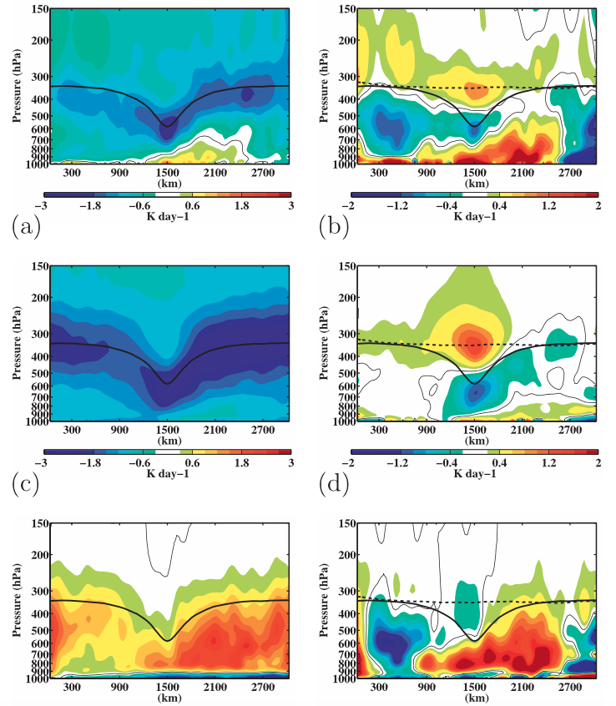



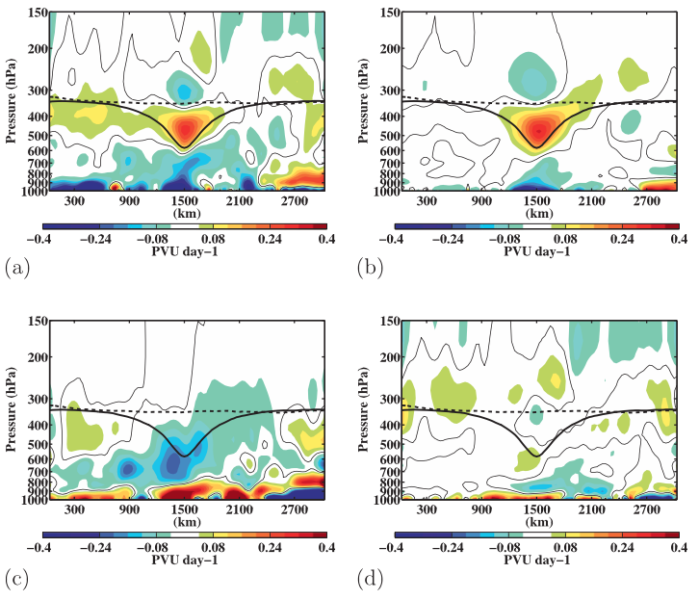
Diabatic Impacts on Composite TPV
Cavallo and Hakim (2010)
radiative heating rate
latent heating rate
Latent Heating
Radiational
heating
radiative heating rate anomaly
latent heating rate anomaly
PV tendency from latent heating
PV tendency from radiational heating
PV tendency due to radiation only
PV tendency due to latent heating only
Schematic above for case of small latent heating adapted from Fig. 3 in Cavallo and Hakim (2009).
Notes:
Adapted from Figs. 10 and 12 in Cavallo and Hakim (2010).

Slide 39
Diabatic Impacts on Composite TPV
Cavallo and Hakim (2010)
radiative heating rate
latent heating rate
Latent Heating
Radiational
heating
radiative heating rate anomaly
latent heating rate anomaly
PV tendency from latent heating
PV tendency from radiational heating
PV tendency due to radiation only
PV tendency due to latent heating only
Schematic above for case of small latent heating adapted from Fig. 3 in Cavallo and Hakim (2009).
Notes:
Adapted from Figs. 10 and 12 in Cavallo and Hakim (2010).

Slide 40
Diabatic Impacts on Composite TPV
Cavallo and Hakim (2010)
radiative heating rate
latent heating rate
Latent Heating
Radiational
heating
radiative heating rate anomaly
latent heating rate anomaly
PV tendency from latent heating
PV tendency from radiational heating
PV tendency due to radiation only
PV tendency due to latent heating only
Schematic above for case of small latent heating adapted from Fig. 3 in Cavallo and Hakim (2009).
Notes:
Adapted from Figs. 10 and 12 in Cavallo and Hakim (2010).

Slide 41
Diabatic Impacts on Composite TPV
Cavallo and Hakim (2010)
radiative heating rate
latent heating rate
Latent Heating
Radiational
heating
radiative heating rate anomaly
latent heating rate anomaly
PV tendency from latent heating
PV tendency from radiational heating
PV tendency due to radiation only
PV tendency due to latent heating only
Schematic above for case of small latent heating adapted from Fig. 3 in Cavallo and Hakim (2009).
Notes:
Adapted from Figs. 10 and 12 in Cavallo and Hakim (2010).

Slide 42
Diabatic Impacts on Composite TPV
Cavallo and Hakim (2010)
radiative heating rate
latent heating rate
Latent Heating
Radiational
heating
radiative heating rate anomaly
latent heating rate anomaly
PV tendency from latent heating
PV tendency from radiational heating
PV tendency due to radiation only
PV tendency due to latent heating only
Schematic above for case of small latent heating adapted from Fig. 3 in Cavallo and Hakim (2009).
Notes:
Adapted from Figs. 10 and 12 in Cavallo and Hakim (2010).

Slide 43
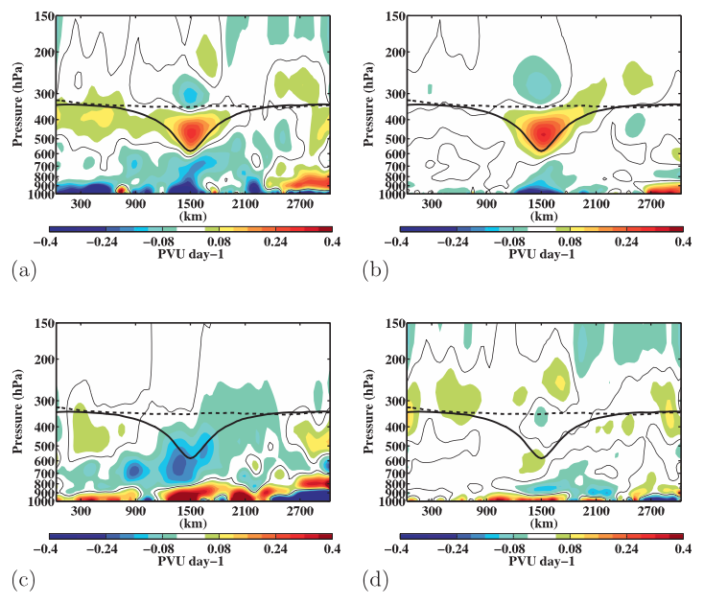
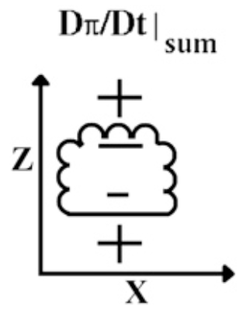
Diabatic Impacts on Composite TPV
Cavallo and Hakim (2010)
PV tendency due to all diabatic effects
PV tendency due to radiation only
Latent Heating
Radiational
heating
PV tendency from latent heating
PV tendency due to latent heating only
PV tendency due to all diabatic effects except radiation and latent heating
PV tendency from radiational heating
Net PV tendency from latent heating and radiational heating
Schematic above for case of small latent heating adapted from Fig. 3 in Cavallo and Hakim (2009).
Notes:
Adapted from Fig. 12 in Cavallo and Hakim (2010).

Slide 44

TPV Climatology
Cavallo and Hakim (2012)
Created two 10-yr TPV climatologies (1990–99):
  NCEP NCAR Reanalysis Project (NNRP): horizontal grid spacing: ~ 210 km (2.5°)
  WRF: Forecasts initialized with NNRP data and boundary; boundary conditions updated with NNRP analyses every 6 h; horizontal grid spacing: 60 × 60 km
Adapted from Table 1 of Cavallo and Hakim (2012)

Slide 45

TPV Climatology
Cavallo and Hakim (2012)
DJF
JJA
NNRP
DJF
JJA
WRF
TPV properties of (top) maximum amplitude and (bottom) average radius for (left) winter and (right) summer for 1990–99. Adapted from Fig. 2 in Cavallo and Hakim (2012).

Slide 46

TPV Climatology
Cavallo and Hakim (2012)
DJF
JJA
TPV lifetime distributions for (left) winter and (right) summer over 1990–99. Heavy line shows linear fit to exponential distributions from NNRP (black) and WRF (gray). Points not included in exponential fits are light gray. Adapted from Fig. 3 in Cavallo and Hakim (2012).

Slide 47

Impact of Radiation on TPVs
Cavallo and Hakim (2012)
TPV amplitude increases (decreases) over time in full-physics (no radiation) climatologies
On average, TPVs with long lifetimes tend to weaken in absence of radiative forcing
DJF
JJA
Full Physics
No Radiation
Average TPV tropopause potential temperature amplitude as a function of time for (left) winter and (right) summer over 1990–99 for TPVs surviving at least five days. Solid (dashed) lines correspond to WRF simulations with full physics (no radiation). Adapted from Fig. 7 in Cavallo and Hakim (2012).

Slide 48

Impact of Radiation on TPVs
Cavallo and Hakim (2012)
DJF
JJA
Full Physics
DJF
JJA
No Radiation
TPV properties of (top) maximum amplitude and (bottom) average radius for (left) winter and (right) summer for 1990–99. Solid (dashed) lines correspond to WRF simulations with full physics (no radiation). Adapted from Fig. 8 in Cavallo and Hakim (2012).

Slide 49

Impact of Radiation on TPVs
Cavallo and Hakim (2012)
DJF θ difference
JJA θ difference
Full Physics 2-PVU surface
DJF PV difference
JJA PV difference
No Radiation 2-PVU surface
Composite cross-sectional difference (no radiation – full physics) anomalies in (top) potential temperature and (bottom) PV for (left) winter and (right) summer. Adapted from Fig. 12 in Cavallo and Hakim (2012).

Slide 50

Mechanisms for TPV Intensity Change
Cavallo and Hakim (2013)
Performed idealized numerical modeling experiments using WRF to examine intensification mechanisms of TPVs
Used a horizontal grid spacing of 24 km × 24 km, with 60 vertical levels, and a time step of 120 s
PV
Potential Temperature
Geopotential Height
Tangential Wind
Relative Humidity
Ozone
Initial condition cross-vortex sections. Anomalies are shown in color shading, while gray contours show field. Adapted from Fig. 2 in Cavallo and Hakim (2013).

Slide 51



Mechanisms for TPV Intensity Change
Cavallo and Hakim (2013)
E1: Longwave radiative forcing exclusive of water vapor
Longwave radiative effects only due to temperature, carbon dioxide, and ozone
Vortex intensifies at slow rate for ~150 days before weakening (not shown)
Time series of TPV amplitude for experiments 1–5 on 2 PVU surface. Adapted from Fig. 3 in Cavallo and Hakim (2013)

Slide 52
Mechanisms for TPV Intensity Change
Cavallo and Hakim (2013)
E2: Longwave radiative forcing inclusive of water vapor
Water vapor is strong absorber of longwave radiation
Lowered tropopause in vortex core promotes vertically thin transition zone between relatively moist tropospheric air and dry stratospheric air
Anomalously high vertical water vapor gradient leads to anomalous longwave cooling just below tropopause in vortex core
With anomalous weak longwave cooling just above tropopause in vortex core, the positive vertical longwave heating gradient results in positive PV tendency near tropopause in vortex core
Time series of TPV amplitude for experiments 1–5 on 2 PVU surface. Adapted from Fig. 3 in Cavallo and Hakim (2013)

Slide 53
Mechanisms for TPV Intensity Change
Cavallo and Hakim (2013)
E3: Longwave radiative forcing inclusive of water vapor and shortwave forcing
Shortwave radiative heating rates are a maximum (minimum) ~100 hPa below (above) tropopause
Shortwave heating results in negative PV tendency over tropopause in vortex core
Shortwave radiation not strongly absorbed by water vapor, thus magnitudes of shortwave heating near tropopause is smaller than magnitudes of longwave cooling
Longwave cooling rates offset partially by shortwave heating rates, so vortex strengthens still, but slightly less than w/o shortwave radiation
Time series of TPV amplitude for experiments 1–5 on 2 PVU surface. Adapted from Fig. 3 in Cavallo and Hakim (2013)

Slide 54
Mechanisms for TPV Intensity Change
Cavallo and Hakim (2013)
E4: Longwave radiative forcing inclusive of water vapor and condensation of water vapor (representative of Arctic winter)
Net longwave cooling is stronger, especially in lower and middle troposphere
Thus, inclusion of cloud radiative forcing results in stronger longwave cooling gradient from below tropopause to above tropopause in vortex core, resulting in enhanced PV production in upper troposphere in vortex core
Clouds more likely associated with TPVs due to reduced static stability and higher relative humidities in lower troposphere
Time series of TPV amplitude for experiments 1–5 on 2 PVU surface. Adapted from Fig. 3 in Cavallo and Hakim (2013)

Slide 55
Mechanisms for TPV Intensity Change
Cavallo and Hakim (2013)
E5: Longwave radiative forcing inclusive of water vapor, shortwave heating, and latent heating (representative of Arctic Summer)
TPV intensification is slower with inclusion of shortwave radiation because there is a reduction of cloud in vortex core
Longwave radiative cooling is thus smaller
Longwave radiative cooling above cloud destabilizes air, promoting cloud maintenance, but shortwave radiative cooling partially offsets the cooling, resulting in reduction in cloud concentration
Even if clouds diminish, vortex will still intensify due to presence of vertical water vapor gradient
Time series of TPV amplitude for experiments 1–5 on 2 PVU surface. Adapted from Fig. 3 in Cavallo and Hakim (2013)

Slide 56
References
Cavallo, S. M., and G. J. Hakim, 2009: Potential Vorticity Diagnosis of a Tropopause Polar
Cyclone. Mon. Wea. Rev., 137, 1358–1371.
Cavallo, S. M., and G. J. Hakim, 2010: The composite structure of tropopause polar cyclones from a
mesoscale model. Mon. Wea. Rev., 138, 3840–3857.
Cavallo, S. M., and G. J. Hakim, 2012: Radiative Impact on Tropopause Polar Vortices over the
Arctic. Mon. Wea. Rev., 140, 1683–1702.
Cavallo, S. M., and G. J. Hakim, 2013: Physical Mechanisms of Tropopause Polar Vortex
Intensity Change. J. Atmos. Sci., 70, 3359–3373.
Hakim, G. J., L. F. Bosart, and D. Keyser, 1995: The Ohio Valley wave-merger cyclogenesis
event of 25–26 January 1978. Part I: Multiscale case study. Mon. Wea. Rev., 123, 2663–
2692.
Hakim, G. J., D. Keyser, and L. F. Bosart, 1996: The Ohio Valley wave-merger cyclogenesis
event of 25–26 January 1978. Part II: Diagnosis using quasigeostrophic potential vorticity inversion. Mon. Wea. Rev., 124, 2176–2205.
Hakim, G. J., 2000: Climatology of coherent structures on the extratropical tropopause. Mon.
Wea. Rev., 128, 385–406.
Hakim, G. J., and A. K. Canavan, 2005: Observed cyclone–anticyclone tropopause vortex
asymmetries. J. Atmos. Sci., 62, 231–240.
Hoskins, B. J., M. E. McIntyre, and A. W. Robertson, 1985: On the use and significance of isentropic
potential vorticity maps. Quart. J. Roy. Meteor. Soc., 111, 877–956.
Pyle, M. E., et al., 2004: A diagnostic study of jet streaks: Kinematic signatures and relationship
to coherent tropopause disturbances. Mon. Wea. Rev., 132, 297–319.
Shapiro, M. A., T. Hampel and A. J. Krueger, 1987: The Arctic tropopause fold. Mon. Wea.
Rev., 115, 444–454.
Takayabu, I., 1991: “Coupling development”: An efficient mechanism for the development of
extratropical cyclones. J. Meteor. Soc. Japan, 69, 609–628.
Thorpe, A. J., 1985: Diagnosis of balanced vortex structure using potential vorticity. J. Atmos.
Sci., 42, 397–406.

