Slide 1
Forecast Skill of the Development of a Strong Extratropical Cyclone Linked to Tropopause Polar Vortices
Kevin A. Biernat
Department of Atmospheric and Environmental Sciences
University at Albany, SUNY
ATM 621: Structure and Dynamics of Extratropical Cyclones
Project Presentation
10 May 2017

Slide 2
What are Tropopause Polar Vortices (TPVs)?
TPVs are defined as tropopause-based vortices of high-latitude origin and are material features (Pyle et al. 2004; Cavallo and Hakim 2009, 2010)
Represent a subset of coherent tropopause disturbances (CTDs)
TPV
TPV
(left) Dynamic tropopause (DT) wind speed (every 15 m s⁻¹ starting at 50 m s⁻¹, thick contours) and DT potential temperature (K, thin contours and shading) on 1.5-PVU surface valid 0000 UTC 1 Dec 1991; (right) same as left except DT pressure (hPa, thin contours and shading). Adapted from Fig. 11 in Pyle et al. (2004).

Slide 3
Motivation
TPVs may interact with and strengthen midlatitude jet streams, and act as precursors to the development of strong extratropical cyclones (ECs)
Strong ECs may lead to extreme weather events (EWEs) associated with heavy precipitation and strong winds that can pose hazards to life and property

Slide 4
Research Goal
Investigate how the forecast skill of a strong EC linked to TPVs is related to the forecast skill of the TPVs and their interaction with the synoptic-scale flow

Slide 5
Literature
Review

Slide 6
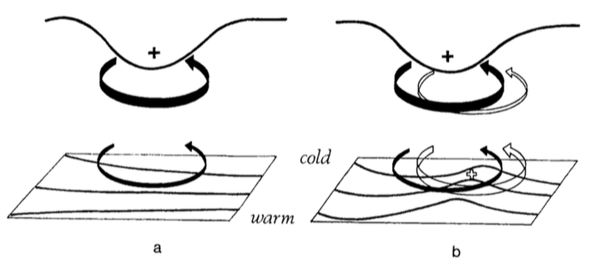
Cyclonic PV Anomalies and Cyclogenesis
Hoskins et al. (1985)
Cyclonic PV Anomaly
Positive PV Advection
Trop.
WAA
“Phase Locking”
θ
Cyclonic PV Anomaly
t = t₀
t = t₀ + Δt
Notes:
Adapted from Fig. 21 in Hoskins et al. (1985).

Slide 7
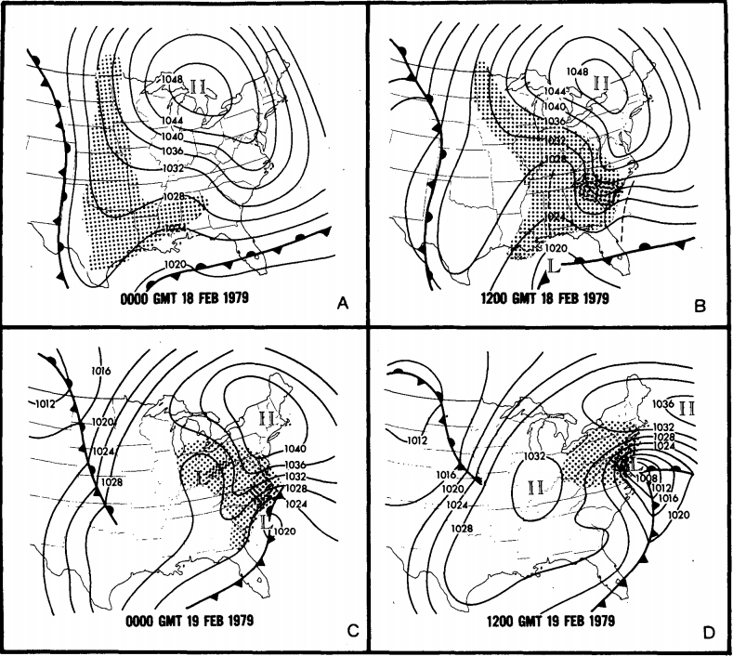
Presidents’ Day Storm of 1979
Uccellini et al. (1985)
Sea level pressure (mb) and surface frontal analyses for (a) 0000 GMT 18 Feb, (b) 1200 GMT 18 Feb, (c) 0000 GMT 19 Feb, and (d) 1200 GMT 19 Feb 1979. Shading represents precipitation; dark shading indicates moderate-to-heavy precipitation. Dashed line in (b) denote inverted and coastal troughs. Adapted from Fig. 1 in Uccellini et al. 1985.

Slide 8
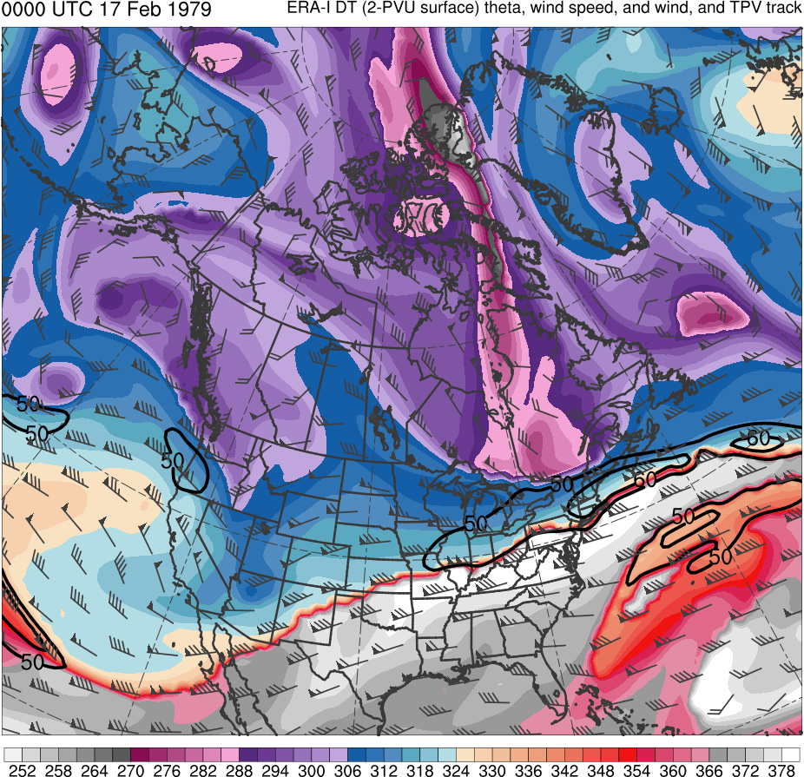
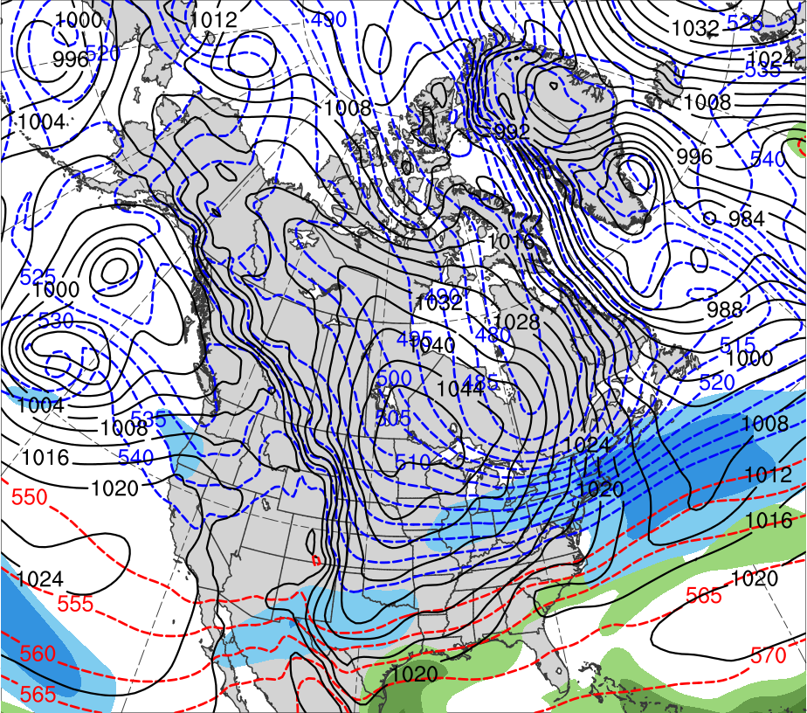
Presidents’ Day Storm of 1979
0000 UTC 17 Feb 1979
Data Source: 0.5° ERA-Interim
(K)
252
258
264
270
276
282
288
294
300
306
312
318
324
330
336
342
348
354
360
366
372
378
(mm)
(m s⁻¹ )
25
30
35
40
45
50
55
50
60
70
80
90
100
110
120
Potential temperature (K, shaded), wind speed (black, every 10 m s⁻¹ starting at 50 m s⁻¹), and wind (m s⁻¹, flags and barbs) on 2-PVU surface
250-hPa wind speed (m s⁻¹, shaded),
1000–500-hPa thickness (dam, blue/red),
MSLP (hPa, black), PW (mm, shaded)

Slide 9
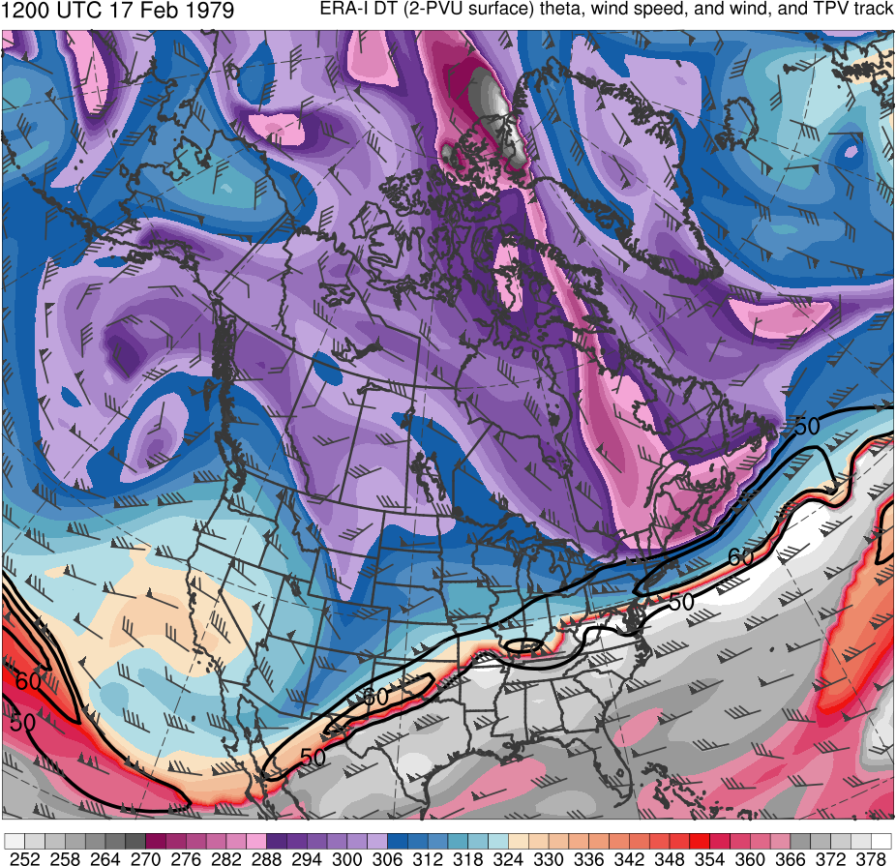
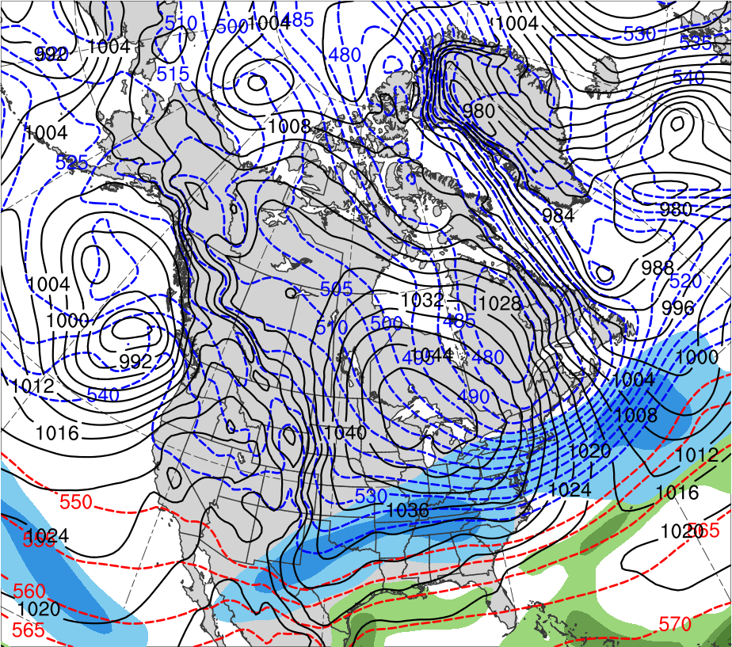
Presidents’ Day Storm of 1979
1200 UTC 17 Feb 1979
Data Source: 0.5° ERA-Interim
CTD
(K)
252
258
264
270
276
282
288
294
300
306
312
318
324
330
336
342
348
354
360
366
372
378
(mm)
(m s⁻¹ )
25
30
35
40
45
50
55
50
60
70
80
90
100
110
120
Potential temperature (K, shaded), wind speed (black, every 10 m s⁻¹ starting at 50 m s⁻¹), and wind (m s⁻¹, flags and barbs) on 2-PVU surface
250-hPa wind speed (m s⁻¹, shaded),
1000–500-hPa thickness (dam, blue/red),
MSLP (hPa, black), PW (mm, shaded)

Slide 10
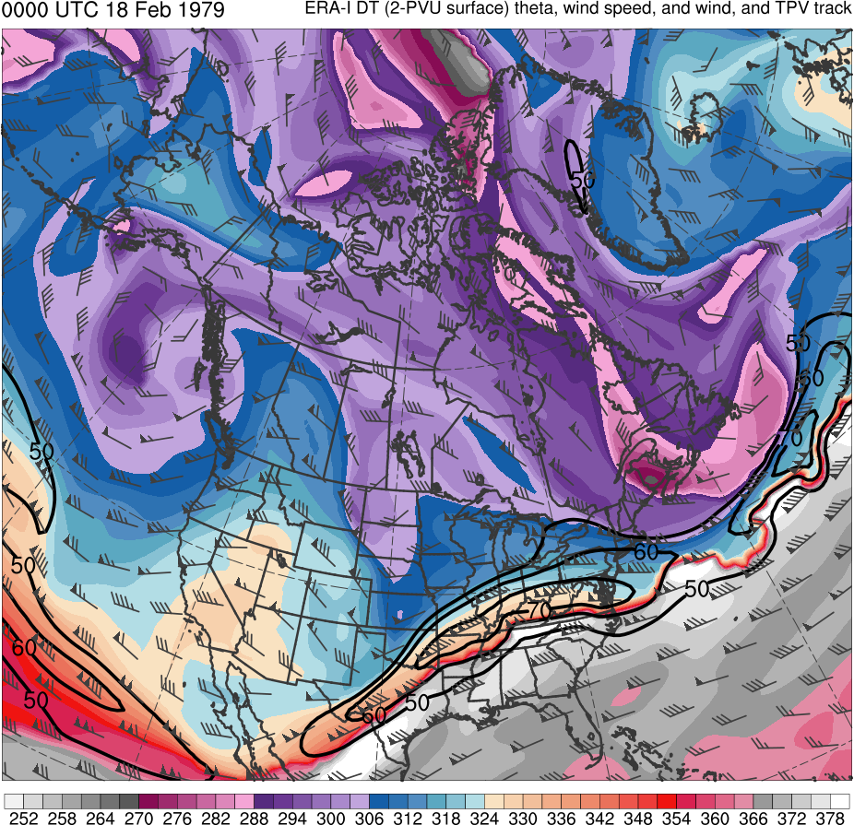
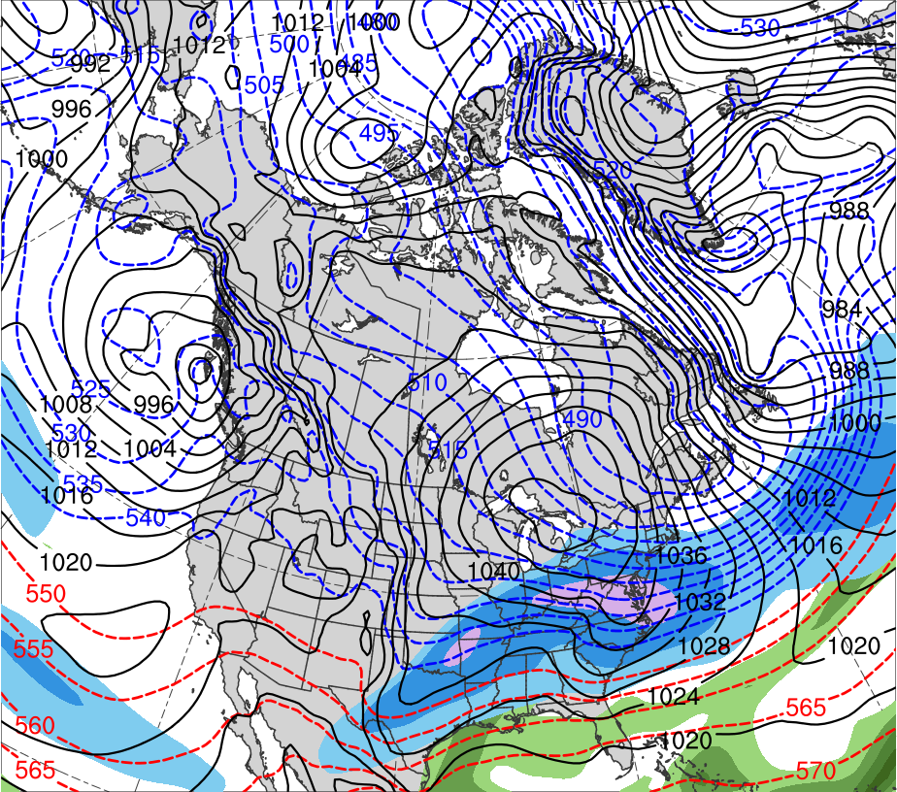
Presidents’ Day Storm of 1979
0000 UTC 18 Feb 1979
Data Source: 0.5° ERA-Interim
CTD
(K)
252
258
264
270
276
282
288
294
300
306
312
318
324
330
336
342
348
354
360
366
372
378
(mm)
(m s⁻¹ )
25
30
35
40
45
50
55
50
60
70
80
90
100
110
120
Potential temperature (K, shaded), wind speed (black, every 10 m s⁻¹ starting at 50 m s⁻¹), and wind (m s⁻¹, flags and barbs) on 2-PVU surface
250-hPa wind speed (m s⁻¹, shaded),
1000–500-hPa thickness (dam, blue/red),
MSLP (hPa, black), PW (mm, shaded)

Slide 11
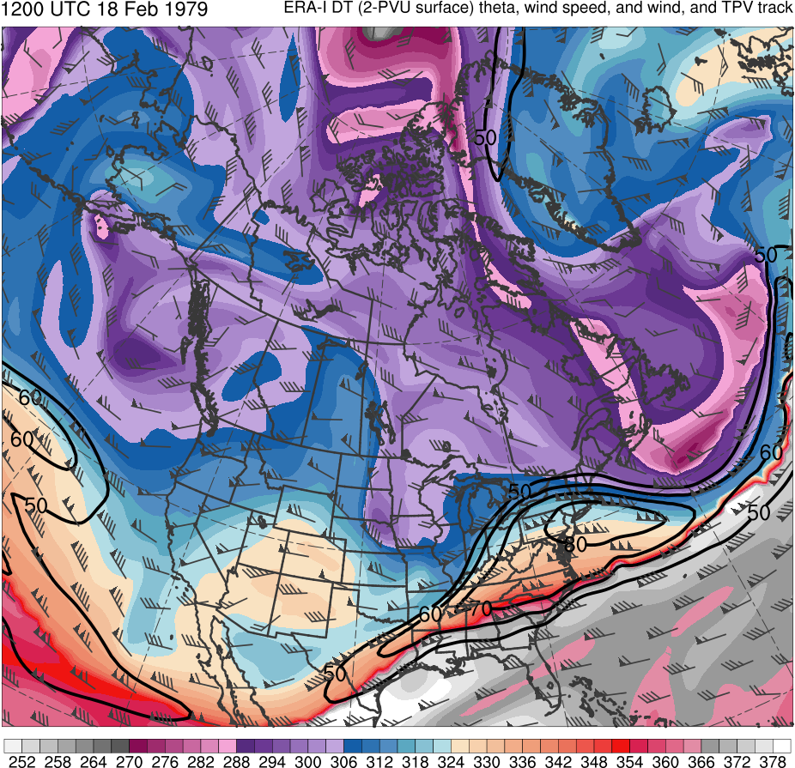
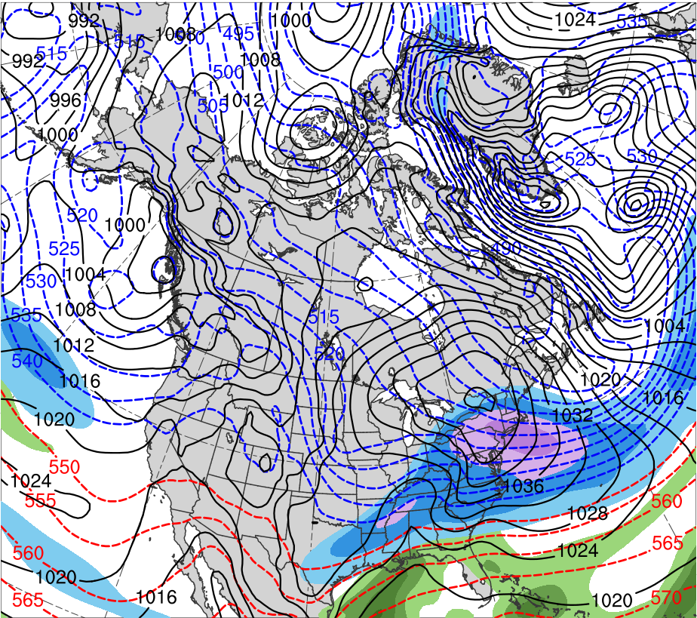
Presidents’ Day Storm of 1979
1200 UTC 18 Feb 1979
Data Source: 0.5° ERA-Interim
CTD
(K)
252
258
264
270
276
282
288
294
300
306
312
318
324
330
336
342
348
354
360
366
372
378
(mm)
(m s⁻¹ )
25
30
35
40
45
50
55
50
60
70
80
90
100
110
120
Potential temperature (K, shaded), wind speed (black, every 10 m s⁻¹ starting at 50 m s⁻¹), and wind (m s⁻¹, flags and barbs) on 2-PVU surface
250-hPa wind speed (m s⁻¹, shaded),
1000–500-hPa thickness (dam, blue/red),
MSLP (hPa, black), PW (mm, shaded)

Slide 12
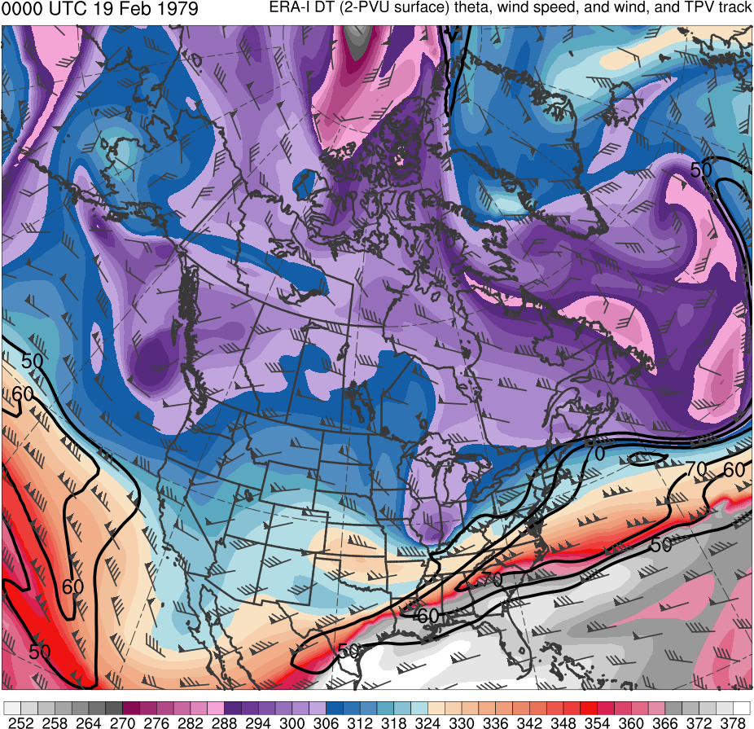
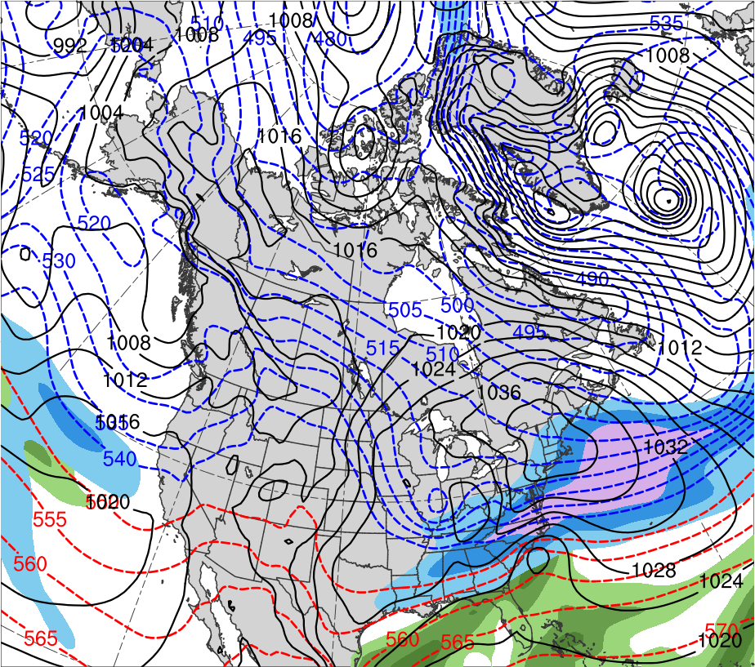
Presidents’ Day Storm of 1979
0000 UTC 19 Feb 1979
Data Source: 0.5° ERA-Interim
CTD
L
L
1018 hPa
(K)
252
258
264
270
276
282
288
294
300
306
312
318
324
330
336
342
348
354
360
366
372
378
(mm)
(m s⁻¹ )
25
30
35
40
45
50
55
50
60
70
80
90
100
110
120
Potential temperature (K, shaded), wind speed (black, every 10 m s⁻¹ starting at 50 m s⁻¹), and wind (m s⁻¹, flags and barbs) on 2-PVU surface
250-hPa wind speed (m s⁻¹, shaded),
1000–500-hPa thickness (dam, blue/red),
MSLP (hPa, black), PW (mm, shaded)

Slide 13
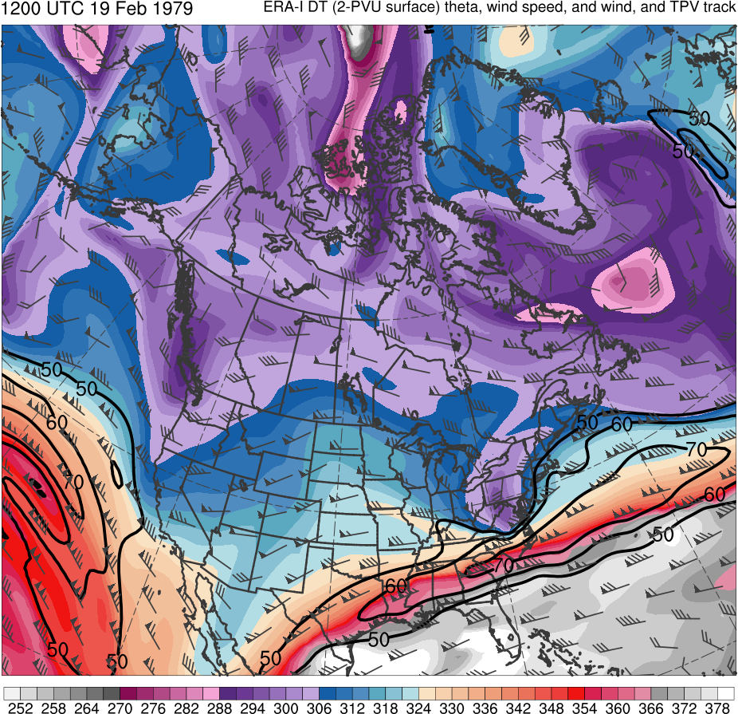
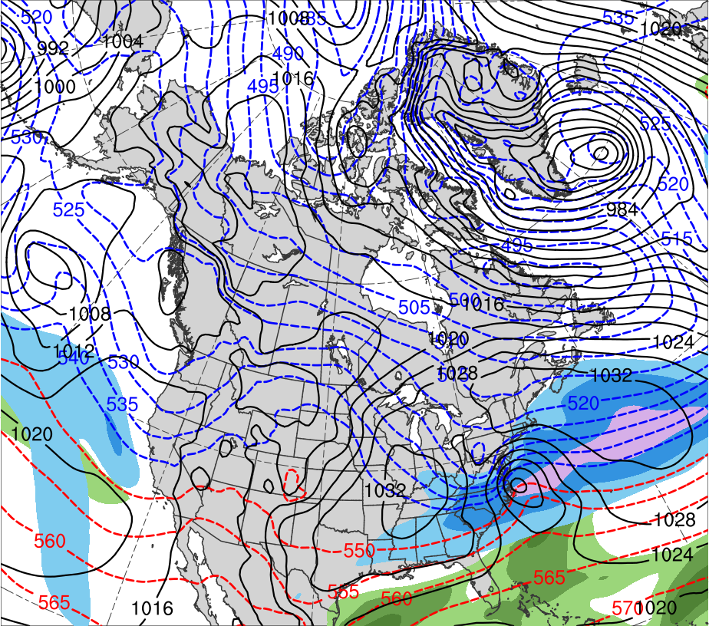
Presidents’ Day Storm of 1979
1200 UTC 19 Feb 1979
Data Source: 0.5° ERA-Interim
CTD
L
1011 hPa
(K)
252
258
264
270
276
282
288
294
300
306
312
318
324
330
336
342
348
354
360
366
372
378
(mm)
(m s⁻¹ )
25
30
35
40
45
50
55
50
60
70
80
90
100
110
120
Potential temperature (K, shaded), wind speed (black, every 10 m s⁻¹ starting at 50 m s⁻¹), and wind (m s⁻¹, flags and barbs) on 2-PVU surface
250-hPa wind speed (m s⁻¹, shaded),
1000–500-hPa thickness (dam, blue/red),
MSLP (hPa, black), PW (mm, shaded)

Slide 14
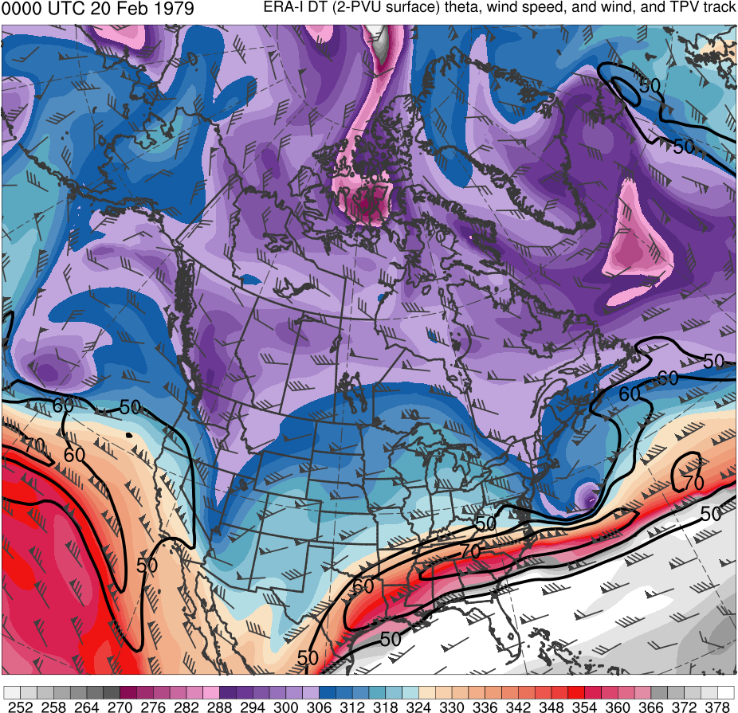
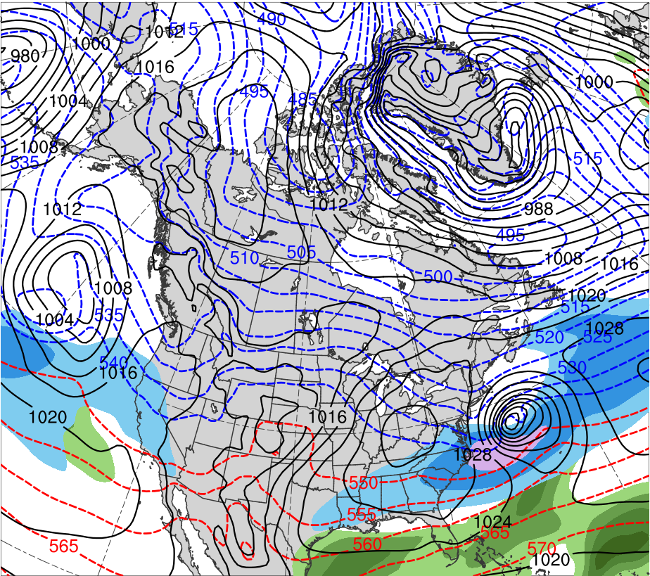
Presidents’ Day Storm of 1979
0000 UTC 20 Feb 1979
Data Source: 0.5° ERA-Interim
CTD
L
993 hPa
(K)
252
258
264
270
276
282
288
294
300
306
312
318
324
330
336
342
348
354
360
366
372
378
(mm)
(m s⁻¹ )
25
30
35
40
45
50
55
50
60
70
80
90
100
110
120
Potential temperature (K, shaded), wind speed (black, every 10 m s⁻¹ starting at 50 m s⁻¹), and wind (m s⁻¹, flags and barbs) on 2-PVU surface
250-hPa wind speed (m s⁻¹, shaded),
1000–500-hPa thickness (dam, blue/red),
MSLP (hPa, black), PW (mm, shaded)

Slide 15
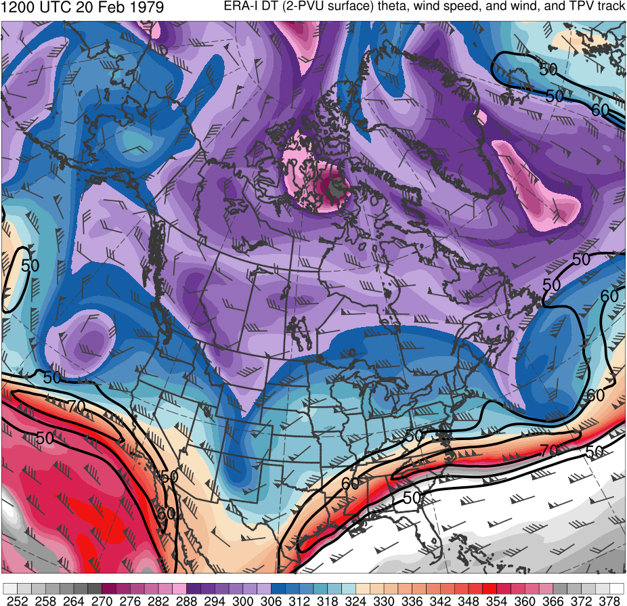
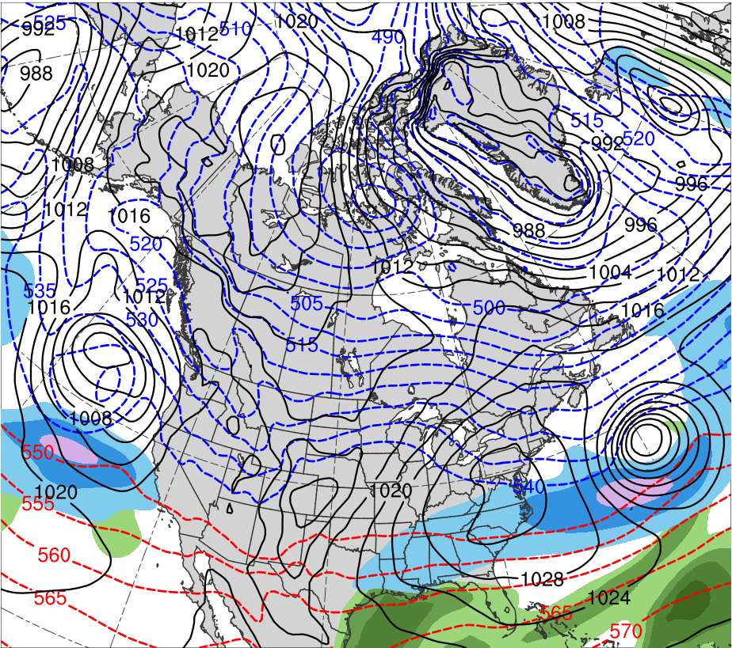
Presidents’ Day Storm of 1979
1200 UTC 20 Feb 1979
Data Source: 0.5° ERA-Interim
CTD
L
992 hPa
(K)
252
258
264
270
276
282
288
294
300
306
312
318
324
330
336
342
348
354
360
366
372
378
(mm)
(m s⁻¹ )
25
30
35
40
45
50
55
50
60
70
80
90
100
110
120
Potential temperature (K, shaded), wind speed (black, every 10 m s⁻¹ starting at 50 m s⁻¹), and wind (m s⁻¹, flags and barbs) on 2-PVU surface
250-hPa wind speed (m s⁻¹, shaded),
1000–500-hPa thickness (dam, blue/red),
MSLP (hPa, black), PW (mm, shaded)

Slide 16
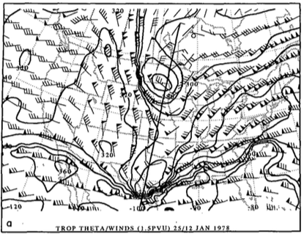
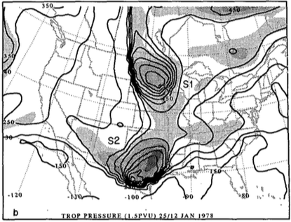
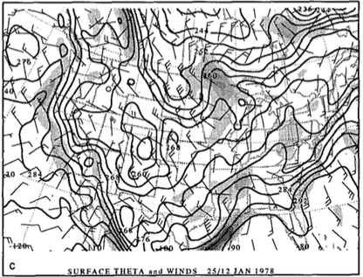
1978 Cleveland Superbomb
Hakim et al. (1995, 1996)
1200 UTC 25 January 1978
R
R
TPV
TPV
CTD
CTD
(a) Dynamic tropopause (DT; 1.5 PVU) potential temperature (black contours, every 10 K) and wind (flags and barbs, m s⁻¹); (b) DT pressure (black contours, every 50 hPa) and relative vorticity (shaded every 2×10⁻⁵ s⁻¹ for values greater than 4×10⁻⁵ s⁻¹ ); (c) surface potential temperature (black contours, every 4 K) and relative vorticity (shaded every 2×10⁻⁵ s⁻¹ for values greater than 2×10⁻⁵ s⁻¹). Adapted from Fig. 6 in Hakim et al. (1995).
A
L
998 hPa

Slide 17
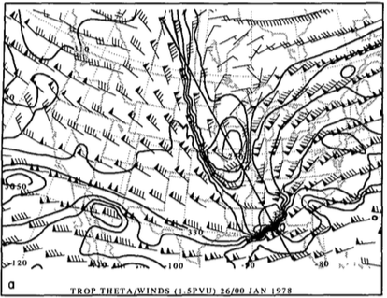
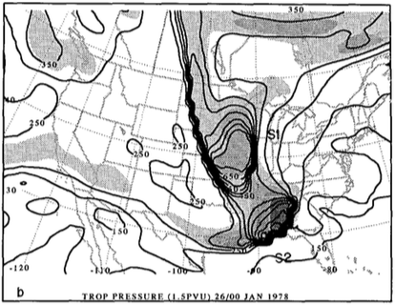
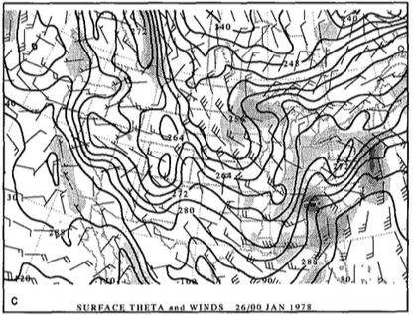
1978 Cleveland Superbomb
Hakim et al. (1995, 1996)
0000 UTC 26 January 1978
R
R
TPV
TPV
CTD
CTD
(a) Dynamic tropopause (DT; 1.5 PVU) potential temperature (black contours, every 10 K) and wind (flags and barbs, m s⁻¹); (b) DT pressure (black contours, every 50 hPa) and relative vorticity (shaded every 2×10⁻⁵ s⁻¹ for values greater than 4×10⁻⁵ s⁻¹ ); (c) surface potential temperature (black contours, every 4 K) and relative vorticity (shaded every 2×10⁻⁵ s⁻¹ for values greater than 2×10⁻⁵ s⁻¹). Adapted from Fig. 8 in Hakim et al. (1995).
A
L
982 hPa

Slide 18
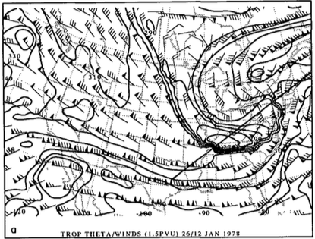
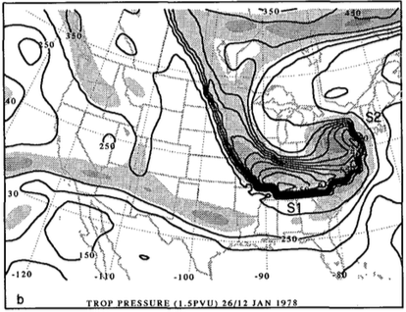
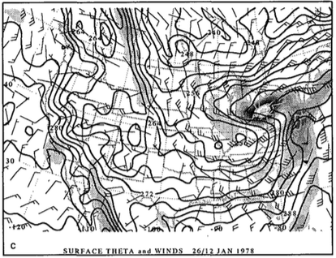
1978 Cleveland Superbomb
Hakim et al. (1995, 1996)
1200 UTC 26 January 1978
CTD
CTD
R
R
TPV
TPV
(a) Dynamic tropopause (DT; 1.5 PVU) potential temperature (black contours, every 10 K) and wind (flags and barbs, m s⁻¹); (b) DT pressure (black contours, every 50 hPa) and relative vorticity (shaded every 2×10⁻⁵ s⁻¹ for values greater than 4×10⁻⁵ s⁻¹ ); (c) surface potential temperature (black contours, every 4 K) and relative vorticity (shaded every 2×10⁻⁵ s⁻¹ for values greater than 2×10⁻⁵ s⁻¹). Adapted from Fig. 9 in Hakim et al. (1995).
L
A
955 hPa

Slide 19
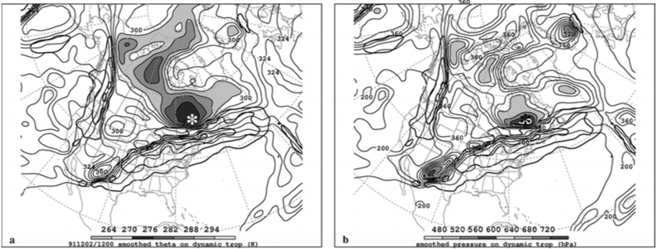
TPV–Jet Interaction
Pyle et al. (2004)
TPV/CTD–jet interactions may lead to formation or intensification of a jet streak
Strengthening ageostrophic circulations associated with strengthening jet streaks may play important roles in the development of tropopause folds and vertical motion patterns that may aid in cyclogenesis.
1200 UTC 2 December 1991
TPV
TPV
J1
J1
J2
J2
(left) DT (1.5-PVU surface) wind speed (every 15 m s⁻¹ starting at 50 m s⁻¹, thick contours) and potential temperature (K, thin contours and shading); (right) same as left except DT pressure (hPa, thin contours and shading). Adapted from Fig. 12 in Pyle et al. (2004).

Slide 20
Hypotheses
Forecast errors of strong ECs linked to TPVs are at least partially attributed to misrepresentation of TPV track and intensity, as well as misrepresentation of the interaction of TPVs with the synoptic-scale flow
Forecasts with low forecast skill of ECs linked to TPVs are associated with larger errors in TPV track and intensity and larger errors in the interaction of TPVs with the synoptic-scale flow compared to forecasts with high forecast skill

Slide 21
Research Plan
Evaluate forecast skill of a strong EC linked to TPVs
Case: An EC that explosively deepened during 30–31 December 1996 near Labrador
Case Motivation:
EC’s development likely influenced by two TPVs that interact with and strengthen a jet streak as well as interact with one another
EC was identified in Alicia Bentley’s climatology of ECs leading to EWEs over central and eastern North America

Slide 22
Research Plan
Use ERA-Interim (Dee et al. 2011) to evaluate synoptic evolution of EC and TPVs
TPVs identified objectively for ERA-Interim by utilizing and adapting a TPV tracking algorithm developed by Nicholas Szapiro and Steven Cavallo
TPVs must last at least 2 days and spend at least 6 h poleward of 60°N (adapted from criteria of Cavallo and Hakim 2010)
Link for Tracking Algorithm: https://github.com/nickszap/tpvTrack

Slide 23
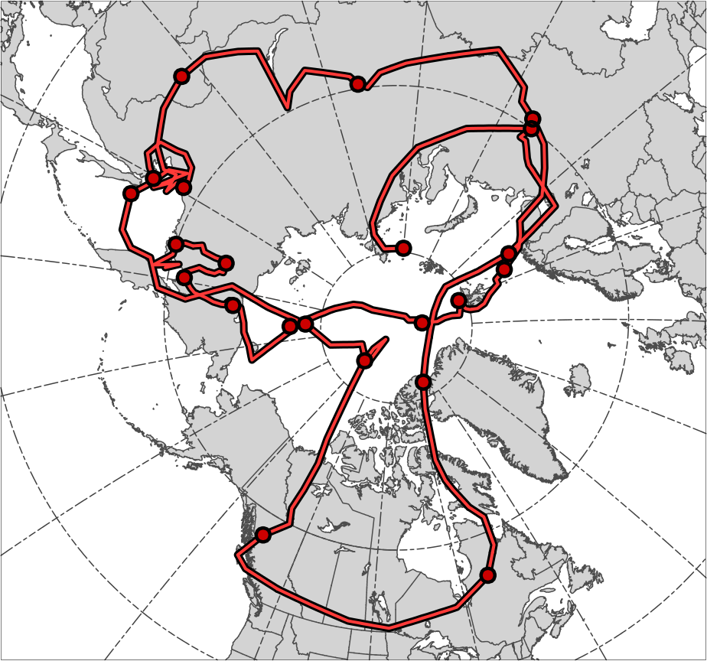
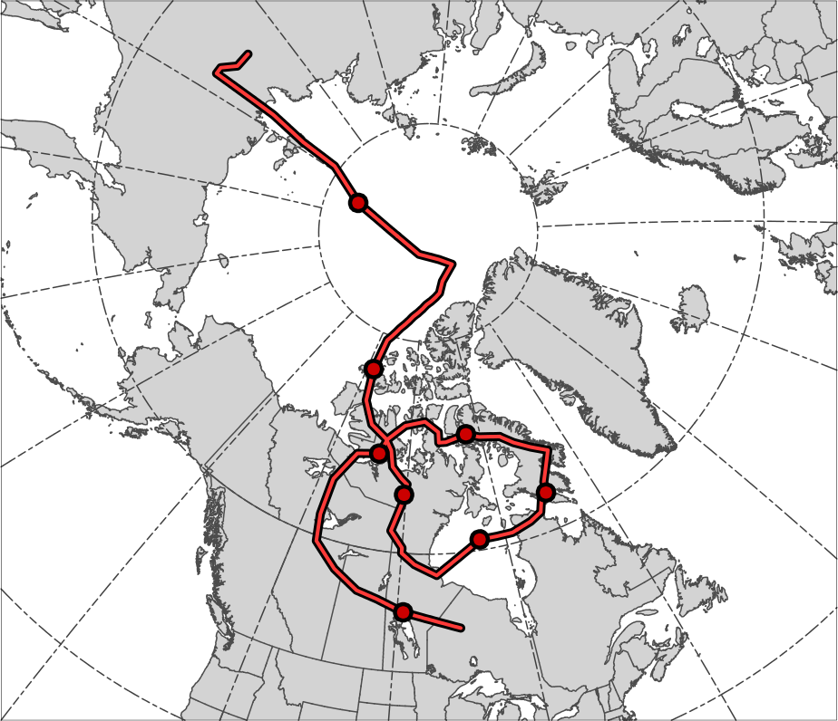
TPV Tracks
(a)
TPV 1
(b)
TPV 2
16
14
12
5
20
16
22
18
26
3
28
7
30
8
10
24
6
2
4
18
26
1
26
28
20
24
22
28
30
30
TPV 1 Track
Genesis:
0600 UTC 24 Nov 1996
Lysis:
0000 UTC 7 Jan 1997
Lifetime:
44 days
Genesis
Lysis
TPV 2 Track
Genesis:
0600 UTC 14 Dec 1996
Lysis:
0600 UTC 30 Dec 1996
Lifetime:
~16 days

Slide 24
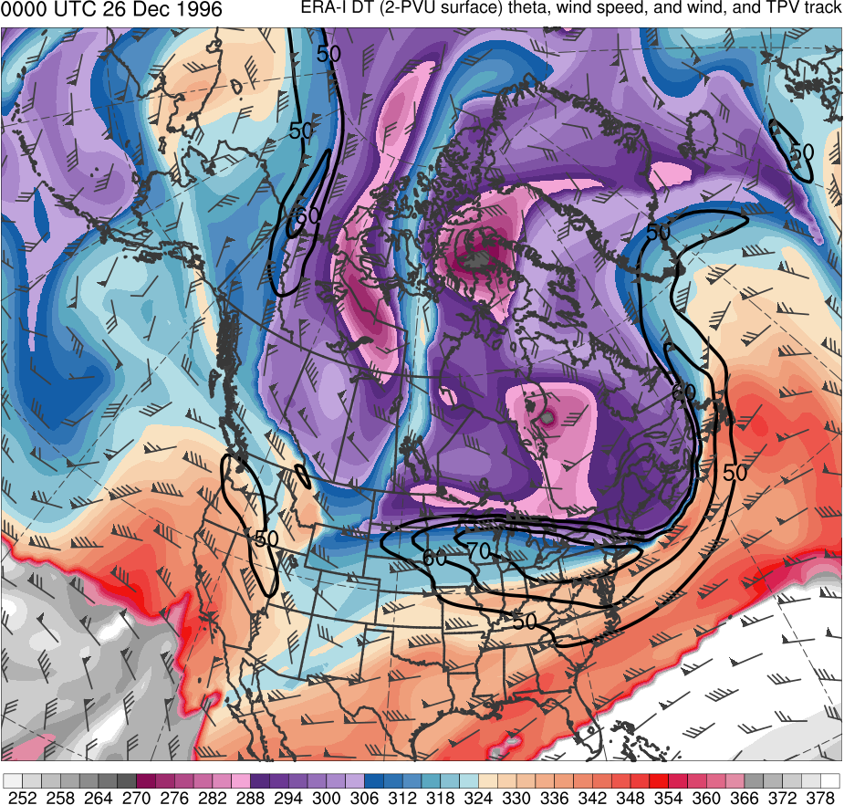
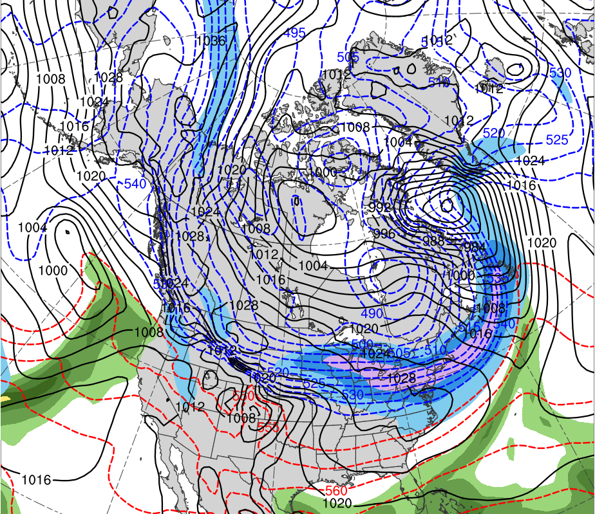
Synoptic Analysis
0000 UTC 26 Dec 1996
Data Source: 0.5° ERA-Interim
TPV 1
TPV 2
CP
(K)
252
258
264
270
276
282
288
294
300
306
312
318
324
330
336
342
348
354
360
366
372
378
(mm)
(m s⁻¹ )
25
30
35
40
45
50
55
50
60
70
80
90
100
110
120
Potential temperature (K, shaded), wind speed (black, every 10 m s⁻¹ starting at 50 m s⁻¹), and wind (m s⁻¹, flags and barbs) on 2-PVU surface
250-hPa wind speed (m s⁻¹, shaded),
1000–500-hPa thickness (dam, blue/red),
MSLP (hPa, black), PW (mm, shaded)

Slide 25
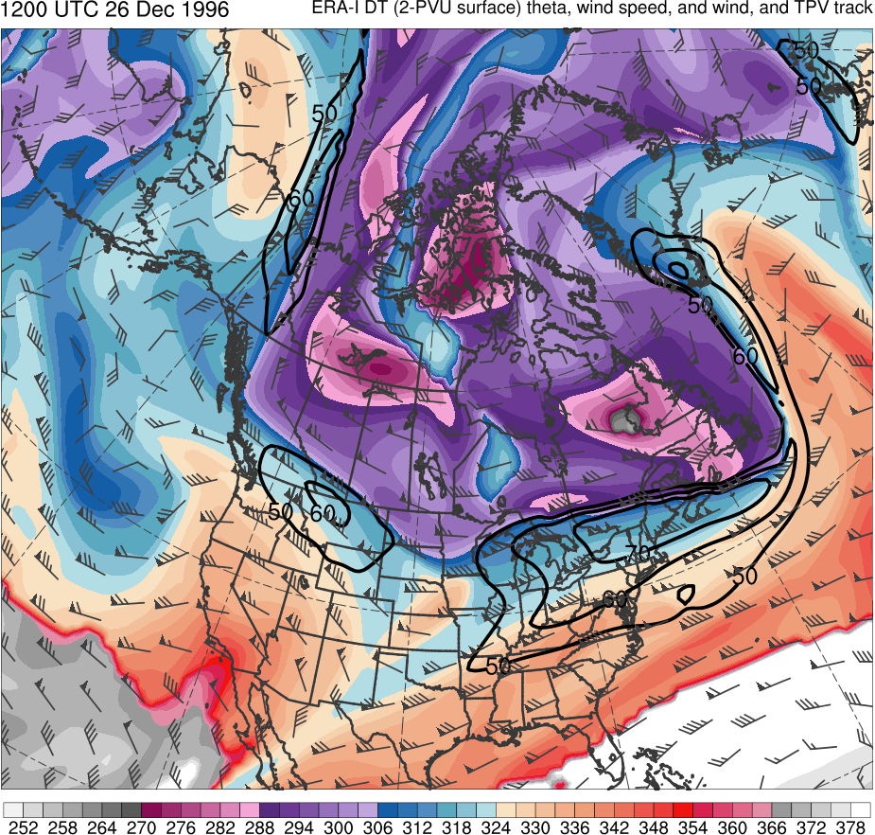
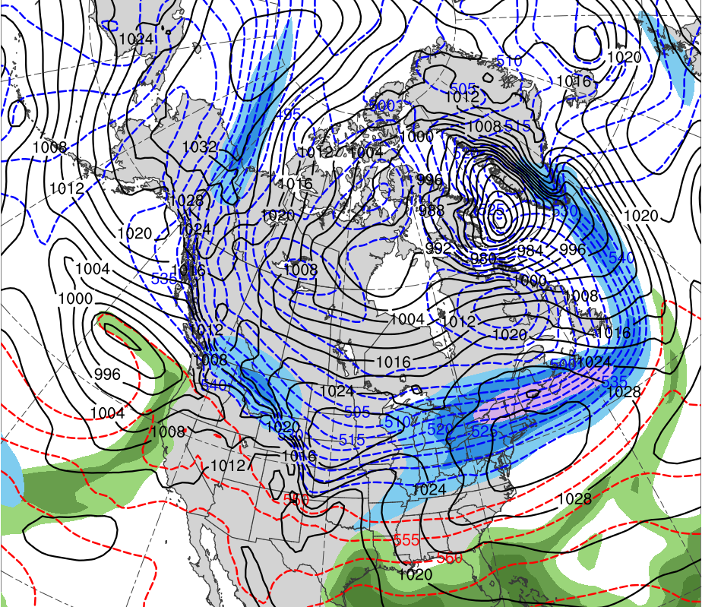
Synoptic Analysis
1200 UTC 26 Dec 1996
Data Source: 0.5° ERA-Interim
TPV 2
TPV 1
CP
(K)
252
258
264
270
276
282
288
294
300
306
312
318
324
330
336
342
348
354
360
366
372
378
(mm)
(m s⁻¹ )
25
30
35
40
45
50
55
50
60
70
80
90
100
110
120
Potential temperature (K, shaded), wind speed (black, every 10 m s⁻¹ starting at 50 m s⁻¹), and wind (m s⁻¹, flags and barbs) on 2-PVU surface
250-hPa wind speed (m s⁻¹, shaded),
1000–500-hPa thickness (dam, blue/red),
MSLP (hPa, black), PW (mm, shaded)

Slide 26
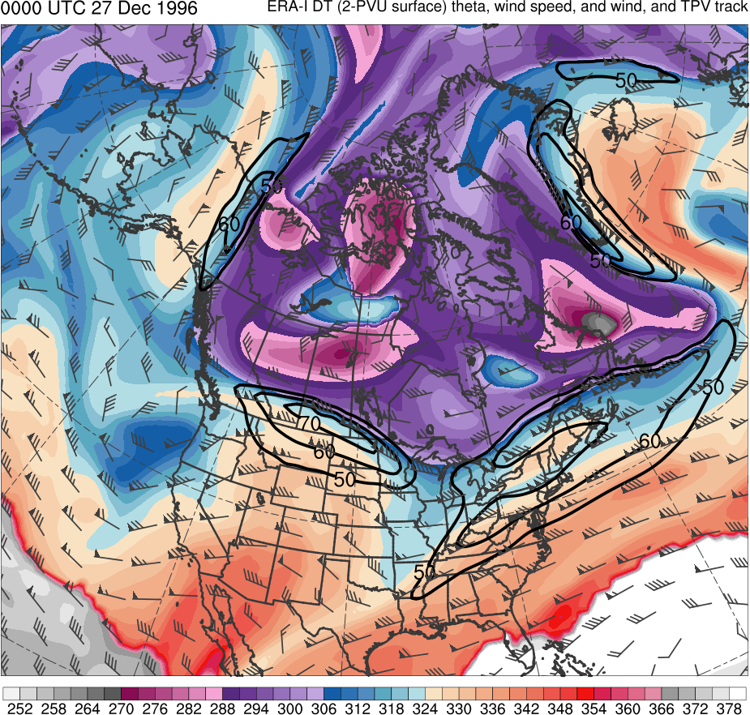
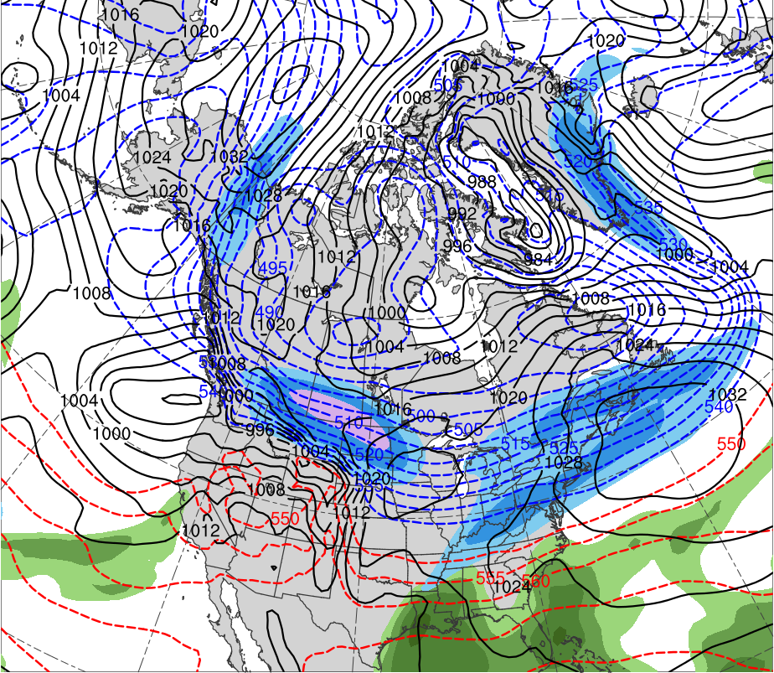
Synoptic Analysis
0000 UTC 27 Dec 1996
Data Source: 0.5° ERA-Interim
TPV 2
TPV 1
CP
(K)
252
258
264
270
276
282
288
294
300
306
312
318
324
330
336
342
348
354
360
366
372
378
(mm)
(m s⁻¹ )
25
30
35
40
45
50
55
50
60
70
80
90
100
110
120
Potential temperature (K, shaded), wind speed (black, every 10 m s⁻¹ starting at 50 m s⁻¹), and wind (m s⁻¹, flags and barbs) on 2-PVU surface
250-hPa wind speed (m s⁻¹, shaded),
1000–500-hPa thickness (dam, blue/red),
MSLP (hPa, black), PW (mm, shaded)

Slide 27
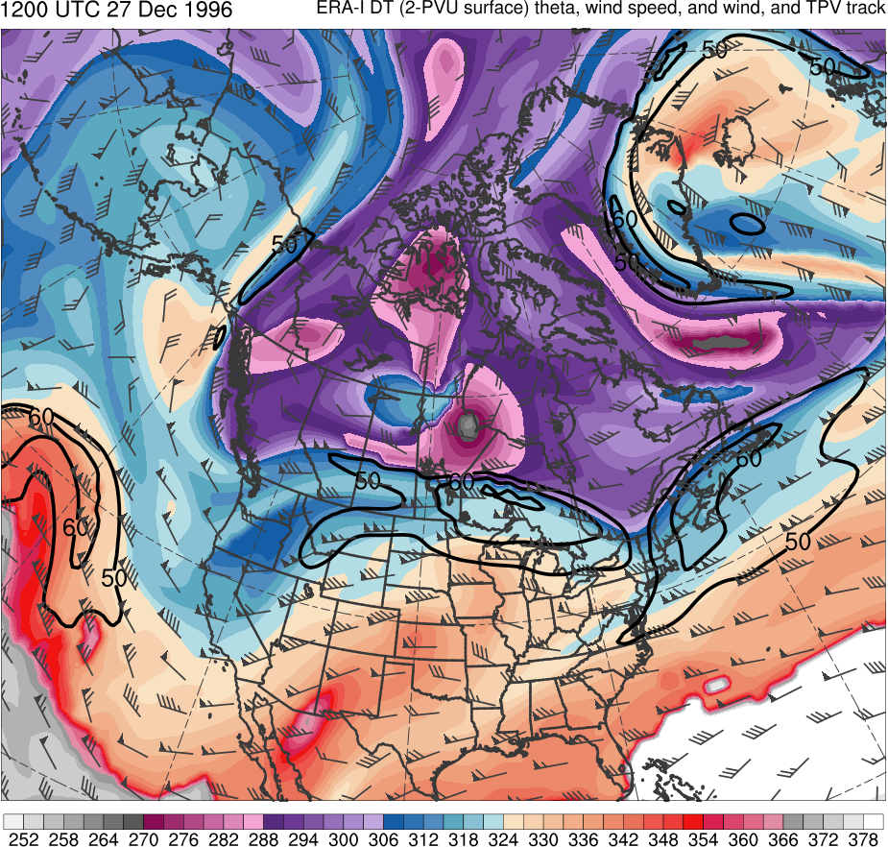
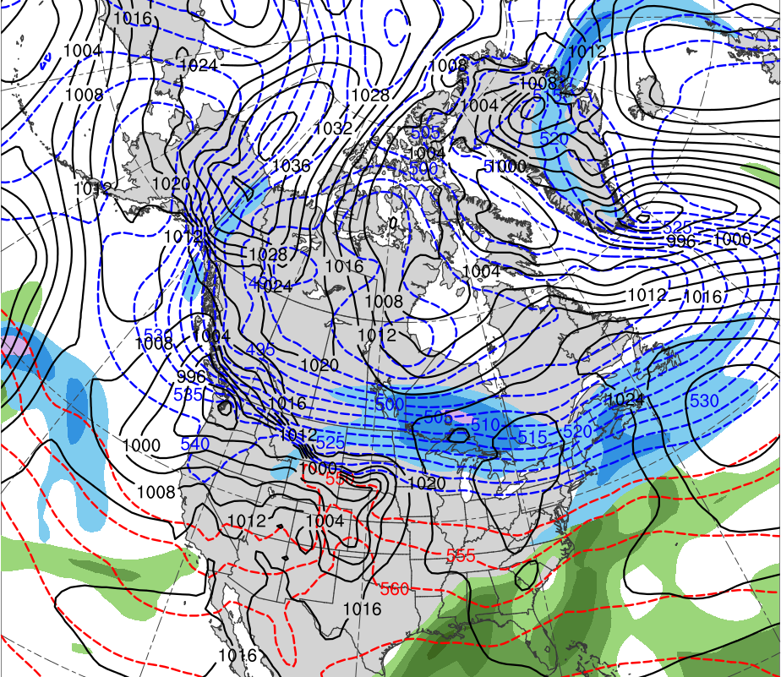
Synoptic Analysis
1200 UTC 27 Dec 1996
Data Source: 0.5° ERA-Interim
TPV 2
CP
TPV 1
(K)
252
258
264
270
276
282
288
294
300
306
312
318
324
330
336
342
348
354
360
366
372
378
(mm)
(m s⁻¹ )
25
30
35
40
45
50
55
50
60
70
80
90
100
110
120
Potential temperature (K, shaded), wind speed (black, every 10 m s⁻¹ starting at 50 m s⁻¹), and wind (m s⁻¹, flags and barbs) on 2-PVU surface
250-hPa wind speed (m s⁻¹, shaded),
1000–500-hPa thickness (dam, blue/red),
MSLP (hPa, black), PW (mm, shaded)

Slide 28
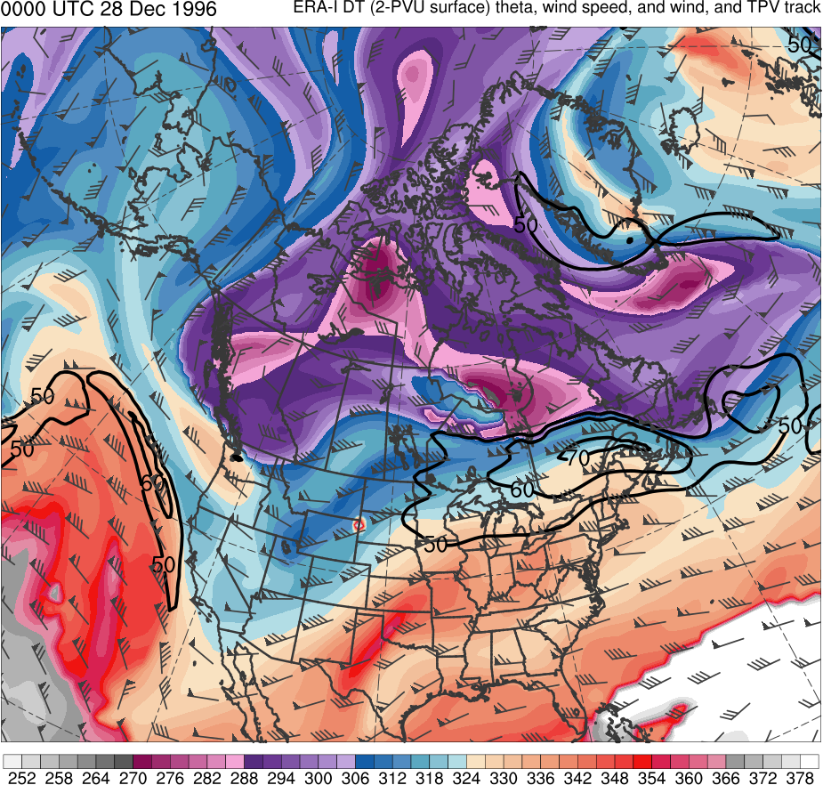
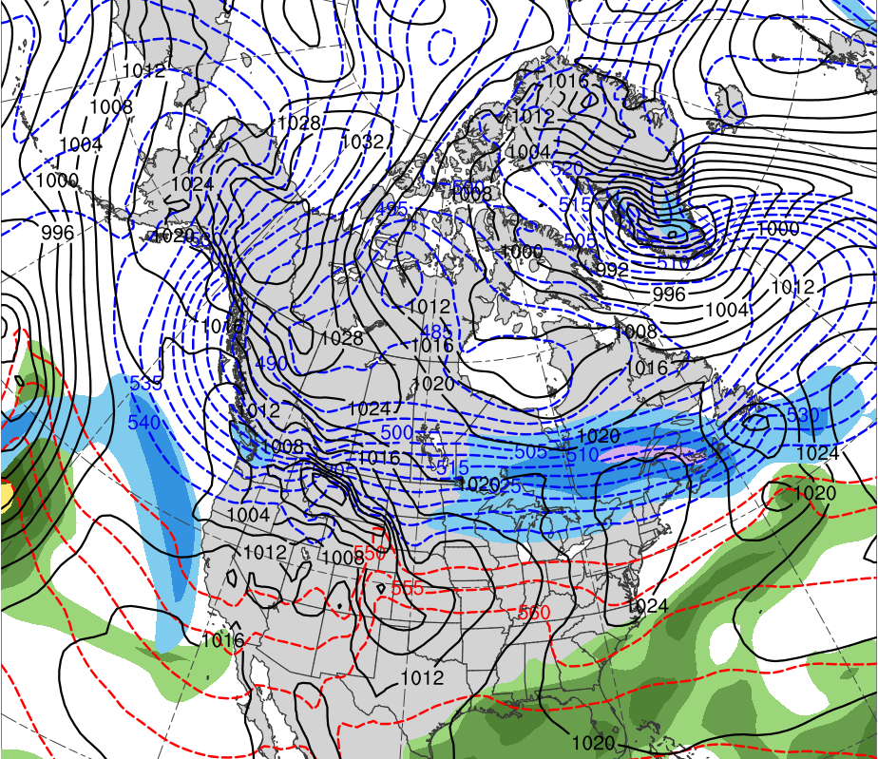
Synoptic Analysis
0000 UTC 28 Dec 1996
Data Source: 0.5° ERA-Interim
TPV 2
CP
TPV 1
(K)
252
258
264
270
276
282
288
294
300
306
312
318
324
330
336
342
348
354
360
366
372
378
(mm)
(m s⁻¹ )
25
30
35
40
45
50
55
50
60
70
80
90
100
110
120
Potential temperature (K, shaded), wind speed (black, every 10 m s⁻¹ starting at 50 m s⁻¹), and wind (m s⁻¹, flags and barbs) on 2-PVU surface
250-hPa wind speed (m s⁻¹, shaded),
1000–500-hPa thickness (dam, blue/red),
MSLP (hPa, black), PW (mm, shaded)

Slide 29
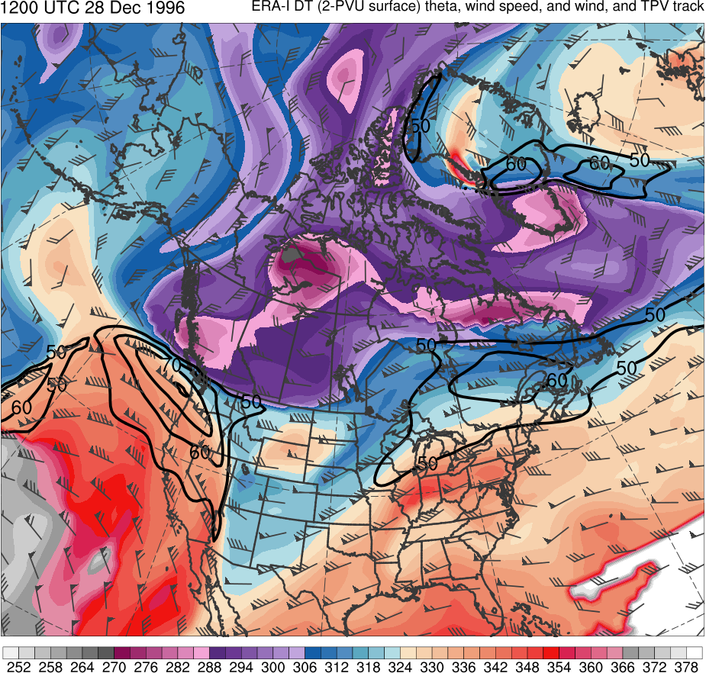
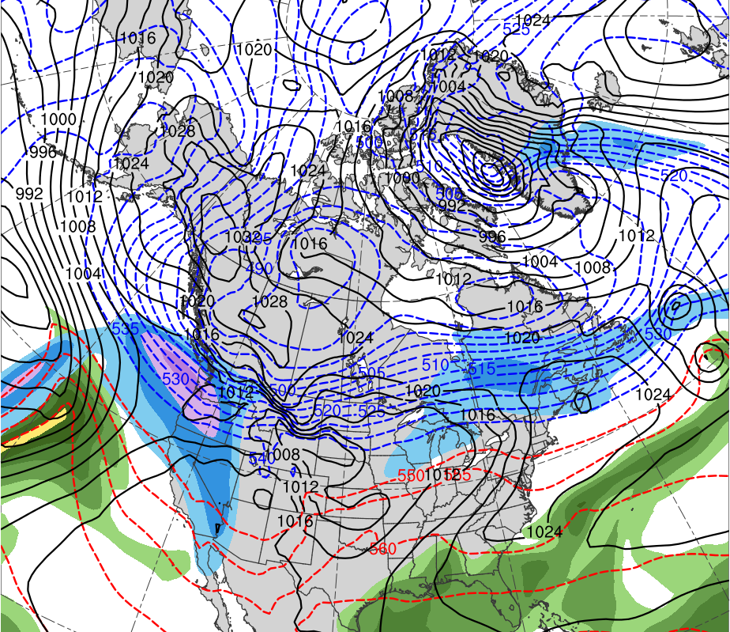
Synoptic Analysis
1200 UTC 28 Dec 1996
Data Source: 0.5° ERA-Interim
TPV 2
CP
TPV 1
(K)
252
258
264
270
276
282
288
294
300
306
312
318
324
330
336
342
348
354
360
366
372
378
(mm)
(m s⁻¹ )
25
30
35
40
45
50
55
50
60
70
80
90
100
110
120
Potential temperature (K, shaded), wind speed (black, every 10 m s⁻¹ starting at 50 m s⁻¹), and wind (m s⁻¹, flags and barbs) on 2-PVU surface
250-hPa wind speed (m s⁻¹, shaded),
1000–500-hPa thickness (dam, blue/red),
MSLP (hPa, black), PW (mm, shaded)

Slide 30
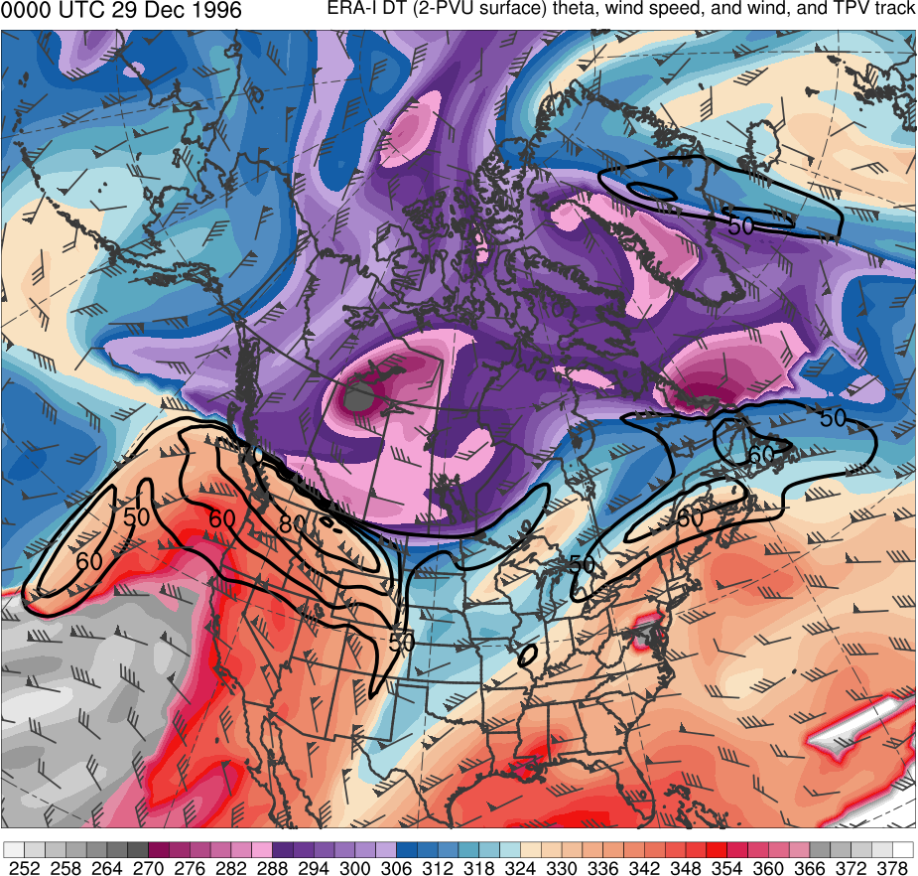
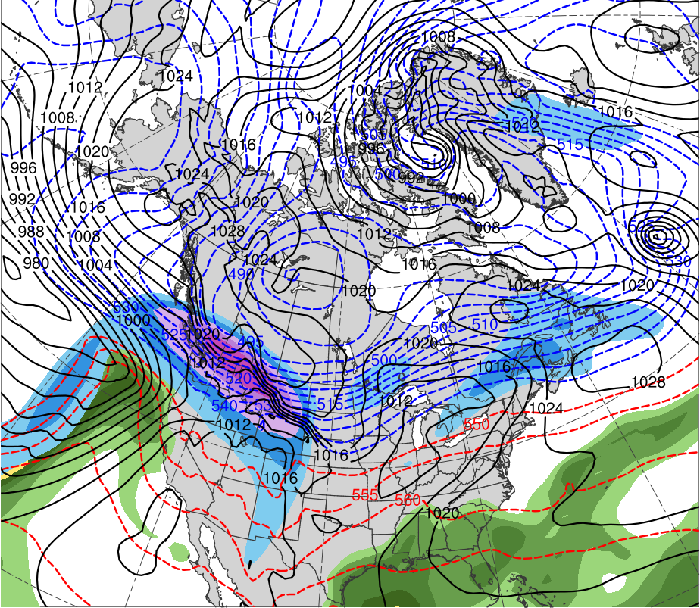
Synoptic Analysis
0000 UTC 29 Dec 1996
Data Source: 0.5° ERA-Interim
TPV 2
CP
TPV 1
(K)
252
258
264
270
276
282
288
294
300
306
312
318
324
330
336
342
348
354
360
366
372
378
(mm)
(m s⁻¹ )
25
30
35
40
45
50
55
50
60
70
80
90
100
110
120
Potential temperature (K, shaded), wind speed (black, every 10 m s⁻¹ starting at 50 m s⁻¹), and wind (m s⁻¹, flags and barbs) on 2-PVU surface
250-hPa wind speed (m s⁻¹, shaded),
1000–500-hPa thickness (dam, blue/red),
MSLP (hPa, black), PW (mm, shaded)

Slide 31
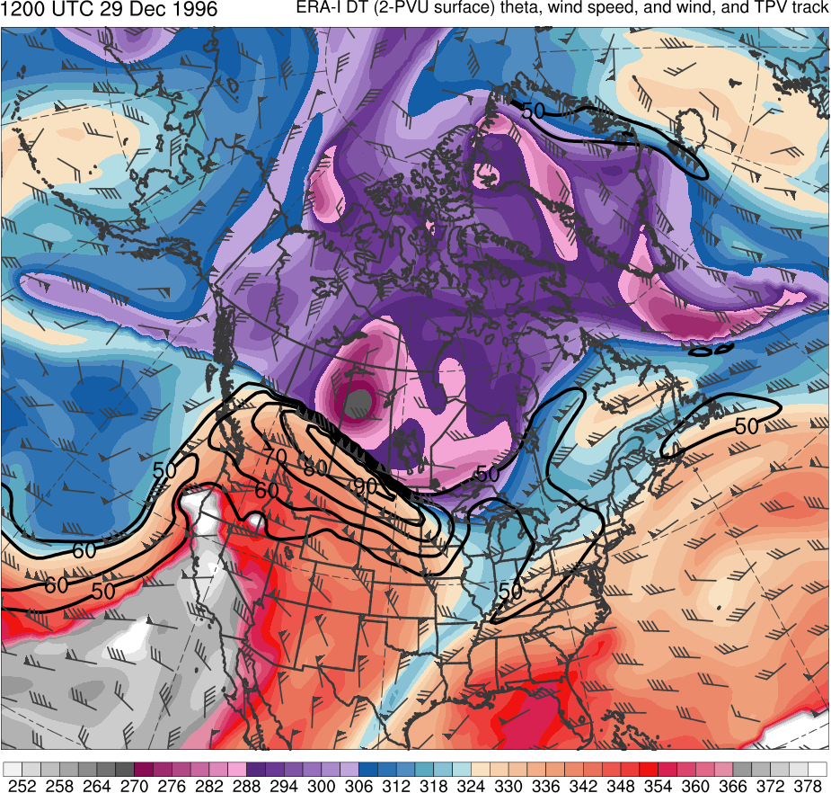
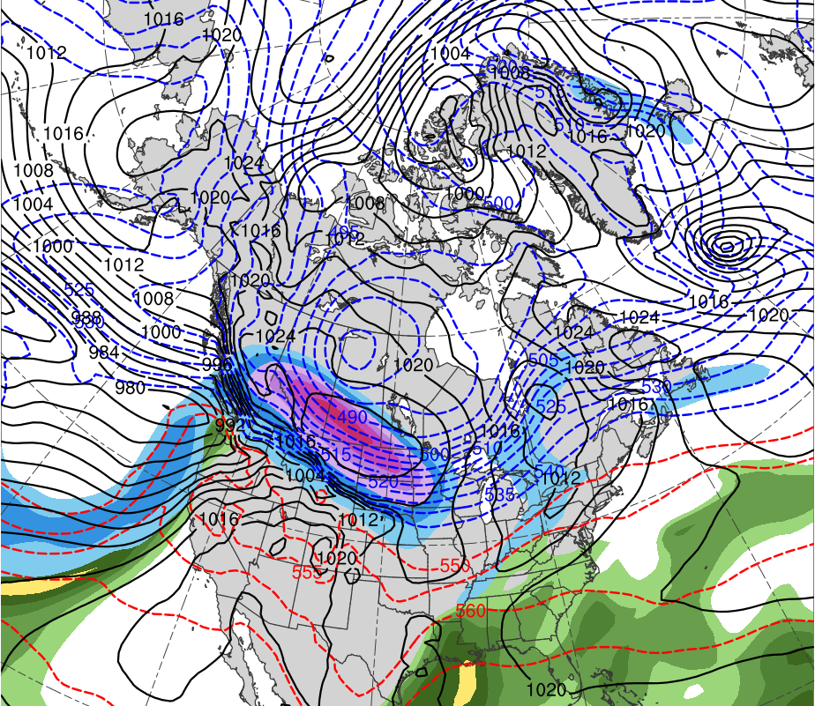
Synoptic Analysis
1200 UTC 29 Dec 1996
Data Source: 0.5° ERA-Interim
TPV 2
CP
TPV 1
(K)
252
258
264
270
276
282
288
294
300
306
312
318
324
330
336
342
348
354
360
366
372
378
(mm)
(m s⁻¹ )
25
30
35
40
45
50
55
50
60
70
80
90
100
110
120
Potential temperature (K, shaded), wind speed (black, every 10 m s⁻¹ starting at 50 m s⁻¹), and wind (m s⁻¹, flags and barbs) on 2-PVU surface
250-hPa wind speed (m s⁻¹, shaded),
1000–500-hPa thickness (dam, blue/red),
MSLP (hPa, black), PW (mm, shaded)

Slide 32
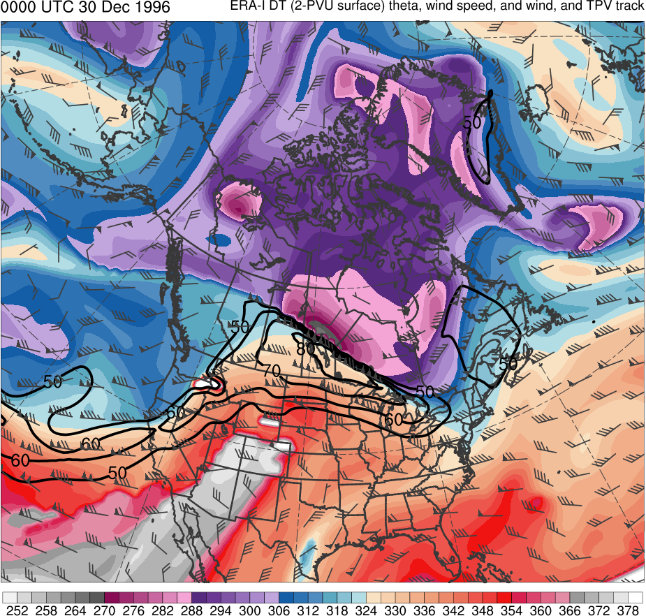
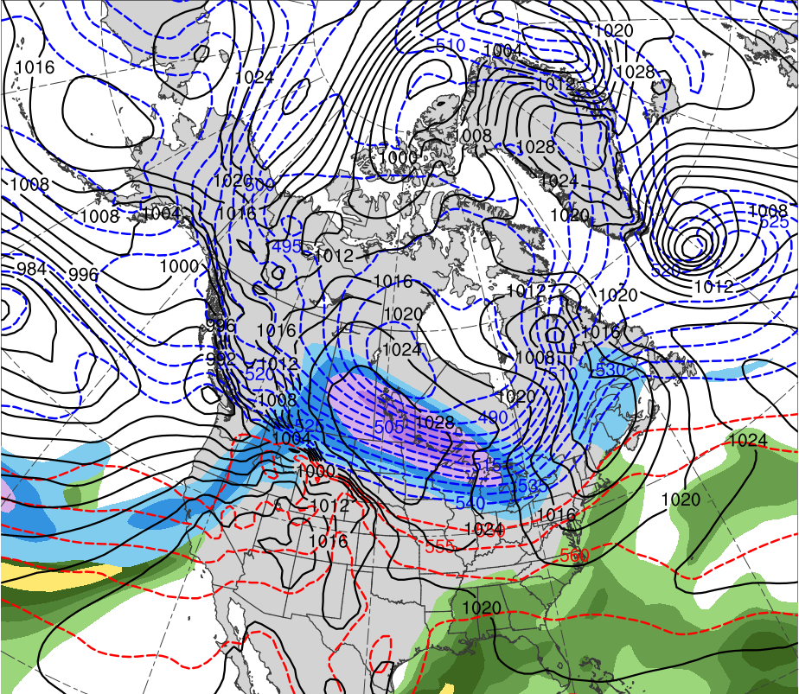
Synoptic Analysis
0000 UTC 30 Dec 1996
Data Source: 0.5° ERA-Interim
TPV 2
TPV 1
CP
L
1004 hPa
(K)
252
258
264
270
276
282
288
294
300
306
312
318
324
330
336
342
348
354
360
366
372
378
(mm)
(m s⁻¹ )
25
30
35
40
45
50
55
50
60
70
80
90
100
110
120
Potential temperature (K, shaded), wind speed (black, every 10 m s⁻¹ starting at 50 m s⁻¹), and wind (m s⁻¹, flags and barbs) on 2-PVU surface
250-hPa wind speed (m s⁻¹, shaded),
1000–500-hPa thickness (dam, blue/red),
MSLP (hPa, black), PW (mm, shaded)

Slide 33
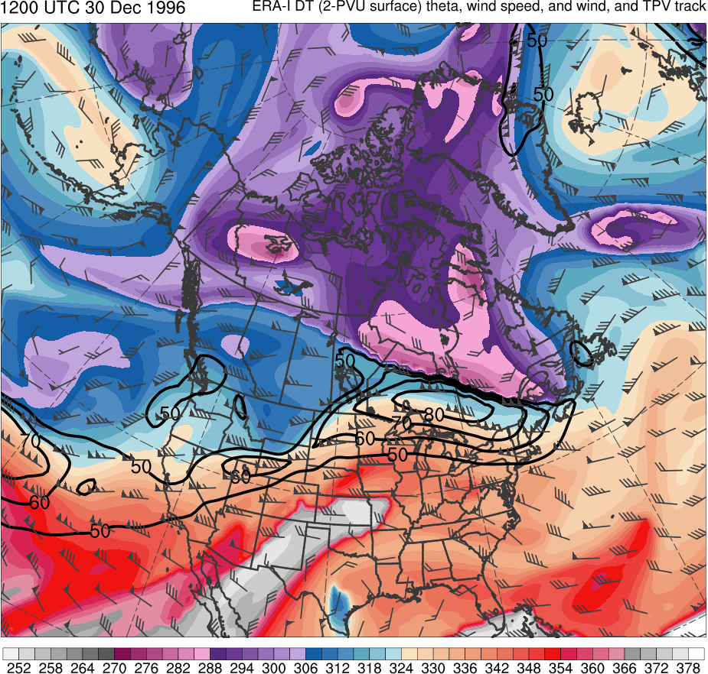
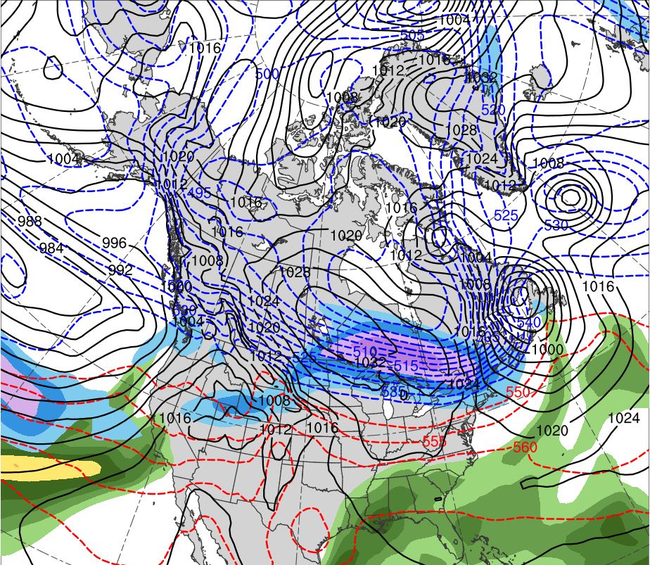
Synoptic Analysis
1200 UTC 30 Dec 1996
Data Source: 0.5° ERA-Interim
TPV 2
TPV 1
L
CP
982 hPa
(K)
252
258
264
270
276
282
288
294
300
306
312
318
324
330
336
342
348
354
360
366
372
378
(mm)
(m s⁻¹ )
25
30
35
40
45
50
55
50
60
70
80
90
100
110
120
Potential temperature (K, shaded), wind speed (black, every 10 m s⁻¹ starting at 50 m s⁻¹), and wind (m s⁻¹, flags and barbs) on 2-PVU surface
250-hPa wind speed (m s⁻¹, shaded),
1000–500-hPa thickness (dam, blue/red),
MSLP (hPa, black), PW (mm, shaded)

Slide 34
Synoptic Analysis
0000 UTC 31 Dec 1996
Data Source: 0.5° ERA-Interim
TPV 1
TPV 2
L
CP
957 hPa
(K)
252
258
264
270
276
282
288
294
300
306
312
318
324
330
336
342
348
354
360
366
372
378
(mm)
(m s⁻¹ )
25
30
35
40
45
50
55
50
60
70
80
90
100
110
120
Potential temperature (K, shaded), wind speed (black, every 10 m s⁻¹ starting at 50 m s⁻¹), and wind (m s⁻¹, flags and barbs) on 2-PVU surface
250-hPa wind speed (m s⁻¹, shaded),
1000–500-hPa thickness (dam, blue/red),
MSLP (hPa, black), PW (mm, shaded)

Slide 35
Synoptic Analysis
1200 UTC 31 Dec 1996
Data Source: 0.5° ERA-Interim
TPV 1
TPV 2
L
CP
952 hPa
(K)
252
258
264
270
276
282
288
294
300
306
312
318
324
330
336
342
348
354
360
366
372
378
(mm)
(m s⁻¹ )
25
30
35
40
45
50
55
50
60
70
80
90
100
110
120
Potential temperature (K, shaded), wind speed (black, every 10 m s⁻¹ starting at 50 m s⁻¹), and wind (m s⁻¹, flags and barbs) on 2-PVU surface
250-hPa wind speed (m s⁻¹, shaded),
1000–500-hPa thickness (dam, blue/red),
MSLP (hPa, black), PW (mm, shaded)

Slide 36
Synoptic Analysis
0000 UTC 1 Jan 1997
Data Source: 0.5° ERA-Interim
TPV 1
TPV 2
L
CP
961 hPa
(K)
252
258
264
270
276
282
288
294
300
306
312
318
324
330
336
342
348
354
360
366
372
378
(mm)
(m s⁻¹ )
25
30
35
40
45
50
55
50
60
70
80
90
100
110
120
Potential temperature (K, shaded), wind speed (black, every 10 m s⁻¹ starting at 50 m s⁻¹), and wind (m s⁻¹, flags and barbs) on 2-PVU surface
250-hPa wind speed (m s⁻¹, shaded),
1000–500-hPa thickness (dam, blue/red),
MSLP (hPa, black), PW (mm, shaded)

Slide 37
Evaluation of Forecast Skill of EC
Evaluate forecast skill of EC using version 2 of ESRL/PSD Global Ensemble Forecasting System (GEFS) reforecast dataset (Hamill et al. 2013)
Available once daily (0000 UTC) at 1° horizontal resolution
Use GEFS ensemble forecasts initialized at 0000 UTC 26 Dec 1996, 5.5 days prior to time of maximum intensity of EC in ERA-Interim
Use ERA-Interim regridded to 1° horizontal resolution as verification

Slide 38
Evaluation of Forecast Skill of EC
Forecast skill of EC is assessed in terms of a metric combining forecast track and intensity error of EC
Metric calculated by adapting methodology of Lamberson et al. (2016) used to rank ensembles by forecast accuracy in terms of track and intensity error for EC Joachim (2011)
Track and intensity error is calculated every 12 h from 0000 UTC 30 Dec 1996 to 0000 UTC 1 Jan 1997 for each GEFS member

Slide 39
Evaluation of Forecast Skill of EC
Track error for each time is calculated as the great circle distance between the location of the EC in ERA-Interim and in each GEFS member
Location of EC at a time corresponds to location of minimum MSLP value of EC at that time
Intensity error for each time is calculated as the absolute difference in intensity of EC in ERA-Interim and in each GEFS member
Intensity of EC at a time corresponds to minimum MSLP value of EC at that time

Slide 40
Evaluation of Forecast Skill of EC
Track and intensity errors are then averaged over time, and the GEFS members are ranked 1–11 for both track and intensity, with 1 corresponding to member with lowest average error
The track error rank is added with the intensity error rank to determine a combined track and intensity error rank for each GEFS member
The GEFS member with the lowest and highest combined track and intensity error rank will be considered the best and worst member, respectively

Slide 41
Results: GEFS Members Ranked by Skill for EC
Member | Track error rank | Intensity error rank | Summed intensity and track error rank
8 | 2 | 2 | 4
6 | 5 | 1 | 6
2 | 6 | 3 | 9
5 | 4 | 6 | 10
9 | 1 | 9 | 10
1 | 8 | 4 | 12
4 | 3 | 11 | 14
7 | 7 | 7 | 14
3 | 10 | 5 | 15
Control | 9 | 8 | 17
10 | 11 | 10 | 21
“best”
“worst”

Slide 42
Results: Comparison of Track and Intensity
Minimum MSLP (hPa) of EC every 6 h from 0000 UTC 30 Dec 1996 to 0000 UTC 1 Jan 1997 for ERA-Interim, best GEFS member, worst GEFS member, and all other GEFS members
Track of EC every 6 h (circles every 12 h) from 0000 UTC 30 Dec 1996 to 0000 UTC 1 Jan 1997 for ERA-Interim, best GEFS member, worst GEFS member, and all other GEFS members

Slide 43
Evaluation of Forecast Skill of TPVs
Evaluate forecast skill of TPVs following aforementioned methodology, but use minimum dynamic tropopause potential temperature instead of minimum MSLP
Track and intensity error for TPV 1 is calculated every 12 h from 0000 UTC 26 Dec 1996 to 1200 UTC 29 Dec 1996 for each GEFS member
Track and intensity error for TPV 2 is calculated every 12 h from 0000 UTC 26 Dec 1996 to 0000 UTC 30 Dec 1996 for each GEFS member

Slide 44
Evaluation of Forecast Skill of TPVs
Track, intensity, and combined track and intensity error ranks are first calculated for each TPV individually
These respective error ranks for each TPV are added together to determine the corresponding error ranks for the TPVs together
Square of the linear correlation (r²) is computed between the combined track and intensity error ranks for the EC and the track, intensity, and combined track and intensity error ranks for the TPVs separately and together
Statistical significance is assessed with a two-sided Student’s t test

Slide 45
Results: Correlation Analysis
r = 0.032
r² = 0.001
Scatterplot and trend lines of combined track and intensity error ranks of all GEFS members for the EC (green dots and green line) and combined track and intensity error ranks of all GEFS members for the TPVs together (gray triangles and gray line)

Slide 46
Results: Correlation Analysis
r = 0.456
r² = 0.208
*Not statistically significant
Scatterplot and trend lines of combined track and intensity error ranks of all GEFS members for the EC (green dots and green line) and intensity error ranks of all GEFS members for TPV 1 (gray triangles and gray line)

Slide 47
Best and Worst Comparison
0000 UTC 29 Dec 1996
378
Best GEFS Member
ERA-Interim
372
TPV 2
TPV 2
366
360
354
348
TPV 1
TPV 1
342
336
330
324
318
312
Worst GEFS Member
306
TPV 2
300
294
288
Potential temperature (K, shaded), wind speed (black, every 10 m s⁻¹ starting at 50 m s⁻¹), and wind (m s⁻¹, flags and barbs) on 2-PVU surface
282
TPV 1
276
270
264
258
252
(K)

Slide 48
Best and Worst Comparison
0000 UTC 29 Dec 1996
Best GEFS Member
ERA-Interim
30
28
26
24
22
20
18
Worst GEFS Member
16
14
500-hPa geopotential height (black contours, every 6 dam), relative vorticity (shading, ×10⁻⁵ s⁻¹), and wind (flags and barbs, m s⁻¹)
12
10
8
6

Slide 49
Best and Worst Comparison
0000 UTC 29 Dec 1996
Best GEFS Member
ERA-Interim
Worst GEFS Member
(mm)
25
30
35
40
45
50
55
(m s⁻¹ )
50
60
70
80
90
100
110
120
250-hPa wind speed (m s⁻¹, shaded),
1000–500-hPa thickness (dam, blue/red),
MSLP (hPa, black), PW (mm, shaded)

Slide 50
Best and Worst Comparison
1200 UTC 29 Dec 1996
378
Best GEFS Member
ERA-Interim
372
TPV 2
366
TPV 2
360
TPV 1
TPV 1
354
348
342
336
330
324
318
312
Worst GEFS Member
306
300
TPV 2
294
288
TPV 1
Potential temperature (K, shaded), wind speed (black, every 10 m s⁻¹ starting at 50 m s⁻¹), and wind (m s⁻¹, flags and barbs) on 2-PVU surface
282
276
270
264
258
252
(K)

Slide 51
Best and Worst Comparison
1200 UTC 29 Dec 1996
Best GEFS Member
ERA-Interim
30
28
26
24
22
20
18
Worst GEFS Member
16
14
500-hPa geopotential height (black contours, every 6 dam), relative vorticity (shading, ×10⁻⁵ s⁻¹), and wind (flags and barbs, m s⁻¹)
12
10
8
6

Slide 52
Best and Worst Comparison
1200 UTC 29 Dec 1996
Best GEFS Member
ERA-Interim
L
1013 hPa
Worst GEFS Member
(mm)
25
30
35
40
45
50
55
(m s⁻¹ )
50
60
70
80
90
100
110
120
L
250-hPa wind speed (m s⁻¹, shaded),
1000–500-hPa thickness (dam, blue/red),
MSLP (hPa, black), PW (mm, shaded)
999 hPa

Slide 53
Best and Worst Comparison
0000 UTC 30 Dec 1996
378
Best GEFS Member
ERA-Interim
372
366
TPV 2
TPV 1
TPV 1
TPV 2
360
354
348
342
336
330
324
318
312
Worst GEFS Member
306
300
294
TPV 2
288
TPV 1
Potential temperature (K, shaded), wind speed (black, every 10 m s⁻¹ starting at 50 m s⁻¹), and wind (m s⁻¹, flags and barbs) on 2-PVU surface
282
276
270
264
258
252
(K)

Slide 54
Best and Worst Comparison
0000 UTC 30 Dec 1996
Best GEFS Member
ERA-Interim
30
28
26
24
22
20
18
Worst GEFS Member
16
14
500-hPa geopotential height (black contours, every 6 dam), relative vorticity (shading, ×10⁻⁵ s⁻¹), and wind (flags and barbs, m s⁻¹)
12
10
8
6

Slide 55
Best and Worst Comparison
0000 UTC 30 Dec 1996
Best GEFS Member
ERA-Interim
L
L
1002 hPa
1004 hPa
Worst GEFS Member
(mm)
25
30
35
40
45
50
55
(m s⁻¹ )
50
60
70
80
90
100
110
120
L
250-hPa wind speed (m s⁻¹, shaded),
1000–500-hPa thickness (dam, blue/red),
MSLP (hPa, black), PW (mm, shaded)
986 hPa

Slide 56
Best and Worst Comparison
1200 UTC 30 Dec 1996
378
Best GEFS Member
ERA-Interim
372
TPV 1
366
360
TPV 2
354
TPV 2
348
342
336
330
324
318
312
Worst GEFS Member
306
300
294
TPV 2
288
TPV 1
Potential temperature (K, shaded), wind speed (black, every 10 m s⁻¹ starting at 50 m s⁻¹), and wind (m s⁻¹, flags and barbs) on 2-PVU surface
282
276
270
264
258
252
(K)

Slide 57
Best and Worst Comparison
1200 UTC 30 Dec 1996
Best GEFS Member
ERA-Interim
30
28
26
24
22
20
18
Worst GEFS Member
16
14
500-hPa geopotential height (black contours, every 6 dam), relative vorticity (shading, ×10⁻⁵ s⁻¹), and wind (flags and barbs, m s⁻¹)
12
10
8
6

Slide 58
Best and Worst Comparison
1200 UTC 30 Dec 1996
Best GEFS Member
ERA-Interim
L
L
982 hPa
983 hPa
Worst GEFS Member
(mm)
25
30
35
40
45
50
55
(m s⁻¹ )
50
60
70
80
90
100
110
120
L
250-hPa wind speed (m s⁻¹, shaded),
1000–500-hPa thickness (dam, blue/red),
MSLP (hPa, black), PW (mm, shaded)
975 hPa

Slide 59
Best and Worst Comparison
0000 UTC 31 Dec 1996
378
Best GEFS Member
ERA-Interim
372
366
TPV 1
TPV 2
TPV 2
360
354
348
342
336
330
324
318
312
Worst GEFS Member
306
300
294
288
TPV 1
Potential temperature (K, shaded), wind speed (black, every 10 m s⁻¹ starting at 50 m s⁻¹), and wind (m s⁻¹, flags and barbs) on 2-PVU surface
282
276
270
264
258
252
(K)

Slide 60
Best and Worst Comparison
0000 UTC 31 Dec 1996
Best GEFS Member
ERA-Interim
30
28
26
24
22
20
18
Worst GEFS Member
16
14
500-hPa geopotential height (black contours, every 6 dam), relative vorticity (shading, ×10⁻⁵ s⁻¹), and wind (flags and barbs, m s⁻¹)
12
10
8
6

Slide 61
Best and Worst Comparison
0000 UTC 31 Dec 1996
Best GEFS Member
ERA-Interim
L
L
957 hPa
958 hPa
Worst GEFS Member
(mm)
25
30
35
40
45
50
55
(m s⁻¹ )
L
50
60
70
80
90
100
110
120
250-hPa wind speed (m s⁻¹, shaded),
1000–500-hPa thickness (dam, blue/red),
MSLP (hPa, black), PW (mm, shaded)
957 hPa

Slide 62
Best and Worst Comparison
1200 UTC 31 Dec 1996
378
Best GEFS Member
ERA-Interim
372
TPV 2
TPV 1
TPV 2
366
360
354
348
342
336
330
324
318
312
Worst GEFS Member
306
300
TPV 1
294
288
Potential temperature (K, shaded), wind speed (black, every 10 m s⁻¹ starting at 50 m s⁻¹), and wind (m s⁻¹, flags and barbs) on 2-PVU surface
282
276
270
264
258
252
(K)

Slide 63
Best and Worst Comparison
1200 UTC 31 Dec 1996
Best GEFS Member
ERA-Interim
30
28
26
24
22
20
18
Worst GEFS Member
16
14
500-hPa geopotential height (black contours, every 6 dam), relative vorticity (shading, ×10⁻⁵ s⁻¹), and wind (flags and barbs, m s⁻¹)
12
10
8
6

Slide 64
Best and Worst Comparison
1200 UTC 31 Dec 1996
Best GEFS Member
ERA-Interim
L
L
950 hPa
953 hPa
Worst GEFS Member
(mm)
25
30
35
40
45
50
55
(m s⁻¹ )
L
50
60
70
80
90
100
110
120
250-hPa wind speed (m s⁻¹, shaded),
1000–500-hPa thickness (dam, blue/red),
MSLP (hPa, black), PW (mm, shaded)
963 hPa

Slide 65
Conclusions
Appears to be two overall camps in GEFS forecasts:
EC in forecast develops too quickly and tracks too far to northwest of actual EC track (including worst member)
EC in forecast develops more slowly like actual EC and tracks closer to actual EC track (though still too far to the northwest in most cases; including best member)
TPVs are likely playing an important role in the development of the EC, which explosively deepens in the poleward exit region of a strong jet streak the TPVs interact with

Slide 66
Conclusions
There is no statistically significant correlation between forecast skill of the EC and forecast skill of the TPVs
The greatest positive linear correlation (though not statistically significant) exists between the combined track and intensity error ranks for the EC and intensity error ranks for TPV 1
Differences in structure of TPV 1 between best and worst members and ERA-Interim likely plays some role in differences in EC development
Although best GEFS member has best intensity forecast of TPV 1, it has worst track forecast of TPV 2

Slide 67
Conclusions
Overall, results suggest that other factors or a combination of factors may be important in terms of errors in the track and intensity of the EC besides just errors in the track and intensity of the TPVs
Failure of best and worst GEFS members to forecast preceding weak cyclone near Great Lakes likely contributes to errors in development of main EC
Improved depiction of this preceding EC may lead to improved forecasts of EC of interest

