Slide 1
Forecast Skill of the Development of a Strong Extratropical Cyclone Linked to Tropopause Polar Vortices
Kevin A. Biernat
Department of Atmospheric and Environmental Sciences
University at Albany, SUNY
ATM 621: Structure and Dynamics of Extratropical Cyclones
Project Proposal
28 March 2017

Slide 2
What are Tropopause Polar Vortices (TPVs)?
TPVs are defined as tropopause-based vortices of high-latitude origin and are material features (Pyle et al. 2004; Cavallo and Hakim 2009, 2010)
TPV
TPV
(left) Dynamic tropopause (DT) wind speed (every 15 m s⁻¹ starting at 50 m s⁻¹, thick contours) and DT potential temperature (K, thin contours and shading) on 1.5-PVU surface valid 0000 UTC 1 Dec 1991; (right) same as left except DT pressure (hPa, thin contours and shading). Adapted from Fig. 11 in Pyle et al. (2004).

Slide 3
Motivation
TPVs may interact with and strengthen midlatitude jet streams, and act as precursors to development of strong extratropical cyclones (ECs)
Lower-tropospheric cold pools that many accompany TPVs can further enhance baroclinicity throughout troposphere, providing additional dynamical support for development of strong ECs
Strong ECs may lead to extreme weather events (EWEs) associated with heavy precipitation and strong winds that can pose hazards to life and property

Slide 4
Research Goal
Investigate how the forecast skill of a strong EC linked to TPVs is related to the forecast skill of the TPVs and their interaction with the large-scale flow and one another

Slide 5
Literature
Review

Slide 6
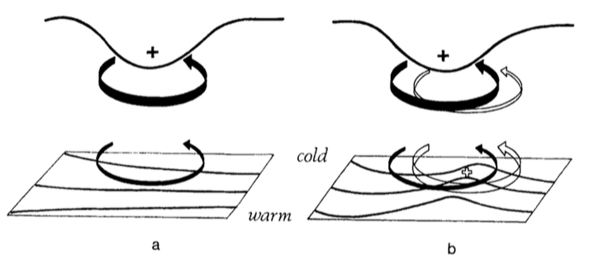
Cyclonic PV Anomalies and Cyclogenesis
Hoskins et al. (1985)
Cyclonic PV Anomaly
Positive PV Advection
Trop.
WAA
“Phase Locking”
θ
Cyclonic PV Anomaly
t = t₀
t = t₀ + Δt
Notes:
Adapted from Fig. 21 in Hoskins et al. (1985).

Slide 7
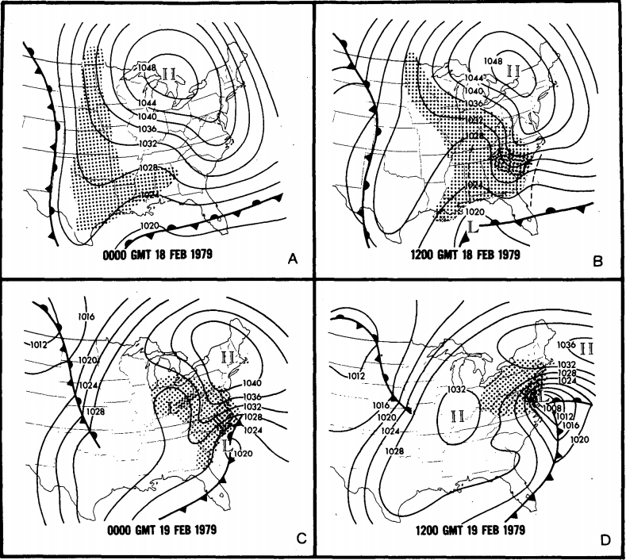
Presidents’ Day Storm of 1979
Uccellini et al. (1985)
Sea level pressure (mb) and surface frontal analyses for (a) 0000 GMT 18 Feb, (b) 1200 GMT 18 Feb, (c) 0000 GMT 19 Feb, and (d) 1200 GMT 19 Feb 1979. Shading represents precipitation; dark shading indicates moderate-to-heavy precipitation. Dashed line in (b) denote inverted and coastal troughs. Adapted from Fig. 1 in Uccellini et al. 1985.

Slide 8
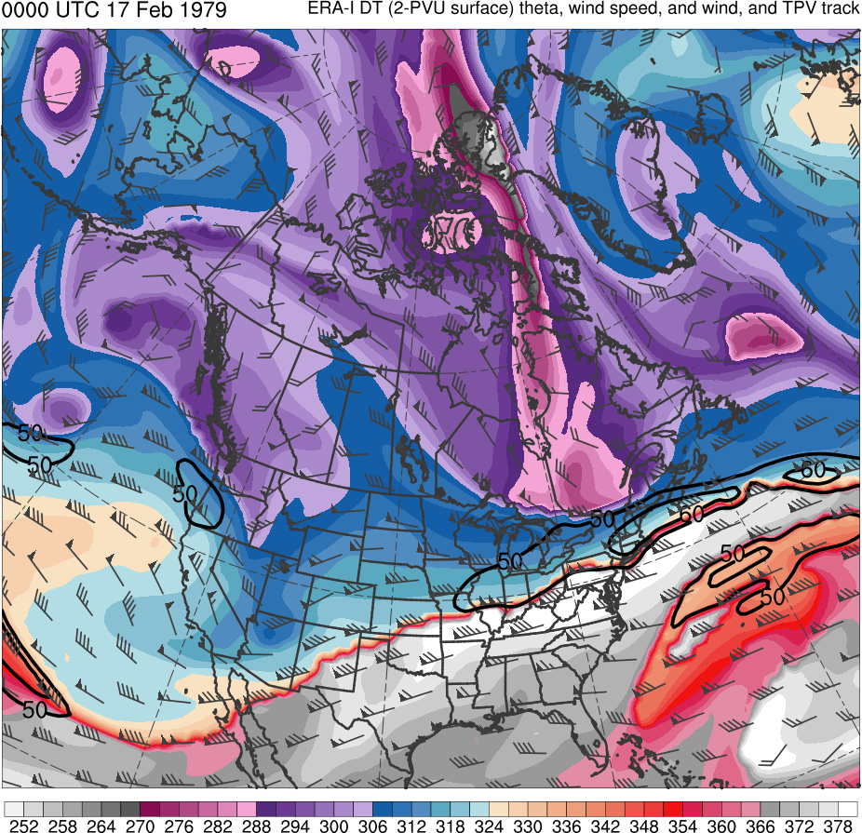
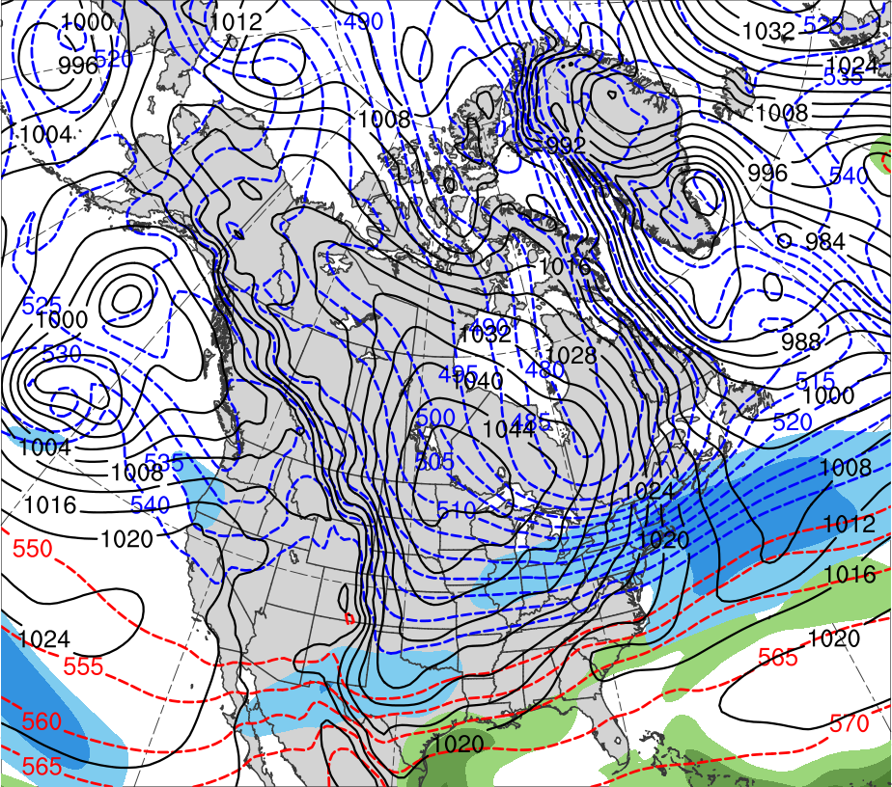
Presidents’ Day Storm of 1979
0000 UTC 17 Feb 1979
Data Source: 0.5° ERA-Interim
(K)
252
258
264
270
276
282
288
294
300
306
312
318
324
330
336
342
348
354
360
366
372
378
(mm)
(m s⁻¹ )
25
30
35
40
45
50
55
50
60
70
80
90
100
110
120
Potential temperature (K, shaded), wind speed (black, every 10 m s⁻¹ starting at 50 m s⁻¹), and wind (m s⁻¹, flags and barbs) on 2-PVU surface
250-hPa wind speed (m s⁻¹, shaded),
1000–500-hPa thickness (dam, blue/red),
MSLP (hPa, black), PW (mm, shaded)

Slide 9
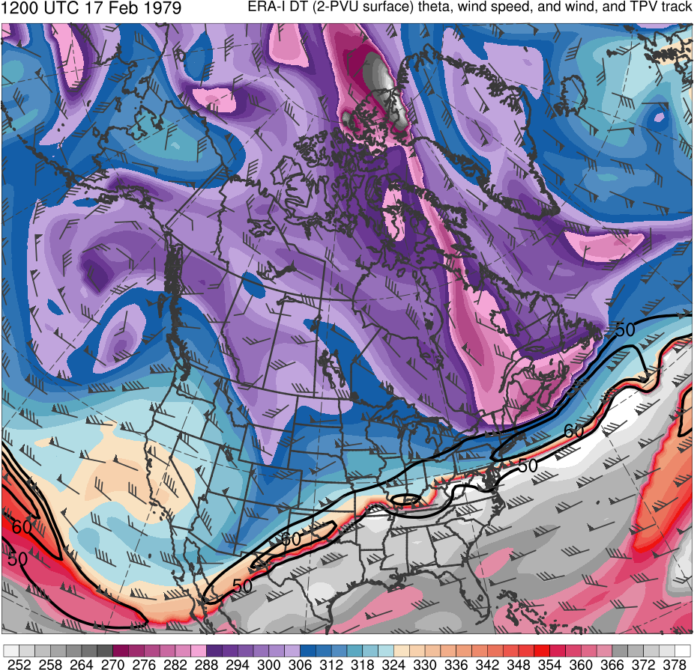
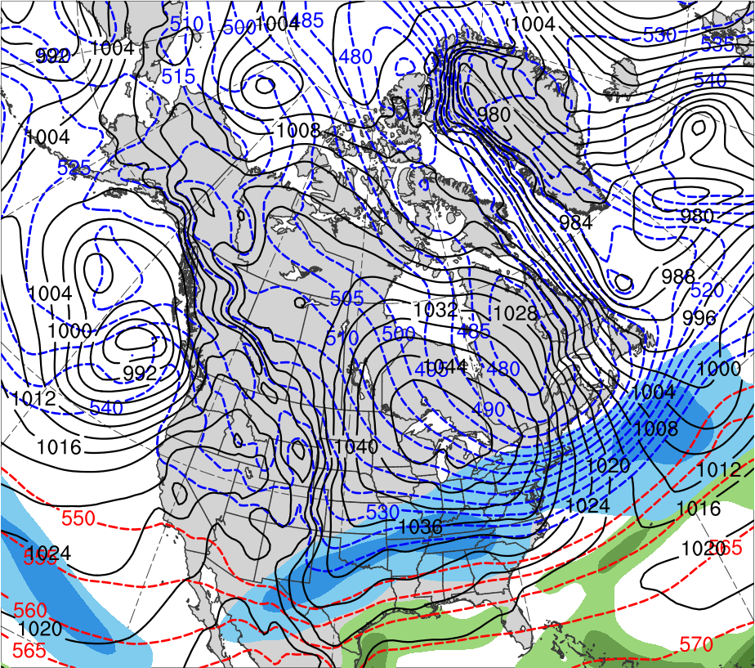
Presidents’ Day Storm of 1979
1200 UTC 17 Feb 1979
Data Source: 0.5° ERA-Interim
CTD
(K)
252
258
264
270
276
282
288
294
300
306
312
318
324
330
336
342
348
354
360
366
372
378
(mm)
(m s⁻¹ )
25
30
35
40
45
50
55
50
60
70
80
90
100
110
120
Potential temperature (K, shaded), wind speed (black, every 10 m s⁻¹ starting at 50 m s⁻¹), and wind (m s⁻¹, flags and barbs) on 2-PVU surface
250-hPa wind speed (m s⁻¹, shaded),
1000–500-hPa thickness (dam, blue/red),
MSLP (hPa, black), PW (mm, shaded)

Slide 10
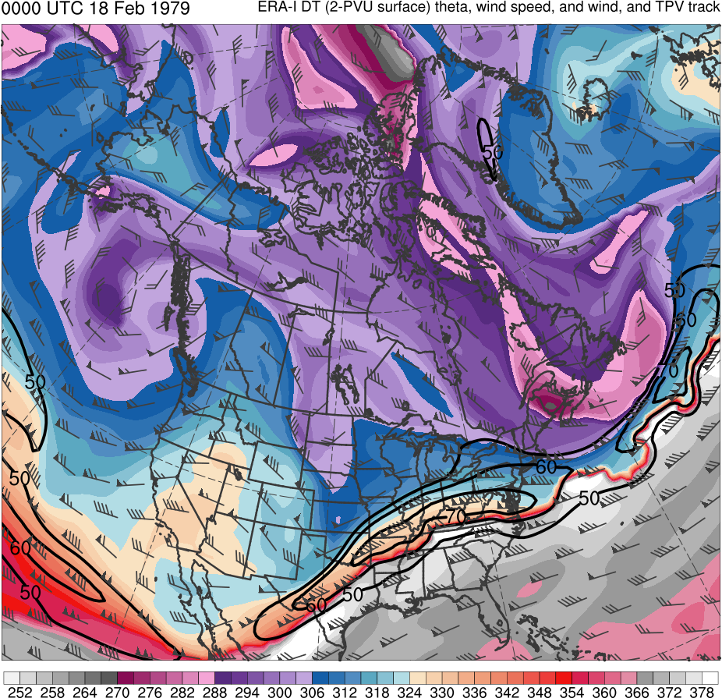
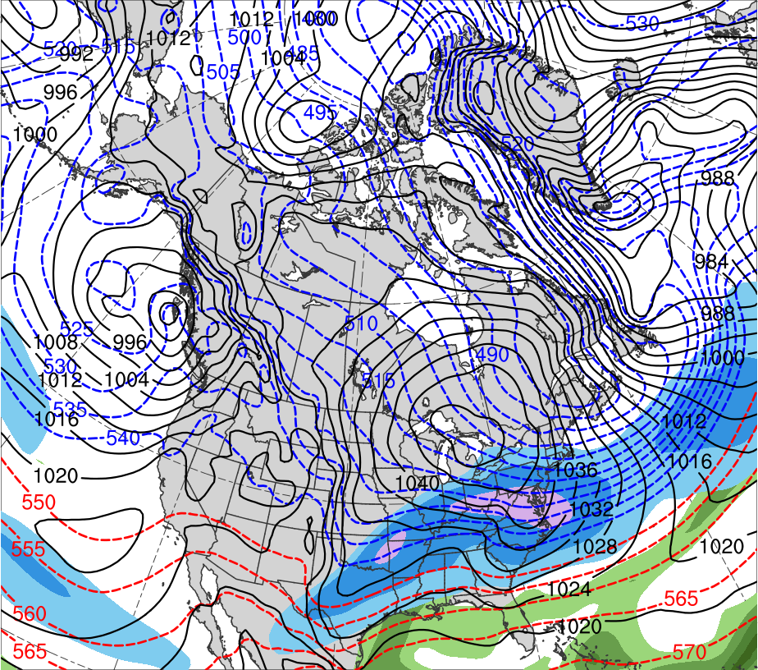
Presidents’ Day Storm of 1979
0000 UTC 18 Feb 1979
Data Source: 0.5° ERA-Interim
CTD
(K)
252
258
264
270
276
282
288
294
300
306
312
318
324
330
336
342
348
354
360
366
372
378
(mm)
(m s⁻¹ )
25
30
35
40
45
50
55
50
60
70
80
90
100
110
120
Potential temperature (K, shaded), wind speed (black, every 10 m s⁻¹ starting at 50 m s⁻¹), and wind (m s⁻¹, flags and barbs) on 2-PVU surface
250-hPa wind speed (m s⁻¹, shaded),
1000–500-hPa thickness (dam, blue/red),
MSLP (hPa, black), PW (mm, shaded)

Slide 11
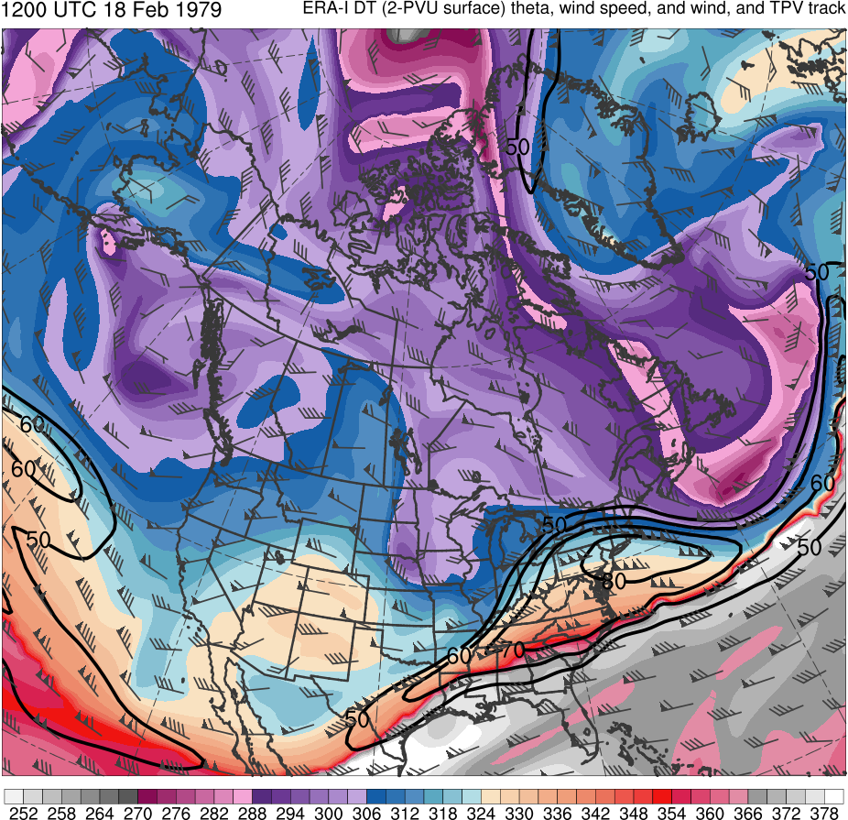
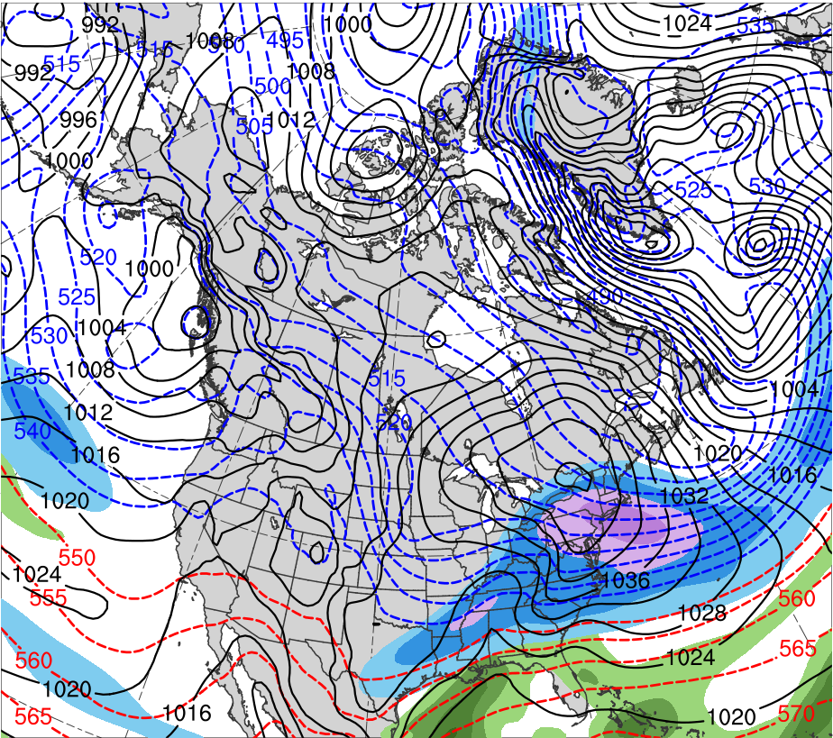
Presidents’ Day Storm of 1979
1200 UTC 18 Feb 1979
Data Source: 0.5° ERA-Interim
CTD
(K)
252
258
264
270
276
282
288
294
300
306
312
318
324
330
336
342
348
354
360
366
372
378
(mm)
(m s⁻¹ )
25
30
35
40
45
50
55
50
60
70
80
90
100
110
120
Potential temperature (K, shaded), wind speed (black, every 10 m s⁻¹ starting at 50 m s⁻¹), and wind (m s⁻¹, flags and barbs) on 2-PVU surface
250-hPa wind speed (m s⁻¹, shaded),
1000–500-hPa thickness (dam, blue/red),
MSLP (hPa, black), PW (mm, shaded)

Slide 12
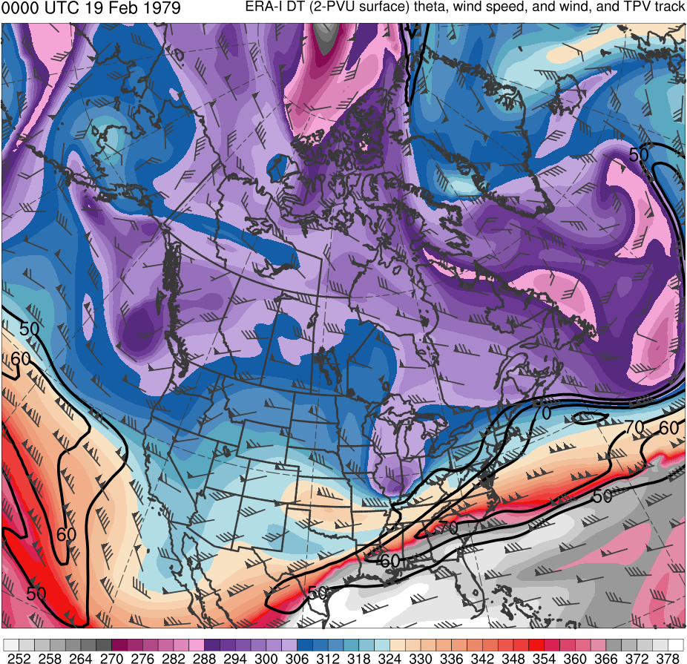
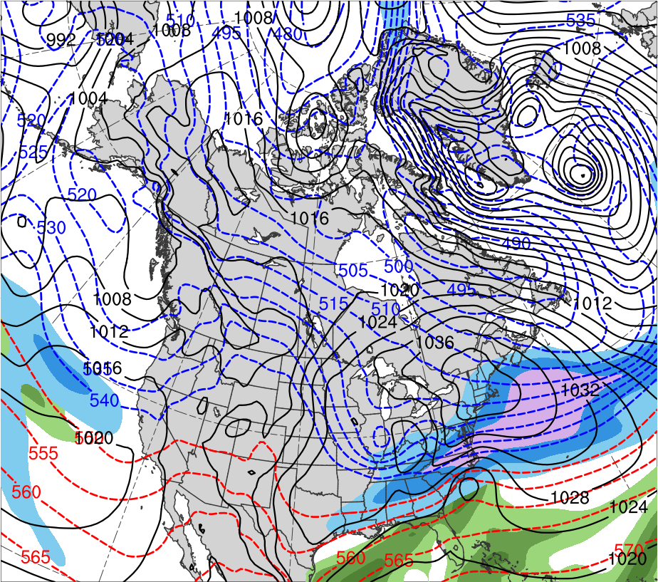
Presidents’ Day Storm of 1979
0000 UTC 19 Feb 1979
Data Source: 0.5° ERA-Interim
CTD
L
L
1018 hPa
(K)
252
258
264
270
276
282
288
294
300
306
312
318
324
330
336
342
348
354
360
366
372
378
(mm)
(m s⁻¹ )
25
30
35
40
45
50
55
50
60
70
80
90
100
110
120
Potential temperature (K, shaded), wind speed (black, every 10 m s⁻¹ starting at 50 m s⁻¹), and wind (m s⁻¹, flags and barbs) on 2-PVU surface
250-hPa wind speed (m s⁻¹, shaded),
1000–500-hPa thickness (dam, blue/red),
MSLP (hPa, black), PW (mm, shaded)

Slide 13
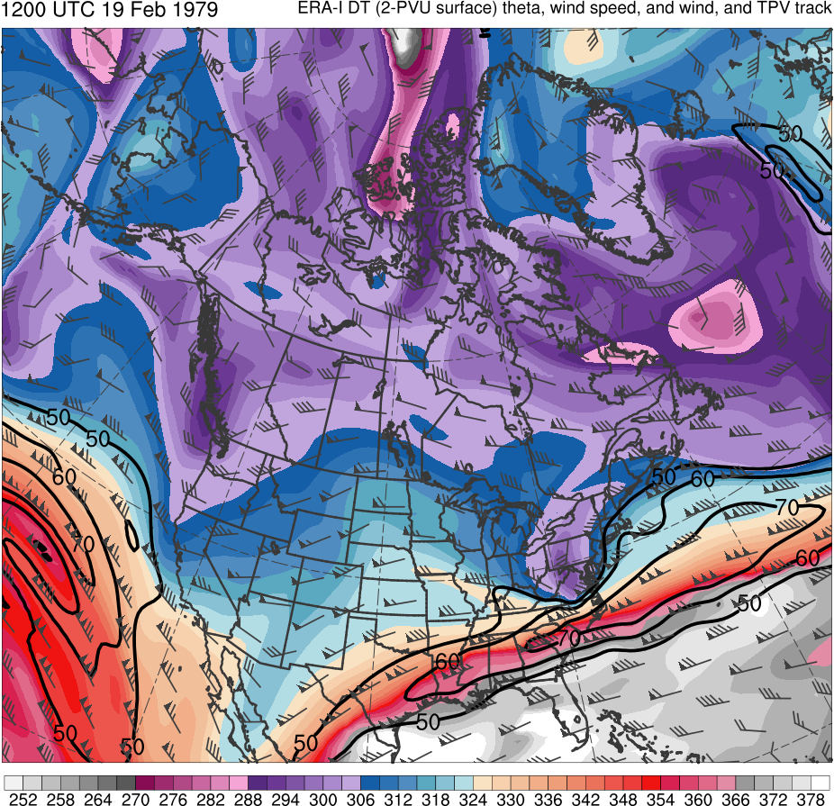
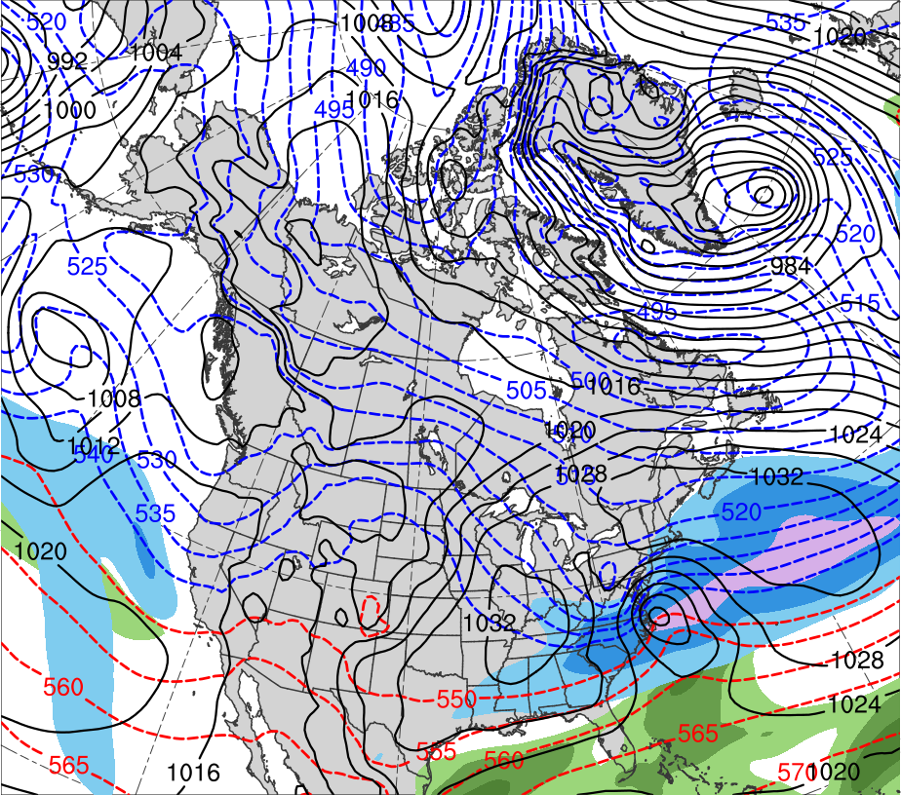
Presidents’ Day Storm of 1979
1200 UTC 19 Feb 1979
Data Source: 0.5° ERA-Interim
CTD
L
1011 hPa
(K)
252
258
264
270
276
282
288
294
300
306
312
318
324
330
336
342
348
354
360
366
372
378
(mm)
(m s⁻¹ )
25
30
35
40
45
50
55
50
60
70
80
90
100
110
120
Potential temperature (K, shaded), wind speed (black, every 10 m s⁻¹ starting at 50 m s⁻¹), and wind (m s⁻¹, flags and barbs) on 2-PVU surface
250-hPa wind speed (m s⁻¹, shaded),
1000–500-hPa thickness (dam, blue/red),
MSLP (hPa, black), PW (mm, shaded)

Slide 14
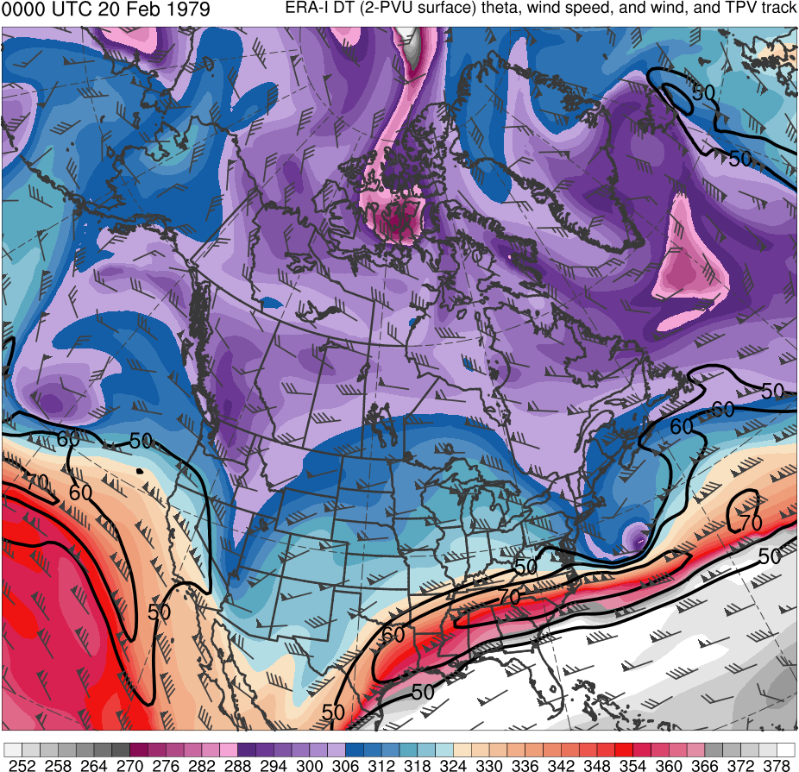
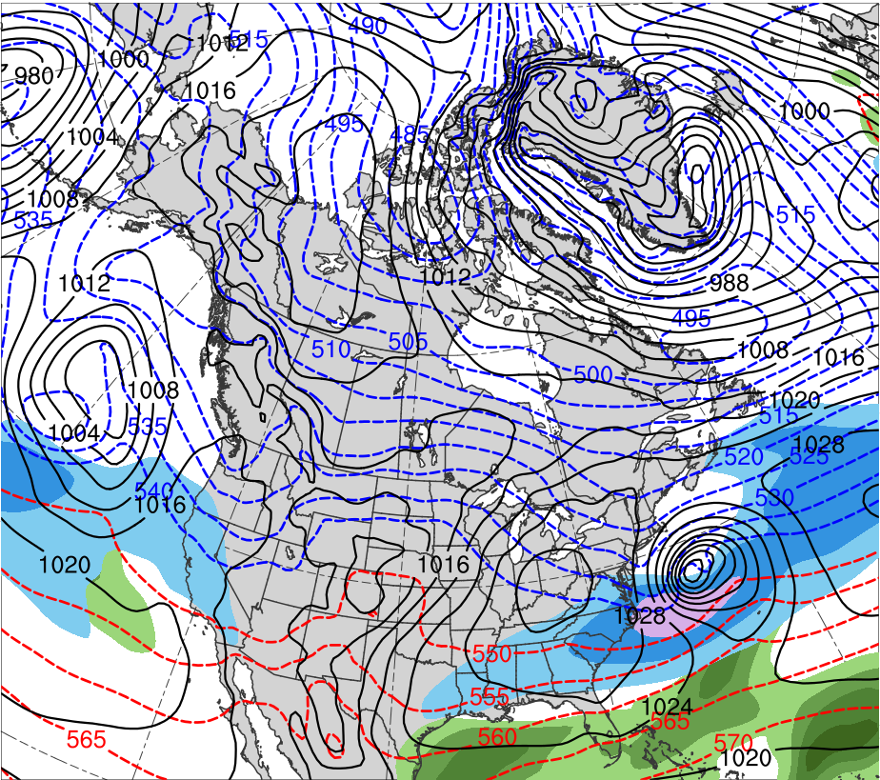
Presidents’ Day Storm of 1979
0000 UTC 20 Feb 1979
Data Source: 0.5° ERA-Interim
CTD
L
993 hPa
(K)
252
258
264
270
276
282
288
294
300
306
312
318
324
330
336
342
348
354
360
366
372
378
(mm)
(m s⁻¹ )
25
30
35
40
45
50
55
50
60
70
80
90
100
110
120
Potential temperature (K, shaded), wind speed (black, every 10 m s⁻¹ starting at 50 m s⁻¹), and wind (m s⁻¹, flags and barbs) on 2-PVU surface
250-hPa wind speed (m s⁻¹, shaded),
1000–500-hPa thickness (dam, blue/red),
MSLP (hPa, black), PW (mm, shaded)

Slide 15
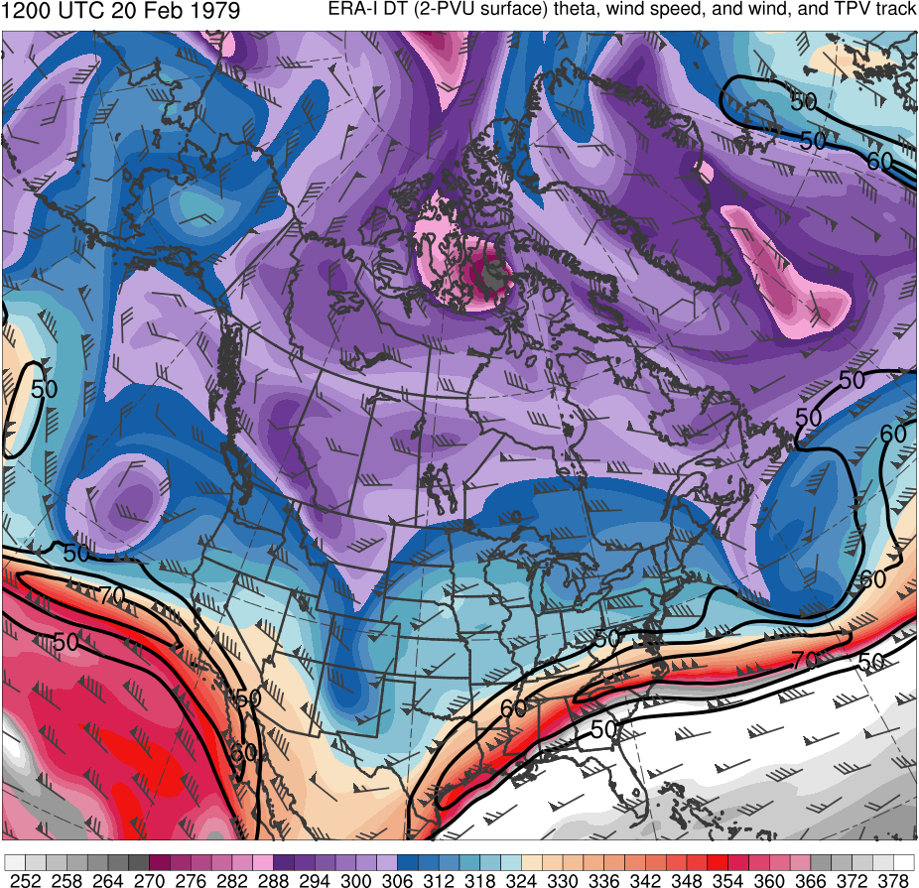
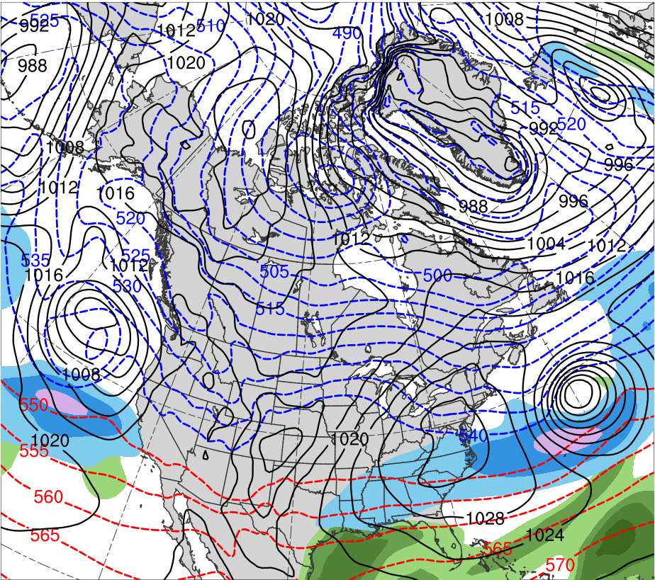
Presidents’ Day Storm of 1979
1200 UTC 20 Feb 1979
Data Source: 0.5° ERA-Interim
CTD
L
992 hPa
(K)
252
258
264
270
276
282
288
294
300
306
312
318
324
330
336
342
348
354
360
366
372
378
(mm)
(m s⁻¹ )
25
30
35
40
45
50
55
50
60
70
80
90
100
110
120
Potential temperature (K, shaded), wind speed (black, every 10 m s⁻¹ starting at 50 m s⁻¹), and wind (m s⁻¹, flags and barbs) on 2-PVU surface
250-hPa wind speed (m s⁻¹, shaded),
1000–500-hPa thickness (dam, blue/red),
MSLP (hPa, black), PW (mm, shaded)

Slide 16
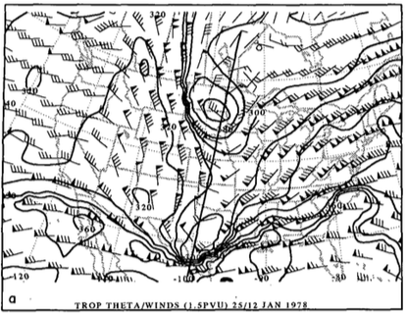
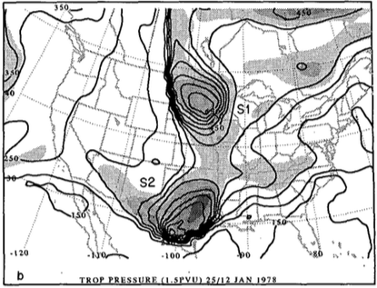
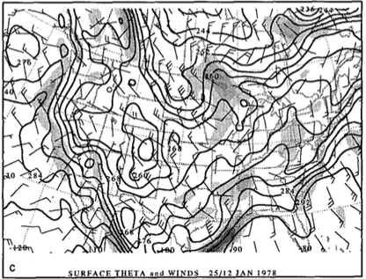
1978 Cleveland Superbomb
Hakim et al. (1995, 1996)
1200 UTC 25 January 1978
R
R
TPV
TPV
CTD 2
CTD 2
(a) Dynamic tropopause (DT; 1.5 PVU) potential temperature (black contours, every 10 K) and wind (flags and barbs, m s⁻¹); (b) DT pressure (black contours, every 50 hPa) and relative vorticity (shaded every 2×10⁻⁵ s⁻¹ for values greater than 4×10⁻⁵ s⁻¹ ); (c) surface potential temperature (black contours, every 4 K) and relative vorticity (shaded every 2×10⁻⁵ s⁻¹ for values greater than 2×10⁻⁵ s⁻¹). Adapted from Fig. 6 in Hakim et al. (1995).
A
L
998 hPa

Slide 17
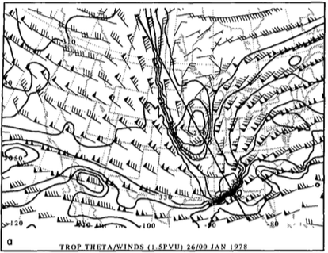
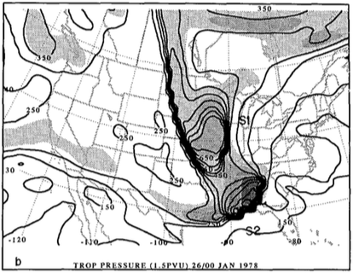
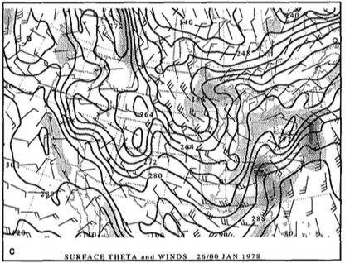
1978 Cleveland Superbomb
Hakim et al. (1995, 1996)
0000 UTC 26 January 1978
R
R
TPV
TPV
CTD 2
CTD 2
(a) Dynamic tropopause (DT; 1.5 PVU) potential temperature (black contours, every 10 K) and wind (flags and barbs, m s⁻¹); (b) DT pressure (black contours, every 50 hPa) and relative vorticity (shaded every 2×10⁻⁵ s⁻¹ for values greater than 4×10⁻⁵ s⁻¹ ); (c) surface potential temperature (black contours, every 4 K) and relative vorticity (shaded every 2×10⁻⁵ s⁻¹ for values greater than 2×10⁻⁵ s⁻¹). Adapted from Fig. 8 in Hakim et al. (1995).
A
L
982 hPa

Slide 18
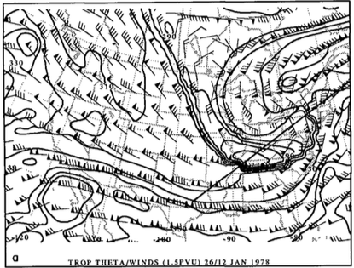
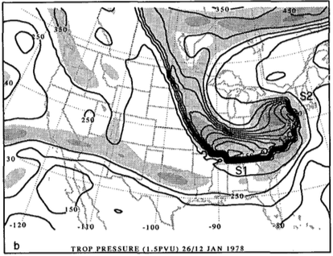
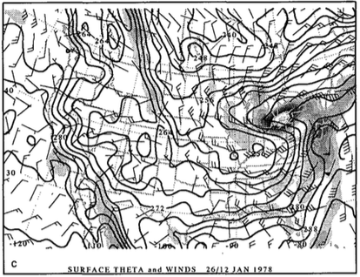
1978 Cleveland Superbomb
Hakim et al. (1995, 1996)
1200 UTC 26 January 1978
CTD 2
CTD 2
R
R
TPV
TPV
(a) Dynamic tropopause (DT; 1.5 PVU) potential temperature (black contours, every 10 K) and wind (flags and barbs, m s⁻¹); (b) DT pressure (black contours, every 50 hPa) and relative vorticity (shaded every 2×10⁻⁵ s⁻¹ for values greater than 4×10⁻⁵ s⁻¹ ); (c) surface potential temperature (black contours, every 4 K) and relative vorticity (shaded every 2×10⁻⁵ s⁻¹ for values greater than 2×10⁻⁵ s⁻¹). Adapted from Fig. 9 in Hakim et al. (1995).
L
A
955 hPa

Slide 19
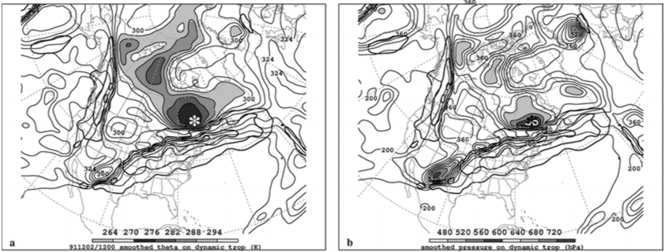
TPV–Jet Interaction
Pyle et al. (2004)
TPV/CTD–jet interactions may lead to formation or intensification of a jet streak
Strengthening ageostrophic circulations associated with strengthening jet streaks may play important roles in the development of tropopause folds and vertical motion patterns that may aid in cyclogenesis.
1200 UTC 2 December 1991
TPV
TPV
J1
J1
J2
J2
(left) DT (1.5-PVU surface) wind speed (every 15 m s⁻¹ starting at 50 m s⁻¹, thick contours) and potential temperature (K, thin contours and shading); (right) same as left except DT pressure (hPa, thin contours and shading). Adapted from Fig. 12 in Pyle et al. (2004).

Slide 20
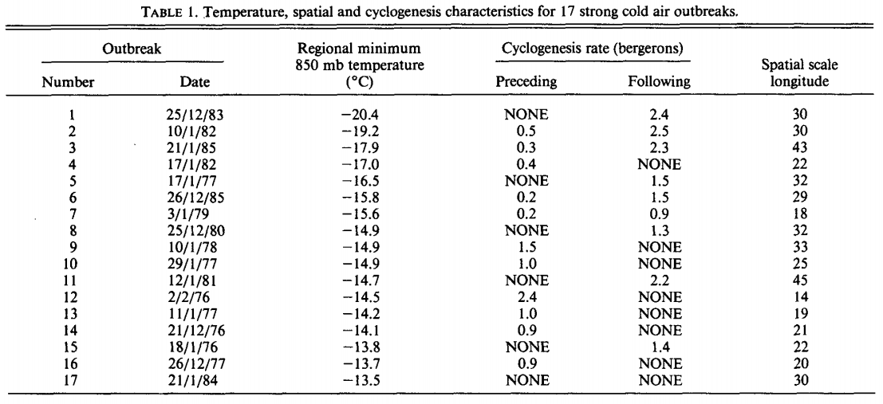
CAOs and ECs
Konrad and Colucci (1989)
Konrad and Colucci (1989) studied 17 strong cold air outbreak (CAOs) over North America and found that rapid cyclogenesis tended to follow the strongest CAOs

Slide 21
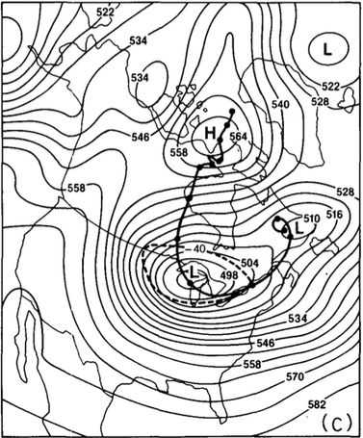
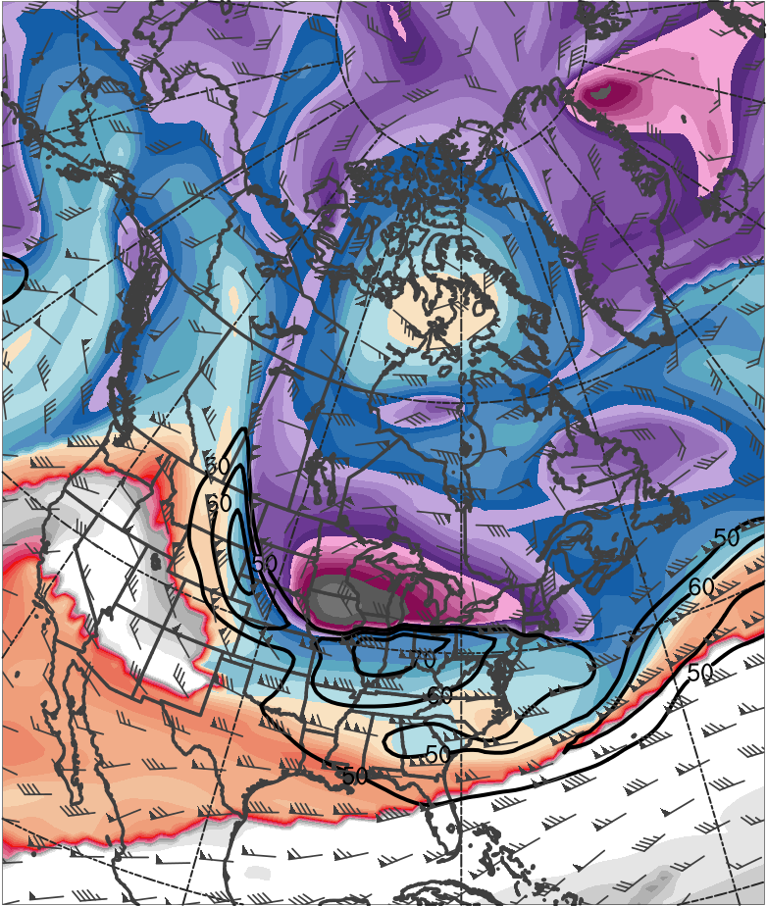
Jan 1985 TPV and CAO
Shapiro et al. (1987)
0000 UTC 20 January 1985
378
372
366
360
354
348
342
336
“Polar Vortex”
TPV
330
324
318
312
306
300
294
288
282
276
270
264
258
252
(K)
500-hPa geopotential height (black, every 6 dam) and −40°C isotherm (dashed contour); track of polar vortex from 0000 UTC 12 January to 0000 UTC 24 January 1985 (heavy black). Adapted from Fig. 5 in Shapiro et al. (1987).
Potential temperature (K, shaded), wind speed (black, every 10 m s⁻¹ starting at 50 m s⁻¹), and wind (m s⁻¹, barbs) on 2-PVU surface. Data source: ERA-Interim.

Slide 22
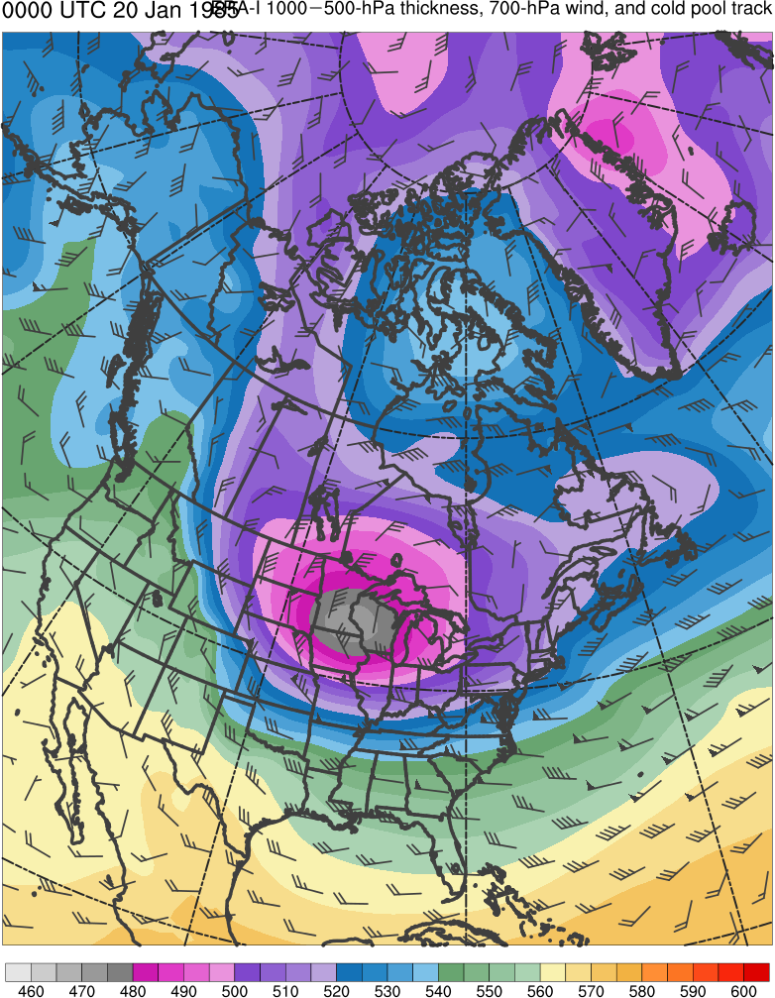
Jan 1985 TPV and CAO
Shapiro et al. (1987)
0000 UTC 20 January 1985
600
590
580
570
560
550
“Polar Vortex”
Cold Pool
540
530
520
510
500
490
480
470
460
(dam)
500-hPa geopotential height (black, every 6 dam) and −40°C isotherm (dashed contour); track of polar vortex from 0000 UTC 12 January to 0000 UTC 24 January 1985 (heavy black). Adapted from Fig. 5 in Shapiro et al. (1987).
1000–500-hPa thickness (dam, shaded) and 700-hPa wind (m s⁻¹, flags and barbs). Data source: ERA-Interim.

Slide 23
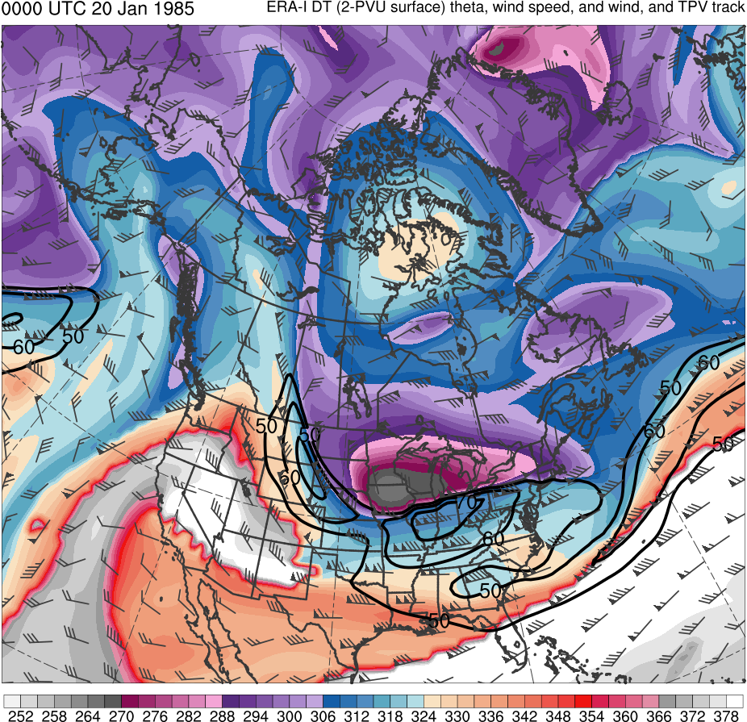
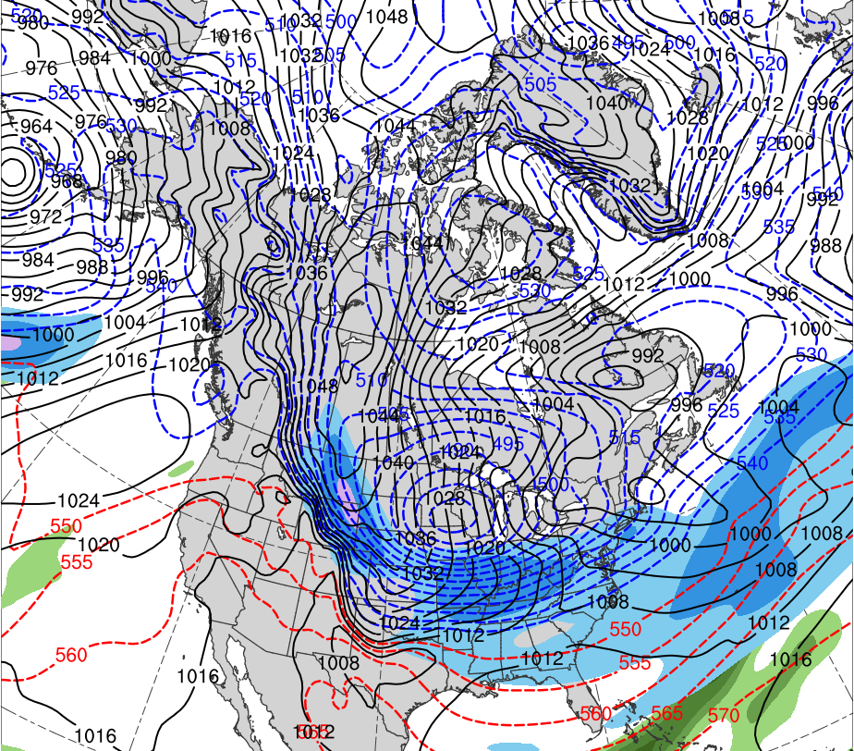
Jan 1985 TPV and CAO
0000 UTC 20 Jan 1985
Data Source: 0.5° ERA-Interim
TPV
CP
(K)
252
258
264
270
276
282
288
294
300
306
312
318
324
330
336
342
348
354
360
366
372
378
(mm)
(m s⁻¹ )
25
30
35
40
45
50
55
50
60
70
80
90
100
110
120
Potential temperature (K, shaded), wind speed (black, every 10 m s⁻¹ starting at 50 m s⁻¹), and wind (m s⁻¹, flags and barbs) on 2-PVU surface
250-hPa wind speed (m s⁻¹, shaded),
1000–500-hPa thickness (dam, blue/red),
MSLP (hPa, black), PW (mm, shaded)

Slide 24
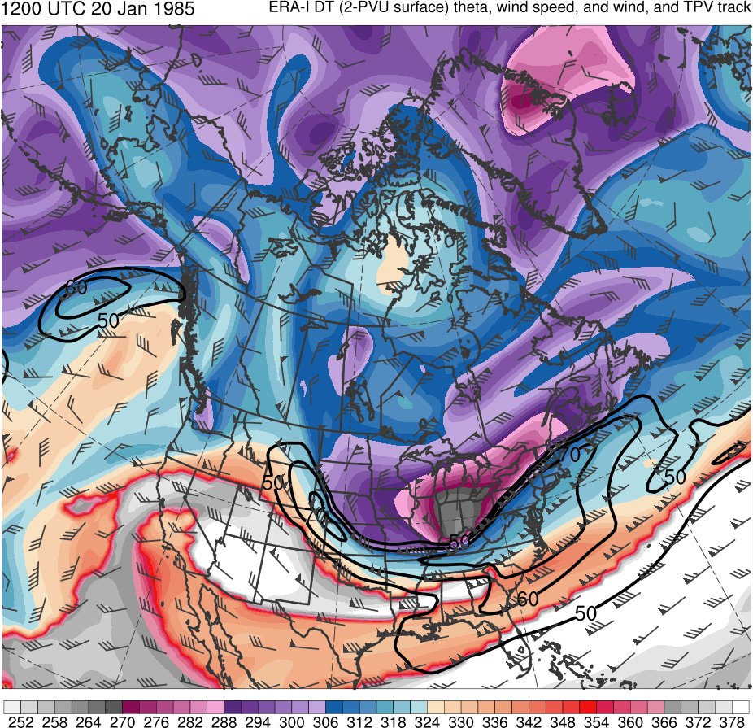
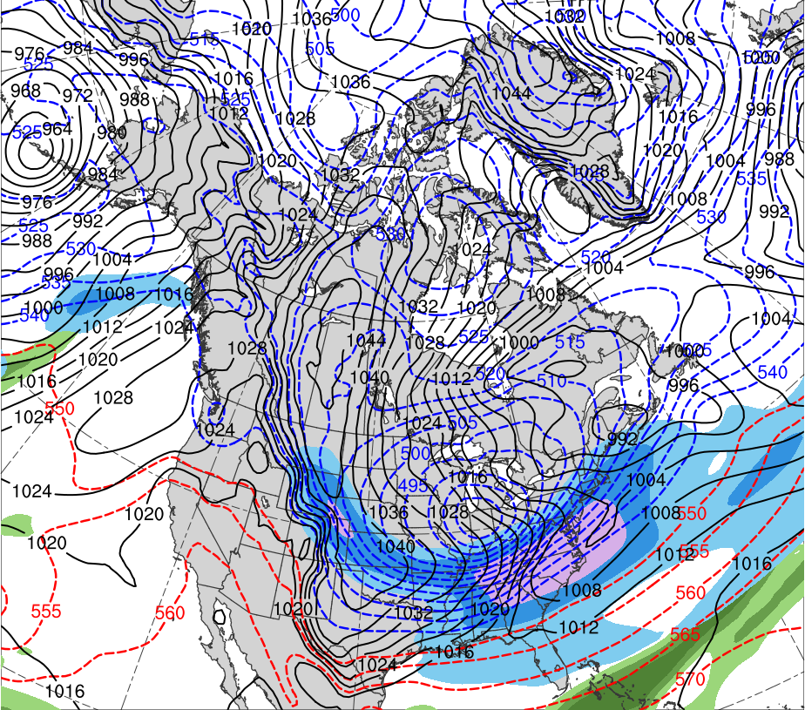
Jan 1985 TPV and CAO
1200 UTC 20 Jan 1985
Data Source: 0.5° ERA-Interim
TPV
L
CP
1003 hPa
(K)
252
258
264
270
276
282
288
294
300
306
312
318
324
330
336
342
348
354
360
366
372
378
(mm)
(m s⁻¹ )
25
30
35
40
45
50
55
50
60
70
80
90
100
110
120
Potential temperature (K, shaded), wind speed (black, every 10 m s⁻¹ starting at 50 m s⁻¹), and wind (m s⁻¹, flags and barbs) on 2-PVU surface
250-hPa wind speed (m s⁻¹, shaded),
1000–500-hPa thickness (dam, blue/red),
MSLP (hPa, black), PW (mm, shaded)

Slide 25
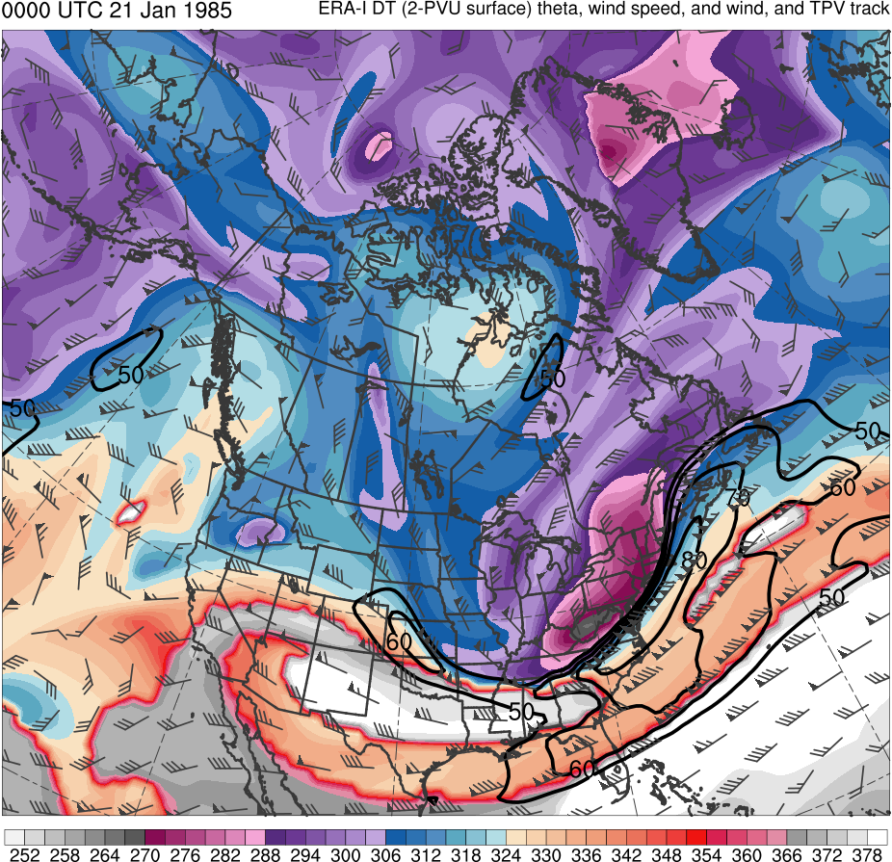
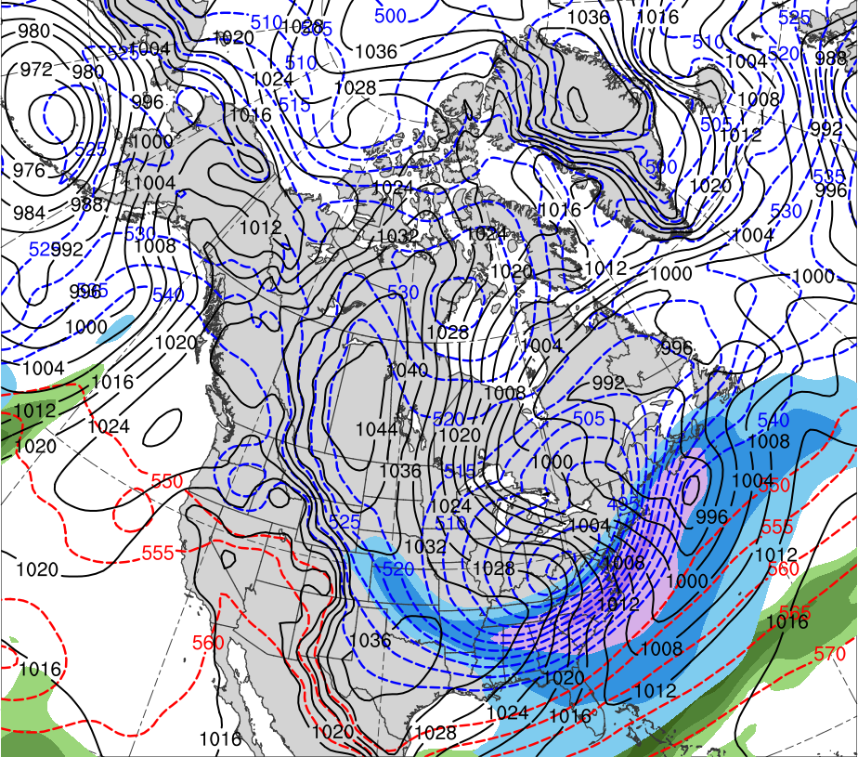
Jan 1985 TPV and CAO
0000 UTC 21 Jan 1985
Data Source: 0.5° ERA-Interim
TPV
L
CP
986 hPa
(K)
252
258
264
270
276
282
288
294
300
306
312
318
324
330
336
342
348
354
360
366
372
378
(mm)
(m s⁻¹ )
25
30
35
40
45
50
55
50
60
70
80
90
100
110
120
Potential temperature (K, shaded), wind speed (black, every 10 m s⁻¹ starting at 50 m s⁻¹), and wind (m s⁻¹, flags and barbs) on 2-PVU surface
250-hPa wind speed (m s⁻¹, shaded),
1000–500-hPa thickness (dam, blue/red),
MSLP (hPa, black), PW (mm, shaded)

Slide 26
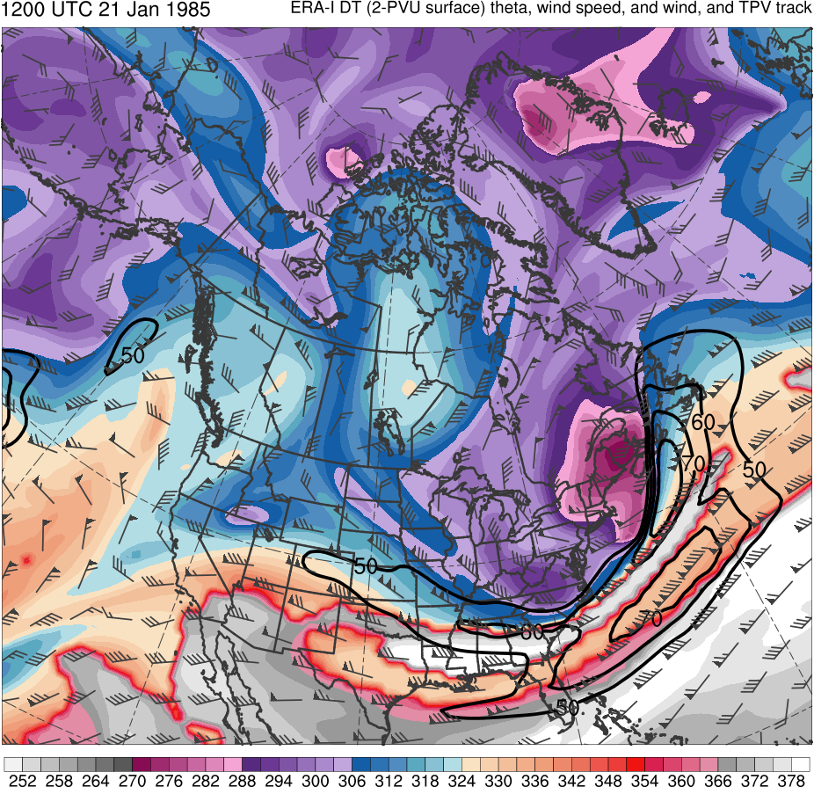
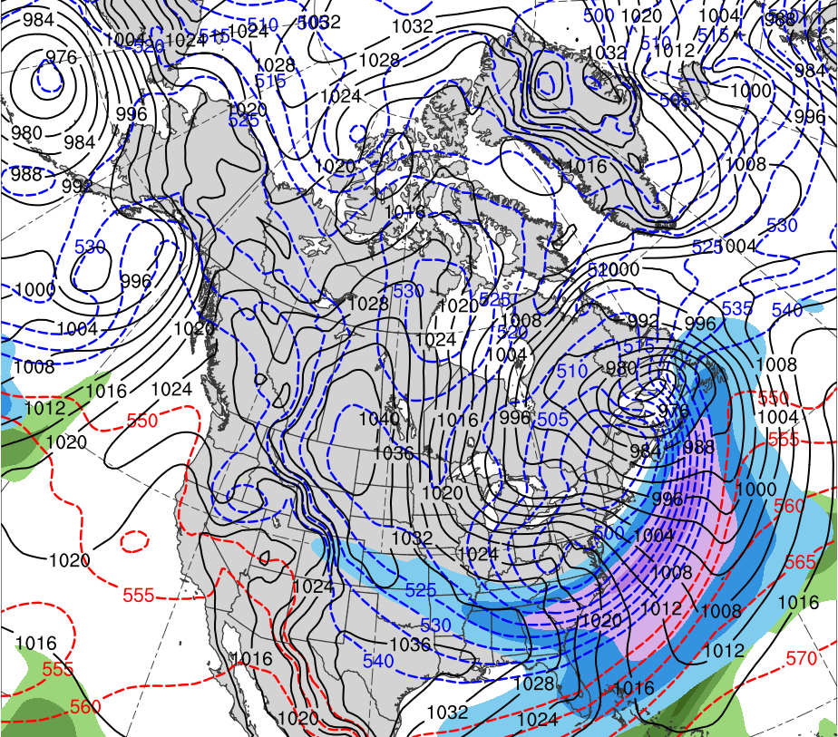
Jan 1985 TPV and CAO
1200 UTC 21 Jan 1985
Data Source: 0.5° ERA-Interim
L
TPV
CP
966 hPa
(K)
252
258
264
270
276
282
288
294
300
306
312
318
324
330
336
342
348
354
360
366
372
378
(mm)
(m s⁻¹ )
25
30
35
40
45
50
55
50
60
70
80
90
100
110
120
Potential temperature (K, shaded), wind speed (black, every 10 m s⁻¹ starting at 50 m s⁻¹), and wind (m s⁻¹, flags and barbs) on 2-PVU surface
250-hPa wind speed (m s⁻¹, shaded),
1000–500-hPa thickness (dam, blue/red),
MSLP (hPa, black), PW (mm, shaded)

Slide 27
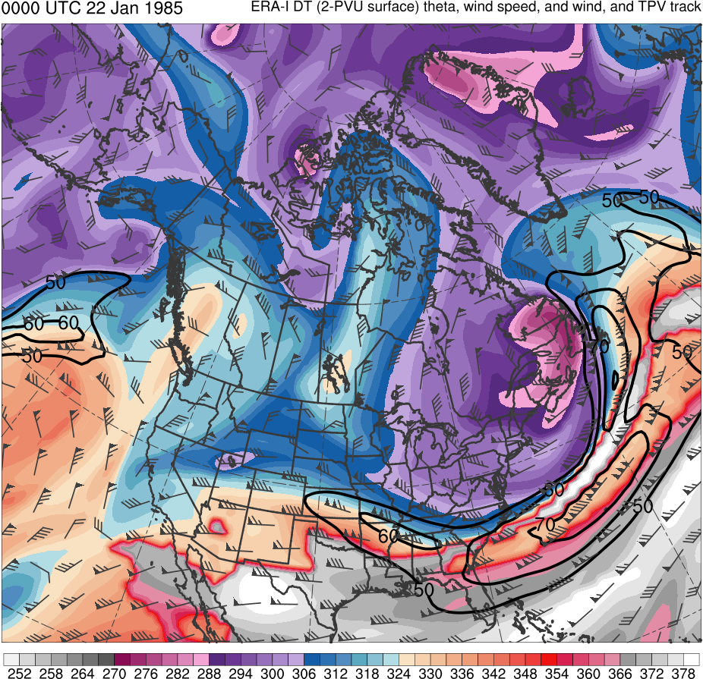
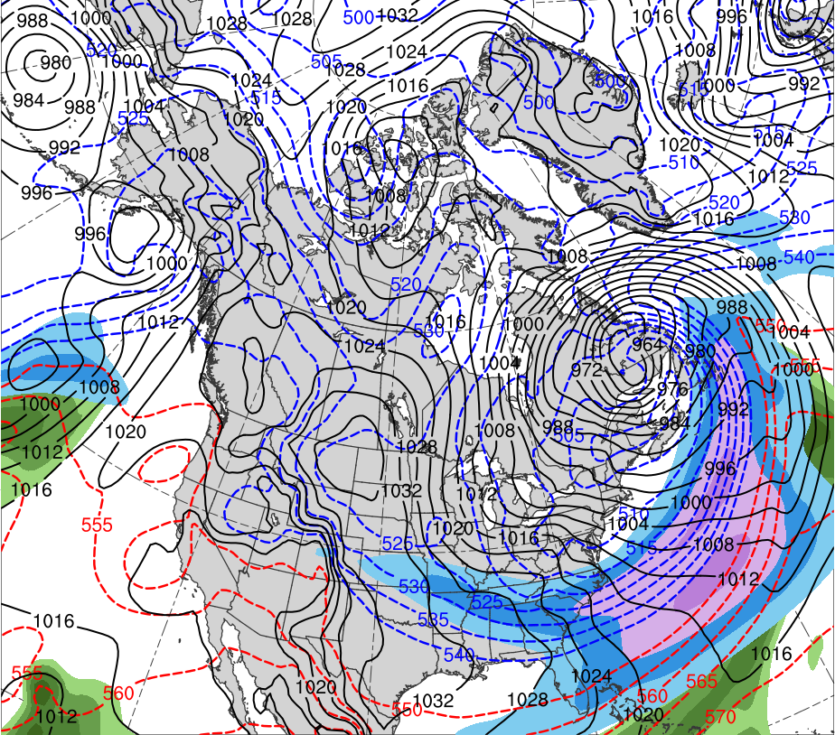
Jan 1985 TPV and CAO
0000 UTC 22 Jan 1985
Data Source: 0.5° ERA-Interim
L
TPV
CP
956 hPa
(K)
252
258
264
270
276
282
288
294
300
306
312
318
324
330
336
342
348
354
360
366
372
378
(mm)
(m s⁻¹ )
25
30
35
40
45
50
55
50
60
70
80
90
100
110
120
Potential temperature (K, shaded), wind speed (black, every 10 m s⁻¹ starting at 50 m s⁻¹), and wind (m s⁻¹, flags and barbs) on 2-PVU surface
250-hPa wind speed (m s⁻¹, shaded),
1000–500-hPa thickness (dam, blue/red),
MSLP (hPa, black), PW (mm, shaded)

Slide 28
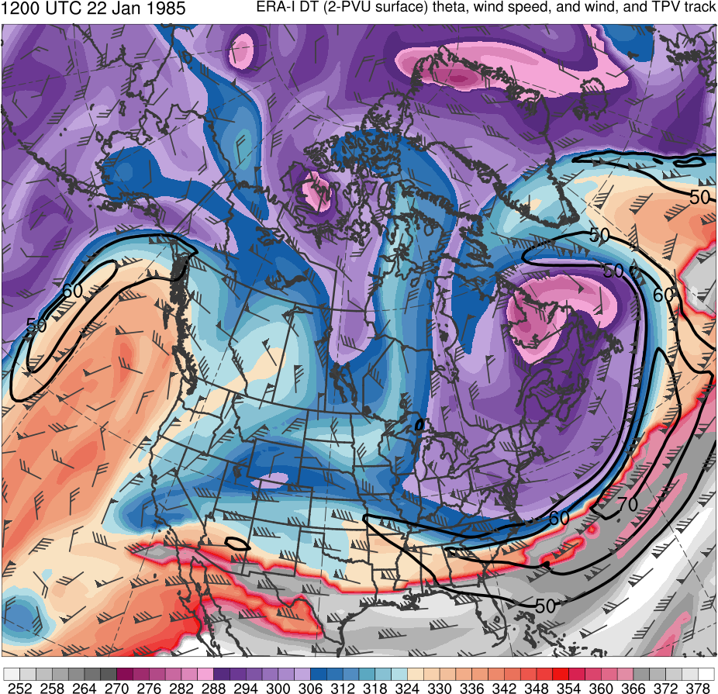
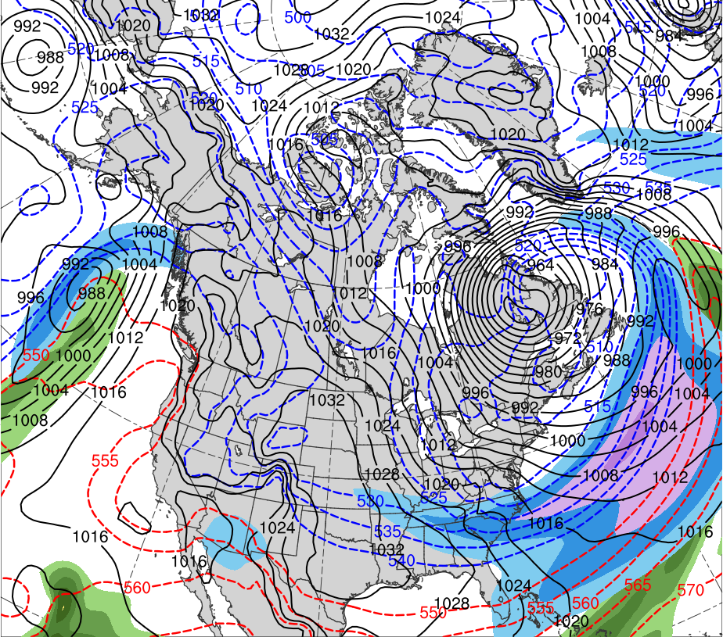
Jan 1985 TPV and CAO
1200 UTC 22 Jan 1985
Data Source: 0.5° ERA-Interim
L
TPV
CP
950 hPa
(K)
252
258
264
270
276
282
288
294
300
306
312
318
324
330
336
342
348
354
360
366
372
378
(mm)
(m s⁻¹ )
25
30
35
40
45
50
55
50
60
70
80
90
100
110
120
Potential temperature (K, shaded), wind speed (black, every 10 m s⁻¹ starting at 50 m s⁻¹), and wind (m s⁻¹, flags and barbs) on 2-PVU surface
250-hPa wind speed (m s⁻¹, shaded),
1000–500-hPa thickness (dam, blue/red),
MSLP (hPa, black), PW (mm, shaded)

Slide 29
Hypotheses
Forecast errors of strong ECs linked to TPVs originate from misrepresentation of the track of the TPVs, as well as misrepresentation of the interaction of the TPVs with the large-scale flow
Forecasts with lower forecast skill of strong ECs linked to TPVs are associated with larger TPV track errors and larger errors in the interaction of the TPVs with the large-scale flow compared to forecasts with higher forecast skill

Slide 30
Research Plan
Evaluate forecast skill of a strong EC linked to TPVs
Case: An EC that explosively deepened during 30–31 December 1996 near Labrador
Case Motivation:
EC’s development likely influenced by two TPVs that interact with and strengthen a jet streak as well as interact with one another
EC was identified in Alicia Bentley’s climatology of ECs leading to EWEs over central and Eastern North America

Slide 31
Research Plan
Use ERA-Interim (Dee et al. 2011) to evaluate synoptic evolution of EC and TPVs
TPVs and cold pools identified objectively for ERA-Interim by utilizing an adapting a TPV tracking algorithm developed by Nicholas Szapiro and Steven Cavallo
TPVs and cold pools must last at least 2 days and spend at least 6 h poleward of 60°N (adapted from criteria of Cavallo and Hakim 2010)
Link for Tracking Algorithm: https://github.com/nickszap/tpvTrack

Slide 32
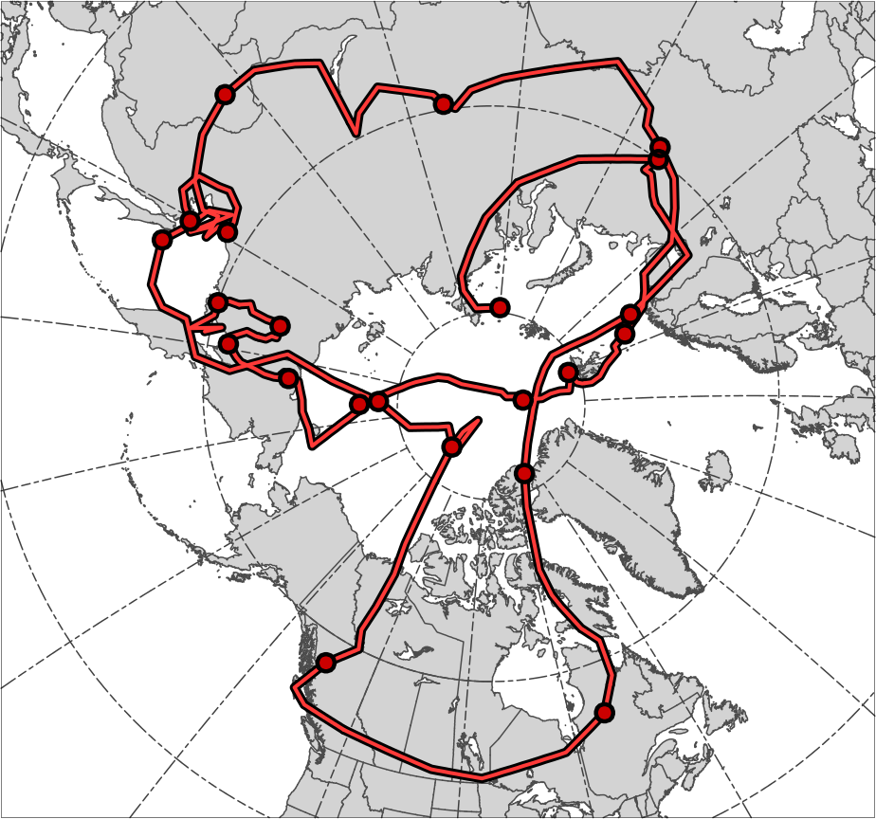
TPV and Cold Pool Tracks
TPV 1
16
14
12
5
20
TPV 1 Track
Genesis:
0600 UTC 24 Nov 1996
Lysis:
0000 UTC 7 Jan 1997
Lifetime:
44 days
22
18
26
3
7
30
28
10
24
6
8
2
4
26
1
28
30
Genesis
Lysis

Slide 33
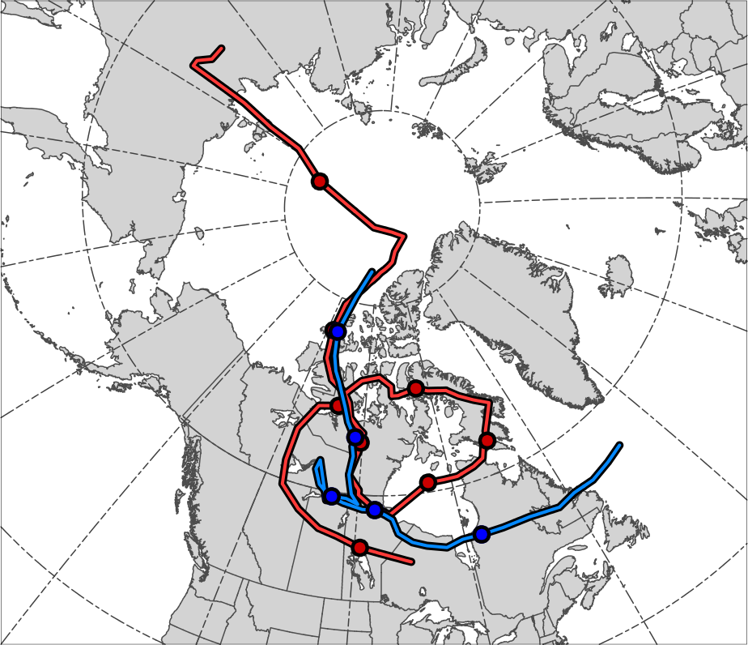
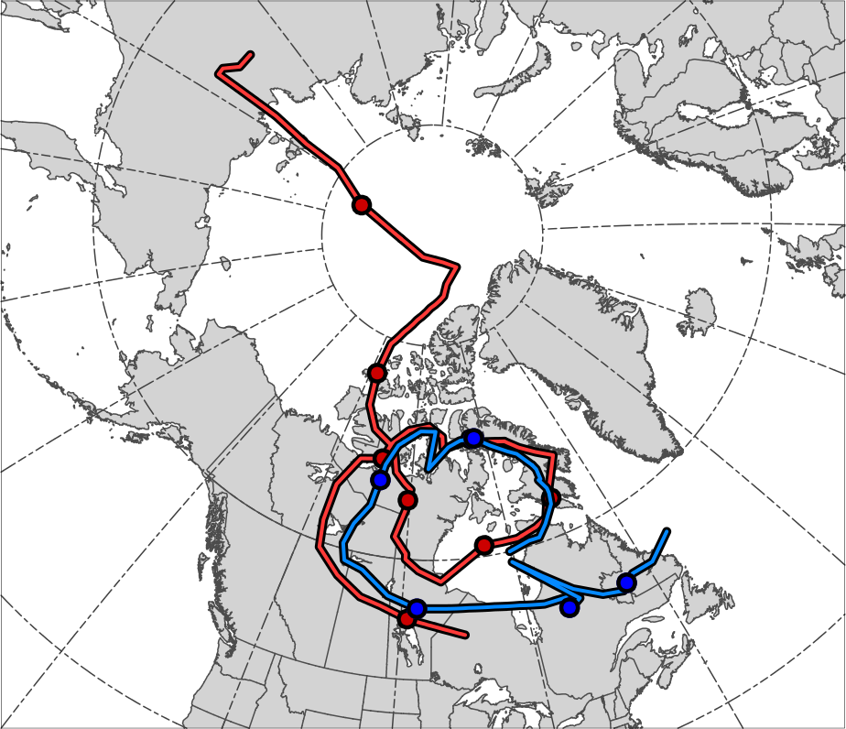
TPV and Cold Pool Tracks
TPV 2
TPV 2
16
16
Cold
Pool
Cold
Pool
18
18
26
26
28
28
20
24
20
24
22
24
22
22
3
30
26
30
1
Genesis
Lysis
TPV 2 Track
Genesis:
0600 UTC 14 Dec 1996
Lysis:
0600 UTC 30 Dec 1996
Lifetime: ~16 days
Cold Pool Track (left)
Genesis:
1200 UTC 17 Dec 1996
Lysis:
1800 UTC 27 Dec 1996
Lifetime: ~10 days
Cold Pool Track (right)
Genesis:
1200 UTC 22 Dec 1996
Lysis:
1800 UTC 3 Jan 1997
Lifetime: ~12 days

Slide 34
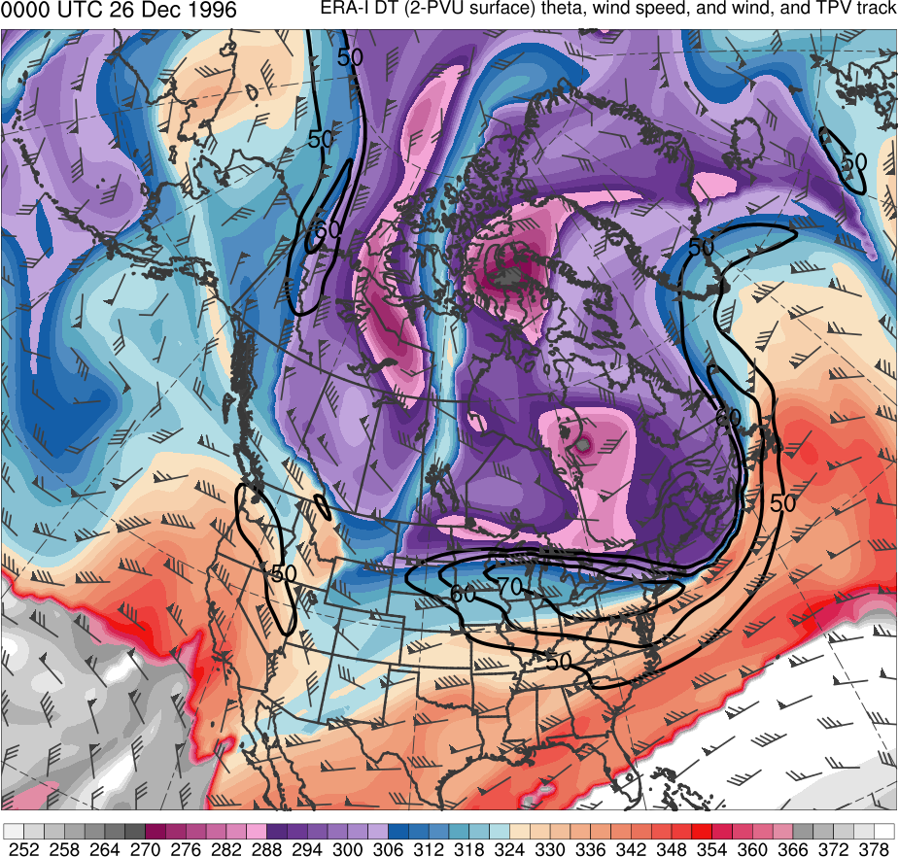
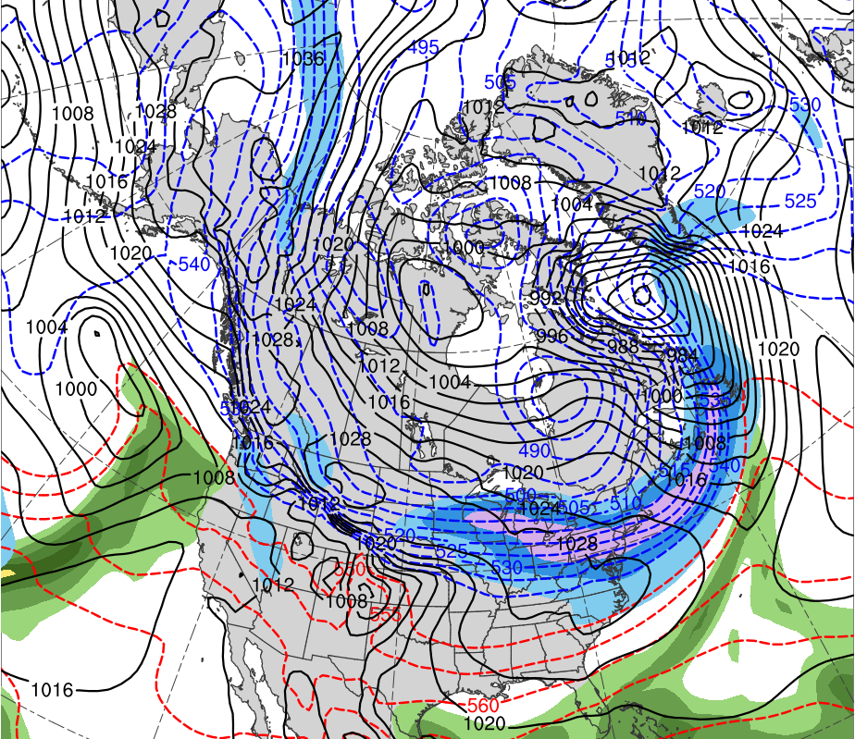
Synoptic Analysis
0000 UTC 26 Dec 1996
Data Source: 0.5° ERA-Interim
TPV 1
TPV 2
CP
(K)
252
258
264
270
276
282
288
294
300
306
312
318
324
330
336
342
348
354
360
366
372
378
(mm)
(m s⁻¹ )
25
30
35
40
45
50
55
50
60
70
80
90
100
110
120
Potential temperature (K, shaded), wind speed (black, every 10 m s⁻¹ starting at 50 m s⁻¹), and wind (m s⁻¹, flags and barbs) on 2-PVU surface
250-hPa wind speed (m s⁻¹, shaded),
1000–500-hPa thickness (dam, blue/red),
MSLP (hPa, black), PW (mm, shaded)

Slide 35
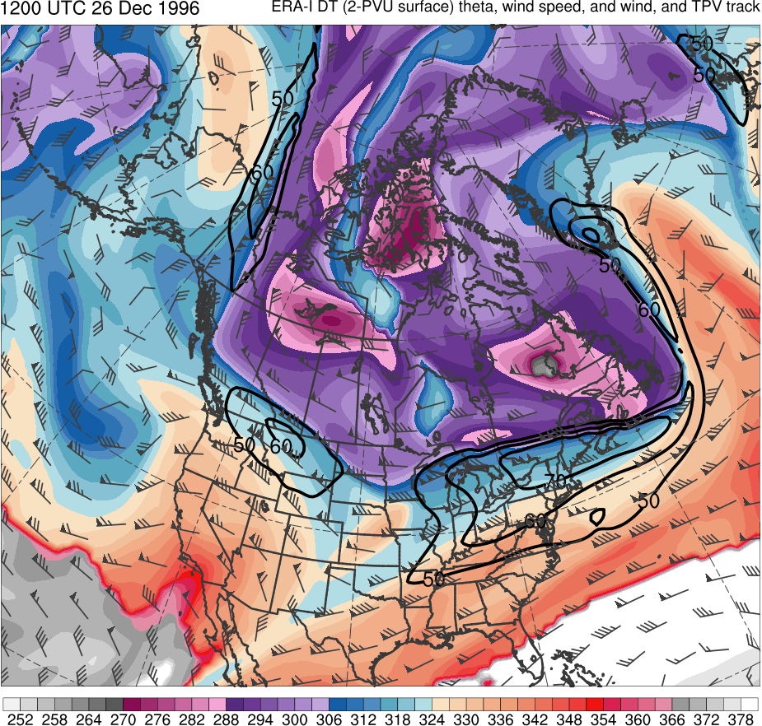
Synoptic Analysis
1200 UTC 26 Dec 1996
Data Source: 0.5° ERA-Interim
TPV 2
TPV 1
CP
(K)
252
258
264
270
276
282
288
294
300
306
312
318
324
330
336
342
348
354
360
366
372
378
(mm)
(m s⁻¹ )
25
30
35
40
45
50
55
50
60
70
80
90
100
110
120
Potential temperature (K, shaded), wind speed (black, every 10 m s⁻¹ starting at 50 m s⁻¹), and wind (m s⁻¹, flags and barbs) on 2-PVU surface
250-hPa wind speed (m s⁻¹, shaded),
1000–500-hPa thickness (dam, blue/red),
MSLP (hPa, black), PW (mm, shaded)

Slide 36
Synoptic Analysis
0000 UTC 27 Dec 1996
Data Source: 0.5° ERA-Interim
TPV 2
TPV 1
CP
(K)
252
258
264
270
276
282
288
294
300
306
312
318
324
330
336
342
348
354
360
366
372
378
(mm)
(m s⁻¹ )
25
30
35
40
45
50
55
50
60
70
80
90
100
110
120
Potential temperature (K, shaded), wind speed (black, every 10 m s⁻¹ starting at 50 m s⁻¹), and wind (m s⁻¹, flags and barbs) on 2-PVU surface
250-hPa wind speed (m s⁻¹, shaded),
1000–500-hPa thickness (dam, blue/red),
MSLP (hPa, black), PW (mm, shaded)

Slide 37
Synoptic Analysis
1200 UTC 27 Dec 1996
Data Source: 0.5° ERA-Interim
TPV 2
CP
TPV 1
(K)
252
258
264
270
276
282
288
294
300
306
312
318
324
330
336
342
348
354
360
366
372
378
(mm)
(m s⁻¹ )
25
30
35
40
45
50
55
50
60
70
80
90
100
110
120
Potential temperature (K, shaded), wind speed (black, every 10 m s⁻¹ starting at 50 m s⁻¹), and wind (m s⁻¹, flags and barbs) on 2-PVU surface
250-hPa wind speed (m s⁻¹, shaded),
1000–500-hPa thickness (dam, blue/red),
MSLP (hPa, black), PW (mm, shaded)

Slide 38
Synoptic Analysis
0000 UTC 28 Dec 1996
Data Source: 0.5° ERA-Interim
TPV 2
CP
TPV 1
(K)
252
258
264
270
276
282
288
294
300
306
312
318
324
330
336
342
348
354
360
366
372
378
(mm)
(m s⁻¹ )
25
30
35
40
45
50
55
50
60
70
80
90
100
110
120
Potential temperature (K, shaded), wind speed (black, every 10 m s⁻¹ starting at 50 m s⁻¹), and wind (m s⁻¹, flags and barbs) on 2-PVU surface
250-hPa wind speed (m s⁻¹, shaded),
1000–500-hPa thickness (dam, blue/red),
MSLP (hPa, black), PW (mm, shaded)

Slide 39
Synoptic Analysis
1200 UTC 28 Dec 1996
Data Source: 0.5° ERA-Interim
TPV 2
CP
TPV 1
(K)
252
258
264
270
276
282
288
294
300
306
312
318
324
330
336
342
348
354
360
366
372
378
(mm)
(m s⁻¹ )
25
30
35
40
45
50
55
50
60
70
80
90
100
110
120
Potential temperature (K, shaded), wind speed (black, every 10 m s⁻¹ starting at 50 m s⁻¹), and wind (m s⁻¹, flags and barbs) on 2-PVU surface
250-hPa wind speed (m s⁻¹, shaded),
1000–500-hPa thickness (dam, blue/red),
MSLP (hPa, black), PW (mm, shaded)

Slide 40
Synoptic Analysis
0000 UTC 29 Dec 1996
Data Source: 0.5° ERA-Interim
TPV 2
CP
TPV 1
(K)
252
258
264
270
276
282
288
294
300
306
312
318
324
330
336
342
348
354
360
366
372
378
(mm)
(m s⁻¹ )
25
30
35
40
45
50
55
50
60
70
80
90
100
110
120
Potential temperature (K, shaded), wind speed (black, every 10 m s⁻¹ starting at 50 m s⁻¹), and wind (m s⁻¹, flags and barbs) on 2-PVU surface
250-hPa wind speed (m s⁻¹, shaded),
1000–500-hPa thickness (dam, blue/red),
MSLP (hPa, black), PW (mm, shaded)

Slide 41
Synoptic Analysis
1200 UTC 29 Dec 1996
Data Source: 0.5° ERA-Interim
TPV 2
CP
TPV 1
(K)
252
258
264
270
276
282
288
294
300
306
312
318
324
330
336
342
348
354
360
366
372
378
(mm)
(m s⁻¹ )
25
30
35
40
45
50
55
50
60
70
80
90
100
110
120
Potential temperature (K, shaded), wind speed (black, every 10 m s⁻¹ starting at 50 m s⁻¹), and wind (m s⁻¹, flags and barbs) on 2-PVU surface
250-hPa wind speed (m s⁻¹, shaded),
1000–500-hPa thickness (dam, blue/red),
MSLP (hPa, black), PW (mm, shaded)

Slide 42
Synoptic Analysis
0000 UTC 30 Dec 1996
Data Source: 0.5° ERA-Interim
TPV 2
TPV 1
CP
L
1004 hPa
(K)
252
258
264
270
276
282
288
294
300
306
312
318
324
330
336
342
348
354
360
366
372
378
(mm)
(m s⁻¹ )
25
30
35
40
45
50
55
50
60
70
80
90
100
110
120
Potential temperature (K, shaded), wind speed (black, every 10 m s⁻¹ starting at 50 m s⁻¹), and wind (m s⁻¹, flags and barbs) on 2-PVU surface
250-hPa wind speed (m s⁻¹, shaded),
1000–500-hPa thickness (dam, blue/red),
MSLP (hPa, black), PW (mm, shaded)

Slide 43
Synoptic Analysis
1200 UTC 30 Dec 1996
Data Source: 0.5° ERA-Interim
“TPV 2”
TPV 1
L
CP
982 hPa
(K)
252
258
264
270
276
282
288
294
300
306
312
318
324
330
336
342
348
354
360
366
372
378
(mm)
(m s⁻¹ )
25
30
35
40
45
50
55
50
60
70
80
90
100
110
120
Potential temperature (K, shaded), wind speed (black, every 10 m s⁻¹ starting at 50 m s⁻¹), and wind (m s⁻¹, flags and barbs) on 2-PVU surface
250-hPa wind speed (m s⁻¹, shaded),
1000–500-hPa thickness (dam, blue/red),
MSLP (hPa, black), PW (mm, shaded)

Slide 44
Synoptic Analysis
0000 UTC 31 Dec 1996
Data Source: 0.5° ERA-Interim
TPV 1
“TPV 2”
L
CP
957 hPa
(K)
252
258
264
270
276
282
288
294
300
306
312
318
324
330
336
342
348
354
360
366
372
378
(mm)
(m s⁻¹ )
25
30
35
40
45
50
55
50
60
70
80
90
100
110
120
Potential temperature (K, shaded), wind speed (black, every 10 m s⁻¹ starting at 50 m s⁻¹), and wind (m s⁻¹, flags and barbs) on 2-PVU surface
250-hPa wind speed (m s⁻¹, shaded),
1000–500-hPa thickness (dam, blue/red),
MSLP (hPa, black), PW (mm, shaded)

Slide 45
Synoptic Analysis
1200 UTC 31 Dec 1996
Data Source: 0.5° ERA-Interim
TPV 1
“TPV 2”
L
CP
952 hPa
(K)
252
258
264
270
276
282
288
294
300
306
312
318
324
330
336
342
348
354
360
366
372
378
(mm)
(m s⁻¹ )
25
30
35
40
45
50
55
50
60
70
80
90
100
110
120
Potential temperature (K, shaded), wind speed (black, every 10 m s⁻¹ starting at 50 m s⁻¹), and wind (m s⁻¹, flags and barbs) on 2-PVU surface
250-hPa wind speed (m s⁻¹, shaded),
1000–500-hPa thickness (dam, blue/red),
MSLP (hPa, black), PW (mm, shaded)

Slide 46
Synoptic Analysis
0000 UTC 1 Jan 1997
Data Source: 0.5° ERA-Interim
TPV 1
“TPV 2”
L
CP
961 hPa
(K)
252
258
264
270
276
282
288
294
300
306
312
318
324
330
336
342
348
354
360
366
372
378
(mm)
(m s⁻¹ )
25
30
35
40
45
50
55
50
60
70
80
90
100
110
120
Potential temperature (K, shaded), wind speed (black, every 10 m s⁻¹ starting at 50 m s⁻¹), and wind (m s⁻¹, flags and barbs) on 2-PVU surface
250-hPa wind speed (m s⁻¹, shaded),
1000–500-hPa thickness (dam, blue/red),
MSLP (hPa, black), PW (mm, shaded)

Slide 47
Evaluation of Forecast Skill
Evaluate forecast skill of EC using version 2 of ESRL/PSD Global Ensemble Forecasting System (GEFS) reforecast dataset (Hamill et al. 2013)
Available once daily (0000 UTC) at 1° horizontal resolution
Use GEFS ensemble forecasts initialized at 0000 UTC 26 Dec 1996, 5.5 days prior to time of maximum intensity of EC in ERA-Interim
Use ERA-Interim regridded to 1° horizontal resolution as verification

Slide 48
Evaluation of Forecast Skill
Forecast skill of EC is assessed in terms of a metric combining forecast track and intensity error of EC
Metric calculated by adapting methodology of Lamberson et al. (2016) to rank ensembles by forecast accuracy in terms of track and intensity error for EC Joachim (2011)
Track and intensity error is calculated every 12 h from 0000 UTC 30 Dec 1996 to 0000 UTC 1 Jan 1997 for each GEFS member

Slide 49
Evaluation of Forecast Skill
Track error for each time is calculated as the great circle distance between the location of the EC in ERA-Interim and in each GEFS member
Location of EC at a time corresponds to location of minimum MSLP value of EC at that time
Intensity error for each time is calculated as the absolute difference in intensity of EC in ERA-Interim and in each GEFS member
Intensity of EC at a time corresponds to minimum MSLP value of EC at that time

Slide 50
Evaluation of Forecast Skill
Track and intensity errors are then averaged over time, and the GEFS members are ranked 1–11 for both track and intensity, with 1 corresponding to member with lowest average error
The track error rank is added with the intensity error rank to determine a combined track and intensity error rank for each GEFS member
The GEFS member with the lowest and highest combined track and intensity error rank will be considered the best and worst member, respectively

Slide 51
Results: GEFS Members Ranked by Skill
Member | Track error rank | Intensity error rank | Summed intensity and track error rank
8 | 2 | 2 | 4
6 | 5 | 1 | 6
2 | 6 | 3 | 9
5 | 4 | 6 | 10
9 | 1 | 9 | 10
1 | 8 | 4 | 12
4 | 3 | 11 | 14
7 | 7 | 7 | 14
3 | 10 | 5 | 15
Control | 9 | 8 | 17
10 | 11 | 10 | 21

Slide 52
Results: GEFS Members Ranked by Skill
Member | Track error rank | Intensity error rank | Summed intensity and track error rank
8 | 2 | 2 | 4
6 | 5 | 1 | 6
2 | 6 | 3 | 9
5 | 4 | 6 | 10
9 | 1 | 9 | 10
1 | 8 | 4 | 12
4 | 3 | 11 | 14
7 | 7 | 7 | 14
3 | 10 | 5 | 15
Control | 9 | 8 | 17
10 | 11 | 10 | 21
“best”
“worst”

Slide 53
Results: Comparison of Track and Intensity
Minimum sea level pressure (hPa) of EC every 6 h from 0000 UTC 30 Dec to 0000 UTC 1 Jan 1997 for ERA-Interim, best GEFS member, worst GEFS member, and all other GEFS members
Track of EC every 6 h (circles every 12 h) from 0000 UTC 30 Dec 1996 to 0000 UTC 1 Jan 1997 for ERA-Interim, best GEFS member, worst GEFS member, and all other GEFS members

Slide 54
Best and Worst Comparison
0000 UTC 29 Dec 1996
Best GEFS Member
ERA-Interim
Worst GEFS Member
(mm)
25
30
35
40
45
50
55
(m s⁻¹ )
50
60
70
80
90
100
110
120
250-hPa wind speed (m s⁻¹, shaded),
1000–500-hPa thickness (dam, blue/red),
MSLP (hPa, black), PW (mm, shaded)

Slide 55
Best and Worst Comparison
1200 UTC 29 Dec 1996
Best GEFS Member
ERA-Interim
L
1013 hPa
Worst GEFS Member
(mm)
25
30
35
40
45
50
55
(m s⁻¹ )
50
60
70
80
90
100
110
120
L
250-hPa wind speed (m s⁻¹, shaded),
1000–500-hPa thickness (dam, blue/red),
MSLP (hPa, black), PW (mm, shaded)
999 hPa

Slide 56
Best and Worst Comparison
0000 UTC 30 Dec 1996
Best GEFS Member
ERA-Interim
L
L
1002 hPa
1004 hPa
Worst GEFS Member
(mm)
25
30
35
40
45
50
55
(m s⁻¹ )
50
60
70
80
90
100
110
120
L
250-hPa wind speed (m s⁻¹, shaded),
1000–500-hPa thickness (dam, blue/red),
MSLP (hPa, black), PW (mm, shaded)
986 hPa

Slide 57
Best and Worst Comparison
1200 UTC 30 Dec 1996
Best GEFS Member
ERA-Interim
L
L
982 hPa
983 hPa
Worst GEFS Member
(mm)
25
30
35
40
45
50
55
(m s⁻¹ )
50
60
70
80
90
100
110
120
L
250-hPa wind speed (m s⁻¹, shaded),
1000–500-hPa thickness (dam, blue/red),
MSLP (hPa, black), PW (mm, shaded)
975 hPa

Slide 58
Best and Worst Comparison
0000 UTC 31 Dec 1996
Best GEFS Member
ERA-Interim
L
L
957 hPa
958 hPa
Worst GEFS Member
(mm)
25
30
35
40
45
50
55
(m s⁻¹ )
L
50
60
70
80
90
100
110
120
250-hPa wind speed (m s⁻¹, shaded),
1000–500-hPa thickness (dam, blue/red),
MSLP (hPa, black), PW (mm, shaded)
957 hPa

Slide 59
Best and Worst Comparison
1200 UTC 31 Dec 1996
Best GEFS Member
ERA-Interim
L
L
950 hPa
953 hPa
Worst GEFS Member
(mm)
25
30
35
40
45
50
55
(m s⁻¹ )
L
50
60
70
80
90
100
110
120
250-hPa wind speed (m s⁻¹, shaded),
1000–500-hPa thickness (dam, blue/red),
MSLP (hPa, black), PW (mm, shaded)
963 hPa

Slide 60
Best and Worst Comparison
0000 UTC 1 Jan 1997
Best GEFS Member
ERA-Interim
L
L
957 hPa
962 hPa
Worst GEFS Member
(mm)
25
30
35
40
45
50
55
(m s⁻¹ )
L
50
60
70
80
90
100
110
120
250-hPa wind speed (m s⁻¹, shaded),
1000–500-hPa thickness (dam, blue/red),
MSLP (hPa, black), PW (mm, shaded)
971 hPa

Slide 61
Best and Worst Comparison
0000 UTC 29 Dec 1996
378
Best GEFS Member
ERA-Interim
372
TPV 2
TPV 2
366
360
354
348
TPV 1
TPV 1
342
336
330
324
318
312
Worst GEFS Member
306
TPV 2
300
294
288
Potential temperature (K, shaded), wind speed (black, every 10 m s⁻¹ starting at 50 m s⁻¹), and wind (m s⁻¹, flags and barbs) on 2-PVU surface
282
TPV 1
276
270
264
258
252
(K)

Slide 62
Best and Worst Comparison
1200 UTC 29 Dec 1996
378
Best GEFS Member
ERA-Interim
372
TPV 2
366
TPV 2
360
TPV 1
TPV 1
354
348
342
336
330
324
318
312
Worst GEFS Member
306
300
TPV 2
294
288
TPV 1
Potential temperature (K, shaded), wind speed (black, every 10 m s⁻¹ starting at 50 m s⁻¹), and wind (m s⁻¹, flags and barbs) on 2-PVU surface
282
276
270
264
258
252
(K)

Slide 63
Best and Worst Comparison
0000 UTC 30 Dec 1996
378
Best GEFS Member
ERA-Interim
372
366
TPV 2
TPV 1
TPV 1
TPV 2
360
354
348
342
336
330
324
318
312
Worst GEFS Member
306
300
294
TPV 2
288
TPV 1
Potential temperature (K, shaded), wind speed (black, every 10 m s⁻¹ starting at 50 m s⁻¹), and wind (m s⁻¹, flags and barbs) on 2-PVU surface
282
276
270
264
258
252
(K)

Slide 64
Best and Worst Comparison
1200 UTC 30 Dec 1996
378
Best GEFS Member
ERA-Interim
372
TPV 1
366
“TPV 1”
360
“TPV 2”
354
TPV 2
348
342
336
330
324
318
312
Worst GEFS Member
306
300
294
“TPV 2”
288
TPV 1
Potential temperature (K, shaded), wind speed (black, every 10 m s⁻¹ starting at 50 m s⁻¹), and wind (m s⁻¹, flags and barbs) on 2-PVU surface
282
276
270
264
258
252
(K)

Slide 65
Best and Worst Comparison
0000 UTC 31 Dec 1996
378
Best GEFS Member
ERA-Interim
372
366
TPV 1
“TPV”
“TPV 2”
360
354
348
342
336
330
324
318
312
Worst GEFS Member
306
300
294
288
“TPV”
Potential temperature (K, shaded), wind speed (black, every 10 m s⁻¹ starting at 50 m s⁻¹), and wind (m s⁻¹, flags and barbs) on 2-PVU surface
282
276
270
264
258
252
(K)

Slide 66
Best and Worst Comparison
1200 UTC 31 Dec 1996
378
Best GEFS Member
ERA-Interim
372
“TPV”
TPV 1
“TPV 2”
366
360
354
348
342
336
330
324
318
312
Worst GEFS Member
306
300
“TPV”
294
288
Potential temperature (K, shaded), wind speed (black, every 10 m s⁻¹ starting at 50 m s⁻¹), and wind (m s⁻¹, flags and barbs) on 2-PVU surface
282
276
270
264
258
252
(K)

Slide 67
Best and Worst Comparison
0000 UTC 1 Jan 1997
378
Best GEFS Member
ERA-Interim
372
“TPV”
TPV 1
“TPV 2”
366
360
354
348
342
336
330
324
318
312
Worst GEFS Member
306
300
“TPV”
294
288
Potential temperature (K, shaded), wind speed (black, every 10 m s⁻¹ starting at 50 m s⁻¹), and wind (m s⁻¹, flags and barbs) on 2-PVU surface
282
276
270
264
258
252
(K)

Slide 68
Preliminary Conclusions
Appears to be two overall camps in GEFS forecasts:
EC in forecast develops too quickly and tracks too far to northwest of actual EC track
EC in forecast develops more slowly like actual EC and tracks closer to actual EC track (though still a bit too far to the northwest in most cases)
Timing of EC development and resulting EC track may be tied to location and strength of TPVs, and the degree of interaction of these TPVs with the jet and with one another
E.g., worst GEFS member has a stronger TPV 1 that appeares to interact more strongly with jet streak, resulting in earlier development of the EC than in ERA-Interim

Slide 69
Next Steps
Calculate similar forecast skill metric for TPVs and determine the degree to which forecast skill of these TPVs is related to forecast skill of the EC
Look more in-depth into best and worst GEFS members to better determine contributions of TPV 1 and TPV 2 to EC development and how these contributions differ from those in the ERA-Interim

