Slide 1
The Structure and Evolution of Arctic Fronts and Their Role in the Development of Polar Lows and Arctic Cyclones
Kevin A. Biernat
Department of Atmospheric and Environmental Sciences
University at Albany, SUNY
ATM 631: Mesoscale Dynamics

Slide 2
What is an Arctic Front?
AMS Glossary Definitions:
Arctic front: “The semipermanent, semicontinuous front between the deep, cold arctic air and the shallower, basically less cold polar air of northern latitudes”
Polar front: “According to the polar-front theory, the semipermenant, semicontinuous front separating air masses of tropical and polar air.”
AMS Glossary: http://glossary.ametsoc.org/wiki/Main_Page

Slide 3
What is an Arctic Front?
AMS Glossary Definitions:
Arctic front: “The semipermanent, semicontinuous front between the deep, cold arctic air and the shallower, basically less cold polar air of northern latitudes”
Polar front: “According to the polar-front theory, the semipermenant, semicontinuous front separating air masses of tropical and polar air.”
Arctic air: “A type of air mass with characteristics developed mostly in winter over arctic surfaces of ice and snow. Arctic air is cold aloft and extends to great heights, but the surface temperatures are often higher than those of polar air.”
Polar air: “A type of air mass with characteristics developed over high latitudes, especially within the subpolar highs. Continental polar air (cP) has low surface temperature, low moisture content, and, especially in its source regions, great stability in the lower layers. It is shallow in comparison with arctic air.”

Slide 4
What is an Arctic Front?
From Palmén and Newton (1969; p. 108):
The Arctic front “separates the coldest air of arctic origin from the more moderately cold PA [polar air]”
The Arctic front “appears mostly as an air-mass boundary in low altitudes and is strongly influenced by the distribution of snow cover on continents and the extent of the ice cover of the Arctic and Antarctic oceans.”
From Grønås and Skeie (1999):
Arctic fronts “are defined as shallow fronts at the ice edge, between cold arctic air masses below the Arctic inversion and the much warmer air masses over the sea”

Slide 5
What is an Arctic Front?
From Serreze et al. (2001):
“It nevertheless seems that despite a fairly ample literature, there is as yet no universally accepted view as to what truly distinguishes “Arctic” from “Polar” front. When combined with the variety of terminology and study approaches employed, it becomes difficult to compare results from previous work.”

Slide 6
What is an Arctic Front?
Hazards of Arctic fronts:
Strong low-level winds (Grønås and Skeie 1999; Kristjánsson et al. 2011; Mc Innes et al. 2013)
Precipitation (e.g., Shapiro et al. 1989; Wang et al. 1995)
Development of hazardous polar lows (e.g., Shapiro et al. 1987; Businger and Reed 1989) and Arctic cyclones (e.g., Crawford and Serreze 2016)

Slide 7
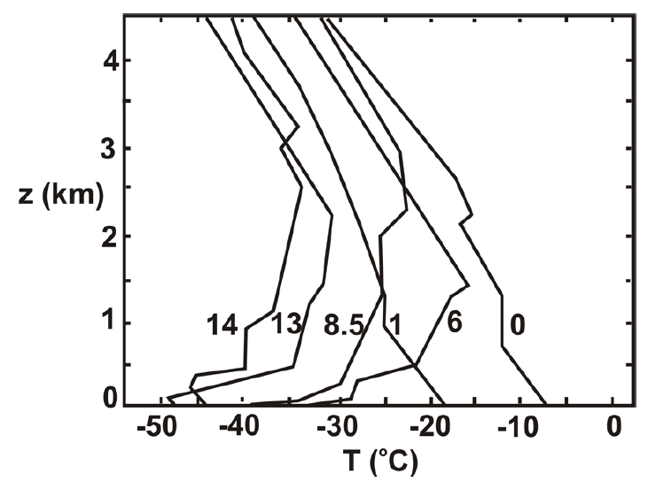
Formation of Arctic Air Masses
Successive temperature soundings at Fairbanks, Alaska, in December 1961. Curves labeled with time in days relative to first sounding. Fig. 1 from Emanuel (2008), who adapted figure from Curry (1983).
Longwave radiative cooling from surface snow and ice cover, as well as from ice crystals, condensate, and low-level clouds often found in the Arctic may lead to Arctic air mass formation (Curry 1983; Emanuel 2008)

Slide 8
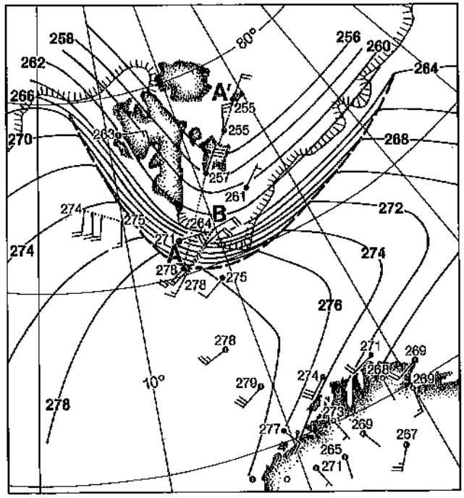
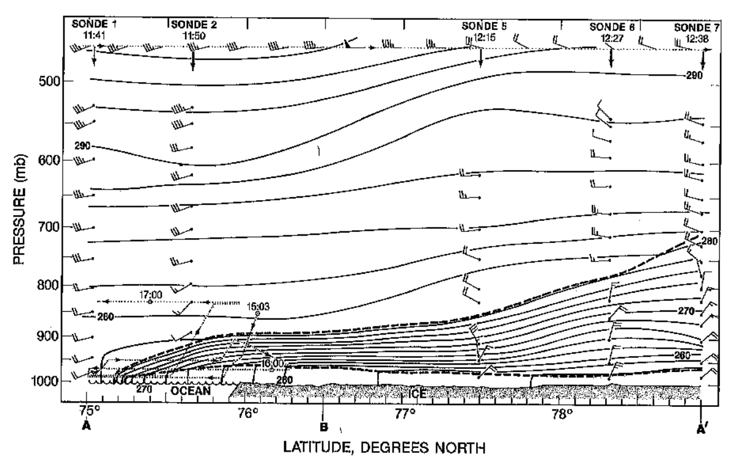
Arctic Front Examples
Shapiro et al. (1989)
Ice Edge
A’
Arctic Front
A
Arctic Front
A
A’
Surface potential temperature (θ; K, thin contours) at 1200 UTC 18 February 1984. Near-surface winds shown by wind barbs where a full barb = 5 m s⁻¹ and a half barb = 2.5 m s⁻¹). Numbers next to barbs represent potential temperature values. Figure 4 adapted from Shapiro et al. (1989).
Cross section of θ (K, thin contours) on 18 February 1984. Heavy dashed lines indicate frontal boundaries. Wind shown by wind barbs, where a full barb = 5 m s⁻¹ and a half barb = 2.5 m s⁻¹. Figure 3 adapted from Shapiro et al. (1989).

Slide 9
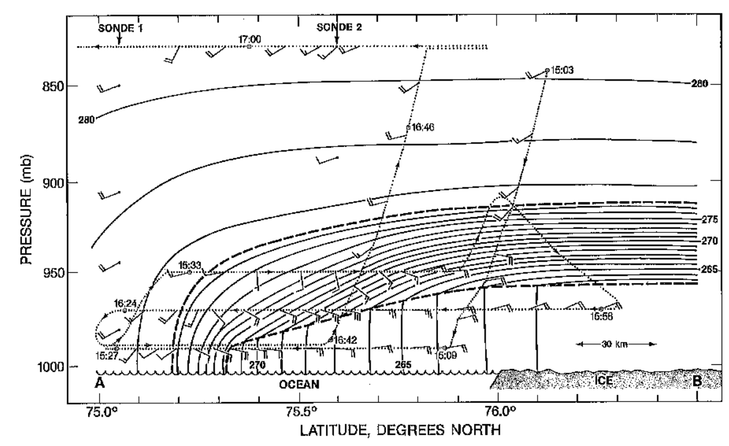
Arctic Front Examples
Shapiro et al. (1989)
Ice Edge
B
Arctic Front
A
Arctic Front
A
B
Surface potential temperature (θ; K, thin contours) at 1200 UTC 18 February 1984. Near-surface winds shown by wind barbs where a full barb = 5 m s⁻¹ and a half barb = 2.5 m s⁻¹). Numbers next to barbs represent potential temperature values. Figure 4 adapted from Shapiro et al. (1989).
Cross section of θ (K, thin contours) on 18 February 1984. Heavy dashed lines indicate frontal boundaries. Wind shown by wind barbs, where a full barb = 5 m s⁻¹ and a half barb = 2.5 m s⁻¹. Figure 5 adapted from Shapiro et al. (1989).

Slide 10
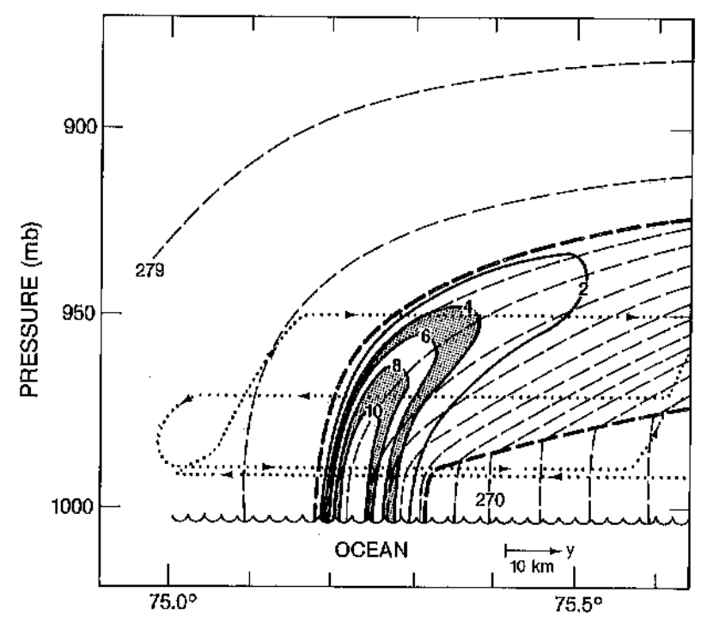
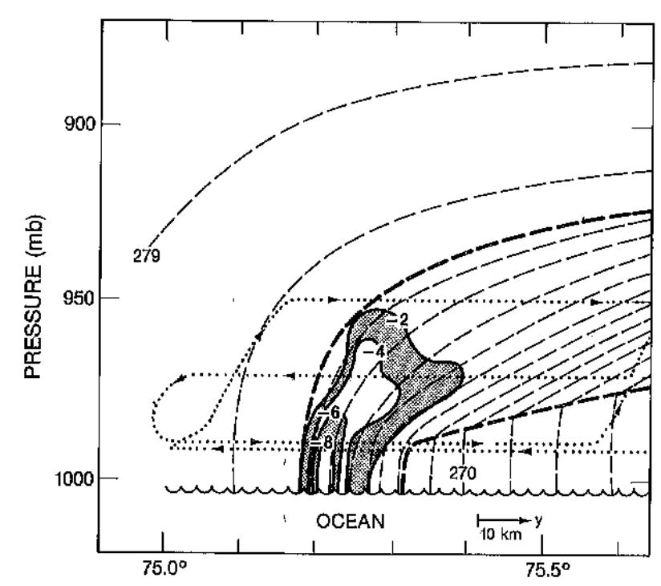
Arctic Front Examples
Shapiro et al. (1989)
Relative vorticity
Divergence
(a)
(b)
(a) Relative vorticity calculated from front-parallel winds (10⁻⁴ s⁻¹, solid lines and shading) and (b) divergence calculated from front-normal winds (10⁻⁴ s⁻¹, solid lines and shading). Also, potential temperature (K, thin dashed lines), frontal boundaries (heavy dashed lines), and flight track (dotted lines). Figure 7 adapted from Shapiro et al. (1989).

Slide 11
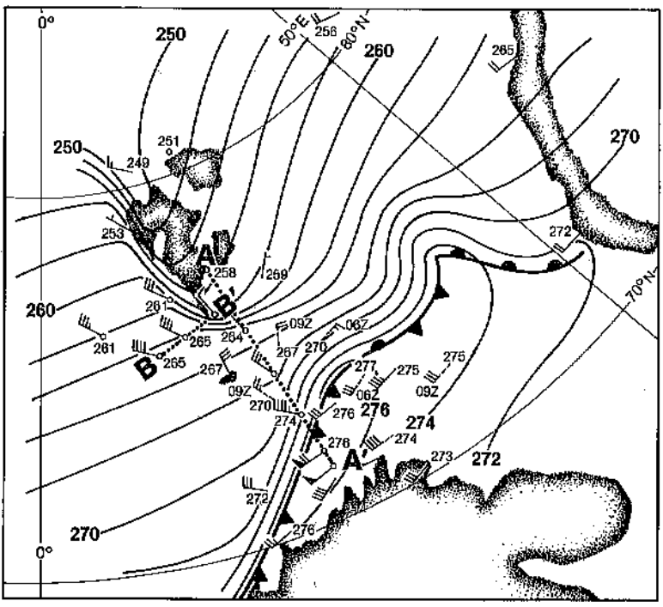
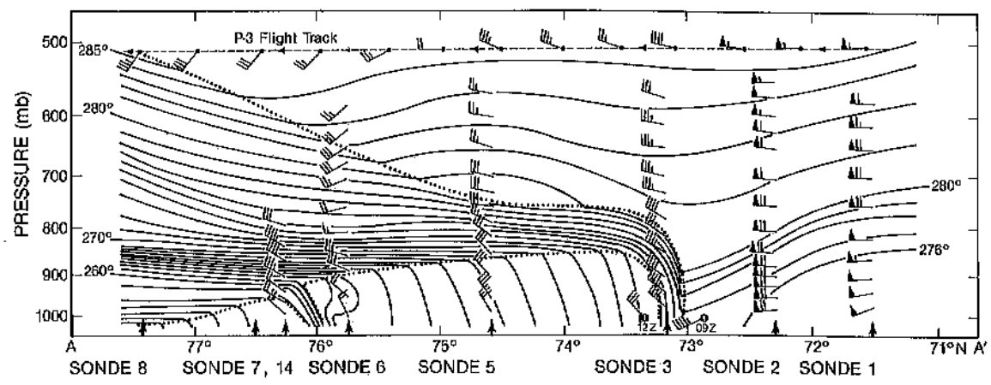
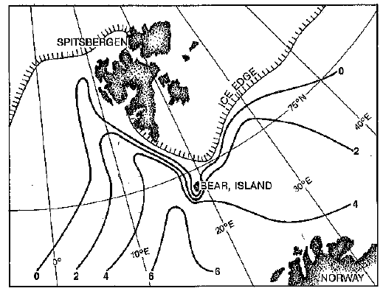
Arctic Front Examples
Shapiro and Fedor (1989)
Analysis of surface θ (K, solid lines) and wind (flags and barbs, with flag = 25 m s⁻¹, full barb = 5 m s⁻¹, and half barb = 5 m s⁻¹) for 1200 UTC 14 February 1984. Figure 7 adapted from Shapiro and Fedor (1989).
A
Arctic Front
A’
Arctic Front
A
A’
Cross section analysis of θ (K, solid lines) on 14 February 1984. Dropwindsonde and selected flight-level wind vectors (flags and barbs, with flag = 25 m s⁻¹, full barb = 5 m s⁻¹, and half barb = 5 m s⁻¹). Figure 5 adapted from Shapiro and Fedor (1989).
Sea surface temperature (SST; °C) and ice edge for 20 February 1984. Figure 1 adapted from Shapiro and Fedor (1989).

Slide 12
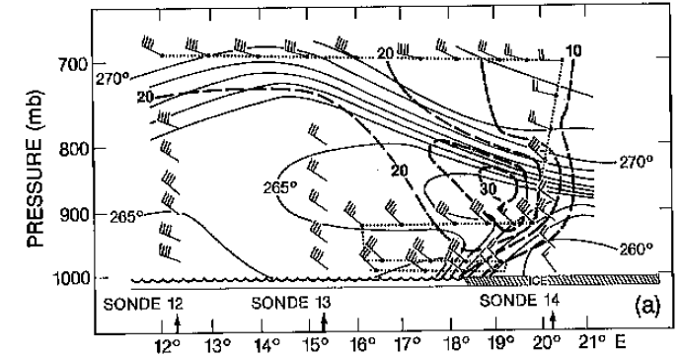
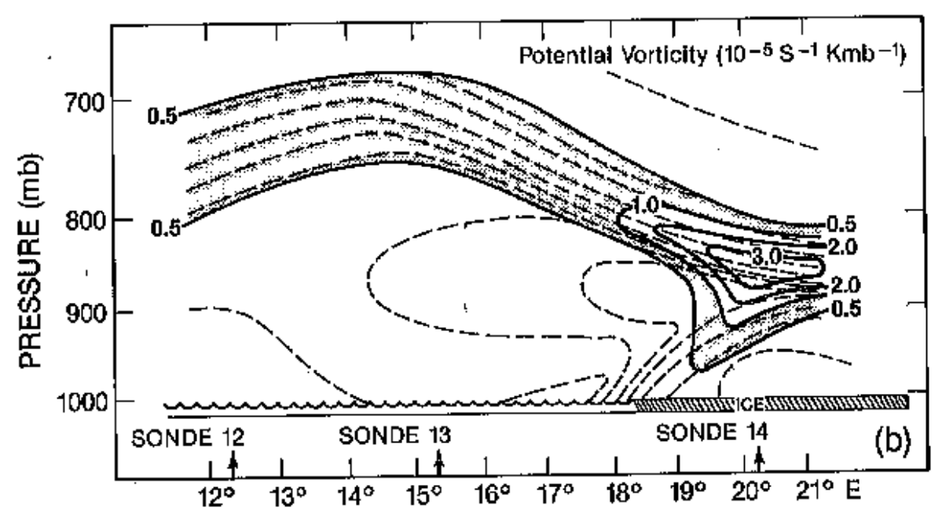
Arctic Front Examples
Shapiro and Fedor (1989)
Analysis of surface θ (K, solid lines) and wind (flags and barbs, with flag = 25 m s⁻¹, full barb = 5 m s⁻¹, and half barb = 5 m s⁻¹) for 1200 UTC 14 February 1984. Figure 7 adapted from Shapiro and Fedor (1989).
(a)
B’
B
Boundary Layer Front
Boundary Layer Front
B
B’
(b)
Boundary Layer Front
B
B’
Cross section analysis of (a) θ (K, solid lines) and wind speed (m s⁻¹, dashed lines), and (b) potential vorticity (10⁻⁵ s⁻¹ K mb⁻¹, solid line) and θ (K, dashed lines) on 14 February 1984. Figure 6 adapted from Shapiro and Fedor (1989)
Sea surface temperature (SST; °C) and ice edge for 20 February 1984. Figure 1 adapted from Shapiro and Fedor (1989).

Slide 13
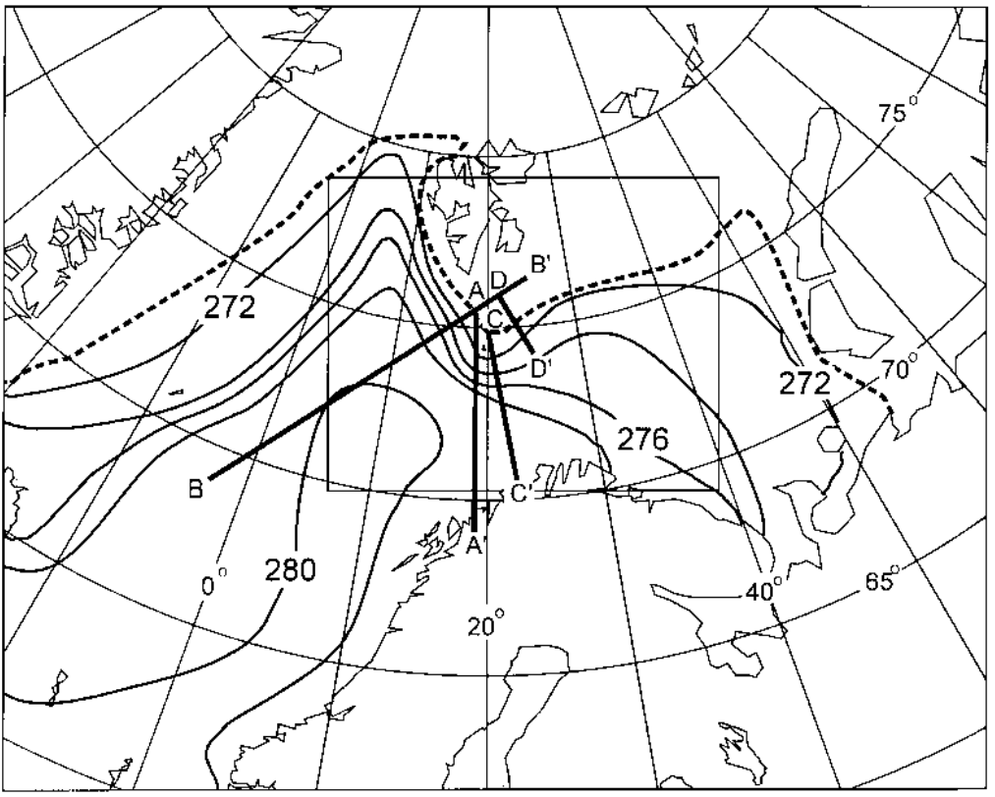
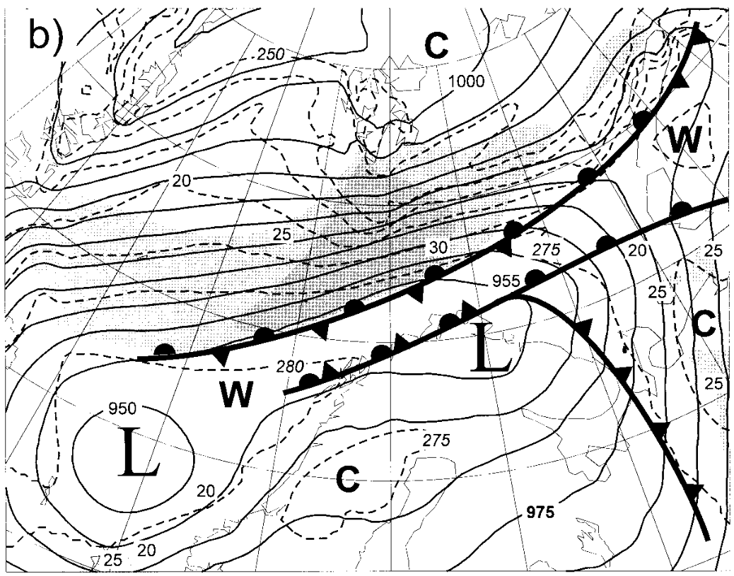
Arctic Front Examples
Grønås and Skeie (1999)
0600 UTC 12 January 1993
Ice Edge
>30 m s⁻¹
Arctic Front
SST (K, black contours) and extent of sea ice (dotted line). Figure 2 adapted from Grønås and Skeie (1999).
Simulated surface map of SLP (hPa, solid contours), 925-hPa θ (K, dashed lines), and 925-hPa wind speed grey shading every 5 m s⁻¹ starting at 20 m s⁻¹ ). Figure 5 adapted from Grønås and Skeie (1999).

Slide 14
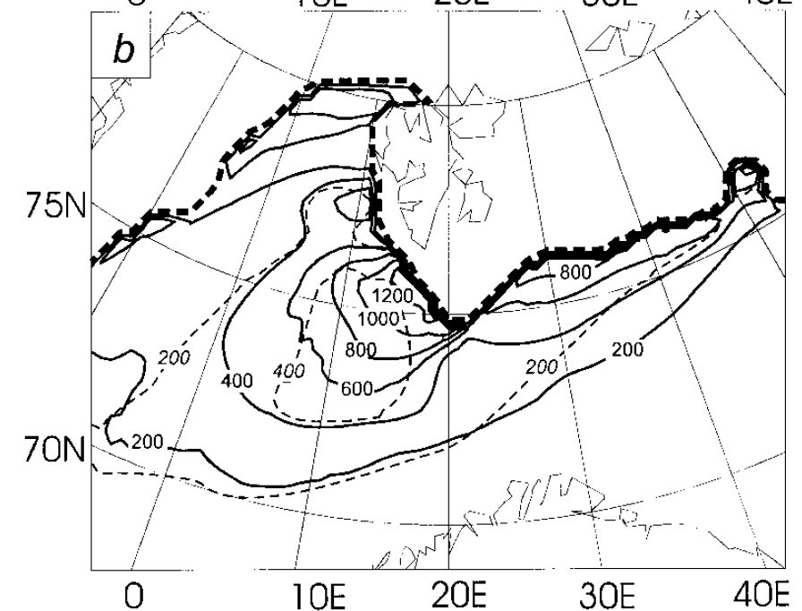
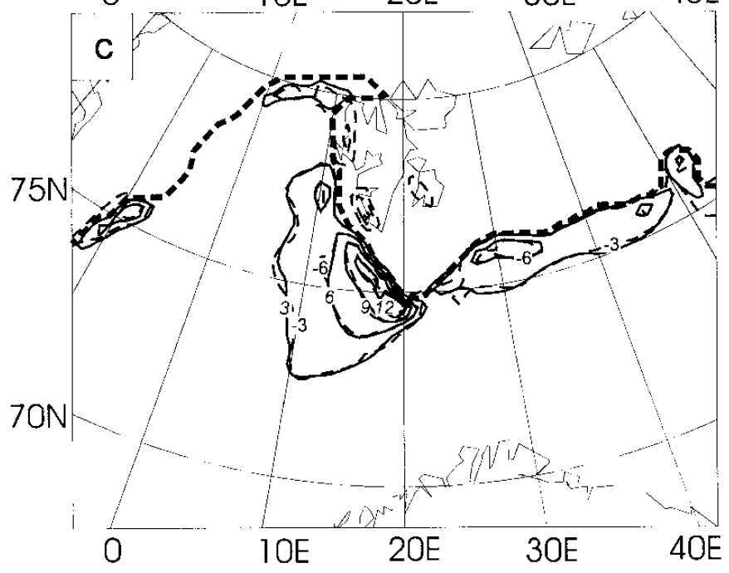
Arctic Front Examples
Grønås and Skeie (1999)
0000 UTC 12 January 1993
Fluxes of sensible (solid lines) and latent heat (dashed lines). Contours every 200 W m⁻². Figure 7 adapted from Grønås and Skeie (1999).
Diabatic sensible heating at second lowest model level (~100 m; solid lines every 3 K h⁻¹) and horizontal temperature advection (dashed lines, contours with negative values every 3 K h⁻¹). Figure 7 adapted from Grønås and Skeie (1999).

Slide 15
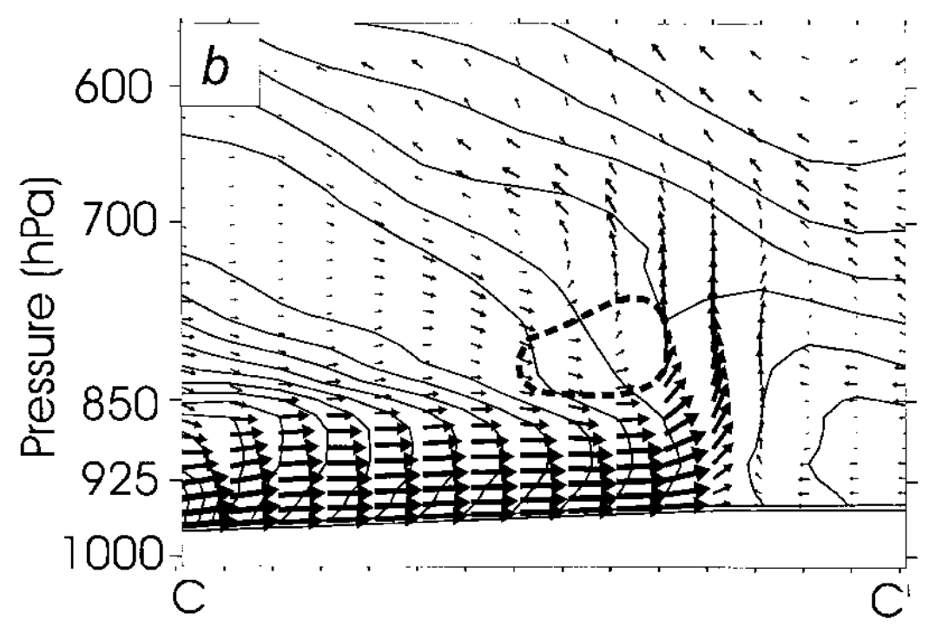
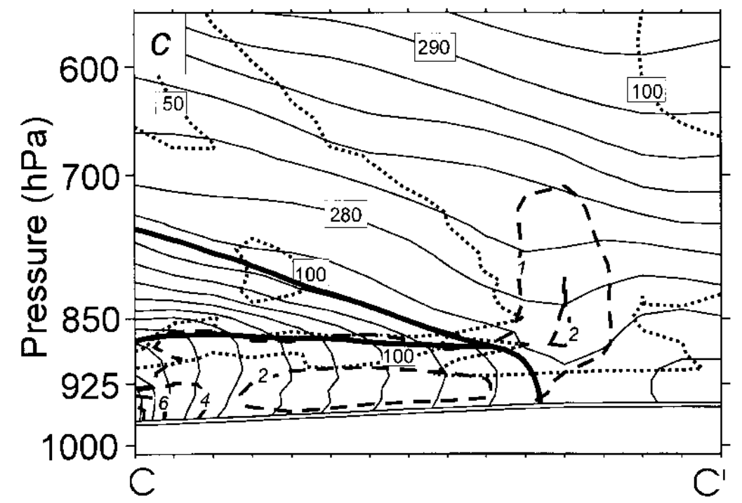
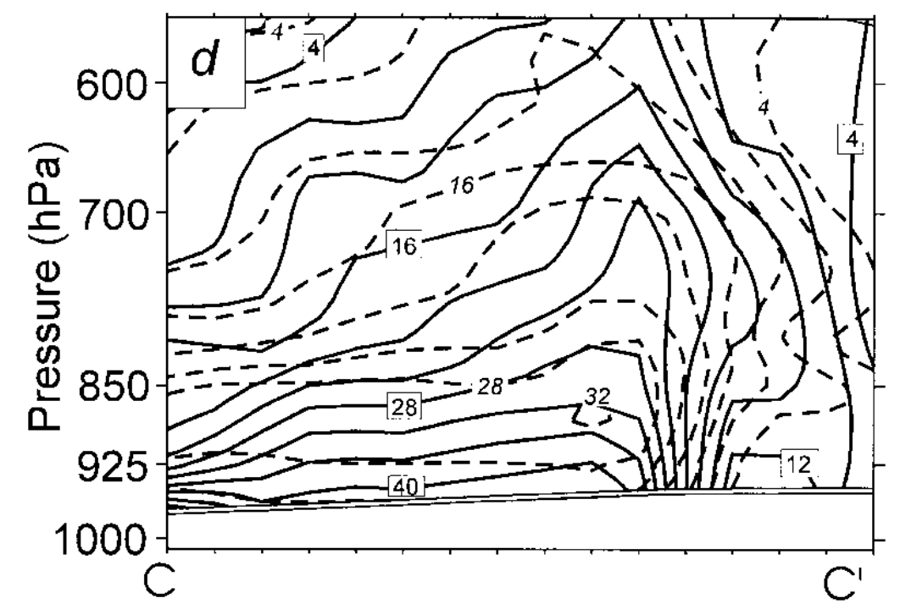
Arctic Front Examples
Grønås and Skeie (1999)
Figures 2 and 9 adapted from Grønås and Skeie (1999).
0300 UTC 12 January 1993
C
C’
C
C’
SSTK, black contours) and extent of sea ice (dotted line)
θ_{e} (K, contours), vertical circulation (vectors), and region of negative conditional symmetric instability (dotted line)
Arctic Front
C
C’
C
C’
θ (K, thin contours), sensible and released latent heating (K h⁻¹; heavy solid contours), and relative humidity (RH; dotted contours for 50 and 100%)
Normal component of wind (m s⁻¹, dashed) and geostrophic wind (solid). Direction is out of screen.

Slide 16
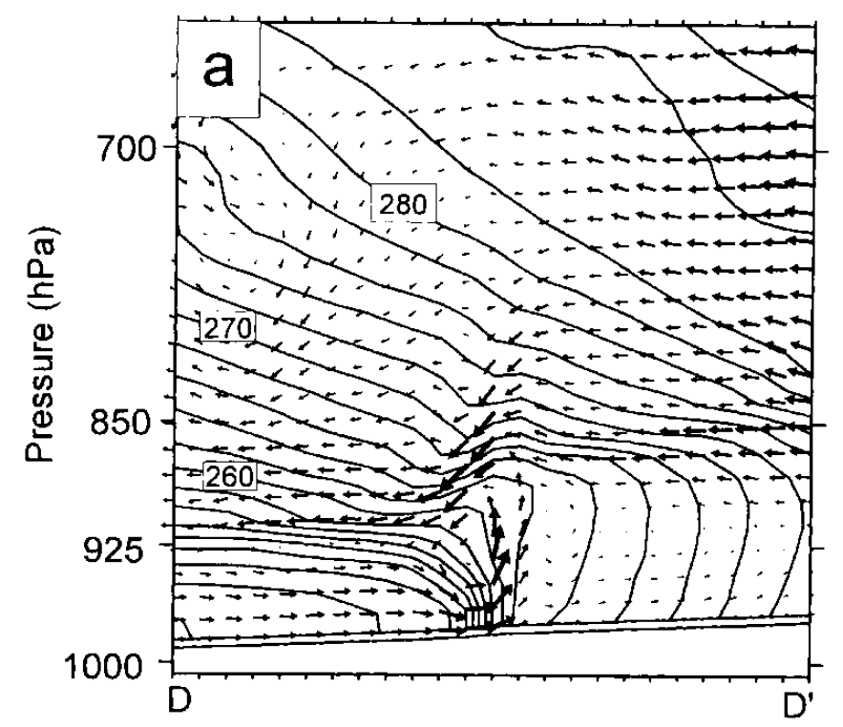
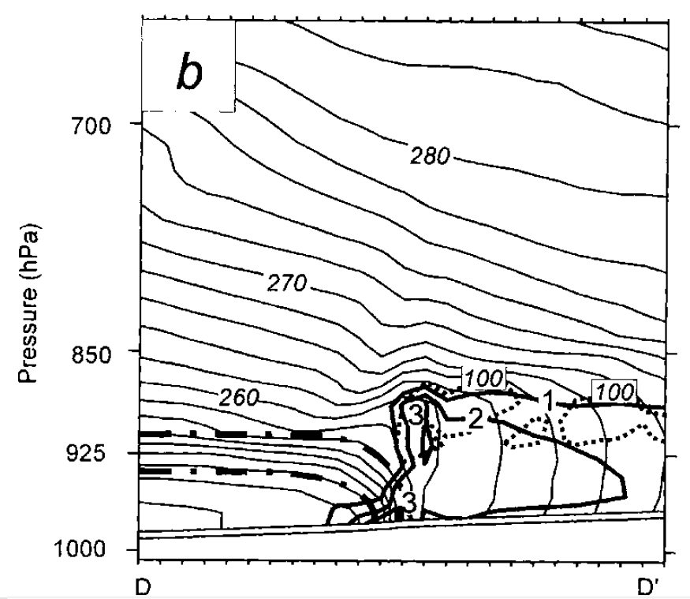
Arctic Front Examples
Grønås and Skeie (1999)
Figures 2 and 10 adapted from Grønås and Skeie (1999).
0000 UTC 12 January 1993
D
D’
Sea surface temperature (SST; K, black contours) and extent of sea ice (dotted line).
D
D’
θ_{e} (K, contours) and vertical circulation (vectors).
θ (K, thin contours), sensible and released latent heating (K h⁻¹; heavy solid contours), and 100% RH (dotted contour).
D
D’

Slide 17
Arctic Fronts and TPVs
Tropopause polar vortices (TPVs) are defined as tropopause-based vortices of high-latitude origin and are material features (Pyle et al. 2004; Cavallo and Hakim 2009, 2010, 2012, 2013)
TPV
TPV
(left) Dynamic tropopause (DT) wind speed (every 15 m s⁻¹ starting at 50 m s⁻¹, thick contours) and DT potential temperature (K, thin contours and shading) on 1.5-PVU surface valid 0000 UTC 1 Dec 1991; (right) same as left except DT pressure (hPa, thin contours and shading). Figure 11 adapted from Pyle et al. (2004).

Slide 18
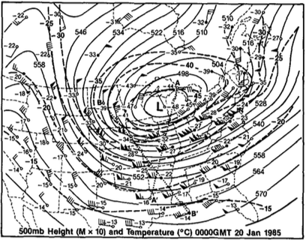
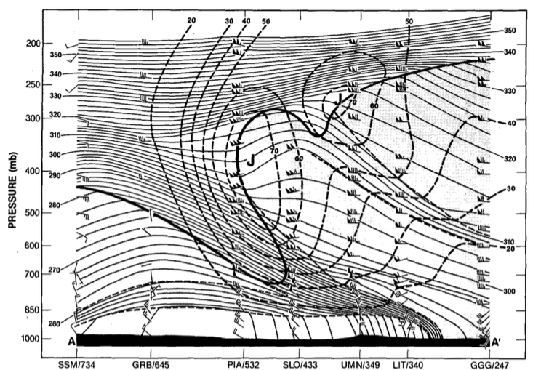
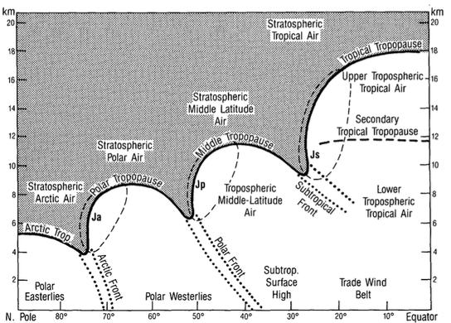
Arctic Fronts and TPVs
Shapiro et al. (1987b)
0000 UTC 20 January 1985
(upper left) 500-hPa geopotential height (dam, solid contours), temperature (°C, dashed contours), and wind (barbs and flags, m s⁻¹). (lower-left) Cross-section of potential temperature (K, thin solid), wind speed (m s⁻¹, heavy dashed contours), and wind (m s⁻¹, barbs and flags) between Sault Sainte Marie, MI and Longview, TX. Heavy solid line is tropopause (10⁻⁷ K s⁻¹ hPa⁻¹ isopleth of PV) and light dashed lines indicate tropospheric frontal and stable layer boundaries. (lower-right) “threefold” structure of tropopause where heavy line is PV discontinuity tropopause, shading is stratospheric air, and light dashed contours represent 40 m s⁻¹ isotach.
A
TPV
A’
Fig. 7 adapted from Shapiro et al. (1987b)
PJ
STJ
AJ
TPV
PJ
AJ
Arctic Front
A
A’
Fig. 17 adapted from Shapiro et al. (1987b)
Fig. 9 adapted from Shapiro et al. (1987b)

Slide 19
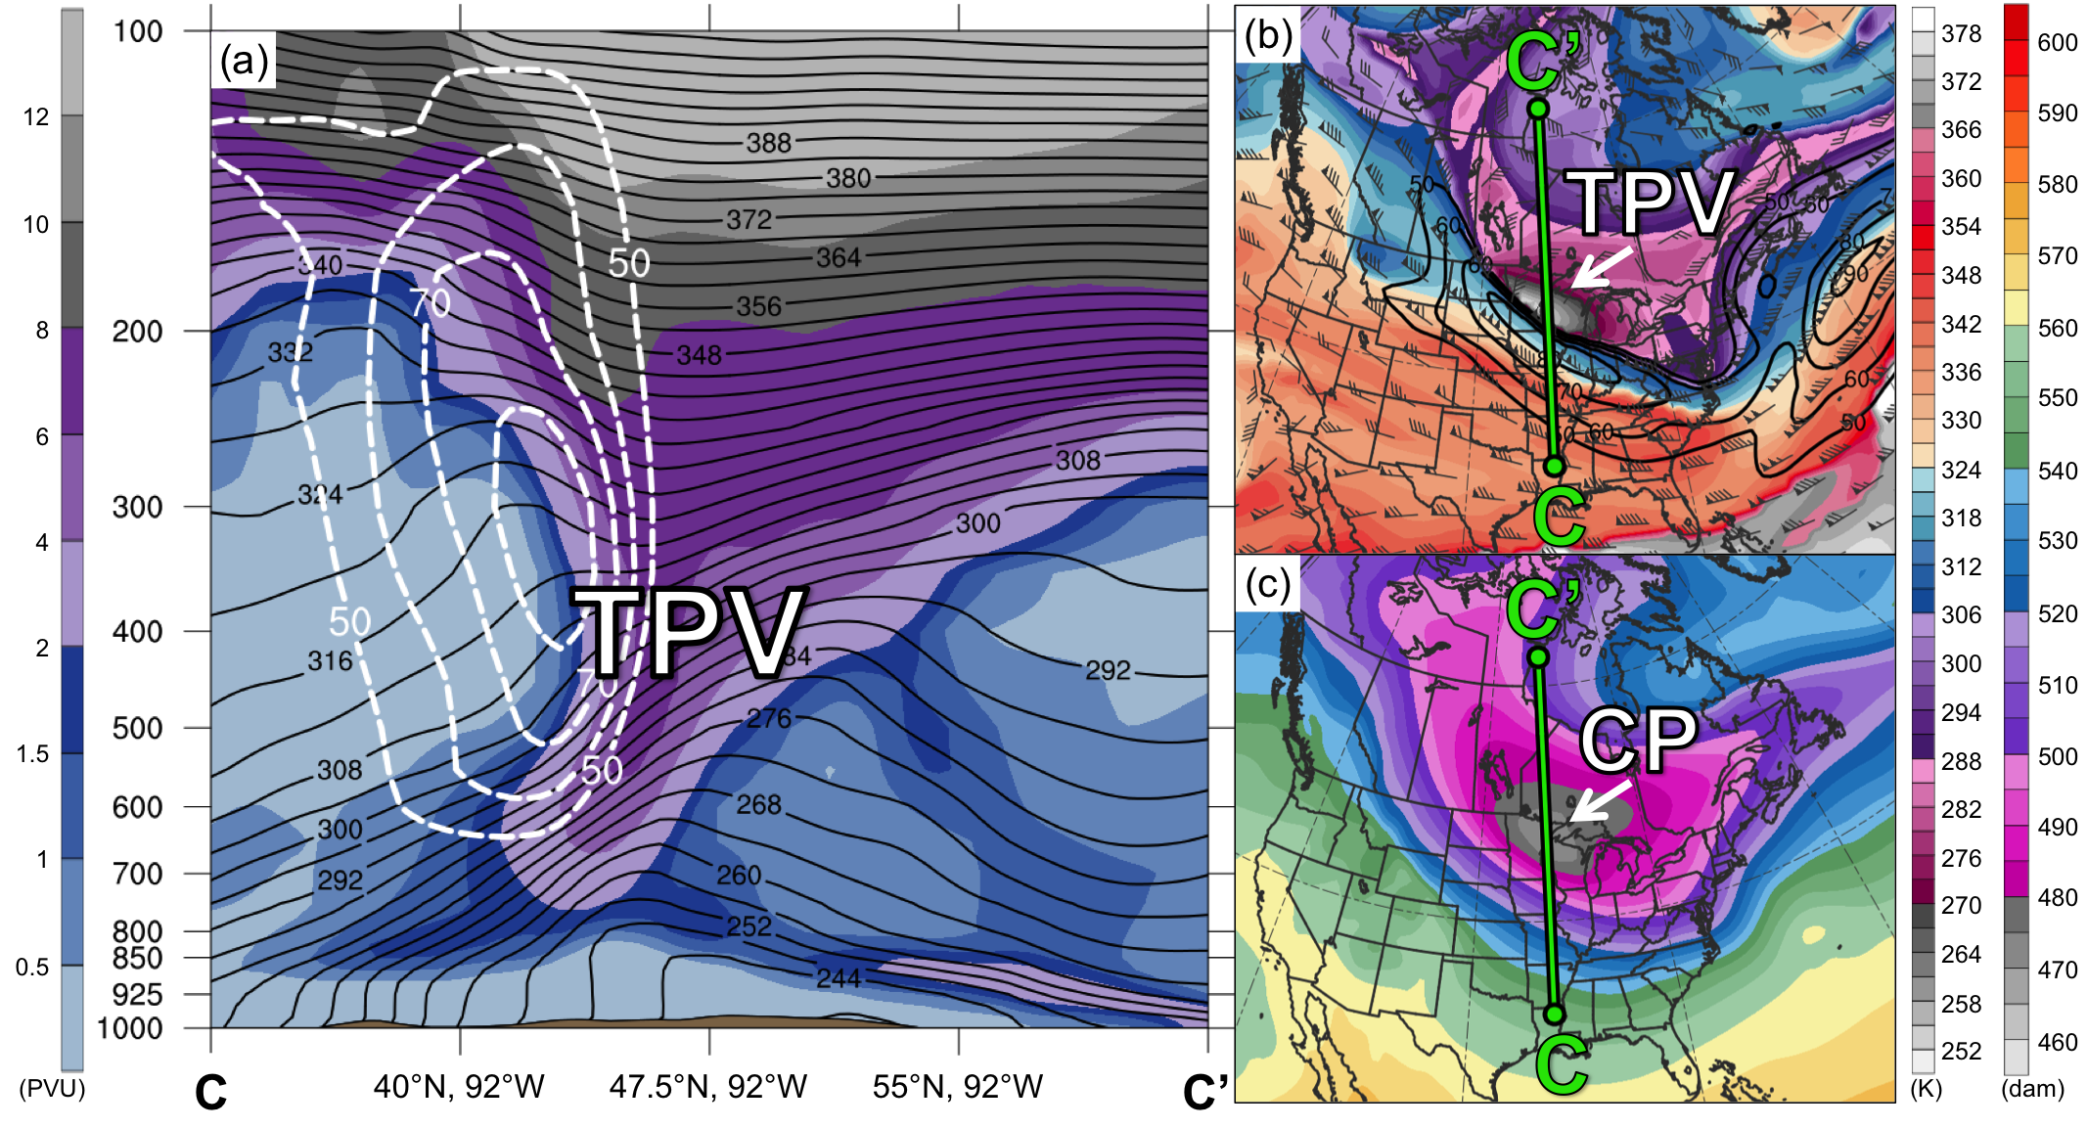
Arctic Fronts and TPVs
0000 UTC 10 Jan 1982
PV (PVU, shaded), θ (K, black), and wind speed (dashed white, m s⁻¹);
(b) DT (2-PVU surface) θ (K, shaded), wind speed (black, m s⁻¹), and wind (m s⁻¹, flags and barbs);
(c) 1000–500-hPa thickness (dam, shaded)

Slide 20
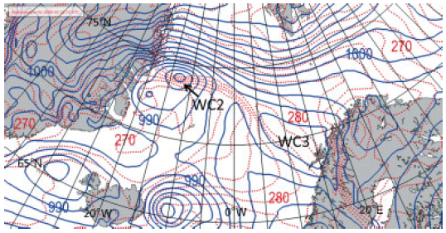
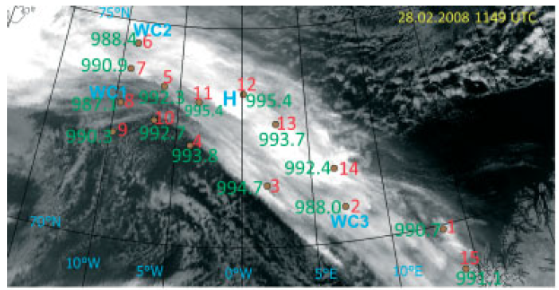
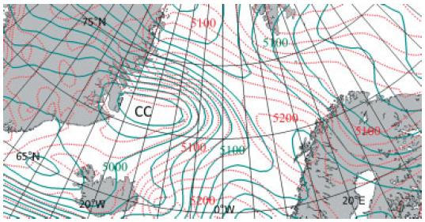
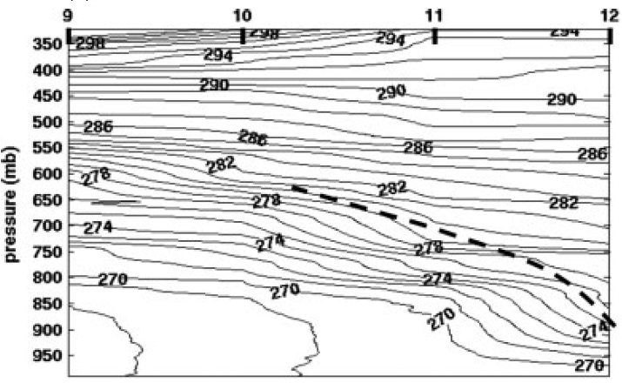
Arctic Front Examples
Mc Innes et al. (2013)
(a)
A’
A
NOAA infrared image from 1149 UTC 28 February 2008 overlaid with dropsonde and observed SLP (green). Figure 7 adapted from Mc Innes et al. (2013).
(b)
ECMWF analysis valid 1200 UTC 28 February of (a) SLP (hPa, blue) and 925-hPa θ_{e} (K, dashed dark red); (b) 500-hPa height (m, green) and 1000–500-hPa thickness (m, dashed red). Figure 4 and caption adapted from Mc Innes et al. (2013).
A
A’
Cross section of potential temperature (K). Dashed line indicates position of Arctic front. Figure 10 adapted from Mc Innes et al. (2013).

Slide 21
Arctic Front Examples
Mc Innes et al. (2013)
B
(a)
B’
NOAA infrared image from 1149 UTC 28 February 2008 overlaid with dropsonde and observed SLP (green). Figure 7 adapted from Mc Innes et al. (2013).
B
B’
(b)
(a) Cross section of observed wind speed (m s⁻¹) and wind (vectors showing direction of horizontal wind at different levels with length proportional to wind speed) based on dropsonde data. Black dashed line indicates Arctic front. (b) Same cross section but wind speed based on Doppler lidar onboard aircraft (m s⁻¹). Figure 14 adapted from Mc Innes et al. (2013).
B
B’

Slide 22
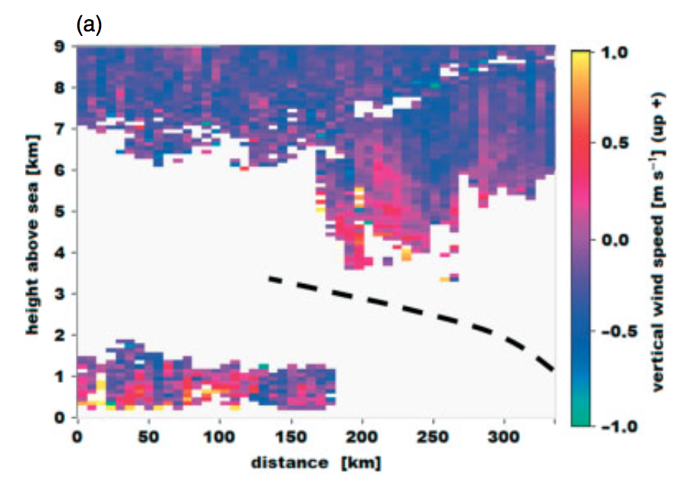
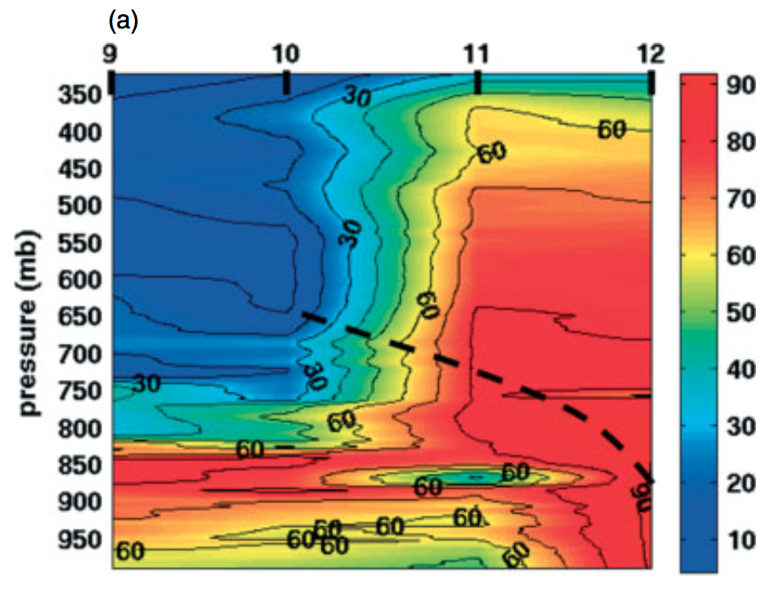
Arctic Front Examples
Mc Innes et al. (2013)
(a)
A’
A
NOAA infrared image from 1149 UTC 28 February 2008 overlaid with dropsonde and observed SLP (green). Figure 7 adapted from Mc Innes et al. (2013).
A
A’
(b)
(a) Cross section of vertical velocity (m s⁻¹) based on Doppler lidar onboard aircraft and (b) relative humidity (%) based on dropsonde data. Dashed black line indicates the Arctic front. Figures 15 and 16 adapted from Mc Innes et al. (2013).
A
A’

Slide 23
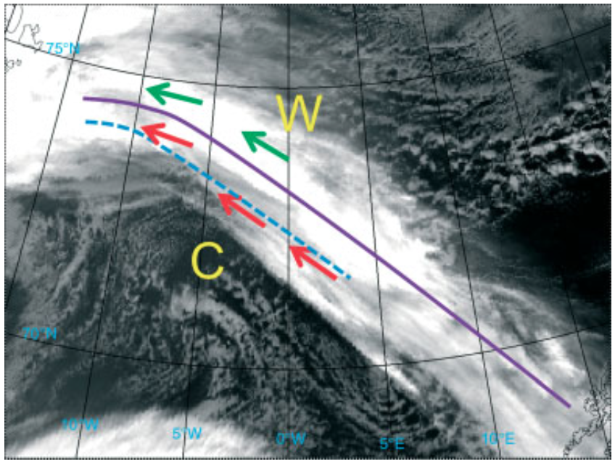
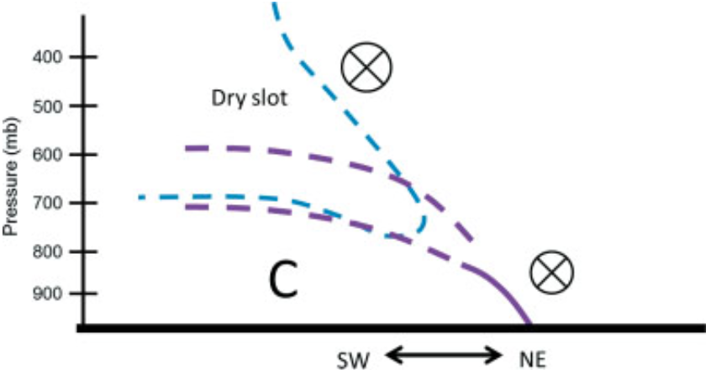
Arctic Front Examples
Mc Innes et al. (2013)
NOAA infrared image from 1149 UTC 28 February 2008.
Figure 18 adapted from Mc Innes et al. (2013).
upper-level jet
low-level jet
northeast edge of dry slot
Arctic front
C
cold air mass
W
warm air mass
Arctic front
Inversion in extension of Arctic front
dry slot
upper-level jet
low-level jet

Slide 24
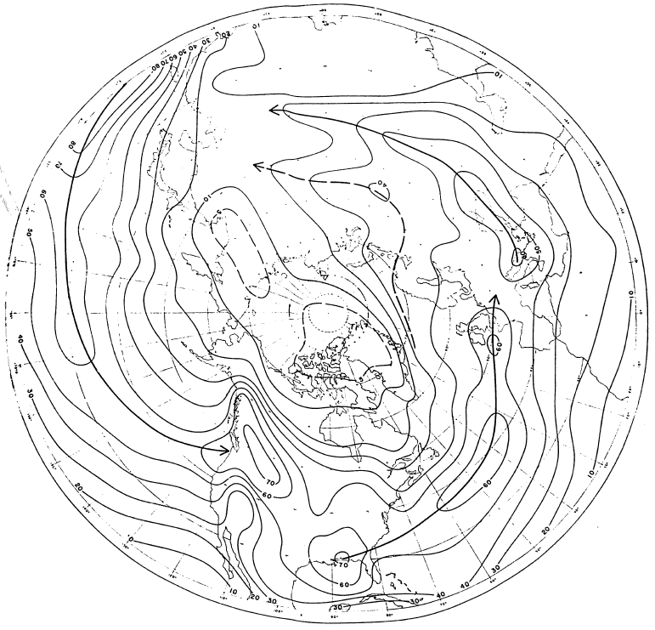
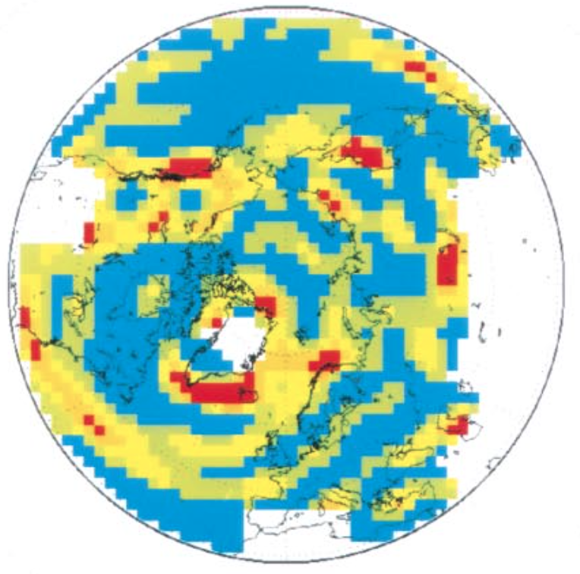
The Arctic Frontal Zone (AFZ)
Reed (1960)
Serreze et al. (2001)
Winter
0.0
0.1
0.125
0.15
0.175
1.0
Percentage frequency of fronts in squares of 400,000 km² during December–February of 1952–1957 based on analyzed fronts from Daily Series Synoptic Weather Maps from the U.S. Weather Bureau. Heavy lines denote axes of maximum frequency. Figure 1 adapted from Reed (1960).
Frontal Frequency (mean number of fronts day⁻¹) for December–February of 1979–1998 using a thermal front parameter with 850-hPa temperature from NCEP-NCAR reanalysis. Figure 4 adapted from Serreze et al. (2001).

Slide 25
The AFZ
Reed (1960)
Serreze et al. (2001)
Winter
A wintertime AFZ
“Atlantic arctic front”
0.0
0.1
0.125
0.15
0.175
1.0
Percentage frequency of fronts in squares of 400,000 km² during December–February of 1952–1957 based on analyzed fronts from Daily Series Synoptic Weather Maps from the U.S. Weather Bureau. Heavy lines denote axes of maximum frequency. Figure 1 adapted from Reed (1960).
Frontal Frequency (mean number of fronts day⁻¹) for December–February of 1979–1998 using a thermal front parameter with 850-hPa temperature from NCEP-NCAR reanalysis. Figure 4 adapted from Serreze et al. (2001).

Slide 26
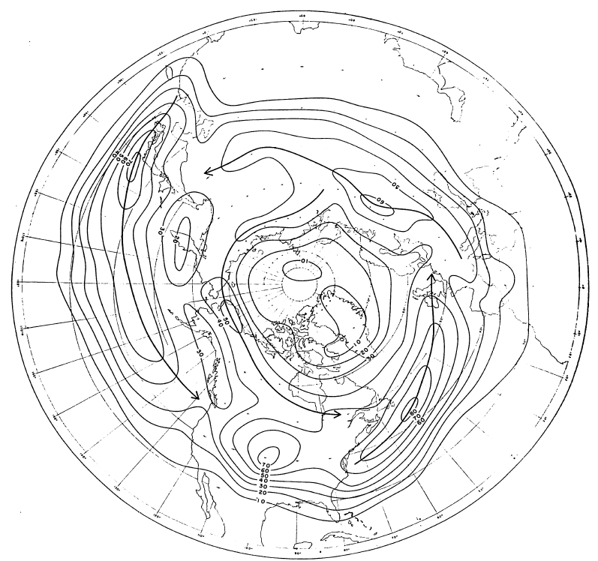
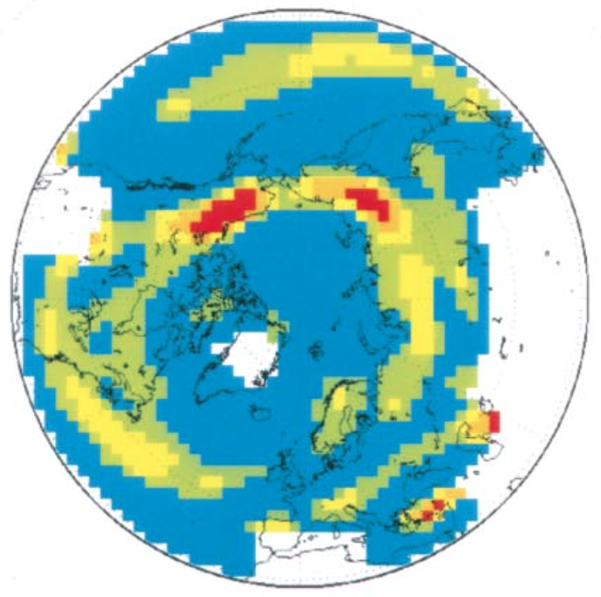
The AFZ
Reed (1960)
Serreze et al. (2001)
Summer
0.0
0.1
0.125
0.15
0.175
1.0
Percentage frequency of fronts in squares of 400,000 km² during June–August of 1952–1956 based on analyzed fronts from Daily Series Synoptic Weather Maps from the U.S. Weather Bureau. Heavy lines denote axes of maximum frequency. Figure 2 adapted from Reed (1960).
Frontal Frequency (mean number of fronts day⁻¹) for June–August of 1979–1998 using a thermal front parameter with 850-hPa temperature from NCEP-NCAR reanalysis. Figure 4 adapted from Serreze et al. (2001).

Slide 27
The AFZ
Reed (1960)
Serreze et al. (2001)
Summer
Summertime
AFZ
0.0
0.1
0.125
0.15
0.175
1.0
Percentage frequency of fronts in squares of 400,000 km² during June–August of 1952–1956 based on analyzed fronts from Daily Series Synoptic Weather Maps from the U.S. Weather Bureau. Heavy lines denote axes of maximum frequency. Figure 2 adapted from Reed (1960).
Frontal Frequency (mean number of fronts day⁻¹) for June–August of 1979–1998 using a thermal front parameter with 850-hPa temperature from NCEP-NCAR reanalysis. Figure 4 adapted from Serreze et al. (2001).

Slide 28
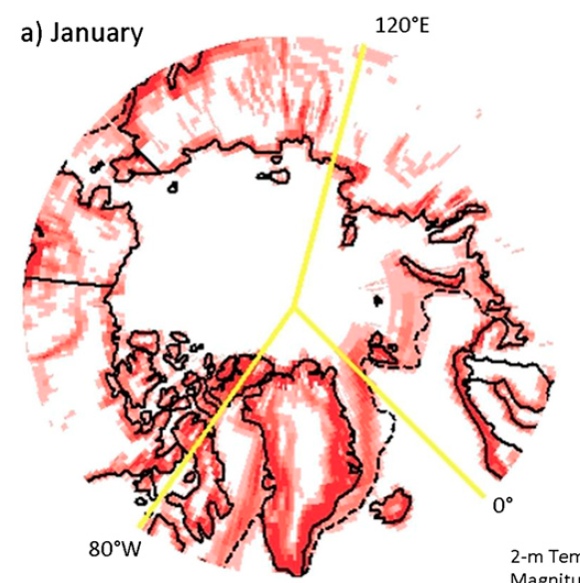
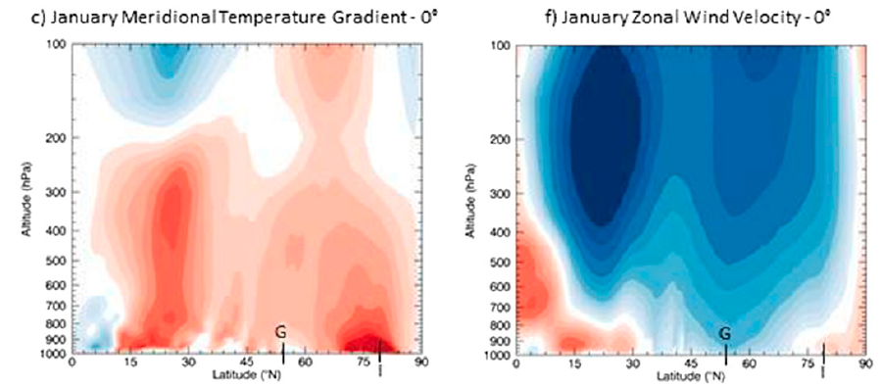
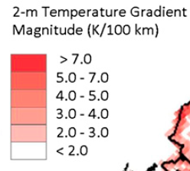
The AFZ
Crawford and Serreze (2015)
AFZ strength quantified by 2-m temperature gradient magnitude. All quantities shown here are 1979–2012 monthly means from MERRA. Figures 3 and 6 adapted from Crawford and Serreze (2015).

Slide 29
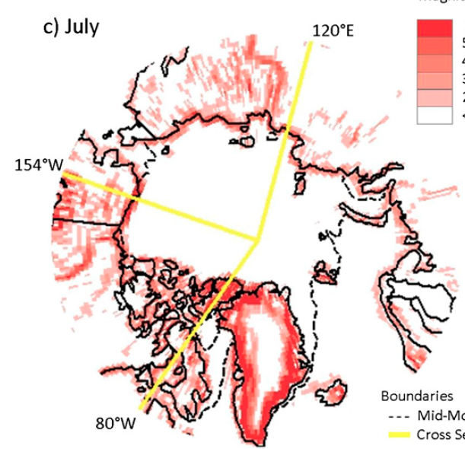
The AFZ
Crawford and Serreze (2015)
AFZ strength quantified by 2-m temperature gradient magnitude. All quantities shown here are 1979–2012 monthly means from MERRA. Figures 3 and 5 adapted from Crawford and Serreze (2015).

Slide 30
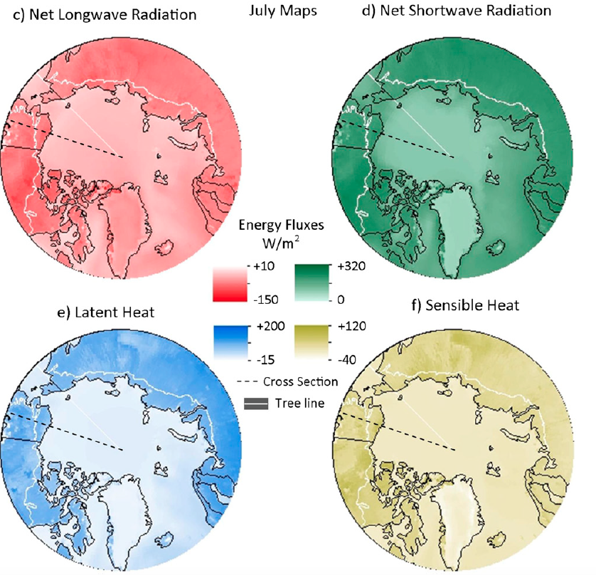
The AFZ
Crawford and Serreze (2015)
Radiation fluxes are positive downward
Quantities shown are July 1979–2012 means from MERRA. Figure 4 adapted from Crawford and Serreze (2015).
Turbulent fluxes are positive upward

Slide 31
Polar Lows and Arctic Cyclones
Polar lows:
Small, intense cyclones with horizontal scales 10s to 100s of km that form in cold air advected over warmer water equatorward of the sea ice margin in high latitudes (AMS glossary; Rasmussen and Turner 2003)
Polar lows may be associated with strong winds [e.g., reaching 35 m s⁻¹ (Shapiro et al. 1987)] and heavy precipitation, posing hazards to ships (e.g., Businger and Reed 1989)
Polar lows have short lifetimes [average lifetime of 14.7 h according to Smirnova et al. (2015)] and may evolve rapidly
AMS Glossary: http://glossary.ametsoc.org/wiki/Main_Page

Slide 32
Polar Lows and Arctic Cyclones
Arctic Cyclones:
Cyclones that form in the Arctic or move into the Arctic (e.g., Zhang et al. 2004; Simmonds and Rudeva 2014; Crawford and Serreze 2016)
Larger in horizontal scale compared to polar lows
Arctic cyclones may be associated with strong surface winds and poleward advection of warm, moist air, contributing to reductions in Arctic sea-ice extent (e.g., Zhang et al. 2013)
Heavy precipitation, strong surface winds, and large waves due to Arctic cyclones may pose hazards to ships moving through open passageways in the Arctic Ocean

Slide 33
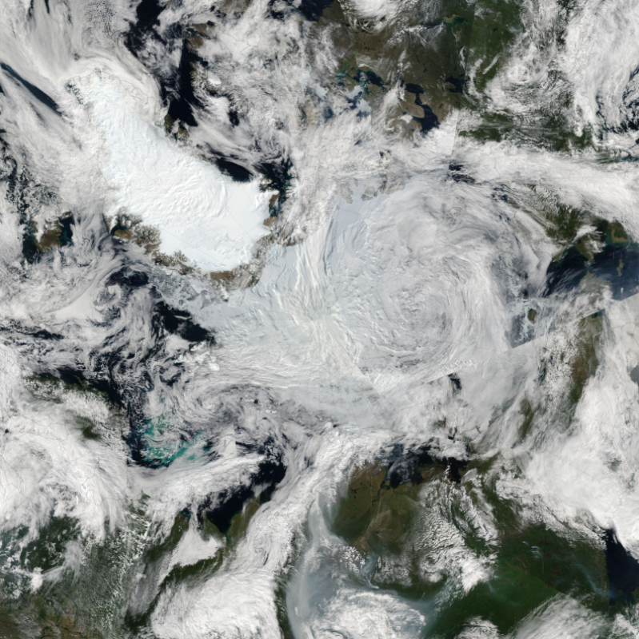
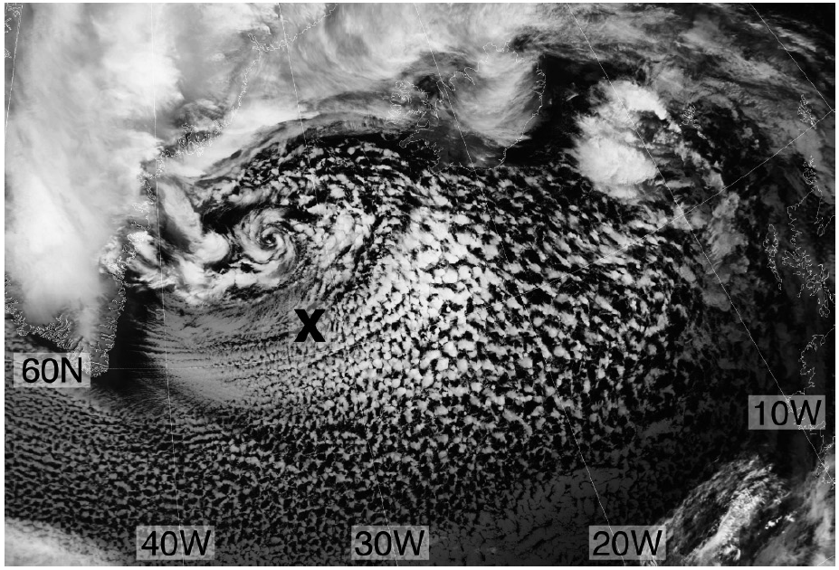
Polar Lows and Arctic Cyclones
Example Arctic Cyclone
Example Polar Low
Advanced Very High Resolution Radiometer (AVHRR; channel 4) satellite image of a polar between Greenland and Iceland at 1209 UTC 2 March 2009. Figure 2 adapted from Kolstad (2011).
Moderate Resolution Imaging Spectroradiometer satellite image on 7 August 2012 of the Great Arctic Cyclone of August 2012. Obtained from: https://earthobservatory.nasa.gov/NaturalHazards/view.php?id=78812

Slide 34
Polar Lows Types
Businger and Reed (1989) discussed three elementary types of polar low development, with combinations thereof as well
Short-wave/jet streak type
Positive vorticity advection aloft, moderate baroclinicity, modest surface fluxes
Arctic-front type
Associated with ice boundaries, shallow baroclinicity, strong surface fluxes
Cold-low type
Weak baroclinicity, strong surface fluxes, deep convection
Rasmussen and Turner (2003) discussed seven possible types of polar lows in the Nordic Seas, including a “boundary layer fronts” type, which can be related to Arctic fronts

Slide 35
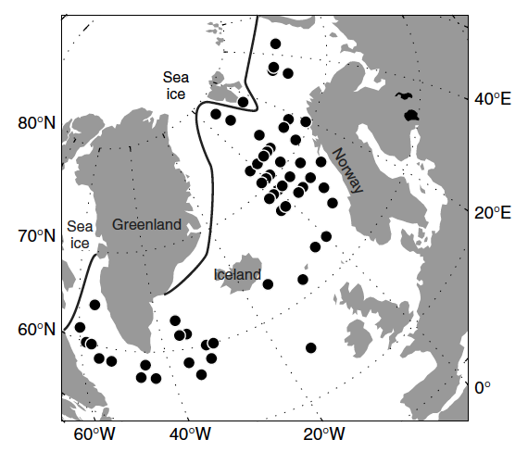
Polar Lows Locations
Polar lows common over northern North Atlantic and adjacent Arctic seas, especially the Nordic Seas (e.g., Rasmussen and Turner 2003; Kolstad 2011; Smirnova et al. 2015)
Polar lows may also form over the North Pacific basin, including Sea of Japan (e.g., Yanase et al. 2016), and the Bering Sea and Gulf of Alaska (e.g., Businger 1987)
Locations of 63 polar lows in database created by Kolstad ( 2011). All polar lows occurred from November 1999 to March 2009. Black line marks approximate boundary between grid points that had water one-third of the time during analysis period and the ones that did not. Figure 1 adapted from Kolstad (2011).

Slide 36
Arctic Fronts and Polar Lows
Strong low-level baroclinicity associated with Arctic fronts may foster development of polar lows (e.g., Reed and Duncan 1987; Shapiro et al. 1987a; Shapiro and Fedor 1989; Yanase and Niino 2007)

Slide 37
Arctic Front Examples
Shapiro and Fedor (1989)
Analysis of surface θ (K, solid lines) and wind (flags and barbs, with flag = 25 m s⁻¹, full barb = 5 m s⁻¹, and half barb = 5 m s⁻¹) for 1200 UTC 14 February 1984. Figure 7 adapted from Shapiro and Fedor (1989).
A
Arctic Front
A’
Arctic Front
A
A’
Cross section analysis of θ (K, solid lines) on 14 February 1984. Dropwindsonde and selected flight-level wind vectors (flags and barbs, with flag = 25 m s⁻¹, full barb = 5 m s⁻¹, and half barb = 5 m s⁻¹). Figure 5 adapted from Shapiro and Fedor (1989).
Sea surface temperature (SST; °C) and ice edge for 20 February 1984. Figure 1 adapted from Shapiro and Fedor (1989).

Slide 38
Arctic Front Examples
Shapiro and Fedor (1989)
Analysis of surface θ (K, solid lines) and wind (flags and barbs, with flag = 25 m s⁻¹, full barb = 5 m s⁻¹, and half barb = 5 m s⁻¹) for 1200 UTC 14 February 1984. Figure 7 adapted from Shapiro and Fedor (1989).
(a)
B’
B
Boundary Layer Front
Boundary Layer Front
B
B’
(b)
Boundary Layer Front
B
B’
Cross section analysis of (a) θ (K, solid lines) and wind speed (m s⁻¹, dashed lines), and (b) potential vorticity (10⁻⁵ s⁻¹ K mb⁻¹, solid line) and θ (K, dashed lines) on 14 February 1984. Figure 6 adapted from Shapiro and Fedor (1989)
Sea surface temperature (SST; °C) and ice edge for 20 February 1984. Figure 1 adapted from Shapiro and Fedor (1989).

Slide 39
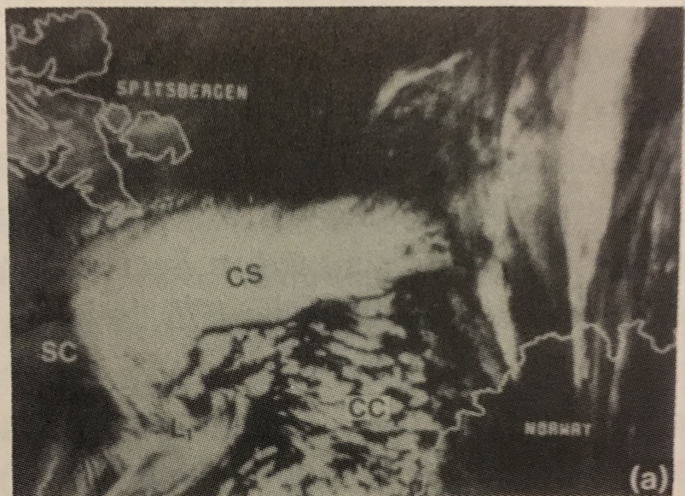
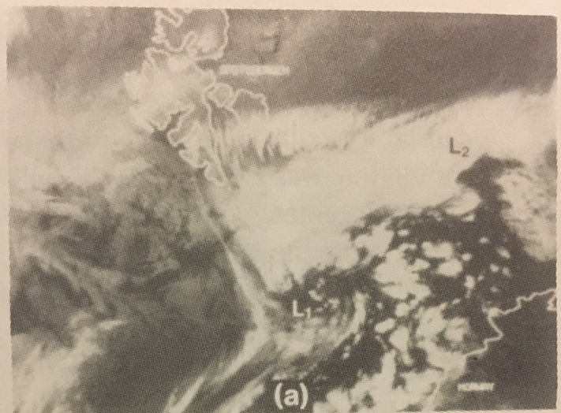
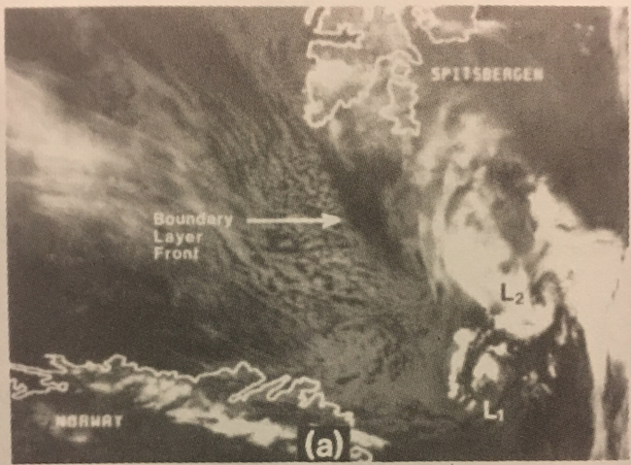
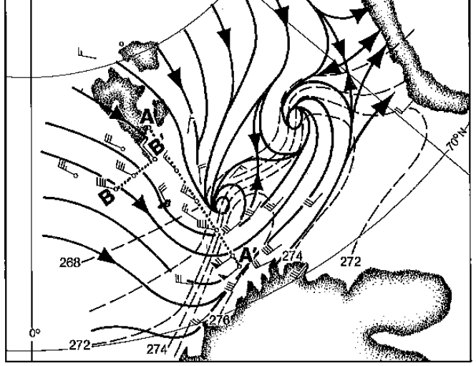
Arctic Fronts and Polar Lows
Shapiro and Fedor (1989)
L2
L1
L1
NOAA infrared image at 0440 UTC 14 February 1984
NOAA infrared image at 0830 UTC 14 February 1984
L2
L1
L2
L1
NOAA infrared image at 1622 UTC 14 February 1984
Composite analysis of streamlines (heavy line and arrows) for 1200 UTC 14 February 1984, surface θ (K, dashed), and wind (m s⁻¹, flags and barbs)

Slide 40
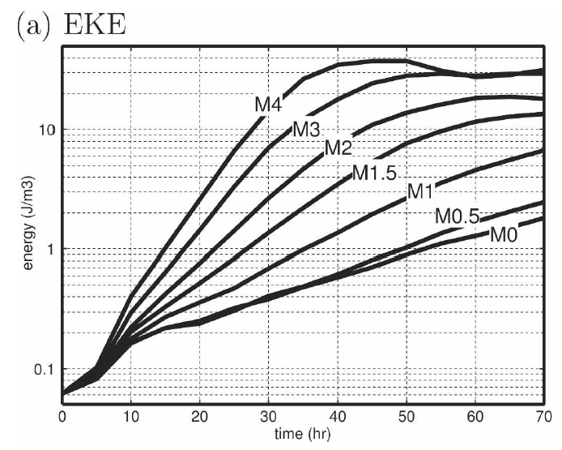
Arctic Fronts and Polar Lows
Yanase and Niino (2007)
Used idealized high-resolution nonhydrostatic model to investigate polar low dynamics
As baroclinicity is increased, growth rate of polar low increases
Baroclinicity can play an important role in polar low development
Increasing Baroclinicity
Time evolution of eddy kinetic energy (EKE; J m⁻³) averaged over calculation domain of 1000 km ✕ 1000 km ✕ 10.42 km. Figure 3 adapted from Yanase and Niino (2007).

Slide 41
Arctic Front and Polar Lows
Cold air outbreaks (CAOs) accompanying Arctic fronts may lead to large upward sensible and latent heat fluxes (e.g., Kolstad 2011; Papritz and Spengler 2017)
Upward sensible and latent heat fluxes may lead to reduction in low-level static stability, which may foster development of polar lows (e.g., Shapiro et al. 1987; Emanuel and Rotunno 1989; Kolstad et al. 2016)

Slide 42
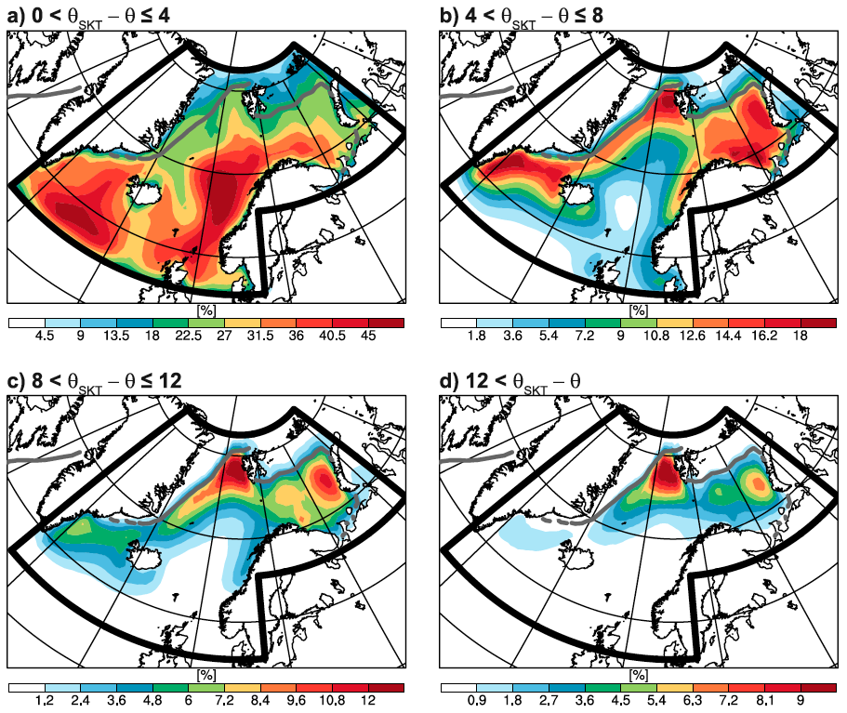
Arctic Front and Polar Lows
Papritz and Spengler (2017)
CAOs identified with air–sea potential temperature difference θ_{SKT} − θ, where θ is potential temperature of an air parcel and θ_{SKT} is potential skin temperature (SKT)
Mean frequency of CAOs with trajectories binned according to CAO intensity for the extended winter (November–April) of 1979/80 to 2013/14. Mean sea ice boundary (50% sea ice concentration) shown in gray. Figure 3 adapted from Papritz and Spengler (2017).

Slide 43
Arctic Front and Polar Lows
Papritz and Spengler (2017)
Percentage of positive (upward) surface turbulent heat flux (sensible and latent) associated with CAO trajectories for all trajectories. The mean sea ice boundary (50% sea ice concentration) shown in gray. Figure 10 adapted from Papritz and Spengler (2017).

Slide 44
Arctic Front and Polar Lows
Shapiro et al. (1987a)
(a)
Arctic Front
(a) 10-m sensible heat flux (W m⁻², solid lines) and (b) 10-m latent heat flux (W m⁻², solid lines) at 1340 UTC 27 February 1984. Streamlines of 300-m wind in light gray lines. Figure 26 from Shapiro et al. (1987a).
850-hPa temperature (°C) and wind (m s⁻¹, flags and barbs) at 1200 UTC 27 February 1984. Figure 13 adapted from Shapiro et al. (1987a).
(b)
NOAA infrared satellite image at 1340 UTC 27 February 1984. Figure 28 adapted from Shapiro et al. (1987a).

Slide 45
Arctic Front and Polar Lows
Upper-level cyclonic PV anomalies and short-wave troughs may provide forcing for polar low development (e.g, Montgomery and Farrell 1992; Føre et al. 2011; Kolstad 2011)
Upper-level cyclonic PV anomalies may include TPVs
CAOs associated with TPVs may provide favorable environments for polar low development

Slide 46
Arctic Front and Polar Lows
Kolstad (2011)
Advanced Very High Resolution Radiometer (AVHRR; channel 4) satellite image of a polar between Greenland and Iceland at 1209 UTC 2 March 2009. Figure 2 adapted from Kolstad (2011).
Marine CAO (MCAO) index M:
, where
T_{s} is skin temperature, P_{SL} is mean SLP, Z is 700-hPa geopotential height, L is a scaling height of 7 ✕ 10⁵ m
×
Grid point with highest value of M within 400 km of polar low
(a) SLP (hPa), (b) MCAO index M, and (c) tropopause pressure (hPa) at 1200 UTC 2 March 2009. Figure 3 adapted from Kolstad (2011).

Slide 47
The AFZ
Crawford and Serreze (2015)
AFZ strength quantified by 2-m temperature gradient magnitude. All quantities shown here are 1979–2012 monthly means from MERRA. Figures 3 and 5 adapted from Crawford and Serreze (2015).

Slide 48
The AFZ and Arctic Cyclones
Crawford and Serreze (2016)
Winter
Summer
Average Eady growth rate (EGR) at 500 hPa (day⁻¹) for (left) winter and right (summer) 1979–2014 using MERRA. Figure 2 adapted from Crawford and Serreze (2016).
V(z) is the vertical profile of the horizontal wind
f is Coriolis parameter
N is Brunt–Väisälä frequency, where

Slide 49
The AFZ and Arctic Cyclones
Crawford and Serreze (2016)
Winter
Summer
Frequency of cyclone tracks (number of tracks per 500 km² area per month) averaged over 1979–2014 for (a) winter and (b) summer using MERRA.
Frequency of cyclogenesis events (number of events per 500 km² area per month) averaged over 1979–2014 for (c) winter and (d) summer using MERRA
Figure 3 adapted from Crawford and Serreze (2016)

Slide 50
The AFZ and Arctic Cyclones
Crawford and Serreze (2016)
Winter
Summer
AFZ not a genesis region for Arctic cyclones
AFZ may act to intensify Arctic cyclones moving poleward across AFZ
Greater deepening of Arctic cyclones moving poleward toward Arctic Ocean when AFZ is strong at midtropospheric levels (i.e., strong temperature gradients at midtropospheric levels)
Positive correlation between summer AFZ at midtropospheric levels and cyclone intensity in Arctic Ocean in summer
Figure 3 adapted from Crawford and Serreze (2016)

Slide 51
The Great Arctic Cyclone of August 2012 (AC12)
AC12 formed over Siberia on 2 August 2012 and tracked northeastward into the Arctic, reaching a minimum central sea level pressure (SLP) of 966.4 hPa at 1800 UTC 6 August (Simmonds and Rudeva 2012)
AC12 led to reductions in Arctic sea-ice extent during a time in which sea ice was thin and sea-ice volume was well below normal (Zhang et al. 2013)
Simmonds and Rudeva (2012) and Yamazaki et al. (2015) found that a TPV interacted with AC12 in a region of strong baroclinicity over Eurasia

Slide 52
TPV and Surface Cyclone Tracks for AC12 case
TPVs
Surface Cyclones
TPV 1
TPV 2
L1
AC12
Genesis
0000 UTC (every 48 h)
Lysis
TPV 1
Genesis: 23 Jul 2012
Lysis: 7 Sep 2012
Lifetime: ~46 days
TPV 2
Genesis: 30 Jul 2012
Lysis: 8 Aug 2012
Lifetime: ~9 days
L1
Genesis: 31 Jul 2012
Lysis: 5 Aug 2012
Lifetime: ~5 days
AC12
Genesis: 2 Aug 2012
Lysis: 14 Aug 2012
Lifetime: ~12 days

Slide 53
Time mean conditions (1–6 Aug 2012)
TPVs
Surface Cyclones
TPV 2
L1
TPV 1
AC12
Genesis
0000 UTC (every 24 h)
1800 UTC 6 Aug 2012
(σ)
-2
-1.5
-1
-0.5
0
0.5
1
1.5
2
1–6 Aug 2012 time-mean (left) 300-hPa geopotential height (dam, black) and standardized anomaly of 300-hPa geopotential height (σ, shaded); (right) 850-hPa temperature (°C, black) and standardized anomaly of 850-hPa temperature (σ, shaded)

Slide 54
Arctic fronts in AC12 case?
0600 UTC 4 Aug 2012
378
372
12
Cross sections of potential vorticity (PVU, shaded), wind speed (white, every 10 m s⁻¹ starting at 30 m s⁻¹), potential temperature (K, black), and upward vertical motion (red, every 2.5 × 10⁻³ hPa s⁻¹)
366
10
360
8
354
6
TPV 1
TPV 2
348
4
342
2
336
Arctic Front?
1.5
AFZ?
330
1
AC12
324
318
0.5
312
(PVU)
A
A’
B
B’
306
(left) Potential temperature (K, shaded), wind speed (black, every 10 m s⁻¹ starting at 30 m s⁻¹), and wind (m s⁻¹, barbs) on 2-PVU surface; and (right) 250-hPa wind speed (m s⁻¹, shaded),1000–500-hPa thickness (dam, blue/red), SLP (hPa, black), and PW (mm, shaded)
300
B’
B’
294
55
100
TPV 2
50
90
288
80
282
45
40
70
A
A
276
60
270
35
50
A’
A’
264
30
40
TPV 1
B
258
AC12
B
25
30
252
(mm)
(m s⁻¹)
(K)

Slide 55
Another Arctic Cyclone Example
Tao et al. (2017)
(a) Pressure–time cross section of the Eady Growth Rate (day⁻¹), and (b) turbulent heat fluxes averaged over a radius of 200 km around the surface storm center during 1800 UTC 23 September–1800 UTC 30 September 2010. Figure 4 adapted from Tao et al. (2017).
SLP (hPa, contours), 2-m temperature (K, shading), and 10-m wind (barbs)
SLP (hPa, contours) and tropopause pressure (hPa)
Figure 3 adapted from Tao et al. (2017)

Slide 56
Predictability and Representation
Skill of weather forecasts in polar regions is relative low, which may be attributed to by the sparseness of observations in polar regions (Jung et al. 2016)
Models predictions of polar lows can be quite poor, especially given that polar lows have mesoscale horizontal dimensions and can grow rapidly (e.g., Kristjánsson et al. 2011; Spengler et al. 2017)
As suggested by Mc Innes et al. (2013), model prediction of Arctic fronts may at least have some impact on model prediction of polar lows

Slide 57
Predictability and Representation
Given their mesoscale horizontal dimensions, polar lows may not be represented well in some reanalysis datasets (e.g., Smirnova and Golubkin 2017; Sprenger et al. 2017)
E.g., Smirnova and Golubkin (2017) found that in a polar low climatology created by Smirnova et al. (2015), only 26% of the polar lows are represented in the ERA-Interim (Dee et al. 2011), which has a horizontal resolution of ~79 km

Slide 58
Discussion Questions
Is there a dynamical difference between Arctic fronts developing in response to surface inhomogeneities compared to those developing in response to TPVs over land?
How often and where may Arctic fronts develop in combination with surface inhomogeneities (e.g., ice–sea boundaries) and TPVs?
How is the development and intensity of polar lows and Arctic cyclones developing in the vicinity of Arctic fronts impacted by the presence or absence of TPVs?
What is the probability of a polar low developing in the cold air in the wake of an Arctic cyclone and how does this probability depend upon the presence or absence of TPVs?
How may uncertainty in the position and strength of Arctic fronts impact the predictability of polar lows and Arctic cyclones?
How might warming in the Arctic via climate change impact the distribution, number, and structure of Arctic fronts, and consequently the development of polar lows and Arctic cyclones?

Slide 59
References
Businger, S., 1987: The synoptic climatology of polar-low outbreaks over the Gulf of Alaska and
the Bering Sea. Tellus, 39A, 307–325.
——, and R. J. Reed, 1989: Cyclogenesis in cold air masses. Wea. Forecasting, 4, 133–156.
Cavallo, S. M., and G. J. Hakim, 2009: Potential vorticity diagnosis of a tropopause polar
cyclone. Mon. Wea. Rev., 137, 1358–1371.
——, and ——, 2010: Composite structure of tropopause polar cyclones. Mon. Wea. Rev., 138,
3840–3857.
——, and ——, 2012: Radiative impact on tropopause polar vortices over the Arctic. Mon. Wea.
Rev., 140, 1683–1702.
——, and ——, 2013: Physical mechanisms of tropopause polar vortex intensity change. J.
Atmos. Sci., 70, 3359–3373.
Crawford, A., and M. Serreze, 2015: A new look at the summer arctic frontal zone. J. Climate,
28, 737–754.
——, and ——, 2016: Does the summer Arctic frontal zone influence Arctic Ocean cyclone
activity? J. Climate, 29, 4977–4993.
Curry, J., 1983: On the formation of continental polar air. J. Atmos. Sci., 40, 2278–2292.
Dee, D. P., and Coauthors, 2011: The ERA-Interim reanalysis: Configuration and performance
of the data assimilation system. Quart. J. Roy. Meteor. Soc., 137, 553–597.
Emanuel, K. A., 2008: Back to Norway: An essay. Meteorological Monographs, 33, 87–96.
——, and R. Rotunno, 1989: Polar lows as arctic hurricanes. Tellus, 41A, 1–17.
Føre, I., J. E. Kristjánsson, Ø. Saetre, Ø. Breivik, B. Røsting, and M. Shapiro, 2011: The full life
cycle of a polar low over the Norwegian Sea observed by three research aircraft flights. Quart. J. Roy. Meteor. Soc., 137, 1659–1673.

Slide 60
References
Grønås, S, and P. Skeie, 1999: A case study of strong winds at an arctic front. Tellus, 51A, 865–
879.
Jung, T. and Coauthors, 2016: Advancing Polar Prediction Capabilities on Daily to Seasonal Time
Scale. Bull. Amer. Meteor. Soc., 92, 1443–1466
Kolstad, E. W., 2011: A global climatology of favourable conditions for polar lows. Quart. J. Roy.
Meteor. Soc., 137, 1749–1761.
Kristjánsson, J. E., and Coauthors, 2011: The Norwegian IPY-THORPEX: Polar lows and Arctic
fronts during the 2008 Andøya Campagn. Bull. Amer. Meteor. Soc., 92, 1443–1466.
Mc Innes, H., J. E. Kristjánsson, S. Rahm, B. Røsting, and H. Schyberg, 2013: An obervational
study of an arctic front during the IPY-THORPEX 2008 campaign. Quart. J. Roy. Meteor. Soc., 137, 2134–2147.
Montgomery, M. T., and B. F. Farrell, 1992: Polar low dynamics. J. Atmos. Sci., 49, 2484–2505
Palmén, E., , and C. W. Newton, 1969: Atmospheric Circulation Systems. Their Structure and
Physical Interpretation. Academic Press, 603 pp.
Papritz, L., and T. Spengler, 2017: A Lagrangian climatology of wintertime cold air outbreaks in the
Irminger and Nordic Seas and their role in shaping air-sea heat fluxes. J. Climate, 30, 2717– 2737.
Pyle, M. E., et al., 2004: A diagnostic study of jet streaks: Kinematic signatures and relationship
to coherent tropopause disturbances. Mon. Wea. Rev., 132, 297–319.
Rasmussen, E., and J. Turner, 2003: Polar Lows: Mesoscale Weather Systems in the Polar
Regions. Cambridge University Press, 612 pp.
Reed, R. J., 1960: Principal frontal zones of the Northern Hemisphere in winter and summer. Bull.
Amer. Meteor. Soc., 41, 591–598.
——, 1979: Cyclogenesis in polar air streams. Mon. Wea. Rev., 107, 38–52.
——, and B. A. Kunkel, 1960: The Arctic circulation in summer. J. Meteor., 17, 489–506.
——, and C. N. Duncan, 1987: Baroclinic instability as a mechanism for the serial
development of polar lows: A case study. Tellus, 39A, 376–384.

Slide 61
References
Serreze, M. C., A. H. Lynch, and M. P. Clark, 2001: The Arctic frontal zone as seen in the NCEP–
NCAR reanalysis. J. Climate, 14, 1550–1567.
Shapiro, M. A., and L. S. Fedor, 1989: A case study of an ice-edge boundary layer front and polar
low development over the Norwegian and Barrents Seas. Polar and Arctic Lows, P. F. Twitchell, E. Rasmussen, and K. L. Davidson, Eds., Deepak, 257–277.
——, L. S. Fedor, and T. Hampel, 1987a: Research aircraft measurements of a polar low over the
Norwegian Sea. Tellus, 39A, 272–306.
——, T. Hampel, and A. J. Krueger, 1987b: The Arctic tropopause fold. Mon. Wea. Rev.,115, 444–
454.
——, T. Hampel, and L. S. Fedor, 1989: Research aircraft observations of an arctic front over the
Barents Sea. Polar and Arctic Lows, P. F. Twitchell, E. Rasmussen, and K. L. Davidson, Eds.,
Deepak, 279–289.
Simmonds, I., and I. Rudeva, 2012: The great Arctic cyclone of August 2012. Geophys. Res. Lett.,
39, L23709.
——, and ——, 2014: A comparison of tracking methods for extreme cyclones in the Arctic
basin. Tellus, 66A, 25252.
Smirnova, J. and P. Golubkin, 2017: Comparing polar lows in atmospheric reanalyses: Arctic
system reanalysis versus ERA-Interim. Mon. Wea. Rev., 145, 2375–2383.
——, ——, L. P. Bobylev, E. V. Zabolotskikh, and B. Chapron, 2015: Polar low climatology
over the Nordic and Barents Seas based on satellite passive microwave data. Geophys. Res. Lett., 42, 5603–5609.
Spengler, T., C. Claud, and G. Heinemann, 2017: Polar low workshop summary. Bull. Amer.
Meteor. Soc., 98, ES139–ES142.
Tao, W., J. Zhang, and X. Zhang, 2017: The role of stratosphere vortex downward intrusion in a
long-lasting late-summer Arctic storm. Quart. J. Roy. Meteor. Soc., 143, 1953–1966.

Slide 62
References
Wang, P.-Y., J. E. Martin, J. D. Locatelli and P. V. Hobbs, 1995: Structure and evolution of winter
cyclones in the central United States and their effects on the distribution of precipitation. Part II: Arctic fronts. Mon. Wea. Rev., 123, 1328-1344.
Yamazaki, A., J. Inoue, K. Dethloff, M. Maturilli, and G. König-Langlo, 2015: Impact of radiosonde
observations on forecasting summertime arctic cyclone formation. J. Geophys. Res. Atmos., 120, 3249–3273.
Yanase, W., and H. Niino, 2007: Dependence of polar low development on baroclinicity and
physical processes: An idealized high-resolution numerical experiment. J. Atmos. Sci., 64, 3044– 3067.
——, ——, S. I. Watanabe, K. Hodges, M. Zahn, T. Spengler, and I. A. Gurvich, 2016:
Climatology of polar lows over the Sea of Japan using the JRA-55 reanalysis. J. Climate, 29, 419– 437.
Zhang, J., R. Lindsay, A. Schweiger, and M. Steele, 2013: The impact of an intense summer
cyclone on 2012 Arctic sea ice retreat. Geophys. Res. Lett., 40, 720–726.
Zhang, X., J. E. Walsh, J. Zhang, U. S. Bhatt, and M. Ikeda, 2004: Climatology and interannual
variability of arctic cyclone activity: 1948–2002. J. Climate, 17, 2300–2317.

