Slide 1
A Multiscale Analysis and Predictability Study of a Polar Low Linked to a Tropopause Polar Vortex
Kevin A. Biernat
Department of Atmospheric and Environmental Sciences
University at Albany, SUNY
ATM 631 Project Presentation
26 April 2018

Slide 2
What are Tropopause Polar Vortices (TPVs)
TPVs are defined as tropopause-based vortices of high-latitude origin and are material features (Pyle et al. 2004; Cavallo and Hakim 2009, 2010, 2012, 2013)
TPV
TPV
(left) Dynamic tropopause (DT) wind speed (every 15 m s⁻¹ starting at 50 m s⁻¹, thick contours) and DT potential temperature (K, thin contours and shading) on 1.5-PVU surface valid 0000 UTC 1 Dec 1991; (right) same as left except DT pressure (hPa, thin contours and shading). Adapted from Fig. 11 in Pyle et al. (2004).

Slide 3
What are Polar Lows?
Polar lows are small, intense cyclones with horizontal scales 10s to 100s of km that form in cold air advected over warmer water equatorward of sea ice margin in high latitudes (AMS glossary; Rasmussen and Turner 2003)
Polar lows may be associated with strong surface winds and heavy precipitation, posing hazards to shipping and infrastructure (e.g., Businger and Reed 1989)
Polar lows have short lifetimes [average lifetime of 14.7 h according to Smirnova et al. (2015)] and may evolve rapidly
AMS Glossary: http://glossary.ametsoc.org/wiki/Main_Page

Slide 4
Favorable Conditions for Polar Low Development
Low values of lower-tropospheric static stability (e.g., Kolstad 2011)
A lowered tropopause (e.g., Kolstad 2011)
Large surface sensible and latent heat fluxes (e.g., Emanuel and Rotunno 1989)
Strong baroclinicity, including at Arctic fronts (e.g., Shapiro et al. 1987)
Quasi-geostrophic (QG) forcing for ascent (e.g., Bracegirdle and Gray 2009)

Slide 5
Favorable Conditions for Polar Low Development
TPVs, which are characterized by a lowered dynamic tropopause (DT), may contribute to QG forcing for ascent and to reductions of lower-to-midtropospheric static stability
Cold surges associated with TPVs may lead to large upward sensible and latent heat fluxes, which may lead to a reduction in low-level static stability (e.g., Emanuel and Rotunno 1989)
Arctic fronts at leading edge of cold surges may be associated with strong low-level baroclinicity, cyclonic relative vorticity, and low-level convergence (e.g., Shapiro et al. 1987)

Slide 6
Favorable Conditions for Polar Low Development
Aforementioned favorable conditions for polar low development may support relatively strong upward vertical motions and stratiform and convective precipitation
Resulting latent heat release may contribute to polar low development by, for example, leading to low-level PV production and intensification of the polar low (e.g. Montgomery and Farrell 1992)

Slide 7
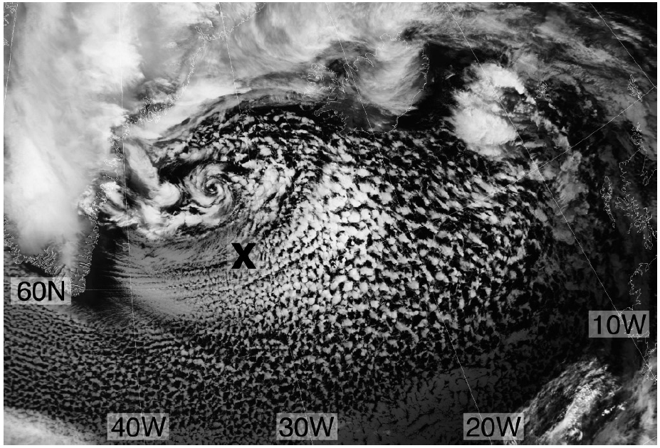
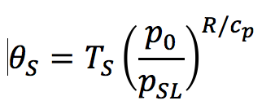
Example
Kolstad (2011)
Advanced Very High Resolution Radiometer (AVHRR; channel 4) satellite image of a polar low between Greenland and Iceland at 1209 UTC 2 March 2009. Figure 2 adapted from Kolstad (2011).
Marine Cold Air Outbreak (MCAO) index M:
, where
T_{s} is skin temperature, P_{SL} is mean SLP, Z is 700-hPa geopotential height, L is a scaling height of 7 ✕ 10⁵ m
×
Grid point with highest value of M within 400 km of polar low
(a) SLP (hPa), (b) MCAO index M, and (c) tropopause pressure (hPa) at 1200 UTC 2 March 2009. Figure 3 adapted from Kolstad (2011).

Slide 8
Research Goals
Analyze the evolution of a polar low that is linked to a TPV
Investigate factors influencing the predictability of the evolution of the polar low

Slide 9
Hypotheses
Forecast errors in the track and intensity of TPVs may contribute to forecast errors in the track and intensity of polar lows that are linked to TPVs
Forecast errors in the track and intensity of TPVs may lead to forecast errors in the position and structure of Arctic fronts, which may also contribute to forecast errors in the track and intensity of polar lows that are linked to TPVs

Slide 10
Climatology of Polar Lows
Polar lows obtained from Sea Surface Temperature and Altimeter Synergy for Improved Forecasting of Polar lows (STARS) database of polar lows in the Norwegian Sea and Barents Sea (Sætra et al. 2010)
The STARS database covers the 2002–2011 period, for a total of 140 polar lows.
Of the total 140 polar lows, 137 occur during the months of October–April, while 3 occur during September or May
The polar lows were identified and tracked hourly via manual inspection of satellite products and operational weather forecasts
Link to STARS Database: http://polarlow.met.no/stars-dat/

Slide 11
Climatology of Polar Lows Linked to TPVs
The STARS database was compared to an existing 1979–2015 database of TPVs constructed using the ERA-Interim
In order to determine which polar lows may be linked to TPVs, polar lows were required to be located within a certain distance threshold of at least one TPV at any point in the lifetime of the polar low
500 km is utilized for this study to ensure that the TPVs are located close enough to the polar lows to have an influence on the life cycles of the polar lows

Slide 12
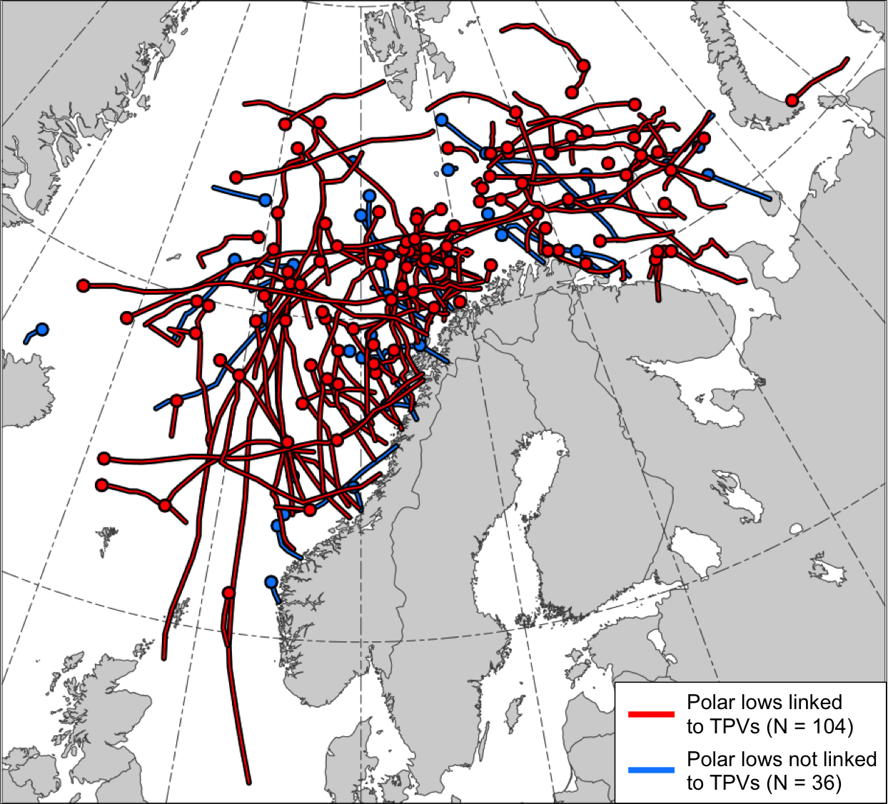
Climatology of Polar Lows Linked to TPVs
104 out of the total 140 polar lows, or 74.3%, match with at least one TPV
Tracks of the polar lows in the STARS database. Tracks of polar lows that are linked to TPVs (red) and tracks of polar lows that are not linked to TPVs (blue). Dots indicate the genesis locations of the polar lows.

Slide 13
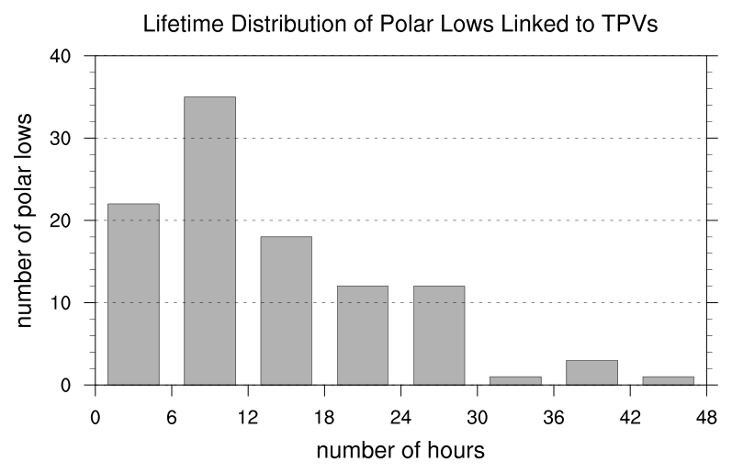
Climatology of Polar Lows Linked to TPVs
N = 104
Mean: 12.9 h
Median: 9 h
Lifetime distribution of polar lows that are linked to TPVs, with lifetime in number of hours. For each bin, the first number on the bottom axis is inclusive while the second number on the bottom axis is exclusive. For example, the second bin includes polar lows that last ≥ 6 h and < 12 h.

Slide 14
Research Goals
Analyze the evolution of a polar low that is linked to a TPV
Investigate factors influencing the predictability of the evolution of the polar low.

Slide 15
Case Selection
Choose a case for which ERA5 (Hersbach and Dee 2016) can be used for analysis
Choose a case for which a polar low can be tracked in the ERA5 and in the 51-member ECMWF Ensemble Prediction System (EPS; Buizza et al. 2007) from TIGGE (Bougeault et al. 2010)
Choose a case for which the polar low is clearly related to a single TPV

Slide 16
Data and Methods for Analysis
Data:
0.3° ERA5 (Hersbach and Dee 2016)
Utilized TPV tracking algorithm developed by Nicholas Szapiro and Steven Cavallo to identify and track TPV of interest
Input variables: potential temperature, relative vorticity, and wind on 2-PVU surface
Potential temperature minima on 2-PVU surface tracked spatially and temporally to create TPV tracks
Link for Tracking Algorithm: https://github.com/nickszap/tpvTrack

Slide 17
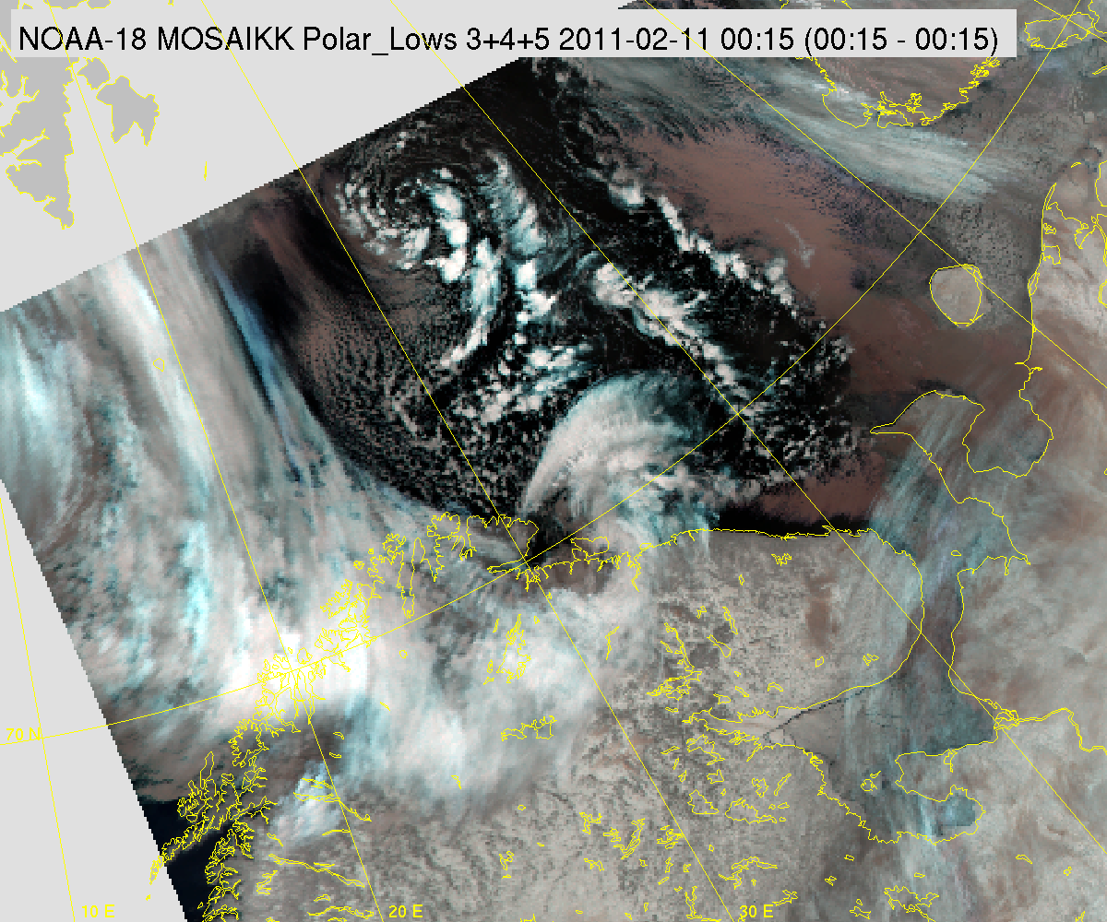
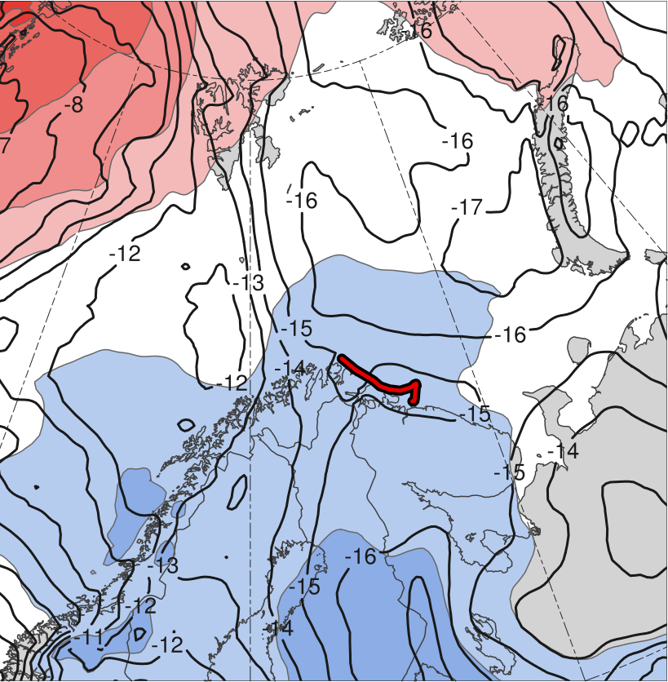
The Polar Low
NOAA AVHRR satellite image valid 0015 UTC 11 February 2011. Image obtained from the STARS database.
(σ)
-2
-1.5
-1
-0.5
0
0.5
1
1.5
2
Genesis
Lysis
Genesis | Lysis | Lifetime
1800 UTC 10 Feb 2011 | 1200 UTC 11 Feb 2011 | 18 h
10–11 Feb 2011 time-mean 850-hPa temperature (°C, black) and standardized anomaly of 850-hPa temperature (σ, shaded)
Link to STARS Database: http://polarlow.met.no/STARS-DAT/browser/view_stars-dat_4tiles.php

Slide 18
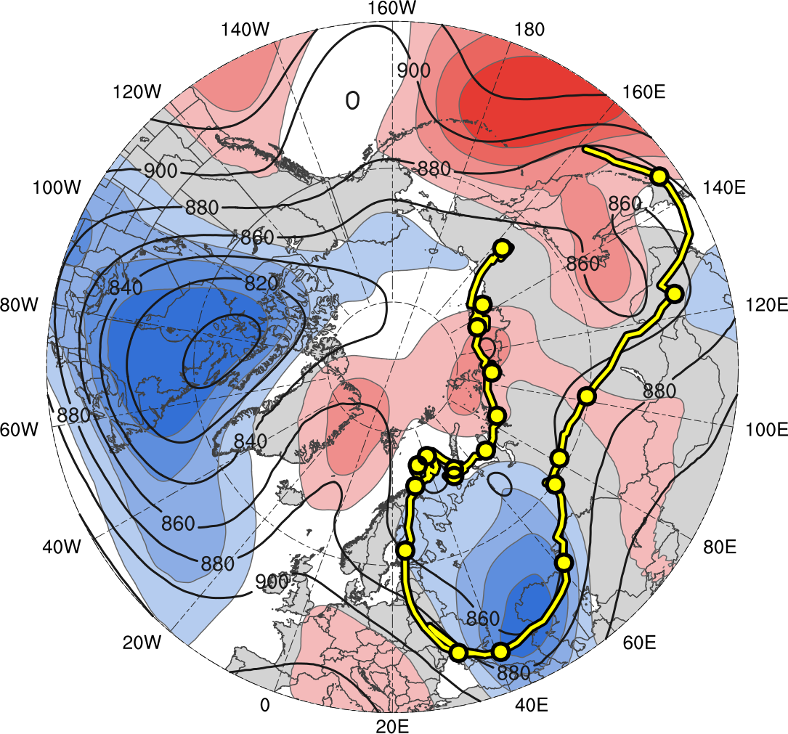
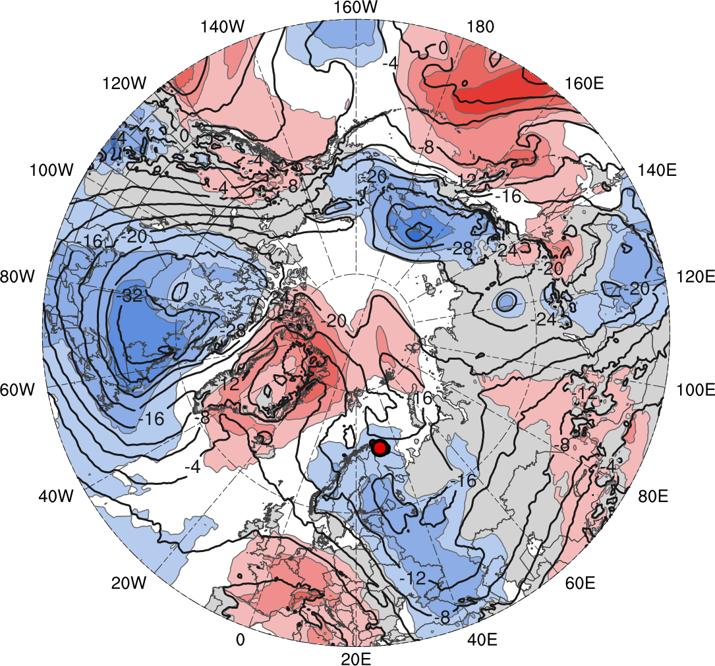
The Polar Low and TPV
Genesis
Lysis
0000 UTC positions
(every 48 h)
(σ)
-2
-1.5
-1
-0.5
0
0.5
1
1.5
2
Feature | Genesis | Lysis | Lifetime
TPV | 31 Jan | 19 Feb | ~21 d
PL | 10 Feb | 11 Feb | 18 h
10–11 Feb 2011 time-mean (left) 300-hPa geopotential height (dam, black) and standardized anomaly of 300-hPa geopotential height (σ, shaded); (right) 850-hPa temperature (°C, black) and standardized anomaly of 850-hPa temperature (σ, shaded)

Slide 19
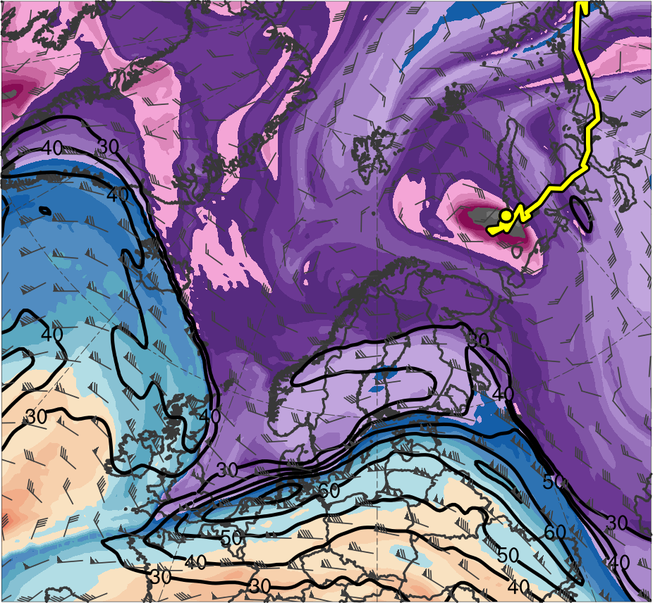
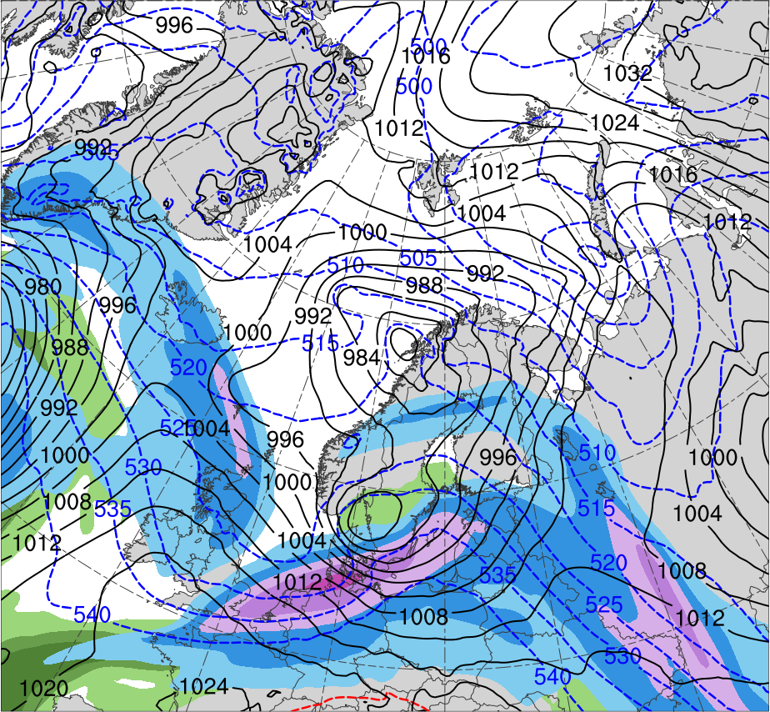
Synoptic Evolution
0000 UTC 8 Feb 2011
R1
TPV
(K)
252
258
264
270
276
282
288
294
300
306
312
318
324
330
336
342
348
354
360
366
372
378
(m s⁻¹ )
(mm)
30
40
50
60
70
80
90
100
10
15
20
25
30
35
40
Potential temperature (K, shaded), wind speed (black, every 10 m s⁻¹ starting at 30 m s⁻¹), and wind (m s⁻¹, flags and barbs) on 2-PVU surface
300-hPa wind speed (m s⁻¹, shaded),
1000–500-hPa thickness (dam, blue/red),
SLP (hPa, black), PW (mm, shaded)

Slide 20
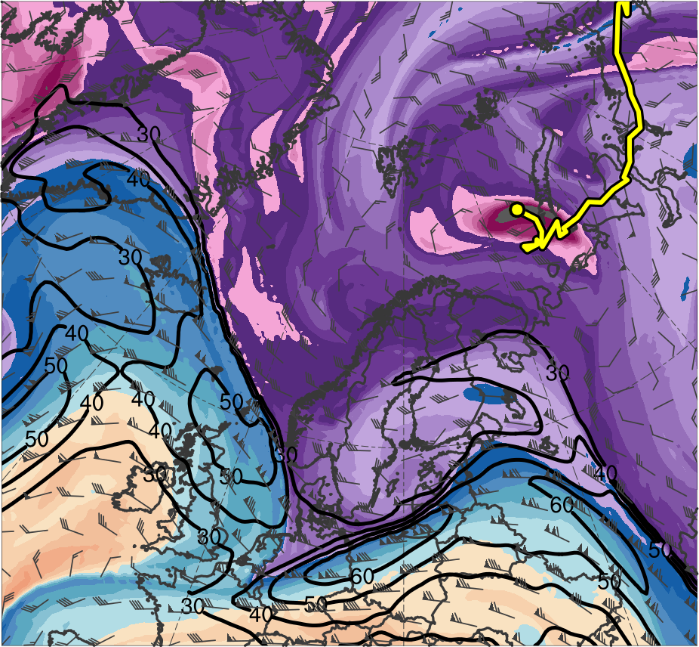
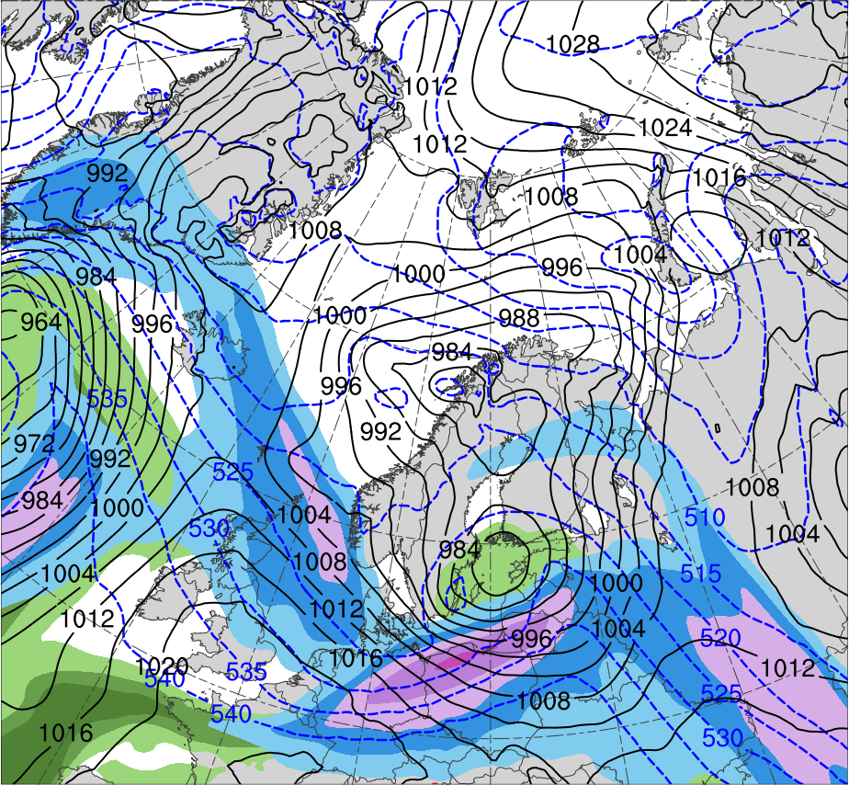
Synoptic Evolution
0600 UTC 8 Feb 2011
R1
TPV
(K)
252
258
264
270
276
282
288
294
300
306
312
318
324
330
336
342
348
354
360
366
372
378
(m s⁻¹ )
(mm)
30
40
50
60
70
80
90
100
10
15
20
25
30
35
40
Potential temperature (K, shaded), wind speed (black, every 10 m s⁻¹ starting at 30 m s⁻¹), and wind (m s⁻¹, flags and barbs) on 2-PVU surface
300-hPa wind speed (m s⁻¹, shaded),
1000–500-hPa thickness (dam, blue/red),
SLP (hPa, black), PW (mm, shaded)

Slide 21
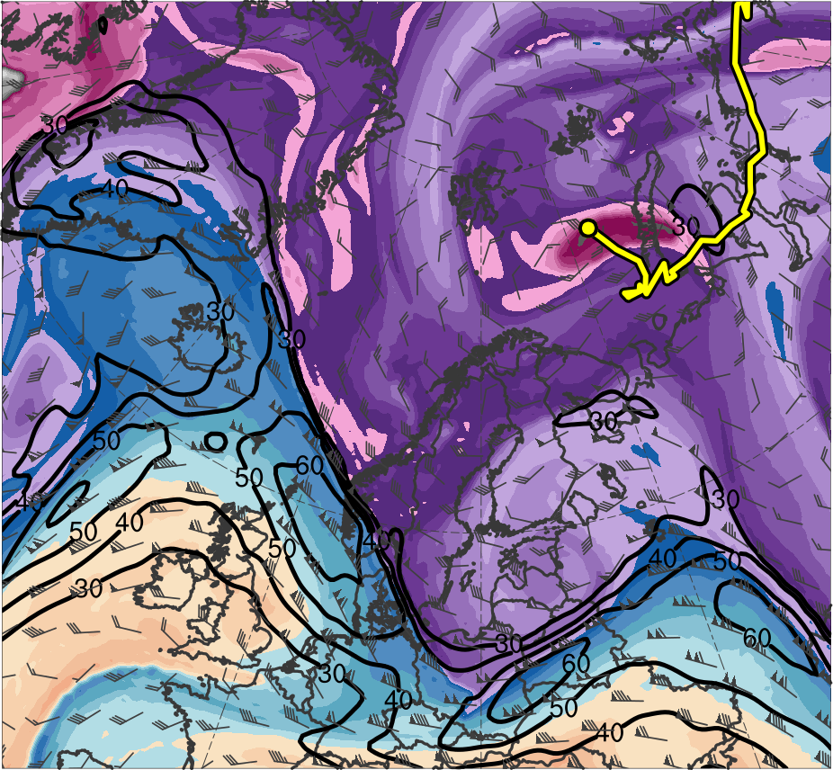
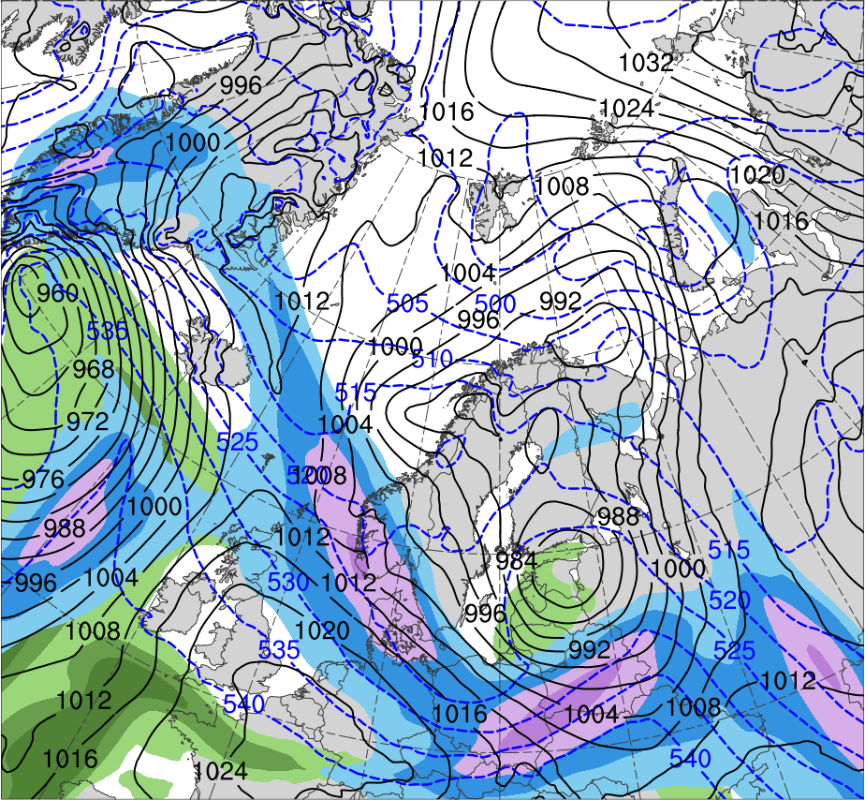
Synoptic Evolution
1200 UTC 8 Feb 2011
R1
TPV
(K)
252
258
264
270
276
282
288
294
300
306
312
318
324
330
336
342
348
354
360
366
372
378
(m s⁻¹ )
(mm)
30
40
50
60
70
80
90
100
10
15
20
25
30
35
40
Potential temperature (K, shaded), wind speed (black, every 10 m s⁻¹ starting at 30 m s⁻¹), and wind (m s⁻¹, flags and barbs) on 2-PVU surface
300-hPa wind speed (m s⁻¹, shaded),
1000–500-hPa thickness (dam, blue/red),
SLP (hPa, black), PW (mm, shaded)

Slide 22
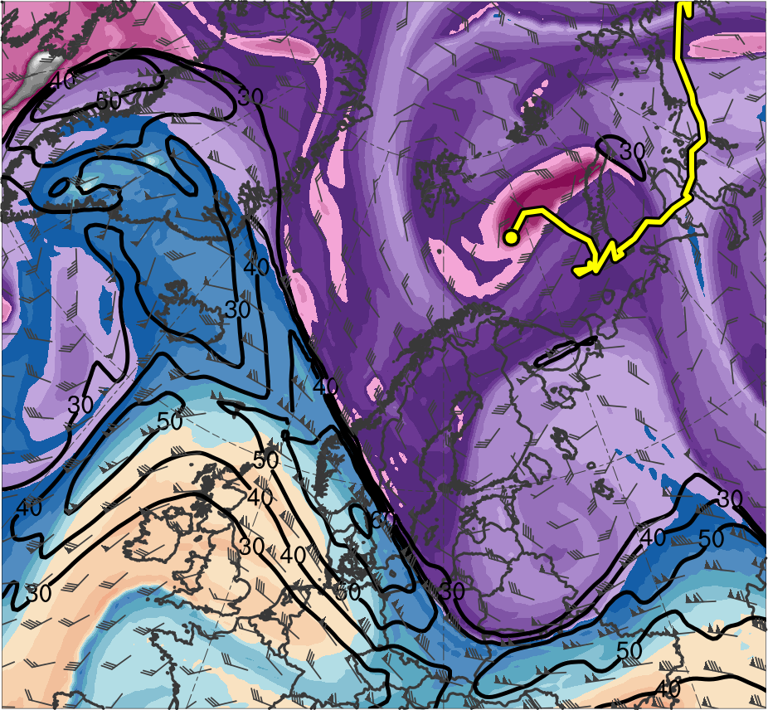
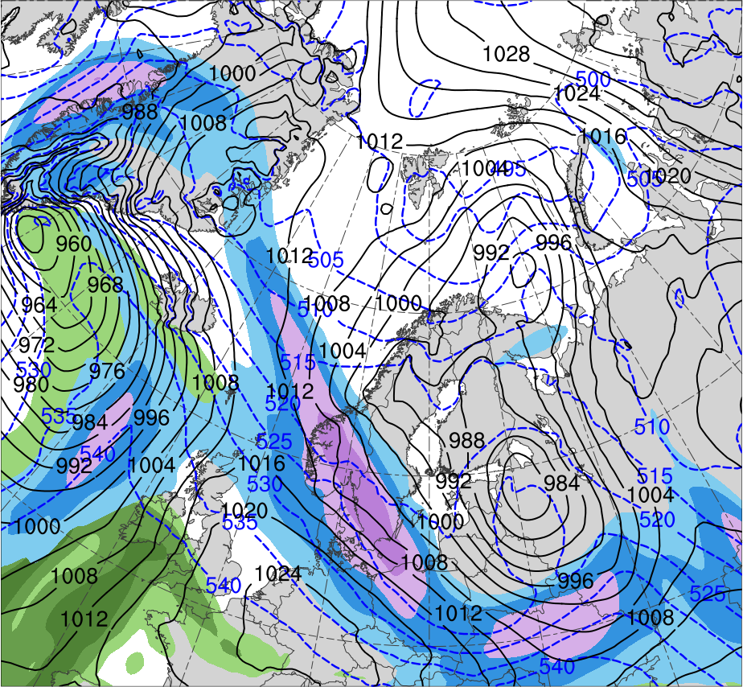
Synoptic Evolution
1800 UTC 8 Feb 2011
R1
TPV
(K)
252
258
264
270
276
282
288
294
300
306
312
318
324
330
336
342
348
354
360
366
372
378
(m s⁻¹ )
(mm)
30
40
50
60
70
80
90
100
10
15
20
25
30
35
40
Potential temperature (K, shaded), wind speed (black, every 10 m s⁻¹ starting at 30 m s⁻¹), and wind (m s⁻¹, flags and barbs) on 2-PVU surface
300-hPa wind speed (m s⁻¹, shaded),
1000–500-hPa thickness (dam, blue/red),
SLP (hPa, black), PW (mm, shaded)

Slide 23
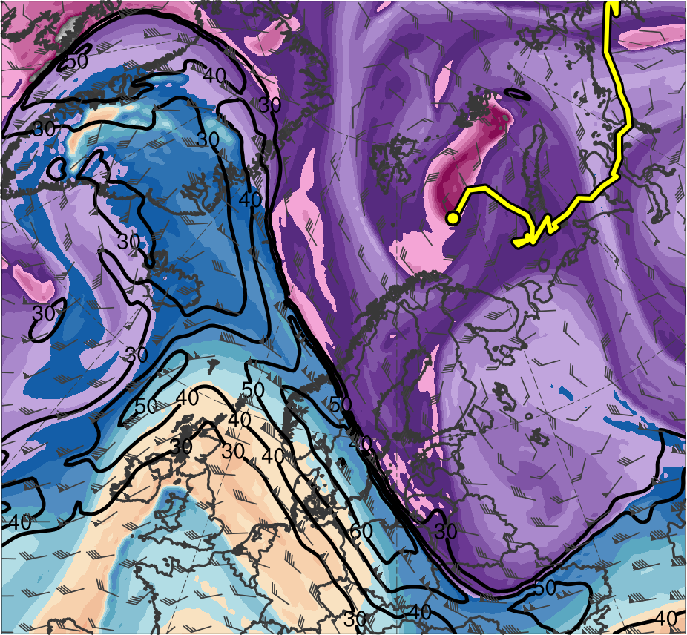
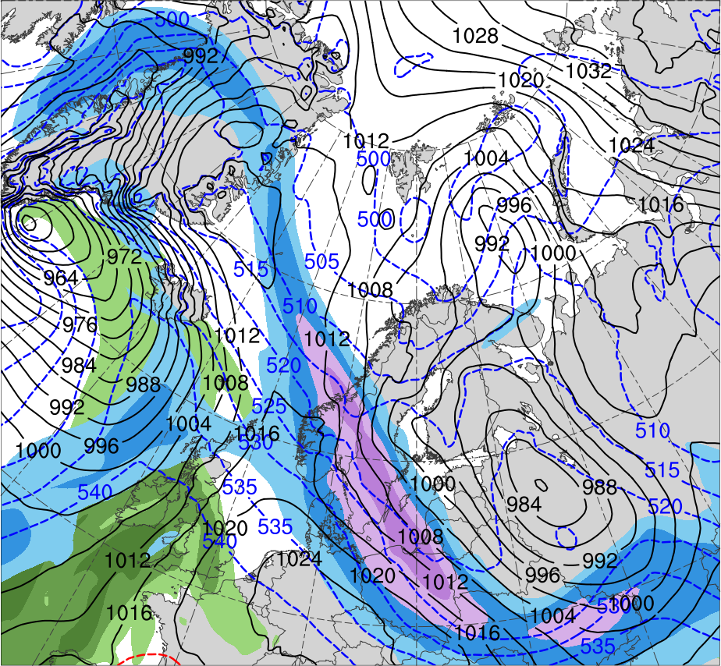
Synoptic Evolution
0000 UTC 9 Feb 2011
R1
R2
TPV
(K)
252
258
264
270
276
282
288
294
300
306
312
318
324
330
336
342
348
354
360
366
372
378
(m s⁻¹ )
(mm)
30
40
50
60
70
80
90
100
10
15
20
25
30
35
40
Potential temperature (K, shaded), wind speed (black, every 10 m s⁻¹ starting at 30 m s⁻¹), and wind (m s⁻¹, flags and barbs) on 2-PVU surface
300-hPa wind speed (m s⁻¹, shaded),
1000–500-hPa thickness (dam, blue/red),
SLP (hPa, black), PW (mm, shaded)

Slide 24
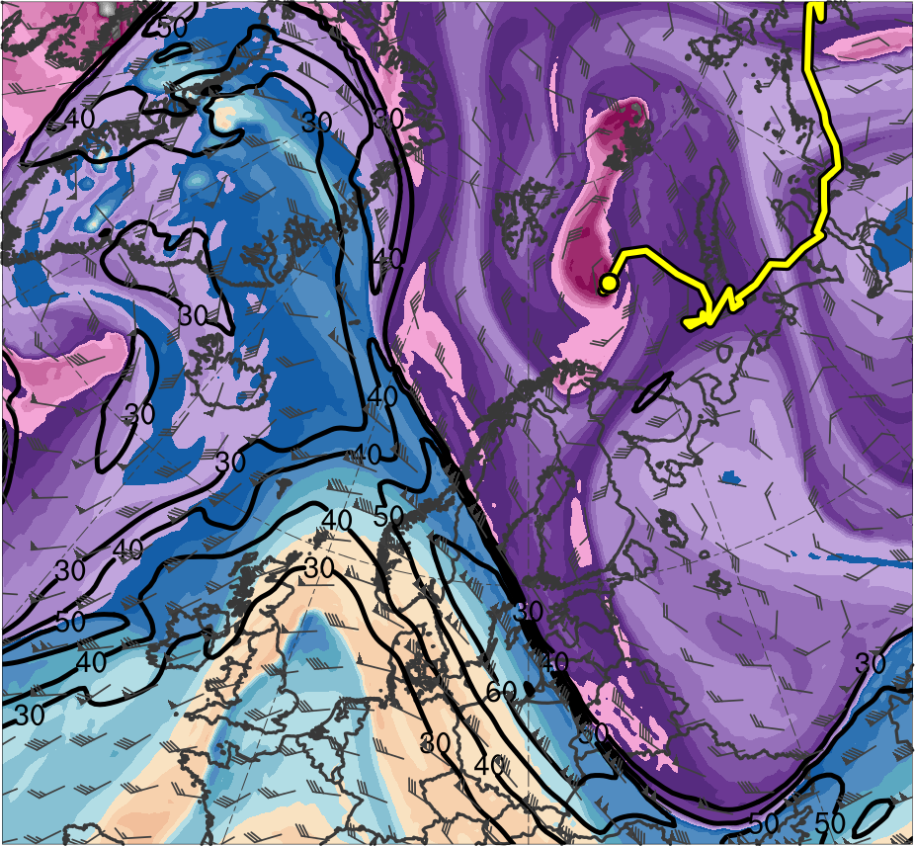
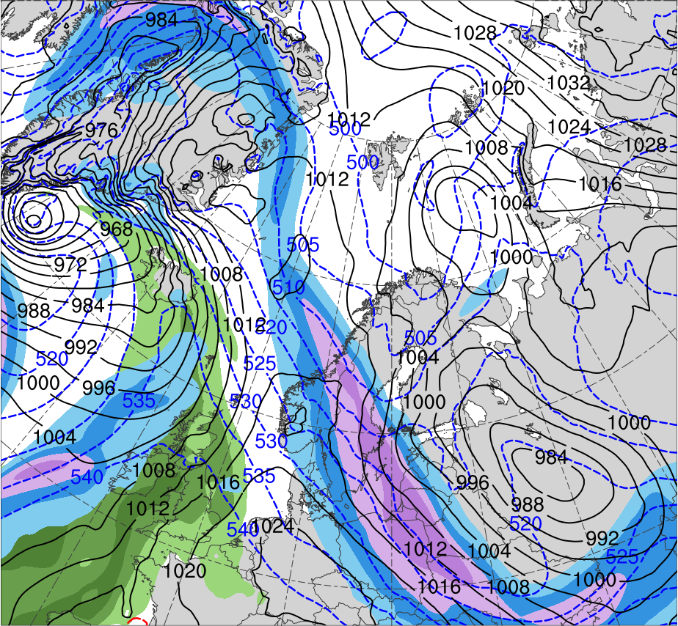
Synoptic Evolution
0600 UTC 9 Feb 2011
R1
R2
TPV
(K)
252
258
264
270
276
282
288
294
300
306
312
318
324
330
336
342
348
354
360
366
372
378
(m s⁻¹ )
(mm)
30
40
50
60
70
80
90
100
10
15
20
25
30
35
40
Potential temperature (K, shaded), wind speed (black, every 10 m s⁻¹ starting at 30 m s⁻¹), and wind (m s⁻¹, flags and barbs) on 2-PVU surface
300-hPa wind speed (m s⁻¹, shaded),
1000–500-hPa thickness (dam, blue/red),
SLP (hPa, black), PW (mm, shaded)

Slide 25
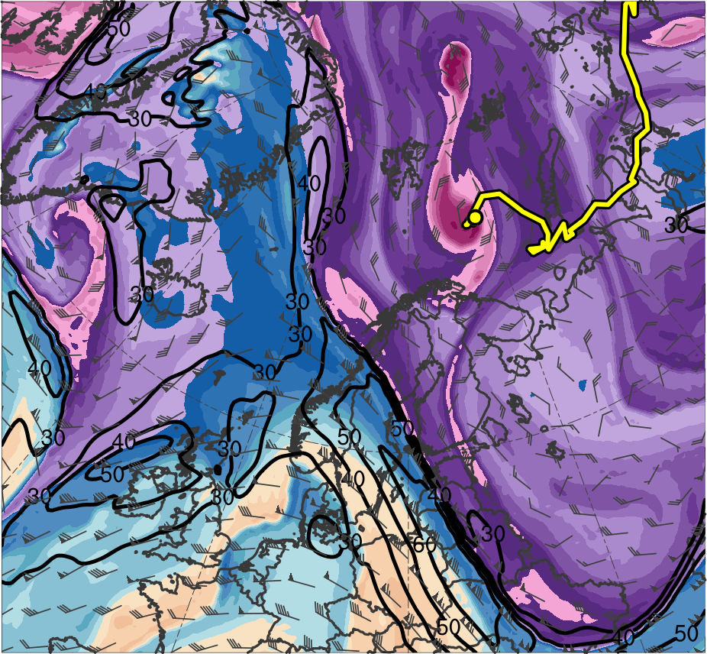
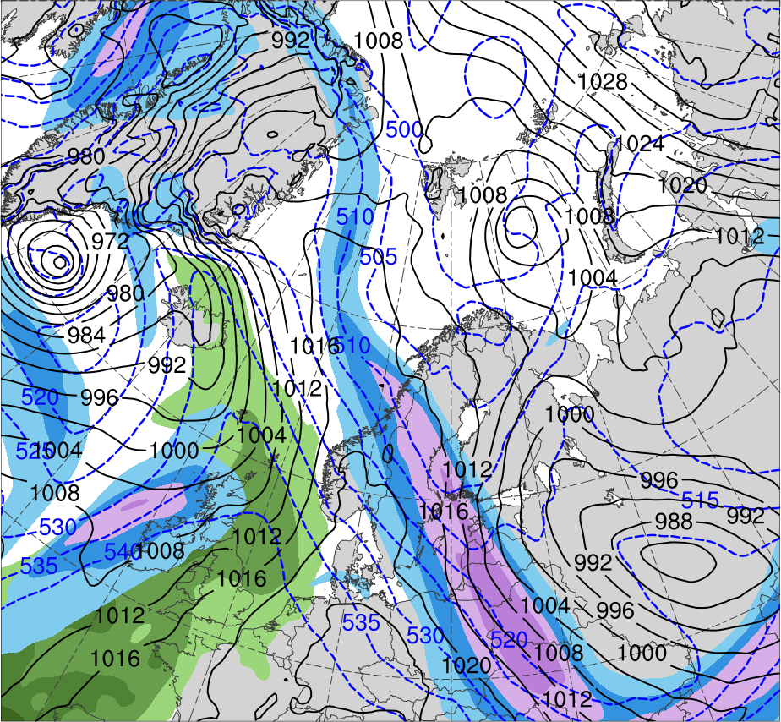
Synoptic Evolution
1200 UTC 9 Feb 2011
R1
R2
TPV
(K)
252
258
264
270
276
282
288
294
300
306
312
318
324
330
336
342
348
354
360
366
372
378
(m s⁻¹ )
(mm)
30
40
50
60
70
80
90
100
10
15
20
25
30
35
40
Potential temperature (K, shaded), wind speed (black, every 10 m s⁻¹ starting at 30 m s⁻¹), and wind (m s⁻¹, flags and barbs) on 2-PVU surface
300-hPa wind speed (m s⁻¹, shaded),
1000–500-hPa thickness (dam, blue/red),
SLP (hPa, black), PW (mm, shaded)

Slide 26
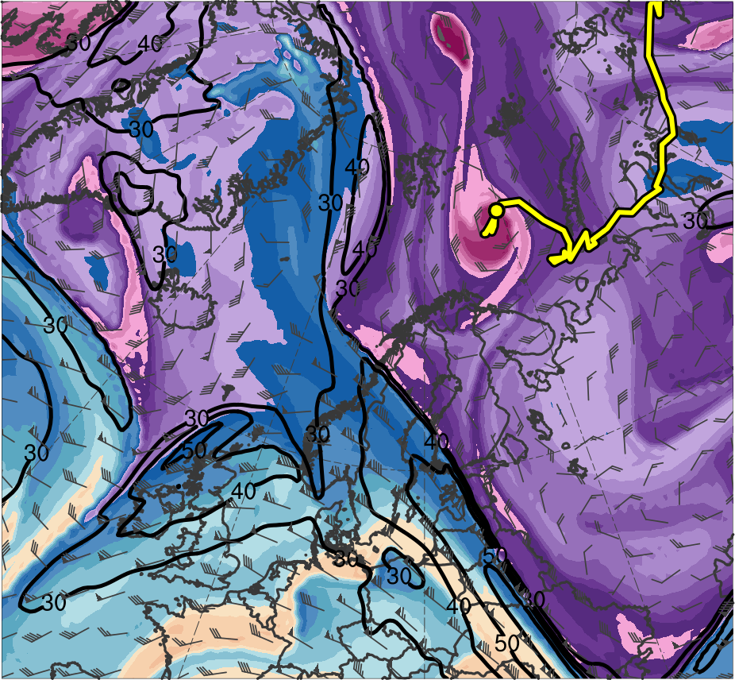
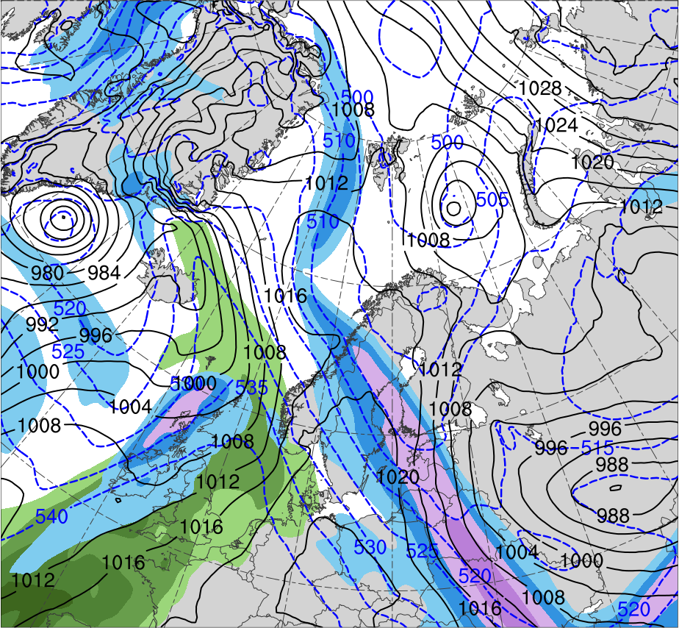
Synoptic Evolution
1800 UTC 9 Feb 2011
R1
R2
TPV
(K)
252
258
264
270
276
282
288
294
300
306
312
318
324
330
336
342
348
354
360
366
372
378
(m s⁻¹ )
(mm)
30
40
50
60
70
80
90
100
10
15
20
25
30
35
40
Potential temperature (K, shaded), wind speed (black, every 10 m s⁻¹ starting at 30 m s⁻¹), and wind (m s⁻¹, flags and barbs) on 2-PVU surface
300-hPa wind speed (m s⁻¹, shaded),
1000–500-hPa thickness (dam, blue/red),
SLP (hPa, black), PW (mm, shaded)

Slide 27
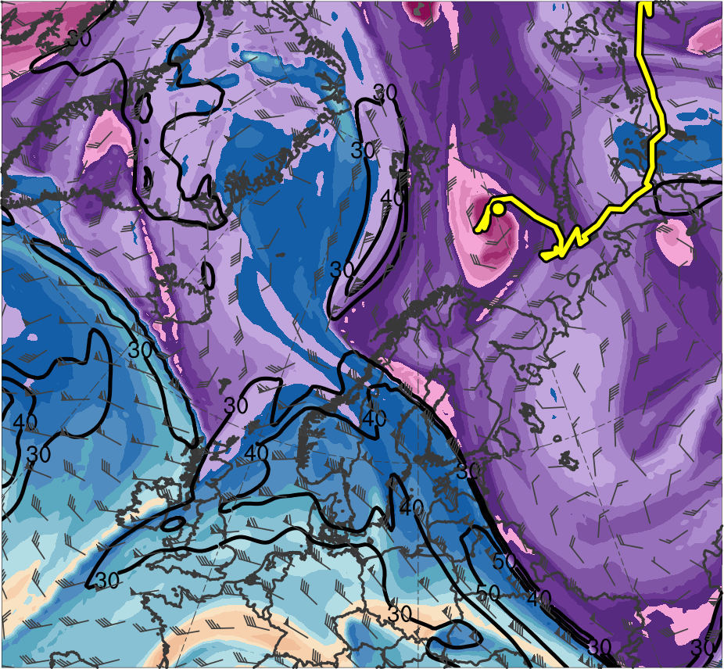
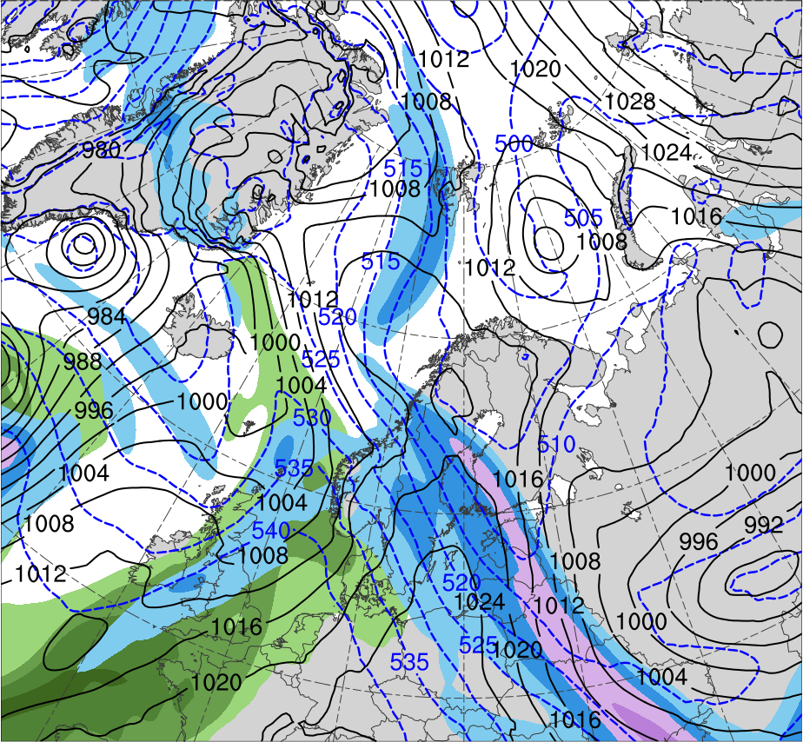
Synoptic Evolution
0000 UTC 10 Feb 2011
R2
R1
TPV
(K)
252
258
264
270
276
282
288
294
300
306
312
318
324
330
336
342
348
354
360
366
372
378
(m s⁻¹ )
(mm)
30
40
50
60
70
80
90
100
10
15
20
25
30
35
40
Potential temperature (K, shaded), wind speed (black, every 10 m s⁻¹ starting at 30 m s⁻¹), and wind (m s⁻¹, flags and barbs) on 2-PVU surface
300-hPa wind speed (m s⁻¹, shaded),
1000–500-hPa thickness (dam, blue/red),
SLP (hPa, black), PW (mm, shaded)

Slide 28
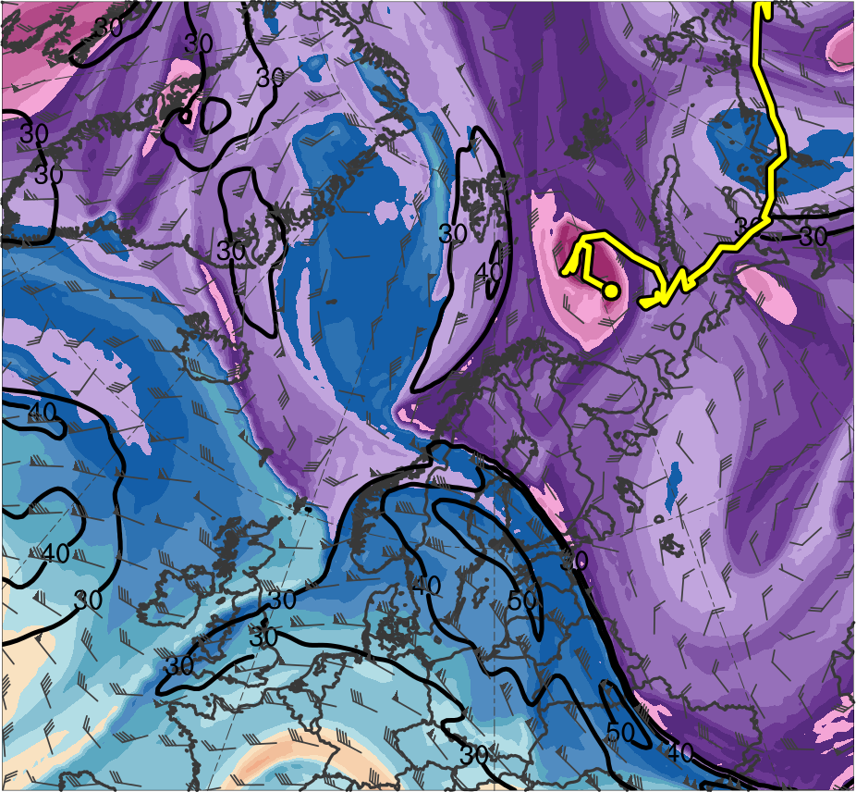
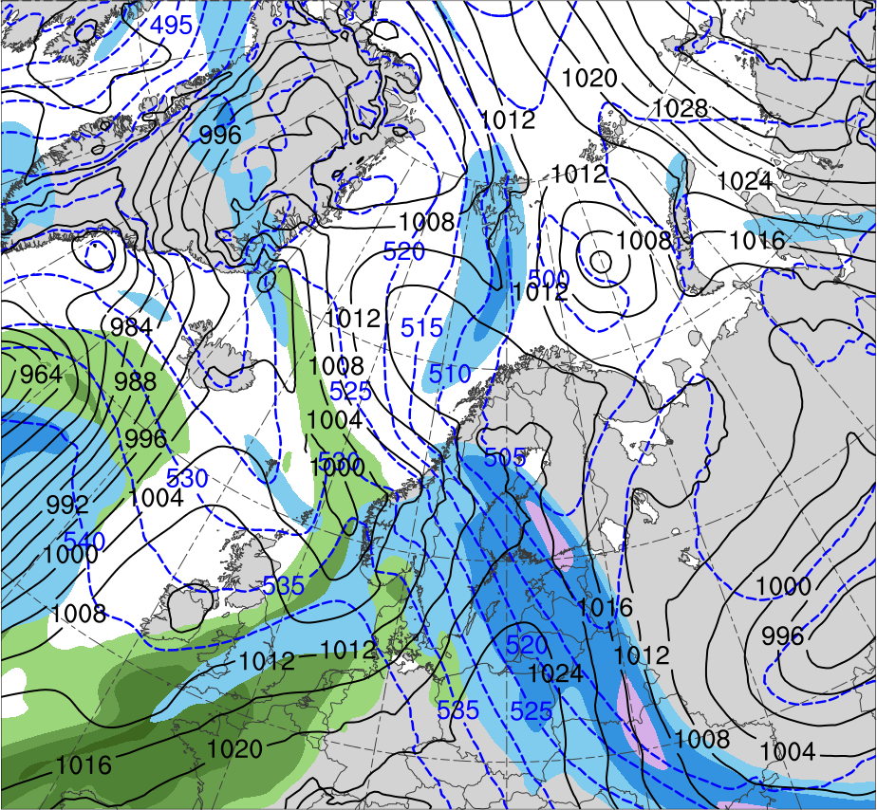
Synoptic Evolution
0600 UTC 10 Feb 2011
R2
R1
TPV
(K)
252
258
264
270
276
282
288
294
300
306
312
318
324
330
336
342
348
354
360
366
372
378
(m s⁻¹ )
(mm)
30
40
50
60
70
80
90
100
10
15
20
25
30
35
40
Potential temperature (K, shaded), wind speed (black, every 10 m s⁻¹ starting at 30 m s⁻¹), and wind (m s⁻¹, flags and barbs) on 2-PVU surface
300-hPa wind speed (m s⁻¹, shaded),
1000–500-hPa thickness (dam, blue/red),
SLP (hPa, black), PW (mm, shaded)

Slide 29
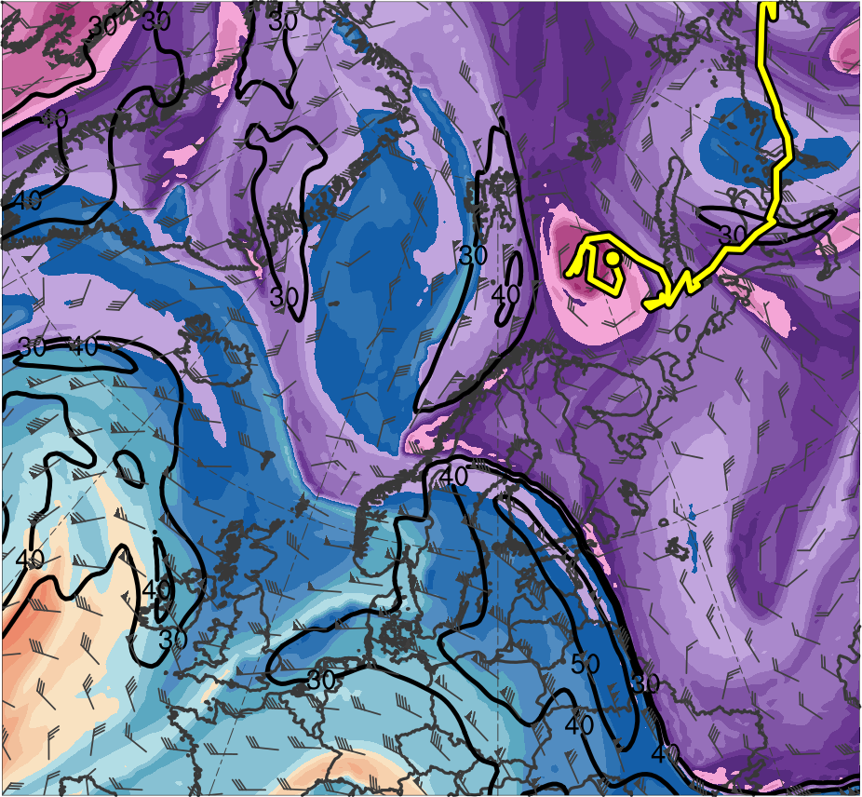
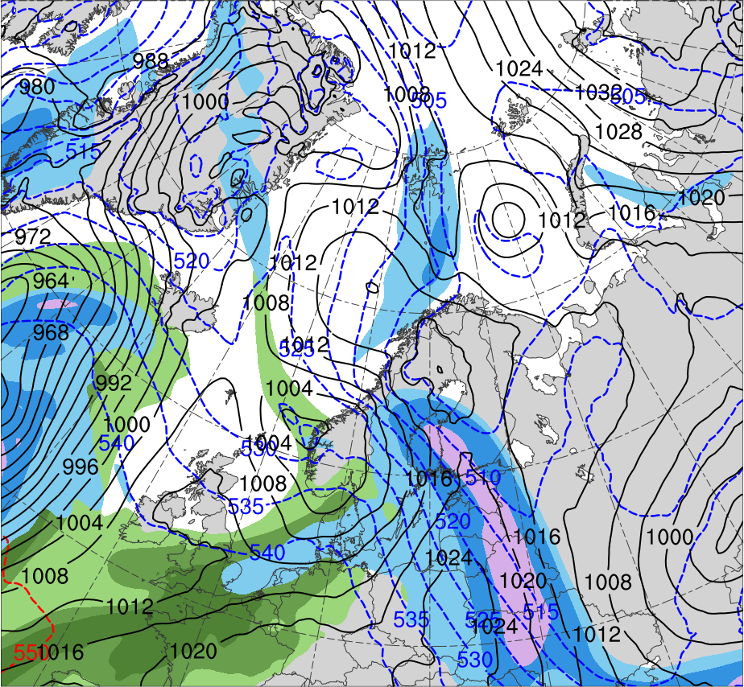
Synoptic Evolution
1200 UTC 10 Feb 2011
R2
R1
TPV
(K)
252
258
264
270
276
282
288
294
300
306
312
318
324
330
336
342
348
354
360
366
372
378
(m s⁻¹ )
(mm)
30
40
50
60
70
80
90
100
10
15
20
25
30
35
40
Potential temperature (K, shaded), wind speed (black, every 10 m s⁻¹ starting at 30 m s⁻¹), and wind (m s⁻¹, flags and barbs) on 2-PVU surface
300-hPa wind speed (m s⁻¹, shaded),
1000–500-hPa thickness (dam, blue/red),
SLP (hPa, black), PW (mm, shaded)

Slide 30
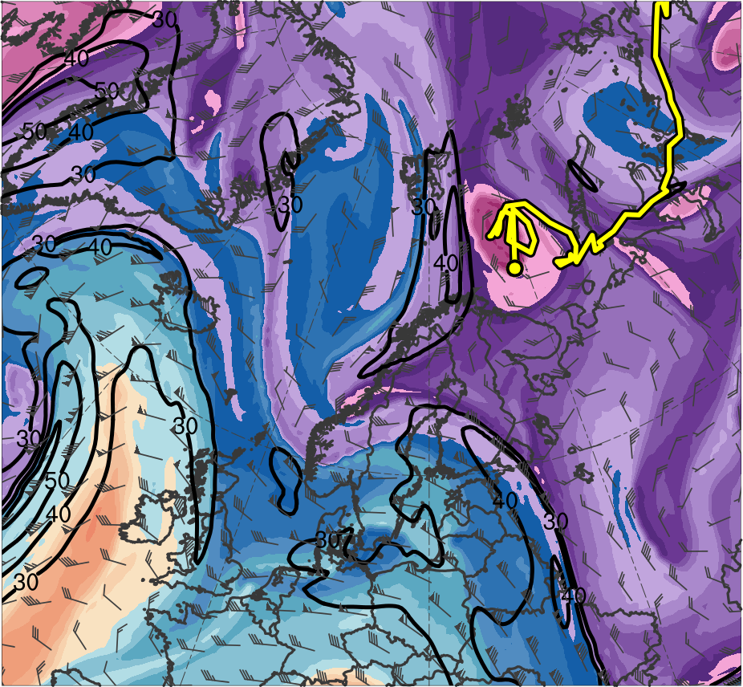
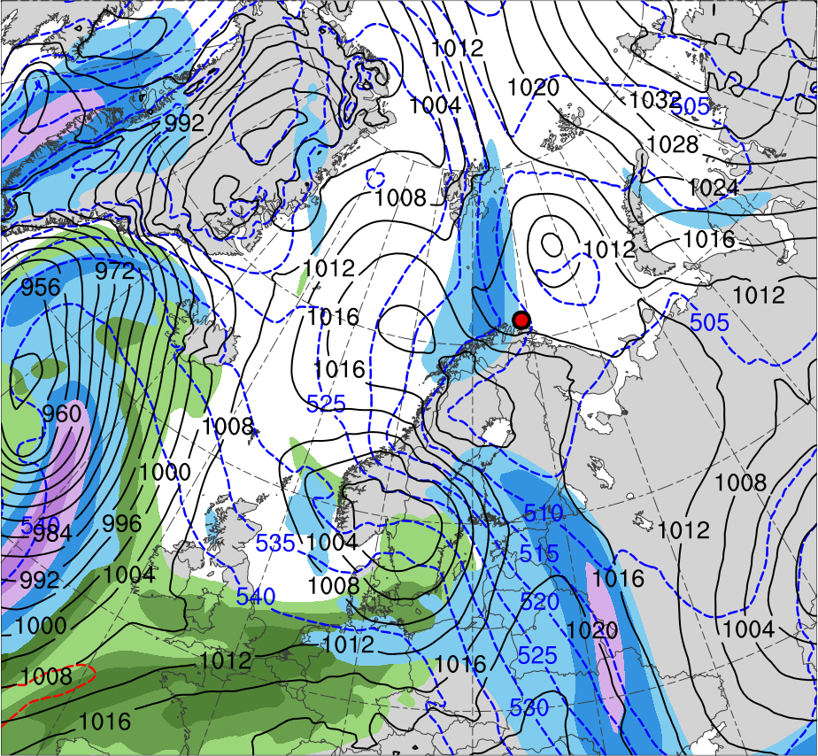
Synoptic Evolution
1800 UTC 10 Feb 2011
R2
R1
TPV
PL
(K)
252
258
264
270
276
282
288
294
300
306
312
318
324
330
336
342
348
354
360
366
372
378
(m s⁻¹ )
(mm)
30
40
50
60
70
80
90
100
10
15
20
25
30
35
40
Potential temperature (K, shaded), wind speed (black, every 10 m s⁻¹ starting at 30 m s⁻¹), and wind (m s⁻¹, flags and barbs) on 2-PVU surface
300-hPa wind speed (m s⁻¹, shaded),
1000–500-hPa thickness (dam, blue/red),
SLP (hPa, black), PW (mm, shaded)

Slide 31
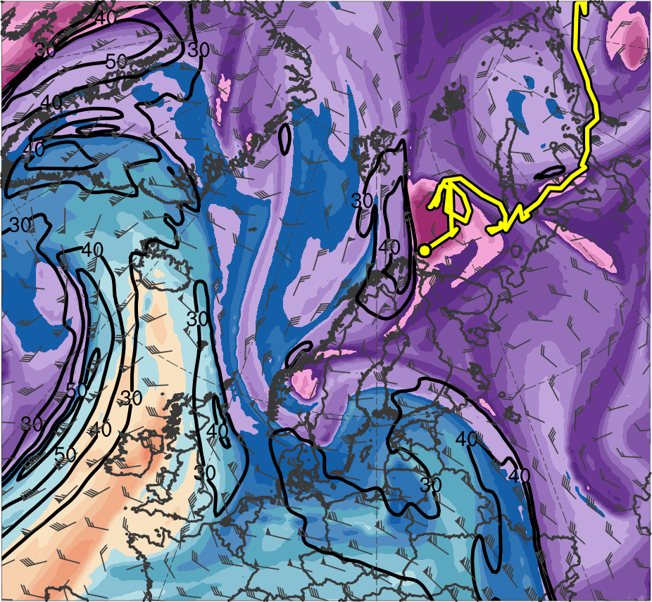
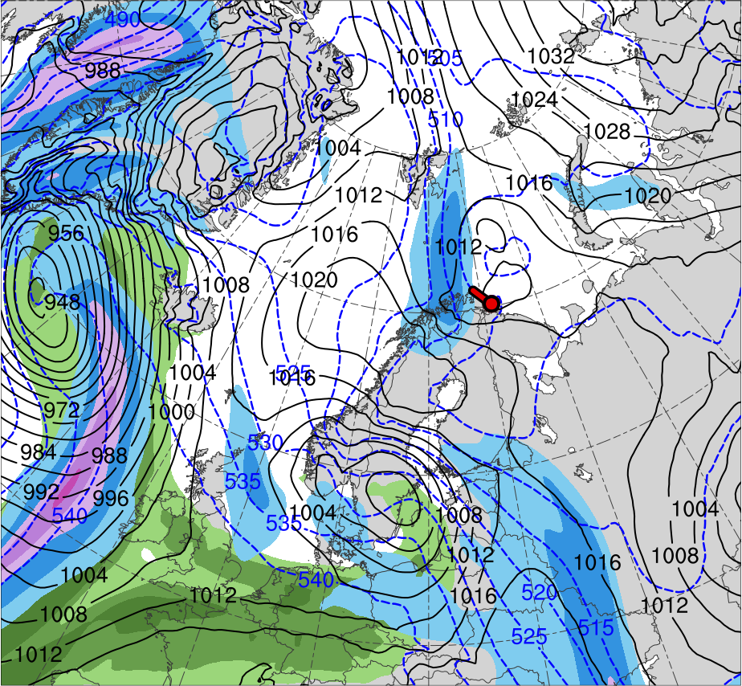
Synoptic Evolution
0000 UTC 11 Feb 2011
R2
R1
TPV
PL
(K)
252
258
264
270
276
282
288
294
300
306
312
318
324
330
336
342
348
354
360
366
372
378
(m s⁻¹ )
(mm)
30
40
50
60
70
80
90
100
10
15
20
25
30
35
40
Potential temperature (K, shaded), wind speed (black, every 10 m s⁻¹ starting at 30 m s⁻¹), and wind (m s⁻¹, flags and barbs) on 2-PVU surface
300-hPa wind speed (m s⁻¹, shaded),
1000–500-hPa thickness (dam, blue/red),
SLP (hPa, black), PW (mm, shaded)

Slide 32
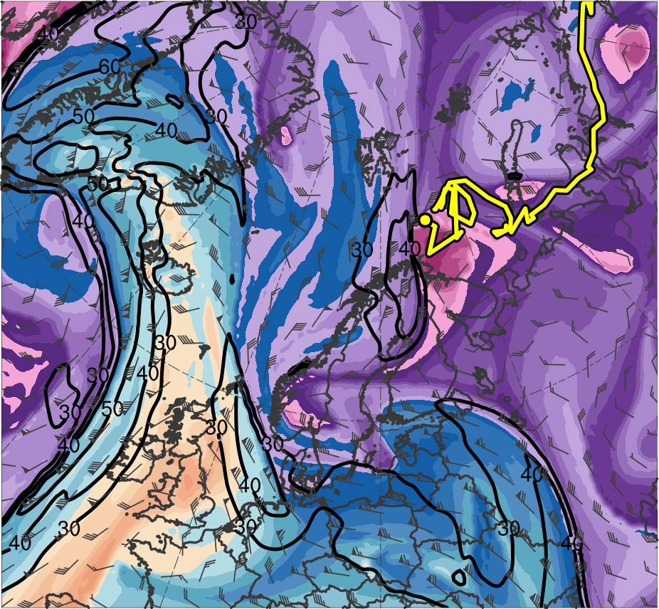
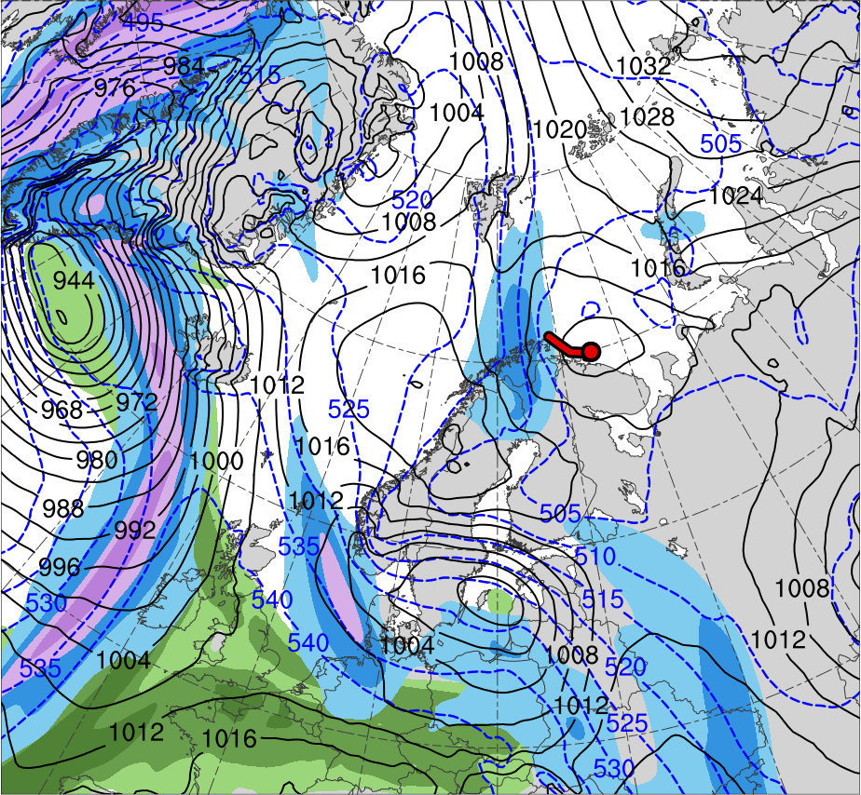
Synoptic Evolution
0600 UTC 11 Feb 2011
R2
R1
TPV
PL
(K)
252
258
264
270
276
282
288
294
300
306
312
318
324
330
336
342
348
354
360
366
372
378
(m s⁻¹ )
(mm)
30
40
50
60
70
80
90
100
10
15
20
25
30
35
40
Potential temperature (K, shaded), wind speed (black, every 10 m s⁻¹ starting at 30 m s⁻¹), and wind (m s⁻¹, flags and barbs) on 2-PVU surface
300-hPa wind speed (m s⁻¹, shaded),
1000–500-hPa thickness (dam, blue/red),
SLP (hPa, black), PW (mm, shaded)

Slide 33
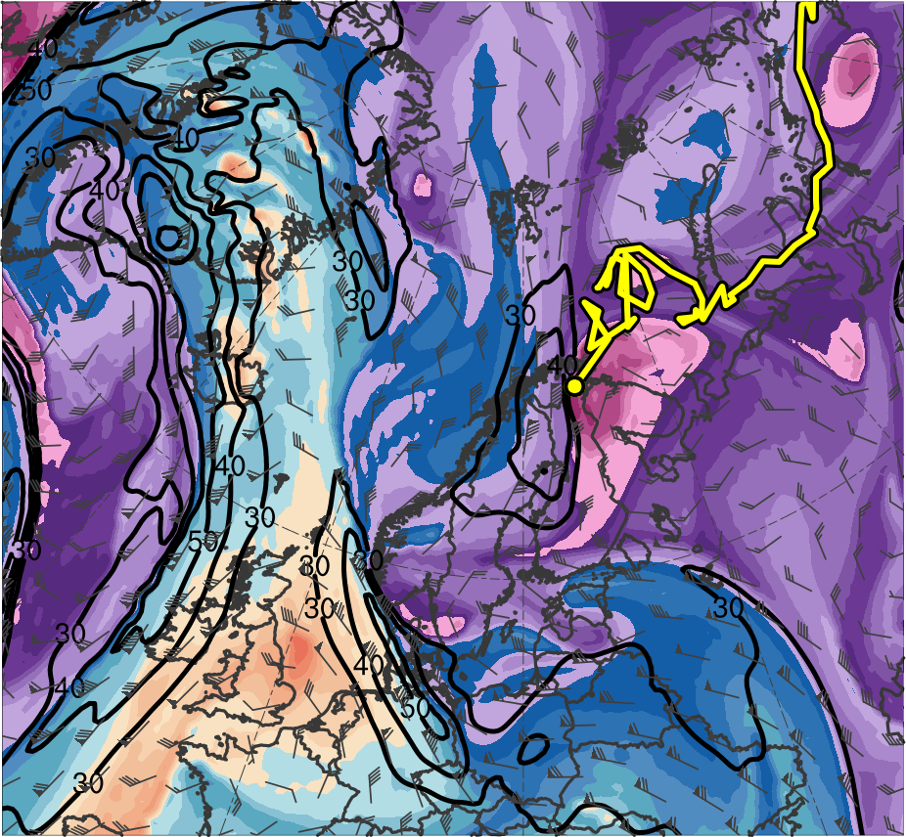
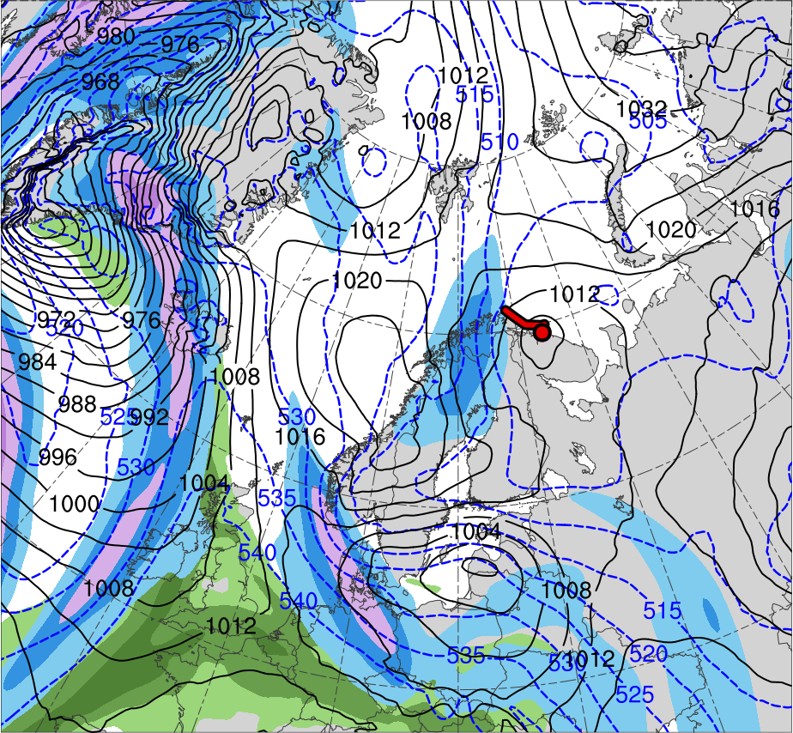
Synoptic Evolution
1200 UTC 11 Feb 2011
R2
R1
TPV
PL
(K)
252
258
264
270
276
282
288
294
300
306
312
318
324
330
336
342
348
354
360
366
372
378
(m s⁻¹ )
(mm)
30
40
50
60
70
80
90
100
10
15
20
25
30
35
40
Potential temperature (K, shaded), wind speed (black, every 10 m s⁻¹ starting at 30 m s⁻¹), and wind (m s⁻¹, flags and barbs) on 2-PVU surface
300-hPa wind speed (m s⁻¹, shaded),
1000–500-hPa thickness (dam, blue/red),
SLP (hPa, black), PW (mm, shaded)

Slide 34
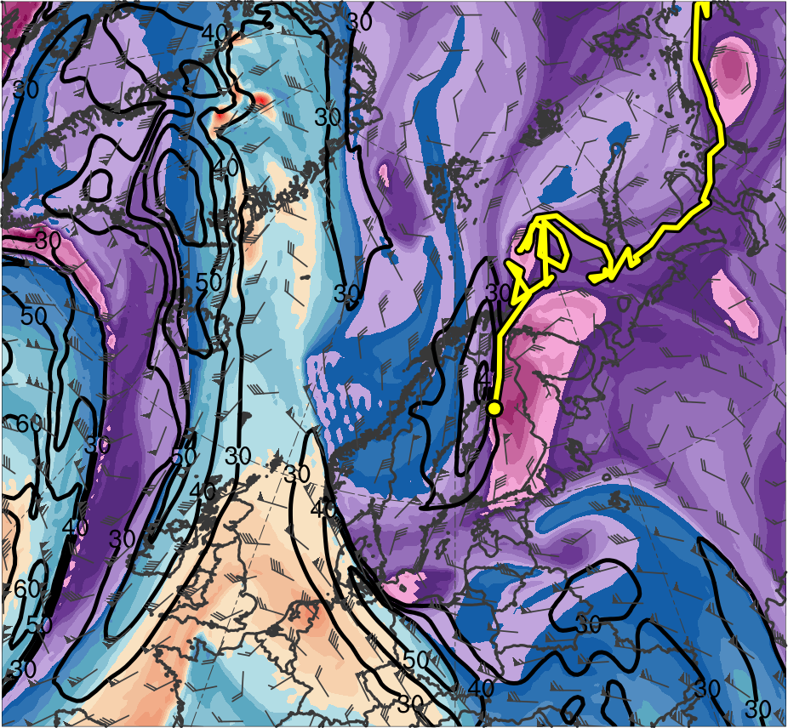
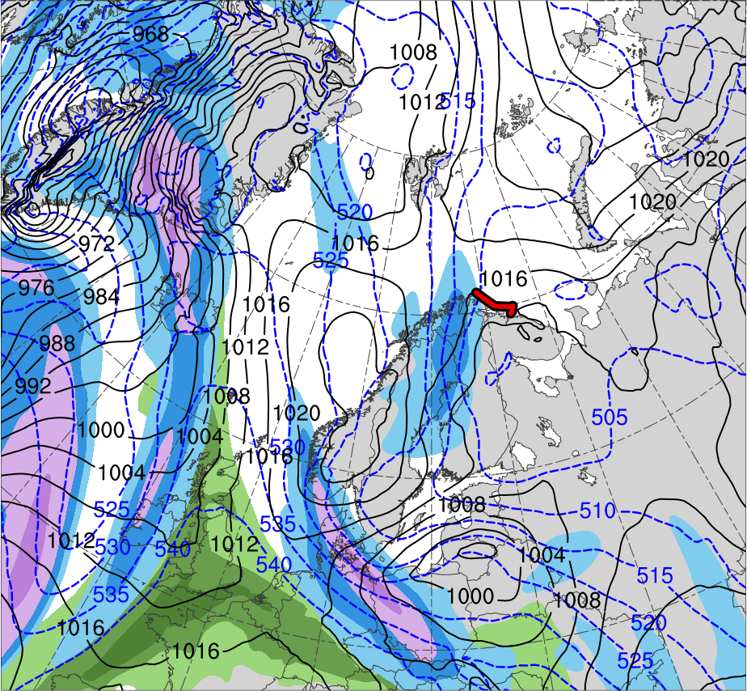
Synoptic Evolution
1800 UTC 11 Feb 2011
R2
R1
TPV
PL
(K)
252
258
264
270
276
282
288
294
300
306
312
318
324
330
336
342
348
354
360
366
372
378
(m s⁻¹ )
(mm)
30
40
50
60
70
80
90
100
10
15
20
25
30
35
40
Potential temperature (K, shaded), wind speed (black, every 10 m s⁻¹ starting at 30 m s⁻¹), and wind (m s⁻¹, flags and barbs) on 2-PVU surface
300-hPa wind speed (m s⁻¹, shaded),
1000–500-hPa thickness (dam, blue/red),
SLP (hPa, black), PW (mm, shaded)

Slide 35
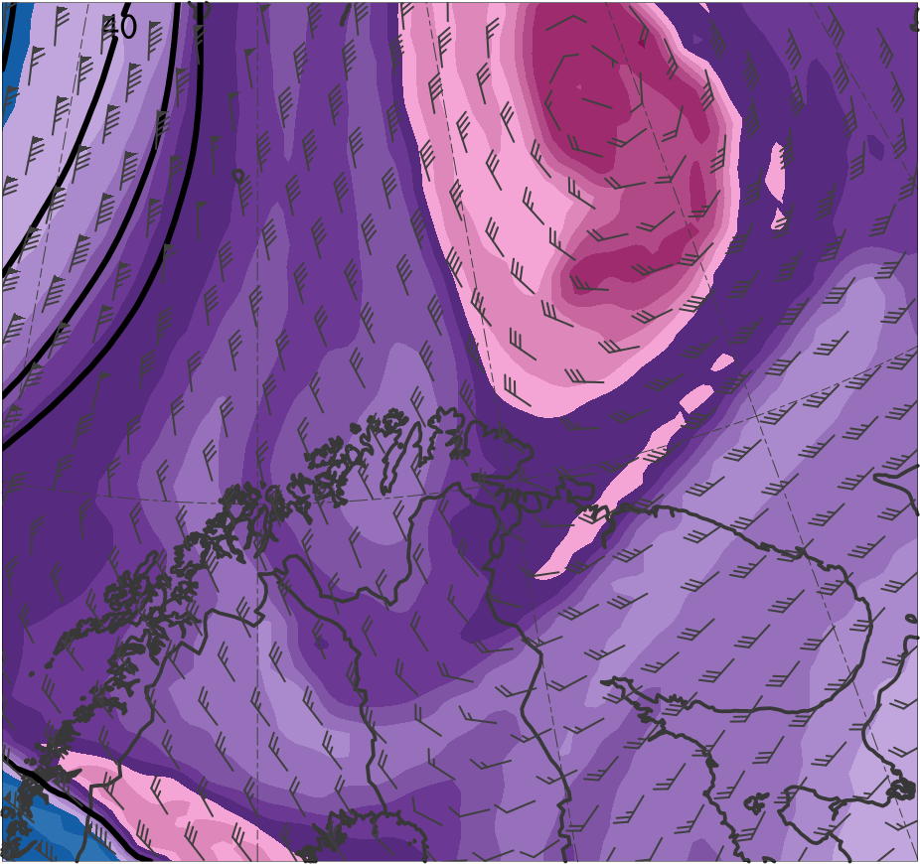
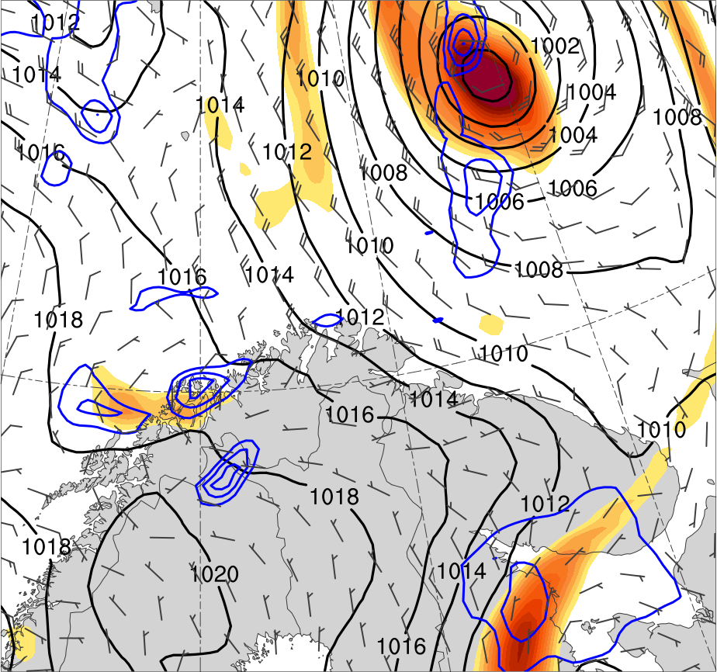
Mesoscale Evolution
0000 UTC 10 Feb 2011
(K)
252
258
264
270
276
282
288
294
300
306
312
318
324
330
336
342
348
354
360
366
372
378
6
8
10
12
14
16
18
20
22
24
26
28
30
Potential temperature (K, shaded), wind speed (black, every 10 m s⁻¹ starting at 30 m s⁻¹), and wind (m s⁻¹, flags and barbs) on 2-PVU surface
850-hPa relative vorticity (10⁻⁵ s⁻¹, shaded),
850–600-hPa ascent (blue, every 2.5 × 10⁻³ hPa s⁻¹),
SLP (hPa, black), 10-m wind (m s⁻¹, barbs)

Slide 36
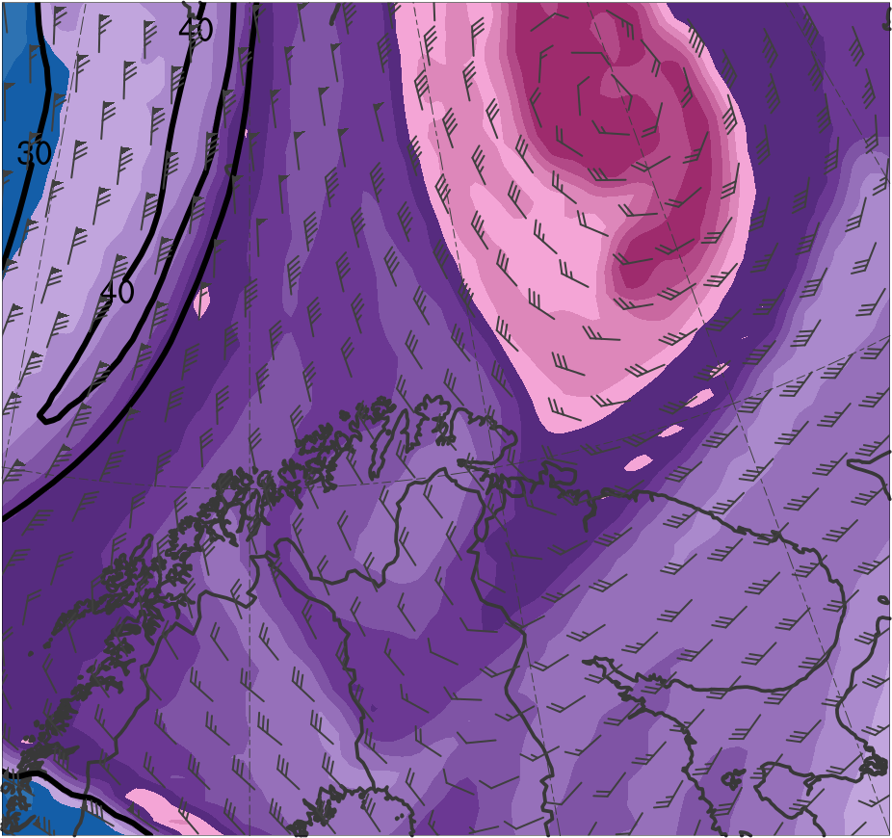
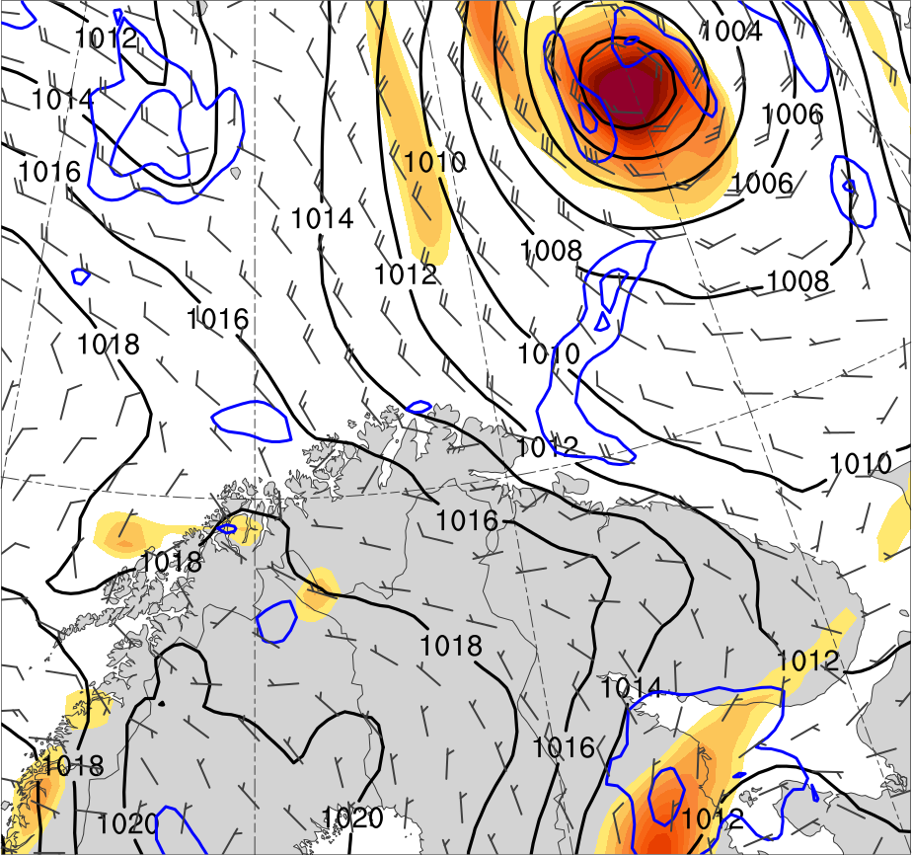
Mesoscale Evolution
0300 UTC 10 Feb 2011
(K)
252
258
264
270
276
282
288
294
300
306
312
318
324
330
336
342
348
354
360
366
372
378
6
8
10
12
14
16
18
20
22
24
26
28
30
Potential temperature (K, shaded), wind speed (black, every 10 m s⁻¹ starting at 30 m s⁻¹), and wind (m s⁻¹, flags and barbs) on 2-PVU surface
850-hPa relative vorticity (10⁻⁵ s⁻¹, shaded),
850–600-hPa ascent (blue, every 2.5 × 10⁻³ hPa s⁻¹),
SLP (hPa, black), 10-m wind (m s⁻¹, barbs)

Slide 37
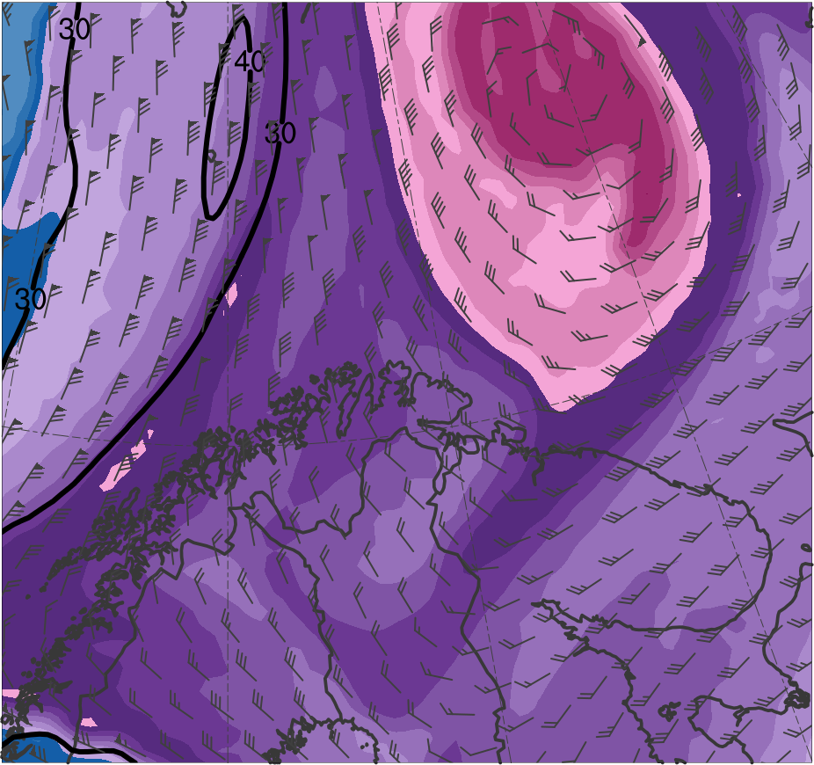
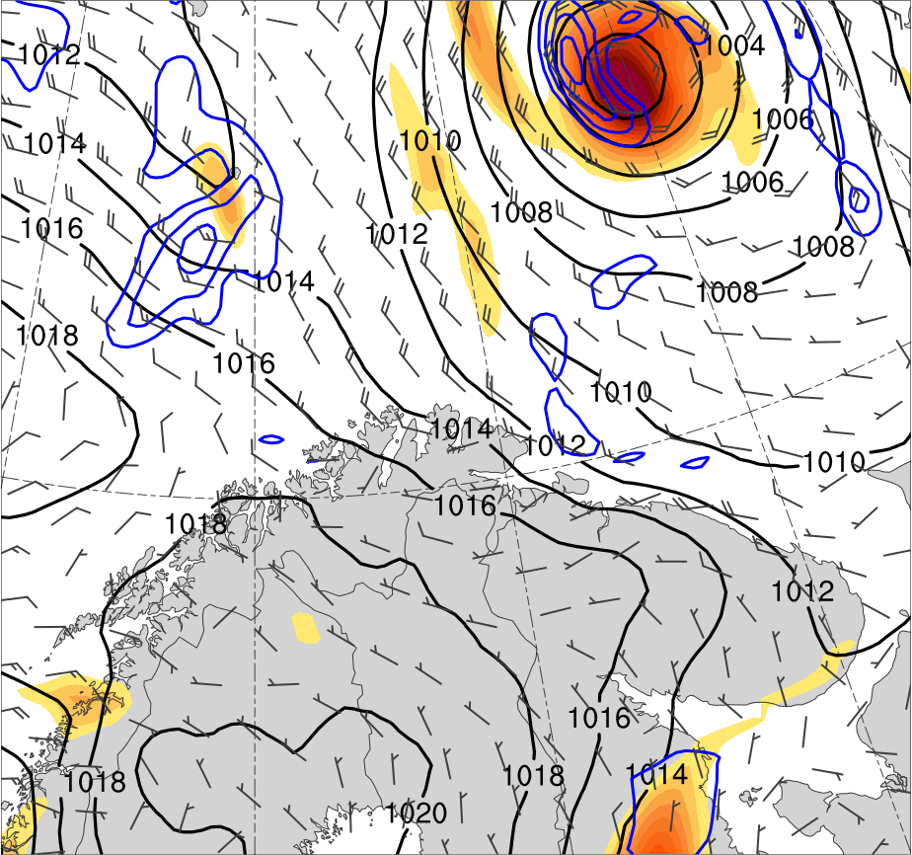
Mesoscale Evolution
0600 UTC 10 Feb 2011
(K)
252
258
264
270
276
282
288
294
300
306
312
318
324
330
336
342
348
354
360
366
372
378
6
8
10
12
14
16
18
20
22
24
26
28
30
Potential temperature (K, shaded), wind speed (black, every 10 m s⁻¹ starting at 30 m s⁻¹), and wind (m s⁻¹, flags and barbs) on 2-PVU surface
850-hPa relative vorticity (10⁻⁵ s⁻¹, shaded),
850–600-hPa ascent (blue, every 2.5 × 10⁻³ hPa s⁻¹),
SLP (hPa, black), 10-m wind (m s⁻¹, barbs)

Slide 38
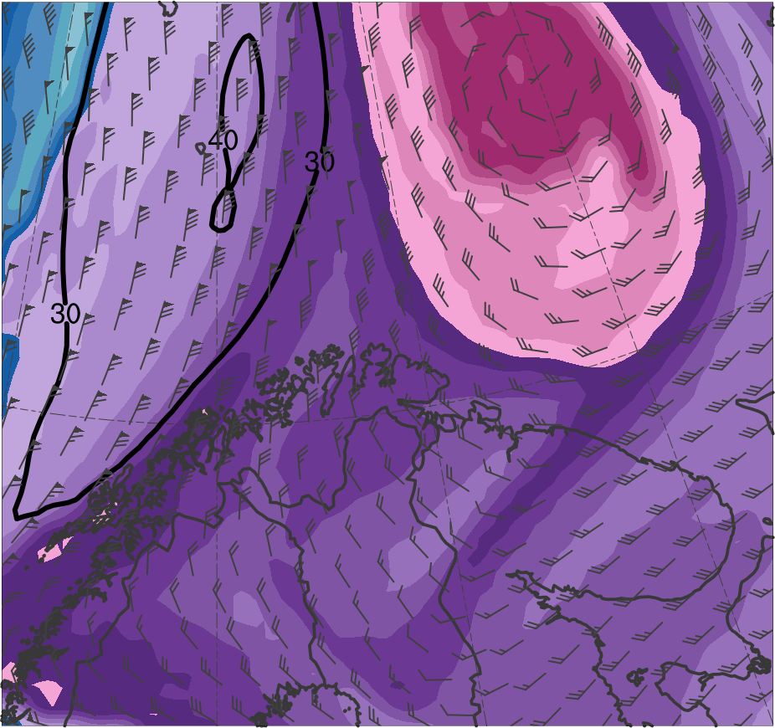
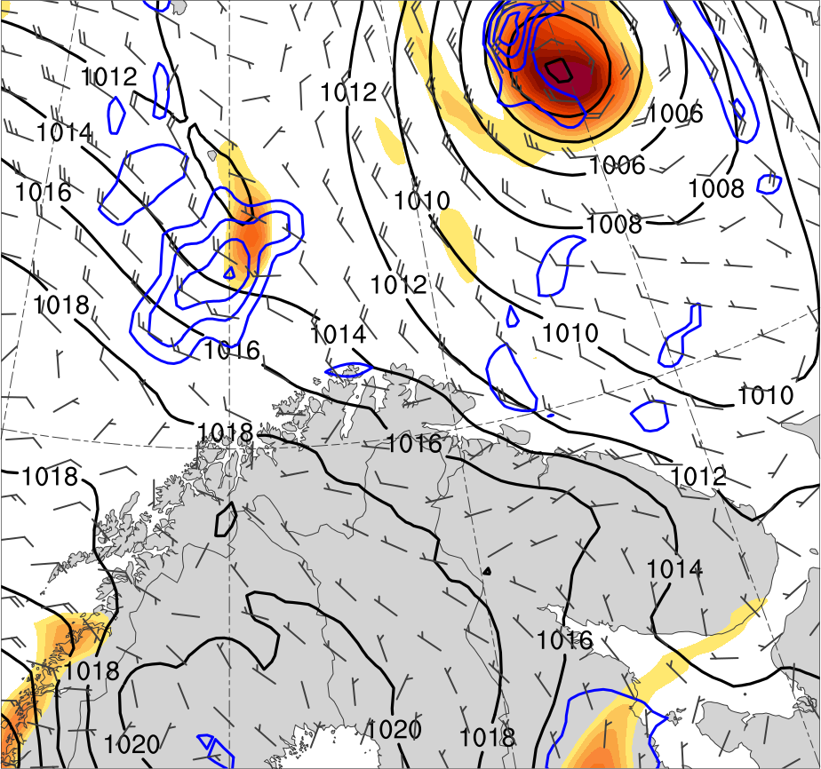
Mesoscale Evolution
0900 UTC 10 Feb 2011
(K)
252
258
264
270
276
282
288
294
300
306
312
318
324
330
336
342
348
354
360
366
372
378
6
8
10
12
14
16
18
20
22
24
26
28
30
Potential temperature (K, shaded), wind speed (black, every 10 m s⁻¹ starting at 30 m s⁻¹), and wind (m s⁻¹, flags and barbs) on 2-PVU surface
850-hPa relative vorticity (10⁻⁵ s⁻¹, shaded),
850–600-hPa ascent (blue, every 2.5 × 10⁻³ hPa s⁻¹),
SLP (hPa, black), 10-m wind (m s⁻¹, barbs)

Slide 39
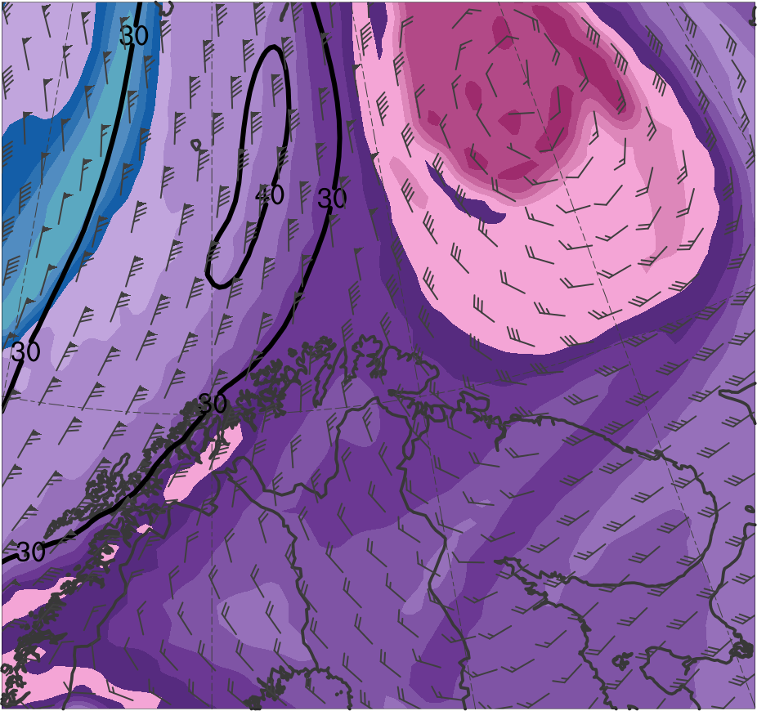
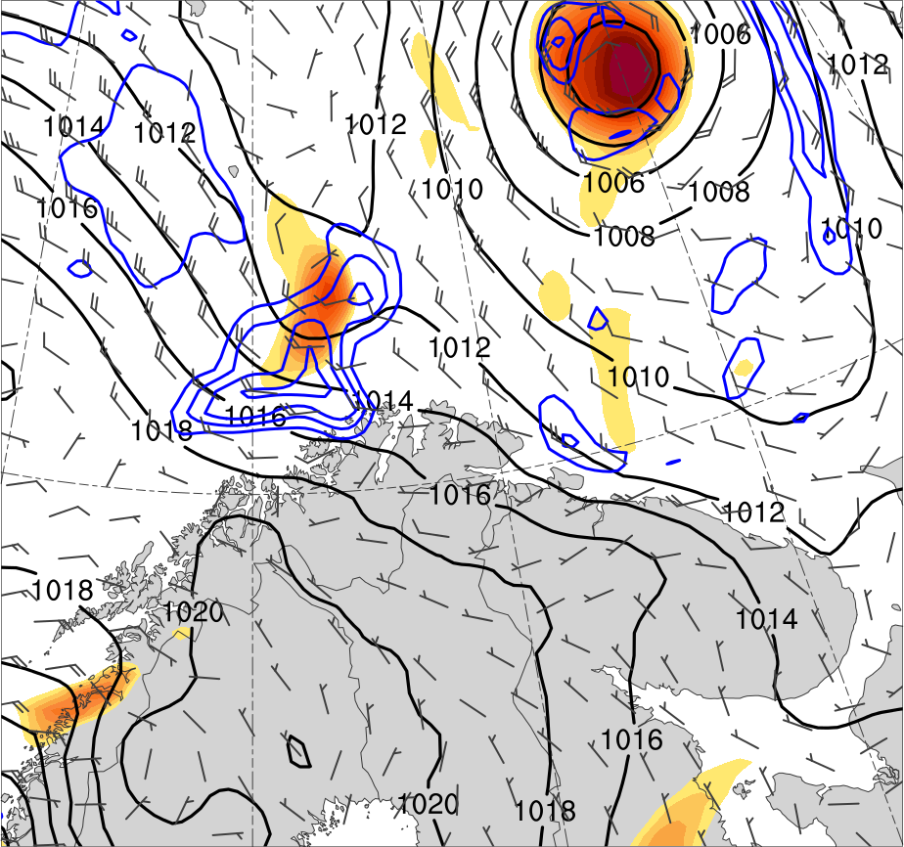
Mesoscale Evolution
1200 UTC 10 Feb 2011
(K)
252
258
264
270
276
282
288
294
300
306
312
318
324
330
336
342
348
354
360
366
372
378
6
8
10
12
14
16
18
20
22
24
26
28
30
Potential temperature (K, shaded), wind speed (black, every 10 m s⁻¹ starting at 30 m s⁻¹), and wind (m s⁻¹, flags and barbs) on 2-PVU surface
850-hPa relative vorticity (10⁻⁵ s⁻¹, shaded),
850–600-hPa ascent (blue, every 2.5 × 10⁻³ hPa s⁻¹),
SLP (hPa, black), 10-m wind (m s⁻¹, barbs)

Slide 40
Mesoscale Evolution
1500 UTC 10 Feb 2011
(K)
252
258
264
270
276
282
288
294
300
306
312
318
324
330
336
342
348
354
360
366
372
378
6
8
10
12
14
16
18
20
22
24
26
28
30
Potential temperature (K, shaded), wind speed (black, every 10 m s⁻¹ starting at 30 m s⁻¹), and wind (m s⁻¹, flags and barbs) on 2-PVU surface
850-hPa relative vorticity (10⁻⁵ s⁻¹, shaded),
850–600-hPa ascent (blue, every 2.5 × 10⁻³ hPa s⁻¹),
SLP (hPa, black), 10-m wind (m s⁻¹, barbs)

Slide 41
Mesoscale Evolution
1800 UTC 10 Feb 2011
PL
(K)
252
258
264
270
276
282
288
294
300
306
312
318
324
330
336
342
348
354
360
366
372
378
6
8
10
12
14
16
18
20
22
24
26
28
30
Potential temperature (K, shaded), wind speed (black, every 10 m s⁻¹ starting at 30 m s⁻¹), and wind (m s⁻¹, flags and barbs) on 2-PVU surface
850-hPa relative vorticity (10⁻⁵ s⁻¹, shaded),
850–600-hPa ascent (blue, every 2.5 × 10⁻³ hPa s⁻¹),
SLP (hPa, black), 10-m wind (m s⁻¹, barbs)

Slide 42
Mesoscale Evolution
2100 UTC 10 Feb 2011
PL
(K)
252
258
264
270
276
282
288
294
300
306
312
318
324
330
336
342
348
354
360
366
372
378
6
8
10
12
14
16
18
20
22
24
26
28
30
Potential temperature (K, shaded), wind speed (black, every 10 m s⁻¹ starting at 30 m s⁻¹), and wind (m s⁻¹, flags and barbs) on 2-PVU surface
850-hPa relative vorticity (10⁻⁵ s⁻¹, shaded),
850–600-hPa ascent (blue, every 2.5 × 10⁻³ hPa s⁻¹),
SLP (hPa, black), 10-m wind (m s⁻¹, barbs)

Slide 43
Mesoscale Evolution
0000 UTC 11 Feb 2011
PL
(K)
252
258
264
270
276
282
288
294
300
306
312
318
324
330
336
342
348
354
360
366
372
378
6
8
10
12
14
16
18
20
22
24
26
28
30
Potential temperature (K, shaded), wind speed (black, every 10 m s⁻¹ starting at 30 m s⁻¹), and wind (m s⁻¹, flags and barbs) on 2-PVU surface
850-hPa relative vorticity (10⁻⁵ s⁻¹, shaded),
850–600-hPa ascent (blue, every 2.5 × 10⁻³ hPa s⁻¹),
SLP (hPa, black), 10-m wind (m s⁻¹, barbs)

Slide 44
Mesoscale Evolution
0300 UTC 11 Feb 2011
PL
(K)
252
258
264
270
276
282
288
294
300
306
312
318
324
330
336
342
348
354
360
366
372
378
6
8
10
12
14
16
18
20
22
24
26
28
30
Potential temperature (K, shaded), wind speed (black, every 10 m s⁻¹ starting at 30 m s⁻¹), and wind (m s⁻¹, flags and barbs) on 2-PVU surface
850-hPa relative vorticity (10⁻⁵ s⁻¹, shaded),
850–600-hPa ascent (blue, every 2.5 × 10⁻³ hPa s⁻¹),
SLP (hPa, black), 10-m wind (m s⁻¹, barbs)

Slide 45
Mesoscale Evolution
0600 UTC 11 Feb 2011
PL
(K)
252
258
264
270
276
282
288
294
300
306
312
318
324
330
336
342
348
354
360
366
372
378
6
8
10
12
14
16
18
20
22
24
26
28
30
Potential temperature (K, shaded), wind speed (black, every 10 m s⁻¹ starting at 30 m s⁻¹), and wind (m s⁻¹, flags and barbs) on 2-PVU surface
850-hPa relative vorticity (10⁻⁵ s⁻¹, shaded),
850–600-hPa ascent (blue, every 2.5 × 10⁻³ hPa s⁻¹),
SLP (hPa, black), 10-m wind (m s⁻¹, barbs)

Slide 46
Mesoscale Evolution
0900 UTC 11 Feb 2011
PL
(K)
252
258
264
270
276
282
288
294
300
306
312
318
324
330
336
342
348
354
360
366
372
378
6
8
10
12
14
16
18
20
22
24
26
28
30
Potential temperature (K, shaded), wind speed (black, every 10 m s⁻¹ starting at 30 m s⁻¹), and wind (m s⁻¹, flags and barbs) on 2-PVU surface
850-hPa relative vorticity (10⁻⁵ s⁻¹, shaded),
850–600-hPa ascent (blue, every 2.5 × 10⁻³ hPa s⁻¹),
SLP (hPa, black), 10-m wind (m s⁻¹, barbs)

Slide 47
Mesoscale Evolution
1200 UTC 11 Feb 2011
PL
(K)
252
258
264
270
276
282
288
294
300
306
312
318
324
330
336
342
348
354
360
366
372
378
6
8
10
12
14
16
18
20
22
24
26
28
30
Potential temperature (K, shaded), wind speed (black, every 10 m s⁻¹ starting at 30 m s⁻¹), and wind (m s⁻¹, flags and barbs) on 2-PVU surface
850-hPa relative vorticity (10⁻⁵ s⁻¹, shaded),
850–600-hPa ascent (blue, every 2.5 × 10⁻³ hPa s⁻¹),
SLP (hPa, black), 10-m wind (m s⁻¹, barbs)

Slide 48
Mesoscale Evolution
1500 UTC 11 Feb 2011
PL
(K)
252
258
264
270
276
282
288
294
300
306
312
318
324
330
336
342
348
354
360
366
372
378
6
8
10
12
14
16
18
20
22
24
26
28
30
Potential temperature (K, shaded), wind speed (black, every 10 m s⁻¹ starting at 30 m s⁻¹), and wind (m s⁻¹, flags and barbs) on 2-PVU surface
850-hPa relative vorticity (10⁻⁵ s⁻¹, shaded),
850–600-hPa ascent (blue, every 2.5 × 10⁻³ hPa s⁻¹),
SLP (hPa, black), 10-m wind (m s⁻¹, barbs)

Slide 49
Mesoscale Evolution
1800 UTC 11 Feb 2011
PL
(K)
252
258
264
270
276
282
288
294
300
306
312
318
324
330
336
342
348
354
360
366
372
378
6
8
10
12
14
16
18
20
22
24
26
28
30
Potential temperature (K, shaded), wind speed (black, every 10 m s⁻¹ starting at 30 m s⁻¹), and wind (m s⁻¹, flags and barbs) on 2-PVU surface
850-hPa relative vorticity (10⁻⁵ s⁻¹, shaded),
850–600-hPa ascent (blue, every 2.5 × 10⁻³ hPa s⁻¹),
SLP (hPa, black), 10-m wind (m s⁻¹, barbs)

Slide 50
Mesoscale Evolution
2100 UTC 11 Feb 2011
PL
(K)
252
258
264
270
276
282
288
294
300
306
312
318
324
330
336
342
348
354
360
366
372
378
6
8
10
12
14
16
18
20
22
24
26
28
30
Potential temperature (K, shaded), wind speed (black, every 10 m s⁻¹ starting at 30 m s⁻¹), and wind (m s⁻¹, flags and barbs) on 2-PVU surface
850-hPa relative vorticity (10⁻⁵ s⁻¹, shaded),
850–600-hPa ascent (blue, every 2.5 × 10⁻³ hPa s⁻¹),
SLP (hPa, black), 10-m wind (m s⁻¹, barbs)

Slide 51
Favorable Conditions
0300 UTC 11 Feb 2011
TPV
TPV
PL
PL
-10
-7.5
-5
-4
-3
-2
-1
-0.5
0
0.5
1
2
3
4
5
7.5
10
0.5
1
1.5
2
2.5
3
3.5
4
5
6
7
8
SLP (hPa, blue); 600–400-hPa Q (K m⁻¹ s⁻¹, vectors), Q forcing for vertical motion (10⁻¹⁷ Pa⁻¹ s⁻³, shaded), θ (°C, red dashed), and geopotential height (dam, black)
900–600-hPa static stability [K (100 hPa)⁻¹, shaded],
SLP (hPa, black)

Slide 52
Favorable Conditions
0300 UTC 11 Feb 2011
PL
PL
-160
-140
-120
-100
-80
-60
-40
-20
0
20
40
60
80
100
120
140
160
ERA5 forecast sensible heat flux [W m⁻², shaded],
SLP (hPa, black), and 10-m wind (m s⁻¹, barbs)
ERA5 forecast latent heat flux [W m⁻², shaded],
SLP (hPa, black), and 10-m wind (m s⁻¹, barbs)

Slide 53
Cross Sections
0300 UTC 11 Feb 2011
(a)
(b)
A
378
12
TPV
372
30
366
28
10
360
354
26
8
348
342
24
6
336
330
22
4
A’
324
20
3
A
318
18
(c)
312
2
306
16
300
1.5
294
14
TPV
288
12
1
PL
282
276
10
0.5
PL
270
264
8
0.25
258
6
A’
252
(PVU)
A
75.0°N, 34.5°E
72.0°N, 34.5°E
69.0°N, 34.5°E
A’
(K)
(a) PV (PVU, shaded), θ (K, black), ascent (red, every 2.5 × 10⁻³ hPa s⁻¹), and wind speed (dashed white, m s⁻¹); (b) DT (2-PVU surface) θ (K, shaded), wind speed (black, m s⁻¹), and wind (m s⁻¹, flags and barbs); (c) 850-hPa relative vorticity (10⁻⁵ s⁻¹, shaded), 850–600-hPa ascent (blue, every 2.5 × 10⁻³ hPa s⁻¹), SLP (hPa, black),10-m wind (m s⁻¹, barbs)

Slide 54
Cross Sections
0300 UTC 11 Feb 2011
(a)
(b)
378
12
TPV
372
30
366
28
10
360
B’
354
26
8
348
B
342
24
6
336
330
22
4
324
20
3
318
18
(c)
312
2
TPV
306
16
300
1.5
294
14
B’
288
12
1
PL
282
276
10
0.5
PL
B
270
264
8
0.25
258
6
252
(PVU)
B
69.9°N, 30.0°E
69.9°N, 37.5°E
69.9°N, 45.0°E
B’
(K)
(a) PV (PVU, shaded), θ (K, black), ascent (red, every 2.5 × 10⁻³ hPa s⁻¹), and wind speed (dashed white, m s⁻¹); (b) DT (2-PVU surface) θ (K, shaded), wind speed (black, m s⁻¹), and wind (m s⁻¹, flags and barbs); (c) 850-hPa relative vorticity (10⁻⁵ s⁻¹, shaded), 850–600-hPa ascent (blue, every 2.5 × 10⁻³ hPa s⁻¹), SLP (hPa, black),10-m wind (m s⁻¹, barbs)

Slide 55
Research Goals
Analyze the evolution of a polar low that is linked to a TPV
Investigate factors influencing the predictability of the evolution of the polar low

Slide 56
Predictability of the Evolution of Polar Low
Utilize 51-member ECMWF EPS from TIGGE at 0.5° horizontal resolution to evaluate forecast skill associated with the prediction of the evolution of the polar low linked to the TPV
Separate ensemble members into two groups: the most and least accurate ensemble members in terms of track and intensity errors of the polar low
Calculate normalized composite differences between the two groups for selected atmospheric quantities at various forecast times

Slide 57
Predictability of the Evolution of Polar Low
Normalized composite differences are utilized to help address the hypotheses:
Forecast errors in the track and intensity of TPVs may contribute to forecast errors in the track and intensity of polar lows that are linked to TPVs
Forecast errors in the track and intensity of TPVs may lead to forecast errors in the position and structure of Arctic fronts, which may also contribute to forecast errors in the track and intensity of polar lows that are linked to TPVs

Slide 58
Evaluating the Forecast Skill of the Polar Low
Use ECMWF EPS initialized at 1200 UTC 9 February 2011
30 h prior to genesis of polar low according to STARS database
Use ERA5 regridded to 0.5° horizontal resolution as verification

Slide 59
Evaluating the Forecast Skill of the Polar Low
Assess forecast skill of polar low in terms of a metric combining forecast track and intensity error of polar low
Metric calculated by adapting methodology of Lamberson et al. (2016) to rank ensembles by forecast accuracy in terms of track and intensity error for a strong extratropical cyclone
Track and intensity error calculated every 6 h from 1800 UTC 10 Feb 2011 to 1200 UTC 11 Feb 2011 for each ensemble member
This time period corresponds to the time period of the life cycle of the polar low in the STARS database

Slide 60
Evaluating the Forecast Skill of the Polar Low
Track error for each time calculated as the distance between the location of the polar low in ERA5 and in each ensemble member
Location of the polar low at a time corresponds to location of maximum 850-hPa relative vorticity of the polar low at that time
Intensity error for each time calculated as the absolute difference in intensity of the polar low in ERA5 and in each ensemble member
Intensity of the polar low at a time corresponds to maximum value of 850-hPa relative vorticity of the polar low at that time

Slide 61
Evaluating the Forecast Skill of the Polar Low
Start with strongest 850-hPa relative vorticity maximum at 1800 UTC 10 Feb 2011, excluding preexisting cyclone, and track through 1200 UTC 11 Feb 2011
×
ERA 5 (regridded to 0.5°)
ECMWF EPS Member 6
ECMWF EPS Member 47
×
850-hPa relative vorticity (10⁻⁵ s⁻¹, shaded), SLP (hPa, black), 10-m wind (m s⁻¹, barbs) valid 1800 UTC 10 Feb 2011. Position of PL in STARS database at this time shown by cyan dot in left panel.
2
4
6
8
10
12
14
16
18
20
25
30
25

Slide 62
Evaluating the Forecast Skill of the Polar Low
The track and intensity errors are averaged over time and the ensemble members are ranked 1–51 for both track and intensity, with 1 corresponding to the member with lowest average error
The track error rank is added to the intensity error rank to determine a combined track and intensity error rank for each ensemble member
Ensemble members are subdivided into two groups: one containing the eight most accurate members and one containing the eight least accurate members in terms of the combined track and intensity error rank

Slide 63
Calculating Normalized Composite Differences
Following Lamberson et al. (2016), normalized composite differences between the most accurate and least accurate groups of ensemble forecasts are computed for selected atmospheric quantities at various forecast times
= mean of the ith state variable for most accurate ensemble members
= mean of the ith state variable for least accurate ensemble members
= ensemble standard deviation of x_{i} computed from all members

Slide 64
Calculating Statistical Significance
A two-sided Student’s t test will be used to calculate statistical significance of differences between the two groups for means of various quantities

Slide 65
Results: Track and Intensity
Member | Track error rank | Intensity error rank | Combined track and intensity error rank
15 | 1 | 2 | 3
16 | 5 | 3 | 8
41 | 8 | 8 | 16
6 | 10 | 7 | 17
39 | 16 | 9 | 25
1 | 15 | 12 | 27
8 | 17 | 10 | 27
3 | 2 | 27 | 29
45 | 39 | 32 | 71
47 | 30 | 42 | 72
9 | 45 | 28 | 73
36 | 49 | 24 | 73
42 | 38 | 37 | 75
5 | 51 | 34 | 85
48 | 44 | 43 | 87
20 | 46 | 51 | 97
Most accurate
members
Least accurate
members

Slide 66
Results: Track and Intensity
850-hPa relative vorticity (10⁻⁵ s⁻¹)
×
1800 UTC 10 Feb
1200 UTC 11 Feb
(left) Track and (right) maximum 850-hPa relative vorticity value of 850-hPa relative vorticity maximum every 6 h from 1800 UTC 10 Feb 2011 to 1200 UTC 11 Feb 2011 for ERA5, most accurate members, least accurate members, and all other ECMWF EPS members

Slide 67
Results: Track and Intensity
850-hPa relative vorticity (10⁻⁵ s⁻¹)
×
1800 UTC 10 Feb
1200 UTC 11 Feb
Quantity (1800 UTC 10 Feb–1200 UTC 11 Feb) | Most accurate (mean ± stdv) | Least accurate (mean ± stdv) | Difference (confidence level)
Mean lat (°N) | 70.2 ± 0.3 | 68.8 ± 0.7 | +1.4 (99.9%)

Slide 68
Results: Track and Intensity
850-hPa relative vorticity (10⁻⁵ s⁻¹)
×
1800 UTC 10 Feb
1200 UTC 11 Feb
Quantity (1800 UTC 10 Feb–1200 UTC 11 Feb) | Most accurate (mean ± stdv) | Least accurate (mean ± stdv) | Difference (confidence level)
Mean lat (°N) | 70.2 ± 0.3 | 68.8 ± 0.7 | +1.4 (99.9%)
Mean lon (°E) | 33.6 ± 1.7 | 29.5 ± 4.6 | +4.1 (96.6%)

Slide 69
Results: Track and Intensity
850-hPa relative vorticity (10⁻⁵ s⁻¹)
×
1800 UTC 10 Feb
1200 UTC 11 Feb
Quantity (1800 UTC 10 Feb–1200 UTC 11 Feb) | Most accurate (mean ± stdv) | Least accurate (mean ± stdv) | Difference (confidence level)
Mean lat (°N) | 70.2 ± 0.3 | 68.8 ± 0.7 | +1.4 (99.9%)
Mean lon (°E) | 33.6 ± 1.7 | 29.5 ± 4.6 | +4.1 (96.6%)
Max 850-hPa ζ (10⁻⁵ s⁻¹) | 33.1 ± 4.9 | 23.2 ± 5.0 | +9.9 (99.8%)

Slide 70
Results: Track and Intensity
850-hPa relative vorticity (10⁻⁵ s⁻¹)
×
1800 UTC 10 Feb
1200 UTC 11 Feb
Quantity (1800 UTC 10 Feb–1200 UTC 11 Feb) | Most accurate (mean ± stdv) | Least accurate (mean ± stdv) | Difference (confidence level)
Mean lat (°N) | 70.2 ± 0.3 | 68.8 ± 0.7 | +1.4 (99.9%)
Mean lon (°E) | 33.6 ± 1.7 | 29.5 ± 4.6 | +4.1 (96.6%)
Max 850-hPa ζ (10⁻⁵ s⁻¹) | 33.1 ± 4.9 | 23.2 ± 5.0 | +9.9 (99.8%)
Min SLP at max ζ (hPa) | 1003.6 ± 2.6 | 1009.1 ± 3.4 | -5.5 (99.7%)

Slide 71
Composite Differences
1800 UTC 10 Feb 2011 (30 h)
DT θ (K)
500-hPa Z (dam)
R2
2
1.75
R1
1.5
TPV
1.25
1
0.75
0.5
0.25
1000–500-hPa thickness (dam)
850-hPa temperature (K)
0
-0.25
-0.5
-0.75
-1
-1.25
-1.5
-1.75
Most accurate PL
-2
Least accurate PL

Slide 72
Composite Differences
0000 UTC 11 Feb 2011 (36 h)
DT θ (K)
500-hPa Z (dam)
R2
2
1.75
R1
1.5
TPV
1.25
1
0.75
0.5
0.25
1000–500-hPa thickness (dam)
850-hPa temperature (K)
0
-0.25
-0.5
-0.75
-1
-1.25
-1.5
-1.75
Most accurate PL
-2
Least accurate PL

Slide 73
Composite Differences
0600 UTC 11 Feb 2011 (42 h)
DT θ (K)
500-hPa Z (dam)
R2
2
1.75
1.5
R1
1.25
TPV
1
0.75
0.5
0.25
1000–500-hPa thickness (dam)
850-hPa temperature (K)
0
-0.25
-0.5
-0.75
-1
-1.25
-1.5
-1.75
Most accurate PL
-2
Least accurate PL

Slide 74
Composite Differences
1200 UTC 11 Feb 2011 (48 h)
DT θ (K)
500-hPa Z (dam)
R2
2
1.75
1.5
1.25
R1
TPV
1
0.75
0.5
0.25
1000–500-hPa thickness (dam)
850-hPa temperature (K)
0
-0.25
-0.5
-0.75
-1
-1.25
-1.5
-1.75
Most accurate PL
-2
Least accurate PL

Slide 75
Conclusions
Polar low develops near a region of tropospheric deep baroclinicity
TPV and associated cold surge contribute to low values of lower-to-midtropospheric static stability, fostering a favorable environment for polar low development
QG forcing for ascent associated with TPV likely supports development of polar low and associated regions of lower-to-midtropospheric ascent
Associated latent heat release may support and strengthen low-level PV tower associated with polar low, concomitantly allowing the polar low to intensify

Slide 76
Conclusions
R1 and R2 and are significantly less amplified in most accurate group compared to least accurate group
May contribute to significantly northward position and slower equatorward transport of TPV in most accurate group compared to least accurate group
Southeastern portion of R1 and concomitantly, the tropospheric-deep baroclinic zone, are located further to the east in most accurate group compared to least accurate group

Slide 77
Conclusions
Northward position of TPV and eastward position of tropospheric-deep baroclinic zone in most accurate group compared to least accurate group may contribute to:
Significantly farther north and east mean position of polar low in most accurate group compared to least accurate group

Slide 78
Conclusions
Significant track differences in polar low may contribute to significant intensity differences in polar low between two groups
Most accurate and least accurate groups have mean position of polar low over the Barents Sea and Scandinavia, respectively, during 1800 UTC 10 Feb–1200 UTC 11 Feb
Thus, thermodynamic environment is likely much more conducive to polar low development in most accurate group compared to least accurate group

Slide 79
Conclusions
Track errors of TPVs may contribute to track and intensity errors of polar lows
Improved predictability of TPVs may lead to improved predictability of polar lows
ECMWF EPS initialization only 30 h prior to polar low genesis
Even at relatively short lead times, there may be significant differences in evolution of polar low amongst ensemble members, thus polar lows may be difficult to predict

Slide 80
Questions?
Track errors of TPVs may contribute to track and intensity errors of polar lows
Improved predictability of TPVs may lead to improved predictability of polar lows
ECMWF EPS initialization only 30 h prior to polar low genesis
Even at relatively short lead times, there may be significant differences in evolution of polar low amongst ensemble members, thus polar lows may be difficult to predict
Acknowledgments
Special thanks to Jeremy Berman!

