Slide 1
Composite Analyses of Low-Skill Arctic Cyclones During Summer
Kevin Biernat, Lance Bosart, and Dan Keyser
Department of Atmospheric and Environmental Sciences
University at Albany, State University of New York
Monday 8 March 2021
Meeting with Clara Deser
Research Supported by ONR Grant N00014-18-1-2200

Slide 2
Overview
Arctic cyclones (ACs) are synoptic-scale low pressure systems that frequently form over the Arctic or move into the Arctic from lower latitudes during summer.
Forecast error growth associated with interactions between ACs and the synoptic-scale flow over the Arctic, baroclinic processes, and latent heating may contribute to relatively low forecast skill of ACs and the synoptic-scale flow over the Arctic.
Purpose: Examine various features and processes governing the evolution of ACs that are characterized by low forecast skill and that occur during periods of low forecast skill of the synoptic-scale flow over the Arctic during summer.

Slide 3
Arctic forecast skill evaluation
Utilize day-5 forecasts of 500-hPa geopotential height initialized at 0000 UTC during June, July, and August of 2007–2017 from 11-member 1° GEFS reforecast dataset v2 (Hamill et al. 2013).
Calculate area-averaged root mean square error (RMSE) of 500-hPa geopotential height over the Arctic, using ERA-Interim as verification.
Calculate standardized anomaly of area-averaged RMSE (σ_{RMSE}).
Refer to forecast days valid at day 5 associated with the top 10% of σ_{RMSE} as low-skill days and forecasts initialized 5 days prior to low-skill days as low-skill forecasts.
Refer to time periods through day 5 encompassed by low-skill forecasts as low-skill periods.

Slide 4
Identification of low-skill ACs
Create a climatology of ACs occurring during June, July, and August of 2007–2017 by obtaining cyclone tracks from 1° ERA-Interim cyclone climatology prepared by Sprenger et al. (2017).
Deem cyclones that last ≥ 48 h and spend at least some portion of their lifetimes in the Arctic (> 70°N) as ACs.
Select ACs occurring during low-skill periods.

Slide 5
Identification of low-skill ACs
Track ACs in forecasts from GEFS reforecast dataset v2 by utilizing an objective sea level pressure (SLP)-based tracking algorithm (Crawford et al. 2020).
Consider forecasts initialized 120 h prior to the time of lowest SLP of the ACs when located in the Arctic during low-skill periods.
Calculate 120-h intensity RMSE based on minimum SLP of the ACs at the aforementioned time of lowest SLP, using ERA-Interim as verification.
Refer to ACs associated with the top 25% of 120-h intensity RMSE as low-skill ACs during low-skill periods

Slide 6
AC-centered composites
Composite top 25% strongest low-skill ACs during low-skill periods (N = 14) at various lag times relative to the time of lowest SLP of the ACs when located in the Arctic using ERA5 (0.25° × 0.25°).

Slide 7
AC-centered composites
Composite top 25% strongest low-skill ACs during low-skill periods (N = 14) at various lag times relative to the time of lowest SLP of the ACs when located in the Arctic using ERA5 (0.25° × 0.25°).
For each lag time:
Determine mean latitude and longitude of ACs.

Slide 8
AC-centered composites
Composite top 25% strongest low-skill ACs during low-skill periods (N = 14) at various lag times relative to the time of lowest SLP of the ACs when located in the Arctic using ERA5 (0.25° × 0.25°).
For each lag time:
Determine mean latitude and longitude of ACs.
Rotate and project ERA5 grids to a 25 × 25 km Equal-Area Scalable Earth 2.0 (EASE2) grid such that the AC center lies on y-axis (0° longitude) of the EASE2 grid.
EASE2 Grid
(source: NSIDC: https://nsidc.org/ease/ease-grid-projection-gt)

Slide 9
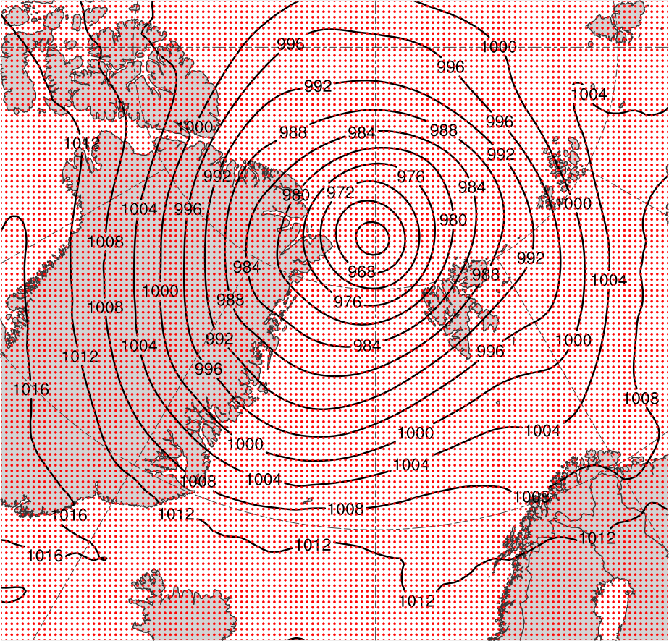
AC-centered composites
Composite top 25% strongest low-skill ACs during low-skill periods (N = 14) at various lag times relative to the time of lowest SLP of the ACs when located in the Arctic using ERA5 (0.25° × 0.25°).
For each lag time:
Determine mean latitude and longitude of ACs.
Rotate and project ERA5 grids to a 25 × 25 km Equal-Area Scalable Earth 2.0 (EASE2) grid such that the AC center lies on y-axis (0° longitude) of the EASE2 grid.
SLP (black) on 25 × 25 km EASE2 grid (grid points in red) valid 1200 UTC 6 Aug 2012

Slide 10
AC-centered composites
Composite top 25% strongest low-skill ACs during low-skill periods (N = 14) at various lag times relative to the time of lowest SLP of the ACs when located in the Arctic using ERA5 (0.25° × 0.25°).
For each lag time:
Determine mean latitude and longitude of ACs.
Rotate and project ERA5 grids to a 25 × 25 km Equal-Area Scalable Earth 2.0 (EASE2) grid such that the AC center lies on y-axis (0° longitude) of the EASE2 grid.
Shift projected grids to mean latitude of ACs.
SLP (black) on 25 × 25 km EASE2 grid (grid points in red) valid 1200 UTC 6 Aug 2012

Slide 11
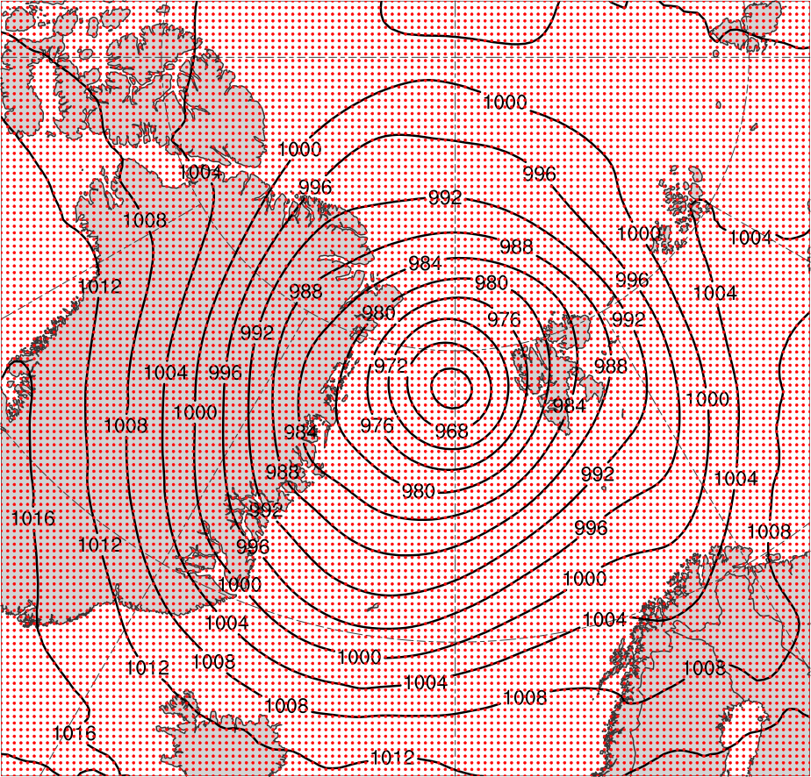
AC-centered composites
Grid before shifting to mean latitude
Grid after shifting to mean latitude

Slide 12
AC-centered composites
Composite top 25% strongest low-skill ACs during low-skill periods (N = 14) at various lag times relative to the time of lowest SLP of the ACs when located in the Arctic using ERA5 (0.25° × 0.25°).
For each lag time:
Determine mean latitude and longitude of ACs.
Rotate and project ERA5 grids to a 25 × 25 km Equal-Area Scalable Earth 2.0 (EASE2) grid such that the AC center lies on y-axis (0° longitude) of the EASE2 grid.
Shift projected grids to mean latitude of ACs.
Rotate shifted grids to mean longitude of ACs.

Slide 13
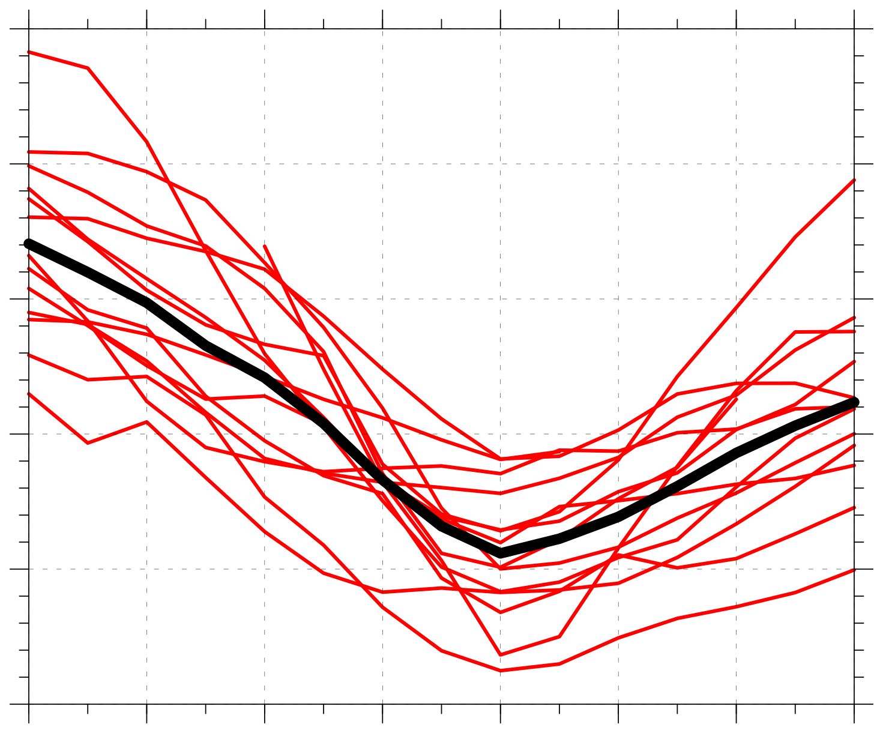
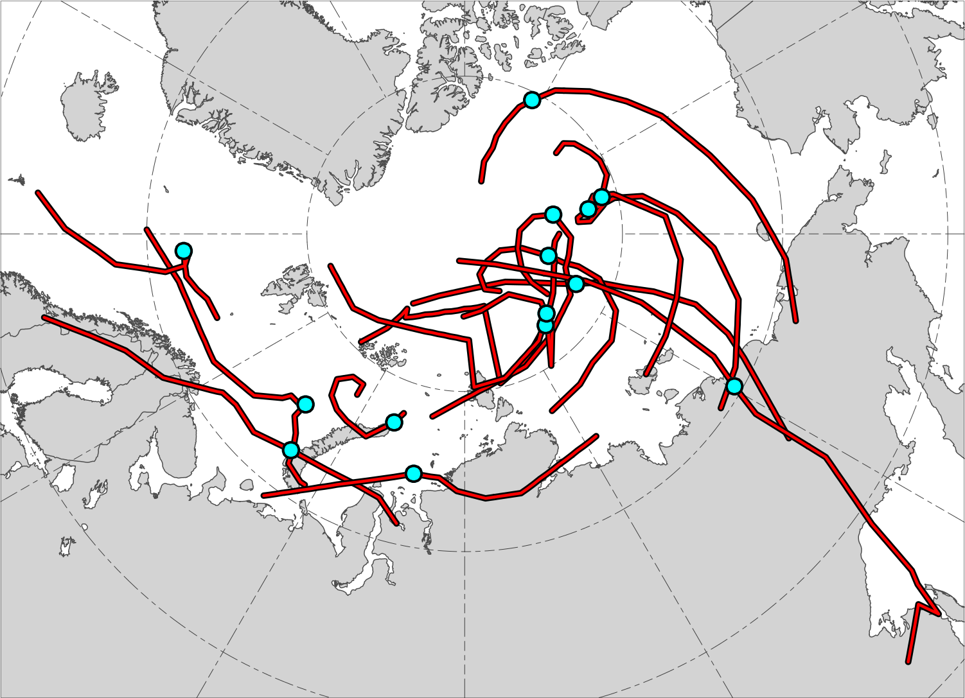
AC-centered composites
N = 14
1010
N = 14
1000
990
Minimum SLP (hPa)
980
970
960
AC location at lag 0 h (time of lowest SLP of AC in Arctic)
−48
−36
−24
−12
0
12
24
36
Lag hour relative to time of lowest SLP of AC in Arctic
Red lines show tracks of ACs during lag –48 h to lag 36 h,
when valid.
Time series of minimum SLP (hPa) of ACs (red) and of mean minimum SLP (hPa) of ACs (black) during lag –48 h to lag 36 h, when valid.

Slide 14
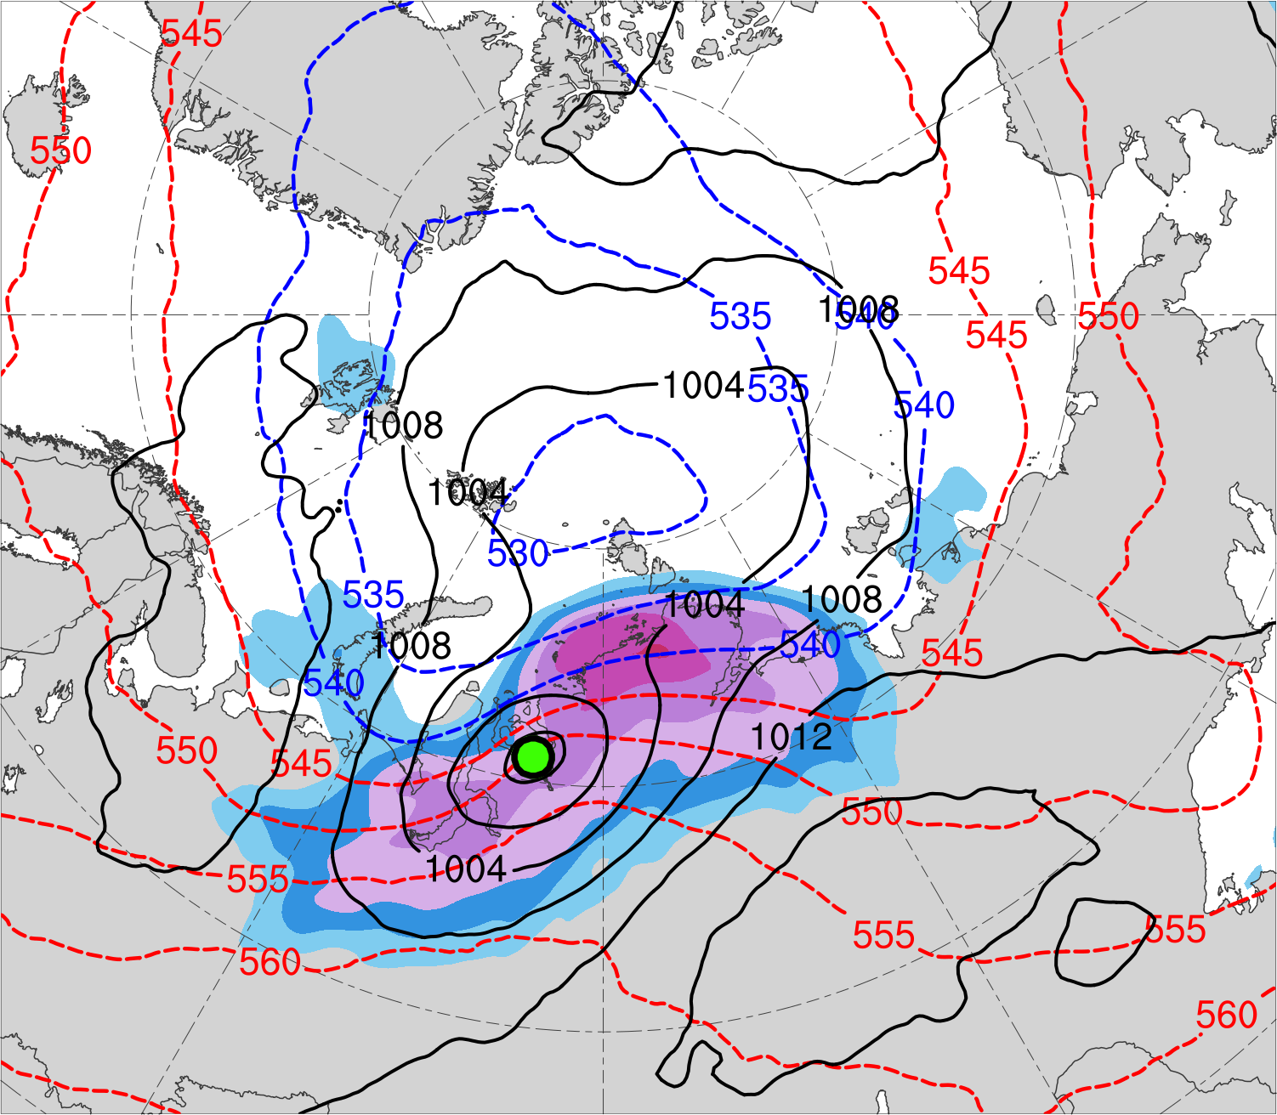
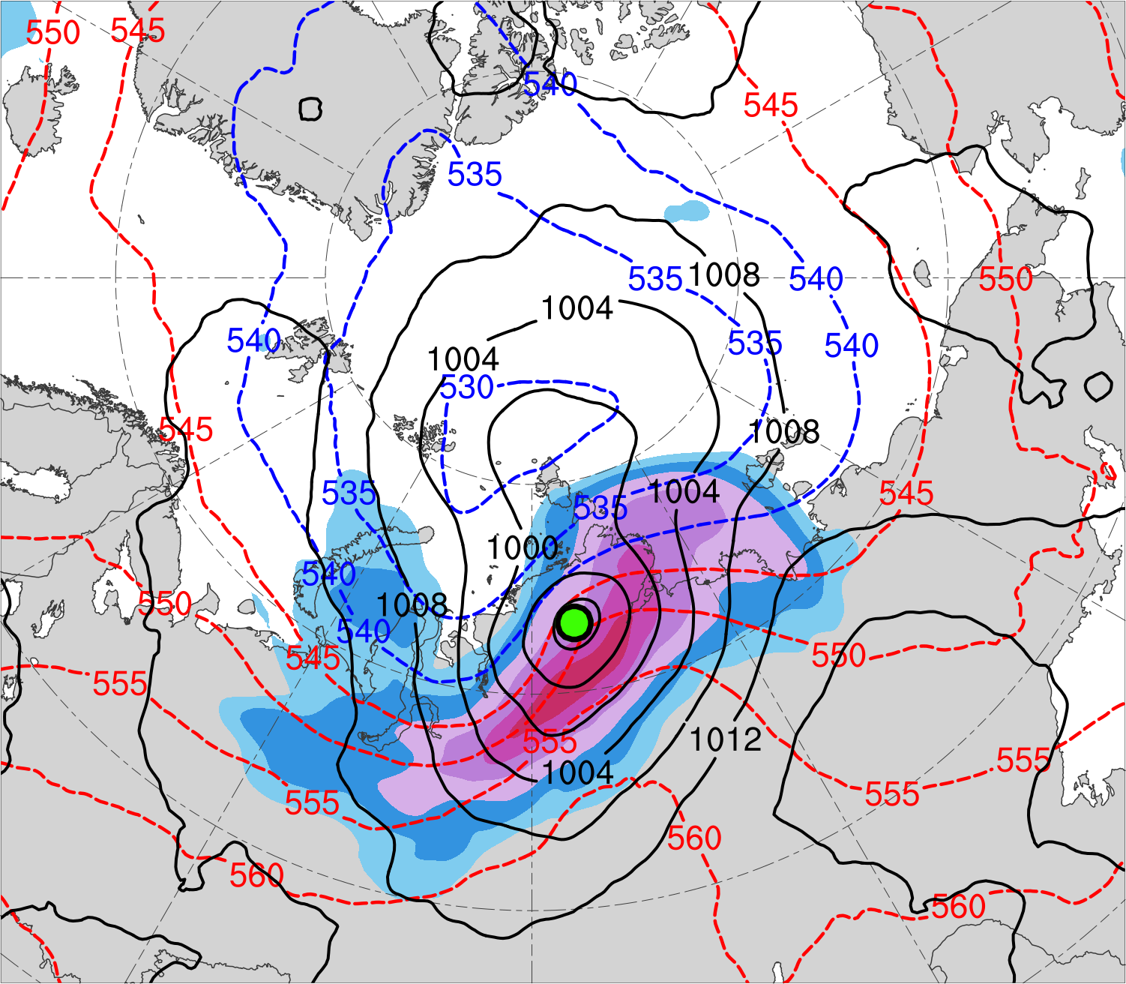
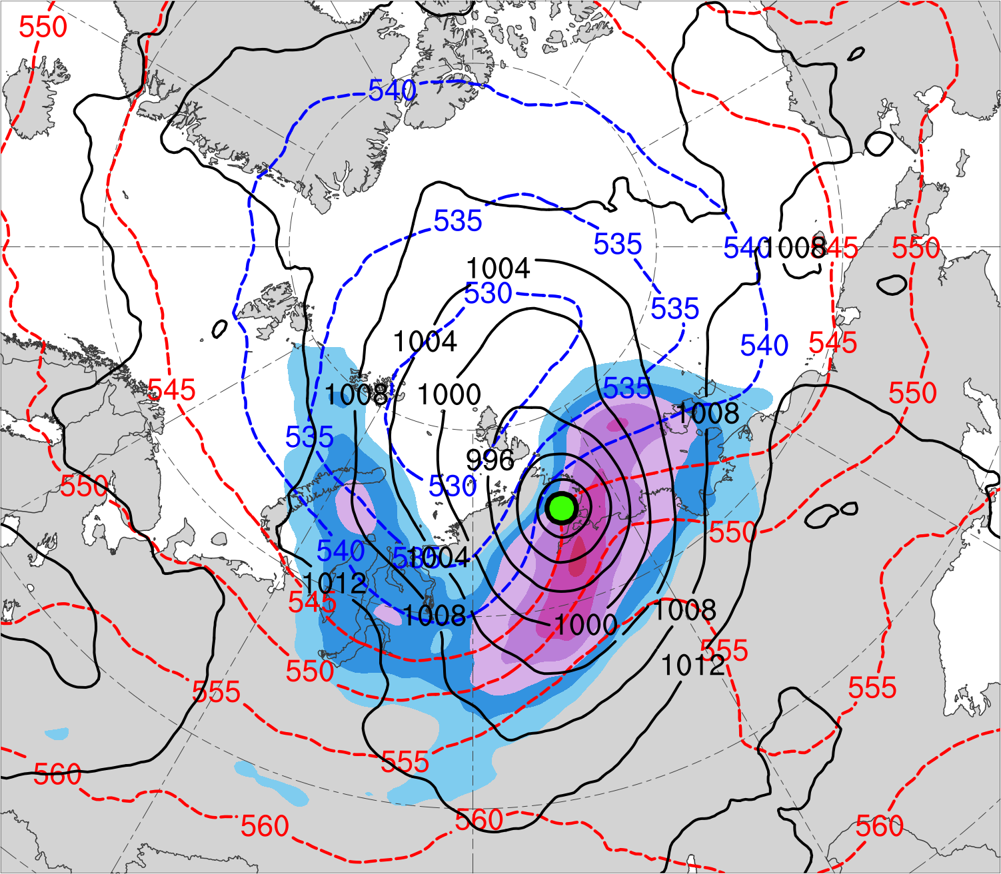
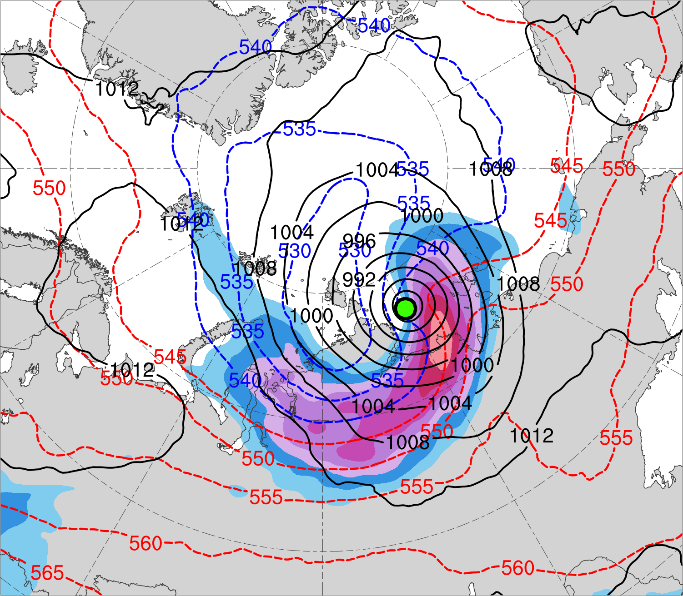
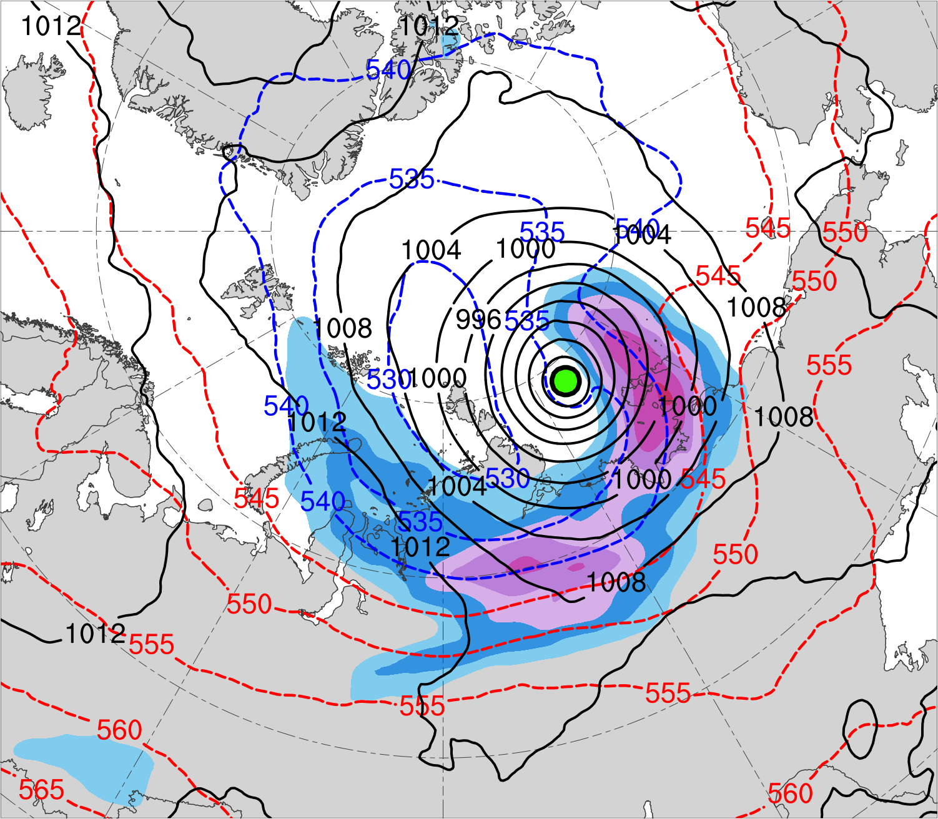
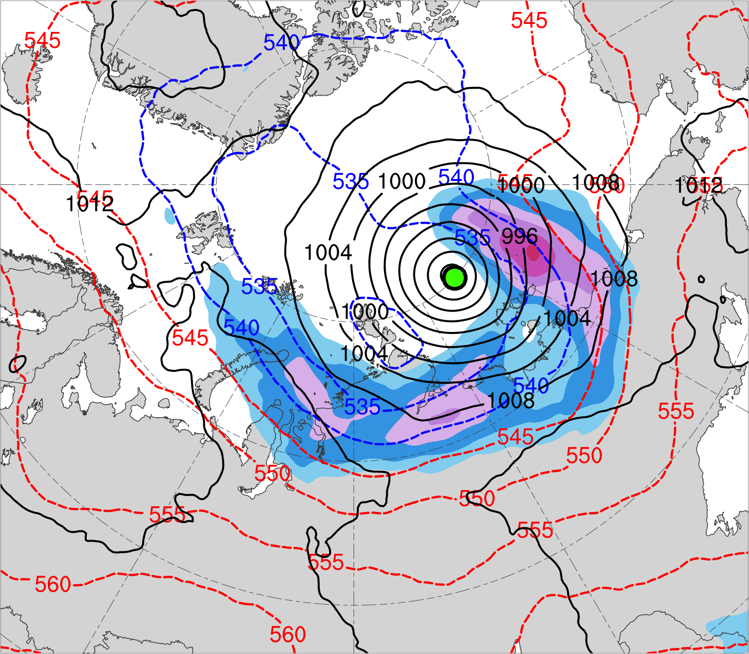
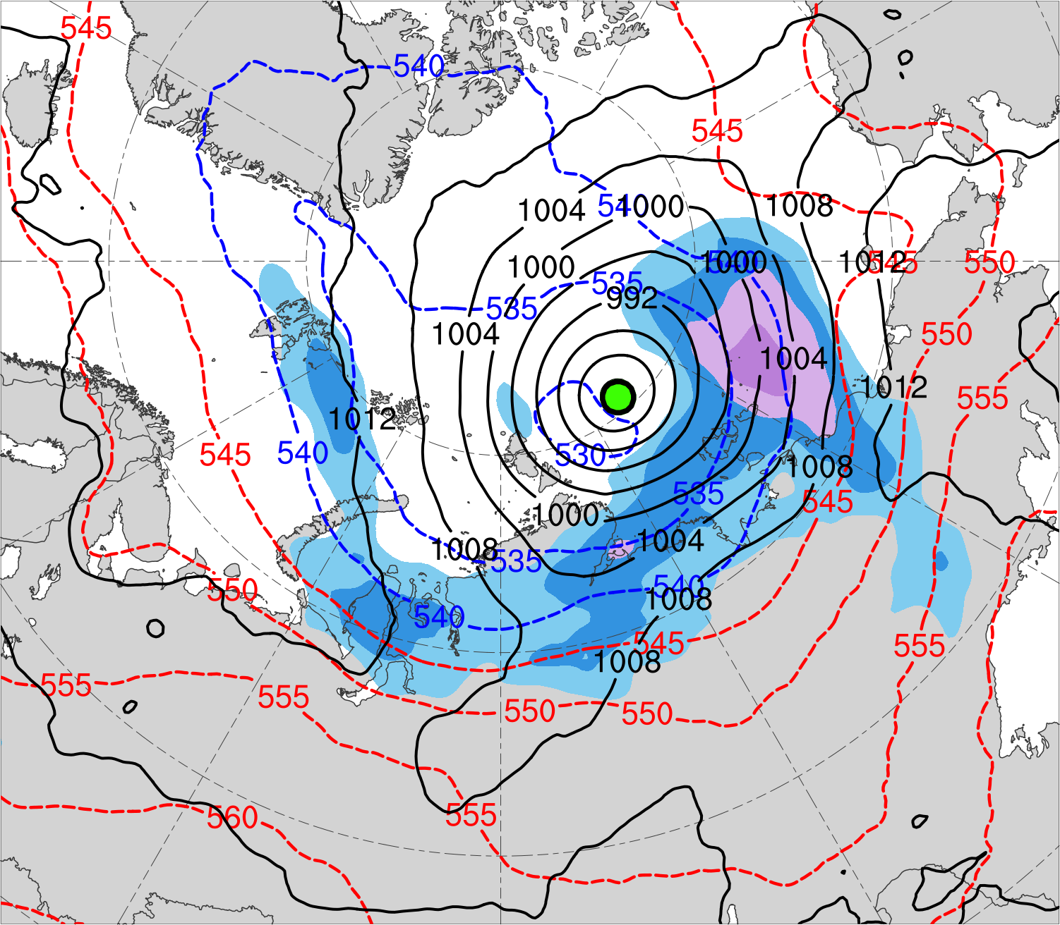
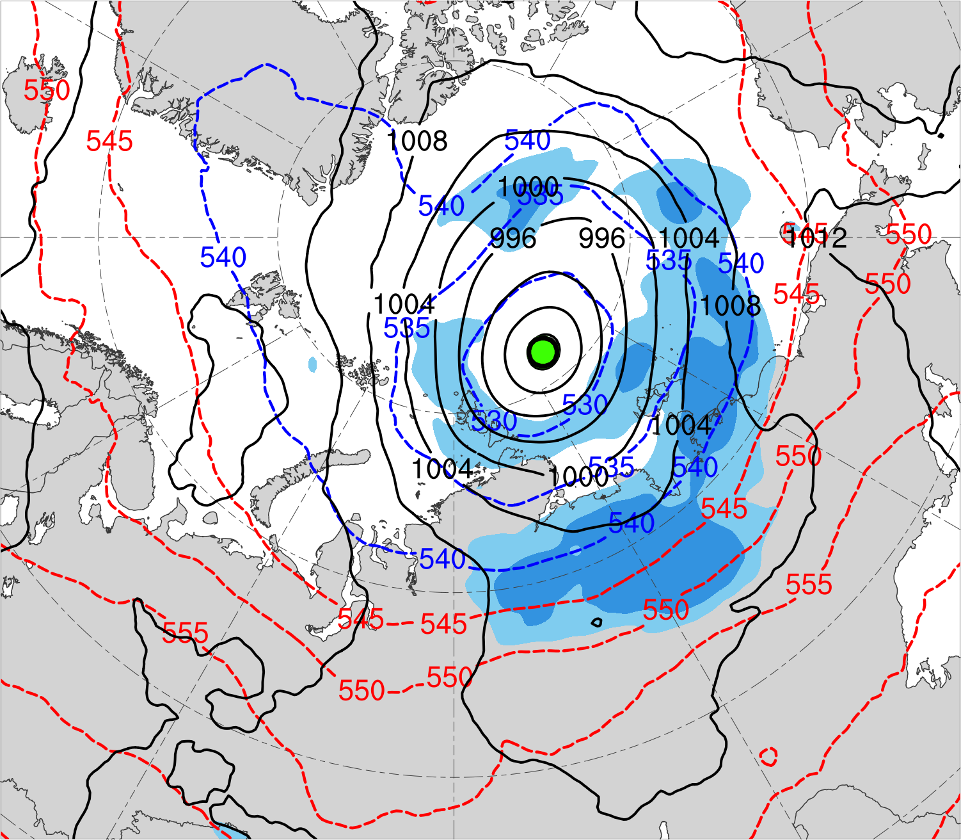
(a) Lag = −48 h (N = 13)
(b) Lag = −36 h (N = 13)
(c) Lag = −24 h (N = 14)
(d) Lag = −12 h (N = 14)
(e) Lag = 0 h (N = 14)
(f) Lag = 12 h (N = 13)
(g) Lag = 24 h (N = 13)
(h) Lag = 36 h (N = 12)
300-hPa wind speed (m s⁻¹)
Mean AC location
18
21
24
27
30
33
36
39
SLP (hPa)
1000–500-hPa thickness (dam)

Slide 15
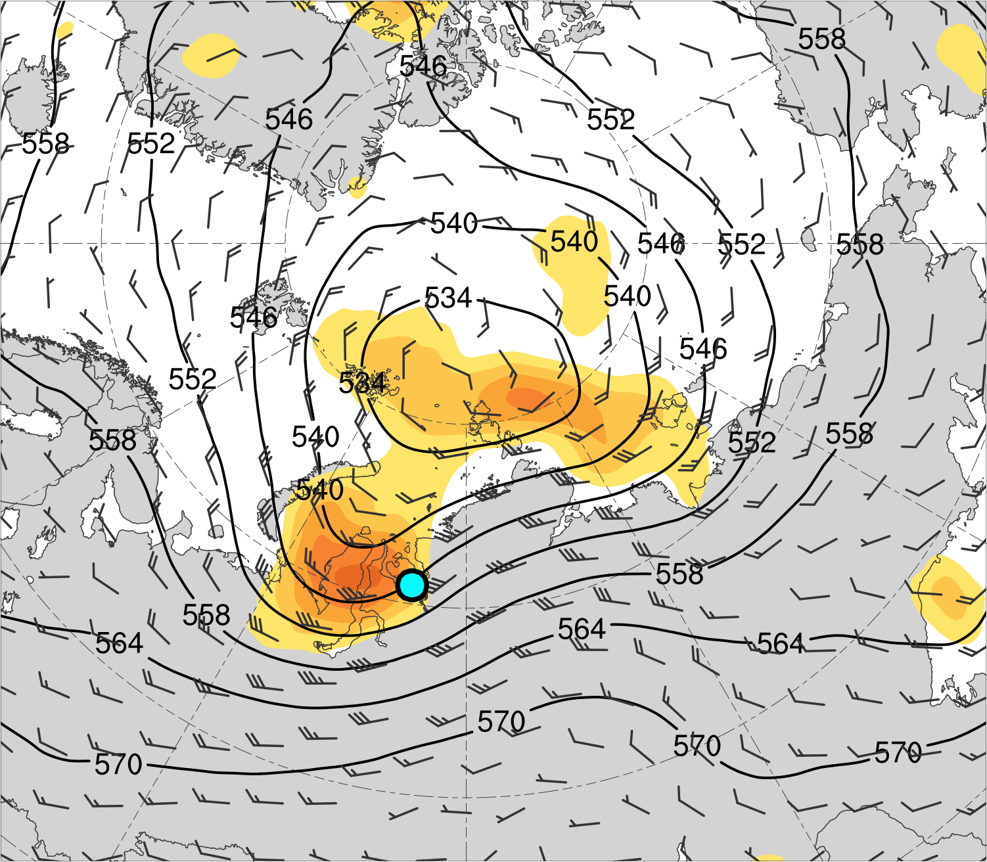
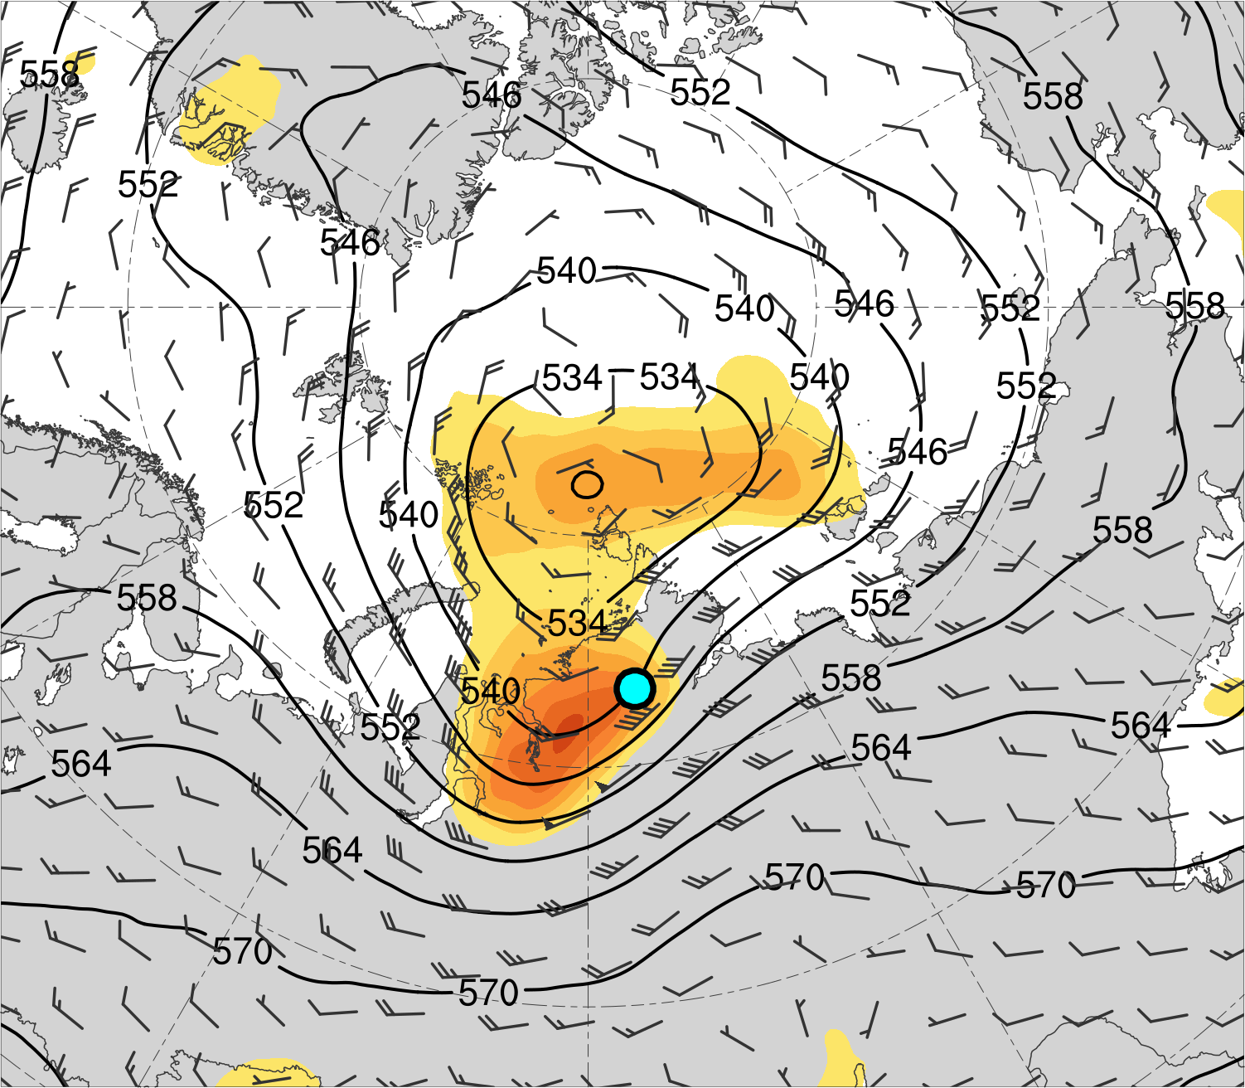
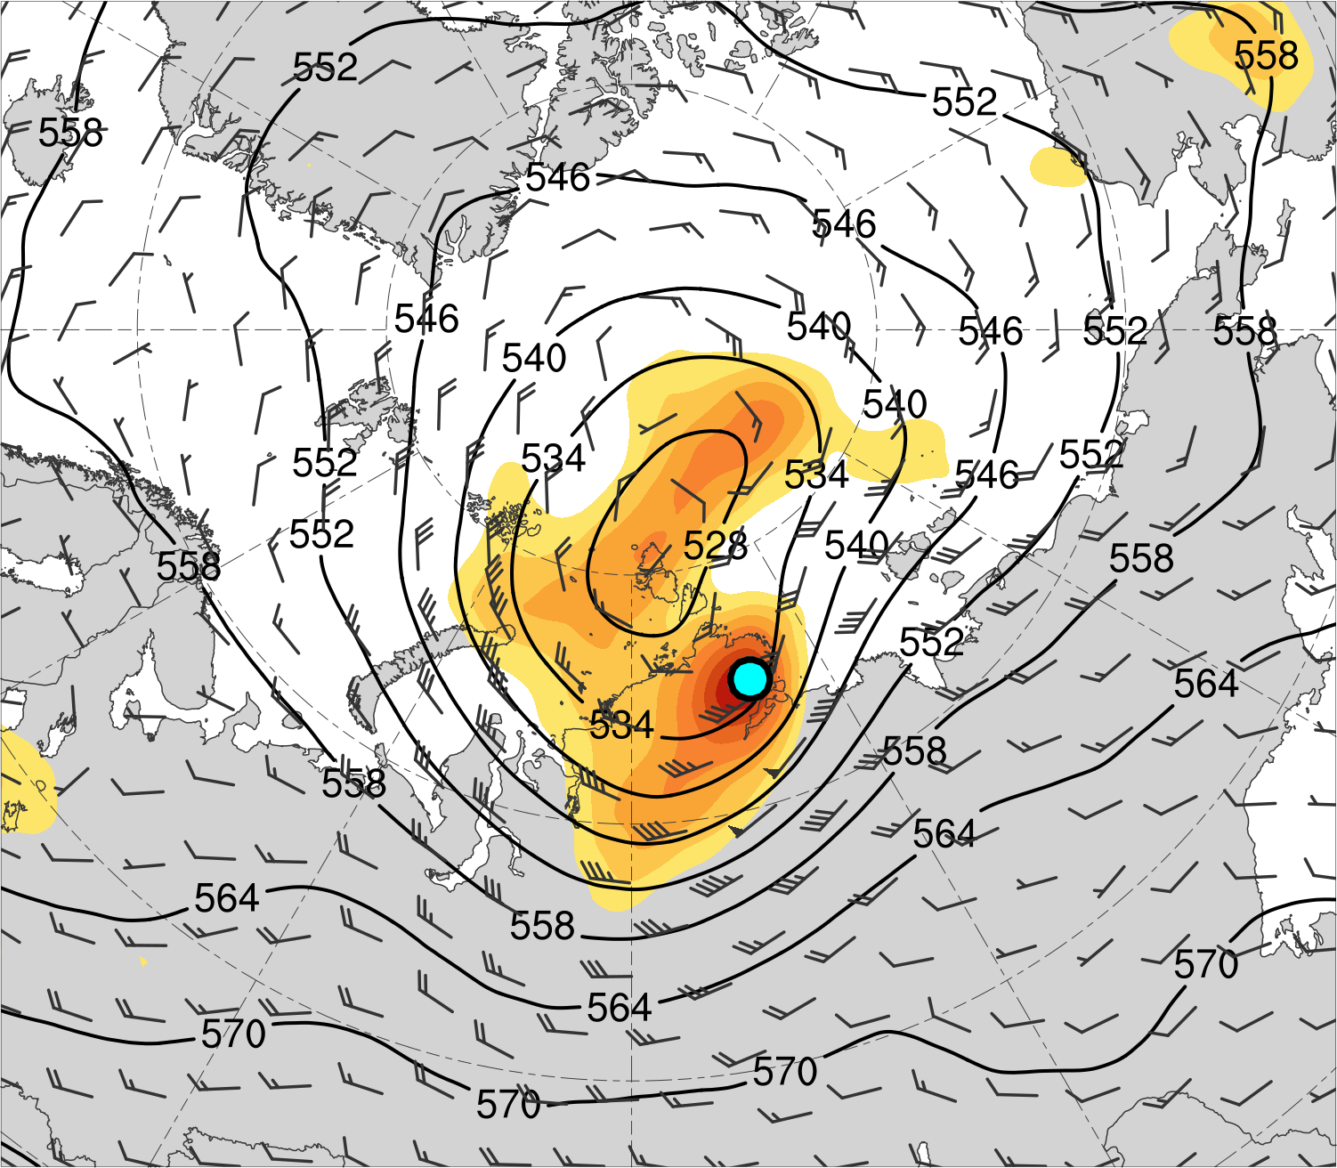
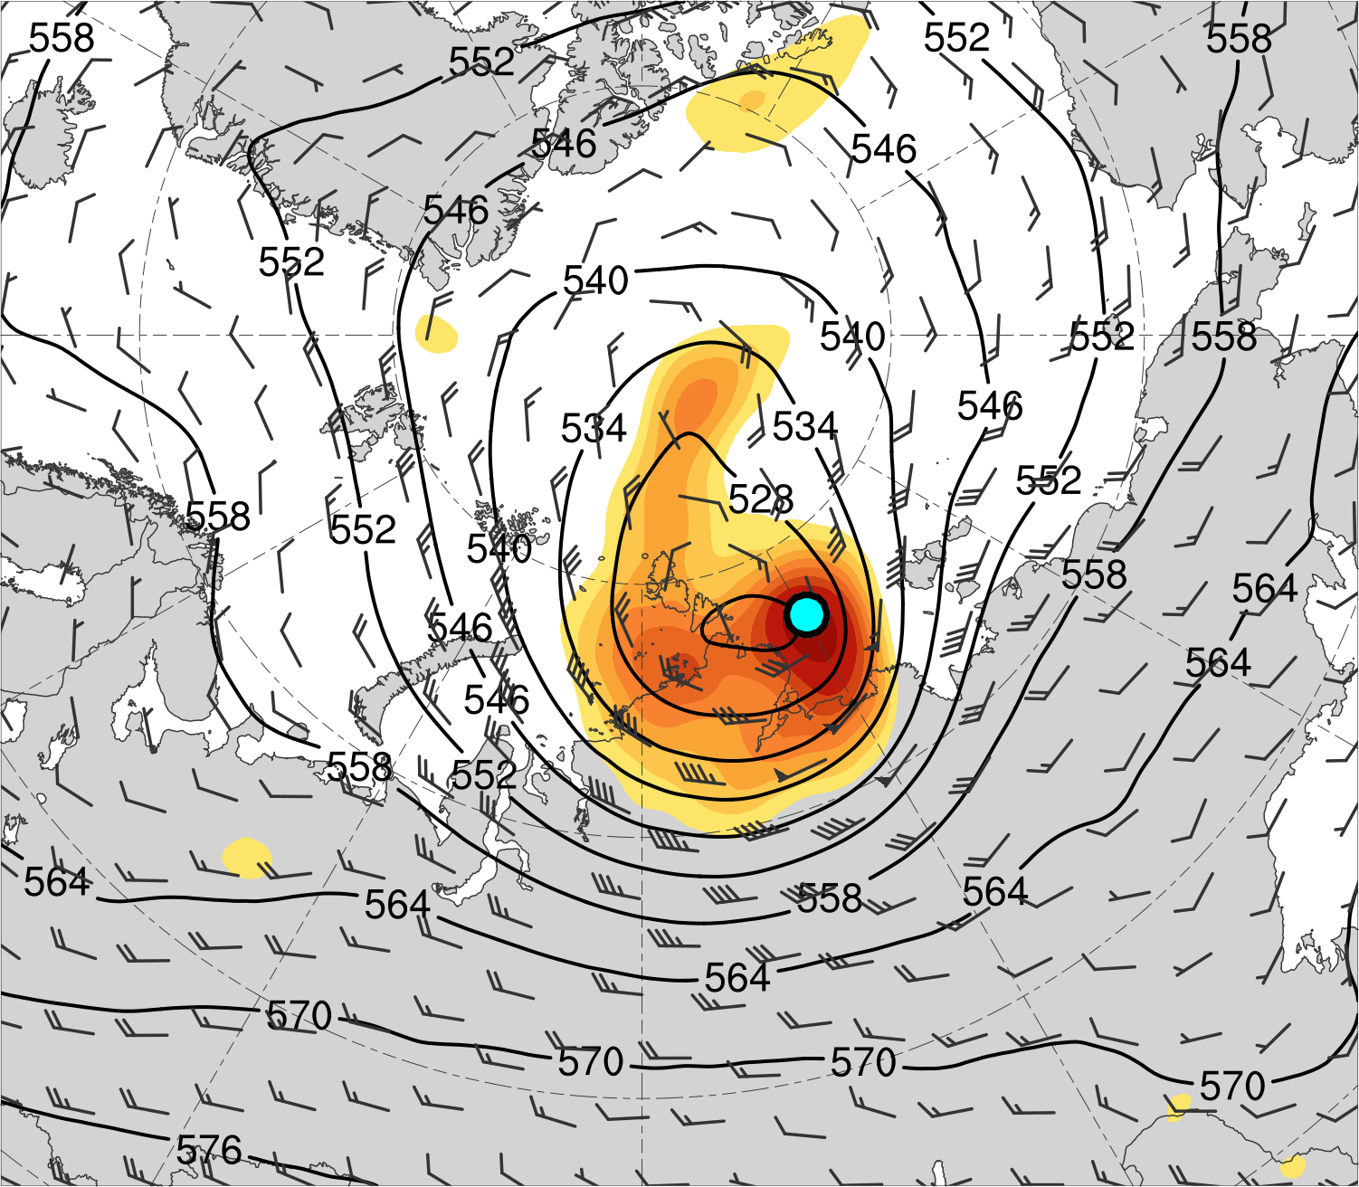
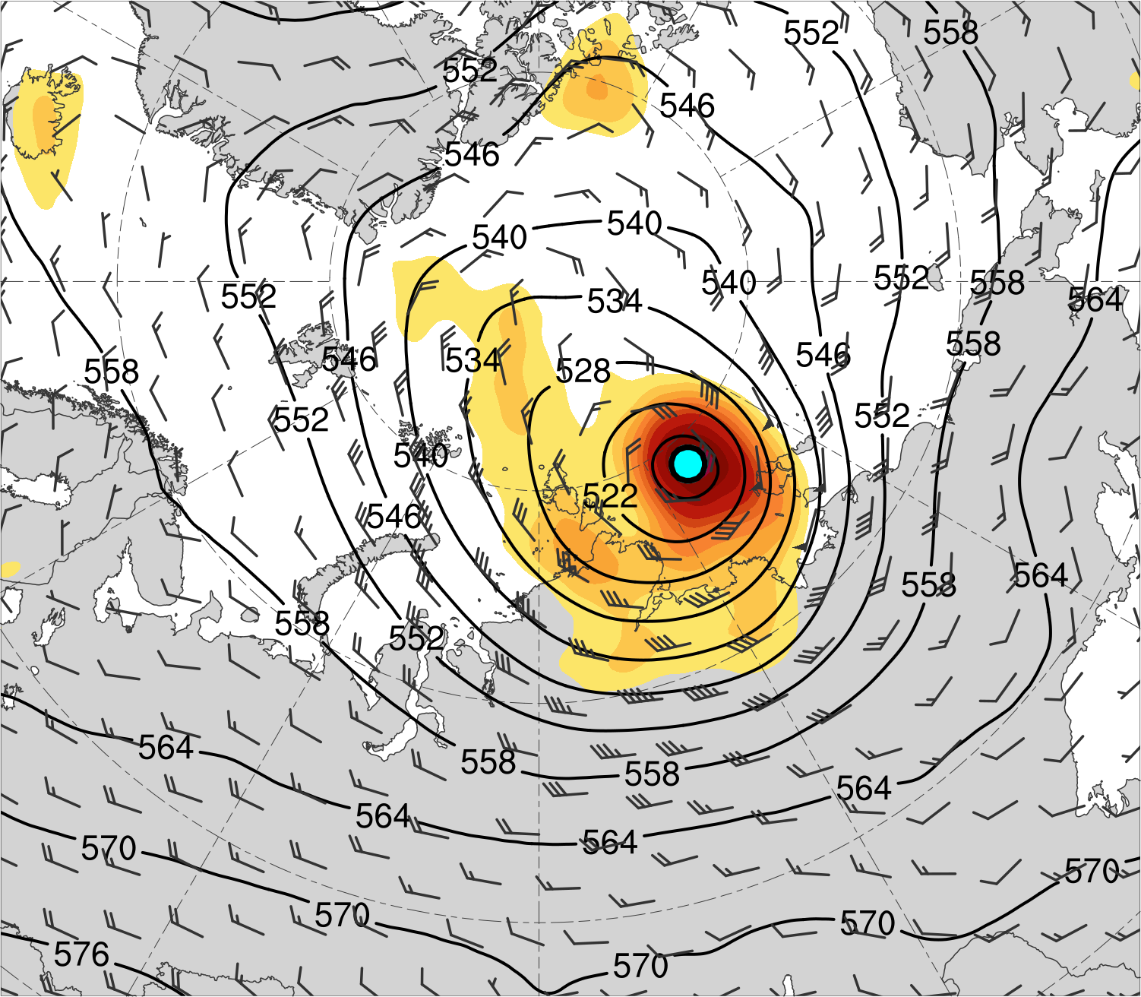
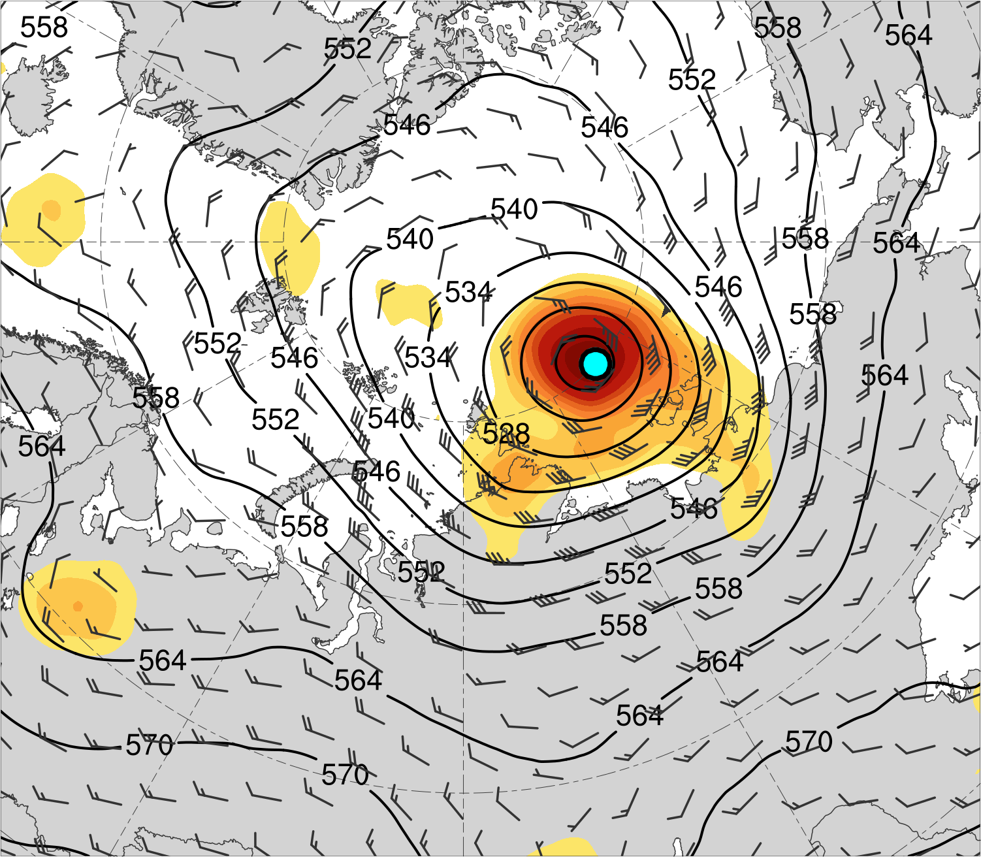
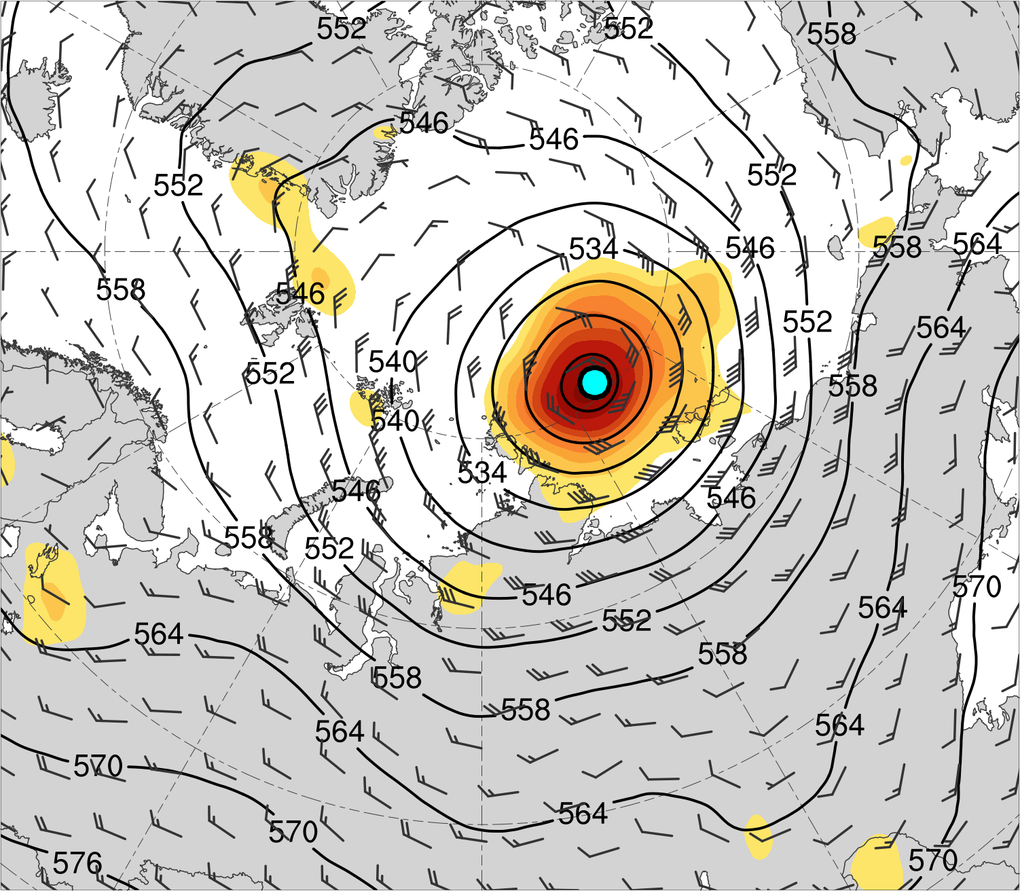
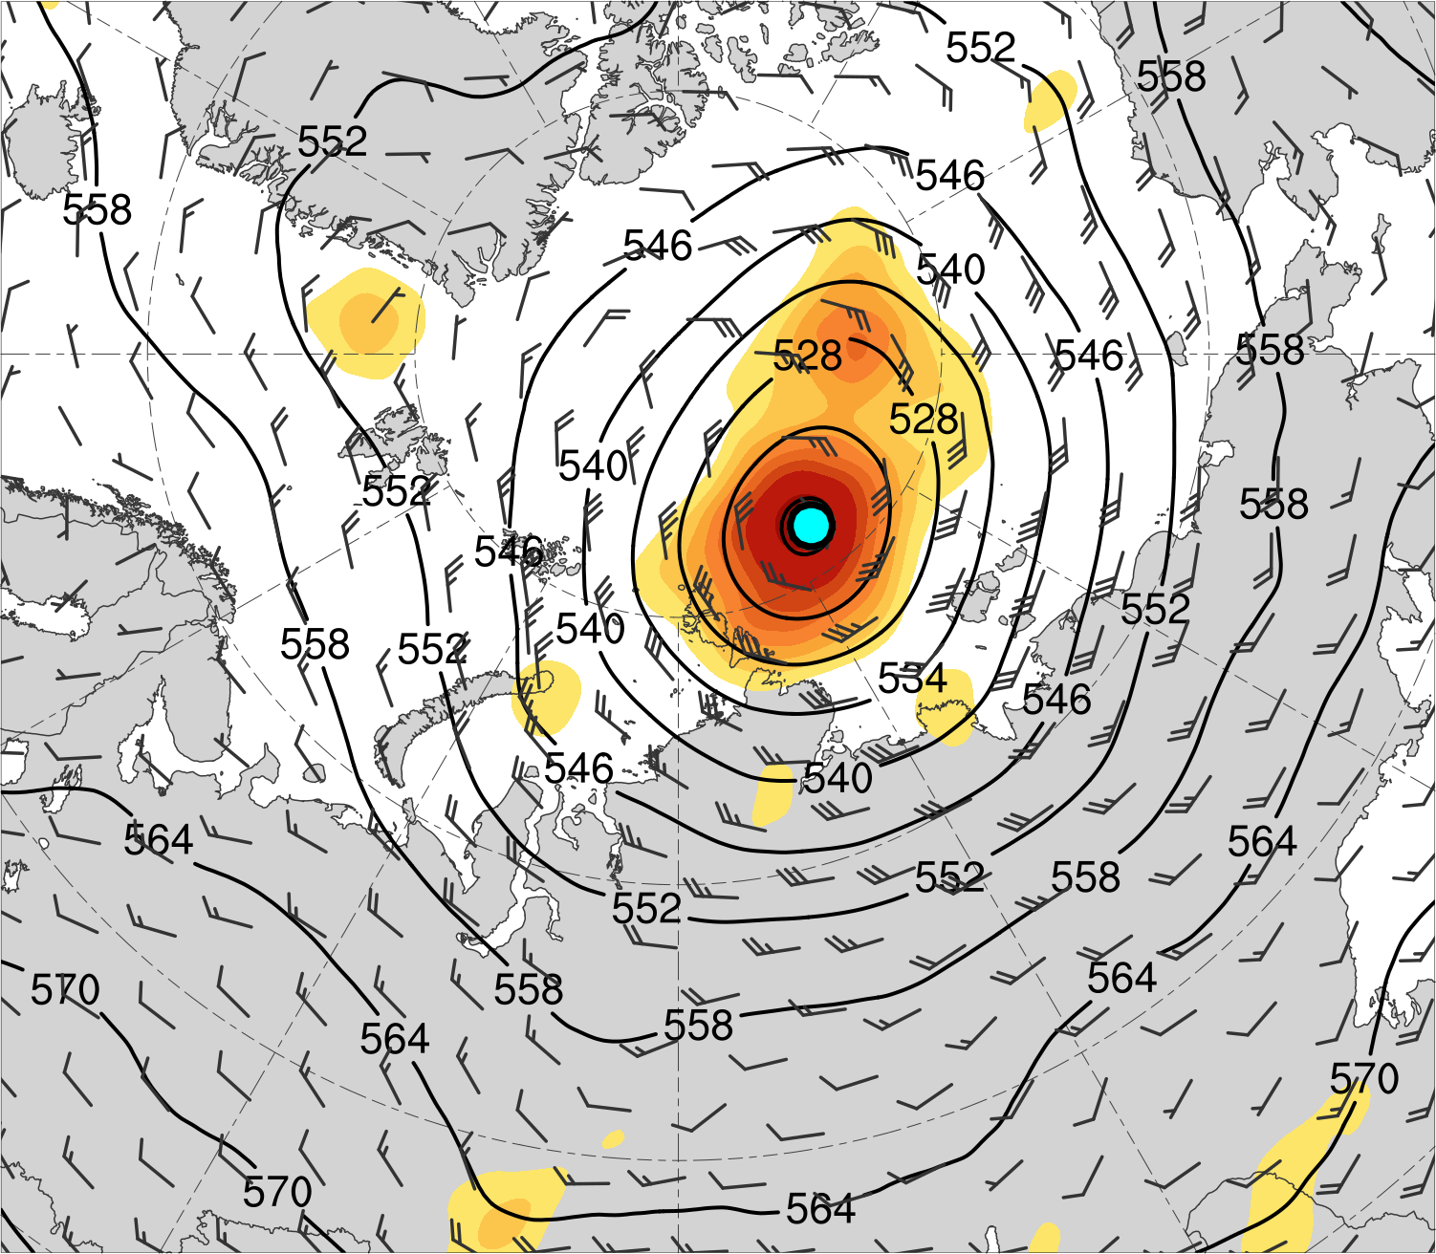
(a) Lag = −48 h (N = 13)
(b) Lag = −36 h (N = 13)
(c) Lag = −24 h (N = 14)
(d) Lag = −12 h (N = 14)
(e) Lag = 0 h (N = 14)
(f) Lag = 12 h (N = 13)
(g) Lag = 24 h (N = 13)
(h) Lag = 36 h (N = 12)
200-km area-averaged 500-hPa relative vorticity (10⁻⁵ s⁻¹)
Mean AC location
2
3
4
5
6
7
8
10
12
14
500-hPa geopotential
height (dam)
500-hPa wind (m s⁻¹)

Slide 16
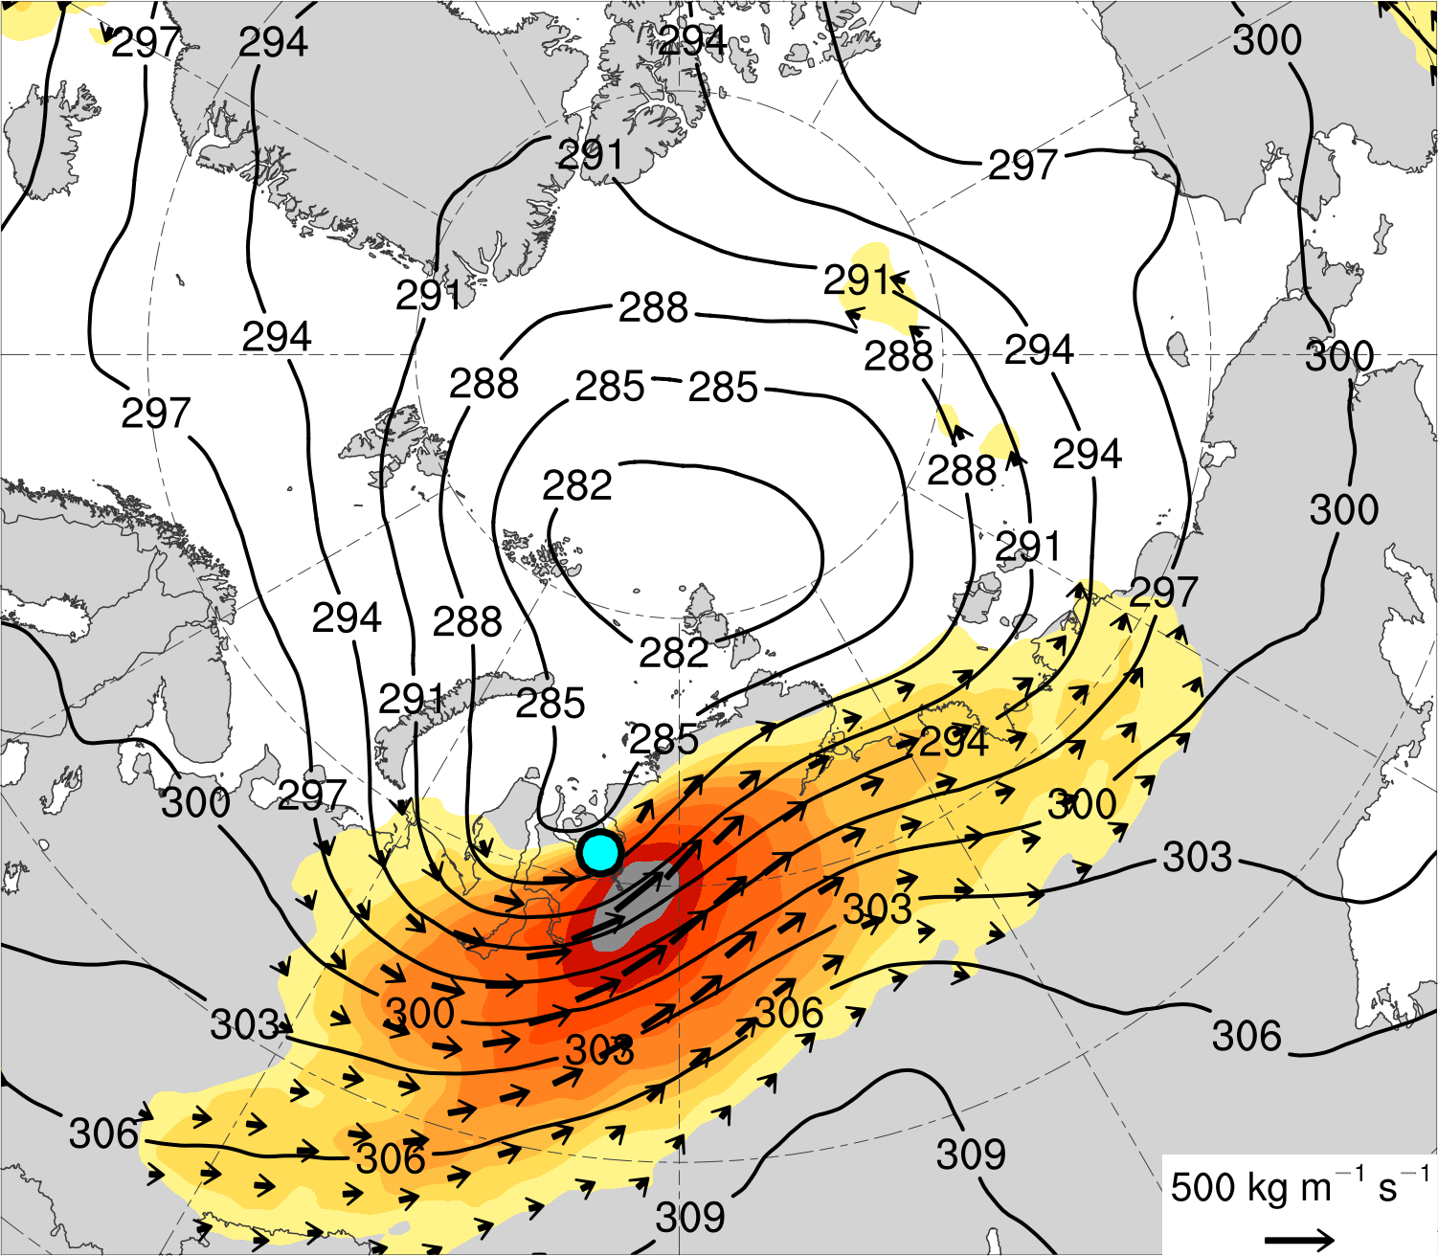
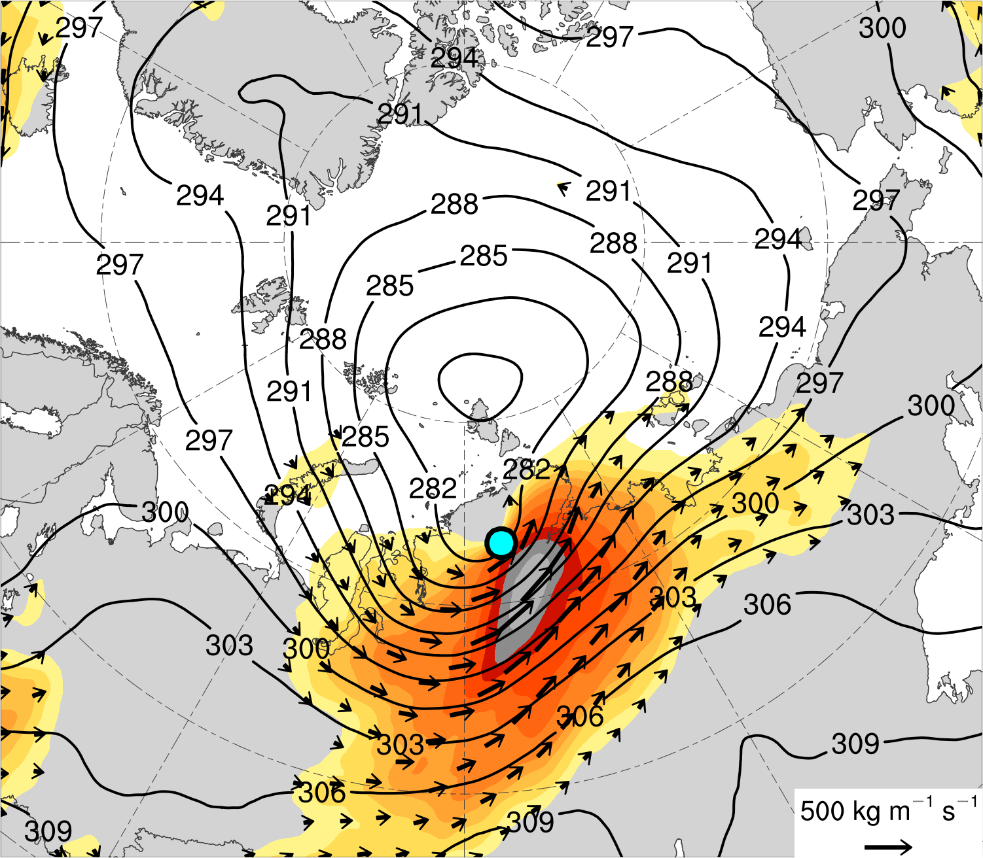
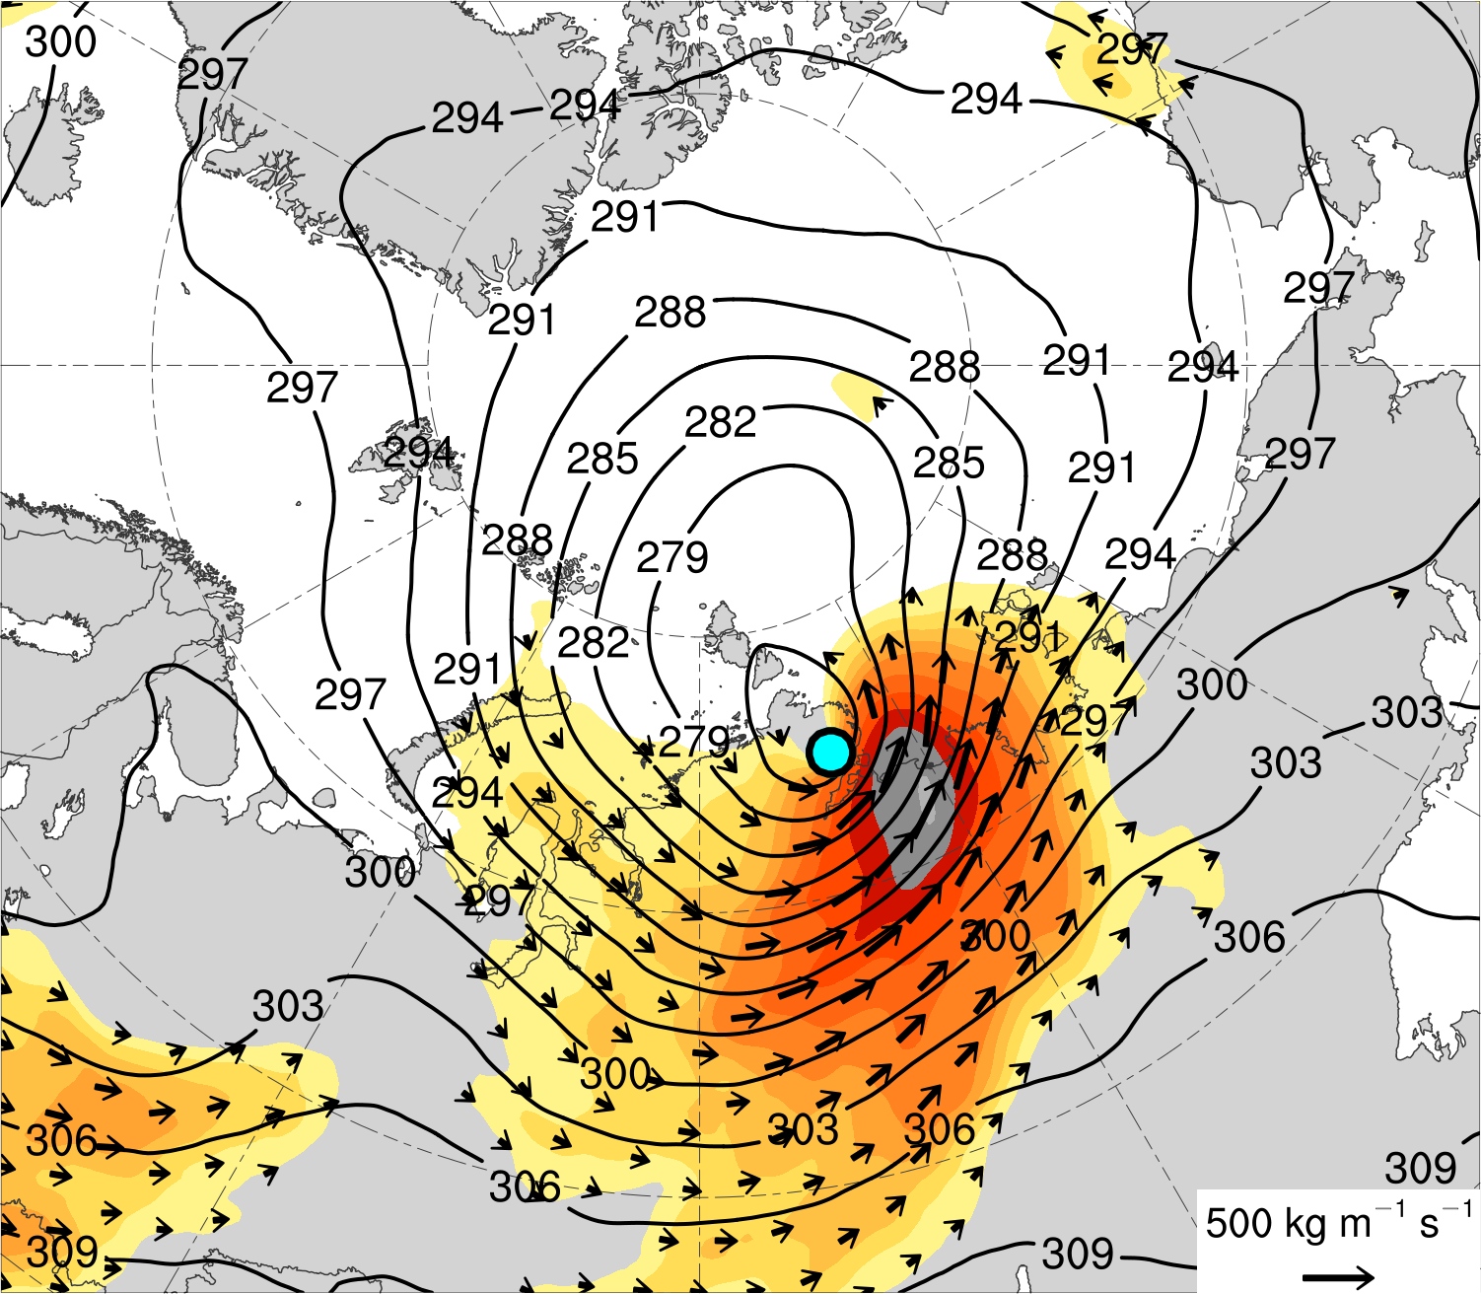
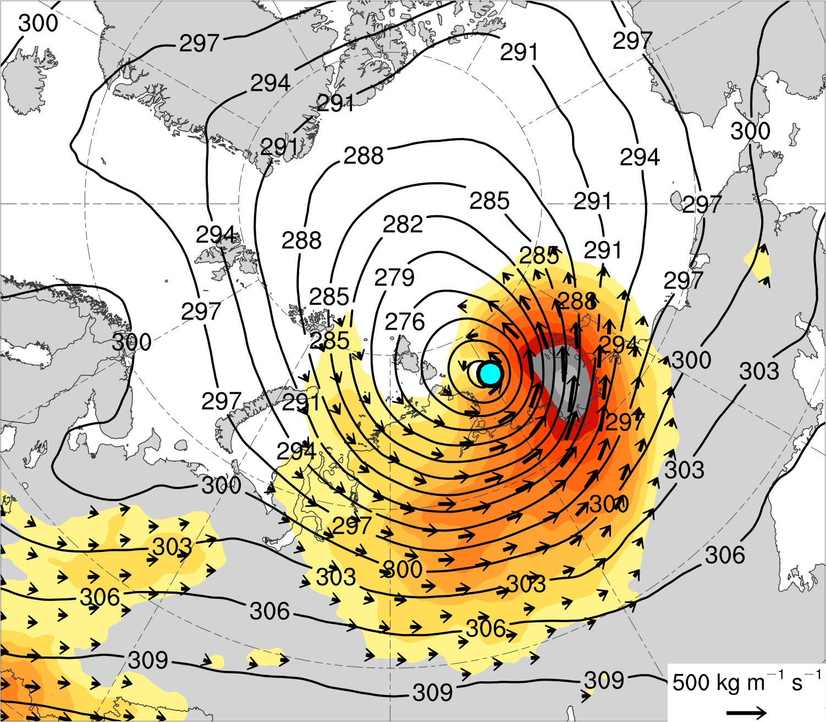
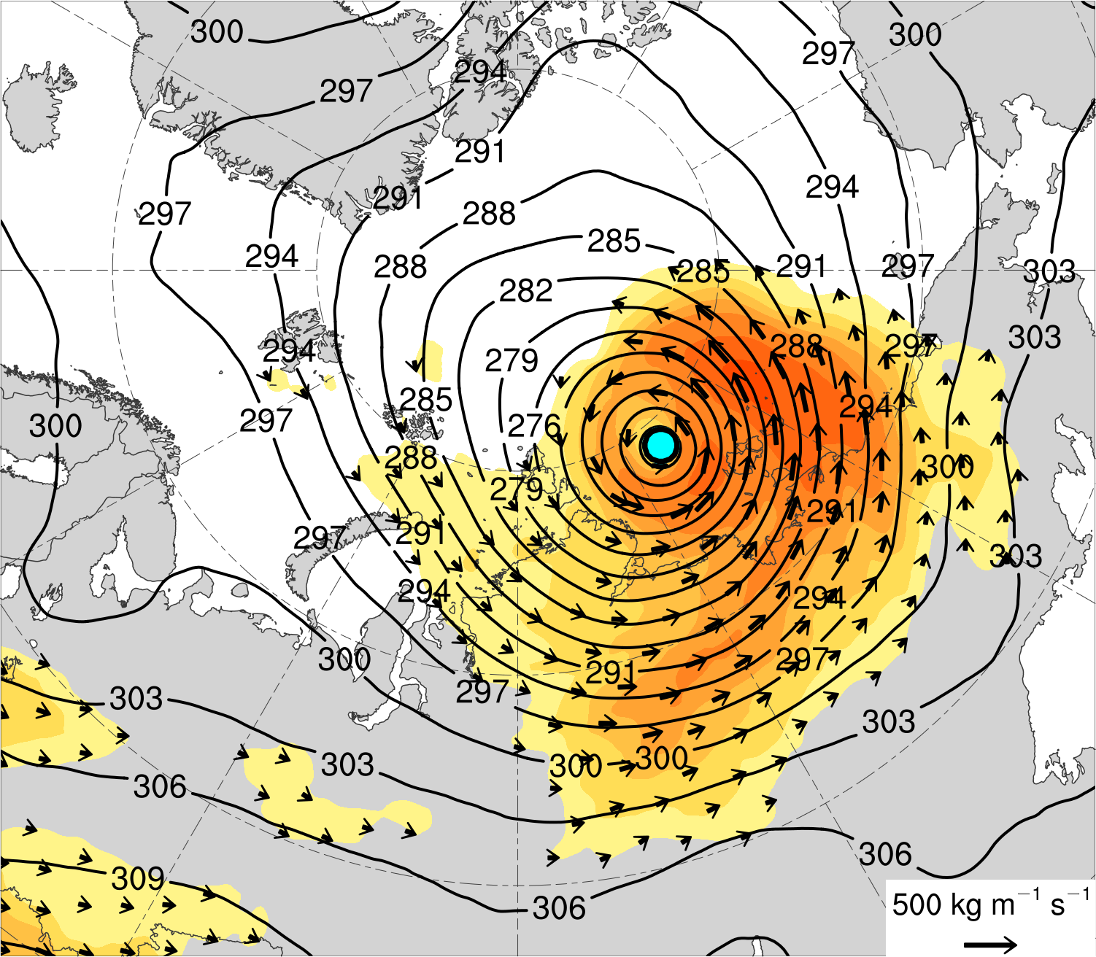
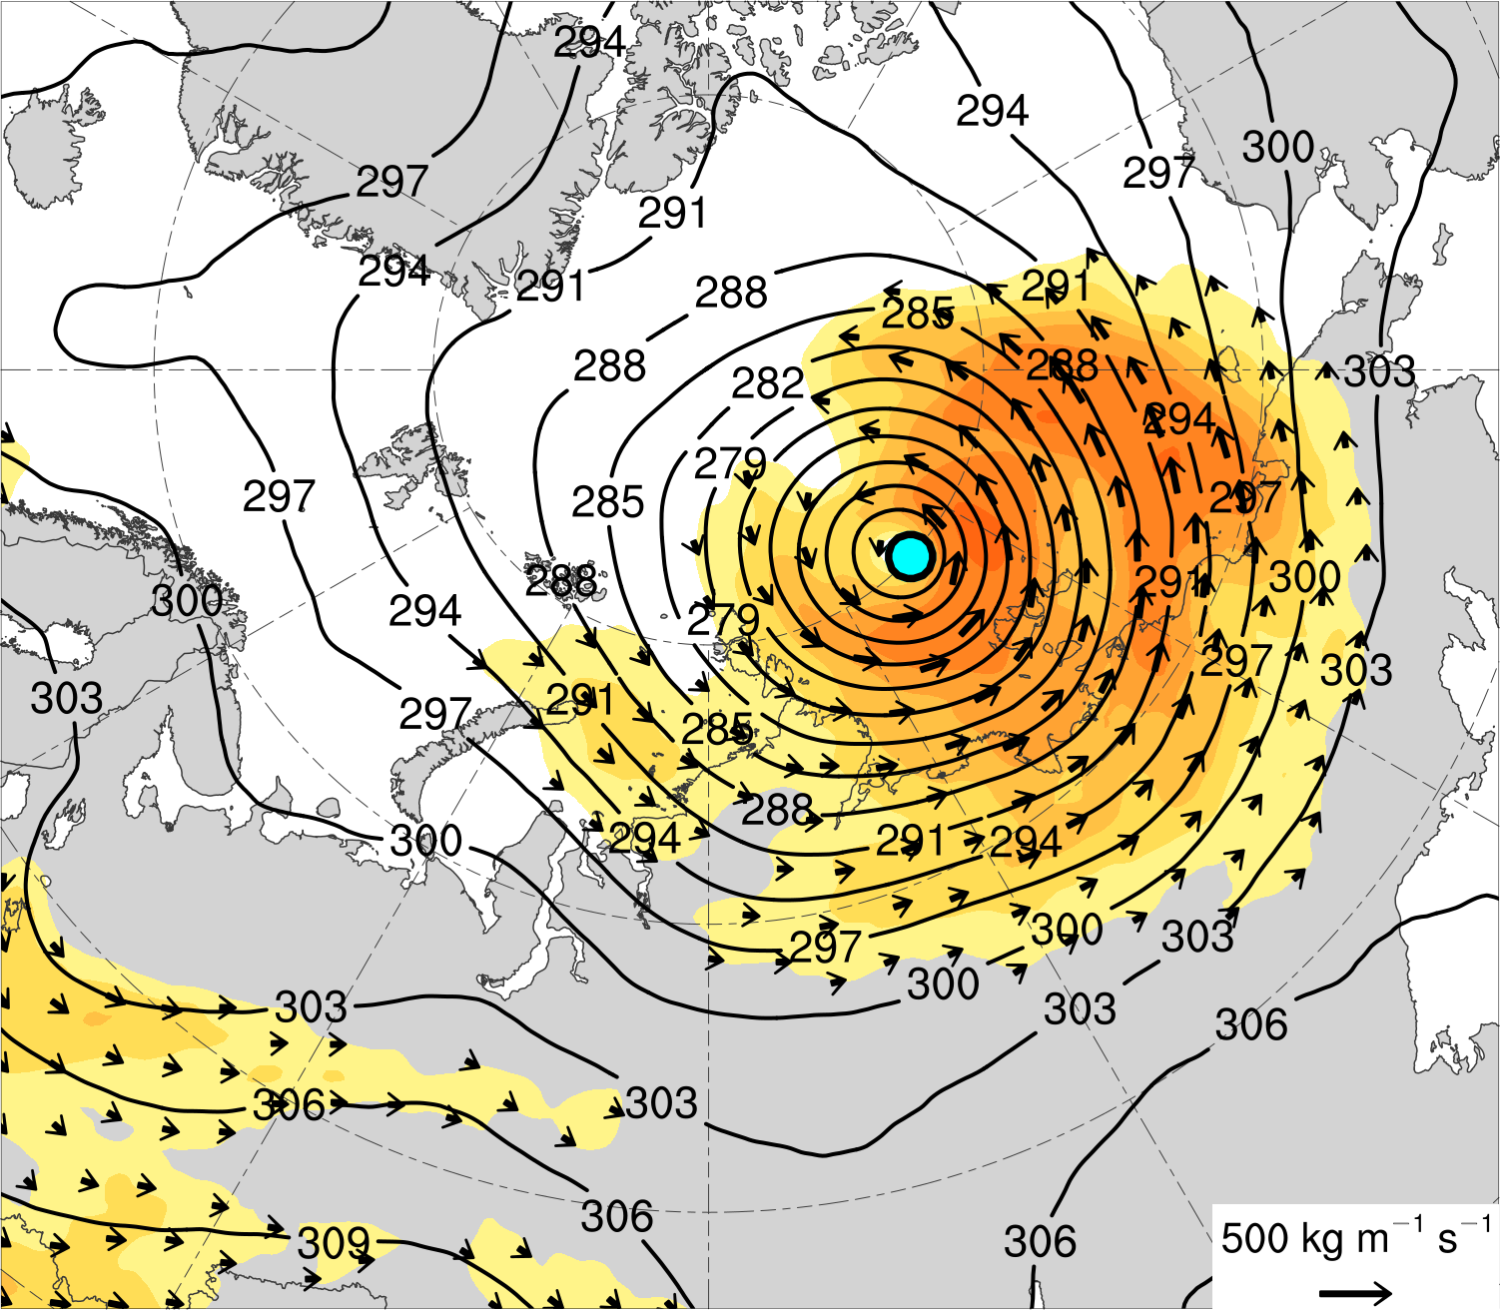
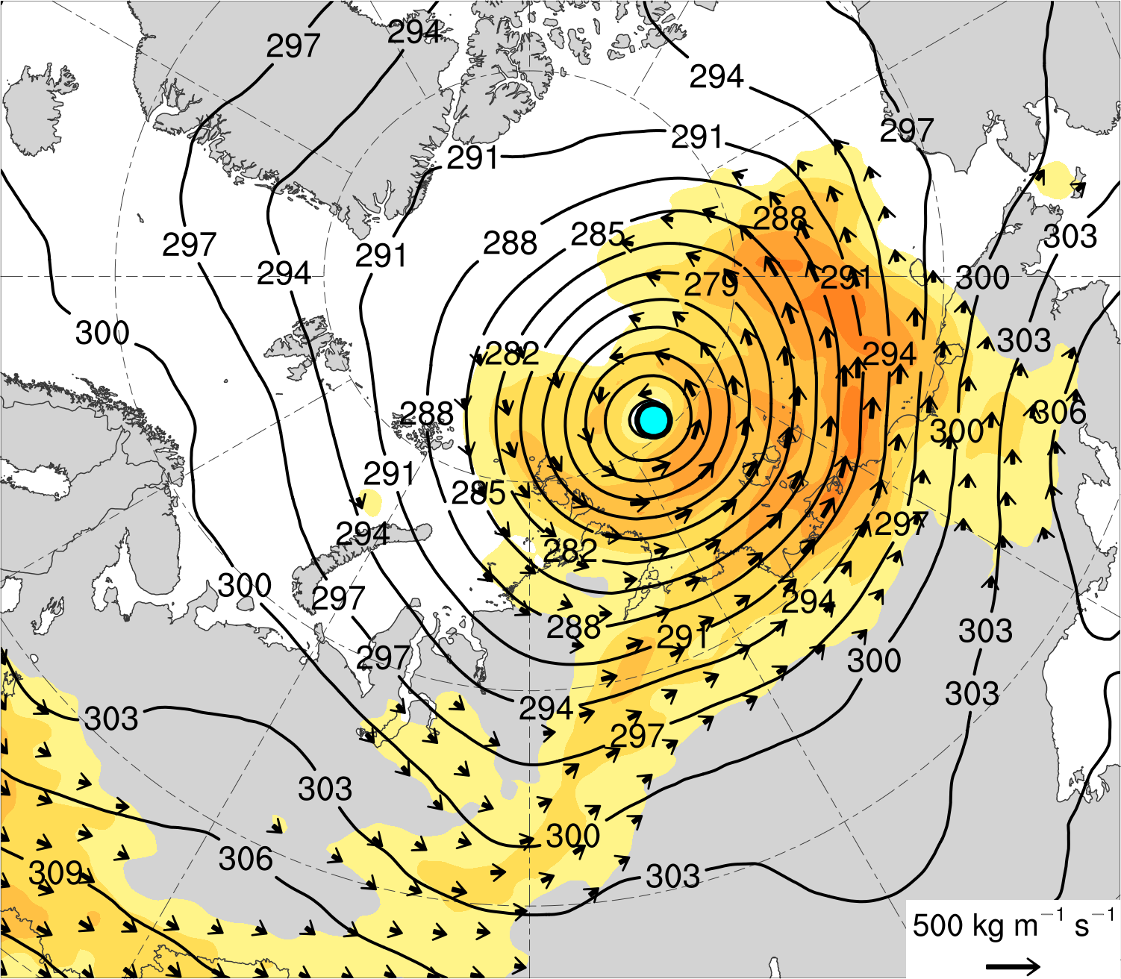
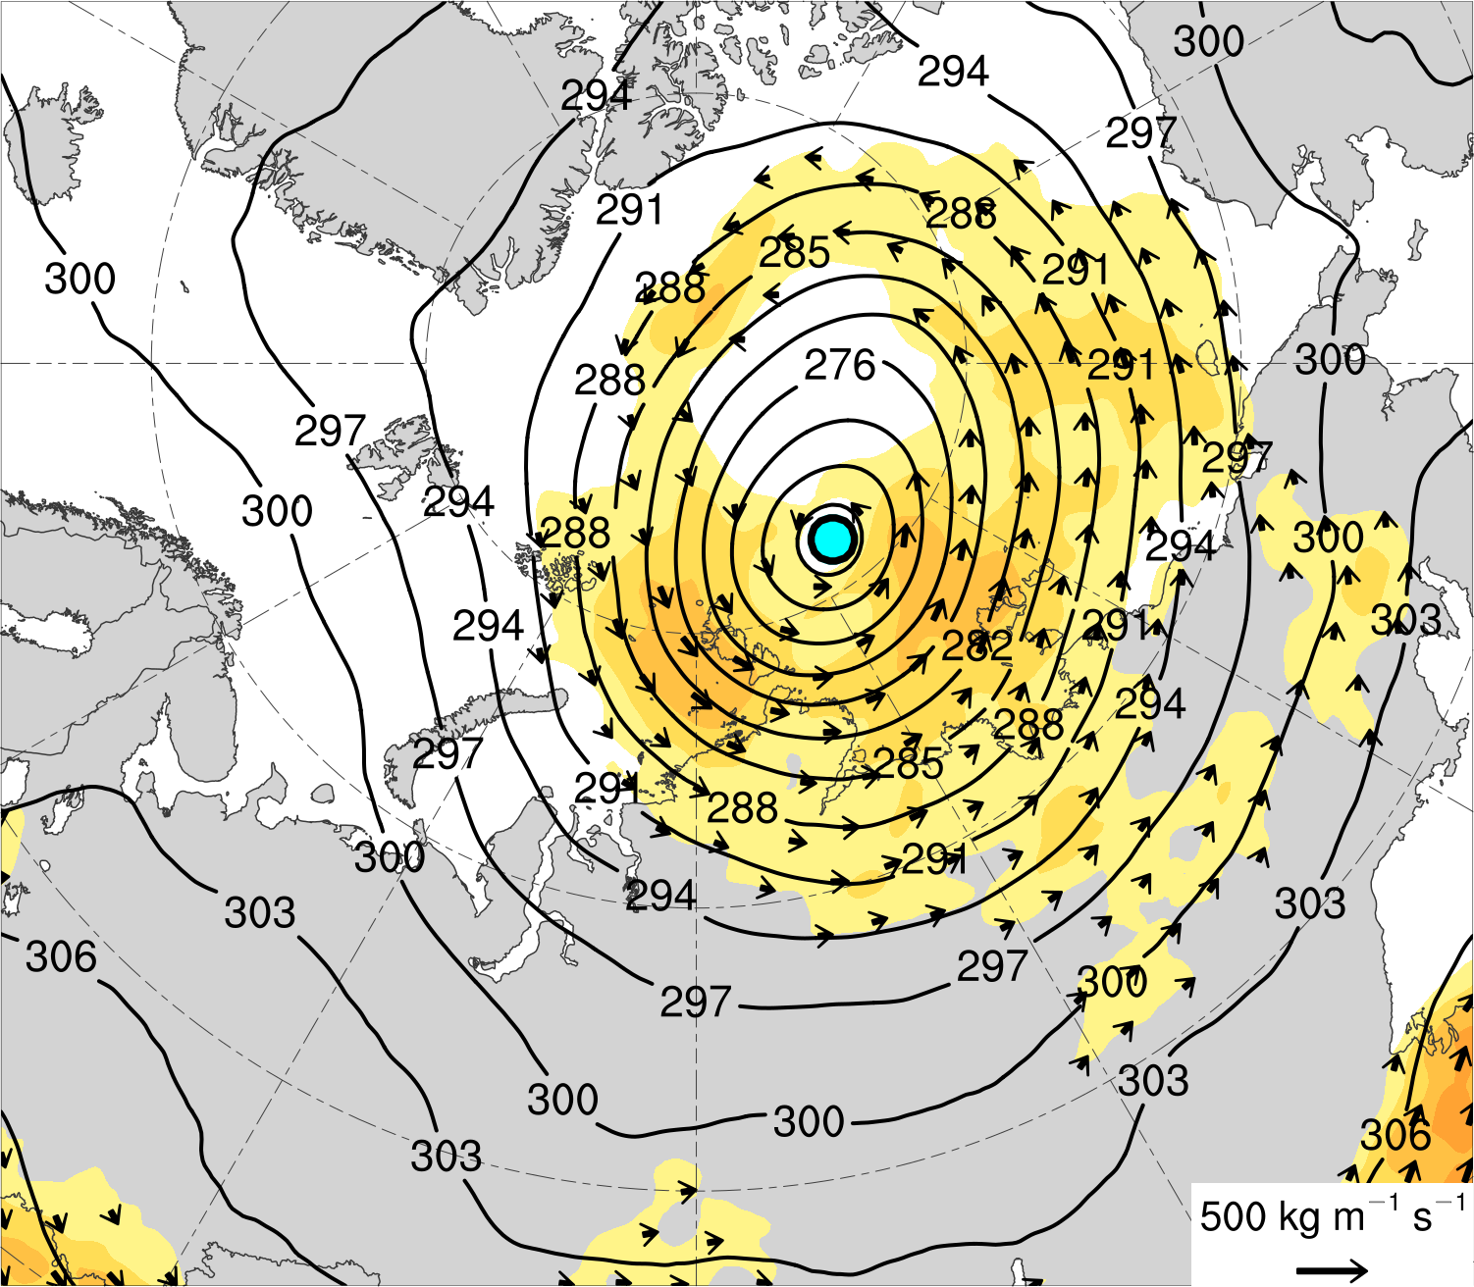
(a) Lag = −48 h (N = 13)
(b) Lag = −36 h (N = 13)
(c) Lag = −24 h (N = 14)
(d) Lag = −12 h (N = 14)
(e) Lag = 0 h (N = 14)
(f) Lag = 12 h (N = 13)
(g) Lag = 24 h (N = 13)
(h) Lag = 36 h (N = 12)
Integrated vapor transport (IVT) (kg m⁻¹ s⁻¹)
Mean AC location
100
125
150
175
200
250
300
350
400
450
500
IVT (kg m⁻¹ s⁻¹)
700-hPa geopotential
height (dam)

Slide 17
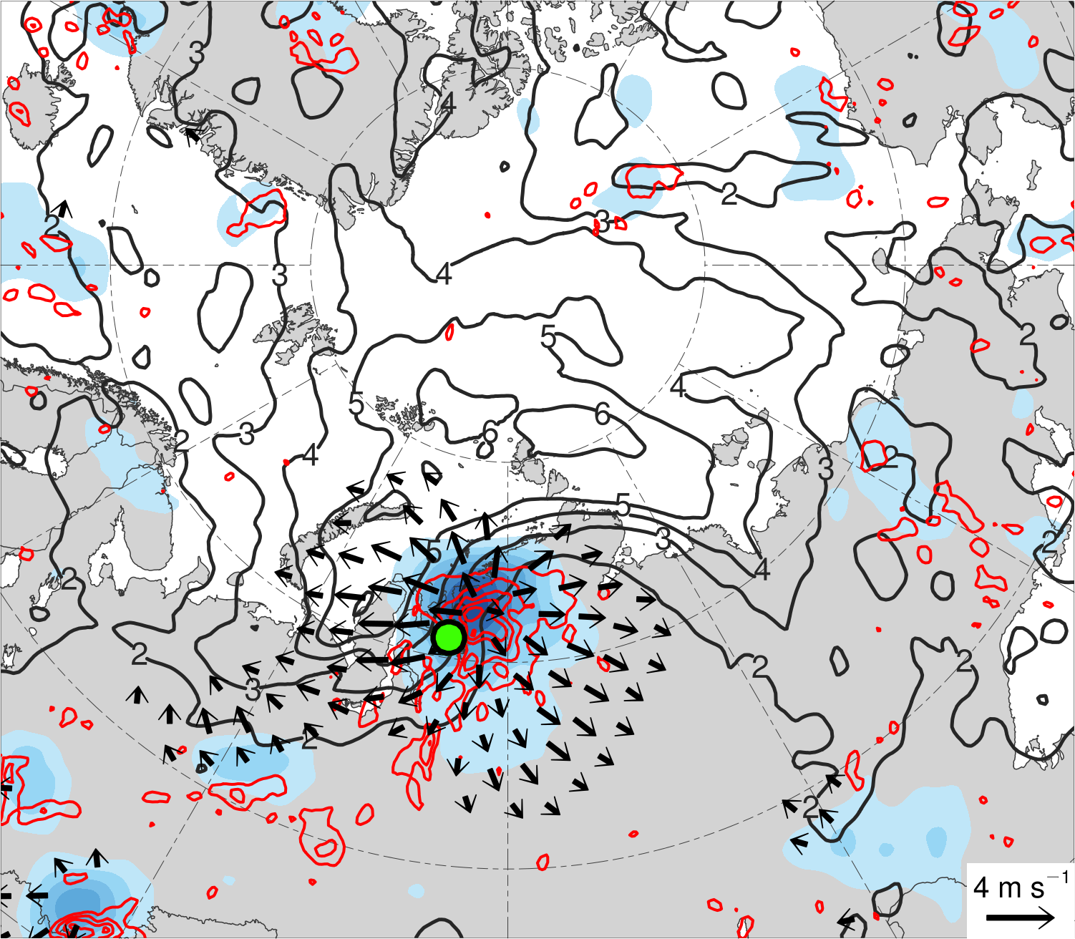
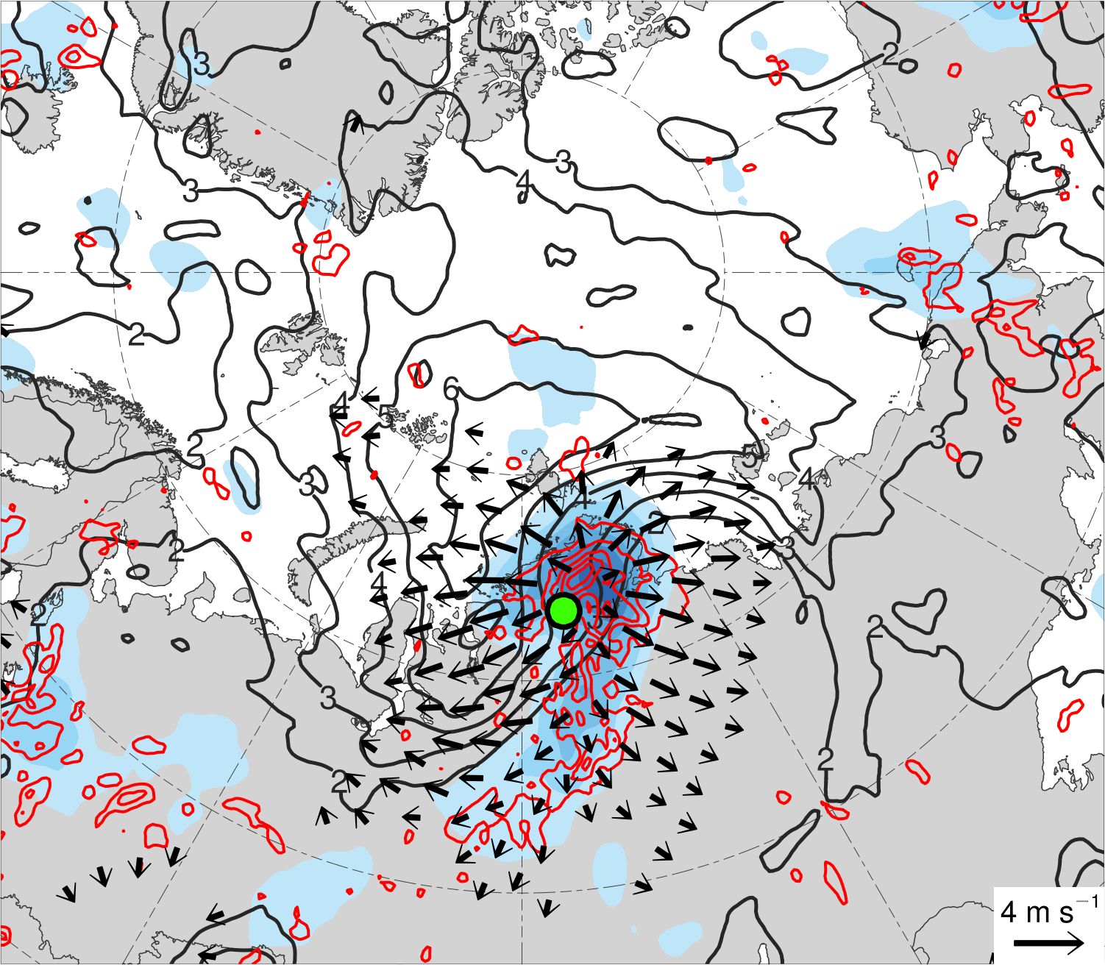
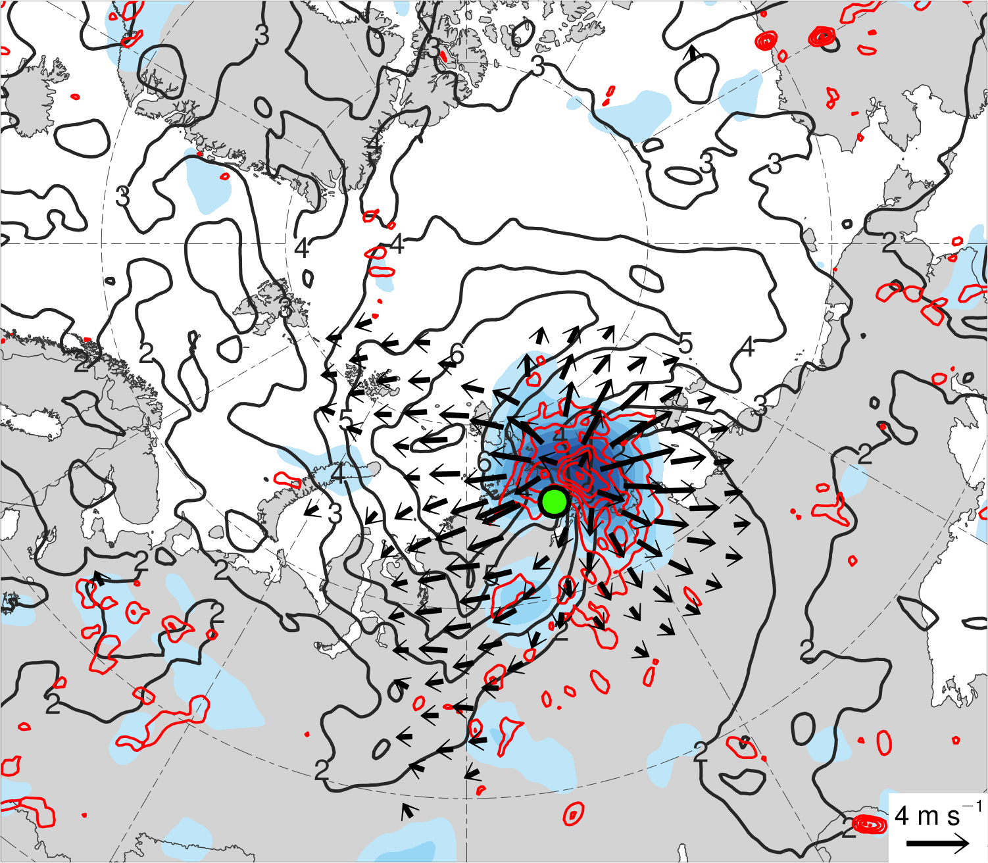
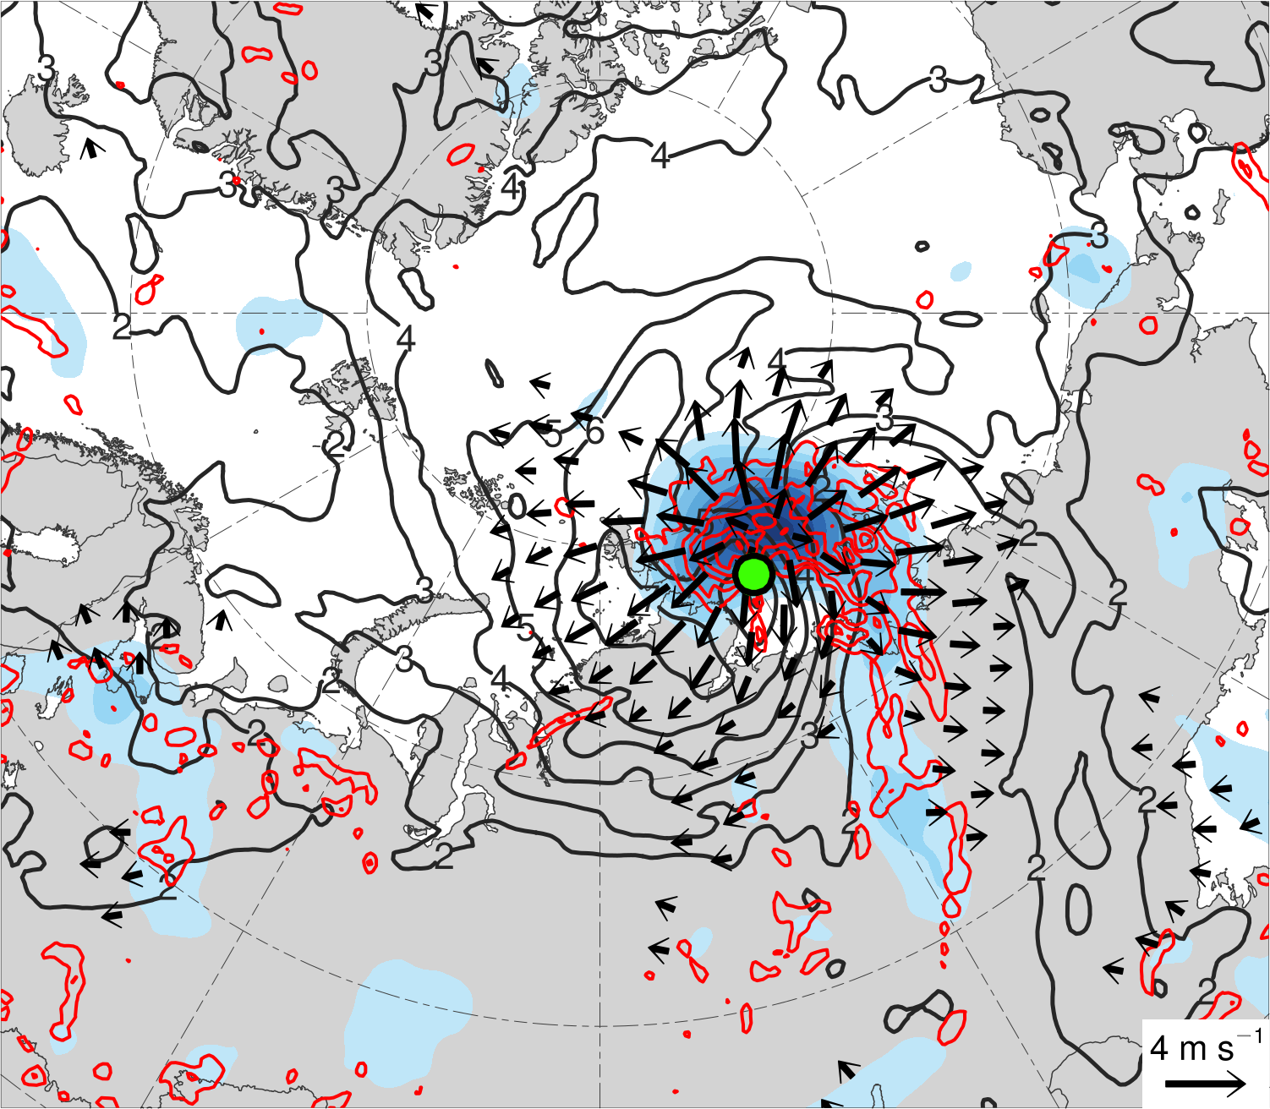
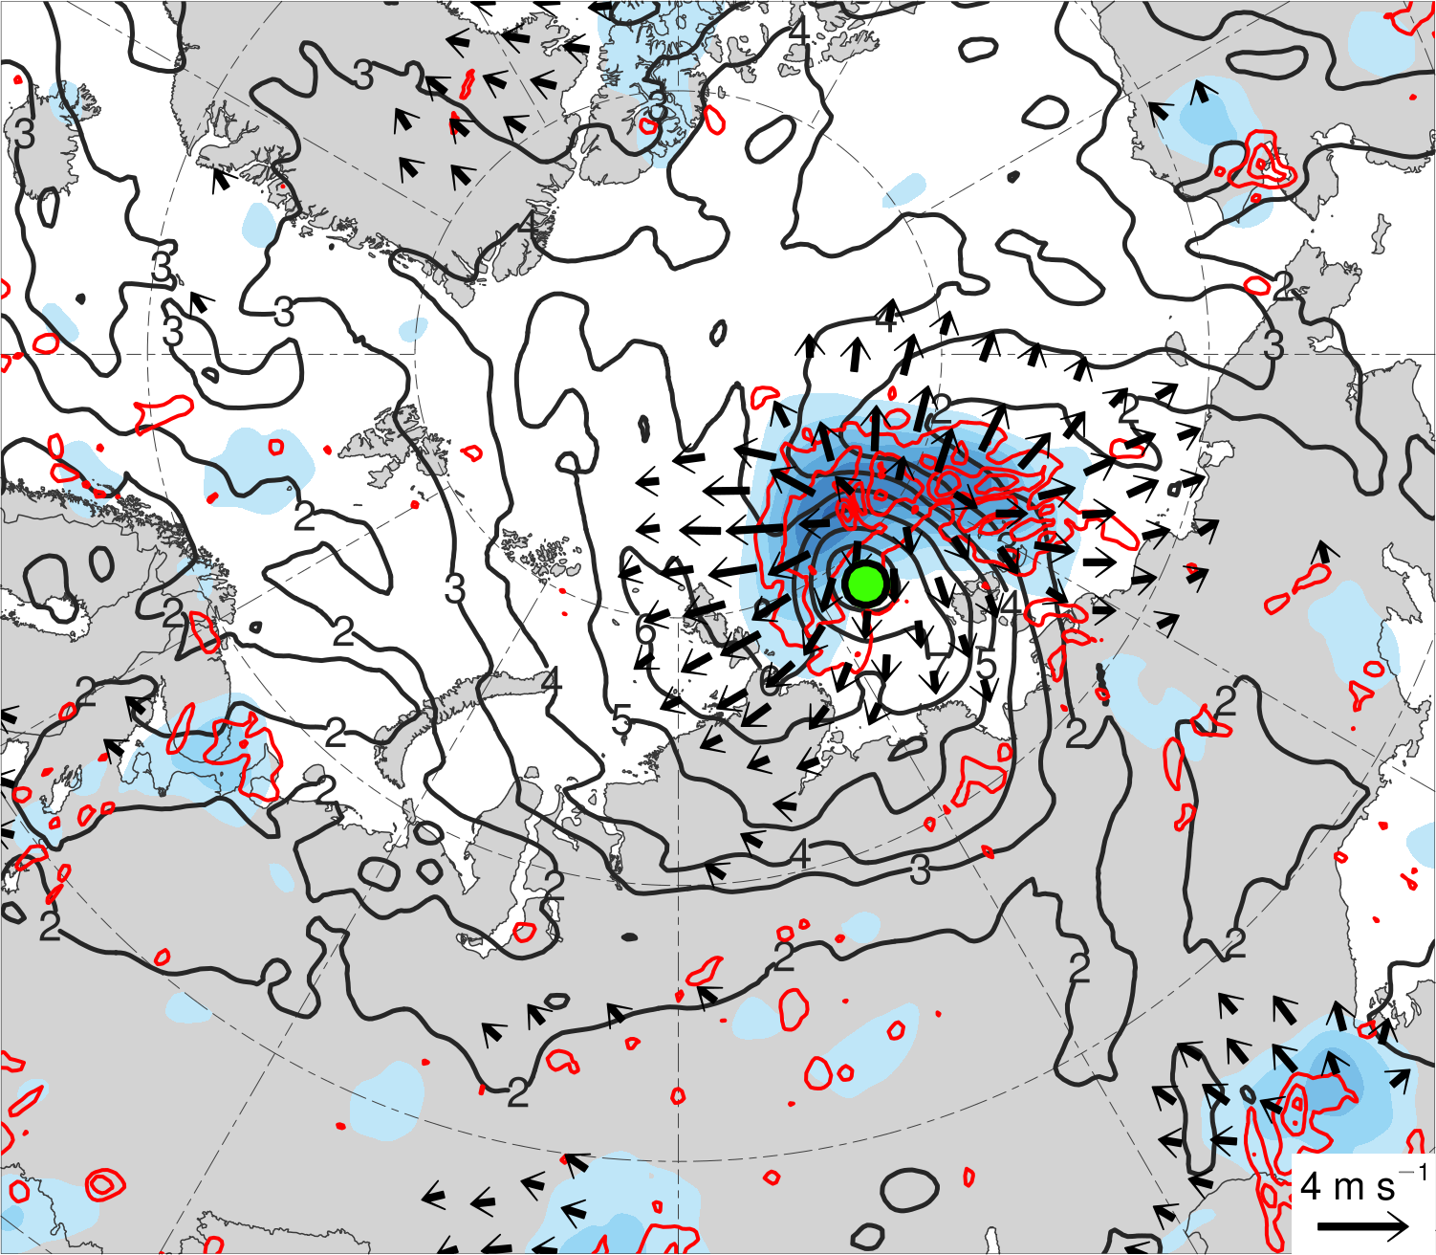
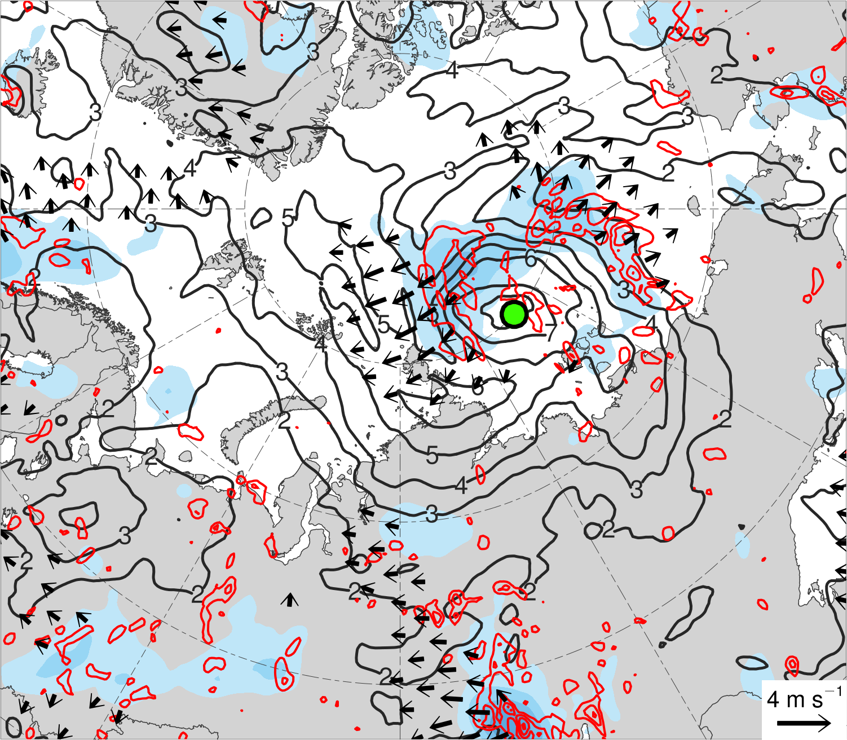
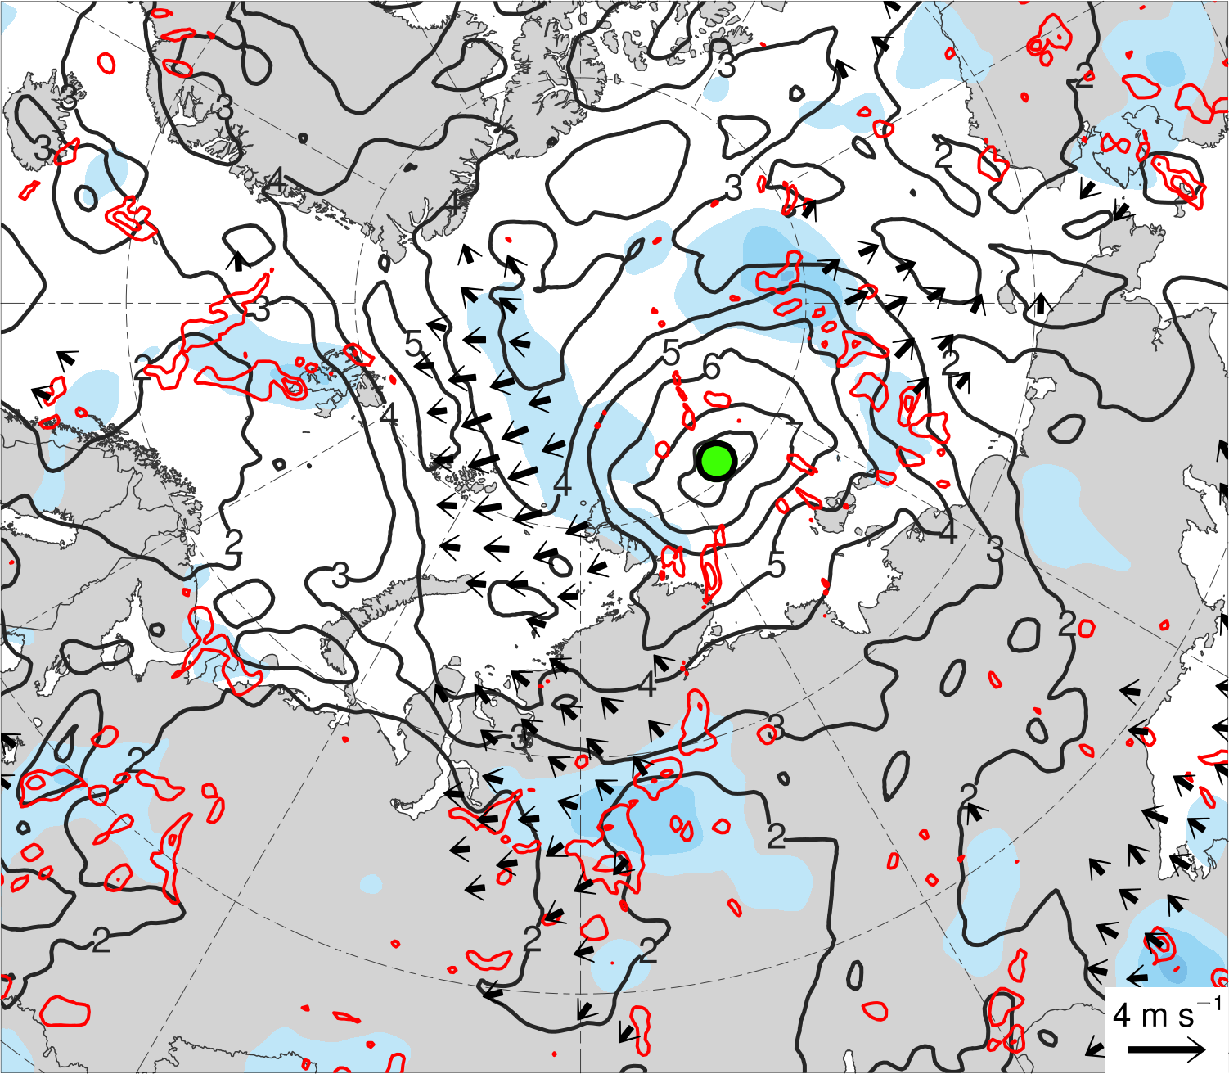
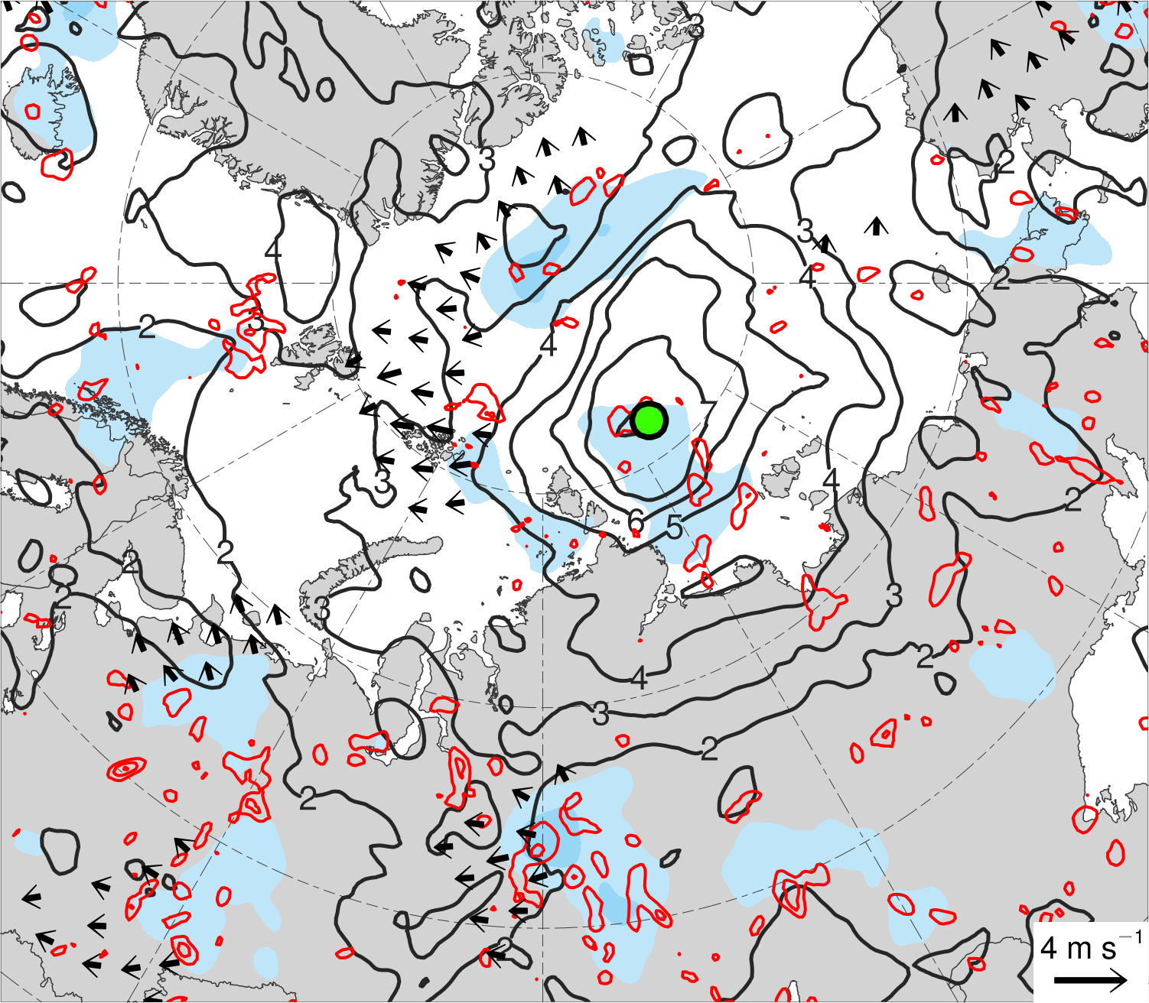
(a) Lag = −48 h (N = 13)
(b) Lag = −36 h (N = 13)
(c) Lag = −24 h (N = 14)
(d) Lag = −12 h (N = 14)
(e) Lag = 0 h (N = 14)
(f) Lag = 12 h (N = 13)
(g) Lag = 24 h (N = 13)
(h) Lag = 36 h (N = 12)
200-km area-averaged 350–250-hPa divergence (10⁻⁶ s⁻¹)
Mean AC location
2
4
6
8
10
12
14
16
350–250-hPa irrotational wind (m s⁻¹)
350–250-hPa PV (PVU)
Negative values of 800–600-hPa ω
(every 1 × 10⁻³ hPa s⁻¹)

Slide 18
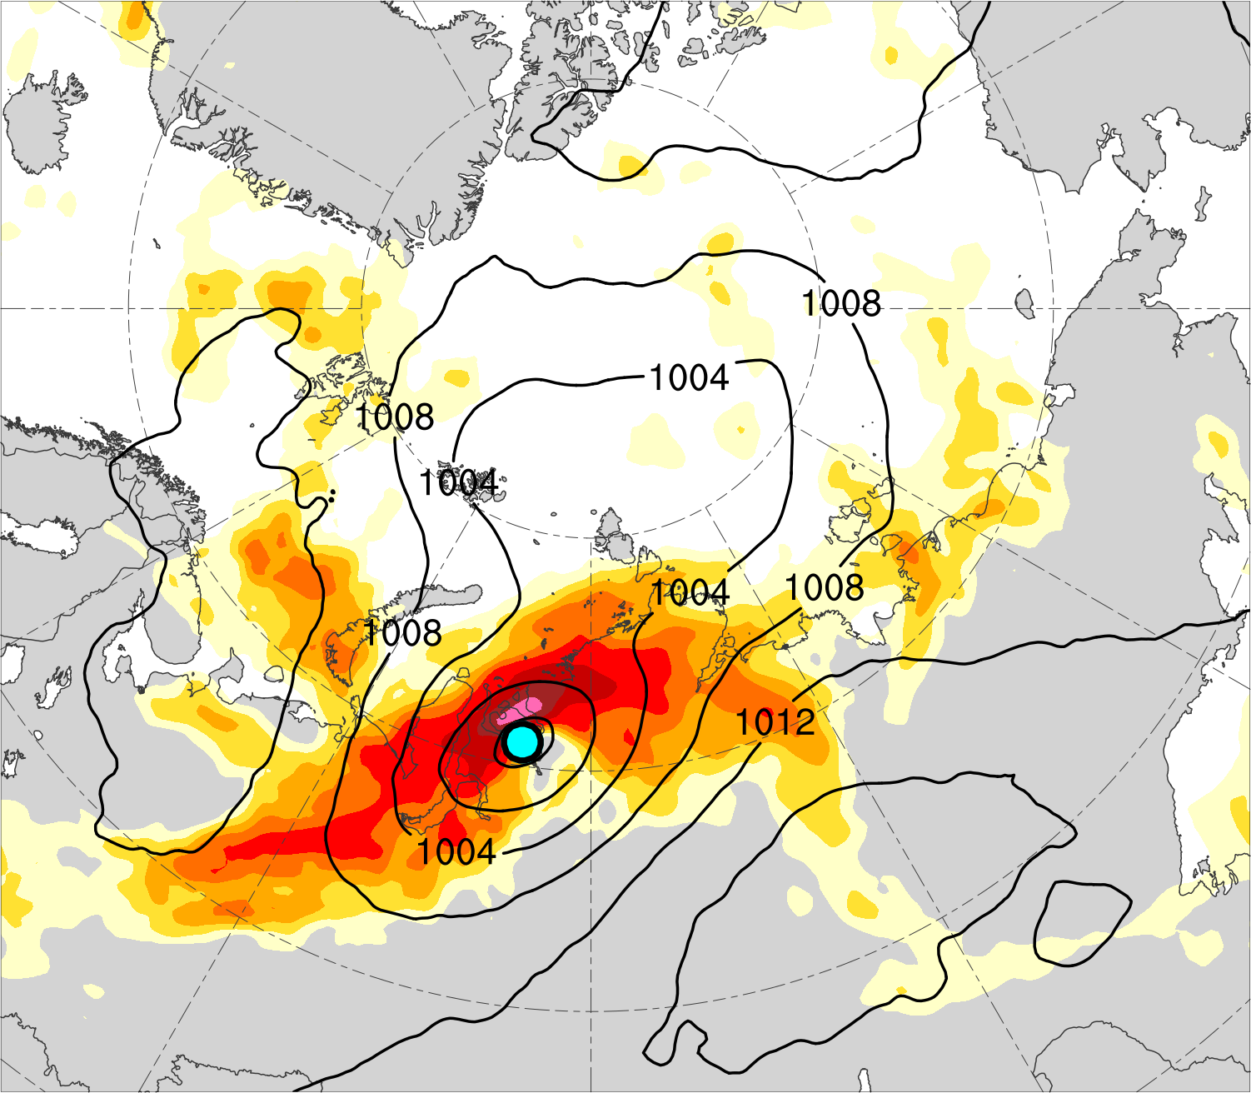
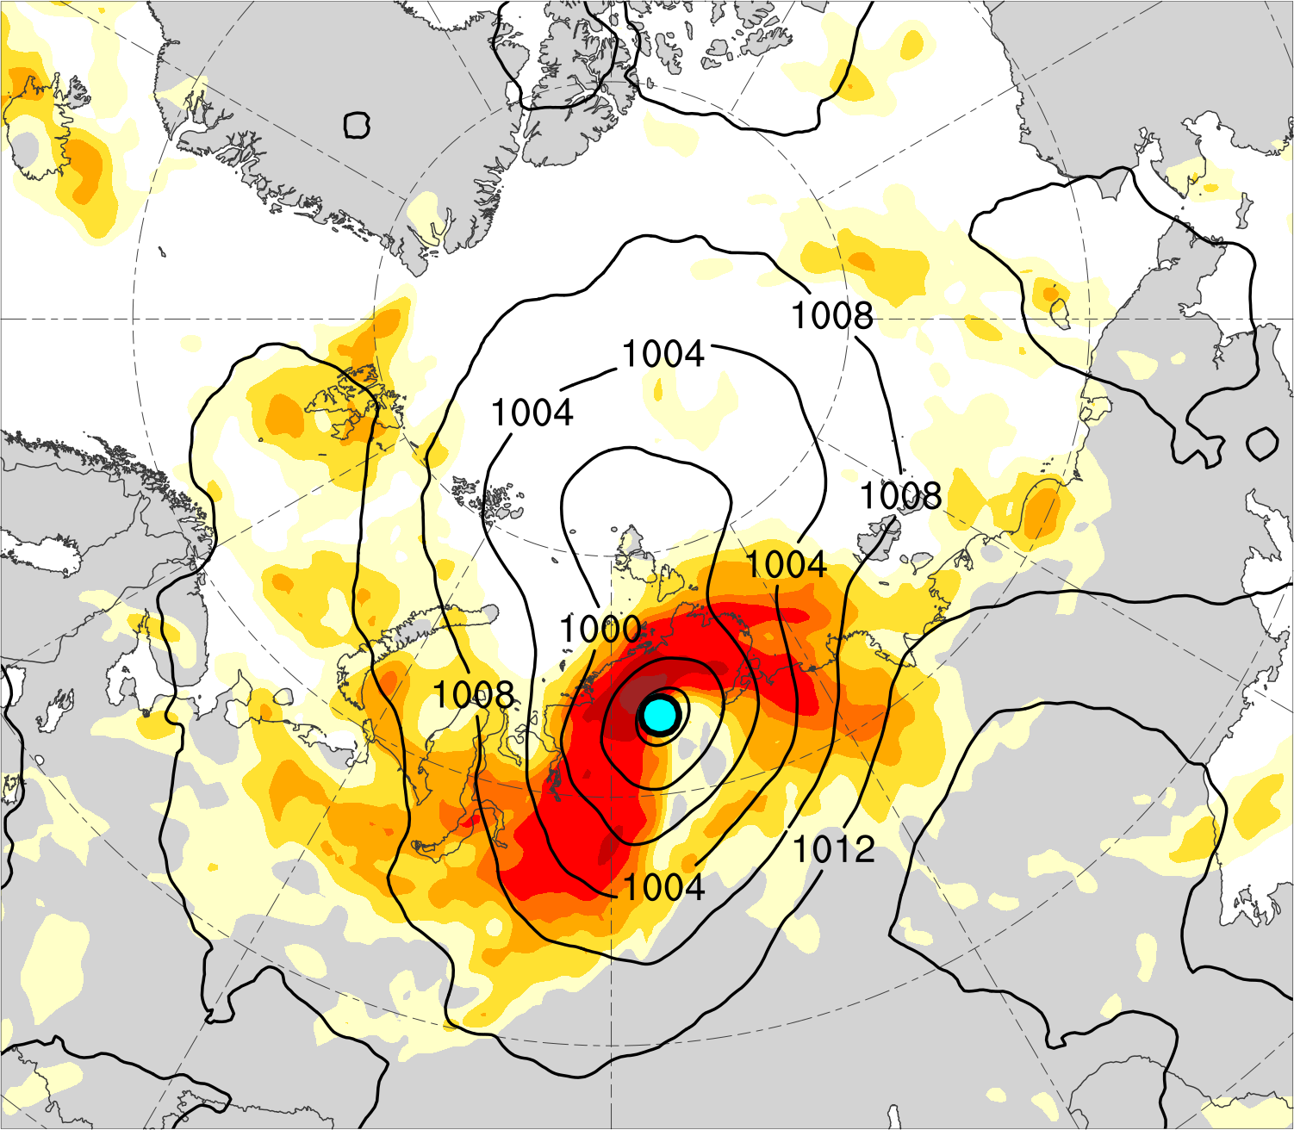
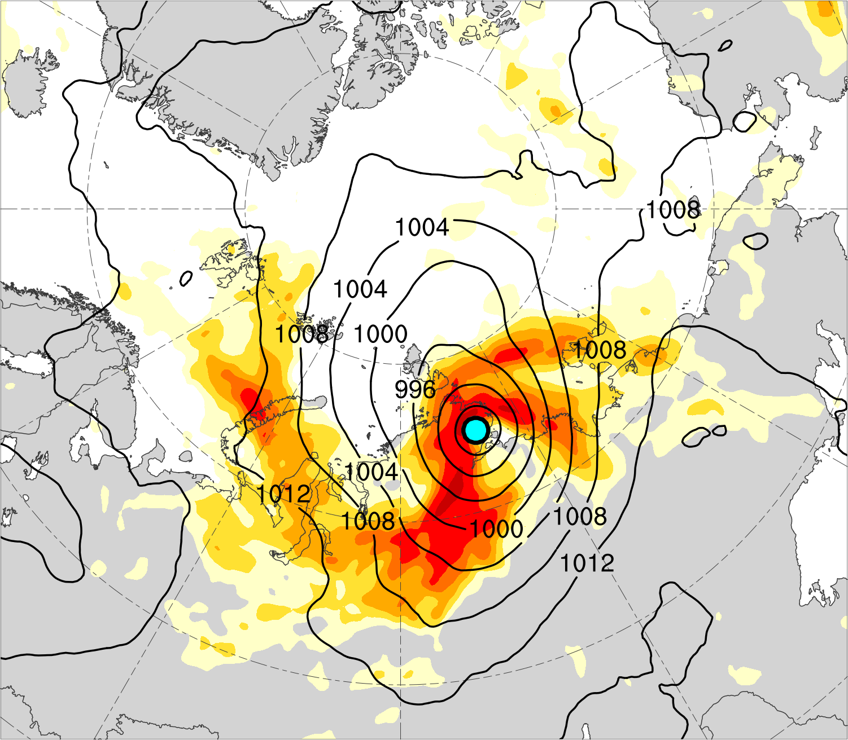
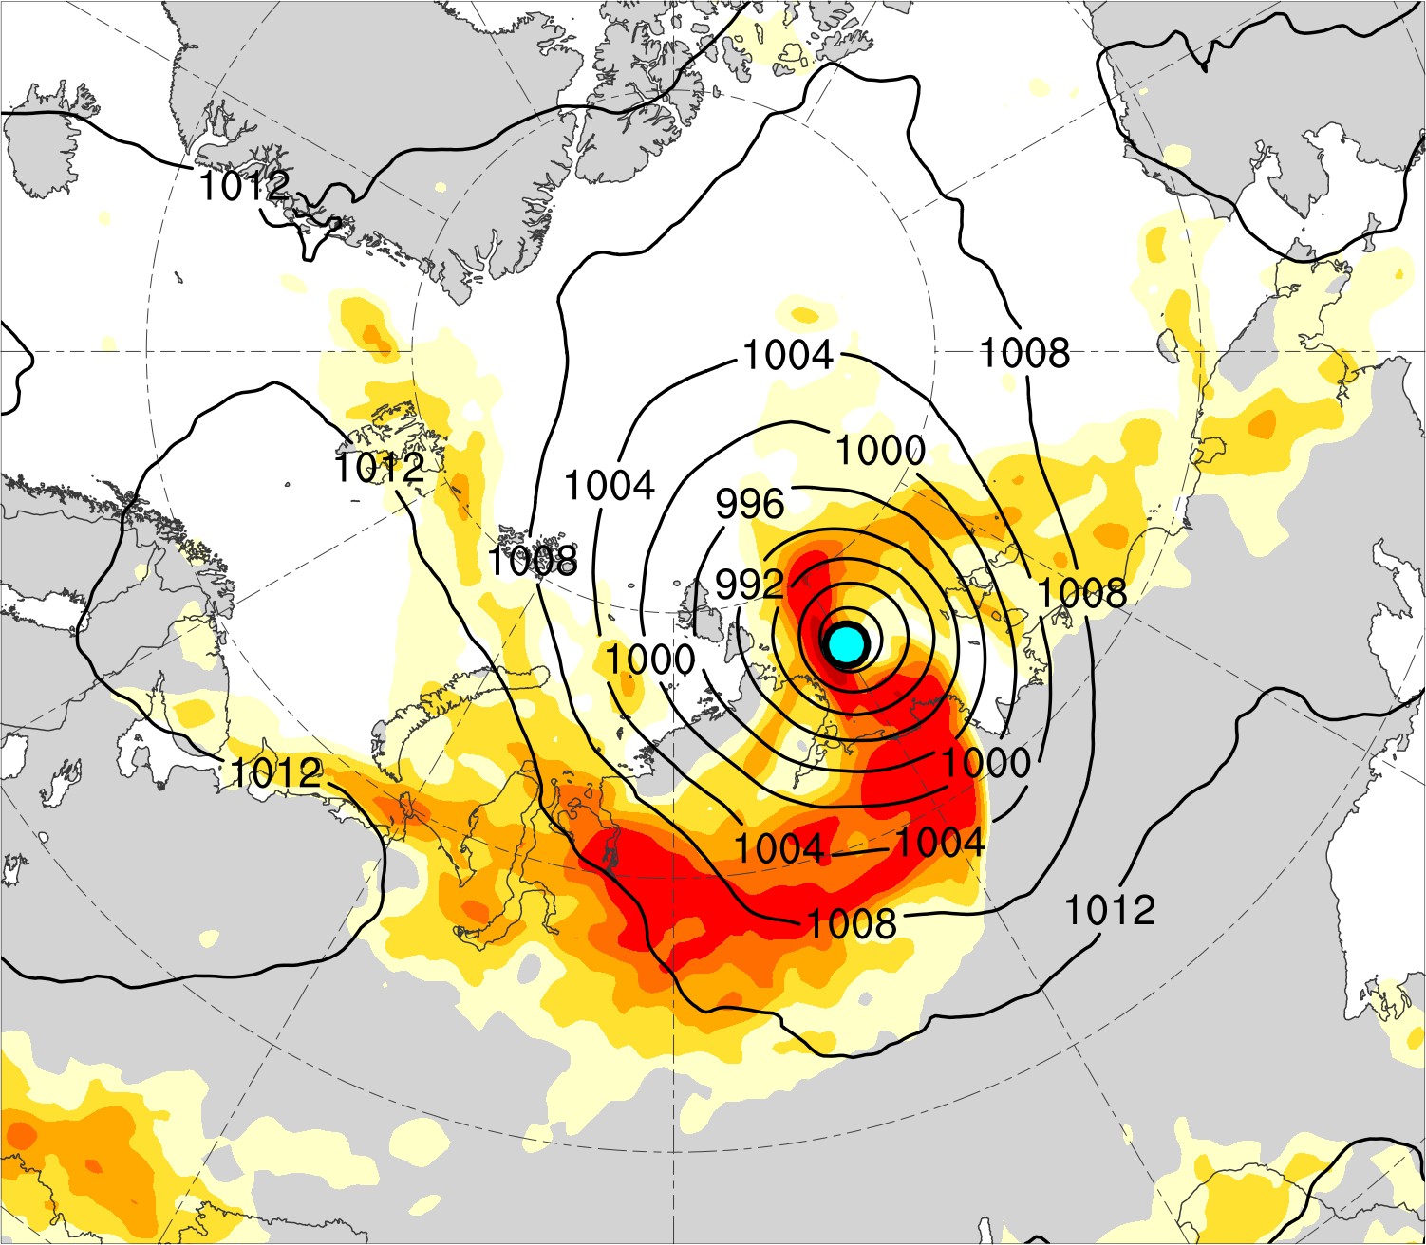
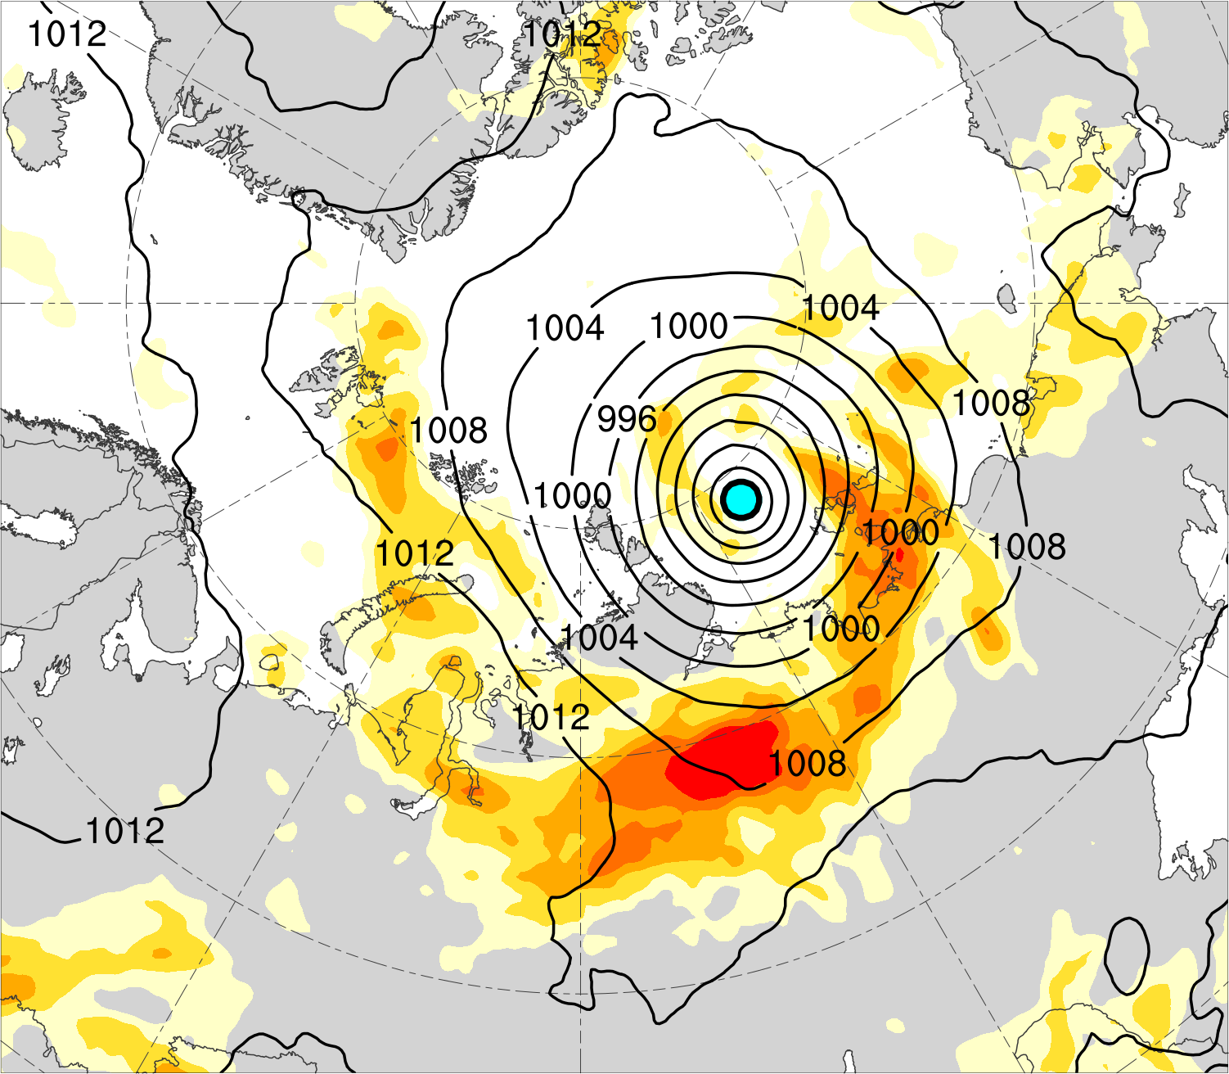
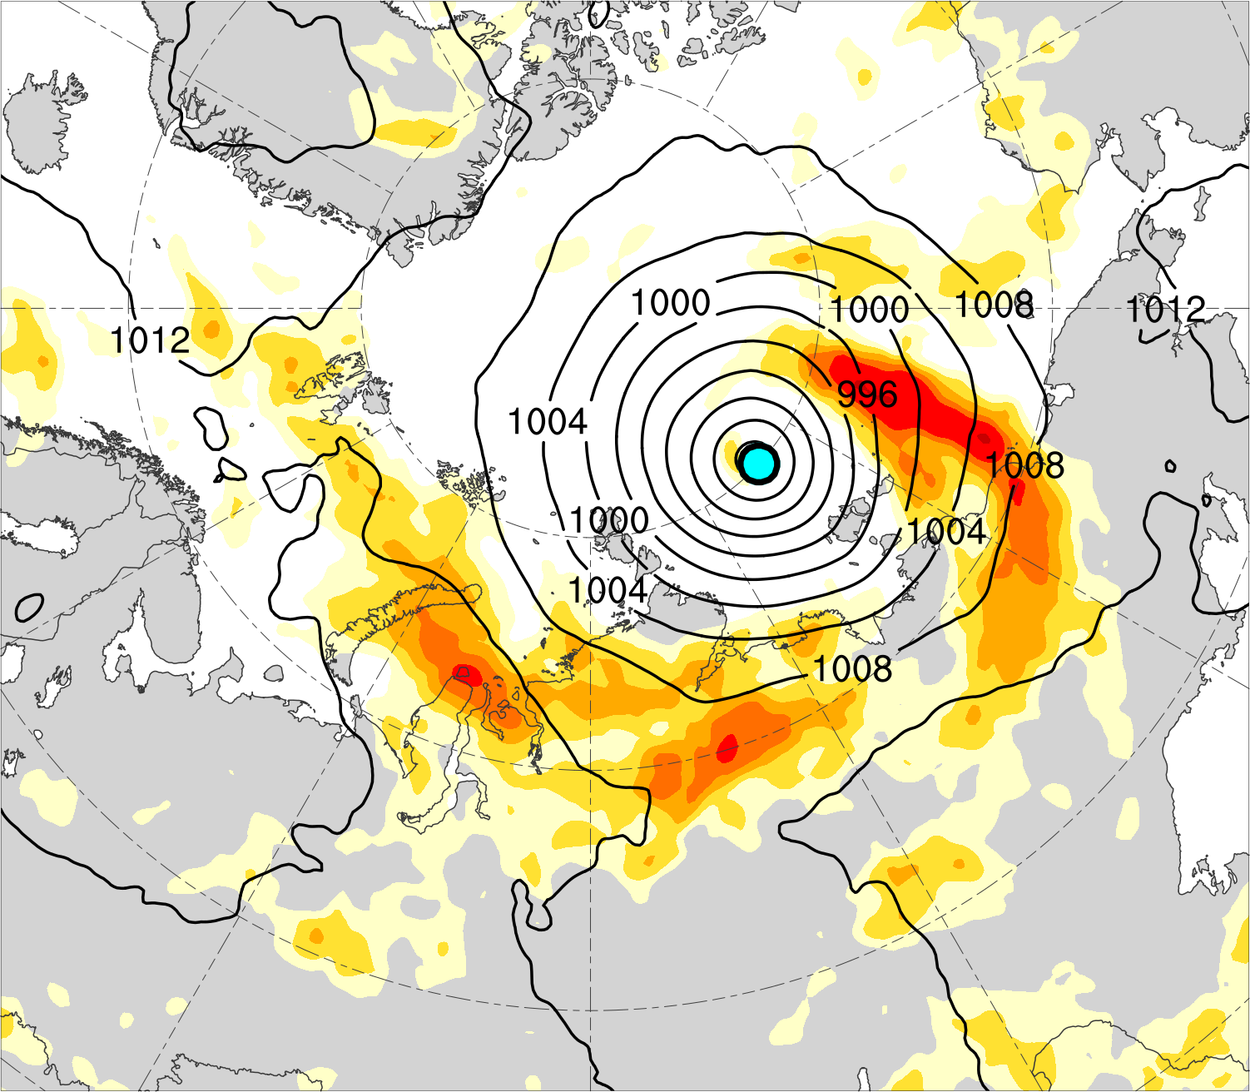
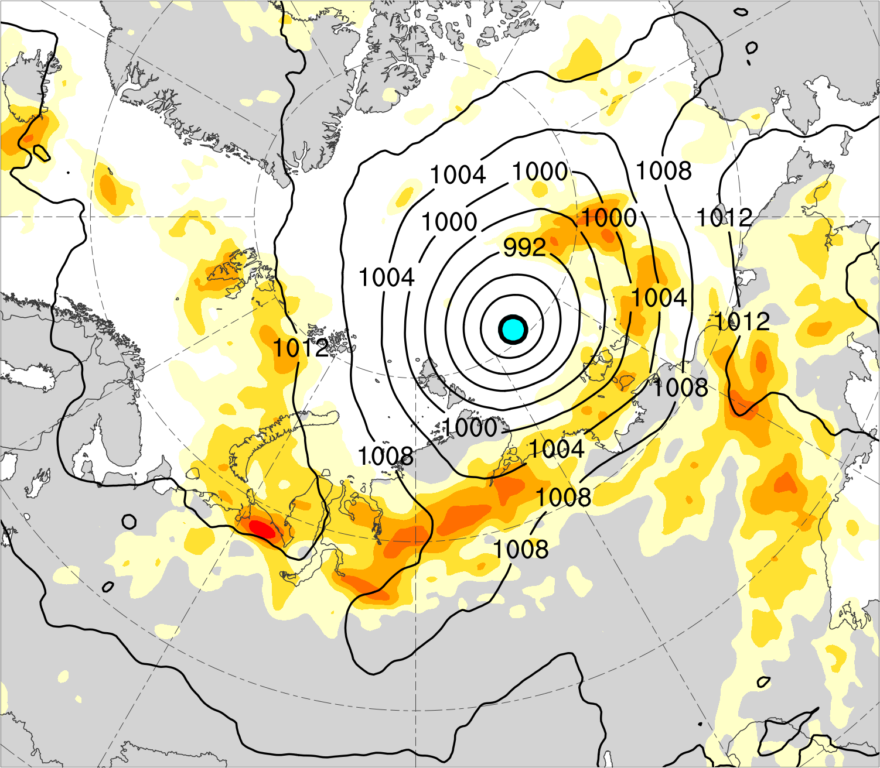
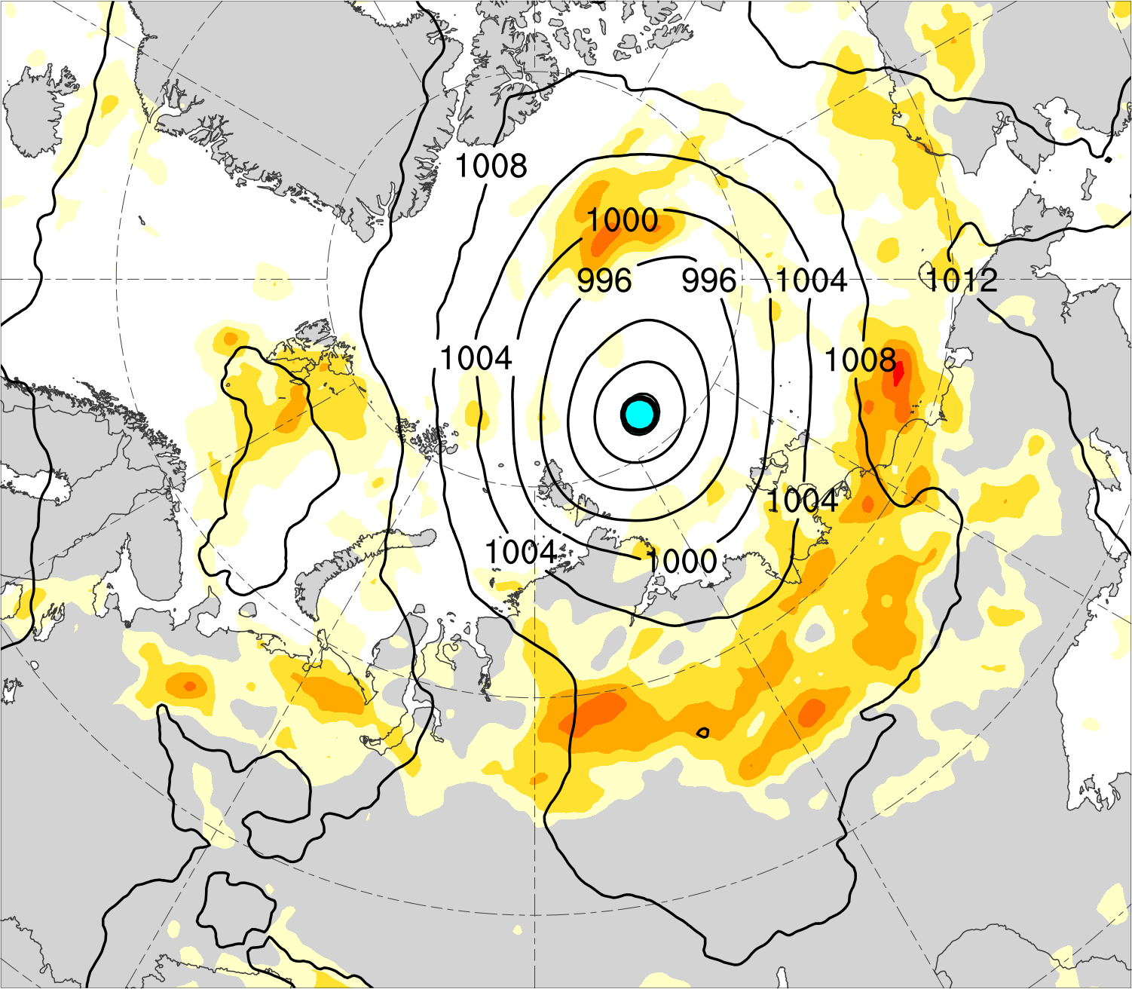
(a) Lag = −48 h (N = 13)
(b) Lag = −36 h (N = 13)
(c) Lag = −24 h (N = 14)
(d) Lag = −12 h (N = 14)
(e) Lag = 0 h (N = 14)
(f) Lag = 12 h (N = 13)
(g) Lag = 24 h (N = 13)
(h) Lag = 36 h (N = 12)
850–600-hPa Eady growth rate (day⁻¹)
Mean AC location
0.4
0.5
0.6
0.7
0.8
1.0
1.2
1.4
SLP (hPa)

Slide 19
Summary
Intense low-skill ACs during low-skill periods intensify downstream of a mid-to-upper-tropospheric vortex in a region of relatively strong lower-to-midtropospheric baroclinicity, lower-to-midtropospheric ascent, tropospheric-integrated vapor transport, and upper-tropospheric divergence.
A combination of baroclinic processes and latent heating likely plays important roles in the intensification of intense low-skill ACs during low-skill periods.

Slide 20
Extra Slides

Slide 21
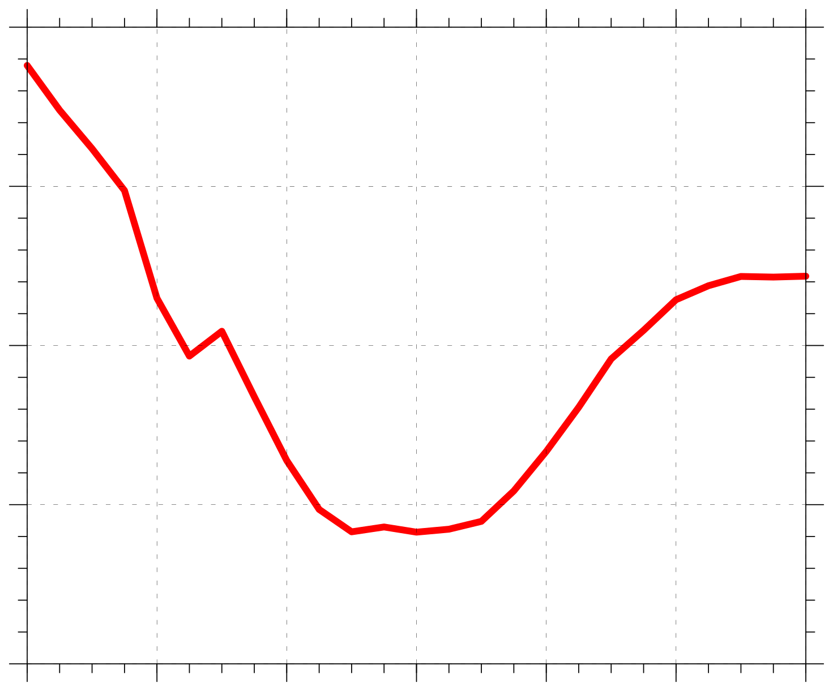
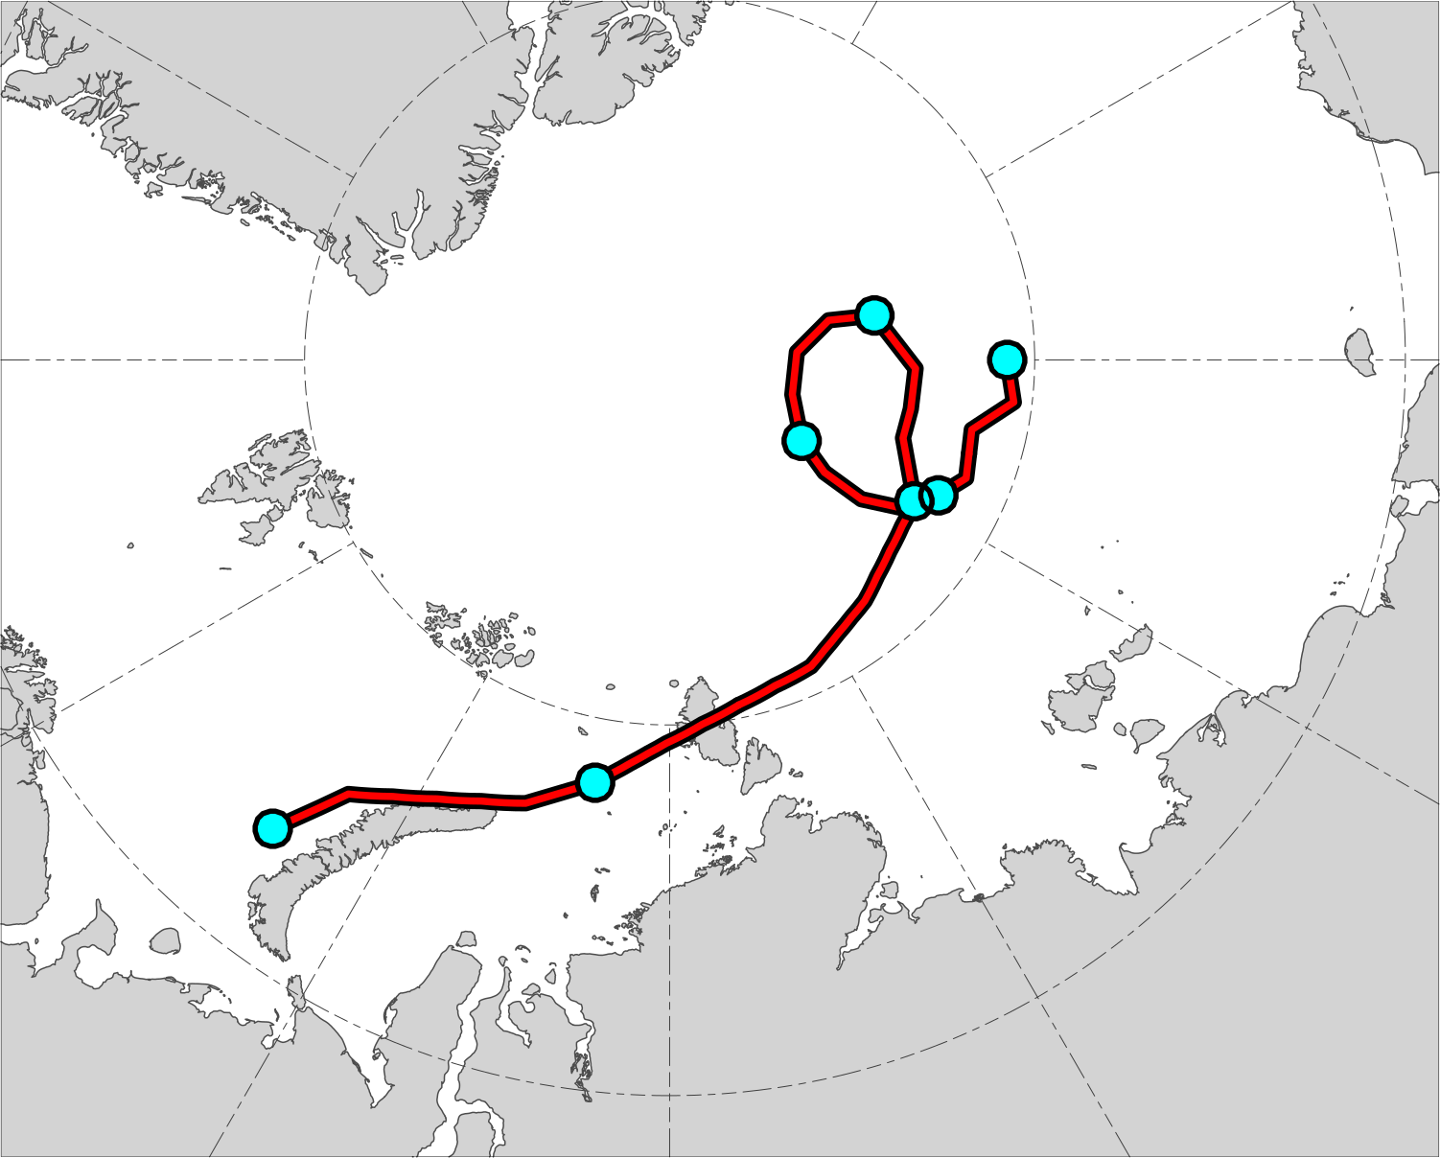
Example AC in Composite (AC during 13–19 Aug 2016)
1000
16
19
990
17
18
Minimum SLP (hPa)
980
14
15
13
970
960
0000 UTC positions of AC
13
14
15
16
17
18
19
Day in August 2016 labeled at 0000 UTC
Red line shows track of AC during 13–19 Aug 2016. Numbers represent dates of 0000 UTC positions of AC.
Time series of minimum SLP (hPa) of AC during 13–19 Aug 2016.
Data source: ERA5

Slide 22
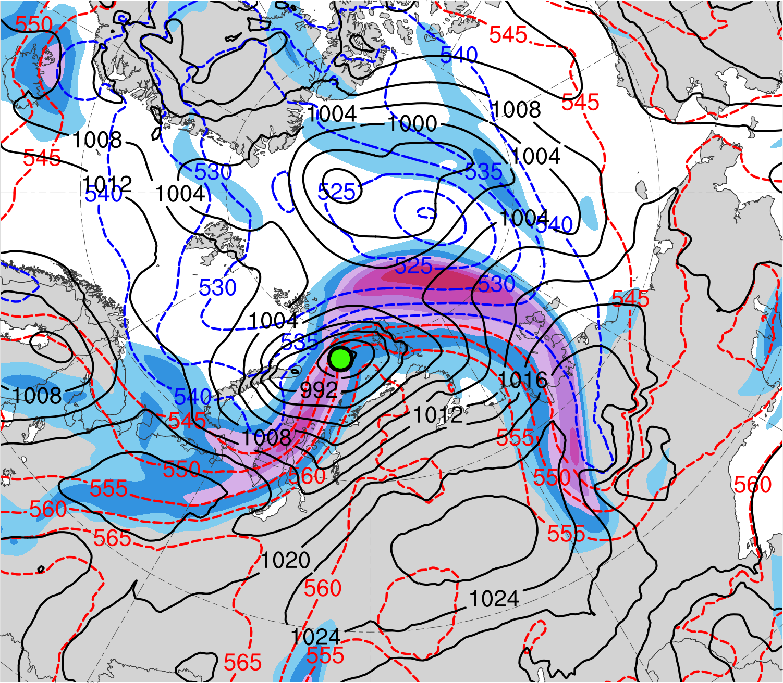
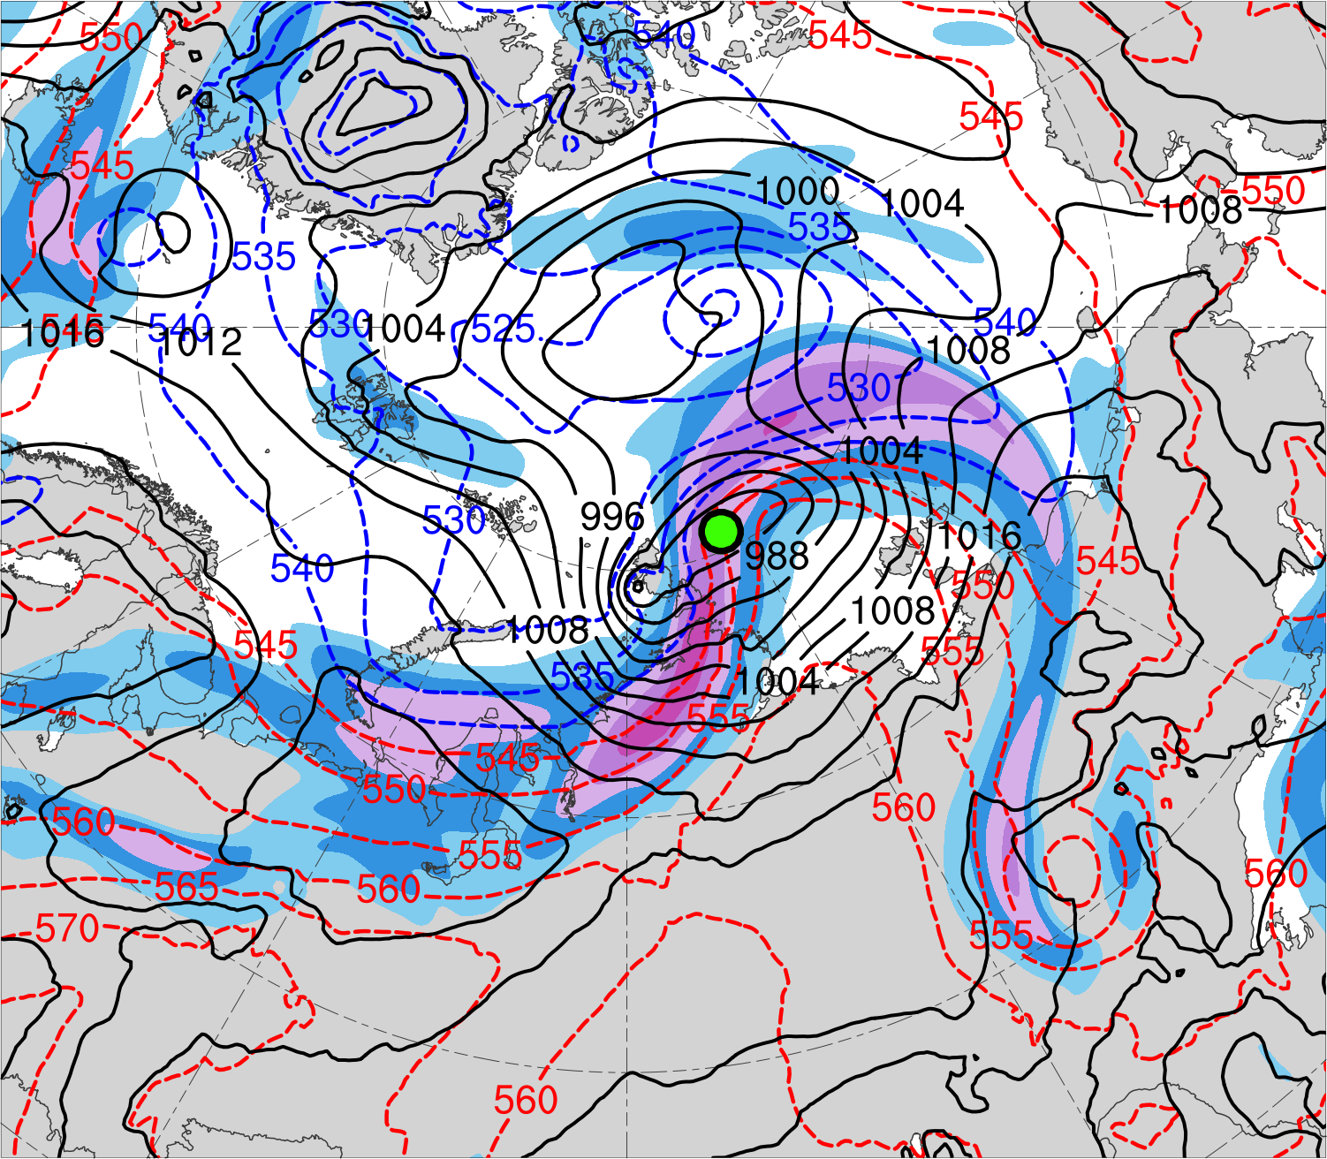
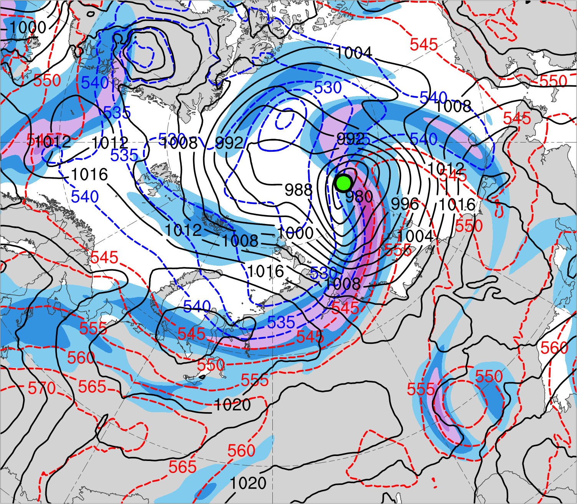
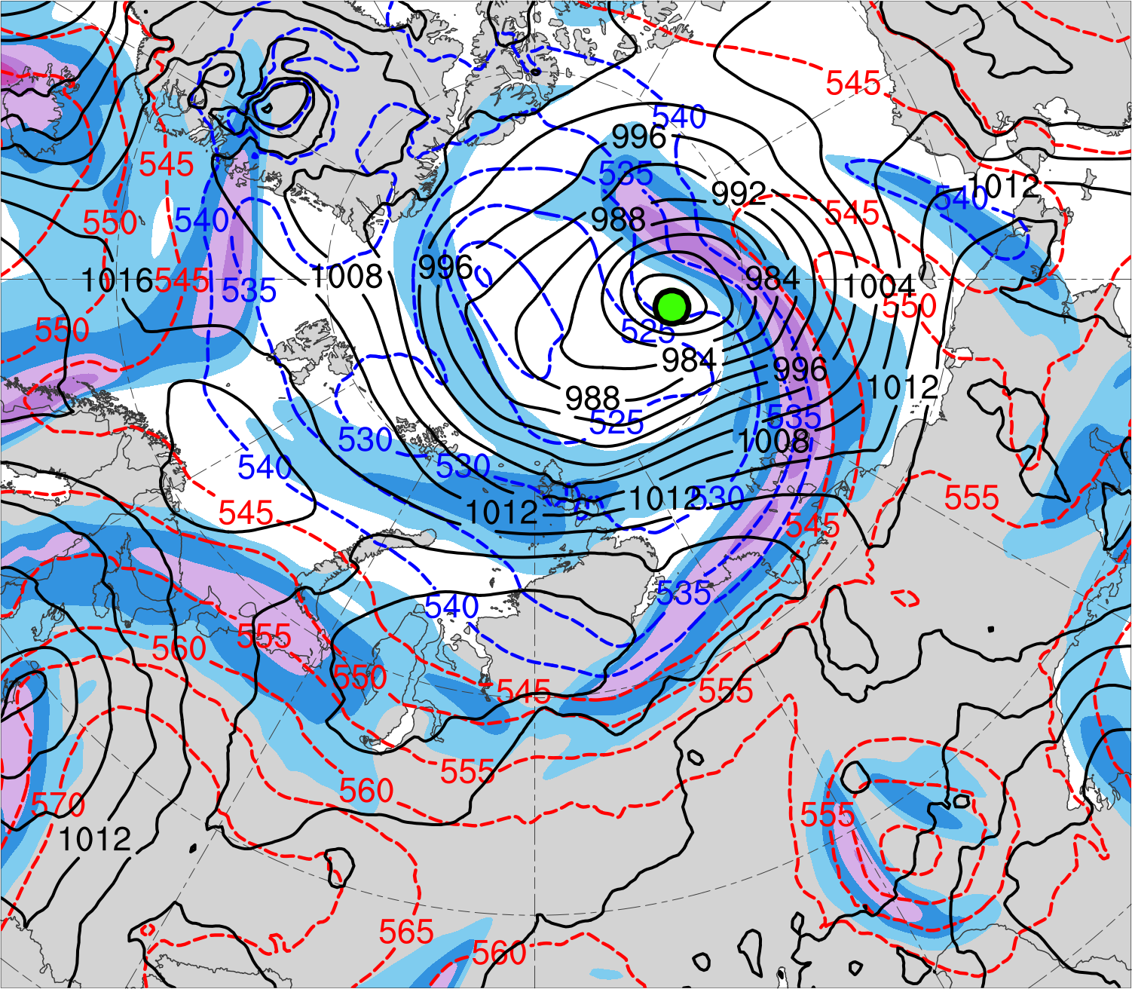
(a) Lag = −48 h (0000 UTC 14 Aug 2016)
(b) Lag = −36 h (1200 UTC 14 Aug 2016)
(c) Lag = −24 h (0000 UTC 15 Aug 2016)
(d) Lag = −12 h (1200 UTC 15 Aug 2016)
(e) Lag = 0 h (0000 UTC 16 Aug 2016)
(f) Lag = 12 h (1200 UTC 16 Aug 2016)
(g) Lag = 24 h (0000 UTC 17 Aug 2016)
(h) Lag = 36 h (1200 UTC 17 Aug 2016)
300-hPa wind speed (m s⁻¹)
AC location
24
32
40
48
56
64
72
80
SLP (hPa)
1000–500-hPa thickness (dam)
Data source: ERA5

Slide 23
(a) Lag = −48 h (0000 UTC 14 Aug 2016)
(b) Lag = −36 h (1200 UTC 14 Aug 2016)
(c) Lag = −24 h (0000 UTC 15 Aug 2016)
(d) Lag = −12 h (1200 UTC 15 Aug 2016)
(e) Lag = 0 h (0000 UTC 16 Aug 2016)
(f) Lag = 12 h (1200 UTC 16 Aug 2016)
(g) Lag = 24 h (0000 UTC 17 Aug 2016)
(h) Lag = 36 h (1200 UTC 17 Aug 2016)
200-km area-averaged 500-hPa relative vorticity (10⁻⁵ s⁻¹)
AC location
2
4
6
8
10
12
14
16
18
20
500-hPa geopotential
height (dam)
500-hPa wind (m s⁻¹)
Data source: ERA5

Slide 24
(a) Lag = −48 h (0000 UTC 14 Aug 2016)
(b) Lag = −36 h (1200 UTC 14 Aug 2016)
(c) Lag = −24 h (0000 UTC 15 Aug 2016)
(d) Lag = −12 h (1200 UTC 15 Aug 2016)
(e) Lag = 0 h (0000 UTC 16 Aug 2016)
(f) Lag = 12 h (1200 UTC 16 Aug 2016)
(g) Lag = 24 h (0000 UTC 17 Aug 2016)
(h) Lag = 36 h (1200 UTC 17 Aug 2016)
Integrated vapor transport (IVT) (kg m⁻¹ s⁻¹)
AC location
200
250
300
350
400
500
600
700
800
900
1000
IVT (kg m⁻¹ s⁻¹)
700-hPa geopotential
height (dam)
Data source: ERA5

Slide 25
(a) Lag = −48 h (0000 UTC 14 Aug 2016)
(b) Lag = −36 h (1200 UTC 14 Aug 2016)
(c) Lag = −24 h (0000 UTC 15 Aug 2016)
(d) Lag = −12 h (1200 UTC 15 Aug 2016)
(e) Lag = 0 h (0000 UTC 16 Aug 2016)
(f) Lag = 12 h (1200 UTC 16 Aug 2016)
(g) Lag = 24 h (0000 UTC 17 Aug 2016)
(h) Lag = 36 h (1200 UTC 17 Aug 2016)
200-km area-averaged 350–250-hPa divergence (10⁻⁶ s⁻¹)
AC location
5
10
15
20
25
30
35
40
350–250-hPa irrotational wind (m s⁻¹)
350–250-hPa PV (PVU)
Negative values of 800–600-hPa ω
(every 1 × 10⁻³ hPa s⁻¹)
Data source: ERA5

Slide 26
(a) Lag = −48 h (0000 UTC 14 Aug 2016)
(b) Lag = −36 h (1200 UTC 14 Aug 2016)
(c) Lag = −24 h (0000 UTC 15 Aug 2016)
(d) Lag = −12 h (1200 UTC 15 Aug 2016)
(e) Lag = 0 h (0000 UTC 16 Aug 2016)
(f) Lag = 12 h (1200 UTC 16 Aug 2016)
(g) Lag = 24 h (0000 UTC 17 Aug 2016)
(h) Lag = 36 h (1200 UTC 17 Aug 2016)
850–600-hPa Eady growth rate (day⁻¹)
AC location
0.5
0.75
1.0
1.25
1.5
2.0
2.5
3.0
Data source: ERA5
SLP (hPa)

