Slide 1
Improving Understanding and Predictability of Polar Lows and Arctic Cyclones that are linked to Tropopause Polar Vortices
Kevin A. Biernat
Department of Atmospheric and Environmental Sciences
University at Albany, SUNY
Prospectus Defense
Monday 24 September 2018
Research Supported by ONR Grant N00014-18-1-2200

Slide 2
What are Polar Lows and Arctic Cyclones?
Polar Lows
Arctic Cyclones
Mesoscale maritime cyclones of horizontal scales from 10s to 100s of km, often characterized by short lifetimes and rapid evolution (e.g., Smirnova et al. 2015)
Synoptic-scale cyclones, usually larger in size and longer lived than polar lows (e.g., Zhang et al. 2004)
Size and Duration

Slide 3
What are Polar Lows and Arctic Cyclones?
Polar Lows
Arctic Cyclones
Mesoscale maritime cyclones of horizontal scales from 10s to 100s of km, often characterized by short lifetimes and rapid evolution (e.g., Smirnova et al. 2015)
Synoptic-scale cyclones, usually larger in size and longer lived than polar lows (e.g., Zhang et al. 2004)
Size and Duration
Often form within a cold air mass or along an Arctic front at the leading edge of a cold air mass moving over warmer sea surfaces in high latitudes (e.g., Rasmussen and Turner 2003)
Either form within the Arctic or move into the Arctic from lower latitudes (e.g., Zhang et al. 2004; Crawford and Serreze 2016)
Location

Slide 4
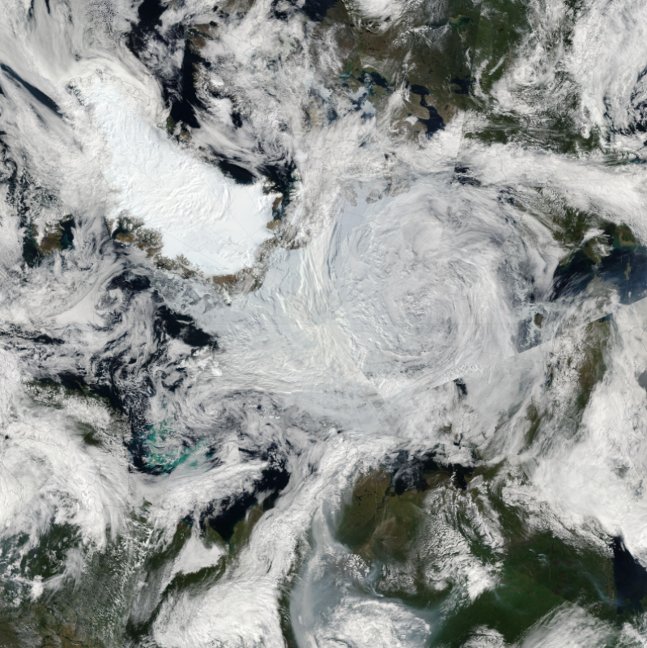
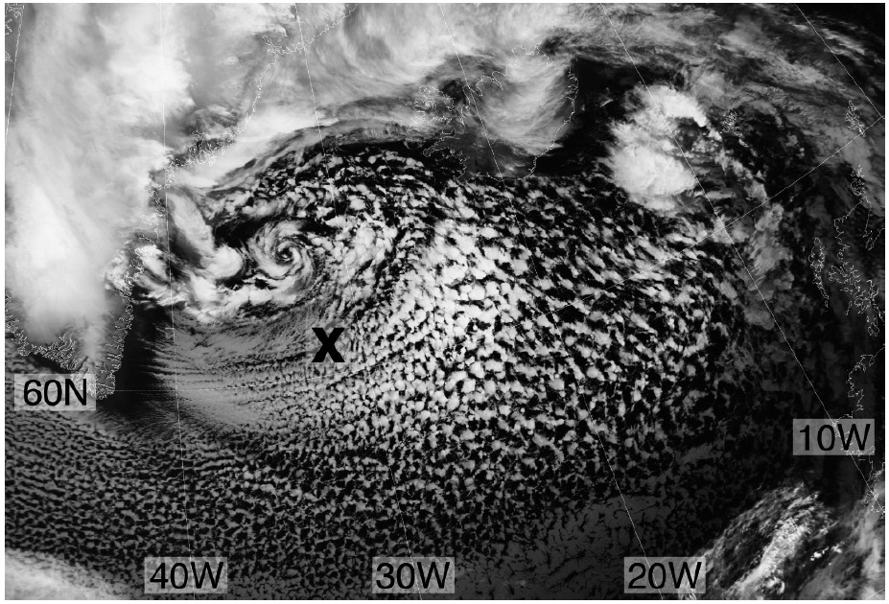
What are Polar Lows and Arctic Cyclones?
Example Arctic Cyclone
Canada
Example Polar Low
Greenland
Greenland
Russia
Satellite image valid 1209 UTC 2 March 2009. Figure 2 adapted from Kolstad (2011).
Satellite image of the Great Arctic Cyclone of August 2012 from 7 August 2012. Obtained from: https://earthobservatory.nasa.gov/NaturalHazards/view.php?id=78812

Slide 5
What are Tropopause Polar Vortices (TPVs)?
TPVs are sub-synoptic tropopause-based vortices of high-latitude origin and are material features (Pyle et al. 2004; Cavallo and Hakim 2009, 2010, 2012, 2013)

Slide 6
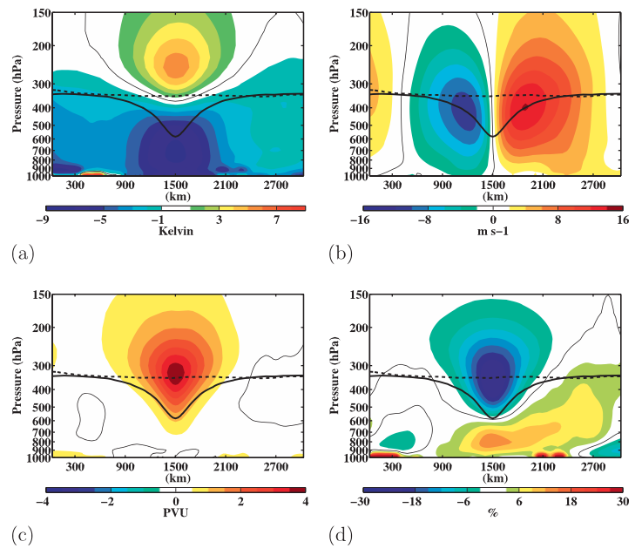
What are Tropopause Polar Vortices (TPVs)?
Temperature anomaly (K)
v-wind anomaly (m s⁻¹)
Ertel PV anomaly (PVU)
relative humidity anomaly (%)
Composite west-to-east cross sections of TPVs. Figure 9 adapted from Cavallo and Hakim (2010).

Slide 7
Motivation
Strong surface winds, large waves, and heavy precipitation that may be associated with polar lows (e.g., Rasmussen and Turner 2003) and Arctic cyclones (e.g., Parkinson and Comiso 2013) may pose hazards to shipping, infrastructure, and coastal communities
Strong surface winds and poleward advection of warm, moist air associated with Arctic cyclones may contribute reductions in Arctic sea-ice extent (e.g., Zhang et al. 2013)
TPVs may play important roles in the development of polar lows (e.g., Bracegirdle and Gray 2009) and Arctic cyclones (e.g., Simmonds and Rudeva 2012)

Slide 8
Motivation
Forecast skill over the Arctic may be worse than in the middle latitudes (e.g., Sandu and Bauer 2018)
Some polar lows (e.g., Kristjánsson et al. 2011) and Arctic Cyclones (e.g., Yamagami et al. 2018a) may be associated with especially low forecast skill
Predictability studies of polar lows and Arctic cyclones are lacking in the literature

Slide 9
Research Goals
Improve understanding of polar lows and Arctic cyclones linked to TPVs
Improve understanding of factors limiting the forecast skill of polar lows and Arctic cyclones linked to TPVs

Slide 10
Outline
Literature review
Research questions
Research hypotheses and research plan

Slide 11
Literature Review–TPVs
TPVs are prevalent features in the high latitudes (e.g., Hakim and Canavan 2005; Cavallo and Hakim 2012)

Slide 12
Literature Review–TPVs
TPVs are prevalent features in the high latitudes (e.g., Hakim and Canavan 2005; Cavallo and Hakim 2012)
TPVs may act as precursors to surface cyclogenesis (e.g., Hoskins et al. 1985; section 6e)
v-wind anomaly (m s⁻¹)
Ertel PV anomaly (PVU)
Figure 9 adapted from Cavallo and Hakim (2010).

Slide 13
Literature Review–TPVs
TPVs are prevalent features in the high latitudes (e.g., Hakim and Canavan 2005; Cavallo and Hakim 2012)
TPVs may act as precursors to surface cyclogenesis (e.g., Hoskins et al. 1985; section 6e)
TPVs may interact with the jet stream and lead to the formation and intensification of jet streaks (e.g., Pyle et al. 2004)

Slide 14
Literature Review–TPVs
TPVs are prevalent features in the high latitudes (e.g., Hakim and Canavan 2005; Cavallo and Hakim 2012)
TPVs may act as precursors to surface cyclogenesis (e.g., Hoskins et al. 1985; section 6e)
TPVs may interact with the jet stream and lead to the formation and intensification of jet streaks (e.g., Pyle et al. 2004)
TPVs may be associated with cold air outbreaks (CAOs; e.g., Shapiro et al. 1987; Biernat 2017)
Temperature anomaly (K)
Figure 9 adapted from Cavallo and Hakim (2010).

Slide 15
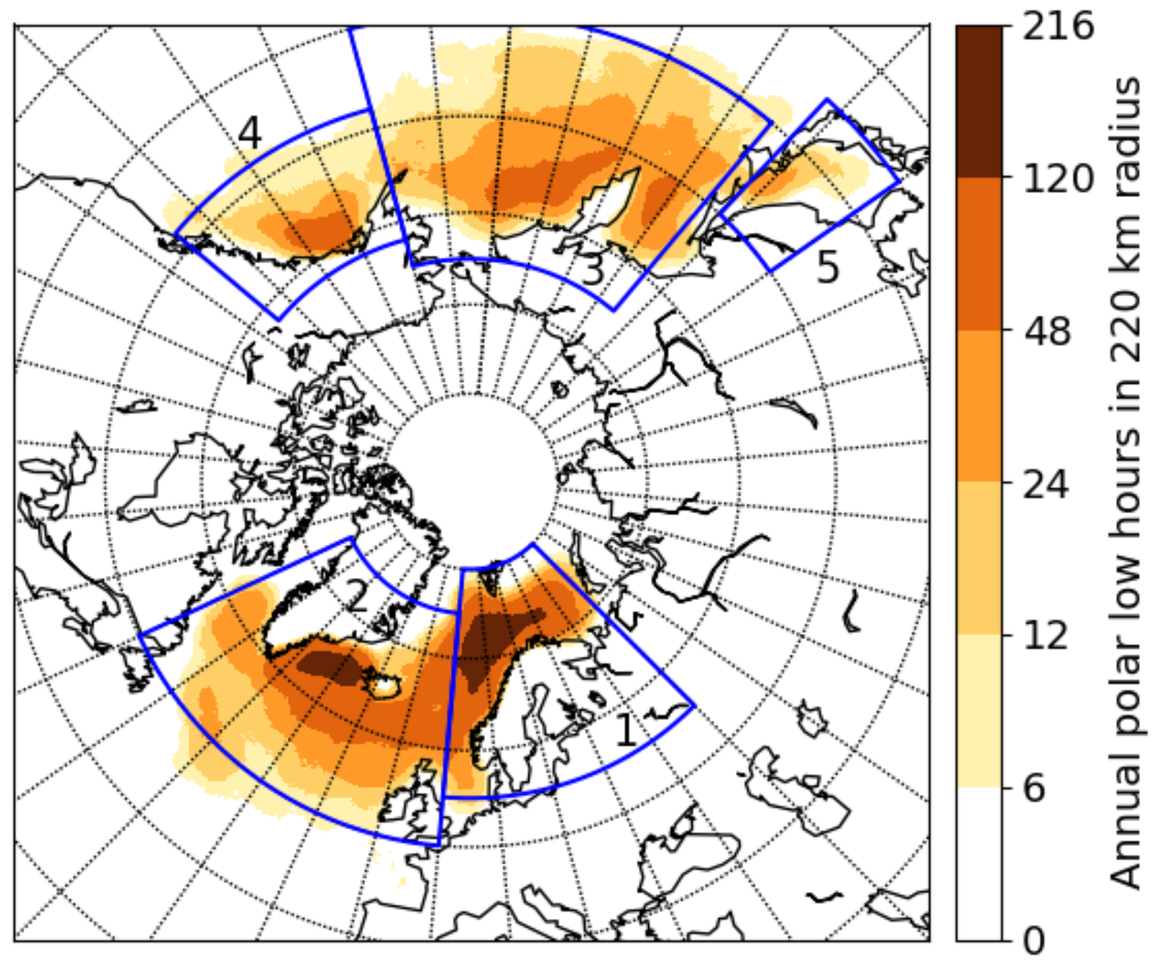
Literature Review–Polar Lows
Polar lows occur in all high-latitude marine basins
Spatial distribution of the average annual polar low hours for the Arctic System Reanalysis v1 during 2000–2012. Figure 5 adapted from Stoll et al. (2018).

Slide 16
Literature Review–Polar Lows
The Norwegian and Barents Seas is a favorable region for polar low development
Spatial distribution of the average annual polar low hours for the Arctic System Reanalysis v1 during 2000–2012. Figure 5 adapted from Stoll et al. (2018).

Slide 17
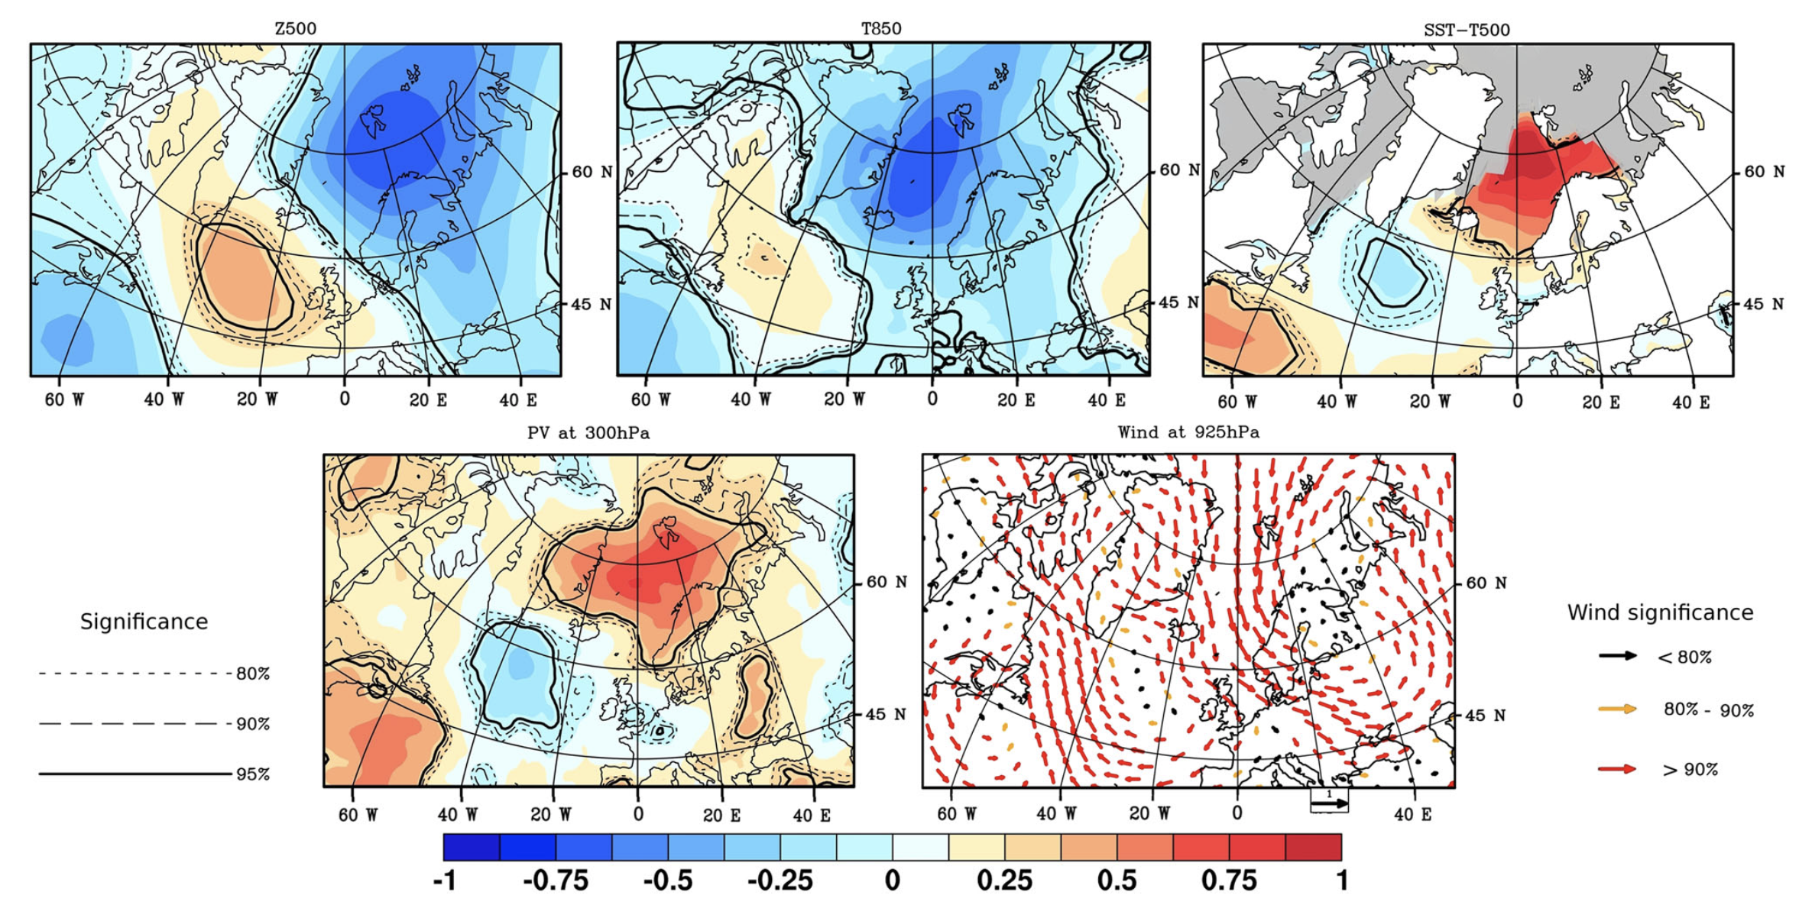
Literature Review–Polar Lows
(a) 500-hPa Geopotential Height
(b) 850-hPa Temperature
(c) SST−T500
(d) 300-hPa PV
(e) 925-hPa Wind
Maximum monthly sea-ice extent (1979–2007)
Significance
Wind Significance
80%
<80%
90%
80–90%
95%
>90%
Composite standardized anomalies for date of formation of 134 polar lows from Noer et al. (2011) occurring during the months of October–March during 1999–2011. Data source: ERA-Interim. Figure 2 adapted from Mallet et al. (2013).

Slide 18
Literature Review–Polar Lows
(a) 500-hPa Geopotential Height
(b) 850-hPa Temperature
(c) SST−T500
(d) 300-hPa PV
(e) 925-hPa Wind
Maximum monthly sea-ice extent (1979–2007)
Significance
Wind Significance
80%
<80%
90%
80–90%
95%
>90%
Composite standardized anomalies for date of formation of 134 polar lows from Noer et al. (2011) occurring during the months of October–March during 1999–2011. Data source: ERA-Interim. Figure 2 adapted from Mallet et al. (2013).

Slide 19
Literature Review–Polar Lows
CAOs occurring over relatively warm waters may provide favorable thermodynamic environment for polar low development (e.g., Emanuel and Rotunno 1989; Kolstad 2011)
  CAOs in combination with strong surface winds may lead to large surface sensible and latent heat fluxes, which may lead to reductions in lower-tropospheric stability

Slide 20
Literature Review–Polar Lows
(a) 500-hPa Geopotential Height
(b) 850-hPa Temperature
(c) SST−T500
(d) 300-hPa PV
(e) 925-hPa Wind
Maximum monthly sea-ice extent (1979–2007)
Significance
Wind Significance
80%
<80%
90%
80–90%
95%
>90%
Composite standardized anomalies for date of formation of 134 polar lows from Noer et al. (2011) occurring during the months of October–March during 1999–2011. Data source: ERA-Interim. Figure 2 adapted from Mallet et al. (2013).

Slide 21
Literature Review–Polar Lows
Anomalous northerly flow from Arctic sea ice to the open waters of the Norwegian and Barents Sea may support strong low-level baroclinicity (e.g., Businger 1985)
Baroclinicity has been shown to be an important ingredient for polar low development (e.g., Harrold and Browning 1969; Reed 1979)
  Baroclinic zones may be associated with relatively strong low-level cyclonic relative vorticity and convergence (e.g., Shapiro and Fedor 1989)

Slide 22
Literature Review–Polar Lows
(a) 500-hPa Geopotential Height
(b) 850-hPa Temperature
(c) SST−T500
(d) 300-hPa PV
(e) 925-hPa Wind
Maximum monthly sea-ice extent (1979–2007)
Significance
Wind Significance
80%
<80%
90%
80–90%
95%
>90%
Fig. 3. Composite standardized anomalies for date of formation of 134 polar lows from Noer et al. (2011) occurring during the months of October–March during 1999–2011. Data source: ERA-Interim. Figure 2 adapted from Mallet et al. (2013).

Slide 23
Literature Review–Polar Lows
Upper-level cyclonic PV anomalies, which may include TPVs associated with CAOs, may:
  Provide upper-level forcing for ascent over polar lows (e.g., Bracegirdle and Gray 2009)
  Become vertically coupled with polar lows (e.g., Føre et al. 2011; Sergeev et al. 2018)
  Destabilize the lower troposphere (e.g., Mallet et al. 2013)

Slide 24
Literature Review–Polar Lows
Favorable ingredients for polar low development may support relatively strong upward vertical motions and stratiform and convective precipitation
Associated latent heat release may contribute to polar low development by, for example, leading to low-level PV production and intensification of the polar low (e.g. Montgomery and Farrell 1992)

Slide 25
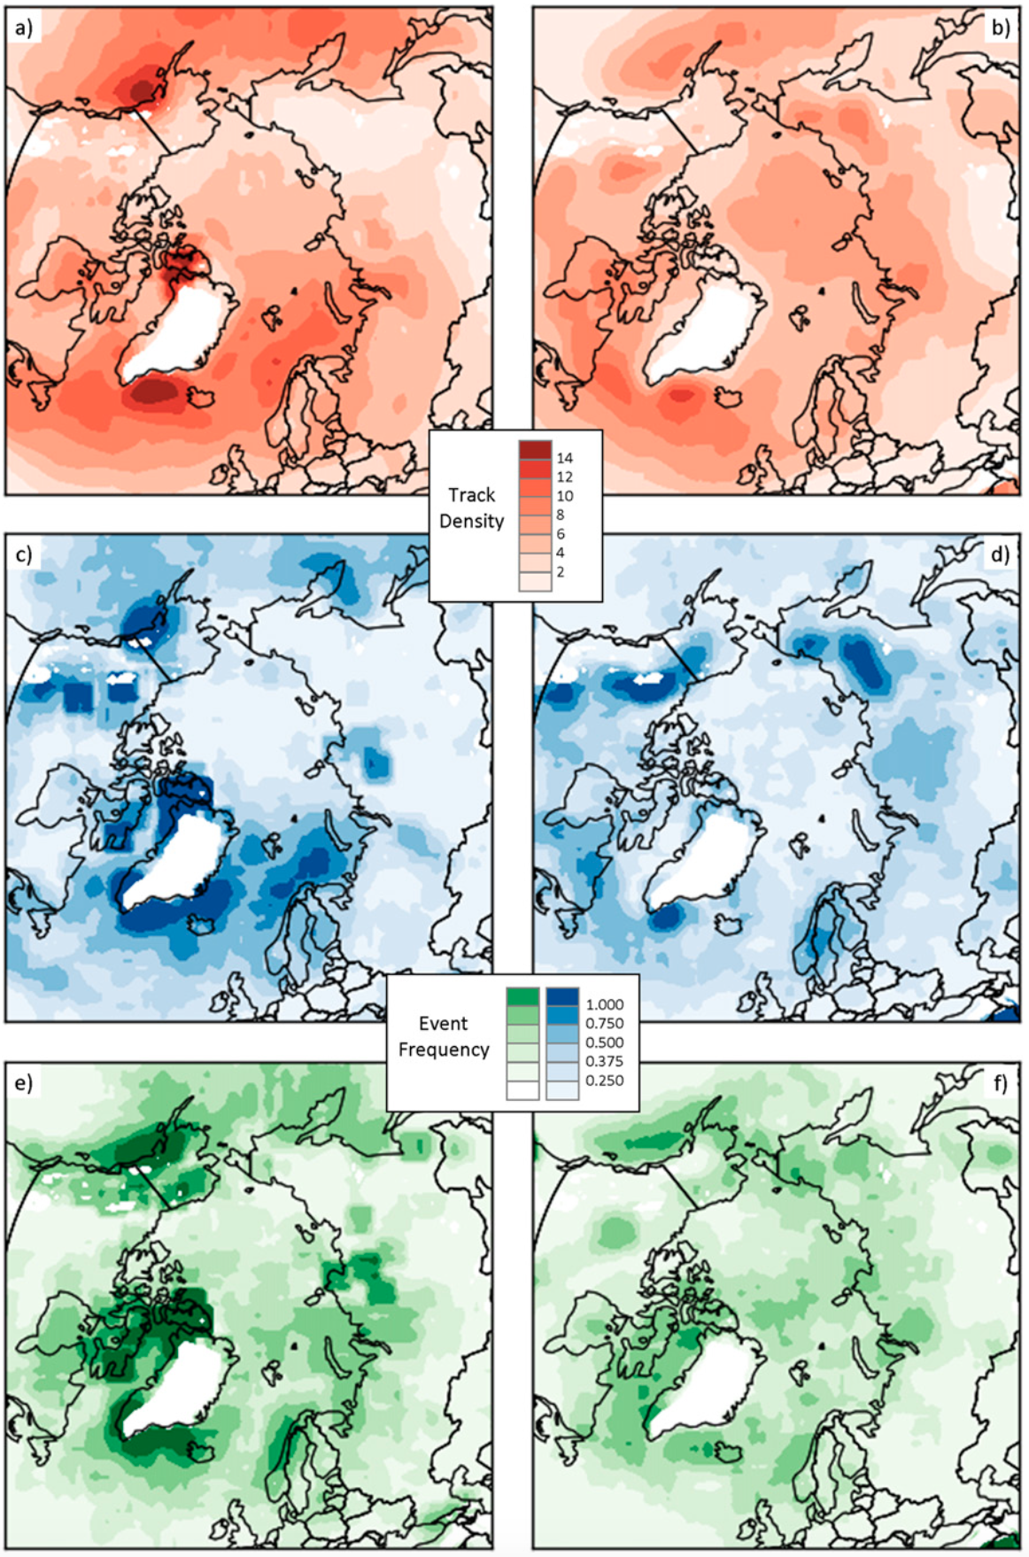
Literature Review–Arctic Cyclones
Winter
Summer
Arctic cyclones may originate within and outside of Arctic
~30–40% of Arctic cyclones originate within Arctic during both winter and Summer
During winter, Arctic cyclones often originate from North Atlantic
During summer, Arctic cyclones often originate from Eurasia
Track Density
Genesis Frequency
Lysis Frequency
Figure 3 adapted from Crawford and Serreze (2016)

Slide 26
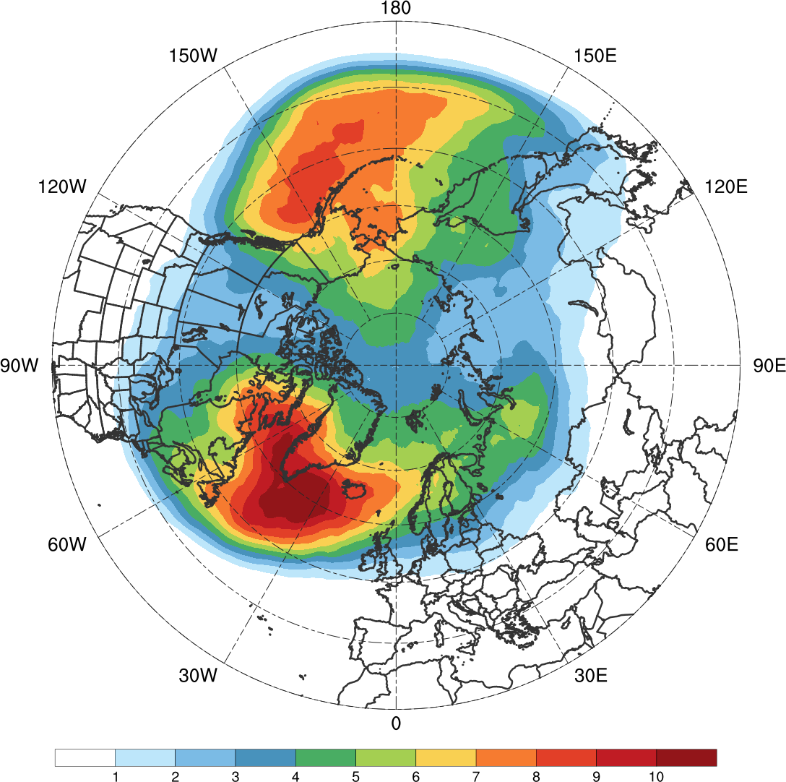
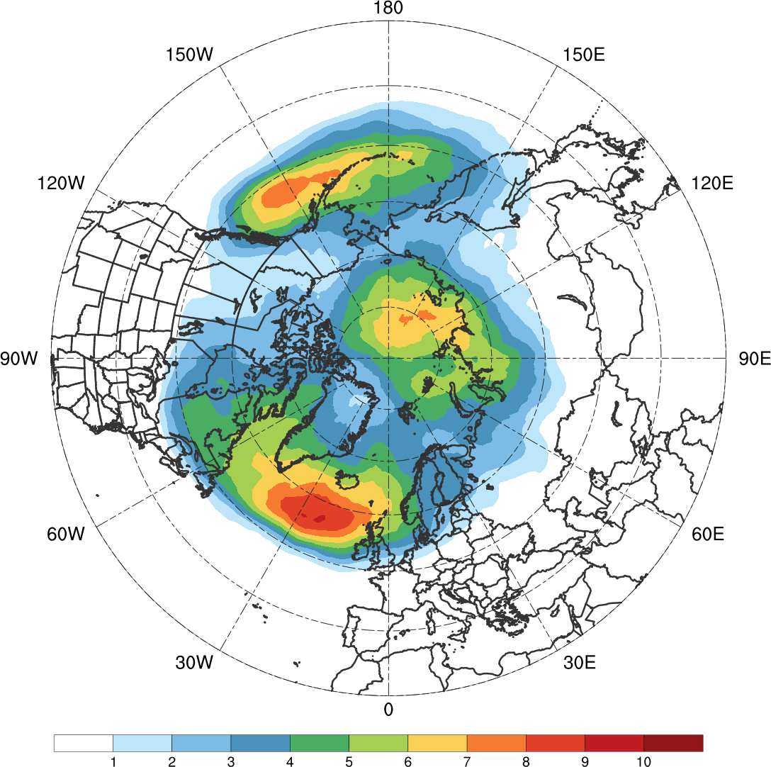
Literature Review–Arctic Cyclones
High-latitude blocking may facilitate Arctic cyclones and associated intrusions of warm, moist air to enter the Arctic
(a) DJF
(b) JJA
1
2
3
4
5
6
7
8
9
10
%
Average percentage of 6-h time steps that a block is located at a grid point during (a) DJF and (b) JJA of 1979–2014 in the ERA-Interim. Data to create images obtained from: Institute for Atmospheric and Climate Science–ETH Zürich (2015).

Slide 27
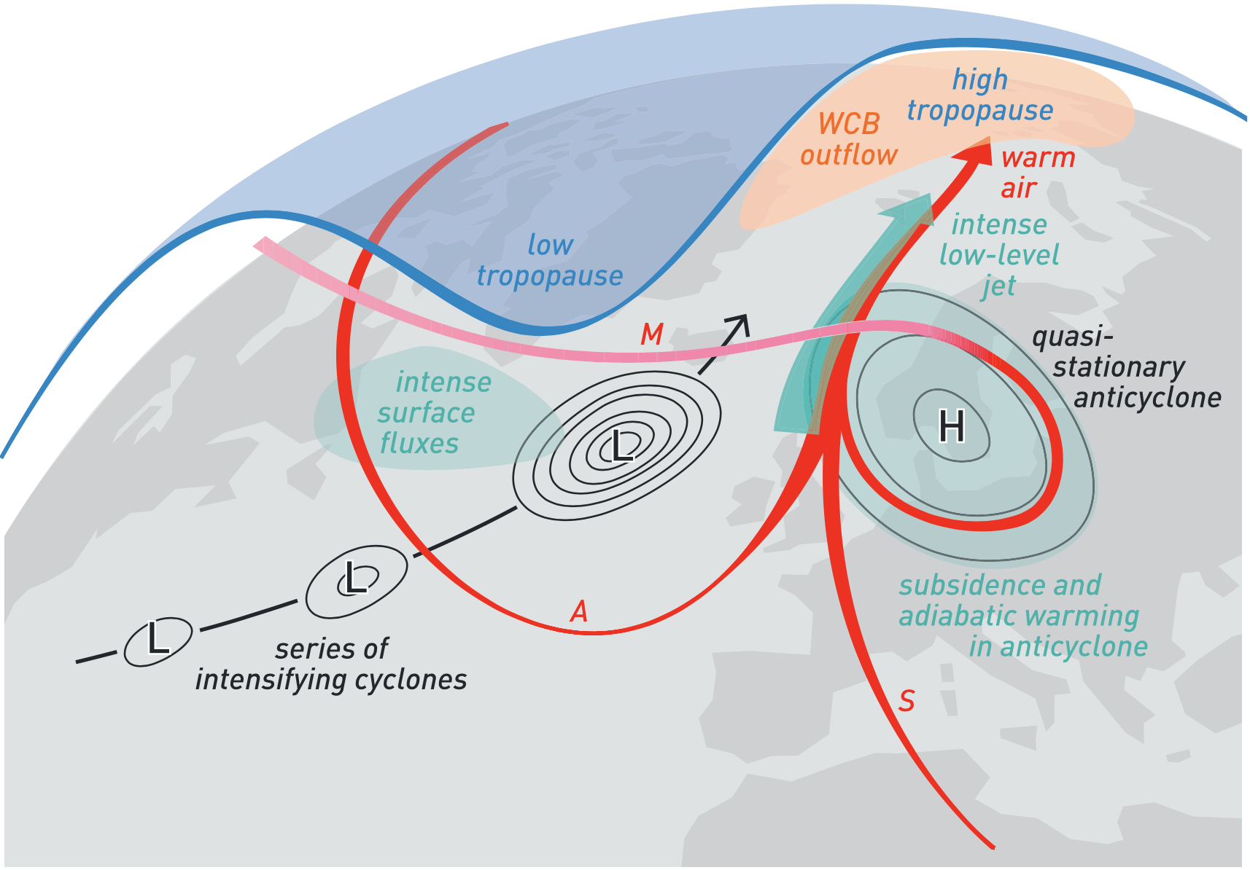
Literature Review–Arctic Cyclones
During late Dec 2015 and early Jan 2016, warm, moist air transported between series of cyclones and blocking anticyclone (Binder et al. 2017)
Figure 4 adapted from Binder et al. (2017).

Slide 28
Literature Review–Arctic Cyclones
During late Dec 2015 and early Jan 2016, warm, moist air transported between series of cyclones and blocking anticyclone (Binder et al. 2017)
L
H
L
L
Figure 4 adapted from Binder et al. (2017).

Slide 29
Literature Review–Arctic Cyclones
During late Dec 2015 and early Jan 2016, warm, moist air transported between series of cyclones and blocking anticyclone (Binder et al. 2017)
Maximum 2-m temperatures greater than 0°C north of 82°N
More than 30 cm of sea ice thinning in the Barents and Kara Seas
Kara
Sea
Barents Sea
L
H
L
L
Figure 4 adapted from Binder et al. (2017).

Slide 30
Literature Review–Arctic Cyclones
TPVs, baroclinic processes, and latent heating may play important roles in the evolution of Arctic cyclones
Strong Arctic cyclones (e.g., Simmonds and Rudeva 2014) and Arctic cyclones linked to extreme summer sea-ice loss events (e.g., Cavallo et al. 2017) have been shown to be frequently associated with TPVs
Simmonds and Rudeva (2012), Yamazaki et al. (2015), and Tao et al. (2017) illustrate that a TPV and baroclinic instability play an important role in the evolution of the Great Arctic Cyclone of August 2012 (AC12)

Slide 31
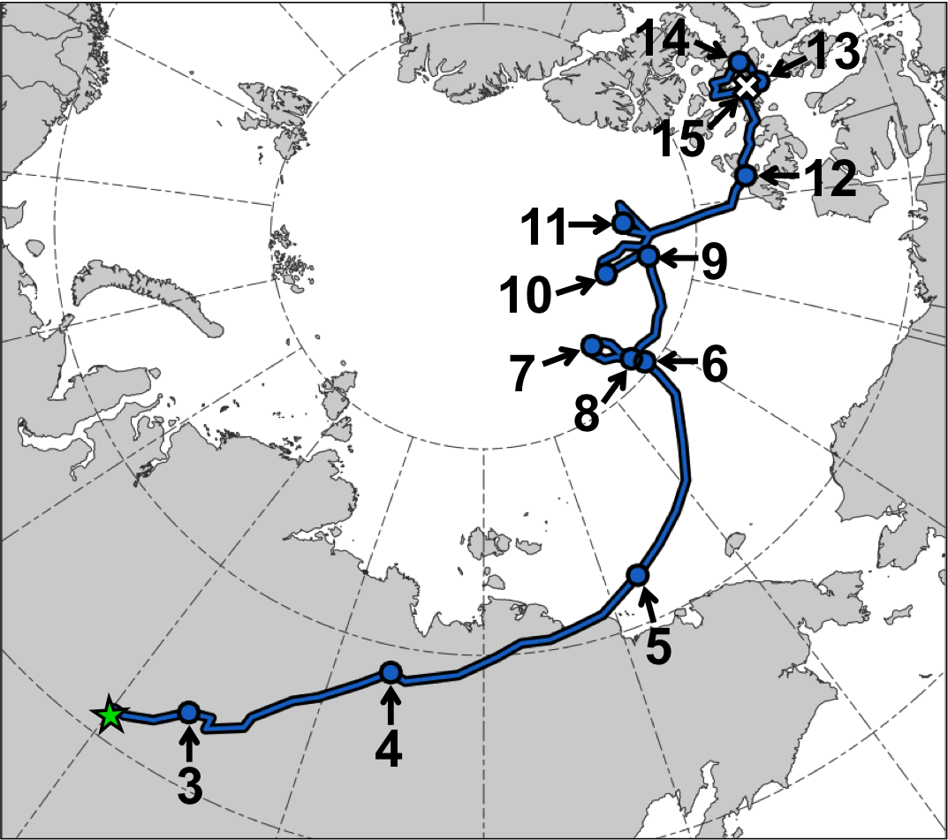
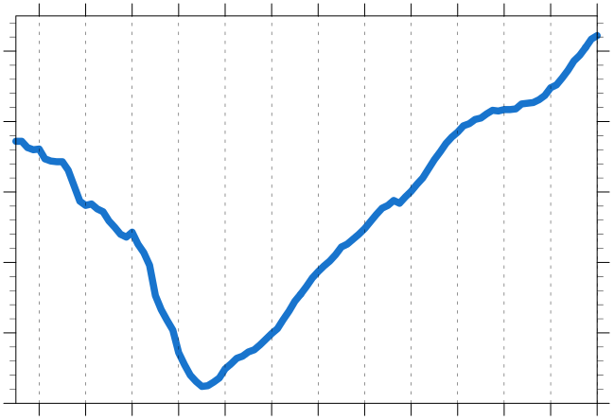
Literature Review–Arctic Cyclones
AC12 Track and Intensity
Minimum SLP (hPa) trace of AC12
1010
1000
990
980
970
960
3
4
5
6
7
8
9
10
11
12
13
14
15
Day in Aug 2012 (at 0000 UTC)
Manual tracking with ERA5 (0.3°; every 3 h)
1200 UTC 2–0000 UTC 15 Aug 2012

Slide 32
Literature Review–Arctic Cyclones
Strong surface winds associated with AC12 helped to break up thin sea ice (e.g., Parkinson and Comiso 2013)
According to Zhang et al. (2013), sea-ice volume decreased twice as fast as normal during AC12 due to melting of the bottom and perimeter of ice floes

Slide 33
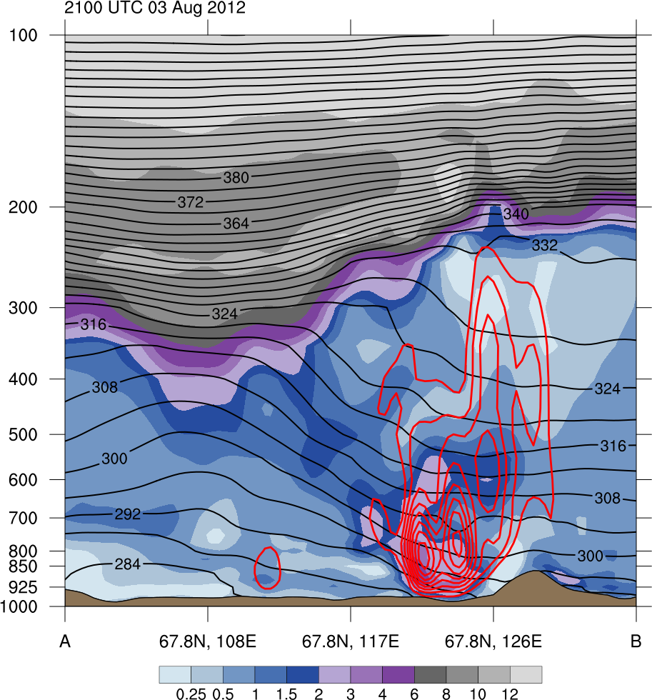
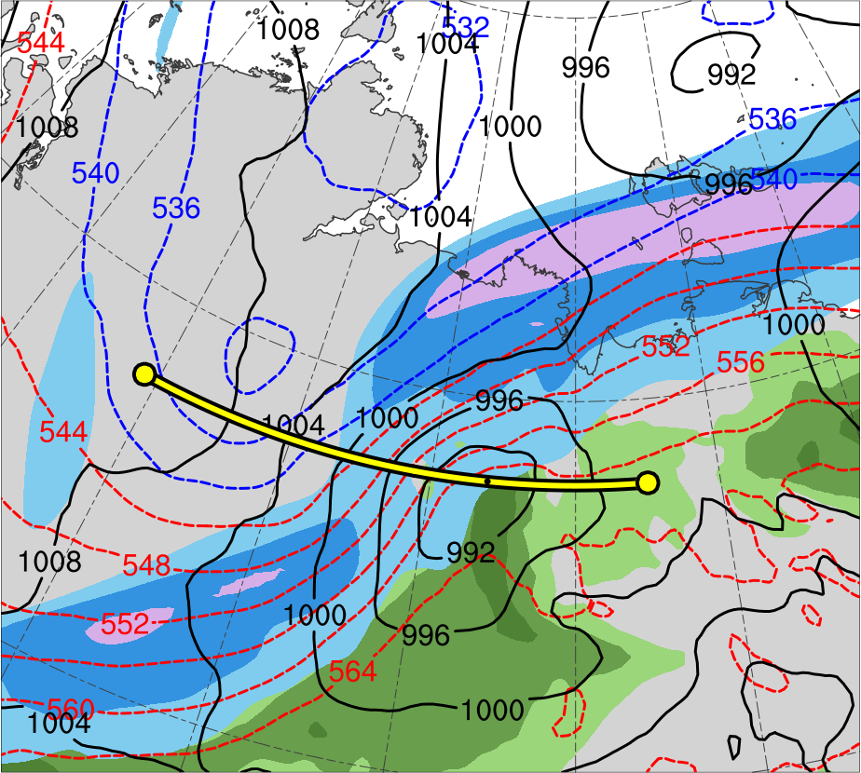
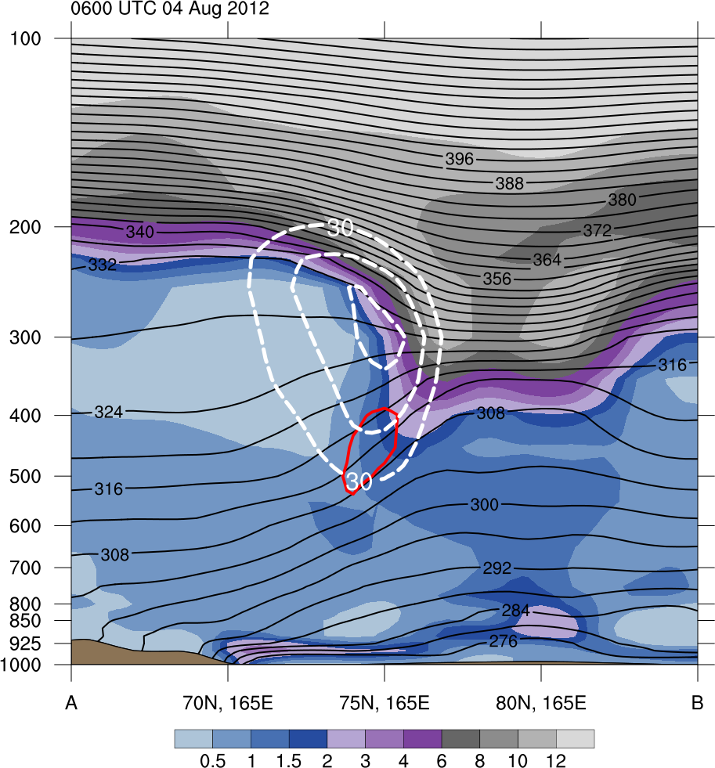
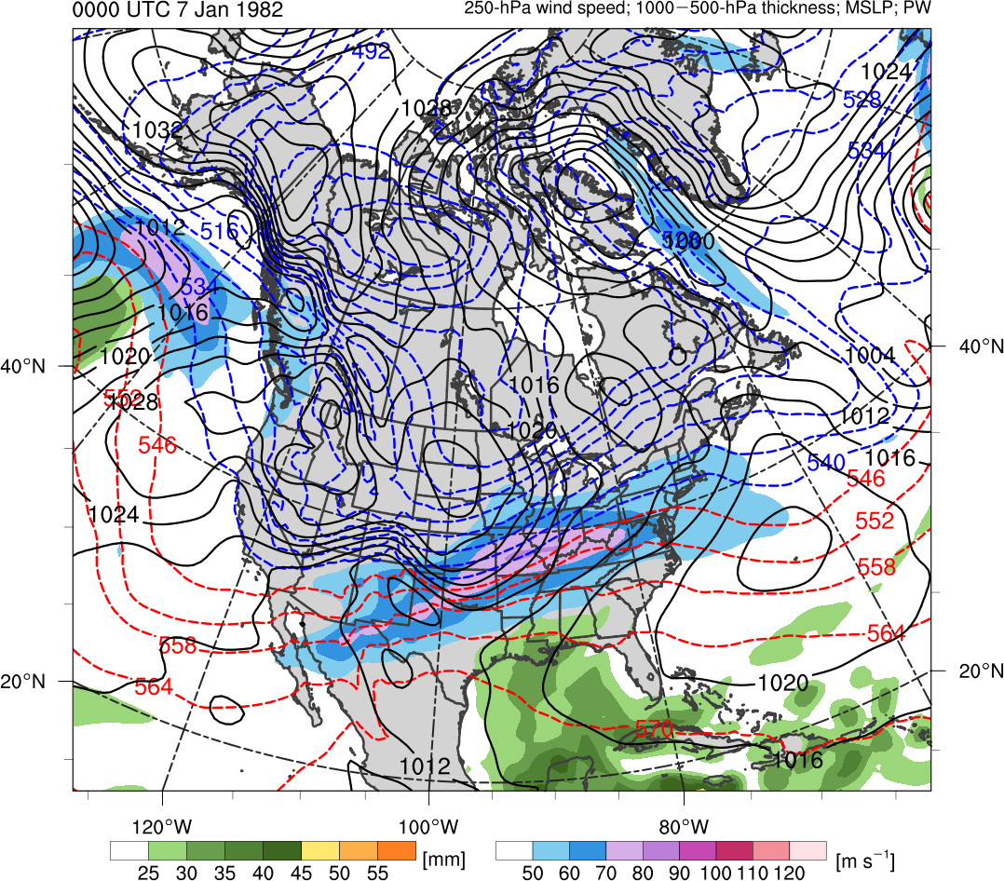
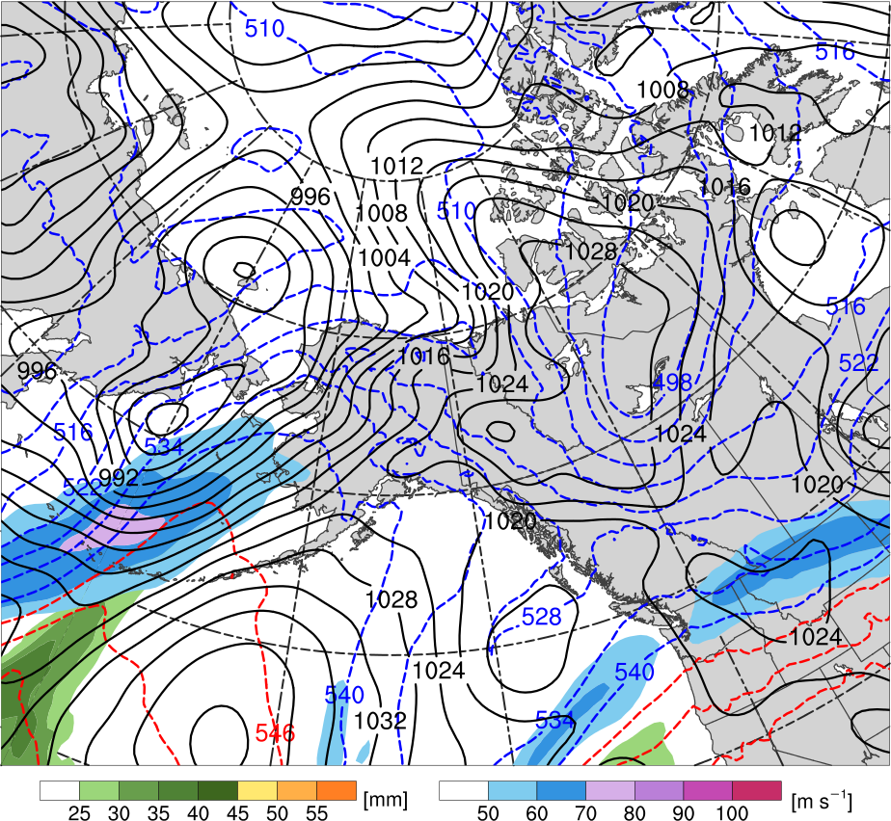
Literature Review–Arctic Cyclones
2100 UTC 3 Aug 2012
PV
(PVU)
(a)
(b)
12
10
A
8
A’
6
4
3
2
TPV
300-hPa wind speed (m s⁻¹)
1.5
30
40
50
60
70
80
90
100
PW (mm)
1
25
30
35
40
45
50
55
0.5
AC12
A
A’
Data Source: ERA5
(a) θ (K, black) and ascent (red, every 5 × 10⁻³ hPa s⁻¹);
(b) 1000–500-hPa thickness (dam, blue/red) and SLP (hPa, black)

Slide 34
Literature Review–Forecast Skill
Predictive skill of polar lows may be limited due to their mesoscale horizontal dimensions, relatively short lifetimes, and rapid evolution
Short-term forecasts from operational models, including high-resolution models, sometimes exhibit large forecast errors in polar lows (e.g., Kristjánsson et al. 2011)

Slide 35
Literature Review–Forecast Skill
Yamagami et al. (2018a) examine the medium range forecast skill of AC12 with five operational ensemble prediction systems (EPSs)
They find that AC12 has low predictability, with accurate forecasts of AC12 only out to 2–3 d lead time prior to peak intensity of AC12
They also find that a more accurate prediction of upper-level features, which may include TPVs, in the vicinity of AC12 results in more accurate prediction of AC12

Slide 36
Literature Review–Forecast Skill
Yamagami et al. (2018b) examine the medium range forecast skill 10 strong Arctic cyclones occurring during the summers of 2008–2016 with five operational EPSs
They find that the forecast skill of the strong Arctic cyclones is lower than that of midlatitude cyclones in the Northern Hemisphere

Slide 37
Literature Review–Forecast Skill
Forecast errors in a variety of factors may limit the forecast skill of polar lows and Arctic cyclones
  Factors may include TPVs, baroclinic zones, and latent heating
Forecast errors in latent heating have been shown to contribute to forecast errors in extratropical cyclones (e.g., Zhang et al. 2003) and in the downstream synoptic-scale flow (e.g., Rodwell et al. 2013)
  Forecast errors in latent heating may also potentially limit forecast skill of Arctic cyclones associated with intrusions of warm, moist air into the Arctic

Slide 38
Literature Review–Forecast Skill
Low Arctic forecast skill may be related to Arctic cyclones
  Factors limiting the forecast skill of Arctic cyclones may concomitantly limit Arctic forecast skill

Slide 39
Research Questions
What factors limit the forecast skill of low-skill polar lows linked to TPVs?

Slide 40
Research Questions
What factors limit the forecast skill of low-skill polar lows linked to TPVs?
How do the characteristic of Arctic cyclones differ between periods of low and high Arctic forecast skill?

Slide 41
Research Questions
What factors limit the forecast skill of low-skill polar lows linked to TPVs?
How do the characteristic of Arctic cyclones differ between periods of low and high Arctic forecast skill?
Do Arctic cyclones linked to TPVs exhibit any difference in forecast skill compared to Arctic cyclones not linked to TPVs during periods of low Arctic forecast skill?

Slide 42
Research Questions
What factors limit the forecast skill of low-skill polar lows linked to TPVs?
How do the characteristic of Arctic cyclones differ between periods of low and high Arctic forecast skill?
Do Arctic cyclones linked to TPVs exhibit any difference in forecast skill compared to Arctic cyclones not linked to TPVs during periods of low Arctic forecast skill?
What factors limit the forecast skill of low-skill Arctic cyclones linked to TPVs and concomitantly limit Arctic forecast skill?

Slide 43
Research Plan–Hypothesis 1
What factors limit the forecast skill of low-skill polar lows linked to TPVs?
Hypothesis: Forecast errors in TPVs and associated CAOs, and baroclinic zones, which may be related to forecast errors in the synoptic-scale flow, especially limit the forecast skill of low-skill polar lows linked to TPVs.

Slide 44
Research Plan–Hypothesis 1
Obtained polar lows from Sea Surface Temperature and Altimeter Synergy for Improved Forecasting of Polar lows (STARS) database of polar lows over the Norwegian Sea and Barents Sea (Sætra et al. 2010)
  STARS database covers the 2002–2011 period, for a total of 140 polar lows
Link for STARS Database: http://polarlow.met.no/stars-dat/

Slide 45
Research Plan–Hypothesis 1
Compared STARS database to a 1979–2015 database of TPVs constructed using the ERA-Interim (Dee et al. 2011) and a TPV tracking algorithm (Szapiro and Cavallo 2018)
Determined which polar lows may be linked to TPVs by requiring that a polar low be located within 500 km of at least one TPV at any point in the lifetime of the polar low
Link for Tracking Algorithm: https://github.com/nickszap/tpvTrack

Slide 46
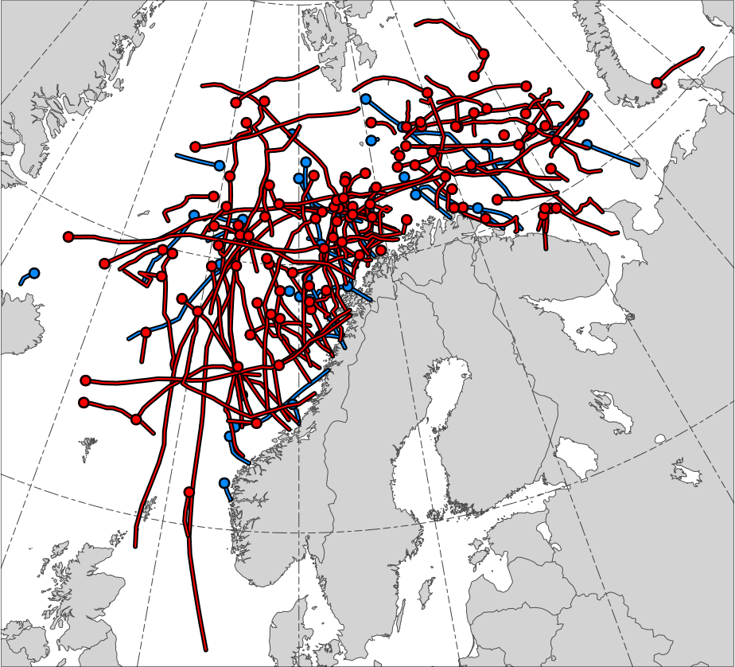
Research Plan–Hypothesis 1
104 out of the total 140 polar lows, or 74.3%, match with at least one TPV
STARS Polar Lows
Polar lows linked to TPVs (N = 104)
Polar lows not linked to TPVs (N = 36)
Genesis positions

Slide 47
Research Plan–Hypothesis 1
Performed an illustrative predictability study of a polar low occurring during 1800 UTC 10–1200 UTC 11 February 2011 to motivate hypothesis 1
  Case was chosen since polar low exhibits a clear linkage to a single well-defined TPV
Used the ERA5 (Hersbach and Dee 2016) for analysis of the polar low
  0.3° horizontal resolution

Slide 48
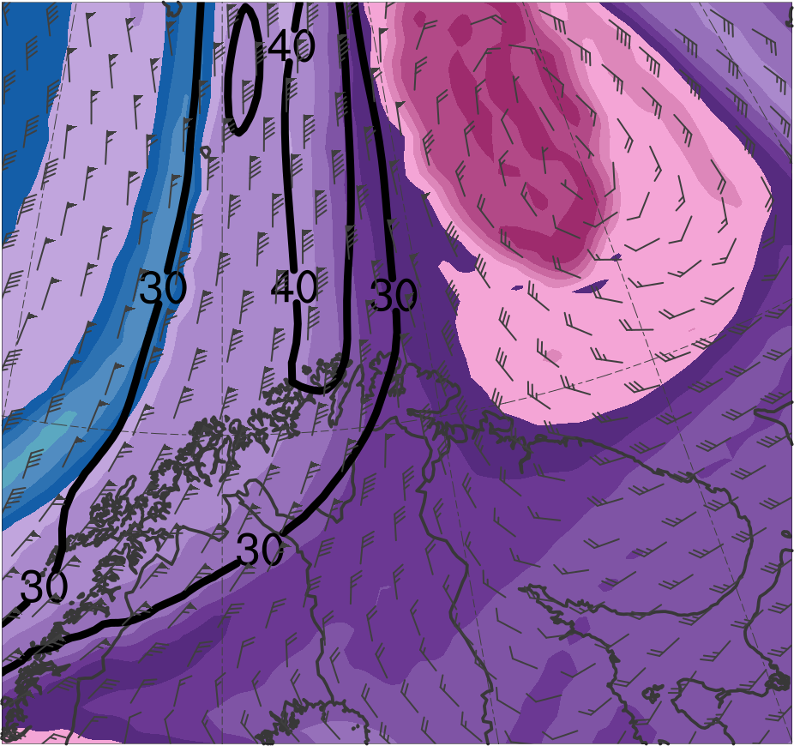
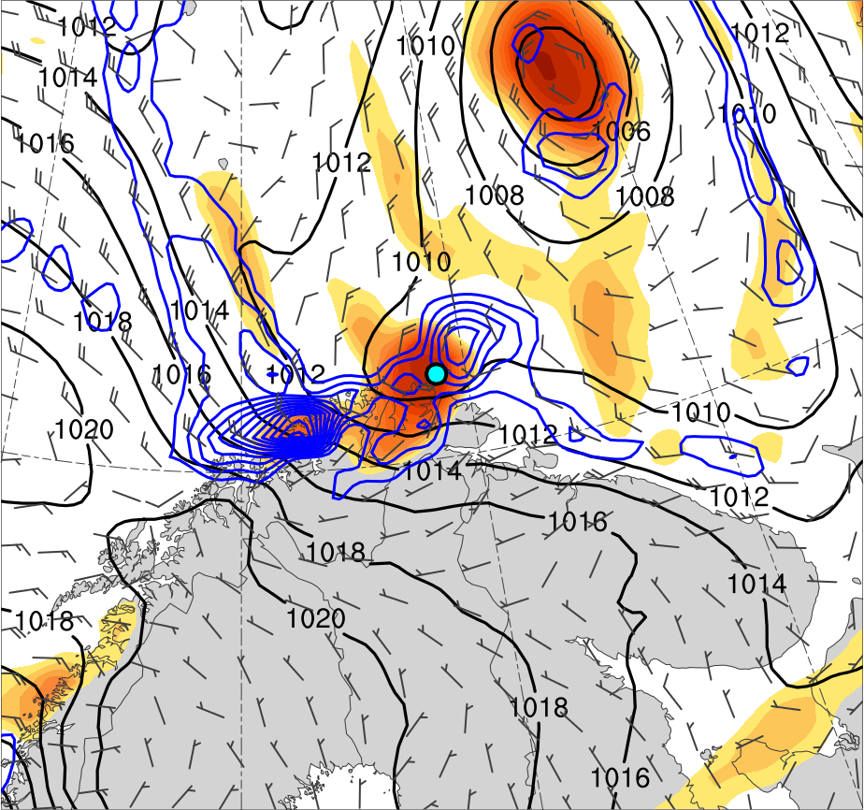
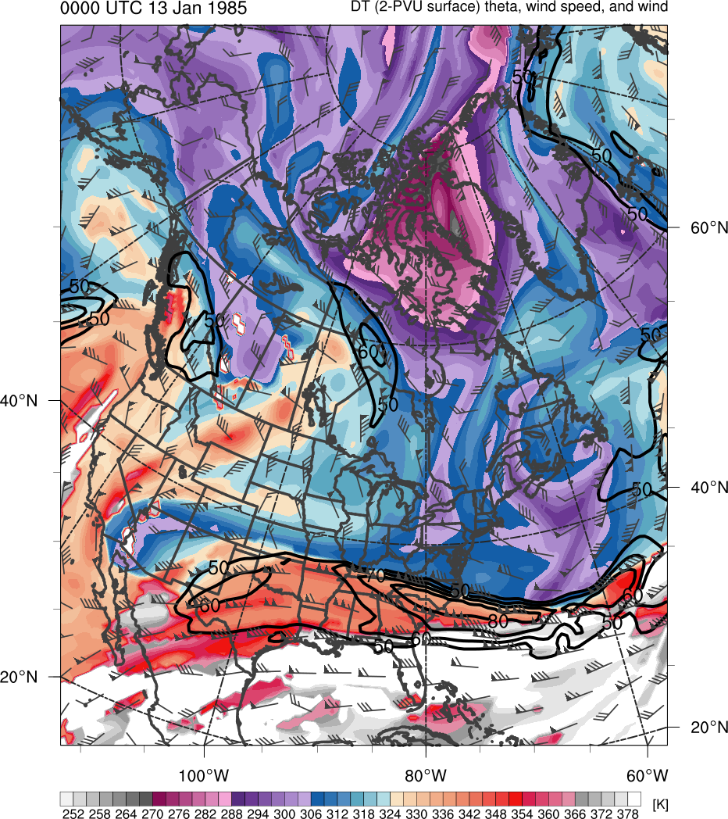
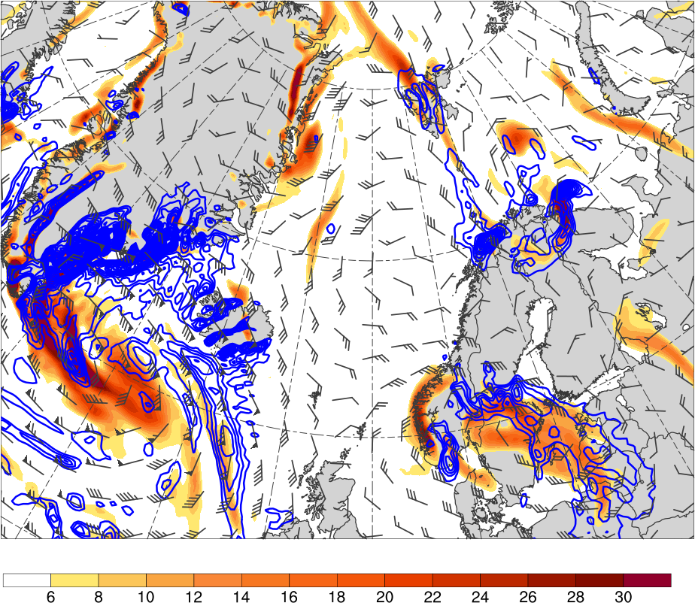
Research Plan–Hypothesis 1
1800 UTC 10 Feb 2011
TPV
PL
(K)
252
258
264
270
276
282
288
294
300
306
312
318
324
330
336
342
348
354
360
366
372
378
4
6
8
10
12
14
16
18
20
25
30
35
40
Potential temperature (K, shaded), wind speed (black, every 10 m s⁻¹ starting at 30 m s⁻¹), and wind (m s⁻¹, flags and barbs) on 2-PVU surface
850-hPa relative vorticity (10⁻⁵ s⁻¹, shaded),
850–600-hPa ascent (blue, every 2.5 × 10⁻³ hPa s⁻¹),
SLP (hPa, black), and 10-m wind (m s⁻¹, barbs)

Slide 49
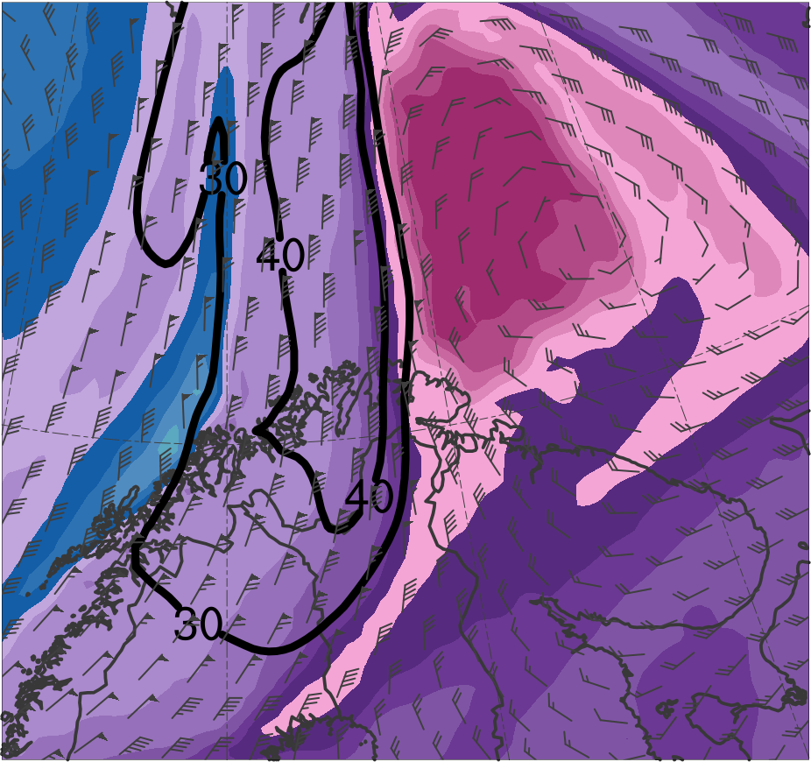
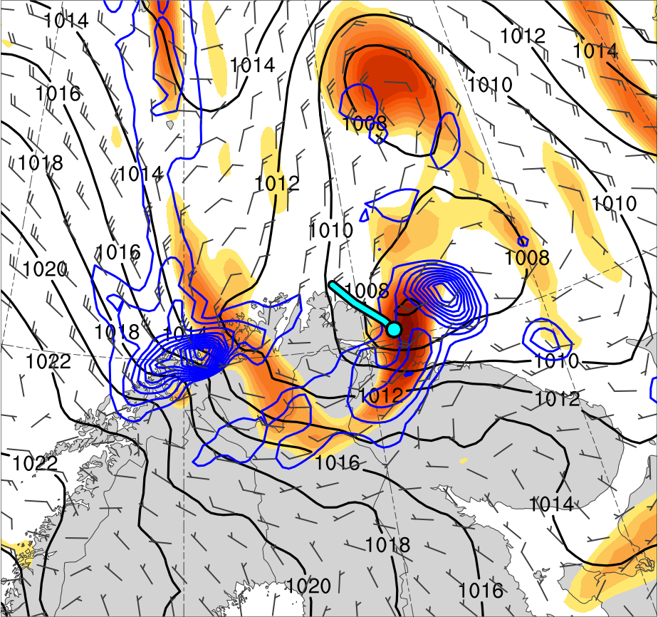
Research Plan–Hypothesis 1
0000 UTC 11 Feb 2011
TPV
PL
(K)
252
258
264
270
276
282
288
294
300
306
312
318
324
330
336
342
348
354
360
366
372
378
4
6
8
10
12
14
16
18
20
25
30
35
40
Potential temperature (K, shaded), wind speed (black, every 10 m s⁻¹ starting at 30 m s⁻¹), and wind (m s⁻¹, flags and barbs) on 2-PVU surface
850-hPa relative vorticity (10⁻⁵ s⁻¹, shaded),
850–600-hPa ascent (blue, every 2.5 × 10⁻³ hPa s⁻¹),
SLP (hPa, black), and 10-m wind (m s⁻¹, barbs)

Slide 50
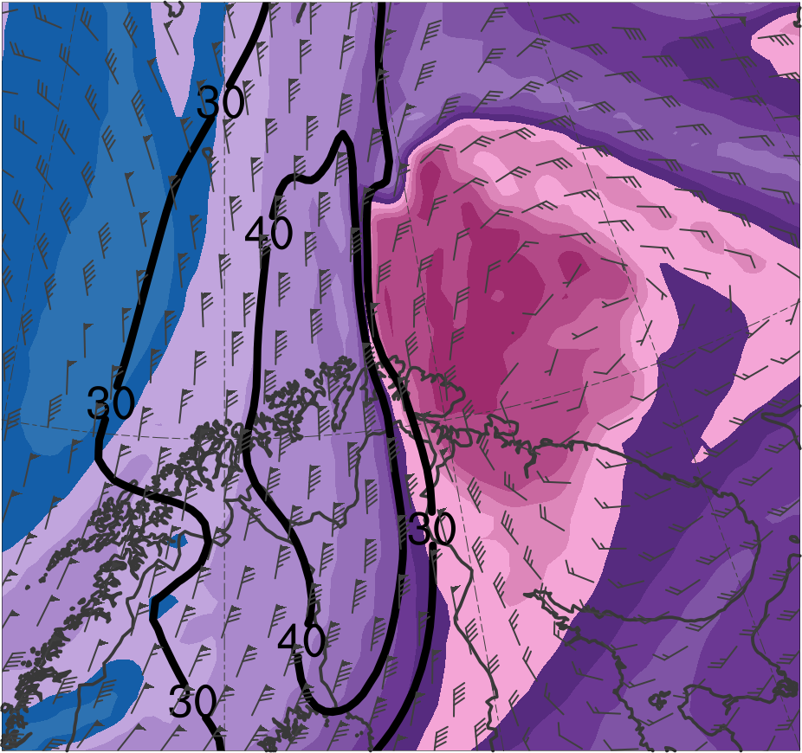
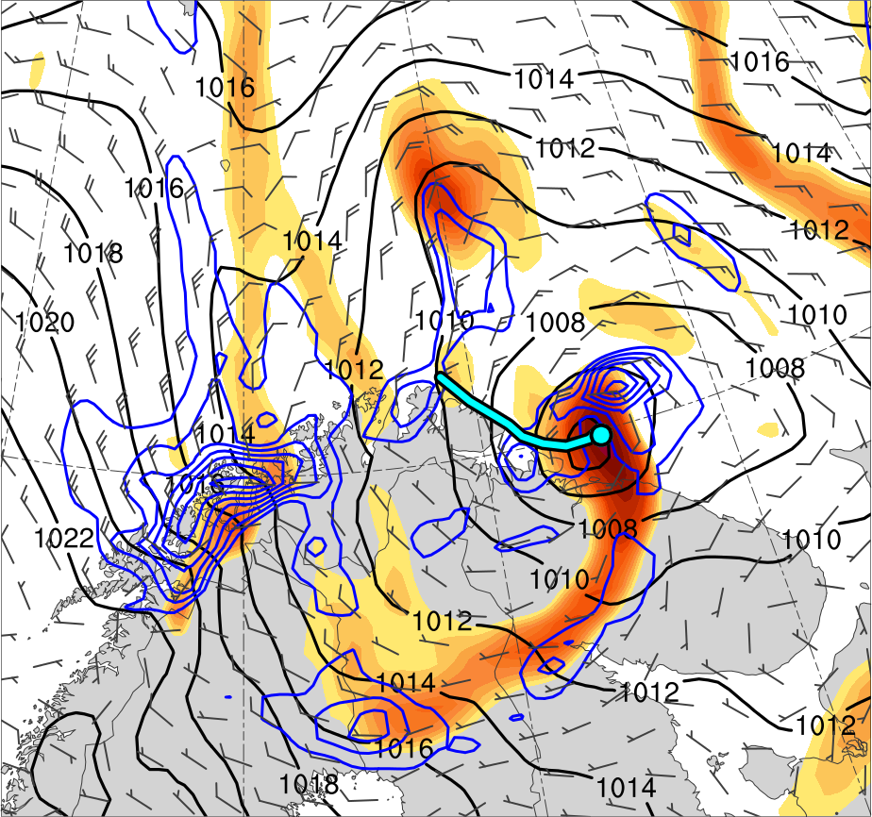
Research Plan–Hypothesis 1
0600 UTC 11 Feb 2011
TPV
PL
(K)
252
258
264
270
276
282
288
294
300
306
312
318
324
330
336
342
348
354
360
366
372
378
4
6
8
10
12
14
16
18
20
25
30
35
40
Potential temperature (K, shaded), wind speed (black, every 10 m s⁻¹ starting at 30 m s⁻¹), and wind (m s⁻¹, flags and barbs) on 2-PVU surface
850-hPa relative vorticity (10⁻⁵ s⁻¹, shaded),
850–600-hPa ascent (blue, every 2.5 × 10⁻³ hPa s⁻¹),
SLP (hPa, black), and 10-m wind (m s⁻¹, barbs)

Slide 51
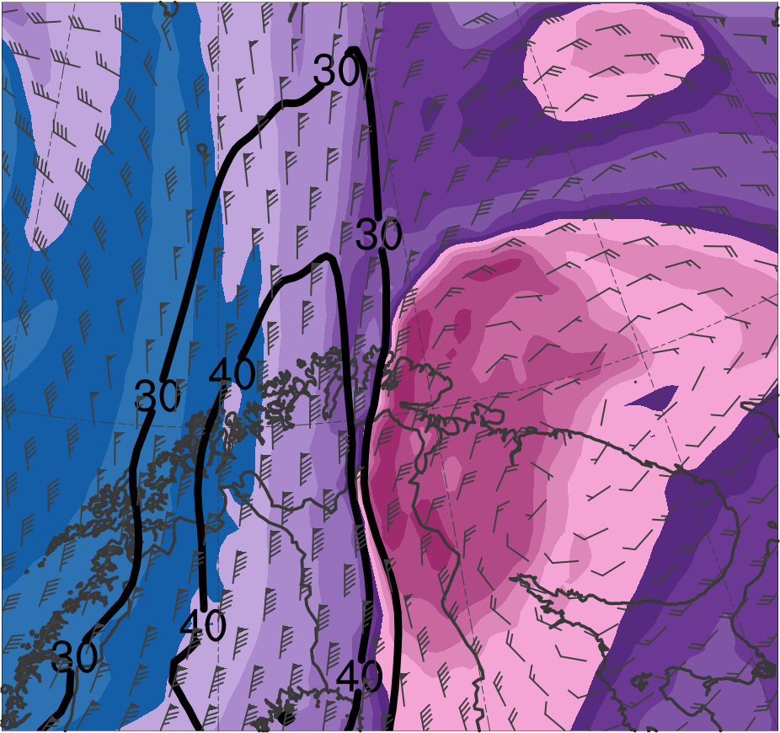
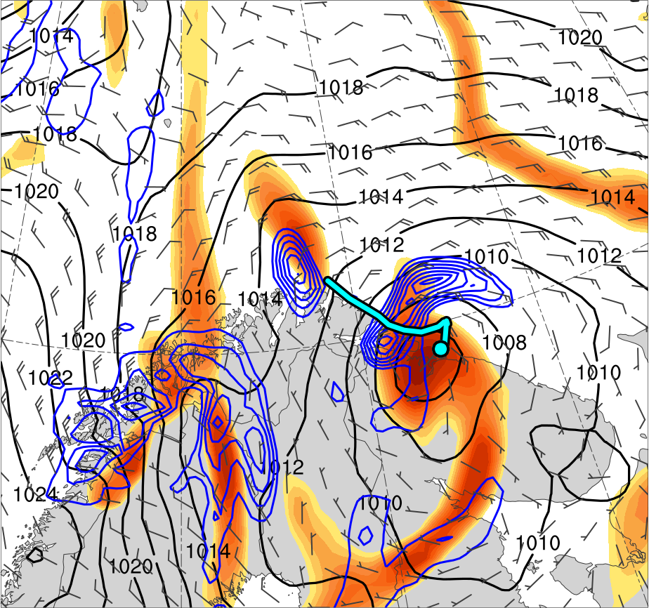
Research Plan–Hypothesis 1
1200 UTC 11 Feb 2011
TPV
PL
(K)
252
258
264
270
276
282
288
294
300
306
312
318
324
330
336
342
348
354
360
366
372
378
4
6
8
10
12
14
16
18
20
25
30
35
40
Potential temperature (K, shaded), wind speed (black, every 10 m s⁻¹ starting at 30 m s⁻¹), and wind (m s⁻¹, flags and barbs) on 2-PVU surface
850-hPa relative vorticity (10⁻⁵ s⁻¹, shaded),
850–600-hPa ascent (blue, every 2.5 × 10⁻³ hPa s⁻¹),
SLP (hPa, black), and 10-m wind (m s⁻¹, barbs)

Slide 52
Research Plan–Hypothesis 1
Evaluated forecast skill of polar low using ECMWF EPS (Buizza et al. 2007) from TIGGE (Bougeault et al. 2010) initialized at 1200 UTC 9 February 2011
  30 h prior to genesis of polar low
  0.5° horizontal resolution
Used ERA5 regridded to 0.5° horizontal resolution as verification

Slide 53
Research Plan–Hypothesis 1
Assessed forecast skill of polar low in terms of a metric combining forecast track and intensity error of the polar low based on 850-hPa relative vorticity by adapting methodology of Lamberson et al. (2016)
Subdivided members into two groups: one containing the eight most accurate members and one containing the eight least accurate members in terms of the aforementioned metric

Slide 54
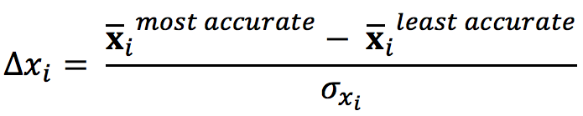
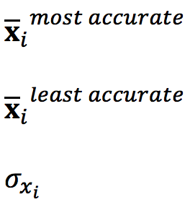
Research Plan–Hypothesis 1
Calculated normalized composite differences between the most accurate and least accurate groups for selected quantities following Torn et al. (2015)
= mean of the ith state variable for most accurate members
= mean of the ith state variable for least accurate members
= ensemble standard deviation of x_{i} computed for all members

Slide 55
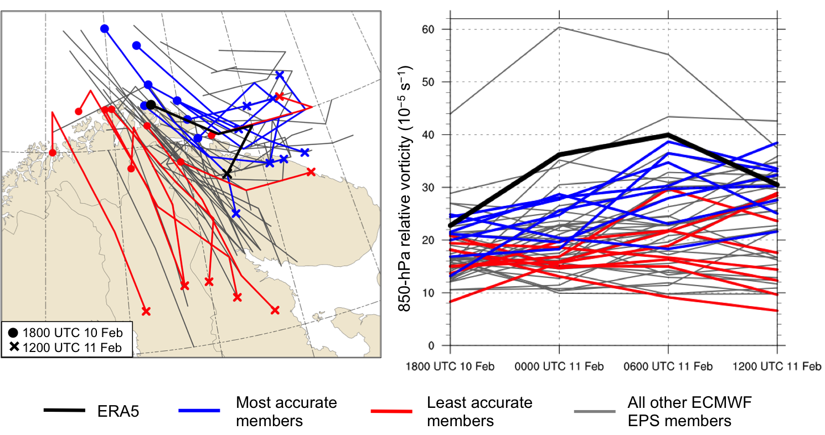
Research Plan–Hypothesis 1
(a)
(b)
(a) Track and (b) intensity of 850-hPa relative vorticity maximum (10⁻⁵ s⁻¹) associated with polar low, every 6 h during 1800 UTC 10–1200 UTC 11 February 2011

Slide 56
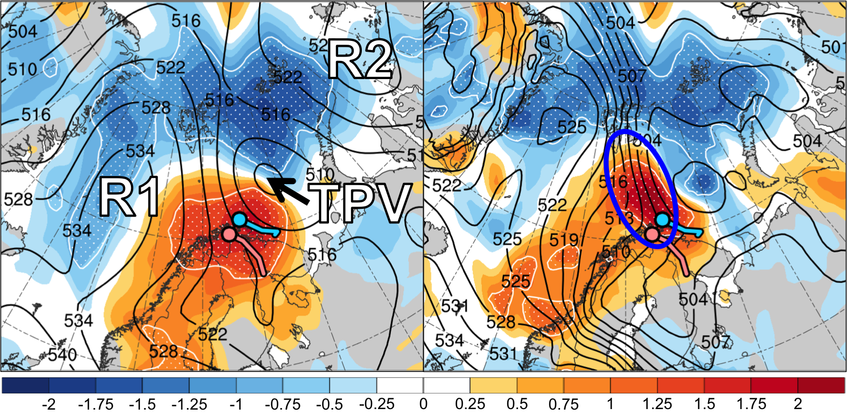
Research Plan–Hypothesis 1
1800 UTC 10 Feb 2011 (30 h)
(a) 500-hPa geopotential height (dam)
(b) 1000–500-hPa thickness (dam)
stippling: statistically significant differences between groups at 95% confidence level according to a two-sided Student’s t test
Mean position of PL in most accurate group*
shading: normalized composite differences (most accurate minus least accurate; units:
standardized anomaly)
Ensemble
mean
Mean position of PL in least accurate group*
*Track: 1800 UTC 10–1200 UTC 11 Feb 2011

Slide 57
Research Plan–Hypothesis 1
Study suggests that forecast errors in the synoptic-scale flow may contribute to forecast errors in the position and structure of TPVs and baroclinic zones
Forecast errors in TPVs and baroclinic zones may contribute to forecast errors in the track and intensity of polar lows

Slide 58
Research Plan–Hypothesis 1
Examine factors limiting the forecast skill of a variety of polar lows linked to TPVs that may be associated with low forecast skill
Determine polar lows that may be associated with low forecast skill by evaluating the forecast skill of the synoptic-scale environment surrounding the polar lows
Utilize the 1° Global Ensemble Forecast System (GEFS) Reforecast v2 (Hamill et al. 2013)
  11 member ensemble initialized once daily (0000 UTC)

Slide 59
Research Plan–Hypothesis 1
Calculate a standardized anomaly of ensemble spread (σ_{anom}) of 1000–500-hPa thickness to assess the forecast skill of the synoptic-scale environment
  The quantity σ_{anom} provides a measure of forecast uncertainty, with higher values indicating higher forecast uncertainty (e.g., Torn 2017)
1000–500-hPa thickness may reveal the location and structure of synoptic flow features, TPVs and associated CAOs, and baroclinic zones that may influence the evolution of polar lows

Slide 60
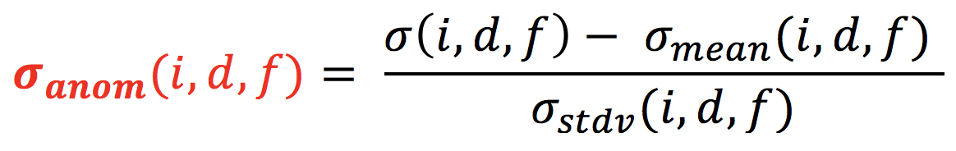
Research Plan–Hypothesis 1
At each grid point (i), day of the year (d), and forecast lead time (f), σ_{anom} is calculated similarly following Torn (2017) as:
σ = raw ensemble spread
σ_{mean} = climatological mean ensemble spread
σ_{stdv} = climatological standard deviation of ensemble spread
σ_{mean} and σ_{stdv} calculated for 1985–2016 period, considering all forecasts initialized within ±14 days of each forecast initialization day of interest

Slide 61
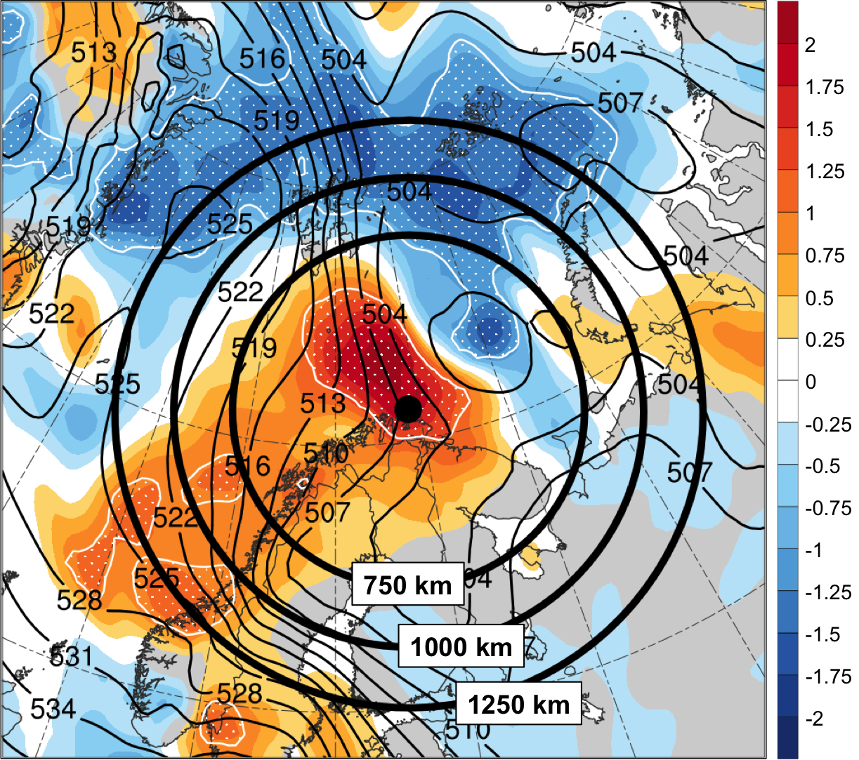
Research Plan–Hypothesis 1
1000–500-hPa thickness (dam) at time of polar low genesis (1800 UTC 10 Feb 2011)
Ensemble
mean
shading: normalized composite differences (most accurate minus least accurate; units:
standardized anomaly)
stippling: statistically significant differences between groups at 95% confidence level according to a two-sided Student’s t test
Position of polar low at genesis according to STARS

Slide 62
Research Plan–Hypothesis 1
An area-weighted average of σ_{anom} will be calculated in each domain for each forecast
  Short-range (24- and 48-h) forecasts valid at or near the time of polar low genesis will be considered
For both 24- and 48-h forecasts, cases that fall within the top quintile of area-averaged σ_{anom} will be considered candidate low-skill polar lows linked to TPVs for each domain
Polar lows consistently identified as candidate low-skill polar lows linked to TPVs among the different domains for either forecast will be deemed low-skill polar lows linked to TPVs

Slide 63
Research Plan–Hypothesis 1
After the low-skill polar lows linked to TPVs are identified, several illustrative cases will be considered for analysis
  Cases will be selected to be representative of different possible types of polar low evolution
The ERA5 will be utilized to investigate key factors that influence the life cycle of these polar lows

Slide 64
Research Plan–Hypothesis 1
The Model for Prediction Across Scales (MPAS; Skamarock et al. 2012) will be used to diagnose factors that may limit the forecast skill of illustrative polar lows
MPAS offers the benefit of variable horizontal resolution, with high resolution focused on a geographic region of interest
  Enhanced grid spacing (e.g., 15 km) over the Arctic and adjacent regions

Slide 65
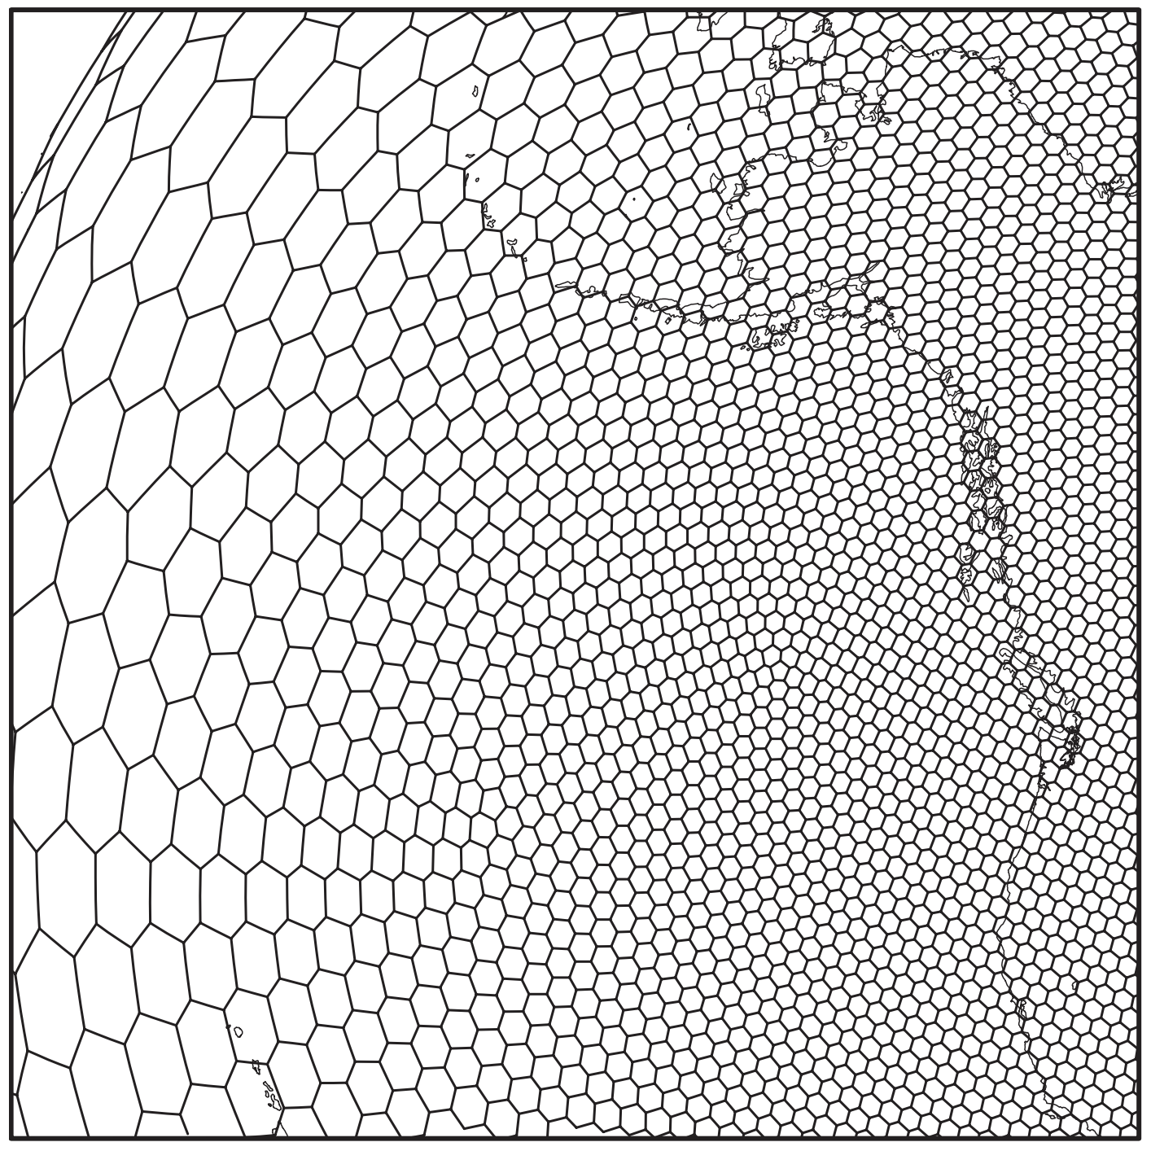
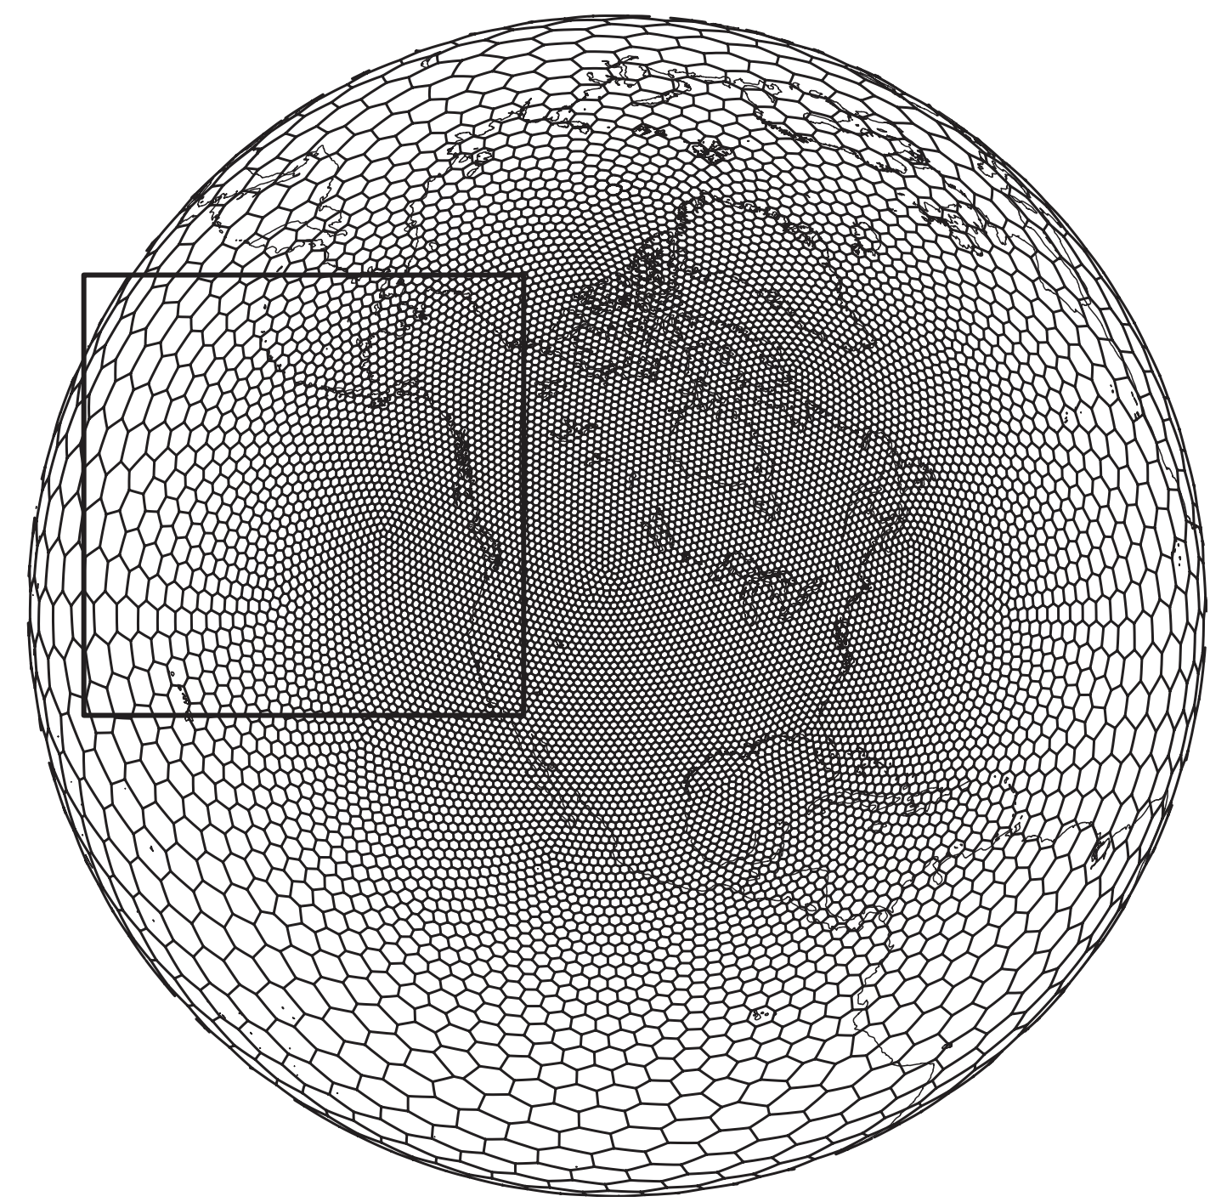
Research Plan–Hypothesis 1
Example MPAS grid
Cell-center distances vary by approximately a factor of 8 and are 650 and 85 km in the coarse- and fine-mesh regions, respectively. Figure 10 adapted from Skamarock et al. (2012).

Slide 66
Research Plan–Hypothesis 1
The Data Assimilation Research Testbed (DART; Anderson et al. 2009) software will be used to assimilate observations and generate an ensemble of analyses that will be initialized in MPAS
  The MPAS–DART system will be used to produce numerous ensemble forecasts (e.g., 50 or more) for each case
Ensemble forecasts will be initialed 24–48 h prior to polar low genesis and integrated forward until the end of the life cycle of the polar low in each case

Slide 67
Research Plan–Hypothesis 1
Ensemble analysis and forecast tools will be utilized to diagnose factors limiting the forecast skill of low-skill polar lows linked to TPVs
  Normalized composite differencing (e.g., Torn et al. 2015)
  Ensemble sensitivity analysis (e.g., Ancell and Hakim 2007; Torn and Hakim 2008)

Slide 68
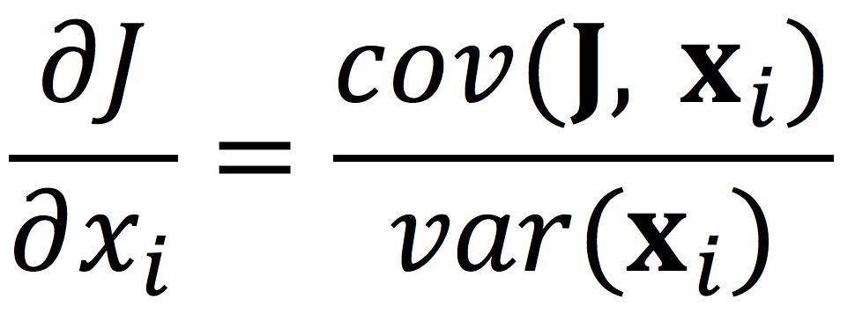
Research Plan–Hypothesis 1
Ensemble sensitivity analysis (e.g., Ancell and Hakim 2007; Torn and Hakim 2008) can be used to determine how sensitive a forecast metric of interest J is to a model state variable x_{i} at an earlier forecast lead time

Slide 69
Research Plan–Hypothesis 1
Ensemble sensitivity analysis (e.g., Ancell and Hakim 2007; Torn and Hakim 2008) can be used to determine how sensitive a forecast metric of interest J is to a model state variable x_{i} at an earlier forecast lead time
As a candidate example, the forecast metric J may be the position of the polar low and the model state variable x_{i} may be upper-level PV
  Sensitivity of the position of the polar low to the structure of the upper-level PV field associated with a TPV can thus be examined

Slide 70
Research Plan–Hypothesis 2a
How do the characteristic of Arctic cyclones differ between periods of low and high Arctic forecast skill?
Hypothesis: When compared to periods of high Arctic forecast skill, periods of low Arctic forecast skill are associated with:
  A greater number of Arctic cyclones

Slide 71
Research Plan–Hypothesis 2a
Arctic cyclones may have low forecast skill (e.g., Yamagami et al. 2018a,b)
  Factors limiting the forecast skill of Arctic cyclones may concomitantly limit Arctic forecast skill

Slide 72
Research Plan–Hypothesis 2a
Create a 1985–2016 Arctic cyclone climatology
Cyclone tracks will be obtained from 1° ERA-Interim cyclone climatology from Sprenger et al. (2017)
  Cyclones were tracked every 6 h utilizing a SLP-based tracking algorithm from Wernli and Schwierz (2006)
Arctic cyclones will be deemed cyclones that last at least 24 h and spend at least some portion of their lifetimes in the Arctic (>70°N), as done by Simmonds and Rudeva (2014)

Slide 73
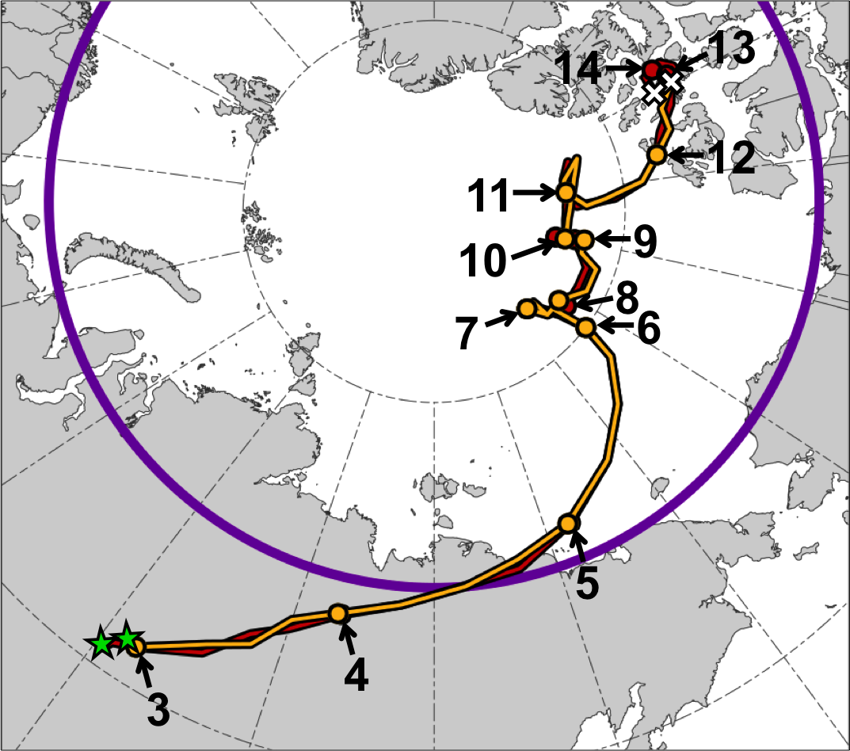
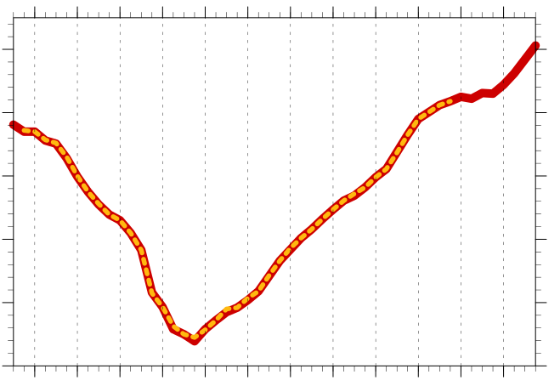
Research Plan–Hypothesis 2a
Example: AC12
Minimum SLP (hPa) trace of AC12
1010
1000
990
980
70N
970
960
3
4
5
6
7
8
9
10
11
12
13
14
Day in Aug 2012 (at 0000 UTC)
Manual tracking with ERA-Interim (0.5°; every 6 h)
1200 UTC 2–1800 UTC 14 Aug 2012
Objective tracking with ERA-Interim (1°; every 6 h) from Sprenger et al. (2017)
1800 UTC 2–1800 UTC 12 Aug 2012

Slide 74
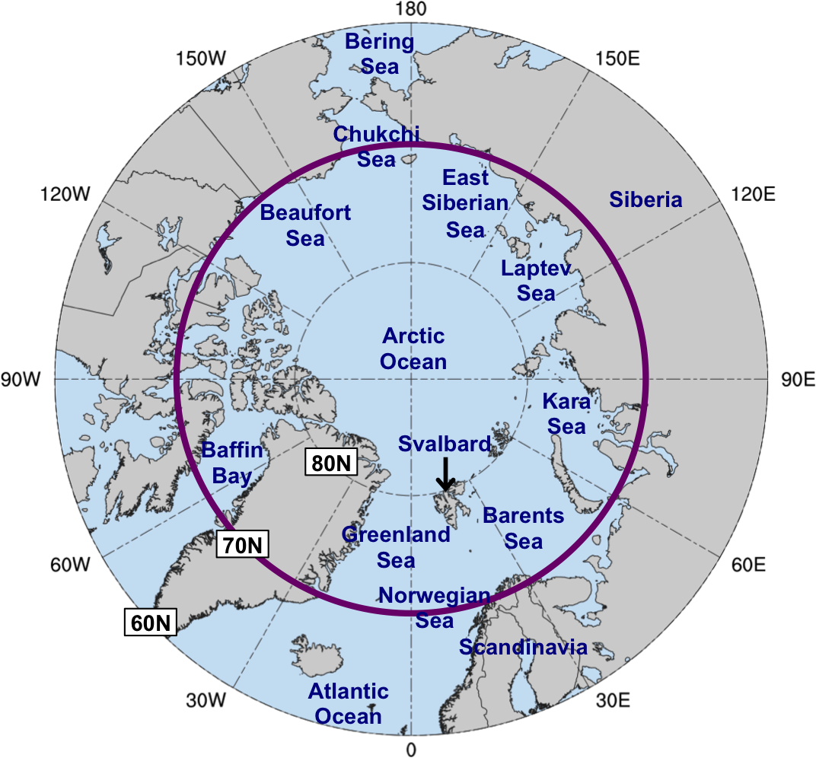
Research Plan–Hypothesis 2a
To evaluate Arctic forecast skill, will calculate an area-averaged standardized anomaly of ensemble spread (area-averaged σ_{anom}) of 500-hPa geopotential height for forecasts valid at day 5 over the Arctic (>70°N) during 1985–2016, using the GEFS reforecast dataset
  A total of 11,687 5-d forecasts

Slide 75
Research Plan–Hypothesis 2a
Forecast days valid at day 5 associated with the top and bottom 5% of area-averaged σ_{anom} will be referred to as low and high Arctic forecast skill days, respectively
  ~584 days of each type
The time periods beginning five days prior to day 5 (i.e. day 0) to day 5 will be referred to as low and high Arctic forecast skill periods
All Arctic cyclones that exist in the Arctic (>70°N) at any time within the low and high Arctic forecast skill periods will be tallied

Slide 76
Research Plan–Hypothesis 2b
How do the characteristic of Arctic cyclones differ between periods of low and high Arctic forecast skill?
Hypothesis: When compared to periods of high Arctic forecast skill, periods of low Arctic forecast skill are associated with:
  Stronger Arctic cyclones

Slide 77
Research Plan–Hypothesis 2b
Stronger Arctic cyclones may be associated with larger fluxes of warm, moist air into the Arctic and greater amounts of latent heating compared to weaker cyclones
  Larger forecast errors that may be associated with the greater latent heating may contribute to larger forecast errors in the synoptic-scale flow over the Arctic
Stronger Arctic cyclones tend to be larger in size and longer lived (e.g., Zahn et al. 2018) and may impact larger areas of the Arctic for a longer duration

Slide 78
Research Plan–Hypothesis 2b
The distribution and mean value of the minimum SLP of the Arctic cyclones for the two periods will be compared
  Statistical significance of the difference between the distributions of minimum SLP for the two periods will be tested using bootstrap resampling

Slide 79
Research Plan–Hypothesis 2c
How do the characteristic of Arctic cyclones differ between periods of low and high Arctic forecast skill?
Hypothesis: When compared to periods of high Arctic forecast skill, periods of low Arctic forecast skill are associated with:
  A greater number and higher percentage of Arctic cyclones originating from outside of the Arctic

Slide 80
Research Plan–Hypothesis 2c
Arctic cyclones that originate outside of the Arctic may be associated with larger intrusions of warm, moist air and latent heating, which may contribute to lower forecast skill in the Arctic
The number and percentage of Arctic cyclones originating outside of the Arctic will be compared between the two periods
  Arctic cyclones originating outside of the Arctic are considered those with a genesis latitude of ≤70°N

Slide 81
Research Plan–Hypothesis 2c
The distributions of the genesis latitudes of Arctic cyclones for the two periods will be compared
  Differences between these distributions will be tested for statistical significance

Slide 82
Research Plan–Hypothesis 2d
How do the characteristic of Arctic cyclones differ between periods of low and high Arctic forecast skill?
Hypothesis: When compared to periods of high Arctic forecast skill, periods of low Arctic forecast skill are associated with:
  A greater number of Arctic cyclones occurring when the large-scale flow is more amplified and when there are more instances of atmospheric blocking

Slide 83
Research Plan–Hypothesis 2d
More highly amplified flow and blocking may facilitate more cyclones originating from outside of the Arctic impacting the Arctic, and may enhance the transport of warm, moist air into the Arctic (e.g., Binder et al. 2017)
Calculate an area-averaged standardized anomaly of the absolute value of 500-hPa meridional wind (area-averaged σ_{V500}) using the ERA-Interim over 60–90°N
  Calculate area-averaged σ_{V500} throughout the low and high Arctic forecast skill periods during which Arctic cyclones are present

Slide 84
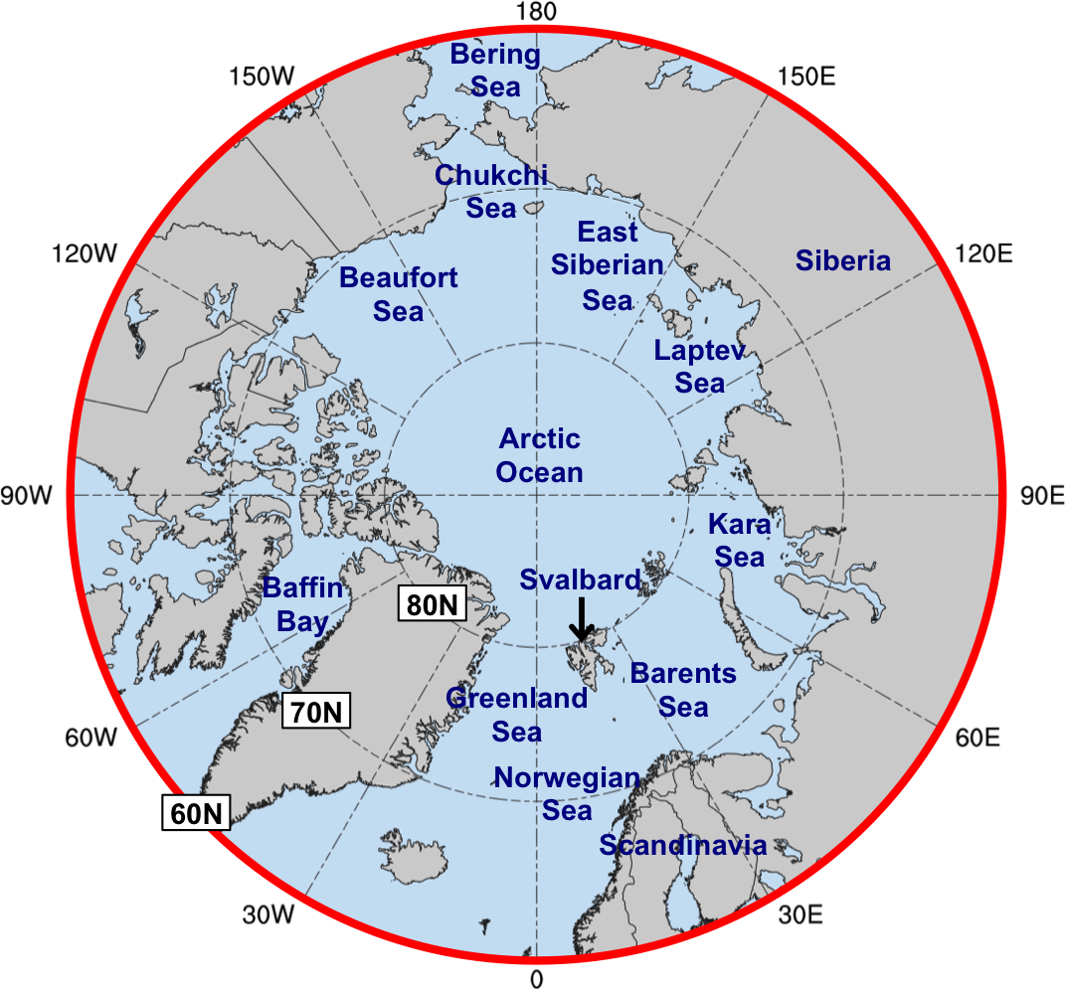
Research Plan–Hypothesis 2d

Slide 85
Research Plan–Hypothesis 2d
Obtained a 1979–2016 ERA-Interim climatology of atmospheric blocks created by Sprenger et al. (2017)
  Blocks were identified following the methodology of Schwierz et al. (2004)
All blocks that intersects 60–90°N domain will be tallied for both low and high Arctic forecast skill periods in which Arctic cyclones are present

Slide 86
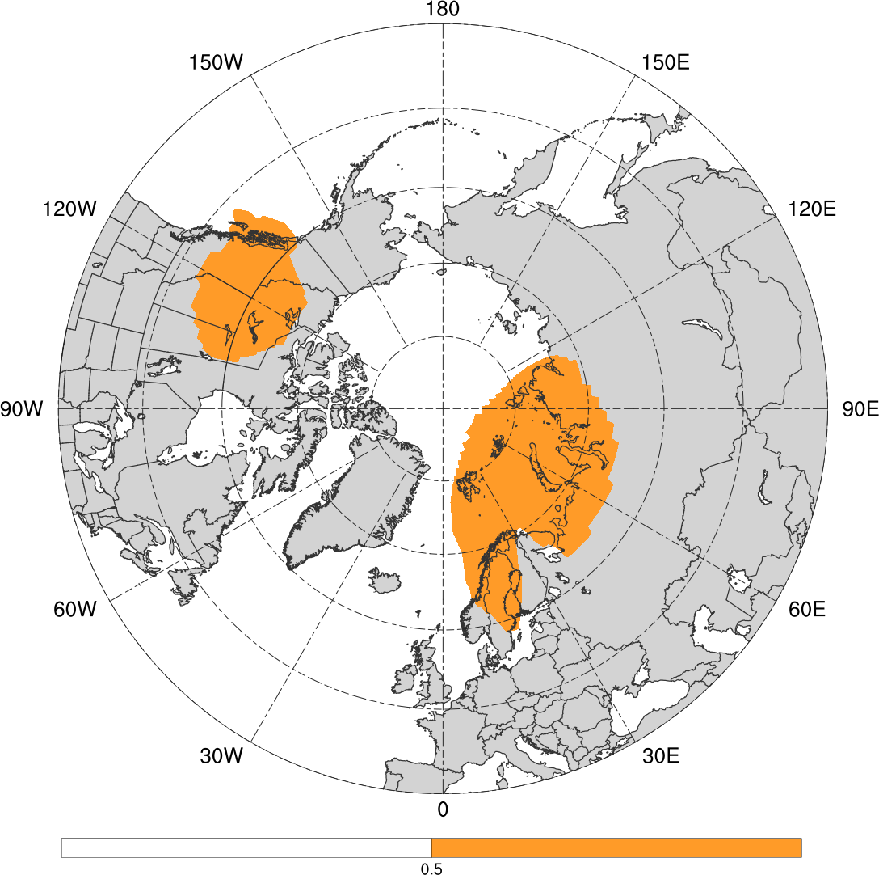
Research Plan–Hypothesis 2d
0000 UTC 1 January 2016
H
Figure 4 adapted from Binder et al. (2017).
Blocks from Sprenger et al. (2017)

Slide 87
Research Plan–Hypothesis 2e
How do the characteristic of Arctic cyclones differ between periods of low and high Arctic forecast skill?
Hypothesis: When compared to periods of high Arctic forecast skill, periods of low Arctic forecast skill are associated with:
  A similar percentage of Arctic cyclones linked to TPVs

Slide 88
Research Plan–Hypothesis 2e
Strong Arctic cyclones are frequently linked to TPVs (e.g., Simmonds and Rudeva 2014)
Anticipate more strong Arctic cyclones during low Arctic forecast skill periods and fewer strong Arctic cyclones during high Arctic forecast skill periods
Based on cyclone strength, it may be anticipated that there is a higher percentage of Arctic cyclones linked to TPVs during low Arctic forecast skill periods

Slide 89
Research Plan–Hypothesis 2e
Another factor to consider is that TPVs are less frequent outside of the Arctic
Anticipate more Arctic cyclones originating outside of the Arctic during low Arctic forecast skill periods and fewer Arctic cyclones originating outside of Arctic during high Arctic forecast skill periods
Based on cyclone location, it may be anticipated that there is a higher percentage of Arctic cyclones linked to TPVs during high Arctic forecast skill periods

Slide 90
Research Plan–Hypothesis 2e
Not clear if there would be an appreciable difference in the percentage of Arctic cyclones linked to TPVs between the low and high Arctic forecast skill periods

Slide 91
Research Plan–Hypothesis 2e
Identify TPVs with ERA-Interim using TPV tracking algorithm from Szapiro and Cavallo (2018)
Identify Arctic cyclones linked to TPVs by requiring TPVs be located within 500 km of the center of an Arctic cyclone for at least four consecutive 6-h time steps
  Test sensitivity to spatial and temporal thresholds
Compare percentage of Arctic cyclones linked to TPVs between low and high Arctic forecast skill periods

Slide 92
Research Plan–Hypothesis 3
Do Arctic cyclones linked to TPVs exhibit any difference in forecast skill compared to Arctic cyclones not linked to TPVs during periods of low Arctic forecast skill?
Hypothesis: There is no significant difference in forecast skill between Arctic cyclones linked to TPVs and Arctic cyclones not linked to TPVs during periods of low Arctic forecast skill.

Slide 93
Research Plan–Hypothesis 3
Anticipate that forecast errors in a variety of factors may limit the forecast skill of Arctic cyclones
  Factors may include TPVs, other upper-level precursors to cyclogenesis, baroclinic zones, and latent heating
Anticipate that there is variability in the degree to which forecast errors in these factors may limit the forecast skill of Arctic cyclones
For example, there may be variability in forecast errors in TPVs

Slide 94
Research Plan–Hypothesis 3
May be possible that forecast errors in upper-level precursors that are not TPVs can limit the forecast skill of Arctic cyclones not linked to TPVs to a similar degree as to which forecast errors in TPVs can limit the forecast skill of Arctic cyclones linked to TPVs
Thus, it is not clear if there would be a significant difference in forecast skill between Arctic cyclones linked to TPVs and those that are not

Slide 95
Research Plan–Hypothesis 3
Calculate forecast skill of Arctic cyclones occurring during low Arctic forecast skill periods in terms of ensemble spread of Arctic cyclone position and intensity
  Use GEFS reforecast dataset
Use cyclone tracking algorithm based on area-averaged 850-hPa relative vorticity developed by Tomer Burg to track Arctic cyclones in all 0–144-h ensemble forecasts valid during the life cycle of the Arctic cyclones
The ensemble spread for both position and intensity will be calculated for these forecasts for each Arctic cyclone

Slide 96
Research Plan–Hypothesis 3
All of the spread values for both position and intensity will be averaged separately for each Arctic cyclone
The distributions of the average spread for both position and intensity will be compared between Arctic cyclones linked to TPVs and Arctic cyclones that are not during low Arctic forecast skill periods
  Statistical significance of differences in the distributions will be assessed

Slide 97
Research Plan–Hypothesis 3
Arctic cyclones within the upper quintile of average spread for either position or intensity will be considered low-skill Arctic cyclones
Anticipate that low-skill Arctic cyclones that are linked to TPVs may be associated with relatively large forecast errors in TPVs

Slide 98
Research Plan–Hypothesis 4
What factors limit the forecast skill of low-skill Arctic cyclones linked to TPVs and concomitantly limit Arctic forecast skill?
Hypothesis: Forecast errors in TPVs and baroclinic zones, which may be related to forecast errors in the synoptic-scale flow, especially limit the forecast skill of low-skill Arctic cyclones linked to TPVs and concomitantly limit Arctic forecast skill.
  Forecast errors in latent heating may also limit the forecast skill of those Arctic cyclones associated with intrusions of warm, moist air into the Arctic.

Slide 99
Research Plan–Hypothesis 4
Several illustrative low-skill Arctic cyclones linked to TPVs will be considered for analysis
  Cases will be selected to be representative of different possible types of Arctic cyclone evolution
The ERA5 will be utilized to investigate key factors that influence the life cycle of these Arctic cyclones

Slide 100
Research Plan–Hypothesis 4
The MPAS–DART system will be utilized to generate numerous ensemble forecasts for each illustrative case
Ensemble analysis and forecast tools used for polar lows can be utilized to diagnose factors limiting the forecast skill of low-skill Arctic cyclones linked to TPVs and concomitantly limiting Arctic forecast skill
  Compare relative contributions of forecast errors in TPVs and latent heating to forecast errors in low-skill Arctic cyclones linked to TPVs and associated with intrusions of warm, moist air into the Arctic

Slide 101
Questions?

Slide 102
Supplementary Slides

Slide 103
Timeline
Year 1:
  Identify low-skill polar lows linked to TPVs
  Construct Arctic cyclone climatology
  Identify low and high Arctic forecast skill periods
  Identify Arctic cyclones occurring during low and high Arctic forecast skill periods and compare characteristics of Arctic cyclones between these two periods
  Identify low-skill Arctic cyclones occurring during low Arctic forecast skill periods

Slide 104
Timeline
Years 2–3:
  Compare forecast skill of Arctic cyclones linked to TPVs to those that are not during low Arctic forecast skill periods
  Use ERA5 to identify factors influencing evolution of several illustrative low-skill polar lows and Arctic cyclones linked to TPVs
  Run MPAS–DART system on the illustrative low-skill polar lows and Arctic cyclones linked to TPVs, and diagnose factors limiting the forecast skill of these features
  Write and defend Ph.D. dissertation

Slide 105
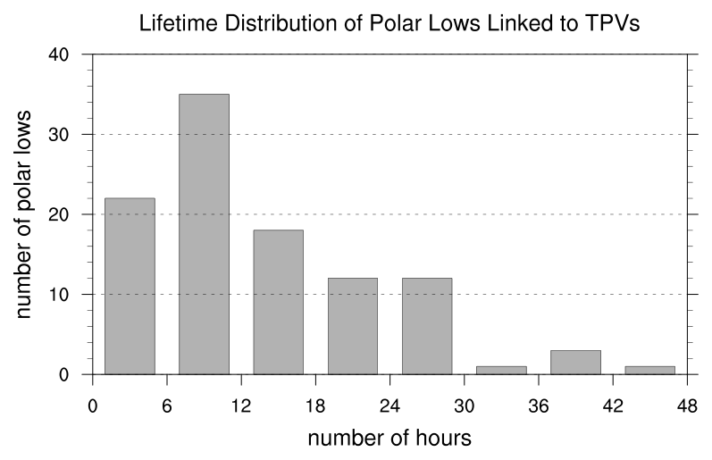
Research Plan–Hypothesis 1
N = 104
Mean: 12.9 h
Median: 9 h
Lifetime distribution of polar lows linked to TPVs, with lifetime in number of hours.

Slide 106
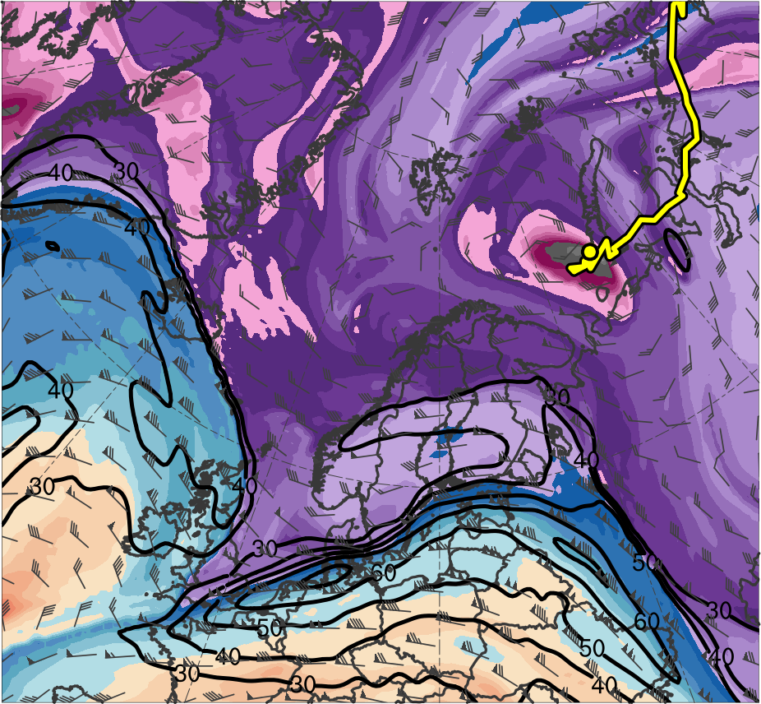
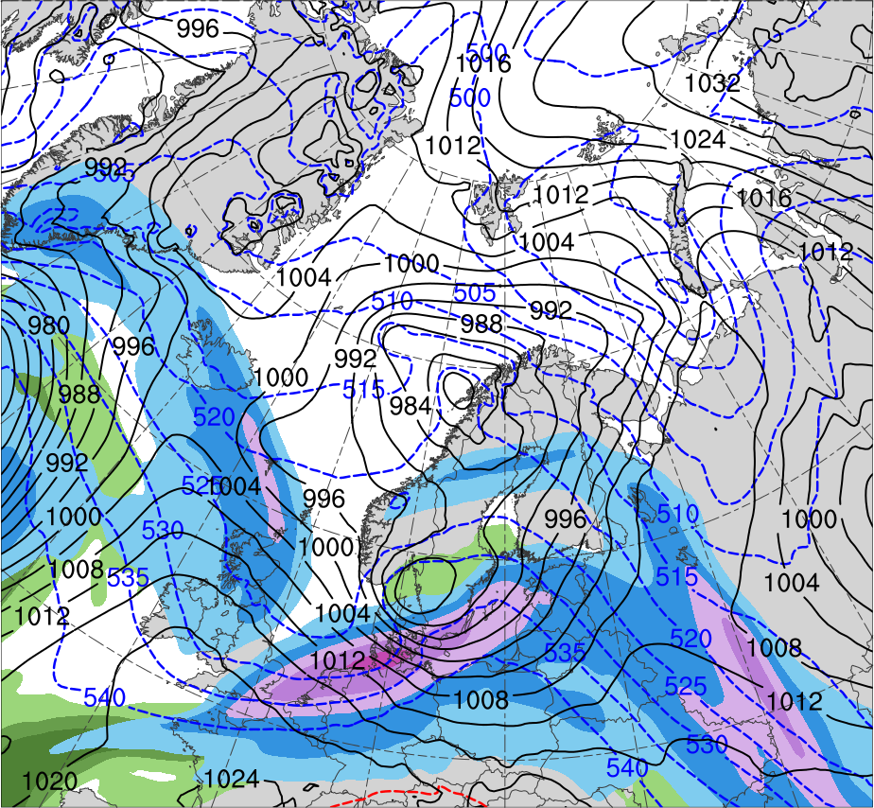
Research Plan–Hypothesis 1
0000 UTC 8 Feb 2011
R1
TPV
(K)
252
258
264
270
276
282
288
294
300
306
312
318
324
330
336
342
348
354
360
366
372
378
(m s⁻¹ )
(mm)
30
40
50
60
70
80
90
100
10
15
20
25
30
35
40
Potential temperature (K, shaded), wind speed (black, every 10 m s⁻¹ starting at 30 m s⁻¹), and wind (m s⁻¹, flags and barbs) on 2-PVU surface
300-hPa wind speed (m s⁻¹, shaded),
1000–500-hPa thickness (dam, blue/red),
SLP (hPa, black), and PW (mm, shaded)

Slide 107
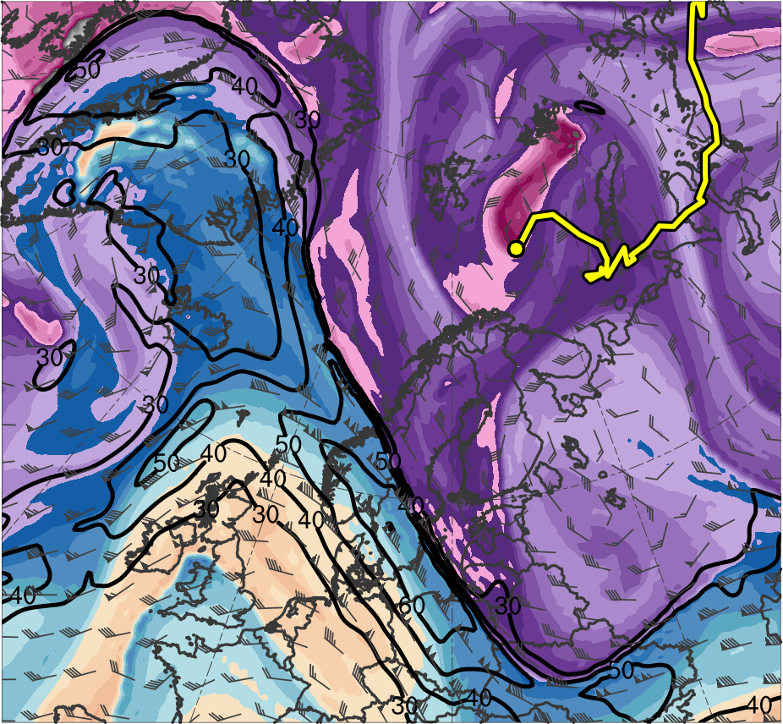
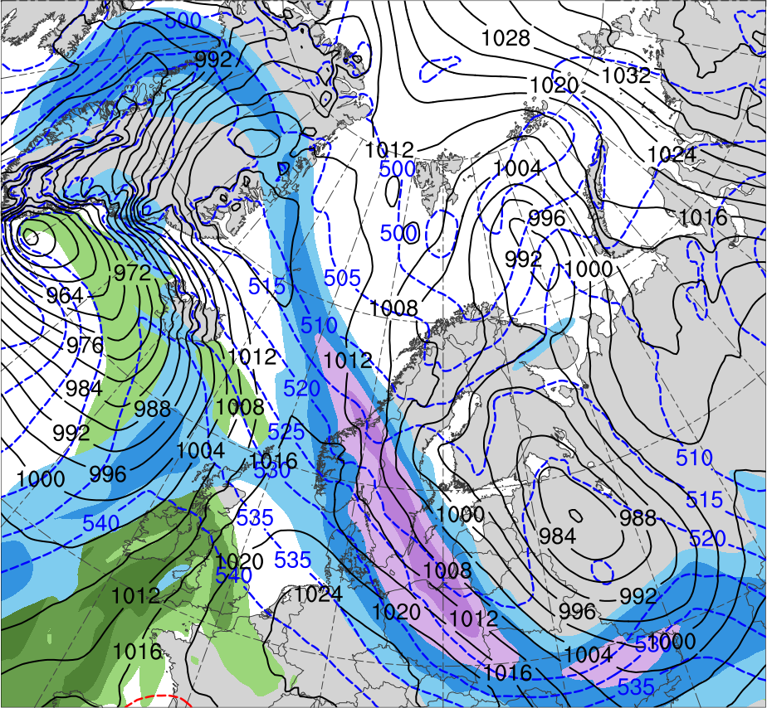
Research Plan–Hypothesis 1
0000 UTC 9 Feb 2011
R1
R2
TPV
(K)
252
258
264
270
276
282
288
294
300
306
312
318
324
330
336
342
348
354
360
366
372
378
(m s⁻¹ )
(mm)
30
40
50
60
70
80
90
100
10
15
20
25
30
35
40
Potential temperature (K, shaded), wind speed (black, every 10 m s⁻¹ starting at 30 m s⁻¹), and wind (m s⁻¹, flags and barbs) on 2-PVU surface
300-hPa wind speed (m s⁻¹, shaded),
1000–500-hPa thickness (dam, blue/red),
SLP (hPa, black), and PW (mm, shaded)

Slide 108
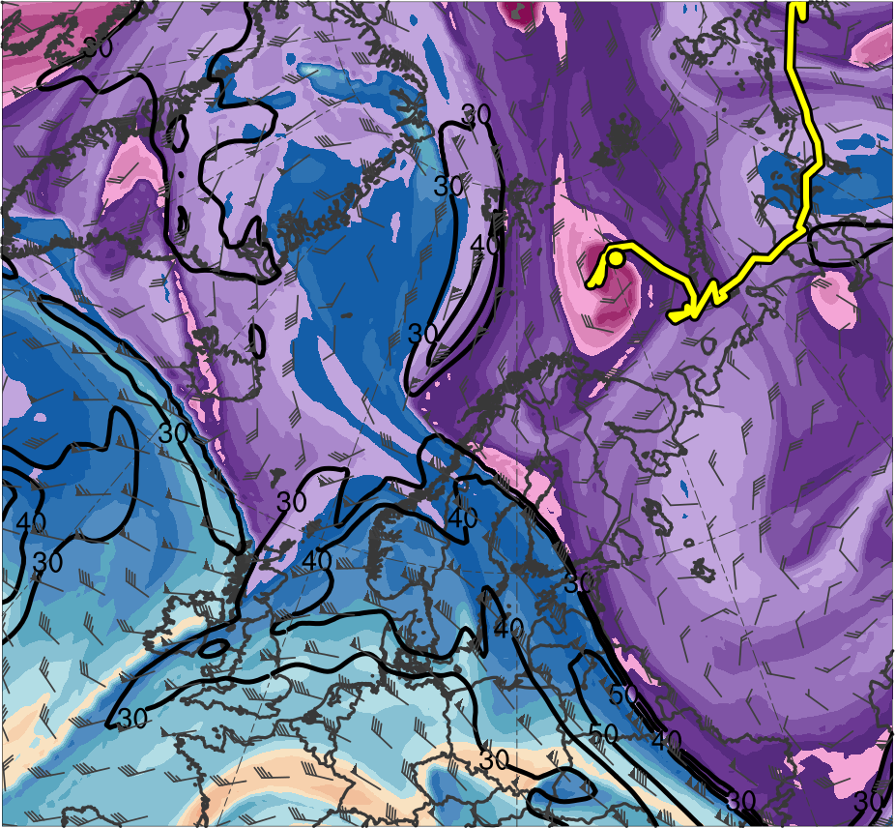
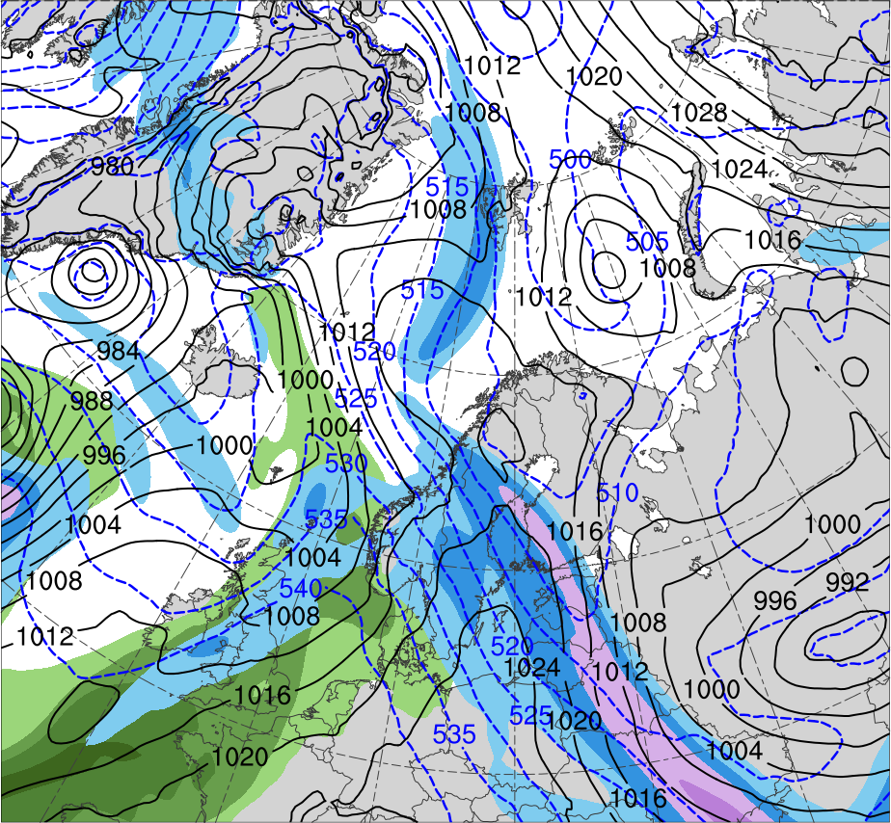
Research Plan–Hypothesis 1
0000 UTC 10 Feb 2011
R2
R1
TPV
(K)
252
258
264
270
276
282
288
294
300
306
312
318
324
330
336
342
348
354
360
366
372
378
(m s⁻¹ )
(mm)
30
40
50
60
70
80
90
100
10
15
20
25
30
35
40
Potential temperature (K, shaded), wind speed (black, every 10 m s⁻¹ starting at 30 m s⁻¹), and wind (m s⁻¹, flags and barbs) on 2-PVU surface
300-hPa wind speed (m s⁻¹, shaded),
1000–500-hPa thickness (dam, blue/red),
SLP (hPa, black), and PW (mm, shaded)

Slide 109
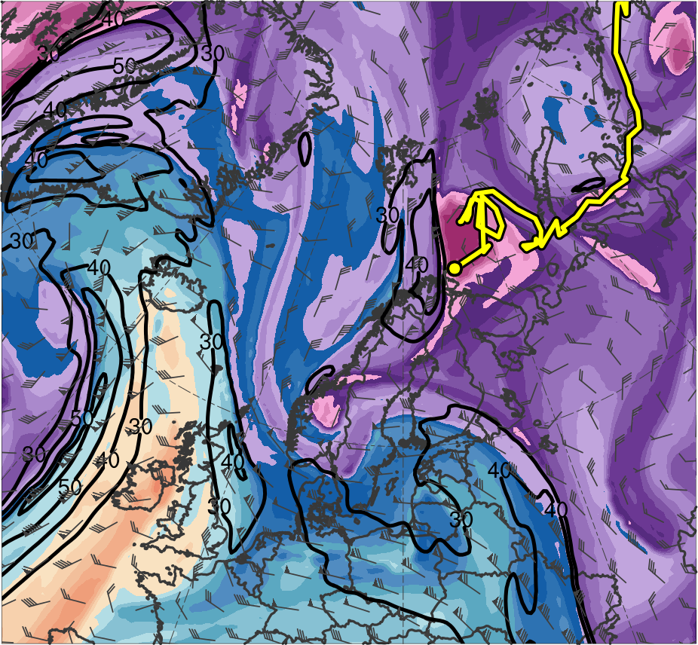
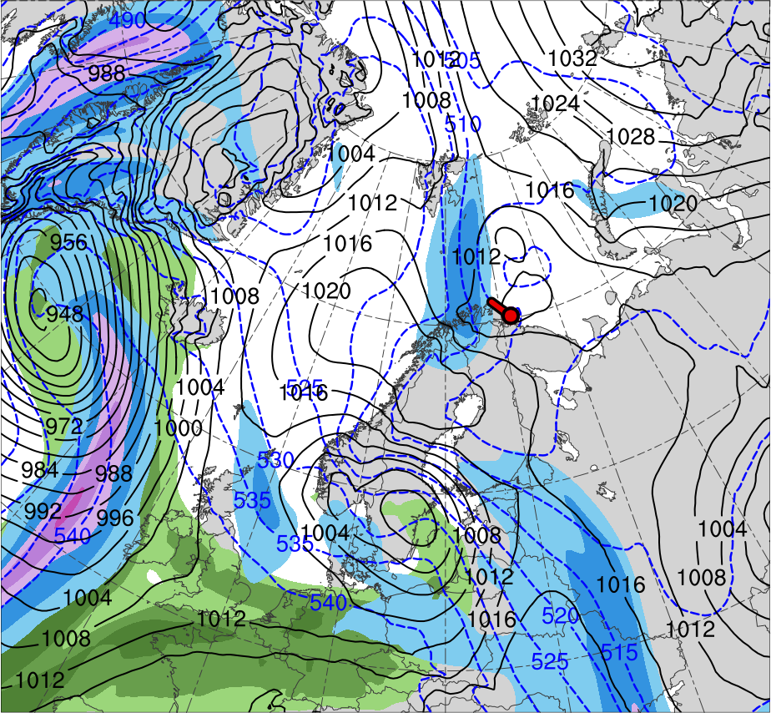
Research Plan–Hypothesis 1
0000 UTC 11 Feb 2011
R2
R1
TPV
PL
(K)
252
258
264
270
276
282
288
294
300
306
312
318
324
330
336
342
348
354
360
366
372
378
(m s⁻¹ )
(mm)
30
40
50
60
70
80
90
100
10
15
20
25
30
35
40
Potential temperature (K, shaded), wind speed (black, every 10 m s⁻¹ starting at 30 m s⁻¹), and wind (m s⁻¹, flags and barbs) on 2-PVU surface
300-hPa wind speed (m s⁻¹, shaded),
1000–500-hPa thickness (dam, blue/red),
SLP (hPa, black), and PW (mm, shaded)

Slide 110




Research Plan–Hypothesis 1
0300 UTC 11 Feb 2011
TPV
TPV
PL
PL
-10
-7.5
-5
-4
-3
-2
-1
-0.5
0
0.5
1
2
3
4
5
7.5
10
0.5
1
1.5
2
2.5
3
3.5
4
5
6
7
8
SLP (hPa, blue); 600–400-hPa Q (K m⁻¹ s⁻¹, vectors), Q forcing for vertical motion (10⁻¹⁷ Pa⁻¹ s⁻³, shaded), θ (°C, red), and geopotential height (dam, black)
900–600-hPa static stability [K (100 hPa)⁻¹, shaded], SLP (hPa, black), SST (°C, purple), and 20% contour of sea-ice concentration (thick blue)

Slide 111



Research Plan–Hypothesis 1
0300 UTC 11 Feb 2011
PL
PL
-160
-140
-120
-100
-80
-60
-40
-20
0
20
40
60
80
100
120
140
160
Sensible heat flux [W m⁻², shaded],
SLP (hPa, black), and 10-m wind (m s⁻¹, barbs)
Latent heat flux [W m⁻², shaded],
SLP (hPa, black), and 10-m wind (m s⁻¹, barbs)

Slide 112



Research Plan–Hypothesis 1
0300 UTC 11 Feb 2011
(a)
(b)
A
378
12
TPV
372
30
366
28
10
360
354
26
8
348
342
24
6
336
330
22
4
A’
324
20
3
A
318
18
(c)
312
2
306
16
300
1.5
294
14
TPV
288
12
1
PL
282
276
10
0.5
PL
270
264
8
0.25
258
6
A’
252
(PVU)
A
75.0°N, 34.5°E
72.0°N, 34.5°E
69.0°N, 34.5°E
A’
(K)
(a) PV (PVU, shaded), θ (K, black), ascent (red, every 2.5 × 10⁻³ hPa s⁻¹), and wind speed (white, every 10 m s⁻¹ starting at 30 m s⁻¹); (b) DT (2-PVU surface) θ (K, shaded), wind speed (black, every 10 m s⁻¹ starting at 30 m s⁻¹), and wind (m s⁻¹, flags and barbs); (c) 850-hPa relative vorticity (10⁻⁵ s⁻¹, shaded), 850–600-hPa ascent (blue, every 2.5 × 10⁻³ hPa s⁻¹), SLP (hPa, black), and 10-m wind (m s⁻¹, barbs)

Slide 113



Research Plan–Hypothesis 1
0300 UTC 11 Feb 2011
(a)
(b)
378
12
TPV
372
30
366
28
10
360
B’
354
26
8
348
B
342
24
6
336
330
22
4
324
20
3
318
18
(c)
312
2
TPV
306
16
300
1.5
294
14
B’
288
12
1
PL
282
276
10
0.5
PL
B
270
264
8
0.25
258
6
252
(PVU)
B
69.9°N, 30.0°E
69.9°N, 37.5°E
69.9°N, 45.0°E
B’
(K)
(a) PV (PVU, shaded), θ (K, black), ascent (red, every 2.5 × 10⁻³ hPa s⁻¹), and wind speed (white, every 10 m s⁻¹ starting at 30 m s⁻¹); (b) DT (2-PVU surface) θ (K, shaded), wind speed (black, every 10 m s⁻¹ starting at 30 m s⁻¹), and wind (m s⁻¹, flags and barbs); (c) 850-hPa relative vorticity (10⁻⁵ s⁻¹, shaded), 850–600-hPa ascent (blue, every 2.5 × 10⁻³ hPa s⁻¹), SLP (hPa, black), and 10-m wind (m s⁻¹, barbs)

Slide 114

Research Plan–Hypothesis 1
Track error rank, intensity error rank, and combined track and intensity error rank for the eight ensemble members in the most accurate group.

Slide 115

Research Plan–Hypothesis 1
Track error rank, intensity error rank, and combined track and intensity error rank for the eight ensemble members in the least accurate group.

Slide 116

Research Plan–Hypothesis 1
Values of selected quantities for 1800 UTC 10 February–1200 UTC 11 February 2011 time period for ERA5, most accurate group, and least accurate group. The difference between the means of the most accurate and least accurate group for each quantity are shown as well, with confidence levels for the significance of the difference between the means of the most accurate and least accurate group for each quantity based on a two-sided Student’s t test given in parentheses.

Slide 117

Research Plan–Hypothesis 1
Statistical piecewise PV inversion (Hakim and Torn 2008) can be applied to upper-level PV differences related to upper-level features between two groups of forecasts
  Can elucidate how such differences may influence the position and intensity other upper-level features (e.g., Lamberson et al. 2016)
shading: ensemble mean
250-hPa PV (PVU)
using ECMWF EPS
subgroup PV differences (every 0.3 PVU) being inverted
Inverted 250-hPa wind field (m s⁻¹)
1
2
3
4
5
6
7
8
9
PVU
Fig. 8 adapted from Lamberson et al. (2016)

Slide 118
Research Plan–Hypothesis 2d
Blocks following the methodology of Schwierz et al. (2004)
  Blocks are identified as regions where there is a negative anomaly of 500–150-hPa vertically averaged PV exceeding −1.3 PVU that persists for at least five days

