Slide 1
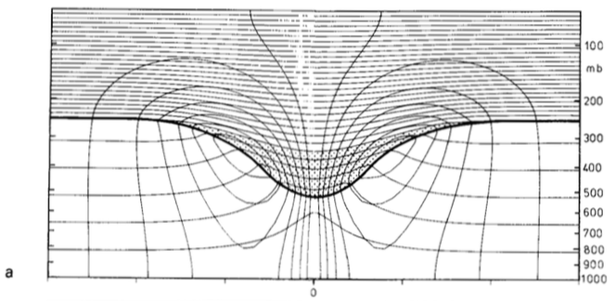
Figure 1
Hoskins et al. (1985)
✕
Fig. 1.1. Cross section of circularly symmetric cyclonic flow induced by simple isolated upper-level cyclonic PV anomaly (stippled region and red plus symbol). The thick line represents the tropopause and the solid contours represent potential temperature (every 5 K) and azimuthal wind velocity (every 3 m s⁻¹). Cross in circle symbol represents maximum of azimuthal wind velocity directed into cross-section and dot in circle symbol represents maximum of azimuthal wind velocity directed out of cross-section. [Fig. 15 and caption adapted from Hoskins et al. (1985, section 3)].

Slide 2
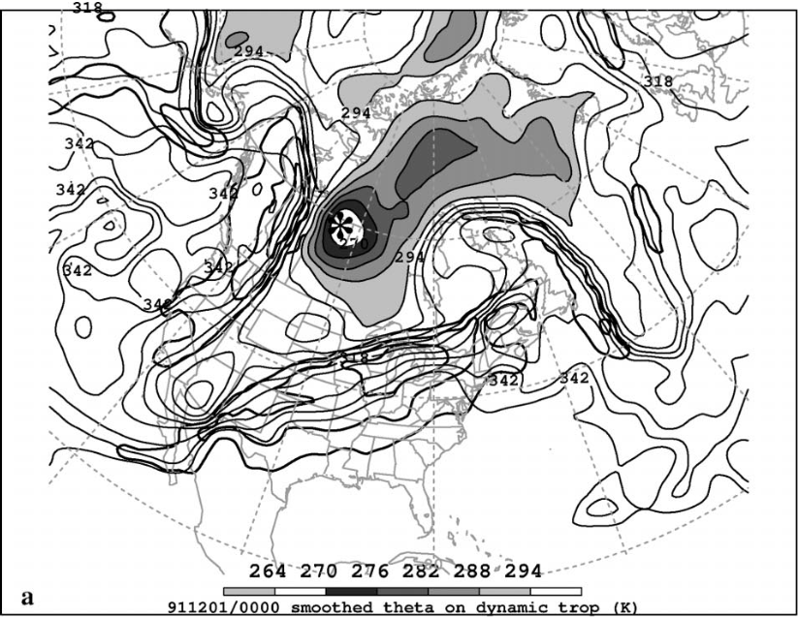
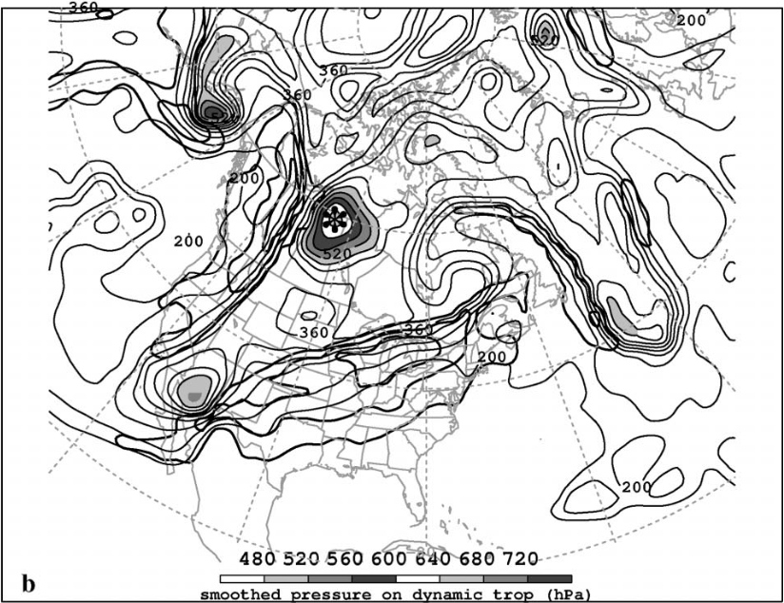
Figure 2
Pyle et al. (2004)
TPV
TPV
Fig 1.2. Analyses for 0000 UTC 30 Nov 1991: (a) DT (1.5-PVU) potential temperature (thin solid, values at and below 342 K contoured at a 6-K interval, shaded as indicated for values below 294 K) and DT wind speed (thick solid; contour interval, 15 m s⁻¹ ; starting at 50 m s⁻¹); and (b) DT pressure (thin solid; contour interval, 40 hPa; shaded as indicated for values greater than 480 hPa) and DT horizontal wind speed [contoured as in (a)]. Label “TPV” and arrow point to position of TPV. [Fig. 11 and caption adapted from Pyle et al. (2004)].

Slide 3
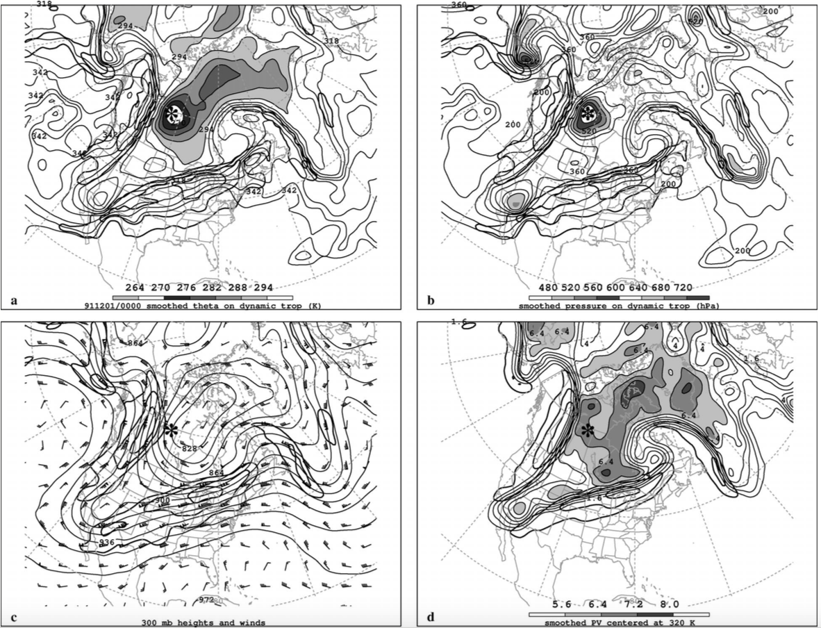
Figure 2
Pyle et al. (2004)
Fig. 2. Analyses for 0000 UTC 30 Nov 1991: (a) DT (1.5-PVU) potential temperature (thin solid, values at and below 342 K contoured at a 6-K interval, shaded as indicated for values below 294 K) and DT wind speed (thick solid; contour interval, 15 m s⁻¹ ; starting at 50 m s⁻¹); (b) DT pressure (thin solid; contour interval, 40 hPa; shaded as indicated for values greater than 480 hPa) and DT wind speed [contoured as in (a)]; (c) 300-hPa geopotential height (thin solid; contour at a 12-dam interval), 300-hPa wind speed [contoured as in (a)], and wind (plotted using standard convention: pennant, full barb, and half barb denote 25, 5, and 2.5 m s⁻¹, respectively); and (d) PV calculated over the 316–324-K layer (thin solid; contour at a 0.8-PVU interval for values greater than 1.6 PVU, shaded as indicated for values greater than 5.6 PVU) and wind speed at 320 K [contoured as in (a)]. The position of the DT pressure maximum associated with the TPV of interest is marked with an asterisk in each panel. [Fig. 11 and caption adapted from Pyle et al. (2004)].

Slide 4
Figure 2
Pyle et al. (2004)
TPV
TPV
TPV
TPV
Fig. 2. Analyses for 0000 UTC 30 Nov 1991: (a) DT (1.5-PVU) potential temperature (thin solid, values at and below 342 K contoured at a 6-K interval, shaded as indicated for values below 294 K) and DT wind speed (thick solid; contour interval, 15 m s⁻¹ ; starting at 50 m s⁻¹); (b) DT pressure (thin solid; contour interval, 40 hPa; shaded as indicated for values greater than 480 hPa) and DT wind speed [contoured as in (a)]; (c) 300-hPa geopotential height (thin solid; contour at a 12-dam interval), 300-hPa wind speed [contoured as in (a)], and wind (plotted using standard convention: pennant, full barb, and half barb denote 25, 5, and 2.5 m s⁻¹, respectively); and (d) PV calculated over the 316–324-K layer (thin solid; contour at a 0.8-PVU interval for values greater than 1.6 PVU, shaded as indicated for values greater than 5.6 PVU) and wind speed at 320 K [contoured as in (a)]. The position of the DT pressure maximum associated with the TPV of interest is marked with an asterisk in each panel. Label “TPV” and arrow point to position of TPV. [Fig. 11 and caption adapted from Pyle et al. (2004)].

Slide 5
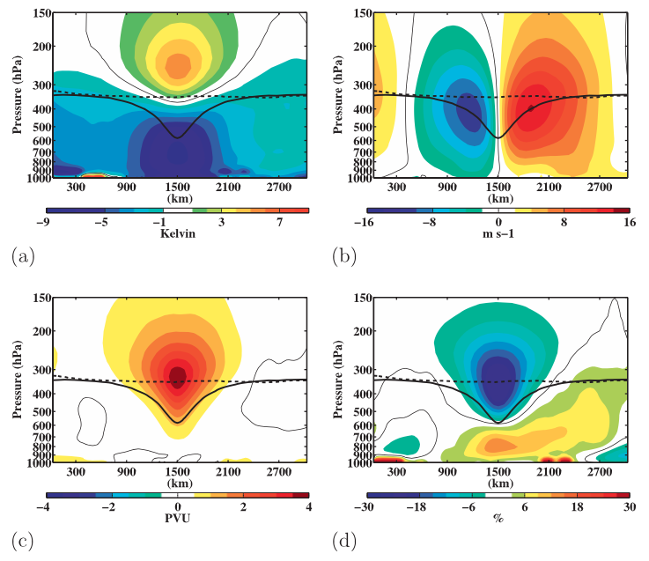
Figure 3
Cavallo and Hakim (2010)
Fig. 1.3. Composite west–east cross-TPV section of anomalous (a) temperature (K), (b) v-wind component (m s⁻¹), (c) Ertel PV (PVU), and (d) relative humidity (%). Thick solid black contour is the composite tropopause and thick dashed black contour is the background tropopause. The 0 contour is denoted by the thin, solid contour. [Fig. 9 and adapted caption from Cavallo and Hakim (2010)].

Slide 6
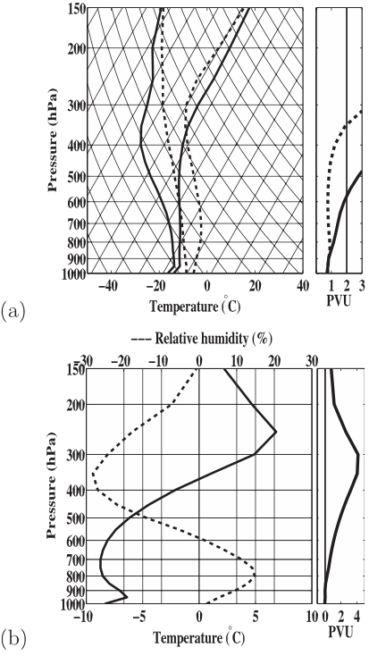
Figure 4
Cavallo and Hakim (2010)
Fig. 1.4. (a) Skew T–logp diagram of composite temperature and dewpoint temperature at the TPV core (solid) and at the background grid point (dashed). (b) Vortex–background difference plots of temperature (solid) and relative humidity (dashed). The plots to the right show the corresponding PV in (a) and PV anomaly from the background in (b) in PVUs at the TPV core (solid) and background grid point (dashed). [Fig. 6 and adapted caption from Cavallo and Hakim (2010)].

Slide 7
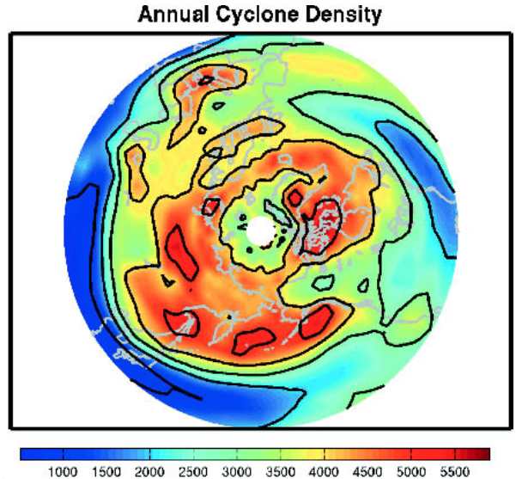
Figure 4
Hakim and Canavan (2005)
Fig. 1.5. Total number of tropopause cyclonic vortex events occurring in a 2.5°–10° lat–lon box centered at a point, with a cosine-latitude normalization applied for equal-area weighting [Fig. 2 and adapted caption from Hakim and Canavan (2005)].

Slide 8
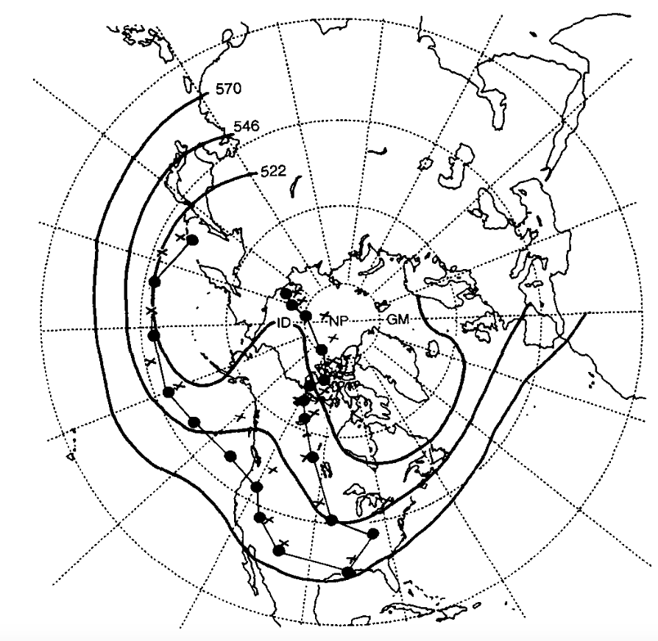
Figure 6
Hakim et al. (1995)
Fig. 1.6. Tracks of QGPV maxima and time-mean 500-hPa geopotential height field (black, contoured every 12 dam) for 17–27 January 1978. Tracks of QGPV maxima (blue dots represent arctic QGPV maximum and green dots represents midlatitude QGPV maximum) and 1000–500-hPa thickness minima (black crosses) involved in the formation of the 1978 Cleveland Superbomb every 24 h starting 0000 UTC 17 January and ending 0000 UTC 27 January 1978. Red dot represents the merger of the two QGPV maxima. [Fig. 3 and caption adapted from Hakim et al. (1995)].

Slide 9
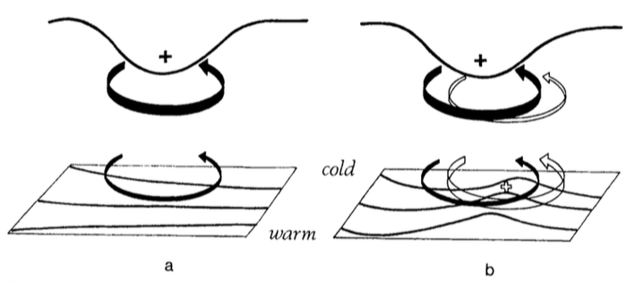
Figure 5
Hoskins et al. (1985)
Fig. 1.7. A schematic picture of cyclogenesis associated with the arrival of an upper-level cyclonic PV anomaly over a low-level baroclinic region. In both (a) and (b) solid plus sign indicates location of upper-level cyclonic PV anomaly, solid black contour at the top represents the tropopause, black contours at bottom represent isentropes at the ground, thick solid arrow represents the cyclonic circulation induced by upper-level cyclonic PV anomaly at upper-levels, and thin solid arrow represents the cyclonic circulation induced by upper-level cyclonic PV anomaly at low-levels. In (b) only, open plus sign represents low-level warm temperature anomaly, thick open arrow represents cyclonic circulation induced by the low-level warm temperature anomaly at low-levels, and the thin open arrow represents the cyclonic circulation induced by the low-level warm temperature anomaly at upper-levels. [Fig. 21 and caption adapted from Hoskins et al. (1985, section 6e)].
Notes:
Adapted from Fig. 21 in Hoskins et al. (1985).

Slide 10
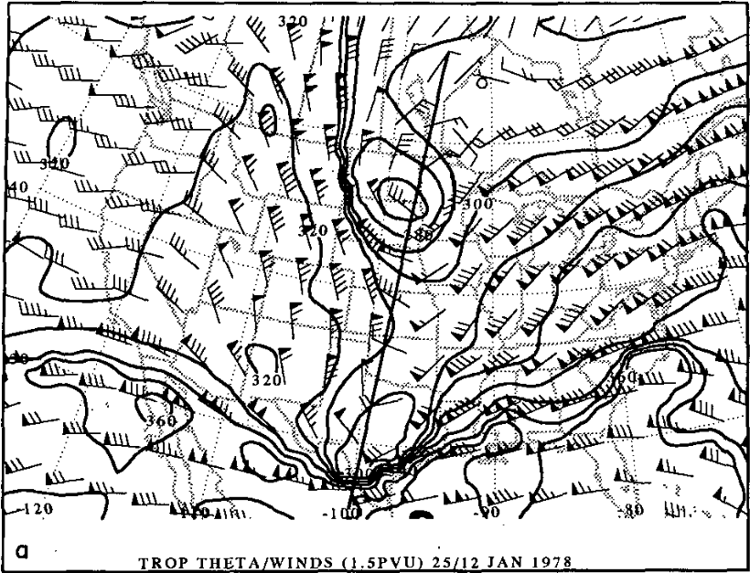
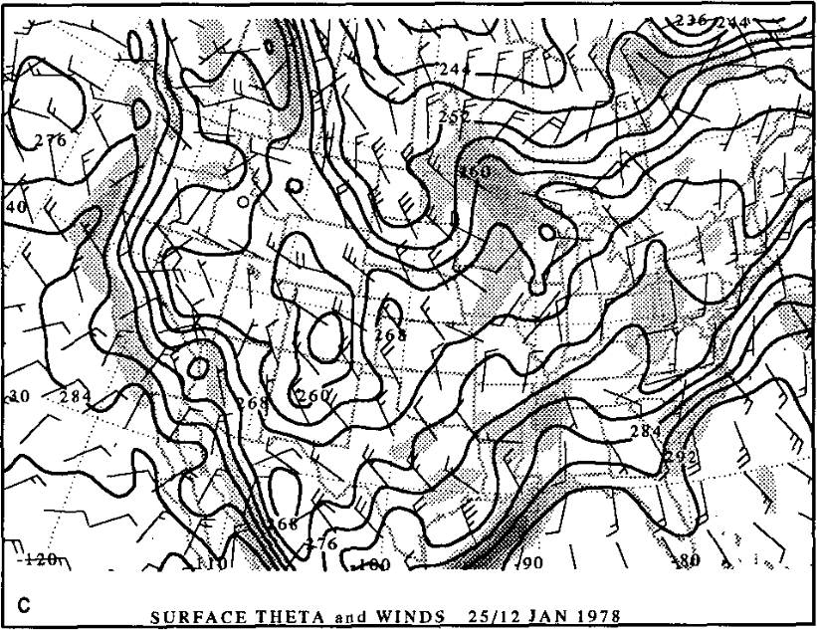
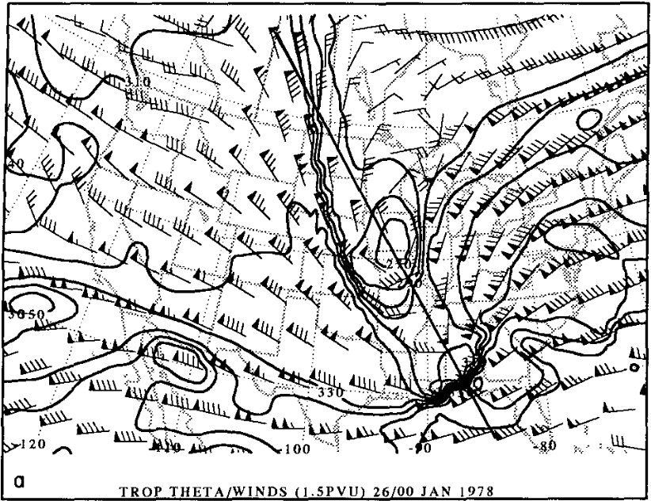
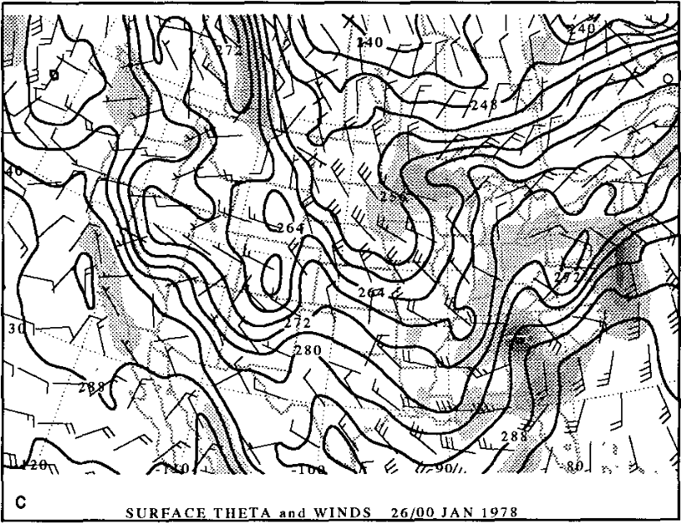
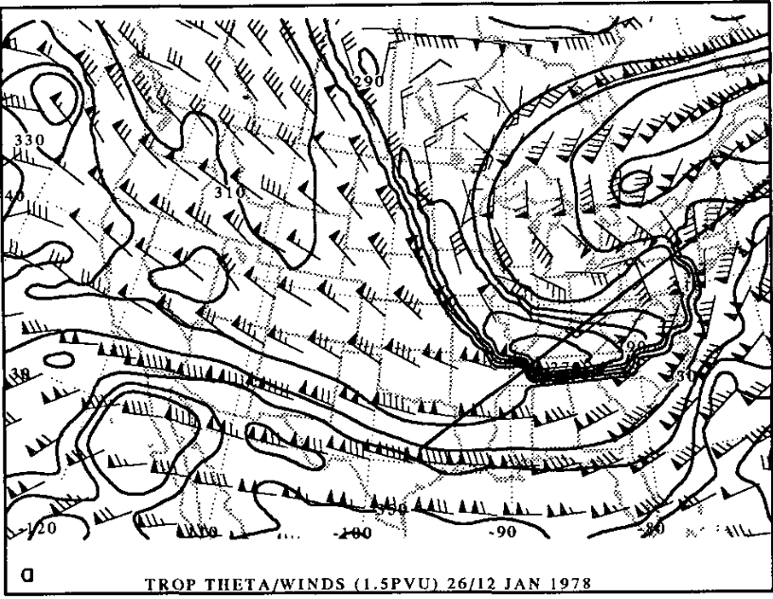
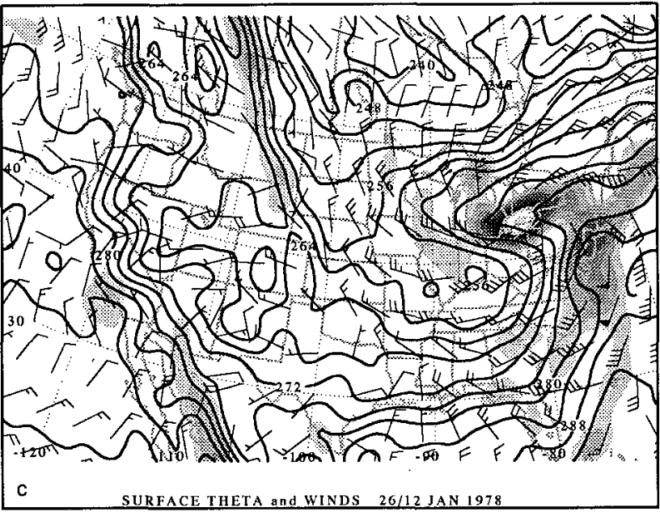
Figure 8
Hakim et al. (1995)
Fig. 1.8. DT (1.5 PVU) potential temperature (black contours, every 10 K) and wind (flags and barbs, m s⁻¹) at (a) 1200 UTC 25 January, (c) 0000 UTC 26 January, and (e) 1200 UTC 26 January 1978; surface potential temperature (black contours, every 4 K), relative vorticity (shaded every 2×10⁻⁵ s⁻¹ for values greater than 2×10⁻⁵ s⁻¹), and wind (flags and barbs, m s⁻¹) at (b) 1200 UTC 25 January, (d) 0000 UTC 26 January, and (f) 1200 UTC 26 January 1978. Winds are plotted with flags, full barbs, and half barbs representing 25 m s⁻¹, 5 m s⁻¹, and 2.5 m s⁻¹, respectively. [Figs. 6,8,9 and captions adapted from Hakim et al. (1995)].
a
b
c
d
e
f

Slide 11
Figure 8
Hakim et al. (1995)
TPV
L
CTD
Fig. 1.8. DT (1.5 PVU) potential temperature (black contours, every 10 K) and wind (flags and barbs, m s⁻¹) at (a) 1200 UTC 25 January, (c) 0000 UTC 26 January, and (e) 1200 UTC 26 January 1978; surface potential temperature (black contours, every 4 K), relative vorticity (shaded every 2×10⁻⁵ s⁻¹ for values greater than 2×10⁻⁵ s⁻¹), and wind (flags and barbs, m s⁻¹) at (b) 1200 UTC 25 January, (d) 0000 UTC 26 January, and (f) 1200 UTC 26 January 1978. Winds are plotted with flags, full barbs, and half barbs representing 25 m s⁻¹, 5 m s⁻¹, and 2.5 m s⁻¹, respectively. Labels “TPV” and “CTD” and associated arrows point to positions of TPV and CTD, respectively. Label “L” represents approximate position of surface cyclone. [Figs. 6,8,9 and captions adapted from Hakim et al. (1995)].
a
b
TPV
L
CTD
c
d
CTD
L
TPV
e
f

Slide 12
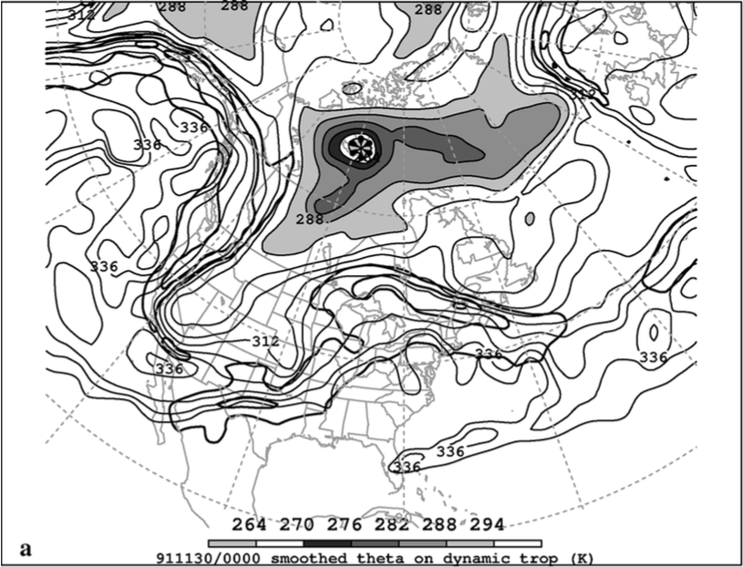
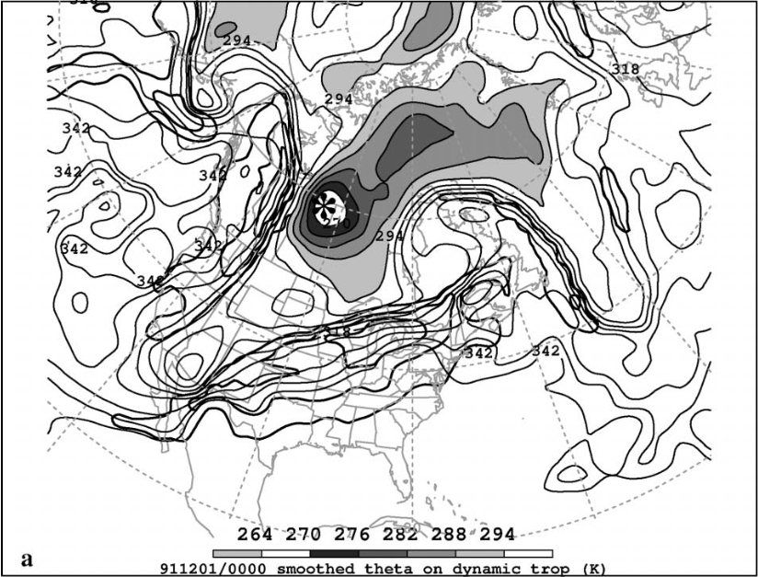
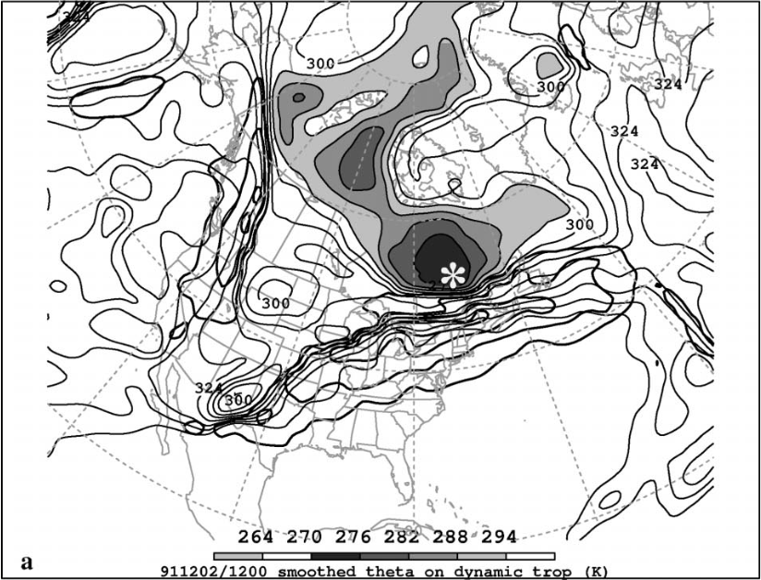
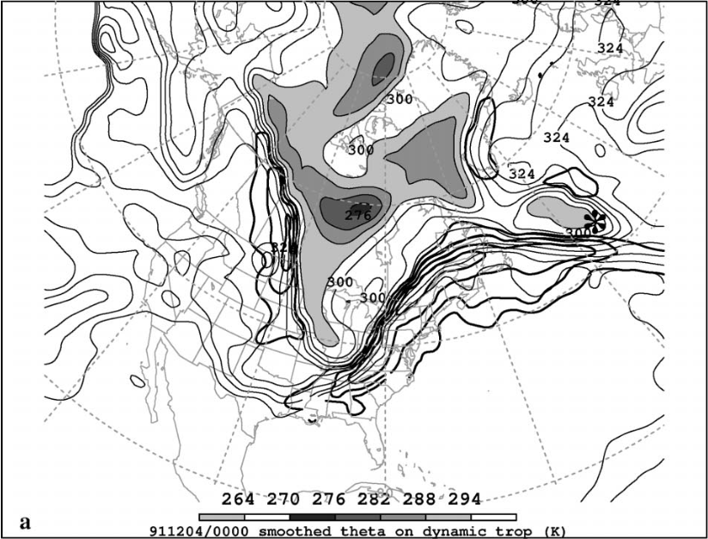
Figure 9
Pyle et al. (2004)
a
b
c
d
Fig. 1.9. DT (1.5-PVU) potential temperature (thin solid, values at and below 342 K contoured at a 6-K interval, shaded as indicated for values below 294 K) and DT wind speed (thick solid; contour interval, 15 m s⁻¹ ; starting at 50 m s⁻¹) valid (a) 0000 UTC 30 November, (b) 0000 UTC 1 December, (c) 1200 UTC 2 December, and (d) 0000 UTC 4 December 1991. The position of the DT pressure maximum associated with the TPV of interest is marked with an asterisk in each panel. [Figs. 10–13 and captions adapted from Pyle et al. (2004)].

Slide 13
Figure 6
Pyle et al. (2004)
TPV
TPV
a
b
TPV
TPV
c
d
Fig. 1.9. DT (1.5-PVU) potential temperature (thin solid, values at and below 342 K contoured at a 6-K interval, shaded as indicated for values below 294 K) and DT wind speed (thick solid; contour interval, 15 m s⁻¹ ; starting at 50 m s⁻¹) valid (a) 0000 UTC 30 November, (b) 0000 UTC 1 December, (c) 1200 UTC 2 December, and (d) 0000 UTC 4 December 1991. The position of the DT pressure maximum associated with the TPV of interest is marked with an asterisk in each panel. Label “TPV” and arrow point to position of TPV. [Figs. 10–13 and captions adapted from Pyle et al. (2004)].

Slide 14
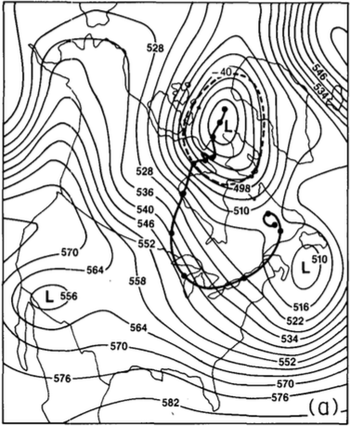
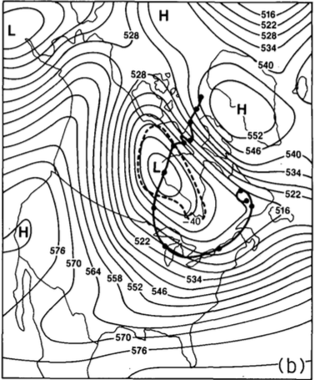
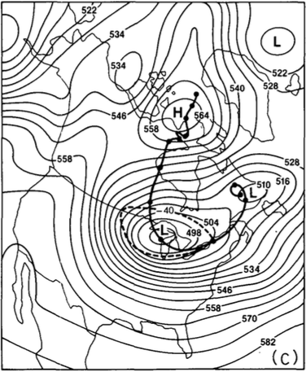
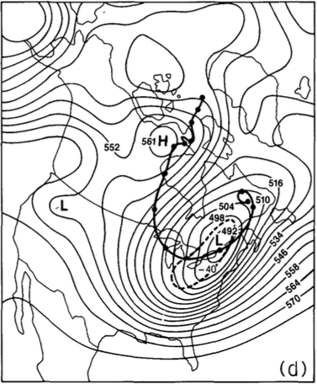
Figure 10
Shapiro et al. (1987)
Fig. 1.10. 500-hPa height (black contours, every 6 dam) and −40°C isotherm (dashed contour) at (a) 0000 UTC 13 January, (b) 0000 UTC 18 January, (c) 0000 UTC 20 January, (d) 0000 UTC 21 January 1985. Heavy solid line shows track of vortex from 0000 UTC 12 January to 0000 UTC 24 January 1985, with dots along track showing position of vortex every 24 hours starting at 0000 UTC 24 January 1985. [Fig. 5 and adapted caption from Shapiro et al. (1987)].

Slide 15
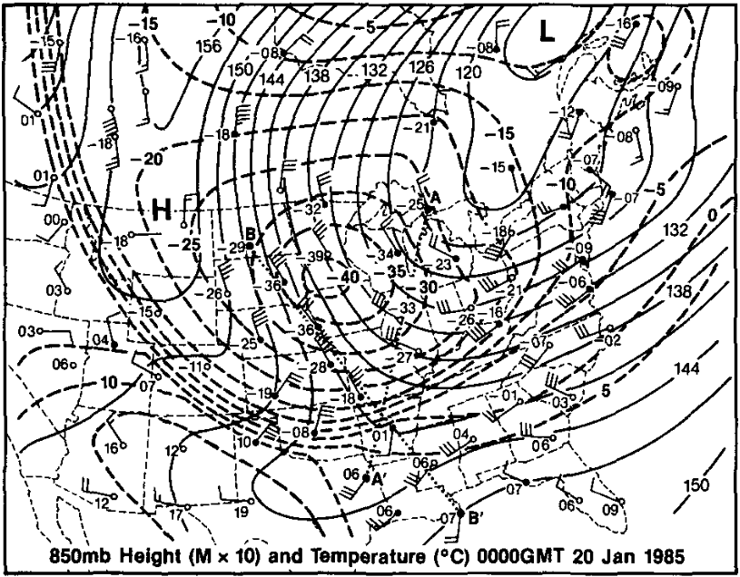
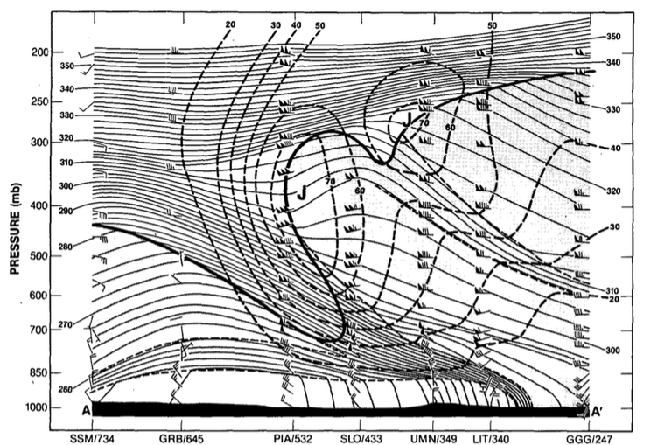
Figure 11
Shapiro et al. (1987)
A
A’
Fig. 1.11. (left) Isopleths showing 850-hPa height (dam; solid black contours) and temperature (°C, dashed contours) and stations showing 850-hPa temperature (°C) and wind (flags and barbs, where flag = 25 m s⁻¹, full barb = 10 m s⁻¹, and half barb = 2.5 m s⁻¹) at 0000 UTC 20 January 1985. Projection line for cross section AA’ is shown by bold red line. (right) Cross section of potential temperature (K, thin solid lines) and wind speed (m s⁻¹, heavy dashed lines) between Sault Sainte Marie, Michigan and Longview, Texas, along the projection line AA’ shown on the left panel. Heavy solid line is tropopause (10⁻⁷ K s⁻¹ hPa⁻¹ isopleth of PV) and light dashed lines indicate tropospheric frontal and stable layer boundaries. Soundings for stations (labeled at bottom) show wind (units and symbols same as for winds shown on left). Jet cores are marked by “J”. [Figs. 8–9 and captions adapted from Shapiro et al. (1987)].

Slide 16
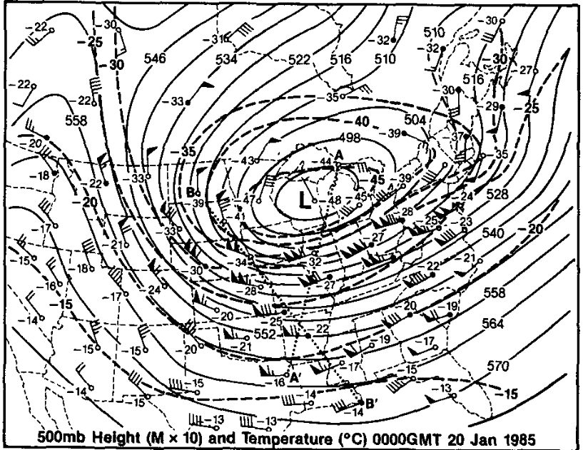
Figure 7
Shapiro et al. (1987)
a
b
A
A’
A
A’
Fig. 1.11. (a) Isopleths showing 500-hPa height (dam; solid black contours) and temperature (°C, dashed contours) and stations showing 500-hPa temperature (°C) and wind (flags and barbs, where flag = 25 m s⁻¹, full barb = 10 m s⁻¹, and half barb = 2.5 m s⁻¹) at 0000 UTC 20 January 1985. Projection line for cross section AA’ is shown by bold red line. (b) Cross section of potential temperature (K, thin solid lines) and wind speed (m s⁻¹, heavy dashed lines) between Sault Sainte Marie, Michigan and Longview, Texas, along the projection line AA’ shown on the left panel. Heavy solid line is tropopause (10⁻⁷ K s⁻¹ hPa⁻¹ isopleth of PV) and light dashed lines indicate tropospheric frontal and stable layer boundaries. Soundings for stations (labeled at bottom) show wind (units and symbols same as for winds shown on left). Jet cores are marked by “J”. [Figs. 8–9 and captions adapted from Shapiro et al. (1987)].

Slide 17
a
A
A’
b
A
A’

