Slide 1
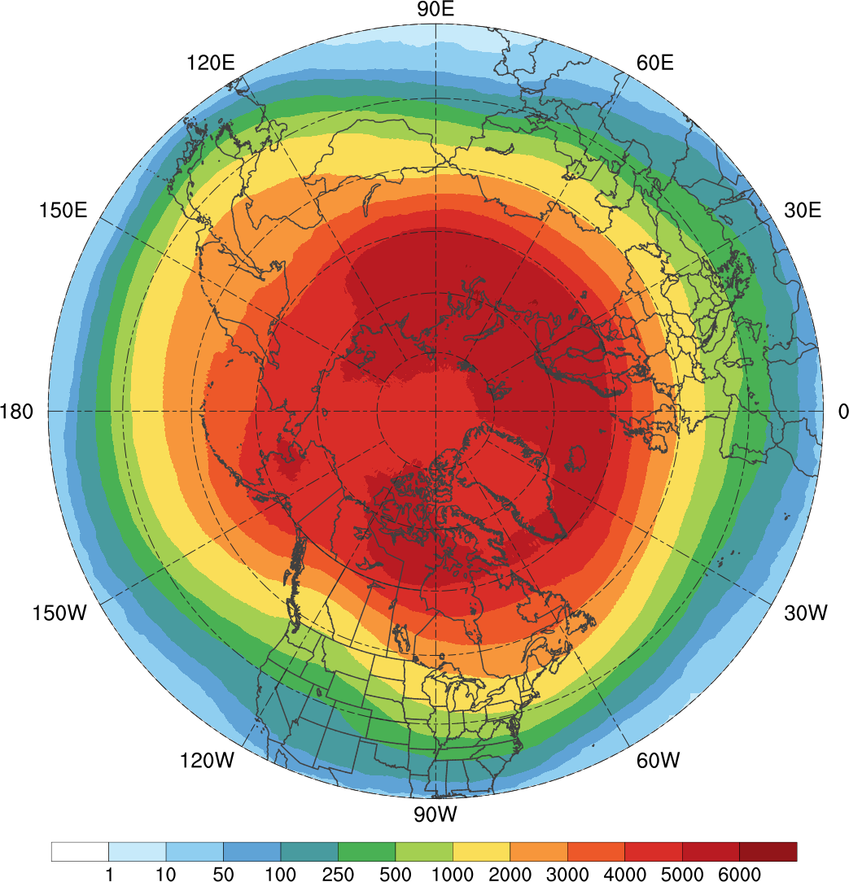
All TPVs
(N = 58,563; avg. of ~1,583 per yr)
(a)
Notes:
All TPVs

Slide 2
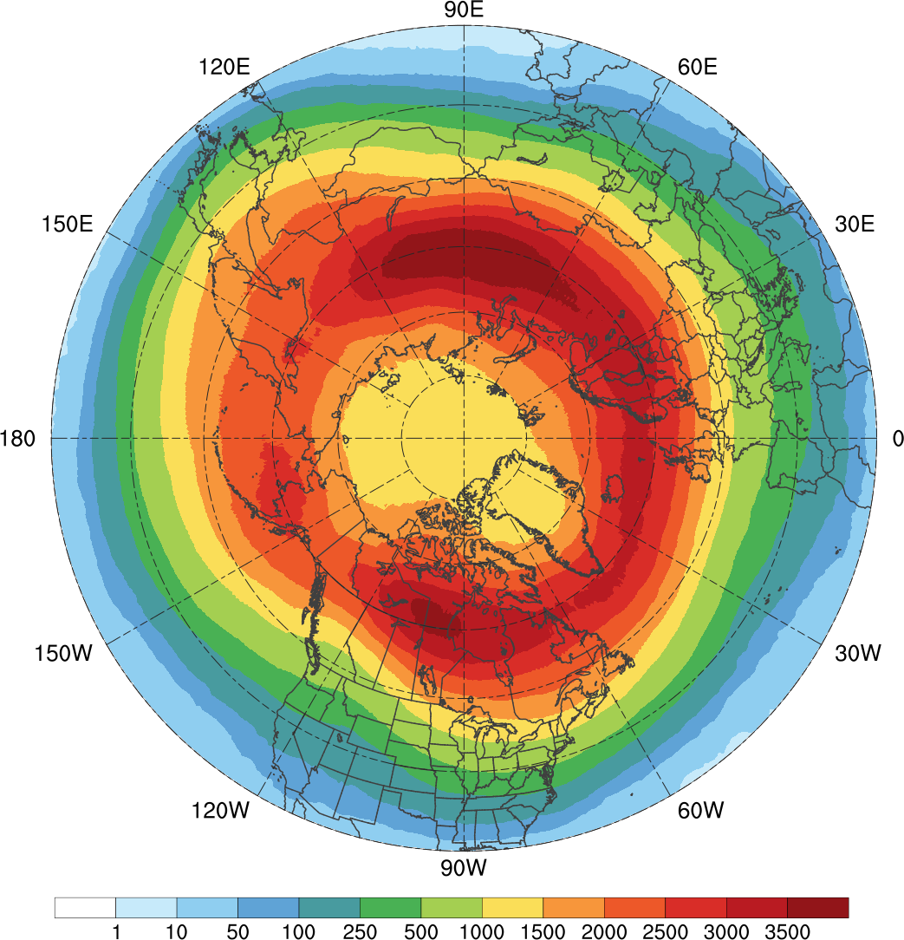
TPVs Transported to Middle Latitudes
(N = 25,085; avg. of ~678 per yr)
(b)
Notes:
TPVs transported to middle latitudes

Slide 3
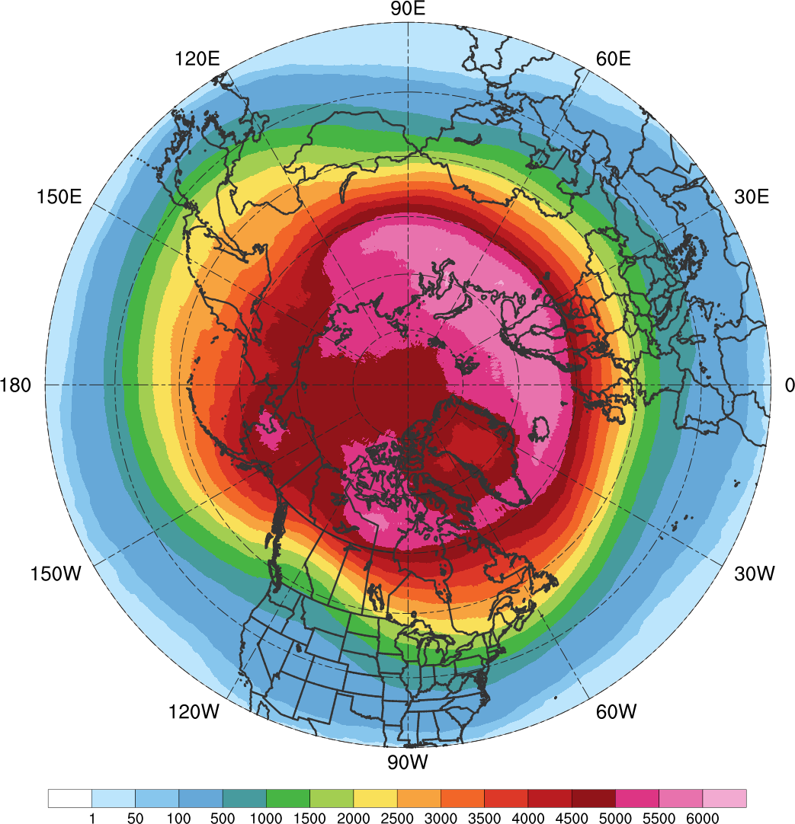
All TPVs
(N = 58,563; avg. of ~1,583 per yr)
(a)
Notes:
All TPVs

Slide 4
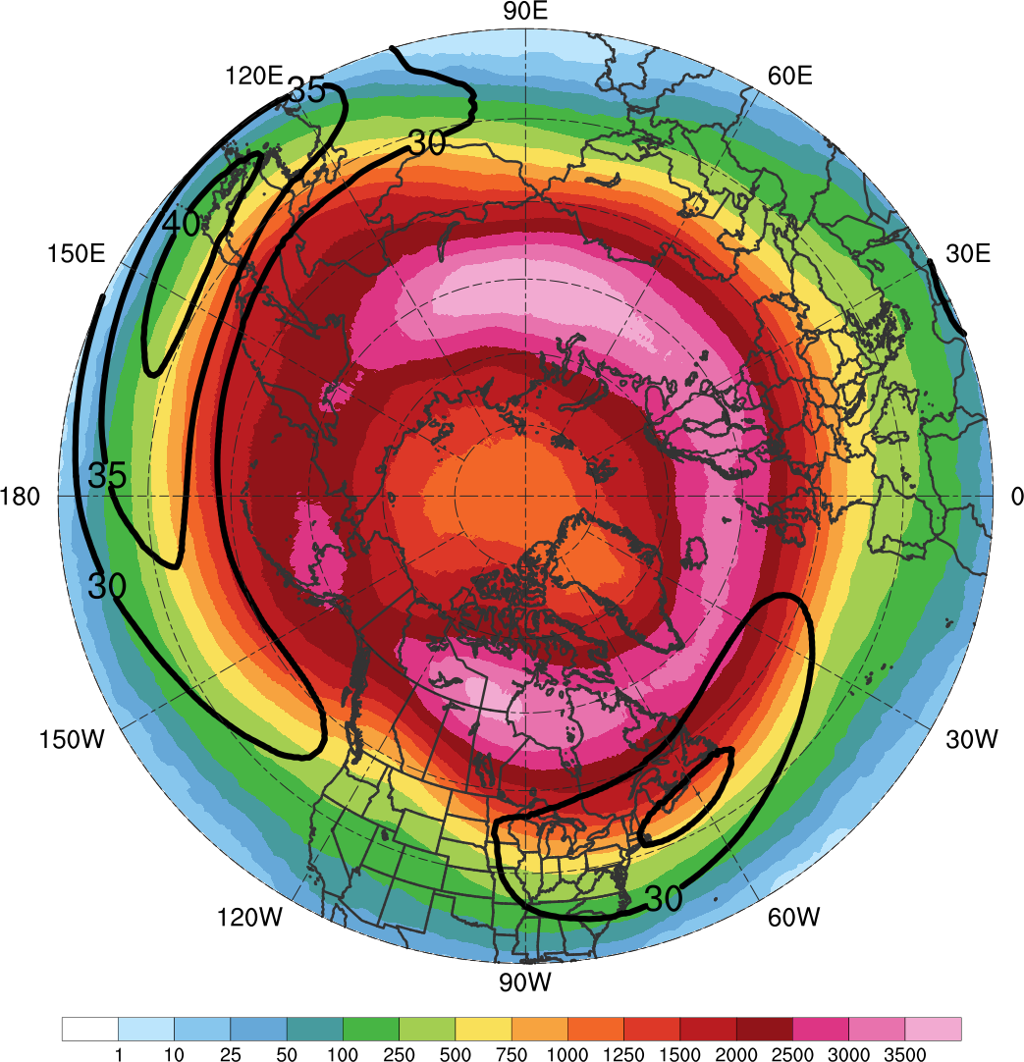
TPVs Transported to Middle Latitudes
(N = 25,085; avg. of ~678 per yr)
(b)
Notes:
TPVs transported to middle latitudes

Slide 5
All TPVs
(N = 58,563; avg. of ~1,583 per yr)
(a)
TPVs Transported to Middle Latitudes
(N = 25,085; avg. of ~678 per yr)
(b)
Notes:
All TPVs

Slide 6
All TPVs
(N = 58,563; avg. of ~1,583 per yr)
All TPVs
(N = 58,563; avg. of ~1,583 per yr)
(a)
TPVs Transported to Middle Latitudes
(N = 25,085; avg. of ~678 per yr)
(b)
Notes:
All TPVs

Slide 7
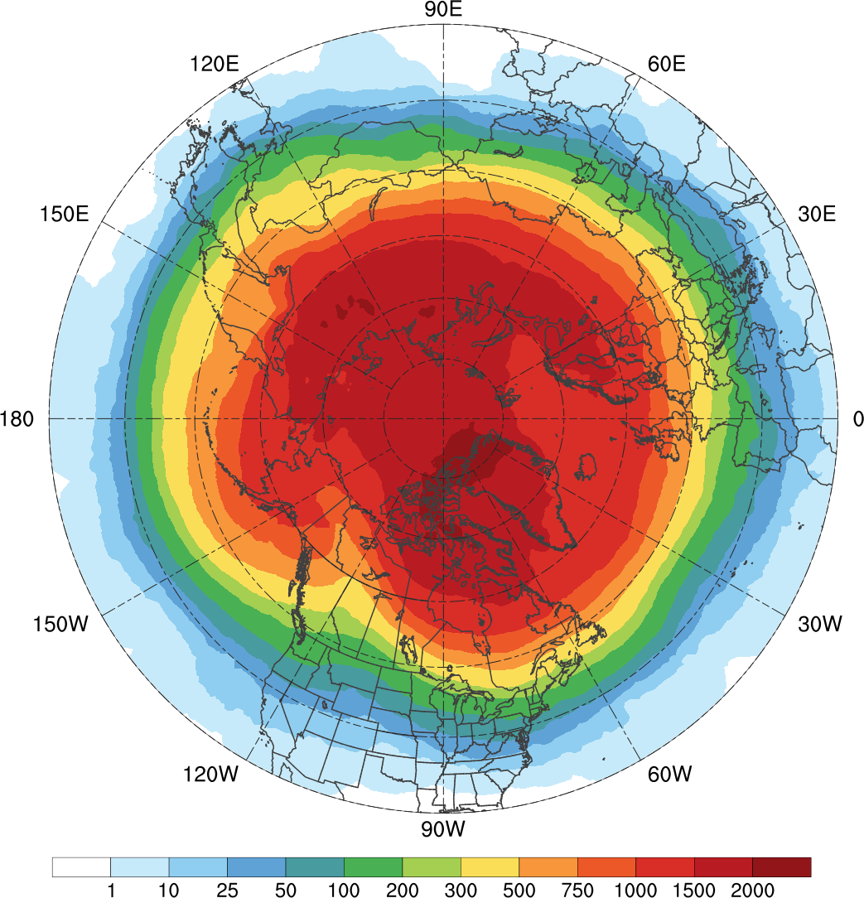
All Cold Pools
(N = 23,045; avg. of ~623 per yr)
(c)
Notes:
All cold pools….Maximum of cold pools may conform mre to land masses and regions of sea ice

Slide 8
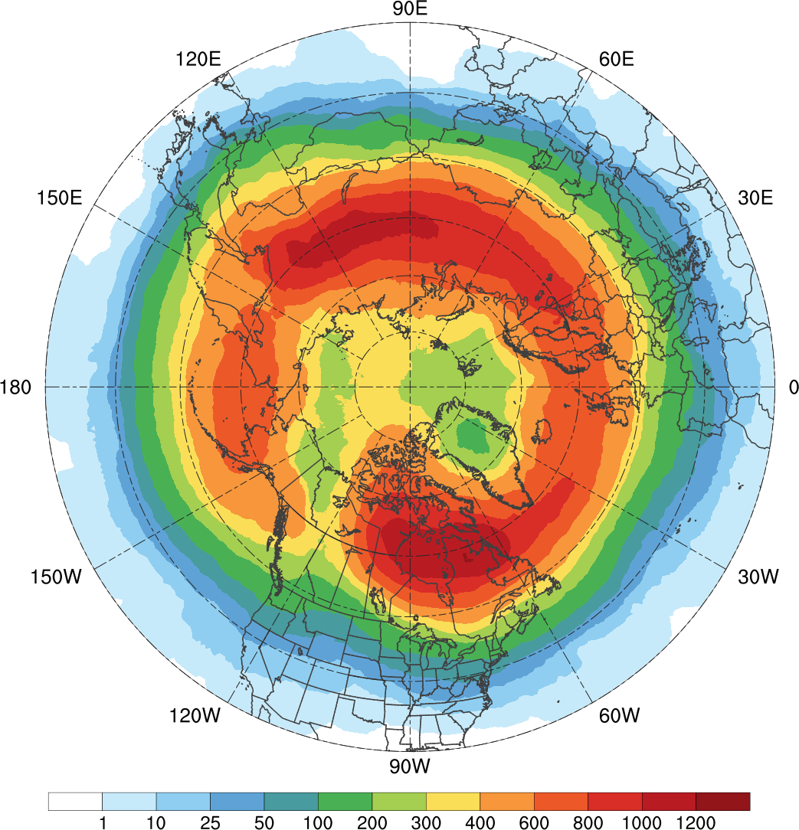
Cold Pools Transported to Middle Latitudes
(N = 8,395; avg. of ~227 per yr)
(d)
Notes:
Cold pools transported to middle latitudes

Slide 9
All TPVs
(N = 58,563; avg. of ~1,583 per yr)
(a)
Notes:
All TPVs

Slide 10
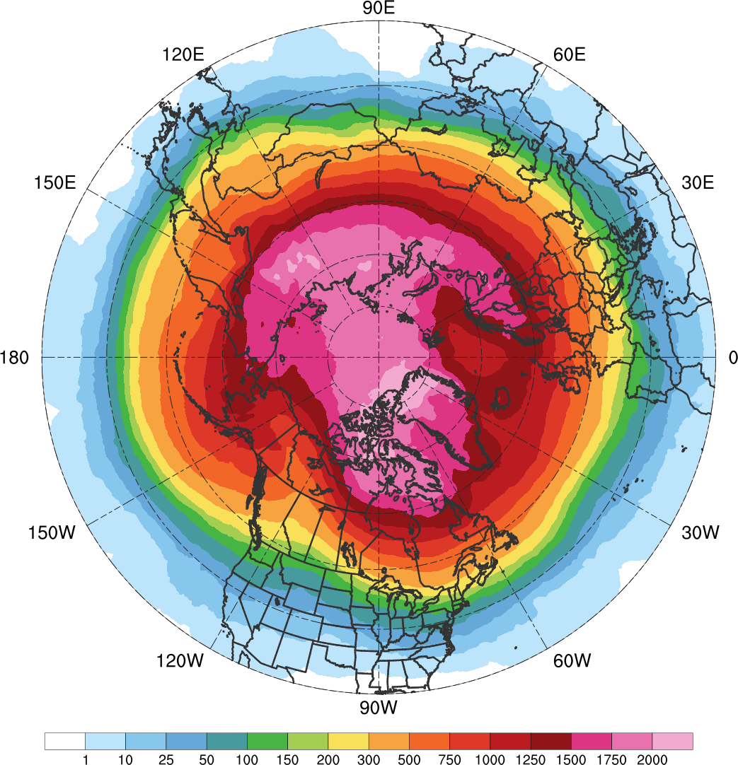
All Cold Pools
(N = 23,045; avg. of ~623 per yr)
(a)
Notes:
All cold pools….Maximum of cold pools may conform mre to land masses and regions of sea ice

Slide 11
TPVs Transported to Middle Latitudes
(N = 25,085; avg. of ~678 per yr)
(b)
Notes:
TPVs transported to middle latitudes

Slide 12
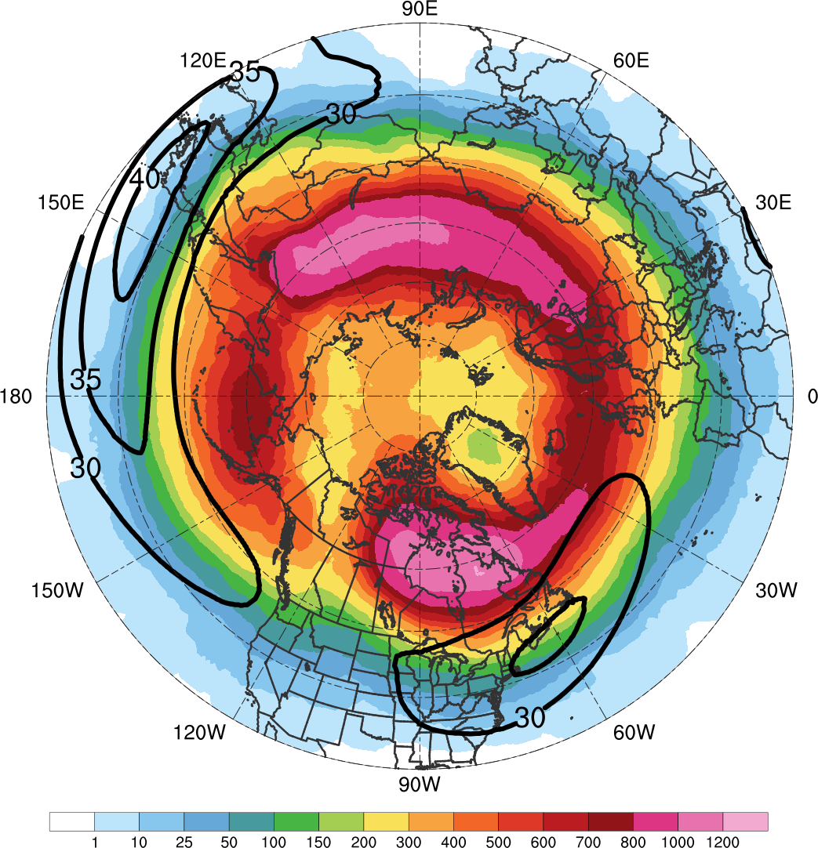
Cold Pools Transported to Middle Latitudes
(N = 8,395; avg. of ~227 per yr)
(b)
Notes:
Cold pools transported to middle latitudes

Slide 13
All Cold Pools
(N = 23,045; avg. of ~623 per yr)
(c)
Cold Pools Transported to Middle Latitudes
(N = 8,395; avg. of ~227 per yr)
(d)
Notes:
Cold pools transported to middle latitudes

Slide 14
All Cold Pools
(N = 23,045; avg. of ~623 per yr)
(a)
Cold Pools Transported to Middle Latitudes
(N = 8,395; avg. of ~227 per yr)
(b)
Notes:
Cold pools transported to middle latitudes

Slide 15
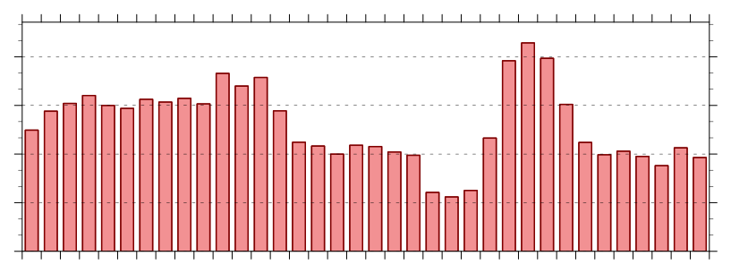
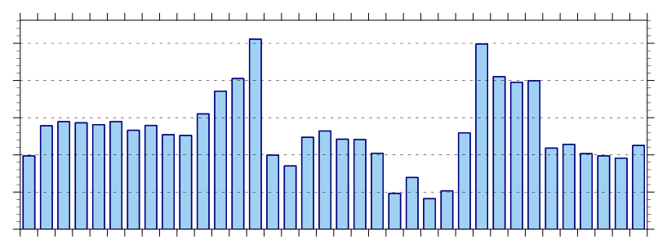
90°N
80°N
70°N
60°N
50°N
40°N
30°N
0°E
30°E
60°E
90°E
120°E
150°E
180°E
210°E
240°E
270°E
300°E
330°E
330°E
1200
900
600
300
0
0°E
30°E
60°E
90°E
120°E
150°E
180°E
210°E
240°E
270°E
300°E
330°E
330°E
500
400
300
200
100
0
0°E
30°E
60°E
90°E
120°E
150°E
180°E
210°E
240°E
270°E
300°E
330°E
330°E
Notes:
Cold pools transported to middle latitudes

Slide 16
90°N
80°N
70°N
60°N
50°N
40°N
30°N
0°E
30°E
60°E
90°E
120°E
150°E
180°E
210°E
240°E
270°E
300°E
330°E
330°E
TPVs
N = 27,990
1200
900
600
300
0
0°E
30°E
60°E
90°E
120°E
150°E
180°E
210°E
240°E
270°E
300°E
330°E
330°E
Cold Pools
N = 9,478
500
400
300
200
100
0
0°E
30°E
60°E
90°E
120°E
150°E
180°E
210°E
240°E
270°E
300°E
330°E
330°E
Notes:
Cold pools transported to middle latitudes

Slide 17
90°N
80°N
70°N
60°N
50°N
40°N
30°N
0°E
30°E
60°E
90°E
120°E
150°E
180°E
210°E
240°E
270°E
300°E
330°E
360°E
TPVs
N = 27,990
1200
900
600
300
0
0°E
30°E
60°E
90°E
120°E
150°E
180°E
210°E
240°E
270°E
300°E
330°E
360°E
Cold Pools
N = 9,478
500
400
300
200
100
0
0°E
30°E
60°E
90°E
120°E
150°E
180°E
210°E
240°E
270°E
300°E
330°E
360°E
Notes:
Cold pools transported to middle latitudes

Slide 18
90°N
80°N
70°N
60°N
50°N
40°N
30°N
0°
30°E
60°E
90°E
120°E
150°E
180°
150°W
120°W
90°W
60°W
30°W
0°
TPVs
N = 27,990
1200
900
600
300
0
0°
30°E
60°E
90°E
120°E
150°E
180°
150°W
120°W
90°W
60°W
30°W
0°
Cold Pools
N = 9,478
500
400
300
200
100
0
0°
30°E
60°E
90°E
120°E
150°E
180°
150°W
120°W
90°W
60°W
30°W
0°
Notes:
Cold pools transported to middle latitudes

Slide 19
90°N
80°N
70°N
60°N
50°N
40°N
30°N
0°
30°E
60°E
90°E
120°E
150°E
180°
150°W
120°W
90°W
60°W
30°W
0°
TPVs
N = 27,990
1200
900
600
300
0
0°
30°E
60°E
90°E
120°E
150°E
180°
150°W
120°W
90°W
60°W
30°W
0°
Notes:
Cold pools transported to middle latitudes

Slide 20
90°N
80°N
70°N
60°N
50°N
40°N
30°N
0°
30°E
60°E
90°E
120°E
150°E
180°
150°W
120°W
90°W
60°W
30°W
0°
Cold Pools
N = 9,478
500
400
300
200
100
0
0°
30°E
60°E
90°E
120°E
150°E
180°
150°W
120°W
90°W
60°W
30°W
0°
Notes:
Cold pools transported to middle latitudes

Slide 21
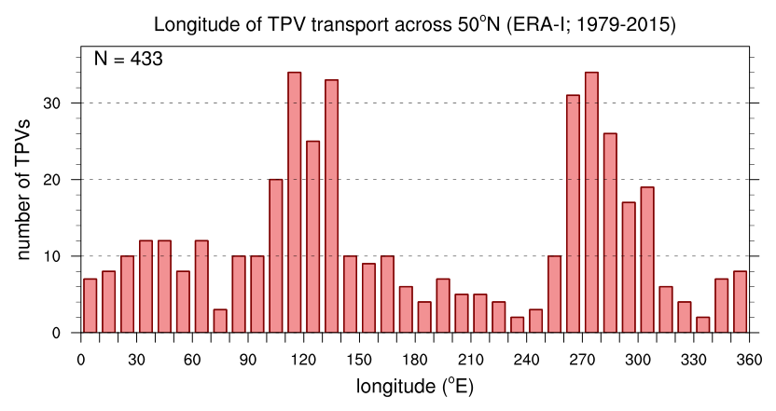
Longitudinal corridors of TPVs transported equatorward of 50°N (CH09)
90°N
80°N
70°N
60°N
50°N
40°N
30°N
0°E
20°E
40°E
60°E
80°E
100°E
120°E
140°E
160°E
180°E
200°E
220°E
240°E
260°E
280°E
300°E
320°E
340°E
The plots for TPVs transported equatorward of 50°N shown here are the same as show before but now for the CH09 filtering method
The same general preferred longitudinal corridors of equatorward TPV transport for the NFM filtering appear for TPVs using the CH09 filtering, except that the central/eastern North America corridor exhibits somewhat greater frequency of equatorward TPV transport than the eastern Asia corridor using the CH09 filtering
The secondary maximum of equatorward TPV transport over eastern Europe and western Asia also appears using the CH09 method
N = 433
The above histogram represents a count of the total number of instances in which a TPV is transported equatorward of 50°N for each 10° longitude bin around the globe using the CH09 filtering method. A TPV can be counted more that once if it returns equatorward of 50°N only after returning poleward of 65°N (there are 3 TPVs that are counted twice)

Slide 22
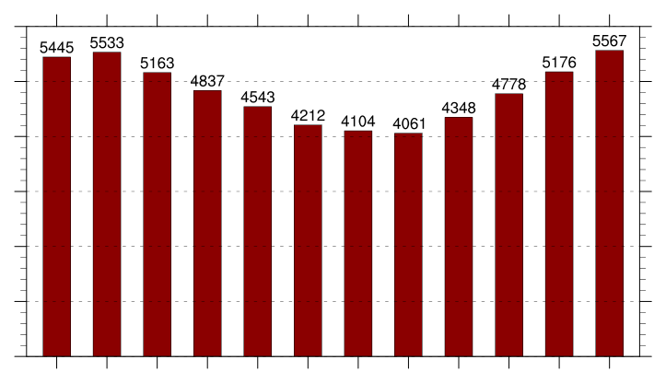
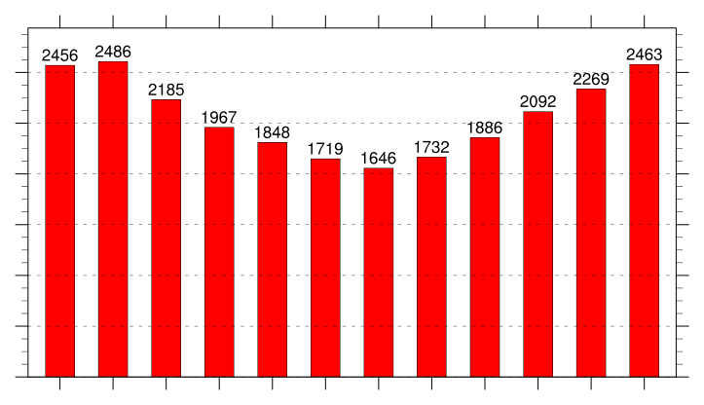
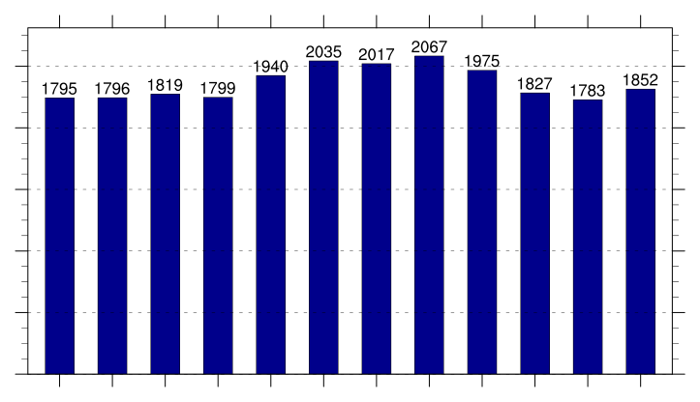
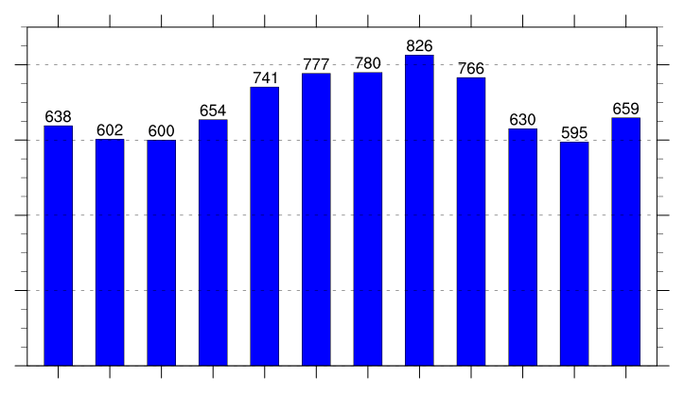
(a)
All TPVs
(b)
TPVs Transported to Middle Latitudes
6000
5000
2400
4000
2000
1600
3000
1200
2000
800
1000
400
0
0
Jan
Feb
Mar
Apr
May
Jun
Jul
Aug
Sep
Oct
Nov
Dec
Jan
Feb
Mar
Apr
May
Jun
Jul
Aug
Sep
Oct
Nov
Dec
(c)
All Cold Pools
(d)
Cold Pools Transported to Middle Latitudes
2000
800
1600
600
1200
400
800
400
200
0
0
Jan
Feb
Mar
Apr
May
Jun
Jul
Aug
Sep
Oct
Nov
Dec
Jan
Feb
Mar
Apr
May
Jun
Jul
Aug
Sep
Oct
Nov
Dec
Notes:
Transport equatorward of 60N

Slide 23
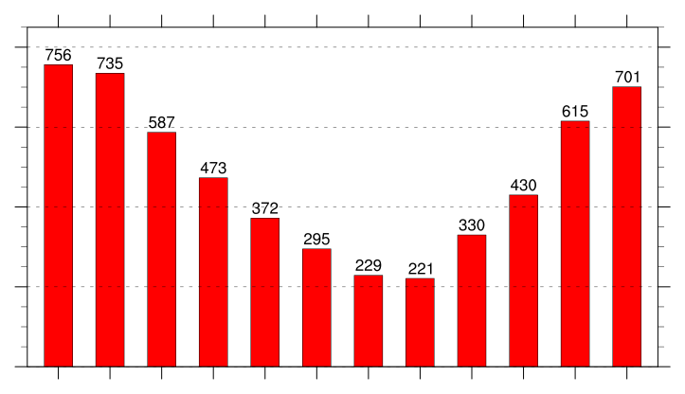
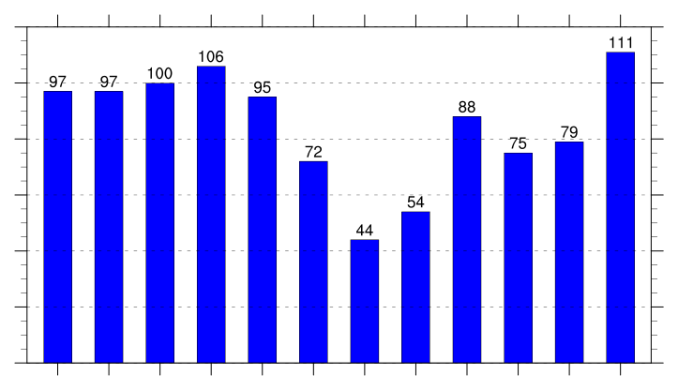
(a)
All TPVs
(b)
TPVs Transported to Middle Latitudes
6000
800
5000
4000
600
3000
400
2000
200
1000
0
0
Jan
Feb
Mar
Apr
May
Jun
Jul
Aug
Sep
Oct
Nov
Dec
Jan
Feb
Mar
Apr
May
Jun
Jul
Aug
Sep
Oct
Nov
Dec
(c)
All Cold Pools
(d)
Cold Pools Transported to Middle Latitudes
120
2000
100
1600
80
1200
60
800
40
400
20
0
0
Jan
Feb
Mar
Apr
May
Jun
Jul
Aug
Sep
Oct
Nov
Dec
Jan
Feb
Mar
Apr
May
Jun
Jul
Aug
Sep
Oct
Nov
Dec
Notes:
Transport Equatorward of 45N

Slide 24
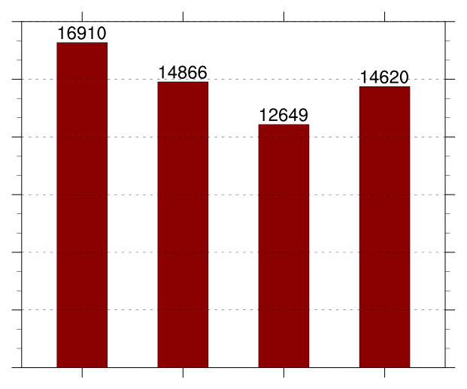
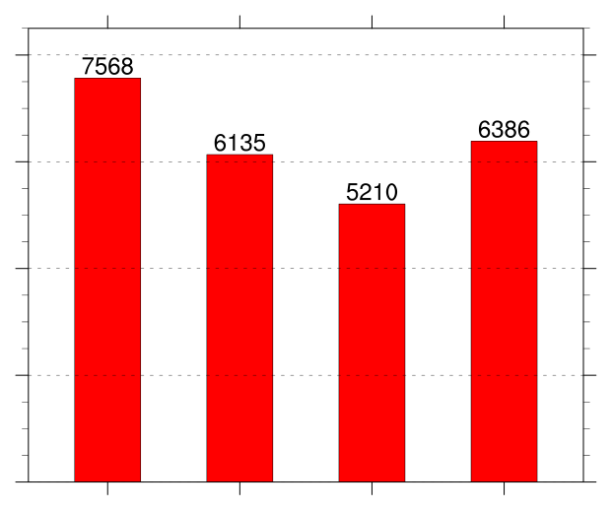
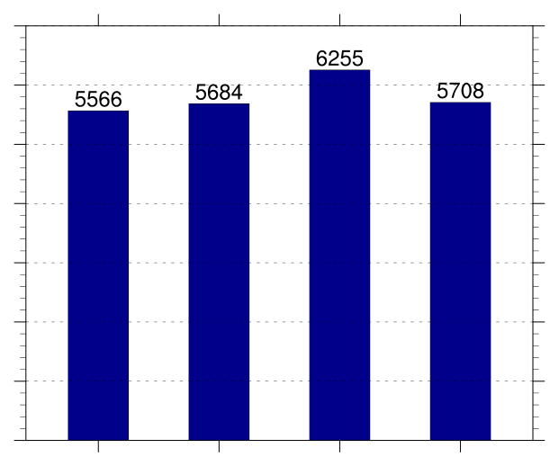
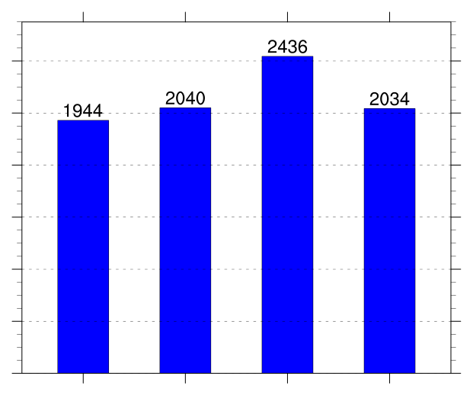
All TPVs
TPVs Transported to Middle Latitudes
18000
(a)
(b)
8000
15000
12000
6000
9000
4000
6000
2000
3000
0
0
DJF
MAM
JJA
SON
DJF
MAM
JJA
SON
All Cold Pools
Cold Pools Transported to Middle Latitudes
7000
(a)
(b)
6000
2400
5000
2000
4000
1600
3000
1200
2000
800
1000
400
0
0
DJF
MAM
JJA
SON
DJF
MAM
JJA
SON
Notes:
Transport equatorward of 45N

Slide 25
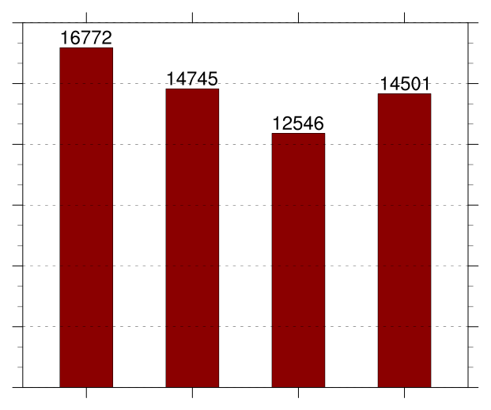
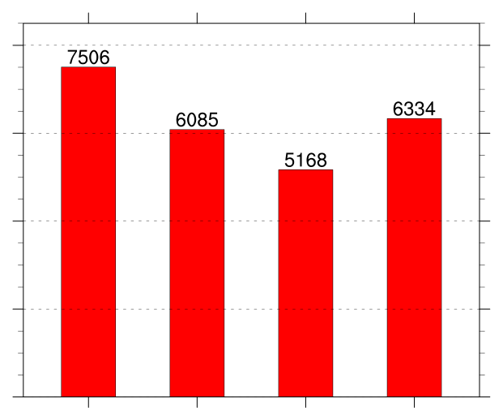
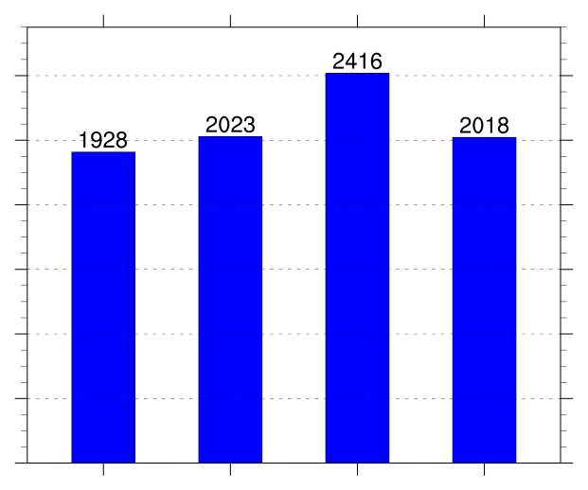
All TPVs
TPVs Transported to Middle Latitudes
18000
(a)
(b)
8000
15000
12000
6000
9000
4000
6000
2000
3000
0
0
DJF
MAM
JJA
SON
DJF
MAM
JJA
SON
All Cold Pools
Cold Pools Transported to Middle Latitudes
7000
(a)
(b)
6000
2400
5000
2000
4000
1600
3000
1200
2000
800
1000
400
0
0
DJF
MAM
JJA
SON
DJF
MAM
JJA
SON
Notes:
Transport equatorward of 45N

Slide 26
All TPVs
TPVs Transported to Middle Latitudes
18000
(a)
(b)
8000
15000
12000
6000
9000
4000
6000
2000
3000
0
0
DJF
MAM
JJA
SON
DJF
MAM
JJA
SON
All Cold Pools
Cold Pools Transported to Middle Latitudes
7000
(c)
(d)
6000
2400
5000
2000
4000
1600
3000
1200
2000
800
1000
400
0
0
DJF
MAM
JJA
SON
DJF
MAM
JJA
SON
Notes:
Transport equatorward of 45N

Slide 27
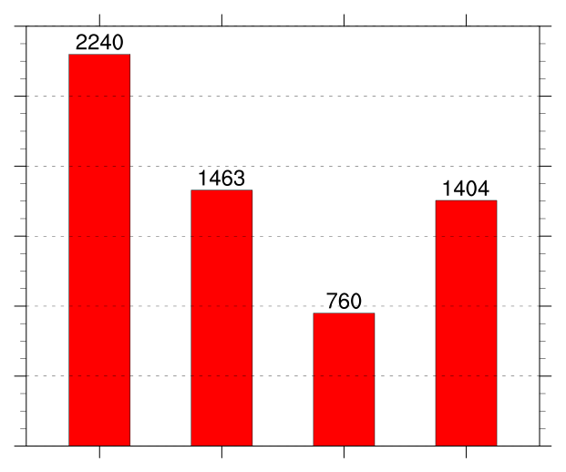
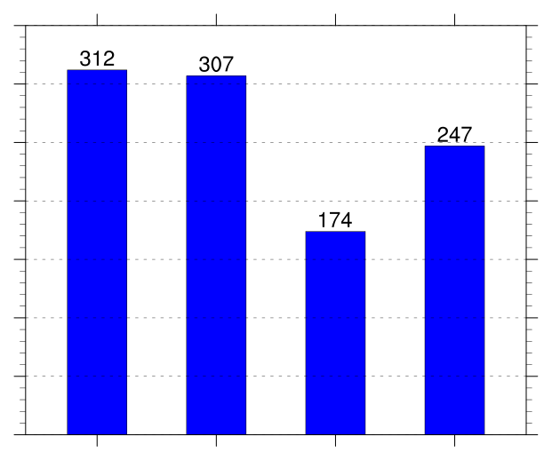
All TPVs
TPVs Transported to Middle Latitudes
18000
(a)
2400
(b)
15000
2000
12000
1600
9000
1200
6000
800
3000
400
0
0
DJF
MAM
JJA
SON
DJF
MAM
JJA
SON
All Cold Pools
Cold Pools Transported to Middle Latitudes
7000
(c)
350
(d)
6000
300
5000
250
4000
200
3000
150
2000
100
1000
50
0
0
DJF
MAM
JJA
SON
DJF
MAM
JJA
SON
Notes:
Transport equatorward of 60N

Slide 28
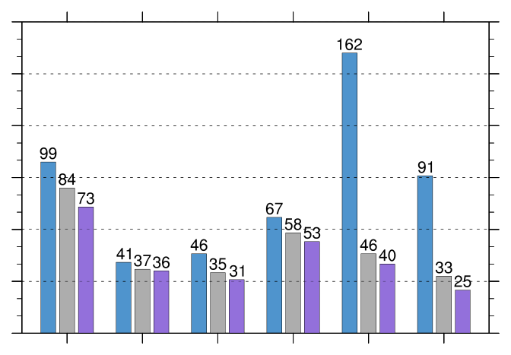
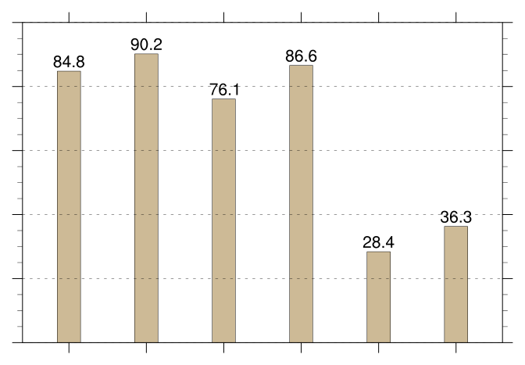
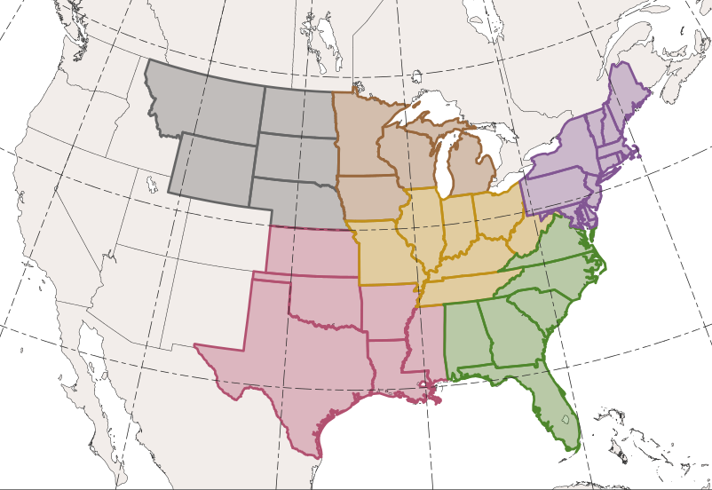
CAOs Linked to Cold Pools Associated with TPVs
Percentage of CAOs Linked to Cold Pools Associated with TPVs
180
100
150
80
120
60
90
count
percent
40
60
30
20
0
0
WNC
ENC
Central
Northeast
South
Southeast
WNC
ENC
Central
Northeast
South
Southeast
Total number of CAOs
East North Central (ENC)
West North Central (WNC)
Northeast
Number of unique CAOs linked to at least one cold pool
Number of unique CAOs linked to at least one cold pool associated with TPVs
Central
South
Southeast
Percentage of unique CAOs linked to at least one cold pool associated with TPVs [(purple/blue) × 100]

Slide 29
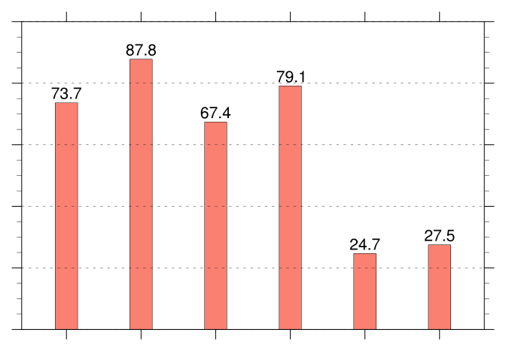
180
100
(a)
(b)
150
80
120
60
90
count
percent
40
60
30
20
0
0
WNC
ENC
Central
Northeast
South
Southeast
WNC
ENC
Central
Northeast
South
Southeast
100
(c)
80
East North Central (ENC)
West North Central (WNC)
Northeast
60
percent
Central
40
South
Southeast
20
0
WNC
ENC
Central
Northeast
South
Southeast
Total number of CAOs
Number of unique CAOs linked to at least one cold pool
Number of unique CAOs linked to at least one cold pool associated with TPVs
Percentage of unique CAOs linked to at least one cold pool [(gray/blue) × 100]
Percentage of unique CAOs linked to at least one cold pool associated with TPVs [(purple/blue) × 100]

