Slide 1
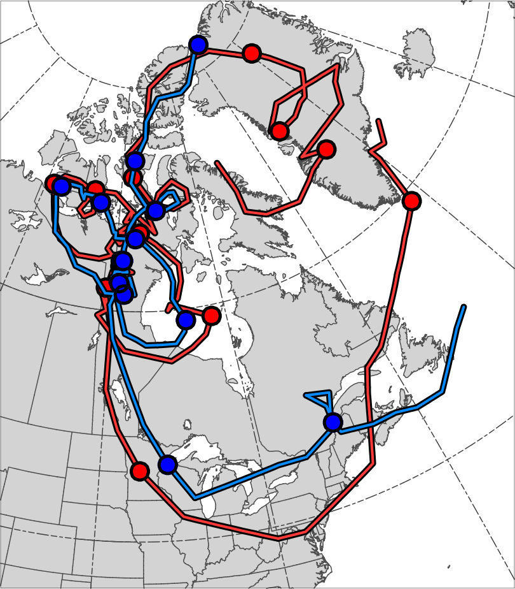
21
6
4
23
19
17
12
25
2
27
29
31
29
8
12
10
Genesis
TPV
Lysis
Cold Pool

Slide 2
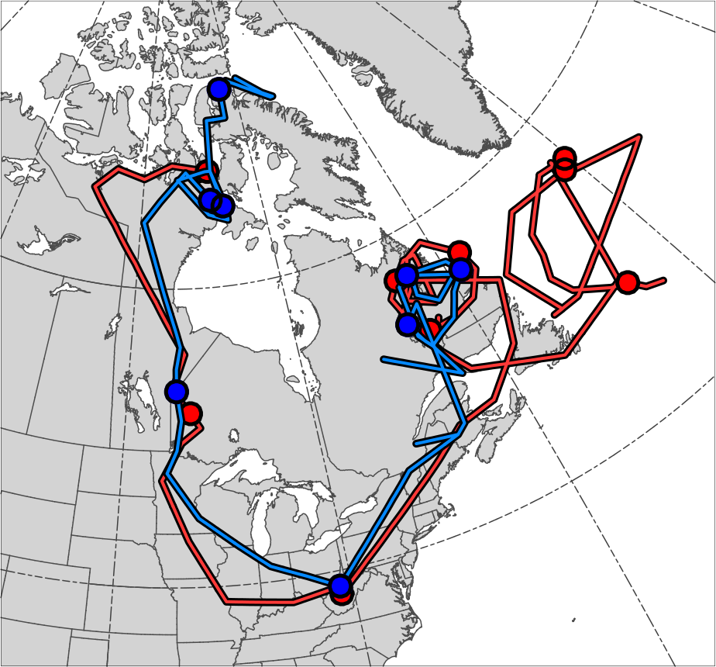
13
31
29
17
15
25
27
2
23
19
21
Genesis
TPV
Lysis
Cold Pool

Slide 3
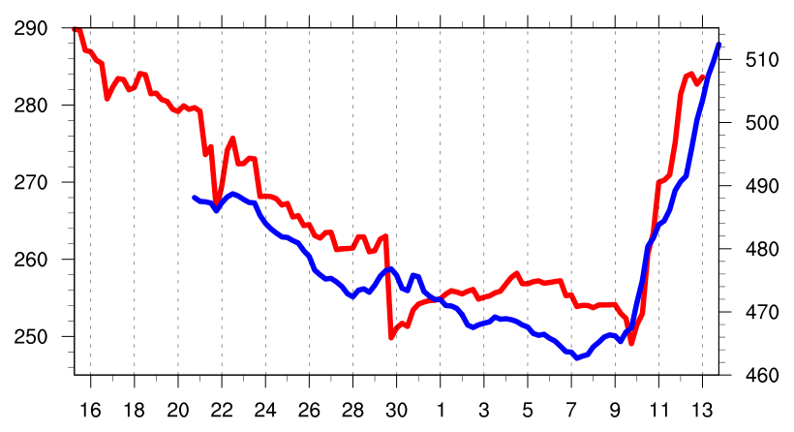
Minimum DT θ of TPV (K)
Minimum 1000–500-hPa Thickness of Cold Pool (dam)
Dec 1981
Jan 1982
Notes:
In caption, make sure to note that theta is potential temperature

Slide 4
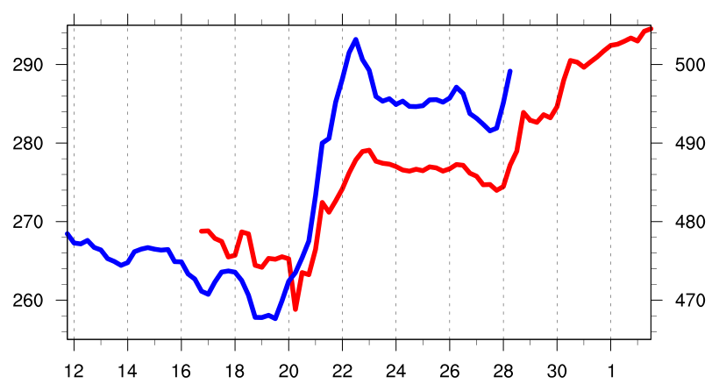
Minimum DT θ of TPV (K)
Minimum 1000–500-hPa Thickness of Cold Pool (dam)
Jan 1985
Feb

Slide 5
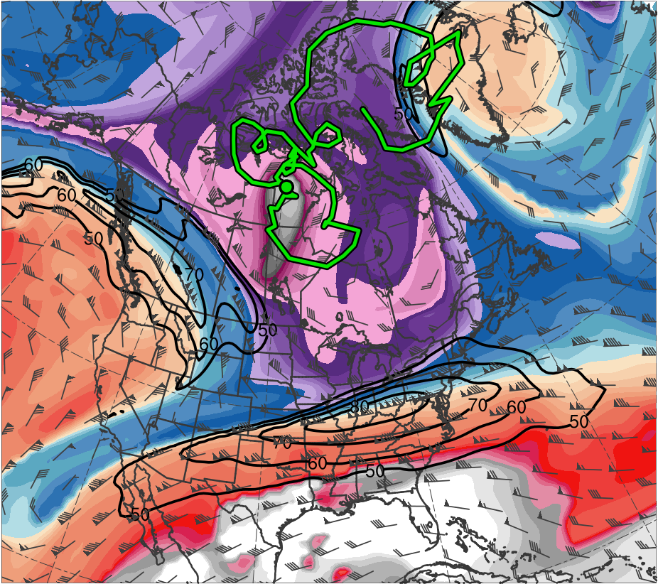
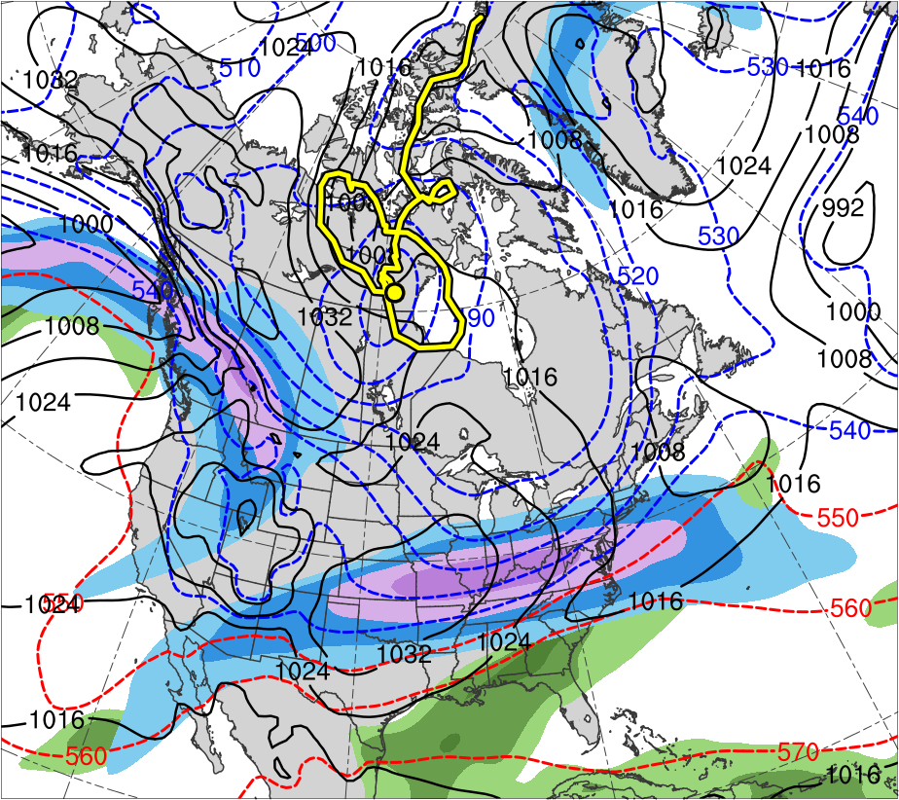
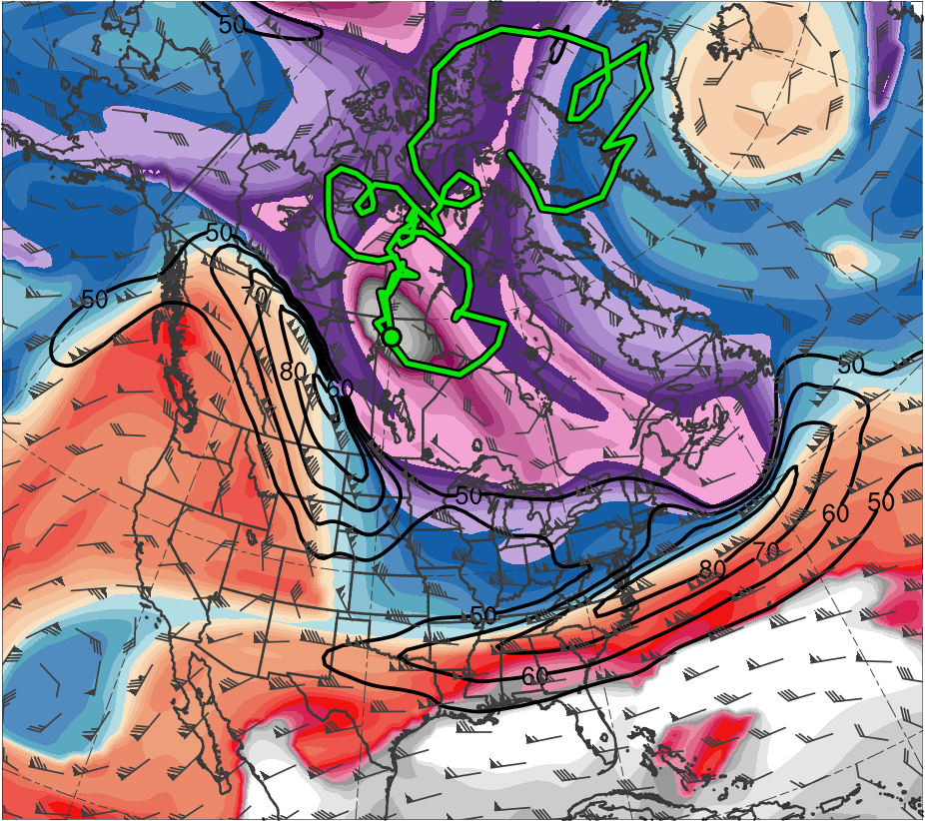
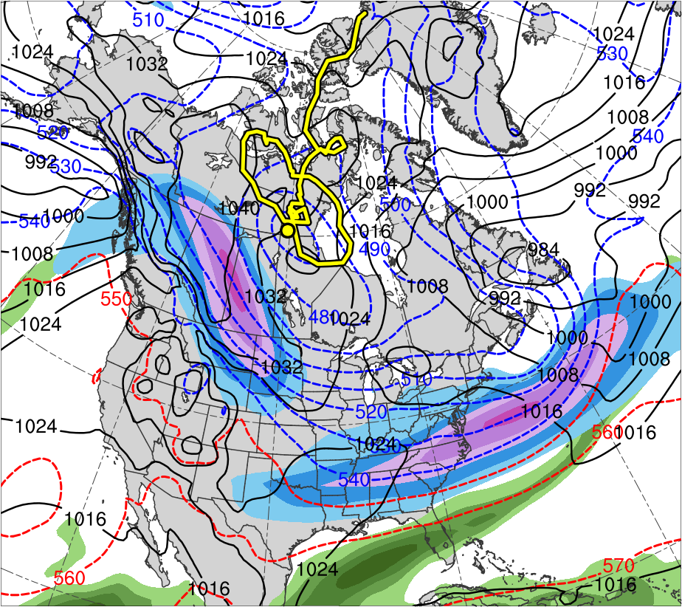
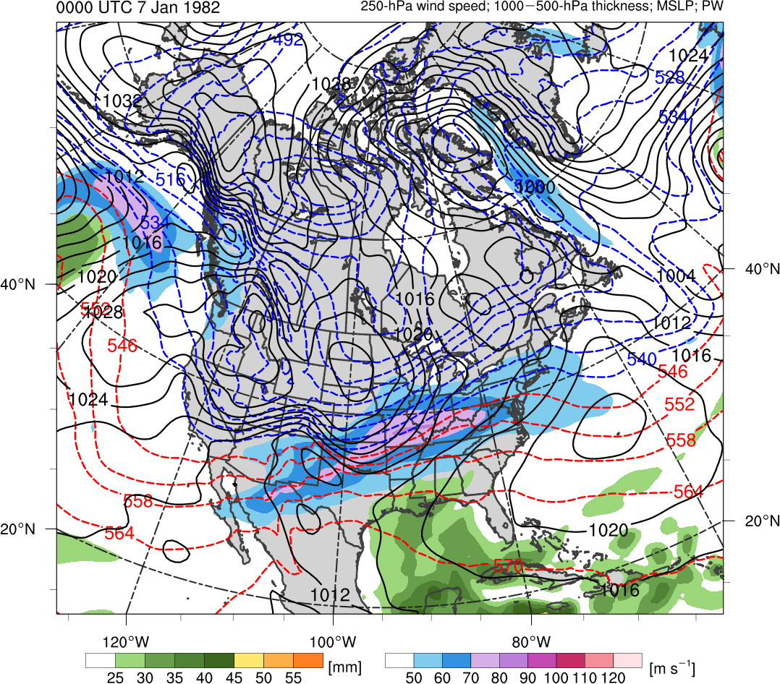
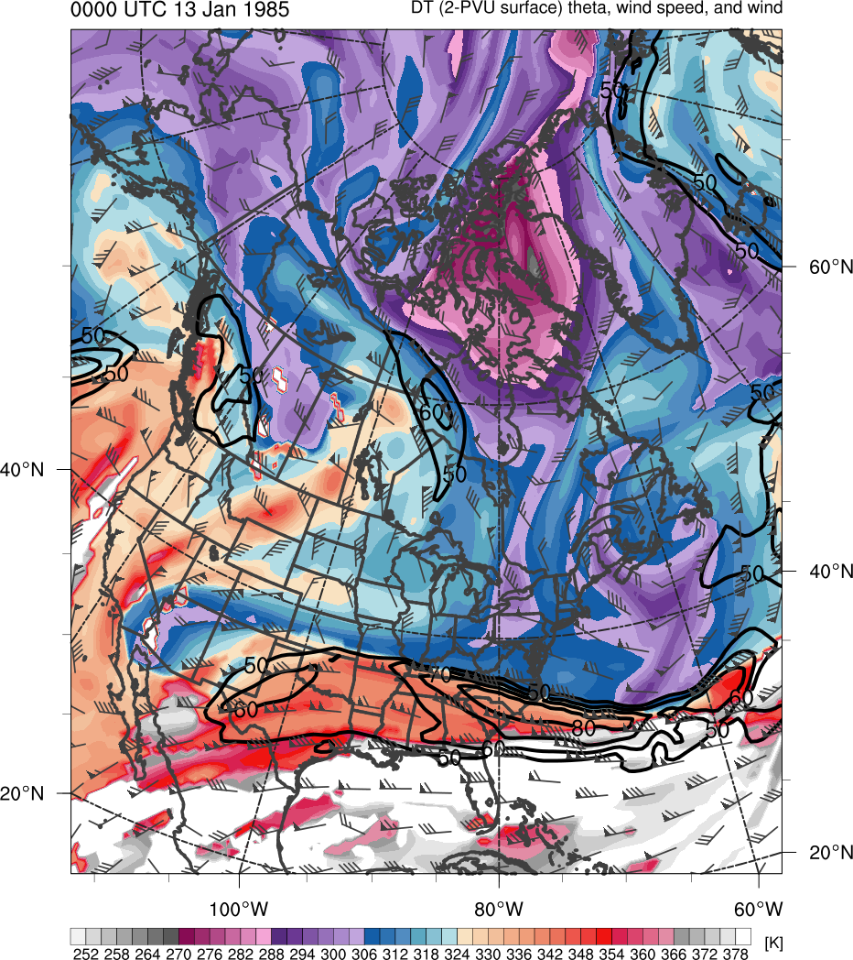
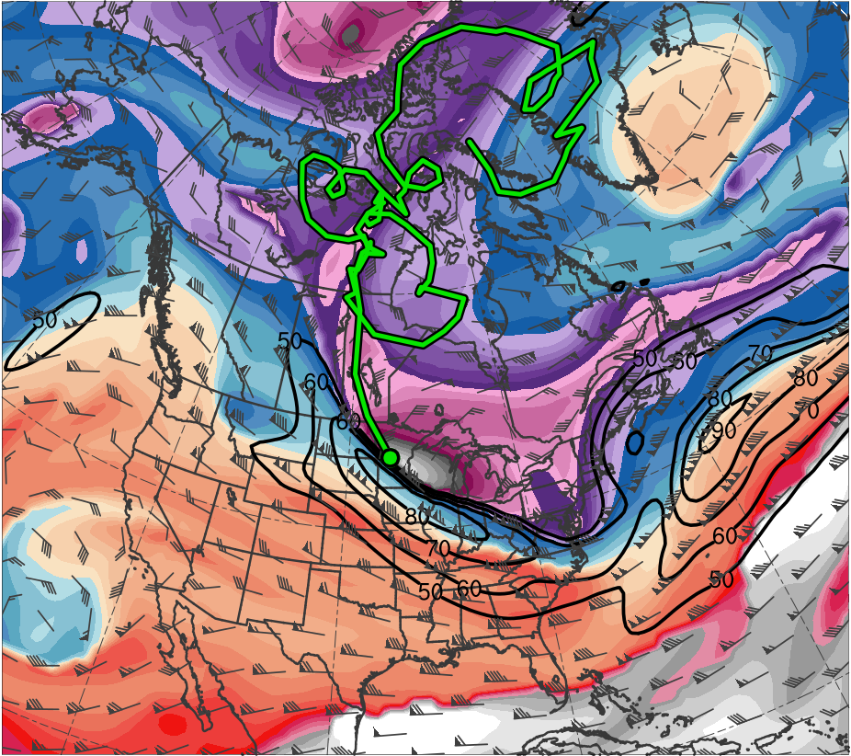
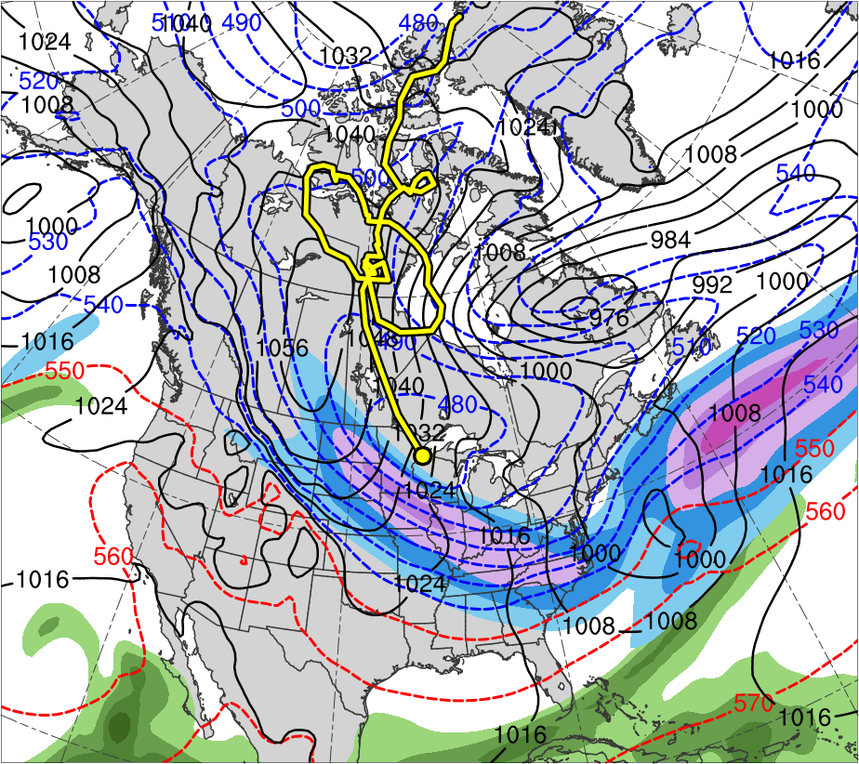
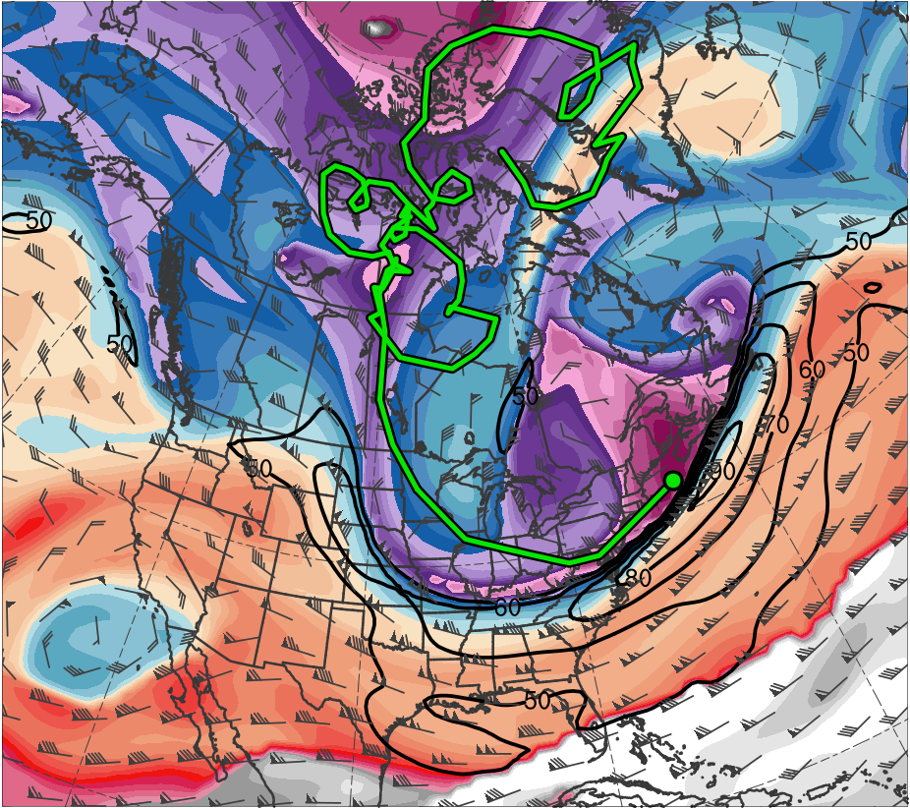
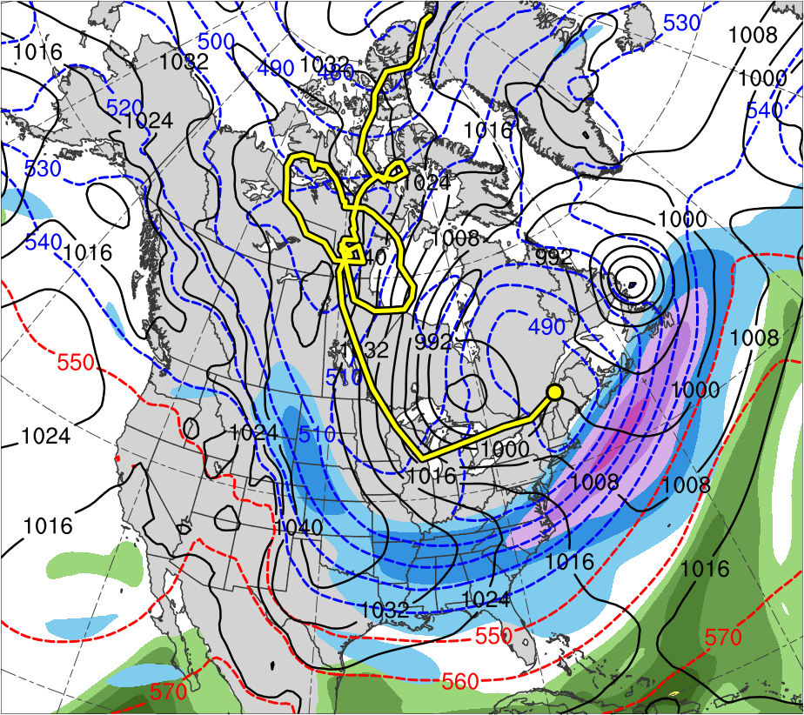
378
372
120
366
110
360
100
354
90
348
80
342
70
336
60
330
50
324
318
(m s⁻¹ )
312
306
300
55
294
50
288
45
282
40
276
35
270
264
30
258
25
252
(mm)
(K)

Slide 6
(a) 0000 UTC 8 Jan 1982
(b) 0000 UTC 8 Jan 1982
378
120
372
366
110
360
100
354
90
348
(c) 0000 UTC 9 Jan 1982
(d) 0000 UTC 9 Jan 1982
80
342
70
336
60
330
324
50
318
(m s⁻¹ )
312
(e) 0000 UTC 10 Jan 1982
(f) 0000 UTC 10 Jan 1982
306
55
300
50
294
288
45
282
40
(g) 0000 UTC 11 Jan 1982
(h) 0000 UTC 11 Jan 1982
276
35
270
264
30
258
25
252
(K)
(mm)

Slide 7

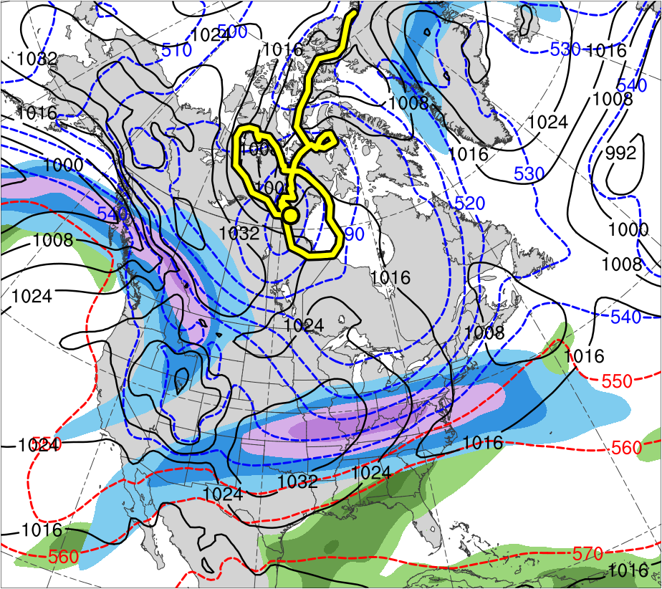

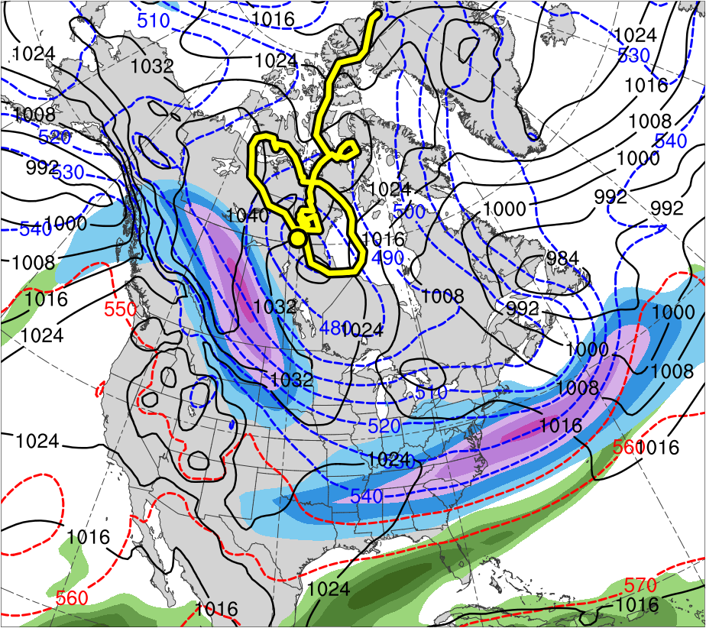
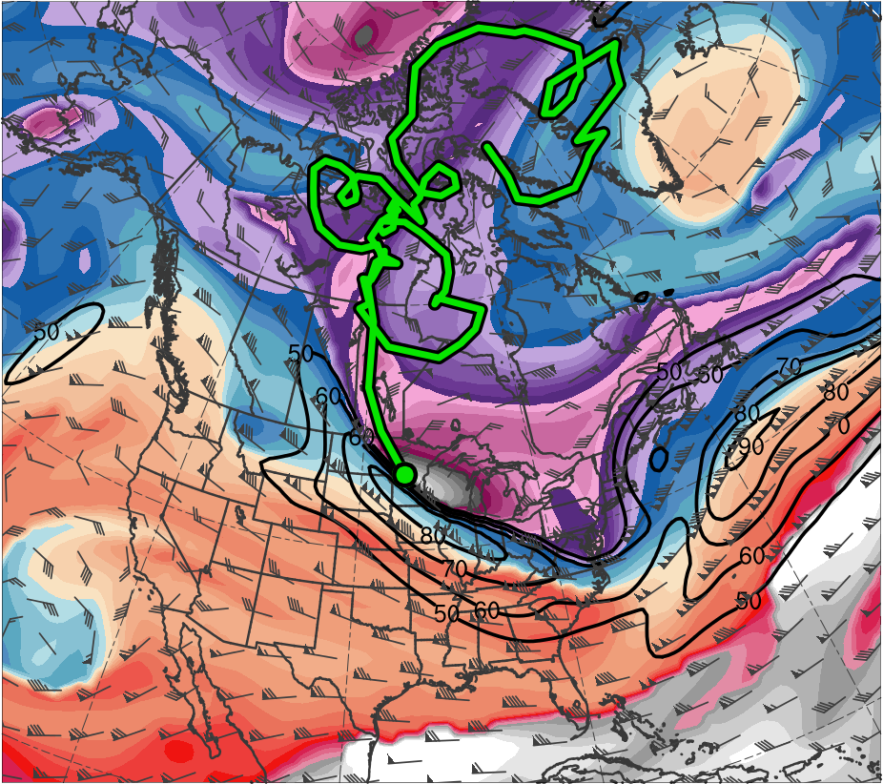
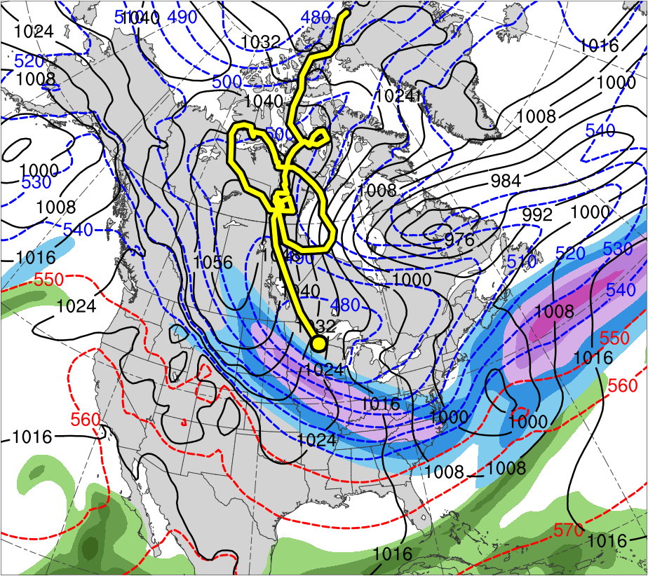
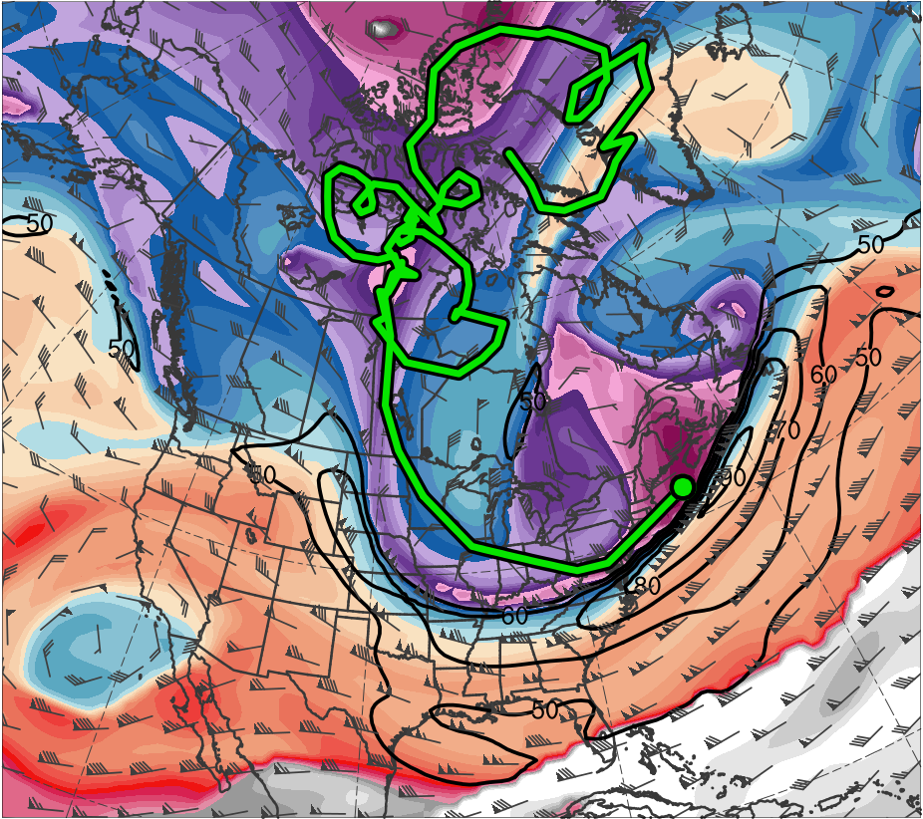
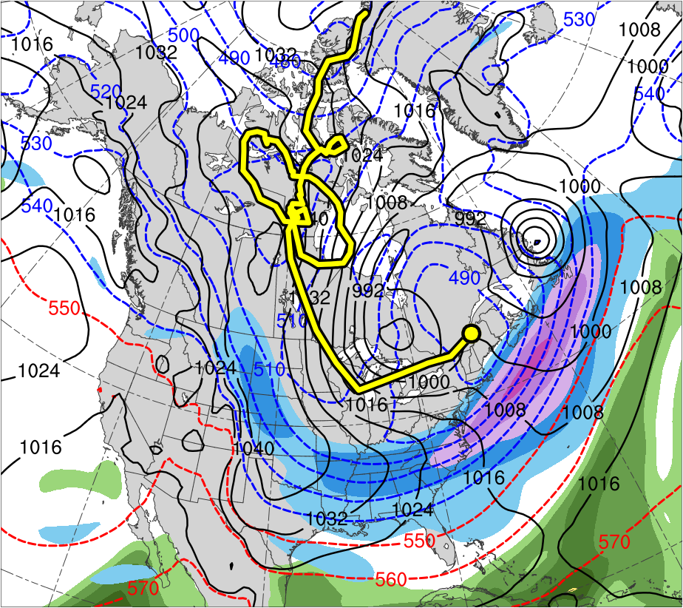
(a) 0000 UTC 8 Jan 1982
(b) 0000 UTC 8 Jan 1982
378
120
372
110
366
360
100
354
90
348
(c) 0000 UTC 9 Jan 1982
(d) 0000 UTC 9 Jan 1982
80
342
70
336
60
330
50
324
318
(m s⁻¹ )
312
(e) 0000 UTC 10 Jan 1982
(f) 0000 UTC 10 Jan 1982
306
55
300
50
294
288
45
282
(g) 0000 UTC 11 Jan 1982
(h) 0000 UTC 11 Jan 1982
40
276
35
270
264
30
258
25
252
(K)
(mm)

Slide 8
(a) 0000 UTC 8 Jan 1982
(b) 0000 UTC 8 Jan 1982
378
120
372
110
366
360
100
354
90
348
(c) 0000 UTC 9 Jan 1982
(d) 0000 UTC 9 Jan 1982
80
342
70
336
60
330
50
324
318
(m s⁻¹ )
312
(e) 0000 UTC 10 Jan 1982
(f) 0000 UTC 10 Jan 1982
306
55
300
50
294
288
45
282
(g) 0000 UTC 11 Jan 1982
(h) 0000 UTC 11 Jan 1982
40
276
35
270
264
30
258
25
252
(K)
(mm)

Slide 9
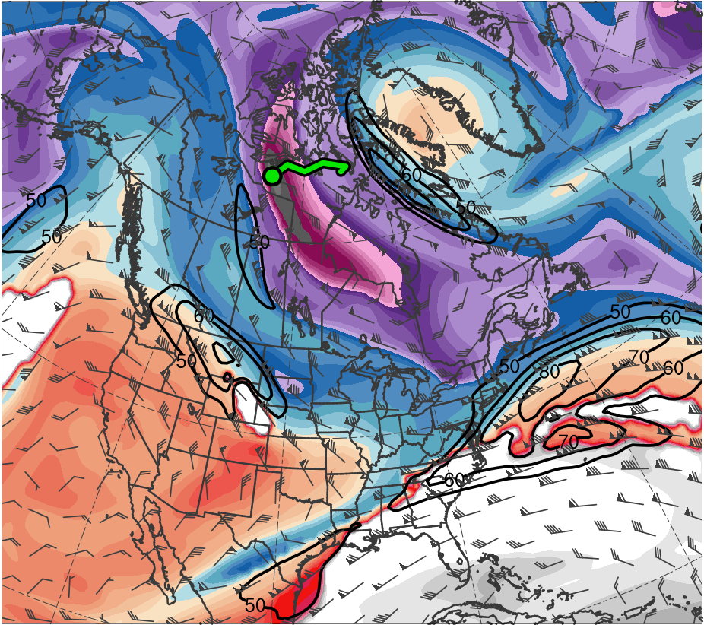
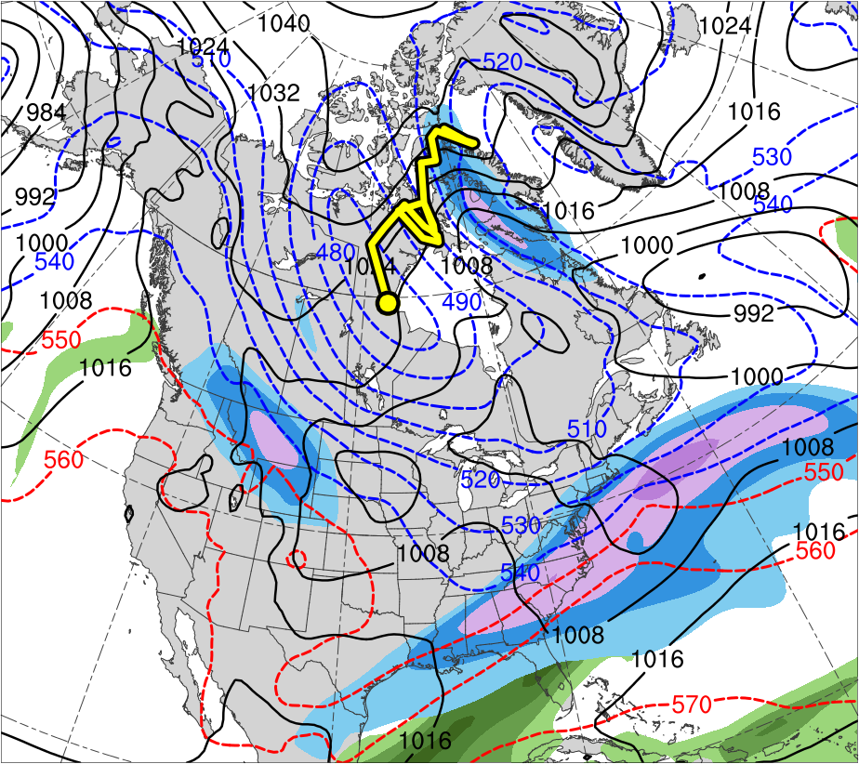
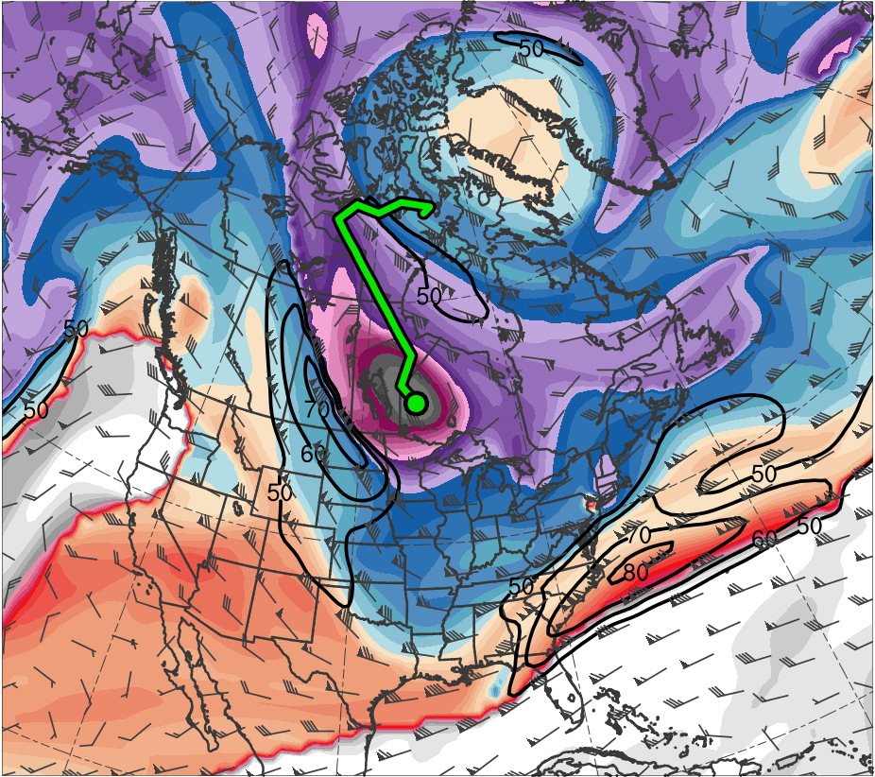
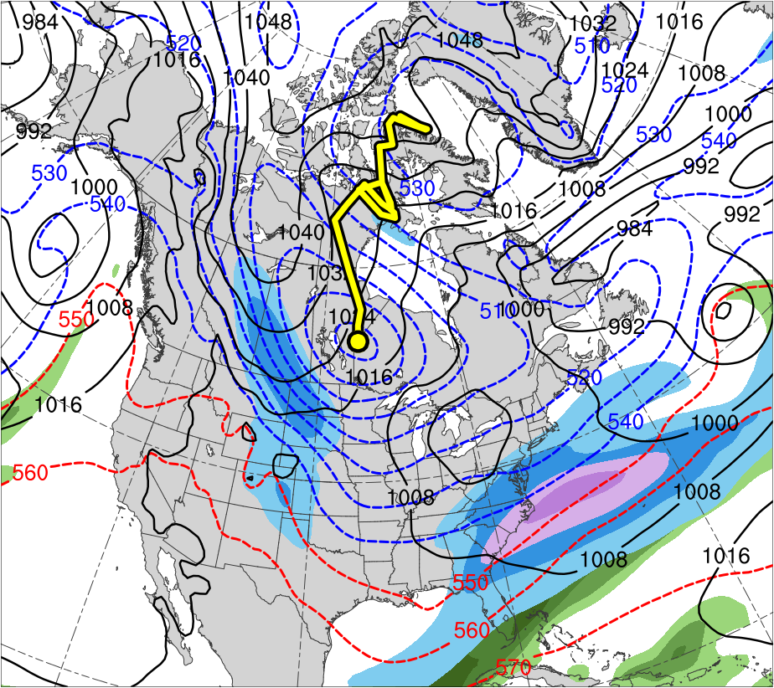
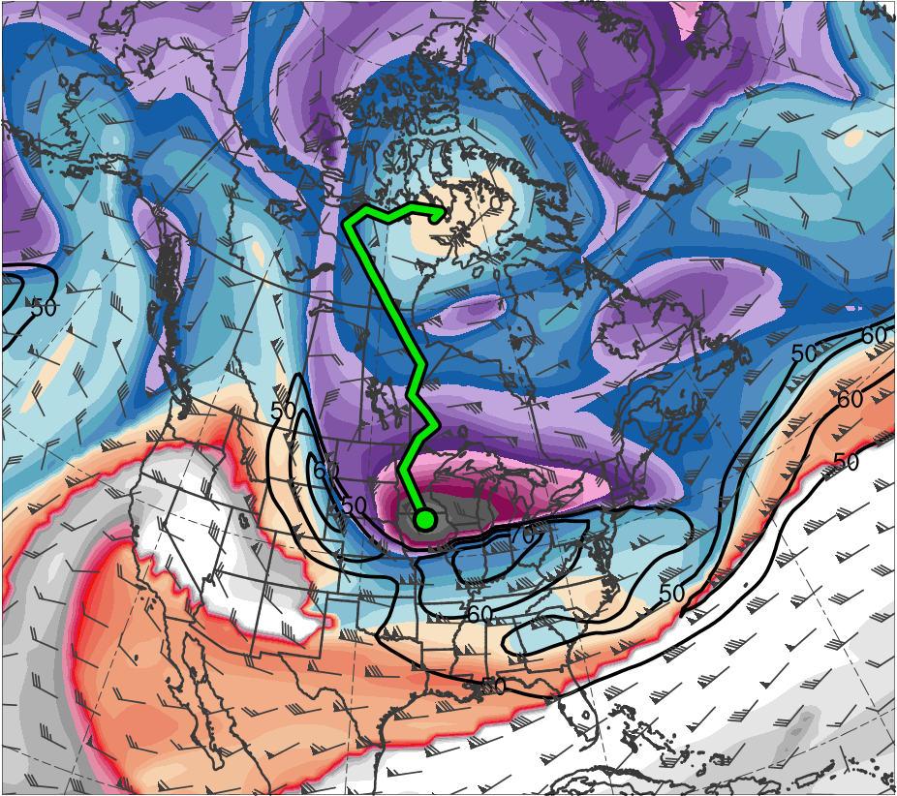
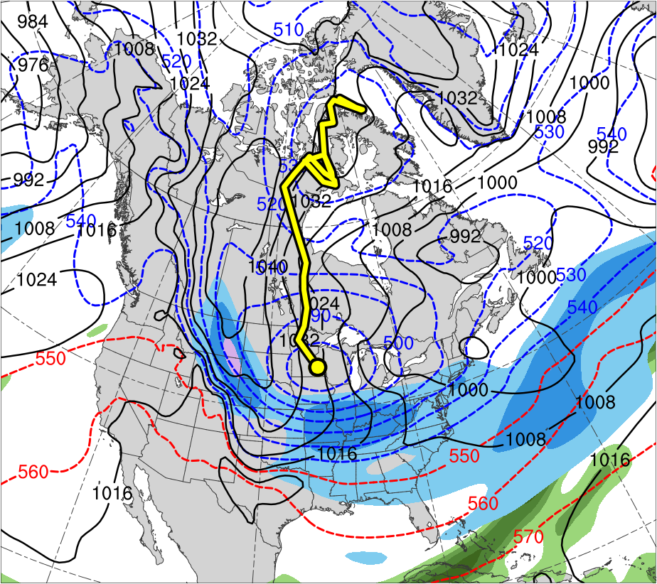
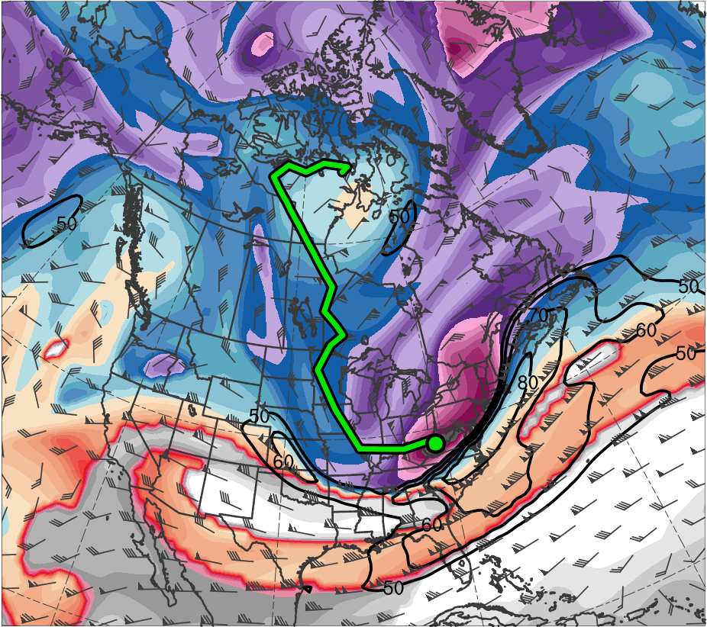
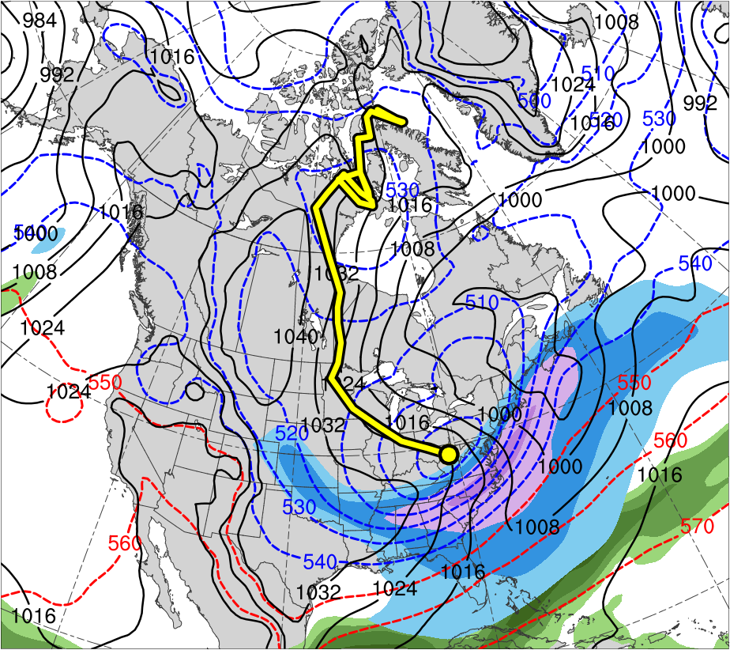
(a) 0000 UTC 18 Jan 1985
(b) 0000 UTC 8 Jan 1982
(b) 0000 UTC 18 Jan 1985
378
120
372
110
366
360
100
354
90
348
(c) 0000 UTC 19 Jan 1985
(d) 0000 UTC 19 Jan 1985
80
342
70
336
60
330
50
324
318
(m s⁻¹ )
312
(e) 0000 UTC 20 Jan 1985
(f) 0000 UTC 20 Jan 1985
306
55
300
50
294
288
45
282
(g) 0000 UTC 21 Jan 1985
(h) 0000 UTC 21 Jan 1985
40
276
35
270
264
30
258
25
252
(K)
(mm)

Slide 10
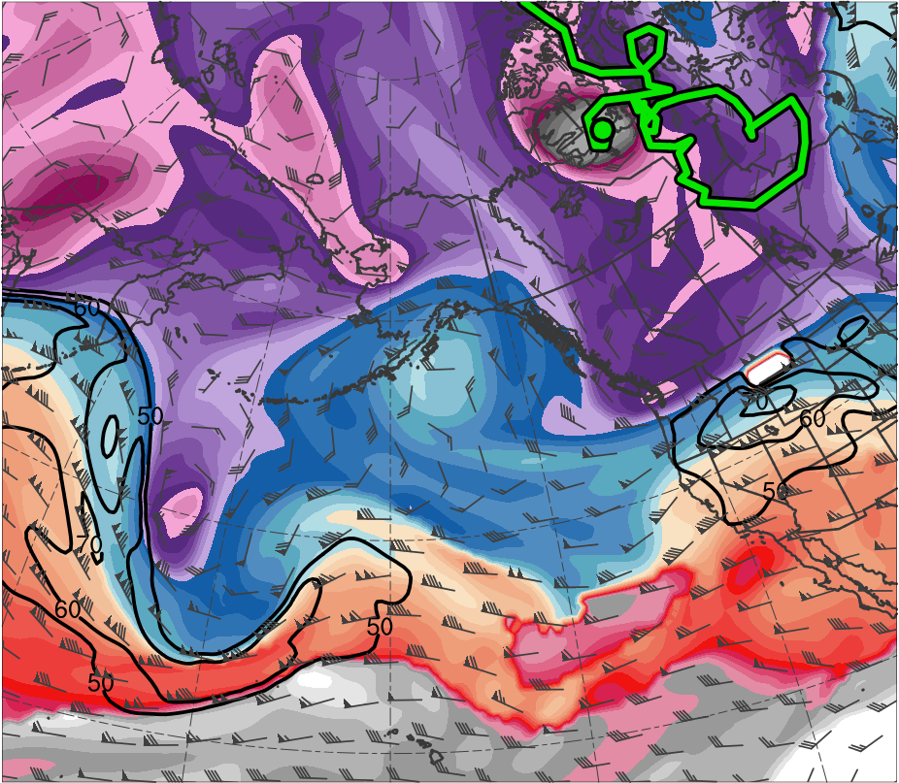
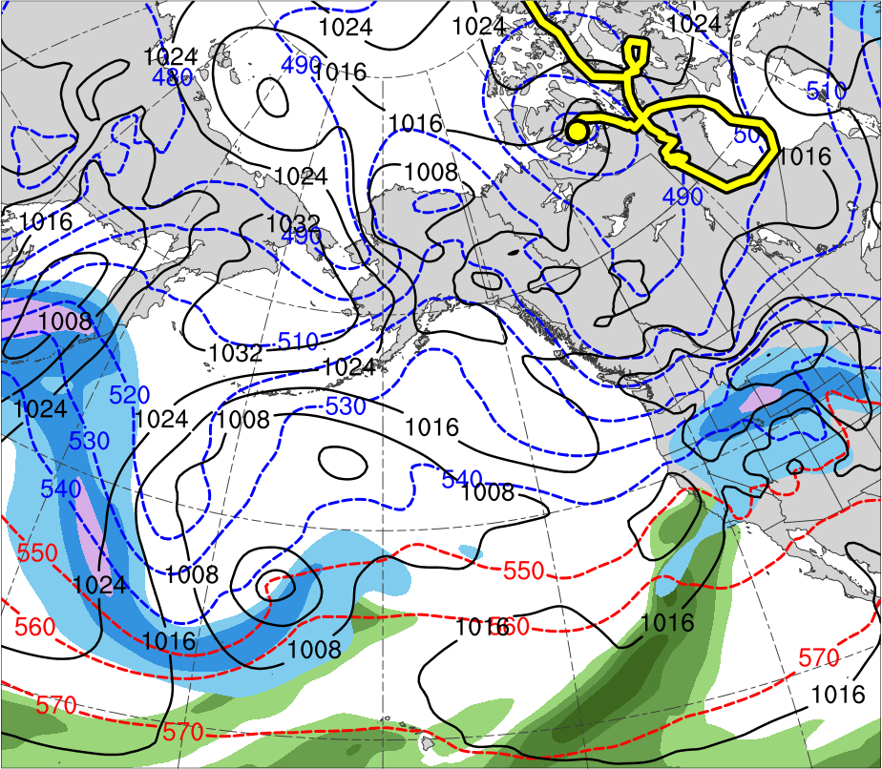
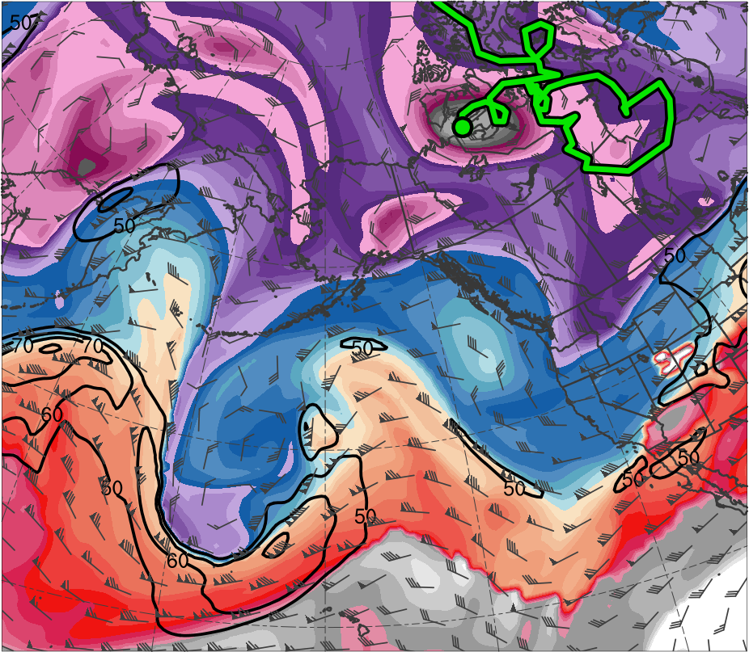
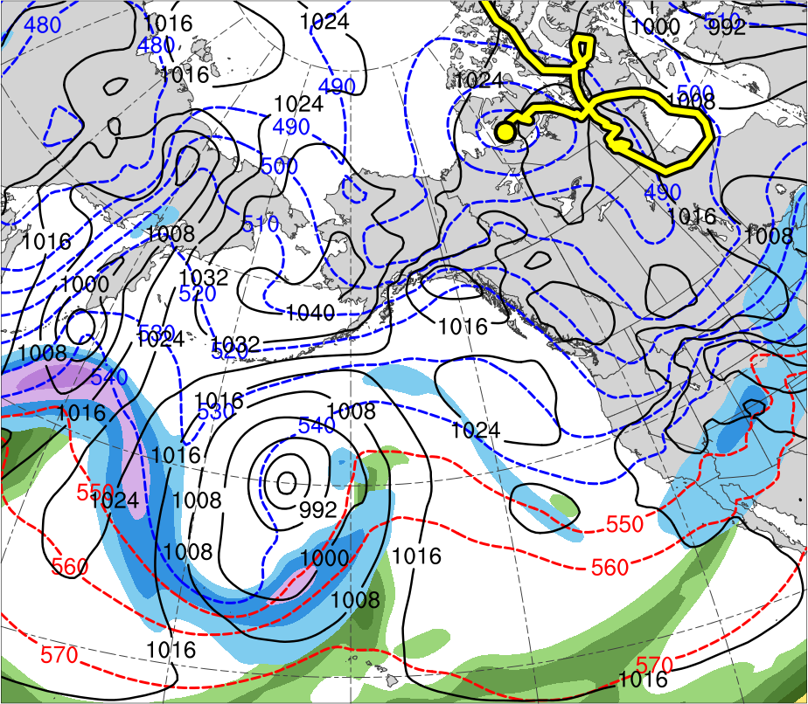
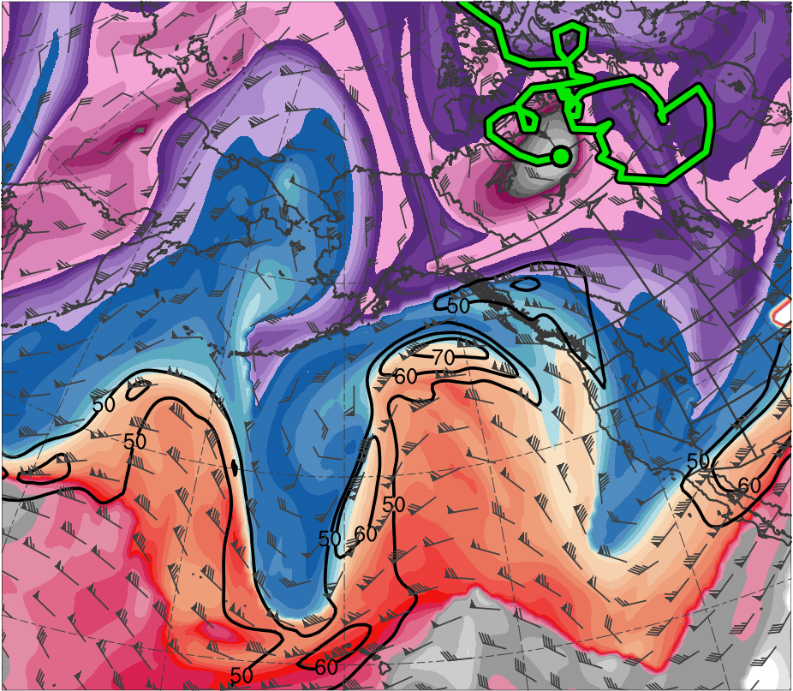
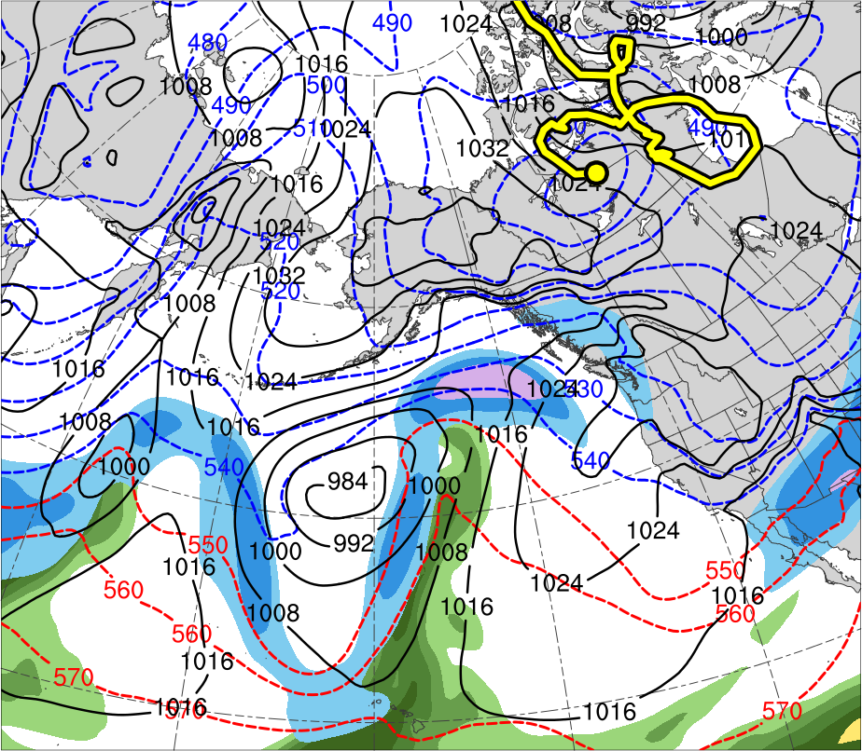
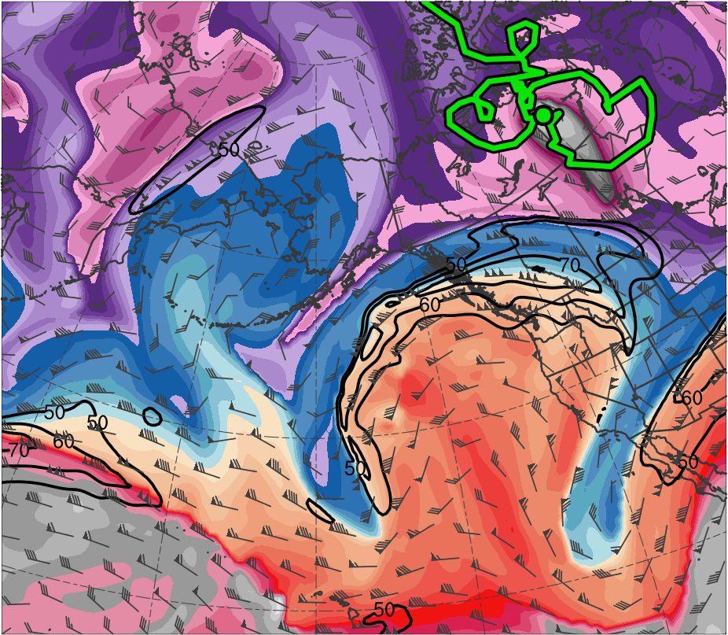
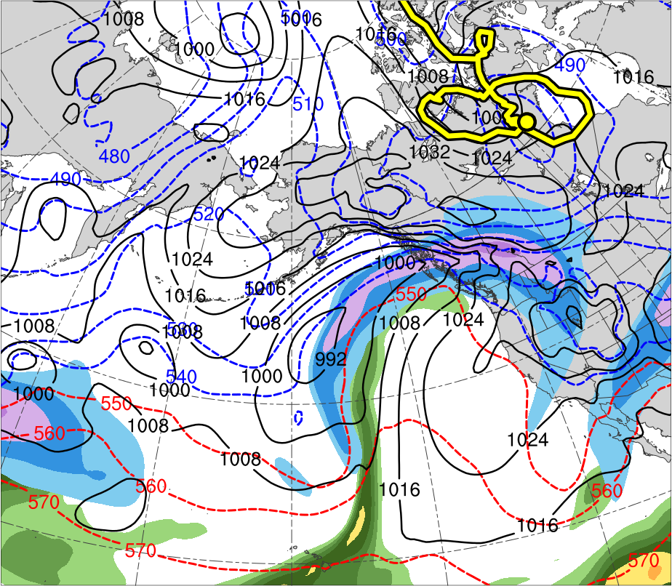
(a) 0000 UTC 5 Jan 1982
(b) 0000 UTC 5 Jan 1982
378
120
372
110
366
360
100
354
90
348
(c) 0000 UTC 6 Jan 1982
(d) 0000 UTC 6 Jan 1982
80
342
70
336
60
330
50
324
318
(m s⁻¹ )
312
(e) 0000 UTC 7 Jan 1982
(f) 0000 UTC 7 Jan 1982
306
55
300
50
294
288
45
282
(g) 0000 UTC 8 Jan 1982
(h) 0000 UTC 8 Jan 1982
40
276
35
270
264
30
258
25
252
(K)
(mm)

Slide 11
(a) 0000 UTC 5 Jan 1982
(b) 0000 UTC 5 Jan 1982
378
120
372
110
366
360
100
354
90
348
(c) 0000 UTC 6 Jan 1982
(d) 0000 UTC 6 Jan 1982
80
342
70
336
60
330
50
324
318
(m s⁻¹ )
312
(e) 0000 UTC 7 Jan 1982
(f) 0000 UTC 7 Jan 1982
306
55
300
50
294
288
45
282
(g) 0000 UTC 8 Jan 1982
(h) 0000 UTC 8 Jan 1982
40
276
35
270
264
30
258
25
252
(K)
(mm)

Slide 12
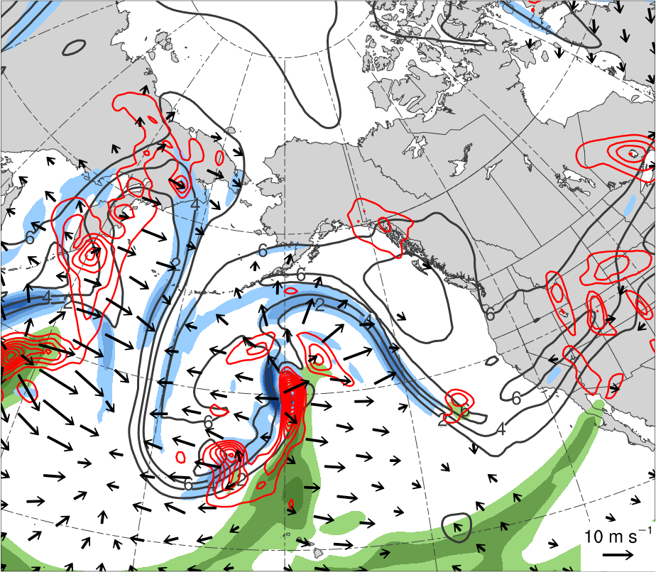
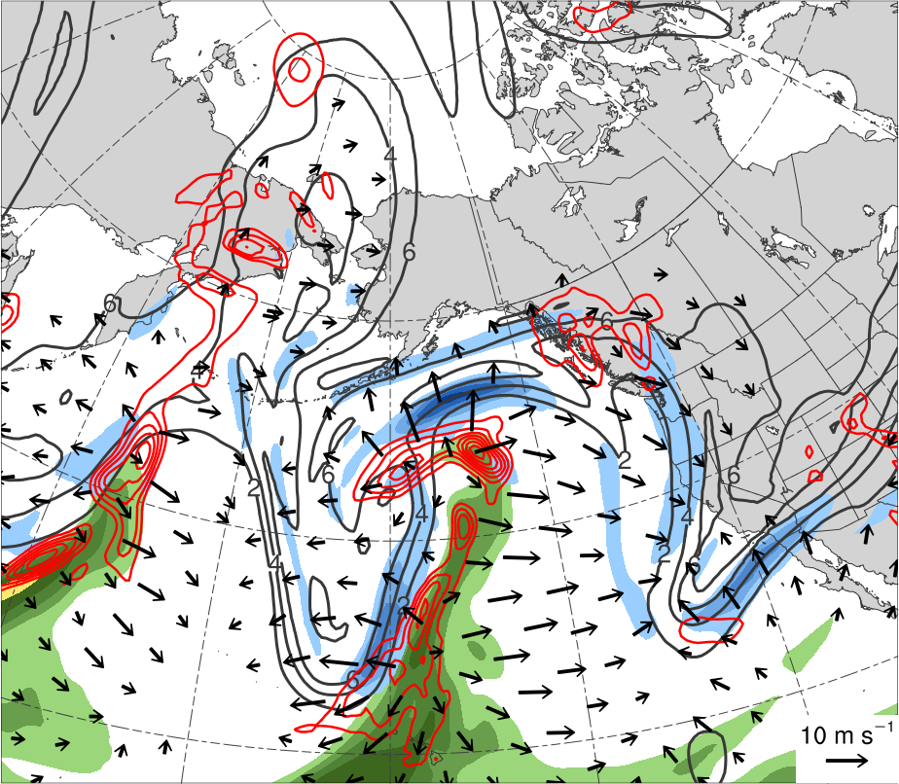
(a) 0000 UTC 6 Jan 1982
(b) 0000 UTC 7 Jan 1982
55
-18
50
-14
45
40
-10
35
-6
30
-2
25
(mm)
(PVU day⁻¹)

Slide 13
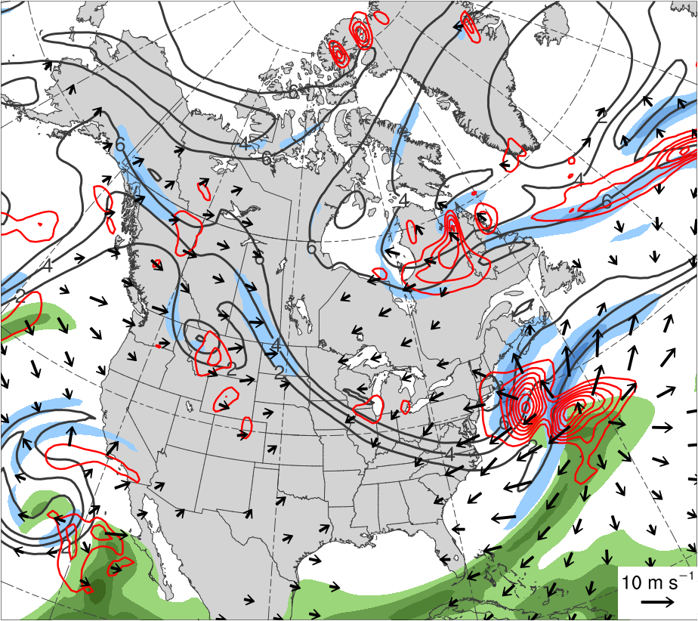
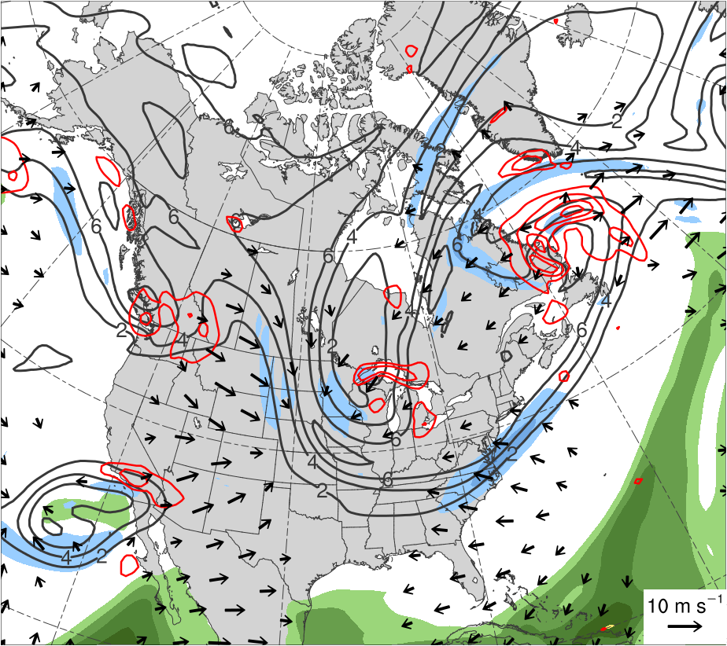
(a) 0000 UTC 10 Jan 1982
(b) 0000 UTC 11 Jan 1982
55
-18
50
-14
45
40
-10
35
-6
30
-2
25
(mm)
(PVU day⁻¹)

Slide 14
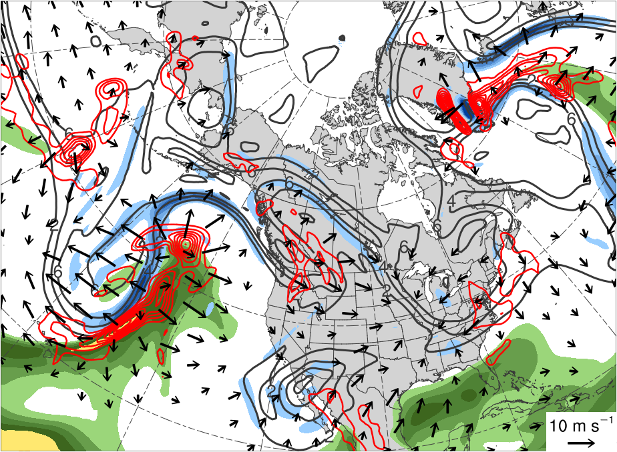
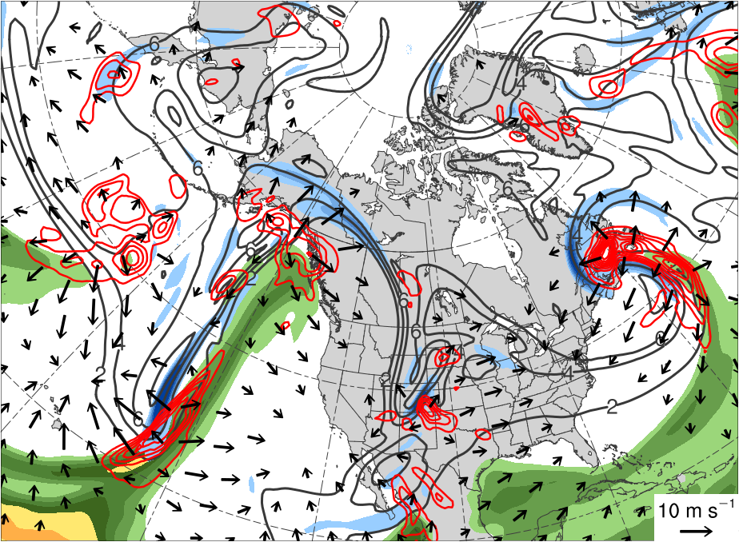
(a) 0000 UTC 15 Jan 1985
(b) 0000 UTC 16 Jan 1985
55
-18
50
-14
45
40
-10
35
-6
30
-2
25
(mm)
(PVU day⁻¹)

Slide 15
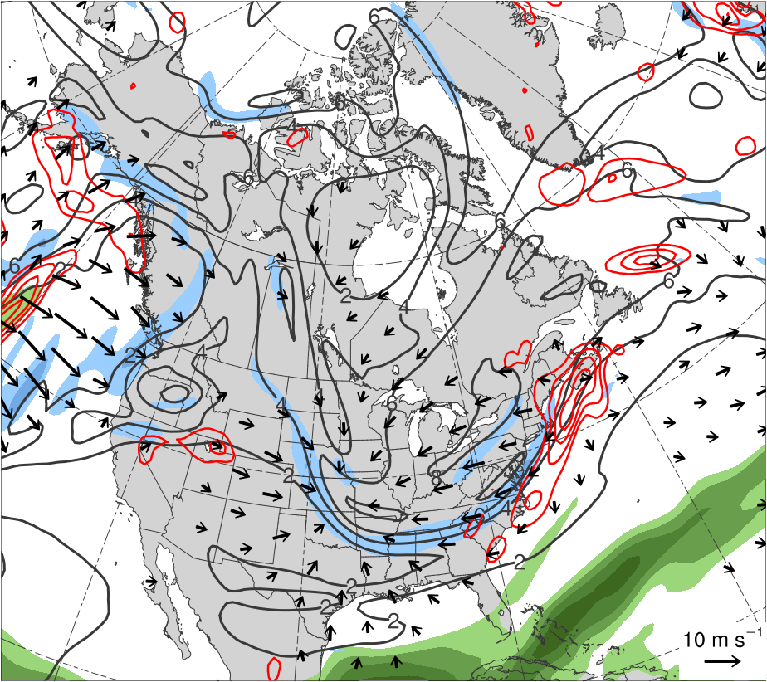
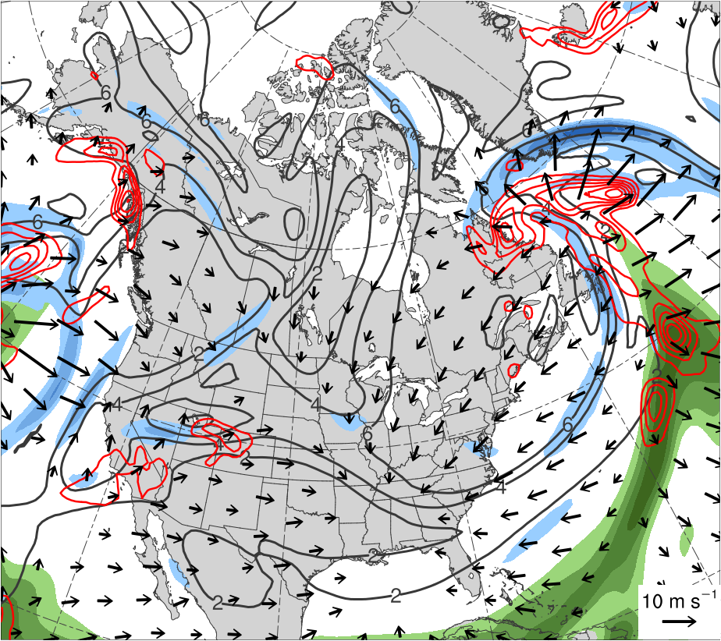
(a) 0000 UTC 21 Jan 1985
(b) 0000 UTC 22 Jan 1985
55
-18
50
-14
45
40
-10
35
-6
30
-2
25
(mm)
(PVU day⁻¹)

Slide 16
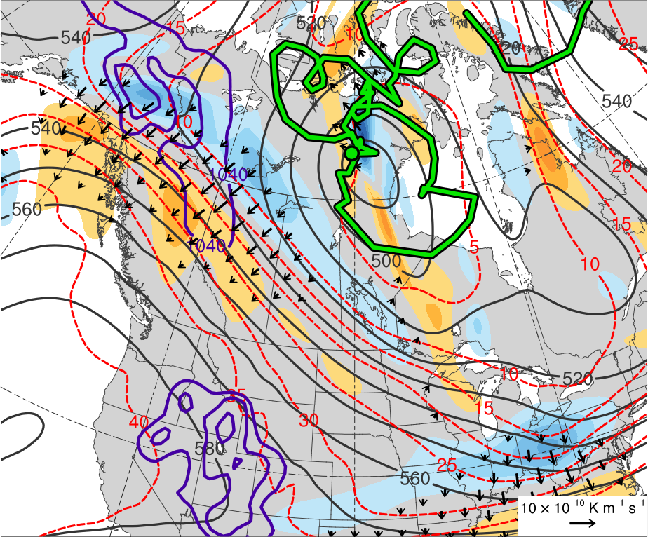
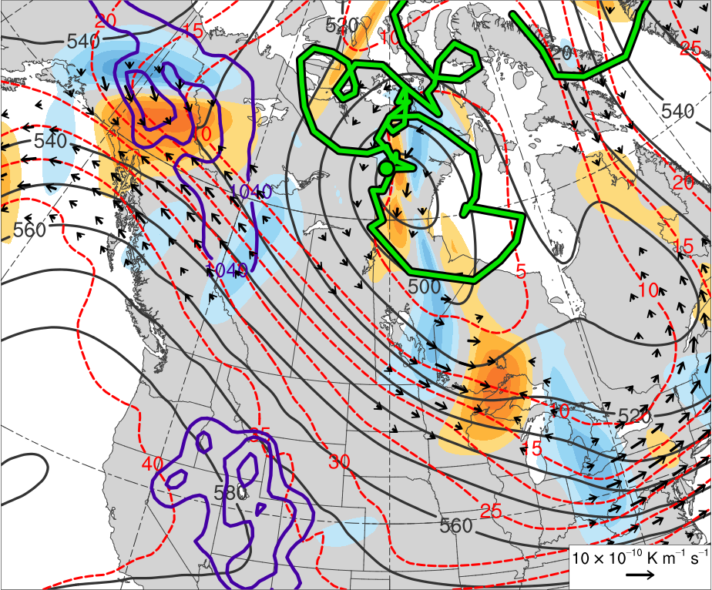
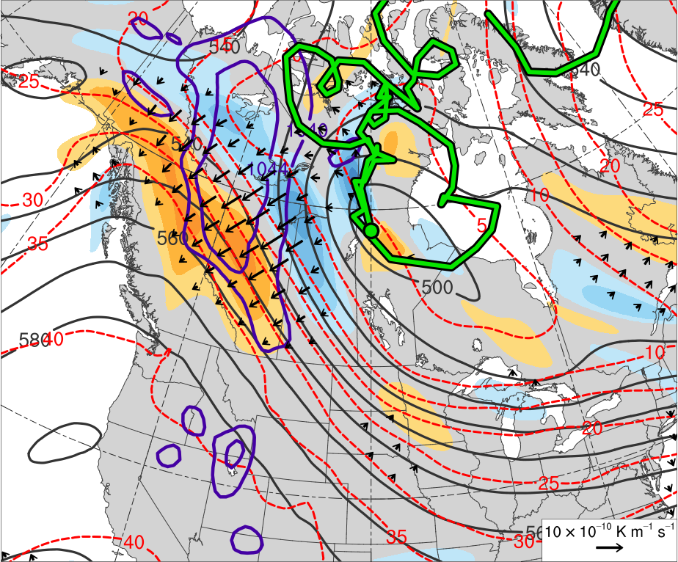
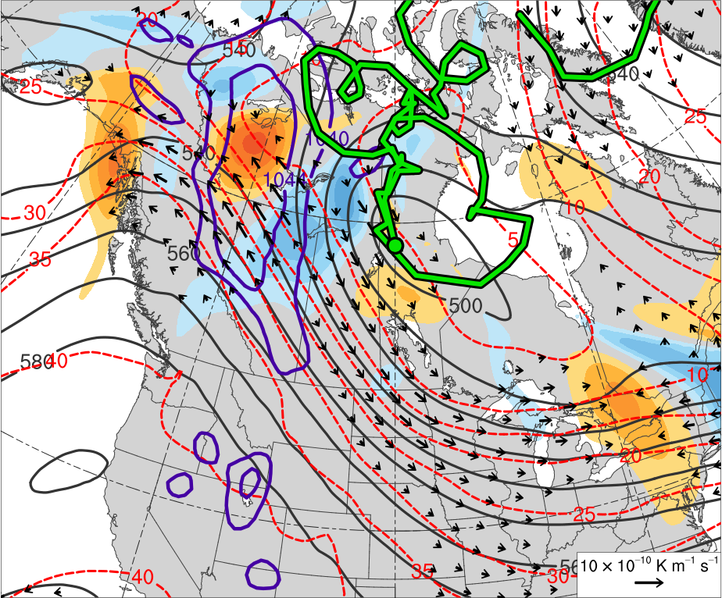
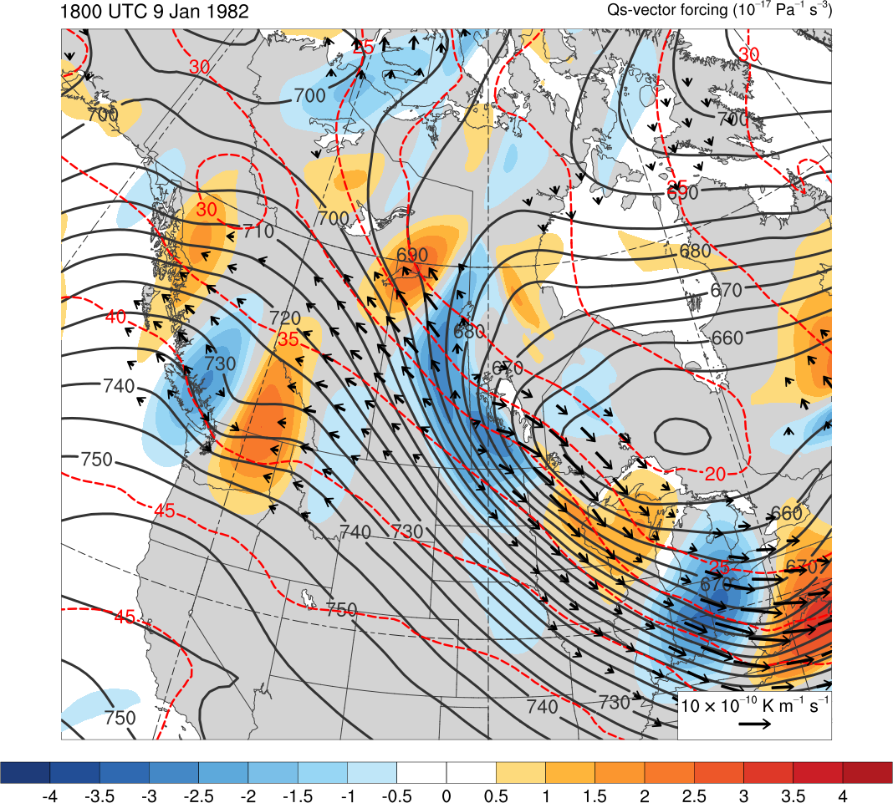
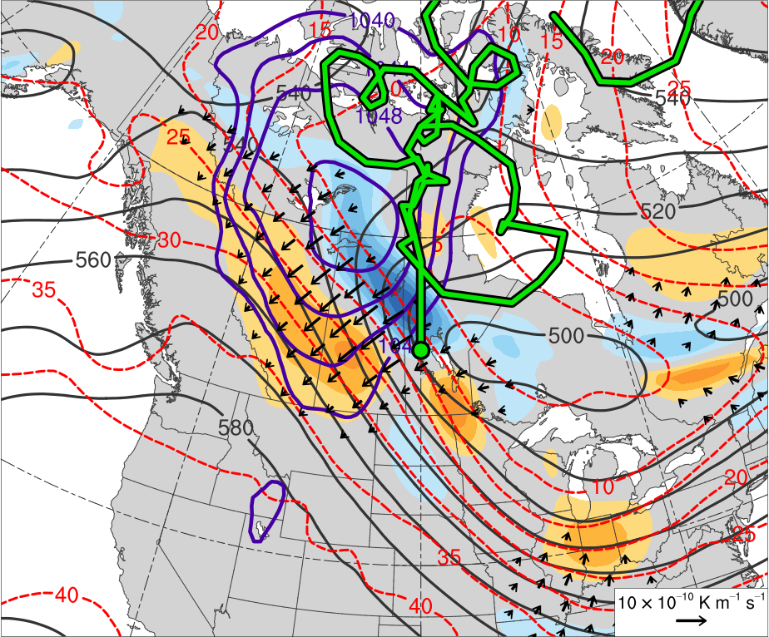



(a) 1200 UTC 8 Jan 1982
(b) 1200 UTC 8 Jan 1982
4
3.5
3
2.5
(c) 0000 UTC 9 Jan 1982
(d) 0000 UTC 9 Jan 1982
2
1.5
1
0.5
(e) 1200 UTC 9 Jan 1982
(f) 1200 UTC 9 Jan 1982
0
-0.5
-1
-1.5
-2
(g) 0000 UTC 10 Jan 1982
(h) 0000 UTC 10 Jan 1982
-2.5
-3
-3.5
-4

Slide 17








(a) 1200 UTC 8 Jan 1982
(b) 1200 UTC 8 Jan 1982
4
3.5
3
2.5
(c) 0000 UTC 9 Jan 1982
(d) 0000 UTC 9 Jan 1982
2
1.5
1
0.5
(e) 1200 UTC 9 Jan 1982
(f) 1200 UTC 9 Jan 1982
0
-0.5
-1
-1.5
-2
(g) 0000 UTC 10 Jan 1982
(h) 0000 UTC 10 Jan 1982
-2.5
-3
-3.5
-4

Slide 18








(a) 1200 UTC 18 Jan 1985
(b) 1200 UTC 18 Jan 1985
4
3.5
3
2.5
(c) 0000 UTC 19 Jan 1985
(d) 0000 UTC 19 Jan 1985
2
1.5
1
0.5
(e) 1200 UTC 19 Jan 1985
(f) 1200 UTC 19 Jan 1985
0
-0.5
-1
-1.5
-2
(g) 0000 UTC 20 Jan 1985
(h) 0000 UTC 20 Jan 1985
-2.5
-3
-3.5
-4

Slide 19








(a) 1200 UTC 18 Jan 1985
(b) 1200 UTC 18 Jan 1985
4
3.5
3
2.5
(c) 0000 UTC 19 Jan 1985
(d) 0000 UTC 19 Jan 1985
2
1.5
1
0.5
(e) 1200 UTC 19 Jan 1985
(f) 1200 UTC 19 Jan 1985
0
-0.5
-1
-1.5
-2
(g) 0000 UTC 20 Jan 1985
(h) 0000 UTC 20 Jan 1985
-2.5
-3
-3.5
-4

Slide 20








(a) 0000 UTC 14 Jan 1985
(b) 0000 UTC 14 Jan 1985
378
120
372
110
366
360
100
354
90
348
(c) 0000 UTC 15 Jan 1985
(d) 0000 UTC 15 Jan 1985
80
342
70
336
60
330
50
324
318
(m s⁻¹ )
312
(e) 0000 UTC 16 Jan 1985
(f) 0000 UTC 16 Jan 1985
306
55
300
50
294
288
45
282
(g) 0000 UTC 17 Jan 1985
(h) 0000 UTC 17 Jan 1985
40
276
35
270
264
30
258
25
252
(K)
(mm)

Slide 21








(i) 0000 UTC 18 Jan 1985
(j) 0000 UTC 18 Jan 1985
378
120
372
110
366
360
100
354
90
348
(k) 0000 UTC 19 Jan 1985
(l) 0000 UTC 19 Jan 1985
80
342
70
336
60
330
50
324
318
(m s⁻¹ )
312
(m) 0000 UTC 20 Jan 1985
(n) 0000 UTC 20 Jan 1985
306
55
300
50
294
288
45
282
(o) 0000 UTC 21 Jan 1985
(p) 0000 UTC 21 Jan 1985
40
276
35
270
264
30
258
25
252
(K)
(mm)

Slide 22
(a) 0000 UTC 18 Jan 1985
(b) 0000 UTC 18 Jan 1985
378
120
372
110
366
360
100
354
90
348
(c) 0000 UTC 19 Jan 1985
(d) 0000 UTC 19 Jan 1985
80
342
70
336
60
330
50
324
318
(m s⁻¹ )
312
(e) 0000 UTC 20 Jan 1985
(f) 0000 UTC 20 Jan 1985
306
55
300
50
294
288
45
282
(g) 0000 UTC 21 Jan 1985
(h) 0000 UTC 21 Jan 1985
40
276
35
270
264
30
258
25
252
(K)
(mm)

Slide 23





F’
378
600
372
12
366
590
360
580
10
354
348
570
8
342
560
336
330
550
6
F
324
540
4
318
530
F’
312
306
520
2
300
294
510
1.5
288
500
282
490
1
276
270
480
0.5
264
470
258
F
F’
F
252
460
(PVU)
(K)
(dam)

Slide 24


F’
378
600
372
12
366
590
TPV
360
580
10
354
348
570
8
342
560
336
550
6
330
F
324
540
318
4
TPV
F’
530
312
306
520
2
300
CP
510
294
1.5
288
500
282
490
1
276
270
480
0.5
264
470
258
F
252
460
(PVU)
F
37.5°N, 93°W
45°N, 93°W
52.5°N, 93°W
F’
(K)
(dam)
Notes:
0000 UTC 20 January 1985

Slide 25



E’
378
600
372
12
366
590
360
580
10
TPV
354
348
570
8
342
560
336
550
6
330
E
324
540
318
4
530
312
TPV
E’
520
306
2
300
510
294
1.5
288
500
CP
282
490
1
276
270
480
0.5
264
470
E
258
252
460
(PVU)
E
57.5°N, 90°W
65°N, 90°W
72.5°N, 90°W
E’
(K)
(dam)
Notes:
0000 UTC 17 January 1985

Slide 26



D’
378
600
372
12
366
590
360
580
10
354
348
570
8
342
560
336
550
6
D
330
324
540
318
4
D’
530
312
306
520
2
300
510
CP
294
1.5
288
500
282
490
1
276
270
480
0.5
264
470
D
258
252
460
(PVU)
D
62.5°N, 83°W
70°N, 83°W
77.5°N, 83°W
D’
(K)
(dam)
Notes:
0000 UTC 13 January 1985

Slide 27



C’
378
600
372
12
366
590
TPV
360
580
10
354
348
570
8
342
560
336
550
6
330
C
324
540
318
4
TPV
530
C’
312
306
520
2
300
510
CP
294
1.5
288
500
282
490
1
276
270
480
0.5
264
470
258
C
460
252
(PVU)
C
40°N, 92°W
47.5°N, 92°W
55°N, 92°W
C’
(K)
(dam)
Notes:
0000 UTC 10 January 1982

Slide 28



B’
378
600
372
12
366
590
360
580
10
354
TPV
570
348
8
342
560
336
550
6
330
B
324
540
318
4
530
312
B’
306
520
2
TPV
300
510
294
1.5
288
500
CP
282
490
1
276
270
480
0.5
264
470
B
258
252
460
(PVU)
B
60°N, 100°W
67.5°N, 100°W
75°N, 100°W
B’
(K)
(dam)
Notes:
1200 UTC 2 January 1982

Slide 29



A’
378
600
372
12
366
590
360
580
10
TPV
354
348
570
8
342
560
336
A
550
6
330
324
540
318
4
TPV
530
312
A’
306
520
2
300
510
294
1.5
288
500
282
490
1
276
270
480
0.5
A
264
470
258
252
460
(PVU)
A
60°N, 54°W
67.5°N, 54°W
75°N, 54°W
A’
(K)
(dam)
Notes:
1200 UTC 16 December 1981

