Slide 1
MJO influence on severe weather synoptic conditions
Matthew Vaughan
Department of Atmospheric and Environmental Sciences
University at Albany/SUNY
Albany, NY 12222
ATM 401/501 Final Presentation
SUNY-Albany
Albany, New York
Monday 12 May 2014

Slide 2
Background
Madden-Julian Oscillation (MJO) is a planetary-scale pattern of winds and convection that propagates eastward
Tropical convection can generate Rossby wave trains that influence mid-latitude flow as they propagate towards the poles (Sardeshmukh and Hoskins 1988)

Slide 3
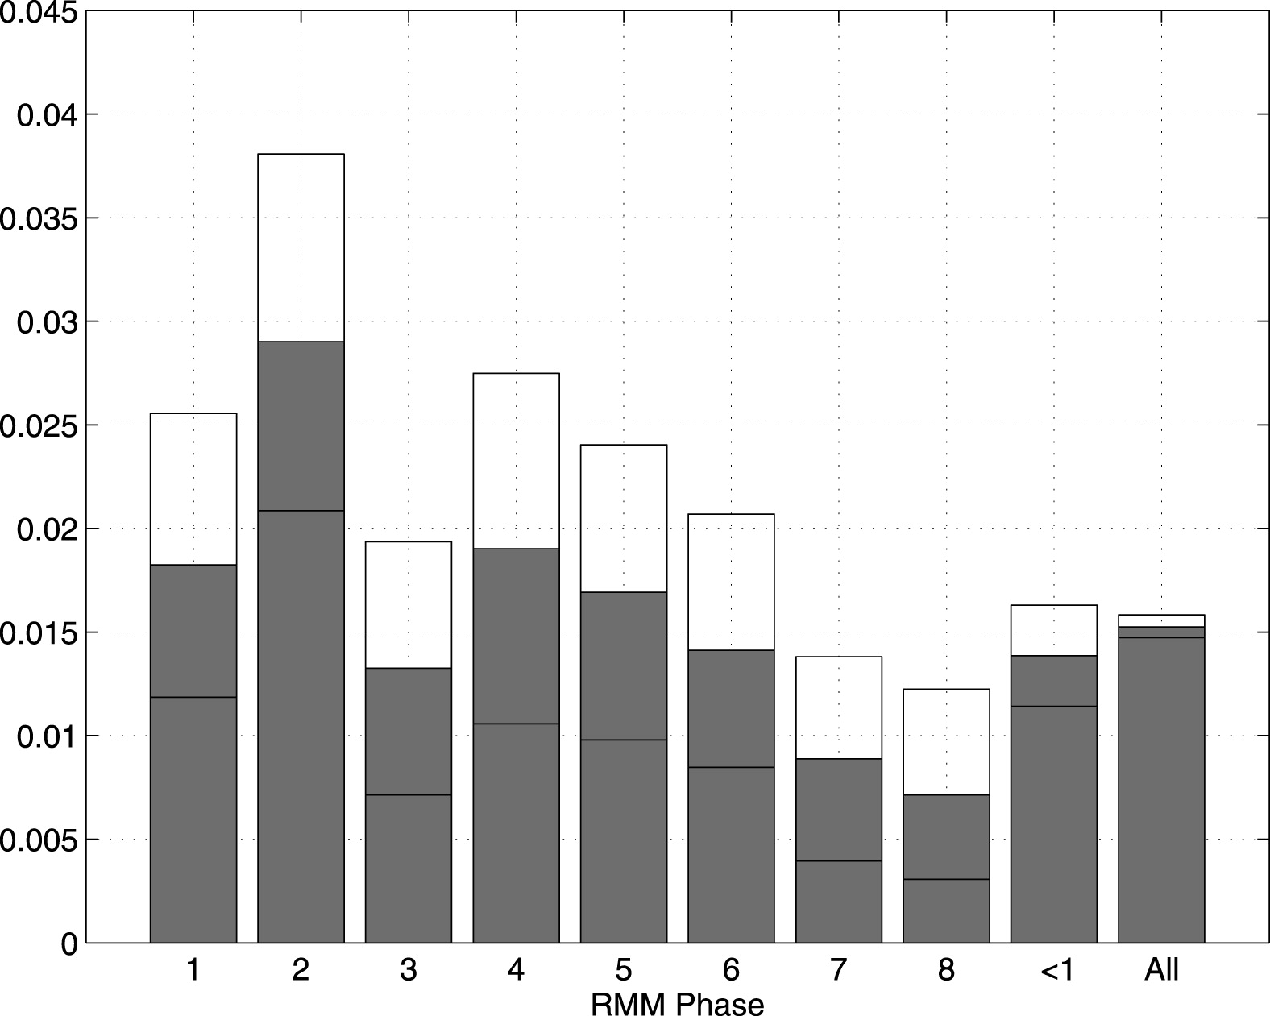
Motivation
1974-2010 (all year)
Thompson and Roundy (2012)
Fraction of days categorized as VTDs by RMM phase >1.0 amplitude (solid bars). Periods when RMM amplitude was <1 appear in the “<1” bar, and the full climatology appears in the “All” bar. Clear bars and lines within the solid bars together represent the 90% confidence interval obtained from a Monte Carlo test.

Slide 4
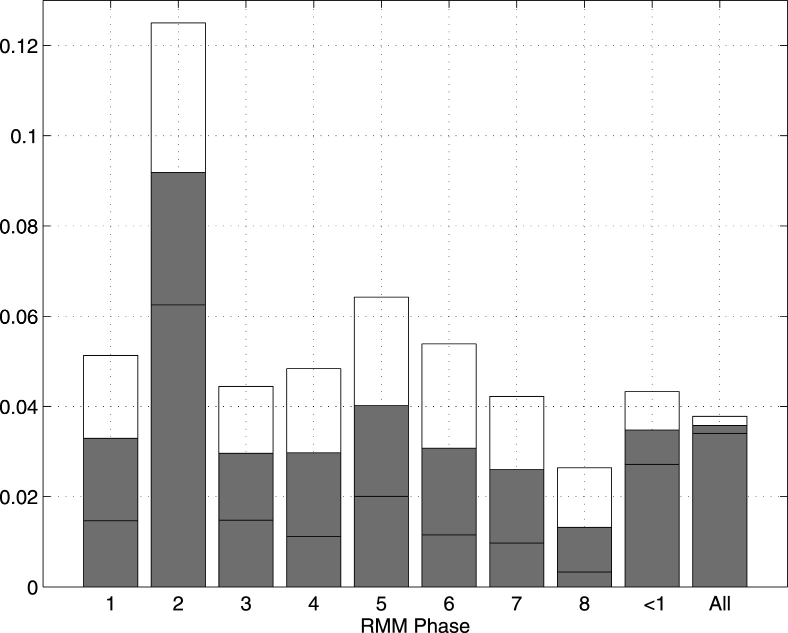
Motivation
1974-2010 (March, April, and May)
Thompson and Roundy (2012)
Fraction of days categorized as VTDs by RMM phase >1.0 amplitude (solid bars). Periods when RMM amplitude was <1 appear in the “<1” bar, and the full climatology appears in the “All” bar. Clear bars and lines within the solid bars together represent the 90% confidence interval obtained from a Monte Carlo test.

Slide 5
Motivation
Aid in medium range forecasting skill for convection in the Eastern CONUS
MJO lead times of 14-17 days demonstrated by Maharaj and Wheeler (2005).

Slide 6
Methodology
MJO phase determined by Real-time Multivariate MJO (RMM) index (Wheeler and Hendon 2004)
Dataset consists of phase-2 MJO events between 2003-2013 with an RMM amplitude >1
Notes:
Design algorithm to do this > Algorithm method

Slide 7
Methodology
Build composite mean and anomaly charts to assess synoptic conditions surrounding phase-2 MJO events using NOAA/ESRL software
Examine days leading up to during, and after the onset of phase-2 MJO event.
Notes:
Design algorithm to do this > Algorithm method

Slide 8
Results
16 MJO phase-2 events occurred between 2003-2013 during March, April, and May (MAM) with an RMM amplitude >1
11 events met the criteria for inclusion based on ENSO conditions

Slide 9
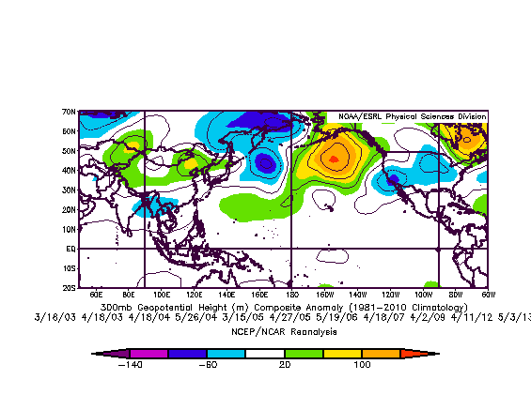
Results
a.)
b.)
c.)
Composite 300-hPa geopotential height anomaly (contour interval of 20 m with warm colors positive and cool colors negative) Time lags of (a) -7, (b) -3, (c) 0, days until the onset of the MJO.

Slide 10
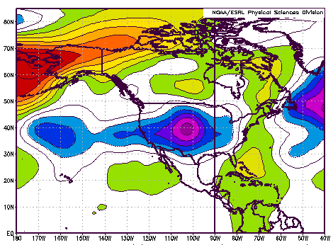
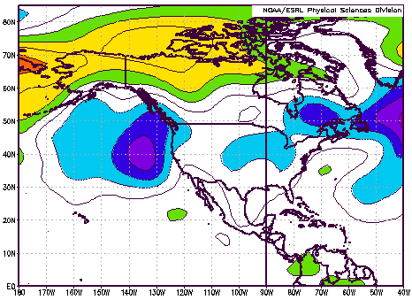
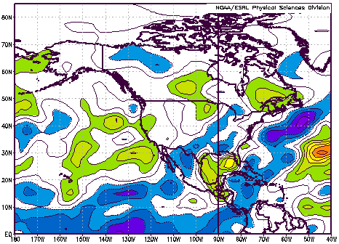
Day +1
a.)
b.)
c.)
Composite (a) 500-hPa geopotential height anomaly (interval of 20 m), (b) 850-hPa geopotential height anomaly (interval of 10 m), and (c) columnar precipitable water anomaly (interval of 1 kg/m²)

Slide 11
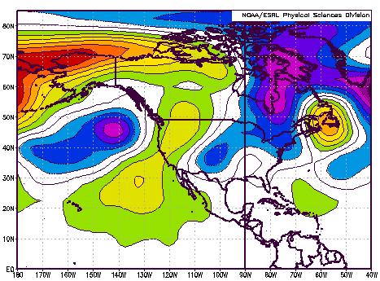
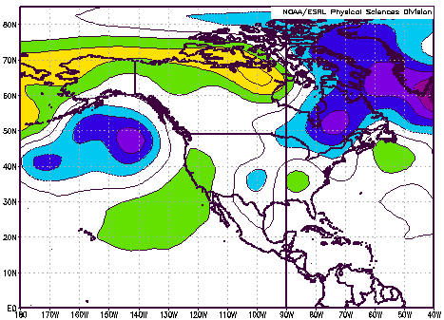
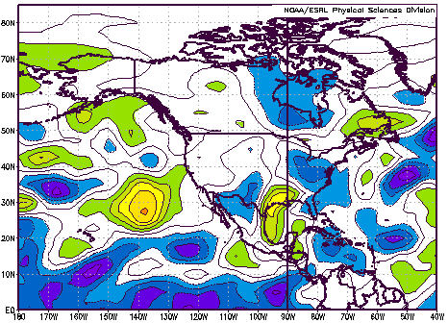
Day +3
a.)
b.)
c.)
Composite (a) 500-hPa geopotential height anomaly (interval of 20 m), (b) 850-hPa geopotential height anomaly (interval of 10 m), and (c) columnar precipitable water anomaly (interval of 1 kg/m²)

Slide 12
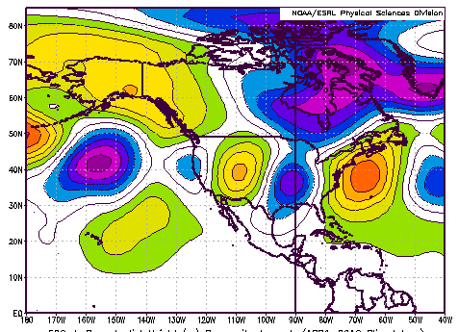
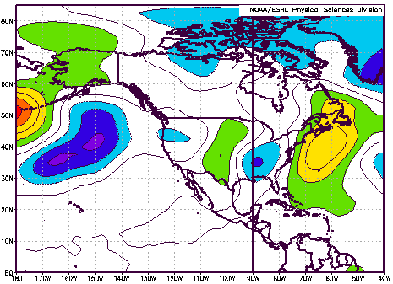
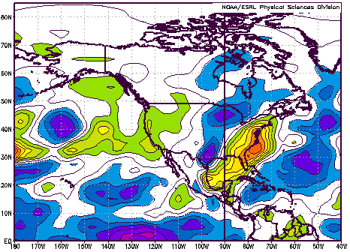
Day +5
a.)
b.)
c.)
Composite (a) 500-hPa geopotential height anomaly (interval of 20 m), (b) 850-hPa geopotential height anomaly (interval of 10 m), and (c) columnar precipitable water anomaly (interval of 1 kg/m²)

Slide 13
Conclusion
MJO is an important teleconnection feature for mid-latitude weather patterns
Results suggest Eastern US has more favorable synoptic precursors to severe weather during MAM phase-2 MJO
MJO-factor can influence medium-range forecasts

Slide 14
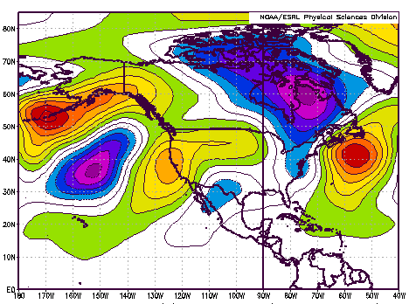
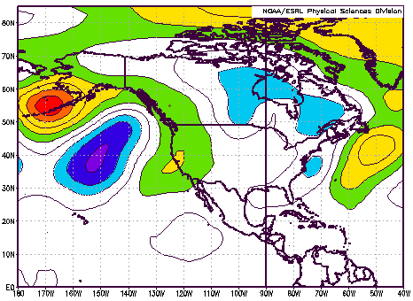
Day +7
a.)
b.)
Composite (a) 500-hPa geopotential height anomaly (interval of 20 m), (b) 850-hPa geopotential height anomaly (interval of 10 m).

